Slide 1

How can a system be trauma informed?
Carl Brown, MEAM
Sue Beecroft, cP&WS housing board

Slide 2
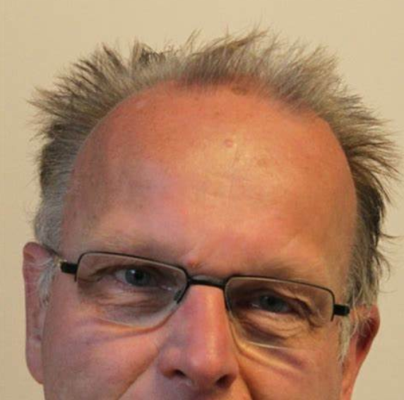
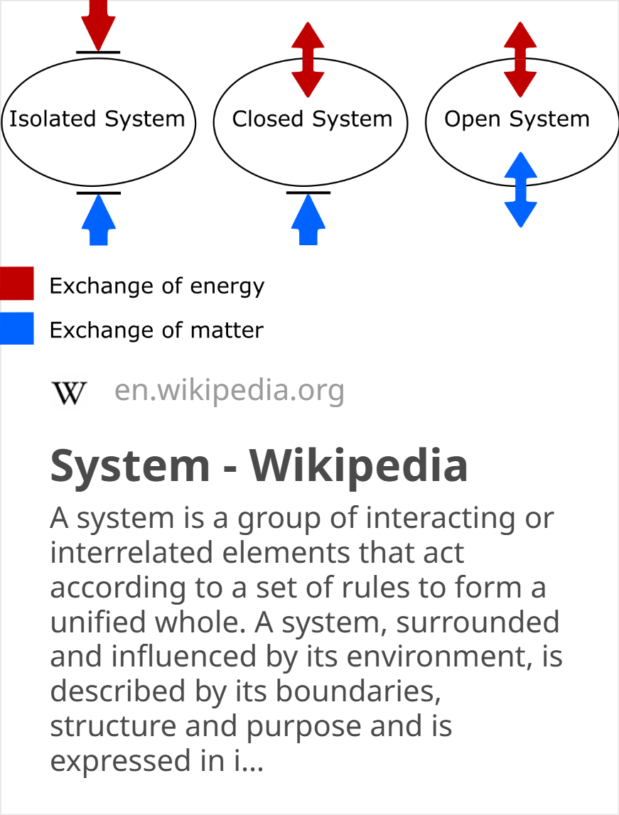
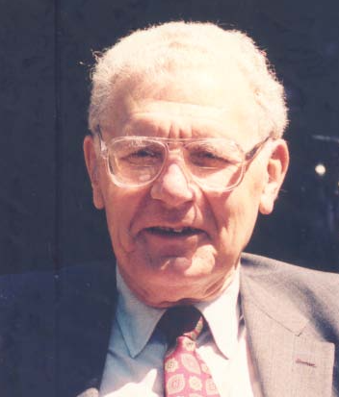
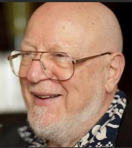
What do we mean by a system?
Roel Wieringa says…
A system is any actual or possible part of reality that, if it exists, can be observed.
Russel Ackoff says…
A system is a set of two or more elements that satisfies the following conditions:
The behavior of each element has an effect on the behavior of the whole.
The behavior of the elements and their effect on the whole are interdependent.
However sub-groups of elements are formed, each has an effect on the behavior of the whole and none has an independent effect on it
Roel Wieringa
Jerry Weinberg says…
A system is a collection of parts, none of which can be changed on its own
Russel Ackoff
Jerry Weinberg

Slide 3
The “six tenets” of trauma informed practice
The NHS and UK government have a working definition of trauma-informed practice, with six key tenets... (from https://napac.org.uk/blog-what-are-the-six-key-principles-of-a-trauma-informed-approach/)
Safety
Trustworthiness
Choice
Collaboration
Empowerment
Cultural consideration

Slide 4
Murmurations
Carl and video(s)
3 rules of murmurations

Slide 5
What we’ve said being trauma informed means…
At two previous workshops we’ve said being TI means to us all…
We have taken these post it notes and organized them under the “6 tenets” side headings
There is a lot of overlap – and it’s reassuring to see that we’ve said something about each of the recognized tents of trauma informed practice…

Slide 6
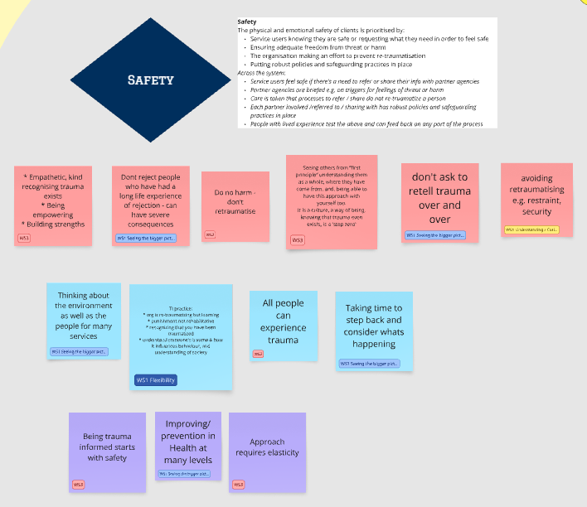

Slide 7
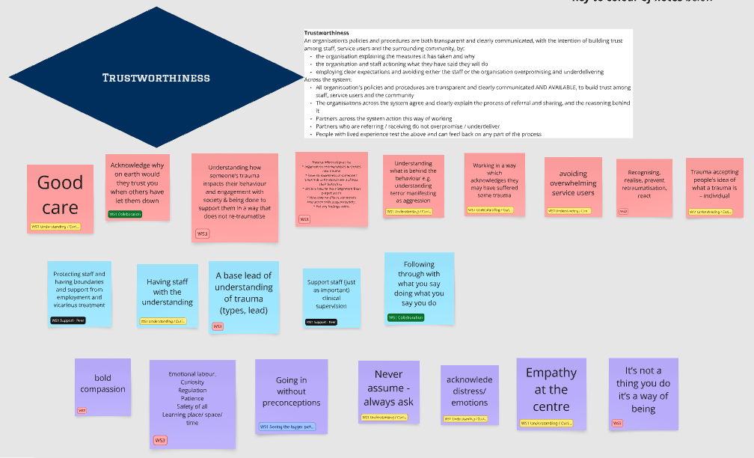

Slide 8
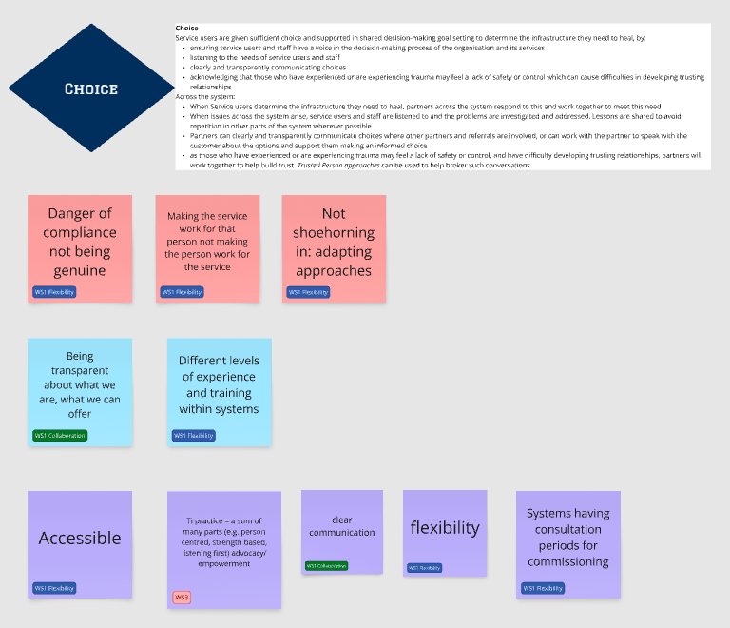

Slide 9
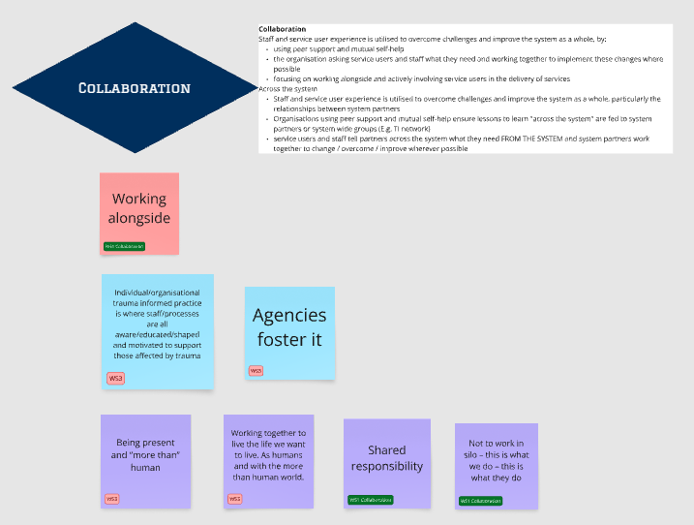

Slide 10
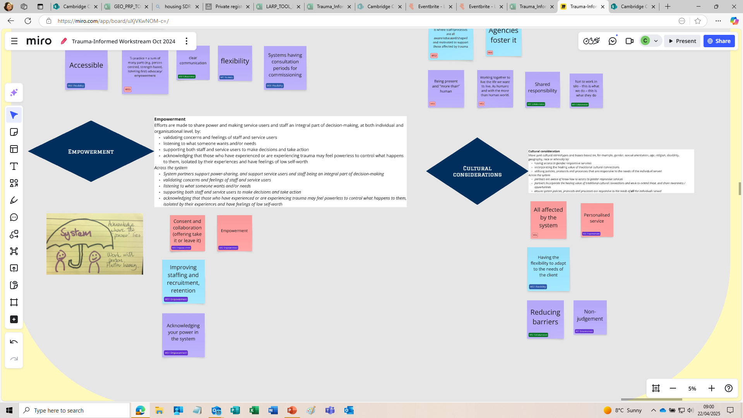

Slide 12
Do we need anything more than a trauma informed approach to individuals, and in each organisation?
If we each deal with individuals (customers & staff) in a trauma informed way
AND
If each organisation deals with its own “area” in a trauma informed way
IS THERE A PROBLEM?

Slide 13
“The glue between us”
I think our sticky notes highlight other issues – things about gaps ‘between’ organisations ---
  Sharing information, making referrals --- safely and efficiently
  Building trust into our policies and through relationships with other organisations (at all levels)
  Being trustworthy with partners – sharing our “rules”, honesty about the time something will take or the resource needed
  Allowed to be flexible with our partners with agreement (each must do its legal duties but how that happens might be negotiated)
  Our organisations using empathy and understanding --- acknowledge their power but also agree to share responsibilities
  Having space and time to share and reflect between organisations, so we learn from our shared experiences

Slide 14
Our mission…
Rather than setting up the 10 rules of a trauma informed system - Or a long list of requirements – we’d prefer to condense what this means, down to something like the 3 rules of a murmuration
1
If you can come up with key points, we will undertake to take all your ideas away and process them into something memorable!
2
If you need more words to describe it , don’t worry just write it down and we will do our best with it. As always, we will come back to you with what we’ve produced as a group.
3
We hope to end up with just 5 single words, or 3 short sentences, a set of emojis… or a haiku!
4
We can be creative, but at this stage we need your ideas so we can crystallize them into a “product”
5

