Slide 1
South Cambridgeshire Strategic Assessment
2025
Final V1.1
Communities and Demography PI Team

Slide 2
Contents
Purpose
Executive Summary
CSP Aims
Statutory Duties
Introduction
Comparison to last year
Community Safety Trends to Note
Analysis
IMD
Relevant Links
Glossary
Instructions on navigation:
1. Use PowerPoint desktop
2. Hold Ctrl and Click with mouse:
on the links to the left or
the blue Home icon in the upper right to return to Contents

Slide 3
Contents
8.1. Crime Overview
8.2. Personal Loss
8.3. Commercial Loss
8.4. Shoplifting
8.5. Violence Against the Person
8.6. Sexual Offences
8.7. Miscellaneous Crimes Against Society
8.8. Domestic Abuse
8.9. Modern Slavery
8.10. County Lines
8.11. CSE
8.12. Drug Offences
8.13. ASB
8.14. Hate Crime
8.15. Arson and Criminal Damage
8.16. Fires
8.17. Probation
8.18. Youth Justice Service
8.19. Offence types which saw no notable change
8.20. Geographic Analysis
Purpose
Executive Summary
CSP Aims
Statutory Duties
Introduction
Comparison to last year
Community Safety Trends to Note
Analysis
IMD
Relevant Links
Glossary
Instructions on navigation:
1. Use PowerPoint desktop
2. Hold Ctrl and Click with mouse
on the links to the left or..
the blue Home icon in the upper right to return to Contents

Slide 4
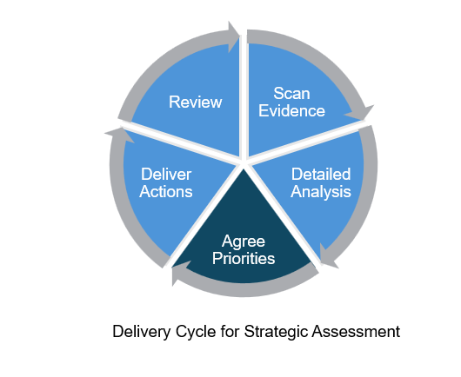
1. Purpose
1. Purpose
The purpose of this strategic assessment is to:
To provide an evidence base for decision-making
To provide detailed analysis of specific issues
To help inform priorities going forward
To help facilitate discussion of the board to identify areas of concern

Slide 5
2.1 Executive Summary - Overview
Prioritisation category | Key Community Safety Issues identified in this year’s Strategic Assessment
High importance – these areas either have high volumes of offences or high increasing trends. | Shoplifting Violence against the person (VAP) Domestic abuse
Concerning – there have been either steady year on year increases or a recent increase in the last year despite decreases or fluctuations in previous years. | Sexual offences (and Miscellaneous crimes against society) Anti-social behaviour (ASB) Drug offences
Community Safety Issues
The key community safety issues can be grouped into the following two categories: high importance and concerning.
Shoplifting, VAP, and Domestic abuse are community safety issues of high importance because of either high volumes and/or high increasing trends.
Slides 6-9 consolidate evidence from this report for the key community safety issues.
Geographic areas
The following wards were highlighted due to high counts or rates:
Milton and Waterbeach
Histon and Impington
Fen Ditton and Fulbourn

Slide 6
2.2 Executive Summary – Key Findings
High importance
1. Shoplifting
Although South Cambridgeshire had the second lowest rate of 4.3 per 1000 in 2025 in Cambridgeshire, South Cambridgeshire had the biggest increase in rate (+0.7; 3.6 to 4.3). This contrasts with Cambridge, East Cambridgeshire, and Cambridgeshire as a whole that saw decreases in rates between 2024 and 2025.
Between 2024 and 2025, shoplifting offences in South Cambridgeshire increased by 21% (+130 offences). This is in comparison to a 5% increase at national level between YE September 2024 and YE September 2025.
Between 2022 and 2025, shoplifting offences in South Cambridgeshire increased by 286% (+557 offences). The most notable change was a 118% increase between 2023 and 2024 (from 285 offences to 622; +337).​
2. Violence against the Person
South Cambridgeshire has consistently had the lowest rate of VAP offences per 1,000 population of all districts in Cambridgeshire between 2022 and 2025. It currently has a rate of 16.7 compared to a rate of 23.4 in Cambridgeshire. The rate has increased from 15.6 in 2024 to 16.7 in 2025 (+1.1).
VAP has accounted for the highest proportion of offences since 2022. In 2025, VAP accounted for 37% of crime in South Cambridgeshire.
VAP offences increased by 9% between 2024 and 2025 (+231 offences).

Slide 7
2.2 Executive Summary – Key Findings
High importance
2. Violence against the Person (continued)
All main components of VAP increased between 2024 and 2025:
Stalking and harassment increased by 9% (+77 offences) compared to 7% at a national level.
Violence with injury increased by 9% (+52 offences) compared to 5% at a national level.
Violence without injury increased by 8% (+102 offences), reaching the highest count in the last four years. This is compared to 1% at a national level.
VAP consistently makes up the highest crime type of domestic abuse (DA) related offences in South Cambridgeshire, ranging between 76% to 81% between 2022 and 2025.
DA marked VAP increased between 2024 and 2025 (+8%, +76). Despite this increase, offence counts have changed little since 2022 (0%; +4).
DA marked violence with injury increased by 15% (+28). This represents the highest count of DA marked violence with injury offences in the last four years.
DA marked violence without injury increased by 14% in the last year (+62). This represents the highest count of DA marked violence without injury offences in the last four years, exceeding 500 offences.​
DA marked stalking and harassment decreased by 4% in the last year (-14).
Knife crime and possession of weapons also saw increases in the last year.
In the last year, knife crime marked offences have increased by 21% (+16 offences). Despite this increase, offence counts still remain lower than 2022. In contrast, at a national level, knife-enabled crime recorded by the police saw a 9% decrease between YE September 2024 and YE September 2025.

Slide 8
2.2 Executive Summary – Key Findings
High importance
2. Violence against the Person (continued)
In 2025, possession of weapon offences reached highest counts seen across the last four years at 112. This was a 62% increase on the previous year (+43 offences).
Youth Justice Service (YJS) data shows that VAP has consistently been the most common offence type in South Cambridgeshire between 2022 and 2025. In 2025, VAP made up 37% of all offences.
3. Domestic abuse
South Cambridgeshire has consistently had the lowest rate of domestic abuse offences per 1,000 population of all districts in Cambridgeshire between 2022 and 2025. In 2025, it had a rate of 13.2 compared to a rate of 16.7 in Cambridgeshire.
Overall, domestic abuse (DA) crimes and incidents saw a notable increase between 2024 and 2025 (+16%, +318).​ ​
DA marked crimes also increased in the last year (+7%, +83 crimes).
DA related incidents saw an increase of 18% between 2024 and 2025 (+277 incidents). This is the highest count seen over the last four years.

Slide 9
2.2 Executive Summary – Key Findings
Although ASB is part of the “concerning” category, consolidated evidence on ASB from this report has been included below for the CSP to assess.
ASB
South Cambridgeshire has consistently had the lowest rate of ASB per 1,000 population of all districts in Cambridgeshire between 2022 and 2025 after Cambridge City. It currently has a rate of 10.5 compared to a rate of 13.6 in Cambridgeshire.
ASB incidents have followed a steadily increasing trend since 2022.
Between 2024 and 2025, ASB incidents increased by 6% (+104 incidents) to 1,833 incidents. ASB nuisance accounted for 83% of all ASB recorded in 2025. The high volumes of ASB are concerning.
This change was driven by increase in ‘nuisance’ ASB, and ‘environmental’ ASB, which between 2024 and 2025, increased by 5% (+76 incidents) and 33% (+41 incidents) respectively.
For Youth ASB, South Cambridgeshire has consistently had the lowest rate of Youth ASB per 1,000 population of all districts in Cambridgeshire between 2022 and 2025 (except for 2023 when it had the second lowest rate). It currently has a rate of 2.2 compared to 2.8 in Cambridgeshire.
The proportion of youth-related ASB has varied over the past four years. In 2025, the proportion reached its lowest level in the past four years (21%).
Between 2024 and 2025, youth-related ASB has decreased by 2% (-8 incidents).​

Slide 10
2.3 Executive Summary - Recommendations
Recommendations
It is recommended that the current aims of the Partnership are continued for a further year.
Aim 1 - Improve resilience in communities across South Cambridgeshire
Inequalities remain an issue in South Cambridgeshire, and therefore involving communities in generating solutions that are right for them increases the likelihood of these being sustainable.
The CSP should consider how best to engage residents and use evidence such as the upcoming lived experience report on children and violence. There is also evidence available to help target based on need (see Cambridgeshire & Peterborough Insight – Poverty – Indices of Deprivation 2025).​
The CSP should consider a workstream tackling vulnerabilities associated with children and young people such as education, poverty, exploitation, NEET in order to reduce offending/reoffending and being exploited and to work upstream in aiding prevention.

Slide 11
2.3 Executive Summary - Recommendations
Recommendations
Aim 2 - Ensure priority areas continue to be driven by data whilst also being informed by professional judgement.
Crime and ASB occurs in geographic hotspots, and it remains vital to engage communities and work with them to tackle the things that are important to them.
It is recommended that the South Cambridgeshire CSP should focus on relevant wards outlined in the geographic analysis: Milton and Waterbeach​; Histon and Impington; and​ Fen Ditton and Fulbourn.​
South Cambridgeshire CSP should monitor drug offences – although recording practices may have been a contributing factor, the large increase in the last year is concerning.
South Cambridgeshire CSP should coordinate with Cambridge City CSP in their retail crime pilot effort that is aiming to prevent and deter shoplifting.

Slide 12
2.3 Executive Summary - Recommendations
Recommendations
Aim 3 - Strive to work in a trauma informed way to protect those vulnerable to abuse, harassment and violence – including domestic abuse and sexual violence.
VAWG - Given the inter-related nature of VAP, Sexual offences (and Misc crimes against society), and Domestic abuse, it is recommended that the South Cambridgeshire CSP consider consolidating workplans under a VAWG heading to maximise impact and simplify delivery. This aligns with the CSP’s Aim 3.
It is recommended that South Cambridgeshire CSP consider relevant parts of the government’s action plan from its recent strategy: Freedom from Violence and Abuse: a cross-government strategy to build a safer society for women and girls Volume 1 Strategy (See pages 11-12 in particular for an overview).
South Cambridgeshire CSP should consider aligning its goals and internal targets at a minimum to the strategy’s national target to halve VAWG in a decade. The strategy outlines specifics related to the proportion of people aged 16 and over who have experienced any of domestic abuse, sexual assault, or stalking.

Slide 13
3. CSP Aims
Below are the aims from the Operational Plan 2025-26:
Improve resilience in communities across South Cambridgeshire
Ensure priority areas continue to be driven by data whilst also being informed by professional judgement
Strive to work in a trauma informed way to protect those vulnerable to abuse, harassment and violence – including domestic abuse and sexual violence

Slide 14
4. Statutory Duties
Community Safety partnerships were brought into existence through the Crime and Disorder Act 1998 and have several statutory duties. Since then, some pieces of legislation have changed their membership and statutory duties. Some examples include;
Formulate and implement a strategy for the reduction of crime and disorder in the area (including anti-social and other behaviour adversely affecting the local environment) as per the Crime and Disorder Act, 1998 (Section 6).
Formulate and implement a strategy for combatting the misuse of drugs, alcohol, and other substances in the area as per the Crime and Disorder Act, 1998 (Section 6).
Formulate and implement a strategy for the reduction of re-offending in the area as per the Crime and Disorder Act, 1998 (Section 6).
Formulate and implement a strategy to prevent and reduce serious violence as per the Crime and Disorder Act, 1998 (Section 6).
Have due regard to the police and crime objectives set out in their correlating area’s police and crime plan as per the Crime and Disorder Act, 1998 (Section 6(1A)).
Conduct Domestic Homicide Reviews (DHRs) as per the Domestic Violence, Crime and Victims Act, 2004, (Section 9).
Prepare a partnership plan, setting out the CSP’s priorities annually and publish the summary of the partnership plan as per the Crime and Disorder (Formulation and Implementation of Strategy) Regulations, 2007.
Carry out an annual strategic assessment assessing the extent to which the partnership plan for the previous year has been implemented and revise the partnership plan accordingly as per the Crime and Disorder (Formulation and Implementation of Strategy) Regulations, 2007.
Guidance can be found here Community Safety Partnerships - GOV.UK that outlines he statutory duties and a range of best practice examples that can be reviewed.

Slide 15
5. Introduction
This year the Strategic Assessment is produced as a navigable PowerPoint pack rather than a pdf document. The aim is to make the information included easier to interpret by a range of audiences. Therefore, the more detailed geographic crime data is released in a separate document. There is also a technical notes document that sits alongside these.
This pack of information is provided to the Community Safety Partnership Board for South Cambridgeshire to support their annual cycle of identifying priorities and consider their progress to date against their existing priorities.
This new strategic assessment layout will share more detailed analysis of crime types which have increased in the last year, crime types which are currently the priority of the CSP and any other notable changes.
In the last strategic assessment, the following were highlighted as key community safety issues:
Shoplifting
Violence against the person (VAP)
Sexual Offences
Anti-social behaviour (ASB)

Slide 16
6. Comparison to 2024
Drug Offences
+120% (+152 offences)
Shoplifting
+21% (+130 offences)
Domestic Abuse (Crimes and Incidents)
+16% (+318 offences)
Commercial Loss
+13% (+107 offences)
Arson and Criminal Damage
+6% (+47 offences)
Misc Crimes Against Society
+15% (+30 offences)
VAP
+9% (+231 offences)
Deliberate Fires
+13% (+9 incidents)
Hate Crime
+10% (+14 offences)
ASB
+6% (+104 incidents)
Notes:
Domestic abuse have been greyed. This is because although it increased in the last year, it is difficult to assume the driver of these increases with high levels of underreporting in these crime types. However, it is important that these remain closely monitored due to the nature of the crimes.

Slide 17
6. Comparison to 2024
Youth-Related ASB
-2% (-8 incidents)
Vehicle Offences
-1% (-7 offences)
Personal Loss
+2% (+24 offences)
Sexual Offences
-1% (-3 offences)
Public Order
-7% (-37 offences)
CSE Offences
-17% (-10 offence)
Notes:
Sexual offences have been greyed. This is because although it slightly decreased in the last year, it is difficult to assume the driver of these decreases with high levels of underreporting in these crime types.
However, it is important that these remain closely monitored due to the nature of the crimes.

Slide 18
7. Community Safety Trends to Note
Table 1: Crimes that either increased or inline with previous year community safety issues
Crime Type/ Issue | Recent Trend | Longer Term Trend
Shoplifting | Increased | Between 2024 and 2025, shoplifting offences in South Cambridgeshire increased by 21% (+130 offences). Between 2022 and 2025, shoplifting offences in South Cambridgeshire increased by 286% (+557 offences). The most notable change was a 118% increase between 2023 and 2024 (from 285 offences to 622; +337).​
ASB | Increased | ASB incidents have followed a steady increasing trend since 2022, with a 55% increase between 2022 and 2025 (+653 incidents). Between 2024 and 2025, ASB incidents increased by 6% (+104 incidents)
Violence Against the Person | Increased | VAP offences increased by 5% between 2022 and 2025 (+143 offences).
Domestic Abuse | Increased | Overall, domestic abuse (DA) crimes and incidents saw a notable increase between 2022 and 2025 (+17%, +333).
Drug Offences | Increased | Drug offences saw fluctuations between 2022 and 2024. However, between 2024 and 2025, there has been a notable increase, from 127 to 279 (+120%, +152 offences).
Arson and Criminal Damage | Increased | Arson and criminal damage offences increased from 809 to 856 between 2024 and 2025 (+6%, +47 offences). Counts in 2025 remain inline with that recorded in 2022 (-1%, -12).
Hate Crime | Increased | Hate crime marked offences have decreased year on year between 2022 and 2024. However, in the last year offences increased by 10% (+14 offences).
Miscellaneous Crimes Against Society | Increased | Offences increased by 23% between 2022 and 2025 (+43 offences).
Deliberate Fires | Increased | In 2025, deliberate fires increased by 13% (+9) when compared with 2024, reaching the highest count seen in the last four years. 2023 saw the lowest count across the last four years (37).

Slide 19
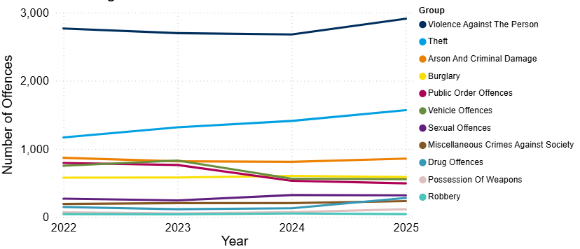
8.1 Crime Overview
In 2025, the total crime count for South Cambridgeshire was 7,952. This was an increase compared to the previous year (+8%, +587 offences).
Overall, counts remained relatively stable between 2022 and 2023, followed by a decrease in 2024 and an increase in 2025, with 2025 recording the highest level in the last four years.
Nationally over a similar period (YE September 2025), police recorded crime remained similar with the previous year (excluding fraud and computer misuse offences), and CSEW total crime saw no statistically significant change to the previous year (ONS, 2026).
Violence against the person (VAP) has accounted for the highest proportion of offences since 2022. In 2025, VAP accounted for 37% of crime in South Cambridgeshire.
Figure 1: Annual trend in police recorded offences in South Cambridgeshire, 2022 to 2025
Note: Chart has been produced by Cambridgeshire County Council’s Communities and Demography PI Team, using data provided by Cambridgeshire Constabulary.

Slide 20
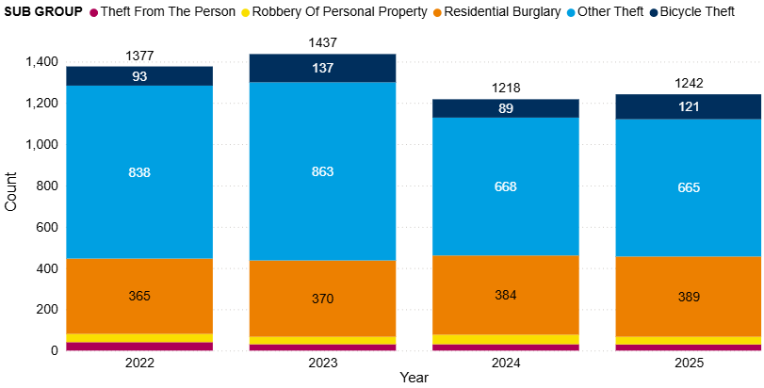
8.2 Personal Loss
Figure 2: Annual trend in police recorded personal loss offences in South Cambridgeshire, 2022 to 2025
Personal loss includes bicycle theft, other theft, residential burglary, robbery of personal property and theft from the person.
Personal loss offences increased from 1,377 in 2022 to 1,437 in 2023, before decreasing by 15% in 2024. Over the last year (2024 to 2025), offence levels remained stable, showing a slight 2% increase (+24 offences).
Other theft remained stable between 2024 and 2025, which is the lowest count seen in the last four years.
Note: Chart has been produced by Cambridgeshire County Council’s Communities and Demography PI Team, using data provided by Cambridgeshire Constabulary.

Slide 21
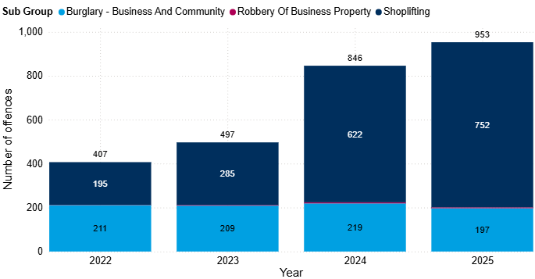
8.3 Commercial Loss
Figure 3: Annual trend in police recorded commercial loss offences in South Cambridgeshire, 2022 to 2025
Commercial loss includes shoplifting, business and community burglary, robbery of a business property and any vehicle offences marked as ‘business victim’.
Commercial loss offences notably increased in South Cambridgeshire between 2024 and 2025 (+13%, +107 offences). This increase was driven by shoplifting, see section 8.4 for further details.
Shoplifting offences accounted for the majority of the commercial loss offences in 2025 (79%).
Note: Chart has been produced by Cambridgeshire County Council’s Communities and Demography PI Team, using data provided by Cambridgeshire Constabulary.

Slide 22
8.4 Shoplifting
Between 2024 and 2025, shoplifting offences in South Cambridgeshire increased by 21% (+130 offences; 622 to 752).
Over the past four years, shoplifting offences have seen incremental increases year on year.
The most notable increase was 118% between 2023 and 2024 (from 285 offences to 622; +337).
Nationally, shoplifting increased by 5% in YE September 2025, rising to 519,381 offences from 492,660 the previous year. However, these figures are no longer the highest since current police recording practices began. They are also lower than the previous year ending period to June 2025 (529,994 offences) (ONS, 2026a).
Figure 3: Annual trend in police recorded commercial loss offences in South Cambridgeshire, 2022 to 2025
Note: Chart has been produced by Cambridgeshire County Council’s Communities and Demography PI Team, using data provided by Cambridgeshire Constabulary.

Slide 23
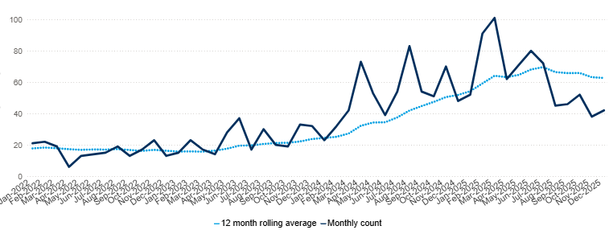
8.4 Shoplifting
Figure 4: Count of shoplifting offences in South Cambridgeshire by month, 2022 to 2025
In 2025, March saw the most offences in a month with 101. This was the highest recorded month in the last four years.
Note: Chart has been produced by Cambridgeshire County Council’s Communities and Demography PI Team, using data provided by Cambridgeshire Constabulary.

Slide 24
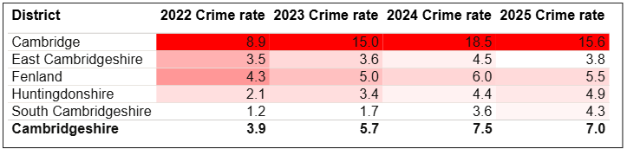
8.4 Shoplifting
Table 2: Rate per 1,000 population of police recorded Shoplifting offences, between 2022 and 2025
As seen in Table 2, South Cambridgeshire had the second lowest rate of 4.3 per 1,000 in 2025.
The shoplifting offences rate for South Cambridgeshire has continued to increase between 2022 and 2025.
While Cambridge, East Cambridgeshire, and Cambridgeshire as a whole saw decreases in rates between 2024 and 2025, South Cambridgeshire had the biggest increase in rate (+0.7; 3.6 to 4.3).
Note: Chart has been produced by Cambridgeshire County Council’s Communities and Demography PI Team, using data provided by Cambridgeshire Constabulary.

Slide 25
8.4 Shoplifting – Dip Sample
A dip sample was conducted to provide further insight into the nature of shoplifting offences which were recorded in 2025. 75 shoplifting offences were analysed (roughly 10% of the total offences). It should be noted that insights are dependent on the level of detail included in the offence description fields; for example, not all offences have details of the value of the stolen property.
The key findings from the dip sample analysis were:
Over a third of the analysed offences (37%) noted food or soft drinks as the stolen property type. 19% of offences within the dip sample noted alcohol as the stolen property type. In some cases, both food and alcohol were stolen together.
Specific food items such as chocolate and meat was also analysed. Chocolate was mentioned in 13% of offences, whilst meat was mentioned in 5%.
In just under a quarter of analysed offences, it was noted that the suspect was known to those reporting the offence (21%).
15% of offences involved stolen property with a value of £100 or over, when it is noted.
Note: Chart has been produced by Cambridgeshire County Council’s Communities and Demography PI Team, using data provided by Cambridgeshire Constabulary.

Slide 26
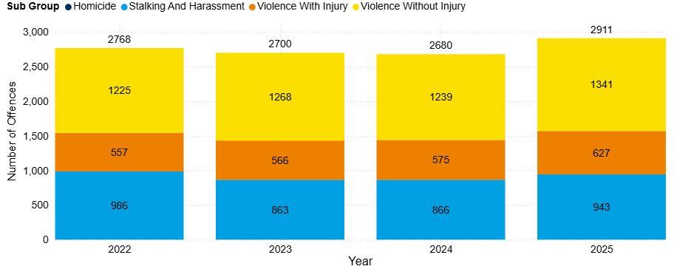
8.5 Violence Against the Person (VAP)
Figure 5: Annual trend in police recorded violence against the person (VAP) offences in South Cambridgeshire, 2022 to 2025
Violence against the person (VAP) offences accounted for 37% of all offences in 2025.
VAP offences increased by 9% between 2024 and 2025 (+231 offences).
‘Violence without injury’ accounted for the majority of the VAP offences in 2025 (46%).
Note: Chart has been produced by Cambridgeshire County Council’s Communities and Demography PI Team, using data provided by Cambridgeshire Constabulary.

Slide 27
8.5 Violence Against the Person (VAP)
Stalking and harassment, violence with injury, and violence without injury all recorded notable increases over the last year:
Stalking and harassment increased by 9% (+77 offences). This is a slight increase compared with national police recorded data over a similar period (YE September). Stalking offences and harassment offences both increased by 7% (ONS, 2026a).
Violence with injury increased by 9% (+52 offences). Nationally, there was a 5% decrease in police recorded violence with injury (YE September) (ONS, 2026a).
Violence without injury increased by 8% (+102 offences), reaching the highest count in the last four years. Nationally, police recorded violence without injury saw a 1% increase across a similar period (YE September) (ONS, 2026a).
Figure 6: Annual trend in police recorded violence against the person (VAP) offences in South Cambridgeshire, 2022 to 2025
Note: Chart has been produced by Cambridgeshire County Council’s Communities and Demography PI Team, using data provided by Cambridgeshire Constabulary.

Slide 28
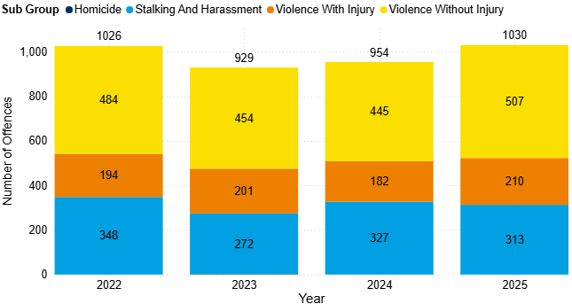
8.5 Violence Against the Person (VAP)
DA marked VAP offences saw an increase between 2024 and 2025 (+8%, +76). Offence counts in 2025 are in line with those seen in 2022 (0%, +4).
Violence with and without injury subgroups saw increases between 2024 and 2025. However, stalking and harassment decreased over the same period.
DA marked violence with injury increased by 15% (+28). This represents the highest count of DA marked violence with injury offences in the last four years.
After a period of decreases, DA marked violence without injury increased by 14% in the last year (+62). This represents the highest count of DA marked violence without injury offences in the last four years, exceeding 500 offences.
DA marked stalking and harassment decreased by 4% in the last year (-14). Overall, this sub-group has fluctuated in the last four years.
Figure 7: Count of DA marked violence against the person (VAP) offences in South Cambridgeshire by subgroup, 2022 to 2025
Note: Chart has been produced by Cambridgeshire County Council’s Communities and Demography PI Team, using data provided by Cambridgeshire Constabulary.

Slide 29
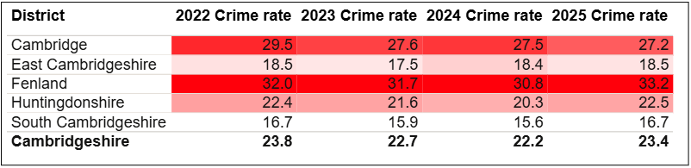
8.5 Violence Against the Person (VAP)
Table 3: Rate per 1,000 population of police recorded VAP offences, between 2022 and 2025
South Cambridgeshire had the lowest rate per 1,000 population for VAP offences (16.7). This is also lower than the rate for Cambridgeshire (23.4).
Note: Table has been produced by Cambridgeshire County Council’s Communities and Demography PI Team, using data provided by Cambridgeshire Constabulary. Rates over time have been calculated using locally produced estimates and forecasts, see Technical notes for further details.

Slide 30
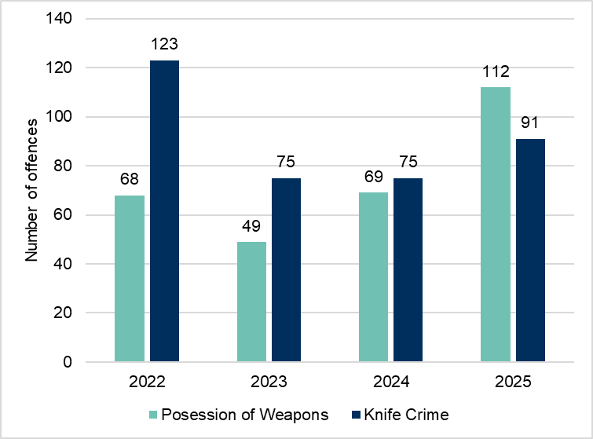
8.5 VAP - Possession of Weapons and Knife Crime
Figure 8: Annual trend in knife crime and possession of weapons offences in South Cambridgeshire, 2022 to 2025
Knife crime related offences increased despite a period of decreases since 2022, and levels remained broadly unchanged between 2023 and 2024. In the last year, knife crime marked offences have increased by 21% (+16 offences). Despite this increases, offence counts still remain lower than 2022. In contrast, nationally, knife-enabled crime recorded by the police saw a 9% decrease between YE September 2024 (from 55,149 offences) and YE September 2025 (to 20,430 offences. This was also 9% lower than YE March 2020 (55,170 offences) (ONS, 2026a).
In 2025, possession of weapon offences reached highest counts seen across the last four years at 112. This was a 62% increase on the previous year (+43 offences). Nationally, police recorded "possession of article with a blade or point" offences saw a slight increase bet YE September 2024 and YE September 2025 (+1%, +399 offences). Trends in possession offences are likely to be influenced by police activity and operations, particularly stop and search (ONS, 2026a).
Note: Chart has been produced by Cambridgeshire County Council’s Communities and Demography PI Team, using data provided by Cambridgeshire Constabulary CADET.

Slide 31
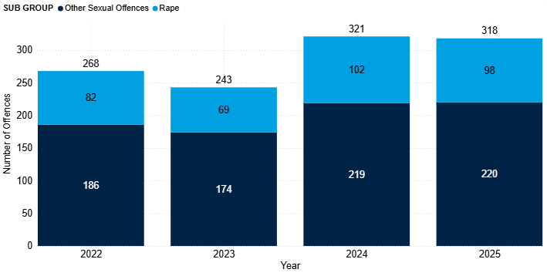
8.6 Sexual Offences
Sexual offences remained stable between 2024 and 2025 (-1%, -3 offences). Overall, counts remain higher than that seen in 2022 (+19%, +50 offences).
Both subgroups remained similar to counts seen in 2024.
Other sexual offences saw no change (0%, +1 offence)
Rape offences decreased slightly by 4% (-4 offences).
Sexual offences accounted for the third highest proportion of DA marked offences (6%). This proportion decreased slightly in the last year (from 7% in 2024 to 6% in 2025).
On a national scale, there was an 8% increase in YE September 2025 (to 214,816 offences) compared with the previous year (198,373 offences). Police-recorded sexual offences have generally increased over the past decade, largely due to improvements in recording practices (ONS, 2026a)
Figure 9: Annual trend in police recorded sexual offences in South Cambridgeshire, 2022 to 2025
Note: Chart has been produced by Cambridgeshire County Council’s Communities and Demography PI Team, using data provided by Cambridgeshire Constabulary.
Notes:
It should be noted that at the time of writing this report there is a lot of media coverage on the Epstein files.

Slide 32
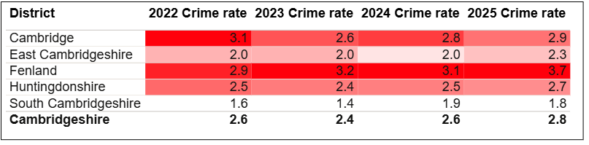
8.6 Sexual Offences
Table 4: Rate per 1,000 population of police recorded sexual offences, between 2022 and 2025
As seen in Table 4, South Cambridgeshire had the lowest rate per 1,000 in 2025 (1.8). This was notably lower than the rate per 1,000 for Cambridgeshire (2.8).
The rate for South Cambridgeshire remained stable between 2024 and 2025.
Note: Table has been produced by Cambridgeshire County Council’s Communities and Demography PI Team, using data provided by Cambridgeshire Constabulary. Rates over time have been calculated using locally produced estimates and forecasts, see Technical notes for further details.

Slide 33
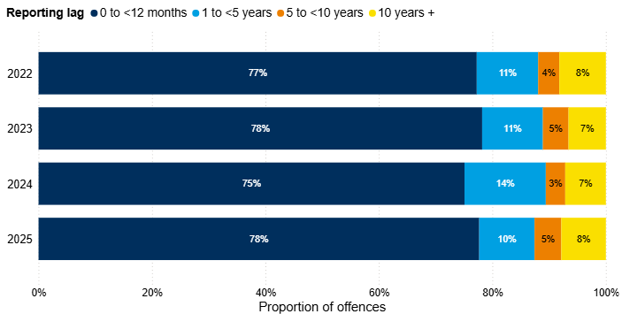
8.6 Sexual Offences
Figure 10: Number of years between offence start date and offence recorded date for police recorded sexual offences in South Cambridgeshire, 2022 to 2025
The proportion of historical offences decreased slightly in 2025, accounting for 22% of all sexual offences recorded in this period. In 2024, this proportion was 25%.
Note: Chart has been produced by Cambridgeshire County Council’s Communities and Demography PI Team, using data provided by Cambridgeshire Constabulary.
Notes:
Reporting sexual offences does not always happen immediately after the offence has occurred. Analysis has been completed on the difference between the date an offence was recorded by the police and the date when the offence occurred. It should be noted that offences can span a wide time period, and analysis here focuses on the offence start date rather than the offence end date due to data completeness.

Slide 34
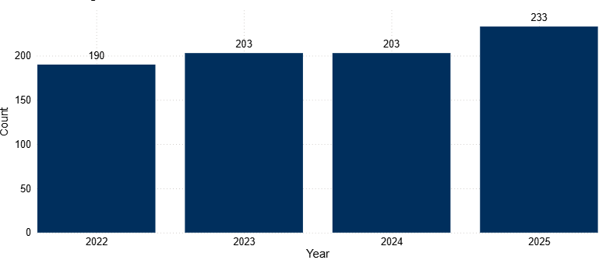
8.7 Miscellaneous Crimes Against Society
Figure 11: Annual trend in police recorded miscellaneous crimes against society offences in South Cambridgeshire, 2022 to 2025
In the last year, offence counts increased by 15% (+30 offences). This meant that counts reached the highest seen in the last four years.
Further analysis into the notable increase in miscellaneous crimes against society between 2024 and 2025 was conducted. During this analysis, the short title of offences was analysed to gain a better understanding into the nature of offences recorded under this crime type.
The highest proportion was accounted for by the short title of ‘take or to make or to distribute indecent photographs or pseudo- photographs, of children’, at 41%. This was followed by ‘threats to destroy or damage property’ at 26%.
Note: Chart has been produced by Cambridgeshire County Council’s Communities and Demography PI Team, using data provided by Cambridgeshire Constabulary.
Notes:
During the further analysis, it was highlighted that some of the offence groups may be relevant in the context of sexual offences. However, due to the Home Office Counting Rules, these offences are not recorded under ‘sexual offences’. These include:
Take or to make or to distribute indecent photographs or pseudo- photographs, of children.
Possession of an indecent or pseudo indecent photo of a child.
Possession of extreme pornographic image - a person performing an act of intercourse or oral sex with an animal (whether dead or alive) (bestiality).
After querying this with Cambridgeshire Constabulary, it was highlighted that the three offences are part of the Obscene Publications sub-section within the Miscellaneous Crimes against Society section of the Home office Counting Rules (HOCR). It was suggested that these specific offences may be more aligned to ‘obscene publications’ as opposed to direct sexual offences.

Slide 35
8.8 Domestic Abuse
Table 5: Police recorded Domestic Abuse (DA) incidents and crimes recorded in South Cambridgeshire, 2022 to 2025
 | 2022 | 2023 | 2024 | 2025
Total police recorded DA (non-crimed incidents & crimes) | 1971 | 1854 | 1986 | 2304
Total DA marked crimes | 1325 | 1146 | 1250 | 1333
Total DA incidents | 1501 | 1470 | 1571 | 1848
Incidents that result in a crime being recorded | 855 | 762 | 835 | 877
Incidents that remain as incident only | 646 | 708 | 736 | 971
Proportion of incidents that were 'crimed' | 57% | 52% | 53% | 47%
DA related incidents saw an increase of 18% between 2024 and 2025 (+277 incidents; 1571 to 1848). This is the highest count seen over the last four years as shown in Table 5.
Just under half of reported DA incidents were ‘crimed’ at 47% (877/1848); this is the smallest proportion across the last four years.
Note: Table has been produced by Cambridgeshire County Council’s Communities and Demography PI Team, using data provided by Cambridgeshire Constabulary.
Notes:
The decrease seen in YE September 2023 is likely to have been impacted by the change in new Home Office counting rules introduced in April 2023. This was referenced in the previous strategic assessment, which can be found here: Cambridgeshire & Peterborough Insight – Crime & Community Safety – Community Safety Partnerships – Cambridge City
The increase in incidents could be a result of online incident reporting making it more accessible for people to raise concerns and report incidents.
DARDRs – There were no ongoing or completed Domestic Abuse Related Death Reviews in East Cambridgeshire in 2025.

Slide 36
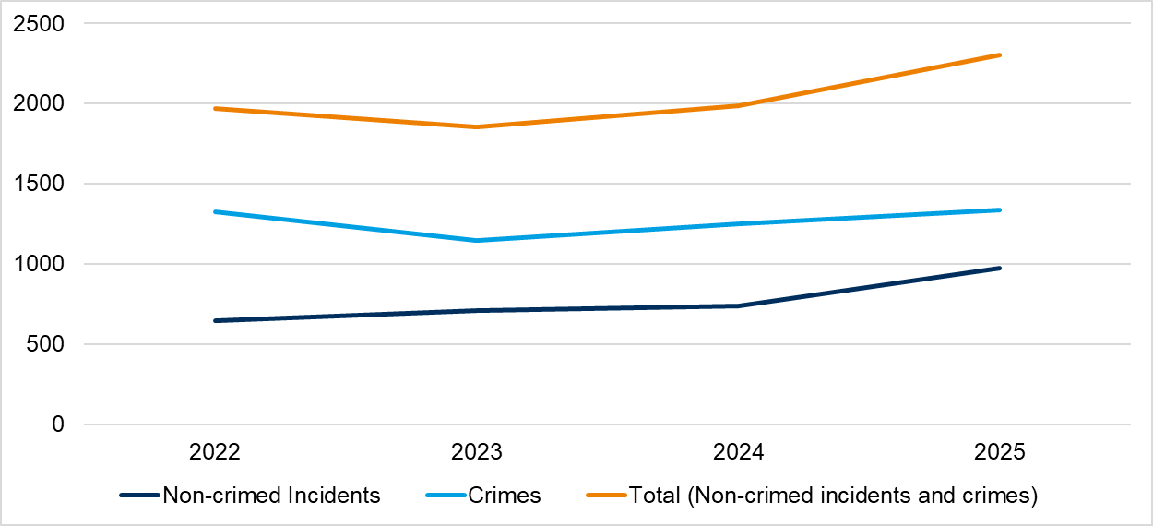
8.8 Domestic Abuse
Figure 12: Police recorded Domestic Abuse (DA) crimes and incidents (non-crimed only) in South Cambridgeshire, 2022 to 2025
Overall, total domestic abuse (DA) crimes and incidents saw a notable increase between 2024 and 2025 (+16%; +318; 1,986 to 2,304) (orange line).
DA marked crimes also increased in the last year (+7%; +83 crimes; 1,250 to 1,333) (light blue line).
Incidents that remain as incident only increased by 32% between 2024 and 2025 (+235; 736 to 971) (dark blue line).
Note: Chart has been produced by Cambridgeshire County Council’s Communities and Demography PI Team, using data provided by Cambridgeshire Constabulary.
Notes:
The decrease seen in YE September 2023 is likely to have been impacted by the change in new Home Office counting rules introduced in April 2023. This was referenced in the previous strategic assessment, which can be found here: Cambridgeshire & Peterborough Insight – Crime & Community Safety – Community Safety Partnerships – Cambridge City
The increase in incidents was said by Cambridgeshire Constabulary to potentially be a result of online incident reporting making it more accessible for people to raise concerns and report incidents.
DARDRs – There were no ongoing or completed Domestic Abuse Related Death Reviews in East Cambridgeshire in 2025.

Slide 37
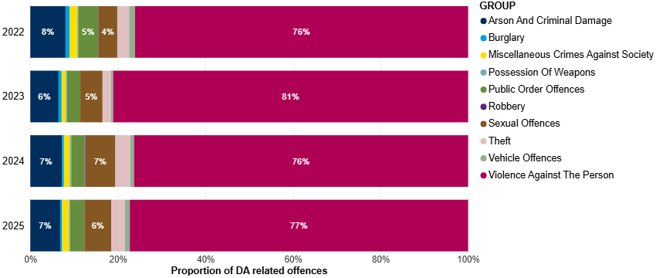
8.8 Domestic Abuse
Figure 13: Crime type breakdown of Domestic Abuse (DA) related offences recorded in South Cambridgeshire, 2022 to 2025
Similarly to national figures for YE September 2025 (ONS, 2026a), the crime type with the highest proportion is violence against the person (VAP) offences. VAP accounted for 77% of the DA marked crimes in 2025 .
Arson and criminal damage accounted for the second highest proportion (7%); this proportion has remained stable.
Note: Chart has been produced by Cambridgeshire County Council’s Communities and Demography PI Team, using data provided by Cambridgeshire Constabulary.

Slide 38
8.8 Domestic Abuse
Table 6: Rate per 1,000 population of domestic abuse (incidents and crimes), 2022 to 2025
As seen in Table 6, South Cambridgeshire had the lowest rate per 1,000 in 2025 (13.2). This was lower than the rate per 1,000 for Cambridgeshire (16.7).
Note: Table has been produced by Cambridgeshire County Council’s Communities and Demography PI Team, using data provided by Cambridgeshire Constabulary. Rates over time have been calculated using locally produced estimates and forecasts, see Technical notes for further details.

Slide 39
8.9 Modern Slavery
The latest National Crime Agency (NCA) Strategic Assessment for 2025 highlighted issues that are influencing risk of exploitation, which local CSPs should be alert to:
“Modern slavery refers to the exploitation of children and adults through slavery, servitude, or forced or compulsory labour” (NCA, 2025).
The National Referral Mechanism (NRM) is a framework to identify potential victims of modern slavery and human trafficking and ensure they receive the appropriate support. In the year ending September 2024, 8,156 referrals were made to the NRM reporting exploitation entirely within the UK. Of these 8,156 referrals, 54% (4,415) were for UK nationals, and in 58% (4,697 of 8,156), the potential victim reported exploitation as a child (NCA, 2025).
Adult victims are typically vulnerable due to debt and unemployment, and other economic factors. In some cases, victims are also vulnerable through factors such as homelessness, learning difficulties or disabilities, mental ill-health, or substance dependency or misuse. Similarly, these factors may also apply to child victims, who are also often vulnerable through their age, and factors such as family breakdown, persistent absence from school, and social isolation from peers.
The CSP should also be aware of sectors in which work is often informal or short-term, such as agriculture, beauty services, construction, food processing and preparation, and hand car washes, are particularly vulnerable to labour exploitation.

Slide 40
8.9 Modern Slavery
Whilst district level data is not available, data is available on the NRM referrals made where Cambridgeshire Constabulary was the first responder. The Cambridgeshire Constabulary police force area covers both Cambridgeshire and Peterborough. The latest end of year summary available is for 2024.
Of the 63 NRM referrals made by Cambridgeshire Constabulary in 2024, more than three quarters were males, accounting for 76% of referrals, a similar proportion recorded in 2023 (77%).
When looking at ages (at time of referral), 65% were adults (18 and over). Adult males accounted for almost half of the total referrals (48%).
Almost half of referrals were from the UK (54%). The next most common nationalities were Albanian (8%), and Vietnamese (8%).
The most common exploitation type was “criminal exploitation” (56%).
The next most common exploitation type was “labour and criminal exploitation” (16%).
Of the 63 referrals where Cambridgeshire Constabulary were first responders, 89% were investigated by Cambridgeshire Constabulary, this is 56 referrals. In total, Cambridgeshire Constabulary investigated 159 referrals; in 2024, there were no referrals from Fenland District Council in this year.
(Home Office, 2025a; Home Office, 2025b).
Notes:
Note that this does not necessarily reflect that Cambridgeshire Constabulary was the responsible police force. See technical notes on the NRM process in Appendix A.7 NRM data.

Slide 41
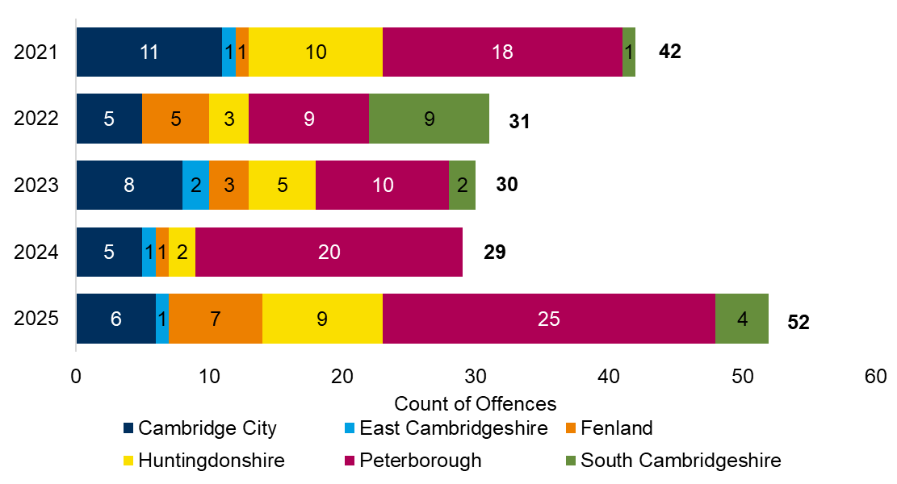
8.9 Modern Slavery
Figure 14: Police recorded modern slavery offences by district, 2021 to 2025
The total number of modern slavery offences in Cambridgeshire and Peterborough was 52 offences. This is a 79% increase on the previous year.
There were 4 modern slavery offences in South Cambridgeshire in 2025, an increase from the previous year when no offences were reported.
Note: Chart has been produced by Cambridgeshire County Council’s Communities and Demography PI Team, using data provided by Cambridgeshire Constabulary CADET.
Notes:
These numbers should not be taken as a true representation of the levels of modern slavery offending in South Cambridgeshire, or countywide, due to high levels of underreporting for this crime type. It should also be noted that local district boundaries are irrelevant to the trafficking and exploitation of people as organised crime gangs are known to move people within the UK. The Partnership should work closely with cross-border agencies.

Slide 42
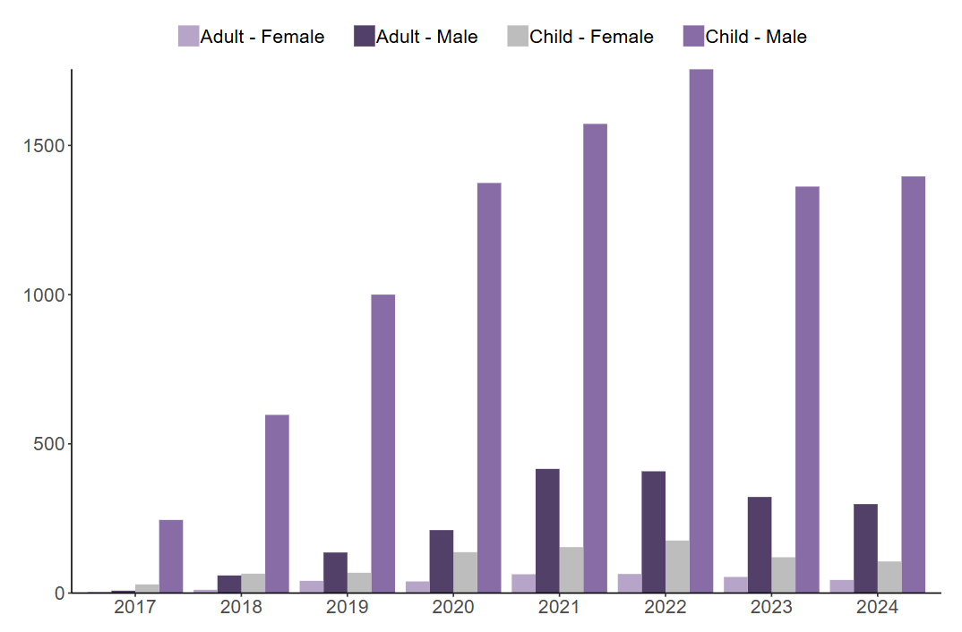
8.10 County Lines
Figure 15: Number of NRM referrals flagged nationally as county lines, by age group at exploitation and gender, 2017 to 2024
The latest strategic assessment published by the National Crime Agency (NCA) indicates that exploitation linked to criminal activity constitutes a significant proportion of the exploitation types reported in the UK. In the YE September 2024, 65% of referrals were for exploitation in criminal activity.
Exploitation in criminal activity occurs when victims are coerced, forced, or otherwise compelled to commit crime, often in drug offences such as cannabis cultivation or distribution via county lines. (NCA, 2025).
County Lines refers to a model of offending whereby gangs and organised crime groups move drugs into supply areas within the UK via the exploitation of vulnerable individuals. These individuals are recruited and coerced into the drug supply chain (NCA, 2019).
The NRM referral system flags referrals that relate to county lines. In 2024, nationally, 10% of all referrals received were flagged as county lines. The majority of these referrals were for male children (76%), as shown in Figure 15; this cohort have consistently accounted for the majority of county lines flagged referrals (Home Office, 2025a).
Source: Figure 8 in Modern Slavery end of year summary 2024 report (Home Office, 2025a).
Note: See technical notes for NRM data in section A.7. NRM referrals.

Slide 43
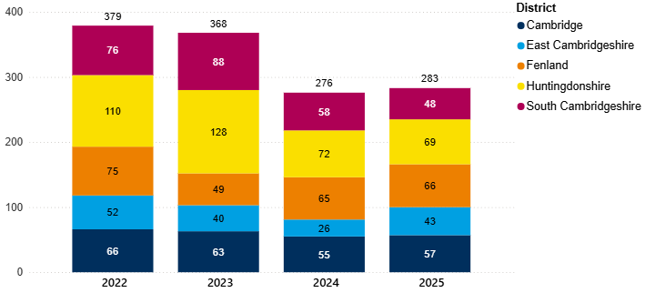
8.11 Child Sexual Exploitation (CSE)
Figure 16: Annual trend of police recorded CSE offences in Cambridgeshire by district, 2022 to 2025
In the last year, CSE offences in South Cambridgeshire have decreased (-17%, -10 offences). This is different to the county-wide picture, whereby Cambridgeshire CSE offences increased by 3% between 2024 and 2025 (+7 offences).
Note: Chart has been produced by Cambridgeshire County Council’s Communities and Demography PI Team, using data provided by Cambridgeshire Constabulary.
Notes:
CSE is a marker that can be applied to any offence that fits the criteria for CSE by police. It is worth noting that like other markers that can be applied there is a potential level of inconsistency in the application of the marker. It would be worth investigating how reliable the marker is as an accurate reflection of CSE crimes within the local police data.

Slide 44
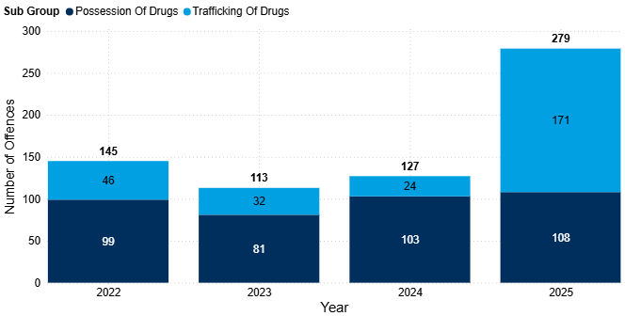
8.12 Drug Offences
Drug offences have seen incremental increases fluctuated between 2022 and 2024. However, between 2024 and 2025, there has been a notable increase, from 127 to 279 (+120%, +152 offences). See note on slide on changes to recording practices.
This increase was solely driven by ‘trafficking of drugs’; this subgroup saw a 613% increase in this period (+147 offences).
Possession of drug offences slightly increased in the last year (+5%, +5 offences).
Nationally, police recorded drug offences saw an 21% increase between YE September 2024 and YE September 2025. Although both possession and trafficking saw increases, this was largely driven by the increase in trafficking offences (+38%) (ONS, 2026b).
Figure 17: Annual trend in police recorded drug offences in South Cambridgeshire, 2022 to 2025
Note: Chart has been produced by Cambridgeshire County Council’s Communities and Demography PI Team, using data provided by Cambridgeshire Constabulary.

Slide 45
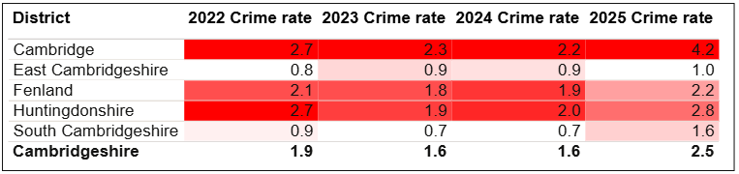
8.12 Drug Offences
Table 7: Rate per 1,000 population of police recorded drug offences by district, 2022 and 2025
As seen in Table 7, South Cambridgeshire had the second lowest rate per 1,000 population in 2025 (1.6). This was a notable increase, given that for 2023 and 2024 South Cambridgeshire had the lowest rate in the county.
Despite increasing, the rate per 1,000 population in 2025 was lower than Cambridgeshire (2.5).
Note: Table has been produced by Cambridgeshire County Council’s Communities and Demography PI Team, using data provided by Cambridgeshire Constabulary. Rates over time have been calculated using locally produced estimates and forecasts, see Technical notes for further details.

Slide 46
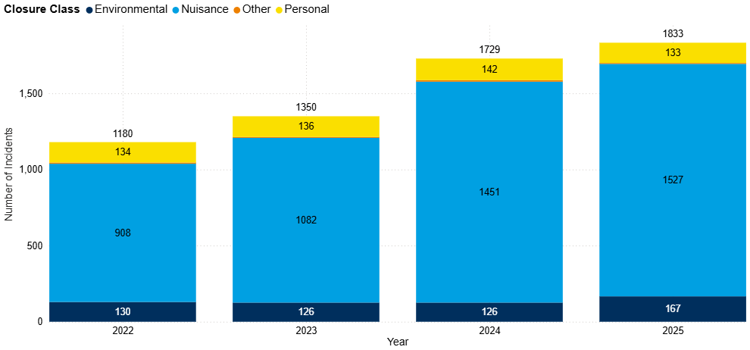
8.13 Anti-Social Behaviour (ASB)
Figure 18: Annual trend in police recorded ASB incidents in South Cambridgeshire, 2022 to 2025
ASB incidents have followed a steadily increasing trend since 2022. Between 2024 and 2025, ASB incidents increased by 6% (+104 incidents), with ASB nuisance accounting for 83% of all ASB recorded in 2025. Nationally, police recorded ASB remained similar over a similar period (YE September 2025) (ONS, 2026a).
This change was driven by increase in ‘nuisance’ ASB, and ‘environmental’ ASB, which between 2024 and 2025, increased by 5% (+76 incidents) and 33% (+41 incidents) respectively.
Note: Chart has been produced by Cambridgeshire County Council’s Communities and Demography PI Team, using data provided by Cambridgeshire Constabulary.

Slide 47
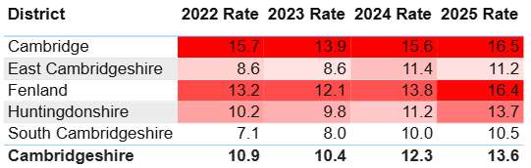
8.13 Anti-Social Behaviour (ASB)
Table 8: Rate per 1,000 population of police recorded ASB incidents, 2022 to 2025
As seen in Table 8, South Cambridgeshire had the lowest rate per 1,000 population in 2025 (10.5). This was lower than the rate per 1,000 for Cambridgeshire (13.6).
Note: Table has been produced by Cambridgeshire County Council’s Communities and Demography PI Team, using data provided by Cambridgeshire Constabulary. Rates over time have been calculated using locally produced estimates and forecasts, see Technical notes for further details.

Slide 48
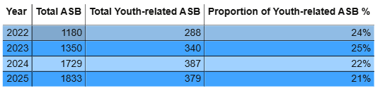
8.13 ASB - Youth-related Anti-Social Behaviour (ASB)
Table 9: Police recorded ASB incidents and the proportion where a youth-related keyword has been identified, 2022 to 2025
The proportion of youth-related ASB has varied over the past four years. In 2025, the proportion reached its lowest level in the past four years (21%), as shown in Table 9.
Between 2024 and 2025, youth-related ASB has decreased by 2% (-8 incidents).
Note: Table has been produced by Cambridgeshire County Council’s Communities and Demography PI Team, using data provided by Cambridgeshire Constabulary.
Notes:
Youth-related ASB has been analysed by applying a keyword search to the incident description field to identify incidents that are likely to be youth-related. It should be noted that this is not a perfect measure, it may include some incidents where young people were present or victims, but the incident itself was not directly attributable to young people. Despite this limitation, it represents the best available indicator of police recorded youth related ASB

Slide 49
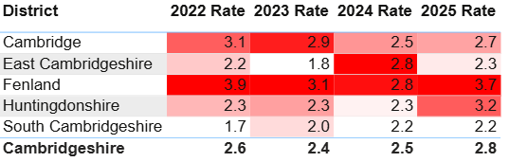
8.13 ASB - Youth-related Anti-Social Behaviour (ASB)
Table 10: Rate per 1,000 population of police recorded youth-related ASB incidents, 2022 and 2025
As seen in Table 10, South Cambridgeshire had the lowest rate per 1,000 population in 2025 (2.2). This was slightly lower than the rate per 1,000 for Cambridgeshire (2.8).
South Cambridgeshire also had the lowest rate in Cambridgeshire in 2022 and 2024.
Note: Table has been produced by Cambridgeshire County Council’s Communities and Demography PI Team, using data provided by Cambridgeshire Constabulary. Rates over time have been calculated using locally produced estimates and forecasts, see Technical notes for further details.

Slide 50
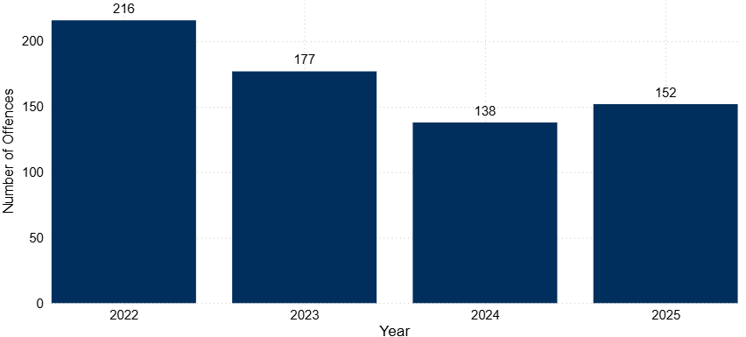
8.14 Hate Crime
Figure 19: Annual trend in police recorded hate crime marked offences in South Cambridgeshire, 2022 to 2025
Hate crime marked offences have decreased year on year between 2022 and 2024. However, in the last year offences increased by 10% (+14 offences).
Despite this increase, counts remained lower than both 2022 and 2023.
Note: Chart has been produced by Cambridgeshire County Council’s Communities and Demography PI Team, using data provided by Cambridgeshire Constabulary.

Slide 51
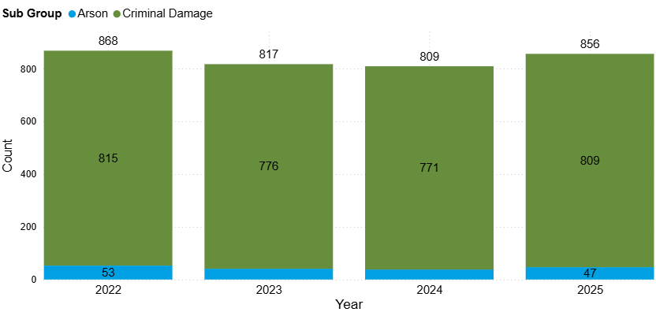
8.15 Arson and Criminal Damage
Figure 20: Annual trend in police recorded arson and criminal damage offences in South Cambridgeshire, 2022 to 2025
Arson and criminal damage offences increased from 809 to 856 between 2024 and 2025 (+6%, +47 offences). Counts have remained relatively stable across the last four years.
In 2025, arson and criminal damage accounted for 11% of the crime in South Cambridgeshire. This proportion has remained unchanged over the last four years.
Note: Chart has been produced by Cambridgeshire County Council’s Communities and Demography PI Team, using data provided by Cambridgeshire Constabulary.

Slide 52
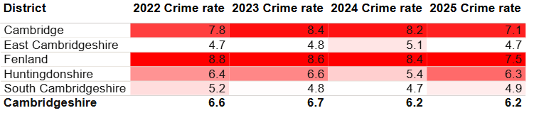
8.15 Arson and Criminal Damage
Table 11: Rate per 1,000 population of police recorded arson and criminal damage offences, 2022 and 2025
As seen in Table 11, South Cambridgeshire had the fourth highest rate per 1,000 population in 2025 (4.9). This was lower than the rate per 1,000 for Cambridgeshire (6.2).
Note: Table has been produced by Cambridgeshire County Council’s Communities and Demography PI Team, using data provided by Cambridgeshire Constabulary. Rates over time have been calculated using locally produced estimates and forecasts, see Technical notes for further details.

Slide 53
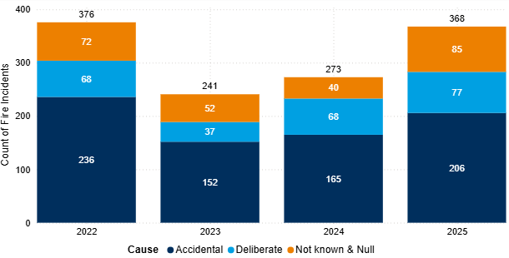
8.16 Fires
Figure 21: Annual trend in fires in South Cambridgeshire, 2022 to 2025
In 2025, there were 368 fires in South Cambridgeshire; this is a 35% increase from the last year (+95 incidents).
Of the 368 fires recorded, 21% (77 incidents) were classified as deliberate. The number of deliberate fires has seen incremental increases since 2023, as shown in Figure 21.
Note: Chart has been produced by Cambridgeshire County Council’s Communities and Demography PI Team, using data provided by Cambridgeshire Fire and Rescue Service.

Slide 54
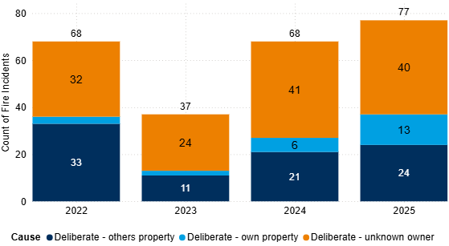
8.16 Deliberate Fires
Figure 22: Annual trend in deliberate fires in South Cambridgeshire, 2022 to 2025
In 2025, deliberate fires increased by 13% (+9) when compared with 2024, reaching the highest count seen in the last four years.
‘Deliberate – unknown owner accounted for the largest proportion of deliberate fires at 52% (40 out of 77).
Note: Chart has been produced by Cambridgeshire County Council’s Communities and Demography PI Team, using data provided by Cambridgeshire Fire and Rescue Service.

Slide 55
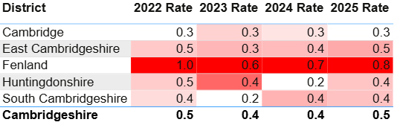
8.16 Deliberate Fires
Table 12: Rate per 1,000 population of deliberate fires by district, 2022 to 2025
In 2025, South Cambridgeshire had a rate per 1,000 population of 0.4, placing it close to Huntingdonshire which had a similar rate of 0.4. The lowest rate per 1,000 population in 2025 was observed in Cambridge City with 0.3.
Note: Table has been produced by Cambridgeshire County Council’s Communities and Demography PI Team, using data provided by Cambridgeshire Constabulary. Rates over time have been calculated using locally produced estimates and forecasts, see Technical notes for further details.

Slide 56
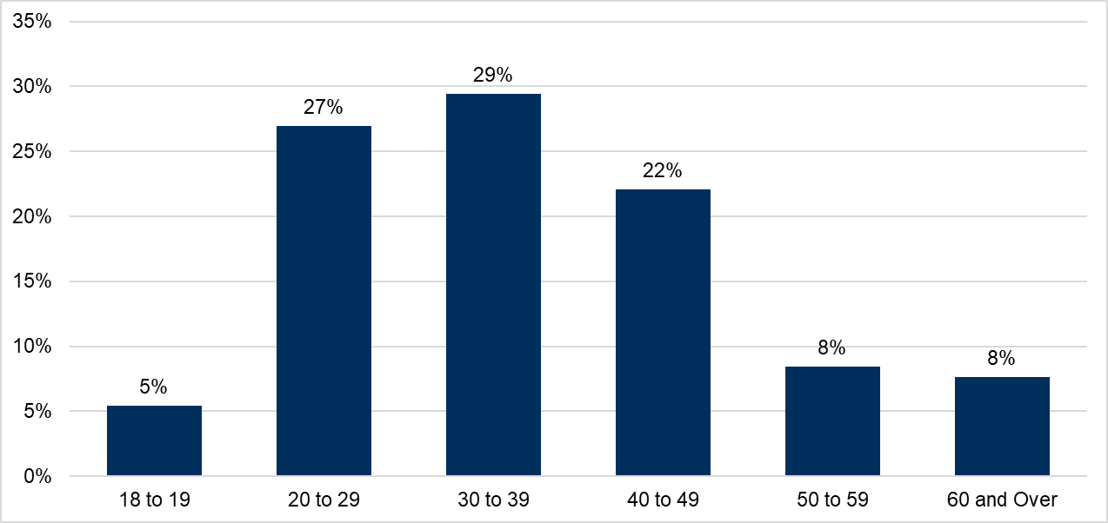
8.17 Probation
Figure 23: Proportion of age groups of those open to the Probation Service in 2025, residing in South Cambridgeshire
The Probation Service have provided a caseload profile for individuals residing in South Cambridgeshire who were open to the service at some point within 2025; in this instance, there were 367 people.
The majority of the cohort were males, with a split of 90% males and 10% females.
30 to 39 years old accounted for the largest proportion of the cohort at 29%.
18- to 19-year-olds accounted for 5% of the cohort; it is to be expected that this proportion is smaller as there are only two single years of age.
Note: Chart has been produced by Cambridgeshire County Council’s Communities and Demography PI Team, using data provided by Cambridgeshire and Peterborough Probation Service.

Slide 57
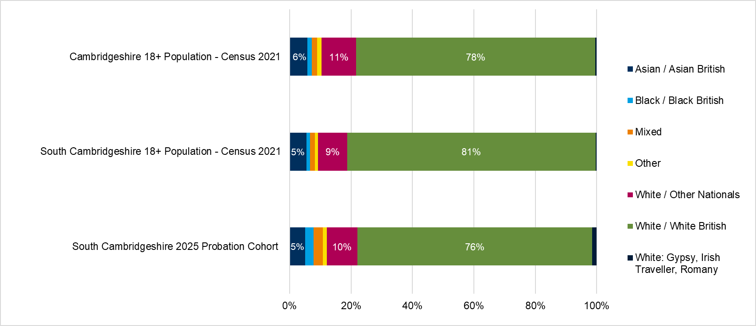
8.17 Probation
Figure 24: Proportion of ethnic group comparison, South Cambridgeshire Probation Service cohort, South Cambridgeshire Census 2021 Population and Cambridgeshire Census 2021 Population
10% (35 of 367) of the current South Cambridgeshire probation caseload had no ethnicity recorded.
Of those who’s ethnicity was recorded (332), Figure 24 shows that the majority of the probation cohort were White British at 76%. This means the cohort were underrepresented in comparison to the South Cambridgeshire (81%) and Cambridgeshire (78%) Census population.
White / Other Nationals group were overrepresented in comparison to South Cambridgeshire Census population (10% vs 9% respectively).
Note: Chart has been produced by Cambridgeshire County Council’s Communities and Demography PI Team, using data provided by Cambridgeshire and Peterborough Probation Service.

Slide 58
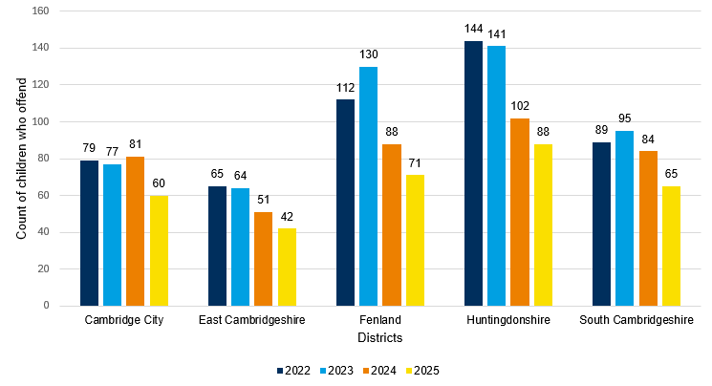
8.18 Youth Justice Service
Figure 25: Count of children who offend by district, 2022 to 2025
Figure 25 shows that for 2025 South Cambridgeshire had the third highest number of children who offend at 65 compared to other districts.
There has been a 27% decrease in the number of children who offend in South Cambridgeshire between 2022 and 2025.
Table 13 below shows there has been an increasing trend in average offences per child in South Cambridgeshire since 2022.
Table 13: Average offences per child who offend by district, 2022 to 2025
Districts | 2022 | 2023 | 2024 | 2025
Cambridge City | 1.73 | 1.65 | 1.59 | 1.35
East Cambridgeshire | 2.20 | 1.45 | 1.20 | 1.10
Fenland | 1.59 | 1.76 | 1.34 | 1.86
Huntingdonshire | 1.44 | 1.28 | 1.43 | 1.44
South Cambridgeshire | 1.12 | 1.24 | 1.68 | 1.40
Note: Chart has been produced by Cambridgeshire County Council’s Communities and Demography PI Team, using data provided by Cambridgeshire Youth Justice Service.

Slide 59
8.18 Youth Justice Service
Table 14: FTEs and Outcomes of children who offend in South Cambridgeshire, 2022 to 2025
Outcome | 2022 | 2023 | 2024 | 2025
First Time Entrants (FTEs) | 13 | 18 | 8 | 10
Out of Court Resolutions (OOCRs) | 80 | 85 | 77 | 66
Court Sentences | 15 | 17 | 17 | 11
Table 14 shows that except for 8 FTEs in 2024, 2025 has had the lowest number of FTEs, OOCRs, and Court Sentences in South Cambridgeshire between 2022 and 2025.
Most OOCRs in South Cambridgeshire are non-substantive outcomes and range between 98% in 2022 and 91% in 2023.
Table 15 shows that violence against the person (VAP) has consistently been the most common offence type in South Cambridgeshire between 2022 and 2025. Theft and handling stolen goods, sexual offences, and public order are the next most common offence types.
Table 15: Offence type of children who offend in South Cambridgeshire, 2022 to 2025
Offence type | 2022 | 2023 | 2024 | 2025 | 2025 - Percentage share of total offences
Violence Against The Person | 35 | 41 | 48 | 34 | 37%
Theft And Handling Stolen Goods | <5 | 6 | 16 | 13 | 14%
Sexual Offences | 8 | 13 | 12 | 12 | 13%
Public Order | 15 | 14 | 13 | 7 | 8%
Criminal Damage | 12 | 7 | 12 | 5 | 5%
Drugs | 5 | 13 | 7 | 5 | 5%
Motoring Offences | <5 | 11 | 16 | 5 | 5%
Fraud And Forgery | 0 | 0 | 0 | <5 | <5%
Other | <5 | <5 | <5 | <5 | <5%
Racially Aggravated | 8 | <5 | <5 | <5 | <5%
Vehicle Theft / Unauthorised Taking | <5 | <5 | <5 | <5 | <5%
Breach Of Statutory Order | 0 | <5 | 0 | <5 | <5%
Robbery | <5 | <5 | <5 | <5 | <5%
Arson | <5 | 0 | 0 | 0 | 0%
Breach Of Bail | 0 | 0 | <5 | 0 | 0%
Domestic Burglary | <5 | <5 | <5 | 0 | 0%
Non-Domestic Burglary | <5 | <5 | <5 | 0 | 0%
Total | 100 | 118 | 141 | 91 | 100%
Note: Tables have been produced by Cambridgeshire County Council’s Communities and Demography PI Team, using data provided by Cambridgeshire Youth Justice Service.

Slide 60
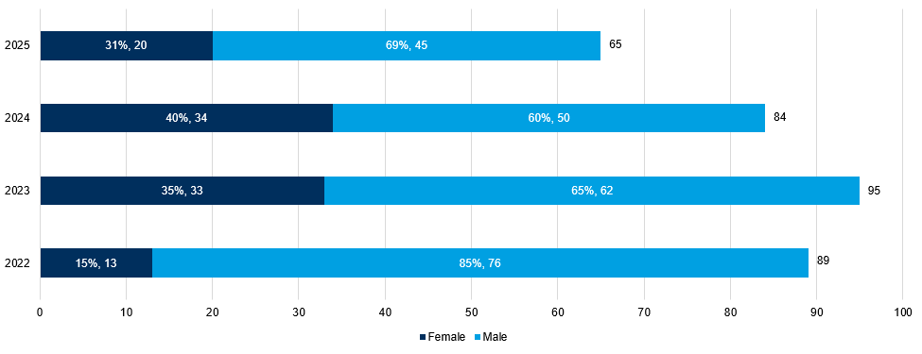
8.18 Youth Justice Service
Table 16: Children who offend in South Cambridgeshire by age group, 2022 to 2025
Age - Table 16 below shows that age 15 and 17 have the highest average count of children who offend in South Cambridgeshire.
Gender - Figure 26 shows most children who offend in South Cambridgeshire are males. However, the proportion of females has at least doubled from 15% in 2022 to 35%, 40%, and 31% in 2023, 2024, and 2025, respectively.
Ethnicity - The most common ethnicity for children who offend in South Cambridgeshire is White British (70% of South Cambridgeshire YJS cohort), and this is followed by White/Other Nationals (18% of South Cambridgeshire YJS cohort). White/Other Nationals is over-represented compared to the 7% South Cambridgeshire 10-17 population from Census 2021.
Children’s social care - The percentage of those associated with children’s social care between 2022 and 2025 is 5%.
Substance misuse - The percentage of those who have had evidence of substance misuse between 2022 and 2025 is 4%.
Mental health - The percentage of those who have had contact with mental health services between 2022 and 2025 is 1%.
Age Groups | 2022 | 2023 | 2024 | 2025 | 4-year average count
10 to 12 | 10 | 8 | 7 | 7 | 8
13 | 8 | 14 | 13 | 8 | 10.75
14 | 20 | 14 | 12 | 13 | 14.75
15 | 22 | 27 | 15 | 13 | 19.25
16 | 10 | 13 | 19 | 14 | 14
17 | 19 | 20 | 19 | 13 | 17.75
Figure 26: Children who offend in South Cambridgeshire by gender, 2022 to 2025
Note: Table and Chart have been produced by Cambridgeshire County Council’s Communities and Demography PI Team, using data provided by Cambridgeshire Youth Justice Service.

Slide 61
8.19 Offence types that saw no notable change or have decreased in the last year
The below are crime types which have not been analysed in further detail above, and they saw no notable change or decreased in the last year.
Public order offences have continued to decrease. Since 2022, offence counts have decreased by 38% (-299 offences).
Vehicle offences decreased slightly by 1% (-7 offences), following a decrease of 32% between 2023 and 2024 (-267 offences).

Slide 62
8.20 Geographic Analysis
The most notable wards across all crime types were Milton and Waterbeach, Histon and Impington, and Fen Ditton and Fulbourn.
Milton and Waterbeach remained in the top 5 highest ward counts in all analysed offence types in 2025, except hate crime. Milton and Waterbeach accounted for just under half of all shoplifting offences in South Cambridgeshire in 2025 (47%).
Histon and Impington had the highest count in 2025 across 4 of the 12 analysed offence types. These included DA (crimes and incidents), personal loss, youth-related ASB and deliberate fires. All analysed offence types saw increases or remained stable with 2024, except sexual offences and vehicle offences.
Fen Ditton and Fulbourn remained in the top 5 highest ward counts in 11 out of 12 analysed offence types in 2025.

Slide 63
9. IMD
The Index of Multiple Deprivation 2025 (IMD 2025) is the official measure of relative deprivation for small area geographies called Lower-layer Super Output Areas (LSOAs), in England. It has been produced every 3 to 5 years since 1970s. Lower Layer Super Output Areas are a geographic hierarchy designed to improve the reporting of small area statistics in England and Wales.
IMD 2025 was released at the end of October 2025. Prior to that the latest release was in September 2019.
South Cambridgeshire is ranked 281 out of 296 of all local authorities nationally, based on local authority score, where 1 is most deprived. This means South Cambridgeshire is the 15th least deprived of the 296 English Local Authorities.
In South Cambridgeshire, there are 99 Lower Super Output Areas (LSOAs).
No LSOAs were in the lowest 3 deciles (most deprived, 1-3). The lowest decile in South Cambridgeshire was 4, of which 2 LSOAs fell into.
There are 43 LSOAs in the highest 2 deciles (9-10).
For more details, there is a full report and dashboard on Cambridgeshire Insight: Cambridgeshire & Peterborough Insight – Poverty – Indices of Deprivation 2025.

Slide 64
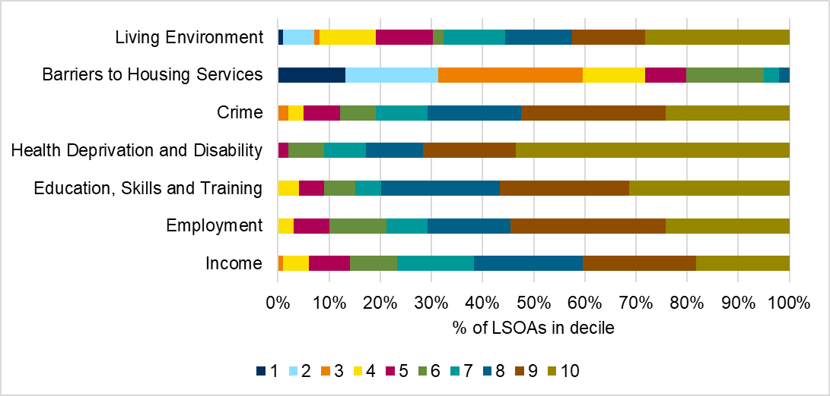
9. IMD
Figure 27: Proportion of LSOAs which fall into each decile by domain in South Cambridgeshire, IMD 2025
In South Cambridgeshire, the most deprived domain is Barriers to Housing and Services, which includes factors such as housing affordability and household overcrowding. 60% of LSOAs in South Cambridgeshire fall into the top 3 most deprived deciles (1-3, where 1 is the most deprived).
The lowest levels of relative deprivation is in the Health Deprivation and Disability domain, with 83% of LSOAs in South Cambridgeshire falling into the top 3 least deprived deciles (8-10, where 10 is least deprived).
Figure 27 breaks down LSOA national decile distribution by individual domain.

Slide 65
10. Relevant Links
South Cambridgeshire Community Safety Operational Plan 2025/26: South Cambridgeshire Community Safety Partnership Operational Plan
Latest National Statistics: Crime in England and Wales - Office for National Statistics YE Sept 2025
Latest National Crime Agency (NCA) Strategic Assessment: NSA 2025 - National Crime Agency
Latest Modern Slavery National Bulletin: Modern slavery: National Referral Mechanism and Duty to Notify statistics UK, end of year summary 2024 - GOV.UK
Cambridgeshire Crime Counts and Rates for 2024: Cambridgeshire Crime Counts 2024 | Cambridgeshire Insight Open Data

Slide 66
10. Relevant Links
Latest National Statistics: Crime in England and Wales - Office for National Statistics YE Sept 2025
Latest National Crime Agency (NCA) Strategic Assessment: NSA 2025 - National Crime Agency
Latest Modern Slavery National Bulletin: Modern slavery: National Referral Mechanism and Duty to Notify statistics UK, end of year summary 2024 - GOV.UK

Slide 67
11. Glossary
Term/acronym | Definition
ASB (Anti-Social Behaviour) | “Antisocial behaviour is defined as 'behaviour by a person which causes, or is likely to cause, harassment, alarm or distress to persons not of the same household as the person' (Antisocial Behaviour Act 2003 and Police Reform and Social Responsibility Act 2011).” (Cambridgeshire Constabulary, n.d.)
ASB categories: personal, environmental and nuisance | Personal antisocial behaviour is when a person targets a specific individual or group. Environmental antisocial behaviour is when a person’s actions affect the wider environment, such as public spaces or buildings. Nuisance antisocial behaviour is when a person causes trouble, annoyance or suffering to a community (Cambridgeshire Constabulary, n.d.).
Accidental Fires | Where the motive for the fire is thought to be accidental or is unknown.
Arson | The criminal act of deliberately setting fire to property.
C&P PHIT | Cambridgeshire and Peterborough Public Health Intelligence Team
CCC PIT | Cambridgeshire County Council Policy and Insight Team
County Lines | “A term used to describe gangs and organised criminal networks involved in exporting illegal drugs into 1 or more importing areas [within the UK], using dedicated mobile phone lines or other form of ‘deal line’. They are likely to exploit children and vulnerable adults to move [and store] the drugs and money and they will often use coercion, intimidation, violence (including sexual violence) and weapons.” (Home Office, 2023b)
CSE (Child Sexual Exploitation) | “Child sexual exploitation is a form of child sexual abuse. It occurs where an individual or group takes advantage of an imbalance of power to coerce, manipulate or deceive a child or young person under the age of 18 into sexual activity (a) in exchange for something the victim needs or wants, and/or (b) for the financial advantage or increased status of the perpetrator or facilitator. The victim may have been sexually exploited even if the sexual activity appears consensual. Child sexual exploitation does not always involve physical contact; it can also occur through the use of technology.” (HM Government, 2016)

Slide 68
11. Glossary
Term/acronym | Definition
CSEW | Crime Survey for England and Wales
CSP | Community Safety Partnership
DA | Domestic Abuse
Domestic Abuse Crime | Domestic Abuse Crime is not limited to specific offences. Any police recorded crime can be flagged as Domestic Abuse related and as such would be counted as a ‘Domestic Abuse Crime’.
Domestic Abuse Incident | “A (police recorded) report of a domestic incident, which occurs in either a public or private place.” Recording such incidents enables data to capture those incidents where the circumstances do not amount to a notifiable crime i.e., not all domestic abuse incidents result in a crime being recorded.” (Home Office, 2011, p. 19)
Domestic Homicide Review | “When a person is murdered in the context of domestic violence or abuse, a Domestic Homicide Review (DHR) is usually carried out. The responsibility for DHR's sits with the relevant district Community Safety Partnership (part of the District Council). The Community Safety Partnership will commission an independent Chair and Author for the DHR and organize a panel of appropriate professionals (membership dependent on the case).” (Cambridgeshire & Peterborough DASV Partnership)
ED | Emergency Department
Hate Crime | “A hate crime is any criminal offence which is perceived by the victim, or anybody else, to be motivated by hostility or prejudice towards someone’s: race, religion, sexual orientation, transgender identity, disability. These aspects are known as ‘protected characteristics’. A hate crime can include verbal abuse, intimidation, threats, harassment, assault and damage to property. A hate incident is behaviour which isn’t a crime, but which is perceived by the victim, or anybody else, to be motivated by hostility or prejudice based on the 5 protected characteristics.” (HM Government)
HMICFRS | Her Majesty’s Inspectorate of Constabulary and Fire & Rescue Services

Slide 69
11. Glossary
Term/acronym | Definition
Modern Slavery | “Modern slavery is a complex crime that covers all forms of slavery, trafficking and exploitation. Trafficking includes transporting, recruiting or harbouring an individual with a view to them being exploited. Modern slavery crimes may involve, or take place alongside, a wide range of abuses and other criminal offences such as grievous bodily harm, assault, rape or child sexual abuse. Victims of modern slavery can be men, women and children of any age across the world. There is an assumption that victims of modern slavery are often trafficked to the UK from other countries, but residents of the UK are also among the victims that are exploited in the UK and other countries.” (ONS, 2020)
National Referral Mechanism (for Modern slavery) (NRM) | “The National Referral Mechanism (NRM) is a framework for identifying and referring potential victims of modern slavery and ensuring they receive the appropriate support”. Only staff at designated first responder organisations can make online NRM or Duty to Notify (DtN) referral. An NRM referral is made for those under 18, and for adults who have consented to be referred. A DtN referral is for those who have not consented to a NRM referral (Home Office; UK Visas and Immigration, 2022)
ONS | Office for National Statistics
PIT | Policy and Insight Team (formerly the Cambridgeshire Research Group)
SVD | Serious Violence Duty
Ward | Wards (or electoral wards), are geographical areas used to elect local authority councillors (ONS, 2023c).
YE | Year Ending
YJS | Youth Justice Service

