Slide 1
Fenland Strategic Assessment
2025
Final V1.1
Communities and Demography PI Team

Slide 2
Contents
Purpose
Executive Summary
CSP Priorities
Statutory Duties
Introduction
Comparison to last year
Community Safety Trends to Note
Analysis
IMD
Relevant Links
Glossary
Instructions on navigation:
1. Use PowerPoint desktop
2. Hold Ctrl and Click with mouse:
on the links to the left or
the blue Home icon in the upper right to return to Contents

Slide 3
Contents
8.1. Crime Overview
8.2. Commercial Loss
8.3. Personal Loss
8.4. Violence Against the Person
8.5. Sexual Offences
8.6. Miscellaneous Crimes Against Society
8.7. Domestic Abuse
8.8. Modern Slavery
8.9. County Lines
8.10. CSE
8.11. Drug Offences
8.12. ASB
8.13. Fires
8.14. Probation
8.15. Youth Justice Service
8.16. Offence types which saw no notable change
8.17. Geographic Analysis
Purpose
Executive Summary
CSP Priorities
Statutory Duties
Introduction
Comparison to last year
Community Safety Trends to Note
Analysis
IMD
Relevant Links
Glossary
Instructions on navigation:
1. Use PowerPoint desktop
2. Hold Ctrl and Click with mouse
on the links to the left or..
the blue Home icon in the upper right to return to Contents

Slide 4
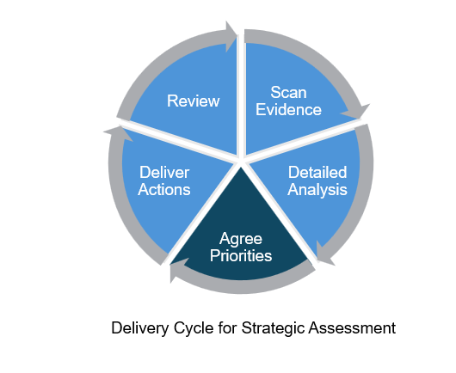
1. Purpose
The purpose of this strategic assessment is
To provide an evidence base for decision-making for the community safety partnership
To provide detailed analysis of specific issues
To help inform priorities going forward
To help facilitate discussion of the board to identify areas of concern

Slide 5
2.1 Executive Summary – Overview
Prioritisation category | Key Community Safety Issues identified in 2024 Strategic Assessment | Key Community Safety Issues identified in this year’s 2025 Strategic Assessment
High importance – these areas either have high volumes of offences or high increasing trends. | Violence against the person (VAP) Vehicle offences Shoplifting | Violence against the person (VAP) Sexual offences (and Misc crimes against society) Domestic abuse ASB (including Youth ASB)
Concerning recent counts – there have been either steady year on year increases or a recent increase in the last year despite decreases or fluctuations in previous years. | Hate crime Sexual offences Exploitation ASB | Drug offences Exploitation Deliberate fires
Consider reviewing in a year or discharging – These are current work streams that have seen decreases or shown inconclusive fluctuations in volume over the last 4 years. | Scams/fraud/cyber crime Domestic abuse* Offending *This was added as a primary work stream by Fenland CSP after strategic assessment presentation at the 2025 board meeting. | Vehicle offences Shoplifting Hate crimes Scams/fraud/cyber crime
Last year’s years key community safety issues were divided into the following prioritisation categories:
High importance
Concerning recent counts
Consider reviewing in a year or discharging
This year’s “High Importance” category includes
Violence against the person (VAP)
Sexual offences (and Misc crimes against society)
Domestic abuse
Anti-social behaviour (ASB) (including Youth ASB)
Slides 6 to 9 consolidate evidence from this year’s strategic assessment for these community safety issues that are “Consider high attention”.

Slide 6
2.2 Executive Summary – Key Findings
The following key community safety issues categorised as “High importance” are expanded below:
Violence Against the Person (VAP)
Fenland has consistently had the highest rate of VAP offences per 1,000 population of all districts in Cambridgeshire between 2022 and 2025. It currently has a rate of 33.2 compared to a rate of 23.4 in Cambridgeshire.
VAP has accounted for the highest proportion of offences since 2022. In 2025, VAP accounted for 44% of crime in Fenland.
VAP offences increased by 9% between 2024 and 2025 (+279 offences).
All main components of VAP increased between 2024 and 2025:
Stalking and harassment increased by 14% (+119 offences) compared to 7% at a national level.
Violence with injury increased by 6% (+49 offences) compared to 5% at a national level.
Violence without injury increased by 7% (+110 offences), reaching the highest count in the last four years. This is compared to 1% at a national level.
VAP consistently makes up the highest crime type of domestic abuse (DA) related offences in Fenland, ranging between 77% to 78% between 2022 and 2025.
DA marked VAP increased between 2024 and 2025 (+10%, +105). Despite this increase, offence counts remain slightly lower than seen in 2022 (-4%, -48).
DA marked stalking and harassment increased by 4% in the last year (+14).
DA marked violence with injury increased by 30% (+66). This increase was notably larger than the increase seen in all violence with injury offences (+6%). This represents the highest count of DA marked violence with injury offences in the last four years.

Slide 7
2.2 Executive Summary – Key Findings
VAP (continued)
DA marked violence without injury increased by 5% in the last year (+25).
Knife crime and possession of weapons also saw increases in the last year.
In the last year, knife crime marked offences have increased by 6% (+7 offences). Despite the increasing trend, offence counts still remain lower than 2022. In contrast, at a national level, knife-enabled crime recorded by the police saw a 9% decrease between YE September 2024 and YE September 2025.
In 2025, possession of weapon offences reached highest counts seen across the last four years at 136. This was a 20% increase on the previous year (+23 offences).
Youth Justice Service (YJS) data shows that VAP has consistently been the most common offence type in Fenland between 2022 and 2025. It made up 36% of all offences.
Sexual offences (and Misc crimes against society)
Fenland has had the highest rate of sexual offences per 1,000 population of all districts in Cambridgeshire between 2023 and 2025. It currently has a rate of 3.7 compared to a rate of 2.8 in Cambridgeshire.
Sexual offences have seen a notable increase between 2024 and 2025, from 329 to 398 (+21%), reaching the highest count in the last four years after three years of fluctuations.
Rape offences increased by 26% (+23) between 2024 and 2025.
Other sexual offences increase by 19% (+46) between 2024 and 2025.
Sexual offences accounted for the second highest proportion of DA marked offences (6%); this proportion has increased over the last 4 years (from 4% in 2022 to 6% in 2025).

Slide 8
2.2 Executive Summary – Key Findings
Sexual offences (and Misc crimes against society) (continued)
Misc crimes against society has been included because of an overlap its relation to sexual offences.
Between 2022 and 2024, Misc crimes against society offence counts saw small incremental increases. In the last year, offence counts increased by 26% (+69 offences). This meant that counts reached the highest seen in the last four years.
The highest proportion was accounted for by the short title of ‘take or to make or to distribute indecent photographs or pseudo- photographs, of children’, at 32%. Home office counting rules currently categorise this offence under Misc crimes against society.
Youth Justice Service (YJS) data shows that sexual offences currently make up 5% of all offences in 2025. It has ranged from 3% to 7% between 2022 and 2025.
Domestic abuse
Fenland has consistently had the highest rate of domestic abuse offences per 1,000 population of all districts in Cambridgeshire between 2022 and 2025. It currently has a rate of 23.0 compared to a rate of 16.7 in Cambridgeshire.
Overall, domestic abuse (DA) crimes and incidents saw a 13% increase between 2024 and 2025 (+288).
DA marked crimes increased between 2024 and 2025 (+11%, +147 crimes); this was after year-on-year decreases between 2022 and 2024.
As mentioned before, VAP has been consistently the crime type with highest proportion for DA related offences with 77% in 2025. Sexual offences accounted for the second highest proportion at 6%.

Slide 9
2.2 Executive Summary – Key Findings
ASB
Fenland has consistently had the second highest rate of ASB per 1,000 population of all districts in Cambridgeshire between 2022 and 2025 after Cambridge City. It currently has a rate of 16.4 compared to a rate of 16.5 in Cambridge City and 13.6 in Cambridgeshire.
Between 2024 and 2025, ASB incidents increased by 20% (+289 incidents), counts in 2025 have remained the highest in the last four years.
This change was driven by increase in ‘nuisance’ ASB, and ‘Environmental’ ASB, which between 2024 and 2025, increased by 20% (+237 incidents) and 66% (+65 incidents) respectively.
Youth-related ASB decreased from 2022 to 2024, but between 2024 and 2025, youth-related ASB have increased by 34% (+101 incidents).
Nuisance ASB has accounted for 84% of all youth-related ASB in 2025, which is similar to the previous year. Between 2024 and 2025, Nuisance ASB increased by 36% (+88 incidents).
For Youth ASB, Fenland has consistently had the highest rate of Youth ASB per 1,000 population of all districts in Cambridgeshire between 2022 and 2025. It currently has a rate of 3.7 compared to 2.8 in Cambridgeshire.

Slide 10
2.3 Executive Summary - Recommendations
Recommendations
The current primary work streams of Fenland CSP are Domestic Abuse, Serious Violence Duty and Young People, Hate Crime, Exploitation, ASB, Sexual Offences, Community Engagement, and Safety Zone.
The primary work streams already include this year’s “High importance” community safety issues of Domestic Abuse, VAP, ASB, and Sexual Offences. Whilst the current primary work streams align to high overall volume and/or high increasing trends, there is benefit in the CSP considering the following recommendations:
VAWG - Given the inter-related nature of VAP, Sexual offences (and Misc crimes against society), and Domestic abuse, it is recommended that the Fenland CSP consider consolidating the workstreams under a VAWG heading to maximise impact and simplify delivery.
1.1 It is recommended that Fenland CSP consider relevant parts of the government’s action plan from its recent strategy: Freedom from Violence and Abuse: a cross-government strategy to build a safer society for women and girls Volume 1 Strategy (See pages 11-12 in particular for an overview).
1.2 Fenland CSP should consider aligning its goals and internal targets at a minimum to the strategy’s national target to halve VAWG in a decade. The strategy outlines specifics related to the proportion of people aged 16 and over who have experienced any of domestic abuse, sexual assault, or stalking.
1.3 Fenland CSP should continue to utilise the recommendations from the recent deep dive report on Sexual Offences.

Slide 11
2.3 Executive Summary - Recommendations
Recommendations
Serious Violence Duty (SVD) and Young People - The Partnership should consider if splitting the SVD and young people workstream might enable a greater alignment with the duty as described by the home office (Serious Violence Duty (accessible) - GOV.UK).
2.1 Have a workstream that is tackling serious violence across all age groups.
2.2 Consider a workstream tackling vulnerabilities associated with children and young people such as education, poverty, exploitation, NEET in order to reduce offending/reoffending and being exploited and to work upstream in aiding prevention.
Community Engagement
3.1 Crime and ASB occurs in geographic hotspots, and it remains vital to engage communities and work with them to tackle the things that are important to them. It is recommended that the Fenland CSP should focus on relevant wards outlined in the geographic analysis: Wisbech South, Wisbech Riverside, Whittlesey South.
3.2 Inequalities remain an issue in Fenland, and therefore involving communities in generating solutions that are right for them increases the likelihood of these being sustainable. The CSP should consider how best to engage residents and use evidence such as the upcoming lived experience report on children and violence. There is also evidence available to help target based on need (see Cambridgeshire & Peterborough Insight – Poverty – Indices of Deprivation 2025).

Slide 12
2.3 Executive Summary - Recommendations
Recommendations
ASB - Given the high increasing trends in ASB (including Youth ASB), Fenland CSP should consider a deep dive report that analyses a range of data such as recent minutes from Fenland CSP problem solving group minutes to better understand anti-social behaviour and district council housing and environmental data.
General
5.1 Fenland CSP should monitor community safety issues that are in the prioritisation category of “Concerning recent counts”: drug offences, exploitation, and deliberate fires.
5.2 The Partnership should consider what it is aiming to achieve in order to know when it would be ready to discharge other work streams.
5.3 Fenland CSP should consider reviewing/evaluating its current activity to consider the impact against its primary work streams.

Slide 13
3. CSP Priorities
Below are the Primary Work Streams of the Fenland CSP from the Delivery Plan (1 May 2025 to 30 April 2026). The next slide lists actions to the work streams.
Domestic Abuse
Serious Violence Duty and Young People
Hate Crime
Exploitation
ASB
Sexual Offences
Community Engagement
Safety Zone
The Fenland CSP also supports activity linked to
Scams/Fraud/Cybercrime
Illegal Money Lending
Shoplifting
Vehicle Crime

Slide 14
3. CSP Priorities
Primary Work Streams | Actions
Domestic Abuse | Delivery of Work Force Development sessions linked to Domestic Abuse for frontline professionals and volunteers who work across Fenland.
 | Work alongside the County DASV Partnership to deliver actions identified through DHR review recommendations.
 | CSP to link closely with County DASV Partnership to deliver other actions based on the findings from the District Strategic Needs Assessment and DASV Needs Assessment.
 | DAHA Accreditation by FDC Housing Options Team
Serious Violence Duty and Young People | Serious Violence Duty Project A: After School Diversion.
 | Serious Violence Duty Project B: Higher Needs Project
Hate Crime | Raise awareness of hate crime amongst partners to include third party Hate Crime reporting opportunities across Fenland.
 | The CSP consider how it can engage with residents in order to gain a greater understanding of peoples experience of hate crime to gain a better understanding of the local picture.

Slide 15
3. CSP Priorities
Primary Work Streams | Actions
Exploitation | Raising awareness of the signs of modern slavery and exploitation of children and adults and how to report locally would likely increase the engagement from the public and increase intelligence gathered locally.
 | Raising awareness of Prevent and how to refer adults and young people and to increase awareness from the public and increase intelligence gathered locally.
ASB | UKSPF: Firebreak; Delivery of three Fire Break sessions by Cambs Fire & Rescue Service.
 | UKSPF: Op Luscombe; Increased police presence in high-risk areas to deter ASB and improve community safety. Police patrol capability to increase visibility, improve community reassurance and positive intervention those who engage in AS/Crime.
 | UKSPF: Young People; Community outreach overseen by County Council Youth Engagement teams to strengthen relationships between young people, their community, law enforcement, and emergency services.
Sexual offences | Commission deep dive assessment of the Fenland picture in relation to sexual offences.
Community Engagement | Community engagement session to be held at each of the four market towns during the year April to March.

Slide 16
3. CSP Priorities
Primary Work Streams | Actions
Community Engagement | Rural Engagement
Safety Zone | Delivery of Safety Zone Sessions to Fenland Primary School Yr 6 Pupils in partnership with Cambs Fire & Rescue and Healthy schools.
Other Work Streams | Actions
Illegal Money Lending | In partnership with England Illegal Money Lending Team deliver a project to improve awareness of loan shark activities and therefore reduction in loan shark activity.
Cyber Crime, Scams and Fraud | Raise awareness of Cyber Crime, Scams and Fraud, local trends and reporting options amongst partners especially those frontline professionals and volunteers who have direct community contact.

Slide 17
4. Statutory Duties
Community Safety partnerships were brought into existence through the Crime and Disorder Act 1998 and have several statutory duties. Since then, some pieces of legislation have changed their membership and statutory duties. Some examples include;
Formulate and implement a strategy for the reduction of crime and disorder in the area (including anti-social and other behaviour adversely affecting the local environment) as per the Crime and Disorder Act, 1998 (Section 6).
Formulate and implement a strategy for combatting the misuse of drugs, alcohol, and other substances in the area as per the Crime and Disorder Act, 1998 (Section 6).
Formulate and implement a strategy for the reduction of re-offending in the area as per the Crime and Disorder Act, 1998 (Section 6).
Formulate and implement a strategy to prevent and reduce serious violence as per the Crime and Disorder Act, 1998 (Section 6).
Have due regard to the police and crime objectives set out in their correlating area’s police and crime plan as per the Crime and Disorder Act, 1998 (Section 6(1A)).
Conduct Domestic Homicide Reviews (DHRs) as per the Domestic Violence, Crime and Victims Act, 2004, (Section 9).
Prepare a partnership plan, setting out the CSP’s priorities annually and publish the summary of the partnership plan as per the Crime and Disorder (Formulation and Implementation of Strategy) Regulations, 2007.
Carry out an annual strategic assessment assessing the extent to which the partnership plan for the previous year has been implemented and revise the partnership plan accordingly as per the Crime and Disorder (Formulation and Implementation of Strategy) Regulations, 2007.
Guidance can be found here Community Safety Partnerships - GOV.UK that outlines he statutory duties and a range of best practice examples that can be reviewed.

Slide 18
5. Introduction
This year the Strategic Assessment is produced as a navigable PowerPoint pack rather than a pdf document. The aim is to make the information included easier to interpret by a range of audiences. Therefore, the more detailed geographic crime data is released in a separate document. There is also a technical notes document that sits alongside these.
This pack of information is provided to the Community Safety Partnership Board for Fenland to support their annual cycle of identifying priorities and consider their progress to date against their existing priorities.
This new strategic assessment layout will share more detailed analysis of crime types which have increased in the last year, crime types which are currently the priority of the CSP, and any other notable changes.
In the last strategic assessment, the below crime types were highlighted as community safety issues:
Violence against the person (VAP)
Vehicle Offences
Shoplifting
The following wards were also highlighted:
Wisbech South
Wisbech Riverside
March North

Slide 19
6. Comparison to 2024
ASB
+20% (+289 incidents)
Youth-Related ASB
+34% (+101 incidents)
Sexual Offences
+21% (+69 offences)
Domestic Abuse (Crimes and Incidents)
+13% (+288 offences)
Misc Crimes Against Society
+26% (+69 offences)
VAP
+9% (+279 offences)
Drug Offences
+15% (+30 offences)
Deliberate Fires
+14% (+11 incidents)
Notes:
Sexual offences and domestic abuse have been greyed. This is because although both types have increased in the last year, it is difficult to assume the driver of these increases with high levels of underreporting in these crime types. However, it is important that these remain closely monitored due to the nature of the crimes.

Slide 20
6. Comparison to 2024
CSE Offences
+2% (+1 offence)
Personal Loss
-1% (-6 offences)
Vehicle Offences
-37% (-191 offences)
Commercial Loss
-10% (-82 offences)
Public Order
-6% (-29 offences)
Hate Crime
-12% (-17 offences)
Arson and Criminal Damage
-10% (-93 offences)
Shoplifting
-7% (-44 offences)

Slide 21
7. Community Safety Trends to Note
Table 1: Community safety issues that either increased or inline with previous year community safety issues
Crime Type/ Issue | Recent Trend | Longer Term Trend
ASB | Increased | ASB incidents declined between 2022 and 2023; however, they have followed an upward, linear trend between 2023 and 2025.
Violence Against the Person | Increased | VAP offences slightly increased by 7% between 2022 and 2025 (+217 offences).
Drug Offences | Increased | Drug offences have fluctuated year on year between 2022 and 2024. In 2025, drug offences increased by 15% (+30 offences), this was driven by trafficking offences.
Miscellaneous Crimes Against Society | Increased | Between 2022 and 2024, offence counts saw small incremental increases. Overall, miscellaneous crimes against society increased by 36% between 2022 and 2025 (+90 offences).
Domestic Abuse | Increased | DA (crimes and incidents) saw incremental decreases between 2022 and 2024, then an increase between 2024 and 2025. Overall, DA crimes and incidents saw a 2% increase between 2022 and 2025 (+37).
Sexual Offences | Increased | Sexual offences have seen a notable increase between 2024 and 2025, from 329 to 398 (+21%), reaching the highest count in the last four years after fluctuations between 2022 and 2024.
Deliberate Fires | Increased | In 2025, deliberate fires increased by 14% (+11 incidents) when compared with 2024. Despite this increase, counts remain lower than 2022 (--13%, 12).
Shoplifting | Decreased | Shoplifting decreased by 7% between 2024 and 2025 (-44 offences).
Vehicle Offences | Decreased | Vehicle offences decreased by 37% in 2025 (-191 offences), following an increasing of 40% between 2023 and 2024 (+149 offences).

Slide 22
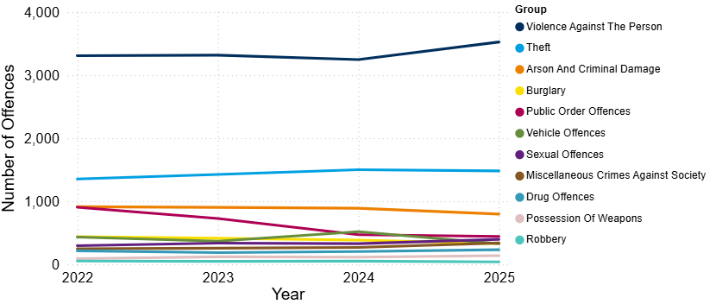
8.1 Crime Overview
Figure 1: Annual trend in police recorded offences in Fenland, 2022 to 2025
In 2025, the total crime count for Fenland was 8,058. This was similar to the previous year (+1%, +71 offences).
Overall, counts have remained relatively stable over the past four years. The highest of which was recorded in 2022 with 8,269 offences.
Nationally over a similar period (YE September 2025), police recorded crime remained similar with the previous year (excluding fraud and computer misuse offences), and CSEW total crime saw no statistically significant change to the previous year (ONS, 2026).
Violence against the person (VAP) has accounted for the highest proportion of offences since 2022. In 2025, VAP accounted for 44% of crime in Fenland.
Note: Chart has been produced by Cambridgeshire County Council’s Communities and Demography PI Team, using data provided by Cambridgeshire Constabulary.

Slide 23
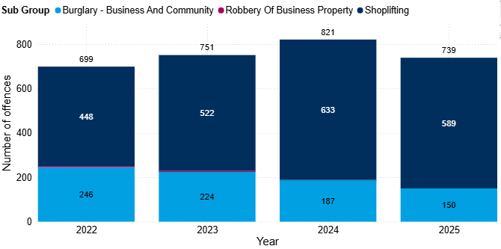
8.2 Commercial Loss
Figure 2: Annual trend in police recorded commercial loss offences in Fenland, 2022 to 2025
Commercial loss includes shoplifting, business and community burglary, robbery of a business property and any vehicle offences marked as ‘business victim’.
Commercial loss offences decreased by 10% between 2024 and 2025 (-82 offences). This decrease was driven by both shoplifting and business and community burglary. Despite this decrease, offence counts remain slightly higher than that seen in 2022 (+6%, +40 offences).
Shoplifting continues to account for the majority of the commercial loss offences in 2025 (80%). This is the highest proportion seen in the last four years.
Note: Chart has been produced by Cambridgeshire County Council’s Communities and Demography PI Team, using data provided by Cambridgeshire Constabulary.

Slide 24
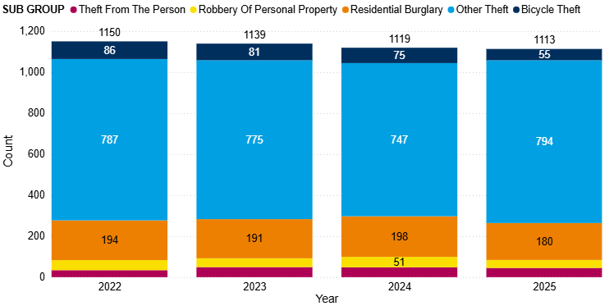
8.3 Personal Loss
Figure 3: Annual trend in police recorded personal loss offences in Fenland, 2022 to 2025
Personal loss includes bicycle theft, other theft, residential burglary, robbery of personal property and theft from the person.
Personal loss offences have seen small decreases year on year between 2022 and 2024. In the last year (between 2024 and 2025), offence counts remained stable, with a small decrease of 1% (-6 offences). All offence types saw decreases in the last year, except for other theft.
Other theft reached the highest count seen in the last four years at 794. This represents a 6% increase compared with 2024 (+47 offences).
Note: Chart has been produced by Cambridgeshire County Council’s Communities and Demography PI Team, using data provided by Cambridgeshire Constabulary.

Slide 25
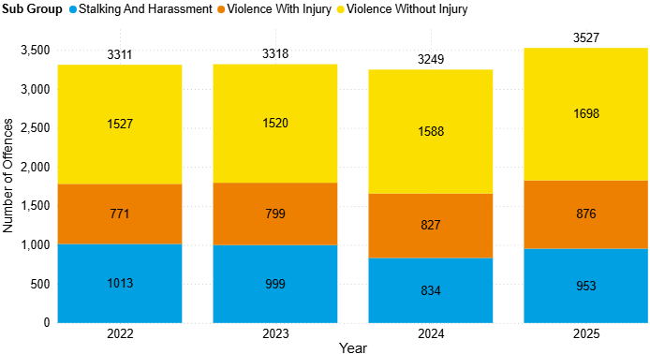
8.4 Violence Against the Person (VAP)
Figure 4: Annual trend in police recorded violence against the person (VAP) offences in Fenland, 2022 to 2025
Violence against the person (VAP) offences accounted for 44% of all offences in 2025.
VAP offences slightly increased by 9% between 2024 and 2025 (+279 offences).
‘Violence without injury’ accounted for the majority of the VAP offences in 2025 (48%).
Note: Chart has been produced by Cambridgeshire County Council’s Communities and Demography PI Team, using data provided by Cambridgeshire Constabulary.

Slide 26
8.4 Violence Against the Person (VAP)
Stalking and harassment, violence with injury, and violence without injury all recorded increases over the last year:
Stalking and harassment increased by 14% (+119 offences). This is above the national police recorded data over a similar time period (YE September). Stalking offences and harassment offences both increased by 7% (ONS, 2026a).
Violence with injury increased by 6% (+49 offences). Nationally, there was a 5% decrease in police recorded violence with injury (YE September) (ONS, 2026a).
Violence without injury increased by 7% (+110 offences), reaching the highest count in the last four years. Nationally, police recorded violence without injury saw a 1% increase across a similar time period (YE September) (ONS, 2026a).
Figure 5: Annual trend in police recorded violence against the person (VAP) offences in Fenland, 2022 to 2025
Note: Chart has been produced by Cambridgeshire County Council’s Communities and Demography PI Team, using data provided by Cambridgeshire Constabulary.

Slide 27
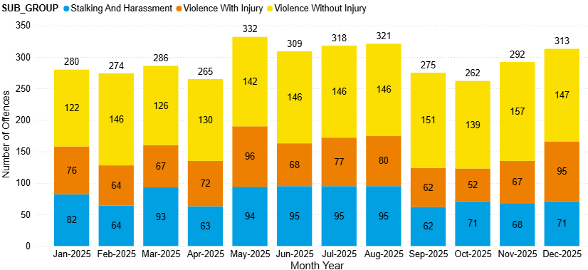
8.4 Violence Against the Person (VAP)
Figure 6: Count of violence against the person (VAP) offences in Fenland by month, 2025
In 2025, the month of May saw the most offences in a month with 332, this is the highest monthly count since October 2022 (343 offences).
“Assault without injury – common assault and battery” accounted for 80% of the violence without injury sub-category in 2025; this is a 5% increase from 2024 (+68 offences).
Note: Chart has been produced by Cambridgeshire County Council’s Communities and Demography PI Team, using data provided by Cambridgeshire Constabulary.

Slide 28
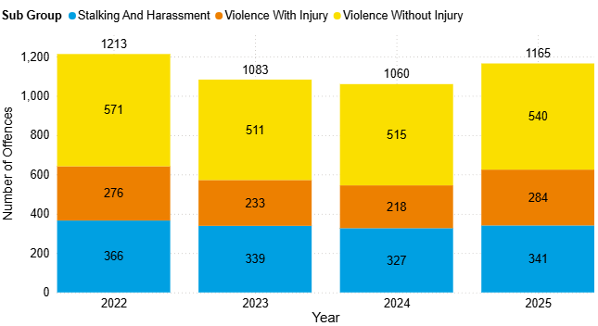
8.4 Violence Against the Person (VAP)
DA marked VAP offences saw an increase between 2024 and 2025 (+10%, +105). Despite this increase, offence counts remain slightly lower than seen in 2022 (-4%, -48).
All subgroups saw increases between 2024 and 2025.
DA marked violence with injury increased by 30% (+66). This increase was notably larger than the increase seen in all violence with injury offences (+6%). This represents the highest count of DA marked violence with injury offences in the last four years.
DA marked stalking and harassment increased by 4% in the last year (+14). Overall, this sub-group has remained stable across the last four years.
DA marked violence without injury increased by 5% in the last year (+25).
Figure 7: Count of DA marked violence against the person (VAP) offences in Fenland by subgroup, 2022 to 2025
Note: Chart has been produced by Cambridgeshire County Council’s Communities and Demography PI Team, using data provided by Cambridgeshire Constabulary.

Slide 29
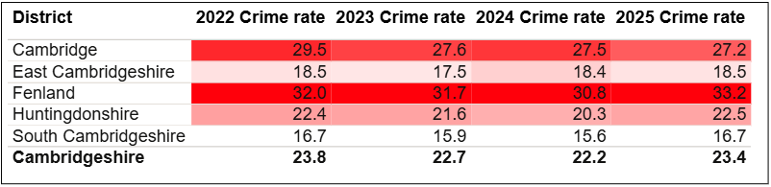
8.4 Violence Against the Person (VAP)
Table 2: Rate per 1,000 population of police recorded VAP offences, between 2022 and 2025
Fenland had the highest rate per 1,000 population for VAP offences (33.2), which is notably higher than the rate for Cambridgeshire (23.4).
Note: Table has been produced by Cambridgeshire County Council’s Communities and Demography PI Team, using data provided by Cambridgeshire Constabulary. Rates over time have been calculated using locally produced estimates and forecasts, see Technical notes for further details.

Slide 30
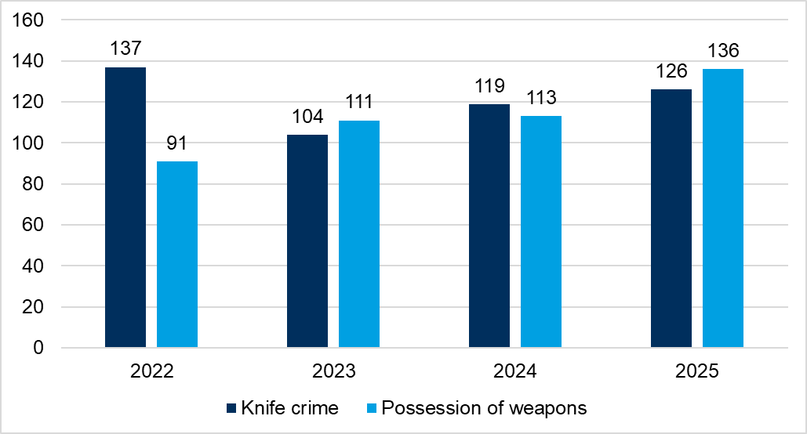
8.4 VAP - Possession of Weapons and Knife Crime
Knife crime marked offences saw an increase after an increase between 2023 and 2024. This was following a notable decrease between 2022 and 2023. In the last year, knife crime marked offences have increased by 6% (+7 offences). Despite the increasing trend, offence counts still remain lower than 2022. In contrast, nationally, knife-enabled crime recorded by the police saw a 9% decrease between YE September 2024 (from 55,149 offences) and YE September 2025 (to 20,430 offences. This was also 9% lower than YE March 2020 (55,170 offences) (ONS, 2026a).
In 2025, possession of weapon offences reached highest counts seen across the last four years at 136. This was a 20% increase on the previous year (+23 offences). Nationally, police recorded "possession of article with a blade or point" offences saw a slight increase bet YE September 2024 and YE September 2025 (+1%, +399 offences). Trends in possession offences are likely to be influenced by police activity and operations, particularly stop and search (ONS, 2026a).
Figure 8: Annual trend in knife crime and possession of weapons offences in Fenland, 2022 to 2025
Note: Chart has been produced by Cambridgeshire County Council’s Communities and Demography PI Team, using data provided by Cambridgeshire Constabulary CADET.

Slide 31
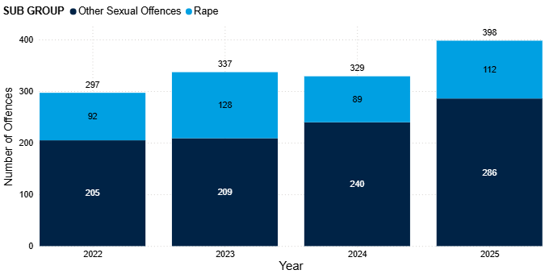
8.5 Sexual Offences
Sexual offences have seen a notable increase between 2024 and 2025, from 329 to 398 (+21%), reaching the highest count in the last four years after three years of fluctuations.
The fluctuation was largely influenced by rape offences, which saw an increase between 2022 and 2023, then a decrease in 2024, and an increase in 2025. The highest count of rape offences in the last four years was seen in 2023 (128).
Other sexual offences has seen incremental increases in the last four years. After remaining stable between 2022 and 2023, notable increases have been seen since. Between 2024 and 2025, offence counts increased by 19% (+46 offences).
Sexual offences accounted for the second highest proportion of DA marked offences (6%); this proportion has increased over the last 4 years (from 4% in 2022 to 6% in 2025).
On a national scale, there was an 8% increase in YE September 2025 (to 214,816 offences) compared with the previous year (198,373 offences). Police-recorded sexual offences have generally increased over the past decade, largely due to improvements in recording practices (ONS, 2026a)
Figure 9: Annual trend in police recorded sexual offences in Fenland, 2022 to 2025
Note: Chart has been produced by Cambridgeshire County Council’s Communities and Demography PI Team, using data provided by Cambridgeshire Constabulary.
Notes:
It should be noted that at the time of writing this report there is a lot of media coverage on the Epstein files which might have influenced the increase in reported sexual offences.

Slide 32
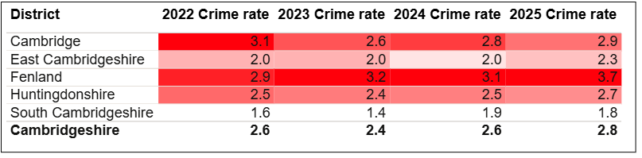
8.5 Sexual Offences
Table 3: Rate per 1,000 population of police recorded sexual offences, between 2022 and 2025
As seen in Table 3, Fenland had the highest rate per 1,000 in 2025 (3.7). This was notably higher than the rate per 1,000 for Cambridgeshire (2.8).
The rate for Fenland remained stable between 2022 to 2024 but saw an increase in 2025.
Note: Table has been produced by Cambridgeshire County Council’s Communities and Demography PI Team, using data provided by Cambridgeshire Constabulary. Rates over time have been calculated using locally produced estimates and forecasts, see Technical notes for further details.

Slide 33
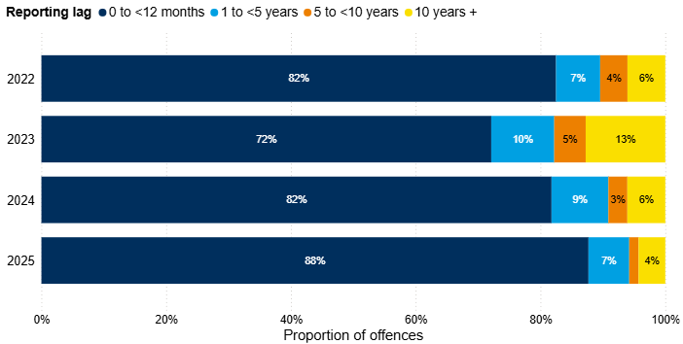
8.5 Sexual Offences
Figure 10: Number of years between offence start date and offence recorded date for police recorded sexual offences in Fenland, 2022 to 2025
The proportion of historical offences decreased in 2025, accounting for 12% of all sexual offences recorded in this period, compared with 18% in 2024. This is the lowest proportion across the last four years.
Fenland CSP commissioned a deep dive into ‘recent’ sexual offences, and this report was completed in October 2025. It should be noted that given that this was produced towards the end of 2025, there will not have been enough time to implement any recommendations or initiatives and for it to be reflected in the data.
Note: Chart has been produced by Cambridgeshire County Council’s Communities and Demography PI Team, using data provided by Cambridgeshire Constabulary.
Notes:
Reporting sexual offences does not always happen immediately after the offence has occurred. Analysis has been completed on the difference between the date an offence was recorded by the police and the date when the offence occurred. It should be noted that offences can span a wide time period, and analysis here focuses on the offence start date rather than the offence end date due to data completeness.

Slide 34
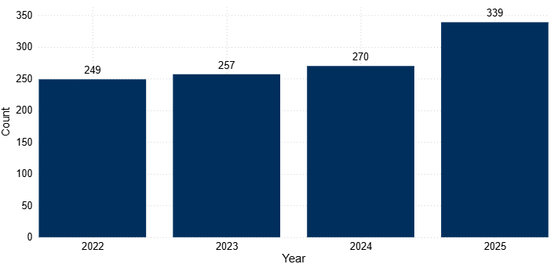
8.6 Miscellaneous Crimes Against Society
Between 2022 and 2024, offence counts saw small incremental increases. In the last year, offence counts increased by 26% (+69 offences). This meant that counts reached the highest seen in the last four years.
Further analysis into the notable increase in miscellaneous crimes against society between 2024 and 2025 was conducted. During this analysis, the short title of offences was analysed to gain a better understanding into the nature of offences recorded under this crime type.
The highest proportion was accounted for by the short title of ‘take or to make or to distribute indecent photographs or pseudo- photographs, of children’, at 32%. This was followed by ‘threats to destroy or damage property’ at 30%.
Figure 11: Annual trend in police recorded miscellaneous crimes against society offences in Fenland, 2022 to 2025
Note: Chart has been produced by Cambridgeshire County Council’s Communities and Demography PI Team, using data provided by Cambridgeshire Constabulary.
Notes:
During the further analysis, it was highlighted that some of the offence groups may be relevant in the context of sexual offences. However, due to the Home Office Counting Rules, these offences are not recorded under ‘sexual offences’. These include:
Take or to make or to distribute indecent photographs or pseudo- photographs, of children.
Possession of an indecent or pseudo indecent photo of a child.
Possession of extreme pornographic image - a person performing an act of intercourse or oral sex with an animal (whether dead or alive) (bestiality).
After querying this with Cambridgeshire Constabulary, it was highlighted that the three offences are part of the Obscene Publications sub-section within the Miscellaneous Crimes against Society section of the Home office Counting Rules (HOCR). It was suggested that these specific offences may be more aligned to ‘obscene publications’ as opposed to direct sexual offences.

Slide 35
8.7 Domestic Abuse
Table 4: Police recorded Domestic Abuse (DA) incidents and crimes recorded in Fenland, 2022 to 2025
 | 2022 | 2023 | 2024 | 2025
Total police recorded DA (non-crimed incidents & crimes) | 2405 | 2222 | 2154 | 2442
Total DA marked crimes | 1564 | 1410 | 1362 | 1509
Total DA incidents | 1867 | 1764 | 1725 | 1914
Incidents that result in a crime being recorded | 1026 | 952 | 933 | 981
Incidents that remain as incident only | 841 | 812 | 792 | 933
Proportion of incidents that were 'crimed' | 55% | 54% | 54% | 51%
Overall, domestic abuse (DA) crimes and incidents saw a 13% increase between 2024 and 2025 (+288).
DA marked crimes increased between 2024 and 2025 (+11%, +147 crimes); this was after year-on-year decreases between 2022 and 2024. Despite this increase counts remain slightly lower than seen in 2022 (-4%, -55 crimes).
Note: Table has been produced by Cambridgeshire County Council’s Communities and Demography PI Team, using data provided by Cambridgeshire Constabulary.

Slide 36
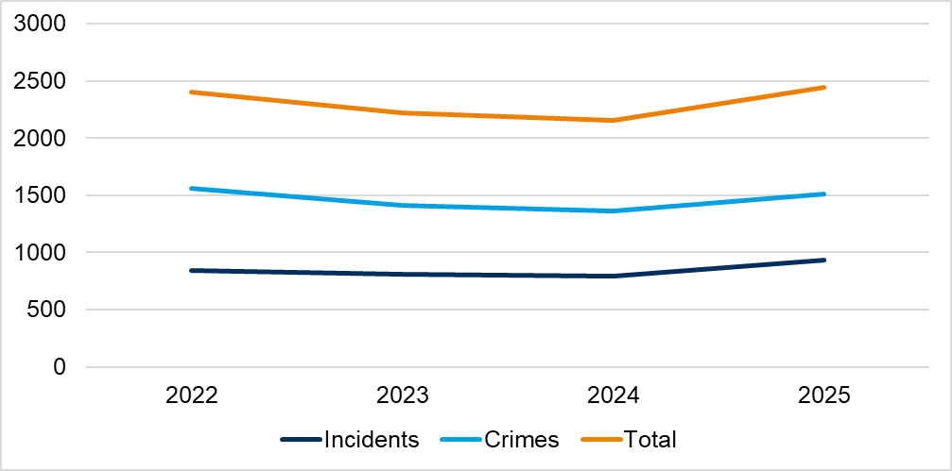
8.7 Domestic Abuse
Figure 12: Police recorded Domestic Abuse (DA) crimes and incidents (non-crimed only) in Fenland, 2022 to 2025
DA related incidents saw an increase of 11% between 2024 and 2025 (+189 incidents). This is the highest count seen over the last four years, as shown in Table 4.
Just over half of reported DA incidents were ‘crimed’ at 51%; this is the lowest proportion seen across the last four years.
Note: Chart has been produced by Cambridgeshire County Council’s Communities and Demography PI Team, using data provided by Cambridgeshire Constabulary.
Notes:
The decrease seen in YE September 2023 is likely to have been impacted by the change in new Home Office counting rules introduced in April 2023. This was referenced in the previous strategic assessment, which can be found here: Cambridgeshire & Peterborough Insight – Crime & Community Safety – Community Safety Partnerships – Cambridge City
The increase in incidents was said by Cambridgeshire Constabulary to potentially be a result of online incident reporting making it more accessible for people to raise concerns and report incidents.

Slide 37
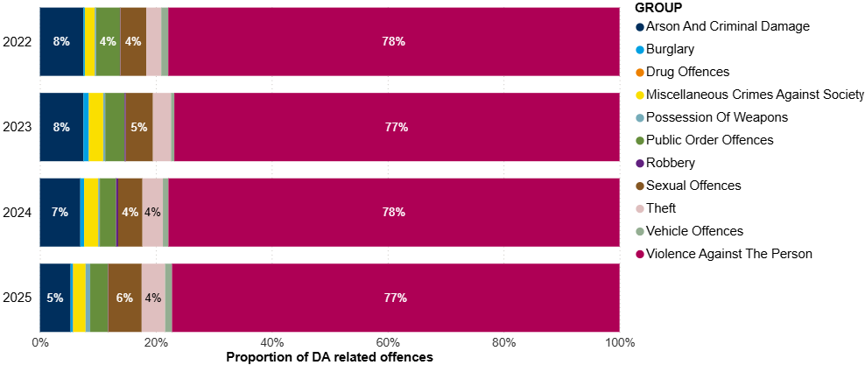
8.7 Domestic Abuse
Figure 13: Crime type breakdown of Domestic Abuse (DA) related offences recorded in Fenland, 2022 to 2025
Similarly to national figures for YE September 2025 (ONS, 2026a), the crime type with the highest proportion is violence against the person (VAP) offences. VAP accounted for 77% of the DA marked crimes in 2025.
Sexual offences accounted for the second highest proportion (6%).
Note: Chart has been produced by Cambridgeshire County Council’s Communities and Demography PI Team, using data provided by Cambridgeshire Constabulary.

Slide 38
8.7 Domestic Abuse
Table 5: Rate per 1,000 population of domestic abuse (incidents and crimes), 2022 to 2025
As seen in Table 5, Fenland had the highest rate per 1,000 in 2025 (23.0). This was notably higher than the rate per 1,000 for Cambridgeshire (16.7).
Note: Table has been produced by Cambridgeshire County Council’s Communities and Demography PI Team, using data provided by Cambridgeshire Constabulary. Rates over time have been calculated using locally produced estimates and forecasts, see Technical notes for further details.

Slide 39
8.8 Modern Slavery
The latest National Crime Agency (NCA) Strategic Assessment for 2025 highlighted issues that are influencing risk of exploitation, which local CSPs should be alert to:
“Modern slavery refers to the exploitation of children and adults through slavery, servitude, or forced or compulsory labour” (NCA, 2025).
The National Referral Mechanism (NRM) is a framework to identify potential victims of modern slavery and human trafficking and ensure they receive the appropriate support. In the year ending September 2024, 8,156 referrals were made to the NRM reporting exploitation entirely within the UK. Of these 8,156 referrals, 54% (4,415) were for UK nationals, and in 58% (4,697 of 8,156), the potential victim reported exploitation as a child (NCA, 2025).
Adult victims are typically vulnerable due to debt and unemployment, and other economic factors. In some cases, victims are also vulnerable through factors such as homelessness, learning difficulties or disabilities, mental ill-health, or substance dependency or misuse. Similarly, these factors may also apply to child victims, who are also often vulnerable through their age, and factors such as family breakdown, persistent absence from school, and social isolation from peers.
The CSP should also be aware of sectors in which work is often informal or short-term, such as agriculture, beauty services, construction, food processing and preparation, and hand car washes, are particularly vulnerable to labour exploitation.

Slide 40
8.8 Modern Slavery
Whilst district level data is not available, data is available on the NRM referrals made where Cambridgeshire Constabulary was the first responder. The Cambridgeshire Constabulary police force area covers both Cambridgeshire and Peterborough. The latest end of year summary available is for 2024.
Of the 63 NRM referrals made by Cambridgeshire Constabulary in 2024, more than three quarters were males, accounting for 76% of referrals, a similar proportion recorded in 2023 (77%).
When looking at ages (at time of referral), 65% were adults (18 and over). Adult males accounted for almost half of the total referrals (48%).
Almost half of referrals were from the UK (54%). The next most common nationalities were Albanian (8%), and Vietnamese (8%).
The most common exploitation type was “criminal exploitation” (56%).
The next most common exploitation type was “labour and criminal exploitation” (16%).
Of the 63 referrals where Cambridgeshire Constabulary were first responders, 89% were investigated by Cambridgeshire Constabulary, this is 56 referrals. In total, Cambridgeshire Constabulary investigated 159 referrals; in 2024, there were no referrals from Fenland District Council in this year.
(Home Office, 2025a; Home Office, 2025b).
Notes:
Note that this does not necessarily reflect that Cambridgeshire Constabulary was the responsible police force. See technical notes on the NRM process in Appendix A.6 NRM data.

Slide 41
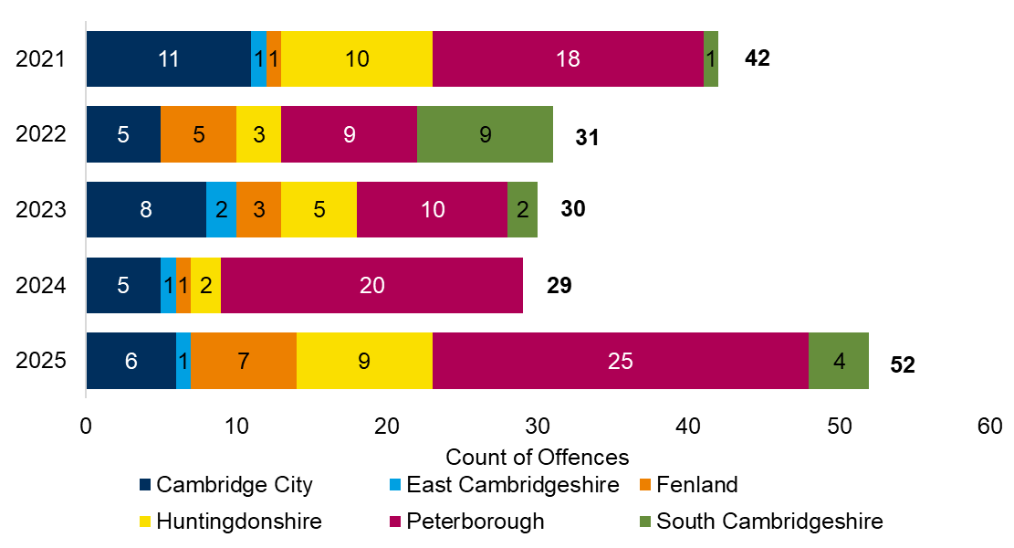
8.8 Modern Slavery
Figure 14: Police recorded modern slavery offences by district, 2021 to 2025
The total number of modern slavery offences in Cambridgeshire and Peterborough was 52 offences. This is a 79% increase on the previous year.
There were 7 modern slavery offences in Fenland in 2025, an increase from the previous year (1 offence).
Note: Chart has been produced by Cambridgeshire County Council’s Communities and Demography PI Team, using data provided by Cambridgeshire Constabulary CADET.
Notes:
These numbers should not be taken as a true representation of the levels of modern slavery offending in Fenland, or countywide, due to high levels of underreporting for this crime type. It should also be noted that local district boundaries are irrelevant to the trafficking and exploitation of people as organised crime gangs are known to move people within the UK. The Partnership should work closely with cross-border agencies.

Slide 42
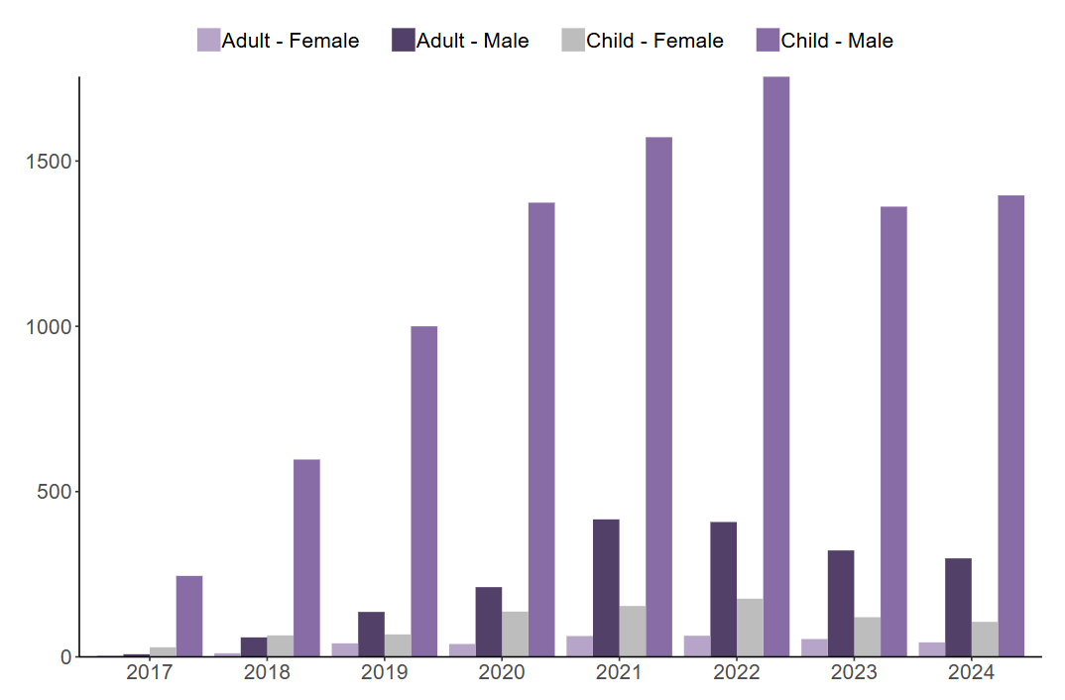
8.9 County Lines
Figure 15: Number of NRM referrals flagged nationally as county lines, by age group at exploitation and gender, 2017 to 2024
The latest strategic assessment published by the National Crime Agency (NCA) indicates that exploitation linked to criminal activity constitutes a significant proportion of the exploitation types reported in the UK. In the YE September 2024, 65% of referrals were for exploitation in criminal activity.
Exploitation in criminal activity occurs when victims are coerced, forced, or otherwise compelled to commit crime, often in drug offences such as cannabis cultivation or distribution via county lines. (NCA, 2025).
County Lines refers to a model of offending whereby gangs and organised crime groups move drugs into supply areas within the UK via the exploitation of vulnerable individuals. These individuals are recruited and coerced into the drug supply chain (NCA, 2019).
The NRM referral system flags referrals that relate to county lines. In 2024, nationally, 10% of all referrals received were flagged as county lines. The majority of these referrals were for male children (76%), as shown in Figure 15, this cohort have consistently accounted for the majority of county lines flagged referrals (Home Office, 2025a).
Source: Figure 8 in Modern Slavery end of year summary 2024 report (Home Office, 2025a).
Note: See technical notes for NRM data in section A.7. NRM referrals.

Slide 43
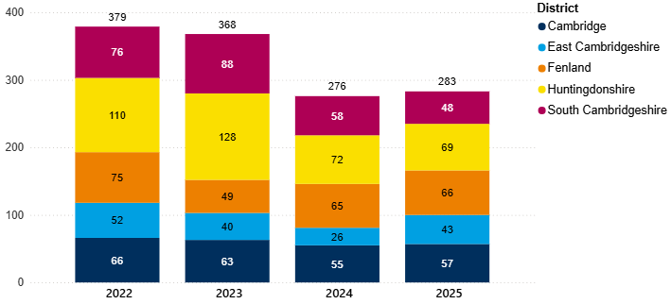
8.10 Child Sexual Exploitation (CSE)
Figure 16: Annual trend of police recorded CSE offences in Cambridgeshire by district, 2022 to 2025
In the last year, CSE offences in Fenland have remained stable (+2%, +1 offence). This is a lower percentage increase than the county-wide picture; Cambridgeshire CSE offences increased by 3% between 2024 and 2025 (+7 offences).
Note: Chart has been produced by Cambridgeshire County Council’s Communities and Demography PI Team, using data provided by Cambridgeshire Constabulary.
Notes:
CSE is a marker that can be applied to any offence that fits the criteria for CSE by police. It is worth noting that like other markers that can be applied there is a potential level of inconsistency in the application of the marker. It would be worth investigating how reliable the marker is as an accurate reflection of CSE crimes within the local police data.

Slide 44
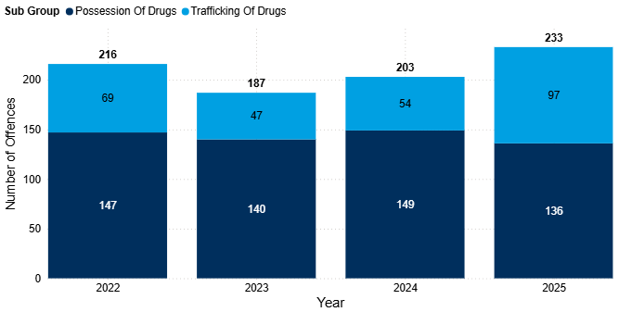
8.11 Drug Offences
Drug offences have fluctuated year on year between 2022 and 2024.
In the last year, drug offences increased by 15% (+30 offences). This increase was solely driven by ‘trafficking of drugs’; this subgroup saw an 80% increase in this period (+43 offences).
Possession of drug offences decreased by 9% in the last year (-13 offences). This meant that this was the lowest recorded count in the last four years.
Nationally, police recorded drug offences saw an 21% increase between YE September 2024 and YE September 2025. Although both possession and trafficking saw increases, this was largely driven by the increase in trafficking offences (+38%) (ONS, 2026b).
Figure 17: Annual trend in police recorded drug offences in Fenland, 2022 to 2025
Note: Chart has been produced by Cambridgeshire County Council’s Communities and Demography PI Team, using data provided by Cambridgeshire Constabulary.

Slide 45
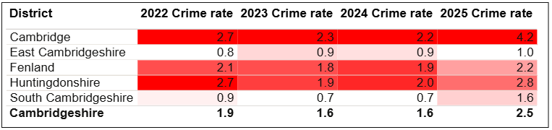
8.11 Drug Offences
Table 6: Rate per 1,000 population of police recorded drug offences in Fenland, between 2022 and 2025
As seen in Table 6, Fenland had the third highest rate per 1,000 population in 2025 (2.2). This was slightly lower than the rate per 1,000 for Cambridgeshire (2.5).
Note: Table has been produced by Cambridgeshire County Council’s Communities and Demography PI Team, using data provided by Cambridgeshire Constabulary. Rates over time have been calculated using locally produced estimates and forecasts, see Technical notes for further details.

Slide 46
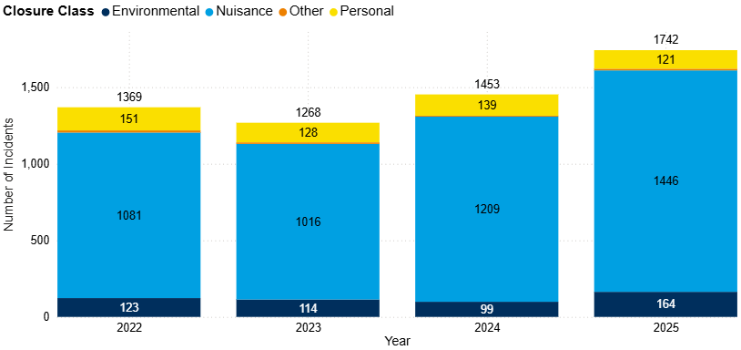
8.12 Anti-Social Behaviour (ASB)
Figure 18: Annual trend in police recorded ASB incidents in Fenland, 2022 to 2025
ASB incidents declined between 2022 and 2023; however, they have followed an upward, linear trend between 2023 and 2025. Between 2024 and 2025, ASB incidents increased by 20% (+289 incidents), counts in 2025 have remained the highest in the last four years. Nationally, police recorded ASB remained similar over a similar time period (YE September 2025) (ONS, 2026a).
This change was driven by increase in ‘nuisance’ ASB, and ‘Environmental’ ASB, which between 2024 and 2025, increased by 20% (+237 incidents) and 66% (+65 incidents) respectively.
In 2025, nuisance ASB accounted for 83% of all ASB recorded in Fenland, which is similar to 2024 (83%).
Note: Chart has been produced by Cambridgeshire County Council’s Communities and Demography PI Team, using data provided by Cambridgeshire Constabulary.

Slide 47
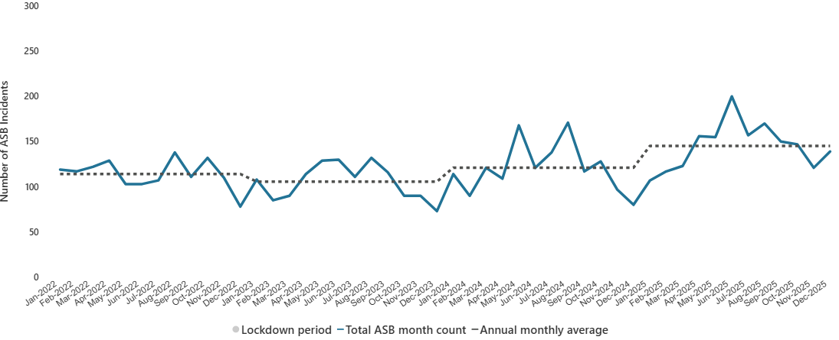
8.12 Anti-Social Behaviour (ASB)
Figure 19: Count of ASB incidents in Fenland by month, 2022 to 2025
ASB incidents in Fenland has varied between 2022 and 2025, with the lowest monthly total recorded in December 2023 at 73 incidents, and the highest in June 2025 with 200 incidents.
All categories of ASB have increased between 2024 and 2025, with the exception of Personal ‘ASB’ which decreased by 13% (-18 incidents).
Note: Chart has been produced by Cambridgeshire County Council’s Communities and Demography PI Team, using data provided by Cambridgeshire Constabulary.

Slide 48
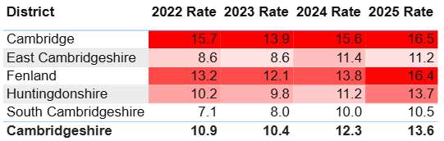
8.12 Anti-Social Behaviour (ASB)
Table 7: Rate per 1,000 population of police recorded ASB incidents, 2022 to 2025
As seen in Table 7, Fenland had the second highest rate per 1,000 population in 2025 (16.4). This was notably higher than the rate per 1,000 for Cambridgeshire (13.6).
Note: Table has been produced by Cambridgeshire County Council’s Communities and Demography PI Team, using data provided by Cambridgeshire Constabulary. Rates over time have been calculated using locally produced estimates and forecasts, see Technical notes for further details.

Slide 49
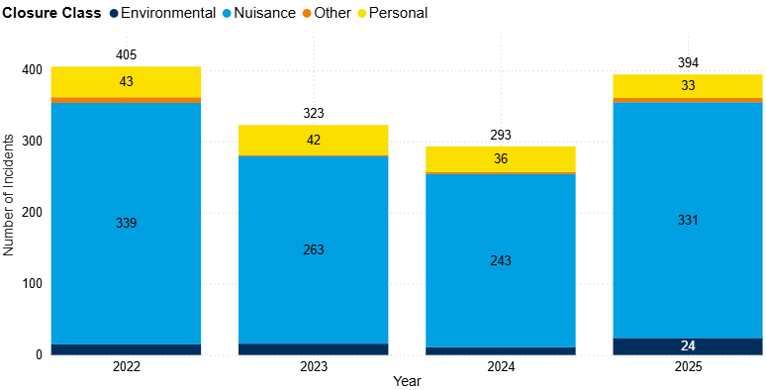
8.12 ASB - Youth-related Anti-Social Behaviour (ASB)
Figure 20: Annual trend in Police recorded ASB incidents where a youth-related keyword has been identified in Fenland, 2022 to 2025
Youth-related ASB decreased from 2022 to 2024 but increased between 2024 and 2025.
Nuisance ASB has accounted for 84% of all youth-related ASB in 2025, which is similar to the previous year. Between 2024 and 2025, Nuisance ASB increased by 36% (+88 incidents).
All categories of youth-related ASB saw increases between 2024 and 2025, except for Personal ‘ASB’ which decreased by 8% (-3 incidents).
Note: Chart has been produced by Cambridgeshire County Council’s Communities and Demography PI Team, using data provided by Cambridgeshire Constabulary.
Notes:
Youth-related ASB has been analysed by applying a keyword search to the incident description field to identify incidents that are likely to be youth-related. It should be noted that this is not a perfect measure, it may include some incidents where young people were present or victims, but the incident itself was not directly attributable to young people. Despite this limitation, it represents the best available indicator of police recorded youth related ASB.

Slide 50
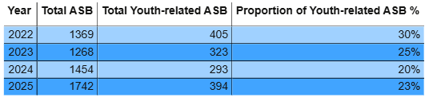
8.12 ASB - Youth-related Anti-Social Behaviour (ASB)
Table 8: Police recorded ASB incidents and the proportion where a youth-related keyword has been identified, 2022 to 2025
The proportion of youth-related ASB has varied over the past four years. In 2025, the proportion reached its second lowest level in the past four years (23%), as shown in Table 8.
Between 2024 and 2025, youth-related ASB have increased by 34% (+101 incidents).
Note: Table has been produced by Cambridgeshire County Council’s Communities and Demography PI Team, using data provided by Cambridgeshire Constabulary.
Notes:
Youth-related ASB has been analysed by applying a keyword search to the incident description field to identify incidents that are likely to be youth-related. It should be noted that this is not a perfect measure, it may include some incidents where young people were present or victims, but the incident itself was not directly attributable to young people. Despite this limitation, it represents the best available indicator of police recorded youth related ASB

Slide 51
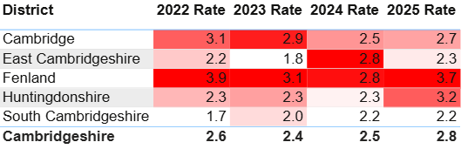
8.12 ASB - Youth-related Anti-Social Behaviour (ASB)
Table 9: Rate per 1,000 population of police recorded youth-related ASB incidents, 2022 and 2025
As seen in Table 9, Fenland had the highest rate per 1,000 population in 2025 (3.7). This was higher than the rate per 1,000 for Cambridgeshire (2.8).
Fenland has had the highest rate in Cambridgeshire since 2022.
Note: Table has been produced by Cambridgeshire County Council’s Communities and Demography PI Team, using data provided by Cambridgeshire Constabulary. Rates over time have been calculated using locally produced estimates and forecasts, see Technical notes for further details.

Slide 52
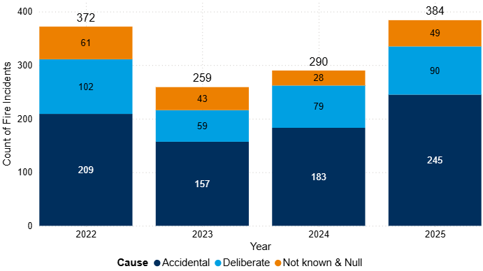
8.13 Fires
Figure 21: Annual trend in fires in Fenland, 2022 to 2025
In 2025, there were 384 fires in Fenland, this is a 32% increase from the last year (+94 incidents).
Of the 384 fires recorded, 23% (90 incidents) were classified as deliberate. The number of deliberate fires has seen incremental increases since 2023, as illustrated in Figure 21.
Note: Chart has been produced by Cambridgeshire County Council’s Communities and Demography PI Team, using data provided by Cambridgeshire Fire and Rescue Service.

Slide 53
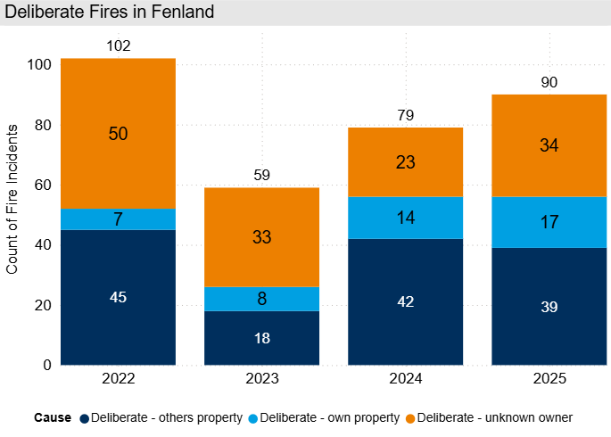
8.13 Deliberate Fires
Figure 22: Annual trend in deliberate fires in Fenland, 2022 to 2025
In 2025, deliberate fires increased by 14% (+11 incidents) when compared with 2024. Despite this increase, counts still remain lower than 2022.
‘Deliberate – others property’ accounted for the largest proportion of deliberate fires at 43% (39 out of 90).
Note: Chart has been produced by Cambridgeshire County Council’s Communities and Demography PI Team, using data provided by Cambridgeshire Fire and Rescue Service.

Slide 54
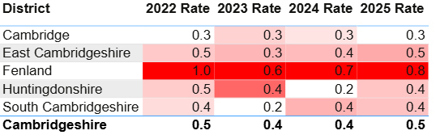
8.13 Deliberate Fires
Table 10: Rate per 1,000 population of deliberate fires by district, 2022 to 2025
In 2025, Fenland had a rate per 1,000 population of 0.8, the highest rate of all districts. The lowest rate per 1,000 population in 2025 was observed in Cambridge City with 0.3.
Note: Table has been produced by Cambridgeshire County Council’s Communities and Demography PI Team, using data provided by Cambridgeshire Constabulary. Rates over time have been calculated using locally produced estimates and forecasts, see Technical notes for further details.

Slide 55
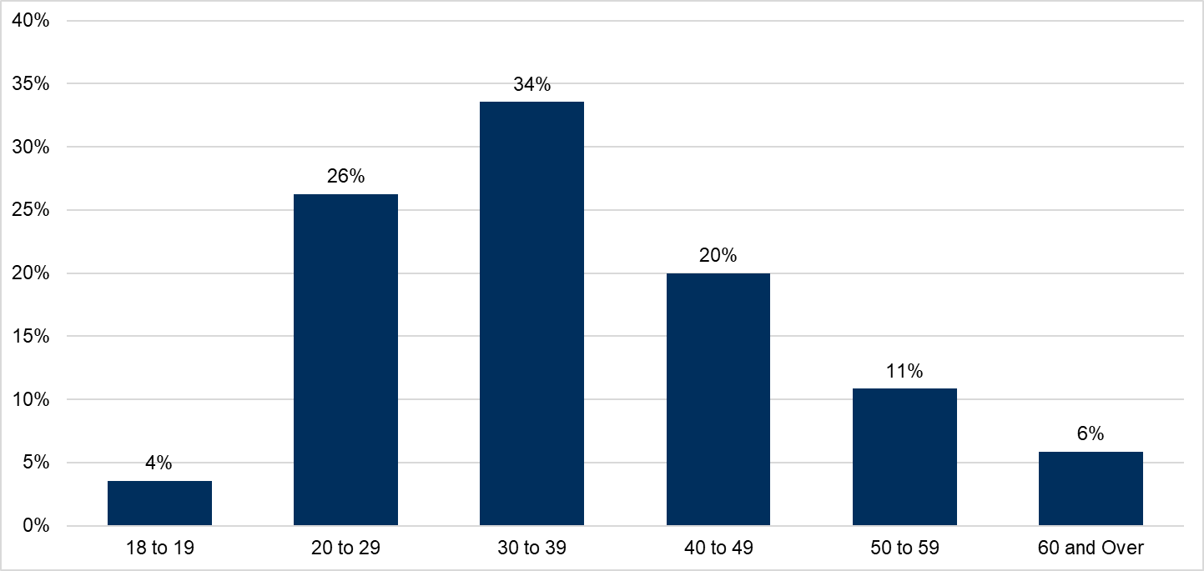
8.14 Probation
Figure 23: Proportion of age groups of those open to the Probation Service in 2025, residing in Fenland
The Probation Service have provided a caseload profile for individuals residing in Fenland who were open to the service at some point within 2025; in this instance, there were 480 people.
The majority of the cohort were males, with a split of 89% males and 11% females.
30 to 39 years old accounted for the largest proportion of the cohort at 34%.
18- to 19-year-olds accounted for 4% of the cohort; it is to be expected that this proportion is smaller as there are only two single years of age.
Note: Chart has been produced by Cambridgeshire County Council’s Communities and Demography PI Team, using data provided by Cambridgeshire and Peterborough Probation Service.

Slide 56
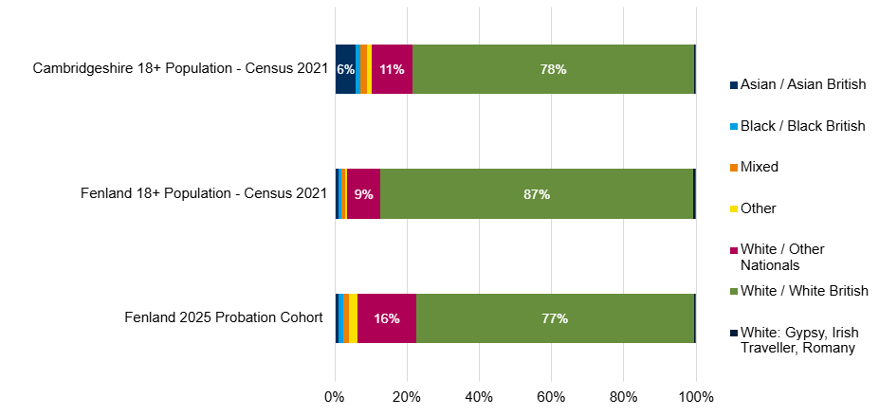
8.14 Probation
Figure 24: Proportion of ethnic group comparison, Fenland Probation Service cohort, Fenland Census 2021 Population and Cambridgeshire Census 2021 Population
4% (21 of 480) of the current Fenland probation caseload had no ethnicity recorded.
Of those who’s ethnicity was recorded (459), Figure 24 shows that the majority of the probation cohort were White British at 77%, underrepresented in comparison to the Fenland (87%) and Cambridgeshire (78%) Census population.
White / Other Nationals group were overrepresented in comparison to Fenland Census population (16% vs 9% respectively).
Note: Chart has been produced by Cambridgeshire County Council’s Communities and Demography PI Team, using data provided by Cambridgeshire and Peterborough Probation Service.

Slide 57
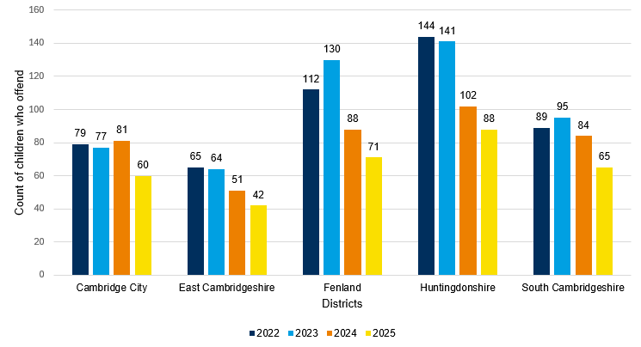
8.15 Youth Justice Service
Figure 25: Count of children who offend by district, 2022 to 2025
Figure 25 shows that Fenland had the second highest number of children who offend in 2025 at 71 children compared to other districts.
However, there has been a 37% decrease in the number of children who offend in Fenland between 2022 and 2025.
Table 11 below shows that Fenland had the highest average offences per child in 2025 at 1.86 offences per child compared to other districts. Except for 2024, there has been increasing trend in the average offences per child in Fenland since 2022.
Table 11: Average offences per child who offend by district, 2022 to 2025
Districts | 2022 | 2023 | 2024 | 2025
Cambridge City | 1.73 | 1.65 | 1.59 | 1.35
East Cambridgeshire | 2.20 | 1.45 | 1.20 | 1.10
Fenland | 1.59 | 1.76 | 1.34 | 1.86
Huntingdonshire | 1.44 | 1.28 | 1.43 | 1.44
South Cambridgeshire | 1.12 | 1.24 | 1.68 | 1.40
Note: Chart has been produced by Cambridgeshire County Council’s Communities and Demography PI Team, using data provided by Cambridgeshire Youth Justice Service.

Slide 58
8.15 Youth Justice Service
Table 12: FTEs and Outcomes of children who offend in Fenland, 2022 to 2025
Outcome | 2022 | 2023 | 2024 | 2025
First Time Entrants (FTEs) | 20 | 28 | 11 | 8
Out of Court Resolutions (OOCRs) | 117 | 125 | 89 | 74
Court Sentences | 23 | 26 | 10 | 15
Table 12 shows that except for an increase in 2023, there has been a general decline in FTEs, OOCRs, and Court Sentences in Fenland between 2022 and 2025.
Most OOCRs in Fenland are non-substantive outcomes and range between 78% in 2023 and 89% in both 2024 and 2025.
Table 13 shows that violence against the person (VAP) has consistently been the most common offence type in Fenland between 2022 and 2025. Drugs, criminal damage, and theft and handling stolen goods are the next most common offence types.
Table 13: Offence type of children who offend in Fenland, 2022 to 2025
Offence type | 2022 | 2023 | 2024 | 2025 | 2025 - Percentage share of total offences
Violence Against The Person | 70 | 79 | 51 | 47 | 36%
Drugs | 17 | 18 | <5 | 18 | 14%
Criminal Damage | 24 | 14 | 10 | 13 | 10%
Theft And Handling Stolen Goods | 14 | 38 | 11 | 12 | 9%
Public Order | 6 | 15 | 7 | 10 | 8%
Other | <5 | 11 | 7 | 7 | 5%
Sexual Offences | 7 | 8 | 8 | 7 | 5%
Vehicle Theft / Unauthorised Taking | <5 | 7 | 5 | 7 | 5%
Motoring Offences | 14 | 19 | <5 | <5 | <4%
Fraud And Forgery | 0 | <5 | <5 | <5 | <4%
Racially Aggravated | 5 | <5 | <5 | <5 | <4%
Arson | <5 | 0 | <5 | <5 | <4%
Domestic Burglary | 0 | <5 | <5 | <5 | <4%
Non-Domestic Burglary | <5 | 8 | <5 | <5 | <4%
Robbery | <5 | 5 | <5 | <5 | <4%
Breach Of Bail | 0 | <5 | 0 | 0 | 0%
Breach Of Statutory Order | 9 | 0 | 0 | 0 | 0%
Total | 178 | 229 | 118 | 132 | 100%
Note: Tables have been produced by Cambridgeshire County Council’s Communities and Demography PI Team, using data provided by Cambridgeshire Youth Justice Service.

Slide 59
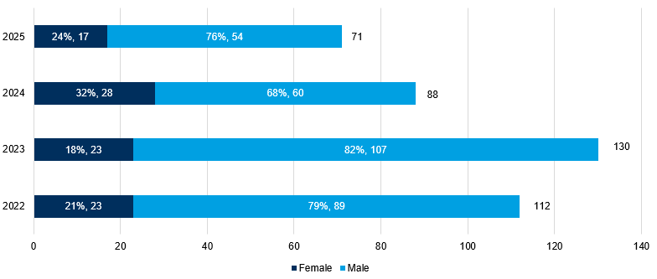
8.15 Youth Justice Service
Table 14: Children who offend in Fenland by age group, 2022 to 2025
Age - Table 14 shows that age 14 to 17 have the highest average count of children who offend in Fenland. In 2024 and 2025, age 15 and 16 have been the most common age.
Gender - Figure 26 shows most children who offend in Fenland are males. Percentages of males range between 68% in 2024 to 76% in 2025.
Ethnicity - The most common ethnicity for children who offend in Fenland is White British (75% of Fenland YJS cohort), and this is followed by White/Other Nationals (19% of Fenland YJS cohort).
Children’s social care - The percentage of those associated with children’s social care between 2022 and 2025 is 11%.
Substance misuse - The percentage of those who have had evidence of substance misuse between 2022 and 2025 is 4%. In 2025, 7% of the Fenland YJS cohort had evidence of substance misuse (5 out of 71).
Mental health - The percentage of those who have had contact with mental health services between 2022 and 2025 is 2%.
Age Groups | 2022 | 2023 | 2024 | 2025 | 4-year average count
10 to 12 | 12 | 20 | 12 | 13 | 14.25
13 | 22 | 14 | 5 | 10 | 12.75
14 | 18 | 32 | 15 | 13 | 19.5
15 | 17 | 25 | 18 | 15 | 18.75
16 | 20 | 23 | 24 | 15 | 20.5
17 | 27 | 22 | 16 | 13 | 19.5
Figure 26: Children who offend in Fenland by gender, 2022 to 2025
Note: Table and Chart have been produced by Cambridgeshire County Council’s Communities and Demography PI Team, using data provided by Cambridgeshire Youth Justice Service.

Slide 60
8.16 Offence types that saw no notable change or have decreased in the last year
The below are crime types which have not been analysed in further detail above, and they saw no notable change or decreased in the last year.
Public order offences have continued to decrease. Since 2022, offence counts have halved (-51%, -463 offences).
Hate crime marked offences have fluctuated across the last four years. Between 2024 and 2025, there was a 12% decrease (-17 offences). Despite this decrease, 2023 saw the lowest count across the last four years at 118, followed by 2025 with 123 offences.
Arson and criminal damage offences decreased by 10% (-93 offences) between 2024 and 2025. This was the lowest count seen in the last four years. Despite this decrease, Fenland had the highest rate per 1,000 population for arson and criminal damage offences in 2025, when compared with other Cambridgeshire districts (7.5). Fenland has had the highest rate in the last four years.
Vehicle offences decreased by 37% (-191 offences), following an increasing of 40% between 2023 and 2024 (+149 offences).

Slide 61
8.17 Geographic Analysis
The most notable ward across all crime types was Wisbech South. Wisbech South had the highest count in 2025 across 11 of the 12 analysed offence types. Other wards were mentioned multiple times:
In 8 out of the 12 analysed offence types, Wisbech Riverside ranked within top 5, based on rate per 1,000 population. In 3 of the analysed offence types, Wisbech Riverside had the highest rate per 1,000 population in 2025 (hate crime, drug offences and VAP).
Whittlesey South saw increases between 2024 and 2025 across all offence types, except hate crime, sexual offences and VAP. The most notable increase between 2024 and 2025 was ASB (+146%, +73).

Slide 62
9. IMD
The Index of Multiple Deprivation 2025 (IMD 2025) is the official measure of relative deprivation for small area geographies called Lower-layer Super Output Areas (LSOAs), in England. It has been produced every 3 to 5 years since 1970s. Lower Layer Super Output Areas are a geographic hierarchy designed to improve the reporting of small area statistics in England and Wales.
IMD 2025 was released at the end of October 2025. Prior to that the latest release was in September 2019.
Fenland is ranked 42 out of 296 of all local authorities nationally, based on local authority score, where 1 is most deprived.
Wisbech North falls into the lowest decile of all wards in Fenland (1) (Decile 1 represents the most deprived and Decile 10 represents the least deprived). Both LSOAs situated in Wisbech North fall into the lowest decile of 1. All other wards in Fenland have an average decile of between 3 and 6.
In Fenland, there are 56 Lower Super Output Areas (LSOAs).
There are 24 LSOAs (nearly half of all LSOAs) in the lowest 3 deciles (most deprived, 1-3), five of which fall into the lowest decile (1).
There were no LSOAs in the highest deciles (least deprived, 8-10) for overall score.
Fenland was ranked as the most relatively deprived local authority district nationally for the Education, Skills and Training domain.
For more details, there is a full report and dashboard on Cambridgeshire Insight: Cambridgeshire & Peterborough Insight – Poverty – Indices of Deprivation 2025.

Slide 63
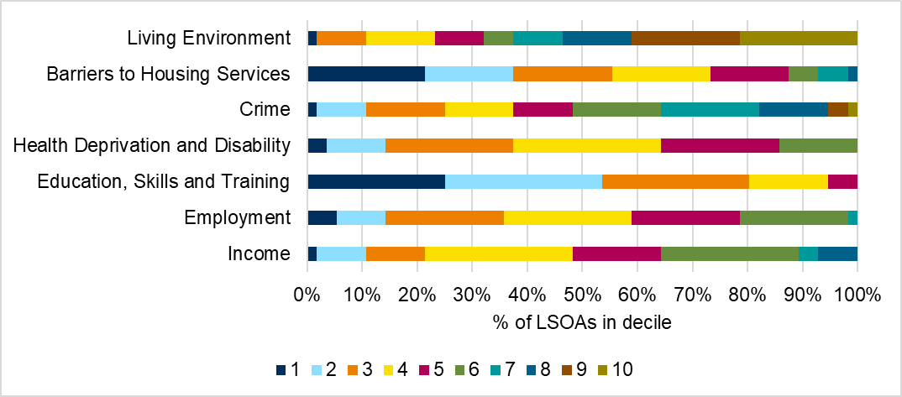
9. IMD
In Fenland, the most deprived domain is Education, Skills and Training, which includes factors such as pupil absence, adult skills, and entry to higher education. 80% of LSOAs in Fenland fall into the top 3 most deprived deciles (1-3, where 1 is the most deprived).
The least deprived domain is in the Living Environment domain, with 54% of LSOAs in Fenland falling into the top 3 least deprived deciles (8-10, where 10 is the least deprived).
Figure 27 breaks down LSOA national decile distribution by individual domain.
Figure 27: Proportion of LSOAs which fall into each decile by domain in Fenland, IMD 2025

Slide 64
10. Relevant Links
Cambridgeshire Constabulary, n.d.. What is antisocial behaviour?: What is antisocial behaviour? | Cambridgeshire Constabulary
CCC PIT, 2024. Cambridgeshire Crime Counts and Rates for 2024: Cambridgeshire Crime Counts 2024 | Cambridgeshire Insight Open Data
CCC PIT, 2026. Cambridgeshire & Peterborough Insight – Poverty – Indices of Deprivation 2025
Fenland Community Safety Delivery Plan 2025/26: Fenland Community Safety Delivery Plan
Home Office; UK Visas and Immigration, 2022. National referral mechanism guidance: adult (England and Wales) - GOV.UK
Home Office, 2011. National standard for incident recording counting rules - GOV.UK

Slide 65
10. Relevant Links
Home Office, 2023. Chapter 5: monitoring and compliance. Serious Violence Duty (accessible) - GOV.UK
Home Office, 2024b. Hate crime, England and Wales, year ending March 2024 - GOV.UK
Home Office, 2025b. Modern Slavery National Bulletin: Modern slavery: National Referral Mechanism and Duty to Notify statistics UK, end of year summary 2024 - GOV.UK
HM Government, n.d. Report hate crime - GOV.UK
HM Government, 2016. Statutory definition of child sexual exploitation - Government consultation
NCA, 2019. County Lines Drug Supply, Vulnerability and Harm 2018

Slide 66
10. Relevant Links
NCA, 2025. National Crime Agency (NCA) Strategic Assessment: NSA 2025 - National Crime Agency
ONS, 2020. Modern slavery in the UK - Office for National Statistics
ONS, 2024d. Crime in England and Wales - Office for National Statistics
ONS, 2026a. Crime in England and Wales - Office for National Statistics YE Sept 2025

Slide 67
11. Glossary
Term/acronym | Definition
ASB (Anti-Social Behaviour) | “Antisocial behaviour is defined as 'behaviour by a person which causes, or is likely to cause, harassment, alarm or distress to persons not of the same household as the person' (Antisocial Behaviour Act 2003 and Police Reform and Social Responsibility Act 2011).” (Cambridgeshire Constabulary, n.d.)
ASB categories: personal, environmental and nuisance | Personal antisocial behaviour is when a person targets a specific individual or group. Environmental antisocial behaviour is when a person’s actions affect the wider environment, such as public spaces or buildings. Nuisance antisocial behaviour is when a person causes trouble, annoyance or suffering to a community (Cambridgeshire Constabulary, n.d.).
Accidental Fires | Where the motive for the fire is thought to be accidental or is unknown.
Arson | The criminal act of deliberately setting fire to property.
C&P PHIT | Cambridgeshire and Peterborough Public Health Intelligence Team
CCC PIT | Cambridgeshire County Council Policy and Insight Team
County Lines | “A term used to describe gangs and organised criminal networks involved in exporting illegal drugs into 1 or more importing areas [within the UK], using dedicated mobile phone lines or other form of ‘deal line’. They are likely to exploit children and vulnerable adults to move [and store] the drugs and money and they will often use coercion, intimidation, violence (including sexual violence) and weapons.” (Home Office, 2023b)
CSE (Child Sexual Exploitation) | “Child sexual exploitation is a form of child sexual abuse. It occurs where an individual or group takes advantage of an imbalance of power to coerce, manipulate or deceive a child or young person under the age of 18 into sexual activity (a) in exchange for something the victim needs or wants, and/or (b) for the financial advantage or increased status of the perpetrator or facilitator. The victim may have been sexually exploited even if the sexual activity appears consensual. Child sexual exploitation does not always involve physical contact; it can also occur through the use of technology.” (HM Government, 2016)

Slide 68
11. Glossary
Term/acronym | Definition
CSEW | Crime Survey for England and Wales
CSP | Community Safety Partnership
DA | Domestic Abuse
Domestic Abuse Crime | Domestic Abuse Crime is not limited to specific offences. Any police recorded crime can be flagged as Domestic Abuse related and as such would be counted as a ‘Domestic Abuse Crime’.
Domestic Abuse Incident | “A (police recorded) report of a domestic incident, which occurs in either a public or private place.” Recording such incidents enables data to capture those incidents where the circumstances do not amount to a notifiable crime i.e., not all domestic abuse incidents result in a crime being recorded.” (Home Office, 2011, p. 19)
Domestic Homicide Review | “When a person is murdered in the context of domestic violence or abuse, a Domestic Homicide Review (DHR) is usually carried out. The responsibility for DHR's sits with the relevant district Community Safety Partnership (part of the District Council). The Community Safety Partnership will commission an independent Chair and Author for the DHR and organize a panel of appropriate professionals (membership dependent on the case).” (Cambridgeshire & Peterborough DASV Partnership)
ED | Emergency Department
Hate Crime | “A hate crime is any criminal offence which is perceived by the victim, or anybody else, to be motivated by hostility or prejudice towards someone’s: race, religion, sexual orientation, transgender identity, disability. These aspects are known as ‘protected characteristics’. A hate crime can include verbal abuse, intimidation, threats, harassment, assault and damage to property. A hate incident is behaviour which isn’t a crime, but which is perceived by the victim, or anybody else, to be motivated by hostility or prejudice based on the 5 protected characteristics.” (HM Government)
HMICFRS | Her Majesty’s Inspectorate of Constabulary and Fire & Rescue Services

Slide 69
11. Glossary
Term/acronym | Definition
Modern Slavery | “Modern slavery is a complex crime that covers all forms of slavery, trafficking and exploitation. Trafficking includes transporting, recruiting or harbouring an individual with a view to them being exploited. Modern slavery crimes may involve, or take place alongside, a wide range of abuses and other criminal offences such as grievous bodily harm, assault, rape or child sexual abuse. Victims of modern slavery can be men, women and children of any age across the world. There is an assumption that victims of modern slavery are often trafficked to the UK from other countries, but residents of the UK are also among the victims that are exploited in the UK and other countries.” (ONS, 2020)
National Referral Mechanism (for Modern slavery) (NRM) | “The National Referral Mechanism (NRM) is a framework for identifying and referring potential victims of modern slavery and ensuring they receive the appropriate support”. Only staff at designated first responder organisations can make online NRM or Duty to Notify (DtN) referral. An NRM referral is made for those under 18, and for adults who have consented to be referred. A DtN referral is for those who have not consented to a NRM referral (Home Office; UK Visas and Immigration, 2022)
ONS | Office for National Statistics
PIT | Policy and Insight Team (formerly the Cambridgeshire Research Group)
SVD | Serious Violence Duty
Ward | Wards (or electoral wards), are geographical areas used to elect local authority councillors (ONS, 2023c).
YE | Year Ending
YJS | Youth Justice Service

