Slide 1
East Cambridgeshire Strategic Assessment
2025
Final v1.1
Communities and Demography PI Team

Slide 2
Contents
Purpose
Executive Summary
CSP Priorities
Statutory Duties
Introduction
Community Safety Trends to Note
Comparison to last year
Analysis
IMD
Relevant Links
Glossary
Instructions on navigation:
1. Use PowerPoint desktop
2. Hold Ctrl and Click with mouse:
on the links to the left or
the blue Home icon in the upper right to return to Contents

Slide 3
Contents
8.1. Crime Overview
8.2. Commercial Loss
8.3. Shoplifting
8.4. Personal Loss
8.5. Violence Against the Person
8.6. Sexual Offences
8.7. Domestic Abuse
8.8. Modern Slavery
8.9. County Lines
8.10. CSE
8.11. Drug Offences
8.12. ASB
8.13. Fires
8.14. Probation
8.15. Youth Justice Service
8.16. Offence types which saw no notable change
8.17. Geographic Analysis
Purpose
Executive Summary
CSP Priorities
Statutory Duties
Introduction
Comparison to 2024
Community Safety Trends to Note
Analysis
IMD
Relevant Links
Glossary
Instructions on navigation:
1. Use PowerPoint desktop
2. Hold Ctrl and Click with mouse
on the links to the left or
the blue Home icon in the upper right to return to Contents

Slide 4
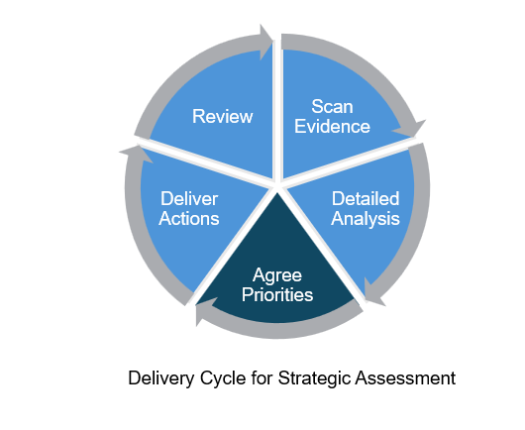
1. Purpose
The purpose of this strategic assessment is to:
To provide an evidence base for decision-making
To provide detailed analysis of specific issues
To help inform priorities going forward
To help facilitate discussion of the board to identify areas of concern

Slide 5
2. Executive Summary
Recommendations
The current priorities are still fit for purpose given the overall volume of crime in those crime types. The Partnership should consider what it is aiming to achieve in order to know when it would be ready to discharge these priorities.
CSP Priority 1 – Adopt a place-based approach to tackling and preventing crime that includes communities in developing solutions
Crime and ASB occurs in geographic hotspots, and it remains vital to engage communities and work with them to tackle the things that are important to them.
Inequalities remain an issue in East Cambridgeshire, and therefore involving communities in generating solutions that are right for them increases the likelihood of these being sustainable.
CSP Priority 2 – Work to tackle violence in East Cambridgeshire, with a particular focus on serious violence.
This remains an area of concern for residents with the potential for high harm.
Although there was a small increase in the last year, violence against the person (VAP) has accounted for the highest proportion of offences since 2022. In 2025, VAP accounted for 41% of crime in East Cambridgeshire.
Domestic abuse, sexual offences, and personal loss are community safety issues to closely monitor.
Ely East, Ely West and Littleport continue to be areas of note.

Slide 6
2.2 Executive Summary - Trends
Below is a summary of some key findings from the analysis in section 7.
Community Safety Issues
Violence Against the Person continues to rise slightly, driven mainly by increases in stalking and harassment (+7%) and violence without injury (+3%), both of which align with national trends.
Domestic Abuse incidents have increased notably (+14%) even though DA‑marked crimes slightly decreased. The proportion of incidents that were ‘crimed‘ was the lowest in four years (50%).
Sexual offences increased substantially (+16%) to the highest level in four years, with a steep rise in rape offences (+30%).
Commercial and personal loss show mixed patterns: shoplifting has decreased overall despite a notable rise between 2023 and 2024, while personal loss offences (including residential burglary and bicycle theft) have increased to their highest level in four years.
Drug offences show a rising trend overall, driven entirely by trafficking offences (+145%); communication with Cambridgeshire Constabulary highlighted this might be influenced by changes in recording practices.
ASB levels have stabilised after a large rise the previous year. Youth‑related ASB has fallen to its lowest share in four years (20%).
Deliberate fires increased by 31%, though numbers remain low, and East Cambridgeshire sits mid‑range within county comparisons of rates.
Geographic
The most notable wards across all crime types were Ely East, Ely West and Littleport.

Slide 7
3. CSP Priorities
In the East Cambridgeshire CSP Action plan, there are two priorities:
CSP Priority 1 – Adopt a place-based approach to tackling and preventing crime that includes communities in developing solutions
CSP Priority 2 – Work to tackle violence in East Cambridgeshire, with a particular focus on serious violence.
Below are activities along with their associated CSP Priorities.
Activity | Location | CSP Priority
Review partnership arrangements at a force level in relation to the thematic topics of domestic abuse and sexual violence, serious violence, and re-offending, considering current evidence. | Districtwide | CSP Priority 2
Review the findings of the Serious Violence Needs Assessment against existing delivery mechanisms used to tackle violence. | Districtwide | CSP Priority 2
Review the findings Violence Against Women and Girls Needs Assessment and where applicable develop appropriate actions in response | Districtwide | CSP Priority 2
Consider and review the risk factors set in the Strategic assessment to develop preventive measures and programmes to address these needs where identified | Districtwide | CSP Priority 1
Deliver 5 court experience events, with a focus on knife crime and county lines to local secondary schools, subject to funding | Districtwide | CSP Priority 2
Encourage parish councils to become third party hate incident/crime reporting centres by engaging with Parish Councils, explaining the process and benefits showcasing existing Hate Crime Reporting Centres and support them in doing so by training Parish Councils and providing them with promotional package such as posters, social media awareness. | Districtwide | CSP Priority 1 & 2

Slide 8
3. CSP Priorities
Activity | Location | CSP Priority
Raise awareness of Prevent through social media channels and/or distribution of information leaflets either in person or events. | Districtwide | CSP Priority 1
CSP Communications Plan to continue to utilise and strengthen social media presence by sharing events/good news/ awareness days from CSP and other relevant partners/agencies. Increase posts and viewers/followers. | Districtwide | CSP Priority 1
Widen the recipient list of CSP quarterly newsletters by advertising them on social media, and by promoting them to Shop Watch members, Libraries, Doctors surgeries. | Districtwide | CSP Priority 1
Promote funding available to support projects to address issues identified through engagement with parish councils and support parish councils to devise solutions to any issues identified. | Districtwide | CSP Priority 1
Promote Shop Watch to local businesses and encourage sign-up | Districtwide | CSP Priority 1
Promote drink spiking awareness raising products to local restaurants, bars, takeaways, and taxi firms by communication tools such as email/social media and visits to the premises. | Districtwide | CSP Priority 1
Raise awareness of anti-bullying toolkit to schools in East Cambridgeshire. | Districtwide | CSP Priority 1
Attend Youth Fusion events to raise awareness of community safety issues, as well as promoting relevant CSP resources and support | Districtwide | CSP Priority 1 & 2
Promote Safe Places National network to the community, raise awareness of the scheme and encourage sign up via Shop Watch, CSP newsletter, emails, in person/online meetings, social media and events. | Districtwide | CSP Priority 1 & 2
Promote Ask for Angela, Ask for Clive and ask for Annie | Districtwide | CSP Priority 1 & 2

Slide 9
3. CSP Priorities
Activity | Location | CSP Priority
Support 2 primary schools in Littleport with the facilitation of 2 court experience events for year 6 students, with a focus on the issues of knife crime and county lines | Littleport | CSP Priority 2
Encourage the Littleport community, especially males to sign up to the White Ribbon pledge, using local social media pages to raise awareness and via Littleport Town Council | Littleport | CSP Priority 2
Encourage organisations in Littleport to be become White Ribbon Accredited, via email | Littleport | CSP Priority 2
Apply for the Purple Flag Accreditation for Littleport as a town. | Littleport | CSP Priority 1 & 2
Communicate and support businesses in Littleport and Ely to develop measures and procedures to tackle shoplifting and target hardening options; and work and build relationships with staff at local shops to develop agreeable measures and procedures for shoplifting and target hardening options and target hardening options | Littleport and Ely (West and East) | CSP Priority 1
Engage via online communication or in person with Littleport foodbank and where identified develop actions to support users during cost-of-living crisis or in need | Littleport | CSP Priority 1
Engage with alcohol and drug services to obtain a better understanding of the links between local addictions presenting in Littleport and shop lifting figures with an aim of identifying measures to reduce shoplifting. | Littleport | CSP Priority 1
Share the Violence Against Women and Girls Needs Assessment, serious violence needs assessment dashboard, Strategic Assessment and Youth and ASB Deep Dive reviews relating to Littleport with Littleport Town Council and Littleport based youth organisations so that they are aware of issues occurring to their parish, and explore opportunities for the CSP to support initiatives led by these organisations in response to the findings | Littleport | CSP Priority 1 & 2
Raise awareness of hate crime and encourage organisations in Ely to become third-party reporting centres | Ely East | CSP Priority 1 & 2
Encourage and promote hate crime awareness training to schools and community groups in Ely and VAWG/VAP through Ely based media channels and/or distribution of information leaflets either in person or events. | Ely East | CSP Priority 2

Slide 10
3. CSP Priorities
Activity | Location | CSP Priority
Raise awareness through Ely social media channels, of reporting methods and the importance of reporting to tackle sexual offences. | Ely East | CSP Priority 1 & 2
Engage with City of Ely Council by email/in person explaining reporting methods and the importance of reporting by sharing the Partnership Intel Form to identify where youth anti-social behaviour is an issue and escalate to PSG, Delivery Group Youth Task and Finish group. | Littleport and Ely (West and East) | CSP Priority 1 & 2
Raise awareness through Ely social media channels, of reporting methods and the importance of reporting to tackle drug offences. | Ely West | CSP Priority 1

Slide 11
4. Statutory Duties
Community Safety partnerships were brought into existence through the Crime and Disorder Act 1998 and have several statutory duties. Since then, some pieces of legislation have changed their membership and statutory duties. Some examples include;
Formulate and implement a strategy for the reduction of crime and disorder in the area (including anti-social and other behaviour adversely affecting the local environment) as per the Crime and Disorder Act, 1998 (Section 6).
Formulate and implement a strategy for combatting the misuse of drugs, alcohol, and other substances in the area as per the Crime and Disorder Act, 1998 (Section 6).
Formulate and implement a strategy for the reduction of re-offending in the area as per the Crime and Disorder Act, 1998 (Section 6).
Formulate and implement a strategy to prevent and reduce serious violence as per the Crime and Disorder Act, 1998 (Section 6).
Have due regard to the police and crime objectives set out in their correlating area’s police and crime plan as per the Crime and Disorder Act, 1998 (Section 6(1A)).
Conduct Domestic Homicide Reviews (DHRs) as per the Domestic Violence, Crime and Victims Act, 2004, (Section 9).
Prepare a partnership plan, setting out the CSP’s priorities annually and publish the summary of the partnership plan as per the Crime and Disorder (Formulation and Implementation of Strategy) Regulations, 2007.
Carry out an annual strategic assessment assessing the extent to which the partnership plan for the previous year has been implemented and revise the partnership plan accordingly as per the Crime and Disorder (Formulation and Implementation of Strategy) Regulations, 2007.
Guidance can be found here Community Safety Partnerships - GOV.UK that outlines he statutory duties and a range of best practice examples that can be reviewed.

Slide 12
5. Introduction
This year the Strategic Assessment is produced as a navigable PowerPoint pack rather than a pdf document. The aim is to make the information included easier to interpret by a range of audiences. Therefore, the more detailed geographic crime data is released in a separate document. There is also a technical notes document that sits alongside these.
This pack of information is provided to the Community Safety Partnership Board for East Cambridgeshire to support their annual cycle of identifying priorities and consider their progress to date against their existing priorities.
This new strategic assessment layout will share more detailed analysis of crime types which have increased in the last year, crime types which are currently the priority of the CSP and any other notable changes.
In the last strategic assessment, the following community safety issues were highlighted:
Shoplifting
Violence against the person (VAP)
Anti-social behaviour (ASB)
The following wards were also highlighted:
Littleport
Ely East
Ely West

Slide 13
6.1. Comparison to 2024
Vehicle Offences
+23% (+44 offences)
Drug Offences
+12% (+10 offences)
Sexual Offences
+16% (+30 offences)
Domestic Abuse (Crimes and Incidents)
+9% (+110 offences)
Burglary
+10% (+25 offences)
Misc Crimes Against Society
+26% (+31 offences)
Personal Loss
+7% (+38 offences)
Bicycle Theft
+116% (+22 offences)
Deliberate Fires
+31% (+11 incidents)
Notes:
Sexual offences and domestic abuse have been greyed. This is because although both types have increased in the last year, it is difficult to assume the driver of these increases with high levels of underreporting in these crime types. However, it is important that these remain closely monitored due to the nature of the crimes.

Slide 14
6.2. Comparison to 2024
ASB
-1% (-7 incidents)
VAP
+2% (+33 offences)
Shoplifting
-13% (-53 offences)
Arson and Criminal Damage
-6% (-28 offences)
Public Order
-20% (-59 offences)
Commercial Loss
-10% (-51 offences)
Hate Crime
-31% (-26 offences)

Slide 15
7. Community Safety Trends to Note
Table 1: Community safety issues that either increased or inline with previous year community safety issues
Crime Type/ Issue | Recent Trend | Longer Term Trend
Shoplifting | Decrease | Counts still higher than that seen in 2022.
Violence Against the Person | Similar to previous year (small increase) | Large volume which has continuously accounted for the highest proportion of crime. Highest count seen in 2025
ASB | Similar to previous year (small decrease) | Overall change in count seen between 2023 and 2024. Counts in 2025 notably higher than 2022.
Vehicle Offences | Increase | Counts lower than seen in 2022 and 2023, despite the increase in the last year, this was driven by both interfering with motor vehicle (+50%, +10 offences) and theft or unauthorised taking of a motor vehicle (+57%, +34 offences). The latter saw a higher volume increase.
Drug Offences | Small increase | Overall increasing trend, increase between 2022 and 2023, stable between 2023 and 2024 and another increase between 2024 and 2025.
Sexual Offences | Increase | Stable counts between 2022 and 2024, then an increase between 2024 and 2025.
Domestic Abuse | Notable increase | Decrease between 2022 and 2023, increasing trend since.
Personal Loss Offences | Increase | Fluctuating counts between 2022 and 2024, counts in 2025 highest in last 4 years.
Miscellaneous Crimes Against Society | Increase | Small numbers, counts still higher than that seen in 2022.
Deliberate Fires | Increase | Decrease between 2022 and 2023, increasing trends from 2023 to 2025.

Slide 16
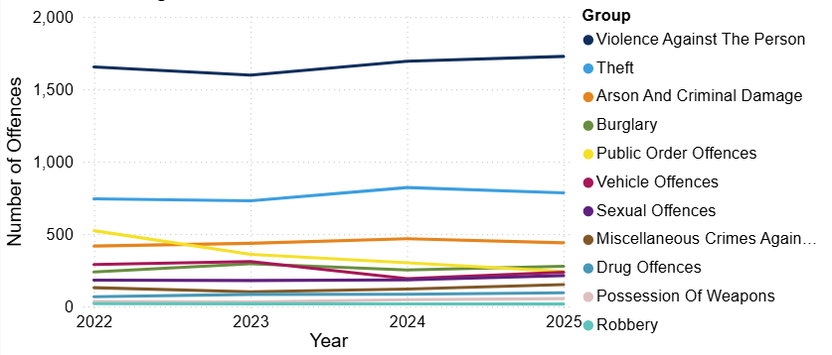
8.1. Crime Overview
Figure 1: Annual trend in police recorded offences in East Cambridgeshire, 2022 to 2025
In 2025, the total crime count for East Cambridgeshire was 4,243. This was similar to the previous year (+1%, +56 offences).
Overall, counts have remained relatively stable over the past four years. The highest of which was recorded in 2022 with 4306 offences.
Nationally over a similar period (YE September 2025), police recorded crime remained similar with the previous year (excluding fraud and computer misuse offences), and CSEW total crime saw no statistically significant change to the previous year (ONS, 2026a).
Violence against the person (VAP) has accounted for the highest proportion of offences since 2022. In 2025, VAP accounted for 41% of crime in East Cambridgeshire.
Note: Chart has been produced by Cambridgeshire County Council’s Communities and Demography PI Team, using data provided by Cambridgeshire Constabulary.

Slide 17
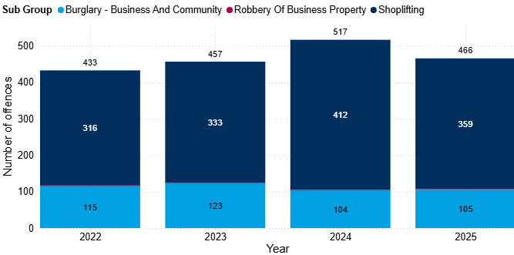
8.2. Commercial Loss
Figure 2: Annual trend in police recorded commercial loss offences in East Cambridgeshire, 2022 to 2025
Commercial loss includes shoplifting, business and community burglary, robbery of a business property and any vehicle offences marked as ‘business victim’.
Commercial loss offences decreased by 10% between 2024 and 2025 (-51 offences). This decrease was driven by shoplifting. Despite this decrease, offence counts remain higher than that seen in 2022 (+8%, +33 offences).
Shoplifting continues to account for the majority of the commercial loss offences in 2025 (76%).
Note: Chart has been produced by Cambridgeshire County Council’s Communities and Demography PI Team, using data provided by Cambridgeshire Constabulary.

Slide 18
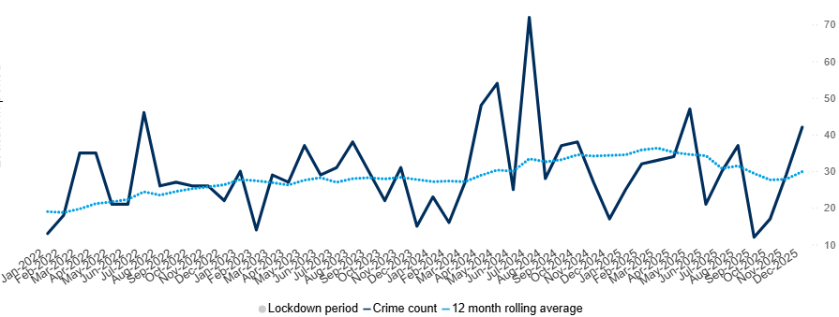
8.3. Shoplifting
Figure 3: Count of shoplifting offences in East Cambridgeshire by month, 2022 to 2025
Between 2024 and 2025 shoplifting offences in East Cambridgeshire decreased by 13% (-53 offences). Despite this decrease counts remain higher than seen in 2022 (+14%, +43 offences).
In 2025, May saw the most offences in a month with 47. This did not exceed the peak of 72 offences in July 2024.
Nationally, shoplifting increased by 5% in YE September 2025, rising to 519,381 offences from 492,660 the previous year. However, these figures are no longer the highest since current police recording practices began. They are also lower than the previous year ending period to June 2025 (529,994 offences) (ONS, 2026a).
Note: Chart has been produced by Cambridgeshire County Council’s Communities and Demography PI Team, using data provided by Cambridgeshire Constabulary.

Slide 19
8.3. Shoplifting
Towards the end of 2025, the Communities and Demography PI Team produced a shoplifting deep dive for East Cambridgeshire. This report provides more detailed analysis. Some key points include:
Littleport and Ely East consistently have the largest annual counts and highest proportion of shoplifting offences, and both wards stand far above the other East Cambridgeshire.
Dip sample analysis (65%) and suspect analysis (77%) showed that the majority of suspects are male.
Dip sample analysis for 2024 showed that the most taken types of items were groceries/food (27% of offences) or alcohol (27% of offences).

Slide 20
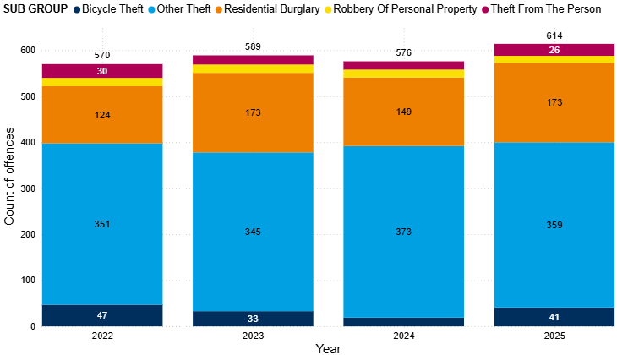
8.4. Personal Loss
Figure 2: Annual trend in police recorded personal loss offences in East Cambridgeshire, 2022 to 2025
Personal loss includes bicycle theft, other theft, residential burglary, robbery of personal property and theft from the person. These offences accounted for 14% of all offences in East Cambridgeshire in 2025.
Personal loss offences increased by 7% between 2024 and 2025 (+38 offences). This increase was driven by residential burglary (+16%, +24), bicycle theft (+116%, +22) and theft from the person (+44%, +8).
Overall personal loss offence counts have reached the highest seen in the last four years.
Note: Chart has been produced by Cambridgeshire County Council’s Communities and Demography PI Team, using data provided by Cambridgeshire Constabulary.

Slide 21
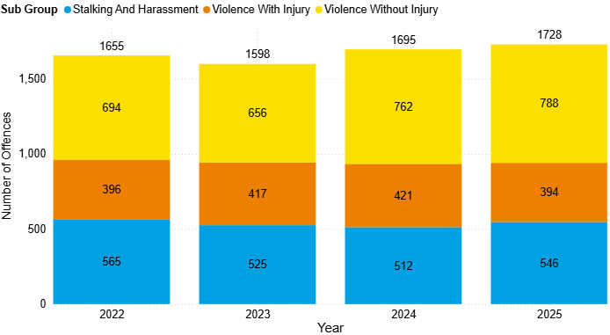
8.5. Violence Against the Person (VAP)
Figure 4: Annual trend in police recorded violence against the person (VAP) offences in East Cambridgeshire, 2022 to 2025
Violence against the person (VAP) offences accounted for 41% of all offences in 2025.
VAP offences slightly increased 2% between 2024 and 2025 (+33 offences).
‘Violence without injury’ accounted for the majority of the VAP offences in 2025 (46%).
Note: Chart has been produced by Cambridgeshire County Council’s Communities and Demography PI Team, using data provided by Cambridgeshire Constabulary.

Slide 22
8.5. Violence Against the Person (VAP)
Figure 4: Annual trend in police recorded violence against the person (VAP) offences in East Cambridgeshire, 2022 to 2025
Both stalking and harassment and violence without injury saw increases in the last year:
Stalking and harassment increased by 7% (+34 offences). This is inline with national police recorded data over a similar time period (YE September). Stalking offences and harassment offences both increased by 7% (ONS, 2026a).
Violence without injury increased by 3% (+26 offences), reaching the highest count across the last 4 years. Nationally, police recorded violence without injury saw a 1% increase across a similar time period (YE September) (ONS, 2026a).
Note: Chart has been produced by Cambridgeshire County Council’s Communities and Demography PI Team, using data provided by Cambridgeshire Constabulary.

Slide 23
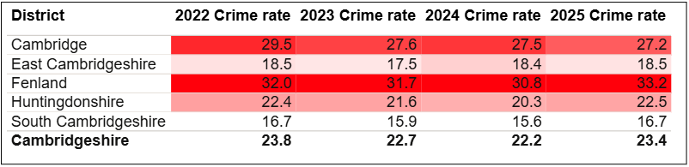
8.5. Violence Against the Person (VAP)
Table 3: Rate per 1,000 population of police recorded VAP offences, between 2022 and 2025
East Cambridgeshire had the fourth highest rate per 1,000 population for VAP offences (18.5). This is also lower than the rate for Cambridgeshire (23.4).
Note: Table has been produced by Cambridgeshire County Council’s Communities and Demography PI Team, using data provided by Cambridgeshire Constabulary. Rates over time have been calculated using locally produced estimates and forecasts, see Technical notes for further details.

Slide 24
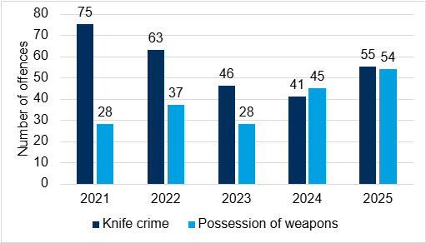
8.5. VAP - Possession of Weapons and Knife Crime
Figure 5: Annual trend in knife crime and possession of weapons offences in East Cambridgeshire, 2021 to 2025
Knife crime marked offences saw an increase despite a period of decreases since 2021. In the last year, offences have increased by 34% (+14 offences). Despite this increases, offence counts still remain lower than both 2021 and 2022. In contrast, nationally, knife-enabled crime recorded by the police saw a 9% decrease between YE September 2024 (from 55,149 offences) and YE September 2025 (to 20,430 offences. This was also 9% lower than YE March 2020 (55,170 offences) (ONS, 2026a).
Possession of weapon offences reached highest counts seen across the last 5 years at 54. This was a 20% increase on the previous year (+9 offences). Nationally, police recorded "possession of article with a blade or point" offences saw a slight increase bet YE September 2024 and YE September 2025 (+1%, +399 offences). Trends in possession offences are likely to be influenced by police activity and operations, particularly stop and search (ONS, 2026a).
Note: Chart has been produced by Cambridgeshire County Council’s Communities and Demography PI Team, using data provided by Cambridgeshire Constabulary CADET.

Slide 25
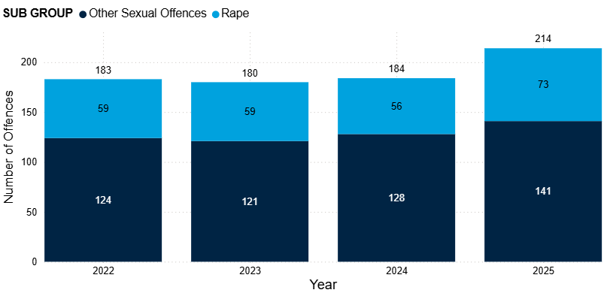
8.6. Sexual Offences
Sexual offences have seen a notable increase between 2024 and 2025, from 184 to 214 (+16%), reaching the highest count in the last four years after three years of little to no change.
Both subgroups saw increases in the last year.
Other sexual offences increased by 10% (+13 offences).
Rape offences increased by 30% between 2024 and 2025 and accounted for 34% of all sexual offences in 2025.
Sexual offences accounted for the second highest proportion of DA marked offences (7%), this proportion has increased over the last 4 years (from 4% in 2022 to 7% in 2025).
On a national scale, there was an 8% increase in YE September 2025 (to 214,816 offences) compared with the previous year (198,373 offences). Police-recorded sexual offences have generally increased over the past decade, largely due to improvements in recording practices (ONS, 2026a).
Figure 6: Annual trend in police recorded sexual offences in East Cambridgeshire, 2022 to 2025
Note: Chart has been produced by Cambridgeshire County Council’s Communities and Demography PI Team, using data provided by Cambridgeshire Constabulary.
Notes:
It should be noted that at the time of writing this report there is a lot of media coverage on cases such as the Epstein files which might have influenced the increase in reported sexual offences.

Slide 26
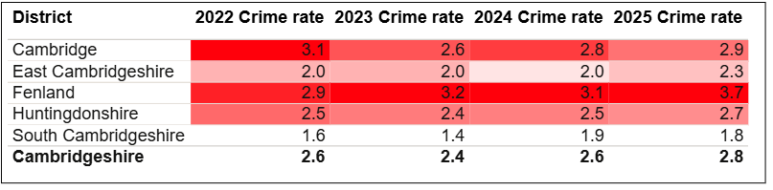
8.6. Sexual Offences
Table 4: Rate per 1,000 population of police recorded sexual offences, between 2022 and 2025
As seen in Table 4, East Cambridgeshire had the fourth highest rate per 1,000 in 2025 (2.3). This was lower than the rate per 1,000 for Cambridgeshire (2.8).
The rate for East Cambridgeshire remained stable between 2022 to 2024 but saw an increase in 2025.
Note: Table has been produced by Cambridgeshire County Council’s Communities and Demography PI Team, using data provided by Cambridgeshire Constabulary. Rates over time have been calculated using locally produced estimates and forecasts, see Technical notes for further details.

Slide 27
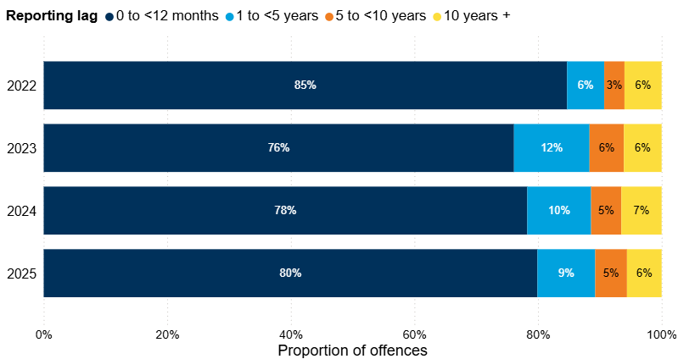
8.6. Sexual Offences
Figure 7: Number of years between offence start date and offence recorded date for police recorded sexual offences in East Cambridgeshire, 2022 to 2025
The proportion of historical offences decreased slightly in 2025, accounting for 20% of all sexual offences recorded in this period. In 2024, this proportion was 22%.
Note: Chart has been produced by Cambridgeshire County Council’s Communities and Demography PI Team, using data provided by Cambridgeshire Constabulary.
Notes:
Reporting sexual offences does not always happen immediately after the offence has occurred. Analysis has been completed on the difference between the date an offence was recorded by the police and the date when the offence occurred. It should be noted that offences can span a wide time period, and analysis here focuses on the offence start date rather than the offence end date due to data completeness.

Slide 28
8.7. Domestic Abuse
Figure 8: Police recorded Domestic Abuse (DA) incidents and crimes recorded in East Cambridgeshire, 2022 to 2025
Overall, domestic abuse (DA) crimes and incidents saw a 9% increase between 2024 and 2025 (+110).
DA related incidents saw an increase of 14% between 2024 and 2025 (+139 incidents). This is the highest count seen over the last four years, as shown in Figure 8.
DA marked crimes saw a decrease in the last year, however, counts still remained higher than the lowest count (across the last four years) seen in 2023.
Half of reported DA incidents were ‘crimed’ at 50%, this is the lowest proportion seen across the last four years.
Incident category | 2022 | 2023 | 2024 | 2025
Total police recorded DA (incidents & crimes) | 1262 | 1122 | 1253 | 1363
Total DA marked crimes | 857 | 713 | 816 | 802
Total DA incidents | 958 | 896 | 976 | 1115
Incidents that result in a crime being recorded | 553 | 487 | 539 | 554
Incidents that remain as incident only | 405 | 409 | 437 | 561
Proportion of incidents that were ‘crimed’ | 58% | 54% | 55% | 50%
Note: Chart has been produced by Cambridgeshire County Council’s Communities and Demography PI Team, using data provided by Cambridgeshire Constabulary.
Notes:
The decrease seen in YE September 2023 is likely to have been impacted by the change in new Home Office counting rules introduced in April 2023. This was referenced in the previous strategic assessment, which can be found here: Cambridgeshire & Peterborough Insight – Crime & Community Safety – Community Safety Partnerships – Cambridge City
The increase in incidents could be a result of online incident reporting making it more accessible for people to raise concerns and report incidents.
DARDRs – There were no ongoing or completed Domestic Abuse Related Death Reviews in East Cambridgeshire in 2025.

Slide 29
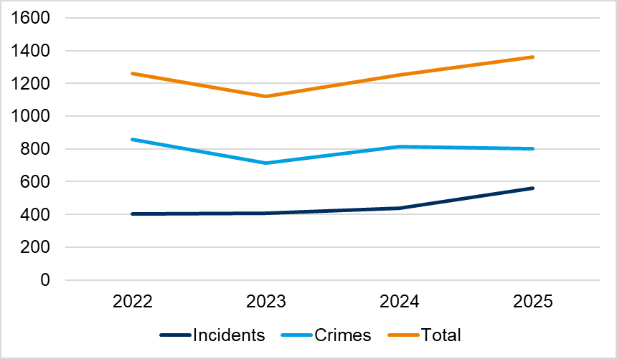
8.7. Domestic Abuse
Figure 8: Police recorded Domestic Abuse (DA) crimes and incidents (non-crimed only) in East Cambridgeshire, 2022 to 2025
Overall, domestic abuse (DA) crimes and incidents saw a 13% increase between 2024 and 2025 (+288).
DA related incidents saw an increase of 14% between 2024 and 2025 (+139 incidents). This is the highest count seen over the last four years, as shown in Figure 8.
DA marked crimes saw a decrease in the last year, however, counts still remained higher than the lowest count (across the last four years) seen in 2023.
Half of reported DA incidents were ‘crimed’ at 50%, this is the lowest proportion seen across the last four years.
Note: Chart has been produced by Cambridgeshire County Council’s Communities and Demography PI Team, using data provided by Cambridgeshire Constabulary.
Notes:
The decrease seen in YE September 2023 is likely to have been impacted by the change in new Home Office counting rules introduced in April 2023. This was referenced in the previous strategic assessment, which can be found here: Cambridgeshire & Peterborough Insight – Crime & Community Safety – Community Safety Partnerships – Cambridge City
The increase in incidents was said by Cambridgeshire Constabulary to potentially be a result of online incident reporting making it more accessible for people to raise concerns and report incidents.
DARDRs – There were no ongoing or completed Domestic Abuse Related Death Reviews in East Cambridgeshire in 2025.

Slide 30
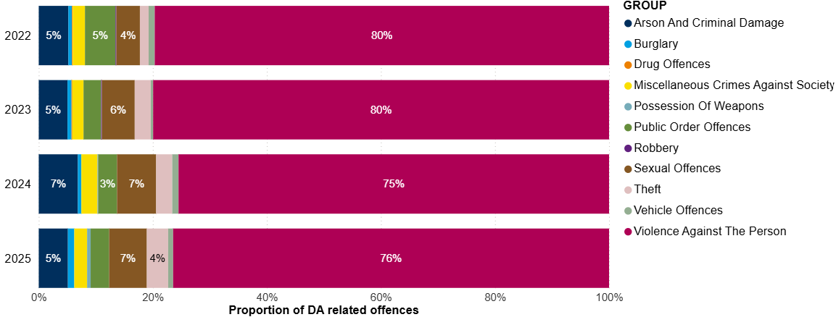
8.7. Domestic Abuse
Figure 9: Crime type breakdown of Domestic Abuse (DA) related offences recorded in East Cambridgeshire, 2022 to 2025
Similarly to national figures for YE September 2025 (ONS, 2026aa), the crime type with the highest proportion is violence against the person (VAP) offences. VAP accounted for 76% of the DA marked crimes in 2025 .
Sexual offences accounted for the second highest proportion (7%), this proportion has increased over the last four years.
Note: Chart has been produced by Cambridgeshire County Council’s Communities and Demography PI Team, using data provided by Cambridgeshire Constabulary.

Slide 31
8.7. Domestic Abuse
Table 5: Rate per 1,000 population of domestic abuse (incidents and crimes), 2022 to 2025
As seen in Table 5, East Cambridgeshire had the fourth highest rate per 1,000 in 2025 (14.6). This was lower than the rate per 1,000 for Cambridgeshire (16.7).
The rate in East Cambridgeshire has increased over the last 4 years.
Note: Table has been produced by Cambridgeshire County Council’s Communities and Demography PI Team, using data provided by Cambridgeshire Constabulary. Rates over time have been calculated using locally produced estimates and forecasts, see Technical notes for further details.

Slide 32
8.8. Modern Slavery
The latest National Crime Agency (NCA) Strategic Assessment for 2025 was released in March 2025, providing an updated overview of threats for 2025. This release highlighted issues that are influencing risk of exploitation, which local CSPs should be alert to:
“Modern slavery refers to the exploitation of children and adults through slavery, servitude, or forced or compulsory labour” (NCA, 2025).
The National Referral Mechanism (NRM) is a framework to identify potential victims of modern slavery and human trafficking and ensure they receive the appropriate support. In the year ending September 2024, 8,156 referrals were made to the NRM reporting exploitation entirely within the UK. Of these 8,156 referrals, 54% (4,415) were for UK nationals, and in 58% (4,697 of 8,156), the potential victim reported exploitation as a child (NCA, 2025).
Adult victims are typically vulnerable due to debt and unemployment, and other economic factors. In some cases, victims are also vulnerable through factors such as homelessness, learning difficulties or disabilities, mental ill-health, or substance dependency or misuse. Similarly, these factors may also apply to child victims, who are also often vulnerable through their age, and factors such as family breakdown, persistent absence from school, and social isolation from peers.
The CSP should also be aware of sectors in which work is often informal or short-term, such as agriculture, beauty services, construction, food processing and preparation, and hand car washes, are particularly vulnerable to labour exploitation.

Slide 33
8.8. Modern Slavery
Whilst district level data is not available, data is available on the NRM referrals made where Cambridgeshire Constabulary was the first responder. The Cambridgeshire Constabulary police force area covers both Cambridgeshire and Peterborough. The latest end of year summary available is for 2024.
Of the 63 NRM referrals made by Cambridgeshire Constabulary in 2024, more than three quarters were males, accounting for 76% of referrals, a similar proportion recorded in 2023 (77%).
When looking at ages (at time of referral), 65% were adults (18 and over). Adult males accounted for almost half of the total referrals (48%).
Almost half of referrals were from the UK (54%). The next most common nationalities were Albanian (8%), and Vietnamese (8%).
The most common exploitation type was “criminal exploitation” (56%).
The next most common exploitation type was “labour and criminal exploitation” (16%).
Of the 63 referrals where Cambridgeshire Constabulary were first responders, 89% were investigated by Cambridgeshire Constabulary, this is 56 referrals. In total, Cambridgeshire Constabulary investigated 159 referrals; in 2024, there were no referrals from Fenland District Council in this year.
(Home Office, 2025a; Home Office, 2025b).
Notes:
Note that this does not necessarily reflect that Cambridgeshire Constabulary was the responsible police force. See technical notes on the NRM process in Appendix A.7 NRM data.

Slide 34
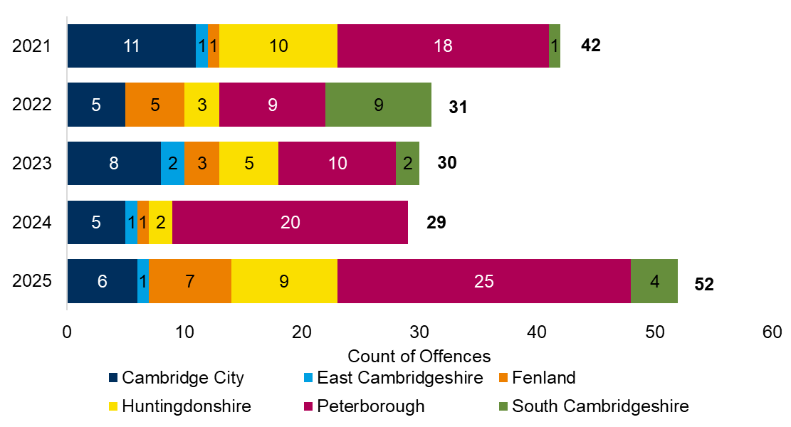
8.8. Modern Slavery
Figure 10: Police recorded modern slavery offences by district, 2021 to 2025
The total number of modern slavery offences in Cambridgeshire was 52 offences. This is a 79% increase on the previous year.
There was 1 modern slavery offence in East Cambridgeshire in 2025.
Note: Chart has been produced by Cambridgeshire County Council’s Communities and Demography PI Team, using data provided by Cambridgeshire Constabulary CADET.
Notes:
These numbers should not be taken as a true representation of the levels of modern slavery offending in East Cambridgeshire, or countywide, due to high levels of underreporting for this crime type. It should also be noted that local district boundaries are irrelevant to the trafficking and exploitation of people as organised crime gangs are known to move people within the UK. The Partnership should work closely with cross-border agencies.

Slide 35
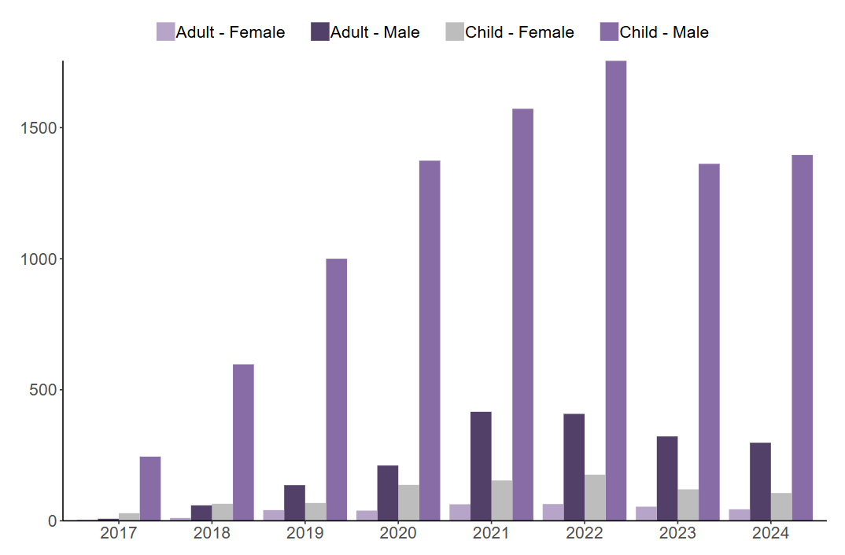
8.9. County Lines
The latest strategic assessment published by the National Crime Agency (NCA) indicates that exploitation linked to criminal activity constitutes a significant proportion of the exploitation types reported in the UK. In the YE September 2024, 65% of referrals were for exploitation in criminal activity.
Exploitation in criminal activity occurs when victims are coerced, forced, or otherwise compelled to commit crime, often in drug offences such as cannabis cultivation or distribution via county lines. (NCA, 2025).
County Lines refers to a model of offending whereby gangs and organised crime groups move drugs into supply areas within the UK via the exploitation of vulnerable individuals. These individuals are recruited and coerced into the drug supply chain (NCA, 2019).
The NRM referral system flags referrals that relate to county lines. In 2024, nationally, 10% of all referrals received were flagged as county lines. The majority of these referrals were for male children (76%), as shown in Figure 24, this cohort have consistently accounted for the majority of county lines flagged referrals (Home Office, 2025a).
Figure 11: Number of NRM referrals flagged nationally as county lines, by age group at exploitation and gender, 2017 to 2024
Source: Figure 8 in Modern Slavery end of year summary 2024 report (Home Office, 2025a).
Note: See technical notes for NRM data in section A.7. NRM referrals.

Slide 36
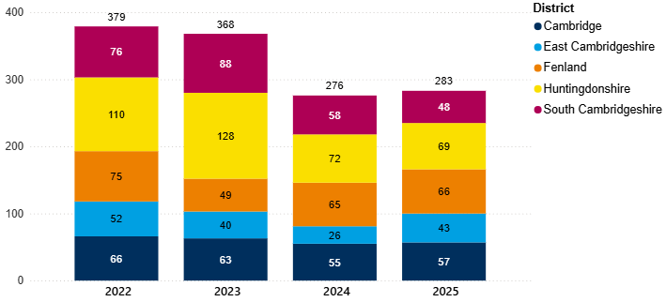
8.10. Child Sexual Exploitation (CSE)
Figure 12: Annual trend of police recorded CSE offences in Cambridgeshire by district, 2022 to 2025
CSE is a marker that can be applied to any offence that fits the criteria for CSE by police. It is worth noting that like other markers that can be applied there is a potential level of inconsistency in the application of the marker. It would be worth investigating how reliable the marker is as an accurate reflection of CSE crimes within the local police data.
In the last year, CSE offences in East Cambridgeshire have increased (+65%, +17 offences). This is a higher percentage increase than the county-wide picture; Cambridgeshire CSE offences increased by 3% between 2024 and 2025 (+7 offences).
Note: Chart has been produced by Cambridgeshire County Council’s Communities and Demography PI Team, using data provided by Cambridgeshire Constabulary.
Notes:
CSE is a marker that can be applied to any offence that fits the criteria for CSE by police. It is worth noting that like other markers that can be applied there is a potential level of inconsistency in the application of the marker. It would be worth investigating how reliable the marker is as an accurate reflection of CSE crimes within the local police data.

Slide 37
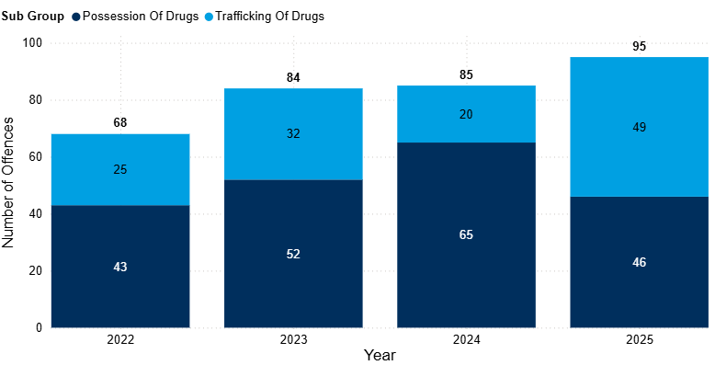
8.11. Drug Offences
Drug offences have seen incremental increases since 2022, from 68 to 95 (+40%).
In the last year, drug offences increased by 12% (+10 offences). This increase was solely driven by ‘trafficking of drugs’, this subgroup saw a 145% increase in this period (+29 offences).
Possession of drug offences decreased by 29% in the last year (-19 offences). This meant that counts reached similar levels to 2022, after a period of incremental increases in 2023 and 2024.
Nationally, police recorded drug offences saw an 21% increase between YE September 2024 and YE September 2025. Although both possession and trafficking saw increases, this was largely driven by the increase in trafficking offences (+38%) (ONS, 2026b).
Figure 13: Annual trend in police recorded drug offences in East Cambridgeshire, 2022 to 2025
Note: Chart has been produced by Cambridgeshire County Council’s Communities and Demography PI Team, using data provided by Cambridgeshire Constabulary.

Slide 38
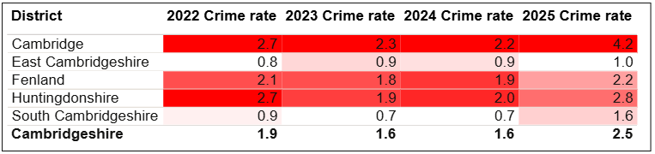
8.11. Drug Offences
Table 6: Rate per 1,000 population of police recorded drug offences in East Cambridgeshire, between 2022 and 2025
As seen in Table 6, East Cambridgeshire had the lowest rate per 1,000 population in 2025 (1.0). This was notably lower than the rate per 1,000 for Cambridgeshire (2.5).
Note: Table has been produced by Cambridgeshire County Council’s Communities and Demography PI Team, using data provided by Cambridgeshire Constabulary. Rates over time have been calculated using locally produced estimates and forecasts, see Technical notes for further details.

Slide 39
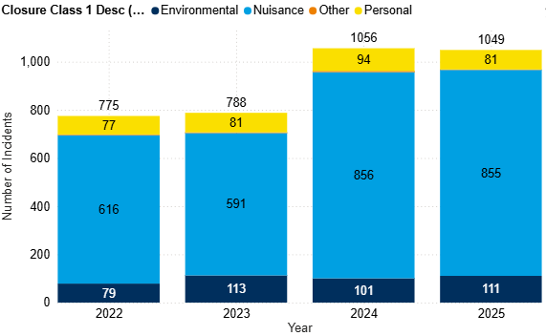
8.12. Anti-Social Behaviour (ASB)
Figure 14: Annual trend in police recorded ASB incidents in East Cambridgeshire, 2022 to 2025
After a notable increase between 2023 and 2024 (+34%, +268 incidents), counts in 2025 have remained similar to the previous year, suggesting an overall change in trend. This is similar to the national police recorded ASB, which remained similar over a similar time period (YE September 2025) (ONS, 2026aa).
This change was driven by an increase in ‘nuisance’ ASB, which between 2023 and 2024, increased by 45% (+265 incidents). ‘Nuisance’ ASB accounted for 82% of ASB in East Cambridgeshire in 2025.
Note: Chart has been produced by Cambridgeshire County Council’s Communities and Demography PI Team, using data provided by Cambridgeshire Constabulary.

Slide 40
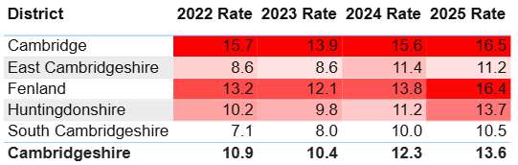
8.12. Anti-Social Behaviour (ASB)
Table 8: Rate per 1,000 population of police recorded ASB incidents, 2022 to 2025
As seen in Table 8, East Cambridgeshire had the fourth highest rate per 1,000 population in 2025 (11.2). This was lower than the rate per 1,000 for Cambridgeshire (13.6).
Note: Table has been produced by Cambridgeshire County Council’s Communities and Demography PI Team, using data provided by Cambridgeshire Constabulary. Rates over time have been calculated using locally produced estimates and forecasts, see Technical notes for further details.

Slide 41
8.12. ASB - Youth-related Anti-Social Behaviour (ASB)
Table 9: Police recorded ASB incidents and the proportion where a youth-related keyword has been identified, 2022 to 2025
The proportion of youth-related ASB has fluctuated over the past 4 years. In the last year, the proportion is the lowest it has been over this period (20%), as seen in Table 9.
Youth-related ASB has decreased by 17% between 2024 and 2025 (-45 incidents).
Note: Table has been produced by Cambridgeshire County Council’s Communities and Demography PI Team, using data provided by Cambridgeshire Constabulary.
Notes:
Youth-related ASB has been analysed by applying a keyword search to the incident description field to identify incidents that are likely to be youth-related. It should be noted that this is not a perfect measure, it may include some incidents where young people were present or victims, but the incident itself was not directly attributable to young people. Despite this limitation, it represents the best available indicator of police recorded youth related ASB

Slide 42
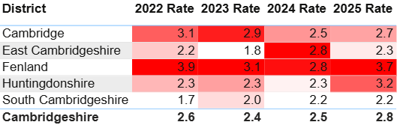
8.12. ASB - Youth-related Anti-Social Behaviour (ASB)
Table 10: Rate per 1,000 population of police recorded youth-related ASB incidents, 2022 and 2025
As seen in Table 10, East Cambridgeshire had the fourth highest rate per 1,000 population in 2025 (2.3). This was slightly lower than the rate per 1,000 for Cambridgeshire (2.8).
In 2024, East Cambridgeshire had the highest rate in Cambridgeshire alongside Fenland.
Note: Table has been produced by Cambridgeshire County Council’s Communities and Demography PI Team, using data provided by Cambridgeshire Constabulary. Rates over time have been calculated using locally produced estimates and forecasts, see Technical notes for further details.

Slide 43
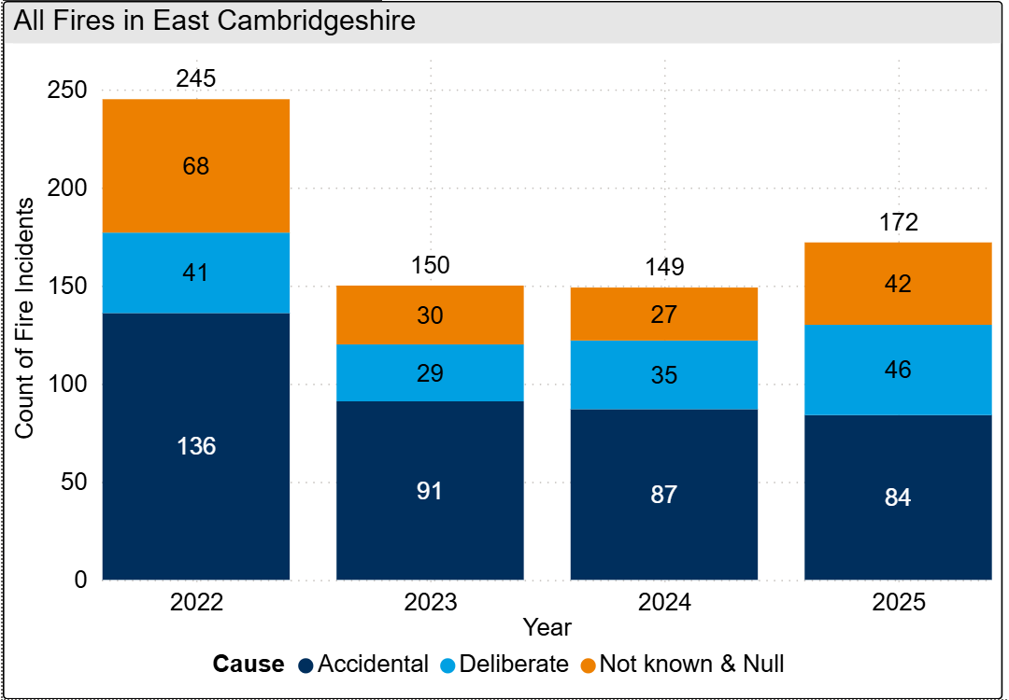
8.13. Fires
Figure 15: Annual trend in fires in East Cambridgeshire, 2022 to 2025
In 2025, there were 172 fires in East Cambridgeshire, this is a 15% increase from the last year (+23 incidents).
Of the 172 fires recorded, 27% (46 incidents) were classified as deliberate. The number of deliberate fires has seen incremental increases since 2023, as illustrated in Figure 15.
Note: Chart has been produced by Cambridgeshire County Council’s Communities and Demography PI Team, using data provided by Cambridgeshire Fire and Rescue Service.

Slide 44
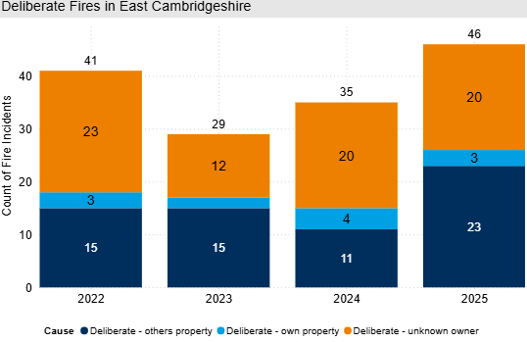
8.13. Deliberate Fires
Figure 16: Annual trend in deliberate fires in East Cambridgeshire, 2022 to 2025
In 2025, deliberate fires increased by 31% (+11) when compared with 2024; however, the overall numbers remain low.
‘Deliberate – others property’ accounted for the largest proportion of deliberate fires at 50% (23 out of 46).
Note: Chart has been produced by Cambridgeshire County Council’s Communities and Demography PI Team, using data provided by Cambridgeshire Fire and Rescue Service.

Slide 45
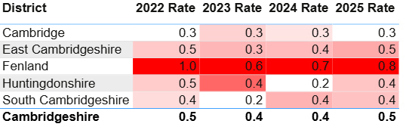
8.13. Deliberate Fires
Table 11: Rate per 1,000 population of deliberate fires by district, 2022 to 2025
In 2025, East Cambridgeshire had a rate per 1,000 population of 0.5, placing it close to Huntingdonshire and South Cambridgeshire, both of which had slightly lower rates at 0.4. The lowest rate per 1,000 population in 2025 was observed in Cambridge City with 0.3.
Note: Table has been produced by Cambridgeshire County Council’s Communities and Demography PI Team, using data provided by Cambridgeshire Constabulary. Rates over time have been calculated using locally produced estimates and forecasts, see Technical notes for further details.

Slide 46
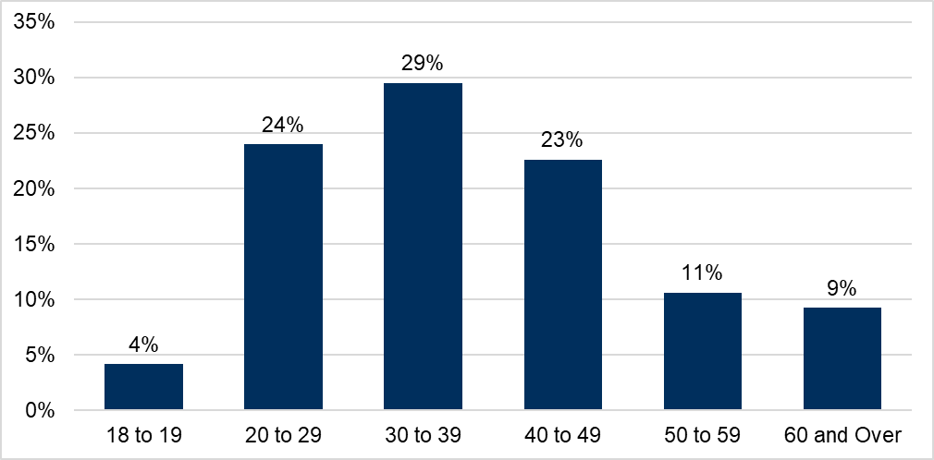
8.14. Probation
Figure 17: Proportion of age groups of those open to the Probation Service in 2025, residing in East Cambridgeshire
The Probation Service have provided a caseload profile for individuals residing in East Cambridgeshire who were open to the service at some point within 2025; in this instance, there were 217 people.
The majority of the cohort were males, with a split of 88% males and 12% females.
30 to 39 years old accounted for the largest proportion of the cohort at 29%.
18- to 19-year-olds accounted for 4% of the cohort, it is to be expected that this proportion is smaller as there are only two single years of age.
Note: Chart has been produced by Cambridgeshire County Council’s Communities and Demography PI Team, using data provided by Cambridgeshire and Peterborough Probation Service.

Slide 47
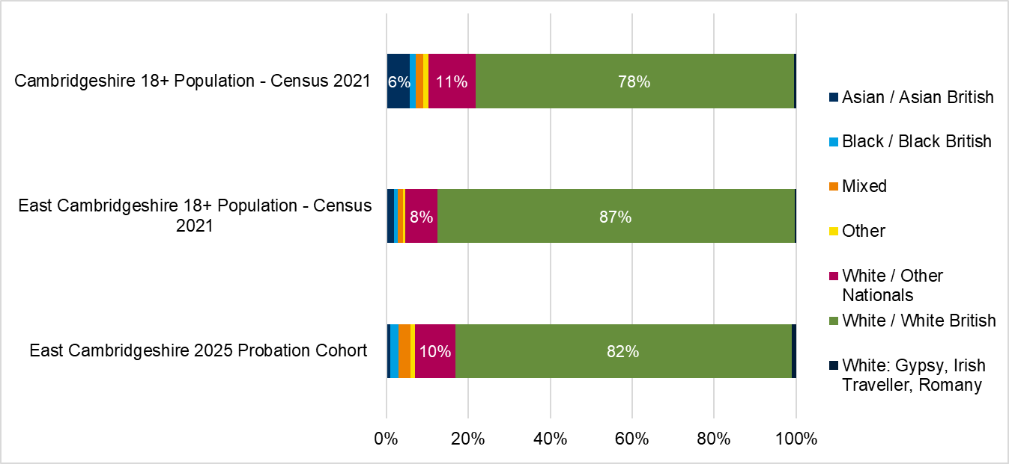
8.14. Probation
Figure 18: Proportion of ethnic group comparison, East Cambridgeshire Probation Service cohort, East Cambridgeshire Census 2021 Population and Cambridgeshire Census 2021 Population
7% (15 of 217) of the current East Cambridgeshire probation caseload had no ethnicity recorded.
Of those who’s ethnicity was recorded (202), Figure 18 shows that the majority of the probation cohort were White British at 82%, underrepresented in comparison to the East Cambridgeshire (87%) and overrepresented in comparison to Cambridgeshire (78%) Census population (ONS, 2023).
White / Other Nationals group were overrepresented in comparison to East Cambridgeshire Census population (10% vs 8% respectively) (ONS, 2023).
Note: Chart has been produced by Cambridgeshire County Council’s Communities and Demography PI Team, using data provided by Cambridgeshire and Peterborough Probation Service and Census 2021 population data sourced from ONS.

Slide 48
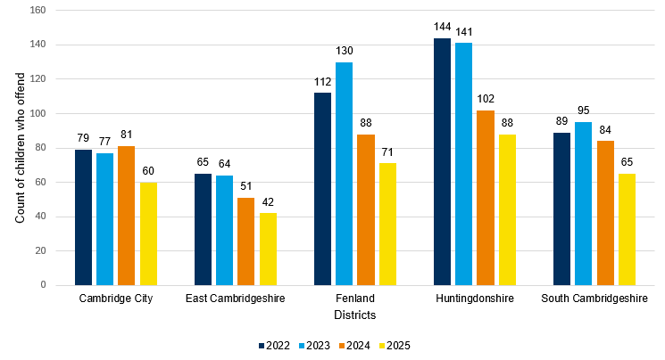
8.15. Youth Justice Service
Figure 19: Count of children who offend by district, 2022 to 2025
Figure 19 shows that East Cambridgeshire has the overall lowest number of children who offend compared to other districts.
There has been a 35% decrease in the number of children who offend in East Cambridgeshire between 2022 and 2025.
Table 12 below shows there has been a 50% decrease in the average number of offences per child who offend in East Cambridgeshire between 2022 and 2025.
Table 12: Average offences per child who offend by district, 2022 to 2025
Districts | 2022 | 2023 | 2024 | 2025
Cambridge City | 1.73 | 1.65 | 1.59 | 1.35
East Cambridgeshire | 2.20 | 1.45 | 1.20 | 1.10
Fenland | 1.59 | 1.76 | 1.34 | 1.86
Huntingdonshire | 1.44 | 1.28 | 1.43 | 1.44
South Cambridgeshire | 1.12 | 1.24 | 1.68 | 1.40
Note: Chart has been produced by Cambridgeshire County Council’s Communities and Demography PI Team, using data provided by Cambridgeshire Youth Justice Service.

Slide 49
8.15. Youth Justice Service
Table 13: FTEs and Outcomes of children who offend in East Cambridgeshire, 2022 to 2025
Outcome | 2022 | 2023 | 2024 | 2025
First Time Entrants (FTEs) | 15 | 15 | <5 | 0
Out of Court Resolutions (OOCRs) | 63 | 67 | 49 | 45
Court Sentence | 15 | 9 | 7 | <5
Table 13 shows there has been a decline in FTEs, OOCRs, and Court Sentences between 2022 and 2025.
Most OOCRs are non-substantive outcomes and range between 81% in 2023 and 100% in 2025.
Table 14 shows that violence against the person (VAP) has consistently been the most common offence type between 2022 and 2025. Criminal damage, public order, and sexual offences are the next most common offence types.
Table 14: Offence type of children who offend in East Cambridgeshire, 2022 to 2025
Offence type | 2022 | 2023 | 2024 | 2025 | 2025 - Percentage share of total offences
Violence Against The Person | 49 | 46 | 20 | 13 | 28%
Criminal Damage | 15 | 14 | 10 | 12 | 26%
Public Order | 22 | 11 | 6 | 7 | 15%
Drugs | 9 | <5 | 5 | <5 | <11%
Racially Aggravated | <5 | <5 | <5 | <5 | <11%
Arson | 0 | <5 | <5 | <5 | <11%
Sexual Offences | 8 | 6 | 11 | <5 | <11%
Theft And Handling Stolen Goods | 9 | <5 | <5 | <5 | <11%
Non Domestic Burglary | <5 | <5 | 0 | <5 | <11%
Robbery | <5 | <5 | <5 | <5 | <11%
Domestic Burglary | <5 | <5 | 0 | 0 | 0%
Fraud And Forgery | <5 | 0 | 0 | 0 | 0%
Motoring Offences | 8 | 0 | <5 | 0 | 0%
Other | 9 | <5 | 0 | 0 | 0%
Vehicle Theft / Unauthorised Taking | <5 | <5 | <5 | 0 | 0%
Total number of offences | 143 | 93 | 61 | 46 | 100%
Note: Tables have been produced by Cambridgeshire County Council’s Communities and Demography PI Team, using data provided by Cambridgeshire Youth Justice Service.

Slide 50
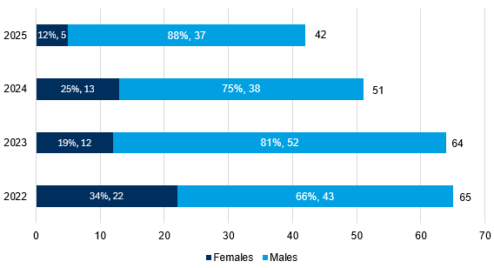
8.15. Youth Justice Service
Table 15: Children who offend in East Cambridgeshire by age group, 2022 to 2025
Age - Table 15 below shows that age 14 is the most common age of children who offend except for 2024.
Gender - Figure 20 shows most children who offend in East Cambridgeshire are males. There has been a large decrease in the proportion of females from 34% in 2022 to 12% in 2025.
Ethnicity - In 2025, the most common ethnicity for children who offend in East Cambridgeshire is White British (82% of East Cambridgeshire YJS cohort), and this is followed by White/Other Nationals (13% of East Cambridgeshire YJS cohort). White/Other Nationals is over-represented compared to the 6% East Cambridgeshire 10-17 population from Census 2021.
Children’s social care - The percentage of those associated with children’s social care between 2022 and 2025 is 7%.
Substance misuse - The percentage of those who have had evidence of substance misuse between 2022 and 2025 is 5%.
Mental health - The percentage of those who have had contact with mental health services between 2022 and 2025 is also 3%.
Age Groups | 2022 | 2023 | 2024 | 2025
10 to 12 | 9 | 13 | 8 | 10
13 | 6 | 8 | 13 | <5
14 | 16 | 14 | 7 | 15
15 | 11 | 10 | 7 | 7
16 | 14 | 10 | 7 | 5
17 | 12 | 12 | 11 | <5
Figure 20: Children who offend in East Cambridgeshire by gender, 2022 to 2025
Note: Table and Chart have been produced by Cambridgeshire County Council’s Communities and Demography PI Team, using data provided by Cambridgeshire Youth Justice Service.

Slide 51
8.16. Offence types that saw no notable change or have decreased in the last year
In last year’s strategic assessment, anti-social behaviour (ASB), violence against the person (VAP) and shoplifting saw notable increases. Out of these crime types, shoplifting was the only crime type in the last year to see a notable decrease. Shoplifting has been analysed in a section above.
The below are crime types which have not been analysed in further detail above, and they saw no notable change or decreased in the last year.
Public order offences have continued to decrease. Since 2022, offence counts have halved (-54%, -282).
Hate crime marked offences have fluctuated across the last four years. However, in 2025, offence counts reached the lowest count seen since 2022 at 57 offences. This was a decrease of 31% (-26 offences), when compared to 2024.
Arson and criminal damage offences decreased by 6% (-28 offences) between 2024 and 2025. Despite this decrease, offence counts remained higher than 2022 (+5%, +22 offences).

Slide 52
8.17. Geographic Analysis
The most notable wards across all crime types were Ely East, Ely West and Littleport.
Littleport had the highest count of total crime in 2025 and remained in the top 5 highest ward counts in all analysed offence types.
Ely East had the highest rate per 1,000 population in 2025. More specifically, Ely East had the rate per 1,000 for all analysed crime types except hate crime, deliberate fires, personal loss (following Ely West which had a rate of 10.7 compared to 10.6 in Ely East), domestic abuse (crimes and incidents), vehicle offences.
Ely West had the second highest count and third highest rate per 1,000 in 2025. All analysed crime types exceeded counts for 2022, except youth ASB (-41%, -12) and deliberate fires (0%, 0).

Slide 53
9. IMD
The Index of Multiple Deprivation 2025 (IMD 2025) is the official measure of relative deprivation for small area geographies called Lower-layer Super Output Areas (LSOAs), in England. It has been produced every 3 to 5 years since 1970s. Lower Layer Super Output Areas are a geographic hierarchy designed to improve the reporting of small area statistics in England and Wales.
IMD 2025 was released at the end of October 2025. Prior to that the latest release was in September 2019.
East Cambridgeshire is ranked 247/296 of all local authorities nationally, based on local authority score, where 1 is most deprived. This means East Cambridgeshire is the 49th least deprived of the 296 English Local Authorities.
In East Cambridgeshire, there are 51 Lower Super Output Areas (LSOAs).
There is one LSOA in the lowest 3 deciles (1-3). East Cambridgeshire 001F/ Littleport Youth and Community Centre (situated in Littleport ward) falls into the lowest decile out of all other LSOAs in East Cambridgeshire (3).
There are 14 LSOAs in the highest 2 deciles (9-10).
For more details, there is a full report and dashboard soon to be published on Cambridgeshire Insight.

Slide 54
10. Relevant Links
East Cambridgeshire Community Safety Action Plan 2025/26: East Cambridgeshire Community Safety Partnership Action Plan
Latest National Statistics: Crime in England and Wales - Office for National Statistics
Latest National Crime Agency (NCA) Strategic Assessment: NSA 2025 - Home - National Crime Agency
Latest Modern Slavery National Bulletin: Modern slavery: National Referral Mechanism and Duty to Notify statistics UK, end of year summary 2024 - GOV.UK
Cambridgeshire Crime Counts and Rates for 2024: Cambridgeshire Crime Counts 2024 | Cambridgeshire Insight Open Data

Slide 55
11. Glossary
Term/acronym | Definition
ASB (Anti-Social Behaviour) | “Antisocial behaviour is defined as 'behaviour by a person which causes, or is likely to cause, harassment, alarm or distress to persons not of the same household as the person' (Antisocial Behaviour Act 2003 and Police Reform and Social Responsibility Act 2011).” (Cambridgeshire Constabulary, n.d.)
ASB categories: personal, environmental and nuisance | Personal antisocial behaviour is when a person targets a specific individual or group. Environmental antisocial behaviour is when a person’s actions affect the wider environment, such as public spaces or buildings. Nuisance antisocial behaviour is when a person causes trouble, annoyance or suffering to a community (Cambridgeshire Constabulary, n.d.).
Accidental Fires | Where the motive for the fire is thought to be accidental or is unknown.
Arson | The criminal act of deliberately setting fire to property.
C&P PHIT | Cambridgeshire and Peterborough Public Health Intelligence Team
CCC PIT | Cambridgeshire County Council Policy and Insight Team
CCC PPI | Cambridgeshire County Council Policy, Performance and Intelligence
County Lines | “A term used to describe gangs and organised criminal networks involved in exporting illegal drugs into 1 or more importing areas [within the UK], using dedicated mobile phone lines or other form of ‘deal line’. They are likely to exploit children and vulnerable adults to move [and store] the drugs and money and they will often use coercion, intimidation, violence (including sexual violence) and weapons.” (Home Office, 2023b)
CSE (Child Sexual Exploitation) | “Child sexual exploitation is a form of child sexual abuse. It occurs where an individual or group takes advantage of an imbalance of power to coerce, manipulate or deceive a child or young person under the age of 18 into sexual activity (a) in exchange for something the victim needs or wants, and/or (b) for the financial advantage or increased status of the perpetrator or facilitator. The victim may have been sexually exploited even if the sexual activity appears consensual. Child sexual exploitation does not always involve physical contact; it can also occur through the use of technology.” (HM Government, 2016)
CSEW | Crime Survey for England and Wales
CSP | Community Safety Partnership
Domestic Abuse Crime | Domestic Abuse Crime is not limited to specific offences. Any police recorded crime can be flagged as Domestic Abuse related and as such would be counted as a ‘Domestic Abuse Crime’.

Slide 56
11. Glossary
Term/acronym | Definition
Domestic Abuse Incident | “A (police recorded) report of a domestic incident, which occurs in either a public or private place.” Recording such incidents enables data to capture those incidents where the circumstances do not amount to a notifiable crime i.e., not all domestic abuse incidents result in a crime being recorded.” (Home Office, 2011, p. 19)
ED | Emergency Department
FTE | First Time Entrant
Hate Crime | “A hate crime is any criminal offence which is perceived by the victim, or anybody else, to be motivated by hostility or prejudice towards someone’s: race, religion, sexual orientation, transgender identity, disability. These aspects are known as ‘protected characteristics’. A hate crime can include verbal abuse, intimidation, threats, harassment, assault and damage to property. A hate incident is behaviour which isn’t a crime but which is perceived by the victim, or anybody else, to be motivated by hostility or prejudice based on the 5 protected characteristics.” (HM Government)
HMICFRS | Her Majesty’s Inspectorate of Constabulary and Fire & Rescue Services
Modern Slavery | “Modern slavery is a complex crime that covers all forms of slavery, trafficking and exploitation. Trafficking includes transporting, recruiting or harbouring an individual with a view to them being exploited. Modern slavery crimes may involve, or take place alongside, a wide range of abuses and other criminal offences such as grievous bodily harm, assault, rape or child sexual abuse. Victims of modern slavery can be men, women and children of any age across the world. There is an assumption that victims of modern slavery are often trafficked to the UK from other countries, but residents of the UK are also among the victims that are exploited in the UK and other countries.” (ONS, 2020)
National Referral Mechanism (for Modern slavery) (NRM) | “The National Referral Mechanism (NRM) is a framework for identifying and referring potential victims of modern slavery and ensuring they receive the appropriate support”. Only staff at designated first responder organisations can make online NRM or Duty to Notify (DtN) referral. An NRM referral is made for those under 18, and for adults who have consented to be referred. A DtN referral is for those who have not consented to a NRM referral (Home Office; UK Visas and Immigration, 2022)
ONS | Office for National Statistics
OOCR | Out of Court Resolution
PIT | Policy and Insight Team (formerly the Cambridgeshire Research Group)
Ward | Wards (or electoral wards), are geographical areas used to elect local authority councillors (ONS, 2023c).
YE | YE
YJS | Youth Justice Service

