Slide 1
Cambridge City Strategic Assessment
2024/25 (Year ending September)
V1.6
Communities and Demography PI Team

Slide 2
Contents
Purpose
Executive Summary
CSP Priorities
Statutory Duties
Comparison to last year
Introduction
Analysis
Appendix – CSP OPCC Activity review
Relevant Links
Instructions on navigation:
1. Use PowerPoint desktop
2. Hold Ctrl and Click with mouse:
on the links to the left or
the blue Home icon in the upper right to return to Contents

Slide 3
Contents
7.1. Crime Overview
7.2. Commercial Loss
7.3. Shoplifting
7.4. Violence Against the Person
7.5. Sexual Offences
7.6. Domestic Abuse
7.7. Modern Slavery
7.8. County Lines
7.9. CSE
7.10. Drug Offences
7.11. ASB
7.12. Deliberate Fires
7.13. Probation
7.14. Youth Justice Service
7.15. Offence types which saw no notable change
7.16. Geographic Analysis
Purpose
Executive Summary
CSP Priorities
Statutory Duties
Comparison to last year
Introduction
Analysis
Appendix – CSP OPCC Activity review
Relevant Links
Instructions on navigation:
1. Use PowerPoint desktop
2. Hold Ctrl and Click with mouse
on the links to the left or..
the blue Home icon in the upper right to return to Contents

Slide 4
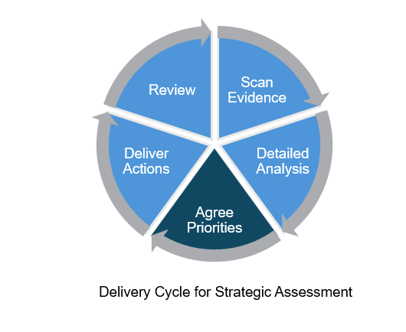
1. Purpose
The purpose of this strategic assessment is
To provide an evidence base for decision-making
To provide detailed analysis of specific issues
To help inform priorities going forward
To help facilitate discussion of the board to identify areas of concern

Slide 5
2. Executive Summary
Below is a summary of the key findings from the analysis in section 7.
Community Safety Issues
Drug offences saw a notable increase in the last year (+21%); this was primarily driven by trafficking of drug offences which saw a 67% increase across the same period. 33% of these trafficking offences were the unlawful importation of Class B drugs including cannabis and ketamine.
Overall, shoplifting has decreased in the last year (-10%). Despite this, 5 wards still saw notable increases, and these wards included Market (+15%).
Violence against the person (VAP) decreased slightly in the last year (-3%) but has remained relatively stable since YE September 2023. Stalking and harassment was the only subgroup within VAP which saw an increase in the last year (+5%).
Geographic
Similar to last year, Market and Abbey ward remain high in terms of volume and some specific crime type increases.
Newnham, whilst overall recording lower volumes of crime, did record some specific increases.

Slide 6
2. Executive Summary
Recommendations
The current priorities are still fit for purpose given the overall volume of crime in those crime types. The Partnership should consider what it is aiming to achieve in order to know when it would be ready to discharge these priorities.
Preventing violence and exploitation
This remains an area of concern for residents with the potential for high harm.
Whilst there was a very small decrease in the last year, the total number of VAP offences for the year remained over 4,000.
A neighbourhood approach
Crime and ASB occurs in geographic hotspots, and it remains vital to engage communities and work with them to tackle the things that are important to them.
Inequalities remain an issue within Cambridge City, and therefore involving communities in generating solutions that are right for them increases the likelihood of these being sustainable.
Tackling acquisitive crime
Whilst acquisitive crime is down overall since last year, it remains higher than 2021/22.
If the partnership wishes to reduce it further and bring it back to the volume of 2021/22, it will need to drop to half the amount recorded in the most recent year.

Slide 7
3. CSP Priorities
In the Cambridge Community Safety Plan (2025-2027), there are three main priorities (as listed below). The current CSP activity to achieving these priorities are included.
1. Preventing Violence and Exploitation
Develop a process for businesses and venues to raise concerns about risks to children outside the home, particularly during the nighttime economy.
Expand the reach of Cambs Against County Lines campaign.
Ensure crime prevention principles are key to the Civic Quarter re-development.
Explore continuation funding for Rose Crescent and Downing Place taxi marshals.
Explore funding for St Johns Ambulance provision on key dates in the nighttime economy.
Develop a localised community Hate Crime awareness campaign.
Renew our Purple Flag accreditation status.
2. A Neighbourhood Approach
Increase opportunities across the CSP to align our approach to neighbourhood engagement.
Work with communities to identify opportunities to utilise crime prevention funding in their neighbourhoods.
Deliver a localised response to ASB hotpots, including deployment of CCTV.
3. Tackling Acquisitive Crime
Develop a crime prevention and support pack for retail workers.
Maintain a dedicated policing team focused on those who commit the majority of thefts to tackle and reduce re-offending.
Engage retailers and support them to give best evidence.
Continue our Awareness, Infrastructure and Enforcement approach to addressing cycle crime.

Slide 8
4. Statutory Duties
Community Safety Partnerships (CSPs) were brought into existence through the Crime and Disorder Act 1998 and have a number of statutory duties. Since then, a number of pieces of legislation have changed their membership and statutory duties. Some examples include:
Formulate and implement a strategy for the reduction of crime and disorder in the area (including anti-social and other behaviour adversely affecting the local environment) as per the Crime and Disorder Act, 1998 (Section 6).
Formulate and implement a strategy for combatting the misuse of drugs, alcohol, and other substances in the area as per the Crime and Disorder Act, 1998 (Section 6).
Formulate and implement a strategy for the reduction of re-offending in the area as per the Crime and Disorder Act, 1998 (Section 6).
Formulate and implement a strategy to prevent and reduce serious violence as per the Crime and Disorder Act, 1998 (Section 6).
Have due regard to the police and crime objectives set out in their correlating area’s police and crime plan as per the Crime and Disorder Act, 1998 (Section 6(1A)).
Conduct Domestic Homicide Reviews (DHRs) as per the Domestic Violence, Crime and Victims Act, 2004, (Section 9).
Prepare a partnership plan, setting out the CSP’s priorities annually and publish the summary of the partnership plan as per the Crime and Disorder (Formulation and Implementation of Strategy) Regulations, 2007.
Carry out an annual strategic assessment assessing the extent to which the partnership plan for the previous year has been implemented and revise the partnership plan accordingly as per the Crime and Disorder (Formulation and Implementation of Strategy) Regulations, 2007.
Guidance can be found here Community Safety Partnerships - GOV.UK that outlines he statutory duties and a range of best practice examples that can be reviewed.

Slide 9
5. Comparison to year ending (YE) September 2024
Drug Offences
+21% (+73 offences)
ASB
+16% (+366 incidents)
Sexual Offences
+8% (+32 offences)
Domestic Abuse – Crimes and Non-Crimed Incidents
+13% (+328)
Deliberate Fires
+16% (+7 offences)
VAP
-3% (-127 offences)
Notes:
Sexual offences and domestic abuse have been greyed. This is because although both types have increased in the last year, it is difficult to assume the driver of these increases with high levels of underreporting in these crime types. However, it is important that these remain closely monitored due to the nature of the crimes.

Slide 10
5. Comparison to year ending (YE) September 2024
Arson and Criminal Damage
-11% (-134 offences)
Commercial Loss
-10% (-316 offences)
Personal Loss
-18% (-646 offences)
Public Order
-23% (-311 offences)
Burglary
-21% (-153 offences)
Theft
-14% (-789 offences)
Vehicle Offences
-14% (-98 offences)
Notes:
Note: Acquisitive crime has been split into commercial loss, personal loss, and vehicle offences. Therefore, burglary and theft are also included within personal loss and commercial loss.
Commercial loss includes shoplifting, robbery of business property and burglary – business and commercial.
Personal loss includes bicycle theft, other theft, residential burglary, robbery of personal property and theft from the person.

Slide 11
6. Introduction
This year the Strategic Assessment is produced as a navigable PowerPoint pack rather than a pdf document. The aim is to make the information included easier to interpret by a range of audiences. Therefore, the more detailed geographic crime data is released in a separate document. There is also a technical notes document that sits alongside these.
This pack of information is provided to the Community Safety Partnership Board for Cambridge City to support their annual cycle of identifying priorities and consider their progress to date against their existing priorities.
This new strategic assessment layout will share more detailed analysis of crime types which have increased in the last year, crime types which are currently the priority of the CSP, and any other notable changes.
In the last strategic assessment, the below crime types were highlighted as community safety issues:
  Shoplifting and Violence against the person were highlighted as requiring a high level of attention.
  Burglary and Deliberate Fires had concerning trends.
  Domestic Abuse and Hate Crime were to be monitored.

Slide 12
6. Introduction
Table 1: Crimes that either increased or were inline with previous year community safety issues
Crime Type/ Issue | Recent Trend | Longer Term Trend
Drug offences | Small volume but increase since last year | Inline with volume 2021/22
Anti-social behaviour | Increase since last year | Above 2021/22 volume
Sexual offences | Increase since last year – known under-reporting | Down compared to 2021/22
Domestic abuse | Increase since last year – known under-reporting | Crime down but non-crimed incidents slightly up compared to 2021/22. Total inline with 2021/22
Deliberate fires | Small increase since last year | Slight down compared to 2021/22
Violence against the Person | Stable compared to last year | Down compared to 2021/22

Slide 13
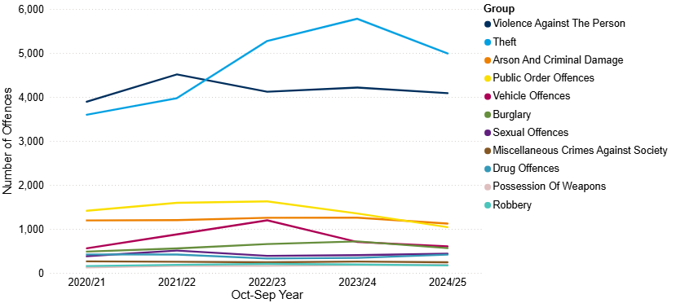
7.1 Crime Overview
Figure 1: Annual trend in police recorded offences in Cambridge City, YE September 2021 to YE September 2025
Total crime in Cambridge City has decreased in the last year, from 15,415 to 13,876 (-10%). This is the lowest count seen across the last four years, and a 3% decrease compared to year ending (YE) September 2022 (-381 offences).
Theft has accounted for the highest proportion of offences since year ending (YE) September 2023. In YE September 2025, theft accounted for 36%, and this is followed by VAP (29%).
Nationally over a similar period (YE June 2025), police recorded crime saw a 1% decrease in total crime (excluding fraud and computer misuse offences), and CSEW total crime remained similar to the previous year (ONS, 2025).
Note: Chart has been produced by Cambridgeshire County Council’s Communities and Demography PI Team, using data provided by Cambridgeshire Constabulary.

Slide 14
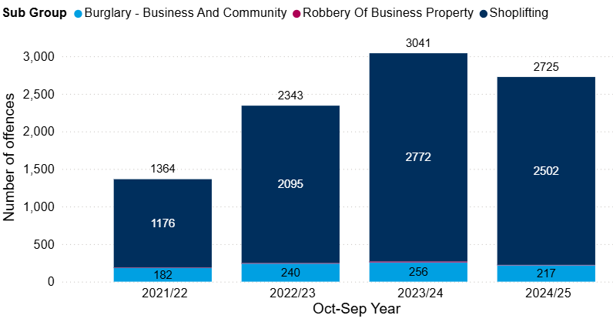
7.2 Commercial Loss
Figure 2: Annual trend in police recorded commercial loss offences in Cambridge City, YE September 2022 to YE September 2025
Commercial loss includes shoplifting, business and community burglary, robbery of a business property and any vehicle offences marked as ‘business victim’. These offences accounted for 20% of all offences in Cambridge City in the year ending (YE) September 2025.
Commercial loss offences decreased by 10% between YE September 2024 and YE September 2025 (-316 offences). This decrease was driven by all sub groups. Despite this decrease, offence counts have doubled since YE September 2021 (+100%, +1361 offences).
Shoplifting accounted for the majority of the commercial loss offences in the YE September 2025 (92%).
Note: Chart has been produced by Cambridgeshire County Council’s Communities and Demography PI Team, using data provided by Cambridgeshire Constabulary.

Slide 15
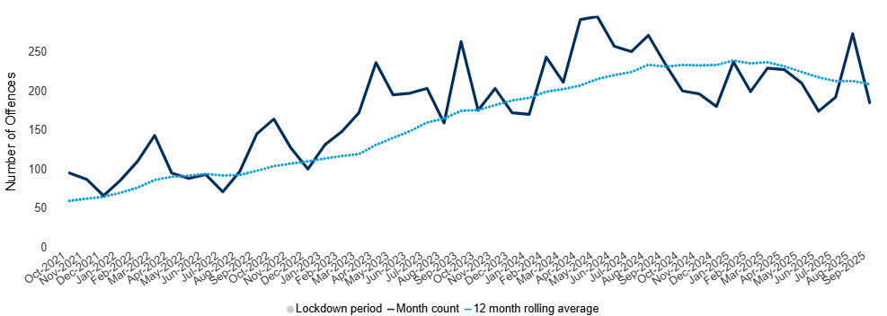
7.3 Shoplifting
Figure 3: Count of shoplifting offences in Cambridge City by month, YE September 2022 to YE September 2025
Shoplifting saw a decrease of 10% (-270 offences); however, nationally shoplifting has increased by 13% over a similar period (YE June 2025) (ONS, 2025).
Offences hit a peak in August 2025; it is also the third highest monthly count seen in the last 4 years.
As shown in Figure 3, the monthly rolling average has decreased slightly after notably increasing.
Despite the decrease, there were increases in 5 wards in the last year:
  Market (+15%, +123), West Chesterton (+23%, +54), King’s Hedges (+13%, +32), Abbey (+20%, +47) and Newnham (+200%, +14).
Note: Chart has been produced by Cambridgeshire County Council’s Communities and Demography PI Team, using data provided by Cambridgeshire Constabulary.

Slide 16
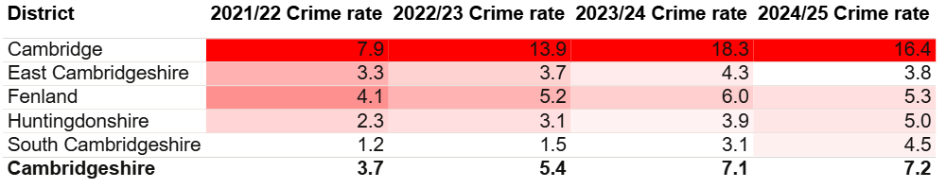
7.3 Shoplifting
Cambridge City had the highest rate per 1,000 population for shoplifting offences (16.4). As shown in Table 2, this is significantly higher than any other district rate in Cambridgeshire and the total rate for Cambridgeshire (7.2).
Given the density of retail in the Cambridge City, it is expected that shoplifting will be higher than other local authority areas in the county. In 2024, Cambridge City had the highest rate of local units per 1,000 population at 4.5; this was compared with the other Cambridgeshire districts which ranged from 3.0 and 3.6 (ONS, 2024).
Table 2: Rate per 1,000 population of police recorded shoplifting offences, between YE September 2022 and YE September 2025
Note: Table has been produced by Cambridgeshire County Council’s Communities and Demography PI Team, using data provided by Cambridgeshire Constabulary. Rates over time have been calculated using locally produced estimates and forecasts, see Technical notes for further details.

Slide 17
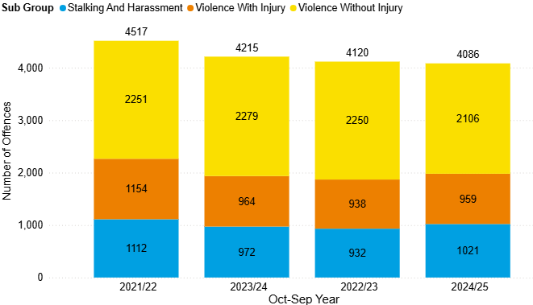
7.4 Violence Against the Person (VAP)
Figure 4: Annual trend in police recorded violence against the person (VAP) offences in Cambridge City, YE September 2022 to YE September 2025
Violence against the person (VAP) offences accounted for 29% of all offences in the year ending (YE) September 2025.
VAP offences decreased by 3% between YE September 2024 and YE September 2025 (-127).
‘Violence without injury’ accounted for the majority of VAP offences in the YE September 2025 (51%).
Stalking and harassment was the only subgroup that saw an increase in the past year in Cambridge City (+5%, +49 offences). Nationally, over a similar time period (YE June 2025), stalking offences increased by 5% and harassment offences increased by 6% (ONS, 2025).
Note: Chart has been produced by Cambridgeshire County Council’s Communities and Demography PI Team, using data provided by Cambridgeshire Constabulary.

Slide 18
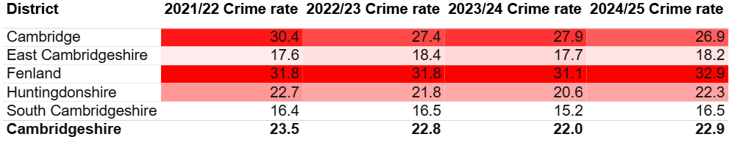
7.4 Violence Against the Person (VAP)
Table 3: Rate per 1,000 population of police recorded VAP offences, between YE September 2022 and YE September 2025
Cambridge City had the second highest rate per 1,000 population for VAP offences (26.9). This is also higher than the rate for Cambridgeshire (22.9).
Note: Table has been produced by Cambridgeshire County Council’s Communities and Demography PI Team, using data provided by Cambridgeshire Constabulary. Rates over time have been calculated using locally produced estimates and forecasts, see Technical notes for further details.

Slide 19
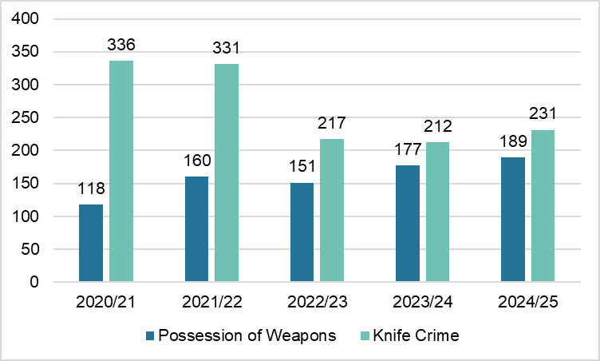
7.4 VAP - Possession of Weapons and Knife Crime
Figure 5: Annual trend in knife crime and possession of weapons offences in Cambridge City, YE September 2021 to YE September 2025
Possession of weapons offences have continued to increase despite a small dip in figures in YE September 2023. In the last year, offences have increased by 7% (+12 offences). Nationally, police recorded ‘possession of article with a blade or point’ offences saw an increase between YE June 2024 and YE June 2025 (+3%) (ONS, 2025).
Despite reaching a peak in the YE September 2021 at 336 knife crime marked offences, from the YE September 2023 onwards, counts notably dropped. However, in the last year, knife crime marked offences increased from 212 (YE September 2024) to 231 (YE September 2025). This is an increase of 9%.
Nationally, knife-enabled crime saw a decrease of 5% over a similar time period (YE June 2025), with offence course reaching levels lower than seen in March 2020 (ONS, 2025).
Note: Chart has been produced by Cambridgeshire County Council’s Communities and Demography PI Team, using data provided by Cambridgeshire Constabulary CADET.

Slide 20
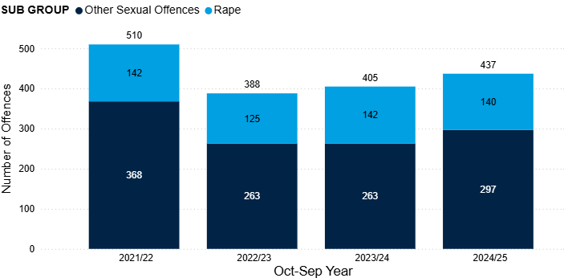
7.5 Sexual Offences
Sexual offences have seen incremental increases since YE September 2023, from 388 to 437 (+13%). Despite these increases, the number of offences is still lower than seen in the YE September 2022 (-14%, -73 offences).
In the last year, sexual offences increased by 8% (+32 offences). This increase was driven by ‘other sexual offences’; this subgroup saw a 13% increase in this period (+34 offences).
Rape offences accounted for 32% of all sexual offences in YE September 2024; this is slightly lower than 34% seen nationally over a similar time period (YE June 2025) (ONS, 2025).
Sexual offences accounted for the second highest proportion of DA marked offences (8%); this proportion has increased over the last 4 years (from 5% to 8%).
Figure 6: Annual trend in police recorded sexual offences in Cambridge City, YE September 2022 to YE September 2025
Note: Chart has been produced by Cambridgeshire County Council’s Communities and Demography PI Team, using data provided by Cambridgeshire Constabulary.

Slide 21
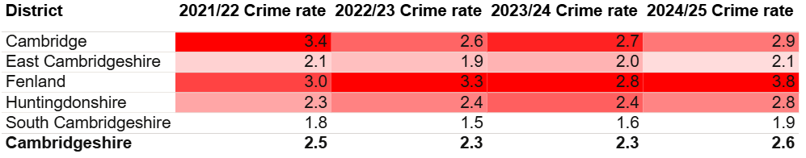
7.5 Sexual Offences
Table 4: Rate per 1,000 population of police recorded sexual offences, between YE September 2022 and YE September 2025
As seen in Table 4, Cambridge City had the second highest rate per 1,000 in the YE September 2025 (2.9). This was slightly higher than the rate per 1,000 for Cambridgeshire (2.6).
Note: Table has been produced by Cambridgeshire County Council’s Communities and Demography PI Team, using data provided by Cambridgeshire Constabulary. Rates over time have been calculated using locally produced estimates and forecasts, see Technical notes for further details.

Slide 22
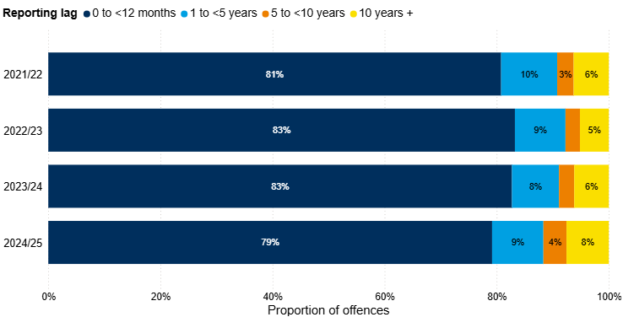
7.5 Sexual Offences
Figure 7: Number of years between offence start date and offence recorded date for police recorded sexual offences in Cambridge City, YE September 2022 to YE September 2025
The proportion of historical offences increased in the YE September 2025. This accounted for 21% of all sexual offences recorded in this period. In YE September 2024, this proportion was 17%.
Note: Chart has been produced by Cambridgeshire County Council’s Communities and Demography PI Team, using data provided by Cambridgeshire Constabulary.
Notes:
Reporting sexual offences does not always happen immediately after the offence has occurred. Analysis has been completed on the difference between the date an offence was recorded by the police and the date when the offence occurred. It should be noted that offences can span a wide time period, and analysis here focuses on the offence start date rather than the offence end date due to data completeness.

Slide 23
7.5 Sexual Offences - What are the CSP doing about Sexual Offences?
The Community Safety Partnership is working with local and national partners to prevent sexual offences and support victims:
Safer Streets Projects: Funded by the Home Office and led by the Police and Crime Commissioner, initiatives in Cambridge, Fenland, Huntingdonshire, and Peterborough focus on preventing violence against women and girls, especially in the night-time economy. Improvements include extra lighting, CCTV, and refuge points in Cambridge City Centre.
Education Through Sport: The Pledge Programme by Cambridge United Foundation uses football to challenge harmful gender norms. Over 120 young people completed the course, all pledging to respect women and girls.
School-Based Prevention: A joint project by Cambridge Rape Crisis Centre and Cambridge United Foundation is being planned to build on the successful Ambassador and Pledge programmes to educate students about sexual violence and promote respectful relationships (April-September 2025).
Awareness Events:
  At Cambridge Station, an information stall provided safety advice and support resources to over 50 visitors (December 2024).
  During Sexual Abuse and Sexual Violence Awareness Week, council staff shared messages under the theme #ITSNOTOK, promoting support services and volunteering with Cambridge Rape Crisis Centre (February 2025).

Slide 24
7.6 Domestic Abuse
Table 5: Police recorded Domestic Abuse (DA) incidents and crimes recorded in Cambridge City, 2021/22 to 2024/25 (YE September)
Overall, domestic abuse (DA) crimes and incidents saw a 5% increase in the last year (between YE September 2024 and YE September 2025).
DA related incidents saw an increase of 14% between YE September 2024 and YE September 2025 (+152 incidents). As shown in Table 5, this is the highest count seen over the last four years.
DA marked crimes remained similar to last year but remain lower than numbers seen in YE September 2022.
Just under half of reported DA incidents were ‘crimed’ at 48%; this is the lowest proportion seen across the last four years.
Incident category | 2021/22 | 2022/23 | 2023/24 | 2024/25
Total police recorded DA (incidents & crimes) | 2532 | 2089 | 2414 | 2541
Total DA marked crimes | 1681 | 1319 | 1495 | 1470
Total DA incidents | 1923 | 1641 | 1914 | 2062
Incidents that result in a crime being recorded | 1072 | 871 | 995 | 991
Incidents that remain as incident only | 851 | 770 | 919 | 1071
Proportion of incidents that were ‘crimed’ | 56% | 53% | 52% | 48%
Note: Table has been produced by Cambridgeshire County Council’s Communities and Demography PI Team, using data provided by Cambridgeshire Constabulary.
Notes:
The decrease seen in YE September 2023 is likely to have been impacted by the change in new Home Office counting rules introduced in April 2023. This was referenced in the previous strategic assessment, which can be found here: Cambridgeshire & Peterborough Insight – Crime & Community Safety – Community Safety Partnerships – Cambridge City
The increase in incidents could be a result of online incident reporting making it more accessible for people to raise concerns and report incidents.

Slide 25
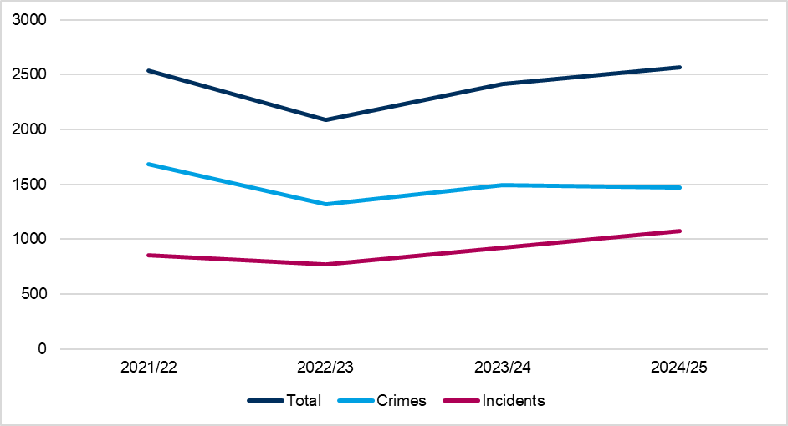
7.6 Domestic Abuse
Figure 8: Police recorded Domestic Abuse (DA) crimes and incidents (non-crimed only) in Cambridge City, 2021/22 to 2024/25 (YE September)
Overall, domestic abuse (DA) crimes and incidents saw a 5% increase in the last year (between YE September 2024 and YE September 2025).
DA related incidents saw an increase of 14% between YE September 2024 and YE September 2025 (+152 incidents). As shown in Figure 8, this is the highest count seen over the last four years.
DA marked crimes remained similar to last year but remain lower than numbers seen in YE September 2022.
Just under half of reported DA incidents were ‘crimed’ at 48%; this is the lowest proportion seen across the last four years.
Note: Chart has been produced by Cambridgeshire County Council’s Communities and Demography PI Team, using data provided by Cambridgeshire Constabulary.
Notes:
The decrease seen in YE September 2023 is likely to have been impacted by the change in new Home Office counting rules introduced in April 2023. This was referenced in the previous strategic assessment, which can be found here: Cambridgeshire & Peterborough Insight – Crime & Community Safety – Community Safety Partnerships – Cambridge City
The increase in incidents was said by Cambridgeshire Constabulary to potentially be a result of online incident reporting making it more accessible for people to raise concerns and report incidents.

Slide 26
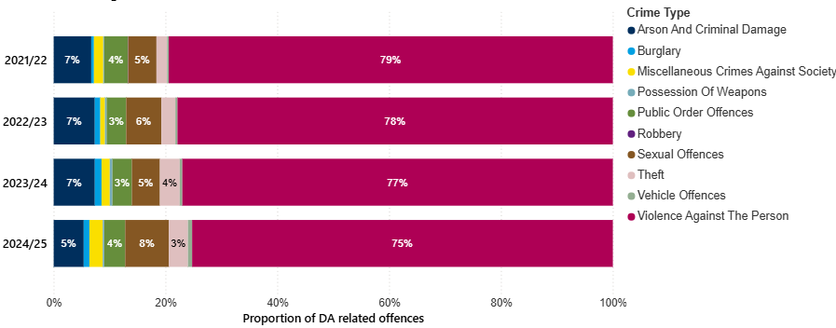
7.6 Domestic Abuse
Figure 9: Crime type breakdown of Domestic Abuse (DA) related offences recorded in Cambridge City, 2020/21 to 2023/24 (YE September)
Similar to national figures for YE June 2025, the crime type with the highest proportion is violence against the person (VAP) offences. This proportion has decreased slightly in Cambridge City over the last four years as seen in Figure 9. However, VAP still accounted for 75% of the DA marked crimes in YE September 2025.
Sexual offences accounted for the second highest proportion (8%); this proportion has increased over the last four years.
Note: Chart has been produced by Cambridgeshire County Council’s Communities and Demography PI Team, using data provided by Cambridgeshire Constabulary.

Slide 27
7.6 Domestic Abuse
Table 6: Rate per 1,000 population of domestic abuse (incidents and crimes), between YE September 2022 and YE September 2025
As seen in Table 6, Cambridge City had the third highest rate per 1,000 in the YE September 2025 (16.7). This was similar to the rate per 1,000 for Cambridgeshire (16.5).
Note: Table has been produced by Cambridgeshire County Council’s Communities and Demography PI Team, using data provided by Cambridgeshire Constabulary. Rates over time have been calculated using locally produced estimates and forecasts, see Technical notes for further details.

Slide 28
7.6 Domestic Abuse - Domestic Abuse Related Death Reviews (DARDRs)
3 DARDRs (formerly Domestic Homicide Reviews) are nearing completion from the previous year and presented to the CSP.
All 3 city residents died by suicide having experienced domestic abuse.
The DARDRs will be sent to the Home Office Quality Assurance Board and action plans produced for each review monitored by the Cambridge CSP.

Slide 29
7.6 Domestic Abuse - What are the CSP doing about Domestic Abuse?
Work closely with partners
Cambridge CSP collaborates with the Cambridgeshire & Peterborough Domestic Abuse and Sexual Violence (DASV) Partnership to reduce harm and prevent abuse.
The CSP contributed to the DASV Strategy 2024–27 and its action plan and is represented on the Countywide DASV Strategic Board, and Domestic Abuse Operations Group (formerly VAWG Operational Group).
Cambridge CSP submitted a formal response to the County DASV Service restructure consultation, which resulted in reduced IDVA provision due to financial pressures. As of 6 May 2025, the IDVA Service and MARAC have been separated across Cambridgeshire and Peterborough, with reduced referral pathways.
Cambridge City Council
Specialist Housing Worker role - since January 2022 funded by the Domestic Abuse Act Safer Accommodation Funding until at least 31 March 2026. The role supports those housed in Cambridge City as a result of fleeing domestic abuse, raises awareness among identified groups with low levels of domestic abuse reporting, contributes to the continuous review of the Council’s response, and provision of service, advice, and housing, to those experiencing and fleeing domestic abuse.
19 cases were supported by the new Specialist Housing Worker (from role commencing 14 July to 30 September)
140 MARAC (Multi-Agency Risk Assessment Conference) cases were collated for City Homes
242 Domestic Abuse related homelessness presentations
Completion of the Sanctuary Schemes survey as part of the Domestic Abuse Act 2021 Part 4 evaluation (September 2025)
Domestic Abuse Housing Alliance (DAHA) Accreditation - successful reaccredited in July 2023, maintaining its status as the first local authority in East Anglia to achieve this national benchmark. The Council continues to work with partner agencies through quarterly meetings and monitoring, ahead of the next reaccreditation in June 2026 - https://www.dahalliance.org.uk
Ongoing work as a licensing authority with safeguarding, equality, and protection training for all licensed taxi drivers. Attendance at refresher training is required every three years. Raising awareness to the public about the different services and support available.
Events and Campaigns
Annual Conference (2 December 2024): Held to mark the UN Day for the Elimination of Violence Against Women and the start of 16 Days of Action to 10 December - Human Rights Day, featuring speakers on AI, Trans and Non-Binary victims, Honour-Based Abuse, and the White Ribbon Campaign.
Survivors Conference (25 March 2025): Supported by the City Council and led by Cambridge Women’s Aid to ensure survivor voices shape services.
White Ribbon Campaign status since 2015 reaccredited until March 2027. Activities include public engagement, such as at a Cambridge United Football match during 16 Days of Action (November 2024) https://www.whiteribbon.org.uk

Slide 30
7.7 Modern Slavery
The latest National Crime Agency (NCA) Strategic Assessment for 2024 highlighted issues that are influencing risk of exploitation, which local CSPs should be alert to:
An increase in labour exploitation in the UK may be linked to ongoing workforce shortages in some sectors. Labour exploitation is most likely to occur in sectors with lower pay, and informal or insecure working arrangements (NCA, 2024).
A higher number of referrals in the first quarter of 2023 was likely linked to the high number of small boats arrivals in 2022, with irregular migrants being vulnerable to exploitation in the UK.
Changes to the NRM reporting criteria likely impacted the number of referrals being made and could be linked to a comparatively low number recorded in quarter 2 of 2023.
The CSP should also be aware that changes in 2024 mean that there are now fewer options for Ukrainian refugees wanting to flee to the UK. Refugees who are able to enter the UK on fraudulent VISA applications (i.e. without a legitimate sponsor) may be at risk of exploitation.

Slide 31
7.7 Modern Slavery
Whilst district level data is not available, data is available on the NRM referrals made where Cambridgeshire Constabulary was the first responder. The Cambridgeshire Constabulary police force area covers both Cambridgeshire and Peterborough. The latest end of year summary available is for 2024.
Of the 63 NRM referrals made by Cambridgeshire Constabulary in 2024, more than three quarters were males, accounting for 76% of referrals. This is a similar proportion to what was recorded in 2023 (77%).
When looking at ages (at time of referral), 65% were adults (18 and over). Adult males accounted for almost half of the total referrals (48%).
Almost half of referrals were from the UK (54%). The next most common nationalities were Albanian (8%) and Vietnamese (8%).
The most common exploitation type was “criminal exploitation” (56%).
The next most common exploitation type was “labour and criminal exploitation” (16%).
Of the 63 referrals where Cambridgeshire Constabulary were first responders, 89% were investigated by Cambridgeshire Constabulary. This is 56 referrals. In total, Cambridgeshire Constabulary investigated 159 referrals; in 2024, there were no referrals from Fenland District Council in this year.
(Home Office, 2025a; Home Office, 2025b).
Notes:
Note that this does not necessarily reflect that Cambridgeshire Constabulary was the responsible police force. See technical notes on the NRM process in Appendix A.7 NRM data.

Slide 32
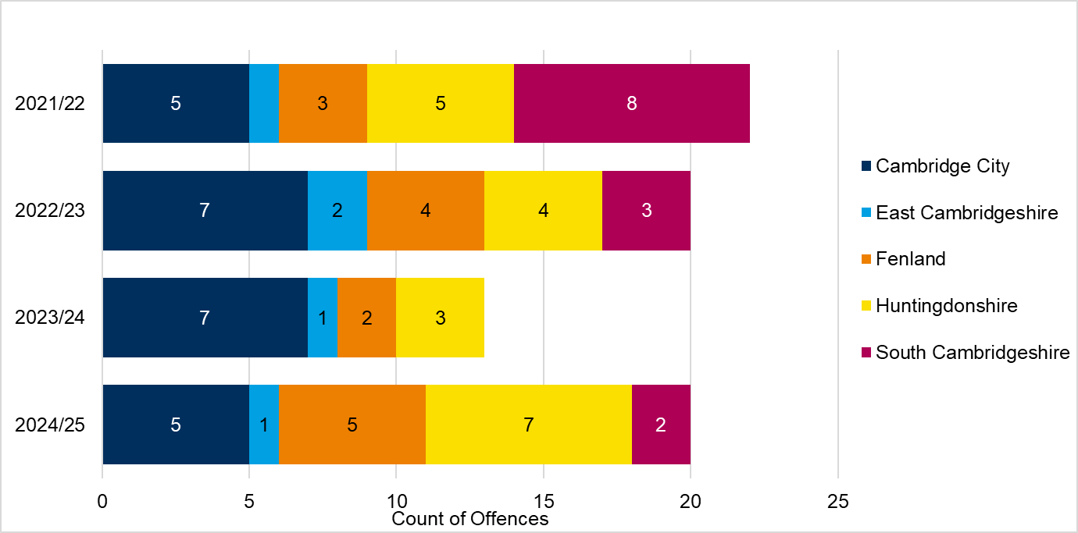
7.7 Modern Slavery
Figure 10: Police recorded modern slavery offences by district, 2021/22 to 2024/25 (YE September)
The total number of modern slavery offences in Cambridgeshire was the same as 2022/23 at 20 offences. This is a 54% increase on the previous year.
There were 5 modern slavery offences in Cambridge City.
Note: Chart has been produced by Cambridgeshire County Council’s Communities and Demography PI Team, using data provided by Cambridgeshire Constabulary CADET.
Notes:
These numbers should not be taken as a true representation of the levels of modern slavery offending in Cambridge City, or countywide, due to high levels of underreporting for this crime type. It should also be noted that local district boundaries are irrelevant to the trafficking and exploitation of people as organised crime gangs are known to move people within the UK. The Partnership should work closely with cross-border agencies.

Slide 33
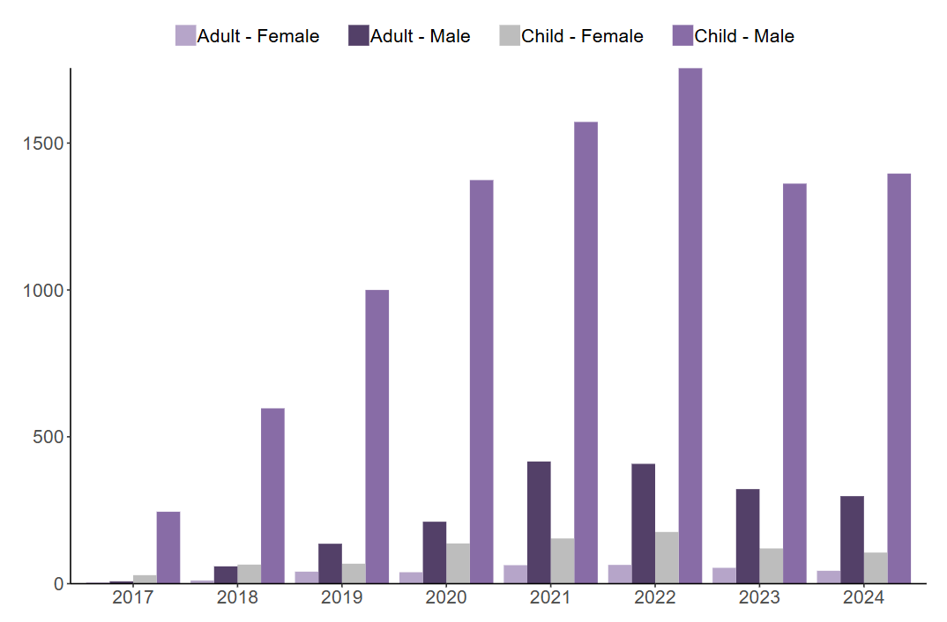
7.8 County Lines
Figure 11: Number of NRM referrals flagged nationally as county lines, by age group at exploitation and gender, 2017 to 2024
County Lines refers to a model of offending whereby gangs and organised crime groups move drugs into supply areas within the UK via the exploitation of vulnerable individuals. These individuals are recruited and coerced into the drug supply chain (NCA, 2019).
The latest strategic assessment published by the National Crime Agency highlights that a large proportion of British victims of modern slavery are exploited within county lines activity. Across the UK, the NCA suggested that heroine and crack cocaine are the drugs most commonly supplied by county lines (NCA, 2024).
The NRM referral system flags referrals that relate to county lines. In 2024, nationally, 10% of all referrals received were flagged as county lines. The majority of these referrals were for male children (76%) as shown in Figure 24; this cohort have consistently accounted for the majority of county lines flagged referrals (Home Office, 2025a).
Source: Figure 8 in Modern Slavery end of year summary 2024 report (Home Office, 2025a).
Note: See technical notes for NRM data in section A.7. NRM referrals.

Slide 34
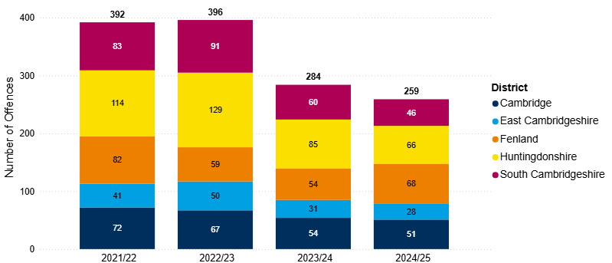
7.9 Child Sexual Exploitation (CSE)
Figure 12: Annual trend of police recorded CSE offences in Cambridge City, 2021/22 to 2024/25 (YE September)
A national report on child sexual abuse and exploitation (CSAE) was released in January 2024 by the Vulnerability Knowledge & Practice Programme. It should be noted that the report flags that figures do not account for underreporting on this crime type, particularly for boys, minority communities, migrant groups, and those with disabilities (Vulnerability Knowledge & Practice Programme, 2024).
In the last year CSE offences in Cambridge City have decreased by 6% (-3 offences). This is slightly less than the county-wide picture; Cambridgeshire CSE offences decreased by 9% between YE September 2023 and YE September 2024 (-25 offences).
Note: Chart has been produced by Cambridgeshire County Council’s Communities and Demography PI Team, using data provided by Cambridgeshire Constabulary.
Notes:
CSE is a marker that can be applied to any offence that fits the criteria for CSE by police. It is worth noting that like other markers that can be applied there is a potential level of inconsistency in the application of the marker. It would be worth investigating how reliable the marker is as an accurate reflection of CSE crimes within the local police data.

Slide 35
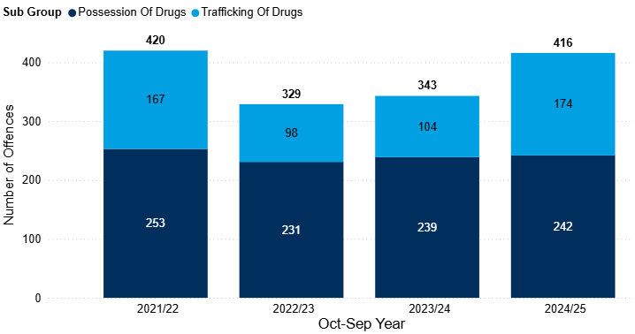
7.10 Drug Offences
Figure 13: Annual trend in police recorded drug offences in Cambridge City, YE September 2022 to YE September 2025
Drug offences have seen incremental increases since YE September 2023 from 329 to 416 (+26%). These increases have meant that the number of drug offences has reached a similar count to that seen in YE September 2022 (-1%, -4 offences).
In the last year, drug offences increased by 21% (+73 offences). This increase was primarily driven by ‘trafficking of drugs’, and this subgroup saw a 67% increase in this period (+70 offences).
Nationally, police recorded drug offences saw an 18% increase between YE June 2024 and YE June 2025. Although both possession and trafficking saw increases, this was largely driven by the increase in trafficking offences (+39%) (ONS, 2025).
Note: Chart has been produced by Cambridgeshire County Council’s Communities and Demography PI Team, using data provided by Cambridgeshire Constabulary.

Slide 36
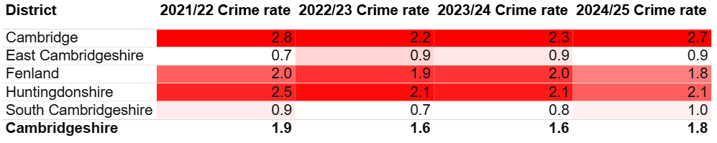
7.10 Drug Offences
Table 7: Rate per 1,000 population of police recorded drug offences, between YE September 2022 and YE September 2025
As seen in Table 7, Cambridge City had the highest rate per 1,000 population in the YE September 2025 (2.7). This was higher than the rate per 1,000 for Cambridgeshire (1.8).
Note: Table has been produced by Cambridgeshire County Council’s Communities and Demography PI Team, using data provided by Cambridgeshire Constabulary. Rates over time have been calculated using locally produced estimates and forecasts, see Technical notes for further details.

Slide 37
7.10 Drug Offences - Trafficking of Drug Offences
As previously mentioned, trafficking of drugs largely influenced the increase in drug offences in the last year. A breakdown of the top 5 offences is shown below. ‘Unlawful importation of a drug controlled under the Misuse of Drugs Act 1971’, regardless of the drug class, accounted for almost half of all trafficking of drug offences in the YE September (46%, 80 offences).
More specifically, ‘unlawful importation of a drug controlled under the Misuse of Drugs Act 1971 – Class B’ accounted for 33% of trafficking of drug offences. Class B drugs include amphetamine, cannabis, synthetic cannabinoid receptor agonists, ketamine and mephedrone (including cathinone derivatives).
This highlights that Class B drugs are the most common type found.
Table 8: Top 5 Offences, based on count, under ‘Trafficking of Drugs’ in Cambridge City, YE September 2025
Ward analysis has been done on all drug offences. In the last strategic assessment (YE September 2024), Market accounted for the highest proportion of drug offences at 30%; in the YE September 2025, both Abbey and Petersfield accounted for the highest proportions at 15% and 13% respectively. Market accounted for 9% in YE September 2025.
Note: Table has been produced by Cambridgeshire County Council’s Communities and Demography PI Team, using data provided by Cambridgeshire Constabulary.

Slide 38
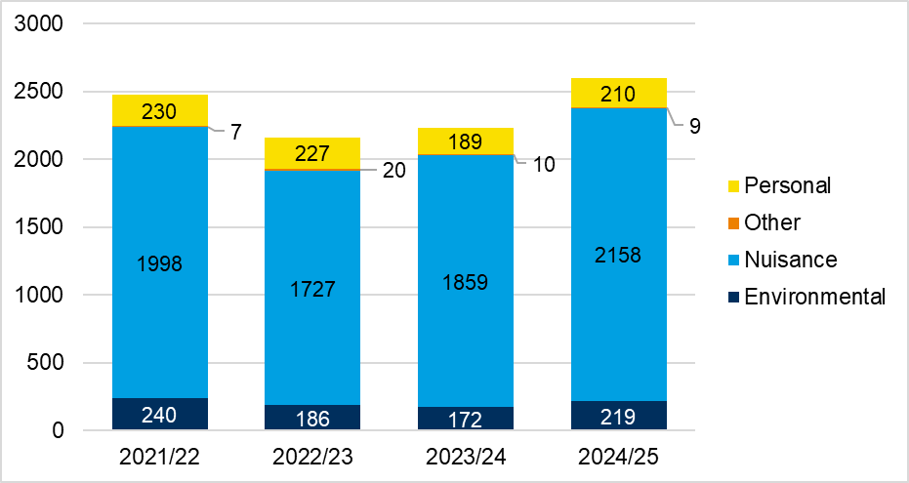
7.11 Anti-Social Behaviour (ASB)
ASB has seen incremental increases since YE September 2023, from 2,160 to 2,596 (+20%). The number of ASB incidents has thus reached a higher count than seen in YE September 2022 (+5%, +121 incidents).
In the last year, ASB increased by 16% (+366 offences). This increase was primarily driven by ‘nuisance’ ASB; this type saw a 16% increase in this period (+299 offences). However, both ‘personal’ and ‘environmental’ saw increases of +21 (11%) and +47 (27%) respectively.
All but one ward saw increases in the last year - some smaller increases than others. The most notable changes were in Trumpington (+58%, +73), Queen Edith’s (+57%, +50), and Newnham (+51%, +20). Refer to the geographic output file for more detail.
Figure 14: Annual trend in police recorded ASB incidents in Cambridge City, YE September 2022 to YE September 2025
2475
2596
2160
2230
Note: Chart has been produced by Cambridgeshire County Council’s Communities and Demography PI Team, using data provided by Cambridgeshire Constabulary.

Slide 39
7.11 Anti-Social Behaviour (ASB)
Table 9: Rate per 1,000 population of police recorded ASB incidents, from YE September 2022 and YE September 2025
As seen in Table 9, Cambridge City had the highest rate per 1,000 population in the YE September 2025 (17.1). This was notably higher than the rate per 1,000 for Cambridgeshire (13.6).
Note: Table has been produced by Cambridgeshire County Council’s Communities and Demography PI Team, using data provided by Cambridgeshire Constabulary. Rates over time have been calculated using locally produced estimates and forecasts, see Technical notes for further details.

Slide 40
7.11 ASB - Youth-related Anti-Social Behaviour (ASB)
Table 10: Police recorded ASB incidents and the proportion where a youth-related keyword has been identified, from 2021/22 to 2024/25 (YE September)
The proportion of youth-related ASB has fluctuated over the past 4 years. In the last year, the proportion is the lowest it has been over this period (15%) as seen in Table 10. Youth-related ASB has slightly increased by 3% in the last year (+13 offences).
Note: Table has been produced by Cambridgeshire County Council’s Communities and Demography PI Team, using data provided by Cambridgeshire Constabulary.
Notes:
Youth-related ASB has been analysed by applying a keyword search to the incident description field to identify incidents that are likely to be youth-related. It should be noted that this is not a perfect measure. It may include some incidents where young people were present or victims, but the incident itself was not directly attributable to young people. Despite this limitation, it represents the best available indicator of police recorded youth-related ASB

Slide 41
7.11 ASB - Youth-related Anti-Social Behaviour (ASB)
Table 11: Rate per 1,000 population of police recorded youth-related ASB incidents, from YE September 2022 and YE September 2025
As seen in Table 11, Cambridge City had the third highest rate per 1,000 population in the YE September 2025 (2.6). This was similar to the rate per 1,000 for Cambridgeshire (2.7).
Fenland had the highest rate at 3.2.
Note: Table has been produced by shire County Council’s Communities and Demography PI Team, using data provided by Cambridgeshire Constabulary. Rates over time have been calculated using locally produced estimates and forecasts, see Technical notes for further details.

Slide 42
7.11 ASB - ASB Case Study 1
Partnership Working – Interim Injunction Granted to Protect Residents at mixed tenure block of flats
“Cambridge City Council’s Anti-Social Behaviour (ASB) and Housing Teams worked in close partnership with Cambridgeshire Constabulary to respond to escalating and violent behaviour from a tenant of the flats.
Over a few months, the Council received multiple reports of serious ASB, including threats to kill, violent assaults, possession of offensive weapons, and intimidation of residents. Residents expressed significant fear of reprisals, with several unwilling to provide statements due to safety concerns. The case was assessed as high risk due to threats, intimidation, and the use of weapons. Safeguarding referrals and additional patrols were put in place.
A coordinated response was initiated between Cambridge City Council’s Housing and ASB Teams, Cambridgeshire Constabulary, and Legal Services leading to the successful application of an emergency without notice injunction with Power of Arrest. This outcome provided immediate protection for residents.
Through strong partnership working, proactive information sharing, and decisive legal action, the Council and Police were able to act swiftly to restore safety and community confidence.
This case demonstrates effective multi-agency collaboration in managing high-risk ASB and safeguarding vulnerable residents. The case also highlights the importance of early escalation and intelligence sharing between housing and police, using both civil and tenancy enforcement tools in tandem and providing reassurance and protection to witnesses who fear retaliation.”
Note: Case study supplied by Cambridge City Council.

Slide 43
7.11 ASB - ASB Case Study 2
The Role of the Public Safety Officer in Tackling Street-Based Anti-Social Behaviour
“As part of the Council’s Transformation process, the former role of Street Support Officer has been restructured and renamed to Public Safety Officer (PSO), reflecting the integration of teams under a new identity. The PSO plays a key role in engaging positively and assertively with the street-based community to address persistent anti-social behaviour (ASB) in the city.
The PSO undertakes regular patrols in the City Centre and has the flexibility to carry out ad hoc visits to locations associated with begging or rough sleeping. Working closely with the Police and partner agencies through the Street Life Working Group, the PSO has access to relevant information about individuals involved in street-based ASB, enabling a coordinated approach.
During patrols, the PSO interacts frequently with members of the street community, offering support to access services while holding informed conversations about personal circumstances, behaviours, and the consequences of ASB.
In one case, a small family group responsible for significant ASB had recently arrived in the city following enforcement action elsewhere in the county. The PSO built a constructive relationship with the elder brother by engaging consistently and listening to his concerns, while clearly explaining the implications of continued ASB. This approach earned trust and cooperation.
Once the individual modified his own behaviour, he assisted the PSO in encouraging others within the group to do the same. As a result, the group cleared their sleeping sites, stopped leaving waste behind, and ceased storing possessions in a car park.
Progress continues: one member has now been reconnected to their home area and provided with accommodation, while efforts are underway to secure housing for the remaining two individuals in their areas of local connection outside the city.”
Note: Case study supplied by Cambridge City Council.

Slide 44
7.11 ASB - What are the CSP doing about ASB?
Service Transformation:
ASB and Environmental Enforcement Teams merged (April 2025).
Recruitment and training underway to build team capacity.
Preventative approaches (e.g., Neighbourhood Resolution) continue; enforcement used when necessary.
Preventative Work Highlights:
Neighbourhood Resolution Panel: 21 referrals – Noise (10), Children/ball games (3), Parking (2), Other neighbour disputes (6).
Street-Based ASB: Temporary vacancy filled; role redefined as Public Safety Officer. Focus on coordinated response to sleep sites and encampments.
City Centre Working Group: Met Oct 2; discussed night-time economy ASB. Partnership with BID, police, CAMBAC to encourage business reporting.
Cambridge Street Aid:
5 contactless terminals; expansion planned with Cambridge University.
Pop-up shop opened (Oct 2024); Street Aid Week 2025 promoted via social media and drop-ins.
Community Problem Solving:
OPCC-funded role supports:
Facilitated stakeholder engagement in 27 ASB hotspots.
Successful bid for Home Office funding for Pledge Programme (delivered in 6 schools).
Management of 20 redeployable CCTV cameras; 12 locations monitored for fly-tipping, drugs, weapons, vehicle nuisance, graffiti, hate related abuse, robberies, and youth-related ASB.
Contextual Safeguarding:
Operation Alleviate launched (March 2025) to enable businesses to refer concerns about children at risk into Risk Outside the Home (ROTH) pathway.
Peer Group & Places Meeting (PGPM): 35 individuals, 14 locations discussed; ASB decreased in all but one. 4 of the individuals and 3 locations were discussed as part of Op Alleviate referrals.
Workshops delivered in schools, training for mobile library staff.
Posters created on serious violence topics (drugs, knife crime, online abuse, unhealthy friendships).
Cambs Against County Lines:
Sessions delivered in secondary schools and to various stakeholders.
4 facilitator training sessions across the county.
Awareness sessions for school and charity staff.
Posters widely disseminated.
Exploring alternatives to current film resource (license ends Dec 2026).
Healthy Belonging package still available, but access tracking limited due to staffing changes.

Slide 45
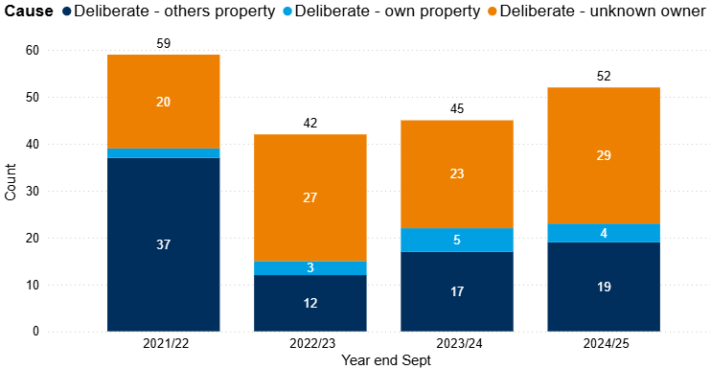
7.12 Deliberate Fires
Figure 15: Annual trend in deliberate fires in Cambridge City, YE September 2022 to YE September 2025
In the year ending (YE) September 2025, there were 239 fires in Cambridge City; this is an 11% increase from the last year (+24 fires).
Of the 239 fires, 22% were deliberate fires (52 fires).The number of deliberate fires have seen incremental increases since YE September 2023 as seen in Figure 6. In the last year, deliberate fires increased by 16% (+7). However, numbers are still lower than see in YE September 2022 (-12%, -7 fires).
‘Deliberate – unknown owner’ accounted for the largest proportion of deliberate fires at 56% (29 out of 52).
Note: Chart has been produced by Cambridgeshire County Council’s Communities and Demography PI Team, using data provided by Cambridgeshire Fire and Rescue Service.

Slide 46
7.12 Deliberate Fires
Table 12: Rate per 1,000 population of deliberate fires, between YE September 2022 and YE September 2025
Cambridge City had the lowest rate per 1,000 population in the YE September 2025 (0.3) when compared with other Cambridgeshire districts.
Note: Table has been produced by Cambridgeshire County Council’s Communities and Demography PI Team, using data provided by Cambridgeshire Fire and Rescue Service. Rates over time have been calculated using locally produced estimates and forecasts, see Technical notes for further details.

Slide 47
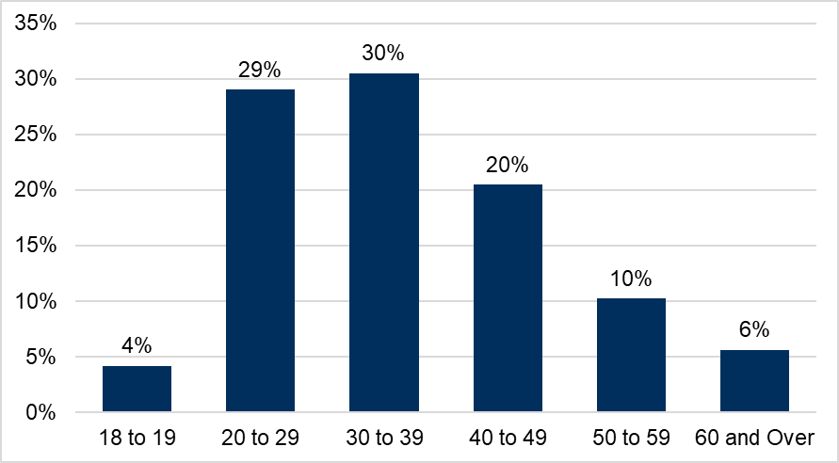
7.13 Probation
Figure 16: Proportion of age groups of those open to the Probation Service in 2025, residing in Cambridge City
The Probation Service have provided a caseload profile for individuals residing in Cambridge City who were open to the service at some point within 2025; in this instance, there were 479 people.
The majority of the cohort were males, with a split of 87% males and 13% females.
30 to 39 years old accounted for the largest proportion of the cohort at 30%, closely followed by 20- to 29-year-olds (29%). In total, 20- to 39-year-olds accounted for over half of the cohort (59%).
18- to 19-year-olds accounted for 4% of the cohort, it is to be expected that this proportion is smaller as there are only two single years of age.
Note: Chart has been produced by Cambridgeshire County Council’s Communities and Demography PI Team, using data provided by Cambridgeshire and Peterborough Probation Service.

Slide 48
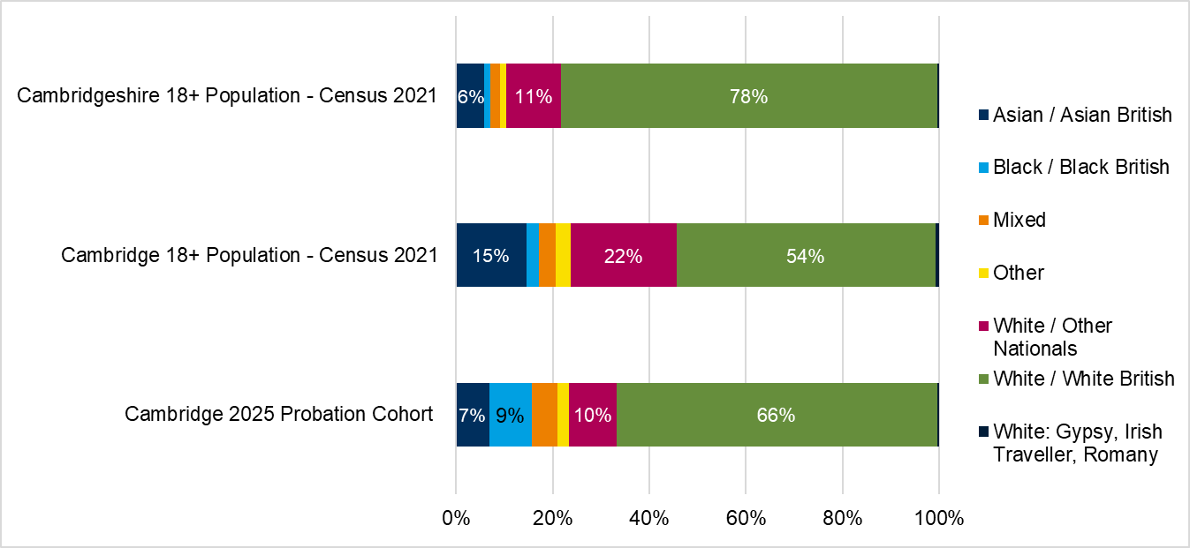
7.13 Probation
Figure 17: Proportion of ethnic group comparison, Cambridge City Probation Service cohort, Cambridge Census 2021 Population and Cambridgeshire Census 2021 Population
6% (30 out of 479) of the current Cambridge City probation caseload had no ethnicity recorded.
Of those who’s ethnicity was recorded (449), Figure 17 shows that the majority of the probation cohort were White British at 66%, overrepresented in comparison to the Cambridge City Census population (54%) but underrepresented when comparing to the overall Cambridgeshire Census population (78%).
Note: Chart has been produced by Cambridgeshire County Council’s Communities and Demography PI Team, using data provided by Cambridgeshire and Peterborough Probation Service.

Slide 49
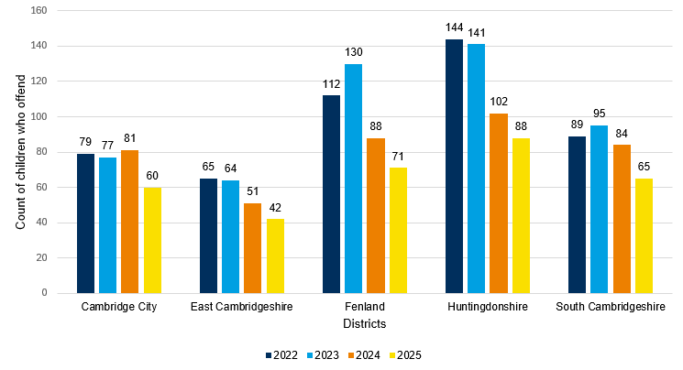
7.14 Youth Justice Service (YJS)
Figure 18: Count of children who offend by district, 2022 to 2025
Figure 18 shows that Cambridge City has the fourth lowest count of children who offend compared to other districts between 2022 and 2025. East Cambridgeshire has the lowest count for each year between 2022 and 2025.
Except for an increase in 2024, there has been a 24% overall decrease in the number of children who offend in Cambridge City between 2022 and 2025.
Table 13 below shows that there has been a decreasing trend in the average offences per child in Cambridge City between 2022 and 2025.
Table 13: Average offences per child who offend by district, 2022 to 2025
Districts | 2022 | 2023 | 2024 | 2025
Cambridge City | 1.73 | 1.65 | 1.59 | 1.35
East Cambridgeshire | 2.20 | 1.45 | 1.20 | 1.10
Fenland | 1.59 | 1.76 | 1.34 | 1.86
Huntingdonshire | 1.44 | 1.28 | 1.43 | 1.44
South Cambridgeshire | 1.12 | 1.24 | 1.68 | 1.40
Note: Chart has been produced by Cambridgeshire County Council’s Communities and Demography PI Team, using data provided by Cambridgeshire Youth Justice Service.

Slide 50
7.14 Youth Justice Service
Table 14: FTEs and Outcomes of children who offend in Cambridge City, 2022 to 2025
Outcome | 2022 | 2023 | 2024 | 2025
First Time Entrants (FTEs) | 28 | 18 | 16 | 8
Out of Court Resolutions (OOCRs) | 68 | 61 | 76 | 58
Court Sentences | 28 | 24 | 21 | 13
Table 14 shows that except for an increase in OCRs in 2024, there has been a general decline in FTEs, OOCRs, and Court Sentences in Cambridge City between 2022 and 2025.
Most OOCRs in Cambridge City are non-substantive outcomes and range between 79% in 2022 and 91% in both 2024 and 2025.
Table 15 shows that violence against the person (VAP) has consistently been the most common offence type in Cambridge City between 2022 and 2025. Theft and handling stolen goods, drugs, and criminal damage are the next most common offence types.
Table 15: Offence type of children who offend in Cambridge City, 2022 to 2025
Offence Type | 2022 | 2023 | 2024 | 2025 | 2025 - Percentage share of total offences
Violence Against The Person | 56 | 52 | 41 | 25 | 31%
Theft And Handling Stolen Goods | 10 | 12 | 13 | 23 | 28%
Drugs | 17 | 28 | 15 | 9 | 11%
Criminal Damage | 7 | 5 | 11 | 5 | 6%
Robbery | 15 | 0 | 13 | <5 | <6%
Public Order | 5 | 5 | 6 | <5 | <6%
Motoring Offences | <5 | 5 | 5 | <5 | <6%
Sexual Offences | 6 | 7 | 13 | <5 | <6%
Other | <5 | <5 | 6 | <5 | <6%
Vehicle Theft / Unauthorised Taking | <5 | <5 | <5 | <5 | <6%
Domestic Burglary | <5 | <5 | 0 | <5 | <6%
Racially Aggravated | <5 | <5 | 0 | <5 | <6%
Non Domestic Burglary | <5 | <5 | <5 | 0 | 0%
Fraud And Forgery | 0 | <5 | 0 | 0 | 0%
Arson | <5 | 0 | 0 | 0 | 0%
Breach Of Statutory Order | <5 | 0 | 0 | 0 | 0%
Total | 137 | 127 | 129 | 81 | 100%
Note: Tables have been produced by Cambridgeshire County Council’s Communities and Demography PI Team, using data provided by Cambridgeshire Youth Justice Service.

Slide 51
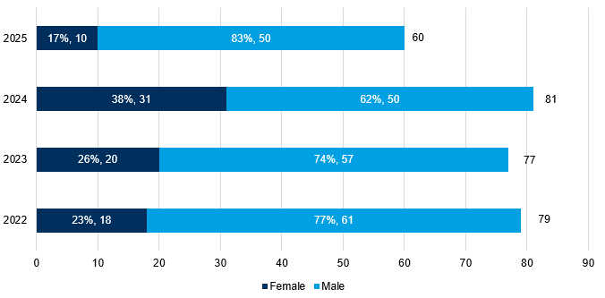
7.14 Youth Justice Service
Table 16: Children who offend in Cambridge City by age group, 2022 to 2025
Age - Table 16 shows that age 17 has the highest 4-year average count of children who offend in Cambridge City.
Gender - Figure 19 shows most children who offend in Cambridge City are males. However, 2024 saw the largest proportion of females at 38% - this more than double the 17% female proportion in 2025.
Ethnicity - The most common ethnicity for children who offend in Cambridge City between 2022 to 2025 is White British (60%), and this is followed by Mixed (11%), White/Other Nationals (11%), and Black British (9%).
Children’s social care - The percentage of those associated with children’s social care between 2022 and 2025 is 7%.
Substance misuse - The percentage of those who have had evidence of substance misuse between 2022 and 2025 is 11%. In 2024 and 2025, 15% of the Cambridge City YJS cohort had evidence of substance misuse (12 out 81 for 2024; 9 out of 60 for 2025).
Mental health - The percentage of those who have had contact with mental health services between 2022 and 2025 is 4%.
Age Groups | 2022 | 2023 | 2024 | 2025 | 4-year average count
10 to 12 | <5 | <5 | 6 | <5 | N/A
13 | 5 | 12 | 14 | 9 | 10
14 | 21 | 12 | 13 | 10 | 14
15 | 15 | 18 | 10 | 17 | 15
16 | 17 | 14 | 21 | 12 | 16
17 | 20 | 20 | 20 | 13 | 18.25
Figure 19: Children who offend in Cambridge City by gender, 2022 to 2025
Note: Table and Chart have been produced by Cambridgeshire County Council’s Communities and Demography PI Team, using data provided by Cambridgeshire Youth Justice Service.

Slide 52
7.15 Offence types that saw no notable change or have decreased in the last year
In last year’s strategic assessment, shoplifting and violence against a person required high attention. Burglary and deliberate fires saw concerning trends. Hate crime and domestic abuse were to be monitored. Of these crime types, burglary and hate crime were the only types which saw decreases in the last year and do not appear to see any concerning trends.
Burglary is now included in both personal loss and commercial loss. Burglary accounted for 4% of total offences in YE September 2025.
  Burglary offences decreased by 21% in the last year (-153 offences); this means that burglary offences have reached a similar count to that seen in YE September 2022.
Hate crime marked offences saw a 4% decrease between YE September 2024 and YE September 2025 (-17). This decrease follows a decrease also seen in the previous year. Despite this, offence counts still remain slightly higher than that seen in YE September 2022.
Acquisitive crime is a priority of the CSP. As previously mentioned acquisitive crime has been split into personal loss, commercial loss and vehicle offences. Both vehicle offences and personal loss have seen notable decreases.
Vehicle offences accounted for 4% of total offences in the YE September 2025.
Vehicle offences saw a 14% decrease in the last year (-98 offences).
In total, personal loss offences have decreased by 18% in the last year (-646 offences).
All sub-groups of personal loss offences saw decreases in the last year: bicycle theft (-17%, -194), other theft (-16%, -220), residential burglary (-25%, -114), robbery of personal property (-7%, -13) and theft from the person (-23%, -105).
Despite the decrease in the last year, theft from the person offences remain higher than counts seen in YE September 2022 (+14%, +45). Offences counts had saw incremental increases between YE September 2022 and YE September 2024.

Slide 53
7.15 Offence types that saw no notable change or have decreased in the last year
Other offence types which were not mentioned in last year’s strategic assessment or which are not listed in CSP priorities are below:
Both arson and criminal damage offences and public order offences each accounted for 8% of total offences in the YE September 2025.
Public order offences decreased in the last year by 23% (-311 offences).
Arson and criminal damage offences also decreased in the last year by 11% (-134 offences).
Cyber crime has continued to decrease when comparing YE September 2024 to YE September 2025 from 213 offences to 177 (-17%).

Slide 54
7.16 Geographic Analysis
Market remained highest in count for all analysed offence types excluding DA (incidents and crimes) and vehicle offences; details can be found in geographic output file.
Abbey ranked highest overall ward and remained in the top 4 highest ward counts in all analysed offence types (apart from youth-related ASB). The below crime types exceeded figures from YE September 2022; however, this should not neglect the fact that counts are still high across the majority of the analysed offence types:
commercial loss (+140%, +184),
shoplifting (153%, +174),
domestic abuse (+1%, +4),
drug offences (+21%, +9),
and VAP (+4%, +16).
Despite small numbers, Newnham has seen increases in most offence types in the last year. Despite these increases, offence counts were only higher than YE September 2022 for:
ASB (+64%, +23),
youth-related ASB (+71%, +5),
domestic abuse (+96%, +22),
personal loss (+90%, +100),
commercial loss (+133%, +16),
shoplifting (+950%, +19),
and vehicle offences (+9%, +3).

Slide 55

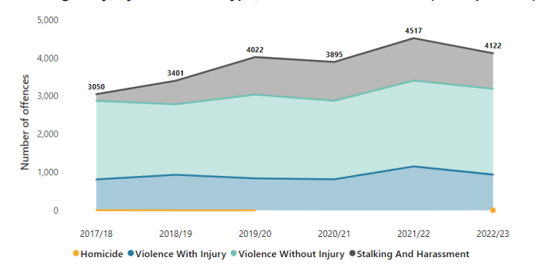
8. Appendix – CSP OPCC Activity review
Cambridge Community Safety Partnership
Action Plan 2023 – 2025
Our Priority: Reducing Violence in our City Centre
What we know:
Our strategic assessment showed us that whilst Cambridge is a safe city, there has been an increase in reports of violence with injury. Most of these incidents are connected to the night-time economy in our city centre, with victims and perpetrators of this violence most likely to be aged 17 - 34.
Our Aim:
To prevent violence and increase safety in the city centre at night
We’ll achieve this by:
Developing educational campaigns to prevent violence, focussing on younger people
Working together to increase safety in our city centre
Lead: Keryn Jalli, Cambridge City Council and Paul Rogerson / Mike Jackman, Cambridgeshire Constabulary
Police recorded Violence Against the Person offences in Cambridge
The rate of violence against the person offences in Cambridge has increased in the last 5 years, but remains lower than the national average

Slide 56
8. Appendix – CSP OPCC Activity review
Year 1: Action Plan September 2023 – March 2024
“The Plan” | What we will do |  | Who will lead | We will check that we’re on track by:
Educational campaigns to prevent violence | 1 | Create Serious Violence prevention materials for young people and practitioners | Anglia Ruskin University (ARU) and Cambridge City Council | Number of students engaged with Live Brief project on Serious Violence prevention
 |  |  |  | Number of educational resources developed
 |  |  |  | Number of organisations educational materials shared with
 | 2 | Create educational material for parents | Cambridge City Council | Parents at workshops have increased understanding of serious violence
 |  |  |  | Parents at workshops have increased understanding of how to access support for children
 |  |  |  | Parents at workshops have increased trust in statutory services to deliver serious violence prevention
 |  |  |  | Number of organisations resources circulated to
Expand Cambs Against County Lines delivery | 3 | Create KS2 Cambs Against County Lines animation and lesson plan | Cambridge City Council (CCC) | Content created and approved by PSHE leads (Personal, social, health and economic education)
 |  |  |  | Number of school content delivered to

Slide 57
8. Appendix – CSP OPCC Activity review
Year 1: Action Plan September 2023 – March 2024
“The Plan” | What we will do |  | Who will lead | We will check that we’re on track by:
Reduce violent crime offending & re-offending | 4 | Increase police presence in the city centre | Cambridgeshire Constabulary | Officer hours of dedicated policing of Night Time Economy (NTE)
Enhancing safety in public spaces | 5 | Deliver a Businesses Against Abuse accreditation scheme | Cambridgeshire Constabulary and Cambridge Business Against Crime (CAMBAC) | Development of a baseline knowledge check and post training knowledge check across all areas of the training
 |  |  |  | Number of training sessions delivered
 |  |  |  | Number of people accredited – overall target 1,000 by March 2025, quarterly target 167
 | 6 | Commission a public guardianship scheme for the city centre and adjoining open spaces | Cambridge Business Against Crime (CAMBAC) | Number of public space guardians in NTE
 | 7 | Increase CCTV surveillance in the city centre | Cambridge City Council | Additional CCTV cameras installed at target locations
 | 8 | Increase taxi marshal coverage in the night-time economy | Cambridge Business Against Crime (CAMBAC) | Number of evenings with taxi marshals
 |  |  |  | % increase of taxi marshals compared with previous 12 months
 | 9 | Review Cumulative Impact Zones | Cambridge City Council | Cumulative Impact Zone (CIZ) continues in City Centre

Slide 58
8. Appendix – CSP OPCC Activity review
Year 2: Action Plan April 2024 – March 2025
“The Plan” | What we will do |  | Who will lead | We will check that we’re on track by:
Listen to people at risk of, or affected by violent crime | 1 | Conduct a Community Safety Survey to understand people’s feelings about safety in the city | Cambridge City Council | Number of survey responses
 |  |  |  | % of people who report feeling safe in Cambridge during the day
 |  |  |  | % of people who report feeling safe in Cambridge during the night

Slide 59
8. Appendix – CSP OPCC Activity review
Year 2: Action Plan April 2024 – March 2025
“The Plan” | What we will do |  | Who will lead | We will check that we’re on track by:
Reduce violent crime offending & re-offending | 2 | Deliver targeted interventions to 18 – 24 year olds on short sentences | Probation Service | Removed from plan as intervention focusses on East Cambridgeshire
Enhancing safety in public spaces | 3 | Deliver a Businesses Against Abuse accreditation scheme | Cambridgeshire Constabulary and Cambridge Business Against Crime (CAMBAC) | Number of training sessions delivered
 |  |  |  | Number of people accredited – overall target 1,000 by March 2025, quarterly target 167
 |  |  |  | Increased knowledge of VAWG and how businesses can respond
 |  |  |  | Annual survey by CAMBAC to measure improved feeling of safety for everyone within the community
 |  |  |  | Reduction in Police recorded rape and sexual offences
 | 4 | Commission a public guardianship scheme for the city centre and adjoining open spaces | Cambridge Business Against Crime (CAMBAC) | Annual survey by CAMBAC to measure reduction in the number of people concerned about VAWG and Neighbourhood Crime (theft from person)
 | 5 | Increase taxi marshal coverage in the night time economy | Cambridge Business Against Crime (CAMBAC) | Number of evenings with taxi marshals
 |  |  |  | % increase of taxi marshals compared with previous 12 months

Slide 60
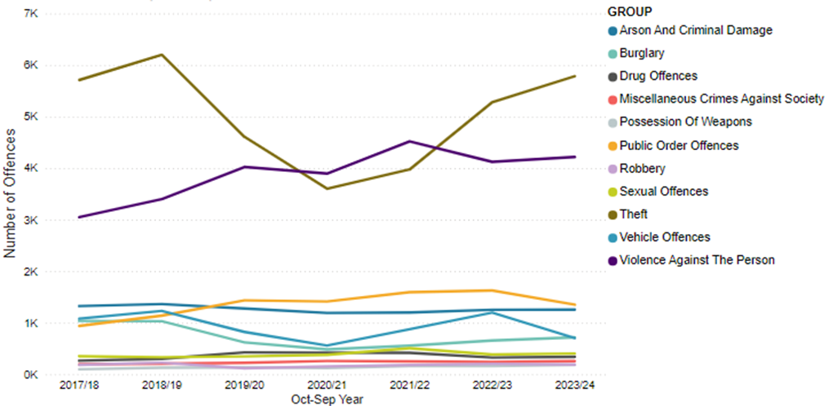
8. Appendix – CSP OPCC Activity review
Cambridge Community Safety Partnership
Action Plan 2025 – 2026
Priority 1: Preventing Violence and Exploitation
What we know:
Our strategic assessment showed us that whilst Cambridge is a safe city, violence against the person offences accounted for 27% of crimes. Market ward, which is the focus of Cambridge’s nighttime economy, has higher rates of both violent crime and drug offences. Both on a national level and in Cambridge, young people at risk of being criminally exploited into supplying drugs are often teenage boys, with children who experience disadvantage, who are care-experienced or who go missing being at higher risk.
Our Aim:
To keep Cambridge safe, by preventing violence and exploitation before it causes significant harm,
as part of the county-wide public health approach to serious violence.
We’ll achieve this by:
Developing a process for businesses and venues to raise concerns about risks to children outside the home,
particularly during the nighttime economy.
Work with specialists to help prevent young people being at risk of or becoming involved in violence.
Ensuring crime prevention principles are key to the Civic Quarter re-development.
Exploring continuation funding for Rose Crescent and Downing Place taxi marshals.
Exploring funding for St Johns Ambulance provision on key dates in the nighttime economy.
Developing a localised community Hate Crime awareness campaign.
Renewing our Purple Flag accreditation status.
Lead: Keryn Jalli, Cambridge City Council and Mike Jackman, Cambridgeshire Constabulary

Slide 61
8. Appendix – CSP OPCC Activity review
Action Plan 2025 – 2026
“The Plan” | What we will do |  | Who will lead | We will check that we’re on track by:
Developing a process for businesses and venues to raise concerns about risks to children outside the home, particularly during the night time economy | 1 | Create a process that is accessible and suitable for use by city businesses and venues to raise their concerns about children at risk outside the home. | Cambridgeshire Constabulary and Cambridge City Council | Creating a process that is accessible to businesses and venues.
 |  |  |  | Number of referrals
 |  |  |  | Number of businesses who have completed a referral
Work with specialists to help prevent young people being at risk of or becoming involved in violence | 2 | Deliver train the facilitator sessions to expand the reach of the Cambs Against County Lines animation and lesson plan | Cambridge City Council | Number of sessions delivered and number of people who attended
 | 3 | Deliver after school youth activities to 25 young people at higher risk of serious violence, reaching a further 50 young people who present with at least one risk factor for serious violence. | Romsey Mill | Number of young people engaged
 |  |  |  | % of children engaged with at least one risk factor for serious violence – target 66%
 |  |  |  | % of young people engaged who present at least 6 risk factors for serious violence – target 33%
 | 4 | Deliver bespoke VAWG prevention programmes to girls and boys in school, and pilot an offer to children not in school | Cambridge Rape Crisis Centre (CRCC) Cambridge United Foundation (CUF) Romsey Mill | Number of young people reached
 |  |  |  | Increased confidence in challenging / responding to inappropriate behaviour within peer groups.
 |  |  |  | Increased understanding of VAWG, key attitudes underpinning it and the impact on victims.

Slide 62
8. Appendix – CSP OPCC Activity review
Action Plan 2025 – 2026
“The Plan” | What we will do |  | Who will lead | We will check that we’re on track by:
Ensuring crime prevention principles are key to the Civic Quarter redevelopment | 5 | Have active involvement in the consultation process in the Civic Quarter redevelopment plans | Cambridgeshire Constabulary and Cambridge City Council | Regularly reviewing public perceptions of safety in Civic Quarter Design process through engagement with Police and Council Public Safety Team
 |  |  |  | Engaging the public and stakeholders in the design process to understand safety concerns and ideas to address this.
Exploring continuation funding for Rose Crescent and Downing Place taxi marshals | 6 | Bid for funding to continue taxi marshals | CAMBAC and Purple Flag Partnership | Apply for funding pots identified to bid into.
 |  |  |  | ________________
Exploring funding for St Johns Ambulance provision on key dates in the nighttime economy | 7 | Research relevant available funding | CAMBAC and Purple Flag Partnership | Apply for funding pots identified to bid into.
 |  |  |  | Once funding obtained impact to be reported.
Developing a localised community Hate Crime awareness campaign | 8 | Create a Hate Crime Awareness Video | Cambridge City Council | Video created with local community groups invited to be involved.
 |  |  |  | Number of video views
 |  |  |  | Number of organisations the video is shared with.
 |  | Raising awareness of Hate Crime at community events |  | Number of activities planned and delivered for the National Hate Crime Awareness Week.
Renewing our Purple Flag accreditation status | 9 | Fulfilling the requirements for the Purple Flag accreditation to demonstrate that Cambridge is officially a safe and vibrant place to visit between 17:00 and 05:00. | Cambridge Business Against Crime (CAMBAC) | Completing the Purple Flag Self-Assessment

Slide 63
8. Appendix – CSP OPCC Activity review
Priority 2: A Neighbourhood Approach
What we know:
Cambridge is a city of contrasts, of both wealth and inequalities. Average life expectancy in Cambridge can differ by 9 years, depending on which ward you live in. Residents’ experiences of crime differs by ward too, our strategic assessment showed us that Coleridge had increases in acquisitive crime, whilst there were higher rates of domestic abuse reported in Arbury. We know that experiences of inequalities, health and crime can intersect, compounding their impacts.
Our Aim:
By working on a neighbourhood level, alongside residents and community groups, we better understand their needs, the crime issues affecting them and work alongside residents to keep their neighbourhoods safe.
We’ll achieve this by:
Increase opportunities across the CSP to align our approach to neighbourhood engagement.
Work with communities to identify opportunities to utilise crime prevention funding in their neighbourhoods.
Deliver a localised response to ASB hotpots, including deployment of CCTV.

Slide 64
8. Appendix – CSP OPCC Activity review
Action Plan 2025 – 2026
“The Plan” | What we will do |  | Who will lead | We will check that we’re on track by:
Increase opportunities across the CSP to align our approach to neighbourhood engagement | 1 | Scope a multi-agency approach to neighbourhood engagement | Health, Cambridgeshire Constabulary and Cambridge City Council | Holding regular meetings to review progress
Work with communities to utilise crime prevention funding in their neighbourhoods | 2 | Look at community safety issues in wards using evidence alongside what residents say as well as what they want to happen. | Cambridgeshire Constabulary | Feeding back to residents on “You Said, We did” activities through regular engagement meetings.
 | 3 | Identify potential funding such as the OPCC Safer Communities Fund and POCA (Proceeds Of Crime Act) put in a funding bid with residents involved. | Cambridgeshire Constabulary and Cambridge City Council | Number of bids submitted, geographical reach and thematic covered
Deliver a localised response to ASB hotpots, including deployment of CCTV | 4 | Deliver multi-agency approach to ASB hotspots | Cambridge City Council | Number of CCTV deployments to monitor and deter crime and ASB
 |  |  |  | Develop a risk assessment for ASB hotspots to track impact of work undertaken.
 | 5 | Deliver localised hotspot policing in neighbourhoods | Cambridgeshire Constabulary | Reviewing local policing hotspots, work undertaken and impact.

Slide 65
8. Appendix – CSP OPCC Activity review
Priority 3: Tackling Acquisitive Crime
What we know:
Cambridge has the highest rates of acquisitive crime across Cambridgeshire. Whilst cycle crime used to be the main type of acquisitive crime in Cambridge, there has been a 56% reduction in bike theft since 2018, through continued and combined efforts with partners across the CSP. Shoplifting is now the most prevalent acquisitive crime, accounting for 37% of offences, with a large proportion of shoplifting being committed by repeat offenders. Nationally, the increased cost of living has also impacted the quantity of goods stolen at one time.
Our Aim:
By continuing with and learning from our approach to cycle crime, we hope to address the increase in shoplifting in the city.
We’ll achieve this by:
Engage retailers and support them to give best evidence.
Scope a retail crime prevention pilot.
Maintain a dedicated policing team focussed on those who commit the majority of thefts to tackle and reduce re-offending.
Engage retailers and support them to give best evidence.
Continue our Awareness, Infrastructure and Enforcement approach to addressing cycle crime.

Slide 66
8. Appendix – CSP OPCC Activity review
Action Plan 2025 – 2026
“The Plan” | What we will do |  | Who will lead | We will check that we’re on track by:
Engage retailers and support them to give best evidence. | 1 | Create a crime prevention and support ‘Retail Pack’, consisting of a booklet with how to deal with different types of ASB and crime, reporting, contact details of key agencies | Cambridge City Council, CAMBAC, Cambridge Constabulary |  | Obtaining funding to develop the pack.
 |  |  |  |  | Number of retailers a pack is provided to across Cambridge City.
 | 2 | Regular engagement with retailers | Cambridgeshire Constabulary |  | Increase in reporting and improved quality of evidence leading to more positive outcomes
 |  |  |  |  | Reduction in filing of investigations
Scope a retail crime prevention pilot | 3 | Develop a pilot with specific shops, trailing Select DNA marking to prevent and address retail crime | Cambridgeshire Constabulary and Cambridge City Council |  | Scoping pilot with shops that experience high levels of retail crime
 |  |  |  |  | Biding for funding to deliver pilot
 |  |  |  |  | Tracking impact on retail crime
Maintain a dedicated policing team focussed on those who commit the majority of thefts to tackle and reduce re-offending. | 4 | Maintain the spree offending team and look to reduce offending through issuing criminal behaviour orders | Cambridgeshire Constabulary |  | Number of arrests
 |  |  |  |  | Number of charges
Continue our Awareness Infra-structure and Enforcement approach to addressing cycle crime. | 5 | Offer free bike marking throughout the city and track trends of bike related theft | Cambridgeshire Constabulary |  | Number of bikes marked
 |  |  |  |  | Reduction in bike theft reported to Police

Slide 67
9. Relevant Links
Latest National Statistics: Crime in England and Wales - Office for National Statistics
Latest National Crime Agency (NCA) Strategic Assessment: NSA 2025 - Home - National Crime Agency
Latest Modern Slavery National Bulletin: Modern slavery: National Referral Mechanism and Duty to Notify statistics UK, end of year summary 2024 - GOV.UK
Cambridgeshire Crime Counts and Rates for 2024: Cambridgeshire Crime Counts 2024 | Cambridgeshire Insight Open Data

