Slide 1
South Cambridgeshire
Indices of Deprivation 2025 District Report
Published on 17th March 2026
Policy, Performance and Intelligence Service
policyandinsight@cambridgeshire.gov.uk

Slide 2
Contents
Background
Key Findings
Overall IMD
  1.1. District – National Ranking
  1.2. Ward – Average Decile
  1.3. LSOA – Decile
  1.4. LSOA – Decile change
Domains by Deciles
  2.1. District – National Domain Ranking and Change
  2.2. Ward – Average Decile
  2.3. LSOAs
  2.4. Most Notable Domain Decile Change – Barriers to Housing
Domains by Scores
  3.1. Income Domain
  3.2. Employment Domain
References
Appendix

Slide 3
Background
The IoD25 is a suite of resources comprising of 7 standalone indexes or measures of deprivation. When combined, they form the IMD25, the official measure of relative deprivation for small area geographies called Lower-layer Super Output Areas (LSOAs), in England. Lower Layer Super Output Areas are a geographic hierarchy designed to improve the reporting of small area statistics in England and Wales. The Minimum population of an LSOA is 1,000 and the mean is 1,500. As of the Census 2021, there is a total of 35,672 LSOAs nationally.
For more information, please refer to the Cambridgeshire and Peterborough IoD 2025 Summary Document, produced by Cambridgeshire County Council: Policy, Performance and Intelligence Service. This document is available here, alongside an interactive dashboard specific to Cambridgeshire and Peterborough.
The data is compiled by the Ministry of Housing, Communities and Local Government (MHCLG) and can be accessed here: English indices of deprivation 2025 - Accredited official statistics announcement - GOV.UK

Slide 4
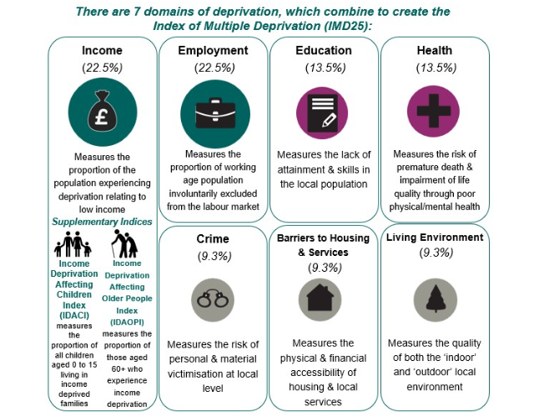
Background
Figure 1: Seven domains of deprivation alongside two supplementary indices
Within the IoD25, there are seven standalone indexes or domains and two supplementary indices, as seen in Figure 1.
The IMD25 combines these seven domains into a single overall score. Each domain contributes a fixed proportion (shown in figure 1) to the final IMD score. The two supplementary indices do not contribute to the overall IMD score but are reported alongside it. These supplementary indices are relevant to the income domain.

Slide 5
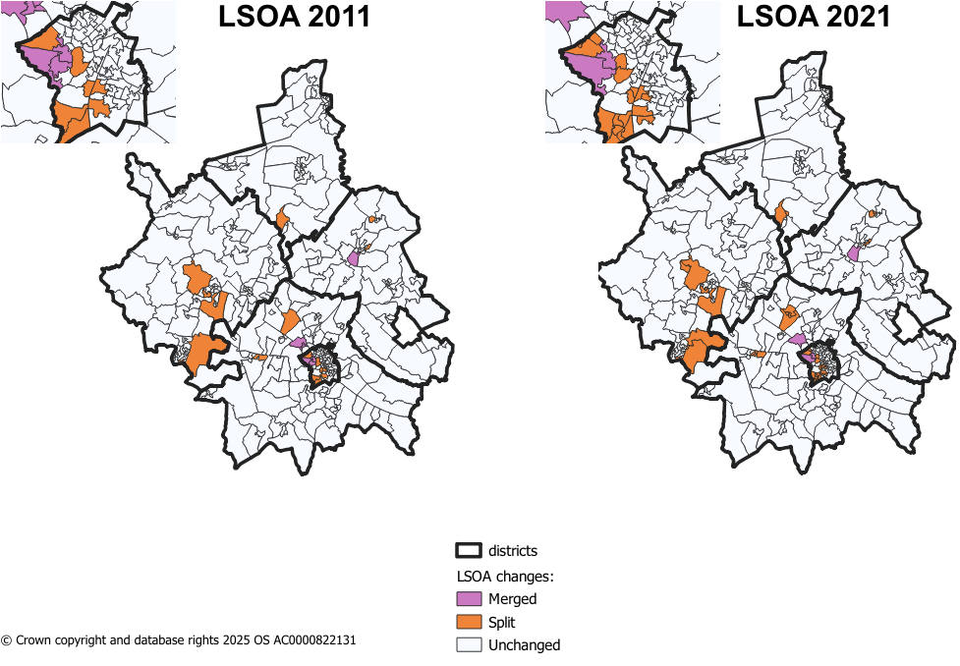
Methodology changes – LSOA boundaries
Figure 2: LSOA changes from 2011 to 2021 in Cambridgeshire
Since IMD 2019, there have been some changes to LSOA boundaries. IMD 2019 used 2011 LSOA boundaries and new boundaries came into effect during the latest Census in 2021.
The majority of LSOAs remained unchanged during this change in Cambridgeshire. The changes were as follows:
8 LSOAs changing only names and not boundaries.
8 LSOAs in 2011 were merged into 4 LSOAs in 2021.
17 2011 LSOAs were split into 41 2021 LSOAs.
Notes:
8 merged LSOAs –
Cambridge 005H (Trinity College to Castle Street) situated in Castle ward.
Cambridge 007I (West Cambridge to The Backs) situated in Newnham ward.
East Cambridgeshire 004H (West Witchford Services) situated in Ely West.
South Cambridgeshire 022D (Girton Village) situated in Girton ward.
41 split LSOAs –
18 in Cambridge City – 7 in Trumpington ward
4 in East Cambridgeshire
2 in Fenland
11 in Huntingdonshire – 5 in St Neots area
6 in South Cambridgeshire – 4 in Longstanton, where 1 LSOA from 2011 was split into 4

Slide 6
Methodology changes – Indicators
There are 55 indicators for the IMD 2025 – this compares to 39 indicators in IMD 2019.
For IMD 2025, 20 new indicators have been added, 14 indicators have been updated and significantly modified, and 21 indicators have been updated without significant modifications. Below are a list of the 20 new indicators.
Domains | New Indicators for IMD 2025
Income Deprivation 22.5% | Adults and children in Housing Benefit claimant benefit units with monthly equivalised income of less than 70% median equivalised monthly income after housing costs
Employment Deprivation 22.5% | Claimants of New Style Jobseeker’s Allowance
 | Claimants of New Style Employment and Support Allowance
 | Claimants of Income Support
 | Claimants of Universal Credit 'Planning for work ' conditionality group
 | Claimants of Universal Credit 'Preparing for work ' conditionality group
Education, Skills & Training Deprivation 13.5% | Persistent pupil absence
Health Deprivation & Disability 13.5% | Mental health composite indicator - Health benefits
Crime 9.3% | Violence with injury
 | Violence without injury
 | Stalking and harassment
 | Public order and Possession of weapons
 | Anti-social behaviour
Barriers to Housing & Services 9.3% | Geographical Barriers: Connectivity Score
 | Core Homelessness
 | Broadband speed
 | Patient-to-GP ratio
Living Environment Deprivation 9.3% | Housing Energy Performance Score
 | Housing lacking private outdoor space
 | Noise pollution
Table 1: Methodology changes between IoD 2019 and IoD 2025
Source: page 12 of English indices of deprivation 2025: technical report

Slide 7
  Key Findings
South Cambridgeshire is one of the least deprived districts nationally, ranking 281 out of 296 local authorities (15th least deprived).
Most South Cambridgeshire wards fall within higher (least deprived) deciles, with Girton and Hardwick in the highest decile (10), and Bassingbourn being the lowest‑scoring ward (decile 6). Decile 1 is the most deprived decile, and decile 10 is the least deprived decile.
70 out of 99 LSOAs are in the top 30% least deprived deciles (8-10), and none fall within the top 30% most deprived deciles (1-3). Two LSOAs, Chesterton Allotments and Bassingbourn Barracks, fall into decile 4, the lowest for the district.
Barriers to Housing and Services is the district’s most deprived domain, seeing notable change in rank from 98 to 45 nationally between 2019 and 2025. There were a number of changes to this domain between 2019 and 2025 releases.
Overall, income deprivation remained relatively low. However, income deprivation affecting children (IDACI) saw a notable change between 2019 and 2025 (+10.5pp).

Slide 8
1.1. District Context - National Ranking
Table 2: District by overall IMD national rank
South Cambridgeshire is ranked 281/296 of all local authorities nationally, based on local authority score, where 1 is most deprived (meaning South Cambridgeshire is the 15th least deprived of the 296 English Local Authorities).
This compares to:
  Cambridge City which is 255/296 (41st least deprived),
  Huntingdonshire which is 249/296 (47th least deprived),
  East Cambridgeshire which is 242/296 (54th least deprived),
  Fenland which is 42/296 (254th least deprived),
  and Peterborough which is 51/296 (245th least deprived).
District | IMD - Rank of average rank out of 296 (2025)
Fenland | 42
Peterborough | 51
East Cambridgeshire | 242
Huntingdonshire | 249
Cambridge | 255
South Cambridgeshire | 281

Slide 9
1.2. Analysis of overall deprivation across South Cambridgeshire wards
Ward | Decile Average | Range
Balsham | 8 | 7 - 8
Bar Hill | 9 | 8 - 10
Barrington | 8 | 7 - 8
Bassingbourn | 6 | 6 - 7
Caldecote | 9 | 9 - 9
Cambourne | 8 | 5 - 9
Caxton & Papworth | 8 | 6 - 9
Cottenham | 8 | 6 - 9
Duxford | 8 | 7 - 9
Fen Ditton & Fulbourn | 8 | 7 - 10
Foxton | 9 | 8 - 9
Gamlingay | 7 | 6 - 8
Girton | 10 | 9 - 10
Hardwick | 10 | 9 - 10
Harston & Comberton | 9 | 7 - 10
Histon & Impington | 8 | 4 - 10
Linton | 8 | 6 - 10
Longstanton | 8 | 7 - 10
Melbourn | 8 | 4 - 10
Milton & Waterbeach | 8 | 5 - 10
Over & Willingham | 9 | 5 - 10
Sawston | 8 | 5 - 10
Shelford | 9 | 8 - 10
Swavesey | 9 | 9 - 9
The Mordens | 7 | 6 - 7
Whittlesford | 9 | 8 - 9
On this page, the average decile is used. This is the decile of each LSOA combined and averaged to give an overall score for the ward. This is to help identify the domains that have a much higher or lower level of deprivation and give a broader overview of the ward, rather than the absolute ‘most’ and ‘least’ deprived domains. It should be noted that LSOA and ward boundaries are not co-terminus and therefore a ‘best fit’ lookup has been used to determine which LSOAs fall into each ward.
Highest scoring wards (least deprived):
Girton and Hardwick fall into the highest decile (10), as seen in Table 3.
Lowest scoring wards (most deprived):
Bassingbourn falls into the lowest decile out of all other wards in South Cambridgeshire (6).
Table 3: Decile average and range of LSOA deciles by ward, IMD 2025

Slide 10
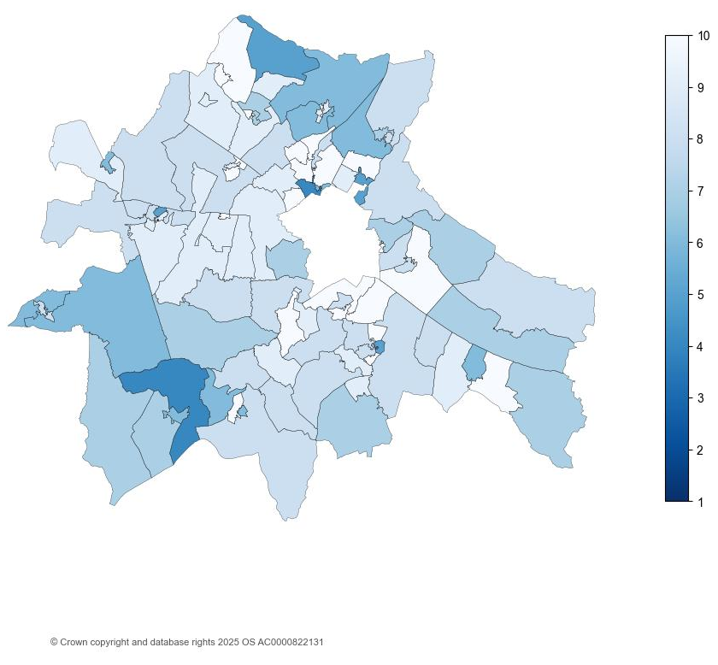
1.3. Analysis of individual Lower Super Output Areas (LSOA) across South Cambridgeshire
Figure 1: National decile for overall relative deprivation in South Cambridgeshire, IMD 2025
South Cambridgeshire has 99 Lower Super Output Areas (LSOAs).
There are 70 LSOAs in the highest 3 deciles (8-10). This is less LSOAs than IMD 2019, where there were 74 LSOAs in the highest 3 deciles. See Appendix B for full list.
No LSOAs in South Cambridgeshire are in the lowest 3 deciles (1-3). This is less LSOAs than in IMD 2019, where there was 1 LSOA in the lowest 3 deciles.
Chesterton Allotments (South Cambridgeshire 006G) and Bassingbourn Barracks (South Cambridgeshire 019A), situated in Histon & Impington and Bassingbourn wards respectively, remains the LSOAs in the lowest decile (4).

Slide 11
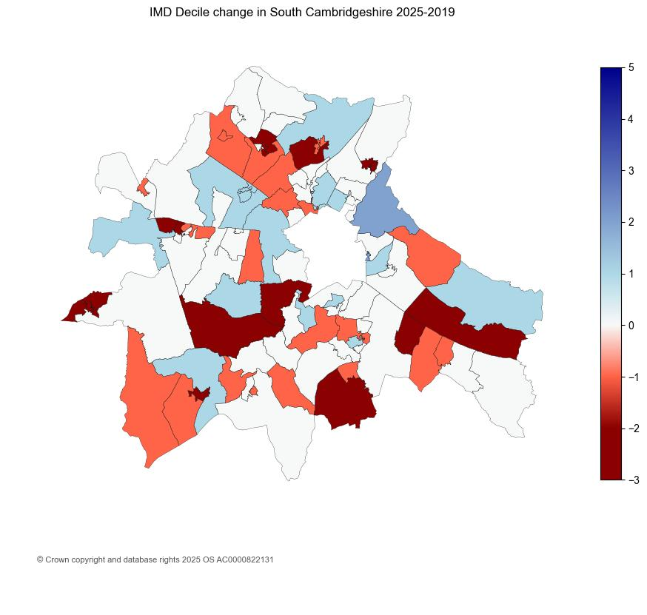
1.4. Analysis of individual Lower Super Output Areas (LSOA) across South Cambridgeshire
Figure 2: IMD decile change in South Cambridgeshire between 2019 and 2025
The map highlights notable changes in South Cambridgeshire overall IMD deciles over the period from 2019 to 2025.
2 LSOAs moved by two or more deciles in the direction of lower relative deprivation since 2019.
  The 2 LSOAs are Horningsea, Fen Ditton and Swot Cum Quy (South Cambridgeshire 007D) and Teversham Foxgloves (South Cambridgeshire 011E) both in Fen Ditton & Fulbourn ward.
15 LSOAs in South Cambridgeshire moved by two or more deciles in the direction of higher relative deprivation since 2019. See Appendix C for full list.

Slide 12
2.1. District Context - National Domain Ranking
The individual domain are ranked from lowest to highest at both district and LSOA. The ranks are based on comparisons between all of the local authority districts LADs nationally. There are 296 LADs. The table, on page 2.1.1., shows the deprivation domains for South Cambridgeshire by rank (out of 296 nationally) where the lower the rank, the more deprived the domain (1 is the most deprived):
The most deprived domain in South Cambridgeshire was Barriers to Housing and Services. However, despite being the most deprived domain, this domain ranks nationally more deprived than IMD 2019, from 98 to 45.
Barriers to Housing and Services domain saw the most notable change in national rank between IMD 2019 and IMD 2025 (from 98 to 45), overall becoming more relatively deprived. There were a number of changes to this domain between 2019 and 2025 releases. Further analysis can be found on page 2.4.
Income Deprivation affecting Older People (IDAOPI) domain nationally ranked more relatively deprived than IMD 2019 (from 301 to 263).
Crime domain also saw notable change becoming less deprived in national rank between IMD 2019 and IMD 2025 (from 248 to 279).
  24 LSOAs in South Cambridgeshire moved by two or more deciles in the direction of lower relative deprivation since 2019.
Notes:
To be mindful that the LGAs in IMD 2019 ranking were 317 compared to IMD 2025 with 296 LGAs.

Slide 13
2.1.1. District Context - National Domain Ranking
Table 4: National local authority rank by domain, IMD 2025
Domain | 2025 National Local Authority Rank out of 296 | 2019 National Local Authority Rank out of 317 | Change in Rank between 2019 and 2025
Income | 277 | 302 | -25
Employment | 280 | 304 | -24
Education, Skills and Training | 288 | 307 | -19
Health Deprivation and Disability | 286 | 304 | -18
Living Environment | 267 | 258 | 9
Crime | 279 | 248 | 31
Barriers to Housing and Services | 45 | 98 | -53
Supplemental
Income Deprivation affecting Children (IDACI) | 281 | 293 | -12
Income Deprivation affecting Older People (IDAOPI) | 263 | 301 | -38
*Supplemental measures are a subset of the income domain.

Slide 14
2.2. Analysis of individual deprivation domains across South Cambridgeshire by decile average
Table 5: Decile average by domain, IMD 2025
On this page, the average decile is used. This is the decile of each LSOA combined and averaged to give an overall score for the district. This is to help identify the domains that have a much higher or lower level of deprivation and give a broader overview of the district/city as a whole, rather than the absolute ‘most’ and ‘least’ deprived domains.
Highest scoring domain (least deprived):
Table 5 shows that the Health Deprivation and Disability domain ranks highest, with an average decile score of 9.
Lowest scoring domain (most deprived):
Barriers to Housing and Services has the lowest average decile amongst the domains (4).
Domain | Average Decile | Range
Health Deprivation and Disability | 9 | 5-10
Education, Skills and Training | 8 | 4-10
Employment | 8 | 4-10
Crime | 8 | 3-10
Income | 8 | 3-10
Living Environment | 7 | 1-10
Barriers to Housing and Services | 4 | 1-8
Overall IMD | 8 | 4-10

Slide 15
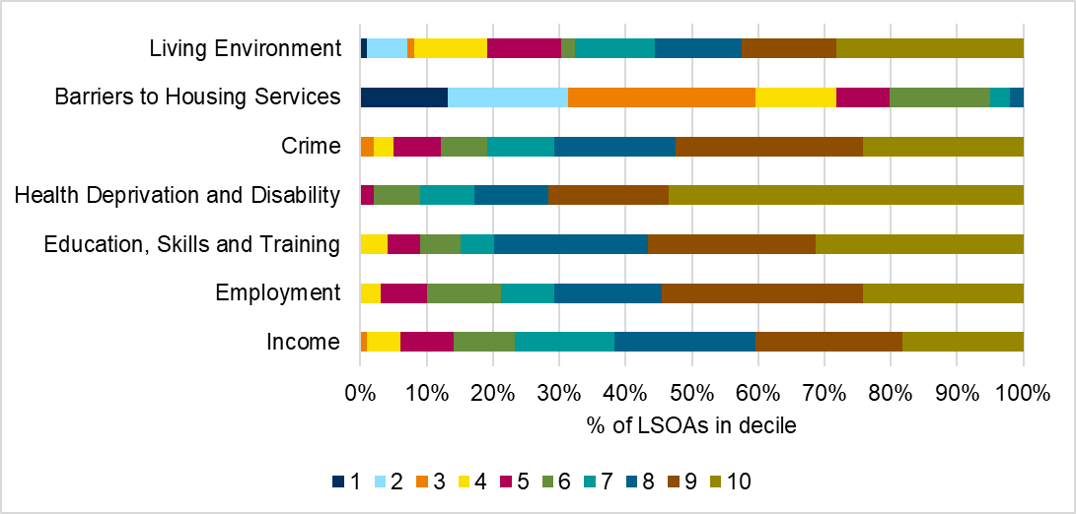
2.3. Analysis of individual deprivation domains across South Cambridgeshire
In South Cambridgeshire, the most deprived domain is Barriers to Housing and Services, which includes factors such as housing affordability and household overcrowding. 60% of LSOAs in South Cambridgeshire fall into the top 3 most deprived deciles (1-3, where 1 is the most deprived).
The lowest levels of relative deprivation is in the Health Deprivation and Disability domain, with 83% of LSOAs in South Cambridgeshire falling into the top 3 least deprived deciles (8-10, where 10 is least deprived).
Figure 3 breaks down LSOA national decile distribution by individual domain.
Figure 3: Proportion of LSOAs which fall into each decile by domain, IMD 2025
See Appendix A for a breakdown of counts of proportions relevant to the graph.

Slide 16
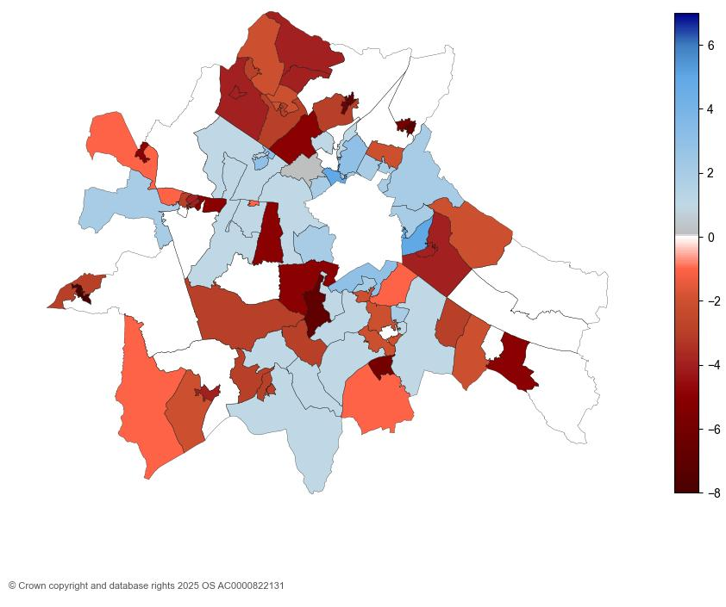
2.4. Analysis of individual Lower Super Output Areas (LSOA) across South Cambridgeshire for Barriers to Housing and Services
Figure 4: Barriers to housing services decile change in South Cambridgeshire between 2019 and 2025
The map shows that substantial changes in the Barriers to Housing and Services domain in South Cambridgeshire from 2019 to 2025.
16 LSOAs moved 2 or more deciles in the direction of relatively less deprived decile between IMD 2019 and IMD 2025. 3 LSOAs moved by 5 deciles between 2019 and 2025. See Appendix D for full list.
Southern Great Shelford (South Cambridgeshire 012B) situated in Shelford ward and Histon High Street (South Cambridgeshire 006D) situated in Histon and Impington ward fall into the highest decile (8).
43 LSOAs in South Cambridgeshire moved 2 or more deciles in the direction of more relatively deprived. Of the 43, 13 moved at least 5 or more deciles. See Appendix E for full list.
13 LSOAs fall into the most deprived decile (1). See Appendix F for full list.

Slide 17
3.1. Analysis of income scores across South Cambridgeshire
Figure 5: Income, IDACI and IDAOPI proportions by district for Cambridgeshire districts
Income Deprivation Affecting Children Index (IDACI) and Income Deprivation Affecting Older People Index (IDAOPI) are supplementary indices which provide context but do not make up the overall IMD scores.
South Cambridgeshire had a score of 0.120 for income domain, meaning that 12% of the population were living in income deprivation. This is the lowest proportion in Cambridgeshire, following Fenland (24%), then East Cambridgeshire and Huntingdonshire at 14% each, and Cambridge City (13%).
South Cambridgeshire had the lowest proportion for the Income Deprivation Affecting Older People Index (IDAOPI) at 9%.
IDACI scores across the county were notably high. South Cambridgeshire had the lowest proportion of children experiencing relative income deprivation (18%).

Slide 18
3.1. Analysis of income scores across South Cambridgeshire
Table 6: Income, IDACI and IDAOPI proportions for South Cambridgeshire, IMD 2019 and IMD 2025
 | IMD 2019 | IMD 2025 | Change
Domain
Income | 5.6% | 11.8% | 6.2pp
Supplementary Domain
Income Deprivation Affecting Children Index (IDACI) | 7.5% | 18% | 10.5pp
Income Deprivation Affecting Older People Index (IDAOPI) | 6.9% | 9.1% | 2.2pp
IDACI saw the most notable change in South Cambridgeshire between IMD 2019 and IMD 2025. This was an increase of 10.5pp.
Proportions for both IDAOPI and income domain saw increases as well.

Slide 19
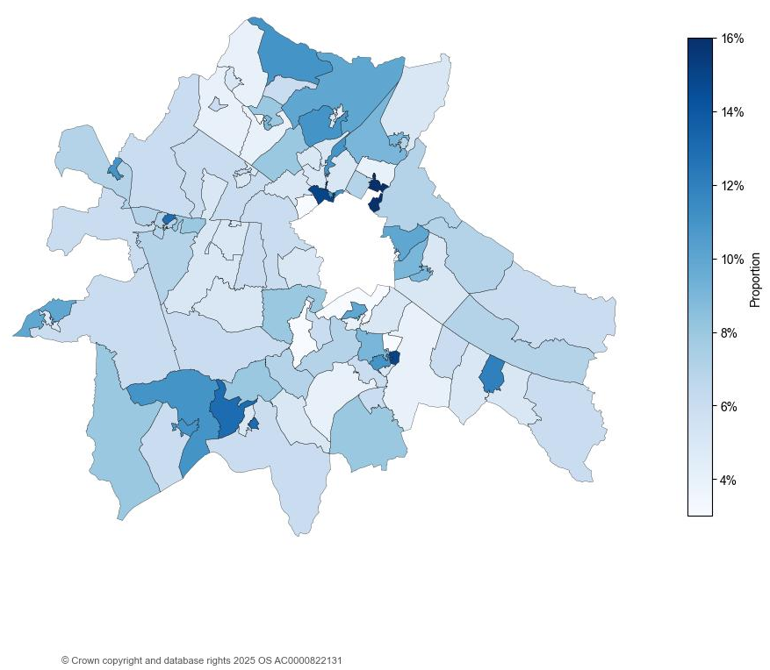
3.2. Analysis of employment scores across South Cambridgeshire
Figure 6: Employment score by LSOA in South Cambridgeshire, IMD 2025
South Cambridgeshire had a score of 0.071 in the employment domain; this means that 7.1% of the population are in relative employment deprivation.
The score for South Cambridgeshire has slightly increased between IMD 2019 and IMD 2025, by 2.5pp (from 4.6% to 7.1%).
Milton Country Park and Cambridge North Station (South Cambridgeshire 007B) in Milton & Waterbeach ward had the highest employment score of 0.155. This means 15.5% of the population are living in employment deprivation.

Slide 20
References
MHCLG. (2019, September 26). English indices of deprivation 2019: statistical release - main findings. Retrieved from https://assets.publishing.service.gov.uk/media/5d8e26f6ed915d5570c6cc55/IoD2019_Statistical_Release.pdf
MHCLG. (2025, October 30). English indices of deprivation 2025: statistical release. Retrieved from https://www.gov.uk/government/statistics/english-indices-of-deprivation-2025/english-indices-of-deprivation-2025-statistical-release

Slide 21
Appendix A
Table 7: Proportion of LSOAs which fall into each decile by domain, IMD 2025
Domain | 1 | 2 | 3 | 4 | 5 | 6 | 7 | 8 | 9 | 10
Income | 0% | 0% | 1% | 5% | 8% | 9% | 15% | 21% | 22% | 18%
Employment | 0% | 0% | 0% | 3% | 7% | 11% | 8% | 16% | 30% | 24%
Education, Skills and Training | 0% | 0% | 0% | 4% | 5% | 6% | 5% | 23% | 25% | 31%
Health Deprivation and Disability | 0% | 0% | 0% | 0% | 2% | 7% | 8% | 11% | 18% | 54%
Crime | 0% | 0% | 2% | 3% | 7% | 7% | 10% | 18% | 28% | 24%
Barriers to Housing Services | 13% | 18% | 28% | 12% | 8% | 15% | 3% | 2% | 0% | 0%
Living Environment | 1% | 6% | 1% | 11% | 11% | 2% | 12% | 13% | 14% | 28%
Table 8: Count of LSOAs which fall into each decile by domain, IMD 2025
Domain | 1 | 2 | 3 | 4 | 5 | 6 | 7 | 8 | 9 | 10
Income | 0 | 0 | 1 | 5 | 8 | 9 | 15 | 21 | 22 | 18
Employment | 0 | 0 | 0 | 3 | 7 | 11 | 8 | 16 | 30 | 24
Education, Skills and Training | 0 | 0 | 0 | 4 | 5 | 6 | 5 | 23 | 25 | 31
Health Deprivation and Disability | 0 | 0 | 0 | 0 | 2 | 7 | 8 | 11 | 18 | 53
Crime | 0 | 0 | 2 | 3 | 7 | 7 | 10 | 18 | 28 | 24
Barriers to Housing Services | 13 | 18 | 28 | 12 | 8 | 15 | 3 | 2 | 0 | 0
Living Environment | 1 | 6 | 1 | 11 | 11 | 2 | 12 | 13 | 14 | 28

Slide 22
LSOA | LSOA Local Name | Ward | IMD 2025 Decile
South Cambridgeshire 007A | North Milton | Milton & Waterbeach | 10
South Cambridgeshire 012A | Outer Great Shelford | Shelford | 10
South Cambridgeshire 006B | Histon Manor | Histon & Impington | 10
South Cambridgeshire 003F | North Longstanton | Longstanton | 10
South Cambridgeshire 012D | Stapleford to Wandlebury Park | Shelford | 10
South Cambridgeshire 006D | Histon High Street | Histon & Impington | 10
South Cambridgeshire 015E | Wakelin Avenue | Sawston | 10
South Cambridgeshire 018B | Melbourn High Street | Melbourn | 10
South Cambridgeshire 001C | East Over and Cuckoo Fen | Over & Willingham | 10
South Cambridgeshire 014B | Harston | Harston & Comberton | 10
South Cambridgeshire 016F | East Linton to Bartlow | Linton | 10
South Cambridgeshire 011C | Fulbourn Fen | Fen Ditton & Fulbourn | 10
South Cambridgeshire 015D | Park Road to Springfield Road | Sawston | 10
South Cambridgeshire 006F | Glebe Way to Cottenham Road | Histon & Impington | 10
South Cambridgeshire 010C | Elison Lane | Hardwick | 10
South Cambridgeshire 001B | West Over | Over & Willingham | 10
South Cambridgeshire 006C | Milton Road | Histon & Impington | 10
South Cambridgeshire 022B | Dry Drayton High Street and Crafts Way | Bar Hill | 10
South Cambridgeshire 011E | Teversham Foxgloves | Fen Ditton & Fulbourn | 10
South Cambridgeshire 012B | Southern Great Shelford | Shelford | 10
South Cambridgeshire 022E | Girton College | Girton | 10
South Cambridgeshire 007C | Cambridge Science Park | Milton & Waterbeach | 9
South Cambridgeshire 022A | Bar Hill Recreation Ground | Bar Hill | 9
South Cambridgeshire 014C | Hauxton to Wale Obelisk | Harston & Comberton | 9
South Cambridgeshire 022F | Madingley, Coton and West Barton | Harston & Comberton | 9
South Cambridgeshire 014A | Foxton | Foxton | 9
Appendix B
Table 9: Top 30% least deprived LSOAs in South Cambridgeshire, IMD 2025

Slide 23
LSOA | LSOA Local Name | Ward | IMD 2025 Decile
South Cambridgeshire 017F | Whittlesford Village | Whittlesford | 9
South Cambridgeshire 021D | Bourn and Caxton End | Cambourne | 9
South Cambridgeshire 021C | Graveley and Ermine Street South | Caxton & Papworth | 9
South Cambridgeshire 003C | Outer Swavesey and Buckingway Business Park | Swavesey | 9
South Cambridgeshire 022D | Girton Village | Girton | 9
South Cambridgeshire 002B | Cottenham Centre | Cottenham | 9
South Cambridgeshire 017B | North Duxford | Duxford | 9
South Cambridgeshire 003D | Central Swavesey | Swavesey | 9
South Cambridgeshire 016D | West Linton | Linton | 9
South Cambridgeshire 002C | Lambs Lane | Cottenham | 9
South Cambridgeshire 010B | Comberton Village | Harston & Comberton | 9
South Cambridgeshire 003H | Longstanton St Michael's | Longstanton | 9
South Cambridgeshire 010D | Main Street | Hardwick | 9
South Cambridgeshire 020C | Foxhollow | Cambourne | 9
South Cambridgeshire 020F | South East Great Cambourne and North West Upper Cambourne | Cambourne | 9
South Cambridgeshire 001D | South Willingham | Over & Willingham | 9
South Cambridgeshire 010A | Highfields Caldecote to Toft | Caldecote | 9
South Cambridgeshire 017D | Hinxton, Pampisford and Babraham | Duxford | 8
South Cambridgeshire 018E | Shepreth and North Meldreth | Melbourn | 8
South Cambridgeshire 011A | Shelford Road | Fen Ditton & Fulbourn | 8
South Cambridgeshire 017E | Thriplow to A505 | Whittlesford | 8
South Cambridgeshire 021B | Fen Drayton, Conington and Elsworth | Caxton & Papworth | 8
South Cambridgeshire 004A | North Waterbeach and Chittering | Milton & Waterbeach | 8
Appendix B
(continued)
Table 9: Top 30% least deprived LSOAs in South Cambridgeshire, IMD 2025

Slide 24
LSOA | LSOA Local Name | Ward | IMD 2025 Decile
South Cambridgeshire 004D | East Waterbeach | Milton & Waterbeach | 8
South Cambridgeshire 013A | Central Gamlingay | Gamlingay | 8
South Cambridgeshire 014D | Haslingfield and South West Trumpington | Harston & Comberton | 8
South Cambridgeshire 017C | The Abingtons | Linton | 8
South Cambridgeshire 020B | Monkfield | Cambourne | 8
South Cambridgeshire 020D | Lower and West Cambourne | Cambourne | 8
South Cambridgeshire 014E | Little Shelford and Newton | Shelford | 8
South Cambridgeshire 015B | Sawston Village College, Hillside and Sawston Cemetery | Sawston | 8
South Cambridgeshire 018A | Fowlmere | Foxton | 8
South Cambridgeshire 020G | Greenhaze Lane | Cambourne | 8
South Cambridgeshire 003A | Oakington | Longstanton | 8
South Cambridgeshire 011B | Fulbourn Hospital | Fen Ditton & Fulbourn | 8
South Cambridgeshire 016A | North Balsham to Willigham Green | Balsham | 8
South Cambridgeshire 015A | Mill Lane | Sawston | 8
South Cambridgeshire 012C | North Great Shelford | Shelford | 8
South Cambridgeshire 007D | Horningsea, Fen Ditton and Stow Cum Quy | Fen Ditton & Fulbourn | 8
South Cambridgeshire 021E | Eltisley | Caxton & Papworth | 8
South Cambridgeshire 022C | Boxworth, West Bar Hill and East Dry Drayton | Bar Hill | 8
South Cambridgeshire 010E | The Eversdens and Harlton | Barrington | 8
South Cambridgeshire 018C | Border of Melbourn to Great Chishill | Melbourn | 8
South Cambridgeshire 006A | Homefield Park | Histon & Impington | 8
Appendix B (continued)
Table 9: Top 30% least deprived LSOAs in South Cambridgeshire, IMD 2025

Slide 25
Appendix C
Table 10: LSOAs moved by two or more deciles (more deprived) between IMD 2019 and IMD 2025
LSOA | LSOA Local Name | Ward | IMD 2025 Decile | IMD 2019 Decile | Change
South Cambridgeshire 003E | Northstowe | Longstanton | 7 | 10 | -3
South Cambridgeshire 003G | South Longstanton | Longstanton | 7 | 10 | -3
South Cambridgeshire 002D | Cottenham Village College | Cottenham | 6 | 8 | -2
South Cambridgeshire 013B | North East Gamlingay | Gamlingay | 6 | 8 | -2
South Cambridgeshire 019B | East Bassingbourn and Kneesworth | Bassingbourn | 6 | 8 | -2
South Cambridgeshire 004B | Waterbeach High Street | Milton & Waterbeach | 7 | 9 | -2
South Cambridgeshire 013D | Wimpole, Orwell and Barrington | Barrington | 7 | 9 | -2
South Cambridgeshire 016B | South Balsham to Streetly End | Balsham | 7 | 9 | -2
South Cambridgeshire 017A | South Duxford to Ickleton | Duxford | 7 | 9 | -2
South Cambridgeshire 004D | East Waterbeach | Milton & Waterbeach | 8 | 10 | -2
South Cambridgeshire 013A | Central Gamlingay | Gamlingay | 8 | 10 | -2
South Cambridgeshire 014D | Haslingfield and South West Trumpington | Harston & Comberton | 8 | 10 | -2
South Cambridgeshire 017C | The Abingtons | Linton | 8 | 10 | -2
South Cambridgeshire 020B | Monkfield | Cambourne | 8 | 10 | -2
South Cambridgeshire 020D | Lower and West Cambourne | Cambourne | 8 | 10 | -2

Slide 26
Appendix D
Table 11: LSOAs moved by two or more deciles (less deprived) in Barriers to housing services domain between IoD 2019 and IoD 2025
LSOA | LSOA Local Name | Ward | IoD 2025 Decile | IoD 2019 Decile | Change
South Cambridgeshire 006G | Chesterton Allotments | Histon & Impington | 7 | 2 | +5
South Cambridgeshire 011B | Fulbourn Hospital | Fen Ditton & Fulbourn | 6 | 1 | +5
South Cambridgeshire 011E | Teversham Foxgloves | Fen Ditton & Fulbourn | 6 | 1 | +5
South Cambridgeshire 006C | Milton Road | Histon & Impington | 7 | 4 | +3
South Cambridgeshire 012A | Outer Great Shelford | Shelford | 6 | 3 | +3
South Cambridgeshire 022B | Dry Drayton High Street and Crafts Way | Bar Hill | 4 | 1 | +3
South Cambridgeshire 006H | Orchard Park | Histon & Impington | 6 | 4 | +2
South Cambridgeshire 007B | Milton Country Park and Cambridge North Station | Milton & Waterbeach | 4 | 2 | +2
South Cambridgeshire 007C | Cambridge Science Park | Milton & Waterbeach | 7 | 5 | +2
South Cambridgeshire 007D | Horningsea, Fen Ditton and Stow Cum Quy | Fen Ditton & Fulbourn | 3 | 1 | +2
South Cambridgeshire 011D | Teversham | Fen Ditton & Fulbourn | 3 | 1 | +2
South Cambridgeshire 012C | North Great Shelford | Shelford | 5 | 3 | +2
South Cambridgeshire 015E | Wakelin Avenue | Sawston | 6 | 4 | +2
South Cambridgeshire 021E | Eltisley | Caxton & Papworth | 3 | 1 | +2
South Cambridgeshire 022E | Girton College | Girton | 5 | 3 | +2
South Cambridgeshire 022G | Barton and Grantchester | Harston & Comberton | 3 | 1 | +2

Slide 27
Appendix E
Table 12: LSOAs moved by two or more deciles (more deprived) in Barriers to housing services domain between IMD 2019 and IMD 2025
LSOA | LSOA Local Name | Ward | IoD 2025 Decile | IoD 2019 Decile | Change
South Cambridgeshire 013A | Central Gamlingay | Gamlingay | 2 | 10 | -8
South Cambridgeshire 002B | Cottenham Centre | Cottenham | 3 | 10 | -7
South Cambridgeshire 004D | East Waterbeach | Milton & Waterbeach | 2 | 9 | -7
South Cambridgeshire 014B | Harston | Harston & Comberton | 3 | 10 | -7
South Cambridgeshire 002C | Lambs Lane | Cottenham | 2 | 8 | -6
South Cambridgeshire 004B | Waterbeach High Street | Milton & Waterbeach | 2 | 8 | -6
South Cambridgeshire 017B | North Duxford | Duxford | 3 | 9 | -6
South Cambridgeshire 003A | Oakington | Longstanton | 2 | 7 | -5
South Cambridgeshire 010B | Comberton Village | Harston & Comberton | 3 | 8 | -5
South Cambridgeshire 014D | Haslingfield and South West Trumpington | Harston & Comberton | 4 | 9 | -5
South Cambridgeshire 016F | East Linton to Bartlow | Linton | 4 | 9 | -5
South Cambridgeshire 020G | Greenhaze Lane | Cambourne | 4 | 9 | -5
South Cambridgeshire 021A | Ermine Street North | Caxton & Papworth | 3 | 8 | -5
South Cambridgeshire 001A | North Willingham | Over & Willingham | 2 | 6 | -4
South Cambridgeshire 001D | South Willingham | Over & Willingham | 3 | 7 | -4
South Cambridgeshire 003C | Outer Swavesey and Buckingway Business Park | Swavesey | 3 | 7 | -4
South Cambridgeshire 003D | Central Swavesey | Swavesey | 4 | 8 | -4
South Cambridgeshire 011A | Shelford Road | Fen Ditton & Fulbourn | 4 | 8 | -4
South Cambridgeshire 011C | Fulbourn Fen | Fen Ditton & Fulbourn | 5 | 9 | -4
South Cambridgeshire 019B | East Bassingbourn and Kneesworth | Bassingbourn | 2 | 6 | -4
South Cambridgeshire 020A | Back Lane | Cambourne | 5 | 9 | -4
South Cambridgeshire 020F | South East Great Cambourne and North West Upper Cambourne | Cambourne | 5 | 9 | -4
South Cambridgeshire 001B | West Over | Over & Willingham | 4 | 7 | -3
South Cambridgeshire 002D | Cottenham Village College | Cottenham | 2 | 5 | -3
South Cambridgeshire 003G | South Longstanton | Longstanton | 3 | 6 | -3
South Cambridgeshire 003H | Longstanton St Michael's | Longstanton | 3 | 6 | -3
South Cambridgeshire 013B | North East Gamlingay | Gamlingay | 1 | 4 | -3

Slide 28
Appendix E (continued)
Table 12: LSOAs moved by two or more deciles (more deprived) in Barriers to housing services domain between IMD 2019 and IMD 2025
LSOA | LSOA Local Name | Ward | IoD 2025 Decile | IoD 2019 Decile | Change
South Cambridgeshire 013D | Wimpole, Orwell and Barrington | Barrington | 1 | 4 | -3
South Cambridgeshire 014A | Foxton | Foxton | 3 | 6 | -3
South Cambridgeshire 017C | The Abingtons | Linton | 3 | 6 | -3
South Cambridgeshire 018B | Melbourn High Street | Melbourn | 6 | 9 | -3
South Cambridgeshire 018D | Melbourn Industrial Park and Cemetery | Melbourn | 5 | 8 | -3
South Cambridgeshire 018F | Meldreth | Melbourn | 3 | 6 | -3
South Cambridgeshire 020B | Monkfield | Cambourne | 6 | 9 | -3
South Cambridgeshire 001C | East Over and Cuckoo Fen | Over & Willingham | 4 | 6 | -2
South Cambridgeshire 003E | Northstowe | Longstanton | 4 | 6 | -2
South Cambridgeshire 003F | North Longstanton | Longstanton | 4 | 6 | -2
South Cambridgeshire 007A | North Milton | Milton & Waterbeach | 6 | 8 | -2
South Cambridgeshire 011F | Great Wilbraham and Little Wilbraham | Fen Ditton & Fulbourn | 1 | 3 | -2
South Cambridgeshire 012B | Southern Great Shelford | Shelford | 8 | 10 | -2
South Cambridgeshire 015B | Sawston Village College, Hillside and Sawston Cemetry | Sawston | 6 | 8 | -2
South Cambridgeshire 015D | Park Road to Springfield Road | Sawston | 5 | 7 | -2
South Cambridgeshire 016D | West Linton | Linton | 3 | 5 | -2
South Cambridgeshire 017F | Whittlesford Village | Whittlesford | 3 | 5 | -2
South Cambridgeshire 019C | Litlington and West Bassignbourn | Bassingbourn | 2 | 4 | -2

Slide 29
Appendix F
Table 13: LSOAs in the lowest decile (most deprived) in South Cambridgeshire for Barriers to housing and services domain IMD 2025
LSOA | LSOA Local Name | Ward | IMD 2025 Decile
South Cambridgeshire 013B | North East Gamlingay | Gamlingay | 1
South Cambridgeshire 013D | Wimpole, Orwell and Barrington | Barrington | 1
South Cambridgeshire 011F | Great Wilbraham and Little Wilbraham | Fen Ditton & Fulbourn | 1
South Cambridgeshire 019D | The Mordens | The Mordens | 1
South Cambridgeshire 002A | North Cottenham and Rampton | Cottenham | 1
South Cambridgeshire 004A | North Waterbeach and Chittering | Milton & Waterbeach | 1
South Cambridgeshire 004C | Landbeach to Waterbeach Station | Milton & Waterbeach | 1
South Cambridgeshire 010E | The Eversdens and Harlton | Barrington | 1
South Cambridgeshire 013C | Little Gransden to Arrington | The Mordens | 1
South Cambridgeshire 016A | North Balsham to Willigham Green | Balsham | 1
South Cambridgeshire 016B | South Balsham to Streetly End | Balsham | 1
South Cambridgeshire 016C | Horseheath to Castle Camps | Linton | 1
South Cambridgeshire 019A | Bassingbourn Barracks | Melbourn | 1

