Slide 1
Huntingdonshire
Indices of Deprivation 2025 District Report
Published on 17th March 2026
Policy, Performance and Intelligence Service
policyandinsight@cambridgeshire.gov.uk

Slide 2
Contents
Background
Key Findings
Overall IMD
  1.1. District – National Ranking
  1.2. Ward – Average Decile
  1.3. LSOA – Decile
  1.4. LSOA – Decile change
Domains by Deciles
  2.1. District – National Domain Ranking and Change
  2.2. Ward – Average Decile
  2.3. LSOAs
  2.4. Most Notable Domain Decile Change – Barriers to Housing
Domains by Scores
  3.1. Income Domain
  3.2. Employment Domain
References
Appendix

Slide 3
Background
The Index of Multiple Deprivation 2025 (IoD 2025) is the official measure of relative deprivation for small area geographies called Lower-layer Super Output Areas (LSOAs), in England. It has been produced every 3 to 5 years since 1970s. Lower Layer Super Output Areas are a geographic hierarchy designed to improve the reporting of small area statistics in England and Wales. The Minimum population of an LSOA is 1,000 and the average is 1,500. As of the Census 2021, there is a total of 35,672 LSOAs nationally.
For more information, please refer to the Cambridgeshire and Peterborough IoD 2025 Summary Document, produced by Cambridgeshire County Council: Policy, Performance and Intelligence Service. This document is available here, alongside an interactive dashboard specific to Cambridgeshire and Peterborough.
The data is compiled by the Ministry of Housing, Communities and Local Government (MHCLG) and can be accessed here: English indices of deprivation 2025 - Accredited official statistics announcement - GOV.UK

Slide 4
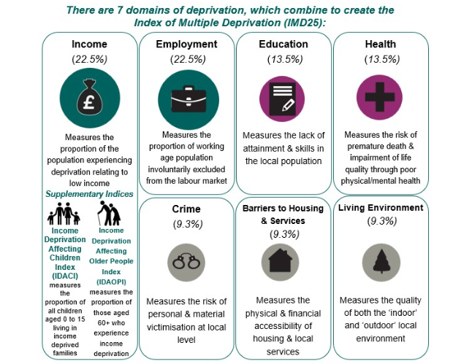
Background
Figure 1: Seven domains of deprivation alongside two supplementary indices
Within the IoD25, there are seven standalone indexes or domains and two supplementary indices, as seen in Figure 1.
The IMD25 combines these seven domains into a single overall score. Each domain contributes a fixed proportion (shown in figure 1) to the final IMD score. The two supplementary indices do not contribute to the overall IMD score but are reported alongside it. These supplementary indices are relevant to the income domain.

Slide 5
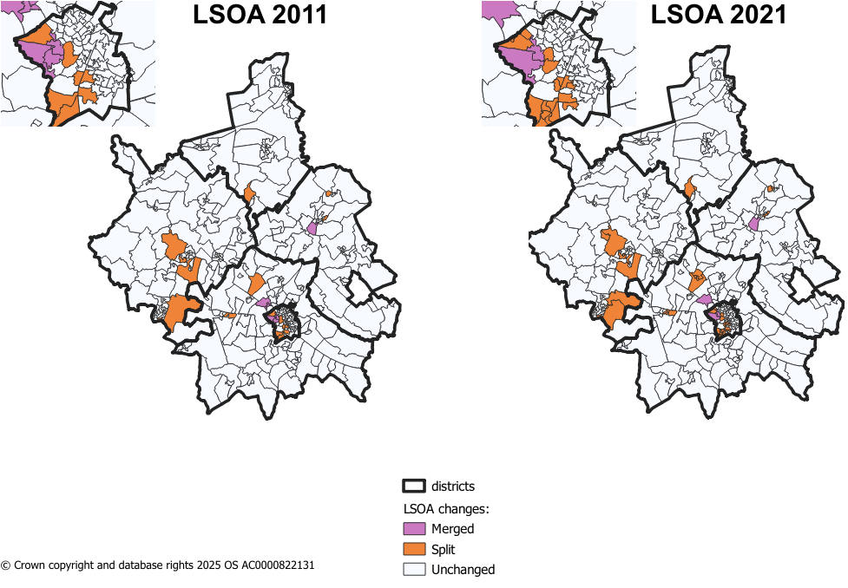
Methodology changes – LSOA boundaries
Figure 2: LSOA changes from 2011 to 2021 in Cambridgeshire
Since IMD 2019, there have been some changes to LSOA boundaries. IMD 2019 used 2011 LSOA boundaries and new boundaries came into effect during the latest Census in 2021.
The majority of LSOAs remained unchanged during this change in Cambridgeshire. The changes were as follows:
8 LSOAs changing only names and not boundaries.
8 LSOAs in 2011 were merged into 4 LSOAs in 2021.
17 2011 LSOAs were split into 41 2021 LSOAs.
Notes:
8 merged LSOAs –
Cambridge 005H (Trinity College to Castle Street) situated in Castle ward.
Cambridge 007I (West Cambridge to The Backs) situated in Newnham ward.
East Cambridgeshire 004H (West Witchford Services) situated in Ely West.
South Cambridgeshire 022D (Girton Village) situated in Girton ward.
41 split LSOAs –
18 in Cambridge City – 7 in Trumpington ward
4 in East Cambridgeshire
2 in Fenland
11 in Huntingdonshire – 5 in St Neots area
6 in South Cambridgeshire – 4 in Longstanton, where 1 LSOA from 2011 was split into 4

Slide 6
Methodology changes – Indicators
There are 55 indicators for the IMD 2025 – this compares to 39 indicators in IMD 2019.
For IMD 2025, 20 new indicators have been added, 14 indicators have been updated and significantly modified, and 21 indicators have been updated without significant modifications. Below are a list of the 20 new indicators.
Domains | New Indicators for IMD 2025
Income Deprivation 22.5% | Adults and children in Housing Benefit claimant benefit units with monthly equivalised income of less than 70% median equivalised monthly income after housing costs
Employment Deprivation 22.5% | Claimants of New Style Jobseeker’s Allowance
 | Claimants of New Style Employment and Support Allowance
 | Claimants of Income Support
 | Claimants of Universal Credit 'Planning for work ' conditionality group
 | Claimants of Universal Credit 'Preparing for work ' conditionality group
Education, Skills & Training Deprivation 13.5% | Persistent pupil absence
Health Deprivation & Disability 13.5% | Mental health composite indicator - Health benefits
Crime 9.3% | Violence with injury
 | Violence without injury
 | Stalking and harassment
 | Public order and Possession of weapons
 | Anti-social behaviour
Barriers to Housing & Services 9.3% | Geographical Barriers: Connectivity Score
 | Core Homelessness
 | Broadband speed
 | Patient-to-GP ratio
Living Environment Deprivation 9.3% | Housing Energy Performance Score
 | Housing lacking private outdoor space
 | Noise pollution
Table 1: Methodology changes between IoD 2019 and IoD 2025
Source: page 12 of English indices of deprivation 2025: technical report

Slide 7
  Key Findings
Huntingdonshire is one of the least deprived districts nationally, ranking 249 out of 296 English local authorities (where 1 = most deprived), making it the 47th least deprived.
Most wards in Huntingdonshire fall toward the least deprived end of the scale, with seven wards in the highest (least deprived) decile, while Huntingdon North is the only ward positioned in the lowest decile (5).
61 of the district’s 111 LSOAs fall within the top 30% least deprived deciles (8-10), a small increase from 58 in 2019. Only three LSOAs fall within the top 30% most deprived deciles (1-3).
Barriers to Housing and Services is the most deprived domain for Huntingdonshire; there were a number of changes to this domain between 2019 and 2025 releases. Living Environment shows the notable change between 2019 and 2025.
Income-related deprivation affects a notable proportion of residents, with 14% of the population in income deprivation, 23% of children experiencing income deprivation (IDACI), and 10% of older people affected (IDAOPI).

Slide 8
1.1. District Context - National Ranking
Table 2: District by overall IoD national rank
Huntingdonshire is ranked 249/296 of all local authorities nationally, based on local authority score, where 1 is most deprived (meaning Huntingdonshire is the 47th least deprived of the 296 English Local Authorities).
This compares to:
  South Cambridgeshire which is 281/296 (15th least deprived),
  Cambridge City which is 255/296 (41st least deprived),
  East Cambridgeshire which is 242/296 (54th least deprived),
  Fenland which is 42/296 (254th least deprived),
  and Peterborough which is 51/296 (245th least deprived).
District | IoD - Rank of average rank out of 296 (2025)
Fenland | 42
Peterborough | 51
East Cambridgeshire | 242
Huntingdonshire | 249
Cambridge | 255
South Cambridgeshire | 281

Slide 9
1.2. Analysis of overall deprivation across Huntingdonshire wards
Table 3: Decile average and range of LSOA deciles by ward, IMD 2025
On this page, the average decile is used. This is the decile of each LSOA combined and averaged to give an overall score for the ward. This is to help identify the domains that have a much higher or lower level of deprivation and give a broader overview of the ward as a whole, rather than the absolute ‘most’ and ‘least’ deprived domains. It should be noted that LSOA and ward boundaries are not co-terminus and therefore a ‘best fit’ lookup has been used to determine which LSOAs fall into each ward.
Highest scoring wards (least deprived):
Seven wards fall within the highest decile (9), as shown in Table 2. These wards are: Fenstanton, Great Paxton, Hemingford Grey & Houghton, St Ives East, St Ives West, St Neots Priory Park & Little Paxton, and The Stukeleys.
Lowest scoring ward (most deprived):
Huntingdon North falls into the lowest decile out of all other wards in Huntingdonshire (5).
Ward | Decile Average | Range
Alconbury | 8 | 7 - 9
Brampton | 8 | 7 - 9
Buckden | 8 | 8 - 8
Fenstanton | 9 | 8 - 9
Godmanchester & Hemingford Abbots | 8 | 5 - 9
Great Paxton | 9 | 8 - 9
Great Staughton | 8 | 7 - 8
Hemingford Grey & Houghton | 9 | 8 - 10
Holywell-cum-Needingworth | 8 | 7 - 9
Huntingdon East | 8 | 6 - 10
Huntingdon North | 5 | 3 - 7
Kimbolton | 8 | 7 - 8
Ramsey | 6 | 3 - 8
Sawtry | 8 | 5 - 10
Somersham | 8 | 6 - 9
St Ives East | 9 | 6 - 10
St Ives South | 8 | 7 - 10
St Ives West | 9 | 8 - 9
St Neots East | 6 | 5 - 7
St Neots Eatons | 8 | 3 - 10
St Neots Eynesbury | 7 | 4 - 10
St Neots Priory Park & Little Paxton | 9 | 6 - 10
Stilton, Folksworth & Washingley | 7 | 6 - 8
The Stukeleys | 9 | 7 - 10
Warboys | 7 | 6 - 8
Yaxley | 7 | 5 - 9

Slide 10
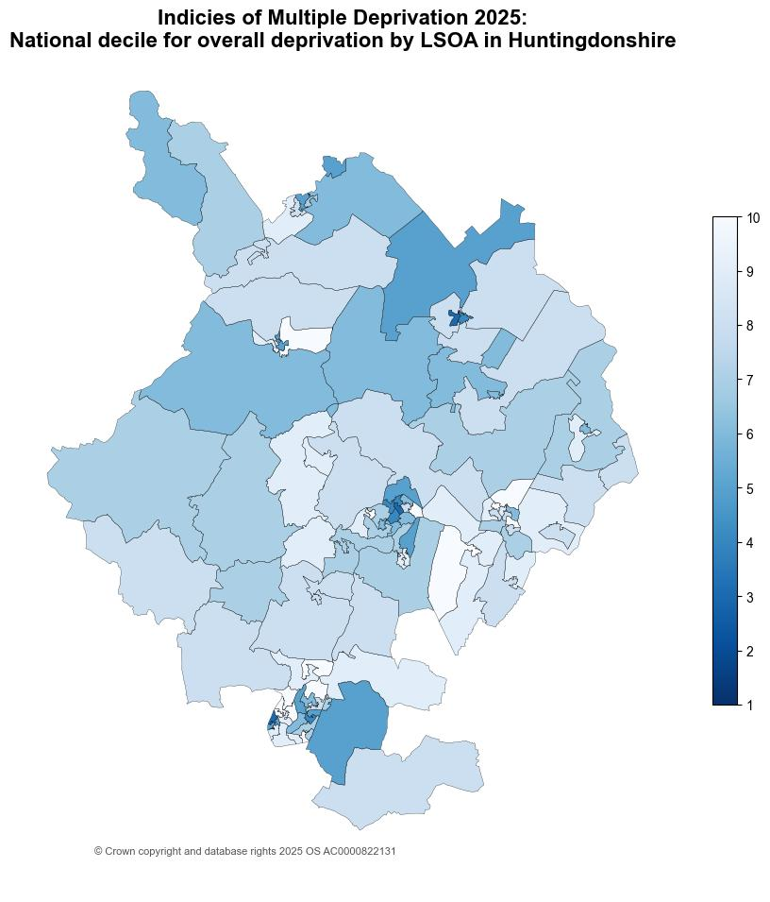
1.3. Analysis of individual Lower Super Output Areas (LSOA) across Huntingdonshire
Figure 3: National decile for overall relative deprivation in Huntingdonshire, IMD 2025
Huntingdonshire has 111 Lower Super Output Areas (LSOAs).
There are 61 LSOAs in the highest three deciles (8–10), which is an increase compared with IMD 2019, where 58 LSOAs fell within these deciles. Of the 61 LSOAs, 14 are in the highest decile (10). A full list is provided in Appendix B.
There are 3 LSOAs in the lowest 3 deciles (1-3). This is less LSOAs than in IMD 2019, where there were 5 LSOAs in the lowest 3 deciles. The 3 LSOAs were:
  Thongsley (Huntingdonshire 008B) situated in Huntingdon North.
  Westfield and The Avenue (Huntingdonshire 003E) situated in Ramsey.
  Peer Road (Huntingdonshire 022D) situated in St Neots Eatons.

Slide 11
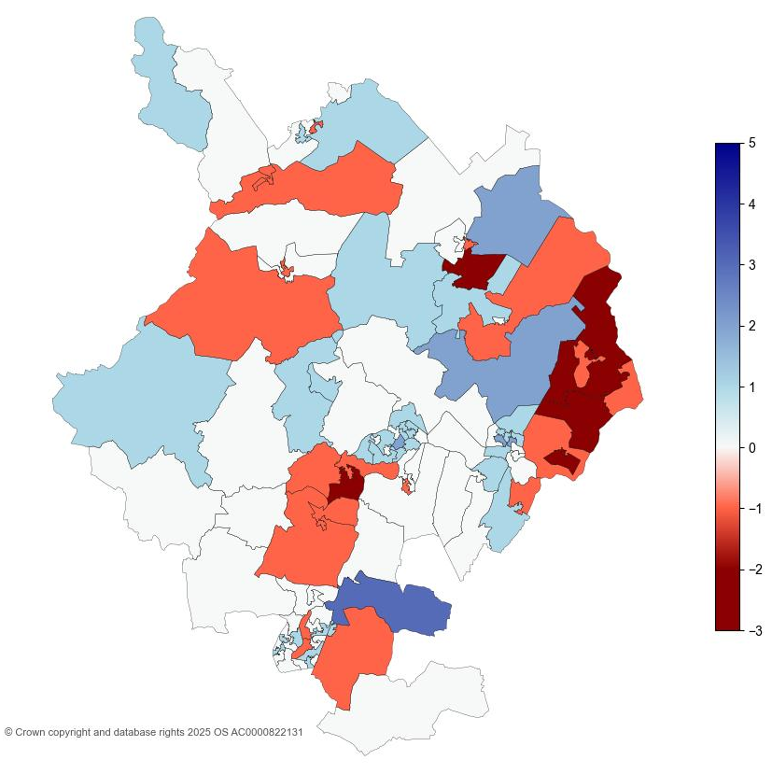
1.4. Analysis of individual Lower Super Output Areas (LSOA) across Huntingdonshire
Figure 4: Overall IMD decile change in Huntingdonshire between 2019 and 2025
The map shows that notable changes in the overall IMD deciles in Huntingdonshire have occurred from 2019 to 2025.
6 LSOAs moved by two or more deciles in the direction of lower relative deprivation since 2019. See Appendix C for a list of relevant LSOAs.
6 LSOAs in Huntingdonshire moved by two or more deciles in the direction of higher relative deprivation since 2019. See Appendix D for full list.

Slide 12
2.1. District Context - National Domain Ranking
The individual domain are ranked from lowest to highest at both district and LSOA. The ranks are based on comparisons between all of the local authority districts LADs nationally. There are 296 LADs. The table, on page 2.1.1., shows the deprivation domains for Huntingdonshire by rank (out of 296 nationally) where the lower the rank, the more deprived the domain (1 is the most deprived):
The most deprived domain in Huntingdonshire was Barriers to Housing and Services. However, despite being the most deprived domain, this domain ranks nationally less deprived than IMD 2019, from 117 to 131.
Living Environment domain saw the most notable change in national rank between IMD 2019 and IMD 2025 (from 208 to 285), overall becoming less relatively deprived. Further analysis can be found on page 2.4.
Income Deprivation affecting Older People (IDAOPI) domain nationally ranked more relatively deprived than IMD 2019 (from 268 to 246).
Education, Skills and Training domain also saw changes in national rank between IMD 2019 and IMD 2025 (from 175 to 191), becoming less deprived.

Slide 13
2.1.1. District Context - National Domain Ranking
Table 4: National local authority rank by domain, IMD 2025
Domain | National Local Authority Rank / 296 | National Local Authority Rank / 317 | Change in Rank between 2019 and 2025
Income | 235 | 250 | -15
Employment | 235 | 245 | -10
Education, Skills and Training | 191 | 175 | 16
Health Deprivation and Disability | 245 | 242 | 3
Living Environment | 285 | 208 | 77
Crime | 228 | 222 | 6
Barriers to Housing and Services | 131 | 117 | 14
Income Deprivation affecting Children (IDACI) | 241 | 234 | 7
Income Deprivation affecting Older People (IDAOPI) | 246 | 268 | -22
*Supplemental measures are a subset of the income domain.

Slide 14
2.2. Analysis of individual deprivation domains across Huntingdonshire by decile average
Table 5: Decile average by domain, IMD 2025
On this page, the average decile is used. This is the decile of each LSOA combined and averaged to give an overall score for the district. This is to help identify the domains that have a much higher or lower level of deprivation and give a broader overview of the district/city as a whole, rather than the absolute ‘most’ and ‘least’ deprived domains.
Highest scoring domains (least deprived):
Living Environment and Health Deprivation and Disability domains have the highest average decile of 8, as seen in Table 5.
Lowest scoring domains (most deprived):
Barriers to Housing and Services has the lowest average decile amongst the domains (5).
Domain | Average Decile | Range
Living Environment | 8 | 1-10
Health Deprivation and Disability | 8 | 2-10
Employment | 7 | 2-10
Income | 7 | 3-10
Crime | 7 | 2-10
Education, Skills and Training | 6 | 1-10
Barriers to Housing and Services | 5 | 1-10
Overall IMD | 7 | 3-10

Slide 15
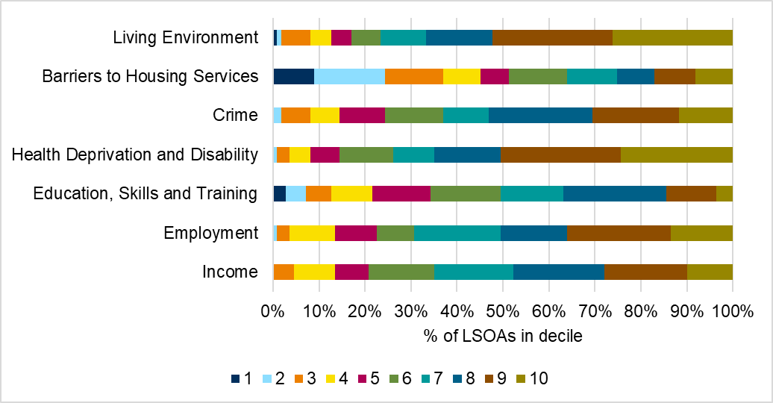
2.3. Analysis of individual deprivation domains across Huntingdonshire
In Huntingdonshire, the most deprived domain is Barriers to Housing and Services, which includes factors such as housing affordability and household overcrowding. 37% of LSOAs in Huntingdonshire fall into the top 3 most deprived deciles (1-3, where 1 is the most deprived).
The lowest levels of relative deprivation is in the Living Environment domains, with 67% of LSOAs in Huntingdonshire falling into the top 3 least deprived deciles (8-10, where 10 is the least deprived).
Figure 5 breaks down LSOA national decile distribution by individual domain.
Figure 5: Proportion of LSOAs which fall into each decile by domain, IMD 2025
See Appendix A for a breakdown of counts of proportions relevant to the graph.

Slide 16
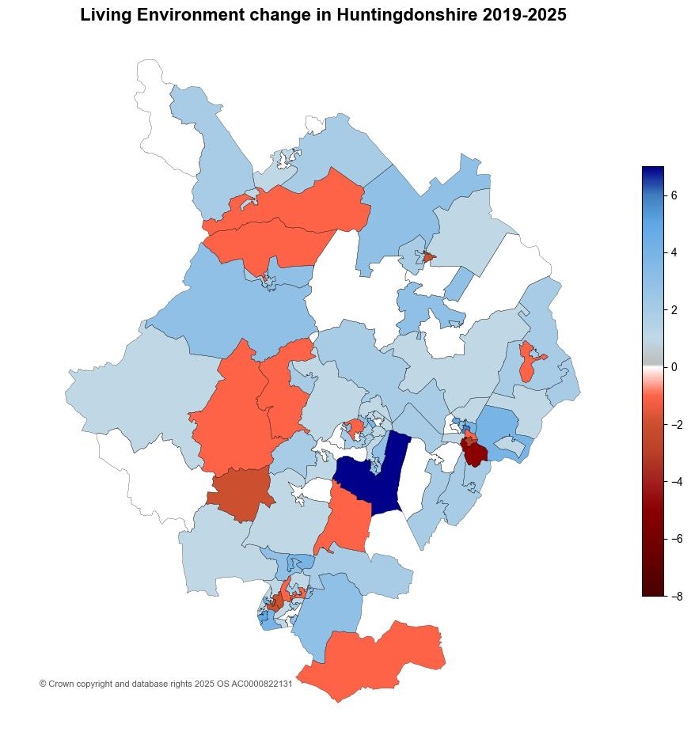
2.4. Analysis of individual Lower Super Output Areas (LSOA) across Huntingdonshire for Living Environment
Figure 6: Living Environment decile change in Huntingdonshire between 2019 and 2025
The map shows substantial changes in the Living Environment domain in Huntingdonshire from 2019 to 2025.
47 LSOAs moved 2 or more deciles in the direction of relatively less deprived between IMD 2019 and IMD 2025. See Appendix E for full list.
6 LSOAs moved 2 or more deciles in the direction of relatively more deprived between IMD 2019 and IMD 2025. See Appendix F for full list.
  Huntingdonshire 013C (St Ives Town Centre and Park and Ride) in St Ives South ward saw a notable change between IMD 2019 and IMD 2025 (from 10 to 5).
The lowest decile represented is decile 1. Only one LSOA was in this decile (Stibbington to Elton in Stilton, Folksworth & Washingley (Huntingdonshire 002B)).

Slide 17
3.1. Analysis of income scores across Huntingdonshire
Figure 7: Income, IDACI and IDAOPI proportions by district for Cambridgeshire districts
Income Deprivation Affecting Children Index (IDACI) and Income Deprivation Affecting Older People Index (IDAOPI) are supplementary indices which provide context but do not make up the overall IMD scores.
Huntingdonshire had a score of 0.140 for income domain, meaning that 14% of the population were living in income deprivation. This is the second highest proportion in Cambridgeshire, following Fenland (24%), then East Cambridgeshire at 14%.
Huntingdonshire had the fourth highest score for the Income Deprivation Affecting Older People Index (IDAOPI) at 10%.
IDACI scores across the county were notably high. Huntingdonshire had the third highest score (23%) of children experiencing relative income deprivation.

Slide 18
3.1. Analysis of income scores across Huntingdonshire
Table 6: Income, IDACI and IDAOPI proportions for Huntingdonshire, IMD 2019 and IMD 2025
 | IMD 2019 | IMD 2025 | Change
Domain
Income | 7.4% | 14.2% | 6.8pp
Supplementary Domain
Income Deprivation Affecting Children Index | 10.7% | 22.7% | 12.0pp
Income Deprivation Affecting Older People Index | 8.1% | 9.8% | 1.7pp
IDACI saw the most notable change in Huntingdonshire between IMD 2019 and IMD 2025. This was an increase of 12.0pp.
Proportions for both IDAOPI and income domain saw increases as well.

Slide 19
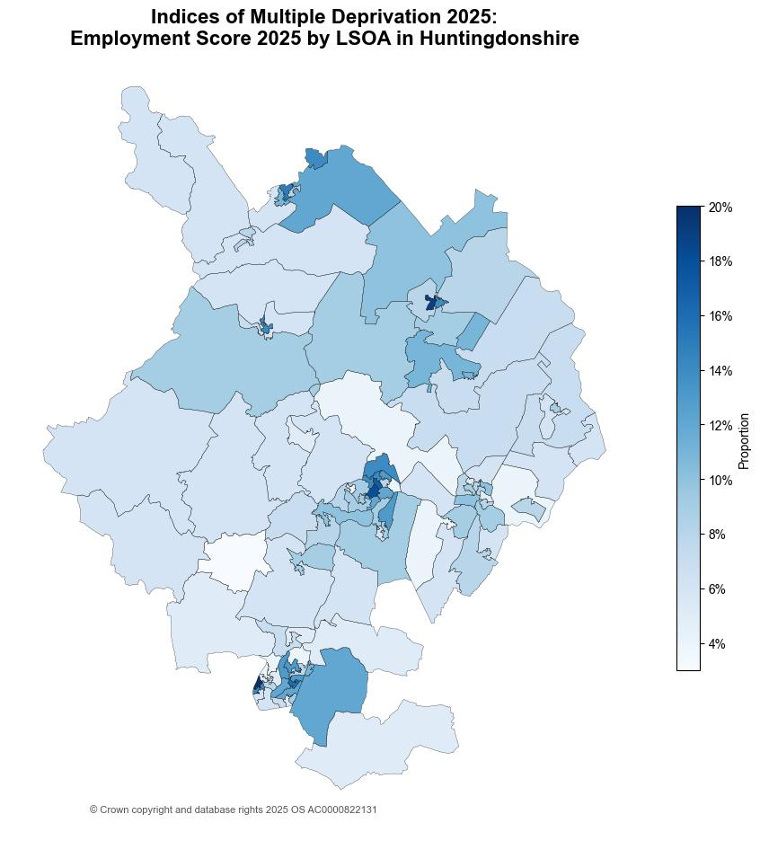
3.2. Analysis of employment scores across Huntingdonshire
Figure 8: Employment score by LSOA in Huntingdonshire, IMD 2025
Huntingdonshire had a score of 0.087 in the employment domain; this means that 8.7% of the population are living in relative employment deprivation.
The score for Huntingdonshire has slightly increased between IMD 2019 and IMD 2025, by 2.5pp (from 6.2% to 8.7%).
Peer Road (Huntingdonshire 022D) situated in St Neots Eatons ward had the highest employment score with 0.200. This means 20% of the population are living in relative employment deprivation.

Slide 20
References
MHCLG. (2019, September 26). English indices of deprivation 2019: statistical release - main findings. Retrieved from https://assets.publishing.service.gov.uk/media/5d8e26f6ed915d5570c6cc55/IoD2019_Statistical_Release.pdf
MHCLG. (2025, October 30). English indices of deprivation 2025: statistical release. Retrieved from https://www.gov.uk/government/statistics/english-indices-of-deprivation-2025/english-indices-of-deprivation-2025-statistical-release

Slide 21
Appendix A
Table 7: Proportion of LSOAs which fall into each decile by domain, IMD 2025
Domain | 1 | 2 | 3 | 4 | 5 | 6 | 7 | 8 | 9 | 10
Income | 0% | 0% | 5% | 9% | 7% | 14% | 17% | 20% | 18% | 10%
Employment | 0% | 1% | 3% | 10% | 9% | 8% | 19% | 14% | 23% | 14%
Education, Skills and Training | 3% | 5% | 5% | 9% | 13% | 15% | 14% | 23% | 11% | 4%
Health Deprivation and Disability | 0% | 1% | 3% | 5% | 6% | 12% | 9% | 14% | 26% | 24%
Crime | 0% | 2% | 6% | 6% | 10% | 13% | 10% | 23% | 19% | 12%
Barriers to Housing Services | 9% | 15% | 13% | 8% | 6% | 13% | 11% | 8% | 9% | 8%
Living Environment | 1% | 1% | 6% | 5% | 5% | 6% | 10% | 14% | 26% | 26%
Table 8: Count of LSOAs which fall into each decile by domain, IMD 2025
Domain | 1 | 2 | 3 | 4 | 5 | 6 | 7 | 8 | 9 | 10
Income | 0 | 0 | 5 | 10 | 8 | 16 | 19 | 22 | 20 | 11
Employment | 0 | 1 | 3 | 11 | 10 | 9 | 21 | 16 | 25 | 15
Education, Skills and Training | 3 | 5 | 6 | 10 | 14 | 17 | 15 | 25 | 12 | 4
Health Deprivation and Disability | 0 | 1 | 3 | 5 | 7 | 13 | 10 | 16 | 29 | 27
Crime | 0 | 2 | 7 | 7 | 11 | 14 | 11 | 25 | 21 | 13
Barriers to Housing Services | 10 | 17 | 14 | 9 | 7 | 14 | 12 | 9 | 10 | 9
Living Environment | 1 | 1 | 7 | 5 | 5 | 7 | 11 | 16 | 29 | 29

Slide 22
LSOA | LSOA Local Name | Ward | IMD 2025 Decile
Huntingdonshire 019C | Rowley Road | St Neots Priory Park & Little Paxton | 10
Huntingdonshire 020E | Milton Avenue | St Neots Priory Park & Little Paxton | 10
Huntingdonshire 012C | Wertheim Way | The Stukeleys | 10
Huntingdonshire 020D | Burwell Road | St Neots Eatons | 10
Huntingdonshire 009C | Owl Way | Huntingdon East | 10
Huntingdonshire 013B | St Audrey Lane and Needingworth Road T Junction | St Ives South | 10
Huntingdonshire 016C | The Hemingfords | Hemingford Grey & Houghton | 10
Huntingdonshire 018D | Little Paxton Lane to Rudd Lakes | St Neots Priory Park & Little Paxton | 10
Huntingdonshire 004C | Sawtry Colts Football Club and Greenfields Fishing Lake | Sawtry | 10
Huntingdonshire 021G | Caernavon Road | St Neots Eynesbury | 10
Huntingdonshire 020B | Honeydon Avenue | St Neots Eatons | 10
Huntingdonshire 011A | The Mallards | St Ives East | 10
Huntingdonshire 011B | Burleigh Hill Community Centre | St Ives East | 10
Huntingdonshire 020A | Sudbury Meadow | St Neots Eatons | 10
Huntingdonshire 014D | Sweetings Road | Godmanchester & Hemingford Abbots | 9
Huntingdonshire 007A | Needingworth High Street and Holywell | Holywell-cum-Needingworth | 9
Huntingdonshire 006C | Somersham High Street | Somersham | 9
Huntingdonshire 016B | Fenstanton and Hilton Primary School | Fenstanton | 9
Huntingdonshire 010F | Brampton Hut Interchange | Brampton | 9
Huntingdonshire 001E | London Road to Broadway T Junction | Yaxley | 9
Huntingdonshire 022A | Rivermill Marina and Colmworth Business Park | St Neots Eatons | 9
Huntingdonshire 020C | Brook Road | St Neots Eatons | 9
Huntingdonshire 022B | Nelson Road | St Neots Eatons | 9
Huntingdonshire 004A | Gidding Road and Westfield Road T Junction | Sawtry | 9
Huntingdonshire 011G | St Ives Outdoor Complex | St Ives West | 9
Appendix B
Table 9: Top 30% least deprived LSOAs in Huntingdonshire, IMD 2025

Slide 23
LSOA | LSOA Local Name | Ward | IMD 2025 Decile
Huntingdonshire 016F | Houghton and Wyton | Hemingford Grey & Houghton | 9
Huntingdonshire 014C | Croftfield Road | Godmanchester & Hemingford Abbots | 9
Huntingdonshire 016E | Hilton | Fenstanton | 9
Huntingdonshire 018C | Gordon Road to Little Paxton Cemetery | St Neots Priory Park & Little Paxton | 9
Huntingdonshire 021H | Bevington Way, Cahpman Way and Buttercup Avenue | St Neots Eynesbury | 9
Huntingdonshire 010H | Rusts Lane | The Stukeleys | 9
Huntingdonshire 012B | Hinchingbrooke Country Park Car Park | Brampton | 9
Huntingdonshire 011D | Wheatfields Playing Field (Metal Park) | St Ives East | 9
Huntingdonshire 010B | Alconbury Weston and Alconbury Hill | Alconbury | 9
Huntingdonshire 016D | Hemingford Road and St Ives Road | Hemingford Grey & Houghton | 9
Huntingdonshire 018E | Paxton Hill to Yelling | Great Paxton | 9
Huntingdonshire 005D | Bury | Ramsey | 8
Huntingdonshire 007B | Needingworth Cemetery | Holywell-cum-Needingworth | 8
Huntingdonshire 007D | Bluntisham | Holywell-cum-Needingworth | 8
Huntingdonshire 017B | Southoe and Diddington | Buckden | 8
Huntingdonshire 002C | Caldecote, Denton and Holme | Stilton, Folksworth & Washingley | 8
Huntingdonshire 007C | Earith | Holywell-cum-Needingworth | 8
Huntingdonshire 005B | Heath Road | Warboys | 8
Huntingdonshire 002D | Church Street and St Mary Magdelene, Church | Stilton, Folksworth & Washingley | 8
Huntingdonshire 017C | Buckden High Street and Lucks Lane | Buckden | 8
Huntingdonshire 006E | Wyton Primary School | Hemingford Grey & Houghton | 8
Huntingdonshire 010I | Little Stukeley and Great Stukeley | The Stukeleys | 8
Huntingdonshire 004D | Glatton, Conington and North Sawtry | Sawtry | 8
Huntingdonshire 017D | The Offords | Godmanchester & Hemingford Abbots | 8
Huntingdonshire 015C | Great Staughton to Hail Weston | Great Staughton | 8
Appendix B
(continued)
Table 9: Top 30% least deprived LSOAs in Huntingdonshire, IMD 2025

Slide 24
LSOA | LSOA Local Name | Ward | IMD 2025 Decile
Huntingdonshire 013A | Warner's Park | St Ives South | 8
Huntingdonshire 018B | Abbotsley and Great Gransden | Great Paxton | 8
Huntingdonshire 015D | Covington to Stonely | Kimbolton | 8
Huntingdonshire 003D | Biggin Lane | Ramsey | 8
Huntingdonshire 009B | Coneygear Park | Huntingdon East | 8
Huntingdonshire 019B | St Neots Train Station | St Neots Priory Park & Little Paxton | 8
Huntingdonshire 016A | Fenstanton High Street and Swan Road | Fenstanton | 8
Huntingdonshire 001F | Westfield Road and Chapel Street | Yaxley | 8
Huntingdonshire 011F | Shakespeare Road | St Ives West | 8
Huntingdonshire 003A | Ramsey to Ramsey Forty Foot | Ramsey | 8
Huntingdonshire 011E | Wheatfields Primary School field | St Ives East | 8
Appendix B (continued)
Table 9: Top 30% least deprived LSOAs in Huntingdonshire, IMD 2025

Slide 25
Appendix C
Table 10: LSOAs moved by two or more deciles (less deprived) between IMD 2019 and IMD 2025
LSOA | LSOA Local Name | Ward | IMD 2025 Decile | IMD 2019 Decile | Change
Huntingdonshire 018E | Paxton Hill to Yelling | Great Paxton | 9 | 6 | +3
Huntingdonshire 011F | Shakespeare Road | St Ives West | 8 | 6 | +2
Huntingdonshire 003A | Ramsey to Ramsey Forty Foot | Ramsey | 8 | 6 | +2
Huntingdonshire 011E | Wheatfields Primary School field | St Ives East | 8 | 6 | +2
Huntingdonshire 006A | Pidley and Woodhurst | Warboys | 7 | 5 | +2
Huntingdonshire 008A | American Lane | Huntingdon North | 4 | 2 | +2

Slide 26
Appendix D
Table 11: LSOAs moved by two or more deciles (more deprived) between IMD 2019 and IMD 2025
LSOA | LSOA Local Name | Ward | IMD 2025 Decile | IMD 2019 Decile | Change
Huntingdonshire 005D | Bury | Ramsey | 8 | 10 | -2
Huntingdonshire 007B | Needingworth Cemetery | Holywell-cum-Needingworth | 8 | 10 | -2
Huntingdonshire 007D | Bluntisham | Holywell-cum-Needingworth | 8 | 10 | -2
Huntingdonshire 006D | Outer Somersham and Colne | Holywell-cum-Needingworth | 7 | 9 | -2
Huntingdonshire 006B | Feoffees Road | Somersham | 6 | 8 | -2
Huntingdonshire 010D | Brampton Cemetery | Brampton | 7 | 10 | -3

Slide 27
Appendix E
Table 12: LSOAs in Huntingdonshire that moved by two or more deciles in the direction of lower relative deprivation since 2019 for Living Environment Domain
LSOA | LSOA Local Name | Ward Name | IMD 2025 Decile | IMD 2019 Decile | Change in Decile
Huntingdonshire 014F | Romans Edge | Godmanchester & Hemingford Abbots | 9 | 2 | +7
Huntingdonshire 011E | Wheatfields Primary School field | St Ives East | 9 | 3 | +6
Huntingdonshire 011A | The Mallards | St Ives East | 9 | 4 | +5
Huntingdonshire 022B | Nelson Road | St Neots Eatons | 10 | 5 | +5
Huntingdonshire 007A | Needingworth High Street and Holywell | Holywell-cum-Needingworth | 9 | 5 | +4
Huntingdonshire 008B | Thongsley | Huntingdon North | 10 | 6 | +4
Huntingdonshire 011C | St Ives Industrial Estate | St Ives East | 10 | 6 | +4
Huntingdonshire 018D | Little Paxton Lane to Rudd Lakes | St Neots Priory Park & Little Paxton | 9 | 5 | +4
Huntingdonshire 020B | Honeydon Avenue | St Neots Eatons | 10 | 6 | +4
Huntingdonshire 022A | Rivermill Marina and Colmworth Business Park | St Neots Eatons | 8 | 4 | +4
Huntingdonshire 003B | Ramsey Heights, St Mary's and Mereside | Ramsey | 8 | 5 | +3
Huntingdonshire 004B | The Giddings, Winwick and Hamerton | Sawtry | 8 | 5 | +3
Huntingdonshire 004C | Sawtry Colts Football Club and Greenfields Fishing Lake | Sawtry | 9 | 6 | +3
Huntingdonshire 005A | Wistow | Warboys | 9 | 6 | +3
Huntingdonshire 008C | Sallowbush Road | Huntingdon North | 9 | 6 | +3
Huntingdonshire 011D | Wheatfields Playing Field (Metal Park) | St Ives East | 9 | 6 | +3
Huntingdonshire 012C | Wertheim Way | The Stukeleys | 10 | 7 | +3

Slide 28
Appendix E (continued)
Table 12: LSOAs in Huntingdonshire that moved by two or more deciles in the direction of lower relative deprivation since 2019 for Living Environment Domain
LSOA | LSOA Local Name | Ward Name | IMD 2025 Decile | IMD 2019 Decile | Change in Decile
Huntingdonshire 014A | Foxgrove | Godmanchester & Hemingford Abbots | 7 | 4 | +3
Huntingdonshire 014D | Sweetings Road | Godmanchester & Hemingford Abbots | 10 | 7 | +3
Huntingdonshire 018C | Gordon Road to Little Paxton Cemetery | St Neots Priory Park & Little Paxton | 10 | 7 | +3
Huntingdonshire 018F | Kester Way | St Neots East | 10 | 7 | +3
Huntingdonshire 018G | Brampton Centre and Hinchingbrooke Country Park | St Neots East | 10 | 7 | +3
Huntingdonshire 021B | Howitts Gardens | St Neots Eynesbury | 8 | 5 | +3
Huntingdonshire 001B | Eagel Business Park to Ramsey Road | Yaxley | 7 | 5 | +2
Huntingdonshire 002A | Chesterton to Washingley | Stilton, Folksworth & Washingley | 5 | 3 | +2
Huntingdonshire 003D | Biggin Lane | Ramsey | 10 | 8 | +2
Huntingdonshire 003E | Westfield and The Avenue | Ramsey | 10 | 8 | +2
Huntingdonshire 004A | Gidding Road and Westfield Road T Junction | Sawtry | 10 | 8 | +2
Huntingdonshire 004E | Sawtry Village Academy | Sawtry | 10 | 8 | +2
Huntingdonshire 005C | School Road to Humberdale Way | Warboys | 8 | 6 | +2
Huntingdonshire 006B | Feoffees Road | Somersham | 9 | 7 | +2
Huntingdonshire 006D | Outer Somersham and Colne | Holywell-cum-Needingworth | 8 | 6 | +2
Huntingdonshire 006E | Wyton Primary School | Hemingford Grey & Houghton | 9 | 7 | +2
Huntingdonshire 007C | Earith | Holywell-cum-Needingworth | 9 | 7 | +2

Slide 29
Appendix E (continued)
Table 12: LSOAs in Huntingdonshire that moved by two or more deciles in the direction of lower relative deprivation since 2019 for Living Environment Domain
LSOA | LSOA Local Name | Ward Name | IMD 2025 Decile | IMD 2019 Decile | Change in Decile
Huntingdonshire 008A | American Lane | Huntingdon North | 9 | 7 | +2
Huntingdonshire 010F | Brampton Hut Interchange | Brampton | 9 | 7 | +2
Huntingdonshire 010H | Rusts Lane | The Stukeleys | 10 | 8 | +2
Huntingdonshire 012A | Riverside Road | Huntingdon East | 4 | 2 | +2
Huntingdonshire 012G | Hinchingbrooke Hospital | Huntingdon North | 5 | 3 | +2
Huntingdonshire 014C | Croftfield Road | Godmanchester & Hemingford Abbots | 10 | 8 | +2
Huntingdonshire 016A | Fenstanton High Street and Swan Road | Fenstanton | 8 | 6 | +2
Huntingdonshire 016B | Fenstanton and Hilton Primary School | Fenstanton | 10 | 8 | +2
Huntingdonshire 016E | Hilton | Fenstanton | 9 | 7 | +2
Huntingdonshire 016F | Houghton and Wyton | Hemingford Grey & Houghton | 6 | 4 | +2
Huntingdonshire 018E | Paxton Hill to Yelling | Great Paxton | 9 | 7 | +2
Huntingdonshire 019D | The Crescent | St Neots Priory Park & Little Paxton | 8 | 6 | +2
Huntingdonshire 021D | Duck Lane | St Neots Eynesbury | 9 | 7 | +2

Slide 30
Appendix F
Table 13: LSOAs in Huntingdonshire that moved by two or more deciles in the direction of higher relative deprivation since 2019 for Living Environment Domain
LSOA | LSOA Local Name | Ward Name | IMD 2025 Decile | IMD 2019 Decile | Change in Decile
Huntingdonshire 013C | St Ives Town Centre and Park and Ride | St Ives South | 5 | 10 | -5
Huntingdonshire 013A | Warner's Park | St Ives South | 4 | 7 | -3
Huntingdonshire 003C | Ramsey Town Centre | Ramsey | 3 | 5 | -2
Huntingdonshire 017A | Grafham Water | Great Staughton | 4 | 6 | -2
Huntingdonshire 020A | Sudbury Meadow | St Neots Eatons | 6 | 8 | -2
Huntingdonshire 020C | Brook Road | St Neots Eatons | 7 | 9 | -2

