Slide 1
Fenland
Indices of Deprivation 2025 District Report
Published on 17th March 2026
Policy, Performance and Intelligence Service
policyandinsight@cambridgeshire.gov.uk

Slide 2
Contents
Background
Key Findings
Overall IMD
  1.1. District – National Ranking
  1.2. Ward – Average Decile
  1.3. LSOA – Decile
  1.4. LSOA – Decile change
Domains by Deciles
  2.1. District – National Domain Ranking and Change
  2.2. Ward – Average Decile
  2.3. LSOAs
  2.4. Most Notable Domain Decile Change – Barriers to Housing
Domains by Scores
  3.1. Income Domain
  3.2. Employment Domain
References
Appendix

Slide 3
Background
The Index of Multiple Deprivation 2025 (IoD 2025) is the official measure of relative deprivation for small area geographies called Lower-layer Super Output Areas (LSOAs), in England. It has been produced every 3 to 5 years since 1970s. Lower Layer Super Output Areas are a geographic hierarchy designed to improve the reporting of small area statistics in England and Wales. The Minimum population of an LSOA is 1,000 and the average is 1,500. As of the Census 2021, there is a total of 35,672 LSOAs nationally.
For more information, please refer to the Cambridgeshire and Peterborough IoD 2025 Summary Document, produced by Cambridgeshire County Council: Policy, Performance and Intelligence Service. This document is available here, alongside an interactive dashboard specific to Cambridgeshire and Peterborough.
The data is compiled by the Ministry of Housing, Communities and Local Government (MHCLG) and can be accessed here: English indices of deprivation 2025 - Accredited official statistics announcement - GOV.UK

Slide 4
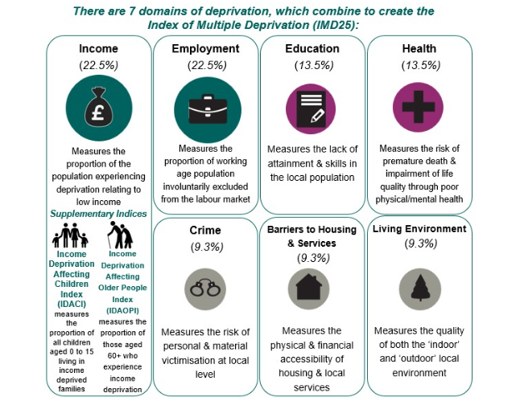
Background
Figure 1: Seven domains of deprivation alongside two supplementary indices
Within the IoD25, there are seven standalone indexes or domains and two supplementary indices, as seen in Figure 1.
The IMD25 combines these seven domains into a single overall score. Each domain contributes a fixed proportion (shown in figure 1) to the final IMD score. The two supplementary indices do not contribute to the overall IMD score but are reported alongside it. These supplementary indices are relevant to the income domain.

Slide 5
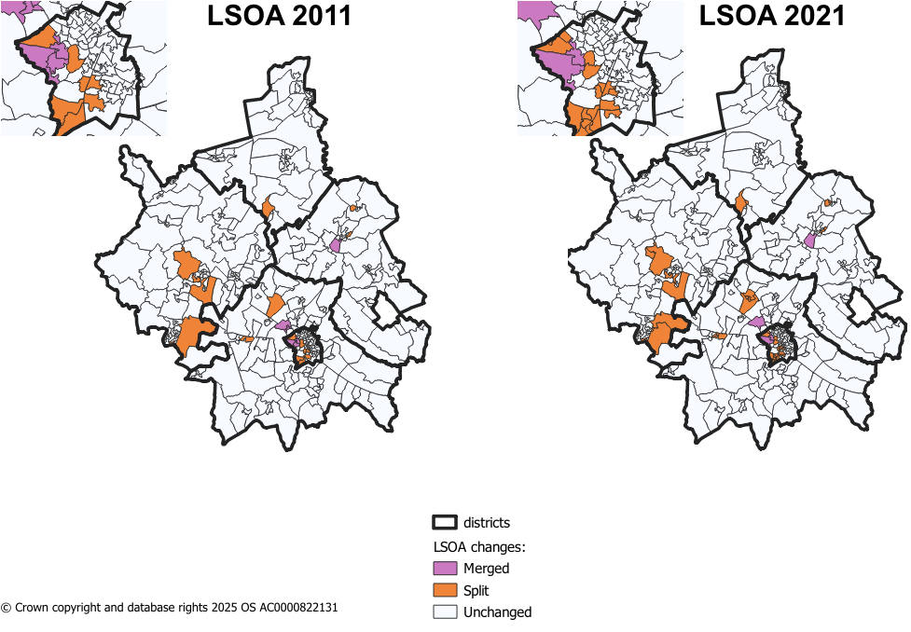
Methodology changes – LSOA boundaries
Figure 2: LSOA changes from 2011 to 2021 in Cambridgeshire
Since IMD 2019, there have been some changes to LSOA boundaries. IMD 2019 used 2011 LSOA boundaries and new boundaries came into effect during the latest Census in 2021.
The majority of LSOAs remained unchanged during this change in Cambridgeshire. The changes were as follows:
8 LSOAs changing only names and not boundaries.
8 LSOAs in 2011 were merged into 4 LSOAs in 2021.
17 2011 LSOAs were split into 41 2021 LSOAs.
Notes:
8 merged LSOAs –
Cambridge 005H (Trinity College to Castle Street) situated in Castle ward.
Cambridge 007I (West Cambridge to The Backs) situated in Newnham ward.
East Cambridgeshire 004H (West Witchford Services) situated in Ely West.
South Cambridgeshire 022D (Girton Village) situated in Girton ward.
41 split LSOAs –
18 in Cambridge City – 7 in Trumpington ward
4 in East Cambridgeshire
2 in Fenland
11 in Huntingdonshire – 5 in St Neots area
6 in South Cambridgeshire – 4 in Longstanton, where 1 LSOA from 2011 was split into 4

Slide 6
Methodology changes – Indicators
There are 55 indicators for the IMD 2025 – this compares to 39 indicators in IMD 2019.
For IMD 2025, 20 new indicators have been added, 14 indicators have been updated and significantly modified, and 21 indicators have been updated without significant modifications. Below are a list of the 20 new indicators.
Domains | New Indicators for IMD 2025
Income Deprivation 22.5% | Adults and children in Housing Benefit claimant benefit units with monthly equivalised income of less than 70% median equivalised monthly income after housing costs
Employment Deprivation 22.5% | Claimants of New Style Jobseeker’s Allowance
 | Claimants of New Style Employment and Support Allowance
 | Claimants of Income Support
 | Claimants of Universal Credit 'Planning for work ' conditionality group
 | Claimants of Universal Credit 'Preparing for work ' conditionality group
Education, Skills & Training Deprivation 13.5% | Persistent pupil absence
Health Deprivation & Disability 13.5% | Mental health composite indicator - Health benefits
Crime 9.3% | Violence with injury
 | Violence without injury
 | Stalking and harassment
 | Public order and Possession of weapons
 | Anti-social behaviour
Barriers to Housing & Services 9.3% | Geographical Barriers: Connectivity Score
 | Core Homelessness
 | Broadband speed
 | Patient-to-GP ratio
Living Environment Deprivation 9.3% | Housing Energy Performance Score
 | Housing lacking private outdoor space
 | Noise pollution
Table 1: Methodology changes between IoD 2019 and IoD 2025
Source: page 12 of English indices of deprivation 2025: technical report

Slide 7
  Key Findings
Fenland is relatively deprived nationally, ranking 42 out of 296 local authorities (1 = most deprived), the most relatively deprived district in Cambridgeshire.
Ward‑level deprivation varies considerably, with Wisbech North the most deprived ward (decile 1) and areas such as Doddington & Wimblington, March South, and Whittlesey North West/South among the least deprived (decile 6). Decile 1 representing the most deprived, and decile 10 representing the least deprived.
A significant number of Fenland’s LSOAs fall into the top 30% most deprived deciles, including 24 LSOAs in deciles 1 to 3, and 5 LSOAs in decile 1, an increase compared with IMD 2019.
Education, Skills & Training is the most deprived domain, with Fenland ranking 1st (most deprived) nationally; meanwhile Living Environment is the least deprived domain (rank from 204 to 244).
Fenland had the highest proportion of those living in relative deprivation in Cambridgeshire, with 24% of residents. Child poverty (IDACI) and older‑people income deprivation (IDAOPI) rates are also notably high.

Slide 8
1.1. District Context - National Ranking
Table 2: District by overall IMD national rank
Fenland is ranked 42/296 of all local authorities nationally, based on local authority score, where 1 is most deprived (meaning Fenland is the 254th least deprived of the 296 English Local Authorities).
This compares to:
  South Cambridgeshire which is 281/296 (15th least deprived),
  Cambridge City which is 255/296 (41st least deprived),
  Huntingdonshire which is 249/296 (47th least deprived),
  East Cambridgeshire which is 242/296 (54th least deprived),
  and Peterborough which is 51/296 (245th least deprived).
District | IMD - Rank of average rank out of 296 (2025)
Fenland | 42
Peterborough | 51
East Cambridgeshire | 242
Huntingdonshire | 249
Cambridge | 255
South Cambridgeshire | 281

Slide 9
1.2. Analysis of overall deprivation across Fenland wards
Table 3: Decile average and range of LSOA deciles by ward, IMD 2025
Ward | Average Decile | Range
Chatteris North & Manea | 4 | 4 - 5
Chatteris South | 5 | 3 - 7
Doddington & Wimblington | 6 | 5 - 6
Elm & Christchurch | 3 | 2 - 5
Leverington & Wisbech Rural | 4 | 3 - 5
March East | 4 | 1 - 6
March North | 5 | 4 - 5
March South | 6 | 4 - 7
March West & Benwick | 4 | 3 - 4
Parson Drove & Wisbech St Mary | 3 | 3 - 3
Whittlesey East & Villages | 5 | 4 - 7
Whittlesey Lattersey | 4 | 2 - 6
Whittlesey North West | 6 | 4 - 7
Whittlesey South | 6 | 5 - 7
Wisbech North | 1 | 1 - 1
Wisbech Riverside | 3 | 2 - 3
Wisbech Walsoken & Waterlees | 3 | 1 - 4
Wisbech South | 3 | 1 - 6
On this page, the average decile is used. This is the decile of each LSOA combined and averaged to give an overall score for the ward. This is to help identify the domains that have a much higher or lower level of deprivation and give a broader overview of the ward as a whole, rather than the absolute ‘most’ and ‘least’ deprived domains. It should be noted that LSOA and ward boundaries are not co-terminus and therefore a ‘best fit’ lookup has been used to determine which LSOAs fall into each ward.
Highest scoring wards (least deprived):
As shown in Table 3, Doddington & Wimblington, March South, Whittlesey North West, and Whittlesey South wards fall within the highest decile out of all other wards in Fenland (6).
Lowest scoring ward (most deprived):
Wisbech North fall into the lowest decile out of all other wards in Fenland (1). Both LSOAs situated in Wisbech North fall into the most deprived decile (1).

Slide 10
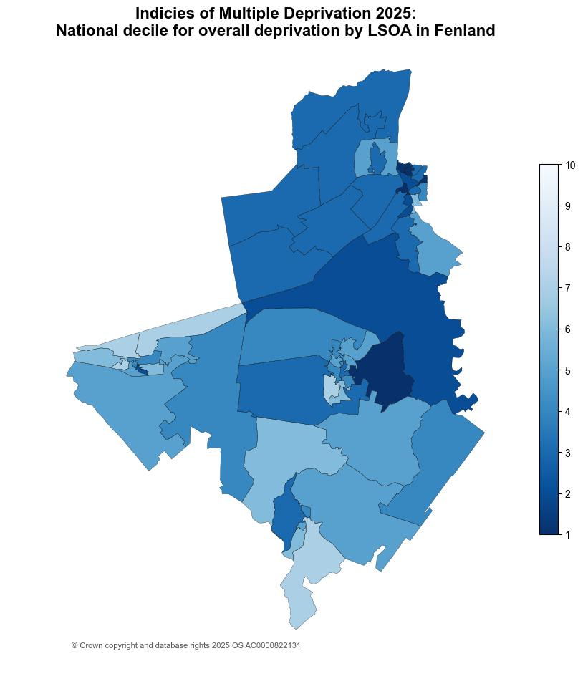
1.3. Analysis of individual Lower Super Output Areas (LSOA) across Fenland
Figure 3: National decile for overall relative deprivation in Fenland, IMD 2025
Fenland has 56 Lower Super Output Areas (LSOAs).
There are no LSOAs in the highest 3 deciles (8-10). This is less LSOAs than IMD 2019, where there were 2 LSOAs in the highest 3 deciles.
There are 24 LSOAs in the lowest 3 deciles (1-3). This is more LSOAs than in IMD 2019, where there were 21 LSOAs in the lowest 3 deciles. See Appendix B for full list from IMD 2025.
5 LSOAs fall into the lowest decile (1), these include:
  Southwell Road (Fenland 002D) situated in Wisbech North ward,
  Smith’s Park (Fenland 007B) situated in March East,
  Trinity Road (Fenland 003F) situated in Wisbech Walsoken & Waterlees ward,
  Mount Pleasant Cemetery (Fenland 002C) situated in Wisbech North ward,
  and, Wisbech Town Centre (Fenland 003I) situated in Wisbech South ward.

Slide 11
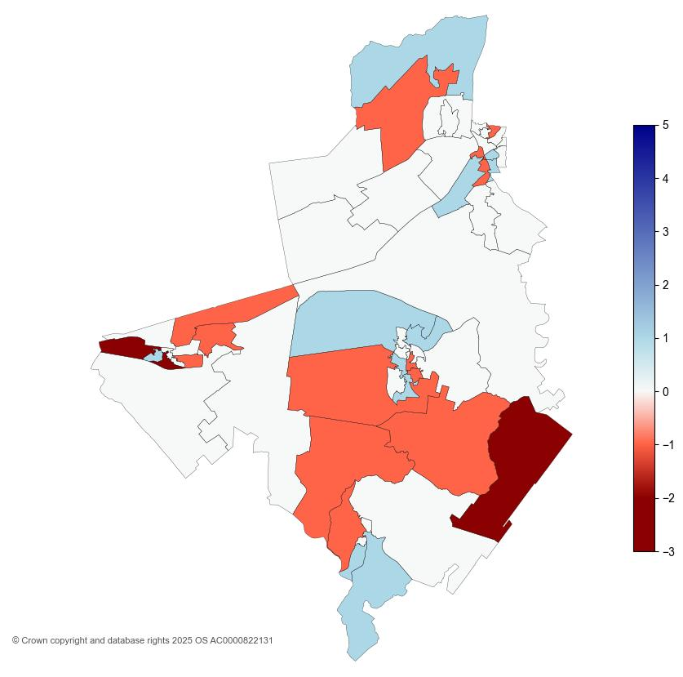
1.4. Analysis of individual Lower Super Output Areas (LSOA) across Fenland
Figure 4: IMD decile change in Fenland between 2019 and 2025
The map shows that notable changes in overall IMD deciles in Fenland have occurred between 2019 and 2025.
No LSOAs moved by two or more deciles in the direction of lower relative deprivation since 2019.
As shown in Figure 2, Kings Dyke to West Snoots Estate (Fenland 006F), Manor Leisure Centre (Fenland 006H), and Manea (Fenland 010B) moved by two or more deciles in the direction of higher relative deprivation since 2019.

Slide 12
2.1. District Context - National Domain Ranking
The individual domain are ranked from lowest to highest at both district and LSOA. The ranks are based on comparisons between all of the local authority districts LADs nationally. There are 296 LADs. The table, on page 2.1.1., shows the deprivation domains for Fenland by rank (out of 296 nationally) where the lower the rank, the more deprived the domain (1 is the most deprived):
The most deprived domain in Fenland was Education, Skills and Training. It is ranked as more deprived nationally compared to IMD 2019, from 3 to 1. This means that Fenland ranks most deprived local authority nationally for Education, Skills and Training domain.
Barriers to Housing and Services domain saw the most notable change in national rank between IMD 2019 and IMD 2025 (from 108 to 38), overall becoming more relatively deprived. There were a number of changes to this domain between 2019 and 2025 releases. Further analysis can be found on page 2.4.
Living Environment domain saw considerable change in national rank between IMD 2019 and IMD 2025 (from 204 to 244), overall becoming less relatively deprived.
  13 LSOAs in Fenland saw an increase of two or more deciles in Living Environment between IMD 2019 and IMD 2025, becoming less deprived.
Income Deprivation affecting Children (IDACI) domain nationally ranked less relatively deprived than IMD 2019 (from 46 to 67).

Slide 13
2.1.1. District Context - National Domain Ranking
Table 4: National local authority rank by domain, IMD 2025
Domain | 2025 National Local Authority Rank out of 296 | 2019 National Local Authority Rank out of 317 | Change in Rank between 2019 and 2025
Income | 76 | 56 | 20
Employment | 51 | 54 | -3
Education, Skills and Training | 1 | 3 | -2
Health Deprivation and Disability | 62 | 55 | 7
Living Environment | 244 | 204 | 40
Crime | 120 | 136 | -16
Barriers to Housing and Services | 38 | 108 | -70
Supplemental
Income Deprivation affecting Children (IDACI) | 67 | 46 | 21
Income Deprivation affecting Older People (IDAOPI) | 88 | 81 | 7
*Supplemental measures are a subset of the income domain.

Slide 14
2.2. Analysis of individual deprivation domains across Fenland by decile average
Table 5: Decile average by domain, IMD 2025
On this page, the average decile is used. This is the decile of each LSOA combined and averaged to give an overall score for the district. This is to help identify the domains that have a much higher or lower level of deprivation and give a broader overview of the district/city as a whole, rather than the absolute ‘most’ and ‘least’ deprived domains.
Highest scoring domains (least deprived):
Table 5 shows that Living Environment domain has the highest average decile of 7.
Lowest scoring domains (most deprived):
Education, Skills and Training has the lowest average decile amongst the domains (2).
Domain | Average Decile | Range
Living Environment | 7 | 1-10
Crime | 5 | 1-10
Income | 5 | 1-8
Employment | 4 | 1-7
Health Deprivation and Disability | 4 | 1-6
Barriers to Housing and Services | 3 | 1-8
Education, Skills and Training | 2 | 1-5
Overall IMD | 4 | 1-7

Slide 15
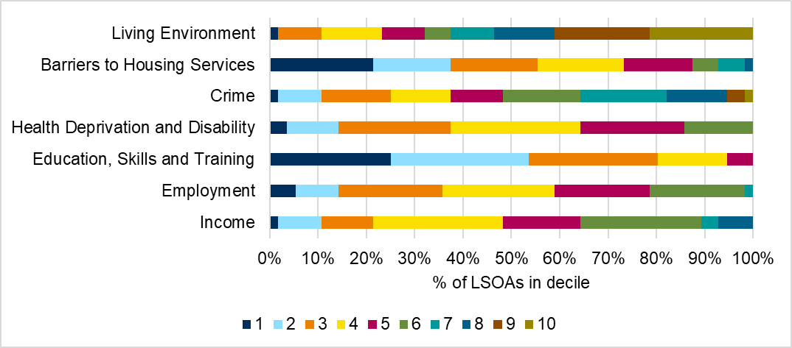
2.3. Analysis of individual deprivation domains across Fenland
In Fenland, the most deprived domain is Education, Skills and Training, which includes factors such as pupil absence, adult skills, and entry to higher education. 80% of LSOAs in Fenland fall into the top 3 most deprived deciles (1-3, where 1 is the most deprived).
The lowest levels of relative deprivation is in the Living Environment domain, with 54% of LSOAs in Fenland falling into the top 3 least deprived deciles (8-10, where 10 is the least deprived).
Figure 3 breaks down LSOA national decile distribution by individual domain.
Figure 5: Proportion of LSOAs which fall into each decile by domain, IMD 2025
See Appendix A for a breakdown of counts of proportions relevant to the graph.

Slide 16
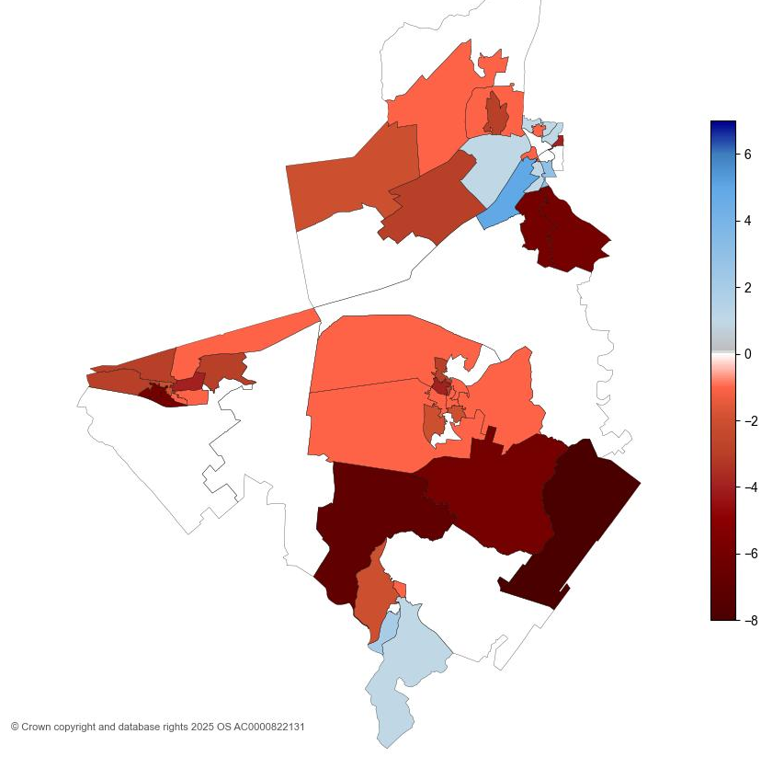
2.4. Analysis of individual Lower Super Output Areas (LSOA) across Fenland for Barriers to Housing and Services
Figure 6: Barriers to housing services decile change in Fenland between 2019 and 2025
The map shows that substantial changes in the Barriers to Housing and Services domain in Fenland have occurred from 2019 to 2025.
3 LSOAs moved 2 or more deciles in the direction of relatively less deprived decile between IMD 2019 and IMD 2025. These are:
  South West Chatteris and Circle Walk (Fenland 011D) in Chatteris South ward.
  Elm Low Road (Fenland 003A) and South Brink (Fenland 003H) both in Wisbech South ward.
21 LSOAs moved 2 or more deciles in the direction of relatively more deprived decile between IMD 2019 and IMD 2025. See Appendix D for full list.
The lowest decile of which Fenland LSOAs fall into is 1. 31 LSOAs falls in the top 30% most deprived for this domain, a notable increase to that seen in IMD 2019, where 18 LSOAs were in the top 30% most deprived (1-3). See Appendix C for full list.
The highest decile of which Fenland LSOAs fall into is 8, in IMD 2025. 1 LSOA (South Brink (Fenland 003H) in Wisbech South ward) falls in the top 30% least deprived for this domain, a notable difference to that seen in IMD 2019, where 8 LSOAs were in the top 30% least deprived (8-10).

Slide 17
3.1. Analysis of income scores across Fenland
Figure 7: Income, IDACI and IDAOPI proportions by district for Cambridgeshire districts
Income Deprivation Affecting Children Index (IDACI) and Income Deprivation Affecting Older People Index (IDAOPI) are supplementary indices which provide context but do not make up the overall IMD scores.
Fenland had a score of 0.240 for income domain, meaning that 24% of the population were living in income deprivation. This is the highest proportion in Cambridgeshire.
Mount Pleasant Cemetery (Fenland 002C) in Wisbech North ward had the highest income score of 0.518. This means 51.8% of the population are living in relative deprivation.

Slide 18
3.1. Analysis of income scores across Fenland
Figure 7: Income, IDACI and IDAOPI proportions by district for Cambridgeshire districts
Fenland had the highest score for the Income Deprivation Affecting Older People Index (IDAOPI) at 16%.
IDACI scores across the county were notably high. Fenland had the highest score (40%) of children experiencing relative income deprivation. This score was 15 percentage points higher than Cambridge City, which was second highest in the county.

Slide 19
3.1. Analysis of income scores across Fenland
Table 6: Income, IDACI and IDAOPI proportions for Fenland, IMD 2019 and IMD 2025
 | IMD 2019 | IMD 2025 | Change
Domain
Income | 14% | 23.8% | 9.8pp
Supplementary Domain
Income Deprivation Affecting Children Index | 20.1% | 39.8% | 19.7pp
Income Deprivation Affecting Older People Index | 14.2% | 16.1% | 1.9pp
IDACI saw the most notable change in Fenland between IMD 2019 and IMD 2025. This was an increase of 19.7pp.
Proportions for both IDAOPI and income domain saw increases as well.

Slide 20
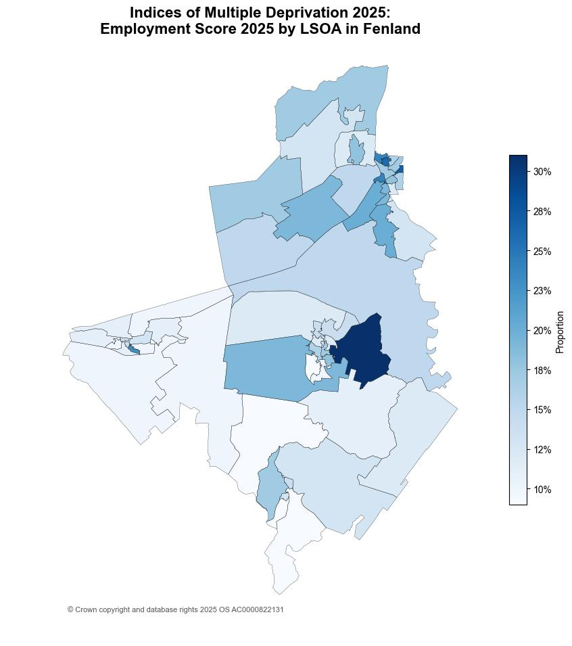
3.2. Analysis of employment scores across Fenland
Figure 8: Employment score by LSOA in Fenland, IMD 2025
Fenland had a score of 0.150 in the employment domain; this means that 15% of the population are in relative employment deprivation.
The score for Fenland has slightly increased between IMD 2019 and IMD 2025, by 3.8pp (from 11.2% to 15%).
Of all Cambridgeshire districts, this was the highest change in percentage points.
Smith's Park (Fenland 007B) in March East ward had the highest employment score of 0.305. This means 30.5% of the population are living in relative deprivation affecting older people.

Slide 21
References
MHCLG. (2019, September 26). English indices of deprivation 2019: statistical release - main findings. Retrieved from https://assets.publishing.service.gov.uk/media/5d8e26f6ed915d5570c6cc55/IoD2019_Statistical_Release.pdf
MHCLG. (2025, October 30). English indices of deprivation 2025: statistical release. Retrieved from https://www.gov.uk/government/statistics/english-indices-of-deprivation-2025/english-indices-of-deprivation-2025-statistical-release

Slide 22
Appendix A
Table 7: Proportion of LSOAs which fall into each decile by domain, IMD 2025
Domain | 1 | 2 | 3 | 4 | 5 | 6 | 7 | 8 | 9 | 10
Income | 2% | 9% | 11% | 27% | 16% | 25% | 4% | 7% | 0% | 0%
Employment | 5% | 9% | 21% | 23% | 20% | 20% | 2% | 0% | 0% | 0%
Education, Skills and Training | 25% | 29% | 27% | 14% | 5% | 0% | 0% | 0% | 0% | 0%
Health Deprivation and Disability | 4% | 11% | 23% | 27% | 21% | 14% | 0% | 0% | 0% | 0%
Crime | 2% | 9% | 14% | 13% | 11% | 16% | 18% | 13% | 4% | 2%
Barriers to Housing Services | 21% | 16% | 18% | 18% | 14% | 5% | 5% | 2% | 0% | 0%
Living Environment | 2% | 0% | 9% | 13% | 9% | 5% | 9% | 13% | 20% | 21%
Table 8: Count of LSOAs which fall into each decile by domain, IMD 2025
Domain | 1 | 2 | 3 | 4 | 5 | 6 | 7 | 8 | 9 | 10
Income | 1 | 5 | 6 | 15 | 9 | 14 | 2 | 4 | 0 | 0
Employment | 3 | 5 | 12 | 13 | 11 | 11 | 1 | 0 | 0 | 0
Education, Skills and Training | 14 | 16 | 15 | 8 | 3 | 0 | 0 | 0 | 0 | 0
Health Deprivation and Disability | 2 | 6 | 13 | 15 | 12 | 8 | 0 | 0 | 0 | 0
Crime | 1 | 5 | 8 | 7 | 6 | 9 | 10 | 7 | 2 | 1
Barriers to Housing Services | 12 | 9 | 10 | 10 | 8 | 3 | 3 | 1 | 0 | 0
Living Environment | 1 | 0 | 5 | 7 | 5 | 3 | 5 | 7 | 11 | 12

Slide 23
LSOA | LSOA Local Name | Ward | IMD 2025 Decile
Fenland 002D | Southwell Road | Wisbech North | 1
Fenland 007B | Smith's Park | March East | 1
Fenland 003F | Trinity Road | Wisbech Walsoken & Waterlees | 1
Fenland 002C | Mount Pleasant Cemetery | Wisbech North | 1
Fenland 003I | Wisbech Town Centre | Wishbech South | 1
Fenland 004C | Coldham and Christchurch | Elm & Christchurch | 2
Fenland 006D | New Road | Whittlesey Lattersey | 2
Fenland 002A | Wisbech Park | Wisbech Riverside | 2
Fenland 001B | Gorefield and Newton South | Parson Drove & Wisbech St Mary | 3
Fenland 011G | Chatteris Industrial Estate and Bartlett Business Park | Chatteris South | 3
Fenland 007A | Elwyn Road to Badgeney Road T Junction | March East | 3
Fenland 001D | Tydd St Giles and Newton North | Leverington & Wisbech Rural | 3
Fenland 003C | Mount Drive | Wishbech South | 3
Fenland 003H | South Brink | Wishbech South | 3
Fenland 003B | Wisbech Retail Park | Wishbech South | 2
Fenland 002B | St Peters Junior School and Walsoken Village Hall | Wisbech Walsoken & Waterlees | 3
Fenland 003E | Barton Road and North Brink | Wisbech Riverside | 3
Fenland 001A | Leverington | Leverington & Wisbech Rural | 3
Fenland 002E | The Spinney Adventure Park | Wisbech Walsoken & Waterlees | 3
Fenland 009B | March West and Marina | March West & Benwick | 3
Fenland 004D | Parson Drove and Murrow | Parson Drove & Wisbech St Mary | 3
Fenland 004A | Friday Bridge | Elm & Christchurch | 3
Fenland 004E | Guyhirn to Thorney Toll | Parson Drove & Wisbech St Mary | 3
Fenland 004F | Wisbech St Mary and Tholomas Drove | Parson Drove & Wisbech St Mary | 3
Appendix B
Table 9: Top 30% most deprived LSOAs in Fenland, IMD 2025

Slide 24
Appendix C
Table 10: Top 30% most deprived LSOAs for Barriers to Housing and Services in Fenland, IMD 2025
LSOA | LSOA Local Name | Ward | IMD 2025 Decile
Fenland 010B | Manea | Chatteris North & Manea | 1
Fenland 004A | Friday Bridge | Elm & Christchurch | 1
Fenland 001A | Leverington | Leverington & Wisbech Rural | 1
Fenland 004F | Wisbech St Mary and Tholomas Drove | Parson Drove & Wisbech St Mary | 1
Fenland 008D | North Estrea and Coates | Whittlesey East & Villages | 1
Fenland 004D | Parson Drove and Murrow | Parson Drove & Wisbech St Mary | 1
Fenland 001B | Gorefield and Newton South | Parson Drove & Wisbech St Mary | 1
Fenland 001D | Tydd St Giles and Newton North | Leverington & Wisbech Rural | 1
Fenland 004C | Coldham and Christchurch | Elm & Christchurch | 1
Fenland 004E | Guyhirn to Thorney Toll | Parson Drove & Wisbech St Mary | 1
Fenland 008B | South Estrea to Pondersbridge | Whittlesey East & Villages | 1
Fenland 008C | Eldernell, Turves and Benwick | March West & Benwick | 1
Fenland 010A | Doddington | Doddington & Wimblington | 2
Fenland 004B | Elm | Elm & Christchurch | 2
Fenland 010C | Wimblington | Doddington & Wimblington | 2
Fenland 003F | Trinity Road | Wisbech Walsoken & Waterlees | 2
Fenland 001C | Outer Leverington | Leverington & Wisbech Rural | 2
Fenland 005A | Westry and HMP Whitemoor | March West & Benwick | 2
Fenland 007B | Smith's Park | March East | 2
Fenland 009B | March West and Marina | March West & Benwick | 2

Slide 25
Appendix C (continued)
Table 10: Top 30% most deprived LSOAs for Barriers to Housing and Services in Fenland, IMD 2025
LSOA | LSOA Local Name | Ward | IMD 2025 Decile
Fenland 005D | March Train Station | March North | 2
Fenland 006B | The Avenues and Whittlesey Green | Whittlesey East & Villages | 3
Fenland 006A | Glenfields and Snowley Park | Whittlesey North West | 3
Fenland 007C | Eastwood Cemetery and St Peter's Road | March East | 3
Fenland 009A | March Cricket Club to St Wendreda's Church | March South | 3
Fenland 006D | New Road | Whittlesey Lattersey | 3
Fenland 007D | March Cemetery | March North | 3
Fenland 008A | The Birds Estate | Whittlesey East & Villages | 3
Fenland 009D | Neale Wade Academy | March East | 3
Fenland 002D | Southwell Road | Wisbech North | 3
Fenland 003E | Barton Road and North Brink | Wisbech Riverside | 3

Slide 26
Appendix D
Table 11: LSOAs in Fenland that moved by two or more deciles in the direction of higher relative deprivation since 2019 for Barriers to Housing and Services Domain
LSOA | LSOA Local Name | Ward | IMD 2025 Decile | IMD 2019 Decile | Change
Fenland 010B | Manea | Chatteris North & Manea | 1 | 9 | -8
Fenland 010A | Doddington | Doddington & Wimblington | 2 | 9 | -7
Fenland 004A | Friday Bridge | Elm & Christchurch | 1 | 7 | -6
Fenland 006E | East Snoots Estate | Whittlesey South | 4 | 10 | -6
Fenland 006H | Manor Leisure Centre | Whittlesey South | 4 | 10 | -6
Fenland 004B | Elm | Elm & Christchurch | 2 | 8 | -6
Fenland 010C | Wimblington | Doddington & Wimblington | 2 | 8 | -6
Fenland 005B | Maple Grove Area | March North | 5 | 9 | -4
Fenland 003F | Trinity Road | Wisbech Walsoken & Waterlees | 2 | 6 | -4
Fenland 006B | The Avenues and Whittlesey Green | Whittlesey East & Villages | 3 | 7 | -4
Fenland 001A | Leverington | Leverington & Wisbech Rural | 1 | 4 | -3
Fenland 004F | Wisbech St Mary and Tholomas Drove | Parson Drove & Wisbech St Mary | 1 | 4 | -3
Fenland 008D | North Estrea and Coates | Whittlesey East & Villages | 1 | 4 | -3
Fenland 005C | Norwoodside and Robingoodfellow's Park | March North | 4 | 7 | -3
Fenland 006F | Kings Dyke to West Snoots Estate | Whittlesey North West | 4 | 7 | -3
Fenland 006A | Glenfields and Snowley Park | Whittlesey North West | 3 | 6 | -3
Fenland 004D | Parson Drove and Murrow | Parson Drove & Wisbech St Mary | 1 | 3 | -2
Fenland 011G | Chatteris Industrial Estate and Bartlett Business Park | Chatteris South | 4 | 6 | -2
Fenland 006G | Whittlesey Town Centre | Whittlesey North West | 6 | 8 | -2
Fenland 007C | Eastwood Cemetery and St Peter's Road | March East | 3 | 5 | -2
Fenland 009A | March Cricket Club to St Wendreda's Church | March South | 3 | 5 | -2

