Slide 1
East Cambridgeshire
Indices of Deprivation 2025 District Report
Published on 17th March 2026
Policy, Performance and Intelligence Service
policyandinsight@cambridgeshire.gov.uk

Slide 2
Contents
Background
Key Findings
Overall IMD
  1.1. District – National Ranking
  1.2. Ward – Average Decile
  1.3. LSOA – Decile
  1.4. LSOA – Decile change
Domains by Deciles
  2.1. District – National Domain Ranking and Change
  2.2. Ward – Average Decile
  2.3. LSOAs
  2.4. Most Notable Domain Decile Change – Health Deprivation and Disability
Domains by Scores
  3.1. Income Domain
  3.2. Employment Domain
References
Appendix

Slide 3
Background
The Index of Multiple Deprivation 2025 (IoD 2025) is the official measure of relative deprivation for small area geographies called Lower-layer Super Output Areas (LSOAs), in England. It has been produced every 3 to 5 years since 1970s. Lower Layer Super Output Areas are a geographic hierarchy designed to improve the reporting of small area statistics in England and Wales. The Minimum population of an LSOA is 1,000 and the mean is 1,500. As of the Census 2021, there is a total of 35,672 LSOAs nationally.
For more information, please refer to the Cambridgeshire and Peterborough IoD 2025 Summary Document, produced by Cambridgeshire County Council: Policy, Performance and Intelligence Service. This document is available here, alongside an interactive dashboard specific to Cambridgeshire and Peterborough.
The data is compiled by the Ministry of Housing, Communities and Local Government (MHCLG) and can be accessed here: English indices of deprivation 2025 - Accredited official statistics announcement - GOV.UK

Slide 4
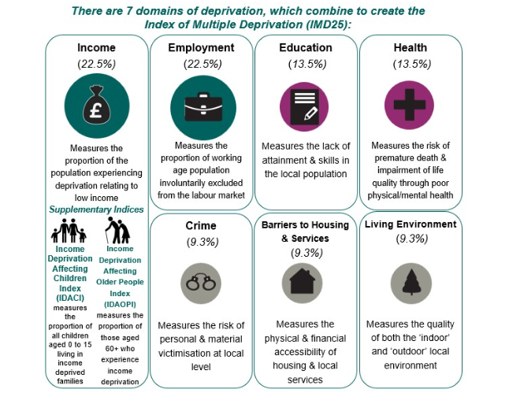
Background
Figure 1: Seven domains of deprivation alongside two supplementary indices
Within the IoD25, there are seven standalone indexes or domains and two supplementary indices, as seen in Figure 1.
The IMD25 combines these seven domains into a single overall score. Each domain contributes a fixed proportion (shown in figure 1) to the final IMD score. The two supplementary indices do not contribute to the overall IMD score but are reported alongside it. These supplementary indices are relevant to the income domain.

Slide 5
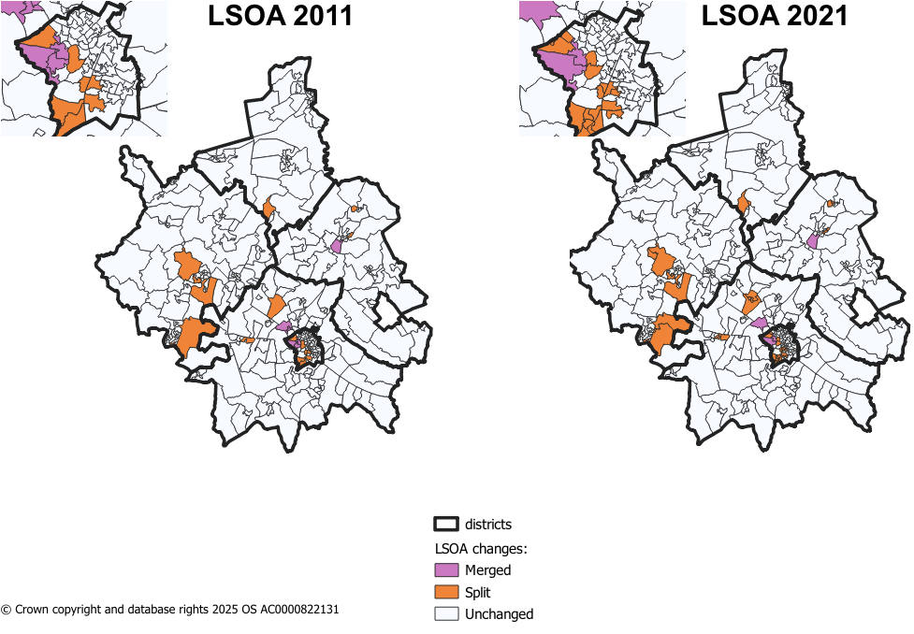
Methodology changes – LSOA boundaries
Figure 2: LSOA changes from 2011 to 2021 in Cambridgeshire
Since IMD 2019, there have been some changes to LSOA boundaries. IMD 2019 used 2011 LSOA boundaries and new boundaries came into effect during the latest Census in 2021.
The majority of LSOAs remained unchanged during this change in Cambridgeshire. The changes were as follows:
8 LSOAs changing only names and not boundaries.
8 LSOAs in 2011 were merged into 4 LSOAs in 2021.
17 2011 LSOAs were split into 41 2021 LSOAs.
Notes:
8 merged LSOAs –
Cambridge 005H (Trinity College to Castle Street) situated in Castle ward.
Cambridge 007I (West Cambridge to The Backs) situated in Newnham ward.
East Cambridgeshire 004H (West Witchford Services) situated in Ely West.
South Cambridgeshire 022D (Girton Village) situated in Girton ward.
41 split LSOAs –
18 in Cambridge City – 7 in Trumpington ward
4 in East Cambridgeshire
2 in Fenland
11 in Huntingdonshire – 5 in St Neots area
6 in South Cambridgeshire – 4 in Longstanton, where 1 LSOA from 2011 was split into 4

Slide 6
Methodology changes – Indicators
There are 55 indicators for the IMD 2025 – this compares to 39 indicators in IMD 2029.
For IMD 2025, 20 new indicators have been added, 14 indicators have been updated and significantly modified, and 21 indicators have been updated without significant modifications. Below are a list of the 20 new indicators.
Domains | New Indicators for IMD 2025
Income Deprivation 22.5% | Adults and children in Housing Benefit claimant benefit units with monthly equivalised income of less than 70% median equivalised monthly income after housing costs
Employment Deprivation 22.5% | Claimants of New Style Jobseeker’s Allowance
 | Claimants of New Style Employment and Support Allowance
 | Claimants of Income Support
 | Claimants of Universal Credit 'Planning for work ' conditionality group
 | Claimants of Universal Credit 'Preparing for work ' conditionality group
Education, Skills & Training Deprivation 13.5% | Persistent pupil absence
Health Deprivation & Disability 13.5% | Mental health composite indicator - Health benefits
Crime 9.3% | Violence with injury
 | Violence without injury
 | Stalking and harassment
 | Public order and Possession of weapons
 | Anti-social behaviour
Barriers to Housing & Services 9.3% | Geographical Barriers: Connectivity Score
 | Core Homelessness
 | Broadband speed
 | Patient-to-GP ratio
Living Environment Deprivation 9.3% | Housing Energy Performance Score
 | Housing lacking private outdoor space
 | Noise pollution
Table 1: Methodology changes between IoD 2019 and IoD 2025
Source: page 12 of English indices of deprivation 2025: technical report

Slide 7
  Key Findings
East Cambridgeshire is among the least deprived areas nationally, ranked 242 out of 296 local authorities (where 1 = most deprived), making it the 54th least deprived overall.
There was variation between wards, with Burwell, Ely North and Ely West among the least deprived (decile 9), while Littleport and Soham South fall within the more deprived wards (decile 6).
22 out of 51 LSOAs sit within the top 30% least deprived deciles (8-10). Only one LSOA (Littleport Youth & Community Centre) falls in the lowest decile seen in East Cambridgeshire (3)
Domain analysis identifies ‘Barriers to Housing and Services’ as the most deprived domain; this domain saw the most notable change; meanwhile, Health Deprivation and Disability shows the most notable change in rank (becoming more relatively deprived).
Income deprivation affecting children (IDACI) increased notably between 2019 and 2025 (+12.4 percentage points). Similar increases have been seen across all other Cambridgeshire districts.

Slide 8
1.1. District Context - National Ranking
Table 2: District by overall IMD national rank
East Cambridgeshire is ranked 242/296 of all local authorities nationally, based on local authority average score, where 1 is most deprived (meaning East Cambridgeshire is the 54th least deprived of the 296 English Local Authorities).
This compares to:
  South Cambridgeshire which is 281/296 (15th least deprived),
  Cambridge City which is 255/296 (41st least deprived),
  Huntingdonshire which is 249/296 (47th least deprived),
  Fenland which is 42/296 (254th least deprived),
  and Peterborough which is 51/296 (245th least deprived).
District | IMD - Rank of average rank out of 296 (2025)
Fenland | 42
Peterborough | 51
East Cambridgeshire | 242
Huntingdonshire | 249
Cambridge City | 255
South Cambridgeshire | 281

Slide 9
1.2. Analysis of overall deprivation across East Cambridgeshire wards
Table 3: Decile average and range of LSOA deciles by ward, IMD 2025
On this page, the average decile is used. This is the decile of each LSOA combined and averaged to give an overall score for the ward. This is to help identify the domains that have a much higher or lower level of deprivation and give a broader overview of the ward, rather than the absolute ‘most’ and ‘least’ deprived domains. It should be noted that LSOA and ward boundaries are not co-terminus and therefore a ‘best fit’ lookup has been used to determine which LSOAs fall into each ward.
Highest scoring wards (least deprived):
As seen in Table 2, Burwell, Ely North and Ely West fall into the highest decile (9).
Lowest scoring wards (most deprived):
Littleport and Soham South both rank within the lowest decile out of all other wards in East Cambridgeshire (6).
Ward | Decile Average | Range
Bottisham | 8 | 7 - 8
Burwell | 9 | 6 - 10
Downham Villages | 7 | 7 - 7
Ely East | 7 | 4 - 9
Ely North | 9 | 6 - 10
Ely West | 9 | 6 - 10
Fordham & Isleham | 7 | 5 - 9
Haddenham | 7 | 5 - 8
Littleport | 6 | 3 - 7
Soham North | 7 | 6 - 8
Soham South | 6 | 5 - 7
Stretham | 7 | 4 - 8
Sutton | 7 | 5 - 9
Woodditton | 8 | 6 - 10

Slide 10
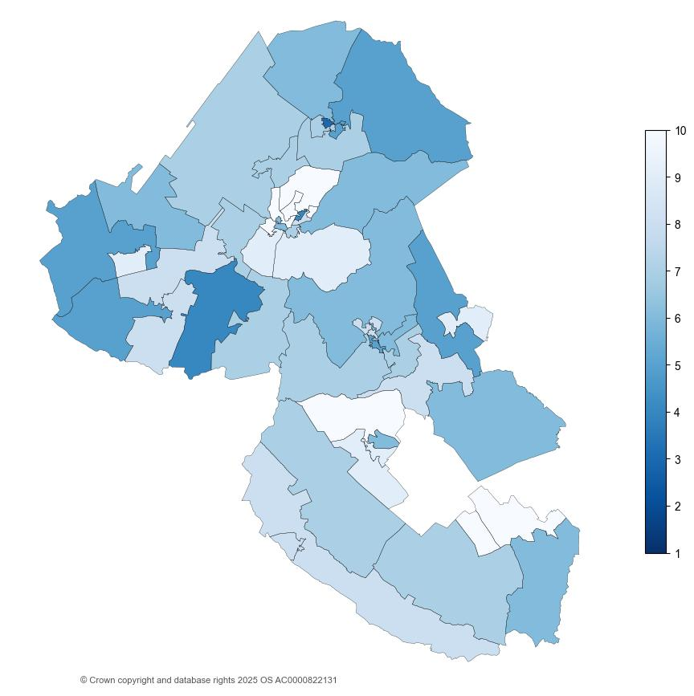
1.3. Analysis of individual Lower Super Output Areas (LSOA) across East Cambridgeshire
Figure 3: National decile for overall relative deprivation in East Cambridgeshire, IMD 2025
East Cambridgeshire has 51 Lower Super Output Areas (LSOAs).
There are 22 LSOAs in the highest 3 deciles (8-10). This is less LSOAs than IMD 2019, where there were 26 LSOAs in the highest 3 deciles. See Appendix B for full list.
There is 1 LSOA in the lowest 3 deciles (1-3). This is higher than in IMD 2019, where there were no LSOAs in the lowest 3 deciles.
  Littleport Youth and Community Centre (East Cambridgeshire 001F) situated in Littleport ward and is the only LSOA in the lowest decile (3).

Slide 11
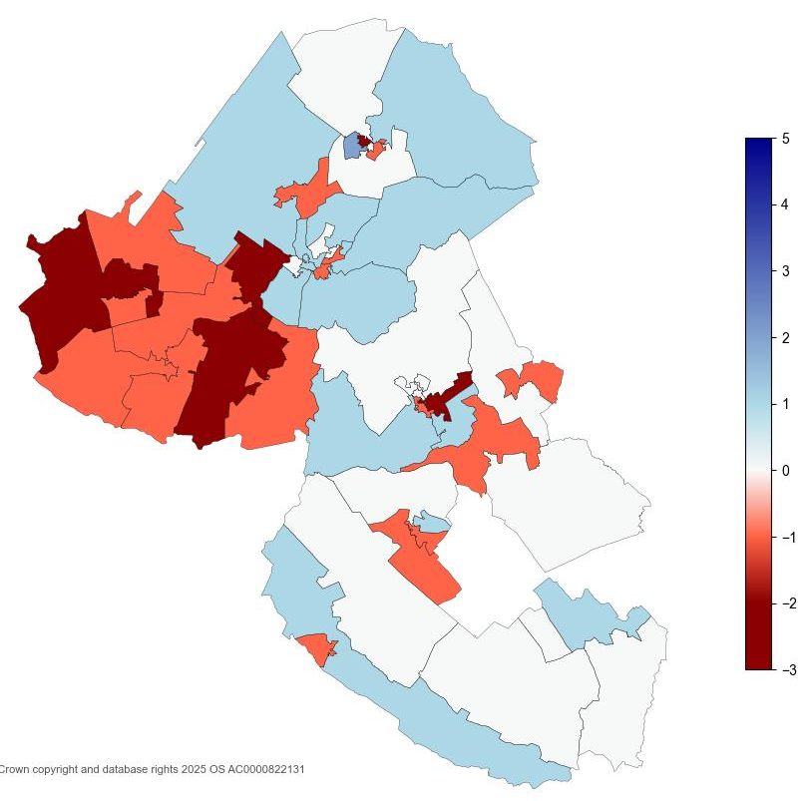
1.4. Analysis of individual Lower Super Output Areas (LSOA) across East Cambridgeshire
Figure 4: IMD decile change in East Cambridgeshire between 2019 and 2025
The map shows changes in the overall IMD deciles in East Cambridgeshire have occurred from 2019 to 2025.
Woodfen Road (East Cambridgeshire 001G), situated in Littleport ward, is the only LSOA that moved by two or more deciles in the direction of lower relative deprivation since 2019 (+2 deciles).
5 LSOAs in East Cambridgeshire moved by two or more deciles in the direction of higher relative deprivation since 2019. See Appendix C for full list.

Slide 12
2.1. District Context - National Domain Ranking
The individual domain are ranked from lowest to highest at both district and LSOA. The ranks are based on comparisons between all of the local authority districts LADs nationally. There are 296 LADs. The table, on page 2.1.1., shows the deprivation domains for East Cambridgeshire by rank (out of 296 nationally) where the lower the rank, the more deprived the domain (1 is the most deprived):
The most deprived domain in East Cambridgeshire was Barriers to Housing and Services. However, despite being the most deprived domain, this domain ranks nationally less deprived than IMD 2019, from 46 to 71.
Health Deprivation and Disability domain saw the most notable change in national rank between IMD 2019 and IMD 2025 (from 288 to 247), overall becoming more relatively deprived. Further analysis can be found on page 2.4.
Education, Skills and Training also saw a notable change in national rank between IMD 2019 and IMD 2025 (from 195 to 224), becoming less deprived.
  11 LSOAs had an increase of 2 or 3 decile between IMD 2019 and IMD 2025.
Income Deprivation affecting Older People (IDAOPI) domain nationally ranked more relatively deprived than IMD 2019 (from 211 to 184).

Slide 13
2.1.1. District Context - National Domain Ranking
Table 4: National local authority rank by domain, IMD 2025
Domain | 2025 National Local Authority Rank out of 296 | 2019 National Local Authority Rank out of 317 | Change in Rank between 2019 and 2025
Income | 239 | 259 | -20
Employment | 254 | 274 | -20
Education, Skills and Training | 224 | 195 | 29
Health Deprivation and Disability | 247 | 288 | -41
Living Environment | 203 | 216 | -13
Crime | 261 | 286 | -25
Barriers to Housing and Services | 71 | 46 | 25
Supplemental
Income Deprivation affecting Children (IDACI) | 257 | 278 | -21
Income Deprivation affecting Older People (IDAOPI) | 184 | 211 | -27
*Supplemental measures are a subset of the income domain.

Slide 14
2.2. Analysis of individual deprivation domains across East Cambridgeshire by decile average
Table 5: Decile average by domain, IMD 2025
On this page, the average decile is used. This is the decile of each LSOA combined and averaged to give an overall score for the district. This is to help identify the domains that have a much higher or lower level of deprivation and give a broader overview of the district/city as a whole, rather than the absolute ‘most’ and ‘least’ deprived domains.
Highest scoring domains (least deprived):
As seen in Table 5, Health Deprivation and Disability, and Employment domains have the highest average decile of 8.
Lowest scoring domains (most deprived):
Barriers to Housing and Services has the lowest average decile amongst the domains (4).
Domain | Average Decile | Range
Health Deprivation and Disability | 8 | 3 – 10
Employment | 8 | 2 – 10
Living Environment | 7 | 2 – 10
Income | 7 | 3 – 10
Education, Skills and Training | 7 | 2 –10
Crime | 7 | 3 – 10
Barriers to Housing and Services | 4 | 1 – 10
Overall IMD | 7 | 3 – 10

Slide 15
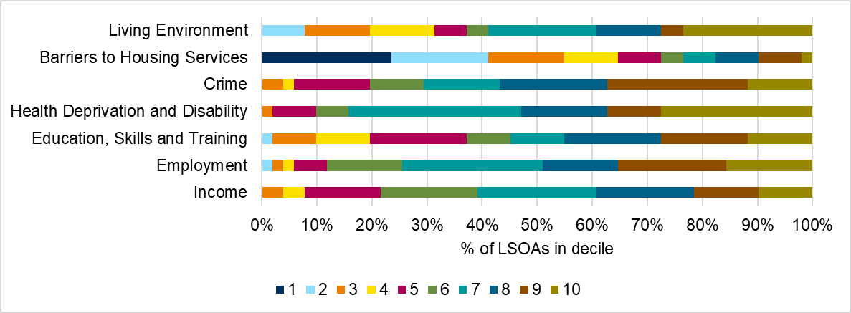
2.3. Analysis of individual deprivation domains across East Cambridgeshire
In East Cambridgeshire, the most deprived domain is Barriers to Housing and Services, which includes factors such as housing affordability and household overcrowding. 55% of LSOAs in East Cambridgeshire fall into the domains top 3 most deprived deciles (1-3, where 1 is the most deprived).
The lowest levels of relative deprivation is in the Crime domain, with 57% of LSOAs in East Cambridgeshire falling into the domains top 3 least deprived deciles (8-10, where 10 is the least deprived).
Figure 5 breaks down LSOA national decile distribution by individual domain.
Figure 5: Proportion of LSOAs which fall into each decile by domain, IMD 2025
See Appendix A for a breakdown of counts of proportions relevant to the graph.

Slide 16
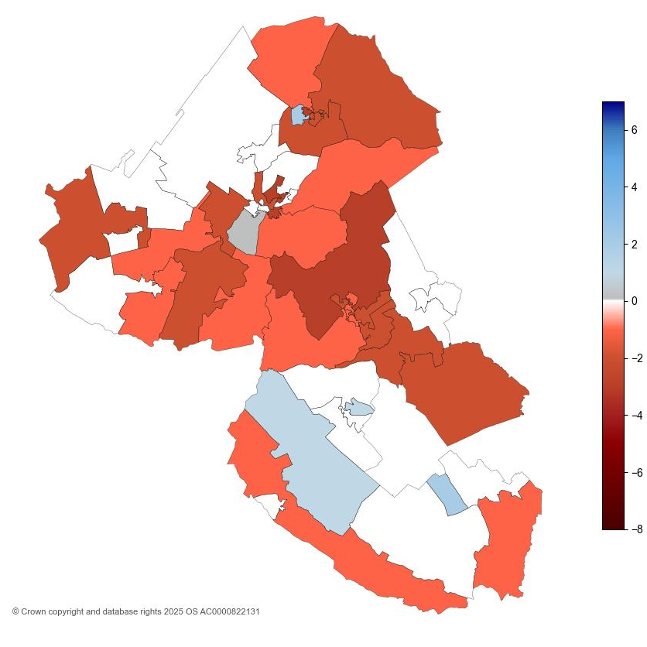
2.4. Analysis of individual Lower Super Output Areas (LSOA) across East Cambridgeshire for Health Deprivation and Disability
Figure 6: Health Deprivation and Disability decile change in East Cambridgeshire between 2019 and 2025
The map shows substantial changes in the Health Deprivation and Disability domain in East Cambridgeshire from 2019 to 2025.
2 LSOAs moved by 2 deciles in the direction of relatively less deprived decile between IMD 2019 and IMD 2025. These are:
  Woodfen Road (East Cambridgeshire 001G) situated in Littleport ward, and,
  Ditton Lodge Primary School (East Cambridgeshire 011B) in Woodditton ward.
17 LSOAs moved by 2 or more in the direction of relatively more deprived decile between IMD 2019 and IMD 2025. See Appendix D for full list.
The lowest decile of which East Cambridgeshire LSOAs fall into is 3, in IMD 2025. 1 LSOA (Littleport Youth and Community Centre (East Cambridgeshire 001F) falls in the top 30% most deprived for this domain. This was slightly different to IMD 2019, where no LSOAs were in the top 30% most deprived (1-3).
The highest decile of which East Cambridgeshire LSOAs fall into is 10, in IMD 2025. 27 LSOAs falls in the top 30% least deprived for this domain, a notable difference to that seen in IMD 2019, where 43 LSOAs were in the top 30% least deprived (8-10).

Slide 17
3.1. Analysis of income scores across East Cambridgeshire
Figure 7: Income, IDACI and IDAOPI proportions by district for Cambridgeshire districts
Income Deprivation Affecting Children Index (IDACI) and Income Deprivation Affecting Older People Index (IDAOPI) are supplementary indices which provide context but do not make up the overall IMD scores.
East Cambridgeshire had a score of 0.140 for income domain, meaning that 14% of the population were living in income deprivation. This is the second highest proportion in Cambridgeshire, following Fenland (24%), and Huntingdonshire (14%).
East Cambridgeshire had the third highest score for the Income Deprivation Affecting Older People Index (IDAOPI) at 12%.
IDACI scores across the county were notably high. East Cambridgeshire had the fourth highest score (21%) of children experiencing relative income deprivation.

Slide 18
3.1. Analysis of income scores across East Cambridgeshire
Table 6: Income, IDACI and IDAOPI proportions for East Cambridgeshire, IMD 2019 and IMD 2025
 | IMD 2019 | IMD 2025 | Change
Domain
Income | 7.0% | 13.7% | 6.7pp
Supplementary Domain
Income Deprivation Affecting Children Index (IDACI) | 8.3% | 20.7% | 12.4pp
Income Deprivation Affecting Older People Index (IDAOPI) | 9.5% | 11.6% | 2.1pp
IDACI saw the most notable change in East Cambridgeshire between IMD 2019 and IMD 2025. This was an increase of 12.4pp.
Proportions for both IDAOPI and income domain saw increases as well.

Slide 19
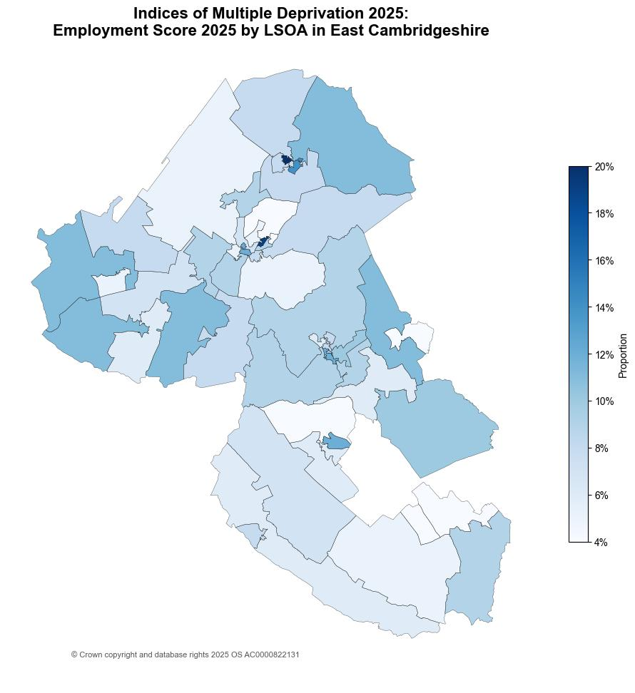
3.2. Analysis of employment scores across East Cambridgeshire
Figure 8: Employment score by LSOA in East Cambridgeshire, IMD 2025
East Cambridgeshire had a score of 0.081 in the employment domain; this means that 8.1% of the population are in relative employment deprivation.
The score for East Cambridgeshire has slightly increased between IMD 2019 and IMD 2025, by 2.6pp (from 5.5% to 8.1%).
Littleport Youth and Community Centre (East Cambridgeshire 001F) situated Littleport ward had the highest employment score of 0.204. This means 20.4% of the population are living in relative deprivation affecting older people.

Slide 20
References
MHCLG. (2019, September 26). English indices of deprivation 2019: statistical release - main findings. Retrieved from https://assets.publishing.service.gov.uk/media/5d8e26f6ed915d5570c6cc55/IoD2019_Statistical_Release.pdf
MHCLG. (2025, October 30). English indices of deprivation 2025: statistical release. Retrieved from https://www.gov.uk/government/statistics/english-indices-of-deprivation-2025/english-indices-of-deprivation-2025-statistical-release

Slide 21
Appendix A
Table 7: Proportion of LSOAs which fall into each decile by domain, IMD 2025
Domain | 1 | 2 | 3 | 4 | 5 | 6 | 7 | 8 | 9 | 10
Income | 0% | 0% | 4% | 4% | 14% | 18% | 22% | 18% | 12% | 10%
Employment | 0% | 2% | 2% | 2% | 6% | 14% | 25% | 14% | 20% | 16%
Education, Skills and Training | 0% | 2% | 8% | 10% | 18% | 8% | 10% | 18% | 16% | 12%
Health Deprivation and Disability | 0% | 0% | 2% | 0% | 8% | 6% | 31% | 16% | 10% | 27%
Crime | 0% | 0% | 4% | 2% | 14% | 10% | 14% | 20% | 25% | 12%
Barriers to Housing Services | 24% | 18% | 14% | 10% | 8% | 4% | 6% | 8% | 8% | 2%
Living Environment | 0% | 8% | 12% | 12% | 6% | 4% | 20% | 12% | 4% | 24%
Table 8: Count of LSOAs which fall into each decile by domain, IMD 2025
Domain | 1 | 2 | 3 | 4 | 5 | 6 | 7 | 8 | 9 | 10
Income | 0 | 0 | 2 | 2 | 7 | 9 | 11 | 9 | 6 | 5
Employment | 0 | 1 | 1 | 1 | 3 | 7 | 13 | 7 | 10 | 8
Education, Skills and Training | 0 | 1 | 4 | 5 | 9 | 4 | 5 | 9 | 8 | 6
Health Deprivation and Disability | 0 | 0 | 1 | 0 | 4 | 3 | 16 | 8 | 5 | 14
Crime | 0 | 0 | 2 | 1 | 7 | 5 | 7 | 10 | 13 | 6
Barriers to Housing Services | 12 | 9 | 7 | 5 | 4 | 2 | 3 | 4 | 4 | 1
Living Environment | 0 | 4 | 6 | 6 | 3 | 2 | 10 | 6 | 2 | 12

Slide 22
LSOA | LSOA Local Name | Ward Name | IMD 2025 Decile
East Cambridgeshire 009B | Bottisham Centre | Bottisham | 8
East Cambridgeshire 003I | Ely Cemetery | Ely East | 8
East Cambridgeshire 007A | Fordham North | Fordham & Isleham | 8
East Cambridgeshire 005C | Wentworth | Stretham | 8
East Cambridgeshire 005B | Station Road to Aldreth High Street | Haddenham | 8
East Cambridgeshire 006G | Broad Piece | Soham North | 8
East Cambridgeshire 006H | Northfield Road to Hall Street | Soham North | 8
East Cambridgeshire 009A | Anglesey Abbey National Trust to Brinkley | Bottisham | 8
East Cambridgeshire 008A | Burwell High Street and Weirs Drove | Burwell | 9
East Cambridgeshire 008B | The Causeway to Mill Lane | Burwell | 9
East Cambridgeshire 007C | Isleham North | Fordham & Isleham | 9
East Cambridgeshire 002D | Sutton High Street | Sutton | 9
East Cambridgeshire 004C | Ely Station and Stuntney | Ely East | 9
East Cambridgeshire 004H | Witchford Services | Ely West | 9
East Cambridgeshire 004F | Beresford Road | Ely West | 10
East Cambridgeshire 011B | Ditton Lodge Primary School | Woodditton | 10
East Cambridgeshire 003F | Cam Drive | Ely North | 10
East Cambridgeshire 008C | North Street | Burwell | 10
East Cambridgeshire 003H | Longchamp Drive to Allen Road | Ely North | 10
East Cambridgeshire 003A | Chettisham and Princess of Wales Hospital | Ely North | 10
East Cambridgeshire 003D | Ely Fire Station | Ely West | 10
East Cambridgeshire 011D | B1063 from Newmarket to Ashley | Woodditton | 10
Appendix B
Table 9: Top 30% least deprived LSOAs in East Cambridgeshire, IMD 2025

Slide 23
Appendix C
Table 10: LSOAs in East Cambridgeshire that moved by two or more deciles in the direction of higher relative deprivation since 2019
LSOA | LSOA Local Name | Ward Name | IMD 2025 Decile | IMD 2019 Decile | Change in Decile
East Cambridgeshire 005E | Wilburton | Stretham | 4 | 7 | -3
East Cambridgeshire 001F | Littleport Youth and Community Center | Littleport | 3 | 5 | -2
East Cambridgeshire 002E | Sutton Community Fire & Rescue Station | Sutton | 5 | 7 | -2
East Cambridgeshire 006D | Staploe Medical Centre | Soham South | 6 | 8 | -2
East Cambridgeshire 005D | Main Street to Common Road | Stretham | 7 | 9 | -2

Slide 24
Appendix D
Table 11: LSOAs in East Cambridgeshire that moved by two or more deciles in the direction of higher relative deprivation since 2019 for Health Deprivation and Disability Domain
LSOA | LSOA Local Name | Ward Name | IMD 2025 Decile | IMD 2019 Decile | Change in Decile
East Cambridgeshire 001A | Littleport Village Hall | Littleport | 5 | 7 | -2
East Cambridgeshire 001B | Ely Road | Littleport | 6 | 8 | -2
East Cambridgeshire 001C | Littleport Station | Littleport | 6 | 8 | -2
East Cambridgeshire 002E | Sutton Community Fire & Rescue Station | Sutton | 7 | 9 | -2
East Cambridgeshire 005D | Main Street to Common Road | Stretham | 7 | 9 | -2
East Cambridgeshire 005E | Wilburton | Stretham | 7 | 9 | -2
East Cambridgeshire 006D | Staploe Medical Centre | Soham South | 7 | 9 | -2
East Cambridgeshire 006E | Fordham Road | Soham South | 7 | 9 | -2
East Cambridgeshire 006G | Broad Piece | Soham North | 7 | 9 | -2
East Cambridgeshire 007B | Fordham South, Chippenham and Kennett | Fordham & Isleham | 7 | 9 | -2
East Cambridgeshire 003D | Ely Fire Station | Ely West | 8 | 10 | -2
East Cambridgeshire 007A | Fordham North | Fordham & Isleham | 8 | 10 | -2
East Cambridgeshire 001F | Littleport Youth and Community Center | Littleport | 3 | 6 | -3
East Cambridgeshire 003G | High Barns | Ely East | 5 | 8 | -3
East Cambridgeshire 003F | Cam Drive | Ely North | 7 | 10 | -3
East Cambridgeshire 004B | Ely City Centre | Ely East | 7 | 10 | -3
East Cambridgeshire 006A | Townsend Road | Soham North | 7 | 10 | -3

