Slide 1
Cambridge City
Indices of Deprivation 2025 District Report
Published on 17th March 2026
Policy, Performance and Intelligence Service
policyandinsight@cambridgeshire.gov.uk

Slide 2
Contents
Background
Key Findings
Overall IMD
1.1. District – National Ranking
1.2. Ward – Average Decile
1.3. LSOA – Decile
1.4. LSOA – Decile change
Domains by Deciles
2.1. District – National Domain Ranking and Change
2.2. Ward – Average Decile
2.3. LSOAs
2.4. Most Notable Domain Decile Change – Barriers to Housing
Domains by Scores
3.1. Income Domain
3.2. Employment Domain
References
Appendix

Slide 3
Background
The Index of Multiple Deprivation 2025 (IoD 2025) is the official measure of relative deprivation for small area geographies called Lower-layer Super Output Areas (LSOAs), in England. It has been produced every 3 to 5 years since 1970s. Lower Layer Super Output Areas are a geographic hierarchy designed to improve the reporting of small area statistics in England and Wales. The Minimum population of an LSOA is 1,000 and the mean is 1,500. As of the Census 2021, there is a total of 35,672 LSOAs nationally.
For more information, please refer to the Cambridgeshire and Peterborough IoD 2025 Summary Document, produced by Cambridgeshire County Council: Policy, Performance and Intelligence Service. This document is available here, alongside an interactive dashboard specific to Cambridgeshire and Peterborough.
The data is compiled by the Ministry of Housing, Communities and Local Government (MHCLG) and can be accessed here: English indices of deprivation 2025 - Accredited official statistics announcement - GOV.UK

Slide 4
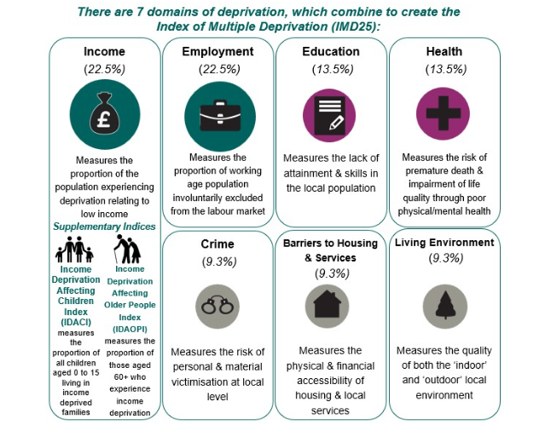
Background
Figure 1: Seven domains of deprivation alongside two supplementary indices
Within the IoD25, there are seven standalone indexes or domains and two supplementary indices, as seen in Figure 1.
The IMD25 combines these seven domains into a single overall score. Each domain contributes a fixed proportion (shown in figure 1) to the final IMD score. The two supplementary indices do not contribute to the overall IMD score but are reported alongside it. These supplementary indices are relevant to the income domain.

Slide 5
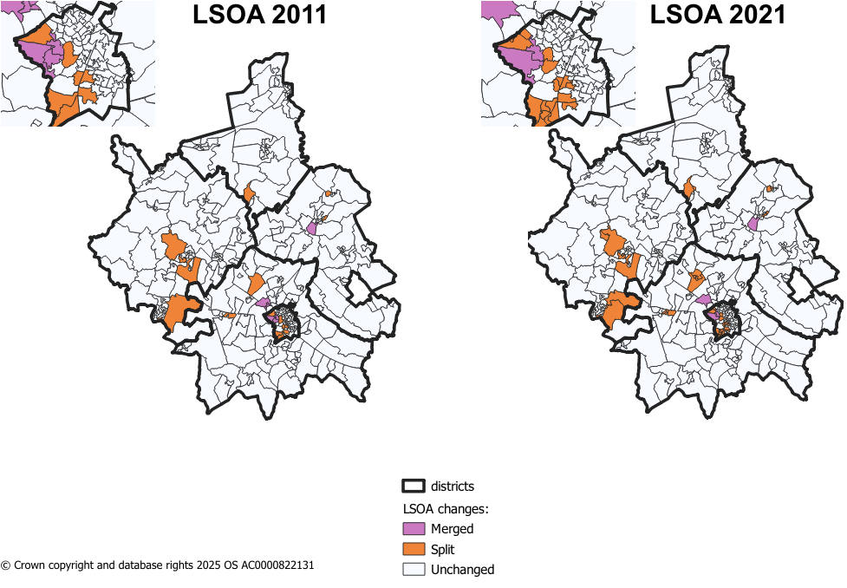
Methodology changes – LSOA boundaries
Figure 2: LSOA changes from 2011 to 2021 in Cambridgeshire
Since IMD 2019, there have been some changes to LSOA boundaries. IMD 2019 used 2011 LSOA boundaries and new boundaries came into effect during the latest Census in 2021.
The majority of LSOAs remained unchanged during this change in Cambridgeshire. The changes were as follows:
8 LSOAs changing only names and not boundaries.
8 LSOAs in 2011 were merged into 4 LSOAs in 2021.
17 2011 LSOAs were split into 41 2021 LSOAs.
Notes:
8 merged LSOAs –
Cambridge 005H (Trinity College to Castle Street) situated in Castle ward.
Cambridge 007I (West Cambridge to The Backs) situated in Newnham ward.
East Cambridgeshire 004H (West Witchford Services) situated in Ely West.
South Cambridgeshire 022D (Girton Village) situated in Girton ward.
41 split LSOAs –
18 in Cambridge City – 7 in Trumpington ward
4 in East Cambridgeshire
2 in Fenland
11 in Huntingdonshire – 5 in St Neots area
6 in South Cambridgeshire – 4 in Longstanton, where 1 LSOA from 2011 was split into 4

Slide 6
Methodology changes – Indicators
There are 55 indicators for the IMD 2025 – this compares to 39 indicators in IMD 2019.
For IMD 2025, 20 new indicators have been added, 14 indicators have been updated and significantly modified, and 21 indicators have been updated without significant modifications. Below are a list of the 20 new indicators.
Domains | New Indicators for IMD 2025
Income Deprivation 22.5% | Adults and children in Housing Benefit claimant benefit units with monthly equivalised income of less than 70% median equivalised monthly income after housing costs
Employment Deprivation 22.5% | Claimants of New Style Jobseeker’s Allowance
 | Claimants of New Style Employment and Support Allowance
 | Claimants of Income Support
 | Claimants of Universal Credit 'Planning for work ' conditionality group
 | Claimants of Universal Credit 'Preparing for work ' conditionality group
Education, Skills & Training Deprivation 13.5% | Persistent pupil absence
Health Deprivation & Disability 13.5% | Mental health composite indicator - Health benefits
Crime 9.3% | Violence with injury
 | Violence without injury
 | Stalking and harassment
 | Public order and Possession of weapons
 | Anti-social behaviour
Barriers to Housing & Services 9.3% | Geographical Barriers: Connectivity Score
 | Core Homelessness
 | Broadband speed
 | Patient-to-GP ratio
Living Environment Deprivation 9.3% | Housing Energy Performance Score
 | Housing lacking private outdoor space
 | Noise pollution
Table 1: Methodology changes between IoD 2019 and IoD 2025
Source: page 12 of English indices of deprivation 2025: technical report

Slide 7
Key Findings
Cambridge City is one of the least deprived local authorities nationally, ranked 255 out of 296 (41st least deprived).
Ward‑level deprivation varies: Abbey and King’s Hedges are the most relatively deprived in the city, but fall into decile 5 (based on averaged LSOA deciles. Decile 1 is the most deprived. Castle and Newnham are in the highest decile (10).
Across the city’s 78 LSOAs, 43 fall into the top 30% least deprived deciles (8-10). While 5 LSOAs fall in the top 30% most deprived deciles (1-3), down from 2019.
Most domains show Cambridge performing well, with average domain deciles at 7, except for Crime, which is the lowest‑scoring domain (average decile 5). Living Environment is the most deprived domain.
Barriers to Housing and Services notably changed, with some LSOAs moving 6+ deciles towards less deprivation since 2019. Only one LSOA remains in the top 30% most deprived for this domain.
Income‑related deprivation has increased, with 13% of residents in income deprivation and a significant rise in child income deprivation (IDACI increasing by 13 percentage points between 2019 and 2025).

Slide 8
1.1. District Context - National Ranking
Cambridge City is ranked 255/296 of all local authorities nationally, based on local authority score, where 1 is most deprived (meaning Cambridge City is the 41st least deprived of the 296 English Local Authorities).
This compares to:
South Cambridgeshire which is 281/296 (15th least deprived),
East Cambridgeshire which is 242/296 (54th least deprived),
Huntingdonshire which is 249/296 (47th least deprived),
Fenland which is 42/296 (254th least deprived),
and Peterborough which is 51/296 (245th least deprived).
Table 2: District by overall IMD national rank
District | IMD - Rank of average rank out of 296 (2025)
Fenland | 42
Peterborough | 51
East Cambridgeshire | 242
Huntingdonshire | 249
Cambridge | 255
South Cambridgeshire | 281

Slide 9
1.2. Analysis of overall deprivation across Cambridge City wards
Table 3: Decile average and range of LSOA deciles by ward, IMD 2025
On this page, the average decile is used. This is the decile of each LSOA combined and averaged to give an overall score for the ward. This is to help identify the domains that have a much higher or lower level of deprivation, and give a more broad overview of the ward as a whole, rather than the absolute ‘most’ and ‘least’ deprived domains. It should be noted that LSOA and ward boundaries are not co-terminus and therefore a ‘best fit’ lookup has been used to determine which LSOAs fall into each ward.
Highest scoring wards (least deprived):
As seen in Table 3, Castle and Newnham fall into the highest decile (10).
Lowest scoring wards (most deprived):
Both Abbey and King’s Hedges fall into the lowest decile out of all other wards in Cambridge City (5).
Ward | Decile Average | Range
Abbey | 5 | 2 - 8
Arbury | 6 | 4 - 10
Castle | 10 | 9 - 10
Cherry Hinton | 8 | 5 - 10
Coleridge | 9 | 6 - 10
East Chesterton | 6 | 4 - 9
King's Hedges | 5 | 3 - 8
Market | 8 | 6 - 9
Newnham | 10 | 9 - 10
Petersfield | 8 | 6 - 8
Queen Edith's | 9 | 7 - 10
Romsey | 8 | 6 - 9
Trumpington | 8 | 7 - 10
West Chesterton | 9 | 5 - 10

Slide 10
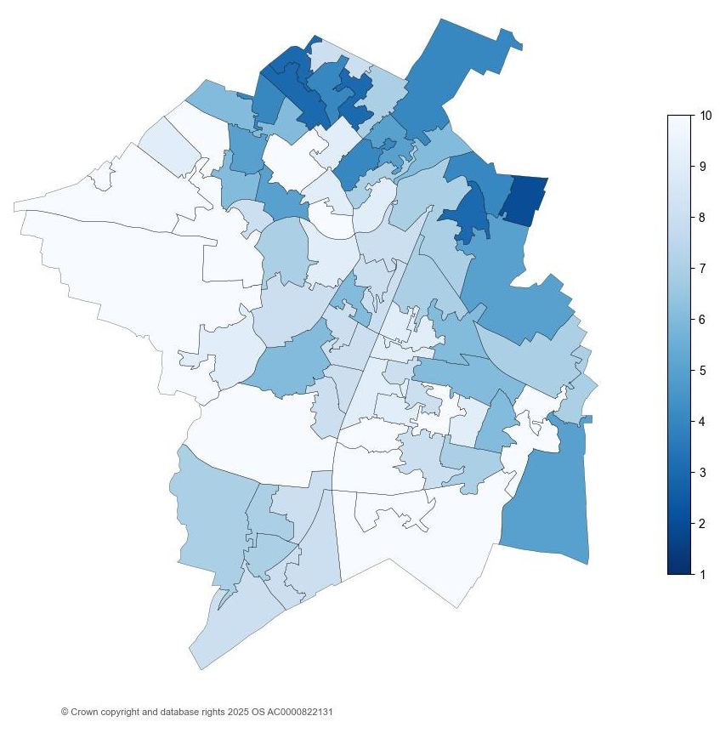
1.3. Analysis of individual Lower Super Output Areas (LSOA) across Cambridge City
Figure 3: National decile for overall relative deprivation in Cambridge City, IMD 2025
Cambridge City has 78 Lower Super Output Areas (LSOAs).
There are 43 LSOAs in the highest 3 deciles (8-10). This is more LSOAs than IMD 2019, where there were 30 LSOAs in the highest 3 deciles. See Appendix B for full list.
There is 5 LSOAs in the lowest 3 deciles (1-3). This is less LSOAs than in IMD 2019, where there were 3 LSOAs in the lowest 3 deciles. See Appendix C for full list.
Thorpe Way (Cambridge 006F) situated in Abbey ward and it remains the LSOA in the lowest decile (2). All other LSOAs in the top 30% most deprived are situated within King’s Hedges or Abbey.

Slide 11
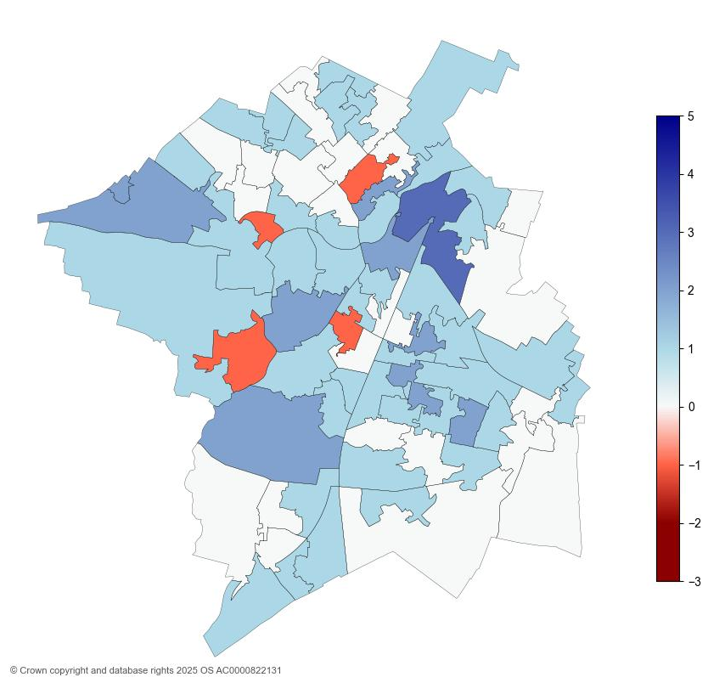
1.4. Analysis of individual Lower Super Output Areas (LSOA) across Cambridge City
Figure 4: IMD decile change in Cambridge City between 2019 and 2025
The map shows that substantial changes in the overall IMD deciles in Cambridge City have occurred from 2019 to 2025.
10 LSOAs moved by two or more deciles in the direction of lower relative deprivation since 2019. See Appendix D for a list of relevant LSOAs.
No LSOAs in Cambridge City moved by two or more deciles in the direction of higher relative deprivation since 2019.

Slide 12
2.1. District Context - National Domain Ranking
The individual domain are ranked from lowest to highest at both district and LSOA. The ranks are based on comparisons between all of the local authority districts LADs nationally. There are 296 LADs. The table, on page 2.1.1., shows the deprivation domains for Cambridge City by rank (out of 296 nationally) where the lower the rank, the more deprived the domain (1 is the most deprived):
The most deprived domain in Cambridge City was Living Environment. However, despite being the most deprived domain, this domain ranks nationally less deprived than IMD 2019, from 51 to 97.
Barriers to Housing and Services domain saw the most notable change in national rank between IMD 2019 and IMD 2025 (from 96 to 263), overall becoming less relatively deprived. There were a number of changes to this domain between 2019 and 2025 releases. Further analysis can be found on page 2.4.
Income Deprivation affecting Older People (IDAOPI) domain nationally ranked more relatively deprived than IMD 2019 (from 172 to 124).
Overall, 66 out of 78 LSOAs in Cambridge City saw an increase in score in IDAOPI between IMD 2019 and IMD 2025, meaning higher proportions of the LSOA were more relatively deprived. The score is a direct ratio for the percentage of the population in relative deprivation.

Slide 13
2.1.1 District Context - National Domain Ranking
Table 4: National local authority rank by domain, IMD 2025
Domain | 2025 National Local Authority Rank out of 296 | 2019 National Local Authority Rank out of 317 | Change in Rank between 2019 and 2025
Income | 260 | 245 | 15
Employment | 279 | 270 | 9
Education, Skills and Training | 270 | 284 | -14
Health Deprivation and Disability | 237 | 202 | 35
Living Environment | 97 | 51 | 46
Crime | 126 | 95 | 31
Barriers to Housing and Services | 263 | 96 | 167
Supplemental*
Income Deprivation affecting Children (IDACI) | 214 | 200 | 14
Income Deprivation affecting Older People (IDAOPI) | 124 | 172 | -48
*Supplemental measures are a subset of the income domain.

Slide 14
2.2. Analysis of individual deprivation domains across Cambridge City by decile average
Table 5: Decile average by domain, IMD 2025
On this page, the average decile is used. This is the decile of each LSOA combined and averaged to give an overall score for the district. This is to help identify the domains that have a much higher or lower level of deprivation, and give a more broad overview of the district/city as a whole, rather than the absolute ‘most’ and ‘least’ deprived domains.
Highest scoring domains (least deprived):
As seen in Table 5, all but two domains have the highest average decile of 7.
Lowest scoring domains (most deprived):
Crime has the lowest average decile amongst the domains (5).
Domain | Average Decile | Range
Employment | 7 | 2-10
Education, Skills and Training | 7 | 1-10
Health Deprivation and Disability | 7 | 1-10
Barriers to Housing and Services | 7 | 3-10
Income | 7 | 2-10
Living Environment | 6 | 1-10
Crime | 5 | 1-10
Overall IMD | 7 | 2-10

Slide 15
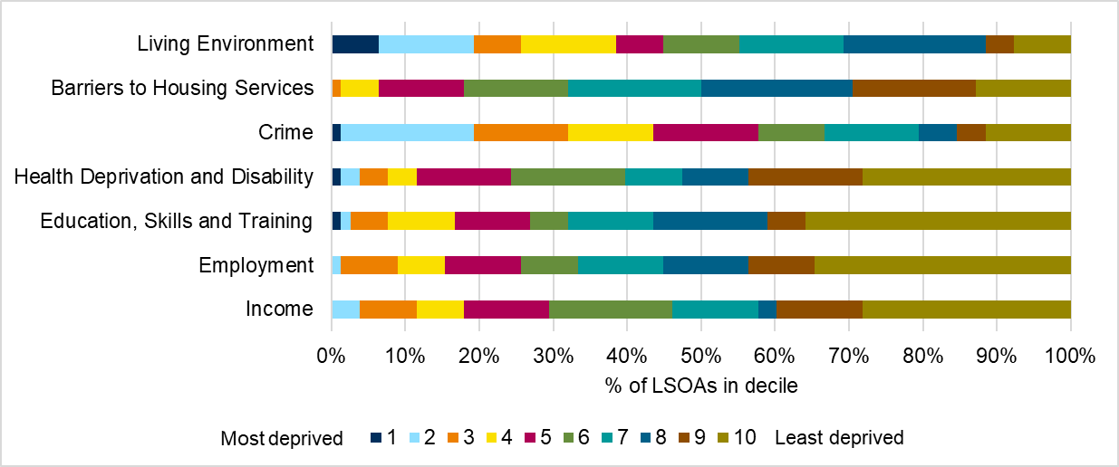
2.3. Analysis of individual deprivation domains across Cambridge City
In Cambridge City, the most deprived domain is Living Environment, which includes factors such as air quality and housing quality. 19% of LSOAs in Cambridge City fall into the top 2 most deprived deciles (1-2, where 1 is the most deprived).
The lowest levels of relative deprivation is in the Employment and Health Deprivation and Disability domains, each with 44% of LSOAs in Cambridge City falling into the top 2 least deprived deciles.
Figure 4 breaks down LSOA national decile distribution by individual domain.
Figure 5: Proportion of LSOAs which fall into each decile by domain, IMD 2025
See Appendix A for a breakdown of counts of proportions relevant to the graph.

Slide 16
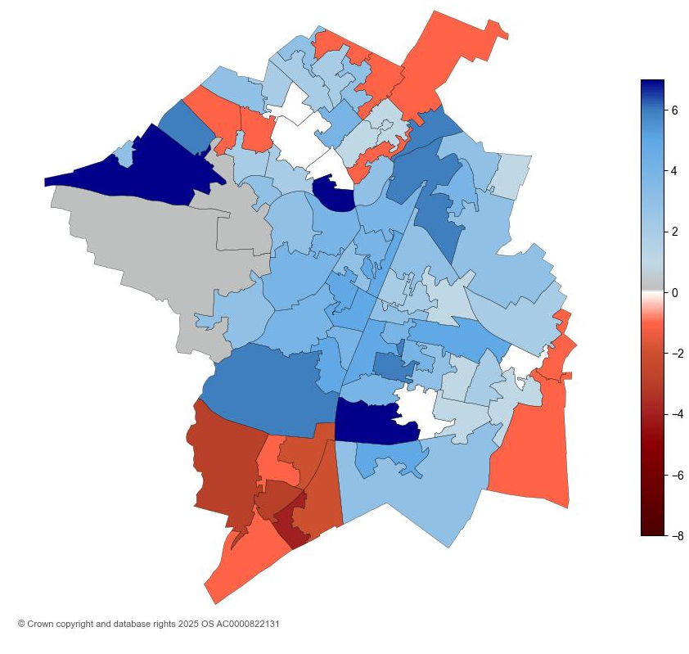
2.4. Analysis of individual Lower Super Output Areas (LSOA) across Cambridge City for Barriers to Housing and Services
Figure 6: Barriers to housing services decile change in Cambridge City between 2019 and 2025
The map shows that substantial changes in the overall IMD deciles in Cambridge City have occurred from 2019 to 2025.
49 LSOAs moved 2 or more deciles in the direction of relatively less deprived, with 8 LSOAs moving over 6 deciles.
The lowest decile of which Cambridge LSOAs fall into is 3. 1 LSOA (Cambridge 006F, Thorpe Way) falls in the top 30% most deprived for this domain, a notable difference to that seen in IMD 2019, where 23 LSOAs were in the top 30% most deprived.
Indicators of Barriers to Housing and Services domain were split into two sub-domains, wider barriers and geographical barriers. The average decile of each of these sub-domains differs slightly, with wider barriers at 5 (range of 2-9) and geographical barriers at 7 (range of 3-9).
18 LSOAs fall into the top 30% most deprived in sub-domain, wider barriers. 11 LSOAs fall into the top 30% least deprived.
1 LSOA (Cambridge 005F, Eddington Centre) falls into the top 30% most deprived in sub-domain, geographic barriers. 33 LSOAs fall into top 30% least deprived.

Slide 17
3.1. Analysis of income scores across Cambridge City
Income Deprivation Affecting Children Index (IDACI) and Income Deprivation Affecting Older People Index (IDAOPI) are supplementary indices which provide context but do not make up the overall IMD scores.
Cambridge City had a score of 0.130 for income domain, meaning that 13% of the population were living in income deprivation. This is the third highest proportion in Cambridgeshire, following Fenland (24%), then East Cambridgeshire and Huntingdonshire at 14% each.
Cambridge City had the second highest score for the Income Deprivation Affecting Older People Index (IDAOPI) at 15%.
IDACI scores across the county were notably high. Cambridge City had the second highest score with a quarter of children experiencing relative income deprivation.
Figure 7: Income, IDACI and IDAOPI proportions by district for Cambridgeshire districts

Slide 18
3.2. Analysis of income scores across Cambridge City
Table 6: Income, IDACI and IDAOPI proportions for Cambridge City, IMD 2019 and IMD 2025
 | IMD 2019 | IMD 2025 | Change
Domain
Income | 8% | 13% | 6pp
Supplementary Domain
Income Deprivation Affecting Children Index | 12% | 25% | 13pp
Income Deprivation Affecting Older People Index | 11% | 15% | 4pp
IDACI saw the most notable change in Cambridge City between IMD 2019 and IMD 2025. This was an increase of 13pp.
Proportions for both IDAOPI and income domain saw increases as well.

Slide 19
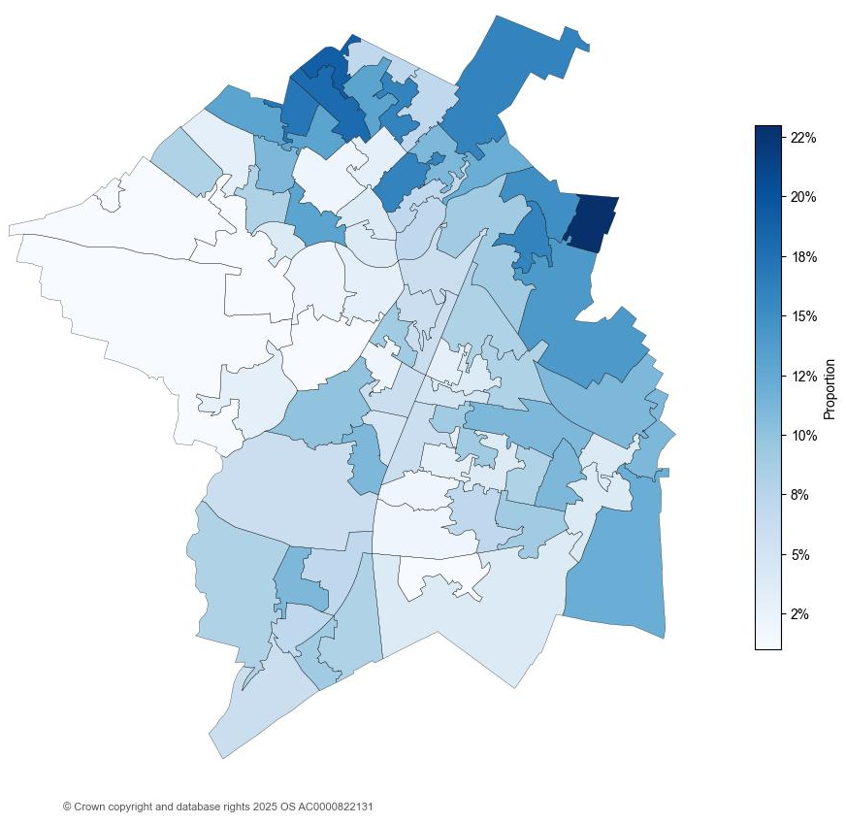
3.3. Analysis of employment scores across Cambridge City
Figure 8: Employment score by LSOA in Cambridge City, IMD 2025
Cambridge City had a score of 0.067 in the employment domain; this means that 6.7% of the population are in relative employment deprivation.
The score for Cambridge City has slightly increased between IMD 2019 and IMD 2025, by 1.2pp (from 5.5% to 6.7%).
Of all Cambridgeshire districts, this was the smallest change in percentage points.
Thorpe Way (Cambridge 006F) situated in King’s Hedges had the highest employment score with 0.232. This means 23.2% of the population are living in relative deprivation affecting older people.

Slide 20
References
MHCLG. (2019, September 26). English indices of deprivation 2019: statistical release - main findings. Retrieved from https://assets.publishing.service.gov.uk/media/5d8e26f6ed915d5570c6cc55/IoD2019_Statistical_Release.pdf
MHCLG. (2025, October 30). English indices of deprivation 2025: statistical release. Retrieved from https://www.gov.uk/government/statistics/english-indices-of-deprivation-2025/english-indices-of-deprivation-2025-statistical-release

Slide 21
Appendix A
Table 7: Proportion of LSOAs which fall into each decile by domain, IMD 2025
Domain | 1 | 2 | 3 | 4 | 5 | 6 | 7 | 8 | 9 | 10
Income | 0% | 4% | 8% | 6% | 12% | 17% | 12% | 3% | 12% | 28%
Employment | 0% | 1% | 8% | 6% | 10% | 8% | 12% | 12% | 9% | 35%
Education, Skills and Training | 1% | 1% | 5% | 9% | 10% | 5% | 12% | 15% | 5% | 36%
Health Deprivation and Disability | 1% | 3% | 4% | 4% | 13% | 15% | 8% | 9% | 15% | 28%
Crime | 1% | 18% | 13% | 12% | 14% | 9% | 13% | 5% | 4% | 12%
Barriers to Housing Services | 0% | 0% | 1% | 5% | 12% | 14% | 18% | 21% | 17% | 13%
Living Environment | 6% | 13% | 6% | 13% | 6% | 10% | 14% | 19% | 4% | 8%
Table 8: Count of LSOAs which fall into each decile by domain, IMD 2025
Domain | 1 | 2 | 3 | 4 | 5 | 6 | 7 | 8 | 9 | 10
Income | 0 | 3 | 6 | 5 | 9 | 13 | 9 | 2 | 9 | 22
Employment | 0 | 1 | 6 | 5 | 8 | 6 | 9 | 9 | 7 | 27
Education, Skills and Training | 1 | 1 | 4 | 7 | 8 | 4 | 9 | 12 | 4 | 28
Health Deprivation and Disability | 1 | 2 | 3 | 3 | 10 | 12 | 6 | 7 | 12 | 22
Crime | 1 | 14 | 10 | 9 | 11 | 7 | 10 | 4 | 3 | 9
Barriers to Housing Services | 0 | 0 | 1 | 4 | 9 | 11 | 14 | 16 | 13 | 10
Living Environment | 5 | 10 | 5 | 10 | 5 | 8 | 11 | 15 | 3 | 6

Slide 22
LSOA | LSOA Local Name | Ward | IMD 2025 Decile
Cambridge 005F | Eddington Centre | Castle | 10
Cambridge 005G | Madingley Rise | Castle | 10
Cambridge 014D | Harding Way to Perse Way | Trumpington | 10
Cambridge 010D | Perne Road South | Coleridge | 10
Cambridge 004E | Aylestone Road | West Chesterton | 10
Cambridge 005H | Trinity College to Castle Street | Castle | 10
Cambridge 013F | The Perse Upper School | Queen Edith's | 10
Cambridge 013G | Nightingale Recreation Ground | Queen Edith's | 10
Cambridge 007I | West Cambridge to The Backs | Newnham | 10
Cambridge 013E | Homerton College | Queen Edith's | 10
Cambridge 011A | Cherry Hinton Rec | Cherry Hinton | 10
Cambridge 013D | Addenbrookes to Queen Edith's Way | Queen Edith's | 10
Cambridge 011F | Chelwood Road | Cherry Hinton | 10
Cambridge 004B | Castle School | West Chesterton | 10
Cambridge 005A | Carisbrooke Road | Arbury | 10
Cambridge 009D | Mill Road Bridge to Brookfields Hospital | Romsey | 9
Cambridge 010E | Derwent Close and St Thomas's Square | Coleridge | 9
Cambridge 007C | Midsummer Common to Grafton Centre | Market | 9
Cambridge 010F | Cambridge Leisure Park | Coleridge | 9
Cambridge 003F | Logan's Meadow | East Chesterton | 9
Cambridge 005E | Falmouth Avenue | Castle | 9
Cambridge 010G | Fanshawe Road | Coleridge | 9
Cambridge 009E | Greville Road | Romsey | 9
Cambridge 009B | Sedgewick Street | Romsey | 9
Cambridge 004C | Chestnut Grove Recreation Ground | West Chesterton | 9
Cambridge 004A | Arbury Road to Milton Road | West Chesterton | 9
Cambridge 007E | Lammas Land | Newnham | 9
Appendix B
Table 9: Top 30% least deprived LSOAs in Cambridge City, IMD 2025

Slide 23
LSOA | LSOA Local Name | Ward | IMD 2025 Decile
Cambridge 002B | Alexandra Gardens | West Chesterton | 8
Cambridge 008B | Parkside to Tenison Road | Petersfield | 8
Cambridge 008D | Coldhams Lane Retail Park | Petersfield | 8
Cambridge 008A | Tenison Road to Mill Road Bridge | Petersfield | 8
Cambridge 013A | Mowbray Road | Queen Edith's | 8
Cambridge 015G | South Trumpington | Trumpington | 8
Cambridge 015D | Hobsons Park | Trumpington | 8
Cambridge 015A | Lime Avenue | Trumpington | 8
Cambridge 014B | Hills Road to Cambridge Train Station | Petersfield | 8
Cambridge 001F | Armitage Way | King's Hedges | 8
Cambridge 015F | South East Trumpington | Trumpington | 8
Cambridge 008C | St Mathew's Piece | Petersfield | 8
Cambridge 014C | Shaftebury Road | Petersfield | 8
Cambridge 006A | Newmarket Road Retail Area | Abbey | 8
Cambridge 007J | Cambridge City Centre | Market | 8
Cambridge 010A | Brackyn Road | Coleridge | 8
Appendix B (continued)
Table 9: Top 30% least deprived LSOAs in Cambridge City, IMD 2025

Slide 24
Appendix C
Table 10: Top 30% most deprived LSOAs in Cambridge City, IMD 2025
LSOA | LSOA Local Name | Ward | IMD 2025 Decile
Cambridge 006F | Thorpe Way | Abbey | 2
Cambridge 001D | Arbury Court | King's Hedges | 3
Cambridge 001E | Buchan Street | King's Hedges | 3
Cambridge 001C | Gladeside | King's Hedges | 3
Cambridge 006D | Ditton Fields Playground | Abbey | 3

Slide 25
Appendix D
Table 11: LSOAs moved by two or more deciles (less deprived) between IMD 2019 and IMD 2025
LSOA | LSOA Local Name | Ward | IMD 2025 Decile | IMD 2019 Decile | Change
Cambridge 006C | Stourbridge Common to Coldham's Common | Abbey | 7 | 4 | +3
Cambridge 009D | Mill Road Bridge to Brookfields Hospital | Romsey | 9 | 7 | +2
Cambridge 010E | Derwent Close and St Thomas's Square | Coleridge | 9 | 7 | +2
Cambridge 007J | Cambridge City Centre | Market | 8 | 6 | +2
Cambridge 003G | Chesterton High Street | East Chesterton | 7 | 5 | +2
Cambridge 010A | Brackyn Road | Coleridge | 8 | 6 | +2
Cambridge 005F | Eddington Centre | Castle | 10 | 8 | +2
Cambridge 005G | Madingley Rise | Castle | 10 | 8 | +2
Cambridge 014D | Harding Way to Perse Way | Trumpington | 10 | 8 | +2
Cambridge 006A | Newmarket Road Retail Area | Abbey | 8 | 6 | +2

