Slide 1

Transport update: Cambridge and South Cambridgeshire
COVID-19 transport impacts and recovery
December 2025
Policy & Insight Team, Cambridgeshire County Council

Slide 2
Transport Update Aims
This report is intended to:
Provide a basis for discussion for the Greater Cambridge Partnership (GCP) to understand and identify existing challenges and future data needs.
Summarise the on-going impacts of COVID-19 on trends in transport and mobility up to 31st December 2025.
Highlight changes in key indicators by comparing December 2025 data to a pre-pandemic baseline (December 2019 or closest possible equivalent), December 2023 and to last year (December 2024).
Due to the availability of comparable data, comparison with pre-COVID levels is not possible for all datasets. Comparison against a 2023 baseline is therefore also provided.
Notes:
Comparison periods may vary across the different datasets based on the availability of historic data – comparison periods are clearly noted for each dataset.
  Where reference is made to ‘Weekdays’ this only includes Monday, Tuesday, Wednesday and Thursday.
  Data from the permanent traffic sensors and Annual Traffic Surveys can also be viewed using our online dashboards.

Slide 3
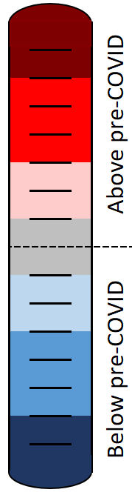
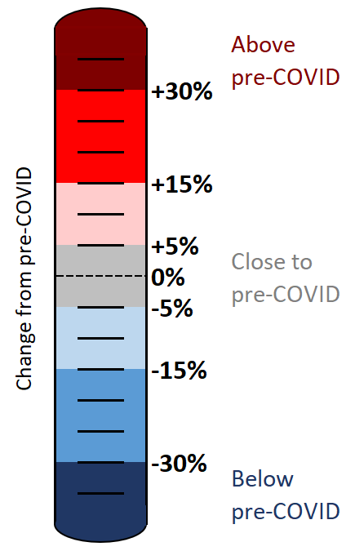
Colour scale
The statistics in this pack have been colour-coded using a heat scale to reflect the level of recovery being experienced (pre-COVID compared to now).
A positive (red) value indicates that levels have increased above those experienced pre-COVID.
A negative (blue) value indicates that levels remain below pre-COVID.
Tip:
Look out for the colour scale bar in the top right-hand corner of each page for a reminder of the heat scale used to indicate the level of recovery throughout the pack.

Slide 4





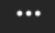
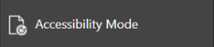
Accessibility
To access the full functionality of PowerPoint, we recommend opening the slides in full screen mode. To do this, click the “Open in New Window” button in the bottom right-hand corner.
1) Navigate through the slide pack using the left and right arrows in the middle-bottom of the screen. Clicking on the sentence “Slide x of x” brings up a pop-up listing all the slides so you can navigate directly to a slide of interest.
2) Open the Notes for each slide to see the data source, technical notes and any additional commentary. See the “Notes” button in the bottom right-hand corner.
3) Use the “Download” button to the right of the centre at the top of the screen to download the slides as a .pptx file.
4) Use the “Print to PDF” option to save the PowerPoint as a PDF document (but please be aware you will lose access to the Notes section which contains additional information for the slide).
5) Use the “More options” icon in the top right-hand corner and choose “Accessibility mode” from the pop-up menu to access the slides in a different format which will display any Alt Text that has been set for charts and images.
We are continually working to improve the accessibility of our content. If you find you are unable to access any part of this update, please contact policyandinsight@cambridgeshire.gov.uk and we will be happy to investigate providing information in an alternative format.

Slide 5
Overview

Slide 6
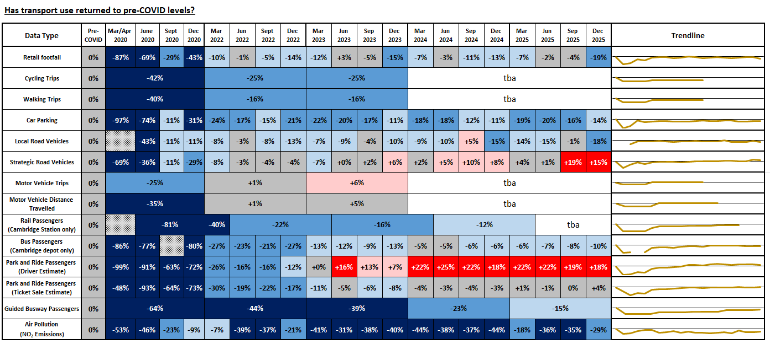
Recovery Tracker: Has transport use returned to pre-COVID levels?
For all data sources and any other relevant information regarding these metrics, please consult the notes section of this slide.
Figures for 2021 have been obscured to improve the display of this recovery tracker. Figures for 2021 still comprise part of the ‘Trendline’ and are available on request.
Notes:
Sources and Geographical Scope:
Retail Footfall: Data Sourced from Cambridge BID. Central Cambridge only
Cycling Trips: Data Sourced from Google Environmental Insights. Cambridge only.
Walking Trips: Data Sourced from Google Environmental Insights. Cambridge only.
Car Parking: Data Sourced from Cambridge City Council. Multi-Storey Car Parks in Central Cambridge only.
Local Road Vehicles: Data Sourced from VivaCity. Greater Cambridge Only – please consult slide pack notes for specific data collection locations.
Strategic Road Vehicles: Data Sourced from National Highways. All of Cambridgeshire – please consult individual slides for specific data collection locations.
Motor Vehicle Trips: Data Sourced from Google Environmental Insights. Cambridge only.
Motor Distance Travelled: Data Sourced from Google Environmental Insights. Cambridge only.
Rail Passengers: Data Sourced from the Office of Rail and Road. Cambridge Station only.
Bus Passengers: Data Sourced from Stagecoach. Cambridge depot only. (“Use” button push methodology – driver estimate)
Park & Ride Passengers: Data Sourced from Stagecoach. Cambridge only. (“Use” button push methodology – driver estimate).
Park & Ride Passengers: Data Sourced from Stagecoach. Cambridge only. (Multiplier methodology – ticket sales estimate).
Guided Busway Passengers: Data Sourced from Stagecoach. Greater Cambridge only.
Air Pollution: Data Sourced from Cambridge City Council. Central Cambridge locations only. NO2 Emissions only.
Technical Notes: Our methodology for analysing the data continues to be refined to react to differing levels of data quality and data gaps. Therefore, you may observe small adjustments to the stats in the latest slide pack compared to previously published versions.
For example:
The method of calculating the strategic road network (SRN) recovery percentages changed in Dec 2022 to include data from a larger number of sites. The SRN percentages have therefore been updated and may not reflect the values presented in previous slide packs for this reason.
The air pollution percentages historically used data from 5 sensors but one of these sensors was removed in April 2022 so the methodology for calculating the air pollution percentages has been adjusted. The air pollution percentages presented here may differ slightly from those in previous slide packs for this reason.
Commentary:
This slide indicates the extent to which each of the transport metrics has recovered over time in comparison to pre-Covid (2019 or early 2020) levels.
Retail footfall, central Cambridge: fluctuating recovery levels linked to seasonal variations - currently far below pre-COVID but in recent quarters has been very close to pre-COVID.
Walking, central Cambridge: Data is only available annually through to 2023. Figures show a gradual recovery in walking volumes; albeit with a plateau between 2022 and 2023.
Cycling, central Cambridge: Data is only available annually through to 2023. Figures show a gradual recovery in walking volumes; albeit with a plateau between 2022 and 2023.
Multi Storey Car Parking, central Cambridge: stable trend in the last two years, consistently between 10-20% below pre-Covid.
Vehicle flows on local roads, central Cambridge: Fluctuating recovery trend - currently far below pre-COVID but has been very close to pre-COVID in recent quarters.
Vehicle flow on strategic roads, gradually improving recovery trend, now consistently above pre-Covid levels.
Motorised trip volumes in Cambridge (sourced from Google). Data is only available annually through to 2023. Figures show a gradual recovery in motorised trip volumes - with figures showing as above pre-COVID for 2022 and 2023.
Motorised distance travelled in Cambridge (sourced from Google). Data is only available annually through to 2023. Figures show a gradual recovery in distances travelled via motorised vehicles - with figures showing as above pre-COVID for 2022 and 2023.
Railway passenger numbers at Cambridge Station (updated annually to March) – improving recovery trend, but still some way below pre-Covid.
Bus passengers, Cambridge: improving recovery trend from March 2022 to March 2024. Stabilising recovery trend. Since March 2024, a stable trend; consistently 5-10% below pre-Covid
Park and Ride passengers (Driver Estimate): consistent recovery trend, now consistently above pre-Covid levels, albeit with some site-by-site variation.
Park and Ride passengers (Ticket Sales Estimate): gradually improving recovery trend - now just ahead of pre-COVID.
Guided Busway passengers (updated annually): Improving recovery trend but still a little way below pre-COVID.
NO2 emissions: consistently remaining some way below pre-Covid.

Slide 7








Headlines: December 2025
Local Roads
Volumes at…
…compared to 2019
…compared to 2023.
Strategic Roads
Volumes at…
…compared to 2019
…compared to 2023.
Car Parking
Patronage at…
…compared to 2019
…compared to 2023.
Bus
Patronage at…
…compared to 2019.
…compared to 2023.
Cambridgeshire depots only.
Park and Ride
Patronage at…
...compared to 2019.
...compared to 2023.
Cambridge sites only (x5).
P
P
+
-18%
+15%
-14%
-7%
+4% to +18%*
-1%
+2%
-3%
+3%
+11 to +13%*
Station Footfall
Analysis paused
pending data quality checks.
Retail Footfall
Volumes at…
…compared to 2019.
…compared to 2023.
Walking
2023 volumes at…
…compared to 2019.
(Google EIE)
2023 is latest available data.
Cycling
2023 volumes at…
...compared to 2019.
(Google EIE)
2023 is latest available data.
NO₂ Emissions
Concentrations at...
...compared to 2017-19.
...compared to 2023**
-19%
-29%
-16%
-25%
-5%
+18%
*Two different methodologies are available for estimating bus passenger volumes - see Slide 44 onwards for more details.
**Excludes Gonville Place.

Slide 8
Travel Demand

Slide 9
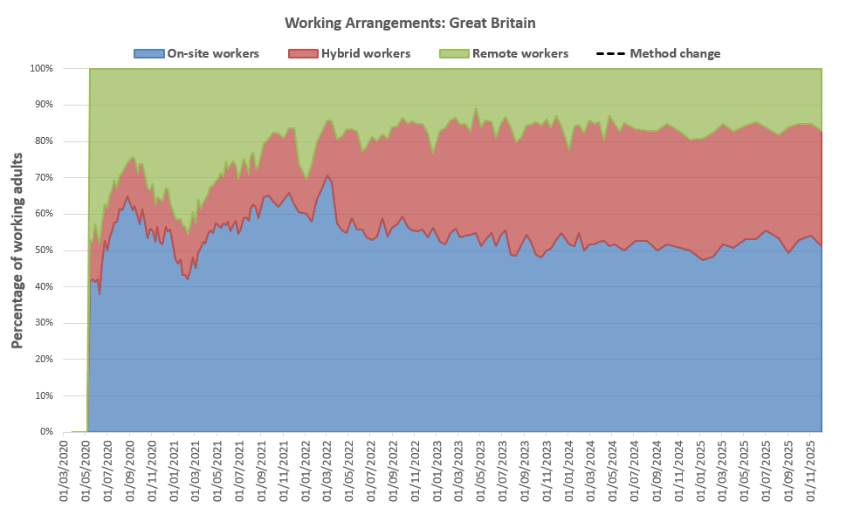
Is home working here to stay?
The ONS captures the working arrangements of a sample of approx. 800 working adults across Great Britain on a monthly basis. The results suggest that on-site working has gradually reduced since the later stages of the pandemic. Hybrid working increased during 2020 but has since stabilised (32%). Remote working decreased and has now stabilised (16%). Census 2021 data suggests that hybrid and remote working is more common in Cambridge & South Cambs than it is nationally.
Year | Percentage of working adults [Great Britain annual average]
 | On-site working | Hybrid working | Remote working
2020 | 54% | 12% | 34%
2021 | 55% | 14% | 30%
2022 | 58% | 24% | 18%
2023 | 53% | 32% | 16%
2024 | 52% | 32% | 16%
2025 | 52% | 32% | 16%
Locally, the 2021 Census (March 2021), demonstrated that levels of remote working in Cambridge (46%) and South Cambs (44%) were higher than the national average (31%) whilst East Cambs (35%) and Hunts (35%) were more similar. Fenland (20%) and Peterborough (25%) were lower than the national average. It is likely that this pattern is a result of the types of employment being undertaken in these areas, with some industries better able to accommodate home working than others. It’s likely that differences between working arrangements across the districts remain today.
Source: Travel to Work Summary
Source: ONS Working Arrangements data for Great Britain. ONS made small changes to the sample of respondents in April 2022 and caution is advised comparing data before/after this date.
On-site working is someone that only worked from a workplace away from home. Remote working is someone who only worked from home. Hybrid working is a combination of working away from home and at home.
Notes:
Source: ONS Working Arrangements data for Great Britain
Commentary: Data is gathered by ONS who survey a sample of 760 people across Great Britain on a weekly, and more recently monthly , basis. Some small changes were made to the sample of people surveyed in April 2022 which may have impacted the comparability of data before/after this date. Despite a possible step change occurring in the data at this time, trends post April 2022 continue to suggest a very gradual reduction in on-site workers.

Slide 10
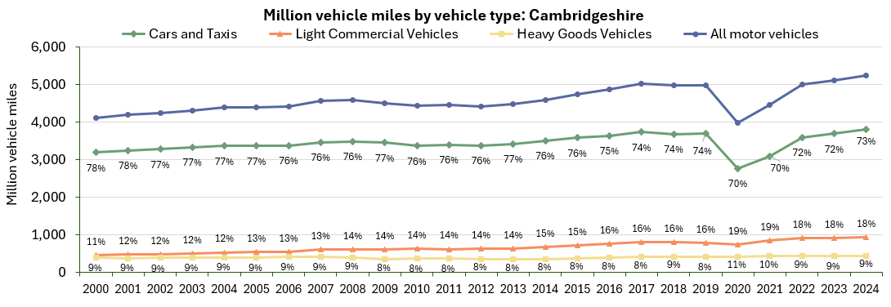
Is vehicle use increasing?
Estimated motor vehicle miles travelled has gradually increased over time, to over 5 billion miles in 2024. The proportion of miles made by cars and taxis has decreased since 2000 (from 78% in 2000 to 73% in 2024) whilst the proportion of miles made by light commercial vehicles (LCVs) has increased from 16% pre-COVID to 18% in 2024.
Note: The percentage labels represent the split between the different vehicle types (Car and Taxi / LCV / HGV)
 | All motor vehicles | Cars and taxis | Light commercial vehicles | Heavy goods vehicles
Pre-COVID to 2024*: 2019 to 2024 | +6% | +3% | +17% | +7%
2023 to 2024*: 2023 to 2024 | +3% | +3% | +2% | +2%
Source: Department for Transport annual mileage estimates (Road traffic statistics).
Notes:
Source: Road traffic statistics - Download data
Commentary: Local authority traffic figures give the total volume (vehicle miles) of traffic across each local authority for the whole year.

Slide 11
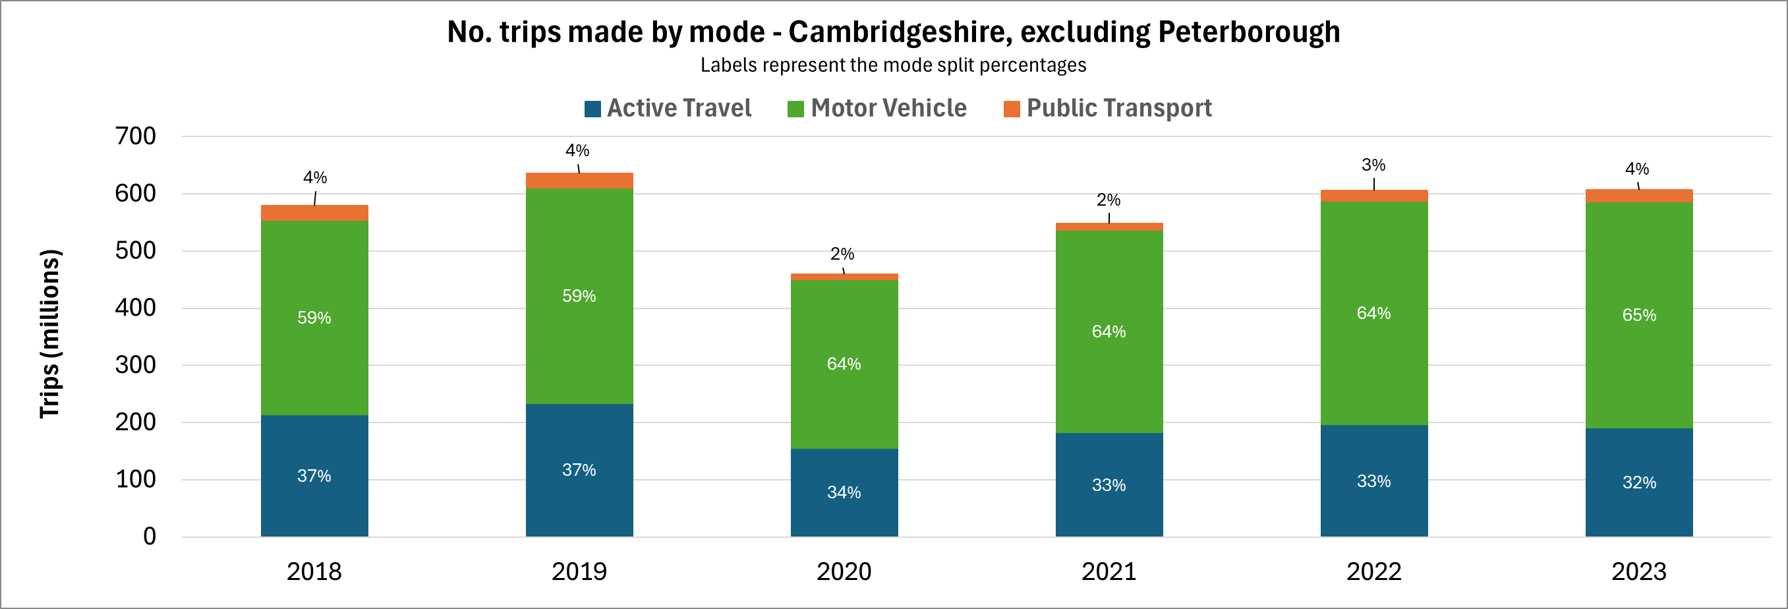
Which methods of travel are being used?
Google collects anonymised location history data from mobile phones to estimate the number of trips and distance travelled by each mode of transport. This data suggests that motor vehicle trips have exceeded pre-COVID levels in all districts whilst active and public transport trips remain below pre-COVID levels, with the exception of South Cambs.
Area | Percentage change in trips (2019 to 2023)
 | Motor Vehicle* | Active Travel | Public Transport | All modes
Cambridge | +6% | -18% | -7% | -8%
East Cambridgeshire | +6% | -9% | -18% | +2%
Fenland | +10% | -10% | -16% | +5%
Huntingdonshire | +1% | -9% | -31% | -2%
South Cambridgeshire | +1% | -12% | +1% | -2%
Cambridgeshire | +5% | -18% | -14% | -4%
*Excludes motorcycle trips due to missing data
Source: Google EIE
All trips entering, exiting and travelling within each area. Data for 2024 and 2025 not yet released.
Notes:
Source: Google Environmental Insights Explorer - Make Informed Decisions
Due to large amounts of missing data, motorcycle trips have been excluded from this analysis. “Motor Vehicle” therefore only includes car trips. “Active Travel” includes walking and cycling trips. “Public Transport” includes bus and rail trips.

Slide 12
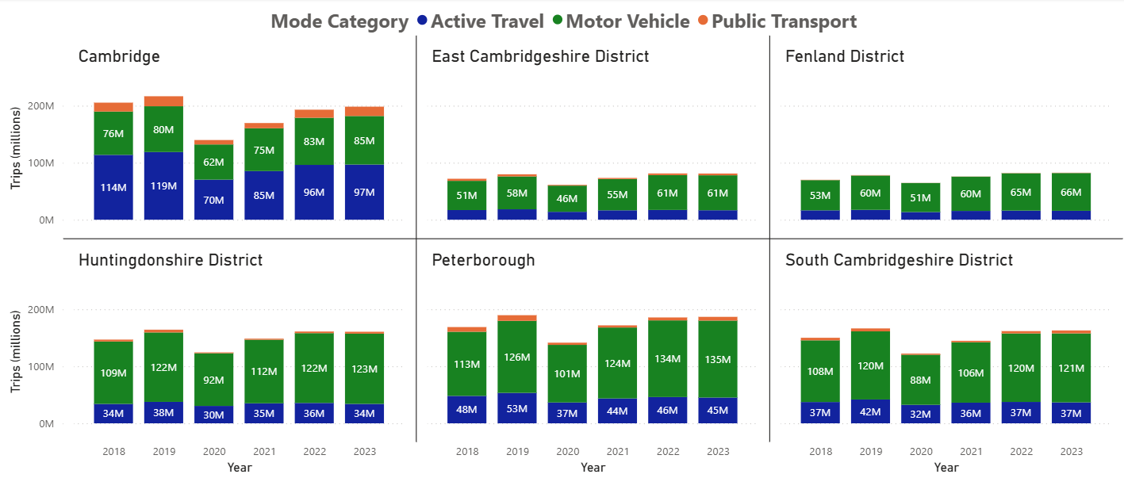
Which methods of travel are being used?
In most districts, the most popular mode choice was motor vehicle with the exception of Cambridge where active travel (walking and cycling) was consistently more popular. For all districts, there is a dip in the number of trips made in 2020 due to COVID-19 and a gradual recovery since then.
No. trips made by mode and year
Source: Google EIE
All trips entering, exiting and travelling within each area. Data for 2024 and 2025 not yet released.
Notes:
Source: Google Environmental Insights Explorer - Make Informed Decisions
Due to large amounts of missing data, motorcycle trips have been excluded from this analysis. “Motor Vehicle” therefore only includes car trips. “Active Travel” includes walking and cycling trips. “Public Transport” includes bus and rail trips.

Slide 13
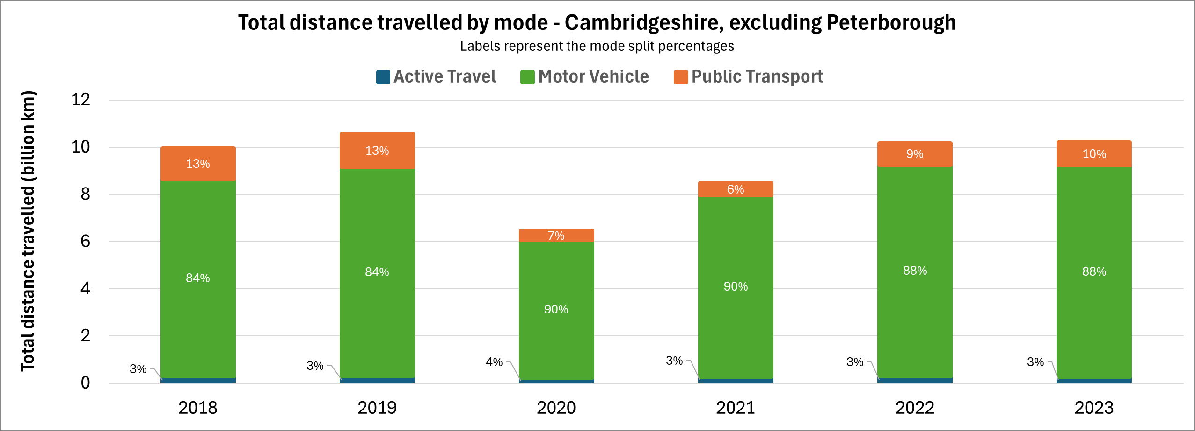
How many kilometres are being travelled by each mode?
Whilst a notable number of journeys are made by active travel (walking and cycling), these trips only make up a small proportion of the distance travelled as they are typically shorter in length. Public transport distances exceed active travel distances despite there being fewer public transport trips.
Area | Percentage change in distance (2019 to 2023)
 | Motor Vehicle* | Active Travel | Public Transport | All modes
Cambridge | +5% | -6% | -19% | -3%
East Cambridgeshire | +1% | +5% | -19% | -1%
Fenland | +5% | -0% | -31% | +4%
Huntingdonshire | -5% | +2% | -51% | -9%
South Cambridgeshire | +2% | -10% | -24% | -0%
Cambridgeshire | +1% | -11% | -30% | -3%
*Excludes motorcycle trips due to missing data
Source: Google EIE
All kilometres travelled by trips entering, exiting and travelling within each area. Data for 2024 and 2025 not yet released.
Notes:
Source: Google Environmental Insights Explorer - Make Informed Decisions
Due to large amounts of missing data, motorcycle trips have been excluded from this analysis. “Motor Vehicle” therefore only includes car trips. “Active Travel” includes walking and cycling trips. “Public Transport” includes bus and rail trips.

Slide 14
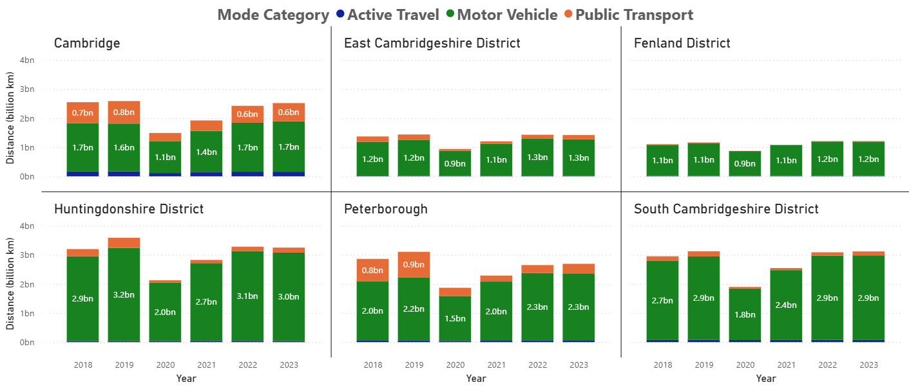
How many kilometres are being travelled by each mode?
In each district, cars consistently had the highest total distance travelled. Cambridge and Peterborough (more urban) both had a higher distance travelled using public transport compared to the other districts, perhaps because they are served by a larger number of bus and rail services and because they are employment centres.
Distance travelled by mode and year
Source: Google EIE
All kilometres travelled by trips entering, exiting and travelling within each area. Data for 2024 and 2025 not yet released.
Notes:
Source: Google Environmental Insights Explorer - Make Informed Decisions
Due to large amounts of missing data, motorcycle trips have been excluded from this analysis. “Motor Vehicle” therefore only includes car trips. “Active Travel” includes walking and cycling trips. “Public Transport” includes bus and rail trips.

Slide 15
Strategic Road Network

Slide 16
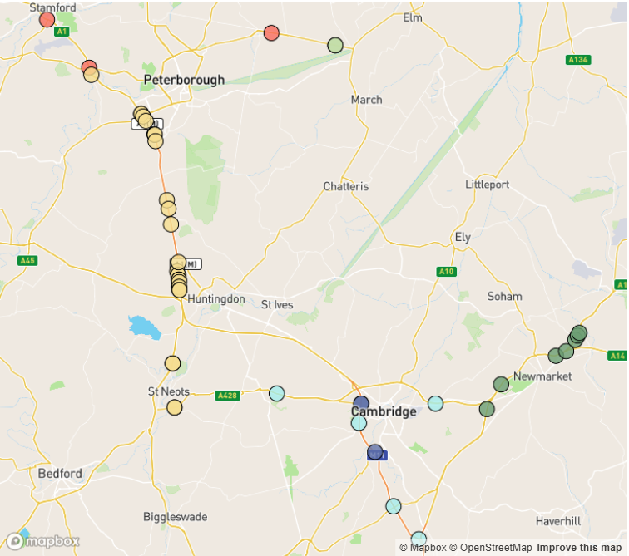
Strategic Road Network Monitoring Sites
Strategic Road Network traffic monitoring sites with continuous data
A1
A47
National Highways have approximately 1,400 permanent traffic monitoring sites on the strategic road network within Cambridgeshire and Peterborough.
Each monitoring site varies in its ability to reliably provide data over time, and periods of inactivity are common. It is therefore not appropriate to conduct comparisons between years at all sites.
For comparison to December 2025, there are 45 sites available across Cambridgeshire and Peterborough.
N
A1
A11
A14
2
A14
2
A14
A428
A11
A1
M11
Notes:
Source: National Highways WebTRIS data. (https://webtris.highwaysengland.co.uk/)
Sites with data in December 2019, 2023, 2024 and 2025:
MIDAS site at M11/6820A Cambridge, MIDAS site at M11/6886A Cambridge, MIDAS site at M11/6886B Cambridge, MIDAS site at A11/0024B East Cambridgeshire, MIDAS site at A11/0041B East Cambridgeshire, MIDAS site at A11/0047B East Cambridgeshire, MIDAS site at A11/0883A East Cambridgeshire, MIDAS site at A14/1157B East Cambridgeshire, MIDAS site at A14/1241B East Cambridgeshire, TMU Site 6317/1 East Cambridgeshire, TMU Site 6350/1 Fenland, TMU Site 6350/2 Fenland, MIDAS site at A1/2033A Huntingdonshire, MIDAS site at A1/2033B Huntingdonshire, MIDAS site at A1/2037A Huntingdonshire, MIDAS site at A1/2037B Huntingdonshire, MIDAS site at A1/2043B Huntingdonshire, MIDAS site at A1/2046A Huntingdonshire, MIDAS site at A1/2046B Huntingdonshire, MIDAS site at A1/2052B Huntingdonshire, MIDAS site at A1M/2056A Huntingdonshire, MIDAS site at A1M/2067B Huntingdonshire, MIDAS site at A1M/2115A Huntingdonshire, MIDAS site at A1M/2134A Huntingdonshire, MIDAS site at A1M/2145B Huntingdonshire, MIDAS site at A1M/2220A Huntingdonshire, MIDAS site at A1M/2228B Huntingdonshire, MIDAS site at A1M/2229A Huntingdonshire, MIDAS site at A1M/2248A Huntingdonshire, MIDAS site at A1M/2254B Huntingdonshire, MIDAS site at A1M/2259A Huntingdonshire, MIDAS site at A1M/2259B Huntingdonshire, TMU Site 6501/2 Huntingdonshire, TMU Site 6999/1 Huntingdonshire, TMU Site 6999/2 Huntingdonshire, TMU Site 9933/1 Huntingdonshire, TMU Site 9933/2 Huntingdonshire, TMU Site 6503/2 Peterborough, TMU Site 6506/2 Peterborough, TMU Site 7156/1 Peterborough, MIDAS site at M11/6694A South Cambridgeshire, MIDAS site at M11/6747A South Cambridgeshire, MIDAS site at M11/6862B South Cambridgeshire, TMU Site 6314/2 South Cambridgeshire, TMU Site 7124/2 South Cambridgeshire.

Slide 17
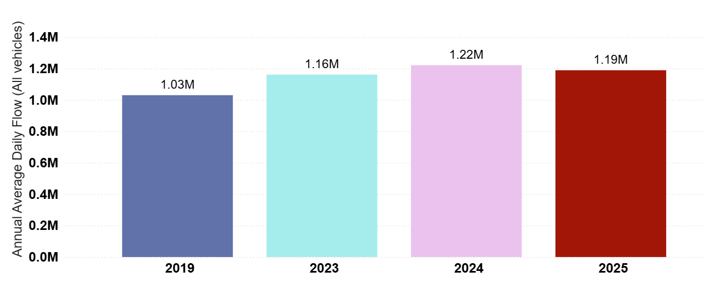
Strategic Road Network: Annual Average Daily Flow by Year
In Cambridgeshire and Peterborough, traffic volumes on the Strategic Road Network (SRN) are above pre-COVID levels (+15%) and are slightly ahead of the typical daily flow in 2023 (+2%). However, during 2025 there has been a 3% decrease in typical daily volumes compared to 2024.
Cambridgeshire and Peterborough
Pre-COVID to Now:
2019 to 2025
+15%
2023 to Now:
2023 to 2025
+2%
Previous year to Now:
2024 to 2025
-3%
Analysis based on 45 sensors across Cambridgeshire and Peterborough.
Notes:
Source: National Highways WebTRIS data.
Technical note: Average Daily Flow by year for main carriageway monitors in each district. This dataset averages across ALL days (Mon-Sun).

Slide 18
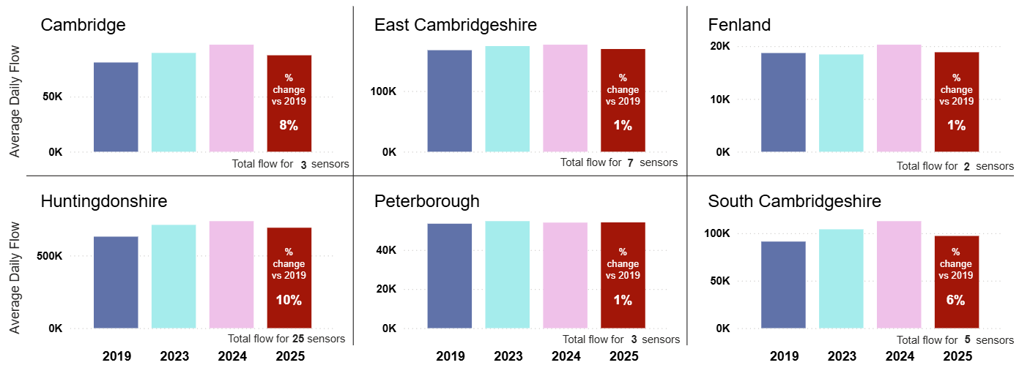
Strategic Road Network: Average Daily Flow by District
Strategic Road Network flows are higher than in December 2019 in all six districts, with Huntingdonshire the furthest ahead of December 2019 (+10%). Most districts show lower flows than this time last year (December 2024), with only Peterborough showing similar flows.
District | Pre-COVID to Now: | 2023 to Now: | Last year to Now:
 | Dec 2019 to Dec 2025 | Dec 2023 to Dec 2025 | Dec 2024 to Dec 2025
Cambridge | +8% | -2% | -10%
East Cambridgeshire | +1% | -3% | -4%
Fenland | +1% | +2% | -7%
Huntingdonshire | +10% | -3% | -6%
Peterborough | +1% | -1% | 0%
South Cambridgeshire | +6% | -7% | -14%
Analysis based on 45 sensors across Cambridgeshire and Peterborough.
Notes:
Source: National Highways WebTRIS data.
Technical note: Average Daily Flow by year for main carriageway monitors in each district. This dataset averages across ALL days (Mon-Sun).

Slide 19
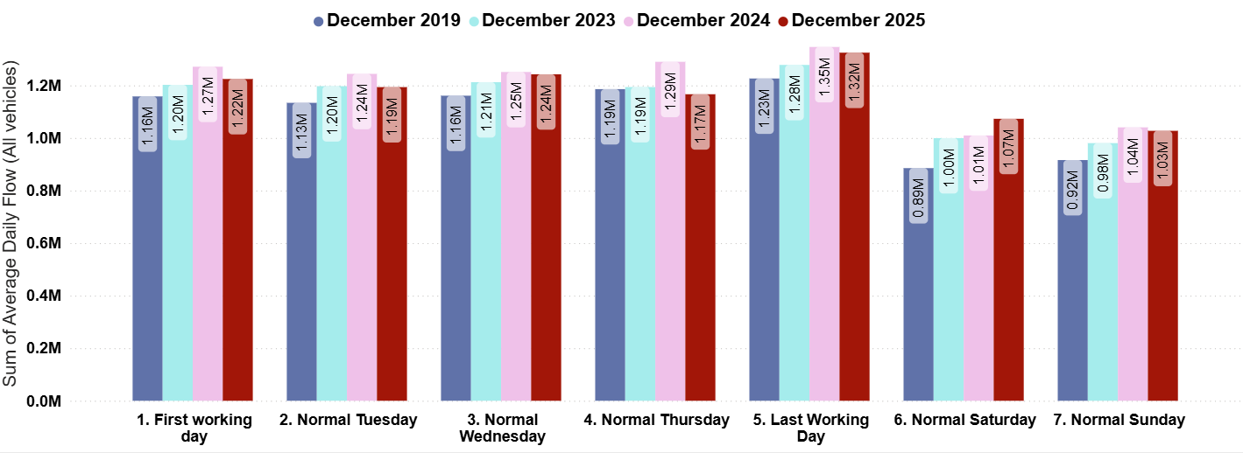
Strategic Road Network: Daily Flow by Day of the Week
On the strategic road network, December 2025 daily volumes were 8% above those observed pre-COVID (December 2019); with weekend volumes (+17%) notably further ahead of the pre-COVID level than weekdays (+4%). Daily volumes have seen a 2% decrease from December 2024.
Pre-COVID to Now:
Dec 2019 to Dec 2025
Mon-Sun | Weekdays (Mon-Thu) | Weekends (Sat-Sun)
+8% | +4% | +17%
2023 to Now:
Dec 2023 to Dec 2025
Mon-Sun | Weekdays (Mon-Thu) | Weekends (Sat-Sun)
+2% | 0% | +6%
Previous year to Now:
Dec 2024 to Dec 2025
Mon-Sun | Weekdays (Mon-Thu) | Weekends (Sat-Sun)
-2% | -5% | +2%
Analysis based on 45 sensors across Cambridgeshire and Peterborough.
Notes:
Source: National Highways WebTRIS data.
Technical note: Average Daily Flow in the week for main carriageway monitors in each district. Note the use of ‘normal’ days which allow for a ‘like-for-like’ comparison between comparable days. For example, bank holidays and school holidays are excluded from average flow calculations for ‘normal’ days. As such, this dataset does not account for the Christmas period, Christmas or New Year bank holidays, school summer holidays etc.

Slide 20
Local Road Network:
Daily Flows

Slide 21
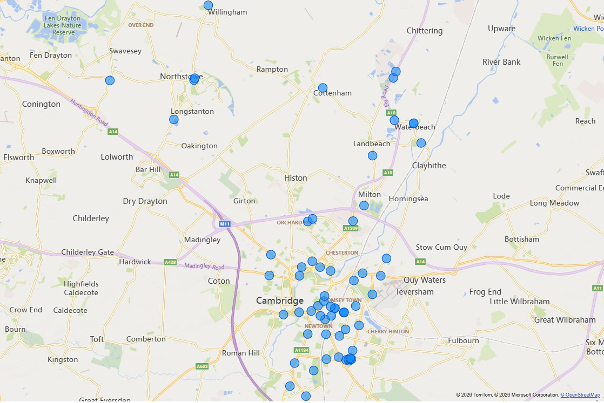
Local Road Network Monitoring Sites
Vivacity Monitoring Sites – Greater Cambridge:
A network of VivaCity sensors is being used to monitor traffic flows across Cambridgeshire. Data from the Greater Cambridge VivaCity sensors (shown on the map) has been used to inform the local road network daily flow analysis presented in this slide pack.
Some sensors have been collecting data for a number of years whilst others are relatively new so the sensors selected to inform each table and chart is based on data availability. For example, relatively few sensors have comparable data stretching back to 2019 so many sensors are excluded from comparisons against 2019.
A list of the sensors included for each piece of analysis is provided in the notes beneath each slide. To access the notes, please view this slide deck in full screen mode by clicking the ‘open in new window’ button (bottom-right) and then click the ‘Notes’ button (bottom-right).
Data from all of the VivaCity sensors across Cambridgeshire can be viewed using the Traffic Flows Dashboard. The locations of all traffic monitoring sites can be viewed on the Traffic Count Sites map.
Notes:
Source: Cambridge Vivacity sensors
Technical note: This analysis has excluded sensors which may compromise the validity of historic comparisons when figures for all sites are combined. For example, some sites may have data gaps, road closures or events impacting data within the comparison period.

Slide 22
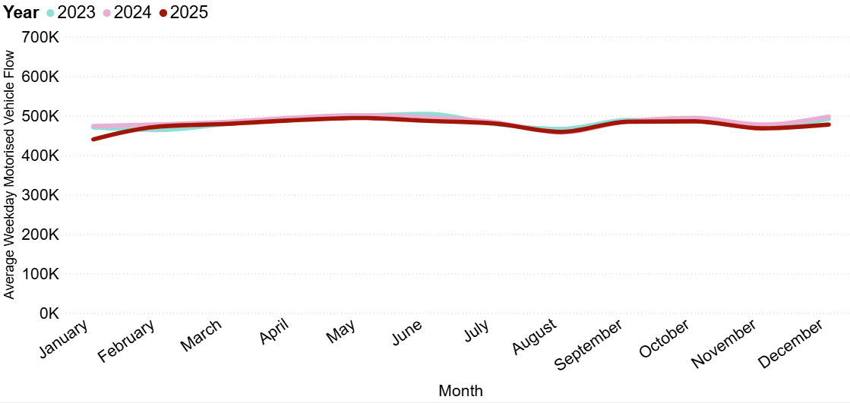
Local Road Network: Motorised Vehicles
In December 2025, local motorised flows were 18% below pre-COVID levels (December 2019) but have remained fairly stable since 2023.
Average weekday vehicular flow (sum of 40 sites)
Pre-COVID to Now [15 sites*]:
December 2019 to December 2025
Mon-Sun | Weekdays (Mon-Thu) | Weekends (Sat-Sun)
-18% | -21% | -16%
2023 to Now [40 sites]:
December 2023 to December 2025
Mon-Sun | Weekdays (Mon-Thu) | Weekends (Sat-Sun)
-1% | -3% | -2%
Previous year to Now [40 sites]:
December 2024 to December 2025
Mon-Sun | Weekdays (Mon-Thu) | Weekends (Sat-Sun)
-2% | -4% | -2%
*Long-term comparable data available at 15 sites - see the slide notes for the full list of locations. Data from all VivaCity sensors across Cambridgeshire can now be viewed in the Traffic Flows Dashboard.
Notes:
Source: Cambridge Vivacity sensors
Technical Notes: 'Non-neutral days' are not included within the calculations.
This chart shows the average volume of motor vehicles counted per weekday for each month/year. We have altered this from previous versions of this slide pack to begin in 2023. This is to enable fuller geographical coverage of Greater Cambridge when comparing motorised traffic flows over time.
There are still 15 sites which provide comparable motorised data in both December 2019 and December 2025; those are listed below; and the comparison between them is shown in the ‘Pre-COVID to now’ table.
The table presents full week and weekend changes against various historic benchmarks to give an indication of how traffic flows are changing.
The comparison figures in the ‘Previous year to Now’ table is generated from data collected at 40 monitoring sites, which are listed below.
Improved data cleaning processes are being developed to improve the omission of any poor quality / non-comparable data.
Commentary:
Motorised traffic flows in 2025 were marginally below those observed in 2023 and 2024.
In December 2025, motorised flows are 2% lower than December 2024 overall; albeit with a larger drop in weekdays (-4%) than at weekends (-2%).
Motorised flows in December 2025 are 18% below pre-Covid (December 2019). Please note in the site groups list below that this metric is compiled from a different selection of sites to the line chart and the other two year-on-year comparisons.
Sites used to generate line chart, and ‘Previous Year to Now’ summary table:
A10 Ely Road (North of Cambridge Research Park), B1050 Earith Road (north of Willingham), B1050 Hatton's Road (South of Longstanton), Barnwell Road, Beach Road, Boxworth End (south of Rose and Crown Rd), Cambridge Road, Cherry Hinton Road, Chesterton Road (East), Chesterton Road (West), Denny End Road, Ditton Lane (just south of Fen Ditton High St), East Road, Elizabeth Way Bridge, Fen Causeway River Bridge, Gonville Place, Hauxton Road (just north of Trumpington PnR), Hills Road (North), just north of Norwich St, Hills Road Bridge, Hills Road, near Holbrook Road, Huntingdon Road (just west of Storey's Way), King's Hedges Road (just west of Northfield Av), Lensfield Road, Long Road (just west of Sedley Taylor Road), Madingley Road (just east of West Cambridge Site), Mill Road (West), Milton Road SB (north of Cowley Rd, all), Newmarket Road (just east of Ditton Lane), Newmarket Road (just west of Ditton Lane), Pathfinder Way (near The Green), Perne Road, Queens Road, Shelford Road, Station Road, Waterbeach, Tenison Road, Trumpington High Street, Trumpington Road, Victoria Road, Vinery Road, Waterbeach Barracks Access (via Denny End Road).
Sites used to generate ‘Pre-COVID to Now’ summary table:
Cherry Hinton Road, Coldham's Lane, Coleridge Road, East Road, Hills Road Bridge, Histon Road (North), Mill Road (East), Mill Road (West), Milton Road (Mid), Milton Road (South), Newmarket Road (just west of Ditton Lane), Perne Road, Station Road, Cambridge, Tenison Road, Vinery Road.

Slide 23
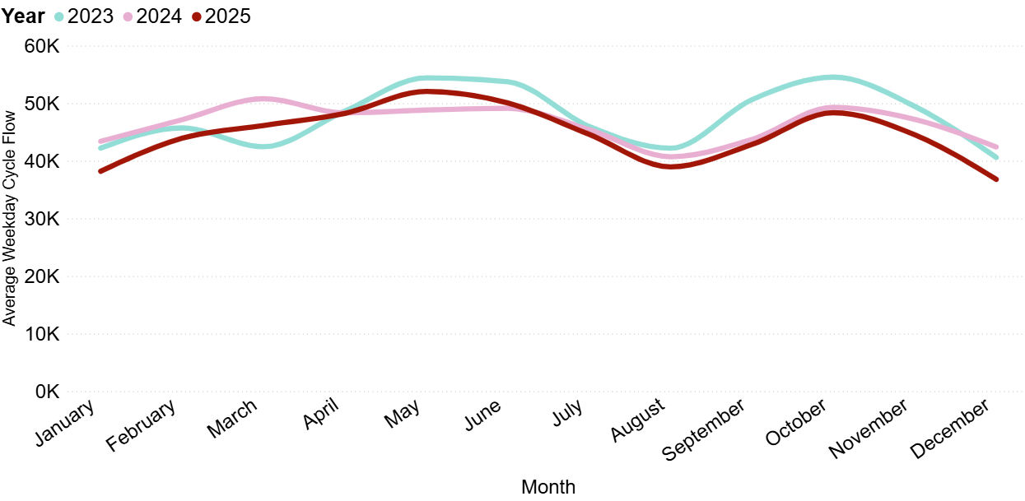
Local Road Network: Cyclists
In December 2025, cycling volumes were 2% below December 2023 volumes. Weekday volumes were much further below 2023 (-9%) than weekend volumes (-1%).
Average weekday cycle flow (sum of 44 sites)
Pre-COVID to Now [1 site*]:
December 2019 to December 2025
Mon-Sun | Weekdays (Mon-Thu) | Weekends (Sat-Sun)
+21% | +13% | +17%
2023 to Now [44 sites]:
December 2023 to December 2025
Mon-Sun | Weekdays (Mon-Thu) | Weekends (Sat-Sun)
-2% | -9% | -1%
Previous year to Now [44 sites]:
December 2024 to December 2025
Mon-Sun | Weekdays (Mon-Thu) | Weekends (Sat-Sun)
-3% | -13% | +13%
*Long-term comparable data only available at 1 site (Tenison Road). Data from all VivaCity sensors across Cambridgeshire can now be viewed in the Traffic Flows Dashboard.
Notes:
Source: Cambridge Vivacity sensors
Technical note: Bank holiday weeks are not included within the calculations. School holidays are also excluded (except summer holidays in order to obtain figures for August).
This chart shows the average volume of bicycles counted per weekday for each month/year. We have altered this from previous versions of this slide pack to begin in 2023. This is to enable fuller geographical coverage of Greater Cambridge when comparing bicycle flows over time.
Tenison Road only has been used to generate the metrics in the ‘Pre-COVID to Now’ table. This is the only remaining site with comparable data for active modes across this time span.
The table presents full week and weekend changes against various historic benchmarks to give an indication of how cycle flows are changing.
The comparison figures in the other tables are generated from data collected at 44 monitoring sites, which are listed below.
Improved data cleaning processes are being developed to improve the omission of any poor quality / non-comparable data.
Commentary:
In December 2025, cycling volumes are 3% below those seen in December 2024. This pattern shows a wide divergence between weekdays (-13%) and weekends (+13%).
December 2025 shows cycling volumes which are 2% below September 2023 overall; with weekdays 9% below 2023, and weekends only 1% below.
Across the year as a whole, 2025 cycling volumes were similar to those seen in the last couple of years in the first 8-9 months, but in late autumn & winter have dipped just below 2023 and 2024.
Sites used to generate chart:
B1050 Earith Road (north of Willingham), B1050 Hatton's Road (South of Longstanton), Barnwell Road, Beach Road, Boxworth End (south of Rose and Crown Rd), Cambridge Road, Cherry Hinton Road, Chesterton Road (East), Chesterton Road (West), Coldham's Common (Eastern Access near Barnwell Road), Denny End Road, Ditton Lane (just south of Fen Ditton High St), East Road, Elizabeth Way Bridge, Fen Causeway River Bridge, Gonville Place, Guided Busway (Orchard Park), Hauxton Road (just north of Trumpington PnR), High Street, Hills Road (North), just north of Norwich St, Hills Road, near Holbrook Road, Huntingdon Road (just west of Storey's Way), King's Hedges Road (just west of Northfield Av), Lensfield Road, Long Road (just west of Sedley Taylor Road), Madingley Road (just east of West Cambridge Site), Mill Road (East), Mill Road (West), Milton Road SB (north of Cowley Rd, all), Mowbray Road, Newmarket Road (just east of Ditton Lane), Newmarket Road (just west of Ditton Lane), Pathfinder Way (near The Green), Perne Road, Queen Edith's Way, Shelford Road, Station Road, Waterbeach, Stirling Road (near The Green), Tenison Road, Trumpington High Street, Trumpington Road, Victoria Road, Vinery Road, Waterbeach Barracks Access (via Denny End Road).

Slide 24
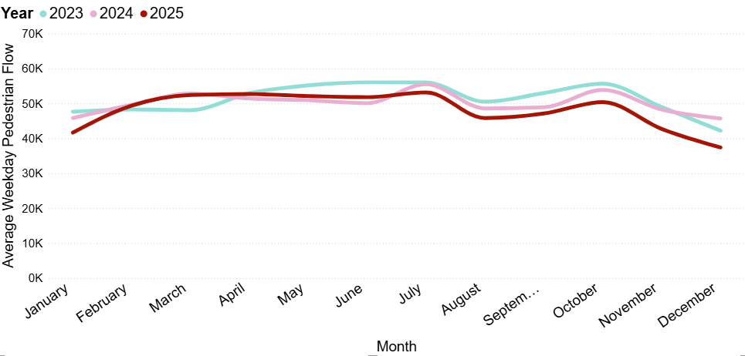
Local Road Network: Pedestrians
In December 2025, pedestrian volumes were 12% below December 2023 volumes, with weekdays further below 2023 (-11%) than weekends (-6%). Pedestrian volumes also show a decrease (-13%) compared to this point last year (December 2024), driven by much lower volumes on weekdays (-18%).
Average weekday pedestrian flow (sum of 44 sites)
Pre-COVID to Now [1 site*]:
December 2019 to December 2025
Mon-Sun | Weekdays (Mon-Thu) | Weekends (Sat-Sun)
+29% | +7% | +98%
2023 to Now [44 sites]:
December 2023 to December 2025
Mon-Sun | Weekdays (Mon-Thu) | Weekends (Sat-Sun)
-12% | -11% | -6%
Previous year to Now [44 sites]:
December 2024 to December 2025
Mon-Sun | Weekdays (Mon-Thu) | Weekends (Sat-Sun)
-13% | -18% | +5%
*Long-term comparable data only available at 1 site (Tenison Road). Data from all VivaCity sensors across Cambridgeshire can now be viewed in the Traffic Flows Dashboard.
Notes:
Source: Cambridge Vivacity sensors
Technical note: Bank holiday weeks are not included within the calculations. School holidays are also excluded (except summer holidays in order to obtain figures for August).
This chart shows the average volume of pedestrians counted per weekday for each month/year. We have altered this from previous versions of this slide pack to begin in 2023. This is to enable fuller geographical coverage of Greater Cambridge when comparing pedestrian flows over time.
Tenison Road only has been used to generate the metrics in the ‘Pre-COVID to Now’ table. This is the only remaining site with comparable data for active modes across this time span.
The table presents full week and weekend changes against various historic benchmarks to give an indication of how pedestrian flows are changing.
The comparison figures in the other tables are generated from data collected at 44 monitoring sites, which are listed below.
Improved data cleaning processes are being developed to improve the omission of any poor quality / non-comparable data.
Commentary:
Pedestrian flows in 2025 were generally very close to those seen in 2024, until July – when pedestrian flows presented as a little way beneath 2024. Volumes continued to be lower than 2024 for the 2nd half of 2025.
In December 2025, pedestrian volumes are 13% below this time last year. There is a stark divergence in trend between weekdays (-18% below 2024) and weekends (+5% above 2024).
December 2025 shows a 12% decrease on 2023 volumes. Weekday pedestrian traffic is further below 2023 (-11%) than weekends (-6%).
Sites used to generate chart:
B1050 Earith Road (north of Willingham), B1050 Hatton's Road (South of Longstanton), Barnwell Road, Beach Road, Boxworth End (south of Rose and Crown Rd), Cambridge Road, Cherry Hinton Road, Chesterton Road (East), Chesterton Road (West), Coldham's Common (Eastern Access near Barnwell Road), Denny End Road, Ditton Lane (just south of Fen Ditton High St), East Road, Elizabeth Way Bridge, Fen Causeway River Bridge, Gonville Place, Guided Busway (Orchard Park), Hauxton Road (just north of Trumpington PnR), High Street, Hills Road (North), just north of Norwich St, Hills Road, near Holbrook Road, Huntingdon Road (just west of Storey's Way), King's Hedges Road (just west of Northfield Av), Lensfield Road, Long Road (just west of Sedley Taylor Road), Madingley Road (just east of West Cambridge Site), Mill Road (East), Mill Road (West), Milton Road SB (north of Cowley Rd, all), Mowbray Road, Newmarket Road (just east of Ditton Lane), Newmarket Road (just west of Ditton Lane), Pathfinder Way (near The Green), Perne Road, Queen Edith's Way, Shelford Road, Station Road, Waterbeach, Stirling Road (near The Green), Tenison Road, Trumpington High Street, Trumpington Road, Victoria Road, Vinery Road, Waterbeach Barracks Access (via Denny End Road).

Slide 25
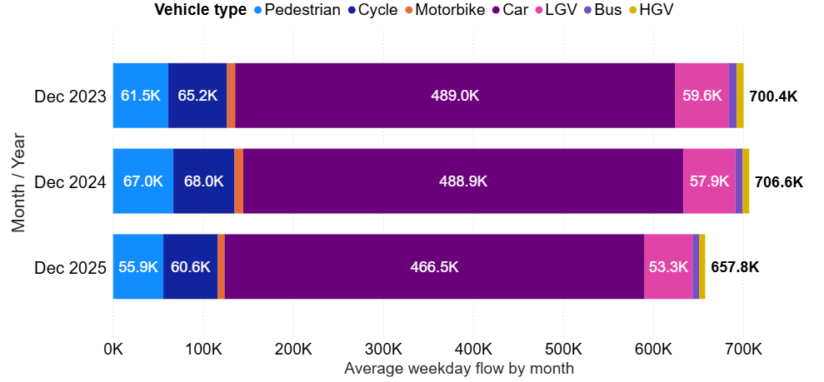
Local Road Network: Vehicle Split
Typical weekday flows in December 2025 were lower than those observed in 2023 and 2024, however the vehicle mode split has remained stable.
Active Travel* proportion by year
Year | Active %​
December 2023 | 18%
December 2024 | 19%
December 2025 | 18%
Average weekday flow (sum of 63 sites)
*Active Travel includes cyclists and pedestrians.
December 2025 Top 5 Active Travel Roads (%)
Location​ | Active %​
Kingston Street (South) | 94%
St Andrew’s Street | 89%
Market Street | 82%
Bene’t Street | 80%
Mill Road (W of Devonshire Rd) | 78%
December 2025 Bottom 5 Active Travel Roads (%)
Location​ | Active %​
Hauxton Road (near P&R) | 1%
B1050 (N of Willingham) | 1%
A10 (near Waterbeach) | 0%
B1050 (S of Longstanton) | 0%
Milton Road (near Cowley Rd) | 0%
Data from all VivaCity sensors across Cambridgeshire can now be viewed in the Traffic Flows Dashboard.
Notes:
Source: Cambridge Vivacity sensors
Technical Notes:
'Non-neutral' days are not included within average weekday flow calculations.
Fridays are not counted as a weekday. Traffic flows on all other days are counted and used to calculate a typical 'average' traffic flow within central Cambridge on a weekday.
We have selected the most recent month of data (December 2025) and compared it to appropriate periods to show how traffic flows have evolved since these sensors were installed or had their software upgraded.
Previous iterations of this slide pack presented this data going back to 2019 – however, a large proportion of sensors had software upgrades, which meant they had to be removed from the overall comparison.
By September 2024, only two sensors remained with comparable data back to 2019, so since then we have re-based at 2023.
Commentary
December 2025 data presents with a typical weekday flow of just below 660k across these 63 sites combined - which is a little way below the flows seen during December 2024 (707k), and December 2023 (700k).
Overall, the proportionate split in travel modes has not changed a huge amount between the three months selected - cars are the dominant mode of transport across Greater Cambridge.
Active modes' share of total flow has remained consistent year-to-year. 18% of total flow on a typical day in December 2025 is made using active modes of travel – which is the same proportion as September 2023 (18%) and just slightly below the proportion seen in December 2024 (19%).
Sites used to generate chart:
A10 (North of Denny End Road), A10 Ely Road (North of Cambridge Research Park), B1050 Earith Road (north of Willingham), B1050 Hatton's Road (South of Longstanton), Barnwell Road, Barton Road (just east of Grange Rd), Beach Road, Boxworth End (south of Rose and Crown Rd), Cambridge Road, Catharine Street, near Mill Road (road only), Cherry Hinton Road, Chesterton Road (East), Chesterton Road (West), Coldham's Common (Chisholm Trail), Coleridge Road, Denny End Road, Devonshire Road Cycle Path, Ditton Lane (just south of Fen Ditton High St), Dutch Roundabout - eastern arm, Dutch Roundabout - inner eastern section, Dutch Roundabout - northern arm, Dutch Roundabout - southern arm, Dutch Roundabout - western arm, East Road, Elizabeth Way Bridge, Fen Causeway River Bridge, Gilbert Road, Gonville Place, Guided Busway (Orchard Park), Guided Busway (south of Hills Road Bridge), Guided Busway (Trumpington), Hauxton Road (just north of Trumpington PnR), High Street, Hills Road (North), just north of Norwich St, Hills Road, near Holbrook Road, Hope Street, near Mill Road (road only), Huntingdon Road (just west of Storey's Way), King's Hedges Road (just west of Northfield Av), Kingston Street (South) - road only, Lensfield Road, Long Road (just west of Sedley Taylor Road), Madingley Road (just east of West Cambridge Site), Mill Road (West), Mill Road, just west of Devonshire Road, Mill Road, near Hope Street, Milton Road SB (north of Cowley Rd, all), Mowbray Road, Newmarket Road (just east of Ditton Lane), Newmarket Road (just west of Ditton Lane), Pathfinder Way (near The Green), Perne Road, Queen Edith's Way, Shelford Road, Station Road, Cambridge, Station Road, Waterbeach, Stirling Road (near The Green), Tenison Road, Trumpington High Street, Trumpington Road, Victoria Road, Vinery Road, Waterbeach Access (opposite Cambridge Research Park), Waterbeach Barracks Access (via Denny End Road).

Slide 26
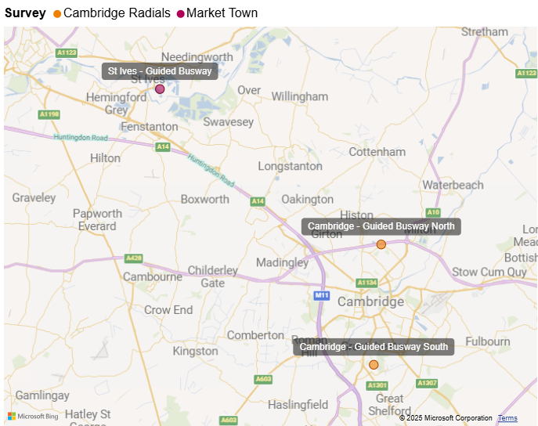
Cambridgeshire Guided Busway – Active Travel
Cambridgeshire Autumn Survey Sites – Busway Utilisation Monitoring
The Cambridgeshire Guided Busway provides a popular walking and cycling route from St Ives to north Cambridge and within northern and southern Cambridge.
Using Cambridgeshire County Council’s annual traffic survey data, active flows on the busway have been monitored over time at 3 locations:
St Ives Guided Busway – just south-east of the St Ives Park & Ride complex.
Cambridge Guided Busway North – just south of the A14 underpass.
Cambridge Guided Busway South – just north of Trumpington Park Primary School.
Data from 2017 onwards can be seen on the next slide.
Notes:
Source: VivaCity

Slide 27
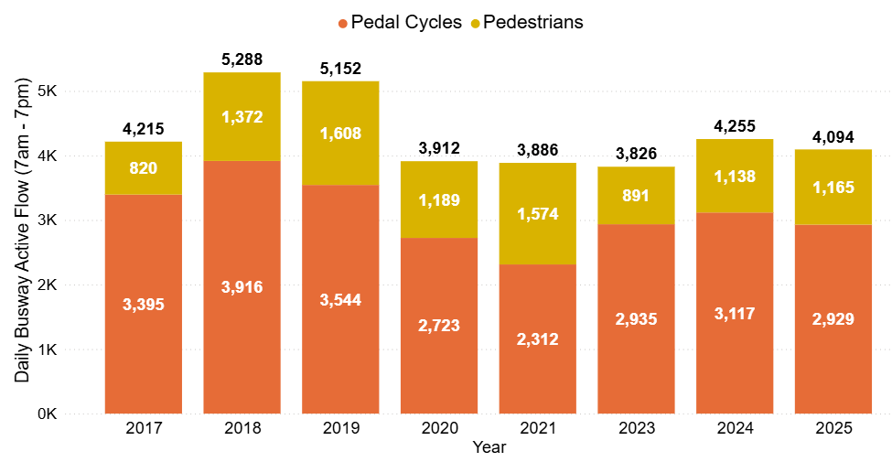
Cambridgeshire Guided Busway – Active Travel
Autumn 2025 Annual Traffic Survey results suggest that total active travel trips along the Guided Busway maintenance track are 21% below pre-COVID (2019) levels; but are 7% ahead of 2023. Busway cycle volumes (-17%) are closer to pre-COVID levels than pedestrian volumes (-28%).
Active flows on the Guided Busway
(12-hour flows from CCC Annual Traffic Surveys)
Cycle Flow Change (%)
Pre-COVID to Now:
2023 to Now:
-17%
0%
Pedestrian Flow Change (%)
Pre-COVID to Now:
2023 to Now:
-28%
+31%
Total Active Flow Change (%)
Pre-COVID to Now:
2023 to Now:
-21%
+7%
Source: CCC Annual Traffic Surveys. Sum of 3 locations on the guided busway: 1. St Ives; 2. Cambridge – A14 Underpass; 3. Trumpington.
The Annual Traffic Surveys Dashboard provides access to the wider dataset. Note: data is not available for 2022.
Notes:
Source: Cambridge Annual traffic surveys

Slide 28
Local Road Network:
Hourly Flows

Slide 29
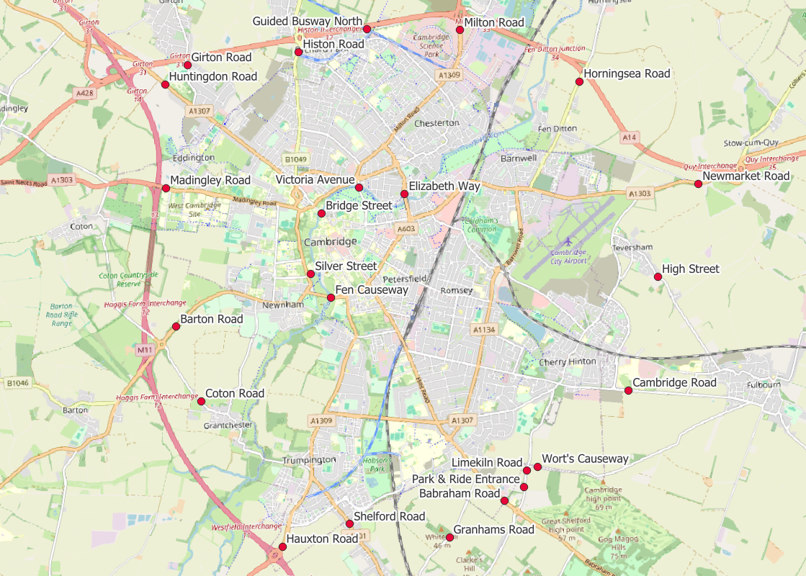
Local Road Network: Motorised Vehicle - Annual Survey Sites
Cambridgeshire Annual Traffic Survey Sites
Annual Survey Sites
Elizabeth Way
Victoria Avenue​​
Bridge Street
Silver Street
Fen Causeway​​
Histon Road
Milton Road
Horningsea Road
Newmarket Road
High Street (Teversham)
Cambridge Road (Fulbourn)
Worts Causeway
Limekiln Road
Babraham Road
Granhams Road
Shelford Road
Hauxton Road
Coton Road
Barton Road
Madingley Road
Huntingdon Road
Girton Road
Guided Busway (North)
Babraham P&R Entrance
Cambridgeshire County Council commissions annual traffic surveys to determine traffic levels around the county on a “typical” weekday.
The sites shown on this map are those in and around Cambridge at which CCC has collected motorised traffic flows consistently over several years.
Analysis of motorised traffic counts from these sites is presented on the following slide.
© OpenStreetMap Contributors
Data from the Annual Traffic Survey sites across Cambridgeshire can now be viewed in the Annual Traffic Surveys Dashboard

Slide 30
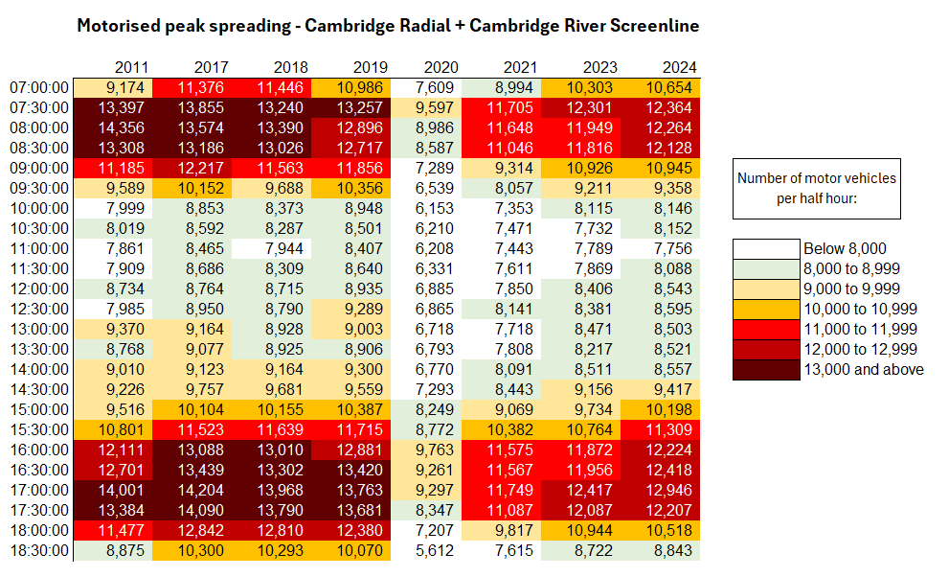
Local Road Network: Motorised Vehicle - Peak Spreading
Daily patterns of motorised traffic are starting to resemble the profiles seen pre-COVID (2017-2019), with morning and afternoon peak periods beginning to widen again, albeit still with lower overall volumes (consistently just over 12,000 motorised trips per half-hour compared to just over 13,000 pre-Covid).
Half hour beginning
Note: 2022 excluded due to lack of reliable data. The 2025 survey data is currently being analysed.
Notes:
Source: Cambridgeshire Annual Traffic Surveys – Cambridge Radial and Cambridge Screenline . Survey data in 2022 was returned to CCC incomplete, therefore 2022 is excluded as it cannot be presented in comparison to other years.
Technical Note: These figures use the annual traffic survey data from sites in the annual Cambridge Screenline and the Cambridge Radial surveys (only sites which have been consistent across all years). The survey days used in this analysis have been chosen to most closely represent a “typical” day for traffic flows (i.e. avoiding bank holidays, weeks with strike action, other special circumstances which can affect traffic volumes).

Slide 31
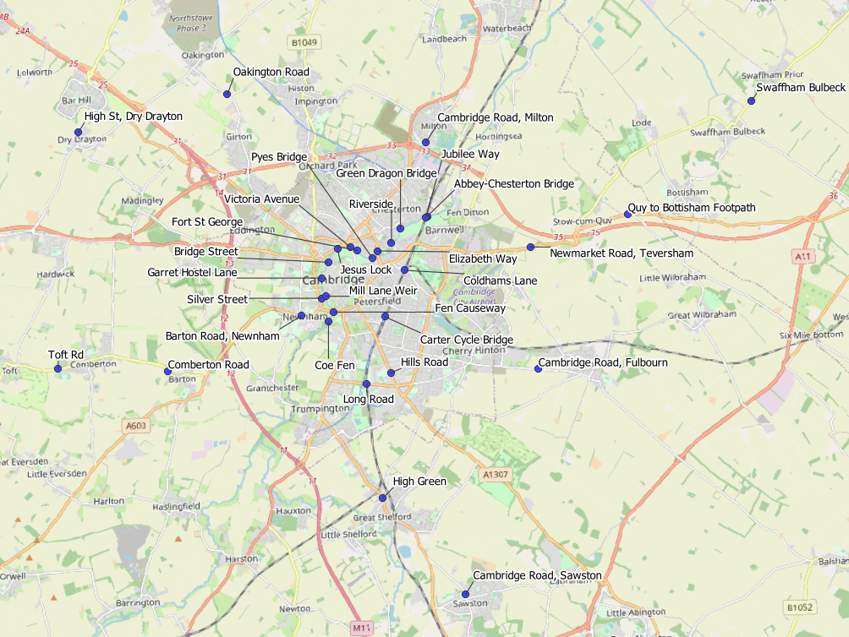
Local Road Network: Active Travel Annual Survey Sites
Cambridgeshire Annual Traffic Survey Sites – River Screenline and Cycle Routes
Sensor Location​​
Elizabeth Way
Victoria Avenue​​
Bridge Street
Silver Street
Fen Causeway​​
Green Dragon Bridge​​
Pye’s Bridge
Fort St George​​
Jesus Lock​​
Garrett Hostel Lane​​
Mill Lane Weir
Coe Fen​
Riverside
Abbey-Chesterton Bridge
Barton Road, Newnham
Cambridge Road, Fulbourn
Cambridge Road, Milton
Cambridge Road, Sawston
Carter Cycle Bridge
Coldhams Lane
Comberton Road
High Green, Great Shelford
High Street, Dry Drayton
Hills Road
Jubilee Way
Long Road
Newmarket Road, Teversham
Oakington Road
Swaffham Bulbeck footpath
Toft Road, Comberton
Quy to Bottisham Footpath
Cambridgeshire County Council commissions annual traffic surveys to determine traffic levels around the county on a “typical” weekday.
The sites shown on this map are active travel routes in and around Cambridge at which CCC has collected active travel flows consistently over several years.
Analysis of active travel counts from these sites is presented on the following slide.
© OpenStreetMap Contributors
Data from the Annual Traffic Survey sites across Cambridgeshire can now be viewed in the Annual Traffic Surveys Dashboard

Slide 32
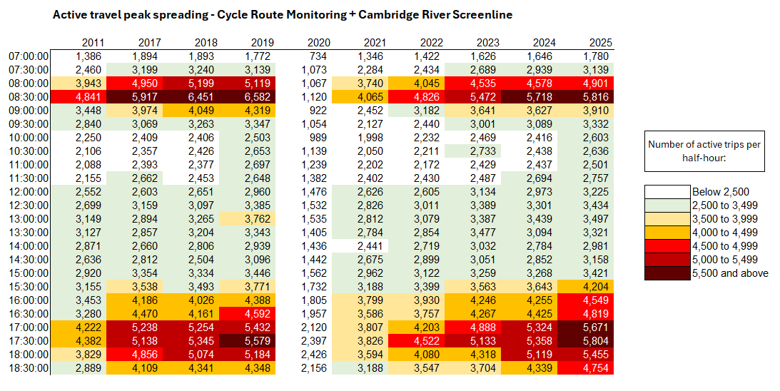
Local Road Network: Active Travel Peak Spreading
Morning peak flows remain below pre-COVID levels with the highest volumes between 08:30 and 09:00. Evening peak flows have now exceeded pre-COVID levels with the highest volumes between 17:00 and 18:00.
Half hour beginning
Note: E-scooters were included in these surveys from 2022 onwards and therefore count towards ‘active travel’ in more recent years.
Notes:
Source: Cambridge Spring Census – Screenline & Cycle Route Monitoring.
Data Note: In previous versions of this slide pack, totals from both survey days of the Cambridge River Screenline have been included. More recent analysis has only included neutral days to avoid any skewing affect from non-neutral days. Where sites have 2 neutral days of data, the two flows are averaged. Where sites only have 1 neutral day of data, the neutral data is retained and the non-neutral data excluded.
Technical Note: These figures use the annual traffic survey data from the annual Cambridge Screenline and the Cycle Route Monitoring surveys. The survey days used in this analysis have been chosen to most closely represent a “typical” day for traffic flows (i.e. avoiding bank holidays, weeks with strike action, other special circumstances which can affect traffic volumes).
As active travel can be quite variable due to weather conditions, caution is advised using these figures as they are taken from daily surveys rather than calculated over longer periods of time. They are intended to provide a rough indication of trends over time.

Slide 33
Retail Footfall

Slide 34
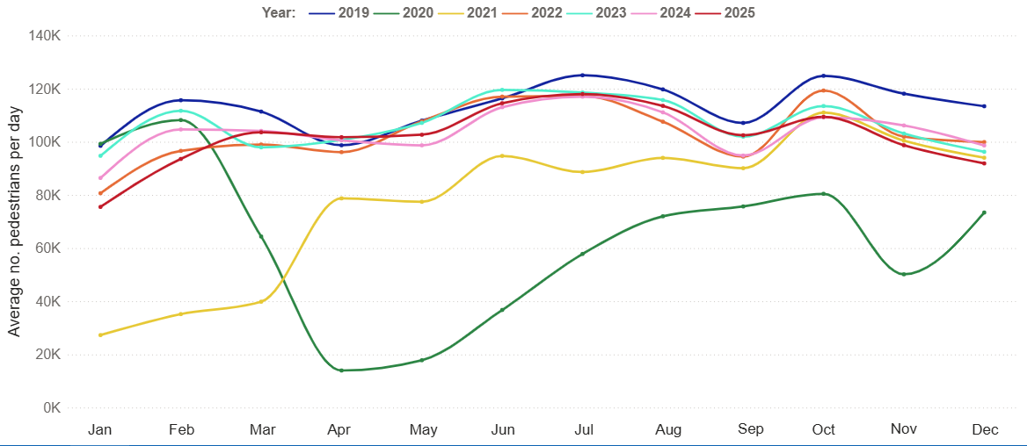
Retail Footfall: Central Cambridge
In December 2025, footfall in central Cambridge was 19% below pre-COVID levels (December 2019) and 7% below this time last year (December 2024).
Average daily pedestrian footfall: Central Cambridge
Pre-COVID to Now:
December 2019 to December 2025
Mon-Sun | Weekdays (Mon-Thu) | Weekends (Sat-Sun)
-19% | -23% | -7%
2023 to Now:
December 2023 to December 2025
Mon-Sun | Weekdays (Mon-Thu) | Weekends (Sat-Sun)
-5% | +3% | +1%
Previous year to Now:
December 2024 to December 2025
Mon-Sun | Weekdays (Mon-Thu) | Weekends (Sat-Sun)
-7% | -8% | +3%
This analysis is based on data from 6 locations in Cambridge: Bridge Street, Fitzroy Street, Market Hill, Rose Crescent, Regent Street and Sidney Street.
Notes:
Source: Cambridge BID footfall data.
Technical note: Data from the following locations: Bridge Street, Fitzroy Street at Waitrose, Market Hill, Regent Street, Rose Crescent, Sidney Street. Excludes data for King’s Parade and One Station Square. As outlined at the start of this slide pack, 'weekdays' do not include Fridays. Table calculations do not include bank holidays, school holidays or any other "non neutral" days. The percentage changes are designed to reflect change on a "typical" day.
Commentary:
December foot traffic in central Cambridge is 19% below the pre-COVID level of December 2019; and is 7% below December 2024.
Weekday foot traffic (Monday to Thursday) is 23% below pre-COVID, whereas weekend foot traffic is only 7% below 2019 levels.
December foot traffic is 7% below December 2024.

Slide 35
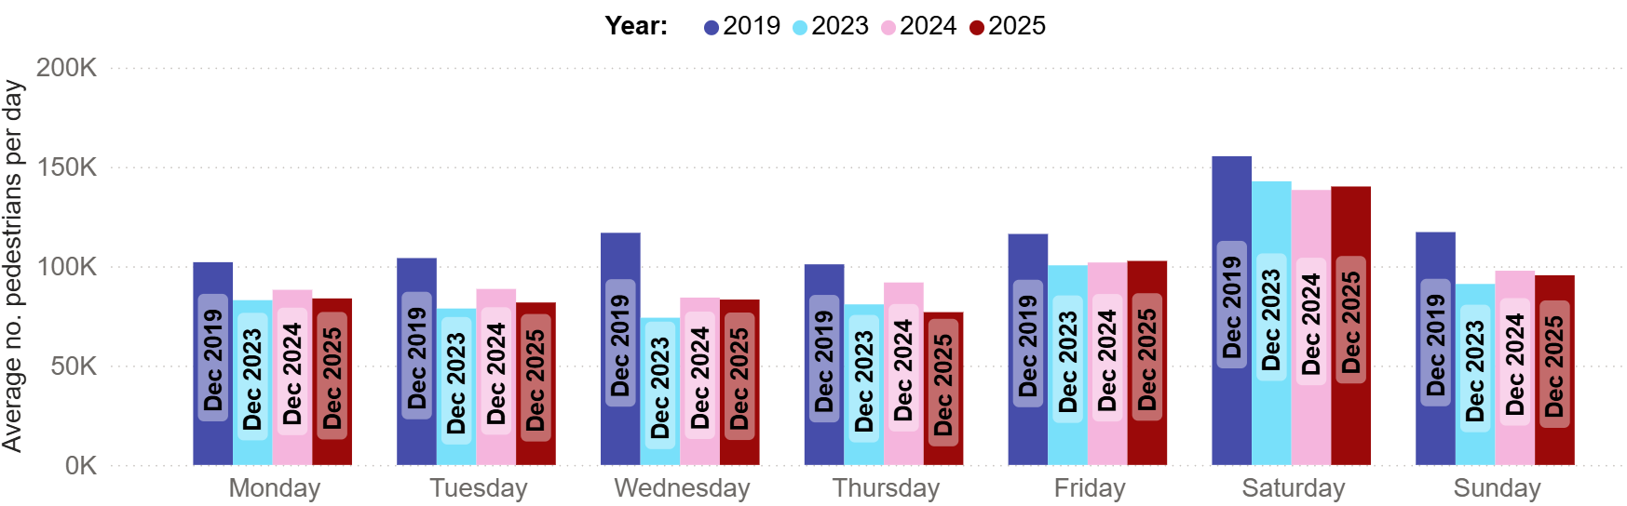
Retail Footfall: Central Cambridge by Day of the Week
In December 2025, retail footfall was below pre-COVID levels (December 2019) on all days of the week.
Wednesday is the least recovered day (-29%) whilst Friday and Saturday were the closest to pre-COVID levels (-12% and -10% change).
Average daily pedestrian footfall: Central Cambridge
Pre-COVID to Now: December 2019 to December 2025
Monday | Tuesday | Wednesday | Thursday | Friday | Saturday | Sunday
-18% | -21% | -29% | -24% | -12% | -10% | -19%
This analysis is based on data from 6 locations: Bridge Street, Fitzroy Street, Market Hill, Rose Crescent, Regent Street and Sidney Street.
Notes:
Source: Cambridge BID footfall data.
Technical note: Data from the following locations: Bridge Street, Fitzroy Street at Waitrose, Market Hill, Regent Street, Rose Crescent, Sidney Street. Excludes data for King’s Parade and One Station Square. Table calculations do not include bank holidays, school holidays or any other "non neutral" days. The percentage changes are designed to reflect change on a "typical" day.
Commentary: All days of the week show a negative change to pre-COVID (December 2019) levels. The largest negative change was a decrease of 29% on Wednesday.
Friday and Saturday footfall figures were the closest to December 2019, with a 12% and 10% decrease.

Slide 36
Car Parking

Slide 37
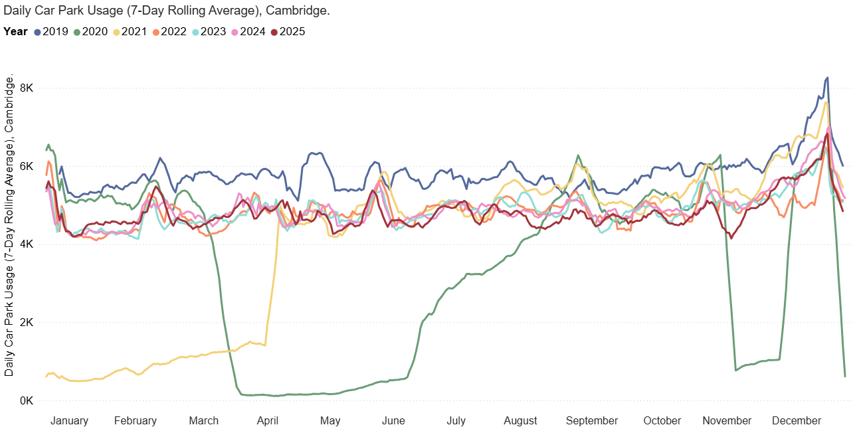
Car Parking: Daily Use
Cambridge multi-storey car park use in December 2025 was 14% below pre-COVID levels and has remained relatively stable over the last 2 years.
Queen Anne Terrace usage is the furthest ahead of pre-COVID (+30%), whilst Grafton East usage is furthest below pre-COVID (-63%).
Multi-storey car park usage, Cambridge
Park St car park closed for redevelopment (Jan 2022)
Park St car park re-opened (Nov 2024)
Pre-COVID to Now:
December 2019 to December 2025
Mon-Sun | Weekdays (Mon-Thu) | Weekends (Sat-Sun)
-14% | -17% | -1%
2023 to Now:
December 2023 to December 2025
Mon-Sun | Weekdays (Mon-Thu) | Weekends (Sat-Sun)
-3% | 1% | 3%
Previous year to Now:
December 2024 to December 2025
Mon-Sun | Weekdays (Mon-Thu) | Weekends (Sat-Sun)
-3% | 1% | 2%
This analysis is based on data from 5 car parks in Cambridge: Grafton East, Grafton West, Grand Arcade, Park Street and Queen Anne Terrace. Park Street car park closed in Jan 2022 and re-opened in Nov 2024 - usage figures for Park Street are included on this chart so that the impact of its closure and re-opening can be seen.
Notes:
Source: Cambridge City Council Car Parking data
Technical notes: Table calculations do not include bank holidays, school holidays, or any other "non neutral" days. The percentage changes are designed to reflect change on a "typical" day. As outlined at the start of this slide pack, 'weekdays' do not include Fridays.
Park Street Car Park re-opened in late November 2024.
Commentary:
Multi-storey car park usage in central Cambridge is 14% below the pre-Covid level of December 2019.
The figures for December 2025 show a small change compared to last year (December 2024). Monday to Thursday figures are 1% above last year, there is also a 2% increase in Weekend usage.
Generally, the line for 2025 has tracked very similarly to that of 2024 – fluctuating between being slightly above and slightly below the 2024 line at various points in the year.
Additionally, an increased charge for car parks was introduced in February 2023 and may be having an impact on usage compared to any periods in which parking was cheaper.
A possible factor in the 63% decrease in Grafton East car park from December 2025 to December 2019 could be the ongoing redevelopment of the Grafton Centre from a retail centre to a science hub.

Slide 38
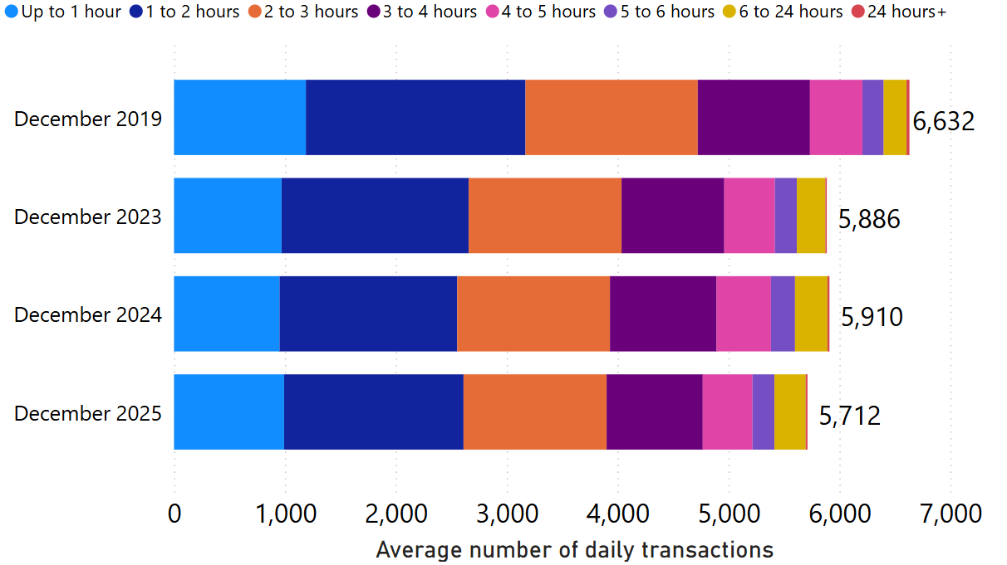
Car Parking: Length of Stay by Month
December 2025 average daily usage of multi-storey car parks is 14% lower than pre-COVID, and 3% lower than last year.
The proportionate split by length-of-stay has stayed fairly consistent over time.
Multi-storey car park average daily usage by month and length of stay
This analysis sums data from 5 multi-storey car parks in Cambridge: Grafton East, Grafton West, Grand Arcade, Park Street and Queen Anne Terrace. Park Street car park was closed from Jan 2022 and re-opened in late Nov 2024 - usage figures for Park Street are included on this chart so that the impact of its closure and re-opening can be seen.
Notes:
Source: Cambridge City Council Car Parking data
Technical notes: School holidays, bank holidays and any other "non neutral" days are not included in calculations for this chart.
Commentary:
The proportionate split in length of stay in Cambridge's multi-storey car parks is relatively consistent across the four months shown within the chart.
The chart indicates that December 2025 usage is similar to 2023 and 2024, but overall volumes are still below that which was seen in 2019.
Caveats with this chart are that Park Street Car park closed in January 2022, and a new car park charge was introduced in February 2023.
Park Street Car Park re-opened in late November 2024.

Slide 39
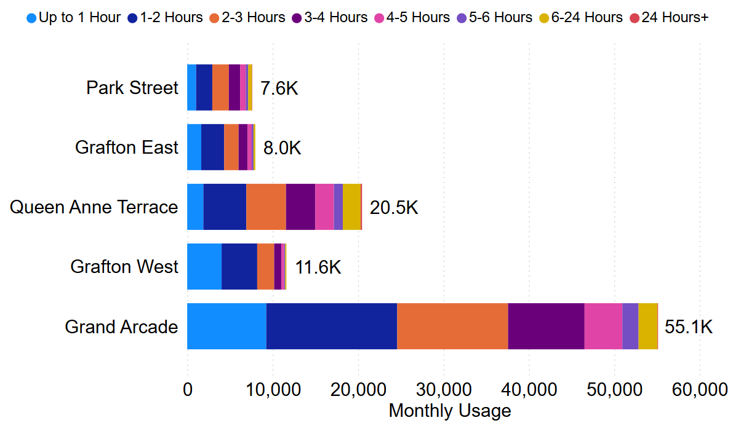
Car Parking: Length of Stay by Car Park
In December 2025, Grafton West had the highest proportion of stays under 3 hours (88%) whilst Queen Anne Terrace had the lowest proportion (56%).
Grand Arcade continues to be the most popular car park despite having a similar number of spaces as Grafton East.
Multi-storey car park usage by site and length of stay (December 2025)
222 spaces
888 spaces
572 spaces
286 spaces
951 spaces
Notes:
Source: Cambridge City Council Car Parking data
Commentary:
88% of December 2025 visits to Grafton West lasted less than three hours – making it the most likely facility to be used for short stays.
Queen Anne Terrace is the facility with the highest proportion of long stays, with 44% of December 2025 visits lasting more than three hours.
Grand Arcade is comfortably the most popular multi storey car park facility in Cambridge – with just over 55,000 patrons in June.

Slide 40
Rail Passengers

Slide 41
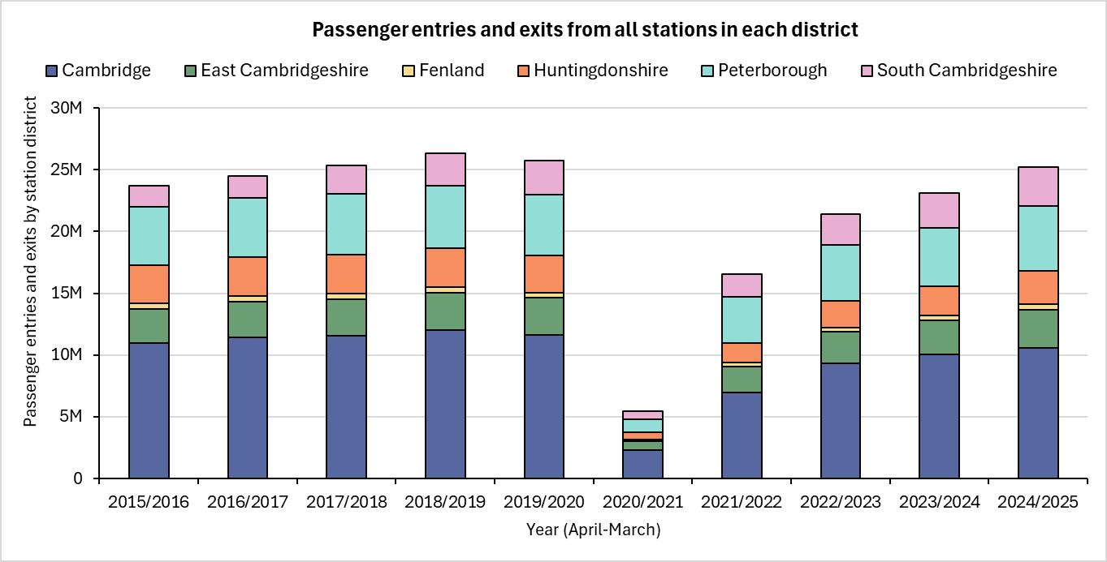
Rail Passengers: Usage
The total number of station entries and exits across Cambridgeshire and Peterborough in 2024/25 were below pre-COVID levels (2018/19) (-4%). South Cambridgeshire and Peterborough were the only districts exceeding pre-COVID, whilst Huntingdonshire was the furthest below pre-COVID (-15%).
Cambridgeshire (incl Pboro)
Pre-COVID to Now:
2018/19* to 2024/25
-4%
Cambridgeshire (excl Pboro)
Pre-COVID to Now:
2018/19* to 2024/25
-6%
District | Cambridge | East Cambridgeshire | Fenland | Huntingdonshire | Peterborough | South Cambridgeshire
Pre-COVID to Now: 2018/19* to 2024/25 | -12% | 0% | -1% | -15% | +5% | +18%
*2018/19 used as the pre-COVID baseline because 2019/20 data is affected by March 2020 being part of the first COVID-19 lockdown.
Notes:
Source: Rail statistics, ORR. Table 1415a
Technical note: Rail Passenger annual data runs April – March. 2018/19 is used as the pre-COVID baseline as 2019/20 entries and exit data is affected in March 2020 by the first COVID-19 lockdown.

Slide 42
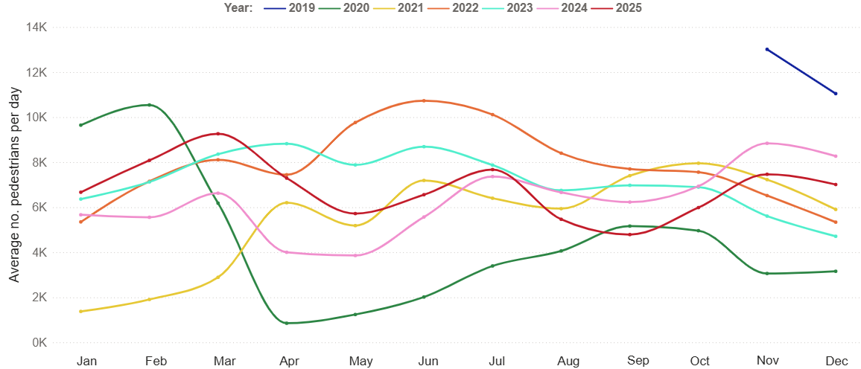
One Station Square Footfall
Footfall at One Station Square (outside Cambridge train station)
Note:
Concerns were raised regarding the reliability of the One Station Square footfall data following a sudden drop in April 2024. Cambridge BID confirmed that an issue was repaired in December 2024.
Following those repairs, the 2025 data continues to show large fluctuations. Cambridge BID have therefore been asked to check the reliability of the 2025 data.
While these checks are ongoing, the graph will continue to be updated but % change figures will not be provided.
Pre-COVID to Now:
Excluded due to sensor issues in 2025
Mon-Sun | Weekdays (Mon-Thu) | Weekends (Sat-Sun)
2023 to Now:
Excluded due to sensor issues in 2025
Mon-Sun | Weekdays (Mon-Thu) | Weekends (Sat-Sun)
Previous year to Now:
Excluded due to sensor issues in 2024
Mon-Sun | Weekdays (Mon-Thu) | Weekends (Sat-Sun)
Notes:
Source: Cambridge BID footfall data​
Technical note: Table calculations do not include bank holidays, school holidays, or any other "non neutral" days. The One Station Square sensor was fitted in December 2019 so pre-COVID data is not available for all months. For March comparisons, we use the first two weeks of March 2020 (1st – 14^{th)} to ensure impacts of the first lockdown are not included, but we acknowledge the comparison is not ideal. Data may be impacted by strike action. As outlined at the start of this slide pack, 'weekdays' do not include Fridays.
The data collected at One Station Square throughout 2024 appears to be erroneous and has therefore been omitted from this slide. Cambridge Bid have confirmed that this footfall counter was repaired in December 2024. Monitoring of this site resumed in January 2025. The 2025 data continues to show fluctuations. Cambridge BID have been asked to comment on the reliability of the 2025 data.

Slide 43
Bus Passengers

Slide 44
Bus Passengers Estimates
There are two methodologies for estimating local bus passenger journeys:
Method 1: the bus driver pushes a button when
a passenger boards the bus.
This method of data collection should be more accurate as it captures observed passenger journeys. However, the accuracy of recording varies by driver and may vary over time.
Suggests higher growth in P&R journeys since 2019 (+18%).
Method 2: estimate passenger journeys based on the
no. tickets sold
This method uses assumptions about the no. journeys made per ticket to estimate total passenger journeys. For example, it is assumed that someone purchasing a 1-week ticket will make 10 journeys on average. The method relies heavily on the accuracy of the assumptions used.
Suggests lower growth in P&R journeys since 2019 (+4%).
There are positive and negative aspects to each method, and one may be more appropriate depending on the use case. For transparency, P&R data using both methods is presented in slides 48-51 to allow a comparison to be made.
From March 2026 onwards, the data provided by Stagecoach will be based on driver estimates (method 1) as this is the method that bus operators are using to report data to the Department for Transport. The multipliers used for method 2 have not been updated post-COVID so this method is less likely to be representative of passenger journeys more recently.
Notes:
Source: Stagecoach

Slide 45
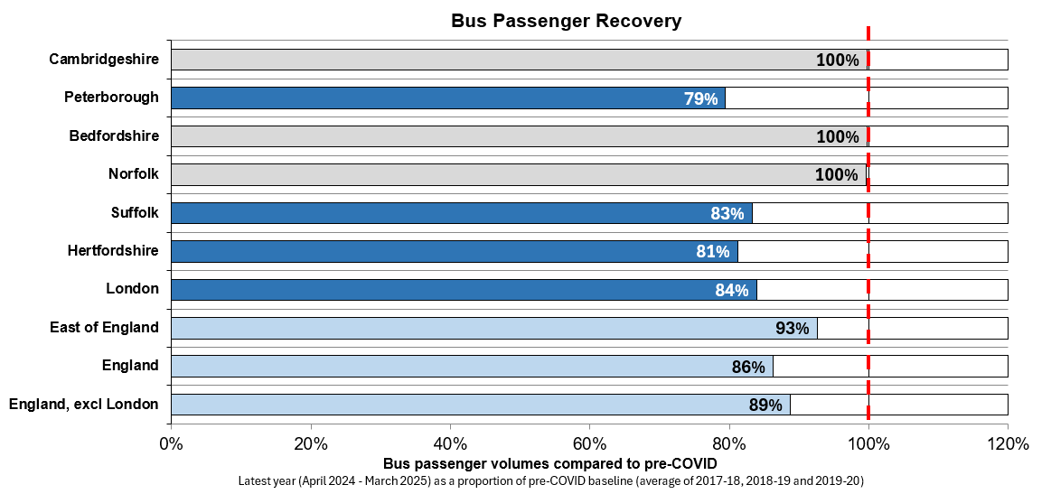
Bus Passengers: national stats Method #1 – Driver estimate
Department for Transport statistics show that 19.7 million passengers used bus services in Cambridgeshire from April 2024 to March 2025. This is level with the pre-COVID baseline. Passenger volumes in Peterborough (7.4 million) are 21% below pre-COVID levels. Bus journeys per person continue to be higher in Peterborough.
Cambridgeshire:
Total Bus Passengers,
April 2024 – March 2025:
19.7 million
(28 journeys per head of population)
Peterborough:
Total Bus Passengers,
April 2024 – March 2025:
7.4 million
(33 journeys per head of population)
*Pre-COVID is defined as the average of three years (2017-18, 2018-19, 2019-20) to minimise the impacts of the pandemic that were present during the last week of the 2019-20 period.
Source: DfT Annual Bus Operator Survey: https://www.gov.uk/government/collections/bus-statistics. Please note – the data is subject to revisions / amendments.
Notes:
Source: DfT Bus Statistics: https://www.gov.uk/government/collections/bus-statistics
Bedfordshire figures are compiled by summing those provided separately for Luton, Bedford, and Mid-Bedfordshire in the DfT dataset.

Slide 46
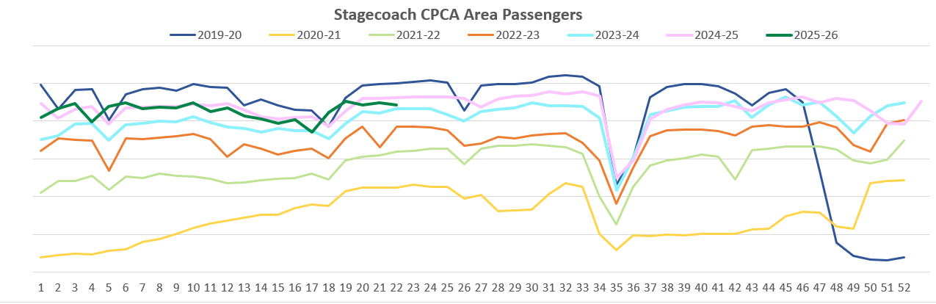
Bus Passengers: all passengers Method #1 – Driver estimate
In December 2025, bus passenger volumes on services based at Stagecoach’s Cambridgeshire depots (Cambridge and Fenstanton) were 7% below pre-COVID. Meanwhile, bus passenger volumes on services based at the Peterborough depot were 19% lower than pre-COVID.
Bus Passengers
May
Jun
Jul
Aug
Sep
Oct
Nov
Dec
Jan
Feb
Mar
Apr
Cambridge and
Fenstanton depots
Pre-COVID to Now:
Peterborough
depot
Pre-COVID to Now:
Cambridge and
Fenstanton depots
2023 to Now:
Peterborough
depot
2023 to Now:
Dec 2019 to Dec 2025
-7%
Dec 2019 to Dec 2025
-19%
Dec 2023 to Dec 2025
+3%
Dec 2023 to Dec 2025
-1%
Due to the commercial sensitivity of this data, bus passenger volumes are not labelled on the y-axis of this graph. Park and Ride services only operate from the Cambridge depot.
This data is estimated by drivers who press a button when a passenger boards the bus.
Notes:
Source: Stagecoach (Button-push methodology)
Technical note: Due to the commercial sensitivity of this data, bus passenger volumes are not marked on the y-axis of this graph.

Slide 47
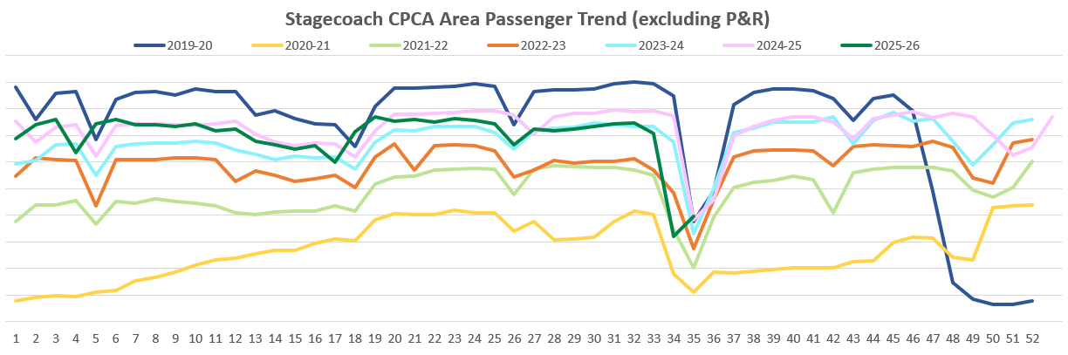
Bus Passengers: non-P&R services Method #1 – Driver estimate
In December 2025, bus passengers on non-Park & Ride services were 14% below pre-COVID at the Cambridgeshire depots (Cambridge and Fenstanton), and 19% below pre-COVID at the Peterborough depot.
Bus Passengers
May
Jun
Jul
Aug
Sep
Oct
Nov
Dec
Jan
Feb
Mar
Apr
Cambridge and Fenstanton depots
Pre-COVID to Now:
Peterborough
depot
Pre-COVID to Now:
Cambridge and Fenstanton depots
2023 to Now:
Peterborough
depot
2023 to Now:
Dec 2019 to Dec 2025
-14%
Dec 2019 to Dec 2025
-19%
Dec 2023 to Dec 2025
0%
Dec 2023 to Dec 2025
-1%
Due to the commercial sensitivity of this data, bus passenger volumes are not marked on the y-axis of this graph.
This data is estimated by drivers who press a button when a passenger boards the bus.
Notes:
Source: Stagecoach (Button-push methodology)
Technical note: Due to the commercial sensitivity of this data, bus passenger volumes are not marked on the y-axis of this graph.
Commentary: Bus passenger numbers, excluding passengers who used the park and ride service, continued to rise through 2023 and 2024 but remained below pre-COVID volumes. So far in 2025, figures have tracked similarly with 2024 – and, in more recent weeks, have just fallen slightly below the volumes seen at this point last year.
Passenger numbers gradually decreased in August 2025 before sharply rising again once September began – this tracks with other years, and is to be expected due to school summer holidays.
Note that, In January 2023, the government announced a £2 cap on single tickets (£2 bus fare cap - GOV.UK (www.gov.uk)).

Slide 48
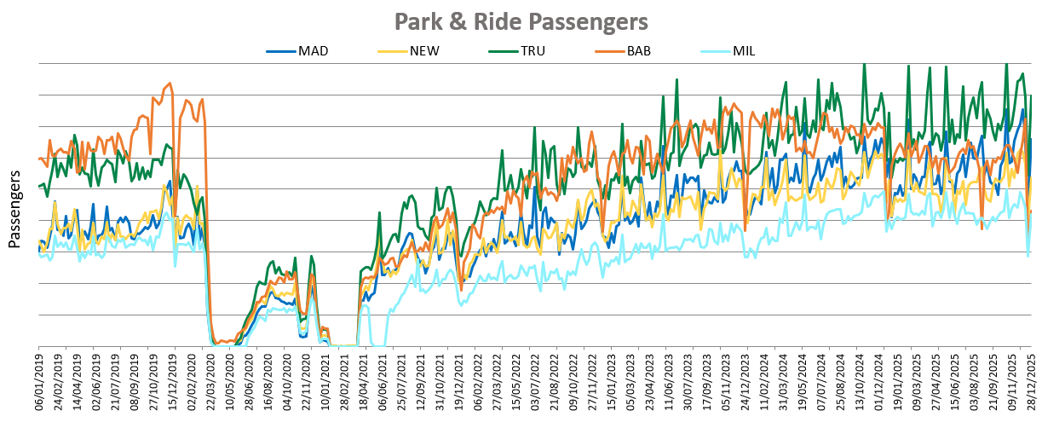
Bus Passengers: P&R services Method #1 – Driver estimate
Based on driver estimates, Park & Ride bus passenger volumes have increased by 18% since December 2019 and by 11% since December 2023.
Cambridge sites
Pre-COVID to Now:
Cambridge sites
2023 to Now:
Dec 2019 to Dec 2025
+18%
Dec 2023 to Dec 2025
+11%
Due to the commercial sensitivity of this data, bus passenger volumes are not marked on the y-axis of this graph.
This data is estimated by drivers who press a button when a passenger boards the bus.
Notes:
Source: Stagecoach (Button-push methodology)
Technical note: Due to the commercial sensitivity of this data, bus passenger volumes are not marked on the y-axis of this graph.
Commentary: Overall volumes have recovered beyond those seen in 2019 (+19%) – with Madingley and Newmarket park & ride sites experiencing the best recovery pattern of all individual sites. Babraham is still a little lower than pre-COVID, in contrast to other sites. This may be due to solar canopy roof works which have been ongoing at that location recently.
Note that in January 2023, the government announced a £2 cap on single tickets (£2 bus fare cap - GOV.UK (www.gov.uk)).
MAD=Madingley Road P&R
NEW = Newmarket Road P&R
TRU = Trumpington P&R
BAB = Babraham Road P&R
MIL = Milton Road P&R

Slide 49
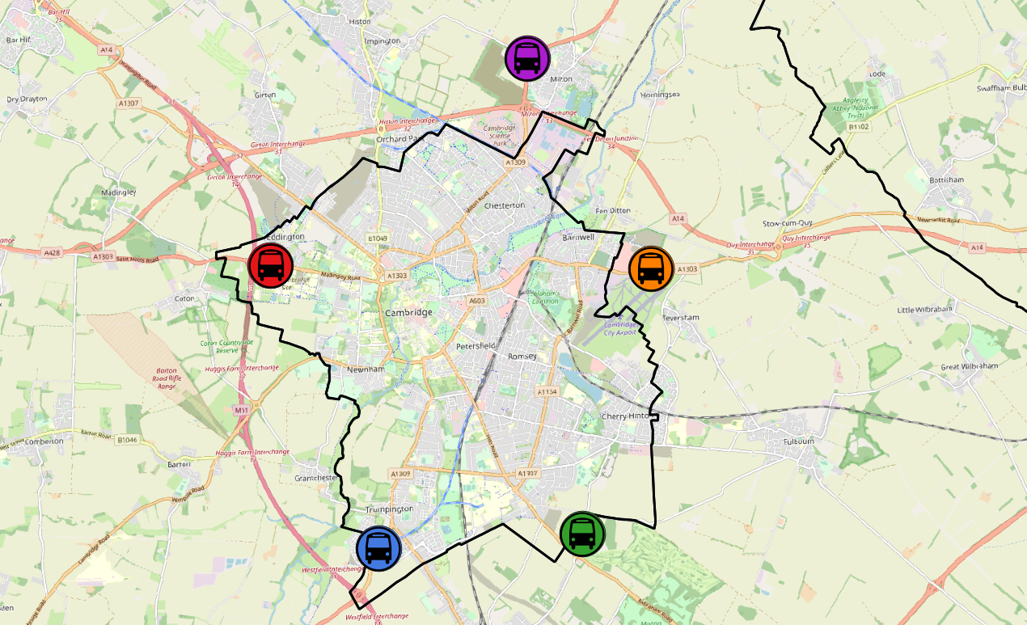
Bus Passengers: P&R services Method #1 – Driver estimate
Based on driver estimates, Park and Ride (P&R) passenger volumes are above pre-COVID levels (+18%); and are 11% above December 2023 levels.
All sites are above 2019 volumes except for Babraham Road (-19%).
All P&R Sites
Dec 2019 to Dec 2025
Dec 2023 to Dec 2025
Milton P&R
Dec 2019 to Dec 2025
Dec 2023 to Dec 2025
+18%
+16%
+11%
+22%
Madingley Road P&R
Dec 2019 to Dec 2025
Dec 2023 to Dec 2025
Newmarket Road P&R
Dec 2019 to Dec 2025
Dec 2023 to Dec 2025
+45%
+30%
+20%
+12%
Babraham Road P&R
Dec 2019 to Dec 2025
Dec 2023 to Dec 2025
Trumpington P&R
Dec 2019 to Dec 2025
Dec 2023 to Dec 2025
-19%
+35%
-12%
+19%
© OpenStreetMap Contributors
This data is estimated by drivers who press a button when a passenger boards the bus.
Notes:
Source: Stagecoach (Button-push methodology)

Slide 50
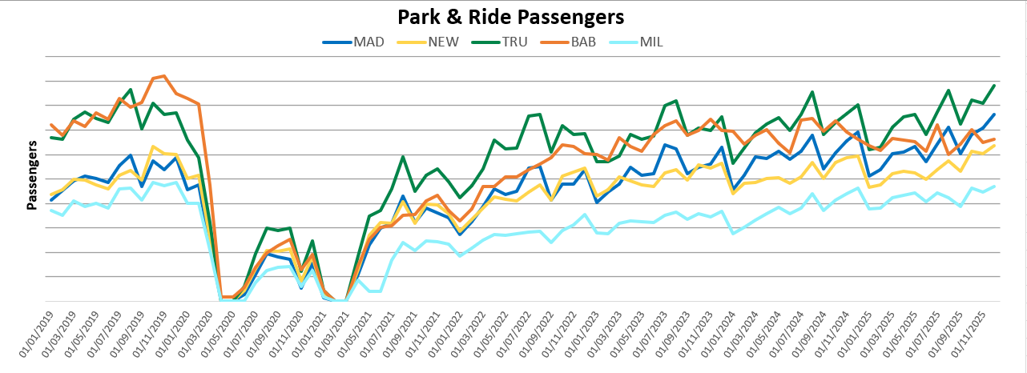
Bus Passengers: P&R only Method #2 – Sales estimate
Using the sales estimate, Park & Ride route usage is 4% above pre-COVID (December 2019) and is 13% up compared to December 2023.
Cambridgeshire sites
Pre-COVID to Now:
Cambridgeshire sites
2023 to Now:
Dec 2019 to Dec 2025
Dec 2023 to Dec 2025
+13%
+4%
Due to the commercial sensitivity of this data, bus passenger volumes are not marked on the y-axis of this graph.
This data is estimated based on the number of tickets sold and assumptions regarding the no. journeys made per ticket.
Notes:
Source: Stagecoach (Multiplier methodology)
Technical note: Due to the commercial sensitivity of this data, bus passenger volumes are not marked on the y-axis of this graph.
Methodology note: multipliers are applied to ticket sales in order to estimate passenger journeys made. These are outlined in full below.
Single – 1 journey.
Concession/Smart – 1 journey.
Return – 2 journeys.
Day – 3.25 journeys.
Mega rider – 10 journeys.
Small Group – 9 journeys.
Large Group – 12 journeys.
Commentary:
Park and ride usage (via ticket sale multiplier methodology) has started to plateau after an increasing trend post-COVID.
Overall usage is 4% above December 2019, and 13% above December 2023.
Note that, In January 2023, the government announced a £2 cap on single tickets
(£2 bus fare cap - GOV.UK (www.gov.uk)).
MAD=Madingley Road P&R
NEW = Newmarket Road P&R
TRU = Trumpington P&R
BAB = Babraham Road P&R
MIL = Milton Road P&R

Slide 51
Bus Passengers: P&R only Method #2 – Sales estimate
Using the sales estimate, Park and Ride (P&R) route usage is just above pre-COVID levels (+4%) and is up by 13% compared to 2023. All routes show an increase compared to 2023 except Babraham (PR4), which may be linked to the solar canopy construction works at Babraham Road P&R Site.
All P&R Sites
Dec 2019 to Dec 2025
Dec 2023 to Dec 2025
Milton P&R
Dec 2019 to Dec 2025
Dec 2023 to Dec 2025
+4%
-3%
+13%
+27%
Madingley Road P&R
Dec 2019 to Dec 2025
Dec 2023 to Dec 2025
Newmarket Road P&R
Dec 2019 to Dec 2025
Dec 2023 to Dec 2025
+30%
+6%
+21%
+13%
Babraham Road P&R
Dec 2019 to Dec 2025
Dec 2023 to Dec 2025
Trumpington P&R
Dec 2019 to Dec 2025
Dec 2023 to Dec 2025
-22%
+15%
-5%
+17%
© OpenStreetMap Contributors
This data is estimated based on the number of tickets sold and assumptions regarding the no. journeys made per ticket
Notes:
Source: Stagecoach (Multiplier methodology)
Methodology note: multipliers are applied to ticket sales in order to estimate passenger journeys made. These are outlined in full below.
Single – 1 journey.
Concession/Smart – 1 journey.
Return – 2 journeys.
Day – 3.25 journeys.
Mega rider – 10 journeys.
Small Group – 9 journeys.
Large Group – 12 journeys.

Slide 52
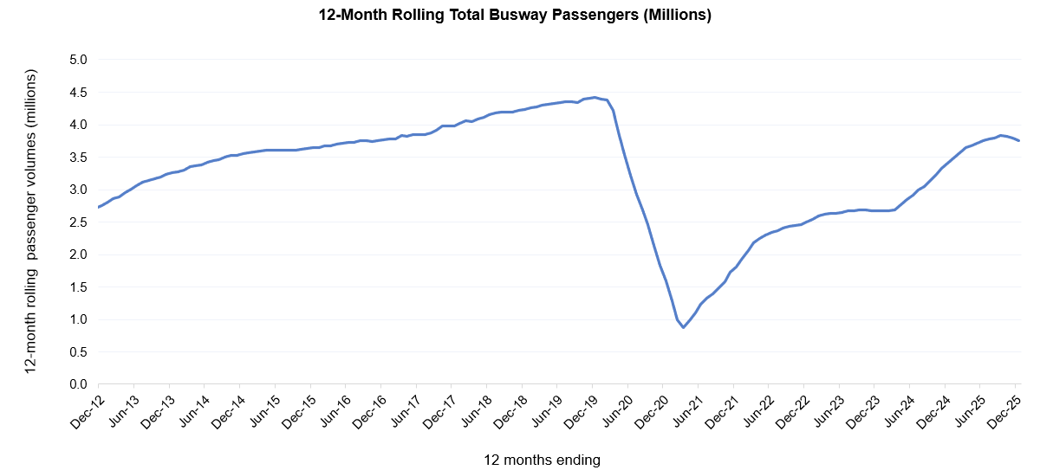
Guided Busway Passengers Method #2 – Sales estimate
Just under 3.8 million passengers are estimated to have used the Cambridgeshire Guided Busway during 2025.
This is a 10% increase on last year’s passenger volume estimate but is 15% below pre-COVID volumes (2019).
3.8m passengers
(Jan – Dec 2025)
Busway Usage (Bus Passengers)
Pre-COVID to Now:
2019 – 2025
4.4m passengers
(Jan – Dec 2019)
-15%
3.4m passengers
(Jan – Dec 2024)
Busway Usage (Bus Passengers)
Previous Year to Now:
2024 – 2025
+10%
Source: Stagecoach and Whippet. This data is estimated based on the number of tickets sold and assumptions regarding the no. journeys made per ticket.
Notes:
Source: Stagecoach / Whippet.

Slide 53
Micro-mobility

Slide 54
Voi E-scooters and E-bikes in Cambridge
The use of Voi e-scooters and e-bikes has increased since the same period last year (+25%). Weekday peak usage is consistently seen at 8am in the morning and between 4pm-5pm in the evening. Riders aged under 40 represent 83% of riders indicating that this mode of transport is less popular with those over 40.
Voi have operated an electric scooter (e-scooter) and electric bike (e-bike) trial scheme in and around Cambridge since October 2020.
Key statistics: October to December 2025
% change from same period in 2024
Number of rides:
+25%
change from same period in 2024
Number of active riders:
+16%
change from same period in 2024
Total ride distance:
+25%
change from same period in 2024
Source: Voi. Note Voi has made a methodological change from June 2025 in the age distribution calculations to better capture e-bike riders who do not need to verify their age with a license.
Notes:
Source: Voi

Slide 55
Air Quality

Slide 56
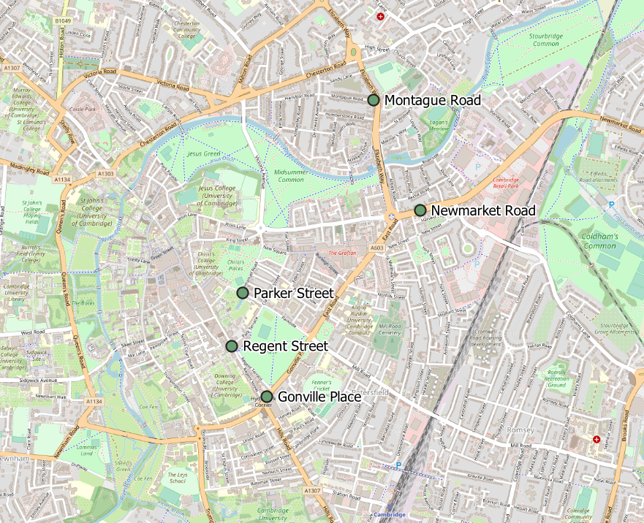
Air Quality Monitoring Locations
Continuous Air Quality Monitoring Sites, Cambridge
Location | Description
Montague Road | Close to the junction with Elizabeth Way.
Newmarket Road | Close to Cambridge Retail park on Newmarket Road. Data unavailable in early 2025 due to sensor upgrade.
Parker Street | Close to the bus station.
Regent Street | To the West of Parker’s Piece. Site monitors Nitrogen dioxide (NO₂) only.
Gonville Place | Near Hill’s Road, South of Parker’s Piece. Inactive from April 2022 to March 2024.
The Cambridge City Council Air Quality team provide data from 5 continuous air quality monitors in central Cambridge. The monitors measure Nitrogen dioxide (NO₂) and Particulate Matter (PM₁₀ and PM_{2.5}) which are all proxies for overall air quality.
© OpenStreetMap Contributors
Notes:
Source: Cambridge City Air Quality team. Data for the Cambridge air quality continuous monitors can also be found at: Air quality in England (airqualityengland.co.uk).
Technical note: Please note there may be slight differences between the data on Air Quality in England and data in this pack as air quality data undergoes a ratification process.

Slide 57
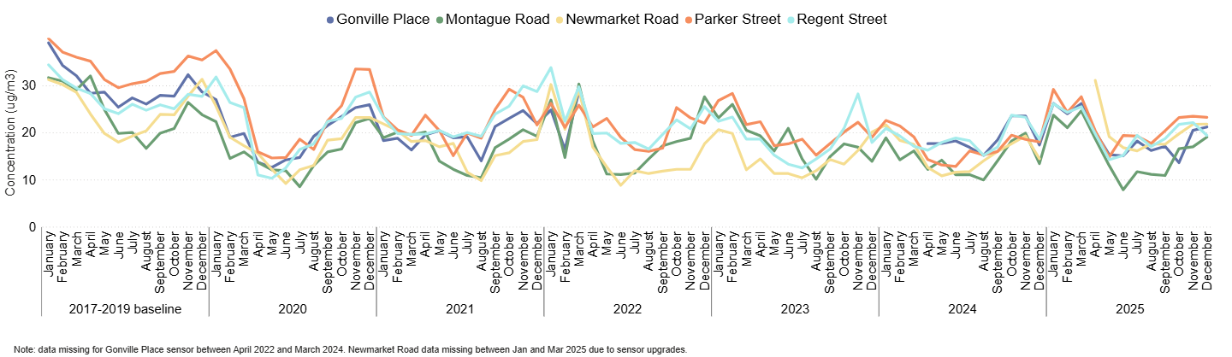
Air Quality: Nitrogen dioxide (NO₂)
All of the continuous monitoring sites in Cambridge city centre show a decrease in nitrogen dioxide pollution since the June 2017-2019 baseline, in particular Parker Street (-34%). Concentrations of NO₂ have seen a decrease since April 2025 but have gradually increased after, in line with usual seasonal trends.
Monthly average NO₂ concentrations (µg/m³) by site
 | Pre-COVID to Now: | 2023 to Now: | Last year to Now:
 | Dec 2017-19 baseline to Dec 2025 | Dec 2023 to Dec 2025 | Dec 2024 to Dec 2025
Gonville Place | -26% | No Dec 2023 data | +22%
Montague Road | -20% | +37% | +42%
Newmarket Road | -30% | +9% | +51%
Parker Street | -34% | +22% | +29%
Regent Street | -30% | +8% | +5%
Overall | -29% | +18% | +28%
NO₂ is partly generated by road transport. Concentrations are given in micrograms (µg) per cubic metre of air (m³ )
Notes:
Source: Cambridge City Air Quality team. Data for the Cambridge air quality continuous monitors can be found at: Air quality in England (airqualityengland.co.uk).
Technical note: Data for the Gonville Place sensor is not available from April 2022 to March 2024. Newmarket Road data is missing between January and March 2025 due to sensor upgrades.
Please note there may be slight differences between the data on Air Quality in England and data in this pack as air quality data is provisional until it has undergone a ratification process.

Slide 58
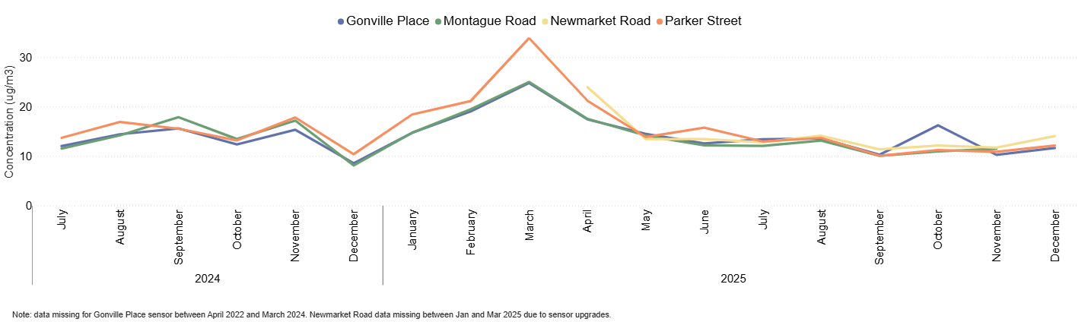
Air Quality: Particulate Matter (PM₁₀)
PM₁₀ concentrations have been between 10 and 16µg/m³ since July 2025 which is below the higher levels detected in Spring 2025.
Concentrations decreased slightly from September.
Monthly average PM₁₀ concentrations (µg/m³) by site
 | Last year to Now:
 | Dec 2024 to Dec 25
Gonville Place | +36%
Montague Road | Data not available for Dec 25
Newmarket Road | Historic data not yet available
Parker Street | +17%
PM₁₀ is a type of pollution that is made up of particulate matter (all the solid and liquid particles in the air e.g. smoke, dust, pollen). PM₁₀ pollution has larger particles (diameter of 0.01mm or less) and is partly generated by road transport.
Concentrations of PM₁₀ must not exceed an annual average of 40 µg/m3 (Air Quality Standards Regulations, 2010).
Concentrations are given in micrograms (µg) per cubic metre of air (m³ )
Notes:
Source: Cambridge City Air Quality team. Data for the Cambridge air quality continuous monitors can be found at: Air quality in England (airqualityengland.co.uk).
Technical note: Please note there may be slight differences between the data on Air Quality in England and data in this pack as air quality data is provisional until it has undergone a ratification process.
A fault was detected on the monitor used to measure PM2.5 and PM10 in December 2025 at Montague road. Due to this, no data is available for this site in December.

Slide 59
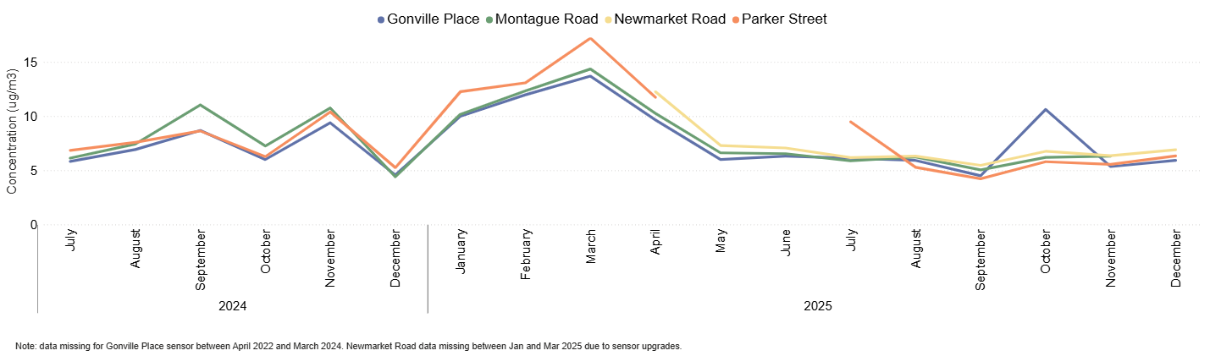
Air Quality: Particulate Matter (PM_{2.5})
PM_{2.5} concentrations have been between 4 and 11 µg/m³ since July 2025 which is below the higher levels detected in Spring 2025.
In October, Gonville Place saw higher concentrations which decreased in November and December.
Monthly average PM_{2.5} concentrations (µg/m³) by site
 | Last year to Now:
 | Dec 2024 to Dec 25
Gonville Place | +29%
Montague Road | Data not available for Dec 25
Newmarket Road | Historic data not yet available
Parker Street | +21%
PM_{2.5} is a type of pollution made up of particulate matter (all the solid and liquid particles in the air e.g. sea spray, smoke). PM_{2.5} pollution has smaller particles (diameter of 0.0025mm or less) and is partly generated by road transport.
Concentrations of PM_{2.5} have an annual mean target level of 10 µg/m3 by 2040 (Environmental Targets (Fine Particulate Matter)(England) Regulations 2023).
Concentrations are given in micrograms (µg) per cubic metre of air (m³ )
Notes:
Source: Cambridge City Air Quality team. Data for the Cambridge air quality continuous monitors can be found at: Air quality in England (airqualityengland.co.uk).
Technical note: Please note there may be slight differences between the data on Air Quality in England and data in this pack as air quality data is provisional until it has undergone a ratification process.
A fault was detected on the monitor used to measure PM2.5 and PM10 in December 2025 at Montague road. Due to this, no data is available for this site in December.

Slide 60
policyandinsight@cambridgeshire.gov.uk

