Slide 1




Digital Inclusion and Social Housing in Cambridgeshire and Peterborough
January 2026

Slide 2
About us
Infrastructure
Innovation
Inclusion
Digital Connectivity Strategy 2025-2029

Slide 3
Experiences of digital exclusion among temporary accommodation and social housing tenants
Cambridge Centre for Housing and Planning Research, May 2025
Estimated over half of social housing tenants face some form of digital exclusion
Challenges:
Unreliable connectivity at home
Reliance on mobile data and handheld devices
High cost of broadband
Public WiFi is not adequate (privacy, transportation, speed)
Difficulty accessing services
Impact on parenting and children’s education
Digital skills gap and a lack of confidence
Long-term access to devices

Slide 4
Experiences of digital exclusion among temporary accommodation and social housing tenants
Cambridge Centre for Housing and Planning Research, May 2025
Recommendations:
Improve collaboration between LAs, local organisations and providers
Establish a single front door for local digital inclusion support for signposting
Ensure residents can communicate with service providers offline
Recognise that levels of digital exclusion fluctuate
Improve staff digital skills training and awareness of support available
Ensure free / subsidised connectivity and devices are high quality
Recruit more volunteers delivering digital skills support
Focus on drop-in, informal support
Raise awareness of social tariffs, automatically informing those on Universal Credit
Fund and deliver public WiFi widely
Ensure there are dedicated private areas in community spaces to access public WiFi

Slide 5
National developments and work elsewhere
Changes to legislation
Connectivity
Pilots
Removing
Barriers to Rollout
New
Approaches
Decent Homes Standard Consultation (2025)
Digital connectivity is included under best practice guidance.
A future standard?
CityFibre IoT-enabled social housing model
Redirects operational savings to residents – offering free broadband
Pilots scoped in Renfrewshire, York, WSCC and Portsmouth
GMCA standardise wayleave agreements
Embedding digital standards into housing charters
Providers delivering holistic digital inclusion programmes.
Combining infrastructure, access and community support.
ISPs improving their affordable product schemes

Slide 6
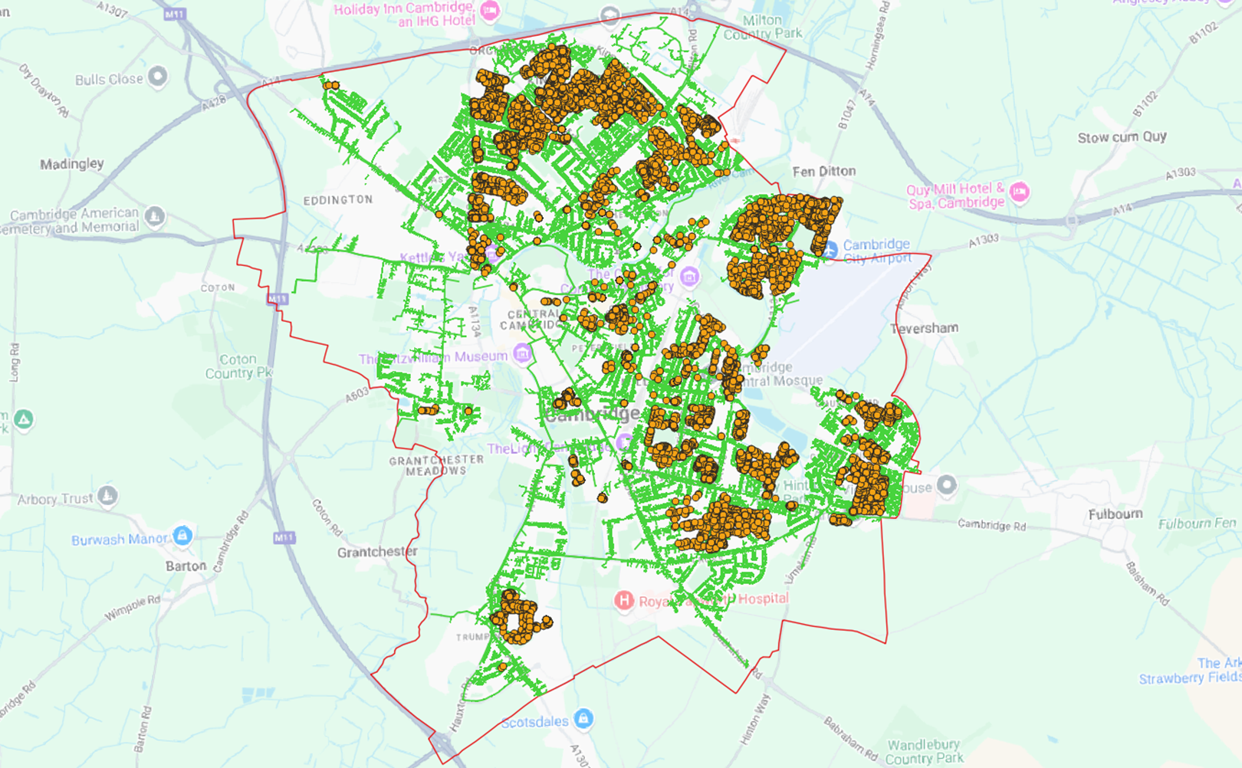

Social Housing in Cambridge ~7.5k homes

Slide 7



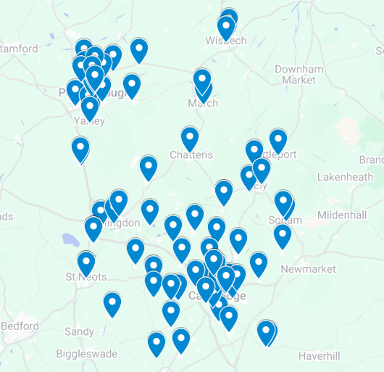







So, what are we doing?
Supporting digital inclusion through local interventions
Mapping the local landscape – identifying gaps in full-fibre rollout and gigabit-capable coverage
Staying aligned with national developments
Reviewing replicable pilots and models
Building an evidence base to inform future work
Hearing from you.

Slide 8
Tell us.
Social tariffs
In-person services
Hardship support
Partnerships
Staff training / volunteers
Communal WiFi
Infrastructure upgrades
What do you currently do to support your residents’ access to…
Connectivity
Devices
Online services
Digital skills

Slide 9
What we hear
Research elsewhere suggests providers face the following challenges in addressing digital exclusion:
Gaps in full fibre rollout or poor performance
Slow or complex wayleave processes
Limited choice of ISPs for tenants within your stock
Digital skills gaps among both residents and staff
Device access and replacement needs
Lack of private space for Wi‑Fi use in temporary / support settings
Capacity constraints and competing priorities

Slide 10
Tell us.
What challenges face your residents?
What challenges are you facing?
Do you have any ambitions you’d like to achieve in the next year, three years?

Slide 11
What we’ll do next.
Corroborate the available research and its findings with findings from this, and further, engagement.
Ongoing engagement with interested partners to support the rollout of gigabit-capable connectivity, and better digital inclusion support.
Develop case studies, testimonials, and impact evaluation to understand the benefits of this work with residents.

Slide 12
Thank you
will.plant@cambridgeshire.gov.uk
sophie.skrimshire@cambridgeshire.gov.uk

