Slide 1

Transport update: Cambridge and South Cambridgeshire
COVID-19 transport impacts and recovery
June 2025
Policy & Insight Team, Cambridgeshire County Council

Slide 2
Transport Update Aims
This report is intended to:
Provide a basis for discussion for the Greater Cambridge Partnership (GCP) to understand and identify existing challenges and future data needs.
Summarise the on-going impacts of COVID-19 on trends in transport and mobility up to 30th June 2025.
Highlight changes in key indicators by comparing June 2025 data to a pre-pandemic baseline (June 2019 or closest possible equivalent), June 2023 and to last year (June 2024).
Due to the availability of comparable data, comparison with pre-COVID levels is not possible for all datasets. Comparison against a 2023 baseline is therefore also provided.
Notes:
Comparison periods may vary across the different datasets based on the availability of historic data – comparison periods are clearly noted for each dataset.
  Where reference is made to ‘Weekdays’ this only includes Monday, Tuesday, Wednesday and Thursday.
  Data from the permanent traffic sensors and Annual Traffic Surveys can also be viewed using our online dashboards.

Slide 3
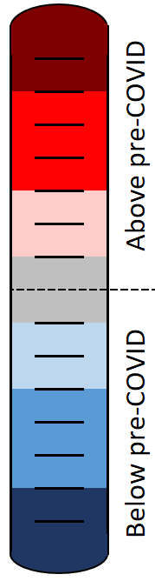
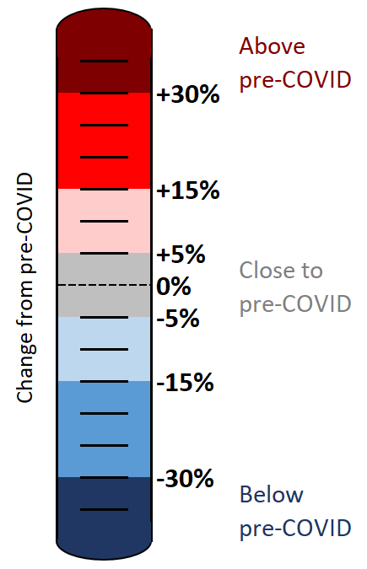
Colour scale
The statistics in this pack have been colour-coded using a heat scale to reflect the level of recovery being experienced (pre-COVID compared to now).
A positive (red) value indicates that levels have increased above those experienced pre-COVID.
A negative (blue) value indicates that levels remain below pre-COVID.
Tip:
Look out for the colour scale bar in the top right-hand corner of each page for a reminder of the heat scale used to indicate the level of recovery throughout the pack.

Slide 4





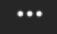
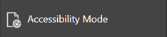
Accessibility
To access the full functionality of PowerPoint, we recommend opening the slides in full screen mode. To do this, click the “Open in New Window” button in the bottom right-hand corner.
1) Navigate through the slide pack using the left and right arrows in the middle-bottom of the screen. Clicking on the sentence “Slide x of x” brings up a pop-up listing all the slides so you can navigate directly to a slide of interest.
2) Open the Notes for each slide to see the data source, technical notes and any additional commentary. See the “Notes” button in the bottom right-hand corner.
3) Use the “Download” button to the right of the centre at the top of the screen to download the slides as a .pptx file.
4) Use the “Print to PDF” option to save the PowerPoint as a PDF document (but please be aware you will lose access to the Notes section which contains additional information for the slide).
5) Use the “More options” icon in the top right-hand corner and choose “Accessibility mode” from the pop-up menu to access the slides in a different format which will display any Alt Text that has been set for charts and images.
We are continually working to improve the accessibility of our content. If you find you are unable to access any part of this update, please contact policyandinsight@cambridgeshire.gov.uk and we will be happy to investigate providing information in an alternative format.

Slide 5
Overview

Slide 6
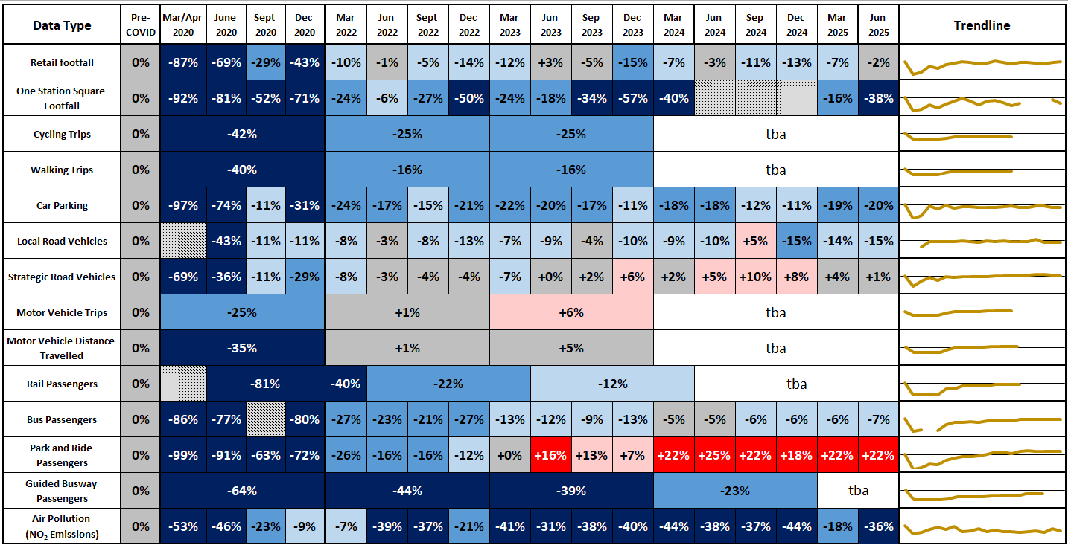
Recovery Tracker: Has transport use returned to pre-COVID levels?
For all data sources and any other relevant information regarding these metrics, please consult the notes section of this slide.
Figures for 2021 have been obscured to improve the display of this recovery tracker. Figures for 2021 still comprise part of the ‘Trendline’ and are available on request.
Notes:
Sources and Geographical Scope:
Retail Footfall: Data Sourced from Cambridge BID. Central Cambridge only
One Station Square Footfall: Data Sourced from Cambridge BID. Central Cambridge (Outside Railway Station only).
Cycling Trips: Data Sourced from Google Environmental Insights. Cambridge only.
Walking Trips: Data Sourced from Google Environmental Insights. Cambridge only.
Car Parking: Data Sourced from Cambridge City Council. Multi-Storey Car Parks in Central Cambridge only.
Local Road Vehicles: Data Sourced from VivaCity. Greater Cambridge Only – please consult slide pack notes for specific data collection locations.
Strategic Road Vehicles: Data Sourced from National Highways. All of Cambridgeshire – please consult individual slides for specific data collection locations.
Motor Vehicle Trips: Data Sourced from Google Environmental Insights. Cambridge only.
Motor Distance Travelled: Data Sourced from Google Environmental Insights. Cambridge only.
Rail Passengers: Data Sourced from the Office of Rail and Road. Cambridge Station only.
Bus Passengers: Data Sourced from Stagecoach. Cambridge depot only.
Park & Ride Passengers: Data Sourced from Stagecoach. Cambridge only.
Guided Busway Passengers: Data Sourced from Stagecoach. Greater Cambridge only.
Air Pollution: Data Sourced from Cambridge City Council. Central Cambridge locations only. NO2 Emissions only.
Technical Notes: Our methodology for analysing the data continues to be refined to react to differing levels of data quality and data gaps. Therefore, you may observe small adjustments to the stats in the latest slide pack compared to previously published versions.
For example:
The method of calculating the strategic road network (SRN) recovery percentages changed in Dec 2022 to include data from a larger number of sites. The SRN percentages have therefore been updated and may not reflect the values presented in previous slide packs for this reason.
The air pollution percentages historically used data from 5 sensors but one of these sensors was removed in April 2022 so the methodology for calculating the air pollution percentages has been adjusted. The air pollution percentages presented here may differ slightly from those in previous slide packs for this reason.
Commentary:
This slide indicates the extent to which each of the transport metrics has recovered over time in comparison to pre-Covid (2019 or early 2020) levels.
Google mobility workplace, Cambridge: Plateaued recovery 31% below pre-Covid in Sept 2022. Data source discontinued in October 2022.
Google mobility workplace, South Cambridgeshire: fluctuating recovery, 11% below pre-Covid in Sept 2022. Data source discontinued in October 2022.
Retail footfall, central Cambridge: fluctuating recovery levels linked to seasonal variations. Currently just below pre-Covid.
One Station Square footfall: Erratic pattern of recovery over time. Currently some way below pre-Covid. Urge caution with this data - supplier has been asked to confirm reliability following issues during 2024.
Walking, central Cambridge: Data is only available annually through to 2023. Figures show a gradual recovery in walking volumes; albeit with a plateau between 2022 and 2023.
Cycling, central Cambridge: Data is only available annually through to 2023. Figures show a gradual recovery in walking volumes; albeit with a plateau between 2022 and 2023.
Multi Storey Car Parking, central Cambridge: stable trend in the last two years, consistently between 10-20% below pre-Covid.
Vehicle flows on local roads, central Cambridge: stabilizing recovery trend, now consistently 10-15% below pre-Covid.
Vehicle flow on strategic roads, gradually improving recovery trend, now consistently above pre-Covid levels.
Motorised trip volumes in Cambridge (sourced from Google). Data is only available annually through to 2023. Figures show a gradual recovery in motorised trip volumes - with figures showing as above pre-COVID for 2022 and 2023.
Motorised distance travelled in Cambridge (sourced from Google). Data is only available annually through to 2023. Figures show a gradual recovery in distances travelled via motorised vehicles - with figures showing as above pre-COVID for 2022 and 2023.
Railway passenger numbers at Cambridge Station (updated annually to March) – improving recovery trend, but still some way below pre-Covid.
Bus passengers, Cambridge: improving recovery trend from March 2022 to March 2024. Stabilising recovery trend since March 2024, consistently 5-7% below pre-Covid.
Park and Ride passengers: consistent recovery trend, now consistently above pre-Covid levels, albeit with some site-by-site variation.
Air pollution: consistently remaining some way below pre-Covid.

Slide 7








Headlines: June 2025
Local Roads
Volumes at…
…compared to 2019
…compared to 2023.
Strategic Roads
Volumes at…
…compared to 2019
…compared to 2023.
Car Parking
Patronage at…
…compared to 2019
…compared to 2023.
Bus
Patronage at…
…compared to 2019.
…compared to 2023.
Cambridgeshire depots only.
Park and Ride
Patronage at…
...compared to 2019.
...compared to 2023.
Cambridgeshire depots only.
P
P
+
-15%
+1%
-20%
+0%
+22%
-3%
-2%
+0%
+11%
+6%
Station Footfall
Volumes at…
…compared to *Feb 2020.
…compared to 2023.
Retail Footfall
Volumes at…
…compared to 2019.
…compared to 2023.
Walking
2023 Volumes at…
…compared to 2019.
2023 is latest available data.
Cycling
2023 Volumes at…
...compared to 2019.
2023 is latest available data.
NO₂ Emissions
Concentrations at...
...compared to 2017-19.
...compared to 2023**.
-38%
-2%
-36%
-16%
-25%
-25%
-4%
-6%
*Sensor installed Dec 2019 so limited pre-COVID data available. **Excludes Gonville Place.

Slide 8
Travel Demand

Slide 9
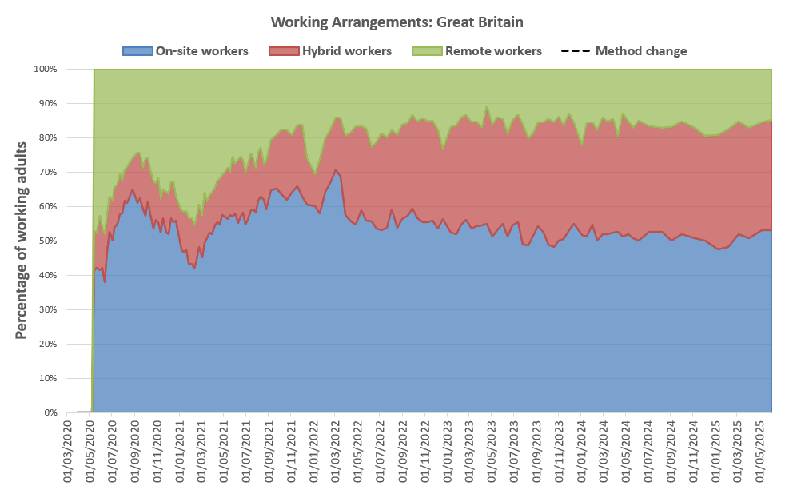
Is home working here to stay?
The ONS captures the working arrangements of a sample of approx. 800 working adults across Great Britain on a fortnightly basis. The results suggest that on-site working has been stable since the latter stages of the pandemic (roughly 50-60% of working adults). Hybrid working has increased since 2020 but has stabilised (32-33%). Remote working decreased and has now stabilised (16-17%). Census 2021 data suggests that hybrid and remote working is more common in Cambridge & South Cambs than it is nationally.
Year | Percentage of working adults [Great Britain annual average]
 | On-site working | Hybrid working | Remote working
2020 | 54% | 12% | 34%
2021 | 55% | 14% | 30%
2022 | 58% | 24% | 18%
2023 | 53% | 32% | 16%
2024 | 52% | 32% | 16%
2025 (so far*) | 51% | 33% | 17%
*Data available to 29th June 2025.
Locally, the 2021 Census (March 2021), demonstrated that levels of remote working in Cambridge (46%) and South Cambs (44%) were higher than the national average (31%) whilst East Cambs (35%) and Hunts (35%) were more similar. Fenland (20%) and Peterborough (25%) were lower than the national average. It is likely that this pattern is a result of the types of employment being undertaken in these areas, with some industries better able to accommodate home working than others. It’s likely that differences between working arrangements across the districts remain today.
Source: Travel to Work Summary
Source: ONS Working Arrangements data for Great Britain. ONS made small changes to the sample of respondents in April 2022 and caution is advised comparing data before/after this date.
On-site working is someone that only worked from a workplace away from home. Remote working is someone who only worked from home. Hybrid working is a combination of working away from home and at home.
Notes:
Source: ONS Working Arrangements data for Great Britain
Commentary: Data is gathered by ONS who survey a sample of 760 people across Great Britain on a weekly, and more recently fortnightly, basis. Some small changes were made to the sample of people surveyed in April 2022 which may have impacted the comparability of data before/after this date. Despite a possible step change occurring in the data at this time, trends post April 2022 continue to suggest a very gradual reduction in on-site workers.

Slide 10
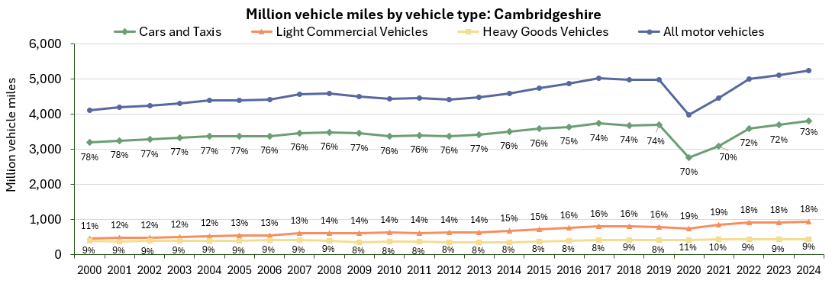
Is vehicle use increasing?
Estimated motor vehicle miles travelled has gradually increased over time, to over 5 billion miles in 2024. The proportion of miles made by cars and taxis has decreased since 2000 (from 78% in 2000 to 73% in 2024) whilst the proportion of miles made by light commercial vehicles (LCVs) has increased from 11% in 2000 to 18% in 2024.
Note: The percentage labels represent the split between the different vehicle types (Car and Taxi / LCV / HGV)
 | All motor vehicles | Cars and taxis | Light commercial vehicles | Heavy goods vehicles
Pre-COVID to 2024*: 2019 to 2024 | +6% | +3% | +17% | +7%
2023 to 2024*: 2023 to 2024 | +3% | +3% | +2% | +2%
Source: Department for Transport annual mileage estimates (Road traffic statistics).
Notes:
Source: Road traffic statistics - Download data
Commentary: Local authority traffic figures give the total volume (vehicle miles) of traffic across each local authority for the whole year.

Slide 11
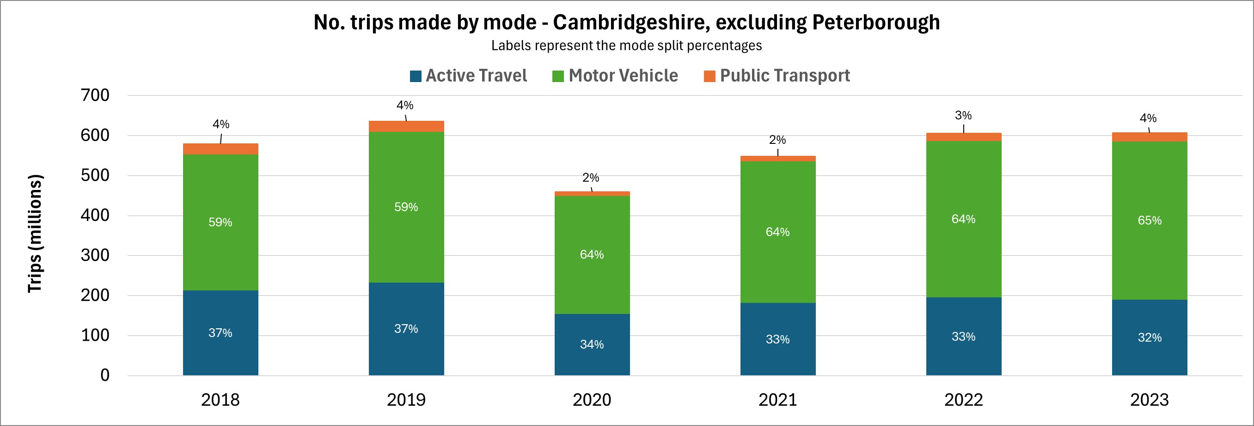
Which methods of travel are being used?
Google collects anonymised location history data from mobile phones to estimate the number of trips and distance travelled by each mode of transport. This data suggests that motor vehicle trips have exceeded pre-COVID levels in all districts whilst active and public transport trips remain below pre-COVID levels, with the exception of South Cambs.
Area | Percentage change in trips (2019 to 2023)
 | Motor Vehicle* | Active Travel | Public Transport | All modes
Cambridge | +6% | -18% | -7% | -8%
East Cambridgeshire | +6% | -9% | -18% | +2%
Fenland | +10% | -10% | -16% | +5%
Huntingdonshire | +1% | -9% | -31% | -2%
South Cambridgeshire | +1% | -12% | +1% | -2%
Cambridgeshire | +5% | -18% | -14% | -4%
*Excludes motorcycle trips due to missing data
Source: Google EIE
All trips entering, exiting and travelling within each area
Notes:
Source: Google Environmental Insights Explorer - Make Informed Decisions
Due to large amounts of missing data, motorcycle trips have been excluded from this analysis. “Motor Vehicle” therefore only includes car trips. “Active Travel” includes walking and cycling trips. “Public Transport” includes bus and rail trips.

Slide 12
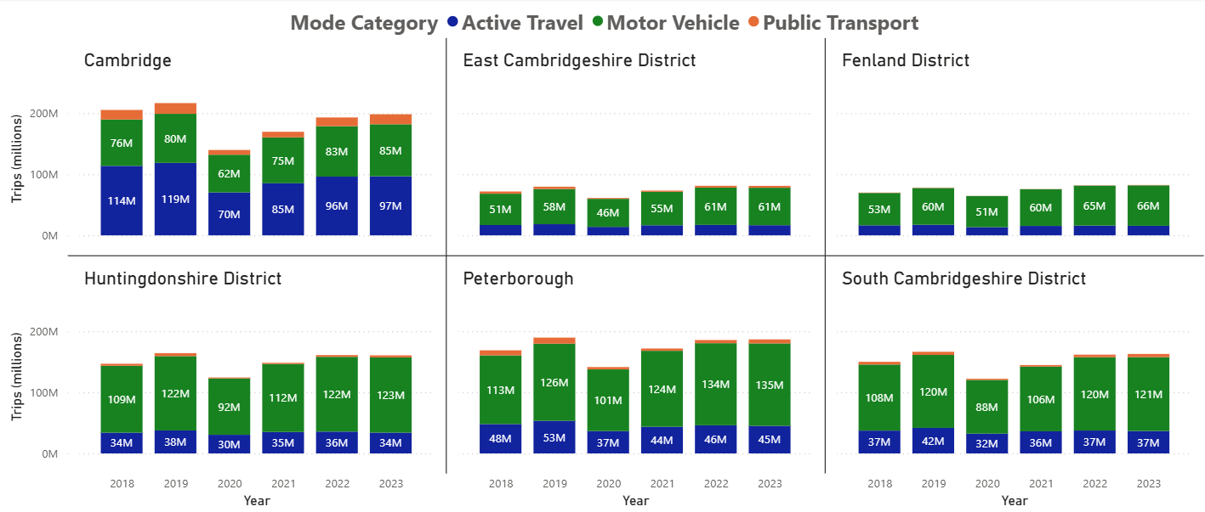
Which methods of travel are being used?
In most districts, the most popular mode choice was motor vehicle with the exception of Cambridge where active travel (walking and cycling) was consistently more popular. For all districts, there is a dip in the number of trips made in 2020 due to COVID-19 and a gradual recovery since then.
No. trips made by mode and year
Source: Google EIE
All trips entering, exiting and travelling within each area
Notes:
Source: Google Environmental Insights Explorer - Make Informed Decisions
Due to large amounts of missing data, motorcycle trips have been excluded from this analysis. “Motor Vehicle” therefore only includes car trips. “Active Travel” includes walking and cycling trips. “Public Transport” includes bus and rail trips.

Slide 13
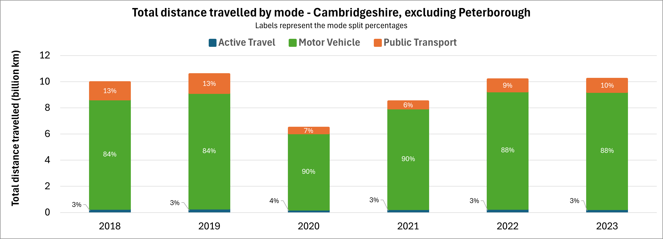
How many kilometres are being travelled by each mode?
Whilst a notable number of journeys are made by active travel (walking and cycling), these trips only make up a small proportion of the distance travelled as they are typically shorter in length. Public transport distances exceed active travel distances despite there being fewer public transport trips.
Area | Percentage change in distance (2019 to 2023)
 | Motor Vehicle* | Active Travel | Public Transport | All modes
Cambridge | +5% | -6% | -19% | -3%
East Cambridgeshire | +1% | +5% | -19% | -1%
Fenland | +5% | -0% | -31% | +4%
Huntingdonshire | -5% | +2% | -51% | -9%
South Cambridgeshire | +2% | -10% | -24% | -0%
Cambridgeshire | +1% | -11% | -30% | -3%
*Excludes motorcycle trips due to missing data
Source: Google EIE
All kilometres travelled by trips entering, exiting and travelling within each area
Notes:
Source: Google Environmental Insights Explorer - Make Informed Decisions
Due to large amounts of missing data, motorcycle trips have been excluded from this analysis. “Motor Vehicle” therefore only includes car trips. “Active Travel” includes walking and cycling trips. “Public Transport” includes bus and rail trips.

Slide 14
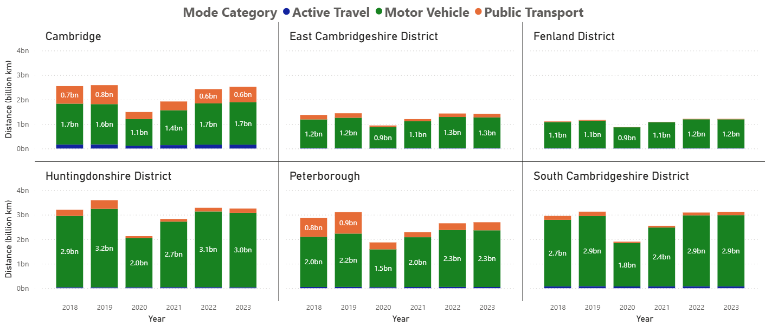
How many kilometres are being travelled by each mode?
In each district, cars consistently had the highest total distance travelled. Cambridge and Peterborough (more urban) both had a higher distance travelled using public transport compared to the other districts, perhaps because they are served by a larger number of bus and rail services and because they are employment centres.
Distance travelled by mode and year
Source: Google EIE
All kilometres travelled by trips entering, exiting and travelling within each area
Notes:
Source: Google Environmental Insights Explorer - Make Informed Decisions
Due to large amounts of missing data, motorcycle trips have been excluded from this analysis. “Motor Vehicle” therefore only includes car trips. “Active Travel” includes walking and cycling trips. “Public Transport” includes bus and rail trips.

Slide 15
Strategic Road Network

Slide 16
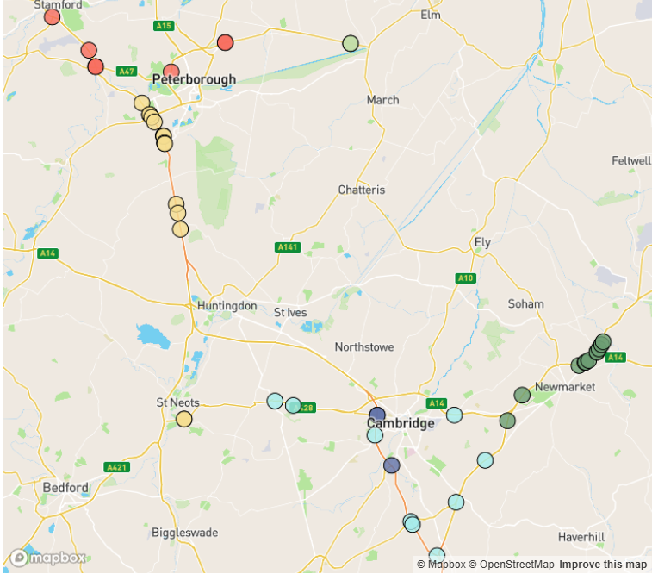
Strategic Road Network Monitoring Sites
Strategic Road Network traffic monitoring sites with continuous data
A1
A47
National Highways have approximately 1,400 permanent traffic monitoring sites on the strategic road network within Cambridgeshire and Peterborough.
Each monitoring site varies in its ability to reliably provide data over time, and periods of inactivity are common. It is therefore not appropriate to conduct comparison between years at all sites.
For comparison to June 2025, there are 46 sites available across Cambridgeshire and Peterborough.
N
A1
A14
A11
A14
2
2
A14
A428
A11
A1
M11
Notes:
Source: National Highways WebTRIS data. (https://webtris.highwaysengland.co.uk/)
Sites with data in June 2019, 2023, 2024 and 2025:
SourceSiteDescription District
MIDAS site at M11/6820A Cambridge
MIDAS site at M11/6886A Cambridge
MIDAS site at M11/6886B Cambridge
MIDAS site at A11/0041B East Cambridgeshire
MIDAS site at A11/0047B East Cambridgeshire
MIDAS site at A11/0883A East Cambridgeshire
MIDAS site at A14/1157B East Cambridgeshire
MIDAS site at A14/1241B East Cambridgeshire
MIDAS site at A14/1250A East Cambridgeshire
MIDAS site at A14/1250B East Cambridgeshire
MIDAS site at A14/1254A East Cambridgeshire
TMU Site 6317/1 East Cambridgeshire
TMU Site 9946/1 East Cambridgeshire
TMU Site 9946/2 East Cambridgeshire
TMU Site 6350/1 Fenland
TMU Site 6350/2 Fenland
MIDAS site at A1M/2115A Huntingdonshire
MIDAS site at A1M/2134A Huntingdonshire
MIDAS site at A1M/2145B Huntingdonshire
MIDAS site at A1M/2219B Huntingdonshire
MIDAS site at A1M/2220A Huntingdonshire
MIDAS site at A1M/2228B Huntingdonshire
MIDAS site at A1M/2229A Huntingdonshire
MIDAS site at A1M/2248A Huntingdonshire
MIDAS site at A1M/2254B Huntingdonshire
MIDAS site at A1M/2259A Huntingdonshire
MIDAS site at A1M/2259B Huntingdonshire
TMU Site 6781/2 Huntingdonshire
TMU Site 6999/1 Huntingdonshire
TMU Site 6999/2 Huntingdonshire
TMU Site 6351/1 Peterborough
TMU Site 6351/2 Peterborough
TMU Site 6353/1 Peterborough
TMU Site 6502/2 Peterborough
TMU Site 6503/2 Peterborough
TMU Site 6504/1 Peterborough
TMU Site 6506/2 Peterborough
MIDAS site at M11/6694A South Cambridgeshire
MIDAS site at M11/6743B South Cambridgeshire
MIDAS site at M11/6747A South Cambridgeshire
MIDAS site at M11/6862B South Cambridgeshire
TMU Site 6310/1 South Cambridgeshire
TMU Site 6312/2 South Cambridgeshire
TMU Site 6314/2 South Cambridgeshire
TMU Site 7123/1 South Cambridgeshire
TMU Site 7125/2 South Cambridgeshire

Slide 17
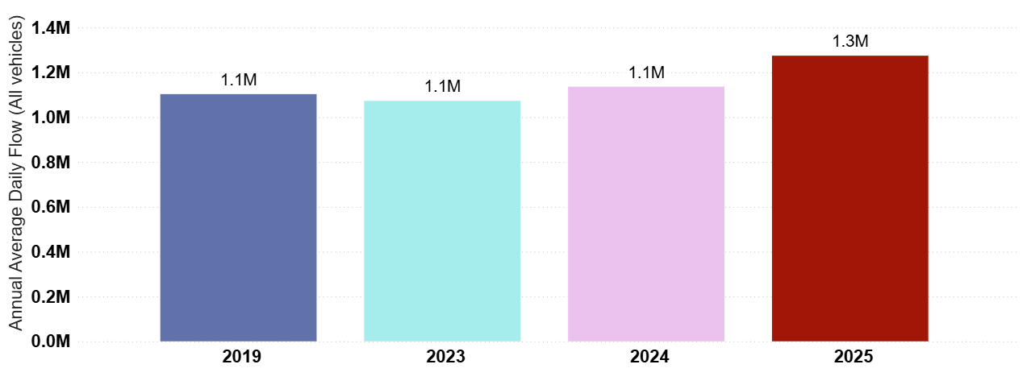
Strategic Road Network: Annual Average Daily Flow by Year
In Cambridgeshire and Peterborough, traffic volumes on the Strategic Road Network (SRN) are above pre-COVID levels (+16%) and have increased year on year since 2023. So far during 2025 there has been a 12% increase in daily volumes compared to 2024.
Cambridgeshire and Peterborough
Jan-June 2025 only
Pre-COVID to Now:
2019 to 2025
+16%
2023 to Now:
2023 to 2025
+19%
Previous year to Now:
2024 to 2025
+12%
Analysis based on 46 sensors across Cambridgeshire and Peterborough.
Notes:
Source: National Highways WebTRIS data.
Technical note: Average Daily Flow by year for main carriageway monitors in each district. This dataset averages across ALL days (Mon-Sun).

Slide 18
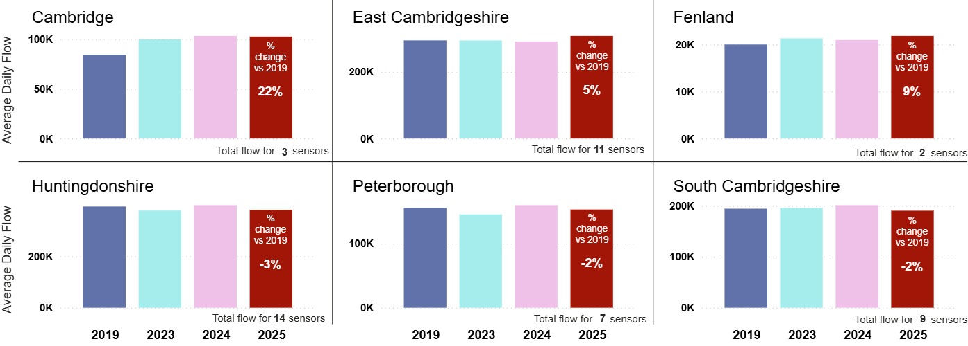
Strategic Road Network: Average Daily Flow by District
Strategic Road Network flows are higher than in June 2019 in three districts, with Huntingdonshire, Peterborough and South Cambridgeshire just below June 2019. Cambridge is furthest above 2019 (M11 sites at +22%). East Cambridgeshire sees the largest increase from the same time last year (June 2024) at +6%.
 | Pre-COVID to Now: | 2023 to Now: | Last year to Now:
 | Jun 2019 to Jun 2025 | Jun 2023 to Jun 2025 | Jun 2024 to Jun 2025
Cambridge | +22% | +3% | -1%
East Cambridgeshire | +5% | +5% | +6%
Fenland | +9% | +2% | +4%
Huntingdonshire | -3% | +1% | -4%
Peterborough | -2% | +5% | -4%
South Cambridgeshire | -2% | -3% | -5%
All districts | +1% | +2% | -2%
Analysis based on 46 sensors across Cambridgeshire and Peterborough.
Notes:
Source: National Highways WebTRIS data.
Technical note: Average Daily Flow by year for main carriageway monitors in each district. This dataset averages across ALL days (Mon-Sun).

Slide 19
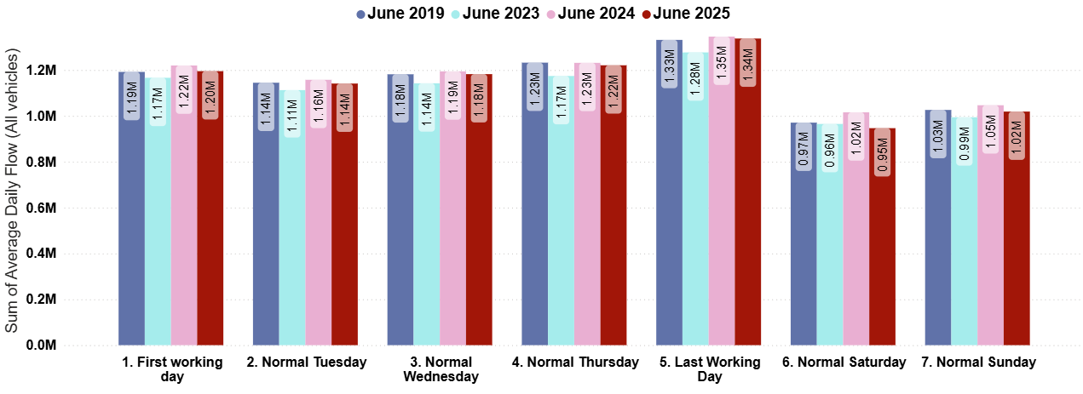
Strategic Road Network: Daily Flow by Day of the Week
On the strategic road network, Mon-Sun volumes are around June 2019 volumes. Weekends are just below 2019 (-2%). Overall volumes have seen a decrease from June 2024 (-2%, Mon-Sun), especially at the weekends (-5%, Sat-Sun).
Pre-COVID to Now:
Jun 2019 to Jun 2025
Mon-Sun | Weekdays (Mon-Thu) | Weekends (Sat-Sun)
No change | No change | -2%
2023 to Now:
Jun 2023 to Jun 2025
Mon-Sun | Weekdays (Mon-Thu) | Weekends (Sat-Sun)
+3% | +3% | No change
Previous year to Now:
Jun 2024 to Jun 2025
Mon-Sun | Weekdays (Mon-Thu) | Weekends (Sat-Sun)
-2% | -1% | -5%
Analysis based on 46 sensors across Cambridgeshire and Peterborough.
Notes:
Source: National Highways WebTRIS data.
Technical note: Average Daily Flow in the week for main carriageway monitors in each district. Note the use of ‘normal’ days which allow for a ‘like-for-like’ comparison between comparable days. For example, bank holidays and school holidays are excluded from average flow calculations for ‘normal’ days. As such, this dataset does not account for the Christmas period, Christmas or New Year bank holidays, school summer holidays etc.

Slide 20
Local Road Network:
Daily Flows

Slide 21
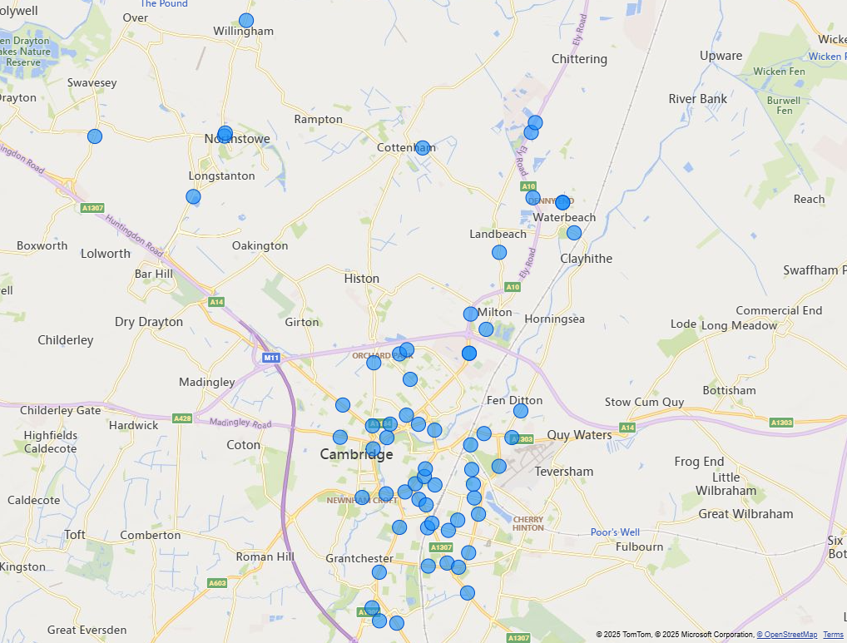
Local Road Network Monitoring Sites
Vivacity Monitoring Sites – Greater Cambridge:
A network of VivaCity sensors is being used to monitor traffic flows across Cambridgeshire. Data from the Greater Cambridge VivaCity sensors (shown on the map) has been used to inform the local road network daily flow analysis presented in this slide pack.
Some sensors have been collecting data for a number of years whilst others are relatively new so the sensors selected to inform each table and chart is based on data availability. For example, relatively few sensors have comparable data stretching back to 2019 so many sensors are excluded from comparisons against 2019.
A list of the sensors included for each piece of analysis is provided in the notes beneath each slide. To access the notes, please view this slide deck in full screen mode by clicking the ‘open in new window’ button (bottom-right) and then click the ‘Notes’ button (bottom-right).
Data from all of the VivaCity sensors across Cambridgeshire can be viewed using the Traffic Flows Dashboard. The locations of all traffic monitoring sites be viewed on the Traffic Count Sites map.
Notes:
Source: Cambridge Vivacity sensors
Technical note: This analysis has excluded sensors which may compromise the validity of historic comparisons when figures for all sites are combined. For example, some sites may have data gaps, road closures or events impacting data within the comparison period.

Slide 22
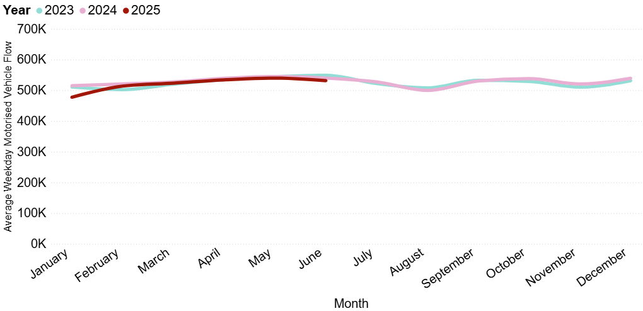
Local Road Network: Motorised Vehicles
In June 2025, local motorised flows were 15% below pre-COVID levels (June 2019) and 1% below this time last year (June 2024).
Average weekday vehicular flow (sum of average flow from 44 sensors in Greater Cambridge).
Pre-COVID* to Now:
June 2019 to June 2025
Mon-Sun | Weekdays (Mon-Thu) | Weekends (Sat-Sun)
-15% | -18% | -8%
2023 to Now:
June 2023 to June 2025
Mon-Sun | Weekdays (Mon-Thu) | Weekends (Sat-Sun)
-3% | -3% | -1%
Previous year to Now:
June 2024 to June 2025
Mon-Sun | Weekdays (Mon-Thu) | Weekends (Sat-Sun)
-1% | -2% | No change
*13 sensors are used to calculate these figures - see the slide notes for the full list of locations. Data from all VivaCity sensors across Cambridgeshire can now be viewed in the Traffic Flows Dashboard.
Notes:
Source: Cambridge Vivacity sensors
Technical Notes: 'Non-neutral days' are not included within the calculations.
This chart shows the average volume of motor vehicles counted per weekday for each month/year. We have altered this from previous versions of this slide pack to begin in 2023. This is to enable fuller geographical coverage of Greater Cambridge when comparing motorised traffic flows over time.
There are still 13 sites which provide comparable motorised data in both June 2019 and June 2025; those are listed below; and the comparison between them is shown in the ‘Pre-COVID to now’ table.
The table presents full week and weekend changes against various historic benchmarks to give an indication of how traffic flows are changing.
The comparison figures in the ‘Previous year to Now’ table is generated from data collected at 44 monitoring sites, which are listed below.
Improved data cleaning processes are being developed to improve the omission of any poor quality / non-comparable data.
Commentary:
Motorised traffic flows in 2025 so far are slightly below those observed in 2023 and 2024.
In June 2025, motorised flows are 1% lower than June 2024 overall; albeit with a larger drop in weekdays (-2%) than at weekends (no change).
Motorised flows in June 2025 are 15% below pre-Covid (June 2019). Please note in the site groups list below that this metric is compiled from a different selection of sites to the line chart and the other two year-on-year comparisons.
Sites used to generate line chart, and ‘Previous Year to Now’ summary table:
A10 (South of Milton PnR), A10 Ely Road (North of Cambridge Research Park), Arbury Road (just north of Campkin Rd), B1050 Earith Road (north of Willingham), B1050 Hatton's Road (South of Longstanton), Barnwell Road, Beach Road, Boxworth End (south of Rose and Crown Rd), Cambridge Road, Cherry Hinton Road, Chesterton Road (East), Chesterton Road (West), Denny End Road, Ditton Lane (just south of Fen Ditton High St), East Road, Elizabeth Way Bridge, Fen Causeway River Bridge, Gonville Place, Hauxton Road (just north of Trumpington PnR), Hills Road (North), just north of Norwich St, Hills Road Bridge, Hills Road, near Holbrook Road, Huntingdon Road (just west of Storey's Way), King's Hedges Road (just west of Northfield Av), Lensfield Road, Long Road (just west of Sedley Taylor Road), Madingley Road (just east of West Cambridge Site), Mill Road (West), Milton Road SB (left into Cowley Park), Milton Road SB (north of Cowley Rd, ahead into city), Milton Road SB (north of Cowley Rd, all), Newmarket Road (just east of Ditton Lane), Newmarket Road (just west of Ditton Lane), Pathfinder Way (near The Green), Perne Road, Queens Road, Shelford Road, Station Road, Waterbeach, Stirling Road (near The Green), Tenison Road, Trumpington High Street, Trumpington Road, Victoria Road, Vinery Road.
Sites used to generate ‘Pre-COVID to Now’ summary table:
Cherry Hinton Road, Coldham's Lane, Coleridge Road, East Road, Hills Road Bridge, Mill Road (East), Mill Road (West), Milton Road (Mid), Newmarket Road (just west of Ditton Lane), Perne Road, Station Road, Cambridge, Tenison Road, Vinery Road.

Slide 23
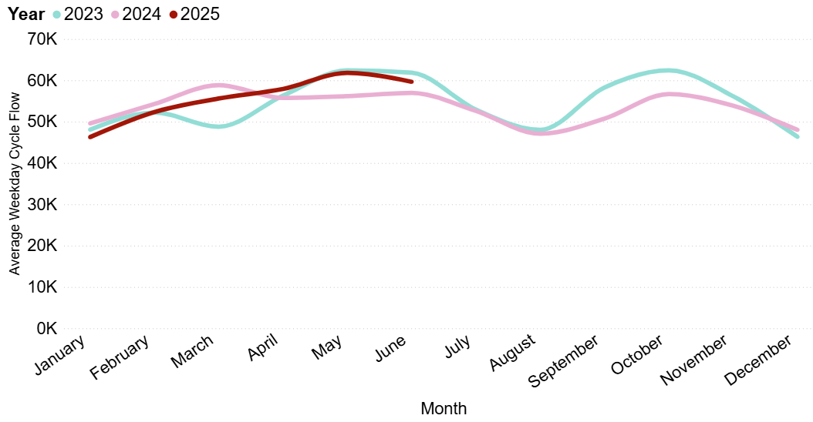
Local Road Network: Cyclists
In June 2025, cycling volumes were 7% below June 2023 volumes, but 4% ahead of this time last year (June 2024).
Average weekday cycle flow (sum of average flow from 47 sensors in Greater Cambridge).
Pre-COVID* to Now:
June 2019 to June 2025
Mon-Sun | Weekdays (Mon-Thu) | Weekends (Sat-Sun)
-2% | -2% | +1%
2023 to Now:
June 2023 to June 2025
Mon-Sun | Weekdays (Mon-Thu) | Weekends (Sat-Sun)
-7% | -4% | -13%
Previous year to Now:
June 2024 to June 2025
Mon-Sun | Weekdays (Mon-Thu) | Weekends (Sat-Sun)
+4% | +5% | +2%
*Only data from Tenison Road is used to calculate the pre-COVID comparison due to limited data availability. Data from all VivaCity sensors across Cambridgeshire can now be viewed in the Traffic Flows Dashboard.
Notes:
Source: Cambridge Vivacity sensors
Technical note: Bank holiday weeks are not included within the calculations. School holidays are also excluded (except summer holidays in order to obtain figures for August).
This chart shows the average volume of bicycles counted per weekday for each month/year. We have altered this from previous versions of this slide pack to begin in 2023. This is to enable fuller geographical coverage of Greater Cambridge when comparing bicycle flows over time.
Tenison Road only has been used to generate the metrics in the ‘Pre-COVID to Now’ table. This is the only remaining site with comparable data for active modes across this time span.
The table presents full week and weekend changes against various historic benchmarks to give an indication of how cycle flows are changing.
The comparison figures in the other tables are generated from data collected at 47 monitoring sites, which are listed below.
Improved data cleaning processes are being developed to improve the omission of any poor quality / non-comparable data.
Commentary:
Cycle flows in 2025 have gradually improved through the year – in January and February, 2025 volumes were lower than 2023 and 2024. Since April, 2025 cycling volumes have been ahead of 2024 levels – and broadly similar to 2023.
In June 2025, cycling volumes are 4% ahead of those seen in June 2024. Weekdays are 5% above last year, whereas weekend cycle flows are 2% ahead of last year.
March 2025 shows cycling volumes which are 7% below June 2023 overall; with weekdays 4% below 2023, and weekends 13% below.
Sites used to generate chart:
Arbury Road (just north of Campkin Rd), B1050 Earith Road (north of Willingham), B1050 Hatton's Road (South of Longstanton), Barnwell Road, Beach Road, Boxworth End (south of Rose and Crown Rd), Cambridge Road, Cherry Hinton Road, Chesterton Road (East), Chesterton Road (West), Coldham's Common (Chisholm Trail), Coldham's Common (Eastern Access near Barnwell Road), Denny End Road, Ditton Lane (just south of Fen Ditton High St), East Road, Elizabeth Way Bridge, Fen Causeway River Bridge, Gonville Place, Guided Busway (Orchard Park), Hauxton Road (just north of Trumpington PnR), High Street, Hills Road (North), just north of Norwich St, Hills Road Bridge, Hills Road, near Holbrook Road, Huntingdon Road (just west of Storey's Way), King's Hedges Road (just west of Northfield Av), Lensfield Road, Long Road (just west of Sedley Taylor Road), Madingley Road (just east of West Cambridge Site), Mill Road (East), Mill Road (West), Milton Road SB (north of Cowley Rd, all), Mowbray Road, Newmarket Road (just east of Ditton Lane), Newmarket Road (just west of Ditton Lane), Pathfinder Way (near The Green), Perne Road, Queen Edith's Way, Shelford Road, Station Road, Waterbeach, Stirling Road (near The Green), Tenison Road, Trumpington High Street, Trumpington Road, Victoria Road, Vinery Road, Waterbeach Barracks Access (via Denny End Road).

Slide 24
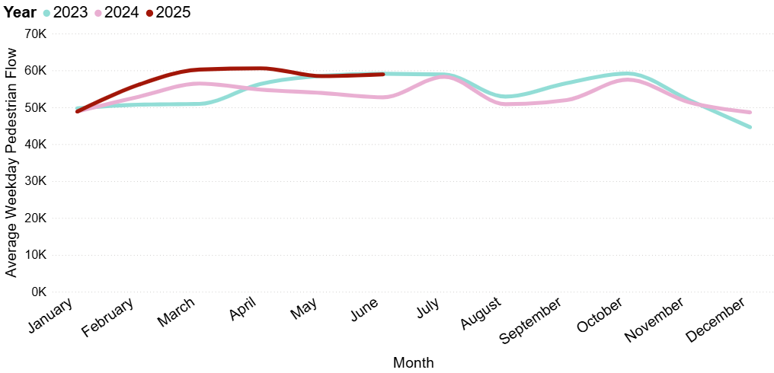
Local Road Network: Pedestrians
In June 2025, pedestrian volumes were 2% below June 2023 volumes. Pedestrian flows showed an 8% increase on this time last year (June 2024), with a divergence in trends between weekdays (+12%) and weekends (no change).
Average weekday pedestrian flow (sum of averages taken from 47 sensors in Greater Cambridge).
Pre-COVID* to Now:
June 2019 to June 2025
Mon-Sun | Weekdays (Mon-Thu) | Weekends (Sat-Sun)
+10% | +10% | +12%
2023 to Now:
June 2023 to June 2025
Mon-Sun | Weekdays (Mon-Thu) | Weekends (Sat-Sun)
-2% | No change | -8%
Previous year to Now:
June 2024 to June 2025
Mon-Sun | Weekdays (Mon-Thu) | Weekends (Sat-Sun)
+8% | +12% | No change
*Only data from Tenison Road is used to calculate the pre-COVID comparison due to limited data availability. Data from all VivaCity sensors across Cambridgeshire can now be viewed in the Traffic Flows Dashboard.
Notes:
Source: Cambridge Vivacity sensors
Technical note: Bank holiday weeks are not included within the calculations. School holidays are also excluded (except summer holidays in order to obtain figures for August).
This chart shows the average volume of pedestrians counted per weekday for each month/year. We have altered this from previous versions of this slide pack to begin in 2023. This is to enable fuller geographical coverage of Greater Cambridge when comparing pedestrian flows over time.
Tenison Road only has been used to generate the metrics in the ‘Pre-COVID to Now’ table. This is the only remaining site with comparable data for active modes across this time span.
The table presents full week and weekend changes against various historic benchmarks to give an indication of how pedestrian flows are changing.
The comparison figures in the other tables are generated from data collected at 47 monitoring sites, which are listed below.
Improved data cleaning processes are being developed to improve the omission of any poor quality / non-comparable data.
Commentary:
Pedestrian flows in 2025 so far are generally ahead of 2024 – and very similar to 2023.
In June 2025, pedestrian volumes are 8% ahead of this time last year. This is entirely due to a weekday increase (+12%). Weekend pedestrian volumes show almost no change with last year.
June 2025 shows a 2% decrease on 2023 volumes. This is entirely due to a decrease in weekend pedestrian traffic (-8%). Weekdays show almost no change with 2023.
Sites used to generate chart:
Arbury Road (just north of Campkin Rd), B1050 Earith Road (north of Willingham), B1050 Hatton's Road (South of Longstanton), Barnwell Road, Beach Road, Boxworth End (south of Rose and Crown Rd), Cambridge Road, Cherry Hinton Road, Chesterton Road (East), Chesterton Road (West), Coldham's Common (Chisholm Trail), Coldham's Common (Eastern Access near Barnwell Road), Denny End Road, Ditton Lane (just south of Fen Ditton High St), East Road, Elizabeth Way Bridge, Fen Causeway River Bridge, Gonville Place, Guided Busway (Orchard Park), Hauxton Road (just north of Trumpington PnR), High Street, Hills Road (North), just north of Norwich St, Hills Road Bridge, Hills Road, near Holbrook Road, Huntingdon Road (just west of Storey's Way), King's Hedges Road (just west of Northfield Av), Lensfield Road, Long Road (just west of Sedley Taylor Road), Madingley Road (just east of West Cambridge Site), Mill Road (East), Mill Road (West), Milton Road SB (north of Cowley Rd, all), Mowbray Road, Newmarket Road (just east of Ditton Lane), Newmarket Road (just west of Ditton Lane), Pathfinder Way (near The Green), Perne Road, Queen Edith's Way, Shelford Road, Station Road, Waterbeach, Stirling Road (near The Green), Tenison Road, Trumpington High Street, Trumpington Road, Victoria Road, Vinery Road, Waterbeach Barracks Access (via Denny End Road).

Slide 25
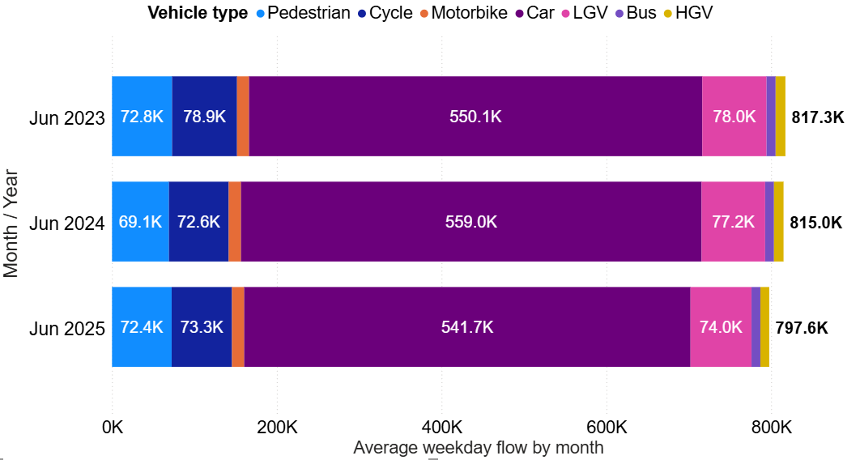
Local Road Network: Vehicle Split
Typical weekday flows in June 2025 were lower than those observed in the last two years (2023 and 2024). The vehicle mode split has remained stable.
Average weekday flow (data from 62 sensors across Greater Cambridge)
Active Travel* proportion by year
Year | Active %​
June 2023 | 19%
June 2024 | 18%
June 2025 | 19%
June 2025 Top 5 Active Travel Roads (%)
Location​ | Active %​
Kingston Street (South) | 95%
Devonshire Road (North) | 83%
Hope Street (near Mill Road) | 72%
Sidgwick Avenue (3 sites) | 71%
Hills Road (nr Norwich St) | 62%
June 2025 Bottom 5 Active Travel Roads (%)
Location​ | Active %​
Addenbrooke’s Rd, Trumpington | 1%
Ditton Lane, Fen Ditton. | 1%
B1050 (Hatton’s Road) | 0%
A10 (all 3 sites) | 0%
Milton Road (near Cowley Rd) | 0%
*Active Travel includes cyclists and pedestrians.
Data from all VivaCity sensors across Cambridgeshire can now be viewed in the Traffic Flows Dashboard.
Notes:
Source: Cambridge Vivacity sensors
Technical Notes:
'Non-neutral' days are not included within average weekday flow calculations.
Fridays are not counted as a weekday. Traffic flows on all other days are counted and used to calculate a typical 'average' traffic flow within central Cambridge on a weekday.
We have selected the most recent month of data (June 2025) and compared it to appropriate periods to show how traffic flows have evolved since these sensors were installed or had their software upgraded.
Previous iterations of this slide pack presented this data going back to 2019 – however, a large proportion of sensors had software upgrades, which meant they had to be removed from the overall comparison.
By September 2024, only two sensors remained with comparable data back to 2019, so we have re-based at 2023.
Commentary
June 2025 data presents with a typical weekday flow of just under 800k - which is a little behind the typical flows for this point last year and 2023, which were both above 815k.
Overall, the proportionate split in travel modes has not changed a huge amount between the three months selected - cars are the dominant mode of transport across Greater Cambridge.
Active modes' share of total flow has remained consistent year-to-year. 19% of total flow on a typical day in June 2025 is made using active modes of travel – which is just slightly ahead of June 2024 (18%) and around the same proportion as June 2023 (19%).
Sites used to generate chart:
A10 (North of Denny End Road), A10 (South of Milton PnR), A10 Ely Road (North of Cambridge Research Park), Addenbrooke's Road, Arbury Road (just north of Campkin Rd), B1050 Earith Road (north of Willingham), B1050 Hatton's Road (South of Longstanton), Babraham (south of Addenbrooke's Hospital), Barnwell Road, Barton Road (just east of Grange Rd), Beach Road, Boxworth End (south of Rose and Crown Rd), Cambridge Road, Cherry Hinton Road, Chesterton Road (East), Chesterton Road (West), Coldham's Common (Chisholm Trail), Coldham's Lane, Coleridge Road, Denny End Road, Ditton Lane (just south of Fen Ditton High St), East Road, Elizabeth Way Bridge, Fen Causeway River Bridge, Gilbert Road, Gonville Place, Guided Busway (Orchard Park), Guided Busway (south of Hills Road Bridge), Hauxton Road (just north of Trumpington PnR), High Street, Hills Road (North), just north of Norwich St, Hills Road Bridge, Hills Road, near Holbrook Road, Histon Road (North), Histon Road (South), Huntingdon Road (just west of Storey's Way), King's Hedges Road (just west of Northfield Av), Lensfield Road, Long Road (just west of Sedley Taylor Road), Madingley Road (just east of West Cambridge Site), Mill Road (East), Mill Road (West), Milton Road SB (north of Cowley Rd, ahead into city), Milton Road SB (north of Cowley Rd, all), Mowbray Road, Newmarket Road (just east of Ditton Lane), Newmarket Road (just west of Ditton Lane), Pathfinder Way (near The Green), Perne Road, Queen Edith's Way, Queens Road, Shelford Road, Station Road, Cambridge, Station Road, Waterbeach, Stirling Road (near The Green), Tenison Road, Trumpington High Street, Trumpington Road, Victoria Road, Vinery Road, Waterbeach Access (opposite Cambridge Research Park), Waterbeach Barracks Access (via Denny End Road).

Slide 26
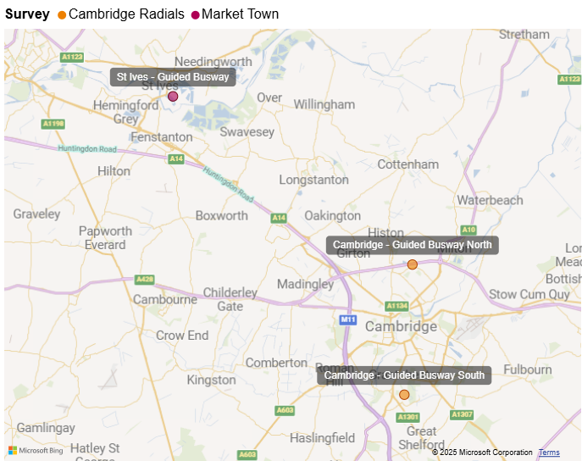
Cambridgeshire Guided Busway – Active Travel
Cambridgeshire Autumn Survey Sites – Busway Utilisation Monitoring
The Cambridgeshire Guided Busway provides a popular walking and cycling route from St Ives to north Cambridge and within northern and southern Cambridge.
Using Cambridgeshire County Council’s annual traffic survey data, active flows on the busway have been monitored over time at 3 locations:
St Ives Guided Busway – just south-east of the St Ives Park & Ride complex.
Cambridge Guided Busway North – just south of the A14 underpass.
Cambridge Guided Busway South – just north of Trumpington Park Primary School.
Data from 2017 onwards can be seen on the next slide.
Notes:
Source: VivaCity

Slide 27
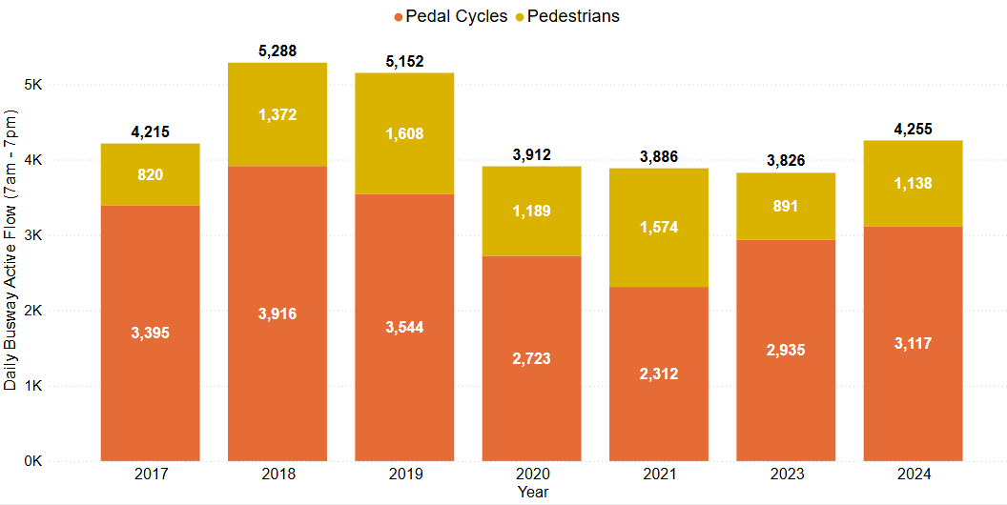
Cambridgeshire Guided Busway – Active Travel
Autumn 2024 Annual Traffic Survey results showed that total active travel trips along the Guided Busway service path are 17% below pre-COVID (2019) levels; but are 11% ahead of last year (2023). Cycle volumes (-12%) are closer to pre-COVID levels than pedestrian volumes (-29%).
Active flows on the Guided Busway
(12-hour flow data from CCC Annual Traffic Surveys)
Cycle Flow Change (%)
Pre-COVID to Now:
2023 to Now:
-12%
+6%
Pedestrian Flow Change (%)
Pre-COVID to Now:
2023 to Now:
-29%
+28%
Total Active Flow Change (%)
Pre-COVID to Now:
2023 to Now:
-17%
+11%
Source: CCC Annual Traffic Surveys. Sum of 3 locations on the guided busway: 1. St Ives; 2. Cambridge – A14 Underpass; 3. Trumpington.
The Annual Traffic Surveys Dashboard provides access to the wider dataset. Note: data is not available for 2022.
Notes:
Source: Cambridge Annual traffic surveys

Slide 28
Local Road Network:
Hourly Flows

Slide 29
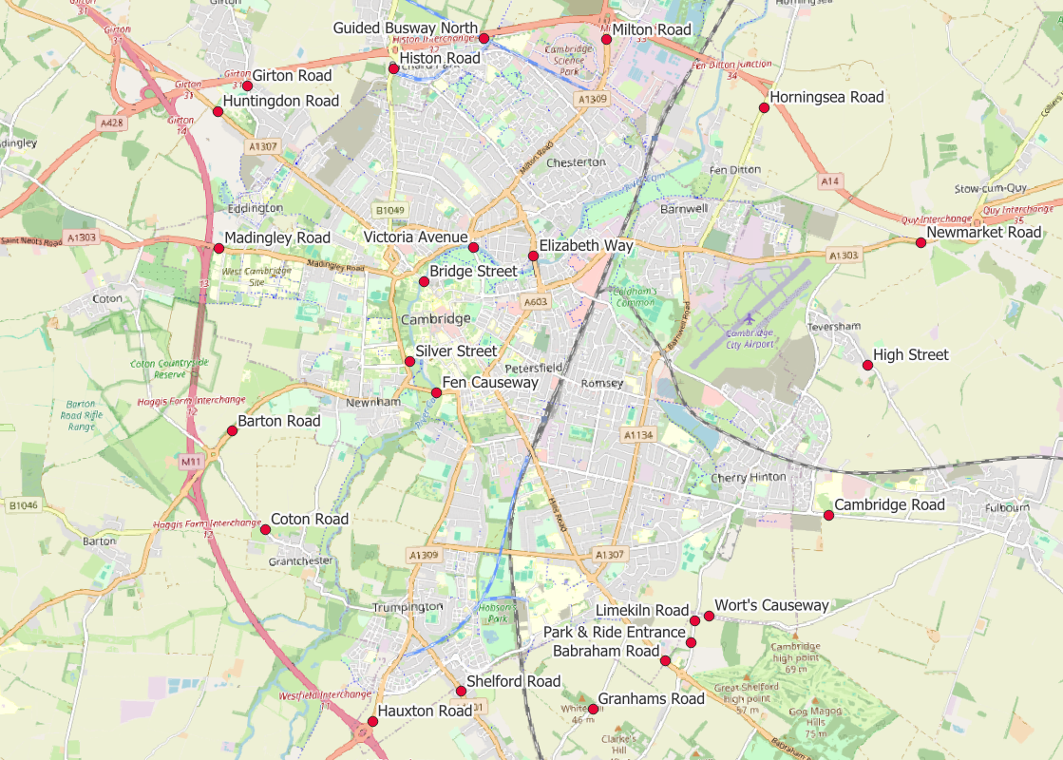
Local Road Network: Motorised Vehicle - Annual Survey Sites
Cambridgeshire Annual Traffic Survey Sites
Annual Survey Sites
Elizabeth Way
Victoria Avenue​​
Bridge Street
Silver Street
Fen Causeway​​
Histon Road
Milton Road
Horningsea Road
Newmarket Road
High Street (Teversham)
Cambridge Road (Fulbourn)
Worts Causeway
Limekiln Road
Babraham Road
Granhams Road
Shelford Road
Hauxton Road
Coton Road
Barton Road
Madingley Road
Huntingdon Road
Girton Road
Guided Busway (North)
Babraham P&R Entrance
Cambridgeshire County Council commissions annual traffic surveys to determine traffic levels around the county on a “typical” weekday.
The sites shown on this map are those in and around Cambridge at which CCC has collected motorised traffic flows consistently over several years.
Analysis of motorised traffic counts from these sites is presented on the following slide.
© OpenStreetMap Contributors
Data from the Annual Traffic Survey sites across Cambridgeshire can now be viewed in the Annual Traffic Surveys Dashboard

Slide 30
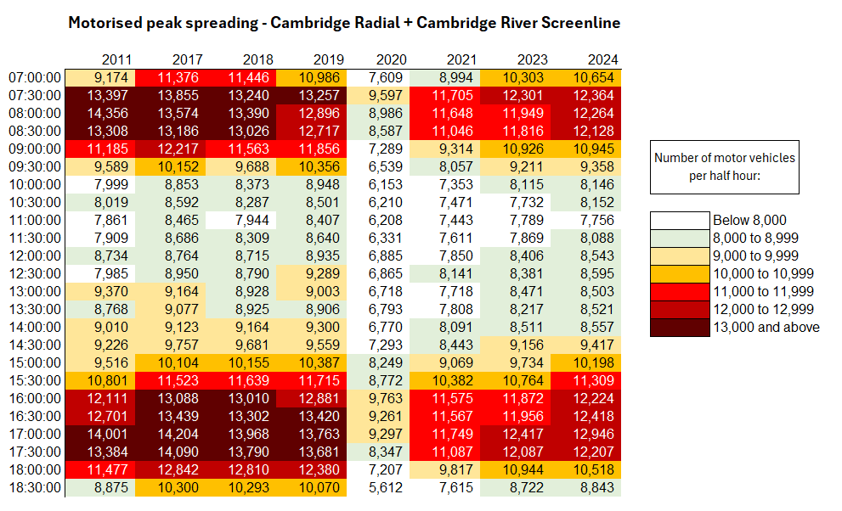
Local Road Network: Motorised Vehicle - Peak Spreading
Daily patterns of motorised traffic are starting to resemble the profiles seen pre-COVID (2017-2019), with morning and afternoon peak periods beginning to widen again, albeit still with lower overall volumes (consistently just over 12,000 motorised trips per half-hour compared to just over 13,000 pre-Covid).
Half hour beginning
Note: 2022 excluded due to lack of reliable data. 2025 surveys for motorised peak spreading not yet conducted.
Notes:
Source: Cambridgeshire Annual Traffic Surveys – Cambridge Radial and Cambridge Screenline . Survey data in 2022 was returned to CCC incomplete, therefore 2022 is excluded as it cannot be presented in comparison to other years.
Technical Note: These figures use the annual traffic survey data from sites in the annual Cambridge Screenline and the Cambridge Radial surveys (only sites which have been consistent across all years). The survey days used in this analysis have been chosen to most closely represent a “typical” day for traffic flows (i.e. avoiding bank holidays, weeks with strike action, other special circumstances which can affect traffic volumes).

Slide 31
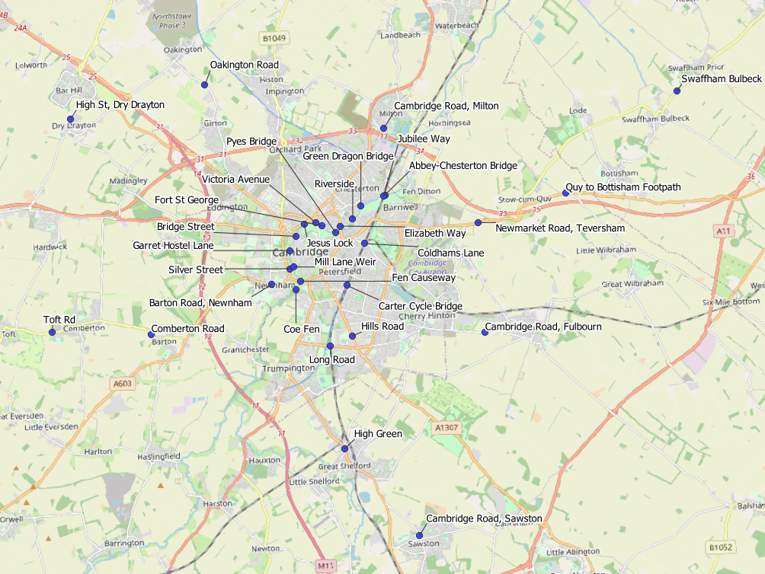
Local Road Network: Active Travel Annual Survey Sites
Cambridgeshire Annual Traffic Survey Sites – River Screenline and Cycle Routes
Sensor Location​​
Elizabeth Way
Victoria Avenue​​
Bridge Street
Silver Street
Fen Causeway​​
Green Dragon Bridge​​
Pye’s Bridge
Fort St George​​
Jesus Lock​​
Garrett Hostel Lane​​
Mill Lane Weir
Coe Fen​
Riverside
Abbey-Chesterton Bridge
Barton Road, Newnham
Cambridge Road, Fulbourn
Cambridge Road, Milton
Cambridge Road, Sawston
Carter Cycle Bridge
Coldhams Lane
Comberton Road
High Green, Great Shelford
High Street, Dry Drayton
Hills Road
Jubilee Way
Long Road
Newmarket Road, Teversham
Oakington Road
Swaffham Bulbeck footpath
Toft Road, Comberton
Quy to Bottisham Footpath
Cambridgeshire County Council commissions annual traffic surveys to determine traffic levels around the county on a “typical” weekday.
The sites shown on this map are active travel routes in and around Cambridge at which CCC has collected active travel flows consistently over several years.
Analysis of active travel counts from these sites is presented on the following slide.
© OpenStreetMap Contributors
Data from the Annual Traffic Survey sites across Cambridgeshire can now be viewed in the Annual Traffic Surveys Dashboard

Slide 32
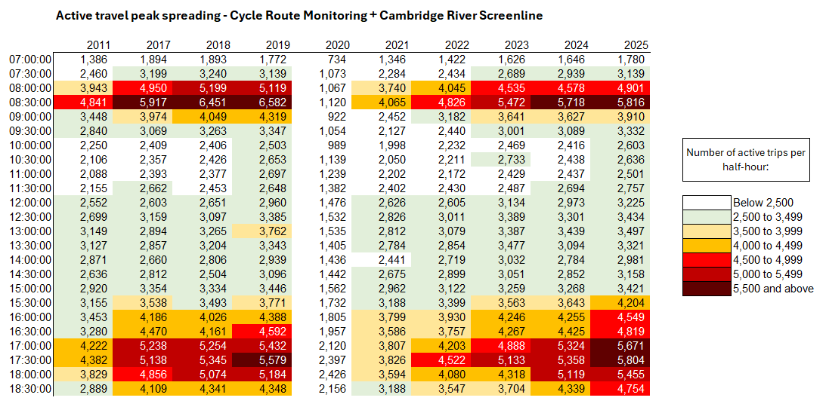
Local Road Network: Active Travel Peak Spreading
Morning peak flows remain below pre-COVID levels with the highest volumes between 08:30 and 09:00. Evening peak flows have now exceeded pre-COVID levels with the highest volumes between 17:00 and 18:00.
Half hour beginning
Note: E-scooters were included in these surveys from 2022 onwards, therefore count towards ‘active travel’ in more recent years.
Notes:
Source: Cambridge Spring Census – Screenline & Cycle Route Monitoring.
Data Note: In previous versions of this slide pack, totals from both survey days of the Cambridge River Screenline have been included. More recent analysis has only included neutral days to avoid any skewing affect from non-neutral days. Where sites have 2 neutral days of data, the two flows are averaged. Where sites only have 1 neutral day of data, the neutral data is retained and the non-neutral data excluded.
Technical Note: These figures use the annual traffic survey data from the annual Cambridge Screenline and the Cycle Route Monitoring surveys. The survey days used in this analysis have been chosen to most closely represent a “typical” day for traffic flows (i.e. avoiding bank holidays, weeks with strike action, other special circumstances which can affect traffic volumes).
As active travel can be quite variable due to weather conditions, caution is advised using these figures as they are taken from daily surveys rather than calculated over longer periods of time. They are intended to provide a rough indication of trends over time.

Slide 33
Retail Footfall

Slide 34
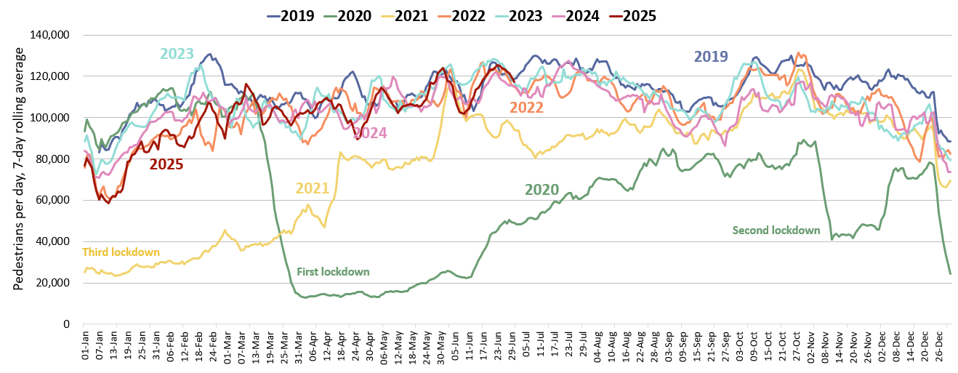
Retail Footfall: Central Cambridge
In June 2025, footfall in central Cambridge was 2% below pre-COVID levels (June 2019) and is 1% above this time last year (June 2024).
Average daily pedestrian footfall: Central Cambridge
Pre-COVID to Now:
June 2019 to June 2025
Mon-Sun | Weekdays (Mon-Thu) | Weekends (Sat-Sun)
-2% | 0% | -2%
2023 to Now:
June 2023 to June 2025
Mon-Sun | Weekdays (Mon-Thu) | Weekends (Sat-Sun)
-4% | -5% | -6%
Previous year to Now:
June 2024 to June 2025
Mon-Sun | Weekdays (Mon-Thu) | Weekends (Sat-Sun)
+1% | +1% | -0%
This analysis is based on data from 6 locations in Cambridge: Bridge Street, Fitzroy Street, Market Hill, Rose Crescent, Regent Street and Sidney Street.
Notes:
Source: Cambridge BID footfall data.
Technical note: Data from the following locations: Bridge Street, Fitzroy Street at Waitrose, Market Hill, Regent Street, Rose Crescent, Sidney Street. Excludes data for King’s Parade and One Station Square. As outlined at the start of this slide pack, 'weekdays' do not include Fridays. Table calculations do not include bank holidays, school holidays or any other "non neutral" days. The percentage changes are designed to reflect change on a "typical" day.
Commentary:
June foot traffic in central Cambridge is 2% below the pre-COVID level of June 2019 and is 1% above what we saw in June 2024.
Weekday (Mon-Thu) footfall is the same as pre-COVID levels, but weekend footfall is 2% below pre-COVID levels.
Weekday (Mon-Thu) foot traffic is 5% below June 2023. Weekend (Sat-Sun) footfall saw a 6% decrease compared to June 2023.

Slide 35
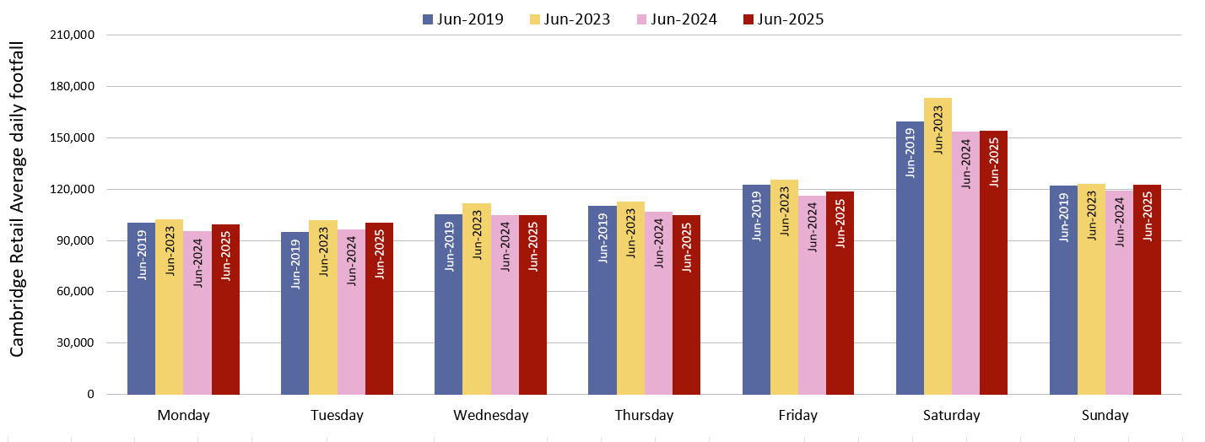
Retail Footfall: Central Cambridge by Day of the Week
In June 2025, retail footfall was slightly below pre-COVID levels (June 2019) on most days of the week
Thursday is the least recovered day (-5%) whilst Tuesday is the most recovered compared to pre-COVID levels (+6%).
Average daily pedestrian footfall: Central Cambridge
Pre-COVID to Now: June 2019 to June 2025
Monday | Tuesday | Wednesday | Thursday | Friday | Saturday | Sunday
-1% | +6% | -0% | -5% | -3% | -3% | +1%
This analysis is based on data from 6 locations: Bridge Street, Fitzroy Street, Market Hill, Rose Crescent, Regent Street and Sidney Street.
Notes:
Source: Cambridge BID footfall data.
Technical note: Data from the following locations: Bridge Street, Fitzroy Street at Waitrose, Market Hill, Regent Street, Rose Crescent, Sidney Street. Excludes data for King’s Parade and One Station Square. Table calculations do not include bank holidays, school holidays or any other "non neutral" days. The percentage changes are designed to reflect change on a "typical" day.
Commentary: Most days of the week show a negative change to pre-COVID (June 2019) levels. The largest negative change was a decrease of 5% on Thursday.
Tuesday footfall figures were most recovered compared to June 2019, with a 6% increase.
Wednesday and Thursday are the only days of the week which present lower footfall volumes than this time last year (June 2024).

Slide 36
Car Parking

Slide 37
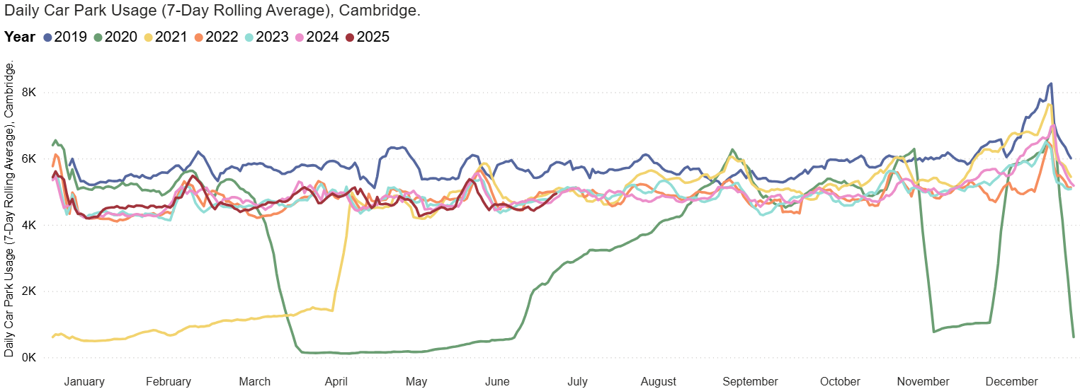
Car Parking: Daily Use
Cambridge multi-storey car park use in June 2025 was 20% below pre-COVID levels and has remained relatively stable over the last 2 years.
Queen Anne Terrace usage is the furthest ahead of pre-COVID (+6%), whilst Park Street usage (having recently re-opened) is furthest below pre-COVID (-52%).
Multi-storey car park usage, Cambridge
Park St car park closed for redevelopment (Jan 2022)
Park St car park re-opened (Nov 2024)
Pre-COVID to Now:
June 2019 to June 2025
Mon-Sun | Weekdays (Mon-Thu) | Weekends (Sat-Sun)
-20% | -21% | -17%
2023 to Now:
June 2023 to June 2025
Mon-Sun | Weekdays (Mon-Thu) | Weekends (Sat-Sun)
0% | -3% | 2%
Previous year to Now:
June 2024 to June 2025
Mon-Sun | Weekdays (Mon-Thu) | Weekends (Sat-Sun)
-1% | -2% | -2%
This analysis is based on data from 5 car parks in Cambridge: Grafton East, Grafton West, Grand Arcade, Park Street and Queen Anne Terrace. Park Street car park closed in Jan 2022 and re-opened in Nov 2024 - usage figures for Park Street are included on this chart so that the impact of its closure and re-opening can be seen.
Notes:
Source: Cambridge City Council Car Parking data
Technical notes: Table calculations do not include bank holidays, school holidays, or any other "non neutral" days. The percentage changes are designed to reflect change on a "typical" day. As outlined at the start of this slide pack, 'weekdays' do not include Fridays.
Park Street Car Park re-opened in late November 2024.
Commentary:
Multi-storey car park usage in central Cambridge is 20% below the pre-Covid level of June 2019.
The figures for June 2025 show very little change compared to last year (June 2024). Monday to Thursday figures are 2% below last year, there is also a 2% decrease in Weekend usage.
Generally, the line for 2025 has tracked very similarly to that of 2024 – fluctuating between being slightly above and slightly below the 2024 line at various points in the year.
Additionally, an increased charge for car parks was introduced in February 2023 and may be having an impact on usage.

Slide 38
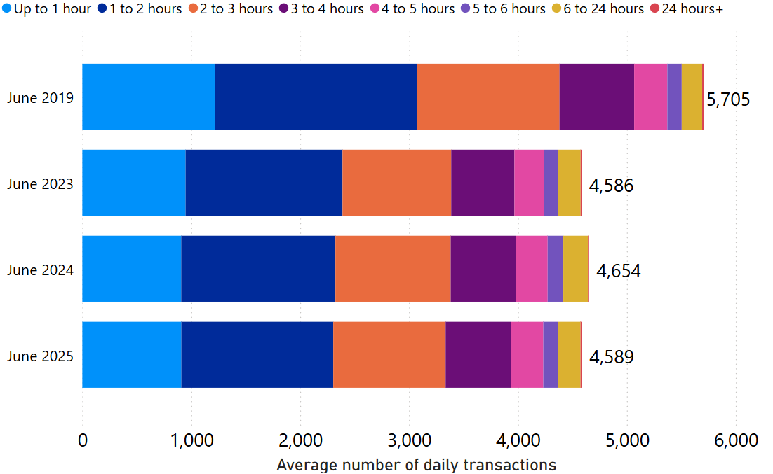
Car Parking: Length of Stay by Month
June 2025 average daily usage of multi-storey car parks is 20% lower than pre-COVID, and 1% lower than last year.
The split by length-of-stay has stayed fairly consistent over time.
Multi-storey car park average daily usage by month, split by length of stay
This analysis sums data from 5 multi-storey car parks in Cambridge: Grafton East, Grafton West, Grand Arcade, Park Street and Queen Anne Terrace. Park Street car park was closed from Jan 2022 and re-opened in late Nov 2024 - usage figures for Park Street are included on this chart so that the impact of its closure and re-opening can be seen.
Notes:
Source: Cambridge City Council Car Parking data
Technical notes: School holidays, bank holidays and any other "non neutral" days are not included in calculations for this chart.
Commentary:
The proportionate split in length of stay in Cambridge's multi-storey car parks is relatively consistent across the four months shown within the chart.
The chart indicates that June 2025 usage is similar to 2024, but overall volumes are still below that which was seen in 2019.
Caveats with this chart are that Park Street Car park closed in January 2022, and a new car park charge was introduced in February 2023.
Park Street Car Park re-opened in late November 2024.

Slide 39
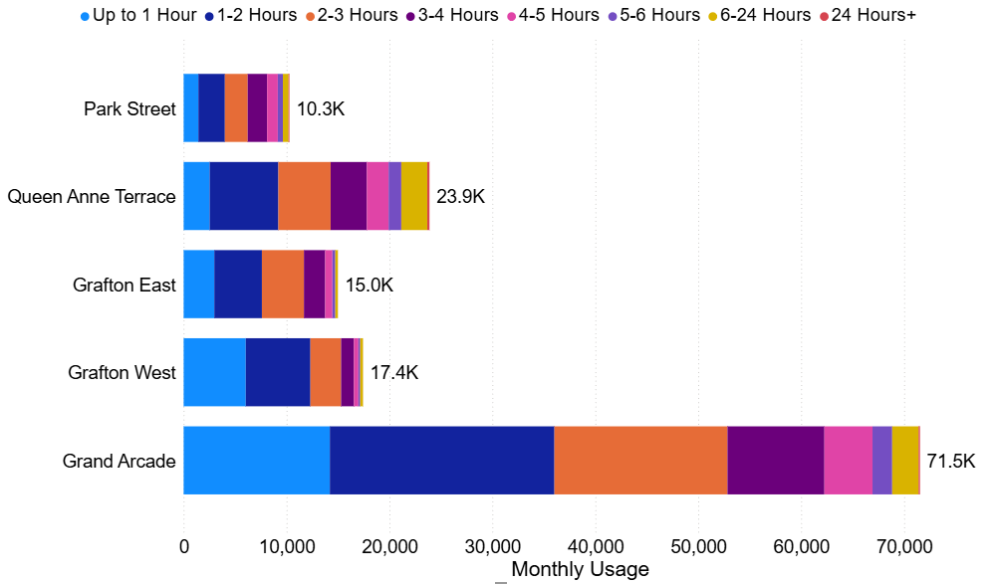
Car Parking: Length of Stay by Car Park
In June 2025, Grafton West had the highest proportion of stays under 3 hours (88%) whilst Queen Anne Terrace had the lowest proportion (60%).
Grand Arcade continues to be comfortably the most popular car park despite having a similar number of spaces as Grafton East.
Multi-storey car park usage by site and length of stay (June 2025)
222 spaces
222 spaces
572 spaces
888 spaces
286 spaces
951 spaces
Notes:
Source: Cambridge City Council Car Parking data
Commentary:
88% of June 2025 visits to Grafton West lasted less than three hours – making it the most likely facility to be used for short stays.
Queen Anne Terrace is the facility with the highest proportion of long stays, with 40% of June 2025 visits lasting more than three hours.
Grand Arcade is comfortably the most popular multi storey car park facility in Cambridge – with just over 70,000 patrons in June.

Slide 40
Rail Passengers

Slide 41
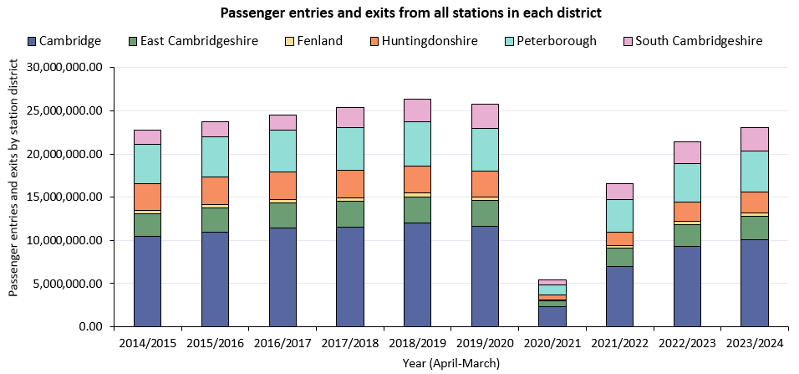
Rail Passengers: Usage
Local station entries and exits are below pre-COVID levels (2018/19) in most districts. South Cambridgeshire is the only district exceeding pre-COVID (+5%), driven by a 56% increase at Cambridge North (the fastest growing station in Cambridgeshire and Peterborough).
Cambridgeshire (incl Pboro)
Pre-COVID to Now:
2018/19* to 2023/24
-12%
Cambridgeshire (excl Pboro)
Pre-COVID to Now:
2018/19* to 2023/24
-14%
District | Cambridge | East Cambridgeshire | Fenland | Huntingdonshire | Peterborough | South Cambridgeshire
Pre-COVID to Now: 2018/19* to 2023/24 | -16% | -11% | -11% | -24% | -7% | +5%
*2018/19 used as the pre-COVID baseline because 2019/20 data is affected by March 2020 being part of the first COVID-19 lockdown.
Notes:
Source: Rail statistics, ORR. Table 1415a
Technical note: Rail Passenger annual data runs April – March. 2018/19 is used as the pre-COVID baseline as 2019/20 entries and exit data is affected in March 2020 by the first COVID-19 lockdown.

Slide 42
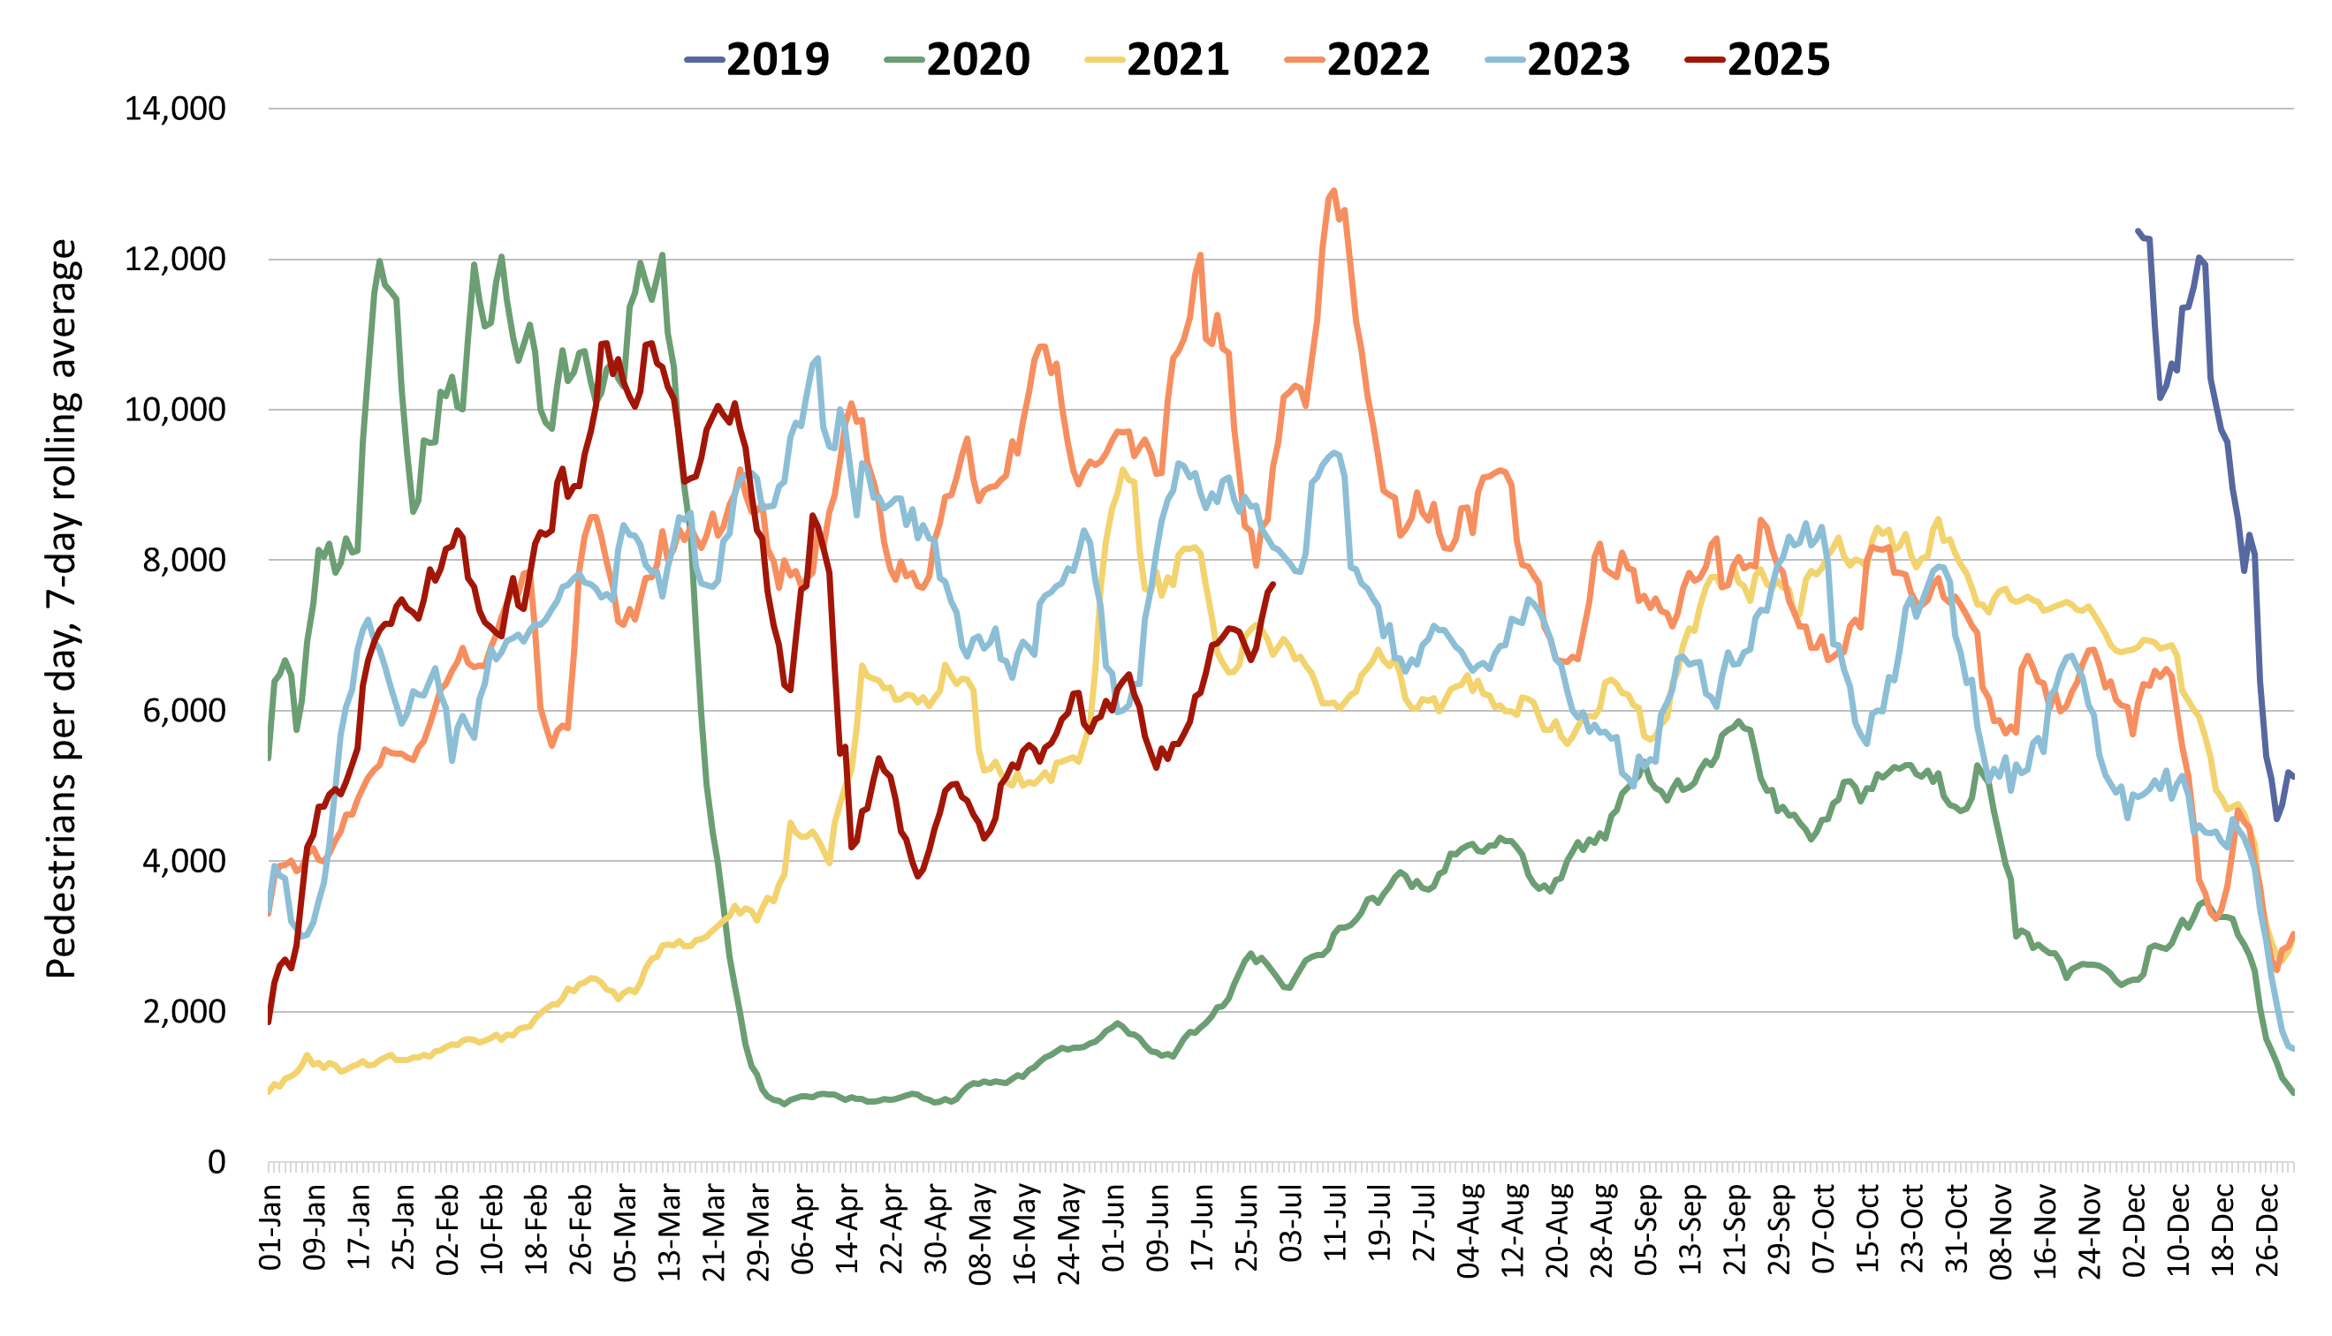
One Station Square Footfall
One Station Square footfall is 38% below pre-COVID levels (February 2020*), with weekends (-21%) much more recovered than weekdays (-43%).
Footfall at One Station Square (outside Cambridge train station)
Note:
Concerns were raised regarding the reliability of the One Station Square footfall data following a sudden drop in April 2024. Cambridge BID confirmed that an issue was repaired in December 2024.
Following those repairs, the 2025 data continues to show large fluctuations. Cambridge BID have therefore been asked to check the reliability of the 2025 data.
Pre-COVID to Now:
Feb 2020* to June 2025
Mon-Sun | Weekdays (Mon-Thu) | Weekends (Sat-Sun)
-38% | -43% | -21%
2023 to Now:
June 2023 to June 2025
Mon-Sun | Weekdays (Mon-Thu) | Weekends (Sat-Sun)
-25% | -21% | -28%
Previous year to Now:
Excluded due to sensor issues in 2024
Mon-Sun | Weekdays (Mon-Thu) | Weekends (Sat-Sun)
*This sensor was installed in December 2019 so pre-COVID data is not available for all months. February 2020 has therefore been used as the baseline for this calculation (pre-lockdown).
Notes:
Source: Cambridge BID footfall data​
Technical note: Table calculations do not include bank holidays, school holidays, or any other "non neutral" days. The One Station Square sensor was fitted in December 2019 so pre-COVID data is not available for all months. For March comparisons, we use the first two weeks of March 2020 (1st – 14^{th)} to ensure impacts of the first lockdown are not included, but we acknowledge the comparison is not ideal. Data may be impacted by strike action. As outlined at the start of this slide pack, 'weekdays' do not include Fridays.
The data collected at One Station Square throughout 2024 appears to be erroneous and has therefore been omitted from this slide. Cambridge Bid have confirmed that this footfall counter was repaired in December 2024. Monitoring of this site resumed in January 2025. The 2025 data continues to show fluctuations. Cambridge BID have been asked to comment on the reliability of the 2025 data.
Commentary: Footfall at One Station Square was 43% below pre-COVID levels (February 2020) on weekdays (Monday to Thursday) and 21% below on weekends (Saturday to Sunday). Compared to June 2023, footfall levels were 25% lower in June 2025. Weekdays saw an 21% decrease compared to June 2023, and weekends saw a 28% decrease.

Slide 43
Bus Passengers

Slide 44
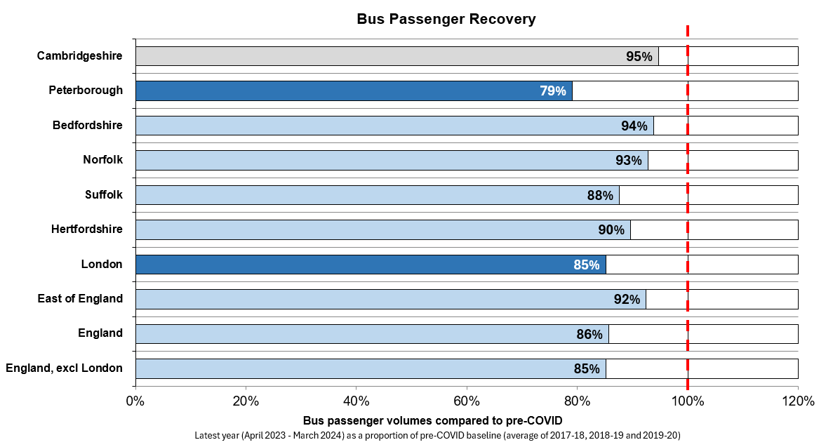
Bus Passengers: recovery across the country
Department for Transport statistics show that 18.7 million passengers used bus services in Cambridgeshire from April 2023 to March 2024. This is only 5% below the pre-COVID baseline. Passenger volumes in Peterborough (7.4 million) are 21% below pre-COVID levels but bus journeys per person continue to be higher in Peterborough.
Cambridgeshire:
Total Bus Passengers,
April 2023 – March 2024:
18.7 million
(25 journeys per head of population)
Peterborough:
Total Bus Passengers,
April 2023 – March 2024:
7.4 million
(32 journeys per head of population)
*Pre-COVID is defined as the average of three years (2017-18, 2018-19, 2019-20) to minimise the impacts of the pandemic that were present during the last week of the 2019-20 period.
Source: https://www.gov.uk/government/collections/bus-statistics
Notes:
Source: DfT Bus Statistics: https://www.gov.uk/government/collections/bus-statistics
Bedfordshire figures are compiled by summing those provided separately for Luton, Bedford, and Mid-Bedfordshire in the DfT dataset.

Slide 45
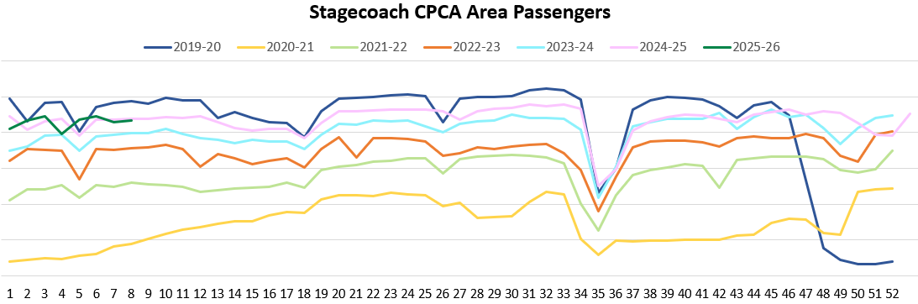
Bus Passengers: including Park and Ride
Bus passenger volumes on services based at Stagecoach’s Cambridgeshire depots (Cambridge and Fenstanton) are back to pre-COVID (0% change) in June 2025*, whereas bus passenger numbers in Peterborough are still some way behind 2019 at -23%.
Bus Passengers
May
Jun
Jul
Aug
Sep
Oct
Nov
Dec
Jan
Feb
Mar
Apr
Cambridgeshire (Cambridge and Fenstanton depots)
Pre-COVID to Now:
Peterborough (Peterborough depot)
Pre-COVID to Now:
Cambridgeshire (Cambridge and Fenstanton depots)
2023 to Now:
Peterborough (Peterborough depot)
2023 to Now:
Jun 2019 to Jun 2025
+0%
Jun 2019 to Jun 2025
-23%
Jun 2023 to Jun 2025
+11%
Jun 2023 to Jun 2025
+3%
Due to the commercial sensitivity of this data, bus passenger volumes are not labelled on the y-axis of this graph. Park and Ride services only operate from the Cambridge depot. *Note June data available to Sat 28th June 2025.
Notes:
Source: Stagecoach
Technical note: Due to the commercial sensitivity of this data, bus passenger volumes are not marked on the y-axis of this graph.

Slide 46
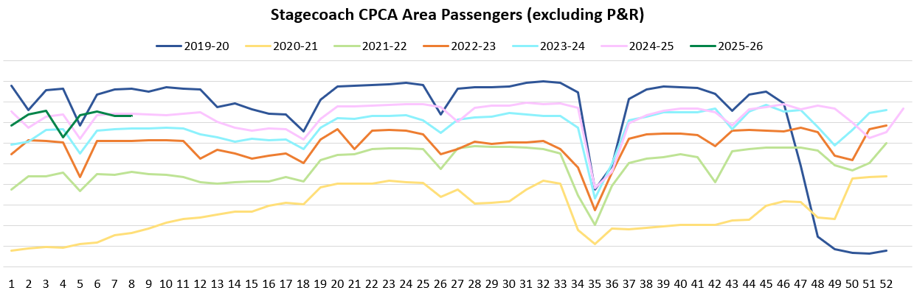
Bus Passengers: excluding Park and Ride
In June 2025*, bus passengers on non-Park & Ride services were 5% below pre-COVID from the Cambridgeshire depots (Cambridge and Fenstanton), and 23% below at the Peterborough depot. Overall volumes are similar to this time last year.
Bus Passengers
May
Jun
Jul
Aug
Sep
Oct
Nov
Dec
Jan
Feb
Mar
Apr
Cambridgeshire (Cambridge and Fenstanton depots)
Pre-COVID to Now:
Peterborough (Peterborough depot)
Pre-COVID to Now:
Cambridgeshire (Cambridge and Fenstanton depots)
2023 to Now:
Peterborough (Peterborough depot)
2023 to Now:
Jun 2019 to Jun 2025
-5%
Jun 2019 to Jun 2025
-23%
Jun 2023 to Jun 2025
+12%
Jun 2023 to Jun 2025
+3%
Due to the commercial sensitivity of this data, bus passenger volumes are not marked on the y-axis of this graph. *Note June data available to Sat 28th June 2025.
Notes:
Source: Stagecoach
Technical note: Due to the commercial sensitivity of this data, bus passenger volumes are not marked on the y-axis of this graph.
Commentary: Bus passenger numbers, excluding passengers who used the park and ride service, have continued to rise through 2023 and 2024 but remain below pre-COVID volumes up until the first lockdown was announced in late March 2020. Bus passenger numbers fell in December in line with other reported years, suggesting that the Christmas holidays and winter weather have an impact. They also experienced a dip in line with the February and May half term holidays and late March/ early April Easter holidays, as is also seen in previous years. In January 2023, the government announced a £2 cap on single tickets (£2 bus fare cap - GOV.UK (www.gov.uk)).

Slide 47
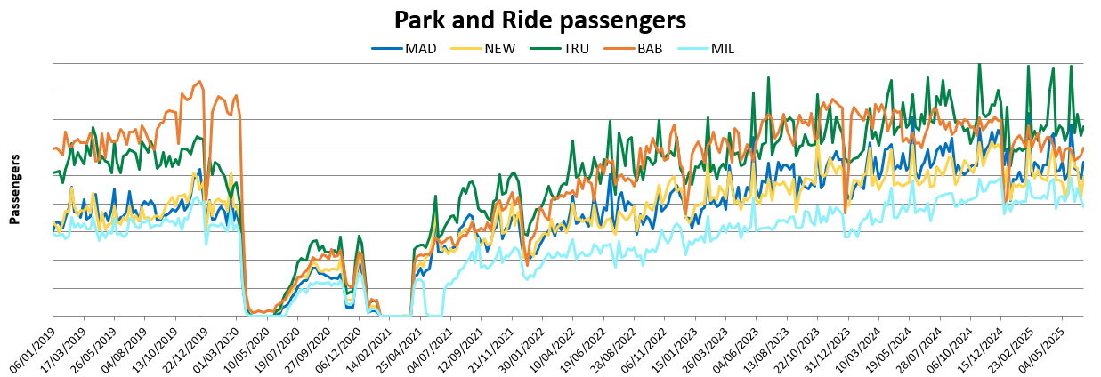
Bus Passengers: Park and Ride only
Trumpington and Babraham Park and Ride continue to be the sites with the highest volumes. All sites are now around or above pre-COVID volumes except for Babraham P&R. Overall Park & Ride usage has increased by 22% compared to June 2019.
Cambridgeshire sites
Pre-COVID to Now:
Cambridgeshire sites
2023 to Now:
Jun 2019 to Jun 2025
+22%
Jun 2023 to Jun 2025
+6%
Due to the commercial sensitivity of this data, bus passenger volumes are not marked on the y-axis of this graph. Note June data available to Sat 28th June 2025.
Notes:
Source: Stagecoach
Technical note: Due to the commercial sensitivity of this data, bus passenger volumes are not marked on the y-axis of this graph.
Commentary: P&R passengers generally sees a sharp increase during the school holidays. In January 2023, the government announced a £2 cap on single tickets (£2 bus fare cap - GOV.UK (www.gov.uk)).
MAD=Madingley Road P&R
NEW = Newmarket Road P&R
TRU = Trumpington P&R
BAB = Babraham Road P&R
MIL = Milton Road P&R

Slide 48
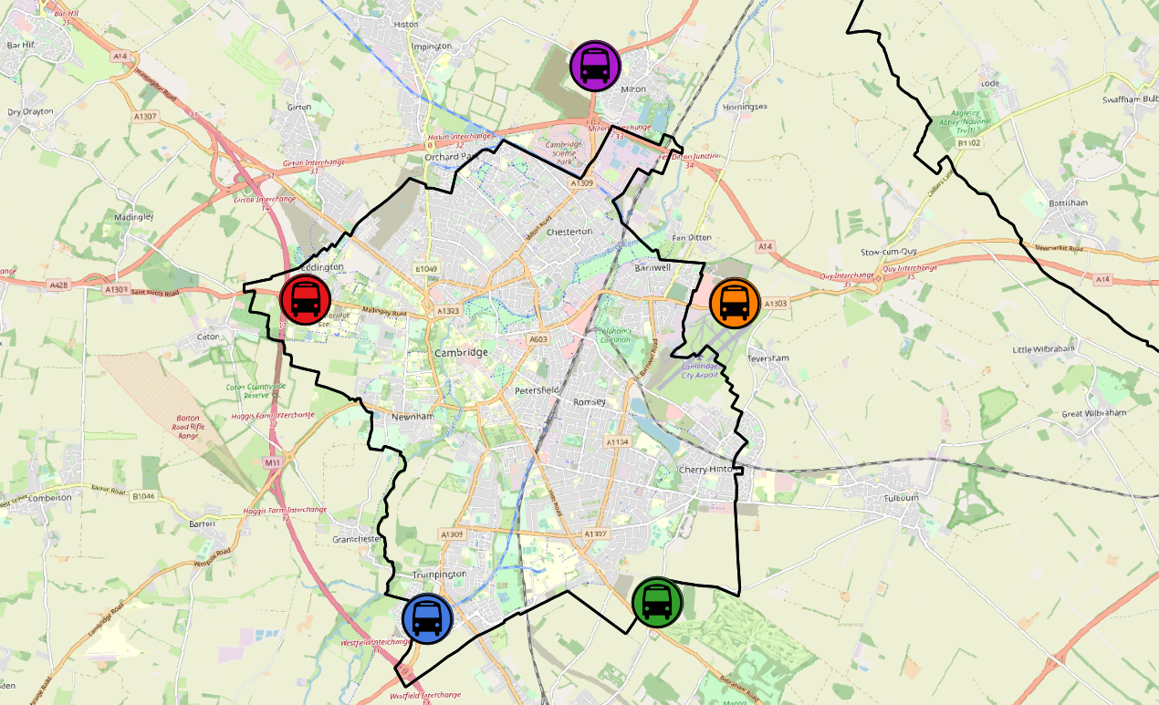
Bus Passengers: Park and Ride by Site
Overall Park and Ride (P&R) site usage exceeds pre-COVID levels. All sites are well above 2019 volumes (from +20% to +44%) except for Babraham Road (-9% from 2019) – this may be linked to the solar canopy construction works at Babraham Road which are now largely complete.
All P&R Sites
Jun 2019 to Jun 2025
Jun 2023 to Jun 2025
Milton P&R
Jun 2019 to Jun 2025
Jun 2023 to Jun 2025
+22%
+41%
+6%
+27%
Madingley Road P&R
Jun 2019 to Jun 2025
Jun 2023 to Jun 2025
Newmarket Road P&R
Jun 2019 to Jun 2025
Jun 2023 to Jun 2025
+42%
+44%
+9%
+13%
Babraham Road P&R
Jun 2019 to Jun 2025
Jun 2023 to Jun 2025
Trumpington P&R
Jun 2019 to Jun 2025
Jun 2023 to Jun 2025
-9%
+20%
-14%
+8%
© OpenStreetMap Contributors
Note June data available to Sat 28th June 2025.
Notes:
Source: Stagecoach

Slide 49
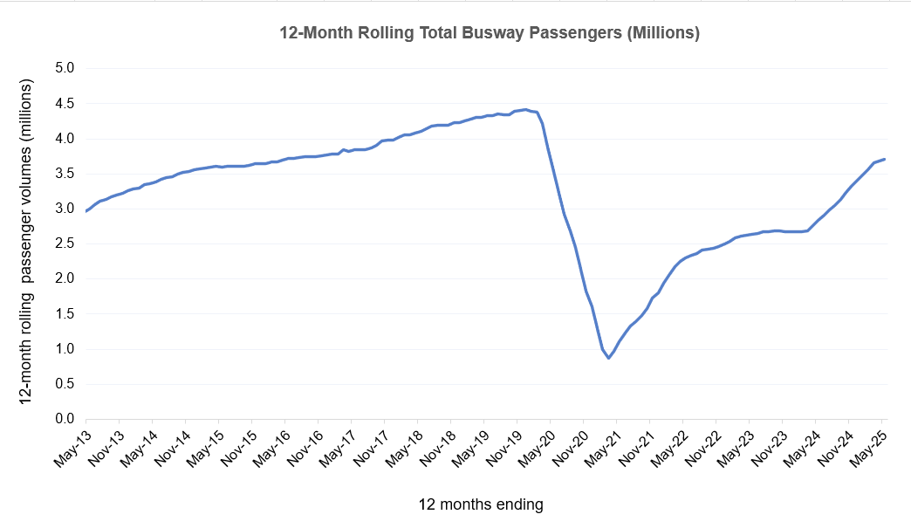
Cambridgeshire Guided Busway – Bus Passengers.
A total of 3.7 million passengers used the Cambridgeshire Guided Busway between June 2024 and May 2025.
This is 31% above the preceding 12 months (June 2023 – May 2024) but is 14% below the equivalent period pre-COVID (June 2018 – May 2019).
3.7m passengers
(June 2024 – May 2025)
Busway Usage (Bus Passengers)
Pre-COVID to Now:
2019 – 2025*
4.3m passengers
(June 2018 – May 2019)
-14%
2.8m passengers
(June 2023 – May 2024)
Busway Usage (Bus Passengers)
Previous Year to Now:
2024 – 2025*
+31%
*All figures are for 12 months ending May.
E.g. for 2019 – 2025, the % change reflects the difference between total passengers from June 2018-May 2019 compared to total passengers from June 2024-May 2025.
Source: Ticket data supplied by Stagecoach & Whippet Bus Operators.
Notes:
Source: Stagecoach / Whippet.

Slide 50
Micro-mobility

Slide 51
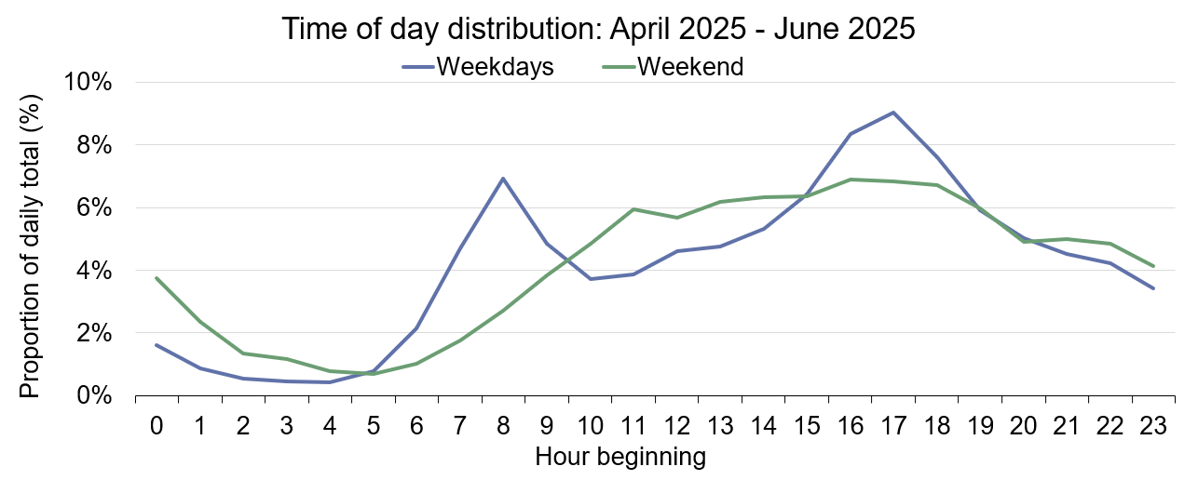
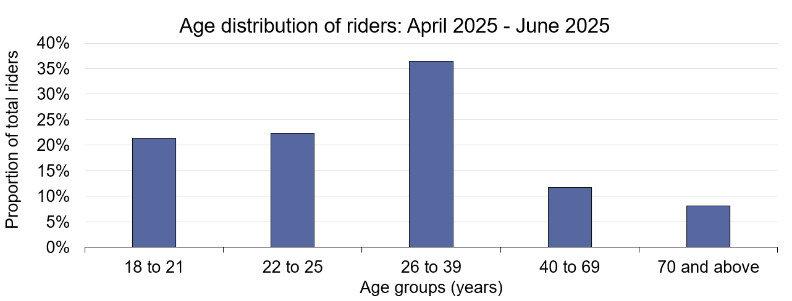
Voi E-scooters and E-bikes in Cambridge
Voi e-scooter and e-bike use has increased since the same period last year (+40% increase from April – June 2024). Morning and afternoon peaks at 8am and 5pm continue on weekdays. The most common rider age bracket is 26-39 at 36% of all riders.
Voi have operated an electric scooter (e-scooter) and electric bike (e-bike) trial scheme in and around Cambridge since October 2020.
Key statistics: April – June 2025
% change from same period in 2024
Number of rides:
+40%
% change from same period in 2024
Number of active riders:
+27%
% change from same period in 2024
Total ride distance:
+34%
% change from same period in 2024
Source: Voi. Note Voi has made a methodological change from June 2025 in the age distribution calculations to better capture e-bike riders who do not need to verify their age with a license.
Notes:
Source: Voi

Slide 52
Air Quality

Slide 53
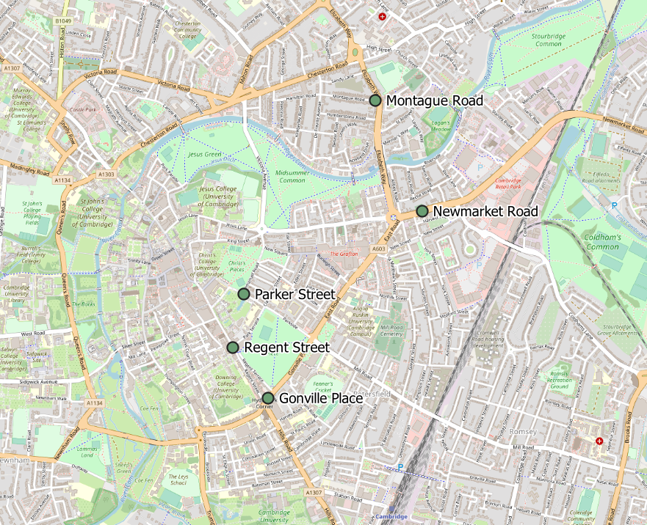
Air Quality Monitoring Locations
Continuous Air Quality Monitoring Sites, Cambridge
Location | Description
Montague Road | Close to the junction with Elizabeth Way
Newmarket Road | Close to Cambridge Retail park on Newmarket Road. Data unavailable in early 2025 due to sensor upgrade.
Parker Street | Close to the bus station
Regent Street | To the West of Parker’s Piece
Gonville Place | Near Hill’s Road, South of Parker’s Piece. Inactive from April 2022 to March 2024.
The Cambridge City Council Air Quality team provide data from 5 continuous air quality monitors in central Cambridge. The monitors measure Nitrogen dioxide (NO₂) and Particulate Matter (PM₁₀ and PM_{2.5}) which are all proxies for overall air quality.
© OpenStreetMap Contributors
Notes:
Source: Cambridge City Air Quality team. Data for the Cambridge air quality continuous monitors can also be found at: Air quality in England (airqualityengland.co.uk).
Technical note: Please note there may be slight differences between the data on Air Quality in England and data in this pack as air quality data undergoes a ratification process.

Slide 54
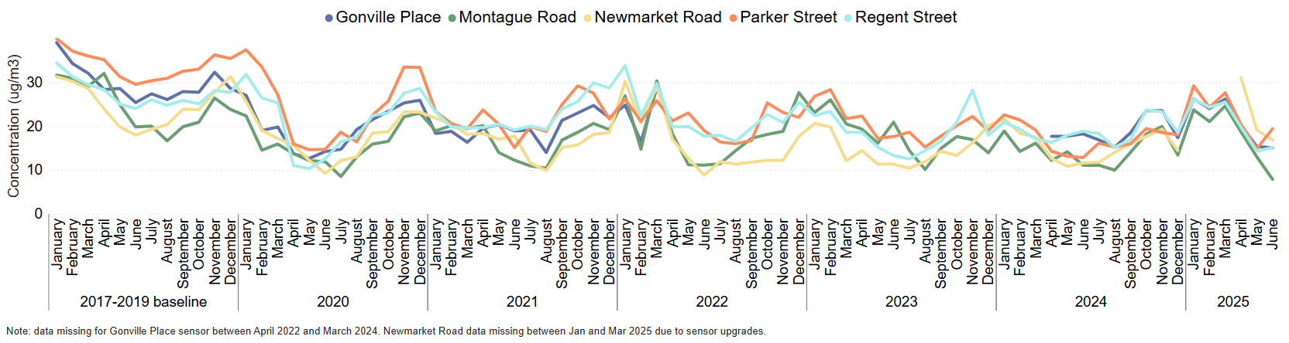
Air Quality: Nitrogen dioxide (NO₂)
All the continuous monitoring sites in Cambridge city centre show a decrease in nitrogen dioxide pollution since the June 2017-2019 baseline, in particular Montague Road (-60%). Concentrations of NO₂ have seen a decrease since April 2025, in line with usual seasonal trends.
Monthly average NO₂ concentrations (µg/m³) by site
 | Pre-COVID to Now: | 2023 to Now: | Last year to Now*:
 | Jun 2017-19 baseline to Jun 2025 | Jun 2023 to Jun 2025 | Jun 2024 to Jun 2025
Gonville Place | -41% | No June 2023 data | -17%
Montague Road | -60% | -62% | -29%
Newmarket Road | -6% | +49% | +45%
Parker Street | -34% | +10% | +51%
Regent Street | -37% | +14% | -20%
NO₂ is partly generated by road transport. Concentrations are given in micrograms (µg) per cubic metre of air (m³ )
Notes:
Source: Cambridge City Air Quality team. Data for the Cambridge air quality continuous monitors can be found at: Air quality in England (airqualityengland.co.uk).
Technical note: Data for the Gonville Place sensor is not available from April 2022 to March 2024. Newmarket Road data is missing between January and March 2025 due to sensor upgrades.
Please note there may be slight differences between the data on Air Quality in England and data in this pack as air quality data is provisional until it has undergone a ratification process.

Slide 55
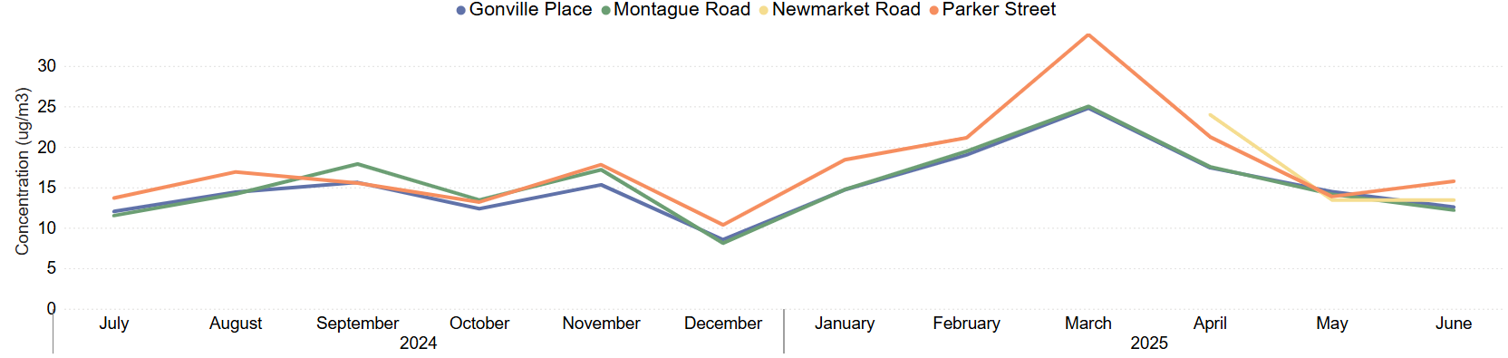
Air Quality: Particulate Matter (PM₁₀)
PM₁₀ concentrations have been between 12 and 24µg/m³ from April to June 2025. April sees the highest concentrations for all four sites in the quarter, with concentrations decreasing in May and June.
Monthly average PM₁₀ concentrations (µg/m³) by site
 | Last year to Now:
 | Coming soon
Gonville Place | Historic data not yet available
Montague Road | Historic data not yet available
Newmarket Road | Historic data not yet available
Parker Street | Historic data not yet available
.
PM₁₀ is a type of pollution that is made up of particulate matter (all the solid and liquid particles in the air e.g. smoke, dust, pollen). PM₁₀ pollution has larger particles (diameter of 0.01mm or less) and is partly generated by road transport.
Concentrations of PM₁₀ must not exceed an annual average of 40 µg/m3 (Air Quality Standards Regulations, 2010).
Concentrations are given in micrograms (µg) per cubic metre of air (m³ )
Notes:
Source: Cambridge City Air Quality team. Data for the Cambridge air quality continuous monitors can be found at: Air quality in England (airqualityengland.co.uk).
Technical note: Please note there may be slight differences between the data on Air Quality in England and data in this pack as air quality data is provisional until it has undergone a ratification process.

Slide 56
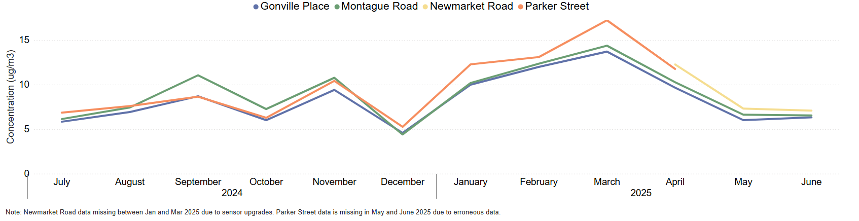
Air Quality: Particulate Matter (PM_{2.5})
PM_{2.5} concentrations have been between 6 and 13 µg/m³ in the last three months.
April saw the highest concentrations in the quarter, with concentrations then decreasing in May and June.
Monthly average PM_{2.5} concentrations (µg/m³) by site
 | Last year to Now:
 | Coming soon
Gonville Place | Historic data not yet available
Montague Road | Historic data not yet available
Newmarket Road | Historic data not yet available
Parker Street | Historic data not yet available
PM_{2.5} is a type of pollution made up of particulate matter (all the solid and liquid particles in the air e.g. sea spray, smoke). PM_{2.5} pollution has smaller particles (diameter of 0.0025mm or less) and is partly generated by road transport.
Concentrations of PM_{2.5} have an annual mean target level of 10 µg/m3 by 2040 (Environmental Targets (Fine Particulate Matter)(England) Regulations 2023).
Concentrations are given in micrograms (µg) per cubic metre of air (m³ )
Notes:
Source: Cambridge City Air Quality team. Data for the Cambridge air quality continuous monitors can be found at: Air quality in England (airqualityengland.co.uk).
Technical note: Please note there may be slight differences between the data on Air Quality in England and data in this pack as air quality data is provisional until it has undergone a ratification process.

Slide 57
policyandinsight@cambridgeshire.gov.uk

