Slide 1
A1 Network - PCN Dashboard Beta Version Powerpoint
View in Power BI
Last data refresh:
26/02/2025 17:48:19 UTC
Downloaded at:
20/03/2025 11:25:52 UTC

Slide 2
Map
Notes:
More patients
No alt text provided
textbox
No alt text provided
Fewer patients
No alt text provided
Practice Locations and Registered Patients as at Jan'25
No alt text provided
Slicer Extract Date
No alt text provided
Registered Patients by Practice as at Jan'25
No alt text provided
slicer
No alt text provided
North
No alt text provided
ICS Total
No alt text provided
slicer
No alt text provided
PBI_CV_EB3A4088_75C5_4746_9D8B_255A7B7ECD6C
No alt text provided
actionButton
No alt text provided
actionButton
No alt text provided
actionButton
No alt text provided

Slide 3
Contents Page
Notes:
Cambridgeshire and Peterborough PCN Dashboard
No alt text provided
card
No alt text provided
pageNavigator
No alt text provided
Slicer PCN
No alt text provided
actionButton
No alt text provided
actionButton
No alt text provided

Slide 4
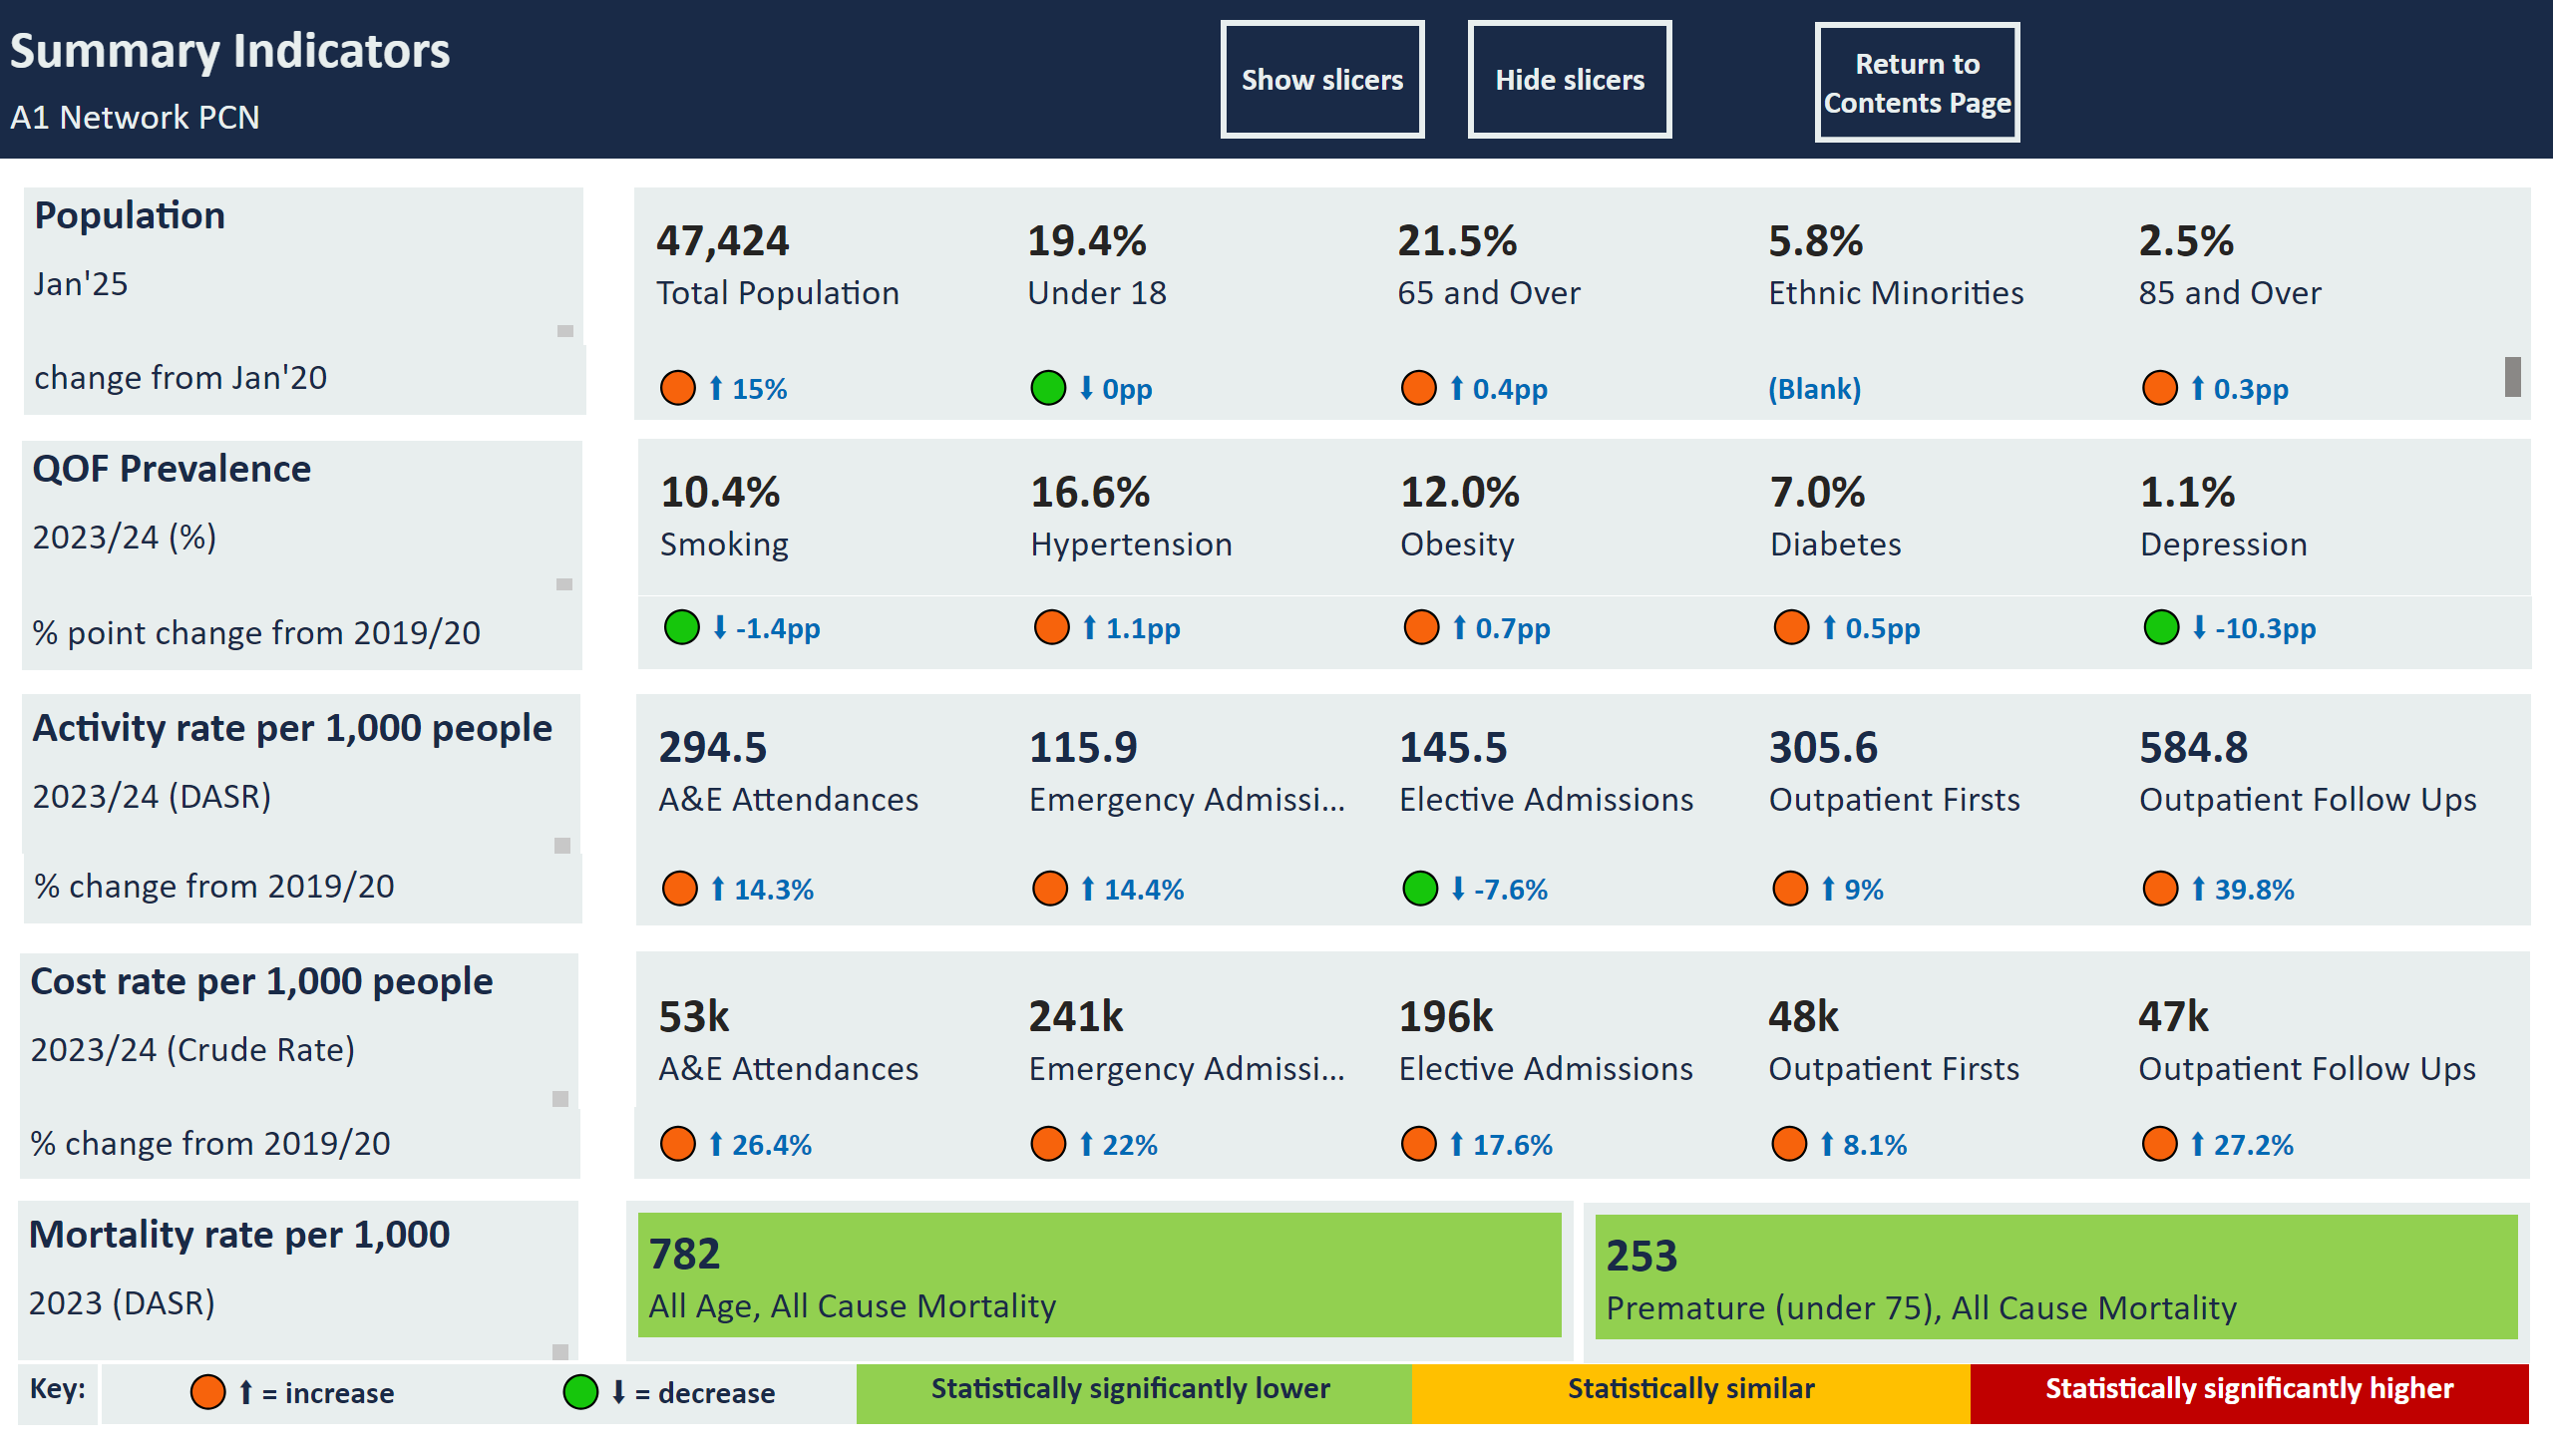
Summary
Notes:
actionButton
No alt text provided
multiRowCard
No alt text provided
QOF Prevalence
No alt text provided
Population
No alt text provided
multiRowCard
No alt text provided
Summary Indicators
No alt text provided
Activity rate per 1,000 people
No alt text provided
multiRowCard
No alt text provided
slicer
No alt text provided
slicer
No alt text provided
slicer
No alt text provided
slicer
No alt text provided
Cost rate per 1,000 people
No alt text provided
multiRowCard
No alt text provided
multiRowCard
No alt text provided
% change from 2019/20
No alt text provided
multiRowCard
No alt text provided
% change from 2019/20
No alt text provided
shape
No alt text provided
actionButton
No alt text provided
actionButton
No alt text provided
change from Jan'20
No alt text provided
% point change from 2019/20
No alt text provided
multiRowCard
No alt text provided
Mortality rate per 1,000
No alt text provided
multiRowCard
No alt text provided
slicer
No alt text provided
multiRowCard
No alt text provided
multiRowCard
No alt text provided
Statistically significantly lower
No alt text provided
Statistically similar
No alt text provided
Statistically significantly higher
No alt text provided
🟢 ⬇ = decrease
No alt text provided
🟠 ⬆ = increase
No alt text provided
Key:
No alt text provided

Slide 5
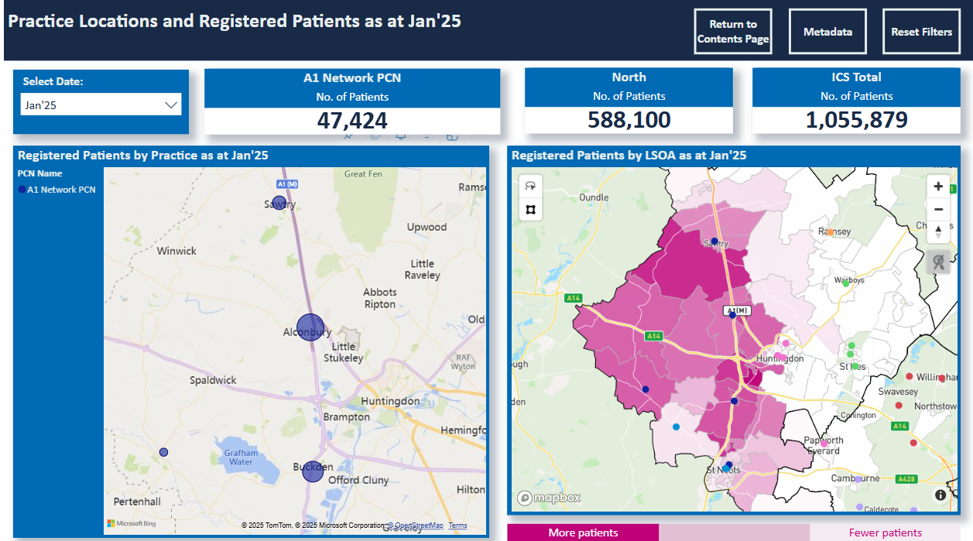
Map
Notes:
More patients
No alt text provided
textbox
No alt text provided
Fewer patients
No alt text provided
Practice Locations and Registered Patients as at Jan'25
No alt text provided
Slicer Extract Date
No alt text provided
Registered Patients by Practice as at Jan'25
No alt text provided
slicer
No alt text provided
North
No alt text provided
A1 Network PCN
No alt text provided
ICS Total
No alt text provided
slicer
No alt text provided
PBI_CV_EB3A4088_75C5_4746_9D8B_255A7B7ECD6C
No alt text provided
actionButton
No alt text provided
actionButton
No alt text provided
actionButton
No alt text provided

Slide 6
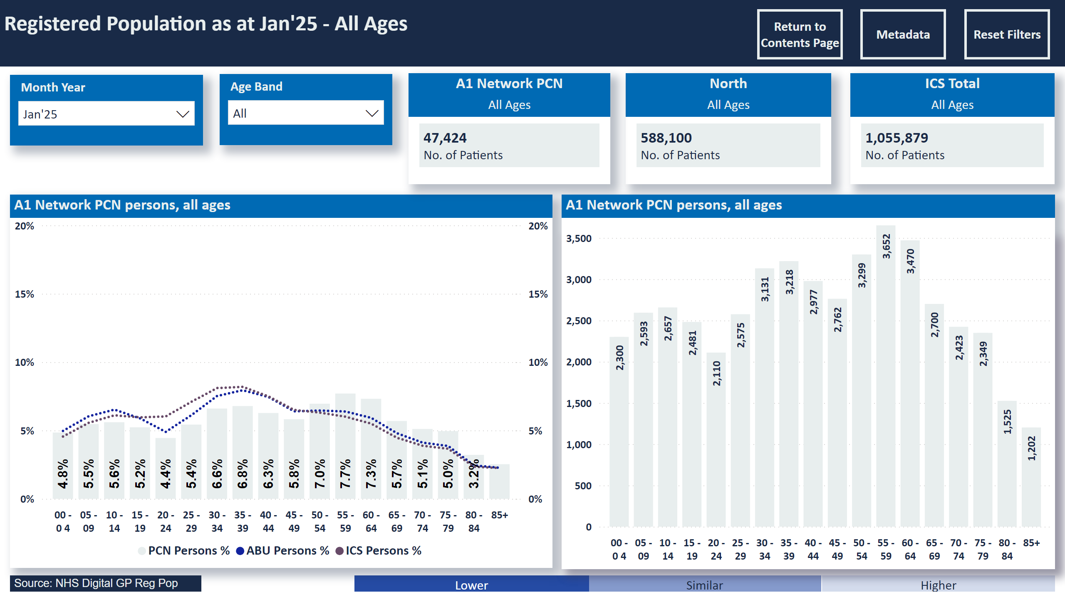
Population
Notes:
A1 Network PCN persons, all ages
No alt text provided
Registered Population as at Jan'25 - All Ages
No alt text provided
slicer
No alt text provided
Select Age
No alt text provided
slicer
No alt text provided
slicer
No alt text provided
clusteredBarChart
No alt text provided
Higher
No alt text provided
Similar
No alt text provided
Lower
No alt text provided
lineClusteredColumnComboChart
No alt text provided
lineClusteredColumnComboChart
No alt text provided
A1 Network PCN persons, all ages
No alt text provided
ICS Total
No alt text provided
North
No alt text provided
A1 Network PCN
No alt text provided
Patients in selected age range as a % of total - trends
No alt text provided
ABU
No alt text provided
actionButton
No alt text provided
Source: NHS Digital GP Reg Pop
No alt text provided
actionButton
No alt text provided
actionButton
No alt text provided
actionButton
No alt text provided

Slide 7
Population 00-17
Notes:
actionButton
No alt text provided
actionButton
No alt text provided
actionButton
No alt text provided
Source: NHS Digital GP Reg Pop
No alt text provided
actionButton
No alt text provided
ABU
No alt text provided
Patients in selected age range as a % of total - trends
No alt text provided
A1 Network PCN
No alt text provided
North
No alt text provided
ICS Total
No alt text provided
ABU
No alt text provided
A1 Network PCN persons, all ages
No alt text provided
lineClusteredColumnComboChart
No alt text provided
lineClusteredColumnComboChart
No alt text provided
ABU
No alt text provided
ABU
No alt text provided
Lower
No alt text provided
Similar
No alt text provided
Higher
No alt text provided
clusteredBarChart
No alt text provided
slicer
No alt text provided
slicer
No alt text provided
Select Age
No alt text provided
slicer
No alt text provided
Registered Population as at Jan'25 - age 00 - 17 (children)
No alt text provided

Slide 8
Population 18-64
Notes:
Registered Population as at Jan'25 - age 18 - 64 (working age)
No alt text provided
slicer
No alt text provided
Select Age
No alt text provided
slicer
No alt text provided
slicer
No alt text provided
clusteredBarChart
No alt text provided
Higher
No alt text provided
Similar
No alt text provided
Lower
No alt text provided
ABU
No alt text provided
ABU
No alt text provided
lineClusteredColumnComboChart
No alt text provided
lineClusteredColumnComboChart
No alt text provided
A1 Network PCN persons, all ages
No alt text provided
ABU
No alt text provided
ICS Total
No alt text provided
North
No alt text provided
A1 Network PCN
No alt text provided
Patients in selected age range as a % of total - trends
No alt text provided
ABU
No alt text provided
actionButton
No alt text provided
Source: NHS Digital GP Reg Pop
No alt text provided
actionButton
No alt text provided
actionButton
No alt text provided
actionButton
No alt text provided

Slide 9
Population 65+
Notes:
Registered Population as at Jan'25 - age 65+ (older people)
No alt text provided
slicer
No alt text provided
Select Age
No alt text provided
slicer
No alt text provided
slicer
No alt text provided
clusteredBarChart
No alt text provided
Higher
No alt text provided
Similar
No alt text provided
Lower
No alt text provided
ABU
No alt text provided
ABU
No alt text provided
lineClusteredColumnComboChart
No alt text provided
lineClusteredColumnComboChart
No alt text provided
A1 Network PCN persons, all ages
No alt text provided
ABU
No alt text provided
ICS Total
No alt text provided
North
No alt text provided
A1 Network PCN
No alt text provided
Patients in selected age range as a % of total - trends
No alt text provided
ABU
No alt text provided
actionButton
No alt text provided
Source: NHS Digital GP Reg Pop
No alt text provided
actionButton
No alt text provided
actionButton
No alt text provided
actionButton
No alt text provided

Slide 10
Ethnicity
Notes:
slicer
No alt text provided
Registered Population by ethnic group as at Apr'23
No alt text provided
A1 Network PCN - % by Ethnic Group
No alt text provided
A1 Network PCN - % by Ethnic Group (excluding Unknown) - summary
No alt text provided
A1 Network PCN - % by Ethnic Group (excluding Unknown) - detail
No alt text provided
A1 Network PCN - Unknown % compared with ICS average
No alt text provided
A1 Network PCN - Ethnic Minorities % compared with ICS average
No alt text provided
A1 Network PCN - Ethnic Minorities % by Practice
No alt text provided
Source: ICB Primary Care Information Team from Systmone / EMIS
No alt text provided
actionButton
No alt text provided
actionButton
No alt text provided
actionButton
No alt text provided

Slide 11
Fertility
Notes:
A1 Network PCN by Practice
No alt text provided
slicer
No alt text provided
slicer
No alt text provided
Birth Rates per 1,000 Females for the year 2023
No alt text provided
A1 Network PCN
No alt text provided
North ABU
No alt text provided
ICS Total
No alt text provided
Birth Rates per 1,000 Females - trends
No alt text provided
Statistically significantly lower
No alt text provided
Statistically similar
No alt text provided
Statistically significantly higher
No alt text provided
Source: ICS DSCRO Births Table
No alt text provided
actionButton
No alt text provided
actionButton
No alt text provided
actionButton
No alt text provided

Slide 12
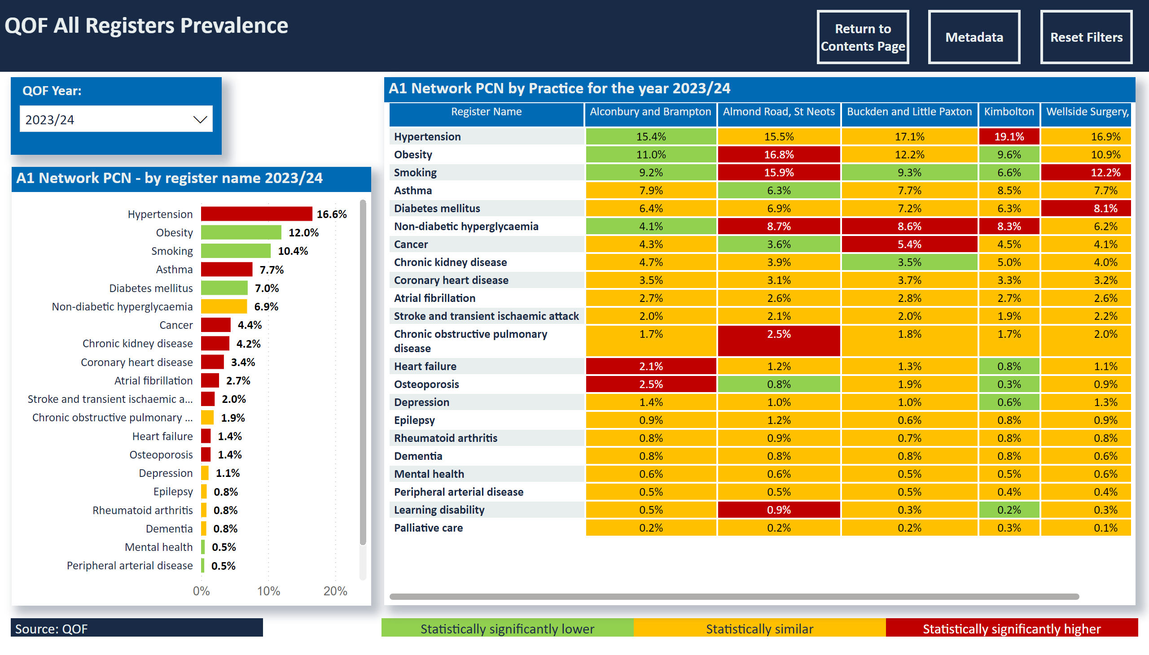
Prevalence - All Registers
Notes:
slicer
No alt text provided
slicer
No alt text provided
slicer
No alt text provided
slicer
No alt text provided
QOF All Registers Prevalence
No alt text provided
A1 Network PCN - by register name 2023/24
No alt text provided
Statistically significantly lower
No alt text provided
Statistically similar
No alt text provided
Statistically significantly higher
No alt text provided
Source: QOF
No alt text provided
actionButton
No alt text provided
actionButton
No alt text provided
actionButton
No alt text provided
A1 Network PCN by Practice for the year 2023/24
No alt text provided

Slide 13
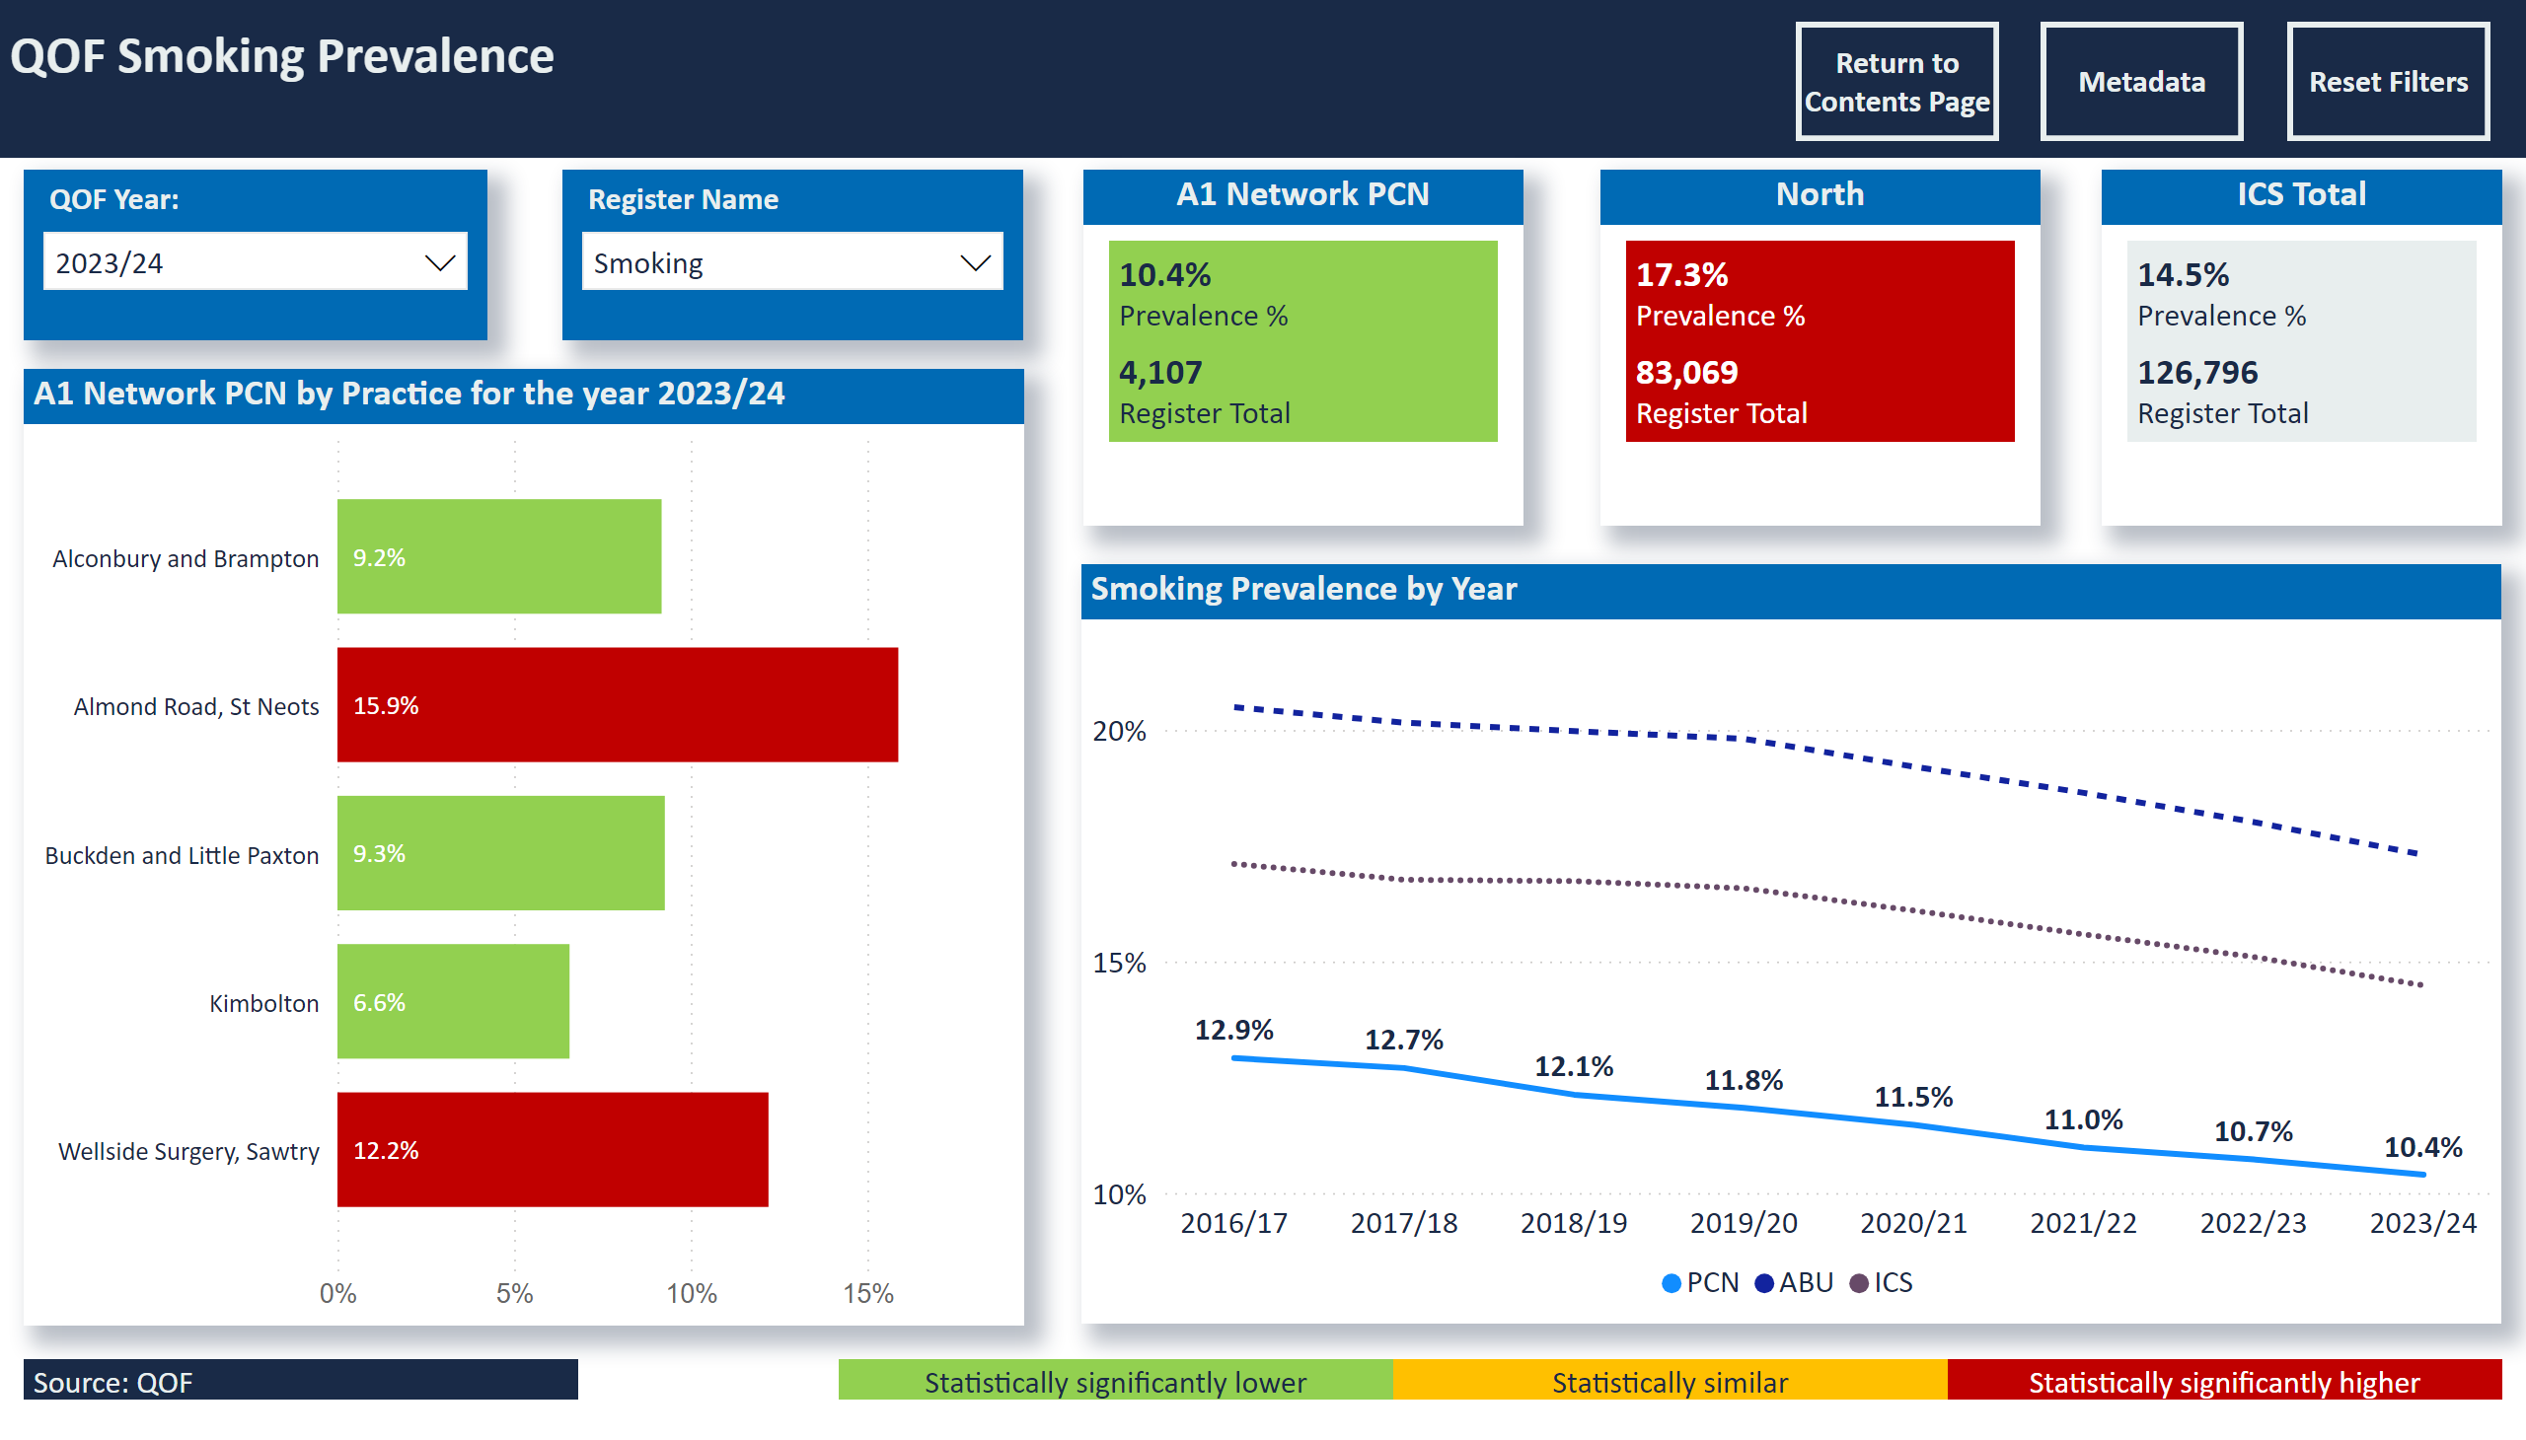
Prevalence Smoking
Notes:
slicer
No alt text provided
slicer
No alt text provided
slicer
No alt text provided
slicer
No alt text provided
QOF Smoking Prevalence
No alt text provided
A1 Network PCN by Practice for the year 2023/24
No alt text provided
North
No alt text provided
ICS Total
No alt text provided
Smoking Prevalence by Year
No alt text provided
A1 Network PCN
No alt text provided
Statistically significantly lower
No alt text provided
Statistically similar
No alt text provided
Statistically significantly higher
No alt text provided
Source: QOF
No alt text provided
actionButton
No alt text provided
actionButton
No alt text provided
actionButton
No alt text provided

Slide 14
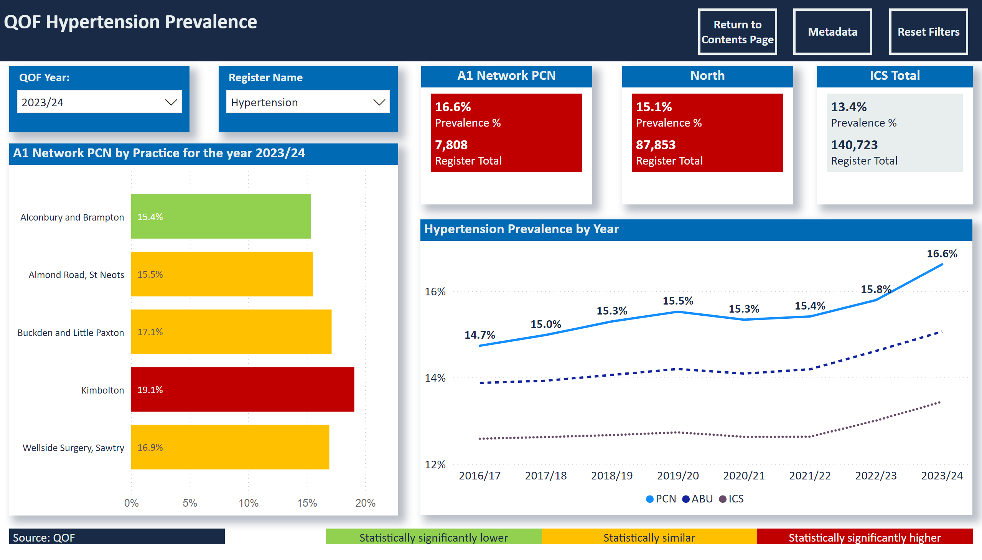
Prevalence Hypertension
Notes:
slicer
No alt text provided
slicer
No alt text provided
slicer
No alt text provided
slicer
No alt text provided
QOF Hypertension Prevalence
No alt text provided
A1 Network PCN by Practice for the year 2023/24
No alt text provided
North
No alt text provided
ICS Total
No alt text provided
Hypertension Prevalence by Year
No alt text provided
A1 Network PCN
No alt text provided
Statistically significantly lower
No alt text provided
Statistically similar
No alt text provided
Statistically significantly higher
No alt text provided
Source: QOF
No alt text provided
actionButton
No alt text provided
actionButton
No alt text provided
actionButton
No alt text provided

Slide 15
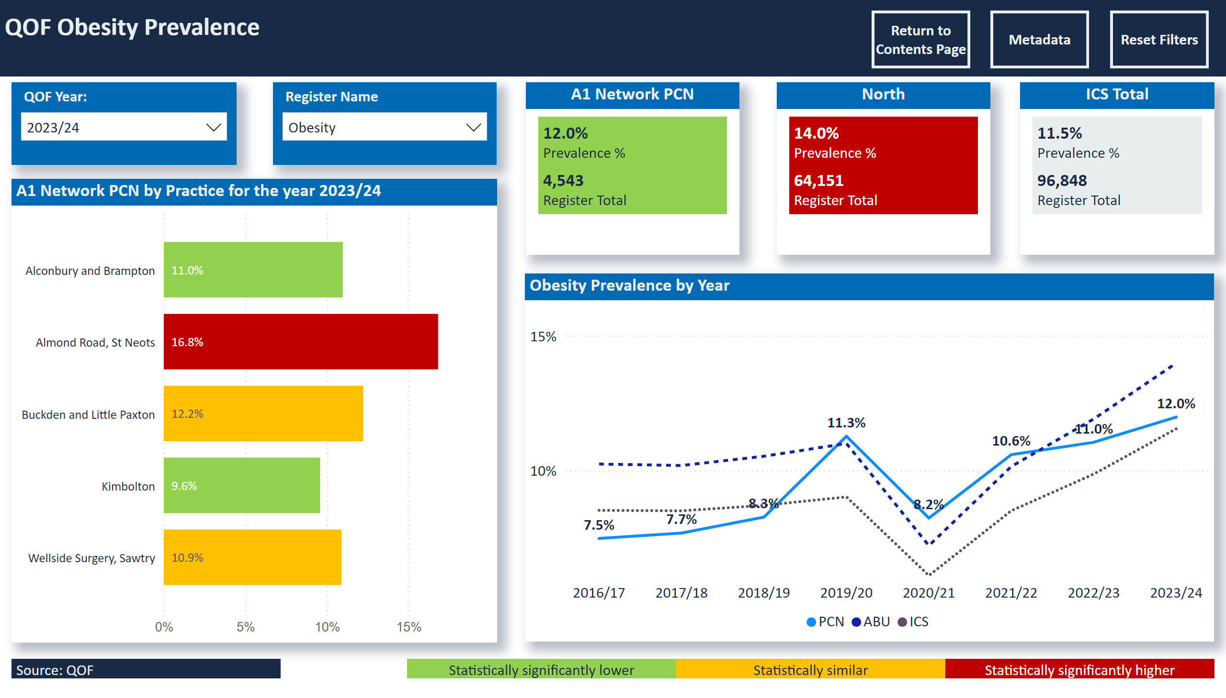
Prevalence Obesity
Notes:
slicer
No alt text provided
slicer
No alt text provided
slicer
No alt text provided
slicer
No alt text provided
QOF Obesity Prevalence
No alt text provided
A1 Network PCN by Practice for the year 2023/24
No alt text provided
North
No alt text provided
ICS Total
No alt text provided
Obesity Prevalence by Year
No alt text provided
A1 Network PCN
No alt text provided
Statistically significantly lower
No alt text provided
Statistically similar
No alt text provided
Statistically significantly higher
No alt text provided
Source: QOF
No alt text provided
actionButton
No alt text provided
actionButton
No alt text provided
actionButton
No alt text provided

Slide 16
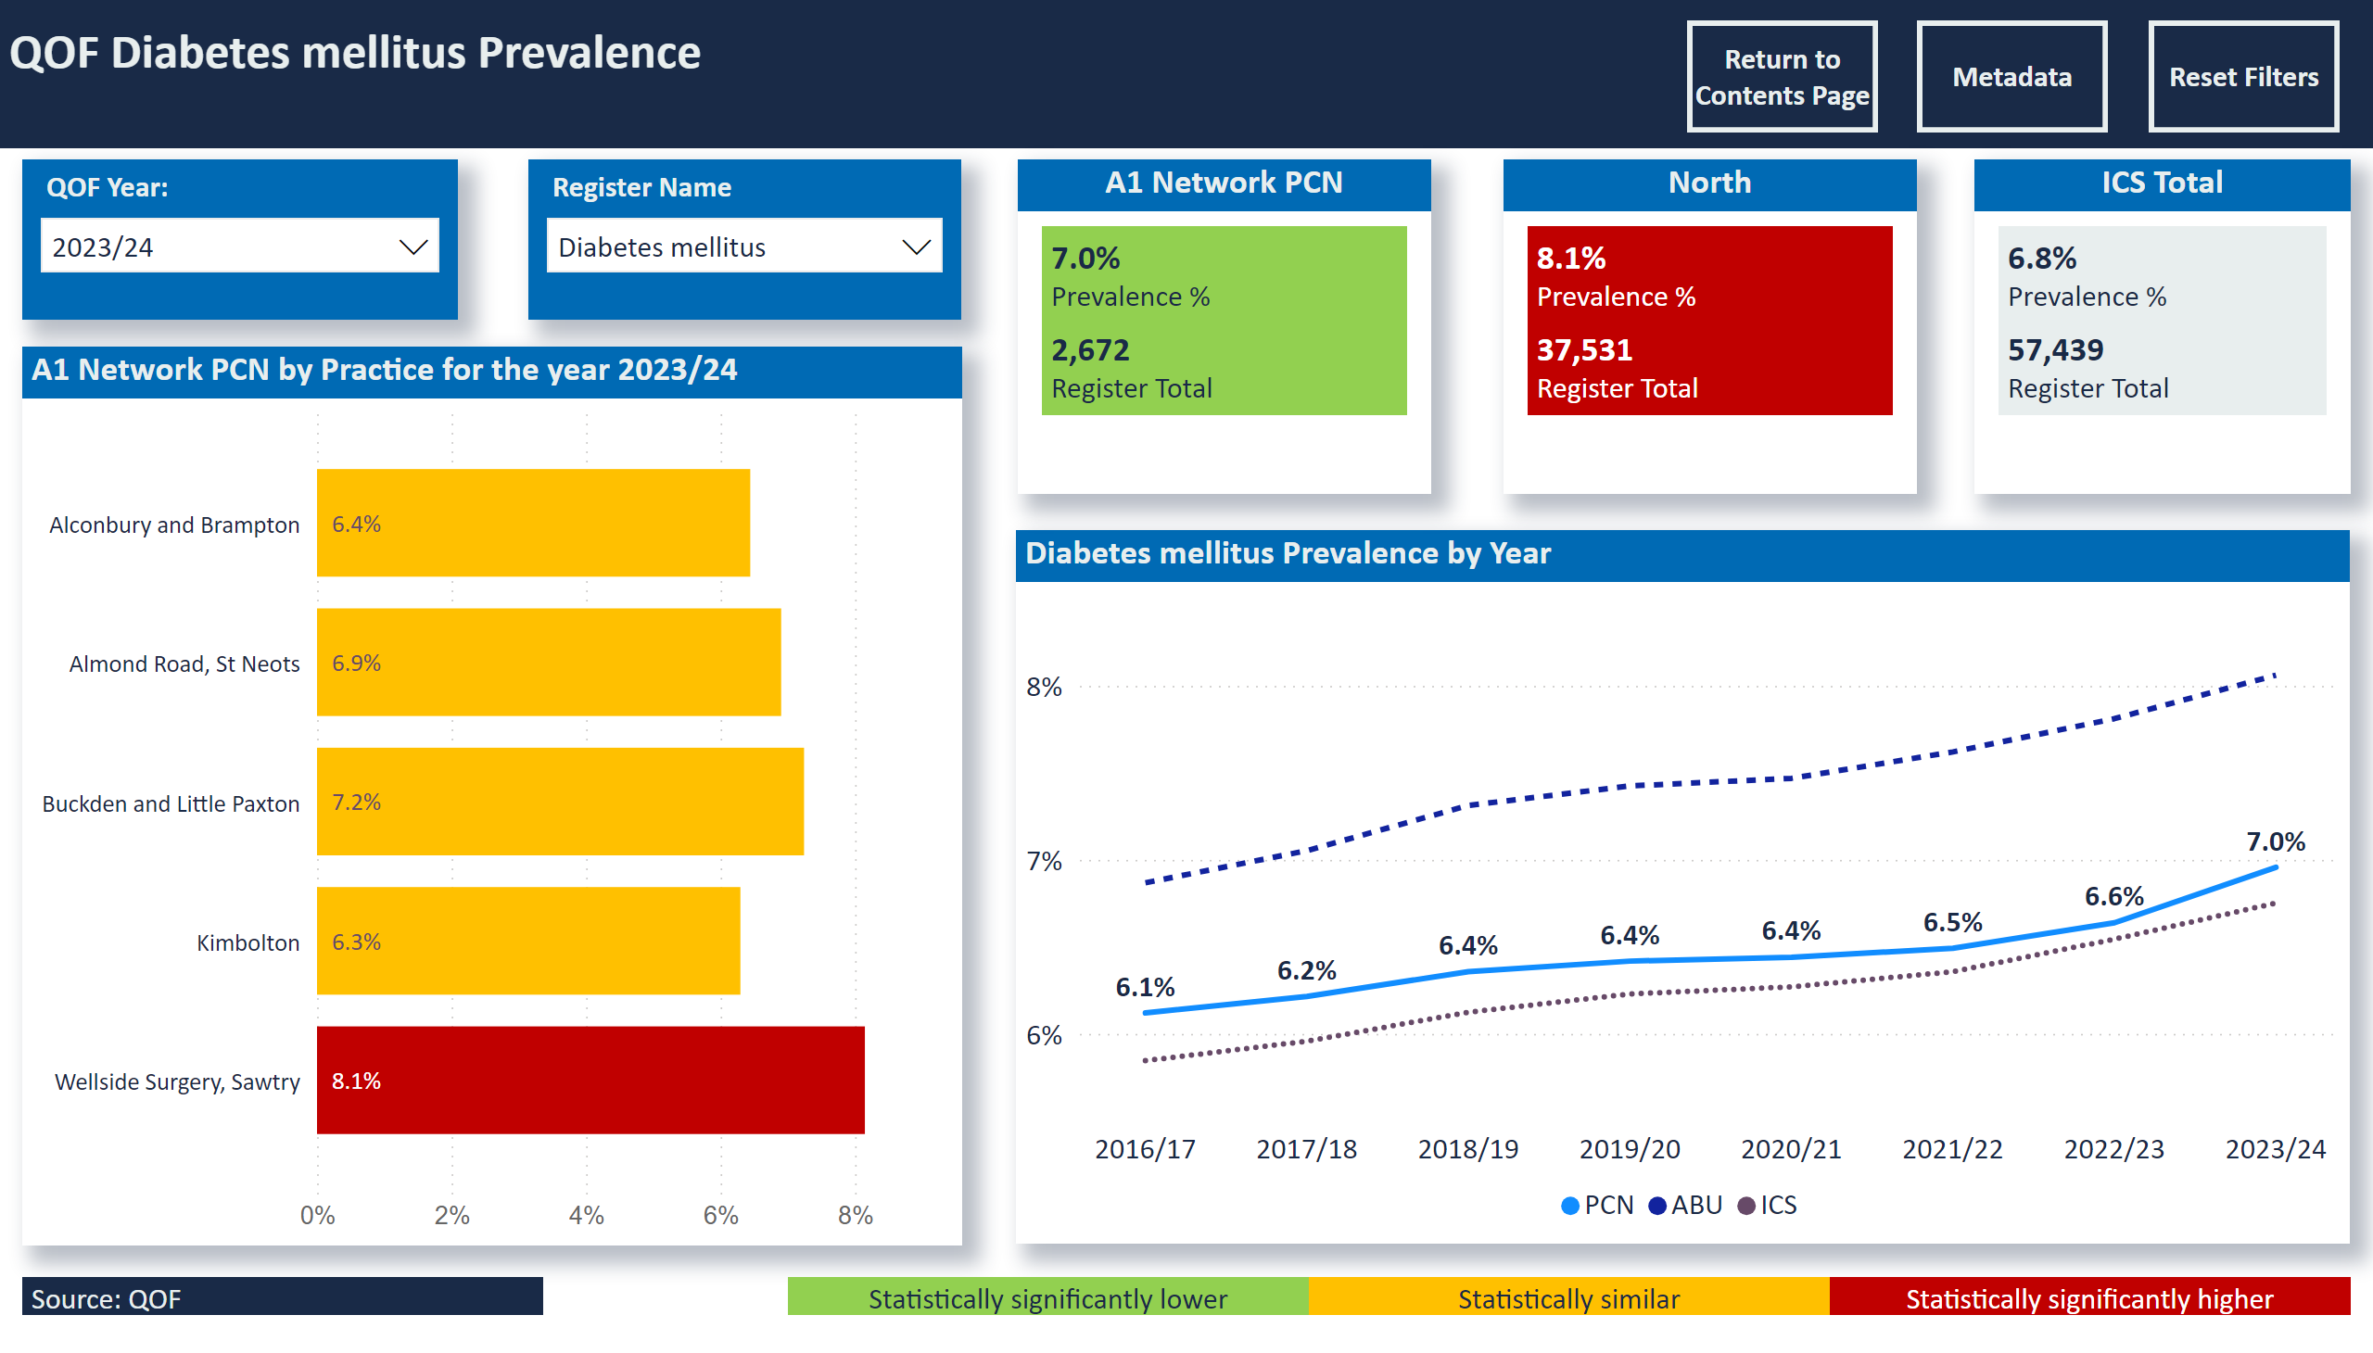
Prevalence Diabetes
Notes:
slicer
No alt text provided
slicer
No alt text provided
slicer
No alt text provided
slicer
No alt text provided
QOF Diabetes mellitus Prevalence
No alt text provided
A1 Network PCN by Practice for the year 2023/24
No alt text provided
North
No alt text provided
ICS Total
No alt text provided
Diabetes mellitus Prevalence by Year
No alt text provided
A1 Network PCN
No alt text provided
Statistically significantly lower
No alt text provided
Statistically similar
No alt text provided
Statistically significantly higher
No alt text provided
Source: QOF
No alt text provided
actionButton
No alt text provided
actionButton
No alt text provided
actionButton
No alt text provided

Slide 17
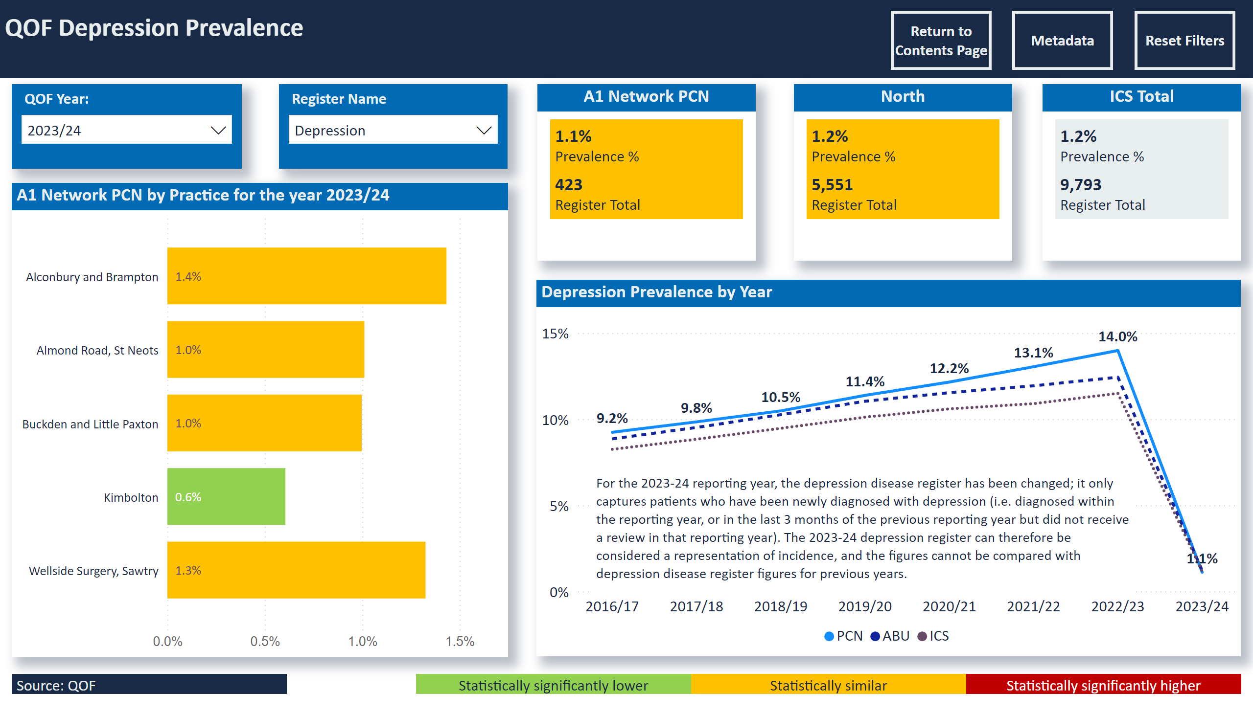
Prevalence Depression
Notes:
textbox
No alt text provided
slicer
No alt text provided
slicer
No alt text provided
slicer
No alt text provided
slicer
No alt text provided
QOF Depression Prevalence
No alt text provided
A1 Network PCN by Practice for the year 2023/24
No alt text provided
North
No alt text provided
ICS Total
No alt text provided
Depression Prevalence by Year
No alt text provided
A1 Network PCN
No alt text provided
Statistically significantly lower
No alt text provided
Statistically similar
No alt text provided
Statistically significantly higher
No alt text provided
Source: QOF
No alt text provided
actionButton
No alt text provided
actionButton
No alt text provided
actionButton
No alt text provided

Slide 18
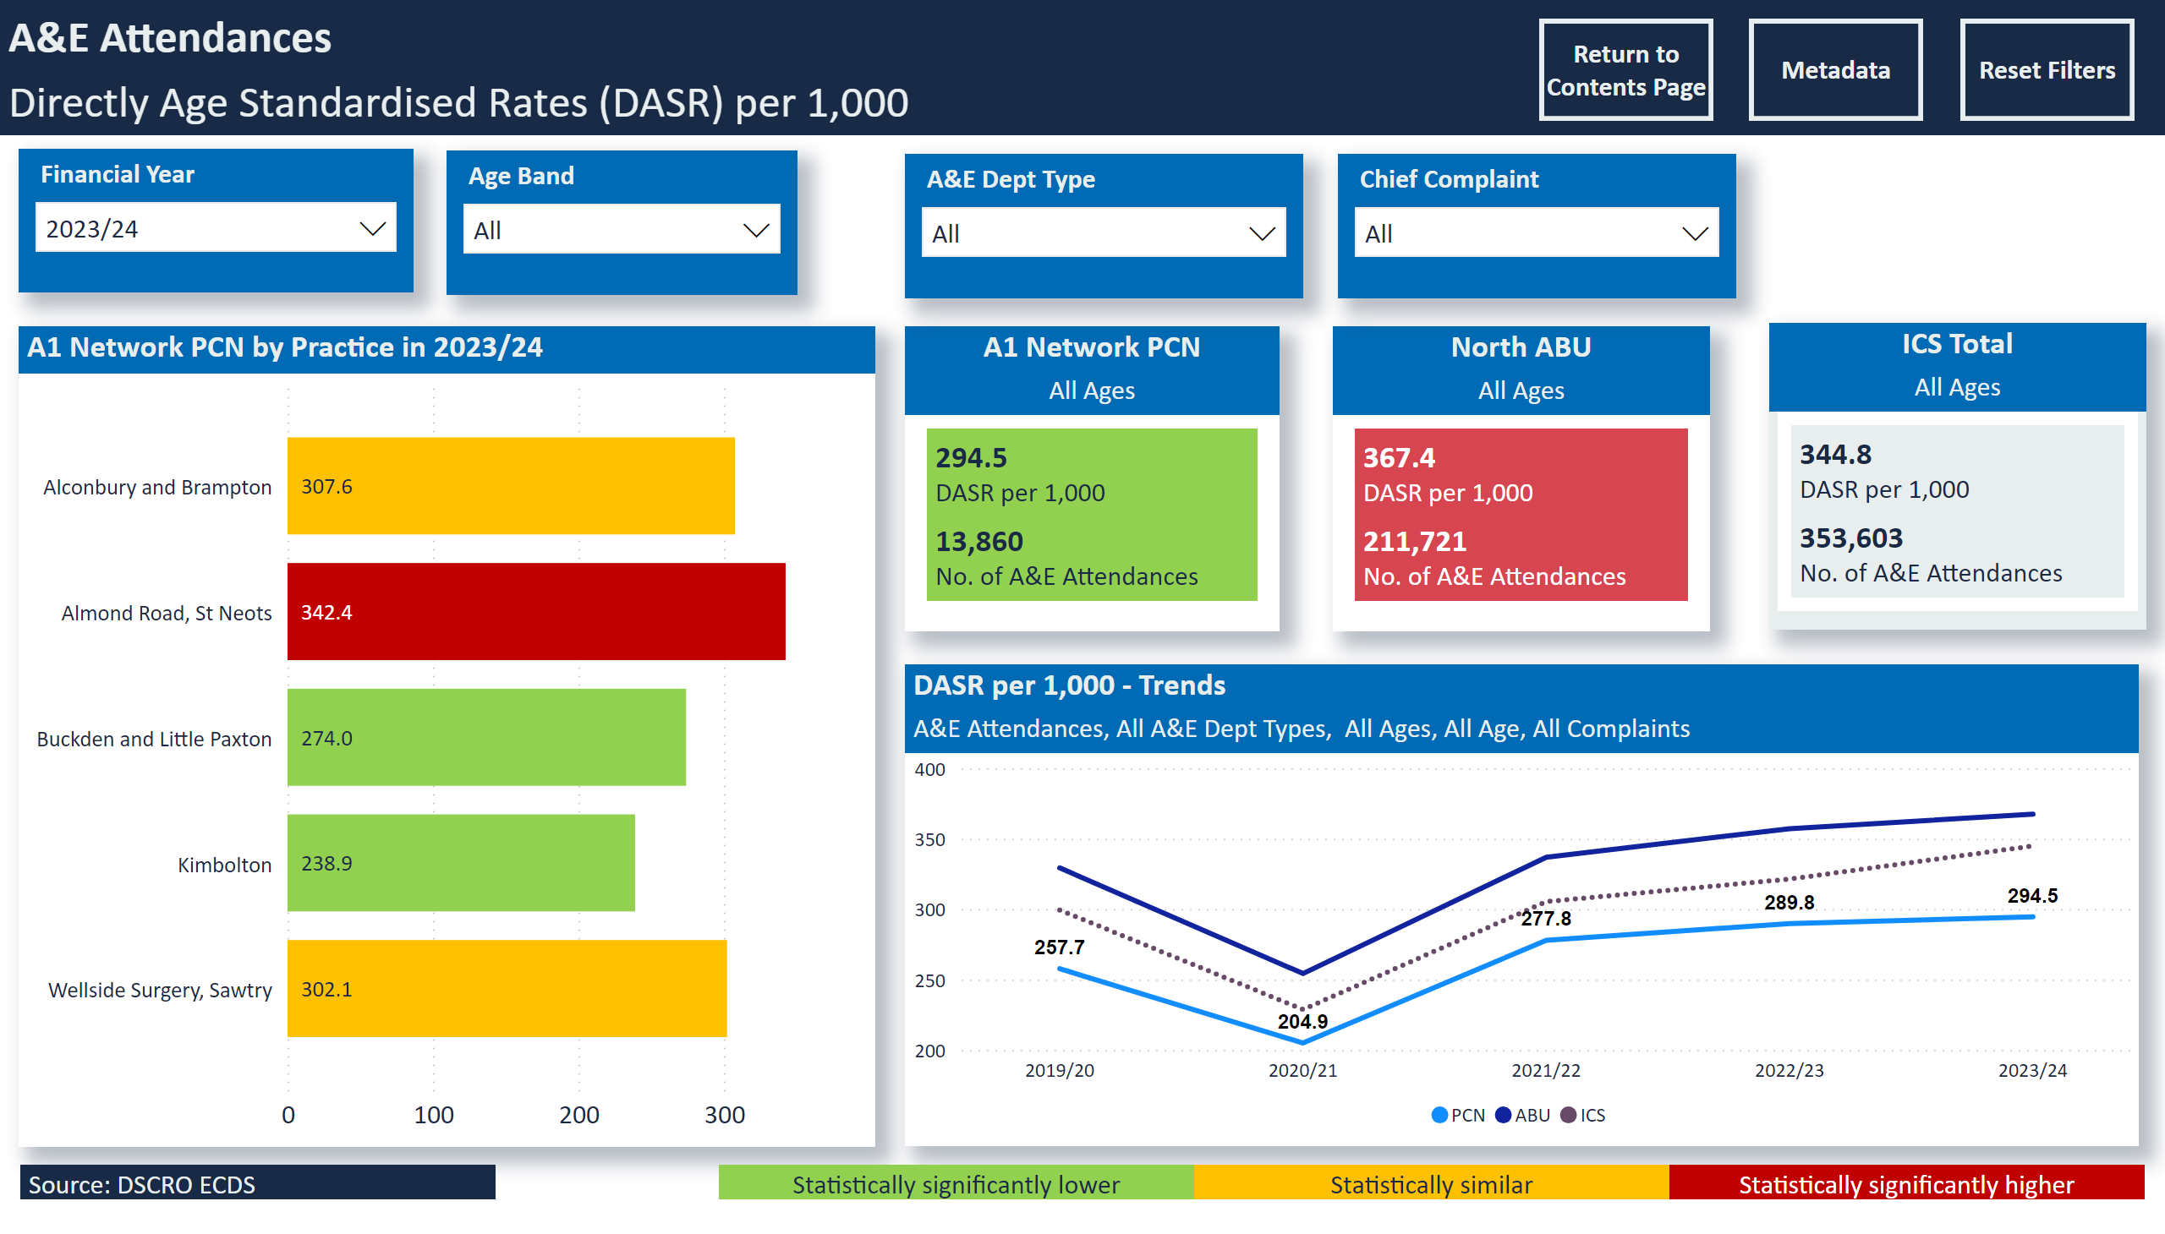
A&E Attendances
Notes:
A1 Network PCN by Practice in 2023/24
No alt text provided
slicer
No alt text provided
slicer
No alt text provided
A&E Attendances
No alt text provided
slicer
No alt text provided
slicer
No alt text provided
slicer
No alt text provided
DASR per 1,000 - Trends
No alt text provided
North ABU
No alt text provided
ICS Total
No alt text provided
A1 Network PCN
No alt text provided
Source: DSCRO ECDS
No alt text provided
Statistically significantly higher
No alt text provided
Statistically similar
No alt text provided
Statistically significantly lower
No alt text provided
slicer
No alt text provided
actionButton
No alt text provided
actionButton
No alt text provided
actionButton
No alt text provided
Select Age Group, Age
No alt text provided
Select Age Group, Age
No alt text provided
Select Age
No alt text provided

Slide 19
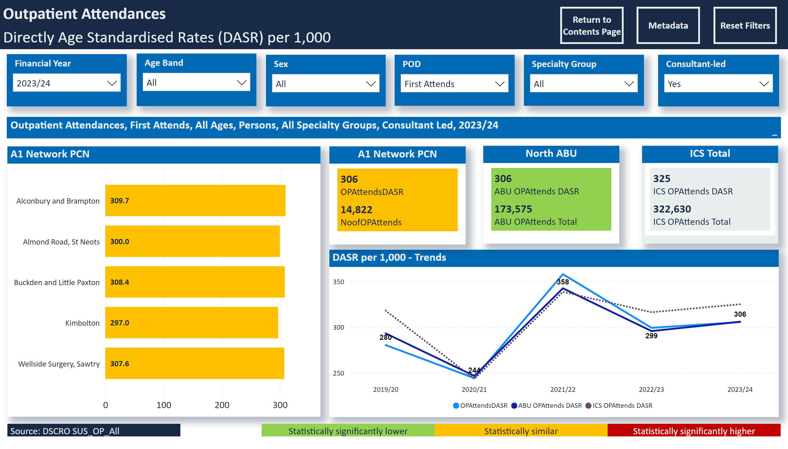
OP Firsts
Notes:
Select Age
No alt text provided
Select Age
No alt text provided
slicer
No alt text provided
Select Age
No alt text provided
Select Age
No alt text provided
Outpatient Attendances, First Attends, All Ages, Persons, All Specialty Groups, Consultant Led, 2023/24
No alt text provided
A1 Network PCN
No alt text provided
slicer
No alt text provided
slicer
No alt text provided
Outpatient Attendances
No alt text provided
slicer
No alt text provided
slicer
No alt text provided
slicer
No alt text provided
DASR per 1,000 - Trends
No alt text provided
North ABU
No alt text provided
ICS Total
No alt text provided
A1 Network PCN
No alt text provided
Source: DSCRO SUS_OP_All
No alt text provided
Statistically significantly higher
No alt text provided
Statistically similar
No alt text provided
Statistically significantly lower
No alt text provided
slicer
No alt text provided
actionButton
No alt text provided
actionButton
No alt text provided
actionButton
No alt text provided
slicer
No alt text provided
slicer
No alt text provided
Select Age
No alt text provided

Slide 20
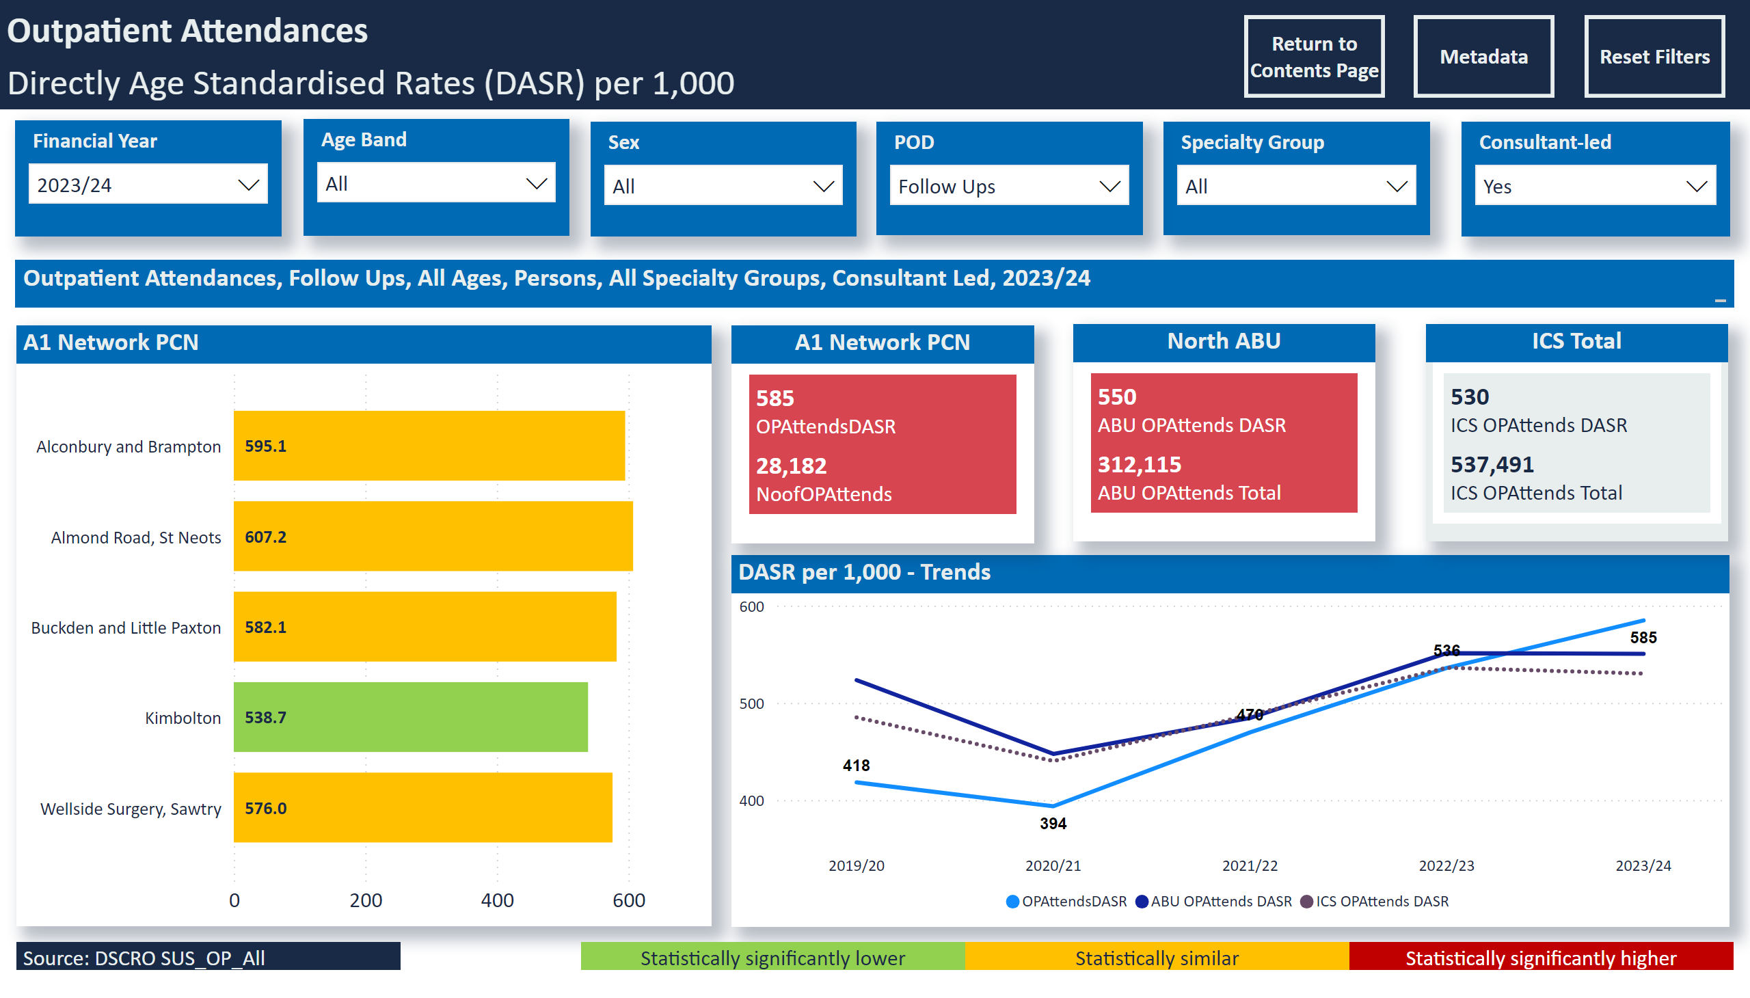
OP Follow Ups
Notes:
Select Age
No alt text provided
Select Age
No alt text provided
slicer
No alt text provided
Select Age
No alt text provided
Select Age
No alt text provided
Outpatient Attendances, Follow Ups, All Ages, Persons, All Specialty Groups, Consultant Led, 2023/24
No alt text provided
A1 Network PCN
No alt text provided
slicer
No alt text provided
slicer
No alt text provided
Outpatient Attendances
No alt text provided
slicer
No alt text provided
slicer
No alt text provided
slicer
No alt text provided
DASR per 1,000 - Trends
No alt text provided
North ABU
No alt text provided
ICS Total
No alt text provided
A1 Network PCN
No alt text provided
Source: DSCRO SUS_OP_All
No alt text provided
Statistically significantly higher
No alt text provided
Statistically similar
No alt text provided
Statistically significantly lower
No alt text provided
slicer
No alt text provided
actionButton
No alt text provided
actionButton
No alt text provided
actionButton
No alt text provided
slicer
No alt text provided
slicer
No alt text provided
Select Age
No alt text provided

Slide 21
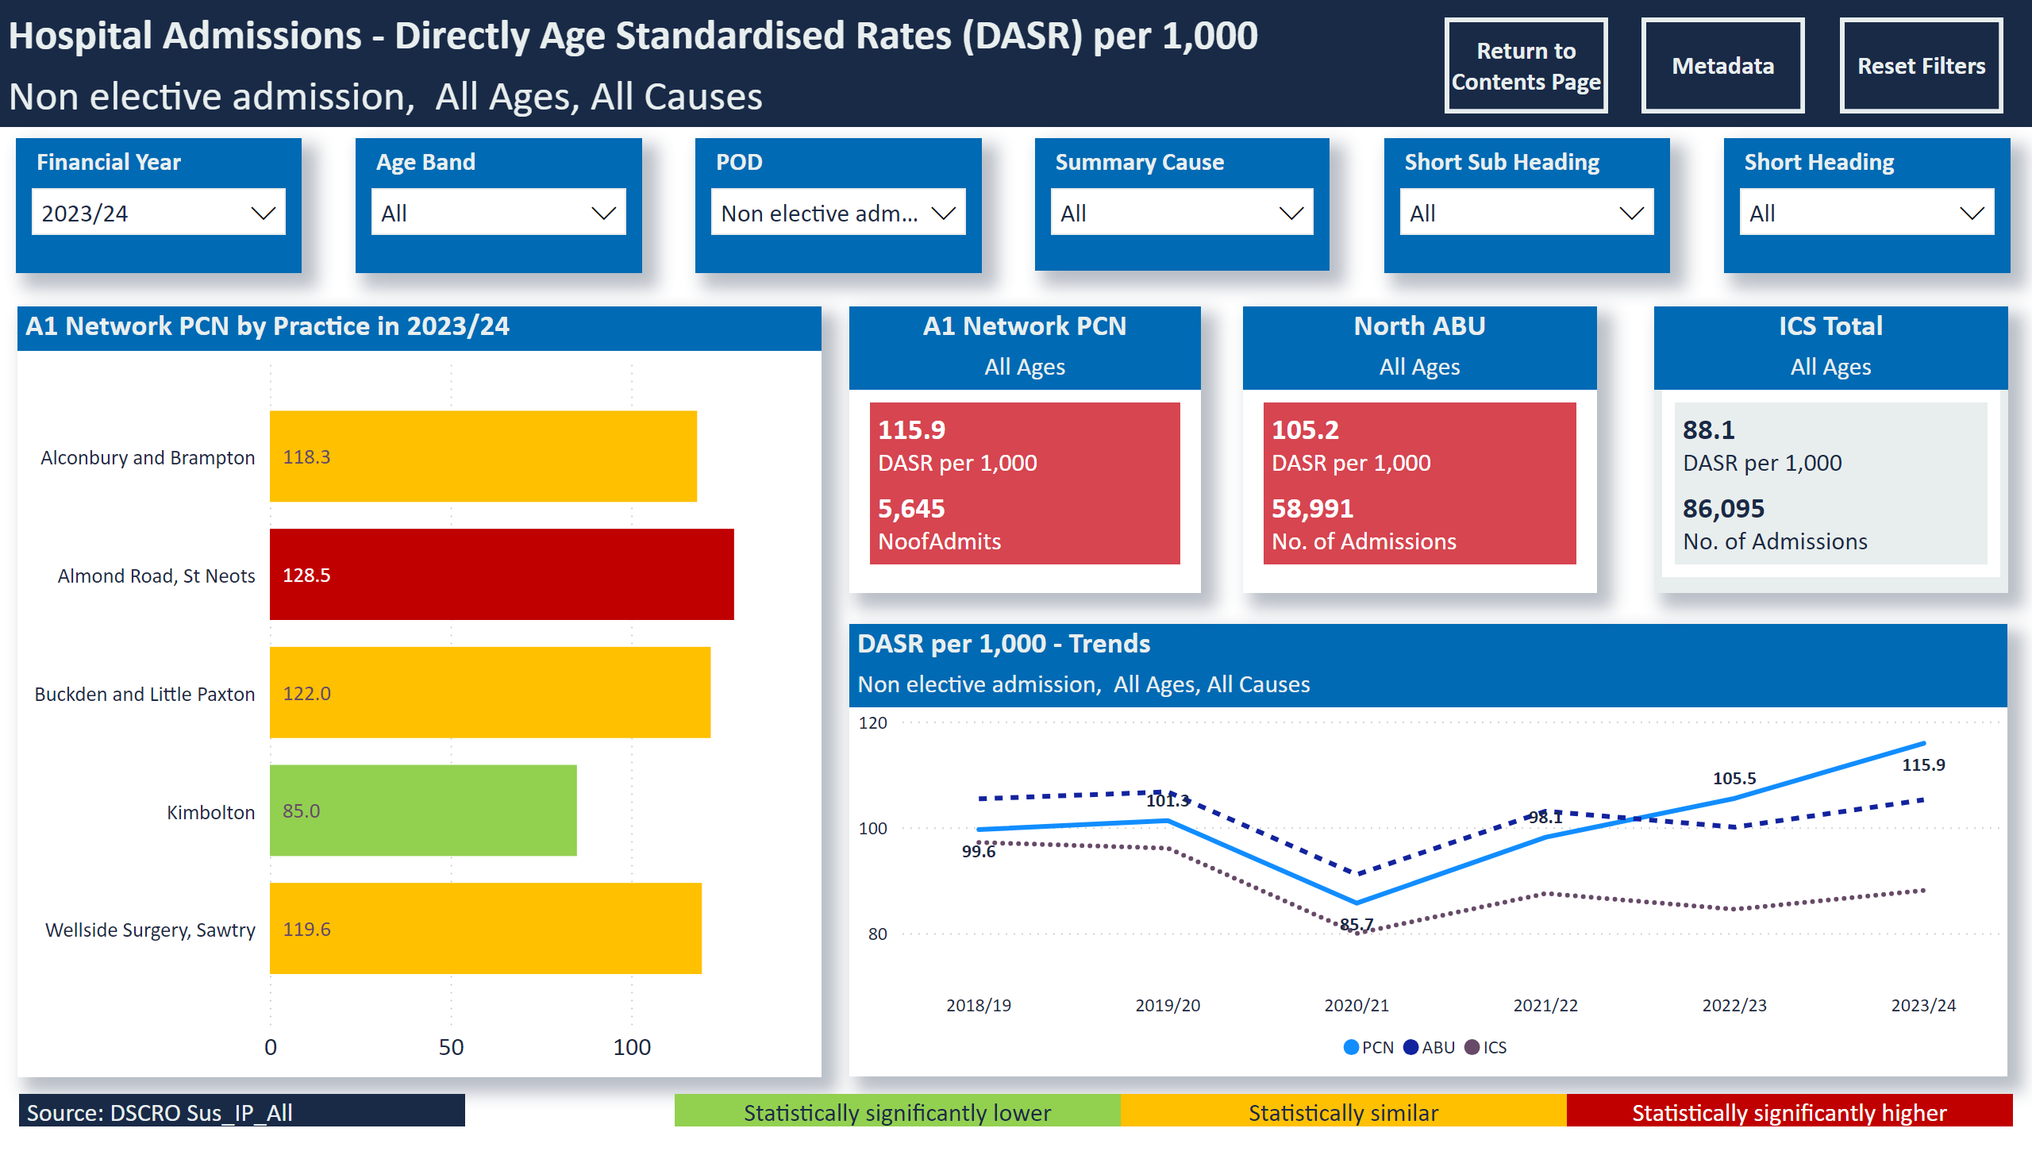
Non electives
Notes:
slicer
No alt text provided
A1 Network PCN by Practice in 2023/24
No alt text provided
slicer
No alt text provided
slicer
No alt text provided
Hospital Admissions - Directly Age Standardised Rates (DASR) per 1,000
No alt text provided
slicer
No alt text provided
slicer
No alt text provided
slicer
No alt text provided
DASR per 1,000 - Trends
No alt text provided
North ABU
No alt text provided
ICS Total
No alt text provided
A1 Network PCN
No alt text provided
Source: DSCRO Sus_IP_All
No alt text provided
Statistically significantly higher
No alt text provided
Statistically similar
No alt text provided
Statistically significantly lower
No alt text provided
slicer
No alt text provided
actionButton
No alt text provided
actionButton
No alt text provided
actionButton
No alt text provided
Select Age
No alt text provided

Slide 22
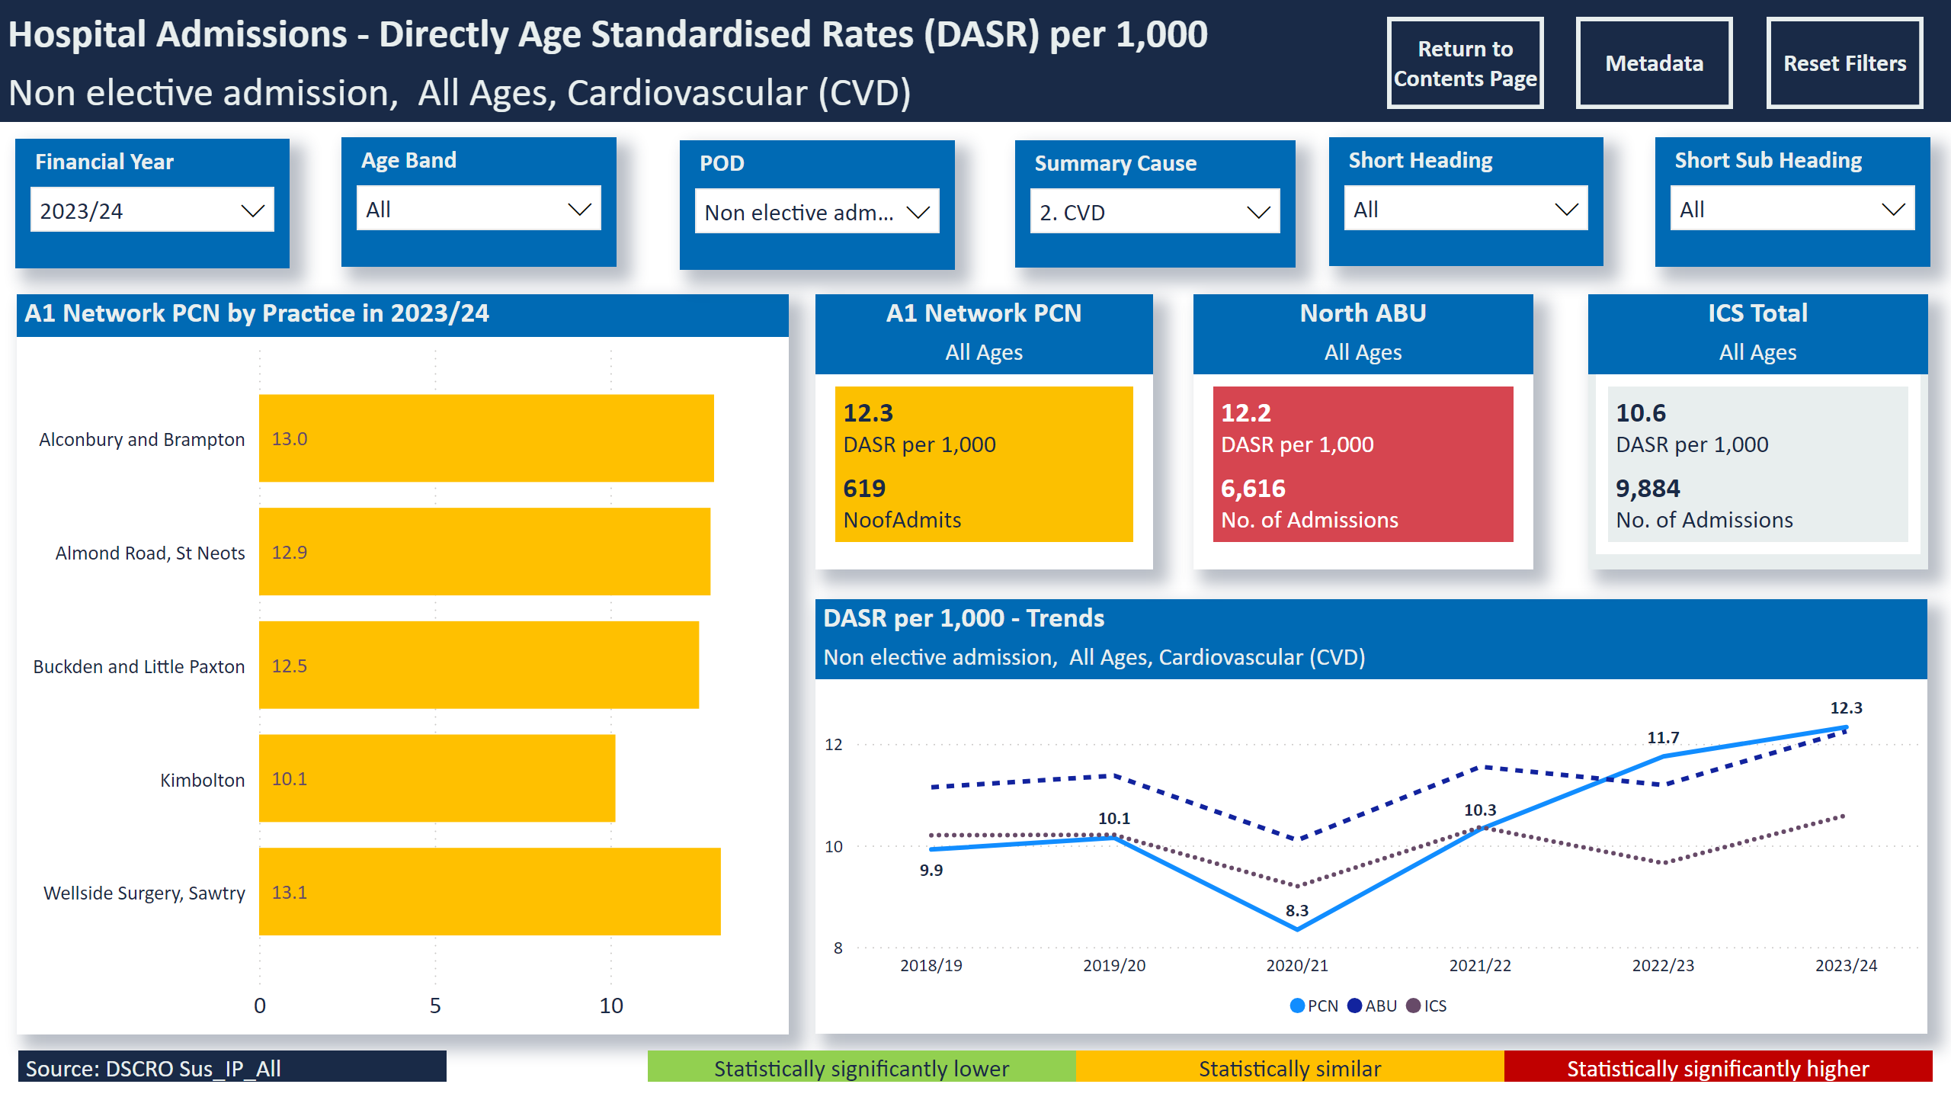
Non electives - CVD
Notes:
slicer
No alt text provided
A1 Network PCN by Practice in 2023/24
No alt text provided
slicer
No alt text provided
slicer
No alt text provided
Hospital Admissions - Directly Age Standardised Rates (DASR) per 1,000
No alt text provided
slicer
No alt text provided
slicer
No alt text provided
slicer
No alt text provided
DASR per 1,000 - Trends
No alt text provided
North ABU
No alt text provided
ICS Total
No alt text provided
A1 Network PCN
No alt text provided
Source: DSCRO Sus_IP_All
No alt text provided
Statistically significantly higher
No alt text provided
Statistically similar
No alt text provided
Statistically significantly lower
No alt text provided
slicer
No alt text provided
actionButton
No alt text provided
actionButton
No alt text provided
actionButton
No alt text provided
Select Age
No alt text provided

Slide 23
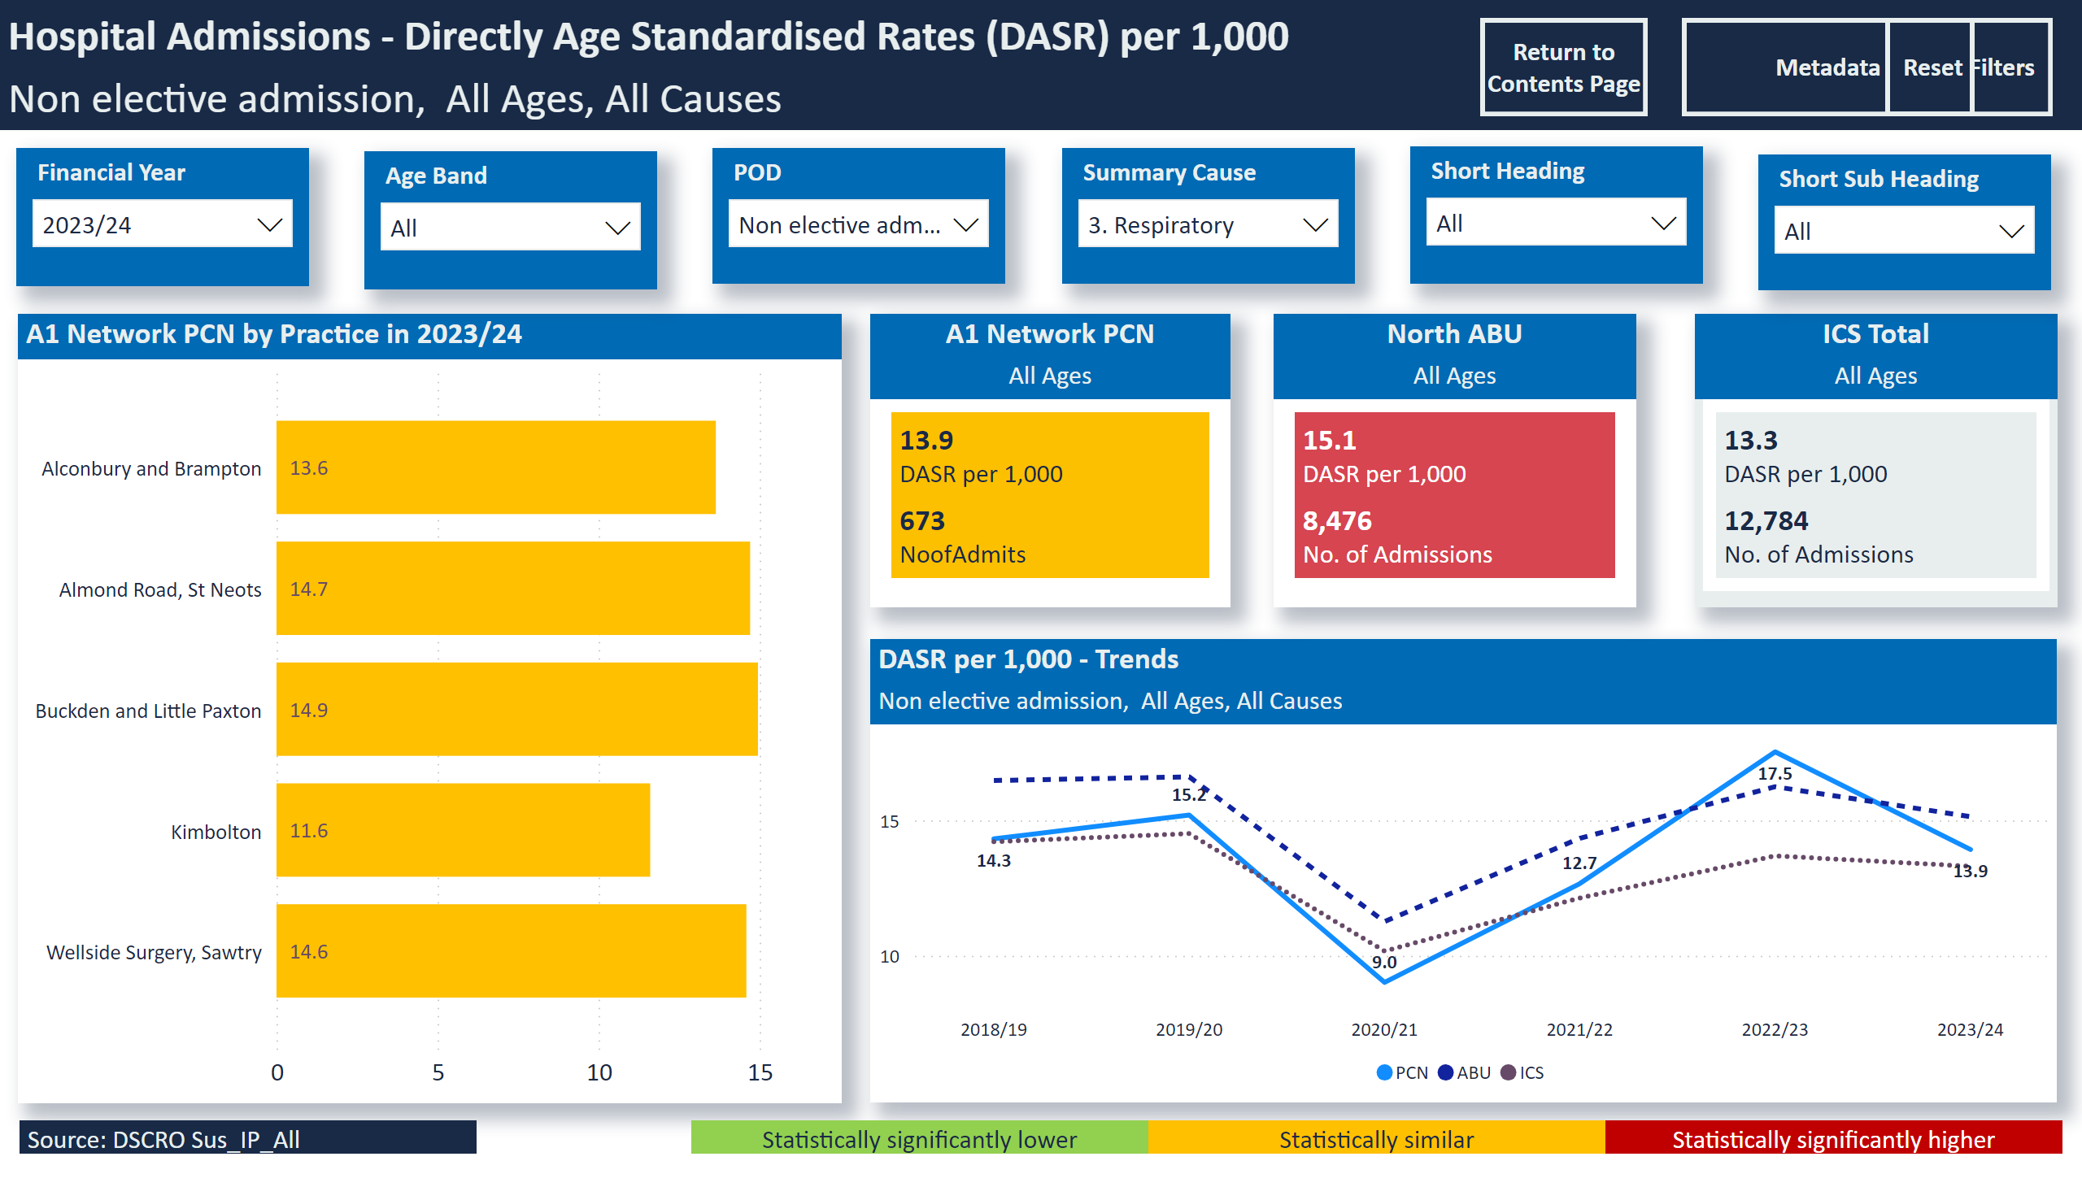
Non electives - Resp
Notes:
slicer
No alt text provided
A1 Network PCN by Practice in 2023/24
No alt text provided
slicer
No alt text provided
slicer
No alt text provided
Hospital Admissions - Directly Age Standardised Rates (DASR) per 1,000
No alt text provided
slicer
No alt text provided
slicer
No alt text provided
slicer
No alt text provided
DASR per 1,000 - Trends
No alt text provided
North ABU
No alt text provided
ICS Total
No alt text provided
A1 Network PCN
No alt text provided
Source: DSCRO Sus_IP_All
No alt text provided
Statistically significantly higher
No alt text provided
Statistically similar
No alt text provided
Statistically significantly lower
No alt text provided
slicer
No alt text provided
actionButton
No alt text provided
actionButton
No alt text provided
actionButton
No alt text provided
Select Age
No alt text provided

Slide 24
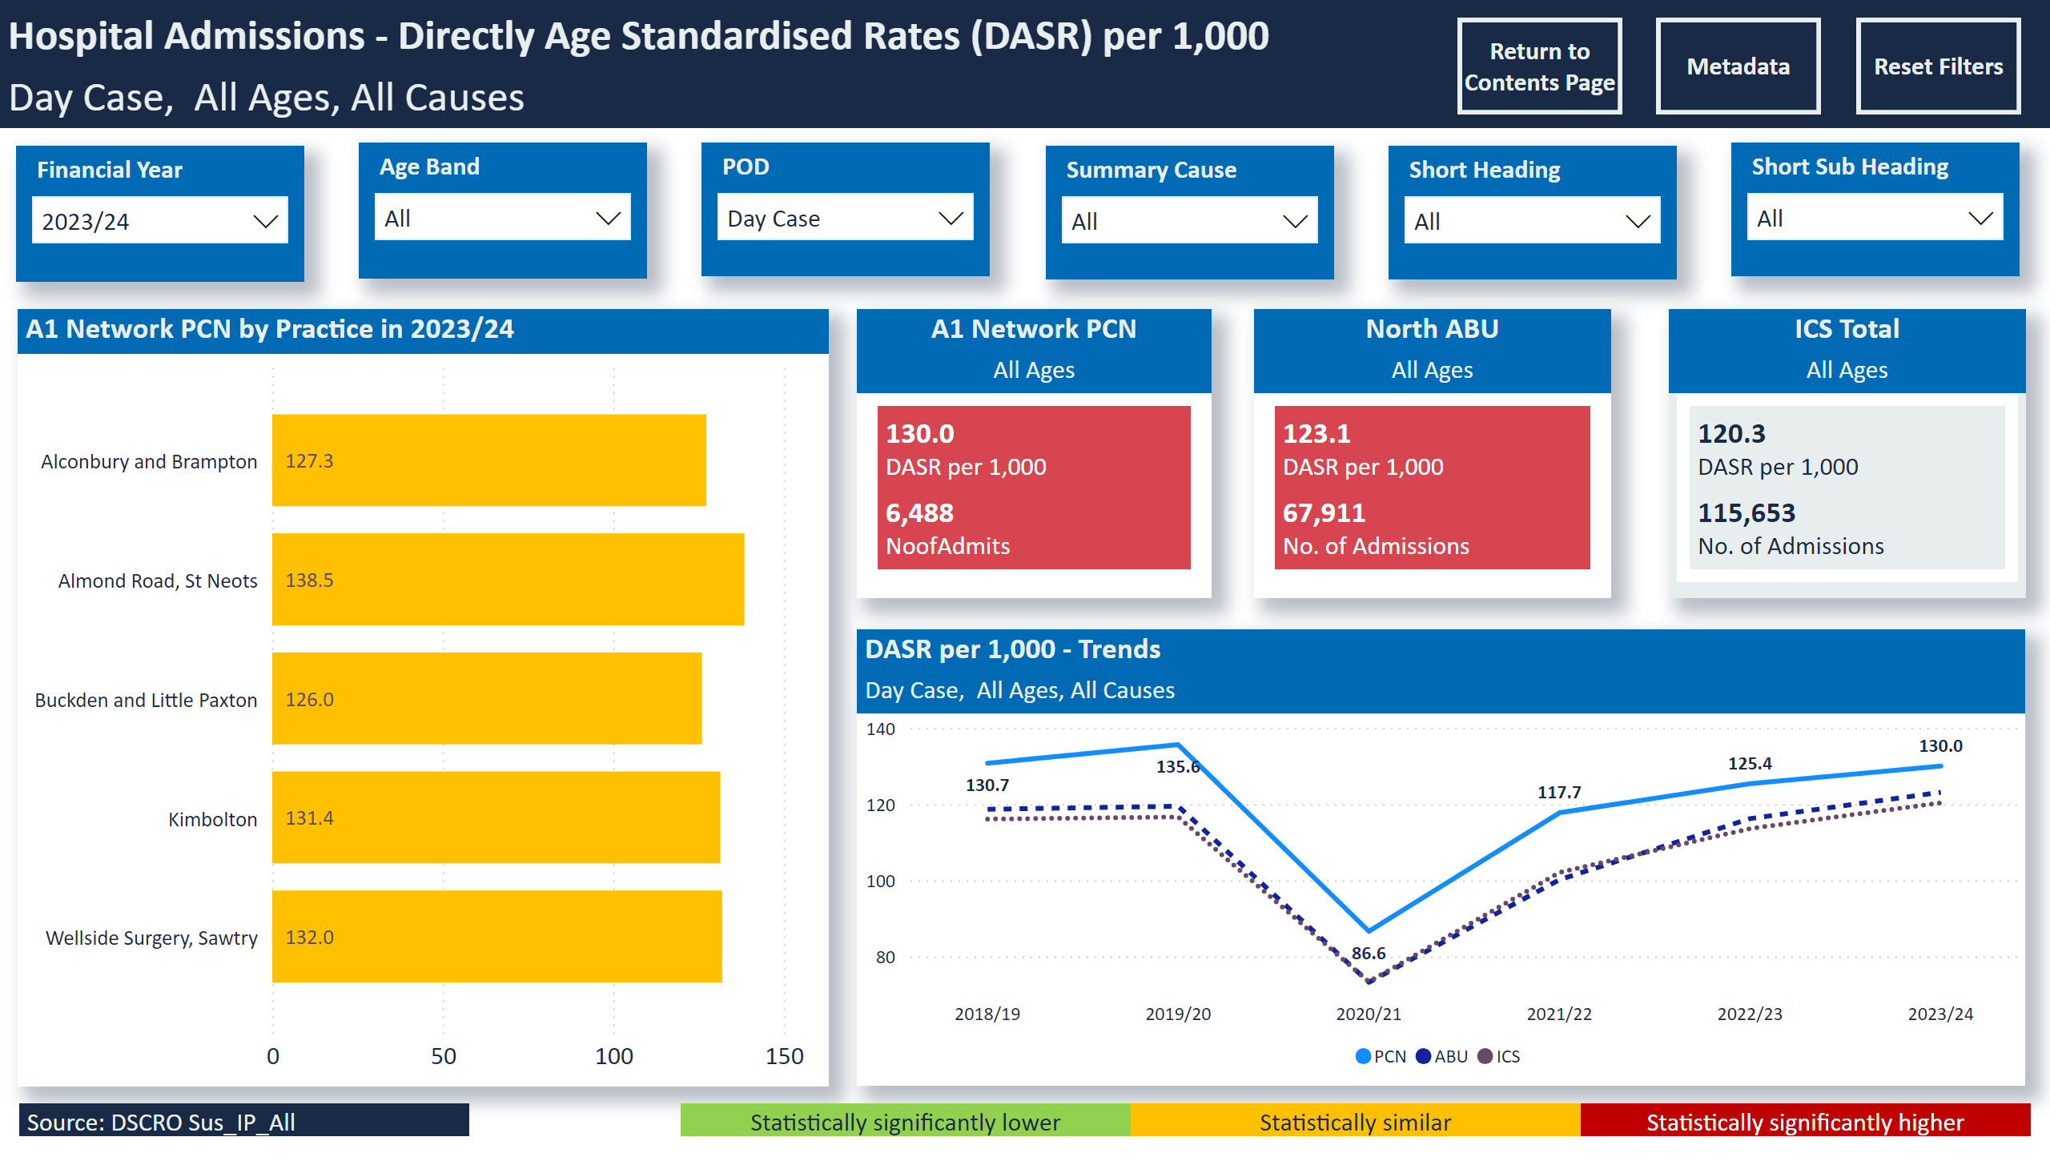
Day Cases
Notes:
slicer
No alt text provided
A1 Network PCN by Practice in 2023/24
No alt text provided
slicer
No alt text provided
slicer
No alt text provided
Hospital Admissions - Directly Age Standardised Rates (DASR) per 1,000
No alt text provided
slicer
No alt text provided
slicer
No alt text provided
slicer
No alt text provided
DASR per 1,000 - Trends
No alt text provided
North ABU
No alt text provided
ICS Total
No alt text provided
A1 Network PCN
No alt text provided
Source: DSCRO Sus_IP_All
No alt text provided
Statistically significantly higher
No alt text provided
Statistically similar
No alt text provided
Statistically significantly lower
No alt text provided
slicer
No alt text provided
actionButton
No alt text provided
actionButton
No alt text provided
actionButton
No alt text provided
Select Age
No alt text provided

Slide 25
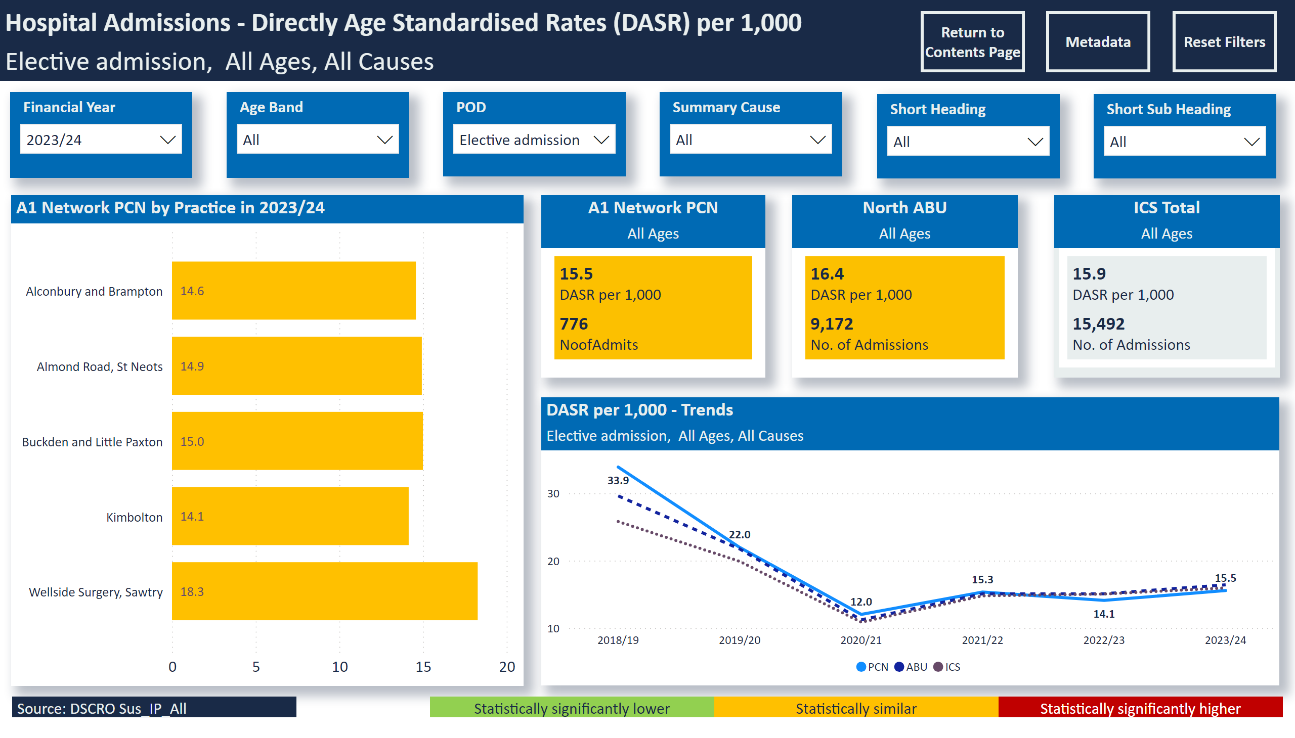
Electives
Notes:
slicer
No alt text provided
A1 Network PCN by Practice in 2023/24
No alt text provided
slicer
No alt text provided
slicer
No alt text provided
Hospital Admissions - Directly Age Standardised Rates (DASR) per 1,000
No alt text provided
slicer
No alt text provided
slicer
No alt text provided
slicer
No alt text provided
DASR per 1,000 - Trends
No alt text provided
North ABU
No alt text provided
ICS Total
No alt text provided
A1 Network PCN
No alt text provided
Source: DSCRO Sus_IP_All
No alt text provided
Statistically significantly higher
No alt text provided
Statistically similar
No alt text provided
Statistically significantly lower
No alt text provided
slicer
No alt text provided
actionButton
No alt text provided
actionButton
No alt text provided
actionButton
No alt text provided
Select Age
No alt text provided

Slide 26
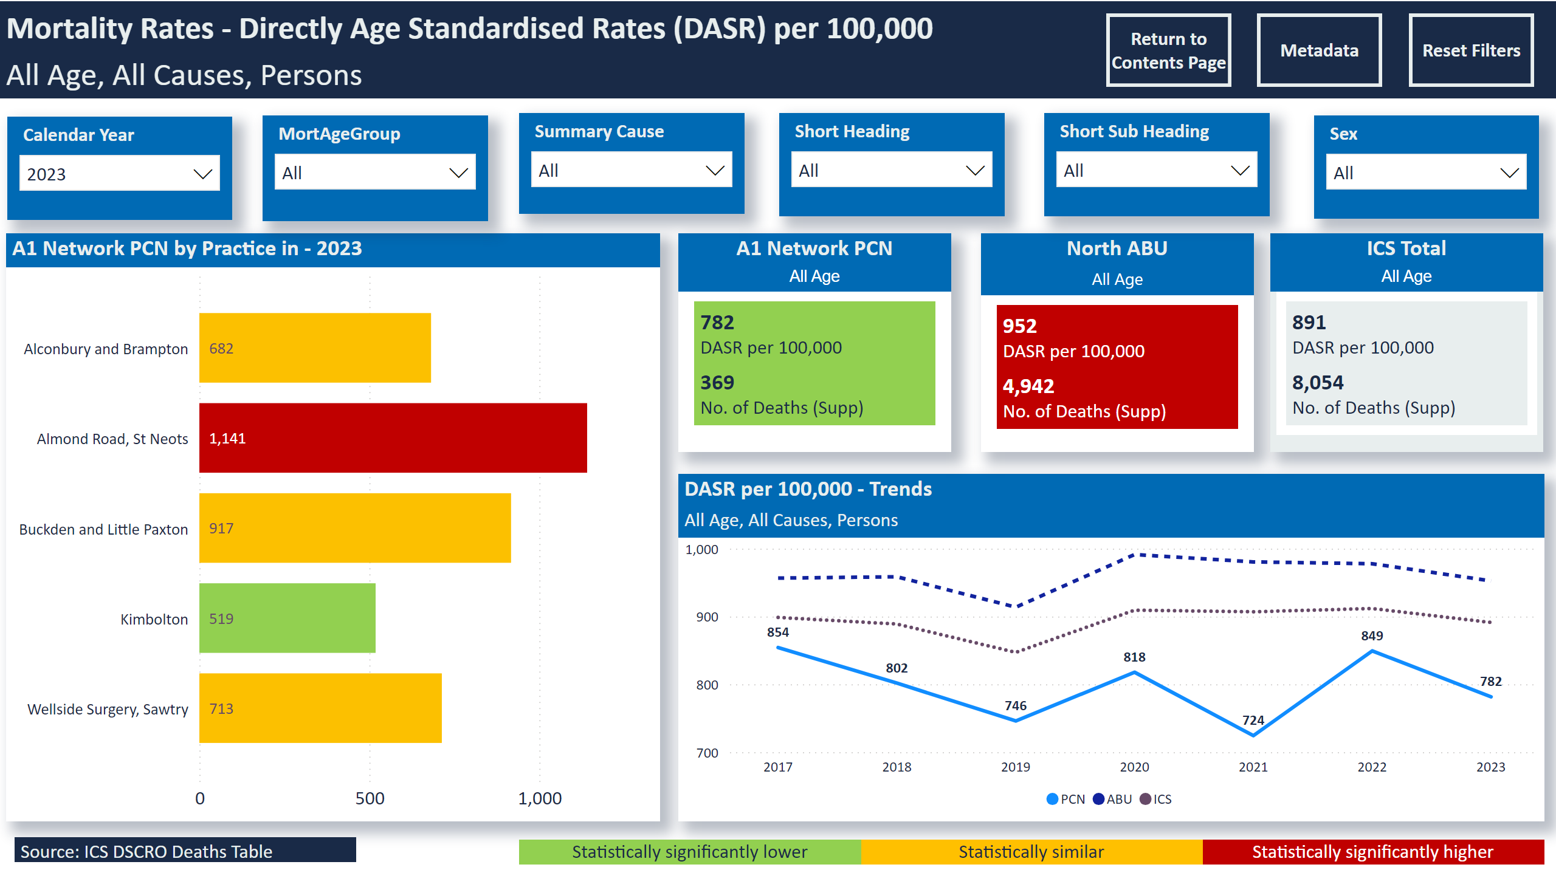
Mortality
Notes:
slicer
No alt text provided
slicer
No alt text provided
slicer
No alt text provided
slicer
No alt text provided
A1 Network PCN by Practice in - 2023
No alt text provided
slicer
No alt text provided
DASR per 100,000 - Trends
No alt text provided
slicer
No alt text provided
Mortality Rates - Directly Age Standardised Rates (DASR) per 100,000
No alt text provided
Statistically significantly higher
No alt text provided
Statistically similar
No alt text provided
Statistically significantly lower
No alt text provided
A1 Network PCN
No alt text provided
North ABU
No alt text provided
ICS Total
No alt text provided
Source: ICS DSCRO Deaths Table
No alt text provided
slicer
No alt text provided
slicer
No alt text provided
slicer
No alt text provided
slicer
No alt text provided
actionButton
No alt text provided
actionButton
No alt text provided
actionButton
No alt text provided
slicer
No alt text provided

Slide 27
Mortality - Prem
Notes:
slicer
No alt text provided
slicer
No alt text provided
slicer
No alt text provided
slicer
No alt text provided
A1 Network PCN by Practice in - 2023
No alt text provided
slicer
No alt text provided
DASR per 100,000 - Trends
No alt text provided
slicer
No alt text provided
Mortality Rates - Directly Age Standardised Rates (DASR) per 100,000
No alt text provided
Statistically significantly higher
No alt text provided
Statistically similar
No alt text provided
Statistically significantly lower
No alt text provided
A1 Network PCN
No alt text provided
North ABU
No alt text provided
ICS Total
No alt text provided
Source: ICS DSCRO Deaths Table
No alt text provided
slicer
No alt text provided
slicer
No alt text provided
slicer
No alt text provided
slicer
No alt text provided
actionButton
No alt text provided
actionButton
No alt text provided
actionButton
No alt text provided
slicer
No alt text provided

Slide 28
Mortality - Prem CVD
Notes:
slicer
No alt text provided
slicer
No alt text provided
slicer
No alt text provided
slicer
No alt text provided
A1 Network PCN by Practice in - 2023
No alt text provided
slicer
No alt text provided
DASR per 100,000 - Trends
No alt text provided
slicer
No alt text provided
Mortality Rates - Directly Age Standardised Rates (DASR) per 100,000
No alt text provided
Statistically significantly higher
No alt text provided
Statistically similar
No alt text provided
Statistically significantly lower
No alt text provided
A1 Network PCN
No alt text provided
North ABU
No alt text provided
ICS Total
No alt text provided
Source: ICS DSCRO Deaths Table
No alt text provided
slicer
No alt text provided
slicer
No alt text provided
slicer
No alt text provided
slicer
No alt text provided
actionButton
No alt text provided
actionButton
No alt text provided
actionButton
No alt text provided
slicer
No alt text provided

Slide 29
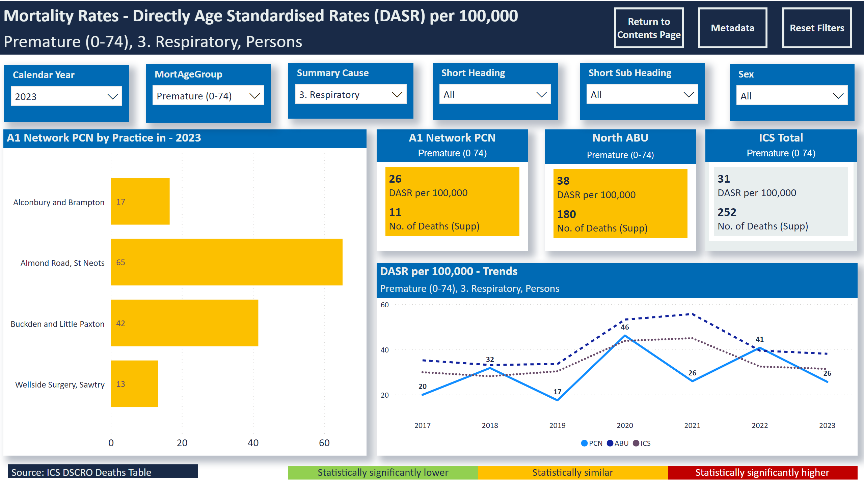
Mortality - Prem Resp
Notes:
slicer
No alt text provided
slicer
No alt text provided
slicer
No alt text provided
slicer
No alt text provided
A1 Network PCN by Practice in - 2023
No alt text provided
slicer
No alt text provided
DASR per 100,000 - Trends
No alt text provided
slicer
No alt text provided
Mortality Rates - Directly Age Standardised Rates (DASR) per 100,000
No alt text provided
Statistically significantly higher
No alt text provided
Statistically similar
No alt text provided
Statistically significantly lower
No alt text provided
A1 Network PCN
No alt text provided
North ABU
No alt text provided
ICS Total
No alt text provided
Source: ICS DSCRO Deaths Table
No alt text provided
slicer
No alt text provided
slicer
No alt text provided
slicer
No alt text provided
slicer
No alt text provided
actionButton
No alt text provided
actionButton
No alt text provided
actionButton
No alt text provided
slicer
No alt text provided

