Slide 1
Cambridgeshire and Peterborough
Mental Health Needs Assessment
Chapter 5: Working Age Adults
Demographics and Service Use

Slide 2
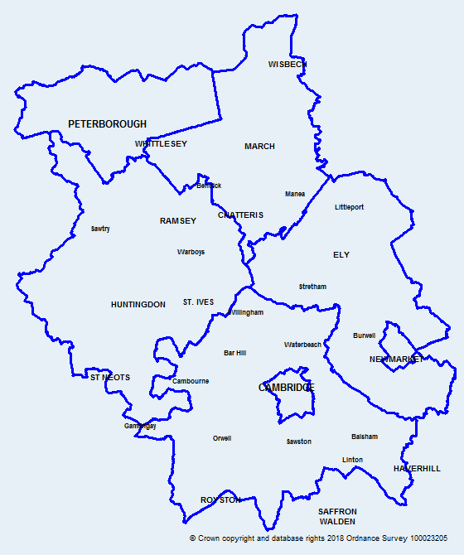
Introduction
Map of Cambridgeshire
and Peterborough
This data pack has been produced on working age adults’ (18 – 64 years) mental health to support the Cambridgeshire and Peterborough all age mental health and learning disabilities needs assessment.
Abbreviations used:
ICB | Integrated Care Board
STP | Sustainability and Transformation Partnership
CCG | Clinical Commissioning Group
C&PCCG | Cambridgeshire and Peterborough Clinical Commissioning Group
C&PICB | Cambridgeshire and Peterborough Integrated Care Board
CPFT | Cambridgeshire and Peterborough NHS Foundation Trust
CCC | Cambridgeshire County Council
PCC | Peterborough City Council
MH | Mental Health
MHA | Mental Health Act

Slide 3
Table of Contents
  Demographics
  NHS Taking Therapies for Anxiety and Depression
  Community Mental Health Services
  Voluntary and Community Sector Support
  Crisis Services
  Mental Health Act episodes and detentions
  Acute Inpatient Mental Health Care

Slide 4
Demographics

Slide 5
Summary - Demographics
In Cambridgeshire and Peterborough, Census 2021 estimates show that there are over 579,960 people aged 15 to 64, which is about 64.8% of the total population.
Around one quarter of the overall population in Peterborough and Cambridge City comprises “Asian, Asian British or Asian Welsh”, “black, black British, black Welsh, Caribbean or African”, “mixed or multiple ethnic groups” and “other ethnic group”.
The highest percentage increase in the working-age population between Census 2011 and 2021 is seen in Cambridge (+18%), followed by Peterborough (+14%). Overall, an increase of 7.9% is seen in Cambridgeshire and Peterborough.
There will be an increase in the working-age population by 16.6% (73,270) from 2021 to 2041 in Cambridgeshire and 12.4% (17,300) in Peterborough. These are locally produced estimates based on what is currently known about our population and local plans for development; they are subject to change.

Slide 6
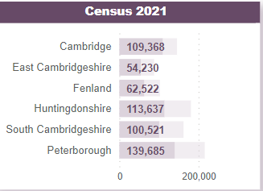
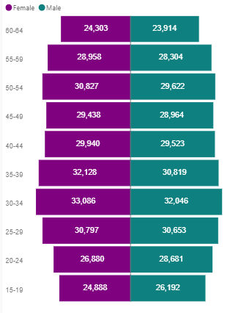
Census population for Cambridgeshire and Peterborough, 15–64 years
Census 2021 population by districts, 15—64 years
Census 2021 population for Cambridgeshire and Peterborough combined, by age band, 15—64 years
Light purple shows Total population
Dark purple shows 15 – 64 population
The prevalence of many mental health conditions varies with age and sex. For example, according to the Adult Psychiatric Morbidity Survey (2014), among the 16–24 age group, the estimated prevalence of common mental disorders was about three times more common in women than in men.
In Cambridgeshire and Peterborough, Census 2021 estimates show that on Census Day there were around 579,960 people aged 15 to 64 (64.8% of the total population), which is similar to England (64.2%).
The number of people in the working-age group is highest in Peterborough, followed by Huntingdonshire and Cambridge.
Overall, the female population is slightly higher than the male population for this age group.
Source: Cambridgeshire & Peterborough Insight – JSNA 2023 – Demography – Age structure and population change (cambridgeshireinsight.org.uk)

Slide 7
Census population for Cambridgeshire and Peterborough, 15–64 years
Census 2021 population by Ethnic group, 15—64 years
Ethnic group | Cambridge | East Cambridgeshire | Fenland | Huntingdonshire | South Cambridgeshire | Cambridgeshire | Peterborough | Cambridgeshire and Peterborough
Asian, Asian British or Asian Welsh | 16.2% | 2.3% | 1.5% | 3.7% | 6.7% | 7.0% | 14.7% | 8.9%
Black, Black British, Black Welsh, Caribbean or African | 2.7% | 1.0% | 0.9% | 1.7% | 1.5% | 1.7% | 4.3% | 2.3%
Mixed or Multiple ethnic groups | 4.3% | 1.8% | 1.3% | 1.9% | 2.3% | 2.5% | 2.8% | 2.6%
Other ethnic group | 3.3% | 0.8% | 0.9% | 0.8% | 1.3% | 1.5% | 2.8% | 1.9%
White | 73.5% | 94.1% | 95.4% | 91.9% | 88.2% | 87.3% | 75.3% | 84.4%
Grand Total | 100.0% | 100.0% | 100.0% | 100.0% | 100.0% | 100.0% | 100.0% | 100.0%
There have been several researches highlighting ethnic inequalities in the prevalence of mental health conditions and across all aspects of the mental health system.
Cambridgeshire and Peterborough's population are a diverse mix of ethnic backgrounds, but this varies across our areas.
In Peterborough and Cambridge, the proportion of the 15–64 population who identify as "Asian, Asian British, or Asian Welsh" is substantially higher than the combined average of Cambridgeshire and Peterborough.
The proportion of people from a "white" ethnic group in East Cambridgeshire, Fenland, and Huntingdonshire is substantially higher than the C&P average, whereas the proportions of people from "Asian, Asian British, or Asian Welsh" and "Black, Black British, Black Welsh, Caribbean, or African" ethnic groups are notably lower than the combined average of Cambridgeshire and Peterborough.
Source: Create a custom dataset - Office for National Statistics (ons.gov.uk)

Slide 8
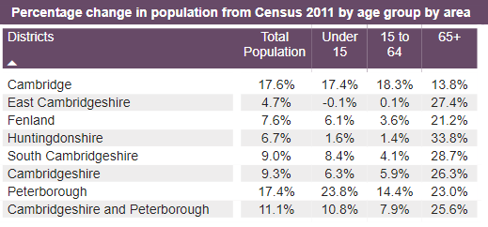
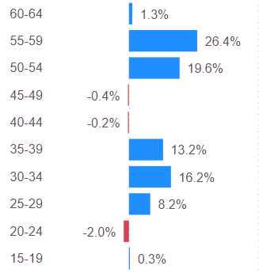
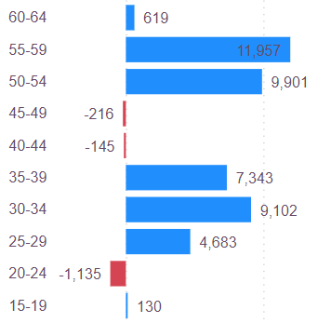

Population change for Cambridgeshire and Peterborough, 15–64 years
Percentage change between Census 2011 and 2021, by age group
Change in population number between Census 2011 and 2021, by age band
Overall, we have seen a substantial increase in the size of our working-age population in the last ten years (between 2011 and 2021); this is likely to be driving additional demand on mental health services.
The highest percentage increase in the working-age population from Census 2011 is seen in Cambridge (+18%), followed by Peterborough (+14%). Overall, an increase of 7.9% is seen in Cambridgeshire and Peterborough as a whole though some areas have seen very little change.
In Cambridgeshire and Peterborough, the highest absolute and percentage increase from 2011 is seen among 50–59 years. Interestingly, the numbers of people in their 40s and of people aged 15-24 has changed very little.
Source: Cambridgeshire & Peterborough Insight – JSNA 2023 – Demography – Age structure and population change (cambridgeshireinsight.org.uk)

Slide 9
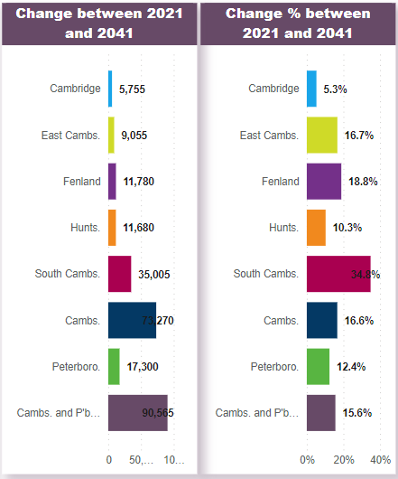
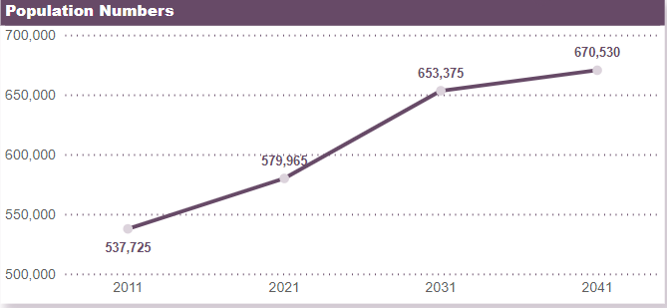
Forecasted population growth for Cambridgeshire and Peterborough, 15–64 years
Based on the Cambridgeshire County Council population forecast, an overall increase of 15.6% will be seen in Cambridgeshire and Peterborough in the working-age group in 2041 compared to 2021.
The forecasting predicts an increase of 16.6% (73,270) from 2021 to 2041 in Cambridgeshire and 12.4% (17,300) in Peterborough.
These are locally produced estimates based on what is currently known about our population and local plans for development; they are subject to change.
Source: Cambridgeshire & Peterborough Insight – JSNA 2023 – Demography – Predicted future change (cambridgeshireinsight.org.uk)

Slide 10
NHS Talking Therapies for anxiety and depression
Notes:
Talking Therapies (previously known as Improving Access to Psychological Therapies (IAPT) and later locally as the CPFT Psychological Wellbeing Service) provides treatment for common mental health conditions
Talking Therapies can be accessed by anyone aged 18 or over, without the need for a mental health diagnosis. People can self-refer into this service or can be referred a GP. Treatment offered includes:
Low intensity interventions
Cognitive behavioural therapy (CBT)
Computerised cognitive behavioural therapy (CBT)
Virtual reality-based therapy
Interpersonal therapy (IPT)
Eye Movement Desensitisation Reprocessing (EMDR)
Wellbeing workshops and group treatments
Specialist support for people who are unemployed.

Slide 11
Summary – NHS Talking Therapies
In Cambridgeshire and Peterborough ICB, a higher proportion of referrals into NHS talking therapies were among 26–64 year olds, and over 60% of all the referrals were female.
In 2023, 46% of the total referrals were repeat referrals, and the number of repeat referrals increased by 63% from 2019.
The waiting times for accessing the talking therapy service have decreased slightly from May 2022 to May 2023.
About 40% to 50% of all the appointments were CBT, with a fairly stable trend, while the proportion of guided self-help has increased since March 2018.
The recovery and improvement rates for the under-18 and 18–25 age groups have been consistently below the national targets.
The recovery rates for ethnic minorities have been consistently lower than white British and the national target, while they're similar to or higher than the target for white British.

Slide 12
Repeat referrals, 16+ years, Cambridgeshire and Peterborough ICB
The number of total referrals and repeat referrals has shown an overall increases since March 2018.
In 2023, 46% of the total referrals were repeat referrals and the repeat referrals increased by 63% from 2019.
A periodic dip is seen in the month of December.
There was a big decrease in April 2020, which could be attributed to the Covid impact.
Source: CPFT
Notes:
Repeat referrals: Count of patients who have a referral date in the reporting period who also finished a course of treatment within 365 days prior to their referral date.

Slide 13
Referrals, 16+ years, Cambridgeshire and Peterborough ICB
A higher proportion of referrals were among 26–64-year-olds. An increase has been seen in the proportion of 26–64 referrals in 2023 (70.9%) compared to 2019 (67.9%).
Over 65% of the total referrals in each year from 2019 to 2023 were among women (including trans women).
The proportion of referrals who identified as Asian or Asian British shows an increase from 2.7% in 2019 to 4.3% in 2023.
In 2023, 81.3% of all referrals were “white”, which is a decline from 84.4% in 2019.
The percentage of Not stated/Not known hasn’t improved over time.
The proportion of “Asian, Asian British or Asian Welsh” referrals (2.7% to 4.3%) is lower compared to the proportion in the general population (7.4% among people aged 18 and over).
Source: CPFT
Notes:
Indeterminate - unable to be classified as either male or female

Slide 14
Activity, 16+ years, Cambridgeshire and Peterborough ICB, May 2022 – May 2023
The number of referrals received by the NHS talking therapies and referrals accessing the services had a substantial drop in December 2022.
The number of referrals that finished the treatment shows a relatively stable trend since May 2022, with a drop during December 2020.
During the period between July 2022 and 2023, 87% of the referrals were accessing the services, and about 48% of the referrals had completed the treatment.
Source: Microsoft Power BI
Notes:
Finished Course of Treatment - Patients are classified as having finished a course of treatment if they have had at least two treatment appointments and their referral has been closed (as indicated by a valid end date). Follow-up appointments do not count. All patients who have finished treatment are eligible for assessment of outcome (recovery, reliable improvement, no reliable change, reliable deterioration).

Slide 15
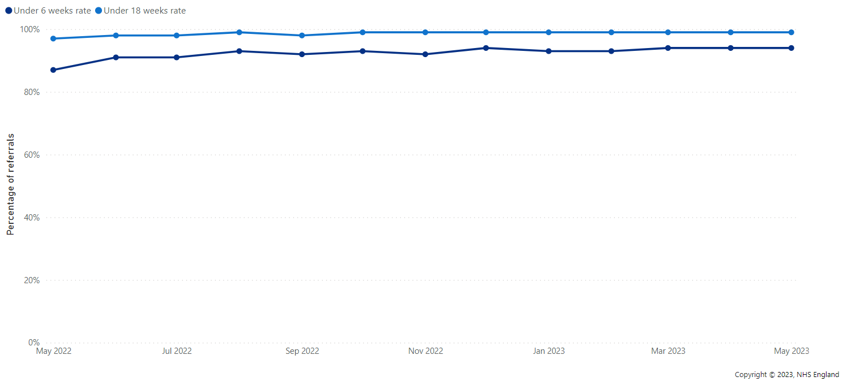
Waiting times, 16+ years, Cambridgeshire and Peterborough ICB, May 2022 – May 2023
The waiting times for accessing the talking therapy service have decreased slightly from May 2022 to May 2023.
The percentage of referrals waiting under 6 weeks shows an overall increase from 87% in May 2022 to 94% in May 2023.
The percentage of referrals waiting under 18 weeks also shows a slight increase from May 2022 to May 2023 (97% to 99%).
Source: Microsoft Power BI

Slide 16
Appointment type, 16+ years , Cambridgeshire and Peterborough ICB
Since March 2018, more than 70% of all the appointments were CBT (cognitive behavioural therapy), guided self-help, pure self-help/information-giving only, integrative, and other low-intensity appointments.
About 40% to 50% of all the appointments were CBT, and it shows a fairly stable trend while the proportion of guided self-help has increased since March 2018.
Source: CPFT
Notes:
All other appointments include
Dealing with Worry
Behavioural Activation (Low Intensity)
Group Therapy/Psychoeducational peer support Counselling
EMDR
Guided Self help - Overcoming Anxiety Book
Employment Support (Low Intensity)
Guided Self help - Depression Recovery Book
Counselling For Depression
Risk Assessment
Interpersonal Psychotherapy (IPT)
Dynamic Interpersonal Therapy (DIPT)
Other High Intensity Employment Support (High Intensity)
Exposure Eye Movement Desensitisation Reprocessing
Virtual Reality
Community Sign-posting
Mindfulness Computerised CBT (CCBT)
Guided Self Help (Computer)
Behavioural Activation (High Intensity)
Collaborative Care
Transdiagnostic Ante/post natal counselling
Applied relaxation
Books on Prescription (Pure self-help)
Brief psychodynamic psychotherapy Couples Therapy
Guided Self Help (Book)
Information Prescription (Pure self-help)
Medication Support (Guided self-help)
Non-Guided Self Help (Computer)
Structured Physical Activity Virtual Reality Height Phobia

Slide 17
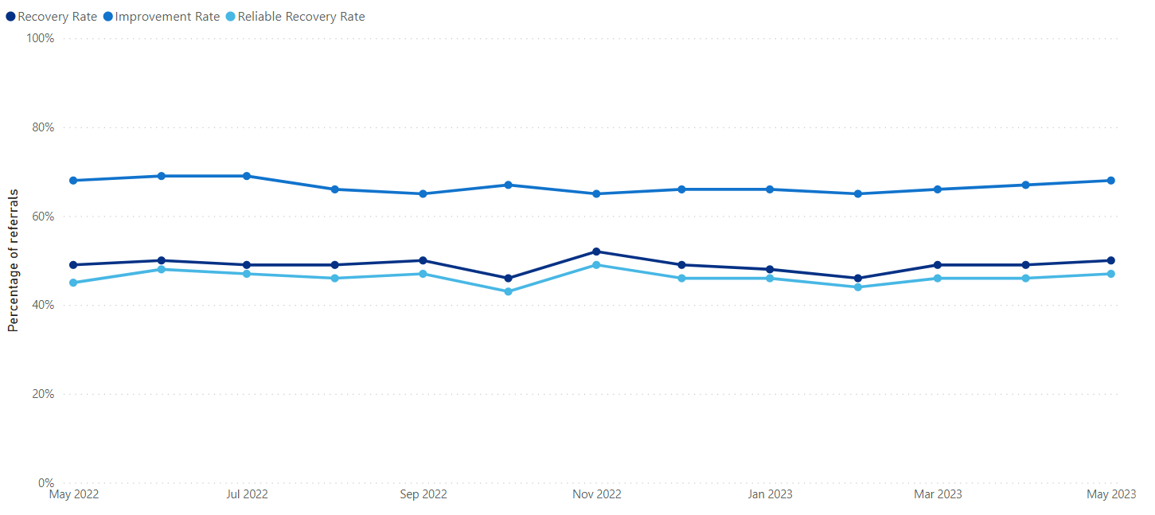
Outcomes, 16+ years, Cambridgeshire and Peterborough ICB, May 2022 – May 2023
The rate of recovery, improvement, and reliable recovery has shown a fairly stable trend since May 2022.
Talking Therapies measures ‘recovery’ according to a range of clinical measures which monitor symptom frequency and severity.
Source: Microsoft Power BI
Notes:
Recovery - Patients who have finished a course of treatment are deemed to have recovered if they are classified as clinical cases when they enter treatment and are no longer classified as cases when they have finished a course of treatment. Recovery is measured in terms of the anxiety and depression scores. To be considered as recovered, a patient needs to score below the clinical threshold on BOTH at the end of treatment, to ensure that recovery is measured by looking at the welfare of the individual rather than one specific symptom.
Recovery is measured in terms of “caseness” – which means that a referral has severe enough symptoms to be regarded as a clinical case.
‘Caseness’ – The term used when a referral is assessed as being a clinical case. This is determined by the scores recorded on the anxiety (ADSM/GAD7) and depression (PHQ9) measures. If patients score above the clinical/non-clinical cut-off on either anxiety, depression or both, the referral is classified as a clinical case.
Improvement - Patients are classed as having shown reliable improvement if they show a reliable decrease in anxiety or depression score between the first and last measurement, and the other clinical state (depression or anxiety) either also reliably decreases or shows no reliable change.
Reliable recovery - If a patient meets the criteria for both recovery and reliable improvement when they have finished a course of treatment, they are said to have reliably recovered.

Slide 18
Outcomes by age group, 16+ years, Cambridgeshire and Peterborough ICB
Note: The Y-axes are different in the graphs and do not start at 0.
Talking therapies measure 'recovery’ according to a range of clinical measures that monitor symptom frequency and severity.
The recovery and improvement rates for under 18-year-olds have been substantially lower compared to all other age groups. Small numbers might affect the under-18 trend.
The recovery and improvement rates for the under-18 and 18–25 age groups have been consistently below the national targets.
For the older age group, the recovery rate is substantially higher than the national target, while the improvement rate is similar to the target.
Source: Workbook: TTAD_ProtectedCharacteristics (england.nhs.uk)
Notes:
Recovery - Patients who have finished a course of treatment are deemed to have recovered if they are classified as clinical cases when they enter treatment and are no longer classified as cases when they have finished a course of treatment. Recovery is measured in terms of the anxiety and depression scores. To be considered as recovered, a patient needs to score below the clinical threshold on BOTH at the end of treatment, to ensure that recovery is measured by looking at the welfare of the individual rather than one specific symptom.
Improvement - Patients are classed as having shown reliable improvement if they show a reliable decrease in anxiety or depression score between the first and last measurement, and the other clinical state (depression or anxiety) either also reliably decreases or shows no reliable change.
The target for recovery rate is 50% and for reliable improvement rate the target is 70% of the total referrals.

Slide 19
Outcomes by ethnic group, 16+ years, Cambridgeshire and Peterborough ICB
Note: The Y-axes are different in the graphs and do not start at 0.
Talking therapies measure 'recovery’ according to a range of clinical measures that monitor symptom frequency and severity.
The recovery rates for ethnic minorities have been consistently lower than the national target, while they're similar to or higher than the target for white British.
The improvement rate for ethnic minorities has been lower than the white British. The rates for both white British and ethnic minorities were lower than the national target.
“Other” includes “Not known” and “Not Stated” Categories
Source: Workbook: TTAD_ProtectedCharacteristics (england.nhs.uk)
Notes:
“Other” includes “Not known” and “Not Stated” Categories
Recovery - Patients who have finished a course of treatment are deemed to have recovered if they are classified as clinical cases when they enter treatment and are no longer classified as cases when they have finished a course of treatment. Recovery is measured in terms of the anxiety and depression scores. To be considered as recovered, a patient needs to score below the clinical threshold on BOTH at the end of treatment, to ensure that recovery is measured by looking at the welfare of the individual rather than one specific symptom.
Improvement - Patients are classed as having shown reliable improvement if they show a reliable decrease in anxiety or depression score between the first and last measurement, and the other clinical state (depression or anxiety) either also reliably decreases or shows no reliable change.

Slide 20
Community Mental Health Services
Notes:
Community mental health teams (CMHTs) support people living in the community who have complex or serious mental health problems. Patients are able to step down to primary care as their circumstances improve.
CMHTs are multidisciplinary; staff can include psychiatrists, social workers, nurses, allied health professionals, psychologists, pharmacists and peer workers.

Slide 21
Summary – Community Services and Voluntary Sector
The number of caseloads and open referrals in core community services has increased overall since October 2021. The proportion of referrals waiting four weeks or more since the last contact has been increasing since Oct-21.
The number of open referrals to the CPFT adult eating disorder services and caseload have shown substantial increases since April 2019. The proportion of referrals with 2+ contacts recorded in 4 weeks has been increasing since Jan-22.
The number of open referrals and caseload for EIP had an overall decline of 25% in Jul-23 compared to Mar-19. However, a declining trend has been seen in the proportion of referrals waiting more than 2 weeks.
In Jul-23, the number of open referrals and caseloads in IPS had an increasing trend and was 8 times higher compared to Nov-19.
The number of people on GP SMI registers receiving all 6 physical health checks shows an increasing trend since Mar-21. For the year ending Mar-23, C&P ICB has achieved the highest percentage of the end-of-year trajectory nationally.
The overall referrals to personality disorder services have seen substantial increases since Sept-22.The number of attendees at Good Mood Cafes shows a substantial increase in 2023 compared to the numbers seen in 2022.

Slide 22
Core community services, 18+ years, Cambridgeshire and Peterborough ICB
Core community mental health teams include mental health experts from the NHS, social care and voluntary sectors. Core teams deliver and coordinate care for adults with mental health problems, including those with co-existing conditions. This involves assessment, specific psychological and pharmacological interventions, and support to access community assets.
The number of caseloads and open referrals shows an overall increase since October 2021.
The DNA (Did not attend) rates shows fluctuating trend since October 2021.
Source: Workbook: CMH Dashboard (england.nhs.uk)
Notes:
Caseload is a measure of referrals that have had at least one attended contact and are still open at the end of the month.
Open referrals is a count of all referrals, including those yet to be seen.

Slide 23
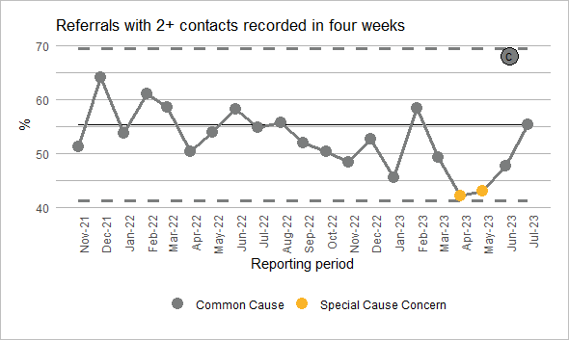
Core community services, 18+ years, Cambridgeshire and Peterborough ICB
The proportion of referrals waiting four weeks or more since the last contact shows an increasing trend since Oct-21.
In the year ending Jul-23, a higher proportion (42%) of referrals were waiting for 4 weeks or more since the last contact compared to 38% in the previous year.
However, a decrease has been seen in the proportion of referrals waiting less than one week since the last contact during the year ending Jul-23 (26%) compared to the previous period (29%). The proportions waiting one to two weeks and two to four weeks were similar to the previous year.
Periodic increases are seen in the month of December.
The proportion of referrals to core community services with two or more contacts recorded in four weeks shows fluctuations, but there was no significant change between November 2021 and July 2023.
Source: Workbook: CMH Dashboard (england.nhs.uk)
Notes:
Care contact - A care contact is defined as anything clinically meaningful or to support the mental health of the person referred.
Time since last contact - Where the referrals is on the Caseload, the time between the last contact and the end of the month.

Slide 24
Core community services, 18+ years, Cambridgeshire and Peterborough ICB
The number of referrals that closed in the reporting period with longer waiting times (2 weeks to 6 months) has increased, while the number of referrals waiting less than 2 weeks has declined.
The proportion of referrals that closed in the reporting period with no contacts to the service shows increases in recent months.
The proportion of referrals with two or more contacts shows a fluctuating trend.
The proportion of referrals with one contact is substantially lower than the proportion of referrals with no contact.
Source: Workbook: CMH Dashboard (england.nhs.uk)
Notes:
Care contact - A care contact is defined as anything clinically meaningful or to support the mental health of the person referred.
Length of referral - The number of referrals that closed in the month, by the time between the start and end of the referral.

Slide 25
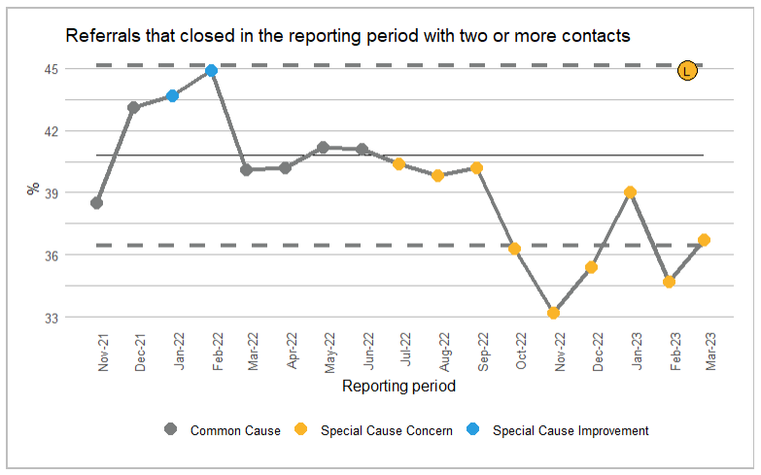
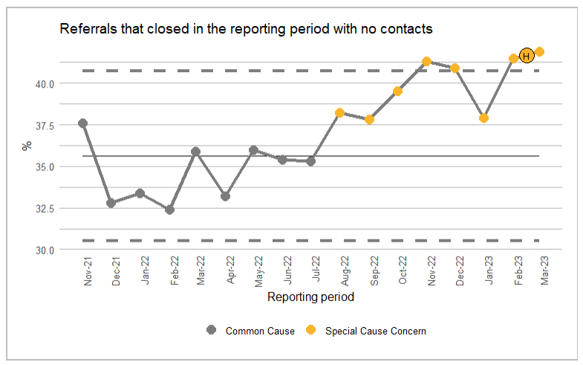
Core community services, 18+ years, Cambridgeshire and Peterborough ICB
The proportion of referrals that closed in the reporting period with two or more contacts shows a shift with 4 points below the lower control limit.
The proportion of referrals that closed in the reporting period with no contacts shows an increasing trend since Jul-22 with a shift.
Shift: a run of 7 or more consecutive data points above or below the mean
Source: Workbook: CMH Dashboard (england.nhs.uk)
Notes:
Care contact - A care contact is defined as anything clinically meaningful or to support the mental health of the person referred.
Length of referral - The number of referrals that closed in the month, by the time between the start and end of the referral.

Slide 26
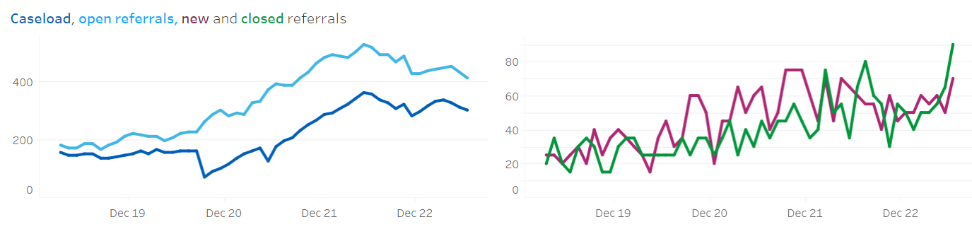
Eating disorder services, 18 - 64 years, Cambridgeshire and Peterborough ICB
Count
Count
The number of open referrals to the CPFT adult eating disorder services and caseload have shown substantial increases since April 2019.
Although, in July 2023, the caseload was 73% of open referrals, which is a substantial decrease from 86% in April 2019.
The number of new and closed referrals shows an increasing trend since April 2019.
Source: Workbook: Eating Disorders Services (england.nhs.uk)
Notes:
Caseload is a measure of referrals that have had at least one attended contact and are still open at the end of the month.
Open referrals is a count of all referrals, including those yet to be seen.

Slide 27
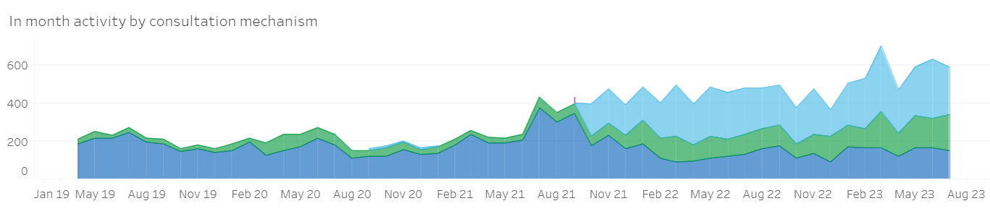
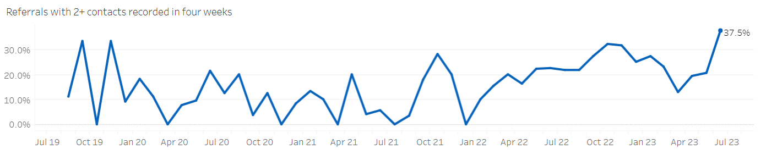
Eating disorder services, 18-64 years, Cambridgeshire and Peterborough ICB
Video consult
Telephone
Face to face
In July 2023, 42% of all consultations were done via video consultation.
A substantial increase is seen in the number of telephone and video consultations. However, a large decrease has been seen in the number of face-to-face consultations since September 21.
The proportion of referrals with 2+ contacts recorded in 4 weeks shows an increasing trend since January 22.
Source: Workbook: Eating Disorders Services (england.nhs.uk)

Slide 28
Eating disorder services, 18-64 years, Cambridgeshire and Peterborough NHS Foundation Trust
In Cambridgeshire and Peterborough NHS Foundation Trust, the number of bed days spent in eating disorder beds in the month shows fluctuating trend since April 2019.
The substantial decline noticed in April 2020 could be attributed to the COVID impact.
Source: Workbook: Eating Disorders Services (england.nhs.uk)

Slide 29
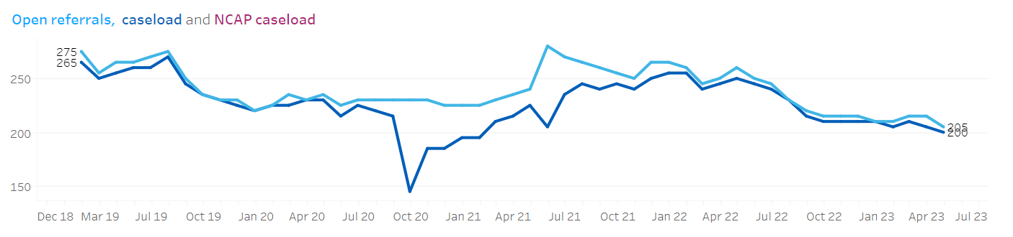
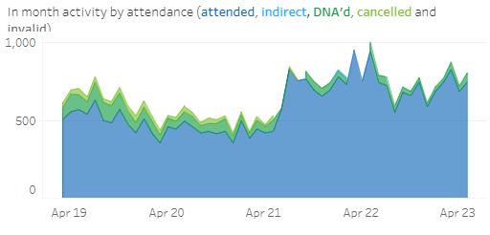
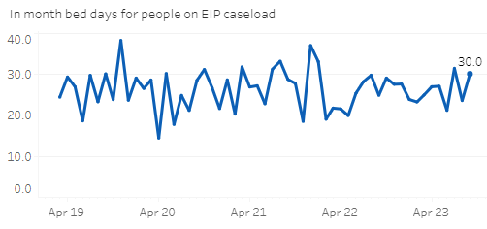
Early intervention in Psychosis (EIP), 14 – 65 years, Cambridgeshire and Peterborough ICB
The number of open referrals and caseload show an overall decline of 25% in July-23 compared to Mar-19.
The DNA (Did not attend) rates show an overall decline since April 2019.
The average number of days spent as an inpatient for those on the EIP caseload shows fluctuations.
A declining trend has been seen in the proportion of referrals waiting more than 2 weeks.
Source:EIP Triangulation Tool - Mental Health, Learning Disability and Autism Resource Hub - FutureNHS Collaboration Platform
Notes:
Caseload is a measure of referrals that have had at least one attended contact and are still open at the end of the month.
Open referrals is a count of all referrals, including those yet to be seen.

Slide 30
Individual placement and support services (IPS), 18 – 64 years, Cambridgeshire and Peterborough ICB
In Jul-23, the number of open referrals and caseloads show increasing trends and 8 times higher compared to Nov-19.
Source: IPS Dashboard - Mental Health, Learning Disability and Autism Resource Hub - FutureNHS Collaboration Platform

Slide 31
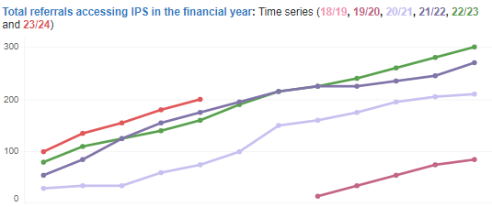
Individual placement and support services (IPS), 18 – 64 years, Cambridgeshire and Peterborough ICB
The number of referrals accessing IPS services in the month of April–August 2023 is higher than that of the previous years for the same time period.
The number of direct contacts (face-to-face, telephone, or video) has been on a sharply increasing trend since November 19.
Source: IPS Dashboard - Mental Health, Learning Disability and Autism Resource Hub - FutureNHS Collaboration Platform

Slide 32
Physical health checks for people with SMI, 18+ years, Cambridgeshire and Peterborough ICB
The proportion of people on GP SMI registers receiving all 6 physical health checks shows an increasing trend since March 21.
A higher percentage of people on GP SMI registers are receiving a blood pressure check, followed by BMI weight and smoking checks.
In the quarter ending June-23, about 63% of people on the SMI register had a complete health check; this is higher than the national rate (52%).
Source:Workbook: Community Mental Health Summary Dashboard (england.nhs.uk)

Slide 33
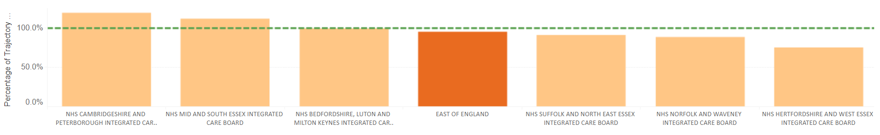
Physical health checks for people with SMI, 18+ years, Cambridgeshire and Peterborough ICB
Percentage of end of year trajectory achieved (Full health check), year ending Mar-23
Please note trajectories are not published and are indicative only. They have been calculated to help measure progress towards the Long-Term Plan commitments. 100% or over = the trajectory has been met.
For the year ending March 2023, the end of year trajectory has been met in Cambridgeshire and Peterborough ICB.
The percentage of end of year trajectory achieved is higher in the C&P ICB compared to other ICBs in the region. It is also higher than the East of England regional value.
For this period, C&P ICB has achieved the highest percentage of the end of year trajectory nationally.
Source: Physical Health Checks for People with Severe Mental Illness - Mental Health, Learning Disability and Autism Resource Hub - FutureNHS Collaboration Platform
Notes:
Percentage of end of year trajectory achieved = No. of people on the SMI register receiving the full physical health check in the 12 months up to the end of Mar-23 divided by trajectory for the end of the year.

Slide 34
Personality Disorder Services, 16-64 years Cambridgeshire and Peterborough ICB
The number of referrals to the Relational, Emotional Difficulties Services (REDS) shows an overall increase overtime with a sharp increase seen in the recent year.
The number of referrals to Personality Disorder Community Service (PDCS) also shows a substantial increase in the recent year compared to the previous year.
The overall referrals increased by 1.8 times in September 2023 compared to September 2022.
Source: CPFT
Notes:
In Cambridgeshire and Peterborough, the Personality Disorder Community Service and the Relational Emotional Difficulties Service offers two separate pathways to help people manage emotional dysregulation, to control unhelpful coping behaviours and improve their ability to sustain meaningful relationship.
Personality Disorder Community Service (PDCS) is a secondary care provided by a multi-disciplinary team. This service supports people who meet the threshold for severe personality disorder over a 6-month engagement pathway, with onward progression to REDS, group therapy, or REDS with wrap around 1:1 support.
Relational Emotional Difficulties Service (REDS) is a new psychological treatment service for people who have a range of difficulties associated with regulating emotions and who may struggle to negotiate relationships. They offer a DBT skills group and a peer support group programme.

Slide 35
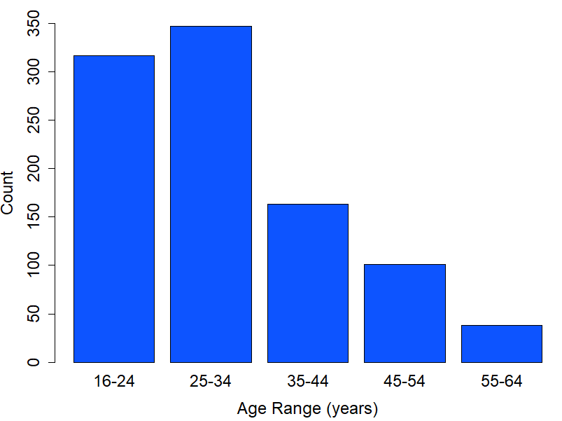
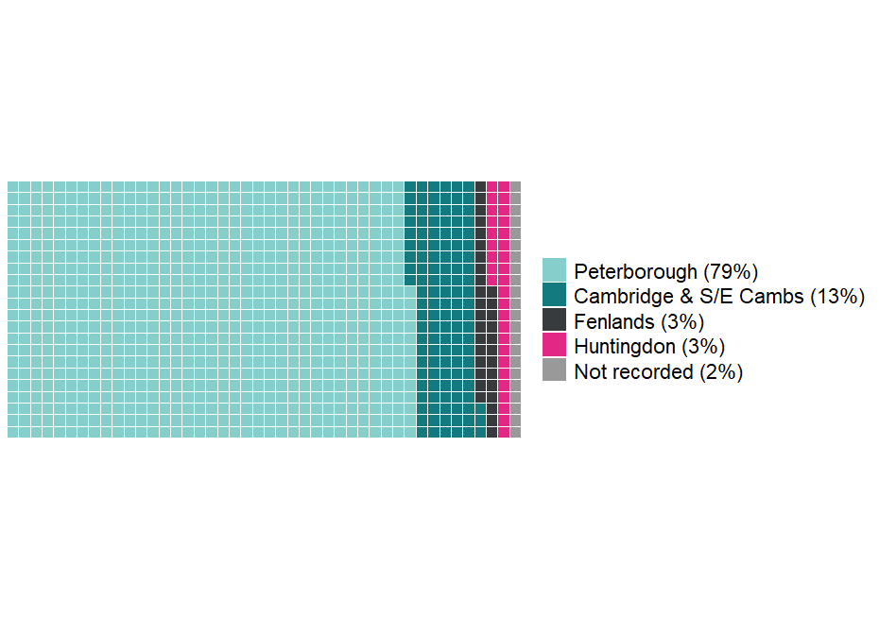
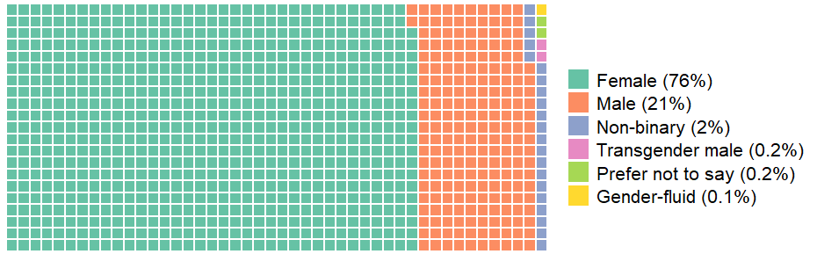
Personality Disorder Services, 16-64 years, Cambridgeshire and Peterborough ICB, June 2020 – April 2023
Number of service users by age group, June 2020 – April 2023
The proportion of service users from each locality (based on registered GP address), June 2020 – April 2023
The proportion of service users by gender, June 2020 – April 2023
During the period from June 2020 to April 2023, there were 968 service users.
79% of the service users were from Peterborough.
A higher proportion of service users were in the 25 –34 and 16 –24 age groups.
76% of the service users were female.
Source: CPFT
Notes:
In Cambridgeshire and Peterborough, the Personality Disorder Community Service and the Relational Emotional Difficulties Service offers two separate pathways to help people manage emotional dysregulation, to control unhelpful coping behaviours and improve their ability to sustain meaningful relationship.
Personality Disorder Community Service (PDCS) is a secondary care provided by a multi-disciplinary team. This service supports people who meet the threshold for severe personality disorder over a 6-month engagement pathway, with onward progression to REDS, group therapy, or REDS with wrap around 1:1 support.
Relational Emotional Difficulties Service (REDS) is a new psychological treatment service for people who have a range of difficulties associated with regulating emotions and who may struggle to negotiate relationships. They offer a DBT skills group and a peer support group programme.

Slide 36
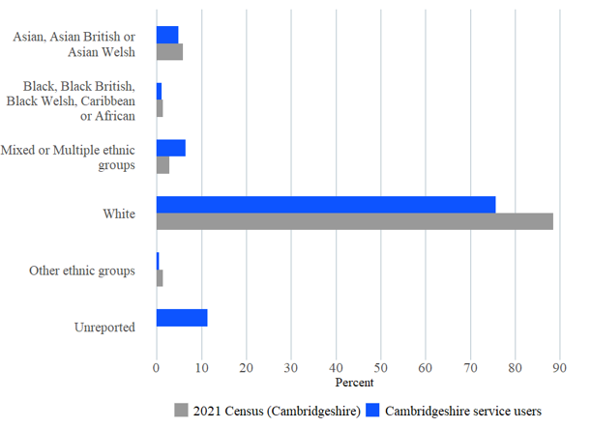
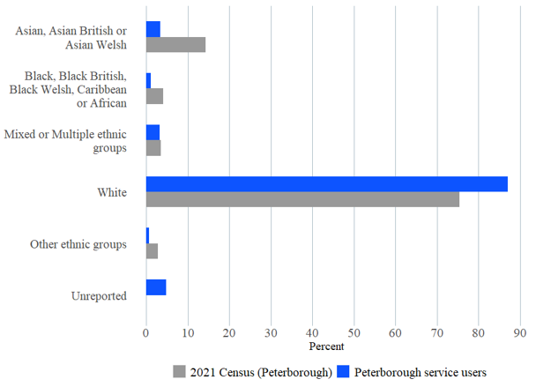
Personality Disorder Services, 16-64 years, Cambridgeshire and Peterborough ICB, June 2020 – April 2023
The proportion of services users by ethnic group compared to Census 2021, Cambridgeshire
The proportion of services users by ethnic group compared to Census 2021, Peterborough
The above charts compare the ethnic variations of service users to the local population using Census 2021 data.
All minority ethnic groups except for “mixed or multiple” were underrepresented among the Peterborough service users, with the most underrepresented group being “Asian” followed by “Black”.
Cambridgeshire service users may be more representative of the local population compared to Peterborough service users.
Source: CPFT
Notes:
In Cambridgeshire and Peterborough, the Personality Disorder Community Service and the Relational Emotional Difficulties Service offers two separate pathways to help people manage emotional dysregulation, to control unhelpful coping behaviours and improve their ability to sustain meaningful relationship.
Personality Disorder Community Service (PDCS) is a secondary care provided by a multi-disciplinary team. This service supports people who meet the threshold for severe personality disorder over a 6-month engagement pathway, with onward progression to REDS, group therapy, or REDS with wrap around 1:1 support.
Relational Emotional Difficulties Service (REDS) is a new psychological treatment service for people who have a range of difficulties associated with regulating emotions and who may struggle to negotiate relationships. They offer a DBT skills group and a peer support group programme.

Slide 37
Voluntary and Community Sector Support
Notes:
There is a range of voluntary and community organisations offering support for people with common mental conditions, as well as those offering social support. Some of the largest organisations offering this support locally are Lifecraft, CPSL Mind and the Samaritans; although there are also a range of helplines run by national organisations.
Many of these organisations are included on the How Are You (H.A.Y) Website.

Slide 38
CPSL mind, 18+ years, Cambridgeshire and Peterborough ICB
The number of hours delivered on specialist mental health services shows a fairly stable trend.
The number of attendees at Good Mood Cafes shows a substantial increase in 2023 compared to the numbers seen in 2022. The average number of attendances from January to July 2023 was 459, compared to 184 for the period May to December 2022.
The attendances for the calm spaces show low numbers, with an average of 34 attendances for the period January–July 2023.
The increase in attendance at the Good Mood Cafes and Calm Space in 2023 is due to the inclusion of the Rural Goodlife team into the Goodlife Service and an increase in staff members.
Source: Good Life Project Board Reports
Notes:
CPSL Mind (Cambridgeshire, Peterborough and South Lincolnshire Mind) provides a range of support services and activities that promote good mental wellbeing through the Good Life service. This includes:
Good Mood Café: an opportunity to meet new people, to share interests and wellbeing tips in an informal space. Cafes are held in local cafes, outdoors and online.
Calm Spaces: offer places to find guidance on self-help techniques which can help people to ground themselves and feel better, both in that moment and in the future. Calm Spaces are held in local community spaces and online.
Good Life Fund: offers grants of up to £500 to people in our local community to help set up groups that connect people, such as book clubs, craft classes, or activities that encourage people to learn new skills.
Qwell: online support and wellbeing community, which includes self-help resources and chat-based counselling.
CPSL Mind also offers Changing Lives Talking Therapies: counselling and cognitive behavioural therapy (CBT) for people experiencing difficulties with their mental health, including group therapy.

Slide 39
Making space, 18+ years, Cambridgeshire and Peterborough ICB
The number of new carer referrals for the period January–September 2023 was 69, compared to 59 for the same period last year.
The proportion of referrals accessing the services ranges from 61% to 94%.
In the latest quarter (July–Sept 2023), 94% of the new referrals were accessing the service, and about 6% were declined a service.
Source: Making Space Monitoring report, September 2023
Notes:
Making Space has been working in healthcare, support and enablement services – originally supporting people affected by mental health conditions. More recently the organisation has resolved to use all of the experience it has gained to extend its service to any group of people who are in need of care and support, including physical and/or mental health conditions and people with learning disabilities and dementia and their carers.
Employees and volunteers work for Making Space to provide the most appropriate care, support and enablement services which promote the wellbeing of people affected by physical and/or mental ill health, dementia and/or learning disabilities. These include family intervention services, rehabilitative employment and education services, supported housing, (Floating and Domiciliary support) care homes, residential accommodation, clinical services (includes Independent Hospitals), computerised cognitive behaviour therapy (CCBT) and extra care services. Information, Advice and Guidance in workshops and training sessions are all part of the service offer made available to people’s carers.

Slide 40
Making space, 18+ years, Cambridgeshire and Peterborough ICB
In July–September 2023, the number of carers who accessed the service decreased to 145 compared to 185 during the same period last year.
The majority of the carers who accessed the service were female.
A higher proportion of carers were aged 51–60 years, followed by 65 and over.
Source: Making Space Monitoring report, September 2023

Slide 41
Crisis services
Notes:
The mental health charity Mind has defined a mental health crisis as when some is in a ‘mental or emotional state where they need urgent help’.
Community crisis services includes NHS crisis service and other crisis services as below
24/7 Crisis response line
Acute day service
Crisis café/Safe Haven/Sanctuary service
Crisis House Service
Crisis Resolution Team/Home Treatment Service
Health Based Place of Safety Service
Psychiatric Decision Unit Service
Single Point of Access Service

Slide 42
Summary – Crisis Services
In the 12-month period ending July 2023, the majority of all referrals to the community crisis services in Cambridgeshire and Peterborough ICB were to the 24/7 crisis response line (86%) and crisis resolution team (11%).
The number of emergency department referrals to liaison psychiatry has increased overall since Apr-17.
For the year ending Aug-23, 76% of the total referrals were from the emergency department, and 11% were from the acute wards.
For the 12-month period ending Jul-23, the rate of attendance at A&E where the primary complaint was mental health (including self-harm) was significantly higher than the regional rate, and the rate of attendance for self-harm was the highest in the region.
C&P ICB ranks second highest in the East of England for the proportion of people attending A&E for mental health-related issues (including self-harm), spending over 6 hours (47%) and 12 hours (17%) in this department.

Slide 43
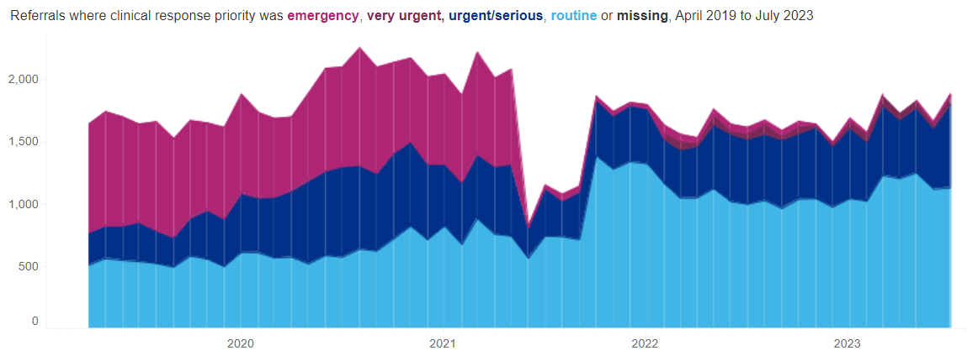
Community Crisis Services, 18 – 64 years, Cambridgeshire and Peterborough ICB
In Cambridgeshire and Peterborough ICB, the total number of emergency referrals was 215 for the 12-month period ending July-23 which is 59% lower than the previous 12-month period (520).
For the year ending July 2023, Cambridgeshire and Peterborough had 64% routine, 32% urgent or serious, 3% very urgent, and 1% emergency referrals. A wide range of referral types are seen across the East of England.
In the 12-month period ending July 2023, majority of all referrals to the community crisis services were to the 24/7 crisis response line (86%) and crisis resolution team (11%).
Source: Urgent and Emergency Mental Health Dashboard - Mental Health, Learning Disability and Autism Resource Hub - FutureNHS Collaboration Platform
Notes:
Source: FutureNHS, updated 14th September 2022
Notes: Regional and STP mapping is based on a person’s CCG of residence, so you may see providers in a region or STP that are not based in that locality, but are delivering care to people who live there.
Referrals by clinical response priority: Count of referrals received in each month to relevant community crisis services. Rejected referrals, where Referral Rejection Date is completed, are excluded from this count. Split by clinical response priority.
Emergency - Immediate response – denotes emergency situations in which there is imminent risk to life or serious harm to themselves or others and will require a “999” response, potentially within minutes. This would require a response from the police or an ambulance but may also require rapid support or a joint response from an MH crisis service.
Very urgent - For those who: present a risk of harm to themselves or others; present acute suicidal ideation with clear plan and intent; have a rapidly worsening mental state; do not require immediate physical health medical intervention; are not threatening violence to others. These referrals require a very urgent face-to-face assessment with a specialist mental health crisis practitioner within 4 hours.
Urgent - Typical presentations in this category include: high risk behaviour due to mental health symptoms; new or increasing psychiatric symptoms that require timely face-to-
face intervention to prevent full relapse; significantly impaired ability for completing activities of daily living; vulnerability due to mental illness; expressing suicidal ideation but no plan or clear intent.
These referrals require an urgent face-to-face assessment with a specialist mental health crisis practitioner within 24 hours.
Routine/non-urgent - This term in the context of crisis care is to be used for all responses that do not require an urgent face-to-face intervention from a specialist NHS mental health crisis service.
Community crisis services includes NHS crisis service and other crisis services as below
24/7 Crisis response line
Acute day service
Crisis café/Safe Haven/Sanctuary service
Crisis House Service
Crisis Resolution Team/Home Treatment Service
Health Based Place of Safety Service
Psychiatric Decision Unit Service
Single Point of Access Service

Slide 44
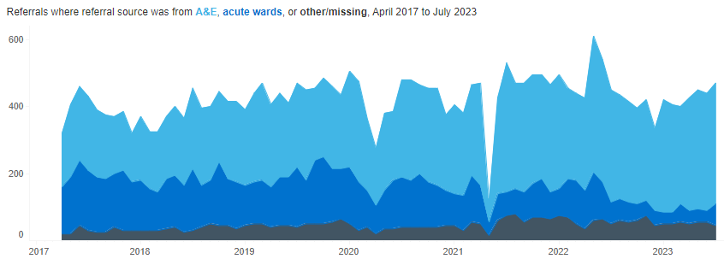
Referrals to Liaison Psychiatry, 18 – 64 years, Cambridgeshire and Peterborough ICB
In Cambridgeshire and Peterborough ICB, a sudden dip in total referrals to Liaison Psychiatry was seen in May 2021 (missed submission?).
For the year ending Aug 2023, 76% of the total referrals were from the Emergency department, and 11% were from the acute wards.
The referral source for Liaison Psychiatry varies widely for the ICBs in the East of England. The proportions vary from 67%–83% for emergency department referrals and 11%–28% for acute secondary care referrals.
Source: Urgent and Emergency Mental Health Dashboard - Mental Health, Learning Disability and Autism Resource Hub - FutureNHS Collaboration Platform
Notes:
Source: FutureNHS, updated 14th September 2022
Notes: Regional and STP mapping us based on a person’s CCG of residence, so you may see providers in a region or STP that are not based in that locality, but are delivering care to people who live there.
Referrals by source: Count of referrals received in each month to relevant psych liaison / other hospital-based crisis teams. Rejected referrals, where Referral Rejection Date is completed, are excluded from this count.
Split by referral source where:
Emergency Department: where referral source is 'Accident and Emergency Department' (H1)
Acute Secondary care: where referral source is 'Other secondary care speciality' (H2)
Other: for any other referral source or referrals where referral source is invalid/null.

Slide 45
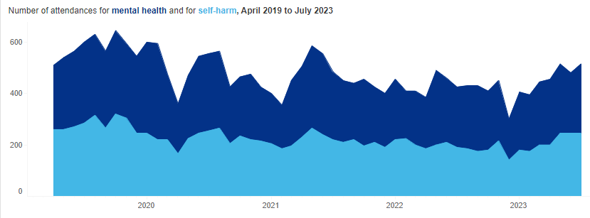
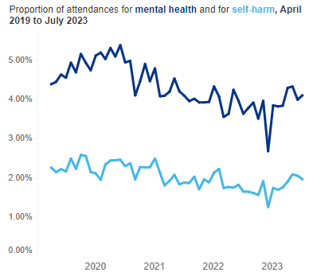
Mental Health A&E Attendances, 18 – 64 years, Cambridgeshire and Peterborough ICB
For the 12-month period ending July 2023, the rate of attendance to A&E where the primary complaint was mental health (including self-harm) was significantly higher than the regional rate.
The rate of attendance where the primary complaint was self-harm was the highest in the region for Cambridgeshire and Peterborough. CUH is designated as the major trauma centre for the East of England so would be expected to have higher rates for self harm. Different hospitals across the region also have very different coding practices that makes comparison difficult.
Source: Urgent and Emergency Mental Health Dashboard - Mental Health, Learning Disability and Autism Resource Hub - FutureNHS Collaboration Platform
Notes:
Source: FutureNHS, updated 14th September 2022
Notes: Regional, STP and CCG mapping is based on provider site code. Restricted to Type 1 departments only.
Number of attendances for mental health:
Count of attendances where EITHER:
Chief Complaint recorded as: Self harm, depressive feelings, feeling anxious, behaviour: unsual, hallucinations/delusions
Diagnosis recorded as: Dementia, Delirium, Personality Disorder, Eating Disorder, Anxiety Disorder, Depressive Disorder, Bipolar Affective Disorder, Schizophrenia, Psychotic Disorder, Somatisation Disorder, Somatoform Disorder, Dissociative (Conversion) Disorder, Adjustment Disorder, Factitious Disorder
Injury intent recorded as: Self-inflicted injury
AND
Discharge status is NOT in ('Streamed to Urgent Care Centre', 'Streamed to Emergency Department' or 'Dead on Arrival’)
Attendance category is NOT in ('Planned follow up care' or 'Not applicable patient dead on arrival’)
Number of attendances for self-harm:
Count of attendances where EITHER:
Chief Complaint recorded as: Self harm
Injury intent recorded as: Self-inflicted injury
AND
Discharge status is NOT in ('Streamed to Urgent Care Centre', 'Streamed to Emergency Department' or 'Dead on Arrival’)
Attendance category is NOT in ('Planned follow up care' or 'Not applicable patient dead on arrival')

Slide 46
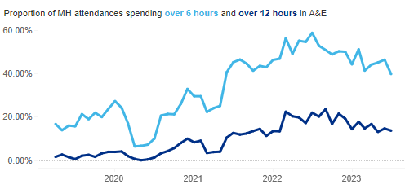
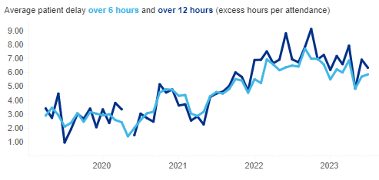
Total Time in A&E for Mental Health Attendances, 18 – 64 years, Cambridgeshire and Peterborough ICB
In Cambridgeshire and Peterborough ICB, the proportion of people attending the A&E department for mental health issues spending over 6 hours and over 12 hours in this department show an overall increase in recent years. The average patient delay over 6 and 12 hours also show an increasing trend in the last 2 years.
Cambridgeshire and Peterborough ranks second highest in the East of England for the proportion of people attending A&E for mental health-related issues (including self-harm), spending over 6 hours (47%) and 12 hours (17%) in this department.
Source: Urgent and Emergency Mental Health Dashboard - Mental Health, Learning Disability and Autism Resource Hub - FutureNHS Collaboration Platform
Notes:
Source: FutureNHS, updated 14th September 2022
Notes: Regional and STP mapping us based on a person’s CCG of residence, so you may see providers in a region or STP that are not based in that locality, but are delivering care to people who live there.
Proportion of attendances classed as MH/self-harm related which have a total time in ED over 6/12 hours:
Denominator Attendances flagged as MH/self-harm based on the criteria listed above
Numerator Attendances where the time between arrival in ED and departure from ED was over 6/12 hours (excluding those where total time was over 24 hours)
Average patient delay over 6 hours and over 12 hours:
Denominator Attendances flagged as MH/self-harm related, where total time in ED was over 6/12 hours
Numerator Total time in ED (in hours) minus 6/12 hours for each attendance in denominator.

Slide 47
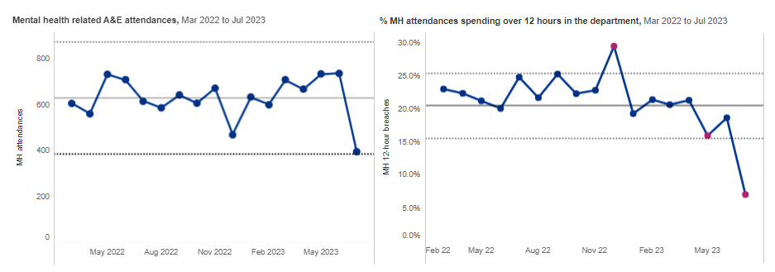
Mental Health attendances, 18+ years, Cambridgeshire and Peterborough ICB
The number of mental health-related A&E attendances showed fluctuations, but there was no significant change during the period from Mar-22 to Jul-23.
The percentage of mental health attendances spending over 12 hours in the department has been declining since Dec-22, and in the most recent month it has shown a significant decrease.
Source: Workbook: Adult acute mental health benchmarking dashboard (england.nhs.uk)

Slide 48
Mental Health Act (MHA) episodes and detentions
Notes:
The Mental Health Act (1983) is the main piece of legislation that covers the assessment, treatment and rights of people with a mental health disorder. People detained under the Mental Health Act need urgent treatment for a mental health disorder and are at risk of harm to themselves or others.

Slide 49
Summary – Mental Health Act
A 25% decline has been seen in the financial year 2023 compared to the previous year for the total number of Mental Health Act episodes in CPFT.
The proportion of people detained in the given month who had been detained in the preceding six months under all sections had a decline in the financial years 2022 and 2023 compared to 2021.
The number of active community treatment orders has seen a substantial increase over the past two financial years.
In 2021/22, the rate of detentions under Section 136 per 100,000 population in Cambridgeshire Constabulary was the second highest in the East of England region.

Slide 50
Detentions under the MHA, All-ages, June 2023, England
Nationally, the highest proportion of detention was under Section 2, with 45% of the total detentions in June 2023, followed by Section 3 (27%) and Section 136 (14%).
Source: Workbook: Mental Health Act Dashboard (england.nhs.uk)
Notes:
Number of distinct MHA detention episodes active in the financial year to date reporting period, includes both episodes starting in the reporting period and episodes starting in prior reporting periods that are ongoing.
Section 2 : A detention in hospital for assessment (or assessment followed by medical treatment) when someone has a mental health problem and needs to be detained for their own health or safety or to protect others. A Section 2 can last for up to 28 days.
Section 3 : A detention in hospital for treatment of a mental health problem, where appropriate treatment cannot be given unless the person is detained, and the detention is necessary for the person’s own health or safety or the protection of others. A Section 3 can last for up to six months in the first instance and can then be renewed by a responsible clinician.
Section 4 : An emergency application made when there is an urgent need to detain someone in hospital under Section 2 of the Mental Health Act, but complying with the provisions of this section (e.g. needing two doctors to recommend that the person is detained) would result in an unacceptable delay. A Section 4 can last up to 72 hours from when someone is admitted to hospital.
Section 5(2) : A detention occurring after a registered doctor or approved clinician issues a report to a hospital manager stating that someone who is in hospital but not currently detained (including patients being treated for physical health problems), should be kept in hospital due to their mental health needs. A Section 5(2) can last up to 72 hours, during which time arrangements can be made for the attendance of an Approved Mental Health Professional (AMHP) and a full assessment under the Mental Health Act.
Section 5(4): Used by an appropriately qualified nurse to prevent a patient who is voluntarily receiving treatment for a mental health problem from leaving hospital, if the nurse deems that it is necessary for the person’s health or safety or for the protection of others, and it is not practical to get a practitioner or clinician to attend immediately to arrange a Section 5(2). A Section 5(4) can last up to 6 hours or until a practitioner with authority to detain someone arrives.
Section 135 : If there is reasonable cause to suspect that a person with a mental health problem has or is being ill-treated or neglected or is unable to care for themself and live alone, then a magistrate can issue a warrant authorising a police officer to enter the person’s premises and take them to (or keep them at) a place of safety. A Section 135 allows someone to be kept in the place of safety for up to 24 hours.
Section 136 : If it appears to a police officer that a person has a mental health problem and is in immediate need of care, the police officer may take the person to a place of safety (or keep the person at a place of safety), if they believe it is in the best interests of the person or for the protection of others. A Section 136 allows someone to be kept in the place of safety for up to 24 hours.
Informal: If a person is having in-patient treatment in a psychiatric hospital voluntarily and not detained by the MHA.

Slide 51
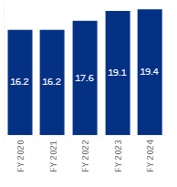
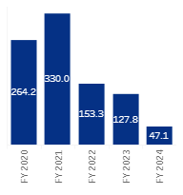
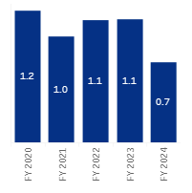
Uses of Act and duration of episodes, 18 – 64 years, CPFT
Average length by financial year, April 2019 to June 2023
Average length by financial year, April 2019 to May 2023
Average length by financial year, April 2019 to May 2023
A 25% decline has been seen in the financial year 2023 compared to the previous year for the total number of Mental Health Act episodes in Cambridgeshire and Peterborough NHS Foundation Trust.
The average length of MHA episodes for Section 2 shows an increasing trend in recent years, while a declining trend is seen for episodes detained under Section 3.
Source: MHA Dashboard - Mental Health, Learning Disability and Autism Resource Hub - FutureNHS Collaboration Platform
Notes:
Section 2 : A detention in hospital for assessment (or assessment followed by medical treatment) when someone has a mental health problem and needs to be detained for their own health or safety or to protect others. A Section 2 can last for up to 28 days.
Section 3 : A detention in hospital for treatment of a mental health problem, where appropriate treatment cannot be given unless the person is detained, and the detention is necessary for the person’s own health or safety or the protection of others. A Section 3 can last for up to six months in the first instance and can then be renewed by a responsible clinician.
Section 4 : An emergency application made when there is an urgent need to detain someone in hospital under Section 2 of the Mental Health Act, but complying with the provisions of this section (e.g. needing two doctors to recommend that the person is detained) would result in an unacceptable delay. A Section 4 can last up to 72 hours from when someone is admitted to hospital.
Section 5(2) : A detention occurring after a registered doctor or approved clinician issues a report to a hospital manager stating that someone who is in hospital but not currently detained (including patients being treated for physical health problems), should be kept in hospital due to their mental health needs. A Section 5(2) can last up to 72 hours, during which time arrangements can be made for the attendance of an Approved Mental Health Professional (AMHP) and a full assessment under the Mental Health Act.
Section 5(4): Used by an appropriately qualified nurse to prevent a patient who is voluntarily receiving treatment for a mental health problem from leaving hospital, if the nurse deems that it is necessary for the person’s health or safety or for the protection of others, and it is not practical to get a practitioner or clinician to attend immediately to arrange a Section 5(2). A Section 5(4) can last up to 6 hours or until a practitioner with authority to detain someone arrives.
Section 135 : If there is reasonable cause to suspect that a person with a mental health problem has or is being ill-treated or neglected or is unable to care for themself and live alone, then a magistrate can issue a warrant authorising a police officer to enter the person’s premises and take them to (or keep them at) a place of safety. A Section 135 allows someone to be kept in the place of safety for up to 24 hours.
Section 136 : If it appears to a police officer that a person has a mental health problem and is in immediate need of care, the police officer may take the person to a place of safety (or keep the person at a place of safety), if they believe it is in the best interests of the person or for the protection of others. A Section 136 allows someone to be kept in the place of safety for up to 24 hours.

Slide 52
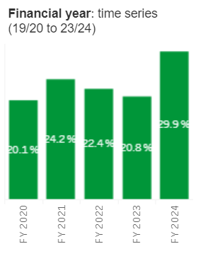
Admissions and detentions under the Act, 18 – 64 years, CPFT
Proportion of repeat detentions within 6 months (Apr-19 to Jun-23)
255
The number of new monthly admissions shows a substantial decrease over the last couple of years.
During the 12-month period between Jun-22 to May-23, the total number of new monthly admissions was 585 compared to 875 in the previous year (a decline of 33%).
The number of new monthly admissions where the person is detained under the MHA in the 24 hours pre-admissions or post-admissions has declined from 315 in Jun-21 to May-22 to 230 in the most recent 12-month period (27% decline).
The proportion of people detained in the given month who had been detained in the preceding six months under all sections shows a decline in the financial years 2022 and 2023 compared to 2021.
During the period from April to June 2023, about 30% of the people had repeat detentions. This is not a full year of data compared to the other years.
Source: MHA Dashboard - Mental Health, Learning Disability and Autism Resource Hub - FutureNHS Collaboration Platform

Slide 53
Community Treatment Orders, 18 – 64 years, CPFT
The number of active community treatment orders in Cambridgeshire and Peterborough shows a substantial increase over the past 2 financial years.
A three-fold increase is seen from the financial year 2022 to 2023.
Source: MHA Dashboard - Mental Health, Learning Disability and Autism Resource Hub - FutureNHS Collaboration Platform
Notes:
Community Treatment Order (CTO): When a person is detained under certain sections, they can be discharged from hospital under a CTO. This means that the person has to adhere to certain rules, which may include meeting with certain professionals, living at a particular address or accepting certain treatments, including medication. If these rules are not adhered to, the person can be returned to hospital. CTOs can last up to six months in the first instance and can then be renewed.

Slide 54
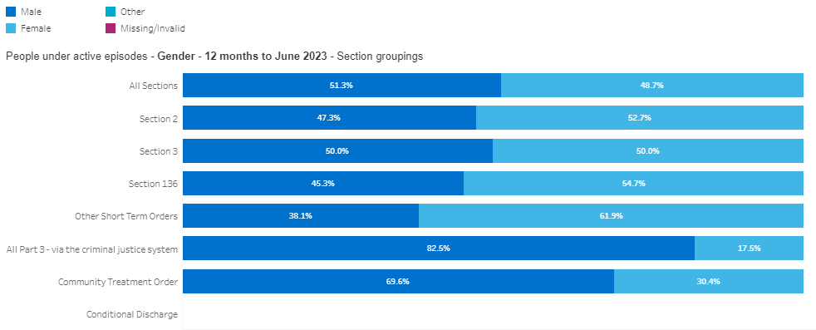
Characteristics of people detained under the Act, All-ages, CPFT
During the 12-month period ending June 2023, about 83% of the people detained via the criminal justice system and 70% via the community treatment order were men in Cambridgeshire and Peterborough.
The proportion of women detained under Section 136 (55%) and other short-term orders (62%) is higher than that of men for this period.
Source: MHA Dashboard - Mental Health, Learning Disability and Autism Resource Hub - FutureNHS Collaboration Platform

Slide 55
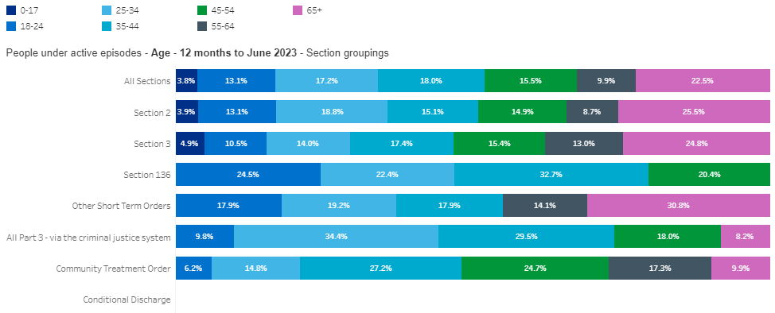
Characteristics of people detained under the Act, All-ages, CPFT
During the 12-month period ending June 2023, the highest proportion of all people under active episodes (all sections) were aged 65 years and over (23%) in Cambridgeshire and Peterborough.
All the people detained under Section 136 were aged between 18 and 54 years, with a higher proportion among the 35–44 age band.
About 31% of all people detained under “other short-term orders” were over 65 years old.
Over one-third of the people detained via the criminal justice system were aged 25–34.
Of the people detained under the Community Treatment Order, a higher proportion were seen among the 35–44 and 45–54 age bands.
Source: MHA Dashboard - Mental Health, Learning Disability and Autism Resource Hub - FutureNHS Collaboration Platform

Slide 56
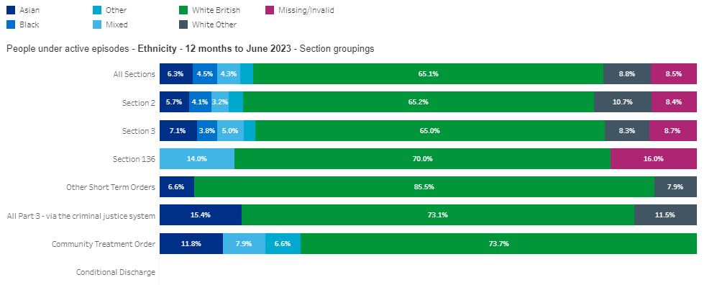
Characteristics of people detained under the Act, All-ages, CPFT
For the period July 2022—June 2023 , the proportion of all people under active episodes who were of Black, Mixed or Other ethnic groups was substantially higher compared to the proportion of these groups within the general population.
All the people detained under Section 136 were White British (70%) and Mixed ethnic groups (14%). The proportion of Mixed ethnic groups detained under this section is 4.6 times higher than the proportion seen in the general population.
People detained under Other short-term orders and via the criminal justice system were White British, White Other and Asian ethnic groups.
About 15% of the people detained via the criminal justice system were Asians; this is over twice the proportion seen in the general population (7.8%).
2.5%
2.7%
2.1%
Source: MHA Dashboard - Mental Health, Learning Disability and Autism Resource Hub - FutureNHS Collaboration Platform

Slide 57
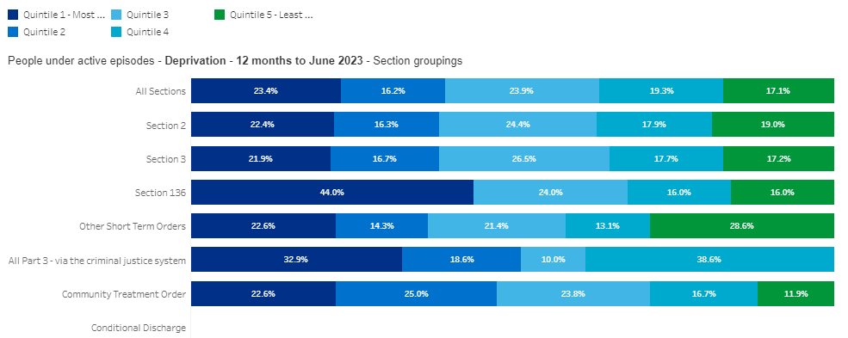
Characteristics of people detained under the Act, All-ages, CPFT
During the 12-month period ending June 2023, 44% and 33% of the people detained under Section 136 and via the criminal justice systems, respectively, were from the most deprived quintile.
However, the highest proportion of the people detained under the Other short-term orders were from the least deprived quintile (29%), and the highest proportion of detentions via the criminal justice systems were among the people from the second least deprived quintile (39%).
Source: MHA Dashboard - Mental Health, Learning Disability and Autism Resource Hub - FutureNHS Collaboration Platform

Slide 58
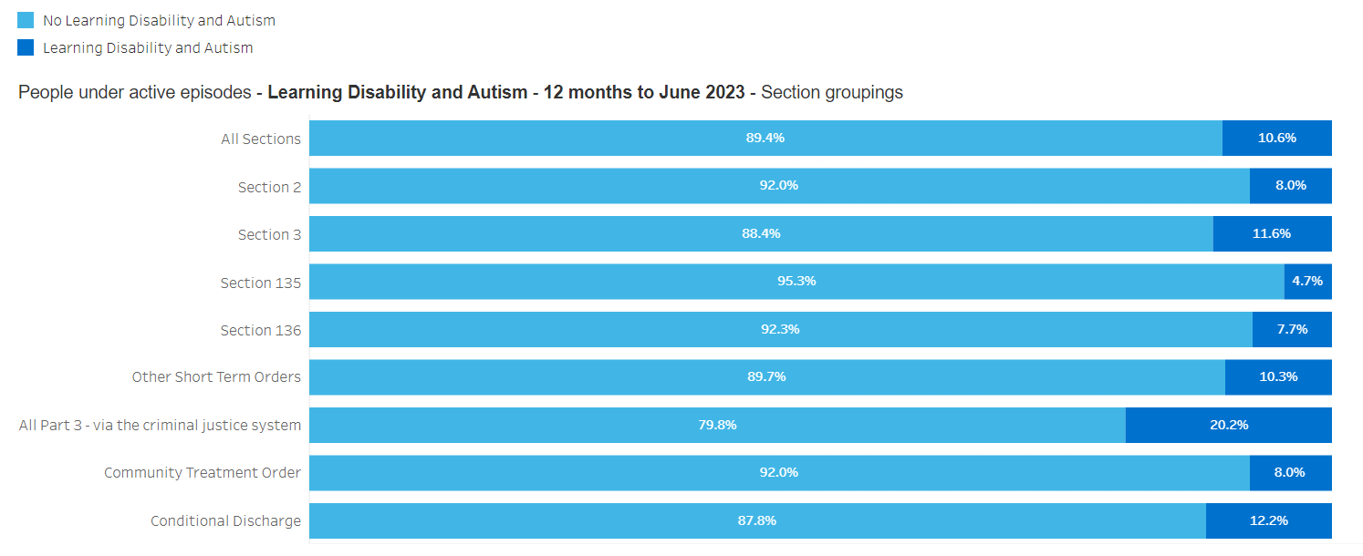
Characteristics of people detained under the Act, All-ages, CPFT
During the 12-month period ending June 2023, about 11% of all people detained under the Act had learning disabilities and/or autism in Cambridgeshire and Peterborough.
About one-fifth of the people detained under the Act via the criminal justice system had learning disabilities and autism.
Source: MHA Dashboard - Mental Health, Learning Disability and Autism Resource Hub - FutureNHS Collaboration Platform

Slide 59
Detentions under the MHA, 2021-22, All-ages
For the period 2021–22, the rate of detention under the Mental Health Act per 100,000 population in Cambridgeshire and Peterborough STP was 64.7, which is the 2nd lowest among other areas in the East of England.
The rate of detention in Cambridgeshire and Peterborough is significantly lower than the national rate.
Source: Mental Health Act Statistics, Annual Figures, 2021-22 - NHS Digital
Notes:
The number of detentions starting in the year, including both civil detentions under Part II and detentions via the Criminal Justice System under Part III of the Act.
Number of distinct MHA detention episodes active in the financial year to date reporting period, includes both episodes starting in the reporting period and episodes starting in prior reporting periods that are ongoing.
Notes:
Detentions data are incomplete in 2021-22 so the counts and rates shown are lower than the true figures.
Demographic breakdowns use the last set of person characteristics (e.g. age, gender or ethnicity) recorded in the year. This is to prevent instances where one person may have been recorded with different characteristics in different submissions. By taking the latest available demographics this ensures each person is consistently assigned with one age, gender and ethnic group. Caution should therefore be used when interpreting small numbers due to possible data quality issues.
Top level STP population figures are based on ONS mid 2020 population estimates for 2020 CCG mapped to 2021 CCG mapped to STP.
STP demographic population figures are based on ONS mid 2019 population estimates for 2019 CCG mapped to 2021 CCG mapped to STP.
STP deprivation figures are based on ONS mid 2019 population estimates for 2019 LSOA mapped to 2021 CCG mapped to STP. LSOA to CCG is based off postcode. 2019 LSOA data is available at: https://www.ons.gov.uk/file?uri=/peoplepopulationandcommunity/populationandmigration/populationestimates/datasets/lowersuperoutputareamidyearpopulationestimates/mid2019sape22dt2/sape22dt2mid2019lsoasyoaestimatesunformatted.zip

Slide 60
Detentions under the MHA by age and gender, 2021-22, All-ages, Cambridgeshire and Peterborough STP
The rate of detention is higher in women (72 per 100,000) than in men (58 per 100,000).
The rate of detentions is higher among 18 to 34-year-olds followed by the 35 – 49 age group.
Source: Mental Health Act Statistics, Annual Figures, 2021-22 - NHS Digital
Notes:
Notes:
Detentions data are incomplete in 2021-22 so the counts and rates shown are lower than the true figures.
Demographic breakdowns use the last set of person characteristics (e.g. age, gender or ethnicity) recorded in the year. This is to prevent instances where one person may have been recorded with different characteristics in different submissions. By taking the latest available demographics this ensures each person is consistently assigned with one age, gender and ethnic group. Caution should therefore be used when interpreting small numbers due to possible data quality issues.Top level STP population figures are based on ONS mid 2020 population estimates for 2020 CCG mapped to 2021 CCG mapped to STP.STP demographic population figures are based on ONS mid 2019 population estimates for 2019 CCG mapped to 2021 CCG mapped to STP.

Slide 61
Detentions by deprivation decile and ethnic category, 2021-22, All-ages, Cambridgeshire & Peterborough STP
The rate of detentions in the top 5 most deprived deciles is significantly higher than the least deprived decile.
People living in the areas with the highest deprivation decile are 3.5 times more likely to be detained than those in the areas with the lowest deprivation decile.
The rate of detentions in Mixed, Black and Other ethnic groups is significantly higher than that of White.
Source: Mental Health Act Statistics, Annual Figures, 2021-22 - NHS Digital
Notes:
Notes:
Detentions data are incomplete in 2021-22 so the counts and rates shown are lower than the true figures.
Demographic breakdowns use the last set of person characteristics (e.g. age, gender or ethnicity) recorded in the year. This is to prevent instances where one person may have been recorded with different characteristics in different submissions. By taking the latest available demographics this ensures each person is consistently assigned with one age, gender and ethnic group. Caution should therefore be used when interpreting small numbers due to possible data quality issues.
Top level STP population figures are based on ONS mid 2020 population estimates for 2020 CCG mapped to 2021 CCG mapped to STP.
STP demographic population figures are based on ONS mid 2019 population estimates for 2019 CCG mapped to 2021 CCG mapped to STP.
STP deprivation figures are based on ONS mid 2019 population estimates for 2019 LSOA mapped to 2021 CCG mapped to STP. LSOA to CCG is based off postcode. 2019 LSOA data is available at: https://www.ons.gov.uk/file?uri=/peoplepopulationandcommunity/populationandmigration/populationestimates/datasets/lowersuperoutputareamidyearpopulationestimates/mid2019sape22dt2/sape22dt2mid2019lsoasyoaestimatesunformatted.zip
Ethnic groups and subgroups
White: White British, White Irish, Any Other White Background, Gypsy or Irish Traveller
Mixed: White and Black Caribbean, White and Black African, White and Asian, Any Other Mixed Background
Asian or Asian British: Indian, Pakistani, Bangladeshi, Any Other Asian Background
Black or Black British: African, Caribbean, Any Other Black Background
Other Ethnic Groups: Chinese, Any Other Ethnic Group, Arab

Slide 62
Detention under section 136 of the Act, by Police Force Area, 2021/22, All-ages
In 2021/22, the rate of detentions under Section 136 per 100,000 population in Cambridgeshire Constabulary (69 per 100,000) was the second highest in the East of England region.
It was significantly higher than the regional average of 57 per 100,000.
Source: https://assets.publishing.service.gov.uk/government/uploads/system/uploads/attachment_data/file/1118160/detentions-under-the-mental-health-act-1983-_police-powers-and-procedures-year-ending-31-March-2022.ods
Notes:
Base population used to calculate rates – 2021 Census usual resident population.
Aggregated UTLA populations to calculate the police force area based on the county areas

Slide 63
Detention under section 136 of the Act, by Police Force Area, 2021/22, All-ages
In 2021/22, the rate of detentions under Section 136 for women in Cambridgeshire Constabulary (75 per 100k) was significantly higher than that of the East of England average (58 per 100k). The rate for men was similar to the regional rate.
The rate of detention for 18 years and over was significantly higher than the regional rate, while the rate for under 18 years was similar to the regional average.
Source: https://assets.publishing.service.gov.uk/government/uploads/system/uploads/attachment_data/file/1118160/detentions-under-the-mental-health-act-1983-_police-powers-and-procedures-year-ending-31-March-2022.ods
Notes:
Base population used to calculate rates – 2021 Census usual resident population.
Aggregated UTLA populations to calculate the police force area based on the county areas

Slide 64
Detention under section 136 of the Act, by Police Force Area, self-defined ethnicity, 2021/22, All-ages
In 2021/22, the rate of detentions per 100,000 white population in the Cambridgeshire constabulary (72 per 100,000) was significantly higher than the regional average.
The rate of detentions among the black, Asian, and minority ethnic groups in the Cambridgeshire constabulary was similar to the regional rate.
Source: https://assets.publishing.service.gov.uk/government/uploads/system/uploads/attachment_data/file/1118160/detentions-under-the-mental-health-act-1983-_police-powers-and-procedures-year-ending-31-March-2022.ods
Notes:
Base population used to calculate rates – 2021 Census usual resident population.
Aggregated UTLA populations to calculate the police force area based on the county areas

Slide 65
Detention under section 136 of the Act, All ages, Cambridgeshire Constabulary
For the period April to October 2023, the proportion of drug and alcohol presentations to the officers at the Section 136 scene ranges between 28% and 42%.
The number of repeat detentions during the period January–October 2023 shows that 6 people were detained between 2 and 5 times, 5 people were detained 6 to 10 times, and one person was detained more than 10 times.
Source: Cambridgeshire Constabulary

Slide 66
Acute Adult Mental Health Care
Notes:
Acute inpatient services provide treatment when a person’s mental health condition cannot be managed in the community, and where specialist care is required in a safe and therapeutic setting.

Slide 67
Summary – Acute Adult Mental Health Care
For the year ending Jul-23, the rate of admissions to acute inpatient mental health care per 100,000 in Cambridgeshire and Peterborough ICB is significantly lower than the regional average.
The proportion of admissions via the emergency department in C&P ICB is lower than the regional rate.
An increasing trend is seen in the average length of discharged hospital spells and closed ward stays since Feb-19. However, the rates were higher than the regional rates.
The proportion of hospital spells with follow-up within 3 days of the discharge date had a shift since Sept-21.
A significant increase has been seen in the average number of follow-up activities for each discharged hospital spell within 2 months of discharge since Apr-21.
During the three-month period ending Sep-23, there were 1,940 OAP days, and a decline has been seen since the period ending Jul-23.

Slide 68
Admissions to inpatient mental health care, All-ages, Cambridgeshire and Peterborough ICB
In C&P ICB, during the period between August 2022 and July 2023, 56% of all admissions to inpatient mental health care were to the acute adult mental health care and 24% to the acute older adult mental health care.
In C&P ICB, there were 65 admissions to the Adult specialist beds for the period Aug 2022 – Jul 2023.
During this period, the highest proportion of beds were occupied for eating disorders (31%).
Source: Workbook: Acute Mental Health Dashboard (england.nhs.uk)
Notes:
Updated 14th September 2023 with data to July (provisional) 2023
Admissions via A&E: Proportion of inpatients admitted via Emergency Department.
Denominator
Count of hospital spells starting in the reporting period
Numerator
Count of hospital spell IDs where ADMISSION METHOD CODE is:
21 - Accident and emergency, or dental casualty department of the Health Care Provider
2A - Accident and Emergency Department of another provider where the PATIENT had not been admitted
Admissions via CRHT: Proportion of inpatients admitted via Crisis Resolution Team
Denominator Count of hospital spells starting in the reporting period
Numerator Count of hospital spell IDs where ADMISSION METHOD CODE is:
25 - Admission via Mental Health Crisis Resolution Team
Admissions not known to mental health services: Proportion of inpatient admissions for people who have had not been in contact with Core Community Mental Health within the previous 6 months
Denominator
Count of hospital spells starting in the reporting period
Numerator
Removing admissions for people 'known' to services, defined as:
Hospital spells where the Person_ID has had either an attended Care Contact or Indirect Activity, in the 365 days before date of admission.
Not counting contacts as part of the hospital spell record
Not counting contacts in the two days prior to admission (i.e. gatekeeping CRHT referrals).

Slide 69
Acute adult mental health care admissions, 18-64 years
In C&P ICB, a total of 540 admissions were there in the 12-month period ending July 2023, compared to 720 in the previous period (25% decline). The number of admissions via the crisis resolution team shows a declining trend.
For the year ending July 2023, the rate of admissions to acute adult mental health care per 100,000 in Cambridgeshire and Peterborough ICB (97/100k) is significantly lower than the regional average.
The proportion of admissions that were not known to the community mental health services within 6 months period prior to the admissions is similar to the regional rate.
The proportion of admissions via the emergency department in C&P ICB is lower than the regional rate.
Source: Workbook: Acute Mental Health Dashboard (england.nhs.uk)
Notes:
Updated 14th September 2023 with data to July (provisional) 2023
Admissions: Count of hospital spells starting in the reporting period.
Admissions via A&E: Proportion of inpatients admitted via Emergency Department.
Denominator
Count of hospital spells starting in the reporting period
Numerator
Count of hospital spell IDs where ADMISSION METHOD CODE is:
21 - Accident and emergency, or dental casualty department of the Health Care Provider
2A - Accident and Emergency Department of another provider where the PATIENT had not been admitted
Admissions via CRHT: Proportion of inpatients admitted via Crisis Resolution Team
Denominator Count of hospital spells starting in the reporting period
Numerator Count of hospital spell IDs where ADMISSION METHOD CODE is:
25 - Admission via Mental Health Crisis Resolution Team
Admissions not known to mental health services: Proportion of inpatient admissions for people who have had not been in contact with Core Community Mental Health within the previous 6 months
Denominator
Count of hospital spells starting in the reporting period
Numerator
Removing admissions for people 'known' to services, defined as:
Hospital spells where the Person_ID has had either an attended Care Contact or Indirect Activity, in the 365 days before date of admission.
Not counting contacts as part of the hospital spell record
Not counting contacts in the two days prior to admission (i.e. gatekeeping CRHT referrals).

Slide 70
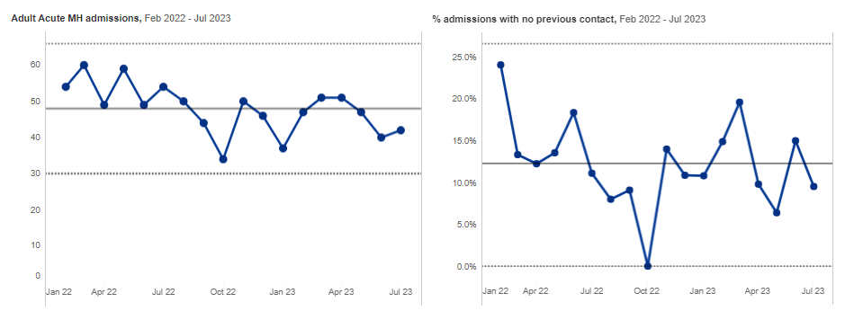
Acute adult mental health care admissions, 18-64 years, Cambridgeshire and Peterborough ICB,
The number of adult acute mental health admissions has shown an overall decrease since Feb-22.
The percentage of admissions with no previous contact showed fluctuations, but no significant change was seen between Feb-22 and Jul-23.
Source: Workbook: Adult acute mental health benchmarking dashboard (england.nhs.uk)

Slide 71
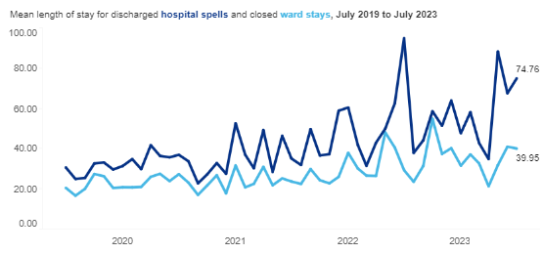
Length of stay (LOS), Acute adult mental health care, 18-64 years
Cambridgeshire and Peterborough ICB
An increasing trend is seen in the average length of discharged hospital spells and closed ward stays in Cambridgeshire and Peterborough since July 2019.
The average length of stay for discharged hospital spells in C&P ICB is substantially higher than the regional averages.
Source: Workbook: Acute Mental Health Dashboard (england.nhs.uk)
Notes:
Updated 14th September 2023 with data to July (provisional) 2023
Hospital spell - A Hospital Provider Spell is the total continuous stay of a PATIENT using a Hospital Bed on premises controlled by a Health Care Provider during which medical care is the responsibility of one or more CONSULTANTS, or the PATIENT is receiving care under one or more Nursing Episodes or Midwife Episodes in a WARD.
Ward stay - A Ward Stay is the time a PATIENT, using a Hospital Bed and/or using a delivery facility, stays in one WARD.
Mean LOS for hospital spells: The mean length of discharged hospital spells in the reporting period
Mean LOS for ward stays: The mean length of closed ward stays in the reporting period
Proportion of hospital spells less than 3 days : The proportion of discharged hospital spells where the LOS is between 0 and 3 days
Proportion of hospital spells over 90 days : The proportion of discharged hospital spells where the LOS is greater than 90 days

Slide 72
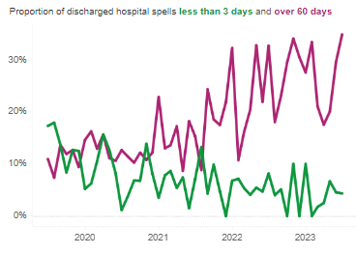
Length of stay (LOS), Acute adult mental health care, 18-64 years
In C&P ICB, the proportion of discharged hospital spells where the length of stay was over 60 days shows an increasing trend from July 2019. However, a decreasing trend is seen where the length of stay is less than 3 days.
For the period between August 2022 and July 2023, the proportion of discharged hospital spells where the length of stay is over 60 days and 90 days is higher than the regional averages.
For the same period, C&P ICB is significantly lower than East of England, where the length of stay is less than 3 days.
Cambridgeshire and Peterborough ICB
Source: Workbook: Acute Mental Health Dashboard (england.nhs.uk)
Notes:
Updated 14th September 2023 with data to July (provisional) 2023
Mean LOS for hospital spells: The mean length of discharged hospital spells in the reporting period
Mean LOS for ward stays: The mean length of closed ward stays in the reporting period
Proportion of hospital spells less than 3 days : The proportion of discharged hospital spells where the LOS is between 0 and 3 days
Proportion of hospital spells over 90 days : The proportion of discharged hospital spells where the LOS is greater than 90 days

Slide 73
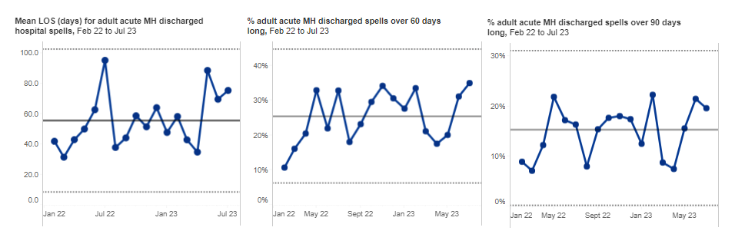
Length of stay (LOS), Acute adult mental health care, 18-64 years, Cambridgeshire and Peterborough ICB
Between Feb-22 and Jul-23, the mean length of stay for discharged adult acute mental health hospital spells showed fluctuations, but no significant change was seen during the period.
An overall increase has been seen in the proportion of discharged hospital spells where the length of stay is over 60 days and 90 days since Feb-22.
Source: Workbook: Adult acute mental health benchmarking dashboard (england.nhs.uk)

Slide 74
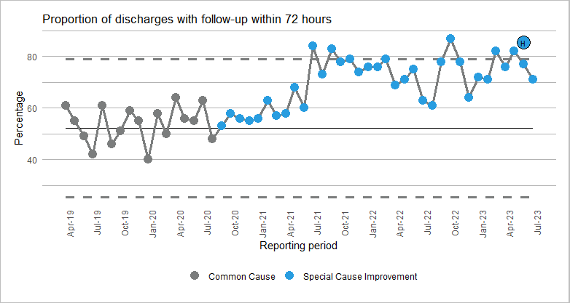
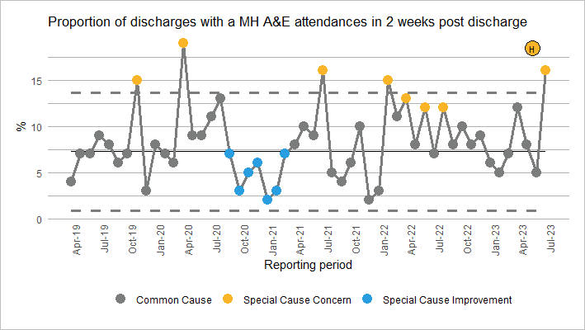
Discharges & Follow Up Activity, Acute adult mental health care, 18-64 years, C&P ICB
In Cambridgeshire and Peterborough ICB, the proportion of hospital spells with follow-up within 3 days of the discharge date shows an increasing trend since September 2020.
The proportion of people discharged from hospitals that have a mental-related A&E attendance within 2 weeks post-discharge shows a fluctuating trend, with a shift seen between Sep-20 and Mar-21, and 5 data points showing significant increases.
Shift: a run of 7 or more consecutive data points above or below the mean
Source: Workbook: Acute Mental Health Dashboard (england.nhs.uk)
Notes:
Updated 14th September 2023 with data to July (provisional) 2023
Proportion of discharges with 72 hour follow up: The proportion of discharged hospital spells with eligible follow up activity recorded within 72 hours of discharge
Numerator: Hospital spells with follow-up within 3 days of discharge date. Follow-up defined as date of either first care contact or first admission, since discharge, where:
Care contact attendance is either 'Attended on time or, if late, before the relevant professional was ready to see the patient' (5) or 'Arrived late, after the relevant professional was ready to see the patient, but was seen' (6).
Care contact consultation medium is either: 'Face to face communication' (01), 'Telephone' (02), 'Telemedicine' (03)', or 'Talk type for a person unable to speak' (04)’
Average number of contacts in 2 weeks, 2 months post discharge: Mean count of follow up activity for each discharged hospital spell within 2 weeks/months of discharge.
Only counted for hospital spells discharged within 2 weeks/months of the reporting period end.
Eligible discharges and follow-up activity defined using the same criteria as the 72-hour follow-up measure above.
Proportion of discharges with a MH A&E attendance in 2 weeks, 2 months post discharge: The proportion of people discharged from hospital that have a MH-related A&E attendance within 2 weeks/months.
Denominator All discharged hospital spells where the discharge date of the hospital was at least 2 weeks/months before the end of the latest reporting period. Unlike the previous discharge measures, this doesn't account for discharge method or discharge destination.
Numerator Discharged spells are linked to A&E attendance data from the Emergency Care Dataset (ECDS) based on NHS Number. See Urgent and Emergency Dashboard for definition of how MH-related attendances are defined in the ECDS.

Slide 75
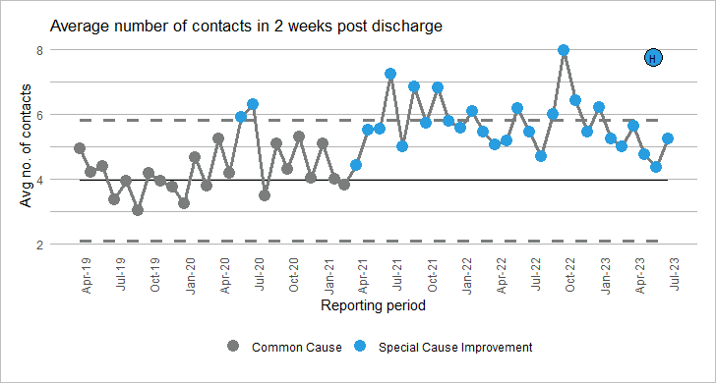
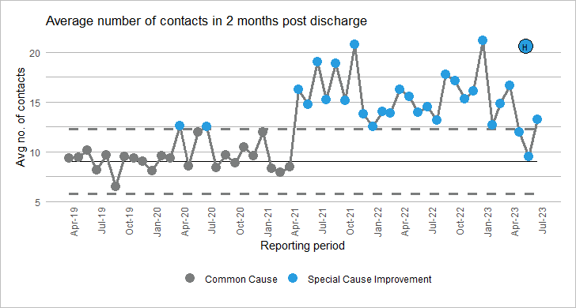
Discharges and Follow Up Activity, Acute adult mental health care, 18-64 years, C&P ICB
The average number of contacts within 2 weeks for each discharged hospital spell shows an increasing trend since Mar-21 with a shift.
A significant increase has been seen in the average number of follow-up activities for each discharged hospital spell within 2 months of discharge since Apr-21.
Shift: a run of 7 or more consecutive data points above or below the mean
Source: Workbook: Acute Mental Health Dashboard (england.nhs.uk)
Notes:
Updated 14th September 2023 with data to July (provisional) 2023
Proportion of discharges with 72 hour follow up: The proportion of discharged hospital spells with eligible follow up activity recorded within 72 hours of discharge
Numerator: Hospital spells with follow-up within 3 days of discharge date. Follow-up defined as date of either first care contact or first admission, since discharge, where:
Care contact attendance is either 'Attended on time or, if late, before the relevant professional was ready to see the patient' (5) or 'Arrived late, after the relevant professional was ready to see the patient, but was seen' (6).
Care contact consultation medium is either: 'Face to face communication' (01), 'Telephone' (02), 'Telemedicine' (03)', or 'Talk type for a person unable to speak' (04)’
Average number of contacts in 2 weeks, 2 months post discharge: Mean count of follow up activity for each discharged hospital spell within 2 weeks/months of discharge.
Only counted for hospital spells discharged within 2 weeks/months of the reporting period end.
Eligible discharges and follow-up activity defined using the same criteria as the 72-hour follow-up measure above.
Proportion of discharges with a MH A&E attendance in 2 weeks, 2 months post discharge: The proportion of people discharged from hospital that have a MH-related A&E attendance within 2 weeks/months.
Denominator All discharged hospital spells where the discharge date of the hospital was at least 2 weeks/months before the end of the latest reporting period. Unlike the previous discharge measures, this doesn't account for discharge method or discharge destination.
Numerator Discharged spells are linked to A&E attendance data from the Emergency Care Dataset (ECDS) based on NHS Number. See Urgent and Emergency Dashboard for definition of how MH-related attendances are defined in the ECDS.

Slide 76
Bed occupancy, 18+ years, Cambridgeshire and Peterborough ICB
The proportion of beds occupied by people who are medically fit for discharge show an increasing trend since March 2023.
Source: Workbook: All Age UEC Pathway Pressures (england.nhs.uk)

Slide 77
Out of Area Placements (OAP), All-age adults, Cambridgeshire and Peterborough ICB
Closure of Mulberry 3
The number of inappropriate out of area placements from patients within Cambridgeshire and Peterborough ICB shows a large increase from the three-month period ending May 2022 (Mulberry 3 was closed in May 2022), before which the numbers were fairly stable under 100.
During the period ending September 2023, there were 1,940 OAP days, and a decline is seen since the period ending July 2023.
Mulberry 3 is a 16-bed treatment and acute recovery ward
Source: Mental Health Out of Area Placement Report - Mental Health, Learning Disability and Autism Resource Hub - FutureNHS Collaboration Platform
Notes:
Updated June 2023
Out of Area Placement (OAP) for acute mental health in-patient care:
A person with assessed acute mental health needs who requires adult mental health acute inpatient care who is admitted to a unit that does not form part of their usual local network of services. By this we mean an inpatient unit that does not usually admit people living in the catchment of the person’s local community mental health service, and where the person cannot be visited regularly by their care co-ordinator to ensure continuity of care and effective discharge planning.
For example, an OAP is a placement of a patient to any other provider that is not the patient’s home provider, including:
- Any other NHS unit, regardless of distance travelled.
- Any Independent Service Provider (ISP), regardless of distance travelled.
Inappropriate OAPs (unavailable beds): An out of area placement that is solely or primarily necessitated because of the unavailability of a local acute bed will not meet the criteria for being appropriate.
The sending provider is the provider that has taken the decision to place someone outside of the usual local network of services
Note:
Regional and STP totals are provided directly from NHS Digital. All aggregations provided by NHS Digital are based on the location of the GP of each patient. Therefore totalling all CCG data in a region may not equal the regional figure given. Please note, no separate regional total has been published for provider data, so the same regional totals have been used in all views.

Slide 78

Out of Area Placements (OAP), All-age adults, Cambridgeshire and Peterborough ICB
Summary of OAP, Cambridgeshire and Peterborough ICB, 3-month period ending June 2023
OAP Activity
Total number of inappropriate OAP days over the period | Percentage of total days due to inappropriate OAPs | Inappropriate OAPs started in period | Inappropriate OAPs ended during period | Inappropriate OAPs active at period end
2,550 | 96% | 30 | 30 | 25
OAP Costs
Total Cost For Inappropriate OAPs in Period | Percentage of Costs incurred by inappropriate placements | Average Cost Per inappropriate OAP bed day
£1,729,589 | 96% | £625
Length of stay (ended in period)
1-7 nights | 8-14 nights | 15-30 nights | 31-90 nights | More than 90 nights
5 | 5 | 5 | 15 | 10
Distance Travelled (OAPs active in the period)
Less than 25 km | 25 km to 50 km | 50 km to 100 km | 100 km to 200 km | 200 km to 300 km | 300 km or greater
5 | 5 | 25 | 20 | 5 | 5
In the three-month period ending June 2023, out of 2,670 OAP days, 2,550 (96%) were inappropriate OAPs from patients within Cambridgeshire and Peterborough ICB.
During this period, 45 out of 65 OAPs from Cambridgeshire and Peterborough ICB were in a unit that was between 50km and 200km away.
The length of stay for 25 out of 40 OAPs that ended in the period was 30 nights and over.
The average daily cost for OAPs for the Cambridgeshire and Peterborough ICB (£625) is higher than the East of England average (£600) but lower than the national average (£667).
Source: Mental Health Out of Area Placement Report - Mental Health, Learning Disability and Autism Resource Hub - FutureNHS Collaboration Platform
Notes:
Updated June 2023
Out of Area Placement (OAP) for acute mental health in-patient care:
A person with assessed acute mental health needs who requires adult mental health acute inpatient care who is admitted to a unit that does not form part of their usual local network of services. By this we mean an inpatient unit that does not usually admit people living in the catchment of the person’s local community mental health service, and where the person cannot be visited regularly by their care co-ordinator to ensure continuity of care and effective discharge planning.
For example, an OAP is a placement of a patient to any other provider that is not the patient’s home provider, including:
- Any other NHS unit, regardless of distance travelled.
- Any Independent Service Provider (ISP), regardless of distance travelled.
Inappropriate OAPs (unavailable beds): An out of area placement that is solely or primarily necessitated because of the unavailability of a local acute bed will not meet the criteria for being appropriate.
The sending provider is the provider that has taken the decision to place someone outside of the usual local network of services
Note:
Regional and STP totals are provided directly from NHS Digital. All aggregations provided by NHS Digital are based on the location of the GP of each patient. Therefore totalling all CCG data in a region may not equal the regional figure given. Please note, no separate regional total has been published for provider data, so the same regional totals have been used in all views.

Slide 79

SPC chart description
An SPC chart is a time series graph with three reference lines – mean, upper and lower control limits. The limits help us understand the variability of data. We use them to distinguish between natural variation (common cause) in performance and unusual patterns (special cause) in data which are unlikely to have occurred due to chance and require investigation.
Special cause variation is statistically significant patterns in data which may require investigation, including:
Trend: 6 or more consecutive points trending upwards or downwards
Shift: 7 or more consecutive points above or below the mean
Outside control limits: One or more data points are beyond the upper or lower control limits

Slide 80
Edits to work on the slide pack before publication
Data on long-term conditions in NHS Talking Therapies
Analysis of Annual Physical Health Checks leading to Healthy You referrals

