Slide 1
Cambridgeshire and Peterborough
Mental Health Needs Assessment
Chapter 5: Working Age Adults
Prevalence of Mental Health Conditions

Slide 2
Table of Contents
  QOF prevalence
  Population projection for mental health conditions
  Estimation of mental disorders in the local population

Slide 3
QOF prevalence

Slide 4
Depression: QOF incidence, 18+ yrs, New diagnosis
In 2021/22, the percentage of patients aged 18 and over with depression recorded on practice disease registers for the first time in the financial year shows an increase compared to the previous year in Cambridgeshire, Peterborough and England.
From 2016/17 to 2021/22, the percentage of new diagnoses of depression was significantly lower than the national rates in Cambridgeshire and Peterborough.
Source: https://digital.nhs.uk/
Notes:
Depression: QOF incidence (18+ yrs): The percentage of patients aged 18 and over with depression recorded on practice disease registers for the first time in the financial year.

Slide 5
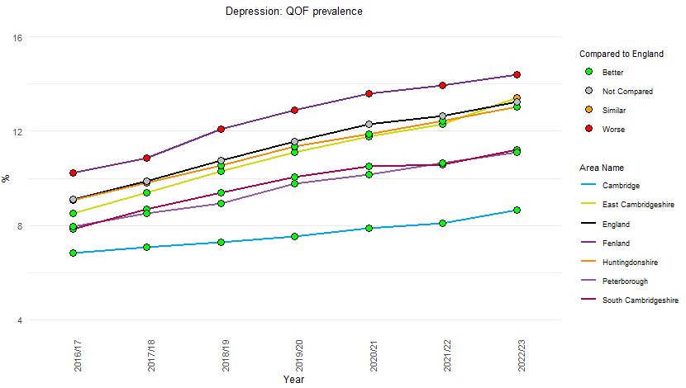
Depression: QOF prevalence, 18+ yrs
The prevalence of depression has shown an increasing trend since 2016/17 across all areas in Cambridgeshire and Peterborough. This is also true for England.
The prevalence of depression in Fenland is significantly higher than the national rate since 2016/17.
In 2022/23, a sharp increase has been seen in East Cambridgeshire than the past year, and the prevalence is statistically similar to the national rate.
Source: https://digital.nhs.uk/
Notes:
Depression: QOF prevalence (18+ yrs): The percentage of patients aged 18 and over with depression, as recorded on practice disease registers.

Slide 6
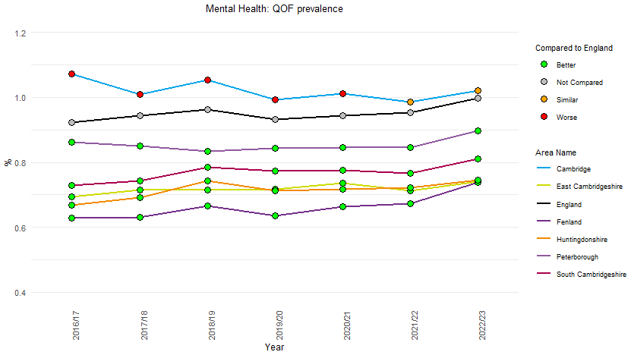
Severe Mental Illness (SMI): QOF prevalence (all ages)
The prevalence of schizophrenia, bipolar disorder, and other psychoses on the practice disease register shows an overall increase since 2016/17 in all Cambridgeshire districts and Peterborough, except Cambridge.
The prevalence in Cambridge shows an overall decline and is now statistically similar to the national rate.
Source: https://digital.nhs.uk/
Notes:
Mental Health: QOF prevalence (all ages): The percentage of patients with schizophrenia, bipolar affective disorder and other psychoses as recorded on practice disease registers.

Slide 7
Population projection for mental health conditions

Slide 8
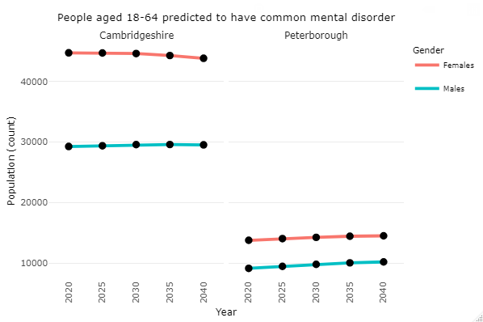
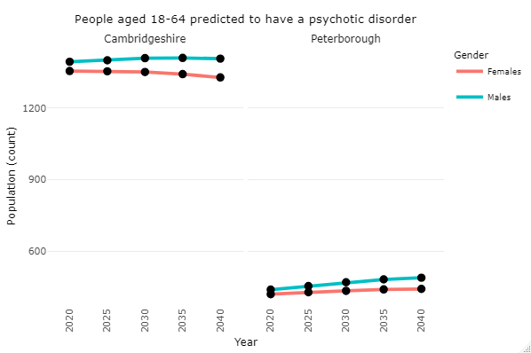
People aged 18-64 predicted to have a mental health condition
People aged 18-64 predicted to have a common mental disorder
People aged 18-64 predicted to have a psychotic disorder
The number of females predicted to have a common mental disorder is substantially higher than the number of males in both Cambridgeshire and Peterborough.
The projections show an increase in numbers for both men and women in Peterborough from 2020 to 2040, while a declining trend is seen for women in Cambridgeshire.
The number of males predicted to have a psychotic disorder is higher than that of females in Cambridgeshire and Peterborough.
The number of people predicted to have a psychotic disorder show an increasing gap between men and women in 2040 compared to 2020.
Source: https://www.pansi.org.uk/
Notes:
Source: Projecting Adult Needs and Service Information (PANSI)
Link: https://www.pansi.org.uk/index.php
This data is based on the report Adult Psychiatric Morbidity Survey: Survey of Mental Health and Wellbeing, England, 2014 (2016), NHS Digital.
The 2014 Adult Psychiatric Morbidity Survey (APMS) is the fourth survey of psychiatric morbidity in adults living in private households. It was carried out by NatCen Social Research in collaboration with the University of Leicester, and was commissioned by NHS Digital.
The prevalence rates have been applied to ONS population projections for the 18-64 population to give estimated numbers predicted to have a mental health problem, projected to 2040.

Slide 9
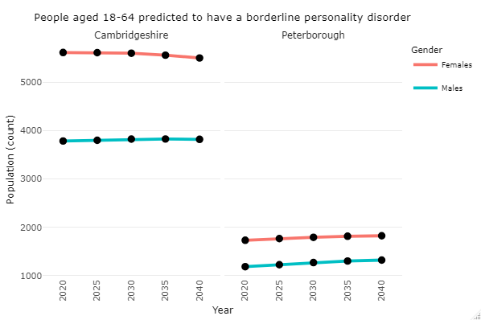
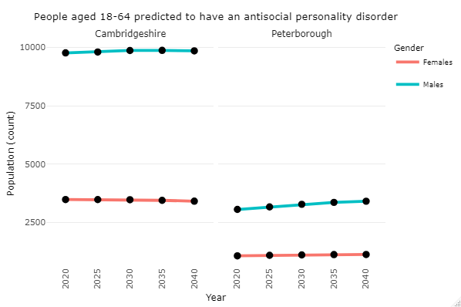
People aged 18-64 predicted to have a mental health condition
People aged 18-64 predicted to have a borderline personality disorder
People aged 18-64 predicted to have an antisocial personality disorder
The number of people aged 18 – 64 predicted to have a borderline personality disorder is higher among females than males in both Cambridgeshire and Peterborough.
In both Cambridgeshire and Peterborough, males are predicted to have a substantially higher rate of antisocial personality disorder than females.
Source: https://www.pansi.org.uk/
Notes:
Source: Projecting Adult Needs and Service Information (PANSI)
Link: https://www.pansi.org.uk/index.php
This data is based on the report Adult Psychiatric Morbidity Survey: Survey of Mental Health and Wellbeing, England, 2014 (2016), NHS Digital.
The 2014 Adult Psychiatric Morbidity Survey (APMS) is the fourth survey of psychiatric morbidity in adults living in private households. It was carried out by NatCen Social Research in collaboration with the University of Leicester, and was commissioned by NHS Digital.
The prevalence rates have been applied to ONS population projections for the 18-64 population to give estimated numbers predicted to have a mental health problem, projected to 2040.

Slide 10
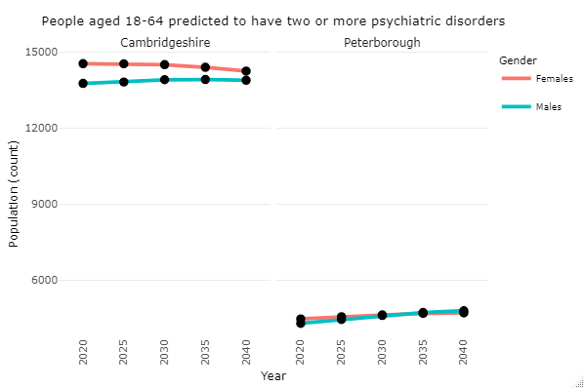
People aged 18-64 predicted to have a mental health condition
People aged 18-64 predicted to have two or more psychiatric disorders
In Cambridgeshire, the number of females predicted to have two or more psychiatric disorders is higher than that of males.
However, the prediction shows a narrow gap between male and female counts in 2040.
In Peterborough, a similar number of male and female population are predicted to experience two or more psychiatric disorders.
Source: https://www.pansi.org.uk/
Notes:
Source: Projecting Adult Needs and Service Information (PANSI)
Link: https://www.pansi.org.uk/index.php
This data is based on the report Adult Psychiatric Morbidity Survey: Survey of Mental Health and Wellbeing, England, 2014 (2016), NHS Digital.
The 2014 Adult Psychiatric Morbidity Survey (APMS) is the fourth survey of psychiatric morbidity in adults living in private households. It was carried out by NatCen Social Research in collaboration with the University of Leicester, and was commissioned by NHS Digital.
The prevalence rates have been applied to ONS population projections for the 18-64 population to give estimated numbers predicted to have a mental health problem, projected to 2040.

Slide 11
Estimation of mental disorders in the local population

Slide 12
Introduction
The Adult Psychiatric Morbidity Survey (APMS) series provides data on the prevalence of both treated and untreated psychiatric disorders in the English adult population (aged 16 and over). The survey has been carried out on 4 occasions, in 1993, 2000, 2007 and 2014. The most recent survey was conducted by NatCen Social Research, in collaboration with the University of Leicester, for NHS Digital.
All the APMS surveys have used largely consistent methods and in 2014 the sample size was around 7,500 adults.
APMS assesses psychiatric morbidity using actual diagnostic criteria for a range of disorders: common mental disorders, post-traumatic stress disorder, psychotic disorder, autism spectrum disorder, personality disorder, attention-deficit/hyperactivity disorder, bipolar disorder, alcohol dependence, drug use and dependence, suicidal thoughts, suicide attempts and self-harm, and comorbidity in mental and physical illness.
Further information about the APMS, definitions and methodology can be found here: https://digital.nhs.uk/data-and-information/publications/statistical/adult-psychiatric-morbidity-survey/adult-psychiatric-morbidity-survey-survey-of-mental-health-and-wellbeing-england-2014
The national prevalence data from the APMS carried out in 2014 has been applied to the Census 2021 population for Cambridgeshire, Peterborough and the five districts to calculate the local estimated population size with different mental disorders by age and sex.
Caveats:
The APMS series consists of surveys of the general population, and is subject to response bias in terms of people’s capacity and inclination to participate
Local estimates have been calculated purely based on applying percentages from the APMS to population demography. The actual prevalence will be affected by random variation and also by local variation in risk factors. Therefore, it should be noted that these are estimates that are indicative of need rather than accurate prevalence data.
The local estimations are based on the local authority population, but the Integrated Care Board (ICB) covers a slightly larger area with a bigger population, so overall numbers of people with a psychiatric disorder will be slightly higher.
This is based on the 2014 national estimates; therefore, there would be some degree of inaccuracy for the present population, especially after the pandemic.
The next publication of the Adult Psychiatric Morbidity Survey (APMS) will be published in 2024 and the local estimations will be updated accordingly.

Slide 13
Instruction for use
To view the values in the graphs:
Enable editing for slides
Click on the chart.
Go to “Chart Design” on the Menu
Select “Add Chart Element” under the Chart Layouts
Select “Data Table”
Choose either “With Legend Keys” or “No Legend Keys” from the options, and this would bring up a table with the values just under the chart.

Slide 14
Population estimates for mental disorders, Cambridgeshire and Peterborough
Types of Common mental disorders
* 16 – 64 years ** 18 – 64 years
The local estimation for mental disorders shows that, about 47,000 males (13.2%) and 76,800 females (20.7%) aged 16 and over in Cambridgeshire and Peterborough were likely to have a common mental disorder (CMD) in the past week.
The largest category of CMD was common mental disorder not otherwise specified (CMD NOS) with an estimation of 20,700 men and 35,600 women, followed by Generalised Anxiety Disorder (GAD) with approximately 17,400 men and 25,200 women in the local population.
Estimation also shows that people who were likely to have Attention Deficit Hyperactivity Disorder (ADHD) have one of the highest numbers in Cambridgeshire and Peterborough, with 35,700 men and 35,100 women.
Note: Lower and upper limits of the error bars show the 95% confidence interval.
Source: APMS 2014 and ONS Census 2021
Notes:
Further information of the definitions and assessment methods for different mental disorders can be found here Adult Psychiatric Morbidity Survey: Survey of Mental Health and Wellbeing, England, 2014. - NHS Digital

Slide 15
Common Mental Disorders (CMD) in the past week
Estimated number of people with CMD, by diagnosis
Common mental disorder (CMD) | Cambridgeshire | Peterborough | Total
Generalised anxiety disorder | 33,019 | 9,887 | 42,906
Depressive episode | 18,468 | 5,530 | 23,998
Phobias | 13,432 | 4,022 | 17,453
Obsessive compulsive disorder | 7,275 | 2,178 | 9,454
Panic Disorder | 3,358 | 1,005 | 4,363
CMD Not Otherwise Specified | 43,652 | 13,070 | 56,723
Any CMD | 95,140 | 28,487 | 123,626
It is estimated that more than 123,500 people have had any common mental disorders in the past week in Cambridgeshire and Peterborough.
About 43,000 were estimated to have anxiety disorder and 24,000 with depression.
Estimated number of people with Any CMD, by age group and district
Area Name | 16-24 yrs | 25-34 yrs | 35-44 yrs | 45-54 yrs | 55-64 yrs | 65-74 yrs | 75+ yrs | 16 and over
 | 18.9% | 19.0% | 19.3% | 19.1% | 18.0% | 11.5% | 8.8% | 17.0%
Cambridge | 5,788 | 5,666 | 3,792 | 3,018 | 2,206 | 1,000 | 697 | 21,211
East Cambridgeshire | 1,341 | 1,932 | 2,265 | 2,427 | 2,071 | 1,115 | 750 | 12,144
Fenland | 1,710 | 2,414 | 2,297 | 2,606 | 2,544 | 1,435 | 961 | 14,422
Huntingdonshire | 2,918 | 4,339 | 4,567 | 4,855 | 4,386 | 2,279 | 1,472 | 25,204
South Cambridgeshire | 2,459 | 3,501 | 4,423 | 4,532 | 3,684 | 1,907 | 1,339 | 22,160
Cambridgeshire | 14,216 | 17,852 | 17,345 | 17,439 | 14,889 | 7,737 | 5,218 | 95,140
Peterborough | 4,066 | 6,198 | 6,280 | 5,262 | 4,096 | 1,925 | 1,219 | 28,487
Total | 18,282 | 24,051 | 23,625 | 22,701 | 18,985 | 9,662 | 6,437 | 123,626
The estimated figures show that Peterborough and Huntingdonshire have the highest numbers of people with any common mental disorder because of the larger population size.
Source: APMS 2014 and ONS Census 2021
Notes:
Further information on CMD definition and assessment methods can be found here adult_psychiatric_study_ch2_web.pdf (digital.nhs.uk)

Slide 16
Any common mental disorders (CMD) in past week
National prevalence (%) | 16-24 | 25-34 | 35-44 | 45-54 | 55-64 | 65-74 | 75+ | 16 and over
 | 10.0 | 17.4 | 16.3 | 13.8 | 15.6 | 8.1 | 5.6 | 13.2
National prevalence (%) | 16-24 | 25-34 | 35-44 | 45-54 | 55-64 | 65-74 | 75+ | 16 and over
 | 28.2 | 20.7 | 22.3 | 24.2 | 20.2 | 14.7 | 11.0 | 20.7
Common mental disorders (CMDs) cause marked emotional distress and interfere with daily function, although they do not usually affect insight. CMDs comprise different types of depression and anxiety. Symptoms of depression and anxiety frequently co-exist, with the result that many people meet criteria for more than one CMD.
Nationally, the overall estimated prevalence of CMD for those aged 16 and over was 17.0%. The prevalence among females was substantially higher than that of male.
Among 16 – 24 age group, CMD were about three times more common in women (28.2%) than men (10.0%).
Locally, the prevalence translates to an estimated population of about 47,000 males (13.2%) and 76,800 females (20.7%) aged 16 and over in Cambridgeshire and Peterborough.
Note: Lower and upper limits of the error bars show the 95% confidence interval.
Source: APMS 2014 and ONS Census 2021
Notes:
Further information on CMD definition and assessment methods can be found here adult_psychiatric_study_ch2_web.pdf (digital.nhs.uk)

Slide 17
Generalised anxiety disorder (GAD) in past week
National prevalence (%) | 16-24 | 25-34 | 35-44 | 45-54 | 55-64 | 65-74 | 75+ | 16 and over
 | 3.8 | 6.0 | 6.8 | 6.0 | 6.2 | 2.0 | 0.9 | 4.9
National prevalence (%) | 16-24 | 25-34 | 35-44 | 45-54 | 55-64 | 65-74 | 75+ | 16 and over
 | 9.0 | 6.3 | 7.0 | 8.5 | 6.7 | 5.8 | 3.6 | 6.8
Generalised anxiety disorder (GAD) was the second most commonly identified CMD (5.9%). It was more common among women than men in each age category.
The prevalence among young women aged 16–24 was more than twice as high as that of men in the same age band. The prevalence among females in the 65+ age group is substantially higher than that of males.
Local estimation for Cambridgeshire and Peterborough shows that approximately 17,400 men (4.9%) and 25,200 women (6.8%) aged 16 and over have experienced GAD in the week prior to the survey.
Note: Lower and upper limits of the error bars show the 95% confidence interval.
Source: APMS 2014 and ONS Census 2021
Notes:
Further information on CMD definition and assessment methods can be found here adult_psychiatric_study_ch2_web.pdf (digital.nhs.uk)

Slide 18
Depressive episodes in past week
National prevalence (%) | 16-24 | 25-34 | 35-44 | 45-54 | 55-64 | 65-74 | 75+ | 16 and over
 | 0.9 | 4.1 | 2.7 | 4.2 | 4.2 | 2.4 | 0.3 | 2.9
National prevalence (%) | 16-24 | 25-34 | 35-44 | 45-54 | 55-64 | 65-74 | 75+ | 16 and over
 | 3.8 | 2.8 | 5.5 | 4.8 | 4.4 | 1.9 | 2.0 | 3.7
Symptoms of depressive episodes include low mood and a loss of interest and enjoyment in ordinary things and experiences. They impair emotional and physical wellbeing and behaviour.
Nationally, depressive episodes were more prevalent in women than in men. The prevalence among females is higher than males in most age groups except the 25 – 34 and 65 – 74 age groups.
The national prevalence when applied to the Cambridgeshire and Peterborough population shows that around 10,300 men (2.9%) and 13,700 women (3.7%) aged 16 and over have experienced depressive episodes in the past week.
Note: Lower and upper limits of the error bars show the 95% confidence interval.
Source: APMS 2014 and ONS Census 2021
Notes:
Further information on CMD definition and assessment methods can be found here adult_psychiatric_study_ch2_web.pdf (digital.nhs.uk)

Slide 19
Phobias in past week
National prevalence (%) | 16-24 | 25-34 | 35-44 | 45-54 | 55-64 | 65-74 | 75+ | 16 and over
 | 1.3 | 2.8 | 2.5 | 2.3 | 1.2 | 0.7 | 0.3 | 1.8
National prevalence (%) | 16-24 | 25-34 | 35-44 | 45-54 | 55-64 | 65-74 | 75+ | 16 and over
 | 5.4 | 3.8 | 3.5 | 3.0 | 3.3 | 0.5 | 0.6 | 3.0
A phobia is a type of anxiety disorder. It is an extreme form of fear or anxiety, triggered by a particular situation or object.
The prevalence of phobias among women was substantially higher than among men. Phobias were more common among young women aged 16 – 24.
Local estimation shows that approximately 6,400 males (1.8%) and 11,100 females (3.0%) aged 16 and over have experienced phobias in Cambridgeshire and Peterborough.
Note: Lower and upper limits of the error bars show the 95% confidence interval.
Source: APMS 2014 and ONS Census 2021
Notes:
Further information on CMD definition and assessment methods can be found here adult_psychiatric_study_ch2_web.pdf (digital.nhs.uk)

Slide 20
Obsessive Compulsive Disorder (OCD) in past week
National prevalence (%) | 16-24 | 25-34 | 35-44 | 45-54 | 55-64 | 65-74 | 75+ | 16 and over
 | 1.2 | 1.1 | 1.7 | 1.4 | 0.7 | 0.3 | 0.3 | 1.1
National prevalence (%) | 16-24 | 25-34 | 35-44 | 45-54 | 55-64 | 65-74 | 75+ | 16 and over
 | 2.4 | 1.6 | 1.6 | 1.8 | 2.1 | 0.4 | 0.2 | 1.5
OCD is characterised by a combination of obsessive thoughts and compulsive behaviours. Obsessions are defined as recurrent and persistent thoughts, impulses or images that are experienced as intrusive and inappropriate, are resisted, and cause marked anxiety or distress. Compulsions are repetitive, purposeful and ritualistic behaviours or mental acts, performed in response to obsessive intrusion and to a set of rigidly prescribed rules (NICE 2006).
The prevalence of OCD among women is higher than that of men across all age groups, except 35 – 44 and 75+ age groups.
In Cambridgeshire and Peterborough, it is estimated that approximately 3,900 males and 5,600 females aged 16 and over have experienced OCD.
Note: Lower and upper limits of the error bars show the 95% confidence interval.
Source: APMS 2014 and ONS Census 2021
Notes:
Further information on CMD definition and assessment methods can be found here adult_psychiatric_study_ch2_web.pdf (digital.nhs.uk)

Slide 21
Panic disorder in past week
National prevalence (%) | 16-24 | 25-34 | 35-44 | 45-54 | 55-64 | 65-74 | 75+ | 16 and over
 | 0.4 | 0.3 | 0.2 | 0.1 | 0.7 | 0.4 | 0.3 | 0.3
National prevalence (%) | 16-24 | 25-34 | 35-44 | 45-54 | 55-64 | 65-74 | 75+ | 16 and over
 | 2.2 | 0.6 | 0.3 | 0.8 | 0.4 | 0.9 | 0.8 | 0.8
The main symptoms of panic disorder are attacks of intense fear and discomfort that happen unexpectedly and repeatedly.
Panic disorder was more prevalent in women than in men in most age groups, except for 55 – 64.
Approximately 1,100 men (0.3%) and 3,000 women (0.8%) were estimated to have panic disorder in the local population (aged 16+).
Note: Lower and upper limits of the error bars show the 95% confidence interval.
Source: APMS 2014 and ONS Census 2021
Notes:
Further information on CMD definition and assessment methods can be found here adult_psychiatric_study_ch2_web.pdf (digital.nhs.uk)

Slide 22
CMD not otherwise specified in past week
National prevalence (%) | 16-24 | 25-34 | 35-44 | 45-54 | 55-64 | 65-74 | 75+ | 16 and over
 | 5.6 | 7.9 | 6.1 | 5.6 | 6.8 | 3.5 | 3.8 | 5.8
National prevalence (%) | 16-24 | 25-34 | 35-44 | 45-54 | 55-64 | 65-74 | 75+ | 16 and over
 | 11.3 | 10.2 | 10.3 | 11.8 | 9.4 | 6.9 | 5.7 | 9.6
Common mental disorder not otherwise specified (CMD-NOS) was defined as having a CIS-R score of 12 or more but falling short of the criteria for any specific CMD.
Unspecified common mental disorder prevalence is substantially higher among women than in men across all age groups. This was more common in females aged 45 – 54 (11.8%) and young women aged 16 – 24 years (11.3%).
The local population estimated to have unspecified CMD was 20,700 males (5.8%) and 35,600 females (9.6%) aged 16 and over.
Note: Lower and upper limits of the error bars show the 95% confidence interval.
Source: APMS 2014 and ONS Census 2021
Notes:
Further information on CMD definition and assessment methods can be found here adult_psychiatric_study_ch2_web.pdf (digital.nhs.uk)

Slide 23
Post Traumatic Stress Disorder (PTSD) in last month
National prevalence (%) | 16-24 | 25-34 | 35-44 | 45-54 | 55-64 | 65-74 | 75+ | 16 and over
 | 3.6 | 4.7 | 4.4 | 4.2 | 5.0 | 1.1 | 0.4 | 3.7
National prevalence (%) | 16-24 | 25-34 | 35-44 | 45-54 | 55-64 | 65-74 | 75+ | 16 and over
 | 12.6 | 6.2 | 4.7 | 4.8 | 2.5 | 2.0 | 0.8 | 5.1
A ‘trauma’ is an event of such severity that a person fears for their own or a loved one’s life or safety. It was defined as: ‘The term traumatic event or experience means something like a major natural disaster, a serious automobile accident, being raped, seeing someone killed or seriously injured, having a loved one die by murder or suicide, or any other experience that either put you or someone close to you at risk of serious harm or death’. A participant could screen positive for PTSD without reporting having experienced a trauma.
Overall, about one participant in twenty (4.4%) screened positive for PTSD in the past month, with similar rates for men and women.
Among women, the likelihood of screening positive for PTSD was particularly high among 16–24 year olds (12.6%) and then declined sharply with age.
In men, the rate remained quite stable between the ages of 16 and 64, only declining in much later life.
In the local population of 16 years and over, the estimation shows that about 13,200 men and 18,900 women had experienced PTSD.
Note: Lower and upper limits of the error bars show the 95% confidence interval.
Source: APMS 2014 and ONS Census 2021
Notes:
Screening positive for probable PTSD involves both achieving a score of 50 or more on the PTSD checklist (PCL) and meeting the DSM-IV criteria.
A ‘trauma’ is an event of such severity that a person fears for their own or a loved one’s life or safety. It was defined as: ‘The term traumatic event or experience means something like a major natural disaster, a serious automobile accident, being raped, seeing someone killed or seriously injured, having a loved one die by murder or suicide, or any other experience that either put you or someone close to you at risk of serious harm or death’. A participant could screen positive for PTSD without reporting having experienced a trauma.
Further information on PTSD definition and assessment methods can be found here adult_psychiatric_study_ch4_web.pdf (digital.nhs.uk)

Slide 24
Psychotic disorder in the past year
National prevalence (%) | 16-24 | 25-34 | 35-44 | 45-54 | 55-64 | 65-74 | 75+ | 16 and over
 | 0.2 | 0.3 | 1.0 | 0.5 | 0.7 | 0.1 | - | 0.5
National prevalence (%) | 16-24 | 25-34 | 35-44 | 45-54 | 55-64 | 65-74 | 75+ | 16 and over
 | 0.5 | 0.8 | 0.9 | 0.5 | 0.8 | 0.3 | 0.2 | 0.6
Psychotic disorders produce disturbances in thinking and perception that are severe enough to distort perception of reality. The main types are schizophrenia and affective psychosis.
The prevalence of psychotic disorder did not show any significant differences in rate between men and women. Although the observed rate was highest in those aged 35–44, associations with age were not statistically significant for psychotic disorder in the last year.
Local estimation for psychotic disorder shows that approximately 1,700 men and 2,300 women have experienced psychotic disorder in the past year.
Note: Lower and upper limits of the error bars show the 95% confidence interval.
Source: APMS 2014 and ONS Census 2021
Notes:
Further information on psychotic disorder definition and assessment methods can be found here adult_psychiatric_study_ch5_web.pdf (digital.nhs.uk)

Slide 25
Autism spectrum disorder (ASD)
National prevalence (%) | 16-34 | 35-54 | 55-74 | 75+ | 16 and over
 | 2.6 | 0.2 | 2.0 | 0.7 | 1.5
National prevalence (%) | 16-34 | 35-54 | 55-74 | 75+ | 16 and over
 | 0.6 | 0.0 | - | - | 0.2
Autism spectrum disorders (ASDs), also referred to as autism, are developmental disorders characterised by impaired social interaction and communication, severely restricted interests, and highly repetitive behaviours.
Estimated rates of ASD were significantly higher in men (1.5%, 95% CI: 0.8% to 2.6%) than women (0.2%, 95% CI: 0.1% to 0.6%). However, it has been suggested that assessments for autism may draw more on how the condition manifests in men, and this may lead to under identification of autism in women (Trubanova et al. 2014).
Local estimates in Cambridgeshire and Peterborough show that around 5,200 males and 800 females aged 16 and over were likely to be screened positive for autism.
There was no clear pattern in the distribution of autism by age. However, a lower number of people in 35 – 54 age group were estimated to likely screen positive for autism.
Note: Lower and upper limits of the error bars show the 95% confidence interval.
Source: APMS 2014 and ONS Census 2021
Notes:
The process of testing for was based on a two phase screening process and required a score of 10 or more on the Autism Diagnostic Observation Schedule (ADOS). Survey assessment of mental disorder is not as robust as a diagnosis made by a clinician over a series of sessions.
In the phase one interview ASD was screened for using the Autism Quotient (AQ-20). In the phase two interview, fuller assessments were carried out by clinically trained interviewers using the Autism Diagnostic Observation Schedule (ADOS) with a subset of participants with an AQ score of 4 or more.
Further information on ASD definition and assessment methods can be found here adult_psychiatric_study_ch6_web.pdf (digital.nhs.uk)

Slide 26
Antisocial personality disorder (ASPD) (lifetime)
National prevalence (%) | 18-24 | 25-34 | 35-54 | 55-64 | 18 – 64
 | 6.4 | 6.6 | 3.6 | 4.1 | 4.9
National prevalence (%) | 18-24 | 25-34 | 35-54 | 55-64 | 18 - 64
 | 3.3 | 2.7 | 1.3 | 0.4 | 1.8
ASPD is characterised by disregard for and violation of the rights of others. People with ASPD have a pattern of aggressive and irresponsible behaviour which emerges in childhood or early adolescence (Goldstein et al. 2006).
The ASPD rate was higher in men (4.9%) than women (1.8%). Screening positive for ASPD was associated with age, with rates highest in younger age bands.
Positive screens for ASPD were more common in men aged 18–24 (6.4%) and 25–34 (6.6%) than in men in older age groups (4.1% of men aged 55–64). A similar pattern was observed among women: 3.3% of women aged 18–24 screened positive for ASPD, compared with 0.4% of women aged 55–64.
In Cambridgeshire and Peterborough, about 13,300 men and 5,000 women were estimated to screen positive for antisocial personality disorder.
Note: Lower and upper limits of the error bars show the 95% confidence interval.
Source: APMS 2014 and ONS Census 2021
Notes:
Based on the self-completion SCID-II questionnaire administered at phase one. These rates are not comparable with those reported for previous waves of the survey, which included a clinician administered SCID-II assessment at phase two.
Further information on ASPD definition and assessment methods can be found here adult_psychiatric_study_ch7_web.pdf (digital.nhs.uk)

Slide 27
Borderline personality disorder (BPD) (lifetime)
National prevalence (%) | 16-24 | 25-34 | 35-54 | 55-64 | 16-64
 | 4.2 | 0.9 | 1.7 | 1.1 | 1.9
National prevalence (%) | 16-24 | 25-34 | 35-54 | 55-64 | 16-64
 | 7.3 | 3.7 | 1.4 | 0.8 | 2.9
BPD is characterised by high levels of personal and emotional instability associated with significant impairment. People with BPD have severe difficulties in sustaining relationships, and self-harm and suicidal behaviour is common (Paris and Zweig-Frank 2001).
An apparent difference in rate by sex did not achieve statistical significance, with 1.9% (95% CI 1.3% to 2.7%) of men screening positive and 2.9% (95% CI 2.3% to 3.7%) of women.
Younger people were more likely to screen positive for BPD than older people, this pattern was more evident in women than men.
Approximately 7,600 men and 11,800 women aged 16 to 64 were estimated to screen positive for borderline personality disorder in Cambridgeshire and Peterborough.
Note: Lower and upper limits of the error bars show the 95% confidence interval.
Source: APMS 2014 and ONS Census 2021
Notes:
Based on the self-completion SCID-II questionnaire administered at phase one. These rates are not comparable with those reported for previous waves of the survey, which included a clinician administered SCID-II assessment at phase two.
Further information on BPD definition and assessment methods can be found here adult_psychiatric_study_ch7_web.pdf (digital.nhs.uk)

Slide 28
Attention Deficit/Hyperactivity Disorder in last 6 months
National prevalence (%) | 16-24 | 25-34 | 35-44 | 45-54 | 55-64 | 65-74 | 75+ | 16 and over
 | 15.2 | 15.2 | 9.3 | 9.9 | 8.7 | 3.4 | 3.3 | 10.0
National prevalence (%) | 16-24 | 25-34 | 35-44 | 45-54 | 55-64 | 65-74 | 75+ | 16 and over
 | 14.1 | 9.1 | 11.7 | 11.4 | 9.2 | 5.0 | 3.5 | 9.5
Attention-deficit/hyperactivity disorder (ADHD) is a complex neurodevelopmental disorder which starts in childhood and often persists into adulthood. Adult ADHD is often unrecognised or misdiagnosed by professionals. It is associated with significant impairment and adverse outcomes, including premature mortality.
Overall, men (10.0%) and women (9.5%) were equally likely to screen positive for ADHD.
The proportion of adults screening positive for ADHD broadly decreased with age. This pattern was observed in both women and men.
In the local population aged 16 and over, around 35,700 men and 35,100 women were estimated to screen positive for ADHD.
Note: Lower and upper limits of the error bars show the 95% confidence interval.
Source: APMS 2014 and ONS Census 2021
Notes:
The ASRS (Adult ADHD Self-Report Scale: A score of 4 or more is considered a positive screen for ADHD.
Further information on ADHD definition and assessment methods can be found here adult_psychiatric_study_ch8_web.pdf (digital.nhs.uk)

Slide 29
Bipolar disorder (lifetime)
National prevalence (%) | 16-24 | 25-34 | 35-44 | 45-54 | 55-64 | 65-74 | 75+ | 16 and over
 | 3.1 | 3.1 | 2.9 | 2.1 | 1.6 | 0.4 | - | 2.1
National prevalence (%) | 16-24 | 25-34 | 35-44 | 45-54 | 55-64 | 65-74 | 75+ | 16 and over
 | 3.7 | 3.1 | 1.9 | 1.2 | 1.3 | 0.4 | - | 1.8
Bipolar disorder, is a common, lifelong, mental health condition characterised by recurring episodes of depression and mania. It is associated with significant impairment. A positive screen required endorsement of at least 7 lifetime manic/hypomanic symptoms, of which several co-occur, and are associated with moderate or serious functional impairment.
Overall, 2.0% of the population screened positive for bipolar disorder. Rates were similar in men and women.
Positive screening for bipolar disorder was more common in younger age-groups. 3.4% of 16–24 year olds screened positive compared with 0.4% of those aged 65–74. None of the participants aged 75 and over screened positive for bipolar disorder.
Estimation for 16+ population in Cambridgeshire and Peterborough shows that approximately 7,600 men and 6,700 women screen positive for bipolar disorder.
Note: Lower and upper limits of the error bars show the 95% confidence interval.
Source: APMS 2014 and ONS Census 2021
Notes:
A positive screen requires endorsement of at least 7 lifetime manic/hypomanic symptoms, of which several co-occur, and are associated with moderate or serious functional impairment.
Further information on bipolar disorder definition and assessment methods can be found here adult_psychiatric_study_ch9_web.pdf (digital.nhs.uk)

Slide 30
Alcohol dependence in the past year
National prevalence (%) | 16-24 | 25-34 | 35-44 | 45-54 | 55-64 | 65-74 | 75+ | 16 and over
 | 5.2 | 6.6 | 6.1 | 4.1 | 3.8 | 1.6 | 0.6 | 4.4
National prevalence (%) | 16-24 | 25-34 | 35-44 | 45-54 | 55-64 | 65-74 | 75+ | 16 - 74
 | 3.2 | 2.2 | 2.4 | 1.6 | 1.9 | 0.7 | - | 1.8
According to the Alcohol Use Disorders Identification Test (AUDIT), 16.6% of adults drank at hazardous levels (AUDIT scores of 8 to 15), 1.9% were harmful or mildly dependent drinkers (AUDIT scores of 16 to 19), and 1.2% were probably dependent drinkers (AUDIT scores of 20 or more).
Nationally, 6.6% of men aged 25 to 34 had an AUDIT score of 16+, indicative of harmful drinking, mild dependence or probable dependence. This proportion declined thereafter with age to 0.6% of those aged 75 and over.
Among women, drinking at these levels was highest in the youngest age group (3.2%), was around 2% for women aged between 25 and 65, and declined to 0.7% of women aged 65 to 74. No female participants aged 75 or over were in this group.
Of the local population aged 16 and over, about 15,700 males (4.4%) and 6,900 females (1.8%) were estimated to have an AUDIT score of 16+.
Note: Lower and upper limits of the error bars show the 95% confidence interval.
Source: APMS 2014 and ONS Census 2021
Notes:
AUDIT (Alcohol Use Disorders Identification Test) scores of
0-7 indicates no or low risk;
8-15, hazardous drinking;
16-19, harmful drinking or mild dependence;
20+, probable dependence.
An AUDIT score of 8-15 suggests probable need of brief alcohol intervention (e.g. in primary care); those scoring 16-19 may warrant an 'extended brief intervention' and referral to specialist treatment for those who don’t respond to the initial intervention (stepped care); 20+ indicates a need for referral to specialist services for further assessment and treatment. Surveys tend to under-estimate the 20+ population due to sampling and participation issues.
https://assets.publishing.service.gov.uk/government/uploads/system/uploads/attachment_data/file/1113175/Alcohol-use-disorders-identification-test-AUDIT_for-print.pdf
Further information on alcohol dependence definition and assessment methods can be found here adult_psychiatric_study_ch10_web.pdf (digital.nhs.uk)

Slide 31
Drug dependence in the past year
National prevalence (%) | 16-24 | 25-34 | 35-44 | 45-54 | 55-64 | 65-74 | 75+ | 16 and over
 | 11.8 | 6.6 | 4.0 | 2.3 | 1.3 | 0.3 | 0.3 | 4.3
National prevalence (%) | 16-24 | 25-34 | 35-44 | 45-54 | 55-64 | 65-74 | 75+ | 16 and over
 | 4.6 | 3.4 | 2.5 | 1.0 | 0.8 | 0.3 | - | 1.9
The prevalence of signs of drug dependence was measured for each of eight types of drug: cannabis, amphetamines, cocaine, crack, ecstasy, opiates (heroin and methadone), tranquillisers and volatile substances (glue, gas, aerosols or solvents).
Overall, 3.1% of participants showed signs of dependence on illicit drugs, with the true rate in the wider population likely to be between 2.6% and 3.6% (95% confidence interval).
Rates varied with age and sex and were greatest in men and in the youngest age group; 4.3% of all men showed signs of dependence on illicit drugs (compared with 1.9% of women).
Local estimates for Cambridgeshire and Peterborough’s population aged 16 and over show that approximately 15,200 men and 7,200 women had signs of drug dependence.
Note: Lower and upper limits of the error bars show the 95% confidence interval.
Source: APMS 2014 and ONS Census 2021
Notes:
Dependence questions were not asked about LSD, magic mushrooms, amyl nitrite, ketamine, mephedrone, and anabolic steroids, as these types of drugs are less associated with the development of dependence. Heroin and methadone were asked about together.
Further information on drug dependence definition and assessment methods can be found here adult_psychiatric_study_ch11_web.pdf (digital.nhs.uk)

Slide 32
Self-harm (lifetime)
National prevalence (%) | 16-24 | 25-34 | 35-44 | 45-54 | 55-64 | 65-74 | 75+ | 16 and over
 | 9.7 | 10.9 | 6.6 | 3.3 | 3.3 | 2.0 | - | 5.7
National prevalence (%) | 16-24 | 25-34 | 35-44 | 45-54 | 55-64 | 65-74 | 75+ | 16 and over
 | 25.7 | 13.2 | 9.2 | 5.0 | 5.0 | 1.8 | 0.6 | 8.9
The overall rate of self-harm in the adult population is 7.3%.
The age gradient for self-harm was more pronounced, and this was particularly evident in women. One in four-women aged 16 to 24 (25.7%) report having self-harmed, compared with one in a hundred women aged 75 and over (0.6%).
Young women were also much more likely than young men to self-harm: 25.7% of women aged 16-24 reported this, compared with 9.7% of men in the same age group. Such variation by sex was not evident in older age groups.
In Cambridgeshire and Peterborough, approximately 20,200 men and 33,100 women were estimated to have self-harmed.
Note: Lower and upper limits of the error bars show the 95% confidence interval.
Source: APMS 2014 and ONS Census 2021
Notes:
Further information on drug dependence definition and assessment methods can be found here adult_psychiatric_study_ch11_web.pdf (digital.nhs.uk)

