Slide 1
Greater Cambridge* Economic Update
August 2024
*The Greater Cambridge area represents Cambridge City and South Cambridgeshire districts of Cambridgeshire.
Policy and Insight Team – policyandinsight@cambridgeshire.gov.uk

Slide 2
Table of Contents
Purpose
Executive Summary
Overview
Economic inactivity
Unemployment
- APS
- Vacancies
- Claimant Count
- Universal Credit
Employment
Concluding remarks and next steps
Glossary

Slide 3
1. Purpose
Economic Inactivity | Unemployment | Employment
To analyse the economic inactivity, unemployment, and employment in the Greater Cambridge region. This is to help achieve the Greater Cambridge Partnership (GCP)’s aim to inspire and develop the future workforce so that businesses can access a workforce with the right skills.
To conduct this analysis with attention to knowledge intensive (KI) and non-knowledge intensive jobs. This is to draw links and complement the KI analysis conducted by the Centre for Business Research (CBR)*.
To identify areas of strength and concern and to identify possible barriers to employment.
* Please note that due to differing sources of data our KI definition is higher level and less granular than the CBR. This means that the number of vacancies we class as KI/Non-KI will differ to the CBR. Therefore, our analysis can be said to be indicative of KI/Non-KI industries, but we urge caution with direct comparisons.

Slide 4
2. Executive Summary
Economic Inactivity | Unemployment | Employment
Overview
Higher unemployment rate and lower economic inactivity rate - Although it is concerning that the Greater Cambridge unemployment rate is higher than the UK, a key area of strength is that the Greater Cambridge economic inactivity rate is lower than the UK and the employment rate is higher than the UK.
Higher economic activity rate - The lower economic inactive rate could be causing the higher unemployment rate where less people in Greater Cambridge are economically inactive and more people are seeking work. This has led to Greater Cambridge having an overall higher economic activity rate than the UK.
Economic inactivity
Female disparity - A key concern is the disparity across economic inactivity between females and males with females having just under double the economic inactivity of males across all age groups. Less available females in the workforce leads to corresponding lower unemployment rates and lower employment rates. This is a big equality and diversity concern for the workforce. This trend is nationwide, and the recent childcare reforms should be closely monitored.
Student reason for economic inactivity and Greater Cambridge resilience – The order of reasons for economic inactivity in Greater Cambridge are 1) student with the highest proportion followed by 2) looking after family/home, 3) long-term sick, and 4) retired. Despite Cambridge's high student population, a key strength is that Greater Cambridge continues to have a lower economic inactivity rate than the UK.
25-49 age group – The highest proportion of economic inactivity occurs for the 16-24 age group followed by 50-64 and then 25-49 across both genders. Given Cambridge's high student population, the reason of student can explain the 16-24 age group. The low economic inactivity in the 25-49 age group, the largest ranging age group, could be the driver of lower economic inactivity in Greater Cambridge compared to the UK.

Slide 5
2. Executive Summary
Economic Inactivity | Unemployment | Employment
Unemployment
Difficult job market - Greater Cambridge's vacancy rate has decreased over the last three years while the unemployment rate has the increased. There are thus more people in Greater Cambridge seeking work, but there are less job opportunities available. This trend is seen in the UK, but it is slightly more severe in Greater Cambridge with proportionally more competition from more job seekers.
Decreasing KI vacancies – There has been consistently more KI vacancies than non-KI vacancies over the last 5 years; however, an area of concern is that the ratio of KI to non-KI job vacancies has been decreasing over the last 5 years and approaching 1. The effects of the August 2024 Bank of England interest rate cut and possible subsequent interest rate cuts should be monitored to see it helps reverse this worrying trend with increased investment.
KI industry sector concentration strength but vulnerability – KI industries are concentrated around a tight group of sectors compared to the breadth of non-KI industry sectors. This can be seen as a strength in depth, but it leaves KI industries somewhat vulnerable to external shocks (e.g. China-Taiwan relations; AI bubble bursting).
Unusual divergence of APS and Claimant Count – Granted that there have been issues with APS sampling, there has been an unusual divergence since 2020 with APS increasing and the claimant rate decreasing. This divergence suggests that there is an increasing cohort that are not claiming unemployment benefits.
Different age group concerns for APS and Claimant Count – For APS, the 16-24 age group is the area of concern for both Greater Cambridge and the UK; however, the 50+ age group is the area of concern for the claimant count. The 16-24 age group could be the increasing cohort that are not claiming unemployment benefits and are possibly living at home with parents. The new Skills England policy should be closely monitored to support these age groups.
Locations of concern - Higher claimant rates seem to especially affect wards in the north of the region such as King’s Hedges, Arbury and Abbey. Further support to secure work may be needed in these areas.
Concerning Universal Credit trend - Since May 2023, universal credit claimants have increased for both employed at 11.4% and unemployed at 13.8%. The current number of Universal credit claimants also remains higher than pre-pandemic levels.

Slide 6
2. Executive Summary
Economic Inactivity | Unemployment | Employment
Employment
Strong median monthly pay – An area of strength is that Greater Cambridge median monthly pay is substantially higher than the UK.
Pay growth and inflation concerns – However, median monthly pay in Cambridge and South Cambridgeshire has been growing almost half the UK growth rate. Furthermore, median monthly pay growth in Cambridge is just in line with inflation growth and South Cambridgeshire growth is just below inflation growth. This is an area of concern that could possibly decrease future spending power.

Slide 7
3. Overview

Slide 8
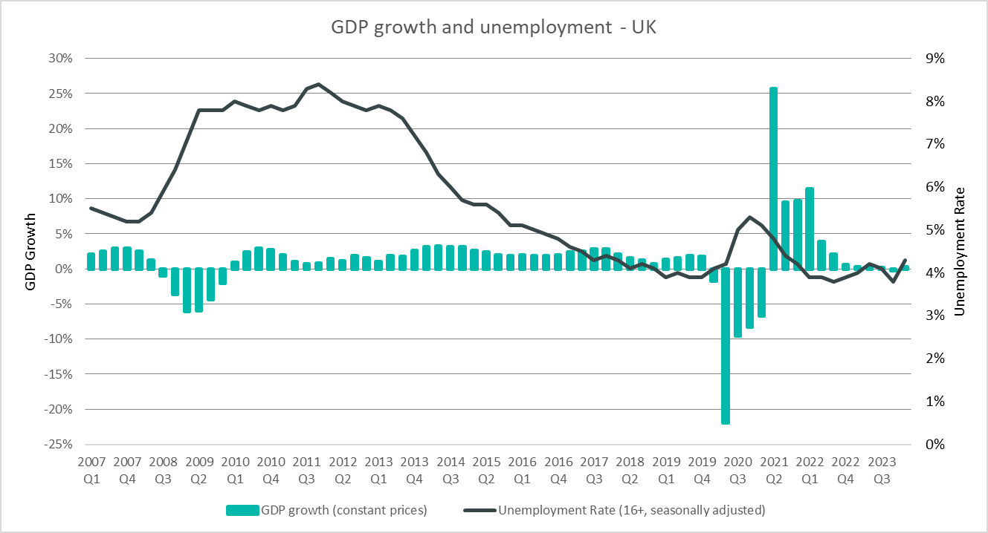
UK Economic Context
The UK is in a fragile recovery phase with modest growth (Q1 2024: +0.7%; Q2 2024: +0.6%) after experiencing a technical recession last year (Q3 2023: –0.1%; Q4 2023: -0.3%). Unemployment, though increasing, is still historically low.
Notes:
Commentary: The UK is in a fragile recovery phase with modest growth (Q1 2024: +0.7%; Q2 2024: +0.6%) after experiencing a technical recession last year (Q3 2023: –0.1%; Q4 2023: -0.3%). Unemployment has recently increased; however, this current post-pandemic period (2022 onwards) has had historically low unemployment compared to post-financial crisis trends (2009-2014).
Sources:
Office for National Statistics - Gross Domestic Product: chained volume measures: Seasonally adjusted £m
Office for National Statistics - Unemployment rate (aged 16 and over, seasonally adjusted): %
Technical note: GDP growth is calculated year on year

Slide 9
Employment Overview
Economic Inactivity Rate
(all aged 16-64):
Unemployment Rate
(all aged 16-64):
Employment Rate
(all aged 16-64):
Greater Cambridge
United
Kingdom
Greater
Cambridge
United Kingdom
Greater Cambridge
United Kingdom
17.1%
21.5%
6.4%
3.9%
77.6%
75.4%
Apr 2023-Mar 2024
Apr 2023-Mar 2024
Apr 2023-Mar 2024
Quarterly Change
Quarterly Change
Quarterly Change
+1.1pp
+0.2pp
-0.2pp
+0.1pp
-0.9pp
-0.3pp
Comparing Apr 2023-Mar 2024 with Jan 2023 – Dec 2023
Comparing Apr 2023-Mar 2024 with Jan 2023 – Dec 2023
Comparing Apr 2023-Mar 2024 with Jan 2023 – Dec 2023
Year on Year (YoY) Change
YoY Change
YoY Change
-0.7pp
-0.2pp
+2.5pp
+0.2pp
-1.5pp
No change
Comparing Apr 2022-Mar 2023 with Apr 2023-Mar 2024
Comparing Apr 2022-Mar 2023 with Apr 2023-Mar 2024
Comparing Apr 2022-Mar 2023 with Apr 2023-Mar 2024
3-Year Average
3-Year Average
3-Year Average
16.8%
21.6%
4.7%
3.9%
79.3%
75.3%
Comparing Apr 2021-Mar 2022 with Apr 2023-Mar 2024
Comparing Apr 2021-Mar 2022 with Apr 2023-Mar 2024
Comparing Apr 2021-Mar 2022 with Apr 2023-Mar 2024
Greater Cambridge's higher unemployment (6.4% vs 3.9%) should be interpreted in context of its lower economic inactivity (17.1% vs 21.5%) and higher employment (77.6% vs 75.4%). Lower economic inactivity could be leading to more people seeking work (higher unemployment) and more people in work (higher employment).
Variable | Economic Inactivity Rate (all aged 16-64) |  | Unemployment Rate (all aged 16-64) |  | Employment Rate (all aged 16-64)
Area | Greater Cambridge | United Kingdom | Greater Cambridge | United Kingdom | Greater Cambridge | United Kingdom
Yearly value (April 2023-March 2024) | 17.1% | 21.5% | 6.4% | 3.9% | 77.6% | 75.4%
Quarterly Change (comparing April 2023-March 2024 with January 2023-December 2023) | +1.1pp | +0.2pp | -0.2pp | +0.1pp | -0.9pp | -0.3pp
Year on Year Change (comparing April 2022-March 2023 with April 2023-March 2024) | -0.7pp | -0.2pp | +2.5pp | +0.2pp | -1.5pp | No change
3 Year Average (comparing April 2021-March 2022 with April 2023-March 2024) | 16.8% | 21.6% | 4.7% | 3.9% | 79.3% | 75.3%
Notes:
Commentary: Areas of strength include Greater Cambridge having a lower economic inactivity rate than the UK (17.1% vs 21.5%) and a higher employment rate than the UK (77.6% vs 75.4%). This is a key strength in Greater Cambridge.
An area of concern is that Greater Cambridge unemployment is higher than the UK for the first time in the analysis period of 2007 to 2024 (6.4% vs 3.9%) with a worrying YoY change of +2.5pp. A possible explanation could be that lower economic inactivity has led to more people seeking work (higher unemployment) and more people in work (higher employment).
However, there are worrying signs of Greater Cambridge economic inactivity creeping up with a recent +1.1pp quarterly change despite a –0.7pp YoY change and Greater Cambridge unemployment decreasing by –0.9pp quarterly and –1.5pp YoY.
Source: Annual Population Survey, April to March Releases
Technical note: A residence based labour market survey encompassing population, economic activity (employment and unemployment), economic inactivity and qualifications. These are broken down where possible by gender, age, ethnicity, industry and occupation. Available at Local Authority level and above. Updated quarterly.
It is important to note that due to the small geographical area considered, and the Annual Population Survey being based on a representative sample, this may be due to a quarterly fluctuation rather than any kind of long-term trend in the data. National figures are now taken from the Labour Force Survey (LFS). Increased volatility of LFS estimates, resulting from smaller achieved sample sizes, means that estimates of quarterly change should be treated with additional caution. Caution should be taken with interpreting these figures and comparisons to Greater Cambridge.
APS Estimates have not been reweighted to new populations and consequently, will be inconsistent with the population totals used for the Labour Force Survey in the latest periods. Again caution is recommended when making comparisons to national statistics.

Slide 10
Employment Overview by Gender – 3-year average
Economic Inactivity Rate
(all aged 16-64)
Unemployment Rate
(all aged 16-64)
Employment Rate
(all aged 16-64)
April 2021-Mar 2022 to April 2023-Mar 2024
April 2021-Mar 2022 to April 2023-Mar 2024
April 2021-Mar 2022 to April 2023-Mar 2024
Male
11.9%
5.1%
83.6%
22.0%
4.3%
Female
74.7%
Females have just under double the economic inactivity of males (22.0% vs. 11.9%). Less available females in the workforce leads to corresponding lower unemployment rates and lower employment rates. This is a big equality and diversity concern for the workforce. This trend is nationwide, and the recent childcare reforms should be closely monitored.
Variable | Economic Inactivity Rate (all aged 16-64) | Unemployment Rate (all aged 16-64) | Employment Rate (all aged 16-64)
Male | 11.9% | 5.1% | 83.6%
Female | 22.0% | 4.3% | 74.7%
Notes:
Commentary: Across Greater Cambridge, the economic inactivity rate for females is just under double the economic inactivity rate for males (22.0% vs. 11.9%). Because there are more economically inactive females, there are thus less females available to seek work (unemployment) or be in work (employment). This explains the lower unemployment rate and employment rate for females compared to males (4.3% vs 5.1% and 74.7% vs 83.6% respectively). These patterns for economic inactivity, unemployment, and employment are also seen at the UK level and is thus a nationwide problem. It will be worth monitoring the effect of the childcare policies that were announced in March 2023 for a staggered roll out from March 2024 to September 2025.
Source: Annual Population Survey, April to March Releases
Technical note: A residence based labour market survey encompassing population, economic activity (employment and unemployment), economic inactivity and qualifications. These are broken down where possible by gender, age, ethnicity, industry and occupation. Available at Local Authority level and above. Updated quarterly.
It is important to note that due to the small geographical area considered, and the Annual Population Survey being based on a representative sample, this may be due to a quarterly fluctuation rather than any kind of long-term trend in the data. National figures are now taken from the Labour Force Survey (LFS). Increased volatility of LFS estimates, resulting from smaller achieved sample sizes, means that estimates of quarterly change should be treated with additional caution. Caution should be taken with interpreting these figures and comparisons to Greater Cambridge.
APS Estimates have not been reweighted to new populations and consequently, will be inconsistent with the population totals used for the Labour Force Survey in the latest periods. Again caution is recommended when making comparisons to national statistics.

Slide 11
Employment Overview by Age – 3-year average
Economic Inactivity Rate
Unemployment Rate
Employment Rate
April 2021-Mar 2022 to April 2023-Mar 2024
April 2021-Mar 2022 to April 2023-Mar 2024
April 2021-Mar 2022 to April 2023-Mar 2024
Greater
Cambridge
United
Kingdom
Greater
Cambridge
United
Kingdom
Greater
Cambridge
United
Kingdom
16-24
16-24
16-24
35.9%
40.3%
16.2%
11.0%
54.6%
53.1%
25-49
25-49
25-49
9.6%
12.4%
2.9%
3.0%
87.8%
85.0%
50-64
50-64
50-64
19.1%
27.1%
5.3%
2.7%
77.7%
71.0%
16-64
16-64
16-64
16.8%
21.6%
4.7%
3.9%
79.3%
75.3%
The large divergence in unemployment for 16-24 from overall 16-64 cannot be explained by the student population. There should be a focus on the unemployed 16-24 age group, and it will be important to monitor the Skills England initiative. The large divergence in the economic inactive 25-49 age group could explain Greater Cambridge’s lower economic inactivity.
Variable | Economic Inactivity Rate (all aged 16-64) |  | Unemployment Rate (all aged 16-64) |  | Employment Rate (all aged 16-64)
Area | Greater Cambridge | United Kingdom | Greater Cambridge | United Kingdom | Greater Cambridge | United Kingdom
16-24 | 35.9% | 40.3% | 16.2% | 11.0% | 54.6% | 53.1%
25-49 | 9.6% | 12.4% | 2.9% | 3.0% | 87.8% | 85.0%
50-64 | 19.1% | 27.1% | 5.3% | 2.7% | 77.7% | 71.0%
16-64 | 16.8% | 21.6% | 4.7% | 3.9% | 79.3% | 75.3%
Notes:
Commentary: The 3-year average rates for Greater Cambridge follow a similar breakdown by age for economic inactivity, unemployment, and employment as the UK as seen in Slide 9 (Employment Overview): Greater Cambridge economic inactivity is lower across all age groups compared to the UK, Greater Cambridge employment is greater than all age groups compared to the UK, and on the most part, Greater Cambridge unemployment is greater than the UK employment except for age group 25-49 (2.9% vs 3.0%).
The 16-24 age group is worrying with rates for both Greater Cambridge and the UK diverging from the overall 16-64 rates for economic inactivity, unemployment, and employment. The 16-24 age group is often made up of students, and this student population can explain higher levels of economic inactivity and lower employment. However, unemployment for the 16-24 age group cannot be explained by the student population, and the unemployed age group 16-24 (16.2% vs 11.0%) greatly diverges from overall 16-64 unemployment. There should be a focus on the unemployed 16-24 age group to convert these jobseekers to employment, and it will be important to monitor the Skills England initiative announced during the King’s Speech in July 2024.
Technical note: A residence based labour market survey encompassing population, economic activity (employment and unemployment), economic inactivity and qualifications. These are broken down where possible by gender, age, ethnicity, industry and occupation. Available at Local Authority level and above. Updated quarterly.
It is important to note that due to the small geographical area considered, and the Annual Population Survey being based on a representative sample, this may be due to a quarterly fluctuation rather than any kind of long-term trend in the data. National figures are now taken from the Labour Force Survey (LFS). Increased volatility of LFS estimates, resulting from smaller achieved sample sizes, means that estimates of quarterly change should be treated with additional caution. Caution should be taken with interpreting these figures and comparisons to Greater Cambridge.
APS Estimates have not been reweighted to new populations and consequently, will be inconsistent with the population totals used for the Labour Force Survey in the latest periods. Again caution is recommended when making comparisons to national statistics.

Slide 12
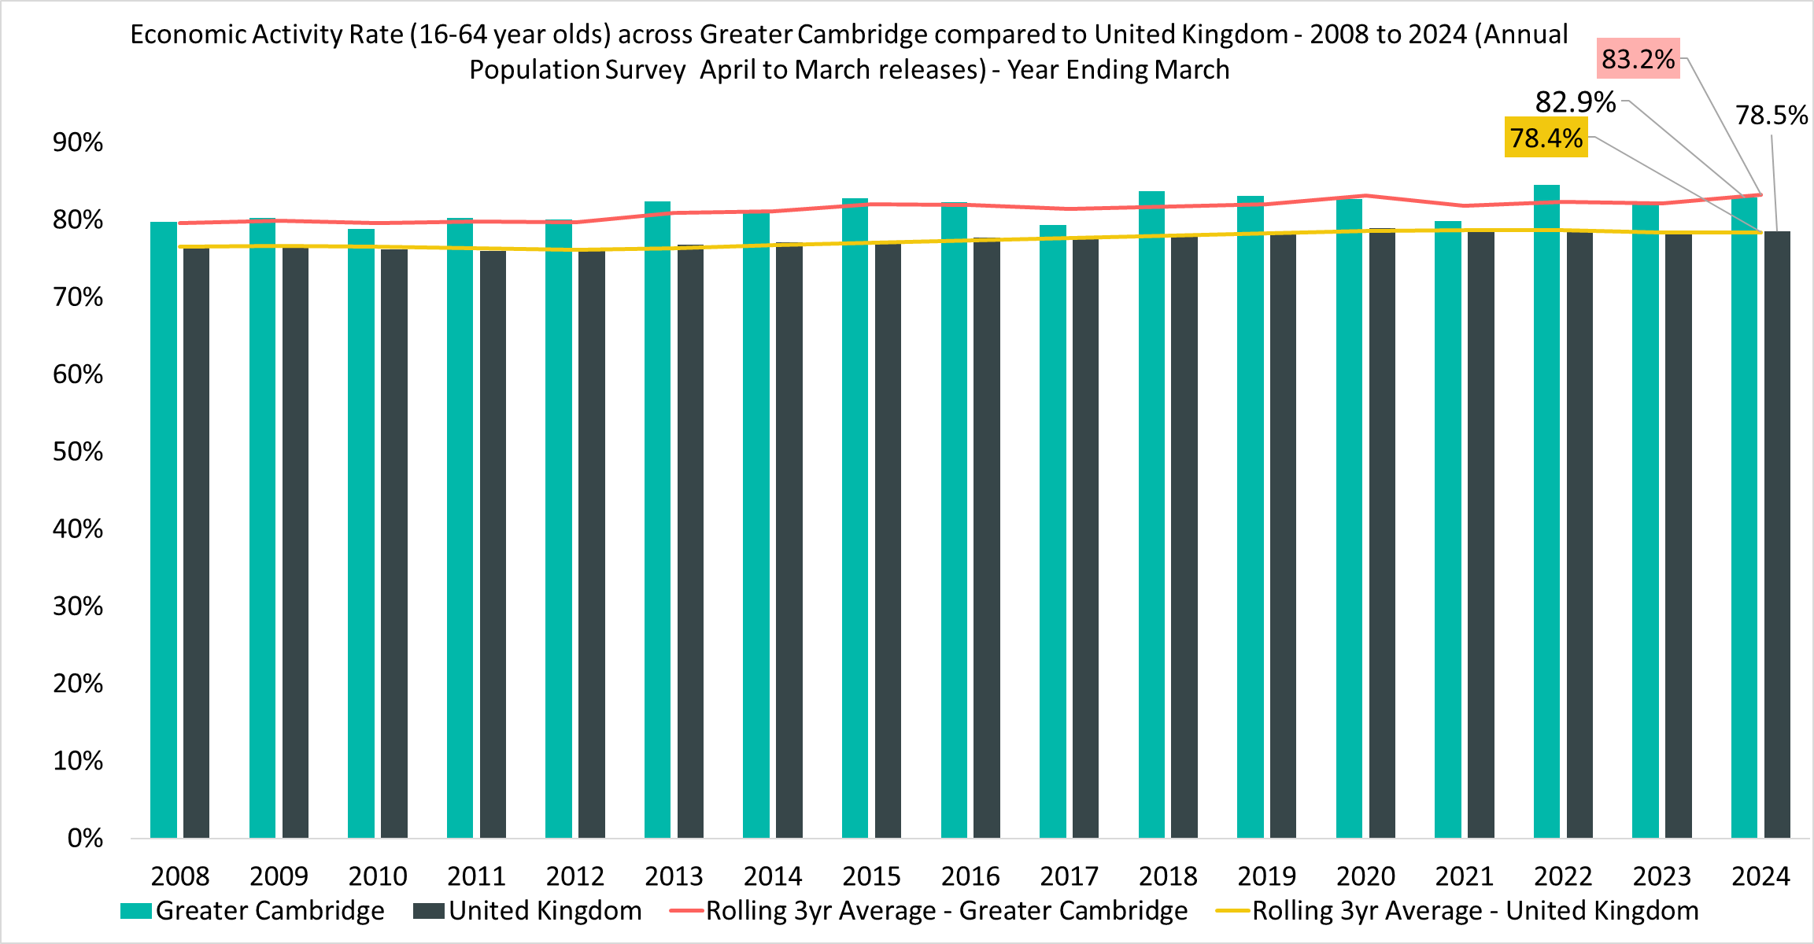
Economic Activity
Economic Activity Rate
(all aged 16-64)
82.9%
Apr 2023-Mar 2024
Quarterly Change
-1.1pp
Comparing Apr 2023-Mar 2024 with Jan 2023 – Dec 2023
Year on Year Change
+0.7pp
Comparing Apr 2022-Mar 2023 with Apr 2023-Mar 2024
Compared to 78.5% UK wide. 3-year average (April 2021-Mar 2022 to April 2023-Mar 2024) is 83.2% compared to 78.4% UK wide.
Greater Cambridge has a higher economic activity rate than the UK (82.9% vs 78.5%). Thus, there are less people economically inactive people and more people who are seeking work or who are in work. 2021 was a notable increase.
Notes:
Commentary: As mentioned in Slide 9 (Employment Overview), Greater Cambridge has strengths of a lower economic inactivity rate than the UK (17.1% vs 21.5%) and a higher employment rate than the UK (77.6% vs 75.4%) but has a concern of Greater Cambridge unemployment that is higher than the UK (6.4% vs 3.9%).
Despite this concern, the Greater Cambridge economic activity rate (also known as the labour force participation rate) is higher than the UK (82.9% vs 78.5%). Thus, overall, there are less people economically inactive in Greater Cambridge than the UK (17.1% vs 21.5%) and more people in Greater Cambridge that are economically active – either seeking work or are in work – than in the UK (82.9% vs 78.5%). This is a notable strength and key difference to the UK. However, the quarterly decrease of –1.1pp to the economic activity rate brings caution with this overall optimism.
Source: Annual Population Survey, April to March Releases
Technical note: A residence based labour market survey encompassing population, economic activity (employment and unemployment), economic inactivity and qualifications. These are broken down where possible by gender, age, ethnicity, industry and occupation. Available at Local Authority level and above. Updated quarterly.
It is important to note that due to the small geographical area considered, and the Annual Population Survey being based on a representative sample, this may be due to a quarterly fluctuation rather than any kind of long-term trend in the data. National figures are now taken from the Labour Force Survey (LFS). Increased volatility of LFS estimates, resulting from smaller achieved sample sizes, means that estimates of quarterly change should be treated with additional caution. Caution should be taken with interpreting these figures and comparisons to Greater Cambridge.
APS Estimates have not been reweighted to new populations and consequently, will be inconsistent with the population totals used for the Labour Force Survey in the latest periods. Again caution is recommended when making comparisons to national statistics.

Slide 13
4. Economic Inactivity

Slide 14
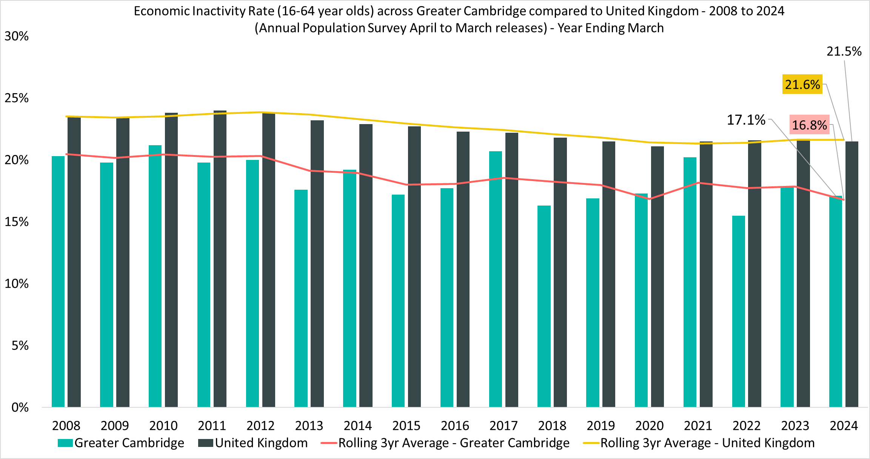
Economic Inactivity Overview
Economic Inactivity Rate
(all aged 16-64)
17.1%
Apr 2023-Mar 2024
Quarterly Change
+1.1pp
Comparing Apr 2023-Mar 2024 with Jan 2023 – Dec 2023
YoY Change
-0.7pp
Comparing Apr 2022-Mar 2023 with Apr 2023-Mar 2024
Compared to 21.5% UK wide. 3-year average (April 2021-Mar 2022 to April 2023-Mar 2024) is 16.8% compared to 21.6% UK wide
Greater Cambridge has demonstrated a consistently lower economic inactivity rate than the UK for the analysis period since 2005. 2020 saw a sudden jump followed by a steep decrease in 2021. The recent +1.1pp quarterly increase is a concern.
Notes:
Commentary: As mentioned in Slide 9 (Employment Overview), an area of strength is that the Greater Cambridge economic inactivity rate is lower than UK economic inactivity rate (17.1% vs 21.5%). This strength has been consistently demonstrated for the analysis period since 2005. Both Greater Cambridge and the UK have had a steady decrease in the 3-year average economic inactivity rate since 2007 with Greater Cambridge being slightly steeper. However, there is a slight concern that the Greater Cambridge economic inactivity rate has increased quarterly by +1.1pp.
Notably, there was a large increase in the Greater Cambridge economic inactivity rate during the pandemic in 2020 that was not as pronounced in the UK. However, the Greater Cambridge economic inactivity rate recovered quickly in 2021 with a large decrease. This possibly shows the strength and resilience of the Greater Cambridge economy.
Source: Annual Population Survey, April to March Releases
Technical note: A residence based labour market survey encompassing population, economic activity (employment and unemployment), economic inactivity and qualifications. These are broken down where possible by gender, age, ethnicity, industry and occupation. Available at Local Authority level and above. Updated quarterly.
It is important to note that due to the small geographical area considered, and the Annual Population Survey being based on a representative sample, this may be due to a quarterly fluctuation rather than any kind of long-term trend in the data. National figures are now taken from the Labour Force Survey (LFS). Increased volatility of LFS estimates, resulting from smaller achieved sample sizes, means that estimates of quarterly change should be treated with additional caution. Caution should be taken with interpreting these figures and comparisons to Greater Cambridge.
APS Estimates have not been reweighted to new populations and consequently, will be inconsistent with the population totals used for the Labour Force Survey in the latest periods. Again caution is recommended when making comparisons to national statistics.

Slide 15
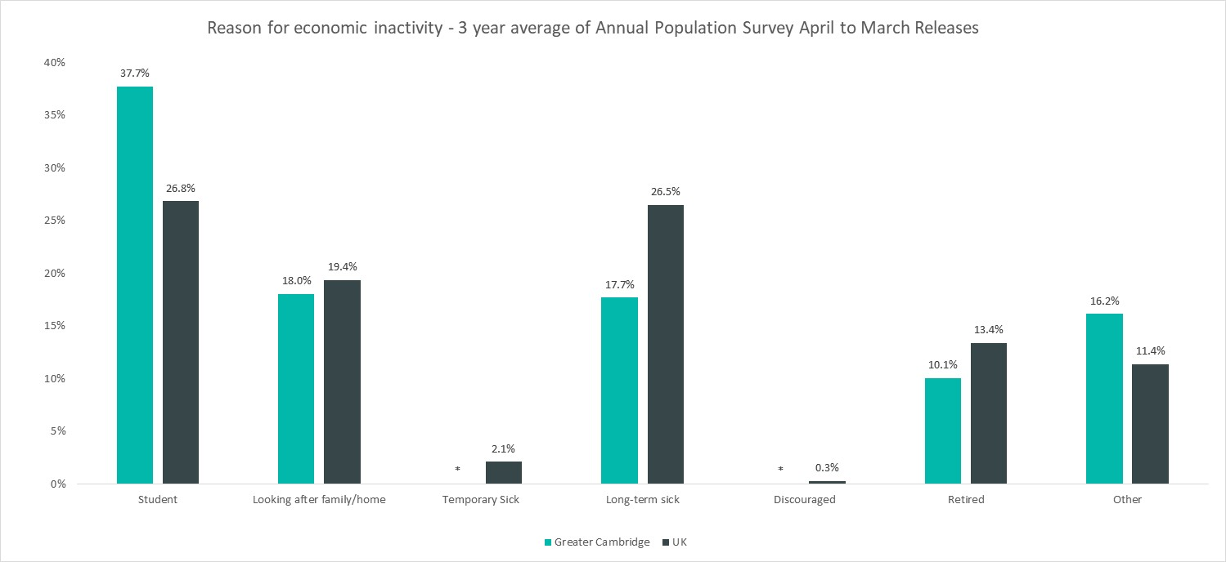
Reasons for Inactivity
April 2021-Mar 2022 to April 2023-Mar 2024
*Data for those inactive due to temporary sickness or discouraged suppressed due to group some size being zero or disclosive (0-2).
The order of reasons for economic inactivity in Greater Cambridge are 1) student (37.7%), 2) looking after family/home (18.0%), 3) long-term sick (17.7%), and 4) retired (10%). A notable strength is that despite the large student population of Greater Cambridge, overall economic inactivity in Greater Cambridge is still lower than the UK.
Notes:
Commentary: The order of reasons for economic inactivity in Greater Cambridge are 1) student (37.7%), 2) looking after family/home (18.0%), 3) long-term sick (17.7%), and 4) retired (10%). Note that looking after family/home (18.0%) and long-term sick (17.7%) are very close for Greater Cambridge.
This loosely follows the top overalls reason for economic inactivity for the UK with student (26.8%), long-term sick (26.5%) being switched with looking after family/home (19.4%), and then retired (13.4%). Here, the student (26.8%) and long-term sick (26.5%) are close for the UK.
Students are a main driver for economic inactivity for both Greater Cambridge and the UK; however, a notable strength is that despite the large student population of Greater Cambridge, overall economic inactivity in Greater Cambridge is lower than the UK.
Two other areas of strength are that long-term sick is much lower in Greater Cambridge than the UK (17.7% vs 26.5%) and the retired are lower in Greater Cambridge than the UK (10% vs 13.4%). These areas could be factors on why overall economic inactivity in Greater Cambridge is lower than the UK.
Source: Annual Population Survey, April to March Releases
Technical note: A residence based labour market survey encompassing population, economic activity (employment and unemployment), economic inactivity and qualifications. These are broken down where possible by gender, age, ethnicity, industry and occupation. Available at Local Authority level and above. Updated quarterly.
It is important to note that due to the small geographical area considered, and the Annual Population Survey being based on a representative sample, this may be due to a quarterly fluctuation rather than any kind of long-term trend in the data. National figures are now taken from the Labour Force Survey (LFS). Increased volatility of LFS estimates, resulting from smaller achieved sample sizes, means that estimates of quarterly change should be treated with additional caution. Caution should be taken with interpreting these figures and comparisons to Greater Cambridge.
APS Estimates have not been reweighted to new populations and consequently, will be inconsistent with the population totals used for the Labour Force Survey in the latest periods. Again caution is recommended when making comparisons to national statistics.

Slide 16
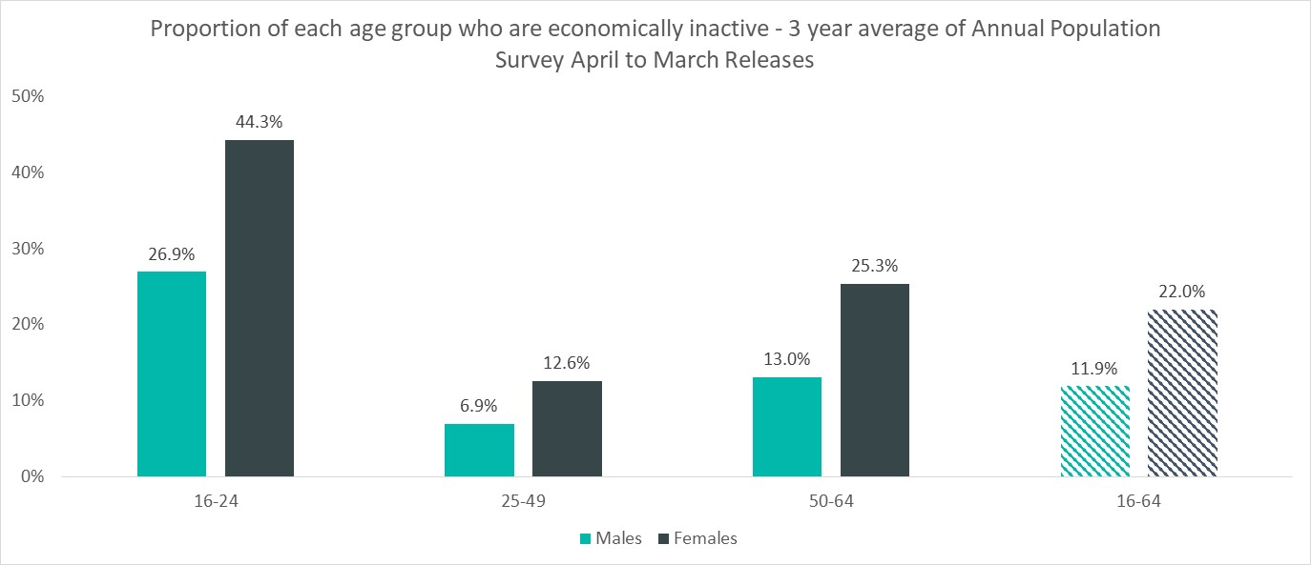
Inactivity by Age and Gender
Economic Inactivity Rate
(all aged 16-64)
11.9%
Male
22.0%
Female
3-Year Average: April 2021-Mar 2022 to April 2023-Mar 2024
The female economic inactivity rate is nearly double the male economic inactivity rate across all age groups. The reasons for this differential are undetermined but concerning.
The reasons for economic inactivity from the previous slide can be loosely linked to the age groups above. The student reason (37.7%) is likely to be associated with the large 16-24 age group. Retired (10%) and long-term sick (17.7%) are more likely associated with the 50-64 age group and can explain why it is the second largest age group. Looking after family/home (18.0%) is most likely associated with 25-49 and possibly the earlier portion of 50-64 and can explain why the 25-49 age group is the smallest age group.
Notes:
Commentary: As mentioned in Slide 15 (Reasons for Inactivity), the top overall reasons for economic inactivity in Greater Cambridge are the student (37.7%), looking after family/home (18.0%), long-term sick (17.7%), and retired (10%). The student reason for economic inactivity explains why the 16-24 age group is the largest for both genders across age groups. Retired (10%) and long-term sick (17.7%) are more likely associated with the 50-64 age group and can thus explain why it is the second largest age group for both genders across age groups. Lastly, looking after family/home (18.0%) is most likely associated with 25-49 and possibly the earlier portion of 50-64 and thus explains why the 25-49 age group is the smallest age for both genders across age groups.
In Slide 10 (Employment Overview by Gender – 3-year average)​, the female economic inactivity rate is just under double the male economic inactivity rate (22.0% vs. 11.9%). This pattern follows with the female economic inactivity rate nearly double the male economic inactivity rate across all age groups.
The reasons for this almost double differential between females and males are undetermined but concerning. A possible reason for the differential in the 16-24 age group could be that apprenticeships are more popular with males than females. A reason for the differential in the 25-49 age group could be that childcare responsibilities fall predominantly on females more than males. Lastly, the differential in the 50-64 age group could be that females are more likely to take early retirement than males. Overall, these differentials impact equality and diversity across the Greater Cambridge workforce.
Source: Annual Population Survey, April to March Releases
Technical note: A residence based labour market survey encompassing population, economic activity (employment and unemployment), economic inactivity and qualifications. These are broken down where possible by gender, age, ethnicity, industry and occupation. Available at Local Authority level and above. Updated quarterly.
It is important to note that due to the small geographical area considered, and the Annual Population Survey being based on a representative sample, this may be due to a quarterly fluctuation rather than any kind of long-term trend in the data. National figures are now taken from the Labour Force Survey (LFS). Increased volatility of LFS estimates, resulting from smaller achieved sample sizes, means that estimates of quarterly change should be treated with additional caution. Caution should be taken with interpreting these figures and comparisons to Greater Cambridge.
APS Estimates have not been reweighted to new populations and consequently, will be inconsistent with the population totals used for the Labour Force Survey in the latest periods. Again caution is recommended when making comparisons to national statistics.

Slide 17
5. Unemployment
APS
Vacancies
Claimant Count
Universal Credit

Slide 18
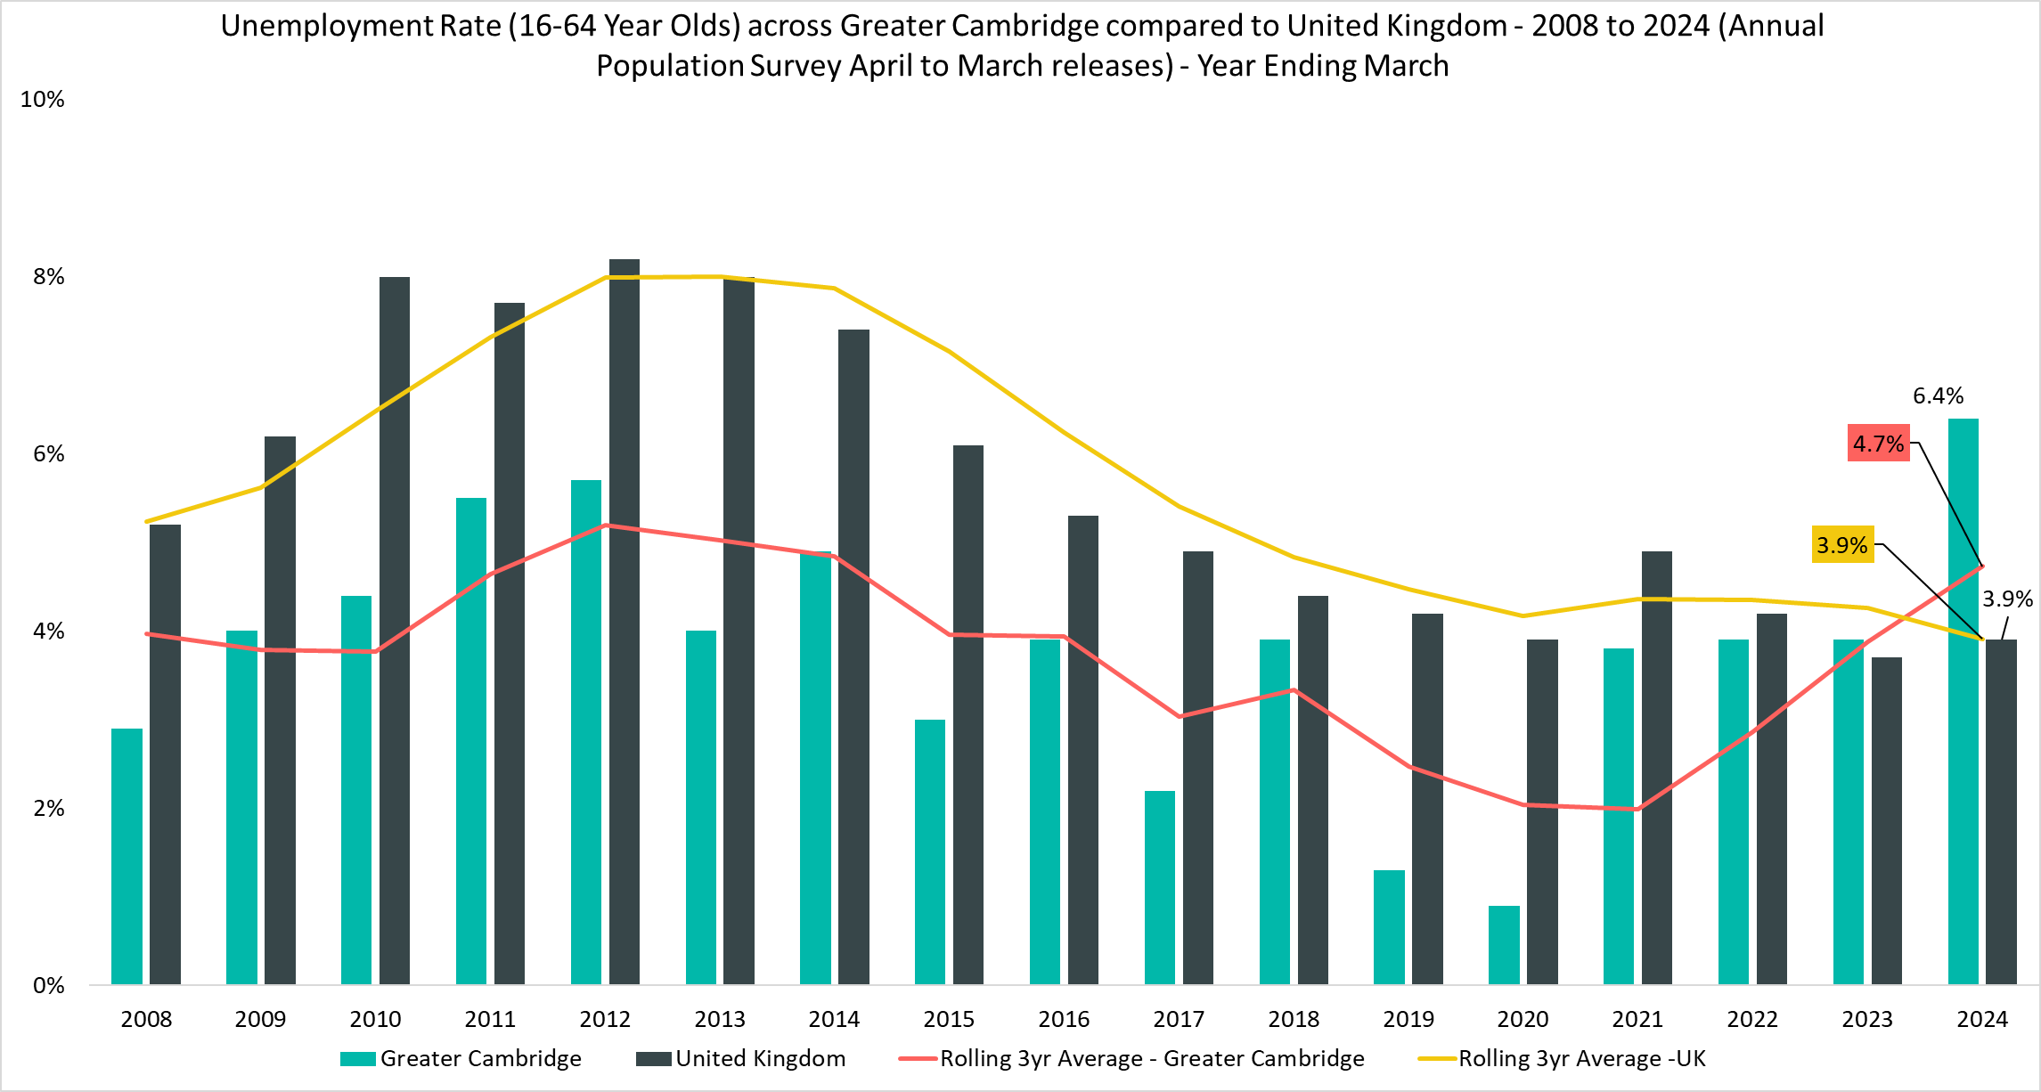
Unemployment Overview
Unemployment rate
(all aged 16-64)
6.4%
Apr 2023-Mar 2024
Quarterly Change
-0.2pp
Comparing Apr 2023-Mar 2024 with Jan 2023 – Dec 2023
YoY Change
+2.5pp
Comparing Apr 2022-Mar 2023 with Apr 2023-Mar 2024
Compared to 3.9% UK wide. 3-year average (April 2021-Mar 2022 to April 2023-Mar 2024) is 4.7% compared to 3.9% UK wide
The UK unemployment rate, though increasing slightly, is still historically low. In contrast, it is concerning that the 3-year average for Greater Cambridge unemployment is approaching the 2011 3-year average peak. There is thus more competition among job seekers and an employer-friendly job market.
Notes:
Commentary: For the first time in the analysis period of 2007 to 2023, the unemployment rate across Greater Cambridge is higher than that of the UK. This is seen across both the latest release and the 3-year average, and the high unemployment rate suggests there are not enough opportunities, or the opportunities are not suitable (e.g. matching issues) for Greater Cambridge residents. Although the unemployment rate is concerning, it could be caused by the reduction in economic inactivity seen on Slide 9 (Employment Overview) and Slide 14 (Economic Inactivity Overview) that has in turn caused a shift to more people seeking work.
As mentioned in Slide 8 (UK Economic Context), this current post-pandemic period (2022 onwards) has had historically low UK unemployment compared to post-financial crisis trends (2009-2014). However, this contrasts with the current Greater Cambridge unemployment rate. The recent 3-year average for Greater Cambridge unemployment is approaching the 2011 3-year average peak. This difference in the historical unemployment context between Greater Cambridge and the UK makes the rising current Greater Cambridge unemployment rate concerning.
Source: Annual Population Survey, April to March Releases
Technical note: A residence based labour market survey encompassing population, economic activity (employment and unemployment), economic inactivity and qualifications. These are broken down where possible by gender, age, ethnicity, industry and occupation. Available at Local Authority level and above. Updated quarterly.
It is important to note that due to the small geographical area considered, and the Annual Population Survey being based on a representative sample, this may be due to a quarterly fluctuation rather than any kind of long-term trend in the data. National figures are now taken from the Labour Force Survey (LFS). Increased volatility of LFS estimates, resulting from smaller achieved sample sizes, means that estimates of quarterly change should be treated with additional caution. Caution should be taken with interpreting these figures and comparisons to Greater Cambridge.
APS Estimates have not been reweighted to new populations and consequently, will be inconsistent with the population totals used for the Labour Force Survey in the latest periods. Again caution is recommended when making comparisons to national statistics.

Slide 19
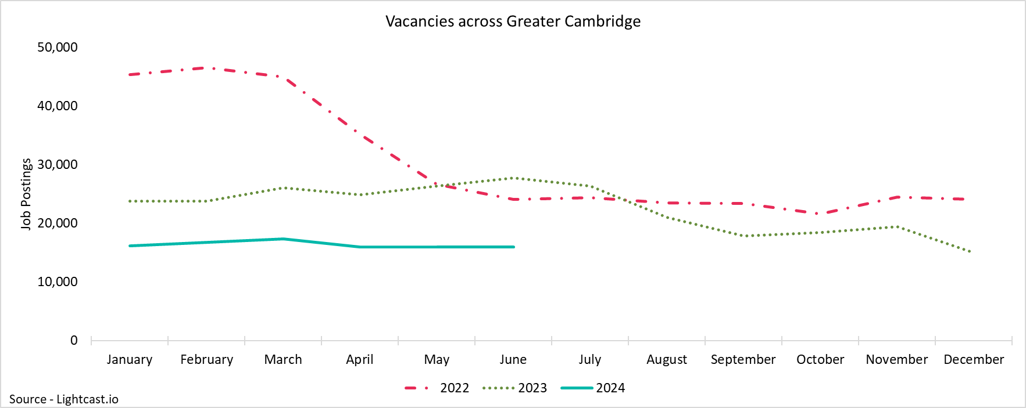
GCP Vacancies
16,032
Unique job postings in Greater Cambridge in June 2024
-8%
Decrease in unique job postings compared to March 2024
Compared to -10% nationally
-42%
Decrease in unique job postings compared to June 2023
Compared to -46% nationally
The Greater Cambridge vacancy rate has continued to decline with the most recent YoY decline of –42%. This decrease is roughly in line with the UK vacancy rate decrease of –46%. This is thus a nationwide trend. Vacancy rate decreases are often associated with a contracting economy, but this conflicts with the two most recent quarters of positive UK GDP growth. This may support the claim that the UK is in a fragile recovery phase.
Notes:
Commentary: Across Greater Cambridge, the vacancy rate was highest in 2021/22, and this suggests employment opportunities were plentiful. Since then, the Greater Cambridge vacancy rate has continued to decline with the most recent YoY decline of –42%. This decrease is roughly in line with the UK vacancy rate decrease of –46%. Decreasing employment opportunities are thus a nationwide trend. Vacancy rate decreases are often associated with a contracting economy, but this conflicts with the two most recent quarters of positive UK GDP growth in Slide 8 (UK Economic Context). This may support the claim that the UK is in a fragile recovery phase.
Source: Lightcast
Technical note: Vacancy data is sourced from Lightcast, a service that has been procured by Cambridgeshire and Peterborough Combined Authority which gives labour market information on Job postings, occupations, and industries. Lightcast has a job posting aggregator which scans jobs websites for posting and presents them together. Lightcast only scans online jobs postings and therefore does not include any jobs which are advertised solely offline. There is also no guarantee that all online job postings are aggregated. For example, a specific job site may not be scanned.
A unique job posting is a deduplicated count of an online job vacancy advertisement. If the same vacancy is posted twice across a sixty-day period, it is only counted once. If the same vacancy is posted twice more than sixty days apart it is counted as two unique job postings.

Slide 20
Vacancy Rate vs Unemployment Rate
Vacancy and Unemployment Rates across Greater Cambridge
Financial Year | Vacancy Rate | Unemployment Rate
2020/21 | 55% | 3.8%
2021/22 | 73% | 3.9%
2022/23 | 68% | 3.9%
2023/24 | 64% | 6.4%
Trends in the table above show that Greater Cambridge vacancy rates have been decreasing since 2021/22, and the unemployment rate has been increasing. Unlike the UK where unemployment, though increasing, is still historically low, the 3-year average of the Greater Cambridge unemployment rate is approaching its 2011 peak. It is thus a very difficult employee job market with fewer vacancies available (less supply) and more unemployed people seeking work (more demand).
Notes:
Commentary: This table compares the relationship between the Greater Cambridge vacancy rate and unemployment rate – the vacancy rate represents the supply of the labour market and the unemployment rate represents the demand of the labour market. This relationship is often plotted as the Beveridge curve where a high vacancy rate and low unemployment rate is attractive and called a “tight labour market”, and a low vacancy rate and high unemployment rate is not attractive and called a “loose labour market”. There is not enough available data for Greater Cambridge to make a traditional plot.
However, trends in the table show that Greater Cambridge vacancy rates have been decreasing since 2021/22, and the unemployment rate has been increasing as outlined in Slide 8 (UK Economic Context) and Slide 18 (Unemployment Overview). The labour market is thus loosening with fewer vacancies available for unemployed people seeking work.
Although the UK unemployment has recently been increasing, it is still historically low compared the post-financial crisis period. In contrast, the 3-year average of the Greater Cambridge unemployment rate is approaching its 2011 peak. The loosening of the UK labour is thus less severe than Greater Cambridge. There are more people seeking work in Greater Cambridge (more demand) and are struggling with fewer employment opportunities (less supply).
Sources:
Office for National Statistics - Claimant count and vacancies time series (UNEM)
Lightcast
Annual Population Survey
Technical note: The vacancy rate has been calculated by dividing the total number of vacancies from Lightcast for the relevant year by the sum of the same vacancy figure and the employed 16-64 population from the Annual Population Survey.
Vacancy data is sourced from Lightcast, a service that has been procured by Cambridgeshire and Peterborough Combined Authority which gives labour market information on Job postings, occupations, and industries. Lightcast has a job posting aggregator which scans jobs websites for posting and presents them together. Lightcast only scans online jobs postings and therefore does not include any jobs which are advertised solely offline. There is also no guarantee that all online job postings are aggregated. For example, a specific job site may not be scanned.
A unique job posting is a deduplicated count of an online job vacancy advertisement. If the same vacancy is posted twice across a sixty-day period, it is only counted once. If the same vacancy is posted twice more than sixty days apart it is counted as two unique job postings.

Slide 21
Vacancies by Sector
Number of Vacancies in Greater Cambridge compared to the UK
July 2023 - June 2024
Employment Sector | Vacancies in Greater Cambridge | Percentage of total vacancies | Vacancies in United Kingdom | Percentage of total vacancies
Administrative and Support Service Activities | 44,417 | 48.7% | 4,870,473 | 48.2%
Human Health and Social Work Activities | 9,407 | 10.3% | 1,068,238 | 10.6%
Professional, Scientific and Technical Activities | 7,335 | 8.0% | 683,796 | 6.8%
Education | 6,589 | 7.2% | 346,284 | 3.4%
Information and Communication | 4,198 | 4.6% | 356,944 | 3.5%
Wholesale and Retail Trade; Repair of Motor Vehicles and Motorcycles | 3,941 | 4.3% | 596,500 | 5.9%
Manufacturing | 3,592 | 3.9% | 315,259 | 3.1%
Accommodation and Food Service Activities | 3,100 | 3.4% | 442,541 | 4.4%
Construction | 2,029 | 2.2% | 208,456 | 2.1%
Other Service Activities | 1,527 | 1.7% | 167,919 | 1.7%
Public Administration and Defence; Compulsory Social Security | 1,187 | 1.3% | 350,436 | 3.5%
Real Estate Activities | 1,039 | 1.1% | 148,181 | 1.5%
Transportation and Storage | 940 | 1.0% | 155,080 | 1.5%
Financial and Insurance Activities | 853 | 0.9% | 196,210 | 1.9%
Arts, Entertainment and Recreation | 568 | 0.6% | 103,259 | 1.0%
Water Supply; Sewerage, Waste Management and Remediation Activities | 230 | 0.3% | 36,815 | 0.4%
Agriculture, Forestry and Fishing | 187 | 0.2% | 19,356 | 0.2%
Electricity, Gas, Steam and Air Conditioning Supply | 40 | 0.0% | 25,800 | 0.3%
Mining and Quarrying | 20 | 0.0% | 14,009 | 0.1%
Greater Cambridge and the UK have the same top 3 sectors that both make up almost two-thirds of total vacancies and that have similar individual proportions. A difference is the education sector; this is due to the strong university presence.
Notes:
Commentary: These next two slides aim to explore the characteristics of vacancies. Vacancies in Greater Cambridge are concentrated in the Administrative and Support Service Activities sector (48.7%) with relatively high proportions in Human, Health and Social Work Activities (10.3%) and Professional, Scientific and Technical Activities (8.0%). The UK has the same top 3 sectors with similar proportions (48.2%, 10.6%, and 6.8% respectively). The top 3 of Greater Cambridge and the UK both make up almost two-thirds of total vacancies. A difference between Greater Cambridge and the UK is the education sector (7.2% vs 3.4%) - this is likely driven in Greater Cambridge by the University of Cambridge and Anglia Ruskin University.
Source: Lightcast
Technical note: Vacancy data is sourced from Lightcast, a service that has been procured by Cambridgeshire and Peterborough Combined Authority which gives labour market information on Job postings, occupations, and industries. Lightcast has a job posting aggregator which scans jobs websites for posting and presents them together. Lightcast only scans online jobs postings and therefore does not include any jobs which are advertised solely offline. There is also no guarantee that all online job postings are aggregated. For example, a specific job site may not be scanned.
A unique job posting is a deduplicated count of an online job vacancy advertisement. If the same vacancy is posted twice across a sixty-day period, it is only counted once. If the same vacancy is posted twice more than sixty days apart it is counted as two unique job postings.

Slide 22
Vacancies by Job Title
Top KI Job Titles in Greater Cambridge July 2023 - June 2024
Job Title | Vacancies in Greater Cambridge: | Median Posting Duration
Quantity Surveyors | 429 | 28 days
Software Engineers | 397 | 21 days
Teaching Assistants | 394 | 28 days
Administrators | 354 | 26 days
Electronics Engineers | 297 | 28 days
Project Managers | 266 | 22 days
Embedded Software Engineers | 261 | 26 days
Recruitment Consultants | 240 | 22 days
Account Assistants | 228 | 23 days
Field Service Engineers | 216 | 29 days
Top Non-KI Job Titles in Greater Cambridge July 2023 - June 2024
Job Title | Vacancies in Greater Cambridge: | Median Posting Duration
Support Workers | 446 | 30 days
Cleaners | 356 | 29 days
Kitchen Porters | 208 | 28 days
Kitchen Assistants | 196 | 30 days
Care Assistants | 173 | 28 days
Catering Assistants | 169 | 32 days
Receptionists | 164 | 26 days
Team Members | 163 | 30 days
Team Leads | 159 | 30 days
Sous Chefs | 152 | 25 days
The top KI job titles link to Cambridge’s strong science park businesses and education sector. The range of posting duration days for the top 10 KI jobs is 21-29 days and for the top 10 non-KI jobs is 25-32 days. Non-KI jobs are posted for slightly longer and may point to minor matching issues for non-KI vacancies and those seeking work.
Notes:
Commentary: The most popular job titles for KI (knowledge intensive) industries in Greater Cambridge in the last year have been Quantity Surveyors, Software Engineers and Teaching Assistants. This links to Cambridge’s strong science park businesses and education sector. The top non-KI jobs are Support Workers, Cleaners and Kitchen Porters for the non-KI industries.
The range of posting duration days for the top 10 KI jobs is 21-29 days, and the range of posting duration days for the top 10 non-KI jobs is 25-32 days. Non-KI jobs are posted for slightly longer and may point to minor matching issues for non-KI vacancies and those seeking work.
Source: Lightcast
Technical note: Vacancy data is sourced from Lightcast, a service that has been procured by Cambridgeshire and Peterborough Combined Authority which gives labour market information on Job postings, occupations, and industries. Lightcast has a job posting aggregator which scans jobs websites for posting and presents them together. Lightcast only scans online jobs postings and therefore does not include any jobs which are advertised solely offline. There is also no guarantee that all online job postings are aggregated. For example, a specific job site may not be scanned.
A unique job posting is a deduplicated count of an online job vacancy advertisement. If the same vacancy is posted twice across a sixty-day period, it is only counted once. If the same vacancy is posted twice more than sixty days apart it is counted as two unique job postings.

Slide 23
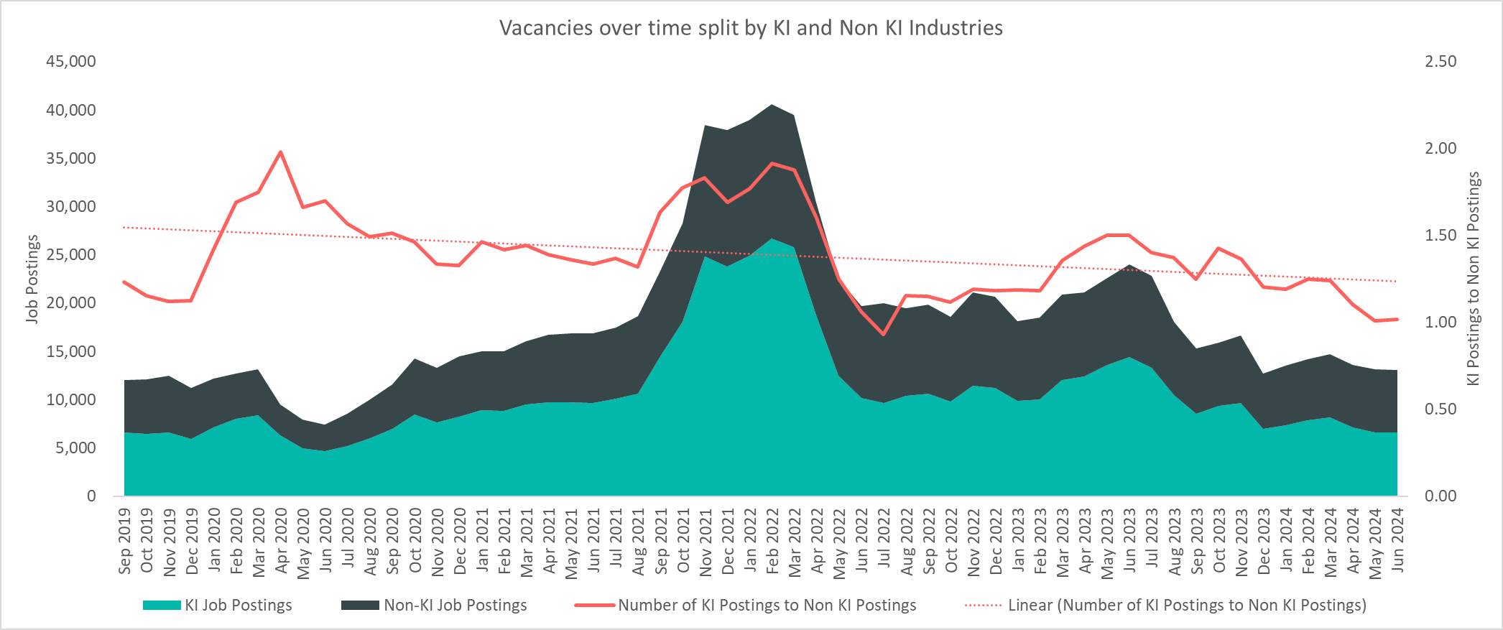
Vacancies by KI Industries
There has been consistently more KI vacancies than non-KI vacancies over the last 5 years. An area of concern is that the ratio of KI to non-KI job vacancies has been decreasing and approaching 1. The effects of the August 2024 Bank of England interest rate cut and possible subsequent interest rate cuts should be monitored to see it helps reverse this worrying trend with increased investment.
Notes:
Commentary: There have been consistently more KI vacancies than non-KI across Greater Cambridge over the last 5 years. This suggests that KI industries drive the local economy given Cambridge’s strong life science clusters and high growth technology startups.
An area of concern is that the ratio of KI to non-KI job vacancies has been decreasing and approaching 1. This suggests that the local economy may be starting to be driven less by KI industries. The effects of the August 2024 Bank of England interest rate cut and possible subsequent interest rate cuts should be monitored to see it helps reverse this worrying trend with increased investment.
Source: Lightcast
Technical note: Vacancy data is sourced from Lightcast, a service that has been procured by Cambridgeshire and Peterborough Combined Authority which gives labour market information on Job postings, occupations, and industries. Lightcast has a job posting aggregator which scans jobs websites for posting and presents them together. Lightcast only scans online jobs postings and therefore does not include any jobs which are advertised solely offline. There is also no guarantee that all online job postings are aggregated. For example, a specific job site may not be scanned.
A unique job posting is a deduplicated count of an online job vacancy advertisement. If the same vacancy is posted twice across a sixty-day period, it is only counted once. If the same vacancy is posted twice more than sixty days apart it is counted as two unique job postings.

Slide 24
KI and Non-KI Vacancies by Sector
Non-KI Vacancies July 2023 - June 2024
Employment Sector | Vacancies in Greater Cambridge | Percentage of total vacancies | Median Posting Time
Human Health and Social Work Activities | 9,407 | 24.2% | 28 days
Education | 6,589 | 17.0% | 28 days
Wholesale and Retail Trade; Repair of Motor Vehicles and Motorcycles | 3,941 | 10.2% | 27 days
Manufacturing | 3,592 | 9.3% | 25 days
Administrative and Support Service Activities | 3,297 | 8.5% | 25 days
Accommodation and Food Service Activities | 3,100 | 8.0% | 29 days
Construction | 2,029 | 5.2% | 26 days
Other Service Activities | 1,527 | 3.9% | 28 days
Public Administration and Defence; Compulsory Social Security | 1,187 | 3.1% | 24 days
Information and Communication | 1,062 | 2.7% | 23 days
Real Estate Activities | 1,039 | 2.7% | 28 days
Transportation and Storage | 907 | 2.3% | 26 days
Arts, Entertainment and Recreation | 568 | 1.5% | 25 days
Water Supply; Sewerage, Waste Management and Remediation Activities | 230 | 0.6% | 27 days
Agriculture, Forestry and Fishing | 187 | 0.5% | 26 days
Professional, Scientific and Technical Activities | 75 | 0.2% | 25 days
Electricity, Gas, Steam and Air Conditioning Supply | 40 | 0.1% | 26 days
Mining and Quarrying | 20 | 0.1% | 18 days
Total | 38,797 |  | 27 days
KI Vacancies July 2023 - June 2024
Employment Sector | Vacancies in Greater Cambridge | Percentage of total vacancies | Median Posting Time
Administrative and Support Service Activities | 41,120 | 78.5% | 27 days
Professional, Scientific and Technical Activities | 7,259 | 13.9% | 27 days
Information and Communication | 3,136 | 6.0% | 24 days
Financial and Insurance Activities | 853 | 1.6% | 27 days
Transportation and Storage | 33 | 0.1% | 23 days
Total | 52,401 |  | 27 days
KI vs Non-KI Average Wages 2023
KI/Non-KI | Vacancies in Greater Cambridge: July 2023 - June 2024 | Average Wages Per Job | Median Posting Time
KI | 52,401 | £44,878 | 27 days
Non-KI | 38,797 | £35,379 | 27 days
KI industries are concentrated around a tight group of sectors compared to the breadth of non-KI industry sectors. This can be seen as a strength in depth, but it leaves KI industries somewhat more vulnerable to external shocks (e.g. China-Taiwan relations; AI bubble bursting).
Notes:
Commentary: Vacancies in KI industries are concentrated in only 4 employment sectors with the vast majority in Administrative and Support Service Activities. This contrasts to non-KI vacancies, which are spread across a higher number of employment sectors. This KI concentration can be seen as a strength in depth, but it leaves KI industries somewhat more vulnerable to external shocks (e.g. China-Taiwan relations; AI bubble bursting).
Note that median posting time for KI and non-KI jobs is 27 days. The minor matching issues between non-KI vacancies and those seeking work mentioned on Slide 22 (Vacancies by Sector) might be immaterial.
Source: Lightcast
Technical note: Vacancy data is sourced from Lightcast, a service that has been procured by Cambridgeshire and Peterborough Combined Authority which gives labour market information on Job postings, occupations, and industries. Lightcast has a job posting aggregator which scans jobs websites for posting and presents them together. Lightcast only scans online jobs postings and therefore does not include any jobs which are advertised solely offline. There is also no guarantee that all online job postings are aggregated. For example, a specific job site may not be scanned.
A unique job posting is a deduplicated count of an online job vacancy advertisement. If the same vacancy is posted twice across a sixty-day period, it is only counted once. If the same vacancy is posted twice more than sixty days apart it is counted as two unique job postings.

Slide 25
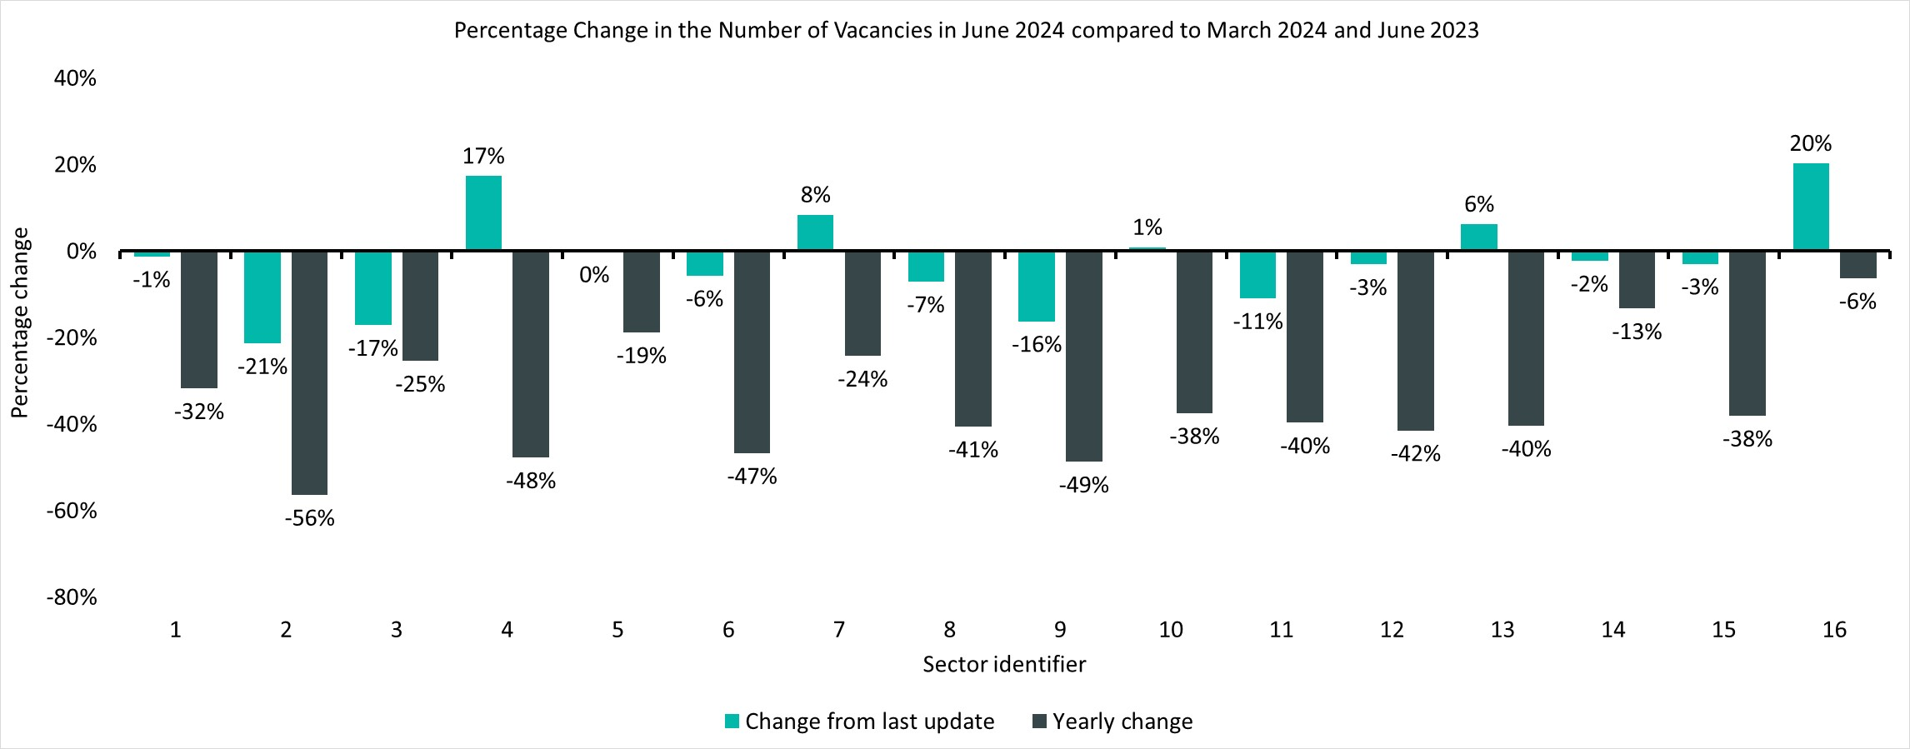
Percentage Change in Vacancies by Sector
Sector Identifier for Chart
Sector Identifier | Sector Name
1 | Accommodation and food service activities
2 | Administrative and support service activities
3 | Arts, entertainment and recreation
4 | Construction
5 | Education
6 | Financial and insurance activities
7 | Human health and social work activities
8 | Information and communication
9 | Manufacturing
10 | Other service activities
11 | Professional, scientific and technical activities
12 | Public administration and defence; compulsory social security
13 | Real estate activities
14 | Transportation and storage
15 | Wholesale and retail trade; repair of motor vehicles and motorcycles
16 | Other sectors (Agriculture, forestry and fishing; Mining and quarrying; Water supply and Waste management, Electricity, Gas, Steam and Air Conditioning Supply)
Vacancies have decreased across all sectors over the last year. The decrease in vacancies from June 2023 has been driven by the Administrative and Support Service Activities sector, and 92% of job postings in this sector were KI.
Top five sectors driving decrease in vacancies from June 2023
Employment Sector | Change from June 2023 | % of overall decrease for all vacancies from June 2023 | % of Job Postings KI – June 2024
Administrative and Support Service Activities | -6,967 | 64% | 92%
Professional, Scientific and Technical Activities | -744 | 7% | 99%
Construction | -291 | 3% | 0%
Information and Communication | -411 | 4% | 75%
Wholesale and Retail Trade; Repair of Motor Vehicles and Motorcycles | -381 | 4% | 0%
Notes:
Commentary: Vacancies have decreased across all sectors over the last year. This suggests that the wider macroeconomic environment is affecting all industries to a similar extent; however, there has been some recent divergence among individual sectors since March 2024. The decrease in vacancies from June 2023 has been driven by the Administrative and Support Service Activities sector, and 92% of job postings in this sector were KI.
Source: Lightcast
Technical note: Vacancy data is sourced from Lightcast, a service that has been procured by Cambridgeshire and Peterborough Combined Authority which gives labour market information on Job postings, occupations, and industries. Lightcast has a job posting aggregator which scans jobs websites for posting and presents them together. Lightcast only scans online jobs postings and therefore does not include any jobs which are advertised solely offline. There is also no guarantee that all online job postings are aggregated. For example, a specific job site may not be scanned.
A unique job posting is a deduplicated count of an online job vacancy advertisement. If the same vacancy is posted twice across a sixty-day period, it is only counted once. If the same vacancy is posted twice more than sixty days apart it is counted as two unique job postings.

Slide 26
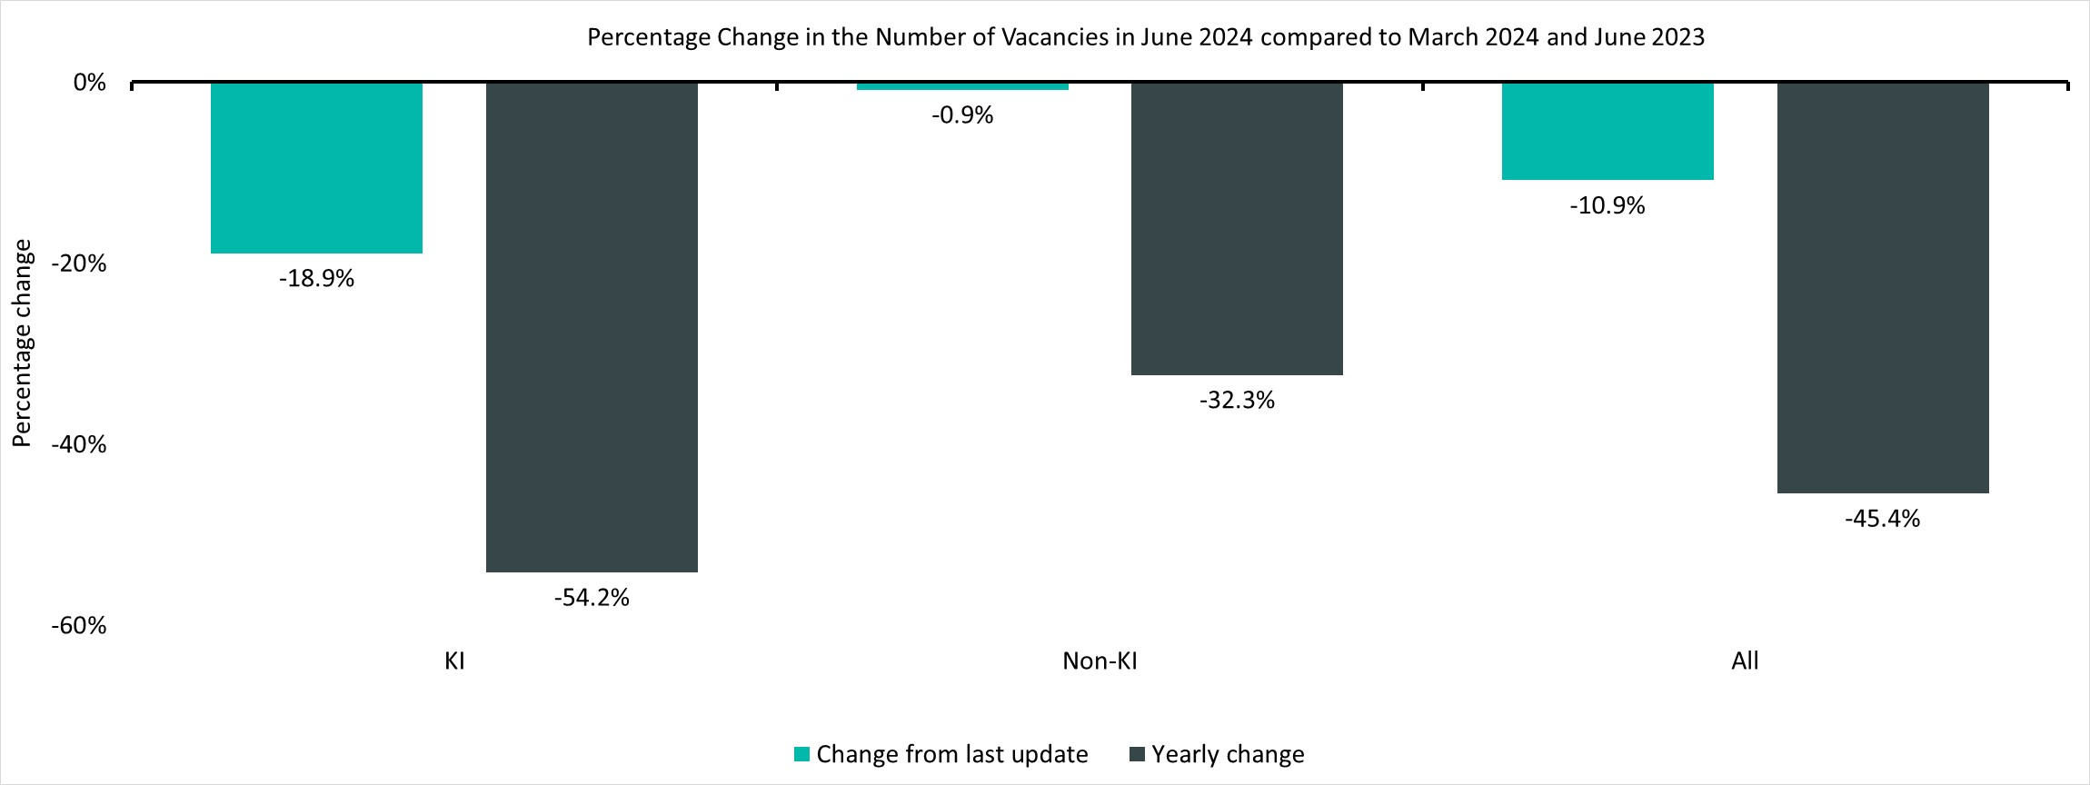
KI vs Non-KI Changes
Vacancies across both KI and non-KI industries have decreased year on year and since March 2024. However, it is concerning that KI industries have seen a larger decrease than non-KI industries when compared to both last year and March 2024
Notes:
Commentary: Vacancies across both KI and non-KI industries have decreased year on year and since March 2024. However, it is concerning that KI industries have seen a larger decrease than non-KI industries when compared to both last year and March 2024. Yearly changes suggest that both sectors of the economy are being equally affected by the wider macroeconomic environment.
Source: Lightcast
Technical note: Vacancy data is sourced from Lightcast, a service that has been procured by Cambridgeshire and Peterborough Combined Authority which gives labour market information on Job postings, occupations, and industries. Lightcast has a job posting aggregator which scans jobs websites for posting and presents them together. Lightcast only scans online jobs postings and therefore does not include any jobs which are advertised solely offline. There is also no guarantee that all online job postings are aggregated. For example, a specific job site may not be scanned.
A unique job posting is a deduplicated count of an online job vacancy advertisement. If the same vacancy is posted twice across a sixty-day period, it is only counted once. If the same vacancy is posted twice more than sixty days apart it is counted as two unique job postings.

Slide 27
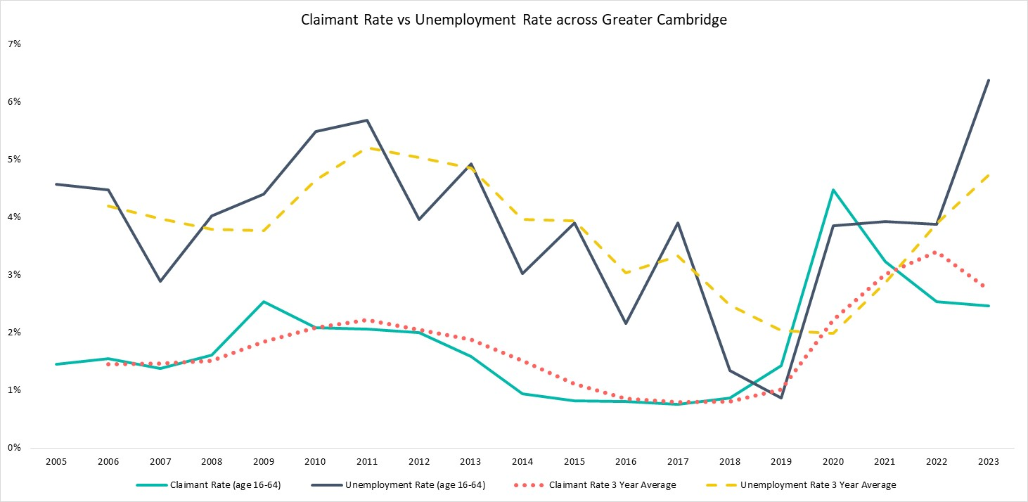
Claimant Count vs Unemployment Rate
There has been an unusual divergence since 2020 with APS increasing and the claimant rate decreasing. This divergence suggests that there is an increasing cohort that are not claiming unemployment benefits.
Notes:
Commentary: The claimant rate and unemployment rate have historically followed the similar trends with the claimant rate being lower than the unemployment rate. However, except for 2019 to 2020, the unemployment rate and claimant rate have been diverging since 2020 with the claimant rate decreasing and the unemployment rate increasing. This suggests that newly unemployed residents are deciding not to claim benefits, and this may be due to greater financial security. For example, graduates may return to their family home after university. However, more research is required to explain the divergence fully.
Sources:
Annual Population Survey
Claimant count, Office for National Statistics
Technical note: Vacancy data is sourced from Lightcast, a service that has been procured by Cambridgeshire and Peterborough Combined Authority which gives labour market information on Job postings, occupations, and industries. Lightcast has a job posting aggregator which scans jobs websites for posting and presents them together. Lightcast only scans online jobs postings and therefore does not include any jobs which are advertised solely offline. There is also no guarantee that all online job postings are aggregated. For example, a specific job site may not be scanned.
A unique job posting is a deduplicated count of an online job vacancy advertisement. If the same vacancy is posted twice across a sixty-day period, it is only counted once. If the same vacancy is posted twice more than sixty days apart it is counted as two unique job postings.
The Claimant Count measures the number of people (age 16+) claiming benefit principally for the reason of being unemployed.

Slide 28
Claimant Count by Area – June 2024
Cambridge
Claimant Count (ages 16+)
South Cambridgeshire
Claimant Count (ages 16+)
Greater Cambridge
Claimant Count
(ages 16+)
Claimant Rate
(ages 16-64)
Unemployment Rate
(ages 16-64)
2,140
1,770
3,915
1.9%
6.4%
Quarterly Change
Quarterly Change
Quarterly Change
Quarterly Change
Quarterly Change
+0.2%
-1.9%
-0.6%
No Change
-0.2%
YoY Change
YoY Change
YoY Change
YoY Change
YoY Change
+7.3%
+2.3%
+5.1%
+0.1pp
+2.5pp
Compared to 1,640,155 claimants UK wide. Quarterly change is +2.0% and YoY change is +6.7% in the UK.
Claimant counts have increased in Greater Cambridge over the last year, and this increase has been driven by Cambridge. Raw numbers of claimants have increased; however, the claimant rate has not changed substantially.
Notes:
Commentary: Claimant counts have increased in Greater Cambridge over the last year, and this increase has been driven by Cambridge. Overall, raw numbers of claimants are increasing; however, the claimant rate has not changed substantially.
The unemployment rate is much higher than the claimant rate suggesting that a large proportion of the unemployed population are not claiming benefits.
Source: Claimant count, Office for National Statistics
Technical note: The Claimant Count measures the number of people (age 16+) claiming benefit principally for the reason of being unemployed.

Slide 29
Claimant Rate by Age and Gender – June 2024
Cambridge
South Cambridgeshire
Greater Cambridge
16-24
16-24
16-24
1.0%
1.6%
1.2%
Male
Male
Male
25-49
1.6%
1.1%
1.3%
25-49
25-49
2.2%
2.0%
2.1%
Female
Female
Female
50-64
1.3%
1.0%
1.1%
50-64
50-64
2.3%
1.2%
1.7%
Like unemployment rates, claimant rates are higher for males than females. The 25-49 age group has high claimant rates in each area above, and the 50-64 age group has the highest claimant rate in Cambridge. When analysing unemployment rates, the 16-24 age group were the key cohort of concern. The lower claimant rate for the 16-24 age group could be due to the student population mostly being ineligible for benefits. However, it should be noted that the largest range in claimant rates (1.0%-2.3%) is still quite small compared to the ranges for the unemployment rates across age groups on Slide 11 (Employment Overview by Age – 3-year average).
Notes:
Commentary: Like unemployment rates, claimant rates are higher for males than females. The 25-49 age group has high claimant rates in each area above, and the 50-64 age group has the highest claimant rate in Cambridge. When analysing unemployment rates, the 16-24 age group were the key cohort of concern. The lower claimant rate for the 16-24 age group could be due to the student population mostly being ineligible for benefits.
However, it should be noted that the largest range in claimant rates (1.0%-2.3%) is still quite small compared to the ranges for the unemployment rates across age groups on Slide 11 (Employment Overview by Age – 3-year average).
Source: Claimant count, Office for National Statistics
Technical note: The Claimant Count measures the number of people (age 16+) claiming benefit principally for the reason of being unemployed.

Slide 30
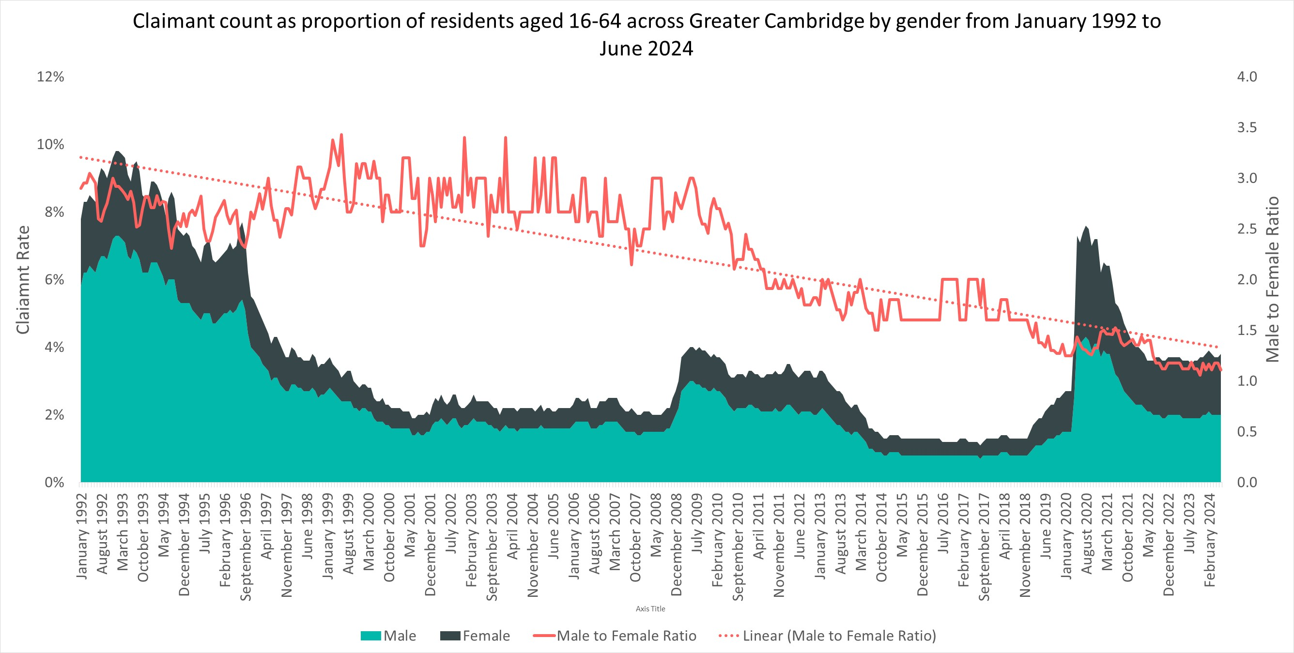
Claimant Rate by Gender
There has been a higher proportion of males who claim benefits than females since 1992. However, the ratio of male to female claimants has been decreasing over time. It is concerning that current claimant rates are still higher than pre-pandemic levels.
Notes:
Commentary: There has been a higher proportion of males who claim benefits than females since 1992. However, the ratio of male to female claimants has been decreasing over time. Claimant rates have generally risen with recessions (e.g. financial crisis in 2009; Covid-19 pandemic); however, it is concerning that current claimant rates are still higher than pre-pandemic levels.
Source: Claimant count, Office for National Statistics
Technical note: The Claimant Count measures the number of people (age 16+) claiming benefit principally for the reason of being unemployed.

Slide 31
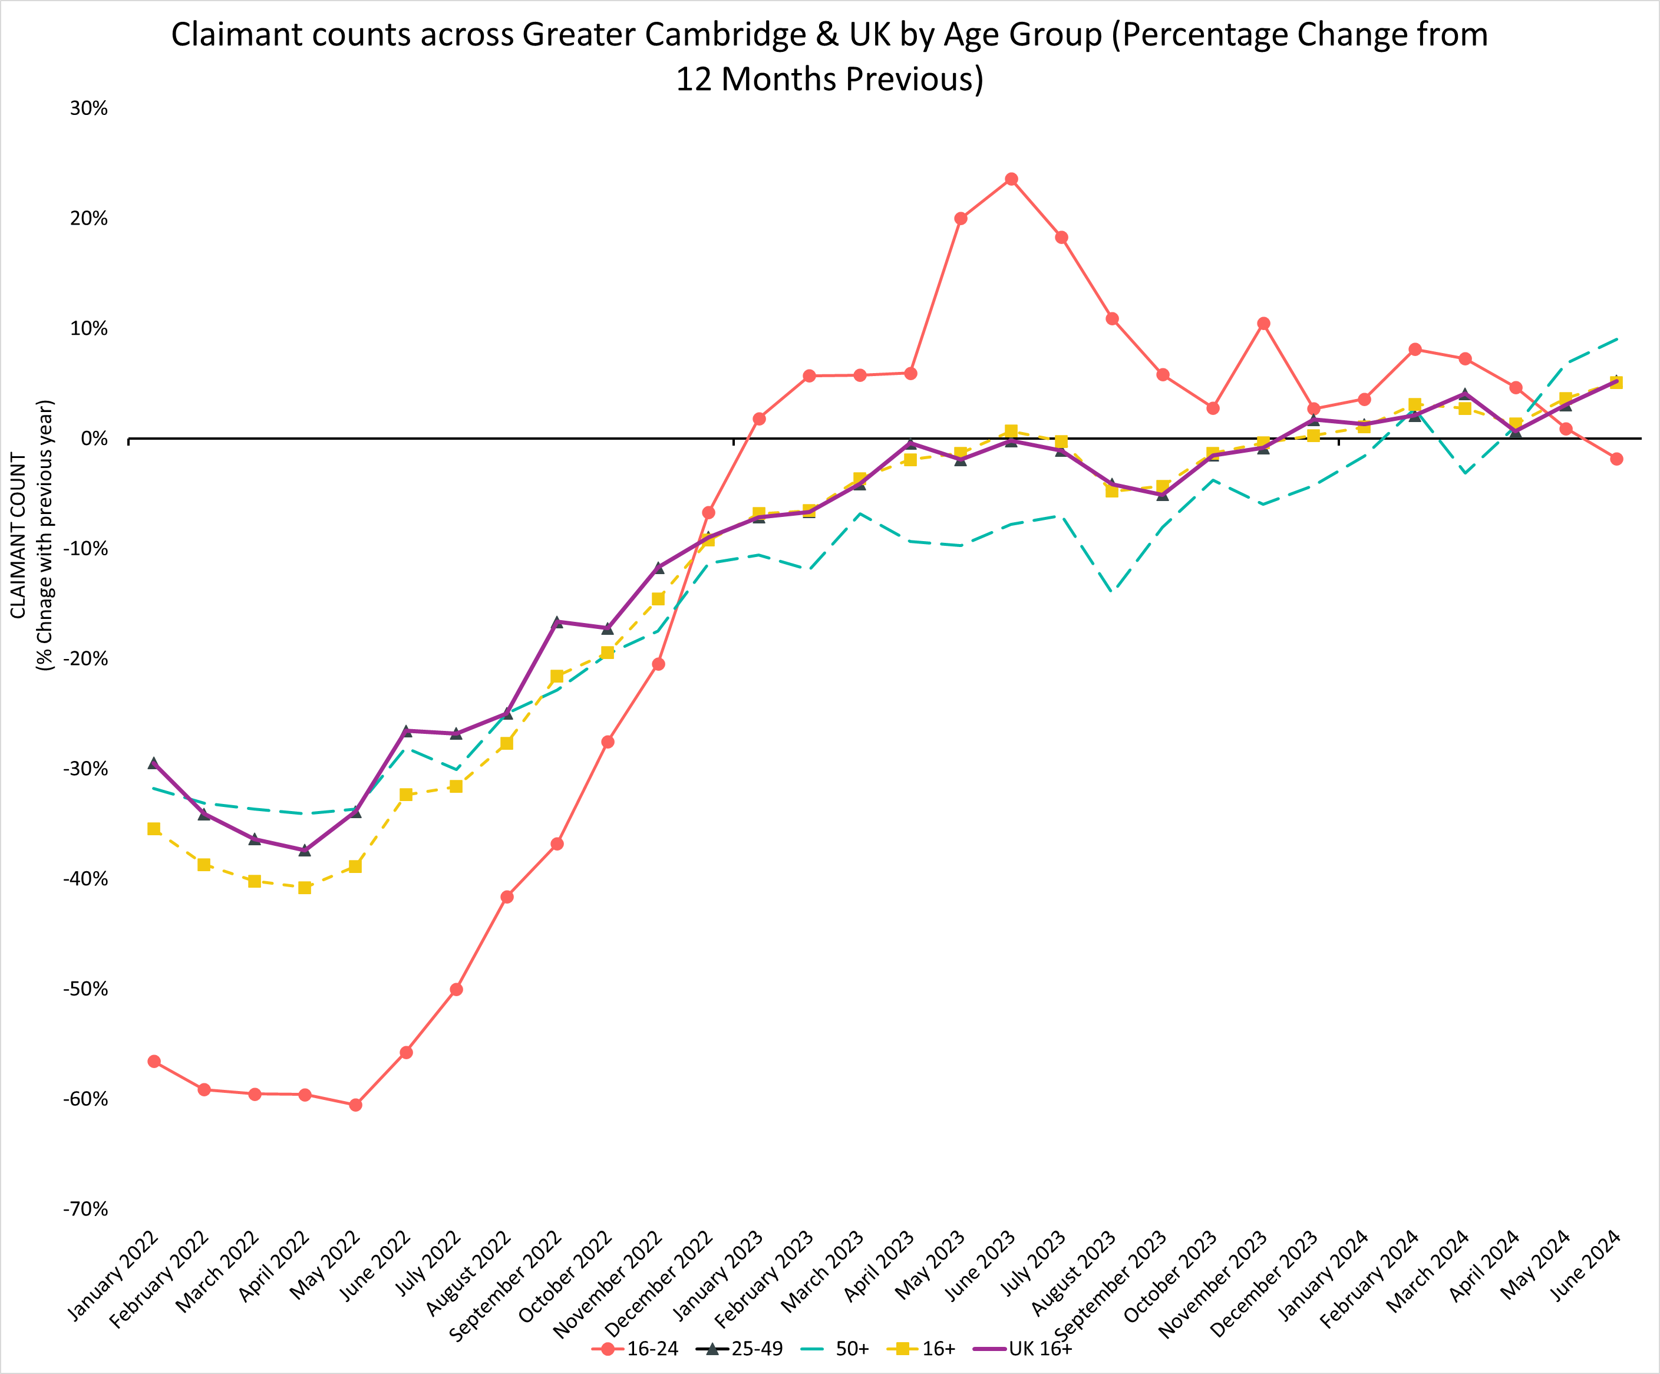
Claimant Count by Age Over Time
% Change in Claimant Counts | 16+ | 16-24 | 25-49 | 50+
Greater Cambridge (June 2023 to June 2024) | +5.1% | -1.8% | +5.2% | +9.0%
United Kingdom (June 2023 to June 2024) | +6.7% | +4.6% | +7.5% | +6.3%
Greater Cambridge (March 2024 to June 2024) | -0.6% | -8.5% | -0.6% | +4.3%
United Kingdom (March 2024 to June 2024) | +0.9% | -4.2% | +1.7% | +2.6%
Over the last year, all age groups had an increasing rate for claimant counts except for the 16-24 age group with -1.8%. The Greater Cambridge 50+ age group is an area of concern with the highest increase of 9.0% across age groups over the last year and the highest increase of 4.3% across age groups between March 2024 and June 2024. Both rates are above the UK.
Notes:
Commentary: Over the last year, all age groups had an increasing rate for claimant counts except for the 16-24 age group with -1.8%. The Greater Cambridge 50+ age group is an area of concern with the highest increase of 9% across age groups over the last year and the highest increase of 4.3% across age groups between March 2024 and June 2024. Both rates are above the UK.
Source: Claimant count, Office for National Statistics
Technical note: The Claimant Count measures the number of people (age 16+) claiming benefit principally for the reason of being unemployed.

Slide 32
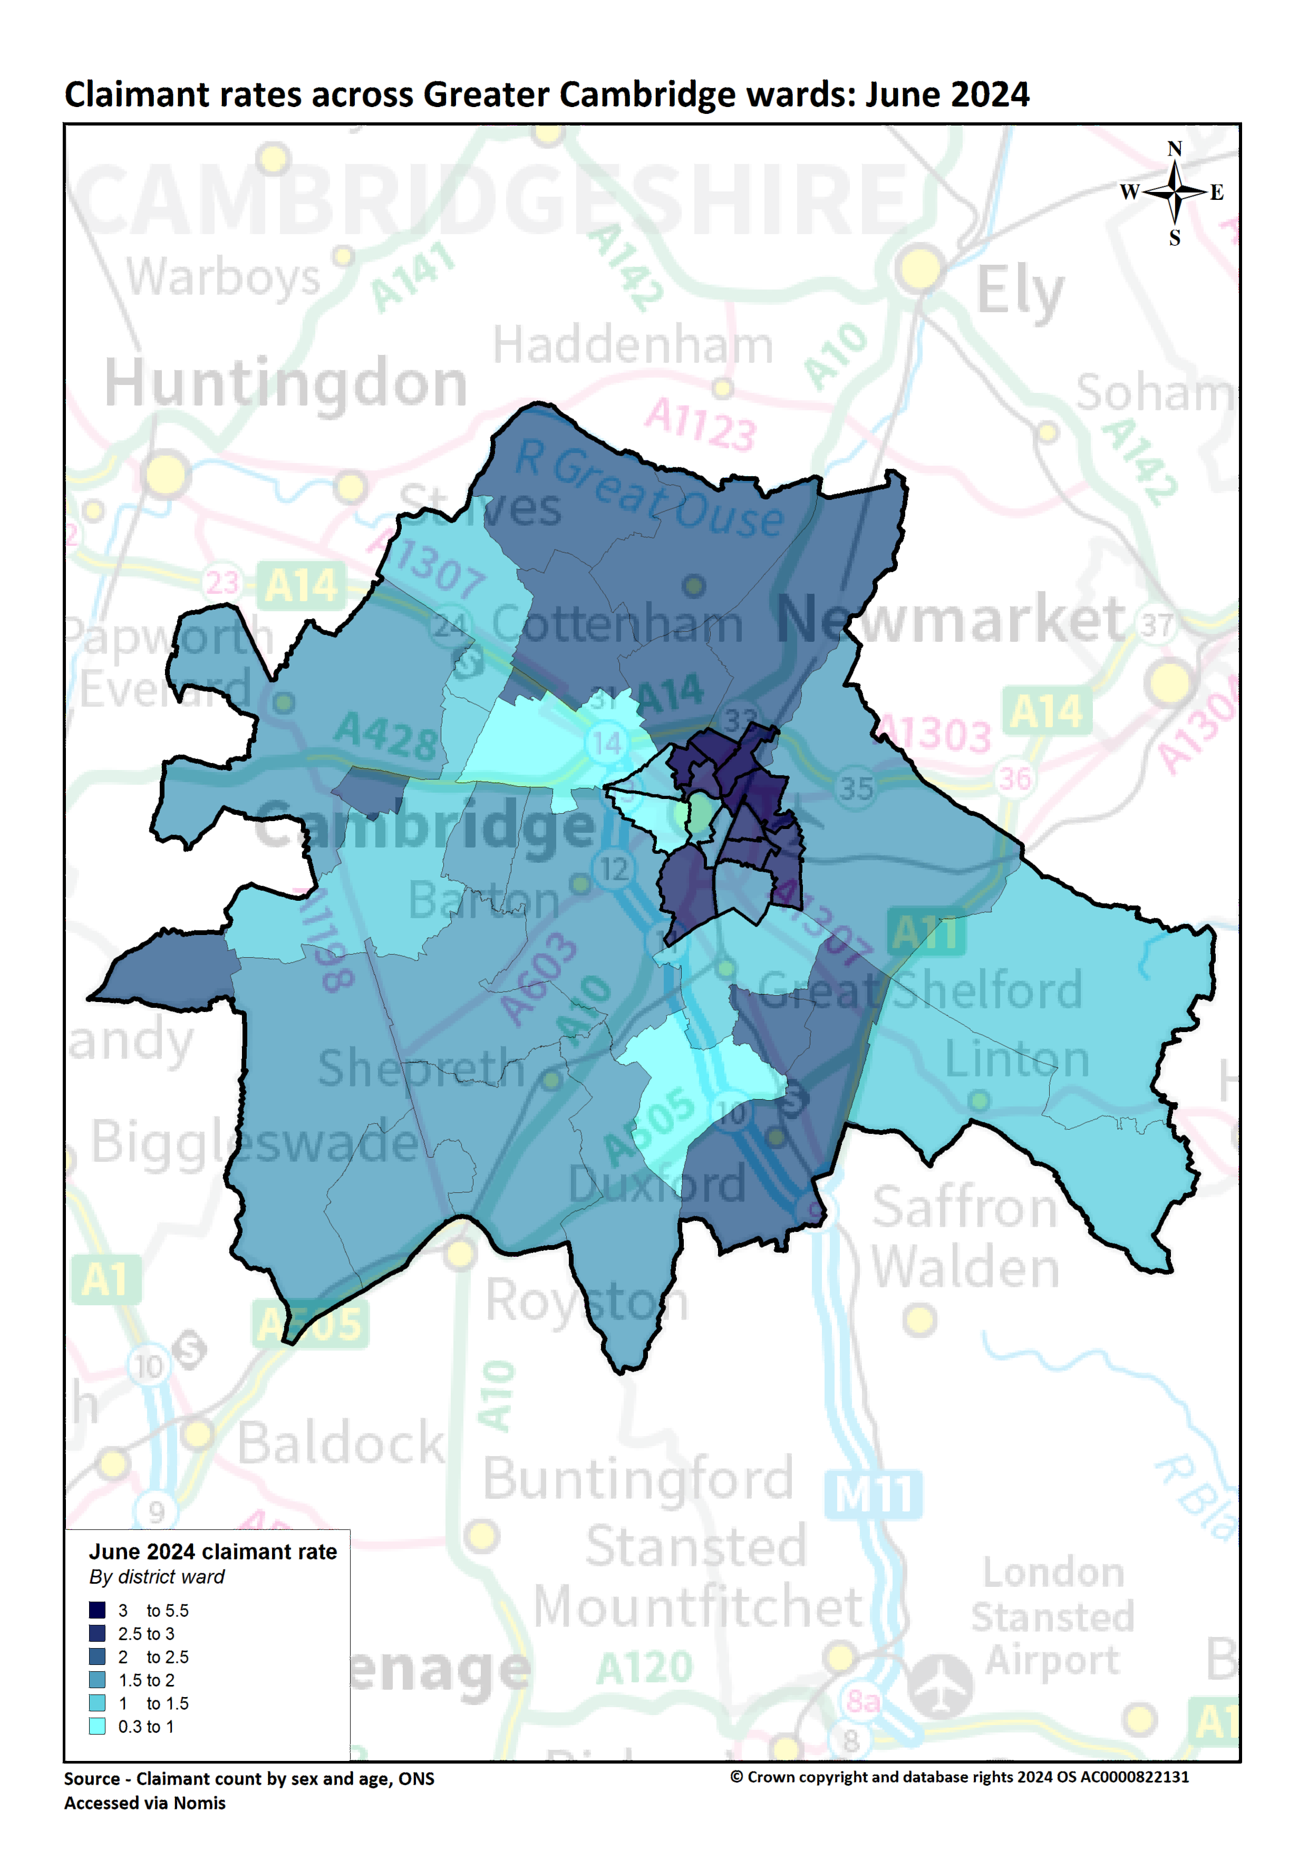
Claimant Map
5 Wards with Highest Claimant Rates
Ward | Claimant Rate | YoY Change Rate
King’s Hedge | 5.3% | +0.8pp
Arbury | 4.7% | +0.7pp
Abbey | 4.1% | +0.5pp
East Chesterton | 3.6% | +0.6pp
Cherry Hinton | 2.9% | -0.4pp
5 Wards with Lowest Claimant Rates
Ward | Claimant Rate | YoY Change Rate
Newnham | 0.3% | +0.0pp
Girton | 0.9% | -0.3pp
Whittelsford | 0.9% | -0.2pp
Castle | 1.1% | -0.1pp
Market | 1.2% | -0.3pp
Higher claimant rates seem to especially affect wards in the north of the region such as King’s Hedges, Arbury and Abbey. Further support to secure work may be needed in these areas.
Notes:
Commentary: A lower proportion of Greater Cambridge residents claim benefits related to unemployment when compared to the UK. However, there is a high degree of disparity within the area itself with claimant rates ranging from 5.5% in King’s Hedges (North Cambridge) to 0.3% in Newnham (Northwest Cambridge). Higher claimant rates seem appear to especially affect wards in the north of the region such as King’s Hedges, Arbury and Abbey. Further support to secure work may be needed in these areas.
King’s Hedges (+1.0pp), Bar Hill (+1.0pp) and Arbury (+0.8pp) had the largest rate increases between June 2023 and June 2024.
Source: Claimant count, Office for National Statistics
Technical note: The Claimant Count measures the number of people (age 16+) claiming benefit principally for the reason of being unemployed.

Slide 33
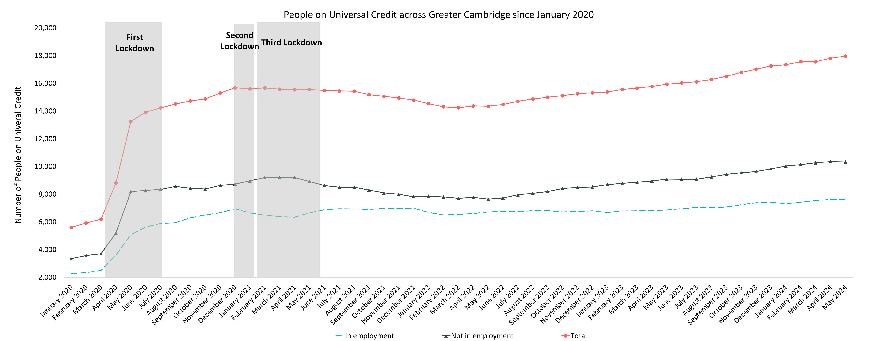
People on Universal Credit
Universal Credit Status | Number of Claimants May 2024 | Share of Total May 2024 | % Change with February 2024 | % Change with May 2023
Employed | 7,639 | 42.5% | +2.8% | +11.4%
Unemployed | 10,336 | 57.5% | +1.9% | +13.8%
Total | 17,967 |  | +2.3% | +12.7%
It is concerning that since May 2023, universal credit claimants have increased for both employed at 11.4% and unemployed at 13.8%. The current number of claimants also remains higher than pre-pandemic levels.
Notes:
Commentary: It is concerning that since May 2023, universal credit claimants have increased for both employed at 11.4% and unemployed at 13.8%. The current number of claimants also remains higher than pre-pandemic levels. Most universal credit claimants are unemployed, but 42.5% are employed suggesting that these residents are in low paying work.
Source: Claimant count, Office for National Statistics
Technical note: Universal Credit is available in every jobcentre across Great Britain. Roll out was completed in December 2018.
Universal Credit is a single payment for each household to help with living costs for those on a low income or out of work. It is replacing six benefits, commonly referred to as the legacy benefits:
Income-based Jobseeker's Allowance
Income-related Employment and Support Allowance
Income Support
Working Tax Credit
Child Tax Credit
Housing Benefit
Support for housing costs, children and childcare costs are integrated into Universal Credit. It also provides additions for people with a disability, health condition or caring responsibilities which may prevent them from working.
The number of Universal Credit claimants includes those who have started Universal Credit (completed the Universal Credit claim process and accepted their Claimant Commitment) and have not had a closure of their claim recorded for this spell, up to the 'count date' (second Thursday in each month). A closure of their claim would be recorded either at the request of the individual or if their entitlement to Universal Credit ends, for example, if they no longer satisfy the financial conditions to receive Universal Credit as they have capital over £16,000.

Slide 34
6. Employment

Slide 35
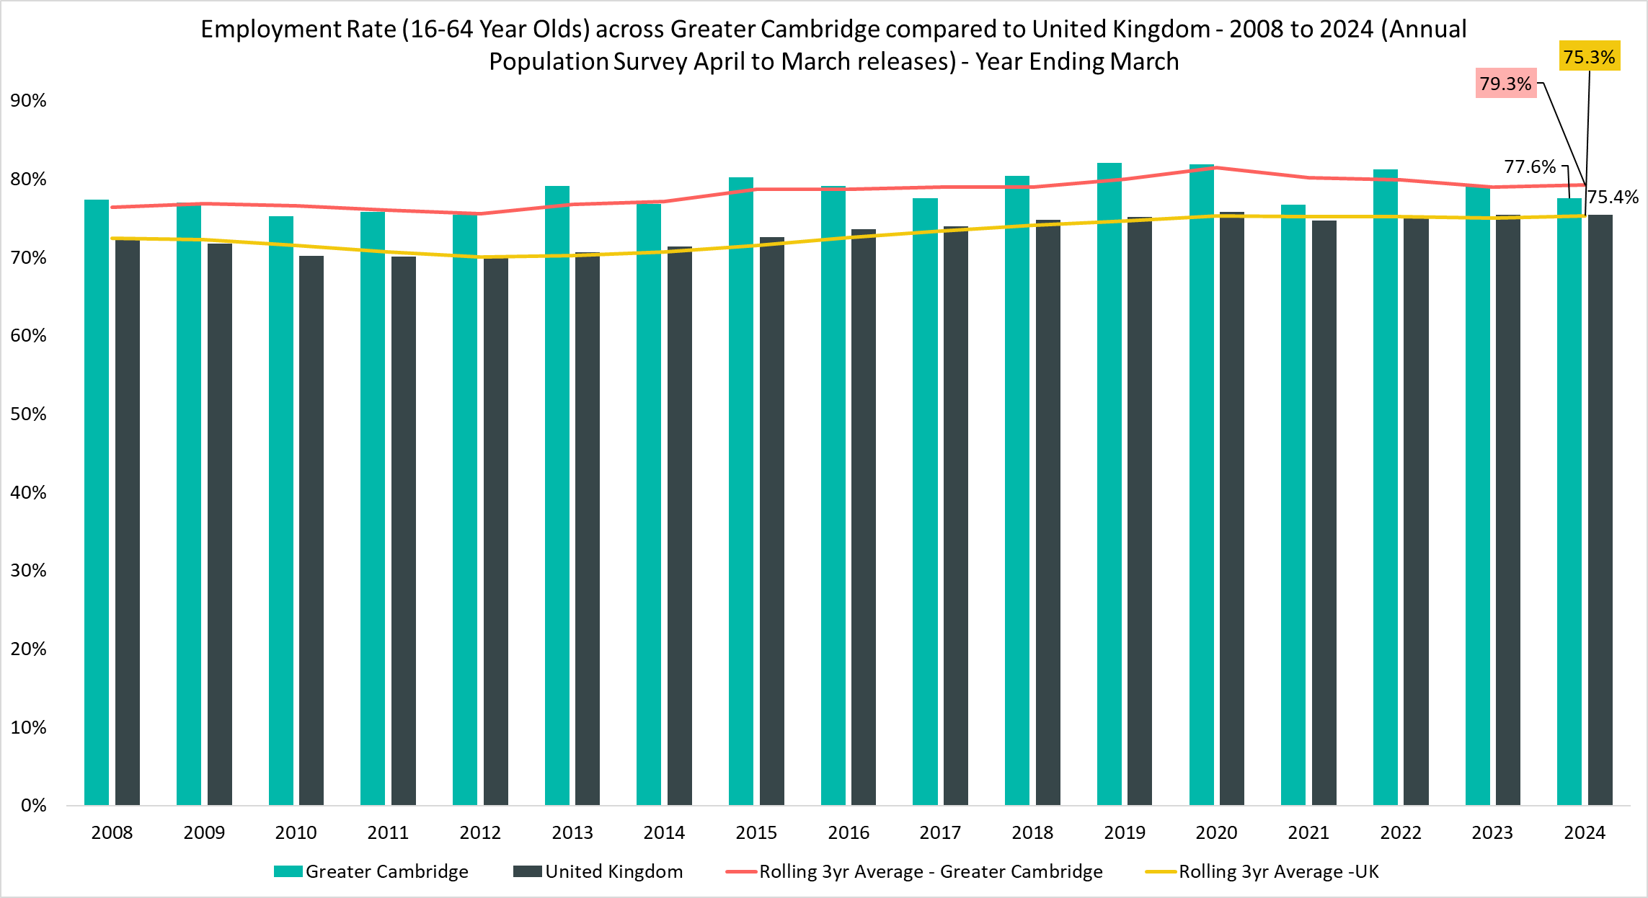
Employment Overview
Employment Rate
(all aged 16-64)
77.6%
Apr 2023-Mar 2024
Quarterly Change
-0.9pp
Comparing Apr 2023-Mar 2024 with Jan 2023 – Dec 2023
YoY Change
-1.5pp
Comparing Apr 2022-Mar 2023 with Apr 2023-Mar 2024
Compared to 75.4% UK wide. 3-year average (April 2021-Mar 2022 to April 2023-Mar 2024) is 79.3% compared to 75.3% UK wide
An area of strength is that the employment rate for Greater Cambridge has been consistently higher than the UK for the analysis period since 2007. However, the recent -1.5pp YOY change and -0.9pp quarterly change are areas of concern.
Notes:
Commentary: An area of strength is that the employment rate for Greater Cambridge has been consistently higher than the UK for the analysis period since 2007. However, the recent -1.5pp YOY change and -0.9pp quarterly change are areas of concern.
Source: Annual Population Survey, April to March Releases
Technical note: A residence based labour market survey encompassing population, economic activity (employment and unemployment), economic inactivity and qualifications. These are broken down where possible by gender, age, ethnicity, industry and occupation. Available at Local Authority level and above. Updated quarterly.
It is important to note that due to the small geographical area considered, and the Annual Population Survey being based on a representative sample, this may be due to a quarterly fluctuation rather than any kind of long-term trend in the data. National figures are now taken from the Labour Force Survey (LFS). Increased volatility of LFS estimates, resulting from smaller achieved sample sizes, means that estimates of quarterly change should be treated with additional caution. Caution should be taken with interpreting these figures and comparisons to Greater Cambridge.
APS Estimates have not been reweighted to new populations and consequently, will be inconsistent with the population totals used for the Labour Force Survey in the latest periods. Again caution is recommended when making comparisons to national statistics.

Slide 36
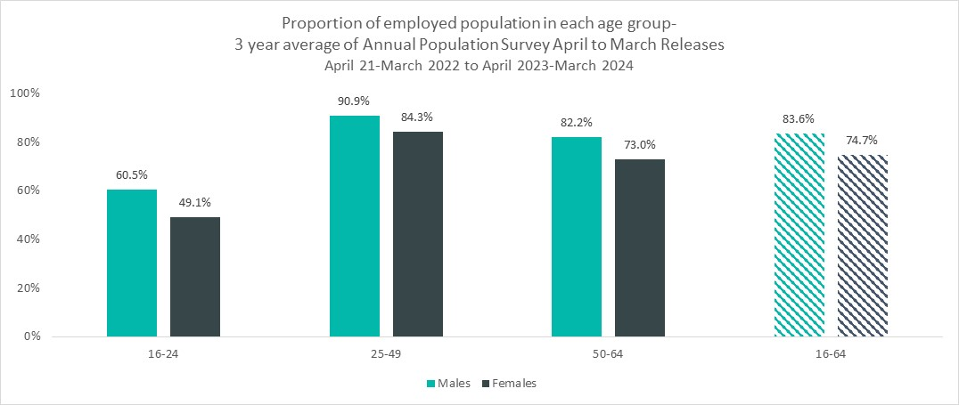
Employment by Age and Gender
Employment Rate
(all aged 16-64)
83.6%
Male
74.7%
Female
3-Year Average: April 2021-Mar 2022 to April 2023-Mar 2024
Males have a higher employment rate than females across all age groups. This is due to the larger proportion of females who are economically inactive and does not suggest hiring differences between genders.
Notes:
Commentary: Males have a higher employment rate than females across all age groups. This is due to the larger proportion of females who are economically inactive and does not suggest hiring differences between genders.
Source: Annual Population Survey, April to March Releases
Technical note: A residence based labour market survey encompassing population, economic activity (employment and unemployment), economic inactivity and qualifications. These are broken down where possible by gender, age, ethnicity, industry and occupation. Available at Local Authority level and above. Updated quarterly.
It is important to note that due to the small geographical area considered, and the Annual Population Survey being based on a representative sample, this may be due to a quarterly fluctuation rather than any kind of long-term trend in the data. National figures are now taken from the Labour Force Survey (LFS). Increased volatility of LFS estimates, resulting from smaller achieved sample sizes, means that estimates of quarterly change should be treated with additional caution. Caution should be taken with interpreting these figures and comparisons to Greater Cambridge.
APS Estimates have not been reweighted to new populations and consequently, will be inconsistent with the population totals used for the Labour Force Survey in the latest periods. Again caution is recommended when making comparisons to national statistics.

Slide 37
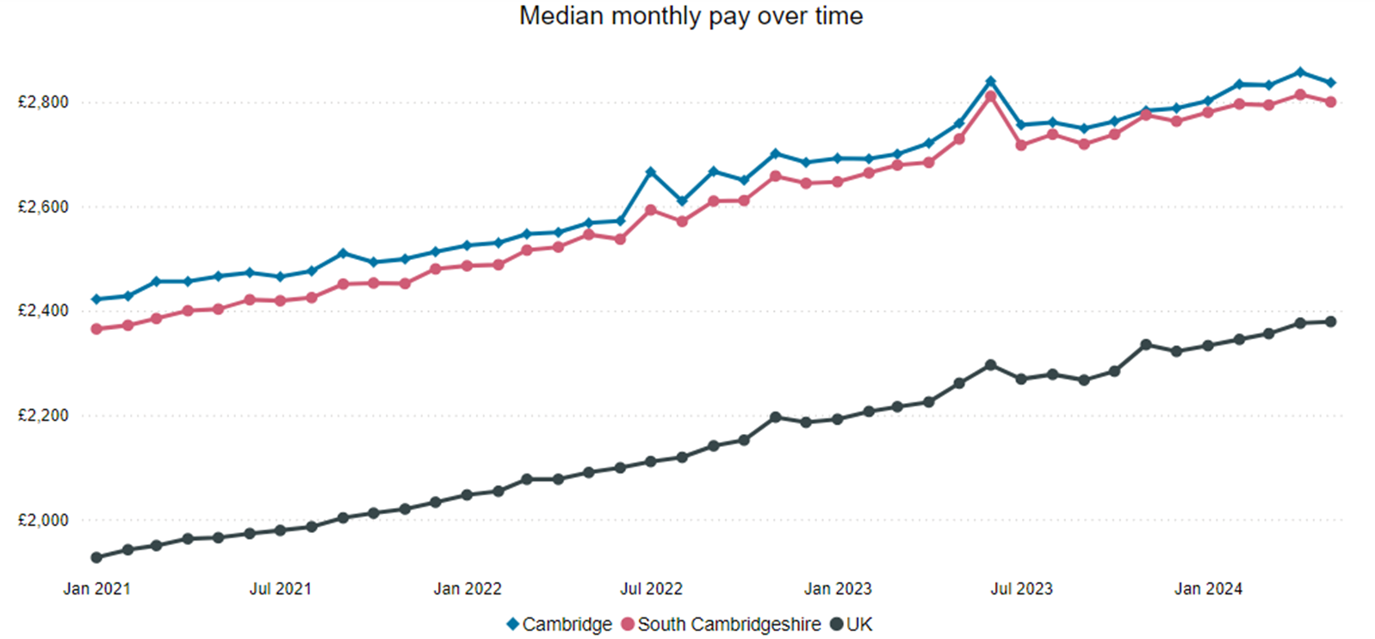
Pay Levels
Median monthly pay
for May 2024
Cambridge
£2,837
South Cambridgeshire
£2,800
UK
£2,379
An area of strength is that median monthly pay across both Cambridge and South Cambridgeshire is substantially higher than the UK.​ This suggests that Greater Cambridge continues to be a highly attractive area for workers.
Notes:
Commentary: An area of strength is that median monthly pay across both Cambridge and South Cambridgeshire is substantially higher than the UK.​ This suggests that Greater Cambridge continues to be a highly attractive area for workers.
Source: Pay as you earn real time information- HMRC
Technical note: This data is sourced from HM Revenue and Customs’ Pay As You Earn system which collects income tax and national insurance. The Pay As you Earn Real Time Information data includes all employees payrolled by employers, therefore it does not include income from pensions, property rental or investments, nor does it include self-employment income.
This data is based on employee’s residence rather than where they work.

Slide 38
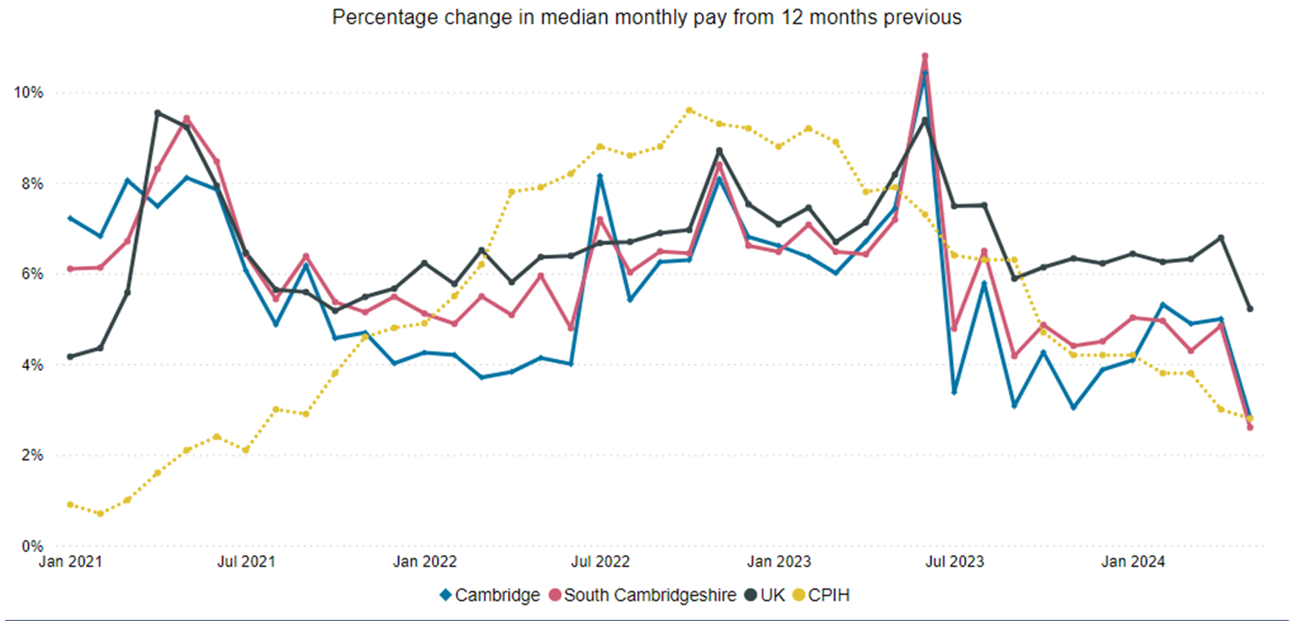
Pay Growth and Inflation
Percentage change in median monthly pay from 12 months
Cambridge
+2.8%
South Cambridgeshire
+2.6%
UK
+5.2%
CPIH
+2.8%
Median monthly pay in Cambridge (+2.8%) and South Cambridgeshire (+2.6%) has been growing almost half the UK growth rate (+5.2%). Furthermore, median monthly pay growth in Cambridge is just in line with inflation growth (+2.8%) and South Cambridgeshire growth is just below inflation growth. This is an area of concern that could possibly decrease future spending power.​
Notes:
Commentary: Median monthly pay in Cambridge (+2.8%) and South Cambridgeshire (+2.6%) has been growing almost half the UK growth rate (+5.2%). Furthermore, median monthly pay growth in Cambridge is just in line with inflation growth (+2.8%) and South Cambridgeshire growth is just below inflation growth. This is an area of concern that could possibly decrease future spending power.​
Source: Pay as you earn real time information- HMRC
Technical note: This data is sourced from HM Revenue and Customs’ Pay As You Earn system which collects income tax and national insurance. The Pay As you Earn Real Time Information data includes all employees payrolled by employers, therefore it does not include income from pensions, property rental or investments, nor does it include self-employment income.
This data is based on employee’s residence rather than where they work.

Slide 39
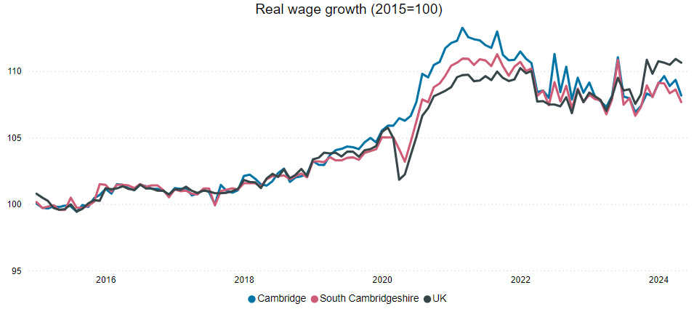
Real Wages
Latest Wage Growth
Cambridge
108.3
South Cambridgeshire
107.7
UK
110.6
It is concerning that real wage growth across Greater Cambridge is below that of the UK, and the latest data suggests this is trending downwards and worsening.
Notes:
Commentary: It is concerning that real wage growth across Greater Cambridge is below that of the UK, and the latest data suggests this is trending downwards and worsening. More data will be needed to determine whether real wage growth will fall below inflation overall, which would lead to harder living conditions for workers. This may over time make the area less attractive to workers.
Source: Pay as you earn real time information- HMRC
Technical note: This data is sourced from HM Revenue and Customs’ Pay As You Earn system which collects income tax and national insurance. The Pay As you Earn Real Time Information data includes all employees payrolled by employers, therefore it does not include income from pensions, property rental or investments, nor does it include self-employment income.
This data is based on employee’s residence rather than where they work.
Real wage growth is calculated by deflating earnings by the Consumer Prices Index including owner occupiers’ housing costs (CPIH).

Slide 40
7. Concluding remarks and next steps
Concluding remarks
Economic inactivity - Gender disparity across the workforce is a concern, and the progress of the government's childcare policies should be monitored.
Unemployment - The 16-24 and 50+ age groups are particularly struggling to find work with fewer job opportunities. The new Skills England policy should be monitored.
Employment – The Greater Cambridge monthly median pay growth rate is much lower than the UK and just in line with inflation. This is an area of concern that could possibly decrease future spending.
Next steps
To further explore matching issues between vacancies (supply of job opportunities) and unemployment (demand of job seekers).

Slide 41
8. Glossary
Term | Formula
Claimant Rate | $$\frac{number of claimants}{ population of claimant area (16−64)}$$
Economic Activity Rate | $$\frac{number of people in employment and unemployed (aged 16+)}{total population (aged 16+)}$$
Economic Inactivity Rate | $$\frac{number people who are neither in employment nor unemployed (aged 16−64)}{total population (aged 16−64)}$$
Employment Rate | $$\frac{number of people in employment (aged 16−64)}{total population (aged 16−64)}$$
Unemployment Rate | $$\frac{number of unemployed people (aged 16+)}{economically active population (aged 16+)}$$
Vacancy Rate | $$\frac{number of job vacancies}{(number of job vacancies+employed population)}$$

