Slide 1
Evaluation of Suicide Prevention Work
2021-2025

Slide 2
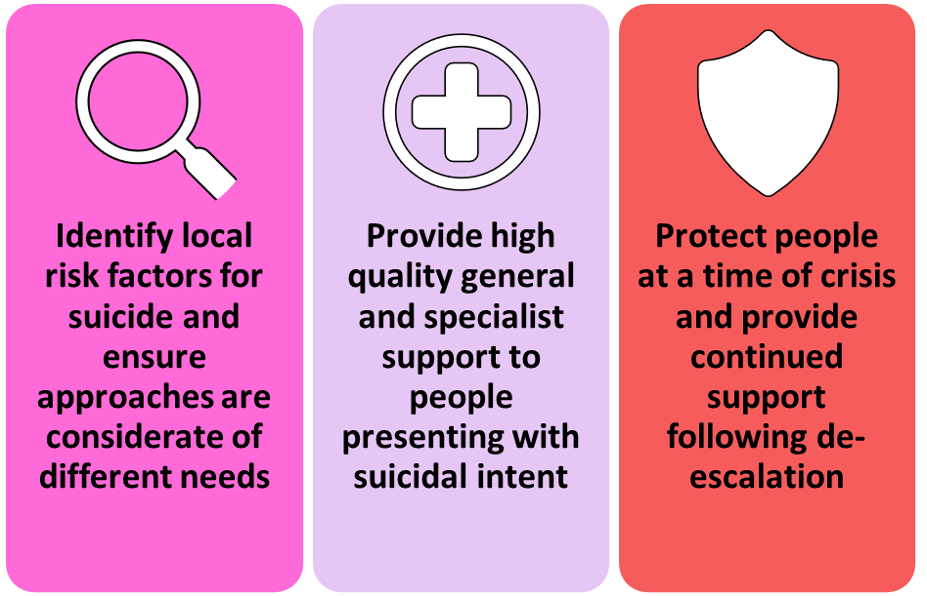
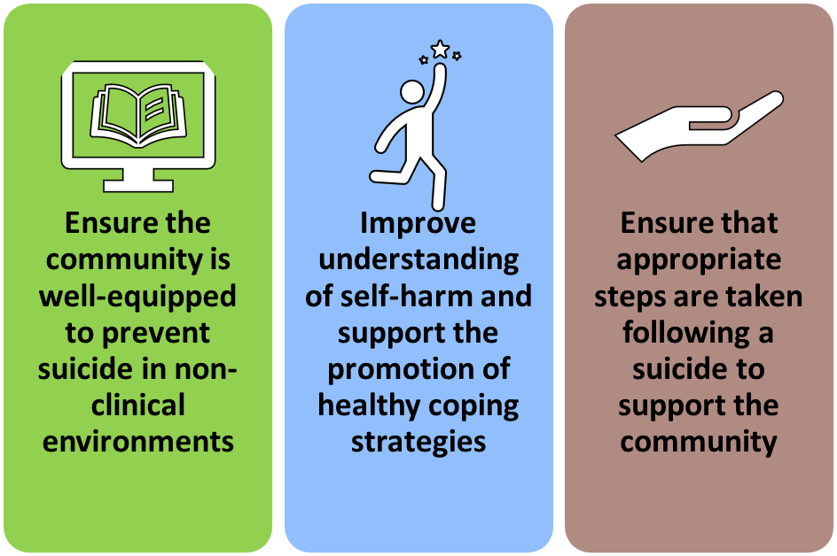
Cambridgeshire and Peterborough Suicide Prevention Strategy 2022-2025
Every person in Cambridgeshire and Peterborough has access to the right care and support, from both the mental health system and their communities, to ensure that they do not die by suicide

Slide 3
Cambridgeshire and Peterborough Suicide Prevention Strategy 2022-2025
Wave 4 Suicide Prevention Programme
Enhanced multi-agency Real-Time Suicide Surveillance
System wide training in Safetool safety planning and risk assessment
Communications and STOP Suicide campaigns
Understanding and addressing self-harm in children and young people
Full time project manager to oversee and deliver some of the proposed work as wall as support the county wide suicide prevention agenda

Slide 4
Suicide Prevention Coordination
Activity
Oversight of the Wave 4 programme and suicide prevention strategy
Led the C&P Suicide Review and Cluster Response process
Expansion of the suicide prevention network
Delivery against the suicide prevention strategy
Representation at local and regional forums
Impact
Better Informed
Better prepared
More responsive
More effective
Collaborative working
We have a greater understanding of suspected and confirmed suicides in C&P and as a result we are,
to respond to clusters or changes in themes/trends identified and as a result we are,
to our local population needs and mobilising responses to prevent further trauma, distress and possible deaths which means we are,
in the utilisation of the resources available and are able to target specific responses/interventions to have the maximum benefit/impact, which has led to improvements in
in the Suicide prevention agenda and has further improved learning leading to strategic influence, which has led to an increase in the reputation of system, being a leader in this field.

Slide 5
Suicide Prevention Coordination
Learning
Whilst investment into commissioned work has been vital in the delivery of suicide prevention activity, centralised coordination of this work has added significant value to the system
There is reputational risk locally and regionally to not have a named lead representing the suicide prevention agenda
Having a dedicated officer with sole remit for suicide prevention allows for greater response to adhoc emerging need. For example, if a suicide cluster is identified, the Suicide Prevention Manager is well-situated to lead this process
The Suicide Prevention Manager post has grown considerably since its inception. This report recommends investing resource into additional suicide prevention roles (for example dedicated analyst support) to further strengthen delivery
To ensure suicide prevention is taken seriously as an ICS, consider enhancing the status of this role to increase the strategic influence this post holds

Slide 6
Real-Time Suicide Surveillance
Impact
Activity
New RTSS provider
Expansion of Information Sharing Agreement to include additional partners
Monthly learning forums and ad-hoc cluster response groups
Task-and-finish groups established to respond to data
14 organisations part of the RTSS network
Improvements in data collection regarding demographic data, contact with services and wider risk factors
90% of cases confirmed by coroners already known to RTSS
Improved system learning and delivery of target work such as support for justice-involved people

Slide 7
Real-Time Suicide Surveillance
Learning
Improved collection of ‘softer’ risk factors has decentred the narrative from mental health services, recognising that there are opportunities for intervention for those who do not access primary or secondary care, provided the relevant services are suicide-aware.
There is a need to develop more robust mechanisms for sharing RTSS data with the wider Integrated System of Care. At present, learning is shared on an ad-hoc basis when a change in pattern is observed, but there is no consistent route for reporting escalation of concerns.
Surface-level analysis of demographic trends is achievable with relatively little work, but to enrich learning, dedicated resource needs to be allocated towards the system, ideally through the provision of a Public Health Intelligence Analyst, to better understand the specifics of people’s lives and how different factors may interplay to result in a higher suicide risk.
Real-time monitoring of suicide attempts is time-intensive and complicated by a lack of consistency in reporting. This would be a valuable resource within wider system learning to better understand the suicide landscape locally. Therefore, work needs to be conducted to ensure consistent, accurate reporting of deliberate self-harm, both with and without suicidal intent.
Future attention towards this workstream should be in raising its profile amongst professionals locally to increase the value of the data being shared, particularly with regard to primary care

Slide 8
STOP Suicide Campaigns
Impact
Activity
2021/2022 ‘Asking Saves Lives’ campaign – Peterborough focus
2022/2023 ‘I’d Ask, Would You?’ – Domestic abuse and Relationship Breakdown
2023/24 ‘Relationship Breakdown’ targeted campaign
Potential reach of over 500,000 people
£4500 suicide prevention grants offered to local organisations
372 organisations supporting people through relationship breakdown directly contacted
Increased awareness of suicide prevention training

Slide 9
STOP Suicide Campaigns
Learning
Whilst there is often scope to tailor a campaign around a particular theme, it is important that the central messaging is not forgotten. Theming of a campaign should add additional context as to how different experiences may contribute to greater suicide risk and thus the need to be aware of how to prevent suicide in different cohorts. This is particularly effective if a call to action associated with a campaign is for professionals working within these settings to take up the STOP Suicide training.
Stronger evaluation is needed for the STOP Suicide campaign activity to understand not only the reach of the work, but also what impact this has had on the community. Specific effort needs to be made with regard to understanding how many attendees of the training have signed up due to campaign messaging, and which channels prove most effective.
STOP Suicide messaging is not aimed at people with suicidal thoughts. It is aimed at those around them, both professionals and members of their community. There is currently no suicide prevention campaign in Cambridgeshire and Peterborough aimed directly at people who are struggling with suicidal thoughts. There is a potential gap in messaging here. This will be an important step in addressing suicide stigma.
There is value in running STOP Suicide campaigns at a reduced capacity when focusing on a specific target audience. Making direct contact with a small number of organisations who are well placed to support those at higher risk may well have more of an impact than general messaging without an identified target audience.

Slide 10
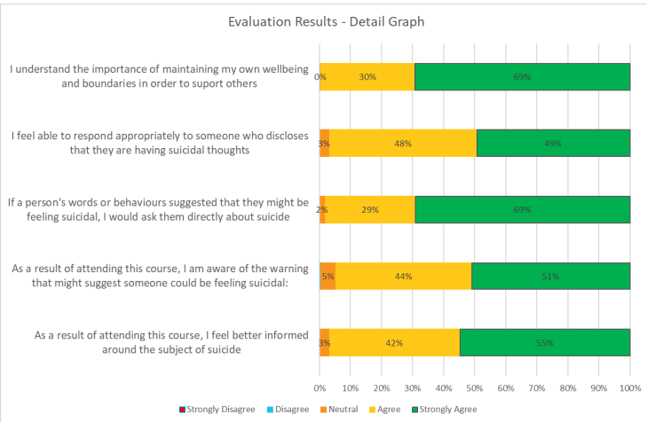
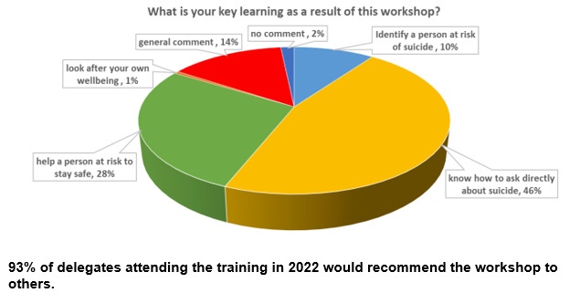
STOP Suicide Training

Slide 11
STOP Suicide Training
Learning
Flexibility in delivery is crucial to work with colleagues who may not have much time to incorporate training into their practice. Variation with regard to length and time of training may lead to increased uptake.
Targeting training towards key groups is more time consuming but would have added benefits as those who are in most need of support will be likely to receive this from those services they are already in contact with.
Expanding training to reach more members of the general public is worth exploring but would require more thought as to how this is advertised and what additional requirements may be needed to offer support to those attending outside of a professional context.
Community of Practice sessions are a useful tool to maintain long-term interest in suicide prevention learning following the initial training session.
Evaluation of long-term impact of training and resulting changes in practice is limited, and relies heavily on continued engagement from training participants. More robust long-term evaluation should be conducted into impacts of training on practice in the subsequent months and years after initial training.

Slide 12

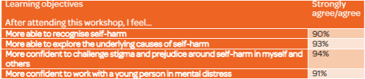
Self-Harm
Impact
Activity
Desk-based research report
Co-production of ‘Ask Me How I Am’ short film and training based on lived experience of young people who self-harm
Delivery of training to schools, GP surgeries and wider VCSE sector
354 attended training
95% participants would recommend training to a colleague
Nominated for NHS Parliamentary Award

Slide 13
Self-Harm
Learning
Understanding self-harm from a young person’s perspective has been vital in guiding the local approach. Co-production should be a vital tool when commissioning/designing new services and resources.
It is important that the parameters for co-production are well understood, with professionals being open to pushing boundaries in order to meet need, whilst making sure those with lived experience are aware of any potential limitations on what can be achieved.
Self-harm requires a different approach to suicide prevention. For many of the young people, the goal was not to ‘reduce self-harm’ but to understand that self-harm is an unhealthy coping mechanism in response to difficulties such as suicidal thoughts. By addressing the underlying issues, there is greater potential in reducing self-harm, without leading to escalating presentations elsewhere.

Slide 14

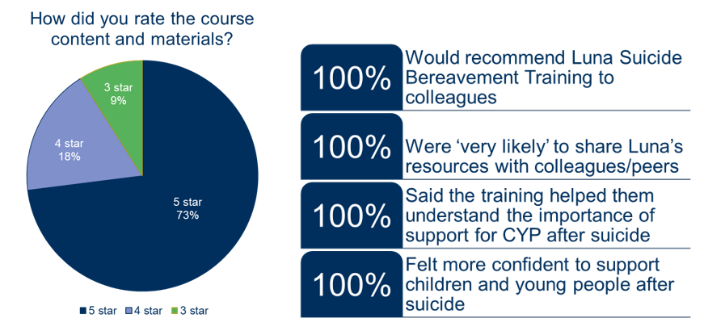
Postvention
Impact
Use of suicide bereavement support service doubled
49 people in receipt of suicide bereavement counselling
38 professionals trained in CYP suicide bereavement
Resources created for CYP bereaved by suicide
Activity
Expanding the scope of the existing service through creation of a second Suicide Bereavement Liaison Worker role.
Introduce longer term support available to those bereaved by suicide, primarily through counselling and a community support approach
Establish a local, specialist provision for children and young people bereaved by suicide
Suicide bereavement peer support groups established

Slide 15
Postvention
Learning
Suicide bereavement is a core component of suicide prevention activity locally. It requires continued and further funding to meet ongoing demand. This is particularly important when support is being offered for up to a year following bereavement.
Further investment into support for children and young people should be an essential feature of future suicide prevention plans.
Efforts should be made to maximise awareness of the Suicide Bereavement Support offer available. This needs to be not only during initial contact, but in the weeks following, to ensure that those who are not open to engaging immediately can self-refer at a later point.
It is a worthwhile exercise in the production of local resources to gather information already publicly available so as to avoid duplication.
Further research is needed into the effectiveness of suicide bereavement support on local people.

Slide 16
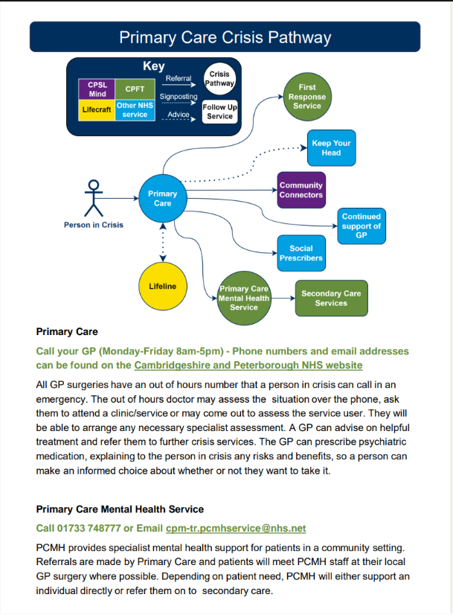
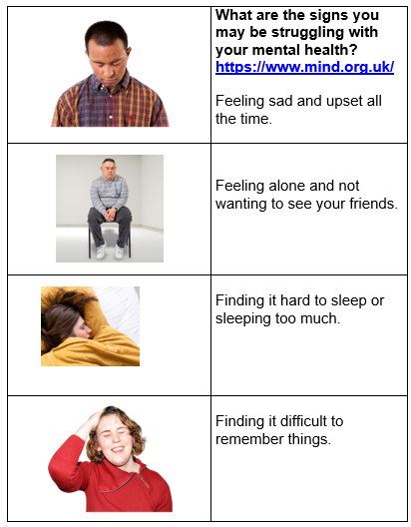
Additional Work
Mental Health Crisis Pathway Resource
Guide for professionals to better support service users along the crisis pathway
Shared with Suicide Prevention Network
Improving Understanding of Self-Harm in 18-25 year olds
Worked with researchers from CUSPE to understand factors affecting mental health in 18-25 years olds and how we can address this
Recommendations included support for students, LGBTQ+ youth and care leaves
Support during cost of living
Mental health resources created and shared with key stakeholders including warm hubs and spaces
Potential reach of 17,000 people across warm spaces

Slide 17
Work not Delivered
Online Safety
Support for Workplaces
Local audits and Domestic Abuse Related Death Reviews have proposed recommendations to upskill workplaces in suicide prevention and postvention
Self-harm guidance
Need to improve consistency in identifying and recording self-harm with and without suicidal intent
Online Safety Bill published in October 2023 outlines offences in relation to promoting suicide online. Potential to share learning locally to improve good practice
Surveys produced for professionals and members of the public but not yet delivered
Reducing access to means
Continuing complexity in improving safety of the home environment

Slide 18
SUPRESE
Strategic approach to suicide prevention
Multi-agency suicide prevention group
Sufficient financial resources for delivery
Sufficient human resources
Sensitivity and responsiveness to cultural beliefs and social attitudes
Engagement with people with lived experience
Reduce suidal behaviour in high-risk groups
Support for people who have self-harmed in primary care
Support for people who have self-harmed in secondary care
Reduce harmful use of alcohol and drugs
Effective postvention support
Reducing access to means
Review process for suicides known to MH services
Review process for suicides not known to MH services
Monitoring of characteristics and determinants of suicidal behaviour
Monitoring data used to inform development of suicide prevention strategy and action
Raise public awareness about suicide and self-harm
Gatekeeper training
Community training
Reducing public stigma
Responsible reporting in media

Slide 19
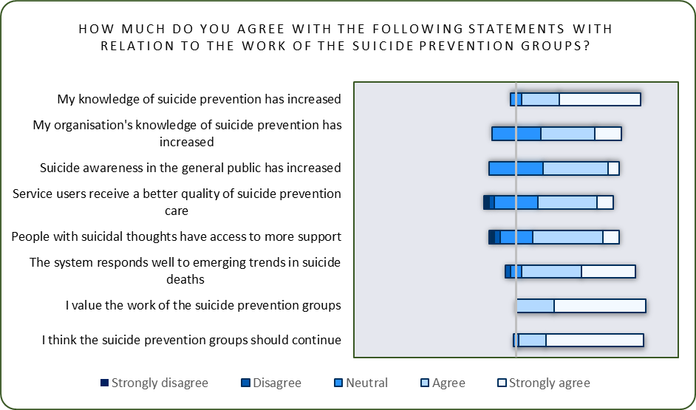
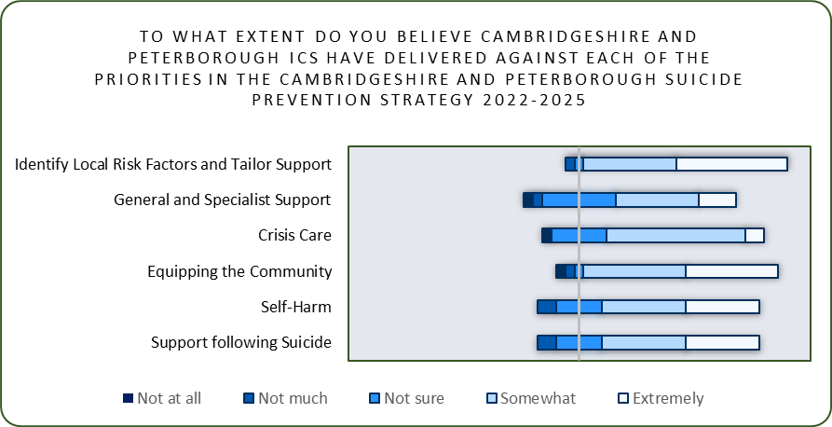
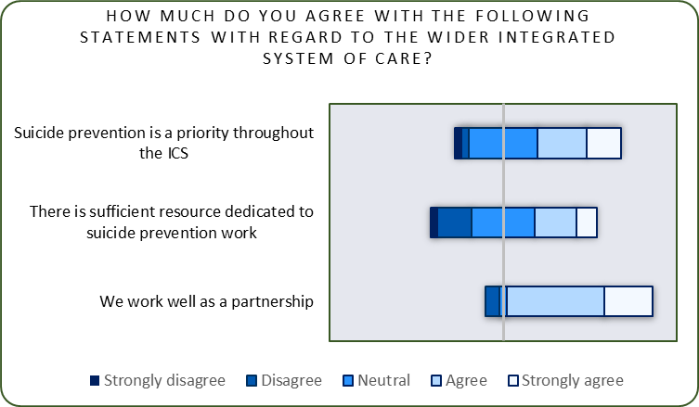
Stakeholder Feedback

Slide 20
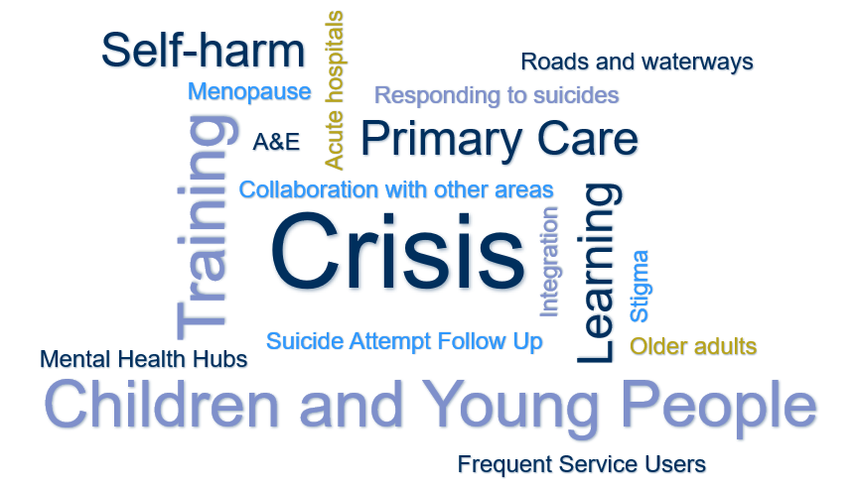
Stakeholder Feedback
Some things within the system don't seem logical or clear sometimes and, as someone new to the system, it can be very confusing and hard to know where to go to get the information needed. Many people who have worked in the system for years have an understanding of how things have evolved and why they are the way they are
I think there is further work needed particularly to get wider system understanding of the importance of this work as there is great engagement within the groups but how do we ensure strategically and senior system leads are aware of and support this agenda?

Slide 21
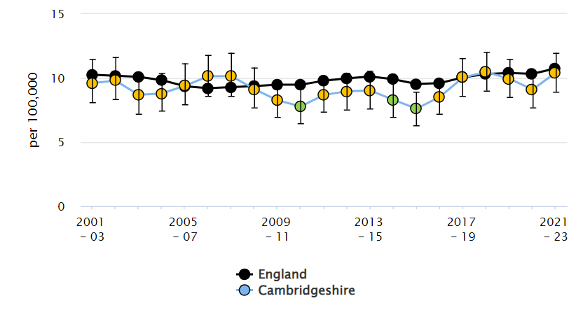
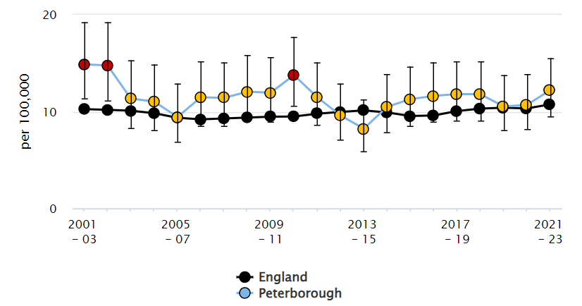
Impact on Rates
Initial decrease for 2020-2022 followed by an increase in 2021-2023
Both within statistical significance of England average

Slide 22

Summary Recommendations
Understanding our local population through RTSS and audits, placing emphasis on the human element of the data
Ensure funding for suicide prevention is maintained, if not increased. Commission longer term wherever possible.
Informed
Challenging
Compassionate
Flexible
Sustainable
Go where we are not wanted, challenge those who are less engaged as these are often the audiences with the greatest impact
Offer support in a variety of formats and deliver training in a way that suits the needs of the attendees. Commission flexibly to allow for a more dynamic response
Engage with people with lived experience in all work and ensure clear parameters for co-production are established

