Slide 1
Cambridgeshire & Peterborough Economic Update
August 2024 Update
Policy and Insight Team – policyandinsight@cambridgeshire.gov.uk

Slide 2
Table of Contents
Purpose
Executive Summary
Overview
Economic inactivity
Unemployment
- APS
- Vacancies
- Claimant Count
- Universal Credit
Employment
Concluding remarks and next steps
Glossary

Slide 3
1. Purpose
Economic Inactivity | Unemployment | Employment
To analyse the economic inactivity, unemployment, and employment in the Cambridgeshire and Peterborough (C&P) region.
This is to help achieve the Cambridgeshire and Peterborough Combined Authority (CPCA)’s ambition to provide the UK’s most technically skilled workforce.
To conduct this analysis with attention to knowledge intensive (KI) and non-knowledge intensive (non-KI) jobs.
This is to help achieve the CPCA’s ambition to grow the international recognition of C&P’s knowledge-based economy.
To identify areas of strength and concern and to identify possible barriers to employment.
This is to help achieve the CPCA’s ambition to improve the quality of life by tackling areas suffering from deprivation.

Slide 4
2. Executive Summary
Economic Inactivity | Unemployment | Employment
Overview
Higher unemployment rate and lower economic inactivity rate - Although it is concerning that the C&P unemployment rate is higher than the UK, a key area of strength is that the C&P economic inactivity rate is lower than the UK and the employment rate is higher than the UK.
Higher economic activity rate - The lower economic inactivity rate could be causing the higher unemployment rate where less people in C&P are economically inactive and more people are seeking work. This has led to C&P having an overall higher economic activity rate than the UK.
Economic inactivity
Female disparity - A key concern is the disparity across economic inactivity between females and males with females having a much higher economic inactivity rate compared to males across all age groups. This is a big equality and diversity concern for the workforce. This trend is nationwide, and the recent childcare reforms should be closely monitored.
Student reason for economic inactivity and C&P resilience – The order of reasons for economic inactivity in C&P are 1) student, 2) long-term sick, 3) looking after family/home, and 4) retired. A notable strength is that despite the large student population of Cambridge in C&P, overall economic inactivity in C&P is still lower than the UK.
25-49 age group – The highest proportion of economic inactivity occurs for the 16-24 age group followed by 50-64 and then 25-49 across both genders. Given Cambridge's high student population, the reason of student can explain the 16-24 age group. The low economic inactivity in the 25-49 age group, the largest ranging age group, could be the driver of lower economic inactivity in C&P.

Slide 5
2. Executive Summary
Economic Inactivity | Unemployment | Employment
Unemployment
Difficult job market – C&P's vacancy rate has decreased over the last 3 years while the unemployment rate has the increased. There are thus more people in C&P seeking work (more demand), but there are less job opportunities available (less supply). This trend is seen in the UK.
Decreasing KI vacancies – There has been consistently more KI vacancies than non-KI vacancies over the last 5 years in C&P; however, an area of concern is that the ratio of KI to non-KI job vacancies has been decreasing over the last 5 years and approaching 1. The effects of the August 2024 Bank of England interest rate cut and possible subsequent interest rate cuts should be monitored to see it helps reverse this worrying trend with increased investment.​
KI industry sector concentration – KI industries are concentrated around a tight group of sectors compared to the breadth of non-KI industry sectors. This can be seen as a strength in depth, but it leaves KI industries somewhat vulnerable to external shocks (e.g. China-Taiwan relations; AI bubble bursting).
Unusual convergence of APS and Claimant Count – Granted that there have been issues with APS sampling, there has been an unusual convergence since 2019. More data is needed to explain this behaviour.
Different age group concerns for APS and Claimant Count – For APS, the 16-24 age group is the area of concern for both C&P and the UK; however, the 18-24 age group and 50+ age group are areas of concern for the claimant count. The new Skills England policy should be closely monitored.
Concerning Universal Credit trend - Since May 2023, universal credit claimants have increased for both employed at +14.5% and unemployed at +16.3%. The current number of claimants also remains higher than pre-pandemic levels. Furthermore, all local authorities in C&P have experienced double digit growth in universal credit claimants in the last year.
Local authorities of concern – Peterborough has the highest claimant counts, claimant rates, and universal credit claimants of all local authorities in the C&P region. In Cambridgeshire, Huntingdonshire has the highest claimant counts, and Fenland has the highest claimant rates. These local authorities require continued attention.

Slide 6
2. Executive Summary
Economic Inactivity | Unemployment | Employment
Employment
Gender differences in full-time and part-time work – A higher proportion of males work full-time compared to females in the 25-49 and 50-64 age groups. For part-time work, a higher proportion of females work part-time compared to males in the 25-49 and 50-64 age groups. There is little difference between males and females in the 16-24 age group for both full time work and part-time work.
Median monthly pay concerns – Cambridge and South Cambridgeshire have median monthly pay levels that are substantially higher than the UK. East Cambridgeshire and Huntingdonshire have median monthly pay levels that are moderately higher than the UK. Fenland and Peterborough have median monthly pay levels that are below the UK. This has concerning inequality implications for the C&P region.
Pay growth and inflation – It is a concern that median monthly pay in Cambridgeshire (+4.4%) and Peterborough (+5.5%) has been growing below the UK growth rate (+5.8%). However, a strength is that median monthly pay in Cambridgeshire (+4.4%) and Peterborough (+5.5%) are above inflation (+3.8%).

Slide 7
3. Overview

Slide 8
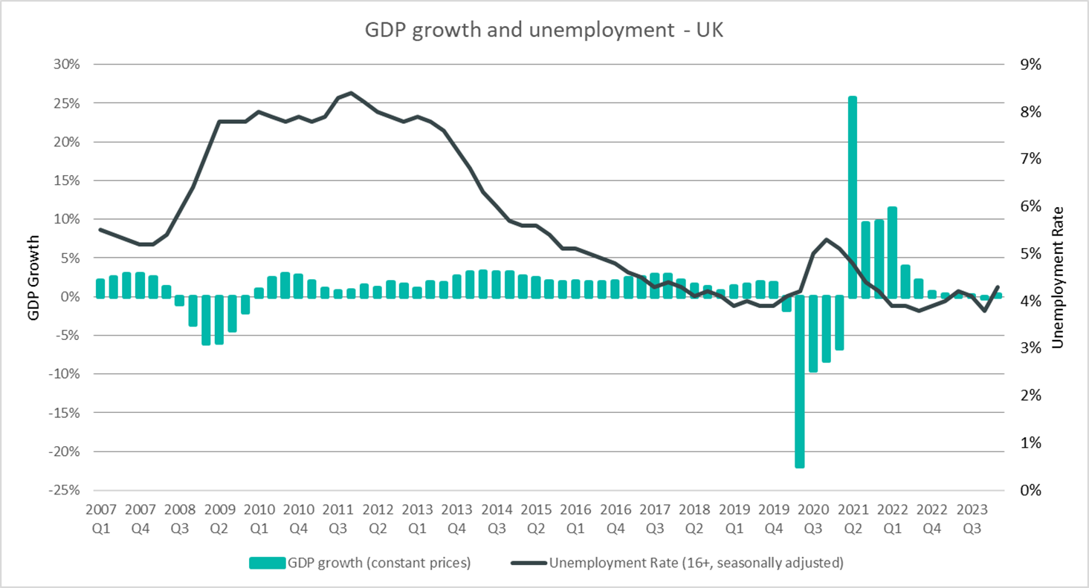
UK Economic Context
The UK is in a fragile recovery phase with modest growth (Q1 2024: +0.7%; Q2 2024: +0.6%) after experiencing a technical recession last year (Q3 2023: –0.1%; Q4 2023: -0.3%). Unemployment, though increasing, is still historically low.
Notes:
Commentary: The UK is in a fragile recovery phase with modest growth (Q1 2024: +0.7%; Q2 2024: +0.6%) after experiencing a technical recession last year (Q3 2023: –0.1%; Q4 2023: -0.3%). Unemployment has recently increased; however, this current post-pandemic period (2022 onwards) has had historically low unemployment compared to post-financial crisis trends (2009-2014).
Sources:
Office for National Statistics - Gross Domestic Product: chained volume measures: Seasonally adjusted £m
Office for National Statistics - Unemployment rate (aged 16 and over, seasonally adjusted): %
Technical note: GDP growth is calculated year on year

Slide 9
Employment Overview
Economic Inactivity Rate
(all aged 16-64):
Unemployment Rate
(all aged 16-64):
Employment Rate
(all aged 16-64):
Cambridgeshire & Peterborough
United Kingdom
Cambridgeshire & Peterborough
United
Kingdom
Cambridgeshire & Peterborough
United
Kingdom
18.5%
21.5%
4.7%
3.9%
77.7%
75.4%
Apr 2023-Mar 2024
Apr 2023-Mar 2024
Apr 2023-Mar 2024
Quarterly Change
Quarterly Change
Quarterly Change
+1.4pp
+0.2pp
+0.6pp
+0.1pp
-1.7pp
-0.3pp
Comparing Apr 2023-Mar 2024 with Jan 2023 – Dec 2023
Comparing Apr 2023-Mar 2024 with Jan 2023 – Dec 2023
Comparing Apr 2023-Mar 2024 with Jan 2023 – Dec 2023
Year on Year (YoY) Change
YoY Change
YoY Change
+0.1pp
-0.2pp
+1.6pp
+0.2pp
-1.4pp
No change
Comparing Apr 2022-Mar 2023 with Apr 2023-Mar 2024
Comparing Apr 2022-Mar 2023 with Apr 2023-Mar 2024
Comparing Apr 2022-Mar 2023 with Apr 2023-Mar 2024
3-Year Average
3-Year Average
3-Year Average
18.6%
21.6%
3.8%
3.9%
78.4%
75.3%
Comparing Apr 2021-Mar 2022 with Apr 2023-Mar 2024
Comparing Apr 2021-Mar 2022 with Apr 2023-Mar 2024
Comparing Apr 2021-Mar 2022 with Apr 2023-Mar 2024
C&P’s higher unemployment (4.7% vs 3.9%) should be interpreted in context of its lower economic inactivity (18.5% vs 21.5%) and higher employment (77.7% vs 75.4%). Lower economic inactivity could be leading to more people seeking work (higher unemployment) and more people in work (higher employment). However, when taking a 3-year average, unemployment remains close to but below that of the UK.
Variable | Economic Inactivity Rate (all aged 16-64) |  | Unemployment Rate (all aged 16-64) |  | Employment Rate (all aged 16-64)
Area | Cambridgeshire & Peterborough | United Kingdom | Cambridgeshire & Peterborough | United Kingdom | Cambridgeshire & Peterborough | United Kingdom
Yearly value (April 2023-March 2024) | 18.5% | 21.5% | 4.7% | 3.9% | 77.7% | 75.4%
Quarterly Change (comparing April 2023-March 2024 with January 2023-December 2023) | +1.4pp | +0.2pp | +0.6pp | +0.1pp | -1.7pp | -0.3pp
Year on Year Change (comparing April 2022-March 2023 with April 2023-March 2024) | +0.1pp | -0.2pp | +1.6pp | +0.2pp | -1.4pp | No change
3 Year Average (comparing April 2021-March 2022 with April 2023-March 2024) | 18.6% | 21.6% | 3.8% | 3.9% | 78.4% | 75.3%
Notes:
Commentary: Areas of strength include C&P having a lower economic inactivity rate than the UK (18.5% vs 21.5%) and a higher employment rate than the UK (77.7% vs 75.4%). This is a key strength in C&P.
An area of concern is that C&P unemployment is higher than the UK for the first time in the analysis period of 2007 to 2024 (4.7% vs 3.9%) with a worrying YoY change of +1.6pp. A possible explanation could be that lower economic inactivity has led to more people seeking work (higher unemployment) and more people in work (higher employment). However, it should be noted that when taking a 3-year average unemployment remains close to but below that of the UK.
Source: Annual Population Survey, April to March Releases
Technical note: A residence based labour market survey encompassing population, economic activity (employment and unemployment), economic inactivity and qualifications. These are broken down where possible by gender, age, ethnicity, industry and occupation. Available at Local Authority level and above. Updated quarterly.
It is important to note that due to the small geographical area considered, and the Annual Population Survey being based on a representative sample, this may be due to a quarterly fluctuation rather than any kind of long-term trend in the data. National figures are now taken from the Labour Force Survey (LFS). Increased volatility of LFS estimates, resulting from smaller achieved sample sizes, means that estimates of quarterly change should be treated with additional caution. Caution should be taken with interpreting these figures and comparisons to C&P.
APS Estimates have not been reweighted to new populations and consequently, will be inconsistent with the population totals used for the Labour Force Survey in the latest periods. Again caution is recommended when making comparisons to national statistics.

Slide 10
Employment Overview by Gender – 3-year average
Economic Inactivity Rate
(all aged 16-64)
Unemployment Rate
(all aged 16-64)
Employment Rate
(all aged 16-64)
April 2021-Mar 2022 to April 2023-Mar 2024
April 2021-Mar 2022 to April 2023-Mar 2024
April 2021-Mar 2022 to April 2023-Mar 2024
Male
15.0%
3.7%
81.8%
22.2%
3.9%
74.7%
Female
Females have a much higher economic inactivity rate than males (22.2% vs. 15.0%). Less available females in the workforce should intuitively lead to lower unemployment rates and lower employment rates. However, C&P’s higher female unemployment rate (3.9% vs 3.7%) is not expected and is a concern. Except for unemployment, the disparity trend is nationwide and is a big equality and diversity concern for the workforce. The recent childcare reforms should be closely monitored.
 | Economic Inactivity Rate (all aged 16-64) | Unemployment Rate (all aged 16-64) | Employment Rate (all aged 16-64)
Male | 15.0% | 3.7% | 81.8%
Female | 22.2% | 3.9% | 74.7%
Notes:
Commentary: Across C&P, the economic inactivity rate for females is substantially higher than the economic inactivity for males (22.2% vs. 15.0%). Less available females in the workforce should intuitively lead to lower unemployment rates and lower employment rates. However, C&P’s higher female unemployment rate (3.9% vs 3.7%) is not expected and is a concern. Except for unemployment, the disparity trend is nationwide and is a big equality and diversity concern for the workforce. It will be worth monitoring the effect of the childcare policies that were announced in March 2023 for a staggered roll out from March 2024 to September 2025.
Source: Annual Population Survey, April to March Releases
Technical note: A residence based labour market survey encompassing population, economic activity (employment and unemployment), economic inactivity and qualifications. These are broken down where possible by gender, age, ethnicity, industry and occupation. Available at Local Authority level and above. Updated quarterly.
It is important to note that due to the small geographical area considered, and the Annual Population Survey being based on a representative sample, this may be due to a quarterly fluctuation rather than any kind of long-term trend in the data. National figures are now taken from the Labour Force Survey (LFS). Increased volatility of LFS estimates, resulting from smaller achieved sample sizes, means that estimates of quarterly change should be treated with additional caution. Caution should be taken with interpreting these figures and comparisons to C&P.
APS Estimates have not been reweighted to new populations and consequently, will be inconsistent with the population totals used for the Labour Force Survey in the latest periods. Again caution is recommended when making comparisons to national statistics.

Slide 11
Employment Overview by Age – 3-year average
Economic Inactivity Rate
Unemployment Rate
Employment Rate
April 2021-Mar 2022 to April 2023-Mar 2024
April 2021-Mar 2022 to April 2023-Mar 2024
April 2021-Mar 2022 to April 2023-Mar 2024
Cambridgeshire
& Peterborough
United Kingdom
Cambridgeshire
& Peterborough
United Kingdom
Cambridgeshire
& Peterborough
United
Kingdom
16-24
16-24
16-24
38.8%
40.3%
9.8%
11.0%
55.2%
53.1%
25-49
25-49
25-49
10.2%
12.4%
3.0%
3.0%
87.1%
85.0%
50-64
50-64
50-64
21.5%
27.1%
2.9%
2.7%
76.2%
71.0%
16-64
16-64
16-64
18.6%
21.6%
3.8%
3.9%
78.4%
75.3%
The large divergence in unemployment for 16-24 from overall 16-64 cannot be explained by the student population. There should be a focus on the unemployed 16-24 age group, and it will be important to monitor the Skills England policy. The large divergence in the economic inactive 25-49 age group could explain C&P’s lower economic inactivity.
Variable | Economic Inactivity Rate (all aged 16-64) |  | Unemployment Rate (all aged 16-64) |  | Employment Rate (all aged 16-64)
Area | Cambridgeshire & Peterborough | United Kingdom | Cambridgeshire & Peterborough | United Kingdom | Cambridgeshire & Peterborough | United Kingdom
16-24 | 38.8% | 40.3% | 9.8% | 11.0% | 55.2% | 53.1%
25-49 | 10.2% | 12.4% | 3.0% | 3.0% | 87.1% | 85.0%
50-64 | 21.5% | 27.1% | 2.9% | 2.7% | 76.2% | 71.0%
16-64 | 18.6% | 21.6% | 3.8% | 3.9% | 78.4% | 75.3%
Notes:
Commentary: The 16-24 age group is worrying with rates for both C&P and the UK diverging from the overall 16-64 age group rates for economic inactivity, unemployment, and employment. The 16-24 age group is often made up of students, and this student population can explain higher levels of economic inactivity and lower employment. However, unemployment for the 16-24 age group cannot be explained by the student population, and the unemployed 16-24 age group (9.8% vs 11.0%) greatly diverges from overall 16-64 unemployment age group. There should be a focus on the unemployed 16-24 age group to convert these jobseekers to employment, and it will be important to monitor the Skills England policy announced during the King’s Speech in July 2024.
In addition, there is a large divergence in the economic inactive 25-49 age group compared to the economic inactive 16-64 age group. This could could explain C&P’s lower economic inactivity to the UK.
Technical note: A residence based labour market survey encompassing population, economic activity (employment and unemployment), economic inactivity and qualifications. These are broken down where possible by gender, age, ethnicity, industry and occupation. Available at Local Authority level and above. Updated quarterly.
It is important to note that due to the small geographical area considered, and the Annual Population Survey being based on a representative sample, this may be due to a quarterly fluctuation rather than any kind of long-term trend in the data. National figures are now taken from the Labour Force Survey (LFS). Increased volatility of LFS estimates, resulting from smaller achieved sample sizes, means that estimates of quarterly change should be treated with additional caution. Caution should be taken with interpreting these figures and comparisons to C&P.
APS Estimates have not been reweighted to new populations and consequently, will be inconsistent with the population totals used for the Labour Force Survey in the latest periods. Again caution is recommended when making comparisons to national statistics.

Slide 12
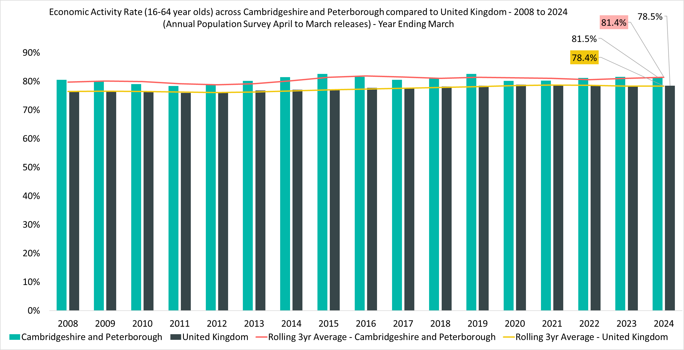
Economic Activity Overview
Economic Activity Rate
(all aged 16-64)
81.5%
Apr 2023-Mar 2024
Quarterly Change
-1.4pp
Comparing Apr 2023-Mar 2024 with Jan 2023 – Dec 2023
Year on Year Change
-0.1pp
Comparing Apr 2022-Mar 2023 with Apr 2023-Mar 2024
Compared to 78.5% UK wide. 3-year average (April 2021-Mar 2022 to April 2023-Mar 2024) is 81.4% compared to 78.4% UK wide.
C&P has a higher economic activity rate than the UK (81.5% vs 78.5). Thus, there are less people economically inactive people and more people who are seeking work or who are in work. %). C&P has consistently demonstrated this strength for the analysis period since 2008.
Notes:
Commentary: As mentioned in Slide 9 (Employment Overview), C&P has strengths of a lower economic inactivity rate than the UK (18.5% vs 21.5%) and a higher employment rate than the UK (77.7% vs 75.4%), but it is a concern that the C&P unemployment rate is higher than the UK (4.7% vs 3.9%).
Despite this concern, the C&P economic activity rate (also known as the labour force participation rate) is higher than the UK (81.5% vs 78.5%). Thus, overall, there are less people economically inactive in C&P than the UK (18.5% vs 21.5%) and more people in C&P that are economically active – either seeking work or are in work – than in the UK (81.5% vs 78.5%). This is a notable strength and key difference to the UK. However, the quarterly decrease of –1.4pp to the economic activity rate brings caution with this overall optimism.
Source: Annual Population Survey, April to March Releases
Technical note: A residence based labour market survey encompassing population, economic activity (employment and unemployment), economic inactivity and qualifications. These are broken down where possible by gender, age, ethnicity, industry and occupation. Available at Local Authority level and above. Updated quarterly.
It is important to note that due to the small geographical area considered, and the Annual Population Survey being based on a representative sample, this may be due to a quarterly fluctuation rather than any kind of long-term trend in the data. National figures are now taken from the Labour Force Survey (LFS). Increased volatility of LFS estimates, resulting from smaller achieved sample sizes, means that estimates of quarterly change should be treated with additional caution. Caution should be taken with interpreting these figures and comparisons to C&P.
APS Estimates have not been reweighted to new populations and consequently, will be inconsistent with the population totals used for the Labour Force Survey in the latest periods. Again caution is recommended when making comparisons to national statistics.

Slide 13
4. Economic Inactivity

Slide 14
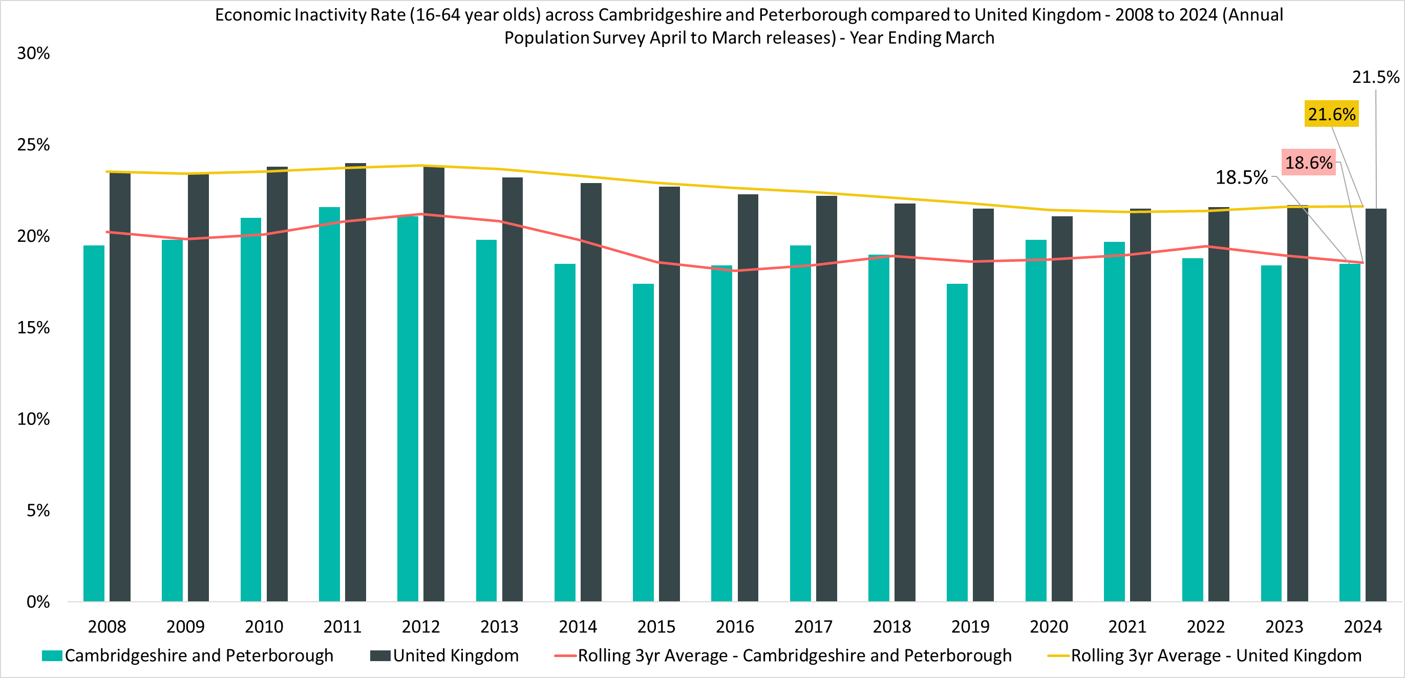
Economic Inactivity Overview
Economic Inactivity Rate
(all aged 16-64)
18.5%
Apr 2023-Mar 2024
Quarterly Change
+1.4pp
Comparing Apr 2023-Mar 2024 with Jan 2023 – Dec 2023
YoY Change
+0.1pp
Comparing Apr 2022-Mar 2023 with Apr 2023-Mar 2024
Compared to 21.5% UK wide. 3-year average (April 2021-Mar 2022 to April 2023-Mar 2024) is 18.6% compared to 21.6% UK wide.
C&P has demonstrated a consistently lower economic inactivity rate than the UK for the analysis period since 2007. The recent +1.4pp quarterly increase is a concern.
Notes:
Commentary: As mentioned in Slide 9 (Employment Overview), an area of strength is that the C&P economic inactivity rate is lower than UK economic inactivity rate (+18.6% vs +21.5%). This strength has been consistently demonstrated over time as seen from 2007 until present. Both C&P and the UK have had a steady decrease in economic inactivity rate since 2010 with C&P being slightly steeper. However, there should be caution with the C&P economic inactivity rate increasing with a recent +1.4pp quarterly change despite a +0.1pp YoY change.
Notably, there was a large increase in the C&P economic inactivity rate during the pandemic in 2020 that was not as pronounced in the UK. However, the C&P economic inactivity rate has recovered more quickly. This possibly shows the strength and resilience of the C&P economy.
Source: Annual Population Survey, April to March Releases
Technical note: A residence based labour market survey encompassing population, economic activity (employment and unemployment), economic inactivity and qualifications. These are broken down where possible by gender, age, ethnicity, industry and occupation. Available at Local Authority level and above. Updated quarterly.
It is important to note that due to the small geographical area considered, and the Annual Population Survey being based on a representative sample, this may be due to a quarterly fluctuation rather than any kind of long-term trend in the data. National figures are now taken from the Labour Force Survey (LFS). Increased volatility of LFS estimates, resulting from smaller achieved sample sizes, means that estimates of quarterly change should be treated with additional caution. Caution should be taken with interpreting these figures and comparisons to C&P.
APS Estimates have not been reweighted to new populations and consequently, will be inconsistent with the population totals used for the Labour Force Survey in the latest periods. Again caution is recommended when making comparisons to national statistics.

Slide 15
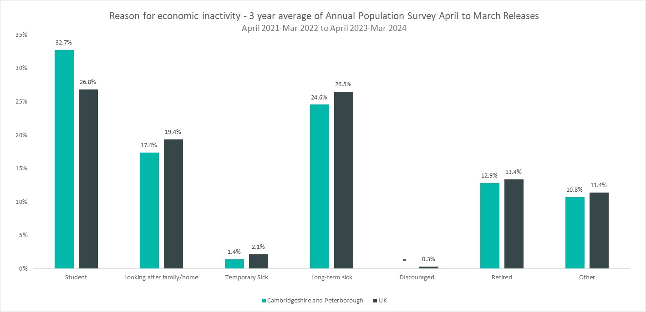
Reasons for Inactivity
*Data for those inactive due to temporary sickness or discouraged suppressed due to group some size being zero or disclosive (0-2).
CPCA value for ‘Temporary Sick’ is a 2-year average.
The order of reasons for economic inactivity in C&P are 1) student (32.7%), 2) long-term sick (24.6%), 3) looking after family/home (17.4%), and 4) retired (12.9%). A notable strength is that despite the large student population of Cambridge in C&P, overall economic inactivity in C&P is still lower than the UK.
Notes:
Commentary: The top overall reasons for economic inactivity in C&P are the student (32.7%), long-term sick (24.6%), looking after family/home (17.4%), and retired (12.9%).
This loosely follows the top overalls reason for economic inactivity for the UK. For the UK, the student (26.8%) and long-term sick (26.5%) reasons are close.
Students are a main driver for economic inactivity for both C&P and the UK; however, a notable area is that despite the large student population of C&P, overall economic inactivity in C&P is lower than the UK.
Three areas of strength are that long-term sick is lower in C&P than the UK (24.6% vs 26.5%), looking after family/home is lower in C&P than the UK (17.4% vs 19.4%), and retired are lower in C&P than the UK (12.9% vs 13.4%). These areas could be factors on why overall economic inactivity in C&P is lower than the UK.
Source: Annual Population Survey, April to March Releases
Technical note: A residence based labour market survey encompassing population, economic activity (employment and unemployment), economic inactivity and qualifications. These are broken down where possible by gender, age, ethnicity, industry and occupation. Available at Local Authority level and above. Updated quarterly.
It is important to note that due to the small geographical area considered, and the Annual Population Survey being based on a representative sample, this may be due to a quarterly fluctuation rather than any kind of long-term trend in the data. National figures are now taken from the Labour Force Survey (LFS). Increased volatility of LFS estimates, resulting from smaller achieved sample sizes, means that estimates of quarterly change should be treated with additional caution. Caution should be taken with interpreting these figures and comparisons to C&P.
APS Estimates have not been reweighted to new populations and consequently, will be inconsistent with the population totals used for the Labour Force Survey in the latest periods. Again caution is recommended when making comparisons to national statistics.

Slide 16
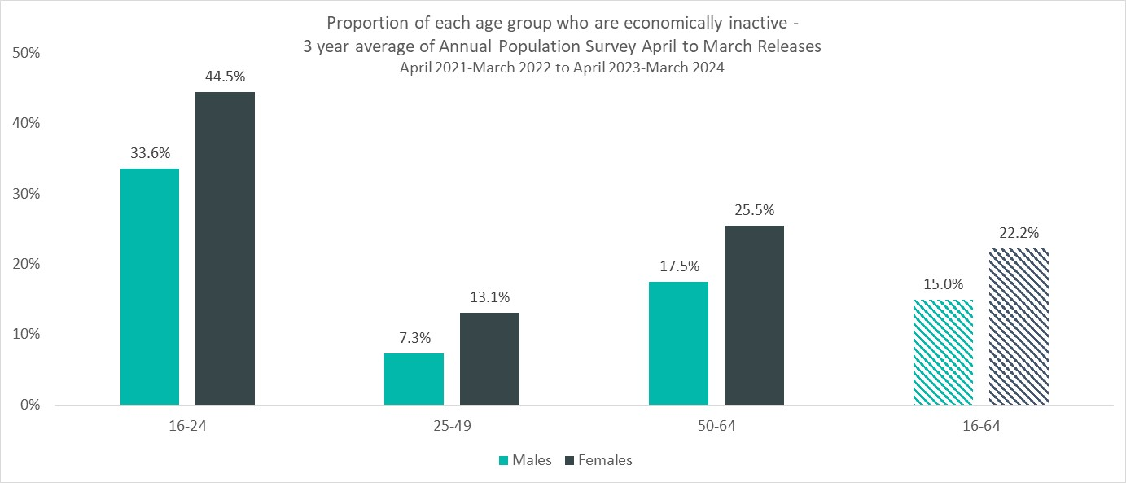
Inactivity by Age and Gender
Economic inactivity rate
(all aged 16-64)
15.0%
Male
22.2%
Female
3-Year Average: April 2021-Mar 2022 to April 2023-Mar 2024
The female economic inactivity rate is much larger than the male economic inactivity rate across all age groups. The reasons for this differential are undetermined but concerning.
The reasons for economic inactivity from the previous slide can be loosely linked to the age groups above. The student reason (32.7%) is likely to be associated with the large 16-24 age group. Retired (12.9%) and long-term sick (24.6%) are more likely associated with the 50-64 age group and can explain why it is the second largest age group. Looking after family/home (17.4%) is most likely associated with 25-49 and possibly the earlier portion of 50-64 and can explain why the 25-49 age group is the smallest age group.
Notes:
Commentary: As mentioned in Slide 15 (Reasons for Inactivity), the top overall reasons for economic inactivity in C&P are the student (32.7%), long-term sick (24.6%), looking after family/home (17.4%), and retired (12.9%). The student reason for economic inactivity explains why the 16-24 age group is the largest for both genders across age groups. Retired (12.9%) and long-term sick (24.6%) are more likely associated with the 50-64 age group and can thus explain why it is the second largest age group for both genders across age groups. Lastly, looking after family/home (17.4%) is most likely associated with 25-49 and possibly the earlier portion of 50-64 and thus explains why the 25-49 age group is the smallest age for both genders across age groups.
In Slide 10 (Employment Overview by Gender – 3-year average), the female economic inactivity rate is higher the male economic inactivity rate (22.2% vs. 15.0%). This pattern is similar across all age groups.
The reasons for this almost double differential between females and males are undetermined but highly concerning. A possible reason for the differential in the 16-24 age group could be that apprenticeships are more popular with males than females. A reason for the differential in the 25-49 age group could be that childcare responsibilities fall predominantly on females more than males. Lastly, the differential in the 50-64 age group could be that females are more likely to take early retirement than males. Overall, these differentials impact equality and diversity across the C&P workforce.
Source: Annual Population Survey, April to March Releases
Technical note: A residence based labour market survey encompassing population, economic activity (employment and unemployment), economic inactivity and qualifications. These are broken down where possible by gender, age, ethnicity, industry and occupation. Available at Local Authority level and above. Updated quarterly.
It is important to note that due to the small geographical area considered, and the Annual Population Survey being based on a representative sample, this may be due to a quarterly fluctuation rather than any kind of long-term trend in the data. National figures are now taken from the Labour Force Survey (LFS). Increased volatility of LFS estimates, resulting from smaller achieved sample sizes, means that estimates of quarterly change should be treated with additional caution. Caution should be taken with interpreting these figures and comparisons to C&P.
APS Estimates have not been reweighted to new populations and consequently, will be inconsistent with the population totals used for the Labour Force Survey in the latest periods. Again caution is recommended when making comparisons to national statistics.

Slide 17
5. Unemployment
APS
Vacancies
Claimant Count
Universal Credit

Slide 18
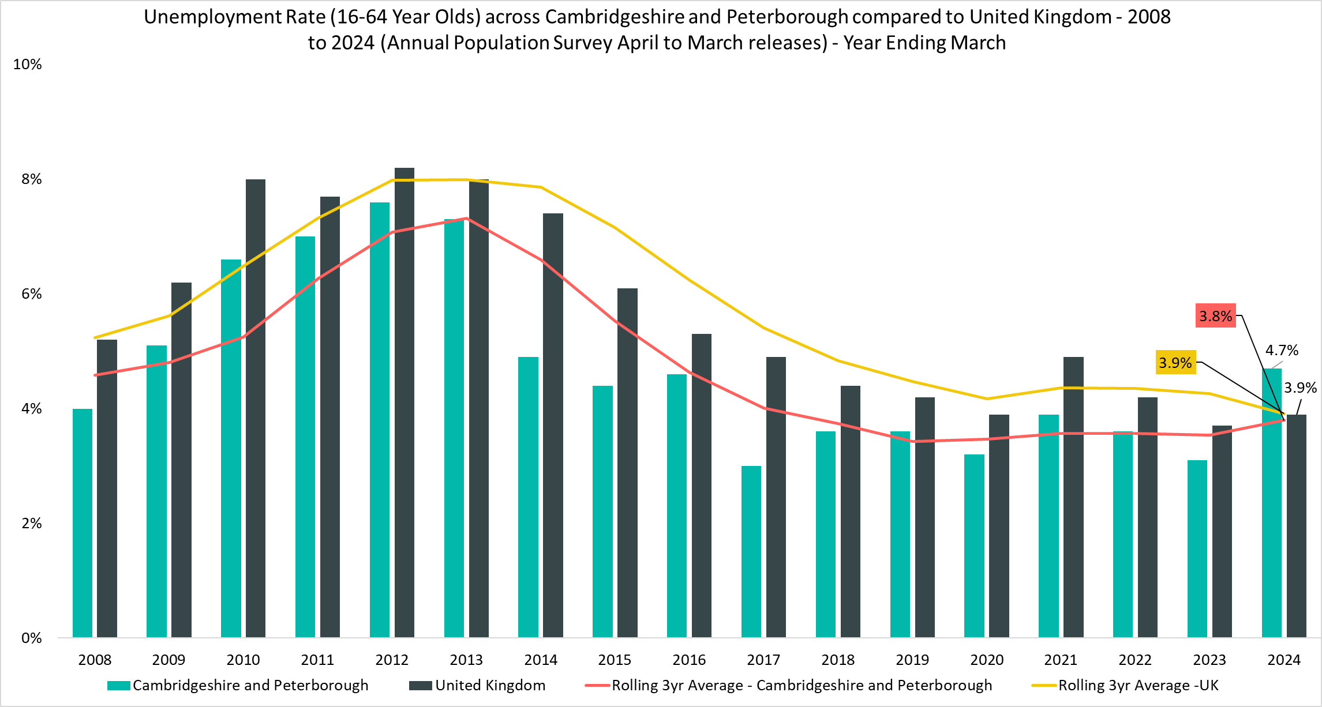
Unemployment Overview
Unemployment Rate
(all aged 16-64)
4.7%
Apr 2023-Mar 2024
Quarterly Change
+0.6pp
Comparing Apr 2023-Mar 2024 with Jan 2023 – Dec 2023
YoY Change
+1.6pp
Comparing Apr 2022-Mar 2023 with Apr 2023-Mar 2024
Compared to 3.9% UK wide. 3-year average (April 2021-Mar 2022 to April 2023-Mar 2024) is 3.8% compared to 3.9% UK wide.
The UK and C&P unemployment rates have recently increased; however, in the context of 2011-2012 unemployment peak, both recent unemployment rates are historically low.
Notes:
Commentary: For the first time in the analysis period of 2007 to 2023, the unemployment rate across C&P is higher than that of the UK. However, whilst this is seen across the latest release, the 3-year average suggests more of an alignment. The high unemployment rate suggests there are not enough opportunities, or the opportunities are not suitable (e.g. matching issues) for C&P residents. Although the unemployment rate is concerning, it could be caused by the reduction in economic inactivity seen on Slide 9 (Employment Overview) and Slide 14 (Economic Inactivity Overview) that has in turn caused a shift to more people seeking work.
As mentioned in Slide 8 (UK Economic Context), this current post-pandemic period (2022 onwards) has had historically low UK unemployment compared to post-financial crisis trends (2009-2014). This can also be said for the C&P unemployment rate which is still substantially lower than the 2011 peak.
Source: Annual Population Survey, April to March Releases
Technical note: A residence based labour market survey encompassing population, economic activity (employment and unemployment), economic inactivity and qualifications. These are broken down where possible by gender, age, ethnicity, industry and occupation. Available at Local Authority level and above. Updated quarterly.
It is important to note that due to the small geographical area considered, and the Annual Population Survey being based on a representative sample, this may be due to a quarterly fluctuation rather than any kind of long-term trend in the data. National figures are now taken from the Labour Force Survey (LFS). Increased volatility of LFS estimates, resulting from smaller achieved sample sizes, means that estimates of quarterly change should be treated with additional caution. Caution should be taken with interpreting these figures and comparisons to C&P.
APS Estimates have not been reweighted to new populations and consequently, will be inconsistent with the population totals used for the Labour Force Survey in the latest periods. Again caution is recommended when making comparisons to national statistics.

Slide 19
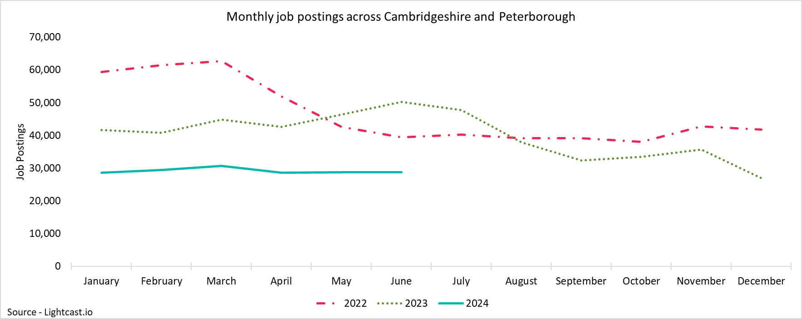
CPCA Vacancies
28,741
Unique job postings in C&P in June 2024
-6%
Decrease in unique job postings compared to March 2024
Compared to -10% nationally
-43%
Decrease in unique job postings compared to June 2023
Compared to -46% nationally
The C&P vacancy rate has continued to decline with the most recent YoY decline of –43%. This decrease is roughly in line with the UK vacancy rate decrease of –46%. This is thus a nationwide trend. Vacancy rate decreases are often associated with a contracting economy, but this conflicts with the two most recent quarters of positive UK GDP growth. This may support the claim that the UK is in a fragile recovery phase.
Notes:
Commentary: Across C&P, the vacancy rate was highest in 2021/22, and this suggests employment opportunities were plentiful. Since then, the Cambridgeshire and Peterborough vacancy rate has continued to decline with the most recent YoY decline of –43%. This decrease is roughly in line with the UK vacancy rate decrease of –46%. Decreasing employment opportunities are thus a nationwide trend. Vacancy rate decreases are often associated with a contracting economy, but this conflicts with the two most recent quarters of positive UK GDP growth on Slide 8 (UK Economic Context). This may support the claim that the UK is in a fragile recovery phase.
Source: Lightcast
Technical note: Vacancy data is sourced from Lightcast, a service that has been procured by C&P Combined Authority which gives labour market information on Job postings, occupations, and industries. Lightcast has a job posting aggregator which scans jobs websites for posting and presents them together. Lightcast only scans online jobs postings and therefore does not include any jobs which are advertised solely offline. There is also no guarantee that all online job postings are aggregated. For example, a specific job site may not be scanned.
A unique job posting is a deduplicated count of an online job vacancy advertisement. If the same vacancy is posted twice across a sixty-day period, it is only counted once. If the same vacancy is posted twice more than sixty days apart it is counted as two unique job postings.

Slide 20
Vacancies vs Unemployment Rate
Vacancy and Unemployment Rates across C&P
Financial Year | Vacancy Rate | Unemployment Rate
2020/21 | 41% | 3.9%
2021/22 | 58% | 3.6%
2022/23 | 55% | 3.1%
2023/24 | 52% | 4.7%
Trends in the table above show that C&P vacancy rates have been decreasing since 2021/22, and the unemployment rate has been increasing. It is thus a difficult employee job market with fewer vacancies available (less supply) and more unemployed people seeking work (more demand).
Notes:
Commentary: This table compares the relationship between the C&P vacancy rate and unemployment rate – the vacancy rate represents the supply of the labour market and the unemployment rate represents the demand of the labour market. This relationship is often plotted as the Beveridge curve where a high vacancy rate and low unemployment rate is attractive and called a “tight labour market” and a low vacancy rate and high unemployment rate is not attractive and called a “loose labour market”. Available data for C&P is limited to make a traditional plot.
However, trends in the table show that C&P vacancy rates have been decreasing since 2021/22, and the unemployment rate has been increasing as outlined in Slide 9 (Employment Overview) and Slide 18 (Unemployment Overview). The labour market is thus loosening with fewer vacancies available for unemployed people seeking work.
Although unemployment has recently been increasing, it is still historically low compared the post-financial crisis period.
Sources:
Office for National Statistics - Claimant count and vacancies time series (UNEM)
Lightcast
Annual Population Survey
Technical note: The vacancy rate has been calculated by dividing the total number of vacancies from Lightcast for the relevant year by the sum of the same vacancy figure and the employed 16-64 population from the Annual Population Survey.
Vacancy data is sourced from Lightcast, a service that has been procured by C&P Combined Authority which gives labour market information on Job postings, occupations, and industries. Lightcast has a job posting aggregator which scans jobs websites for posting and presents them together. Lightcast only scans online jobs postings and therefore does not include any jobs which are advertised solely offline. There is also no guarantee that all online job postings are aggregated. For example, a specific job site may not be scanned.
A unique job posting is a deduplicated count of an online job vacancy advertisement. If the same vacancy is posted twice across a sixty-day period, it is only counted once. If the same vacancy is posted twice more than sixty days apart it is counted as two unique job postings.

Slide 21
Vacancies by Sector
Number of Vacancies in C&P compared to the UK
July 2023 - June 2024
Employment Sector | Vacancies in CPCA | Percentage of total vacancies | Vacancies in United Kingdom | Percentage of total vacancies
Administrative and Support Service Activities | 79,473 | 48.3% | 4,870,473 | 48.2%
Human Health and Social Work Activities | 18,773 | 11.4% | 1,068,238 | 10.6%
Professional, Scientific and Technical Activities | 11,636 | 7.1% | 683,796 | 6.8%
Wholesale and Retail Trade; Repair of Motor Vehicles and Motorcycles | 8,747 | 5.3% | 346,284 | 5.9%
Education | 8,252 | 5.0% | 356,944 | 3.4%
Accommodation and Food Service Activities | 6,217 | 3.8% | 596,500 | 4.4%
Manufacturing | 6,214 | 3.8% | 315,259 | 3.1%
Information and Communication | 5,974 | 3.6% | 442,541 | 3.5%
Construction | 3,959 | 2.4% | 208,456 | 2.1%
Other Service Activities | 3,217 | 2.0% | 167,919 | 1.7%
Public Administration and Defence; Compulsory Social Security | 3,150 | 1.9% | 350,436 | 3.5%
Real Estate Activities | 2,306 | 1.4% | 148,181 | 1.5%
Transportation and Storage | 2,112 | 1.3% | 155,080 | 1.5%
Financial and Insurance Activities | 1,869 | 1.1% | 196,210 | 1.9%
Arts, Entertainment and Recreation | 1,021 | 0.6% | 103,259 | 1.0%
Water Supply; Sewerage, Waste Management and Remediation Activities | 821 | 0.5% | 36,815 | 0.4%
Agriculture, Forestry and Fishing | 447 | 0.3% | 19,356 | 0.2%
Electricity, Gas, Steam and Air Conditioning Supply | 127 | 0.1% | 25,800 | 0.3%
Mining and Quarrying | 85 | 0.1% | 14,009 | 0.1%
C&P and the UK have the same top 4 sectors that both make up more than two-thirds of total vacancies and that have similar individual proportions. A difference is the education sector; this is likely due to the strong university presence in Cambridge.
Notes:
Commentary: These next two slides aim to explore the characteristics of vacancies. Vacancies in C&P are concentrated in the Administrative and Support Service Activities sector (48%) with relatively high proportions in Human, Health and Social Work Activities (11%) and Professional, Scientific and Technical Activities (7%). The UK has the same top 3 sectors with the same proportions (48%, 11%, and 7% respectively). A notable difference between C&P and the UK is the education sector (5% vs 3%) - this is likely driven in C&P by the University of Cambridge and Anglia Ruskin University.
Source: Lightcast
Technical note: Vacancy data is sourced from Lightcast, a service that has been procured by C&P Combined Authority which gives labour market information on Job postings, occupations, and industries. Lightcast has a job posting aggregator which scans jobs websites for posting and presents them together. Lightcast only scans online jobs postings and therefore does not include any jobs which are advertised solely offline. There is also no guarantee that all online job postings are aggregated. For example, a specific job site may not be scanned.
A unique job posting is a deduplicated count of an online job vacancy advertisement. If the same vacancy is posted twice across a sixty-day period, it is only counted once. If the same vacancy is posted twice more than sixty days apart it is counted as two unique job postings.

Slide 22
Vacancies by Job Title
Top KI Job Titles in C&P July 2023 - June 2024
Job Title | Vacancies in C&P: | Median Posting Duration
Teaching Assistants | 792 | 28 days
Administrators | 648 | 26 days
Quantity Surveyors | 646 | 28 days
Field Service Engineers | 466 | 28 days
Account Assistants | 446 | 24 days
Warehouse Operatives | 443 | 27 days
Support Workers | 431 | 28 days
Software Engineers | 419 | 23 days
Project Managers | 417 | 24 days
Credit Controllers | 398 | 25 days
Top Non-KI Job Titles in C&P July 2023 - June 2024
Job Title | Vacancies in C&P: | Median Posting Duration
Support Workers | 1,255 | 31 days
Cleaners | 912 | 26 days
Care Assistants | 496 | 29 days
Health Care Assistants | 404 | 29 days
Team Leads | 339 | 29 days
Catering Assistants | 336 | 30 days
Team Members | 336 | 29 days
Kitchen Assistants | 318 | 30 days
Sales Assistants | 306 | 27 days
Receptionists | 288 | 27 days
This slide helps to further explore characteristics of vacancies in C&P by identifying the top 10 KI and non-KI job titles. Tracking the top KI jobs titles in C&P over time may help to identify corresponding skills and improve matching between vacancies and job seekers.
Notes:
Commentary: This slide helps to further explore characteristics of vacancies in C&P by identifying the top 10 KI and non-KI job titles. The most popular job titles for KI (knowledge intensive) industries in C&P in the last year have been Teaching Assistants, Administrators, and Quantity Surveyors. The top non-KI jobs are Support Workers, Cleaners, and Care Assistants. Tracking the top KI jobs titles in C&P over time may help to identify corresponding skills and improve matching between vacancies and job seekers.
The range of posting duration days for the top 10 KI jobs is 23-28 days, and the range of posting duration days for the top 10 non-KI jobs is 26-31 days. Non-KI jobs are posted for slightly longer and may point to minor matching issues for non-KI vacancies and those seeking work.
Source: Lightcast
Technical note: Vacancy data is sourced from Lightcast, a service that has been procured by C&P Combined Authority which gives labour market information on Job postings, occupations, and industries. Lightcast has a job posting aggregator which scans jobs websites for posting and presents them together. Lightcast only scans online jobs postings and therefore does not include any jobs which are advertised solely offline. There is also no guarantee that all online job postings are aggregated. For example, a specific job site may not be scanned.
A unique job posting is a deduplicated count of an online job vacancy advertisement. If the same vacancy is posted twice across a sixty-day period, it is only counted once. If the same vacancy is posted twice more than sixty days apart it is counted as two unique job postings.

Slide 23
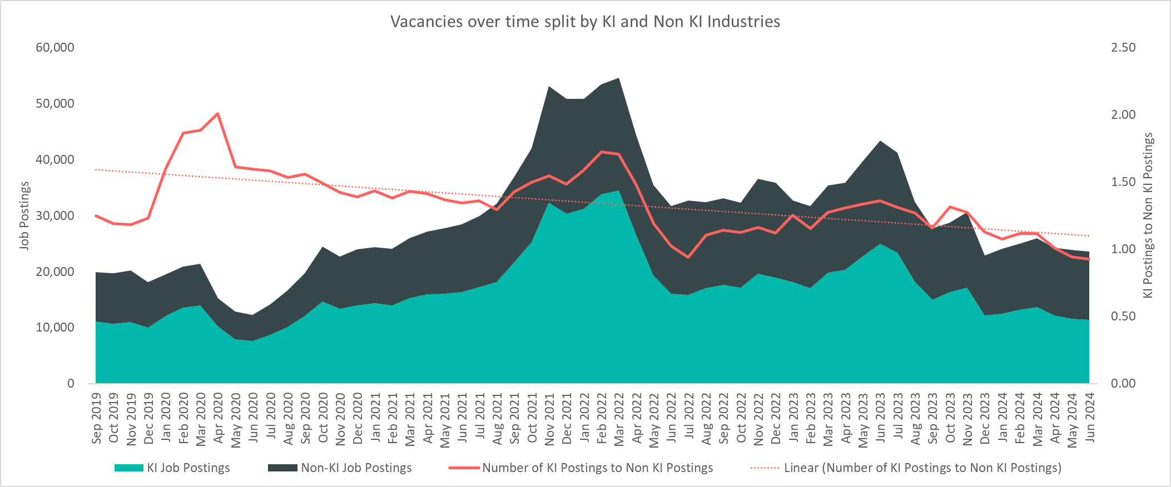
Vacancies by KI Industries
There has been consistently more KI vacancies than non-KI vacancies over the last 5 years. An area of concern is that the ratio of KI to non-KI job vacancies has been decreasing and approaching 1. The effects of the August 2024 Bank of England interest rate cut and possible subsequent interest rate cuts should be monitored to see it helps reverse this worrying trend with increased investment.
Notes:
Commentary: There have been consistently more KI vacancies than non-KI across C&P over the last 5 years. An area of concern is that the ratio of KI to non-KI job vacancies has been decreasing and approaching 1. This suggests that the local economy may be starting to be driven less by KI industries. The effects of the August 2024 Bank of England interest rate cut and possible subsequent interest rate cuts should be monitored to see it helps reverse this worrying trend with increased investment.
Source: Lightcast
Technical note: Vacancy data is sourced from Lightcast, a service that has been procured by C&P Combined Authority which gives labour market information on Job postings, occupations, and industries. Lightcast has a job posting aggregator which scans jobs websites for posting and presents them together. Lightcast only scans online jobs postings and therefore does not include any jobs which are advertised solely offline. There is also no guarantee that all online job postings are aggregated. For example, a specific job site may not be scanned.
A unique job posting is a deduplicated count of an online job vacancy advertisement. If the same vacancy is posted twice across a sixty-day period, it is only counted once. If the same vacancy is posted twice more than sixty days apart it is counted as two unique job postings.

Slide 24
KI and Non-KI Vacancies by sector
Non-KI Vacancies July 2023 - June 2024
Employment Sector | Vacancies in CPCA | Percentage of total vacancies | Median Posting Time
Human Health and Social Work Activities | 18,773 | 25.5% | 29 days
Wholesale and Retail Trade; Repair of Motor Vehicles and Motorcycles | 8,747 | 11.9% | 27 days
Education | 8,252 | 11.2% | 27 days
Administrative and Support Service Activities | 6,919 | 9.4% | 25 days
Accommodation and Food Service Activities | 6,217 | 8.4% | 29 days
Manufacturing | 6,214 | 8.4% | 26 days
Construction | 3,959 | 5.4% | 27 days
Other Service Activities | 3,217 | 4.4% | 28 days
Public Administration and Defence; Compulsory Social Security | 3,150 | 4.3% | 23 days
Real Estate Activities | 2,306 | 3.1% | 29 days
Transportation and Storage | 2,043 | 2.8% | 27 days
Information and Communication | 1,248 | 1.7% | 23 days
Arts, Entertainment and Recreation | 1,021 | 1.4% | 26 days
Water Supply; Sewerage, Waste Management and Remediation Activities | 821 | 1.1% | 24 days
Agriculture, Forestry and Fishing | 447 | 0.6% | 25 days
Professional, Scientific and Technical Activities | 181 | 0.2% | 26 days
Electricity, Gas, Steam and Air Conditioning Supply | 127 | 0.2% | 26 days
Mining and Quarrying | 85 | 0.1% | 18 days
Total | 73,727 |  | 27 days
KI Vacancies July 2023 - June 2024
Employment Sector | Vacancies in CPCA | Percentage of total vacancies | Median Posting Time
Administrative and Support Service Activities | 72,554 | 80.0% | 27 days
Professional, Scientific and Technical Activities | 11,455 | 12.6% | 28 days
Information and Communication | 4,726 | 5.2% | 24 days
Financial and Insurance Activities | 1,869 | 2.1% | 26 days
Transportation and Storage | 69 | 0.1% | 23 days
Total | 90,673 |  | 27 days
KI vs Non-KI Average Wages
KI/Non-KI | Vacancies in C&P: July 2023 - June 2024 | Average Wages Per Job | Median Posting Time
KI | 90,673 | £38,190 | 27 days
Non-KI | 73,727 | £32,586 | 27 days
KI industries are concentrated around a tight group of sectors compared to the breadth of non-KI industry sectors. This can be seen as a strength in depth, but it leaves KI industries somewhat more vulnerable to external shocks (e.g. China-Taiwan relations; AI bubble bursting).
Notes:
Commentary: Vacancies in KI industries are concentrated in only 4 employment sectors with the vast majority in Administrative and Support Service Activities. This contrasts to non-KI vacancies, which are spread across a higher number of employment sectors. This KI concentration can be seen as a strength in depth, but it leaves KI industries somewhat more vulnerable to external shocks (e.g. China-Taiwan relations; AI bubble bursting).
Note that median posting time for KI and non-KI jobs is 27 days. The minor matching issues between non-KI vacancies and those seeking work mentioned on Slide 21 (Vacancies by Sector) might be immaterial.
Source: Lightcast
Technical note: Vacancy data is sourced from Lightcast, a service that has been procured by C&P Combined Authority which gives labour market information on Job postings, occupations, and industries. Lightcast has a job posting aggregator which scans jobs websites for posting and presents them together. Lightcast only scans online jobs postings and therefore does not include any jobs which are advertised solely offline. There is also no guarantee that all online job postings are aggregated. For example, a specific job site may not be scanned.
A unique job posting is a deduplicated count of an online job vacancy advertisement. If the same vacancy is posted twice across a sixty-day period, it is only counted once. If the same vacancy is posted twice more than sixty days apart it is counted as two unique job postings.

Slide 25
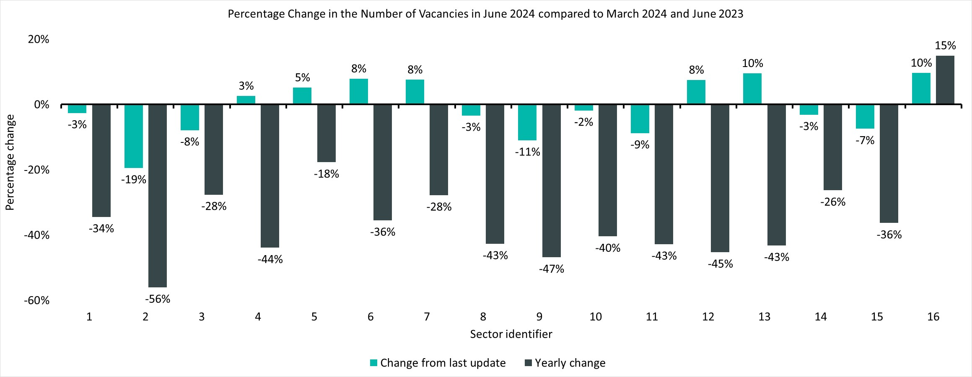
Percentage Change in Vacancies by Sector
Sector Identifier for Chart
Sector Identifier | Sector Name
1 | Accommodation and food service activities
2 | Administrative and support service activities
3 | Arts, entertainment and recreation
4 | Construction
5 | Education
6 | Financial and insurance activities
7 | Human health and social work activities
8 | Information and communication
9 | Manufacturing
10 | Other service activities
11 | Professional, scientific and technical activities
12 | Public administration and defence; compulsory social security
13 | Real estate activities
14 | Transportation and storage
15 | Wholesale and retail trade; repair of motor vehicles and motorcycles
16 | Other sectors (Agriculture, forestry and fishing; Mining and quarrying; Water supply and Waste management, Electricity, Gas, Steam and Air Conditioning Supply)
Top five sectors driving decrease in vacancies from June 2023
Employment Sector | Change from June 2023 | % of overall decrease for all vacancies from June 2023 | % of Job Postings KI – June 2024
Administrative and Support Service Activities | -12,306 | 62% | 90%
Professional, Scientific and Technical Activities | -1,336 | 7% | 98%
Construction | -1,324 | 7% | 0%
Information and Communication | -794 | 4% | 77%
Wholesale and Retail Trade; Repair of Motor Vehicles and Motorcycles | -785 | 4% | 0%
Vacancies have decreased across all sectors over the last year except for Other Sectors. The decrease in vacancies from June 2023 has been driven by the Administrative and Support Service Activities sector, and 90% of job postings in this sector were KI.
Notes:
Commentary: Vacancies have decreased across all sectors over the last year except for Other Sectors. This suggests that the wider macroeconomic environment is affecting all industries to a similar extent; however, there has been some recent divergence among individual sectors since March 2024. The decrease in vacancies from June 2023 has been driven by the Administrative and Support Service Activities sector, and 90% of job postings in this sector were KI.
Source: Lightcast
Technical note: Vacancy data is sourced from Lightcast, a service that has been procured by C&P Combined Authority which gives labour market information on Job postings, occupations, and industries. Lightcast has a job posting aggregator which scans jobs websites for posting and presents them together. Lightcast only scans online jobs postings and therefore does not include any jobs which are advertised solely offline. There is also no guarantee that all online job postings are aggregated. For example, a specific job site may not be scanned.
A unique job posting is a deduplicated count of an online job vacancy advertisement. If the same vacancy is posted twice across a sixty-day period, it is only counted once. If the same vacancy is posted twice more than sixty days apart it is counted as two unique job postings.

Slide 26
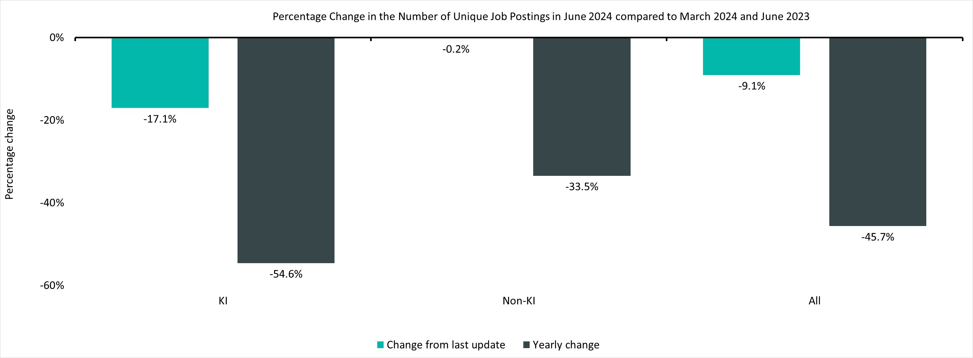
KI vs Non-KI Changes
Vacancies across both KI and non-KI industries have decreased year on year and since March 2024. However, it is concerning that KI industries have seen a larger decrease than non-KI industries when compared to both last year and March 2024.
Notes:
Commentary: Vacancies across both KI and non-KI industries have decreased year on year and since March 2024. However, it is concerning that KI industries have seen a larger decrease than non-KI industries when compared to both last year and March 2024. Yearly changes suggest that both sectors of the economy are being equally affected by the wider macroeconomic environment.
Source: Lightcast
Technical note: Vacancy data is sourced from Lightcast, a service that has been procured by C&P Combined Authority which gives labour market information on Job postings, occupations, and industries. Lightcast has a job posting aggregator which scans jobs websites for posting and presents them together. Lightcast only scans online jobs postings and therefore does not include any jobs which are advertised solely offline. There is also no guarantee that all online job postings are aggregated. For example, a specific job site may not be scanned.
A unique job posting is a deduplicated count of an online job vacancy advertisement. If the same vacancy is posted twice across a sixty-day period, it is only counted once. If the same vacancy is posted twice more than sixty days apart it is counted as two unique job postings.

Slide 27
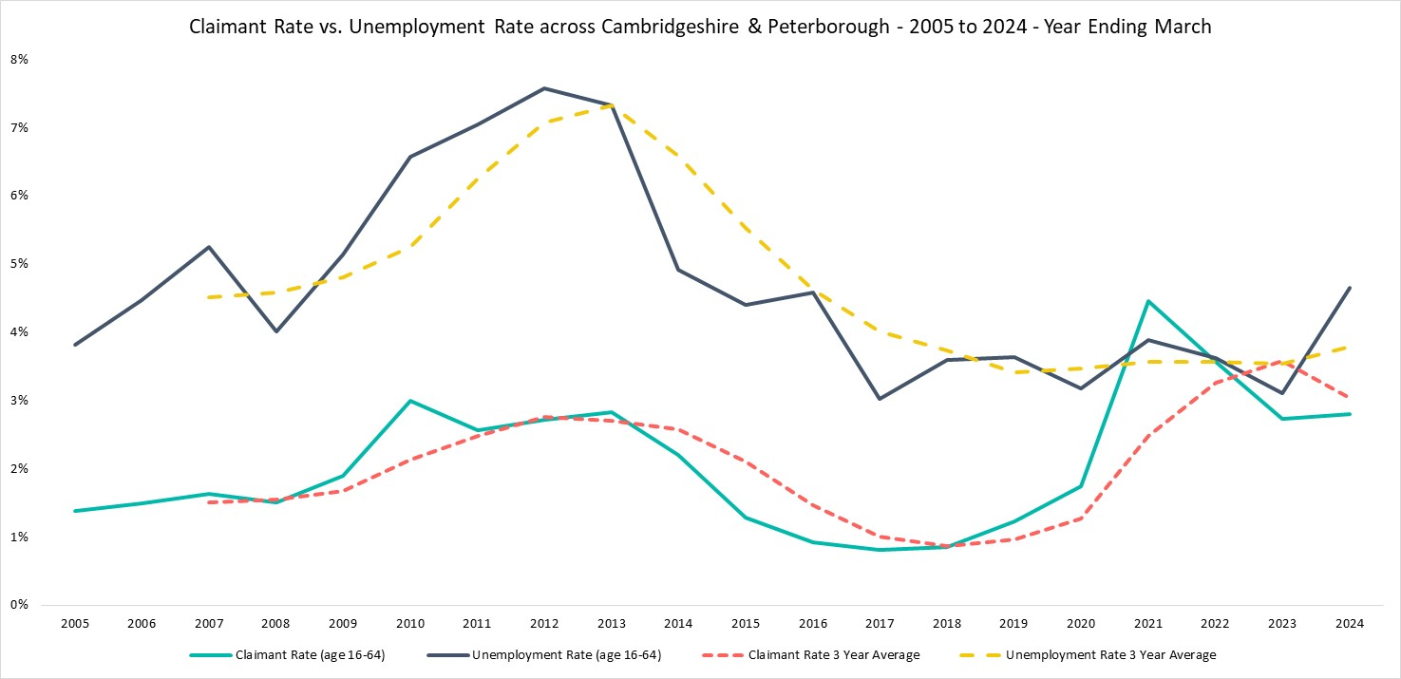
Claimant Count vs Unemployment Rate
The claimant rate and unemployment rate historically follow similar trends with the claimant rate being lower than the unemployment rate. Since 2019, there has been an unusual convergence. More data is needed to explain this behaviour.
Notes:
Commentary: The claimant rate and unemployment rate historically follow similar trends with the claimant rate being lower than the unemployment rate. Since 2019, there has been an unusual convergence. More data is needed to explain this behaviour.
Sources:
Annual Population Survey
Claimant count, Office for National Statistics
Technical note: Vacancy data is sourced from Lightcast, a service that has been procured by C&P Combined Authority which gives labour market information on Job postings, occupations, and industries. Lightcast has a job posting aggregator which scans jobs websites for posting and presents them together. Lightcast only scans online jobs postings and therefore does not include any jobs which are advertised solely offline. There is also no guarantee that all online job postings are aggregated. For example, a specific job site may not be scanned.
A unique job posting is a deduplicated count of an online job vacancy advertisement. If the same vacancy is posted twice across a sixty-day period, it is only counted once. If the same vacancy is posted twice more than sixty days apart it is counted as two unique job postings.
The Claimant Count measures the number of people (age 16+) claiming benefit principally for the reason of being unemployed.

Slide 28
Claimant Count by Area – June 2024
CPCA
Cambridgeshire
Claimant Count (ages 16+)
Peterborough
Claimant Count (ages 16+)
Claimant Count
(ages 16+)
Claimant Rate
(ages 16-64)
9,910
7,815
17,730
3.8%
Quarterly Change
Quarterly Change
Quarterly Change
Quarterly Change
-0.5%
+1.5%
+0.4%
No Change
Comparing June 2024
with March 2024
Comparing June 2024
with March 2024
Comparing June 2024 with March 2024
Comparing June 2024 with March 2024
YoY Change
YoY Change
YoY Change
YoY Change
+6.0%
+10.9%
+8.2%
+0.2pp
Comparing June 2024 with June 2023
Comparing June 2024 with June 2023
Comparing June 2024
with June 2023
Comparing June 2024
with June 2023
Compared to 1,640,155 claimants UK wide. Quarterly change is +2.0% and YoY change is +6.7% in the UK.
Claimant counts have increased in C&P over the last year, and this increase has been prevalent in Peterborough. Raw numbers of claimants have increased; however, the claimant rate has not changed substantially.
Notes:
Commentary: Claimant counts have increased in C&P over the last year, and this increase is more prevalent in Peterborough. Overall, raw numbers of claimants are increasing; however, the claimant rate has not changed substantially.
Source: Claimant count, Office for National Statistics
Technical note: The Claimant Count measures the number of people (age 16+) claiming benefit principally for the reason of being unemployed.

Slide 29
Claimant Counts by Local Authority
Claimant Counts | Number of claimants June 2024 | Proportion of Total C&P Claimants | % Change 12 Months ago vs Now: June 2023 to June 2024 | % Change Previous update vs Now: March 2024 to June 2024
Cambridgeshire | 9,910 | 55.9% | +6.0% | -0.5%
Cambridge City | 2,140 | 12.1% | +7.3% | +0.2%
East Cambridgeshire | 1,080 | 6.1% | +5.9% | -1.8%
Fenland | 2,315 | 13.1% | +1.3% | -2.3%
Huntingdonshire | 2,600 | 14.7% | +12.3% | +2.0%
South Cambridgeshire | 1,770 | 10.0% | +2.3% | -1.9%
Peterborough | 7,815 | 44.1% | +10.9% | +1.5%
Cambridgeshire & Peterborough | 17,730 |  | +8.2% | +0.4%
United Kingdom | 1,640,155 |  | +6.7% | +2.0%
The two areas of concern are in Peterborough and Huntingdonshire. The most severe is in Peterborough, which has nearly half of all claimants in C&P at 44.1% and is increasing substantially year on year at +10.9%. In Cambridgeshire, Huntingdonshire has the largest proportion of claimants in C&P at 14.7% with the highest year on year increase at +12.3%. Both areas are worth close attention.
Notes:
Commentary: The two areas of concern are in Peterborough and Huntingdonshire. The most severe is in Peterborough, which has nearly half of all claimants in C&P at 44.1% and is increasing substantially year on year at +10.9%. In Cambridgeshire, Huntingdonshire has the largest proportion of claimants in C&P at 14.7% with the highest year on year increase at +12.3%. Both areas are worth close attention.
Source: Claimant count, Office for National Statistics
Technical note: The Claimant Count measures the number of people (age 16+) claiming benefit principally for the reason of being unemployed.

Slide 30
Claimant Rate by Gender – June 2024
Cambridgeshire
Peterborough
Cambridgeshire & Peterborough
Male
Male
Male
1.5%
3.9%
2.1%
Female
Female
Female
1.3%
3.2%
1.7%
On Slide 10 (Employment Overview by Gender – 3-year average), the unemployment rate for females was unusually higher than males (3.9% vs 3.7%). However, claimant rates are higher for males than females across all three areas above. This trend for claimant rates is more intuitive given that females have a much higher economic inactivity rate than males (22.2% vs. 15.0%). Less available females in the workforce should intuitively lead to lower claimant rates and lower employment rates.
Notes:
Commentary: On Slide 10 (Employment Overview by Gender – 3-year average), the unemployment rate for females was unusually higher than males (3.9% vs 3.7%). However, claimant rates are higher for males than females across all three areas above. This trend for claimant rates is more intuitive given that females have a much higher economic inactivity rate than males (22.2% vs. 15.0%). Less available females in the workforce should intuitively lead to lower claimant rates and lower employment rates.
Source: Claimant count, Office for National Statistics
Technical note: The Claimant Count measures the number of people (age 16+) claiming benefit principally for the reason of being unemployed.

Slide 31
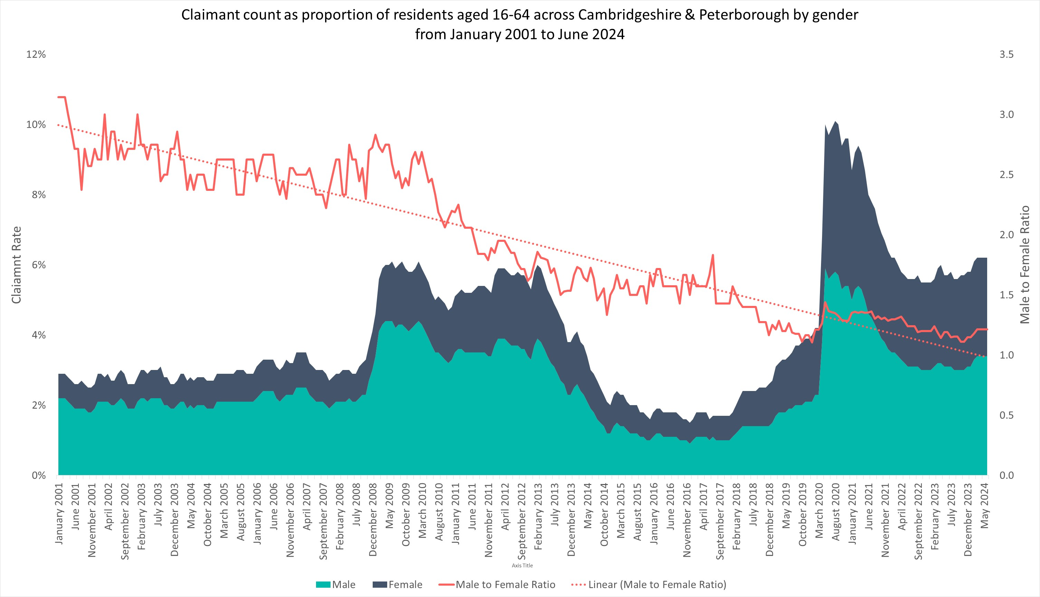
Claimant Rate by Gender
There has been a higher proportion of males who claim benefits than females since 1992. However, the ratio of male to female claimants has been decreasing over time. It is concerning that current claimant rates are still higher than pre-pandemic levels.
Notes:
Commentary: There has been a higher proportion of males who claim benefits than females since 1992. However, the ratio of male to female claimants has been decreasing over time. Claimant rates have generally risen with recessions (e.g. financial crisis in 2009; Covid-19 pandemic); however, it is concerning that current claimant rates are still higher than pre-pandemic levels.
Source: Claimant count, Office for National Statistics
Technical note: The Claimant Count measures the number of people (age 16+) claiming benefit principally for the reason of being unemployed.

Slide 32
Claimant Rates by Age Group – June 2024
Claimant Rates | Number of claimants 16-64 June 2024 | 16-64 June 2024 | 16-24 June 2024 | 16-17 June 2024 | 18-24 June 2024 | 25-49 June 2024 | 50-64 June 2024
Cambridgeshire | 9,910 | 2.2% | 2.0% | 0.1% | 2.5% | 2.6% | 1.6%
Cambridge City | 2,140 | 1.9% | 1.0% | 0.2% | 1.0% | 2.2% | 2.3%
East Cambridgeshire | 1,080 | 1.9% | 2.3% | 0.2% | 3.1% | 2.2% | 1.4%
Fenland | 2,315 | 3.7% | 4.9% | 0.2% | 6.6% | 4.4% | 2.3%
Huntingdonshire | 2,600 | 2.2% | 2.8% | 0.3% | 3.8% | 2.6% | 1.4%
South Cambridgeshire | 1,770 | 1.7% | 1.6% | 0.0% | 2.4% | 2.0% | 1.2%
Peterborough | 7,815 | 5.6% | 5.9% | 0.2% | 8.1% | 6.3% | 4.0%
Cambridgeshire & Peterborough | 17,730 | 3.0% | 2.9% | 0.1% | 3.6% | 3.5% | 2.2%
United Kingdom | 1,640,155 | 3.8% | 3.9% | 0.2% | 4.9% | 4.5% | 2.7%
Peterborough continues to be an area of concern with the highest claimant rates across all age groups except for 16-17. For Cambridgeshire, Fenland has the highest claimant rates except for 16-17. The 18-24 age group has the highest claimant rage across all areas except for Cambridge City.
Notes:
Commentary: Peterborough continues to be an area of concern with the highest claimant rates across all age groups except for 16-17. For Cambridgeshire, Fenland has the highest claimant rates except for 16-17. The 18-24 age group has the highest claimant rage across all areas except for Cambridge City.
Source: Claimant count, Office for National Statistics
Technical note: The Claimant Count measures the number of people (age 16+) claiming benefit principally for the reason of being unemployed.

Slide 33
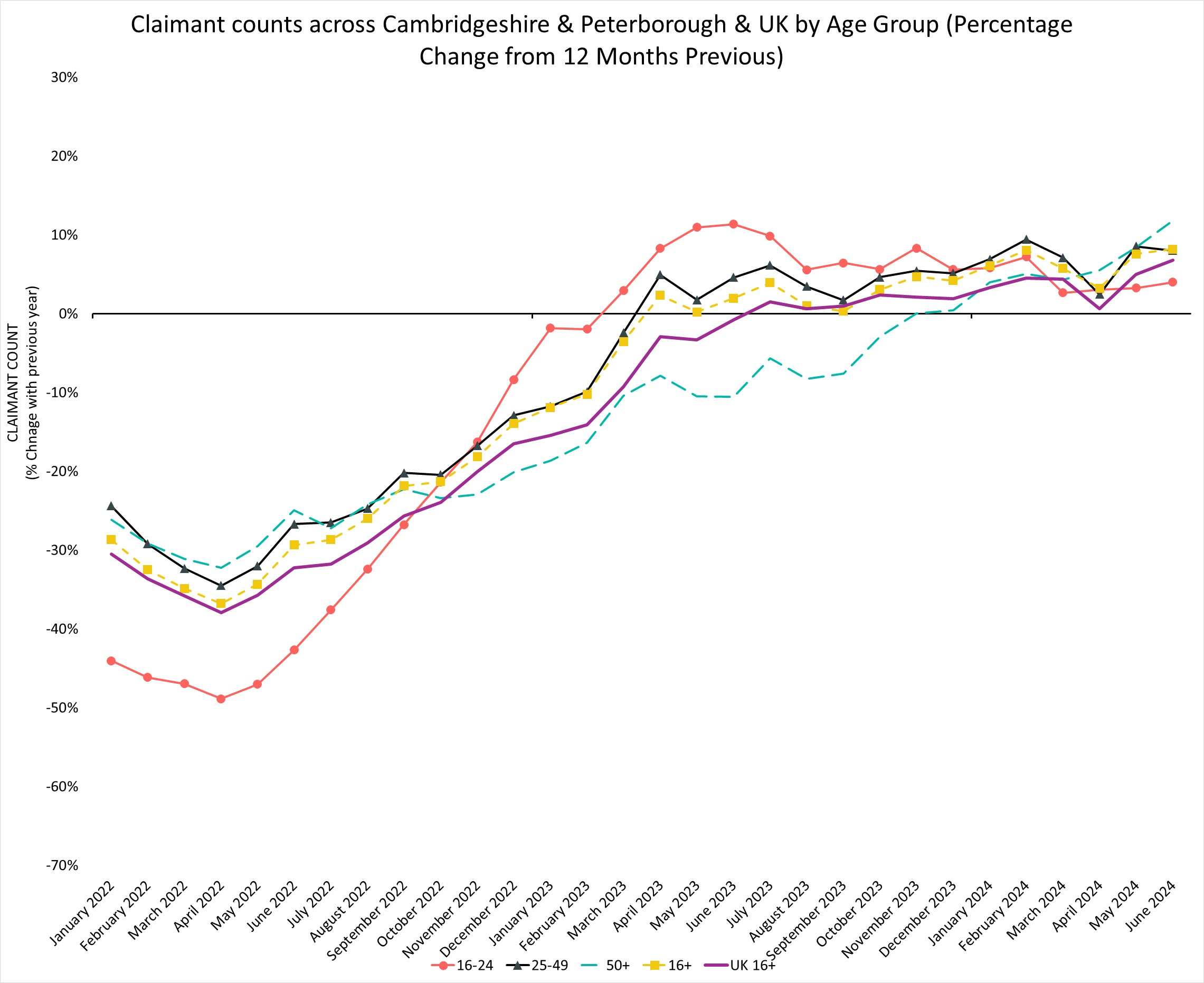
Claimant Count by Age Over Time
% Change in Claimant Counts | 16+ | 16-24 | 25-49 | 50+
Cambridgeshire & Peterborough (June 2023 to June 2024) | 8.2% | 4.0% | 8.0% | 11.8%
United Kingdom (June 2023 to June 2024) | 6.7% | 4.6% | 7.5% | 6.3%
Cambridgeshire & Peterborough (March 2024 to June 2024) | 0.4% | -1.5% | 0.7% | 0.9%
United Kingdom (March 2024 to June 2024) | 0.9% | -4.2% | 1.7% | 2.6%
Over the last year, all age groups had an increasing rate for claimant counts. The C&P 50+ age group is an area of concern with the highest increase of 11.8% across age groups over the last year and the highest increase of 0.9% across age groups between March 2024 and June 2024.
Notes:
Commentary: Over the last year, all age groups had an increasing rate for claimant counts. The C&P 50+ age group is an area of concern with the highest increase of 11.8% across age groups over the last year and the highest increase of 0.9% across age groups between March 2024 and June 2024.
Source: Claimant count, Office for National Statistics
Technical note: The Claimant Count measures the number of people (age 16+) claiming benefit principally for the reason of being unemployed.

Slide 34
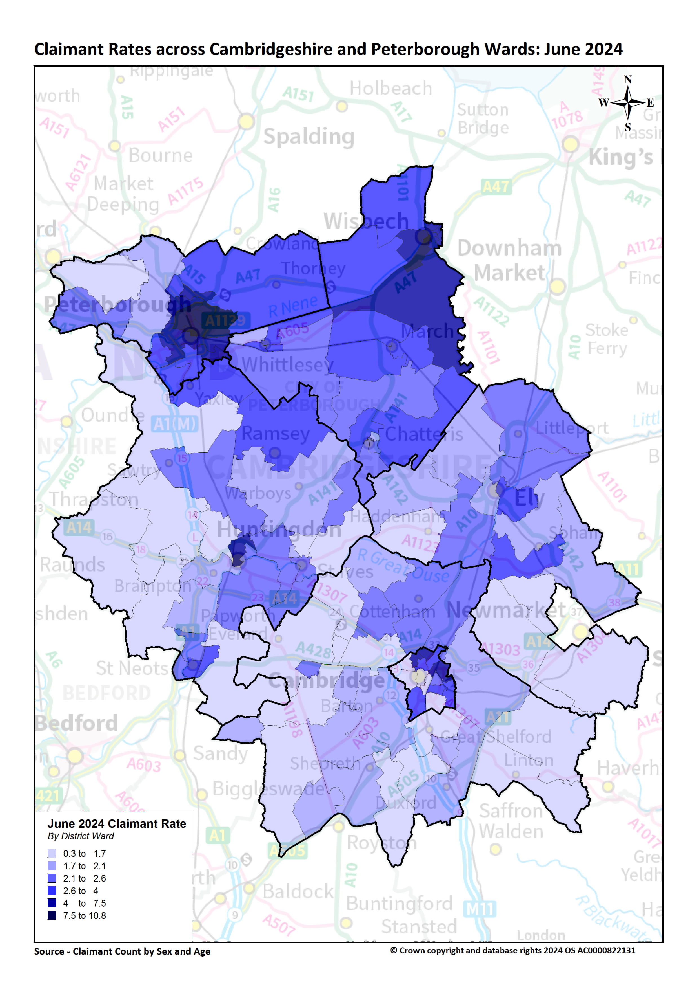
Claimant Map
5 Wards with Highest Claimant Rates
Ward | Claimant Rate | YoY Change Rate
Central | 10.8% | +2.0pp
North | 10.5% | +1.1pp
East | 9.4% | +0.7pp
Park | 8.9% | +2.0pp
Medworth | 8.8% | -0.7pp
5 Wards with Lowest Claimant Rates
Ward | Claimant Rate | YoY Change Rate
Newnham | 0.3% | +0.0pp
Great Staughton | 0.9% | +0.3pp
The Stukeleys | 0.9% | +0.3pp
Girton | 0.9% | -0.3pp
Whittlesford | 0.9% | -0.2pp
There is a high degree of disparity within the region itself with claimant rates ranging from 10.8% in Central (Peterborough) to 0.3% in Newnham (Northwest Cambridge).
Higher claimant rates seem to especially affect wards in Peterborough such as Central, North and East. Claimant rates are also continuing to increase in these areas. Further support to secure work may be needed in these areas.
Notes:
Commentary: A lower proportion of C&P residents claim benefits related to unemployment when compared to the UK. However, there is a high degree of disparity within the region itself with claimant rates ranging from 10.8% in Central (Peterborough) to 0.3% in Newnham (Northwest Cambridge). Higher claimant rates seem to especially affect wards in Peterborough such as Central, North and East. Claimant rates are also continuing to increase in these areas. Further support to secure work may be needed in these areas.
Source: Claimant count, Office for National Statistics
Technical note: The Claimant Count measures the number of people (age 16+) claiming benefit principally for the reason of being unemployed.

Slide 35
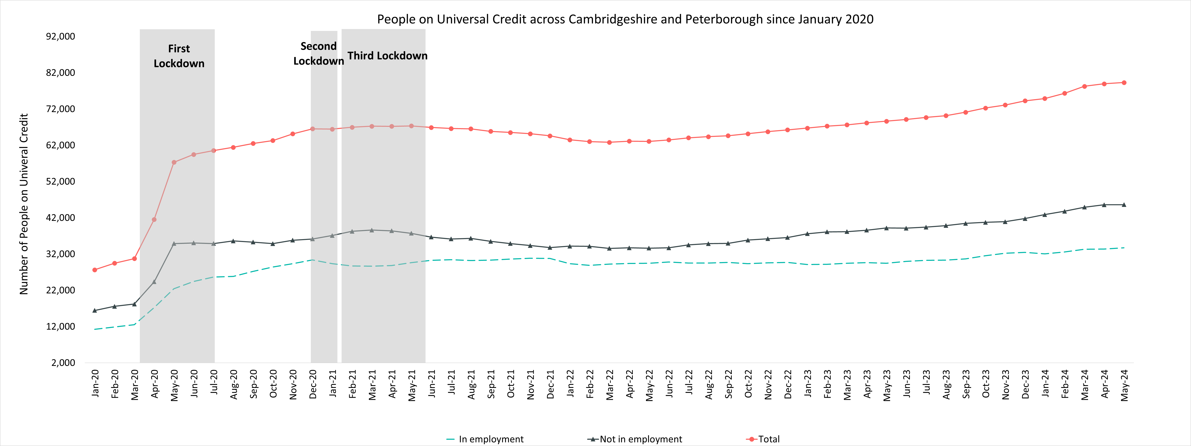
People on Universal Credit
Universal Credit Status | Number of Claimants May 2024 | Share of Total May 2024 | % Change with February 2024 | % Change with May 2023
Employed | 33,706 | 42.5% | +3.5% | +14.5%
Unemployed | 45,593 | 57.5% | +4.1% | +16.3%
Total | 79,301 |  | +3.9% | +15.5%
It is concerning that since May 2023, universal credit claimants have increased for both employed at +14.5% and unemployed at +16.3%. The current number of claimants also remains higher than pre-pandemic levels.
Notes:
Commentary: It is concerning that since May 2023, universal credit claimants have increased for both employed at +14.5% and unemployed at +16.3%. The current number of claimants also remains higher than pre-pandemic levels. Most universal credit claimants are unemployed, but 42.5% are employed suggesting that these residents are in low paying work.
Source: Claimant count, Office for National Statistics
Technical note: Universal Credit is available in every jobcentre across Great Britain. Roll out was completed in December 2018.
Universal Credit is a single payment for each household to help with living costs for those on a low income or out of work. It is replacing six benefits, commonly referred to as the legacy benefits:
Income-based Jobseeker's Allowance
Income-related Employment and Support Allowance
Income Support
Working Tax Credit
Child Tax Credit
Housing Benefit
Support for housing costs, children and childcare costs are integrated into Universal Credit. It also provides additions for people with a disability, health condition or caring responsibilities which may prevent them from working.
The number of Universal Credit claimants includes those who have started Universal Credit (completed the Universal Credit claim process and accepted their Claimant Commitment) and have not had a closure of their claim recorded for this spell, up to the 'count date' (second Thursday in each month). A closure of their claim would be recorded either at the request of the individual or if their entitlement to Universal Credit ends, for example, if they no longer satisfy the financial conditions to receive Universal Credit as they have capital over £16,000.

Slide 36
People on Universal Credit by Local Authority
People on Universal Credit | Number of total people on Universal Credit May 2024 | Proportion of Total C&P Universal Credit Claimants May 2024 | % 16-64 resident population May 2024 | % Change 12 Months ago vs Now: May 2023 to May 2024 | % Change Previous update vs Now: February 2024 to May 2024
Cambridgeshire | 47,603 | 60.0% | 10.5% | +15.2% | +3.2%
Cambridge City | 8,918 | 11.2% | 7.8% | +11.9% | +2.4%
East Cambridgeshire | 5,703 | 7.2% | 10.1% | +16.8% | +2.7%
Fenland | 11,016 | 13.9% | 17.7% | +13.1% | +2.6%
Huntingdonshire | 12,880 | 16.2% | 11.1% | +19.8% | +5.1%
South Cambridgeshire | 9,086 | 11.5% | 8.8% | +14.0% | +2.6%
Peterborough | 31,698 | 40.0% | 22.7% | +16.0% | +4.9%
Cambridgeshire & Peterborough | 79,301 |  | 13.4% | +15.5% | +3.9%
Great Britain | 6,754,188 |  | 16.2% | +14.0% | +4.6%
Peterborough has 40% of all C&P Universal Credit Claimants. Even more concerning is that 22.7% of the Peterborough population are claiming Universal Credit. This is almost one in four. Lastly, Peterborough and all the districts in Cambridgeshire are concerningly seeing double-digit year on year increases and quarterly increases.
Notes:
Commentary: Peterborough has 40% of all C&P Universal Credit Claimants – this is similar to the 44.1% share of all C&P claimants on Slide 29 (Claimant Counts by Local Authority). Even more concerning is that 22.7% of the Peterborough population are claiming Universal Credit. This is almost one in four. Lastly, Peterborough and all the districts in Cambridgeshire are concerningly seeing double-digit year on year increases and quarterly increases.
Source: Claimant count, Office for National Statistics
Technical note: Universal Credit is available in every jobcentre across Great Britain. Roll out was completed in December 2018.
Universal Credit is a single payment for each household to help with living costs for those on a low income or out of work. It is replacing six benefits, commonly referred to as the legacy benefits:
Income-based Jobseeker's Allowance
Income-related Employment and Support Allowance
Income Support
Working Tax Credit
Child Tax Credit
Housing Benefit
Support for housing costs, children and childcare costs are integrated into Universal Credit. It also provides additions for people with a disability, health condition or caring responsibilities which may prevent them from working.
The number of Universal Credit claimants includes those who have started Universal Credit (completed the Universal Credit claim process and accepted their Claimant Commitment) and have not had a closure of their claim recorded for this spell, up to the 'count date' (second Thursday in each month). A closure of their claim would be recorded either at the request of the individual or if their entitlement to Universal Credit ends, for example, if they no longer satisfy the financial conditions to receive Universal Credit as they have capital over £16,000.

Slide 37
6. Employment

Slide 38
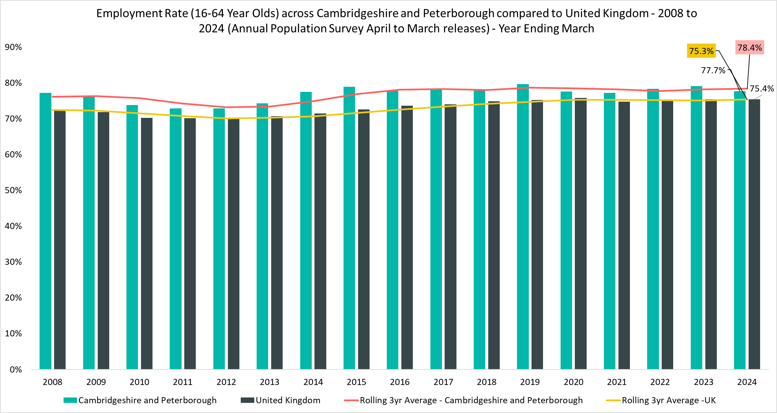
Employment Overview
Employment Rate
(all aged 16-64)
77.7%
Apr 2023-Mar 2024
Quarterly Change
-1.7pp
Comparing Apr 2023-Mar 2024 with Jan 2023 – Dec 2023
YoY Change
-1.4pp
Comparing Apr 2022-Mar 2023 with Apr 2023-Mar 2024
Compared to 75.4% UK wide. 3-year average (April 2021-Mar 2022 to April 2023-Mar 2024) is 78.4% compared to 75.3% UK wide.
An area of strength is that the employment rate for C&P has been consistently higher than the UK for the analysis period since 2007. However, the recent -1.4pp YOY change and -1.7pp quarterly change are areas of concern.
Notes:
Commentary: An area of strength is that the employment rate for C&P has been consistently higher than the UK for the analysis period since 2007. However, the recent -1.4pp YOY change and -1.7pp quarterly change are areas of concern.
Source: Annual Population Survey, April to March Releases
Technical note: A residence based labour market survey encompassing population, economic activity (employment and unemployment), economic inactivity and qualifications. These are broken down where possible by gender, age, ethnicity, industry and occupation. Available at Local Authority level and above. Updated quarterly.
It is important to note that due to the small geographical area considered, and the Annual Population Survey being based on a representative sample, this may be due to a quarterly fluctuation rather than any kind of long-term trend in the data. National figures are now taken from the Labour Force Survey (LFS). Increased volatility of LFS estimates, resulting from smaller achieved sample sizes, means that estimates of quarterly change should be treated with additional caution. Caution should be taken with interpreting these figures and comparisons to C&P.
APS Estimates have not been reweighted to new populations and consequently, will be inconsistent with the population totals used for the Labour Force Survey in the latest periods. Again caution is recommended when making comparisons to national statistics.

Slide 39
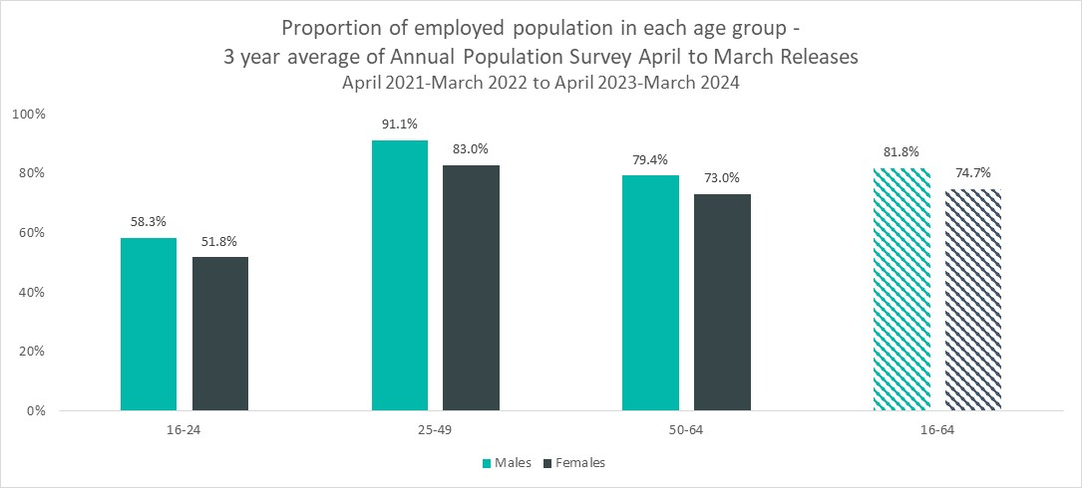
Employment by Age and Gender
Employment Rate
(all aged 16-64)
81.8%
Male
74.7%
Female
3-Year Average: April 2021-Mar 2022 to April 2023-Mar 2024
Males have a higher employment rate than females across all age groups. This is due to the larger proportion of females who are economically inactive and does not suggest hiring differences between genders.
Notes:
Commentary: Males have a higher employment rate than females across all age groups. This is due to the larger proportion of females who are economically inactive and does not suggest hiring differences between genders.
Source: Annual Population Survey, April to March Releases
Technical note: A residence based labour market survey encompassing population, economic activity (employment and unemployment), economic inactivity and qualifications. These are broken down where possible by gender, age, ethnicity, industry and occupation. Available at Local Authority level and above. Updated quarterly.
It is important to note that due to the small geographical area considered, and the Annual Population Survey being based on a representative sample, this may be due to a quarterly fluctuation rather than any kind of long-term trend in the data. National figures are now taken from the Labour Force Survey (LFS). Increased volatility of LFS estimates, resulting from smaller achieved sample sizes, means that estimates of quarterly change should be treated with additional caution. Caution should be taken with interpreting these figures and comparisons to C&P.
APS Estimates have not been reweighted to new populations and consequently, will be inconsistent with the population totals used for the Labour Force Survey in the latest periods. Again caution is recommended when making comparisons to national statistics.

Slide 40
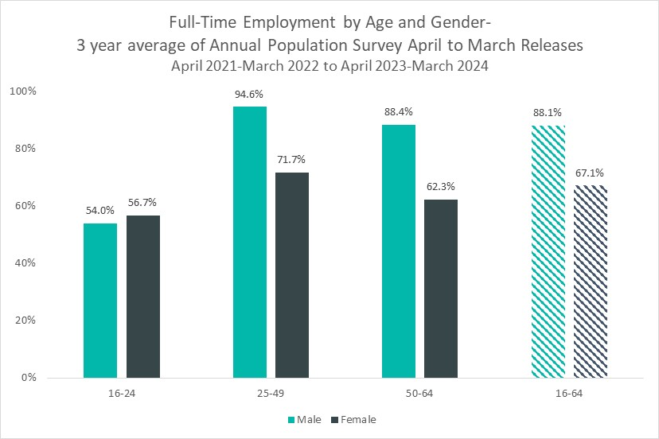
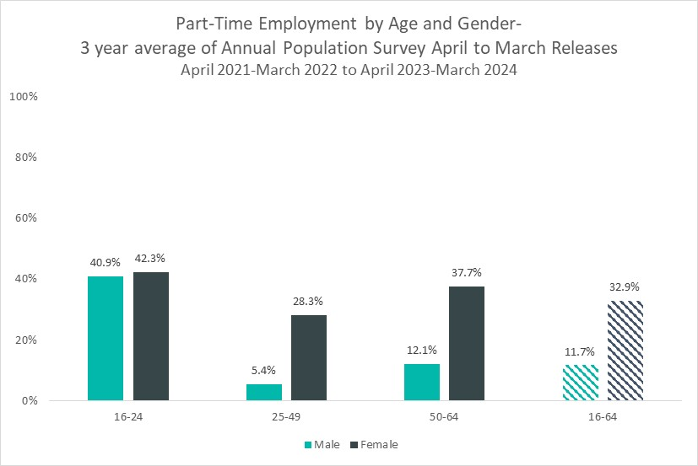
Employment Type by Age and Gender
Full-time employment: 16-24 age group is a 2-year average.
A higher proportion of males work full-time compared to females in the 25-49 and 50-64 age groups.
Correspondingly, a higher proportion of females work part-time compared to males in the 25-49 and 50-64 age groups. The gender differences in part-time work could be due to females seeking more flexible working arrangements for childcare or taking phased retirement. Note that there is little difference between males and females in the 16-24 age group for both full time work and part-time work.
Notes:
Commentary:
A higher proportion of males work full-time compared to females in the 25-49 and 50-64 age groups.
Correspondingly, a higher proportion of females work part-time compared to males in the 25-49 and 50-64 age groups. The gender differences in part-time work could be due to females seeking more flexible working arrangements for childcare or taking phased retirement. It is important to note that females are in part-time work by choice, and this is not due to inequalities.
Note that there is little difference between males and females in the 16-24 age group for both full time work and part-time work.
Source: Annual Population Survey, April to March Releases
Technical note: A residence based labour market survey encompassing population, economic activity (employment and unemployment), economic inactivity and qualifications. These are broken down where possible by gender, age, ethnicity, industry and occupation. Available at Local Authority level and above. Updated quarterly.
It is important to note that due to the small geographical area considered, and the Annual Population Survey being based on a representative sample, this may be due to a quarterly fluctuation rather than any kind of long-term trend in the data. National figures are now taken from the Labour Force Survey (LFS). Increased volatility of LFS estimates, resulting from smaller achieved sample sizes, means that estimates of quarterly change should be treated with additional caution. Caution should be taken with interpreting these figures and comparisons to C&P.
APS Estimates have not been reweighted to new populations and consequently, will be inconsistent with the population totals used for the Labour Force Survey in the latest periods. Again caution is recommended when making comparisons to national statistics.

Slide 41
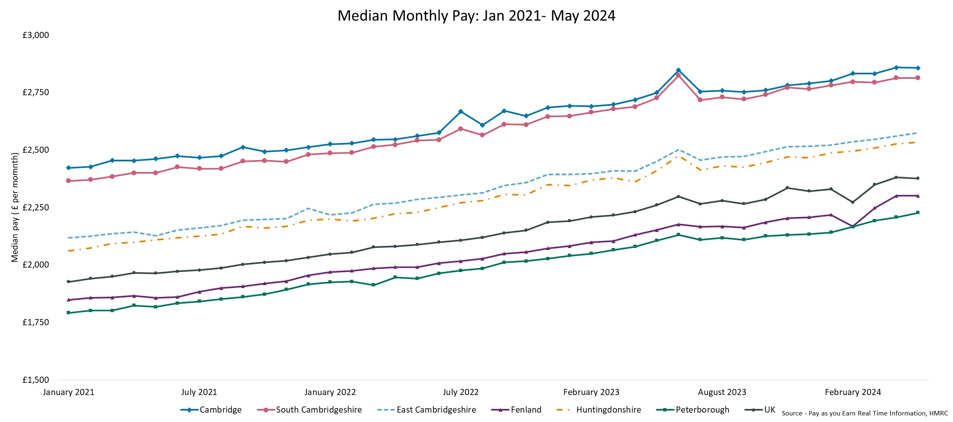
Pay Levels
Local Authority | Cambridge | South Cambridgeshire | East Cambridgeshire | Fenland | Huntingdonshire | Peterborough | United Kingdom
Median Monthly Pay (May 2024) | £2,858 | £2,814 | £2,575 | £2,301 | £2,535 | £2,228 | £2,377
On a local authority level, monthly median pay levels can be grouped into three categories. First, Cambridge and South Cambridgeshire have median monthly pay levels that are substantially higher the UK. Second, East Cambridgeshire and Huntingdonshire have median monthly pay levels that are moderately higher than the UK. Lastly, Fenland and Peterborough have median monthly pay levels that are below the UK. This has concerning inequality implications for the C&P region.
Notes:
Commentary: On a local authority level, monthly median pay levels can be grouped into three categories. First, Cambridge and South Cambridgeshire have median monthly pay levels that are substantially higher the UK. Second, East Cambridgeshire and Huntingdonshire have median monthly pay levels that are moderately higher than the UK. Lastly, Fenland and Peterborough have median monthly pay levels that are below the UK. This has concerning inequality implications for the C&P region.
Source: Pay as you earn real time information- HMRC
Technical note: This data is sourced from HM Revenue and Customs’ Pay As You Earn system which collects income tax and national insurance. The Pay As you Earn Real Time Information data includes all employees payrolled by employers, therefore it does not include income from pensions, property rental or investments, nor does it include self-employment income.
This data is based on employee’s residence rather than where they work.

Slide 42
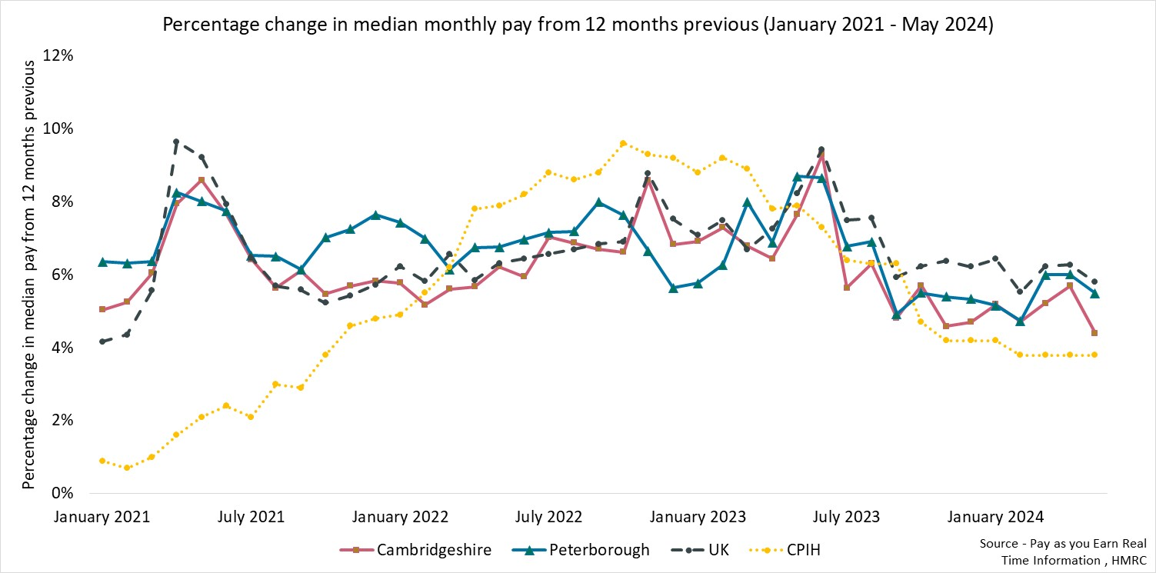
Pay Growth and Inflation
Percentage change in median monthly pay from 12 months
May 2024
Cambridgeshire
+4.4%
Peterborough
+5.5%
UK
+5.8%
CPIH
+3.8%
It is a concern that median monthly pay in Cambridgeshire (+4.4%) and Peterborough (+5.5%) has been growing below UK growth rate (+5.8%). However, a strength is that median monthly pay in Cambridgeshire (+4.4%) and Peterborough (+5.5%) are above inflation (+3.8%).
Notes:
Commentary: It is a concern that median monthly pay in Cambridgeshire (+4.4%) and Peterborough (+5.5%) has been growing below UK growth rate (+5.8%). However, a strength is that median monthly pay in Cambridgeshire (+4.4%) and Peterborough (+5.5%) are above inflation (+3.8%).
Source: Pay as you earn real time information- HMRC
Technical note: This data is sourced from HM Revenue and Customs’ Pay As You Earn system which collects income tax and national insurance. The Pay As you Earn Real Time Information data includes all employees payrolled by employers, therefore it does not include income from pensions, property rental or investments, nor does it include self-employment income.
This data is based on employee’s residence rather than where they work.

Slide 43
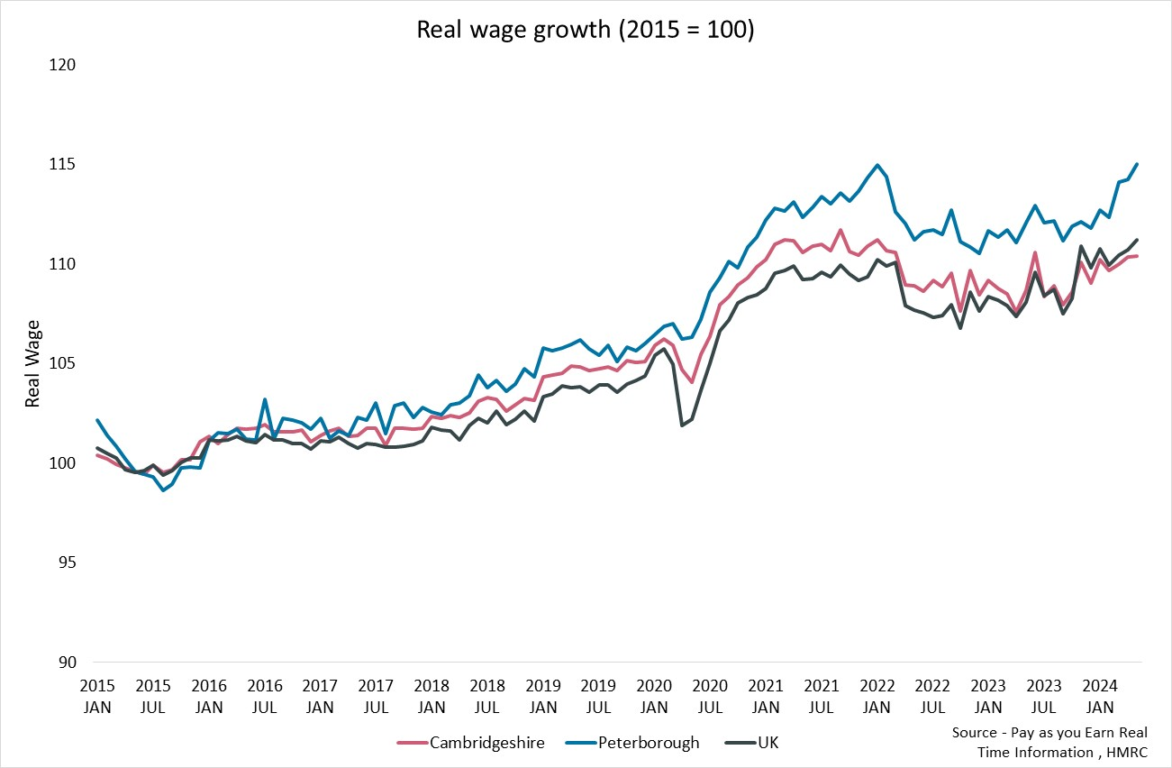
Real Wages
Latest Wage Growth
May 2024
Cambridgeshire
110.4
Peterborough
115.0
UK
111.2
Real wage growth across Peterborough is higher than the UK and Cambridgeshire. Although median wages in Peterborough are lower, it is encouraging that wages are growing. Cambridgeshire wage growth is slightly below the UK.
Notes:
Commentary: Real wage growth across Peterborough is higher than the UK and Cambridgeshire. Although median wages in Peterborough are lower, it is encouraging that wages are growing. Cambridgeshire wage growth is slightly below the UK.
Source: Pay as you earn real time information- HMRC
Technical note: This data is sourced from HM Revenue and Customs’ Pay As You Earn system which collects income tax and national insurance. The Pay As you Earn Real Time Information data includes all employees payrolled by employers, therefore it does not include income from pensions, property rental or investments, nor does it include self-employment income.
This data is based on employee’s residence rather than where they work.
Real wage growth is calculated by deflating earnings by the Consumer Prices Index including owner occupiers’ housing costs (CPIH).

Slide 44
7. Concluding remarks and next steps
Concluding remarks
Economic Inactivity - Female disparity in economic inactivity is a concern, and the progress of the government's childcare policies should be monitored.
Unemployment – Decreasing job opportunities coupled with increasing unemployment is creating a difficult job market particularly for the 16-24 and 50+ age groups. The new Skills England policy should be closely monitored.
Employment - It is a concern that median monthly pay in C&P has been growing below the UK growth rate. However, a strength is that median monthly pay in C&P is above inflation. Fenland and Peterborough are the only two local authorities with median monthly pay levels that are below the UK.
KI vs non-KI - Although there have been more KI vacancies than non-KI vacancies over the last 5 years, it is concerning that the ratio of KI to non-KI job vacancies has been decreasing over the last 5 years and approaching 1. The decrease in KI vacancies has been larger than the decrease in non-KI vacancies.
Local authorities of concern – Peterborough has the highest claimant counts, claimant rates, and universal credit claimants of all local authorities in the C&P region. In Cambridgeshire, Huntingdonshire has the highest claimant counts, and Fenland has the highest claimant rates. These local authorities require continued attention.
Next steps
To further explore matching issues between vacancies (supply of job opportunities) and unemployment (demand of job seekers).

Slide 45
8. Glossary
Term | Formula
Claimant Rate | $$\frac{number of claimants}{ population of claimant area (16−64)}$$
Economic Activity Rate | $$\frac{number of people in employment and unemployed (aged 16+)}{total population (aged 16+)}$$
Economic Inactivity Rate | $$\frac{number people who are neither in employment nor unemployed (aged 16−64)}{total population (aged 16−64)}$$
Employment Rate | $$\frac{number of people in employment (aged 16−64)}{total population (aged 16−64)}$$
Unemployment Rate | $$\frac{number of unemployed people (aged 16+)}{economically active population (aged 16+)}$$
Vacancy Rate | $$\frac{number of job vacancies}{(number of job vacancies+employed population)}$$

