Slide 1
Apprenticeships delivered in the Cambridgeshire and Peterborough area, 2023/24 Academic Year
Up to and including Q3 2023/24 (August 2023 – April 2024)
Policy and Insight Team – policyandinsight@cambridgeshire.gov.uk

Slide 2
Table of Contents
Purpose
Approach
Executive Summary
Starts
- Delivery to date
- Starts by level – quarter and national comparison
- Starts by subject area – quarter and national comparison
- Starts by age group – quarter and national comparison
- Starts by provider
Achievements
- Delivery to date
- Achievements by level – quarter and national comparison
- Achievements by subject area – quarter and national comparison
- Achievements by age group – quarter and national comparison
- Achievements by provider

Slide 3
1. Purpose
To analyse the starts and achievements of apprenticeships in the Cambridgeshire and Peterborough area.
This is to help achieve the Cambridgeshire and Peterborough Combined Authority (CPCA)’s ambition to provide the UK’s most technically skilled workforce.

Slide 4
2. Approach
The data in this slide pack is sourced from the GOV.UK Apprenticeship and Traineeship Statistical First Release.
This is publicly available data accessible through this link: Apprenticeships, Academic year 2023/24 – Explore education statistics – GOV.UK (explore-education-statistics.service.gov.uk)
There are two approaches for analysing apprenticeships:
The first is learner location-based, which looks at the delivery of apprenticeships to learners residing in Cambridgeshire and Peterborough regardless of delivery location. This analysis will include learners who travel outside of the Cambridgeshire and Peterborough region for learning.
The second approach is delivery location-based, which looks at the delivery of apprenticeships where the provider is based within Cambridgeshire and Peterborough. This analysis will include learners who reside outside of Cambridgeshire and Peterborough but travel into the region for learning.
This slide pack uses the latter delivery location-based approach.

Slide 5
3. Executive Summary - Starts
Overview
Little change in overall starts - Starts across Cambridgeshire and Peterborough up to and including Q3 of 2023/24 are in line with the same point in the previous year with no substantial increases or decreases. This is also seen nationally. This suggests that apprenticeship demand may be plateauing.
By Level
Starts by higher level apprenticeships increased and starts by lower level apprenticeships decreased - When looking at starts by level, it tends to be higher level apprenticeship starts which are increasing and lower level apprenticeship starts which are decreasing. Cambridgeshire and Peterborough sees a higher proportion of Level 4-6 apprenticeships than nationally reflecting the higher skills levels and demands of the region.
By subject area
Little change in starts by subject area - Starts by subject area up to and including Q3 of 2023/24 have remained in line with the previous year across Cambridgeshire and Peterborough. Whilst the local breakdown is also generally in line with the national breakdown, the most notable difference is the higher proportion of starts in the Agriculture, Horticulture and Animal Care subject area, likely driven by demand for agriculture in the rural areas of the region such as Fenland.
By age
Little change in starts by age group - Starts by age group are generally in line with previous years and nationally.
By provider
Top five providers - The top five providers for starts remains similar to previous years.

Slide 6
3. Executive Summary – Achievements
Overview
Increase in overall achievements - Achievements across Cambridgeshire and Peterborough up to and including Q3 of 2023/24 have increased substantially from the same point in the previous year. Although achievements have also increased nationally, the national increase is of a smaller magnitude. The local increase has been driven by two providers: Medipro, a provider which took on apprenticeships from East of England Ambulance Service which ceased provision in 2021/22, and Anglia Ruskin University. This has had implications for level and subject area breakdowns.
By Level
Increase in Level 4 achievements - When looking at achievements by level, Level 4 achievements have substantially increased from the previous year. This is due to apprenticeship achievements delivered by Medipro. Cambridgeshire and Peterborough sees a higher proportion of Level 4-5 apprenticeship achievements than nationally, reflecting the higher skills levels and demands of the region.
By subject area
Increase in the Health, Public Services and Care subject area - Achievements by subject area up to and including Q3 of 2023/24 have changed due to a substantial increase in the Health, Public Services and Care subject area. Again, this has been driven my Medipro and Anglia Ruskin University and has caused the proportion of other sectors to decrease despite only two subject areas seeing actual small decreases in achievements. Cambridgeshire and Peterborough had a higher proportion of achievements in Health, Public Services and Agriculture, Horticulture and Animal Care than nationally.
By age
Decrease in share across Under 19 age group and increases in achievements in 19-24+ and 25+ age groups - Achievements by age group have seen decreases in the share across the Under 19 age group. However, this has been driven by increases in achievements across the 19-24 and 25+ age groups rather than large decreases in those Under 19. As a result of this Cambridgeshire and Peterborough sees a lower proportion of achievements across those Under 19 but a higher proportion across 19-24 and 25+ than nationally.
By provider
Top five providers - The top five providers for achievements remain similar to previous years except for Medipro, which is now top provider for achievements.

Slide 7
4. Starts

Slide 8
Delivery to date
Up to and including Q3 2023/24 (August 2023 – January 2024), there have been 4,062 apprenticeship starts across Cambridgeshire and Peterborough.
This is in line with the number of starts up to and including Q3 of 2022/23, where there were 4,504 apprenticeship starts.
Nationally, starts were also in line when comparing Q3 of 2023/24 to Q2 of 2022/23.
*Please note that differences in proportion of 1 percentage point are considered “in line”

Slide 9
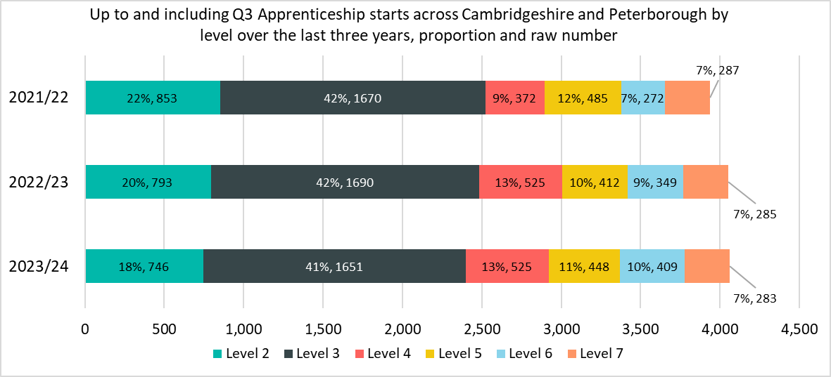
Starts by level – quarter comparison
While the total number of starts across the Cambridgeshire and Peterborough area decreased up to and including Q3 of 2023/24, there is some variation between each level:
Level 6 (+60 starts, +17%) and Level 5 (+36, +9%) were the only levels to see an increase in starts.
Level 2 (-47 starts, -6%%) and Level 3 (-39 starts, -2%) saw the largest decreases in starts.
*Please note that differences in proportion of 1 percentage point are considered “in line”

Slide 10
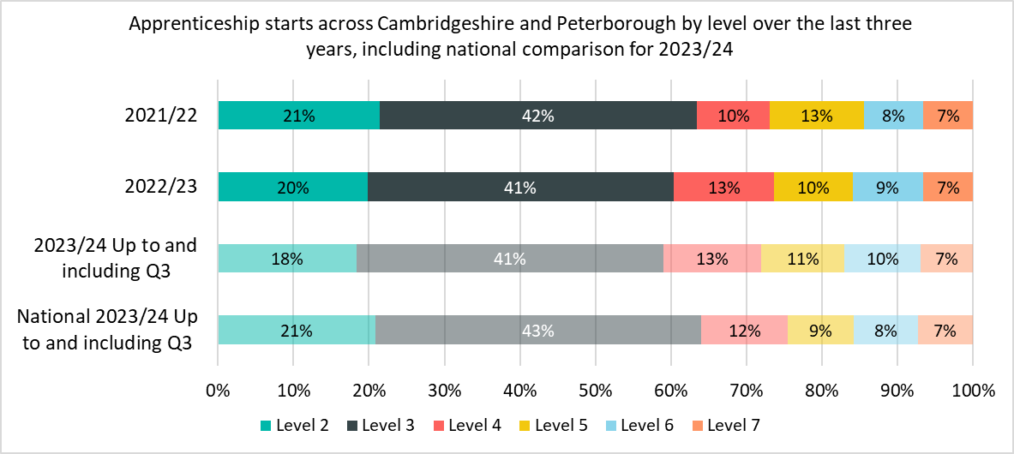
Starts by level – national comparison
Cambridgeshire and Peterborough is broadly inline with the national breakdown when looking at starts by level.
The largest proportion difference was across Level 2 apprenticeships (18% compared to 21% nationally).
*Please note that differences in proportion of 1 percentage point are considered “in line”

Slide 11
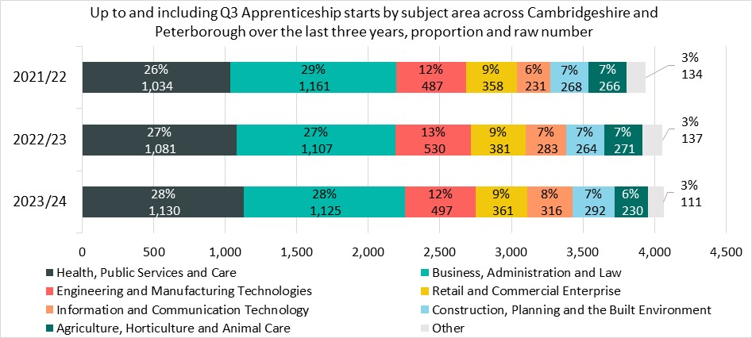
Starts by subject area – quarter comparison
Although there is some variation in the number of starts, the percentage of overall starts in each subject area is in line with the previous year.
The single biggest decrease in starts was in the Agriculture, Horticulture and Animal Care subject area, with -41 fewer starts (-15%).
The largest increase in the volume of starts was in the Health, Public Services and Care subject area with +49 starts (+5%).
Information and Communication Technologies and Construction, Planning and the Built Environment saw the largest percentage increases (+12% and +11% respectively).
*Please note that differences in proportion of 1 percentage point are considered “in line”
*Other includes: Science & Mathematics, Education & Training, Arts, Media & Publishing, and Leisure, Travel & Tourism

Slide 12
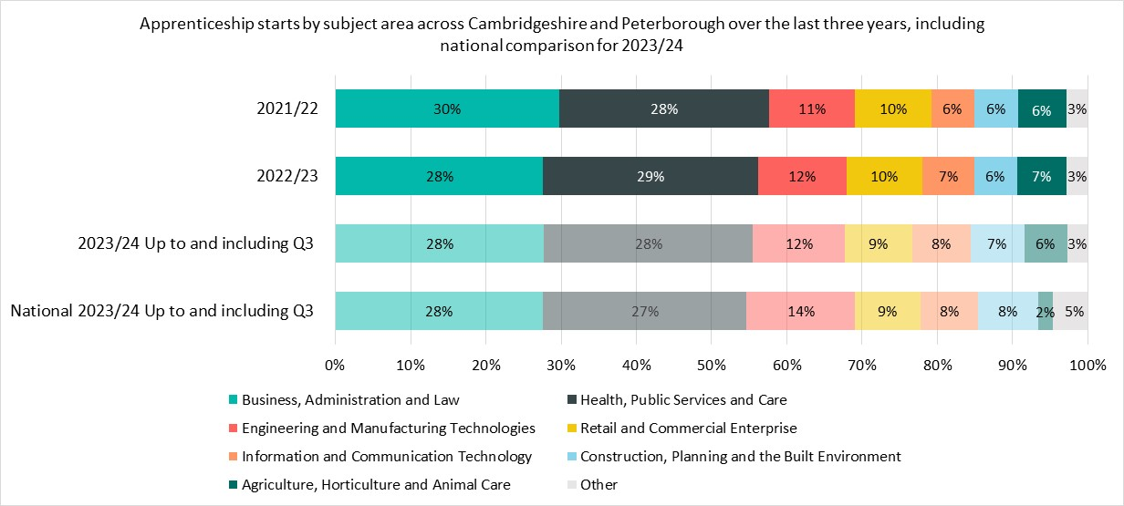
Starts by subject area – national comparison
The notable differences for starts by subject area up to and including Q3 between Cambridgeshire and Peterborough and nationally are
Cambridgeshire and Peterborough had a higher proportion of starts in Agriculture, Horticulture and Animal Care (6% compared to 2% nationally) likely driven by demand for agriculture in the rural areas of the region such as Fenland.
Most other subject areas were within 1 percentage point of each other.
*Please note that differences in proportion of 1 percentage point are considered “in line”
*Other includes: Science & Mathematics, Education & Training, Arts, Media & Publishing, and Leisure, Travel & Tourism

Slide 13
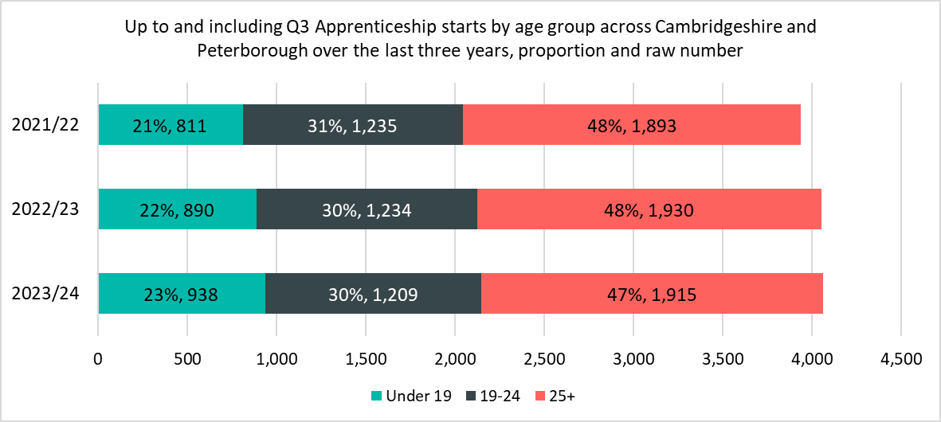
Starts by age group – quarter comparison
Although there is some variation in the number of starts, the percentage of overall starts in each age group is in line with the previous year.
Apprenticeships across those aged Under 19 saw the only increase in starts (+48, +5%).
*Please note that differences in proportion of 1 percentage point are considered “in line”

Slide 14
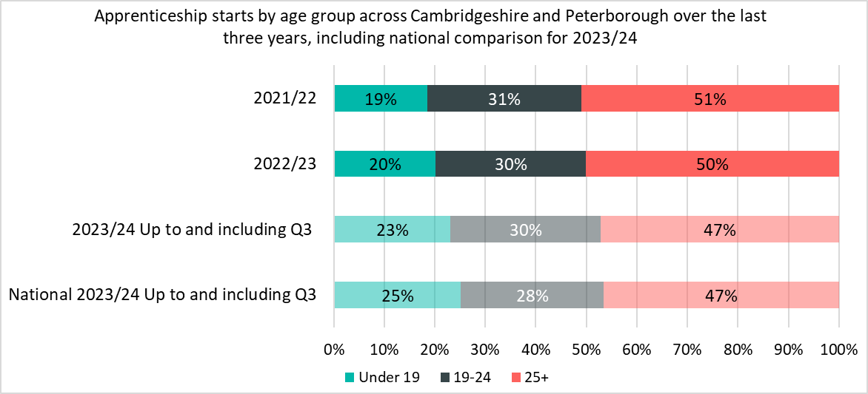
Starts by age group – national comparison
Cambridgeshire and Peterborough is broadly in line with the national breakdown when looking at starts by level.
The largest proportion differences were seen in Under 19 apprenticeships (23% compared to 25% nationally) and 19-24 apprenticeships (30% compared to 28% nationally).
*Please note that differences in proportion of 1 percentage point are considered “in line”

Slide 15
Starts by provider
When looking at starts up to and including Q3 of 2023/24 Inspire Education Group have decreased their provision by -54% since the same point in 2022/23. This is a result of a decrease of provision in Level 3 apprenticeships from 181 to 95 and having no starts in Level 5, 6 or 7 apprenticeships which accounted for 25 starts last year.
The top five providers by starts up to and including Q3 2023/24 are the same as at the same point last year.
Top Five Providers by Starts (Up to and including Q3 2023/24)
Provider | 2023/24 delivery to date (starts) | % of Total 2023/24 starts | 2022/23 delivery (starts) | % Change between 2022/23 and 2023/24
ANGLIA RUSKIN UNIVERSITY HIGHER EDUCATION CORPORATION | 464 | 11% | 403 | +15%
CAMBRIDGE REGIONAL COLLEGE | 279 | 7% | 258 | +8%
LIFETIME TRAINING GROUP LIMITED | 206 | 5% | 225 | -8%
WEST SUFFOLK COLLEGE | 164 | 4% | 163 | +1%
INSPIRE EDUCATION GROUP | 138 | 3% | 303 | -54%

Slide 16
5. Achievements

Slide 17
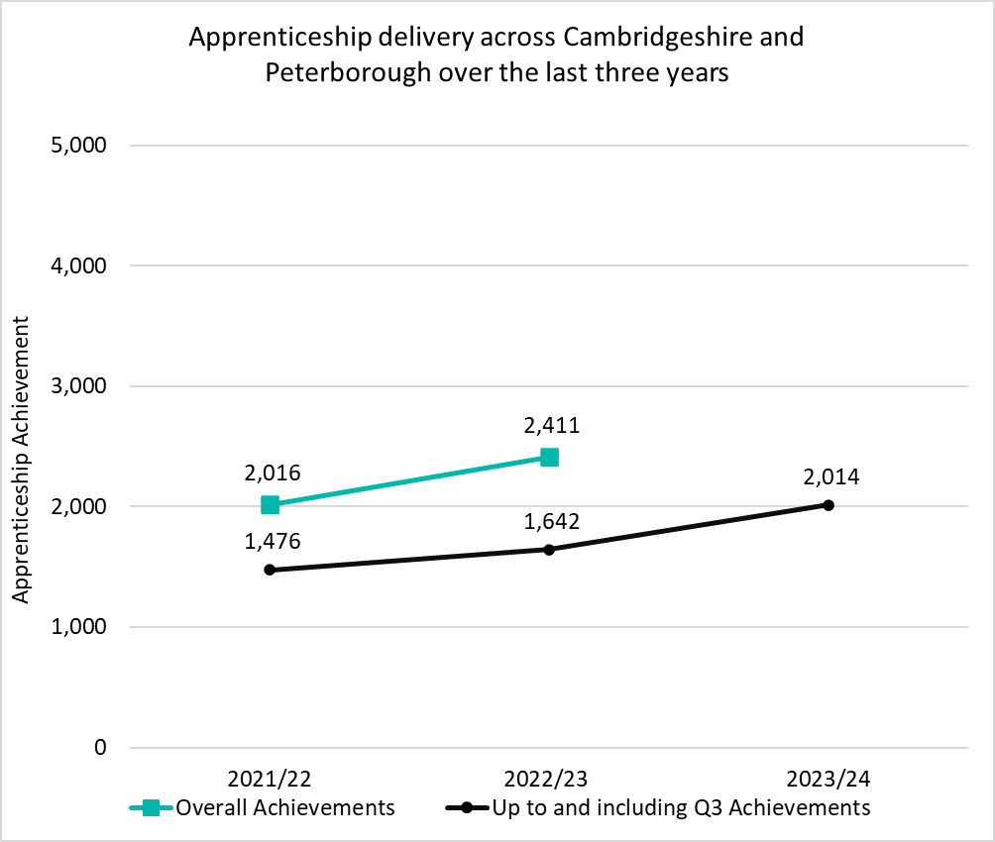
Delivery to date
Up to and including Q3 2023/24 (August 2023 – April 2024), there have been 2,014 apprenticeship achievements across Cambridgeshire and Peterborough.
This is +23% higher than the number of achievements up to and including Q3 of 2022/23, where there were 1,642 apprenticeship achievements. The vast majority of this increase has been driven by Medipro and Anglia Ruskin University.
Nationally, achievements increased by +7% when comparing Q23 of 2023/24 to Q3 of 2022/23.
*Apprenticeships take approximately 18-24 months to complete, and this timeline will have been impacted by COVID-19. Therefore, the number of achievements in each period do not necessarily correspond to the equivalent number of starts in a previous time period.
*Please note that differences in proportion of 1 percentage point are considered “in line”

Slide 18
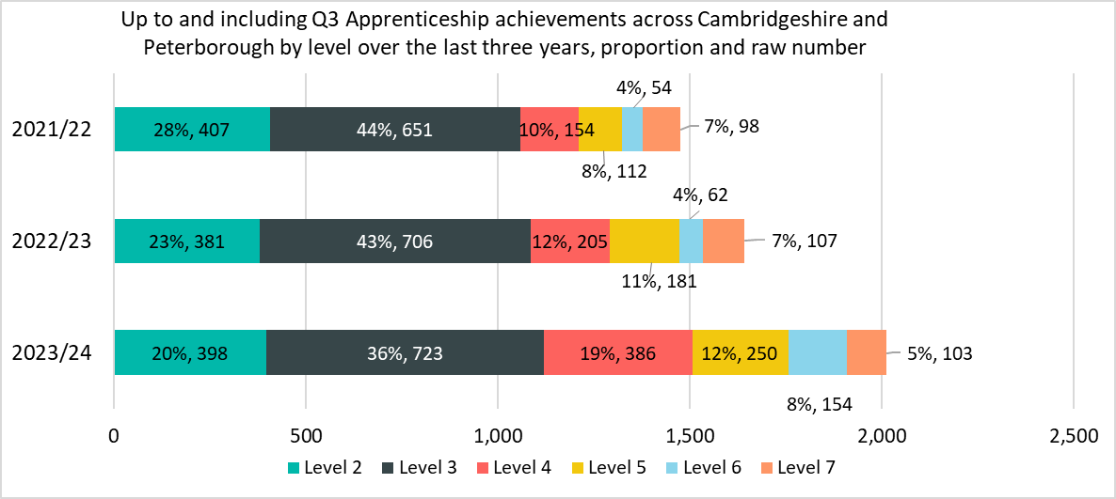
Achievement by level – quarter comparison
While the total number of achievements across the Cambridgeshire and Peterborough area increased up to and including Q3 of 2023/24, there is some variation between each level:
Level 4 (+181 achievements, +88%) saw the largest increase in achievements. This has been driven my Medipro, which took on apprentices from East of England Ambulance service after this provider ceased provision in 2021/22.
Level 7 saw the only decrease in achievements although this was very small (-4, -4%).
*Apprenticeships take approximately 18-24 months to complete, and this timeline will have been impacted by COVID-19. Therefore, the number of achievements in each period do not necessarily correspond to the equivalent number of starts in a previous time period.
*Please note that differences in proportion of 1 percentage point are considered “in line”

Slide 19
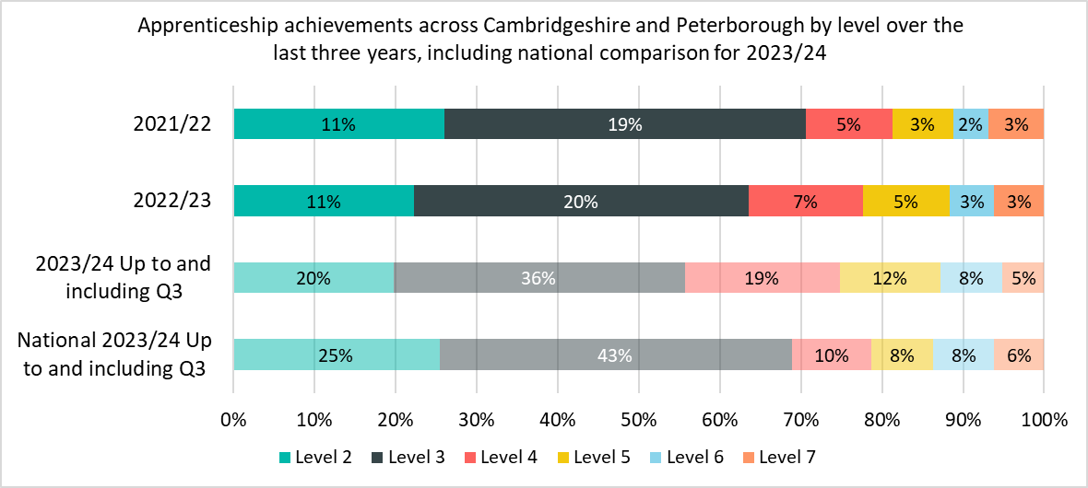
Achievement by level – national comparison
The notable differences for achievements by level up to and including Q3 between Cambridgeshire and Peterborough and nationally are
Cambridgeshire and Peterborough had a lower proportions of achievements in Level 2 apprenticeships (20% compared to 25% nationally) and Level 3 apprenticeships (36% compared to 43% nationally).
Cambridgeshire and Peterborough had a higher proportion of Level 4 apprenticeships (19% compared to 10% nationally).
*Apprenticeships take approximately 18-24 months to complete, and this timeline will have been impacted by COVID-19. Therefore, the number of achievements in each period do not necessarily correspond to the equivalent number of starts in a previous time period.
*Please note that differences in proportion of 1 percentage point are considered “in line”

Slide 20
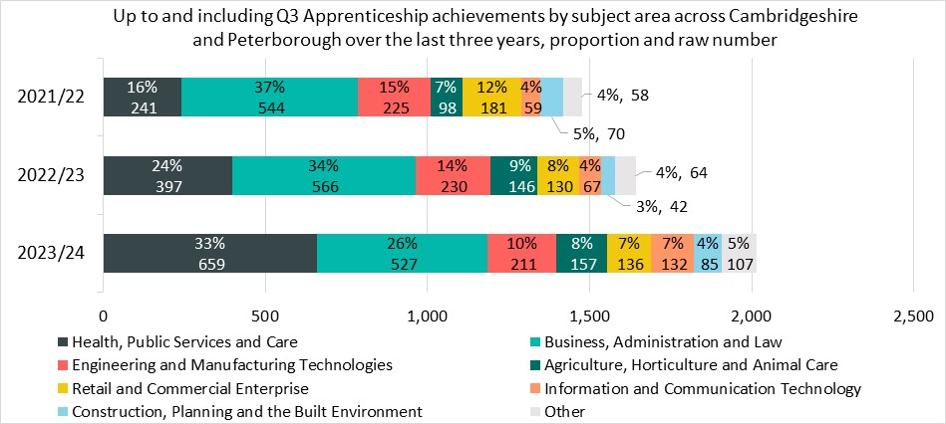
Achievement by subject area – quarter comparison
While the total number of achievements across the Cambridgeshire and Peterborough area increased up to and including Q3 of 2023/24, there is some variation between each subject area:
Health, Public Services and Care achievements saw the largest increase in achievements (+262, +66%) This has been driven by Medipro and Anglia Ruskin University.
Only two subject areas saw decreases: Engineering and Manufacturing and Technologies (-19, -8%) and Business, Administration and Law (-39, -7%).
*Apprenticeships take approximately 18-24 months to complete, and this timeline will have been impacted by COVID-19. Therefore, the number of achievements in each period do not necessarily correspond to the equivalent number of starts in a previous time period.
*Please note that differences in proportion of 1 percentage point are considered “in line”
*Other includes: Science & Mathematics, Education & Training, Arts, Media & Publishing, and Leisure, Travel & Tourism

Slide 21
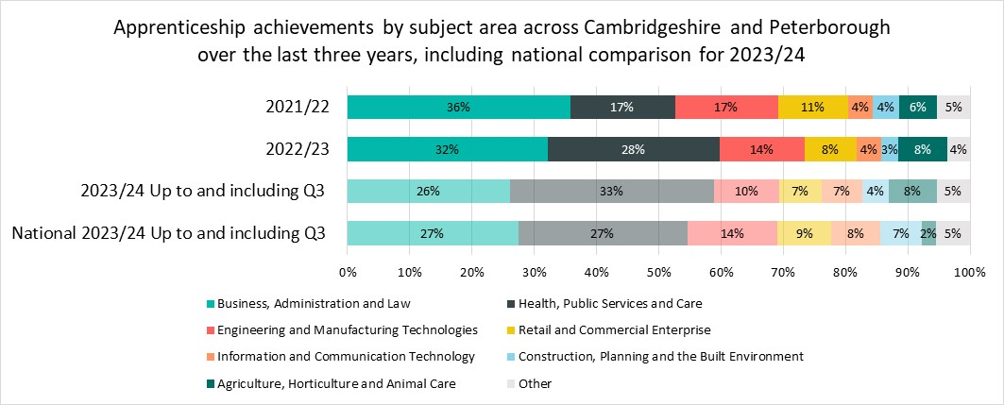
Achievement by subject area – national comparison
The notable differences for achievements by subject area up to and including Q3 between Cambridgeshire and Peterborough and nationally are
Cambridgeshire and Peterborough had a higher proportion of achievements in Health, Public Services and Care (33% vs 27% nationally) and Agriculture, Horticulture and Animal Care (8% vs 2% nationally).
Cambridgeshire and Peterborough saw a lower proportion of achievements in Construction, Planning and the Built Environment (4% vs 7% nationally) and Engineering and Manufacturing Technologies (10% vs 14% nationally)
*Apprenticeships take approximately 18-24 months to complete, and this timeline will have been impacted by COVID-19. Therefore, the number of achievements in each period do not necessarily correspond to the equivalent number of starts in a previous time period.
*Please note that differences in proportion of 1 percentage point are considered “in line”
*Other includes: Science & Mathematics, Education & Training, Arts, Media & Publishing, and Leisure, Travel & Tourism

Slide 22
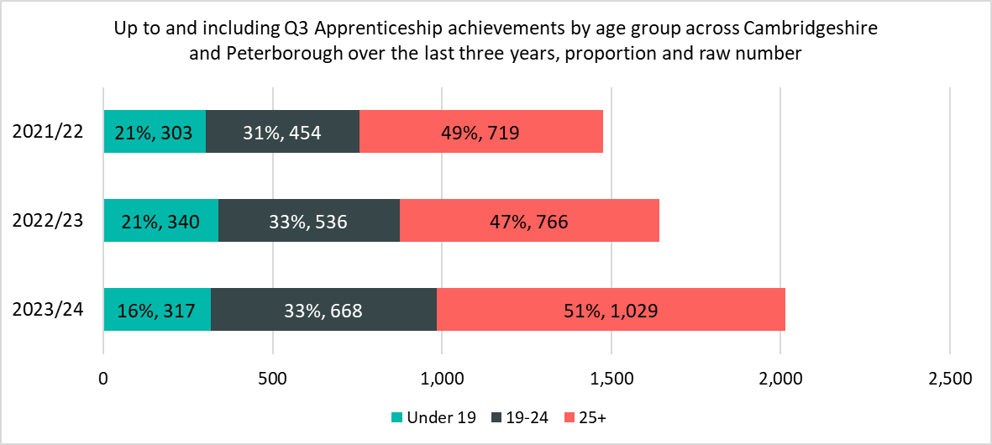
Achievement by age group – quarter comparison
The notable differences up to and including Q3 between 2022/23 and 2023/24 are
There has been a lower proportion (-5 percentage points) of apprenticeship achievements in 2023/24 among those aged under 19.
Whilst achievements across the Under 19 age group have decreased, the proportion decrease has mainly been driven by increases across 19-24 and 25+. These increases have been driven my Medipro and Anglia Ruskin University.
*Apprenticeships take approximately 18-24 months to complete, and this timeline will have been impacted by COVID-19. Therefore, the number of achievements in each period do not necessarily correspond to the equivalent number of starts in a previous time period.
*Please note that differences in proportion of 1 percentage point are considered “in line”

Slide 23
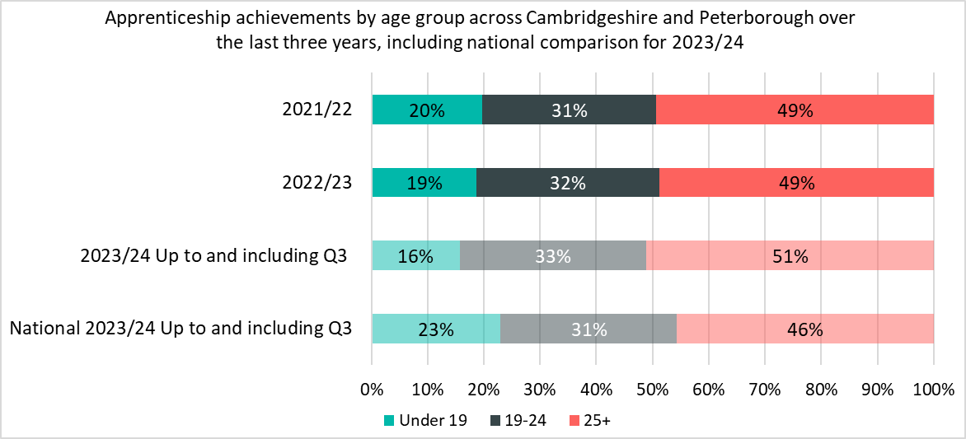
Achievement by age group – national comparison
The notable differences for achievements by age up to and including Q3 between Cambridgeshire and Peterborough and nationally are
There were a lower proportion of achievements in the Under 19 age group (16%) compared to nationally (23%).
There were higher proportions of achievements in the 19-24 (33%) compared to nationally (31%) and 25+ age groups (51%) compared to nationally (46%).
*Apprenticeships take approximately 18-24 months to complete, and this timeline will have been impacted by COVID-19. Therefore, the number of achievements in each period do not necessarily correspond to the equivalent number of starts in a previous time period.
*Please note that differences in proportion of 1 percentage point are considered “in line”

Slide 24
Achievement by providers
When looking at achievements up to and including Q3 of 2023/24, Medipro have substantially increased their number of achievements. This is due to an increase in Level 4 Heath and Social Care courses in light of Medripro taking on apprentices from East of England Ambulance Service which ceased provision in 2021.
When looking at the top five providers by achievements up to and including Q3 2023/24 compared to Q3 of 2022/23, the breakdown was similar with West Suffolk College the only provider not to feature in the top five in 2023/24
Top Five Providers by Achievements (Up to and including Q3 2023/24)
Provider | 2023/24 delivery to date (achievements) | % of Total 2023/24 achievements | 2022/23 delivery (achievements) | % Change between 2022/23 and 2023/24
MEDIPRO LIMITED | 242 | 12% | 54 | +348%
ANGLIA RUSKIN UNIVERSITY HIGHER EDUCATION CORPORATION | 199 | 10% | 75 | +165%
CAMBRIDGE REGIONAL COLLEGE | 146 | 7% | 183 | -20%
THE COLLEGE OF ANIMAL WELFARE LIMITED | 116 | 6% | 80 | +45%
INSPIRE EDUCATION GROUP | 84 | 4% | 59 | +42%
*Apprenticeships take approximately 18-24 months to complete, and this timeline will have been impacted by COVID-19. Therefore, the number of achievements in each period do not necessarily correspond to the equivalent number of starts in a previous time period.

