Slide 1
Apprenticeships delivered in the Greater Cambridge area, 2023/24 Academic Year
Policy and Insight Team – policyandinsight@cambridgeshire.gov.uk

Slide 2
Table of Contents
Purpose
Approach
Executive Summary
Overall Delivery
Starts
Starts by level
Starts by subject area
Starts by age group
Starts by provider
Achievements
Achievements by level
Achievements by subject area
Achievements by age group
Achievements by provider

Slide 3
Purpose
To analyse the starts and achievements of apprenticeships in the Greater Cambridge area.
This is to help achieve the Greater Cambridge Partnership (GCP)’s aim to inspire and develop the future workforce so that businesses can access a workforce with the right skills.

Slide 4
2. Approach
The data in this slide pack is sourced from the GOV.UK Apprenticeship and Traineeship Statistical First Release.
This is publicly available data accessible through this link: Apprenticeships, Academic year 2023/24 – Explore education statistics – GOV.UK (explore-education-statistics.service.gov.uk)
There are two approaches for analysing apprenticeships:
The first approach is learner location-based, which looks at the delivery of apprenticeships to learners residing in Greater Cambridge regardless of delivery location. This analysis will include learners who travel outside of the Greater Cambridge region for learning.
The second approach is delivery location-based, which looks at the delivery of apprenticeships where the provider is based within Greater Cambridge. This analysis will include learners who reside outside of Greater Cambridge but travel into the region for learning.
This slide pack uses the latter delivery location-based approach.

Slide 5
3. Executive Summary - Starts
Overview
Little change in overall starts - Starts across Greater Cambridge in 2023/24 slightly decreased by -2.0% (-45) from the starts in 2022/23. This suggests that apprenticeship demand may be plateauing.
By level
Starts by Level 3 and Level 6 apprenticeships increased and starts by Level 4 and Level 5 apprenticeships decreased - Level 3 starts increased by +9% (+65), and Level 6 starts increased by +15% (+47). However, Level 4 starts decreased by -19% (-68), and Level 5 starts decreased by -21% (-64 starts). Greater Cambridge has a higher proportion of Level 4-7 starts than nationally (51% vs 36%). This may reflect the higher skills levels and demands of the region.
By subject area
Engineering and Manufacturing Technologies increased and Health, Public Services and Care decreased – In 2023/24, starts by subject area have remained broadly similar to previous year across Greater Cambridge. The most notable shift has been an increase in Engineering and Manufacturing Technologies by +23% (+45) and a decrease in Health, Public Services and Care starts by -13% (-92). The overall subject area breakdown is also generally in line with national data except for Agriculture, Horticulture, and Animal care having a slightly higher proportion than national (4% vs 2%) and Engineering and Manufacturing Technologies having a slightly lower proportion than national (11% vs 13%).
By age
Starts for Under 19 age group increased and starts for the 19-24 and 25+ age groups decreased - Starts for the Under 19 age group increased by 17% (+66) and starts for the 19-24 and 25+ age groups decreased (-7, -1% and -104, -9% respectively). Compared to the national level, the Under 19 age group has a lower proportion of starts (21% vs 23%) and the 19-24 age group has a higher proportion of starts (31% vs 28%).
By provider
Top five providers - The top five providers for starts remain similar to previous years. Medipro, whilst remaining in the top five, has substantially decreased provision by -44% (-61) in the last year. This is due to an influx in the previous year of apprentices that the provider took on from East of England Ambulance Service, which ceased provision in 2021/22.

Slide 6
3. Executive Summary – Achievements
Overview
Increase in overall achievements - Achievements across Greater Cambridge in 2023/24 have increased from 2022/23 by +14.0% (+174). Although achievements have also increased nationally, the national increase of +9.8% is smaller. The Greater Cambridge increase has been driven by Medipro, a provider which took on apprentices from East of England Ambulance Service (EEAS) after EEAS ceased provision in 2021/22. This has had implications for level and subject area breakdowns.
By level
Achievements in Level 4 and Level 7 increased and achievements in Level 2, 3, and 5 decreased - Level 4 achievements have substantially increased from the previous year by +73% (+163). This is due to apprenticeship achievements delivered by Medipro. Level 7 achievements also increased by +33% (+36). However, Level 2 achievements decreased by -14% (-28), Level 3 achievements decreased by -8% (-34), and Level 5 achievements decreased by -5% (-8). Greater Cambridge has a higher proportion of Level 4-7 apprenticeship achievements than nationally (59% vs 33%). This may reflect the higher skills levels and demands of the region.
By subject area
Engineering and Manufacturing Technologies decreased and Health, Public Services and Care increased - Achievements in Engineering and Manufacturing Technologies decreased by -23% (-37), and achievements in Health, Public Services and Care increased by +34% (+142). The increase in Health, Public Services and Care was driven by Medipro. As a result, Greater Cambridge has a much higher proportion of achievements in Health, Public Services and Care than nationally (39% vs 27%). Engineering and Manufacturing Technologies is the most notable subject area to have a smaller share of achievements across Greater Cambridge than nationally (9% vs 14%).
By age
Achievements in the Under 19 age group decrease and achievements in the 19-24 and 25+ age groups increase - Achievements in the Under 19 age group decreased by -13% (-27), and achievements in the 19-24 and 25+ age groups increased (+84, +20% and +117, +19% respectively). As a result of this, Greater Cambridge has a lower proportion of achievements across those Under 19 age group than nationally (13% vs 23%) but a higher proportion across the 19-24 and 25+ age groups than nationally (51% vs 46% and 36% vs 32% respectively).
By provider
Top five providers - The top five providers for achievements remain similar to previous years with any changes generally driven by Medipro, which is currently the top provider for achievements. Medipro made up 21% of total achievements from all providers in 2023/24.

Slide 7
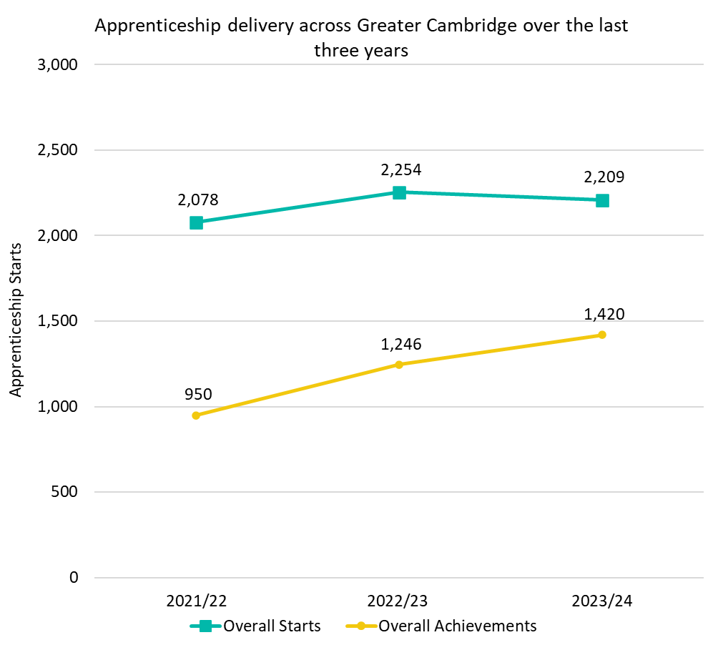
4. Overall Delivery
In the 2023/24 academic year (August 2023 – July 2024), there were 2,209 apprenticeship starts across Greater Cambridge. This is a slight decrease (-45; -2.0%) from 2022/23 where there were 2,254 starts.
At a national level, starts were in line when comparing 2022/23 to 2023/24.
In the 2023/24 academic year, there were 1,420 apprenticeship achievements across Greater Cambridge. This was a +14.0% (+174) increase from 2022/23 where there were 1,246 achievements.
At a national level, achievements increased by +9.8% from 2022/23.

Slide 8
5. Starts

Slide 9
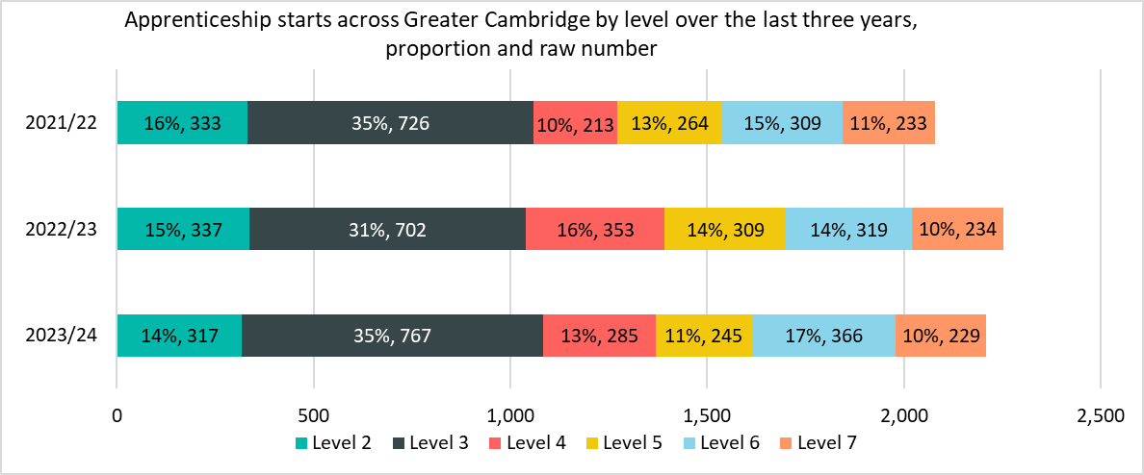
Starts by level
The notable differences between 2022/23 and 2023/24 are
Level 3 and Level 6 had the only increase in starts (Level 3: +65 starts, +9%; Level 6: +47 starts, +15%).
The proportion of Level 3 starts increased by 4 percentage points (pp) from 31% to 35%.
Level 4 and Level 5 had the largest raw number and percentage decreases in starts (Level 4: -68 starts, -19%; Level 5: -64 starts, -21%).
The proportion of Level 4 starts decreased by -3pp from 16% to 13%.
*Please note that differences in proportion of 1 percentage point are considered “in line”

Slide 10
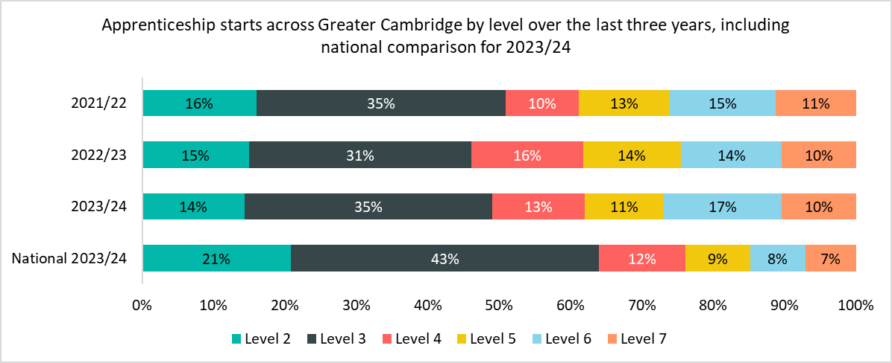
Starts by level – national comparison
Greater Cambridge has a higher proportion of Level 4-7 starts than nationally (51% vs 36%). The most notable differences when comparing to the national breakdown are
Greater Cambridge had a higher proportion of starts in Level 6 apprenticeships (17% vs 8% nationally) and Level 7 apprenticeships (10% vs 7% nationally).
Greater Cambridge had a lower proportions of starts in Level 2 apprenticeships (14% vs 21% nationally) and Level 3 apprenticeships (35% vs 43% nationally).
*Please note that differences in proportion of 1 percentage point are considered “in line”

Slide 11
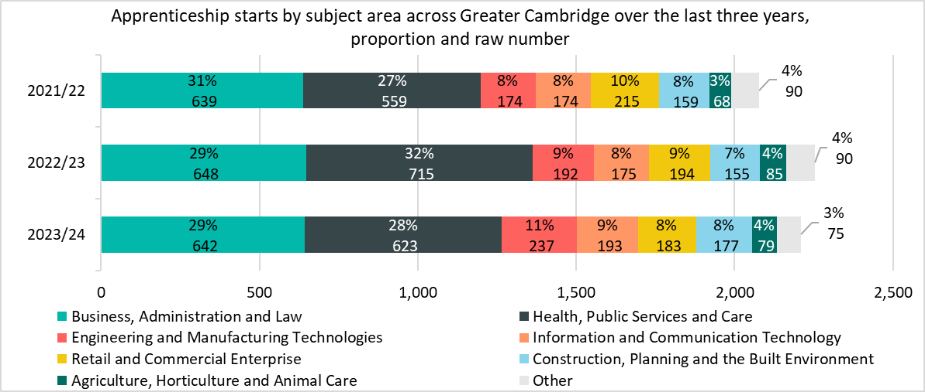
Starts by subject area
The notable differences between 2022/23 and 2023/24 are
Engineering and Manufacturing Technologies had the largest raw number and percentage increase in starts (+45 starts, +23%). The proportion of total starts also increased from 9% to 11%.
Health, Public Services and Care had the largest raw number and percentage decrease in starts (-92 starts, -13%).
*Please note that differences in proportion of 1 percentage point are considered “in line”
*Other includes Science & Mathematics, Education & Training, Arts, Media & Publishing, and Leisure, Travel & Tourism.

Slide 12
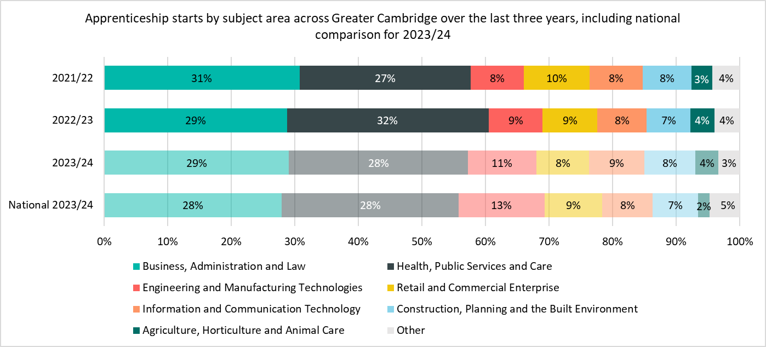
Starts by subject area – national comparison
The notable differences for starts by subject area between Greater Cambridge and nationally are
Greater Cambridge had a higher proportion of starts in Agriculture, Horticulture and Animal Care (4% vs 2% nationally).
Greater Cambridge had a lower proportion of starts in Engineering and Manufacturing Technologies subject area (11% vs 13% nationally).
*Please note that differences in proportion of 1 percentage point are considered “in line”
*Other includes Science & Mathematics, Education & Training, Arts, Media & Publishing, and Leisure, Travel & Tourism.

Slide 13
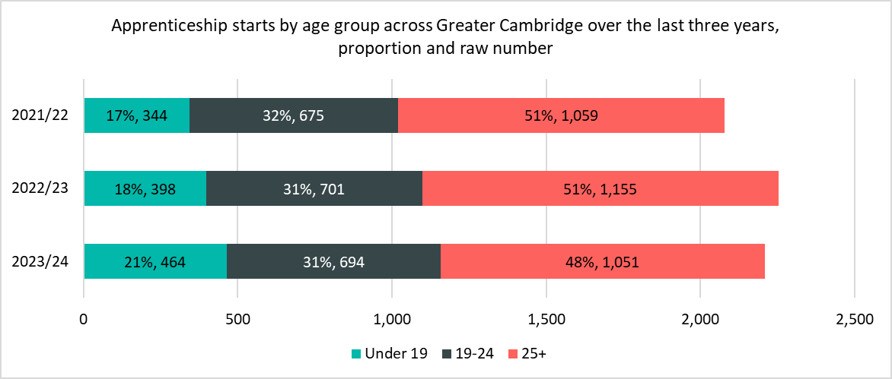
Starts by age group
The notable differences between 2022/23 and 2023/24 are
The Under 19 age group is the only age group to have an increase in starts (+66 starts, +17%).
The proportion of those in the Under 19 age group increased by +3pp from 18% in 2022/23 to 21% in 2023/24.
Starts for 19-24 age group decreased (-7 starts, -1%) and starts for the 25+ age group also decreased (-104 starts, -9%).
The proportion of those in the 25+ age group decreased by -3pp from 51% in 2022/23 to 48% in 2023/24.
*Please note that differences in proportion of 1 percentage point are considered “in line”

Slide 14
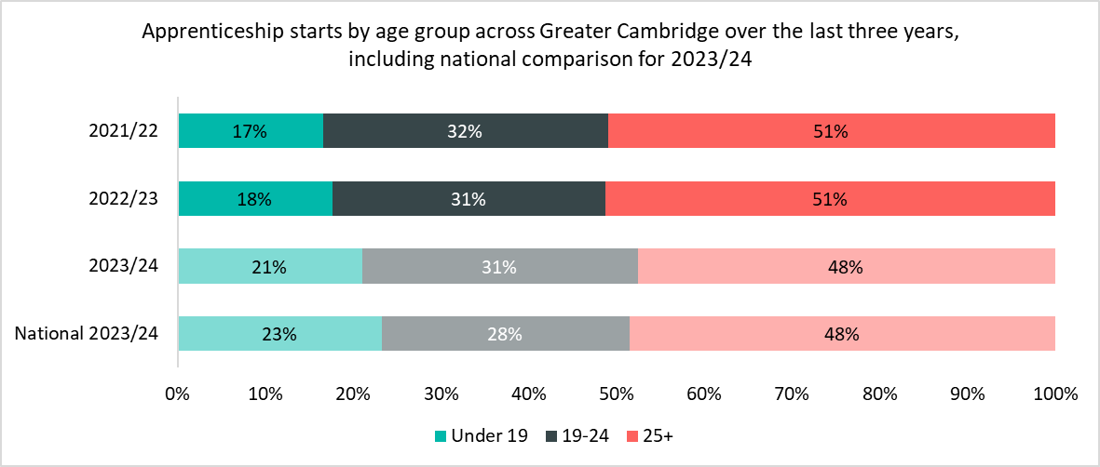
Starts by age group – national comparison
The notable differences for starts between Greater Cambridge and nationally are
There was a higher proportion of Great Cambridge starts across the 19-24 age group compared to nationally (31% vs 28%).
There were a lower proportion of starts in Greater Cambridge across the Under 19 age group compared to nationally (21% vs 23%).
*Please note that differences in proportion of 1 percentage point are considered “in line”

Slide 15
Starts by provider
The largest provider in Greater Cambridge in 2023/24 was Anglia Ruskin University, which accounted for 18% (394) of all starts - this is an increase of +1% from the same period last year.
Whilst still in the top five providers, MediPro Limited have had a substantial drop in provision with -44% less starts when compared to the previous year.
Top Five Providers by Starts
Provider | 2023/24 delivery (starts) | % of Total 2023/24 starts | 2022/23 delivery (starts) | % Change between 2022/23 and 2023/24
ANGLIA RUSKIN UNIVERSITY HIGHER EDUCATION CORPORATION (10000291) | 394 | 18% | 392 | +1%
CAMBRIDGE REGIONAL COLLEGE (10001116) | 291 | 13% | 280 | +4%
FIRST INTUITION CAMBRIDGE LIMITED (10030926) | 79 | 4% | 58 | +36%
WEST SUFFOLK COLLEGE (10007431) | 79 | 4% | 88 | -10%
MEDIPRO LIMITED (10023428) | 78 | 4% | 139 | -44%
*Please note that differences in proportion of 1 percentage point are considered “in line”

Slide 16
6. Achievements

Slide 17
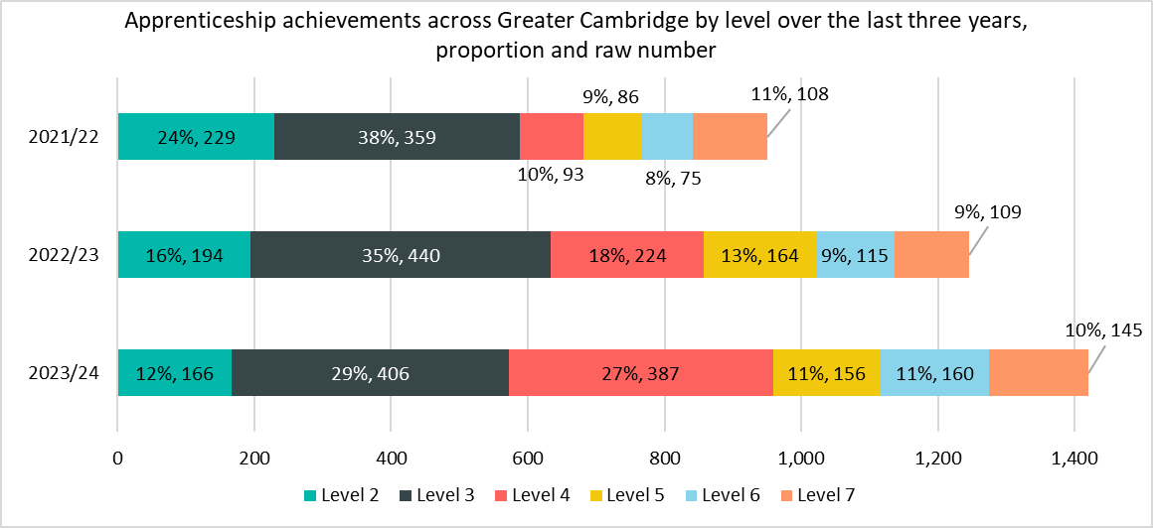
Achievements by level
The notable differences between 2022/23 and 2023/24 are
Level 4 apprenticeships had the largest raw number and percentage increase in achievements (+163, +73%). This has been driven my Medipro, which has taken on apprentices from East of England Ambulance Service.
The proportion of Level 4 apprenticeships increased by +9pp from 18% to 27%.
Level 7 apprenticeships also increased (+36, 33%).
Level 2, Level 3, and Level 5 apprenticeships had decreases (Level 2: -28, -14%; Level 3: -34, -8%; Level 5: -8, -5%).
The proportion of Level 2 apprenticeships decreased by -4pp from 16% to 12%.
The proportion of Level 3 apprenticeships decreased by -6pp from 35% to 29%.
The proportion of Level 5 apprenticeships decreased by -2pp from 13% to 11%.
*Apprenticeships take approximately 18-24 months to complete, and this timeline will have been impacted by COVID-19. Therefore, the number of achievements in each period do not necessarily correspond to the equivalent number of starts in a previous time period.
*Please note that differences in proportion of 1 percentage point are considered “in line”

Slide 18
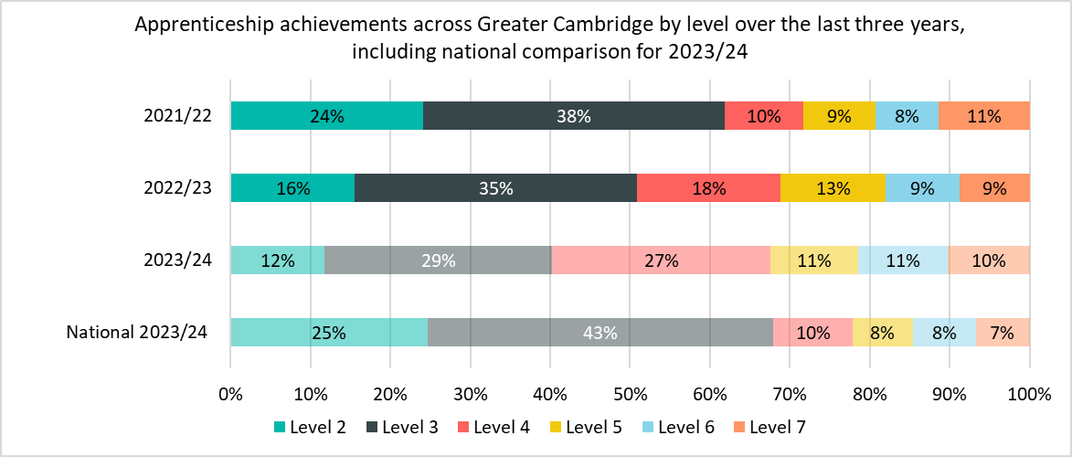
Achievements by level – national comparison
Greater Cambridge has a higher proportion of achievements at higher levels of apprenticeship (Level 4-7) than nationally (59% vs 33%) and a lower proportion of achievements at lower level apprenticeships (Level 2-3) than nationally (41% vs 68%).
Greater Cambridge had a higher proportion of achievements in Level 6 apprenticeships (11% vs 8% nationally) and Level 7 apprenticeships (10% vs 7% nationally).
Greater Cambridge had a lower proportions of achievements in Level 2 apprenticeships (12% vs 25% nationally) and Level 3 achievements (29% vs 43% nationally).
*Apprenticeships take approximately 18-24 months to complete, and this timeline will have been impacted by COVID-19. Therefore, the number of achievements in each period do not necessarily correspond to the equivalent number of starts in a previous time period.
*Please note that differences in proportion of 1 percentage point are considered “in line”

Slide 19
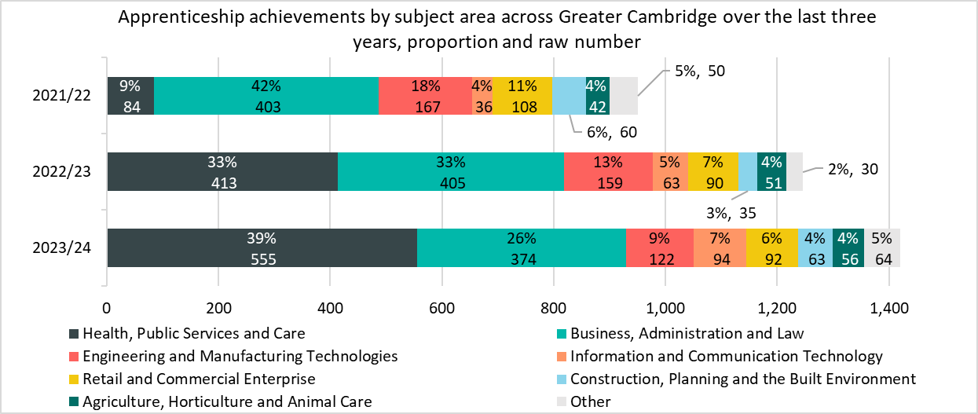
Achievements by subject area
The notable differences between 2022/23 and 2023/24 are
Engineering and Manufacturing Technologies had the largest raw number and percentage decrease in achievements (-37, -23%).
Health Public Services and Care had by far the largest increase in achievements (+142, +34%), increasing the share of achievements from 33% to 39% (+6pp). This has been driven my Medipro, which has taken on apprentices from East of England Ambulance Service.
*Apprenticeships take approximately 18-24 months to complete, and this timeline will have been impacted by COVID-19. Therefore, the number of achievements in each period do not necessarily correspond to the equivalent number of starts in a previous time period.
*Please note that differences in proportion of 1 percentage point are considered “in line”
*Other includes Science & Mathematics, Education & Training, Arts, Media & Publishing, and Leisure, Travel & Tourism.

Slide 20
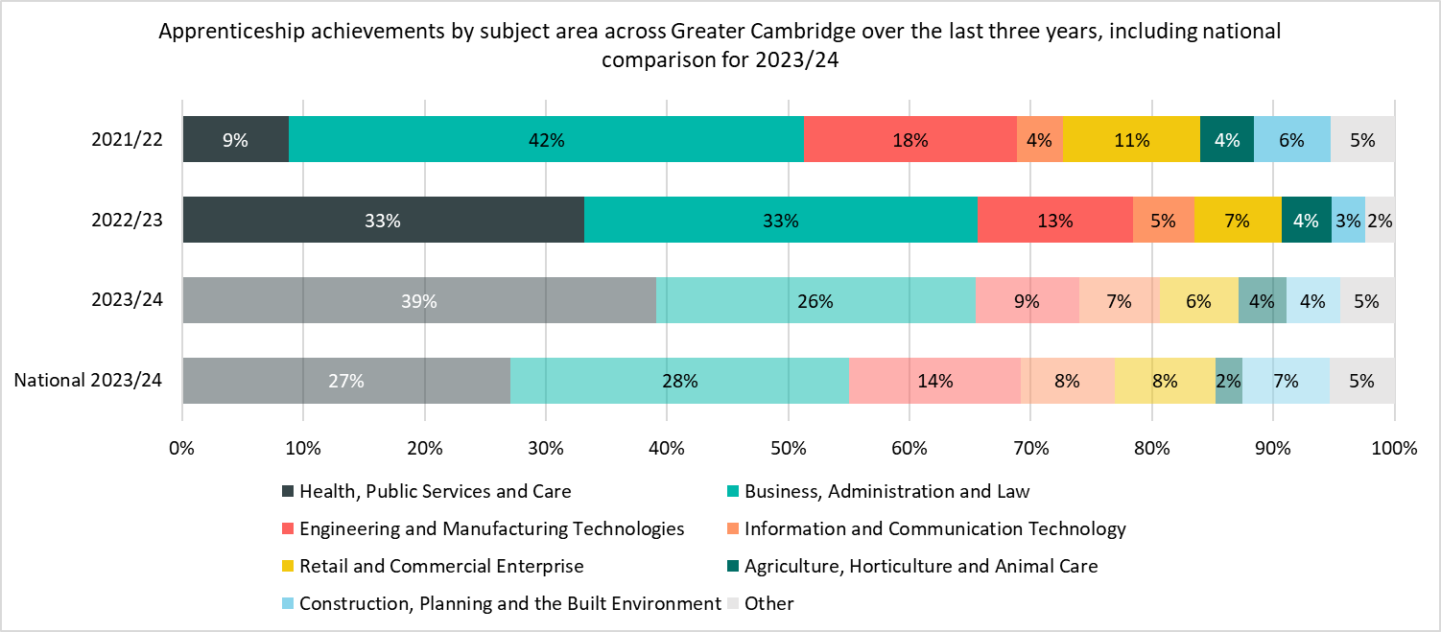
Achievements by subject area – national comparison
The most notable differences for achievements by subject area between Greater Cambridge and nationally are
Greater Cambridge had a much higher proportion of achievements in Health, Public Services and Care (39% vs 27% nationally).
Greater Cambridge had a lower proportion of achievements in Engineering and Manufacturing Technologies subject area (9% vs 14% nationally).
*Apprenticeships take approximately 18-24 months to complete, and this timeline will have been impacted by COVID-19. Therefore, the number of achievements in each period do not necessarily correspond to the equivalent number of starts in a previous time period.
*Please note that differences in proportion of 1 percentage point are considered “in line”
*Other includes Science & Mathematics, Education & Training, Arts, Media & Publishing, and Leisure, Travel & Tourism.

Slide 21
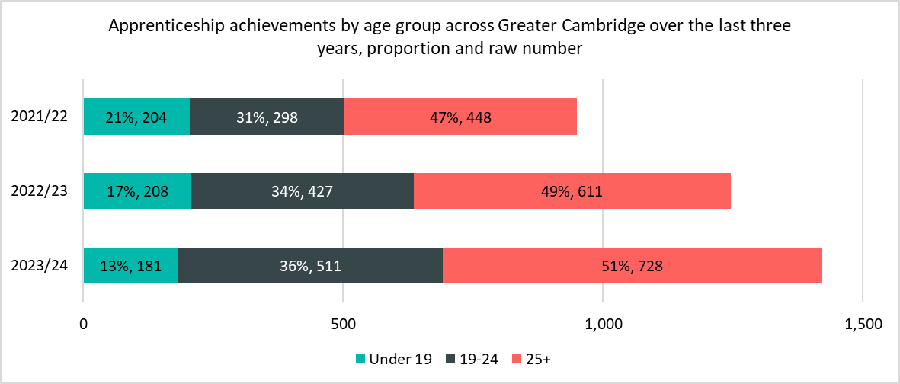
Achievements by age group
The notable differences between 2022/23 and 2023/24 are
Both the 19-24 and 25+ age groups had substantial increases in the number of achievements (+84, +20% and +117, +19% respectively).
Under 19 is the only age group to have a decrease in achievements (-27, -13%) resulting in a -4pp decrease in proportion share from 17% to 13%.
*Apprenticeships take approximately 18-24 months to complete, and this timeline will have been impacted by COVID-19. Therefore, the number of achievements in each period do not necessarily correspond to the equivalent number of starts in a previous time period.
*Please note that differences in proportion of 1 percentage point are considered “in line”

Slide 22
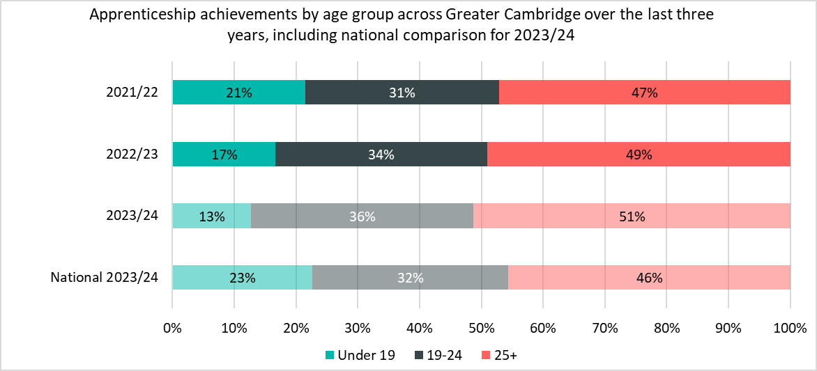
Achievements by age group – national comparison
The notable differences for achievements between Greater Cambridge and nationally are
There was a higher proportion of Greater Cambridge achievements across the 25+ age group (51% vs 46% nationally) and across the 19-24 age group (36% vs 32% nationally).
There was a lower proportion of Greater Cambridge achievements across the Under 19 age group (13% vs 23% nationally).
*Apprenticeships take approximately 18-24 months to complete, and this timeline will have been impacted by COVID-19. Therefore, the number of achievements in each period do not necessarily correspond to the equivalent number of starts in a previous time period.
*Please note that differences in proportion of 1 percentage point are considered “in line”

Slide 23
Achievements by provider
The largest provider in Greater Cambridge for achievements in 2023/24 is Medipro Limited, which accounted for 21% (292) of total achievements from all providers.
This is a large increase of +118% from the same period last year and has been driven by Medipro taking on Health, Public Services and Care apprentices from East of England Ambulance Service which ceased provision in 2021/22.
Top Five Providers by Achievements
Provider | 2023/24 delivery to date (achievements) | % of Total 2023/24 achievements | 2022/23 delivery (achievements) | % Change between 2022/23 and 2023/24
MEDIPRO LIMITED | 292 | 21% | 134 | +118%
ANGLIA RUSKIN UNIVERSITY HIGHER EDUCATION CORPORATION | 191 | 13% | 147 | +30%
CAMBRIDGE REGIONAL COLLEGE | 184 | 13% | 243 | -24%
FIRST INTUITION CAMBRIDGE LIMITED | 44 | 3% | 45 | -2%
WEST SUFFOLK COLLEGE | 41 | 3% | 39 | +5%
*Apprenticeships take approximately 18-24 months to complete, and this timeline will have been impacted by COVID-19. Therefore, the number of achievements in each period do not necessarily correspond to the equivalent number of starts in a previous time period.
*Please note that differences in proportion of 1 percentage point are considered “in line”

