Slide 1
Apprenticeships delivered in the Cambridgeshire and Peterborough area, 2023/24 Academic Year
Policy and Insight Team – policyandinsight@cambridgeshire.gov.uk

Slide 2
Table of Contents
Purpose
Approach
Executive Summary
Overall Delivery
Starts
Starts by level
Starts by subject area
Starts by age group
Starts by provider
Achievements
Achievements by level
Achievements by subject area
Achievements by age group
Achievements by provider

Slide 3
1. Purpose
To analyse the starts and achievements of apprenticeships in the Cambridgeshire and Peterborough area.
This is to help achieve the Cambridgeshire and Peterborough Combined Authority (CPCA)’s ambition to provide the UK’s most technically skilled workforce.

Slide 4
2. Approach
The data in this slide pack is sourced from the GOV.UK Apprenticeship and Traineeship Statistical First Release.
This is publicly available data accessible through this link: Apprenticeships, Academic year 2023/24 – Explore education statistics – GOV.UK (explore-education-statistics.service.gov.uk)
There are two approaches for analysing apprenticeships:
The first is learner location-based, which looks at the delivery of apprenticeships to learners residing in Cambridgeshire and Peterborough regardless of delivery location. This analysis will include learners who travel outside of the Cambridgeshire and Peterborough region for learning.
The second approach is delivery location-based, which looks at the delivery of apprenticeships where the provider is based within Cambridgeshire and Peterborough. This analysis will include learners who reside outside of Cambridgeshire and Peterborough but travel into the region for learning.
This slide pack uses the latter delivery location-based approach.

Slide 5
3. Executive Summary - Starts
Overview
Little change in overall starts - Starts across Cambridgeshire and Peterborough in 2023/24 slightly decreased by -1.0% (-48) from the starts in 2022/23. This suggests that apprenticeship demand may be plateauing.
By level
Starts by Level 6 apprenticeships increased and starts by Level 2 apprenticeships decreased- Level 6 starts increased by +18% (+84), and Level 2 starts decreased by -11% (-110). Cambridgeshire and Peterborough has a slightly higher proportion of Level 4-7 starts than nationally (42% vs 36%). This may reflect the higher skills levels and demands of the region.​
By subject area
Information and Communication Technology increased and Agriculture, Horticulture and Animal Care decreased - Starts by subject area in 2023/24 have remained in line with the previous year across Cambridgeshire and Peterborough. The most notable shift has been an increase in Information and Communication Technology starts by +12% (+40) and a decrease in Agriculture, Horticulture and Animal Care starts by -17% (-56). The overall subject area breakdown is also generally in line with national data except for Agriculture, Horticulture, and Animal care having a higher proportion than national (5% vs 2%) and Engineering and Manufacturing Technologies having a slightly lower proportion than national (11% vs 13%).​
By age
Starts for Under 19 age group increased and starts for the 19-24 and 25+ age groups decreased - Starts for the Under 19 age group increased by 4% (+44) and starts for the 19-24 and 25+ age groups decreased (-21, -1% and -71, -3% respectively). Compared to the national level, the Under 19 age group has a lower proportion of starts (21% vs 23%) and the 19-24 age group has a higher proportion of starts (30% vs 28%).​
By provider
Top five providers - The top five providers for starts remains similar to previous years. Anglia Ruskin University had the largest increase in starts over the last year in the top 5 by +12% (+59). Inspire Education Group had the largest decrease in starts over the last year in the top 5 by -45% (-143).

Slide 6
3. Executive Summary – Achievements
Overview
Increase in overall achievements - Achievements across Cambridgeshire and Peterborough in 2023/24 have increased from 2022/23 by +18.0% (+436). Although achievements have also increased nationally, the national increase of +9.8% is smaller. The local increase has been driven by two providers: Medipro, a provider which took on apprenticeships from East of England Ambulance Service which ceased provision in 2021/22, and Anglia Ruskin University. This has had implications for level and subject area breakdowns.
By level
Increase in achievements over all levels - Achievements increased across all levels. Level 4 (+177 achievements, +52%) had the largest increase in achievements. This is due to apprenticeship achievements delivered by Medipro. Cambridgeshire and Peterborough had a higher proportion of achievements at Level 4-5 apprenticeships than nationally (30% vs 18%). Cambridgeshire and Peterborough had a lower proportions of achievements in Level 2 apprenticeships (19% vs 25% nationally) and Level 3 apprenticeships (38% vs 43% nationally).
By subject area
Engineering and Manufacturing Technologies only subject area to decrease - Engineering and Manufacturing Technologies had the only decrease (-40, -12%) over all subject areas. Health, Public Services and Care achievements increased (+232, +35%). This has been driven my Medipro and Anglia Ruskin University. Information and Communication Technology achievements increased (+89, +92%), and Business, Administration and Law also increased (+56, +84%).
By age
Increase in achievements across all age groups - The Under 19, 19-24, and 25+ age groups all had increases of 1% (+3), 22% (+176), and 22% (+257) respectively. In comparing to the national level, there were higher proportions of achievements in the 19-24 age group (34% vs 32% nationally) and 25+ age group (50% vs 46% nationally).​ There were a lower proportion of achievements in the Under 19 age group (16% vs 23% nationally).
By provider
Top five providers - The top five providers for achievements remain similar to previous years. Medipro had the highest increase in achievements over the past year in the top five providers (+158, +118%). There was also an increase in achievements in the past year in the top five providers for Anglia Ruskin University (+98, +67%), The College of Animal Welfare (+47, +39%), and Inspire Education Group (+48, +51%). Cambridge Regional College was the only provider in the top five providers to have a decrease over the past year (-59, -24%).

Slide 7
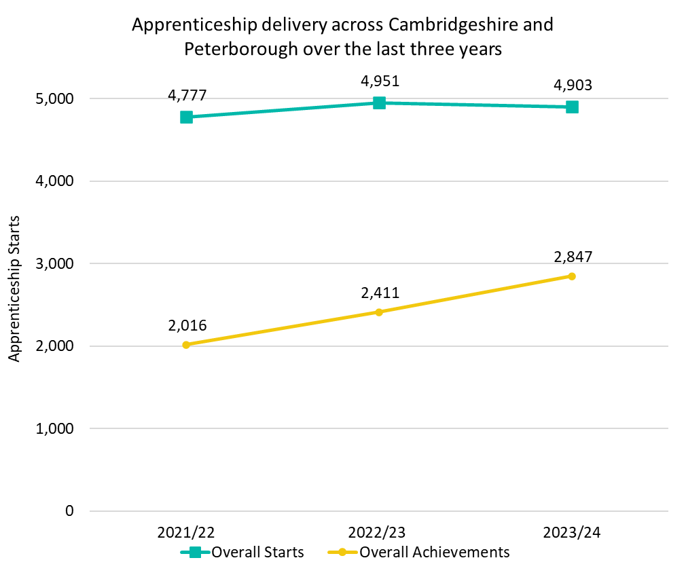
4. Overall Delivery
In the 2023/24 academic year (August 2023 – July 2024), there have been 4,903 apprenticeship starts across Cambridgeshire and Peterborough. This is a slight decrease (-48; -1.0%) from 2022/23 where there were 4,951 starts.
At a national level, starts were also in line when comparing 2022/23 to 2023/24.
In the 2023/24 academic year, there were 2,847 apprenticeship achievements across Cambridgeshire and Peterborough. This was a +18.0% (+436) increase from 2022/23 where there were 2,411 achievements.
At a national level, achievements increased by +9.8% from 2022/23.
*Please note that differences in proportion of 1 percentage point are considered “in line”

Slide 8
5. Starts

Slide 9
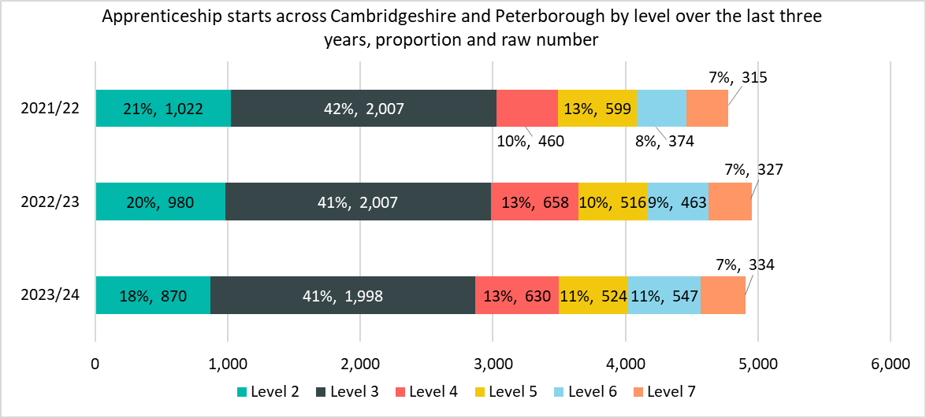
Starts by level
The notable differences between 2022/23 and 2023/24 are
Level 6 (+84 starts, +18%) had the largest raw number and percentage increase in starts.
The proportion of Level 6 starts increased by 2 percentage points (pp) from 9% to 11%.
Level 2 (-110 starts, -11%) had the largest raw number and percentage decrease in starts.
The proportion of Level 2 starts decreased by 2 percentage points (pp) from 20% to 18%.
*Please note that differences in proportion of 1 percentage point are considered “in line”

Slide 10
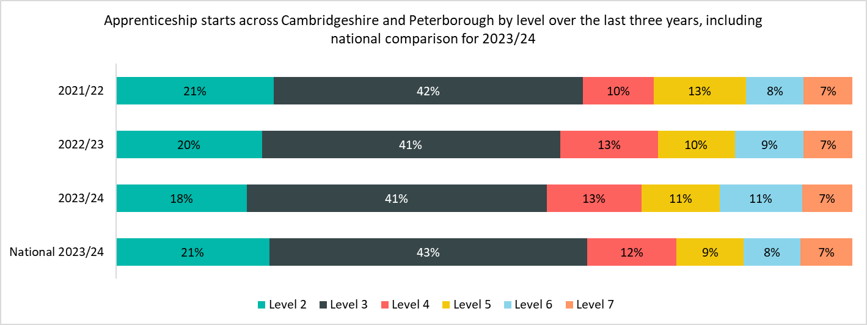
Starts by level – national comparison
Cambridgeshire and Peterborough has a slightly higher proportion of Level 4-7 starts than nationally (42% vs 36%). The most notable differences when comparing to the national breakdown are
Cambridgeshire and Peterborough had a higher proportion of starts in Level 6 apprenticeships (11% vs 8% nationally).
Cambridgeshire and Peterborough had a lower proportion of starts in Level 2 apprenticeships (18% vs 21% nationally).
*Please note that differences in proportion of 1 percentage point are considered “in line”

Slide 11
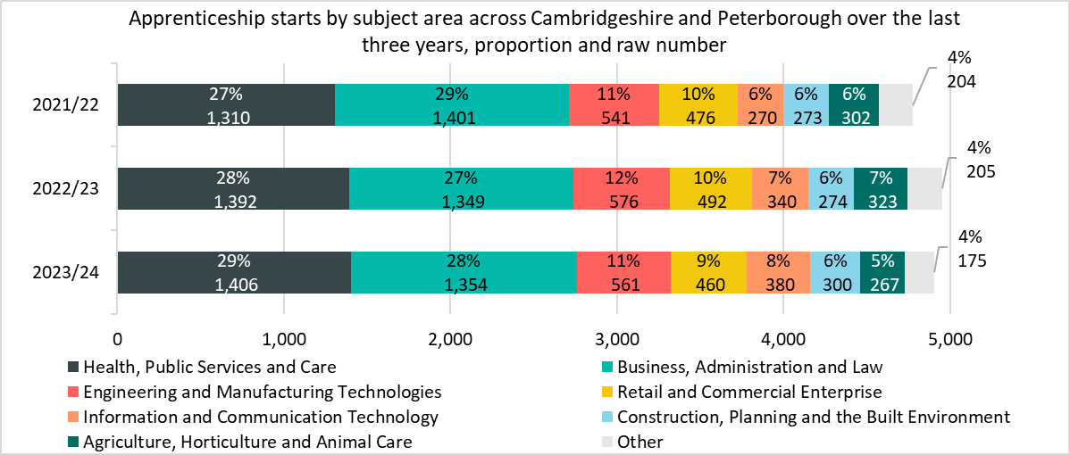
Starts by subject area
The notable differences between 2022/23 and 2023/24 are
Information and Communication Technology had the largest percentage and raw number increase in starts (+40 starts, +12%).
Agriculture, Horticulture and Animal Care had the largest percentage and raw number decrease in starts (-56 starts, -17%). The proportion of starts within Agriculture, Horticulture and Animal Care decreased by 2pp from 7% to 5%.
*Please note that differences in proportion of 1 percentage point are considered “in line”
*Other includes Science & Mathematics, Education & Training, Arts, Media & Publishing, and Leisure, Travel & Tourism.

Slide 12
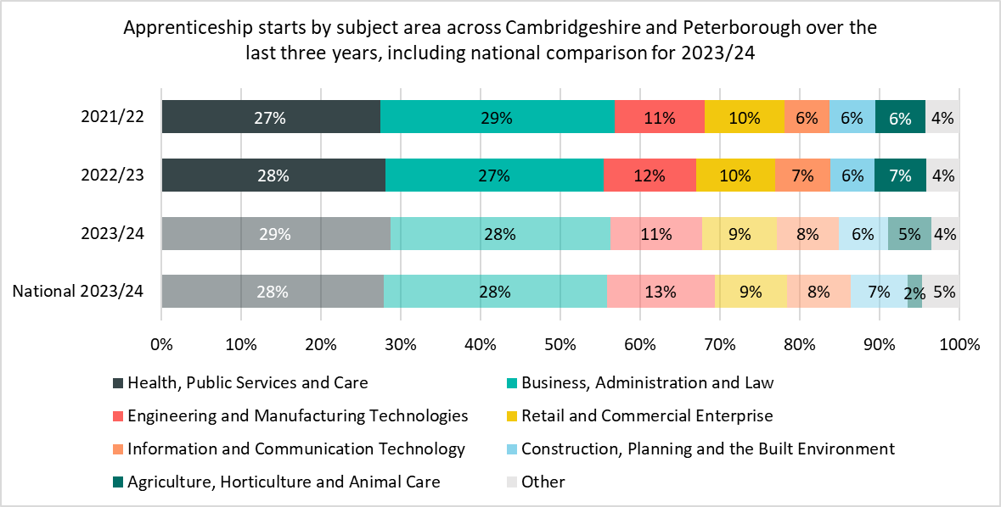
Starts by subject area – national comparison
The notable differences for starts by subject area between Cambridgeshire and Peterborough and nationally are
Cambridgeshire and Peterborough had a higher proportion of starts in Agriculture, Horticulture and Animal Care (5% vs 2% nationally). This is likely driven by demand for agriculture in the rural areas of the region such as Fenland.
Cambridgeshire and Peterborough had a lower proportion of starts in Engineering and Manufacturing Technologies subject area (11% vs 13% nationally).
Most other subject areas were within 1 percentage point of each other.
*Please note that differences in proportion of 1 percentage point are considered “in line”
*Other includes Science & Mathematics, Education & Training, Arts, Media & Publishing, and Leisure, Travel & Tourism.

Slide 13
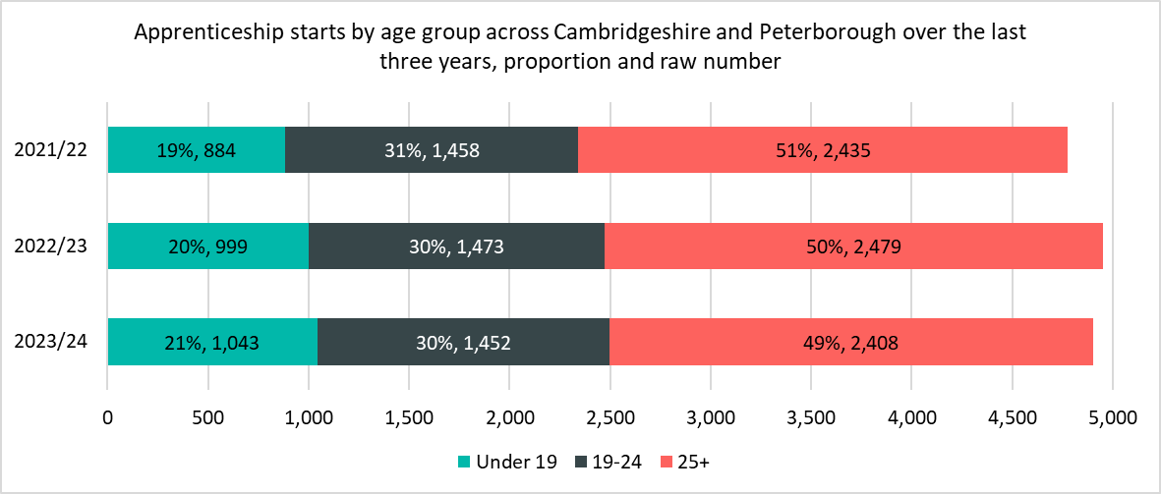
Starts by age group
The notable differences between 2022/23 and 2023/24 are
The Under 19 age group is the only age group to have an increase in starts (+44 starts, +4%).
Starts for 19-24 age group decreased (-21 starts, -1%) and starts for the 25+ age group also decreased (-71 starts, -3%).
*Please note that differences in proportion of 1 percentage point are considered “in line”

Slide 14
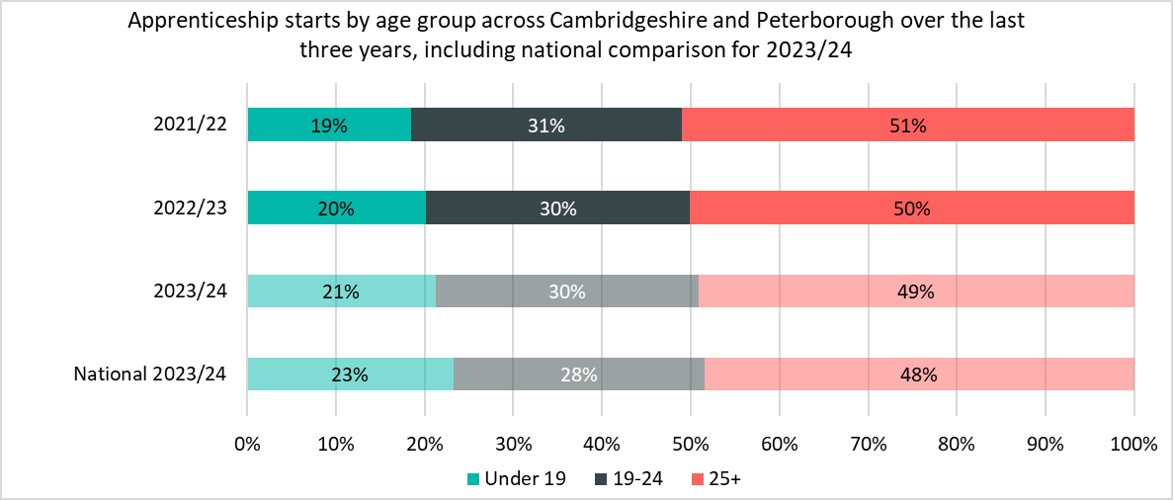
Starts by age group – national comparison
Cambridgeshire and Peterborough is broadly in line with the national breakdown when looking at starts by age.
The notable differences for starts between Cambridgeshire and Peterborough and nationally are
There was a higher proportion of starts across the 19-24 age group (30% vs 28% nationally).
There was a lower proportion of starts across the Under 19 age group (21% vs 23% nationally).
*Please note that differences in proportion of 1 percentage point are considered “in line”

Slide 15
Starts by provider
Anglia Ruskin University had the largest increase in starts over the last year in the top five providers by +12% (+59).
Inspire Education Group had the largest decrease in starts over the last year in the top five providers by -45% (-143). This has been driven by a decrease of provision in Level 2 apprenticeships from 71 to 38 and Level 3 apprenticeships from 203 to 125.
The top five providers by starts in 2023/24 are the same as last year.
Top Five Providers by Starts 2023/24
Provider | 2023/24 delivery (starts) | % of Total 2023/24 starts | 2022/23 delivery (starts) | % Change between 2022/23 and 2023/24
ANGLIA RUSKIN UNIVERSITY HIGHER EDUCATION CORPORATION | 562 | 11% | 503 | +12%
CAMBRIDGE REGIONAL COLLEGE | 291 | 6% | 280 | +4%
LIFETIME TRAINING GROUP LIMITED | 262 | 5% | 297 | -12%
WEST SUFFOLK COLLEGE | 183 | 4% | 180 | +2%
INSPIRE EDUCATION GROUP | 172 | 4% | 315 | -45%

Slide 16
6. Achievements

Slide 17
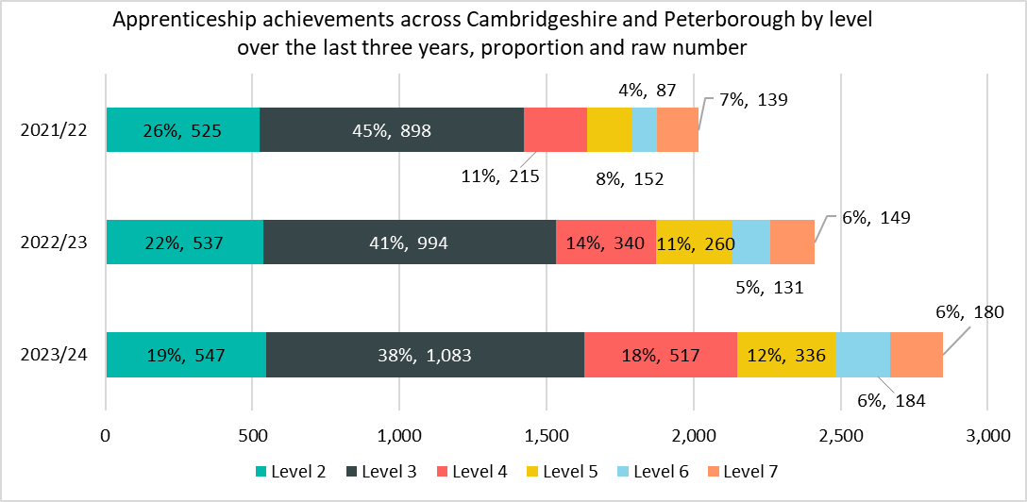
Achievement by level
While the total number of achievements across the Cambridgeshire and Peterborough area increased by +18% between 2022/23 and 2023/24, there is some variation between each level:
Achievements increased across all levels.
Level 4 (+177 achievements, +52%) had the largest increase in achievements. This has been driven my Medipro, which took on apprentices from East of England Ambulance service after this provider ceased provision in 2021/22.
*Apprenticeships take approximately 18-24 months to complete, and this timeline will have been impacted by COVID-19. Therefore, the number of achievements in each period do not necessarily correspond to the equivalent number of starts in a previous time period.
*Please note that differences in proportion of 1 percentage point are considered “in line”

Slide 18
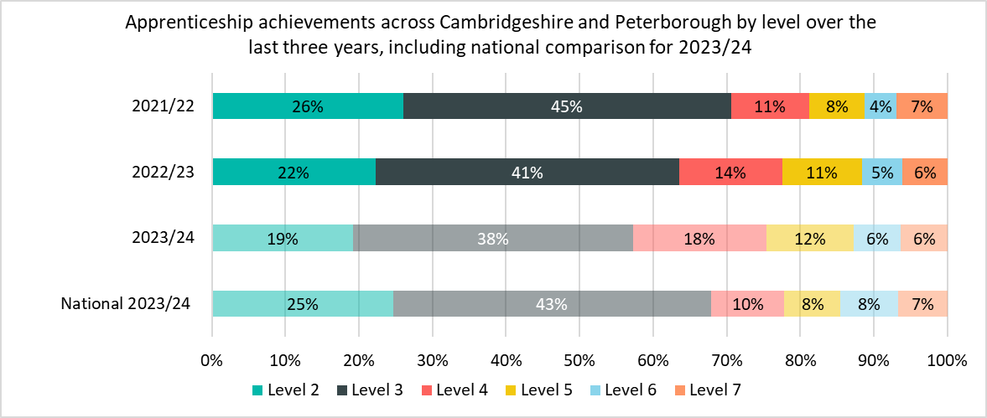
Achievement by level – national comparison
Cambridgeshire and Peterborough had a higher proportion of achievements at Level 4-5 apprenticeships than nationally (30% vs 18%).
Cambridgeshire and Peterborough had a higher proportion of Level 4 apprenticeships (18% vs 10% nationally) and Level 5 apprenticeships (12% vs 8% nationally).
Cambridgeshire and Peterborough had a lower proportions of achievements in Level 2 apprenticeships (19% vs 25% nationally) and Level 3 apprenticeships (38% vs 43% nationally).
*Apprenticeships take approximately 18-24 months to complete, and this timeline will have been impacted by COVID-19. Therefore, the number of achievements in each period do not necessarily correspond to the equivalent number of starts in a previous time period.
*Please note that differences in proportion of 1 percentage point are considered “in line”

Slide 19
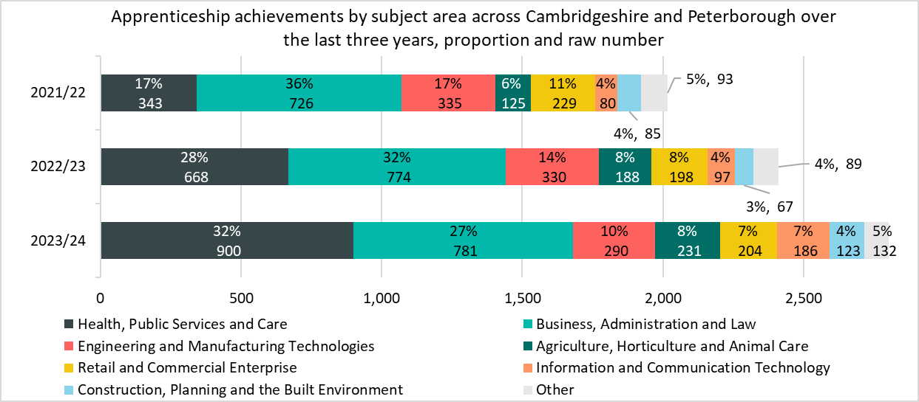
Achievement by subject are
While the total number of achievements across the Cambridgeshire and Peterborough area increased by +18% between 2022/23 and 2023/24, there is some variation between each subject area:
Health, Public Services and Care achievements increased (+232, +35%). This has been driven by Medipro and Anglia Ruskin University. The share of achievements increased +4pp from 28% to 32%.
Information and Communication Technology achievements increased (+89, +92%), and Business, Administration and Law also increased (+56, +84%).
Engineering and Manufacturing Technologies had the only decrease (-40, -12%). The share of achievements decreased -4pp from 14% to 10%.
*Apprenticeships take approximately 18-24 months to complete, and this timeline will have been impacted by COVID-19. Therefore, the number of achievements in each period do not necessarily correspond to the equivalent number of starts in a previous time period.
*Please note that differences in proportion of 1 percentage point are considered “in line”
*Other includes Science & Mathematics, Education & Training, Arts, Media & Publishing, and Leisure, Travel & Tourism.

Slide 20
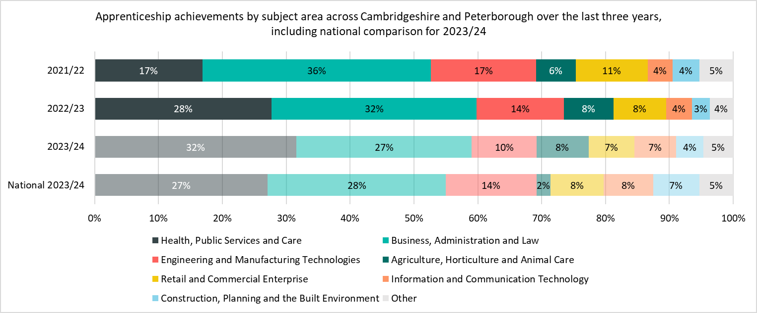
Achievement by subject area – national comparison
The notable differences for achievements by subject area between 20232/23 and 2023/24 in between Cambridgeshire and Peterborough and nationally are
Cambridgeshire and Peterborough had a higher proportion of achievements in Health, Public Services and Care (32% vs 27% nationally) and Agriculture, Horticulture and Animal Care (8% vs 2% nationally).
Cambridgeshire and Peterborough had a lower proportion of achievements in Engineering and Manufacturing Technologies (10% vs 14% nationally) and Construction, Planning and the Built Environment (4% vs 7% nationally).
*Apprenticeships take approximately 18-24 months to complete, and this timeline will have been impacted by COVID-19. Therefore, the number of achievements in each period do not necessarily correspond to the equivalent number of starts in a previous time period.
*Please note that differences in proportion of 1 percentage point are considered “in line”
*Other includes Science & Mathematics, Education & Training, Arts, Media & Publishing, and Leisure, Travel & Tourism.

Slide 21
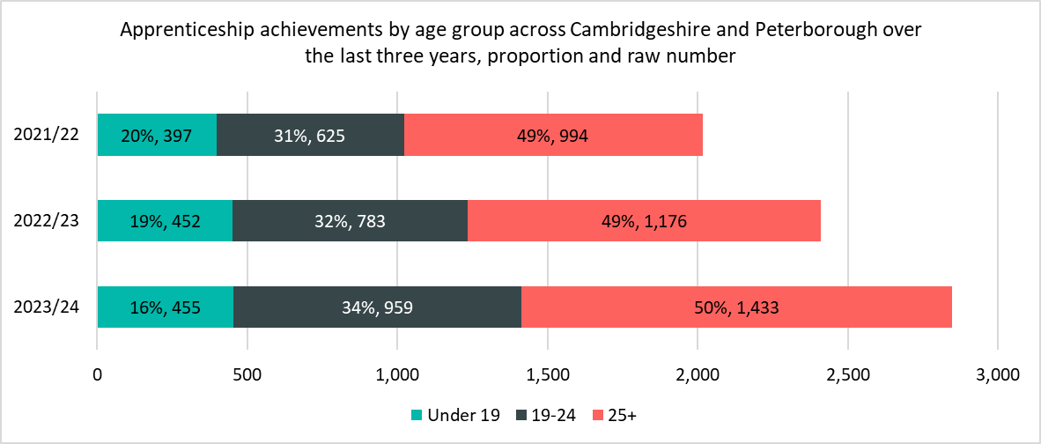
Achievement by age group
The notable differences between 2022/23 and 2023/24 are
The Under 19, 19-24, and 25+ age groups all had increases of 1% (+3), 22% (+176), and 22% (+257) respectively.
There was a higher proportion of starts in Cambridgeshire and Peterborough across the Under 19 age group compared to nationally (19% vs 16%).
Despite the large increase in the 19-24 age group, there was a lower proportion of starts in Cambridgeshire and Peterborough across the 19-24 age group compared to nationally (32% vs 34%).
*Apprenticeships take approximately 18-24 months to complete, and this timeline will have been impacted by COVID-19. Therefore, the number of achievements in each period do not necessarily correspond to the equivalent number of starts in a previous time period.
*Please note that differences in proportion of 1 percentage point are considered “in line”
*Other includes Science & Mathematics, Education & Training, Arts, Media & Publishing, and Leisure, Travel & Tourism.

Slide 22
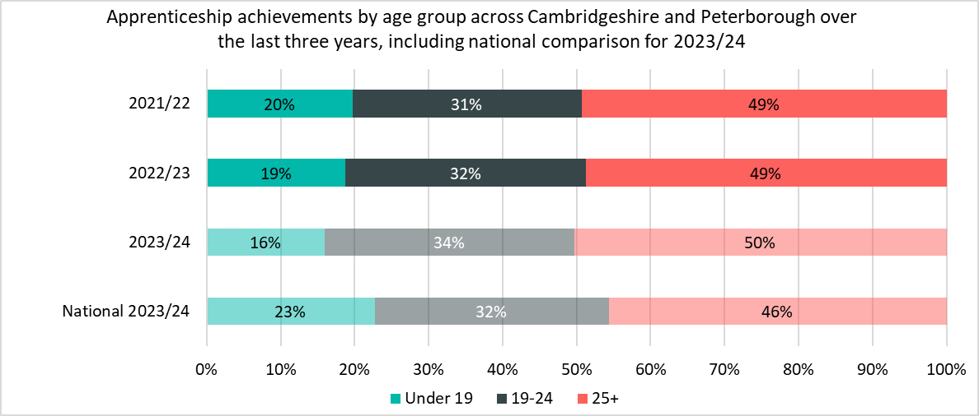
Achievement by age group – national comparison
The notable differences for achievements by between Cambridgeshire and Peterborough and nationally are
There were higher proportions of achievements in the 19-24 age group (34% vs 32% nationally) and 25+ age group (50% vs 46% nationally).
There were a lower proportion of achievements in the Under 19 age group (16% vs 23% nationally).
*Apprenticeships take approximately 18-24 months to complete, and this timeline will have been impacted by COVID-19. Therefore, the number of achievements in each period do not necessarily correspond to the equivalent number of starts in a previous time period.
*Please note that differences in proportion of 1 percentage point are considered “in line”

Slide 23
Achievement by providers
Medipro had the highest increase in achievements over the past year in the top five providers (+158, +118%). This is due to an increase in Level 4 Heath and Social Care courses when Medripro took on apprentices from East of England Ambulance Service which ceased provision in 2021/22.
There was also an increase in achievements in the past year in the top five providers for Anglia Ruskin University (+98, +67%), The College of Animal Welfare (+47, +39%), and Inspire Education Group (+48, +51%).
Cambridge Regional College was the only provider in the top five providers to have a decrease over the past year (-59, -24%).
The breakdown was similar for the top five providers by achievements in 2023/24 compared to 2022/23. West Suffolk College are the only provider not to feature in the top five in 2023/24.
Top Five Providers by Achievements
Provider | 2023/24 delivery (achievements) | % of Total 2023/24 achievements | 2022/23 delivery (achievements) | % Change between 2022/23 and 2023/24
MEDIPRO LIMITED | 292 | 10% | 134 | +118%
ANGLIA RUSKIN UNIVERSITY HIGHER EDUCATION CORPORATION | 245 | 9% | 147 | +67%
CAMBRIDGE REGIONAL COLLEGE | 184 | 6% | 243 | -24%
THE COLLEGE OF ANIMAL WELFARE LIMITED | 166 | 6% | 119 | +39%
INSPIRE EDUCATION GROUP | 142 | 5% | 94 | +51%
*Apprenticeships take approximately 18-24 months to complete, and this timeline will have been impacted by COVID-19. Therefore, the number of achievements in each period do not necessarily correspond to the equivalent number of starts in a previous time period.

