Slide 1
Cambridgeshire and Peterborough
Mental Health Needs Assessment
Chapter 6: Older age adults

Slide 2
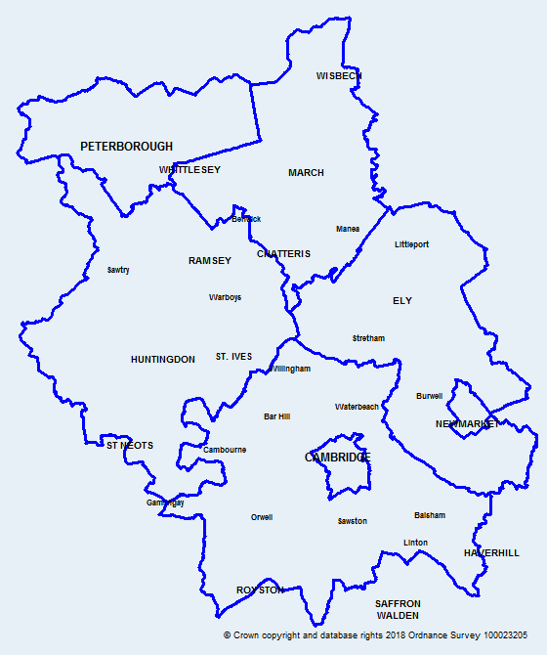
Introduction
Map of Cambridgeshire
and Peterborough
This data pack has been produced on older adults (65 years and over) mental health to support the Cambridgeshire and Peterborough all age mental health and learning disabilities needs assessment.
Colour coding and abbreviations used:
Key:
 | Statistically significantly worse than England
 | Statistically similar to England
 | Statistically significantly better than England
ICB | Integrated Care Board
STP | Sustainability and Transformation Partnership
CCG | Clinical Commissioning Group
MH | Mental Health
C&PCCG | Cambridgeshire and Peterborough Clinical Commissioning Group
C&PICB | Cambridgeshire and Peterborough Integrated Care Board
CPICS | Cambridgeshire and Peterborough Integrated Care System
CCC | Cambridgeshire County Council
PCC | Peterborough City Council

Slide 3
Table of Contents
  Demographics and population factors
  Social care services
  Crisis services
  Acute older adult mental health care
  Mental Health Act
  Older Peoples Mental Health (OPMH) services
  NHS Talking Therapies
  Dementia
  Drug and alcohol
  POPPI projections
  Comorbidities

Slide 4
Demographics and Population Factors

Slide 5
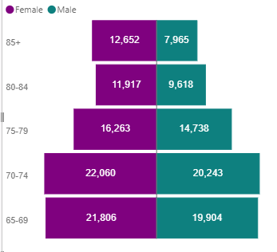
Census population for Cambridgeshire and Peterborough, 65 years and over, Census 2021
Census 2021 population by districts, 65 years and over
Census 2021 population for Cambridgeshire and Peterborough combined, by age band, 65 years and over
In Cambridgeshire and Peterborough, Census 2021 estimates show that on Census Day there were around 157,170 people aged 65 years and over (17.6% of the total population), which is similar to England (18.4%).
At a district level, the number of people in the older adults is the highest in Huntingdonshire, followed by South Cambridgeshire and Peterborough.
Overall, the female population is slightly higher than the male population for this age group.
Source: Cambridgeshire & Peterborough Insight – JSNA 2023 – Demography – Age structure and population change (cambridgeshireinsight.org.uk), Census - Office for National Statistics (ons.gov.uk)

Slide 6
Census population for Cambridgeshire and Peterborough, 65 years and over, Census 2021
Census 2021 population by Ethnic group, 65 years and over
Ethnic group | Cambridge | East Cambridgeshire | Fenland | Huntingdonshire | South Cambridgeshire | Cambridgeshire | Peterborough | Cambridgeshire and Peterborough
Asian, Asian British or Asian Welsh | 5.1% | 0.7% | 0.6% | 1.1% | 1.4% | 1.6% | 5.9% | 2.4%
Black, Black British, Black Welsh, Caribbean or African | 0.8% | 0.2% | 0.3% | 0.4% | 0.2% | 0.4% | 1.2% | 0.5%
Mixed or Multiple ethnic groups | 0.8% | 0.3% | 0.3% | 0.3% | 0.3% | 0.4% | 0.6% | 0.4%
Other ethnic group | 1.3% | 0.3% | 0.2% | 0.3% | 0.5% | 0.4% | 0.7% | 0.5%
White | 92.0% | 98.4% | 98.6% | 97.9% | 97.6% | 97.3% | 91.5% | 96.1%
Grand Total | 100.0% | 100.0% | 100.0% | 100.0% | 100.0% | 100.0% | 100.0% | 100.0%
There have been several researches highlighting ethnic inequalities in the prevalence of mental health conditions and across all aspects of the mental health system.
Cambridgeshire and Peterborough's population are a diverse mix of ethnic backgrounds, but this varies across our areas.
In Peterborough and Cambridge, the proportion of the older adult population who identify as "Asian, Asian British, or Asian Welsh" is substantially higher than the combined average of Cambridgeshire and Peterborough.
The proportion of people from a "white" ethnic group in East Cambridgeshire and Fenland is substantially higher than the C&P average, whereas the proportions of people from "Asian, Asian British, or Asian Welsh" ethnic groups are notably lower than the combined average of Cambridgeshire and Peterborough.
Source: Census - Office for National Statistics (ons.gov.uk)

Slide 7
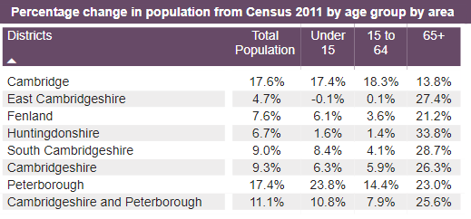
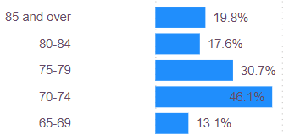
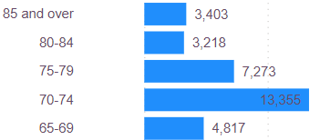

Population change for Cambridgeshire and Peterborough, 65 years and over
Percentage change between Census 2011 and 2021, by age group
Change in population number between Census 2011 and 2021, by age band
Overall, there is a substantial increase in the size of our older adult population in the last ten years (between 2011 and 2021);
The highest percentage increase in the older age group population from Census 2011 is seen in Huntingdonshire (+34%), followed by South Cambridgeshire (+29%). Overall, an increase of 26% is seen in Cambridgeshire and Peterborough as a whole.
In Cambridgeshire and Peterborough, the highest absolute and percentage increase from 2011 is seen among 70 – 74 years.
Source: Cambridgeshire & Peterborough Insight – JSNA 2023 – Demography – Age structure and population change (cambridgeshireinsight.org.uk), Census - Office for National Statistics (ons.gov.uk)

Slide 8
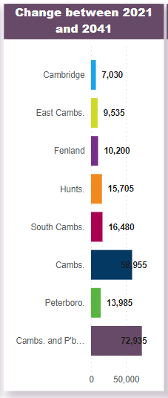
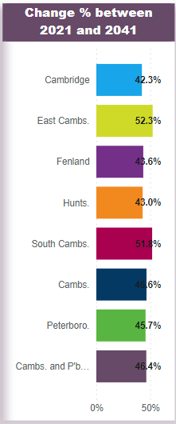
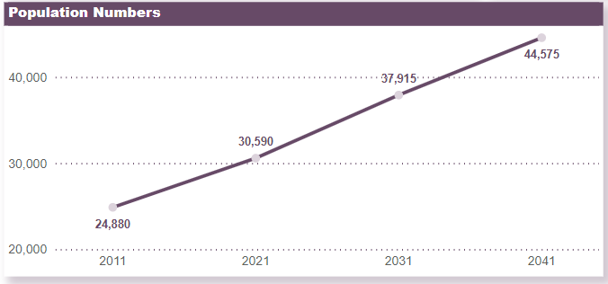
Forecasted population growth for Cambridgeshire and Peterborough, 65 years and over
Based on the Cambridgeshire County Council population forecast, an overall increase of 46.4% will be seen in Cambridgeshire and Peterborough in the older adult's group in 2041 compared to 2021.
The forecasting predicts an increase of 46.6% (58,955) from 2021 to 2041 in Cambridgeshire and 45.7% (13,985) in Peterborough.
These are locally produced estimates based on what is currently known about our population and local plans for development; they are subject to change.
Source: Cambridgeshire & Peterborough Insight – JSNA 2023 – Demography – Predicted future change (cambridgeshireinsight.org.uk), Census - Office for National Statistics (ons.gov.uk)

Slide 9
Household living arrangements, 65 years and over, Census 2021
Living arrangements can be an indicator of the level of social support. They can play an important part in day-to-day wellbeing and practical, social, and economic support in the home.
The percentage of older people that are not living as a couple is significantly higher than the national average in Cambridge and Peterborough.
Of the people who are not living as a couple, a higher proportion of people were widowed or surviving partner from a civil partnership. The proportion is significantly higher than the national average in all areas except Cambridge and Peterborough.
Source: Census - Office for National Statistics (ons.gov.uk)
Notes:
The “living arrangements” classification combines responses to the question on marital and civil partnership status with information about whether or not a person is living in a couple. This topic is only applicable to people in households. Living arrangements differs from marital and civil partnership status because cohabiting takes priority over other categories. For example, if a person is divorced and cohabiting, then in results for living arrangements they are classified as cohabiting.
Living in a couple category includes
Living in a couple: Separated, but still married or in a civil partnership
Living in a same-sex couple: Cohabiting
Living in a same-sex couple: Married or in a civil partnership
Living in an opposite-sex couple: Cohabiting
Living in an opposite-sex couple: Married or in a civil partnership
Not living in a couple category includes
Not living in a couple: Divorced or formerly in a civil partnership which is now legally dissolved
Not living in a couple: Married or in a registered civil partnership
Not living in a couple: Separated (including those who are married and those who are in civil partnerships)
Not living in a couple: Single (never married and never registered a civil partnership)
Not living in a couple: Widowed or surviving partner from a civil partnership

Slide 10
Unpaid care, 65 years and over, Census 2021
Unpaid carers provide significant levels of support to family or friends. However, carers often need support with their own health and wellbeing.
The proportion of older people who are not providing unpaid care is similar to the national average in all areas across Cambridgeshire and Peterborough except Huntingdonshire (significantly higher than England).
In Fenland, the proportion of older people providing 50 or more hours of unpaid care a week is significantly higher than England average.
The proportion of older people providing less than 19 hours is significantly higher than England in Cambridge, East Cambridgeshire, and South Cambridgeshire.
Source: Census - Office for National Statistics (ons.gov.uk)
Notes:
An unpaid carer may look after, give help or support to anyone who has long-term physical or mental ill-health conditions, illness or problems related to old age.
This does not include any activities as part of paid employment.
This help can be within or outside of the carer's household.

Slide 11
General health and Disability, 65 years and over, Census 2021
Self-reported health captures subjective assessment, which can be used to evaluate the general health status and health care needs at the population level.
The proportion of people who self-reported as being in good or very good health is significantly lower than the national average in Fenland and Peterborough.
Likewise, the proportion of people who self-reported as being in bad or very bad health is significantly higher in Fenland and Peterborough.
In Fenland and Peterborough, the proportion of older population whose day-to-day activities are limited a lot due to disability is significantly higher than the national average.
Similarly, the proportion of older population with no long-term physical or mental health conditions is significantly lower than the national average in Cambridge and Peterborough.
Source: Census - Office for National Statistics (ons.gov.uk)
Notes:
A person's assessment of the general state of their health from very good to very bad. This assessment is not based on a person's health over any specified period of time.
People who assessed their day-to-day activities as limited by long-term physical or mental health conditions or illnesses are considered disabled. This definition of a disabled person meets the harmonised standard for measuring disability and is in line with the Equality Act (2010).

Slide 12
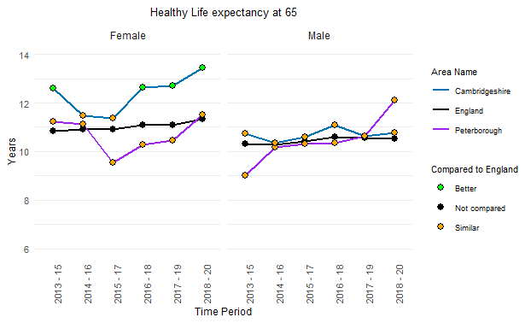
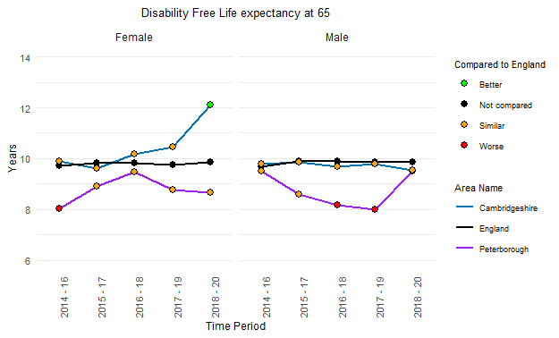
Healthy life expectancy and Disability free life expectancy at 65
Note: The Y-axes does not start at 0
DFLE at age 65 years is an important summary measure of health and has implications for: quality of life; fitness for work given increases in the State Pension age; personal finances; social connections and contributions; health and care services; and the wider economy.
This indicator complements the proposed indicator of healthy life expectancy at age 65 to measure progress on the government's 'Ageing Grand Challenge' mission to "ensure that people can enjoy at least 5 extra healthy, independent years of life by 2035, while narrowing the gap between the experience of the richest and poorest.“
The average number of years a person aged 65 would expect to live in good health is higher for females than males. The average number of years for females in Cambridgeshire is significantly higher than the national average.
The average number of years a person aged 65 years would expect to live without a long lasting physical or mental health condition or disability is increasing for Cambridgeshire females and was significantly higher than the national average. However, this is similar to England for Peterborough males and females, and Cambridgeshire males.
Source: English indices of deprivation 2019 - GOV.UK (www.gov.uk)
Notes:
Healthy life expectancy at 65: A measure of the average number of years a person aged 65 years would expect to live in good health based on contemporary mortality rates and prevalence of self reported good health.
The prevalence of good health is derived from responses to a survey question on general health. For a particular area and time period, it is an estimate of the average number of years a person aged 65 years would live in good general health if he or she experienced the age specific mortality rates and prevalence of good health for that area and time period throughout his or her remaining life. Figures are calculated from deaths from all causes, mid year population estimates, and self reported general health status, based on data aggregated over a three year period.
Disability free life expectancy (DFLE) at 65 is an estimate of the number of years a person aged 65 years would expect to live without a long lasting physical or mental health condition or disability limiting their ability to carry out day to day activities. This is based on contemporary mortality rates and prevalence of self-reported disability free state.
The prevalence of disability free state is derived from responses to a survey question on general health. For a particular area and time period, it is an estimate of the average number of years a person aged 65 years would live without disability if he or she experienced the age specific mortality rates and prevalence of disability free state for that area and time period throughout his or her remaining life. Figures are calculated from deaths from all causes, mid year population estimates, and self reported disability free state, based on data aggregated over a three year period.

Slide 13
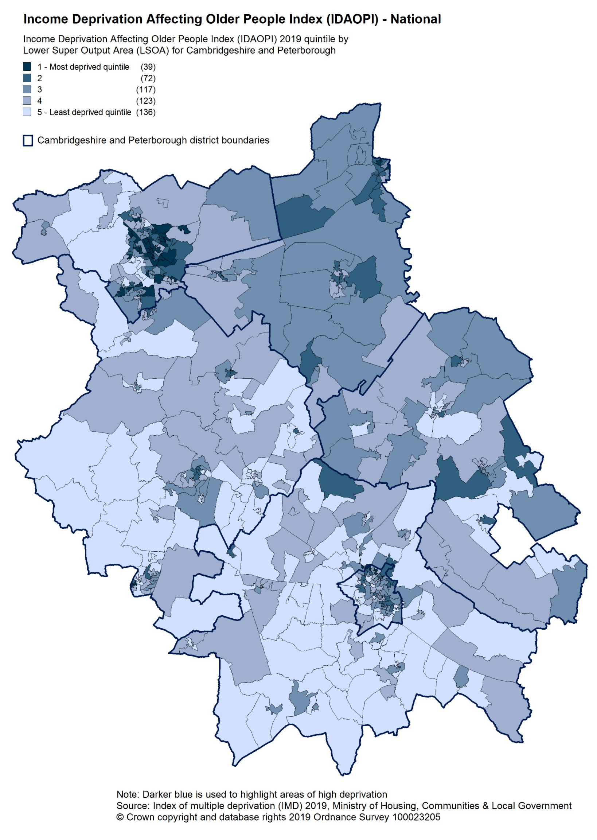
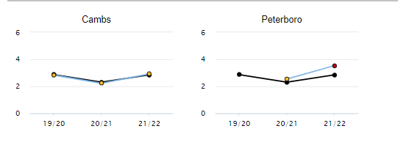
Income deprivation affecting older people and Homelessness
Homelessness - households owed a duty under the Homelessness Reduction Act (main applicant aged 55 and over), crude rate per 1,000
Peterborough has a significantly higher rate of households owed a prevention or relief duty under the HRA during the financial year 21/22, where the main applicant is aged 55 and over.
The rate of income deprivation affecting older people is high in Peterborough and Fenland, with fewer deprived areas seen in other parts of Cambridgeshire.
Source: English indices of deprivation 2019 - GOV.UK (www.gov.uk), Productive Healthy Ageing Profile - OHID (phe.org.uk)
Notes:
The Income Deprivation Affecting Older People Index is the proportion of all those aged 60 or over who experience income deprivation, here defined as adults aged 60 or over receiving Income Support or income-based Jobseekers Allowance or income-based Employment and Support Allowance or Pension Credit (Guarantee) or Universal Credit (in the ‘Searching for work’, ‘No work requirements’, ‘Planning for work’, ‘Working – with requirements’ and ‘Preparing for work’ conditionality groups) or families not in receipt of these benefits but in receipt of Working Tax Credit or Child Tax Credit with an equivalised income (excluding housing benefit) below 60 per cent of the national median before housing costs. Asylum seekers aged 60 and over are not included in the Income Deprivation Affecting Older People Index. Shrinkage was applied to construct the Income Deprivation Affecting Older People Index score.
This is a subset of the Income Deprivation Domain of the English Indices of Deprivation.
Homelessness - households owed a duty under the Homelessness Reduction Act (main applicant aged 55 and over): Households owed a prevention or relief duty under the Homelessness Reduction Act, where the main applicant is aged 55 years and over, crude rate per 1,000 estimated households where the household reference person is aged 55 years and over

Slide 14
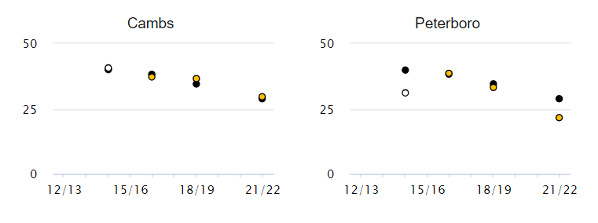
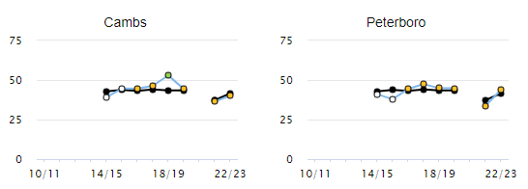
Social isolation, 65 years and over
Social Isolation: percentage of adult carers who have as much social contact as they would like, 65+ years, %
Social Isolation: percentage of adult social care users who have as much social contact as they would like, 65+ years, %
%
%
Note: The Y-axes are different
The percentage of adult carers who have as much as social contact as they would like shows an overall decline over time.
The rate was similar to the national average in Cambridgeshire and Peterborough in 2021/22.
The percentage of adult social care users who have as much social contact as they would like shows an increase in the year 2022/23 compared to the previous year.
The rate was similar to the national average in Cambridgeshire and Peterborough.
Source: Productive Healthy Ageing Profile - OHID (phe.org.uk)
Notes:
Social Isolation: percentage of adult carers who have as much social contact as they would like
The percentage of respondents to the Personal Social Services Survey of Adult Carers in England who responded to the question "Thinking about how much contact you have had with people you like, which of the following best describes your social situation?" with the answer "I have as much social contact I want with people I like".
This measure applies to those people in receipt, at the point that data are extracted, of long-term support services funded or managed by social services following a full assessment of need
Social Isolation: percentage of adult social care users who have as much social contact as they would like
The percentage of respondents to the Adult Social Care Survey (service users) who responded to the question "Thinking about how much contact you've had with people you like, which of the following statements best describes your social situation?" with the answer "I have as much social contact as I want with people I like".
This measure applies to those people in receipt, at the point that data are extracted, of long-term support services funded or managed by social services following a full assessment of need.
Note:
The Covid19 impact from March 2020 onwards has had an effect on adult social care data collections, processing and quality assurance.
The 2020 to 2021 Adult Social Care survey was voluntary for councils to participate. As only 18 councils participated, this indicator has not been updated for 2020 to 2021 in the Profile.

Slide 15
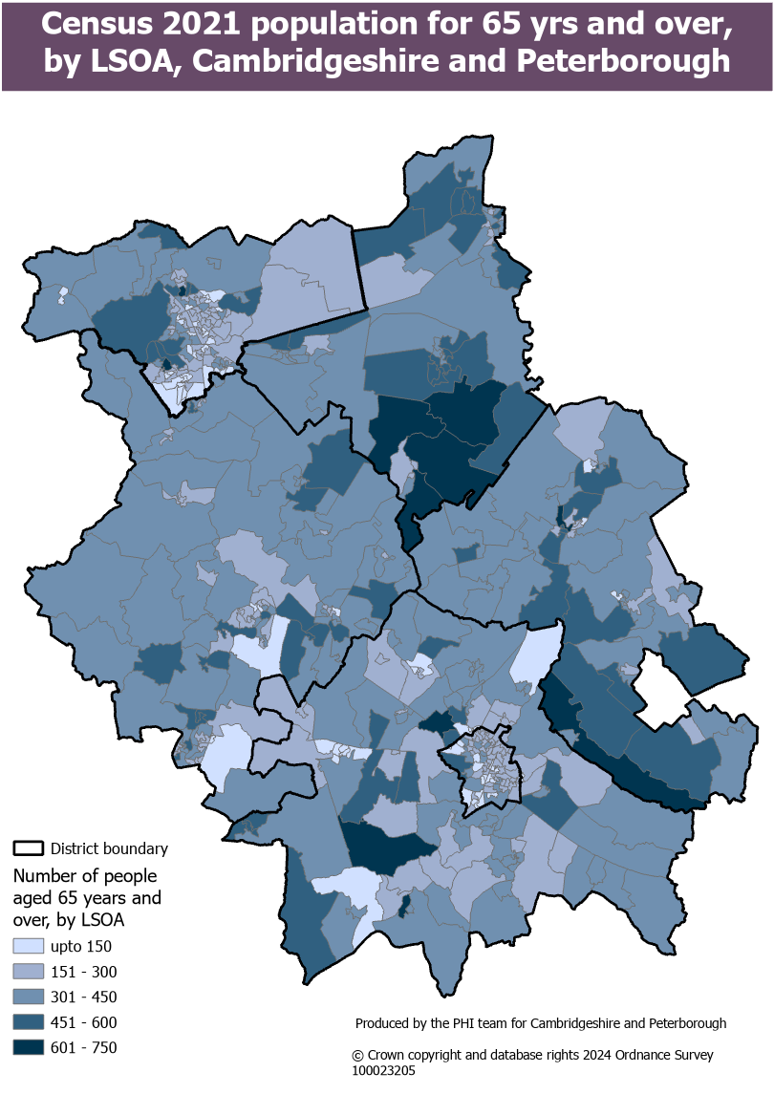
Older adults' population spread, Cambridgeshire and Peterborough
The map shows the spread of older adults’ population (aged 65 years and over) by LSOA.
Most of the LSOAs with a higher number of older people are in rural areas.
There are high numbers of older people in Fenland, which has a mix of urban and rural towns
There are smaller numbers of older people living in the centre of Peterborough City
There is a high number of older people in rural villages in East Cambridgeshire
There is a high number of older people in some rural villages in South Cambridgeshire
There are smaller numbers of older people living in Cambridge City
Source: Census - Office for National Statistics (ons.gov.uk)

Slide 16
Social Care Services

Slide 17
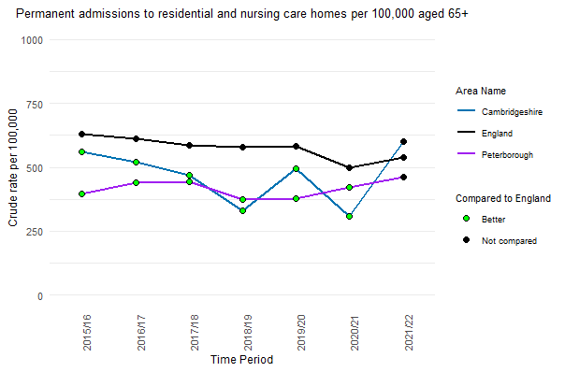
Care home residents
The rate of permanent admissions of people aged 65 years and over to care homes was significantly lower than the national rates in Cambridgeshire and Peterborough.
However, in 2021/22, a substantial increase is seen in Cambridgeshire compared to the previous year.
The rate of care home residents per 1,000 population in Cambridge is significantly higher for both 65+ and 85+ populations than other areas in Cambridgeshire and Peterborough.
Source: Productive Healthy Ageing Profile - OHID (phe.org.uk), Older people living in care homes in 2021 and changes since 2011 - Office for National Statistics (ons.gov.uk
Notes:
Permanent admissions to residential and nursing care homes per 100,000 aged 65+
This is part 2 of a two part-measure reflecting the number of council-supported admissions of younger adults (part 1) and older people (part 2) to residential and nursing care homes relative to the population size of each group. The measure combines council records with ONS population estimates.
People counted as a permanent admission include: Residents where the local authority makes any contribution to the costs of care, no matter how trivial the amount and irrespective of how the balance of these costs are met; Supported residents in Local authority staffed care homes for residential care, independent sector care homes for residential care and registered care homes for nursing care; Residential or nursing care which is of a permanent nature and where the intention is that the spell of care should not be ended by a set date. For people classified as permanent residents, the care home would be regarded as their normal place of residence.
Note: People funding their own residence in a care home with no support from the council are excluded. Counts and denominators in the source data used to derive the values for this indicator are only available rounded to the nearest five or ten.
Number of care home residents per 1,000 population
The number of usual residents aged 65 years and over and aged 85 years and over living in care homes, per 1,000 population in those age groups by local authority in 2021, England and Wales

Slide 18
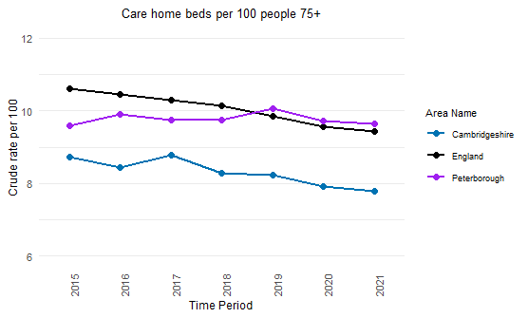
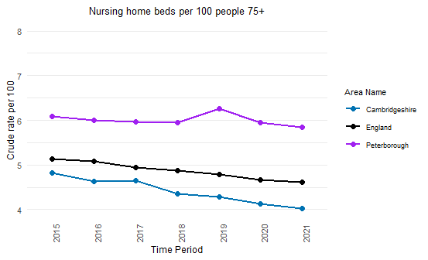
Care home beds
Note: The Y-axes does not start at 0
The rate of care home beds (includes nursing and residential beds) per 100 people aged 75 years and over shows a declining trend in Cambridgeshire and England.
Although a relatively stable trend is seen for Peterborough, the rate is slightly higher than the national average in the last 3 years.
The rate of nursing home beds per 100 people aged 75 years and over shows a declining trend in Cambridgeshire and England.
Although a relatively stable trend is seen for Peterborough, the rate is substantially higher than the national average.
Source: Productive Healthy Ageing Profile - OHID (phe.org.uk)
Notes:
Care home beds per 100 people 75+ : the annual proportion of beds in care homes (all; nursing and residential) per 100 population aged 75 and over. This is an all age indicator because people under 75 years of age can also use care home beds.
Nursing home beds per 100 people 75+: The annual proportion of beds in nursing homes per 100 population aged 75 and over. This is an all age indicator because people under 75 years of age can also use nursing home beds.

Slide 19
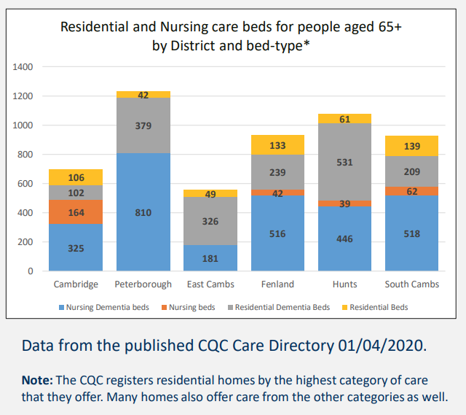
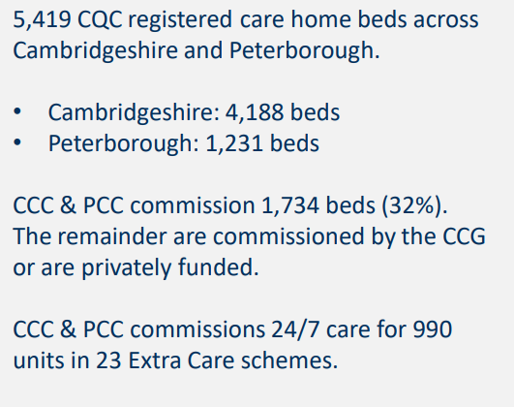
Residential and nursing care beds
No. of beds
Source: Older People's accommodation demand profiles (cambridgeshire.gov.uk)
Notes:
The number of usual residents aged 65 years and over and aged 85 years and over living in care homes, per 1,000 population in those age groups by local authority in 2021, England and Wales

Slide 20
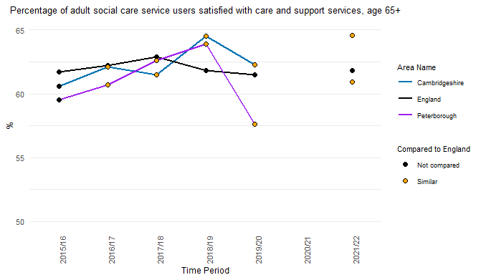
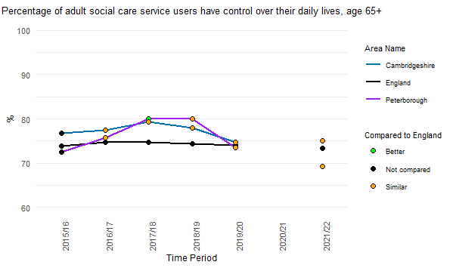
Social care service users
Cambridgeshire
Peterborough
Cambridgeshire
Peterborough
Note: The Y-axes does not start at 0
The percentage of adult social care service users aged 65 years and over who are satisfied with the care and support services shows fluctuations, with a recent increase seen in 2021/22 compared to 2019/20.
Although both Cambridgeshire and Peterborough were similar to the national average, over 3 in 10 older adults using social care were not satisfied with the care and support they received.
The percentage of adult social care service users aged 65 years and over who have responded as having control over their daily lives was similar to England in Cambridgeshire and Peterborough.
Source: Productive Healthy Ageing Profile - OHID (phe.org.uk)
Notes:
Percentage of adult social care service users satisfied with care and support services, age 65+:
This measure applies to those people aged 65 and over in receipt, at the point that data are extracted, of long-term support services funded or managed by social services following a full assessment of need.
It is based on
i) responses to Question 1 in the Adult Social Care Survey: “Overall, how satisfied or dissatisfied are you with the care and support services you receive
and
ii) responses to Question 1 in the 'Easy Read' version of the questionnaire: “How happy are you with the way staff help you
The measure is defined by determining the percentage of all those adults aged 65 and over responding who identify strong satisfaction – i.e. by choosing the answer “I am extremely satisfied” or the answer “I am very satisfied”, and of those responding to the Easy Read questionnaire, those who choose the answer “I am very happy with the way staff help me, it’s really good”.
This is Adult Social Care Outcome Framework (ASCOF) Indicator 3A. Further details are provided in the ASCOF Handbook of Definitions available here:
https://www.gov.uk/government/publications/adult-social-care-outcomes-framework-handbook-of-definitions
Percentage of adult social care service users have control over their daily lives, age 65+
This measure applies to those people aged 65 and over in receipt, at the point that data are extracted, of long-term support services funded or managed by social services following a full assessment of need.
It is based on responses to Question 3a in the Adult Social Care Survey: ‘Which of the following statements best describes how much control you have over your daily life?’
The measure is defined by determining the percentage of all those responding either ‘I have as much control over my daily life as I want’ or “I have adequate control over my daily life”. These two responses have been chosen to focus the measure on those individuals achieving the best outcomes, identifying no or limited need in this area. The intention is that this will allow for better use in benchmarking.
This is Adult Social Care Outcome Framework (ASCOF) Indicator 1B. Further details are provided in the ASCOF Handbook of Definitions available here:
https://www.gov.uk/government/publications/adult-social-care-outcomes-framework-handbook-of-definitions

Slide 21
Crisis services
Notes:
The mental health charity Mind has defined a mental health crisis as when some is in a ‘mental or emotional state where they need urgent help’.
Community crisis services includes NHS crisis service and other crisis services as below
24/7 Crisis response line
Acute day service
Crisis café/Safe Haven/Sanctuary service
Crisis House Service
Crisis Resolution Team/Home Treatment Service
Health Based Place of Safety Service
Psychiatric Decision Unit Service
Single Point of Access Service

Slide 22
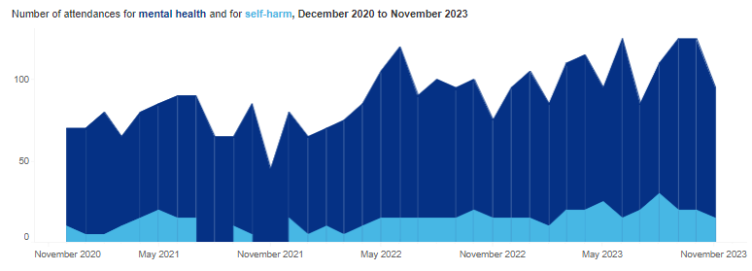
Mental Health A&E Attendances, 65+ years, Cambridgeshire and Peterborough ICB
In C&P ICB, an overall increase has been seen in the number of A&E attendances for mental health since Nov-20 with fluctuations seen over time.
For the 12-month period ending Nov-23, the rate of A&E attendance for mental health was significantly higher than the regional rate.
However, the proportion of attendance to A&E department where the primary complaint was mental health (including self-harm) was significantly lower than the regional rate.
Note: The total attendances includes the data only for 65+ age group.
Source: Urgent and Emergency Mental Health Dashboard - Mental Health, Learning Disability and Autism Resource Hub - FutureNHS Collaboration Platform
Notes:
Source: FutureNHS
Notes: Regional, STP and CCG mapping is based on provider site code. Restricted to Type 1 departments only.
Number of attendances for mental health:
Count of attendances where EITHER:
Chief Complaint recorded as: Self harm, depressive feelings, feeling anxious, behaviour: unsual, hallucinations/delusions
Diagnosis recorded as: Dementia, Delirium, Personality Disorder, Eating Disorder, Anxiety Disorder, Depressive Disorder, Bipolar Affective Disorder, Schizophrenia, Psychotic Disorder, Somatisation Disorder, Somatoform Disorder, Dissociative (Conversion) Disorder, Adjustment Disorder, Factitious Disorder
Injury intent recorded as: Self-inflicted injury
AND
Discharge status is NOT in ('Streamed to Urgent Care Centre', 'Streamed to Emergency Department' or 'Dead on Arrival’)
Attendance category is NOT in ('Planned follow up care' or 'Not applicable patient dead on arrival’)
Number of attendances for self-harm:
Count of attendances where EITHER:
Chief Complaint recorded as: Self harm
Injury intent recorded as: Self-inflicted injury
AND
Discharge status is NOT in ('Streamed to Urgent Care Centre', 'Streamed to Emergency Department' or 'Dead on Arrival’)
Attendance category is NOT in ('Planned follow up care' or 'Not applicable patient dead on arrival')

Slide 23
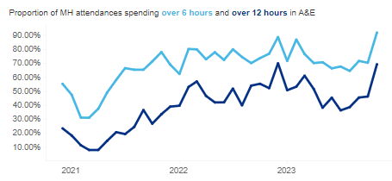
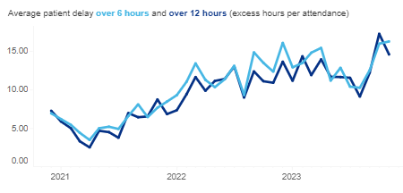
Total Time in A&E for Mental Health Attendances, 65+ years, Cambridgeshire and Peterborough ICB
Dec 20 – Nov 23
Dec 20 – Nov 23
In C&P ICB, the proportion of people attending the A&E department for mental health issues spending over 6 hours and over 12 hours in this department shows an increasing trend. The average patient delay over 6 and 12 hours also shows an increasing trend since Apr-21.
C&P ICB ranks highest in the East of England for the proportion of people attending A&E for mental health-related issues (including self-harm), spending over 6 hours (74%) and 12 hours (50%) in this department. Average patient delays over 6 hours and 12 hours are also the highest in the region for C&P ICB.
Source: Urgent and Emergency Mental Health Dashboard - Mental Health, Learning Disability and Autism Resource Hub - FutureNHS Collaboration Platform
Notes:
Source: FutureNHS
Notes: Regional and STP mapping us based on a person’s CCG of residence, so you may see providers in a region or STP that are not based in that locality, but are delivering care to people who live there.
Proportion of attendances classed as MH/self-harm related which have a total time in ED over 6/12 hours:
Denominator Attendances flagged as MH/self-harm based on the criteria listed above
Numerator Attendances where the time between arrival in ED and departure from ED was over 6/12 hours (excluding those where total time was over 24 hours)
Average patient delay over 6 hours and over 12 hours:
Denominator Attendances flagged as MH/self-harm related, where total time in ED was over 6/12 hours
Numerator Total time in ED (in hours) minus 6/12 hours for each attendance in denominator.

Slide 24
Referrals to Liaison Psychiatry, 65+ years, Cambridgeshire and Peterborough ICB
In Cambridgeshire and Peterborough ICB, the total number of referrals to liaison psychiatry has fluctuated over the years.
The number of referrals from the emergency department shows an increasing trend in the last two years, with a substantial increase seen in the most recent year ending Nov-23. However, a declining trend is seen in the number of referrals from acute wards in the last two years.
For the year ending Nov-23, 45% of the total referrals were from the emergency department, and 22% were from the acute wards. However, all the ICBs in the region have a higher percentage of referrals from acute wards, in contrast to the C&P ICB.
Note: For Cambridgeshire and Peterborough ICB, a higher proportion of referrals from “other” is seen due to some coding issues from one of the acute providers.
Source: Urgent and Emergency Mental Health Dashboard - Mental Health, Learning Disability and Autism Resource Hub - FutureNHS Collaboration Platform
Notes:
Source: FutureNHS
Notes: Regional and STP mapping us based on a person’s CCG of residence, so you may see providers in a region or STP that are not based in that locality, but are delivering care to people who live there.
Referrals by source: Count of referrals received in each month to relevant psych liaison / other hospital-based crisis teams. Rejected referrals, where Referral Rejection Date is completed, are excluded from this count.
Split by referral source where:
Emergency Department: where referral source is 'Accident and Emergency Department' (H1)
Acute Secondary care: where referral source is 'Other secondary care speciality' (H2)
Other: for any other referral source or referrals where referral source is invalid/null.

Slide 25
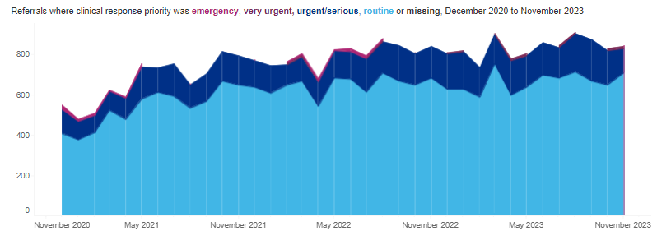
Community Crisis Services, 65+ years, Cambridgeshire and Peterborough ICB
In C&P ICB, an increasing trend is seen in the number of total referrals to community crisis services. There were 10,055 total referrals in the year ending Nov-23 an increase of about 5% compared to the previous year (9,615 total referrals).
During the period between Dec-22 and Nov-23, about 69% were routine referrals, and 28% were urgent or serious referrals. The proportion of urgent or serious referrals was the second highest in the region for C&P ICB.
In the 12-month period ending Nov-23, the majority of all referrals to the community crisis services were to the single point of access service (66%) and 23% to the 24/7 crisis response line.
Source: Urgent and Emergency Mental Health Dashboard - Mental Health, Learning Disability and Autism Resource Hub - FutureNHS Collaboration Platform
Notes:
Source: FutureNHS
Notes: Regional and STP mapping is based on a person’s CCG of residence, so you may see providers in a region or STP that are not based in that locality, but are delivering care to people who live there.
Referrals by clinical response priority: Count of referrals received in each month to relevant community crisis services. Rejected referrals, where Referral Rejection Date is completed, are excluded from this count. Split by clinical response priority.
Emergency - Immediate response – denotes emergency situations in which there is imminent risk to life or serious harm to themselves or others and will require a “999” response, potentially within minutes. This would require a response from the police or an ambulance but may also require rapid support or a joint response from an MH crisis service.
Very urgent - For those who: present a risk of harm to themselves or others; present acute suicidal ideation with clear plan and intent; have a rapidly worsening mental state; do not require immediate physical health medical intervention; are not threatening violence to others. These referrals require a very urgent face-to-face assessment with a specialist mental health crisis practitioner within 4 hours.
Urgent - Typical presentations in this category include: high risk behaviour due to mental health symptoms; new or increasing psychiatric symptoms that require timely face-to-
face intervention to prevent full relapse; significantly impaired ability for completing activities of daily living; vulnerability due to mental illness; expressing suicidal ideation but no plan or clear intent.
These referrals require an urgent face-to-face assessment with a specialist mental health crisis practitioner within 24 hours.
Routine/non-urgent - This term in the context of crisis care is to be used for all responses that do not require an urgent face-to-face intervention from a specialist NHS mental health crisis service.
Community crisis services includes NHS crisis service and other crisis services as below
24/7 Crisis response line
Acute day service
Crisis café/Safe Haven/Sanctuary service
Crisis House Service
Crisis Resolution Team/Home Treatment Service
Health Based Place of Safety Service
Psychiatric Decision Unit Service
Single Point of Access Service

Slide 26
Acute Older Adult Mental Health Care
Notes:
Acute inpatient services provide treatment when a person’s mental health condition cannot be managed in the community, and where specialist care is required in a safe and therapeutic setting.

Slide 27
Acute older adult mental health care admissions
Number of admissions to acute older mental health care
Time period | Total admissions | Out of which
 |  | Admissions via CRHT | Admissions not known to MH service
Dec 19 - Nov 20 | 260 | 5 | 5
Dec 20 - Nov 21 | 235 | 10 | 5
Dec 21 - Nov 22 | 260 | 60 | 0
Dec 22 - Nov 23 | 240 | 95 | 0
During the period Dec-22 to Nov-23, the total number of admissions to the older adult acute care showed a slight decline compared to the previous year.
However, in year ending Nov-23, the number of admissions via the crisis resolution team shows a substantial increase (58%) from the previous year.
For the year ending Nov-23, the rate of admissions to acute older adult mental health care per 100,000 in Cambridgeshire and Peterborough ICB (149/100k) is similar to the regional average.
The proportion of admissions via the crisis resolution team in C&P ICB is higher than the regional average.
Source: Workbook: Acute Mental Health Dashboard (england.nhs.uk)
Notes:
Source: FutureNHS
Admissions: Count of hospital spells starting in the reporting period.
Admissions via A&E: Proportion of inpatients admitted via Emergency Department.
Denominator
Count of hospital spells starting in the reporting period
Numerator
Count of hospital spell IDs where ADMISSION METHOD CODE is:
21 - Accident and emergency, or dental casualty department of the Health Care Provider
2A - Accident and Emergency Department of another provider where the PATIENT had not been admitted
Admissions via CRHT: Proportion of inpatients admitted via Crisis Resolution Team
Denominator Count of hospital spells starting in the reporting period
Numerator Count of hospital spell IDs where ADMISSION METHOD CODE is:
25 - Admission via Mental Health Crisis Resolution Team
Admissions not known to mental health services: Proportion of inpatient admissions for people who have had not been in contact with Core Community Mental Health within the previous 6 months
Denominator
Count of hospital spells starting in the reporting period
Numerator
Removing admissions for people 'known' to services, defined as:
Hospital spells where the Person_ID has had either an attended Care Contact or Indirect Activity, in the 365 days before date of admission.
Not counting contacts as part of the hospital spell record
Not counting contacts in the two days prior to admission (i.e. gatekeeping CRHT referrals).

Slide 28
Length of stay (LOS), Acute older adult mental health care
C&P ICB has the lowest average length of stay for discharged hospital spells and closed ward stays.
The percentages of discharged hospital spells with a length of stay over 60 days and 90 days are lower than the regional averages.
Source: Workbook: Acute Mental Health Dashboard (england.nhs.uk)
Notes:
Source: FutureNHS
Hospital spell - A Hospital Provider Spell is the total continuous stay of a PATIENT using a Hospital Bed on premises controlled by a Health Care Provider during which medical care is the responsibility of one or more CONSULTANTS, or the PATIENT is receiving care under one or more Nursing Episodes or Midwife Episodes in a WARD.
Ward stay - A Ward Stay is the time a PATIENT, using a Hospital Bed and/or using a delivery facility, stays in one WARD.
Mean LOS for hospital spells: The mean length of discharged hospital spells in the reporting period
Mean LOS for ward stays: The mean length of closed ward stays in the reporting period
Proportion of hospital spells less than 3 days : The proportion of discharged hospital spells where the LOS is between 0 and 3 days
Proportion of hospital spells over 90 days : The proportion of discharged hospital spells where the LOS is greater than 90 days

Slide 29
Mental Health Act (MHA) episodes and detentions

Slide 30
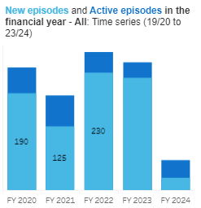
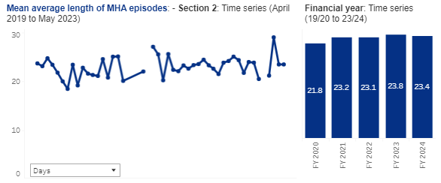
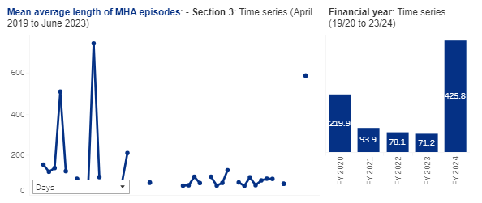
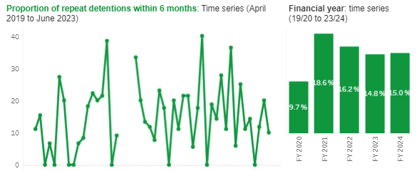
Uses of Act and duration of episodes, 65 years and over, CPFT
Upto May-23
270
250
240
185
220
Upto Jun-23
Up to Jun-23
A 7% decline has been seen in the financial year 2023 compared to the previous year for the total number of Mental Health Act episodes in Cambridgeshire and Peterborough.
In FY-2023, the average length of MHA episodes for Section 2 shows an overall increase compared to FY-2020, while a substantial decline is seen for episodes detained under Section 3 during the period.
The proportion of people detained in the given month who had been detained in the preceding six months under all sections shows a decline in the financial years 2022 and 2023 compared to 2021.
Source: MHA Dashboard - Mental Health, Learning Disability and Autism Resource Hub - FutureNHS Collaboration Platform
Notes:
Section 2 : A detention in hospital for assessment (or assessment followed by medical treatment) when someone has a mental health problem and needs to be detained for their own health or safety or to protect others. A Section 2 can last for up to 28 days.
Section 3 : A detention in hospital for treatment of a mental health problem, where appropriate treatment cannot be given unless the person is detained, and the detention is necessary for the person’s own health or safety or the protection of others. A Section 3 can last for up to six months in the first instance and can then be renewed by a responsible clinician.
Section 4 : An emergency application made when there is an urgent need to detain someone in hospital under Section 2 of the Mental Health Act, but complying with the provisions of this section (e.g. needing two doctors to recommend that the person is detained) would result in an unacceptable delay. A Section 4 can last up to 72 hours from when someone is admitted to hospital.
Section 5(2) : A detention occurring after a registered doctor or approved clinician issues a report to a hospital manager stating that someone who is in hospital but not currently detained (including patients being treated for physical health problems), should be kept in hospital due to their mental health needs. A Section 5(2) can last up to 72 hours, during which time arrangements can be made for the attendance of an Approved Mental Health Professional (AMHP) and a full assessment under the Mental Health Act.
Section 5(4): Used by an appropriately qualified nurse to prevent a patient who is voluntarily receiving treatment for a mental health problem from leaving hospital, if the nurse deems that it is necessary for the person’s health or safety or for the protection of others, and it is not practical to get a practitioner or clinician to attend immediately to arrange a Section 5(2). A Section 5(4) can last up to 6 hours or until a practitioner with authority to detain someone arrives.
Section 135 : If there is reasonable cause to suspect that a person with a mental health problem has or is being ill-treated or neglected or is unable to care for themself and live alone, then a magistrate can issue a warrant authorising a police officer to enter the person’s premises and take them to (or keep them at) a place of safety. A Section 135 allows someone to be kept in the place of safety for up to 24 hours.
Section 136 : If it appears to a police officer that a person has a mental health problem and is in immediate need of care, the police officer may take the person to a place of safety (or keep the person at a place of safety), if they believe it is in the best interests of the person or for the protection of others. A Section 136 allows someone to be kept in the place of safety for up to 24 hours.

Slide 31
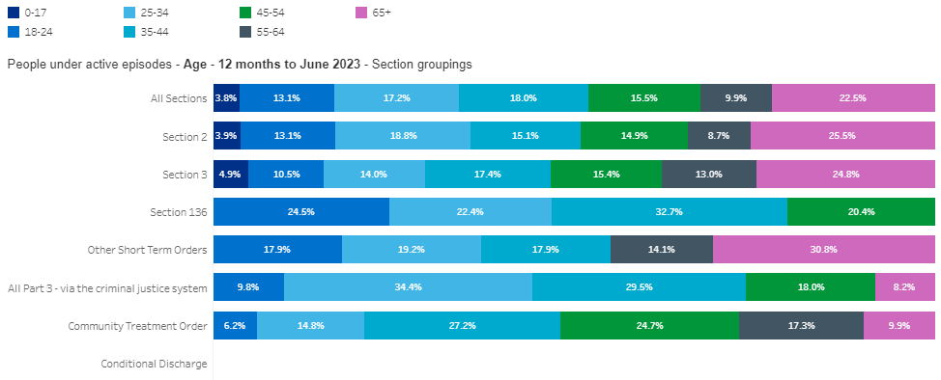
Characteristics of people detained under the Act, CPFT
During the 12-month period ending June 2023, the highest proportion of all people under active episodes (all sections) were aged 65 years and over (23%) in Cambridgeshire and Peterborough.
About 31% of all people detained under “other short-term orders” were over 65 years old.
All the people detained under Section 136 were aged between 18 and 54 years, with a higher proportion among the 35–44 age band.
Over one-third of the people detained via the criminal justice system were aged 25–34.
Of the people detained under the Community Treatment Order, a higher proportion were seen among the 35–44 and 45–54 age bands.
Source: MHA Dashboard - Mental Health, Learning Disability and Autism Resource Hub - FutureNHS Collaboration Platform

Slide 32
Older Peoples Mental Health (OPMH) Services
Notes:
The service offers help for those over the age of 65 years with more complex mental health problems (such as anxiety, depression, psychosis, bi-polar depression) and/or memory problems.
They offer assessments and interventions with different staff depending on the needs. This can include psychiatrists, nurses, social workers, occupational therapists and support workers.

Slide 33
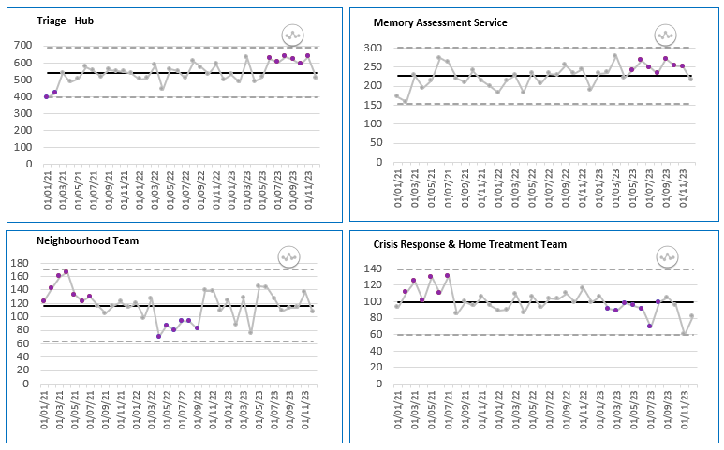
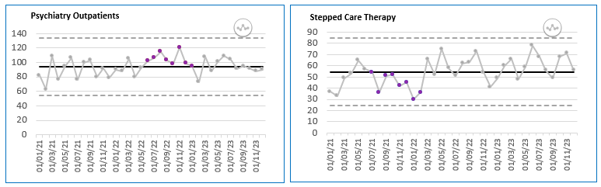
Referral trend for OPMH Pathways, CPFT, Jan 21 to Dec 23
The number of people referred to the Triage Hub (OPMH referral admin team) and memory assessment service shows a fairly stable trend over time. However, a shift is seen in the more recent reporting periods, with numbers above the mean.
The number of referrals to the neighbourhood team shows fluctuations over time, but they are within the control limits.
The number of referrals to the crisis response and home treatment teams shows fluctuations with recent declines.
The number of referrals to psychiatry outpatients shows a relatively stable trend.
The number of referrals to stepped care therapy shows some increases in the recent reporting months compared to the 2021 levels.
Shift: a run of 6 or more consecutive data points above or below the mean
Source: CPFT
Notes:
The triage hub monitor is the OPMH referrals admin team. All non-urgent new mental health referrals received by OPAC Directorate (e.g. excluding CRHT pathway), are registered within this team first.
Subsequently, these referrals are subject to triage by senior mental health practitioners, and if accepted for care, patients will be subject to onward referral to one or more OPAC Directorate mental health teams for care. (e.g. the triage referral is discharged, and one or more new referrals are registered on the respective pathways to meet patient mental health care needs).
The memory assessment services (memory clinics) exist in each of the four geographical areas (localities). The memory clinics model aims to offer high quality, high throughput, low cost model of assessment of memory problems to ensure that accurate diagnoses are provided in a timely manner, and an earlier stage in the illness, allowing patients themselves to make decisions about both their current and future care plans.
Neighbourhood Teams (NTs) are responsible for the promotion of health and independence in the community working with colleagues across multiple health, social and voluntary sector organisations. NTs offer multi-disciplinary, seamless care closer to a patient’s home. They provide a service for patients in a variety of settings primarily the person’s own home but delivering some interventions in other locations such as GP practices.
Older Peoples Crisis Response and Home Treatment Team - the service provides assessment and short-term intensive treatment (up to 6 weeks0 for older people experiencing a major mental health concern that may otherwise require a period of hospital admission.
Psychiatry Outpatients is a medic led service in OPAC Directorate and it does NOT include liaison psychiatry.
The Older People's Stepped Care Therapies Service will provide psychological therapy, occupational and psychosocial therapies for people over the age of 65 in Cambridgeshire and Peterborough. Staff will also offer advice, consultation, supervision, training and support in areas of their therapeutic expertise to staff within mental health and integrated older people’s services including inpatient units.
The triage – advice and guidance teams, describe a limited number of referrals, whose next steps post triage and referral acceptance, are for the appropriate OPAC mental health practitioner (often a medic) to provide advice and guidance to the referrer (e.g. the GP) about the patient referred, as opposed to engaging the patient for mental health assessment or care delivery. As stated this is a small % of OPAC total mental health activity.
Electroconvulsive therapy (ECT) is an effective treatment for some types of severe mental illness.
It is usually considered when other treatment options, such as psychotherapy or medication, have not been successful or when someone is very unwell and needs urgent treatment.

Slide 34
Demographics data for the referrals by OPMH pathways, 65 years and over, CPFT, Jan 21 – Dec 23
Proportion of referrals by ethnic group for OPMH services |  |  |  |  | % in the general population for 65+ (Census 2021)
Ethnic group | Triage Hub | CRHT | NT and Psychiatry Outpatient | Stepped Care Therapy
White | 81.8% | 85.3% | 82.5% | 85.7% | 96.1%
Asian or Asian British | 1.7% | 0.9% | 2.1% | 1.3% | 2.4%
Black or Black British | 0.5% | 0.5% | 0.5% | 0.4% | 0.5%
Mixed | 0.3% | 0.2% | 0.4% | 0.6% | 0.4%
Other | 0.4% | 0.6% | 0.5% | 0.4% | 0.5%
Not stated/ Not known/Null | 15.2% | 12.5% | 14.0% | 11.6% | -
The proportion of referrals to the Triage Hub was higher among 75- to 84-year-olds. However, the proportion of referrals to the other pathways was higher among the 70–79 age group.
Females had a substantially higher number of referrals to OPMH services compared to males. This might be due to a higher female population than males in this age group.
More than 80% of the referrals to the OPMH services were "white,” and about 12–15% of the referrals did not have any coding for the ethnic group.
Source: CPFT

Slide 35
Demographics data for the referrals by OPMH pathways, 65 years and over, CPFT, Jan 21 – Dec 23
During the period between Jan-21 and Dec-23, less than 3% of referrals to the OPMH services were from the most deprived areas of Cambridgeshire and Peterborough.
A higher proportion of referrals were from the least deprived areas. This includes referrals for dementia services also, and it is expected that a higher proportion of people in the dementia services are from the least deprived areas.
Source: CPFT

Slide 36
Primary diagnosis for the patients registered for OPMH services, CPFT, Jan 21 – Dec 23
During the period between Jan-21 and Dec-23, about 42% of all the patients registered for the OPMH services had a primary diagnosis of organic, including symptomatic, mental disorders (including types of dementia, delirium, and mild cognitive disorder), and 31% had other degenerative diseases of the nervous system (including Alzheimer).
Source: CPFT
Notes:
Organic, including symptomatic, mental disorders - This block comprises a range of mental disorders grouped together on the basis of their having in common a demonstrable etiology in cerebral disease, brain injury, or other insult leading to cerebral dysfunction. The dysfunction may be primary, as in diseases, injuries, and insults that affect the brain directly and selectively; or secondary, as in systemic diseases and disorders that attack the brain only as one of the multiple organs or systems of the body that are involved.

Slide 37
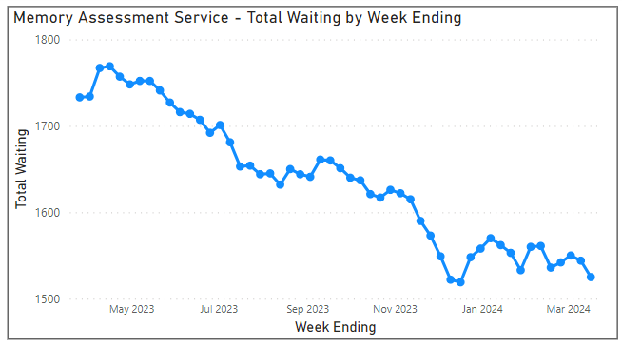
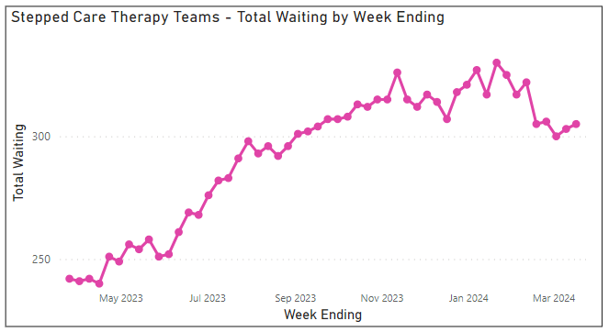
Total waiting per week over the last 12 months to 17/03/24, 65 years and over, CPFT
Note: The Y-axes does not start at 0
The number of people waiting per week shows a declining trend in the last 12 months for the memory assessment service.
However, the total number of people waiting at the end of reporting week shows an increasing trend for the stepped care therapy teams.
There were 1,525 cases waiting to access the memory assessment service and 305 cases for stepped care therapy in the reporting week ending 17th March 2024.
Source: CPFT

Slide 38
NHS Talking Therapies
Notes:
Talking Therapies (previously known as Improving Access to Psychological Therapies (IAPT) and later locally as the CPFT Psychological Wellbeing Service) provides treatment for common mental health conditions
Talking Therapies can be accessed by anyone aged 18 or over, without the need for a mental health diagnosis. People can self-refer into this service or can be referred a GP. Treatment offered includes:
Low intensity interventions
Cognitive behavioural therapy (CBT)
Computerised cognitive behavioural therapy (CBT)
Virtual reality-based therapy
Interpersonal therapy (IPT)
Eye Movement Desensitisation Reprocessing (EMDR)
Wellbeing workshops and group treatments
Specialist support for people who are unemployed.

Slide 39
Referrals, 65+ years, CPFT
The number of referrals to NHS Talking Therapies for adults aged 65 and over has seen an overall increase from 2018 to 2023.
The number of referrals for 65+ has increased by 35% in 2023 compared to the previous year.
The proportion of referrals aged 65 and older among total referrals to Talking Therapies has been growing since 2021, following a decline.
It has increased from 4.4% in 2021 to 6.5% in 2023.
Source: CPFT

Slide 40
Referrals, 65+ years, CPFT
The proportion of referrals to talking therapies is higher among women than in men in the 65+ age group.
Over 60% of all the referrals to talking therapies for this age group are women. This is higher than the proportion of females (54%) in the population for this age group.
For the 65+ age group, the proportion of referrals to talking therapies for white ethnic group has increased from 73% in 2018 to 83% in 2023 (an increase of about 11%).
The proportion of black, Asian, mixed, and other ethnic groups also increased from 1.8% in 2018 to 4.6% in 2023.
Source: CPFT
Notes:
Note: White ethnic groups include White British, White Irish and Any other White

Slide 41
Attendance rate, 65+ years, CPFT
The rate of attendance for both men and women show an overall decline since 2018.
The attendance rates for men and women have remained similar in the last two years.
The rate of attendance by ethnic groups shows a declining trend since 2018.
The attendance rates for the White ethnic group (69.9%) is similar to the Black, Asian, Mixed and Other ethnic groups (70.2%) in 2023.
Source: CPFT
Notes:
Note: White ethnic groups include White British, White Irish and Any other White

Slide 42
Dementia

Slide 43

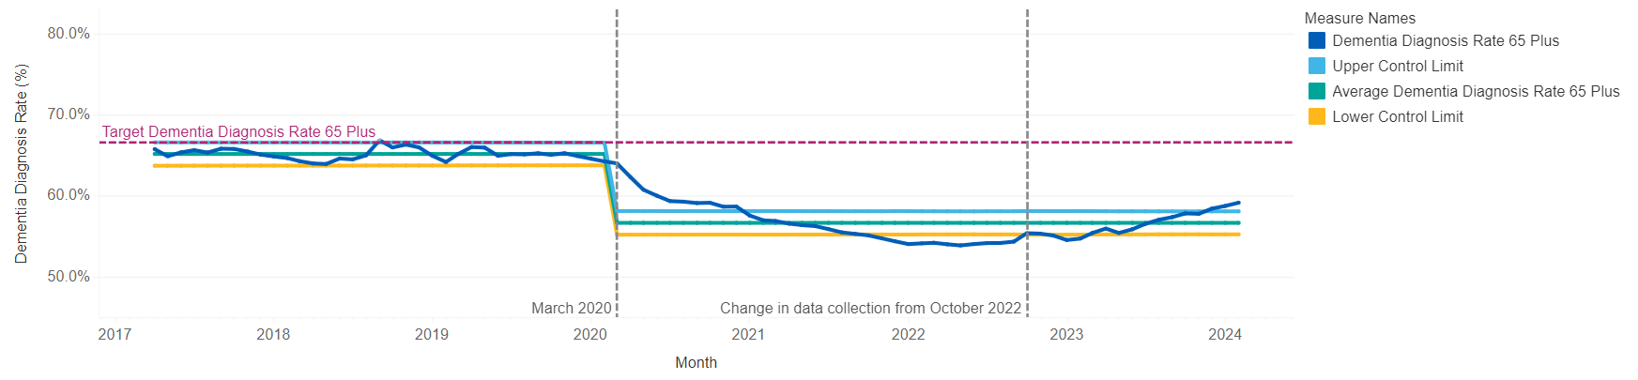
Dementia diagnosis rate, Cambridgeshire and Peterborough ICB
The diagnosis rate for dementia in Cambridgeshire and Peterborough for 65 years and over shows an increasing trend since October 2022.
In February 2024, there were 10,946 people aged 65 and overestimated to have dementia in Cambridgeshire and Peterborough ICB. Of these, 6,473 have been formally diagnosed and added to the dementia register making the estimated dementia diagnosis rate for the ICB 59.1%. This was significantly below the 66.7% aspiration, significantly below the England value of 64.5%.
Source: Dementia Diagnosis Rate Dashboard - Mental Health, Learning Disability and Autism Resource Hub - FutureNHS Collaboration Platform
Notes:
ICB Pre- and Post-Covid Time Series
In this graph the average, upper and lower control limits were calculated for pre and post- covid time periods to better reflect the difference in pre and post covid dementia diagnosis rate.
The target dementia diagnosis rate 65 plus is displayed as a dashed line at 66.6% for reference.
Dementia diagnosis rate 65 plus: This is the dementia register divided by the dementia estimate for those age 65 plus.
Upper Control Limit and Lower Control Limit: These are limits calculated based in the dementia register and estimate data. One set of limits is calculated for the time period before March 2020 and one set for the time period from March 2020 until the latest month.
The limits can be interpreted in the following ways: If the dementia diagnosis rate is relatively stable and not changing, you will see all data points within these limits. However, if a data point is outside of these limits, this tells us that there has been a significant change in the dementia diagnosis rate.
Average dementia diagnosis rate 65 plus: The average is calculated from the sum of the dementia register divided by the sun of the dementia estimate. One average was calculated for the time period before March 2020 and one for the time period from March 2020 until the latest month. The average sits between the upper and lower control limits.

Slide 44
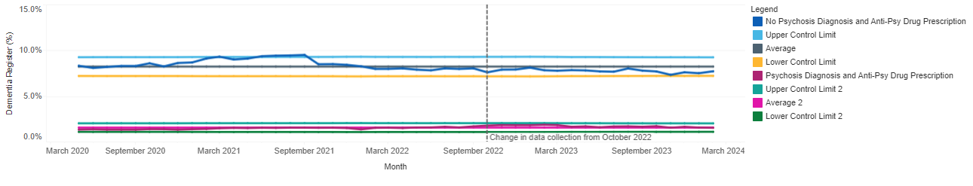
Anti-Psychotic prescription, Cambridgeshire and Peterborough ICB
The above chart displays the percentage breakdown of the dementia register for those with "no psychosis diagnosis and anti-psychotic drug prescription" and those with "psychosis diagnosis and anti-psychotic drug prescription" for each month in the time period.
The percentage of those prescribed anti-psychotic drugs without a psychosis diagnosis is substantially higher than that of those being prescribed the drug with a psychosis diagnosis.
In the reporting period of February 2024, 7.7% of people on the dementia register were prescribed antipsychotic drugs without a psychosis diagnosis, and 1.6% were prescribed a psychosis diagnosis.
Source: Anti-Psychotic Prescribing Dashboard - Mental Health, Learning Disability and Autism Resource Hub - FutureNHS Collaboration Platform
Notes:
No Psychosis Diagnosis and Anti-Psy Drug Prescription: This is the number of people with no psychosis diagnosis and are prescribed anti-psychotic drugs divided by the dementia register.
No Psychosis Diagnosis and Anti-Psy Drug Prescription: This is the number of people with a psychosis diagnosis and are prescribed anti-psychotic drugs divided by the dementia register.
Upper Control Limit and Lower Control Limit: These are limits calculated for the full time period based on either the percentage with No Psychosis Diagnosis and Anti-Psy Drug Prescription or the percentage with Psychosis Diagnosis and Anti-Psy Drug Prescription.
Average for No Psychosis Diagnosis and Anti-Psy Drug Prescription: This is calculated from the sum of the number of people with no psychosis diagnosis and are prescribed anti-psychotic drugs divided by the sum of the dementia register from May 2020 to the latest month. The average sits between the upper and lower control limits.
Average for Psychosis Diagnosis and Anti-Psy Drug Prescription: This is calculated from the sum of the number of people with a psychosis diagnosis and are prescribed anti-psychotic drugs divided by the sum of the dementia register from May 2020 to the latest month. The average sits between the upper and lower control limits.
If the percentage with No Psychosis Diagnosis and Anti-Psy Drug prescription or Psychosis Diagnosis and Anti-Psy Drug prescription is relatively stable, you will see all data points within these limits. However, if a data point is outside of these limits, this tells us that there has been a significant change in the rate of prescribing.

Slide 45
Primary care dementia data, 65 years and over, Cambridgeshire and Peterborough ICB, Apr 23 – Jan 24
From April 2023, more than 65% of the patients with a recorded dementia diagnosis are 75 years and over.
A slight increase is seen in the proportion of people aged 90 years and over since April 2023.
About 62% of all the patients with a recorded dementia diagnosis were women.
This is higher than the proportion of females (54%) in the population for this age group.
Source: Primary Care Dementia Data, January 2024 - NHS Digital
Notes:
Recorded dementia prevalence = (Number of patients aged 65 and over on dementia register / Number of patients aged 65 and over registered at practice) x 100

Slide 46
Primary care dementia data, 65 years and over, Cambridgeshire and Peterborough ICB, Apr 23 – Jan 24
The proportion of patients aged 65 years and over who are recorded as having dementia and one or more of the comorbidities (diabetes, stroke, hypertension, and coronary heart disease) shows an increasing trend since April 2023.
About 14–15% of the patients who are recorded as having dementia are receiving palliative care.
The recorded prevalence of dementia shows slight increases, while the prevalence of mild cognitive impairment shows a stable trend since Apr-23.
Source: Primary Care Dementia Data, January 2024 - NHS Digital
Notes:
Dementia diagnosis recorded with one or more comorbidities
GP Practices also supply the number of patients aged 65 and over who were recorded as having dementia and one or more of the following comorbidities: diabetes, stroke, hypertension and coronary heart disease (COMORBIDITIES)
Dementia diagnosis recorded with a record of receiving palliative care
GP Practices also supply the number of patients aged 65 and over who were recorded as having dementia and are included on the QOF palliative care register (PALLIATIVE_CARE).

Slide 47
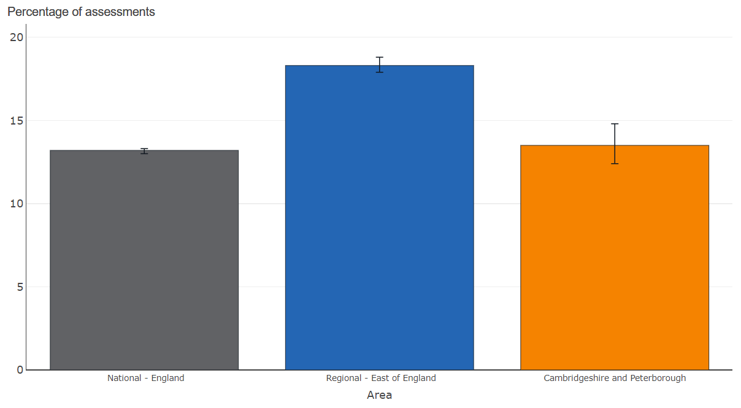
Memory assessments received, Cambridgeshire and Peterborough ICB
Memory assessments received: cumulative from 1st April 2023 to February 2024, all ages
There were 449 patients who were both referred to memory assessment services and received an assessment in Cambridgeshire and Peterborough between April 2023 and February 2024.
This was 13.5% of the dementia assessments provided in the ICB. This percentage was not significantly different from the national England value of 13.2% but significantly below the East of England regional value of 18.3%.
Note: The total number of referrals received by memory assessment services in Cambridgeshire and Peterborough over this time period is substantially greater.
Source: Dementia surveillance factsheet (phe.org.uk)
Notes:
Received Memory Assessment - Number of patients with a record of receiving an assessment for dementia by the GP practice since 1 April of the reporting year who have also received an initial memory assessment since 1 April of the reporting year

Slide 48
Primary care dementia data, Cambridgeshire and Peterborough ICB, Apr 23 – Jan 24
During the period between Apr-23 and Jan-24, nearly half of the patients on the dementia register had Alzheimer’s disease, around 13% had vascular dementia, and less than 5% had mixed dementia.
Around one-third of the patients had other types of dementia.
33–34% of the patients on the dementia register live in a residential care home; around 7% are in a nursing home; and about a quarter of the patients live in a private residence.
Source: Primary Care Dementia Data, January 2024 - NHS Digital
Notes:
Dementia type
From April 2023 data has also been collected on counts of patients on the GP practice's dementia register which are aggregated in to 4 dementia types:
Alzheimer's disease
Vascular dementia
Mixed dementia - patients diagnosed as having more than one type of dementia
Other dementia types - most recently diagnosed dementia type is not Alzheimer's disease, vascular dementia or mixed dementia.
Residential type
From April 2023 data has also been collected on counts of patients on the GP practice's dementia register which are aggregated in to 5 residential types:
Residential care home
Nursing home
Private residence
No permanent address
Other residential type - most recent residential type is not recorded

Slide 49
Dementia in patients registered for OPMH services, C&P ICB, Jan 21 – Dec 23
Primary diagnosis | Number of patients
Dementia in Alzheimer disease | 688
Vascular dementia, unspecified | 416
Unspecified dementia | 330
Mixed cortical and subcortical vascular dementia | 180
Other vascular dementia | 143
Subcortical vascular dementia | 115
Delirium not superimposed on dementia, so described | 83
Multi-infarct dementia | 57
Vascular dementia of acute onset | 43
Delirium superimposed on dementia | 36
Dementia in Parkinson disease | 31
Dementia in other diseases | 28
Total | 2150
2,150 patients were registered in the Older People Mental Health Service from January 2021 to December 2023 with dementia as a primary diagnosis. This is about 29.4% of all the patients registered in the service during this time period.
Of this, about 32% were classified as dementia in Alzheimer diseases, 19% had unspecified vascular dementia, and 15% had unspecified dementia.
Source: CPFT

Slide 50
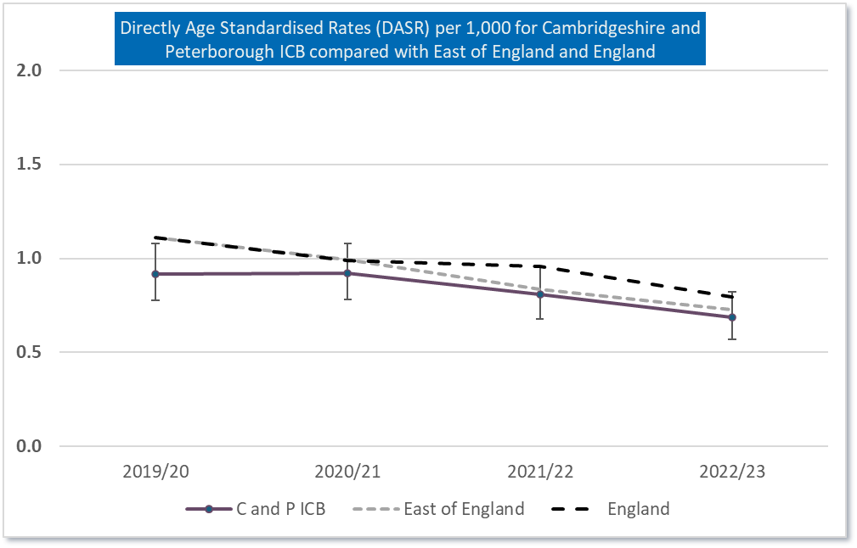
Emergency hospital admissions – patients aged 65+, dementia and Alzheimer’s disease, C&P ICB registered patients
Statistically significantly better than England | Statistically similar to England | Statistically significantly worse than England
The directly age-standardised rate of emergency hospital admissions per 1,000 population aged 65+ for dementia and Alzheimer’s disease shows a declining trend in Cambridgeshire and Peterborough ICB. This is also true for the East of England and England.
The rate of admissions in C&P ICB has been statistically similar to the national rates since 2020/21.
Note: The number of emergency admissions includes only the patients who were admitted because of dementia or Alzheimer's disease, and the rates are based on the Cambridgeshire and Peterborough ICB registered population.
Source: Healthcare Evaluation Data (HED)

Slide 51
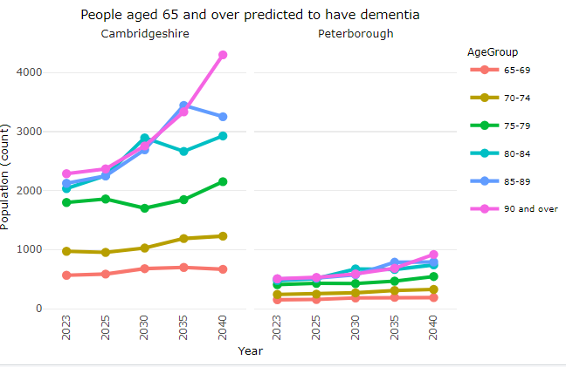
Dementia – POPPI projections
In Cambridgeshire and Peterborough, the number of people predicted to have dementia shows a substantial increase in people aged 80 years and over.
In 2040, the number of people aged 90 years and over predicted to have dementia will increase by about 88% in Cambridgeshire and 81% in Peterborough compared to 2023.
The overall 65+ population predicted to have dementia will have an increase of about 49% in Cambridgeshire and 54% in Peterborough between 2023 and 2040.
Note: The prevalence rates have been applied to ONS population projections of the 65 and over population to give estimated numbers of people predicted to have dementia to 2040.
Number of people aged 65 and over predicted to have dementia
Area Name | 2023 | 2025 | 2030 | 2035 | 2040
Cambridgeshire | 9,783 | 10,274 | 11,753 | 13,181 | 14,531
Peterborough | 2,287 | 2,392 | 2,713 | 3,101 | 3,511
Source: Projecting Older People Population Information System (poppi.org.uk)
Notes:
Figures are taken from Dementia UK: Update (2014) prepared by King’s College London and the London School of Economics for the Alzheimer’s Society. This report updates the Dementia UK (2007) report. It provides a synthesis of best available evidence for the current cost and prevalence of dementia. It aims to provide an accurate understanding of dementia prevalence and cost in the UK to assist in policy development, influencing, commissioning and service design.
The prevalence rates have been applied to ONS population projections of the 65 and over population to give estimated numbers of people predicted to have dementia to 2040.
To calculate the prevalence rates for the 90+ population, rates from the research for the 90-94 and 95+ age groups have been applied to the England population 2013 (when the research was undertaken) to calculate the numbers in each age group, the sum of these groups is then expressed as a percentage of the total 90+ population to establish the predicted prevalence of the 90+ population as a whole.

Slide 52
Drug and alcohol

Slide 53
Adults in treatment for drug and alcohol use, 50 years and over
The number of adults aged 50 and over in contact with the specialist substance misuse services shows an increasing trend for Cambridgeshire and Peterborough since 2013/14.
In 2022/23, the number of people in contact with the service increased by 122% in Cambridgeshire and 118% in Peterborough compared to 2013/14.
Source: NDTMS - ViewIt - Adult
Notes:
Adults in treatment
The data below shows the number of people in contact with specialist substance misuse services. People may access treatment for either problematic drug use, alcohol use or both.
Individuals presenting to adult alcohol and drug treatment services are categorised by the substances they cite as problematic at the start of treatment. They are categorised by the following hierarchal criteria:
any mention of opiate use would result in the person being categorised as OPIATE (irrespective of what other substances are cited)
people who present with non-opiate substances (without opiates or alcohol) will be classified as NON-OPIATE ONLY
people who present with a non-opiate substance and problematic alcohol use during their treatment journeys will be classified as NON-OPIATE AND ALCOHOL
people who present with alcohol and no other substances will be categorised as ALCOHOL ONLY

Slide 54
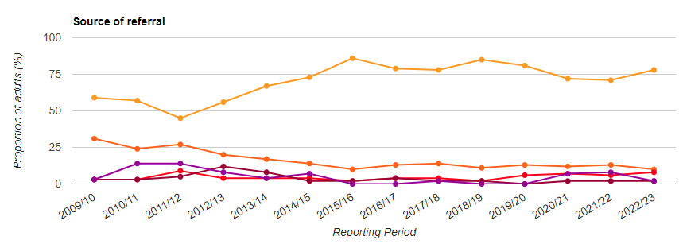
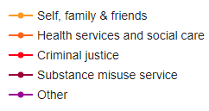
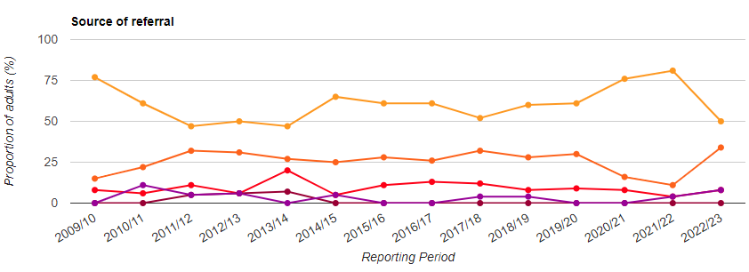
Source of referral for adults in treatment for drug and alcohol use, 50 years and over
Cambridgeshire
In Cambridgeshire and Peterborough, for the adults aged 50 and over, a higher proportion of referrals to the specialist substance misuse services were from “self, family or friends”.
In Cambridgeshire, from April 2022 to March 2023, about 78% of the referrals were from “self, family or friends”, 10% from “health services and social care”, 8% from “criminal justice” and 2% from “substance misuse services”.
In Peterborough, during the same period, about 50% of the referrals were from “self, family or friends”, 34% from “health services and social care”, 8% from “criminal justice” and 8% from “other”.
Peterborough
Source: NDTMS - ViewIt - Adult

Slide 55
Admission episodes for alcohol-related conditions, 65 years and over
Admission episodes for alcohol-related conditions (Narrow) – 65+ years, 2021/22, Directly standardised rate per 100,000
Area name | Count | Value | 95% lower CI | 95% Upper CI
Cambridge | 157 | 960 | 815 | 1,123
East Cambridgeshire | 120 | 651 | 539 | 779
Fenland | 183 | 778 | 669 | 899
Huntingdonshire | 251 | 681 | 599 | 771
South Cambridgeshire | 201 | 630 | 546 | 724
Cambridgeshire | 911 | 718 | 672 | 766
Peterborough | 228 | 739 | 646 | 842
England | 84,509 | 810 | 804 | 815
The rate of admissions for 65 years and over where the main reason for admission is an alcohol-related condition in Cambridge was significantly higher than the national rate in 2021/22.
The rates in Fenland and Peterborough were statistically similar to England.
Statistically significantly better than England | Statistically similar to England | Statistically significantly worse than England
Source: Alcohol Profile - OHID (phe.org.uk)
Notes:
Admission episodes for alcohol-related conditions (Narrow) – 65+ years: Admissions to hospital for 65+ year olds where the primary diagnosis (main reason for admission) is an alcohol-related condition. This represents a Narrower measure. Since every hospital admission must have a primary diagnosis it is less sensitive to coding practices but may also understate the part alcohol plays in the admission.

Slide 56
POPPI projections

Slide 57
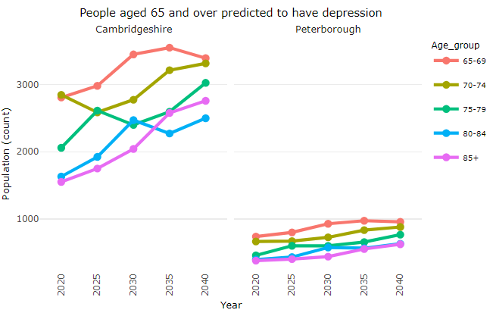
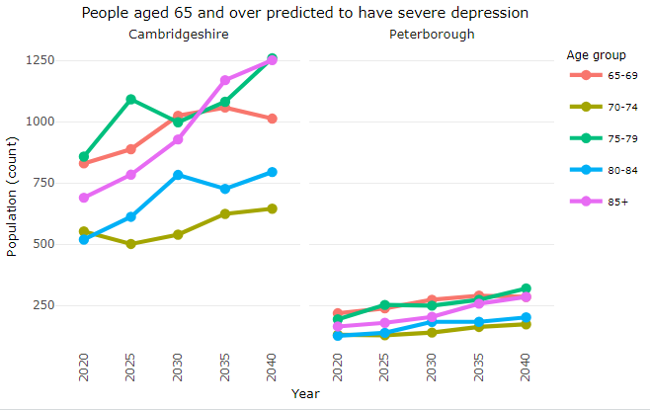
Depression, 65 years and over
Note: The Y-axes are different.
Number of people aged 65 and over predicted to have depression
Area Name | 2023 | 2025 | 2030 | 2035 | 2040
Cambridgeshire | 11,440 | 11,856 | 13,139 | 14,211 | 14,996
Peterborough | 2,790 | 2,910 | 3,273 | 3,584 | 3,862
Number of people aged 65 and over predicted to have severe depression
Area Name | 2023 | 2025 | 2030 | 2035 | 2040
Cambridgeshire | 3,720 | 3,876 | 4,273 | 4,659 | 4,964
Peterborough | 893 | 935 | 1,046 | 1,165 | 1,262
In 2040, the number of people aged 65 years and over predicted to have depression will increase by about 31% in Cambridgeshire and 38% in Peterborough compared to 2023.
In 2040, the number of people aged 65 years and over predicted to have severe depression will increase by about 33% in Cambridgeshire and 41% in Peterborough compared to 2023.
The projection shows a sharp increase in the 85+ population.
Source: Projecting Older People Population Information System (poppi.org.uk)
Notes:
Figures are taken from McDougall et al, Prevalence of depression in older people in England and Wales: the MRC CFA Study in Psychological Medicine, 2007, 37, 1787–1795.
The prevalence rates have been applied to ONS population projections of the 65 and over population to give estimated numbers predicted to have depression, to 2040.

Slide 58
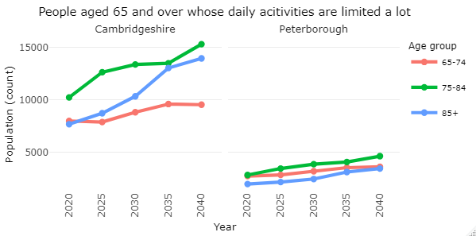
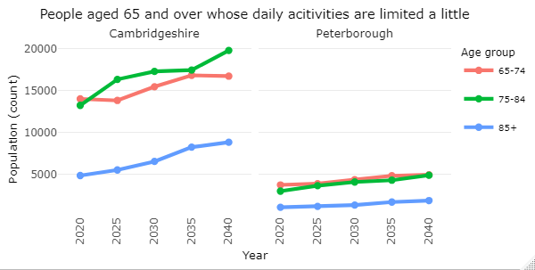
Limiting long term illness, 65 years and over
Note: The Y-axes are different
Number of people aged 65 and over whose daily activities are limited a lot
Area Name | 2023 | 2025 | 2030 | 2035 | 2040
Cambridgeshire | 28,030 | 29,262 | 32,538 | 36,135 | 38,800
Peterborough | 8,143 | 8,526 | 9,567 | 10,782 | 11,756
Number of people aged 65 and over whose daily activities are limited a little
Area Name | 2023 | 2025 | 2030 | 2035 | 2040
Cambridgeshire | 34,294 | 35,667 | 39,267 | 42,495 | 45,311
Peterborough | 8,376 | 8,756 | 9,814 | 10,863 | 11,745
In 2040, the number of people aged 65 years and over whose daily activities are limited a lot is predicted to increase by about 38% in Cambridgeshire and 44% in Peterborough compared to 2023.
The projection shows a sharp increase in the 85+ population in Cambridgeshire.
The number of people aged 65 years and over whose daily activities are limited a little is predicted to increase by about 32% in Cambridgeshire and 40% in Peterborough in 2040 compared to 2023.
Source: Projecting Older People Population Information System (poppi.org.uk)
Notes:
Figures are taken from Office for National Statistics (ONS) 2011 Census, Long term health problem or disability by health by sex by age, reference DC3302EW.
Numbers have been calculated by applying percentages of people with a limiting long-term illness in 2011 to projected population figures.

Slide 59
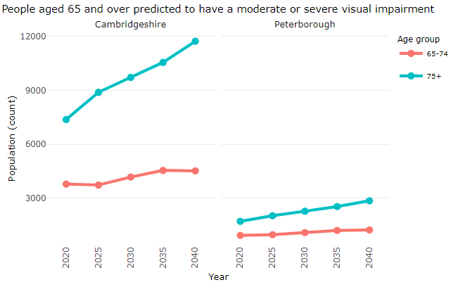
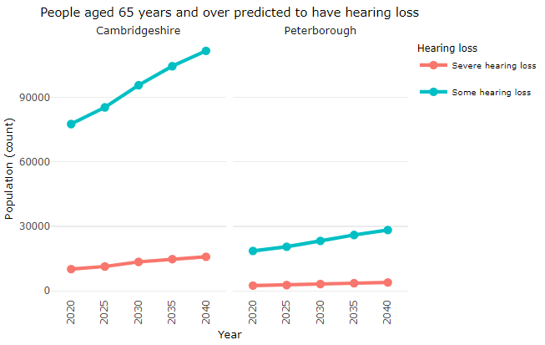
Visual impairment and hearing loss, 65 years and over
Number of people aged 65 and over predicted to have a moderate or severe visual impairment
Area Name | Measure | 2023 | 2025 | 2030 | 2035 | 2040
Cambridgeshire | 65-74 | 3,702 | 3,741 | 4,183 | 4,553 | 4,525
Peterborough | 65-74 | 952 | 980 | 1,098 | 1,215 | 1,243
Cambridgeshire | 75+ | 8,395 | 8,891 | 9,722 | 10,552 | 11,730
Peterborough | 75+ | 1,922 | 2,034 | 2,282 | 2,542 | 2,864
Number of people aged 65 and over predicted to have hearing loss
Area Name | Measure | 2023 | 2025 | 2030 | 2035 | 2040
Cambridgeshire | Severe hearing loss | 10,694 | 11,327 | 13,461 | 14,749 | 15,825
Peterborough | Severe hearing loss | 2,530 | 2,655 | 3,133 | 3,529 | 3,880
Cambridgeshire | Some hearing loss | 82,070 | 85,421 | 95,731 | 104,618 | 111,765
Peterborough | Some hearing loss | 19,651 | 20,515 | 23,250 | 25,982 | 28,308
Prevention of sight loss will help people maintain independent lives and reduce the need for social care support, which might be required for permanent sight loss.
In 2040, the number of people aged 65 and over predicted to have a moderate or severe visual impairment will increase sharply in the 75+ population.
The projection for people aged 65+ to have some hearing loss shows an increase of 36% in Cambridgeshire and 44% in Peterborough between 2023 and 2040.
Source: Projecting Older People Population Information System (poppi.org.uk)
Notes:
Visual impairment
Figures are taken from 'The number of people in the UK with a visual impairment: the use of research evidence and official statistics to estimate and describe the size of the visually impaired population', Nigel Charles, RNIB, July 2006.
The overall prevalence of all causes of visual impairment in those aged 65-74 years and over with visual acuity (VA) of less than 6/18 (moderate or severe) is 5.6%, and 12.4% for those aged over 75. VA of less than 6/18 is largely used as the point which approximates to the statutory threshold for qualifying as registered severely sight impaired (blind) or registered sight impaired (partially sighted).
Of those aged 75 and over, approximately half have cataracts or refractive error (i.e. correctable sight loss) and if these are excluded, the prevalence estimate of those with 'registrable' eye conditions is 6.4% in this age group. A small proportion have both cataracts and some other registrable cause of vision impairment and these are included within this figure.
Age related macular degeneration is the most common cause of registerable sight loss in older people.
The prevalence rates have been applied to ONS population projections of the 65 and over population to give estimated numbers of people predicted to have visual impairment to 2040.
Hearing loss
Hearing loss and deafness is usually measured by finding the quietest sounds someone can hear using tones with different frequencies, which are heard as different pitches. The person being tested is asked to respond, usually by pressing a button, when they can hear a tone and the level of the tone is adjusted until they can just hear it. This level is called the threshold. Thresholds are measured in units called dBHL: dB stands for 'decibels' and HL stands for 'hearing level'.
The greater the threshold level is in dBHL the worse the hearing loss. Anyone with thresholds between 0 and 20 dBHL across all the frequencies is considered to have 'normal' hearing. The threshold of 25 dBHL indicates some hearing loss; the threshold of 65 dBHL indicates severe hearing loss.
Evidence shows that hearing loss is a serious health condition that can have an adverse impact on a person’s health and quality of life, for example people with hearing loss may find it difficult communicate with other people and have an increased risk of social isolation and other problems such as anxiety, depression and dementia. People with hearing loss may also face barriers to employment due to poor deaf awareness or the lack of communication support.
Hearing loss is a common long-term condition and is most cases is not remediable by medical intervention. The primary intervention for most people with hearing loss is hearing aids provided by audiologists. Some people with hearing loss may use British Sign Language (BSL) as their first or preferred language and may consider themselves part of the Deaf community, with a shared history, culture and language.
The prevalence rates have been applied to ONS population projections of the 65 and over population to give estimated numbers predicted to have a severe or profound hearing impairment, to 2040.

Slide 60
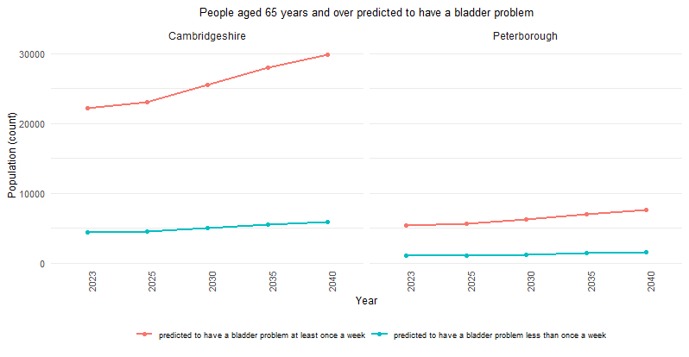
Continence, 65 years and over
In 2040, the number of people aged 65+ predicted to have a bladder problem at least once a week will increase by 34% and 42% in Cambridgeshire and Peterborough, respectively, compared to 2023.
Between 2023 and 2040, the predicted number of people to have a bladder problem less than once a week will increase by 35% in Cambridgeshire and 43% in Peterborough.
Number of people aged 65 and over predicted to have a bladder problem
Area Name | Measure | 2023 | 2025 | 2030 | 2035 | 2040
Cambridgeshire | Bladder problem at least once a week | 22,135 | 23,013 | 25,533 | 27,976 | 29,762
Peterborough | Bladder problem at least once a week | 5,324 | 5,575 | 6,248 | 6,925 | 7,542
Cambridgeshire | Bladder problem less than once a week | 4,339 | 4,511 | 5,052 | 5,547 | 5,871
Peterborough | Bladder problem less than once a week | 1,043 | 1,093 | 1,234 | 1,379 | 1,494

Slide 61
Comorbidities

Slide 62



Depression, 65 years and over, Cambridgeshire and Peterborough ICB
For people aged 65 and over, about 34% of the Cambridgeshire and Peterborough ICB registered population with depression had 5+ comorbidities.
Hypertension, osteoarthritis, coronary heart disease, diabetes, and cancer are the top five comorbidities for depression.
The prevalence of depression in the 65+ population is lower than the national average.
Alcohol Dependence (3.9%)
Severe Heart Failure (4.6%)
Physical Disability (4.3%)
Severe COPD (4.5%)
7.1%
Source: Population and Person Insight (PaPI) dashboard
Notes:
Data analytics for the PaPI dashboard have been derived from a person-level clinical segmentation data model produced by OBH (Outcome Based Healthcare), using linked predominantly secondary care datasets held in the NCDR, covering people registered to a GP practice in England, since April 2016.
The PaPI dashboard has been developed using a range of person, event and geo-spatially linked data available from national datasets including a Master Person Index, secondary care, emergency care, community services and specialised services data. The dashboards group/cohort patients into segments based on common healthcare needs and common socio-demographics such as age, gender, ethnicity and Index of Multiple Deprivation.

Slide 63



Serious Mental Illness (SMI), 65 years and over, Cambridgeshire and Peterborough ICB
For people aged 65 and over, over 37% of the Cambridgeshire and Peterborough ICB registered population with serious mental illness (SMI) had 5 or more comorbidities.
Hypertension, depression, diabetes, osteoarthritis, and coronary heart disease are the top five comorbidities for SMI.
The prevalence of SMI in the 65+ population is lower than the national average.
Cerebrovascular Disease (19.7%)
Chronic Kidney Disease (9.7%)
HFRS (8.5%)
Source: Population and Person Insight (PaPI) dashboard
Notes:
Data analytics for the PaPI dashboard have been derived from a person-level clinical segmentation data model produced by OBH (Outcome Based Healthcare), using linked predominantly secondary care datasets held in the NCDR, covering people registered to a GP practice in England, since April 2016.
The PaPI dashboard has been developed using a range of person, event and geo-spatially linked data available from national datasets including a Master Person Index, secondary care, emergency care, community services and specialised services data. The dashboards group/cohort patients into segments based on common healthcare needs and common socio-demographics such as age, gender, ethnicity and Index of Multiple Deprivation.

Slide 64



Dementia, 65 years and over, Cambridgeshire and Peterborough ICB
For people aged 65 and over, about 43% of the Cambridgeshire and Peterborough ICB registered population with dementia had 5 or more comorbidities.
Hypertension, osteoarthritis, cerebrovascular disease, coronary heart disease, and osteoporosis are the top five comorbidities for SMI.
The prevalence of dementia in the 65+ population is substantially lower than the national average.
Cerebrovascular Disease (31.3%)
Neurological organ failure (6.3%)
Serious Mental Illness (5.5%)
Parkinson's disease(5.7%)
5.2%
Source: Population and Person Insight (PaPI) dashboard
Notes:
Data analytics for the PaPI dashboard have been derived from a person-level clinical segmentation data model produced by OBH (Outcome Based Healthcare), using linked predominantly secondary care datasets held in the NCDR, covering people registered to a GP practice in England, since April 2016.
The PaPI dashboard has been developed using a range of person, event and geo-spatially linked data available from national datasets including a Master Person Index, secondary care, emergency care, community services and specialised services data. The dashboards group/cohort patients into segments based on common healthcare needs and common socio-demographics such as age, gender, ethnicity and Index of Multiple Deprivation.

