Slide 1
Health Related Behaviour Survey 2024
Key Findings
Public Health Intelligence, December 2024
PHI-Team@cambridgeshire.gov.uk

Slide 2
Summary
Nearly 7,000 Year 8 and 10 Cambridgeshire pupils completed the 2024 Health Related Behaviour Survey.
Only half of boys are definitely physically active, and less than a third of girls.
More than half of girls and around a third of boys want to lose weight, with only a fifth of pupils eating 5 a day.
Two-thirds of pupils report sleeping less than the 8-10 hours recommended per night, with just under half reporting 4 hours or more online (out of school).
In year 10, a third of girls and a quarter of boys have tried vaping and a quarter of pupils have had alcohol in the past week.
There are low levels of good mental health wellbeing and resilience generally, particularly among girls. Percentages are similar between year groups.
However, just over 60% of Cambridgeshire boys and 40% of girls are highly satisfied with their lives.

Slide 3
Background to the HRBS
The Health-Related Behaviour Survey (HRBS), developed by the Schools Health Education Unit (SHEU), is commissioned by Public Health.
The survey is administered bi-annually to Year 8 and Year 10 pupils across the county.
It provides a rich insight into the health-related attitudes and behaviours of our young people, that we can use to inform decision making and make sure that services meet their needs.
6,955 Cambridgeshire pupils participated in 2024.
Data on postcodes are not collected so it is not possible to analyse the data by deprivation.
 | Males | Females | Total*
Year 8 | 1,915 | 1,744 | 3,785
Year 10 | 1,478 | 1,556 | 3,170
*126 Year 8 and 136 Year 10 pupils answered that they describe their gender in some other way than male or female or preferred not to state their gender. These pupils will not be included in any tables or charts which are split by gender; however they will be included in any total figures.
Notes:
Total number of Yr8 and Yr10 pupils surveyed by districts:
Cambridge: 1,316
East Cambridgeshire: 1,027
Fenland: 807
Huntingdonshire: 1,927
South Cambridgeshire: 1,878

Slide 4
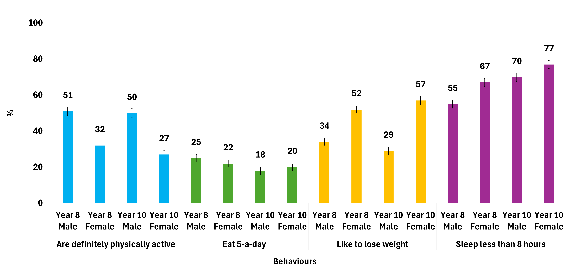
There are low levels of healthy behaviours
Only half of boys in years 8 and 10 are physically active and under a third of girls, with less than a quarter of pupils reporting eating 5 a day. More than half of girls and around a third of boys would like to lose weight. Many pupils are not getting the recommended levels of sleep (8-10 hours).
Source: HRBS, 2024

Slide 5
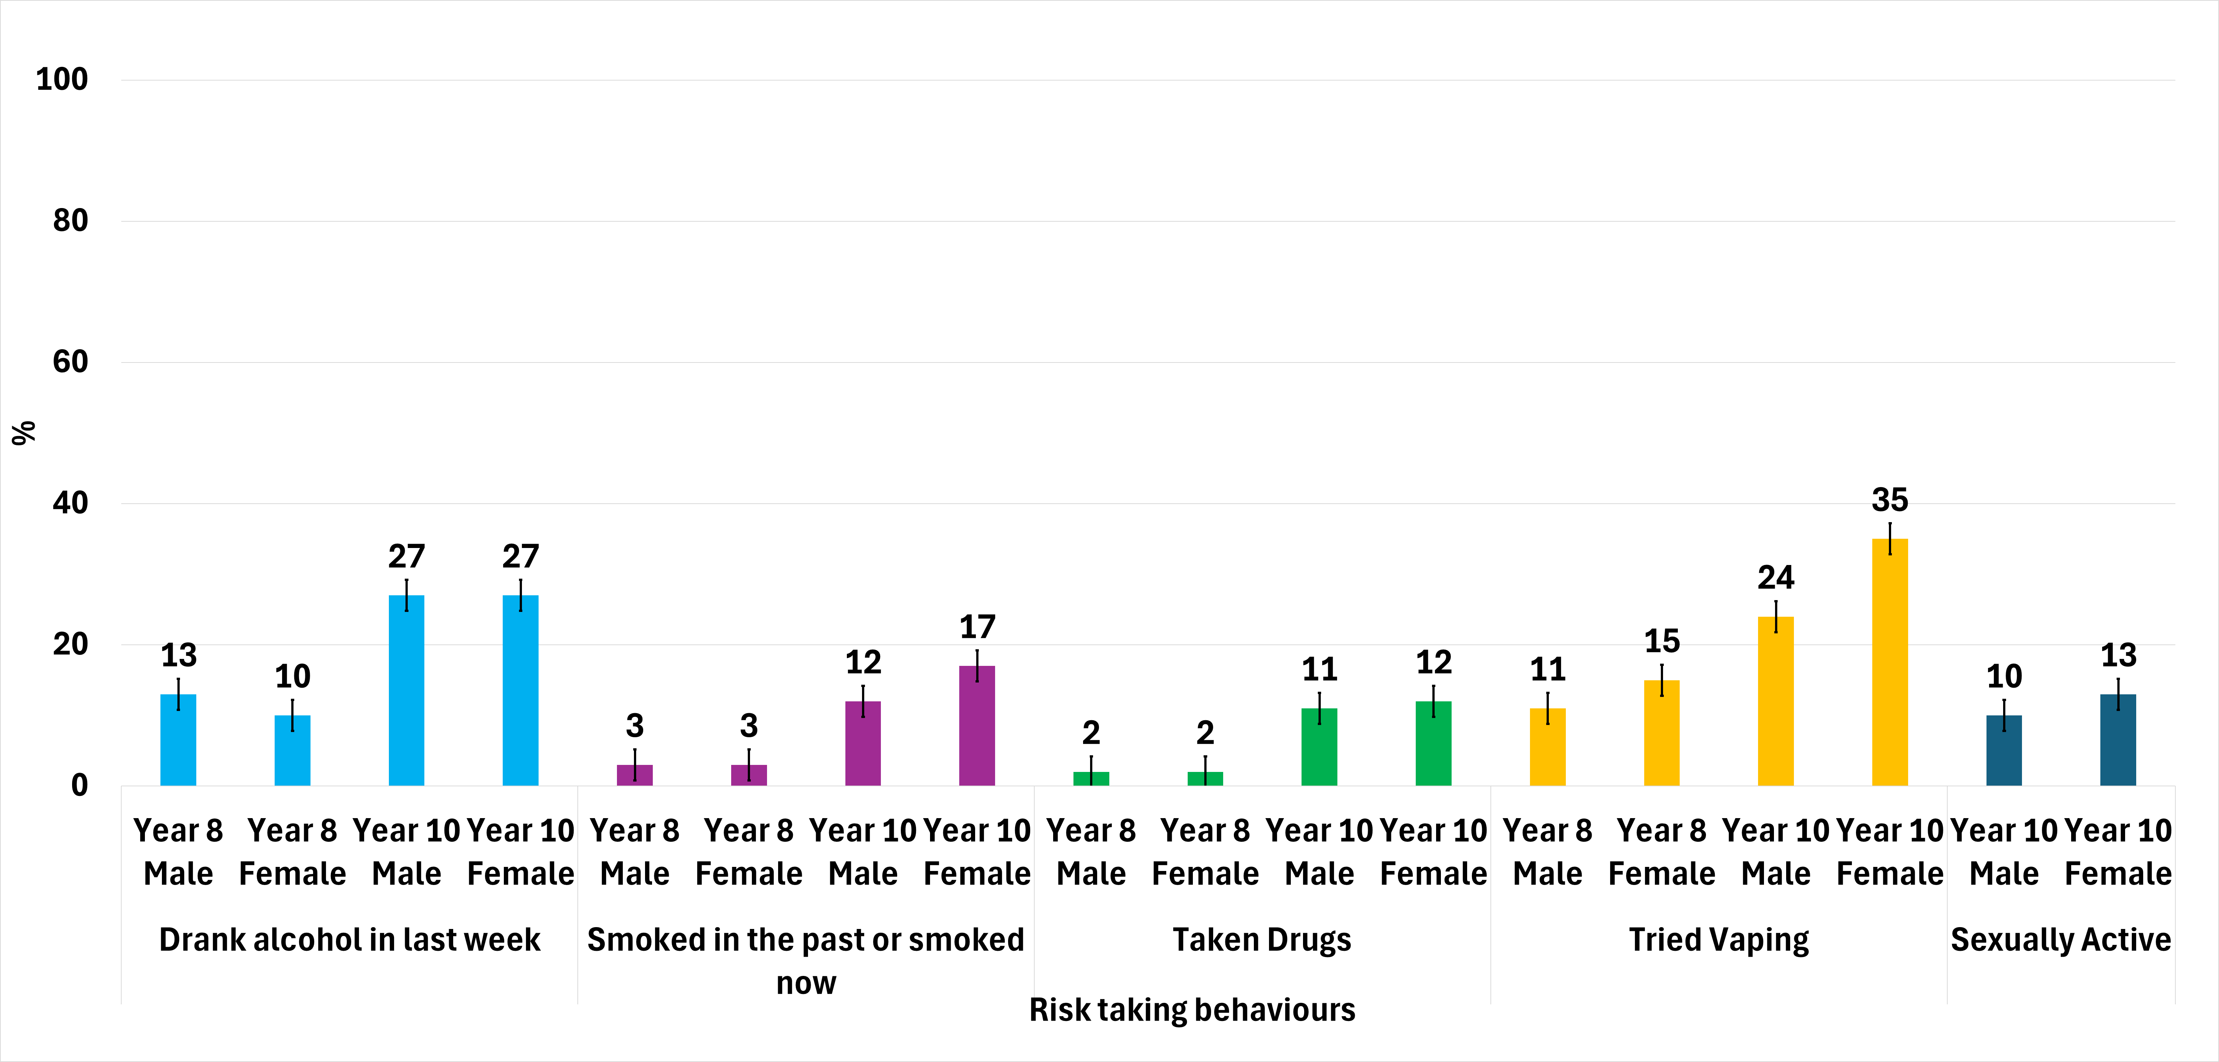
Of year 10s, a quarter report drinking alcohol in the past week, and a third of girls vape
Risk taking behaviours increase with age, and for vaping and smoking are higher among girls. More than one in ten year 10s reports taking drugs.
Source: HRBS, 2024

Slide 6
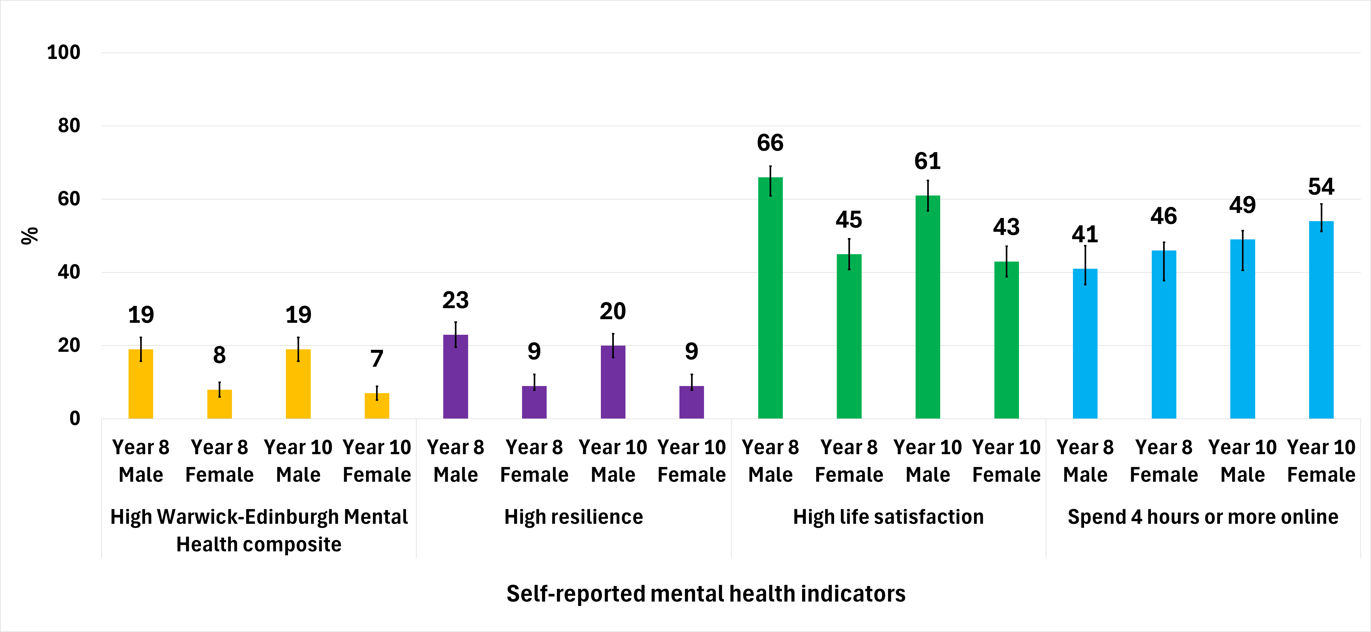
Mental health wellbeing is poor and high resilience is low, particularly in girls
Measures of mental health and resilience are higher in boys and levels are similar between different age groups. A high percentage of year 8s and year 10s are spending 4 hours or more online each day (excl. school). High life satisfaction is higher among boys.
Source: HRBS, 2024
Notes:
The Warwick–Edinburgh Mental Wellbeing Scale (WEMWBS) was developed to enable the monitoring of mental wellbeing in the general population and the evaluation of projects, programmes and policies which aim to improve mental wellbeing. A high WEMWBS score reflects high mental wellbeing.
The Warwick-Edinburgh Mental Wellbeing Scale (WEMWBS)

Slide 7
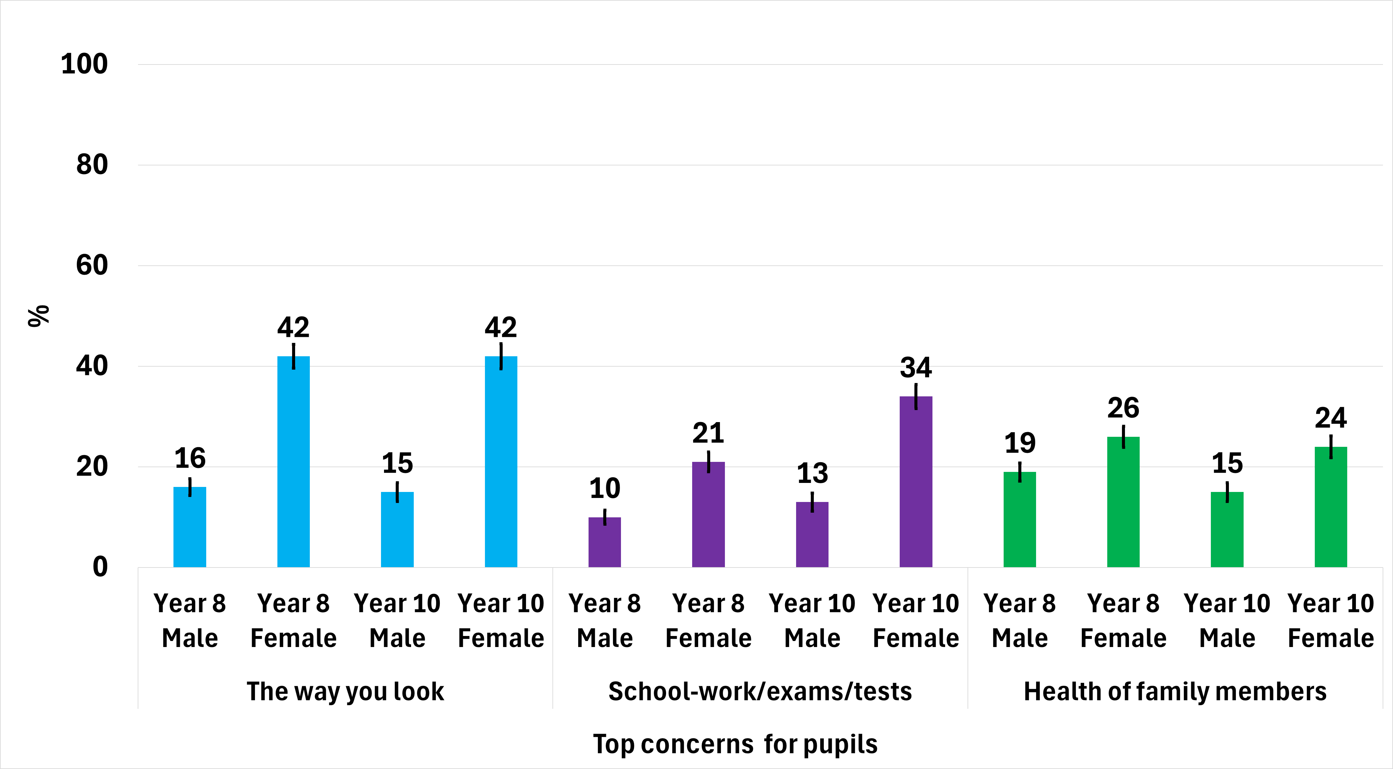
The top 3 concerns for pupils are how they look, school-work, and family health
A higher percentage of girls were concerned than boys, and particularly about how they looked and school-work.
Source: HRBS, 2024

Slide 8
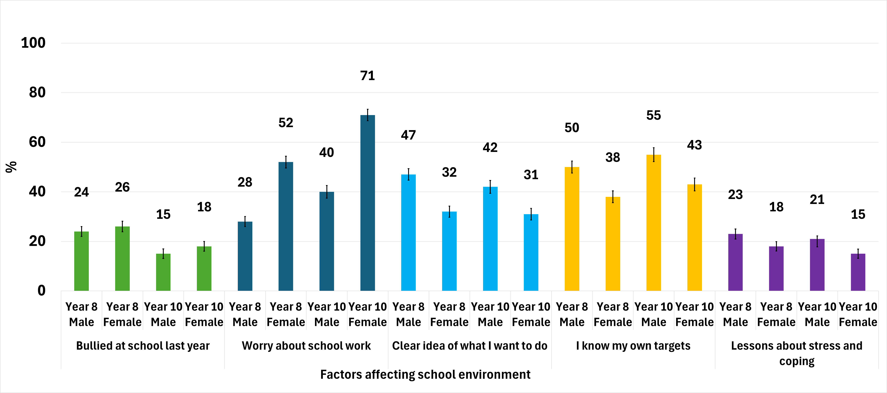
Girls are more worried about school and less likely to be clear about their future
A quarter of year 8s report being bullied. Most pupils do not find lessons about stress or coping helpful.
Source: HRBS, 2024

Slide 9
Trends over time in survey responses

Slide 10
District comparisons
These charts show the differences between districts for year 8 and year 10 pupils combined.
Total number of Yr8 and Yr10 pupils surveyed by district:
Cambridge: 1,316; East Cambridgeshire: 1,027; Fenland: 807; Huntingdonshire: 1,927; South Cambridgeshire: 1,878
Colours on the bars indicate whether the district value is statistically significantly worse than the Cambridgeshire average, similar or statistically significantly better.

Slide 11
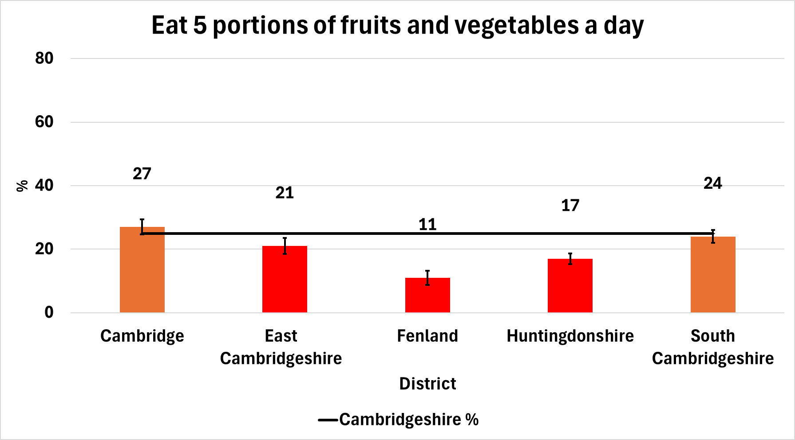
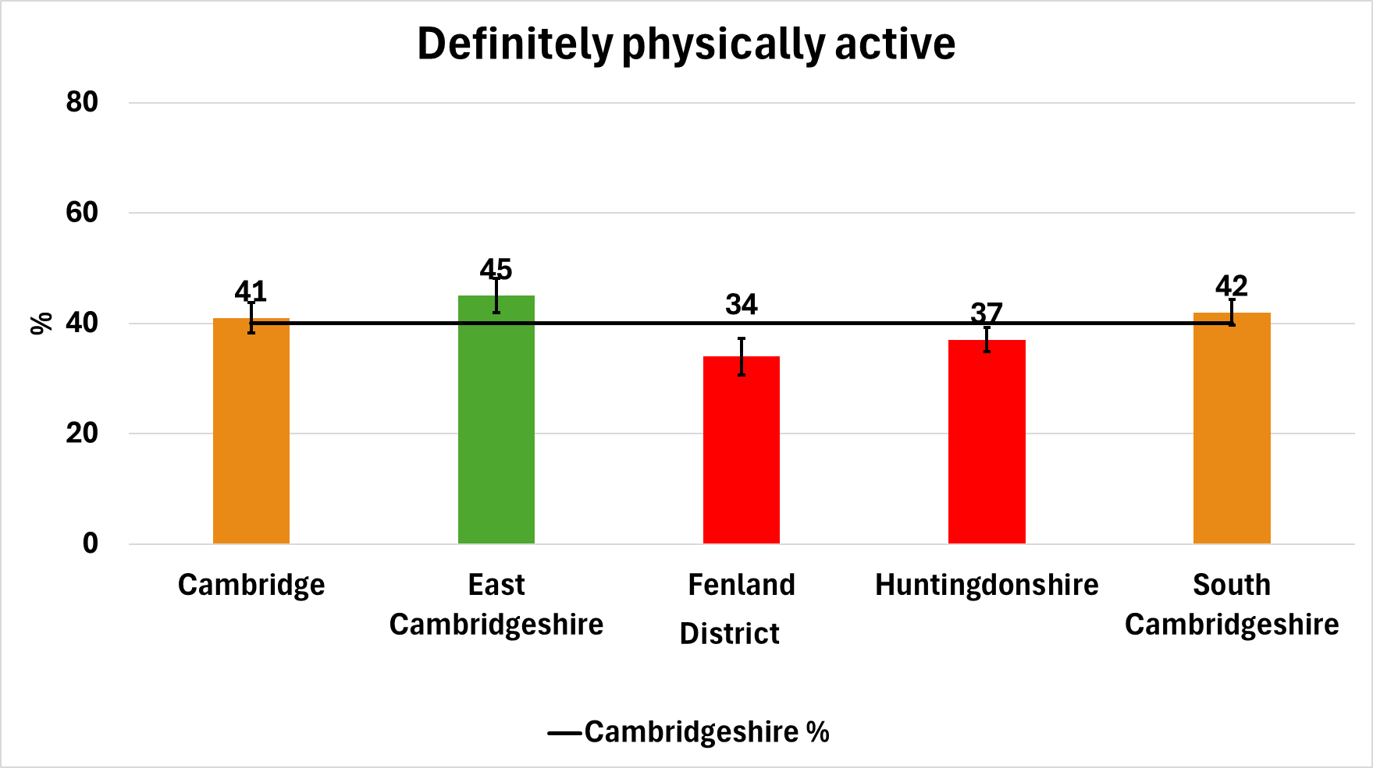
Healthy eating and physical activity
Just over a fifth of Cambridgeshire pupils reported that they consume at least 5 fruit or veg portions a day. Levels are lower in Fenland, Huntingdonshire and East Cambridgeshire.
40% of Cambridgeshire pupils report being ‘definitely’ physically active. Levels are higher in East Cambridgeshire and lower in Huntingdonshire and Fenland.
Source: HRBS, 2024
Notes:
Total number of Yr8 and Yr10 pupils surveyed by districts:
Cambridge: 1,316
East Cambridgeshire: 1,027
Fenland: 807
Huntingdonshire: 1,927
South Cambridgeshire: 1,878

Slide 12
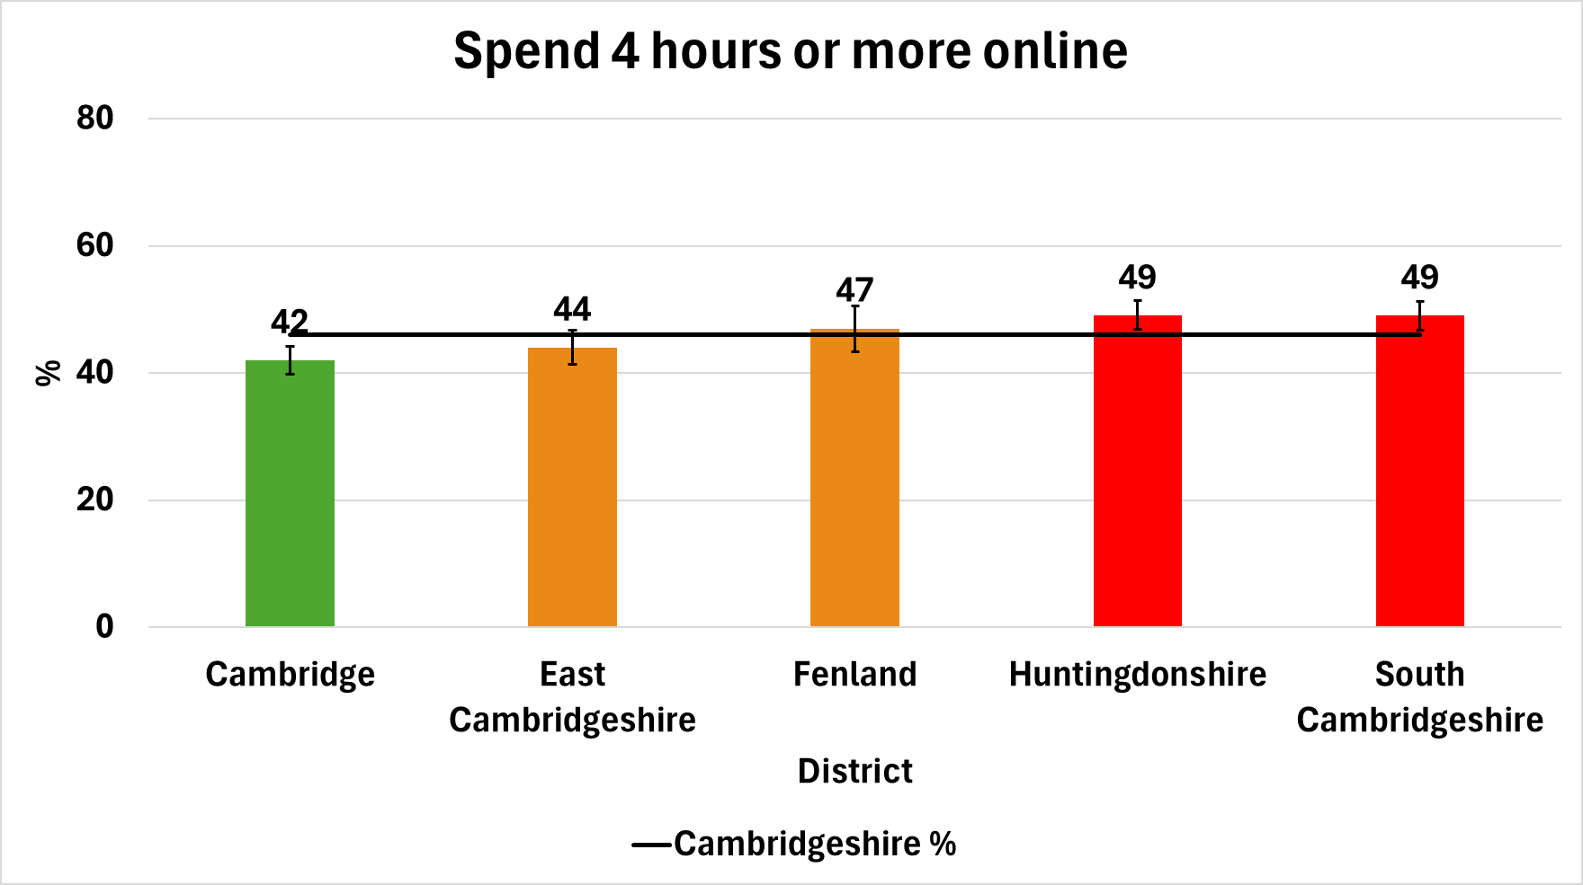
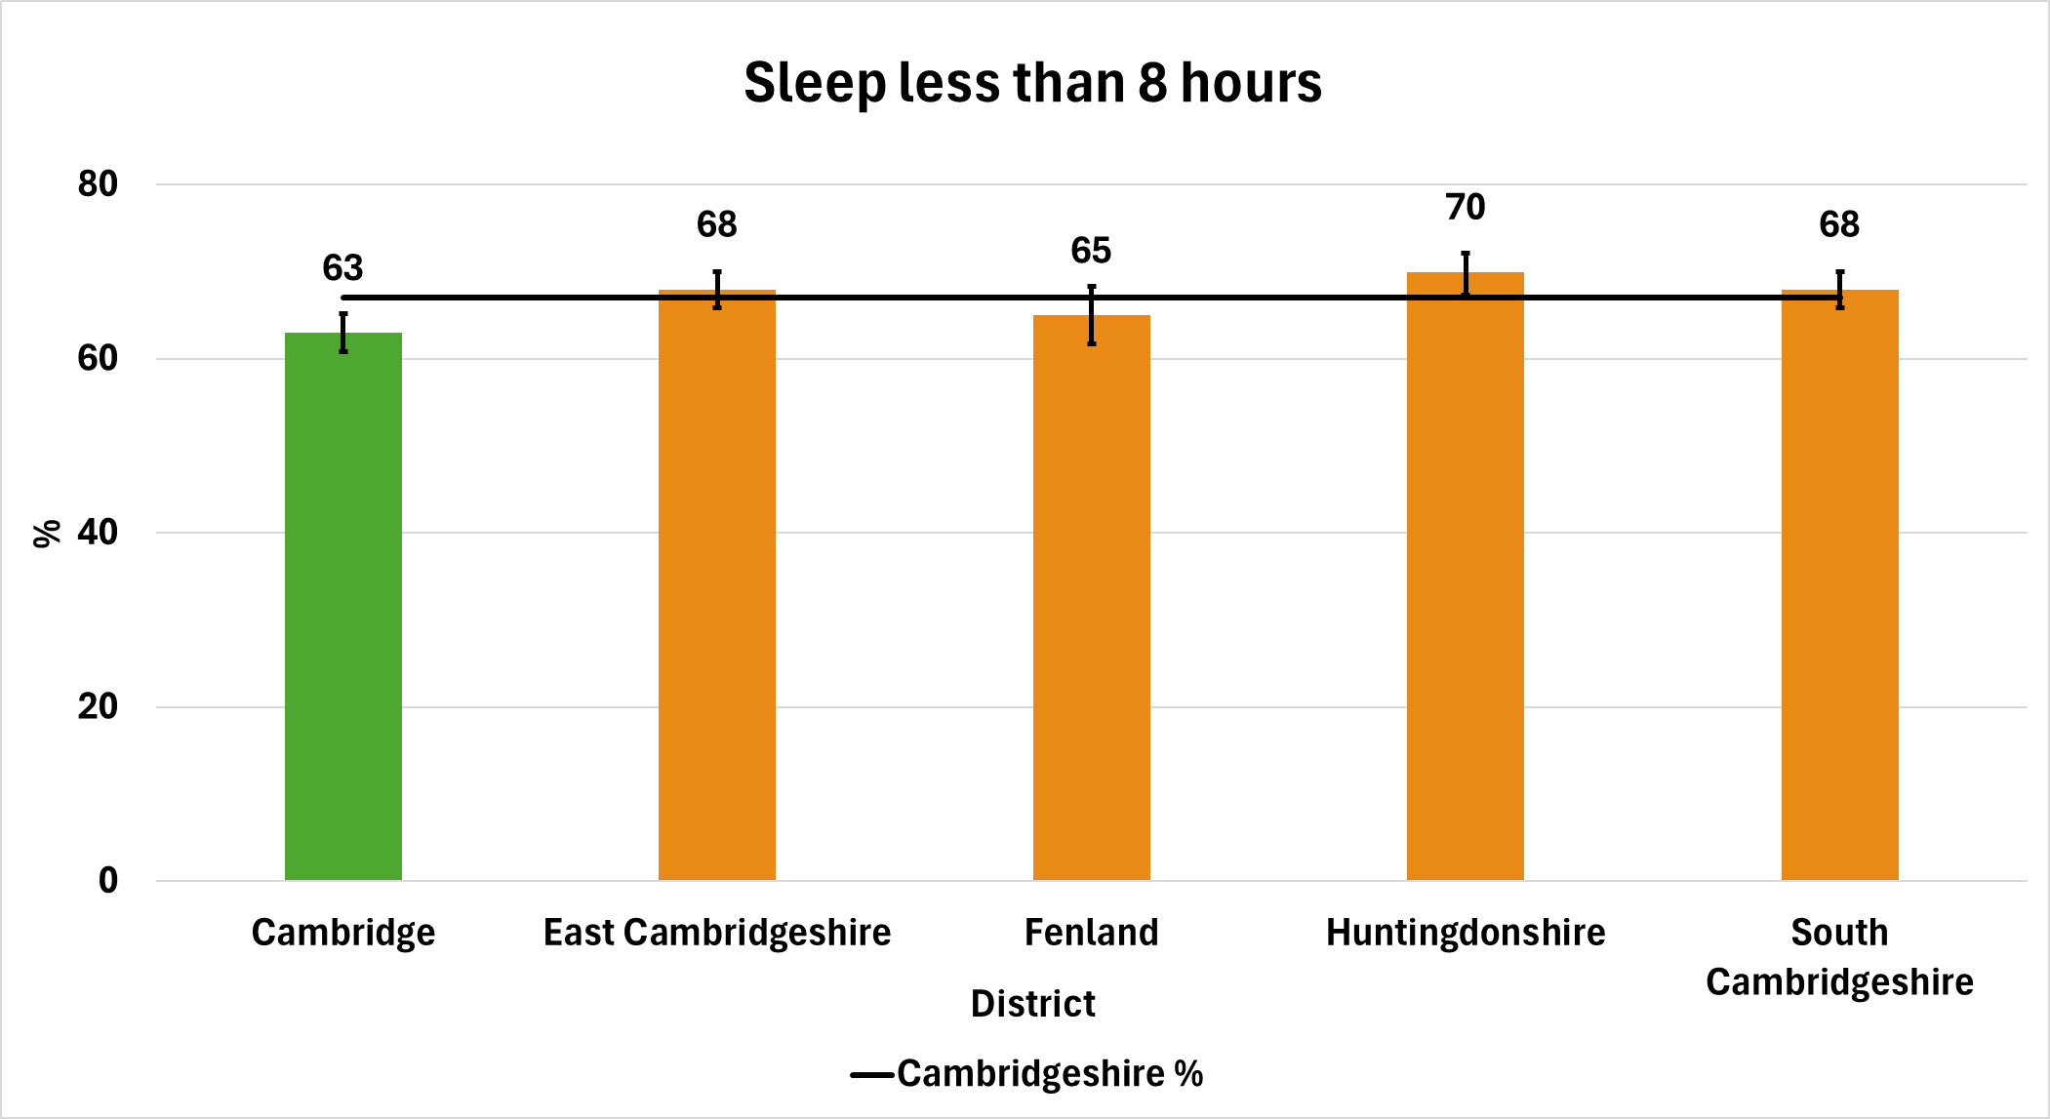
Being online and sleep
Nearly half of Cambridgeshire pupils spent 4 hours of more online (outside of school) in the previous day. This proportion is lower in Cambridge.
Two-thirds of pupils report to sleeping less than 8 hours a night (8-10 hours sleep is recommended). Proportionately more young people in Cambridge are getting the recommended levels of sleep.
Source: HRBS, 2024

Slide 13
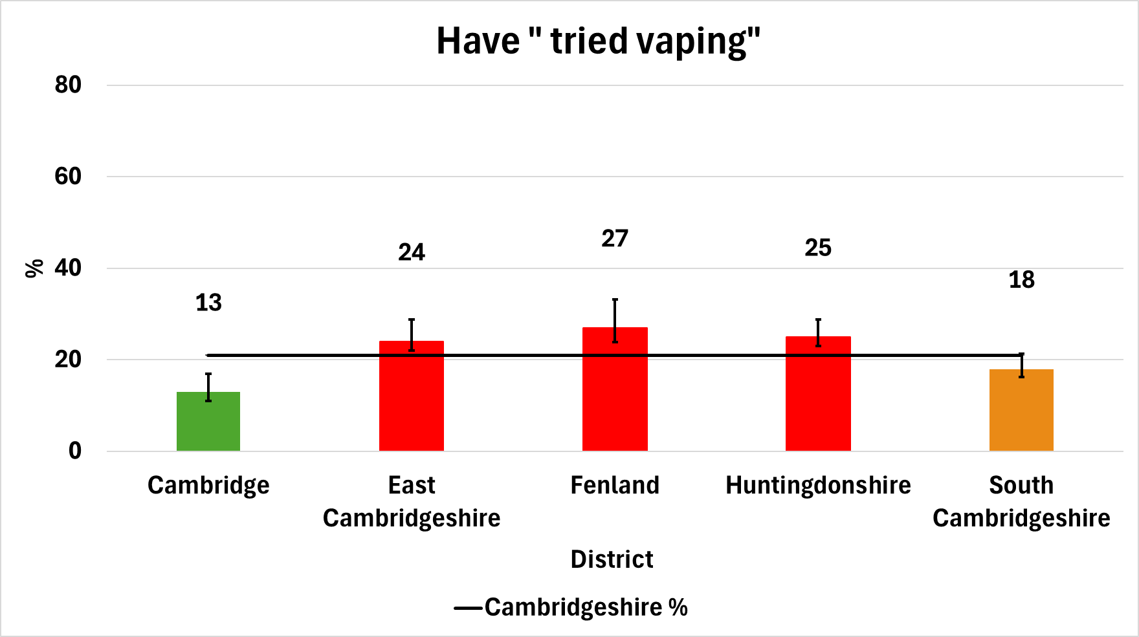
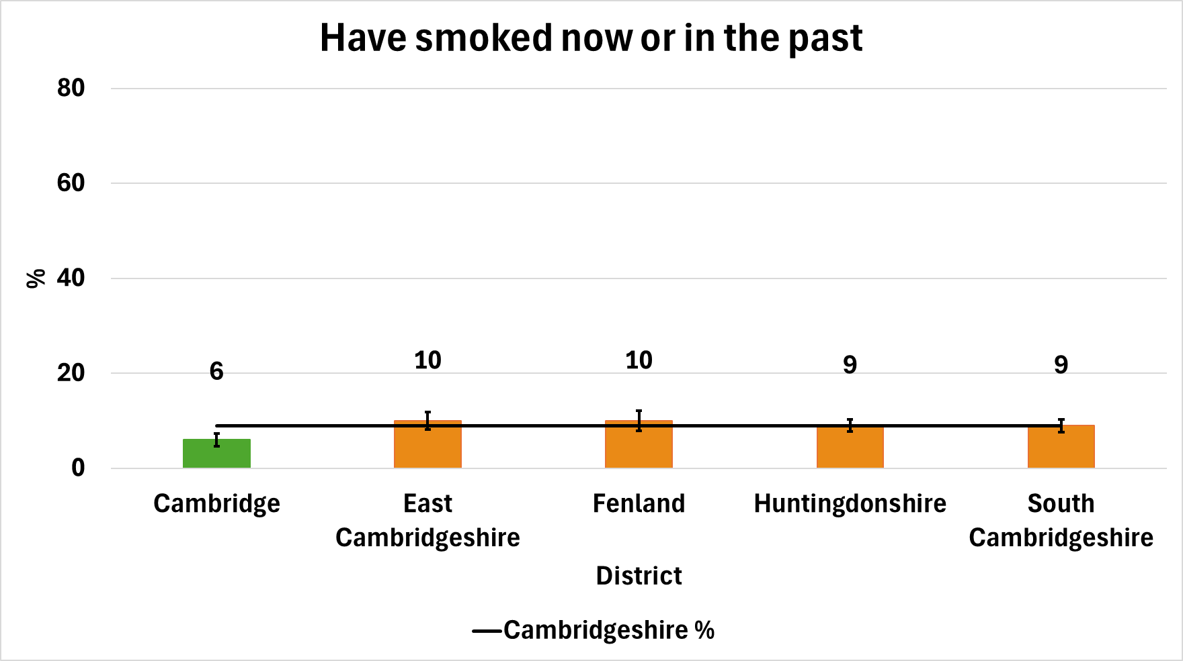
Smoking & vaping
21% of Cambridgeshire pupils report they have tried vaping. Levels are higher in East Cambridgeshire, Fenland and Huntingdonshire, and lower in Cambridge.
8% of Cambridgeshire pupils have smoked in the past or smoke now. Levels are lower in Cambridge.
Source: HRBS, 2024

Slide 14
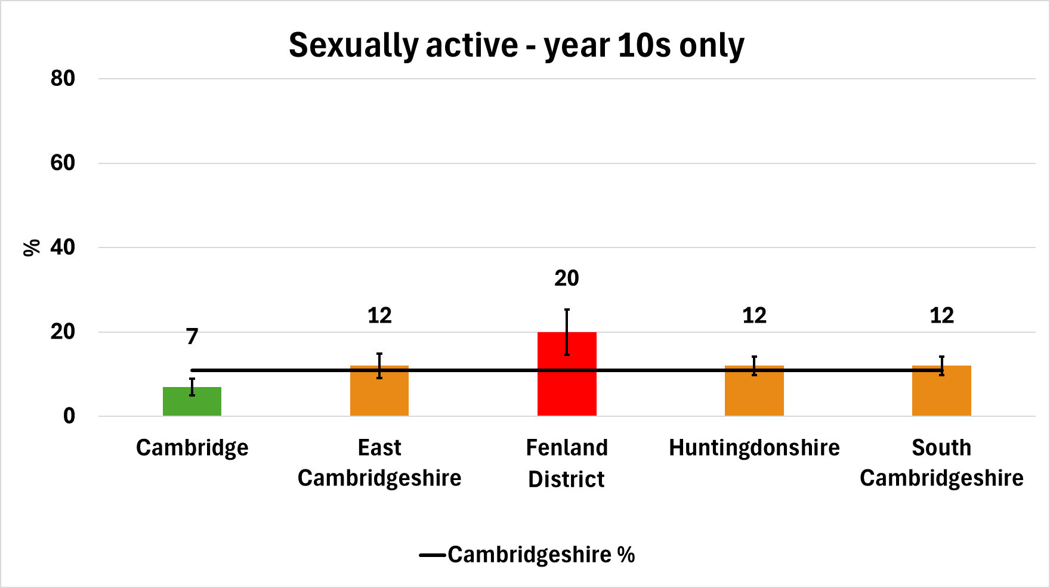
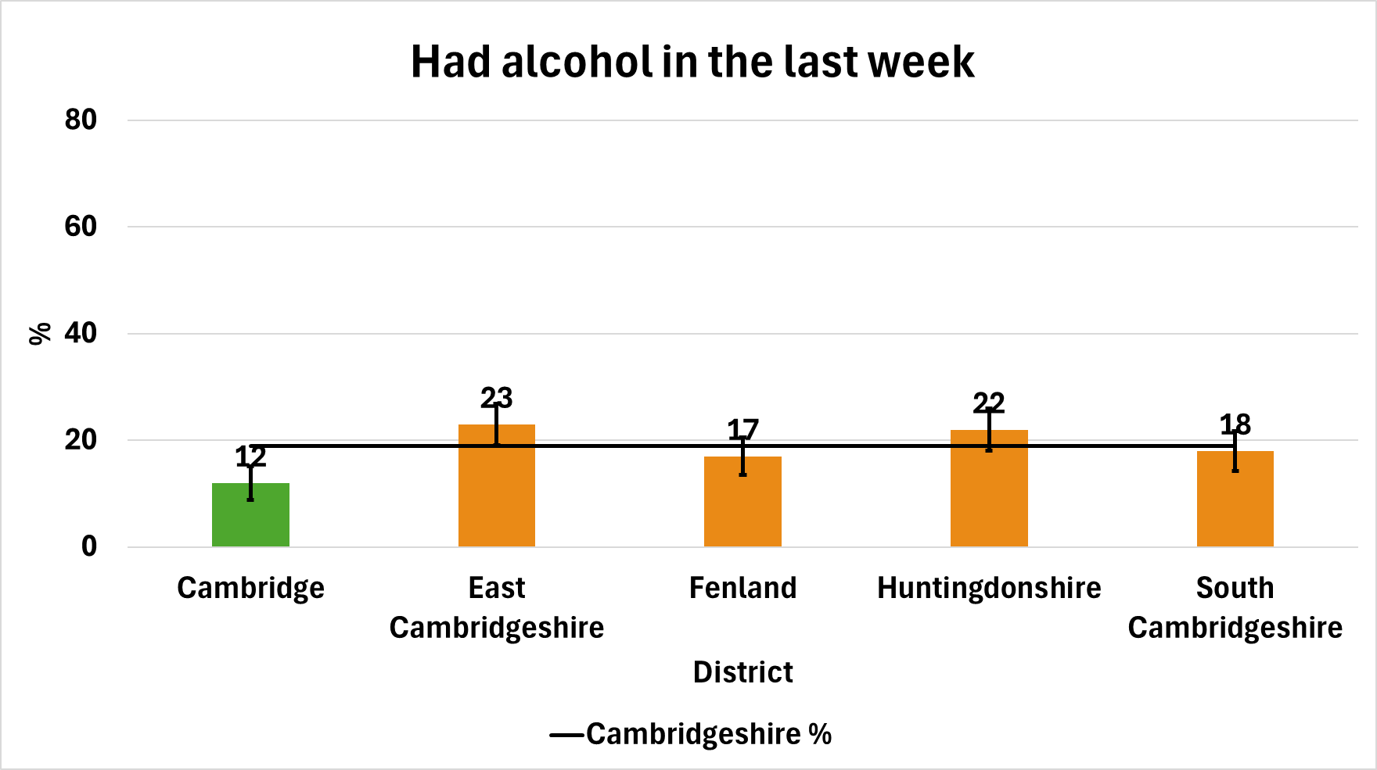
Sex and alcohol
On average, 12% of Cambridgeshire pupils are sexually active.
Higher levels are reported in Fenland and lower levels in Cambridge.
19% of Cambridgeshire pupils have consumed alcohol in the last week. Levels are lower in Cambridge.
Source: HRBS, 2024

Slide 15
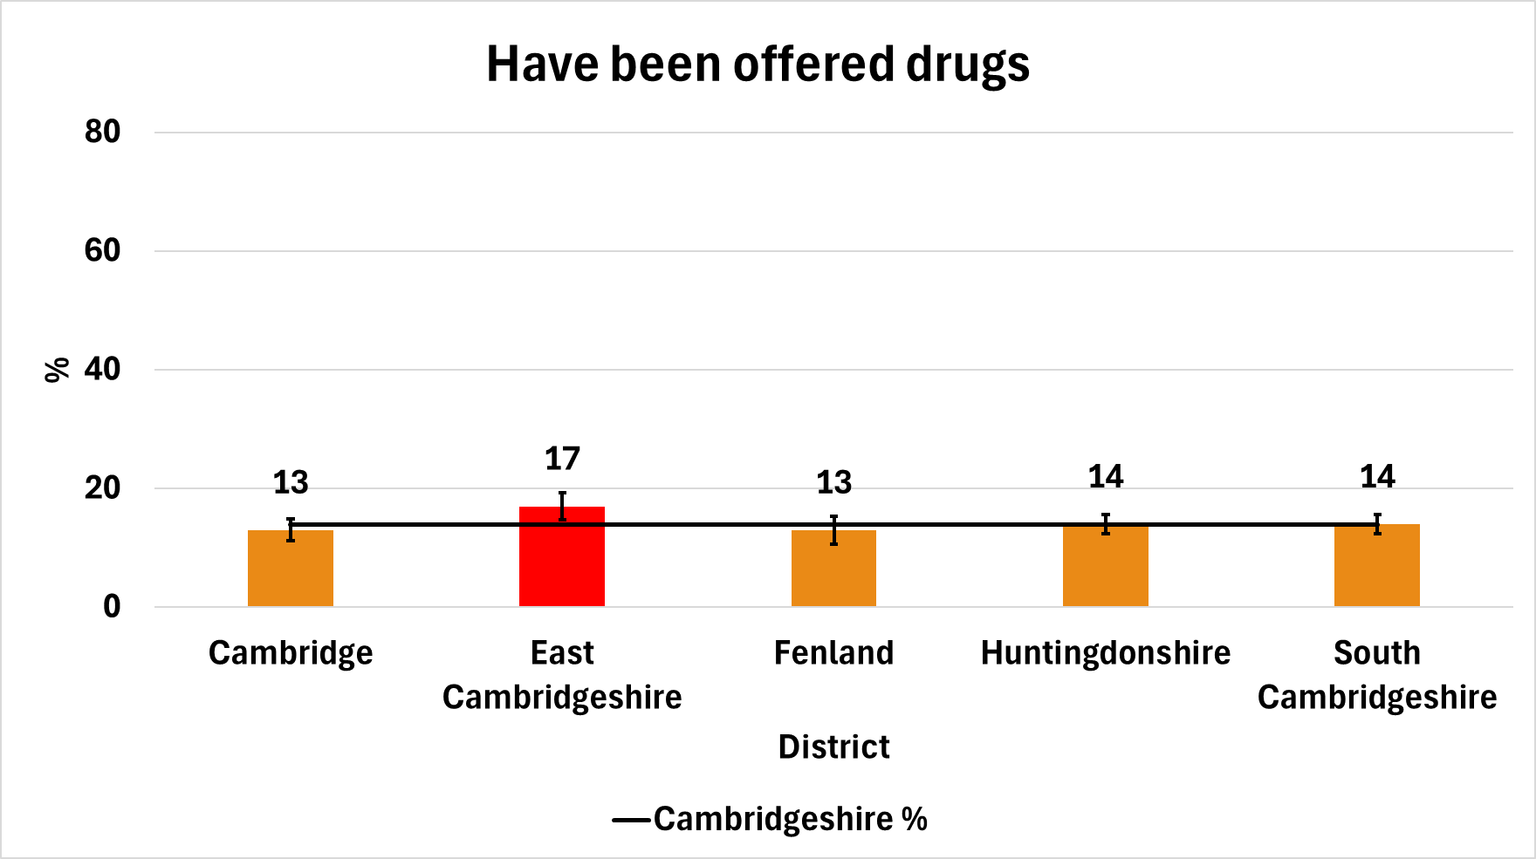
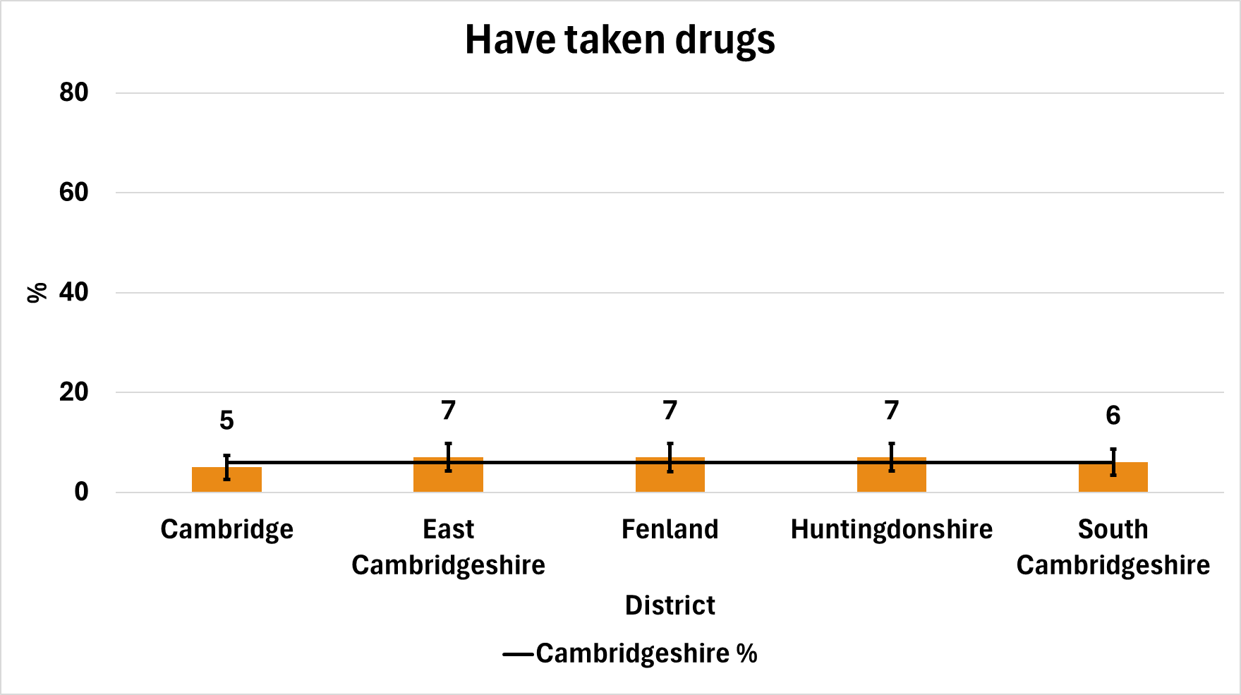
Drugs
14% of Cambridgeshire pupils have been offered drugs to get high. Rates are higher among East Cambridgeshire pupils.
6% of Cambridgeshire pupils reported that they have taken drugs. Rates are similar across all 5 districts.
Source: HRBS, 2024

Slide 16
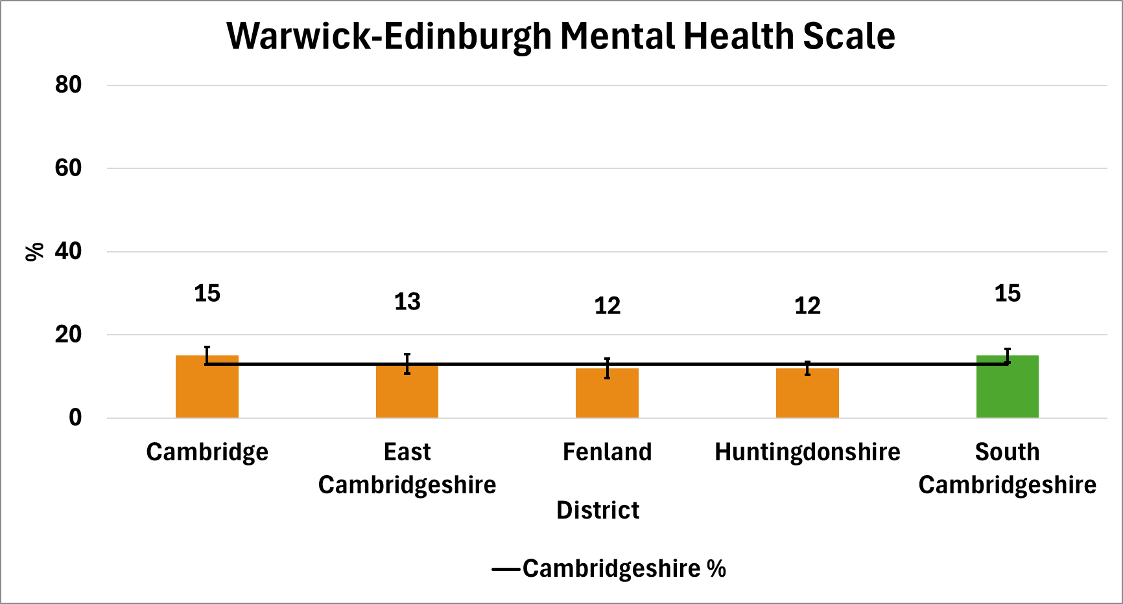
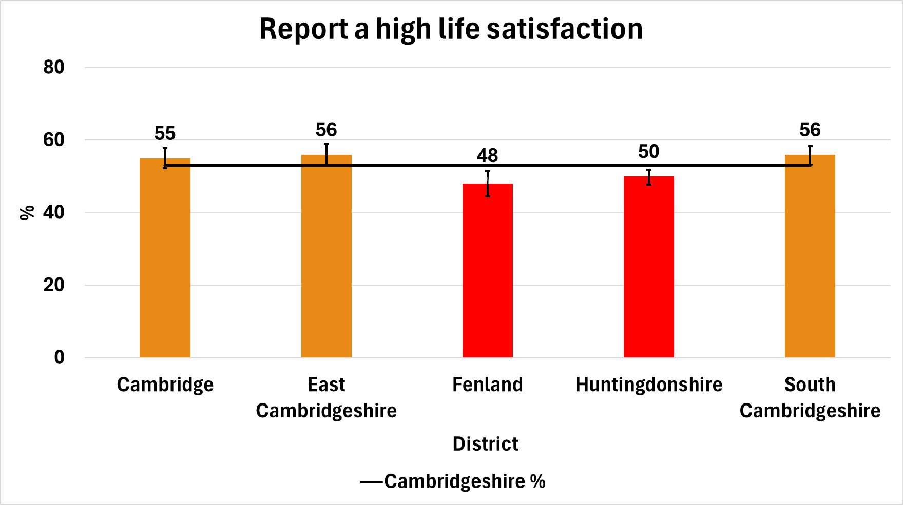
Mental health and life satisfaction
13% of Cambridgeshire pupils score ‘high’ Warwick-Edinburgh Mental Health Composite Scores – an indicator of good mental health. The percentage is higher in South Cambridgeshire but still only 15%.
On average, 53% of Cambridgeshire pupils report a high level of life satisfaction. Levels in Fenland and Huntingdonshire are lower.
Source: HRBS, 2024

Slide 17
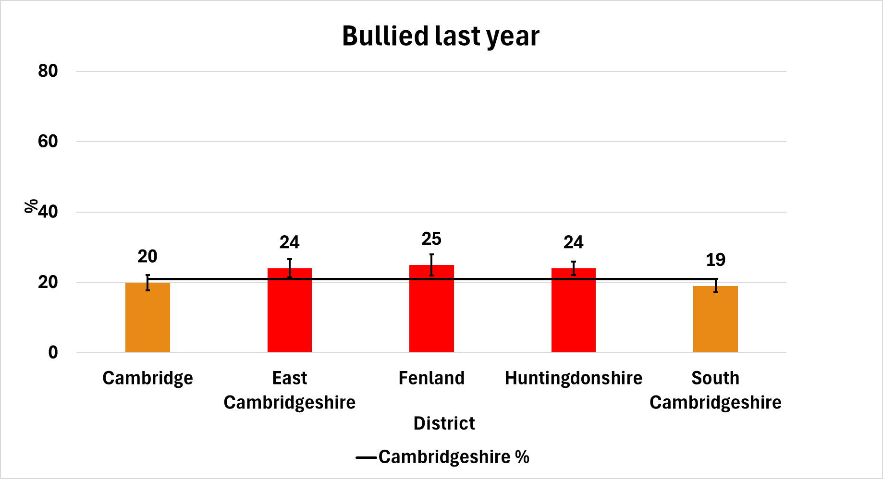
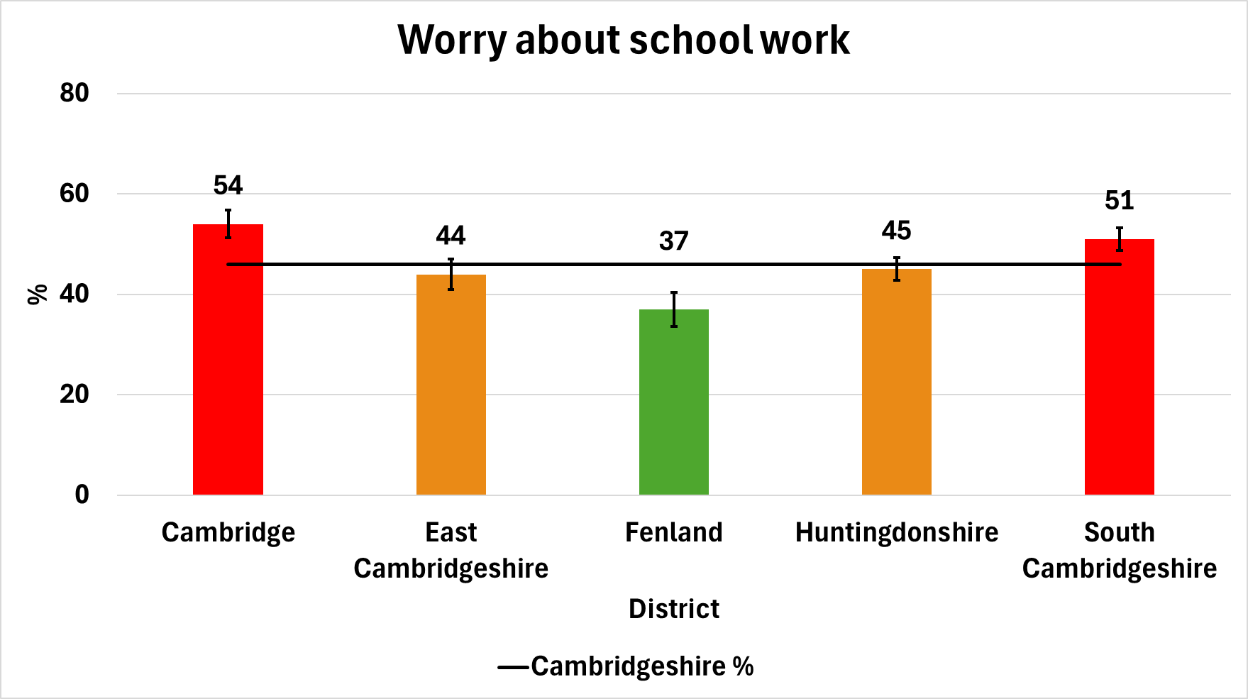
Bullying and worry
22% of Cambridgeshire pupils reported they have been bullied at school in the last 12 months. South Cambridgeshire pupils report lower levels of bullying in the last year.
47% of Cambridgeshire pupils worry about school-work/exams ‘quite a lot’ or ‘a lot’. In Cambridge and South Cambridgeshire rates are higher, whilst in Fenland rates are lower.
Source: HRBS, 2024

Slide 18
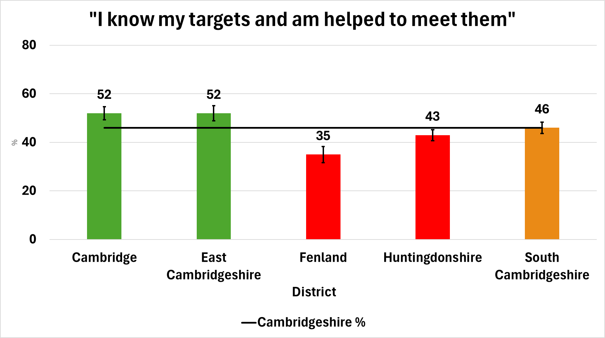
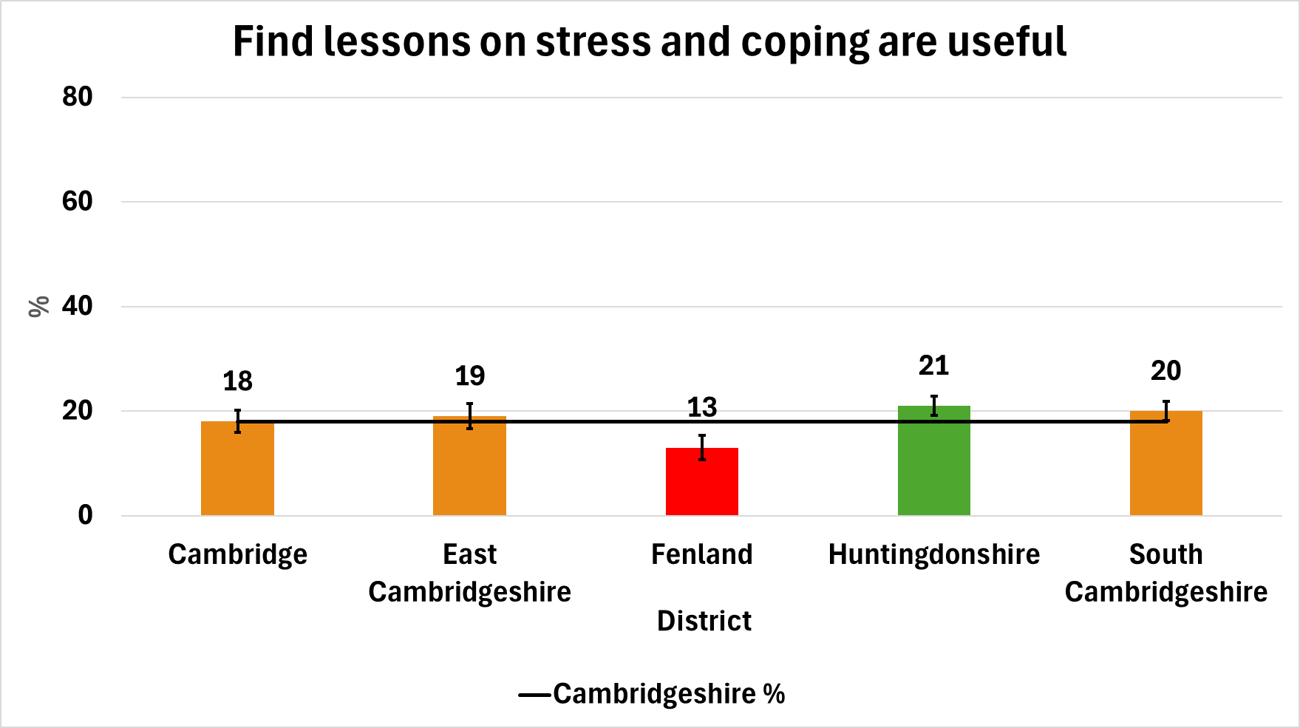
Targets and lessons on stress
46% of Cambridgeshire pupils report that they know their own targets and are helped to meet them. Rates are higher in Cambridge and East Cambridgeshire, and lower in Fenland and East Cambridgeshire.
19% of Cambridgeshire pupils reported having found school lessons about stress and coping useful. Higher levels are reported in Huntingdonshire and lower levels in Fenland.
Source: HRBS, 2024

Slide 19
Further information
These are the summary statistics from the HRBS.
We will be producing more in-depth analysis on specific topic areas to support service delivery and commissioners over the weeks.
If you require any further information on the survey or its results, or would like to request a pack on a specific topic, then please email phi-team@cambridgeshire.gov.uk

