Slide 1
Poverty - Cambridgeshire Context
2024
September 2024

Slide 2
Cambridgeshire – The people
A rapidly growing county (10-15% growth in people and dwellings expected from 2022 to 2030) with increasing diversity and an aging population.​
A relatively wealthy county with concentrated areas of deprivation.
Five areas of Cambridgeshire in the most deprived 20% of England:
Wisbech
March
Whittlesey
King’s Hedges and Abbey, Cambridge
Oxmoor, Huntingdon
A workforce aligned to national expectation, with variety in earnings and skills across the county.

Slide 3
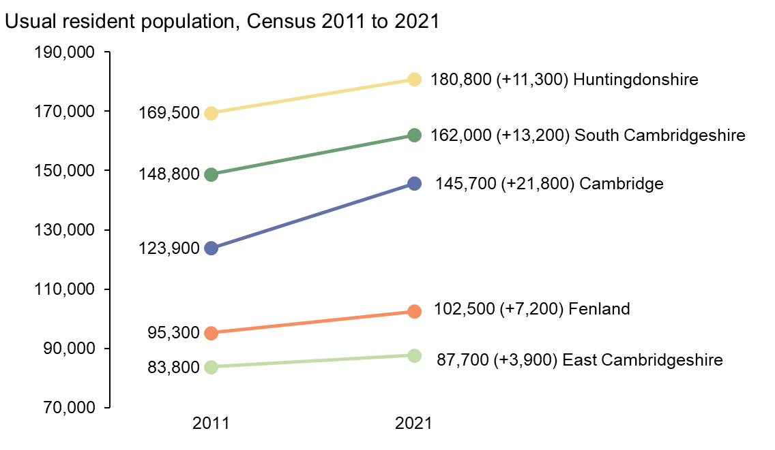
Population change by district (2011 vs 2021)
England experienced population growth of 6.6% whilst the Eastern region saw growth of 8.3%.
Population growth in the more rural districts ranged from 4.7% in East Cambridgeshire to 8.9% in South Cambridgeshire.
Cambridge saw particularly high growth of 17.6%.
All districts, except for East Cambridgeshire, experienced population growth in excess of the national average.

Slide 4
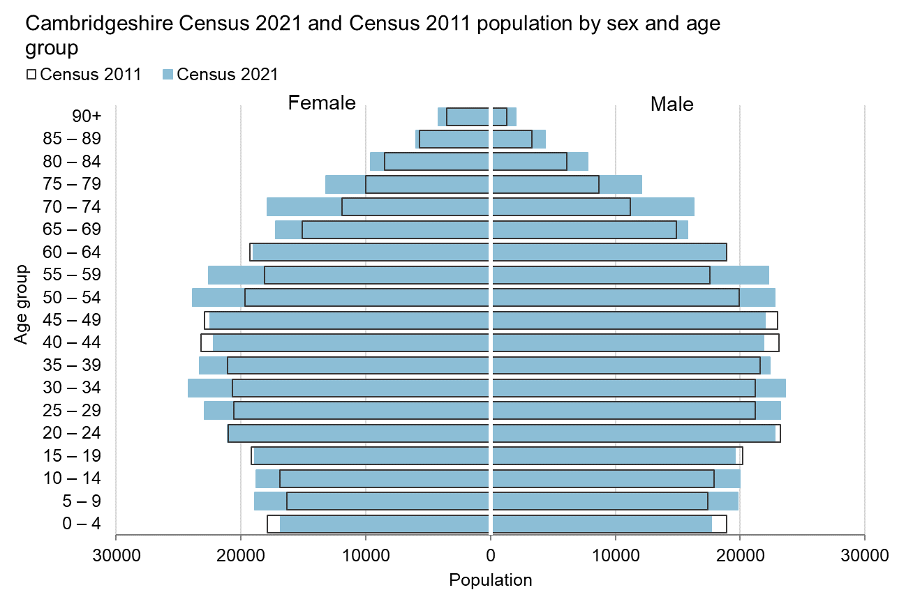
Population change (2011 vs 2021)
The Cambridgeshire population grew by 9.2% from 2011 to 2021.
Cambridgeshire has an ageing population. Notable population growth in the 50-60 and 70+ age groups.
Lower birth rates since 2015 has resulted in fewer under 4s more recently.
Notes:
This first chart is a population pyramid which shows the usual resident population at Census 2021 and Census 2011 by sex and five year age group. The black outlined bars are for Census 2011 and the solid blue bars are for Census 2021. If there is a white gap between the blue bar and black outline, this signifies a decrease in population between 2011 and 2021, whereas if the blue bar extends beyond the black outline, this signifies a population increase between 2011 and 2021.
The key trends for Cambridgeshire shown in this chart are the population decrease in the 0-4 age group and the notable population increases in the 50-59 and 70-79 age groups.

Slide 5
Increasing diversity in ethnicity
Communities have become more diverse, especially in the “urban” areas:
the proportions of the population in all high level ethnic groups apart from “White” have increased since 2011
In Cambridgeshire the proportions of the population who identify in ethnic groups other than “White” are below the national and East of England averages
Apart from those who identify as in “Mixed or multiple ethnic groups” where it is very similar
But in Cambridge the proportions in the “Asian, Asian British or Asian Welsh”, “Mixed or Multiple ethnic groups”, “White: Other ethnic group”, and “Other ethnic groups” are all higher than the national and East of England averages
Similar to national trends, the percentage of the population in the “White” category has fallen across Cambridgeshire compared to Census 2011
The falls have been most pronounced in Cambridge where the White UK populations now account for 53.0% of total population compared to 66.0% at Census 2011
And in Cambridge (-5.6%) and South Cambridgeshire (-0.6%) the number of residents who identify as White UK has fallen compared to Census 2011
All districts have seen a notable increase in the White: Other ethnic groups since Census 2011

Slide 6
Forecast population growth
Cambridgeshire County Council’s forecasts:
 | Mid-2022 population estimate | Mid-2025 population forecast | Mid-2030 population forecast | % change 2022 to 2030 | % change 2025 to 2030
Cambridge | 147,390 | 150,160 | 156,320 | 6.1% | 4.1%
East Cambridgeshire | 89,580 | 95,460 | 101,720 | 13.6% | 6.6%
Fenland | 103,580 | 107,840 | 114,050 | 10.1% | 5.8%
Huntingdonshire | 183,000 | 189,430 | 198,970 | 8.7% | 5.0%
South Cambridgeshire | 165,970 | 175,190 | 190,710 | 14.9% | 8.9%
Cambridgeshire | 689,530 | 718,075 | 761,775 | 10.5% | 6.1%
Cambridgeshire’s population is forecast to grow by 72k between mid-2022 and mid-2030 (+10.5%)
The most significant growth from 2022 to 2030 is expected in South Cambridgeshire (+25k) and Huntingdonshire (+16k).
Particularly high growth is expected in the 65+ age group.
Notes:
9.2% from 2011 to 2021.
East Cambs and Fenland will also experience significant population growth as a percentage of current population.

Slide 7
Housing Delivery
Dwellings completed (net) in Cambridgeshire
Source: Policy and Insight team Planning Monitoring Survey

Slide 8
Forecast dwelling growth
Cambridgeshire County Council’s mid-2022 dwelling stock estimates and 2022-based dwelling stock forecasts
Local authority | Mid-2022 dwelling stock estimate | Mid-2025 dwelling forecast | Mid-2030 dwelling forecast | change 2025 to 2030 | % change 2025 to 2030
Cambridge | 57,120 | 58,775 | 62,170 | +3,395 | +5.8%
East Cambridgeshire | 39,575 | 42,465 | 46,065 | +3,600 | +8.5%
Fenland | 46,800 | 49,025 | 52,580 | +3,555 | +7.3%
Huntingdonshire | 81,165 | 84,425 | 89,405 | +4,980 | +5.9%
South Cambridgeshire | 71,005 | 75,105 | 82,540 | +7,435 | +9.9%
Cambridgeshire | 295,665 | 309,795 | 332,760 | +22,965 | +7.4%
Cambridgeshire’s dwelling stock is forecast to increase by 23k between 2025 and 2030, a rise of 7.4%.
The most significant growth is expected in Huntingdonshire and South Cambridgeshire which mirrors the forecast population growth.

Slide 9
Deprivation / Poverty
Cambridgeshire is relatively wealthy - 129^{th /} 151 in the deprivation ranking for England (IMD 2019).
At a district level, deprivation varies greatly with Fenland being our most deprived district (51st most deprived out of 317), but Cambridge and Huntingdonshire do have pockets of relatively high deprivation.
Five areas of Cambridgeshire fall within the most deprived 20% of England:
Parts of Wisbech
Parts of March
Parts of Whittlesey
Parts of King’s Hedges and Abbey wards, Cambridge
Oxmoor, Huntingdon
Fenland has the highest percentage of Universal Credit claimants, households in fuel poverty and children living in households with ‘Relative Low Income’.
Other metrics such as Universal Credit, Fuel Poverty and Children Living in Households with Relative Low Income are all lower in Cambridgeshire than in the Eastern region or England.
Absolute poverty as measured by DWP is going down.
Notes:
There is no one single measure or datapoint that can tell the full story of poverty or deprivation in our area. We have lots of different measures / data that can help to do that though. They have different strengths and weaknesses, different geographic coverages, different lag times, timespans, different limitations, and different conclusions can be drawn from them. When I talk about deprivation I am largely going to be referring to the IMD dataset produced by DLUHC. We get a release every 4-6 years. The last release was in 2019 and the next release is in 2025. I will explain more about that dataset. I will explain the others as I go on.

Slide 10
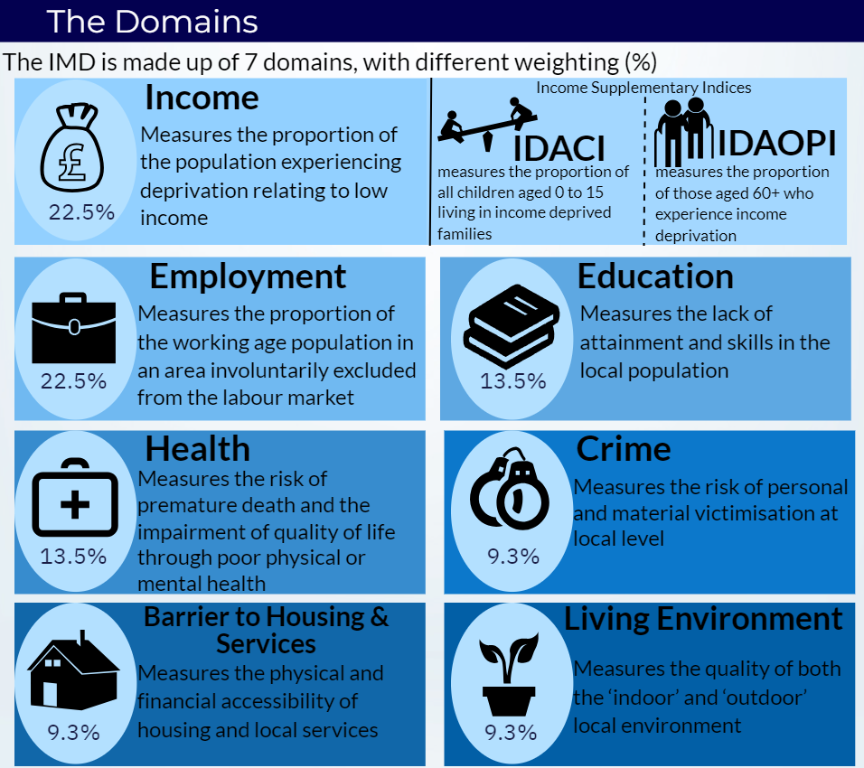

Slide 11
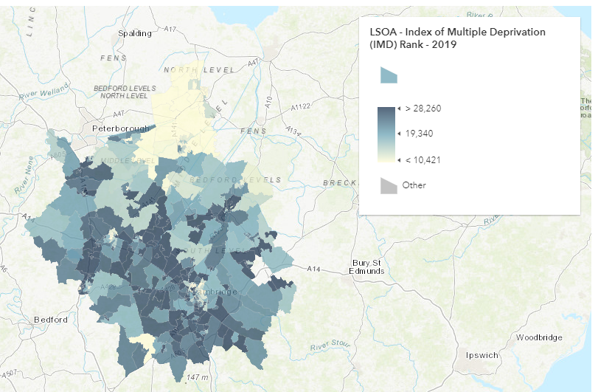
129 / 151st Least Deprived Upper Tier Local authority IMD 2019 (DLUHC)
Local Authority name (2019) | IMD - Rank of average rank High = Low Deprivation
Cambridgeshire | 129
Number of upper tier local authorities | 151
Cambridge | 205
East Cambridgeshire | 266
Fenland | 51
Huntingdonshire | 247
South Cambridgeshire | 300
Number of lower tier local authorities | 317
Source: IMD DLUHC 2019
Notes:
IMD dataset – table is district level averages. Fenland 51st and South Cambridgeshire 300th. Map is LSOA based highlighting the pockets in Fenland, Hunts, City

Slide 12
(Relative) Deprivation change over time
The table below shows the average rank of all LSOAs in the district where 1 is the most deprived and 317 is the least deprived. This is a relative measure and does not necessarily mean a district become more or less deprived over time, only that it ranks differently against other areas.
East Cambridgeshire was the only district to rank higher (become relatively less deprived) between 2015 and 2019.

Slide 13
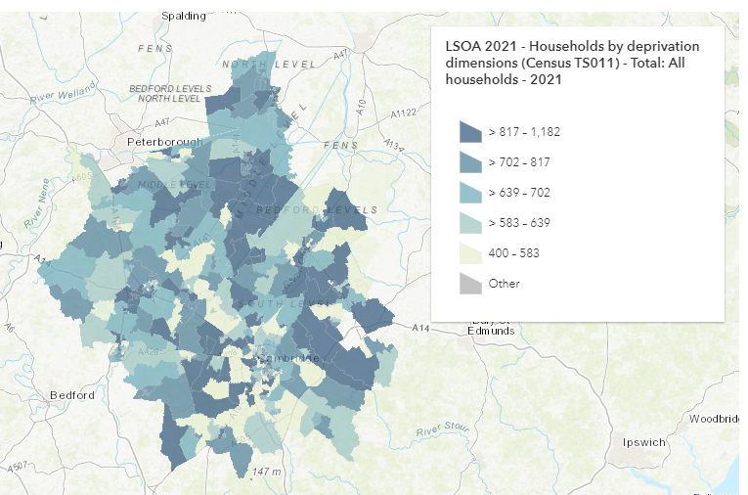
46.6% of Households are deprived in any dimension (ONS Census 2021) * Employment: A household is classified as deprived in the employment dimension if any member, not a full-time student, is either unemployed or economically inactive due to long-term sickness or disability. * Health: A household is classified as deprived in the health dimension if any person in the household has general health that is bad or very bad or is identified as disabled. People who have assessed their day-to-day activities as limited by long-term physical or mental health conditions or illnesses are considered disabled. This definition of a disabled person meets the harmonised standard for measuring disability and is in line with the Equality Act (2010). * Housing: A household is classified as deprived in the housing dimension if the household's accommodation is either overcrowded, in a shared dwelling, or has no central heating.
Local Authority | % of households deprived in at least one dimension | Number of households deprived in at least one dimension
Cambridge | 43.5 | 22825
East Cambridgeshire | 46.6 | 17333
Fenland | 58.3 | 25714
Huntingdonshire | 46.4 | 35676
South Cambridgeshire | 41.6 | 27863
Cambridgeshire | 46.6 | 129411
East of England | 50.4
England | 51.6
Source: CENSUS ONS 2021
Notes:
Different way of looking at Deprivation. This is a Census measure that asked people questions about their households and the people in it and then classified them as deprived in one of four deprivation dimensions. Employment, education, health and disability, and household overcrowding. We can look at the individual dimensions to break it down further but I’ve just brought this graph in to show there are different metrics and ways we can look at deprivation. Again the takeaway is that Fenland sticks out on its own and South Cambridgeshire is the least deprived by this metric.

Slide 14
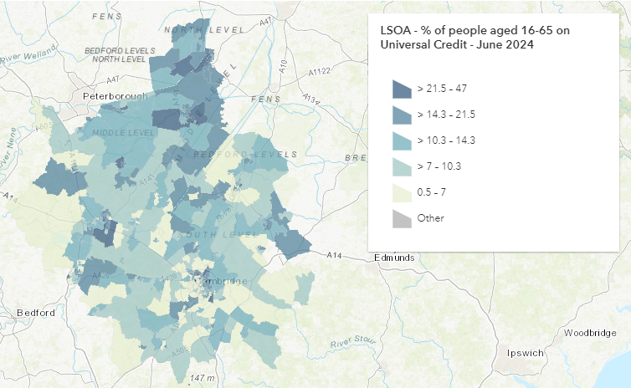
10.8% of 16-65 year olds on Universal Credit (DWP - June 24)
Local Authority | % of people aged 16-65 on Universal Credit | Number of people aged 16-65 on Universal Credit
Cambridge | 8.1 | 8,973
East Cambridgeshire | 10.4 | 5,732
Fenland | 18 | 11,015
Huntingdonshire | 11.4 | 12,983
South Cambridgeshire | 9 | 9,176
Cambridgeshire | 10.8 | 47,879
East of England | 14.2 | 564,707
England | 16.4 | 5,946,666
Source: DWP June 2024
Notes:
Universal credit is a good proxy for ‘deprivation’ as it shows the people who are actively being supported by the DWP. This could be in work or out of work. We haven’t separated them in this graphic. However we know it is approximately half and half showing that working isn’t always the solution to getting yourself out of poverty. Cambridgeshire as a whole is lower than the region and national average and all districts bar Fenland are also lower. Again the map shows pockets (LSOAs) where there are significantly higher percentages of people on universal credit. The only issue we have with universal credit is that it shows us people who have made the claim – there could be a lot more people who are eligible that have not. In fact one of our ways to monitor progress on Ambition 5 – reducing poverty is to monitor universal credit claimants but we also have income maximisation work going on through our contract with the Citizen advice bureau to increase the uptake of universal credit. Therefore we have to judge carefully how we view claimant counts going up or down.

Slide 15
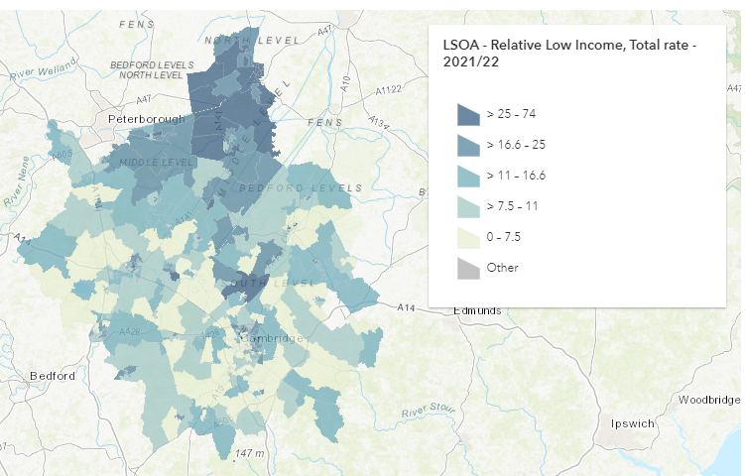
11.1% of families with children living with ‘Relative Low Income’ (DWP 22/23) Relative low-income is defined as a family whose equivalised income is below 60 per cent of contemporary median income. Gross income measure is Before Housing Costs (BHC) and includes contributions from earnings, state support and pensions.. A family in low income before housing costs (BHC) in the reference year. A family must have claimed one or more of Universal Credit, Tax Credits or Housing Benefit at any point in the year to be classed as low income in these statistics.
Local Authority | % of families with dependents (under 16 or in full time education under 19) living with 'Relative Low Income’ | Number of families with dependents (under 16 or in full time education under 19) living with 'Relative Low Income'
Cambridge | 10.7 | 2266
East Cambridgeshire | 9.3 | 1541
Fenland | 21 | 3752
Huntingdonshire | 10.8 | 3477
South Cambridgeshire | 7.6 | 2480
Cambridgeshire | 11.1 | 16709
East of England | 13.8 | -
England | 19.8 | -
Source: 2022/23 DWP
Notes:
IMD doesn’t really tell us the whole story as I’ve explained. What we want to know is are people’s live improving or getting worse or staying much the same. This graph / measure is a good proxy for that. It gives a better measure of how many families we have living with low income. Cambridgeshire as a whole is lower than the region and nation. Fenland is higher than both. That doesn’t tell the whole story though. In two LSOAs in Fenland and South Cambs we have over 40% of families with children living with relative low income and...
All the darkest areas are where we have over 25% of families living in low income households. We have LSOAs in every area.

Slide 16
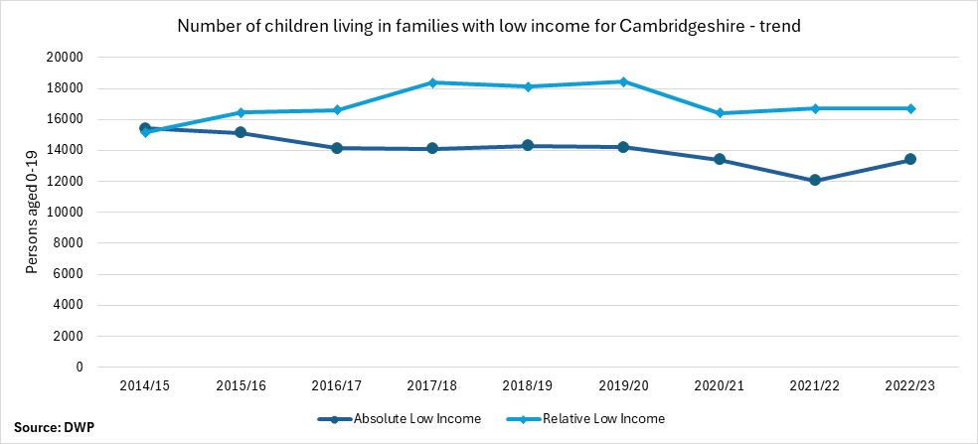
Absolute Low Income over time
The percentage of residents measured as living with absolute low income has reduced over time in Cambridgeshire, however relative low income has increased over the same period meaning that there are more families with children living with low income relative to the median wage of the population in 2021/22 than 2014/15.
Notes:
Another way of looking at deprivation or low income. How has this changed over time? This graph shows the number to give some scale for both absolute and relative low income but in percentage terms there has been a decrease from 13% in 2014 to 11.3% in 2022/23. There was a big reduction recently in relative low income because the national median income reduced during the pandemic so relatively there were fewer living in poverty based on the national average income. For absolute low income the percentage has dropped significantly from 13.2% in 2014/15 to 9.8 in 2021/22%

Slide 17
Local Income Disparity
The next slides highlight the districts with the largest income disparities in Cambridgeshire as measured by the IMD. The maps show the proportion of people in an area who are out of work or on low earnings. In Cambridge these areas are mainly located to the north and East of the city around Arbury, Kings Hedges and Abbey ward.
In Huntingdonshire the biggest income disparity is highlighted in Huntingdon, specifically around the Oxmoor estate.
In Fenland the areas are concentrated in many of the urban population centres of Wisbech, March, Whittlesey and Chatteris.
Notes:
So far we’ve looked mainly at local authority level although the maps were at LSOA level and it is possible to drill down to LSOA. Next slides are an example of how we can also look deeper to see the local disparities as well. I have a couple of examples of where within districts there are great differences of wealth.

Slide 18
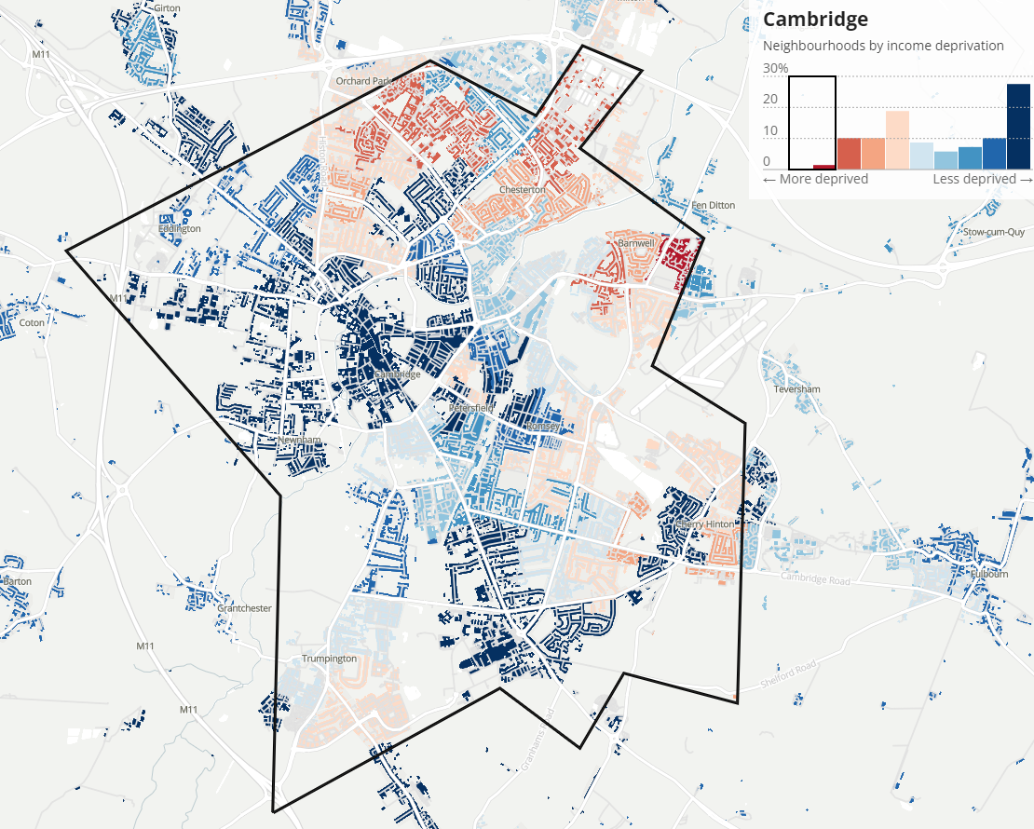
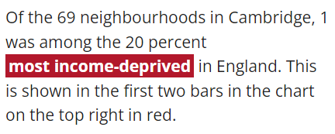
Cambridge City
Notes:
Prime example is Cambridge. Within the city there is almost a south west / north east divide.

Slide 19
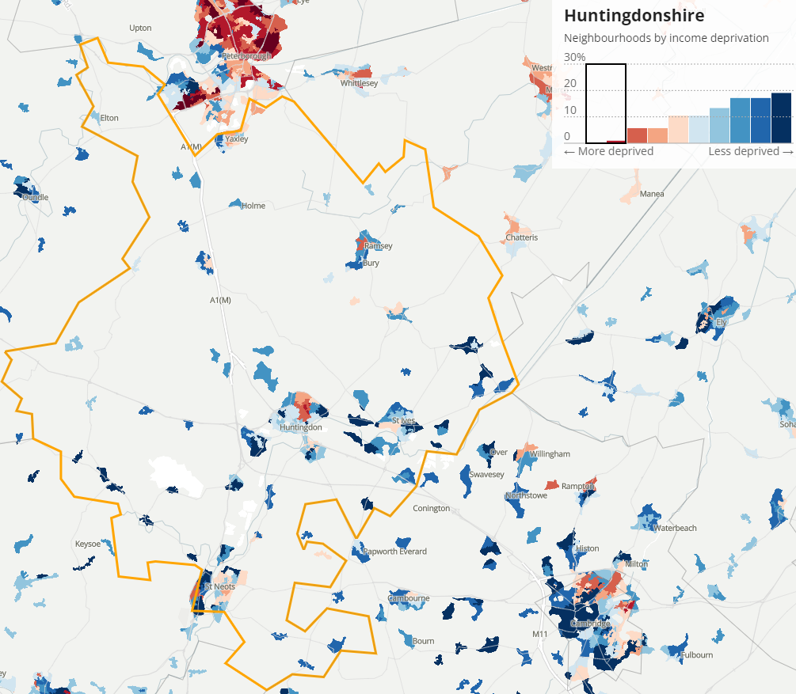
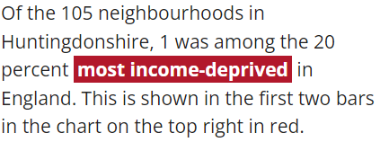
Huntingdonshire
Notes:
Mainly Huntingdon, St Neots, Yaxley, Ramsey

Slide 20
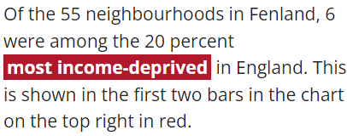
Fenland
Notes:
Wisbech, Chatteris, Whittlesey, March and other pockets

Slide 21
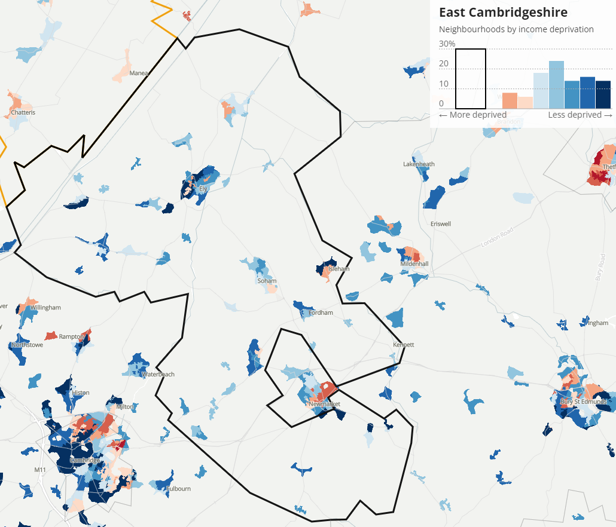
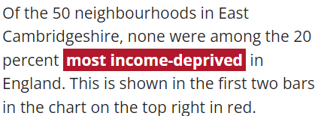
East Cambridgeshire
Notes:
Ely, Isleham In top 20 LTLAs in country for smallest deprivation gaps (11th).

Slide 22
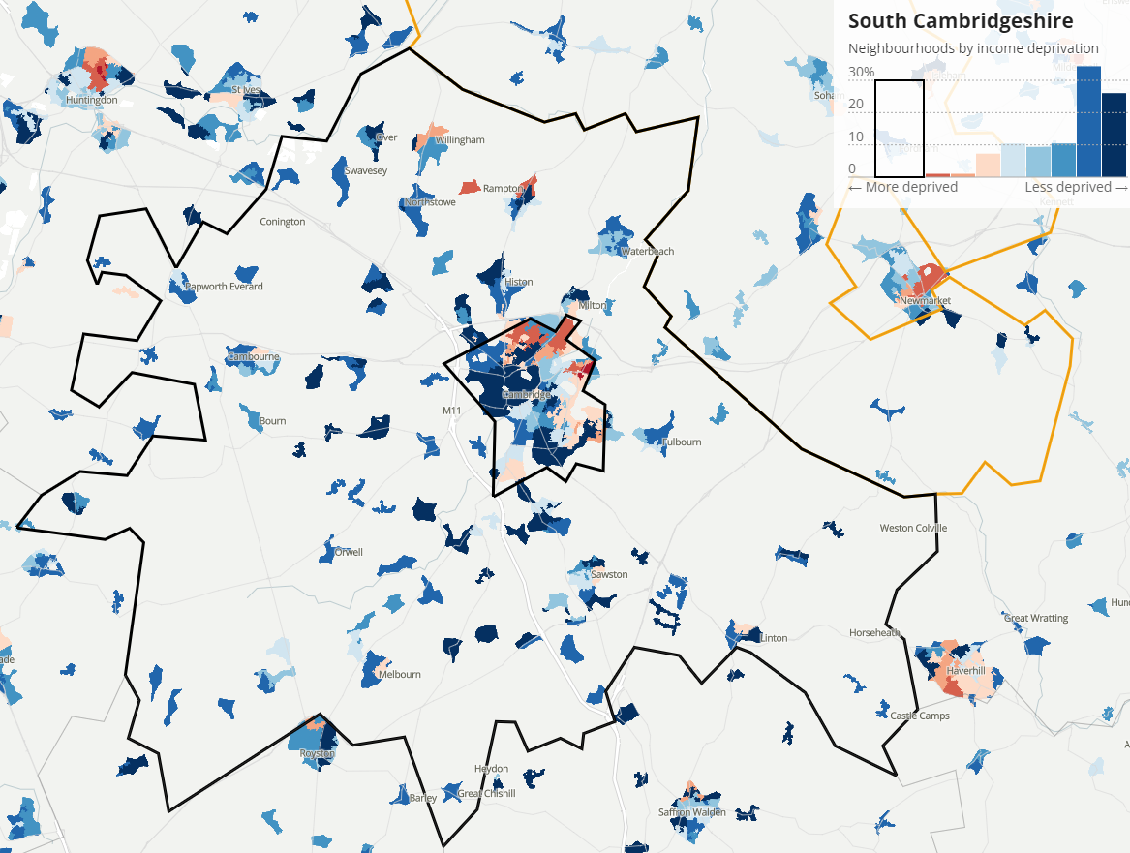
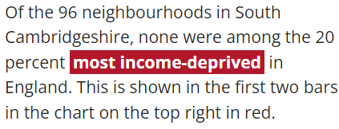
South Cambridgeshire
Notes:
Willingham, Rampton, Cottenham, Cambourne

Slide 23
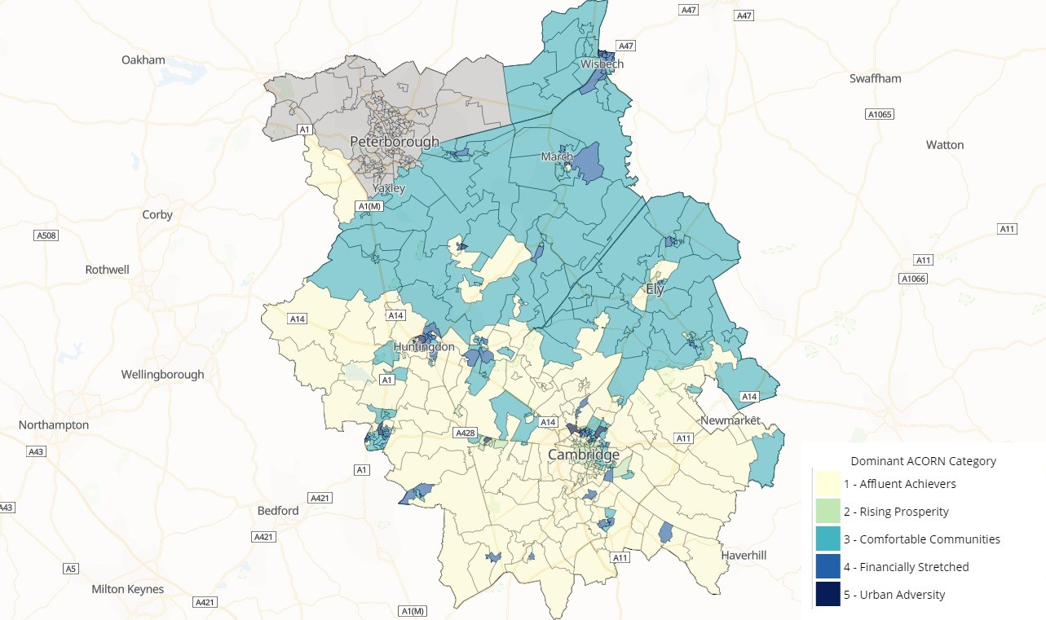
ACORN customer segmentation
Notes:
ACORN is a tool that tells us about the sort of people we have living in Cambridgeshire. It isn’t specifically a measure of poverty or deprivation but a customer profile detailing a persons habits, how they engage with information, what they spend money on, how wealthy they are, their age, their interests etc. We in the council use it for supporting comms campaigns so that we target the right people with the right messaging for example. We can do the same for communities work, engaging people in their place, judging who we are dealing with on a larger scale etc. The map above shows the dominant grouping per LSOA in Cambridgeshire, it shows a (rough) north south divide with the affluent achievers in S.Cambs and Comfortable communities in Hunts / East and Fenland too. Then it shows the financially stretched in various areas and small pockets of urban adversity in the urban areas. This dataset is the best dataset we have for knowing our residents without actually speaking to them…

Slide 24
What do our residents think?
87% of residents are concerned about cost-of-living increases

Slide 26
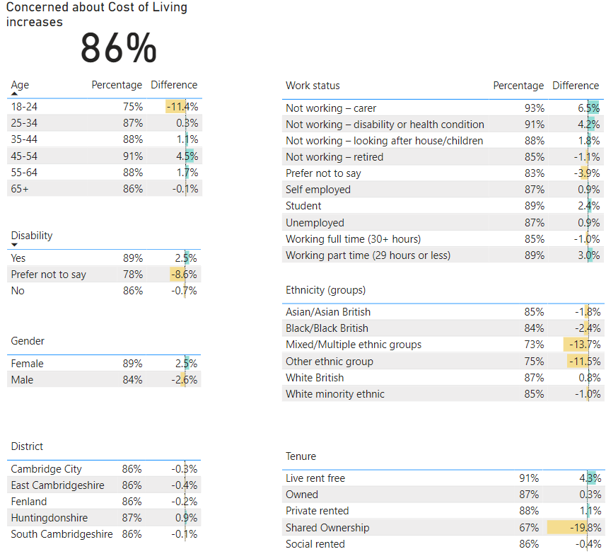
Demographic summary vs average (QoL Survey 2023)
Notes:
11 groups below the average (less concerned) with the young not as concerned, people living in shared ownership, adults 65 and over who cannot live independently More concerned than average – non working carers, non working because of health / disability, and those looking after children, those with a disability, female > male, and those with children between 4-18.

Slide 27
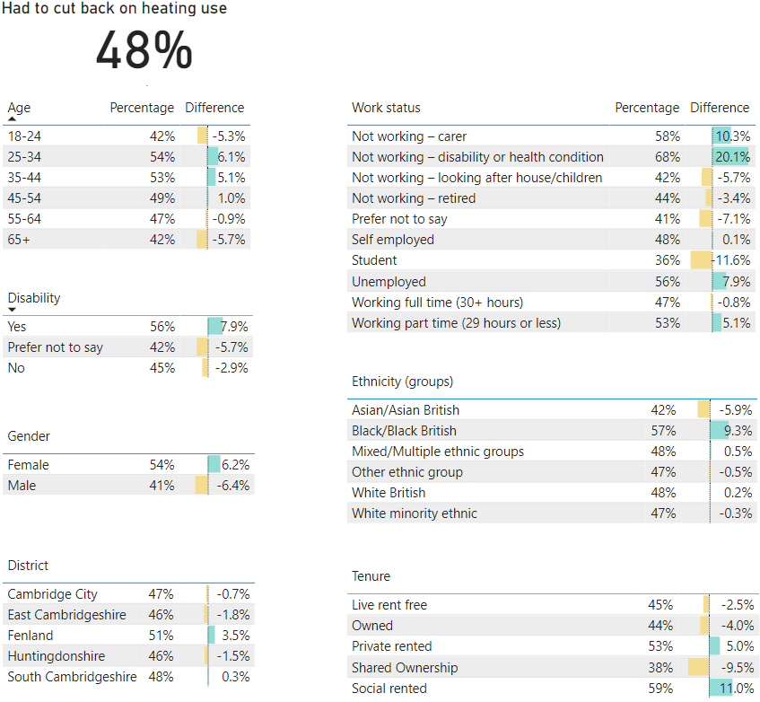
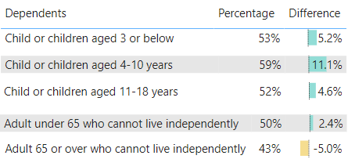
Behavioural change as a result of 2023 CoL Crisis: % difference from average response
Notes:
This is one example of behavioural change that we asked if people had taken as a result of cost of living and also the most frequent change. Key groups are those who are disabled, not working because of ill health or they are caring for someone, they aren’t working or are working part time, females and Fenland has a higher response rate as well on cutting back on heating use too.

Slide 28
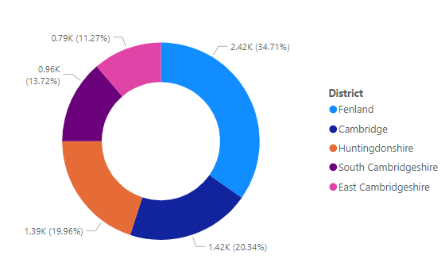
Household Support Fund - Summary
5,489 - No of completed applications
£766,961 - Value of vouchers issued
Countywide data 10 April to 31st July 2024
No of Applications
Trusted Group Applications by District
District | Energy Voucher | Supermarket Voucher | Paypoint Cash | BACS | Total
Cambridge | 67 | 265 | 327 | 597 | 1,198
East Cambridge | 4 | 56 | 37 | 501 | 594
Fenland | 23 | 425 | 653 | 828 | 1,840
Huntingdonshire | 4 | 87 | 297 | 753 | 1,119
South Cambridgeshire | 9 | 82 | 134 | 524 | 738
Total | 107 | 915 | 1,448 | 3,203 | 5,489
Value of Vouchers
District | Energy Voucher | Supermarket Voucher | Paypoint Cash | BACS | Total
Cambridge | £5,725 | £29,085 | £38,145 | £83,191 | £156,146
East Cambridge | £530 | £7,390 | £5,060 | £73,150 | £86,130
Fenland | £2,075 | £54,080 | £90,365 | £118,680 | £265,200
Huntingdonshire | £275 | £11,615 | £35,465 | £108,570 | £155,925
South Cambridgeshire | £710 | £10,115 | £17,495 | £75,240 | £103,560
Total | £9,315 | £112,285 | £186,530 | £458,831 | £766,961

Slide 29
Key points
Rapid population growth in the past decade and forecast to continue
Ethnic and age profiles also changing significantly
Deprivation is low overall but with pockets of high deprivation / inequality
Long term trends indicate poverty levels appear to be decreasing overall
Cost of living crisis has impacted residents locally

Slide 30
Further data
To explore the data displayed in these slides in more detail and to access further relevant datasets please click the link below. Cambridgeshire & Peterborough Insight – Poverty – Contextual Data (cambridgeshireinsight.org.uk)

Slide 31
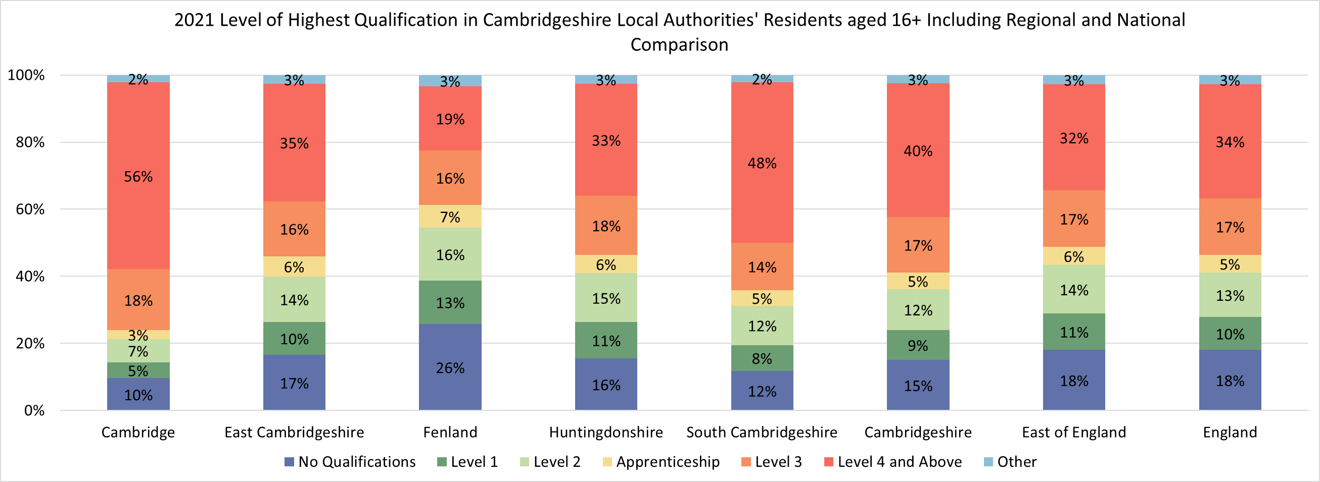
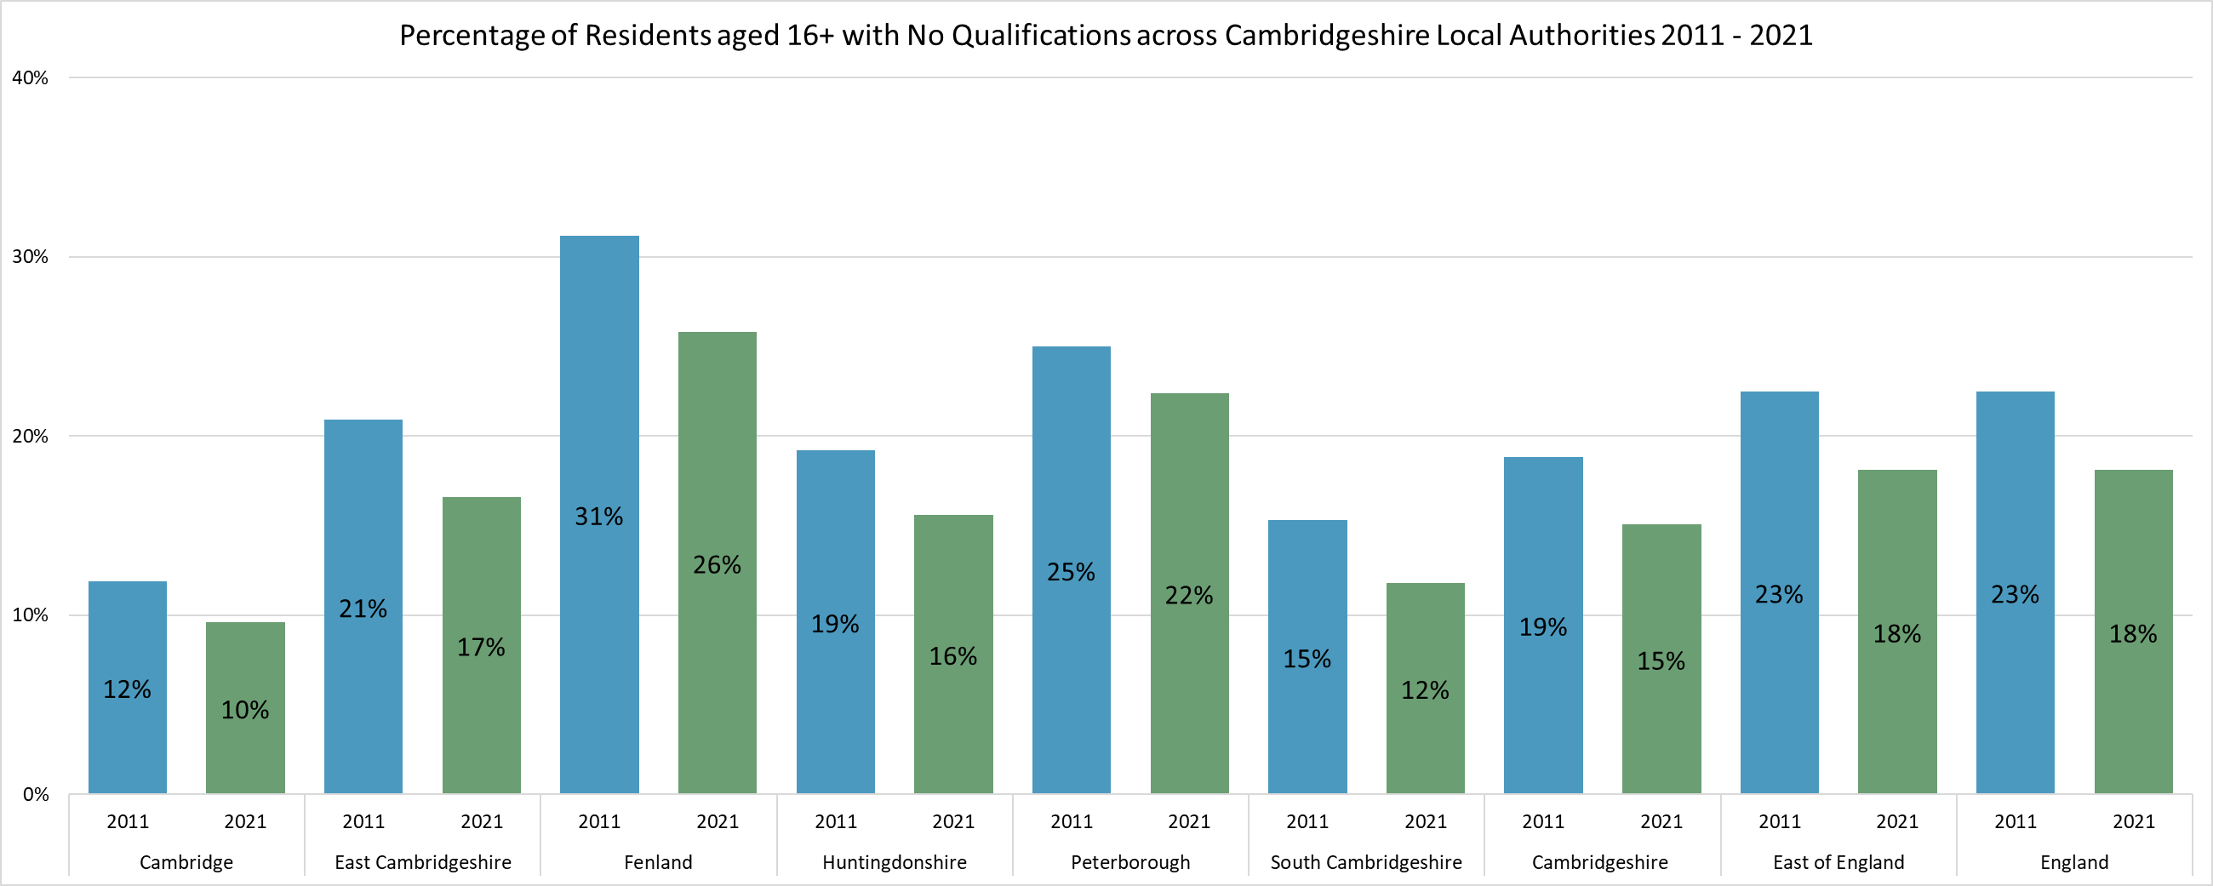
Skill levels
According to Census 2021 40% of Cambridgeshire residents aged 16+ have a Level 4+ qualification, higher than England (34%). However, as within other areas of the economy there are inequalities across districts. In Cambridge 56% of residents have a Level 4+ qualification but in Fenland this proportion is only 19%.
The proportion with no qualifications has reduced from Census 2011 across all districts but there are areas when the proportion is still high. Cambridgeshire as a whole sees 15% of residents with no qualifications but this ranges from 10% in Cambridge to 26% in Fenland.
Source – Census 2021, ONS

Slide 32
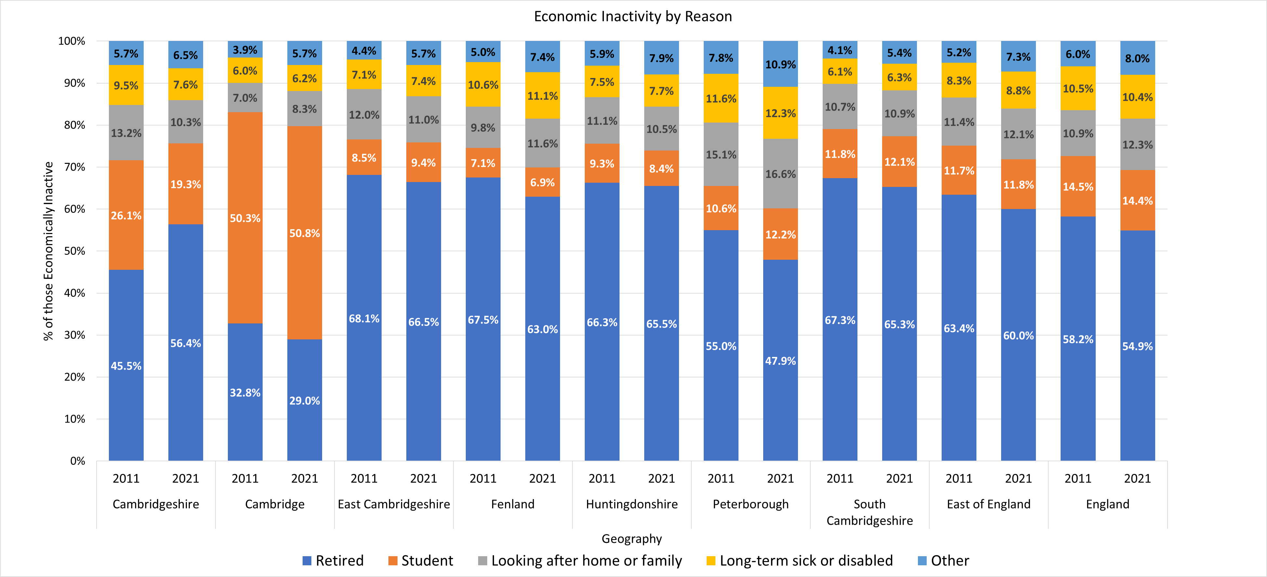
Employment
Approx. 60% of working-aged residents are economically active at both a local, regional and national level. Of those that are economically inactive, retiring is the no.1 reason, with the exception of Cambridge which has a large student population.

