Slide 1

Transport update: Cambridge and South Cambridgeshire
COVID-19 transport impacts and recovery
June 2024
Policy & Insight Team, Cambridgeshire County Council

Slide 2
Transport Update Aims
This report is intended to:
Provide a basis for discussion for the Greater Cambridge Partnership (GCP) to understand and identify existing challenges and future data needs.
Summarise the on-going impacts of COVID-19 on trends in transport and mobility up to 30th June 2024.
Highlight changes in key indicators by comparing June 2024 data to a pre-pandemic baseline (June 2019 or closest possible equivalent), mid-COVID (June 2021) and to last year (June 2023).
Notes:
Comparison periods may vary across the different datasets based on the availability of historic data – comparison periods are clearly noted for each dataset.
  Where reference is made to ‘Weekdays’ this only includes Monday, Tuesday, Wednesday and Thursday.

Slide 3
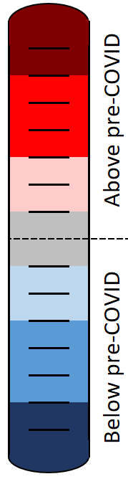
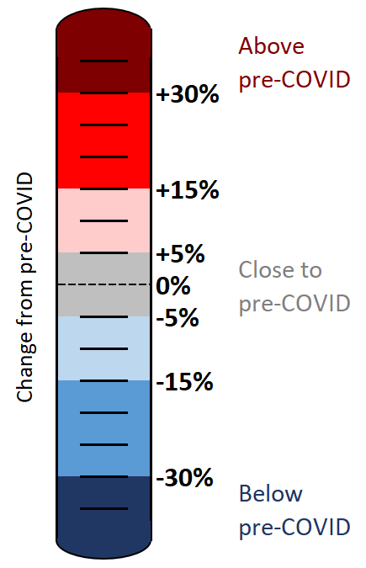
Colour scale
The statistics in this pack have been colour-coded using a heat scale to reflect the level of recovery being experienced (pre-COVID compared to now).
A positive (red) value indicates that levels have increased above those experienced pre-COVID.
A negative (blue) value indicates that levels remain below pre-COVID.
Tip:
Look out for the colour scale bar in the top right-hand corner of each page for a reminder of the heat scale used to indicate the level of recovery throughout the pack.

Slide 4





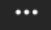
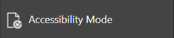
Accessibility
To access the full functionality of PowerPoint, we recommend opening the slides in full screen mode. To do this, click the “Open in New Window” button in the bottom right-hand corner.
1) Navigate through the slide pack using the left and right arrows in the middle-bottom of the screen. Clicking on the sentence “Slide x of x” brings up a pop-up listing all the slides so you can navigate directly to a slide of interest.
2) Open the Notes for each slide to see the data source, technical notes and any additional commentary. See the “Notes” button in the bottom right-hand corner.
3) Use the “Download” button to the right of the centre at the top of the screen to download the slides as a .pptx file.
4) Use the “Print to PDF” option to save the PowerPoint as a PDF document (but please be aware you will lose access to the Notes section which contains additional information for the slide).
5) Use the “More options” icon in the top right-hand corner and choose “Accessibility mode” from the pop-up menu to access the slides in a different format which will display any Alt Text that has been set for charts and images.
We are continually working to improve the accessibility of our content. If you find you are unable to access any part of this update, please contact policyandinsight@cambridgeshire.gov.uk and we will be happy to investigate providing information in a different format.

Slide 5
Overview

Slide 6
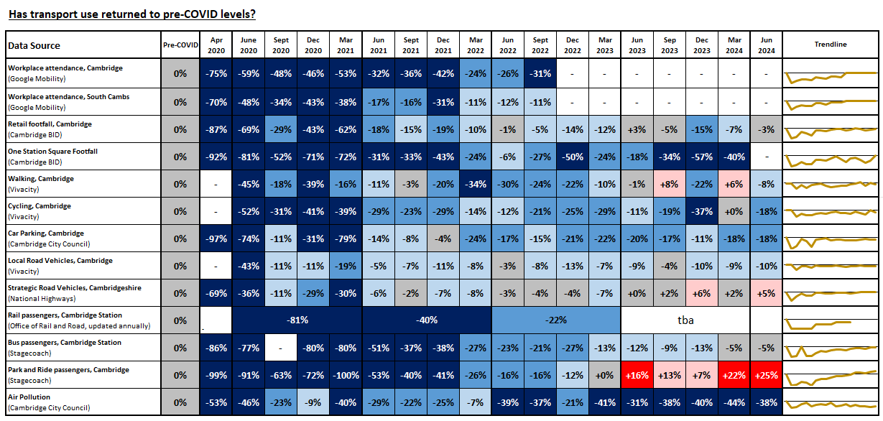
Recovery Tracker
Notes:
Source: Various, listed in the Data Source column
Technical Notes: Our methodology for analysing the data continues to be refined to react to differing levels of data quality and data gaps. Therefore, you may observe small adjustments to the stats in the latest slide pack compared to previously published versions.
For example:
The method of calculating the strategic road network (SRN) recovery percentages changed in Dec 2022 to include data from a larger number of sites. The SRN percentages have therefore been updated and may not reflect the values presented in previous slide packs for this reason.
The air pollution percentages historically used data from 5 sensors but one of these sensors was removed in April 2022 so the methodology for calculating the air pollution percentages has been adjusted. The air pollution percentages presented here may differ slightly from those in previous slide packs for this reason.
Commentary:
This slide indicates the extent to which each of the transport metrics has recovered over time in comparison to pre-Covid (2019 or early 2020) levels.
Google mobility workplace, Cambridge: Plateaued recovery 31% below pre-Covid in Sept 2022. Data source discontinued in October 2022.
Google mobility workplace, South Cambridgeshire: fluctuating recovery, 11% below pre-Covid in Sept 2022. Data source discontinued in October 2022.
Retail footfall, central Cambridge: fluctuating recovery levels linked to seasonal variations. Currently very close to pre-Covid.
One Station Square footfall: Erratic pattern of recovery over time. Was some way below pre-Covid levels in March 2024. Analysis paused on this data pending sensor checks being conducted by Cambridge BID.
Walking, central Cambridge: Fluctuating recovery trend between above and below pre-Covid. Currently just below pre-Covid.
Cycling, central Cambridge: fluctuating recovery trend (either far below pre-Covid, or close to pre-Covid) - currently below pre-Covid.
Multi Storey Car Parking, central Cambridge: stable trend in the last two years, consistently around 20% below pre-Covid.
Vehicle flows on local roads, central Cambridge: fairly stable over the last year, consistently around 10% below pre-Covid.
Vehicle flow on strategic roads, gradually improving recovery trend, now consistently above pre-Covid levels.
Railway passenger numbers at Cambridge Station (updated annually to March) – improving recovery trend, but still some way below pre-Covid.
Bus passengers, Cambridge: improving recovery trend since March 2022. Currently just below pre-Covid.
Park and Ride passengers: consistent recovery trend, now consistently above pre-Covid levels, albeit with some site-by-site variation.
Air pollution: consistently remaining some way below pre-Covid.

Slide 7








Headlines: June 2024
Local Roads
Volumes at
compared to pre-COVID
(see analysis on slide 22 onwards)
Strategic Roads
Volumes at
-
compared to pre-COVID
(see analysis on slide 14 onwards)
Car Parking
Patronage at
compared to pre-COVID
(see analysis on slide 43 onwards)
Bus
Patronage at
-
compared to pre-COVID
(see analysis on slide 49 onwards)
Park and Ride
Patronage at
compared to pre-COVID
(see analysis on slide 52)
P
P
+
-10%
+5%
-18%
-5%
+25%
Station Square Footfall*
Volumes at
-50%
compared to pre-COVID
(see analysis on slide 48)
Retail Footfall
Volumes at
-14%
compared to pre-COVID
(see analysis on slide 40 onwards)
Walking
Volumes at
-22%
compared to pre-COVID
(see analysis on slide 36)
Cycling
Volumes at
-25%
compared to pre-COVID
(see analysis on slide 35)
Air Pollution
Concentrations at
-22%
compared to pre-COVID
(see analysis on slide 53 onwards)
-40%*
-3%
-8%
-18%
-38%
*Analysis of Station Square footfall has not been updated since March 2024. The reliability of the footfall counter at this location is currently undergoing checks by Cambridge BID.

Slide 8
Travel Demand

Slide 9
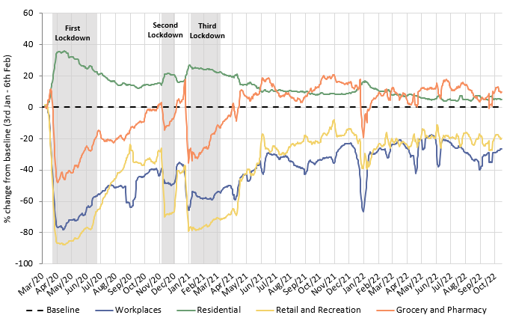
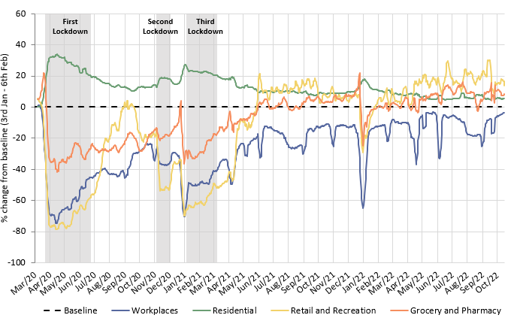
Has COVID-19 changed where we spend our time?
The pandemic caused us to spend more time at home and less time at a designated workplace. Whilst the extent of this impact has steadily reduced since Spring 2021, an impact was still being seen when Google discontinued this dataset in October 2022, particularly in Cambridge.
Cambridge
South Cambridgeshire
 | Pre-Covid to Now: Baseline (Jan/Feb 2020) to Oct* 2022
Pre-Covid vs Now: | Workplaces | Residential | Retail and Recreation | Grocery and Pharmacy
Cambridge | -26 | +5 | -19 | +11
South Cambridgeshire | -3 | +5 | +16 | +9
*Sourced from Google Mobility data which was discontinued on 16th October 2022. Numbers represent the % change from the baseline period. The baseline period is defined by Google as 3rd Jan – 6th Feb 2020.
Notes:
Source: Google LLC "Google COVID-19 Community Mobility Reports". https://www.google.com/covid19/mobility/
Technical notes: Data is gathered from Google account holders location history. This helps to demonstrate where people are spending their time. The data is based on the most recent month (October 2022) compared to the median of the corresponding day in the baseline period (3rd Jan-6th Feb 2020) as calculated by Google. Tabulated percentages represent the change from the baseline (3rd Jan – 6th Feb) to the most recent month.
Commentary: Cambridge: Cambridge grocery and pharmacy visits finished at 11% above pre-pandemic levels in October 2022. Meanwhile, retail and recreation visits finished 19% below pre-pandemic levels, which suggested that essential shopping recovered to a much stronger extent than leisure shopping. The proportion of people making workplace visits stayed steadfastly below the pre-Covid baseline, ending at -26% in October 2022. Conversely, residential visits finished 5% higher than the baseline, in part likely due to the persistence of remote working.
South Cambridgeshire: Data on workplace visits finished at 3% below pre-pandemic baseline levels. Similarly to Cambridge data, residential numbers were continually above the pre-pandemic baseline since the dataset began, finishing at 5% above the baseline in October 2022. Retail and recreation (+16%), and grocery and pharmacy (+9%) visits remain ahead of the pre-pandemic baseline in South Cambridgeshire, suggesting that people’s shopping and leisure habits recovered and then stabilised after the heavy disruption caused by the pandemic and associated lockdowns.

Slide 10
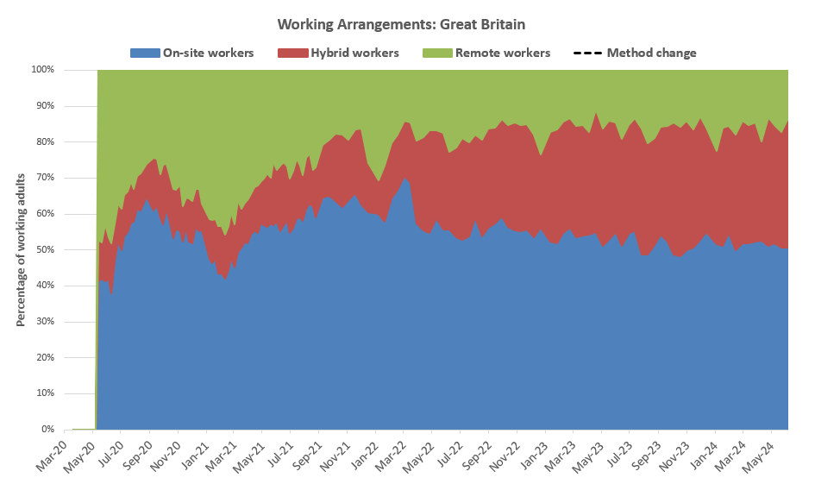
Is home working here to stay?
The ONS captures the working arrangements of a sample of approx. 800 working adults across Great Britain on a fortnightly basis. The results suggest that on-site working has been stable since the latter stages of the pandemic (50-60%). Hybrid working has increased since 2020 but is now stabilising (32%); whereas fully remote work has decreased since the pandemic. Census 2021 data suggests that hybrid and remote working arrangements are more common in Cambridge & South Cambs than the national benchmark.
Locally, the 2021 Census (March 2021), demonstrated that levels of remote working in Cambridge (46%) and South Cambs (44%) were higher than the national average (31%) whilst East Cambs (35%) and Hunts (35%) were more similar. Fenland (20%) and Peterborough (25%) were lower than the national average. It is likely that this pattern is a result of the types of employment being undertaken in these areas, with some industries better able to accommodate home working than others. It’s likely that differences between working arrangements across the districts remain today.
Source: Travel to Work Summary
Year | Percentage of working adults [Great Britain annual average]
 | On-site working | Hybrid working | Remote working
2020 | 54% | 12% | 34%
2021 | 55% | 14% | 30%
2022 | 58% | 24% | 18%
2023 | 53% | 32% | 16%
2024 (partial) | 52% | 32% | 16%
Source: ONS Working Arrangements data for Great Britain. ONS made small changes to the sample of respondents in April 2022 and caution is advised comparing data before/after this date.
On-site working is someone that only worked from a workplace away from home. Remote working is someone who only worked from home. Hybrid working is a combination of working away from home and at home.
Notes:
Source: ONS Working Arrangements data for Great Britain
Commentary: Data is gathered by ONS who survey a sample of 760 people across Great Britain on a weekly, and more recently fortnightly, basis. Some small changes were made to the sample of people surveyed in April 2022 which may have impacted the comparability of data before/after this date. Despite a possible step change occurring in the data at this time, trends post April 2022 continue to suggest a gradual reduction in on-site workers.

Slide 11
Strategic Road Network

Slide 12
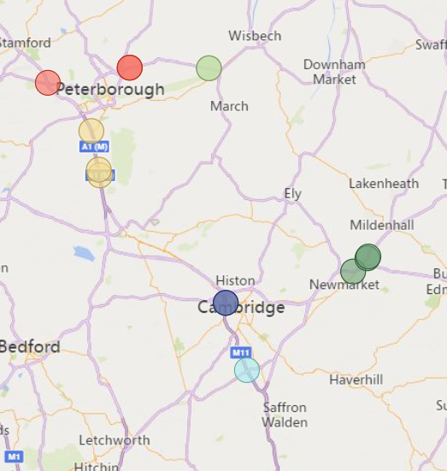
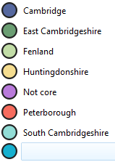
Strategic Road Network Monitoring Sites
Strategic Road Network traffic monitoring sites with continuous data
A1
National Highways have approximately 1,400 permanent traffic monitoring sites on the strategic road network within Cambridgeshire and Peterborough.
Each monitoring site varies in its ability to reliably provide data over time, and periods of inactivity are common. It is therefore not appropriate to conduct a long-term analysis for all sites.
For this reason, only the 14 sensors with uninterrupted data from January 2019 onwards are included in this analysis. These 14 sites are shown on the map to the left.
Please note the number of sensors used within this analysis has decreased since the last update due to sensor outages. Therefore, absolute flow volumes will not be comparable to previous updates.
2
2
A47
N
2
2
A14
A1
A11
A14
2
Cambridge sites
A14
East Cambridgeshire sites
A428
2
2
Fenland sites
Huntingdonshire sites
Peterborough sites
A1
South Cambridgeshire sites
M11
Strategic Road Network in Cambridgeshire and Peterborough
© OpenStreetMap Contributors © Tom Tom © Microsoft Corporation
Notes:
Source: National Highways WebTRIS data. (https://webtris.highwaysengland.co.uk/)
Technical notes:
District and Site IDs
Cambridge MIDAS site at M11/6886A
Cambridge MIDAS site at M11/6886B
East Cambridgeshire MIDAS site at A11/0047B
East Cambridgeshire MIDAS site at A14/1241B
East Cambridgeshire TMU Site 6317/1
Fenland TMU Site 6350/1
Fenland TMU Site 6350/2
Huntingdonshire MIDAS site at A1M/2134A
Huntingdonshire MIDAS site at A1M/2145B
Huntingdonshire MIDAS site at A1M/2220A
Peterborough TMU Site 6351/1
Peterborough TMU Site 6351/2
Peterborough TMU Site 6502/2
South Cambridgeshire MIDAS site at M11/6747A

Slide 13
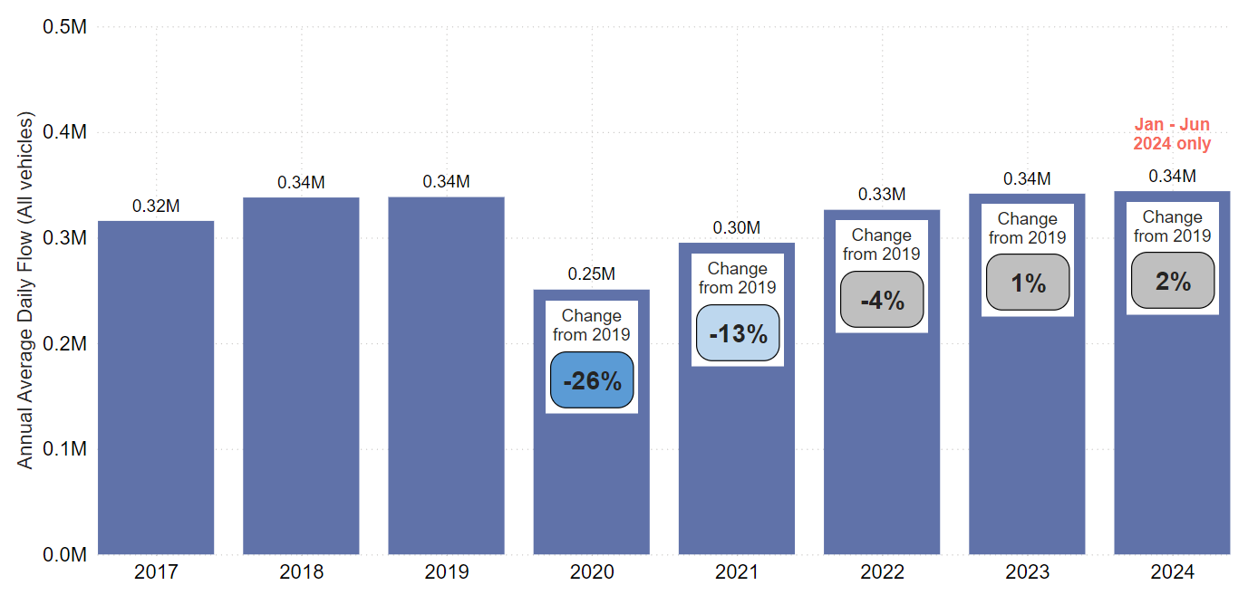
Strategic Road Network: Annual Average Daily Flow by Year
In Cambridgeshire and Peterborough, traffic volumes on the Strategic Road Network so far in 2024 are just above pre-COVID volumes (+2%). This puts it in a similar position to 2023 volumes.
Annual Average Daily Flow (sum of 14 sensors)
Analysis based on 14 sensors across Cambridgeshire and Peterborough.
Notes:
Source: National Highways WebTRIS data.
Technical note: Average Daily Flow by year for main carriageway monitors in each district, all with data 2019 – 2024. This dataset averages across ALL days (Mon-Sun).

Slide 14
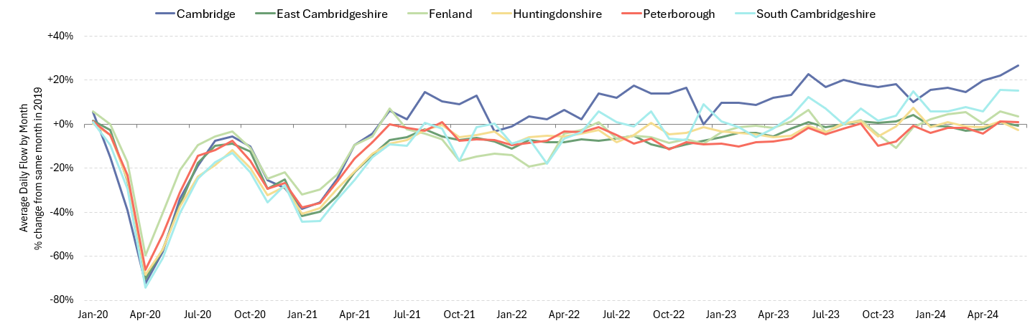
Strategic Road Network: Average Daily Flow by Month
In June 2024, strategic road flows were most above pre-COVID volumes in Cambridge (+27%) and South Cambridgeshire (+15%). Fenland (+3%) and Peterborough (+1%) were just above pre-COVID volumes, whilst East Cambridgeshire (-1%) and Huntingdonshire (-3%) were just below.
Percentage change from the same month in 2019
Pre-COVID to Now: Jun 2019 to Jun 2024
Cambridge | East Cambridgeshire | Fenland | Huntingdonshire | Peterborough | South Cambridgeshire | All Districts
+27% | -1% | +3% | -3% | +1% | +15% | +5%
Analysis based on 14 sensors across Cambridgeshire and Peterborough.
Notes:
Source: National Highways WebTRIS data.
Technical note: The graph shows the percentage difference from the corresponding month in 2019 (e.g. March 2023 compared to March 2019). Created using Average Daily Flow by month data for main carriageway monitors in each district, all with data 2019 – 2024. This dataset averages across ALL days (Mon-Sun).

Slide 15
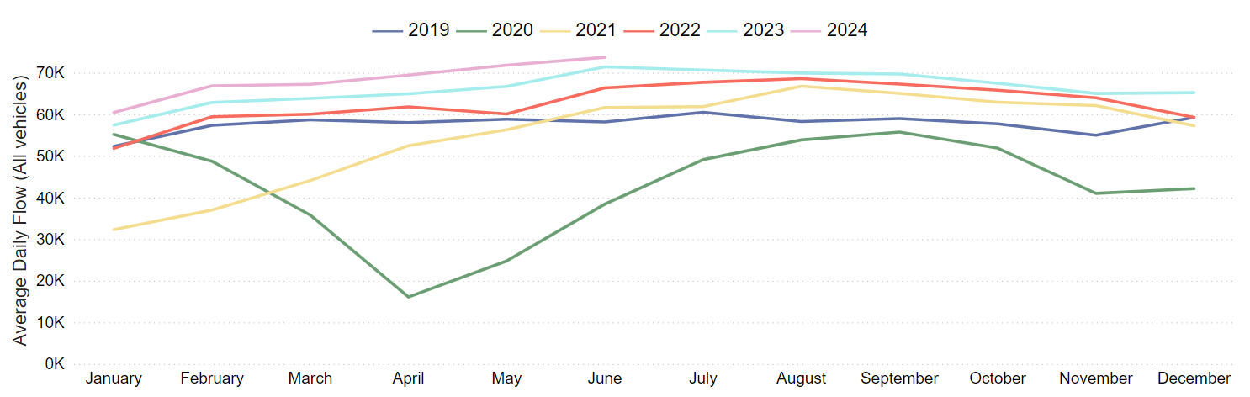
Strategic Road Network: Cambridge
Cambridge strategic road volumes now well exceed pre-COVID volumes (+27% in June 2024). Traffic volumes on the M11 have increased month-on-month since the start of 2024.
Pre-COVID to Now: Jun 2019 to Jun 2024 | Mid-COVID to Now: Jun 2021 to Jun 2024 | Previous year to Now: Jun 2023 to Jun 2024
+27% | +20% | +3%
Analysis based on 2 sensors on the M11.
Notes:
Source: National Highways WebTRIS data.
Technical note: This dataset averages across ALL days (Mon-Sun).

Slide 16
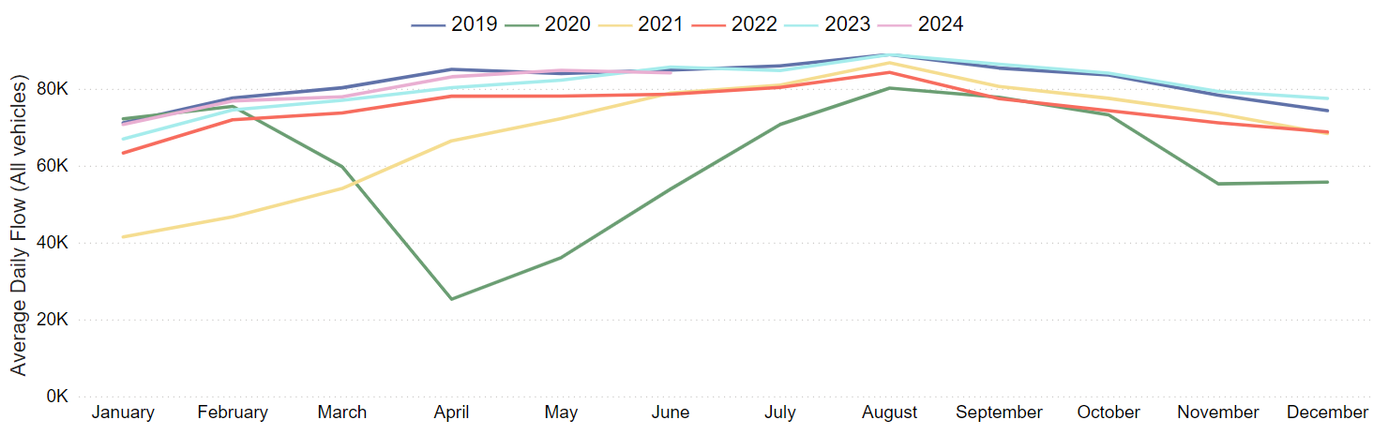
Strategic Road Network: East Cambridgeshire
East Cambridgeshire strategic road volumes are back to pre-COVID volumes (-1%) in June 2024. Volumes have increased throughout 2024 and show a similar trend to 2019.
Pre-COVID to Now: Jun 2019 to Jun 2024 | Mid-COVID to Now: Jun 2021 to Jun 2024 | Previous year to Now: Jun 2023 to Jun 2024
-1% | +7% | -2%
Analysis based on 3 sensors, 1 on the A14 and two on the A11.
Notes:
Source: National Highways WebTRIS data.
Technical note: This dataset averages across ALL days (Mon-Sun).

Slide 17
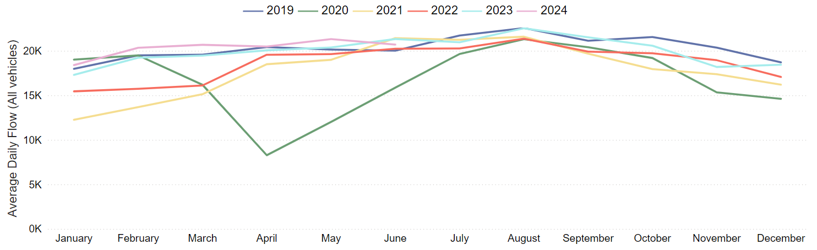
Strategic Road Network: Fenland
Fenland strategic road volumes are around pre-COVID levels so far in 2024 (+3% in June 2024) and show a similar trend to 2023 volumes so far in the year.
Pre-COVID to Now: Jun 2019 to Jun 2024 | Mid-COVID to Now: Jun 2021 to Jun 2024 | Previous year to Now: Jun 2023 to Jun 2024
+3% | -3% | -3%
Analysis based on 2 sensors on the A47.
Notes:
Source: National Highways WebTRIS data.
Technical note: This dataset averages across ALL days (Mon-Sun).

Slide 18
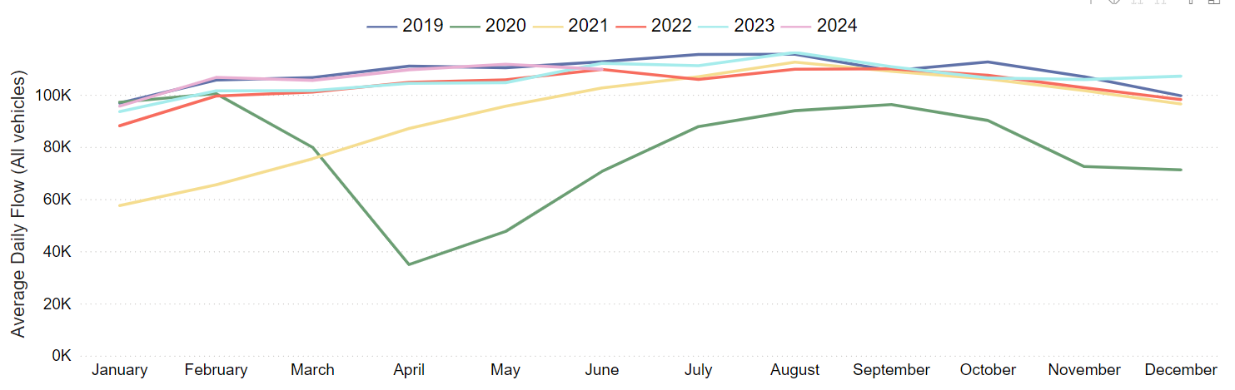
Strategic Road Network: Huntingdonshire
Huntingdonshire strategic road volumes are similar to pre-COVID 2019 (-3%) in June 2024. Trends on Huntingdonshire roads are very similar to 2019 throughout 2024 so far (-2% from June 2023).
Pre-COVID to Now: Jun 2019 to Jun 2024 | Mid-COVID to Now: Jun 2021 to Jun 2024 | Previous year to Now: Jun 2023 to Jun 2024
-3% | +7% | -2%
Analysis based on 3 sensors on the A1(M).
Notes:
Source: National Highways WebTRIS data.
Technical note: This dataset averages across ALL days (Mon-Sun).

Slide 19
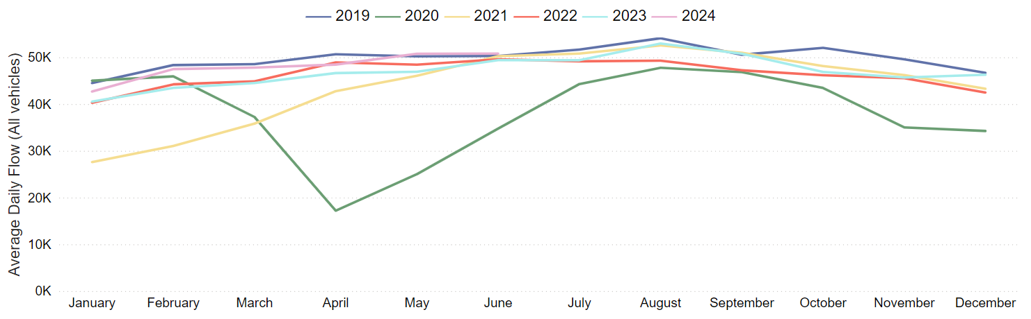
Strategic Road Network: Peterborough
Peterborough strategic road volumes are back to pre-COVID volumes in June 2024 (+1%). 2024 volumes see an increase in volumes throughout the year, closely mirroring the 2019 trend.
Pre-COVID to Now: Jun 2019 to Jun 2024 | Mid-COVID to Now: Jun 2021 to Jun 2024 | Previous year to Now: Jun 2023 to Jun 2024
+1% | +1% | +3%
Analysis based on 2 sensors on the A47 and 1 sensor on the A1.
Notes:
Source: National Highways WebTRIS data.
Technical note: This dataset averages across ALL days (Mon-Sun).

Slide 20
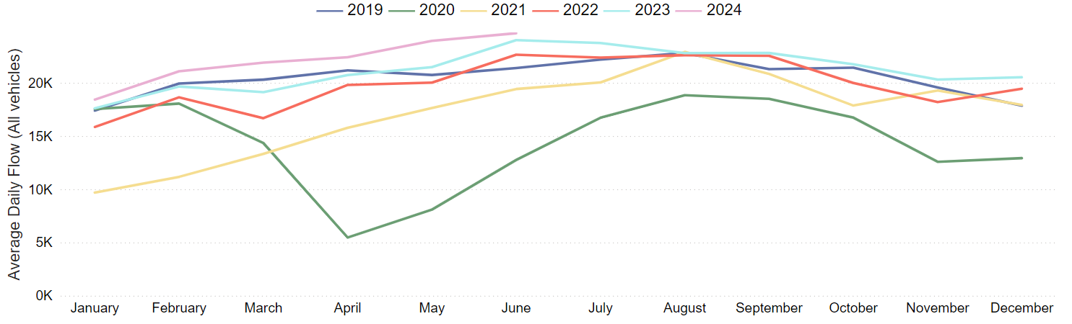
Strategic Road Network: South Cambridgeshire
South Cambridgeshire strategic road volumes are well ahead of pre-COVID in June 2024 (+15%). Volumes have increased a lot since mid-COVID (+27%) but also have increased slightly from the same time last year (+3%).
Pre-COVID to Now: Jun 2019 to Jun 2024 | Mid-COVID to Now: Jun 2021 to Jun 2024 | Previous year to Now: Jun 2023 to Jun 2024
+15% | +27% | +3%
Analysis based on 1 sensor on the M11.
Notes:
Source: National Highways WebTRIS data.
Technical note: This dataset averages across ALL days (Mon-Sun).

Slide 21
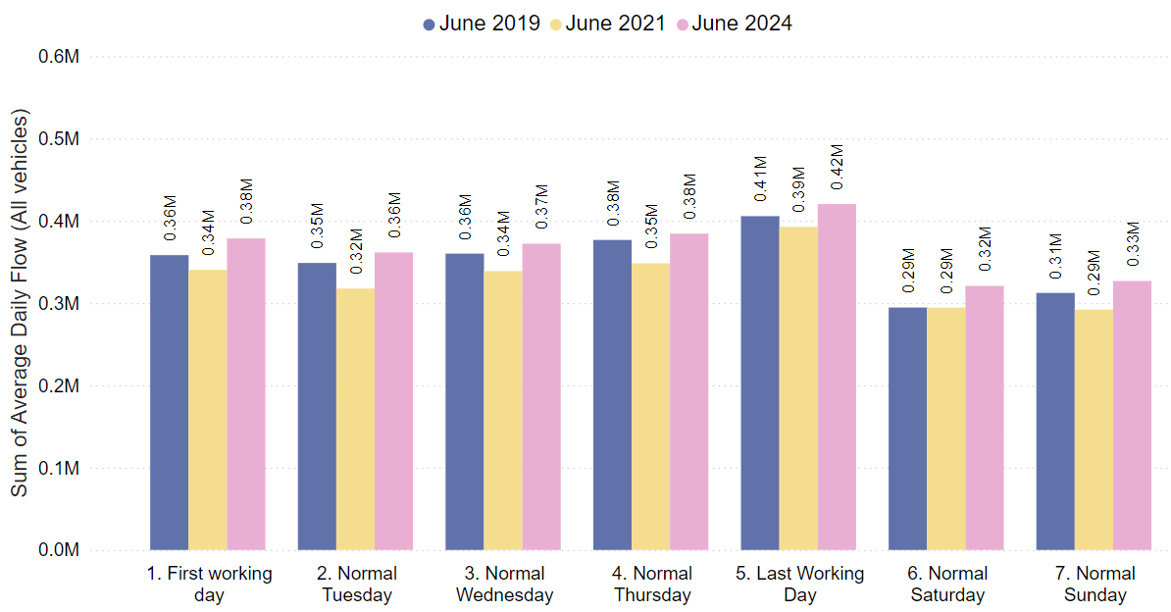
Strategic Road Network: Daily Flow by Day of the Week
On the strategic road network, all days of the week are now above 2019 levels. Saturdays are furthest ahead of pre-COVID at +9%. Weekend volumes (Sat-Sun, +7%) are ahead of weekday volumes (Mon-Thurs, +4%).
 | Pre-COVID to Now: Jun 2019 to Jun 2024
Average Daily Flow % change | First Working Day | Normal Tuesday | Normal Wednesday | Normal Thursday | Last Working Day | Normal Saturday | Normal Sunday
 | +6% | +4% | +3% | +2% | +4% | +9% | +5%
Analysis based on 14 sensors across Cambridgeshire and Peterborough.
Notes:
Source: National Highways WebTRIS data.
Technical note: Average Daily Flow in the week for main carriageway monitors in each district, all with data 2019 – 2024. Note the use of ‘normal’ days which allow for a ‘like-for-like’ comparison between comparable days. For example, bank holidays and school holidays are excluded from average flow calculations for ‘normal’ days. As such, this dataset does not account for the Christmas period, Christmas or New Year bank holidays, school summer holidays etc.

Slide 22
Local Road Network:
Motorised Vehicles

Slide 23
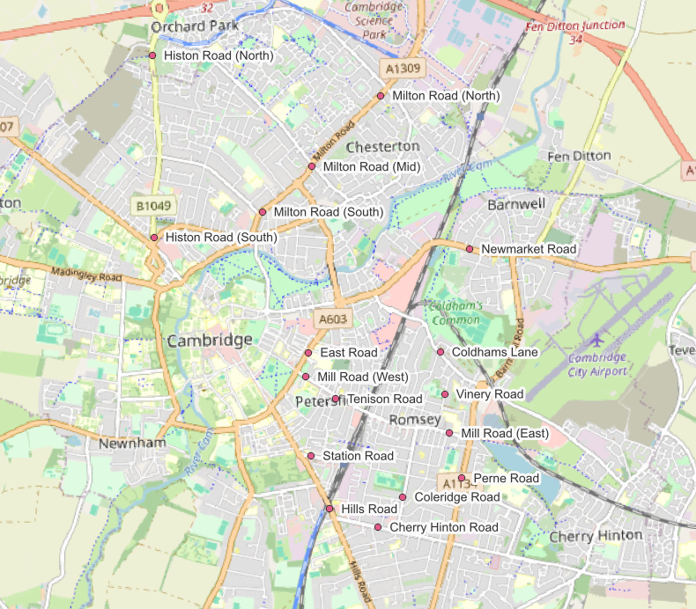
Local Road Network Monitoring Sites: Motorised Vehicles
Long Term Vivacity Monitoring Sites – Motorised Vehicles
The Mill Road and East Road sensors were upgraded in Sept 2022 and are now detecting significantly more cycles and pedestrians. As a result, the active travel flows at these locations are no longer comparable pre/post Sept 2022.
Sensor Location​​ | Location description​​ | Installed​
Cherry Hinton Road ​​ | Near Rock Road​​ | May 2019​
Coldham’s Lane​​ | Near Coldham’s Common​​ | May 2019​
Coleridge Road ​​ | Near Coleridge recreation ground​​ | May 2019​
East Road​​ | Close to ARU site​​ | May 2019​
Hills Road Bridge​​ | Near Cherry Hinton Road​​ | May 2019​
Histon Road (North)​​ | Just south of A14​ | Sep 2019​
Histon Road (South) ​​ | Near Victoria Road​ | Sep 2019​
Mill Road (East)​​ | Close to Brookfield’s hospital​​ | May 2019​
Mill Road (West)​​ | Close to Parker’s Piece​​ | May 2019​
Milton Road (Mid)​​ | Near Union Lane​​ | May 2019​
Milton Road (North)​​ | Near King’s Hedges Road​ | Sep 2019​
Milton Road (South)​ | Near Gilbert Road​ | Sep 2019​
Newmarket Road | Near Ditton Fields | May 2019
Perne Road | Near Birdwood Road roundabout | May 2019
Station Road | Near Kett House | May 2019
Tenison Road​​ | Near Mill Road​​ | May 2019​
Vinery Road ​​ | Near Romsey recreation ground​​ | May 2019​
Legend
Comparable motorised vehicle data available for most months and years.
Comparable motorised vehicle data available for June 2019, June 2021, June 2023 and June 2024.
Comparable motorised vehicle data available for June 2019 and June 2024.
© OpenStreetMap Contributors
Comparable data not available for June 2019 and / or June 2024.
Notes:
Source: Cambridge Vivacity sensors
Technical note: This analysis has excluded sensors which may compromise the validity of historic comparisons when figures for all sites are combined. For example, some sites may have data gaps, road closures or events impacting data within the comparison period.

Slide 24
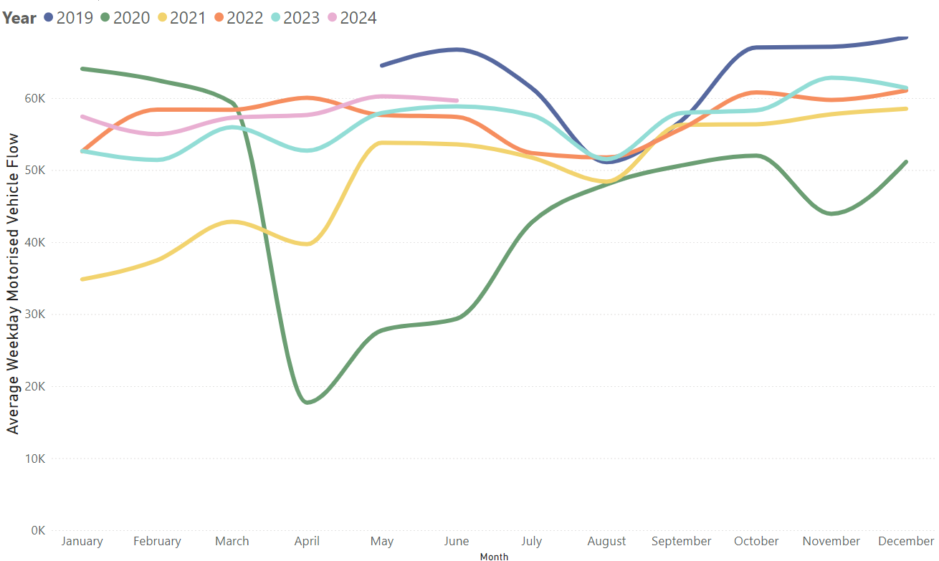
Local Road Network: Motorised Vehicle – Trends
In June 2024, motorised traffic flows are 10% below pre-Covid (June 2019) and are very similar to this time last year (June 2023).
Average weekday vehicular flow by month, 2019-2024.
Pre-COVID to Now:
June 2019 to June 2024
Mon-Sun | Weekdays (Mon-Thu) | Weekends (Sat-Sun)
-10% | -11% | -8%
Mid-COVID to Now:
June 2021 to June 2024
Mon-Sun | Weekdays (Mon-Thu) | Weekends (Sat-Sun)
+10% | +11% | +5%
Previous year to Now:
June 2023 to June 2024
Mon-Sun | Weekdays (Mon-Thu) | Weekends (Sat-Sun)
+1% | +1% | No change
Sensors used for the analysis on this slide: Coleridge Road, East Road, Hills Road, Mill Road (West), and Tenison Road.
Notes:
Source: Cambridge Vivacity sensors
Technical Notes: 'Non-neutral days' are not included within the calculations.
This chart shows the average volume of motor vehicles counted per weekday for each month/year .
The table presents full week and weekend changes against various historic benchmarks to give an indication of how traffic flows are recovering.
Improved data cleaning processes are being developed to improve the omission of any poor quality / non-comparable data – gaps on the graph may be present for this reason. Care should be taken in interpreting these charts as they are solely based on the 5 locations stated – which dilutes the geographical coverage and may not provide a city-wide / holistic view.
Commentary:
Motorised traffic flows in 2024 so far are very similar to those seen in 2023. June 2024 overall is just ahead of June 2023.
Motorised flows remain below June 2019 (‘pre-COVID’) levels (-10%). Weekends (-8%) are closer to pre-Covid than weekdays (-11%).

Slide 25
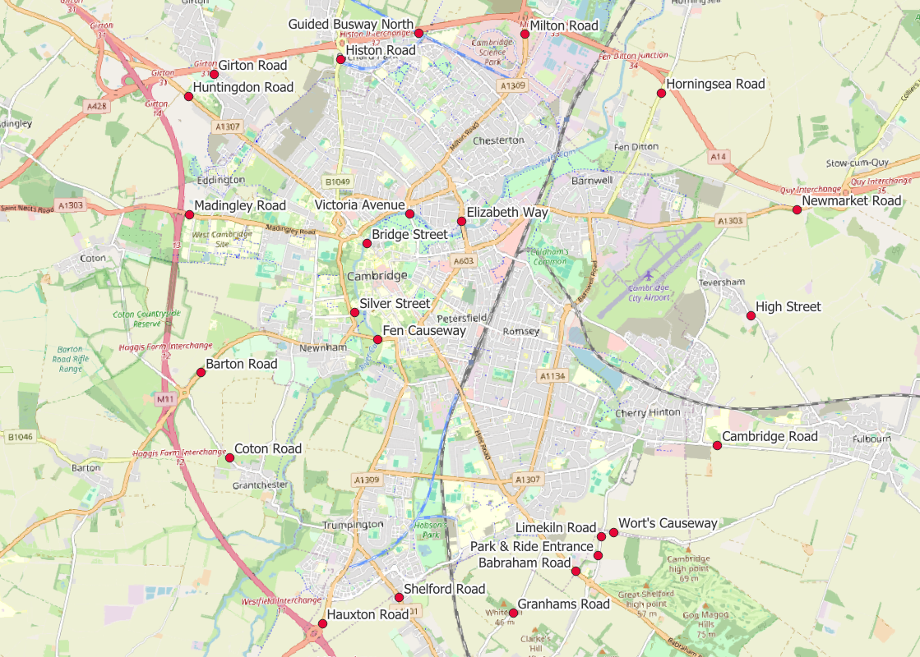
Local Road Network: Motorised Vehicle - Annual Survey Sites
Cambridgeshire Annual Traffic Survey Sites
Annual Survey Sites
Elizabeth Way
Victoria Avenue​​
Bridge Street
Silver Street
Fen Causeway​​
Histon Road
Milton Road
Horningsea Road
Newmarket Road
High Street (Teversham)
Cambridge Road (Fulbourn)
Worts Causeway
Limekiln Road
Babraham Road
Granhams Road
Shelford Road
Hauxton Road
Coton Road
Barton Road
Madingley Road
Huntingdon Road
Girton Road
Guided Busway (North)
Babraham P&R Entrance
Cambridgeshire County Council commissions annual traffic surveys to determine traffic levels around the county on a “typical” weekday.
The sites shown on this map are those in and around Cambridge at which CCC has collected motorised traffic flows consistently over several years.
Analysis of motorised traffic counts from these sites is presented on the following slide.
© OpenStreetMap Contributors

Slide 26
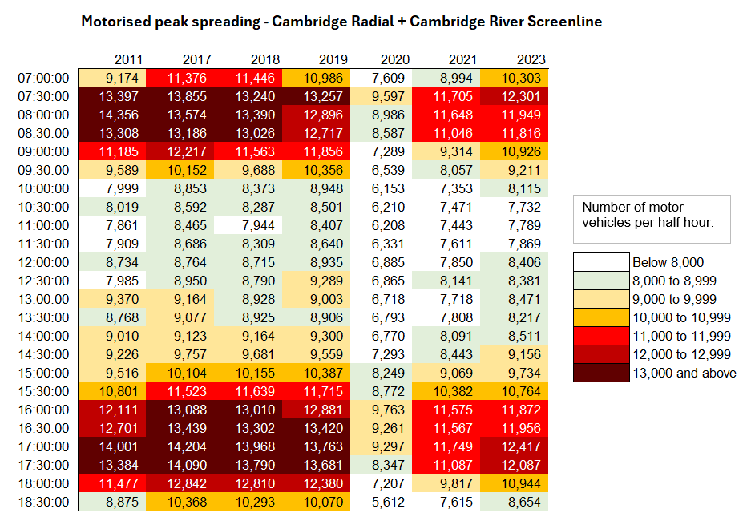
Local Road Network: Motorised Vehicle - Peak Spreading
Daily patterns of motorised traffic are starting to resemble the profiles seen pre-COVID (2017-2019), with morning and afternoon peak periods beginning to widen again, albeit with lower overall volumes. 2023 survey data has detected an evening peak above 12k vehicles per half hour for the first time since 2019.
Half hour beginning
Note: Reliable survey data for Autumn 2022 is not available and 2022 is therefore excluded from this analysis.
Notes:
Source: Cambridgeshire Annual Traffic Surveys – Cambridge Radial and Cambridge Screenline . Survey data in 2022 was returned to CCC incomplete, therefore 2022 is excluded as it cannot be presented in comparison to other years.
Technical Note: These figures use the annual traffic survey data from sites in the annual Cambridge Screenline and the Cambridge Radial surveys (only sites which have been consistent across all years). The survey days used in this analysis have been chosen to most closely represent a “typical” day for traffic flows (i.e. avoiding bank holidays, weeks with strike action, other special circumstances which can affect traffic volumes).

Slide 27
Local Road Network:
Vehicle Split

Slide 28
Local Road Network Monitoring Sites: Vehicle Split
Long Term Vivacity Monitoring Sites – Motorised Vehicles
The Mill Road and East Road sensors were upgraded in Sept 2022 and are now detecting significantly more cycles and pedestrians. As a result, the active travel flows at these locations are no longer comparable pre/post Sept 2022.
Sensor Location​​ | Location description​​ | Installed​
Cherry Hinton Road ​​ | Near Rock Road​​ | May 2019​
Coldham’s Lane​​ | Near Coldham’s Common​​ | May 2019​
Coleridge Road ​​ | Near Coleridge recreation ground​​ | May 2019​
East Road​​ | Close to ARU site​​ | May 2019​
Hills Road Bridge​​ | Near Cherry Hinton Road​​ | May 2019​
Histon Road (North)​​ | Just south of A14​ | Sep 2019​
Histon Road (South) ​​ | Near Victoria Road​ | Sep 2019​
Mill Road (East)​​ | Close to Brookfield’s hospital​​ | May 2019​
Mill Road (West)​​ | Close to Parker’s Piece​​ | May 2019​
Milton Road (Mid)​​ | Near Union Lane​​ | May 2019​
Milton Road (North)​​ | Near King’s Hedges Road​ | Sep 2019​
Milton Road (South)​ | Near Gilbert Road​ | Sep 2019​
Newmarket Road | Near Ditton Fields | May 2019
Perne Road | Near Birdwood Road roundabout | May 2019
Station Road | Near Kett House | May 2019
Tenison Road​​ | Near Mill Road​​ | May 2019​
Vinery Road ​​ | Near Romsey recreation ground​​ | May 2019​
Legend
Comparable motorised vehicle data available for most months and years.
Comparable motorised vehicle data available for June 2019, June 2021, June 2023 and June 2024.
Comparable motorised vehicle data available for June 2019 and June 2024.
© OpenStreetMap Contributors
Comparable data not available for June 2019 and / or June 2024.
Notes:
Source: Cambridge Vivacity sensors
Technical note: This analysis has excluded sensors which may compromise the validity of historic comparisons when figures for all sites are combined. For example, some sites may have data gaps, road closures or events impacting data within the comparison period.

Slide 29
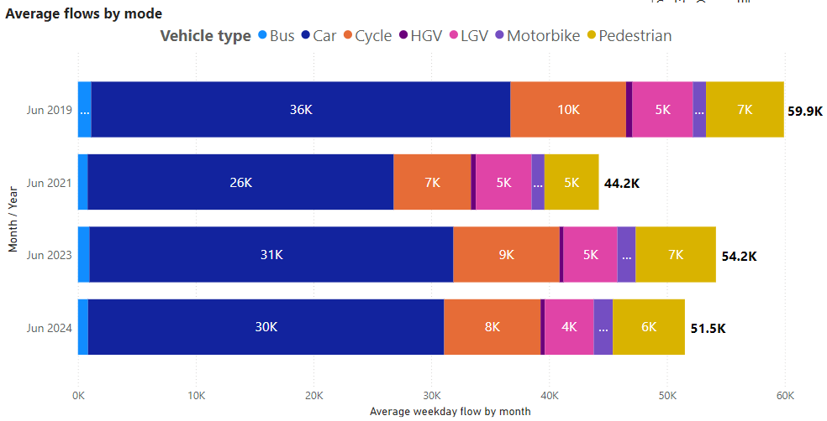
Local Road Vehicle Split: Overall
June 2024 typical weekday volumes are just below those recorded at this point last year (June 2023) and are 14% below the typical weekday volumes recorded pre-COVID (June 2019). The vehicle mode split has not altered a lot between the four years.
Vehicle type split – sum of 4 sensors in Cambridge
Active Travel* proportion by year
Year | Active %
June 2019 | 27%
June 2021 | 25%
June 2023 | 29%
June 2024 | 28%
June 2024 Active Travel* proportion by location
Location​ | Active %​
Station Road | 53%
Mill Road (West) | 49%
Tenison Road | 40%
Milton Road (South) | 36%
Mill Road (East) | 33%
Cherry Hinton Road | 27%
East Road | 27%
Hills Road | 26%
Histon Road (South) | 26%
Coleridge Road | 20%
Perne Road | 14%
Histon Road (North) | 11%
Newmarket Road | 10%
Coldham’s Lane | 9%
Sensors used for the analysis on this slide: Cherry Hinton Road, Coleridge Road, Hills Road, and Tenison Road.
*Active Travel includes cyclists and pedestrians
Notes:
Source: Cambridge Vivacity sensors
Technical Notes: Sensors included within the four-year chart are: Cherry Hinton Road, Coleridge Road, Hills Road, and Tenison Road. 'Non-neutral' days are not included within average weekday flow calculations. Fridays are not counted as a weekday. Traffic flows on all other days are counted and used to calculate a typical 'average' traffic flow within central Cambridge on a weekday.
We have selected the most recent month of data (March 2024) and compared it to three historic time periods to show how traffic flows have evolved since these sensors were installed.
Commentary
June 2024 data presents with a typical weekday flow of 51,500 - which just below this point last year, when June 2023 showed a typical weekday flow of 54,200.
Pre-Covid (June 2019) typical weekday flows in central Cambridge were significantly higher than in subsequent years, reaching almost 60,000.
Overall, the proportionate split in travel modes has not changed a huge amount between the four months selected- cars are the dominant mode of transport in all four years.
Active modes' share of total flow has remained fairly consistent across the four months analysed. 28% of total flow on a typical day in June 2024 is made using active modes of travel – slightly down from 29% in June 2023; but slightly up on both June 2021 (25%) and June 2019 (27%).

Slide 30
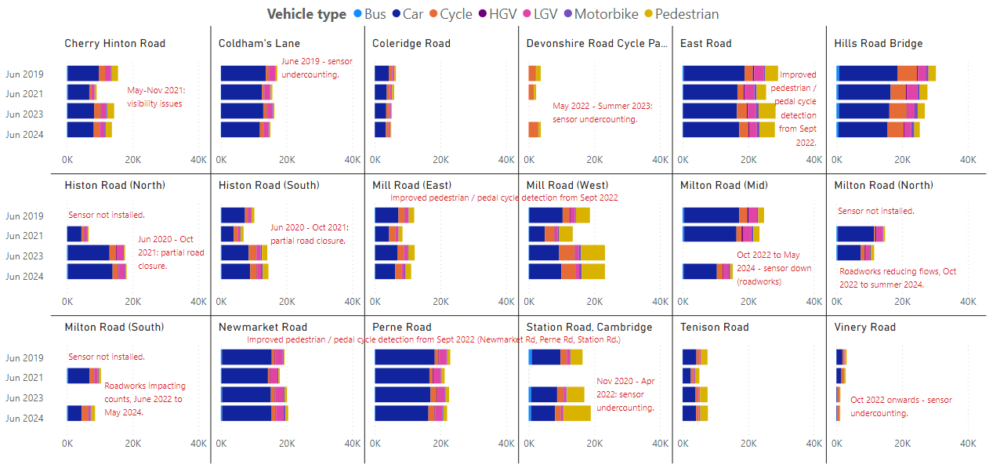
Local Road Vehicle Split: By Location
Average weekday flow by mode
Notes:
Source: Cambridge Vivacity sensors
Technical Note:
Non-neutral days are not included within the average weekday flow calculations. Weekdays are defined as Monday to Thursday, as per DfT guidance. We have selected the most recent month of data and compared it to three historic months to show how traffic flows have evolved since these sensors were installed.
Please see the comments on the slide which highlight events which are considered likely to have impacted the data. For example, there may be a data gap or a change that is likely to affect the counts either upwards or downwards – and so require caution to be taken when assessing the outputs.
Commentary:
Cars are the largest individual category in all locations (except Devonshire Rd Cycle Path) across all years – but some sites are seeing the dominance of cars recede slightly.
Overall, there has not been a significant impact on modal split at most locations - with the exceptions being sites which have had a sensor upgrade that enables vastly improved active mode counts (these are East Road, Mill Road West, Mill Road East, Newmarket Road, Station Road and Perne Road).

Slide 31
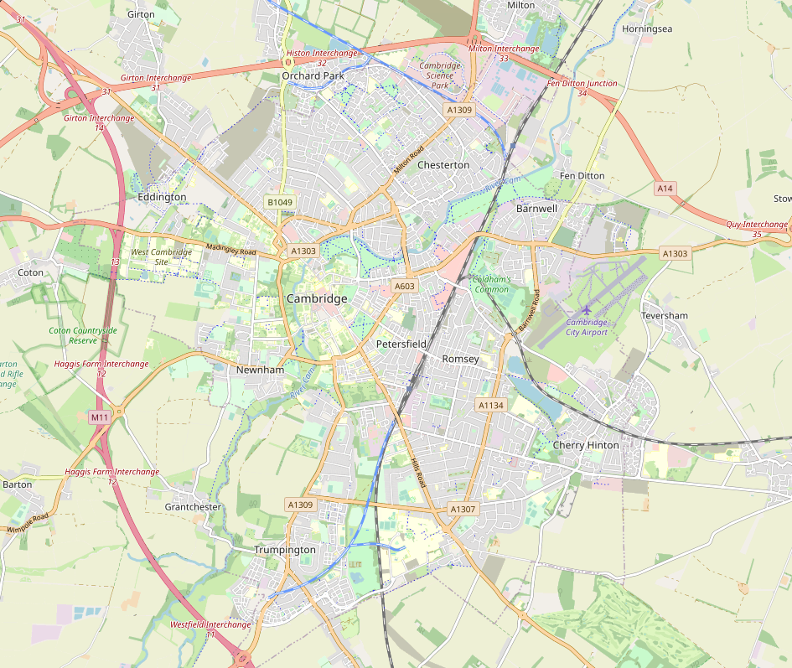
Local Road Network: Recovery Map
In June 2024 in Cambridge, motorised flows were approximately 14% below pre-COVID levels (June 2019) and active flows were 13% below. The level of recovery varies greatly by site with active flows 9% above pre-COVID levels on Tenison Road but 21% below on Hills Road and 32% below on Coleridge Road.
% change in traffic flows, June 2019 to June 2024
All 4 Sites Combined
Active Travel:
Motorised Travel:
-13%
-14%
Tenison Road
Active Travel:
Motorised Travel:
+9%
-3%
Hills Road Bridge
Active Travel:
Motorised Travel:
-21%
-14%
Coleridge Road
Active Travel:
Motorised Travel:
-32%
Cherry Hinton Road
Active Travel:
Motorised Travel:
-19%
-3%
-15%
© OpenStreetMap Contributors
Notes:
Source: Cambridge Vivacity sensors
Technical Note: Calculations are made on an average weekday. Low and zero flows are removed from any average calculations. Any ‘non neutral’ days - such as bank holidays or school holidays – are also excluded.
Data is shown only for the five sensors with comparable data for June 2019 and June 2024 for both active and motorised traffic flows.
Commentary:
Active travel is 13% below pre-Covid levels across these sites; albeit with a wide variation by site.
Hills Road (-21%) and Coleridge Road (-32%) show large decreases compared to June 2019; whereas Cherry Hinton Road only presents a 3% decrease over the same time-span.
Tenison Road presents as 9% above pre-Covid for active flows on a typical weekday.
Motorised travel is 14% below pre-pandemic levels overall across these sites; with all individual sites presenting a drop against June 2019 levels.
Coleridge Road has seen the largest individual drop in motorised vehicle flows against June 2019 (-19%).

Slide 32
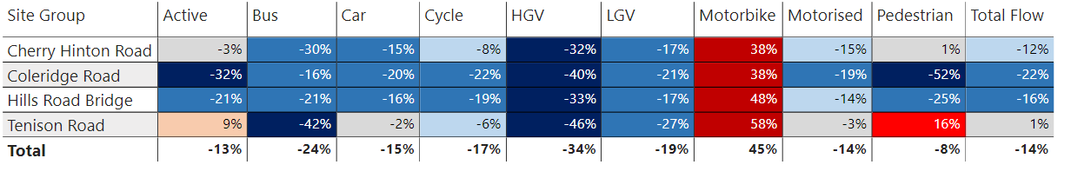
Local Road Network: Recovery by Location and Mode
Motorcycle volumes continue to exceed pre-COVID levels (June 2019). Pedestrian flow recovery continues to vary by site, with Coleridge Road 52% below 2019 but Tenison Road 16% above. Cycle flows were relatively low in June compared to 2019 levels, perhaps in part due to the unseasonal weather.
% change in weekday flows
Pre-COVID to Now:
June 2019 to June 2024
Data shown only for the sensors with comparable data for June 2019 and June 2024.
Notes:
Source: Cambridge Vivacity sensors
Technical Note: Weekday volumes do not include Fridays. Low and zero flows are removed from any average calculations, and any ‘non neutral’ days - such as bank holidays or school holidays – are also excluded.
Commentary:
Motorcycles are ahead of pre-Covid (June 2019) counts at all sites. Most other modes of transport are below pre-Covid levels at all sites, with the exception of Pedestrians at Tenison Road (+16%) and Cherry Hinton Road (+1%).
Coleridge Road is showing the largest fall in car volumes (-20% compared to June 2019).
Tenison Road is showing the largest increase in Active travel (+9% compared to June 2019), driven by an increase in pedestrians.
Cycling counts are lower than pre-Covid across all sites, but there is some variation by location in the extent to which volumes have fallen below June 2019. Volumes are 22% below pre-Covid at Coleridge Road, but only 6% below pre-Covid at Tenison Road.
HGV volumes are some way below pre-Covid at all locations (between 32 and 46% below June 2019).

Slide 33
Local Road Network:
Active Travel

Slide 34
Local Road Network Monitoring Sites: Active Travel
Long Term Vivacity Monitoring Sites – Active Travel.
The Mill Road and East Road sensors were upgraded in Sept 2022 and are now detecting significantly more cycles and pedestrians. As a result, the active travel flows at these locations are no longer comparable pre/post Sept 2022.
Sensor Location​​ | Location description​​ | Installed​
Cherry Hinton Road ​​ | Near Rock Road​​ | May 2019​
Coldham’s Lane​​ | Near Coldham’s Common​​ | May 2019​
Coleridge Road ​​ | Near Coleridge recreation ground​​ | May 2019​
East Road​​ | Close to ARU site​​ | May 2019​
Hills Road Bridge​​ | Near Cherry Hinton Road​​ | May 2019​
Histon Road (North)​​ | Just south of A14​ | Sept 2019​
Histon Road (South) ​​ | Near Victoria Road​ | Sept 2019​
Mill Road (East)​​ | Close to Brookfield’s hospital​​ | May 2019​
Mill Road (West)​​ | Close to Parker’s Piece​​ | May 2019​
Milton Road (Mid)​​ | Near Union Lane​​ | May 2019​
Milton Road (North)​​ | Near King’s Hedges Road​ | Sept 2019​
Milton Road (South)​ | Near Gilbert Road​ | Sept 2019​
Newmarket Road | Near Ditton Fields | May 2019
Perne Road | Near Birdwood Road roundabout | May 2019
Station Road | Near Kett House | May 2019
Tenison Road​​ | Near Mill Road​​ | May 2019​
Vinery Road ​​ | Near Romsey recreation ground​​ | May 2019​
Legend
Comparable active modes data available for most months and years.
Comparable active modes data available for June 2019, June 2021, June 2023 and June 2024.
Comparable active modes data available for June 2019 and June 2024.
© OpenStreetMap Contributors
Comparable data not available for June 2019 and / or June 2024.
Notes:
Source: Cambridge Vivacity sensors
Technical note: This analysis has excluded sensors which may compromise the validity of historic comparisons when figures for all sites are combined. For example, some sites may have data gaps, road closures or events impacting data within the comparison period.

Slide 35
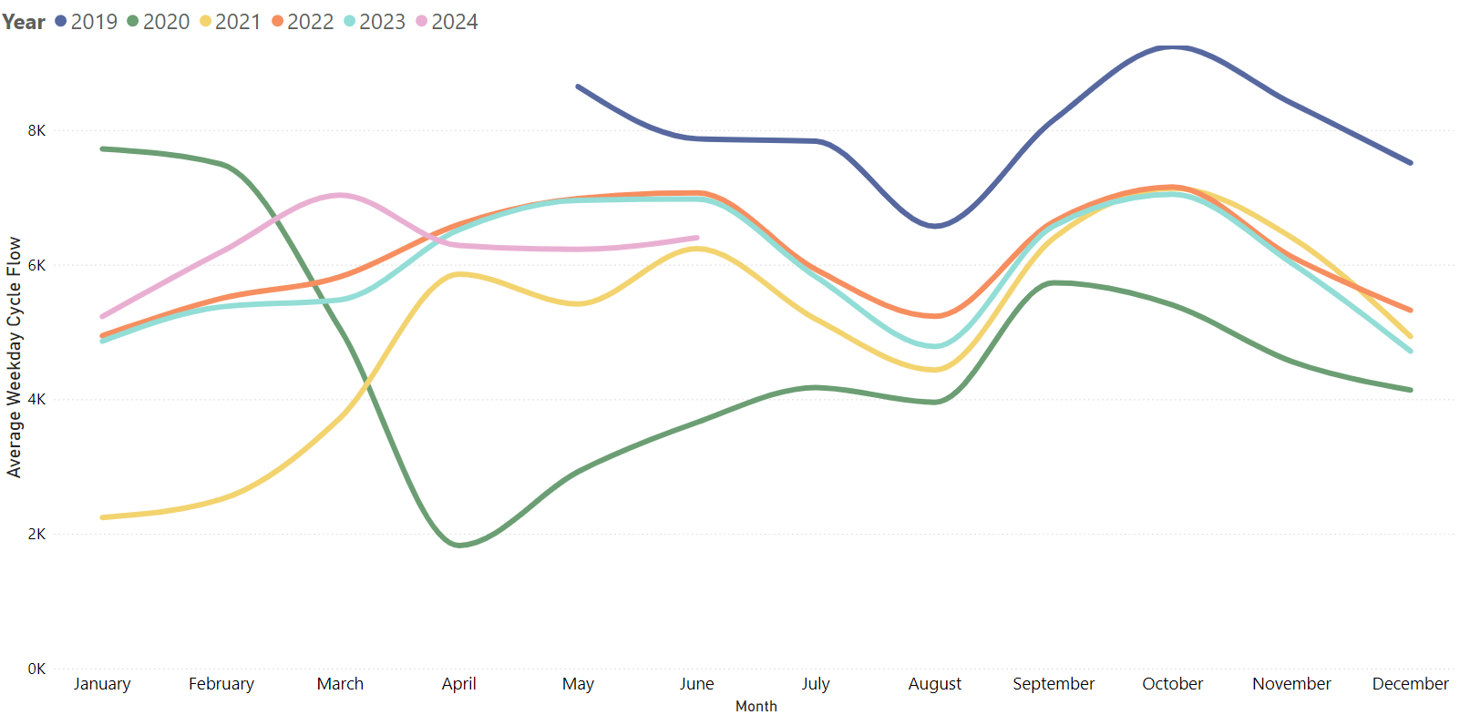
Local Road Network: Cyclists
June 2024 cycling volumes were 18% below pre-COVID (June 2019) and also 11% below last year. Typically, cycle volumes steadily increase from January to June but in 2024 this pattern stopped in April. Flows in April, May and June 2024 were similar to February 2024 levels and lower than spring/summer 2022 and 2023. This pattern is perhaps due to the unseasonal weather.
Average weekday cycle flow
Pre-COVID to Now:
June 2019 to June 2024
Mon-Sun | Weekdays (Mon-Thu) | Weekends (Sat-Sun)
-18% | -19% | -19%
Mid-COVID to Now:
June 2021 to June 2024
Mon-Sun | Weekdays (Mon-Thu) | Weekends (Sat-Sun)
+1% | +3% | -6%
Previous year to Now:
June 2023 to June 2024
Mon-Sun | Weekdays (Mon-Thu) | Weekends (Sat-Sun)
-11% | -8% | -14%
Sensors used for this analysis: Coleridge Road, Hills Road, and Tenison Road.
Notes:
Source: Cambridge Vivacity sensors
Technical note: Bank holiday weeks are not included within the calculations. School holidays are also excluded (except summer holidays in order to obtain figures for August). Sensors used within the calculations: Coleridge Road, Hills Road, and Tenison Road.
Commentary: June 2024 is showing an 18% decrease compared to pre-Covid (June 2019) cycling volumes. Weekends and Weekdays (Mon-Thu) are both 19% below pre-Covid.
In comparison to last year, cycling volumes are 11% below June 2023 overall – with weekdays 8% below last year; and weekends 14% below. June 2024 had relatively cold and cloudy weather compared to other years – this is one possible factor to explain such a drop-off in volumes.

Slide 36
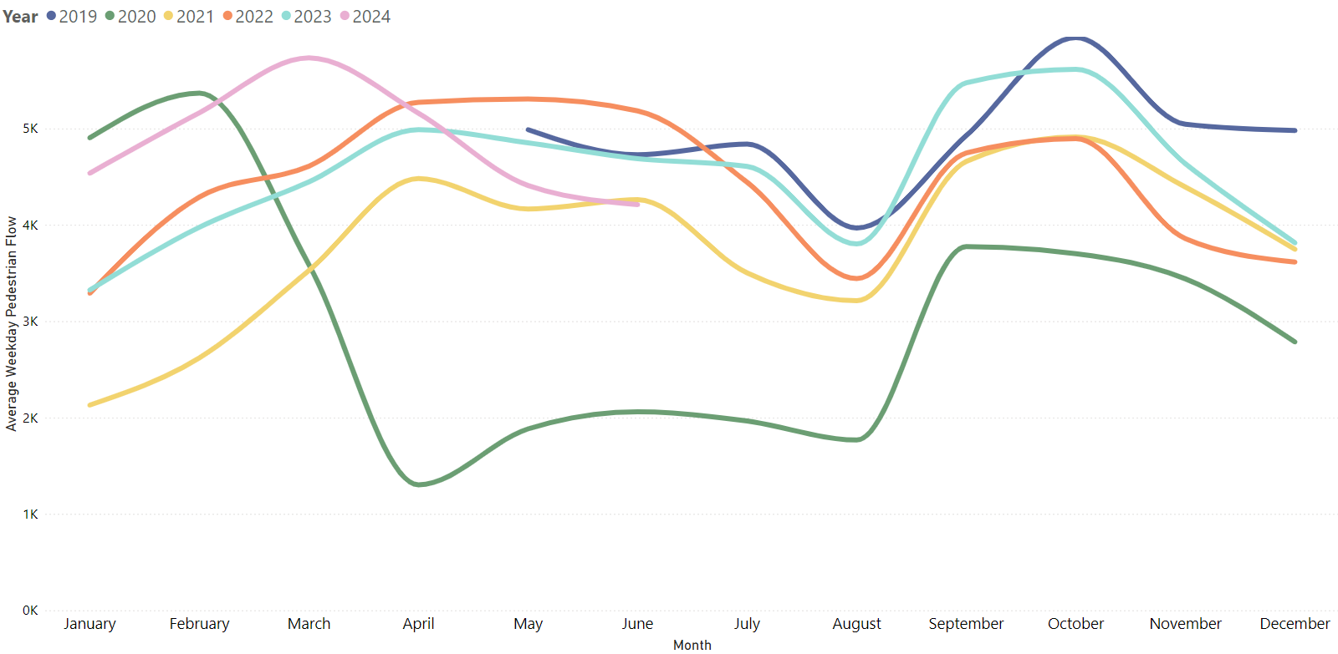
Local Road Network: Pedestrians
After a strong start to the year, pedestrian volumes in June 2024 were 8% below pre-COVID (June 2019) and 8% below this time last year (June 2023). Typically, pedestrian volumes would gradually increase from January to June but in 2024 pedestrian flows consistently decreased from April to June. This pattern is perhaps due to the unseasonal weather.
Average weekday pedestrian flow
Pre-COVID to Now:
June 2019 to June 2024
Mon-Sun | Weekdays (Mon-Thu) | Weekends (Sat-Sun)
-8% | -11% | No change
Mid-COVID to Now:
June 2021 to June 2024
Mon-Sun | Weekdays (Mon-Thu) | Weekends (Sat-Sun)
-1% | -1% | -9%
Previous year to Now:
June 2023 to June 2024
Mon-Sun | Weekdays (Mon-Thu) | Weekends (Sat-Sun)
-8% | -10% | -1%
Sensors used for this analysis: Coleridge Road, Hills Road, and Tenison Road.
Notes:
Source: Cambridge Vivacity sensors
Technical Note: Bank holidays and school holidays do not get included in these monthly averages. Fridays are not counted as a 'weekday’ - but Fridays are included in the 'Mon-Sun' calculations.
Sensors used within the calculations: Coleridge Road, Hills Road, and Tenison Road.
Commentary: Pedestrian volumes in June 2024 are 8% below pre-Covid (June 2019) levels. Weekdays (Mon-Thu) are 11% below June 2019, while Weekends present as level with pre-Covid.
Overall, pedestrian volumes present a 1% drop compared to mid-Covid (June 2021). This is the first time that the line chart has shown lower pedestrian volumes than 2021 since late 2022. It is possible that weather conditions in June have suppressed walking volumes slightly – with colder and cloudier June conditions experienced in 2024 than in other years.

Slide 37
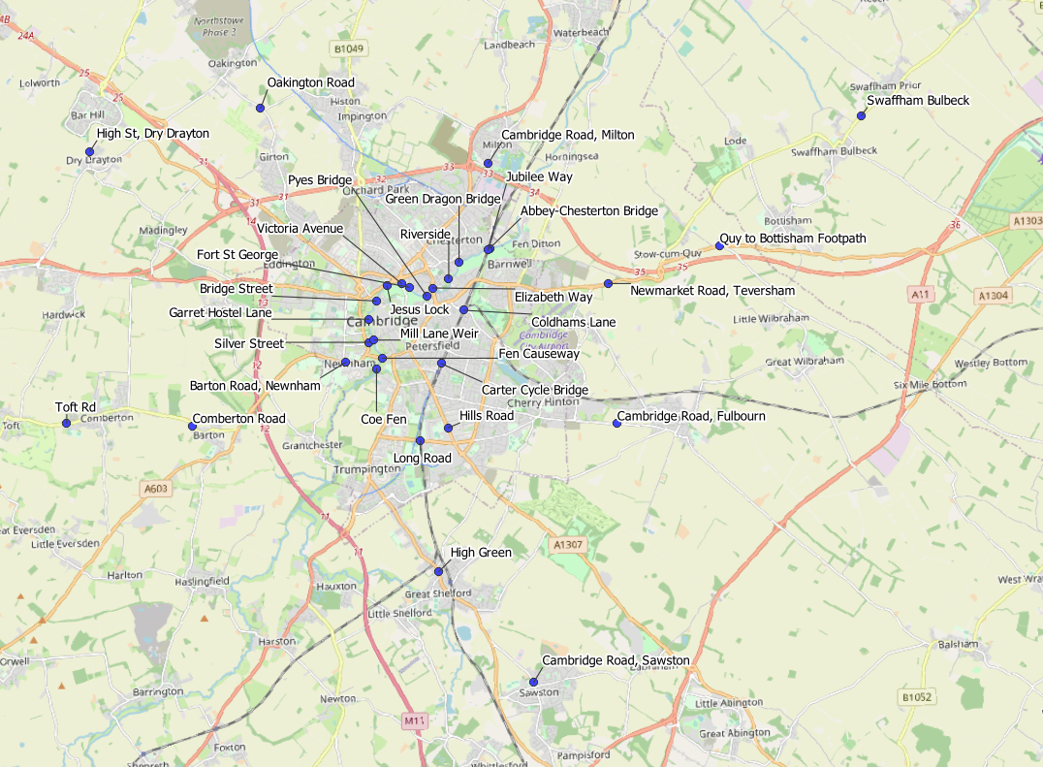
Local Road Network: Active Travel Annual Survey Sites
Cambridgeshire Annual Traffic Survey Sites – River Screenline and Cycle Routes
Sensor Location​​ | Survey
Elizabeth Way | Screenline
Victoria Avenue​​ | Screenline
Bridge Street | Screenline
Silver Street | Screenline
Fen Causeway​​ | Screenline
Green Dragon Bridge​​ | Screenline
Pye’s Bridge | Screenline
Fort St George​​ | Screenline
Jesus Lock​​ | Screenline
Garrett Hostel Lane​​ | Screenline
Mill Lane Weir | Screenline
Coe Fen​ | Screenline
Riverside | Screenline
Abbey-Chesterton Bridge | Screenline
Barton Road, Newnham | Cycle Route
Cambridge Road, Fulbourn | Cycle Route
Cambridge Road, Milton | Cycle Route
Cambridge Road, Sawston | Cycle Route
Carter Cycle Bridge | Cycle Route
Coldhams Lane | Cycle Route
Comberton Road | Cycle Route
High Green, Great Shelford | Cycle Route
High Street, Dry Drayton | Cycle Route
Hills Road | Cycle Route
Jubilee Way | Cycle Route
Long Road | Cycle Route
Newmarket Road, Teversham | Cycle Route
Oakington Road | Cycle Route
Swaffham Bulbeck footpath | Cycle Route
Toft Road, Comberton | Cycle Route
Quy to Bottisham Footpath | Cycle Route
© OpenStreetMap Contributors
© OpenStreetMap Contributors

Slide 38
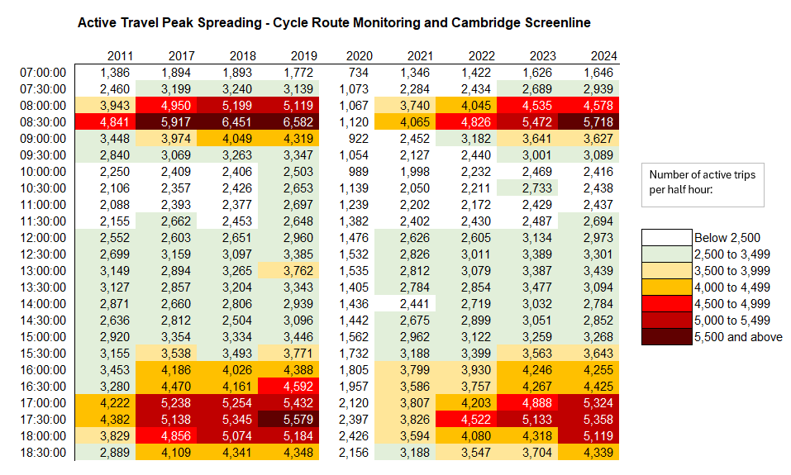
Local Road Network: Active Travel Peak Spreading
The daily pattern of pedestrian and pedal cycle flows in 2024 now resembles the pattern observed pre-COVID (2017-2019), albeit at slightly lower volumes.
Clearer morning and evening peak periods have re-emerged, spanning 1 hour in the morning and almost 2 hours in the evening.
Notes:
Source: Cambridge Spring Census – Screenline & Cycle Route Monitoring.
Data Note: In previous versions of this slide pack, totals from both survey days of the Cambridge River Screenline have been included. More recent analysis has only included neutral days to avoid any skewing affect from non-neutral days. Where sites have 2 neutral days of data, the two flows are averaged. Where sites only have 1 neutral day of data, the neutral data is retained and the non-neutral data excluded.
Technical Note: These figures use the annual traffic survey data from the annual Cambridge Screenline and the Cycle Route Monitoring surveys. The survey days used in this analysis have been chosen to most closely represent a “typical” day for traffic flows (i.e. avoiding bank holidays, weeks with strike action, other special circumstances which can affect traffic volumes).
As active travel can be quite variable due to weather conditions, caution is advised using these figures as they are taken from daily surveys rather than calculated over longer periods of time. They are intended to provide a rough indication of trends over time.

Slide 39
Retail Footfall

Slide 40
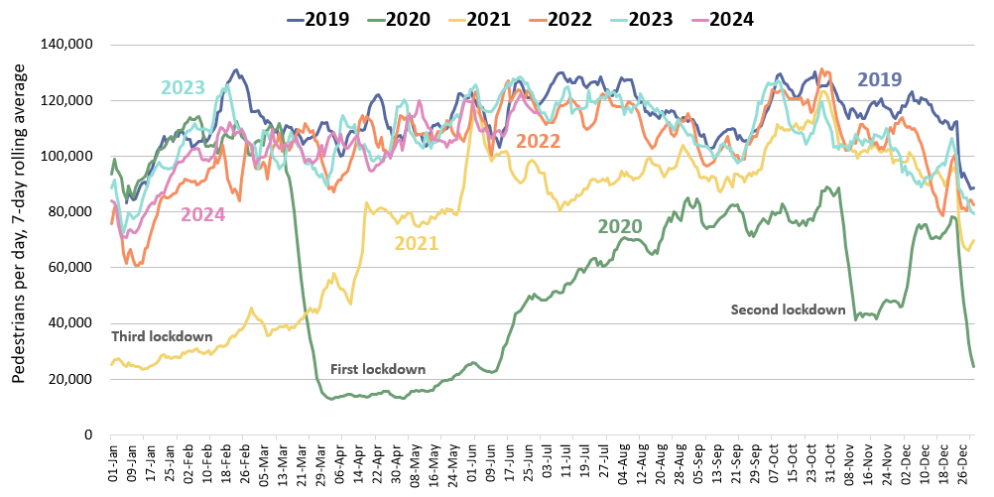
Retail Footfall: Central Cambridge
In June 2024, retail footfall in Cambridge was 3% below pre-COVID (June 2019) levels and 5% below last year (June 2023).
Pre-COVID to Now:
June 2019 to June 2024
Mon-Sun | Weekdays (Mon-Thu) | Weekends (Sat-Sun)
-3% | -2% | -3%
Mid-COVID to Now:
June 2021 to June 2024
Mon-Sun | Weekdays (Mon-Thu) | Weekends (Sat-Sun)
+20% | +18% | +15%
Previous year to Now:
June 2023 to June 2024
Mon-Sun | Weekdays (Mon-Thu) | Weekends (Sat-Sun)
-5% | -6% | -8%
Notes:
Source: Cambridge BID footfall data.
Technical note: Data from the following locations: Bridge Street, Fitzroy Street at Waitrose, Market Hill, Regent Street, Rose Crescent, Sidney Street. Excludes data for King’s Parade and One Station Square. As outlined at the start of this slide pack, 'weekdays' do not include Fridays. Table calculations do not include bank holidays, school holidays or any other "non neutral" days. The percentage changes are designed to reflect change on a "typical" day.
Commentary:
March foot traffic in central Cambridge is 3% below the pre-Covid level of June 2019 and is 5% below what we saw in June 2023.
Weekday (Mon-Thu) footfall is 2% below pre-Covid levels, and weekend footfall is 3% below pre-Covid levels.
Weekday (Mon-Thu) foot traffic is 6% below June 2023. Weekend (Sat-Sun) footfall also saw a decrease compared to last year (June 2023), at an 8% decrease. Weather in June 2024 has been colder and cloudier than June 2023 – this may have impacted the levels of footfall seen in June 2024. Cycling and pedestrian volumes on local roads are also lower than last year.
Overall, footfall levels for June 2024 have increased by 20% when compared to June 2021 (Mid-Covid).

Slide 41
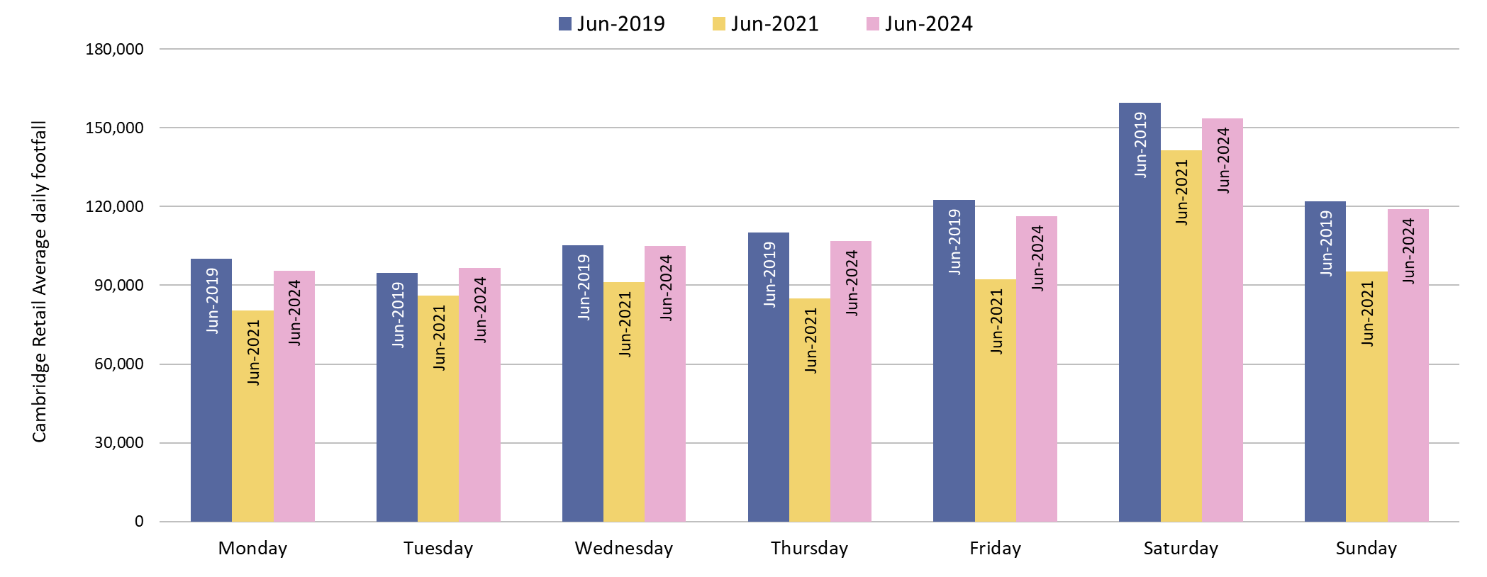
Retail Footfall: Central Cambridge by Day of the Week
In June 2024, retail footfall was near pre-COVID levels (June 2019) on all days of the week. Monday and Friday were least recovered (-5%) whilst Wednesdays were at pre-COVID levels and Tuesdays were just above.
Pre-COVID to Now: June 2019 to June 2024
Monday | Tuesday | Wednesday | Thursday | Friday | Saturday | Sunday
-5% | +2% | 0% | -3% | -5% | -4% | -3%
Notes:
Source: Cambridge BID footfall data.
Technical note: Data from the following locations: Bridge Street, Fitzroy Street at Waitrose, Market Hill, Regent Street, Rose Crescent, Sidney Street. Excludes data for King’s Parade and One Station Square. Table calculations do not include bank holidays, school holidays or any other "non neutral" days. The percentage changes are designed to reflect change on a "typical" day.
Commentary: All days of the week show a modest negative change to pre-COVID (June 2019) levels, apart from Wednesday that had no change. The largest change was a decrease of 5% on Monday and Friday.
All days showed a recovery from mid-Covid (June 2021), with Thursday and Friday levels the highest above mid-Covid, both increasing by 26%.

Slide 42
Car Parking

Slide 43
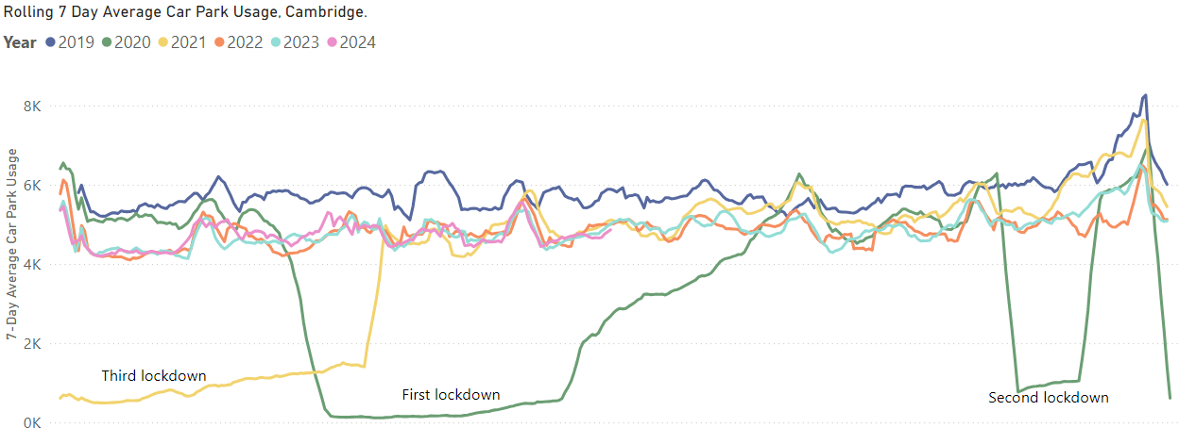
Car Parking: Daily Use
Multi-storey car park use in June 2024 remains 18% below pre-COVID (June 2019) levels; but just ahead of last year (+1% vs June 2023). Grafton East (-33%) continues to see the least recovery, whilst Queen Anne Terrace is now the most recovered (+5%).
Park St car park closed for redevelopment
Pre-COVID to Now:
June 2019 to June 2024
Mon-Sun | Weekdays (Mon-Thu) | Weekends (Sat-Sun)
-18% | -20% | -16%
Mid Covid to Now:
June 2021 to June 2024
Mon-Sun | Weekdays (Mon-Thu) | Weekends (Sat-Sun)
-2% | -3% | 0%
Previous year to Now:
June 2023 to June 2024
Mon-Sun | Weekdays (Mon-Thu) | Weekends (Sat-Sun)
+1% | -1% | +4%
*Park Street car park closed for redevelopment on 4th January 2022; usage figures for this car park are included up to its closure. Park Street car park is expected to re-open in August 2024.
Notes:
Source: Cambridge City Council Car Parking data
Technical notes: Table calculations do not include bank holidays, school holidays, or any other "non neutral" days. The percentage changes are designed to reflect change on a "typical" day. As outlined at the start of this slide pack, 'weekdays' do not include Fridays.
Commentary:
Multi-storey car park usage in central Cambridge is 18% below the pre-Covid level of June 2019.
June 2024 multi-storey car park usage presents as 2% below mid-Covid (June 2021) levels. From 17th May 2021 lockdown restrictions began to be lifted, meaning that by June 2021 people were beginning to return to their normal daily activities, with this being a possible reason for this 2% reduction.
The figures for June 2024 are 2% ahead of last year (June 2023). Monday to Thursday figures are 1% below last year, whilst there is a 4% increase on Weekend usage.
Generally, the line for 2024 so far has tracked very similarly to that of 2023 – fluctuating between being slightly above and slightly below the 2023 line at various points in the year.
Additionally, an increased charge for car parks was introduced in February 2023 and may be having an impact on usage.

Slide 44
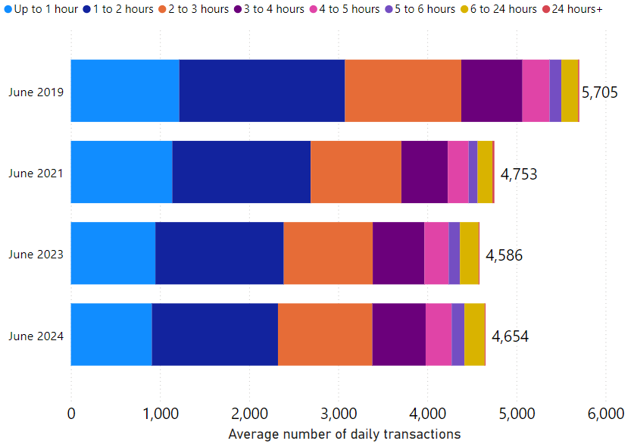
Car Parking: Length of Stay by Month
Typical daily multi-storey car park usage has slightly increased in June 2024 in comparison to last year (1% higher than June 2023) but is 18% lower than pre-COVID (June 2019). The proportionate split in length-of-stay within multi-storey car parks has stayed fairly consistent over time.
Park Street car park closed for redevelopment on 4th January 2022; usage figures for this car park are included up to its closure. Park Street car park is expected to re-open in August 2024
Notes:
Source: Cambridge City Council Car Parking data
Technical notes: School holidays, bank holidays and any other "non neutral" days are not included in calculations for this chart.
Commentary:
The proportionate split in length of stay in Cambridge's multi-storey car parks is relatively consistent across the four months shown within the chart.
The chart indicates that June 2024 usage is similar to 2021 and 2023, but overall volumes are still below that which was seen in 2019.
Caveats with this chart are that Park Street Car park closed in January 2022, and a new car park charge was introduced in February 2023.
Park Street Car Park is expected to re-open in the second half of 2024.

Slide 45
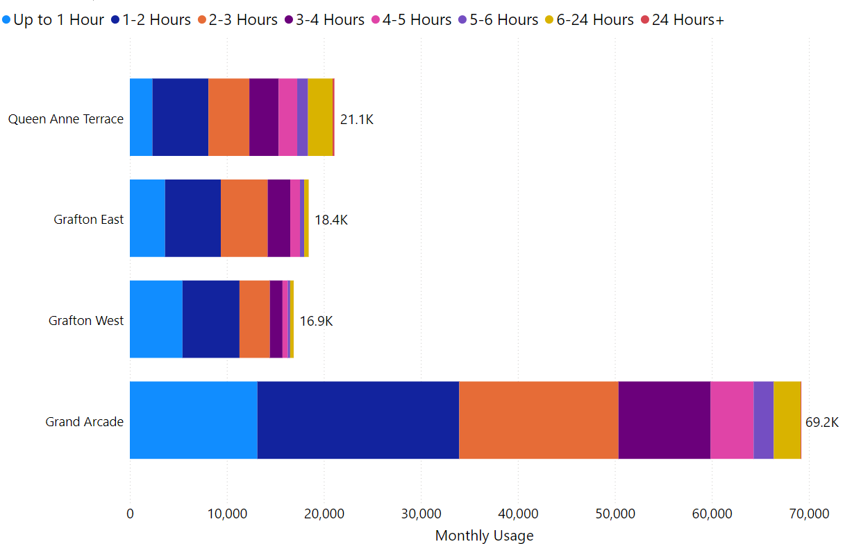
Car Parking: Length of Stay by Car Park
In June 2024, Grafton West had the highest proportion of stays under 3 hours (85%) whilst Queen Anne’s Terrace had the lowest proportion (58%). Grand Arcade remains comfortably the most popular car park – with over 69,000 transactions recorded in June 2024.
Car Park Usage (June 2024)
Notes:
Source: Cambridge City Council Car Parking data
Technical notes: School holidays, bank holidays and any other "non neutral" days are not included in calculations for this chart.
Commentary:
85% of June 2024 visits to Grafton West lasted less than three hours – making it the most likely facility to be used for short stays.
Queen Anne's Terrace is the facility with the highest proportion of long stays, with 42% of June 2024 visits lasting more than three hours.
Grand Arcade is comfortably the most popular multi storey car park facility in Cambridge – with more than 69,000 patrons in June (neutral days only).

Slide 46
Rail Passengers

Slide 47
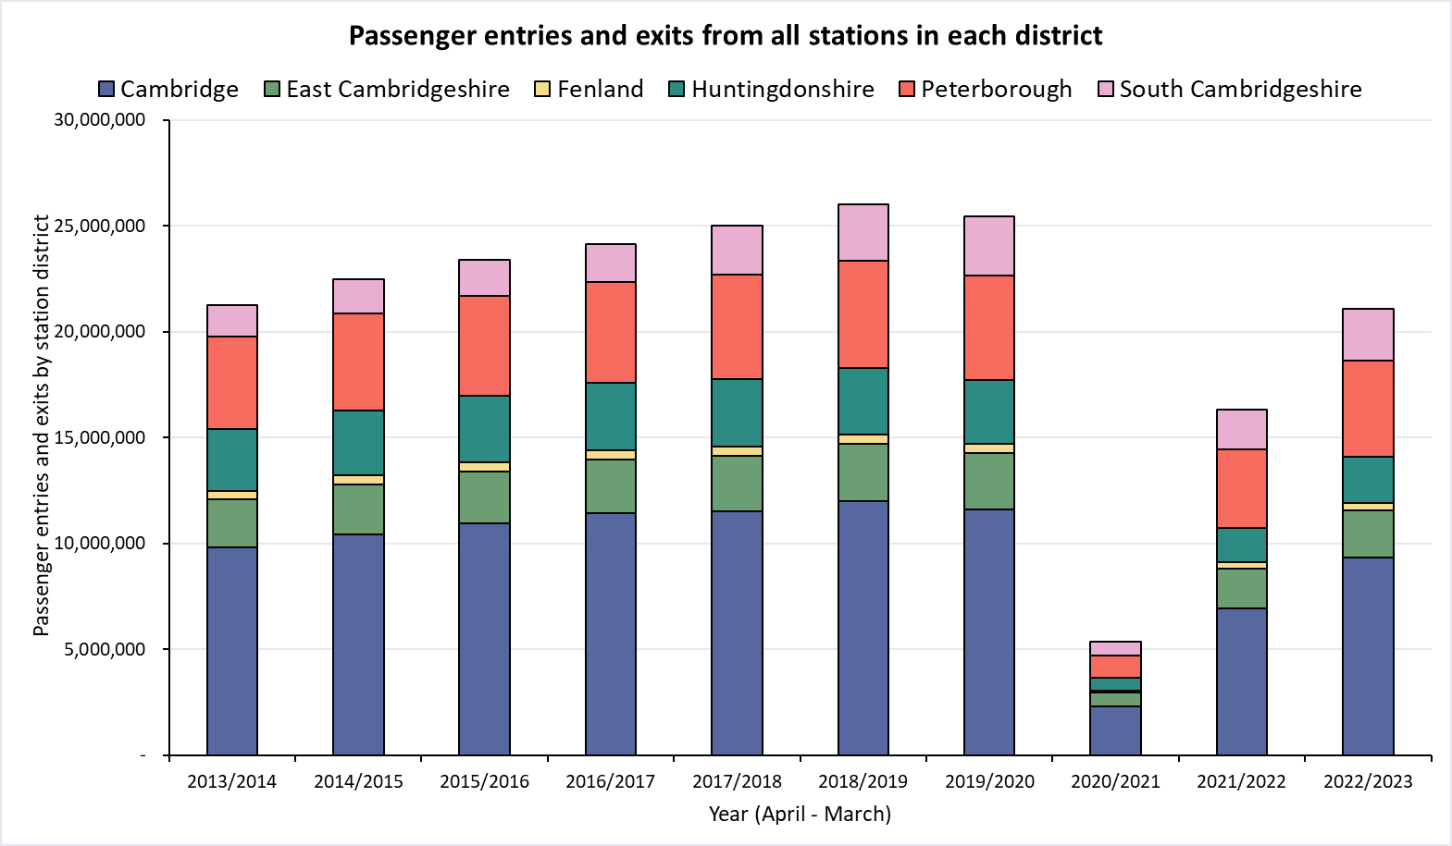
Rail Passengers: Usage
Railway station entries and exits across Cambridgeshire are still below pre-COVID (2018/19) volumes. Huntingdonshire (-30%) presents the largest fall since pre-COVID, while South Cambridgeshire (-7%) is closest to pre-COVID.
Cambridgeshire (incl Pboro)
Pre-COVID to Now:
2018/19* to 2022/23
-19%
Cambridgeshire (excl Pboro)
Pre-COVID to Now:
2018/19* to 2022/23
-21%
District | Cambridge | East Cambridgeshire | Fenland | Huntingdonshire | Peterborough | South Cambridgeshire
Pre-COVID to Now: 2018/19* to 2022/23
-22%
-19%
-22%
-30%
-11%
-7%
*2018/19 used as the pre-COVID baseline as 2019/20 entries and exit data is affected in March 2020 by the first COVID-19 lockdown.
Notes:
Source: Rail statistics, ORR. Table 1415a
Technical note: Rail Passenger annual data runs April – March and is released in April each year. As such, 2018/19 is used as the pre-COVID baseline as 2019/20 entries and exit data is affected in March 2020 by the first COVID-19 lockdown.
Commentary: Rail usage overall is down on pre-Covid baselines. Stations in Huntingdonshire have seen the largest decrease in passenger entries and exits, presenting as 30% below 2018/19 figures. Stations in South Cambridgeshire have the smallest decline when compared to 2018/19 levels, showing only a 7% decrease.

Slide 48
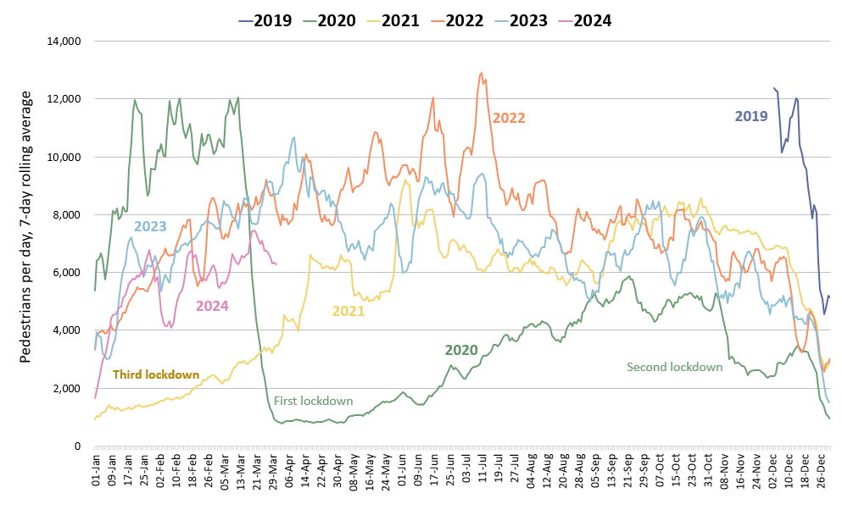
One Station Square Footfall (to March 2024)
One Station Square footfall was 40% below pre-COVID (March 2020*) and is 21% below last year (March 2023).
Footfall at One Station Square (directly outside Cambridge train station)
Please note:
The latest footfall data collected at One Station Square (April 2024 onwards) may be erroneous. More recent analysis for this location has not been presented whilst Cambridge BID conduct checks on the footfall counter here.
Pre-COVID to Now:
Mar 2020* to Mar 2024
Mon-Sun | Weekdays (Mon-Thu) | Weekends (Sat-Sun)
-40% | -36% | -35%
Mid-COVID to Now:
Mar 2021 to Mar 2024
Mon-Sun | Weekdays (Mon-Thu) | Weekends (Sat-Sun)
+129% | -131% | +159%
Previous year to Now:
Mar 2023 to Mar 2024
Mon-Sun | Weekdays (Mon-Thu) | Weekends (Sat-Sun)
-21% | -17% | -27%
*This sensor was installed in December 2019 so pre-COVID data is not available for all months. March 1st-14th 2020 has been used as a baseline for this calculation (pre-lockdown).
Notes:
Source: Cambridge BID footfall data​
Technical note: Table calculations do not include bank holidays, school holidays, or any other "non neutral" days. The One Station Square sensor was fitted in December 2019 so pre-COVID data is not available for all months. For March comparisons, we use the first two weeks of March 2020 (1st – 14^{th)} to ensure impacts of the first lockdown are not included, but we acknowledge the comparison is not ideal. Data may be impacted by strike action. As outlined at the start of this slide pack, 'weekdays' do not include Fridays.
The latest data collected at One Station Square (April 2024 onwards) appears to be erroneous and has therefore been omitted from this slide whilst Cambridge Bid conduct checks on the counter.
Commentary:
Footfall at One Station Square during March 2024 was 40% down on pre-Covid (March 2020) levels.
Compared to March 2023, footfall levels have decreased by 21% overall – with weekends 27% lower than this time last year. Weekdays (Mon-Thu), meanwhile, are 17% down in comparison to March 2023.
Overall March 2024 footfall levels at One Station Square are 129% above mid-Covid (March 2021).
Recent low figures are likely caused (partially) by industrial action that took place over several days in January and February of 2024.

Slide 49
Bus Passengers

Slide 50
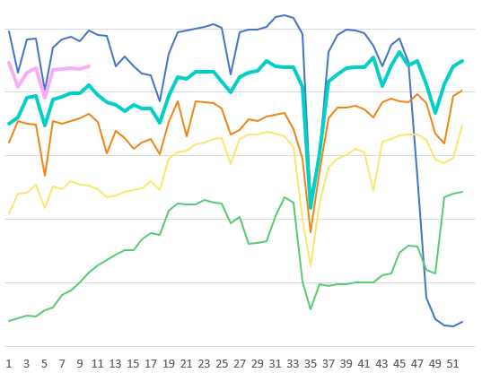
Bus Passengers: including Park and Ride
Bus passenger volumes on services based at Stagecoach’s Cambridge depot continue to be just below pre-COVID levels (-5%) which is largely driven by increased P&R use. Bus passenger numbers in Peterborough remain further below pre-COVID levels at -22%.
Stagecoach CPCA Area Bus Passengers
£2 bus fare cap introduced by the government (1st Jan 2023)
2019-20
2024-25
Cambridge Depot
Pre-COVID to Now:
2023-24
June 2019 to June 2024
-5%
2022-23
Bus Passengers
Fenstanton Depot
Pre-COVID to Now:
2021-22
June 2019 to June 2024
+12%
Second lockdown
First lockdown continued
2020-21
Third lockdown
First lockdown begins
Peterborough Depot
Pre-COVID to Now:
June 2019 to June 2024
-22%
May
Jun
Jul
Aug
Sep
Oct
Nov
Dec
Jan
Feb
Mar
Apr
Due to the commercial sensitivity of this data, bus passenger volumes are not marked on the y-axis of this graph.
Notes:
Source: Stagecoach
Technical note: Due to the commercial sensitivity of this data, bus passenger volumes are not marked on the y-axis of this graph.
Commentary: Bus passenger numbers have continued to rise through 2023 and 2024 but remain below pre-COVID volumes up until the first lockdown was announced in late March 2020. Bus passenger numbers fell in December in line with other reported years, suggesting that the Christmas holidays and winter weather have an impact. They also experienced a dip in line with the February and May half term holidays and late March/early April Easter holidays, as is also seen in previous years. In January 2023, the government announced a £2 cap on single tickets (£2 bus fare cap - GOV.UK (www.gov.uk)).

Slide 51
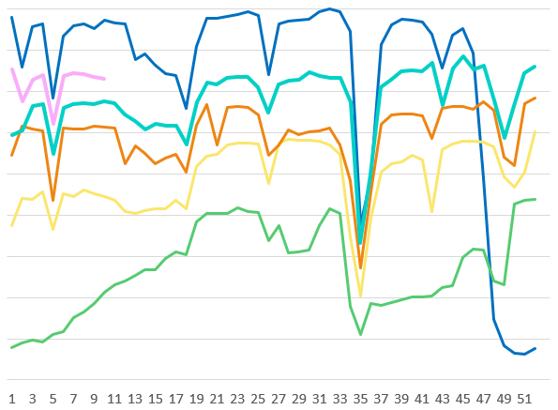
Bus Passengers: excluding Park and Ride
In June 2024, bus passengers on non-P&R services were 14% below pre-COVID at the Cambridge depot and 12% above at the Fenstanton depot. Peterborough passenger numbers continue to be particularly low at 22% below pre-COVID levels.
Stagecoach CPCA Area Bus Passengers (excluding P&R)
£2 bus fare cap introduced by the government (1st Jan 2023)
2019-20
2024-25
Cambridge Depot
Pre-COVID to Now:
2023-24
June 2019 to June 2024
-14%
2022-23
2021-22
Bus Passengers
Fenstanton Depot
Pre-COVID to Now:
June 2019 to June 2024
+12%
2020-21
Second lockdown
First lockdown continued
Third lockdown
First lockdown begins
Peterborough Depot
Pre-COVID to Now:
June 2019 to June 2024
-22%
May
Jun
Jul
Aug
Sep
Oct
Nov
Dec
Jan
Feb
Mar
Apr
Due to the commercial sensitivity of this data, bus passenger volumes are not marked on the y-axis of this graph. P&R services only operate from the Cambridge depot.
Notes:
Source: Stagecoach
Technical note: Due to the commercial sensitivity of this data, bus passenger volumes are not marked on the y-axis of this graph.
Commentary: Bus passenger numbers, excluding passengers who used the park and ride service, have continued to rise through 2023 and 2024 but remain below pre-COVID volumes up until the first lockdown was announced in late March 2020. Bus passenger numbers fell in December in line with other reported years, suggesting that the Christmas holidays and winter weather have an impact. They also experienced a dip in line with the February and May half term holidays and late March/ early April Easter holidays, as is also seen in previous years. In January 2023, the government announced a £2 cap on single tickets (£2 bus fare cap - GOV.UK (www.gov.uk)).

Slide 52
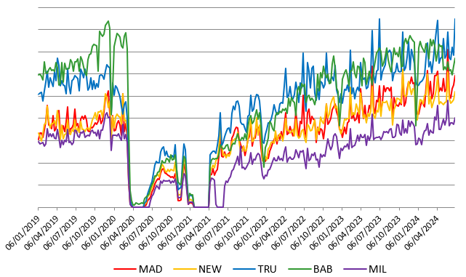
Bus Passengers: Park and Ride only
Usage of most park and ride sites dipped in late March in line with the Easter holiday period but then recovered.
Babraham Road and Trumpington Road P&Rs are the most popular sites, with Trumpington Road usage now above pre-COVID (2019).
Stagecoach Park and Ride Passengers
2019
2020
2021
2022
2023
2024
Third lockdown
Second lockdown
Cambridge Depot
Pre-COVID to Now:
P&R Passengers
First lockdown
June 2019 to June 2024
+25%
Milton P&R service temporarily suspended
Due to the commercial sensitivity of this data, bus passenger volumes are not marked on the y-axis of this graph.
Notes:
Source: Stagecoach
Technical note: Due to the commercial sensitivity of this data, bus passenger volumes are not marked on the y-axis of this graph.
Commentary: P&R passengers generally sees a sharp increase during the school holidays. In January 2023, the government announced a £2 cap on single tickets (£2 bus fare cap - GOV.UK (www.gov.uk)).
MAD=Madingley Road P&R
NEW = Newmarket Road P&R
TRU = Trumpington P&R
BAB = Babraham Road P&R
MIL = Milton Road P&R

Slide 53
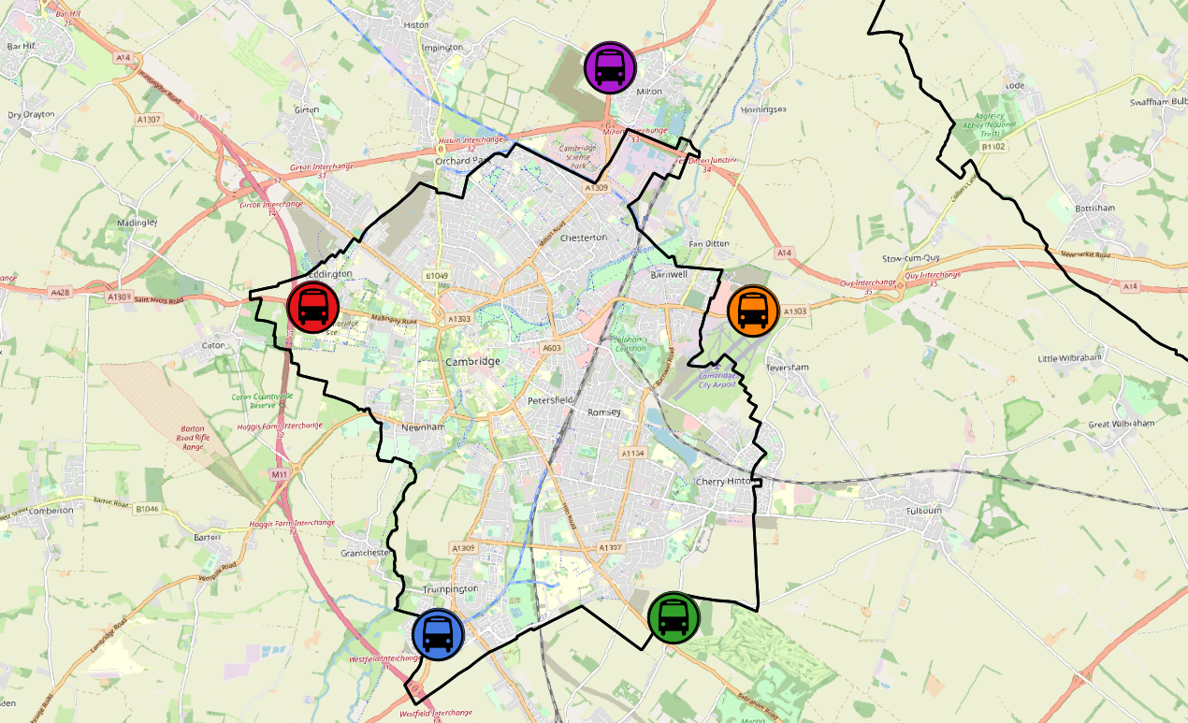
Bus Passengers: Park and Ride by Site
Park and Ride (P&R) site usage continues to exceed pre-COVID levels across most sites. Madingley Road and Newmarket Road show the largest increases on pre-COVID volumes at +48% and +43% respectively. However, recovery at Babraham Road has dropped from +19% in March 2024 to -2% in June 2024.
All P&R Sites
June 2019 to June 2024
+25%
Milton P&R
June 2019 to June 2024
+32%
Madingley Road P&R
June 2019 to June 2024
+48%
Newmarket Road P&R
June 2019 to June 2024
+43%
Babraham Road P&R
June 2019 to June 2024
Trumpington Road P&R
June 2019 to June 2024
-2%
+24%
© OpenStreetMap Contributors
Notes:
Source: Stagecoach

Slide 54
Micro-mobility

Slide 55
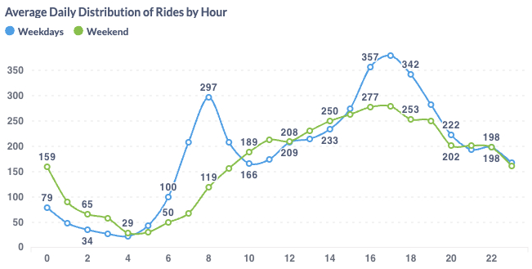
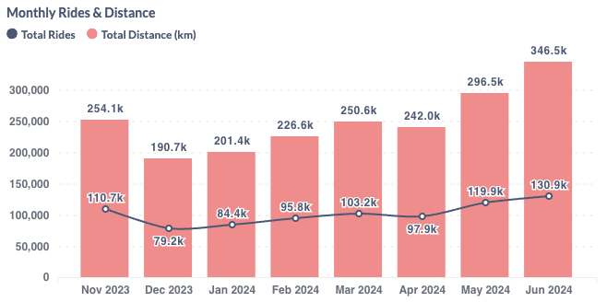
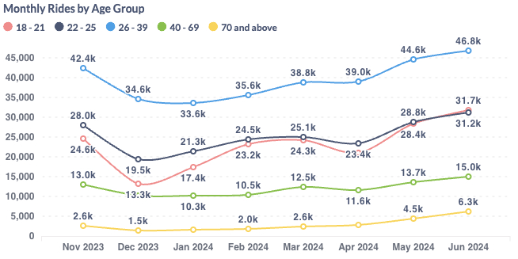
Voi E-scooters and E-bikes in Cambridge
June 2024 saw over 130,000 Voi rides. Weekdays continue to see peaks in travel around 8am and 5pm, suggesting use for commuting/education. The weekends see a late-afternoon peak. The 26-39 age group has consistently seen the largest number of riders.
Voi have operated an electric bike (e-bike) and electric scooter (e-scooter) trial scheme in and around Cambridge City since October 2020.
June 2024 key statistics
Total
journeys:
130,900
Total distance:
346,500 km
Returning users:
21,288
New
users:
4,371
Notes:
Source: Voi monthly update

Slide 56
Air Quality

Slide 57
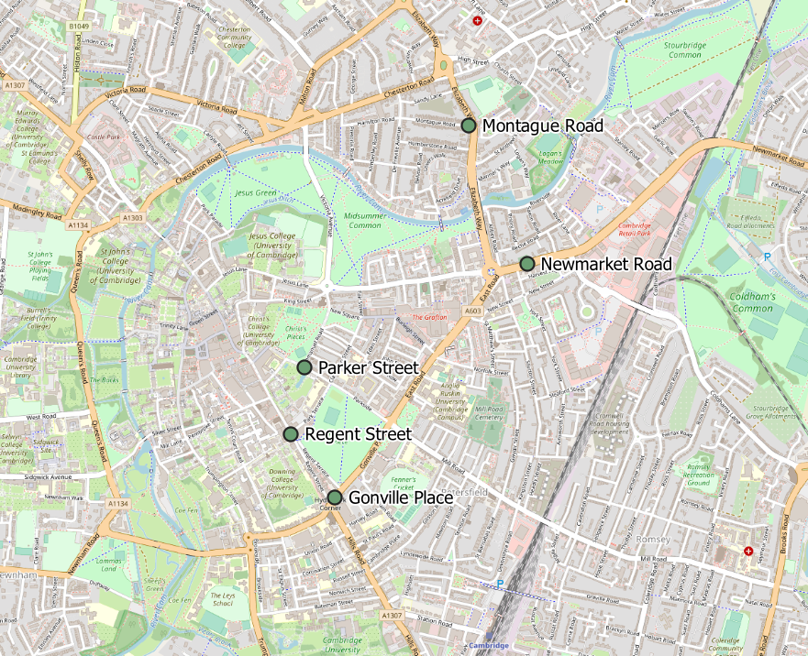
Air Quality Monitoring Locations
Continuous Air Quality Monitoring Sites, Cambridge
Location | Description
Montague Road | Close to the junction with Elizabeth Way
Newmarket Road | Close to Cambridge Retail park on Newmarket Road.
Parker Street | Close to the bus station
Regent Street | To the West of Parker’s Piece
Gonville Place | Near Hill’s Road, South of Parker’s Piece. Note: This sensor had no data from April 2022 to March 2024.
The Cambridge City Council Air Quality team provide data from 5 continuous air quality monitors in central Cambridge. The monitors primarily measure Nitrogen Oxides (NOx) and Particulate Matter (PM) which are proxies for overall air quality.
© OpenStreetMap Contributors
Notes:
Source: Cambridge City Air Quality team. Data for the Cambridge air quality continuous monitors can also be found at: Air quality in England (airqualityengland.co.uk).
Technical note: Please note there may be slight differences between the data on Air Quality in England and data in this pack as air quality data undergoes a ratification process.

Slide 58
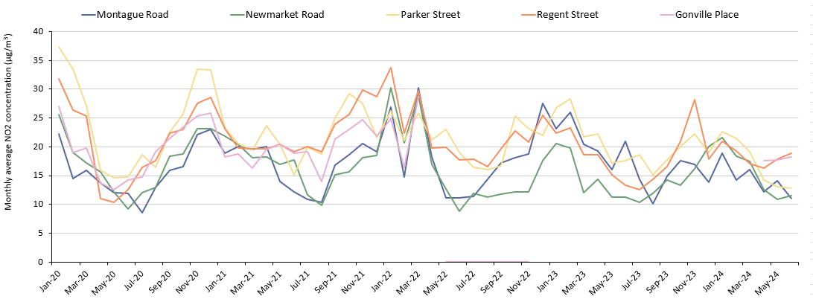
Air Quality: Individual Sites
Three of the five sites show a decrease in concentrations between April and June 2024, two see an increase. Data for Gonville Place is available again from April 2024 – it sees the second highest NO₂ concentrations in June, after Regent Street, but concentrations are still below the 2017-2019 baseline (-28%).
Monthly average NO₂ concentrations by site
 | Pre-COVID to Now: | Mid-COVID to Now: | Last year to Now:
 | Jun 2017-19 baseline to Jun 2024 | Jun 2021 to Jun 2024 | Jun 2023 to Jun 2024
Montague Road | -44% | -10% | -47%
Newmarket Road | -36% | -35% | +2%
Parker Street | -57% | -15% | -27%
Regent Street | -21% | -1% | +42%
Gonville Place | -28% | -4% | No 2023 data
*Data was not available for Gonville Place sensor from April 2022 to March 2024.
Notes:
Source: Cambridge City Air Quality team. Data for the Cambridge air quality continuous monitors can be found at: Air quality in England (airqualityengland.co.uk).
Technical note: Data for the Gonville Place sensor is not available from April 2022 to March 2024. Please note there may be slight differences between the data on Air Quality in England and data in this pack as air quality data undergoes a ratification process.

Slide 59
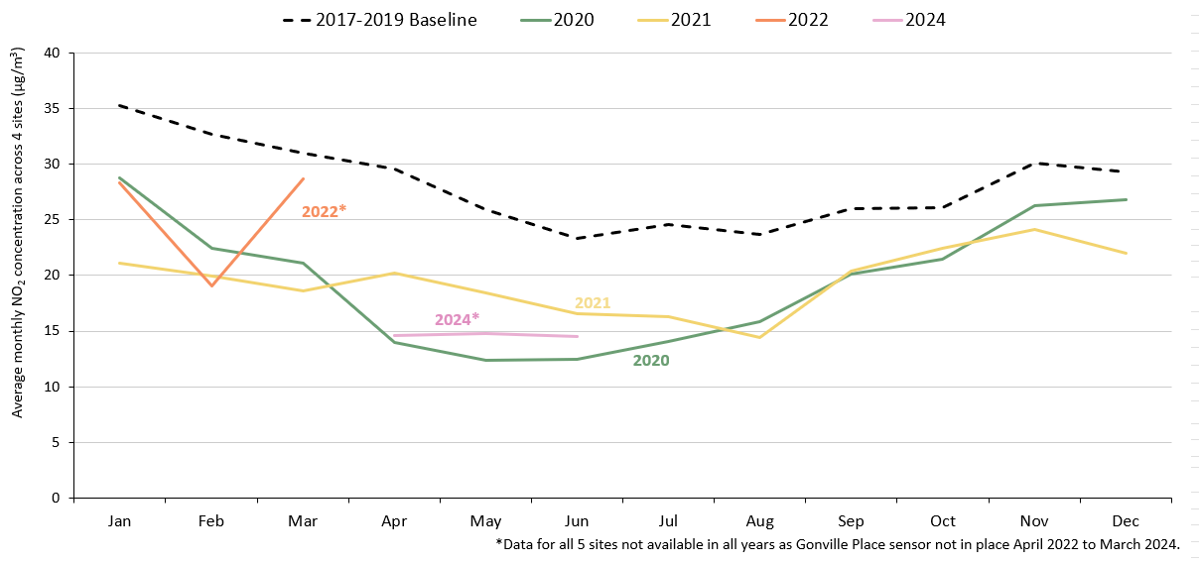
Air Quality: All Sites
NO₂ concentrations continue to decrease in 2024, in line with the expected seasonal decline in NO₂. In June 2024, concentrations are well below the 2017-2019 baseline (-38%).
Monthly average NO₂ concentration across all 5 continuous monitoring sites*
 | Pre-COVID to Now: | Mid-COVID to Now: | Last year to Now:
 | Jun 2017-19 baseline to Jun 2024 | Jun 2021 to Jun 2024 | Jun 2023 to Jun 2024
All sites average | -38% | -13% | No comparable data
Notes:
Source: Cambridge City Air Quality team. Data for the Cambridge air quality continuous monitors can also be found at: Air quality in England (airqualityengland.co.uk).
Technical note: Analysis based on 5 sensors: Gonville Pl, Montague Rd, Newmarket Rd, Regent St and Parker St. Data for Gonville Place is excluded from April 2022 to March 2024 due to the removal of the sensor. Please note there may be slight differences between the data on Air Quality in England and data in this pack as air quality data undergoes a ratification process.

Slide 60
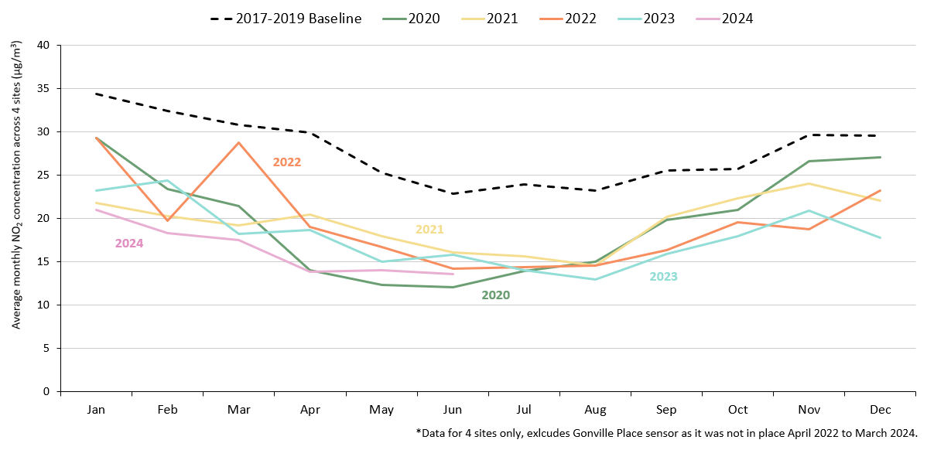
Air Quality: All Sites excluding Gonville Place
NO₂ concentrations continue to decrease in 2024, in line with the expected seasonal decline in NO₂. In June 2024, concentrations are below all other years on the graph, excluding 2020, and are 41% below the 2017-2019 average.
Monthly average NO₂ concentration across 4 continuous monitoring sites*
 | Pre-COVID to Now: | Mid-COVID to Now: | Last year to Now:
 | Jun 2017-19 baseline to Jun 2024 | Jun 2021 to Jun 2024 | Jun 2023 to Jun 2024
All sites average | -41% | -15% | -14%
Notes:
Source: Cambridge City Air Quality team. Data for the Cambridge air quality continuous monitors can also be found at: Air quality in England (airqualityengland.co.uk).
Technical note: Analysis based on 5 sensors: Gonville Pl, Montague Rd, Newmarket Rd, Regent St and Parker St. Data for Gonville Place is excluded due to the removal of the sensor from April 2022 to March 2024. Please note there may be slight differences between the data on Air Quality in England and data in this pack as air quality data undergoes a ratification process.

Slide 61
policyandinsight@cambridgeshire.gov.uk

