Slide 1

Greater Cambridge Economy & Employment Update
January 2024 Update
Policy & Insight Team, Cambridgeshire County Council
policyandinsight@cambridgeshire.gov.uk

Slide 2
Labour Market Overview
(October 2022 – September 2023)

Slide 3
Labour Market Headline Findings – October 2022 – September 2023
Across the latest full year of data (October 2022 to September 2023) the Greater Cambridge area had a higher unemployment rate than the UK. Positively, employment rates remain higher and economic inactivity rates lower than the UK averages.
The rise in unemployment coupled with the fall in those economically inactive, seen on both quarterly and annual basis may suggest those re-entering the labour market are struggling to find work. This is reinforced when looking at rising claimant counts and low vacancies. Whilst these changes are seen nationally, they are more prominent in Greater Cambridge.
It should be emphasised, that because the Annual Population Survey is an estimate based on a representative sample and the small area of the Greater Cambridge Partnership that these changes are within the margin of error for the survey, so should be treated as purely indicative. Students are also captured in this data and therefore economic inactivity will be influenced by student population dynamics.
It is important to also note that due to the small geographical area and the way that the Annual Population Survey’s data is collated, all three measures are expected to fluctuate from release to release and should be treated as broadly indicative. National data should also be treated with caution – this is due to the experimental nature of labour market statistics whilst the Labour Force Survey is redesigned. Caution should be taken with interpreting these figures and comparisons to Greater Cambridge.

Slide 4
Labour Market Headlines - Definitions
Employment Rate (Employed Population/Total Population): The percentage of the total population who are employed
Unemployment Rate (Unemployed Population/Economically Active Population): The proportion of the Economically Active Population without a job, have been actively seeking work in the past four weeks and are available to start work in the next two weeks or are out of work, have found a job and are waiting to start it in the next two weeks
  Economic Inactivity Rate (Economically Inactive Population/Total Population: The proportion of the population without a job and have not sought work in the last four weeks and/or are not available to start work in the next two weeks. Example reasons for being economically inactive could include being a student, having caring responsibilities, being sick and disabled and retirement
Note – All of these measures are calculated on the basis of the working age (16-64) population

Slide 5

Key Economic Indicators
Unemployment Rate Overall (aged 16-64): 6.0%
Quarterly change
Previous quarterly change
Change since previous year
The unemployment rate between October 2022 and September 2023 was 6.0% (higher than the 4.1% nationally). This has increased by +1.8pp percentage points since the last quarter and is +2.5pp higher than 12 months previously.
+1.8pp
+0.3pp
+2.5pp
Comparing Oct 2022 – Sep 2023 with Jul 2022 - June 2023
Comparing Oct 2022 – Sep 2023 with Jul 2022 - June 2023
Comparing Oct 2022 – Sept 2023 with Oct 2021 - Sept 2022
Employment Rate Overall (aged 16-64): 78.7%
Previous quarterly change
The employment rate between October 2022 and September 2023 was 78.7% (higher than the 75.7% nationally). This has increased by +0.8 percentage points since the last quarter but is -0.4 percentage points lower than the level 12 months previously.
Quarterly change
Change since previous year
+0.8pp
-1.2pp
-0.4pp
Comparing Oct 2022 – Sep 2023 with Jul 2022 - June 2023
Comparing Oct 2022 – Sep 2023 with Jul 2022 - June 2023
Comparing Oct 2022 – Sept 2023 with Oct 2021 - Sept 2022
Economically Inactive (aged 16-64): 16.3%
Previous quarterly change
Change since previous year
16.3% of residents (aged 16-64) were economically inactive between October 2022 and September 2023 (lower than the 21.2% nationally). This has decreased by -2.4pp percentage points since the last quarter and is -1.8pp lower than the level 12 months previously.
Quarterly change
-2.4pp
+0.9pp
-1.8pp
Comparing Oct 2022 – Sep 2023 with Jul 2022 - June 2023
Comparing Oct 2022 – Sep 2023 with Jul 2022 - June 2023
Comparing Oct 2022 – Sept 2023 with Oct 2021 - Sept 2022
* Please note: estimates and confidence intervals are unreliable due to small sample sizes and so should be treated as indicative.
Notes:
Source – Annual Population Survey, Office for National Statistics
Technical Notes
A residence based labour market survey encompassing population, economic activity (employment and unemployment), economic inactivity and qualifications. These are broken down where possible by gender, age, ethnicity, industry and occupation. Available at Local Authority level and above. Updated quarterly.
Commentary
Across the latest full year of data the Greater Cambridge region had a higher unemployment rate than the UK as a whole but also had a higher employment rate and lower rate of economic inactivity.
It is important to note that due to the small geographical area considered, and the Annual Population Survey being based on a representative sample, this may be due to a quarterly fluctuation rather than any kind of long-term trend in the data. National data should also be treated with caution – this is due to the experimental nature of labour market statistics whilst the Labour Force Survey is redesigned. Caution should be taken with interpreting these figures and comparisons to Greater Cambridge.
Taking this into account, however, by looking at the quarterly and annual changes across all three metrics we can see where this rise in the unemployment rate may have originated.
Quarterly changes (Comparing Oct 2022 – Sep 2023 with Jul 2022 - June 2023 )
Over the last quarter Greater Cambridge has seen an increase in the unemployment rate (+1.8pp) but increases in the employment rate (+0.8pp) and a fall in economic inactivity (-2.4pp). This compares to a +0.2pp increase in the unemployment rate, no change in the employment rate and a smaller decrease in the economic inactivity rate (-0.2pp) across the UK.
Annual Change (Comparing Oct 2022 – Sep 2023 with Oct 2021 - Sep 2022 )
Looking at the change between this release, and the comparable release in the previous year the Greater Cambridge Partnership has seen a rise in the unemployment rate, a smaller rise in the employment rate and a decrease in economic inactivity rate. The rise in unemployment coupled with the fall in those economically inactive on a quartely and annual basis suggests those re-entering the labour market may be struggling to find work. This is reenforced when looking at rising claimant counts and low vacancies. Whilst these changes are seen nationally, they are more prominent in Greater Cambridge. It should be emphasised, however, that because the Annual Population Survey is an estimate based on a representative sample and the small area of the Greater Cambridge Partnership that these changes are within the margin of error for the survey, so should be treated as purely indicative. Students are also captured in this data and therefore economic inactivity will be influenced by student population dynamics.
Compared to the same point in the previous year, Greater Cambridge has seen a decrease in the employment rate (-0.4pp percentage points in Greater Cambridge compared to +0.2pp in the UK) an increase in the unemployment rate (+2.5pp) compared to a +0.2pp increase in the UK and a decrease in the economic inactivity rate (-1.8pp in Greater Cambridge compared to a fall of -0.4pp in the UK as a whole).

Slide 6
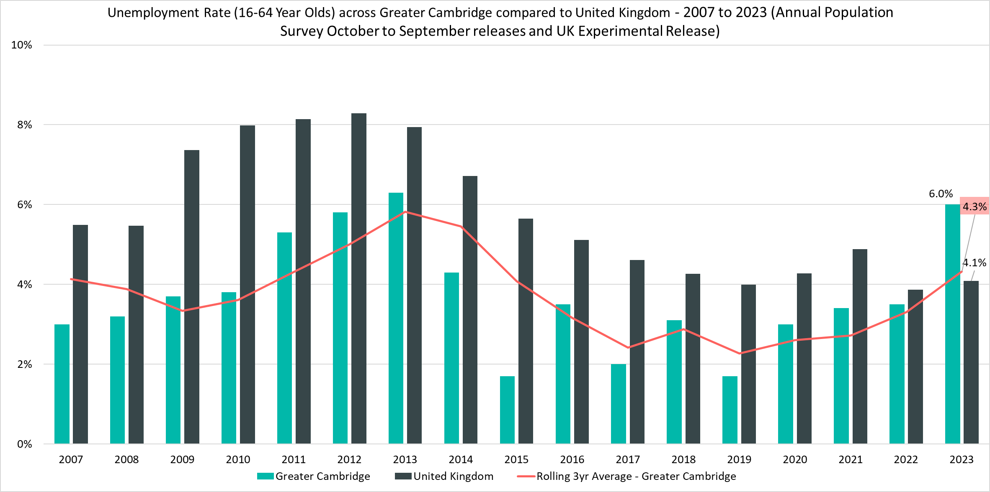
Unemployment Rate (16-64 year olds) – 6%, (October 2022 – September 2023)
Rolling Quarterly change
(Jun 23– Sept 23):
Previous change
Mar 23– June 23):
Change since Sept 2022:
+1.8pp
+0.3pp
+2.5pp
Comparing October 2022 - September 2023 with July 2022 - June 2023
Comparing July 2022 - June 2023 with Apr 2022 - Mar 2022
Comparing October 2022 - September 2023 with October 2021 - September 2022
Notes:
Source – Annual Population Survey (2006-2023), Office for National Statistics
Technical Notes
A residence based labour market survey encompassing population, economic activity (employment and unemployment), economic inactivity and qualifications. These are broken down where possible by gender, age, ethnicity, industry and occupation. Available at Local Authority level and above. Updated quarterly.
It is important to note that due to the small geographical area considered, and the Annual Population Survey being based on a representative sample, this may be due to a quarterly fluctuation rather than any kind of long-term trend in the data. National data should also be treated with caution – this is due to the experimental nature of labour market statistics whilst the Labour Force Survey is redesigned. Caution should be taken with interpreting these figures and comparisons to Greater Cambridge.
Percentage point changes use the full percentage decimal number in calculations and therefore when comparing rounded percentages, the result may differ.
Commentary
The above chart shows the unemployment rate across Greater Cambridge and the United Kingdom from 2007 to 2023 alongside a rolling three year average for the area.
Across the latest data, due to a sharp increase the unemployment rate in Greater Cambridge is now higher than the UK at 6.0% compared to 4.2% UK wide. Until this point, Greater Cambridges has had a lower unemployment rate than the United Kingdom across the time period. However, since 2019 the unemployment rate in Greater Cambridge has risen steadily each year narrowing the gap with the UK

Slide 7
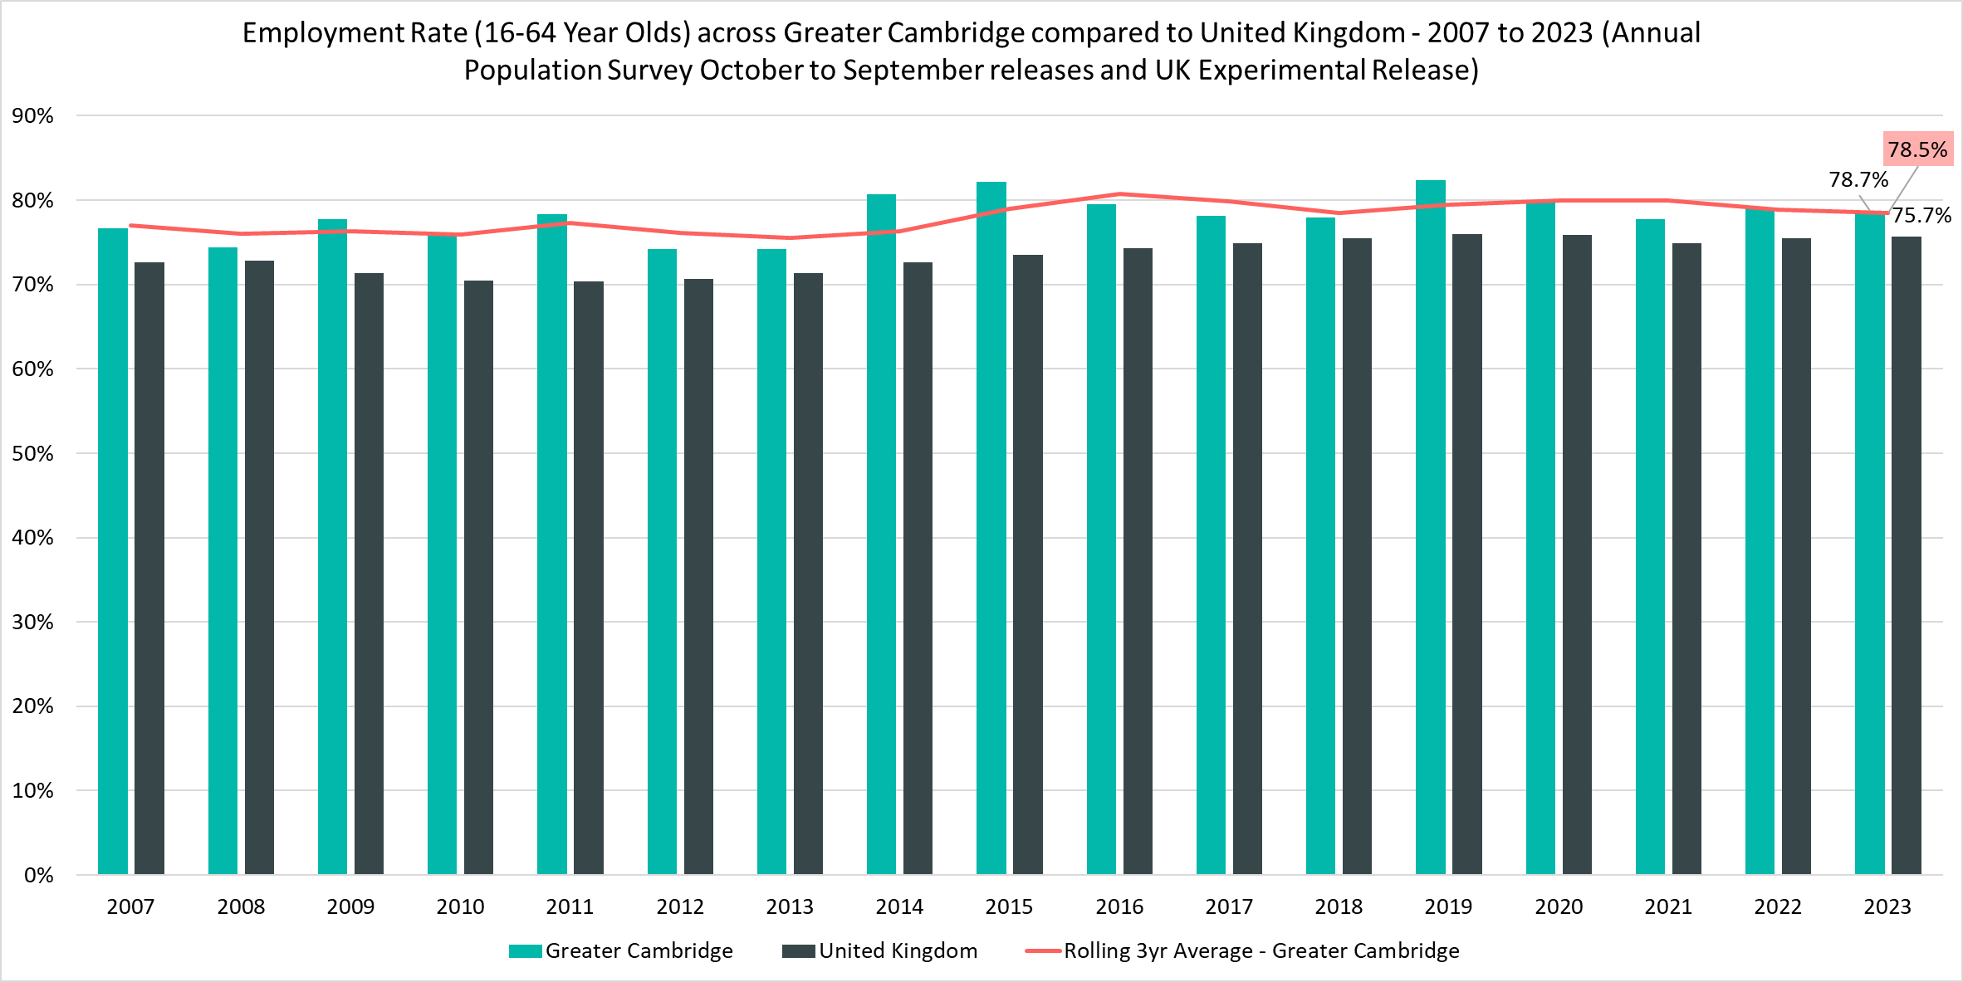
Employment Rate (16-64) – 77.9%, (October 2022 – September 2023)
Rolling Quarterly change
(Jun 23– Sept 23):
Previous change
Mar 23– June 23):
Change since Sept 2022:
+0.8pp
-1.2pp
-0.4pp
Comparing October 2022 - September 2023 with July 2022 - June 2023
Comparing July 2022 - June 2023 with Apr 2022 - Mar 2022
Comparing October 2022 - September 2023 with October 2021 - September 2022
Notes:
Source – Annual Population Survey (2006-2023), Office for National Statistics
Technical Notes
A residence based labour market survey encompassing population, economic activity (employment and unemployment), economic inactivity and qualifications. These are broken down where possible by gender, age, ethnicity, industry and occupation. Available at Local Authority level and above. Updated quarterly.
It is important to note that due to the small geographical area considered, and the Annual Population Survey being based on a representative sample, this may be due to a quarterly fluctuation rather than any kind of long-term trend in the data. National data should also be treated with caution – this is due to the experimental nature of labour market statistics whilst the Labour Force Survey is redesigned. Caution should be taken with interpreting these figures and comparisons to Greater Cambridge.
Percentage point changes use the full percentage decimal number in calculations and therefore when comparing rounded percentages, the result may differ.
Commentary
The above chart shows the employment rate across Greater Cambridge and United Kingdom from 2007 to 2023.
The employment rate across Greater Cambridge has been consistently higher than the rate seen nationally, however within the last five years the gap between the two has decreased from 6.4 percentage points to 3.0 percentage points

Slide 8
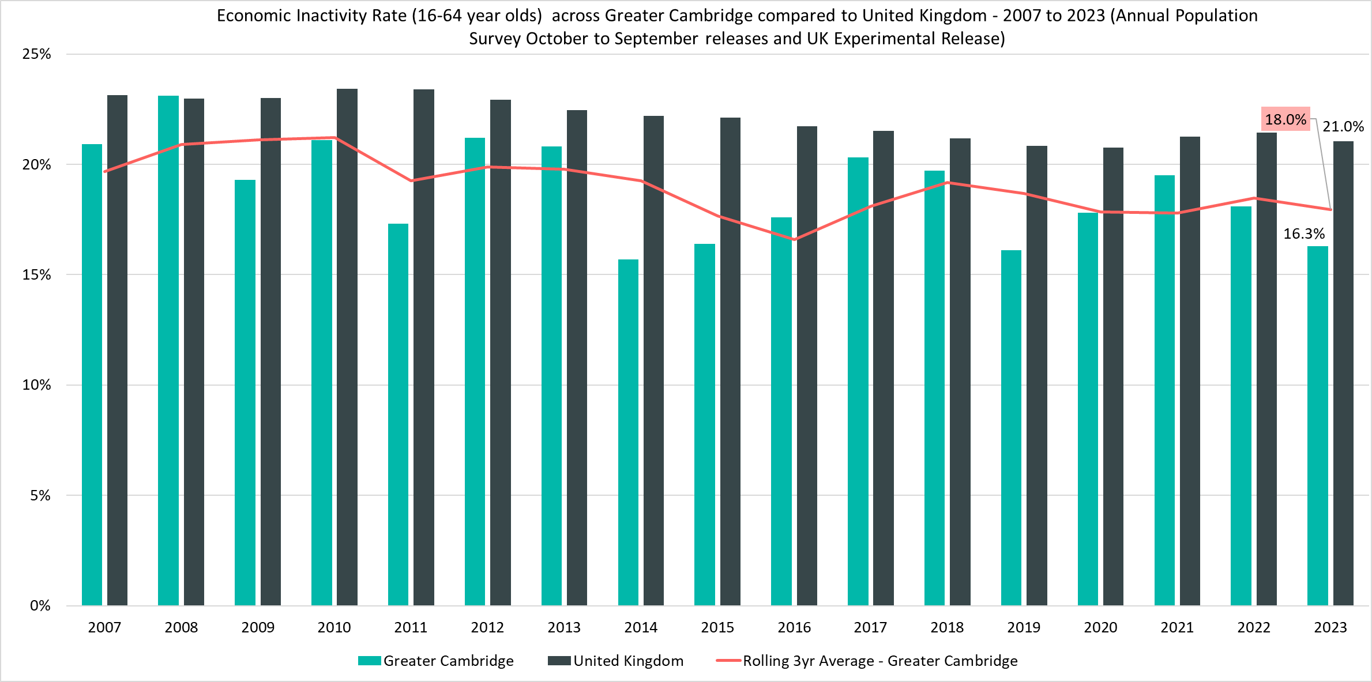
Economically Inactive (16-64 Year Olds) – 18.7%, (October 2022 – September 2023)
Rolling Quarterly change
(Jun 23– Sept 23):
Previous change
Mar 23– June 23):
Change since Sept 2022:
-2.4pp
+0.9pp
+1.8pp
Comparing October 2022 - September 2023 with July 2022 - June 2023
Comparing July 2022 - June 2023 with Apr 2022 - Mar 2022
Comparing October 2022 - September 2023 with October 2021 - September 2022
Notes:
Source – Annual Population Survey (2006-2023), Office for National Statistics
Technical Notes
A residence based labour market survey encompassing population, economic activity (employment and unemployment), economic inactivity and qualifications. These are broken down where possible by gender, age, ethnicity, industry and occupation. Available at Local Authority level and above. Updated quarterly.
It is important to note that due to the small geographical area considered, and the Annual Population Survey being based on a representative sample, this may be due to a quarterly fluctuation rather than any kind of long-term trend in the data. National data should also be treated with caution – this is due to the experimental nature of labour market statistics whilst the Labour Force Survey is redesigned. Caution should be taken with interpreting these figures and comparisons to Greater Cambridge.
Percentage point changes use the full percentage decimal number in calculations and therefore when comparing rounded percentages, the result may differ.
Commentary
The above chart shows the percentage of those aged 16-64 who are economically inactive across Greater Cambridge and the United Kingdom from 2007 to 2023.
The percentage of those who were economically inactive in Greater Cambridge has been consistently below the national level
Over the last year there has been a decrease in the economic inactivity rate across Greater Cambridge (-1.8pp) meaning that that the gap has widened with the UK as a whole

Slide 9
Claimant Counts
Claimant Count of Benefits Related to Unemployment – December 2023
Universal Credit Claimant Counts – December 2023

Slide 10
Claimants of Benefits related to Unemployment – December 2023
Claimant counts across Greater Cambridge have increased across all age groups since the last quarter update (September 2023 to December 2023) and have also increased slightly overall year on year (comparing December 2022 to December 2023), with increases across both Cambridge and South Cambridgeshire.
A lower proportion (1.9%) of Greater Cambridge residents claim benefits related to unemployment compared to the UK (3.6%). However, there is a high degree of disparity within the area itself with claimant rates ranging from 5.2% in King’s Hedges (North Cambridge) to 0.3% in Newnham (North West Cambridge).
In Cambridge, residents in the 25-49 age range have the highest claimant rate (2.2%) whilst in South Cambridgeshire, the 18-24 age group account for the highest claimant rate (2.4%). This could suggest that youth unemployment is more prevalent in South Cambridgeshire than Cambridge City, potentially because of Cambridge’s large full time student population who are mostly ineligible for unemployment benefits.
Compared to December 2022, the 12 month rolling percentage changes in the number of claimants show increases across all age groups except for those aged 50+. This has resulted in overall increases for claimants aged 16+. The magnitude of increases across the 16-24 age group has decreased since June 2023 but the latest data suggests stabilisation rather than a sustained decrease.

Slide 11
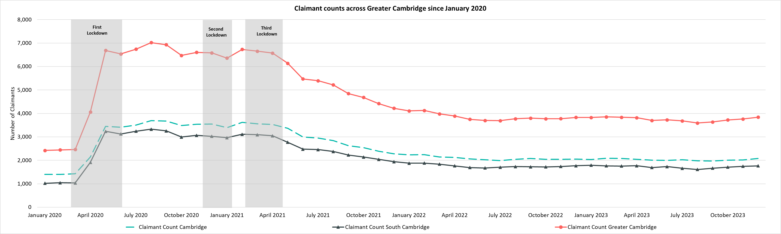
Labour Market – Claimant Count
The Claimant Count measures the number of people (age 16+) claiming benefit principally for the reason of being unemployed. We use data on claimants rather than unemployed numbers because – although the numbers are lower – they are more up to date. It is however a narrower measure of unemployment, and as such does not cover all those out of work, since not all can claim assistance.
Claimant Counts | Number of claimants December 2023 | % Change 12 Months ago vs Now: December 2022 to December 2023 | % Change Previous update vs Now: September 2023 to December 2023
Greater Cambridge | 3,840 | +0.3% | +5.6%
Cambridge City | 2,075 | +1.0% | +5.3%
South Cambridgeshire | 1,765 | -0.3% | +6.0%
United Kingdom | 1,543,460 | +1.9% | +1.3%
Notes:
Source – Claimant Count, Office for National Statistics
Technical Notes
The Claimant Count measures the number of people (age 16+) claiming benefit principally for the reason of being unemployed. We use data on claimants rather than unemployed numbers because although the numbers are lower they are more up to date. It is however a narrower measure of unemployment, and as such does not cover all those out of work, since not all can claim assistance. The latest claimant count data is a snapshot of the number of claimants on the 14th December 2023.
Commentary
The above chart presents claimant counts across Greater Cambridge from January 2020 to December 2023.
Whilst across Greater Cambridge the proportion of residents who are claiming benefits for reason of unemployment is lower than the UK there is a wide amount of disparity in Cambridge City with most claimants concentrated in the more relatively deprived wards in the north east of the city such as Kings Hedges
December 2023 data showed increases in claimant count since the last update, there was a +5.6% increase from September 2023 across Greater Cambridge compared to a +1.3% increase across the United Kingdom.
When comparing December 2023 to December 2022, there a was +1.9% increase in claimant counts across Greater Cambridge, with a +1.0% increase in Cambridge City and a -0.3% decrease in South Cambridgeshire. This compares to a +1.9% annual increase across the United Kingdom.

Slide 12
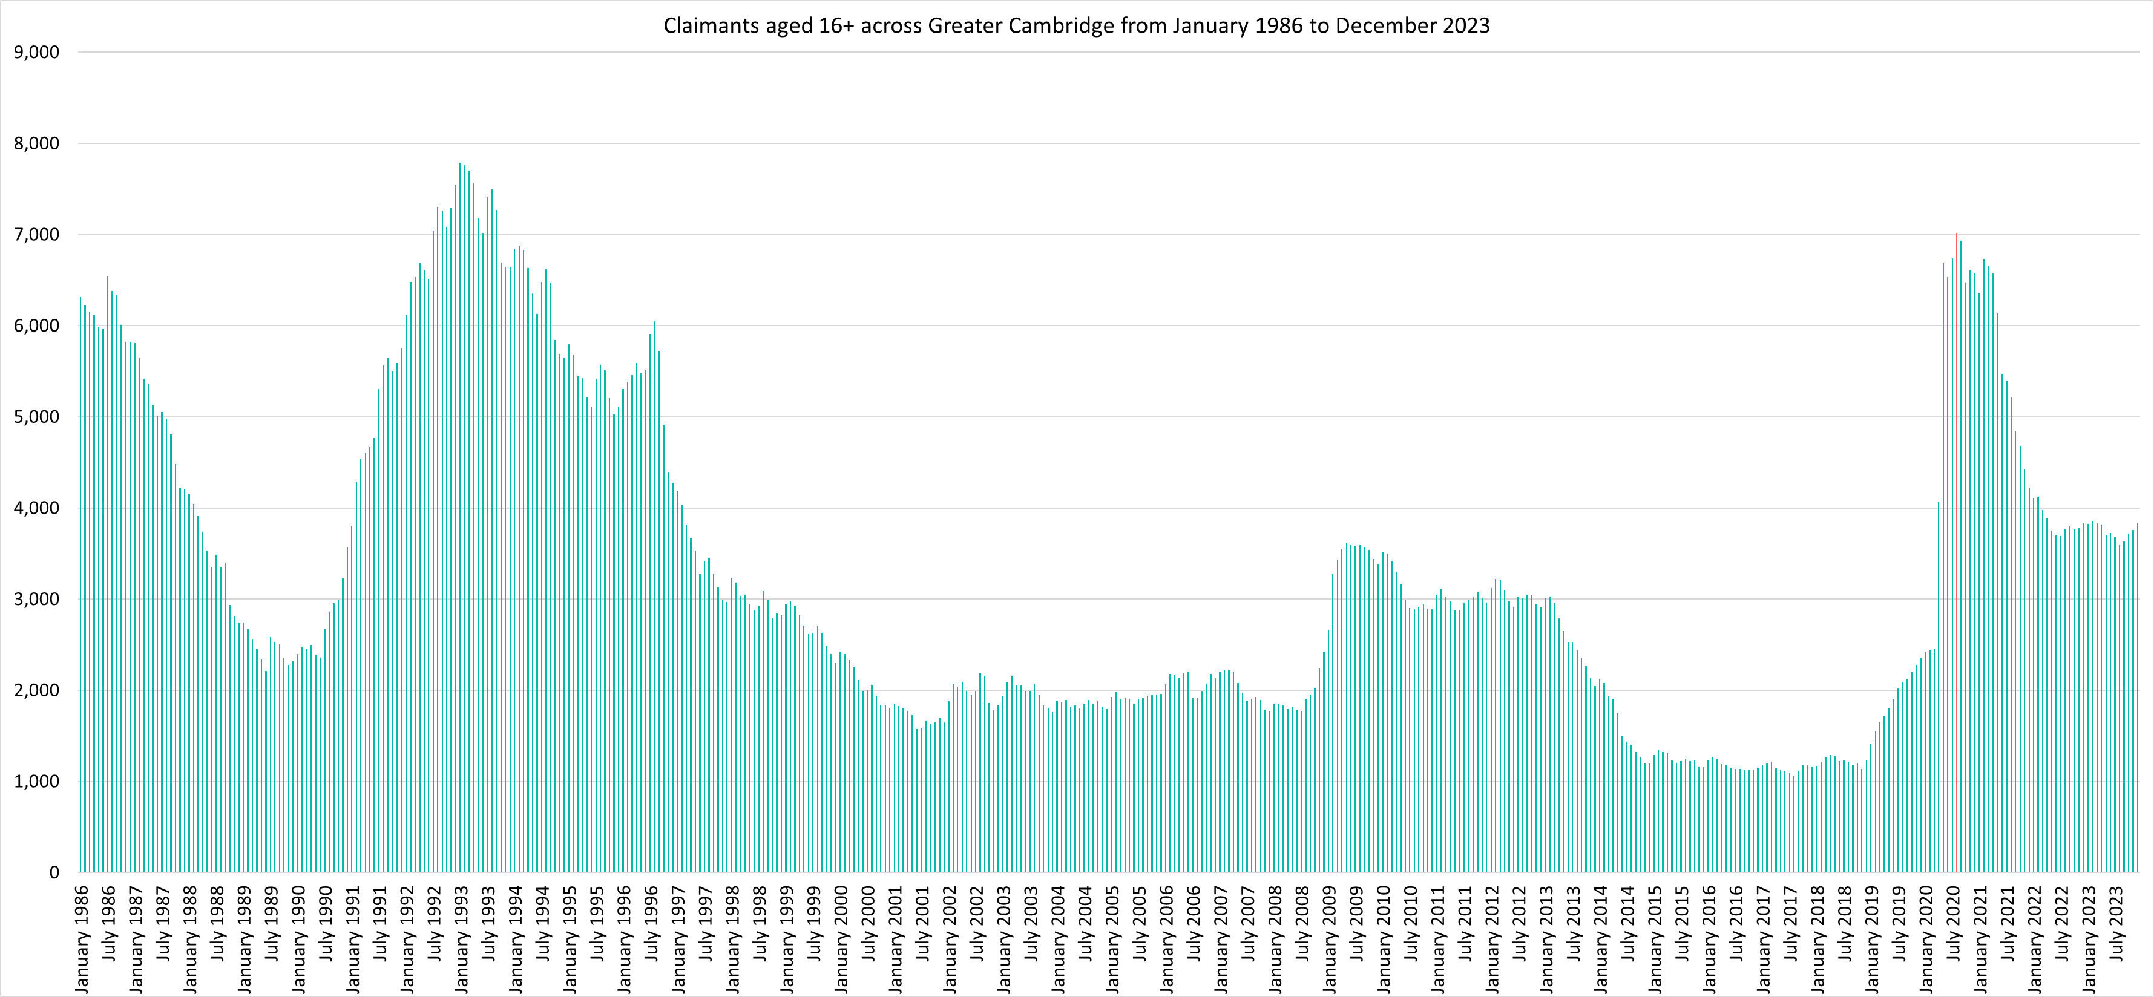
Labour Market – Claimant counts across time
Notes:
Source – Claimant Count, Office for National Statistics
Technical Notes
The Claimant Count measures the number of people (age 16+) claiming benefit principally for the reason of being unemployed. We use data on claimants rather than unemployed numbers because although the numbers are lower they are more up to date. It is however a narrower measure of unemployment, and as such does not cover all those out of work, since not all can claim assistance. The latest claimant count data is a snapshot of the number of claimants on the 14th December 2023.
Commentary
The above chart presents claimant counts across Greater Cambridge from January 1986 to December 2023.
August 2020 (7,020) saw the highest number of claimants since 1993.
Claimant counts have decreased at a faster rate than seen from 1992, but this decline appears to have now stabilised.

Slide 13
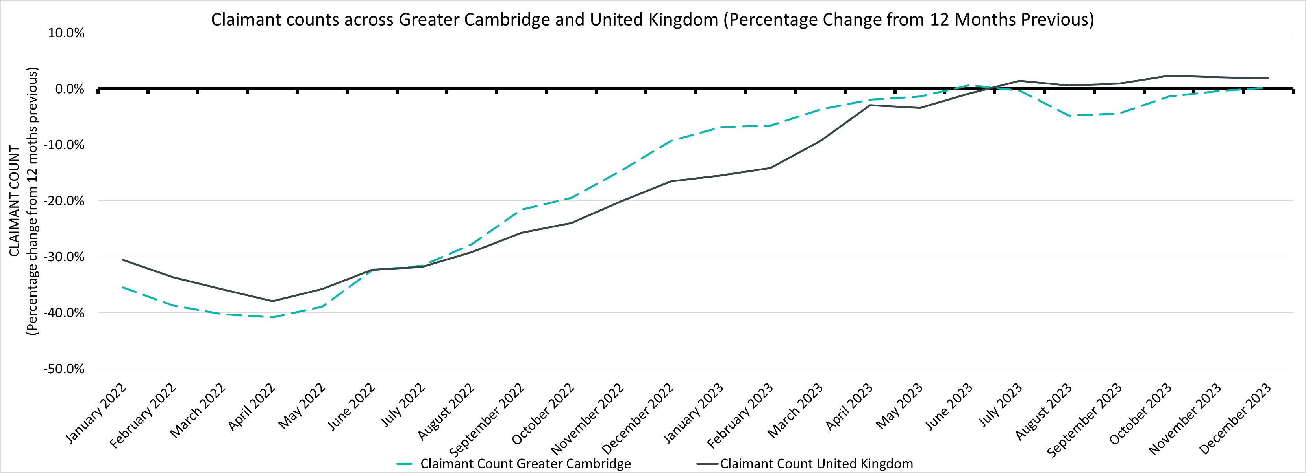
Labour Market – Claimant Count Percentage Change from 12 Months Previous
Claimant Counts | Number of claimants December 2023 | % Change 12 Months ago vs Now: December 2022 to December 2023 | % Change Previous update vs Now: September 2023 to December 2023
Greater Cambridge | 3,840 | +0.3% | +5.6%
United Kingdom | 1,543,460 | +1.9% | +1.3%
Notes:
Source – Claimant Count, Office for National Statistics
Technical Notes
The Claimant Count measures the number of people (age 16+) claiming benefit principally for the reason of being unemployed. We use data on claimants rather than unemployed numbers because although the numbers are lower they are more up to date. It is however a narrower measure of unemployment, and as such does not cover all those out of work, since not all can claim assistance. The latest claimant count data is a snapshot of the number of claimants on the 14th December 2023.
Commentary
The above chart presents claimant counts across Greater Cambridge and as a percentage change from 12 months previous.
Throughout 2022 and the first half of 2023 the number of claimants compared to the same point in the previous year has been lower in Greater Cambridge as well as the UK as a whole
From June 2023 claimants started to increase when comparing to the previous 12 months, both across Greater Cambridge and the UK. However, in Greater Cambridge increases were only seen across June and July before a return to year on year decreases. This has contrasted with UK which has consistently seen year on year increases since July 2023
In the latest data for December 2023 year on year increases are now seen across Greater Cambridge

Slide 14
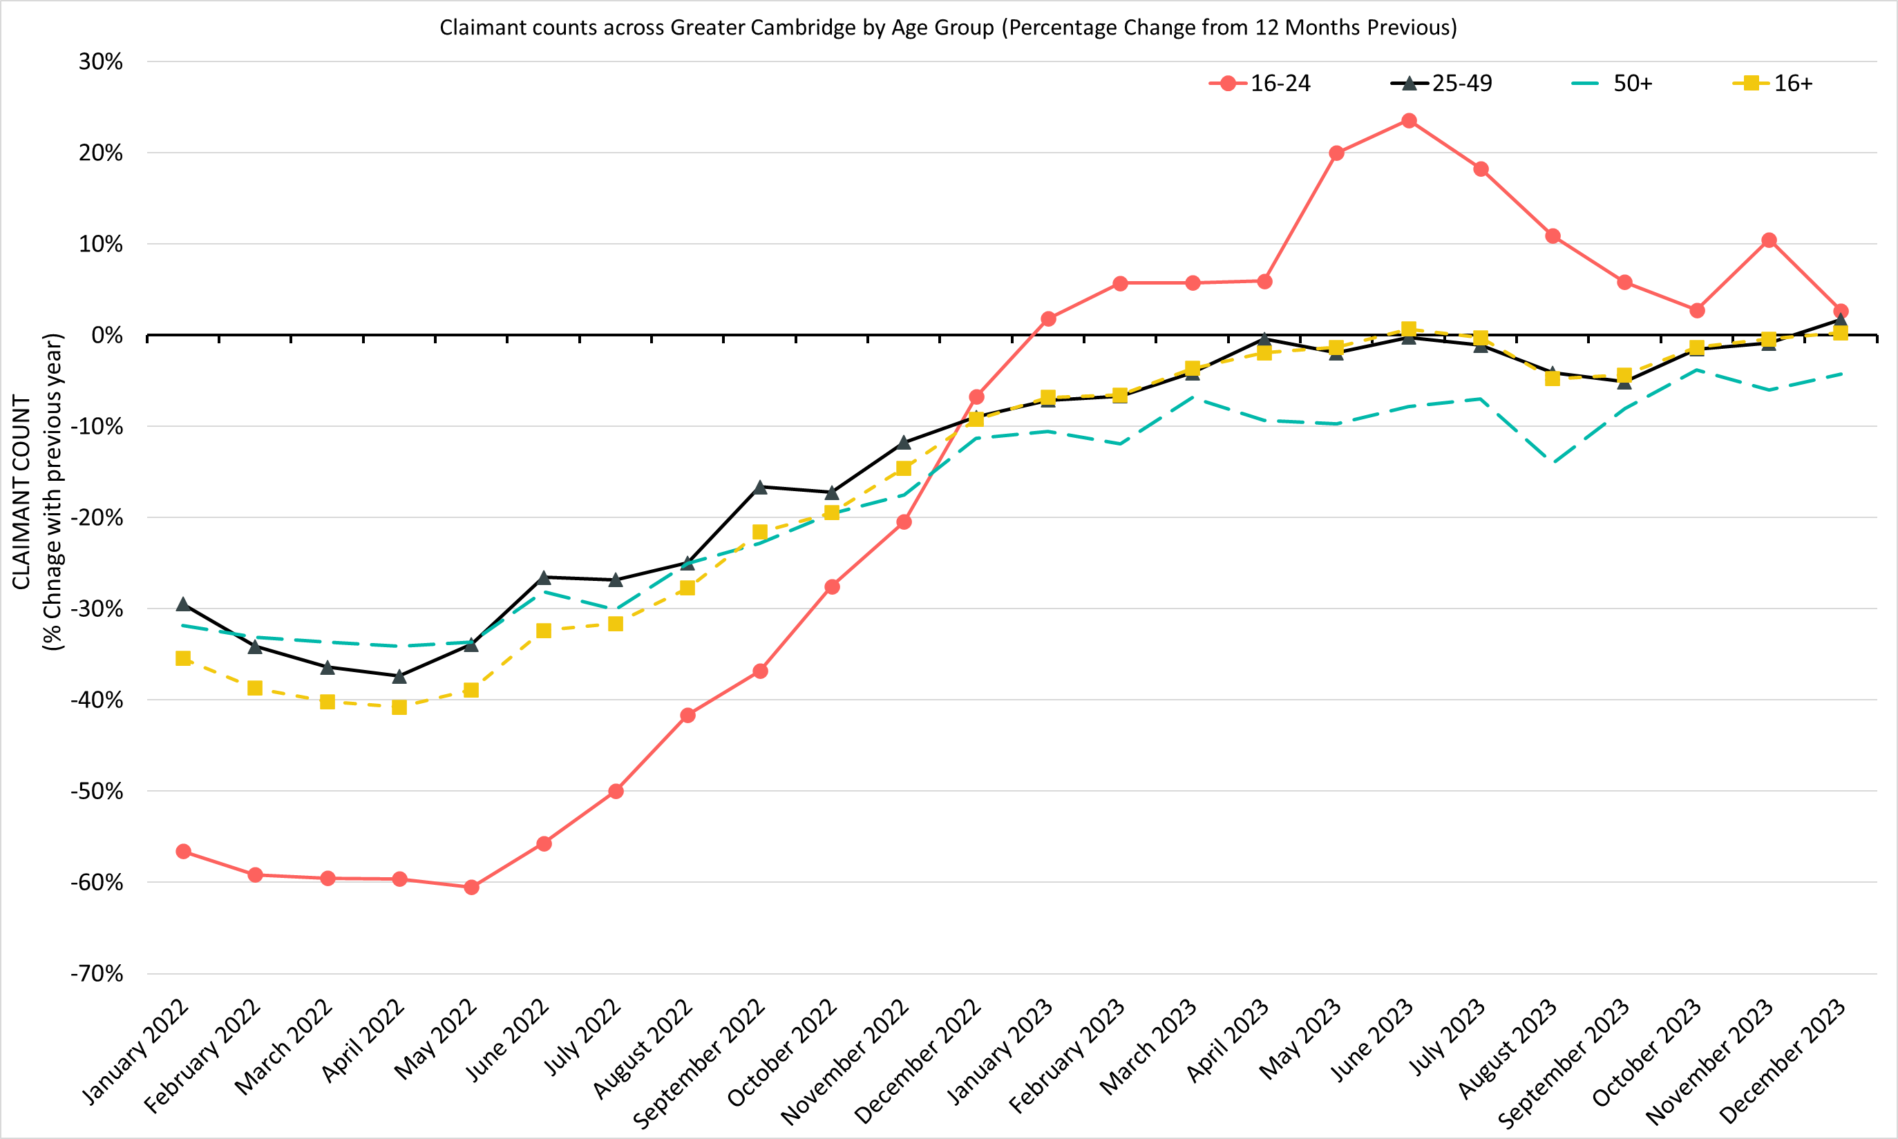
Labour Market – Claimant counts by age
December 2023 Claimant Counts by Age Group (Previous 12 month % Change)
% Change in Claimant Counts | 16+ | 16-24 | 25-49 | 50+
Annual Greater Cambridge (Dec 2022 to Dec 2023) | +0.3% | +2.7% | +1.7% | -4.3%
Annual United Kingdom (Dec 2022 to Dec 2023) | +1.9% | +6.4% | +3.0% | -4.3%
Quarterly/Last Update Greater Cambridge (Sep 2023 to Dec 2023) | +5.6% | +4.6% | +6.3% | +5.3%
Quarterly/Last Update United Kingdom (Sep 2023 to Dec 2023) | +1.3% | +2.0% | +1.5% | +0.2%
% of Total 16+ Claimants (December 2023) | 16-24 | 25-49 | 50+
 | 15% | 62% | 23%
Notes:
Source – Claimant Count, Office for National Statistics
Technical Notes
The Claimant Count measures the number of people (age 16+) claiming benefit principally for the reason of being unemployed. We use data on claimants rather than unemployed numbers because although the numbers are lower they are more up to date. It is however a narrower measure of unemployment, and as such does not cover all those out of work, since not all can claim assistance. The latest claimant count data is a snapshot of the number of claimants on the 14th December 2023.
Compared to December 2022, the 12 month rolling percentage changes in the number of claimants show increases across the all age groups except for those aged 50+. This has resulted in overall increases for claimants aged 16+. The magniude of increases across the 16-24 age group has decreased since June 2023.

Slide 15
Labour Market – Claimant Rates by Age Group
December 2023 Claimant Rates by Age Group
Claimant Rates | 16-64 December 2023 | 16-24 December 2023 | 16-17 December 2023 | 18-24 December 2023 | 25-49 December 2023 | 50-64 December 2023
Cambridge City | 1.9% | 1.1% | 0.4% | 1.2% | 2.2% | 2.2%
South Cambridgeshire | 1.7% | 1.7% | 0.1% | 2.4% | 2.1% | 1.2%
Greater Cambridge | 1.8% | 1.3% | 0.2% | 1.5% | 2.1% | 1.6%
United Kingdom | 3.6% | 3.9% | 0.2% | 4.9% | 4.2% | 2.4%
Notes:
Source – Claimant Count, Office for National Statistics
Technical Notes
The Claimant Count measures the number of people (age 16+) claiming benefit principally for the reason of being unemployed. We use data on claimants rather than unemployed numbers because although the numbers are lower they are more up to date. It is however a narrower measure of unemployment, and as such does not cover all those out of work, since not all can claim assistance. The latest claimant count data is a snapshot of the number of claimants on the 14th December 2023.
Commentary
The above table presents the December 2023 claimant count as a rate of the resident population by age group.
National statistics on claimant count since the pandemic have indicated that younger age groups have been disproportionately impacted. The above chart highlights the levels of change each age group has seen in claimant counts across the Greater Cambridge area.
The 18-24 claimant rate remains higher than the other age groups across South Cambridgeshire. Cambridge City bucks this trend, this may be because a large proportion of 18-24 year olds there will be full time students who are, for the most part, ineligible for claiming unemployment benefits.
In Greater Cambridge overall, residents in the 25-49 age range have the highest claimant rate (2.2%).

Slide 16
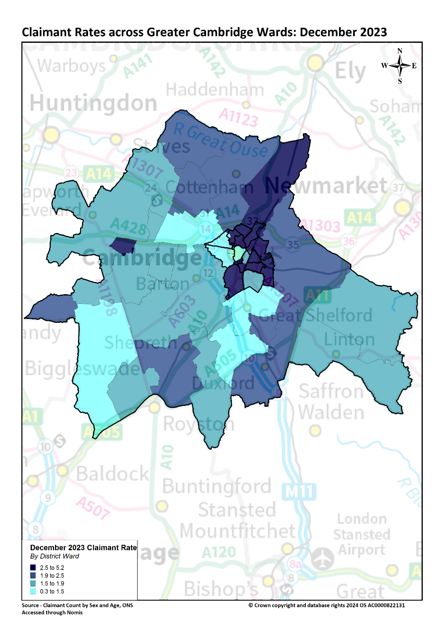
Labour Market – Claimant counts by location
Claimant Rates | Number of claimants December 2023 | % 16-64 population December 2023 | PP Change 12 Months ago vs Now: December 2022 to December 2023 | PP Change Previous update vs Now: September 2023 to December 2023
Cambridge City | 2,110 | 1.9% | No Change | +0.1
South Cambridgeshire | 1,785 | 1.7% | No Change | +0.1
Greater Cambridge | 3,895 | 1.8% | No Change | +0.1
United Kingdom | 1,556,660 | 3.6% | +0.1 | +0.1
Notes:
Claimant counts across Greater Cambridge have increased across all age groups since the last update (September 2023 to December 2023), with increases across Cambridge and South Cambridgeshire. Both short term and longer term trends show that younger claimants (16-24) and those who live in more relatively deprived areas such as north Cambridge City are particular areas of focus.
A lower proportion of Greater Cambridge residents claim benefits related to unemployment when compared to the UK. However, there is a high degree of disparity within the area itself with claimant rates ranging from 5.2% in King’s Hedges (North Cambridge) to 0.3% in Newnham (North West Cambridge)
Higher claimant rates seem appear to especially affect wards in the north of the region such as the King’s Hedges, Arbury, and Abbey.
King's Hedges, Melbourn, Swavesey ,Gamlingay and Hardwick had the largest rate increases Dec 22 to Dec 23

Slide 17
Universal Credit Claimants – December 2023
Policy changes to provide economic support during the Covid-19 pandemic allowed those on higher incomes than previously to claim Universal Credit, resulting in a permanent rise in claimants since the Spring lockdowns of 2020.
Both on a quarterly and annual basis Greater Cambridge has seen a higher increase in the number of claimants than Great Britain as a whole. This has mostly been driven by a rise in unemployed claimants but the number of employed claimants is also now increasing.
As with the other benefit claimant measure, Greater Cambridge as a whole has a lower claimant rate than Great Britain as a whole.
Unemployed claimants have consistently made up the majority of claimants at both a wider area and local authority level. Unemployed claimants have driven both the annual increases in the number of claimants. The number of employed claimants has now also started to increase, contributing towards the quarterly increase and some of the annual increase.
Notes:
Source – Universal Credit Claimants, Department for Work and Pensions
Technical Notes
Universal Credit is available in every jobcentre across Great Britain. Roll out was completed in December 2018.
Universal Credit is a single payment for each household to help with living costs for those on a low income or out of work. It is replacing six benefits, commonly referred to as the legacy benefits:
Income-based Jobseeker's Allowance
Income-related Employment and Support Allowance
Income Support
Working Tax Credit
Child Tax Credit
Housing Benefit
Support for housing costs, children and childcare costs are integrated into Universal Credit. It also provides additions for people with a disability, health condition or caring responsibilities which may prevent them from working.

Slide 18
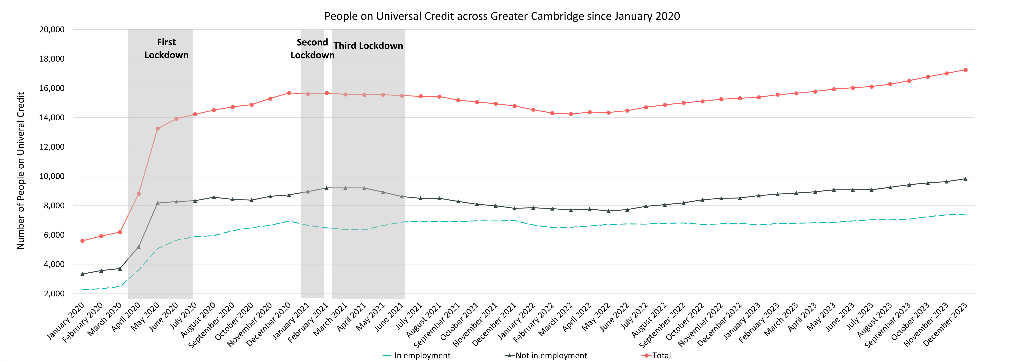
Labour Market – People on Universal Credit
Universal Credit Status | Number of Claimants December 2023 | Share of Total December 2023 | % Change with August 2023 | % Change with December 2022
Employed | 7,429 | 43% | +5.7% | +9.3%
Unemployed | 9,832 | 57% | +6.3% | +15.4%
Total | 17,255 |  | +1.6% | +12.7%
Notes:
Source – Universal Credit Claimants, Department for Work and Pensions
Technical Notes
Universal Credit is available in every jobcentre across Great Britain. Roll out was completed in December 2018.
Universal Credit is a single payment for each household to help with living costs for those on a low income or out of work. It is replacing six benefits, commonly referred to as the legacy benefits:
Income-based Jobseeker's Allowance
Income-related Employment and Support Allowance
Income Support
Working Tax Credit
Child Tax Credit
Housing Benefit
Support for housing costs, children and childcare costs are integrated into Universal Credit. It also provides additions for people with a disability, health condition or caring responsibilities which may prevent them from working.
Commentary
The chart above highlights changes in the number of people on universal credit across Greater Cambridge by Employment Status from January 2020.
The number of Universal Credit claimants includes those who have started Universal Credit (completed the Universal Credit claim process and accepted their Claimant Commitment) and have not had a closure of their claim recorded for this spell, up to the 'count date' (second Thursday in each month). A closure of their claim would be recorded either at the request of the individual or if their entitlement to Universal Credit ends, for example, if they no longer satisfy the financial conditions to receive Universal Credit as they have capital over £16,000.
It is important to note that the initial rise in claimants during the first lockdown period was due to policy changes brought in as part of the pandemic response that allowed people on higher incomes than before to claim the benefit, the peak of this increase came during the second lockdown in the Winter of 2020.
Unemployed claimants have consistently made up the majority of claimants. The increases across the last quarter, and the last 12 months, have mostly been driven by these unemployed claimants. However, employed claimants are also increasing on a quartely and annual basis.
Despite decreases from Q1 of 2021, the numbers of those on universal credit remains much higher than Pre-Covid with numbers trending upwards from May 2022.
Unemployed claimants make up the majority of people on universal credit (57%) and saw a +6.3% increase from August 2023 and a +15.4% increase from December 2022. In comparison employed claimants saw a +5.7% increase from August 2023 and a +9.3% increase from December 2022.

Slide 19
Labour Market – People on Universal Credit, Rates and Percentage Changes
People on Universal Credit | Number of total people on Universal Credit December 2023 | % 16-64 population December 2023 | % Change 12 Months ago vs Now: December 2022 to December 2023 | % Change Previous update vs Now: August 2023 to December 2023
Cambridge City | 8,534 | 8.0% | +10.8% | +4.8%
South Cambridgeshire | 8,721 | 8.8% | +14.5% | +7.2%
Greater Cambridge | 17,255 | 8.4% | +12.7% | +6%
Great Britain | 6,308,051 | 15.4% | +9.2% | +4.4%
Notes:
Source – Universal Credit Claimants, Department for Work and Pensions
Technical Notes
Universal Credit is available in every jobcentre across Great Britain. Roll out was completed in December 2018.
Universal Credit is a single payment for each household to help with living costs for those on a low income or out of work. It is replacing six benefits, commonly referred to as the legacy benefits:
Income-based Jobseeker's Allowance
Income-related Employment and Support Allowance
Income Support
Working Tax Credit
Child Tax Credit
Housing Benefit
Support for housing costs, children and childcare costs are integrated into Universal Credit. It also provides additions for people with a disability, health condition or caring responsibilities which may prevent them from working.
Commentary
The above table highlights changes in the number of people on universal credit across Greater Cambridge in December 2023.
The number of Universal Credit claimants includes those who have started Universal Credit (completed the Universal Credit claim process and accepted their Claimant Commitment) and have not had a closure of their claim recorded for this spell, up to the 'count date' (second Thursday in each month). A closure of their claim would be recorded either at the request of the individual or if their entitlement to Universal Credit ends, for example, if they no longer satisfy the financial conditions to receive Universal Credit as they have capital over £16,000.
Greater Cambridge saw that 8.4% of the 16-64 population claimed Universal Credit, a much lower proportion than Great Britain as a whole (15%)
Cambridge has a lower rate claiming (8.0%) than South Cambridgeshire (8.8%)
South Cambridgeshire has seen a larger change since December 2022 than Cambridge City (+14.5% compared to +10.8%) and both areas have seen larger increases than Great Britain (+9.2%)

Slide 20
Pay and Inflation
Pay As You Earn (PAYE) Real Time Information – August 2023

Slide 21
Pay and Inflation– November 2023
Workers who are resident in Greater Cambridge continue to have higher median monthly pay than the UK overall.
Annual pay growth in the Greater Cambridge area fell below national levels in 2021 and annual pay growth in the Greater Cambridge area fell below inflation in early 2022. Both continue to remain lower.
Since August 2023, the annual pay growth has been decreasing in Cambridge, South Cambridgeshire and the United Kingdom. Inflation has also followed the same trend. Whilst the United Kingdom pay growth has remained above inflation during this decrease, Cambridge and South Cambridgeshire has fallen below.
Cambridge (£2,765) and South Cambridgeshire (£2,760) both have average median pay much higher than the United Kingdom (£2,310), all three geographies have followed similar trends throughout the period 2021-2023
Cambridge and South Cambridgeshire have both seen average pay growth consistently below that of the United Kingdom since September 2021, and despite the gap narrowing throughout 2022 and 2023, pay growth remains below the United Kingdom across the latest data

Slide 22
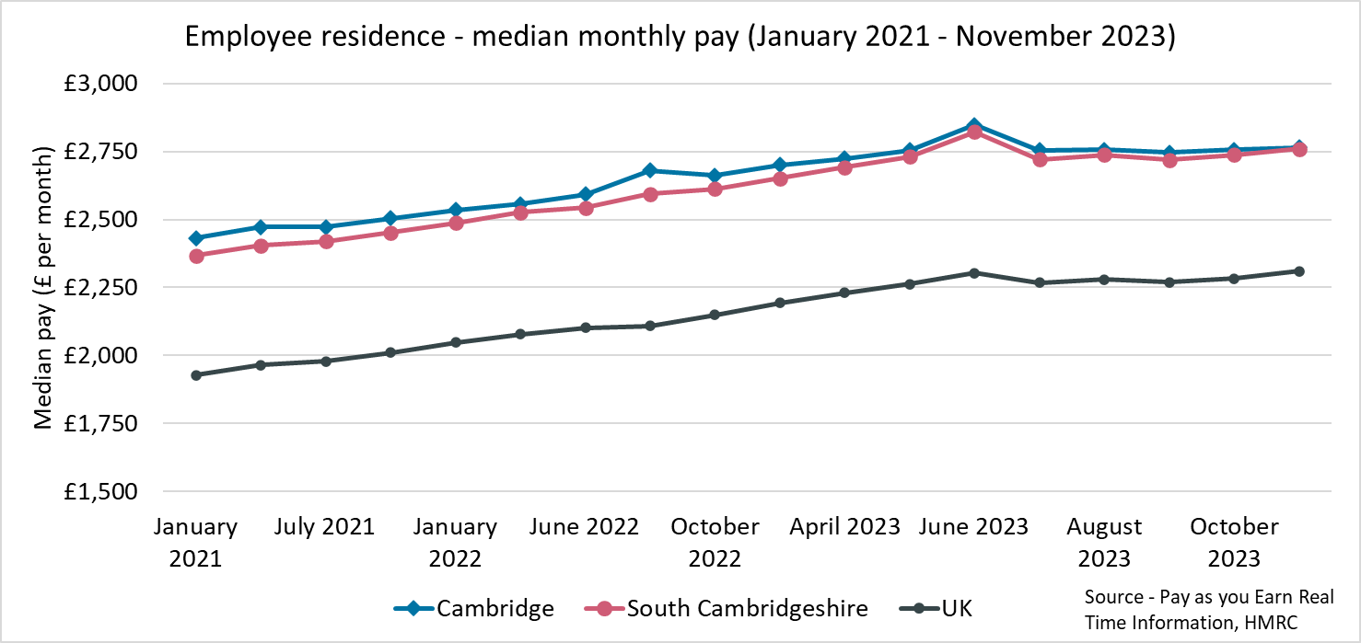
Employment Trends – Median monthly pay (PAYE)
Local Authority | Cambridge | South Cambridgeshire | United Kingdom
Median monthly pay (November 2023) | £2,765 | £2,760 | £2,310
Source – Pay as you earn real time information - HMRC
Previous change
(Jun – Sept 22):
+2.2pp
-2.2pp
Comparing Jan 2022- Dec 2022 with Oct 2021 - Sept 2022
Comparing Oct 2021– Sept 2022 with Jul 2021 – Jun 2022
Comparing Jan 2022- Dec 2022 with Jan 2021 - Dec 2021
Notes:
Source – Pay as you earn real time information- HMRC
Technical Notes
This data is sourced from HM Revenue and Customs’ Pay As You Earn system which collects income tax and national insurance. The Pay As you Earn Real Time Information data includes all employees payrolled by employers, therefore it does not include income from pensions, property rental or investments, nor does it include self-employment income.
This data is based on employee’s residence rather than where they work.
Commentary
The chart above shows median monthly pay for the period January 2021 – November 2023.
Median monthly pay has remained consistently higher in Cambridge (£2,765 in November 2023) and South Cambridgeshire (£2,760 in November 2023) than in the United Kingdom (£2,310 in November 2023).

Slide 23
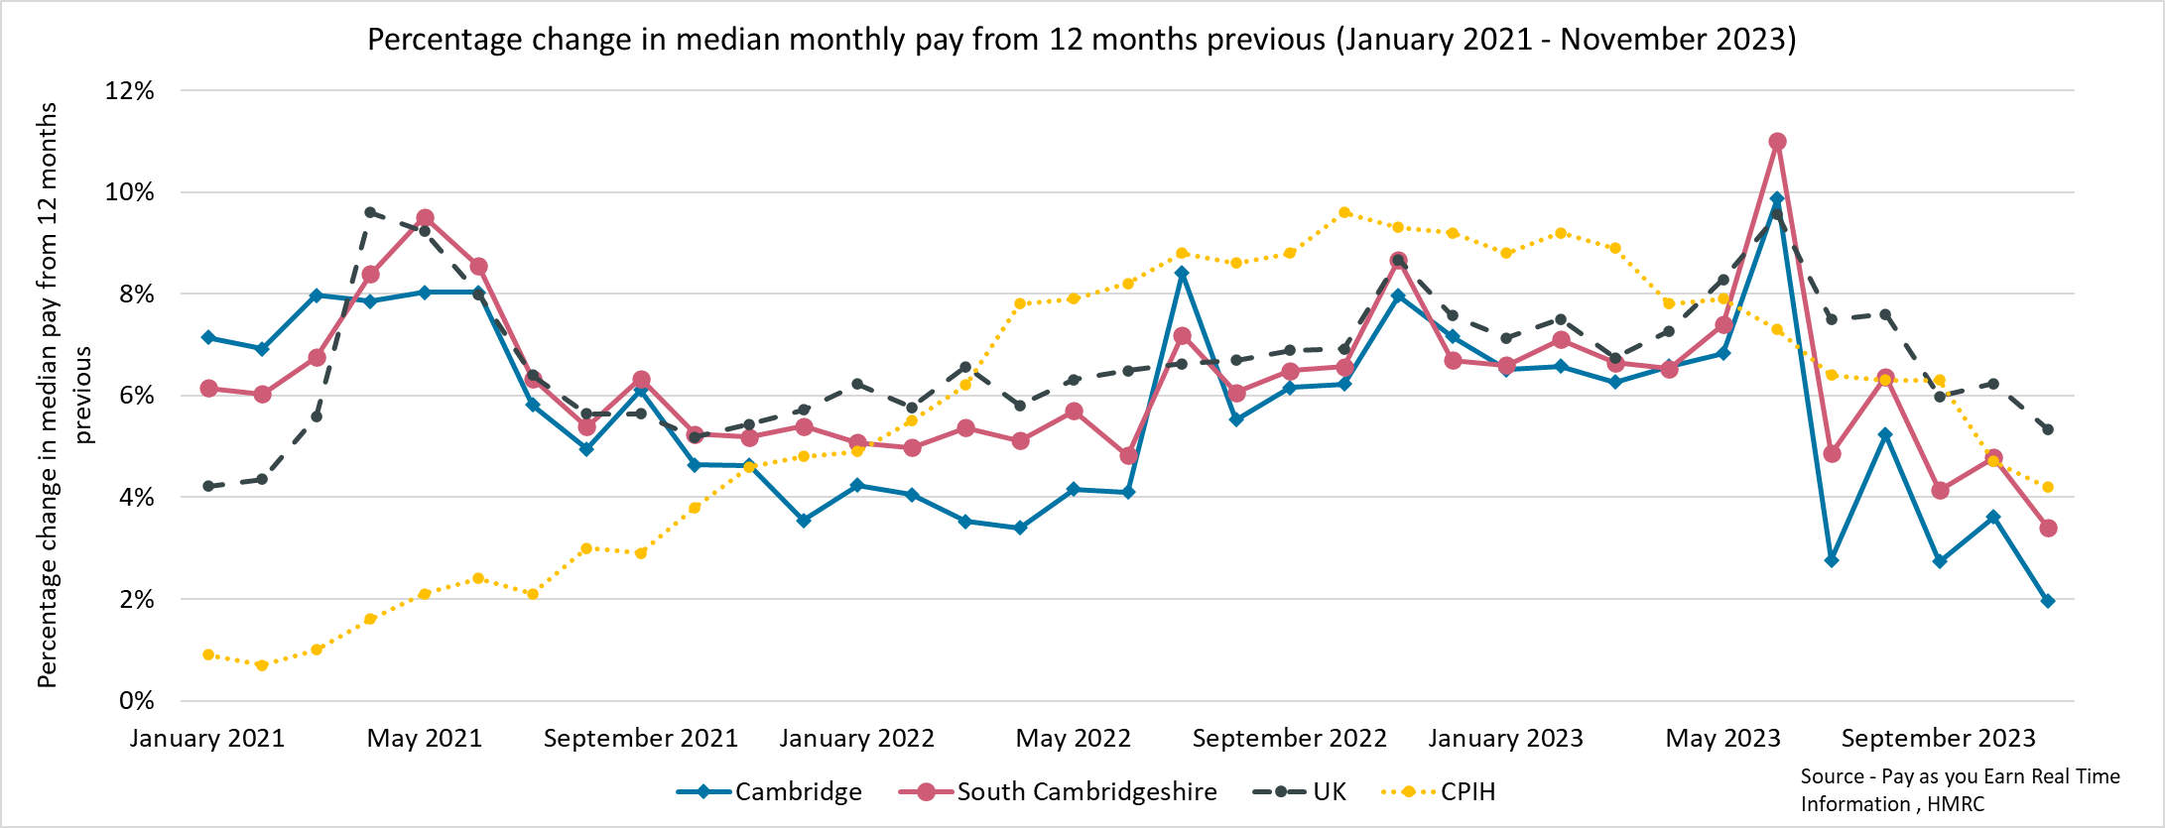
Employment Trends – Median monthly pay growth (PAYE) (January 2021- November 2023)
Local Authority | CPIH (November 2023)* | Cambridge | South Cambridgeshire | United Kingdom
% Change from November 2022 | +4.2% | +2% | +3.4% | +5.3%
*The Consumer Prices Index including owner occupiers' housing costs (CPIH) is the office for national statistics’ headline inflation measure Source - Pay as you earn real time information – HMRC
*Inflation given by CPIH – Consumer Price Index including Housing Costs
Notes:
Source – Pay as you earn real time information- HMRC
Technical Notes
This data is sourced from HM Revenue and Customs’ Pay As You Earn system which collects income tax and national insurance. The Pay As you Earn Real Time Information data includes all employees payrolled by employers, therefore it does not include income from pensions, property rental or investments, nor does it include self-employment income.
Commentary
The chart above shows the percentage change in median monthly pay from 12 months previous for the period January 2021 – November 2023.
Throughout the time period all three geographies follow a similar pattern, pay rises in the Greater Cambridge local authorities are always within 2.1 percentage points of each other. From April 2021 to July 2022, Cambridge experienced a lower percentage change in median monthly pay than South Cambridgeshire and the UK. It was then only larger for the month of July 2022 and December 2022 before falling below again, since then it has not risen above South Cambridgeshire although they have been very close and have followed a similar pattern.
In June 2023, the percentage change in median monthly pay from 12 months previous increased rapidly from the previous month in South Cambridgeshire (+3.7 percentage points), Cambridge (+3.2pp) and the United Kingdom (+1.3pp).
In July 2023 the percentage change in median monthly pay from 12 months previous decreased sharply, in Cambridge it fell to +2.8%, . In South Cambridgeshire growth fell to +5%. Both of these decreases are due to July 2022 having high rates of pay increase from 12 months previous.
Since the peak in median pay percentage increase in June 2023 ,the United Kingdom has experienced higher wage growth than Cambridge and South Cambridgeshire
In November 2023, median monthly pay growth was lower in Cambridge (+2.0%) and South Cambridgeshire (+3.4%) than CPIH (+4.2%), whereas United Kingdom pay growth (+5.3%) was higher than CPIH.
Since August 2023, the percentage change in median pay from 12 months previous has been decreasing in Cambridge, South Cambridgeshire and the United Kingdom, CPIH has also followed the same trend.
CPIH was consistently below the percentage change in median pay for Cambridge and South Cambridgeshire until November 2021 and since then CPIH has been higher than the percentage change in median pay for Cambridge with the exception of June 2023. South Cambridgeshire has experienced wage growth closer to CPIH across the period, and has been higher than CPIH in June, August and October 2023.

Slide 24
Vacancies
Lightcast Vacancies Data – December 2023

Slide 25
Vacancies – December 2023
After record numbers of vacancies in late 2021 and early 2022, vacancies have declined. December 2023 saw the lowest number of vacancies since September 2020. This is in line with national decreases and suggests a cooling labour market making it harder to find work.
Looking at how vacancies have changed since the previous update, and when compared to the same point in 2023, vacancies have experienced a decrease from September 2023 (-16%) and compared to December 2022 (-37%).
All sectors with the exception of Education experienced a decrease in vacancies from September 2023. All sectors also had fewer vacancies than in December 2022
Notes:
Technical Information
Vacancy data is sourced from Lightcast, a service that has been procured by Greater Cambridge Combined Authority which gives labour market information on Job postings, occupations, and industries. Lightcast has a job posting aggregator which scans jobs websites for posting and presents them together.
Lightcast only scans online jobs postings and therefore does not include any jobs which are advertised solely offline. There is also no guarantee that all online job postings are aggregated. For example, a specific job site may not be scanned.
A unique job posting is a deduplicated count of an online job vacancy advertisement. If the same vacancy is posted twice across a sixty-day period, it is only counted once. If the same vacancy is posted twice more than sixty days apart it is counted as two unique job postings.
The other category includes agriculture, forestry and fishing; Mining and quarrying; Water supply and Waste management

Slide 26
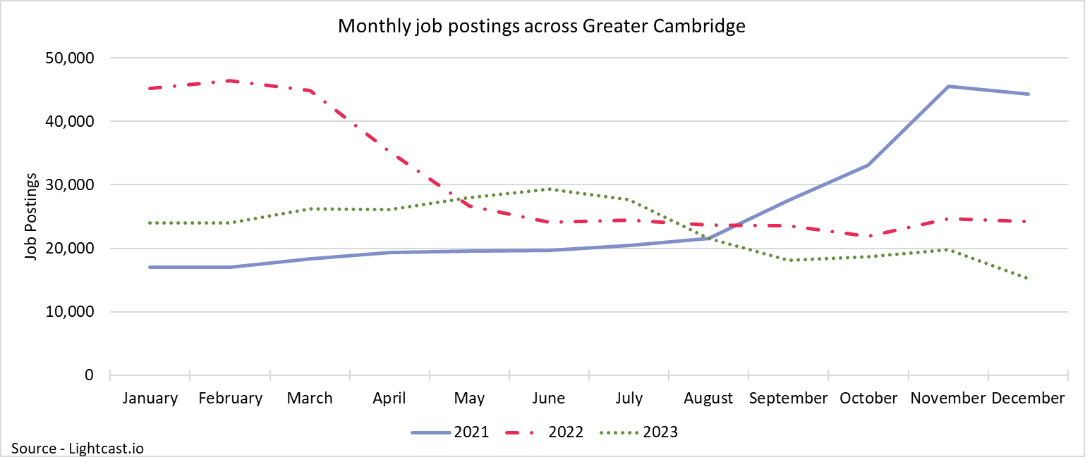
Vacancy Trends
15,277
Unique job postings in Greater Cambridge in December 2023
-16%
Decrease in unique job postings compared to September 2023
Compared to -18% nationally
-37%
Decrease in unique job postings compared to December 2022
Compared to -30% nationally
Notes:
Source – Lightcast
Technical Information
Vacancy data is sourced from Lightcast, a service that has been procured by Greater Cambridge Combined Authority which gives labour market information on Job postings, occupations, and industries. Lightcast has a job posting aggregator which scans jobs websites for posting and presents them together.
Lightcast only scans online jobs postings and therefore does not include any jobs which are advertised solely offline. There is also no guarantee that all online job postings are aggregated. For example, a specific job site may not be scanned.
A unique job posting is a deduplicated count of an online job vacancy advertisement. If the same vacancy is posted twice across a sixty-day period, it is only counted once. If the same vacancy is posted twice more than sixty days apart it is counted as two unique job postings.
The other category includes agriculture, forestry and fishing; Mining and quarrying; Water supply and Waste management
Commentary
The above chart illustrates online vacancy data across the Greater Cambridge area since January 2021. A unique job posting is a deduplicated count of an online job vacancy advertisement. If the same vacancy is posted twice across a sixty-day period, it is only counted once. If the same vacancy is posted twice more than sixty days apart it is counted as two unique job postings.
Across Greater Cambridge, there were 15,277 job postings in December 2023, this is a decrease of -16% from September 2023. Nationally job postings decreased by -18% across the same period
February 2022 saw the highest number of vacancies across Greater Cambridge within the last three years
In May 2023, there was an increase in job postings of +14% from the previous month. This is the largest percentage increase from the previous month since November 2021
The number of vacancies increased rapidly in the final quarter of 2021 but appear to have peaked in late 2021/early 2022 before rapidly decreasing and then stabilising across the 2nd half of 2022. In the first half of 2023 job postings steadily increased, but have been declining since June falling to the lowest levels recorded in the past three years
December 2023 saw the lowest number of job postings since February 2021
*Lightcast data is available from 2012 onwards.

Slide 27
Employment Trends – Vacancies by Industry
Number of Vacancies in Greater Cambridge in December 2023 compared to the UK Top three sectors with highest proportion of vacancies highlighted green
Sector Identifier | Employment Sector | Vacancies in Greater Cambridge: December 2023 | Percentage of total vacancies | Vacancies in United Kingdom: December 2023 | Percentage of total vacancies
1 | Accommodation and food service activities | 563 | 3% | 67,387 | 3%
2 | Administrative and support service activities | 1,268 | 7% | 166,467 | 8%
3 | Arts, entertainment and recreation | 811 | 4% | 94,303 | 4%
4 | Construction | 754 | 4% | 81,792 | 4%
5 | Education | 1,325 | 7% | 178,464 | 8%
6 | Financial and insurance activities | 447 | 2% | 63,191 | 3%
7 | Human health and social work activities | 1,886 | 10% | 264,924 | 12%
8 | Information and communication | 1,982 | 11% | 116,021 | 5%
9 | Manufacturing | 1,211 | 7% | 126,842 | 6%
10 | Other service activities | 58 | 0% | 8,870 | 0%
11 | Professional, scientific and technical activities | 1,095 | 6% | 124,663 | 6%
12 | Public administration and defence; compulsory social security | 286 | 2% | 33,394 | 2%
13 | Real estate activities | 201 | 1% | 20,423 | 1%
14 | Transportation and storage | 550 | 3% | 90,766 | 4%
15 | Wholesale and retail trade; repair of motor vehicles and motorcycles | 770 | 4% | 115,828 | 5%
16 | Other sectors (Agriculture, forestry and fishing; Mining and quarrying; Water supply and Waste management) | 667 | 4% | 68,020 | 3%
Notes:
The above table shows the number of Vacancies in Greater Cambridge in December 2023 by employment sector and includes a national comparison;
Information and Communication (11%) , Human health and social work activities (10%), and Education (7%) have the highest proportion of vacancies across Greater Cambridge. Human health and social work is also the largest sector nationally (12%)
A greater proportion of job vacancies in Greater Cambridge were in the Information and communications sector (11%) compared to the UK as a whole (5%), a difference of 6 percentage points.
Human health and social work activities accounts for 10% of job vacancies in Greater Cambridge, 2 percentage points lower than the UK as a whole (12%)

Slide 28
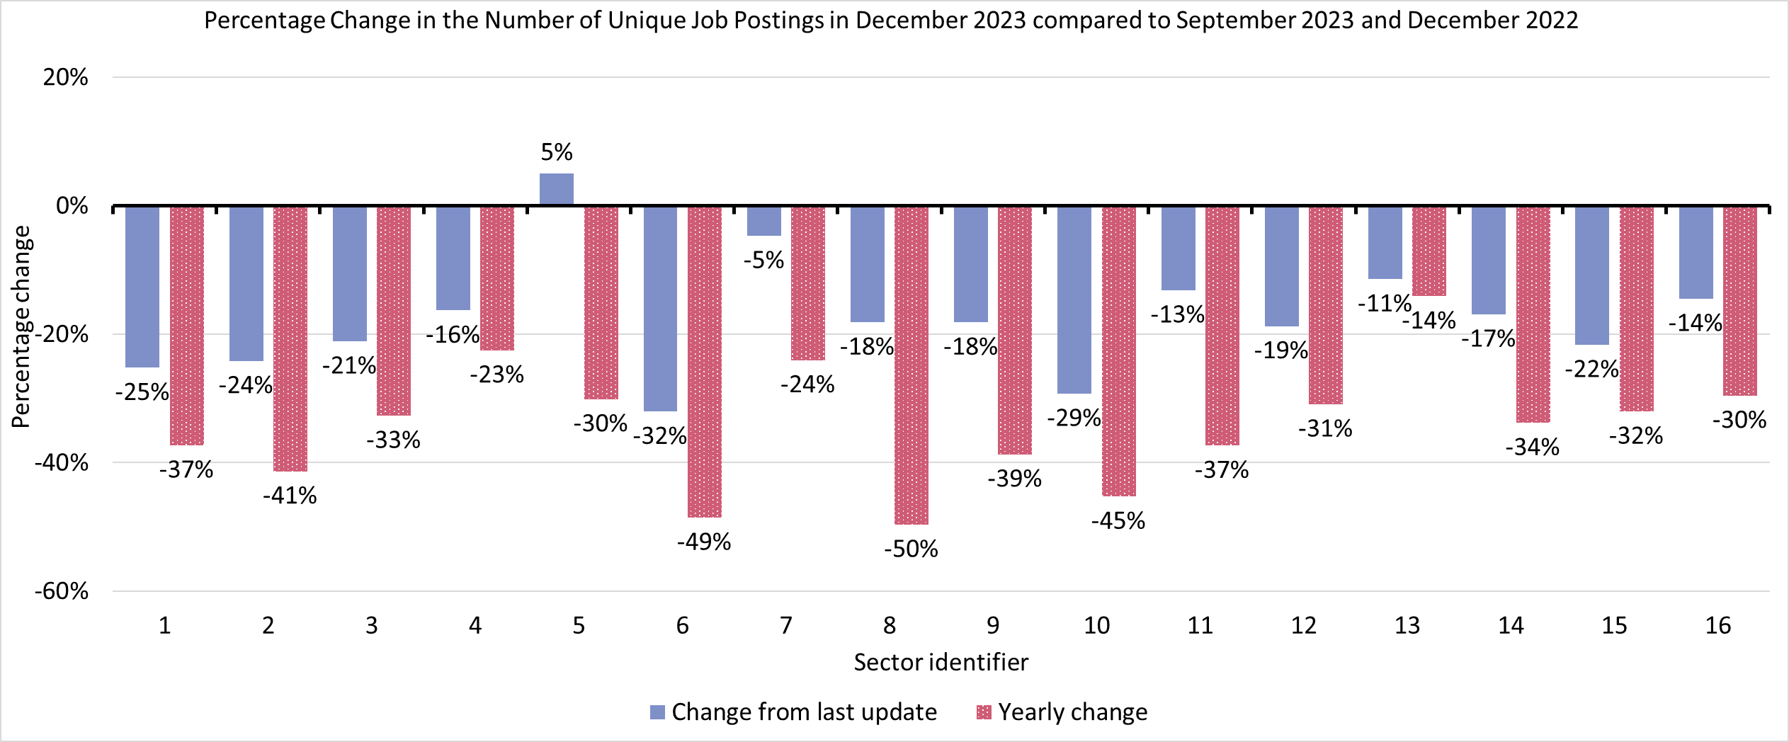
Employment Trends – Vacancies by Industry Changes
Sector Identifier for Chart
Sector Identifier | Sector Name
1 | Accommodation and food service activities
2 | Administrative and support service activities
3 | Arts, entertainment and recreation
4 | Construction
5 | Education
6 | Financial and insurance activities
7 | Human health and social work activities
8 | Information and communication
9 | Manufacturing
10 | Other service activities
11 | Professional, scientific and technical activities
12 | Public administration and defence; compulsory social security
13 | Real estate activities
14 | Transportation and storage
15 | Wholesale and retail trade; repair of motor vehicles and motorcycles
16 | Other sectors (Agriculture, forestry and fishing; Mining and quarrying; Water supply and Waste management)
Notes:
Source – Lightcast
Technical Information
Vacancy data is sourced from Lightcast, a service that has been procured by Greater Cambridge Combined Authority which gives labour market information on Job postings, occupations, and industries. Lightcast has a job posting aggregator which scans jobs websites for posting and presents them together.
Lightcast only scans online jobs postings and therefore does not include any jobs which are advertised solely offline. There is also no guarantee that all online job postings are aggregated. For example, a specific job site may not be scanned.
A unique job posting is a deduplicated count of an online job vacancy advertisement. If the same vacancy is posted twice across a sixty-day period, it is only counted once. If the same vacancy is posted twice more than sixty days apart it is counted as two unique job postings.
The other category includes agriculture, forestry and fishing; Mining and quarrying; Water supply and Waste management
Commentary
The above chart shows how the number of vacancies in December 2023 has changed in each sector compared to the last update (September 2023) and compared to the same point in 2022 (December 2022)
All sectors with the exception of Education experienced a decrease in vacancies from September 2023 which saw an increase of (+5%, +63)
The three sectors with the largest percentage decreases from September 2023 were Financial and insurance activities (-32%), Other service activities (-29%) and Accommodation and Food Service Activities (-25%). The sectors to see the largest raw number decreases were Manufacturing (-755), Administrative and Support Services (-749), and Information and Communication (-675)
All sectors saw a decrease in job postings from December 2022:
The largest decreases from a year previous were in Information and Communication (-50%, -1,955), and Financial and insurance activities (-49%, -422)
December 2023 saw the lowest number of job postings since September 2020

Slide 29
Employment Trends –by Industry
Median Posting Duration (October – December 2023) (Greater Cambridge) | Posting Intensity (October – December 2023) (Greater Cambridge)
23 Days | 3:1
Median Posting Duration for Vacancies across Greater Cambridge in Days by Employment Sector October – December 2023
Sector Identifier | Employment Sector | October – December 2023 Median Posting Duration (Days) | October – December 2023 Posting Intensity
1 | Accommodation and food service activities | 25 | 3:1
2 | Administrative and support service activities | 23 | 3:1
3 | Arts, entertainment and recreation | 25 | 3:1
4 | Construction | 24 | 3:1
5 | Education | 25 | 2:1
6 | Financial and insurance activities | 20 | 2:1
7 | Human health and social work activities | 24 | 3:1
8 | Information and communication | 20 | 3:1
9 | Manufacturing | 26 | 3:1
10 | Other service activities | 27 | 3:1
11 | Professional, scientific and technical activities | 21 | 2:1
12 | Public administration and defence; compulsory social security | 21 | 3:1
13 | Real estate activities | 26 | 3:1
14 | Transportation and storage | 24 | 3:1
15 | Wholesale and retail trade; repair of motor vehicles and motorcycles | 23 | 3:1
16 | Other sectors (Agriculture, forestry and fishing; Mining and quarrying; Water supply and Waste management) | 26 | 3:1
The chart above shows two metrics to measure the potential difficulty in filling roles in certain sectors:
Median Posting Duration measures how long the average job posting is live online for. A longer time up could suggest that the company anticipates the role being harder to fill
Posting Intensity is a ratio of how many times the same job role is posted. A higher ratio could suggest difficulty filling the role
Notes:
Source – Lightcast
Technical Information
Vacancy data is sourced from Lightcast, a service that has been procured by Greater Cambridge Combined Authority which gives labour market information on Job postings, occupations, and industries. Lightcast has a job posting aggregator which scans jobs websites for posting and presents them together.
Lightcast only scans online jobs postings and therefore does not include any jobs which are advertised solely offline. There is also no guarantee that all online job postings are aggregated. For example, a specific job site may not be scanned.
Median Posting Duration measures how long the average job posting is live online for. A longer time up could suggest that the company anticipates the role being harder to fill.
Posting Intensity is a ratio of how many times the same job role is posted. A higher ratio could suggest difficulty filling the role.
Commentary
The table above shows the median posting duration and the posting intensity for employment sectors from October to December 2023. Both measures can be used as an indication of difficult to fill roles.
Across Greater Cambridge, the median posting duration was 23 days. Other service activities (27) had the highest median posting duration
Information and Communication (20), and Financial and insurance activities (20) had the lowest median posting duration. The next lowest median posting durations were Professional, scientific and technical activates and Public administration and defence; compulsory social security (both 21)
The posting intensity across Greater Cambridge was 3:1. no sectors exceeded this
Professional, scientific and technical activities, Education, and Financial and insurance activities (all 2:1) are the only sectors below the area average

