Slide 1

Greater Cambridge Economy & Employment Update
April 2024 Update
Policy & Insight Team, Cambridgeshire County Council
policyandinsight@cambridgeshire.gov.uk

Slide 2
Labour Market Overview
(January 2023 – December 2023)

Slide 3
Labour Market Headline Findings – January 2023 – December 2023
Across the latest full year of data (January 2023 to December 2023) the Greater Cambridge area had a higher unemployment rate than the UK. This contrasts with the historic trend of the last 16 years where the Greater Cambridge has had a lower unemployment rate than nationally. When looking at three year averages, the unemployment rate across the Greater Cambridge area is also higher than the UK but there is a smaller difference then when looking at solely the latest data. Positively, employment rates remain higher, and economic inactivity rates lower, than the UK averages.
The rise in unemployment coupled with the fall in those economically inactive, seen on both quarterly and annual basis, can suggest those re-entering the labour market may be struggling to find work. This is potentially reinforced when looking at other data, such as rising claimant counts and low vacancies. Whilst these changes are seen nationally, they are much more prominent in the Greater Cambridge figures. This may be due to a larger number of those re-entering the local labour market compared to the United Kingdom. However, it is also important to note that due to the smaller area of Greater Cambridge measures can be more likely to fluctuate between extremes.
It should be emphasised, that because the Annual Population Survey is an estimate based on a representative sample and the small area of the Greater Cambridge Partnership that these changes are within the margin of error for the survey, so should be treated as purely indicative. Students are also captured in this data and therefore economic inactivity will be influenced by student population dynamics.
It is also important to also note that due to the small geographical area and the way that the Annual Population Survey’s data is collated, all three measures are expected to fluctuate from release to release and should be treated as broadly indicative.
The experimental national labour market statistics release has been discontinued. National figures are now taken from the Labour Force Survey (LFS). Increased volatility of LFS estimates, resulting from smaller achieved sample sizes, means that estimates of quarterly change should be treated with additional caution. Caution should be taken with interpreting these figures and comparisons to Greater Cambridge.
Notes:
Source – Annual Population Survey (2006-2023), Office for National Statistics
Technical Notes
A residence based labour market survey encompassing population, economic activity (employment and unemployment), economic inactivity and qualifications. These are broken down where possible by gender, age, ethnicity, industry and occupation. Available at Local Authority level and above. Updated quarterly.
It is important to note that due to the small geographical area considered, and the Annual Population Survey being based on a representative sample, this may be due to a quarterly fluctuation rather than any kind of long-term trend in the data.
The experimental national labour market statistics release has been discontinued. National figures are now taken from the Labour Force Survey (LFS). Increased volatility of LFS estimates, resulting from smaller achieved sample sizes, means that estimates of quarterly change should be treated with additional caution. Caution should be taken with interpreting these figures and comparisons to Greater Cambridge.

Slide 4
Labour Market Headlines - Definitions
Employment Rate (Employed Population/Total Population): The percentage of the total population who are employed
Unemployment Rate (Unemployed Population/Economically Active Population): The proportion of the Economically Active Population without a job, have been actively seeking work in the past four weeks and are available to start work in the next two weeks or are out of work, have found a job and are waiting to start it in the next two weeks
  Economic Inactivity Rate (Economically Inactive Population/Total Population: The proportion of the population without a job and have not sought work in the last four weeks and/or are not available to start work in the next two weeks. Example reasons for being economically inactive could include being a student, having caring responsibilities, being sick and disabled and retirement
Note – All of these measures are calculated on the basis of the working age (16-64) population

Slide 5

Key Economic Indicators
Unemployment Rate Overall (aged 16-64): 6.6%
Quarterly change
Previous quarterly change
Change since previous year
The unemployment rate between January 2023 and December 2023 was 6.6% (compared to 3.8% nationally). This has increased by +0.6pp percentage points since the last quarter and is +4.2pp higher than 12 months previously.
+0.6pp
+1.8pp
+4.2pp
+1.9%
Comparing Jan 2023 – Dec 2023 with Oct 2022 – Sep 2023
Comparing Oct 2022 – Sep 2023 with Jul 2022 - June 2023
Comparing Jan 2023 – Dec 2023 with Jan 2022 – Dec 2022
Employment Rate Overall (aged 16-64): 78.5%
Previous quarterly change
The employment rate between January 2023 and December 2023 was 78.5% (higher than the 75.7% nationally). This has decreased by -0.2 percentage points since the last quarter and is -0.4 percentage points lower than the level 12 months previously.
Quarterly change
Change since previous year
-0.2pp
+0.8pp
-0.4pp
Comparing Jan 2023 – Dec 2023 with Oct 2022 – Sep 2023
Comparing Oct 2022 – Sep 2023 with Jul 2022 - June 2023
Comparing Jan 2023 – Dec 2023 with Jan 2022 – Dec 2022
Economically Inactive (aged 16-64): 16.0%
Previous quarterly change
Change since previous year
16.0% of residents (aged 16-64) were economically inactive between January 2023 and December 2023 (lower than the 21.3% nationally). This has decreased by -0.3pp percentage points since the last quarter and is -3.2pp lower than the level 12 months previously.
Quarterly change
-0.3pp
-2.4pp
-3.2pp
Comparing Oct 2022 – Sep 2023 with Jul 2022 - June 2023
Comparing Oct 2022 – Sep 2023 with Jul 2022 - June 2023
Comparing Jan 2023 – Dec 2023 with Jan 2022 – Dec 2022
* Please note: estimates and confidence intervals are unreliable due to small sample sizes and so should be treated as indicative.
Notes:
Source – Annual Population Survey, Office for National Statistics
Technical Notes
A residence based labour market survey encompassing population, economic activity (employment and unemployment), economic inactivity and qualifications. These are broken down where possible by gender, age, ethnicity, industry and occupation. Available at Local Authority level and above. Updated quarterly.
Commentary
Across the latest full year of data the Greater Cambridge region had a higher unemployment rate than the UK as a whole but positively had higher employment rate and lower rate of economic inactivity.
It is important to note that due to the small geographical area considered, and the Annual Population Survey being based on a representative sample, this may be due to a quarterly fluctuation rather than any kind of long-term trend in the data. National data should also be treated with caution – this is due to the experimental nature of labour market statistics whilst the Labour Force Survey is redesigned. Caution should be taken with interpreting these figures and comparisons to Greater Cambridge.
The experimental national labour market statistics release has been discontinued. National figures are now taken from the Labour Force Survey (LFS). Increased volatility of LFS estimates, resulting from smaller achieved sample sizes, means that estimates of quarterly change should be treated with additional caution. Caution should be taken with interpreting these figures and comparisons to Greater Cambridge.
Quarterly changes (Comparing Jan 2023 – Dec 2023 with Oct 2022 - Sept 2023)
Over the last quarter Greater Cambridge has seen an increase in the unemployment rate (+0.6pp) and decreases in the employment rate (-0.2pp) and a fall in economic inactivity (-0.3pp).
Annual Change (Comparing Jan 2023 – Dec 2023 Jan Oct 2022 - Dec 2022 )
Compared to the same point in the previous year, Greater Cambridge has seen a decrease in the employment rate (-0.2pp percentage points in Greater Cambridge compared to +0.2pp in the UK) an increase in the unemployment rate (+4.2pp) compared to a +0.2pp increase in the UK and a decrease in the economic inactivity rate (-3.2pp in Greater Cambridge compared to a fall of -0.4pp in the UK as a whole).
The increase in the unemployment rate with falling economic inactivity levels suggests those re-entering the labour market are struggling to find work. The fact the unemployment rate in the Greater Cambridge area is substantially higher than the UK suggests this problem is more acute in this area but this may be due to a larger number of people re-entering the labour market with falls in year on year economic activity much smaller in the UK.
It should be emphasised, however, that because the Annual Population Survey is an estimate based on a representative sample and the small area of the Greater Cambridge Partnership that these changes are within the margin of error for the survey, so should be treated as purely indicative. Students are also captured in this data and therefore economic inactivity will be influenced by student population dynamics.

Slide 6
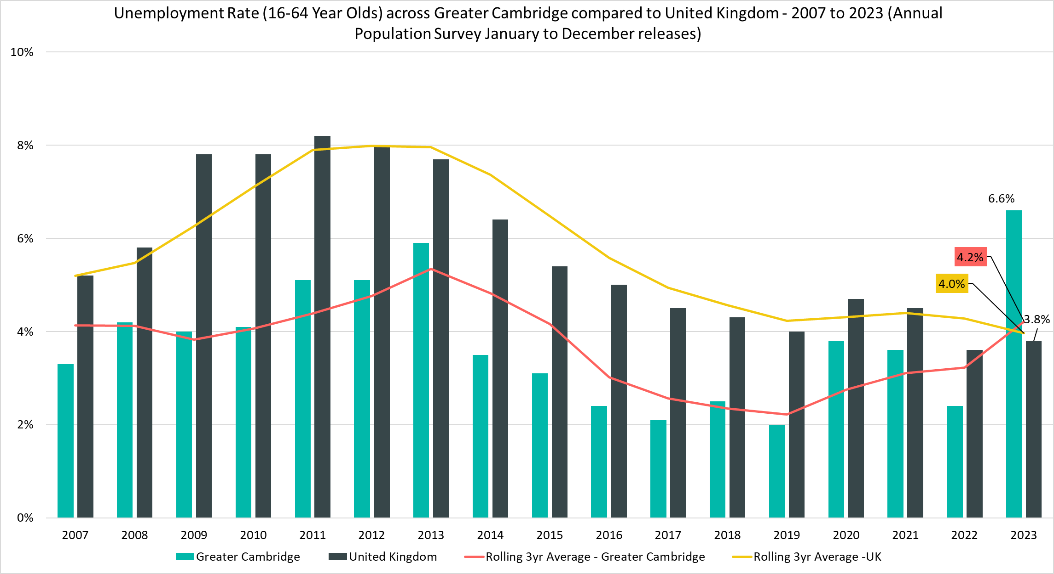
Unemployment Rate (16-64 year olds) – 6.6%, (January 2023 – December 2023)
Rolling Quarterly change
(Sept 23– Dec 23):
Previous change
(Jun 23– Sept 23):
Change since Dec 2022:
+0.6pp
+1.8pp
+4.2pp
Comparing January 2023 - December 2023 with October 2022 - September 2023
Comparing October 2022 - September 2023 with July 2022 - June 2023
Comparing January 2023 - December 2023 with January 2022 - December 2022
Notes:
Source – Annual Population Survey (2006-2023), Office for National Statistics
Technical Notes
A residence based labour market survey encompassing population, economic activity (employment and unemployment), economic inactivity and qualifications. These are broken down where possible by gender, age, ethnicity, industry and occupation. Available at Local Authority level and above. Updated quarterly.
It is important to note that due to the small geographical area considered, and the Annual Population Survey being based on a representative sample, this may be due to a quarterly fluctuation rather than any kind of long-term trend in the data.
The experimental national labour market statistics release has been discontinued. National figures are now taken from the Labour Force Survey (LFS). Increased volatility of LFS estimates, resulting from smaller achieved sample sizes, means that estimates of quarterly change should be treated with additional caution. Caution should be taken with interpreting these figures and comparisons to Greater Cambridge.
Percentage point changes use the full percentage decimal number in calculations and therefore when comparing rounded percentages, the result may differ.
Commentary
The above chart shows the unemployment rate across Greater Cambridge and the United Kingdom from 2007 to 2023 alongside a rolling three year average for the area.
Across the latest data, due to an increase the unemployment rate in Greater Cambridge is now higher than the UK at 6.6% compared to 3.8% UK wide. The Greater Cambridge area has historically had a lower unemployment rate than the United Kingdom.
It is important to note that when looking at the three year average the Greater Cambridge area also has a higher unemployment rate than the UK at 4.2% compared to 4.0%. However, the difference is smaller (+0.2pp) than the +3.0pp difference when looking solely at the latest data release.

Slide 7
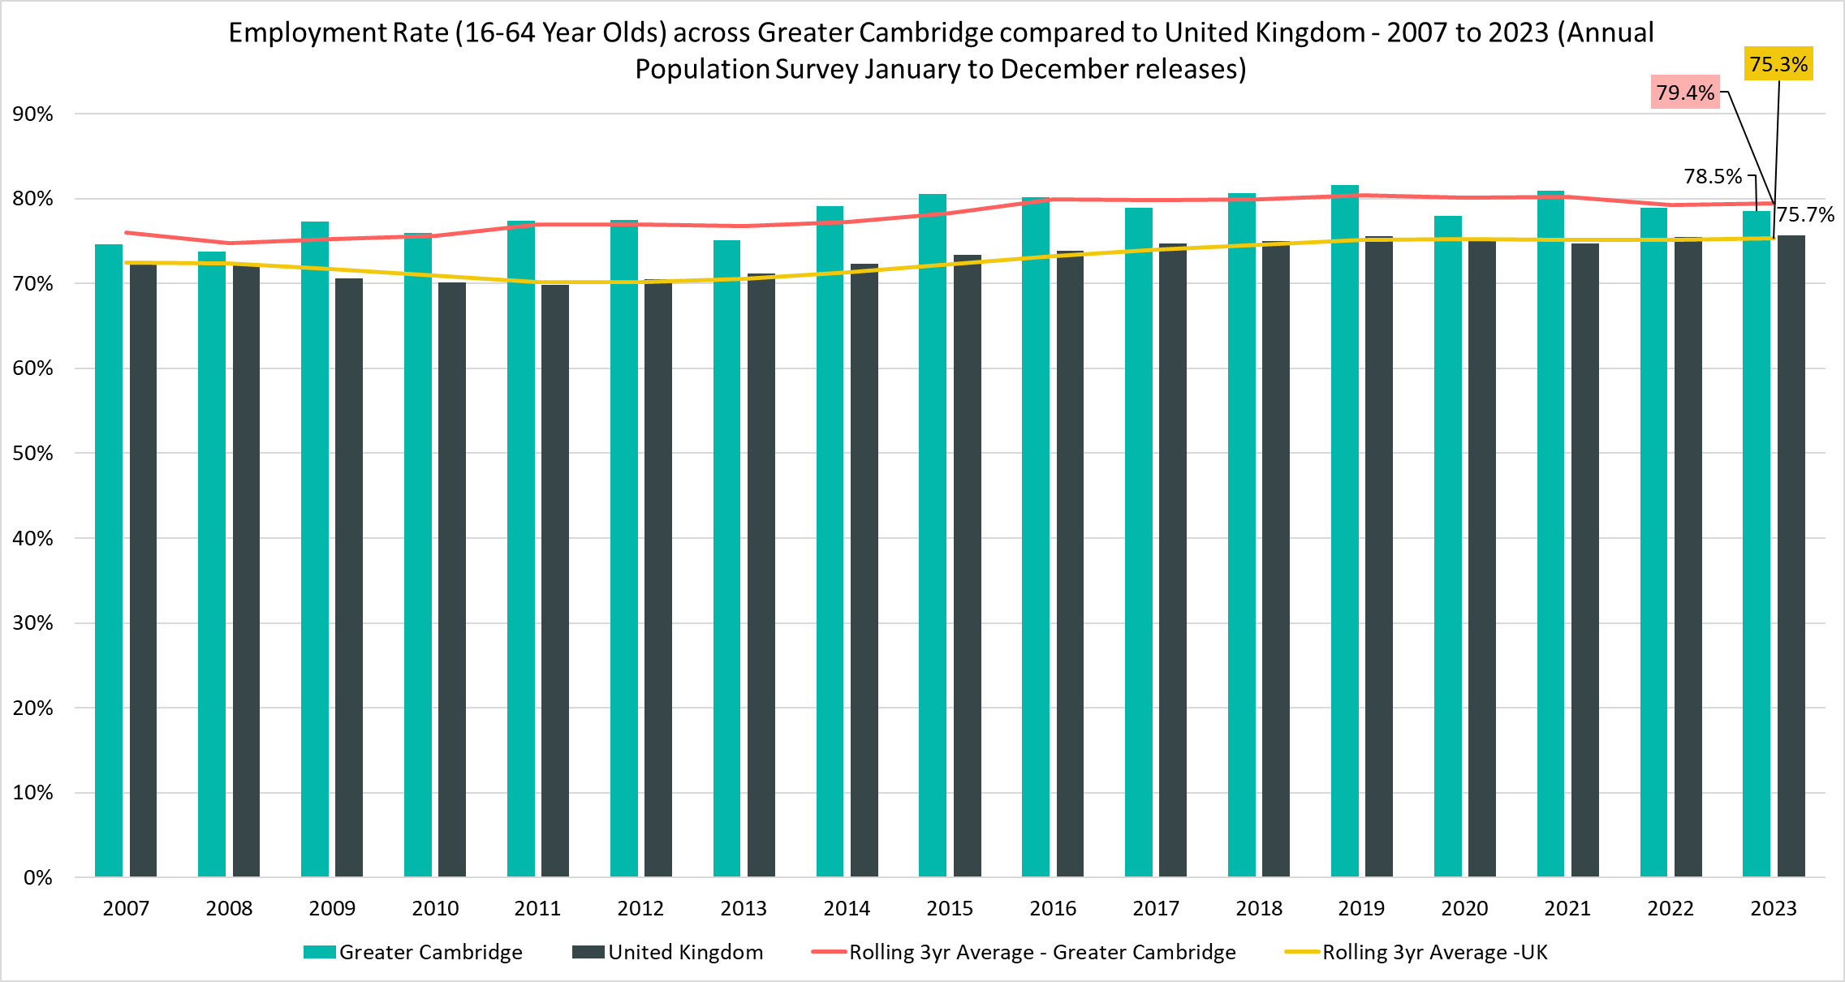
Employment Rate (16-64) – 78.7%, (January 2023 – December 2023)
Rolling Quarterly change
(Sept 23– Dec 23):
Previous change
(Jun 23– Sept 23):
Change since Dec 2022:
-0.2pp
+0.8pp
-0.4pp
Comparing January 2023 - December 2023 with October 2022 - September 2023
Comparing October 2022 - September 2023 with July 2022 - June 2023
Comparing January 2023 - December 2023 with January 2022 - December 2022
Notes:
Source – Annual Population Survey (2006-2023), Office for National Statistics
Technical Notes
A residence based labour market survey encompassing population, economic activity (employment and unemployment), economic inactivity and qualifications. These are broken down where possible by gender, age, ethnicity, industry and occupation. Available at Local Authority level and above. Updated quarterly.
It is important to note that due to the small geographical area considered, and the Annual Population Survey being based on a representative sample, this may be due to a quarterly fluctuation rather than any kind of long-term trend in the data.
The experimental national labour market statistics release has been discontinued. National figures are now taken from the Labour Force Survey (LFS). Increased volatility of LFS estimates, resulting from smaller achieved sample sizes, means that estimates of quarterly change should be treated with additional caution. Caution should be taken with interpreting these figures and comparisons to Greater Cambridge.
Percentage point changes use the full percentage decimal number in calculations and therefore when comparing rounded percentages, the result may differ.
Commentary
The above chart shows the employment rate across Greater Cambridge and United Kingdom from 2007 to 2023.
The employment rate across Greater Cambridge has been consistently higher than the rate seen nationally, however within the last five years the gap has narrowed.

Slide 8
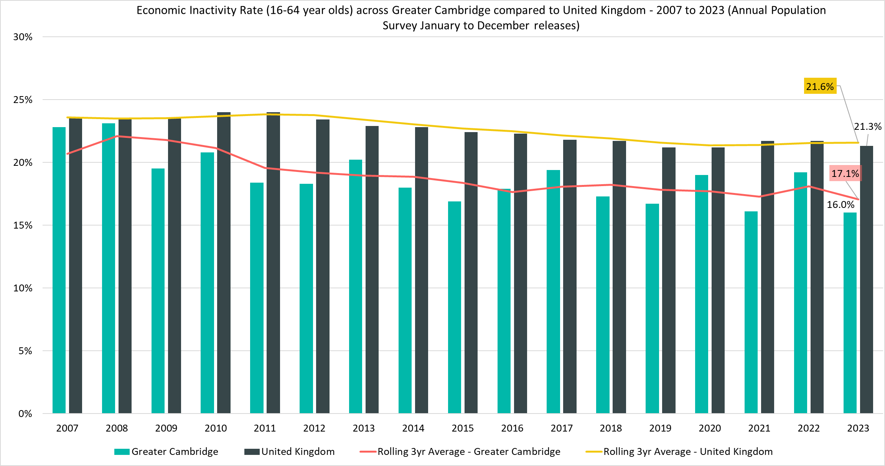
Economically Inactive (16-64 Year Olds) – 16.3%, (January 2023 – December 2023)
Rolling Quarterly change
(Sept 23– Dec 23):
Previous change
(Jun 23– Sept 23):
Change since Dec 2022:
-0.3pp
-2.4pp
-3.2pp
Comparing January 2023 - December 2023 with October 2022 - September 2023
Comparing October 2022 - September 2023 with July 2022 - June 2023
Comparing January 2023 - December 2023 with January 2022 - December 2022
Notes:
Source – Annual Population Survey (2006-2023), Office for National Statistics
Technical Notes
A residence based labour market survey encompassing population, economic activity (employment and unemployment), economic inactivity and qualifications. These are broken down where possible by gender, age, ethnicity, industry and occupation. Available at Local Authority level and above. Updated quarterly.
It is important to note that due to the small geographical area considered, and the Annual Population Survey being based on a representative sample, this may be due to a quarterly fluctuation rather than any kind of long-term trend in the data.
The experimental national labour market statistics release has been discontinued. National figures are now taken from the Labour Force Survey (LFS). Increased volatility of LFS estimates, resulting from smaller achieved sample sizes, means that estimates of quarterly change should be treated with additional caution. Caution should be taken with interpreting these figures and comparisons to Greater Cambridge.
Percentage point changes use the full percentage decimal number in calculations and therefore when comparing rounded percentages, the result may differ.
Commentary
The above chart shows the percentage of those aged 16-64 who are economically inactive across Greater Cambridge and the United Kingdom from 2007 to 2023.
The percentage of those who were economically inactive in Greater Cambridge has been consistently below the national level
Over the last year there has been a decrease in the economic inactivity rate across Greater Cambridge (-3.2pp) meaning that that the gap has widened with the UK as a whole. This influx of those re-entering the labour market could be driving the high unemployment rate in the Greater Cambridge area.

Slide 9
Claimant Counts
Claimant Count of Benefits Related to Unemployment – March 2024
Universal Credit Claimant Counts – March 2024

Slide 10
Claimants of Benefits related to Unemployment – March 2024
Claimant counts across Greater Cambridge have increased across all groups since the last update (December 2023 to March 2024) and have also increased year on year (comparing March 2023 to March 2024), with increases across both Cambridge and South Cambridgeshire districts. Year on year and quarterly increases are smaller than those nationally. The increasing claimant counts suggest those who are unemployed are struggling to find work.
A lower proportion (1.9%) of Greater Cambridge residents claim benefits related to unemployment compared to the UK (3.8%). However, there is a high degree of disparity within the area itself with claimant rates ranging from 5.2% in King’s Hedges (North Cambridge) to 0.3% in Newnham (North West Cambridge).
In Cambridge, residents in the 25-634 age range have the highest claimant rate (2.3%) whilst in South Cambridgeshire, the 18-24 age group account for the highest claimant rate (2.7%). This could suggest that youth unemployment is more prevalent in South Cambridgeshire than Cambridge City, potentially because of Cambridge’s large full time student population who are mostly ineligible for unemployment benefits.
Compared to March 2023, the 12 month rolling percentage changes in the number of claimants show increases across all age groups except for those aged 50+. This has resulted in overall increases for claimants aged 16+. The magnitude of increases across the 16-24 age group has decreased since June 2023 with increases now in line with other age groups.

Slide 11
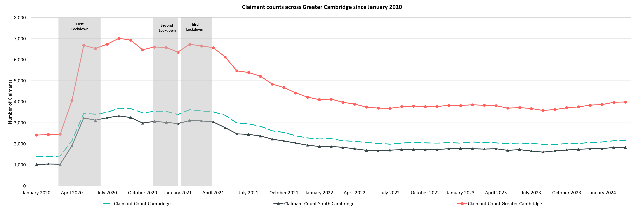
Labour Market – Claimant Count
The Claimant Count measures the number of people (age 16+) claiming benefit principally for the reason of being unemployed. We use data on claimants rather than unemployed numbers because – although the numbers are lower – they are more up to date. It is however a narrower measure of unemployment, and as such does not cover all those out of work, since not all can claim assistance.
Claimant Counts | Number of claimants March 2024 | % Change 12 Months ago vs Now: March 2023 to March 2024 | % Change Previous update vs Now: December 2023 to March 2024
Greater Cambridge | 3,990 | +4.0% | +3.9%
Cambridge City | 2,170 | +4.6% | +4.6%
South Cambridgeshire | 1,820 | +3.7% | +3.1%
United Kingdom | 1,626,235 | +4.4% | +5.4%
Notes:
Source – Claimant Count, Office for National Statistics
Technical Notes
The Claimant Count measures the number of people (age 16+) claiming benefit principally for the reason of being unemployed. We use data on claimants rather than unemployed numbers because although the numbers are lower they are more up to date. It is however a narrower measure of unemployment, and as such does not cover all those out of work, since not all can claim assistance. The latest claimant count data is a snapshot of the number of claimants on the 14th March 2024
Commentary
The above chart presents claimant counts across Greater Cambridge from January 2020 to March 2024.
March 2024 data showed increases in claimant count since the last update, there was a +3.9% increase from December 2023 across Greater Cambridge compared to a +5.4% increase across the United Kingdom.
When comparing March 2024 to March 2023, there a was +4.0% increase in claimant counts across Greater Cambridge, with a +4.6% increase in Cambridge City and a +3.7% increase in South Cambridgeshire. This compares to a +4.4% annual increase across the United Kingdom.
Claimant counts are still above pre-pandemic levels but this may be masked by policy changes.

Slide 12
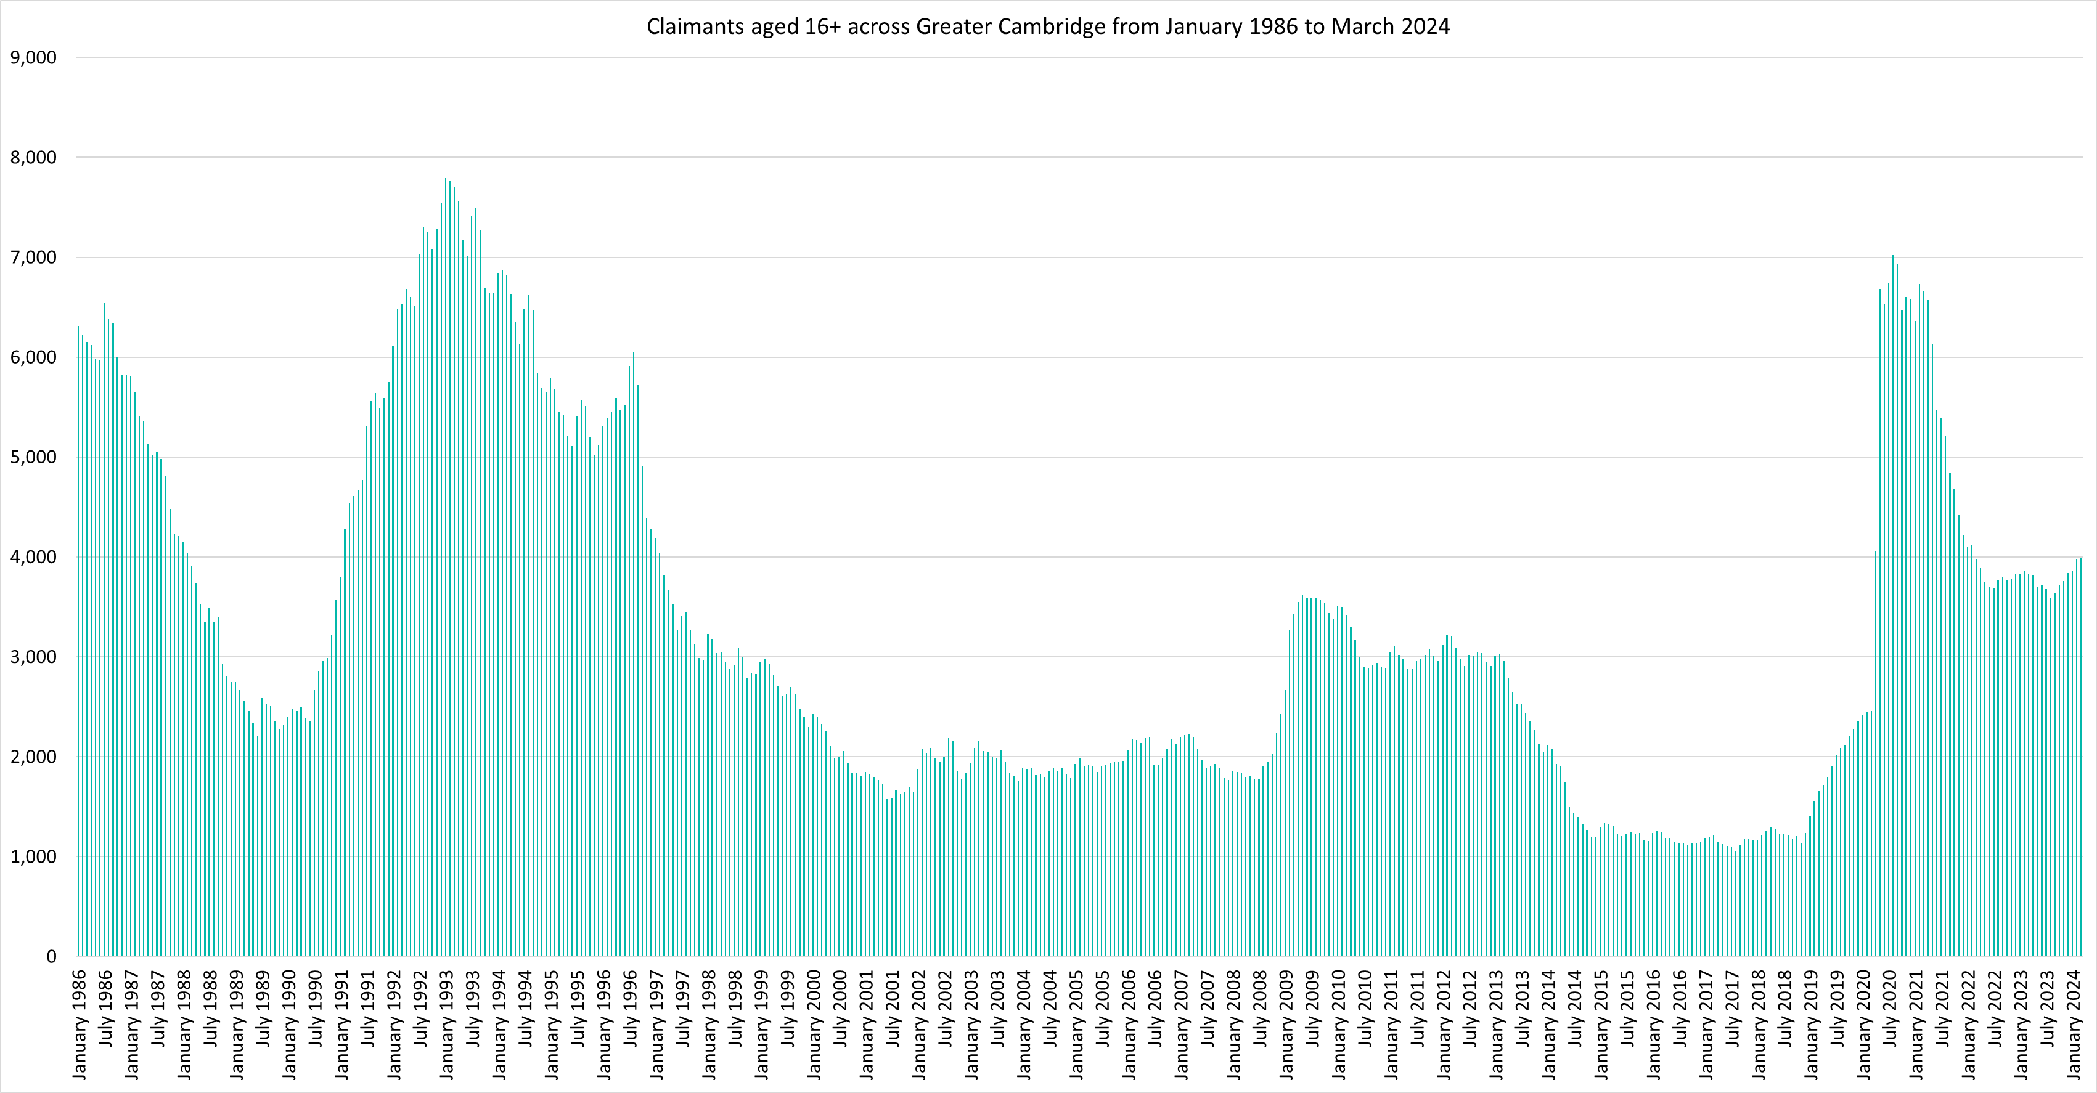
Labour Market – Claimant counts across time
Notes:
Source – Claimant Count, Office for National Statistics
Technical Notes
The Claimant Count measures the number of people (age 16+) claiming benefit principally for the reason of being unemployed. We use data on claimants rather than unemployed numbers because although the numbers are lower they are more up to date. It is however a narrower measure of unemployment, and as such does not cover all those out of work, since not all can claim assistance. The latest claimant count data is a snapshot of the number of claimants on the 14th March 2024.
Commentary
The above chart presents claimant counts across Greater Cambridge from January 1986 to March 2024.
August 2020 (7,020) saw the highest number of claimants since 1993.
Claimant counts have decreased at a faster rate than seen from 1992, but this decline appears to have now stabilised with claimant counts now trending upwards.

Slide 13
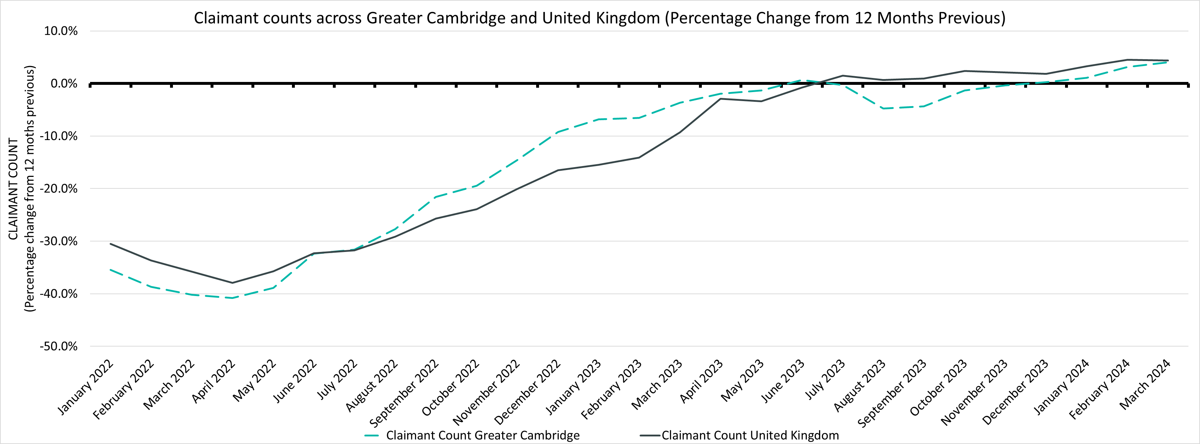
Labour Market – Claimant Count Percentage Change from 12 Months Previous
Claimant Counts | Number of claimants March 2024 | % Change 12 Months ago vs Now: March 2023 to March 2024 | % Change Previous update vs Now: Decembre 2023 to March 2024
Greater Cambridge | 3,990 | +4.0% | +3.9%
United Kingdom | 1,626,235 | +4.4% | +5.4%
Notes:
Source – Claimant Count, Office for National Statistics
Technical Notes
The Claimant Count measures the number of people (age 16+) claiming benefit principally for the reason of being unemployed. We use data on claimants rather than unemployed numbers because although the numbers are lower they are more up to date. It is however a narrower measure of unemployment, and as such does not cover all those out of work, since not all can claim assistance. The latest claimant count data is a snapshot of the number of claimants on the 14th March 2024.
Commentary
The above chart presents claimant counts across Greater Cambridge and as a percentage change from 12 months previous.
Throughout 2022 and the first half of 2023 the number of claimants compared to the same point in the previous year has been lower in Greater Cambridge as well as the UK as a whole.
Year on year increases have been seen across Greater Cambridge since December 2023. The latest data shows continuing increases across both the United Kingdom and Greater Cambridge.

Slide 14
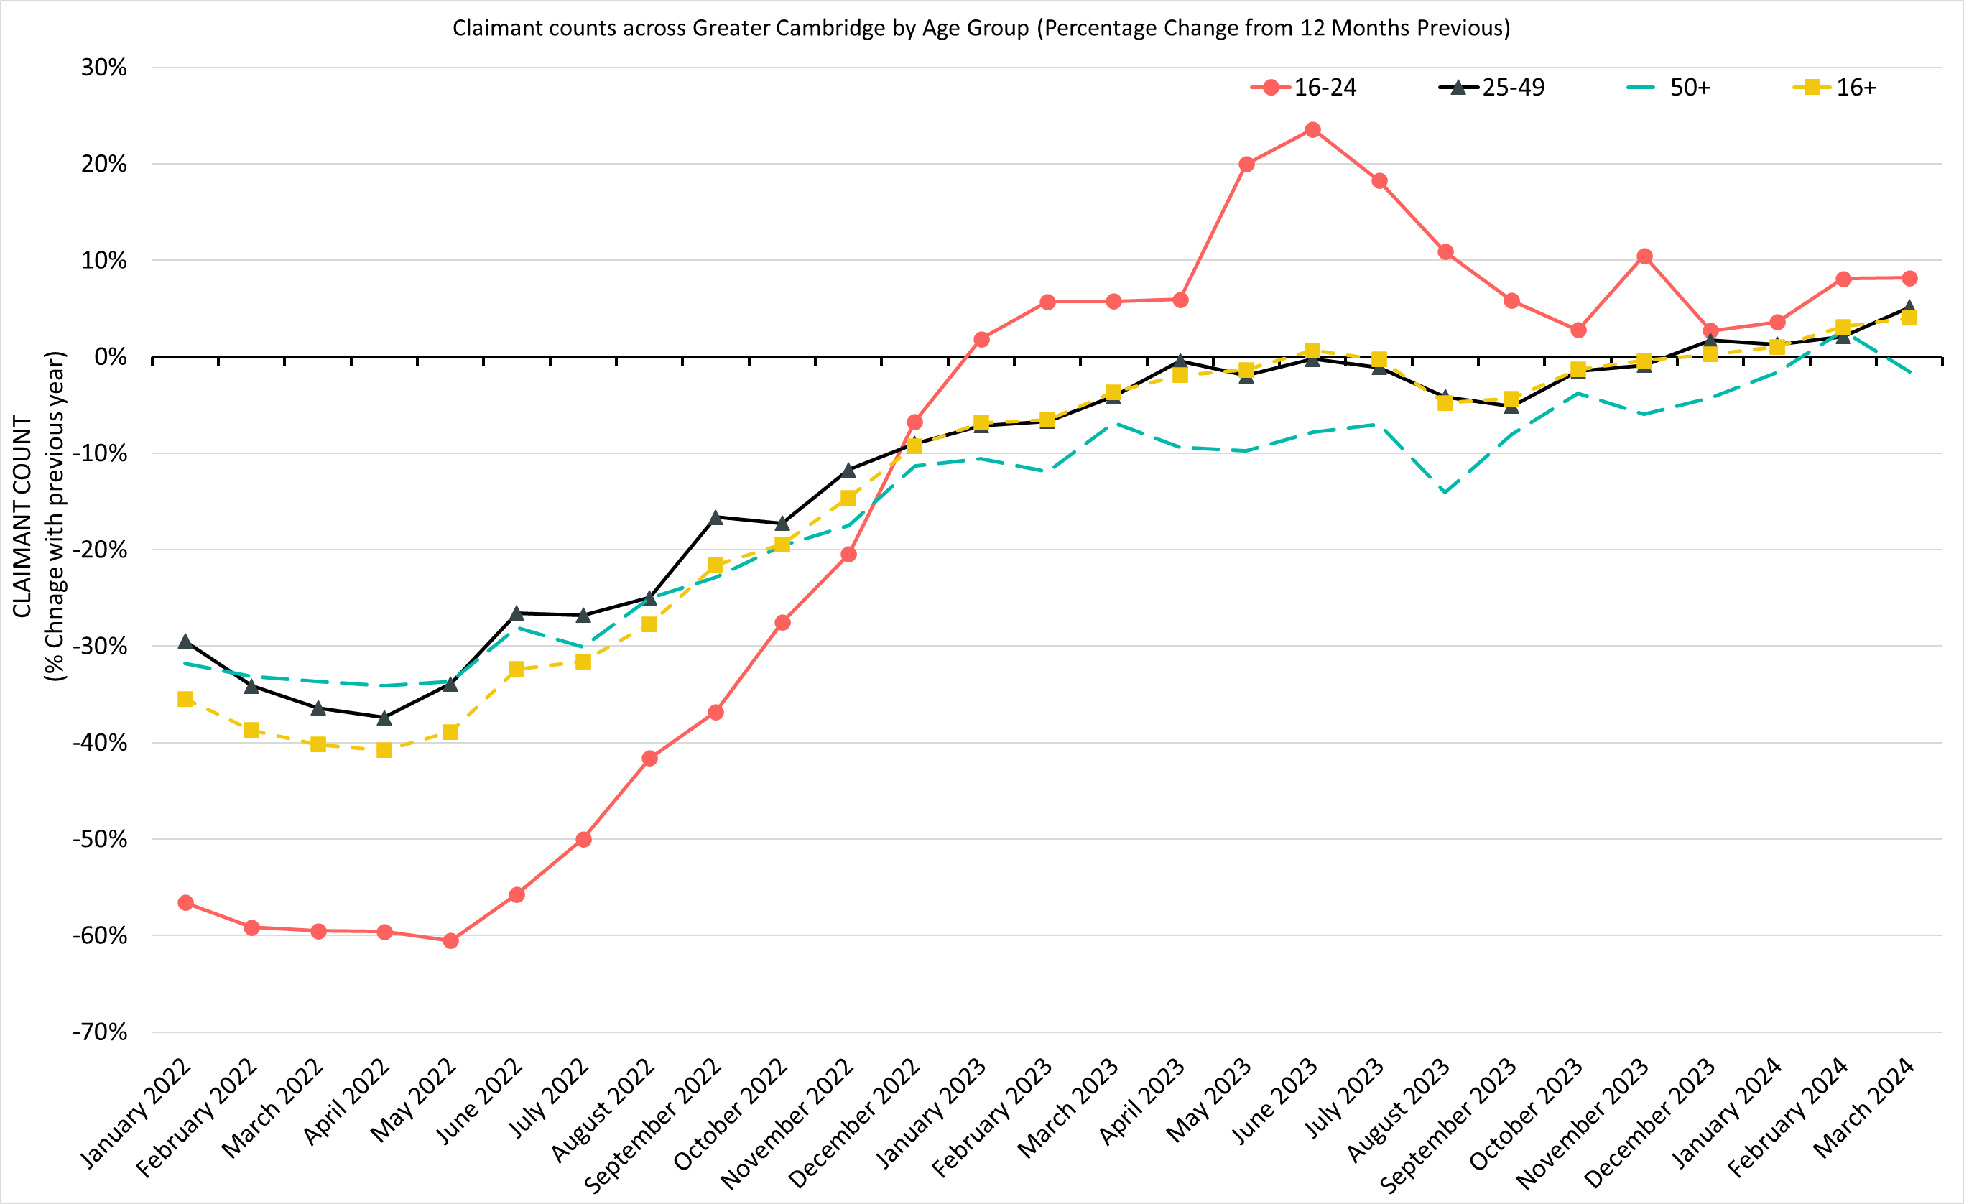
Labour Market – Claimant counts by age
March 2024 Claimant Counts by Age Group (Previous 12 month % Change)
% Change in Claimant Counts | 16+ | 16-24 | 25-49 | 50+
Greater Cambridge (March 2023 to March 2024) | +4.0% | +8.2% | +5.2% | -1.6%
Greater Cambridge (December 2023 to March 2024 | +3.9% | +4.4% | +3.2% | +4.4%
United Kingdom (March 2023 to March 2024) | +5.8% | +9.2% | +5.7% | +3.7%
United Kingdom (September 2022 to December 2023) | +5.4% | +4.6% | +5.1% | +6.6%
% of Total 16+ Claimants (March 2024) | 16-24 | 25-49 | 50+
 | 15% | 61% | 24%
Notes:
Source – Claimant Count, Office for National Statistics
Technical Notes
The Claimant Count measures the number of people (age 16+) claiming benefit principally for the reason of being unemployed. We use data on claimants rather than unemployed numbers because although the numbers are lower they are more up to date. It is however a narrower measure of unemployment, and as such does not cover all those out of work, since not all can claim assistance. The latest claimant count data is a snapshot of the number of claimants on the 14th March 2024.
Compared to March 2024, the 12 month rolling percentage changes in the number of claimants show increases across the all age groups except for those aged 50+. This has resulted in overall increases for claimants aged 16+.

Slide 15
Labour Market – Claimant Rates by Age Group
March 2024 Claimant Rates by Age Group
Claimant Rates | Number of Claimants 16-64 March 2024 | 16-64 March 2024 | 16-24 March 2024 | 16-17 March 2024 | 18-24 March 2024 | 25-49 March 2024 | 50-64 March 2024
Cambridge City | 2,130 | 2.0% | 1.1% | 0.2% | 1.2% | 2.3% | 2.3%
South Cambridgeshire | 1,790 | 1.8% | 1.9% | 0.1% | 2.7% | 2.1% | 1.3%
Greater Cambridge | 3,920 | 1.9% | 1.3% | 0.2% | 1.5% | 2.2% | 1.6%
United Kingdom | 1,600,700 | 3.8% | 4.1% | 0.2% | 5.2% | 4.4% | 2.6%
Notes:
Source – Claimant Count, Office for National Statistics
Technical Notes
The Claimant Count measures the number of people (age 16+) claiming benefit principally for the reason of being unemployed. We use data on claimants rather than unemployed numbers because although the numbers are lower they are more up to date. It is however a narrower measure of unemployment, and as such does not cover all those out of work, since not all can claim assistance. The latest claimant count data is a snapshot of the number of claimants on the 14th March 2024
Commentary
The above table presents the March 2024 claimant count as a rate of the resident population by age group.
The 18-24 claimant rate remains higher than the other age groups across South Cambridgeshire. Cambridge City bucks this trend, this may be because a large proportion of 18-24 year olds there will be full time students who are, for the most part, ineligible for claiming unemployment benefits.
In Greater Cambridge overall, residents in the 25-49 age range have the highest claimant rate (2.2%).

Slide 16
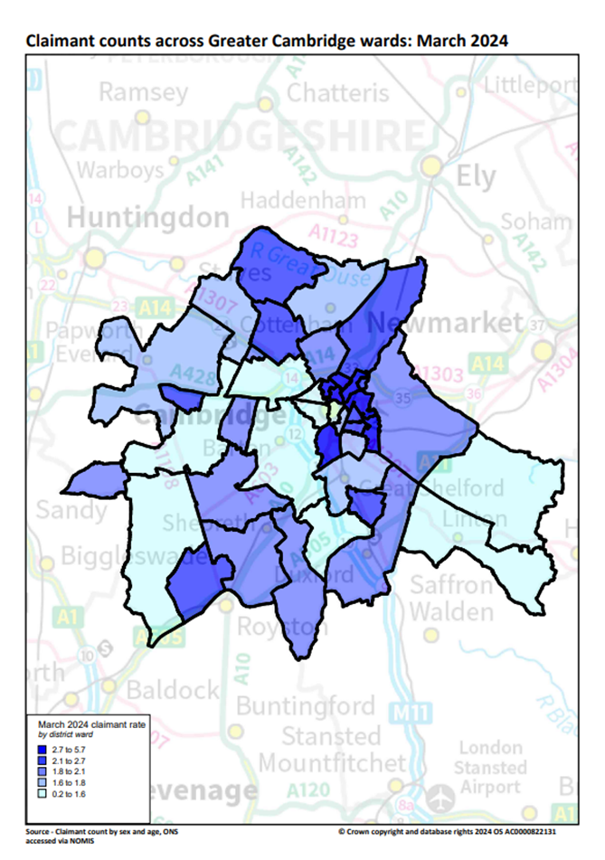
Labour Market – Claimant counts by location
Please note: this slide analyses claimant numbers (16+) against working age population (16-64), therefore not directly comparable to the previous slide.
A lower proportion of Greater Cambridge residents claim benefits related to unemployment when compared to the UK. However, there is a high degree of disparity within the area itself with claimant rates ranging from 5.7% in King’s Hedges (North Cambridge) to 0.2% in Newnham (North West Cambridge).
Higher claimant rates seem appear to especially affect wards in the north of the region such as the King’s Hedges, Arbury, and Abbey.
King's Hedges (+0.9pp), Hardwick (+0.8pp), Arbury, and Bar Hill (both +0.5pp) had the largest rate increases between March 23 to March 24.
Notes:
Technical Notes
The Claimant Count measures the number of people (age 16+) claiming benefit principally for the reason of being unemployed. We use data on claimants rather than unemployed numbers because although the numbers are lower they are more up to date. It is however a narrower measure of unemployment, and as such does not cover all those out of work, since not all can claim assistance. The latest claimant count data is a snapshot of the number of claimants on the 14th March 2024
A lower proportion of Greater Cambridge residents claim benefits related to unemployment when compared to the UK. However, there is a high degree of disparity within the area itself with claimant rates ranging from 5.7% in King’s Hedges (North Cambridge) to 0.2% in Newnham (North West Cambridge).
Higher claimant rates seem appear to especially affect wards in the north of the region such as the King’s Hedges, Arbury, and Abbey.
King's Hedges (+0.9pp), Hardwick (+0.8pp), Arbury, and Bar Hill (both +0.5pp) had the largest rate increases between March 23 to March 24.

Slide 17
Universal Credit Claimants – March 2024
Policy changes to provide economic support during the Covid-19 pandemic allowed those on higher incomes than previously to claim Universal Credit, resulting in a permanent rise in claimants since the Spring lockdowns of 2020.
On an annual basis Greater Cambridge continues to see a higher increase in the number of claimants than Great Britain as a whole. This has been driven by a rise in both unemployed claimants and employed claimants.
The number of claimants on a quartely basis is also increasing across Greater Cambridge although these increases are smaller than nationally. These increases are only due to increases in unemployed claimants.
This again suggests those re-entering the labour market are struggling to find work.
As with the other benefit claimant measure, Greater Cambridge has a lower claimant rate than Great Britain.
Unemployed claimants have consistently made up the majority of claimants at both a wider area and local authority level. Unemployed claimants have driven both the quartely and annual increases in the number of claimants. The number of employed claimants is increasing on an annual basis but has not changed since the last update.
Notes:
Source – Universal Credit Claimants, Department for Work and Pensions
Technical Notes
Universal Credit is available in every jobcentre across Great Britain. Roll out was completed in December 2018.
Universal Credit is a single payment for each household to help with living costs for those on a low income or out of work. It is replacing six benefits, commonly referred to as the legacy benefits:
Income-based Jobseeker's Allowance
Income-related Employment and Support Allowance
Income Support
Working Tax Credit
Child Tax Credit
Housing Benefit
Support for housing costs, children and childcare costs are integrated into Universal Credit. It also provides additions for people with a disability, health condition or caring responsibilities which may prevent them from working.

Slide 18
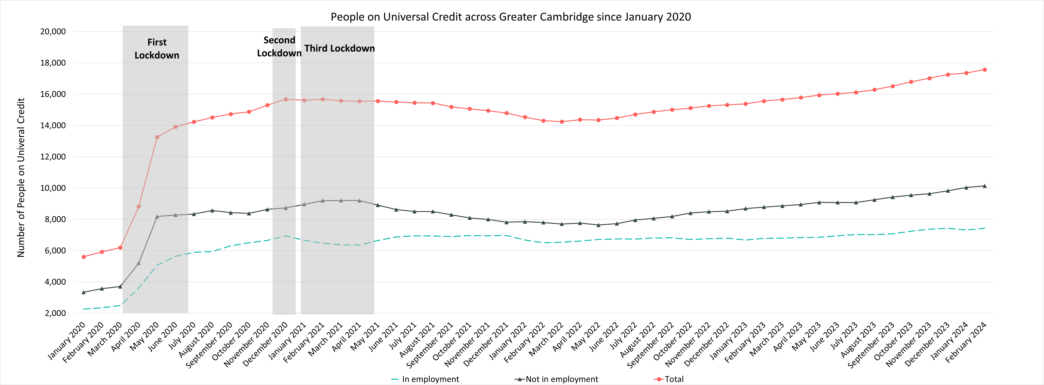
Labour Market – People on Universal Credit
Universal Credit Status | Number of Claimants February 2024 | Share of Total February 2024 | % Change with December 2023 | % Change with February 2023
Employed | 7,428 | 42% | +0.0% | +9.5%
Unemployed | 10,140 | 58% | +3.1% | +15.5%
Total | 17,568 |  | +1.8% | +12.9%
Notes:
Source – Universal Credit Claimants, Department for Work and Pensions
Technical Notes
Universal Credit is available in every jobcentre across Great Britain. Roll out was completed in December 2018.
Universal Credit is a single payment for each household to help with living costs for those on a low income or out of work. It is replacing six benefits, commonly referred to as the legacy benefits:
Income-based Jobseeker's Allowance
Income-related Employment and Support Allowance
Income Support
Working Tax Credit
Child Tax Credit
Housing Benefit
Support for housing costs, children and childcare costs are integrated into Universal Credit. It also provides additions for people with a disability, health condition or caring responsibilities which may prevent them from working.
The number of Universal Credit claimants includes those who have started Universal Credit (completed the Universal Credit claim process and accepted their Claimant Commitment) and have not had a closure of their claim recorded for this spell, up to the 'count date' (second Thursday in each month). A closure of their claim would be recorded either at the request of the individual or if their entitlement to Universal Credit ends, for example, if they no longer satisfy the financial conditions to receive Universal Credit as they have capital over £16,000.
Commentary
The chart above highlights changes in the number of people on universal credit across Greater Cambridge by Employment Status from January 2020.
It is important to note that the initial rise in claimants during the first lockdown period was due to policy changes brought in as part of the pandemic response that allowed people on higher incomes than before to claim the benefit, the peak of this increase came during the second lockdown in the Winter of 2020.
Unemployed claimants have consistently made up the majority of claimants. The increases across the last quarter, and the last 12 months, have mostly been driven by these unemployed claimants. Employed claimants continue to see increases on a year on year basis.
The numbers of those on universal credit remains much higher than Pre-Covid but this may be masked by policy changes.
Unemployed claimants make up the majority of people on universal credit (58%) and saw a +3.1% increase from December 2023 and a +15.5% increase from February 2022. In comparison employed claimants saw no change from December 2023 and a +9.5% increase from February 2023

Slide 19
Labour Market – People on Universal Credit, Rates and Percentage Changes
People on Universal Credit | Number of total people on Universal Credit February 2024 | Number of claimants aged 16-64 as % 16-64 population February 2024 | % Change 12 Months ago vs Now: February 2023 to February 2024 | % Change Previous update vs Now: December 2023 to February 2024
Cambridge City | 8,543 | 7.9% | +11.1% | +2.0%
South Cambridgeshire | 8,706 | 8.7% | +14.6% | +1.6%
Greater Cambridge | 17,249 | 8.3% | +12.8% | +1.8%
Great Britain | 6,333,689 | 15.4% | +10.7% | +2.3%
Notes:
Source – Universal Credit Claimants, Department for Work and Pensions
Technical Notes
Universal Credit is available in every jobcentre across Great Britain. Roll out was completed in December 2018.
Universal Credit is a single payment for each household to help with living costs for those on a low income or out of work. It is replacing six benefits, commonly referred to as the legacy benefits:
Income-based Jobseeker's Allowance
Income-related Employment and Support Allowance
Income Support
Working Tax Credit
Child Tax Credit
Housing Benefit
Support for housing costs, children and childcare costs are integrated into Universal Credit. It also provides additions for people with a disability, health condition or caring responsibilities which may prevent them from working.
Commentary
The above table highlights changes in the number of people on universal credit across Greater Cambridge in December 2023.
The number of Universal Credit claimants includes those who have started Universal Credit (completed the Universal Credit claim process and accepted their Claimant Commitment) and have not had a closure of their claim recorded for this spell, up to the 'count date' (second Thursday in each month). A closure of their claim would be recorded either at the request of the individual or if their entitlement to Universal Credit ends, for example, if they no longer satisfy the financial conditions to receive Universal Credit as they have capital over £16,000.
Greater Cambridge saw that 8.3% of the 16-64 population claimed Universal Credit, a much lower proportion than Great Britain as a whole (15.4%).
South Cambridgeshire has a higher rate claiming (8.7%) than Cambridge City (7.9%).
South Cambridgeshire has seen a larger change since February 2023 than Cambridge City (+14.6% compared to +11.1%), both higher than Great Britain (10.7%).

Slide 20
Pay and Inflation
Pay As You Earn (PAYE) Real Time Information – February 2024

Slide 21
Pay and Inflation– February 2024
Workers who are resident in Greater Cambridge continue to have higher median monthly pay than the UK overall.
Annual pay growth in the Greater Cambridge area continues to be below inflation contrasting to the United Kingdom. Pay growth across South Cambridgeshire is closer to inflation than Cambridge. Real term wage growth across both Cambridge and South Cambridgeshire is also lower than the United Kingdom.
Since August 2023, the annual pay growth has been decreasing in Cambridge, South Cambridgeshire and the United Kingdom. Inflation has also followed the same trend. Whilst the United Kingdom pay growth has remained above inflation during this decrease, Cambridge and South Cambridgeshire has fallen below.
Cambridge (£2,799) and South Cambridgeshire (£2,767) both have average median pay much higher than the United Kingdom (£2,311), all three geographies have followed similar trends throughout the period 2021-2023
Cambridge and South Cambridgeshire have both seen average pay growth consistently below that of the United Kingdom since September 2021, and despite the gap narrowing throughout 2022 and 2023, pay growth remains below the United Kingdom across the latest data.
Across the latest data pay growth is below inflation across both Cambridge and South Cambridgeshire contrasting to the United Kingdom.
Notes:
Source – Pay as you earn real time information- HMRC
Technical Notes
This data is sourced from HM Revenue and Customs’ Pay As You Earn system which collects income tax and national insurance. The Pay As you Earn Real Time Information data includes all employees payrolled by employers, therefore it does not include income from pensions, property rental or investments, nor does it include self-employment income.
This data is based on employee’s residence rather than where they work.

Slide 22
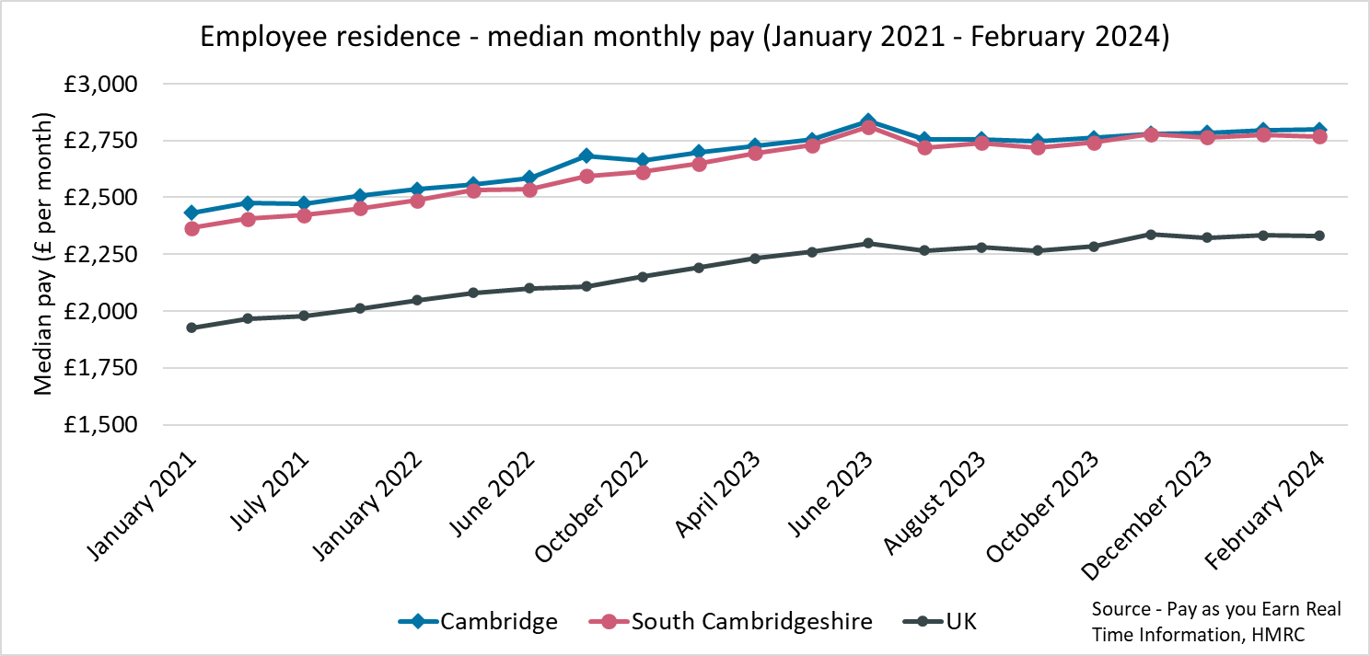
Employment Trends – Median monthly pay (PAYE)
Local Authority | Cambridge | South Cambridgeshire | United Kingdom
Median monthly pay (November 2023) | £2,799 | £2,767 | £2,311
Source – Pay as you earn real time information - HMRC
Previous change
(Jun – Sept 22):
+2.2pp
-2.2pp
Comparing Jan 2022- Dec 2022 with Oct 2021 - Sept 2022
Comparing Oct 2021– Sept 2022 with Jul 2021 – Jun 2022
Comparing Jan 2022- Dec 2022 with Jan 2021 - Dec 2021
Notes:
Source – Pay as you earn real time information- HMRC
Technical Notes
This data is sourced from HM Revenue and Customs’ Pay As You Earn system which collects income tax and national insurance. The Pay As you Earn Real Time Information data includes all employees payrolled by employers, therefore it does not include income from pensions, property rental or investments, nor does it include self-employment income.
This data is based on employee’s residence rather than where they work.
Commentary
The chart above shows median monthly pay for the period January 2021 – February 2024.
Median monthly pay has remained consistently higher in Cambridge (£2,799 in February 2024) and South Cambridgeshire (£2,767 in February 2024) than in the United Kingdom (£2,311 in February 2024).

Slide 23
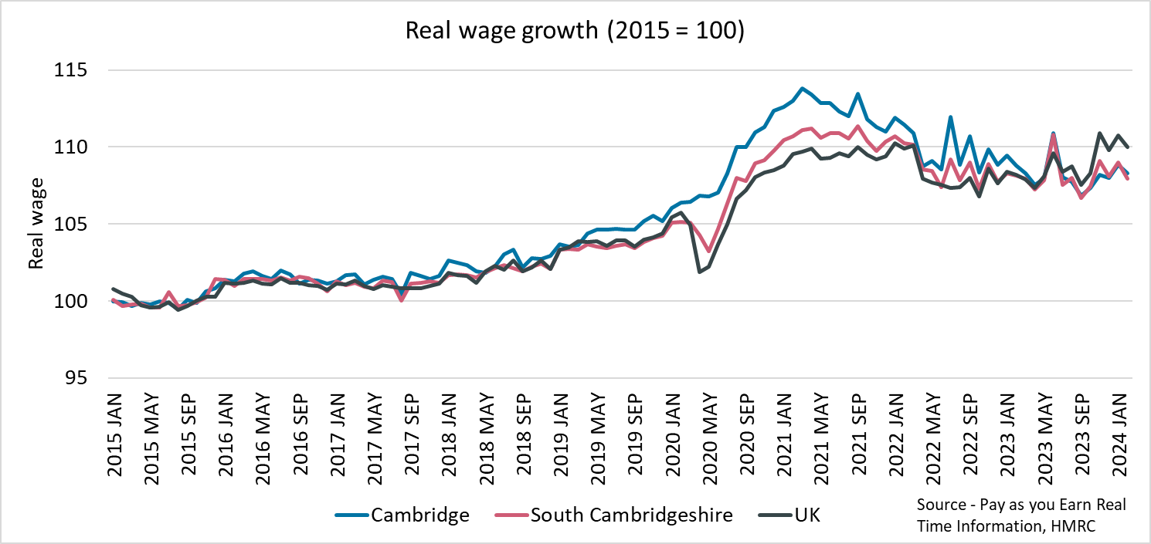
Employment Trends – Real wage growth (PAYE)
Previous change
(Jun – Sept 22):
+2.2pp
-2.2pp
Comparing Jan 2022- Dec 2022 with Oct 2021 - Sept 2022
Comparing Oct 2021– Sept 2022 with Jul 2021 – Jun 2022
Comparing Jan 2022- Dec 2022 with Jan 2021 - Dec 2021
Notes:
Source – Pay as you earn real time information- HMRC
Technical Notes
Real wage growth is calculated by deflating earnings by the Consumer Prices Index including owner occupiers’ housing costs (CPIH).
Commentary
The chart above shows real wage growth for the period January 2015 – February 2024.
Real wage growth in Greater Cambridge has remained consistently in line with the UK except for 2020 to 2022 where growth was substantially higher than the UK across both Cambridge and South Cambridgeshire.
Across the latest data real wage growth is higher in the UK than both Cambridge and South Cambridgeshire.

Slide 24
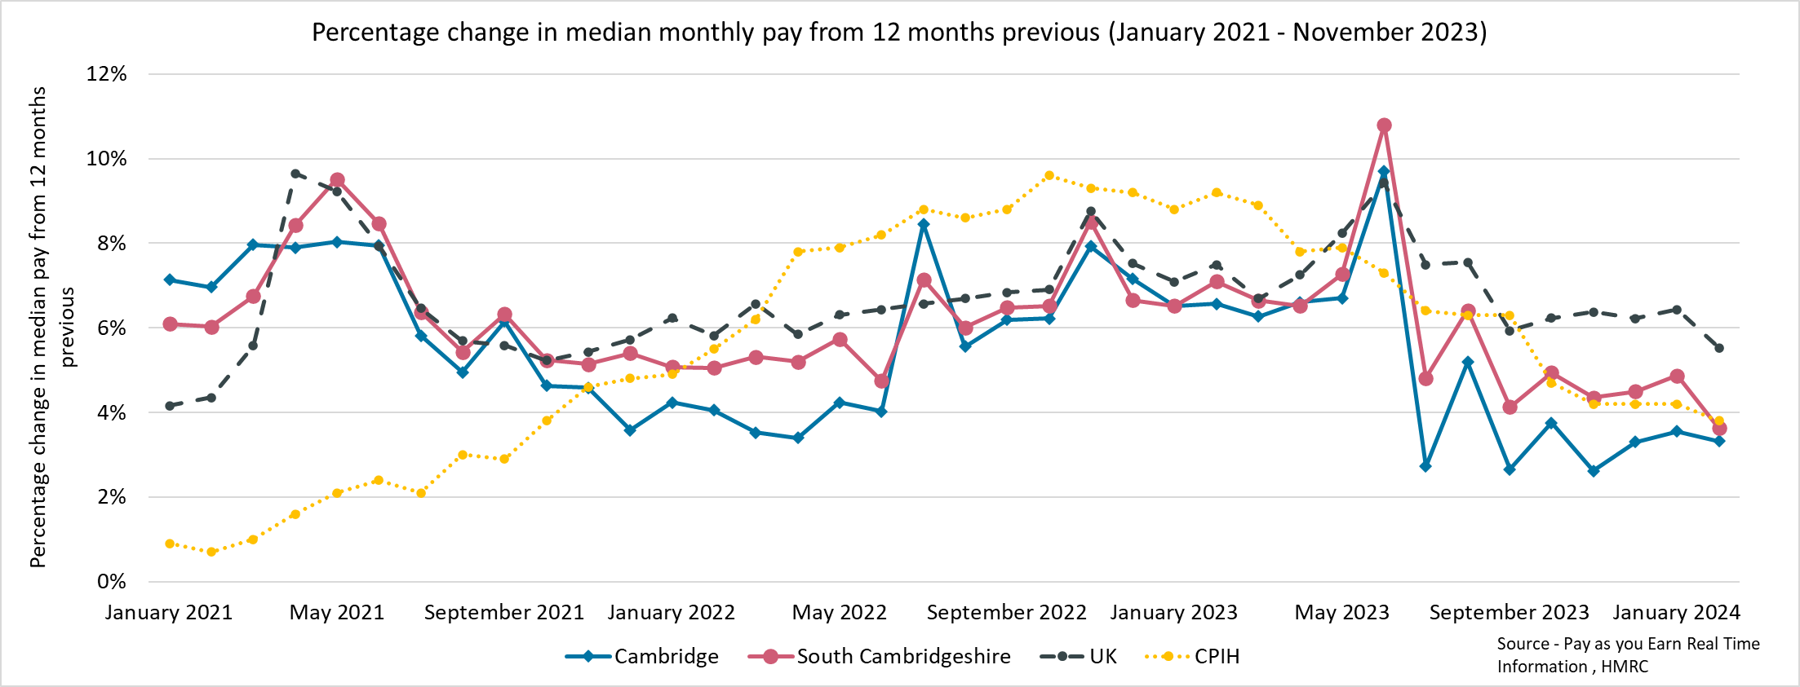
Employment Trends – Median monthly pay growth (PAYE) (January 2021- February 2024)
Local Authority | CPIH (February 2024)* | Cambridge | South Cambridgeshire | United Kingdom
% Change from February 2023 | +3.8% | +3.3% | +3.6% | +5.5%
*The Consumer Prices Index including owner occupiers' housing costs (CPIH) is the office for national statistics’ headline inflation measure Source - Pay as you earn real time information – HMRC
*Inflation given by CPIH – Consumer Price Index including Housing Costs
Notes:
Source – Pay as you earn real time information- HMRC
Technical Notes
This data is sourced from HM Revenue and Customs’ Pay As You Earn system which collects income tax and national insurance. The Pay As you Earn Real Time Information data includes all employees payrolled by employers, therefore it does not include income from pensions, property rental or investments, nor does it include self-employment income.
Commentary
The chart above shows the percentage change in median monthly pay from 12 months previous for the period January 2021 – February 2024.
In February 2024, median monthly pay growth was lower in Cambridge (+3.3%) and South Cambridgeshire (+3.6%) than CPIH (+3.8%), whereas United Kingdom pay growth (+5.5%) was higher than CPIH.
Pay growth in the United Kingdom has been routinely higher than CPIH . In Cambridge pay growth has been below inflation since May 2023. South Cambridgeshire has seen pay growth slightly higher then CPIH, although this has now fallen below in the latest data.

Slide 25
Vacancies
Lightcast Vacancies Data – March 2024

Slide 26
Vacancies – March 2024
After record numbers of vacancies in late 2021 and early 2022, vacancies have declined. Whilst vacancies are still showing year on year decreases, on a quarterly basis they are increasing. Despite this vacancies are very low compared to the previous highs in 2021 and 2022, suggesting opportunities for those re-entering the labour market remain in short supply.
Looking at how vacancies have changed since the previous update, and when compared to the same point in 2023, vacancies have experienced an increase from December 2023 (+16%) but a decrease compared to March 2023 (-33%). These changes are in line with national data.
All sectors experienced an increase in vacancies from December 2023. All sectors also had fewer vacancies than in March 2023.
Notes:
Technical Information
Vacancy data is sourced from Lightcast, a service that has been procured by Greater Cambridge Combined Authority which gives labour market information on Job postings, occupations, and industries. Lightcast has a job posting aggregator which scans jobs websites for posting and presents them together.
Lightcast only scans online jobs postings and therefore does not include any jobs which are advertised solely offline. There is also no guarantee that all online job postings are aggregated. For example, a specific job site may not be scanned.
A unique job posting is a deduplicated count of an online job vacancy advertisement. If the same vacancy is posted twice across a sixty-day period, it is only counted once. If the same vacancy is posted twice more than sixty days apart it is counted as two unique job postings.
The other category includes agriculture, forestry and fishing; Mining and quarrying; Water supply and Waste management

Slide 27
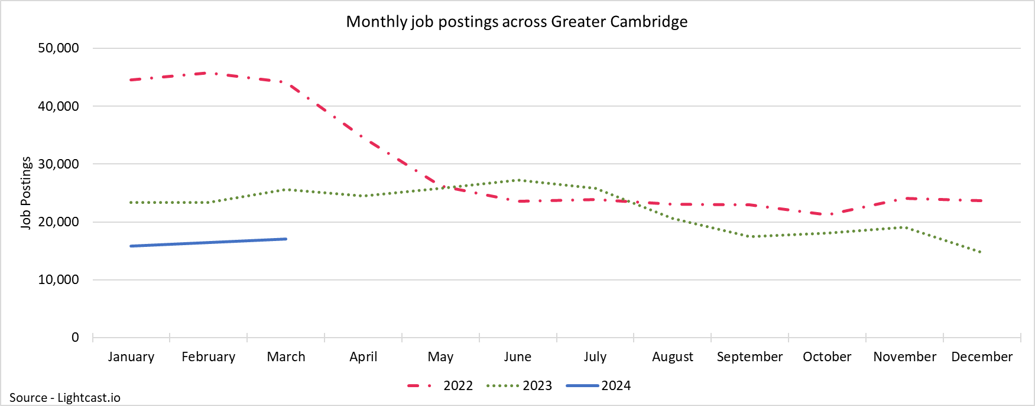
Vacancy Trends– March 2024
17,089
Unique job postings in Greater Cambridge in March 2024
+16%
Increase in unique job postings compared to December 2023
Compared to +11% nationally
-33%
Decrease in unique job postings compared to March 2023
Compared to -32% nationally
Notes:
Source – Lightcast
Technical Information
Vacancy data is sourced from Lightcast, a service that has been procured by Greater Cambridge Combined Authority which gives labour market information on Job postings, occupations, and industries. Lightcast has a job posting aggregator which scans jobs websites for posting and presents them together.
Lightcast only scans online jobs postings and therefore does not include any jobs which are advertised solely offline. There is also no guarantee that all online job postings are aggregated. For example, a specific job site may not be scanned.
A unique job posting is a deduplicated count of an online job vacancy advertisement. If the same vacancy is posted twice across a sixty-day period, it is only counted once. If the same vacancy is posted twice more than sixty days apart it is counted as two unique job postings.
The other category includes agriculture, forestry and fishing; Mining and quarrying; Water supply and Waste management
Commentary
The above chart illustrates online vacancy data across the Greater Cambridge area since January 2021. A unique job posting is a deduplicated count of an online job vacancy advertisement. If the same vacancy is posted twice across a sixty-day period, it is only counted once. If the same vacancy is posted twice more than sixty days apart it is counted as two unique job postings.
Across Greater Cambridge, there were 17,089 job postings in February 2024, this is an increase of +16% from December 2023. Nationally job postings increased by +11% across the same period.
Quartely and annual trends continue to be in line with the national data.
*Lightcast data is available from 2012 onwards.

Slide 28
Employment Trends – Vacancies by Industry
Number of Vacancies in Greater Cambridge in March 2024 compared to the UK Top three sectors with highest proportion of vacancies highlighted green
Sector Identifier | Employment Sector | Vacancies in Greater Cambridge: March 2024 | Percentage of total vacancies | Vacancies in United Kingdom: March 2024 | Percentage of total vacancies
1 | Accommodation and food service activities | 738 | 4% | 86,490 | 5%
2 | Administrative and support service activities | 1,434 | 8% | 186,224 | 10%
3 | Arts, entertainment and recreation | 933 | 5% | 104,097 | 6%
4 | Construction | 1,004 | 6% | 90,276 | 5%
5 | Education | 1,433 | 8% | 185,388 | 10%
6 | Financial and insurance activities | 525 | 3% | 70,949 | 4%
7 | Human health and social work activities | 2,127 | 12% | 267,483 | 14%
8 | Information and communication | 2,226 | 13% | 120,712 | 6%
9 | Manufacturing | 1,349 | 8% | 128,417 | 7%
10 | Other service activities | 63 | 0% | 9,264 | 0%
11 | Professional, scientific and technical activities | 1,227 | 7% | 137,175 | 7%
12 | Public administration and defence; compulsory social security | 302 | 2% | 34,500 | 2%
13 | Real estate activities | 215 | 1% | 22,072 | 1%
14 | Transportation and storage | 628 | 4% | 95,640 | 5%
15 | Wholesale and retail trade; repair of motor vehicles and motorcycles | 897 | 5% | 118,751 | 6%
16 | Other sectors (Agriculture, forestry and fishing; Mining and quarrying; Water supply and Waste management) | 651 | 4% | 68,765 | 4%
Notes:
The above table shows the number of Vacancies in Greater Cambridge in December 2023 by employment sector and includes a national comparison;
Information and Communication (13%) , Human health and social work activities (12%), and Education (8%) have the highest proportion of vacancies across Greater Cambridge. Human health and social work is also the largest sector nationally (14%)
A greater proportion of job vacancies in Greater Cambridge were in the Information and communications sector (13%) compared to the UK as a whole (6%), a difference of 7 percentage points.

Slide 29
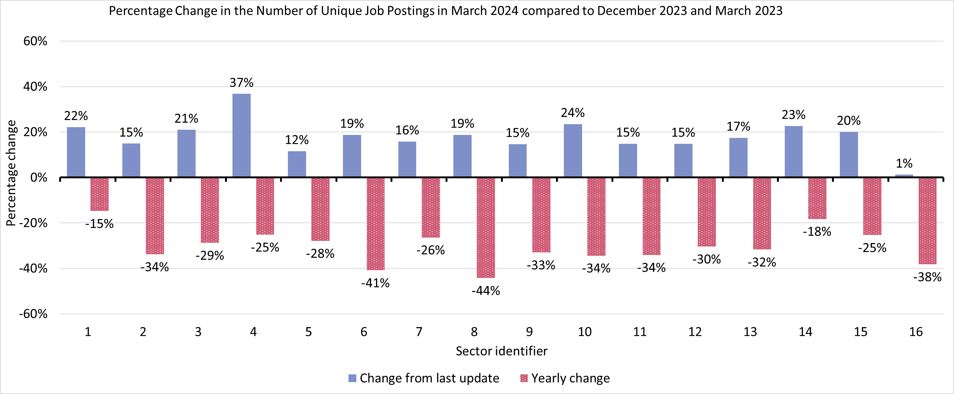
Employment Trends – Vacancies by Industry Changes
Sector Identifier for Chart
Sector Identifier | Sector Name
1 | Accommodation and food service activities
2 | Administrative and support service activities
3 | Arts, entertainment and recreation
4 | Construction
5 | Education
6 | Financial and insurance activities
7 | Human health and social work activities
8 | Information and communication
9 | Manufacturing
10 | Other service activities
11 | Professional, scientific and technical activities
12 | Public administration and defence; compulsory social security
13 | Real estate activities
14 | Transportation and storage
15 | Wholesale and retail trade; repair of motor vehicles and motorcycles
16 | Other sectors (Agriculture, forestry and fishing; Mining and quarrying; Water supply and Waste management)
Notes:
Source – Lightcast
Technical Information
Vacancy data is sourced from Lightcast, a service that has been procured by Greater Cambridge Combined Authority which gives labour market information on Job postings, occupations, and industries. Lightcast has a job posting aggregator which scans jobs websites for posting and presents them together.
Lightcast only scans online jobs postings and therefore does not include any jobs which are advertised solely offline. There is also no guarantee that all online job postings are aggregated. For example, a specific job site may not be scanned.
A unique job posting is a deduplicated count of an online job vacancy advertisement. If the same vacancy is posted twice across a sixty-day period, it is only counted once. If the same vacancy is posted twice more than sixty days apart it is counted as two unique job postings.
The other category includes agriculture, forestry and fishing; Mining and quarrying; Water supply and Waste management
Commentary
The above chart shows how the number of vacancies in March 2024 has changed in each sector compared to the last update (December 2023) and compared to the same point in 2023 (March 2023)
All sectors experienced an increase in vacancies from December 2023. This may suggest that vacancies are starting to starting to trend upwards.
The three sectors with the largest percentage increases from December 2023 were Construction (+37%,), Other service activities (+24%) and Transportation and Storage (+23%). The sectors to see the largest raw number increases were Information and Communication (+352), Human health and social work activities (+291), and Construction (+270).
All sectors saw a decrease in job postings from March 2023:
The largest decreases from a year previous were in Information and Communication (-44%, -1,768), and Financial and insurance activities (-41%, -363).

Slide 30
Employment Trends –by Industry
Median Posting Duration (January – March 2024) (Greater Cambridge) | Posting Intensity (January – March 2024) (Greater Cambridge)
27 Days | 3:1
Median Posting Duration for Vacancies across Greater Cambridge in Days by Employment Sector January – March 2024
Sector Identifier | Employment Sector | January – March 2024 Median Posting Duration (Days) | January – March 2024 Posting Intensity
1 | Accommodation and food service activities | 26 | 3:1
2 | Administrative and support service activities | 26 | 3:1
3 | Arts, entertainment and recreation | 28 | 3:1
4 | Construction | 28 | 3:1
5 | Education | 28 | 2:1
6 | Financial and insurance activities | 25 | 2:1
7 | Human health and social work activities | 29 | 3:1
8 | Information and communication | 24 | 2:1
9 | Manufacturing | 27 | 3:1
10 | Other service activities | 26 | 3:1
11 | Professional, scientific and technical activities | 25 | 2:1
12 | Public administration and defence; compulsory social security | 26 | 2:1
13 | Real estate activities | 27 | 3:1
14 | Transportation and storage | 26 | 3:1
15 | Wholesale and retail trade; repair of motor vehicles and motorcycles | 27 | 3:1
16 | Other sectors (Agriculture, forestry and fishing; Mining and quarrying; Water supply and Waste management) | 27 | 3:1
The chart above shows two metrics to measure the potential difficulty in filling roles in certain sectors:
Median Posting Duration measures how long the average job posting is live online for. A longer time up could suggest that the company anticipates the role being harder to fill
Posting Intensity is a ratio of how many times the same job role is posted. A higher ratio could suggest difficulty filling the role
Notes:
Source – Lightcast
Technical Information
Vacancy data is sourced from Lightcast, a service that has been procured by Greater Cambridge Combined Authority which gives labour market information on Job postings, occupations, and industries. Lightcast has a job posting aggregator which scans jobs websites for posting and presents them together.
Lightcast only scans online jobs postings and therefore does not include any jobs which are advertised solely offline. There is also no guarantee that all online job postings are aggregated. For example, a specific job site may not be scanned.
Median Posting Duration measures how long the average job posting is live online for. A longer time up could suggest that the company anticipates the role being harder to fill.
Posting Intensity is a ratio of how many times the same job role is posted. A higher ratio could suggest difficulty filling the role.
Commentary
The table above shows the median posting duration and the posting intensity for employment sectors from January to March 2024. Both measures can be used as an indication of difficult to fill roles.
Across Greater Cambridge, the median posting duration was 27 days. Human health and social work activities (29) had the highest median posting duration
Information and Communication (24) had the lowest median posting duration. The next lowest median posting duration was Professional, scientific and technical activities (25)
The posting intensity across Greater Cambridge was 3:1. no sectors exceeded this
Professional, scientific and technical activities, Education, and Financial and insurance activities, and Public administration and defence; compulsory social security (all 2:1) are the only sectors below the area average

