Slide 1
CPCA Economy & Employment Update
January 2024 Update
Policy & Insight Team, Cambridgeshire County Council
policyandinsight@cambridgeshire.gov.uk

Slide 2
Labour Market Overview
(July 2022 – June 2023)

Slide 3
Labour Market Headline Findings – October 2022 – September 2023
Across the latest full year of data (October 2022 to September 2023) the Cambridgeshire and Peterborough area had a higher unemployment rate but a higher employment rate and a lower rate of economic inactivity than the UK.
The rise in unemployment coupled with the fall in those economically inactive, seen on both quarterly and annual basis may suggest those re-entering the labour market are struggling to find work. This is reinforced when looking at rising claimant counts and low vacancies.
It should be emphasised, that because the Annual Population Survey is an estimate based on a representative sample so should be treated as purely indicative. Students are also captured in this data and therefore economic inactivity will be influenced by student population dynamics.
It is important to also note that all three measures are expected to fluctuate from release to release and should be treated as broadly indicative. National data should also be treated with caution – this is due to the experimental nature of labour market statistics whilst the Labour Force Survey is redesigned. Caution should be taken with interpreting these figures and comparisons to Cambridgeshire and Peterborough.

Slide 4
Labour Market Headlines - Definitions
Employment Rate (Employed Population/Total Population): The percentage of the total population who are employed
Unemployment Rate (Unemployed Population/Economically Active Population): The proportion of the Economically Active Population without a job, have been actively seeking work in the past four weeks and are available to start work in the next two weeks or are out of work, have found a job and are waiting to start it in the next two weeks
Economic Inactivity Rate (Economically Inactive Population/Total Population: The proportion of the population without a job and have not sought work in the last four weeks and/or are not available to start work in the next two weeks. Example reasons for being economically inactive could include being a student, having caring responsibilities, being sick and disabled and retirement
Note – All of these measures are calculated on the basis of the working age (16-64) population

Slide 5
Key Economic Indicators
Unemployment Rate Overall (aged 16-64) – 4.3%
Quarterly change
Previous Quarterly change
Change since previous year
The unemployment rate between October 2022 and September 2023 was 4.2% (higher than the 4.1% nationally), this has increased by +0.5 percentage points since the last quarter and is +0.8 percentage points higher than the level 12 months previously
Rolling Quarterly change (Jan – Mar 2022):
+0.5pp
+0.7pp
+0.8pp
+1.9%
Comparing Oct 2022 – Sept 2023 with Jul 2022 - June 2023
Comparing Oct 2022 – Sept 2023 with Jul 2022 - June 2023
Comparing Oct 2022 – Sept 2023 with Oct 2021 - Sept 2022
Employment Rate Overall (aged 16-64) – 79.6%
Quarterly change
Previous change
Change since previous year
The employment rate between October 2022 and September 2023 was 79.6% (higher than the 75.7% nationally), this has Increased by +0.9 percentage points since the last quarter and is +1.7 percentage points lower than the level 12 months previously
+0.9pp
-0.4pp
+1.9%
+1.7pp
Comparing Oct 2022 – Sept 2023 with Jul 2022 - June 2023
Comparing Oct 2022 – Sept 2023 with Jul 2022 - June 2023
Comparing Oct 2022 – Sept 2023 with Oct 2021 - Sept 2022
Economically Inactive (aged 16-64) – 16.8%
Previous change
16.8% of residents (aged 16-64) were economically inactive between October 2022 and September 2023 (lower than the 21.0% nationally), this has decreased by -1.4 percentage points since the last quarter and is -2.5 percentage points lower than 12 months previously
Quarterly change
Change since previous year
-1.4pp
-0.2pp
-2.5pp
+1.9%
Comparing Oct 2022 – Sept 2023 with Jul 2022 - June 2023
Comparing Oct 2022 – Sept 2023 with Jul 2022 - June 2023
Comparing Oct 2022 – Sept 2023 with Oct 2021 - Sept 2022
* Please note: estimates and confidence intervals are unreliable due to small sample sizes and so should be treated as indicative.
Notes:
Source – Annual Population Survey, Office for National Statistics
Technical Notes A residence based labour market survey encompassing population, economic activity (employment and unemployment), economic inactivity and qualifications. These are broken down where possible by gender, age, ethnicity, industry and occupation. Available at Local Authority level and above. Updated quarterly.
It is important to note that due to the smaller geographical area considered, and the Annual Population Survey being based on a representative sample, this may be due to a quarterly fluctuation rather than any kind of long-term trend in the data. National data should also be treated with caution – this is due to the experimental nature of labour market statistics whilst the Labour Force Survey is redesigned. Caution should be taken with interpreting these figures and comparisons to Cambridgeshire and Peterborough.
Percentage point changes use the full percentage decimal number in calculations and therefore when comparing rounded percentages the result may differ.
Commentary In a change from previous quarterly releases, Cambridgeshire and Peterborough has a higher unemployment rate than the UK as a whole, but it maintains a higher employment rate and lower rate of economic inactivity amongst the working age population than the UK as a whole.
However, there are a few differences it is important to highlight when looking at how these measures have changed on a quarterly and annual basis.
Quarterly changes – (October 2022 – September 2023)
Compared to the July 2022 – June 2023 release of the Annual Population Survey, Cambridgeshire and Peterborough saw an increase in the unemployment rate (+0.5pp), an increase in the employment rate (+0.9pp) and a decrease in the economic inactivity rate (-1.4pp). A decrease in the economic inactivity rate coupled with the rise in unemployment, suggests residents are re-entering the labour market but struggling to find work.
Annual Change (October 2022 – September 2023 compared to October 2021 – September 2022)
Compared to the same point in the previous year, Cambridgeshire and Peterborough has seen a increase in the employment rate (+0.8pp) an increase in the unemployment rate (+1.7pp) and a decrease in the economic inactivity rate (-2.5pp).

Slide 6
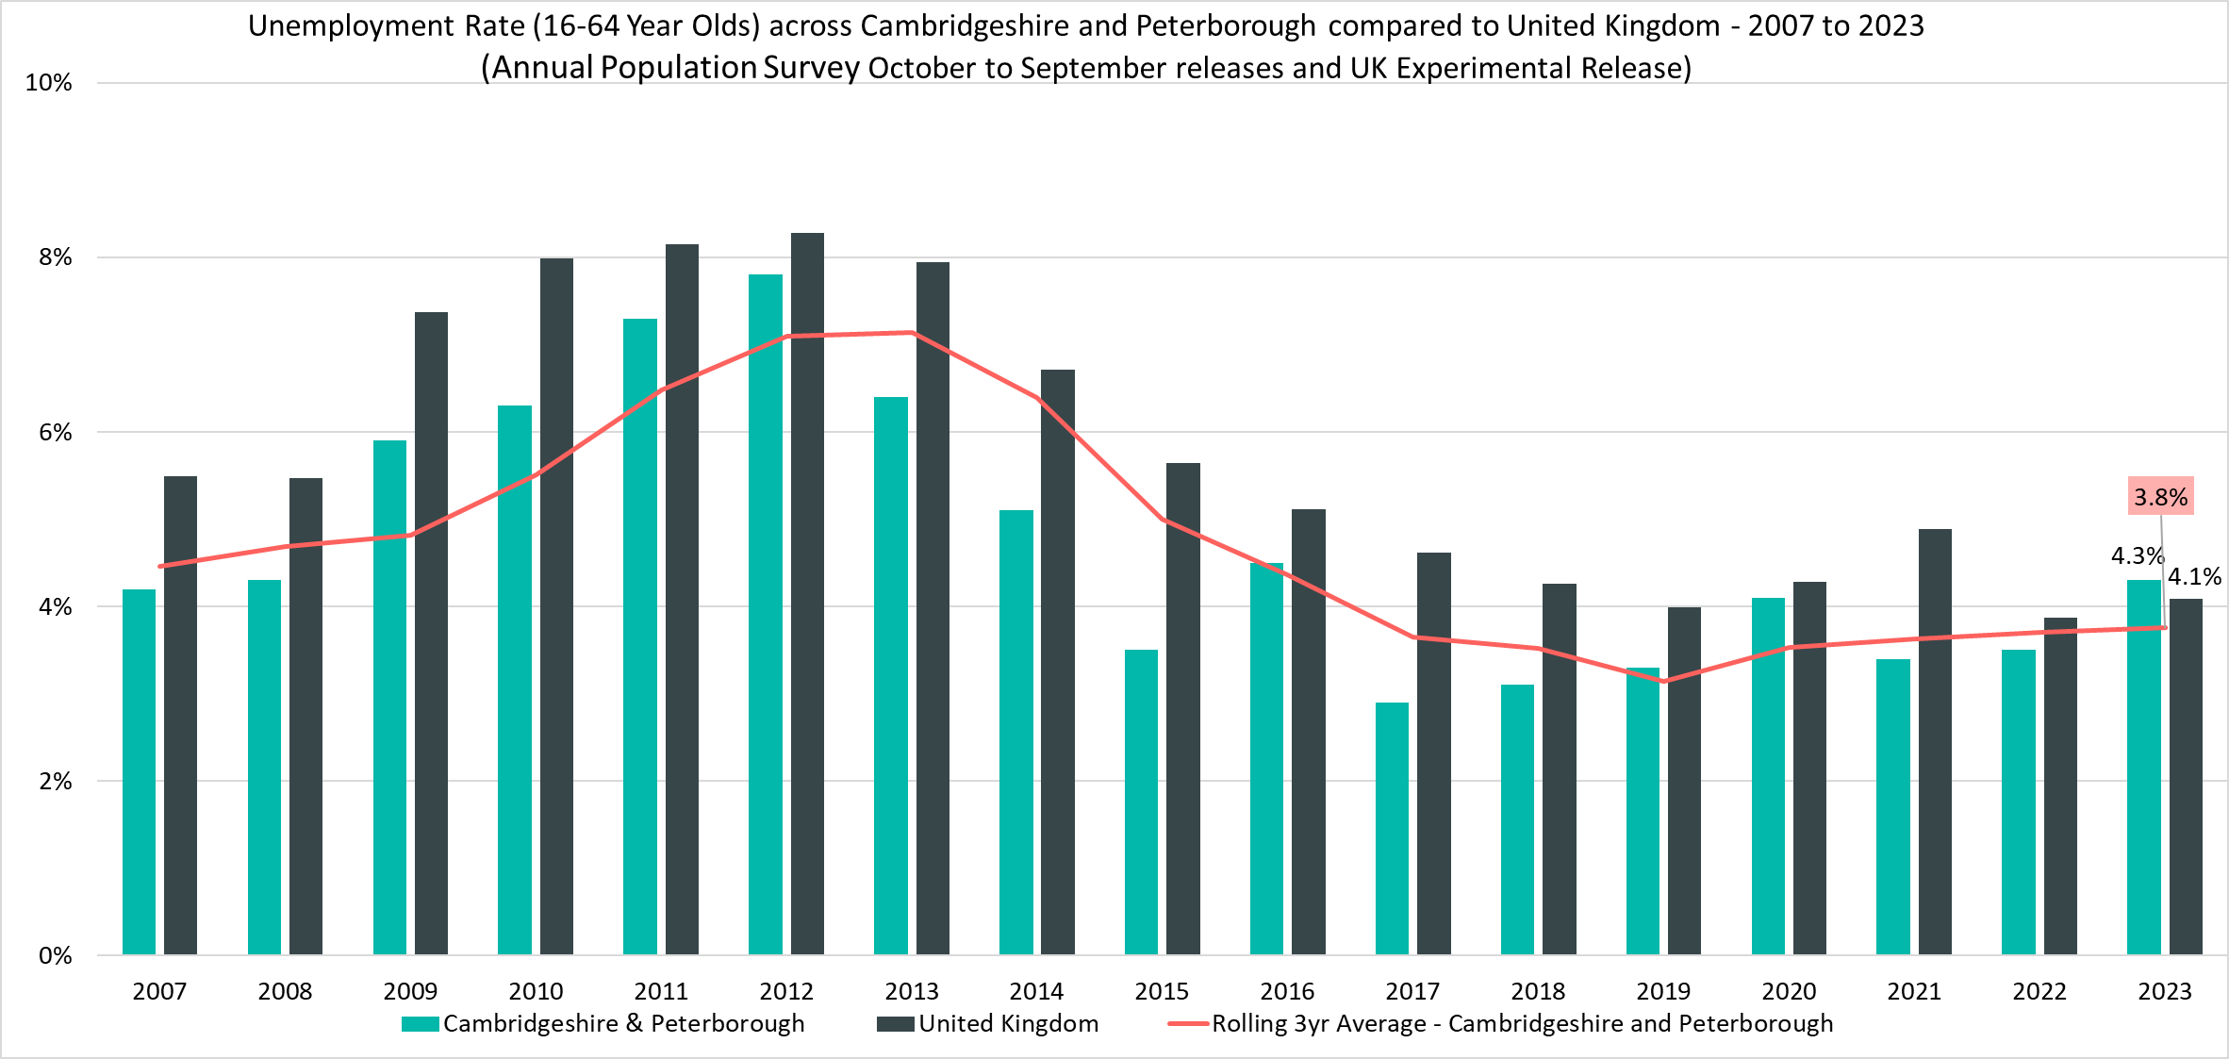
Unemployment Rate (16-64 year olds) – 4.3%, (October 2022 – September 2023)
Rolling Quarterly change (Jun 23– Sept 23):
Previous change Mar 23– June 23):
Change since Sept 2022:
+0.5pp
+0.7pp
+0.8pp
Comparing October 2022 - September 2023 with July 2022 - June 2023
Comparing July 2022 - June 2023 with Apr 2022 - Mar 2022
Comparing October 2022 - September 2023 with October 2021 - September 2022
Notes:
Source – Annual Population Survey (2007-2023), Office for National Statistics
Technical Notes
A residence based labour market survey encompassing population, economic activity (employment and unemployment), economic inactivity and qualifications. These are broken down where possible by gender, age, ethnicity, industry and occupation. Available at Local Authority level and above. Updated quarterly.
It is important to note that due to the smaller geographical area considered, and the Annual Population Survey being based on a representative sample, this may be due to a quarterly fluctuation rather than any kind of long-term trend in the data. National data should also be treated with caution – this is due to the experimental nature of labour market statistics whilst the Labour Force Survey is redesigned. Caution should be taken with interpreting these figures and comparisons to Cambridgeshire and Peterborough.
Percentage point changes use the full percentage decimal number in calculations and therefore when comparing rounded percentages the result may differ.
Commentary
The above chart shows the unemployment rate across Cambridgeshire & Peterborough and the United Kingdom from 2007 to 2023 alongside a rolling three year average for the region using the October to September releases of the Annual Population Survey.
In 2023, for the first time in the period, the unemployment rate in Cambridgeshire and Peterborough (4.3%) is larger than for the United Kingdom (4.1%)
Compared to the previous quarter Cambridgeshire and Peterborough saw a +0.5pp increase in the unemployment rate, compared to the UK where there was a slight decrease of -0.2pp

Slide 7
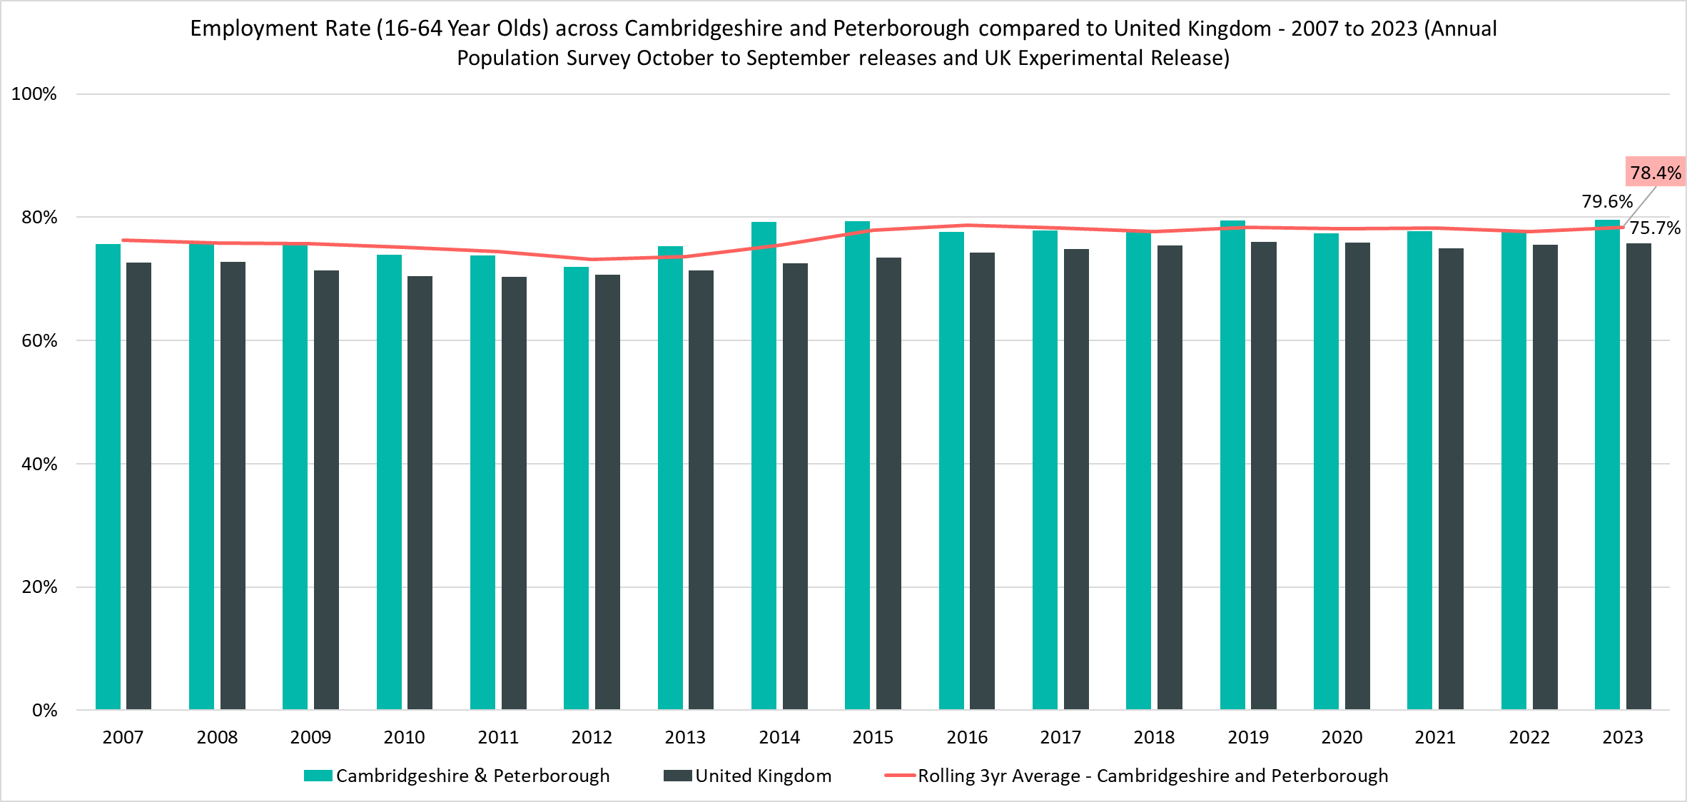
Employment Rate (16-64) – 79.6%, (October 2022 – September 2023)
Rolling Quarterly change (Jun 23– Sept 23):
Previous change Mar 23– June 23):
Change since Sept 2022:
+0.9pp
-0.4pp
+1.7pp
Comparing October 2022 - September 2023 with July 2022 - June 2023
Comparing July 2022 - June 2023 with Apr 2022 - Mar 2022
Comparing October 2022 - September 2023 with October 2021 - September 2022
Notes:
Source – Annual Population Survey (2007-2023), Office for National Statistics
Technical Notes
A residence based labour market survey encompassing population, economic activity (employment and unemployment), economic inactivity and qualifications. These are broken down where possible by gender, age, ethnicity, industry and occupation. Available at Local Authority level and above. Updated quarterly.
It is important to note that due to the smaller geographical area considered, and the Annual Population Survey being based on a representative sample, this may be due to a quarterly fluctuation rather than any kind of long-term trend in the data. National data should also be treated with caution – this is due to the experimental nature of labour market statistics whilst the Labour Force Survey is redesigned. Caution should be taken with interpreting these figures and comparisons to Cambridgeshire and Peterborough.
Percentage point changes use the full percentage decimal number in calculations and therefore when comparing rounded percentages the result may differ.
Commentary
The above chart shows the employment rate across Cambridgeshire & Peterborough and the United Kingdom from 2007 to 2023 alongside a rolling three year average for the region using the October to September releases of the Annual Population Survey.
The employment rate across Cambridgeshire & Peterborough has been consistently higher than the rate seen nationally, compared to the previous quarter, the Cambridgeshire and Peterborough employment rate has increased (+0.9pp) compared to no change for the United Kingdom

Slide 8
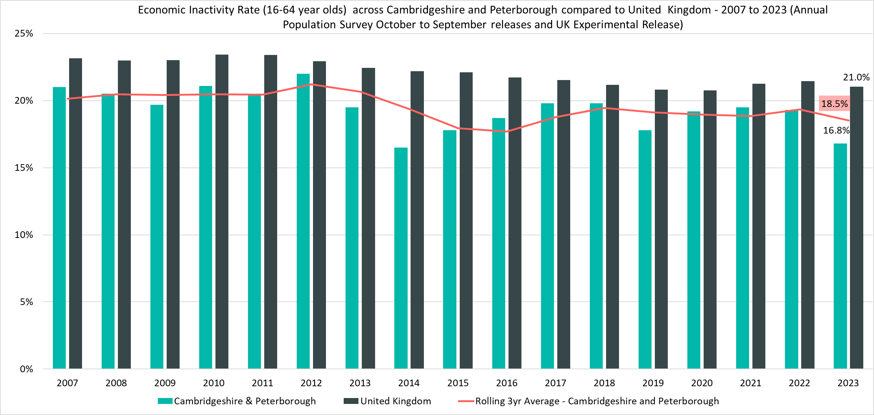
Economically Inactive (16-64 Year Olds) – 16.8%, (October 2022 – September 2023)
Rolling Quarterly change (Jun 23– Sept 23):
Previous change Mar 23– June 23):
Change since Sept 2022:
-1.4pp
-0.2pp
-2.5pp
Comparing October 2022 - September 2023 with July 2022 - June 2023
Comparing July 2022 - June 2023 with Apr 2022 - Mar 2022
Comparing October 2022 - September 2023 with October 2021 - September 2022
Notes:
Source – Annual Population Survey (2007-2023), Office for National Statistics
Technical Notes A residence based labour market survey encompassing population, economic activity (employment and unemployment), economic inactivity and qualifications. These are broken down where possible by gender, age, ethnicity, industry and occupation. Available at Local Authority level and above. Updated quarterly.
It is important to note that due to the smaller geographical area considered, and the Annual Population Survey being based on a representative sample, this may be due to a quarterly fluctuation rather than any kind of long-term trend in the data. National data should also be treated with caution – this is due to the experimental nature of labour market statistics whilst the Labour Force Survey is redesigned. Caution should be taken with interpreting these figures and comparisons to Cambridgeshire and Peterborough.
Percentage point changes use the full percentage decimal number in calculations and therefore when comparing rounded percentages the result may differ.
Commentary
The above chart shows the economically inactive rate across Cambridgeshire & Peterborough and the United Kingdom from 2007 to 2023 alongside a rolling three year average for the region using the October to September releases of the Annual Population Survey.
The percentage of those who were economically inactive in Cambridgeshire and Peterborough has been consistently below the national level
Looking at the change in economic inactivity since the last quarter, Cambridgeshire and Peterborough has seen a decrease (-1.4pp), compared to a slight increase for the UK (+0.1pp)
Whilst the gap in economic inactivity between Cambridgeshire and Peterborough and the UK as a whole closed during the pandemic, with the Cambridgeshire and Peterborough rate of inactivity rising faster than the national one, the region appears have made a faster recovery. This contrasts with the UK where economic inactivity has only slightly decreased.

Slide 9
Claimant Counts
Claimant Count of Benefits Related to Unemployment – December 2023 Universal Credit Claimant Counts – December 2023

Slide 10
Claimants of Benefits related to Unemployment – December 2023
Claimant counts across Cambridgeshire and Peterborough have increased across all age groups since the last update (September 2023) and have also increased slightly year on year (comparing December 2022 to December 2023), with increases across most districts.
As with the Unemployment rate a lower proportion of Cambridgeshire and Peterborough residents claim benefits related to unemployment when compared to the UK. However, there is a high degree of disparity within the region itself as both Fenland and Peterborough have higher claimant rates than nationally wth 42% in Peterborough itself.
18-24 year olds across East Cambridgeshire, Fenland, South Cambridgeshire and Peterborough all have a higher claimant rate than other age groups and the working age population as a whole. This difference was especially apparent within the more relatively deprived local authorities like Fenland and Peterborough where the claimant rate of 18-24 year olds was 2.6 percentage points and 2.7 percentage points higher respectively than the claimant rate for 16-64 year olds overall. It is interesting to note that a less relatively deprived local authority like South Cambridgeshire had the lowest percentage point difference between young adults and the working age population.
Compared to December 2022, the 12 month rolling change in the number of claimants continues to show increases, especially younger claimants and those who live in more relatively deprived areas. Peterborough saw a steep increase in the number of claimants across the year (+9.1% compared to +4.2% in Cambridgeshire and Peterborough and +1.9% in the UK).

Slide 11
Labour Market – Claimant Count
The Claimant Count measures the number of people (age 16+) claiming benefit principally for the reason of being unemployed. We use data on claimants rather than unemployed numbers because – although the numbers are lower – they are more up to date. It is however a narrower measure of unemployment, and as such does not cover all those out of work, since not all can claim assistance.
Claimant Counts | Number of claimants December 2023 | % Change 12 Months ago vs Now: December 2022 to December 2023 | % Change Previous update vs Now: September 2023 to December 2023
Cambridgeshire | 9,430 | +0.8% | +3.9%
Peterborough | 6,920 | +9.1% | -1.1%
Cambridgeshire & Peterborough | 16,355 | +4.2% | +1.7%
United Kingdom | 1,543,460 | +1.9% | +1.3%
Notes:
Source – Claimant Count, Office for National Statistics
Technical Notes
The Claimant Count measures the number of people (age 16+) claiming benefit principally for the reason of being unemployed. We use data on claimants rather than unemployed numbers because although the numbers are lower they are more up to date. It is however a narrower measure of unemployment, and as such does not cover all those out of work, since not all can claim assistance. The latest claimant count data is a snapshot of the number of claimants on the 14th December 2023.
Commentary
The above chart presents claimant counts across Cambridgeshire & Peterborough from January 2020 to December 2023.
Across Cambridgeshire and Peterborough the proportion of residents who are claiming benefits for reason of unemployment is lower than the UK.
December 2023 data showed an increase in claimant counts, there was a +1.7% increase from September 2023 across Cambridgeshire & Peterborough, with a +3.9% increase in Cambridgeshire, and a -1.1% decrease in Peterborough compared to a +1.3% increase across the United Kingdom overall.
When comparing December 2023 to December 2022 there has been a +4.2% increase in claimants across Cambridgeshire & Peterborough, this has been driven by a +9.1% increase in Peterborough, this compares to a smaller increase of +1.9% in the United Kingdom.

Slide 12
Labour Market – Claimant Counts by Local Authority
Claimant Counts | Number of claimants December 2023 | % Change 12 Months ago vs Now: December 2022 to December 2023 | % Change Previous update vs Now: September 2023 to December 2023
Cambridgeshire | 9,430 | +0.8% | +3.9%
Cambridge City | 2,075 | +1.0% | +5.3%
East Cambridgeshire | 1,015 | +3.6% | +8.6%
Fenland | 2,230 | +0.9% | +0.5%
Huntingdonshire | 2,345 | +0.4% | +2.6%
South Cambridgeshire | 1,765 | -0.3% | +6.0%
Peterborough | 6,920 | +9.1% | -1.1%
Cambridgeshire & Peterborough | 16,355 | +4.2% | +1.7%
United Kingdom | 1,543,460 | +1.9% | +1.3%
Notes:
Source – Claimant Count, Office for National Statistics
Technical Notes
The Claimant Count measures the number of people (age 16+) claiming benefit principally for the reason of being unemployed. We use data on claimants rather than unemployed numbers because although the numbers are lower they are more up to date. It is however a narrower measure of unemployment, and as such does not cover all those out of work, since not all can claim assistance. The latest claimant count data is a snapshot of the number of claimants on the 14th December 2023.
Commentary
The above table presents claimant counts across Cambridgeshire & Peterborough in December 2023.
Whilst across Cambridgeshire and Peterborough the proportion of residents who are claiming benefits for reason of unemployment is lower than the UK there is a wide amount of disparity across the region with Fenland, Huntingdonshire and Peterborough both having a higher number of claimants compared to other local authorities. Claimants are especially concentrated within the Peterborough area.
When comparing December 2023 to December 2022, Peterborough (+9.1%) saw the largest year on year increase, East Cambridgeshire (3.6%) was the only other local authority to see year on year growth larger than 1.0%
South Cambridgeshire (-0.3%) was the only local authority to see a year on year decrease
When comparing December 2023 to September 2023, each geography saw an increase in claimant counts except Peterborough (-1.1%)
East Cambridgeshire (+8.6%) and South Cambridgeshire (+6.0%) saw the largest increases from September 2023

Slide 13
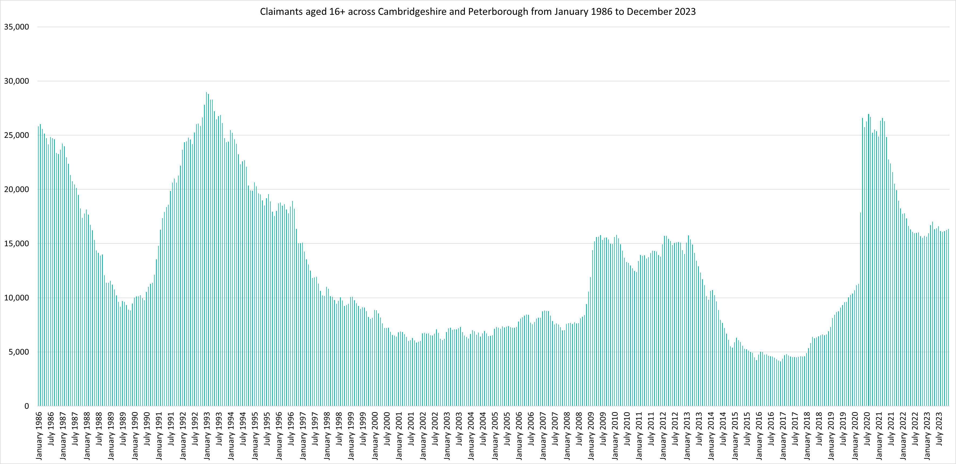
Labour Market – Claimant counts across time
Notes:
Source – Claimant Count, Office for National Statistics
Technical Notes
The Claimant Count measures the number of people (age 16+) claiming benefit principally for the reason of being unemployed. We use data on claimants rather than unemployed numbers because although the numbers are lower they are more up to date. It is however a narrower measure of unemployment, and as such does not cover all those out of work, since not all can claim assistance. The latest claimant count data is a snapshot of the number of claimants on the 14th December 2023.
Commentary
The above chart presents claimant counts across Cambridgeshire & Peterborough from January 1986 to September 2023.
September 2020 (26,700) and August 2020 (26,935) saw the highest number of claimants since 1992.
Claimant counts have decreased at a faster rate than seen from 1992, but this decline appears to have stabilised.

Slide 14
Labour Market – Percentage Change in Claimant Counts
Claimant Counts | Number of claimants December 2023 | % Change 12 Months ago vs Now: December 2022 to December 2023 | % Change Previous update vs Now: September 2023 to December 2023
Cambridgeshire & Peterborough | 16,355 | +4.2% | +1.7%
United Kingdom | 1,543,460 | +1.9% | +1.3%
Notes:
Source – Claimant Count, Office for National Statistics
Technical Notes
The Claimant Count measures the number of people (age 16+) claiming benefit principally for the reason of being unemployed. We use data on claimants rather than unemployed numbers because although the numbers are lower they are more up to date. It is however a narrower measure of unemployment, and as such does not cover all those out of work, since not all can claim assistance. The latest claimant count data is a snapshot of the number of claimants on the 14th December 2023.
Commentary
The above chart presents claimant counts across Cambridgeshire & Peterborough and as a percentage change from 12 months previous.
Throughout 2022 and the first quarter of 2023 the number of claimants compared to the same point in the previous year has been lower in Cambridgeshire and Peterborough, however the annual % decrease has always been lower than that of the UK as a whole.
In Cambridgeshire and Peterborough, from April 2023 onwards claimants have started to increase when comparing to the previous 12 months, this started occurring in the UK from July.
The rate at which these counts have increased had been faster in Cambridgeshire and Peterborough compared to the UK, before being broadly similar from August 2023 to October 2023 before the gap increased again, with Cambridgeshire and Peterborough again higher

Slide 15
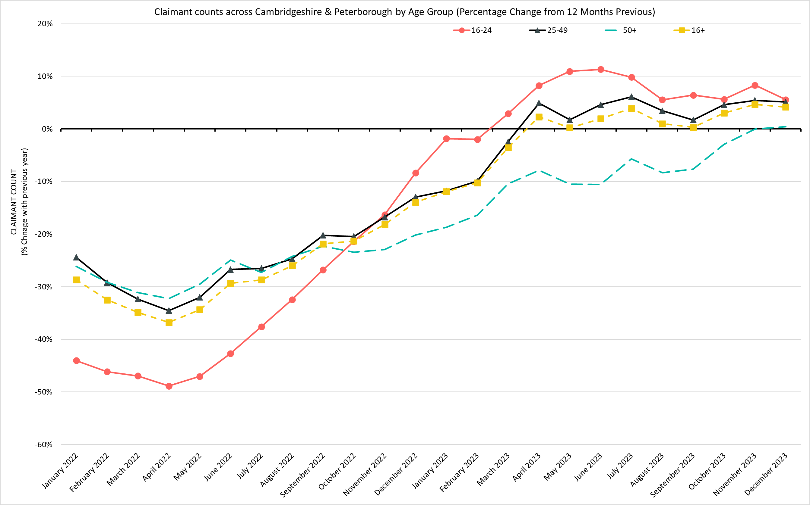
Labour Market – Claimant counts by age
December 2023 Claimant Counts by Age Group (Previous 12 month % Change)
% Change in Claimant Counts | 16+ | 16-24 | 25-49 | 50+
Cambridgeshire & Peterborough (December 2022 to December 2023) | +4.2% | +5.6% | +5.1% | +0.4%
United Kingdom (December 2022 to December 2023) | +1.9% | +6.4% | +3.0% | -+4.3%
Cambridgeshire & Peterborough (September 2023 to December 2023) | +1.7% | +0.9% | +1.7% | +2.3%
United Kingdom (December 2023 to December 2023) | +1.3% | +2.0% | +1.5% | +0.2%
Notes:
Source – Claimant Count, Office for National Statistics
Technical Notes
The Claimant Count measures the number of people (age 16+) claiming benefit principally for the reason of being unemployed. We use data on claimants rather than unemployed numbers because although the numbers are lower they are more up to date. It is however a narrower measure of unemployment, and as such does not cover all those out of work, since not all can claim assistance. The latest claimant count data is a snapshot of the number of claimants on the 14th December 2023.
Commentary
The above chart presents the percentage change in claimant counts by age for the 12 months previous,
National statistics on claimant count since the pandemic have indicated that younger age groups have been disproportionately impacted. The above chart highlights the levels of change each age group has seen in claimant counts across the Cambridgeshire & Peterborough area.
As with the overall trend, all age groups are now seeing increases in claimant counts when compared to the last 12 months, when looking at the change since September 2023, the percentage change in the 50+ age group (+2.3%) is the largest. This contrasts with the percentage changes from 12 months previous where the 50+ age group has the smallest increase (+0.4%).

Slide 16
Labour Market – Claimant Rates by Age Group
December 2023 Claimant Rates by Age Group
Claimant Rates | 16-64 December 2023 | 16-24 December 2023 | 16-17 December 2023 | 18-24 December 2023 | 25-49 December 2023 | 50-64 December 2023
Cambridgeshire | 2.2% | 2.1% | 0.2% | 2.6% | 2.5% | 1.5%
Cambridge City | 1.9% | 1.1% | 0.4% | 1.2% | 2.2% | 2.2%
East Cambridgeshire | 1.9% | 2.3% | 0.0% | 3.0% | 2.1% | 1.4%
Fenland | 3.6% | 4.9% | 0.2% | 6.3% | 4.3% | 2.0%
Huntingdonshire | 2.1% | 2.7% | 0.3% | 3.5% | 2.4% | 1.2%
South Cambridgeshire | 1.8% | 1.7% | 0.1% | 2.4% | 2.1% | 1.2%
Peterborough | 5.0% | 5.7% | 0.3% | 7.6% | 5.4% | 3.5%
Cambridgeshire & Peterborough | 2.9% | 2.9% | 0.2% | 3.6% | 3.2% | 2.0%
United Kingdom | 3.6% | 3.9% | 0.2% | 4.9% | 4.2% | 2.4%
Notes:
Source – Claimant Count, Office for National Statistics
Technical Notes
The Claimant Count measures the number of people (age 16+) claiming benefit principally for the reason of being unemployed. We use data on claimants rather than unemployed numbers because although the numbers are lower they are more up to date. It is however a narrower measure of unemployment, and as such does not cover all those out of work, since not all can claim assistance. The latest claimant count data is a snapshot of the number of claimants on the 14th December 2023.
Commentary
The above table presents the December 2023 claimant count as a rate of the resident population by age group.
National statistics on claimant count since the pandemic have indicated that younger age groups have been disproportionately impacted. The above chart highlights the levels of change each age group has seen in claimant counts across the Cambridgeshire & Peterborough area.
The 18-24 claimant rate also remains higher than the other age groups across Cambridgeshire and Peterborough and four of the six local authorities that make up the Combined Authority. It is particularly high in the more relatively deprived local authorities of Peterborough and Fenland.
In Peterborough, the 18-24 age group also account for the highest claimant rate (7.6%), substantially higher than the 3.6% of this age group claiming across Cambridgeshire and Peterborough. This suggests that youth unemployment is more prevalent in Peterborough than Cambridgeshire as a whole. Fenland also has a high proportion of those aged 18-24 claiming relative to the other local authorities (6.3%).

Slide 17
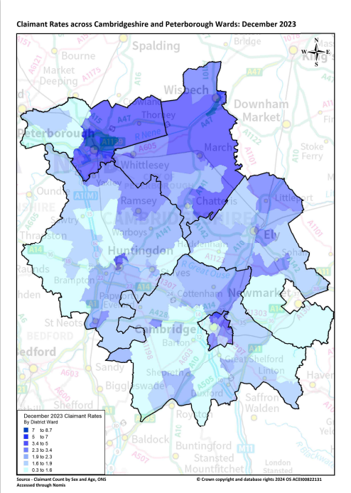
Labour Market – Claimant counts by location
Claimant Rates | Number of claimants 16+ December 2023 | Number of claimants 16-64 as % of 16-64 population December 2023 | PP Change in Claimant Rate 12 Months ago vs Now: December 2022 to December 2023 | PP Change in Claimant Rate Previous update vs Now: September 2023 to December 2023
Cambridgeshire | 9,430 | 2.2% | No Change | +0.1pp
Cambridge City | 2,075 | 1.9% | No Change | +0.1pp
East Cambridgeshire | 1,015 | 1.9% | +0.1pp | +0.2pp
Fenland | 2,230 | 3.6% | No Change | No Change
Huntingdonshire | 2,345 | 2.1% | No Change | +0.1pp
South Cambridgeshire | 1,765 | 1.8% | No Change | +0.1pp
Peterborough | 6,920 | 5.0% | +0.4pp | -0.1pp
Cambridgeshire & Peterborough | 16,355 | 2.9% | +0.1pp | +0.1pp
United Kingdom | 1,543,460 | 3.6% | +0.1pp | +0.1pp
Notes:
Source – Claimant Count, Office for National Statistics
Technical Notes
The Claimant Count measures the number of people (age 16+) claiming benefit principally for the reason of being unemployed. We use data on claimants rather than unemployed numbers because although the numbers are lower they are more up to date. It is however a narrower measure of unemployment, and as such does not cover all those out of work, since not all can claim assistance. The latest claimant count data is a snapshot of the number of claimants on the 14th September 2023.
Commentary
The above map illustrates claimant rate by ward across the Cambridgeshire & Peterborough area. We use this to highlight the wards with the highest claimant rate (represented in dark blue), rather than looking at absolute figures which allows us to see the areas with the highest number of claimants for the population.
Claimant rates are generally higher in the north of the region and in urban areas. Whilst the city of Peterborough and Fenland as a whole stand out as areas with particularly high claimant rates, the north of Huntingdon and the North East and East of Cambridge City also stand out as areas with higher claimant rates.
The lowest claimant rates across Cambridgeshire & Peterborough are in the Cambridge City ward of Newnham (0.3%) and the Huntingdonshire wards of Great Staughton (0.7%) and The Stukeleys (0.8%).
The top 5 wards with highest claimant rates are: Central (8.7%), North (8.3%), East (8.0%), Medworth (7.9%) and Dogsthorpe (7.4%). 4 out of five of these wards are in the city of Peterborough whilst Medworth covers the south west of Wisbech.
The top 5 wards with the largest year on year increases in claimant rates are Orton Longueville (+1.1pp), Hargate & Hempstead (+1.1pp), St Andrews (+1.1pp), March North (+0.9pp) and Central (+0.8pp)
Whilst Cambridgeshire and Peterborough as a whole saw a +0.1 percentage point increase in the claimant rate compared to December 2022 , this was driven by a +0.4pp increase in Peterborough with East Cambridgeshire (+0.1pp) the only other local authority to see an increase
When comparing claimant rates to the previous update (September 2023), there was a +0.1pp increase in rates overall in Cambridgeshire and Peterborough. East Cambridgeshire saw the largest increase (+0.2pp), with all others seeing changes between -0.1pp and +0.1pp

Slide 18
Universal Credit Claimants – December 2023
Policy changes to provide economic support during the Covid-19 pandemic allowed those on higher incomes than previously to claim Universal Credit, resulting in a permanent rise in claimants since the Spring lockdowns of 2020.
Both on a quarterly and annual basis Cambridgeshire and Peterborough has seen a higher increase in the number of claimants than Great Britain as a whole. This has mostly been driven by a rise in unemployed claimants.
As with the other benefit claimant measure, Cambridgeshire and Peterborough as a whole had a lower claimant rate than Great Britain as a whole. Again, this varies at the local authority level with Peterborough and Fenland being the only ones where the claimant rates are higher than Great Britain as a whole.
Unemployed claimants have consistently made up the majority of claimants at both a regional and local authority level. Unemployed claimants have driven the annual increases in the number of claimants. The number of employed claimants has also now started to rise, on both an annual and quarterly basis.
Notes:
Technical Notes
Universal Credit is available in every jobcentre across Great Britain. Roll out was completed in December 2018.
Universal Credit is a single payment for each household to help with living costs for those on a low income or out of work. It is replacing six benefits, commonly referred to as the legacy benefits:
Income-based Jobseeker's Allowance
Income-related Employment and Support Allowance
Income Support
Working Tax Credit
Child Tax Credit
Housing Benefit
Support for housing costs, children and childcare costs are integrated into Universal Credit. It also provides additions for people with a disability, health condition or caring responsibilities which may prevent them from working.

Slide 19
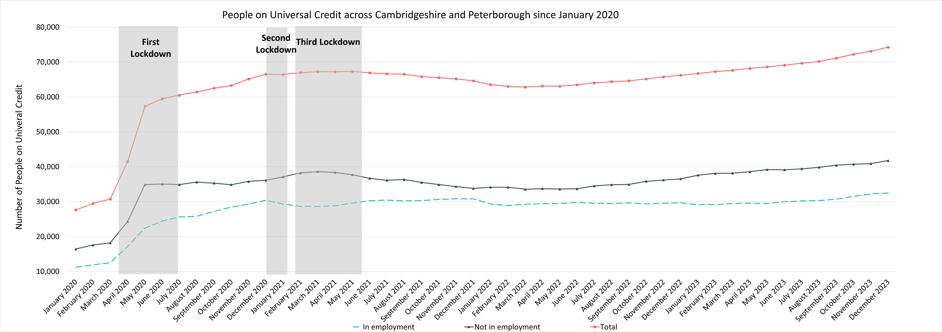
Labour Market – People on Universal Credit
Universal Credit Status | Number of Claimants December 2023 | Share of Total Universal Credit Claimants December 2023 | % Change with Previous Update (August 2023) | % Change with December 2022
Employed | 32,477 | 44% | +7.1% | +9.4%
Unemployed | 41,776 | 56% | +4.8% | +14.3%
Total | 74,242 |  | +5.8% | +12.1%
Notes:
Source – Universal Credit Claimants, Department for Work and Pensions
Technical Notes
Universal Credit is available in every jobcentre across Great Britain. Roll out was completed in December 2018.
Universal Credit is a single payment for each household to help with living costs for those on a low income or out of work. It is replacing six benefits, commonly referred to as the legacy benefits:
Income-based Jobseeker's Allowance
Income-related Employment and Support Allowance
Income Support
Working Tax Credit
Child Tax Credit
Housing Benefit
Support for housing costs, children and childcare costs are integrated into Universal Credit. It also provides additions for people with a disability, health condition or caring responsibilities which may prevent them from working.
Commentary
The chart above highlights changes in the number of people on universal credit across Cambridgeshire and Peterborough by Employment Status from January 2020.
The number of Universal Credit claimants includes those who have started Universal Credit (completed the Universal Credit claim process and accepted their Claimant Commitment) and have not had a closure of their claim recorded for this spell, up to the 'count date' (second Thursday in each month). A closure of their claim would be recorded either at the request of the individual or if their entitlement to Universal Credit ends, for example, if they no longer satisfy the financial conditions to receive Universal Credit as they have capital over £16,000.
It is important to note that the initial rise in claimants during the first lockdown period was due to policy changes brought in as part of the pandemic response that allowed people on higher incomes than before to claim the benefit, the peak of this increase came during the second lockdown in the Winter of 2020.
Despite decreases from Q1 of 2021, the numbers of those on universal credit remains much higher than Pre-Covid with numbers trending upwards from May 2022.
Unemployed claimants make up the majority of people on universal credit (56%) and saw a +4.8% increase from August 2023 and a +14.3% increase from December 2022. In comparison employed claimants saw a +7.1% increase from August 2023 and a +9.4% increase from December 2022.

Slide 20
Labour Market – People on Universal Credit by Local Authority
People on Universal Credit | Number of total people on Universal Credit December 2023 | % 16-64 population December 2023 | % Change 12 Months ago vs Now: December 2022 to December 2023 | % Change Previous update vs Now: August 2023 to December 2023
Cambridgeshire | 45,073 | 10.4% | 13.2% | 6.5%
Cambridge City | 8,534 | 8.0% | 10.8% | 4.8%
East Cambridgeshire | 5,359 | 10.0% | 13.8% | 7.2%
Fenland | 11,916 | 17.1% | 12.9% | 6.4%
Huntingdonshire | 10,543 | 10.6% | 14.0% | 7.0%
South Cambridgeshire | 8,721 | 8.8% | 14.5% | 7.2%
Peterborough | 29,169 | 21.2% | 10.4% | 4.8%
Cambridgeshire & Peterborough | 74,242 | 13.0% | 12.1% | 5.8%
Great Britain | 6,308,051 | 15.4% | 9.2% | 4.4%
Notes:
Source – Universal Credit Claimants, Department for Work and Pensions
Technical Notes
Universal Credit is available in every jobcentre across Great Britain. Roll out was completed in December 2018.
Universal Credit is a single payment for each household to help with living costs for those on a low income or out of work. It is replacing six benefits, commonly referred to as the legacy benefits:
Income-based Jobseeker's Allowance
Income-related Employment and Support Allowance
Income Support
Working Tax Credit
Child Tax Credit
Housing Benefit
Support for housing costs, children and childcare costs are integrated into Universal Credit. It also provides additions for people with a disability, health condition or caring responsibilities which may prevent them from working.
Commentary
The above table highlights changes in the number of people on universal credit across Cambridgeshire and Peterborough in August 2023.
The number of Universal Credit claimants includes those who have started Universal Credit (completed the Universal Credit claim process and accepted their Claimant Commitment) and have not had a closure of their claim recorded for this spell, up to the 'count date' (second Thursday in each month). A closure of their claim would be recorded either at the request of the individual or if their entitlement to Universal Credit ends, for example, if they no longer satisfy the financial conditions to receive Universal Credit as they have capital over £16,000.
Peterborough has the highest proportion of the 16-64 population claiming at 21.2%. Cambridge City has the lowest at 8.0%.
All local authorities have seen increases in the number of those on universal credit from the previous 12 months (December 2022) with the largest percentage increase seen in South Cambridgeshire (+14.5%). Peterborough seen the smallest increase (+10.4%) whilst the overall region saw a +12.1% increase and Great Britain a +9.2% increase.
All local authorities have seen an increase in the number of those on universal credit from the previous update (August 2023).

Slide 21
Wages and Inflation
Pay As You Earn (PAYE) Real Time Information – September 2023
Notes:
Source – Pay as you earn real time information- HMRC
Technical Notes
This data is sourced from HM Revenue and Customs’ Pay As You Earn system which collects income tax and national insurance. The Pay As you Earn Real Time Information data includes all employees payrolled by employers, therefore it does not include income from pensions, property rental or investments, nor does it include self-employment income. This data is based on employee’s residence rather than where they work.

Slide 22
Wages and Inflation– December 2023
Whilst workers who are resident in Cambridgeshire and Peterborough overall have higher median monthly wages than the UK there is not an even distribution across the region. Residents of Cambridge and South Cambridgeshire have higher median wages and Fenland and Peterborough residents have lower. Annual wage growth in the region has fallen below national levels since 2021 and fell well below inflation in 2022. In 2023 annual wage growth is closer to inflation but still below.
When comparing the median monthly wages of Cambridgeshire and Peterborough’s residents by district/unitary local authorities to the United Kingdom (£2,260), only Fenland (£2,160) and Peterborough (£2,104) are below the average. Cambridge (£2,738)and South Cambridgeshire (£2,718) are the local authorities with the highest median monthly wage.
Looking at annual wage growth, both Cambridgeshire and Peterborough have had average wage growth be lower than CPIH from March 2022, with the exception of June 2023

Slide 23
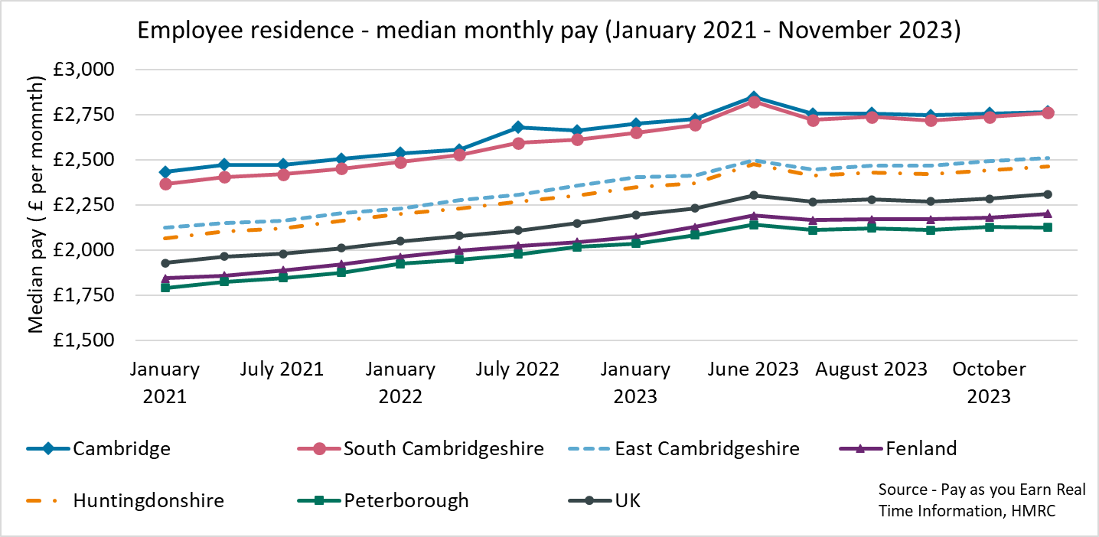
Employment Trends – Median monthly pay (PAYE Experimental Residence Data)
Local Authority | Cambridge | East Cambridgeshire | Fenland | Huntingdonshire | Peterborough | South Cambridgeshire | United Kingdom
Median monthly pay (November 2023) | £2,765 | £2,511 | £2,202 | £2,465 | £2,126 | £2,760 | £2,310
Source – Pay as you earn real time information - HMRC
Notes:
Source – Pay as you earn real time information- HMRC
Technical Notes
This data is sourced from HM Revenue and Customs’ Pay As You Earn system which collects income tax and national insurance. The Pay As you Earn Real Time Information data includes all employees payrolled by employers, therefore it does not include income from pensions, property rental or investments, nor does it include self-employment income. This data is based on employee’s residence rather than where they work.
Commentary
The above chart and table show how the median monthly wage of workers across the local authorities of Cambridgeshire and Peterborough the United Kingdom has changed since January 2021.
Median monthly pay has remained consistently higher in Cambridge (£2,765 in November 2023) and South Cambridgeshire (£2,760) than the other local authorities in Cambridgeshire and Peterborough
Fenland (£2,202) and Peterborough (£2,126) are the only local authorities to consistently have a median monthly wage lower than the United Kingdom (£2,310),

Slide 24
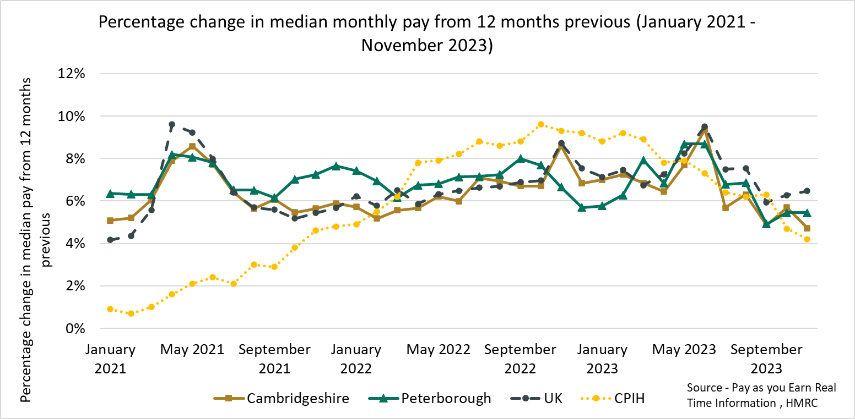
Employment Trends – Median monthly pay growth (PAYE) (January 2021- August 2023)
Local Authority | CPIH (November 2023)* | Cambridgeshire | Peterborough | Cambridge | East Cambridgeshire | Fenland | Huntingdonshire | South Cambridgeshire | United Kingdom
% Change from November 2022 | +4.2% | +4.7% | +5.4% | +2.0% | +4.1% | +5.6% | +5.0% | +3.4% | +5.3%
*The Consumer Prices Index including owner occupiers' housing costs (CPIH) is the office for national statistics’ headline inflation measure Source - Pay as you earn real time information – HMRC
Notes:
Source – Pay as you earn real time information- HMRC
Technical Notes
This data is sourced from HM Revenue and Customs’ Pay As You Earn system which collects income tax and national insurance. The Pay As you Earn Real Time Information data includes all employees payrolled by employers, therefore it does not include income from pensions, property rental or investments, nor does it include self-employment income.
Commentary
CPIH was higher than median monthly pay increase from April 2022 in all three geographies. Peterborough and the United Kingdom experienced wage growth above CPIH in May 2023. Wage growth has been above CPIH for the last two months
The percentage change in median monthly pay in Cambridgeshire exceeded CPIH in June 2023, later than Peterborough and the UK. In July 2023 CPIH was again higher than the percentage change in median monthly pay in Cambridgeshire

Slide 25
Vacancies
Lightcast Vacancies Data – September 2023

Slide 26
Vacancies – December 2023
After record numbers of vacancies across Quarter 4 of 2021 and Quarter 1 of the 2022, vacancies decreased in the first half of 2022 and had stabilised at a new baseline before falling across the second half of 2023
Looking at how vacancies have changed since the previous update, and when compared to the same point in 2023, vacancies have decreased from September 2023 and are also lower than December 2022.
The vacancies decrease from July 2023 can be observed across all sectors except from Education. When compared to December 2022, Construction (+14%), Accommodation and food service activities (+6%) and Real estate activities (+1%) were the only sectors to see increases.
Notes:
Source – Lightcast
Technical Information
Vacancy data is sourced from Lightcast, a service that has been procured by Cambridgeshire and Peterborough Combined Authority which gives labour market information on Job postings, occupations, and industries. Lightcast has a job posting aggregator which scans jobs websites for posting and presents them together. Lightcast only scans online jobs postings and therefore does not include any jobs which are advertised solely offline. There is also no guarantee that all online job postings are aggregated. For example, a specific job site may not be scanned.
A unique job posting is a deduplicated count of an online job vacancy advertisement. If the same vacancy is posted twice across a sixty-day period, it is only counted once. If the same vacancy is posted twice more than sixty days apart it is counted as two unique job postings.
The other category includes agriculture, forestry and fishing; Mining and quarrying; Water supply and Waste management

Slide 27
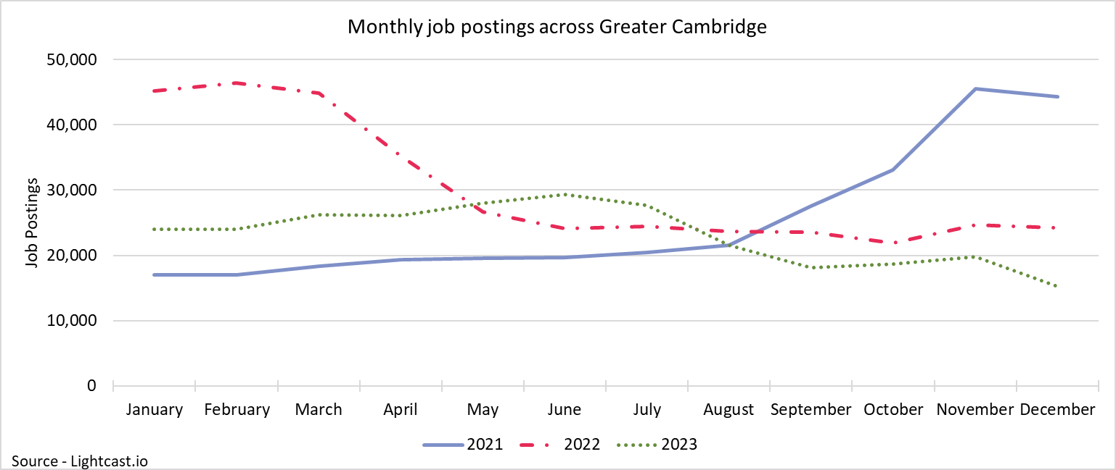
Vacancies – December 2023
After record numbers of vacancies in late 2021 and early 2022, vacancies have declined. December 2023 saw the lowest number of vacancies since September 2020. This is in line with national decreases and suggests a cooling labour market making it harder to find work.
27,098
Unique job postings in Cambridgeshire and Peterborough in December 2023
-17%
Decrease in unique job postings compared to September 2023
Compared to -18% nationally
-36%
Decrease in unique job postings compared to December 2022
Compared to -30% nationally
Notes:
Source – Lightcast
Technical Information
Vacancy data is sourced from Lightcast, a service that has been procured by Cambridgeshire and Peterborough Combined Authority which gives labour market information on Job postings, occupations, and industries. Lightcast has a job posting aggregator which scans jobs websites for posting and presents them together. Lightcast only scans online jobs postings and therefore does not include any jobs which are advertised solely offline. There is also no guarantee that all online job postings are aggregated. For example, a specific job site may not be scanned.
A unique job posting is a deduplicated count of an online job vacancy advertisement. If the same vacancy is posted twice across a sixty-day period, it is only counted once. If the same vacancy is posted twice more than sixty days apart it is counted as two unique job postings.
Commentary
The above chart illustrates online vacancy data across the Cambridgeshire & Peterborough area since January 2020. A unique job posting is a deduplicated count of an online job vacancy advertisement. If the same vacancy is posted twice across a sixty-day period, it is only counted once. If the same vacancy is posted twice more than sixty days apart it is counted as two unique job postings.
Across Cambridgeshire and Peterborough, there were 27,098 job postings in December 2023, this is a decrease of -17% from September 2023. Nationally job postings decreased by -18% across the same period.
There were -36% fewer job postings in Cambridgeshire and Peterborough in December 2023 compared to December 2022. Nationally job postings decreased by -30% in the same period
In May 2023, there was an increase in job postings of +15% from the previous month. This is the largest percentage increase from the previous month since November 2021
The number of vacancies increased rapidly in the final quarter of 2021 but appear to have peaked in late 2021/early 2022 before rapidly decreasing and then stabilising across the 2nd half of 2022. In the first half of 2023 job postings steadily increased, but have been declining since June falling to the lowest levels recorded since November 2020
December 2023 saw the lowest number of job postings since November 2020
*Lightcast data is available from 2012 onwards.

Slide 28
Employment Trends – Vacancies by Industry
Number of Vacancies in Cambridgeshire and Peterborough in December 2023 compared to the UK Top three sectors with highest proportion of vacancies highlighted green
Sector Identifier | Employment Sector | Vacancies in Cambridgeshire and Peterborough: December 2023 | Percentage of total vacancies in Cambridgeshire and Peterborough | Vacancies in UK: December 2023 | Percentage of total vacancies in UK
1 | Accommodation and food service activities | 944 | 3% | 67,387 | 3%
2 | Administrative and support service activities | 2,463 | 8% | 166,467 | 8%
3 | Arts, entertainment and recreation | 1,405 | 4% | 94,303 | 4%
4 | Construction | 1,277 | 4% | 81,792 | 4%
5 | Education | 2,268 | 7% | 178,464 | 8%
6 | Financial and insurance activities | 795 | 2% | 63,191 | 3%
7 | Human health and social work activities | 4,023 | 12% | 264,924 | 12%
8 | Information and communication | 2,560 | 8% | 116,021 | 5%
9 | Manufacturing | 2,175 | 7% | 126,842 | 6%
10 | Other service activities | 105 | 0% | 8,870 | 0%
11 | Professional, scientific and technical activities | 1,874 | 6% | 124,663 | 6%
12 | Public administration and defence; compulsory social security | 501 | 2% | 33,394 | 2%
13 | Real estate activities | 299 | 1% | 20,423 | 1%
14 | Transportation and storage | 1,337 | 4% | 90,766 | 4%
15 | Wholesale and retail trade; repair of motor vehicles and motorcycles | 1,658 | 5% | 115,828 | 5%
16 | Other sectors (agriculture, forestry and fishing; Mining and quarrying; Water supply and Waste management) | 1,178 | 4% | 68,020 | 3%
Notes:
Source – Lightcast
Technical Information
Vacancy data is sourced from Lightcast, a service that has been procured by Cambridgeshire and Peterborough Combined Authority which gives labour market information on Job postings, occupations, and industries. Lightcast has a job posting aggregator which scans jobs websites for posting and presents them together.
Lightcast only scans online jobs postings and therefore does not include any jobs which are advertised solely offline. There is also no guarantee that all online job postings are aggregated. For example, a specific job site may not be scanned.
A unique job posting is a deduplicated count of an online job vacancy advertisement. If the same vacancy is posted twice across a sixty-day period, it is only counted once. If the same vacancy is posted twice more than sixty days apart it is counted as two unique job postings. The other sectors category includes agriculture, forestry and fishing; Mining and quarrying; Water supply and Waste management
Commentary
The above table shows the number of Vacancies in Cambridgeshire and Peterborough in December 2023 by employment sector and includes a national comparison;
Human health and social work activities (12%), Information and Communication (8%), and Education(7%) have the highest proportion of vacancies across Cambridgeshire and Peterborough. Human health and social work is also the largest sector nationally (12%)
Information and Communication accounts for 5% of national postings, -3 percentage points lower than in Cambridgeshire and Peterborough

Slide 29
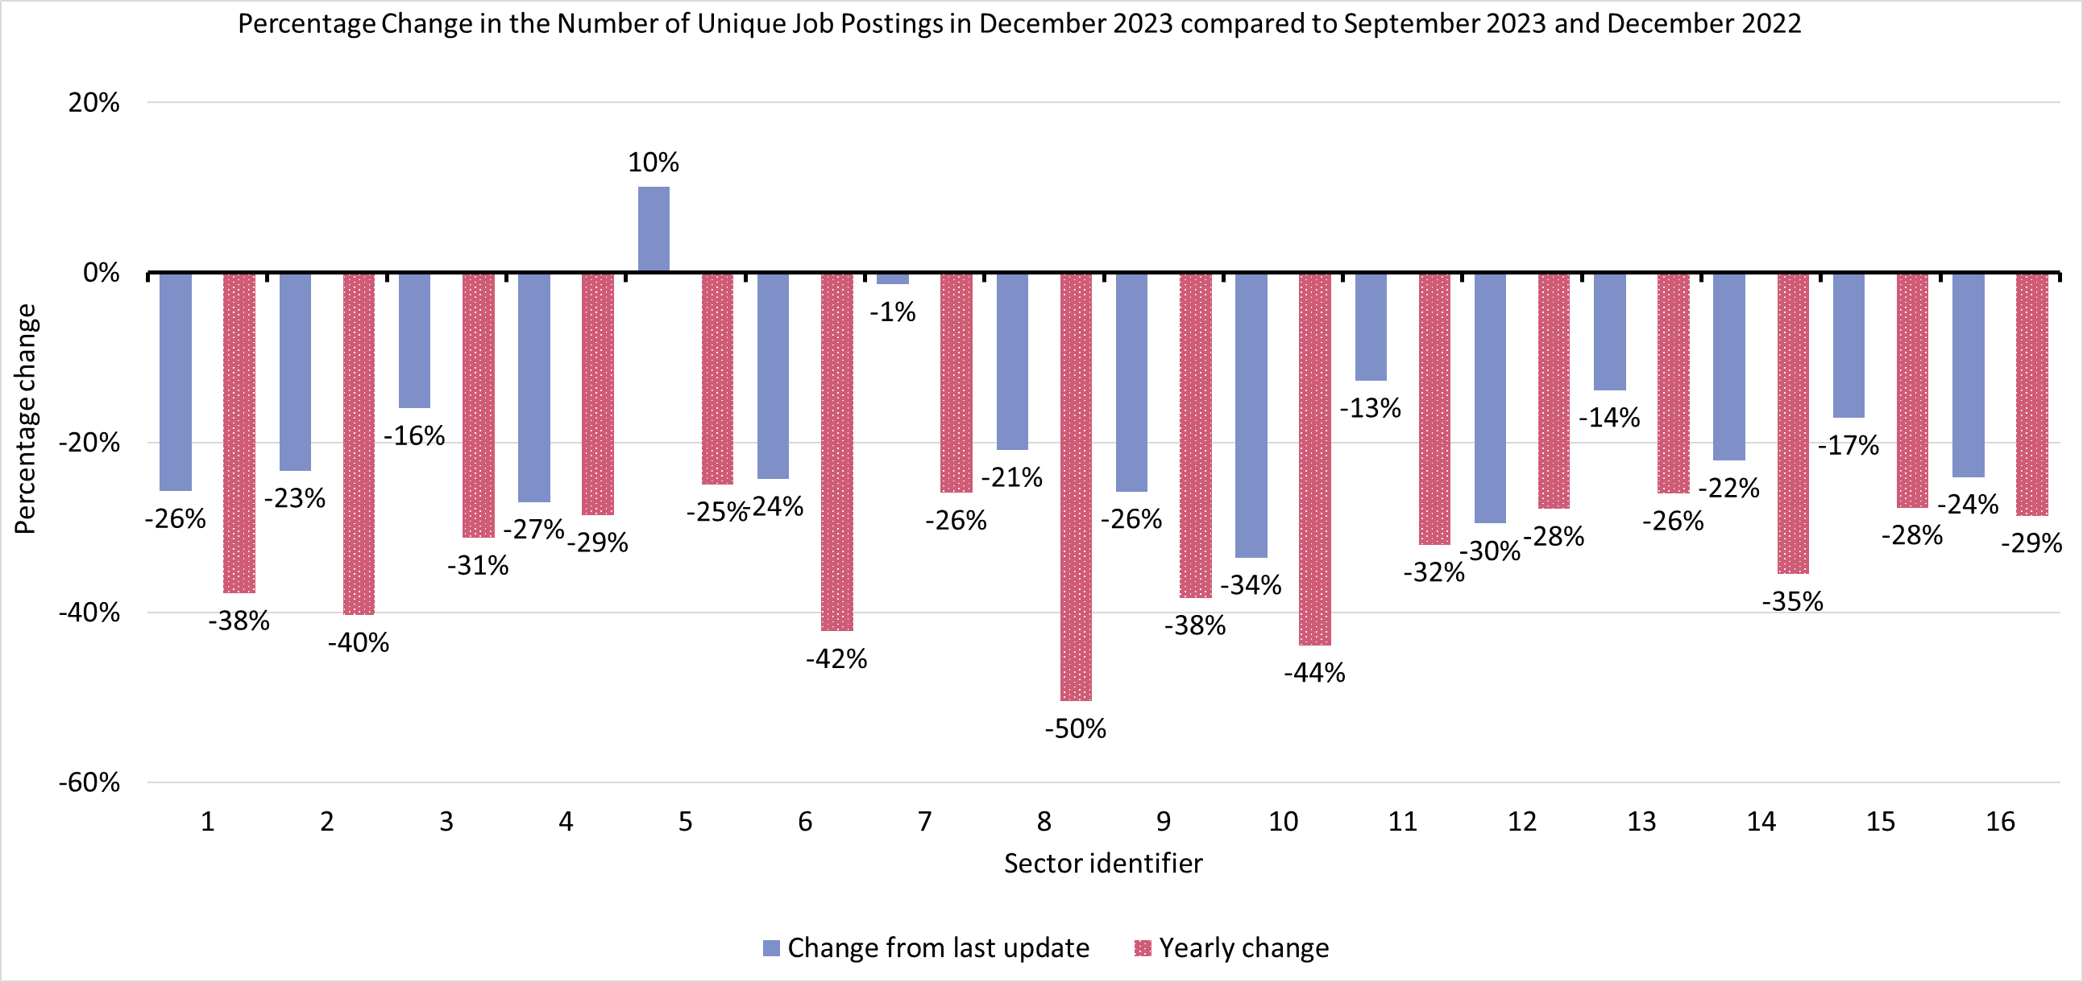
Employment Trends – Vacancies by Industry Changes
Sector Identifier for Chart
Sector Identifier | Sector Name
1 | Accommodation and food service activities
2 | Administrative and support service activities
3 | Arts, entertainment and recreation
4 | Construction
5 | Education
6 | Financial and insurance activities
7 | Human health and social work activities
8 | Information and communication
9 | Manufacturing
10 | Other service activities
11 | Professional, scientific and technical activities
12 | Public administration and defence; compulsory social security
13 | Real estate activities
14 | Transportation and storage
15 | Wholesale and retail trade; repair of motor vehicles and motorcycles
16 | Other sectors (Agriculture, forestry and fishing; Mining and quarrying; Water supply and Waste management)
Notes:
Source – Lightcast
Technical Information
Vacancy data is sourced from Lightcast, a service that has been procured by Cambridgeshire and Peterborough Combined Authority which gives labour market information on Job postings, occupations, and industries. Lightcast has a job posting aggregator which scans jobs websites for posting and presents them together. Lightcast only scans online jobs postings and therefore does not include any jobs which are advertised solely offline. There is also no guarantee that all online job postings are aggregated. For example, a specific job site may not be scanned.
A unique job posting is a deduplicated count of an online job vacancy advertisement. If the same vacancy is posted twice across a sixty-day period, it is only counted once. If the same vacancy is posted twice more than sixty days apart it is counted as two unique job postings.
The other category includes Agriculture, forestry and fishing; Mining and quarrying; Water supply and Waste management
Commentary
The above chart shows how the number of vacancies in December has changed in each sector compared to the last update (September 2023) and compared to the same point in 2022 (December 2022)
Almost all sectors have seen a decrease in job postings when compared to September 2023. the largest decreases was Information and communication (-50%, -675)
The only sector to increase from September 2023 was in Education (+10%, +208)
The largest percentage decreases from September 2023 were: : Other service activities (-34%), Public administration and defence; compulsory social security (-30%), and Construction (-27%). The largest raw number decreases were: Manufacturing (-755), Administrative and Support Services (-749) and Information and Communication (-675)
In December 2023 there was the lowest number of job postings since November 2020 with decreases across all sectors. Information and Communication Technology (-50%), Other Service Activities (-44%) and Financial and insurance activities (-42%) seeing the largest percentage decreases. The largest raw number decreases were Information and Communication Technology (-2,605), Administrative and Support Service Activities (-1,663) and Human Health and Social Work Activities (-1,406).

Slide 30
Employment Trends –by Industry
Median Posting Duration (October – December 2023) (Cambridgeshire and Peterborough) | Posting Intensity (October – December 2023) (Cambridgeshire and Peterborough)
26 Days | 3:1
Median Posting Duration for Vacancies across Cambridgeshire and Peterborough in Days by Employment Sector October to December 2023
Sector Identifier | Employment Sector | October – December 2023 Median Posting Duration (Days) | October – December 2023 Posting Intensity
1 | Accommodation and food service activities | 24 | 3:1
2 | Administrative and support service activities | 23 | 3:1
3 | Arts, entertainment and recreation | 25 | 3:1
4 | Construction | 25 | 3:1
5 | Education | 24 | 2:1
6 | Financial and insurance activities | 20 | 2:1
7 | Human health and social work activities | 24 | 3:1
8 | Information and communication | 20 | 3:1
9 | Manufacturing | 26 | 3:1
10 | Other service activities | 26 | 3:1
11 | Professional, scientific and technical activities | 21 | 2:1
12 | Public administration and defence; compulsory social security | 23 | 3:1
13 | Real estate activities | 26 | 4:1
14 | Transportation and storage | 24 | 3:1
15 | Wholesale and retail trade; repair of motor vehicles and motorcycles | 24 | 3:1
16 | Other sectors (Agriculture, forestry and fishing; Mining and quarrying; Water supply and Waste management) | 26 | 3:1
Notes:
Source – Lightcast
Technical Information
Vacancy data is sourced from Lightcast, a service that has been procured by Cambridgeshire and Peterborough Combined Authority which gives labour market information on Job postings, occupations, and industries. Lightcast has a job posting aggregator which scans jobs websites for posting and presents them together. Lightcast only scans online jobs postings and therefore does not include any jobs which are advertised solely offline. There is also no guarantee that all online job postings are aggregated. For example, a specific job site may not be scanned.
The other category includes agriculture, forestry and fishing; Mining and quarrying; Water supply and Waste management
Median Posting Duration measures how long the average job posting is live online for. A longer time up could suggest that the company anticipates the role being harder to fill.
Posting Intensity is a ratio of how many times the same job role is posted. A higher ratio could suggest difficulty filling the role.
Commentary
The table above shows the median posting duration and the posting intensity for employment sectors from August to September 2023. Both measures can be used as an indication of difficult to fill roles.
Across Cambridgeshire and Peterborough, the median posting duration was 26 days. (down from 28 days at the last update). No sectors exceeded the regional median posting duration.
Financial and insurance, and Information and communication (both 20) had the lowest median posting duration. Professional scientific and technical activities (21) had the next lowest median posting duration
The posting intensity across Cambridgeshire and Peterborough was 3:1. Real estate activities (4:1) is the only sector above the regional average
Education, and Financial and insurance activities (both 2:1) had a lower than average posting duration.

