Slide 1

Transport update: Cambridge and South Cambridgeshire
COVID-19 transport impacts and recovery
March 2024
Policy & Insight Team, Cambridgeshire County Council

Slide 2
Transport Update Aims
This report is intended to:
Summarise the on-going impacts of COVID-19 on trends in transport and mobility up to 31st March 2024.
Highlight changes in key indicators by comparing March 2024 data to a pre-pandemic baseline (March 2019 or closest possible equivalent), mid-COVID (March 2021) and to last year (March 2023).
Provide a basis for discussion for the Greater Cambridge Partnership (GCP) to understand and identify existing challenges and future data needs.
Notes:
Comparison periods may vary across the different datasets based on the availability of historic data – comparison periods are clearly noted for each dataset.
  Where reference is made to ‘Weekdays’ this only includes Monday, Tuesday, Wednesday and Thursday, as per DfT guidance.

Slide 3
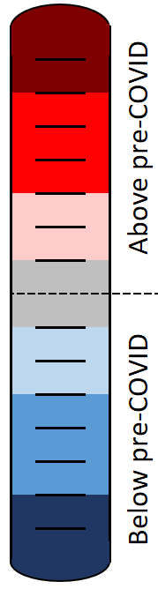
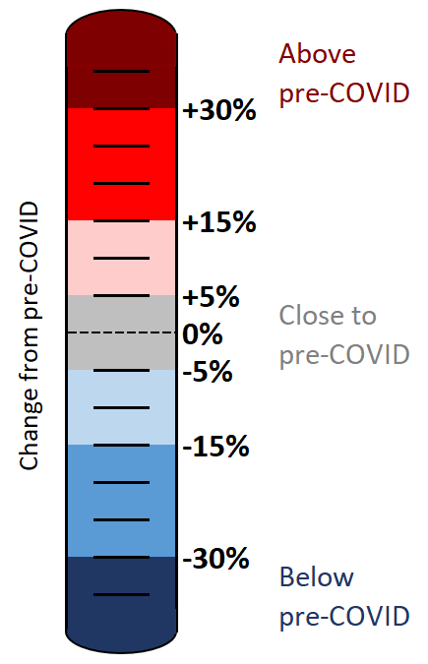
Colour scale
The statistics in this pack have been colour-coded using a heat scale to reflect the level of recovery being experienced (pre-COVID compared to now).
A positive (red) value indicates that levels have increased above those experienced pre-COVID.
A negative (blue) value indicates that levels remain below pre-COVID.
Top tip:
Lookout for the colour scale bar in the top right-hand corner of each page for a reminder of the heat scale used to indicate the level of recovery throughout the pack.

Slide 4





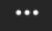
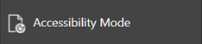
Accessibility
To access the full functionality of PowerPoint, we recommend opening the slides in full screen mode. To do this, click the “Open in New Window” button in the bottom right-hand corner.
1) Navigate through the slide pack using the left and right arrows in the middle-bottom of the screen. Clicking on the sentence “Slide x of x” brings up a pop-up listing all the slides so you can navigate directly to a slide of interest.
2) Open the Notes for each slide to see the data source, technical notes and any additional commentary. See the “Notes” button in the bottom right-hand corner.
3) Use the “Download” button to the right of the centre at the top of the screen to download the slides as a .pptx file.
4) Use the “Print to PDF” option to save the PowerPoint as a PDF document (but please be aware you will lose access to the Notes section which contains additional information for the slide).
5) Use the “More options” icon in the top right-hand corner and choose “Accessibility mode” from the pop-up menu to access the slides in a different format which will display any Alt Text that has been set for charts and images.
We are continually working to improve the accessibility of our content. If you find you are unable to access any part of this update, please contact policyandinsight@cambridgeshire.gov.uk and we will be happy to investigate providing information in a different format.

Slide 5
Overview

Slide 6
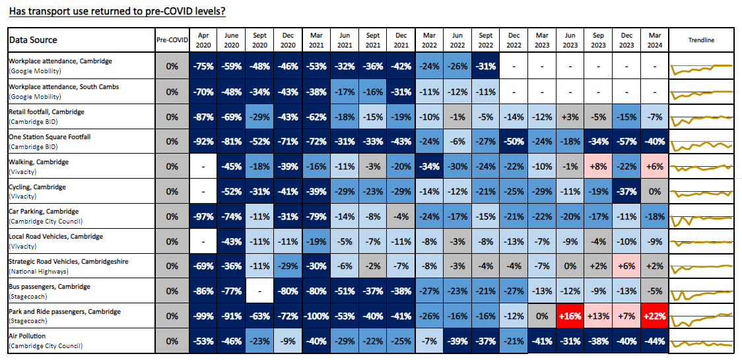
Recovery Tracker
Notes:
Source: Various, listed in the Data Source column
Technical Notes: Our methodology for analysing the data continues to be refined to react to differing levels of data quality and data gaps. Therefore, you may observe small adjustments to the stats in the latest slide pack compared to previously published versions.
For example:
The method of calculating the strategic road network (SRN) recovery percentages changed in Dec 2022 to include data from a larger number of sites. The SRN percentages have therefore been updated and may not reflect the values presented in previous slide packs for this reason.
The air pollution percentages historically used data from 5 sensors but one of these sensors was removed in April 2022 so the methodology for calculating the air pollution percentages has been adjusted. The air pollution percentages presented here may differ slightly from those in previous slide packs for this reason.

Slide 7








Headlines: March 2024
Local Roads
Volumes at
compared to pre-COVID
(see analysis on slide 21 onwards)
Strategic Roads
Volumes at
-
compared to pre-COVID
(see analysis on slide 13 onwards)
Car Parking
Patronage at
compared to pre-COVID
(see analysis on slide 42 onwards)
Bus
Patronage at
-
compared to pre-COVID
(see analysis on slide 48)
Park and Ride
Patronage at
compared to pre-COVID
(see analysis on slide 51)
P
P
+
-9%
+2%
-18%
-5%
+22%
Station Square Footfall
Volumes at
-50%
compared to pre-COVID
(see analysis on slide 47)
Retail Footfall
Volumes at
-14%
compared to pre-COVID
(see analysis on slide 39 onwards)
Walking
Volumes at
-22%
compared to pre-COVID
(see analysis on slide 35)
Cycling
Volumes at
-25%
compared to pre-COVID
(see analysis on slide 34)
Air Pollution
Concentrations at
-22%
compared to pre-COVID
(see analysis on slide 54 onwards)
-40%
-7%
+6%
0%
-44%

Slide 8
Travel Demand

Slide 9
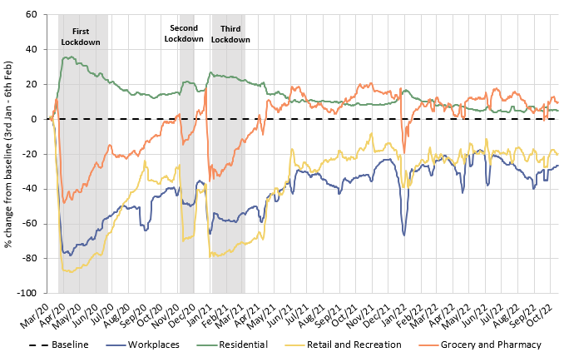
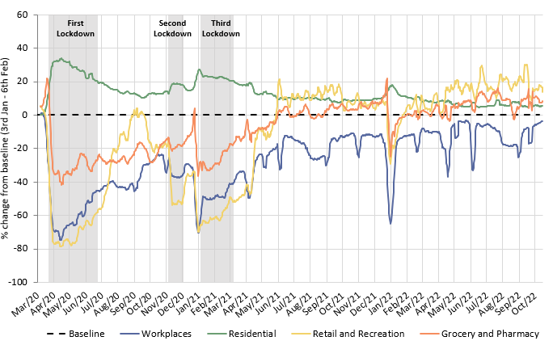
Has COVID-19 changed where we spend our time?
The pandemic caused us to spend more time at home and less time at a designated workplace. Whilst the extent of this impact has steadily reduced since Spring 2021, an impact was still being seen when Google discontinued this dataset in October 2022, particularly in Cambridge.
Cambridge
South Cambridgeshire
 | Pre-Covid to Now: Baseline (Jan/Feb 2020) to Oct* 2022
Pre-Covid vs Now: | Workplaces | Residential | Retail and Recreation | Grocery and Pharmacy
Cambridge | -26 | +5 | -19 | +11
South Cambridgeshire | -3 | +5 | +16 | +9
*Sourced from Google Mobility data which was discontinued on 16th October 2022. Numbers represent the % change from the baseline period. The baseline period is defined by Google as 3rd Jan – 6th Feb 2020.
Notes:
Source: Google LLC "Google COVID-19 Community Mobility Reports". https://www.google.com/covid19/mobility/
Technical notes: Data is gathered from Google account holders location history. This helps to demonstrate where people are spending their time. The data is based on the most recent month (October 2022) compared to the median of the corresponding day in the baseline period (3rd Jan-6th Feb 2020) as calculated by Google. Tabulated percentages represent the change from the baseline (3rd Jan – 6th Feb) to the most recent month.
Commentary: Cambridge: Cambridge grocery and pharmacy visits finished at 11% above pre-pandemic levels in October 2022. Meanwhile, retail and recreation visits finished 19% below pre-pandemic levels, which suggested that essential shopping recovered to a much stronger extent than leisure shopping. The proportion of people making workplace visits stayed steadfastly below the pre-Covid baseline, ending at -26% in October 2022. Conversely, residential visits finished 5% higher than the baseline, in part likely due to the persistence of remote working.
South Cambridgeshire: Data on workplace visits finished at 3% below pre-pandemic baseline levels. Similarly to Cambridge data, residential numbers were continually above the pre-pandemic baseline since the dataset began, finishing at 5% above the baseline in October 2022. Retail and recreation (+16%), and grocery and pharmacy (+9%) visits remain ahead of the pre-pandemic baseline in South Cambridgeshire, suggesting that people’s shopping and leisure habits recovered and then stabilised after the heavy disruption caused by the pandemic and associated lockdowns.

Slide 10
Strategic Road Network

Slide 11
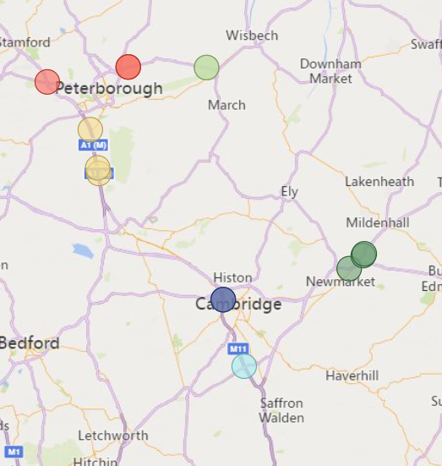
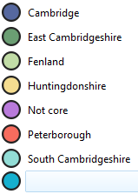
Strategic Road Network Monitoring Sites
Strategic Road Network traffic monitoring sites with continuous data
A1
National Highways have approximately 1,400 permanent traffic monitoring sites on the strategic road network within Cambridgeshire and Peterborough.
Each monitoring site varies in its ability to reliably provide data over time, and periods of inactivity are common. It is therefore not appropriate to conduct a long-term analysis for all sites.
For this reason, only the 14 sensors with uninterrupted data from January 2019 onwards are included in this analysis. These 14 sites are shown on the map to the left.
Please note the number of sensors used within this analysis has decreased since the last update due to sensor outages. Therefore, absolute flow volumes will not be comparable to previous updates.
2
2
A47
N
2
2
A14
A1
A11
A14
2
Cambridge sites
A14
East Cambridgeshire sites
A428
2
2
Fenland sites
Huntingdonshire sites
Peterborough sites
A1
South Cambridgeshire sites
M11
Strategic Road Network in Cambridgeshire and Peterborough
© OpenStreetMap Contributors © Tom Tom © Microsoft Corporation
Notes:
Source: National Highways WebTRIS data. (https://webtris.highwaysengland.co.uk/)
Technical notes:
District and Site IDs
Cambridge MIDAS site at M11/6886A
Cambridge MIDAS site at M11/6886B
East Cambridgeshire MIDAS site at A11/0047B
East Cambridgeshire MIDAS site at A14/1241B
East Cambridgeshire TMU Site 6317/1
Fenland TMU Site 6350/1
Fenland TMU Site 6350/2
Huntingdonshire MIDAS site at A1M/2134A
Huntingdonshire MIDAS site at A1M/2145B
Huntingdonshire MIDAS site at A1M/2220A
Peterborough TMU Site 6351/1
Peterborough TMU Site 6351/2
Peterborough TMU Site 6502/2
South Cambridgeshire MIDAS site at M11/6747A

Slide 12
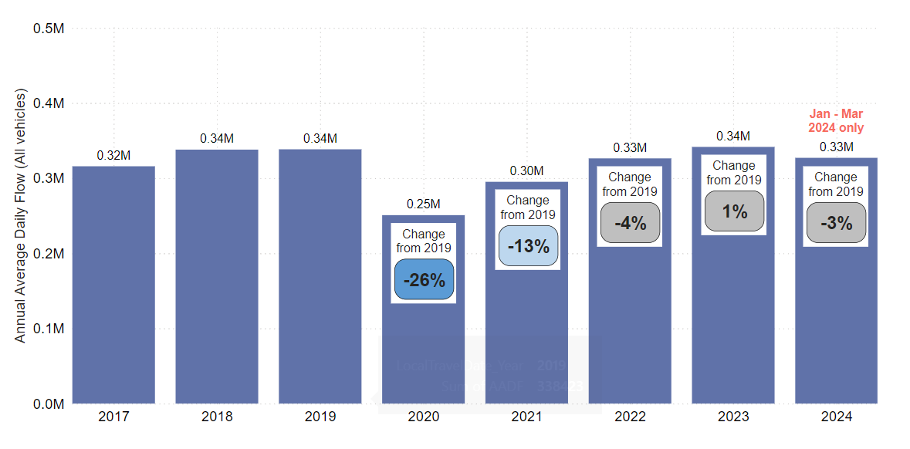
Strategic Road Network: Annual Average Daily Flow by Year
In Cambridgeshire and Peterborough, traffic volumes on the Strategic Road Network so far in 2024 are just below pre-COVID volumes (-3%). However, a similar pattern was seen in early 2023, suggesting the early part of the year may generally see lower flows than later in the year.
Annual Average Daily Flow (sum of 14 sensors)
Analysis based on 14 sensors across Cambridgeshire and Peterborough.
Notes:
Source: National Highways WebTRIS data.
Technical note: Average Daily Flow by year for main carriageway monitors in each district, all with data 2019 – 2024. This dataset averages across ALL days (Mon-Sun).

Slide 13
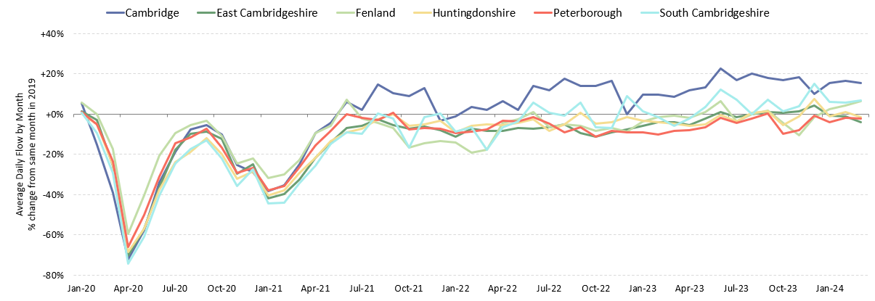
Strategic Road Network: Average Daily Flow by Month
In March 2024, three districts are above the pre-COVID baseline, Cambridge (+15%), Fenland (+6%) and South Cambridgeshire (+7%). On average, the districts are now back at pre-COVID volumes (+2%). East Cambridgeshire is the furthest below pre-COVID (-4%).
Percentage change from the same month in 2019
Pre-COVID to Now: Mar 2019 to Mar 2024
Cambridge | East Cambridgeshire | Fenland | Huntingdonshire | Peterborough | South Cambridgeshire | All Districts
+15% | -4% | +6% | -1% | -2% | +7% | +2%
Analysis based on 14 sensors across Cambridgeshire and Peterborough.
Notes:
Source: National Highways WebTRIS data.
Technical note: The graph shows the percentage difference from the corresponding month in 2019 (e.g. March 2023 compared to March 2019). Created using Average Daily Flow by month data for main carriageway monitors in each district, all with data 2019 – 2024. This dataset averages across ALL days (Mon-Sun).

Slide 14
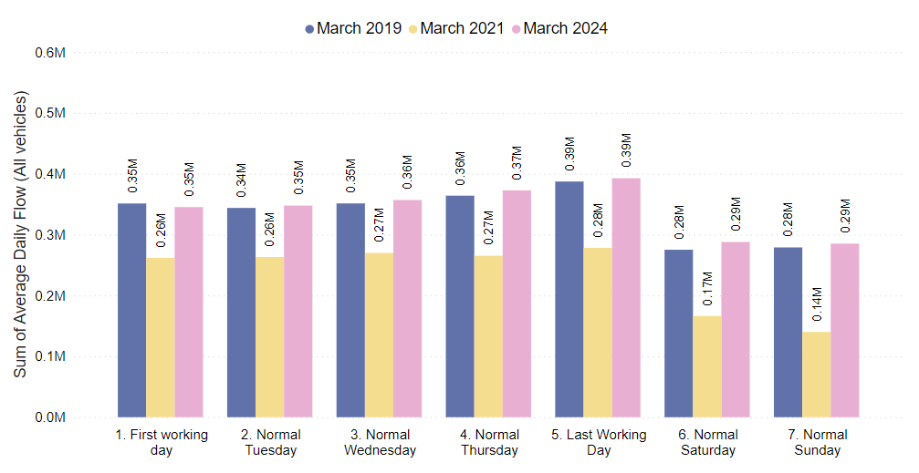
Strategic Road Network: Daily Flow by Day of the Week
On the strategic road network in early 2024, all days are within 5% of pre-COVID volumes. Saturdays are furthest ahead of pre-COVID (+5%), whilst Mondays are furthest behind (-2%). Weekend volumes (Sat-Sun, +3%) are just ahead of weekday volumes (Mon-Thurs, +1%).
 | Pre-COVID to Now: Mar 2019 to Mar 2024
Average Daily Flow % change | First Working Day | Normal Tuesday | Normal Wednesday | Normal Thursday | Last Working Day | Normal Saturday | Normal Sunday
 | -2% | +1% | +2% | +2% | +1% | +5% | +2%
Analysis based on 14 sensors across Cambridgeshire and Peterborough.
Notes:
Source: National Highways WebTRIS data.
Technical note: Average Daily Flow in the week for main carriageway monitors in each district, all with data 2019 – 2024. Note the use of ‘normal’ days which allow for a ‘like-for-like’ comparison between comparable days. For example, bank holidays and school holidays are excluded from average flow calculations for ‘normal’ days. As such, this dataset does not account for the Christmas period, Christmas or New Year bank holidays, school summer holidays etc.

Slide 15
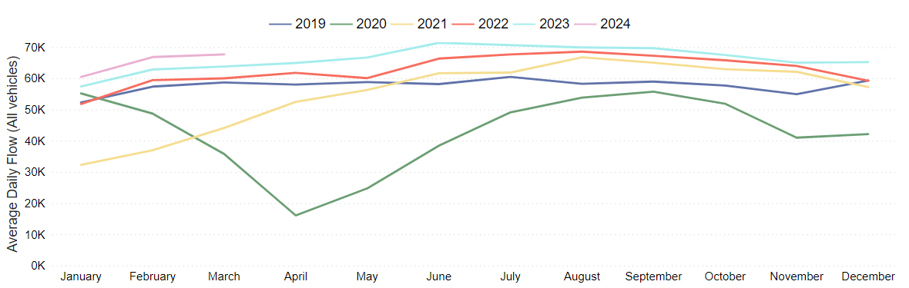
Strategic Road Network: Cambridge
Cambridge strategic road volumes continue to exceed pre-COVID volumes (+15% in March 2024). An increasing trend in traffic volumes is seen across the first months of 2024.
Pre-COVID to Now: Mar 2019 to Mar 2024 | Mid-COVID to Now: Mar 2021 to Mar 2024 | Previous year to Now: Mar 2023 to Mar 2024
+15% | +53% | +6%
Analysis based on 2 sensors.
Notes:
Source: National Highways WebTRIS data.
Technical note: This dataset averages across ALL days (Mon-Sun).

Slide 16
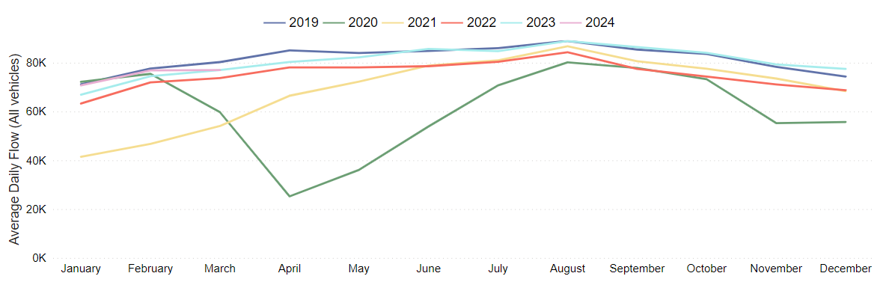
Strategic Road Network: East Cambridgeshire
East Cambridgeshire strategic road volumes are near pre-COVID volumes (-4%) and have shown little change since the same time last year.
Pre-COVID to Now: Mar 2019 to Mar 2024 | Mid-COVID to Now: Mar 2021 to Mar 2024 | Previous year to Now: Mar 2023 to Mar 2024
-4% | +42% | No change
Analysis based on 3 sensors.
Notes:
Source: National Highways WebTRIS data.
Technical note: This dataset averages across ALL days (Mon-Sun).

Slide 17
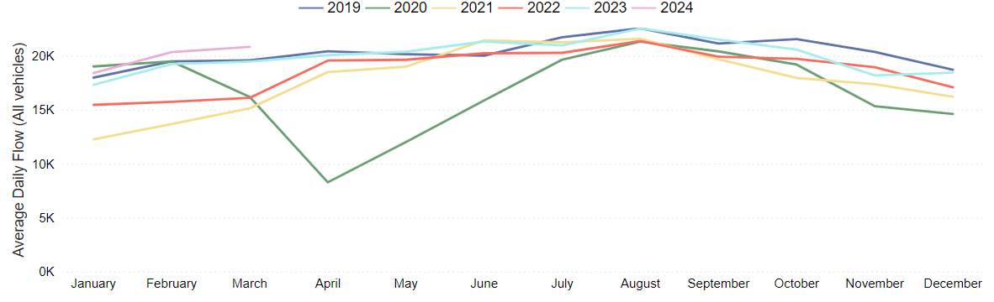
Strategic Road Network: Fenland
Fenland strategic road volumes are above pre-COVID levels in early 2024 (+6%). This marks an increase in volumes on mid-COVID and also from the same time last year.
Pre-COVID to Now: Mar 2019 to Mar 2024 | Mid-COVID to Now: Mar 2021 to Mar 2024 | Previous year to Now: Mar 2023 to Mar 2024
+6% | +38% | +7%
Analysis based on 2 sensors.
Notes:
Source: National Highways WebTRIS data.
Technical note: This dataset averages across ALL days (Mon-Sun).

Slide 18
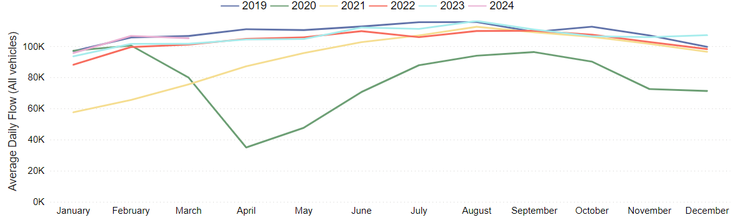
Strategic Road Network: Huntingdonshire
Huntingdonshire strategic road volumes are similar to pre-COVID 2019 (-1%) and have shown an increasing trend so far throughout 2024.
Pre-COVID to Now: Mar 2019 to Mar 2024 | Mid-COVID to Now: Mar 2021 to Mar 2024 | Previous year to Now: Mar 2023 to Mar 2024
-1% | +39% | +3%
Analysis based on 3 sensors.
Notes:
Source: National Highways WebTRIS data.
Technical note: This dataset averages across ALL days (Mon-Sun).

Slide 19
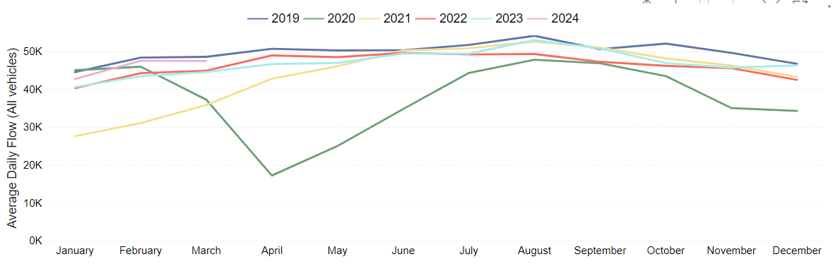
Strategic Road Network: Peterborough
Peterborough strategic road volumes continue to remain around pre-COVID volumes (-2%). They see an increase on the same time last year (+7%).
Pre-COVID to Now: Mar 2019 to Mar 2024 | Mid-COVID to Now: Mar 2021 to Mar 2024 | Previous year to Now: Mar 2023 to Mar 2024
-2% | +32% | +7%
Analysis based on 3 sensors.
Notes:
Source: National Highways WebTRIS data.
Technical note: This dataset averages across ALL days (Mon-Sun).

Slide 20
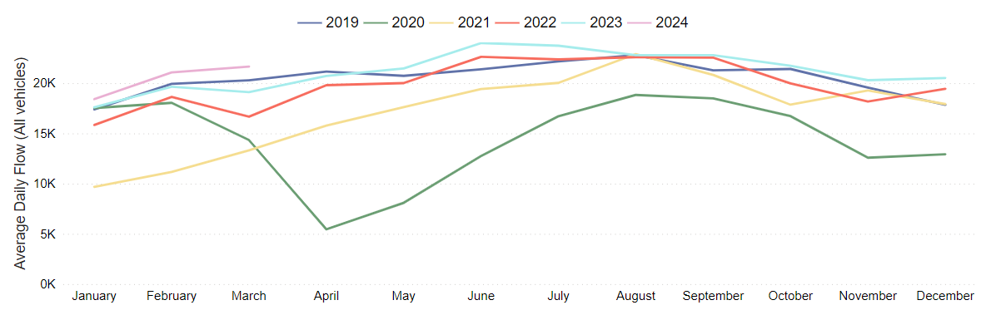
Strategic Road Network: South Cambridgeshire
South Cambridgeshire strategic road volumes continue to be ahead of pre-COVID (+7%). Volumes have seen a large increase since mid-COVID (+63%) and an increase on the same time last year (+13%).
Pre-COVID to Now: Mar 2019 to Mar 2024 | Mid-COVID to Now: Mar 2021 to Mar 2024 | Previous year to Now: Mar 2023 to Mar 2024
+7% | +63% | +13%
Analysis based on 1 sensor.
Notes:
Source: National Highways WebTRIS data.
Technical note: This dataset averages across ALL days (Mon-Sun).

Slide 21
Local Road Network:
Motorised Vehicles

Slide 22
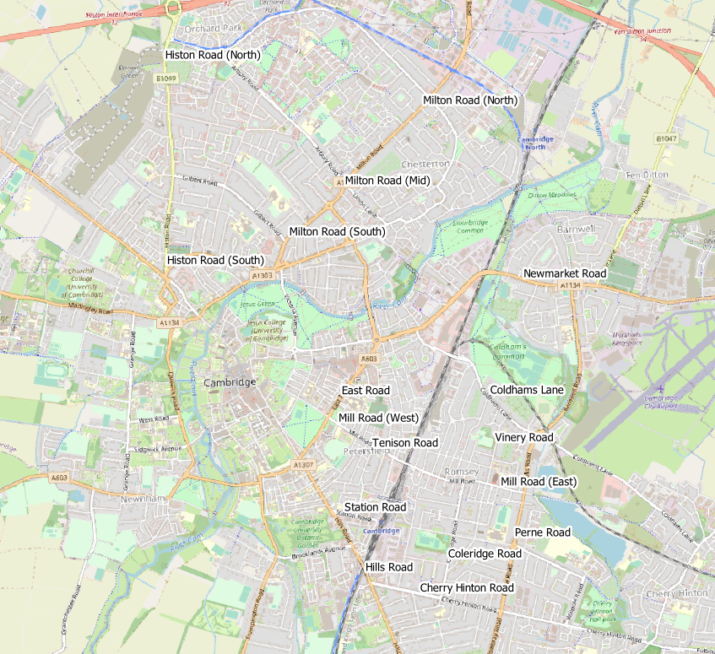
Local Road Network Monitoring Sites: Motorised Vehicles
Long Term Vivacity Monitoring Sites – Motorised Vehicles
The Mill Road and East Road sensors were upgraded in Sept 2022 and are now detecting significantly more cycles and pedestrians. As a result, the active travel flows at these locations are no longer comparable pre/post Sept 2022.
The Milton Road (Mid) sensor is currently inactive.
Sensor Location​​ | Location description​​ | Installed​
Cherry Hinton Road ​​ | Near Rock Road​​ | May 2019​
Coldham’s Lane​​ | Near Coldham’s Common​​ | May 2019​
Coleridge Road ​​ | Near Coleridge recreation ground​​ | May 2019​
East Road​​ | Close to ARU site​​ | May 2019​
Hills Road Bridge​​ | Near Cherry Hinton Road​​ | May 2019​
Histon Road (North)​​ | Just south of A14​ | Sep 2019​
Histon Road (South) ​​ | Near Victoria Road​ | Sep 2019​
Mill Road (East)​​ | Close to Brookfield’s hospital​​ | May 2019​
Mill Road (West)​​ | Close to Parker’s Piece​​ | May 2019​
Milton Road (Mid)​​ | Near Union Lane​​ | May 2019​
Milton Road (North)​​ | Near King’s Hedges Road​ | Sep 2019​
Milton Road (South)​ | Near Gilbert Road​ | Sep 2019​
Newmarket Road | Near Ditton Fields | May 2019
Perne Road | Near Birdwood Road roundabout | May 2019
Station Road | Near Kett House | May 2019
Tenison Road​​ | Near Mill Road​​ | May 2019​
Vinery Road ​​ | Near Romsey recreation ground​​ | May 2019​
Legend
Comparable motorised vehicle data available for most months and years.
Comparable motorised vehicle data available for Feb 2020*, Mar 2021, Mar 2023 & Mar 2024.
Comparable motorised vehicle data available for Feb 2020* and Mar 2024.
© OpenStreetMap Contributors
Comparable data not available for Feb 2020* and / or Mar 2024.
*The Vivacity sensor network was installed from May 2019 onwards. Therefore, the best 'pre-Covid' estimate for traffic flows which can be compared with subsequent March data is February 2020.
Notes:
Source: Cambridge Vivacity sensors
Technical note: This analysis has excluded sensors which may compromise the validity of historic comparisons when figures for all sites are combined. For example, some sites may have data gaps, road closures or events impacting data within the comparison period.

Slide 23
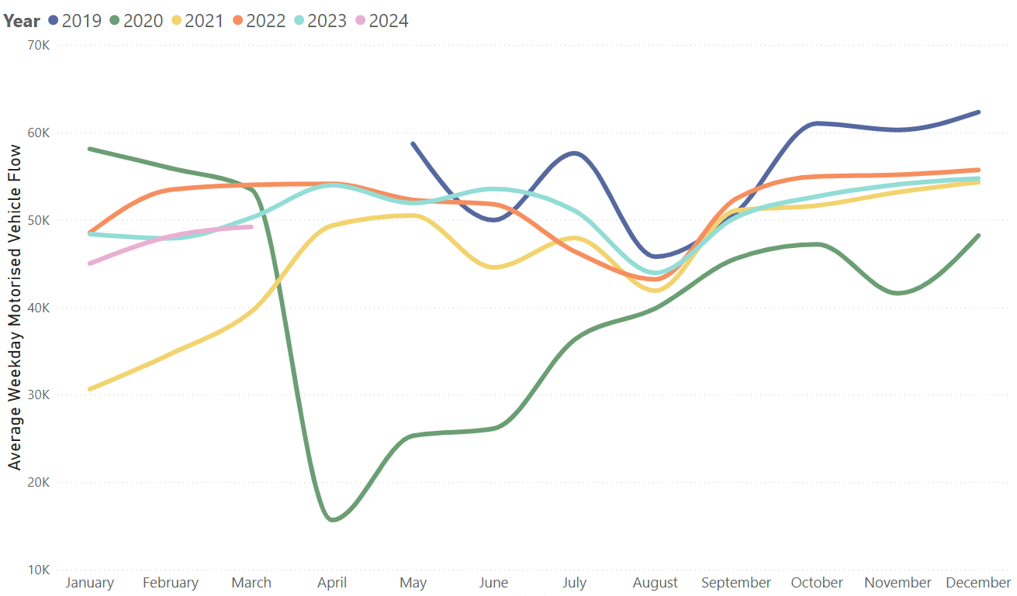
Local Road Network: Motorised Vehicle – Trends
In March 2024, motorised traffic flows are 9% below pre-Covid (February 2020), and 1% below this time last year (March 2023).
Average weekday vehicular flow by month, 2019-2024.
Pre-COVID to Now:
February 2020* to March 2024
Mon-Sun | Weekdays (Mon-Thu) | Weekends (Sat-Sun)
-9% | -12% | -3%
Mid-COVID to Now:
March 2021 to March 2024
Mon-Sun | Weekdays (Mon-Thu) | Weekends (Sat-Sun)
+30% | +25% | +65%
Previous year to Now:
March 2023 to March 2024
Mon-Sun | Weekdays (Mon-Thu) | Weekends (Sat-Sun)
-1% | -2% | +6%
*The Vivacity sensor network was installed from May 2019 onwards. Therefore, the best 'pre-Covid' estimate for traffic flows which can be compared with subsequent March data is February 2020.
Sensors used for the analysis on this slide: Coldham’s Lane Coleridge Road, Hills Road, Mill Road (West), and Tenison Road.
Notes:
Source: Cambridge Vivacity sensors
Technical Notes: 'Non-neutral days' are not included within the calculations.
This chart shows the average volume of motor vehicles counted per weekday for each month/year .
The table presents full week and weekend changes against various historic benchmarks to give an indication of how traffic flows are recovering.
Improved data cleaning processes are being developed to improve the omission of any poor quality / non-comparable data – gaps on the graph may be present for this reason. Care should be taken in interpreting these charts as they are solely based on the 5 locations stated – which dilutes the geographical coverage and may not provide a city-wide / holistic view.
Commentary:
Motorised traffic flows in 2024 so far are very similar to those seen in 2023. March 2024 is only 1% lower than this time last year, although weekend motorised traffic is up 6% on March 2023.
Motorised flows remain below February 2020 (‘pre-COVID’) levels (-9%). Weekends (-3%) are closer to pre-Covid than weekdays (-12%).

Slide 24
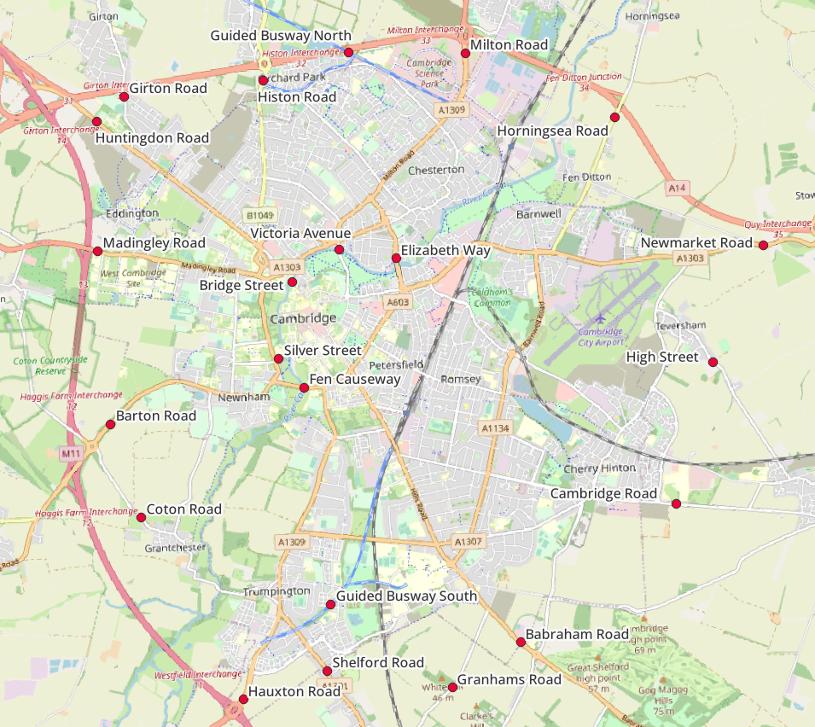
Local Road Network: Motorised Vehicle - Annual Survey Sites
Cambridgeshire Annual Traffic Survey Sites
Annual Survey Sites
Elizabeth Way
Victoria Avenue​​
Bridge Street
Silver Street
Fen Causeway​​
Histon Road
Milton Road
Horningsea Road
Newmarket Road
High Street (Teversham)
Cambridge Road (Fulbourn)
Babraham Road
Shelford Road
Hauxton Road
Coton Road
Barton Road
Madingley Road
Huntingdon Road
Girton Road
Guided Busway (North)
Guided Busway (South)
Cambridgeshire County Council commissions annual traffic surveys to determine traffic levels around the county on a “typical” weekday.
The sites shown on this map are those in and around Cambridge at which CCC has collected motorised traffic flows consistently over several years.
Analysis of motorised traffic counts from these sites is presented on the following slide.
© OpenStreetMap Contributors

Slide 25
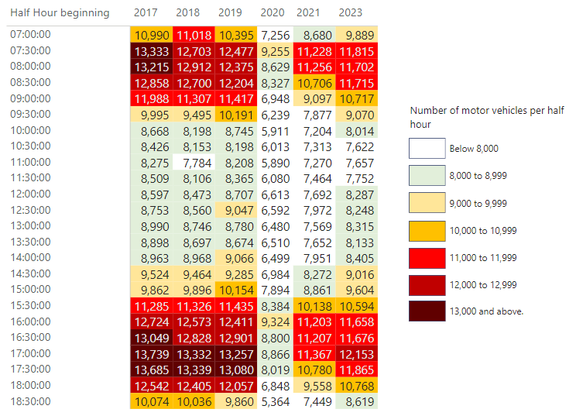
Local Road Network: Motorised Vehicle - Peak Spreading
Daily patterns of motorised traffic starting to show profiles more like pre-Covid (2017-2019), with morning and afternoon peaks, albeit with lower overall volumes. 2023 survey data has detected an evening peak above 12,000 for the first time since 2019.
Note: Survey data in Autumn 2022 was returned to CCC incomplete, therefore 2022 data is excluded from this comparison.
Notes:
Source: Cambridgeshire Annual Traffic Surveys – Cambridge Radial and Cambridge Screenline . Survey data in 2022 was returned to CCC incomplete, therefore 2022 is excluded as it cannot be presented in comparison to other years.
Technical Note: These figures use the annual traffic survey data from sites in the annual Cambridge Screenline and the Cambridge Radial surveys (only sites which have been consistent across all years). The survey days used in this analysis have been chosen to most closely represent a “typical” day for traffic flows (i.e. avoiding bank holidays, weeks with strike action, other special circumstances which can affect traffic volumes).

Slide 26
Local Road Network:
Vehicle Split

Slide 27
Local Road Network Monitoring Sites: Vehicle Split
Long Term Vivacity Monitoring Sites – Vehicle Split
The Mill Road and East Road sensors were upgraded in Sept 2022 and are now detecting significantly more cycles and pedestrians. As a result, the active travel flows at these locations are no longer comparable pre/post Sept 2022.
The Milton Road (Mid) sensor is currently inactive.
Sensor Location​​ | Location description​​ | Installed​
Cherry Hinton Road ​​ | Near Rock Road​​ | May 2019​
Coldham’s Lane​​ | Near Coldham’s Common​​ | May 2019​
Coleridge Road ​​ | Near Coleridge recreation ground​​ | May 2019​
East Road​​ | Close to ARU site​​ | May 2019​
Hills Road Bridge​​ | Near Cherry Hinton Road​​ | May 2019​
Histon Road (North)​​ | Just south of A14​ | Sept 2019​
Histon Road (South) ​​ | Near Victoria Road​ | Sept 2019​
Mill Road (East)​​ | Close to Brookfield’s hospital​​ | May 2019​
Mill Road (West)​​ | Close to Parker’s Piece​​ | May 2019​
Milton Road (Mid)​​ | Near Union Lane​​ | May 2019​
Milton Road (North)​​ | Near King’s Hedges Road​ | Sept 2019​
Milton Road (South)​ | Near Gilbert Road​ | Sept 2019​
Newmarket Road | Near Ditton Fields | May 2019
Perne Road | Near Birdwood Road roundabout | May 2019
Station Road | Near Kett House | May 2019
Tenison Road​​ | Near Mill Road​​ | May 2019​
Vinery Road ​​ | Near Romsey recreation ground​​ | May 2019​
Legend
Comparable motorised vehicle data available for most months and years.
Comparable motorised vehicle data available for Feb 2020*, Mar 2021, Mar 2023 & Mar 2024.
Comparable motorised vehicle data available for Feb 2020* and Mar 2024.
© OpenStreetMap Contributors
Comparable data not available for Feb 2020* and / or Mar 2024.
*The Vivacity sensor network was installed from May 2019 onwards. Therefore, the best 'pre-Covid' estimate for traffic flows which can be compared with subsequent March data is February 2020.
Notes:
Source: Cambridge Vivacity sensors
Technical note: This analysis has excluded sensors which may compromise the validity of historic comparisons when figures for all sites are combined. For example, some sites may have data gaps, road closures or events impacting data within the comparison period.

Slide 28
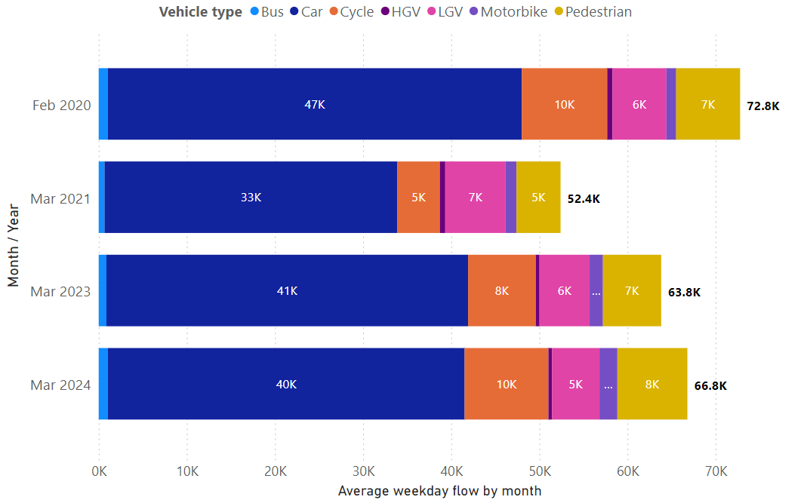
Local Road Vehicle Split: Overall
March 2024 typical weekday volumes are ahead of this point last year (Mar 2023), although still below pre-Covid (Feb 2020). The proportion of flows which were made using active travel has increased from 22% last year to 26% in March 2024 – helped by an increase in cycling volumes.
Vehicle type split – sum of 5 sensors in Cambridge
Active Travel* proportion by year
Year | Active %
February 2020 | 23%
March 2021 | 19%
March 2023 | 22%
March 2024 | 26%
March 2024 Active Travel* proportion by location
Location​ | Active %​
Station Road | 54%
Mill Road (West) | 49%
Tenison Road | 45%
Mill Road (East) | 36%
Hills Road | 29%
East Road | 28%
Histon Road (South) | 27%
Cherry Hinton Road | 26%
Coleridge Road | 21%
Perne Road | 12%
Histon Road (North) | 10%
Coldham's Lane | 10%
Newmarket Road | 4%
*Active Travel includes cyclists and pedestrians
Sensors used for the analysis on this slide: Cherry Hinton Road, Coldham’s Lane, Coleridge Road, Hills Road, and Tenison Road.
Notes:
Source: Cambridge Vivacity sensors
Technical Notes: Sensors included within the four-year chart are: Cherry Hinton Road, Coldham’s Lane, Coleridge Road, Hills Road, and Tenison Road. 'Non-neutral' days are not included within average weekday flow calculations. Fridays are not counted as a weekday. Traffic flows on all other days are counted and used to calculate a typical 'average' traffic flow within central Cambridge on a weekday.
We have selected the most recent month of data (March 2024) and compared it to three historic time periods to show how traffic flows have evolved since these sensors were installed.
Commentary
March 2024 data presents with a typical weekday flow of just over 66,000 across the 5 sensors - this is ahead of this point last year, with March 2023 presenting just under 64,000.
Pre-Covid (February 2020) typical weekday flows in central Cambridge were significantly higher than in subsequent years, reaching almost 73,000.
Overall, the proportionate split in travel modes has not changed a huge amount between the four months selected- cars are the dominant mode of transport in all four years.
Active mode share of traffic flow has noticeably increased in March 2024 – with pedestrians and pedal cycles combining to account for 26% of typical weekday flows. Up from 22% in March 2023, and ahead of pre-Covid (23% in February 2020).

Slide 29
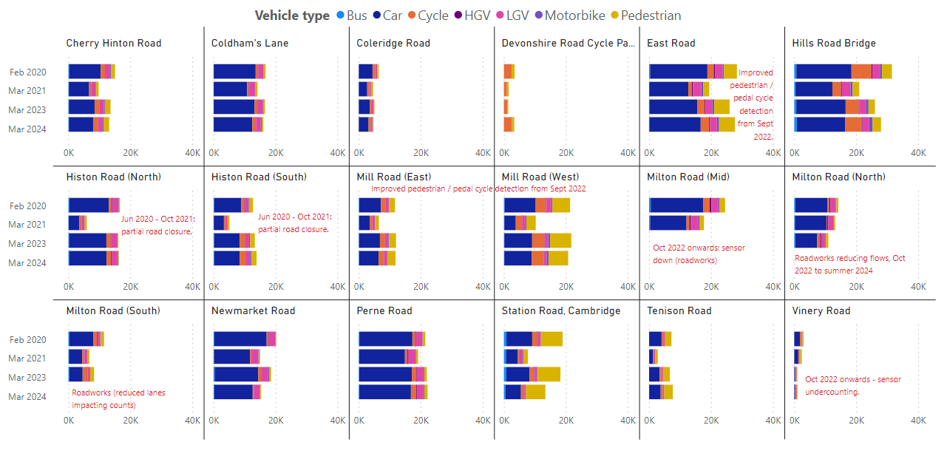
Local Road Vehicle Split: By Location
Average weekday flow by mode
Notes:
Source: Cambridge Vivacity sensors
Technical Note:
Non-neutral days are not included within the average weekday flow calculations. Weekdays are defined as Monday to Thursday, as per DfT guidance. We have selected the most recent month of data (March 2023) and compared it to three historic months to show how traffic flows have evolved since these sensors were installed.
Please see the comments on the slide which highlight events which are considered likely to have impacted the data. For example, there may be a data gap or a change that is likely to affect the counts either upwards or downwards – and so require caution to be taken when assessing the outputs.
Commentary:
Cars are the largest individual category in all locations across all years – but some sites are seeing the dominance of cars recede slightly.
Overall, there has not been a significant impact on modal split at most locations - with the exceptions being sites which have had a sensor upgrade that enables vastly improved active mode counts (these are East Road, Mill Road West and Mill Road East).

Slide 30
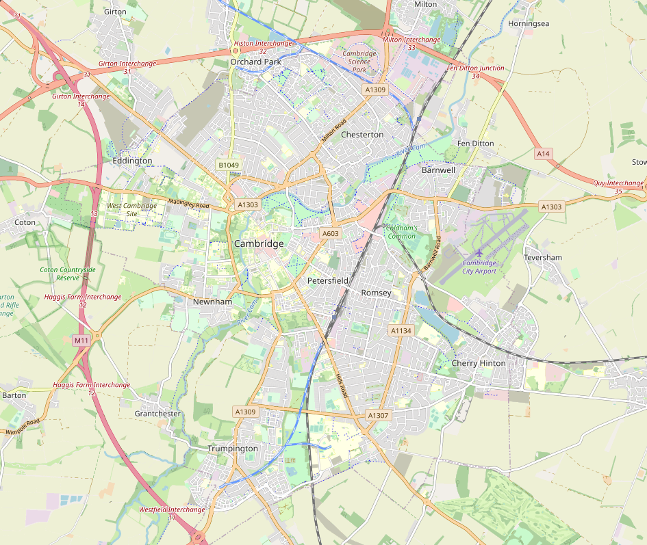
Local Road Network: Recovery Map
The motorised flow across 5 Cambridge sensors in March 2024 is 12% below pre-COVID levels (February 2020). There is a variation in active travel volume changes across the sites, but the combined overall figure for these 5 locations is a 3% increase against pre-COVID volumes.
% change in traffic flows, Feb 2020 to Mar 2024
All 5 Sites Combined
Active Travel:
Motorised Travel:
Coldham's Lane
Active Travel:
Motorised Travel:
+3%
+29%
-12%
-7%
Hills Road Bridge
Active Travel:
Motorised Travel:
Tenison Road
Active Travel:
Motorised Travel:
-15%
+27%
-9%
-6%
Coleridge Road
Active Travel:
Motorised Travel:
Cherry Hinton Road
Active Travel:
Motorised Travel:
-21%
+21%
-20%
-27%
© OpenStreetMap Contributors
Notes:
Source: Cambridge Vivacity sensors
Technical Note: Calculations are made on an average weekday. Low and zero flows are removed from any average calculations. Any ‘non neutral’ days - such as bank holidays or school holidays – are also excluded.
Data is shown only for the five sensors with comparable data for February 2020 and March 2024 for both active and motorised traffic flows. February 2020 is chosen as the comparison month as the sensors were installed from May 2019 onwards.
Commentary:
Active travel is 3% above pre-Covid levels across these sites; albeit with a wide fluctuation by site. Hills Road (-15%) and Coleridge Road (-21%) show decreases against February 2020; whereas Tenison Road, Coldham’s Lane and Cherry Hinton Road are all more than 20% ahead of pre-Covid active travel volumes on a typical weekday.
Motorised travel is 12% below pre-pandemic levels overall across these sites; with all individual sites presenting a drop against February 2020 levels.
Coleridge Road has seen the largest individual drop in motorised vehicle flows against February 2020 (-27%).

Slide 31
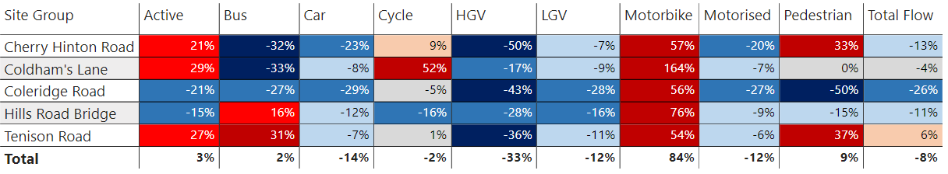
Local Road Network: Recovery by Location and Mode
Motorcycle volumes are higher than pre-Covid (February 2020) at all sites. Overall, active modes are up 3% in comparison to pre-Covid; but there is variation by location. Motorised volumes remain lower than pre-Covid volumes at all 5 sites.
% change in weekday flows
Pre-COVID to Now:
February 2020* to March 2024
*The Vivacity sensor network was installed from May 2019 onwards. Therefore, the best 'pre-Covid' estimate for traffic flows which can be compared with subsequent March data is February 2020.
Data shown only for the sensors with comparable data for February 2020 and March 2024.
Notes:
Source: Cambridge Vivacity sensors
Technical Note: Weekday volumes do not include Fridays. Low and zero flows are removed from any average calculations, and any ‘non neutral’ days - such as bank holidays or school holidays – are also excluded.
Commentary:
Motorcycles are ahead of pre-Covid (Feb 2020) counts at all sites. HGV volumes and Car volumes are below pre-Covid levels at all sites.
Coleridge Road is showing the largest fall in car volumes (-29% against February 2020).
Coldham’s Lane is showing the largest increase in Active travel (+29% against February 2020).
There is a noticeable variation in cycling and pedestrian volumes across these sites in comparison to pre-Covid. For example, Cherry Hinton Road shows a 33% increase in pedestrian counts; whereas Coleridge Road shows a 50% decrease.
Elsewhere, cycling counts are 52% ahead of pre-Covid at Coldham’s Lane; whereas Hills Road shows a 16% drop across the same time-span.

Slide 32
Local Road Network:
Active Travel

Slide 33
Local Road Network Monitoring Sites: Active Travel
Long Term Vivacity Monitoring Sites – Vehicle Split
The Mill Road and East Road sensors were upgraded in Sept 2022 and are now detecting significantly more cycles and pedestrians. As a result, the active travel flows at these locations are no longer comparable pre/post Sept 2022.
The Milton Road (Mid) sensor is currently inactive.
Sensor Location​​ | Location description​​ | Installed​
Cherry Hinton Road ​​ | Near Rock Road​​ | May 2019​
Coldham’s Lane​​ | Near Coldham’s Common​​ | May 2019​
Coleridge Road ​​ | Near Coleridge recreation ground​​ | May 2019​
East Road​​ | Close to ARU site​​ | May 2019​
Hills Road Bridge​​ | Near Cherry Hinton Road​​ | May 2019​
Histon Road (North)​​ | Just south of A14​ | Sept 2019​
Histon Road (South) ​​ | Near Victoria Road​ | Sept 2019​
Mill Road (East)​​ | Close to Brookfield’s hospital​​ | May 2019​
Mill Road (West)​​ | Close to Parker’s Piece​​ | May 2019​
Milton Road (Mid)​​ | Near Union Lane​​ | May 2019​
Milton Road (North)​​ | Near King’s Hedges Road​ | Sept 2019​
Milton Road (South)​ | Near Gilbert Road​ | Sept 2019​
Newmarket Road | Near Ditton Fields | May 2019
Perne Road | Near Birdwood Road roundabout | May 2019
Station Road | Near Kett House | May 2019
Tenison Road​​ | Near Mill Road​​ | May 2019​
Vinery Road ​​ | Near Romsey recreation ground​​ | May 2019​
Legend
Comparable motorised vehicle data available for most months and years.
Comparable motorised vehicle data available for Feb 2020*, Mar 2021, Mar 2023 & Mar 2024.
Comparable motorised vehicle data available for Feb 2020* and Mar 2024.
© OpenStreetMap Contributors
Comparable data not available for Feb 2020* and / or Mar 2024.
*The Vivacity sensor network was installed from May 2019 onwards. Therefore, the best 'pre-Covid' estimate for traffic flows which can be compared with subsequent March data is February 2020.
Notes:
Source: Cambridge Vivacity sensors
Technical note: This analysis has excluded sensors which may compromise the validity of historic comparisons when figures for all sites are combined. For example, some sites may have data gaps, road closures or events impacting data within the comparison period.

Slide 34
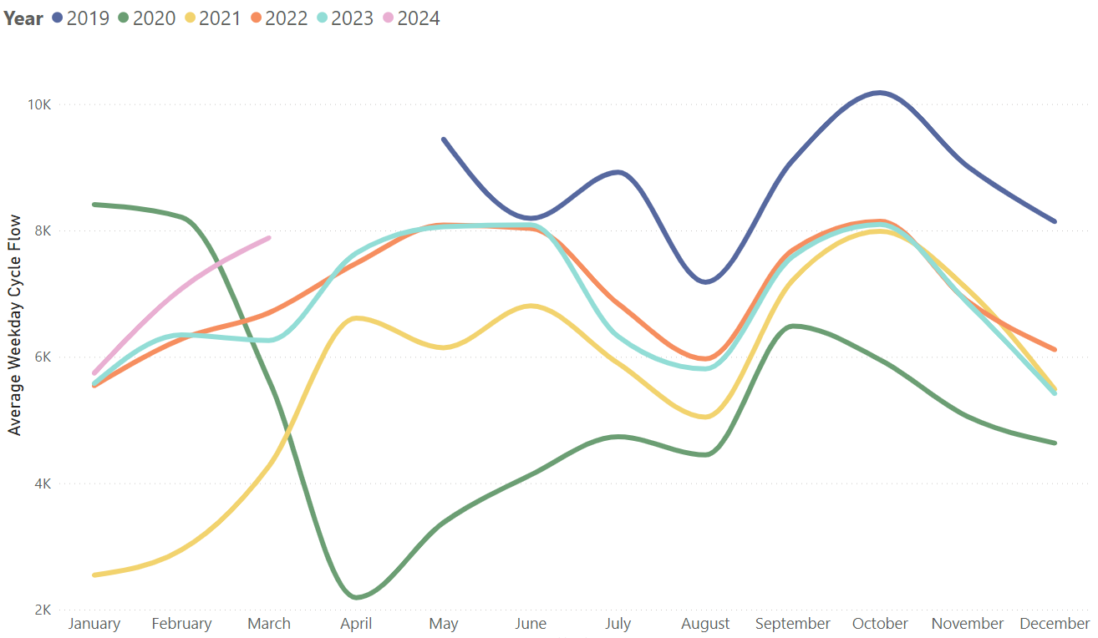
Local Road Network: Cyclists
March 2024 overall cycling volumes are at pre-Covid (Feb 2020) levels. Cycle flows are a little way ahead of this point last year (+17% against March 2023).
Average weekday cycle flow
Pre-COVID to Now:
February 2020 to March 2024
Mon-Sun | Weekdays (Mon-Thu) | Weekends (Sat-Sun)
0% | -4% | +11%
Mid-COVID to Now:
March 2021 to March 2024
Mon-Sun | Weekdays (Mon-Thu) | Weekends (Sat-Sun)
+65% | +85% | +39%
Previous year to Now:
March 2023 to March 2024
Mon-Sun | Weekdays (Mon-Thu) | Weekends (Sat-Sun)
+17% | +26% | +16%
Sensors used for this analysis: Coldham’s Lane, Coleridge Road, Hills Road, and Tenison Road.
Notes:
Source: Cambridge Vivacity sensors
Technical note: Bank holiday weeks are not included within the calculations. School holidays are also excluded (except summer holidays in order to obtain figures for August). Sensors used within the calculations: Coldham’s Lane, Coleridge Road, Hills Road, and Tenison Road.
Commentary: March 2024 is showing no change overall against pre-Covid (Feb 2020) cycling volumes. Weekends are 11% ahead of pre-Covid; whilst weekdays are 4% below pre-Covid.
In comparison to last year, cycling volumes are 17% ahead of March 2023 overall – with weekdays 26% ahead of March 2023; and weekends 16% ahead.

Slide 35
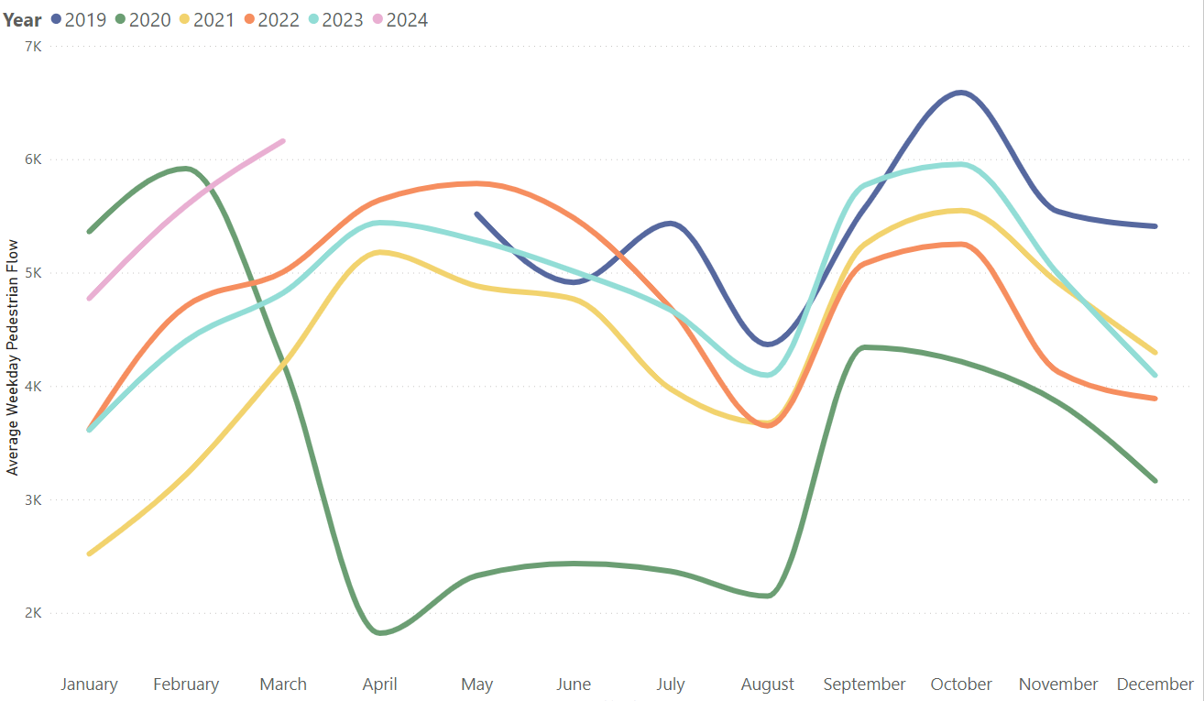
Local Road Network: Pedestrians
Pedestrian volumes in March 2024 were 6% ahead of pre-Covid (Feb 2020) – and 18% ahead of this time last year (March 2023)
Average weekday pedestrian flow
Pre-COVID to Now:
February 2020 to March 2024
Mon-Sun | Weekdays (Mon-Thu) | Weekends (Sat-Sun)
+6% | +4% | +4%
Mid-COVID to Now:
March 2021 to March 2024
Mon-Sun | Weekdays (Mon-Thu) | Weekends (Sat-Sun)
+28% | +47% | -2%
Previous year to Now:
March 2023 to March 2024
Mon-Sun | Weekdays (Mon-Thu) | Weekends (Sat-Sun)
+18% | +28% | +9%
Sensors used for this analysis: Coldham’s Lane, Coleridge Road, Hills Road, and Tenison Road.
Notes:
Source: Cambridge Vivacity sensors
Technical Note: Bank holidays and school holidays do not get included in these monthly averages. Fridays are not counted as a 'weekday’ - but Fridays are included in the 'Mon-Sun' calculations.
Sensors used within the calculations: Coldham’s Lane, Coleridge Road, Hills Road, and Tenison Road.
Commentary: Pedestrian volumes in March 2024 are 6% above pre-Covid (February 2020) levels. Weekdays (Mon-Thu) and Weekends both show a 4% increase against pre-Covid.
Overall, pedestrian volumes present a 28% increase against mid-Covid levels (March 2021), however weekends are showing a 2% drop against mid-Covid pedestrian traffic – while weekdays (Mon-Thu) show a 47% increase against March 2021.
Pedestrian volumes in March 2024 are above last year (+18% in comparison to March 2023). Weekends (+9%) and Weekdays (+28%) are both ahead of this point last year.

Slide 36
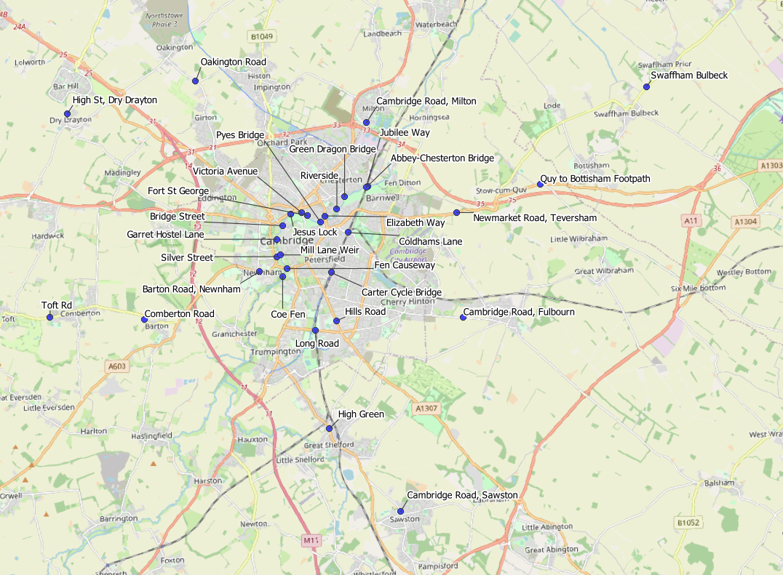
Local Road Network: Active Travel Census Sites
Cambridgeshire Annual Traffic Survey Sites – River Screenline and Cycle Routes
Sensor Location​​
Elizabeth Way
Victoria Avenue​​
Bridge Street
Silver Street
Fen Causeway​​
Green Dragon Bridge​​
Pye’s Bridge
Fort St George​​
Jesus Lock​​
Garrett Hostel Lane​​
Mill Lane Weir
Coe Fen​
Riverside
Abbey-Chesterton Bridge (NEW for 2022, excluded from peak spreading analysis for comparability over time)
Barton Road, Newnham
Comberton Road
Toft Road
High Street, Dry Drayton
Oakington Road
Cambridge Road, Milton
Cambridge Road, Fulbourn
Newmarket Road, Teversham
Coldhams Lane
Carter Cycle Bridge
High Green, Great Shelford
Hills Road
Long Road
Jubilee Way
Cambridge Road, Sawston
Swaffham Bulbeck Footpath
Quy to Bottisham Footpath
© OpenStreetMap Contributors
© OpenStreetMap Contributors

Slide 37
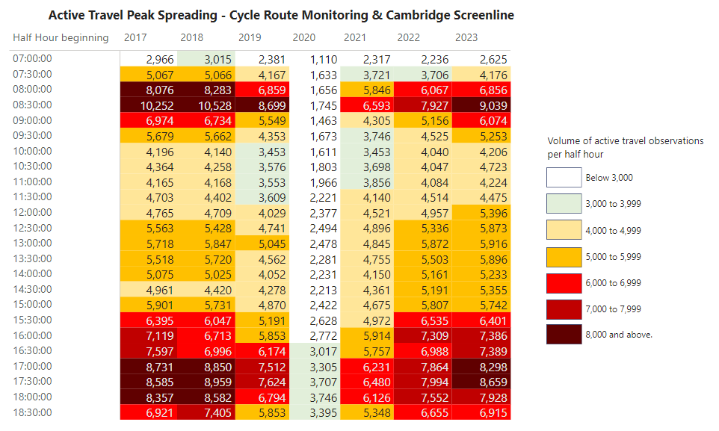
Local Road Network: Active Travel Peak Spreading
The pattern of pedestrian and pedal cycle travel in 2023 more closely resembles that from 2017 and 2018, particularly the extent of peak spreading in the afternoon / evening although volumes are still a little below pre-COVID levels.
Notes:
Source: Cambridge Spring Census – Screenline & Cycle Route Monitoring.
Technical Note: These figures use the annual traffic survey data from the annual Cambridge Screenline and the Cycle Route Monitoring surveys (excluding the Abbey-Chesterton Bridge which only opened in recent years, to ensure year-on-year comparability). The survey days used in this analysis have been chosen to most closely represent a “typical” day for traffic flows (i.e. avoiding bank holidays, weeks with strike action, other special circumstances which can affect traffic volumes).
As active travel can be quite variable due to weather conditions, we would advise some caution in using these figures as they are taken from daily surveys rather than calculated over longer periods of time.

Slide 38
Retail Footfall

Slide 39
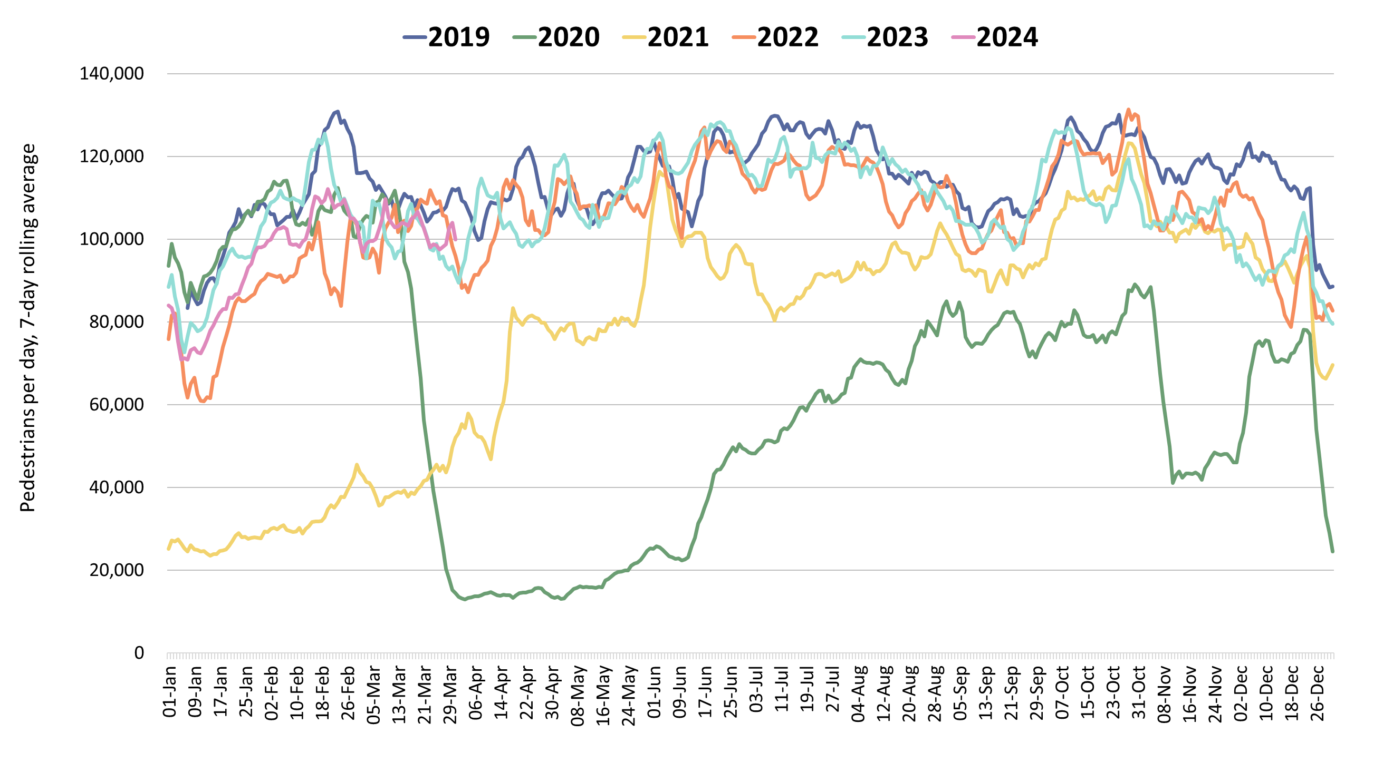
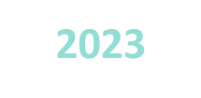
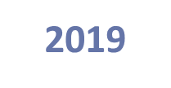
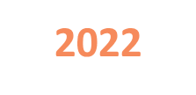
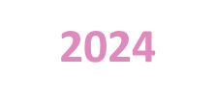
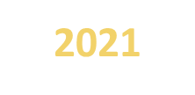
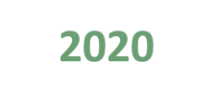


Retail Footfall: Central Cambridge
Retail footfall in Cambridge is 7% below pre-COVID (March 2019) levels - but is now 6% above last year (March 2023).
Third lockdown
Pre-COVID to Now:
Mar 2019 to Mar 2024
Mon-Sun | Weekdays (Mon-Thu) | Weekends (Sat-Sun)
-7% | -8% | -5%
Mid-COVID to Now:
Mar 2021 to Mar 2024
Mon-Sun | Weekdays (Mon-Thu) | Weekends (Sat-Sun)
+161% | +151% | +170%
Previous year to Now:
Mar 2023 to Mar 2024
Mon-Sun | Weekdays (Mon-Thu) | Weekends (Sat-Sun)
+6% | +4% | 0%
Notes:
Source: Cambridge BID footfall data.
Technical note: Data from the following locations: Bridge Street, Fitzroy Street at Waitrose, Market Hill, Regent Street, Rose Crescent, Sidney Street. Excludes data for King’s Parade and One Station Square. As outlined at the start of this slide pack, 'weekdays' do not include Fridays. Table calculations do not include bank holidays, school holidays or any other "non neutral" days. The percentage changes are designed to reflect change on a "typical" day.
Commentary:
March foot traffic in central Cambridge is 7% below the pre-Covid level of March 2019 but is now 6% above what we saw in March 2023 last year.
Weekday (Mon-Thu) footfall is 8% below pre-Covid levels, and weekend footfall is 5% below pre-Covid levels.
Weekday (Mon-Thu) foot traffic is 4% above March 2023. However, there was a 0% change in weekend footfall when compared to March 2023, suggesting that foot traffic in central Cambridge is beginning to settle as the city adapts to post-Covid life.
Overall, footfall levels for March 2024 have surged by 161% when compared to March 2021 (Mid-Covid), indicating a significant rebound in city centre activity and a recovery in central Cambridge dynamics .

Slide 40
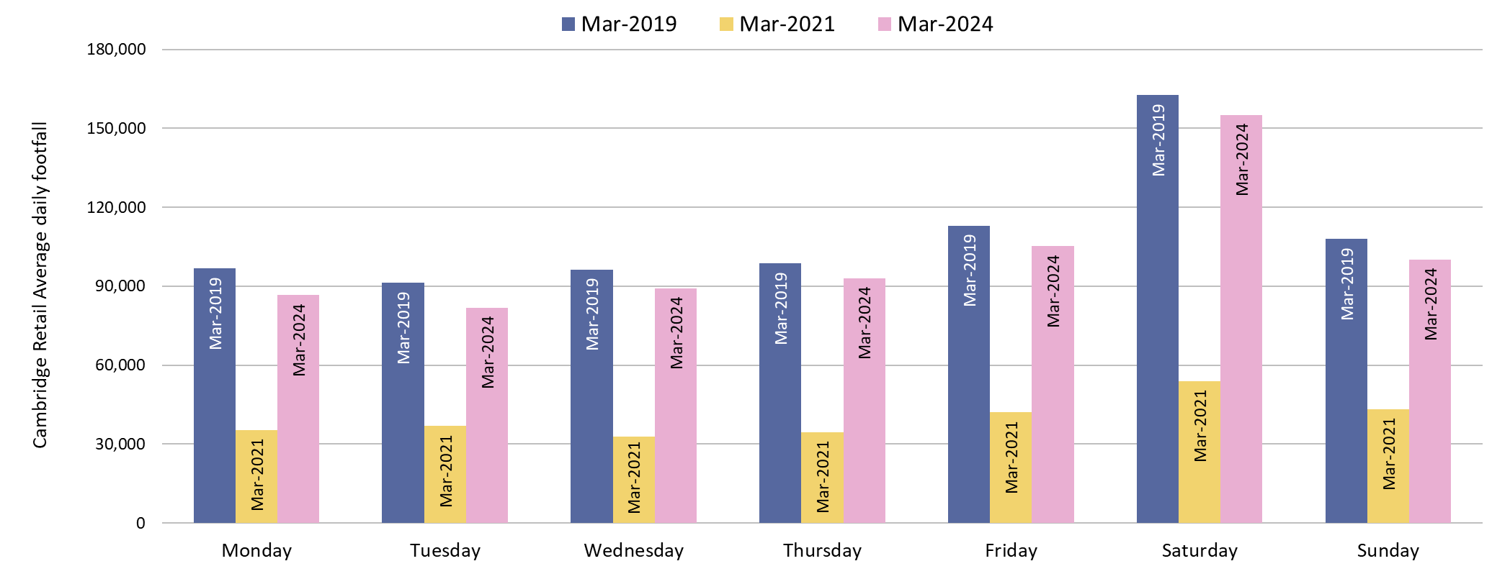
Retail Footfall: Central Cambridge by Day of the Week
All days are below pre-Covid (March 2019) levels. Monday and Tuesday (-10%) experienced the largest decrease, while Saturday (-5%) is closest to pre-Covid.
Pre-COVID to Now: Mar 2019 to Mar 2024
Monday | Tuesday | Wednesday | Thursday | Friday | Saturday | Sunday
-10% | -10% | -7% | -6% | -7% | -5% | -7%
Notes:
Source: Cambridge BID footfall data.
Technical note: Data from the following locations: Bridge Street, Fitzroy Street at Waitrose, Market Hill, Regent Street, Rose Crescent, Sidney Street. Excludes data for King’s Parade and One Station Square. Table calculations do not include bank holidays, school holidays or any other "non neutral" days. The percentage changes are designed to reflect change on a "typical" day.
Commentary: All days of the week show a modest negative change to pre-COVID (March 2019) levels, with the largest change being a decrease of 10% (Monday and Tuesday). Saturday footfall levels are closest to March 2019, at 5% below March 2019.
All days showed a strong recovery from mid-Covid (March 2021), with Saturday levels increasing by 187%.

Slide 41
Car Parking

Slide 42
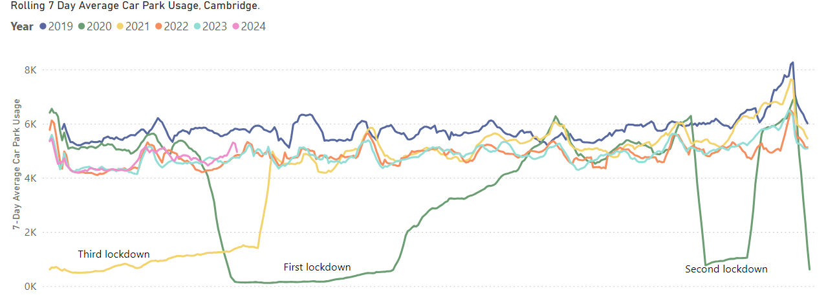
Car Parking: Daily Use
Multi-storey car park use in March 2024 was 18% below pre-Covid (March 2019) levels. Grafton East (-28%) has seen the largest fall in average daily usage among individual car parks compared to pre-Covid; whereas Grand Arcade has seen the largest increase in average daily usage (+6%).
Pre-COVID to Now:
March 2019 to March 2024
Mon-Sun | Weekdays (Mon-Thu) | Weekends (Sat-Sun)
-18% | -21% | -18%
Mid Covid to Now:
March 2021 to March 2024
Mon-Sun | Weekdays (Mon-Thu) | Weekends (Sat-Sun)
+302% | +235% | +407%
Previous year to Now:
March 2023 to March 2024
Mon-Sun | Weekdays (Mon-Thu) | Weekends (Sat-Sun)
+5% | 0% | -1%
*Park Street car park closed for redevelopment on 4th January 2022; usage figures for this car park are included up to its closure.
Notes:
Source: Cambridge City Council Car Parking data
Technical notes: Table calculations do not include bank holidays, school holidays, or any other "non neutral" days. The percentage changes are designed to reflect change on a "typical" day. As outlined at the start of this slide pack, 'weekdays' do not include Fridays.
Commentary:
Multi-storey car park usage in central Cambridge is 18% below the pre-Covid level of March 2019.
March 2024 multi-storey car park usage presents as 302% above mid-Covid (March 2021) levels. A possible reason for this large increase is that England was under lockdown restrictions, with the last stage of lockdown restrictions being lifted coming on 17th May.
The figures for March 2024 are 5% ahead of last year (March 2023). Weekend figures are 1% below last year, whilst Monday to Thursday usage remains unchanged.
Additionally, an increased charge for car parks was introduced in February 2023 and may be having an impact on usage.

Slide 43
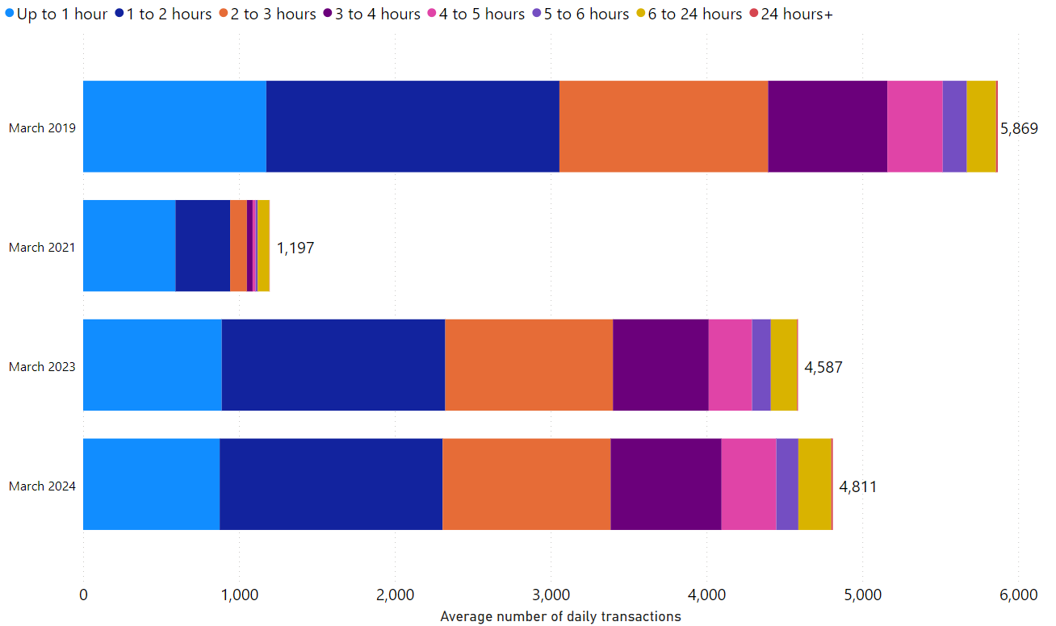
Car Parking: Length of Stay by Month
Typical daily multi-storey car park usage has increased in March 2024 in comparison to last year (5% higher than March 2023).
The proportionate split in length-of-stay within multi-storey car parks has stayed fairly consistent over time.
Park Street car park closed for redevelopment on 4th January 2022; usage figures for this car park are included up to its closure.
Notes:
Source: Cambridge City Council Car Parking data
Technical notes: School holidays, bank holidays and any other "non neutral" days are not included in calculations for this chart.
Commentary:
The proportionate split in length of stay in Cambridge's multi-storey car parks is relatively consistent across the four months shown within the chart.
The chart indicates that March 2024 has seen an increase in car park usage in comparison to 2021 and 2023 but overall volumes are still below that which was seen in 2019.
Caveats with this chart are that Park Street Car park closed in January 2022, and a new car park charge was introduced in February 2023.

Slide 44
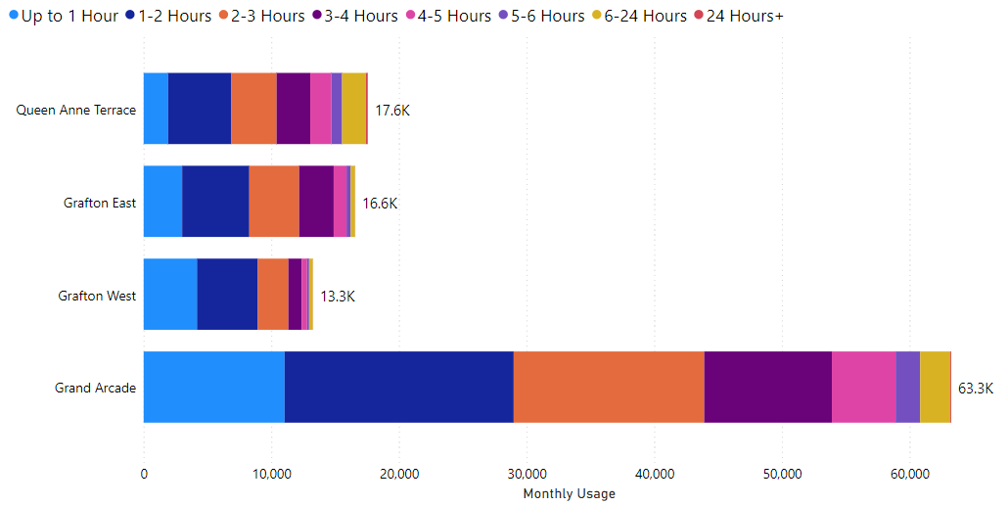
Car Parking: Length of Stay by Car Park
In March 2024, Grafton West had the highest proportion of stays under 3 hours (85%) whilst Queen Anne’s Terrace had the lowest proportion (59%). Grand Arcade remains comfortably the most popular car park – with over 63,000 transactions recorded in March 2024.
Car Park Usage (March 2024)
Notes:
Source: Cambridge City Council Car Parking data
Technical notes: School holidays, bank holidays and any other "non neutral" days are not included in calculations for this chart.
Commentary:
85% of March 2024 visits to Grafton West lasted less than three hours – making it the most likely facility to be used for short stays.
Queen Anne's Terrace is the facility with the highest proportion of long stays, with 41% of March 2024 visits lasting more than three hours.
Grand Arcade is comfortably the most popular multi storey car park facility in Cambridge – with more than 63,000 patrons in March (neutral days only).

Slide 45
Rail Passengers

Slide 46
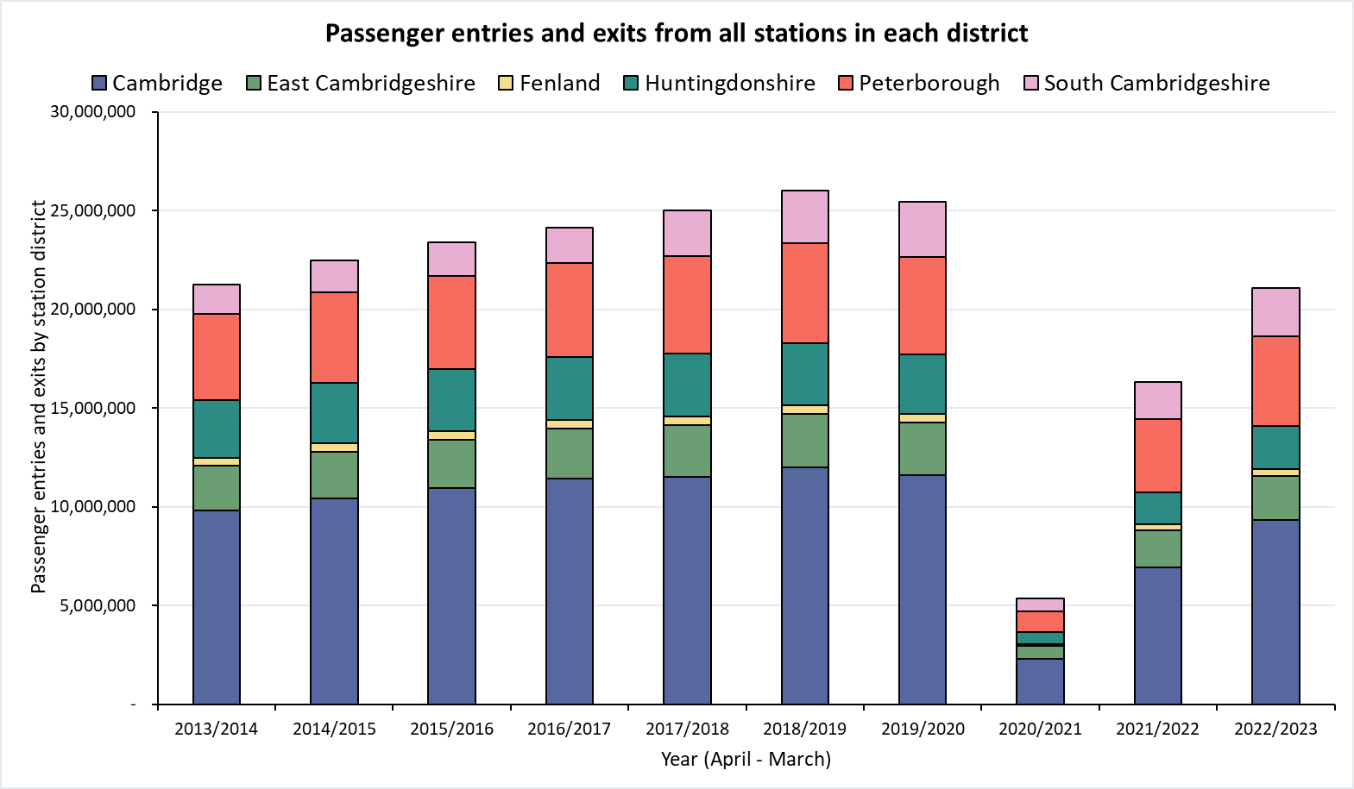
Rail Passengers: Usage
Railway station entries and exits across Cambridgeshire are still below pre-COVID (2018/19) volumes. Huntingdonshire (-30%) presents the largest fall since pre-COVID, while South Cambridgeshire (-7%) is closest to pre-COVID.
District | Cambridge | East Cambridgeshire | Fenland | Huntingdonshire | Peterborough | South Cambridgeshire
Pre-COVID to Now: 2018/19* to 2022/23
-22%
-19%
-22%
-30%
-11%
-7%
*2018/19 used as the pre-COVID baseline as 2019/20 entries and exit data is affected in March 2020 by the first COVID-19 lockdown.
Notes:
Source: Rail statistics, ORR. Table 1415a
Technical note: Rail Passenger annual data runs April – March and is released in April each year. As such, 2018/19 is used as the pre-COVID baseline as 2019/20 entries and exit data is affected in March 2020 by the first COVID-19 lockdown.
Commentary: Rail usage overall is down on pre-Covid baselines. Stations in Huntingdonshire have seen the largest decrease in passenger entries and exits, presenting as 30% below 2018/19 figures. Stations in South Cambridgeshire have the smallest decline when compared to 2018/19 levels, showing only a 7% decrease.

Slide 47
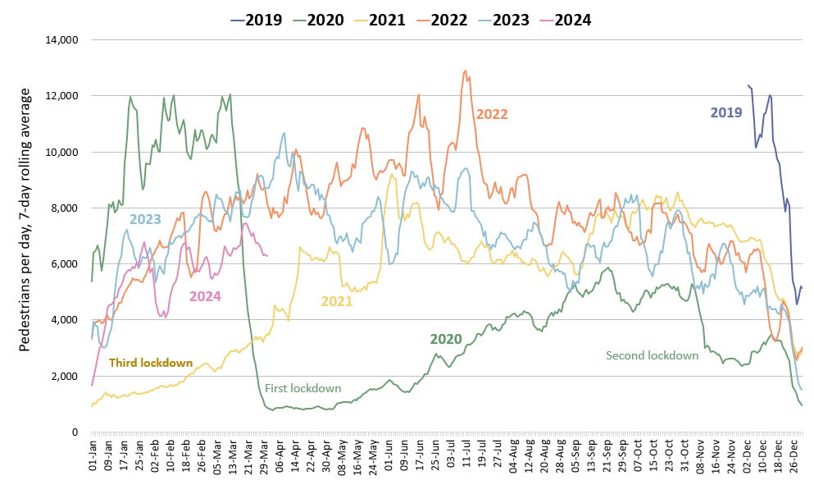
One Station Square Footfall
One Station Square footfall is 40% below pre-Covid (March 2020*) and is 21% below last year (March 2023).
Footfall at One Station Square (directly outside Cambridge train station)
Pre-COVID to Now:
Mar 2020* to Mar 2024
Mon-Sun | Weekdays (Mon-Thu) | Weekends (Sat-Sun)
-40% | -36% | -35%
Mid-COVID to Now:
Mar 2021 to Mar 2024
Mon-Sun | Weekdays (Mon-Thu) | Weekends (Sat-Sun)
+129% | -131% | +159%
Previous year to Now:
Mar 2023 to Mar 2024
Mon-Sun | Weekdays (Mon-Thu) | Weekends (Sat-Sun)
-21% | -17% | -27%
*This sensor was installed in December 2019 so pre-Covid data is not available for all months. We have used data from March 1st-14th 2020 as the baseline for this calculation (pre-lockdown).
Notes:
Source: Cambridge BID footfall data​
Technical note: Table calculations do not include bank holidays, school holidays, or any other "non neutral" days. The One Station Square sensor was fitted in December 2019 so pre-COVID data is not available for all months. For March comparisons, we use the first two weeks of March 2020 (1st – 14^{th)} to ensure impacts of the first lockdown are not included, but we acknowledge the comparison is not ideal. Data may be impacted by strike action. As outlined at the start of this slide pack, 'weekdays' do not include Fridays.
Commentary:
Footfall at One Station Square during March 2024 was 40% down on pre-Covid (March 2020) levels.
Compared to March 2023, footfall levels have decreased by 21% overall – with weekends 27% lower than this time last year. Weekdays (Mon-Thu), meanwhile, are 17% down in comparison to March 2023.
Overall March 2024 footfall levels at One Station Square are 129% above mid-Covid (March 2021).
Recent low figures are likely caused (partially) by industrial action that took place over several days in January and February of 2024.

Slide 48
Bus Passengers

Slide 49
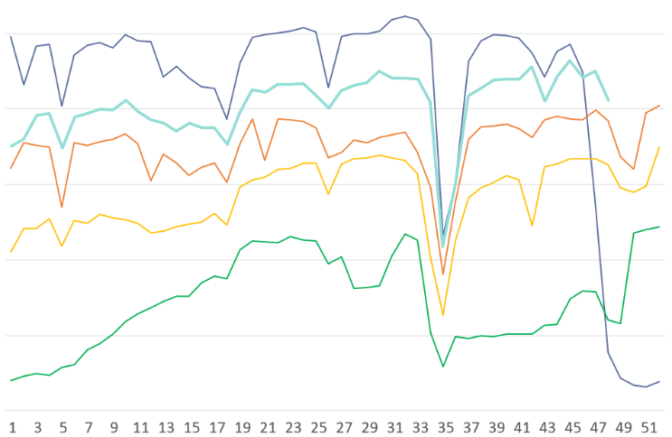
Bus Passengers in Cambridgeshire and Peterborough
Bus passenger volumes in Cambridge have continued to improve and as of March 2024 were within 5% of pre-COVID levels. Bus passenger numbers in Peterborough remain further below pre-COVID levels at -23%.
Stagecoach CPCA Area Bus Passengers
£2 bus fare cap introduced by the government (1st Jan 2023)
2019-20
Cambridge
Pre-COVID to Now:
2023-24
2022-23
Mar 2019 to Mar 2024
-5%
Bus Passengers
2021-22
Peterborough
Pre-COVID to Now:
Mar 2019 to Mar 2024
-23%
2020-21
Second lockdown
First lockdown continued
Third lockdown
First lockdown begins
May
Jun
Jul
Aug
Sep
Oct
Nov
Dec
Jan
Feb
Mar
Apr
Due to the commercial sensitivity of this data, bus passenger volumes are not marked on the y-axis of this graph.
Notes:
Source: Stagecoach
Technical note: Due to the commercial sensitivity of this data, bus passenger volumes are not marked on the y-axis of this graph.
Commentary: Bus passenger numbers have continued to rise through 2023 and 2024 but remain below pre-COVID volumes up until the first lockdown was announced in late March 2020. Bus passenger numbers fell in December in line with other reported years, suggesting that the Christmas holidays and winter weather have an impact. They also experienced a dip in line with the February half term holidays, as is also seen in previous years. In January 2023, the government announced a £2 cap on single tickets (£2 bus fare cap - GOV.UK (www.gov.uk)).

Slide 50
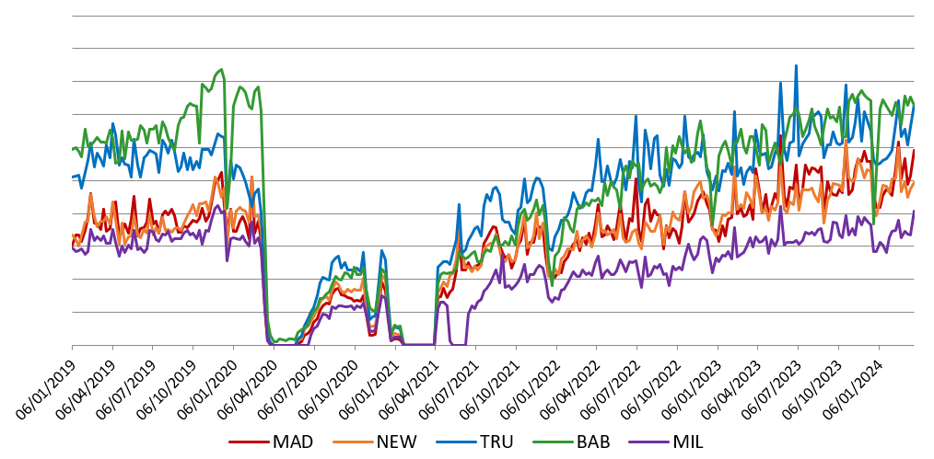
Bus Passengers: Park and Ride
Usage of all park and ride sites dipped in late December to early January in line with the Christmas and New Year holiday period but then recovered.
Babraham Road and Trumpington Road P&Rs are the most popular sites, with usage now above pre-COVID (2019).
Stagecoach Park and Ride Passengers
2019
2020
2021
2022
2023
2024
Second lockdown
Third lockdown
P&R Passengers
First lockdown
Milton P&R service temporarily suspended
Due to the commercial sensitivity of this data, bus passenger volumes are not marked on the y-axis of this graph.
Notes:
Source: Stagecoach
Technical note: Due to the commercial sensitivity of this data, bus passenger volumes are not marked on the y-axis of this graph.
Commentary: P&R passengers generally sees a sharp increase during the school holidays. In January 2023, the government announced a £2 cap on single tickets (£2 bus fare cap - GOV.UK (www.gov.uk)).
MAD=Madingley Road P&R
NEW = Newmarket Road P&R
TRU = Trumpington P&R
BAB = Babraham Road P&R
MIL = Milton Road P&R

Slide 51
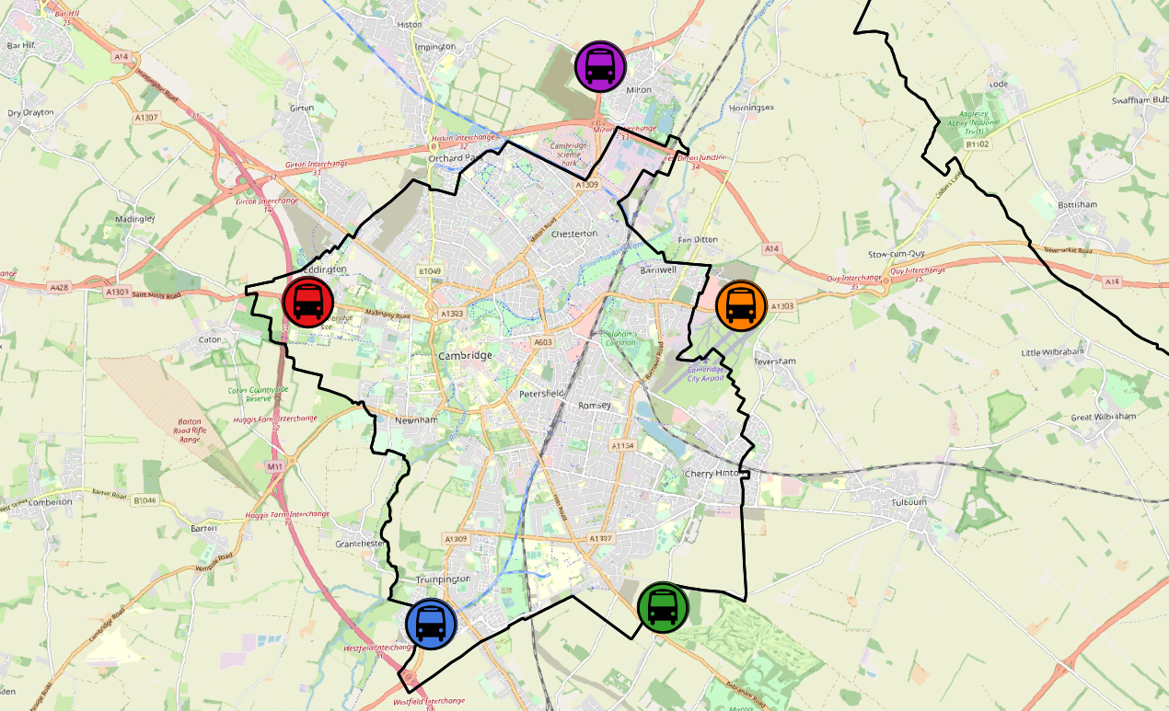
Bus Passengers: Park and Ride by Site
Park and Ride (P&R) site usage continues to exceed pre-COVID levels across all sites. Madingley Road and Newmarket Road show the largest increases on pre-COVID volumes at +44% and +26% respectively.
All P&R Sites
Mar 2019 to Mar 2024
+22%
Milton Road P&R
Mar 2019 to Mar 2024
+10%
Madingley Road P&R
Mar 2019 to Mar 2024
+44%
Newmarket Road P&R
Mar 2019 to Mar 2024
+26%
Babraham Road P&R
Mar 2019 to Mar 2024
Trumpington Road P&R
Mar 2019 to Mar 2024
+19%
+15%
© OpenStreetMap Contributors
Notes:
Source: Stagecoach

Slide 52
Micro-mobility

Slide 53
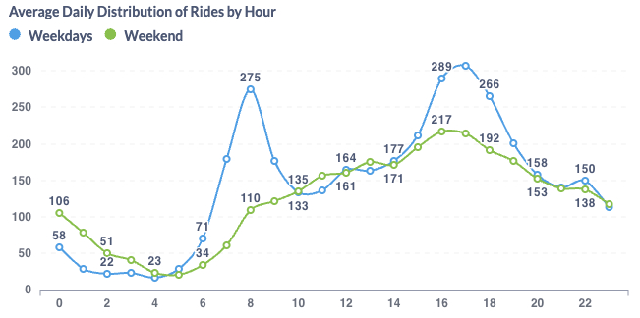
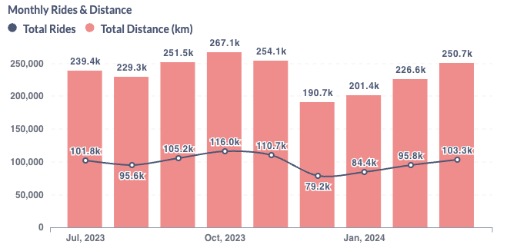
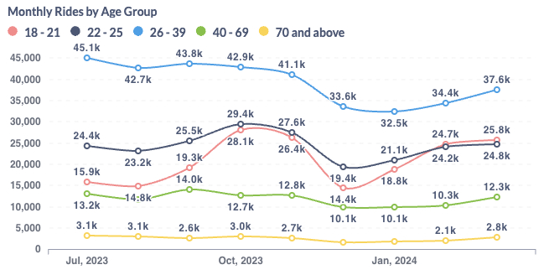
Voi E-scooters and E-bikes in Cambridge
March 2024 saw over 100,000 Voi rides. Weekdays continue to see peaks in travel around 8am and 5pm, suggesting use for commuting/education. The weekends see a mid-afternoon peak. The 26-39 age group has consistently seen the largest number of riders.
Voi have operated an electric bike (e-bike) and electric scooter (e-scooter) trial scheme in and around Cambridge City since October 2020.
March 2024 key statistics
Total
journeys:
103,300
Total distance:
250,700 km
Returning users:
17,548
New
users:
2,992
Notes:
Source: Voi monthly update

Slide 54
Air Quality

Slide 55
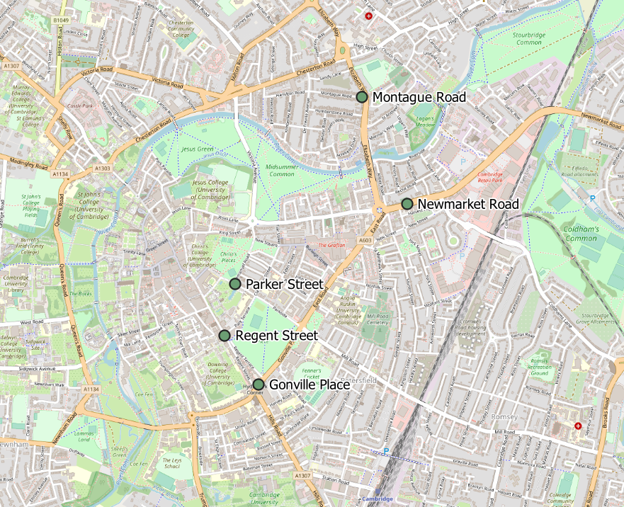
Air Quality Monitoring Locations
Continuous Air Quality Monitoring Sites, Cambridge
Location | Description
Montague Road | Close to the junction with Elizabeth Way
Newmarket Road | Close to Cambridge Retail park on Newmarket Road.
Parker Street | Close to the bus station
Regent Street | To the West of Parker’s Piece
Gonville Place | Near Hill’s Road, South of Parker’s Piece. This sensor was removed in April 2022 so data is no longer available for this site.
Cambridge City Air Quality team provide data from 4 continuous air quality monitors in central Cambridge. The monitors primarily measure Nitrogen Oxides (NOx) and Particulate Matter (PM) which are proxies for overall air quality.
© OpenStreetMap Contributors
Notes:
Source: Cambridge City Air Quality team. Data for the Cambridge air quality continuous monitors can also be found at: Air quality in England (airqualityengland.co.uk).
Technical note: Please note there may be slight differences between the data on Air Quality in England and data in this pack as air quality data undergoes a ratification process.

Slide 56

Air Quality: All Sites
NO₂ concentrations remained well below the 2017-2019 baseline in March 2024 (-44%). The March concentration is also lower than the concentrations in mid-COVID (-6%) and last year (-4%).
Monthly average NO₂ concentration across the continuous monitoring sites
Pre-COVID to Now: | Mid-COVID to Now: | Last year to Now:
Mar 2017-19 baseline to Mar 2024 | Mar 2021 to Mar 2024 | Mar 2023 to Mar 2024
-44% | -6% | -4%
*Data for Gonville Place is only included in the 2022 line until March 2022 as the sensor was removed in April 2022.
Notes:
Source: Cambridge City Air Quality team. Data for the Cambridge air quality continuous monitors can also be found at: Air quality in England (airqualityengland.co.uk).
Technical note: Analysis based on 5 sensors: Gonville Pl, Montague Rd, Newmarket Rd, Regent St and Parker St. Data for Gonville Place is included in the averages for all values before it was removed in April 2022. Please note there may be slight differences between the data on Air Quality in England and data in this pack as air quality data undergoes a ratification process.

Slide 57

Air Quality: Individual Sites
NO₂ concentrations have increased gradually since the Summer 2023, which is expected as NO2 concentrations are usually higher in the winter months. However, all sites remain below the 2017-19 baseline concentrations, and all except Newmarket Road remain below March 2023 concentrations.
Monthly average NO₂ concentration by site
 | Pre-COVID to Now: | Mid-COVID to Now: | Last year to Now:
 | Mar 2017-19 baseline to Mar 2024 | Mar 2021 to Mar 2024 | Mar 2023 to Mar 2024
Montague Road | -45% | -17% | -21%
Newmarket Road | -39% | -3% | +45%
Parker Street | -47% | -2% | -12%
Regent Street | -42% | -13% | -8%
Gonville Place | No 2024 data | No 2024 data | No 2024 data
Notes:
Source: Cambridge City Air Quality team. Data for the Cambridge air quality continuous monitors can be found at: Air quality in England (airqualityengland.co.uk).
Technical note: The Gonville Place sensor was removed in April 2022 so there is no data for this site from May 2022 onwards. Please note there may be slight differences between the data on Air Quality in England and data in this pack as air quality data undergoes a ratification process.

Slide 58
policyandinsight@cambridgeshire.gov.uk

