Slide 1



PCN Dashboard Beta Version – St Neots PCN
View in Power BI
Last data refresh:
12/04/2024 15:40:25 UTC
Downloaded at:
12/04/2024 17:23:27 UTC

Slide 2
Contents Page
Notes:
Cambridgeshire and Peterborough PCN Dashboard
No alt text provided
card
No alt text provided
pageNavigator
No alt text provided
Slicer PCN
No alt text provided
actionButton
No alt text provided
actionButton
No alt text provided

Slide 3
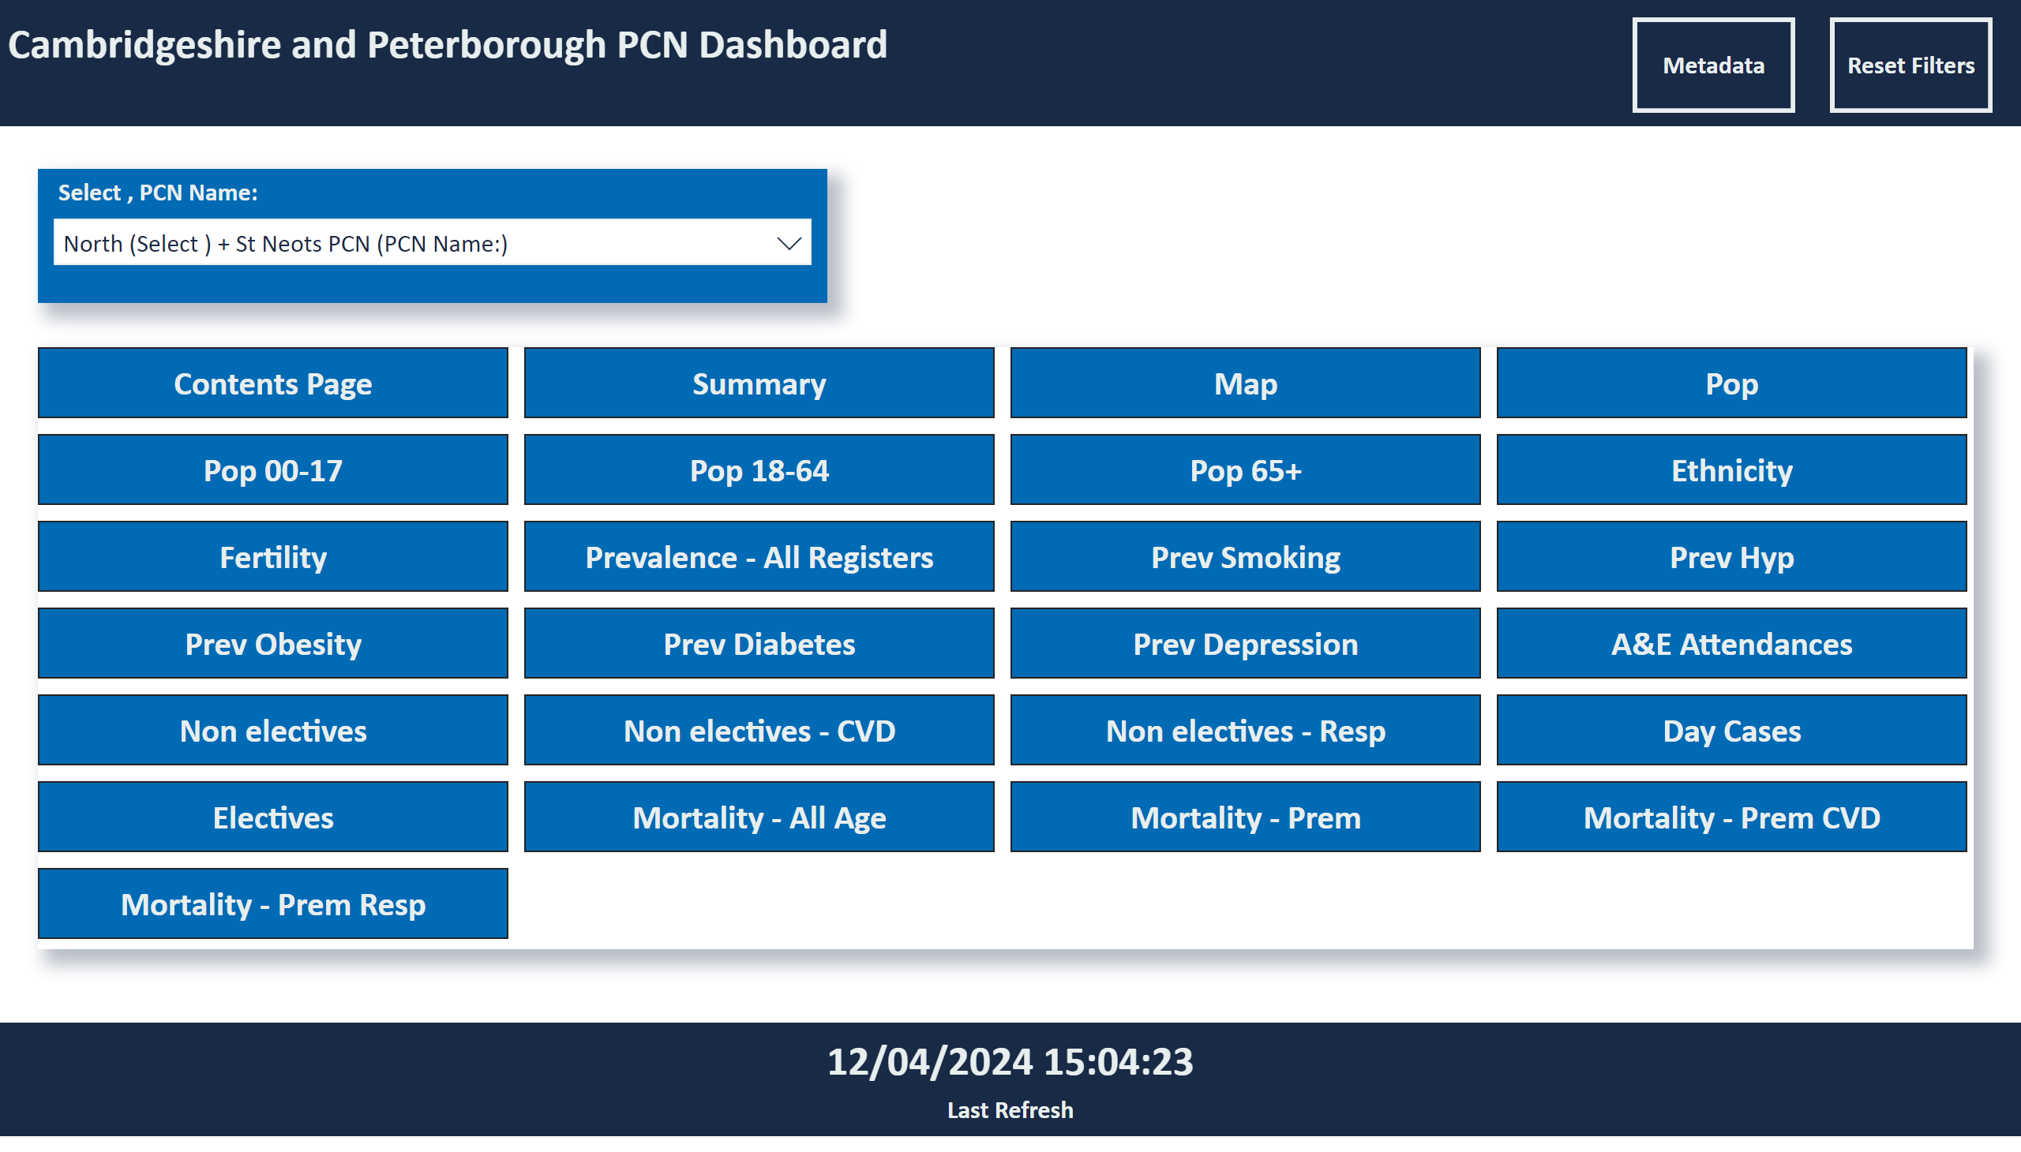
Contents Page
Notes:
Cambridgeshire and Peterborough PCN Dashboard
No alt text provided
card
No alt text provided
pageNavigator
No alt text provided
Slicer PCN
No alt text provided
actionButton
No alt text provided
actionButton
No alt text provided

Slide 4
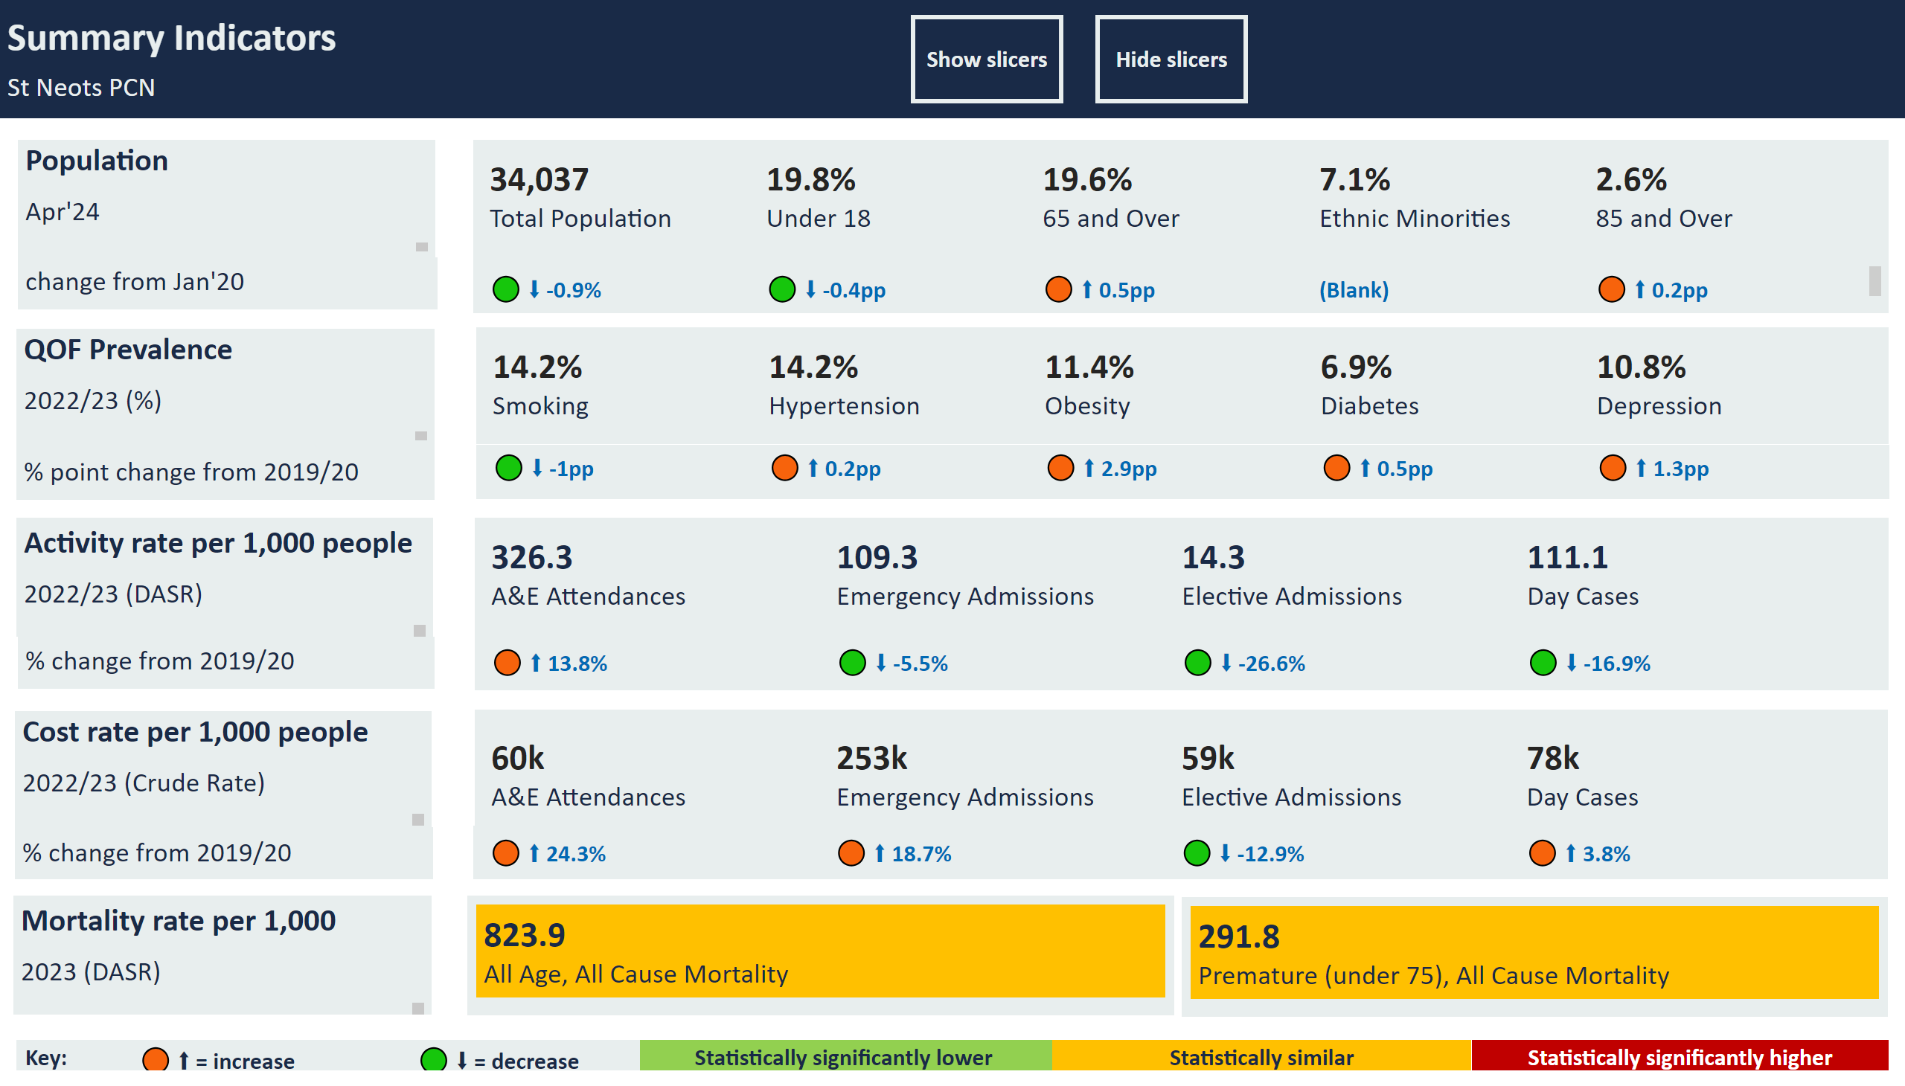
Summary
Notes:
multiRowCard
No alt text provided
QOF Prevalence
No alt text provided
Population
No alt text provided
multiRowCard
No alt text provided
Summary Indicators
No alt text provided
Activity rate per 1,000 people
No alt text provided
multiRowCard
No alt text provided
slicer
No alt text provided
slicer
No alt text provided
slicer
No alt text provided
slicer
No alt text provided
Cost rate per 1,000 people
No alt text provided
multiRowCard
No alt text provided
multiRowCard
No alt text provided
% change from 2019/20
No alt text provided
multiRowCard
No alt text provided
% change from 2019/20
No alt text provided
shape
No alt text provided
actionButton
No alt text provided
actionButton
No alt text provided
change from Jan'20
No alt text provided
% point change from 2019/20
No alt text provided
multiRowCard
No alt text provided
Mortality rate per 1,000
No alt text provided
multiRowCard
No alt text provided
slicer
No alt text provided
multiRowCard
No alt text provided
multiRowCard
No alt text provided
Statistically significantly lower
No alt text provided
Statistically similar
No alt text provided
Statistically significantly higher
No alt text provided
🟢 ⬇ = decrease
No alt text provided
🟠 ⬆ = increase
No alt text provided
Key:
No alt text provided

Slide 5
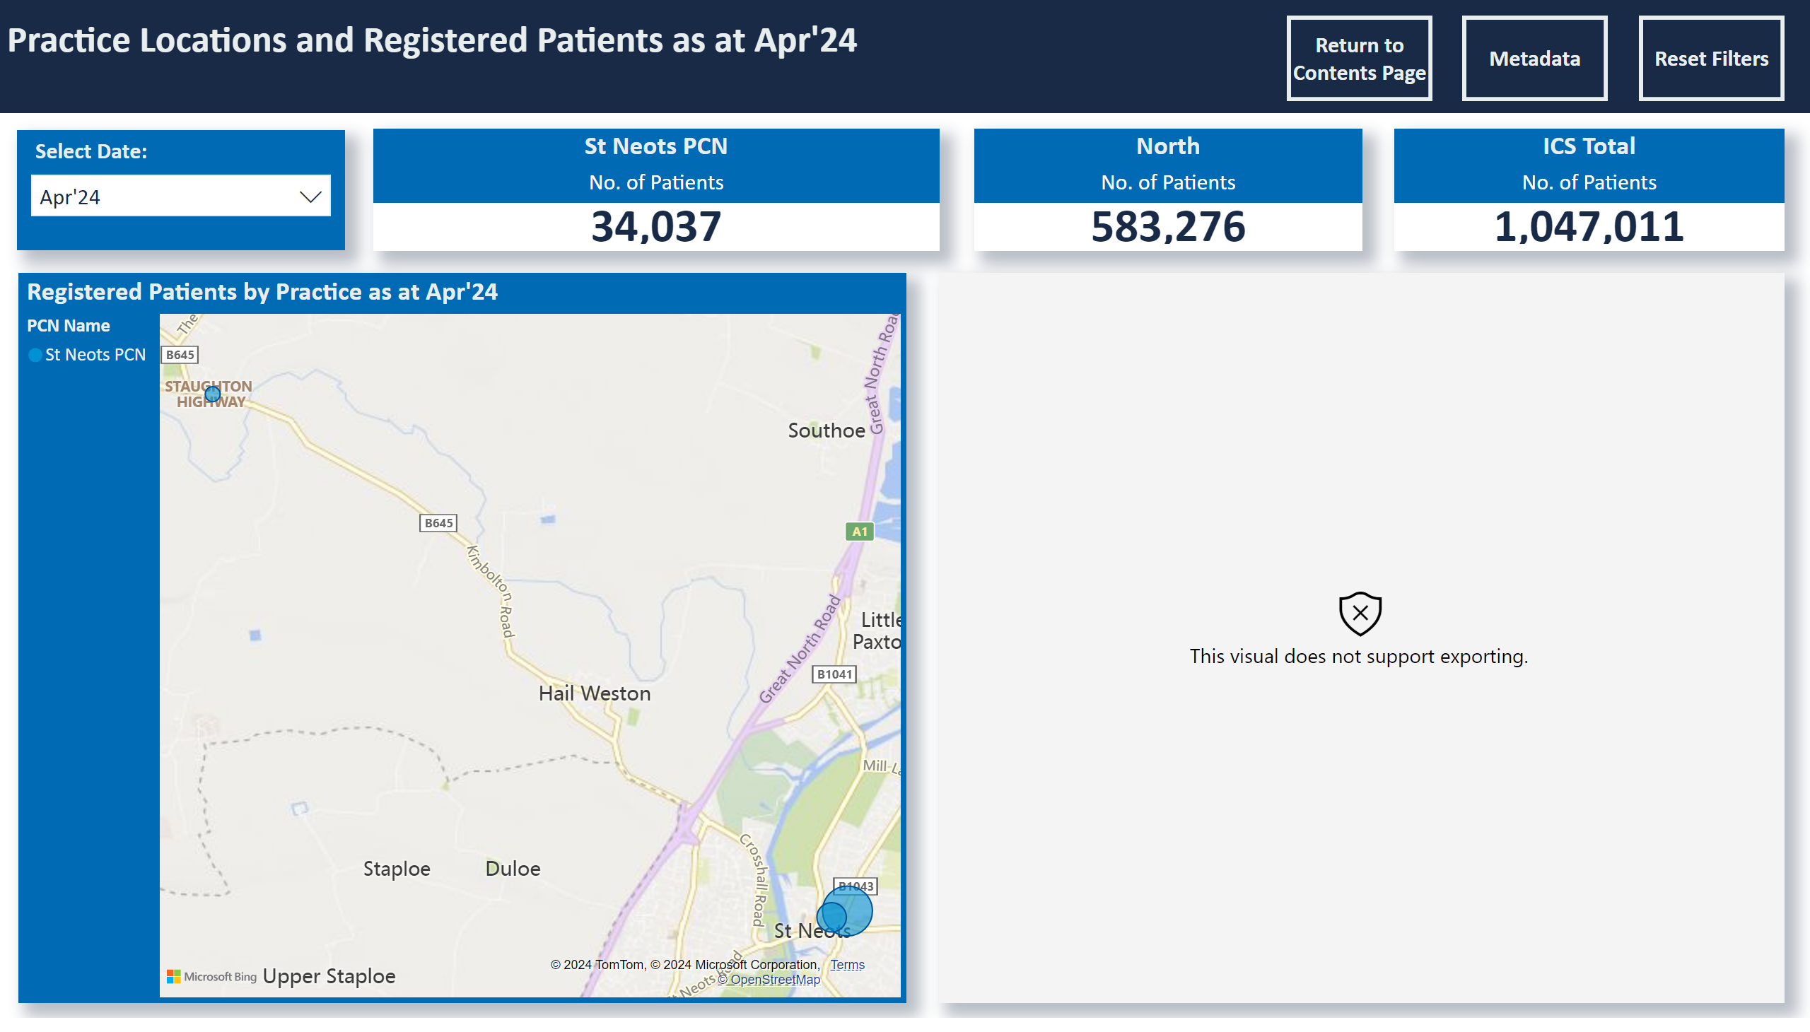
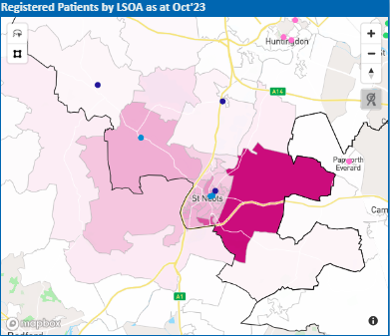
Map
Notes:
Practice Locations and Registered Patients as at Apr'24
No alt text provided
Slicer Extract Date
No alt text provided
Registered Patients by Practice as at Apr'24
No alt text provided
slicer
No alt text provided
North
No alt text provided
St Neots PCN
No alt text provided
ICS Total
No alt text provided
slicer
No alt text provided
PBI_CV_EB3A4088_75C5_4746_9D8B_255A7B7ECD6C
No alt text provided
actionButton
No alt text provided
actionButton
No alt text provided
actionButton
No alt text provided

Slide 6
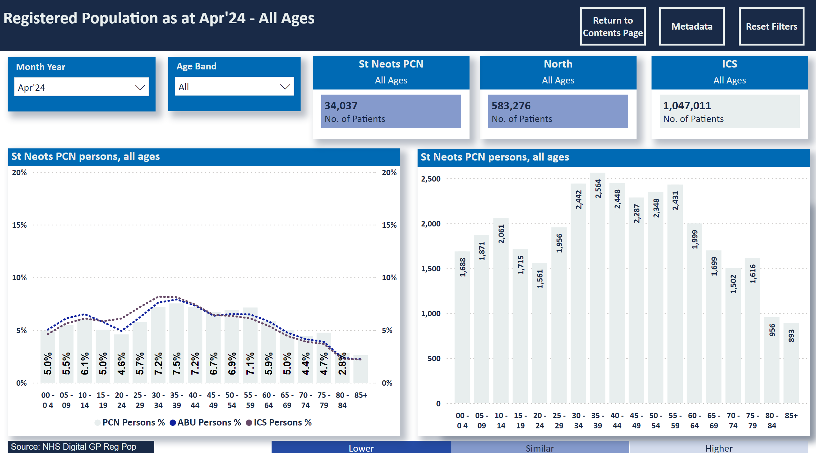
Pop
Notes:
Registered Population as at Apr'24 - All Ages
No alt text provided
slicer
No alt text provided
Select Age
No alt text provided
slicer
No alt text provided
slicer
No alt text provided
Patients in selected age range as % of total by practice:
No alt text provided
Higher
No alt text provided
Similar
No alt text provided
Lower
No alt text provided
lineClusteredColumnComboChart
No alt text provided
lineClusteredColumnComboChart
No alt text provided
St Neots PCN persons, all ages
No alt text provided
ICS
No alt text provided
North
No alt text provided
St Neots PCN
No alt text provided
lineChart
No alt text provided
actionButton
No alt text provided
ABU
No alt text provided
Source: NHS Digital GP Reg Pop
No alt text provided
actionButton
No alt text provided
actionButton
No alt text provided
actionButton
No alt text provided
St Neots PCN persons, all ages
No alt text provided

Slide 7
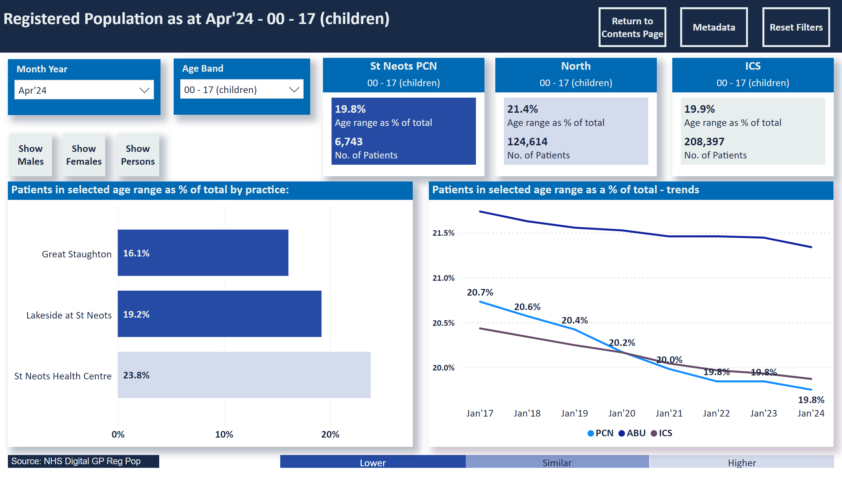
Pop 00-17
Notes:
Registered Population as at Apr'24 - 00 - 17 (children)
No alt text provided
slicer
No alt text provided
Select Age
No alt text provided
slicer
No alt text provided
slicer
No alt text provided
clusteredBarChart
No alt text provided
Higher
No alt text provided
Similar
No alt text provided
Lower
No alt text provided
ABU
No alt text provided
ABU
No alt text provided
lineClusteredColumnComboChart
No alt text provided
lineClusteredColumnComboChart
No alt text provided
ABU
No alt text provided
ICS
No alt text provided
North
No alt text provided
St Neots PCN
No alt text provided
Patients in selected age range as a % of total - trends
No alt text provided
ABU
No alt text provided
actionButton
No alt text provided
Source: NHS Digital GP Reg Pop
No alt text provided
actionButton
No alt text provided
actionButton
No alt text provided
actionButton
No alt text provided
Patients in selected age range as % of total by practice:
No alt text provided

Slide 8
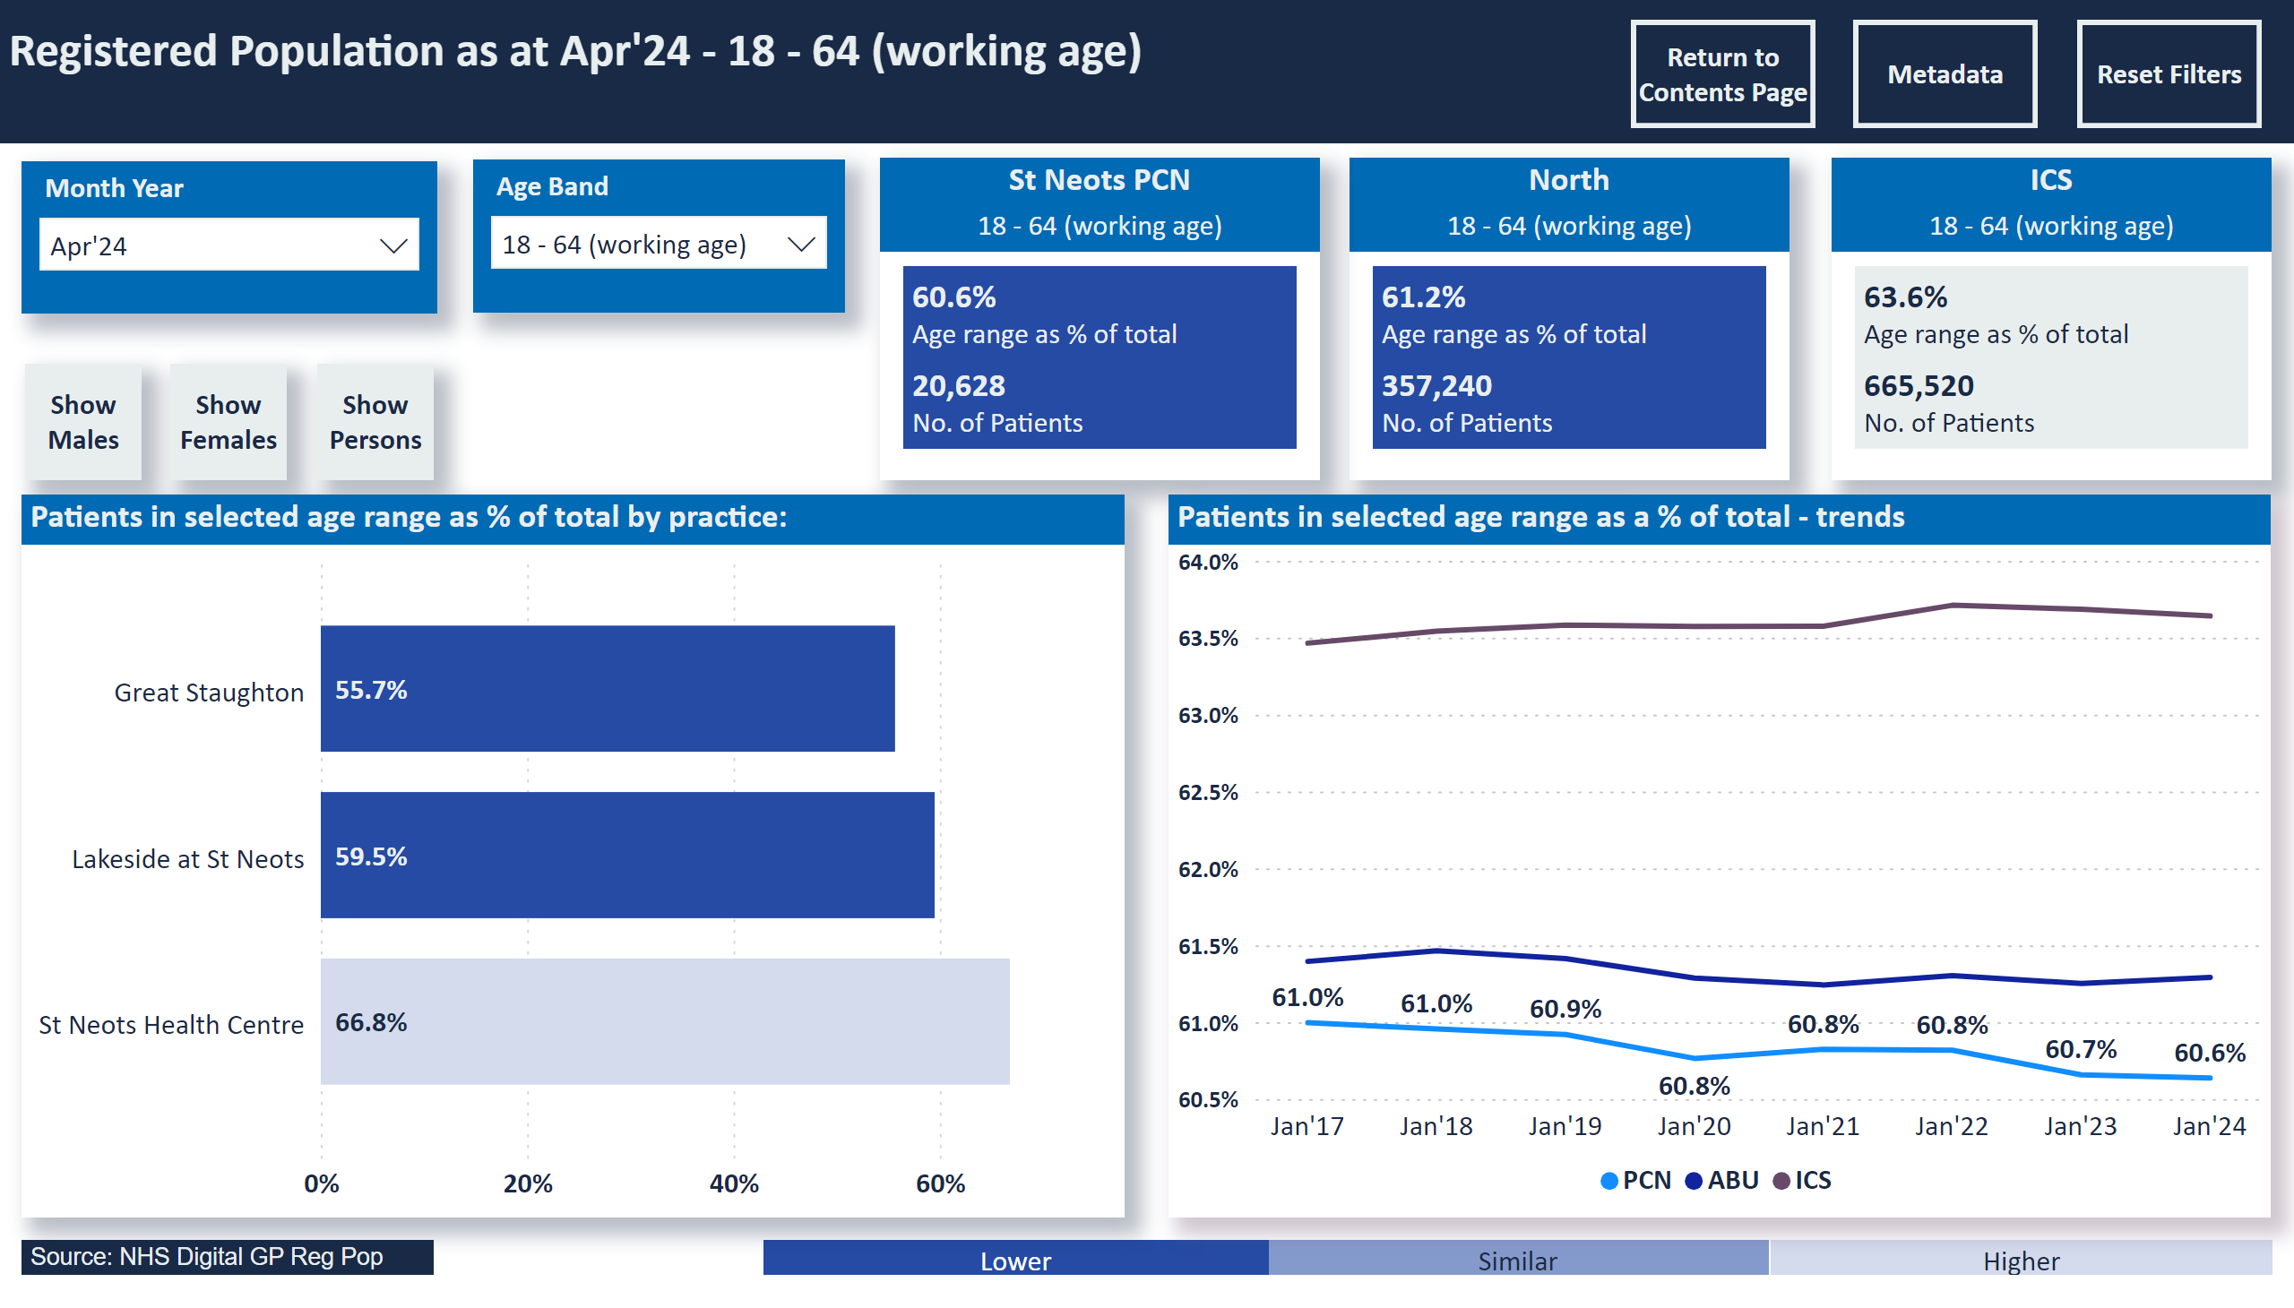
Pop 18-64
Notes:
Registered Population as at Apr'24 - 18 - 64 (working age)
No alt text provided
slicer
No alt text provided
Select Age
No alt text provided
slicer
No alt text provided
slicer
No alt text provided
clusteredBarChart
No alt text provided
Higher
No alt text provided
Similar
No alt text provided
Lower
No alt text provided
ABU
No alt text provided
ABU
No alt text provided
lineClusteredColumnComboChart
No alt text provided
lineClusteredColumnComboChart
No alt text provided
ABU
No alt text provided
ICS
No alt text provided
North
No alt text provided
St Neots PCN
No alt text provided
Patients in selected age range as a % of total - trends
No alt text provided
ABU
No alt text provided
actionButton
No alt text provided
Source: NHS Digital GP Reg Pop
No alt text provided
actionButton
No alt text provided
actionButton
No alt text provided
actionButton
No alt text provided
Patients in selected age range as % of total by practice:
No alt text provided

Slide 9
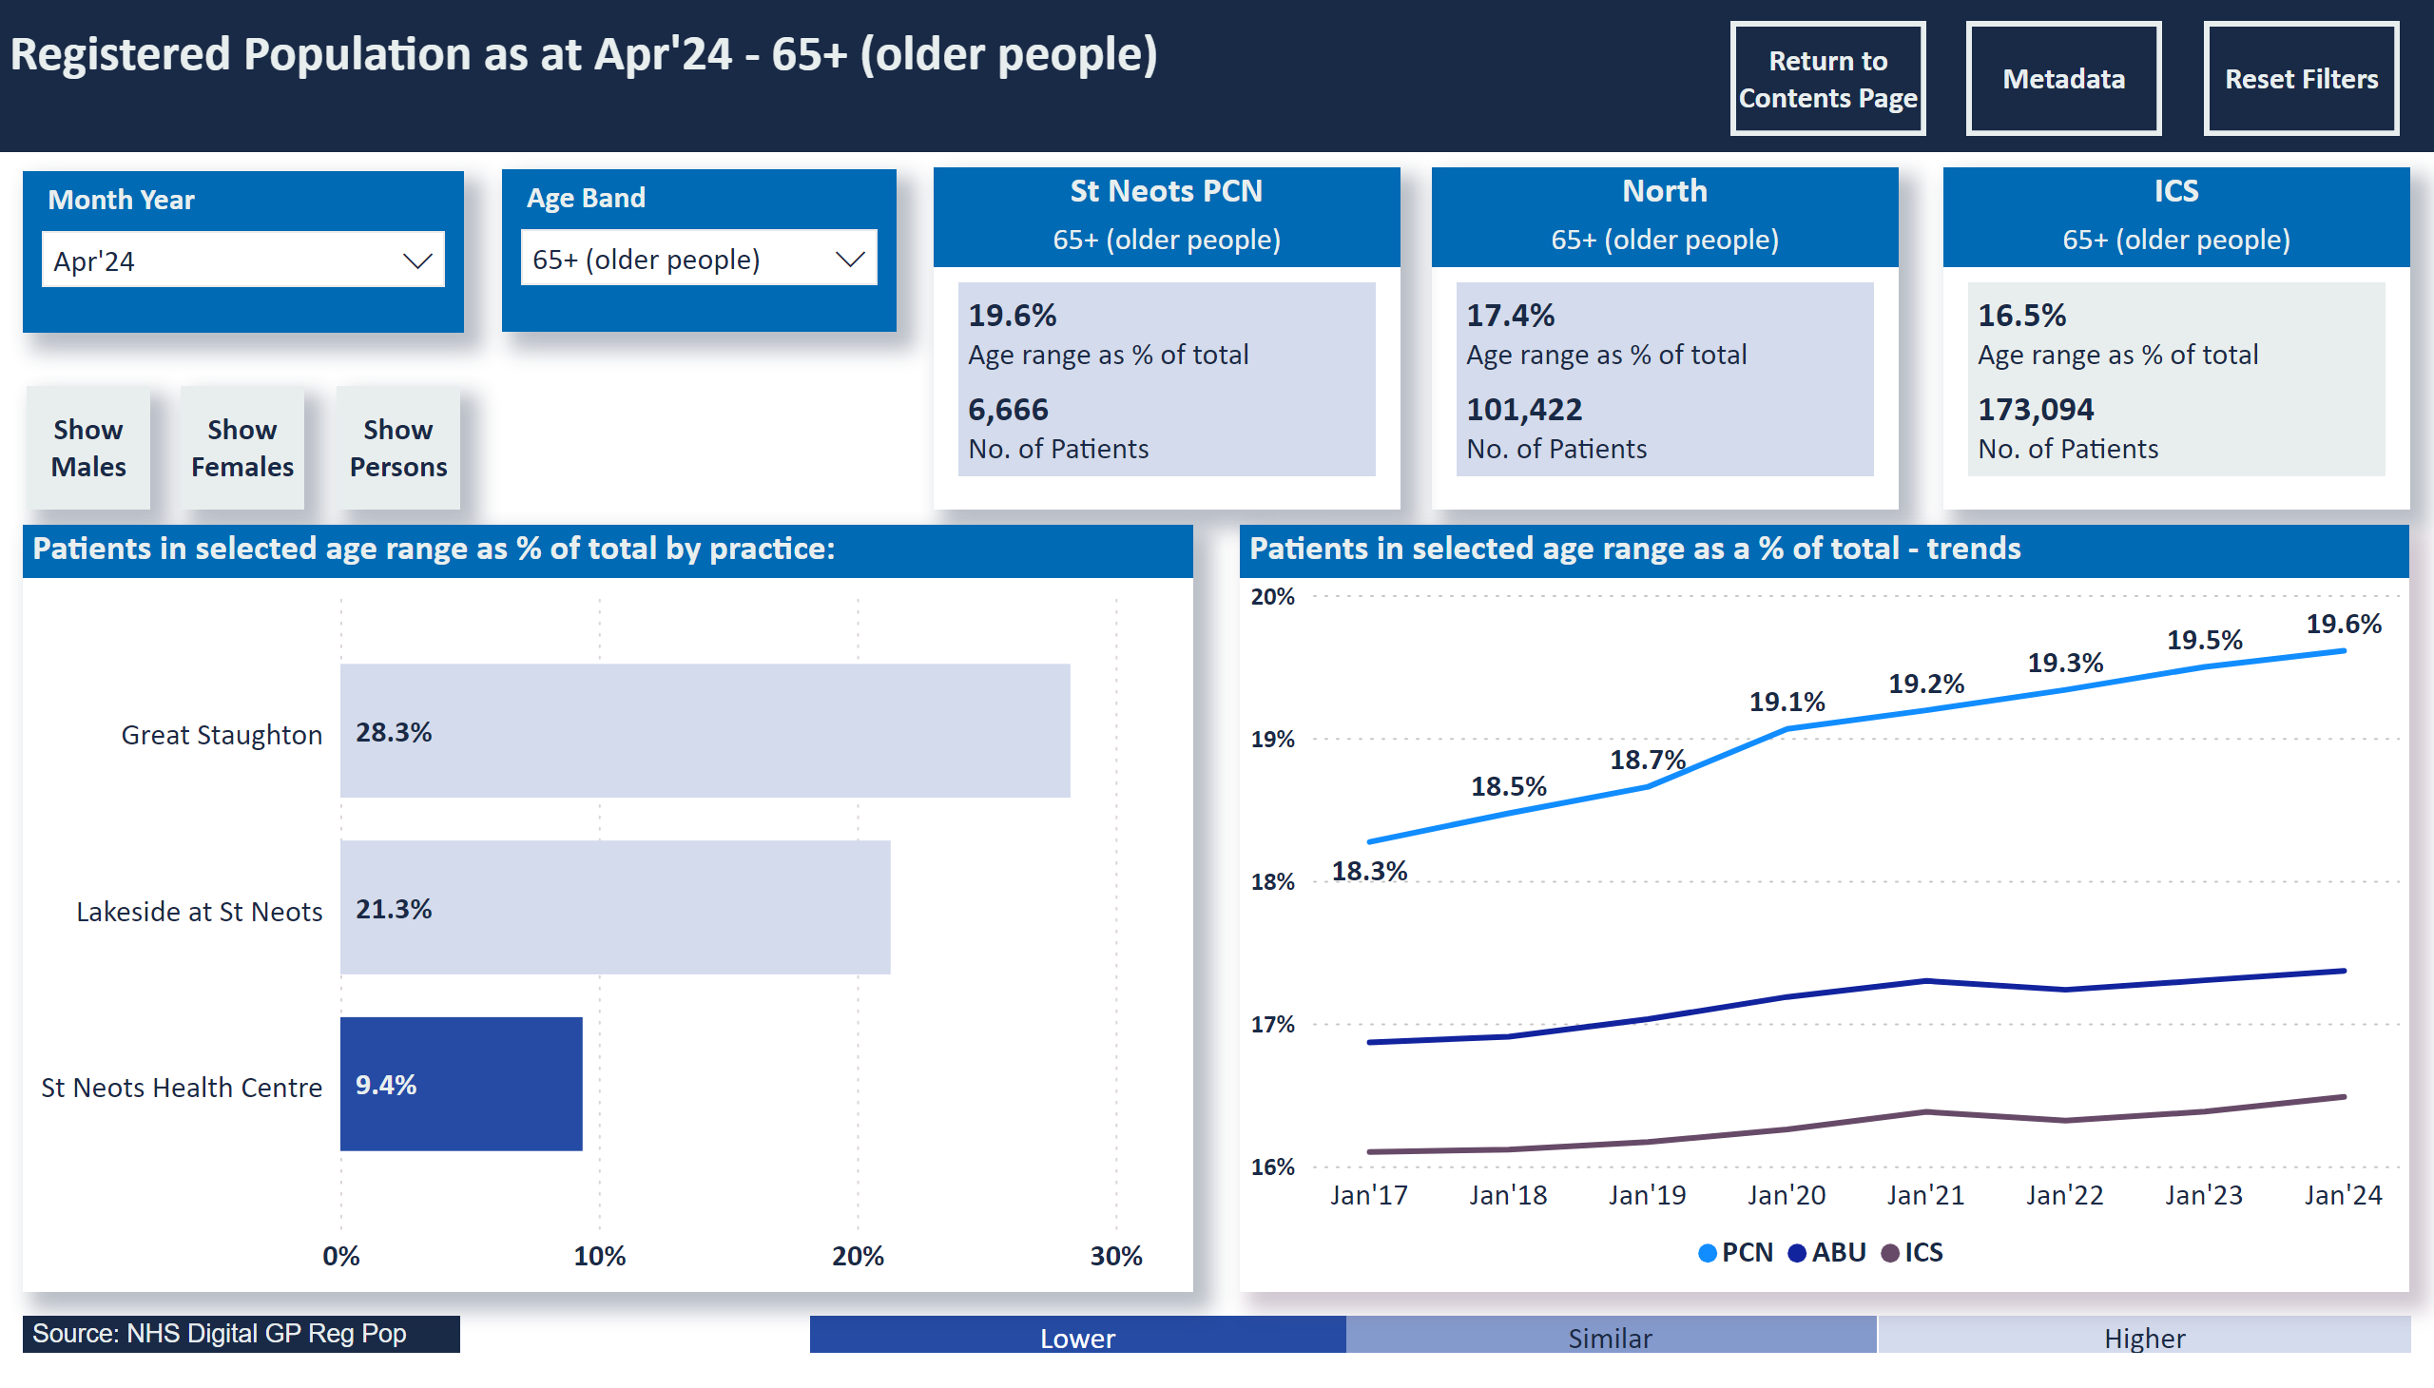
Pop 65+
Notes:
Registered Population as at Apr'24 - 65+ (older people)
No alt text provided
slicer
No alt text provided
Select Age
No alt text provided
slicer
No alt text provided
slicer
No alt text provided
clusteredBarChart
No alt text provided
Higher
No alt text provided
Similar
No alt text provided
Lower
No alt text provided
ABU
No alt text provided
ABU
No alt text provided
lineClusteredColumnComboChart
No alt text provided
lineClusteredColumnComboChart
No alt text provided
ABU
No alt text provided
ICS
No alt text provided
North
No alt text provided
St Neots PCN
No alt text provided
Patients in selected age range as a % of total - trends
No alt text provided
ABU
No alt text provided
actionButton
No alt text provided
Source: NHS Digital GP Reg Pop
No alt text provided
actionButton
No alt text provided
actionButton
No alt text provided
actionButton
No alt text provided
Patients in selected age range as % of total by practice:
No alt text provided

Slide 10
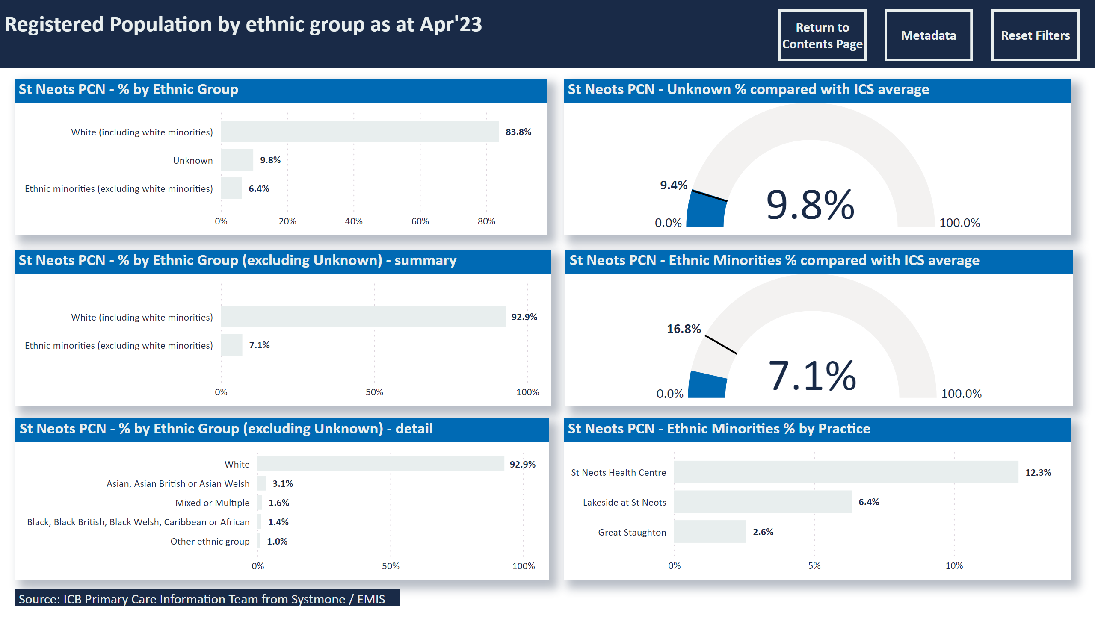
Ethnicity
Notes:
slicer
No alt text provided
Registered Population by ethnic group as at Apr'23
No alt text provided
St Neots PCN - % by Ethnic Group
No alt text provided
St Neots PCN - % by Ethnic Group (excluding Unknown) - summary
No alt text provided
St Neots PCN - % by Ethnic Group (excluding Unknown) - detail
No alt text provided
St Neots PCN - Unknown % compared with ICS average
No alt text provided
St Neots PCN - Ethnic Minorities % compared with ICS average
No alt text provided
St Neots PCN - Ethnic Minorities % by Practice
No alt text provided
Source: ICB Primary Care Information Team from Systmone / EMIS
No alt text provided
actionButton
No alt text provided
actionButton
No alt text provided
actionButton
No alt text provided

Slide 11
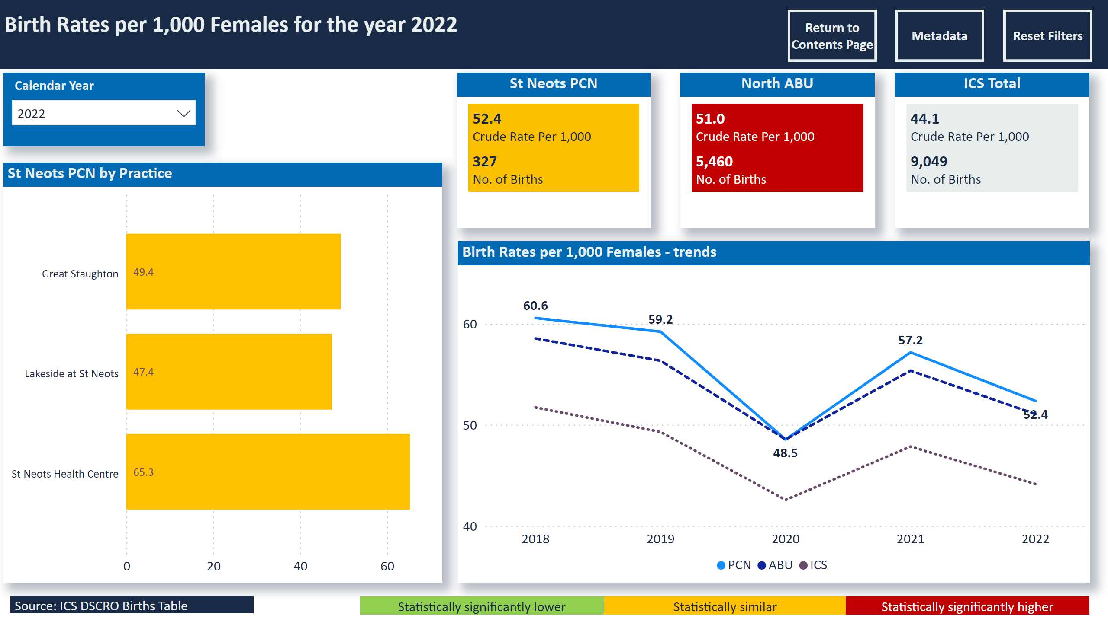
Fertility
Notes:
St Neots PCN by Practice
No alt text provided
slicer
No alt text provided
slicer
No alt text provided
Birth Rates per 1,000 Females for the year 2022
No alt text provided
St Neots PCN
No alt text provided
North ABU
No alt text provided
ICS Total
No alt text provided
Birth Rates per 1,000 Females - trends
No alt text provided
Statistically significantly lower
No alt text provided
Statistically similar
No alt text provided
Statistically significantly higher
No alt text provided
Source: ICS DSCRO Births Table
No alt text provided
actionButton
No alt text provided
actionButton
No alt text provided
actionButton
No alt text provided

Slide 12
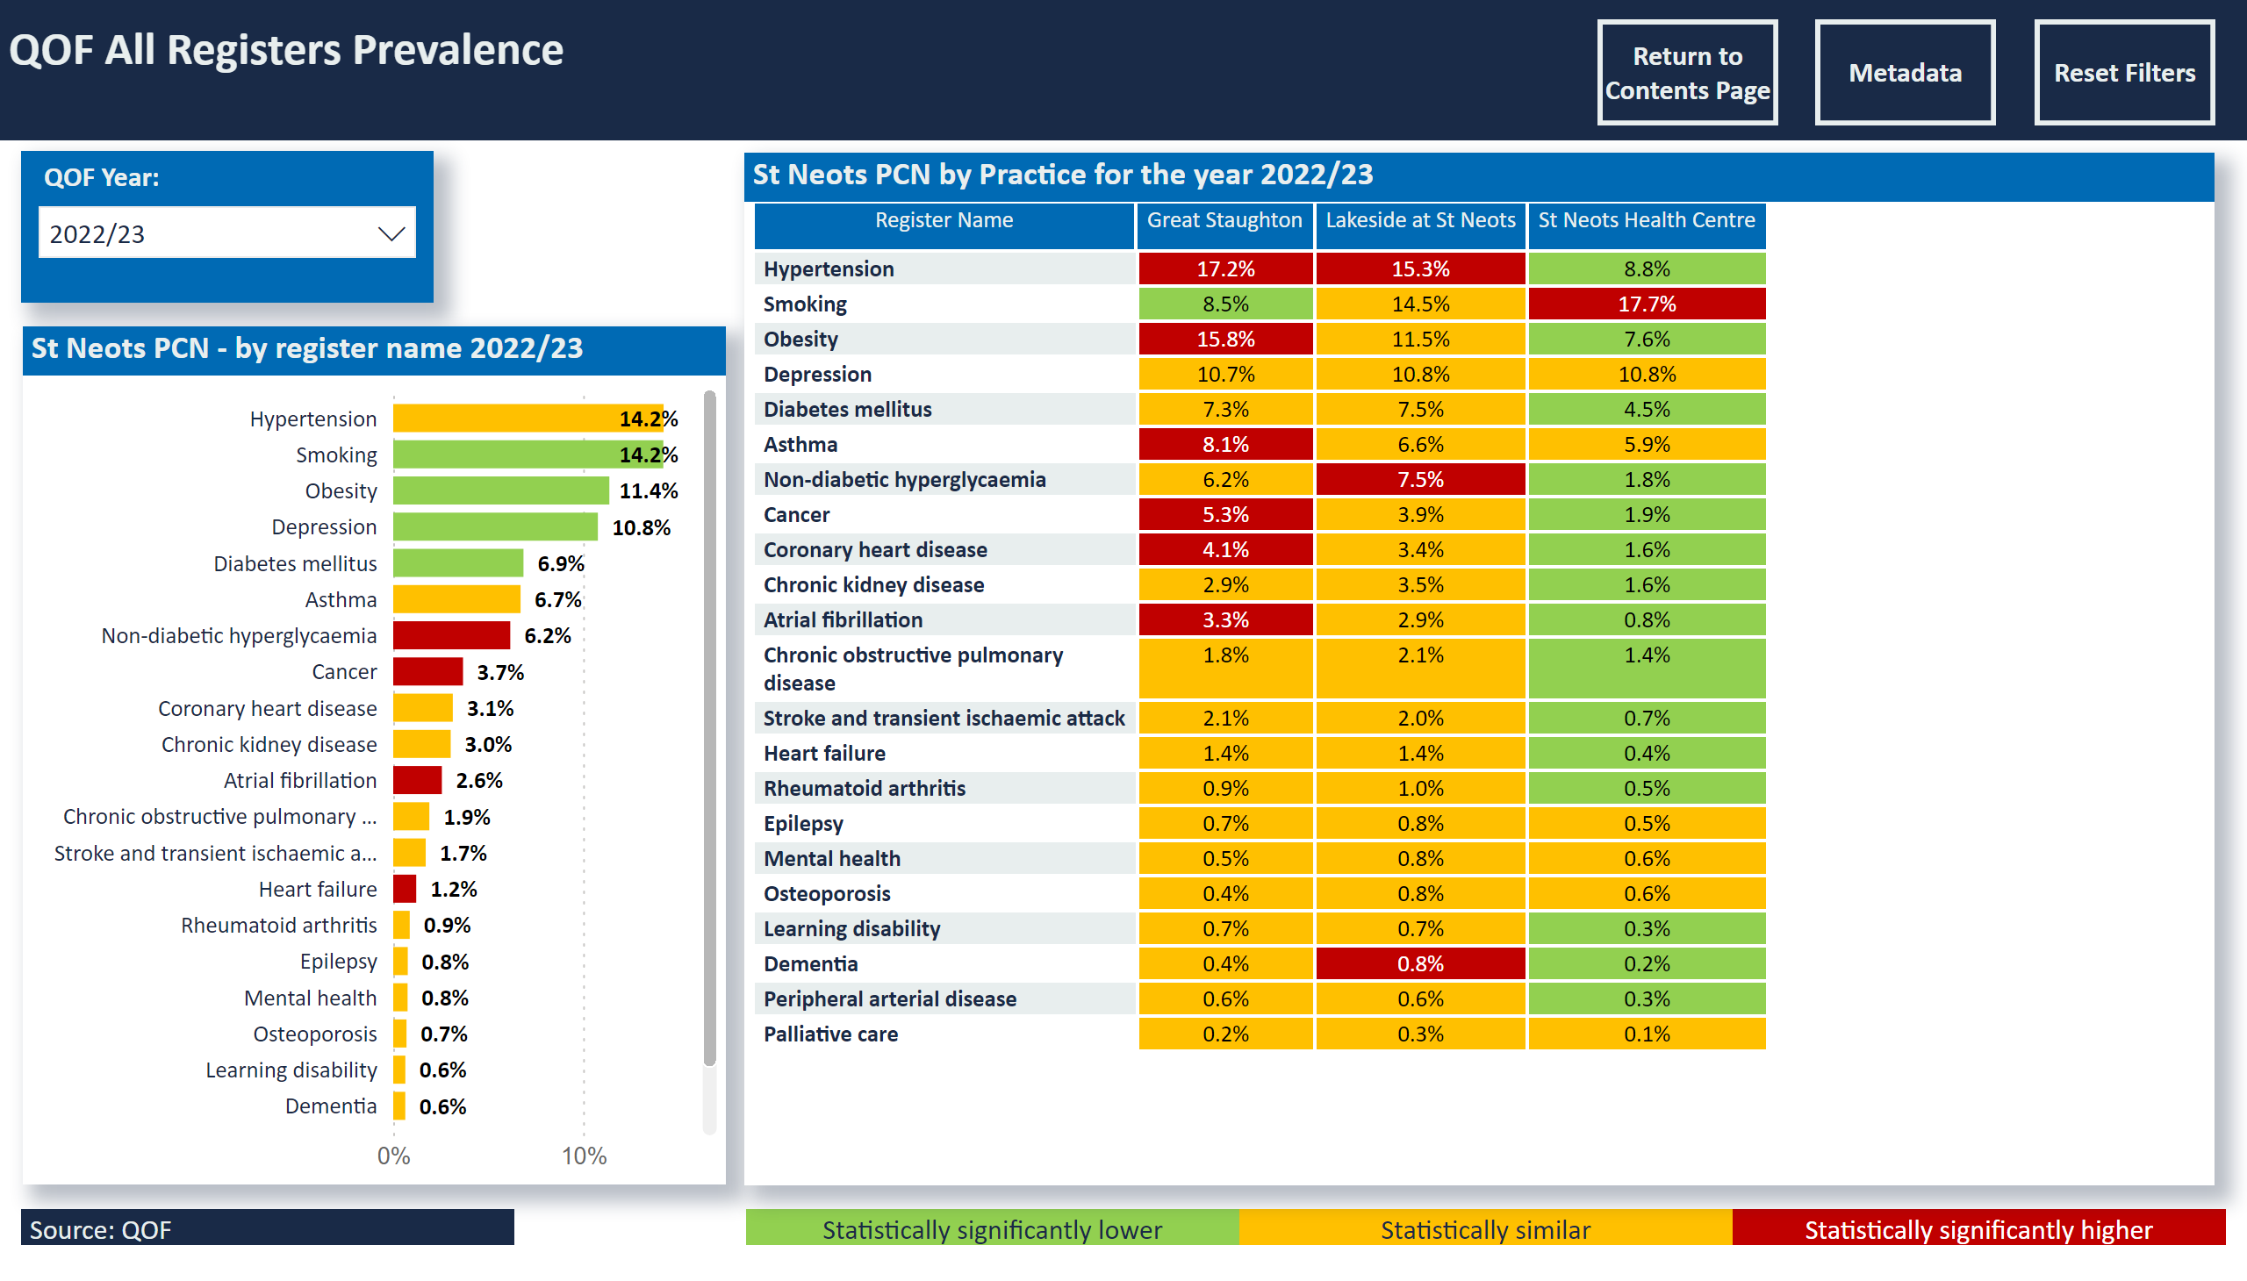
Prevalence - All Registers
Notes:
slicer
No alt text provided
slicer
No alt text provided
slicer
No alt text provided
slicer
No alt text provided
QOF All Registers Prevalence
No alt text provided
St Neots PCN - by register name 2022/23
No alt text provided
Statistically significantly lower
No alt text provided
Statistically similar
No alt text provided
Statistically significantly higher
No alt text provided
Source: QOF
No alt text provided
actionButton
No alt text provided
actionButton
No alt text provided
actionButton
No alt text provided
St Neots PCN by Practice for the year 2022/23
No alt text provided

Slide 13
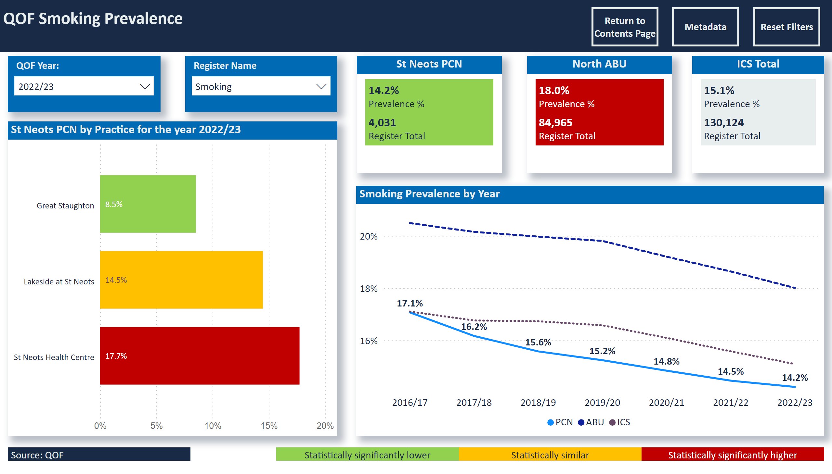
Prev Smoking
Notes:
slicer
No alt text provided
slicer
No alt text provided
slicer
No alt text provided
slicer
No alt text provided
QOF Smoking Prevalence
No alt text provided
St Neots PCN by Practice for the year 2022/23
No alt text provided
North ABU
No alt text provided
ICS Total
No alt text provided
Smoking Prevalence by Year
No alt text provided
St Neots PCN
No alt text provided
Statistically significantly lower
No alt text provided
Statistically similar
No alt text provided
Statistically significantly higher
No alt text provided
Source: QOF
No alt text provided
actionButton
No alt text provided
actionButton
No alt text provided
actionButton
No alt text provided

Slide 14
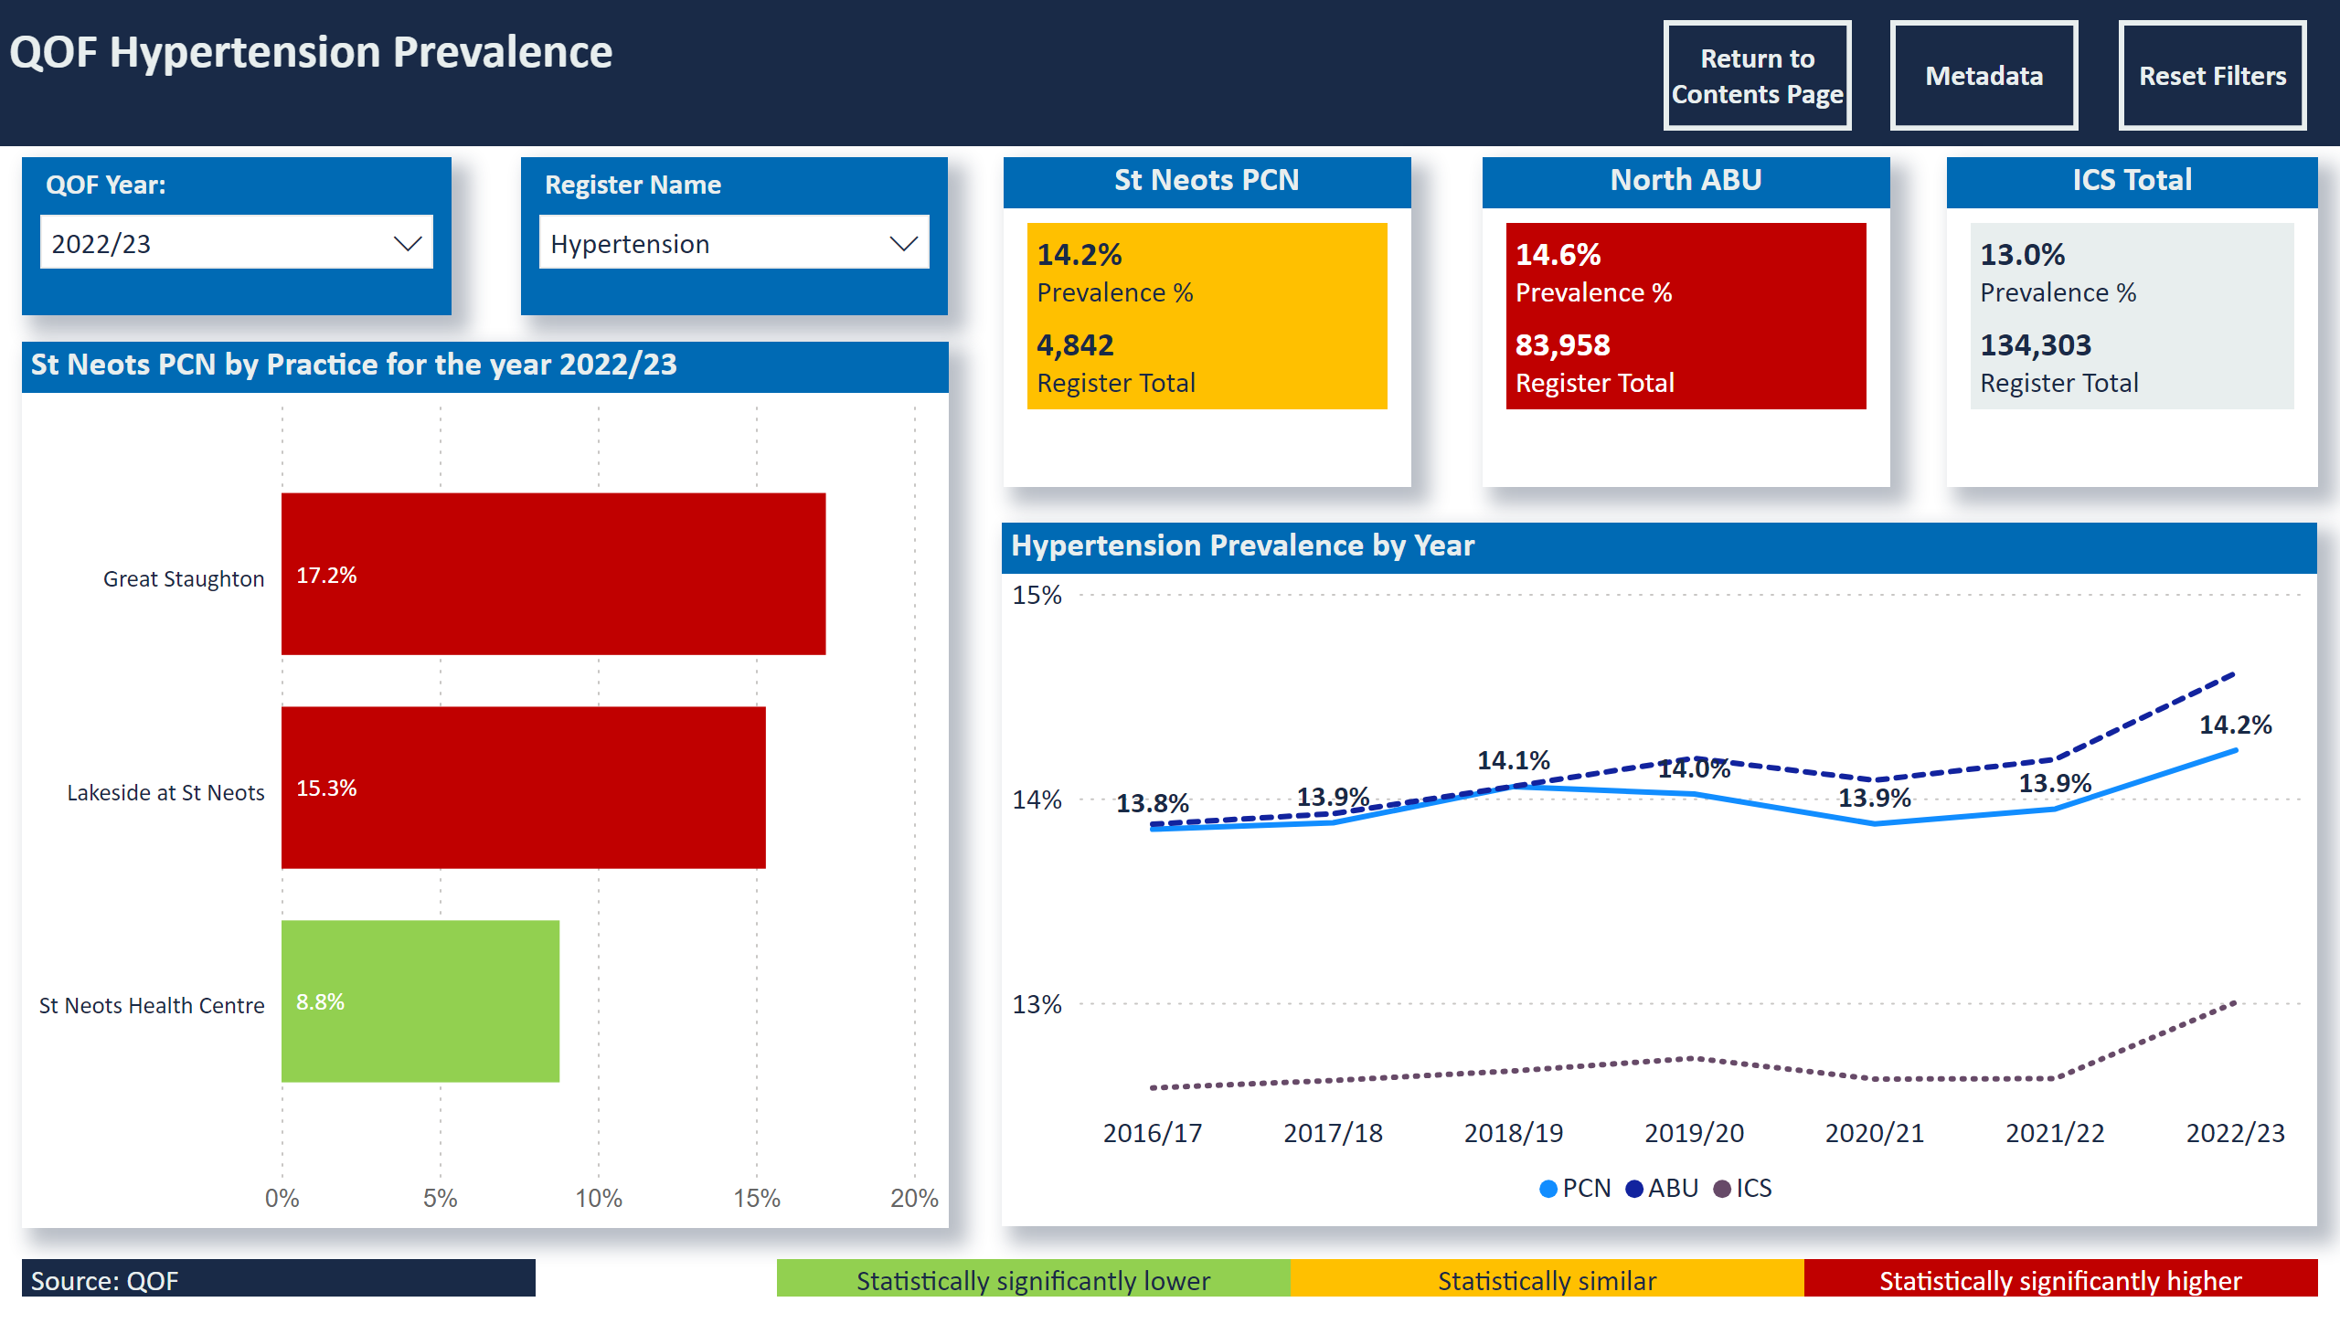
Prev Hyp
Notes:
slicer
No alt text provided
slicer
No alt text provided
slicer
No alt text provided
slicer
No alt text provided
QOF Hypertension Prevalence
No alt text provided
St Neots PCN by Practice for the year 2022/23
No alt text provided
North ABU
No alt text provided
ICS Total
No alt text provided
Hypertension Prevalence by Year
No alt text provided
St Neots PCN
No alt text provided
Statistically significantly lower
No alt text provided
Statistically similar
No alt text provided
Statistically significantly higher
No alt text provided
Source: QOF
No alt text provided
actionButton
No alt text provided
actionButton
No alt text provided
actionButton
No alt text provided

Slide 15
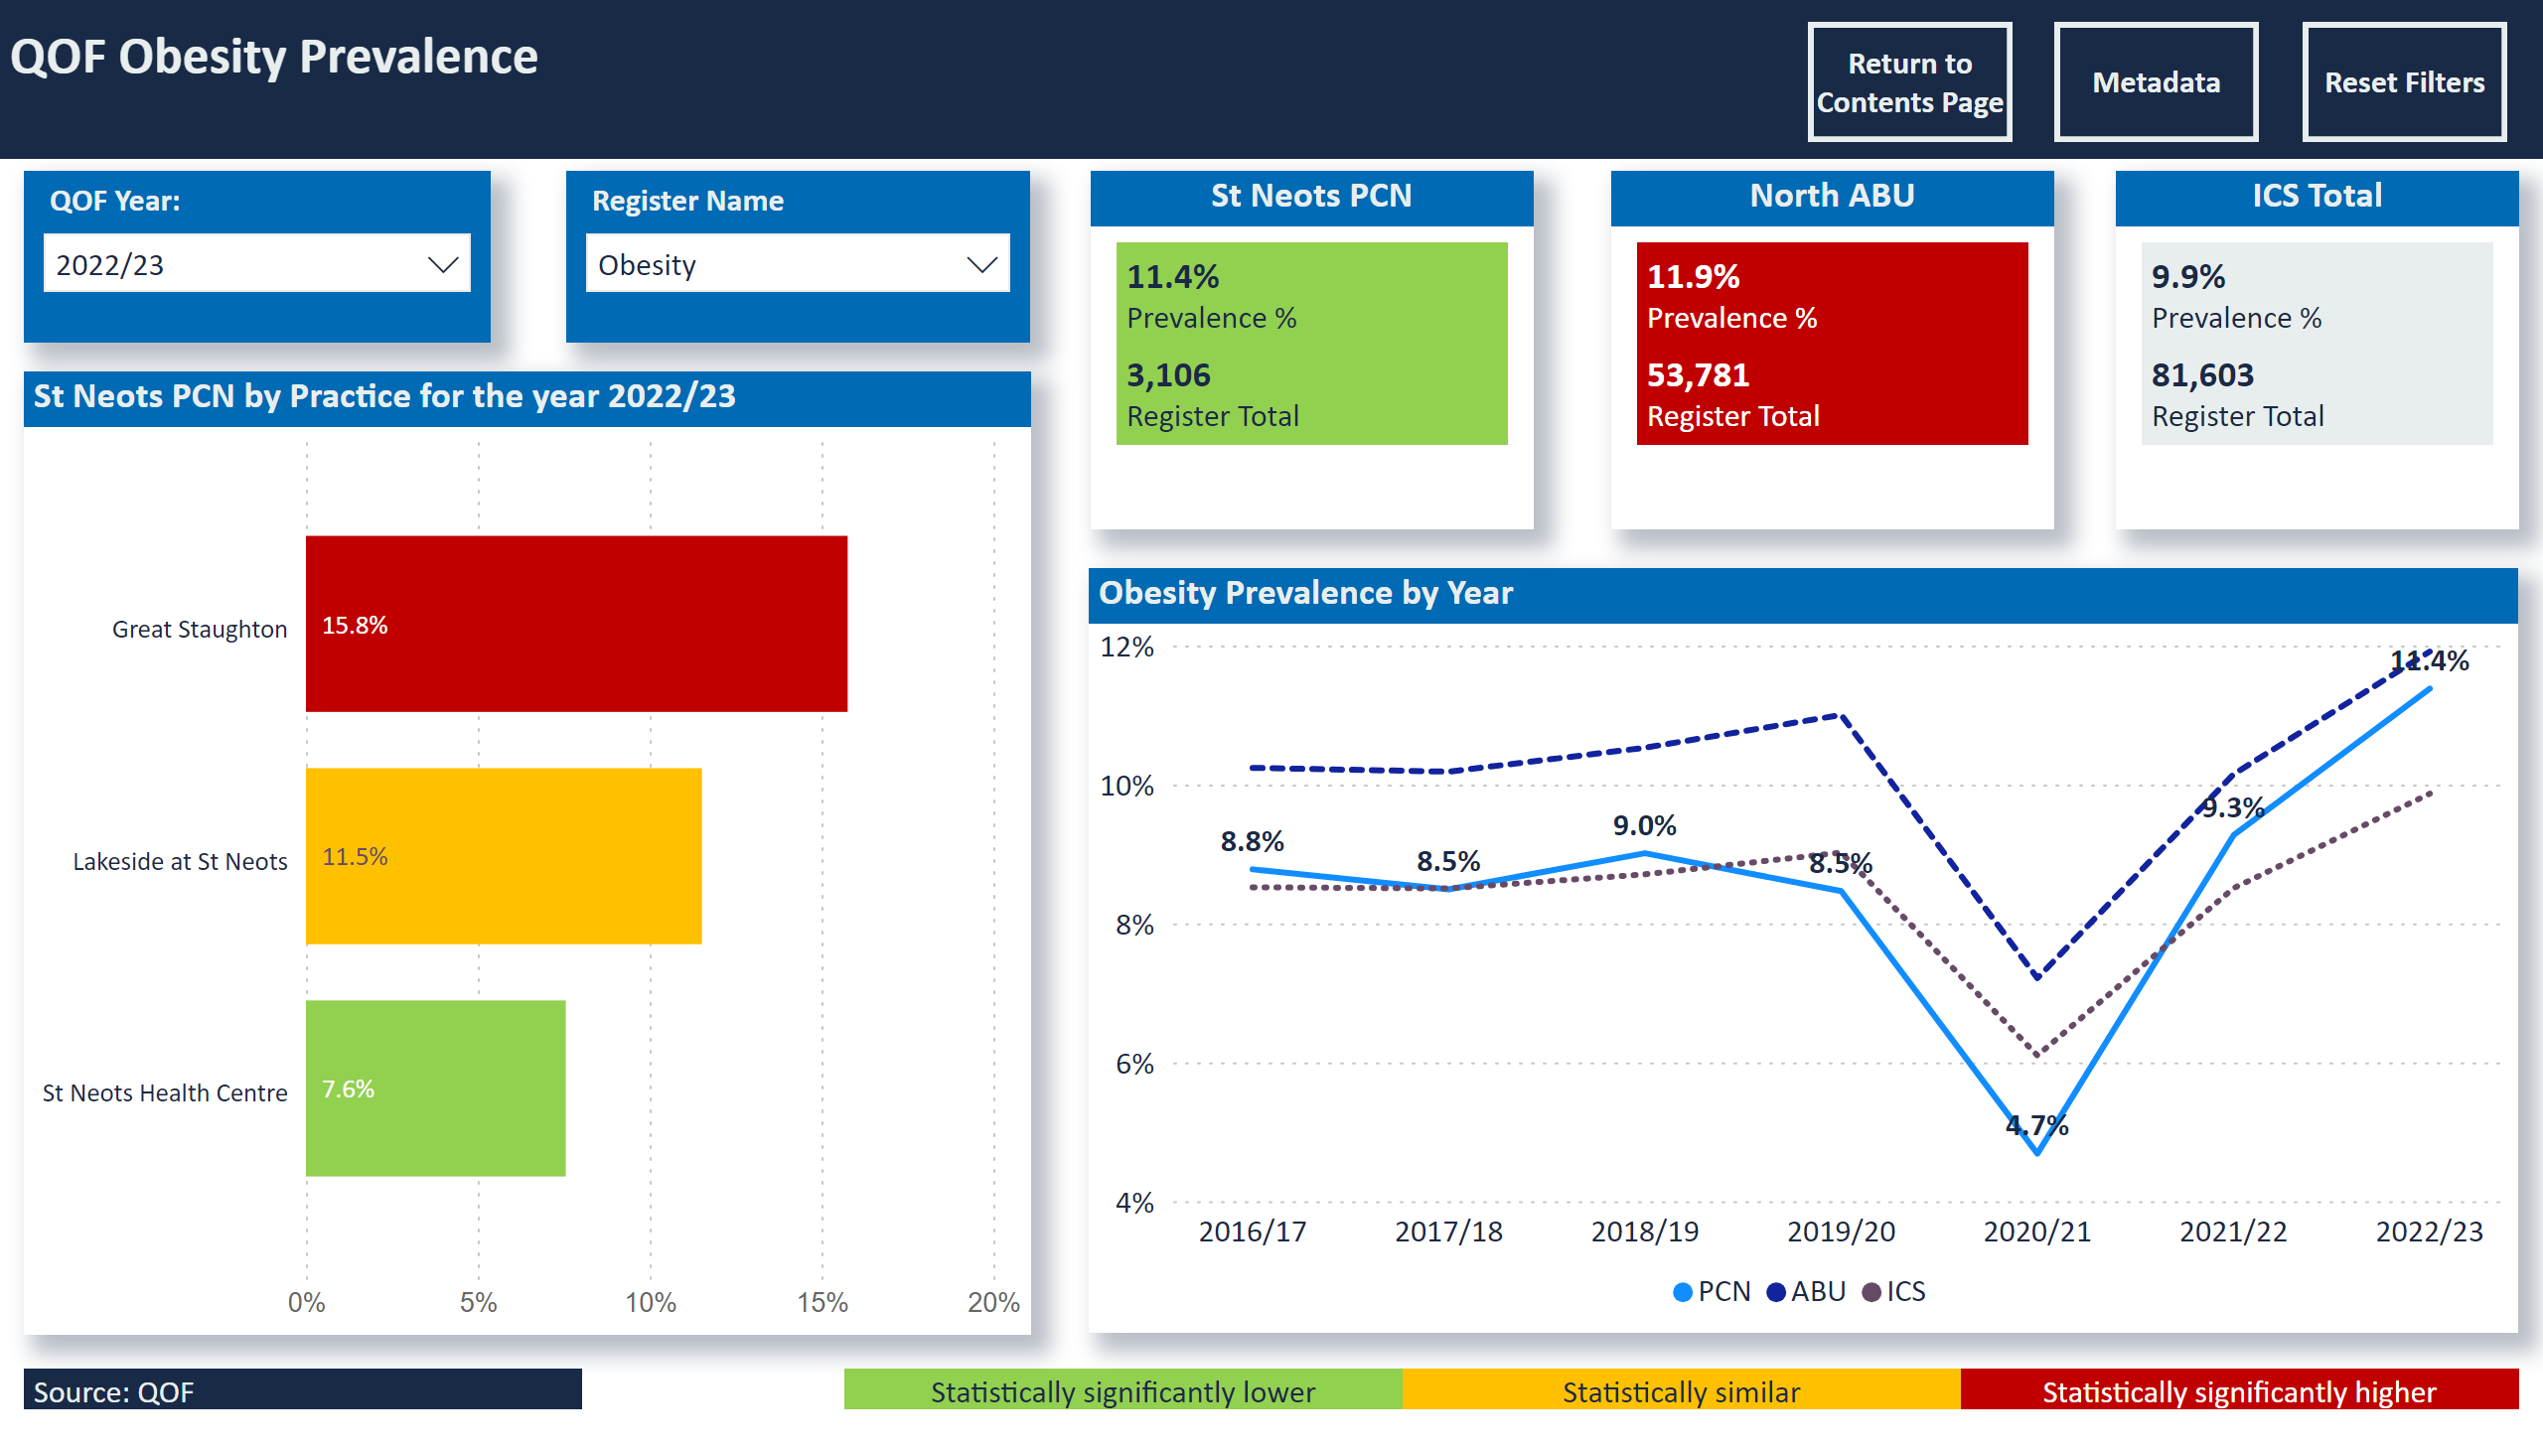
Prev Obesity
Notes:
slicer
No alt text provided
slicer
No alt text provided
slicer
No alt text provided
slicer
No alt text provided
QOF Obesity Prevalence
No alt text provided
St Neots PCN by Practice for the year 2022/23
No alt text provided
North ABU
No alt text provided
ICS Total
No alt text provided
Obesity Prevalence by Year
No alt text provided
St Neots PCN
No alt text provided
Statistically significantly lower
No alt text provided
Statistically similar
No alt text provided
Statistically significantly higher
No alt text provided
Source: QOF
No alt text provided
actionButton
No alt text provided
actionButton
No alt text provided
actionButton
No alt text provided

Slide 16
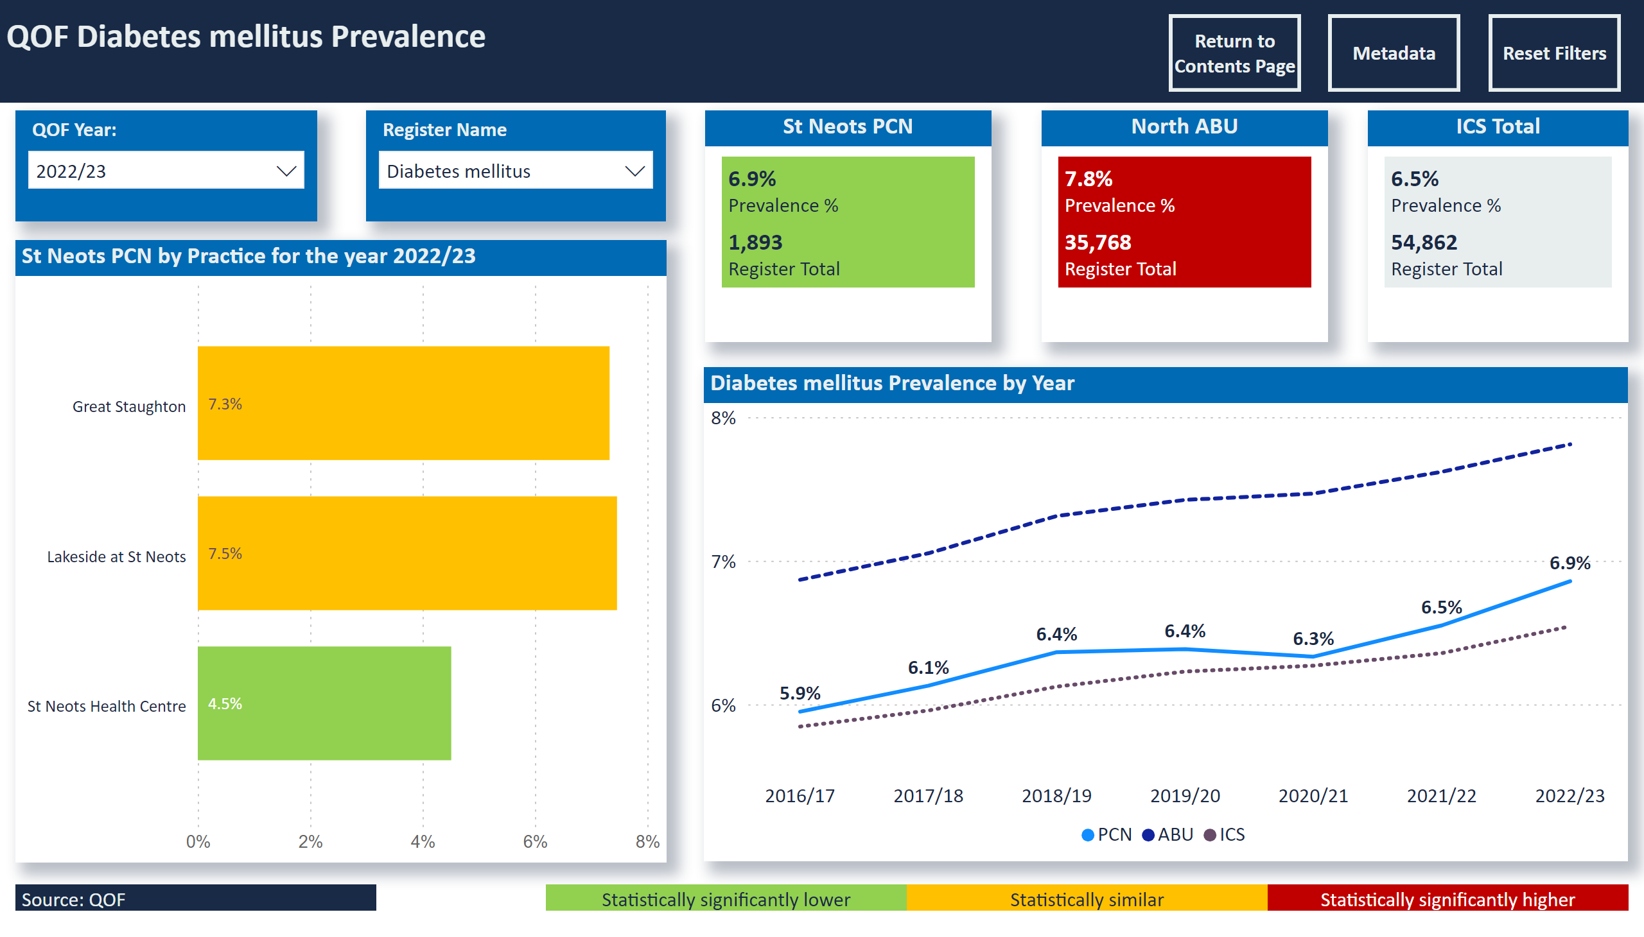
Prev Diabetes
Notes:
slicer
No alt text provided
slicer
No alt text provided
slicer
No alt text provided
slicer
No alt text provided
QOF Diabetes mellitus Prevalence
No alt text provided
St Neots PCN by Practice for the year 2022/23
No alt text provided
North ABU
No alt text provided
ICS Total
No alt text provided
Diabetes mellitus Prevalence by Year
No alt text provided
St Neots PCN
No alt text provided
Statistically significantly lower
No alt text provided
Statistically similar
No alt text provided
Statistically significantly higher
No alt text provided
Source: QOF
No alt text provided
actionButton
No alt text provided
actionButton
No alt text provided
actionButton
No alt text provided

Slide 17
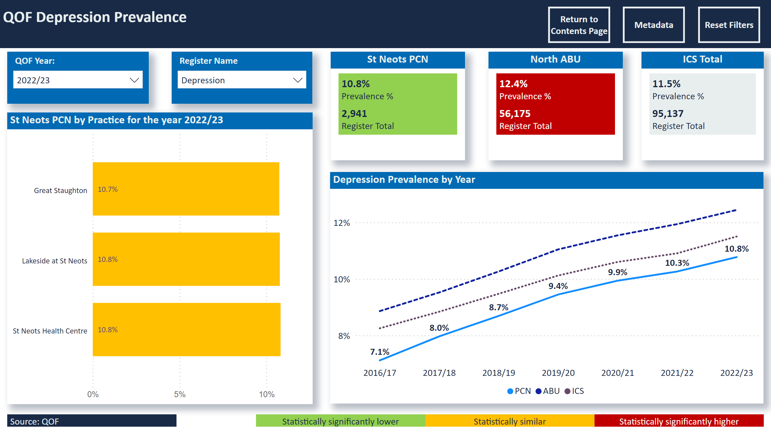
Prev Depression
Notes:
slicer
No alt text provided
slicer
No alt text provided
slicer
No alt text provided
slicer
No alt text provided
QOF Depression Prevalence
No alt text provided
St Neots PCN by Practice for the year 2022/23
No alt text provided
North ABU
No alt text provided
ICS Total
No alt text provided
Depression Prevalence by Year
No alt text provided
St Neots PCN
No alt text provided
Statistically significantly lower
No alt text provided
Statistically similar
No alt text provided
Statistically significantly higher
No alt text provided
Source: QOF
No alt text provided
actionButton
No alt text provided
actionButton
No alt text provided
actionButton
No alt text provided

Slide 18
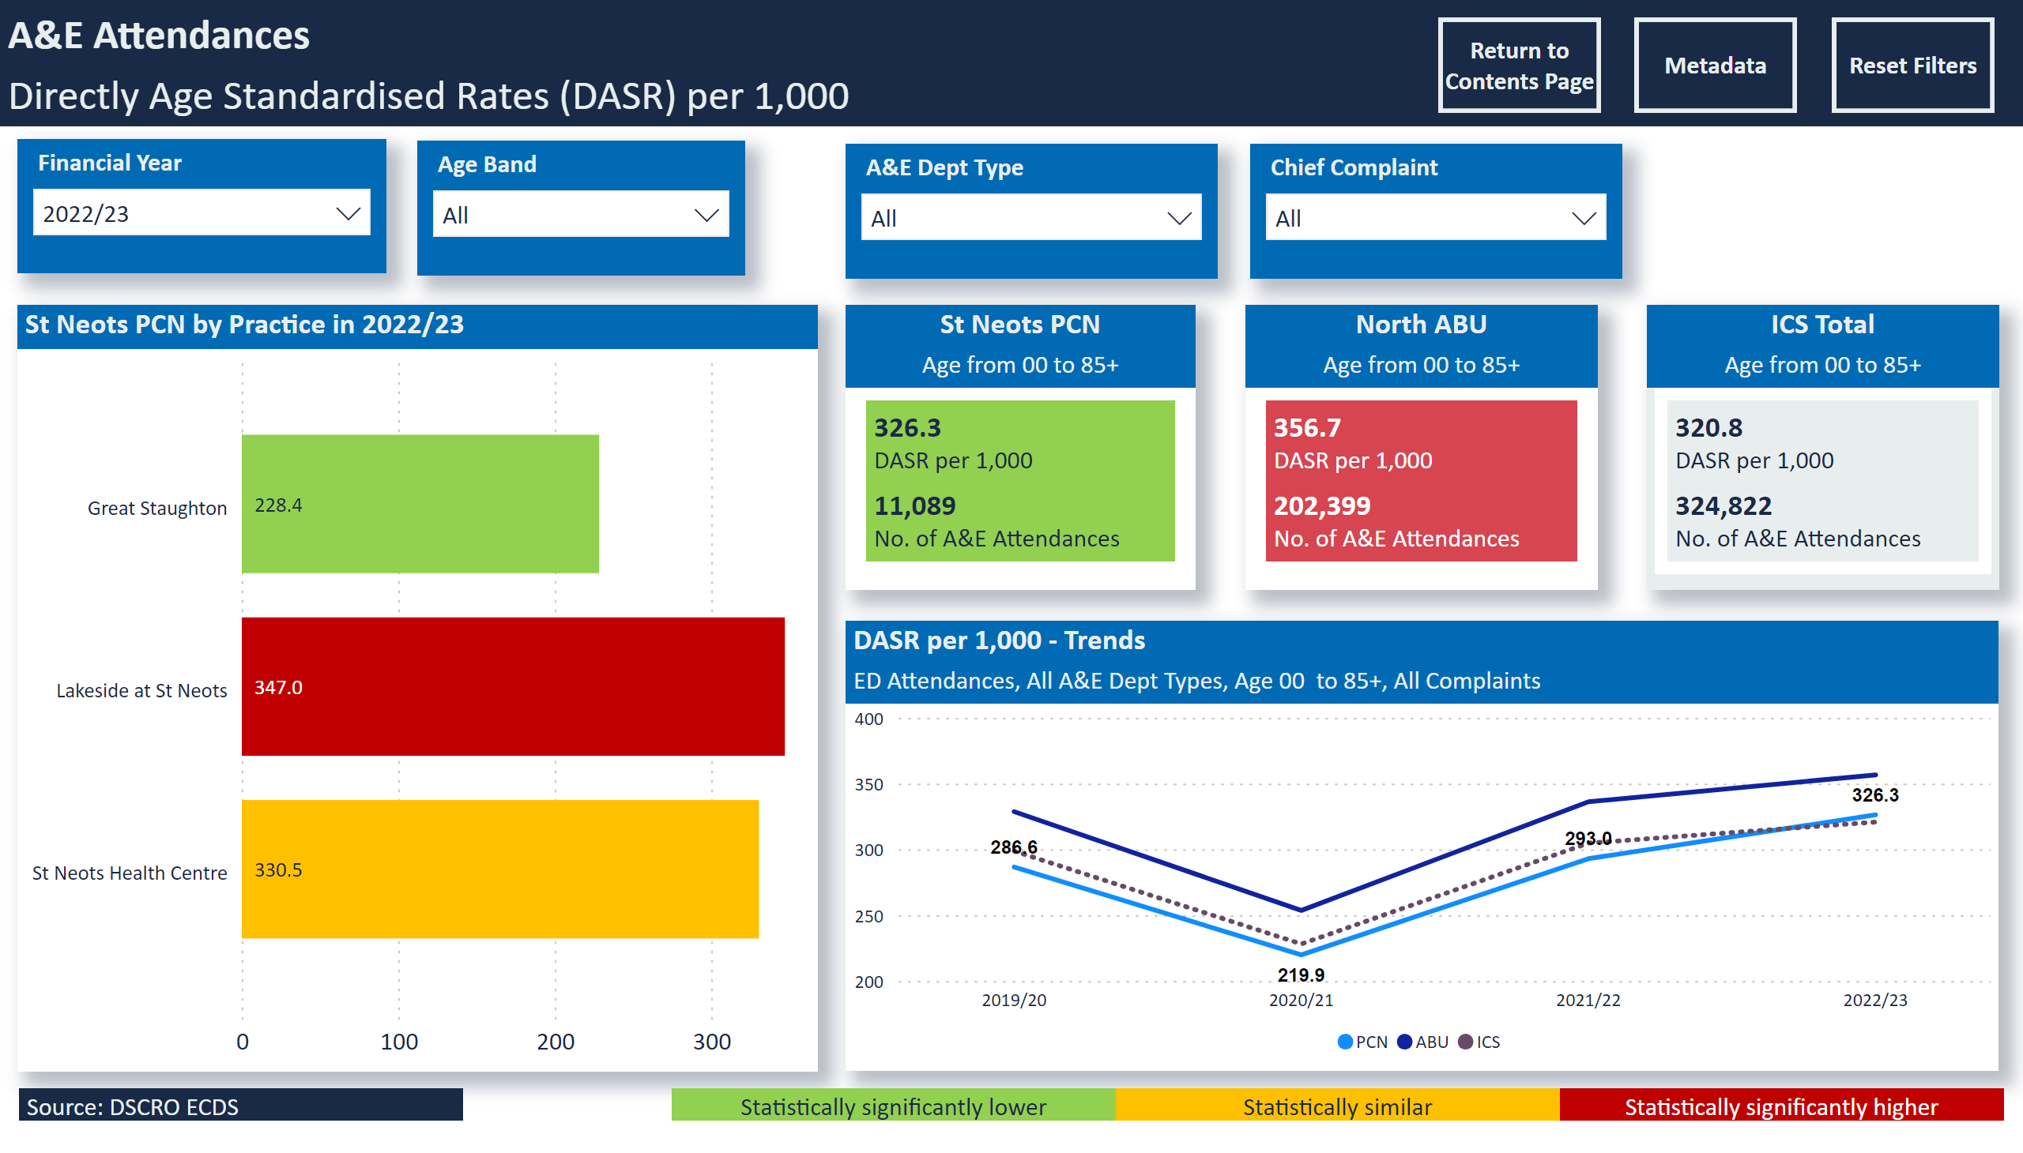
A&E Attendances
Notes:
St Neots PCN by Practice in 2022/23
No alt text provided
slicer
No alt text provided
slicer
No alt text provided
A&E Attendances
No alt text provided
slicer
No alt text provided
slicer
No alt text provided
slicer
No alt text provided
DASR per 1,000 - Trends
No alt text provided
North ABU
No alt text provided
ICS Total
No alt text provided
St Neots PCN
No alt text provided
Source: DSCRO ECDS
No alt text provided
Statistically significantly higher
No alt text provided
Statistically similar
No alt text provided
Statistically significantly lower
No alt text provided
slicer
No alt text provided
actionButton
No alt text provided
actionButton
No alt text provided
actionButton
No alt text provided
Select Age Group, Age
No alt text provided
Select Age Group, Age
No alt text provided
Select Age
No alt text provided

Slide 19
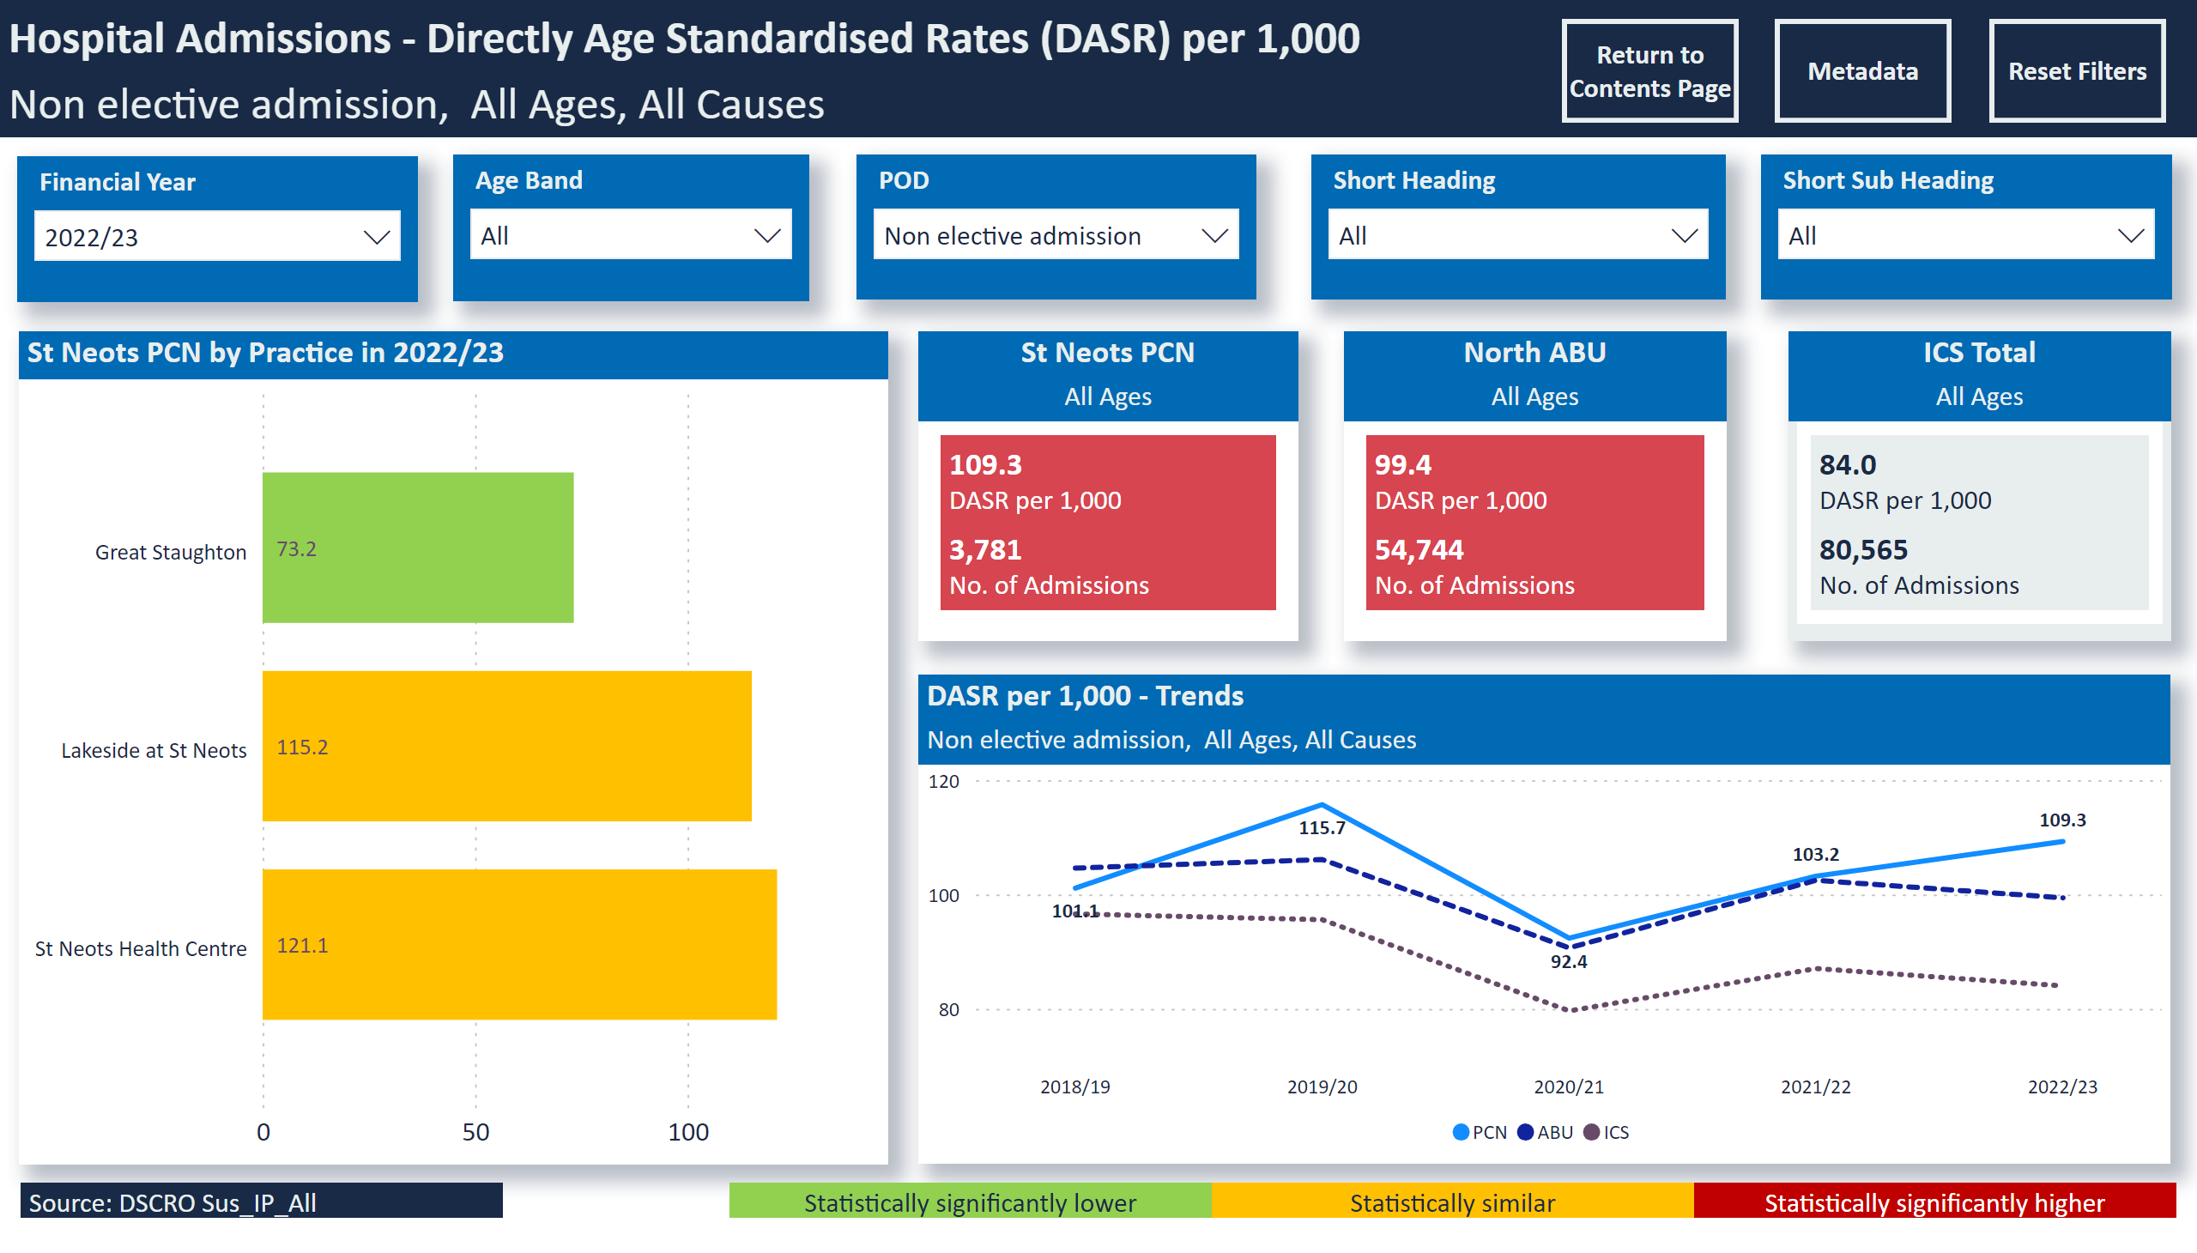
Non electives
Notes:
St Neots PCN by Practice in 2022/23
No alt text provided
slicer
No alt text provided
slicer
No alt text provided
Hospital Admissions - Directly Age Standardised Rates (DASR) per 1,000
No alt text provided
slicer
No alt text provided
slicer
No alt text provided
slicer
No alt text provided
DASR per 1,000 - Trends
No alt text provided
North ABU
No alt text provided
ICS Total
No alt text provided
St Neots PCN
No alt text provided
Source: DSCRO Sus_IP_All
No alt text provided
Statistically significantly higher
No alt text provided
Statistically similar
No alt text provided
Statistically significantly lower
No alt text provided
slicer
No alt text provided
actionButton
No alt text provided
actionButton
No alt text provided
actionButton
No alt text provided
Select Age
No alt text provided

Slide 20
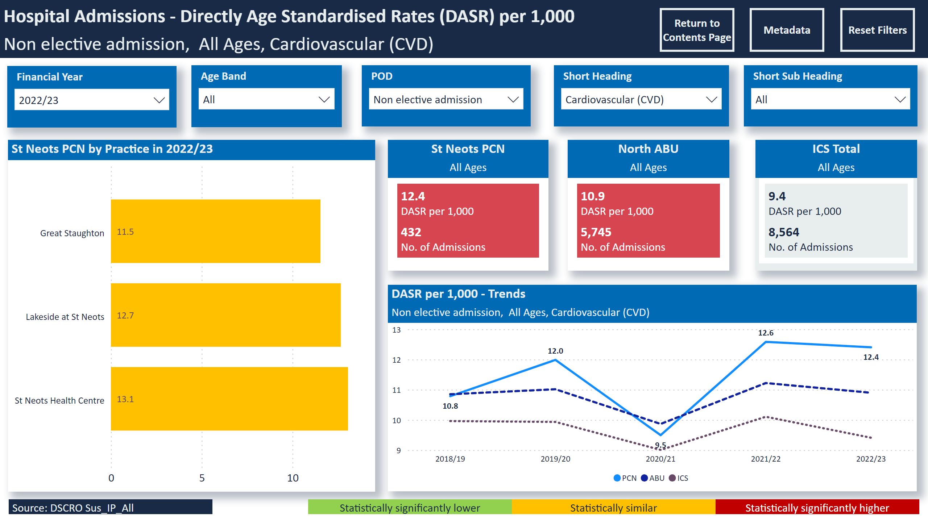
Non electives - CVD
Notes:
St Neots PCN by Practice in 2022/23
No alt text provided
slicer
No alt text provided
slicer
No alt text provided
Hospital Admissions - Directly Age Standardised Rates (DASR) per 1,000
No alt text provided
slicer
No alt text provided
slicer
No alt text provided
slicer
No alt text provided
DASR per 1,000 - Trends
No alt text provided
North ABU
No alt text provided
ICS Total
No alt text provided
St Neots PCN
No alt text provided
Source: DSCRO Sus_IP_All
No alt text provided
Statistically significantly higher
No alt text provided
Statistically similar
No alt text provided
Statistically significantly lower
No alt text provided
slicer
No alt text provided
actionButton
No alt text provided
actionButton
No alt text provided
actionButton
No alt text provided
Select Age
No alt text provided

Slide 21
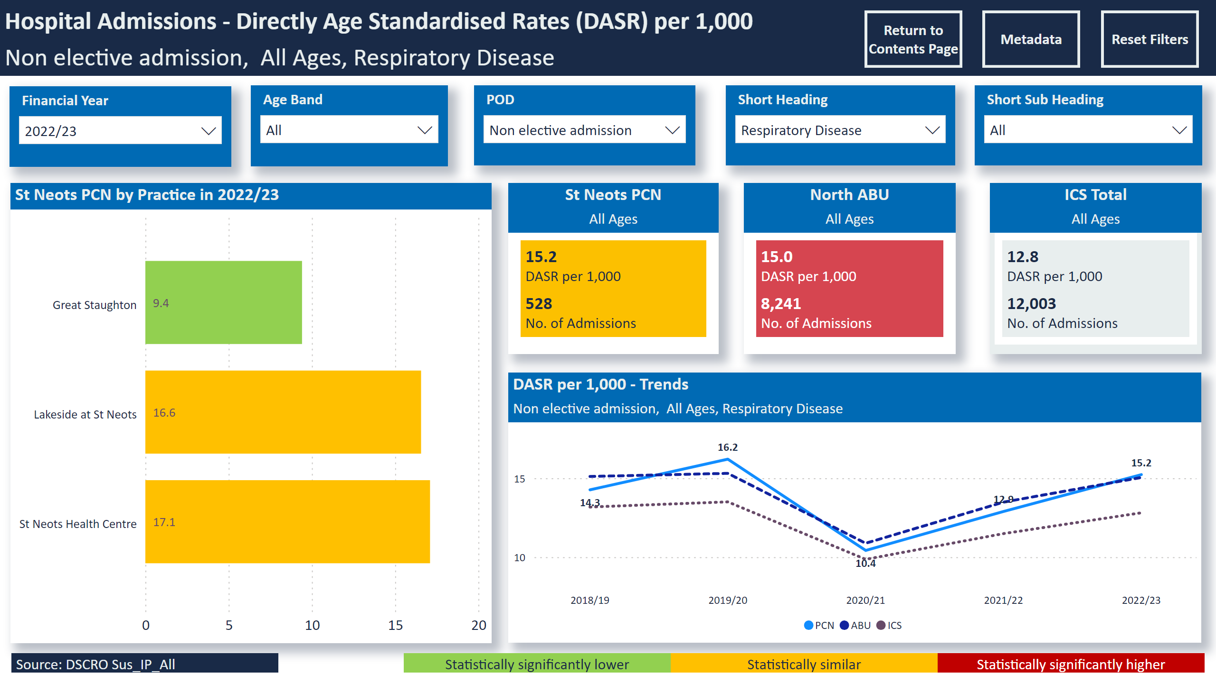
Non electives - Resp
Notes:
St Neots PCN by Practice in 2022/23
No alt text provided
slicer
No alt text provided
slicer
No alt text provided
Hospital Admissions - Directly Age Standardised Rates (DASR) per 1,000
No alt text provided
slicer
No alt text provided
slicer
No alt text provided
slicer
No alt text provided
DASR per 1,000 - Trends
No alt text provided
North ABU
No alt text provided
ICS Total
No alt text provided
St Neots PCN
No alt text provided
Source: DSCRO Sus_IP_All
No alt text provided
Statistically significantly higher
No alt text provided
Statistically similar
No alt text provided
Statistically significantly lower
No alt text provided
slicer
No alt text provided
actionButton
No alt text provided
actionButton
No alt text provided
actionButton
No alt text provided
Select Age
No alt text provided

Slide 22
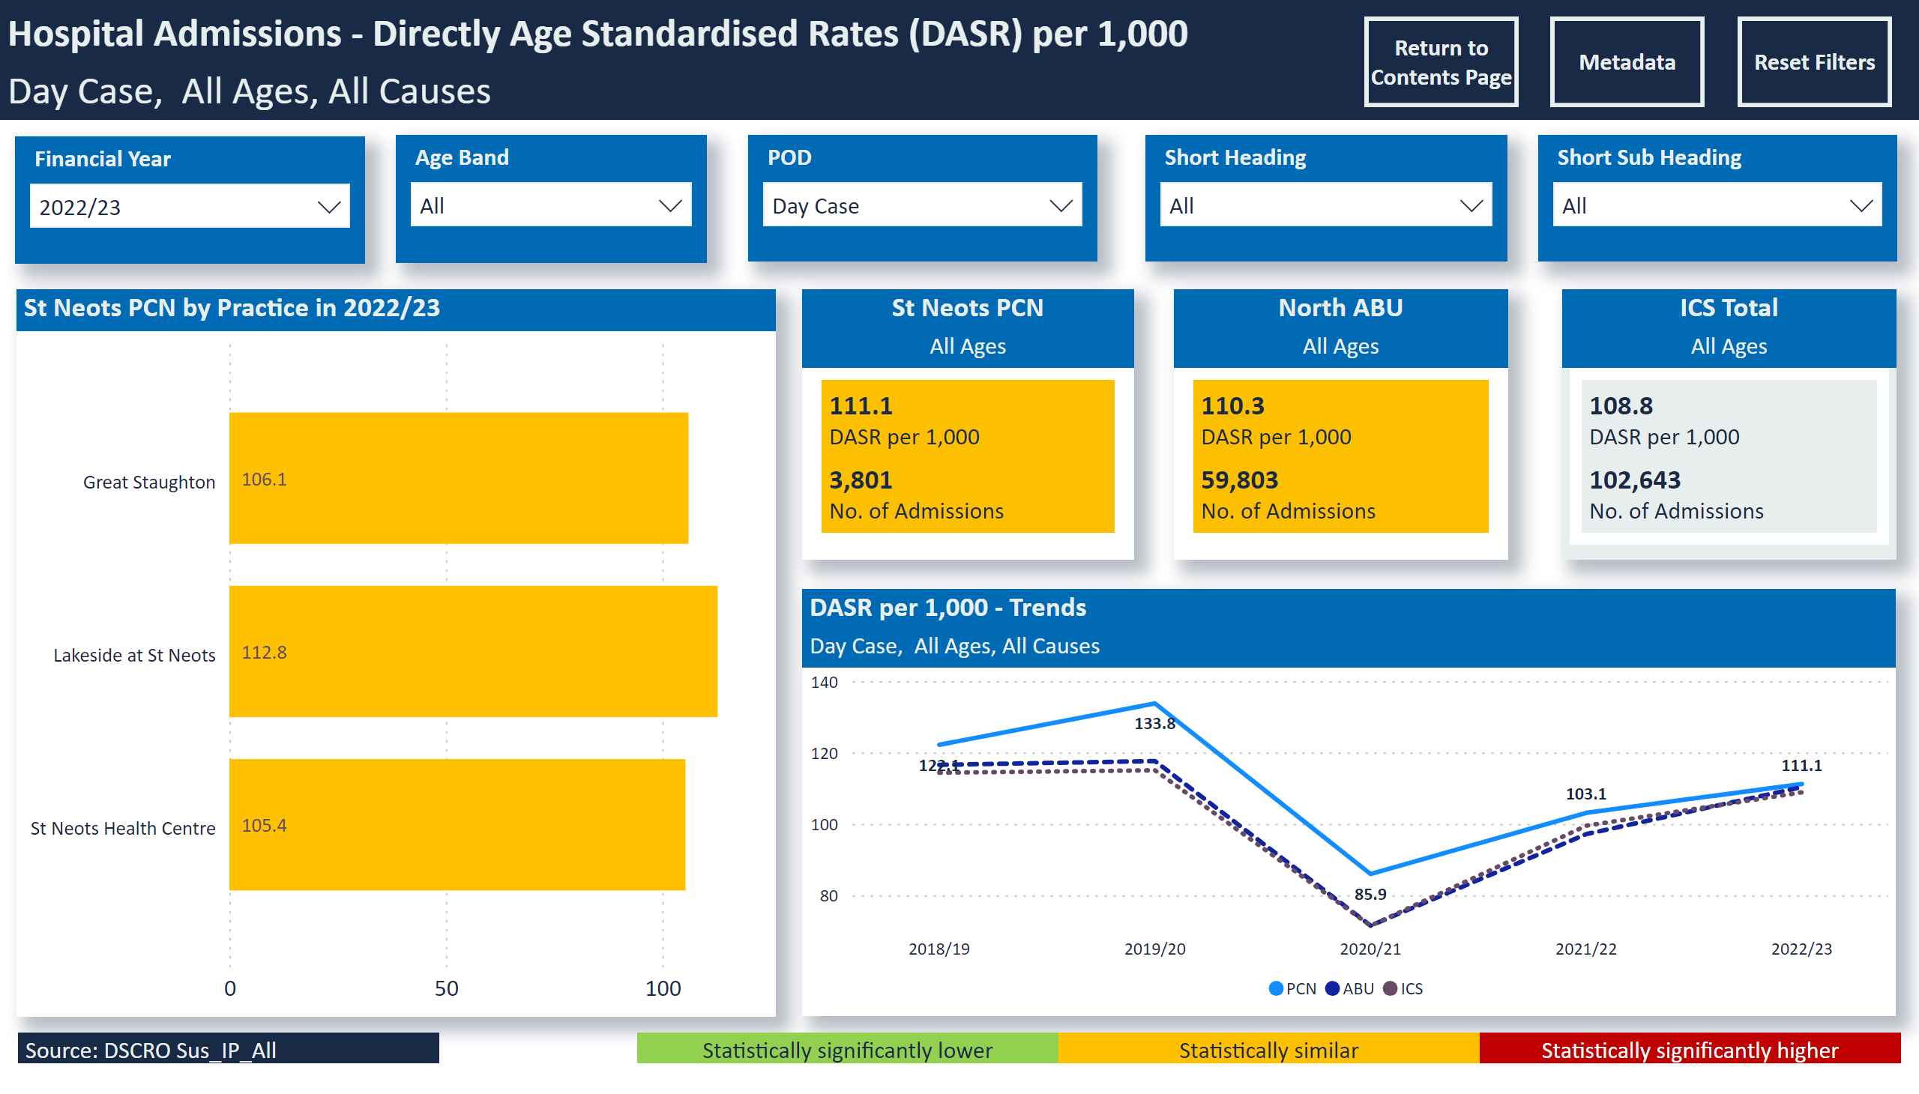
Day Cases
Notes:
St Neots PCN by Practice in 2022/23
No alt text provided
slicer
No alt text provided
slicer
No alt text provided
Hospital Admissions - Directly Age Standardised Rates (DASR) per 1,000
No alt text provided
slicer
No alt text provided
slicer
No alt text provided
slicer
No alt text provided
DASR per 1,000 - Trends
No alt text provided
North ABU
No alt text provided
ICS Total
No alt text provided
St Neots PCN
No alt text provided
Source: DSCRO Sus_IP_All
No alt text provided
Statistically significantly higher
No alt text provided
Statistically similar
No alt text provided
Statistically significantly lower
No alt text provided
slicer
No alt text provided
actionButton
No alt text provided
actionButton
No alt text provided
actionButton
No alt text provided
Select Age
No alt text provided

Slide 23
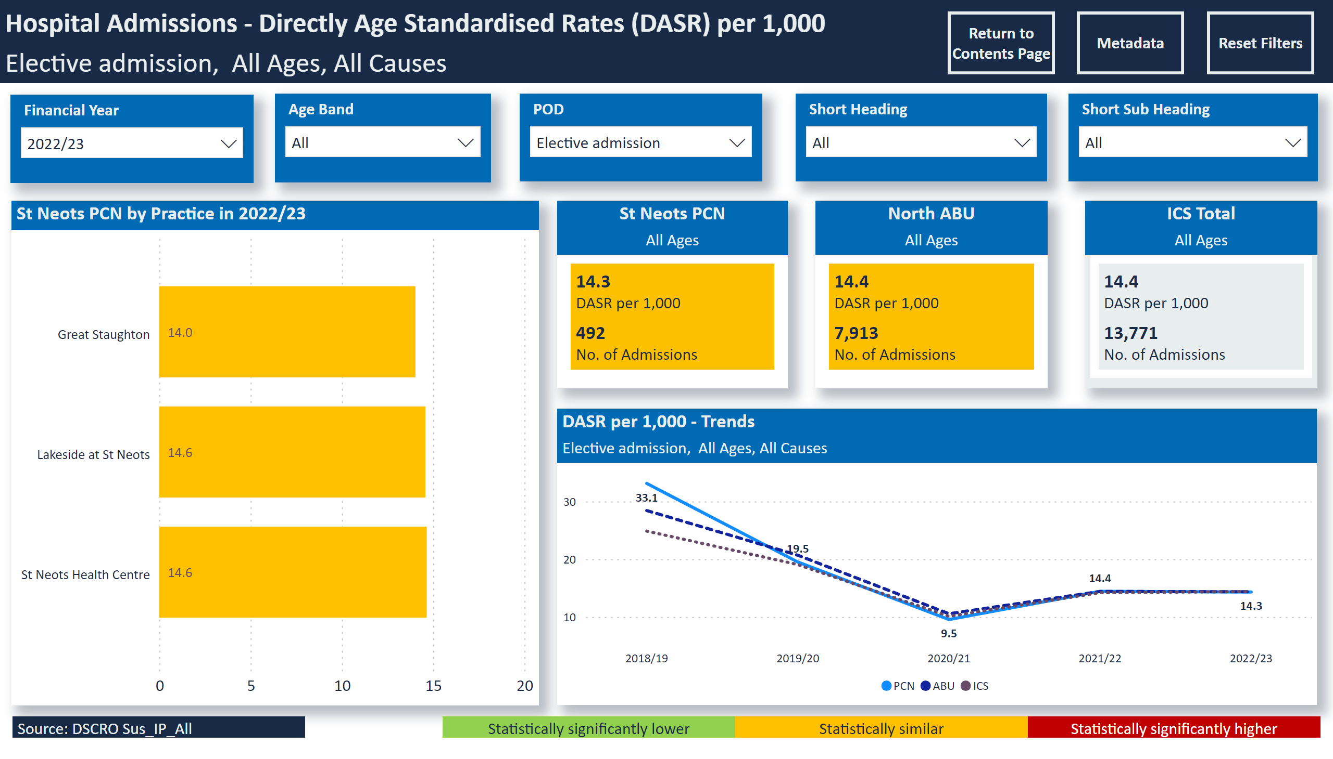
Electives
Notes:
St Neots PCN by Practice in 2022/23
No alt text provided
slicer
No alt text provided
slicer
No alt text provided
Hospital Admissions - Directly Age Standardised Rates (DASR) per 1,000
No alt text provided
slicer
No alt text provided
slicer
No alt text provided
slicer
No alt text provided
DASR per 1,000 - Trends
No alt text provided
North ABU
No alt text provided
ICS Total
No alt text provided
St Neots PCN
No alt text provided
Source: DSCRO Sus_IP_All
No alt text provided
Statistically significantly higher
No alt text provided
Statistically similar
No alt text provided
Statistically significantly lower
No alt text provided
slicer
No alt text provided
actionButton
No alt text provided
actionButton
No alt text provided
actionButton
No alt text provided
Select Age
No alt text provided

Slide 24
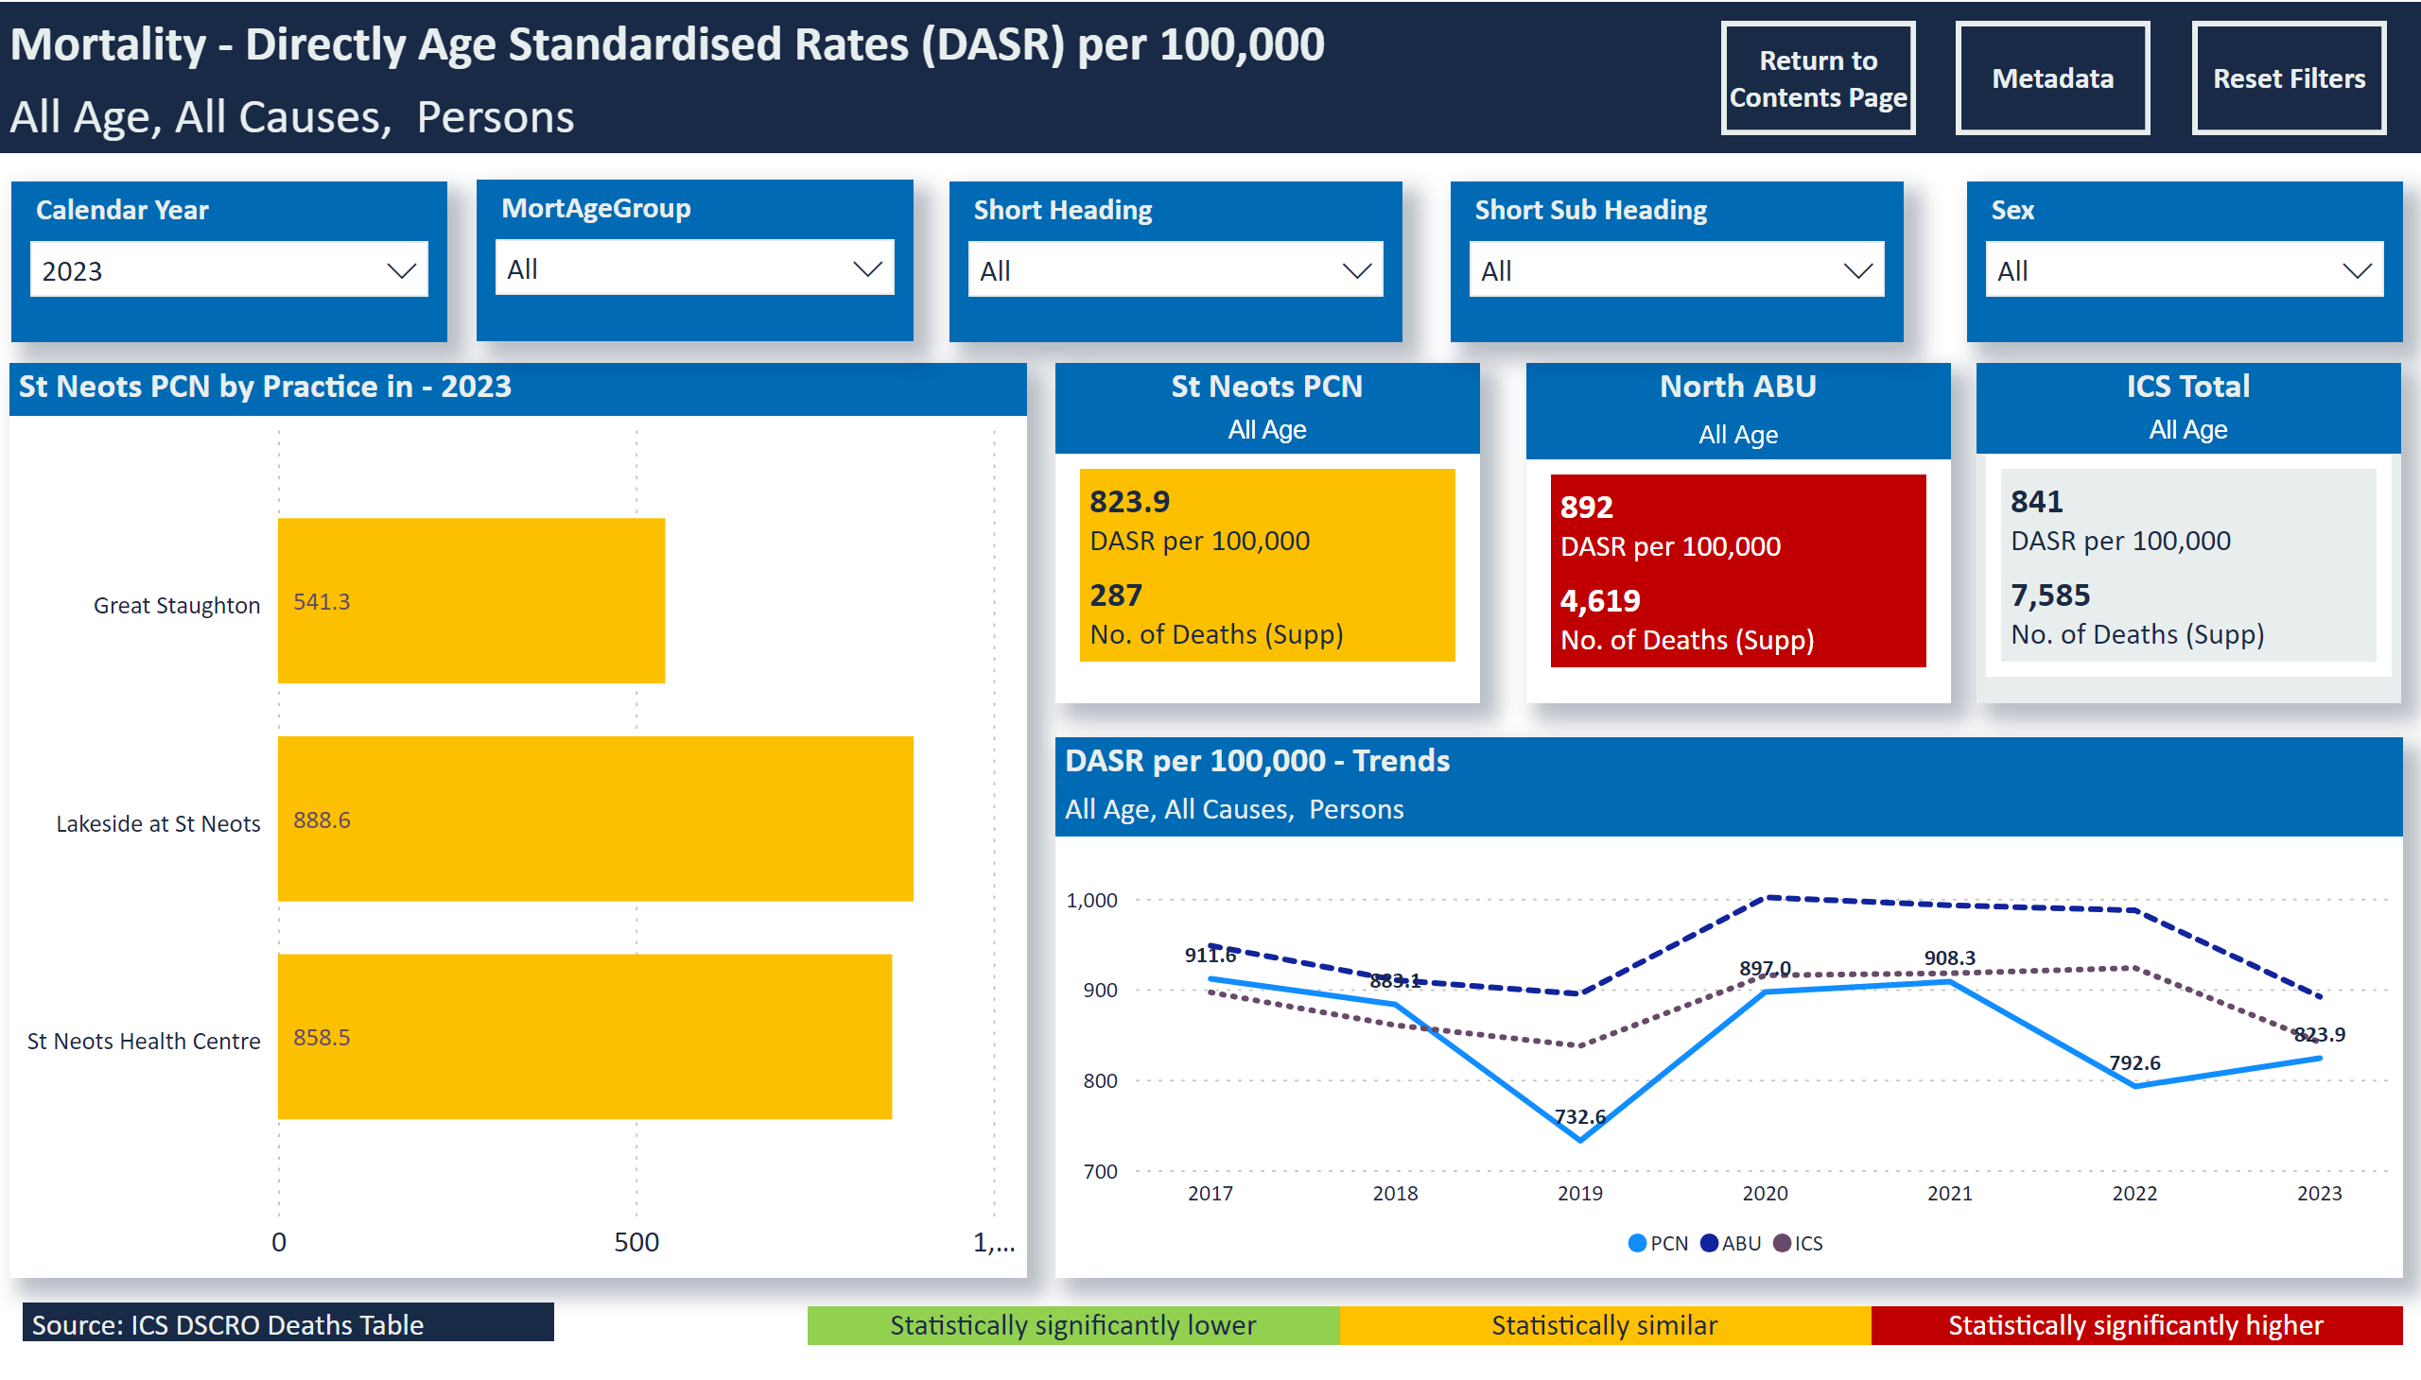
Mortality - All Age
Notes:
slicer
No alt text provided
slicer
No alt text provided
slicer
No alt text provided
St Neots PCN by Practice in - 2023
No alt text provided
slicer
No alt text provided
DASR per 100,000 - Trends
No alt text provided
slicer
No alt text provided
Mortality - Directly Age Standardised Rates (DASR) per 100,000
No alt text provided
Statistically significantly higher
No alt text provided
Statistically similar
No alt text provided
Statistically significantly lower
No alt text provided
St Neots PCN
No alt text provided
North ABU
No alt text provided
ICS Total
No alt text provided
Source: ICS DSCRO Deaths Table
No alt text provided
slicer
No alt text provided
slicer
No alt text provided
slicer
No alt text provided
slicer
No alt text provided
actionButton
No alt text provided
actionButton
No alt text provided
actionButton
No alt text provided
slicer
No alt text provided

Slide 25
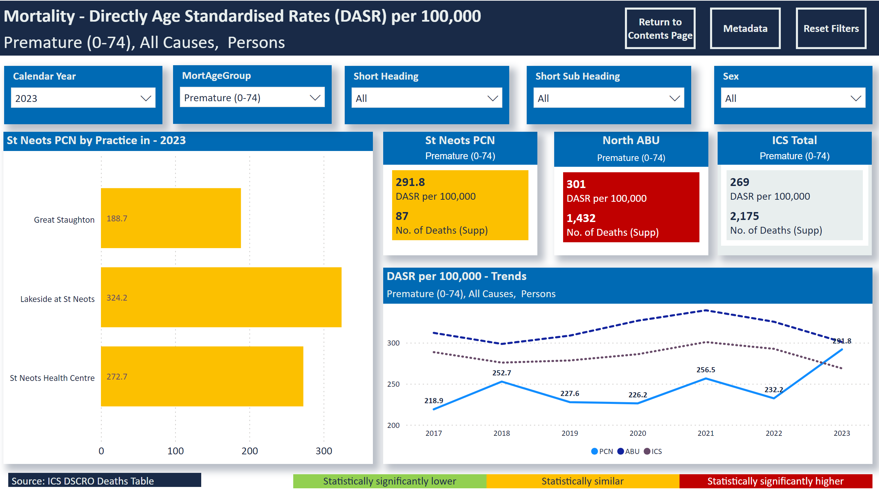
Mortality - Prem
Notes:
slicer
No alt text provided
slicer
No alt text provided
slicer
No alt text provided
St Neots PCN by Practice in - 2023
No alt text provided
slicer
No alt text provided
DASR per 100,000 - Trends
No alt text provided
slicer
No alt text provided
Mortality - Directly Age Standardised Rates (DASR) per 100,000
No alt text provided
Statistically significantly higher
No alt text provided
Statistically similar
No alt text provided
Statistically significantly lower
No alt text provided
St Neots PCN
No alt text provided
North ABU
No alt text provided
ICS Total
No alt text provided
Source: ICS DSCRO Deaths Table
No alt text provided
slicer
No alt text provided
slicer
No alt text provided
slicer
No alt text provided
slicer
No alt text provided
actionButton
No alt text provided
actionButton
No alt text provided
actionButton
No alt text provided
slicer
No alt text provided

Slide 26
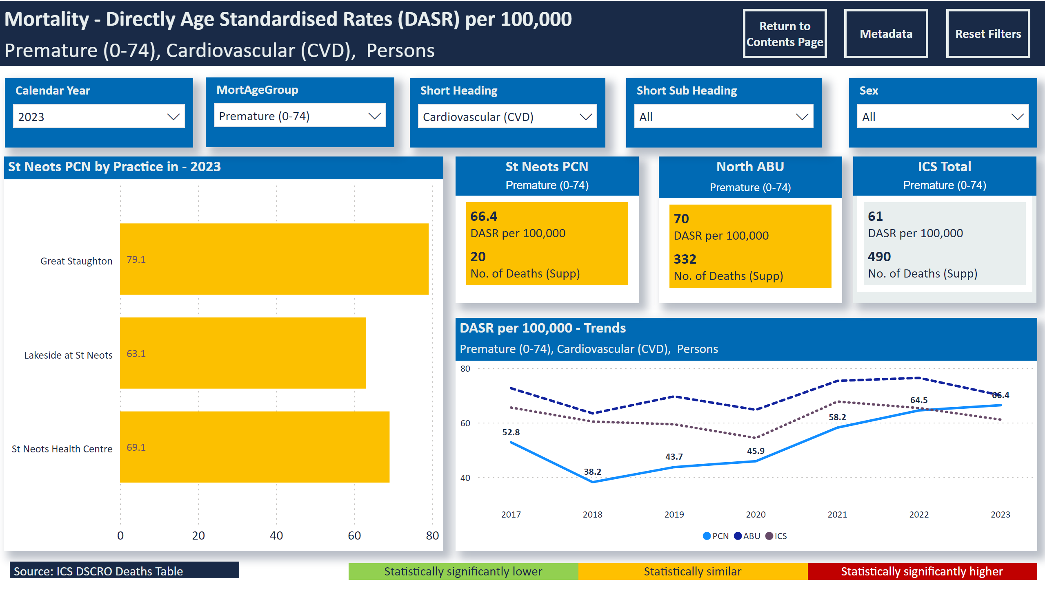
Mortality - Prem CVD
Notes:
slicer
No alt text provided
slicer
No alt text provided
slicer
No alt text provided
St Neots PCN by Practice in - 2023
No alt text provided
slicer
No alt text provided
DASR per 100,000 - Trends
No alt text provided
slicer
No alt text provided
Mortality - Directly Age Standardised Rates (DASR) per 100,000
No alt text provided
Statistically significantly higher
No alt text provided
Statistically similar
No alt text provided
Statistically significantly lower
No alt text provided
St Neots PCN
No alt text provided
North ABU
No alt text provided
ICS Total
No alt text provided
Source: ICS DSCRO Deaths Table
No alt text provided
slicer
No alt text provided
slicer
No alt text provided
slicer
No alt text provided
slicer
No alt text provided
actionButton
No alt text provided
actionButton
No alt text provided
actionButton
No alt text provided
slicer
No alt text provided

Slide 27
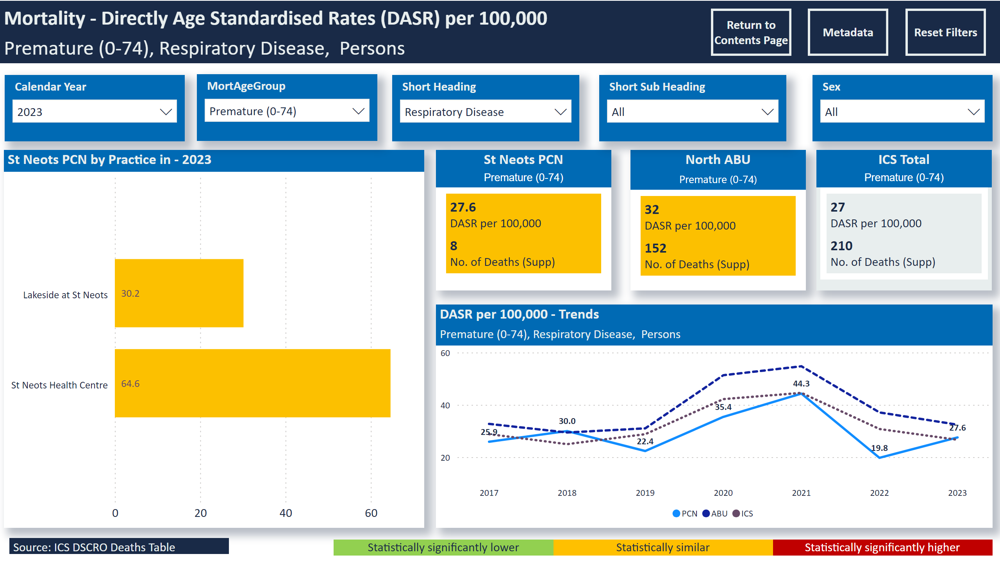
Mortality - Prem Resp
Notes:
slicer
No alt text provided
slicer
No alt text provided
slicer
No alt text provided
St Neots PCN by Practice in - 2023
No alt text provided
slicer
No alt text provided
DASR per 100,000 - Trends
No alt text provided
slicer
No alt text provided
Mortality - Directly Age Standardised Rates (DASR) per 100,000
No alt text provided
Statistically significantly higher
No alt text provided
Statistically similar
No alt text provided
Statistically significantly lower
No alt text provided
St Neots PCN
No alt text provided
North ABU
No alt text provided
ICS Total
No alt text provided
Source: ICS DSCRO Deaths Table
No alt text provided
slicer
No alt text provided
slicer
No alt text provided
slicer
No alt text provided
slicer
No alt text provided
actionButton
No alt text provided
actionButton
No alt text provided
actionButton
No alt text provided
slicer
No alt text provided

