Slide 1
National Child Measurement Programme (NCMP) 2022/23
Cambridgeshire & Peterborough
Public Health Intelligence, CCC and PCC
PHI-Team@cambridgeshire.gov.uk
Notes:
Nicola Gowers
Public Health Analyst, PHI

Slide 2
Introduction
The National Child Measurement Programme (NCMP) measures the height and weight of children across the country to assess overweight and obesity levels in children within primary schools to:
  support national and local public health initiatives,
  inform the local planning and delivery of services for children
This data pack provides a summary of key findings from the NCMP for pupils in Reception (aged 4 to 5 years) and Year 6 (aged 10 to 11 years) in Cambridgeshire and Peterborough.
Note on the impact of COVID-19 The COVID-19 pandemic led to disruption of 2019/20 and 2020/21 NCMP data collection, therefore, some data is unavailable or has not been published due to data validity. In previous NCMP analysis, the Public Health Intelligence team aggregated the local dataset across 3 NCMP years in order to increase the statistical validity of the findings and to smooth out annual fluctuations. However, due to data gaps the local dataset analysis provided in this data pack is for 2 years only (2021/22 and 2022/23) and therefore must be observed with a level of caution.
Children's measurements are grouped according to the below weight status categories (UK90 population monitoring BMI cut offs):
RAG rating
Unless stated otherwise, the statistical significance rating (or Red-Amber-Green/RAG rating) is calculated in comparison to the England average:
Cole TJ, Freeman JV, Preece MA. Body mass index reference curves for the UK, 1990. Archives of Disease in Childhood 1995 73:25-29
Notes:
Cole TJ, Freeman JV, Preece MA. Body mass index reference curves for the UK, 1990. Archives of Disease in Childhood 1995 73:25-29
Note: Severe obesity is a sub-set of obesity. The term ‘Living with obesity’ is the same as ‘obesity’ prevalence.
Source: NCMP, national dataset

Slide 3
National dataset

Slide 4
East of England NCMP prevalence figures 2022/23
For many areas, prevalence of overweight and obesity combined have seen small reductions between since 2021/22 (data not shown). The national rate has reduced from 22.3% to 21.3% for Reception aged children, and 37.8% to 36.6% for Year 6 children. Cambridgeshire has seen a reduction for both age groups (down from Reception: 18.5%, Year 6: 32.1%), whilst Peterborough has had a reduction in Year 6 (down from 41.2%) but has a similar prevalence in Reception aged children (up from 22.0%).
2022/23 NCMP data shows that Cambridgeshire has generally better weight status outcomes than the national average. Peterborough has generally similar or worse weight status outcomes than the national average. There are increases in obesity prevalence between Reception and Year 6, as is also found nationally.
Table 1. Prevalence of weight status (%) in East of England with RAG ratings comparing Cambridgeshire and Peterborough to England, 2022/23
Source: National Child Measurement Programme, NHS Digital. National dataset.
Pupils from the Cambridgeshire and Peterborough local authority schools' submission, based on the child’s residential postcode.
RAG rating compared to England
Notes:
Source: NCMP 2022/23
NCMP East of England UTLAs Table 3b, national dataset
Table 3b: Prevalence and number of children underweight, healthy weight, overweight, living with obesity and living with severe obesity in Reception/Year 6, by region and upper tier local authority (based on the postcode of the child)

Slide 5
Prevalence of overweight and obesity combined, 2022/23
Overweight and obesity prevalence is higher in older children and varies considerably across our area.
18.0% of Cambridgeshire and 21.8% of Peterborough Reception age children measured as overweight and obesity combined.
30.3% of Cambridgeshire and 38.5% of Peterborough Year 6 children measured as overweight and obesity combined.
Peterborough is significantly worse than the England average for Year 6 prevalence, as is Fenland (40.0%). Fenland is also significantly worse for Reception prevalence at 24.3%.
Table 2. Prevalence of overweight and obesity combined (%) in Cambridgeshire and its districts, Peterborough, East of England, and England with RAG ratings comparing against England, 2022/23
Source: National Child Measurement Programme, NHS Digital. National dataset.
Pupils from the Cambridgeshire and Peterborough local authority schools' submission, based on the child’s residential postcode.
RAG rating compared to England
Notes:
Source: NCMP 2022/23, national dataset
Table 3b: Prevalence and number of children underweight, healthy weight, overweight, living with obesity and living with severe obesity in Reception, by region and upper tier local authority (based on the postcode of the child)^{1,2} Table 3b: Prevalence and number of children underweight, healthy weight, overweight, living with obesity and living with severe obesity in Year 6, by region and lower tier local authority (based on the postcode of the child)1,2

Slide 6


Prevalence of overweight and obesity combined, 2022/23
Approximately 2 in 10 children in Reception
(aged 4-5 years) (Cambridgeshire 18.0%, Peterborough 21.8%, England 21.3%)
In 2021/22, Cambridgeshire 18.5%, Peterborough 22.0%, England 22.3%
3 in 10 children in Cambridgeshire Year 6
(aged 10-11 years) (30.3%, England 36.6%)
In 2021/22, 32.1%, England 37.8%
Approximately 4 in 10 children in Peterborough Year 6 (aged 10-11 years) (38.5%, England 36.6%)
In 2021/22, 41.2% England 37.8%
Source: National Child Measurement Programme, NHS Digital. National dataset.
Pupils from the Cambridgeshire and Peterborough local authority schools' submission, based on the child’s residential postcode.
Notes:
Source: NCMP 2022/23, national dataset
Table 3b: Prevalence and number of children underweight, healthy weight, overweight, living with obesity and living with severe obesity in Reception, by region and upper tier local authority (based on the postcode of the child)^{1,2} Table 3b: Prevalence and number of children underweight, healthy weight, overweight, living with obesity and living with severe obesity in Year 6, by region and lower tier local authority (based on the postcode of the child)1,2

Slide 7
Prevalence of obesity (including severe obesity), 2022/23
Rates of obesity (including severe obesity) vary widely across our area, but prevalence is always higher in Year 6 children than in Reception.
7.0% of Cambridgeshire and 9.7% of Peterborough Reception age children are measured as living with obesity.
17.8% of Cambridgeshire and 25.2% of Peterborough Year 6 children are measured as living with obesity.
Peterborough is statistically significantly worse, as is Fenland (25.2%), than the England average for Year 6 prevalence of obesity. Fenland (11.4%) is also significantly worse than England for prevalence in Reception.
Table 3. Prevalence of obesity (including severe obesity) in Cambridgeshire and its districts, Peterborough, East of England and England with RAG ratings comparing against England, 2022/23
Source: National Child Measurement Programme, NHS Digital. National dataset.
Pupils from the Cambridgeshire and Peterborough local authority schools' submission, based on the child’s residential postcode.
RAG rating compared to England
Notes:
Source: NCMP 2022/23, national dataset
Table 3b: Prevalence and number of children underweight, healthy weight, overweight, living with obesity and living with severe obesity in Reception, by region and upper tier local authority (based on the postcode of the child)^{1,2} Table 3b: Prevalence and number of children underweight, healthy weight, overweight, living with obesity and living with severe obesity in Year 6, by region and lower tier local authority (based on the postcode of the child)1,2

Slide 8

Prevalence of children living with obesity (including severe obesity)
Less than 1 in 10 children in Reception
(aged 4-5 years) (Cambridgeshire 7.0%, Peterborough 9.7%, England 9.2%)
In 2021/22, Cambridgeshire 8.2%, Peterborough 10.5%, England 10.1%
Approximately 2 in 10 children in Cambridgeshire Year 6
(aged 10-11 years) (17.8%, England 22.7%)
In 2021/22, 18.6%, England 23.4%
Less than 3 in 10 children in Peterborough Year 6
(aged 10-11 years) (25.2%, England 22.7%)
In 2021/22, 26.0%, England 23.4%)
Source: National Child Measurement Programme, NHS Digital. National dataset.
Pupils from the Cambridgeshire and Peterborough local authority schools' submission, based on the child’s residential postcode.
Notes:
Source: NCMP 2022/23, national dataset
Table 3b: Prevalence and number of children underweight, healthy weight, overweight, living with obesity and living with severe obesity in Reception, by region and upper tier local authority (based on the postcode of the child)^{1,2} Table 3b: Prevalence and number of children underweight, healthy weight, overweight, living with obesity and living with severe obesity in Year 6, by region and lower tier local authority (based on the postcode of the child)1,2

Slide 9
East of England prevalence of overweight and obesity combined, 2022/23
Compared to other East of England local authorities, Peterborough has among the highest rates of overweight and obesity in both Reception and Year 6 children, and Cambridgeshire has among the lowest.
Table 4. Prevalence of overweight and obesity combined (%) in East of England with RAG ratings comparing against East of England, 2022/23
RAG rating compared to East of England
Source: National Child Measurement Programme, NHS Digital. National dataset.
Pupils from the Cambridgeshire and Peterborough local authority schools' submission, based on the child’s residential postcode.
Notes:
Source: NCMP 2022/23, national dataset
Table 3b: Prevalence and number of children underweight, healthy weight, overweight, living with obesity and living with severe obesity in Reception, by region and upper tier local authority (based on the postcode of the child)^{1,2} Table 3b: Prevalence and number of children underweight, healthy weight, overweight, living with obesity and living with severe obesity in Year 6, by region and lower tier local authority (based on the postcode of the child)1,2

Slide 10
East of England prevalence of obesity (including severe obesity), 2022/23
Compared to other East of England local authorities, Peterborough has among the highest rates of obesity in both Reception and Year 6 children, and Cambridgeshire has among the lowest.
Table 5. Prevalence of obesity (including severe obesity) (%) in East of England with RAG ratings comparing against East of England, 2022/23
Source: National Child Measurement Programme, NHS Digital. National dataset.
Pupils from the Cambridgeshire and Peterborough local authority schools' submission, based on the child’s residential postcode.
RAG rating compared to East of England
Notes:
Source: NCMP 2022/23, national dataset
Table 3b: Prevalence and number of children underweight, healthy weight, overweight, living with obesity and living with severe obesity in Reception, by region and upper tier local authority (based on the postcode of the child)^{1,2} Table 3b: Prevalence and number of children underweight, healthy weight, overweight, living with obesity and living with severe obesity in Year 6, by region and lower tier local authority (based on the postcode of the child)1,2

Slide 11
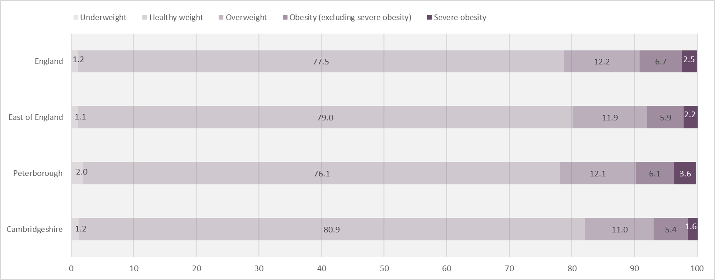
BMI status of children in Reception Year, 2022/23
Figure 1. Prevalence (%) of BMI status in Cambridgeshire, Peterborough, East of England, and England for Reception children (aged 4 to 5), 2022/23
Source: National Child Measurement Programme, NHS Digital. National dataset.
Pupils from the Cambridgeshire and Peterborough local authority schools submission, based on the child’s residential postcode.
Notes:
Source: NCMP 2022/23 national dataset
Table 3b: Prevalence and number of children underweight, healthy weight, overweight, living with obesity and living with severe obesity in Reception, by region and upper tier local authority (based on the postcode of the child)^{1,2} Table 3b: Prevalence and number of children underweight, healthy weight, overweight, living with obesity and living with severe obesity in Year 6, by region and lower tier local authority (based on the postcode of the child)1,2

Slide 12
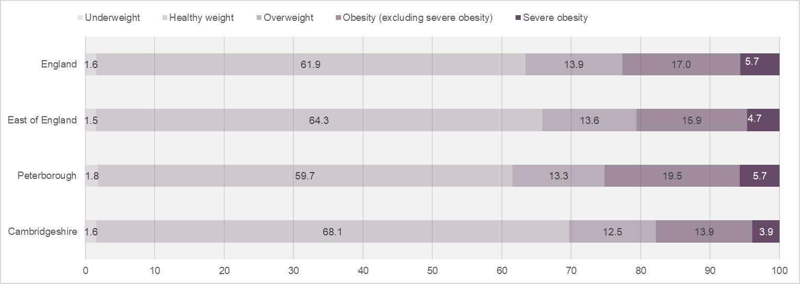
BMI status of children in Year 6, 2022/23
Figure 2. Prevalence (%) of BMI status in Cambridgeshire, Peterborough, East of England, and England for Year 6 children (aged 10 to 11), 2022/23
Source: National Child Measurement Programme, NHS Digital. National dataset.
Pupils from the Cambridgeshire and Peterborough local authority schools submission, based on the child’s residential postcode.
Notes:
Source: NCMP 2022/23, national dataset
Table 3b: Prevalence and number of children underweight, healthy weight, overweight, living with obesity and living with severe obesity in Reception, by region and upper tier local authority (based on the postcode of the child)^{1,2} Table 3b: Prevalence and number of children underweight, healthy weight, overweight, living with obesity and living with severe obesity in Year 6, by region and lower tier local authority (based on the postcode of the child)1,2

Slide 13
Prevalence of overweight and obesity combined since 2015/16
Table 6. Prevalence of overweight and obesity combined in Cambridgeshire and its districts, Peterborough, England with RAG ratings comparing against England, 2015/16 to 2022/23
Note: ‘–’ in table denotes no data is available.
Whilst Cambridgeshire has had a reduction in prevalence of overweight and obese Reception pupils between 2021/22 and 2022/23, not all districts have shown the same trend. Cambridge has increased in the last data period, and whilst Fenland has maintained its prevalence, it is now statistically significantly worse than the national average.
Prevalence of Year 6 children measured as overweight and obesity combined is lower than 2021/22 for all local areas, however Fenland is now statistically significantly worse than England, and Peterborough also continues to be statistically significantly worse.
RAG rating compared to England
Source: National Child Measurement Programme, NHS Digital. National dataset.
Pupils from the Cambridgeshire and Peterborough local authority schools' submission, based on the child’s residential postcode.
Notes:
Source: NCMP 2022/23, national dataset
Table 3b: Prevalence and number of children underweight, healthy weight, overweight, living with obesity and living with severe obesity in Reception, by region and upper tier local authority (based on the postcode of the child)^{1,2} Table 3b: Prevalence and number of children underweight, healthy weight, overweight, living with obesity and living with severe obesity in Year 6, by region and lower tier local authority (based on the postcode of the child)1,2

Slide 14
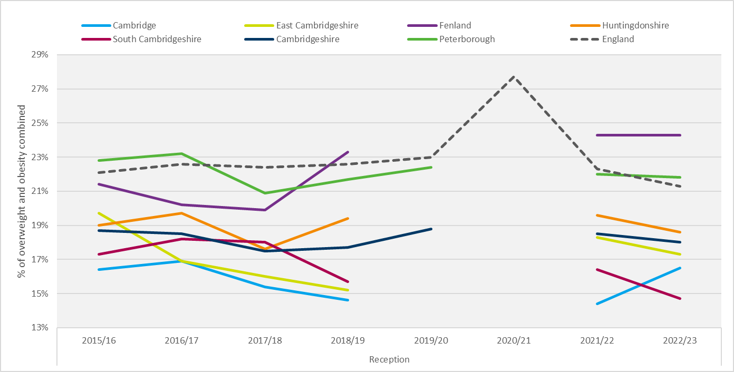
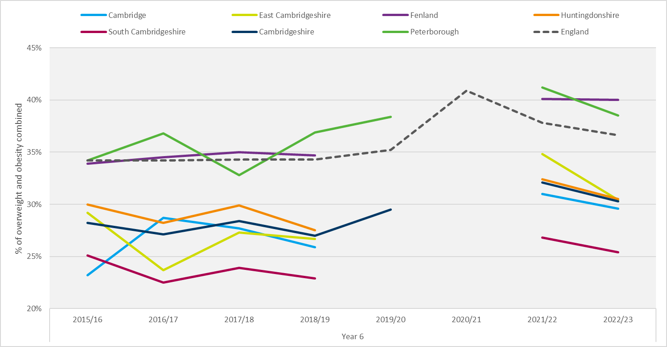
Prevalence of overweight and obesity combined since 2015/16
Figure 3. Trend for prevalence of obesity in Reception children in Cambridgeshire and its districts, Peterborough, and England, 2015/16- 2022/23
Figure 4. Trend for prevalence of obesity in Year 6 children in Cambridgeshire and its districts, Peterborough, and England, 2015/16-2022/23
Note: 2019/20 & 2020/21 some data not available. Axes do not start at 0.
Source: National Child Measurement Programme, NHS Digital. National dataset.
Pupils from the Cambridgeshire and Peterborough local authority schools' submission, based on the child’s residential postcode.
Notes:
Source: NCMP 2022/23, national dataset
Table 3b: Prevalence and number of children underweight, healthy weight, overweight, living with obesity and living with severe obesity in Reception, by region and upper tier local authority (based on the postcode of the child)^{1,2} Table 3b: Prevalence and number of children underweight, healthy weight, overweight, living with obesity and living with severe obesity in Year 6, by region and lower tier local authority (based on the postcode of the child)1,2

Slide 15
BMI category by ethnicity (Reception), England, 2022/23
Table 7. Prevalence of BMI category for children in Reception by ethnic categories for England with RAG ratings, 2022/23
Prevalence of weight status varies by ethnicity.
Prevalence of ‘Healthy weight’ pupils is lower/worse* than the national average amongst Black and ‘Any other ethnic group’ ethnicities.
Additional commentary is provided on slide 15.
Source: National Child Measurement Programme, NHS Digital. National dataset.
Pupils from the Cambridgeshire and Peterborough local authority schools' submission, based on the child’s residential postcode.
RAG rating compared to England
Notes:
Source: NCMP 2022/23, national dataset
Table 4_R: Prevalence and number of children underweight, healthy weight, overweight, living with obesity and living with severe obesity in Reception, by ethnic category, England
National Dataset

Slide 16
BMI category by ethnicity (Year 6), England, 2022/23
Table 8. Prevalence of BMI category for children in Year 6 by ethnic categories for England with RAG ratings, 2022/23
Prevalence of weight status varies by ethnicity.
The disparity between the ethnic groups is wider in Year 6 than for Reception pupils.
Additional commentary is provided on slide 15.
Source: National Child Measurement Programme, NHS Digital. National dataset.
Pupils from the Cambridgeshire and Peterborough local authority schools' submission, based on the child’s residential postcode.
RAG rating compared to England
Notes:
Source: NCMP 2022/23, national dataset
Table 4_R: Prevalence and number of children underweight, healthy weight, overweight, living with obesity and living with severe obesity in Reception, by ethnic category, England
National Dataset

Slide 17
BMI categories by ethnicity (2022/23 NCMP)
Weight data from the 2021/22 and 2022/23 local dataset were analysed by ethnicity for Cambridgeshire and Peterborough. However, very small numbers can affect data validity and make interpretations difficult or unreliable. Therefore, data analysis has not been published (Please contact the PHI team with any queries).
This slide reflects key points from the national NCMP ethnicity data set for England as a whole, rather than Cambridgeshire and Peterborough figures. (Accompanying data tables are on Slides 13 and 14).
Reception age pupils
Year 6 pupils
Rates of ‘Healthy weight’ pupils vary across ethnic groups (77.5% of all Reception pupils; 72.3% Black, 87.5% Chinese).
Rates of ‘Healthy weight’ pupils vary across ethnic groups (61.9% of all Year 6 pupils; 51.7% Black, 56.1% Asian).
Rates of ‘Underweight’ pupils are three times as high* within Asian ethnicities compared to other ethnicities (1.2% of all Reception pupils; 4.3% Asian; 0.6% White, 1.2% Black ).
Chinese and White ethnic groups have higher*/better rates of ‘Healthy weight’ pupils. (Though there is variation with in the White sub-groupings) (70.4% Chinese, 63.6% White).
Rates of ‘Overweight’ and ‘Obese’ pupils are high* within Black ethnic groups.
High* rates of ‘Underweight’ pupils are predominantly within Asian ethnicities (1.6% of all Year 6 pupils; 3.8% Asian; 5.0% Asian: Indian; 2.4% Mixed: White Asian).
Several ethnic minority groups have high*/worse rates of pupils living with obesity.
Rates of ‘Overweight’ and ‘Obese’ pupils are high* across many ethnic groups and sub-groups.
Some ‘Asian’ ethnic groups have lower* rates of ‘Overweight’ pupils but high* rates of pupils ‘Living with obesity’.
‘Obesity’ rates are high* among Asian, Black, Mixed and the ‘Any other ethnic group’ categories.
Source: National Child Measurement Programme, NHS Digital. National dataset.
Pupils from the Cambridgeshire and Peterborough local authority schools' submission, based on the child’s residential postcode.
*Statistically Significantly
Notes:
NCMP National Dataset, Table 4.
Table 4: Prevalence and number of children underweight, healthy weight, overweight, living with obesity and living with severe obesity in Reception, by ethnic category, England
National Dataset

Slide 18
Local enhanced dataset

Slide 19
Introduction
The NCMP local enhanced dataset is provided to Public Health teams through a joint agreement between the Office for Health Improvement and Disparities (OHID) and NHS Digital (source of tables and graphs presented within this section).
The Cambridgeshire and Peterborough data in this section includes pupils who are resident in the Cambridgeshire and Peterborough area and who attend a Cambridgeshire or Peterborough maintained or special school. (Note: NCMP data was collected in Cambridgeshire and Peterborough Special Schools for the first time in 2022/23).
Data exclude pupils who are resident in Cambridgeshire or Peterborough but attend a school located within another geographical area and pupils that attend a school within Cambridgeshire or Peterborough but do not live within the area. Independent schools (estimated to comprise approximately 6% of primary school-aged children nationally) are also excluded.
Count of pupils weighted
Notes:
Note: Since the local enhanced dataset includes Special Schools data for 2022/23, comparisons to the 2021/22 C&P datapack must be done with caution.

Slide 20
NCPM local dataset: notes and limitations
Analysis of two-year data - 2021/22 and 2022/23 Following national guidance, NCMP local analysis usually includes 3 years of pooled data to increase the statistical validity of findings and to smooth out annual fluctuations. However, due to data gaps through the Covid-19 pandemic the local dataset analysis provided hereafter is for two years only (2021/22 and 2022/23) and therefore must be observed with a level of caution.
Small numbers within this dataset often lead to numerically higher/lower numbers, but ones that are not necessarily statistically significant. Data with small numbers can be difficult to interpret and must be used with caution.
Inclusion of Special School data for 2022/23 For the first time, NCMP data was collected across Cambridgeshire and Peterborough special schools in 2022/23. Data on special school pupils who are also resident in Cambridgeshire and Peterborough has been included in this pack. Prevalence of Overweight and Obesity is higher in special schools; for 2022/23 across Cambridgeshire and Peterborough the rate for Year 6 pupils was 54%*. However, the number of special school pupils measured are small therefore there is no significant impact on the aggregated Cambridgeshire and Peterborough figures, or key messages, presented within this datapack.
Statistical significance/RAG rating Within this section the Red-Amber-Green (RAG) rating is done in comparison to a parent geography:
  Cambridgeshire districts are compared Cambridgeshire
  Cambridgeshire and Peterborough are compared to C&P combined.
Child status categories
The BMI status categories follow the same approach as the National dataset (UK90 population monitoring cut offs). Though, following national guidance, ‘Obesity’ is referred to as ‘Very Overweight’ within the local enhanced dataset.
Notes:
BMI status categories: Cole TJ, Freeman JV, Preece MA. Body mass index reference curves for the UK, 1990. Archives of Disease in Childhood 1995 73:25-29
*Reception cohort not reported due to very small numbers. UK90 population monitoring cut off used in this analysis,

Slide 21
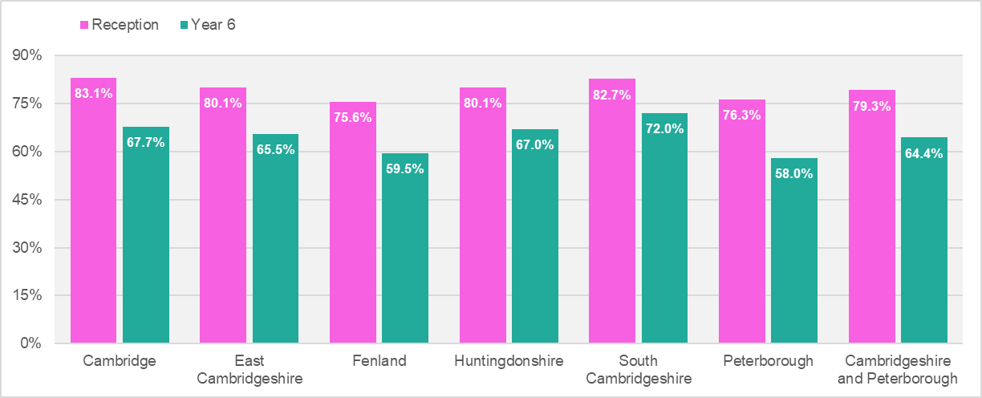
Weight category ‘Healthy weight’ by district
Pupils measured as ‘Healthy Weight’
Figure 5. ‘Healthy weight’ prevalence for Reception and Year 6 children by district and Cambridgeshire and Peterborough, 2021/22 - 2022/23
Approx. 8 in 10 Reception pupils
‘Healthy weight’ prevalence for Reception pupils across C&P is 79.3%, this varies between areas; 83.1% Cambridge, 75.6% Fenland.
Approx. 6 in 10 Year 6 pupils
‘Healthy weight’ prevalence for Year 6 pupils across C&P is 64.4%, this varies across areas; 72.0% South Cambridgeshire, 58.0% Peterborough.
Fenland and Peterborough have worse/lower* rates of ‘Healthy weight’ pupils.
Source: National Child Measurement Programme, NHS Digital. Local enhanced dataset.
Pupils from the Cambridgeshire and Peterborough local authority schools' submission, based on the child’s residential postcode.
*Statistically Significantly
Notes:
LTLAs (the Cambridgeshire districts) are compared to the Cambridgeshire average.
UTLAs are compared to the Cambridgeshire and Peterborough combined, average
2021/22-2022/23 NCMP weight status groupings by district
The BMI status categories in the local enhanced dataset follow the same approach as the National dataset. Though ‘obesity’ is referred to ‘Very overweight’ within the local enhanced dataset.

Slide 22
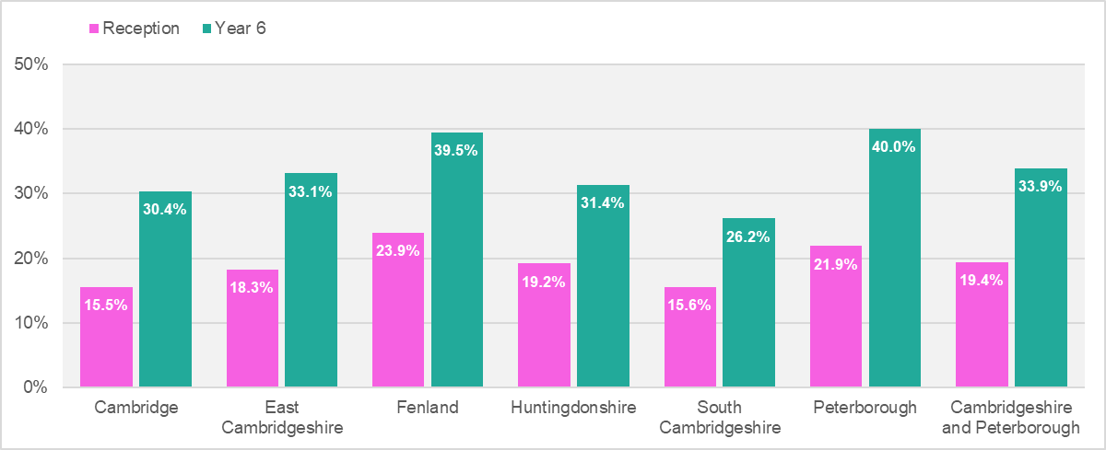
Weight category ‘Overweight or very overweight’ by district
Pupils measured as ‘Overweight or very overweight’
Figure 6. ‘Overweight or very overweight’ prevalence for Reception and Year 6 children by district and Cambridgeshire and Peterborough, 2021/22 - 2022/23
Approx. 2 in 10 Reception pupils
‘Overweight or very overweight’ prevalence for Reception pupils across Cambridgeshire and Peterborough is 19.4%, this varies between areas; 15.5% Cambridge, 23.9% Fenland.
Approx. 3 in 10 Year 6 pupils
‘Overweight or overweight’ prevalence for Year 6 pupils across Cambridgeshire and Peterborough is 33.9%, this varies across areas; 26.2% South Cambridgeshire, 40.0% Peterborough.
Fenland and Peterborough have worse/lower* rates of ‘Healthy weight’ pupils.
Source: National Child Measurement Programme, NHS Digital. Local enhanced dataset.
Pupils from the Cambridgeshire and Peterborough local authority schools' submission, based on the child’s residential postcode.
*Statistically Significantly
Notes:
LTLAs (the Cambridgeshire districts) are compared to the Cambridgeshire average.
UTLAs are compared to the Cambridgeshire and Peterborough combined, average
2021/22-2022/23 NCMP weight status groupings by district
The BMI status categories in the local enhanced dataset follow the same approach as the National dataset. Though ‘obesity’ is referred to ‘Very overweight’ within the local enhanced dataset.

Slide 23
Weight categories by district (Reception), 2021/22 – 2022/23
Reception year
Table 9. Prevalence of BMI category for children in Reception by district for Cambridgeshire and its districts, and Peterborough, 2021/22-2022/23
Fenland and Peterborough have rates for ‘Healthy weight’ and ‘Very overweight’ that are statistically significantly worse compared to the Cambridgeshire and Cambridgeshire and Peterborough averages, respectively.
RAG rating compared to Cambridgeshire (for districts), and Cambridgeshire and Peterborough (for UTLAs)
Source: National Child Measurement Programme, NHS Digital. Local enhanced dataset.
Pupils from the Cambridgeshire and Peterborough local authority schools' submission, based on the child’s residential postcode.
Notes:
2021/22-2022/23 NCMP weight status groupings by district

Slide 24
Weight categories by district (Year 6), 2021/22 – 2022/23
Year 6
Table 10. Prevalence of BMI category for children in Year 6 by district for Cambridgeshire and its districts, and Peterborough, 2021/22-2022/23
Fenland and Peterborough have rates for ‘Healthy weight’ and ‘Very overweight’ that are statistically significantly worse compared to the Cambridgeshire and Cambridgeshire and Peterborough averages, respectively.
RAG rating compared to Cambridgeshire (for districts), and Cambridgeshire and Peterborough (for UTLAs)
Source: National Child Measurement Programme, NHS Digital. Local enhanced dataset.
Pupils from the Cambridgeshire and Peterborough local authority schools' submission, based on the child’s residential postcode.
Notes:
2021/22-2022/23 NCMP weight status groupings by district

Slide 25


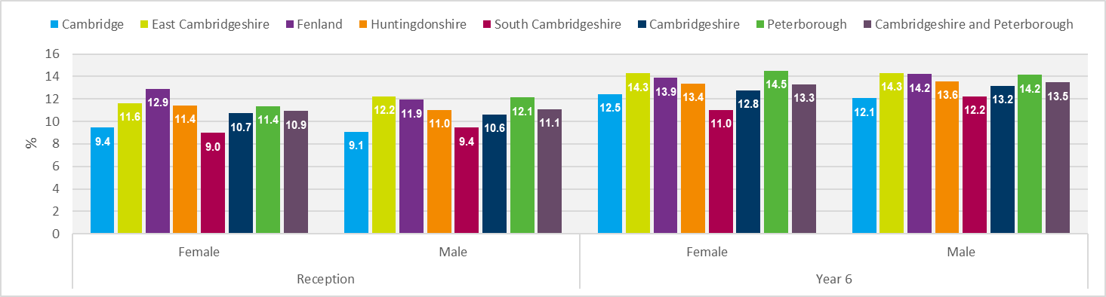
Overweight by district and sex, 2021/22 – 2022/23
Reception
Year 6
‘Overweight’ prevalence is approximately 13% for both males and females in Year 6 across Cambridgeshire and Peterborough.
Approx. 1 in 10 Reception pupils
~ 13%
~ 13%
‘Overweight’ prevalence are similar between males and females in Reception – approx. 11% across Cambridgeshire and Peterborough.
Figure 7. ‘Overweight’ prevalence for Reception and Year 6 children by district and sex, Cambridgeshire and Peterborough, 2021/22 - 2022/23
Source: National Child Measurement Programme, NHS Digital. Local enhanced dataset.
Pupils from the Cambridgeshire and Peterborough local authority schools' submission, based on the child’s residential postcode.
Notes:
NCMP Overweight, by sex, 2021/22-2022/23
Cambridgeshire districts are compared to the Cambridgeshire average, Peterborough is compared to the Cambridgeshire and Peterborough average
The BMI status categories in the local enhanced dataset follow the same approach as the National dataset. Though ‘obesity’ is referred to ‘Very overweight’ within the local enhanced dataset.

Slide 26
Overweight by district and sex, 2021/22 – 2022/23
Prevalence of overweight
Table 11. Prevalence of overweight for children in Reception and Year 6 by sex for districts in Cambridgeshire and Peterborough, 2021/22 - 2022/23
RAG rating compared to Cambridgeshire (for districts), and Cambridgeshire and Peterborough (for UTLAs)
Source: National Child Measurement Programme, NHS Digital. Local enhanced dataset.
Pupils from the Cambridgeshire and Peterborough local authority schools' submission, based on the child’s residential postcode.
Notes:
NCMP Overweight, by sex, 2021/22-2022/23
Cambridgeshire districts are compared to the Cambridgeshire average, Peterborough is compared to the Cambridgeshire and Peterborough average
The BMI status categories in the local enhanced dataset follow the same approach as the National dataset. Though ‘obesity’ is referred to ‘Very overweight’ within the local enhanced dataset.

Slide 27
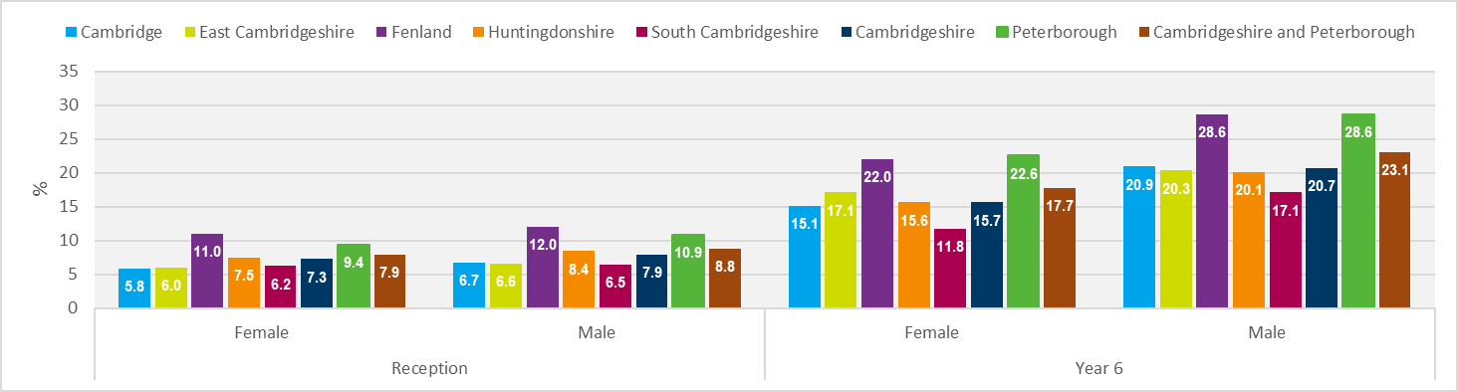
Very overweight by district and sex, 2021/22 – 2022/23
Reception
Year 6
‘Very overweight’ prevalence is higher in male pupils than female pupils across all Cambridgeshire and Peterborough areas. It is particularly high in Fenland and Peterborough for both male and female pupils.
Approx. 1 in 10 Reception pupils
‘Very overweight’ prevalence is similar between males and females in Reception – approx. 10% across Cambridgeshire and Peterborough with most districts having a prevalence of less than 10%, except for Fenland both sexes, and Peterborough males.
~ 23%
~ 18%
Figure 8. ‘Very overweight’ prevalence for Reception and Year 6 children by district and sex, Cambridgeshire and Peterborough, 2021/22 - 2022/23
Source: National Child Measurement Programme, NHS Digital. Local enhanced dataset.
Pupils from the Cambridgeshire and Peterborough local authority schools' submission, based on the child’s residential postcode.
*Statistically Significantly
Notes:
NCMP Very overweight, by sex, 2021/22-2022/23
Cambridgeshire districts are compared to the Cambridgeshire average, Peterborough is compared to the Cambridgeshire and Peterborough average
The BMI status categories in the local enhanced dataset follow the same approach as the National dataset. Though ‘obesity’ is referred to ‘Very overweight’ within the local enhanced dataset.

Slide 28
Very overweight by sex, 2021/22 – 2022/23
Prevalence of very overweight
Table 12. Prevalence of very overweight for children in Reception and Year 6 by sex for districts in Cambridgeshire and Peterborough, 2021/22 - 2022/23
Proportions for Fenland are significantly worse than Cambridgeshire for all groupings. A similar pattern is seen for Peterborough with the exception of Reception females (statistically similar to Cambridgeshire and Peterborough).
RAG rating compared to Cambridgeshire (for districts), and Cambridgeshire and Peterborough (for UTLAs)
Source: National Child Measurement Programme, NHS Digital. Local enhanced dataset.
Pupils from the Cambridgeshire and Peterborough local authority schools' submission, based on the child’s residential postcode.
Notes:
NCMP Very overweight, by sex, 2021/22-2022/23
Cambridgeshire districts are compared to the Cambridgeshire average, Peterborough is compared to the Cambridgeshire and Peterborough average
The BMI status categories in the local enhanced dataset follow the same approach as the National dataset. Though ‘obesity’ is referred to ‘Very overweight’ within the local enhanced dataset.

Slide 29
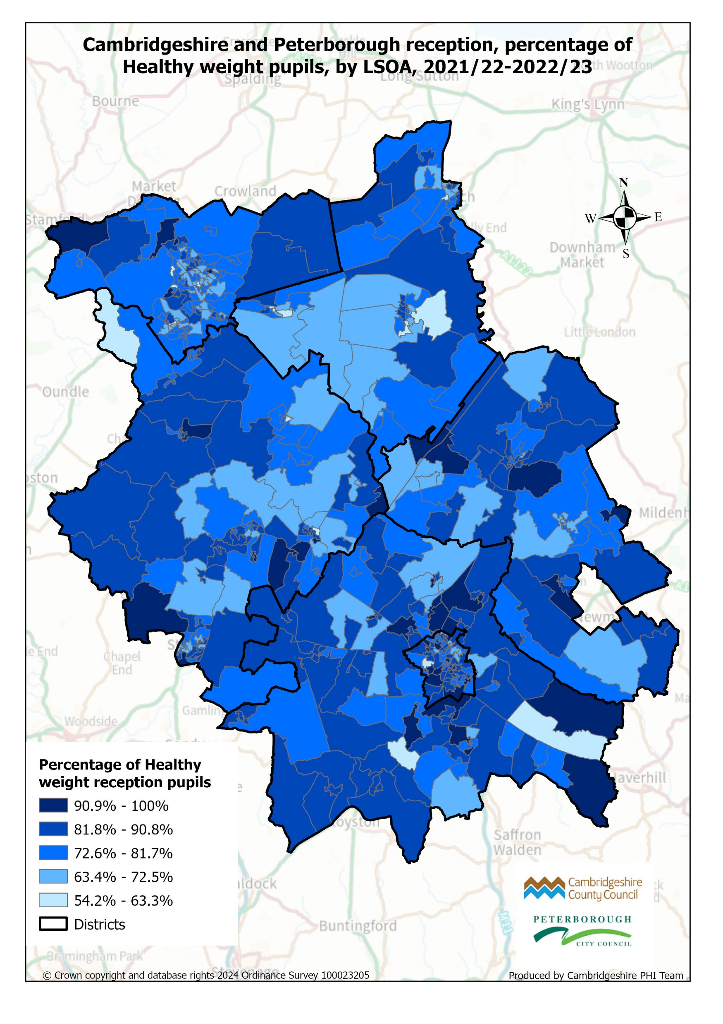
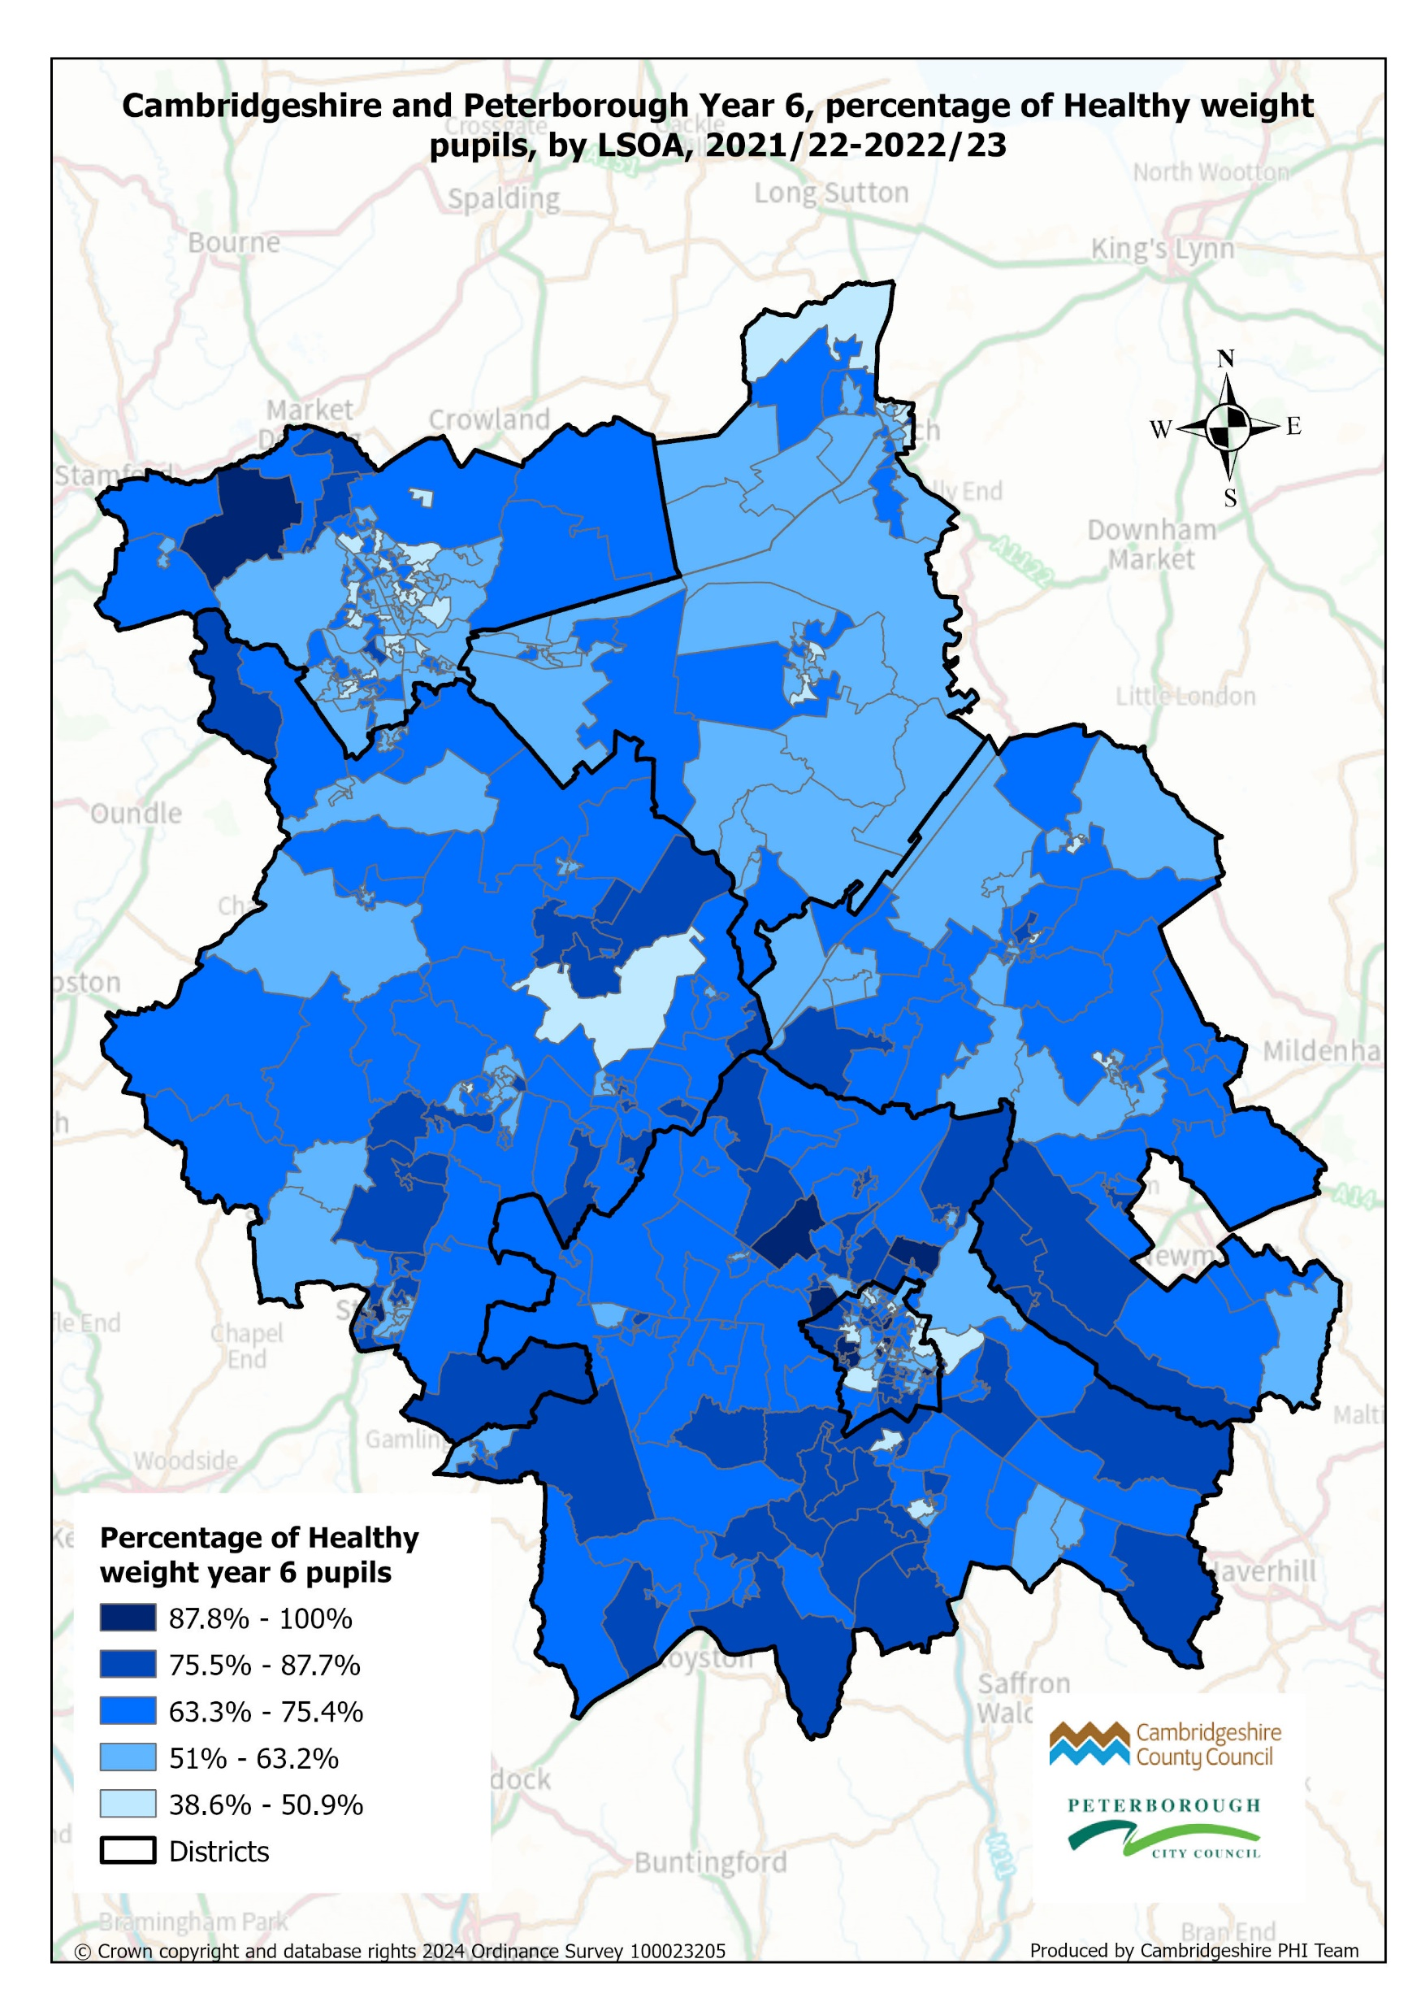
Healthy weight, by LSOA, 2021/22 – 2022/23
Figure 9. ‘Healthy weight’ prevalence for Reception and Year 6 children mapped by LSOA for Cambridgeshire and Peterborough, 2021/22 - 2022/23
Darker areas represent wards with higher proportions of pupils measured as ‘Healthy weight’.
Each district has LSOAs with higher and lower levels of ‘Healthy’ pupils, however there appears to be an emergent pattern of prevalence, particularly within the Year 6 map, that is similar to other health outcomes.
Measured pupils' numbers at LSOA level can be small and therefore must be used with caution.
Source: National Child Measurement Programme, NHS Digital. Local enhanced dataset.
Pupils from the Cambridgeshire and Peterborough local authority schools' submission, based on the child’s residential postcode.
Notes:
Maps cover only two year of NCMP data (2021/22-2022/23) and within some LSOAs measured pupil numbers are very small and therefore must be used with caution.

Slide 30
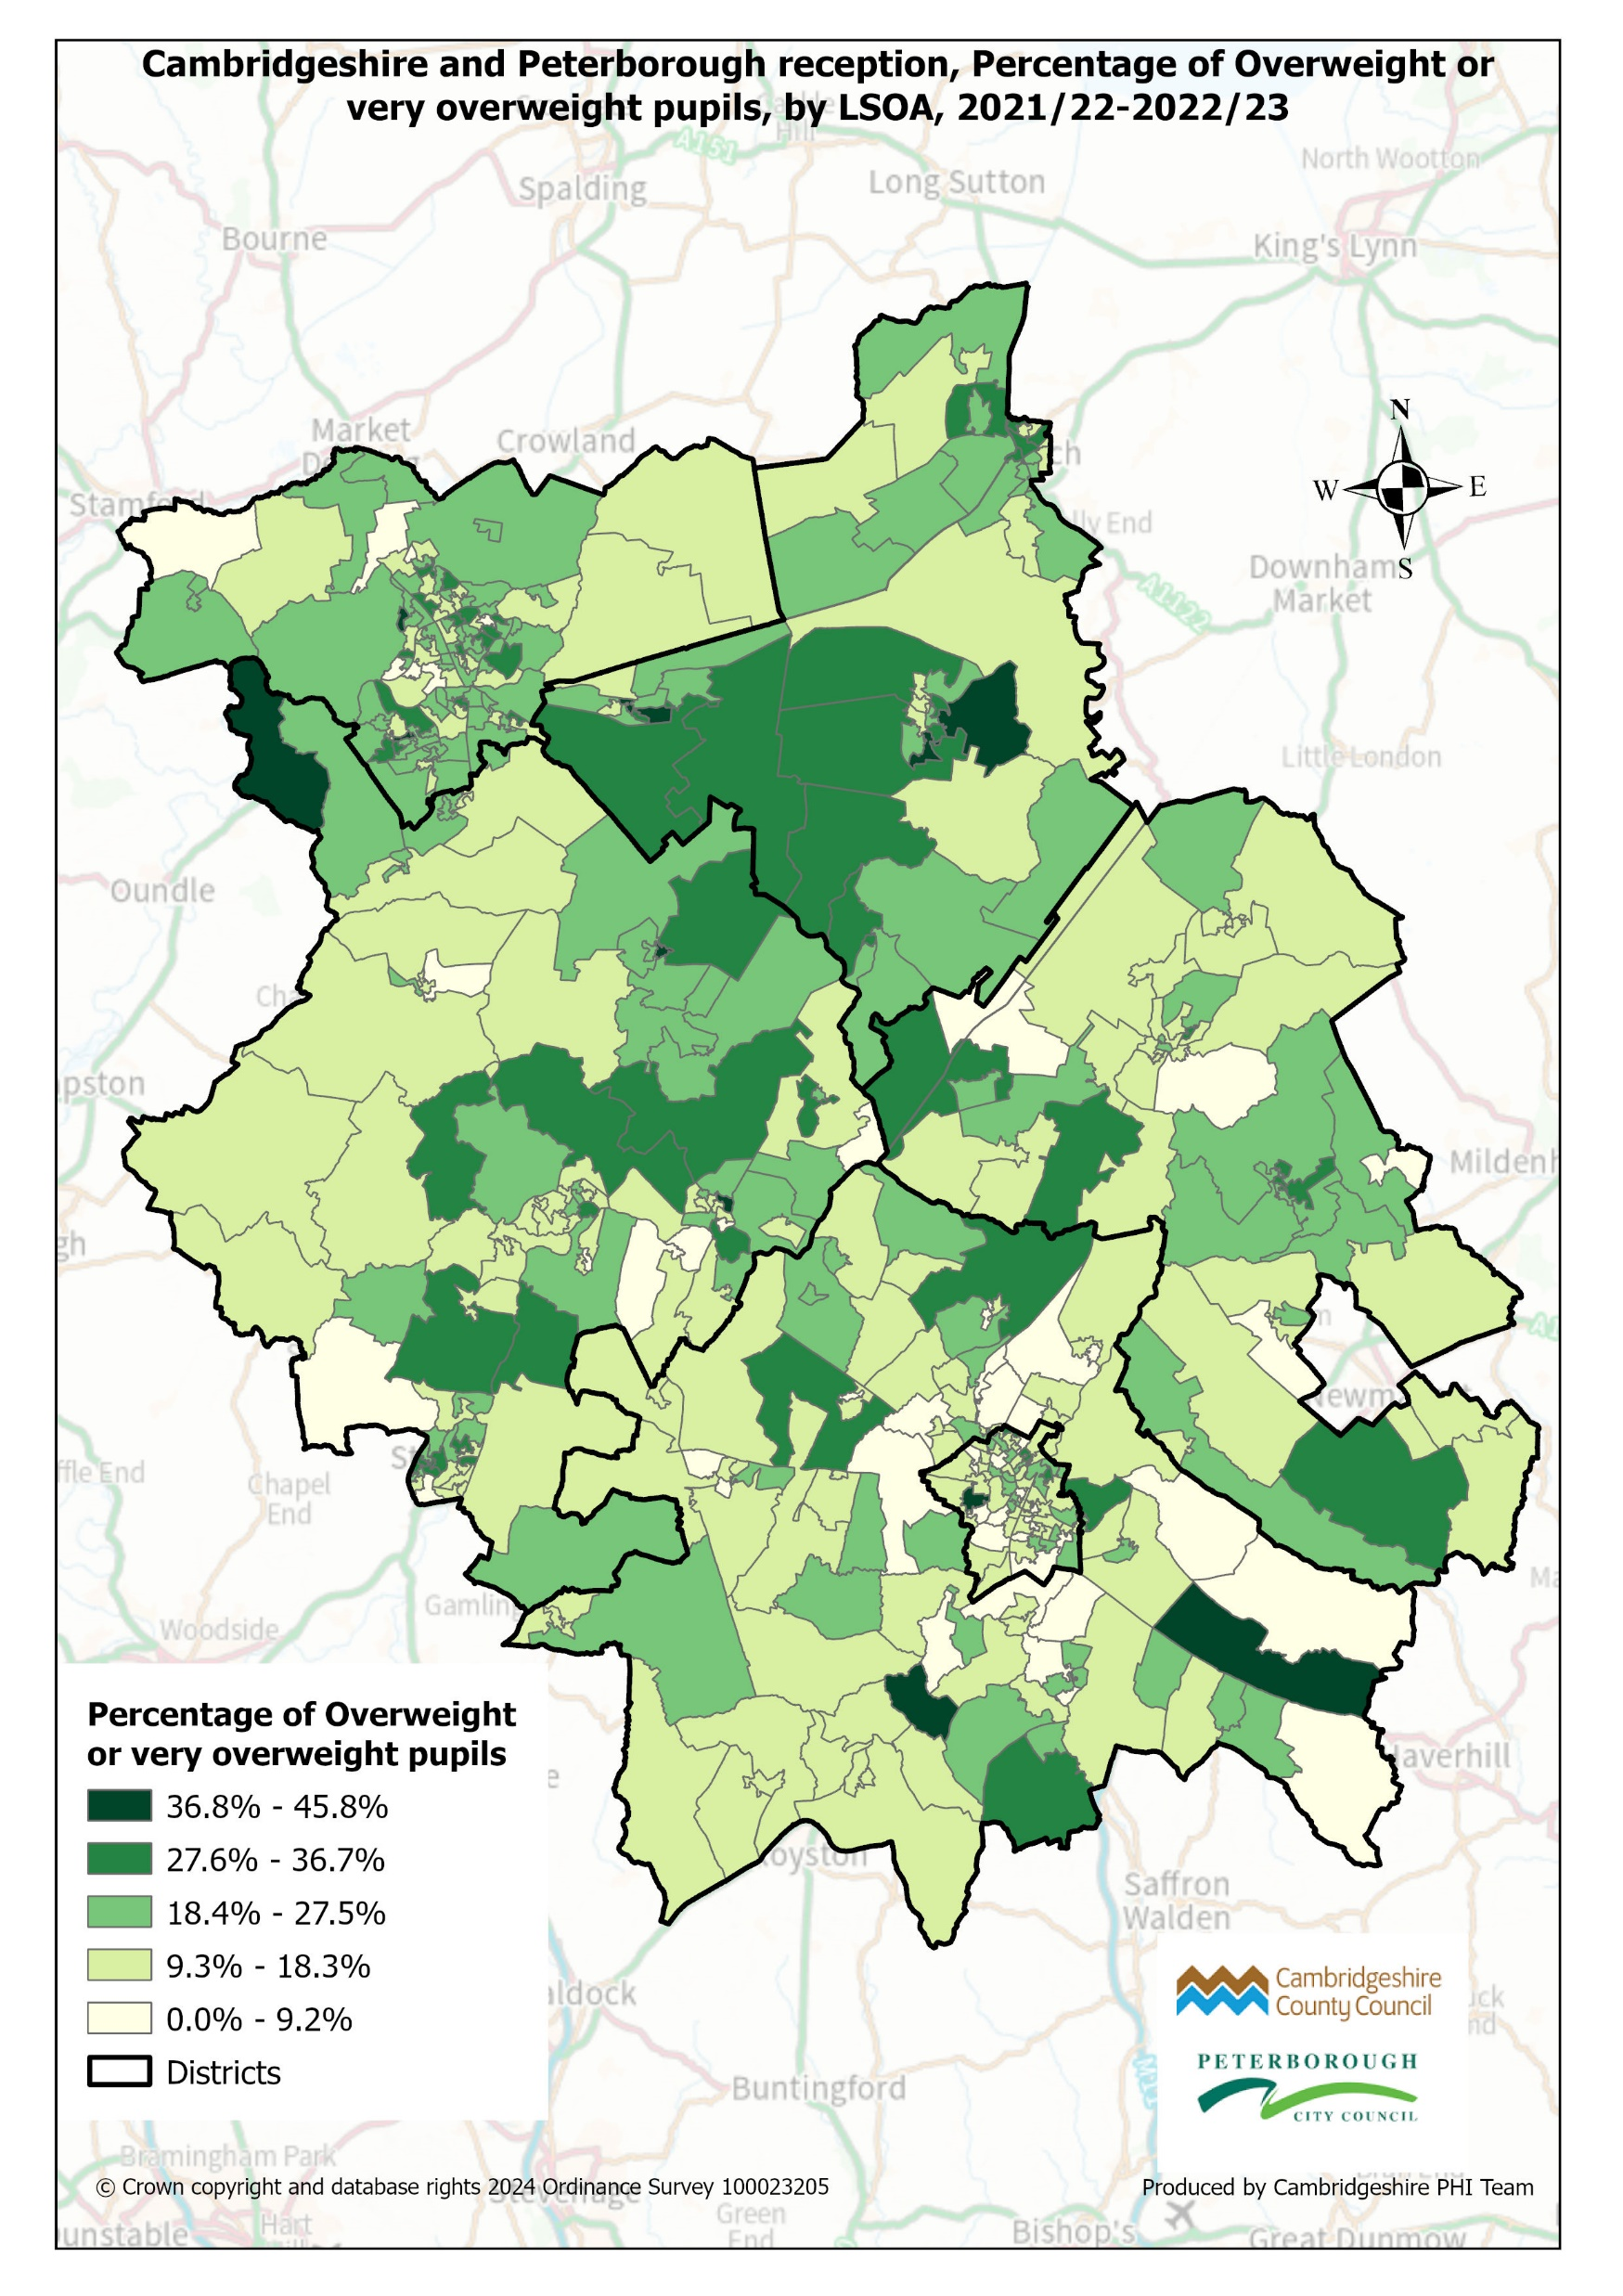
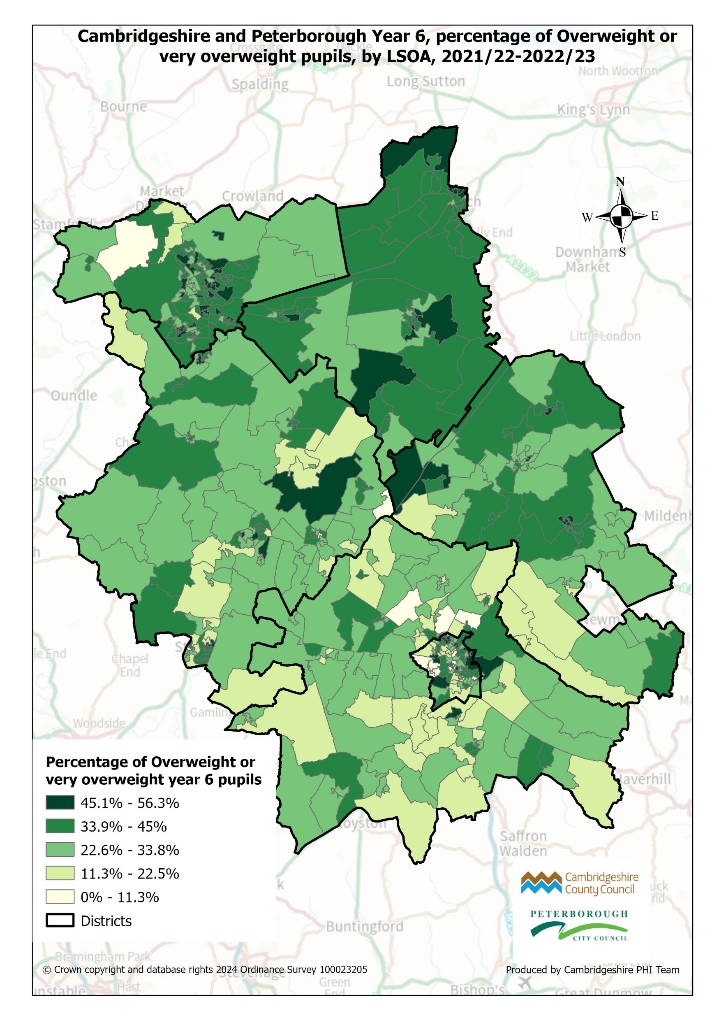
Overweight or very overweight, by LSOA, 2021/22 – 2022/23
Figure 10. ‘Overweight or overweight’ prevalence for Reception and Year 6 children mapped by LSOA for Cambridgeshire and Peterborough, 2021/22 - 2022/23
Darker areas represent wards with higher proportions of pupils measured as ‘Overweight or very overweight’.
Each district has LSOAs with higher and lower levels of ‘Overweight or very overweight’ pupils, however there appears to be an emergent pattern of prevalence, particularly within the Year 6 map, that is similar to other health outcomes.
Measured pupils' numbers at LSOA level can be small and therefore must be used with caution.
Source: National Child Measurement Programme, NHS Digital. Local enhanced dataset.
Pupils from the Cambridgeshire and Peterborough local authority schools' submission, based on the child’s residential postcode.
Notes:
Maps cover only two year of NCMP data (2021/22-2022/23) and within some LSOAs measured pupil numbers are very small and therefore must be used with caution.

Slide 31
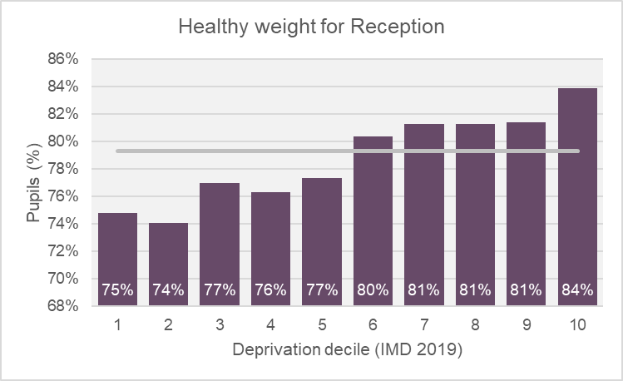
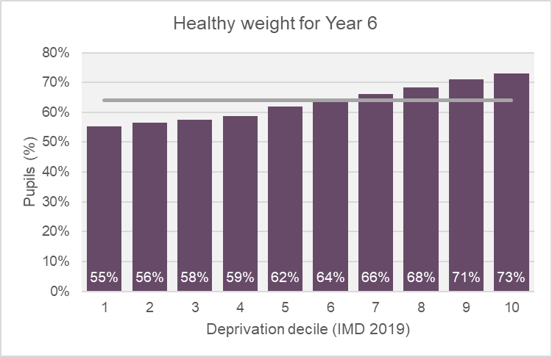
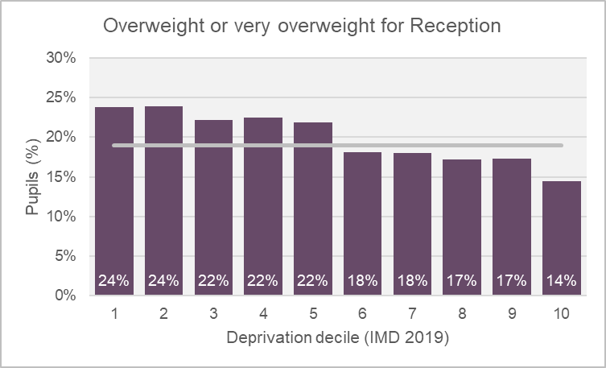
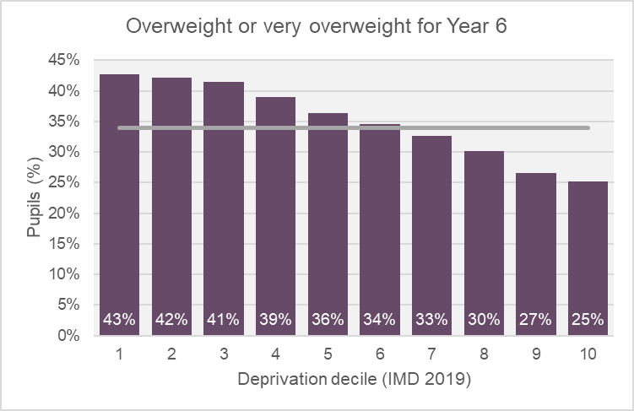

Weight status categories by IMD 2019 decile, 2021/22 - 2022/23
Figure 11. Weight status categories by IMD 2019 decile for Reception and Year 6 children, 2021/22 - 2022/23
For Reception and Year 6 pupils the most deprived deciles have lower proportions of ‘Healthy weight’ pupils.
For Reception and Year 6 pupils the most deprived deciles have higher proportions of ‘Overweight or very overweight’ pupils.
For Cambridgeshire and Peterborough IMD 2019 deciles, there appears to be correlation between deprivation and weight status for both Reception and Year 6 pupils. Inequalities in obesity prevalence by deprivation also exist at a national level (data not shown).
Deprivation decile 1 is the most deprived decile
Source: National Child Measurement Programme, NHS Digital. Local enhanced dataset.
Pupils from the Cambridgeshire and Peterborough local authority schools' submission, based on the child’s residential postcode.

Slide 32
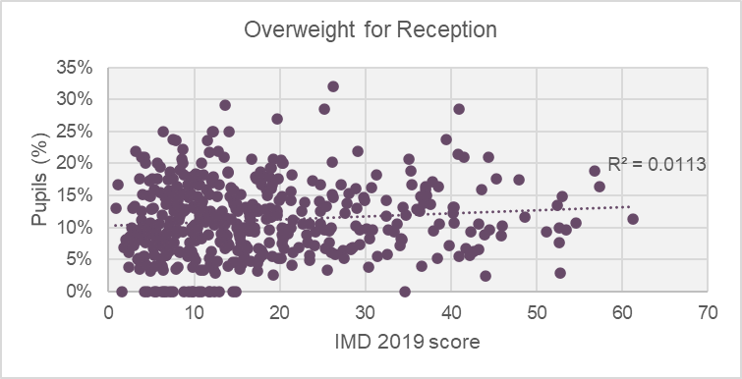
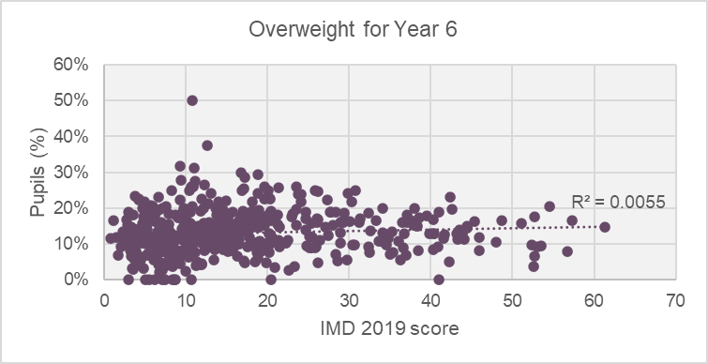
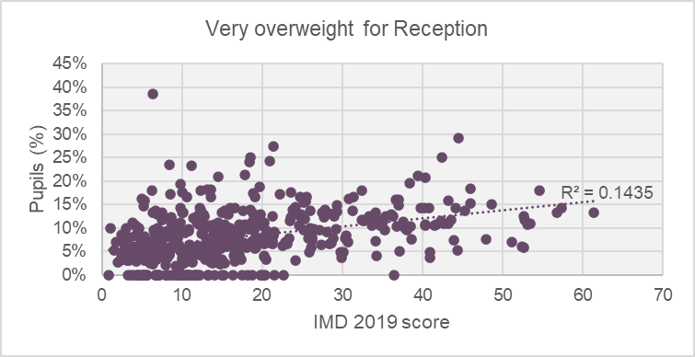
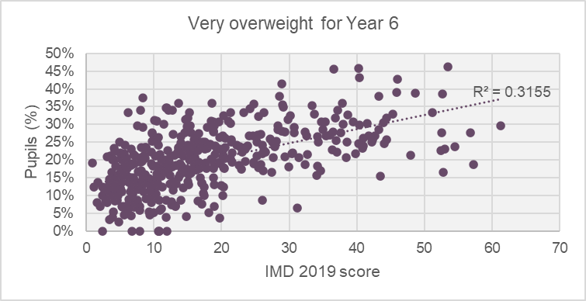
Overweight and Very overweight category, by ward and deprivation, 2021/22 – 2022/23
Figure 12. Overweight and Very overweight by ward and IMD 2019 deprivation score for Reception and Year 6 children, 2021/22 - 2022/23
For Cambridgeshire and Peterborough wards, there appears to be increased correlation between deprivation and the ‘Very overweight’ category. This correlation is stronger for Year 6 pupils.
Inequalities in obesity prevalence by deprivation also exist at a national level (data not shown).
Note: Within some wards measured pupil numbers are very small and therefore analysis must be used with caution.
Source: National Child Measurement Programme, NHS Digital. Local enhanced dataset.
Pupils from the Cambridgeshire and Peterborough local authority schools' submission, based on the child’s residential postcode.
Notes:
Within some wards measured pupil numbers are very small and therefore must be used with caution.

