Slide 1
Changing Futures Cambridgeshire & Peterborough

Slide 2
Images from today

Slide 3
Celebrating & Aspiring
Activity
Pair with someone you don't know or have not spoken to for some time
Introduce yourself and discuss why you have come today
Either:
Identify one success that you have been involved with in relation to systems change in the last 3-6 months (blue cards)
Or
Share something you are working on or hope to achieve in relation to systems change in the next 3-6 months (green cards)

Slide 4
A Case Study Effective partnerships improve outcomes

Slide 5
Programme Update – Trusted Person Approaches
Rough Sleeper Drug & Alcohol partnership, Cambridge
Streets to Home partnership, Cambridge
An emerging housing-led partnership, Wisbech
Safer off the Streets, Peterborough
Co-occuring Conditions partnership, Cambridgeshire
The Acorn Project, Abbey Ward, Cambridge
High Intensity User programme, Cambridgeshire & Peterborough
How does your service or part of the system respond when you are not the trusted person or place?

Slide 6
Newsletter & Comms

Slide 7
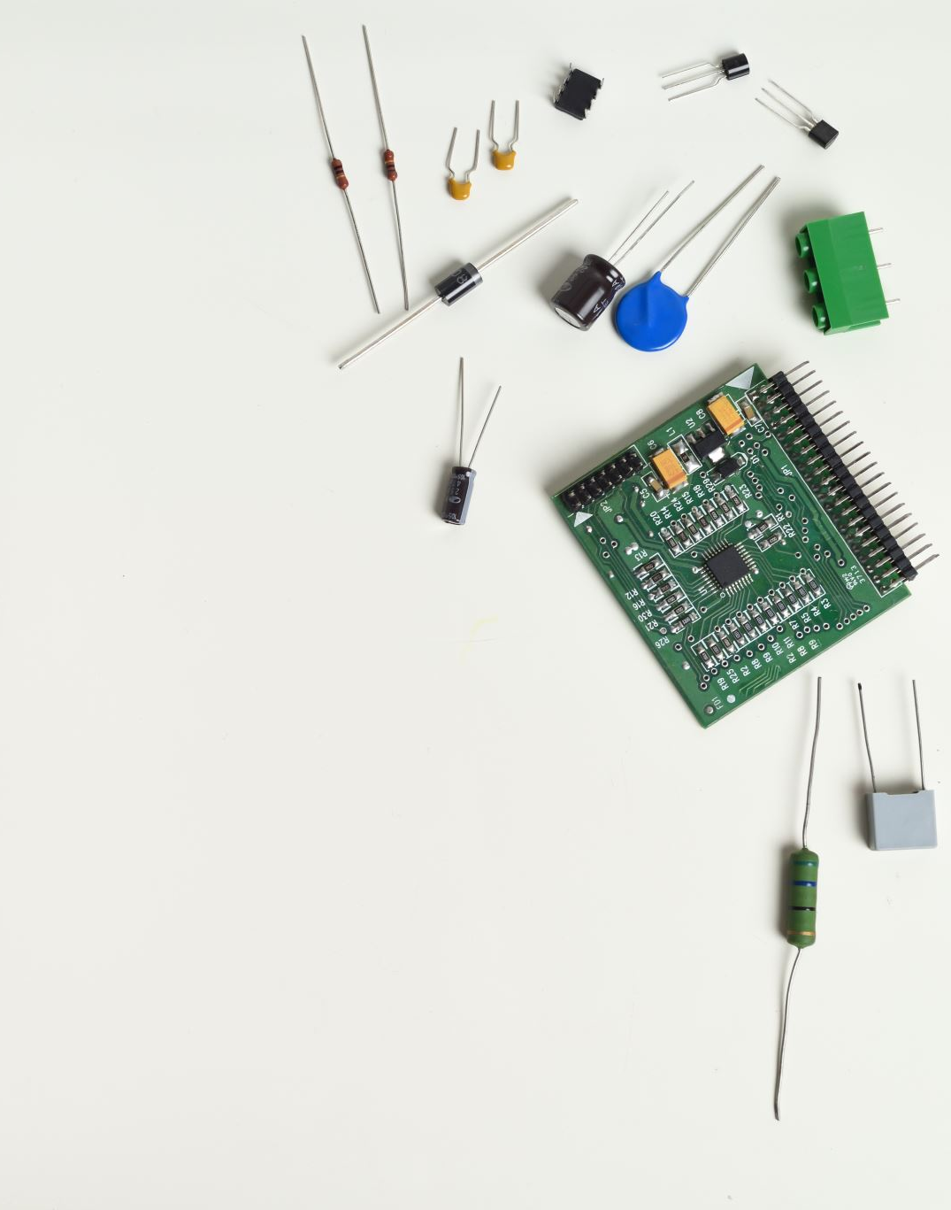
Introducing…
Kyle Buckle-Hodgson
Systems Leadership, Learning and Development Manager
kyle.buckle-Hodgson@cambridgeshire.gov.uk

Slide 8
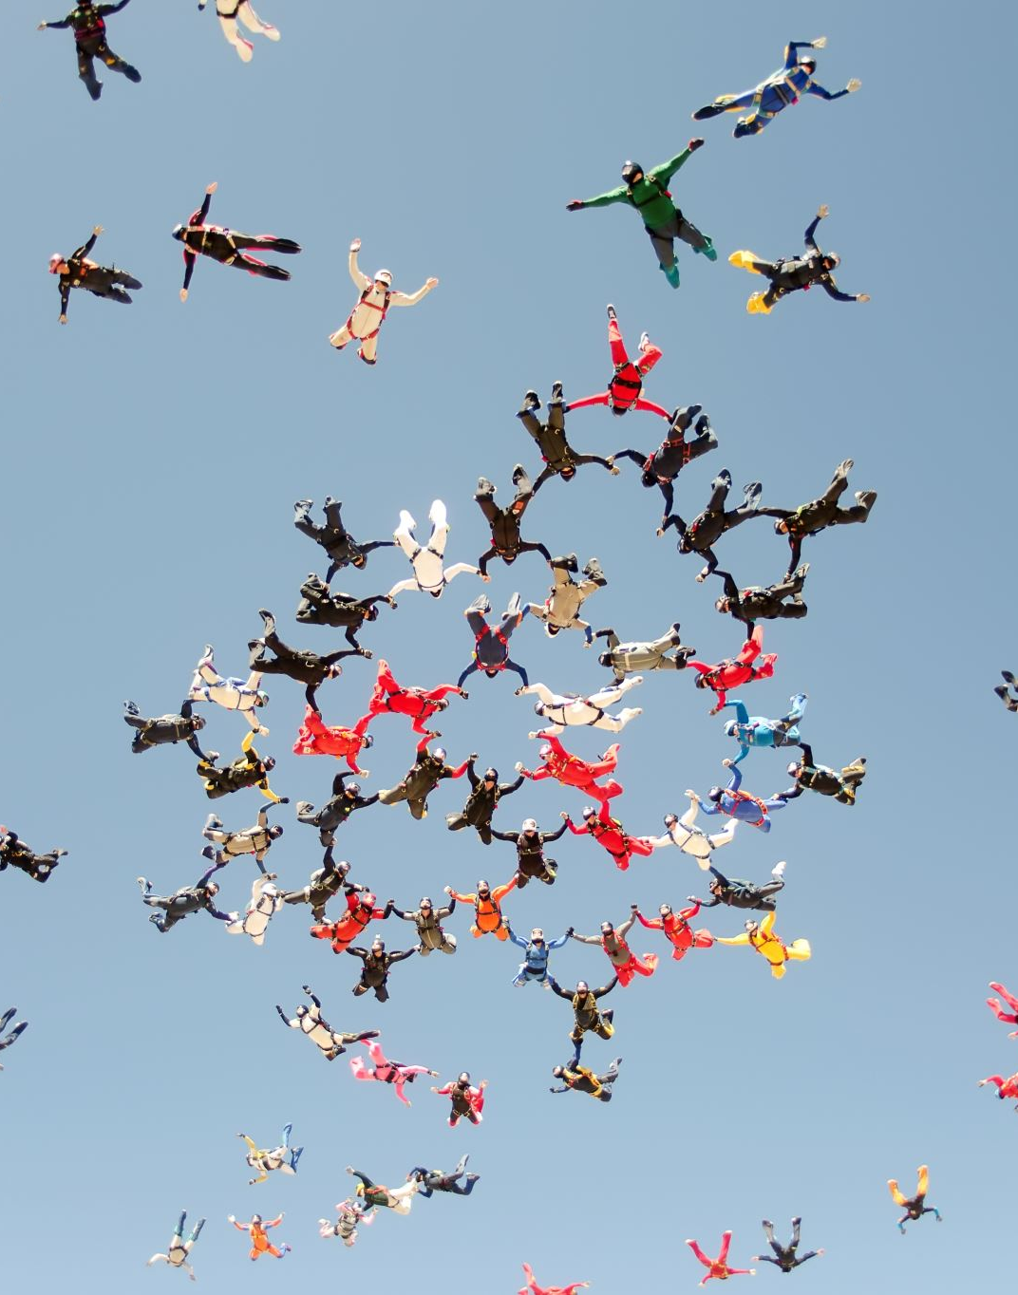
Introducing…
Joe Gilbert
Coproduction, Inclusion and Involvement Manager
joe.gilbert@Cambridgeshire.gov.uk

Slide 9
Committing to Coproduction and Involving People with Lived Experience
Activity
On your tables you have a series of commitment that were made in this meeting in September
Discuss:
Which of these commitments could you take and drive within your part of the systems
What issues can you foresee?
What support do you need to do this?
Celebrate:
If you are achieving any of these commitments or know where else it is being achieved

Slide 10
The Buddy System – Tips for a Buddy
Support me to be myself
Give me confidence to speak
Help me prepare for the meeting
Allow time to ask questions after the meeting
Ensure I am an equal member of the group
Be a consistent person for this task
Treat me as an individual
Listen
Trust
Be the buddy that you would want if you were in my position
Feedback what my contribution has done or changed

Slide 11
The Buddy System – Reasons to be a Buddy
Direct connection to experts by experience
Expertise that may not have been previously contributed
Insight into other areas of work unrelated to the topic of the meeting
Time to reflect with an expert in the field
Opportunity to think about why we are doing what we do

Slide 12
The Buddy System
Changing Futures Systems Leaders Group
It Takes A City Homeless Charter Group
Cambs Criminal Justice Board Rehabilitation & Resettlement Group
Domestic Abuse & Sexual Violence Board (proposing in May)
Is this happening in your system, is there ambition to do more?

Slide 13
Break

Slide 15
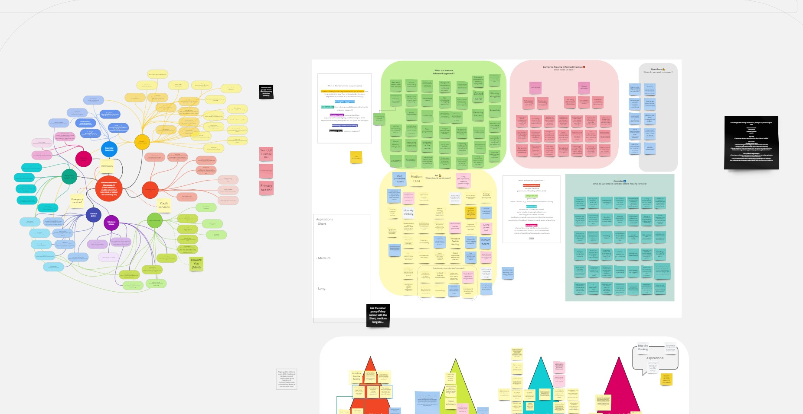
Trauma Informed Systems - workshop 1
We asked:
What do we mean by Trauma Informed Approaches?
What are the barriers to trauma informed practice?
What do we need to consider before moving forward?
What should we do next?
Notes:
Showing the extent of the output from last session
Showing what work has gone into understand what they said TI practice is.
Distiguish between theories and practice elsewhere ten moving into local vision/practice
Show the theming (working out) – from the 3 hours in July, this is where we are now…

Slide 16
The Four Pathways to the Sun
Path 4 Explore, design and pilot support systems for staff
Path 1 Establish our Network
Path 3 Consistency around trauma informed approaches (Framework)
Path 2 Embed coproduction

Slide 17
Path 1 Establish our Network
This is the vehicle through which we do the doing! So…
What does our Network (or whatever we agree to call it) look like?
How does it operate? (structure/set-up)
What is its purpose? And how do we approach our purpose?
Co-production and Trauma informed approaches
Consistency and process around TIA
Feedback, staff support and learning
What is our membership?

Slide 18
Path 2 Embed coproduction
We believe our work should be informed by collaborative working and lived experience voice. Can we establish via our Network:
What do we mean when we do co-production?
What co-production exists locally and where is there good practice?
What do we need to improve in our system? For example contact points, service user journey mapping
How do we have co-production supporting our Network and trauma informed working?

Slide 19
Path 3 Consistency around trauma informed approaches
We heard from areas developing their local frameworks around trauma informed approaches. Through our network can we establish…
What do we need, to develop consistency around trauma informed approaches?
What is our shared definition of trauma?
What are our principles related to trauma informed approaches e.g. minimum practice standards?
How do we achieve these?
How do monitor improvement, change and journeys?

Slide 20
Path 4 Explore, design and pilot support systems for staff
Our Network can be brought together to help:
How do we learn and sharing learning?
How do we discuss cases and share good practice, and how that is enabled by the system? What does that look like?
What topics could we benefit learning more about? What are the current training provisions and where are the gaps?
How do we approach the gaps? For example for workforce development, what training standards do we want included: could be
practical skills
training for different parts of the system
diversity and trauma.

Slide 21
Trauma Informed Systems - workshop 2
We asked:
What does a local network look like?
What do we want from it?
What can we commit to?
What do we need?

Slide 22
Trauma Informed Systems
Activity
Each table will focus on one of the Four Pathways to the Sun.
Network
Framework
Coproduction
Staff Support
At that table you find some of the output from the workshops. Spend the first few minutes reviewing this and discuss:
What resonates with you?
After 15 minutes we will ask you to move a new table and discuss:
What can I commit to as an individual?
Finally move once more and discuss:
What can we commit to as a group?

Slide 23
Forward Look and Reflections

Slide 24
Thank you
Changingfutures@cambridgeshire.gov,uk
https://cambridgeshireinsight.org.uk/changing-futures-cp/

