Slide 1
Ethnic Inequalities in Improving Access to Psychological Therapies (IAPT)
Key findings from the NHS Race and Health Observatory Report
Notes:
https://www.nhsrho.org/wp-content/uploads/2023/10/Ethnic-Inequalities-in-Improving-Access-to-Psychological-Therapies-IAPT.Full-report.pdf

Slide 2
Previous research
In their equalities strategy, NHS England acknowledges its duty to advance equalities in NHS services. This duty involves considering the needs of groups of people experiencing or at risk of inequalities, and working to find ways to reduce inequalities, such as providing culturally sensitive care.
The strategy acknowledges that people from some minoritised ethnic groups have ‘poorer recovery rates in talking therapy services (IAPT) than ‘White British’ groups’.

Slide 3
Key findings
Used 10 years of data
In comparison with White British people, with the exception of Chinese people, people from minoritised ethnic groups (including non-British White people):
experienced worse outcomes, although this has narrowed in recent years
waited longer for assessment
were less likely to receive a course of treatment following assessment

Slide 4
Key findings
Inequalities in outcome for people from minoritised ethnic groups are associated with:
increased symptom severity at initial assessment
living in areas with higher levels of deprivation, and higher unemployment
waiting longer for assessment, waiting longer between treatment.
The IAPT Black, Asian and Minority Ethnic Service User Positive Practice Guide (PPG), published in 2019 was well received by services, but:
does not appear to be used consistently across services
commissioners did not report good knowledge of the PPG’s recommendations when compared with IAPT staff and leads.

Slide 5
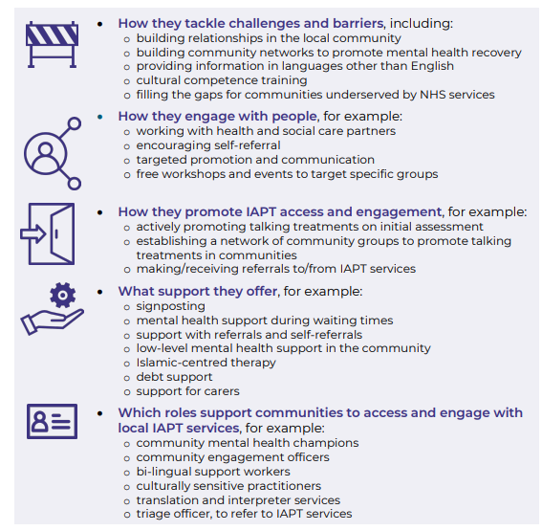
Recommendations
Influencing system leaders
Implementing the positive practice guide
Meeting the needs of PCREF through
Community engagement
Providing culturally sensitive care
Advancing equality
Workforce training and competence
Workforce recruitment and retention

