Slide 1

Transport update: Cambridge and South Cambridgeshire
COVID-19 transport impacts and recovery
December 2023
Policy & Insight Team, Cambridgeshire County Council

Slide 2
Transport Update Aims
This report is intended to:
Summarise the on-going impacts of COVID-19 on trends in transport and mobility up to 31st December 2023.
Highlight changes in key indicators by comparing December 2023 data to a pre-pandemic baseline (December 2019 or closest possible equivalent), mid-COVID (December 2021) and to last year (December 2022).
Provide a basis for discussion for the Greater Cambridge Partnership (GCP) to understand and identify existing challenges and future data needs.
Notes:
Comparison periods may vary across the different datasets based on the availability of historic data – comparison periods are clearly noted for each dataset.
  Where reference is made to ‘Weekdays’ this only includes Monday, Tuesday, Wednesday and Thursday, as per DfT guidance.

Slide 3
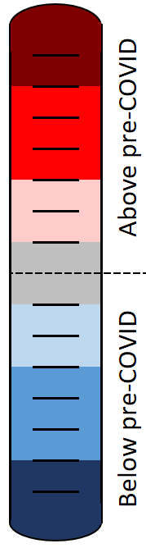
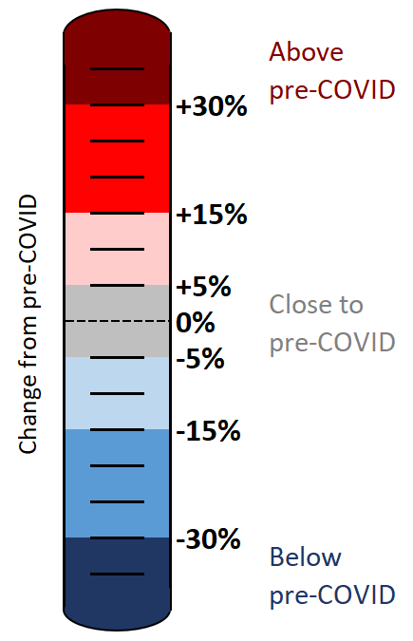
Colour scale
The statistics in this pack have been colour-coded using a heat scale to reflect the level of recovery being experienced (pre-COVID compared to now).
A positive (red) value indicates that levels have increased above those experienced pre-COVID.
A negative (blue) value indicates that levels remain below pre-COVID.
Top tip:
Lookout for the colour scale bar in the top right-hand corner of each page for a reminder of the heat scale used to indicate the level of recovery throughout the pack.

Slide 4





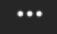
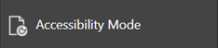
Accessibility
To access the full functionality of PowerPoint, we recommend opening the slides in full screen mode. To do this, click the “Open in New Window” button in the bottom right-hand corner.
1) Navigate through the slide pack using the left and right arrows in the middle-bottom of the screen. Clicking on the sentence “Slide x of x” brings up a pop-up listing all the slides so you can navigate directly to a slide of interest.
2) Open the Notes for each slide to see the data source, technical notes and any additional commentary. See the “Notes” button in the bottom right-hand corner.
3) Use the “Download” button to the right of the centre at the top of the screen to download the slides as a .pptx file.
4) Use the “Print to PDF” option to save the PowerPoint as a PDF document (but please be aware you will lose access to the Notes section which contains additional information for the slide).
5) Use the “More options” icon in the top right-hand corner and choose “Accessibility mode” from the pop-up menu to access the slides in a different format which will display any Alt Text that has been set for charts and images.
We are continually working to improve the accessibility of our content. If you find you are unable to access any part of this update, please contact research.group@cambridgeshire.gov.uk and we will be happy to investigate providing information in a different format.

Slide 5
Overview

Slide 6
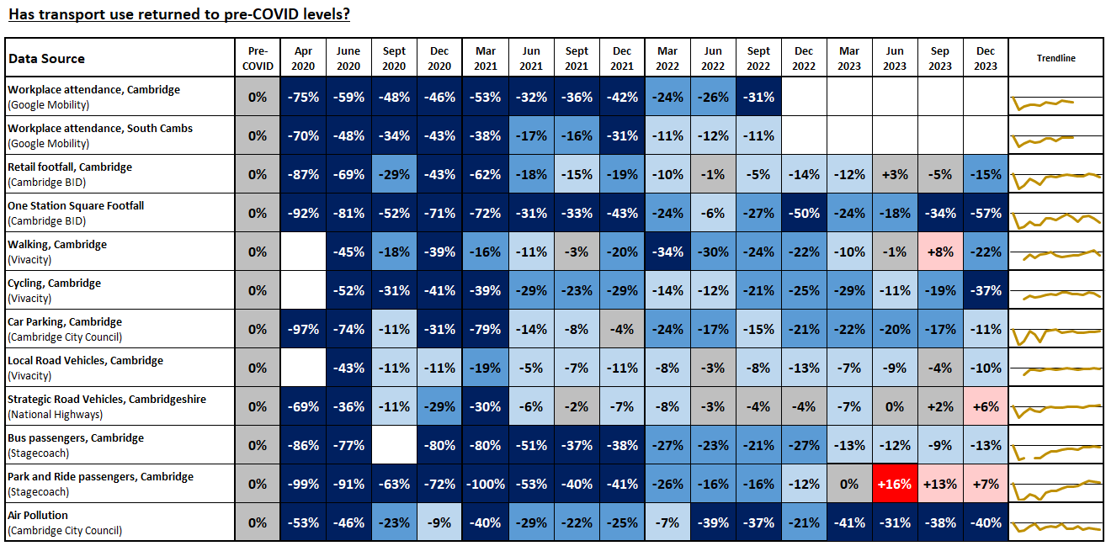
Recovery Tracker
Notes:
Source: Various, listed in the Data Source column
Technical Notes: Our methodology for analysing the data continues to be refined to react to differing levels of data quality and data gaps. Therefore, you may observe small adjustments to the stats in the latest slide pack compared to previously published versions.
For example:
The method of calculating the strategic road network (SRN) recovery percentages changed in Dec 2022 to include data from a larger number of sites (originally 6 sites, now 24 sites). The SRN percentages have therefore been updated and may not reflect the values presented in previous slide packs for this reason.
The air pollution percentages historically used data from 5 sensors but one of these sensors was removed in April 2022 so the methodology for calculating the air pollution percentages has been adjusted. The air pollution percentages presented here may differ slightly from those in previous slide packs for this reason.
Commentary:
This slide indicates the extent to which each of the transport metrics has recovered over time in comparison to pre-Covid (2019 or early 2020) levels.
Google mobility workplace, Cambridge: Plateaued recovery 31% below pre-Covid in Sept 2022. Data source discontinued in October 2022.
Google mobility workplace, South Cambridgeshire: fluctuating recovery, 11% below pre-Covid in Sept 2022. Data source discontinued in October 2022.
Retail footfall, central Cambridge: fluctuating recovery levels linked to seasonal variations. Currently below pre-Covid.
One Station Square footfall: Erratic pattern of recovery over time. Currently some way below pre-Covid levels.
Walking, central Cambridge: Fluctuating recovery trend. Currently below pre-Covid levels, albeit with variation by monitoring site.
Cycling, central Cambridge: fluctuating recovery trend - currently some way below pre-Covid, albeit with variation by monitoring site.
Multi Storey Car Parking, central Cambridge: slowly improving recovery trend, currently below pre-Covid.
Vehicle flows on local roads, central Cambridge: stable recovery trend - currently just below pre-Covid.
Vehicle flow on strategic roads, gradually improving recovery trend, now above pre-Covid levels for the first time, albeit with variation by district.
Bus passengers, Cambridge: improving recovery trend since March 2022. Currently just below pre-Covid.
Park and Ride passengers: stable recovery trend, now above pre-Covid levels in terms of overall passenger numbers, albeit with variation by P&R site..
Air pollution: A stable recovery trend after initially fluctuating post-Covid. Currently some way below pre-Covid levels.

Slide 7








Headlines: December 2023
Local Roads
Volumes at
compared to pre-COVID
(see analysis on slide 21 onwards)
Strategic Roads
Volumes at
-
compared to pre-COVID
(see analysis on slide 10 onwards)
Car Parking
Patronage at
compared to pre-COVID
(see analysis on slide 41 onwards)
Bus
Patronage at
-
compared to pre-COVID
(see analysis on slide 49)
Park and Ride
Patronage at
compared to pre-COVID
(see analysis on slide 50 onwards)
P
P
+
-10%
+6%
-11%
-13%
+7%
Station Square Footfall
Volumes at
-50%
compared to pre-COVID
(see analysis on slide 47)
Retail Footfall
Volumes at
-14%
compared to pre-COVID
(see analysis on slide 38 onwards)
Walking
Volumes at
-22%
compared to pre-COVID
(see analysis on slide 35)
Cycling
Volumes at
-25%
compared to pre-COVID
(see analysis on slide 34)
Air Pollution
Concentrations at
-22%
compared to pre-COVID
(see analysis on slide 54 onwards)
-57%
-15%
-22%
-37%
-40%

Slide 8
Travel Demand

Slide 9
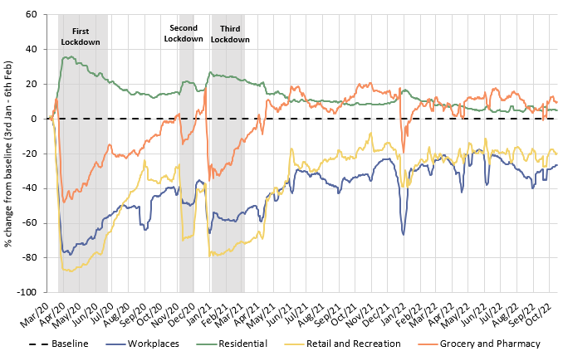
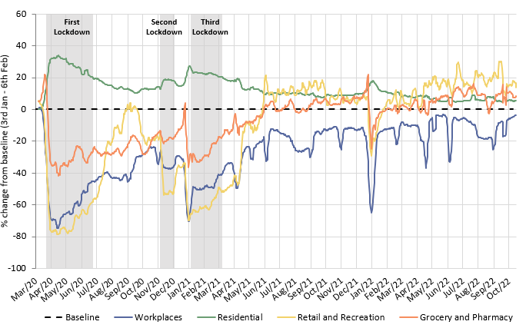
Has COVID-19 changed where we spend our time?
The pandemic caused us to spend more time at home and less time at a designated workplace. Whilst the extent of this impact has steadily reduced since Spring 2021, an impact was still being seen when Google discontinued this dataset in October 2022, particularly in Cambridge.
Cambridge
South Cambridgeshire
 | Pre-Covid to Now: Baseline (Jan/Feb 2020) to Oct* 2022
Pre-Covid vs Now: | Workplaces | Residential | Retail and Recreation | Grocery and Pharmacy
Cambridge | -26 | +5 | -19 | +11
South Cambridgeshire | -3 | +5 | +16 | +9
*Sourced from Google Mobility data which was discontinued on 16th October 2022. Numbers represent the % change from the baseline period. The baseline period is defined by Google as 3rd Jan – 6th Feb 2020.
Notes:
Source: Google LLC "Google COVID-19 Community Mobility Reports". https://www.google.com/covid19/mobility/
Technical notes: Data is gathered from Google account holders location history. This helps to demonstrate where people are spending their time. The data is based on the most recent month (October 2022) compared to the median of the corresponding day in the baseline period (3rd Jan-6th Feb 2020) as calculated by Google. Tabulated percentages represent the change from the baseline (3rd Jan – 6th Feb) to the most recent month.
Commentary: Cambridge: Cambridge grocery and pharmacy visits finished at 11% above pre-pandemic levels in October 2022. Meanwhile, retail and recreation visits finished 19% below pre-pandemic levels, which suggested that essential shopping recovered to a much stronger extent than leisure shopping. The proportion of people making workplace visits stayed steadfastly below the pre-Covid baseline, ending at -26% in October 2022. Conversely, residential visits finished 5% higher than the baseline, in part likely due to the persistence of remote working.
South Cambridgeshire: Data on workplace visits finished at 3% below pre-pandemic baseline levels. Similarly to Cambridge data, residential numbers were continually above the pre-pandemic baseline since the dataset began, finishing at 5% above the baseline in October 2022. Retail and recreation (+16%), and grocery and pharmacy (+9%) visits remain ahead of the pre-pandemic baseline in South Cambridgeshire, suggesting that people’s shopping and leisure habits recovered and then stabilised after the heavy disruption caused by the pandemic and associated lockdowns.

Slide 10
Strategic Road Network

Slide 11
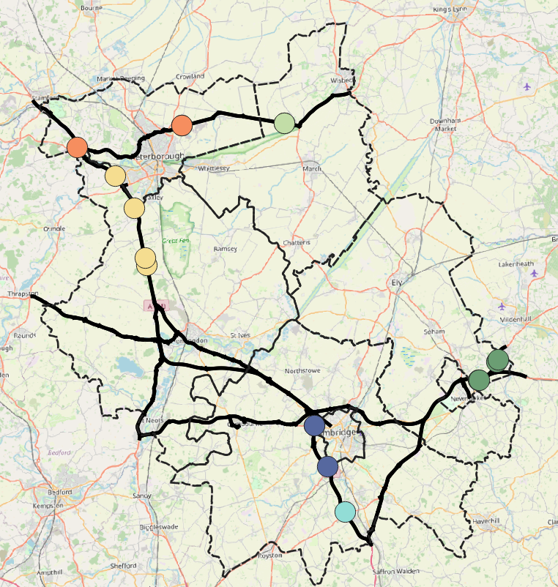
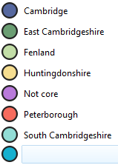
Strategic Road Network Monitoring Sites
Strategic Road Network traffic monitoring sites with continuous data
National Highways have approximately 1,400 permanent traffic monitoring sites on the strategic road network within Cambridgeshire and Peterborough.
Each monitoring site varies in its ability to reliably provide data over time, and periods of inactivity are common. It is therefore not appropriate to conduct a long-term analysis for all sites.
For this reason, only the 17 sensors with uninterrupted data from January 2019 onwards are included in this analysis. These 17 sites are shown on the map to the left.
Please note the number of sensors used within this analysis has decreased since the last update due to sensor outages. Therefore, absolute flow volumes will not be comparable to previous updates.
A47
A1
N
2
2
A14
A1
Cambridge sites
A11
2
East Cambridgeshire sites
A14
A14
2
Fenland sites
A428
2
Huntingdonshire sites
A1
Peterborough sites
South Cambridgeshire sites
Strategic Road Network in Cambridgeshire and Peterborough
M11
© OpenStreetMap Contributors
Notes:
Source: National Highways WebTRIS data. (https://webtris.highwaysengland.co.uk/)
Technical notes:
Count site locations and IDs:
Cambridge: MIDAS site at M11/6886B, MIDAS site at M11/6820A, MIDAS site at M11/6886A
Peterborough: TMU Site 6502/2, TMU Site 6351/1, TMU Site 6351/2
East Cambridgeshire: MIDAS site at A11/0047B, TMU Site 6317/1, MIDAS site at A14/1241A, MIDAS site at A14/1241B.
Fenland: TMU Site 6350/2, TMU Site 6350/1
Huntingdonshire: TMU Site 6781/2, MIDAS site at A1M/2134A, MIDAS site at A1M/2220A, MIDAS site at A1M/2145B *Removed in December 2023 MIDAS site at A1M/2219B.
South Cambridgeshire: MIDAS site at M11/6747A *Removed in December 2023 TMU Site 6312/2, TMU Site 6310/1

Slide 12
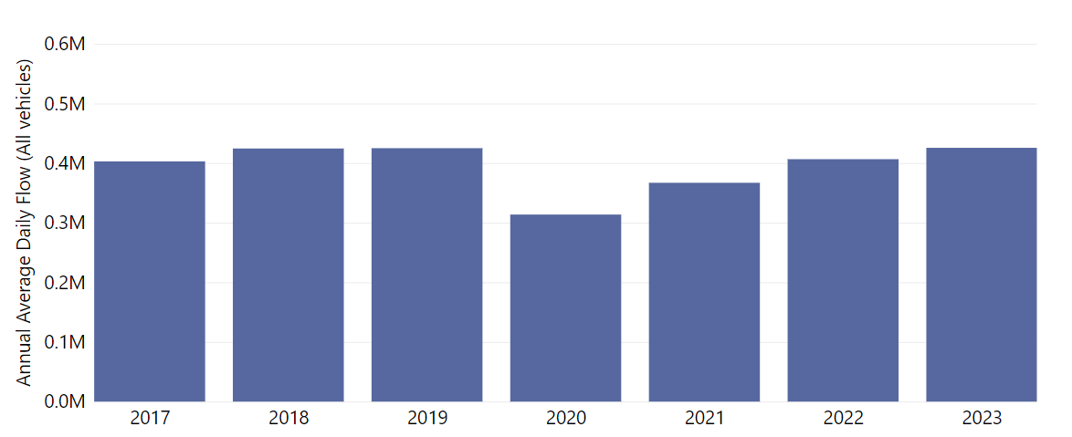
Strategic Road Network: Annual Average Daily Flow by Year
In Cambridgeshire and Peterborough, traffic volumes on the Strategic Road Network in 2023 are back to pre-COVID 2019 volumes.
Annual Average Daily Flow across all 17 sensors
no change from 2019
change from 2019
0%
-4%
change from 2019
-14%
change from 2019
-26%
Analysis based on 17 sensors - 3 sensors in Cambridge, 4 in East Cambridgeshire, 2 in Fenland, 4 in Huntingdonshire, 3 in Peterborough and 1 in South Cambridgeshire
Notes:
Source: National Highways WebTRIS data.
Technical note: Average Daily Flow by year for main carriageway monitors in each district, all with data 2019 – 2023. This dataset averages across ALL days (Mon-Sun).

Slide 13
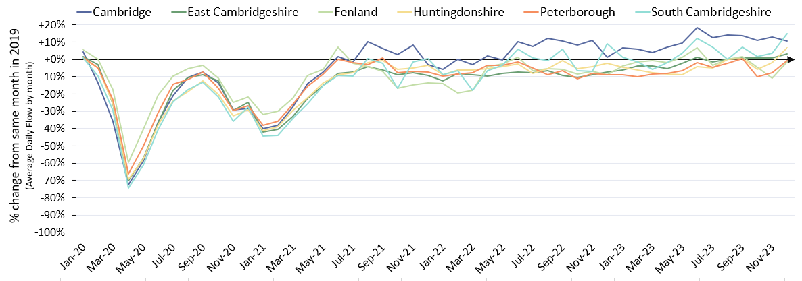
Strategic Road Network: Average Daily Flow by Month
In December 2023 all districts present as extremely close to, or beyond, the pre-Covid (December 2019) baseline. Cambridge and South Cambridgeshire are highest above the pre-COVID baseline.
Percentage change from the same month in 2019
Pre-COVID to Now: Dec 2019 to Dec 2023
Cambridge | East Cambridgeshire | Fenland | Huntingdonshire | Peterborough | South Cambridgeshire | All Districts
+11% | +3% | -1% | +7% | -1% | +15% | +6%
Analysis based on 17 sensors - 3 sensors in Cambridge, 4 in East Cambridgeshire, 2 in Fenland, 4 in Huntingdonshire, 3 in Peterborough and 1 in South Cambridgeshire. Includes bank holidays.
Notes:
Source: National Highways WebTRIS data.
Technical note: The graph shows the percentage difference from the corresponding month in 2019 (e.g. March 2023 compared to March 2019). Created using Average Daily Flow by month data for main carriageway monitors in each district, all with data 2019 – 2023. This dataset averages across ALL days (Mon-Sun).

Slide 14
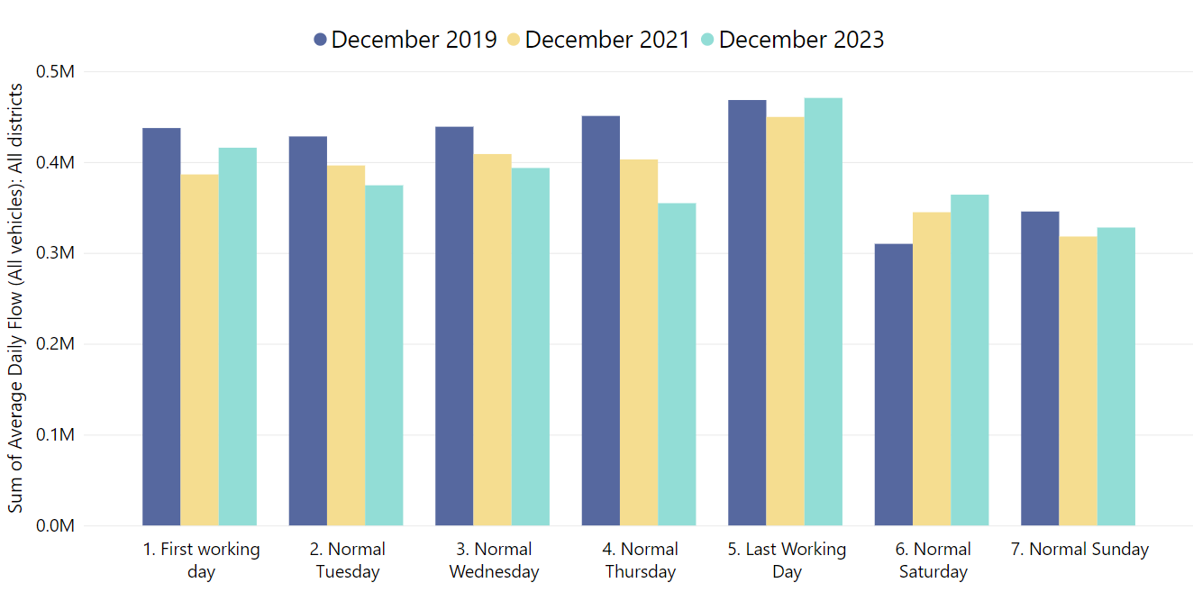
Strategic Road Network: Daily Flow by Day of the Week
On the strategic road network in Cambridgeshire, Monday, Friday and Sunday show similar average flows to pre-COVID volumes in December 2023. However, Tuesday, Wednesday and Thursday are still below 2019, whilst Saturday (+17%) is much higher than pre-COVID.
Dec 2019
Dec 2023
Dec 2019
Dec 2019
Dec 2019
Dec 2019
Dec 2021
Dec 2023
Dec 2021
Dec 2021
Dec 2021
Dec 2021
Dec 2023
Dec 2023
Dec 2023
Dec 2023
Dec 2021
Dec 2019
Dec 2023
Dec 2019
Dec 2021
 | Pre-COVID to Now:
 | Dec 2019 to Dec 2023
Average Daily Flow % change | First Working Day | Normal Tuesday | Normal Wednesday | Normal Thursday | Last Working Day | Normal Saturday | Normal Sunday
 | -5% | -13% | -10% | -21% | 0% | 17% | -5%
Analysis based on 17 sensors - 3 sensors in Cambridge, 4 in East Cambridgeshire, 2 in Fenland, 4 in Huntingdonshire, 3 in Peterborough and 1 in South Cambridgeshire. Excludes bank holidays.
Notes:
Source: National Highways WebTRIS data.
Technical note: Average Daily Flow in the week for main carriageway monitors in each district, all with data 2019 – 2023. Note the use of ‘normal’ days which allow for a ‘like-for-like’ comparison between comparable days. For example, bank holidays and school holidays are excluded from average flow calculations for ‘normal’ days. As such, this dataset does not account for the Christmas period, Christmas or New Year bank holidays, school summer holidays etc.

Slide 15
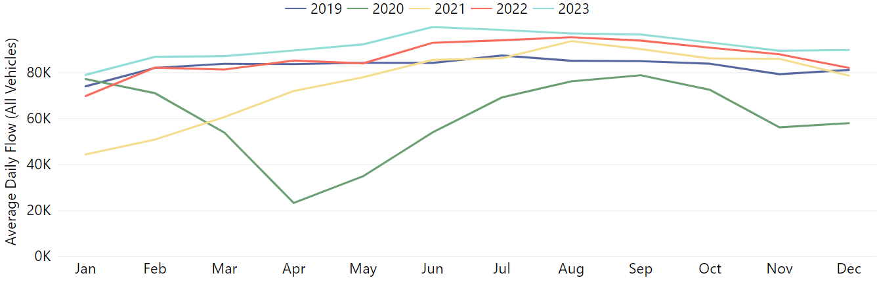
Strategic Road Network: Cambridge
Cambridge strategic road volumes continue to exceed pre-COVID volumes (+11% in December 2023) though have plateaued slightly after experiencing a peak over the summer months.
Pre-COVID to Now: Dec 2019 to Dec 2023 | Mid-COVID to Now: Dec 2021 to Dec 2023 | Previous year to Now: Dec 2022 to Dec 2023
+11% | +14% | +10%
Analysis based on 3 sensors - all on the main carriageway of the M11 (2 near Madingley Road and 1 near Trumpington).
Notes:
Source: National Highways WebTRIS data.
Technical note: This dataset averages across ALL days (Mon-Sun). Analysis based on 3 sensors - all on the main carriageway of the M11 (2 near Madingley Road and 1 near Trumpington).

Slide 16
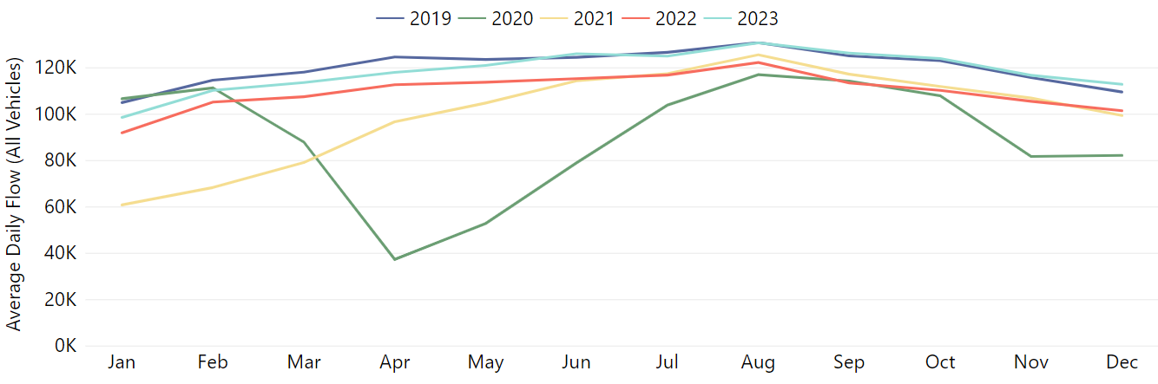
Strategic Road Network: East Cambridgeshire
East Cambridgeshire strategic road volumes are near pre-COVID volumes (+3%) and have also seen an increase from December 2022 (+11%).
Pre-COVID to Now: Dec 2019 to Dec 2023 | Mid-COVID to Now: Dec 2021 to Dec 2023 | Previous year to Now: Dec 2022 to Dec 2023
+3% | +14% | +11%
Analysis based on 4 sensors - 2 on the main carriageway of the A11 (close to Red Lodge) and 2 on the main carriageway of the A14 (2 north of Newmarket).
Notes:
Source: National Highways WebTRIS data.
Technical note: This dataset averages across ALL days (Mon-Sun). Analysis based on 5 sensors - 2 on the main carriageway of the A11 (close to Red Lodge) and 2 on the main carriageway of the A14 (2 north of Newmarket).

Slide 17
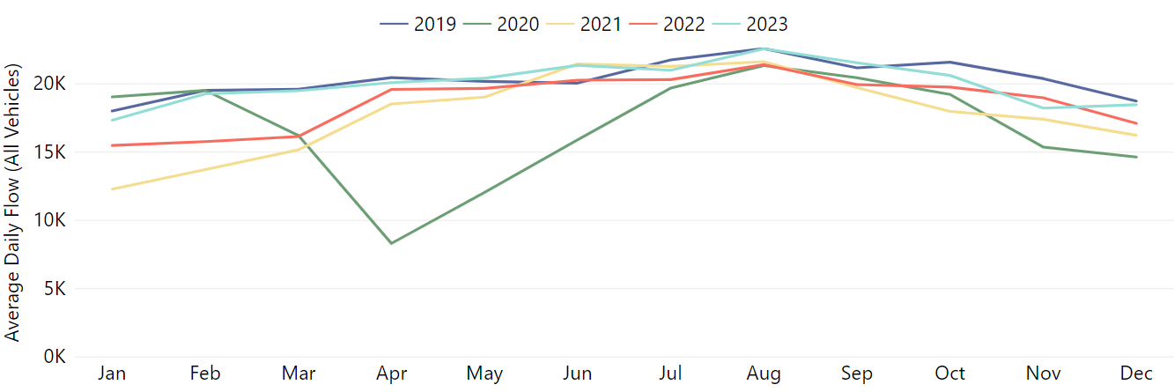
Strategic Road Network: Fenland
Fenland strategic road volumes are around pre-COVID levels (-1%). Following a gradual increase during 2023, more recent months have experienced a drop in traffic volumes – albeit still ahead of December 2022 (+8%).
Pre-COVID to Now: Dec 2019 to Dec 2023 | Mid-COVID to Now: Dec 2021 to Dec 2023 | Previous year to Now: Dec 2022 to Dec 2023
-1% | +14% | +8%
Analysis based on 2 sensors on the main carriageway of the A47 (both close to Guyhirn).
Notes:
Source: National Highways WebTRIS data.
Technical note: This dataset averages across ALL days (Mon-Sun). Analysis based on 2 sensors on the main carriageway of the A47 (both close to Guyhirn).

Slide 18
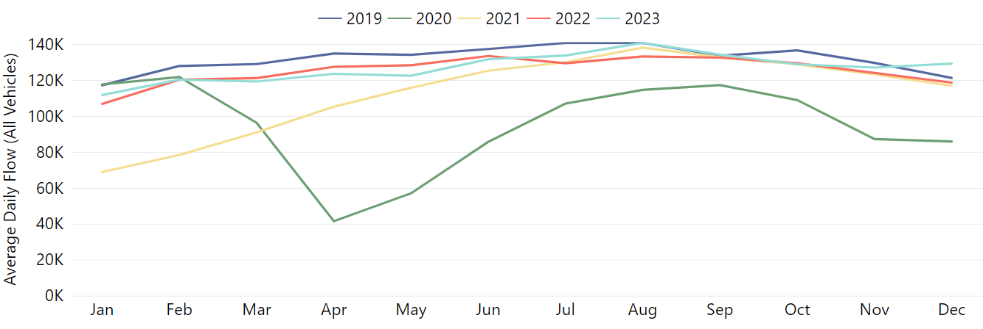
Strategic Road Network: Huntingdonshire
Huntingdonshire strategic road volumes have climbed above 2019 volumes in December 2023 (+7%).
Pre-COVID to Now: Dec 2019 to Dec 2023 | Mid-COVID to Now: Dec 2021 to Dec 2023 | Previous year to Now: Dec 2022 to Dec 2023
+7% | +10% | +9%
Analysis based on 4 sensors - 4 on the A1(M) (2 east of Sawtry, 1 west of Yaxley, 1 near Alwalton). A428 sensors excluded to avoid data bias due to the A14 roadworks.
Notes:
Source: National Highways WebTRIS data.
Technical note: This dataset averages across ALL days (Mon-Sun). Analysis based on 4 sensors - 4on the A1(M) (2 east of Sawtry, 1 west of Yaxley, 1 near Alwalton). A428 sensors excluded to avoid data bias due to the A14 roadworks.

Slide 19
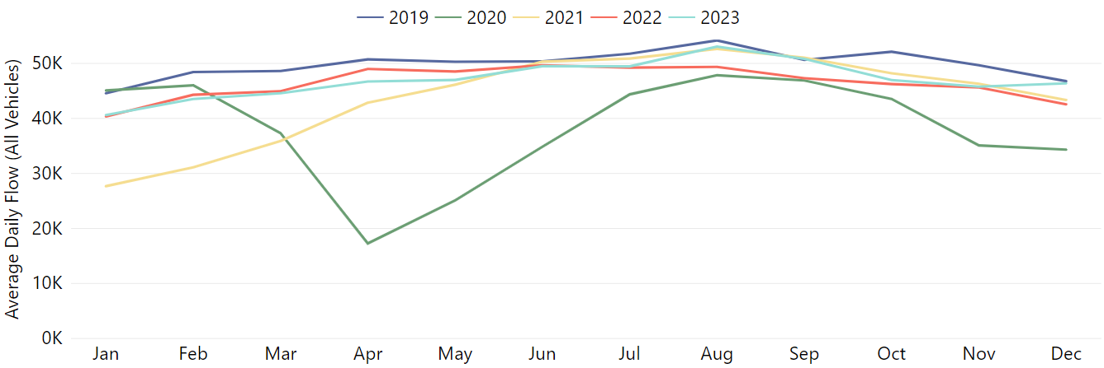
Strategic Road Network: Peterborough
Peterborough strategic road volumes are around pre-COVID volumes (-1%) and have seen a jump from December 2022 (+9%).
Pre-COVID to Now: Dec 2019 to Dec 2023 | Mid-COVID to Now: Dec 2021 to Dec 2023 | Previous year to Now: Dec 2022 to Dec 2023
-1% | +7% | +9%
Analysis based on 3 sensors – 2 on the A47 (2 east of Dogsthorpe) and 1 on the A1 (1 north of Wansford).
Notes:
Source: National Highways WebTRIS data.
Technical note: This dataset averages across ALL days (Mon-Sun). Analysis based on 3 sensors – 2 on the A47 (2 east of Dogsthrope) and 1 on the A1 (1 north of Wansford).

Slide 20
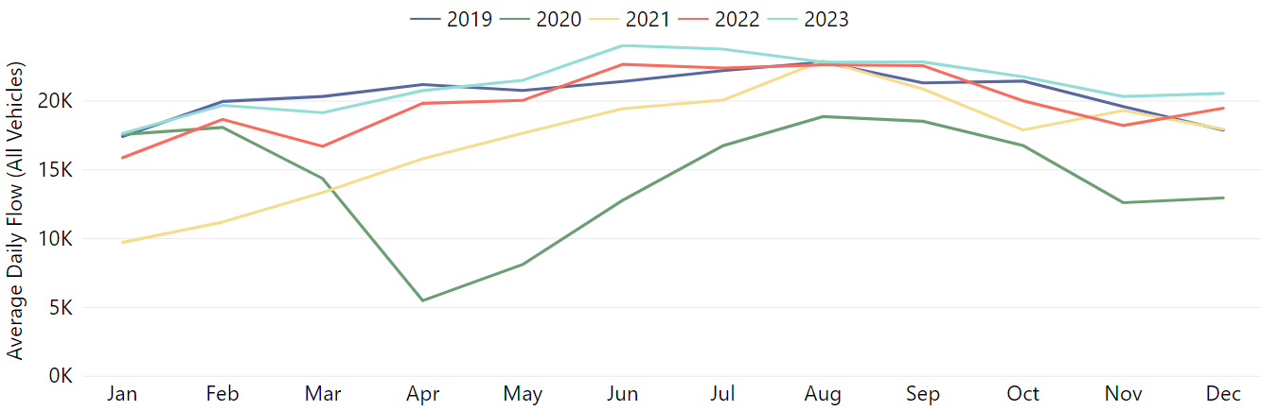
Strategic Road Network: South Cambridgeshire
South Cambridgeshire strategic road volumes are some way ahead of pre-COVID volumes +15%) and show an increase on both December 2021 (+14%)
and December 2022 (+6%).
Pre-COVID to Now: Dec 2019 to Dec 2023 | Mid-COVID to Now: Dec 2021 to Dec 2023 | Previous year to Now: Dec 2022 to Dec 2023
+15% | +14% | +6%
Analysis based on 1 sensors - 1 on the M11 (near Duxford) A428 sensors excluded to avoid data bias due to the A14 roadworks.
Notes:
Source: National Highways WebTRIS data.
Technical note: This dataset averages across ALL days (Mon-Sun). Analysis based on 1 sensor - 1 on the M11 (near Duxford). A428 sensors excluded to avoid data bias due to the A14 roadworks.

Slide 21
Local Road Network:
Motorised Vehicles

Slide 22
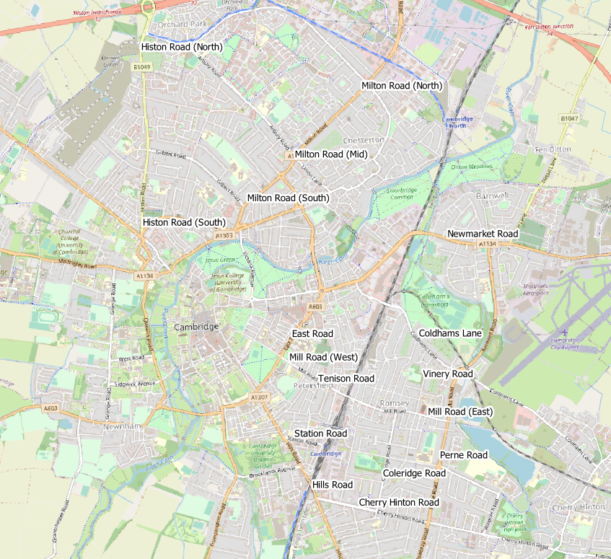
Local Road Network Monitoring Sites: Motorised Vehicles
Long Term Vivacity Monitoring Sites – Motorised Vehicles
The Mill Road and East Road sensors were upgraded in Sept 2022 and are now detecting significantly more cycles and pedestrians. As a result, the active travel flows at these locations are no longer comparable pre/post Sept 2022.
The Milton Road (Mid) sensor is currently inactive.
Sensor Location​​ | Location description​​ | Installed​
Cherry Hinton Road ​​ | Near Rock Road​​ | May 2019​
Coldham’s Lane​​ | Near Coldham’s Common​​ | May 2019​
Coleridge Road ​​ | Near Coleridge recreation ground​​ | May 2019​
East Road​​ | Close to ARU site​​ | May 2019​
Hills Road Bridge​​ | Near Cherry Hinton Road​​ | May 2019​
Histon Road (North)​​ | Just south of A14​ | Sep 2019​
Histon Road (South) ​​ | Near Victoria Road​ | Sep 2019​
Mill Road (East)​​ | Close to Brookfield’s hospital​​ | May 2019​
Mill Road (West)​​ | Close to Parker’s Piece​​ | May 2019​
Milton Road (Mid)​​ | Near Union Lane​​ | May 2019​
Milton Road (North)​​ | Near King’s Hedges Road​ | Sep 2019​
Milton Road (South)​ | Near Gilbert Road​ | Sep 2019​
Newmarket Road | Near Ditton Fields | May 2019
Perne Road | Near Birdwood Road roundabout | May 2019
Station Road | Near Kett House | May 2019
Tenison Road​​ | Near Mill Road​​ | May 2019​
Vinery Road ​​ | Near Romsey recreation ground​​ | May 2019​
Legend
Comparable motorised vehicle data available for most months and years.
Comparable motorised vehicle data available for Dec 2019, Dec 2021, Dec 2022 & Dec 2023.
Comparable motorised vehicle data available for Dec 2019 and Dec 2023.
© OpenStreetMap Contributors
Comparable data not available for Dec 2019 and / or Dec 2023.
Notes:
Source: Cambridge Vivacity sensors
Technical note: This analysis has excluded sensors which may compromise the validity of historic comparisons when figures for all sites are combined. For example, some sites may have data gaps, road closures or events impacting data within the comparison period.

Slide 23
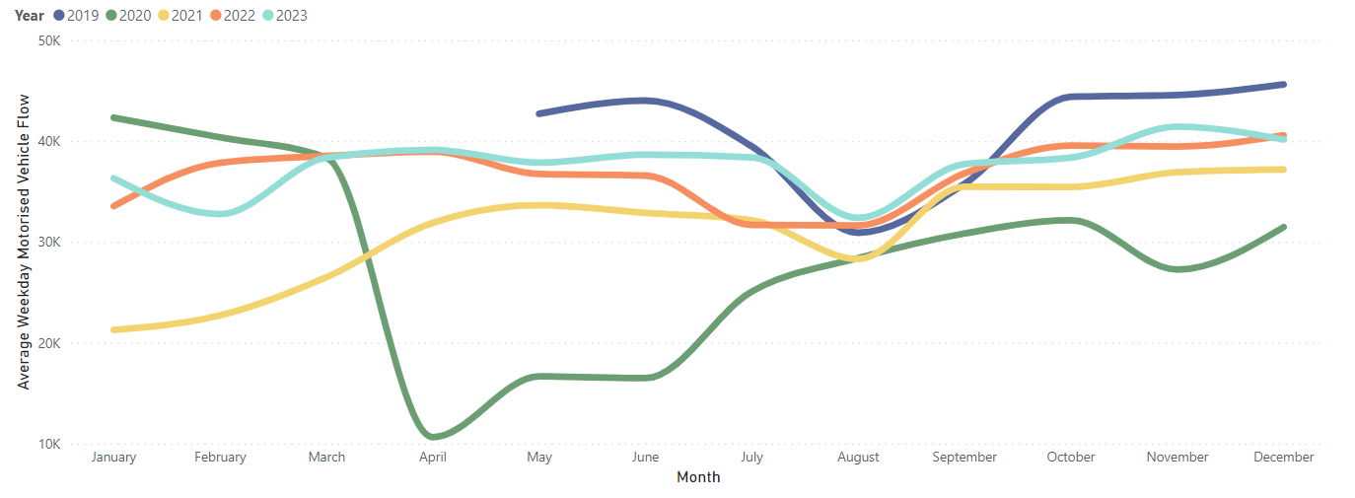
Local Road Network: Motorised Vehicle – Trends
In December 2023, local road vehicle flows were just ahead of December 2022 (+3%). However, volumes are below pre-Covid, December 2019 (-10%).
Average weekday vehicular flow by month, 2019-2023.
Pre-COVID to Now:
December 2019 to December 2023
Mon-Sun | Weekdays (Mon-Thu) | Weekends (Sat-Sun)
-10% | -12% | -9%
Mid-COVID to Now:
December 2021 to December 2023
Mon-Sun | Weekdays (Mon-Thu) | Weekends (Sat-Sun)
+7% | +8% | +4%
Previous year to Now:
December 2022 to December 2023
Mon-Sun | Weekdays (Mon-Thu) | Weekends (Sat-Sun)
+3% | -1% | +7%
Sensors used for the analysis on this slide: Coleridge Road, Hills Road, Mill Road (West), and Tenison Road.
Notes:
Source: Cambridge Vivacity sensors
Technical Notes: 'Non-neutral days' are not included within the calculations.
This chart shows the average volume of motor vehicles counted per weekday for each month/year .
The table presents full week and weekend changes against various historic benchmarks to give an indication of how traffic flows are recovering.
Improved data cleaning processes are being developed to improve the omission of any poor quality / non-comparable data – gaps on the graph may be present for this reason. Care should be taken in interpreting these charts as they are solely based on the 4 locations stated – which dilutes the geographical coverage and may not provide a city-wide / holistic view.
Commentary:
Motorised traffic flows have fluctuated slightly across summer months after having been relatively stable prior. Average motorised flows in December are 3% ahead of this point last year
Motorised flows remain below September 2019 (‘pre-COVID’) levels (-10%).

Slide 24
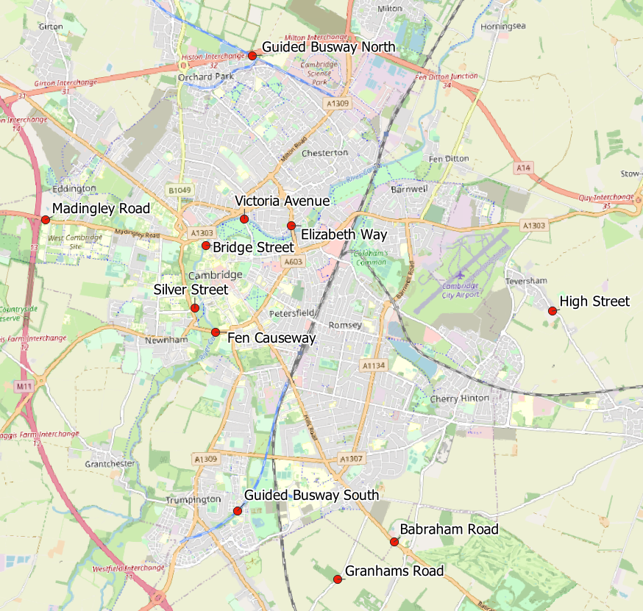
Local Road Network: Motorised Vehicle - Annual Survey Sites
Cambridgeshire Annual Traffic Survey Sites
Traffic Survey Site Name
Elizabeth Way
Victoria Avenue​​
Bridge Street
Silver Street
Fen Causeway​​
High Street, Teversham
Babraham Road
Granhams Road
Madingley Road
Guided Busway (North)
Guided Busway (South)
Cambridgeshire County Council commissions annual traffic surveys to determine traffic levels around the county on a “typical” weekday.
The sites shown in this map are those in and around Cambridge at which CCC has collected motorised traffic flows over several years.
Analysis of motorised traffic counts from these sites is presented on the following slide.
© OpenStreetMap Contributors
*2023 data is currently being analysed and not yet available.

Slide 25
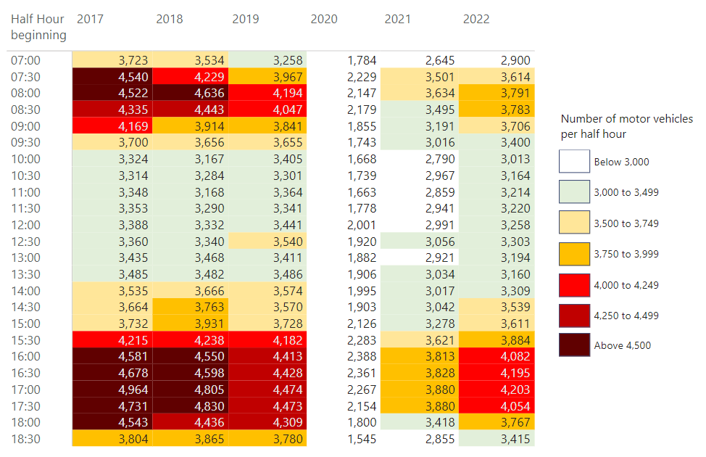
Local Road Network: Motorised Vehicle - Peak Spreading
Motorised traffic is more evenly spread across the morning and afternoon than was observed pre-COVID (2017 – 2019). There is a gradual return of the evening peak in motorised traffic, though volumes are lower than in 2017, 2018 and 2019.
*2023 data is currently being analysed and not yet available.
Notes:
Source: Cambridgeshire Annual Traffic Surveys (2017, 2018, 2019, 2020, 2021 and 2022).
Technical Note: These figures are based on the sum of motorised traffic counts across sites in Cambridge (see previous slide) on a single day (i.e. not an average across a longer time period). The survey day is chosen in order to most closely represent a “typical” day for traffic flows (i.e. avoid bank holidays, any weeks with strike action, any other special circumstances which can distort volumes).
Commentary:
The years before Covid (2017 to 2019) show a greater number of cells with high traffic volumes (above 4,000 per half hour period), with a particularly prominent morning peak between 7:30 and 9:00 am which is not replicated in 2022. Only 4pm to 5.30pm presents with more than 4,000 vehicles per half hour in 2022. While the pre-Covid morning peak is not yet visible, motorised flows have gradually increased each year since the pandemic (2020).

Slide 26
Local Road Network:
Vehicle Split

Slide 27
Local Road Network Monitoring Sites: Vehicle Split
Long Term Vivacity Monitoring Sites – Vehicle Split
The Mill Road and East Road sensors were upgraded in Sept 2022 and are now detecting significantly more cycles and pedestrians. As a result, the active travel flows at these locations are no longer comparable pre/post Sept 2022.
The Milton Road (Mid) sensor is currently inactive.
Sensor Location​​ | Location description​​ | Installed​
Cherry Hinton Road ​​ | Near Rock Road​​ | May 2019​
Coldham’s Lane​​ | Near Coldham’s Common​​ | May 2019​
Coleridge Road ​​ | Near Coleridge recreation ground​​ | May 2019​
East Road​​ | Close to ARU site​​ | May 2019​
Hills Road Bridge​​ | Near Cherry Hinton Road​​ | May 2019​
Histon Road (North)​​ | Just south of A14​ | Sept 2019​
Histon Road (South) ​​ | Near Victoria Road​ | Sept 2019​
Mill Road (East)​​ | Close to Brookfield’s hospital​​ | May 2019​
Mill Road (West)​​ | Close to Parker’s Piece​​ | May 2019​
Milton Road (Mid)​​ | Near Union Lane​​ | May 2019​
Milton Road (North)​​ | Near King’s Hedges Road​ | Sept 2019​
Milton Road (South)​ | Near Gilbert Road​ | Sept 2019​
Newmarket Road | Near Ditton Fields | May 2019
Perne Road | Near Birdwood Road roundabout | May 2019
Station Road | Near Kett House | May 2019
Tenison Road​​ | Near Mill Road​​ | May 2019​
Vinery Road ​​ | Near Romsey recreation ground​​ | May 2019​
Legend
Comparable motorised vehicle data available for most months and years.
Comparable motorised vehicle data available for Dec 2019, Dec 2021, Dec 2022 & Dec 2023.
Comparable motorised vehicle data available for Dec 2019 and Dec 2023.
© OpenStreetMap Contributors
Comparable data not available for Dec 2019 and / or Dec 2023.
Notes:
Source: Cambridge Vivacity sensors
Technical note: This analysis has excluded sensors which may compromise the validity of historic comparisons when figures for all sites are combined. For example, some sites may have data gaps, road closures or events impacting data within the comparison period.

Slide 28
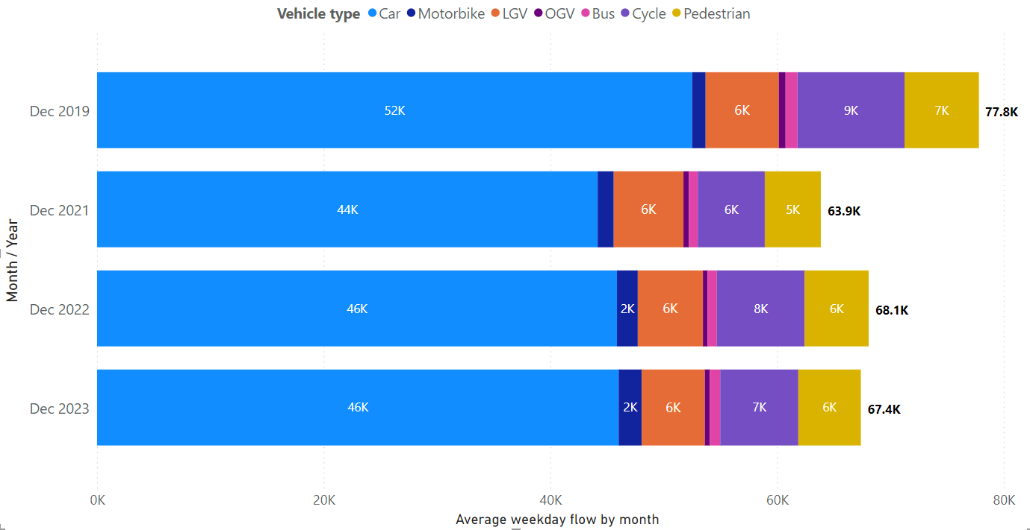
Local Road Vehicle Split: Overall
December 2023 weekday flows are similar to December 2022 and some way below pre-COVID levels in December 2019. The proportion of active compared to motorised travel has held fairly steady since 2019, at approx. 20%.
Vehicle type split – sum of 5 sensors in Cambridge
Active Travel* proportion by year
Year | Active %
December 2019 | 21%
December 2021 | 17%
December 2022 | 20%
December 2023 | 18%
Dec 2023 Active Travel* proportion by location
Location​ | Active %​
Mill Road (West) | 46%
Station Road | 42%
Tenison Road | 35%
East Road | 26%
Cherry Hinton Road | 21%
Hills Road | 21%
Coleridge Road | 14%
Perne Road | 11%
Histon Road (North) | 8%
Coldham's Lane | 6%
Newmarket Road | 5%
*Active Travel includes cyclists and pedestrians
Sensors used for the analysis on this slide: Cherry Hinton Road, Coldham’s Lane, Coleridge Road, Hills Road, and Tenison Road.
Notes:
Source: Cambridge Vivacity sensors
Technical Notes: Sensors included within the four-year chart are: Cherry Hinton Road, Coldham’s Lane, Coleridge Road, Hills Road, and Tenison Road. 'Non-neutral' days are not included within average weekday flow calculations. Fridays are not counted as a weekday. Traffic flows on all other days are counted and used to calculate a typical 'average' traffic flow within central Cambridge on a weekday.
We have selected the most recent month of data (December 2023) and compared it to three historic time periods to show how traffic flows have evolved since these sensors were installed.
Commentary
December 2023 data presents with a typical weekday flow of just over 67,000 - which is marginally lower than December 2022 (68,000).
Pre-Covid (December 2019) typical weekday flows in central Cambridge were significantly higher than in subsequent years, reaching almost 78,000.
Overall, the proportionate split in travel modes has not changed a huge amount between the four years in December - cars are the dominant mode of transport in all four years.
Active modes' share of traffic flow has decreased in December 2023 (18%) in comparison to last year (20%).

Slide 29
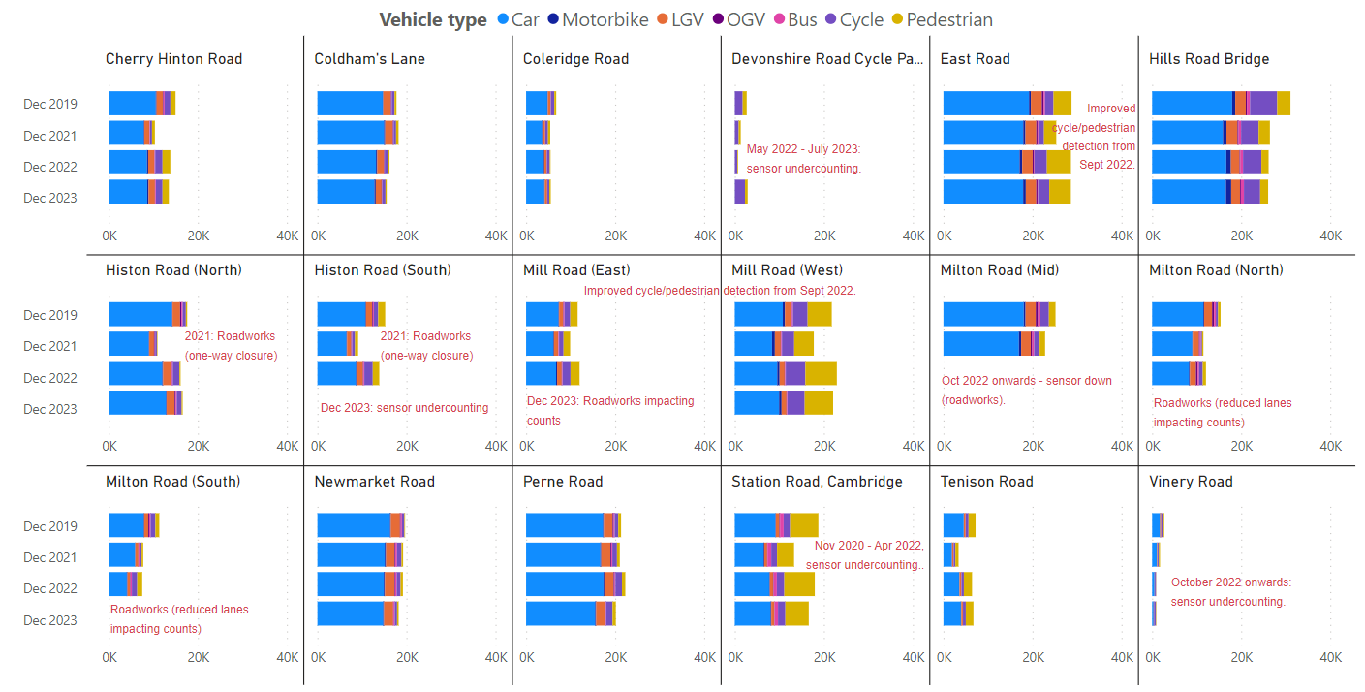
Local Road Vehicle Split: By Location
Average two-way weekday flow by mode for Dec 2019, Dec 2021, Dec 2022, Dec 2023.
Notes:
Source: Cambridge Vivacity sensors
Technical Note:
Non-neutral days are not included within the average weekday flow calculations. Weekdays are defined as Monday to Thursday, as per DfT guidance. We have selected the most recent month of data (March 2023) and compared it to three historic months to show how traffic flows have evolved since these sensors were installed.
Please see the comments on the slide which highlight events which are considered likely to have impacted the data. For example, there may be a data gap or a change that is likely to affect the counts either upwards or downwards – and so require caution to be taken when assessing the outputs.
Commentary:
Cars are the largest individual category in all locations across all years – but some sites are seeing the dominance of cars recede slightly, such as Newmarket Road, Perne Road and Station Road.
Overall, however, there has not been a significant impact on modal split at most locations - with the exceptions being sites which have had a sensor upgrade that enables vastly improved active mode counts (these are East Road, Mill Road West and Mill Road East).

Slide 30
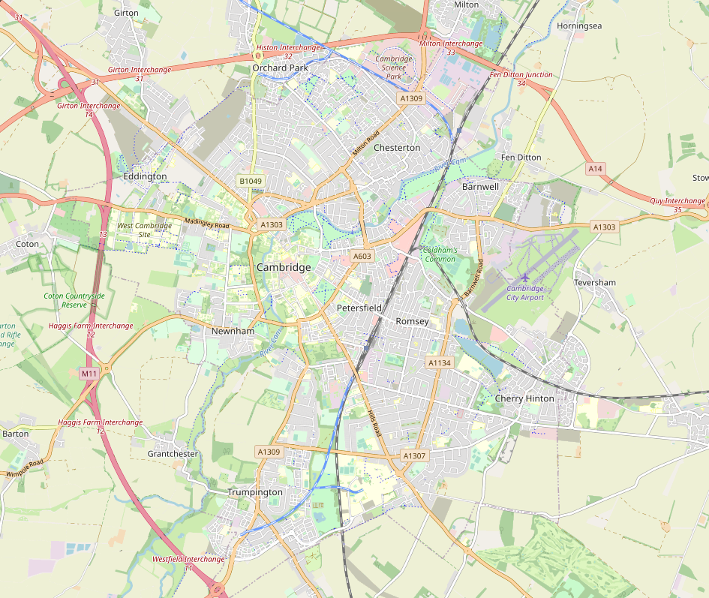
Local Road Network: Recovery Map
The motorised flow across 6 Cambridge sensors in December 2023 is 11% below pre-COVID levels (December 2019). Some sites have seen large increases in active travel volumes in comparison to December 2019 – however, the combined overall figure for these 6 sites is a 16% drop against pre-COVID volumes.
All 6 Sites Combined
Active Travel: +1%
Motorised Travel: -17%
% change in traffic flows, Dec 2019 to Dec 2023
-16%
Coldham's Lane
Active Travel: +21%
Motorised Travel: -44%
-11%
-7%
-13%
Tenison Road
Active Travel: +36%
Motorised Travel: -17%
+7%
-13%
Perne Road
Active Travel: -31%
Motorised Travel: -19%
+50%
Hills Road
Active Travel: -36%
Motorised Travel: -7%
-10%
-40%
-6%
Coleridge Road
Active Travel: -31%
Motorised Travel: -19%
Cherry Hinton Road
Active Travel: +43%
Motorised Travel: -17%
-38%
-14%
+18%
-15%
Notes:
Source: Cambridge Vivacity sensors
Technical Note: Calculations are made on an average weekday. Low and zero flows are removed from any average calculations. Any ‘non neutral’ days - such as bank holidays or school holidays – are also excluded.
Data is shown only for the six sensors with comparable data for December 2019 and December 2023 for both active and motorised traffic flows.
Commentary:
Active travel is 16% below pre-Covid levels across these sites; albeit with some sites presenting large increases against December 2019. Notably Perne Road (+50%) and Cherry Hinton Road (+18%). This is somewhat counterbalanced by decreases at Coleridge Road (-38%) and Hills Road (-40%).
Motorised travel is 11% below pre-pandemic levels overall across these sites; with all individual sites presenting a drop against December 2019 levels.
Cherry Hinton Road has seen the largest individual drop in motorised vehicle flows against December 2019 (-15%).

Slide 31
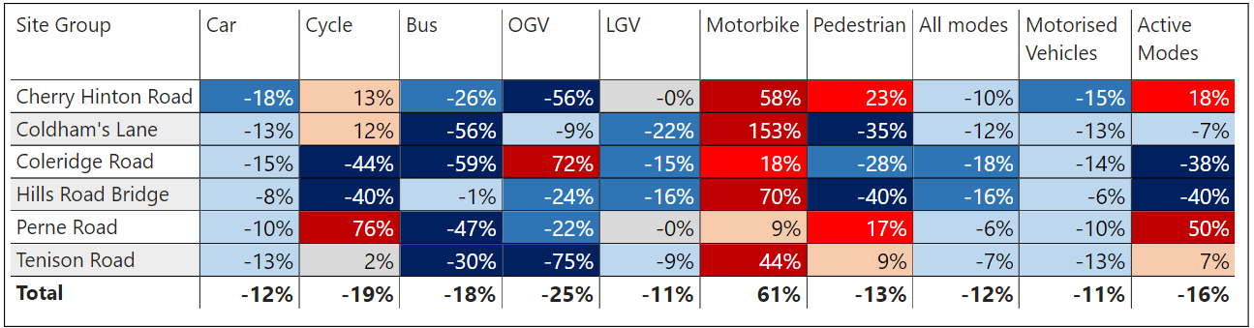
Local Road Network: Recovery by Location and Mode
Motorcycle volumes are higher than pre-Covid (December 2019) at all sites. Some sites show a large increase in active travel volumes – most notably Perne Road (+50%) and Cherry Hinton Road (+18%). Motorised volumes have fallen at all sites in comparison to pre-Covid.
% change in weekday volumes
Pre-COVID to Now:
December 2019 to December 2023
Data shown only for the sensors with comparable data for December 2019 and December 2023.
Notes:
Source: Cambridge Vivacity sensors
Technical Note: Weekday volumes do not include Fridays. Low and zero flows are removed from any average calculations, and any ‘non neutral’ days - such as bank holidays or school holidays – are also excluded.
Commentary: Motorcycles are ahead of pre-Covid (Dec 2019) counts at all sites.
Cherry Hinton Road is showing the largest fall in car volumes (-18% against December 2019).
Perne Road is showing the largest increase in Active travel (+50% against December 2019).
There is a noticeable variation in cycling and pedestrian volumes across these sites in comparison to pre-Covid. For example, Cherry Hinton Road shows a 23% increase in pedestrian counts; whereas Hills Road shows a 40% decrease.
Elsewhere, cycling counts are 76% ahead of pre-Covid at Perne Road; whereas Coleridge Road shows a 44% drop across the same time-span.

Slide 32
Local Road Network:
Active Travel

Slide 33
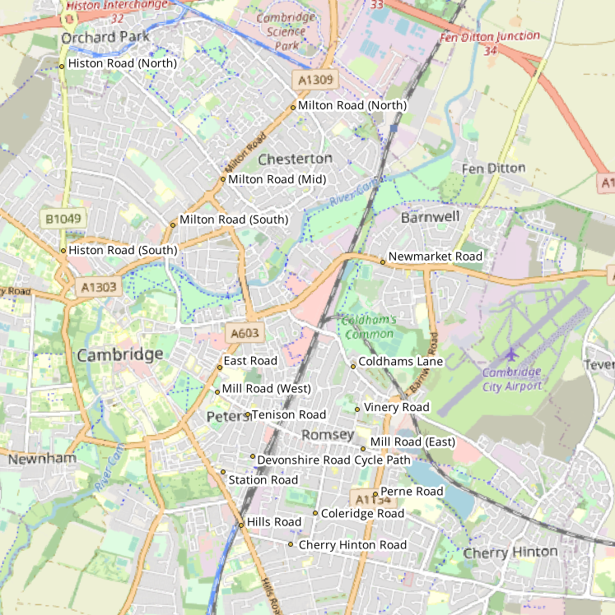
Local Road Network Monitoring Sites: Active Travel
Long Term Vivacity Monitoring Sites – Active Travel
The Mill Road and East Road sensors were upgraded in Sept 2022 and are now detecting significantly more cycles and pedestrians. As a result, the active travel flows at these locations are no longer comparable pre/post Sept 2022.
The Milton Road (Mid) sensor is currently inactive.
Sensor Location​​ | Location description​​ | Installed​
Cherry Hinton Road ​​ | Near Rock Road​​ | May 2019​
Coldham’s Lane​​ | Near Coldham’s Common​​ | May 2019​
Coleridge Road ​​ | Near Coleridge recreation ground​​ | May 2019​
Devonshire Rd Cycle Path | Opposite 55-57 Devonshire Road | May 2019​
East Road​​ | Close to ARU site​​ | May 2019​
Hills Road Bridge​​ | Near Cherry Hinton Road​​ | May 2019​
Histon Road (North)​​ | Just south of A14​ | Sept 2019​
Histon Road (South) ​​ | Near Victoria Road​ | Sept 2019​
Mill Road (East)​​ | Close to Brookfield’s hospital​​ | May 2019​
Mill Road (West)​​ | Close to Parker’s Piece​​ | May 2019​
Milton Road (Mid)​​ | Near Union Lane​​ | May 2019​
Milton Road (North)​​ | Near King’s Hedges Road​ | Sept 2019​
Milton Road (South)​ | Near Gilbert Road​ | Sept 2019​
Newmarket Road | Near Ditton Fields | May 2019
Perne Road | Near Birdwood Road roundabout | May 2019
Station Road | Near Kett House | May 2019
Tenison Road​​ | Near Mill Road​​ | May 2019​
Vinery Road ​​ | Near Romsey recreation ground​​ | May 2019​
Legend
Comparable motorised vehicle data available for most months and years.
Comparable motorised vehicle data available for Dec 2019, Dec 2021, Dec 2022 & Dec 2023.
Comparable motorised vehicle data available for Dec 2019 and Dec 2023.
© OpenStreetMap Contributors
Comparable data not available for Dec 2019 and / or Dec 2023.
Notes:
Source: Cambridge Vivacity sensors
Technical note: This analysis has excluded sensors which may compromise the validity of historic comparisons when figures for all sites are combined. For example, some sites may have data gaps, road closures or events impacting data within the comparison period.

Slide 34
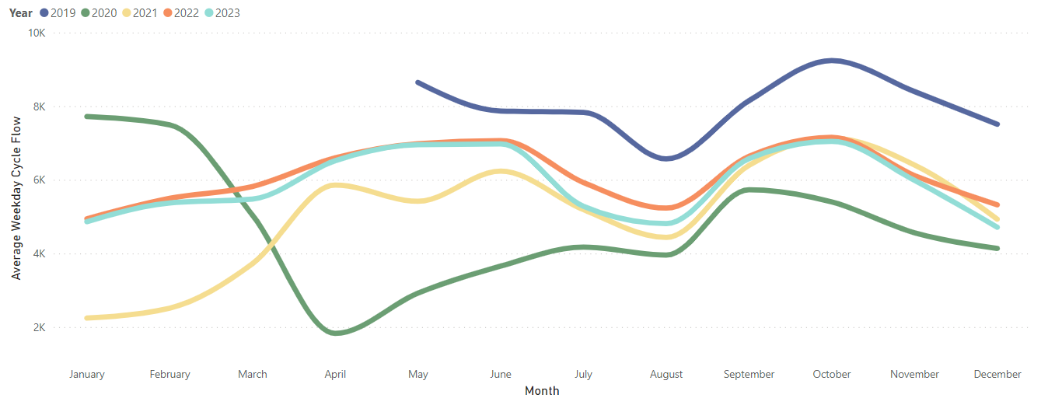
Local Road Network: Cyclists
December 2023 weekday cycling volumes are 37% below pre-COVID levels (December 2019) but are much closer to the volumes seen in Dec 2021 (-11%) and in Dec 2022 (-3%).
Average weekday cycle flow by month, 2019-2023.
Pre-COVID to Now:
December 2019 to December 2023
Mon-Sun | Weekdays (Mon-Thu) | Weekends (Sat-Sun)
-37% | -37% | -33%
Mid-COVID to Now:
December 2021 to December 2023
Mon-Sun | Weekdays (Mon-Thu) | Weekends (Sat-Sun)
-11% | -4% | -19%
Previous year to Now:
December 2022 to December 2023
Mon-Sun | Weekdays (Mon-Thu) | Weekends (Sat-Sun)
-3% | -11% | +30%
Sensors used for this analysis: Coleridge Road, Hills Road, and Tenison Road.
Notes:
Source: Cambridge Vivacity sensors
Technical note: Bank holiday weeks are not included within the calculations. School holidays are also excluded (except summer holidays in order to obtain figures for August). Sensors used within the calculations: Coleridge Road, Hills Road, and Tenison Road.
Commentary: December 2023 is 37% below pre-Covid overall, but only presents with a -3% decrease against this time last year. 2023 has presented a very similar monthly pattern to that which we saw in 2022.
Weekend cycling volumes are 33% below pre-Covid (December 2019), whereas weekday (Mon-Thu) recovery is at -37%.
Weekend cycling volumes in December 2023 are 30% ahead of last year (December 2022), in contrast to weekdays, which present as 11% below this point last year.
December volumes can be heavily impacted by weather. A particularly cold December may mean that active modes are heavily suppressed.

Slide 35
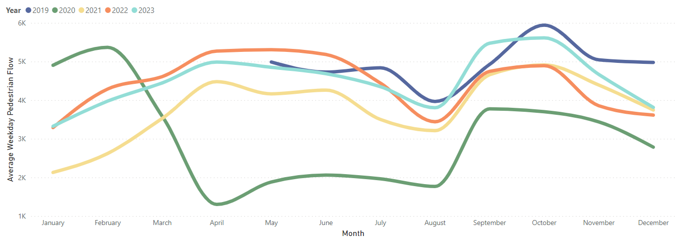
Local Road Network: Pedestrians
Pedestrian volumes in December 2023 were 22% below pre-Covid (December 2019) but 13% ahead of last year (December 2022).
Average weekday pedestrian flow by month, 2019-2023.
Pre-COVID to Now:
December 2019 to December 2023
Mon-Sun | Weekdays (Mon-Thu) | Weekends (Sat-Sun)
-22% | -23% | -18%
Mid-COVID to Now:
December 2021 to December 2023
Mon-Sun | Weekdays (Mon-Thu) | Weekends (Sat-Sun)
No change | +2% | -4%
Previous year to Now:
December 2022 to December 2023
Mon-Sun | Weekdays (Mon-Thu) | Weekends (Sat-Sun)
+13% | +6% | +36%
Sensors used for this analysis: Coleridge Road, Hills Road, and Tenison Road.
Notes:
Source: Cambridge Vivacity sensors
Technical Note: Bank holidays and school holidays do not get included in these monthly averages. Fridays are not counted as a 'weekday’ - but Fridays are included in the 'Mon-Sun' calculations.
Sensors used within the calculations: Coleridge Road, Hills Road, and Tenison Road.
Commentary: Pedestrian volumes in December 2023 are 22% below pre-Covid (December 2019) levels. Weekdays show a 23% drop against pre-Covid, while weekends show a decrease of 18%.
Overall, December 2023 pedestrian volumes present no change against mid-Covid levels (December 2021), however weekends are showing a 4% drop against mid-Covid pedestrian traffic.
Pedestrian volumes in December 2023 are above last year (+13% in comparison to December 2022), with weekends a long way ahead of this point last year (+36%).
December volumes can be heavily impacted by weather. A particularly cold December may mean that active modes are heavily suppressed.

Slide 36
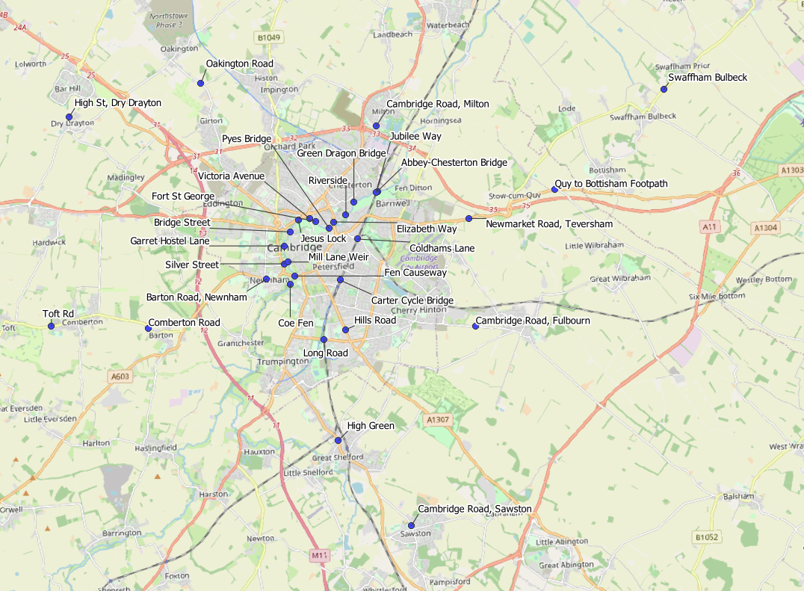
Local Road Network: Active Travel Census Sites
Cambridgeshire Annual Traffic Survey Sites – River Screenline and Cycle Routes
Sensor Location​​
Elizabeth Way
Victoria Avenue​​
Bridge Street
Silver Street
Fen Causeway​​
Green Dragon Bridge​​
Pye’s Bridge
Fort St George​​
Jesus Lock​​
Garrett Hostel Lane​​
Mill Lane Weir
Coe Fen​
Riverside
Abbey-Chesterton Bridge (new for 2022)
Barton Road, Newnham
Comberton Road
Toft Road
High Street, Dry Drayton
Oakington Road
Cambridge Road, Milton
Cambridge Road, Fulbourn
Newmarket Road, Teversham
Coldhams Lane
Carter Cycle Bridge
High Green, Great Shelford
Hills Road
Long Road
Jubilee Way
Cambridge Road, Sawston
Swaffham Bulbeck Footpath
Quy to Bottisham Footpath
© OpenStreetMap Contributors

Slide 37
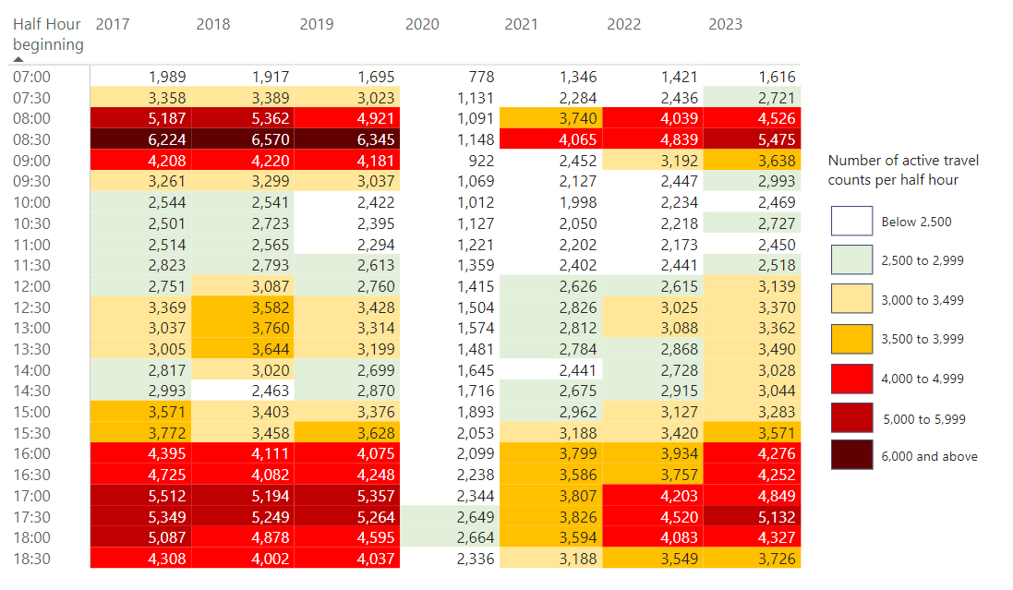
Local Road Network: Active Travel Peak Spreading
The pattern of active travel in 2023 more closely resembles that from 2017 to 2019, particularly the extent of peak spreading in the afternoon / evening – although volumes are still a little below pre-COVID levels. Morning peak volumes are still some way below pre-COVID levels.
Notes:
Source: Cambridge Spring Census – Screenline & Cycle Route Monitoring.
Technical Note: The data is derived from a single survey day, conducted in spring across all the years shown. The survey day is chosen in order to most closely represent a “typical” day for traffic flows (i.e. avoid bank holidays, any weeks with strike action, any other special circumstance which can distort volumes). The flows calculated here are a total for all 14 sites in 2022 and 2023, and 13 sites in 2017-2021 inclusive (Abbey Chesterton Bridge only opened in early 2022).
As active travel can be erratic due to weather conditions on an individual day, we would advise some caution in using these figures as they are taken from an individual daily survey rather than an average volume calculated over a long period of times
Commentary: Prior to Covid (2017 - 2019), there was a morning peak of more than 6,000 at 8:30am. This has not been since 2019, albeit with the 8:30am morning peak gradually returning (albeit at a lower volume of 5,475 in 2023). Evening peak volumes and spread are much closer to those seen pre-Covid, hitting between 4,000 and 5,500 trips between the hours of 4pm and 6.30pm.

Slide 38
Retail Footfall

Slide 39
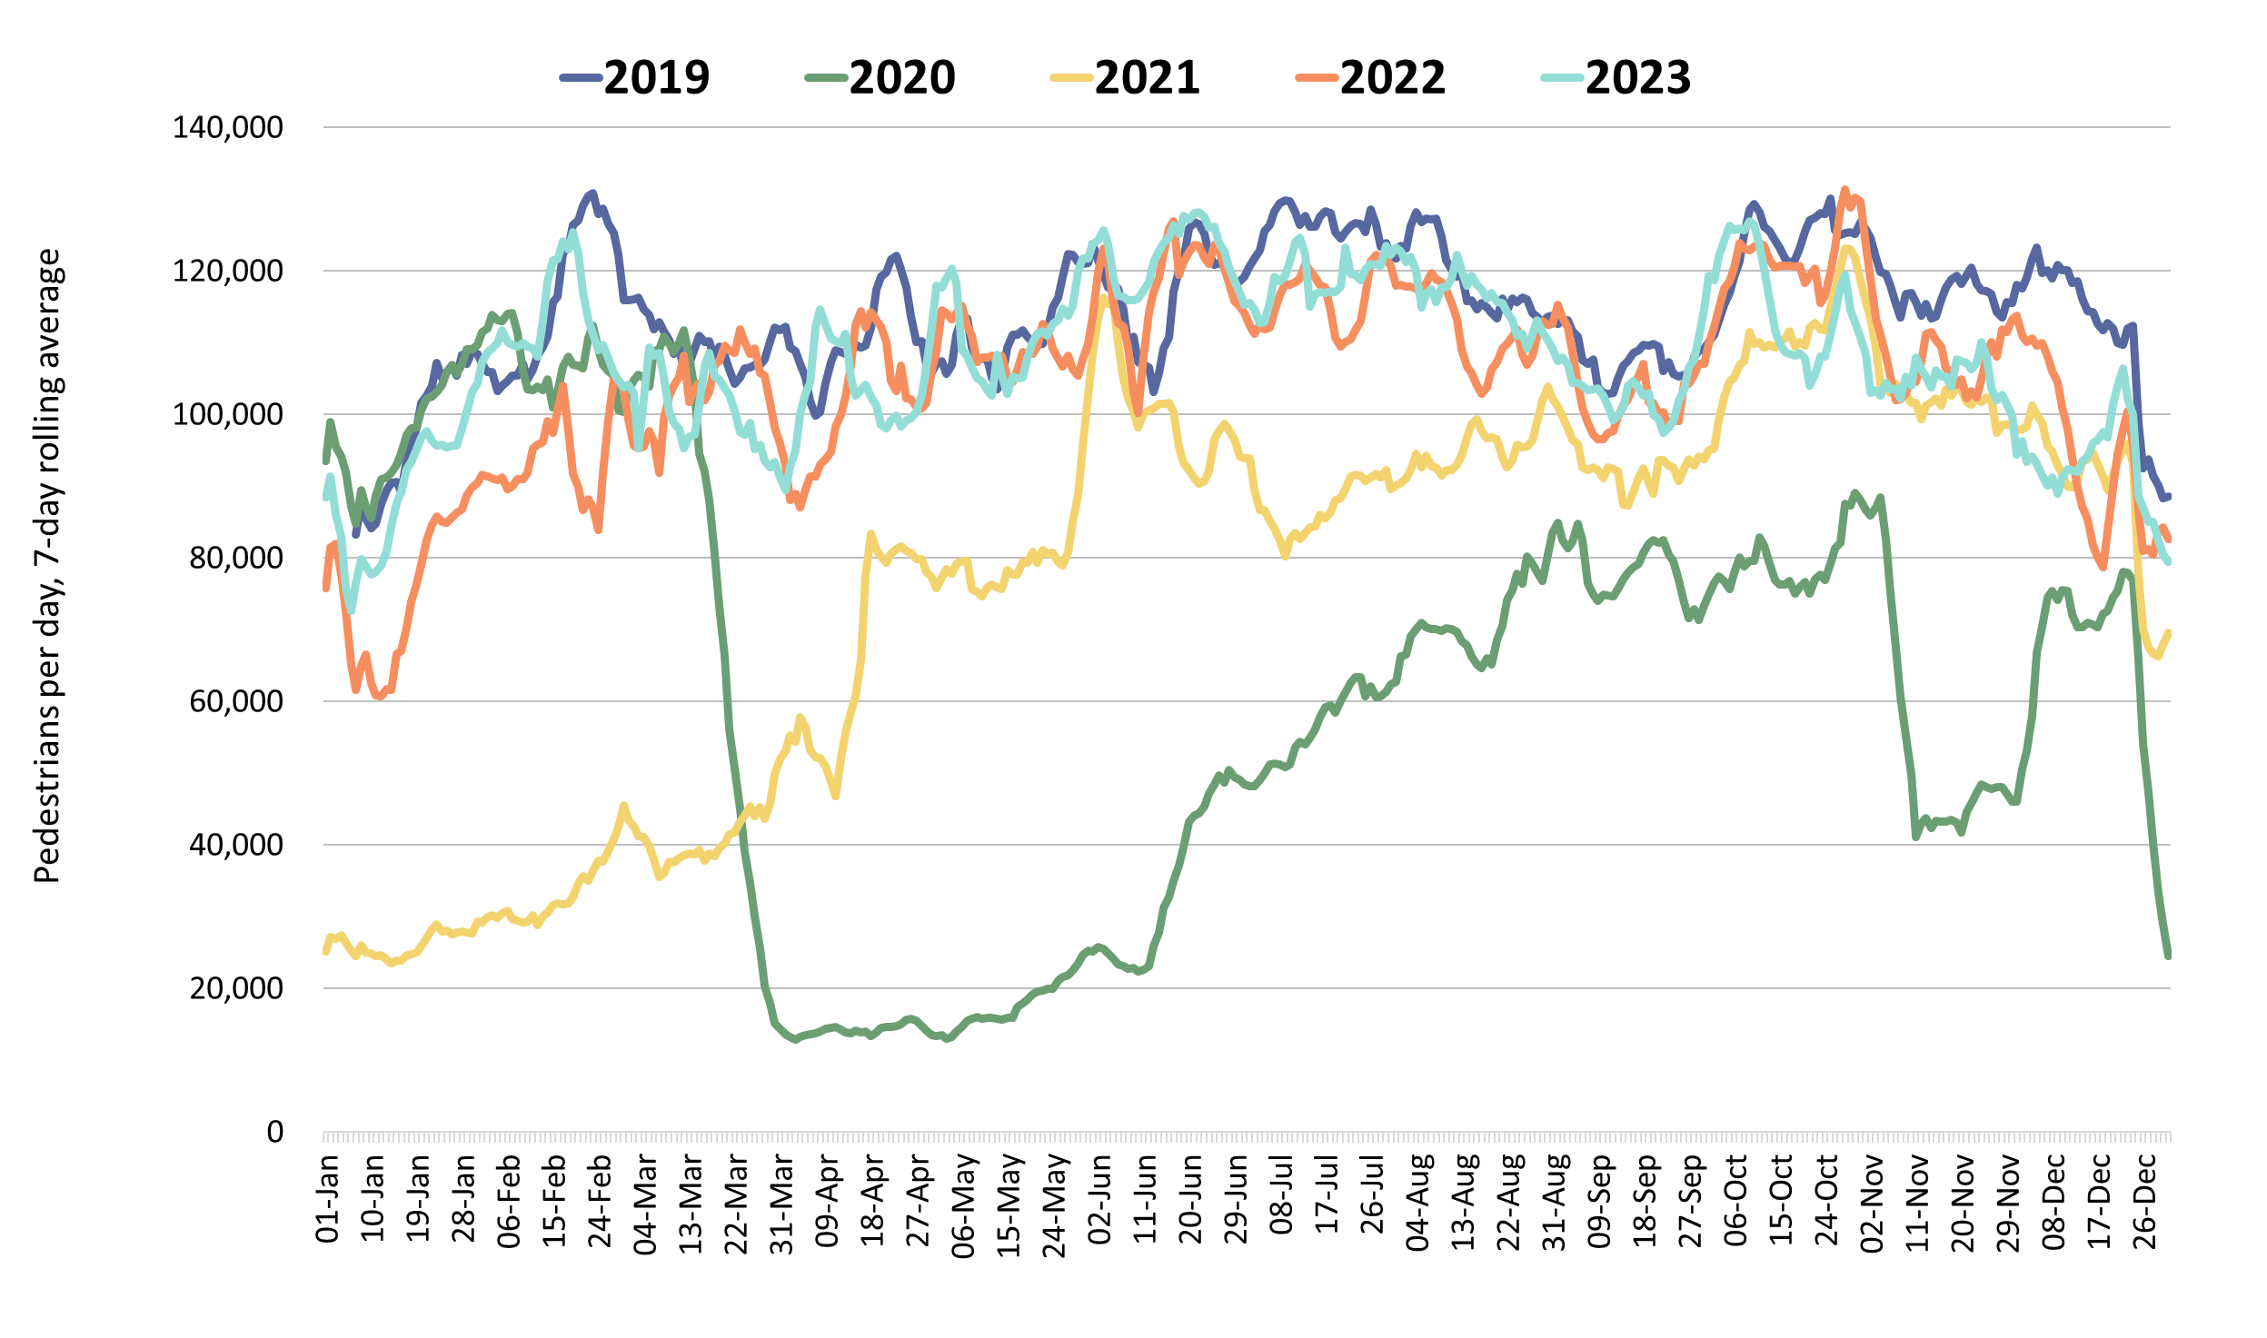
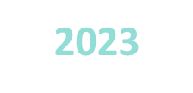
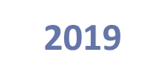
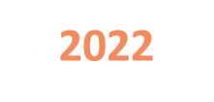
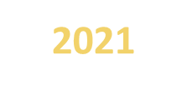
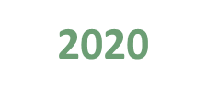

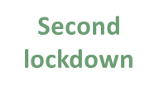

Retail Footfall: Central Cambridge
Retail footfall in Cambridge is 15% below pre-COVID (December 2019) levels – and is 4% below last year (December 2022).
Pre-COVID to Now:
Dec 2019 to Dec 2023
Mon-Sun | Weekdays (Mon-Thu) | Weekends (Sat-Sun)
-15% | -25% | -8%
Mid-COVID to Now:
Dec 2021 to Dec 2023
Mon-Sun | Weekdays (Mon-Thu) | Weekends (Sat-Sun)
+2% | -1% | +4%
Previous year to Now:
Dec 2022 to Dec 2023
Mon-Sun | Weekdays (Mon-Thu) | Weekends (Sat-Sun)
-4% | -12% | +10%
Notes:
Source: Cambridge BID footfall data.
Technical note: Data from the following locations: Bridge Street, Fitzroy Street at Waitrose, Market Hill, Regent Street, Rose Crescent, Sidney Street. Excludes data for King’s Parade and One Station Square. As outlined at the start of this slide pack, 'weekdays' do not include Fridays. Table calculations do not include bank holidays, school holidays or any other "non neutral" days. The percentage changes are designed to reflect change on a "typical" day.
Commentary:
December foot traffic in central Cambridge is 15% below the pre-Covid level of December 2019 and is 4% below what we saw in December 2022 last year.
Weekday (Mon-Thu) footfall is 25% below pre-Covid levels, and weekend footfall is 8% below pre-Covid levels.
Weekday (Mon-Thu) foot traffic is 4% below December 2022, although weekends are presenting a 10% increase in comparison to last year.
Overall, December 2023 was 2% ahead of December 2021 (Mid-Covid).

Slide 40
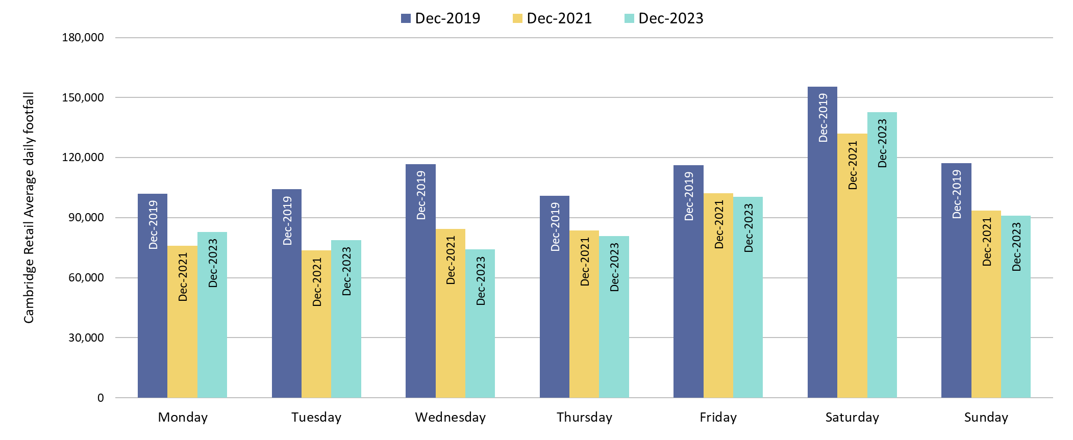
Retail Footfall: Central Cambridge by Day of the Week
All days are below pre-Covid (December 2019) levels. Wednesday (-37%) experienced the largest decrease, while Saturday (-8%) is closest to pre-Covid.
Pre-COVID to Now: Dec 2019 to Dec 2023
Monday | Tuesday | Wednesday | Thursday | Friday | Saturday | Sunday
-19% | -24% | -37% | -20% | -14% | -8% | -22%
Notes:
Source: Cambridge BID footfall data.
Technical note: Data from the following locations: Bridge Street, Fitzroy Street at Waitrose, Market Hill, Regent Street, Rose Crescent, Sidney Street. Excludes data for King’s Parade and One Station Square. Table calculations do not include bank holidays, school holidays or any other "non neutral" days. The percentage changes are designed to reflect change on a "typical" day.
Commentary: All days of the week are below pre-COVID (December 2019) levels, with Wednesday showing the largest decrease of -37%.
Saturdays are closest to pre-COVID, at 8% below December 2019.

Slide 41
Car Parking

Slide 42
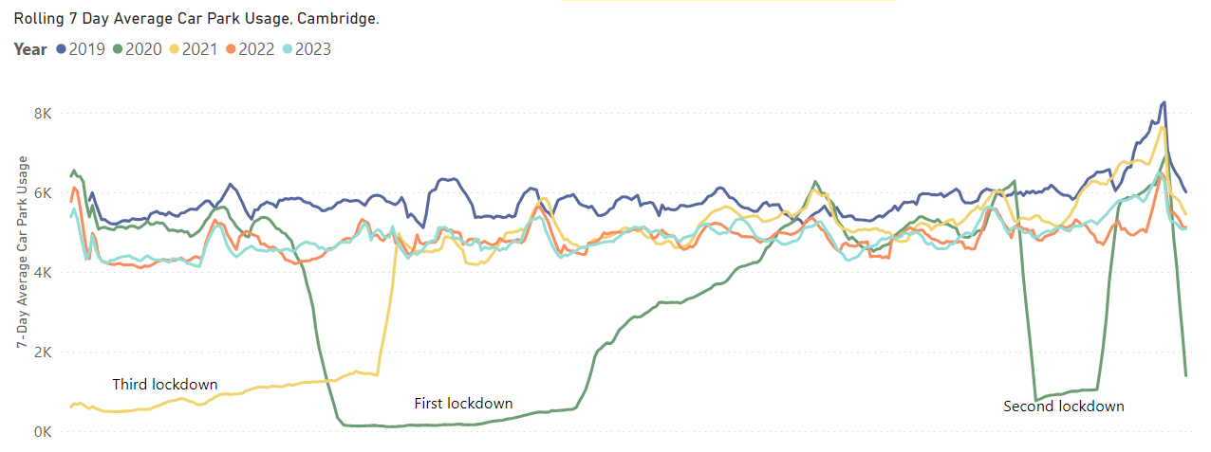
Car Parking: Daily Use
Multi-storey car park use in December 2023 was 11% below pre-Covid (December 2019) levels. Grafton East (-20%) has seen the largest fall in usage among individual car parks compared to pre-Covid; whereas Grand Arcade has seen the largest increase in usage (+12%).
Pre-COVID to Now:
December 2019 to December 2023
Mon-Sun | Weekdays (Mon-Thu) | Weekends (Sat-Sun)
-11% | -18% | -4%
Mid Covid to Now:
December 2021 to December 2023
Mon-Sun | Weekdays (Mon-Thu) | Weekends (Sat-Sun)
-12% | -13% | -12%
Previous year to Now:
December 2022 to December 2023
Mon-Sun | Weekdays (Mon-Thu) | Weekends (Sat-Sun)
+18% | +11% | +27%
*Park Street car park closed for redevelopment on 4th January 2022; usage figures for this car park are included up to its closure.
Notes:
Source: Cambridge City Council Car Parking data
Technical notes: Table calculations do not include bank holidays, school holidays, or any other "non neutral" days. The percentage changes are designed to reflect change on a "typical" day. As outlined at the start of this slide pack, 'weekdays' do not include Fridays.
Commentary:
Multi-storey car park usage in central Cambridge is 11% below the pre-Covid level of December 2019.
December 2023 multi-storey car park usage presents as 12% below mid-Covid (December 2021) levels.
The figures for December 2023 are 18% ahead of last year (December 2022). Weekend figures are up 27% from last year, compared to an increase of 11% from Monday to Thursday.
Additionally, an increased charge for car parks was introduced in February 2023 and may be having an impact on usage.

Slide 43
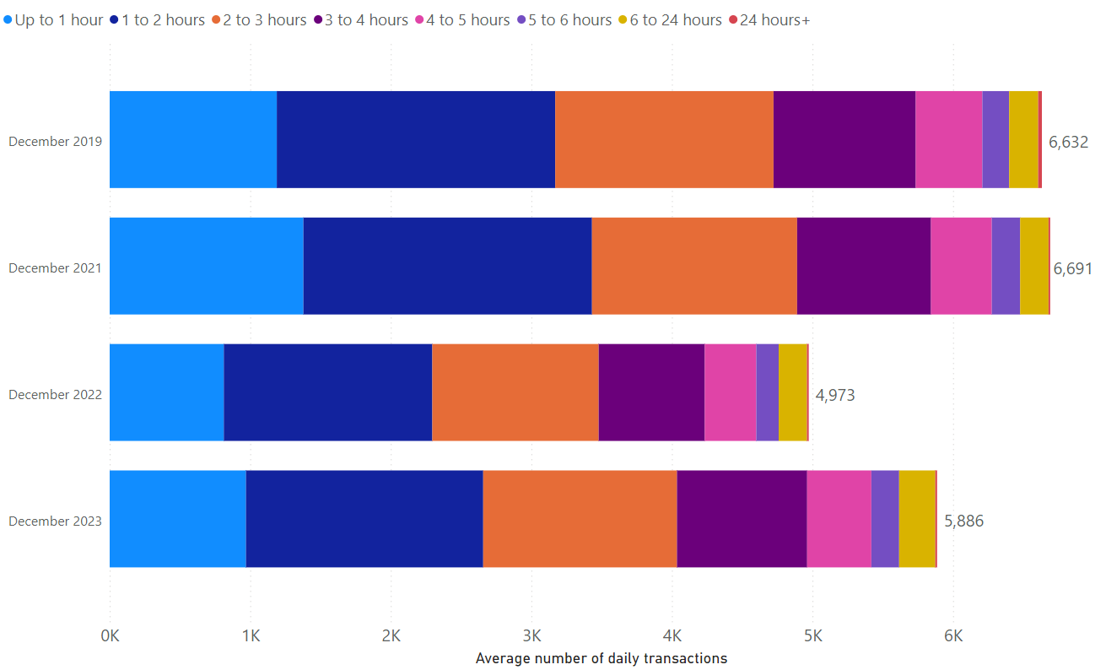
Car Parking: Length of Stay by Month
Typical daily multi-storey car park usage has increased in December 2023 in comparison to last year (18% higher than December 2022).
The proportionate split in length-of-stay within multi-storey car parks has stayed fairly consistent over time.
Park Street car park closed for redevelopment on 4th January 2022; usage figures for this car park are included up to its closure.
Notes:
Source: Cambridge City Council Car Parking data
Technical notes: School holidays, bank holidays and any other "non neutral" days are not included in calculations for this chart.
Commentary:
The proportionate split in length of stay in Cambridge's multi-storey car parks is relatively consistent across the four months shown within the chart.
The chart indicates that December 2023 has seen an increase in car park usage in comparison to 2022 – albeit that overall volumes are still below that which was seen in 2021 and 2019.
Caveats with this chart are that Park Street Car park closed in January 2022, and a new car park charge was introduced in February 2023.

Slide 44
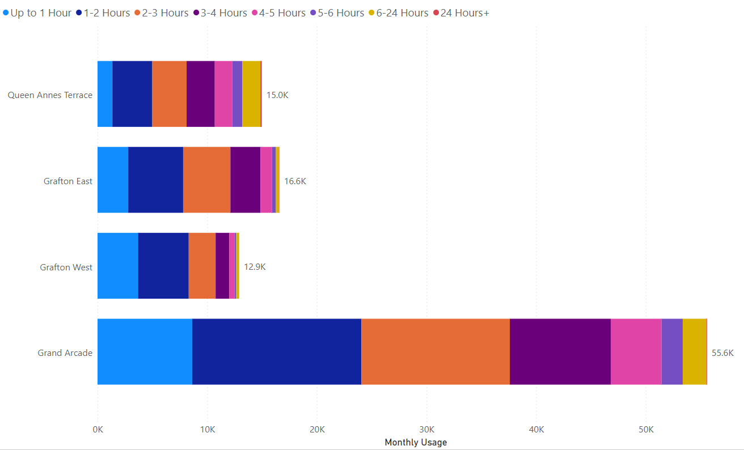
Car Parking: Length of Stay by Car Park
In December 2023, Grafton West had the highest proportion of stays under 3 hours (83%) whilst Queen Anne’s Terrace had the lowest proportion (54%). Grand Arcade remains comfortably the most popular car park – with over 55,000 transactions recorded in December 2023.
Notes:
Source: Cambridge City Council Car Parking data
Technical notes: School holidays, bank holidays and any other "non neutral" days are not included in calculations for this chart.
Commentary:
83% of December 2023 visits to Grafton West lasted less than three hours – making it the most likely facility to be used for short stays.
Queen Anne's Terrace is the facility with the highest proportion of long stays, with 46% of December 2023 visits lasting more than three hours.
Grand Arcade is comfortably the most popular multi storey car park facility in Cambridge – with more than 55,000 patrons in December (neutral days only).

Slide 45
Rail Passengers

Slide 46
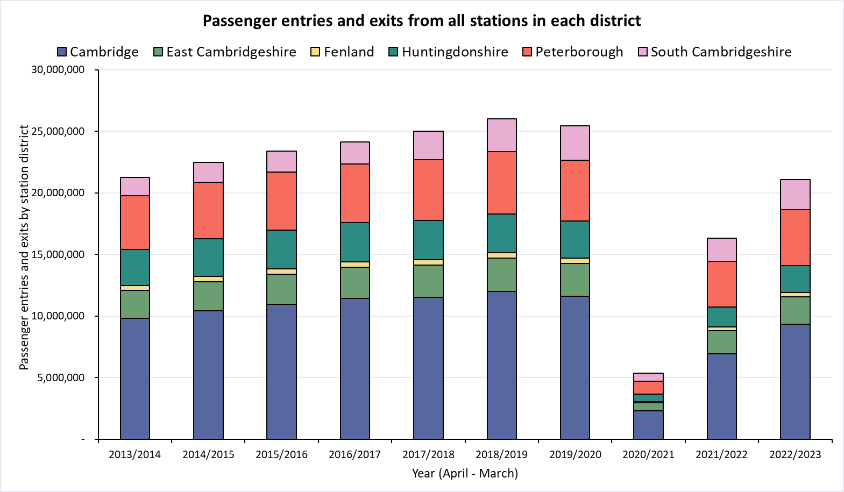
Rail Passengers: Usage
Railway station entries and exits across Cambridgeshire are still below pre-COVID (2018/19) volumes. Huntingdonshire (-30%) presents the largest fall since pre-COVID, while South Cambridgeshire (-7%) is closest to pre-COVID.
District | Cambridge | East Cambridgeshire | Fenland | Huntingdonshire | Peterborough | South Cambridgeshire
Pre-COVID to Now: 2018/19* to 2022/23
-22%
-19%
-22%
-30%
-11%
-7%
*2018/19 used as the pre-COVID baseline as 2019/20 entries and exit data is affected in March 2020 by the first COVID-19 lockdown.
Notes:
Source: Rail statistics, ORR. Table 1415a
Technical note: Rail Passenger annual data runs April – March and is released in April each year. As such, 2018/19 is used as the pre-COVID baseline as 2019/20 entries and exit data is affected in March 2020 by the first COVID-19 lockdown.
Commentary: Rail usage overall is down on pre-Covid baselines. Stations in Huntingdonshire have seen the largest decrease in passenger entries and exits, presenting as 30% below 2018/19 figures. Stations in South Cambridgeshire have the smallest decline when compared to 2018/19 levels, showing only a 7% decrease.

Slide 47
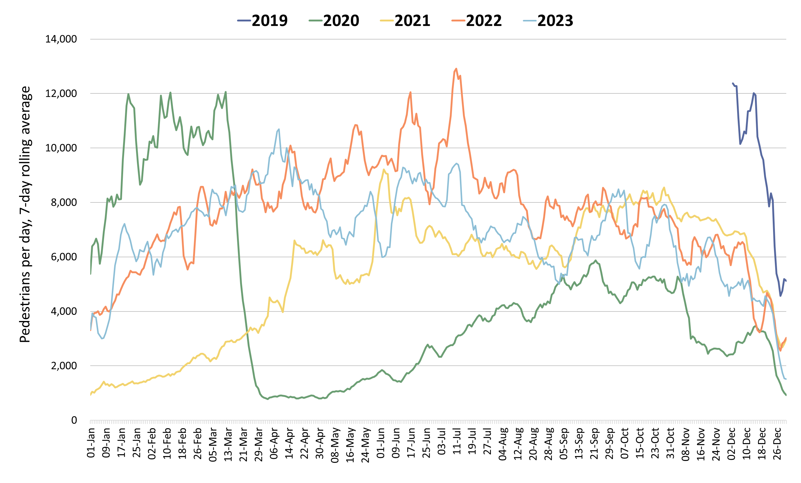
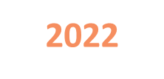
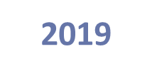
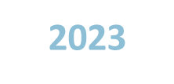
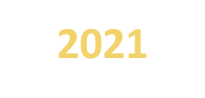
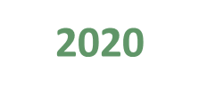


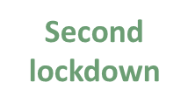
One Station Square Footfall
One Station Square footfall is 57% below pre-Covid (December 2019) and is 12% below last year (December 2022).
This is likely due to disruption to rail services caused by engineering works at Cambridge Station beginning in September 2023.
Footfall at One Station Square (directly outside Cambridge train station)
Pre-COVID to Now:
Dec 2019 to Dec 2023
Mon-Sun | Weekdays (Mon-Thu) | Weekends (Sat-Sun)
-57% | -61% | -53%
Mid-COVID to Now:
Dec 2021 to Dec 2023
Mon-Sun | Weekdays (Mon-Thu) | Weekends (Sat-Sun)
-20% | -22% | -20%
Previous year to Now:
Dec 2022 to Dec 2023
Mon-Sun | Weekdays (Mon-Thu) | Weekends (Sat-Sun)
-12% | -25% | +22%
Notes:
Source: Cambridge BID footfall data​
Technical note: Table calculations do not include bank holidays, school holidays, or any other "non neutral" days. The One Station Square sensor was fitted in December 2019 so pre-COVID data is not available for all months. For September comparisons, we use February 2020 as that is technically the ‘closest’ month to June out of all available pre-Covid months, but we acknowledge the comparison is not ideal. Data may be impacted by strike action. As outlined at the start of this slide pack, 'weekdays' do not include Fridays.
Commentary:
Footfall at One Station Square during December 2023 was 57% down on pre-Covid (December 2019) levels.
Compared to December 2022, footfall levels have decreased by 12% overall – with weekends 22% lower than this time last year. Weekdays (Mon-Thu), meanwhile, are 25% down in comparison to December 2022.
Overall December 2023 footfall levels at One Station Square are 20% below mid-Covid (December 2021).
Recent low figures are likely caused (partially) by the engineering works currently being undertaken at Cambridge Station.

Slide 48
Bus Passengers

Slide 49

Bus Passengers in Cambridgeshire and Peterborough
Bus passenger volumes remain below pre-COVID but are gradually increasing. The number of bus passengers decreases during school holidays.
Stagecoach CPCA Area Bus Passengers
2019-20
£2 bus fare cap introduced by the government (1st Jan 2023)
2023-24
Cambridge
Pre-COVID to Now:
2022-23
Dec 2019 to Dec 2023
-13%
2021-22
Bus Passengers
Peterborough
Pre-COVID to Now:
Dec 2019 to Dec 2023
-18%
Second lockdown
First lockdown continued
2020-21
Third lockdown
First lockdown begins
May
Jun
Jul
Aug
Sep
Oct
Nov
Dec
Jan
Feb
Mar
Apr
Due to the commercial sensitivity of this data, bus passenger volumes are not marked on the y-axis of this graph.
Notes:
Source: Stagecoach
Technical note: Due to the commercial sensitivity of this data, bus passenger volumes are not marked on the y-axis of this graph.
Commentary: Bus passenger numbers have continued to rise through 2023 but are still not back to pre-COVID volumes. Bus passenger numbers fell in December in line with other reported years, suggesting that the Christmas holidays and winter weather have an impact. In January 2023, the government announced a £2 cap on single tickets (£2 bus fare cap - GOV.UK (www.gov.uk)).

Slide 50

Bus Passengers: Park and Ride
Usage of all P&R sites has increased month-on-month in 2023 with a particular peak in the May and October half terms and the summer holidays.
Babraham Road and Trumpington are the most popular sites, with usage now similar to pre-COVID (2019).
Stagecoach Park and Ride Passengers
2019
2020
2021
2022
2023
Second lockdown
P&R Passengers
Third lockdown
First lockdown
Milton Rd bus service temporarily suspended
Due to the commercial sensitivity of this data, bus passenger volumes are not marked on the y-axis of this graph.
Notes:
Source: Stagecoach
Technical note: Due to the commercial sensitivity of this data, bus passenger volumes are not marked on the y-axis of this graph.
Commentary: P&R passengers generally sees a sharp increase during the school holidays. In January 2023, the government announced a £2 cap on single tickets (£2 bus fare cap - GOV.UK (www.gov.uk)).
MAD=Madingley Road P&R
NEW = Newmarket Road P&R
TRU = Trumpington P&R
BAB = Babraham Road P&R
MIL = Milton Road P&R

Slide 51

Bus Passengers: Park and Ride by Site
Park and Ride site usage has exceeded pre-COVID levels across most sites. Madingley Road and Newmarket Road show the largest increases on pre-COVID volumes at +21% and +16% respectively.
All P&R Sites
Dec 2019 to Dec 2023
+7%
Milton Road P&R
Dec 2019 to Dec 2023
-5%
Madingley Road P&R
Dec 2019 to Dec 2023
+21%
Newmarket Road P&R
Dec 2019 to Dec 2023
+16%
Babraham Road P&R
Dec 2019 to Dec 2023
Trumpington Road P&R
Dec 2019 to Dec 2023
-7%
+13%
© OpenStreetMap Contributors
Notes:
Source: Stagecoach

Slide 52
Micro-mobility

Slide 53



E-scooters and E-bikes in Cambridge
December 2023 saw just under 80,000 Voi rides. Weekdays continue to see peaks in travel around 8am and 5pm, suggesting use for commuting/education. The weekends see a mid-afternoon peak. Throughout 2023, the 26-39 age group has consistently seen the largest number of riders.
Voi have operated an electric bike (e-bike) and electric scooter (e-scooter) trial scheme in Cambridge City since October 2020.
December 2023 key statistics
Total
journeys:
79,230
Total distance:
190,700 km
Returning users:
15,350
New
users:
2,000
Notes:
Source: Voi monthly updates and Voi dashboard

Slide 54
Air Quality

Slide 55

Air Quality Monitoring Locations
Continuous Air Quality Monitoring Sites, Cambridge
Location | Description
Montague Road | Close to the junction with Elizabeth Way
Newmarket Road | Close to Cambridge Retail park on Newmarket Road.
Parker Street | Close to the bus station
Regent Street | To the West of Parker’s Piece
Gonville Place | Near Hill’s Road, South of Parker’s Piece. This sensor was removed in April 2022 so data is no longer available for this site.
Cambridge City Air Quality team provide data from 4 continuous air quality monitors in central Cambridge. The monitors primarily measure Nitrogen Oxides (NOx) and Particulate Matter (PM) which are proxies for overall air quality.
© OpenStreetMap Contributors
Notes:
Source: Cambridge City Air Quality team. Data for the Cambridge air quality continuous monitors can also be found at: Air quality in England (airqualityengland.co.uk).
Technical note: Please note there may be slight differences between the data on Air Quality in England and data in this pack as air quality data undergoes a ratification process.

Slide 56

Air Quality: All Sites
NO₂ concentrations remained below the 2017-2019 baseline level throughout 2023. December 2023 is 40% below the baseline and lower than December concentrations in the previous three years.
Monthly average NO₂ concentration across the continuous monitoring sites
Pre-COVID to Now: | Mid-COVID to Now: | Last year to Now:
Dec 2017-19 baseline to Dec 2023 | Dec 2021 to Dec 2023 | Dec 2022 to Dec 2023
-40% | -19% | -24%
*Data for Gonville Place is only included in the 2022 line until March 2022 as the sensor was removed in April 2022.
Notes:
Source: Cambridge City Air Quality team. Data for the Cambridge air quality continuous monitors can also be found at: Air quality in England (airqualityengland.co.uk).
Technical note: Analysis based on 5 sensors: Gonville Pl, Montague Rd, Newmarket Rd, Regent St and Parker St. Data for Gonville Place is included in the averages for all values before it was removed in April 2022. Please note there may be slight differences between the data on Air Quality in England and data in this pack as air quality data undergoes a ratification process.
Please note: data was temporarily unavailable from 13th December 2023 – 4th January 2024 at the Newmarket Road sensor.

Slide 57

Air Quality: Individual Sites
NO₂ concentrations have increased in all locations since the summer of 2023, likely in part due to expected seasonal variations. Regent Street saw a particularly notable peak in November 2023 but concentrations had reduced again by December 2023.
Monthly average NO₂ concentration by site
Location | Pre-COVID to Now: | Mid-COVID to Now: | Last year to Now:
 | Dec 2017-19 baseline to Dec 2023 | Dec 2021 to Dec 2023 | Dec 2022 to Dec 2023
Montague Road | -42% | -28% | -50%
Newmarket Road | -36% | +9% | +14%
Parker Street | -46% | -12% | -14%
Regent Street | -35% | -38% | -30%
Gonville Place | No 2023 data | No 2023 data | No 2023 data
Notes:
Source: Cambridge City Air Quality team. Data for the Cambridge air quality continuous monitors can be found at: Air quality in England (airqualityengland.co.uk).
Technical note: The Gonville Place sensor was removed in April 2022 so there is no data for this site from May 2022 onwards. Please note there may be slight differences between the data on Air Quality in England and data in this pack as air quality data undergoes a ratification process.
Please note: data was temporarily unavailable from 13th December 2023 – 4th January 2024 at the Newmarket Road sensor.

Slide 58
policyandinsight@cambridgeshire.gov.uk

