Slide 1
Homelessness Trends - Annual Review 2022-23
Homelessness data from across the Sub Regional Local Housing Authorities

Slide 2
Homelessness 2022-23
Figures cover all LHAs in Sub region
Noticeable different trends between councils
More detailed analysis drilling down to LA level – will be analysed by S/R Homelessness Group
Notes:
Explain timeline of prevention – Relief – Main duty

Slide 3
Homelessness 2022-23
Overall in 22/23 …..
7% increase in the number of homelessness duties (prevention plus relief) compared to 21/22.

Slide 4
At Prevention Duty Stage
Households owed prevention duty in 2022-23 | % change against 2021-22 | National position - % change against 2021-22
2,864 | 15% increase | 5% increase
November 3, 2023

Slide 5
At Relief Duty Stage
Households owed relief duty in 2022-23 | % change against 2021-22 | National position - % change against 2021-22
2,468 | 2% decrease | 9% increase
November 3, 2023

Slide 6
At Main Duty Stage
Households owed relief duty in 2022-23 | % change against 2021-22 | National position - % change against 2021-22
1,105 | 8% increase | 3% increase
November 3, 2023

Slide 7
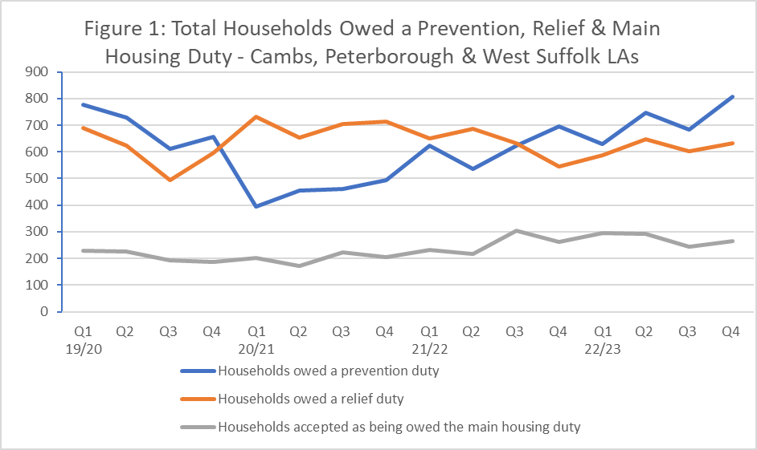
November 3, 2023

Slide 8
Causes of Homelessness – Prevention Duty
November 3, 2023
Notes:
Main causes of homelessness are same 2 as last year (and as nationally)
Family or friends unable to accomm – 29% of all cases – 823 apps which was 29% higher than last year
End of PRS tenancies – 34% all cases – 961 apps – 40% higher than last year
Other notable variances:
Non-violent relationship breakdown down 18% compared to last year
Domestic Abuse down 3%

Slide 9
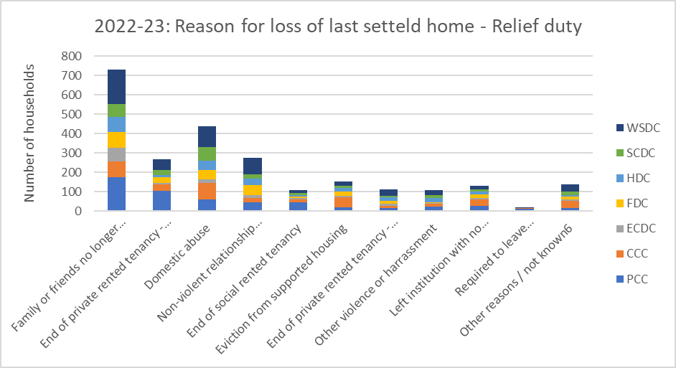
Causes of Homelessness – Relief Duty
November 3, 2023
Notes:
Main cause @ relief duty was Family or friends unable to accomm – 18% of all cases – 730 apps which was 5 % reduction on last year
DA was second largest cause at this stage - 18% all cases – 439 apps – 5% reduction
Other notable variances and although it was comparably smaller numbers:
Eviction from social tenancies – 107 apps which was an increase of 55%
Whereas in 2021/22 more instances were at the relief duty stage this has shifted in 22/23 so that homelessness assistance and duties are being triggered at prevention stage.

Slide 10
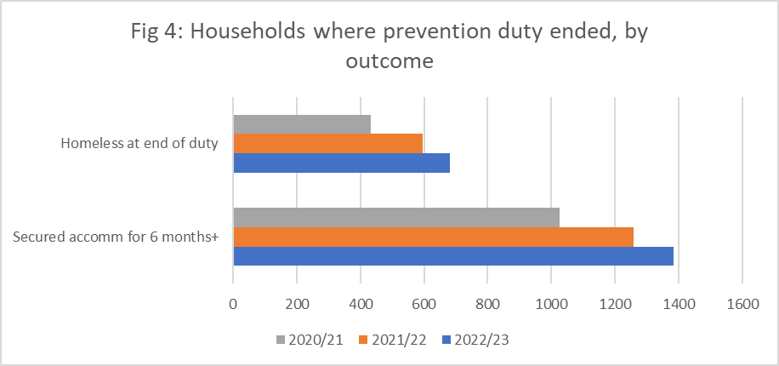
Outcomes – Prevention Duty
November 3, 2023
Notes:
As you’d expect with more prevention duties being triggered in the year – there were more outcomes
50% of prevention duties ending were as a result of accommodation being secured at that stage (national figure is 53% successes)
25% of households became homeless at the end of the prevention duty and were then owed the relief duty (24% nationally)

Slide 11
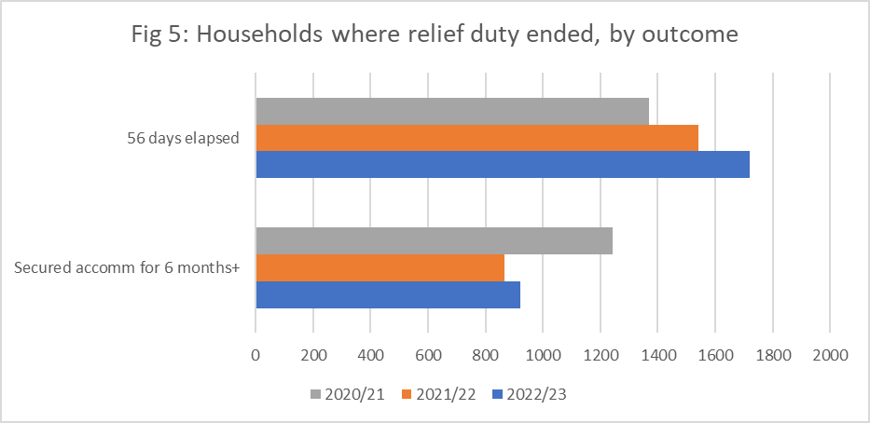
Outcomes – Relief Duty
November 3, 2023
Notes:
30% of outcomes at relief stage were successful with accommodation being secured – compared to 34% in previous year – compares to 36% nationally
In 55% of cases homelessness wasn’t resolved and the councils then considered whether the main housing duty was owed

Slide 12
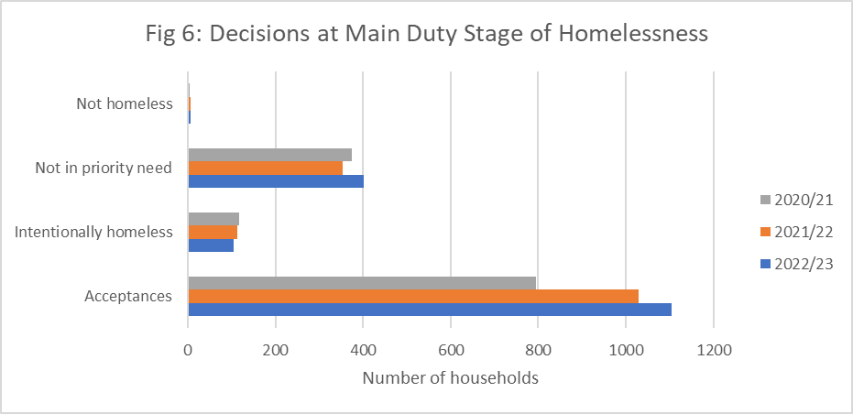
Decisions at Main Duty
November 3, 2023
Notes:
68% of applications assessed as being owed the main housing duty – with commitment to help secure longer term housing.
Compares to 69% of cases last year.

Slide 13
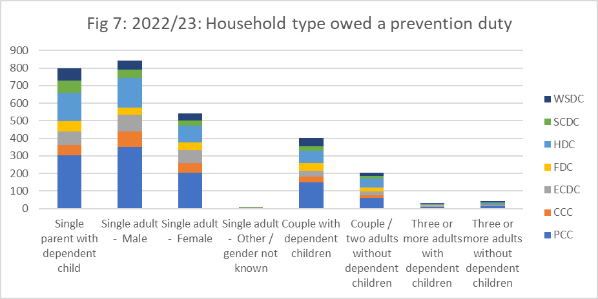
Household types – Prevention Duty
November 3, 2023
Notes:
Two largest household types:
Single men 29%
Single parent with dependant child 28%
Both comparable to last year

Slide 14
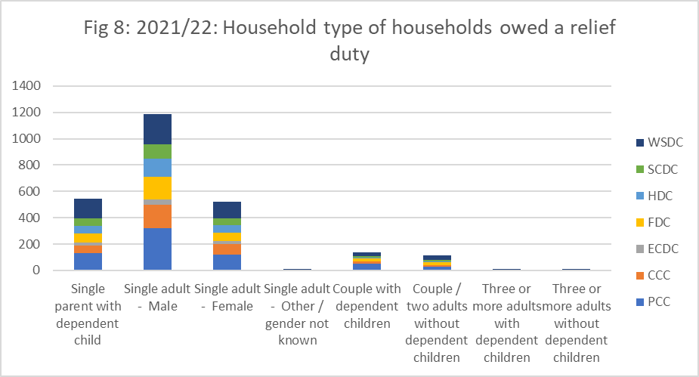
Household types – Relief Duty
November 3, 2023
Notes:
By far largest household type is single men 48% of all cases
More than double the number of the next two largest household types
Single parent with dep child and single female – both 21% of cases and comparable to last year.

Slide 15
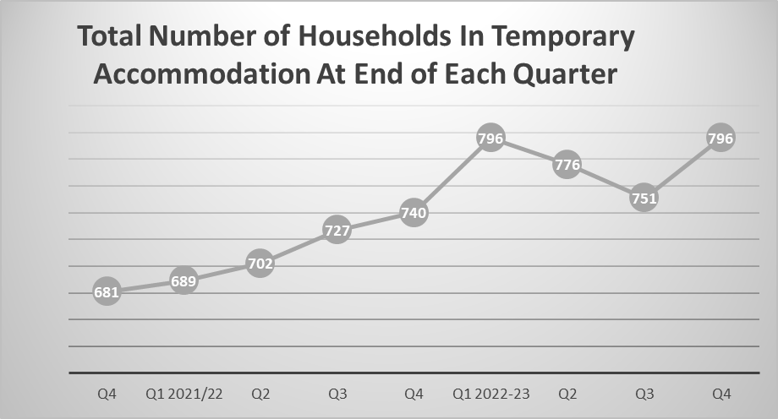
November 3, 2023
Notes:
Number of households in TA saw a reduction in Q’s 2 & 3 – but an increase in Q4 an back to same position as at beginning of year.
If we look back over a 2 year period from Apr 2021 to end of March 2023 we’ve seen a 17% rise in the number of households in TA

Slide 16
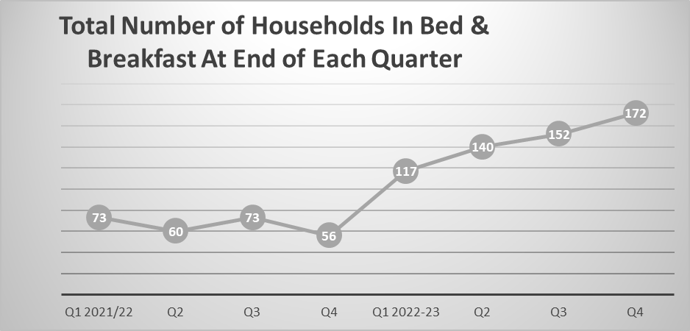
November 3, 2023
Notes:
A worrying trend is the increase in use of B&B accommodation
Number of households in B&B at end of March 22 was 56 – at the end of March 23 this had increased to 172

Slide 17
Pressures
Demands
Limited Options
Increasing demand from s.21 notices – delays in Renters Reform Bill
HfU – hosting arrangements ending
Closure Afghan bridging hotels
Asylum seekers – increasing numbers of decisions and evictions from HO accomm
PRS options remaining unaffordable for many
Difficulties with accessing social rented – affordability assessments, risk assessments.
Insufficient temporary accomm to cope with demand – LAs competing for same TA
November 3, 2023

