Slide 1
Cambridgeshire and Peterborough
Overarching
Joint Strategic
Needs Assessment 2023
Summary

Slide 2
Recommendations
Fast growth with more to come
All service plans need to take account of recent substantial growth and additional future growth, bearing in mind that Cambridgeshire and Peterborough have high numbers of people moving here from outside the UK.
Big changes to the age structure of our population
Increasing numbers of older people should encourage the whole system to focus on prevention of ill health and disease, to reduce future demands on services. This is wider than just an NHS responsibility, it requires all parts of the public sector to enable healthy living and disease prevention.
The large increases in the numbers of children in our cities, and future increases in our rural areas, needs to be recognised and planned for by all parts of the public sector; early years, education, healthcare and children’s social care.
Overarching Joint Strategic Needs Assessment
Many overall health indicators have not improved
We should aim to turn the curve on high-level measures of health. This will require a much greater focus on prevention for all our residents, from infancy to later life. Improving health behaviour and addressing the wider determinants of health is key.
Patches of poorer health
All services across the public sector need to take account of how health and need varies across our areas, without overlooking the majority of residents who live outside the most at risk areas.

Slide 3
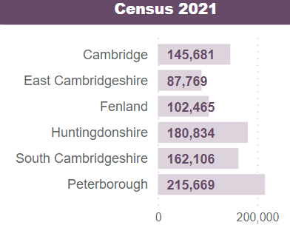
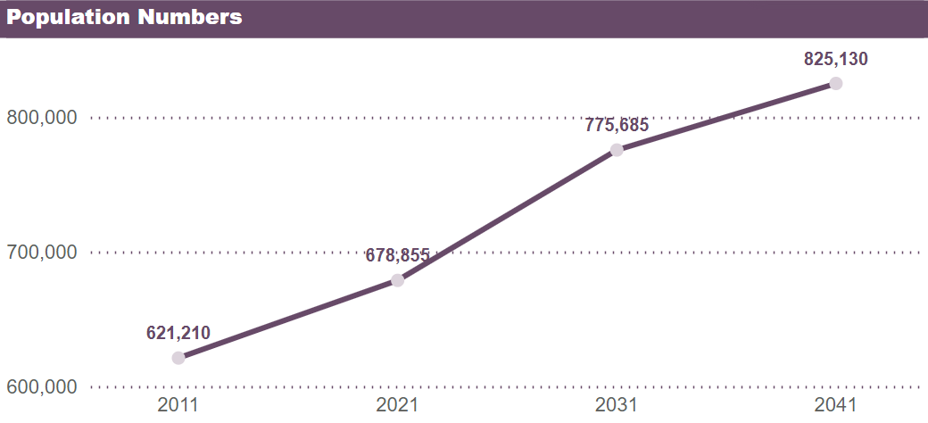
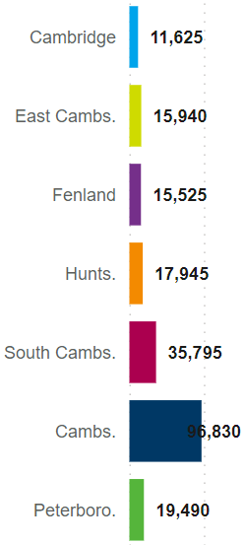
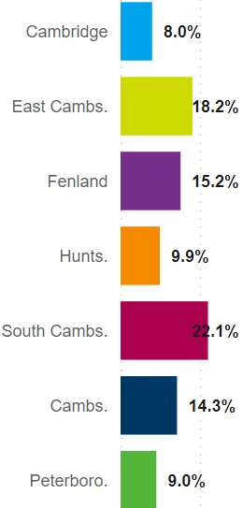
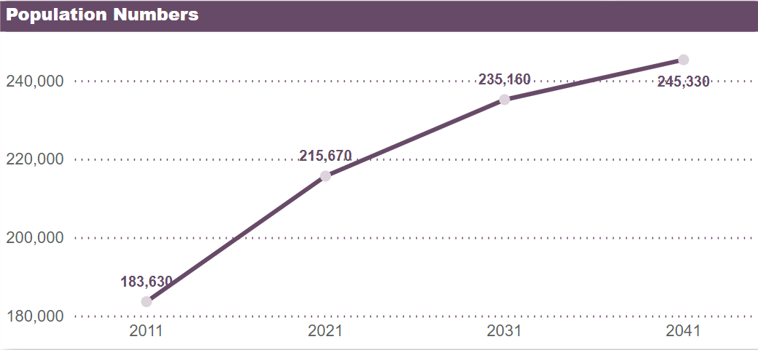
Fast growth with more to come
Change
from 2011
Cambridgeshire
The population of Cambridgeshire grew by 9.3% between 2011 and 2021 and it is expected there will be a larger proportional increase in the following 10 years (14.3%). However, this rate of increase is forecast to slow between 2031 and 2041 (6.4%).
All districts saw substantial increases between 2011 and 2021, most notably Cambridge. All districts, except Cambridge, are forecast to see a greater rate of increase to 2031, most notably in East and South Cambridgeshire.
+ 17.6%
+ 4.7%
+ 7.6%
+ 6.7%
+ 9.0%
+ 17.4%
+ 6.4%
+ 14.3%
Forecast: change in population 2021 to 2031
Forecast
additional people
Forecast % change
+ 9.3%
Peterborough
+ 4.3%
Peterborough experienced a large increase in its population between 2011 and 2021 (17.4%) and is forecast a slower rate of increase to 2031 (9.0%) followed by another slower period of growth to 2041 (4.3%).
+ 9.0%
96,830
+ 17.4%
https://cambridgeshireinsight.org.uk/jsna-2023/demography/age-structure-and-population-change/

Slide 4
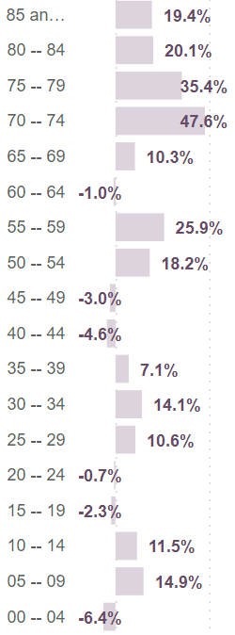
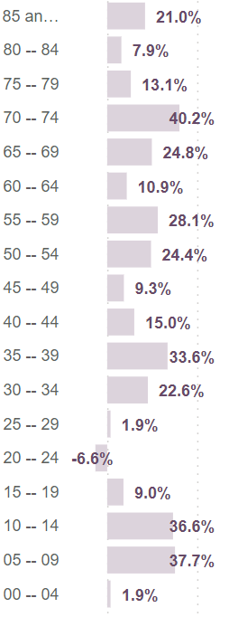
Big changes to the age structure of our population - past
Change in population 2011 to 2021 |  | Cambridgeshire |  | Peterborough
 | Children and young people (0-14 years) | ↑ | 6,655 | ↑ | 8,720
 |  |  | 6.3% |  | 23.8%
 | Working age adults (15-64 years) | ↑ | 24,630 | ↑ | 17,610
 |  |  | 5.9% |  | 14.4%
 | Older people (65+ years) | ↑ | 26,355 | ↑ | 5,710
 |  |  | 26.3% |  | 23.0%
Change by age band between 2011 and 2021
Change in population 2011 to 2021 | Children and young people | Working age adults | Older people
Cambridge
East Cambridgeshire
Fenland
Huntingdonshire
South Cambridgeshire
Cambridgeshire
Peterborough
Cambridgeshire & Peterborough
The population of Cambridgeshire grew by 9.3% between 2011 and 2021 and by 17.4% in Peterborough.
However, decreases were seen in some age bands.
Cambridgeshire:
preschool children
young people aged 15 to 19
people in their forties
pre-retirement age
Peterborough:
young adults aged 20 to 24
East Cambridgeshire and Huntingdonshire saw minimal changes in their population aged under 65 years but large increases in people over this age.
Peterborough experienced large population increases in all age cohorts.
All areas saw large increases in their older populations.
26.3%
https://cambridgeshireinsight.org.uk/jsna-2023/demography/age-structure-and-population-change/

Slide 5
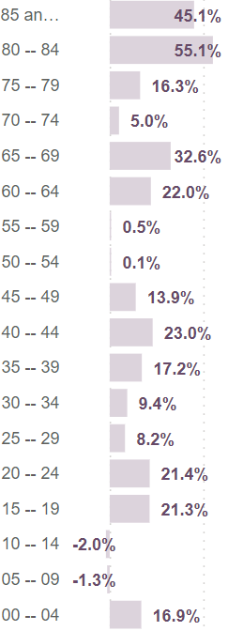
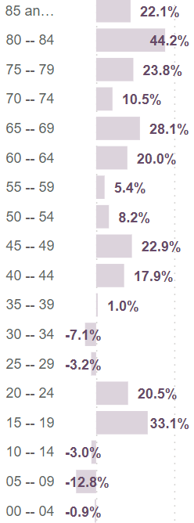
Big changes to the age structure of our population - future
Change in population 2021 to 2031 |  | Cambridgeshire |  | Peterborough
 | Children and young people (0-14 years) | ↑ | 4,515 | ↓ | 2,615
 |  |  | 4.0% |  | 5.8%
 | Working age adults (15-64 years) | ↑ | 58,630 | ↑ | 14,780
 |  |  | 13.3% |  | 10.6%
 | Older people (65+ years) | ↑ | 33,685 | ↑ | 7,325
 |  |  | 26.6% |  | 23.9%
Change by age band between 2021 and 2031
Forecast change in population 2021 to 2031 | Children and young people | Working age adults | Older people
Cambridge
East Cambridgeshire
Fenland
Huntingdonshire
South Cambridgeshire
Cambridgeshire
Peterborough
Cambridgeshire & Peterborough
The population of Cambridgeshire is forecast to grow by 14.3% between 2021 and 2031 and by 9.0% in Peterborough.
However, the changes are uneven across age bands with some expected to experience decreases:
Cambridgeshire:
Children aged 5 to 14
Peterborough:
Children aged under 15
Adults aged 25 to 39
Cambridge and Peterborough are predicted to see fewer children aged under 15 by 2031, with a minimal increase expected in Huntingdonshire. South Cambridgeshire is forecast to have large increases in all ages; mainly due to the development of new communities.
All areas are forecast to have large proportional increases in their older populations.
26.6%
https://cambridgeshireinsight.org.uk/jsna-2023/demography/age-structure-and-population-change/

Slide 6
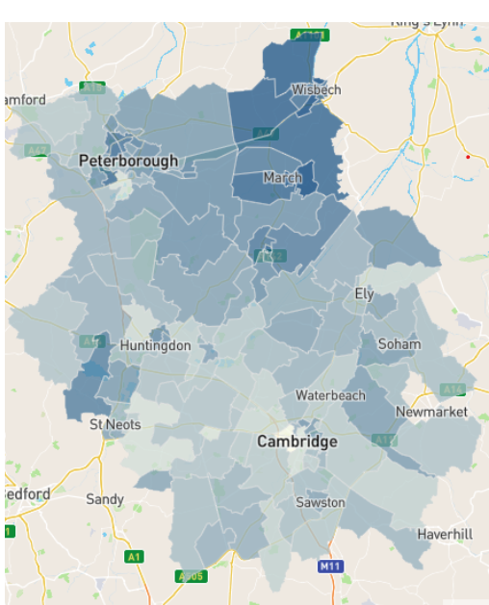
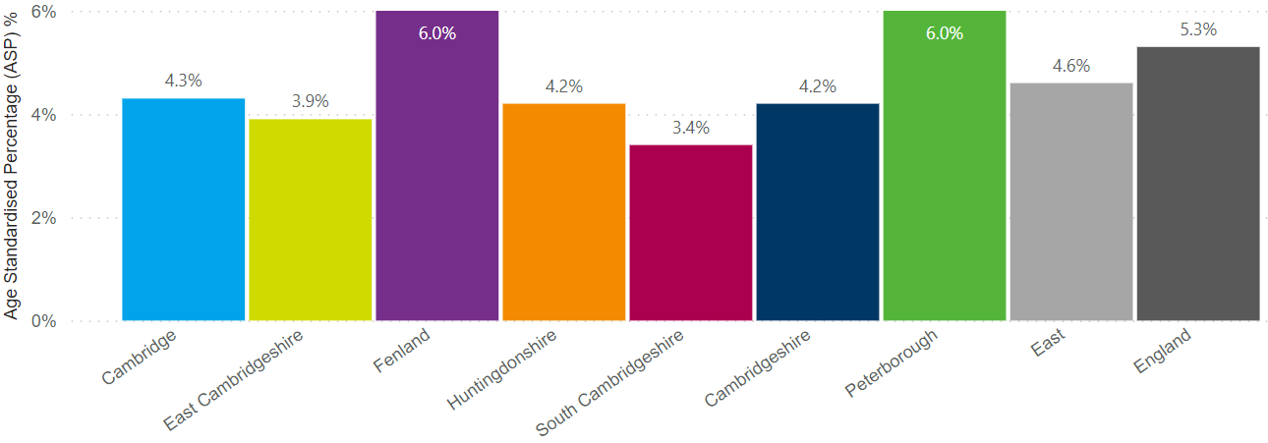
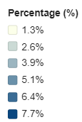
Patches of poorer health
Residents who reported they were in poor health, 2021
Residents who reported they were in ‘bad’ or ‘very bad’ health, 2021
Self-reported poor health varies from 3.4% of residents in South Cambridgeshire to 6.0% in Fenland and Peterborough
Highest in Fenland and central Peterborough with hotspots in other areas
People living with disability – day to day activities limited a lot, 2021
Disabled residents whose day-to-day activities are limited a lot varies from 5.1% in South Cambridgeshire to 7.9% in Peterborough and 8.4% in Fenland
https://cambridgeshireinsight.org.uk/jsna-2023/overarching-health-indicators/burden-of-disease/

Slide 7
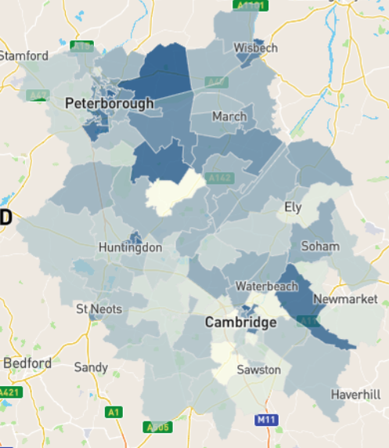
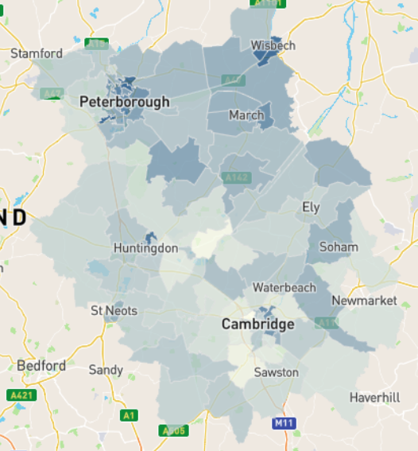
Patches of poorer health
Deaths from all causes, all ages, 2016-20
Deaths from causes considered preventable, under 75 years, 2016-20
Dark areas on the map show areas with higher mortality.
All age all-cause mortality is generally higher in Fenland, most notably around Wisbech, and the more urban areas of Peterborough - however there are other hotspots where mortality is higher than expected across Cambridgeshire and Peterborough.
Premature deaths that are considered preventable are highest in central Peterborough and Wisbech, with hotspots in Huntingdon and Cambridge.
Middle Super Output Area Standardised Mortality Ratio
Middle Super Output Area Standardised Mortality Ratio
Note: small densely populated areas may be overlooked due to their small size. Conversely low populated rural areas are larger in geographical size. Health measures for small areas are usually subject to considerable statistical uncertainty
https://cambridgeshireinsight.org.uk/jsna-2023/all-dashboards/jsna-2023-dashboard-local-health/

Slide 8
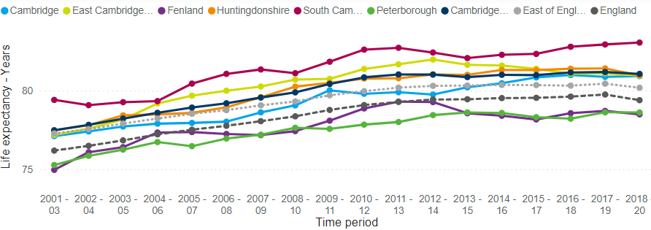
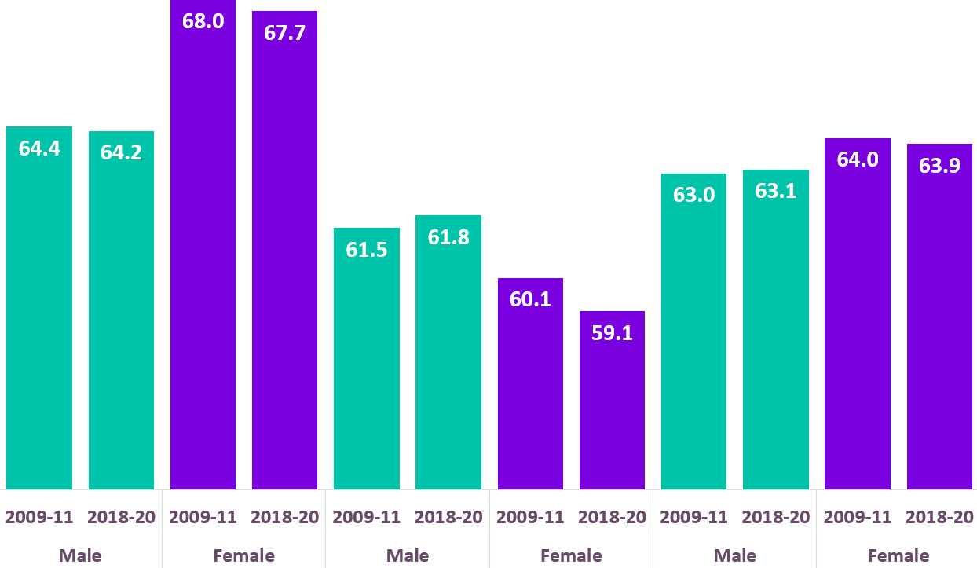
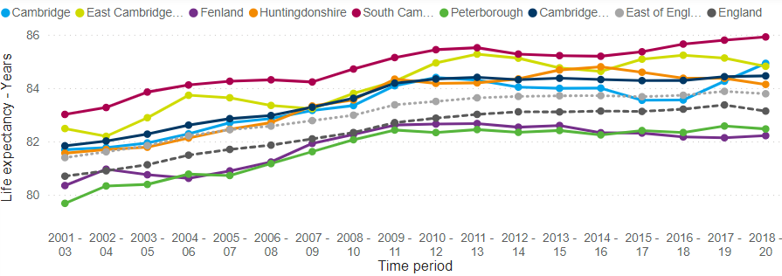
Many overall indicators have not improved
Life expectancy
There has been little change in life expectancy or healthy life expectancy over the last decade.
Fenland and Peterborough have low male and female life expectancy at birth compared to England.
Cambridge has the highest inequality in life expectancy between their most and least deprived areas, with trends showing a worsening picture (data not shown)
Life expectancy at birth
Life expectancy at birth 2018-20 - years
Cambridgeshire
Peterborough
England
81.1
84.5
78.6
82.5
79.4
83.1
Male
Healthy life expectancy at birth (years) – change over 9 years
Cambridgeshire
Peterborough
England
Female
https://cambridgeshireinsight.org.uk/jsna-2023/all-dashboards/jsna-2023-dashboards-life-expectancy/

Slide 9
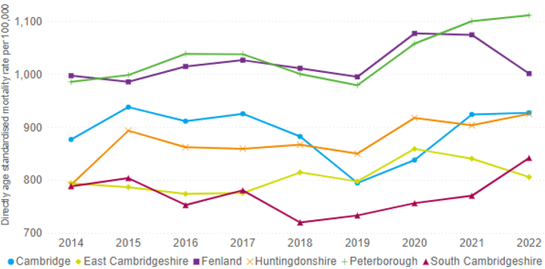
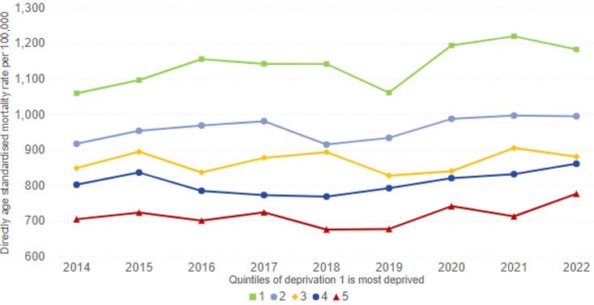
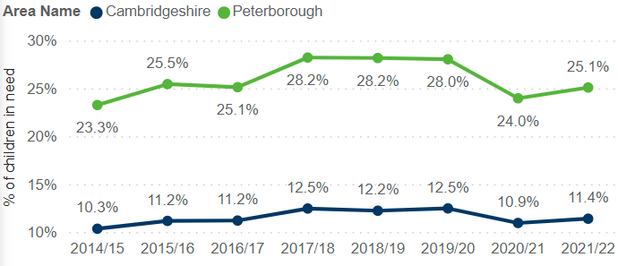
Many overall indicators have not improved
All-age all-cause mortality rates by district, persons
All-age all-cause mortality rates by deprivation, persons
Death rates fell between 2017 and 2019 but rose in 2020 due to deaths from COVID-19
Most deprived
Mortality rates are highest in the most relatively deprived 20% of areas and the difference remains large
Least deprived
Children living in relative low income
Change in self-reported poor health between 2011 and 2021
Increases in the proportion of children living in relative low income
Poor health has remained stable or increased over the last 10 years
https://cambridgeshireinsight.org.uk/jsna-2023/overarching-health-indicators/mortality-and-premature-mortality-overall-rates-and-causes/

Slide 10
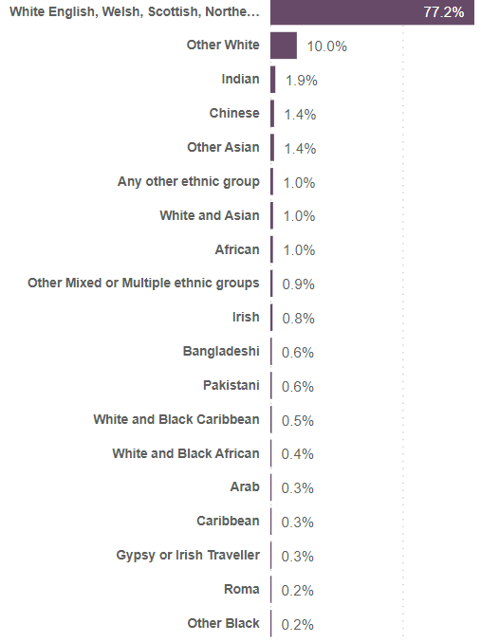
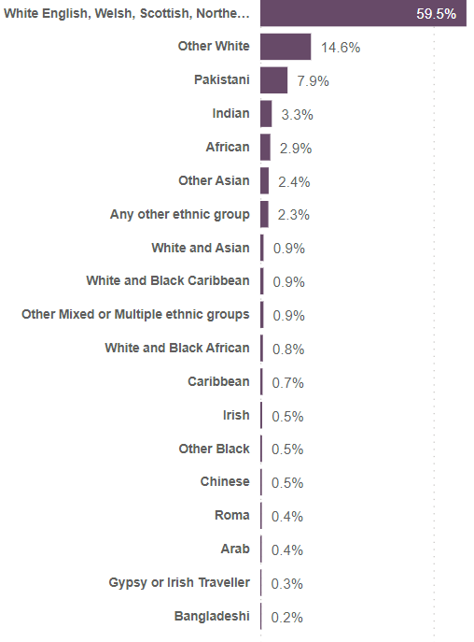
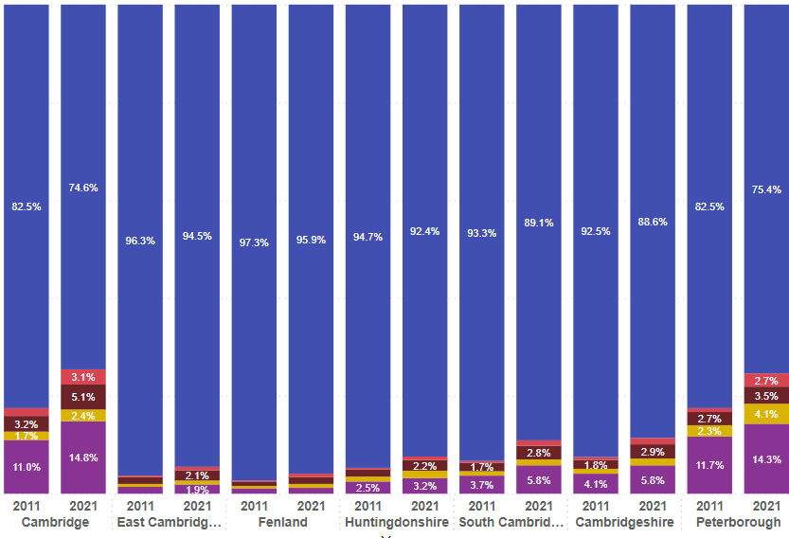
Other key facts - ethnicity
Cambridgeshire
Peterborough
Change in ethnicity between 2011 and 2021
Ethnic diversity has increased in all areas over the last 10 years
Ethnicity varies across Cambridgeshire and Peterborough
Top 3 ethnic groups (after White UK)
 | Cambridge | East Cambridgeshire | Fenland | Huntingdonshire | South Cambridgeshire | Cambridgeshire | Peterborough
1 | Other White | Other White | Other White | Other White | Other White | Other White | Other White
2 | Chinese | Irish | Any other ethnic | Indian | Indian | Indian | Pakistani
3 | Indian | Other Mixed or Multiple | Gypsy or Irish traveller | African | Other Asian | Chinese | Indian
https://cambridgeshireinsight.org.uk/jsna-2023/demography/ethnicity-and-languages/

Slide 11
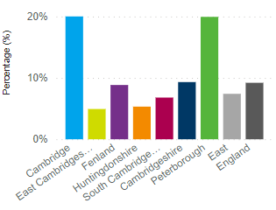
Other key facts - languages
Main language is not English
Main language is not English and cannot speak English well or at all
20% of residents in Cambridge and Peterborough do not have English as their main language …
… but proficiency in English is high in Cambridge. Fenland and Peterborough have high proportions of residents who cannot speak English well or at all.
Top 3 languages spoken
(excluding English)
Top 3 countries of birth
(excluding England)
 | Cambridge | East Cambridgeshire | Fenland | Huntingdonshire | South Cambridgeshire | Cambridgeshire | Peterborough
1 | Spanish | Polish | Lithuanian | Polish | Polish | Polish | Polish
2 | Polish | Romanian | Polish | Romanian | Romanian | Lithuanian | Lithuanian
3 | Italian | Lithuanian | Russian | Lithuanian | Spanish | Romanian | Portuguese
Cambridgeshire |  | Peterborough
1 | Poland | 1 | Poland
2 | Scotland | 2 | Lithuania
3 | India | 3 | Pakistan
https://cambridgeshireinsight.org.uk/jsna-2023/demography/ethnicity-and-languages/

Slide 12
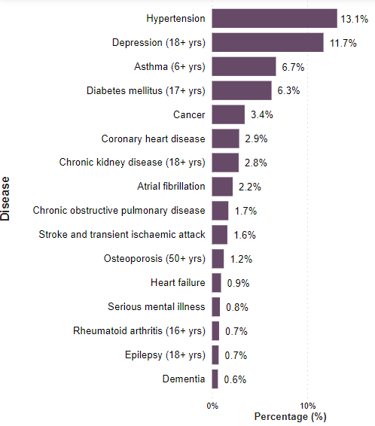
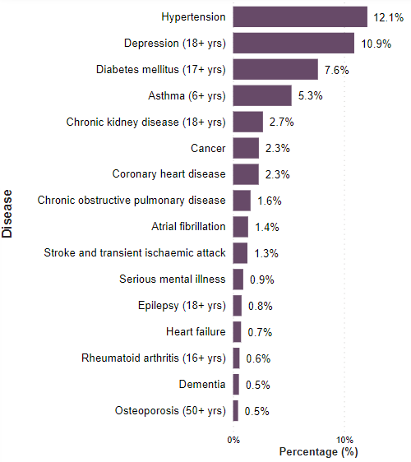
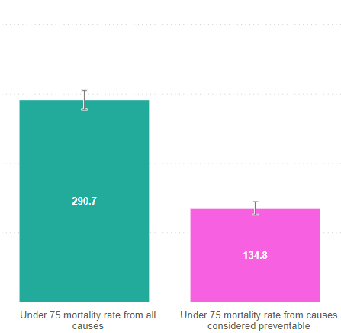
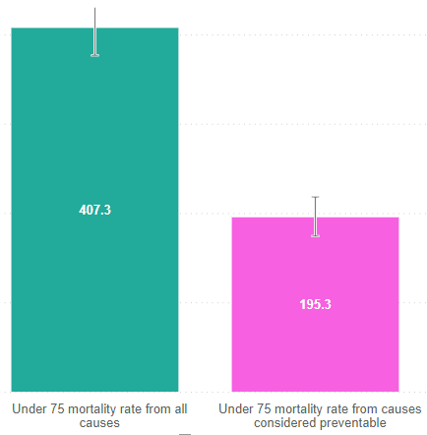
Other key facts - health
Recorded health conditions on GP registers
Preventable causes of mortality
Cambridgeshire
Peterborough
Cambridgeshire
Peterborough
Condition
Condition
Almost half of premature deaths (under 75) are considered preventable through public health and primary prevention interventions. For examples, cancer deaths attributable to asbestos exposure or liver disease deaths attributable to alcohol use.
Hypertension and depression are the most common conditions on GP registers
https://cambridgeshireinsight.org.uk/jsna-2023/all-dashboards/

Slide 13
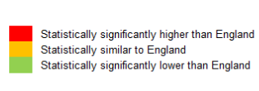
How do we compare against similar areas?
Healthy Life Expectancy at birth, males, 2018-2020
Cambridgeshire
These charts present healthy life expectancy in males in Cambridgeshire and Peterborough compared to their CIPFA statistical neighbours (a feature available in the majority of JSNA dashboards)
Male healthy life expectancy is within the middle of the range of local authorities in Cambridgeshire and towards the top of the range in Peterborough. This shows that there is room for improvement in both areas.
Peterborough
https://cambridgeshireinsight.org.uk/jsna-2023/all-dashboards/

Slide 14
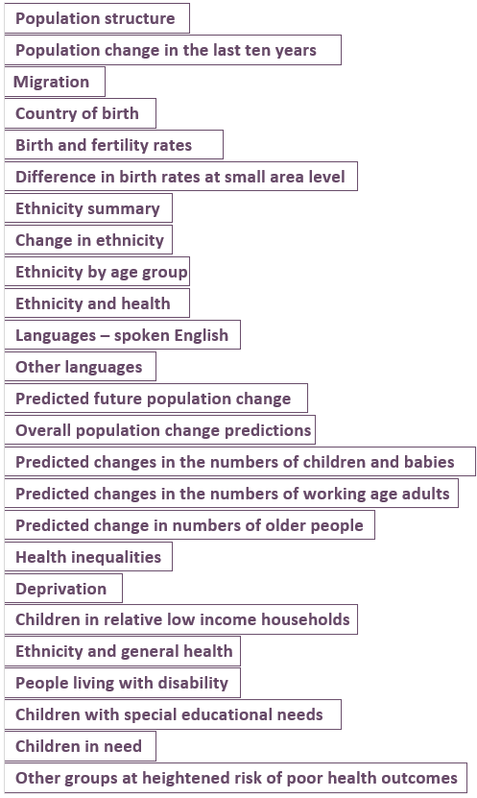
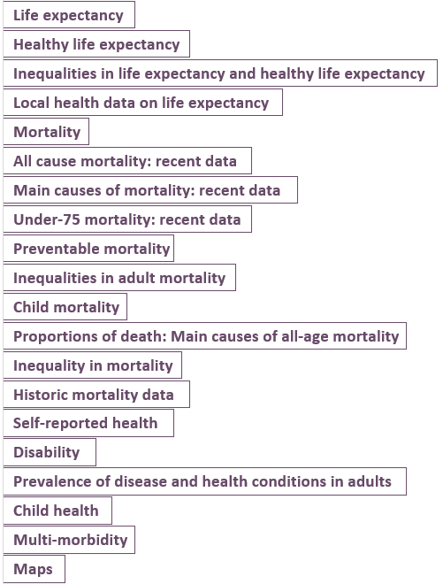
What is available in the JSNA?
Demography
Overall health
Age structure
and population change
Life expectancy and healthy life expectancy
Mortality and
premature mortality
Ethnicity and languages
Predicted future change
Disease and poor health
Inequality groups
Local health
https://cambridgeshireinsight.org.uk/jsna-2023/all-dashboards/

Slide 15
Future needs assessments
JSNAs (needing sign off by the Health and Wellbeing Board) | Other planned needs assessments
Children and young people JSNA (April 2024) Healthy Places JSNA (April 2024) Mental Health JSNA (July 2024) | Sexual and reproductive health (Feb 24) Health behaviour services needs assessment Serious Violence needs assessment (going to High Harms Board)
Potential future needs assessments
Older Adults JSNA Alcohol prevention JSNA Poverty and deprivation

Slide 16
Cambridgeshire in 2021
Population | Number of people |  |  |  |  |  | Demography | Life expectancy at birth |  | Health | Poor health
 | 678,855 |  |  |  |  |  |  | Male | Female |  | 4.2%
 | Proportion of population by age group |  |  |  |  |  |  | 81.1 years | 84.5 years |  | Day-to-day activities limited a lot
 | Children (0-14 years) |  | Working age (15-64 years) |  | Older (65+ years) |  |  | Births | Deaths |  | 6.1%
 | 16.5% |  | 64.9% |  | 18.6% |  |  | 6,677 | 5,931 |  | Recorded prevalence
 | Change in population 2011-2021 |  |  |  |  |  |  | Non-white ethnicity |  |  | Hypertension | Depression
 | Total | Children |  | Working |  | Older |  | 11.4% |  |  | 13.1% | 11.7%
 | +9.3% | +6.3% |  | +5.9% |  | +26.3% |  | Born outside of England |  |  | Diabetes | Asthma
 | Forecast population change 2021 to 2031 |  |  |  |  |  |  | 21.5% |  |  | 6.3% | 6.7%
 | Total | Children |  | Working |  | Older |  | Main language is not English | Languages spoken |  | Main causes of death
 | +14.3% | +4.0% |  | +13.3% |  | +26.6% |  | 9.3% | 85+ |  | Cancer 27.8% | Cardiovascular 25.0%
https://cambridgeshireinsight.org.uk/jsna-2023/

Slide 17
Peterborough in 2021
Population | Number of people |  |  |  |  |  | Demography | Life expectancy at birth |  | Health | Poor health
 | 215,670 |  |  |  |  |  |  | Male | Female |  | 6.0%
 | Proportion of population by age group |  |  |  |  |  |  | 78.6 years | 82.5 years |  | Day-to-day activities limited a lot
 | Children (0-14 years) |  | Working age (15-64 years) |  | Older (65+ years) |  |  | Births | Deaths |  | 7.9%
 | 21.0% |  | 64.8% |  | 14.2% |  |  | 2,668 | 1,801 |  | Recorded prevalence
 | Change in population 2011-2021 |  |  |  |  |  |  | Non-white ethnicity |  |  | Hypertension | Depression
 | Total | Children |  | Working |  | Older |  | 24.6% |  |  | 12.1% | 10.9%
 | +17.4% | +23.8% |  | +14.4% |  | +23.0% |  | Born outside of England |  |  | Diabetes | Asthma
 | Forecast population change 2021 to 2031 |  |  |  |  |  |  | 30.2% |  |  | 7.6% | 5.3%
 | Total | Children |  | Working |  | Older |  | Main language is not English | Languages spoken |  | Main causes of death
 | +9.0% | -5.8% |  | +10.6% |  | +23.9% |  | 20.0% | 85+ |  | Cancer 25.8% | Cardiovascular 24.3%
https://cambridgeshireinsight.org.uk/jsna-2023/

