Slide 1



Family Hubs Data Pack
December 2023
Children and Young People’s Public Health Team
sian.cowell@cambridgeshire.gov.uk

Slide 2
CONTENTS
Background (Slide 3)
Health and Wellbeing Strategy (Slide 4)
Population Data (Slides 5-9)
Education and Child Development (Slides 10- 25)
Health Outcomes (Slides 26-31)
Perinatal Mental Health and Parent-Infant Relationships (Slides 32-49)
Infant Feeding (Slides 50-57)

Slide 3
BACKGROUND
Aim: To understand the needs of local families to help inform the development of the Family Hubs Model in Peterborough and Cambridgeshire.
Family Hubs and Start For Life:
75 Local Authorities were identified for TF2 funding​ including 5 local authorities in the Eastern region – Luton, Bedford, Norfolk, Peterborough and Thurrock. A decision was made in Cambridgeshire to start to work towards a Family Hubs offer there as well as funding allows.​
The Family Hubs programme aims to deliver on the government’s commitments as set out in ‘The Best Start for Life: A Vision for the 1,001 Critical Days’. A Family Hub supports families from conception, through the child’s early years, to later childhood, up to the age of 19 (or 25 for young people with special educational needs and disabilities). ​Family Hubs can support all families, particularly in the first 1,001 days, but they are designed to be particularly accessible to families from lower socio-economic groups, families who have special education needs or a disability, or those from minority groups who are experiencing exclusion.
There are four funded elements:
Parenting Support (for parents of children aged 0-2)​
Parent–infant relationships and perinatal mental health support:
Early language and the home learning environment (HLE)
Infant feeding support
The information for the Needs Assessment has been collated in partnership with key local stakeholders including charities supporting local families, service providers, health, early years, child and family centres, the perinatal and infant mental health network.
Family Hubs and Start for Life programme: local authority guide - GOV.UK (www.gov.uk)

Slide 4
THE FAMILY HUBS PROGRAMME WILL:
CYP OUTCOMES, SEPTEMBER 2023
provide support to parents and carers so they are able to nurture their babies and children, improving health and education outcomes for all
contribute to a reduction in inequalities in health and education outcomes for babies, children and families across England by ensuring that support provided is communicated to all parents and carers, including those who are hardest to reach and/or most in need of it
build the evidence base for what works when it comes to improving health and education outcomes for babies, children and families in different delivery contexts
Maternity.
Children and young people lead healthy lives.
Children and young people are safe from harm.
Children and young people are confident, resilient, thrive in their learning and are prepared for adulthood.
Children and young people engage actively and positively in their communities as young adults.
CYP-Outcomes_Sept2023-Cambs-Insight.2.xlsx (live.com)
Family Hubs and Start for Life Programme Guide (publishing.service.gov.uk)

Slide 5
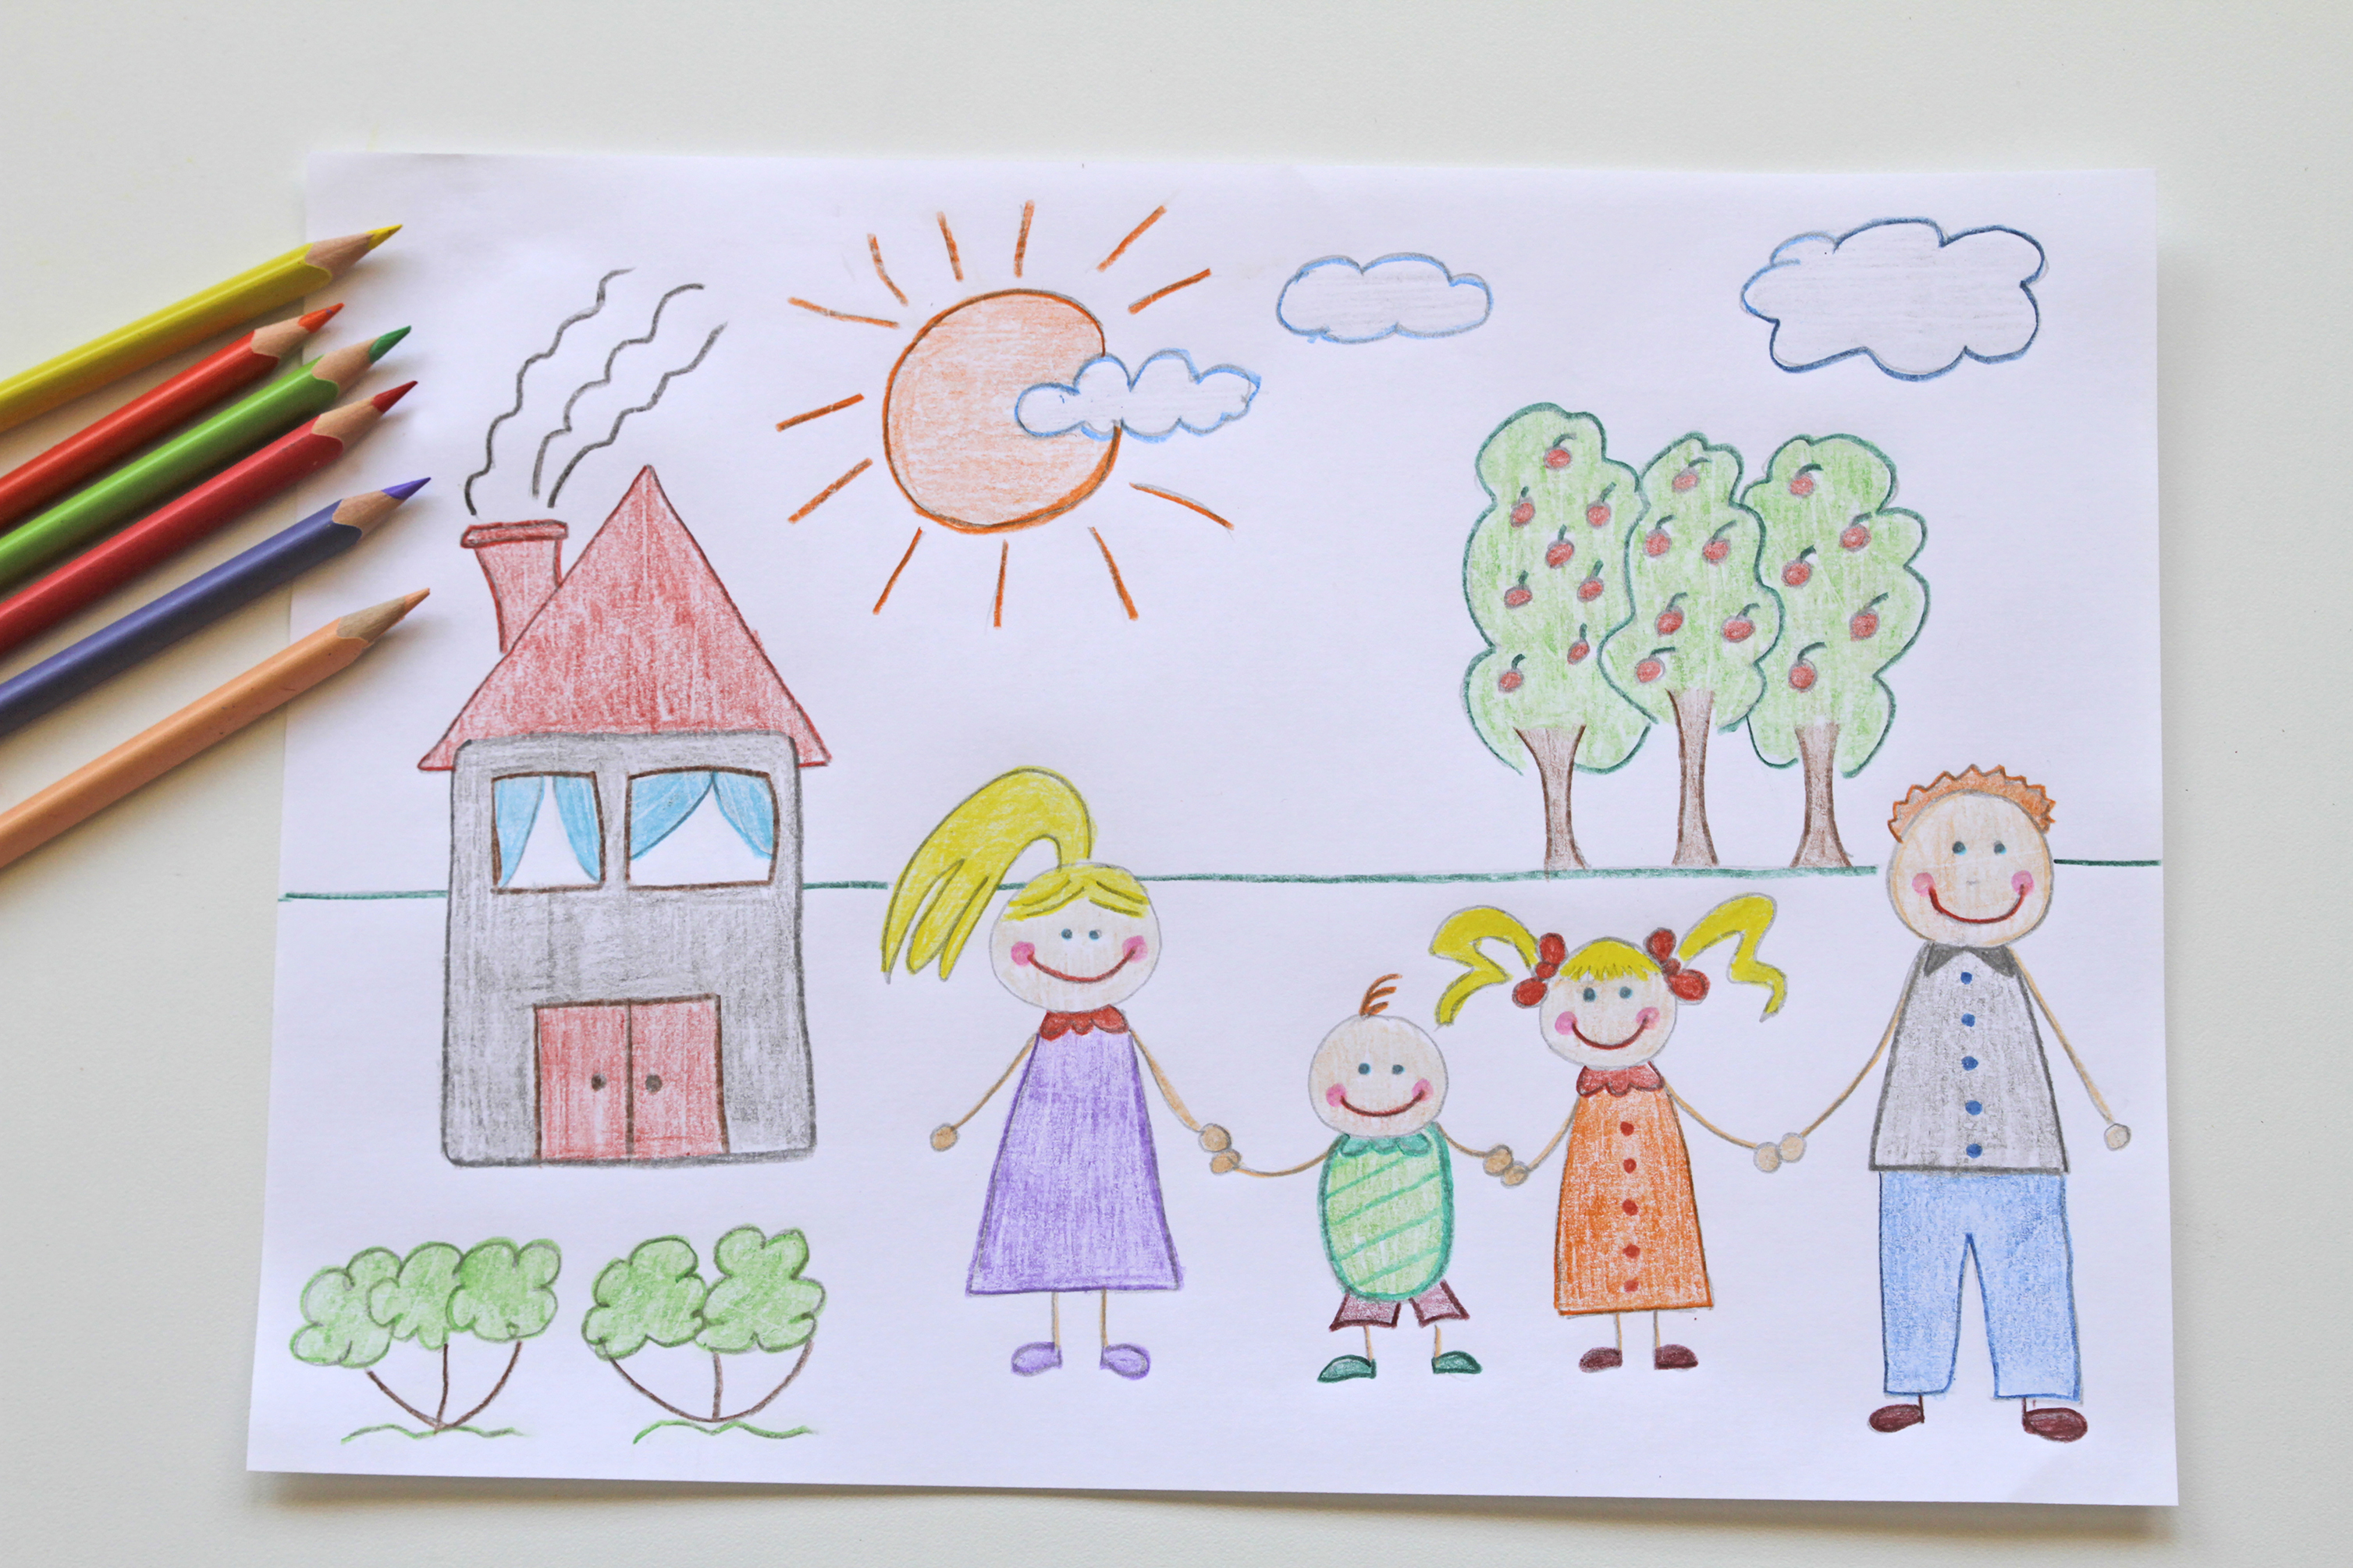
Population Data

Slide 6
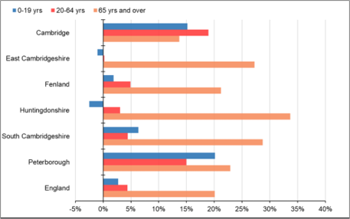
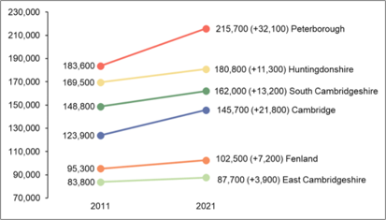
CHANGES IN THE CYP POPULATION
Population Data
Population growth in the CYP age groups in recent years means additional pressure on Children’s services
Population growth between 2011 and 2021 census (by age group)
Population growth between 2011 and 2021 census (all ages)
Largest growth areas for CYP up to 2021:
Cambridge City: 32% increase in 5-9s and 33% in 10-14s
Peterborough: 38% increase in 5-9s and 37% in 10-14s
Source: 2011 and 2011 Census, ONS

Slide 7
Population Data
BIRTH RATES
2021 | Number of live births | Total Fertility Rate (TFR)
Cambridgeshire | 6,677 | 1.71
-Cambridge | 1,293 | 1.90
-East Cambridgeshire | 837 | 1.60
-Fenland | 1,023 | 1.76
-Huntingdonshire | 1,890 | 1.81
-South Cambridgeshire | 1,634 | 1.85
Peterborough | 2,668 | 2.01
ENGLAND | 595,948 | 1.62
Total fertility rate is higher in Peterborough than in Cambridgeshire and the England average, however it has been declining over the last 10 years. Cambridge city is the only area where an increasing trend has been seen over the last 10 years.
Source: ONS, Births in England and Wales

Slide 8
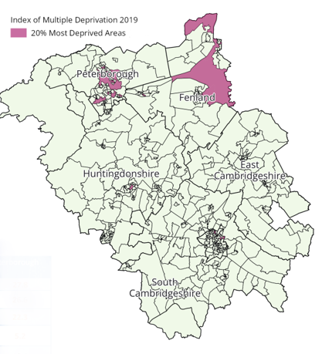
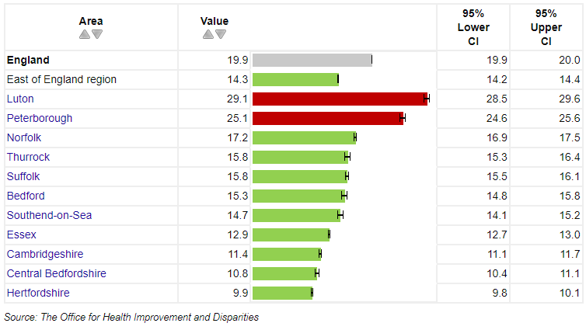
Population Data
CHILDREN LIVING IN POVERTY
25% of Peterborough children, and 11% of Cambridgeshire children, are living in relative low-income families.
Indices of Multiple Deprivation (2019)
Children living in relative low-income families (under 16s) 2021/22 (%)
There are some of the 20% most deprived areas in England, within C&P. These are concentrated in Peterborough and Fenland, but also pockets of deprivation in other districts.
Source: English indices of deprivation 2019, Ministry of Housing, Communities & Local Government, IMD 2019
Notes:
Public health profiles - OHID (phe.org.uk)
No trend data available.

Slide 9
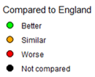
Population Data
ETHNICITY AND LANGUAGE FOR SCHOOL PUPILS
Peterborough has a higher proportion of children from ethnic minorities and where English is not their first language compared to the England average, Cambridge is lower than the national average for these metrics.
Source: Department of Education, Schools, Pupils and Their Characteristics 2022

Slide 10

Education and Child Development
Education and Child Development

Slide 11
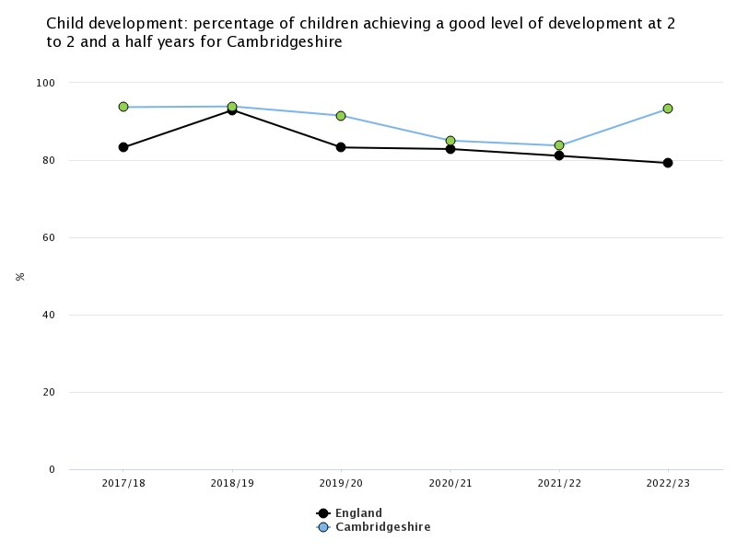
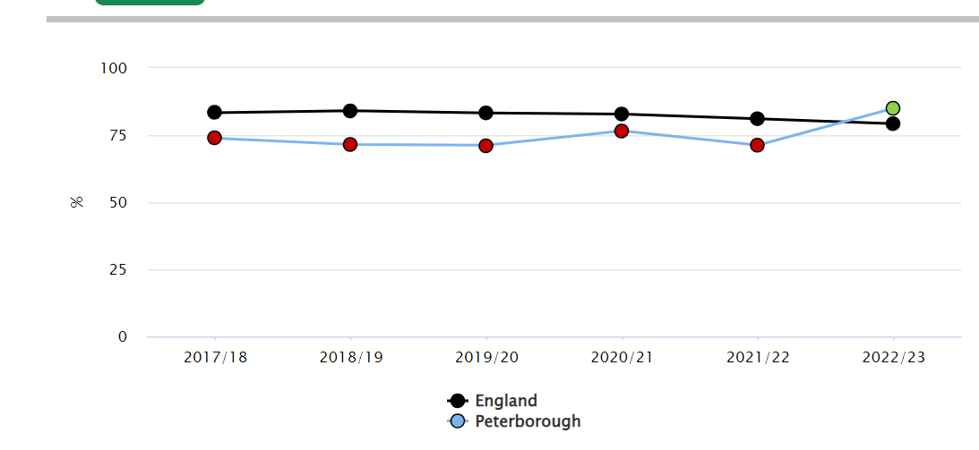
Education and Child Development
AGES AND STAGES QUESTIONNAIRES (ASQ-3)
The % of children in Cambridgeshire achieving a good level of development at 2 to 2 and a half years has been higher than the England average. In Peterborough, the % achieving this was lower than England. The 2022/23 data shows an improvement in this; however, data quality issues have been reported and it is too soon to identify a change in trend.
Source: Office for National Statistics (ONS)
Data quality issues reported**

Slide 12
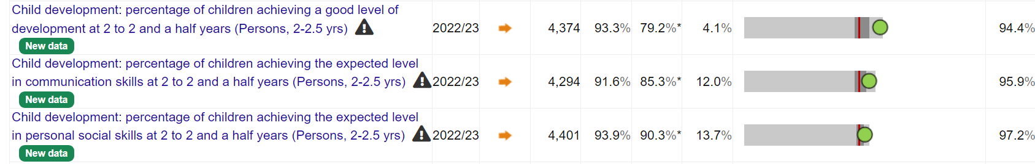
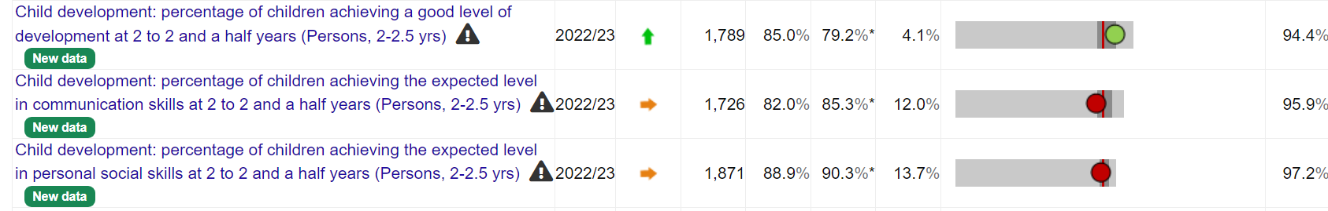
Education and Child Development
AGES AND STAGES QUESTIONNAIRES (ASQ-3)
Cambridgeshire
Peterborough
The % of Children achieving a good level of development at 2-2.5-year checks is higher in Cambridgeshire compared with Peterborough.
Source: Office for National Statistics (ONS)
Data quality issues reported**

Slide 13
Education and Child Development
EARLY YEARS FOUNDATION STAGE PROFILE (2022)
Indicator (%) | Locality |  |  | Percentage Difference (Local Authority vs Nationally) (2022)
 | Peterborough | Cambridgeshire | National | Peterborough | Cambridgeshire
Good Level of Development | 60.7% | 65.8% | 65.2% | -4.5% | +0.6%
Communication and Language | 76.7% | 80.5% | 79.5% | -2.8% | +1%
Personal, Social and Emotional Development | 81.5% | 83.3% | 83.0% | -1.5% | +0.3%
Physical Development | 82.9% | 85.8% | 84.9% | -2% | +0.9%
Literacy | 63.0% | 69.3% | 68.0% | -5% | +1.3%
Maths | 71.2% | 78% | 75.9% | -4.7% | +2.1%
Understanding The World | 73.3% | 81.4% | 79.6% | -6.3% | +1.8%
Expressive Arts and Design | 79.9% | 86.1% | 84.5% | -4.6% | +1.6%
Cambridgeshire has a high % of children achieving a good level of development, with results consistently higher than national figures across all indicators. This is not reflected in Peterborough, where children achieved lower levels of good development
Sources: NCER EYFSP (2022).

Slide 14
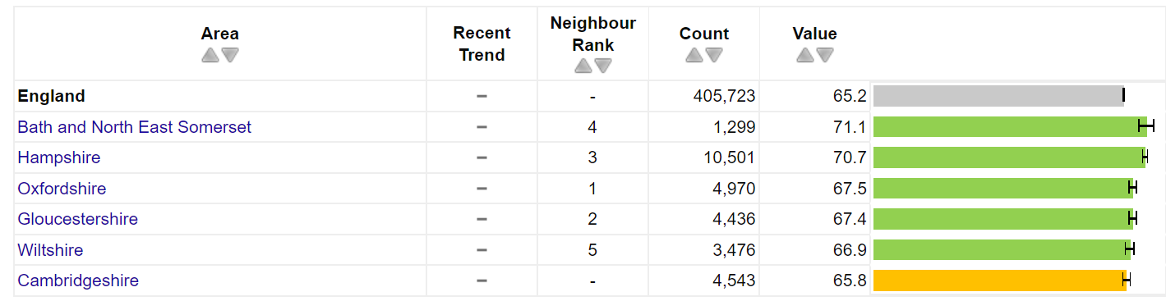
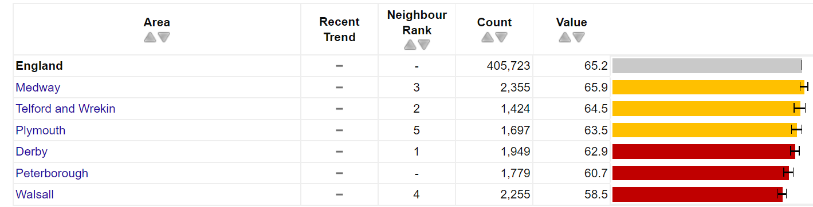
Education and Child Development
SCHOOL READINESS COMPARED WITH STATISTICAL NEIGHBOURS
Percentage of children achieving a good level of development at the end of Reception
Although Cambridgeshire had a higher % of children achieving this indicator compared to Peterborough, it has a lower % than all statistical neighbours (other local authorities with similar characteristics)
Peterborough also has the second lowest % compared with its statistical neighbours (other local authorities with similar characteristics).
Source: Department for Education (DfE), EYFS Profile: EYFS Profile statistical series

Slide 15
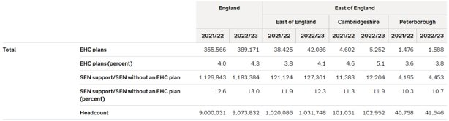
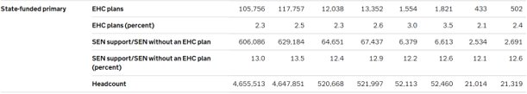
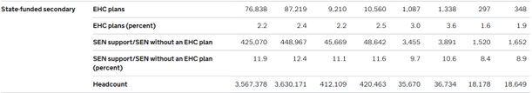
Education and Child Development
SPECIAL EDUCATIONAL NEEDS (SEN)
Many children require special support for Special Educational Needs (SEN). Peterborough rates are lower than Cambridgeshire, and the national rate.
Sources: Department of Education- Education provision: children under 5 years of age 2022, Special Educational Needs in England
* Education, Health and Care plan

Slide 16
LOCAL SUPPORT FOR FAMILIES
Education and Child Development

Slide 17
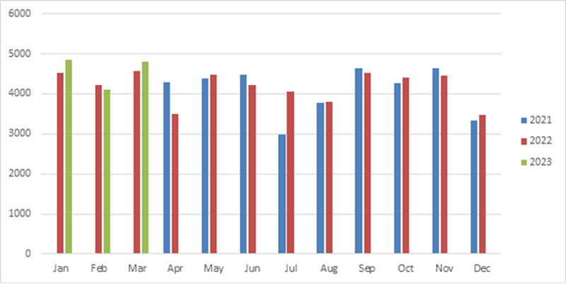

Education and Child Development
THE HEALTHY CHILD PROGRAMME #CallUsTextUs SERVICE
- Access into the service can be via telephone, text message or email, branded as #callustextus​.
- Telephone contact remains the preferred method of contact – with most calls relating to children between the ages of 0-4.
Demand for the service is consistently high
Total amount of calls answered by service
Source: Local Data CCS/CPFT Cambridgeshire and Peterborough
0-19 Healthy Child Programme - Health Visiting and School Nursing (cambscommunityservices.nhs.uk)

Slide 18
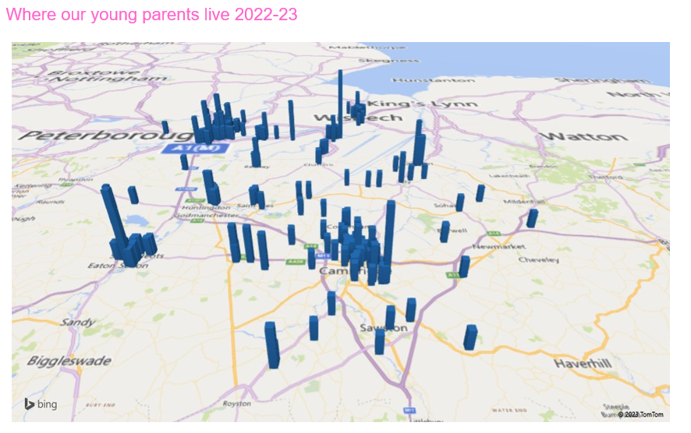
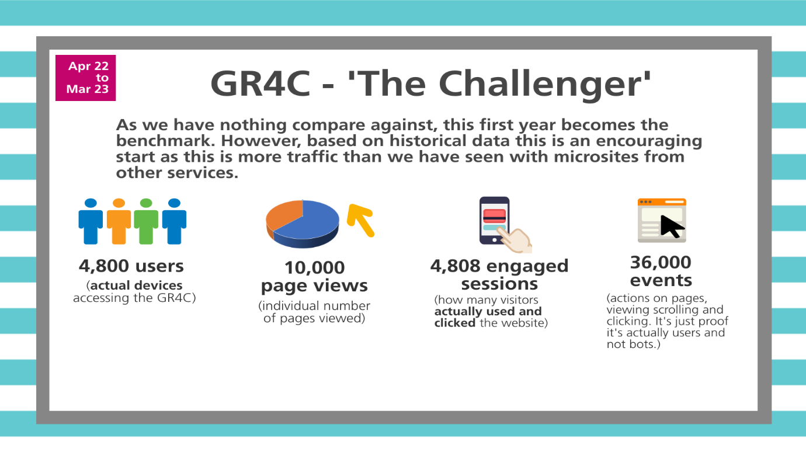
Education and Child Development
THE HEALTHY CHILD PROGRAMME ‘GETTING READY FOR CHANGE’ QUESTIONNAIRE AND SUPPORT FOR YOUNG PARENTS
2022 saw the launch of the digital health questionnaires branded as ‘Getting Ready for Change’ - GR4C. These are newly developed digital health questionnaires for children and young people at times of transition commencing for Year Reception, Year 6, Year 9 and Year 11.
Here is the link to the information page for young people:
Getting Ready for Change - information for young people (cambscommunityservices.nhs.uk)
The above map shows where our young parents live in Cambridgeshire and Peterborough. All young parents aged 19 or under are offered an enhanced service on either the Family Nurse Partnership (FNP) programme or the Enhanced Young Parent Pathway (EYPP).
FNP is a trauma-informed, strengths based, intensive home visiting programme for first time parents.
Demand for this service remains high
Source: The Healthy Child Programme, CPFT, CCS
Cambridgeshire and Peterborough 0-19 Healthy Child Programme - Health Visiting and School Nursing (cambscommunityservices.nhs.uk)

Slide 19
Education and Child Development
THE HEALTHY CHILD PROGRAMME,
CHECKS AND REVIEWS
The Healthy Child Programme carries out new birth checks, 6–8-week checks, 12-month checks and 2–5-year checks to support families and babies and ensure their development is on track.
The % of checks being completed within time-frames was very low at the beginning of 2021/22 (graph A), significantly contributed to by COVID-19 pandemic and staffing pressures, although 87-96% of New Birth Visits and 6–8-week checks were still completed (Graph B) during this time.
The % of checks being completed within time-frame has now significantly improved (Graph A).
The service sees children and families on a large scale, completing 8,727 New Birth Visits and 8,408 6-8 Week Checks across Cambridgeshire and Peterborough last year (2021/22), alongside their other work.
Source: The Healthy Child Programme, CPFT, CCS

Slide 20
Education and Child Development
PERCENTAGE OF CHILDREN TAKING UP 2 YEAR-FUNDING
Peterborough
2-year funding take up has increased across Peterborough and Cambridgeshire, roughly in line with national figures.
Percentage of children taking up their 2-year funding | 2019 | 2020 | 2021 | 2022 | 2023
Peterborough | 68.8 | 66.5 | 62.1 | 70.3 | 74.2
National | 67.8 | 69.2 | 61.8 | 71.9 | 73.9
Cambridgeshire
Percentage of children taking up their 2-year funding | 2019 | 2020 | 2021 | 2022 | 2023
Cambridgeshire | 67.0 | 65.2 | 59.1 | 67.6 | 73.5
National | 67.8 | 69.2 | 61.8 | 71.9 | 73.9
Source: Cambridgeshire County Council and Peterborough City Council

Slide 21
Education and Child Development
PERCENTAGE OF CHILDREN TAKING UP 3- & 4-YEAR FUNDING
Peterborough
3- & 4-year funding take up percentages across Cambridgeshire are roughly aligned with national figures. Peterborough report slightly lower uptake than Cambridgeshire and national figures, although the reasons for this are unknown.
Percentage of children taking up their 3- & 4-year funding | 2019 | 2020 | 2021 | 2022 | 2023
Peterborough | 90.8 | 90.2 | 88.6 | 90.5 | 90.5
National | 93.4 | 92.9 | 89.7 | 92.3 | 93.7
Cambridgeshire
Percentage of children taking up their 3- & 4-year funding | 2019 | 2020 | 2021 | 2022 | 2023
Cambridgeshire | 94.0 | 93.5 | 90.5 | 93.4 | 96.9
National | 93.4 | 92.9 | 89.7 | 92.3 | 93.7
Source: Cambridgeshire County Council and Peterborough City Council

Slide 22
Education and Child Development
CHILDREN IN GOOD/OUTSTANDING SETTINGS
Percentage of children attending a Good/Outstanding Early Years setting for their funded hours | 2019 | 2020 | 2021 | 2022 | 2023
Cambridgeshire | 93.6 | 94.0 | 93.7 | 94.5 | 96.8
National | 93.5 | 94.3 | 94.6 | 94.5 | 95.2
93-97% of children are attending a good/outstanding early years setting and accessing a high quality of education.
Data for Cambridgeshire and Peterborough cannot be directly compared because of differing time periods.
Peterborough - Percentage of children attending a Good/Outstanding Early Years setting for their funded hours | Peterborough
August 2021 | 96%
March 2022 | 97%
August 2022 | 97%
March 2022 | 96%
The % of Cambridgeshire and Peterborough children attending good/outstanding early years settings is generally aligned with national figures.
Source: Cambridgeshire County Council and Peterborough City Council

Slide 23

Education and Child Development
CHILD AND FAMILY CENTRES IMPACT
“As a new mum I learnt a lot through these baby play groups, and they inspired me to run my own Polish language group for L and Polish parents of young children.”
Between 2022-2023, 44,908 adults and children have accessed a Child and Family Centre Stay and Play or Pop-Up activity in Cambridgeshire
648 families have accessed SEND services through the Child and Family Centres.
9,664 families accessed a health service at a Child and Family Centre.
1,244 children received support via a Child and Family Centre Family Worker.
782 Armed Forces families have accessed Child and Family Centre services.
215 contacts to support young parents have been made by the Child and Family Centre team
2,810,849 views of Child and Family Centre Facebook posts.
“I find this Facebook page so helpful in supporting my parenting.”
“I can’t thank you both enough, the support you’ve given us over the past year is incredible, I started the young mums group as a scared 21- year-old. You grew my confidence and helped me become the best mum I can!”
Source: Cambridgeshire County Council

Slide 24


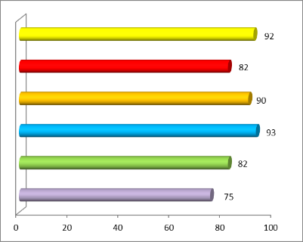
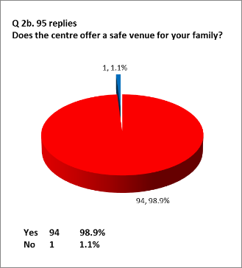

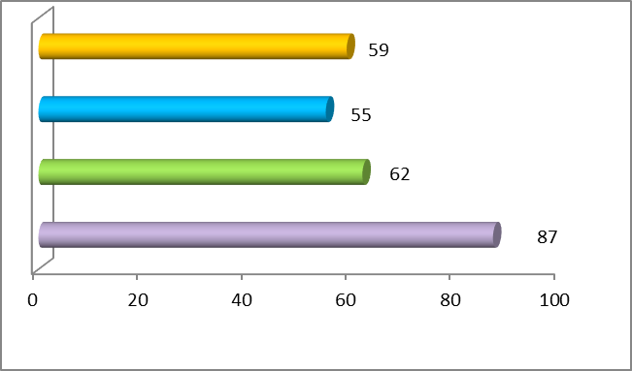
Education and Child Development
CHILD AND FAMILY CENTRES IMPACT
During Q4 2023/24 alone, there were 6,048 attendances at universal face to face sessions in Peterborough.
Recently, 98.9% of families providing feedback said that child and family centres offer a safe venue for their family.
‘They help families source funding and support, provide a supportive network and reduce isolation, and help parents understand, interact and play with their children, supporting child development’.
Source: Barnardo's, Peterborough City Council

Slide 25
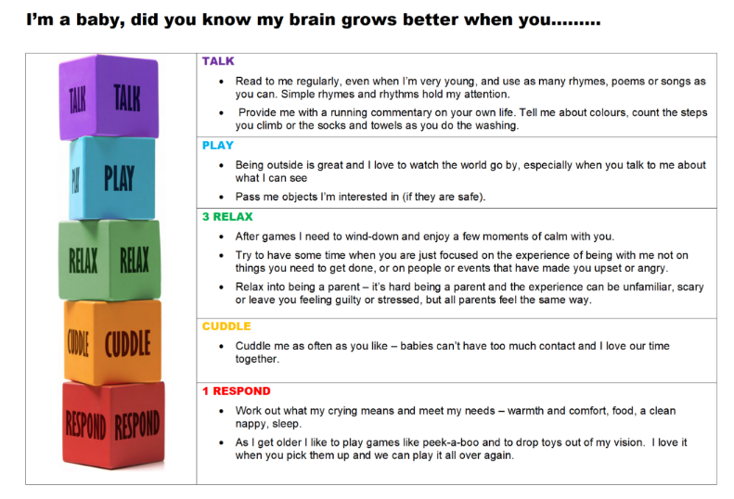

Education and Child Development
INFANT MENTAL HEALTH AND PARENT-INFANT RELATIONSHIPS
‘Infancy is a crucial time for brain development. It is vital that babies and their parents are supported during this time to promote attachment. Without a good initial bond, children are less likely to grow up to become happy, independent and resilient adults.’
The Solihull Approach and Five to Thrive principles are embedded within services in Cambridgeshire and Peterborough.
Like perinatal mental health, a significant gap has been identified regarding the lack of a clear parent-infant relationship/ infant mental health pathway in Cambridgeshire and Peterborough.
London J Prim Care (Abingdon). 2016; 8(1): 12–14. Published online 2016 Feb 24. doi: 10.1080/17571472.2015.1133012
Five to Thrive - An attachment-based approach to positive parenting
Solihull Approach: It focuses on developing nurturing and supportive relationships between children and their carer by promoting reflective, sensitive and effective parenting. It aims to improve the parent-child relationship as well as the child’s confidence, self-esteem and behaviour.
Home - Solihull Approach | Parenting (solihullapproachparenting.com)
Five to Thrive - An attachment-based approach to positive parenting

Slide 26

Education and Child Development
50 THINGS BEFORE YOU’RE FIVE
An app which allows families to take part in learning activities with their children to support them to thrive in their first five years of development.
6,710 unique users of which 1,494 are registered with Peterborough post codes and 5,216 in Cambridgeshire.
Developing packs being delivered to disadvantaged children across Cambridgeshire Peterborough to support home learning
26.8% growth of users across Cambridgeshire & Peterborough
‘I personally think the key and one of the most important things about making the most of 50 Things is not seeing it as a tick-list and thinking once an activity has been completed it is done forever. The beauty of 50 Things is that repetition of the experiences allows children to encounter new things each time and to also embed any new knowledge learned by having opportunities to repeat and understand what they have done as they reach different ages and stages of their development’
Carrie, mother of three to Amber aged ten, Olly aged five and Isla who is four months old
50 Things to Do | Cambridgeshire & Peterborough
Why Families Love 50 Things :: 50 Things To Do

Slide 27

Health Outcomes

Slide 28
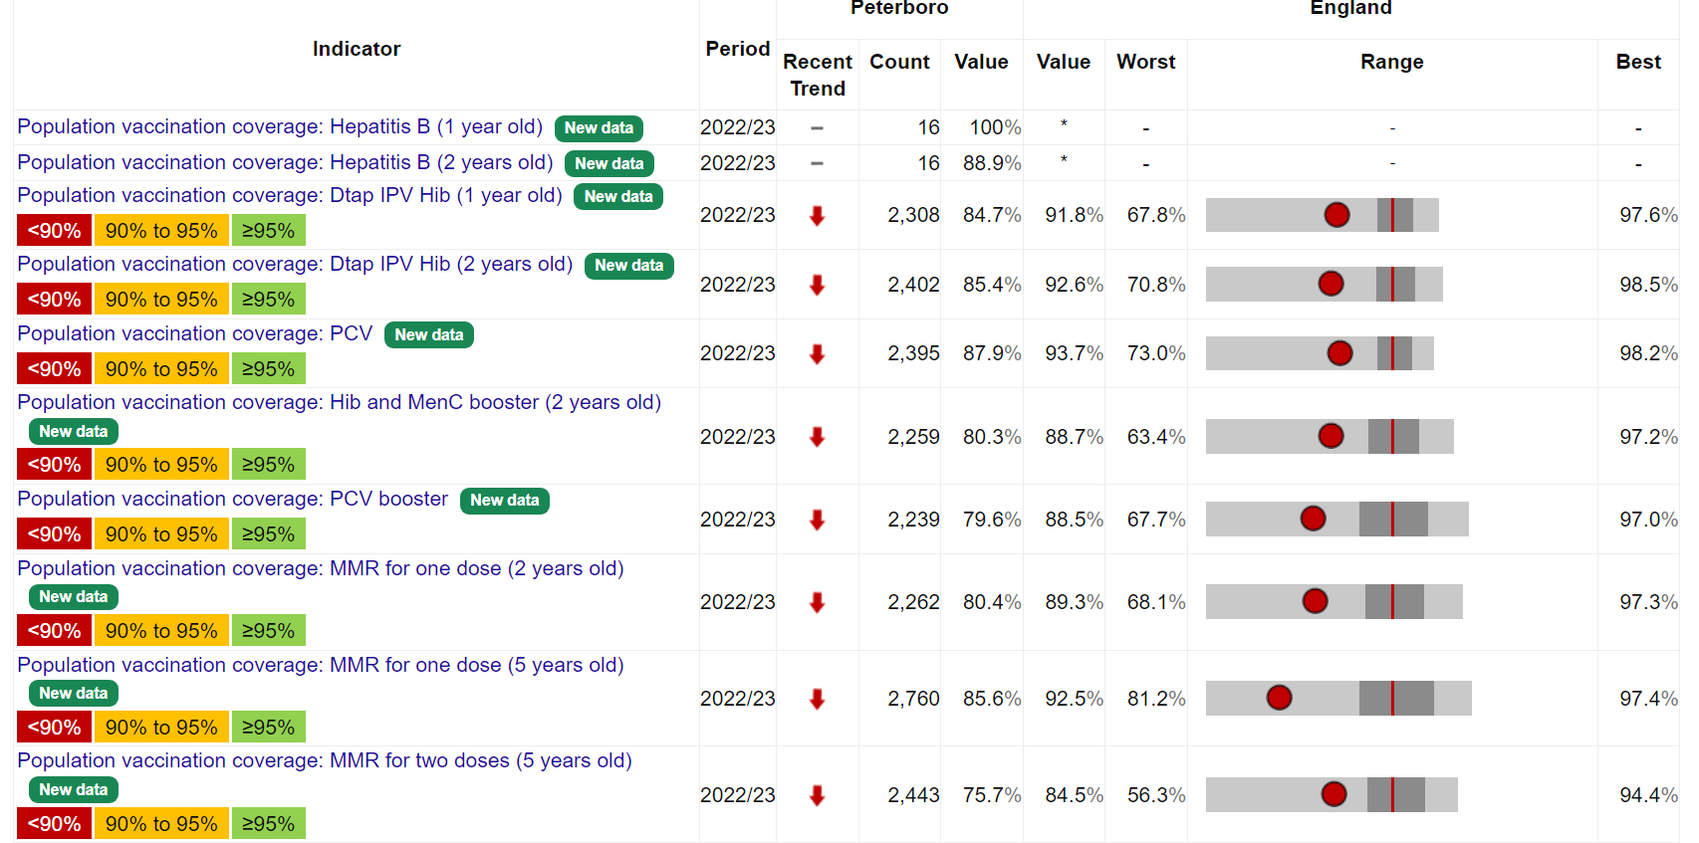
Health Outcomes
CHILDHOOD IMMUNISATIONS
Peterborough
Cambridgeshire
Peterborough is significantly below the benchmark for population coverage of all childhood immunisations and is showing a decreasing trend for both.
Cambridgeshire meets the benchmark for MMR and exceeds the benchmarks for school-aged flu and Dtap/IPV/Hib vaccine coverage in 2 year olds.
Source: Cover of Vaccination Evaluated Rapidly (COVER) data collected by UK Health Security Agency (UKHSA). Available from NHS Digital

Slide 29
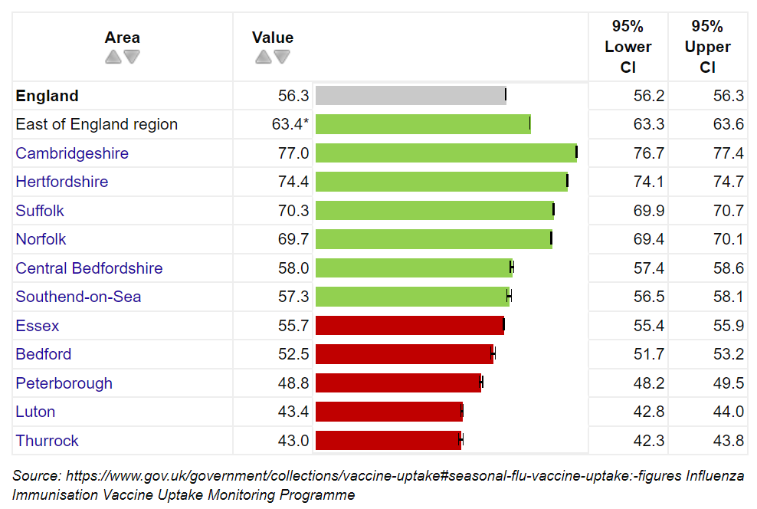
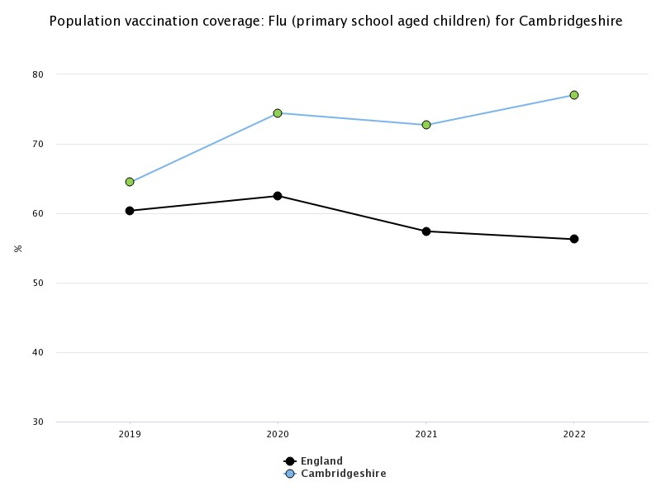
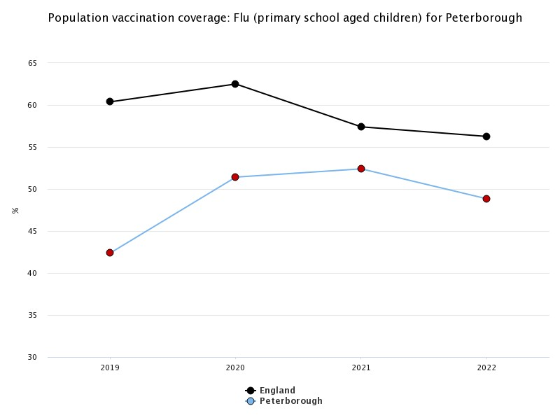
Health Outcomes
CHILDHOOD IMMUNISATIONS
Immunisation gives protection against some infectious diseases. Overall, Peterborough immunisation uptake rates are low.
Population vaccination coverage: Flu (primary school aged children) 2022 (%)
Population vaccination coverage: Flu (primary school aged children) 2019-2022 (%)

Slide 30
Health Outcomes
1 YEAR HEALTHY WEIGHT CHECKS
Infants that fall on the 95th centile are taller and heavier than 95% of other infants in their age and sex group.
%s range between 9-16% of children falling on the 95th Centile across Cambridgeshire and Peterborough.
We only have baseline data for this indicator at present and will monitor for trends over the next few years.
Source: The Healthy Child Programme/ CCS/ CPFT
Notes:
Peterborough, North – Huntingdonshire and Fenland. South- Cambridge City South and East. Table – commentary weight checks explanation

Slide 31


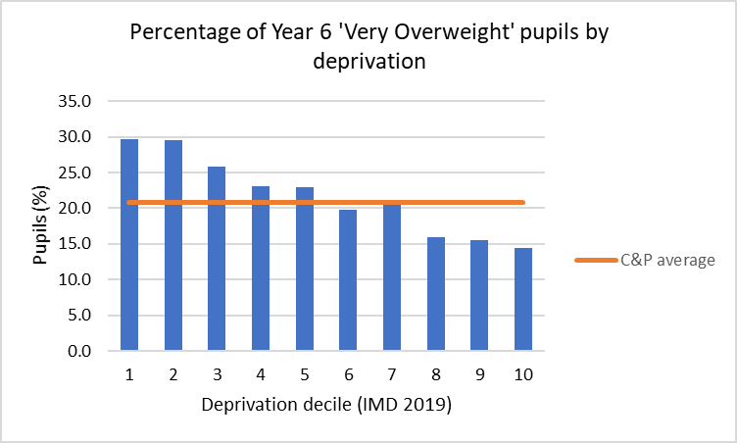





Health Outcomes
OBESITY
Approx 2 in 10 children in C&P Reception year
are overweight or obese (aged 4-5 years)
(Cambs 18.5%, Peterborough 22.0%, England 22.3%)
Higher prevalence of obesity in more deprived areas
More than 3 in 10 children in Cambridgeshire Year 6
are overweight or obese (aged 10-11 years) (32.1%, England 37.8%)
More than 4 in 10 children in Peterborough Year 6
are overweight or obese (aged 10-11 years) (41.2% England 37.8%)
Decile 1 is the most deprived decile
Higher prevalence of obesity among certain ethnicities
Substantial increase between Reception and Year 6
Higher prevalence of overweight and obesity in males
‘Obesity’ rates are statistically significantly high among Black and Asian (excluding Chinese) sub-categories
% overweight or obese
% obese
For most C&P areas, rates of ‘Overweight’ pupils are higher among males (Reception M:10% F:9%, Year 6 M:20% F:15% for C&P combined).
Source: National Child Measurement Programme, NHS Digital. 2021/22
Pupils from the Cambridgeshire and Peterborough local authority schools submission, based on the child’s residential postcode.
Notes:
Source: National Child Measurement Programme, NHS Digital. National dataset. 2021/22
Pupils from the Cambridgeshire and Peterborough local authority schools submission, based on the child’s residential postcode.
Source: NCMP 2021/22, national dataset
Table 3b: Prevalence and number of children underweight, healthy weight, overweight, living with obesity and living with severe obesity in Reception, by region and upper tier local authority (based on the postcode of the child)^{1,2} Table 3b: Prevalence and number of children underweight, healthy weight, overweight, living with obesity and living with severe obesity in Year 6, by region and lower tier local authority (based on the postcode of the child)1,2
Prevalence of children overweight or living with obesity
Fenland/Peterborough worse prevalence compared to England for some indicators

Slide 32
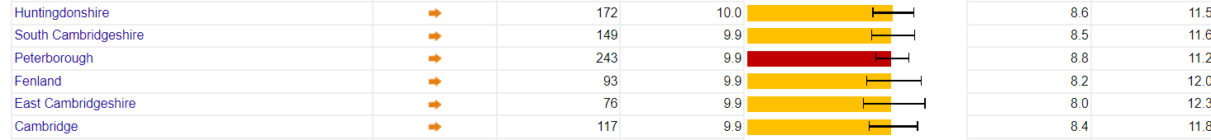
Health Outcomes
MATERNITY AND BIRTH INDICATORS
The percentage (value) of mothers smoking at the time of delivery is similar across Cambridgeshire and Peterborough but higher than England and East of England region average.
District | Low Birth Weight of Term Babies % (2021) | Infant Mortality per 1000 (2018-2020) | Under 18s birth rate/ 1000 (2021)
Cambridge | 2.7% | 3.3 | 1.6
East Cambridgeshire | 2.7% | 3.1 | 0.7
Fenland | 2.5% | 3.6 | 3.9
Huntingdonshire | 2.5% | 3.1 | 1.8
South Cambridgeshire | 1.5% | 1.9 | 1.1
Peterborough | 2.6% | 4.2 | 6.7
England | 2.8% | 3.9 | 3.2
All districts in Cambridgeshire and Peterborough report a lower percentage of term babies with low birth weight than England.
The infant mortality rate was higher in Peterborough than England between 2018-2020.
The under 18s birth rate is higher in Fenland and Peterborough than England.
Source: Office for National Statistics (ONS)

Slide 33

Perinatal Mental Health

Slide 34
Perinatal Mental Health
BACKGROUND
-Suicide is a leading cause of death during the perinatal period in high income countries (accounting for 5 to 20% of maternal deaths)
- Perinatal mental health problems are those which occur during pregnancy or in the two years following the birth of a child.
- It impacts up to 27% of new and expectant mothers and covers a wide range of conditions. If left untreated, mental health issues can have significant and long-lasting effects on the woman, the child, and the wider family.
- From conception to age two, babies are very susceptible to their environment and entirely reliant on their caregivers. A loving attachment between babies and their parents is crucial for the child’s development and to help avoid adverse childhood experiences (ACEs), such as poor parental mental health, which can have long-lasting damaging effects.
- Some risk factors for poor perinatal mental health include a history of mental health problems, traumatic childbirth experiences, domestic violence and abuse and poor social support.
NHS England » Perinatal mental health
The_best_start_for_life_a_vision_for_the_1_001_critical_days.pdf (publishing.service.gov.uk)
The healthcare resource impact of maternal mental illness on children and adolescents: UK retrospective cohort study | The British Journal of Psychiatry | Cambridge Core
The influence of maternal mental illness on vaccination uptake in children: a UK population-based cohort study | SpringerLink
Perinatal mental health: a review of progress and challenges - Howard - 2020 - World Psychiatry - Wiley Online Library
Cambridgeshire & Peterborough Insight – Mental Health Needs Assessment – Chapter Three: Perinatal mental health (cambridgeshireinsight.org.uk)

Slide 35
ESTIMATING LOCAL NEED
Perinatal Mental Health
We have identified a need for more robust local data collection for Perinatal Mental Health during this needs assessment and therefore recognise limitations to the data published.
Please see the published Perinatal Mental Health Chapter of the Public Health Mental Health Needs Assessment for a more extensive review: Cambridgeshire & Peterborough Insight – Mental Health Needs Assessment – Chapter Three: Perinatal mental health (cambridgeshireinsight.org.uk)

Slide 36
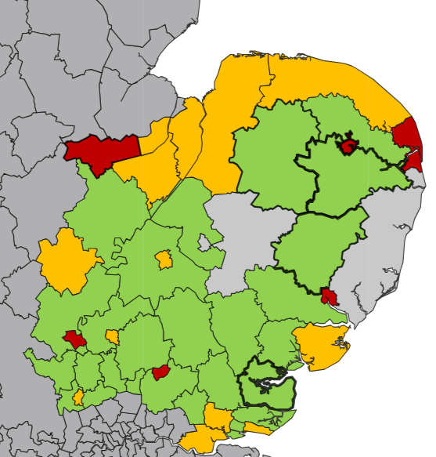
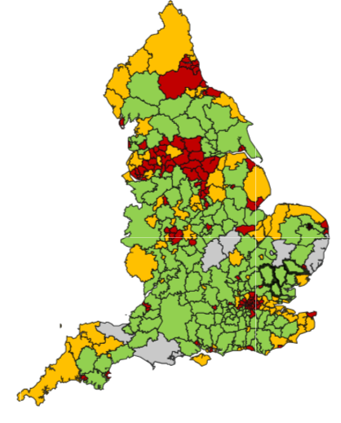
Perinatal Mental Health
RISK FACTOR: HISTORY OF MENTAL HEALTH PROBLEMS
The prevalence of mental health problems within Cambridgeshire and Peterborough can help indicate the risk of maternal mental health problems within the area = higher levels of overall mental health problems indicate a potential for higher levels of maternal mental health problems.
Peterborough, Fenland and Cambridge are estimated to have the highest prevalence of common mental health problems in C&P with Peterborough being the worst.
Huntingdonshire 13.3%
Peterborough 18.8%
Fenland 17.6%
East Cambridgeshire 13.2%
South Cambridgeshire
12%
Estimated prevalence of common mental disorders (% of population aged 16 and over)
Cambridge
16.2%
Source: Office for National Statistics (ONS), 2017

Slide 37
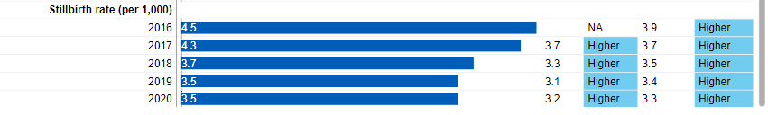
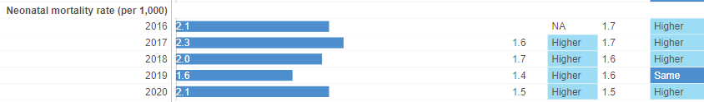
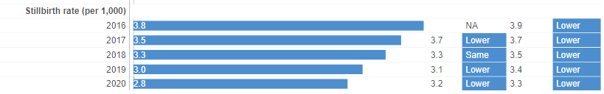
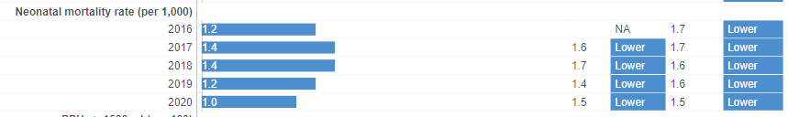
Perinatal Mental Health
RISK FACTOR: TRAUMATIC CHILDBIRTH EXPERIENCES
Cambridge University Hospitals NHS Trust
Traumatic childbirth experiences, including stillbirth and death, are associated with mental health problems, particularly PTSD.
Cambridge University Hospitals report a higher still birth rate and neonatal mortality rate than England and NWAFT. This could be related to the specialist level of care provided at this Trust.
North West Anglia NHS Foundation Trust
Source: Local Maternity and Neonatal System

Slide 38
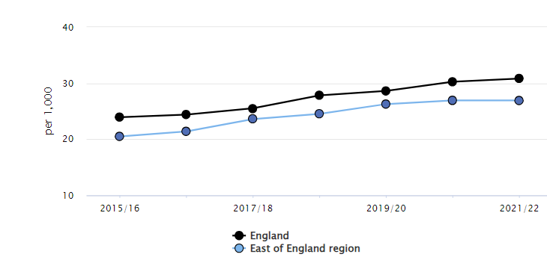
Perinatal Mental Health
RISK FACTORS: DOMESTIC VIOLENCE AND ABUSE, POOR SOCIAL SUPPORT
Higher levels of domestic violence/abuse in populations is associated with poorer mental health.
Cambridgeshire and Peterborough report lower levels of domestic abuse related incidents and crimes than England.
Domestic abuse related incidents and crimes are increasing in the East of England.
Domestic abuse related incidents and crimes 2021/22 (value) | Cambridgeshire | 27.7 | *Count currently unavailable for C&P. Value is taken from police force within region
 | Peterborough | 27.7
 | England | 30.8
Source: Office for National Statistics (ONS)

Slide 39
Perinatal Mental Health
HEALTHY CHILD PROGRAMME,
% WITH HIGHER RISK AT 6-8 WEEK CHECKS
The Healthy Child Programme carries out maternal mood reviews at health visiting checks. North Cambridgeshire reported the highest % of mothers scoring highly on GAD and PHQ assessments (higher risk anxiety and depression) during this time-period, and this is showing an upward trend.
Note: Cambridgeshire North = Huntingdonshire and Fenland districts
Cambridgeshire South = Cambridge City, East Cambridgeshire and South Cambridgeshire districts
Source: Healthy Child Programme, CPFT, CCS

Slide 40
LOCAL SUPPORT
FOR FAMILIES
Perinatal Mental Health

Slide 41
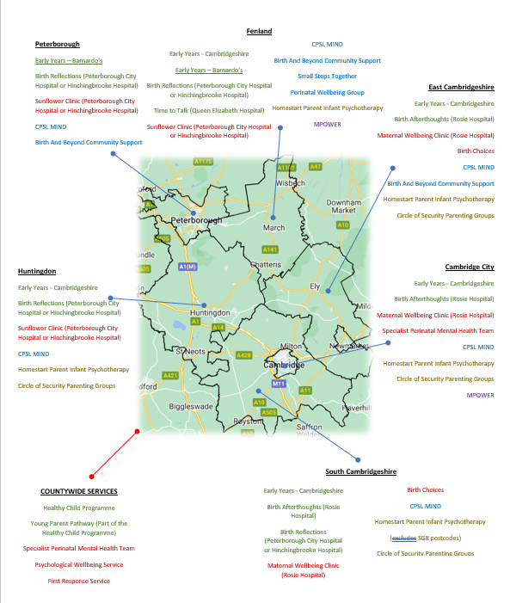
Perinatal Mental Health
SERVICE PROVISION
Countywide services are delivered via the:
Healthy Child Programme
Specialist Perinatal Mental Health Teams
First Response Service
Psychological Wellbeing Service
with a range of other services being offered in specific areas by hospitals and community organisations.
Author: Dr Susan Sadek, Healthy Child Programme

Slide 42
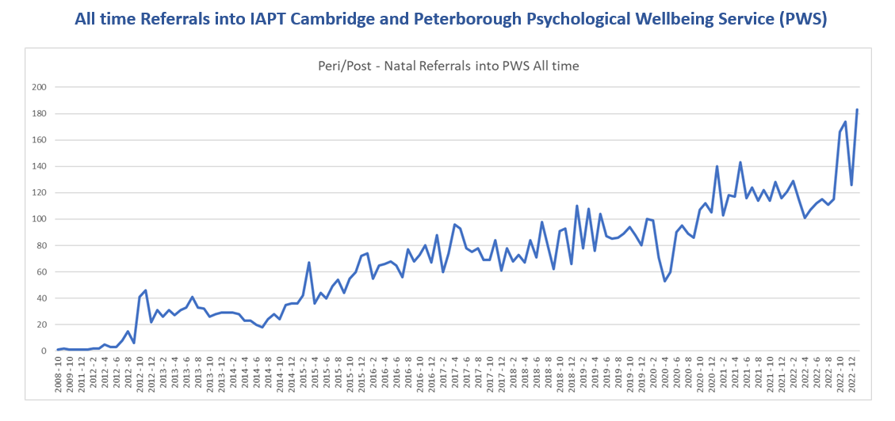
Perinatal Mental Health
IAPT CAMBRIDGESHIRE AND PETERBOROUGH PSYCHOLOGICAL WELLBEING SERVICE (PWS)
All time referrals in to IAPT Cambridge and Peterborough Psychological Wellbeing Service (PWS) have remained in an upward trend since 2008.

Slide 43
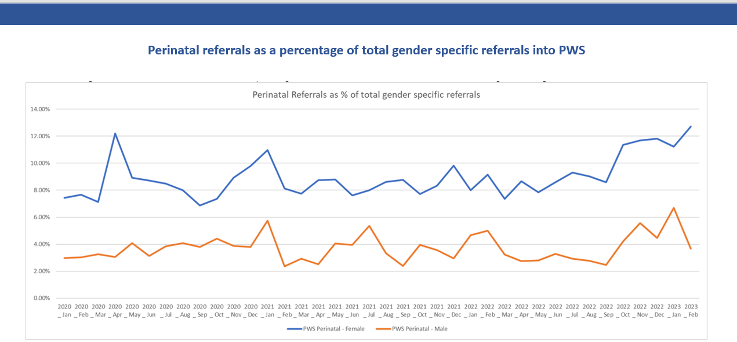
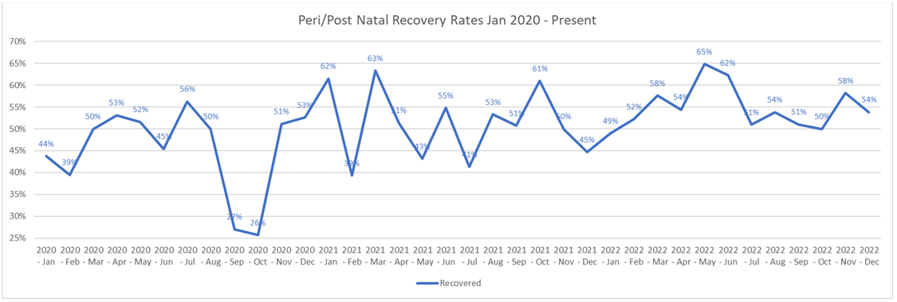
Perinatal Mental Health
IAPT CAMBRIDGESHIRE AND PETERBOROUGH PSYCHOLOGICAL WELLBEING SERVICE (PWS)
The % of peri/post natal recovery rates between 2020- 2023 are erratic due to smaller numbers in this cohort, however, the trendline generally shows recovery rates of around 50%, with peaks and troughs. The significant trough in 2020 coincides with the COVID-19 pandemic and likely occurred due to increased need (more isolation/ worry etc.) and potentially a change in delivery of services (remote).
Recovery in IAPT is measured in terms of ‘caseness’ – a term which means a referral has severe enough symptoms of anxiety or depression to be regarded as a clinical case. A referral has moved to recovery if they were defined as a clinical case at the start of their treatment (‘at caseness’) and not as a clinical case at the end of their treatment, measured by scores from questionnaires tailored to their specific condition.

Slide 44
Perinatal Mental Health
GAPS IN THE SYSTEM
A pathways assessment was conducted as part of the PNMH chapter of the Mental Health Needs Assessment and the following gaps were identified:
- Infant Mental Health - Can be difficult to determine which services provide support for infant mental health
- The clarity of care pathways varies for different levels of mental health need, with some new parents reporting that they do not understand which services are available to support them
- Workforce pressures have impacted continuity of care, midwife training, and provision of support for fathers/partners after baby loss
- Lack of information provision about mental after discharge from maternity services (due to be put in place shortly)
- Limited interventions promoting infant mental health
- Provision for dads and partners is not available in all areas
- Limited interventions promoting infant mental health
- Provision for dads and partners is not available in all areas
Cambridgeshire & Peterborough Insight – Mental Health Needs Assessment – Chapter Three: Perinatal mental health – Service provision – Gaps in service provision (cambridgeshireinsight.org.uk).

Slide 45
WHAT ARE LOCAL PEOPLE SAYING?
Perinatal Mental Health

Slide 46

Perinatal Mental Health
LOCAL FEEDBACK
BARRIERS AND INEQUALITIES
INDIVIDUAL
FACILITATORS
WORKFORCE
- Stigma, fear - worried they will have their child ‘taken away’ or are failing as a mother
Cultural barriers - language barriers, unable to access culturally sensitive resources in this country, cultural norms surrounding motherhood and mental health
Symptoms of PNMH problems inhibiting the ability to obtain help, emotional isolation and loneliness, anxiety preventing leaving the house
Education - poor awareness of how and when to seek help
Physical barriers – lack of transport in rural areas, childcare issues
Lack of training, knowledge, confidence and experience- staff unclear of what is within their scope of practice, some checks such as GP checks reported as being treated as a ‘tick box exercise’ and patients not being signposted onwards, inappropriate referrals from clinicians into community services, healthcare professionals may be less likely to ask those from ethnic minority groups about their mental health
Continuity, community, advocacy - a key contact to build a rapport and provide advice and signpost, culturally sensitive content, education for families and staff, flexibility in offer (some may prefer/need remote), integrated system which links up, accessible education, de-stigmatisation campaigns, well-trained and supervised workforce
SYSTEM-LEVEL
Unclear/broken pathways and fragmented services – community services from many different providers with insecure funding, community organisations cannot refer to some other services, lack of local guidelines or policies, not easy to navigate the system – not clear what is available
System-wide pressures in maternity -discharged from midwifery care earlier – less opportunity for identification, lack of clinical support and supervision of staff due to capacity issues
Women from Black African, Asian and White Other backgrounds and gypsy, Roma traveller communities struggle to access PNMH services, potentially putting them at higher risk of requiring specialist services
(C&P Perinatal and Infant Mental Health Network)

Slide 47
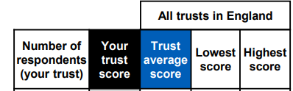

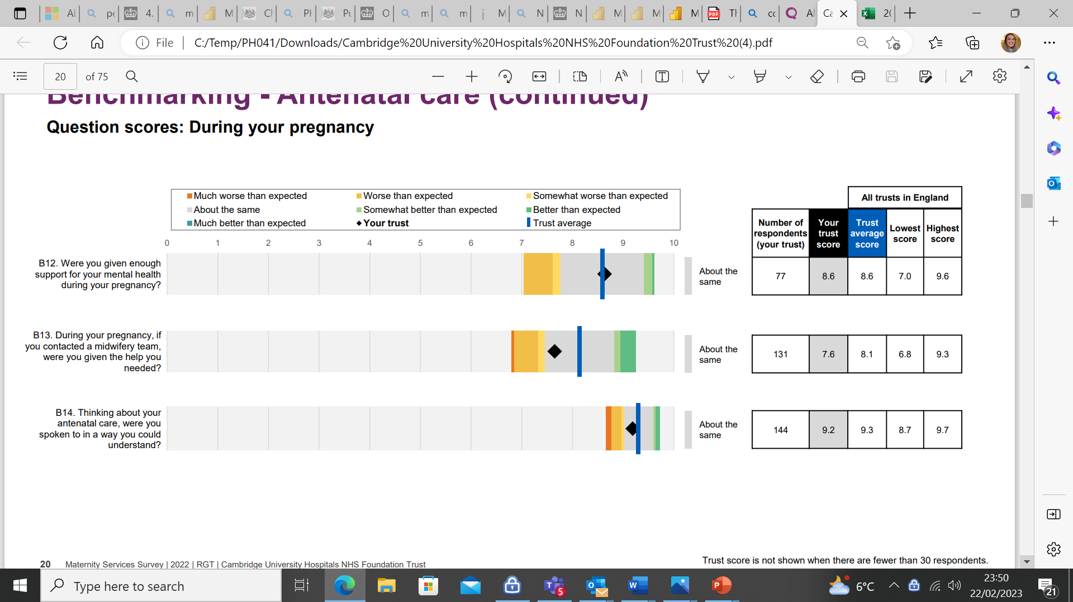
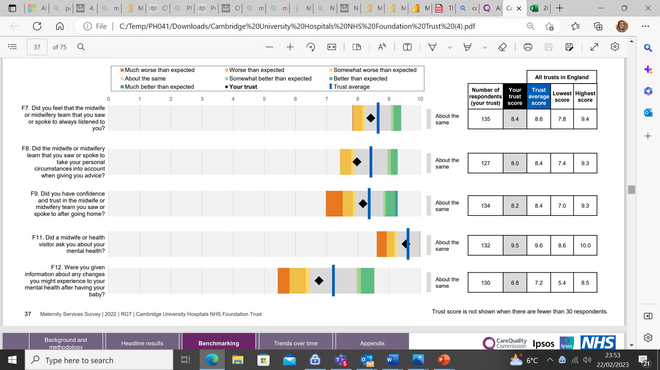
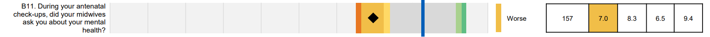
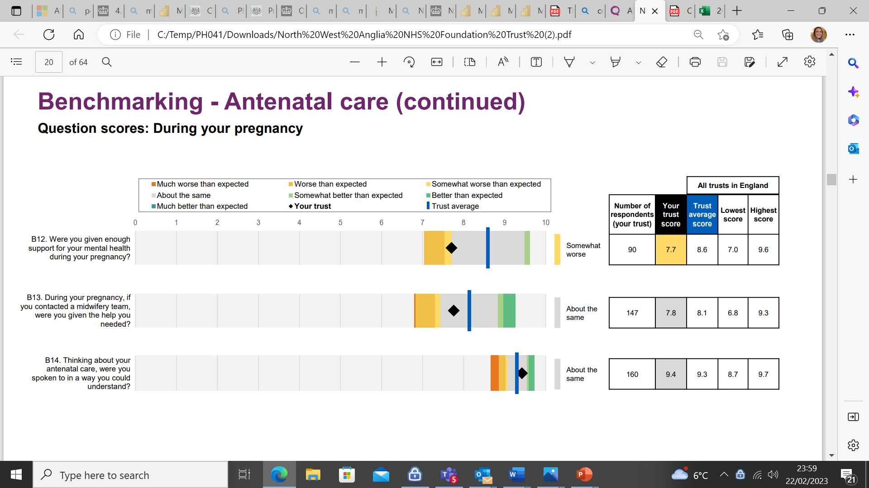
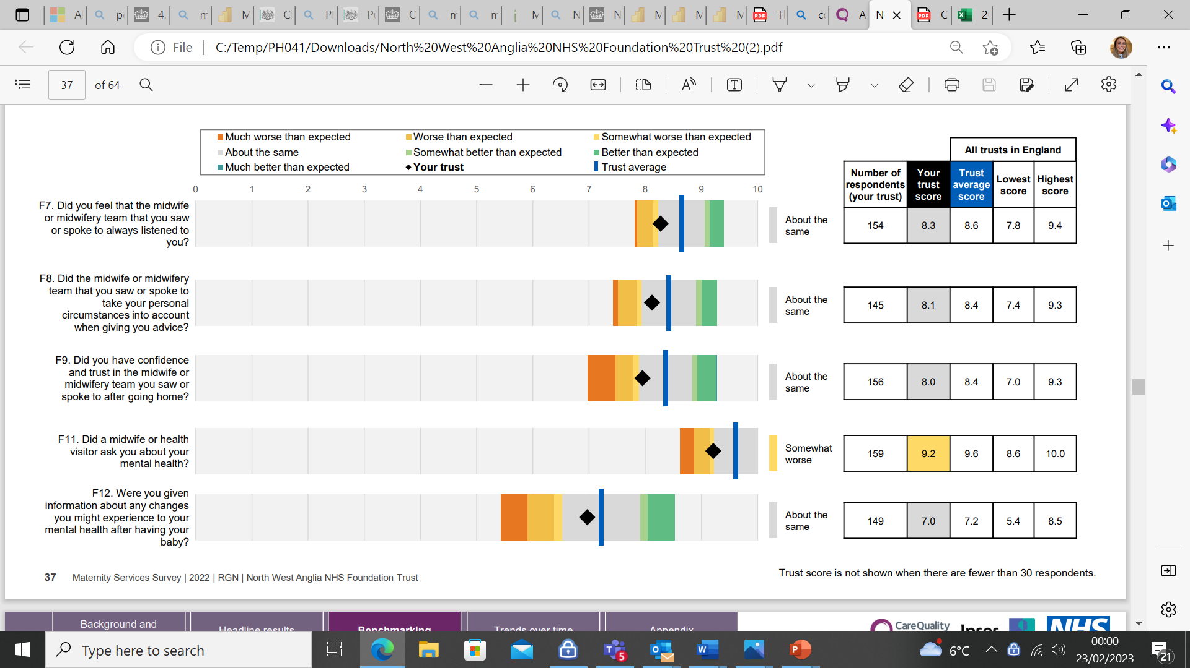
Perinatal Mental Health
MATERNITY SERVICES SURVEY
NWAFT scored lower than average trust scores across questions regarding mental health support antenatally and postnatally. CUH scored averagely for these questions. It is likely that the significant workforce pressures that maternity services are facing is impacting this scoring.
Cambridge University Hospitals NHS Trust
North West Anglia Foundation NHS Trust
NHS Maternity Services Survey 2022 Benchmark Report

Slide 48
Perinatal Mental Health
LOCAL VOICES – MENTAL HEALTH NEEDS ASSESSMENT
There is a need for specialist bereavement support for parents experiencing miscarriage, stillbirth and/or trauma around birth including removal of baby from parent’s care. Organisations reported many women ask for this support and there are no specialist local services which they can be referred to
Poor perinatal MH often is the result of complex issues (including but not limited to financial worries, relationship problems, lack of social support, and lack of parenting skills) but it is difficult to find holistic support to address all those issues. Many community and voluntary sector organisations report that their staff and volunteers spend a lot of time supporting mothers with financial and housing issues or signpost to other support services before the parent can engage with mental health support
Mothers report experiencing differing mental health support from midwives and health visitors across Cambridgeshire and Peterborough. Significant differences are not observed at district level; which seems to be caused by differences in individual health professionals’ skills, knowledge and attitudes around mental health issues
The majority of baby weigh in clinics have been held as self-weigh in clinics with no heath professional to provide support to mothers at the clinic missing opportunities to build trusted relationships with health visitors. Many mothers report missing the informal opportunities these clinics provided to quickly ask questions around baby’s development as well as their own mental wellbeing. Mothers can struggle with the current system where they don’t personally know their health visitor and where they must make a phone call if they need support. If they already struggle with mental health issues the current system can be a barrier as it requires mothers to be proactive in seeking help.
Partners also reported that engaging male parents/partners in support groups or education classes has been challenging. Fathers may prefer more flexibility around timing and formality of activities due to work and other commitments. It has also been reported that the lack of male health care or support worker professionals can be a barrier as men may feel their perspective is not fully understood by female workers.
Cambridgeshire & Peterborough Insight – Mental Health Needs Assessment – Chapter Three: Perinatal mental health – Service provision – Gaps in service provision (cambridgeshireinsight.org.uk)

Slide 49
Perinatal Mental Health
PERINATAL MENTAL HEALTH SURVEY FOR ROSIE MATERNITY AND NEONATAL VOICES (2021)
The following issues were identified as the most important ones to local survey respondents:
Perinatal-related anxieties e.g. infant-feeding (14%)
Depressive feelings (11.3%)
Covid-19 related anxieties (10.7%
Loneliness (10.5%)
Birth trauma and/or neonatal care (9.3%)
Pregnancy loss and neonatal bereavement (6.4%)
Other anxieties e.g. financial (5.1%)
Severe depression or severe anxiety disorder (4.2%)
Parental relationships (e.g. separation) (3.9%)
Medication support (3.6%)
Cambridgeshire & Peterborough Insight – Mental Health Needs Assessment – Chapter Three: Perinatal mental health – Service provision – Gaps in service provision (cambridgeshireinsight.org.uk)

Slide 50
Perinatal Mental Health
OUR LOCAL PERINATAL MENTAL HEALTH PRIORITIES
The following points were agreed by the Cambridgeshire and Peterborough Perinatal Mental Health Network in 2022 as priorities for perinatal mental health:
A robust antenatal education offer: The introduction of a flexible and accessible antenatal education offer providing a sense of community and peer support throughout the perinatal period, supporting all families in developing strong parent-infant relationships and an awareness of perinatal mental health, including tackling stigma, recognising risk factors, preventing poor mental health, and knowing how and when to access support.
Dedicated support from a key contact during the perinatal period: Starting during the perinatal period, families and parents will receive consistent and proactive support from a trained and trusted contact, empowering them to overcoming barriers to accessing perinatal support. Recognising the link between a positive feeding experience and good mental health this will include supporting parents on their infant-feeding journey.
Promoting strong parent-infant relationships: Holistically supporting parents to develop strong parent-infant relationships through enriching activities which promote good short- and long-term parent and infant mental health and child development.
Clear and supportive referral pathways: Working with the wider system, we will encourage more parents to access perinatal help by offering clear community perinatal mental health service referral pathways which provide proactive follow-up and reassurance during the referral process, to ensure those identified with mild-moderate perinatal mental health issues feel able to access community support.
Support for the whole family, including fathers and partners: Information and support, including self-help materials and peer support groups will be easily accessed by families through different platforms intended to meet the perinatal needs of the whole family, including resources and services designed with fathers and partners in mind.
Working with the wider system to tackle health inequalities and stigma: We will co-design and consult with the wider system to support vital community work engaging vulnerable populations and campaigning against perinatal mental health stigma, to make certain that all communities feel able to access culturally sensitive perinatal support.
Workforce training, development, and supervision: Training and access to appropriate supervision will be offered to those working with families and parents to encourage the de-stigmatisation of perinatal mental health and providing staff with the ability to identify and support parents at risk of poor perinatal mental health in a sensitive and evidence-based way.
Cambridgeshire & Peterborough Insight – Mental Health Needs Assessment – Chapter Three: Perinatal mental health – Policy context (cambridgeshireinsight.org.uk)

Slide 51

Infant Feeding
Infant Feeding

Slide 52
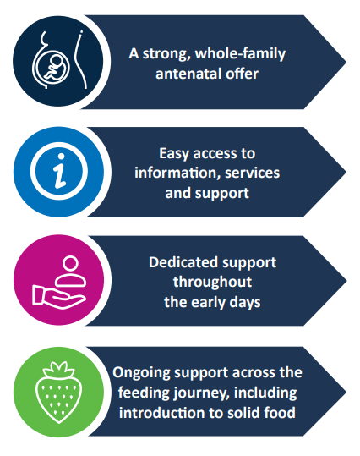
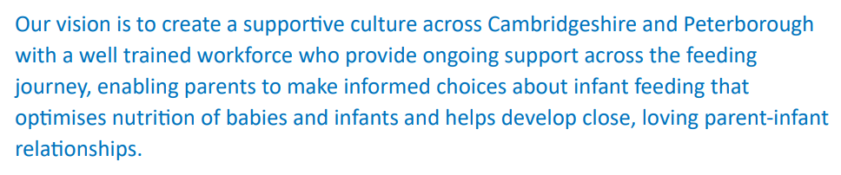
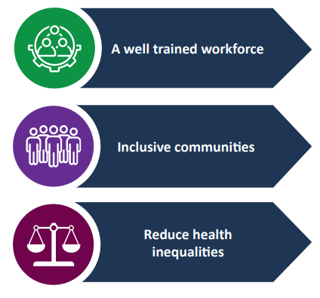
Infant Feeding
OUR LOCAL INFANT FEEDING STRATEGY
Cambridgeshire and Peterborough Infanct Feeding Strategy 2022-27 (cambridgeshireinsight.org.uk)

Slide 53
WHAT ARE LOCAL PEOPLE SAYING?
Infant Feeding

Slide 54
Infant Feeding
NWAFT MATERNITY AND NEONATAL VOICES USER FEEDBACK
The Peterborough and Hinchingbrooke Maternity Voices Partnership is a team of women, midwives, doctors, health visitors, charities and commissioners working together to review and contribute to the development of local maternity care.
Over 300 responses to survey that was released via Facebook from MVP.
210 reported a link between feeding journey and mental health (both positive and negative impacts)
Key highlighted issues:
Feelings of guilt when things didn’t go as planned.
Positive impact from the connection breastfeeding gives.
Formula feeding also having positive impact in some ways, reduces strain on mothers/pressure lifted.
Stress of being babies only food source – feelings of failure when you cannot/ do not breastfeed.
Exhaustion caused from breastfeeding impacts upon mental health, as well as the physical pain associated with breastfeeding.
Working with our Maternity Partners | NW Anglia Website (nwangliaft.nhs.uk)

Slide 55
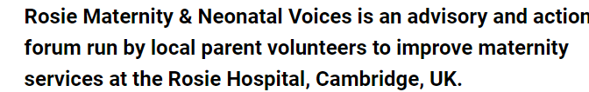
Infant Feeding
ROSIE MATERNITY AND NEONATAL VOICES USER FEEDBACK
Over half of those surveyed did not receive antenatal information on feeding choices – 1/5 would’ve liked to receive this.
Infant feeding support was the aspect of care second most likely to be poor (after partner/family involvement and support).
Infant feeding support within the community was most likely to be poor and least likely to be good or excellent.
86% of respondents intended to exclusively breastfeed, whereas only 58% were exclusively breastfeeding at 6 weeks.
Highlighted issues:
Midwives approach was not always appropriate.
Lack of in-depth information provided (told to formula feed and express but no information about how often/how much)
Health visitors gave conflicting advice.
Not enough visits/phone calls missed.
Support for tongue tie needs to be improved.
Rosie Maternity and Neonatal Voices | Cambridge | Facebook
Rosie Maternity and Neonatal Voices Partnership | CUH

Slide 56
BREASTFEEDING PREVALENCE
Infant Feeding

Slide 57
Infant Feeding
BREASTFEEDING STATUS AT 6-8 WEEK HEALTH VISITING CHECK BY DISTRICT
Although breastfeeding prevalence across Peterborough and Fenland remains an area of concern when compared with national levels, the prevalence is now generally in line with the local 50% target. Fenland has the lowest prevalence across all districts.
Source: Healthy Child Programme, CPFT, CCS

Slide 58
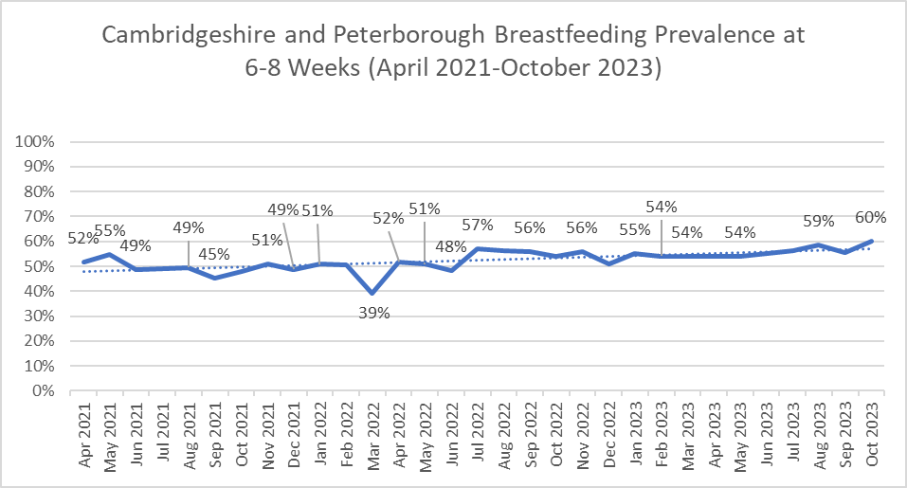

Infant Feeding
BREASTFEEDING STATUS AT 6-8 WEEK HEALTH VISITING CHECK TREND
Breastfeeding prevalence is gradually increasing across Cambridgeshire and Peterborough and is above national average (49.2%).
Source: Healthy Child Programme, CPFT, CCS and OHID's (formerly PHE) interim reporting of health visiting metrics

Slide 59





Infant Feeding
INFANT FEEDING SUPPORT
Demand for infant feeding support remains high.
The Healthy Child Programme Infant Feeding Team is made up NHS staff with specific training and qualifications to support parents with their feeding preferences.
Source: Healthy Child Programme, CPFT, CCS
NCT Birth, Feeding and You is a jointly commissioned service by Peterborough City Council and Cambridgeshire County Council to provide community infant feeding and emotional well-being peer support across Peterborough & Cambridgeshire.
#FreeToFeedCP is steadily growing across the county with South Cambridgeshire, East Cambridgeshire and Peterborough all working to help grow #FreeToFeedCP in the community. More areas will be added to the campaign.
Locations of infant feeding support
Free to feed (cambspborochildrenshealth.nhs.uk)
Peterborough & Cambridgeshire Infant Feeding Support (pbcinfantfeeding.org)

Slide 60
Please contact CYP Public Health Manager sian.cowell@cambridgeshire.gov.uk with any questions regarding this data pack

