Slide 1
Greater Cambridge Economy & Employment Update
Quarter 2 2023 (April – June 2023) Research Group, Cambridgeshire County Council
Research.Group@Cambridgeshire.gov.uk

Slide 2
Labour Market Overview
(April 2022 – March 2023)

Slide 3
Labour Market Headline Findings – April 2022 – March 2023
Within this latest quarter the Greater Cambridge region had a higher unemployment rate than the UK as a whole but also had a higher employment rate and lower rate of economic inactivity.
However, this may be because of an increase in the proportion of the 16-64 population being recorded as economically active rather than an increase in the number of people moving from employment to unemployment
Over the last quarter Greater Cambridge has seen a larger increase in both the employment and unemployment rate than the UK as a whole and a greater fall in the economic inactivity rate. This indicates that the rise in unemployment may be due to more people entering the labour market rather than an increase in the number of people losing their jobs.
Looking at the change between this latest quarter, and the comparable one in the previous year the Greater Cambridge Partnership has seen an increase in economic inactivity and a decrease in the employment rate, suggesting that those of working age are moving out of the labour market. It should be emphasised, however, that because the Annual Population Survey is an estimate based on a representative sample and the small area of the Greater Cambridge Partnership that these changes are within the margin of error for the survey, so should be treated as purely indicative.
It is important to note that due to the small geographical area and the way that the Annual Population Survey’s data is collated, all three measures are expected to fluctuate from release to release and should be treated as broadly indicative.

Slide 4
Labour Market Headlines - Definitions
Employment Rate (Employed Population/Total Population): The percentage of the total population who are employed
Unemployment Rate (Unemployed Population/Economically Active Population): The proportion of the Economically Active Population without a job, have been actively seeking work in the past four weeks and are available to start work in the next two weeks or are out of work, have found a job and are waiting to start it in the next two weeks
Economic Inactivity Rate (Economically Inactive Population/Total Population: The proportion of the population without a job and have not sought work in the last four weeks and/or are not available to start work in the next two weeks. Example reasons for being economically inactive could include being a student, having caring responsibilities, being sick and disabled and retirement
Note – All of these measures are calculated on the basis of the working age (16-64) population

Slide 5
Key Economic Indicators
Unemployment Rate Overall (aged 16-64) – 3.9%
Quarterly change
Previous Quarterly change
Change since previous year
The unemployment rate between April 2022 and March 2023 was 3.9% (higher than the 3.7% nationally), this has increased by +1.5 percentage points since the last quarter and is at the same level as 12 months previously
Rolling Quarterly change (Jan – Mar 2022):
+1.5pp
-1.1pp
No Change
+1.9%
Comparing Apr 2022- Mar 2023 with Jan 2022 - Dec 2022
Comparing Jan 2022- Dec 2022 with Oct 2021 - Sept 2022
Comparing Apr 2022- Mar 2023 with Apr 2021 - Mar 2022
Employment Rate Overall (aged 16-64) – 79.1%
Quarterly change
Previous change
Change since previous year
The employment rate between April 2022 and March 2023 was 79.1% (higher than the 75.4% nationally), this has increased by +0.2 percentage points since the last quarter and is -2.1 percentage points lower than the level 12 months previously.
+0.2pp
-0.2pp
+1.9%
-2.1pp
Comparing Apr 2022- Mar 2023 with Jan 2022 - Dec 2022
Comparing Jan 2022- Dec 2022 with Oct 2021 - Sept 2022
Comparing Apr 2022- Mar 2023 with Apr 2021 - Mar 2022
Economically Inactive (aged 16-64) – 17.8%
Previous change
17.8% of residents (aged 16-64) were economically inactive between April 2022 and March 2023(lower than the 21.7% nationally), this has decreased by -1.4 percentage points since the last quarter and is -2.4pp lower than the level 12 months previously.
Quarterly change
Change since previous year
-1.4pp
+1.1pp
+2.3pp
+1.9%
Comparing Apr 2022- Mar 2023 with Jan 2022 - Dec 2022
Comparing Jan 2022- Dec 2022 with Oct 2021 - Sept 2022
Comparing Apr 2022- Mar 2023 with Apr 2021 - Mar 2022
* Please note: estimates and confidence intervals are unreliable due to small sample sizes and so should be treated as indicative.
Notes:
Source – Annual Population Survey, Office for National Statistics
Technical Notes A residence based labour market survey encompassing population, economic activity (employment and unemployment), economic inactivity and qualifications. These are broken down where possible by gender, age, ethnicity, industry and occupation. Available at Local Authority level and above. Updated quarterly.
Commentary Within this latest quarter the Greater Cambridge region had a higher unemployment rate than the UK as a whole but also had a higher employment rate and lower rate of economic inactivity.
This represents the first time since 2006 that the unemployment rate in Greater Cambridge was higher than the national levels.
It is important to note that due to the small geographical area considered, and the Annual Population Survey being based on a representative sample, this may be due to a quarterly fluctuation rather than any kind of long-term trend in the data.
Taking this into account, however, by looking at the quarterly and annual changes across all three metrics we can see where this rise in the unemployment rate may have originated.
Quarterly changes – (April 2022 – March 2023 compared to January – December 2022)
Over the last quarter Greater Cambridge has seen a larger increase in both the employment and unemployment rate than the UK as a whole and a greater fall in the economic inactivity rate.
Compared to the January – December 2022 release of the Annual Population Survey, Greater Cambridge saw an increase in the unemployment rate (+1.5pp), an increase in the employment rate (+0.2pp) and a decrease in the economic inactivity rate (-1.4pp). This decrease in economic inactivity coupled with the rise in the employment rate suggests that the rise in unemployment is not due to a loss of jobs but rather an increase in the proportion entering the labour market as economically inactive but unemployed.
This is compared to the national quarterly changes which saw a smaller decrease in the employment rate (-0.1pp) and a comparable increase in the unemployment rate (+0.1pp) with no change in the economic inactivity rate. This means that, in terms of net changes, working age people may be becoming unemployed but are remaining economically active and looking for work.
Annual Change (April 2022 – March 2023 compared to April 2021 – March 2022)
Looking at the change between this latest quarter, and the comparable one in the previous year the Greater Cambridge Partnership has seen an increase in economic inactivity and a decrease in the employment rate, suggesting that those of working age are moving out of the labour market. It should be emphasised, however, that because the Annual Population Survey is an estimate based on a representative sample and the small area of the Greater Cambridge Partnership that these changes are within the margin of error for the survey, so should be treated as purely indicative.
Compared to the same point in the previous year, Greater Cambridge has seen a decrease in the employment rate (-2.1 percentage points in Greater Cambridge compared to +0.3pp in the UK) no change in the unemployment rate compared to a -0.5pp fall in the UK and a greater increase in the economic inactivity rate (-2.3pp in Greater Cambridge compared to a rise of 0.1pp in the UK as a whole).

Slide 6
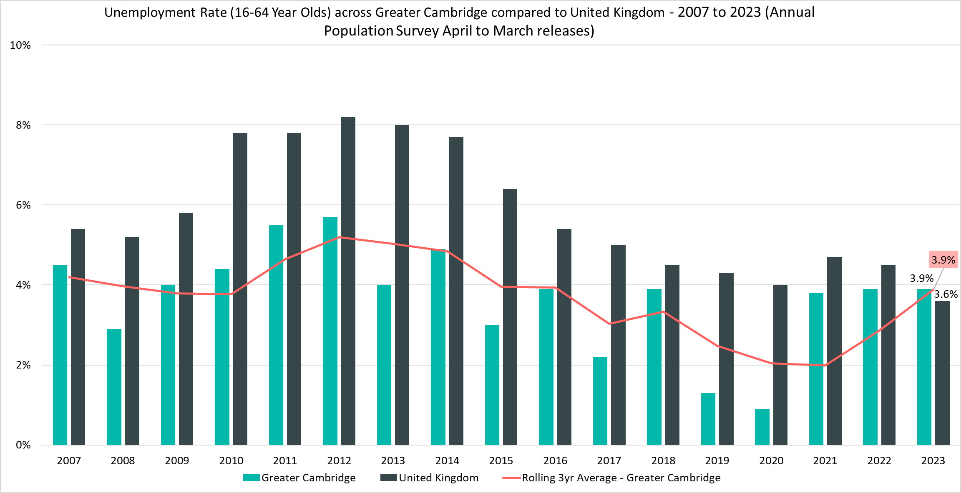
Unemployment Rate (16-64 year olds) – 3.9%, (April 2022 - March 2023)
Rolling Quarterly change (Dec 22 – Mar 23):
Previous change (Sept – Dec 22):
Change since March 2022:
+1.5pp
-1.1pp
No Change
Comparing Apr 2022 - Mar 2023 with Jan 2022 - Dec 2022
Comparing Jan 2022 – Dec 2022 with Oct 2021– Sept 2022
Comparing Apr 2022- Mar 2023 with Apr 2021 - Mar 2022
Notes:
Source – Annual Population Survey (2006-2022), Office for National Statistics
Technical Notes
A residence based labour market survey encompassing population, economic activity (employment and unemployment), economic inactivity and qualifications. These are broken down where possible by gender, age, ethnicity, industry and occupation. Available at Local Authority level and above. Updated quarterly.
Commentary
The above chart shows the unemployment rate across Greater Cambridge and the United Kingdom from 2007 to 2023 alongside a rolling three year average for the region.
Between April 2022 and March 2023 Greater Cambridge’s unemployment rate was higher than the UK as a whole for the first time since at least 2007.
It should be noted that this contradicts the longer term trend where the unemployment rate has been consistently below the national level.
This change compared to the national trend is primarily due to the fact that the UK unemployment rate fell compared to last year, whilst in Greater Cambridge it has not changed.

Slide 7
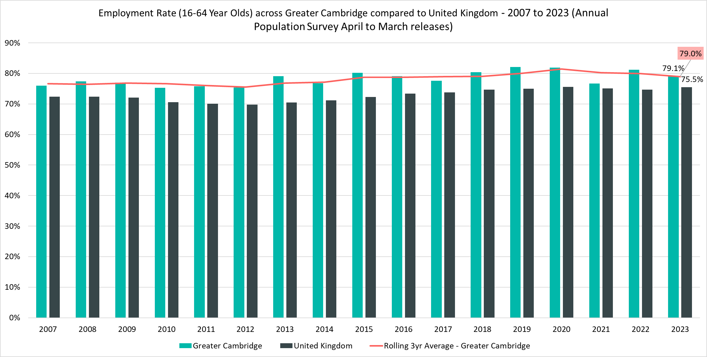
Employment Rate (16-64) – 79.1%, (April 2022 - March 2023)
Rolling Quarterly change (Dec 22 – Mar 23):
Previous change (Sept – Dec 22):
Change since March 2022:
+0.2pp
-0.2pp
-2.1pp
Comparing Apr 2022 - Mar 2023 with Jan 2022 - Dec 2022
Comparing Jan 2022 – Dec 2022 with Oct 2021– Sept 2022
Comparing Apr 2022- Mar 2023 with Apr 2021 - Mar 2022
Notes:
Source – Annual Population Survey (2006-2022), Office for National Statistics
Technical Notes
A residence based labour market survey encompassing population, economic activity (employment and unemployment), economic inactivity and qualifications. These are broken down where possible by gender, age, ethnicity, industry and occupation. Available at Local Authority level and above. Updated quarterly.
Commentary
The above chart shows the employment rate across Greater Cambridge and United Kingdom from 2006 to 2021.
The employment rate across Greater Cambridge has been consistently higher than the rate seen nationally, however within the latest year the gap between the two has decreased, mainly due to a -2.1pp decrease in the employment rate in Greater Cambridge compared to the previous year.

Slide 8
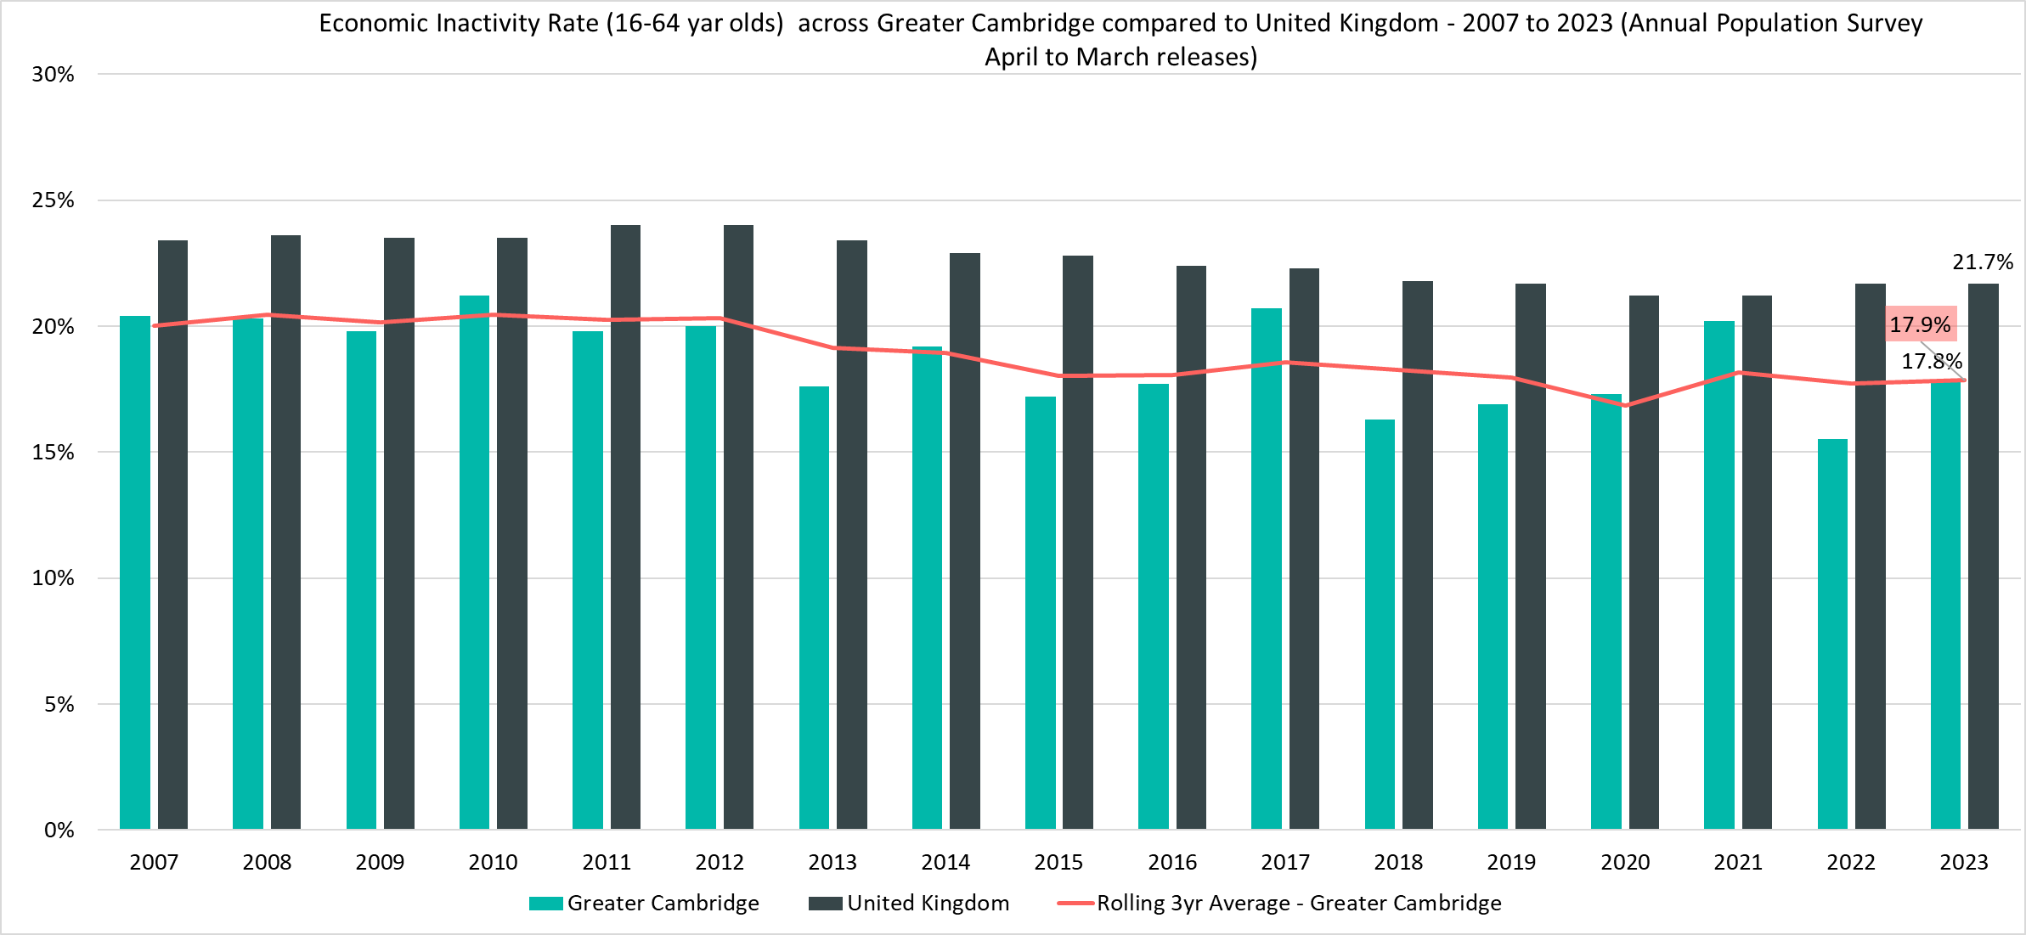
Economically Inactive (16-64 Year Olds) - 17.8%, (April 2022 - March 2023)
Rolling Quarterly change (Dec 22 – Mar 23):
Previous change (Sept – Dec 22):
Change since March 2022:
-1.4pp
+1.1pp
+2.3pp
Comparing Apr 2022 - Mar 2023 with Jan 2022 - Dec 2022
Comparing Jan 2022 – Dec 2022 with Oct 2021– Sept 2022
Comparing Apr 2022- Mar 2023 with Apr 2021 - Mar 2022
Notes:
Source – Annual Population Survey (2006-2022), Office for National Statistics
Technical Notes A residence based labour market survey encompassing population, economic activity (employment and unemployment), economic inactivity and qualifications. These are broken down where possible by gender, age, ethnicity, industry and occupation. Available at Local Authority level and above. Updated quarterly.
Commentary
The above chart shows the percentage of those aged 16-64 who are economically inactive across Greater Cambridge and the United Kingdom from 2004 to 2021.
The percentage of those who were economically inactive in Greater Cambridge has been consistently below the national level.
Over the last 12 months there has been an increase in the economic inactivity rate across Greater Cambridge (+2.3pp) meaning that that the gap has narrowed with the UK as a whole.
This, alongside the decrease in the employment rate implies that, in general, a larger proportion of the Greater Cambridge working age population are leaving the workforce when compared to the previous year. However it should be noted that a large proportion of Greater Cambridge’s economically inactive working age population will be full time students at one of the universities in the city of Cambridge.

Slide 9
Claimant Counts
Claimant Count of Benefits Related to Unemployment – July 2023 Universal Credit Claimant Counts – June 2023

Slide 10
Claimants of Benefits related to Unemployment – July 2023
Claimant counts have decreased over the last quarter (March 2023 to July 2023) in Cambridge and South Cambridgeshire. Both short term and longer term trends show that younger claimants (16-24) and those who live in more relatively deprived areas such as north Cambridge City are particular areas of focus.
As with the Unemployment rate a lower proportion of Greater Cambridge residents claim benefits related to unemployment when compared to the UK. However, there is a high degree of disparity within the area itself with claimant rates ranging from 4.7% in King’s Hedges (North Cambridge) to 0.3% in Newnham (North West Cambridge)
Higher claimant rates seem appear to especially affect wards in the north of the region such as the King’s Hedges, Arbury, and East Chesterton.
In Cambridge, residents in the 25-49 age range have the highest claimant rate (2.2%) whilst in South Cambridgeshire, the 18-24 age group account for the highest claimant rate (2.6%). This suggests that youth unemployment is more prevalent in South Cambridgeshire than Cambridge City, likely because of Cambridge’s large full time student population who are mostly ineligible for unemployment benefits.
Compared to July 2022, the 12 month rolling decreases in the number of claimants have slowed and started to increase for all age groups except for those claimants aged 50+. There are concerns for younger claimants and those who live in more relatively deprived areas with thenumber of younger claimants (aged 16-24) having increased by +20.4% since July 2022. However, the magnitude of increases across the 16-24 age group appears to have stabilised with the latest data showing these increases to be trending smaller.

Slide 11
Labour Market – Claimant Count
The Claimant Count measures the number of people (age 16+) claiming benefit principally for the reason of being unemployed. We use data on claimants rather than unemployed numbers because – although the numbers are lower – they are more up to date. It is however a narrower measure of unemployment, and as such does not cover all those out of work, since not all can claim assistance.
Claimant Counts | Number of claimants July 2023 | % Change 12 Months ago vs Now: July 2022 to July 2023 | % Change Previous update vs Now: March 2023 to July 2023
Greater Cambridge | 3,755 | +1.8% | -2.0%
Cambridge City | 2,055 | +3.5% | -1.0%
South Cambridgeshire | 1,700 | -0.3% | -3.1%
United Kingdom | 1,564,510 | +2.7% | +0.4%
Notes:
Source – Claimant Count, Office for National Statistics
Technical Notes
The Claimant Count measures the number of people (age 16+) claiming benefit principally for the reason of being unemployed. We use data on claimants rather than unemployed numbers because although the numbers are lower they are more up to date. It is however a narrower measure of unemployment, and as such does not cover all those out of work, since not all can claim assistance. The latest claimant count data is a snapshot of the number of claimants on the 13th July 2023.
Commentary
The above chart presents claimant counts across Greater Cambridge from January 2020 to July 2023.
Whilst across Greater Cambridge the proportion of residents who are claiming benefits for reason of unemployment is lower than the UK there is a wide amount of disparity in Cambridge City with most claimants concentrated in the more relatively deprived wards in the north east of the city such as Kings Hedges
July 2023 data showed quarterly decreases in claimant count, there was a -2.0% decrease from March 2023 across Greater Cambridge compared to a +0.4% increase across the United Kingdom.
When comparing July 2023 to July 2022, there was a +1.8% increase in claimant counts across Greater Cambridge, driven by a +3.5% increase in claimants in Cambridge City. South Cambridgeshire saw an annual decrease of -0.3%. This compares to a +2.7% annual increase across the United Kingdom.

Slide 12
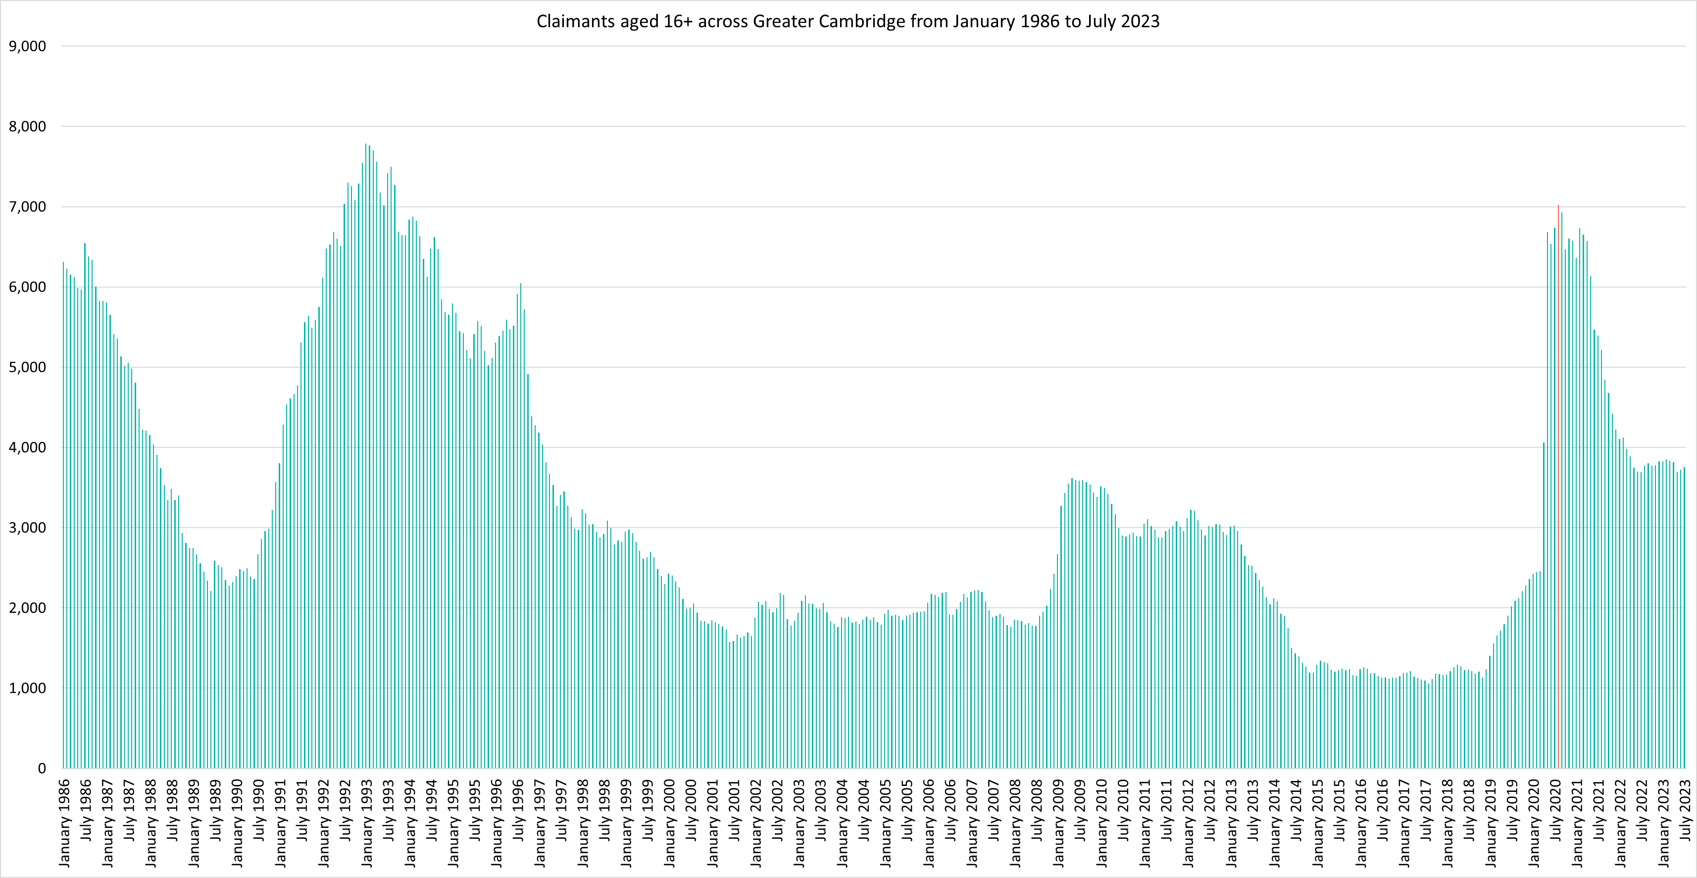
Labour Market – Claimant counts across time
Notes:
Source – Claimant Count, Office for National Statistics
Technical Notes
The Claimant Count measures the number of people (age 16+) claiming benefit principally for the reason of being unemployed. We use data on claimants rather than unemployed numbers because although the numbers are lower they are more up to date. It is however a narrower measure of unemployment, and as such does not cover all those out of work, since not all can claim assistance. The latest claimant count data is a snapshot of the number of claimants on the 13th July 2023.
Commentary
The above chart presents claimant counts across Greater Cambridge from January 1986 to July 2023.
August 2020 (7,020) saw the highest number of claimants since 1993.
Claimant counts have decreased at a faster rate than seen from 1992, but this decline appears to have now stabilised.

Slide 13
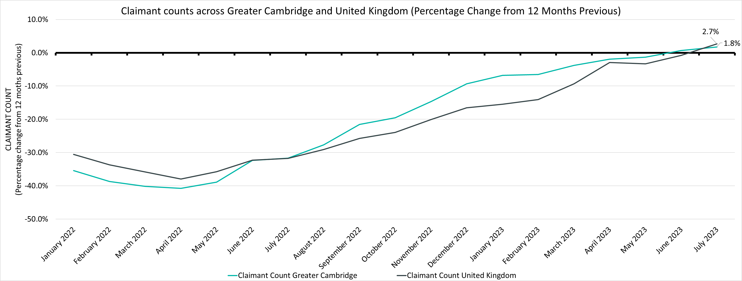
Labour Market – Claimant Count Percentage Change from 12 Months Previous
Claimant Counts | Number of claimants June 2023 | % Change 12 Months ago vs Now: June 2022 to June 2023 | % Change Previous update vs Now: March 2023 to June 2023
Greater Cambridge | 3,755 | +1.8% | -2.0%
United Kingdom | 1,564,510 | +2.7% | +0.4%
Notes:
Source – Claimant Count, Office for National Statistics
Technical Notes
The Claimant Count measures the number of people (age 16+) claiming benefit principally for the reason of being unemployed. We use data on claimants rather than unemployed numbers because although the numbers are lower they are more up to date. It is however a narrower measure of unemployment, and as such does not cover all those out of work, since not all can claim assistance. The latest claimant count data is a snapshot of the number of claimants on the 13th July 2023.
Commentary
The above chart presents claimant counts across Greater Cambridge and as a percentage change from 12 months previous.
Throughout 2022 and the first half of 2023 the number of claimants compared to the same point in the previous year has been lower in Greater Cambridge as well as the UK as a whole.
However, from June 2023 claimants have started to increase when comparing to the previous 12 months, both across Greater Cambridge and the UK.
The rate at which these counts have increased was initially faster than the UK as a whole but in the latest update the Greater Cambridge 12 months % increase has fallen below the national level.

Slide 14
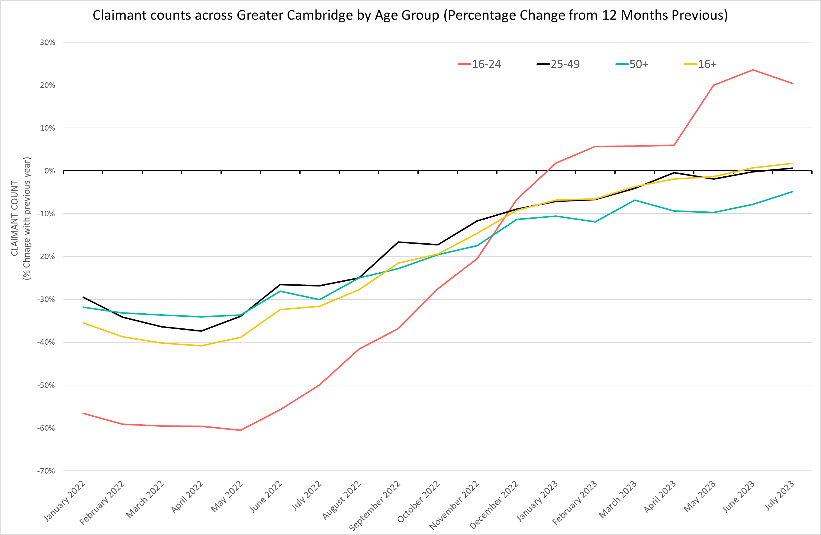
Labour Market – Claimant counts by age
July 2023 Claimant Counts by Age Group (Previous 12 month % Change)
% Change in Claimant Counts | 16+ | 16-24 | 25-49 | 50+
Greater Cambridge (July 2022 to July 2023) | +1.8% | +20.4% | +0.7% | -4.8%
United Kingdom (July 2022 to July 2023) | +2.7% | +9.3% | +3.5% | -3.5%
Greater Cambridge (March 2023 to July 2023) | -2.1% | +1.8% | -0.9% | -7.3%
United Kingdom (March 2023 to July 2023) | +0.4% | -0.2% | +1.2% | -1.2%
Notes:
Source – Claimant Count, Office for National Statistics
Technical Notes
The Claimant Count measures the number of people (age 16+) claiming benefit principally for the reason of being unemployed. We use data on claimants rather than unemployed numbers because although the numbers are lower they are more up to date. It is however a narrower measure of unemployment, and as such does not cover all those out of work, since not all can claim assistance. The latest claimant count data is a snapshot of the number of claimants on the 13th July 2023.
Commentary
The above chart presents the percentage change in claimant counts by age for the 12 months previous,
National statistics on claimant count since the pandemic have indicated that younger age groups have been disproportionately impacted. The above chart highlights the levels of change each age group has seen in claimant counts across the Greater Cambridge area.
As with the overall trend, all age groups except for those 50+ are now seeing increases in claimant counts when compared to the last 12 months. The magnitude of these increases across the latest quarter is also trending upwards. However, the magnitude of increases across the 16-24 age group appears to have stabilised and may be starting to decrease. Whilst those aged 50+ are not seeing raw number increases in claimant counts when comparing to the previous 12 months, the magnitude of decreases is trending to be smaller and getting closer to being an increase.
In July 2023, there was an -2.1% decrease in claimants aged 16+ from March 2023, a 1.8% increase in claimants aged 16-24, a -0.9% decrease in claimants aged 25-49 and a -7.3% decrease in claimants aged 50+.

Slide 15
Labour Market – Claimant Rates by Age Group
July 2023 Claimant Rates by Age Group
Claimant Rates | 16-64 July 2023 | 16-24 July 2023 | 16-17 July 2023 | 18-24 July 2023 | 25-49 July 2023 | 50-64 July 2023
Cambridge City | 1.9% | 1.1% | 0.2% | 1.2% | 2.2% | 2.2%
South Cambridgeshire | 1.7% | 1.9% | 0.1% | 2.6% | 2.0% | 1.2%
Greater Cambridge | 1.8% | 1.3% | 0.2% | 1.5% | 2.1% | 1.5%
United Kingdom | 3.6% | 3.8% | 0.2% | 4.9% | 4.3% | 2.5%
Notes:
Source – Claimant Count, Office for National Statistics
Technical Notes
The Claimant Count measures the number of people (age 16+) claiming benefit principally for the reason of being unemployed. We use data on claimants rather than unemployed numbers because although the numbers are lower they are more up to date. It is however a narrower measure of unemployment, and as such does not cover all those out of work, since not all can claim assistance. The latest claimant count data is a snapshot of the number of claimants on the 13th July 2023.
Commentary
The above table presents the July 2023 claimant count as a rate of the resident population by age group.
National statistics on claimant count since the pandemic have indicated that younger age groups have been disproportionately impacted. The above chart highlights the levels of change each age group has seen in claimant counts across the Greater Cambridge area.
The 18-24 claimant rate remains higher than the other age groups across South Cambridgeshire. Cambridge City bucks this trend, this may be because a large proportion of 18-24 year olds there will be full time students who are, for the most part, ineligible for claiming unemployment benefits.
In Greater Cambridge, residents in the 25-49 age range have the highest claimant rate (2.1%).

Slide 16
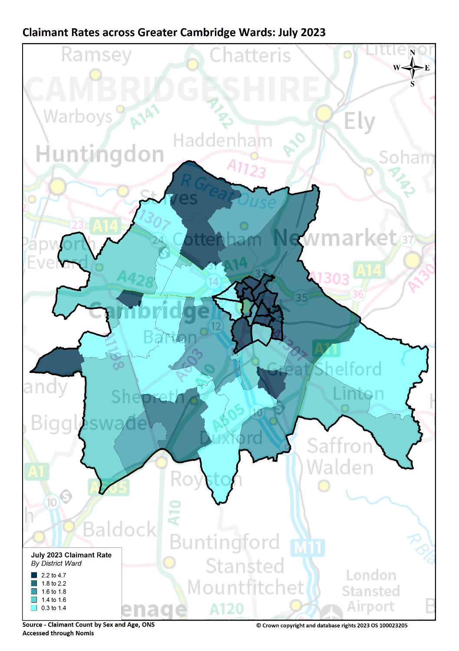
Labour Market – Claimant counts by location
Claimant Rates | Number of claimants July 2023 | % 16-64 population July 2023 | PP Change 12 Months ago vs Now: July 2022 to July 2023 | PP Change Previous update vs Now: March 2023 to July 2023
Cambridge City | 2,055 | 1.9% | No Change | No Change
South Cambridgeshire | 1,700 | 1.7% | No Change | -0.1pp
Greater Cambridge | 3,755 | 1.8% | No Change | -0.1pp
United Kingdom | 1,564,510 | 3.7% | +0.1pp | No Change
Notes:
Source – Claimant Count, Office for National Statistics
Technical Notes
The Claimant Count measures the number of people (age 16+) claiming benefit principally for the reason of being unemployed. We use data on claimants rather than unemployed numbers because, although the numbers are lower, they are more up to date,. It is however a narrower measure of unemployment, and as such does not cover all those out of work, since not all can claim assistance. The latest claimant count data is a snapshot of the number of claimants on the 9th March 2023.
Commentary
The above map illustrates claimant rate by ward across the Greater Cambridge area. We use this to highlight the wards with the highest claimant rate (represented in dark blue).
Claimant rates are generally higher in the north of the region and in urban areas. North East and East of Cambridge City stand out as areas with higher claimant rates.
The lowest claimant rates across the Greater Cambridge area are in the Cambridge City ward of Newnham (0.3%) and the South Cambridgeshire wards of Balsham (0.9%) and Whittlesford (1.0%)
Top 5 wards with highest claimant rates are (July 2023): King’s Hedges (4.7%), Arbury (4.0%), Abbey (3.8%), Cherry Hinton (3.4%) and East Chesterton (3.2%). All these wards are in Cambridge City.
On a local authority level both Cambridge City and South Cambridgeshire saw a small decease in claimant rate (-0.1pp) from July 2022 to July 2023. South Cambridgeshire did see a -0.1pp decrease in claimant rate between March 2023 and July 2023 whilst Cambridge City saw no change.

Slide 17
Universal Credit Claimants – March 2023
Policy changes to provide economic support during the Covid-19 pandemic allowed those on higher incomes than previously to claim Universal Credit, resulting in a permanent rise in claimants since the Spring lockdowns of 2020.
Both on a quarterly and annual basis Greater Cambridge has seen a higher increase in the number of claimants than Great Britain as a whole. This has mostly been driven by a rise in unemployed claimants but the number of employed claimants is also now increasing.
As with the other benefit claimant measure, Greater Cambridge as a whole has a lower claimant rate than Great Britain as a whole.
Unemployed claimants have consistently made up the majority of claimants at both a regional and local authority level. Unemployed claimants have driven both the annual increases in the number of claimants. The number of employed claimants has now also started to increase, contributing towards the quarterly increase and some of the annual increase.

Slide 18
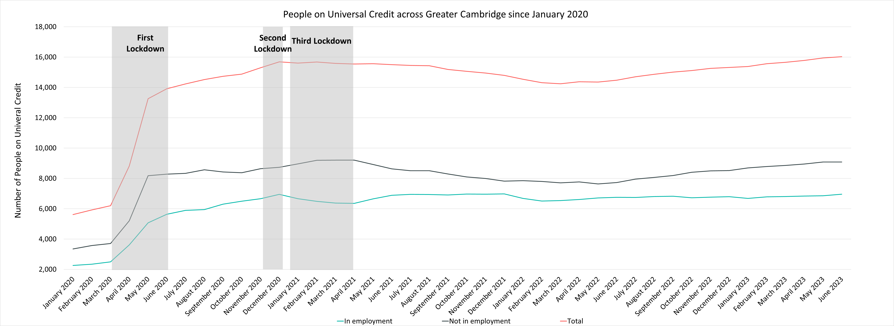
Labour Market – People on Universal Credit
Universal Credit Status | Number of Claimants June 2023 | Share of Total June 2023 | % Change with February 2023 | % Change with June 2022
Employed | 6,954 | 43% | +2.5% | +3.0%
Unemployed | 9,080 | 57% | +3.4% | +17.5%
Total | 16,027 |  | +3.0% | +10.7%
Notes:
Source – Universal Credit Claimants, Department for Work and Pensions
Technical Notes
Universal Credit is available in every jobcentre across Great Britain. Roll out was completed in December 2018.
Universal Credit is a single payment for each household to help with living costs for those on a low income or out of work. It is replacing six benefits, commonly referred to as the legacy benefits:
Income-based Jobseeker's Allowance
Income-related Employment and Support Allowance
Income Support
Working Tax Credit
Child Tax Credit
Housing Benefit
Support for housing costs, children and childcare costs are integrated into Universal Credit. It also provides additions for people with a disability, health condition or caring responsibilities which may prevent them from working.
Commentary
The chart above highlights changes in the number of people on universal credit across Greater Cambridge by Employment Status from January 2020.
The number of Universal Credit claimants includes those who have started Universal Credit (completed the Universal Credit claim process and accepted their Claimant Commitment) and have not had a closure of their claim recorded for this spell, up to the 'count date' (second Thursday in each month). A closure of their claim would be recorded either at the request of the individual or if their entitlement to Universal Credit ends, for example, if they no longer satisfy the financial conditions to receive Universal Credit as they have capital over £16,000.
It is important to note that the initial rise in claimants during the first lockdown period was due to policy changes brought in as part of the pandemic response that allowed people on higher incomes than before to claim the benefit, the peak of this increase came during the second lockdown in the Winter of 2020.
Unemployed claimants have consistently made up the majority of claimants. The increases across the last quarter, and the last 12 months, have mostly been driven by these unemployed claimants with the number of employed claimants remaining stable over the last 12 months and even decreasing in the last quarter.
Despite decreases from Q1 of 2021, the numbers of those on universal credit remains much higher than Pre-Covid with numbers trending upwards from May 2022.
Unemployed claimants make up the majority of people on universal credit (57%) and saw a +3.4% increase from February 2023 and a +16.5% increase from July 2022. In comparison employed claimants saw a +2.5% increase from February 2023 and a +3.0% increase from June 2022.

Slide 19
Labour Market – People on Universal Credit, Rates and Percentage Changes
People on Universal Credit | Number of total people on Universal Credit June 2023 | % 16-64 population June 2023 | % Change 12 Months ago vs Now: June 2022 to June 2023 | % Change Previous update vs Now: February 2023 to June 2023
Cambridge City | 8,041 | 7.5% | +7.8% | +2.6%
South Cambridgeshire | 7,986 | 5.8% | +13.8% | +3.4%
Greater Cambridge | 16,027 | 7.8% | +10.7% | +3.0%
Great Britain | 5,961,951 | 14.5% | +7.4% | +2.2%
Notes:
Source – Universal Credit Claimants, Department for Work and Pensions
Technical Notes
Universal Credit is available in every jobcentre across Great Britain. Roll out was completed in December 2018.
Universal Credit is a single payment for each household to help with living costs for those on a low income or out of work. It is replacing six benefits, commonly referred to as the legacy benefits:
Income-based Jobseeker's Allowance
Income-related Employment and Support Allowance
Income Support
Working Tax Credit
Child Tax Credit
Housing Benefit
Support for housing costs, children and childcare costs are integrated into Universal Credit. It also provides additions for people with a disability, health condition or caring responsibilities which may prevent them from working.
Commentary
The above table highlights changes in the number of people on universal credit across Greater Cambridge in June 2023.
The number of Universal Credit claimants includes those who have started Universal Credit (completed the Universal Credit claim process and accepted their Claimant Commitment) and have not had a closure of their claim recorded for this spell, up to the 'count date' (second Thursday in each month). A closure of their claim would be recorded either at the request of the individual or if their entitlement to Universal Credit ends, for example, if they no longer satisfy the financial conditions to receive Universal Credit as they have capital over £16,000.
Greater Cambridge saw that 7.8% of the 16-64 population claimed Universal Credit, a much lower proportion than Great Britain as a whole (14.5%)
Cambridge has a higher rate claiming (7.5%) than South Cambridgeshire (5.8%)
South Cambridgeshire has seen larger annual (+13.8%) and quarterly increases in claimants (+3.4%) compared to Cambridge City (+7.8% and +2.6% respectively)

Slide 20
Wages and Inflation
Pay As You Earn (PAYE) Real Time Information – April 2023

Slide 21
Wages and Inflation– April 2023
Whilst workers who are resident in Greater Cambridge overall have higher median monthly wages than the UK there is not an even distribution across the region. Residents of Cambridge and South Cambridgeshire have higher median wages and Fenland and Peterborough residents have lower. Annual wage growth in the region has fallen below national levels since 2021 and fell well below inflation in 2022. in 2023 annual wage growth in the region is closer to inflation but still below current levels especially when compared to UK annual wage growth which is close to the current level of inflation.
Cambridge (£2,724) and South Cambridgeshire (£2,694) both have median monthly wages much higher than the United Kingdom (£2,234) but all three geographies have followed similar trends.
Cambridge and South Cambridgeshire have both seen average wage growth consistently below that of the United Kingdom since September 2021, but the gap has narrowed throughout 2022 and 2023 with wage growth nearing surpassing the United Kingdom across certain months.
CPIH has been higher than the average wage growth for both local authorities since January 2022

Slide 22
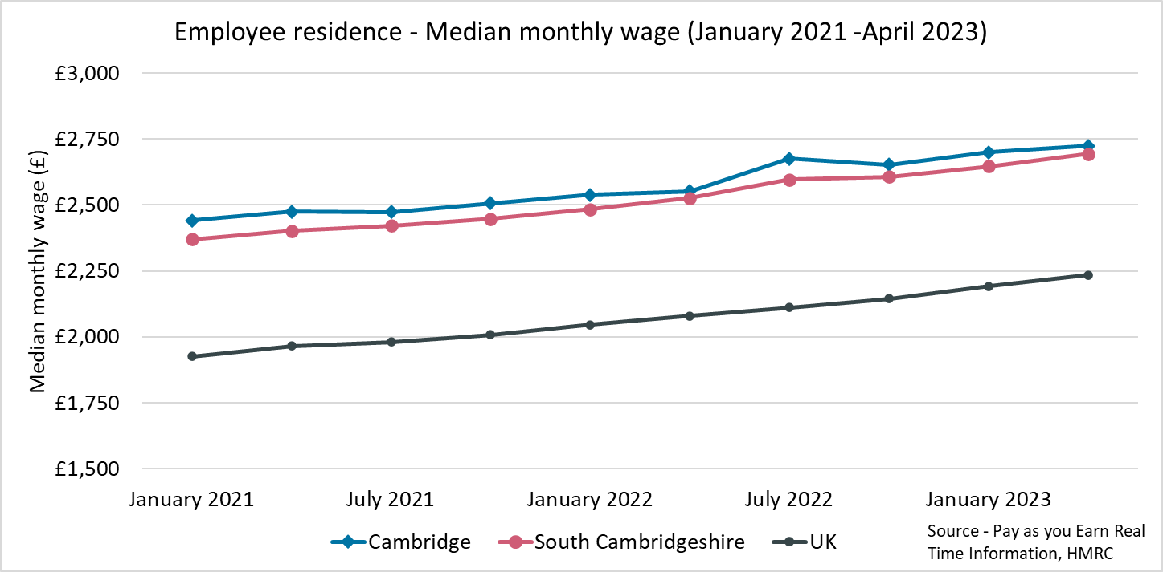
Employment Trends – Median monthly wage (PAYE)
Local Authority | Cambridge | South Cambridgeshire | United Kingdom
Median monthly wage (April 2023) | £2,724 | £2,694 | £2,234
Source – Pay as you earn real time information - HMRC
Previous change (Jun – Sept 22):
+2.2pp
-2.2pp
Comparing Jan 2022- Dec 2022 with Oct 2021 - Sept 2022
Comparing Oct 2021– Sept 2022 with Jul 2021 – Jun 2022
Comparing Jan 2022- Dec 2022 with Jan 2021 - Dec 2021
Notes:
Source – Pay as you earn real time information- HMRC
Technical Notes
This data is sourced from HM Revenue and Customs’ Pay As You Earn system which collects income tax and national insurance. The Pay As you Earn Real Time Information data includes all employees payrolled by employers, therefore it does not include income from pensions, property rental or investments, nor does it include self-employment income.
This data is based on employee’s residence rather than where they work
Commentary
Median monthly wages have remained consistently higher in Cambridge (£2,724 in April 2023) and South Cambridgeshire (£2,694 April 2023) than in the United Kingdom (£2,234 in April 2023)

Slide 23
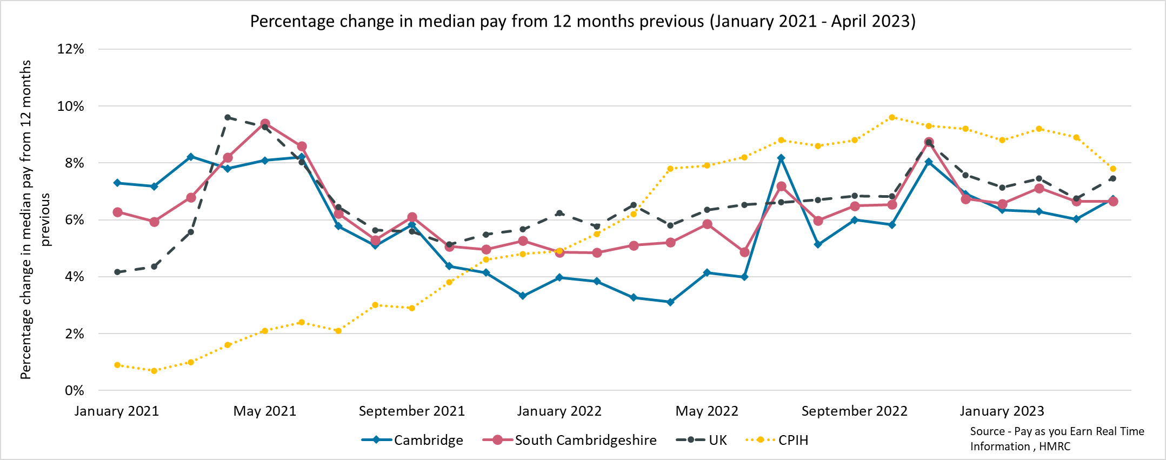
Employment Trends – Median monthly wage growth (PAYE) (January 2021- June 2023)
Local Authority | CPIH (April 2023)* | Cambridge | South Cambridgeshire
% Change from April 2022 | +7.8% | +6.7% | +6.7%
*The Consumer Prices Index including owner occupiers' housing costs (CPIH) is the office for national statistics’ headline inflation measure Source - Pay as you earn real time information – HMRC
Notes:
Source – Pay as you earn real time information- HMRC
Technical Notes
This data is sourced from HM Revenue and Customs’ Pay As You Earn system which collects income tax and national insurance.
the Pay As you Earn Real Time Information data includes all employees payrolled by employers, therefore it does not include income from pensions, property rental or investments, nor does it include self-employment income.
Commentary
The chart above shows the percentage change in median pay from 12 months previous for the period January 2021 – April 2023.
Throughout the time period all three geographies follow a similar pattern, wage rises in theGreater Cambridge local authorities are always within 2 percentage points of each other. From April 2021 to July 2022, Cambridge experienced a lower percentage change in median weekly wage than South Cambridgeshire and the UK. It was then only larger for the month of July 2022 before falling below again, since then it has not risen above South Cambridgeshire although they have been very close and have broadly followed a similar pattern.
CPIH was consistently below the percentage change in median pay until November 2021 and since then CPIH has been higher than the percentage change in median pay.

Slide 24
Vacancies
Lightcast Vacancies Data – March 2023

Slide 25
Vacancies – March 2023
After record numbers of vacancies across Quarter 4 of 2021 and Quarter 1 of the 2022, vacancies decreased in the first half of 2022 and have stabilised at a new baseline.
Looking at how vacancies have changed since the previous update, and when compared to the same point in 2023, vacancies have increased from March 2023 and compared to July 2022.
Most sectors (12 of 16) experienced an increase in vacancies from March 2023, the same number of sectors also had more vacancies than in July 2022.

Slide 26
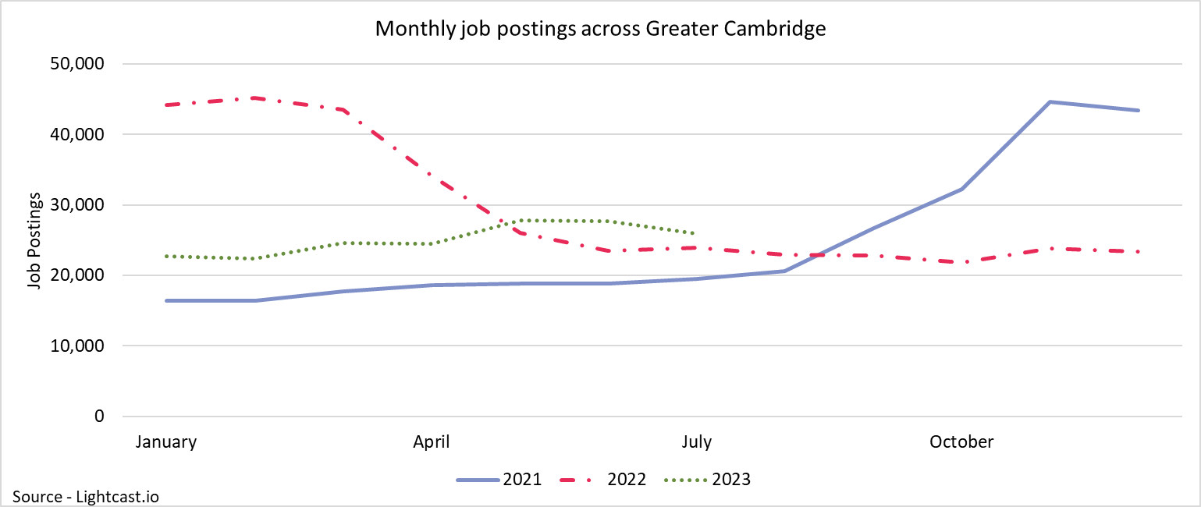
Employment Trends – Vacancies
25,956
+6%
Compared to +6% nationally
+9%
Compared to +2% nationally
Unique job postings in Greater Cambridge in July 2023
Increase in unique job postings compared to March 2023
Increase in unique job postings compared to July 2022
Notes:
Source – Lightcast
Technical Information
Vacancy data is sourced from Lightcast, a service that has been procured by Greater Cambridge Combined Authority which gives labour market information on Job postings, occupations, and industries. Lightcast has a job posting aggregator which scans jobs websites for posting and presents them together.
Lightcast only scans online jobs postings and therefore does not include any jobs which are advertised solely offline. There is also no guarantee that all online job postings are aggregated. For example, a specific job site may not be scanned.
A unique job posting is a deduplicated count of an online job vacancy advertisement. If the same vacancy is posted twice across a sixty-day period, it is only counted once. If the same vacancy is posted twice more than sixty days apart it is counted as two unique job postings.
The other category includes agriculture, forestry and fishing; Mining and quarrying; Water supply and Waste management
Commentary
The above chart illustrates online vacancy data across the Greater Cambridge area since April 2020. A unique job posting is a deduplicated count of an online job vacancy advertisement. If the same vacancy is posted twice across a sixty-day period, it is only counted once. If the same vacancy is posted twice more than sixty days apart it is counted as two unique job postings.
Across Greater Cambridge, there were 25,926 job postings in July 2023, this is an increase of +6% from March 2023. Nationally job postings increased by 6% across the same period.
February 2022 saw the highest number of vacancies across Greater Cambridge within the last 3 years.
In May 2023, there was an increase in job postings of +14% from the previous month. This is the largest percentage increase from the previous month since November 2021
The number of vacancies increased rapidly in the final quarter of 2021 but appear to have peaked in late 2021/early 2022 before rapidly decreasing and then stabilising across the 2nd half of 2022. In 2023 job postings have increased slightly.
*Lightcast data is available from 2012 onwards.

Slide 27
Employment Trends – Vacancies by Industry
Number of Vacancies in Greater Cambridge in July 2023 compared to the UK
Sector Identifier | Employment Sector | Vacancies in Greater Cambridge: July 2023 | Percentage of total vacancies | Vacancies in United Kingdom: July 2023 | Percentage of total vacancies
1 | Accommodation and food service activities | 1,364 | 5% | 165,141 | 5%
2 | Administrative and support service activities | 2,022 | 7% | 291,336 | 9%
3 | Arts, entertainment and recreation | 1,113 | 4% | 136,662 | 4%
4 | Construction | 1,371 | 5% | 151,008 | 5%
5 | Education | 1,425 | 5% | 235,695 | 7%
6 | Financial and insurance activities | 928 | 3% | 123,713 | 4%
7 | Human health and social work activities | 2,571 | 9% | 402,250 | 13%
8 | Information and communication | 3,491 | 13% | 245,645 | 8%
9 | Manufacturing | 1,694 | 6% | 207,996 | 7%
10 | Other service activities | 93 | 0% | 11,701 | 0%
11 | Professional, scientific and technical activities | 1,689 | 6% | 216,122 | 7%
12 | Public administration and defence; compulsory social security | 243 | 1% | 29,526 | 1%
13 | Real estate activities | 429 | 2% | 48,582 | 2%
14 | Transportation and storage | 728 | 3% | 141,563 | 4%
15 | Wholesale and retail trade; repair of motor vehicles and motorcycles | 785 | 3% | 114,283 | 4%
16 | Other sectors (Agriculture, forestry and fishing; Mining and quarrying; Water supply and Waste management) | 1,807 | 7% | 170,444 | 5%
Notes:
The above table shows the number of Vacancies in Greater Cambridge in July 2023 by employment sector and included a national comparison;
Information and Communication (13%) , Human health and social work activities (9%), and Administration and support services (7%) have the highest proportion of vacancies across Greater Cambridge. Human health and social work is also the largest sector nationally (13%)
A greater proportion of job vacancies in Greater Cambridge were in the Information and communications sector (13%) compared to the UK as a whole (8%), a difference of 5 percentage points.

Slide 28
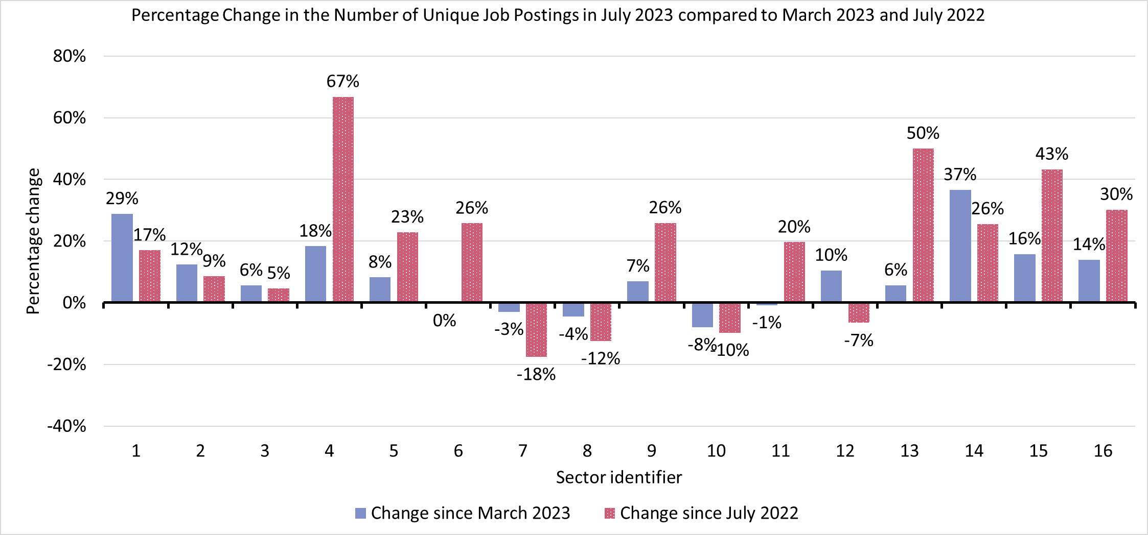
Employment Trends – Vacancies by Industry Changes
Sector Identifier for Chart
Sector Identifier | Sector Name
1 | Accommodation and food service activities
2 | Administrative and support service activities
3 | Arts, entertainment and recreation
4 | Construction
5 | Education
6 | Financial and insurance activities
7 | Human health and social work activities
8 | Information and communication
9 | Manufacturing
10 | Other service activities
11 | Professional, scientific and technical activities
12 | Public administration and defence; compulsory social security
13 | Real estate activities
14 | Transportation and storage
15 | Wholesale and retail trade; repair of motor vehicles and motorcycles
16 | Other sectors (Agriculture, forestry and fishing; Mining and quarrying; Water supply and Waste management)
Notes:
Source – Lightcast
Technical Information
Vacancy data is sourced from Lightcast, a service that has been procured by Greater Cambridge Combined Authority which gives labour market information on Job postings, occupations, and industries. Lightcast has a job posting aggregator which scans jobs websites for posting and presents them together.
Lightcast only scans online jobs postings and therefore does not include any jobs which are advertised solely offline. There is also no guarantee that all online job postings are aggregated. For example, a specific job site may not be scanned.
A unique job posting is a deduplicated count of an online job vacancy advertisement. If the same vacancy is posted twice across a sixty-day period, it is only counted once. If the same vacancy is posted twice more than sixty days apart it is counted as two unique job postings.
The other category includes agriculture, forestry and fishing; Mining and quarrying; Water supply and Waste management
Commentary
The above chart shows the quarterly and annual percentage change in number of job vacancies by sector.
Transportation and storage (+37%) had the largest increase from the previous update. Alongside Public and Accommodation and food services (+29%) these two sectors saw the largest increases from the previous update.
Other service activities (-8%), Information and communication (-4%), and Human health and social work activities (-3%) were the only sectors to decrease from the previous update
Construction (+67%) experienced the largest yearly change. Real estate activities (+50%) and Wholesale and retail trade; repair of motor vehicles and motor cycles (+43%) are the next largest yearly increases.
Human health and social work (-18%), Information and communication (-12%), Other service activities (-10%) and public administration and defence; compulsory social security (-7%) were the 4 sectors to see a decrease in the number of vacancies compared to a year ago.

Slide 29
Employment Trends –by Industry
Median Posting Duration (April - July 2023) (Greater Cambridge) | Posting Intensity (April – July 2023) (Greater Cambridge)
42 Days | 3:1
Median Posting Duration for Vacancies across Greater Cambridge in Days by Employment Sector April to July 2023
Sector Identifier | Employment Sector | May – July 2023 Median Posting Duration (Days) | May - July 2023 Posting Intensity
1 | Accommodation and food service activities | 39 | 3:1
2 | Administrative and support service activities | 43 | 3:1
3 | Arts, entertainment and recreation | 44 | 2:1
4 | Construction | 44 | 3:1
5 | Education | 47 | 3:1
6 | Financial and insurance activities | 46 | 3:1
7 | Human health and social work activities | 42 | 5:1
8 | Information and communication | 49 | 3:1
9 | Manufacturing | 47 | 3:1
10 | Other service activities | 40 | 4:1
11 | Professional, scientific and technical activities | 47 | 3:1
12 | Public administration and defence; compulsory social security | 41 | 3:1
13 | Real estate activities | 42 | 3:1
14 | Transportation and storage | 43 | 3:1
15 | Wholesale and retail trade; repair of motor vehicles and motorcycles | 43 | 3:1
16 | Other sectors (Agriculture, forestry and fishing; Mining and quarrying; Water supply and Waste management) | 47 | 3:1
The chart above shows two metrics to measure the potential difficulty in filling roles in certain sectors:
Median Posting Duration measures how long the average job posting is live online for. A longer time up could suggest that the company anticipates the role being harder to fill
Posting Intensity is a ratio of how many times the same job role is posted. A higher ratio could suggest difficulty filling the role
Notes:
Source – Lightcast
Technical Information
Vacancy data is sourced from Lightcast, a service that has been procured by Greater Cambridge Combined Authority which gives labour market information on Job postings, occupations, and industries. Lightcast has a job posting aggregator which scans jobs websites for posting and presents them together.
Lightcast only scans online jobs postings and therefore does not include any jobs which are advertised solely offline. There is also no guarantee that all online job postings are aggregated. For example, a specific job site may not be scanned.
Median Posting Duration measures how long the average job posting is live online for. A longer time up could suggest that the company anticipates the role being harder to fill.
Posting Intensity is a ratio of how many times the same job role is posted. A higher ratio could suggest difficulty filling the role.
Commentary
The table above shows the median posting duration and the posting intensity for employment sectors from April to June 2023. Both measures can be used as an indication of difficult to fill roles.
Across Greater Cambridge, the median posting duration was 33 days. Human Health and Social work, Manufacturing, other service activities and transportation and storage (all 34) were above this. Construction (35 days) had the longest median posting duration.
Professional and Scientific activities (31), Information and Communication (31), are the 2 sectors most below the median posting duration. Arts, Entertainment and recreation, Financial and Insurance activities, Public administration and Defence; compulsory social security and real estate activities (All 32) were also below the Median posting duration for Greater Cambridge.
The posting intensity across Greater Cambridge was 3:1. Human health and social work activities is the only sector above the regional average (4:1).

