Slide 1
CPCA Economy & Employment Update
Quarter 2 2023 (April – June 2023) Research Group, Cambridgeshire County Council
Research.Group@Cambridgeshire.gov.uk

Slide 2
Labour Market Overview
(April 2022 – March 2023)

Slide 3
Labour Market Headline Findings – April 2022 – March 2023
As with previous quarterly releases, Cambridgeshire and Peterborough has maintained a lower unemployment rate, a higher employment rate and lower rate of economic inactivity amongst the working age population than the UK as a whole.
Over the last quarter Cambridgeshire and Peterborough has seen a larger increase in both unemployment and economic inactivity compared to the UK. An increase in the economic inactivity rate, as well as unemployment, implies that working age residents are not only becoming unemployed but are leaving the labour market overall.
This change, however, may be seasonal as looking at changes compared to the same point in the previous year, a higher proportion of Cambridgeshire and Peterborough’s economically inactive population are both becoming economically active and then employed compared to the UK as a whole.

Slide 4
Labour Market Headlines - Definitions
Employment Rate (Employed Population/Total Population): The percentage of the total population who are employed
Unemployment Rate (Unemployed Population/Economically Active Population): The proportion of the Economically Active Population without a job, have been actively seeking work in the past four weeks and are available to start work in the next two weeks or are out of work, have found a job and are waiting to start it in the next two weeks
Economic Inactivity Rate (Economically Inactive Population/Total Population: The proportion of the population without a job and have not sought work in the last four weeks and/or are not available to start work in the next two weeks. Example reasons for being economically inactive could include being a student, having caring responsibilities, being sick and disabled and retirement
Note – All of these measures are calculated on the basis of the working age (16-64) population

Slide 5
Key Economic Indicators
Unemployment Rate Overall (aged 16-64) – 3.1%
Quarterly change
Previous Quarterly change
Change since previous year
The unemployment rate between April 2022 and March 2023 was 3.1% (lower than the 3.7% nationally), this has increased by +0.2 percentage points since the last quarter and is -0.5 percentage points lower than the level 12 months previously
Rolling Quarterly change (Jan – Mar 2022):
+0.2pp
-0.6pp
-0.5pp
+1.9%
Comparing Apr 2022- Mar 2023 with Jan 2022 - Dec 2022
Comparing Jan 2022- Dec 2022 with Oct 2021 - Sept 2022
Comparing Apr 2022- Mar 2023 with Apr 2021 - Mar 2022
Employment Rate Overall (aged 16-64) – 79.1%
Quarterly change
Previous change
Change since previous year
The employment rate between April 2022 and March 2023 was 79.1% (higher than the 75.4% nationally), this has decreased by -1.0 percentage points since the last quarter but is +0.8 percentage points higher than the level 12 months previously
-1.0pp
+2.2pp
+1.9%
+0.8pp
Comparing Apr 2022- Mar 2023 with Jan 2022 - Dec 2022
Comparing Jan 2022- Dec 2022 with Oct 2021 - Sept 2022
Comparing Apr 2022- Mar 2023 with Apr 2021 - Mar 2022
Economically Inactive (aged 16-64) – 18.4%
Previous change
18.4% of residents (aged 16-64) were economically inactive between April 2022 and March 2023(lower than the 21.7% nationally), this has increased by +0.9 percentage points since the last quarter and is -0.4pp lower than the level 12 months previously
Quarterly change
Change since previous year
+0.9pp
-1.8pp
-0.4pp
+1.9%
Comparing Apr 2022- Mar 2023 with Jan 2022 - Dec 2022
Comparing Jan 2022- Dec 2022 with Oct 2021 - Sept 2022
Comparing Apr 2022- Mar 2023 with Apr 2021 - Mar 2022
* Please note: estimates and confidence intervals are unreliable due to small sample sizes and so should be treated as indicative.
Notes:
Source – Annual Population Survey, Office for National Statistics
Technical Notes A residence based labour market survey encompassing population, economic activity (employment and unemployment), economic inactivity and qualifications. These are broken down where possible by gender, age, ethnicity, industry and occupation. Available at Local Authority level and above. Updated quarterly.
Commentary As with previous quarterly releases, Cambridgeshire and Peterborough has maintained a lower unemployment rate, a higher employment rate and lower rate of economic inactivity amongst the working age population than the UK as a whole.
However there are a few differences it is important to highlight when looking at how these measures have changed on a quarterly and annual basis.
Quarterly changes – (April 2022 – March 2023 compared to January – December 2022)
Over the last quarter Cambridgeshire and Peterborough has seen a larger increase in both unemployment and economic inactivity compared to the UK.
It is important to note that this may not be indicative of a longer-term trend in the data and may be affected by a variety of factors, including seasonal patterns between quarterly releases of the APS
Compared to the January – December 2022 release of the Annual Population Survey, Cambridgeshire and Peterborough saw an increase in the unemployment rate (+0.2pp), a decrease in the employment rate (-1.0pp) and an increase in the economic inactivity rate (+0.9pp). An increase in the economic inactivity rate, as well as unemployment, implies that working age residents are not only becoming unemployed but are leaving the labour market overall.
This is compared to the national quarterly changes which saw a smaller decrease in the employment rate (-0.1pp) and a comparable increase in the unemployment rate (+0.1pp) with no change in the economic inactivity rate. This means that, in terms of net changes, working age people may be becoming unemployed but they are not leaving the labour market in the same way as they have done within Cambridgeshire and Peterborough.
Annual Change (April 2022 – March 2023 compared to April 2021 – March 2022)
Looking at changes to a comparable period in the previous year, a higher proportion of Cambridgeshire and Peterborough’s economically inactive population are both becoming economically active and then employed compared to the UK as a whole.
Compared to the same point in the previous year, Cambridgeshire and Peterborough has seen a higher increase in the employment rate (+0.8 percentage points in C&P compared to +0.3pp in the UK) a comparable fall in the unemployment rate (-0.5pp in both geographies) and a greater decrease in the economic inactivity rate (-0.4pp in C&P compared to a rise of 0.1pp in the UK as a whole).

Slide 6
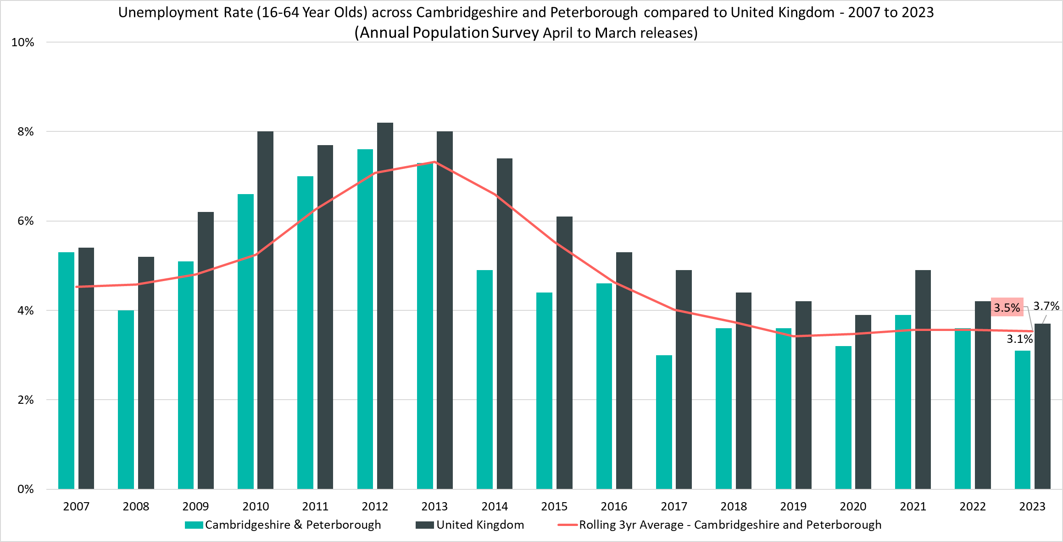
Unemployment Rate (16-64 year olds) – 3.1%, (April 2022 - March 2023)
Rolling Quarterly change (Dec 22 – Mar 23):
Previous change (Sept – Dec 22):
Change since March 2022:
+0.2pp
-0.6pp
-0.5pp
Comparing Apr 2022 - Mar 2023 with Jan 2022 - Dec 2022
Comparing Jan 2022 – Dec 2022 with Oct 2021– Sept 2022
Comparing Apr 2022- Mar 2023 with Apr 2021 - Mar 2022
Notes:
Source – Annual Population Survey (2006-2023), Office for National Statistics
Technical Notes
A residence based labour market survey encompassing population, economic activity (employment and unemployment), economic inactivity and qualifications. These are broken down where possible by gender, age, ethnicity, industry and occupation. Available at Local Authority level and above. Updated quarterly.
Commentary
The above chart shows the unemployment rate across Cambridgeshire & Peterborough and the United Kingdom from 2007 to 2023 alongside a rolling three year average for the region using the April to March releases of the Annual Population Survey.
The unemployment rate has been consistently below the national level and has broadly followed the same pattern as seen nationally: a rise during 2021, to reflect the impacts of the pandemic before a decrease to pre-pandemic levels in 2023.
Compared to the previous quarter Cambridgeshire and Peterborough saw a +0.2pp increase in the unemployment rate, compared to a decrease across the UK of -0.1pp. It should be noted, however that this may be a short-term fluctuation as both Cambridgeshire and Peterborough and the UK as a whole saw a -0.5pp decrease in the unemployment rate when compared to the same point in 2022.

Slide 7
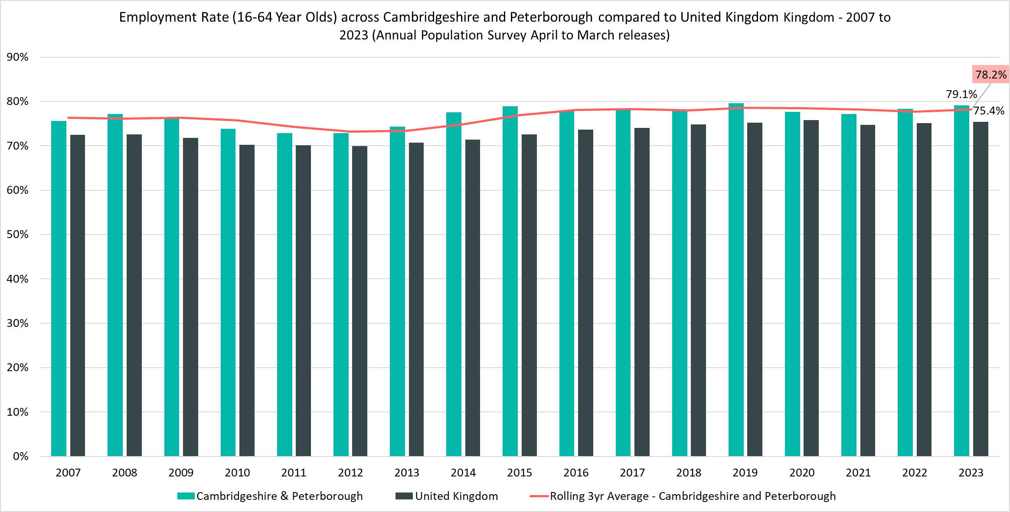
Employment Rate (16-64) – 79.1%, (April 2022 - March 2023)
Rolling Quarterly change (Dec 22 – Mar 23):
Previous change (Sept – Dec 22):
Change since March 2022:
-1.0pp
+2.2pp
+0.8pp
Comparing Apr 2022 - Mar 2023 with Jan 2022 - Dec 2022
Comparing Jan 2022 – Dec 2022 with Oct 2021– Sept 2022
Comparing Apr 2022- Mar 2023 with Apr 2021 - Mar 2022
Notes:
Source – Annual Population Survey (2006-2022), Office for National Statistics
Technical Notes
A residence based labour market survey encompassing population, economic activity (employment and unemployment), economic inactivity and qualifications. These are broken down where possible by gender, age, ethnicity, industry and occupation. Available at Local Authority level and above. Updated quarterly.
Commentary
The above chart shows the employment rate across Cambridgeshire & Peterborough and United Kingdom from 2007 to 2023.
The employment rate across Cambridgeshire & Peterborough has been consistently higher than the rate seen nationally. Whilst, compared to the previous quarter, the Cambridgeshire and Peterborough employment rate has decreased at the same rate as the UK as a whole (-1.0pp) in the longer term it has increased at a faster rate than the UK. This, coupled with the decreasing amount of economic inactivity, indicates that residents of Cambridgeshire and Peterborough are re-entering the workforce.

Slide 8
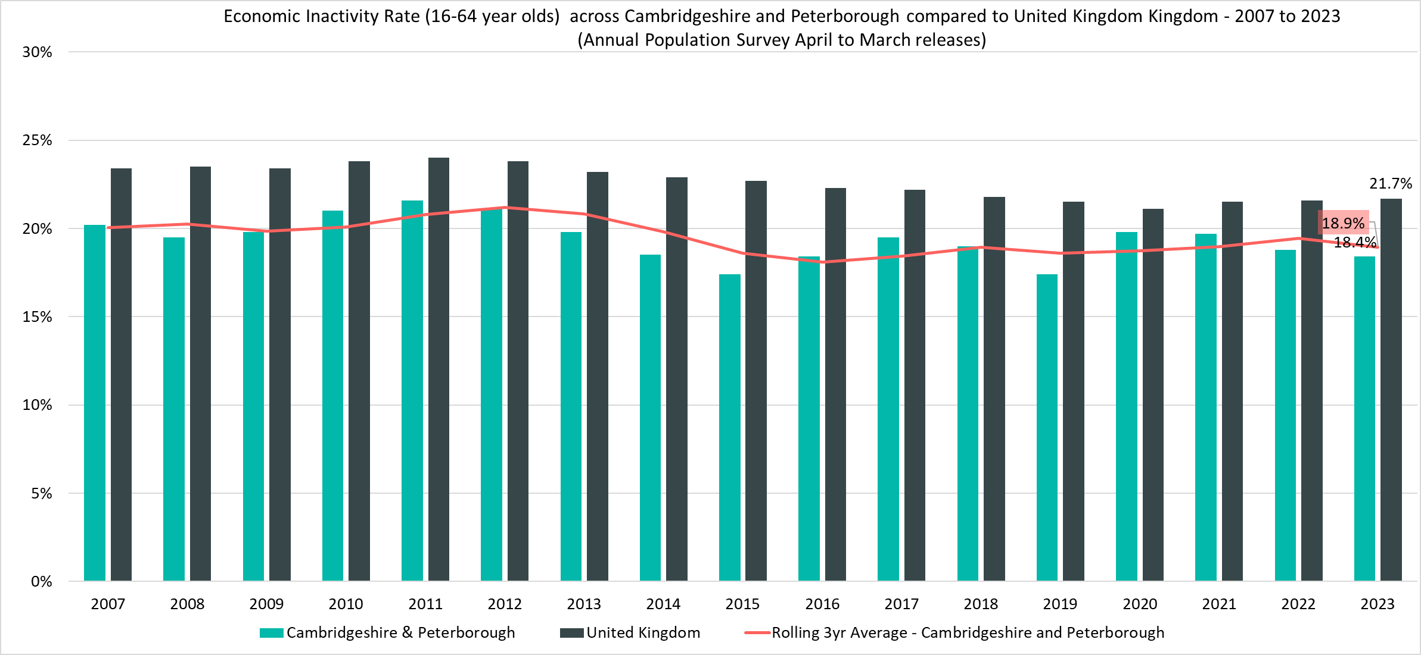
Economically Inactive (16-64 Year Olds) – 18.4%, (April 2022 - March 2023)
Rolling Quarterly change (Dec 22 – Mar 23):
Previous change (Sept – Dec 22):
Change since March 2022:
+0.9pp
-1.8pp
-0.4pp
Comparing Apr 2022 - Mar 2023 with Jan 2022 - Dec 2022
Comparing Jan 2022 – Dec 2022 with Oct 2021– Sept 2022
Comparing Apr 2022- Mar 2023 with Apr 2021 - Mar 2022
Notes:
Source – Annual Population Survey (2006-2022), Office for National Statistics
Technical Notes A residence based labour market survey encompassing population, economic activity (employment and unemployment), economic inactivity and qualifications. These are broken down where possible by gender, age, ethnicity, industry and occupation. Available at Local Authority level and above. Updated quarterly.
Commentary
The above chart shows the percentage of those aged 16-64 who are economically inactive across Cambridgeshire & Peterborough and the United Kingdom from 2007 to 2023
The percentage of those who were economically inactive in Cambridgeshire and Peterborough has been consistently below the national level.
Looking at the change in economic inactivity since the last quarter, Cambridgeshire and Peterborough has seen an increase (+0.9pp) whilst the rate has not changed in the UK. This, coupled with the increase in the unemployment rate would imply that a greater proportion of residents are not just becoming unemployed but also leaving the labour market as a whole.
However, looking at longer term annual trends: Whilst the gap in economic inactivity between Cambridgeshire and Peterborough and the UK as a whole closed during the pandemic, with the Cambridgeshire and Peterborough rate rising more quickly than the national one, the region appears to have more quickly recovered. This contrasts with the UK where it has only slightly decreased.
This will mean that a higher proportion of Cambridgeshire and Peterborough residents are entering the labour market. The long-term fall in the unemployment rate and rise in the employment rate implies that these residents are not just looking for work but that they are finding it.

Slide 9
Claimant Counts
Claimant Count of Benefits Related to Unemployment – July 2023 Universal Credit Claimant Counts – June 2023

Slide 10
Claimants of Benefits related to Unemployment – July 2023
Claimant counts have slightly increased over the last quarter (March 2023 to July 2023). Both short term and longer term trends show that younger claimants (16-24) and those who live in more relatively deprived areas such as Fenland and Peterborough are particular areas of focus.
As with the Unemployment rate a lower proportion of Cambridgeshire and Peterborough residents claim benefits related to unemployment when compared to the UK. However, there is a high degree of disparity within the region itself as both Fenland and Peterborough have higher claimant rates than nationally. 58% of claimants live in these local authorities with 44% in Peterborough itself.
Higher claimant rates seem appear to especially affect urban areas in the north of the region such as the city of Peterborough and towns in Fenland such as Wisbech. Outside of Fenland and Peterborough areas such as the north of Huntingdon and the North and West of Cambridge City also have higher claimant rates. All of these also stand out as more relatively deprived areas within the region.
18-24 year olds across East Cambridgeshire, Fenland, South Cambridgeshire and Peterborough all have a higher claimant rate than other age groups and the working age population as a whole. This difference was especially apparent within the more relatively deprived local authorities like Fenland and Peterborough where the claimant rate of 18-24 year olds was 2.4 percentage points and 2.3 percentage points higher respectively than the claimant rate for 16-64 year olds overall. It is interesting to note that a less relatively deprived local authority like South Cambridgeshire had the lowest percentage point difference between young adults and the working age population.
Over the last quarter the number of claimants in Cambridgeshire and Peterborough has been rising at a faster rate than the UK as a whole (+1.0% in Cambridgeshire and Peterborough compared to +0.4% in the UK). This has been entirely driven by Peterborough which has seen +6.8% more claimants compared to March 2023, the only local authority to see a rise in claimants across the last quarter.
Compared to July 2022, the 12 month rolling change in the number of claimants has started to increase, especially younger claimants and those who live in more relatively deprived areas. Although this seems to follow a national trend it is more apparent in Cambridgeshire and Peterborough compared to the UK. Peterborough saw a steep increase in the number of claimants across the year (+14.6% compared to +5.7% in Cambridgeshire and Peterborough and +2.7% in the UK).
Looking at the 12 month rolling change by age shows all age groups except for those aged 50+ seeing increases in the raw number of claimants compared to 12 months ago. However, the latest quarter of data suggests that the magnitude of increase across those aged 16-24 may have stabilised. Whilst the 50+ age group is still seeing decreases in the raw number of claimants compared to 12 months ago, the magnitude of decrease is getting smaller.

Slide 11
Labour Market – Claimant Count
The Claimant Count measures the number of people (age 16+) claiming benefit principally for the reason of being unemployed. We use data on claimants rather than unemployed numbers because – although the numbers are lower – they are more up to date. It is however a narrower measure of unemployment, and as such does not cover all those out of work, since not all can claim assistance.
Claimant Counts | Number of claimants July 2023 | % Change 12 Months ago vs Now: July 2022 to July 2023 | % Change Previous update vs Now: March 2023 to July 2023
Cambridgeshire | 9,430 | -0.4% | -3.1%
Peterborough | 7,450 | +14.6% | +6.8%
Cambridgeshire & Peterborough | 16,880 | +5.7% | +1.0%
United Kingdom | 1,564,510 | +2.7% | +0.4%
Notes:
Source – Claimant Count, Office for National Statistics
Technical Notes
The Claimant Count measures the number of people (age 16+) claiming benefit principally for the reason of being unemployed. We use data on claimants rather than unemployed numbers because although the numbers are lower they are more up to date. It is however a narrower measure of unemployment, and as such does not cover all those out of work, since not all can claim assistance. The latest claimant count data is a snapshot of the number of claimants on the 13th July 2023.
Commentary
The above chart presents claimant counts across Cambridgeshire & Peterborough from January 2020 to July 2023.
Whilst across Cambridgeshire and Peterborough the proportion of residents who are claiming benefits for reason of unemployment is lower than the UK, the number of claimants is also increasing at a faster rate than seen nationally, driven by Peterborough.
July 2023 data showed a slight increase in claimant count, there was a +1.0% increase from December 2022 across Cambridgeshire & Peterborough, with a -3.1% decrease in Cambridgeshire, and a +6.8% increase in Peterborough compared to a +0.4% increase across the United Kingdom overall.
A similar pattern can be seen when comparing July 2023 to July 2022 with a +5.7% increase in claimants across Cambridgeshire & Peterborough. This increase is driven by a +14.6% increase in Peterborough with Cambridgeshire seeing a -0.4% decrease. The +5.7% increase overall compares to an increase of +2.7% in the United Kingdom.

Slide 12
Labour Market – Claimant Counts by Local Authority
Claimant Counts | Number of claimants July 2023 | % Change 12 Months ago vs Now: July 2022 to July 2023 | % Change Previous update vs Now: March 2023 to July 2023
Cambridgeshire | 9,430 | -0.4% | -3.1%
Cambridge City | 2,055 | +3.5% | -1.0%
East Cambridgeshire | 1,005 | -7.4% | -6.9%
Fenland | 2,345 | +2.0% | -1.3%
Huntingdonshire | 2,325 | -2.5% | -4.9%
South Cambridgeshire | 1,700 | -0.3% | -3.1%
Peterborough | 7,450 | +14.6% | +6.8%
Cambridgeshire & Peterborough | 16,880 | +5.7% | +1.0%
United Kingdom | 1,564,510 | +2.7% | +0.4%
Notes:
Source – Claimant Count, Office for National Statistics
Technical Notes
The Claimant Count measures the number of people (age 16+) claiming benefit principally for the reason of being unemployed. We use data on claimants rather than unemployed numbers because although the numbers are lower they are more up to date. It is however a narrower measure of unemployment, and as such does not cover all those out of work, since not all can claim assistance. The latest claimant count data is a snapshot of the number of claimants on the 13th July 2023.
Commentary
The above table presents claimant counts across Cambridgeshire & Peterborough in July 2023.
Whilst across Cambridgeshire and Peterborough the proportion of residents who are claiming benefits for reason of unemployment is lower than the UK there is a wide amount of disparity across the region with Fenland and Peterborough both having a higher number of claimants compared to other local authorities. Claimants are especially concentrated within the Peterborough area. The number of claimants is also increasing at a faster rate than seen nationally, driven entirely by Peterborough.
Claimant counts are lower in every district except for Peterborough when comparing July 2023 to March 2022, East Cambridgeshire (-6.9%) has seen the largest percentage decrease and Peterborough (+6.8%) the only increase.
When comparing July 2023 to July 2022, Cambridge City (+3.5%), Fenland (+2.0%) and Peterborough (+14.6%) have all seen increases in claimant counts with Cambridge and Peterborough’s counts increasing at a faster rate than the UK as a whole (+2.7%)

Slide 13
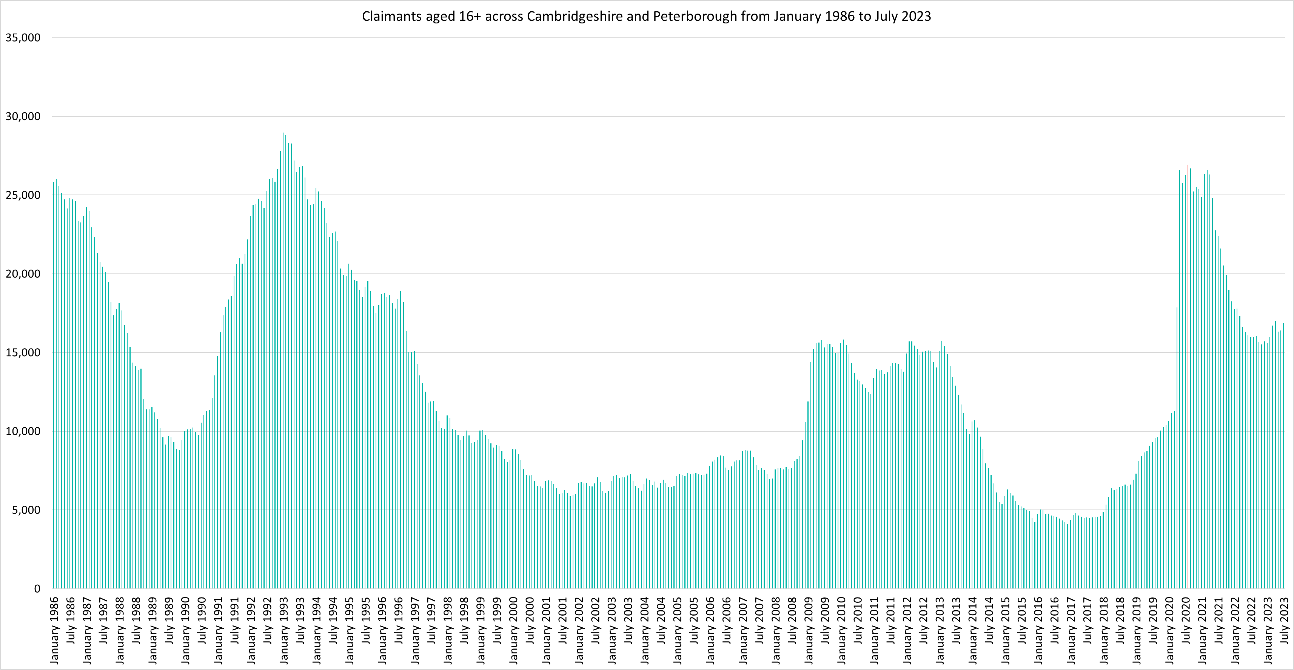
Labour Market – Claimant counts across time
Notes:
Source – Claimant Count, Office for National Statistics
Technical Notes
The Claimant Count measures the number of people (age 16+) claiming benefit principally for the reason of being unemployed. We use data on claimants rather than unemployed numbers because although the numbers are lower they are more up to date. It is however a narrower measure of unemployment, and as such does not cover all those out of work, since not all can claim assistance. The latest claimant count data is a snapshot of the number of claimants on the 13th July 2023.
Commentary
The above chart presents claimant counts across Cambridgeshire & Peterborough from January 1986 to July 2023.
September 2020 (26,700) and August 2020 (26,935) saw the highest number of claimants since 1992.
Claimant counts have decreased at a faster rate than seen from 1992, but this decline appears to have stabilised and with the count showing signs of trending upwards.

Slide 14
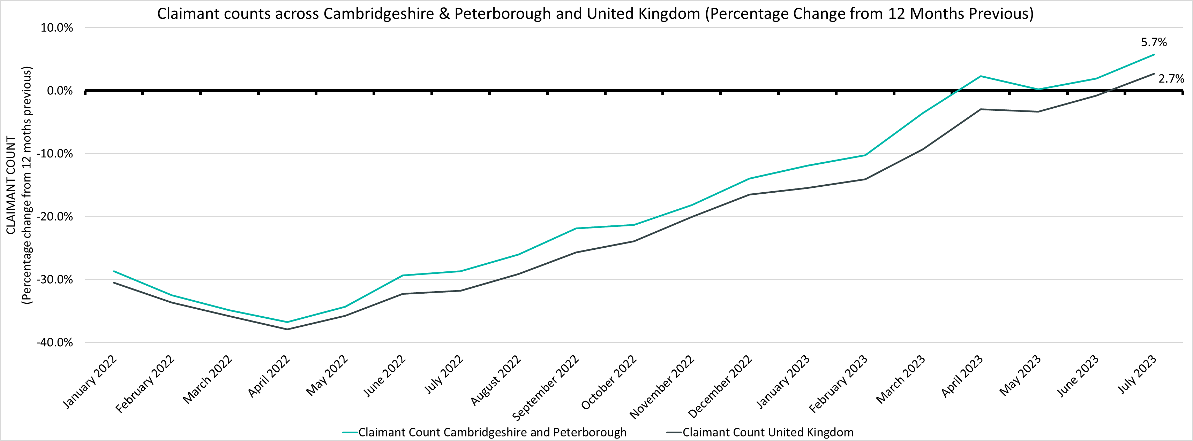
Labour Market – Percentage Change in Claimant Counts
Claimant Counts | Number of claimants June 2023 | % Change 12 Months ago vs Now: June 2022 to June 2023 | % Change Previous update vs Now: March 2023 to June 2023
Cambridgeshire & Peterborough | 16,880 | +5.7% | +1.0%
United Kingdom | 1,564,510 | +2.7% | +0.4%
Notes:
Source – Claimant Count, Office for National Statistics
Technical Notes
The Claimant Count measures the number of people (age 16+) claiming benefit principally for the reason of being unemployed. We use data on claimants rather than unemployed numbers because although the numbers are lower they are more up to date. It is however a narrower measure of unemployment, and as such does not cover all those out of work, since not all can claim assistance. The latest claimant count data is a snapshot of the number of claimants on the 13th July 2023.
Commentary
The above chart presents claimant counts across Cambridgeshire & Peterborough and as a percentage change from 12 months previous.
Throughout 2022 and the first quarter of 2023 the number of claimants compared to the same point in the previous year has been lower in Cambridgeshire and Peterborough, however the annual % decrease has always been lower than that of the UK as a whole.
In Cambridgeshire and Peterborough, from April 2023 onwards claimants have started to increase when comparing to the previous 12 months, this only started occurring in the UK from July.
The rate at which these counts have increased has been faster in Cambridgeshire and Peterborough compared to the UK.

Slide 15
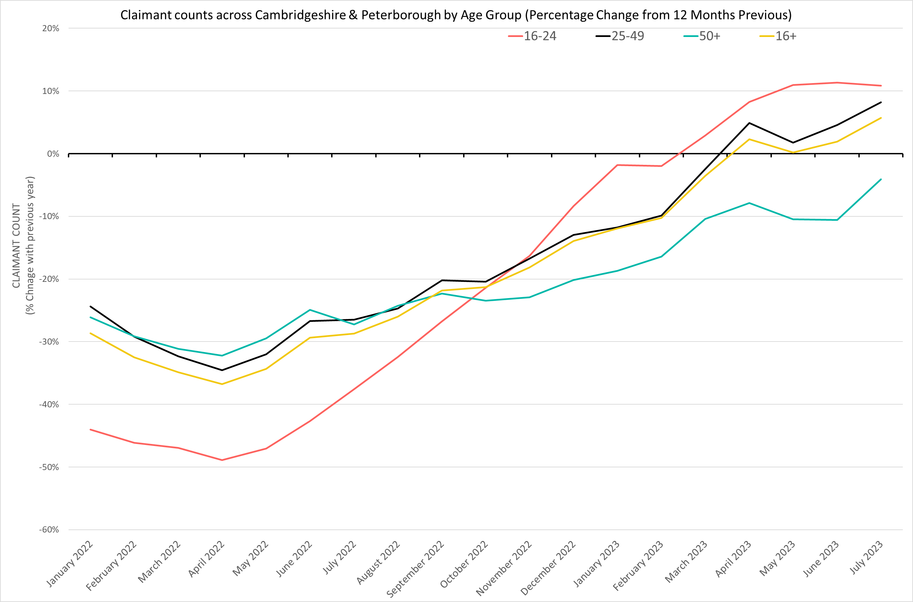
Labour Market – Claimant counts by age
July 2023 Claimant Counts by Age Group (Previous 12 month % Change)
% Change in Claimant Counts | 16+ | 16-24 | 25-49 | 50+
Cambridgeshire & Peterborough (July 2022 to July 2023) | +5.7% | +10.8% | +8.2% | -4.1%
United Kingdom (July 2022 to July 2023) | +2.7% | +9.3% | +3.5% | -3.5%
Cambridgeshire & Peterborough (March 2023 to July 2023) | +1.0% | -0.5% | +2.8% | -2.7%
United Kingdom (March 2023 to July 2023) | +0.4% | -0.2% | +1.2% | -1.2%
Notes:
Source – Claimant Count, Office for National Statistics
Technical Notes
The Claimant Count measures the number of people (age 16+) claiming benefit principally for the reason of being unemployed. We use data on claimants rather than unemployed numbers because although the numbers are lower they are more up to date. It is however a narrower measure of unemployment, and as such does not cover all those out of work, since not all can claim assistance. The latest claimant count data is a snapshot of the number of claimants on the 13th July 2023.
Commentary
The above chart presents the percentage change in claimant counts by age for the 12 months previous,
National statistics on claimant count since the pandemic have indicated that younger age groups have been disproportionately impacted. The above chart highlights the levels of change each age group has seen in claimant counts across the Cambridgeshire & Peterborough area.
As with the overall trend, all age groups except for those 50+ are now seeing increases in claimant counts when compared to the last 12 months. The magnitude of these increases across the latest quarter is also trending upwards. However, the magnitude of increases across the 16-24 age group appears to have stabilised. Whilst those aged 50+ are not seeing raw number increases in claimant counts when comparing to the previous 12 months, the magnitude of decreases is trending to be smaller and getting closer to being an increase.

Slide 16
Labour Market – Claimant Rates by Age Group
July 2023 Claimant Rates by Age Group
Claimant Rates | 16-64 July 2023 | 16-24 July 2023 | 16-17 July 2023 | 18-24 July 2023 | 25-49 July 2023 | 50-64 July 2023
Cambridgeshire | 2.9% | 2.1% | 0.2% | 2.6% | 2.5% | 2.0%
Cambridge City | 2.1% | 1.1% | 0.2% | 1.2% | 2.2% | 1.6%
East Cambridgeshire | 1.9% | 2.2% | 0.3% | 2.9% | 2.0% | 2.2%
Fenland | 1.8% | 4.9% | 0.2% | 6.2% | 4.4% | 1.4%
Huntingdonshire | 3.8% | 2.6% | 0.3% | 3.4% | 2.4% | 2.4%
South Cambridgeshire | 2.0% | 1.9% | 0.1% | 2.6% | 2.0% | 1.2%
Peterborough | 5.4% | 5.7% | 0.1% | 7.7% | 6.0% | 3.7%
Cambridgeshire & Peterborough | 1.7% | 2.9% | 0.2% | 3.6% | 3.4% | 1.2%
United Kingdom | 3.6% | 3.8% | 0.2% | 4.9% | 4.3% | 2.5%
Notes:
Source – Claimant Count, Office for National Statistics
Technical Notes
The Claimant Count measures the number of people (age 16+) claiming benefit principally for the reason of being unemployed. We use data on claimants rather than unemployed numbers because although the numbers are lower they are more up to date. It is however a narrower measure of unemployment, and as such does not cover all those out of work, since not all can claim assistance. The latest claimant count data is a snapshot of the number of claimants on the 13th July 2023.
Commentary
The above table presents the July 2023 claimant count as a rate of the resident population by age group.
National statistics on claimant count since the pandemic have indicated that younger age groups have been disproportionately impacted. The above chart highlights the levels of change each age group has seen in claimant counts across the Cambridgeshire & Peterborough area.
The 18-24 claimant rate also remains higher than the other age groups across Cambridgeshire and Peterborough and four of the six local authorities that make up the Combined Authority. It is particularly high in the more relatively deprived local authorities of Peterborough and Fenland.
In Peterborough, the 18-24 age group also account for the highest claimant rate (7.7%), substantially higher than the 2.6% of this age group claiming across Cambridgeshire. This suggests that youth unemployment is more prevalent in Peterborough than Cambridgeshire as a whole. Fenland also has a high proportion of those aged 18-24 claiming relative to the other local authorities (6.2%).

Slide 17
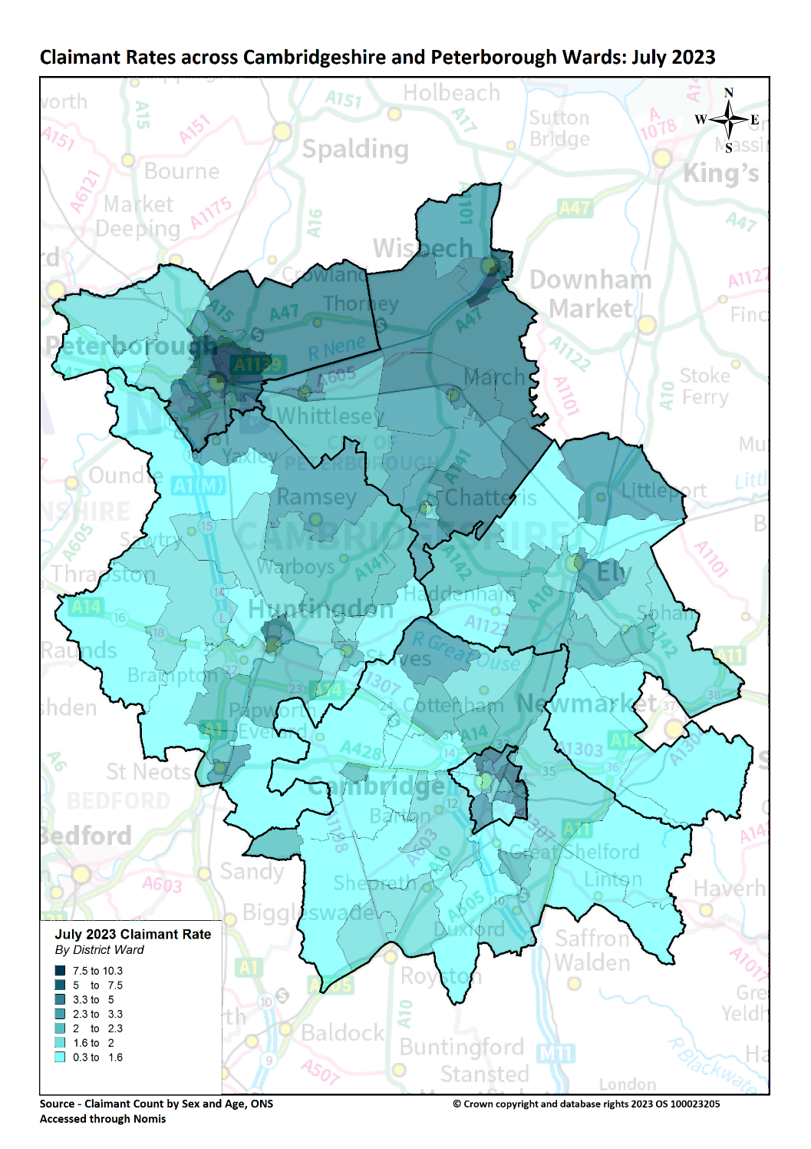
Labour Market – Claimant counts by location
Claimant Rates | Number of claimants July 2023 | % 16-64 population July 2023 | PP Change in Claimant Rate 12 Months ago vs Now: July 2022 to July 2023 | PP Change in Claimant Rate Previous update vs Now: March 2023 to July 2023
Cambridgeshire | 9,430 | 2.2% | No Change | No Change
Cambridge City | 2,055 | 1.9% | No Change | No Change
East Cambridgeshire | 1,005 | 1.9% | -0.1pp | -0.1pp
Fenland | 2,345 | 3.8% | +0.1pp | -0.1pp
Huntingdonshire | 2,325 | 2.1% | No Change | -0.1pp
South Cambridgeshire | 1,700 | 1.7% | No Change | -0.1pp
Peterborough | 7,450 | 5.4% | +0.7pp | +0.3pp
Cambridgeshire & Peterborough | 16,880 | 3.0% | +0.2pp | +0.1pp
United Kingdom | 1,564,510 | 3.7% | +0.1pp | No Change
Notes:
Source – Claimant Count, Office for National Statistics
Technical Notes
The Claimant Count measures the number of people (age 16+) claiming benefit principally for the reason of being unemployed. We use data on claimants rather than unemployed numbers because although the numbers are lower they are more up to date. It is however a narrower measure of unemployment, and as such does not cover all those out of work, since not all can claim assistance. The latest claimant count data is a snapshot of the number of claimants on the 13th July 2023.
Commentary
The above map illustrates claimant rate by ward across the Cambridgeshire & Peterborough area. We use this to highlight the wards with the highest claimant rate (represented in dark blue), rather than looking at absolute figures which allows us to see the areas with the highest number of claimants for the population.
Claimant rates are generally higher in the north of the region and in urban areas. Whilst the city of Peterborough and Fenland as a whole stand out as areas with particularly high claimant rates, the north of Huntingdon and the North East and East of Cambridge City also stand out as areas with higher claimant rates.
The lowest claimant rates across Cambridgeshire & Peterborough are in the Cambridge City ward of Newnham (0.3%) and the Huntingdonshire wards of Great Staughton (0.7%) and The Stukeleys (0.9%).
Top 5 wards with highest claimant rates are: North (10.3%), Medworth (9.7%), East (8.0%), Central (9.4%) and Dogsthorpe (8.0%). 4 out of five of these wards are in the city of Peterborough whilst Medworth covers the south west of Wisbech.
Whilst Cambridgeshire and Peterborough as a whole saw a +0.2 percentage point increase in the claimant rate compared to July 2022 , four out of the six district or unitary local authorities have seen decreases or no change in claimant rates when compared to the previous 12 months. Fenland and Peterborough were the only local authorities which saw an increase of +0.1pp and +0.7pp respectively.
A similar pattern was seen when comparing claimant rates to the previous update (March 2023). Whilst the Cambridgeshire and Peterborough region as a whole saw a 0.1pp increase in the claimant rate, the majority of local authorities also saw decreases or no change in claimant rates when compared to the previous update (March 2023) except for Peterborough which saw an increase of +0.3pp.

Slide 18
Universal Credit Claimants – June 2023
Policy changes to provide economic support during the Covid-19 pandemic allowed those on higher incomes than previously to claim Universal Credit, resulting in a permanent rise in claimants since the Spring lockdowns of 2020.
Both on a quarterly and annual basis Cambridgeshire and Peterborough has seen a higher increase in the number of claimants than Great Britain as a whole. This has mostly been driven by a rise in unemployed claimants.
As with the other benefit claimant measure, Cambridgeshire and Peterborough as a whole had a lower claimant rate than Great Britain as a whole. Again, this varies at the local authority level with Peterborough and Fenland being the only ones where the claimant rates are higher than Great Britain as a whole.
Unemployed claimants have consistently made up the majority of claimants at both a regional and local authority level. Unemployed claimants have driven the annual increases in the number of claimants. The number of employed claimants has also now started to rise, on both an annual and quarterly basis.

Slide 19
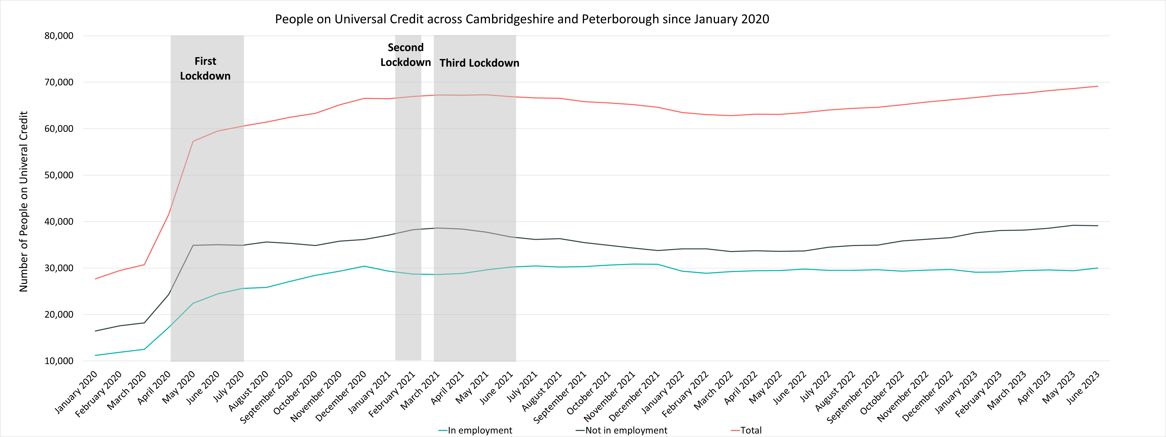
Labour Market – People on Universal Credit
Universal Credit Status | Number of Claimants June 2023 | Share of Total Universal Credit Claimants June 2023 | % Change with Previous Update (February 2023) | % Change with June 2022
Employed | 29,992 | 43% | +2.8% | +0.7%
Unemployed | 39,315 | 57% | +2.7% | +16.1%
Total | 69,123 |  | +2.7% | +8.9%
Notes:
Source – Universal Credit Claimants, Department for Work and Pensions
Technical Notes
Universal Credit is available in every jobcentre across Great Britain. Roll out was completed in December 2018.
Universal Credit is a single payment for each household to help with living costs for those on a low income or out of work. It is replacing six benefits, commonly referred to as the legacy benefits:
Income-based Jobseeker's Allowance
Income-related Employment and Support Allowance
Income Support
Working Tax Credit
Child Tax Credit
Housing Benefit
Support for housing costs, children and childcare costs are integrated into Universal Credit. It also provides additions for people with a disability, health condition or caring responsibilities which may prevent them from working.
Commentary
The chart above highlights changes in the number of people on universal credit across Cambridgeshire and Peterborough by Employment Status from January 2020.
The number of Universal Credit claimants includes those who have started Universal Credit (completed the Universal Credit claim process and accepted their Claimant Commitment) and have not had a closure of their claim recorded for this spell, up to the 'count date' (second Thursday in each month). A closure of their claim would be recorded either at the request of the individual or if their entitlement to Universal Credit ends, for example, if they no longer satisfy the financial conditions to receive Universal Credit as they have capital over £16,000.
It is important to note that the initial rise in claimants during the first lockdown period was due to policy changes brought in as part of the pandemic response that allowed people on higher incomes than before to claim the benefit, the peak of this increase came during the second lockdown in the Winter of 2020.
Unemployed claimants have consistently made up the majority of claimants. Whilst the increase in claimants across the last 12 months has been mostly driven by unemployed claimants, it is worth noting that since the last update (February 2023) both unemployed and employed claimants saw a similar percentage increase in the number of claimants.
Despite decreases from Q1 of 2021, the numbers of those on universal credit remains much higher than Pre-Covid with numbers trending upwards from May 2022.
Unemployed claimants make up the majority of people on universal credit (57%) and saw a +2.7% increase from February 2023 and a +16.1% increase from June 2022. In comparison employed claimants saw a +2.8% increase from March 2023 and a +0.7% increase from June 2022.

Slide 20
Labour Market – People on Universal Credit by Local Authority
People on Universal Credit | Number of total people on Universal Credit June 2023 | % 16-64 population June 2023 | % Change 12 Months ago vs Now: June 2022 to June 2023 | % Change Previous update vs Now: February 2023 to June 2023
Cambridgeshire | 41,602 | 9.6% | +10.4% | +3.0%
Cambridge City | 8,041 | 7.5% | +7.8% | +2.6%
East Cambridgeshire | 4,902 | 9.2% | +11.3% | +2.0%
Fenland | 9,783 | 15.9% | +8.9% | +2.7%
Huntingdonshire | 10,890 | 9.7% | +11.1% | +3.6%
South Cambridgeshire | 7,986 | 5.8% | +13.8% | +3.4%
Peterborough | 27,521 | 27.8% | +6.6% | +2.4%
Cambridgeshire & Peterborough | 69,123 | 12.1% | +8.9% | +2.7%
Great Britain | 5,961,951 | 14.5% | +7.4% | +2.2%
Notes:
Source – Universal Credit Claimants, Department for Work and Pensions
Technical Notes
Universal Credit is available in every jobcentre across Great Britain. Roll out was completed in December 2018.
Universal Credit is a single payment for each household to help with living costs for those on a low income or out of work. It is replacing six benefits, commonly referred to as the legacy benefits:
Income-based Jobseeker's Allowance
Income-related Employment and Support Allowance
Income Support
Working Tax Credit
Child Tax Credit
Housing Benefit
Support for housing costs, children and childcare costs are integrated into Universal Credit. It also provides additions for people with a disability, health condition or caring responsibilities which may prevent them from working.
Commentary
The above table highlights changes in the number of people on universal credit across Cambridgeshire and Peterborough in June 2023.
The number of Universal Credit claimants includes those who have started Universal Credit (completed the Universal Credit claim process and accepted their Claimant Commitment) and have not had a closure of their claim recorded for this spell, up to the 'count date' (second Thursday in each month). A closure of their claim would be recorded either at the request of the individual or if their entitlement to Universal Credit ends, for example, if they no longer satisfy the financial conditions to receive Universal Credit as they have capital over £16,000.
Peterborough has the highest proportion of the 16-64 population claiming at 27.8%. Cambridge City has the lowest at 7.5%.
All local authorities have seen increases in the number of those on universal credit from the previous 12 months (June 2022) with the largest percentage increase seen in South Cambridgeshire (+13.8%). Peterborough has seen the smallest increase (+6.6%) whilst the overall region saw a +8.9% increase and Great Britain a +7.4 increase.
All local authorities have seen an increase in the number of those on universal credit from the previous update (February 2023).

Slide 21
Wages and Inflation
Pay As You Earn (PAYE) Real Time Information – April 2023

Slide 22
Wages and Inflation– April 2023
Whilst workers who are resident in Cambridgeshire and Peterborough overall have higher median monthly wages than the UK there is not an even distribution across the region. Residents of Cambridge and South Cambridgeshire have higher median wages and Fenland and Peterborough residents have lower. Annual wage growth in the region has fallen below national levels since 2021 and fell well below inflation in 2022. In 2023 annual wage growth is closer to inflation but still below.
When comparing the median monthly wages of Cambridgeshire and Peterborough’s residents by district/unitary local authorities to the United Kingdom (£2,234), only Fenland (£2,131) and Peterborough (£2,082) are below the average. Cambridge (£2,724) and South Cambridgeshire (£2,694) are the local authorities with the highest median monthly wage.
Looking at annual wage growth, both Cambridgeshire and Peterborough have had average wage growth be lower than CPIH since March 2022.
Cambridgeshire has followed a similar trend in wage growth to the United Kingdom, whilst Peterborough has experienced broadly lower wage growth since November 2022 .

Slide 23
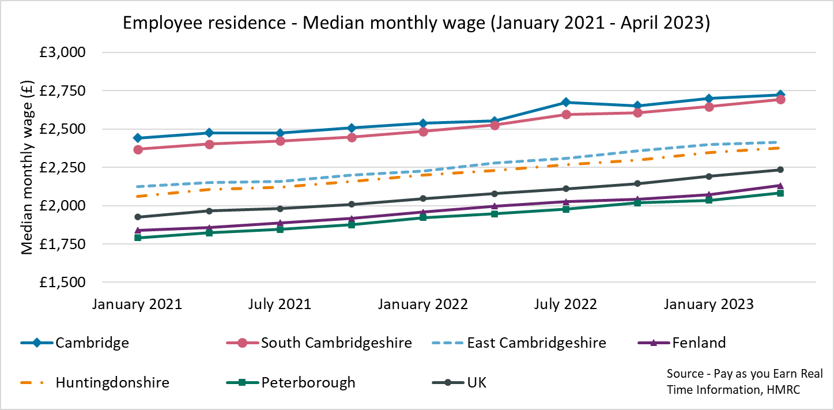
Employment Trends – Median monthly wage (PAYE Experimental Residence Data)
Local Authority | Cambridge | East Cambridgeshire | Fenland | Huntingdonshire | Peterborough | South Cambridgeshire | United Kingdom
Median monthly wage (April 2023) | £2,724 | £2,414 | £2,131 | £2,376 | £2,082 | £2,694 | £2,234
Source – Pay as you earn real time information - HMRC
Notes:
Source – Pay as you earn real time information- HMRC
Technical Notes
This data is sourced from HM Revenue and Customs’ Pay As You Earn system which collects income tax and national insurance.
the Pay As you Earn Real Time Information data includes all employees payrolled by employers, therefore it does not include income from pensions, property rental or investments, nor does it include self-employment income.
This data is based on employee’s residence rather than where they work
Commentary
The above chart and table show how the median monthly wage of workers across the local authorities of Cambridgeshire and Peterborough the United Kingdom has changed since January 2021.
Median monthly wages have remained consistently higher in Cambridge (£2,724 in April 2023) and South Cambridgeshire (£2,694 April 2023) than the other local authorities in Cambridgeshire and Peterborough
Peterborough (£2,082 in April 2023) and Fenland (£2,131) have consistently seen the lowest median monthly wages in Cambridgeshire and Peterborough.

Slide 24
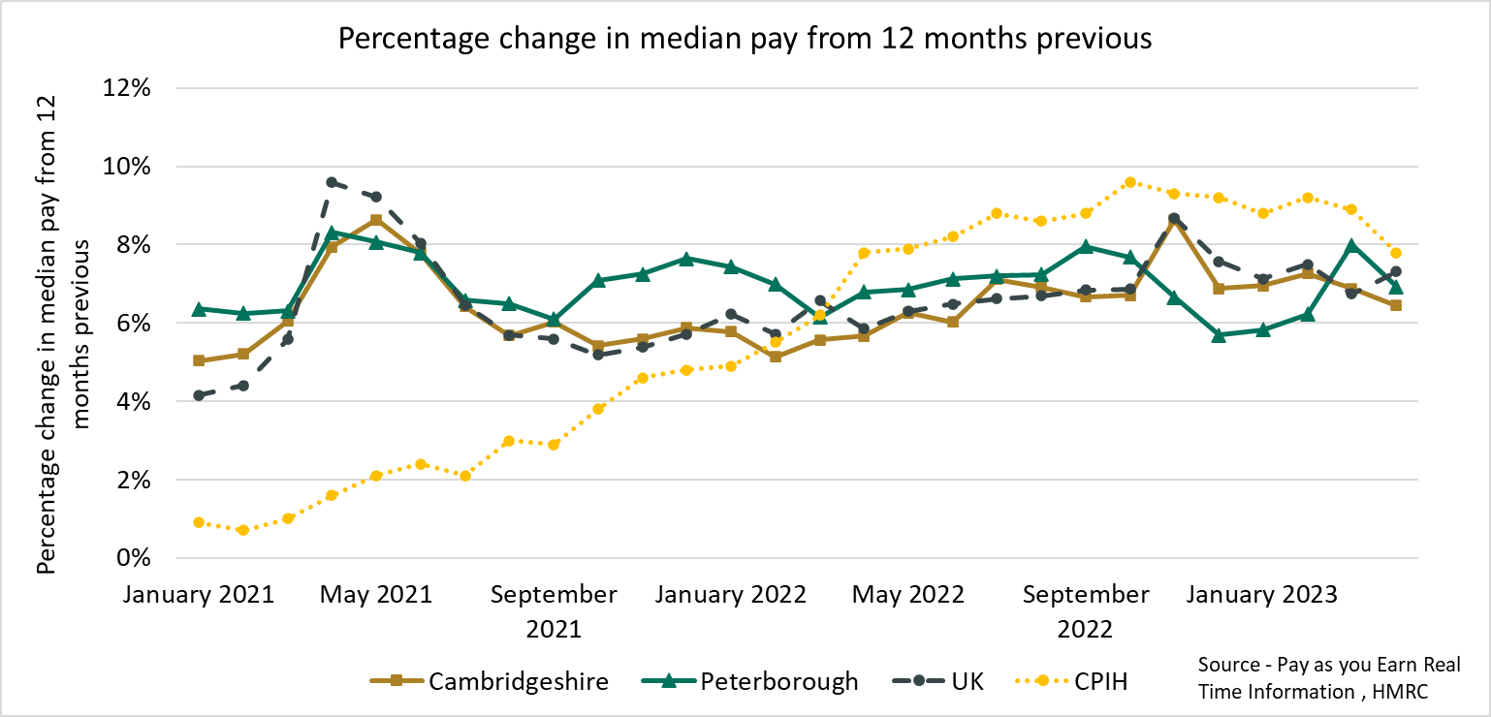
Employment Trends – Median monthly wage growth (PAYE) (January 2021- April 2023)
Local Authority | CPIH (April 2023)* | Cambridge | East Cambridgeshire | Fenland | Huntingdonshire | Peterborough | South Cambridgeshire
% Change from April 2022 | +7.8% | +6.7% | +5.9% | +6.7% | +6.5% | +7.0% | +6.7%
*The Consumer Prices Index including owner occupiers' housing costs (CPIH) is the office for national statistics’ headline inflation measure Source - Pay as you earn real time information – HMRC
Notes:
Source – Pay as you earn real time information- HMRC
Technical Notes
This data is sourced from HM Revenue and Customs’ Pay As You Earn system which collects income tax and national insurance.
the Pay As you Earn Real Time Information data includes all employees payrolled by employers, therefore it does not include income from pensions, property rental or investments, nor does it include self-employment income.
Commentary
As of April 2023, compared to 12 months previously, all Cambridgeshire and Peterborough local authorities saw increases in pay that fell below inflation for that period.

Slide 25
Vacancies
Lightcast Vacancies Data – March 2023

Slide 26
Vacancies – July 2023
After record numbers of vacancies across Quarter 4 of 2021 and Quarter 1 of the 2022, vacancies decreased in the first half of 2022 and have since stabilised at a new baseline.
Looking at how vacancies have changed since the previous update, and when compared to the same point in 2023, vacancies have increased from March 2023 and are much higher compared to July 2022.
The vacancies increase from March 2022 can be observed across all sectors, except for Other service activities. When compared to July 2022, Construction (+78%) and Real estate activities (+47%) saw the largest increases.

Slide 27
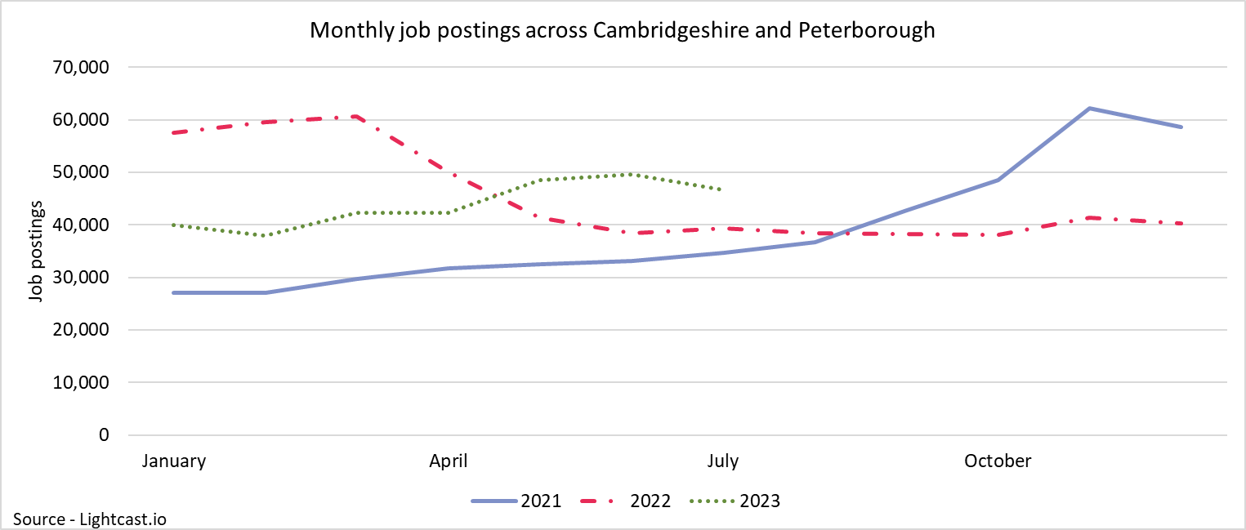
Employment Trends – Vacancies
46,628
+10%
Compared to +6% nationally
+22%
Compared to +3% nationally
Unique job postings in Cambridgeshire and Peterborough in July 2023
Increase in unique job postings compared to March 2023
Increase in unique job postings compared to July 2022
Notes:
Source – Lightcast
Technical Information
Vacancy data is sourced from Lightcast, a service that has been procured by Cambridgeshire and Peterborough Combined Authority which gives labour market information on Job postings, occupations, and industries. Lightcast has a job posting aggregator which scans jobs websites for posting and presents them together.
Lightcast only scans online jobs postings and therefore does not include any jobs which are advertised solely offline. There is also no guarantee that all online job postings are aggregated. For example, a specific job site may not be scanned.
A unique job posting is a deduplicated count of an online job vacancy advertisement. If the same vacancy is posted twice across a sixty-day period, it is only counted once. If the same vacancy is posted twice more than sixty days apart it is counted as two unique job postings.
Commentary
The above chart illustrates online vacancy data across the Cambridgeshire & Peterborough area since April 2020. A unique job posting is a deduplicated count of an online job vacancy advertisement. If the same vacancy is posted twice across a sixty-day period, it is only counted once. If the same vacancy is posted twice more than sixty days apart it is counted as two unique job postings.
Across Cambridgeshire and Peterborough, there were 46,628 job postings in July 2023, this is an increase of +10% from March 2023. Nationally job postings increased by 6% across the same period.
In May 2023, there was an increase in job postings of +15% from the previous month. This is the largest percentage increase from the previous month since November 2021
The number of vacancies increased rapidly in the final quarter of 2021 but appear to have peaked in late 2021/early 2022 before rapidly decreasing and then stabilising across the 2nd half of 2022. In 2023 job postings have steadily increased
*Lightcast data is available from 2012 onwards.

Slide 28
Employment Trends – Vacancies by Industry
Number of Vacancies in Cambridgeshire and Peterborough in July 2023 compared to the UK
Sector Identifier | Employment Sector | Vacancies in Cambridgeshire and Peterborough: July 2023 | Percentage of total vacancies in Cambridgeshire and Peterborough | Vacancies in UK: July 2023 | Percentage of total vacancies in UK
1 | Accommodation and food service activities | 2,214 | 5% | 156,691 | 5%
2 | Administrative and support service activities | 4,045 | 9% | 267,579 | 9%
3 | Arts, entertainment and recreation | 1,813 | 4% | 126,740 | 4%
4 | Construction | 2,606 | 6% | 143,970 | 5%
5 | Education | 2,461 | 5% | 215,465 | 7%
6 | Financial and insurance activities | 1,528 | 3% | 111,994 | 4%
7 | Human health and social work activities | 5,541 | 12% | 374,989 | 13%
8 | Information and communication | 4,870 | 10% | 222,337 | 8%
9 | Manufacturing | 3,394 | 7% | 196,893 | 7%
10 | Other service activities | 178 | 0% | 10,614 | 0%
11 | Professional, scientific and technical activities | 2,891 | 6% | 197,928 | 7%
12 | Public administration and defence; compulsory social security | 486 | 1% | 27,248 | 1%
13 | Real estate activities | 675 | 1% | 44,924 | 2%
14 | Transportation and storage | 1,931 | 4% | 131,355 | 4%
15 | Wholesale and retail trade; repair of motor vehicles and motorcycles | 1,679 | 4% | 109,060 | 4%
16 | Other sectors (agriculture, forestry and fishing; Mining and quarrying; Water supply and Waste management) | 3,222 | 7% | 162,612 | 6%
Notes:
Source – Lightcast
Technical Information
Vacancy data is sourced from Lightcast, a service that has been procured by Cambridgeshire and Peterborough Combined Authority which gives labour market information on Job postings, occupations, and industries. Lightcast has a job posting aggregator which scans jobs websites for posting and presents them together.
Lightcast only scans online jobs postings and therefore does not include any jobs which are advertised solely offline. There is also no guarantee that all online job postings are aggregated. For example, a specific job site may not be scanned.
A unique job posting is a deduplicated count of an online job vacancy advertisement. If the same vacancy is posted twice across a sixty-day period, it is only counted once. If the same vacancy is posted twice more than sixty days apart it is counted as two unique job postings.
The other sectors category includes agriculture, forestry and fishing; Mining and quarrying; Water supply and Waste management
Commentary
The above table shows the number of Vacancies in Cambridgeshire and Peterborough in July 2023 by employment sector and included a national comparison;
Human health and social work activities (12%), Information and Communication (10%) and Administration and support services (9%) have the highest proportion of vacancies across Cambridgeshire and Peterborough. Human health and social work is also the largest sector nationally (13%)

Slide 29
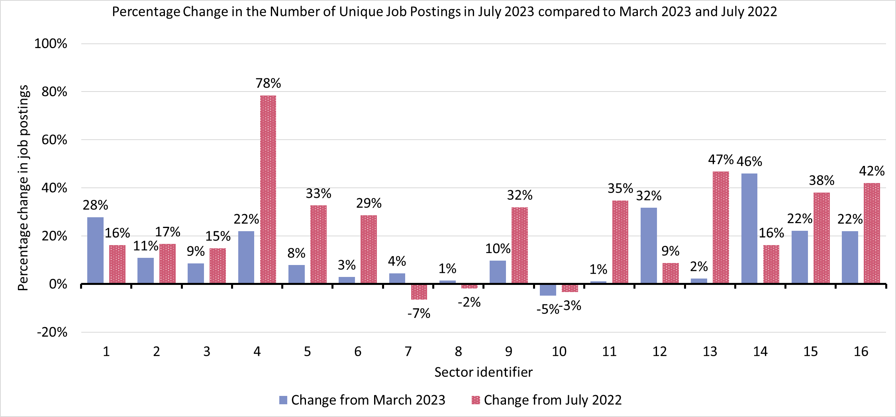
Employment Trends – Vacancies by Industry Changes
Sector Identifier for Chart
Sector Identifier | Sector Name
1 | Accommodation and food service activities
2 | Administrative and support service activities
3 | Arts, entertainment and recreation
4 | Construction
5 | Education
6 | Financial and insurance activities
7 | Human health and social work activities
8 | Information and communication
9 | Manufacturing
10 | Other service activities
11 | Professional, scientific and technical activities
12 | Public administration and defence; compulsory social security
13 | Real estate activities
14 | Transportation and storage
15 | Wholesale and retail trade; repair of motor vehicles and motorcycles
16 | Other sectors (Agriculture, forestry and fishing; Mining and quarrying; Water supply and Waste management)
Notes:
Source – Lightcast
Technical Information
Vacancy data is sourced from Lightcast, a service that has been procured by Cambridgeshire and Peterborough Combined Authority which gives labour market information on Job postings, occupations, and industries. Lightcast has a job posting aggregator which scans jobs websites for posting and presents them together.
Lightcast only scans online jobs postings and therefore does not include any jobs which are advertised solely offline. There is also no guarantee that all online job postings are aggregated. For example, a specific job site may not be scanned.
A unique job posting is a deduplicated count of an online job vacancy advertisement. If the same vacancy is posted twice across a sixty-day period, it is only counted once. If the same vacancy is posted twice more than sixty days apart it is counted as two unique job postings.
The other category includes agriculture, forestry and fishing; Mining and quarrying; Water supply and Waste management
Commentary
The above chart shows how the number of vacancies has changed in each sector compared to the last update (March 2023) and compared to the same point in 2022 (July 2022)
Transportation and storage (+46%) had the largest increase from the previous update. Public administration and defence; compulsory social security (+32%) and Accommodation and food services (+28%) complete the three largest increases from the previous update.
Other service activities (-5%) was the only sector to see a decrease from the previous update
Construction (+78%) experienced the largest yearly change. Real estate activities (+47%) and other sectors (+42%) are the next largest yearly increases.
Human health and social work (-7%), Other service activities (-3%) and Information and communication (-2%) were the only sectors to see a decrease from a year ago.

Slide 30
Employment Trends –by Industry
Median Posting Duration (April - July 2023) (Cambridgeshire and Peterborough) | Posting Intensity (April – July 2023) (Cambridgeshire and Peterborough)
42 Days | 3:1
Median Posting Duration for Vacancies across Cambridgeshire and Peterborough in Days by Employment Sector April to July 2023
Sector Identifier | Employment Sector | April – July 2023 Median Posting Duration (Days) | April - July 2023 Posting Intensity
1 | Accommodation and food service activities | 38 | 3:1
2 | Administrative and support service activities | 40 | 3:1
3 | Arts, entertainment and recreation | 43 | 3:1
4 | Construction | 41 | 3:1
5 | Education | 46 | 2:1
6 | Financial and insurance activities | 45 | 2:1
7 | Human health and social work activities | 41 | 4:1
8 | Information and communication | 47 | 3:1
9 | Manufacturing | 43 | 2:1
10 | Other service activities | 35 | 3:1
11 | Professional, scientific and technical activities | 46 | 3:1
12 | Public administration and defence; compulsory social security | 40 | 3:1
13 | Real estate activities | 41 | 2:1
14 | Transportation and storage | 38 | 3:1
15 | Wholesale and retail trade; repair of motor vehicles and motorcycles | 42 | 3:1
16 | Other sectors (Agriculture, forestry and fishing; Mining and quarrying; Water supply and Waste management) | 45 | 3:1
The chart above shows two metrics to measure the potential difficulty in filling roles in certain sectors:
Median Posting Duration measures how long the average job posting is live online for. A longer time up could suggest that the company anticipates the role being harder to fill
Posting Intensity is a ratio of how many times the same job role is posted. A higher ratio could suggest difficulty filling the role
Notes:
Source – Lightcast
Technical Information
Vacancy data is sourced from Lightcast, a service that has been procured by Cambridgeshire and Peterborough Combined Authority which gives labour market information on Job postings, occupations, and industries. Lightcast has a job posting aggregator which scans jobs websites for posting and presents them together.
Lightcast only scans online jobs postings and therefore does not include any jobs which are advertised solely offline. There is also no guarantee that all online job postings are aggregated. For example, a specific job site may not be scanned.
The other category includes agriculture, forestry and fishing; Mining and quarrying; Water supply and Waste management
Median Posting Duration measures how long the average job posting is live online for. A longer time up could suggest that the company anticipates the role being harder to fill.
Posting Intensity is a ratio of how many times the same job role is posted. A higher ratio could suggest difficulty filling the role.
Commentary
The table above shows the median posting duration and the posting intensity for employment sectors from April to July 2023. Both measures can be used as an indication of difficult to fill roles.
Across Cambridgeshire and Peterborough, the median posting duration was 42 days. (Up from 33 days at the last update). There were 6 sectors with a longer median posting duration than this: Information and communication (47), Education, professional scientific and technical activities (46), Financial and insurance activities (45), Arts entertainment and recreation, and manufacturing (both 43)
Other service activities had the lowest median posting duration (35). Transportation and storage, and accommodation and food service activities (both 38) were the only two others below 40 days
The posting intensity across Cambridgeshire and Peterborough was 3:1. Human health and social work activities is the only sector above the regional average (4:1).

