Slide 1
An overview of apprenticeships delivered in the Greater Cambridge area – Q3 (February – April) 2022/23
GCP Update
Contact: Dominic.Milham@cambridgeshire.gov.uk

Slide 2
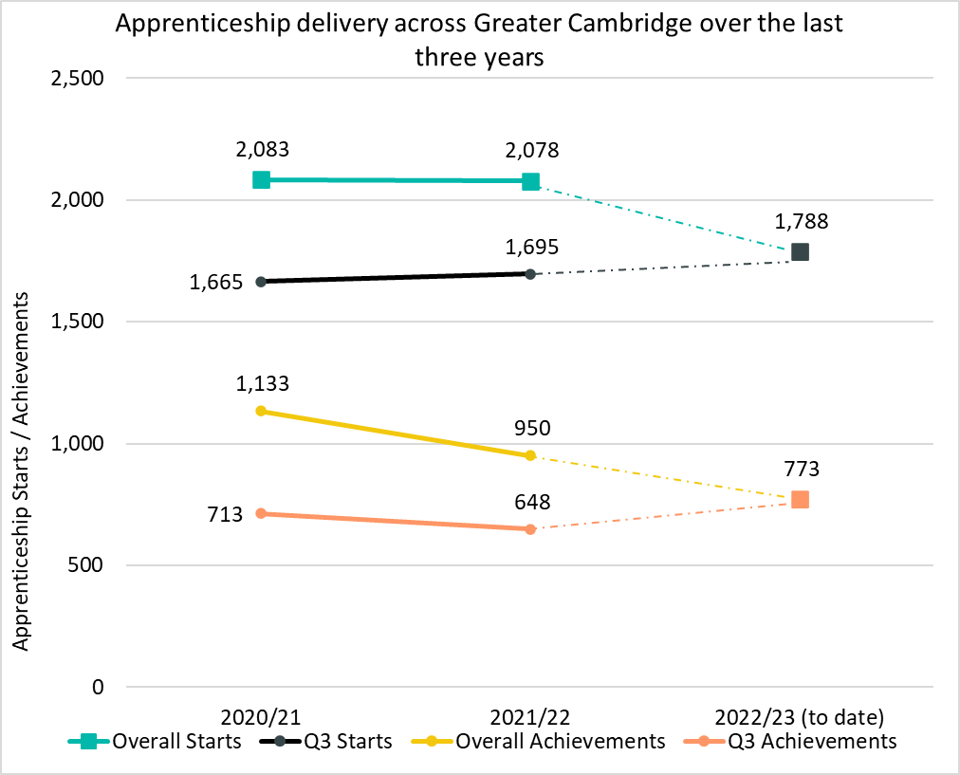
Delivery to date (April 2022/23)
Up to Q3 2022/23 there have been 1,788 apprenticeship starts* across the Greater Cambridge area. This is +5% more compared to the number of starts up to Q3 in 2021/22, where there were 1,695 apprenticeship starts.
Up to Q3 2022/23 there have been 773 apprenticeship achievements, a +19% increase compared to the number of achievements up to Q3 in 2021/22.
*Apprenticeship starts and achievements are calculated based on the course delivery location.

Slide 3
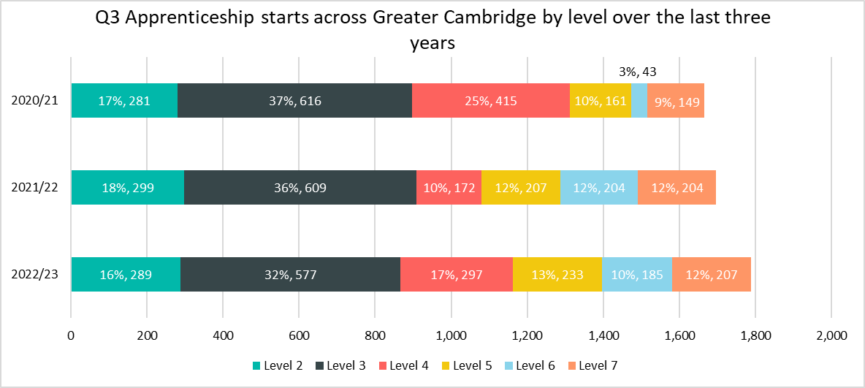
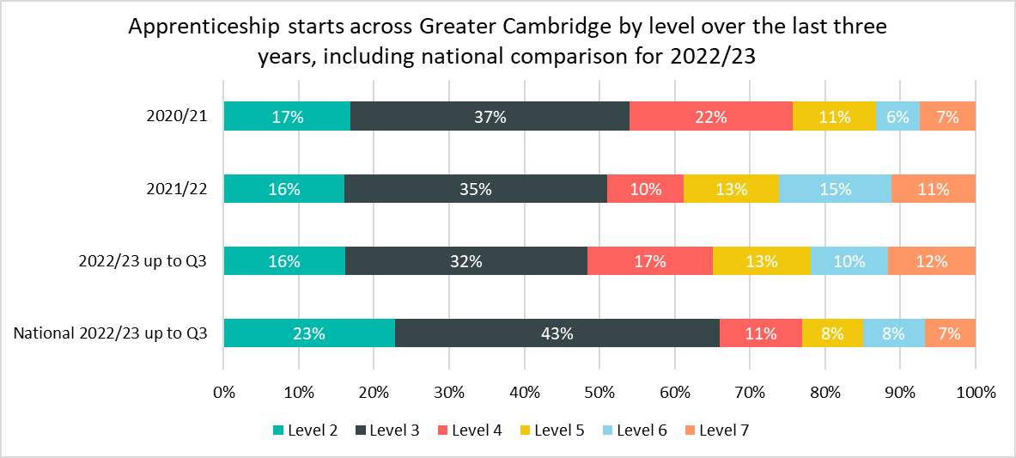
Starts by Level
Up to Q3 2022/23 (August 2022 – April 2023) there have been 1,788 apprenticeship starts* across the Greater Cambridge area.
As in previous years, the largest proportion of starts were in level 3 apprenticeships (32%), although this is lower than the national proportion (43%) and 4 percentage points lower than in the same point in 2021/22.
Across Greater Cambridge, there were higher proportions of apprenticeship starts in level 4, 5, 6 and 7 apprenticeships compared to what was observed nationally.
While the total number of starts across the GCP area in all apprenticeship levels increased across Q3 in 2022/23, there is some variation between each level:
Level 3 apprenticeships saw the largest raw number decrease in this period with -32 (-5%) less starts compared to the same period in 2021/22.
Level 4 apprenticeships saw the largest percentage and raw number increase, +125 starts (+73%) in this period compared to last year.
In comparison, the largest decrease nationally was in Level 2 Apprenticeships (-18% starts compared to GCP’s -3%). Level 4 and above apprenticeships all saw an increase nationally, with Level 6 apprenticeships seeing the largest % increase (+10% compared to GCPs -9%).
*Apprenticeship starts are calculated based on the course delivery location.

Slide 4
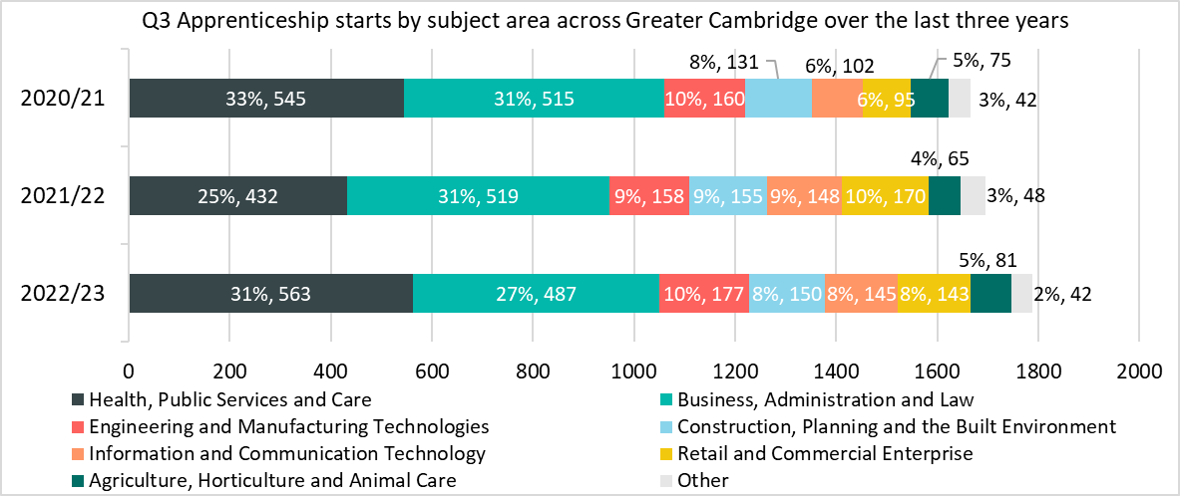
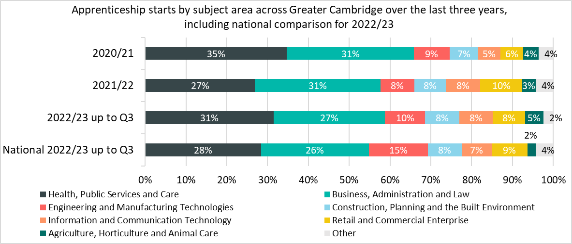
Starts by subject area
While apprenticeships have seen an increase in the number of starts, the impact on individual subject areas has varied when considering starts across Q3 in 2022/23 compared with equivalent periods in 2021/22 and 2020/21.
Comparing Q3 2022/23 with the same point in the previous year, the single biggest raw number decrease in starts was in the Business, Administration and Law subject area, with -32 fewer starts (-6%).
Retail and Commercial Enterprises saw the largest percentage decrease (-16%) with 27 fewer starts.
The Health, Public Services and care sector accounted for a higher percentage of apprenticeship starts across the Greater Cambridge area as of Q3 2022/23 at 31%, compared with 25% for the same period in 2021/22. This sector saw starts increase by +131 (+30%), the largest raw number increase across all sectors. This is largely driven by Medipro, a new provider who accounted for 23% (130) of all starts in the sector. All of these starts first appeared in Q3 of the 2022/23 year
Health, Public Services and Care accounted for a higher percentage of starts in Greater Cambridge (31%) than it did nationally (28%)
*Sectors which account for less than 3% of starts in the Greater Cambridge area and nationally in Q3 of 2022/23 have been included within the Other category. This includes Education and Training; Leisure, Travel and Tourism; Arts, Media and Publishing; Science and Mathematics.

Slide 5
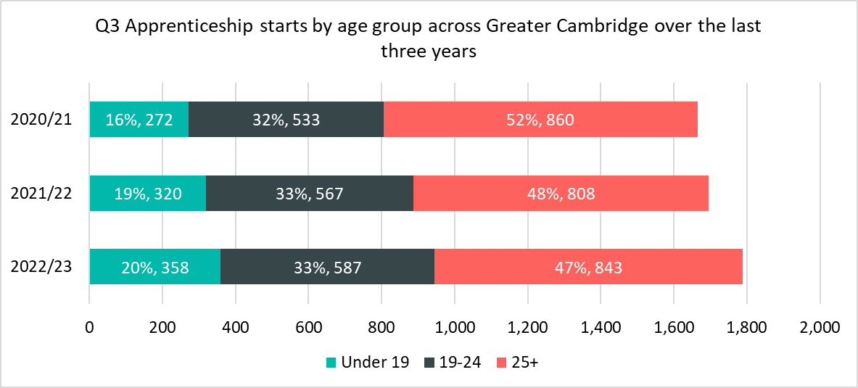
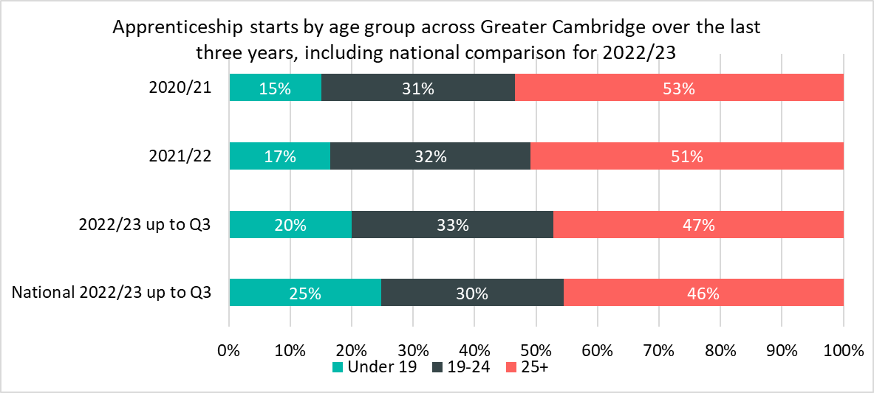
Starts by age groups
Of the 1,788 apprenticeship starts up to Q3 in 2022/23, 843 (47%) starts were among 25+ year olds, 587 (33%) starts were among 19-24 year olds and those aged Under 19 accounted for 358 (20%) starts.
Under 19s were the age group that saw the largest percentage increase in starts between Q3 2021/22 and Q3 2022/23 (+38, +12%). The 19-24 age group and the 25+ age group both increased by +4% from the previous year.
This resulted in a higher proportion of starts being for those aged under 19 (20% in Q3 2022/23 compared to 19% in Q3 2021/22, a difference of 1 percentage points).
Nationally, a higher proportion of apprenticeship starts were in the Under 19 age group (25% compared to 20% in Greater Cambridge).

Slide 6
Who are the main providers delivering starts in the GCP area?
Top Five Providers by Q3 Starts 2022/23
Provider | 2022/23 delivery to date (starts) | % of Total 2022/23 starts | 2021/22 delivery (starts) | % Change between 2021/22 and 2022/23
ANGLIA RUSKIN UNIVERSITY HIGHER EDUCATION CORPORATION | 295 | 17% | 269 | +10%
CAMBRIDGE REGIONAL COLLEGE | 257 | 14% | 320 | -20%
MEDIPRO LIMITED | 130 | 7% | Not a Provider | N/A
WEST SUFFOLK COLLEGE | 83 | 5% | 60 | +38%
KAPLAN FINANCIAL LIMITED | 74 | 4% | 48 | +54%
The largest provider in the area to date in 2022/23 was Anglia Ruskin University, which accounted for 16% (295) of apprenticeship starts. In the 2021/22 year the college accounted for 17% (376) of all starts overall with 269 starts up to Q3. This provider saw a +10% increase in the number of Q3 starts between 2021/22 and 2022/23.
Cambridge Regional College is the second largest provider of apprenticeships in the Greater Cambridge area, it accounted for 14% (257) of all apprenticeship starts up to Q3 in 2022/23. In the 2021/22 year the college accounted for 16% (336) of all starts overall and 19% of starts at Q3. Cambridge Regional College has also been the top provider overall for 2020/21 and second largest in 2021/22. This provider saw a -20% decrease in the number of Q3 starts between 2021/22 and 2022/23.
Medipro Limited, Kaplan Financial Limited and Lifetime Training Group Limited were all in the top 5 up to Q3 in 2022/23. All three provider saw an increase in provision, Medipro Limited is a new provider, and Kaplan Financial Limited increased their provision by +54% from the same point last year.

Slide 7
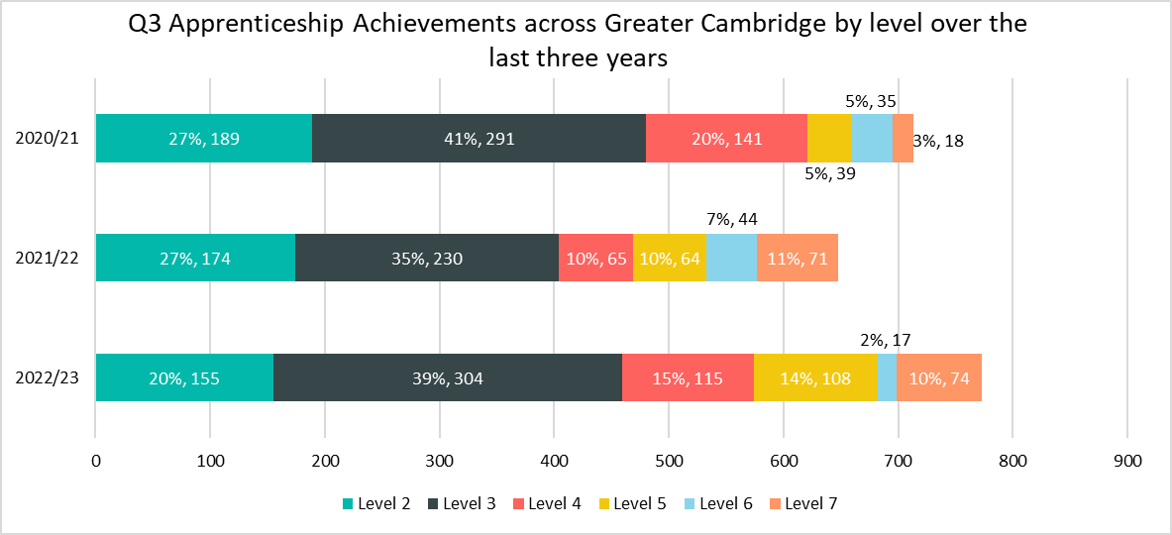
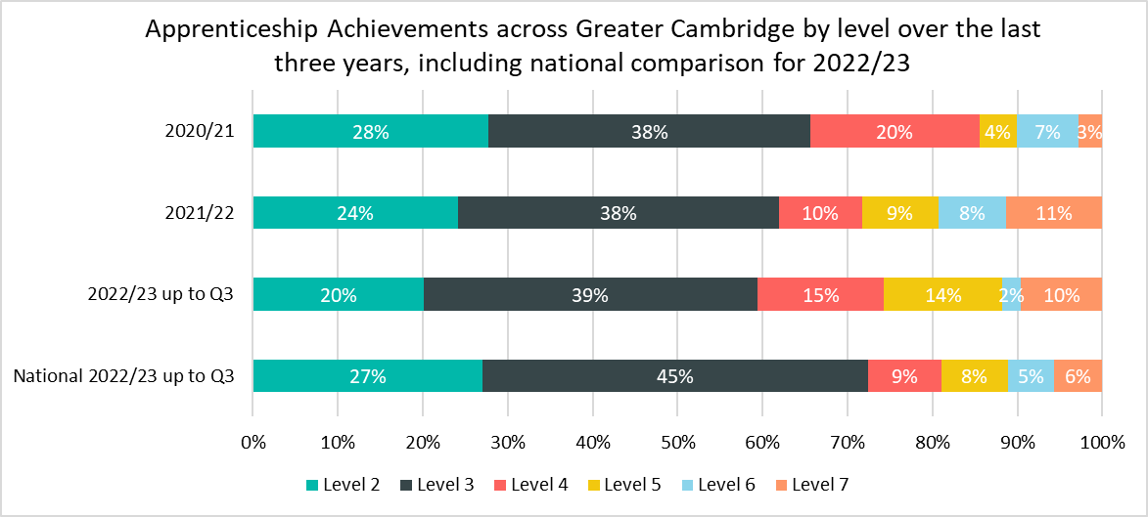
Achievements by Level
Up to Q3 of the 2022/23 academic year (August 2022 – April 2023) there have been 773 apprenticeship achievements* across the Greater Cambridge area.
As in previous years - up to Q3 of 2022/23, the largest proportion of achievements were in level 3 apprenticeships (39%), 4 percentage points higher than in 2021/22, although this is lower than the national proportion (45%).
Across Greater Cambridge, there were higher proportions of apprenticeship achievements in level 4 (15% compared to 9%), 5 (14% compared to 8%) and 7 (10% compared to 6%) apprenticeships compared to what was observed nationally.
Level 6 apprenticeships accounted for 7% of achievements up to Q3 2021/22 but just 2% up to Q3 2022/23, this was the largest raw number and percentage decrease: -27 achievements (-61%).
Level 3 achievements saw the largest raw number increase of +74 starts (+32%) from the same period last year. Level 4 achievements had the largest percentage increase: +77%(+50).
*Apprenticeship achievements are calculated based on the course delivery location.

Slide 8
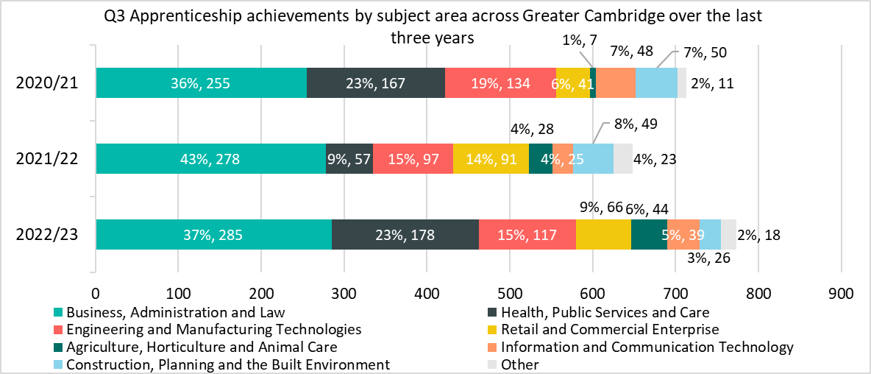
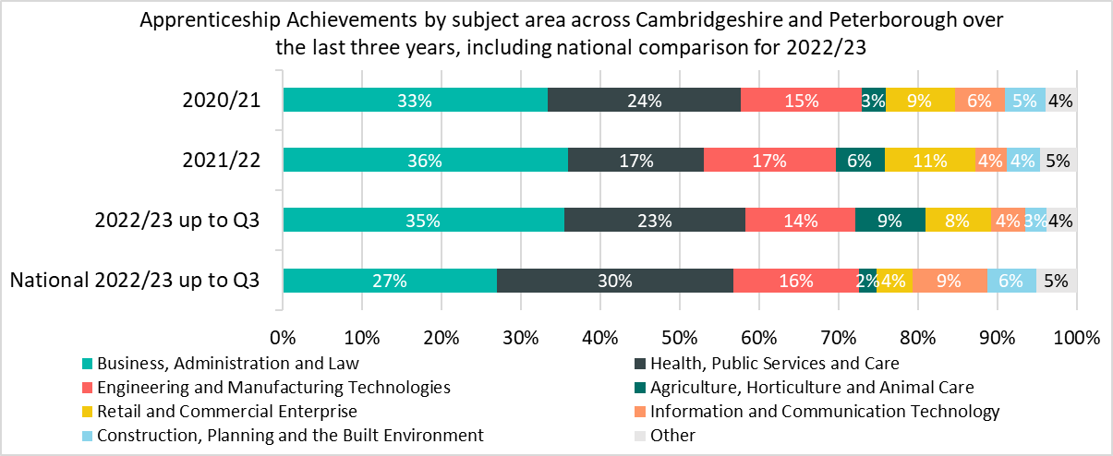
Achievements by subject area
While apprenticeships have seen an increase in the number of achievements, the impact on individual subject areas has varied when considering achievements across Q3 in 2022/23 compared with equivalent periods in 2021/22 and 2020/21.
Comparing Q3 2022/23 with the same point in the previous year, the single biggest raw number decrease in achievements was in the Retail and Commercial Enterprise subject area, with -25 fewer achievements (-27%).
The largest percentage decrease in achievements was in Construction, Planning and the Built Environment (-47%, -23). This is partly due to Cambridge Regional College decreasing its achievements in this subject sector from 50 achievements up to Q3 2020/21 and 49 up to Q3 2021/22 to 26 up to Q3 2022/23
Health, Public Services and Care had the largest raw number and percentage increase to their achievements: 178 up to Q3 2022/23 from 57 in the same period last year. This is an increase of +212%. And driven by Medipro, a new provider, having 54 achievements so far this year. This provider is already processing achievements due to taking on learners from the East of England Ambulance Service which ceased provision in 2021/22.
The Agriculture, Horticulture and Animal Care sector accounted for a higher percentage of apprenticeship achievements across Greater Cambridge across Q3 in 2022/23 at 6%, compared with 4% for the same period in 2021/22.
Health, Public Services and Care accounts for a higher proportion of national achievements up to Q3 (27%) than it does in Greater Cambridge (23%). A lower proportion of national achievements are also in the Business, Administration and Law subject area (30% nationally compared to 37% in Greater Cambridge).
*Sectors which account for less than 3% of achievements in the Greater Cambridge area and nationally in Q3 of 2022/23 have been included within the Other category. This includes Education and Training; Leisure, Travel and Tourism; Arts, Media and Publishing; Science and Mathematics.

Slide 9
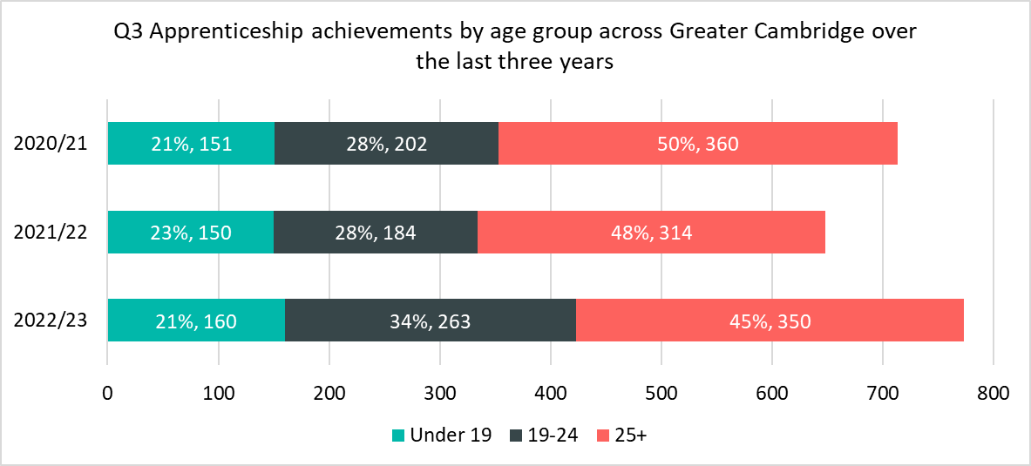
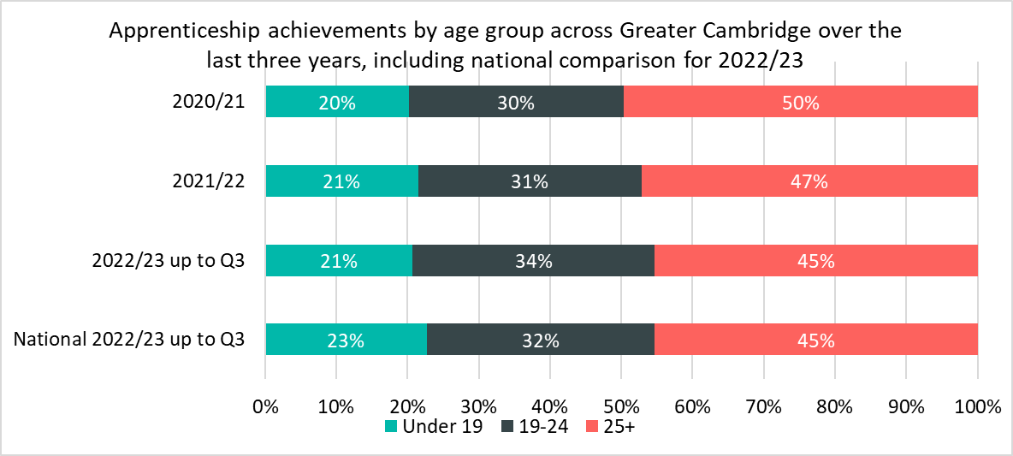
Achievements by age groups
Of the 733 apprenticeship achievements up to Q3 in 2022/23, 350 (45%) achievements were 25+ year olds, 263 (34%) achievements were among 19-24 year olds and those aged 19 and under accounted for 160 (21%) achievements. In Q3 of 2021/22 it accounted for 150 (23%) of achievements.
There has been a higher proportion (+6 percentage points) of apprenticeship achievements in 2022/23 up to Q3 among those aged 19-24 compared to the same period in 2021/22, achievements increased in this age group by +79 (+43%).
There were lower proportions of those aged 25+ undertaking apprenticeships compared to the equivalent period 2021/22. However, the number of achievements across the 25+ age group increased by +36 (+11%).
Nationally, a slightly higher proportion of achievements were for those aged under 19 (23% compared to 21% in Greater Cambridge) and a slightly lower proportion of 19-24 (32% compared to 34%)

Slide 10
Who are the main providers delivering achievements in the GCP area?
Top Five Providers by Q3 Achievements 2022/23
Provider | 2022/23 delivery to date (achievements) | % of Total 2022/23 achievements | 2021/22 delivery (achievements) | % Change between 2021/22 and 2022/23
CAMBRIDGE REGIONAL COLLEGE | 183 | 24% | 166 | 10%
MEDIPRO LIMITED | 54 | 7% | Not a Provider | N/A
CORNDEL LIMITED | 42 | 5% | 49 | -14%
ANGLIA RUSKIN UNIVERSITY HIGHER EDUCATION CORPORATION | 33 | 4% | 41 | -20%
DICK WHITE REFERRALS LIMITED | 33 | 4% | 17 | 94%
The largest provider in the area to date in 2022/23 was Cambridge Regional College, which accounted for 24% (183) of apprenticeship achievements. In the 2021/22 year the college accounted for 26% (166)of achievements up to Q3. This provider saw a +10% increase in the number of Q3 achievements between 2021/22 and 2022/23.
Medipro Limited is a new provider and has the second most achievements this year.
Up to Q3 2021/22, the University of Cambridge was the third largest provider but up to Q3 2022/23 it is the ninth largest. Its share of achievements has fallen from 6% to 3%.
Dick White Referrals has seen a 94% increase on achievements from the same point last year. Rising from 17 to 33. This is the first time they have appeared in the top five providers. In the same period in 2021/22, Dick White Referrals was the ninth largest provider.

