Slide 1
An overview of apprenticeships delivered in the Cambridgeshire and Peterborough area – Q3 2022/23
Cambridgeshire and Peterborough Update
Contact: Dominic.Milham@cambridgeshire.gov.uk

Slide 2
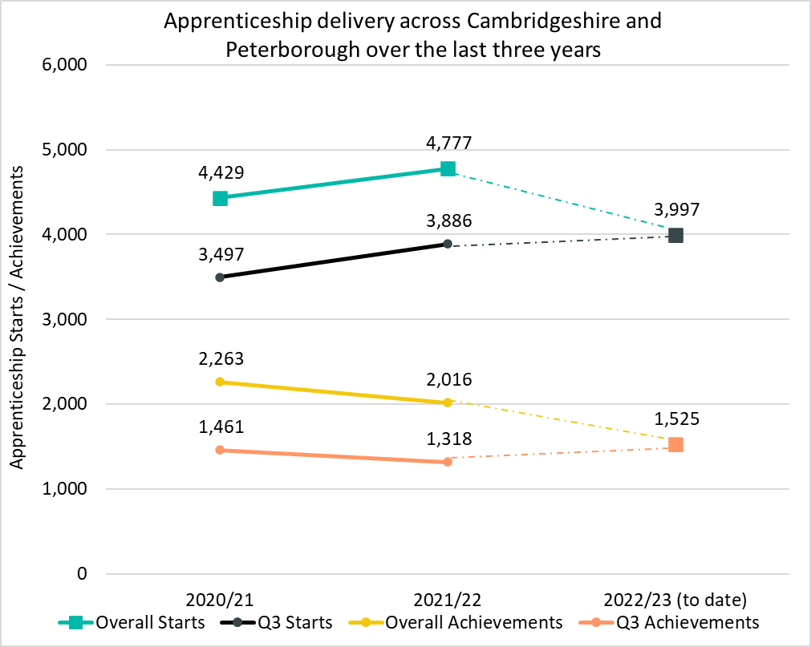
Delivery to date (April 2022/23)
Up to Q3 of 2022/23 (August 2022 – April 2023) there have been 3,997 apprenticeship starts* across Cambridgeshire and Peterborough. This is +3% more than the number of starts up to Q3 in 2021/22, where there were 3,886 apprenticeship starts.
There has been 1,525 achievements up to Q3 2022/23, an increase of +16% from the same point last year where there was 1,318 achievements
*Apprenticeship starts are calculated based on the course delivery location.

Slide 3
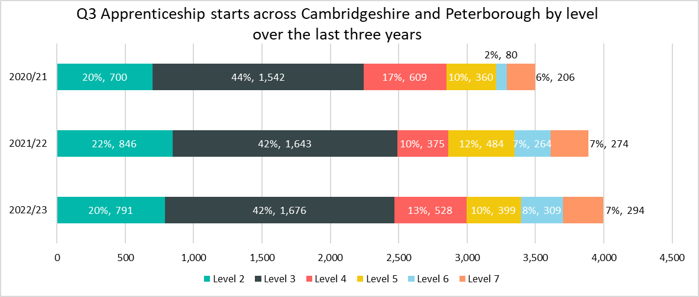
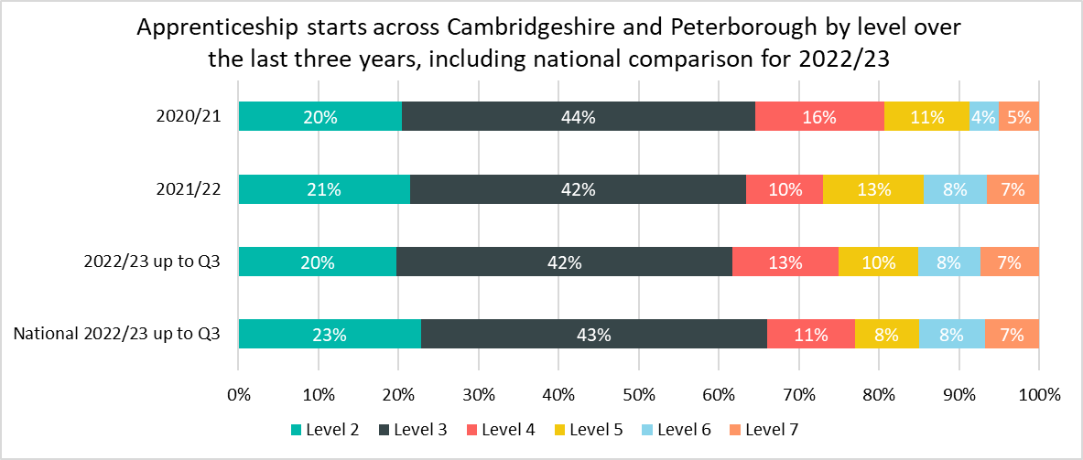
Starts by Level
Up to Q3 (August 2022 - April 2023) there have been 3,997 apprenticeship starts* across Cambridgeshire and Peterborough.
Up to Q3 of 2022/23, the largest proportion of starts were in Level 3 apprenticeships (42%), this is lightly lower than the national proportion (43%).
Across Cambridgeshire and Peterborough, there were higher proportions of apprenticeship starts in Level 4 apprenticeships (13% in C&P compared to 11% nationally) and in Level 5 apprenticeships (10% in C&P compared to 8% nationally) compared to what was observed nationally
A lower proportion of starts were at Level 2 (20% compared to 23% nationally), Level 3 apprenticeships (42% compared to 43% nationally)
While the total number of starts across the Cambridgeshire and Peterborough area across all apprenticeship Levels increased across Q3 in 2022/23, there is some variation between each level:
Level 4 apprenticeships saw the largest raw number and percentage increase for this period with +153 (+41%) more starts compared to the same period in 2021/22. Nationally, Level 4 apprenticeships saw a +4% increase.
Level 2 and Level 5 apprenticeships were the only levels to see a decrease of -55 starts (-7%) and -85 (-18%) in this period.
*Apprenticeship starts are calculated based on the course delivery location.

Slide 4
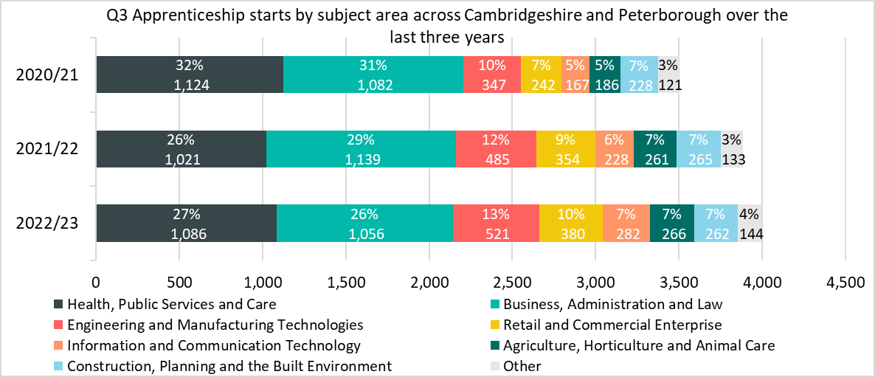
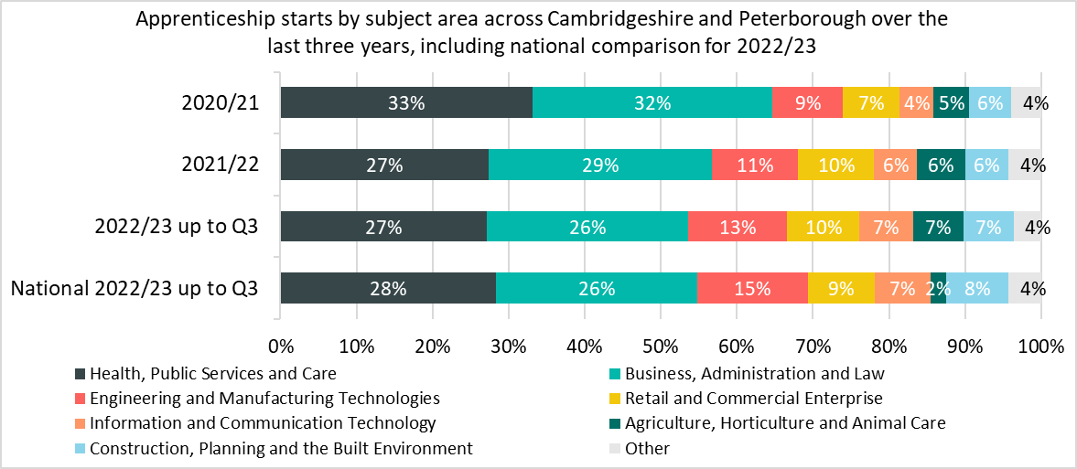
Starts by subject area
While apprenticeships have seen an increase in the number of starts, the impact on individual subject areas has varied when considering starts across Q3 in 2022/23 compared with equivalent periods in 2021/22 and 2020/21.
Comparing Q3 2022/23 with the same point in the previous year, the single biggest raw number decrease in starts was in the Business, Administration and Law subject area, with -83 fewer starts (-7%).
The Other sector saw a -9% (-12) decrease in starts, the largest percentage decrease.
The Health, Public Services and Care sector accounted the largest raw number increase from 2021/22 with +65 more starts (+6%) but this is still -38 (-3%) below the 2020/21 level . This increase is as a result of Medipro, a new provider who accounts for 12% (130) of all apprenticeships in the sector. The reason the overall increase is just 6% is that the 6 largest providers in the previous year all decreased their provision up to Q3 2022/23.
The information and Communication Technology sector experienced the largest percentage increase from 2021/222 (+24%, +54 starts).
A higher proportion of national starts are also in the construction subject area (8% nationally compared to 7% in Cambridgeshire and Peterborough) and in the Engineering and Manufacturing Technology subject area (15% compared to 13%)
*Sectors which account for less than 3% of starts in the Greater Cambridge area and nationally in Q3 of 2022/23 have been included within the Other category. This includes Education and Training; Leisure, Travel and Tourism; Arts, Media and Publishing, Science and Mathematics, History, Philosophy and Theology and Social Sciences

Slide 5
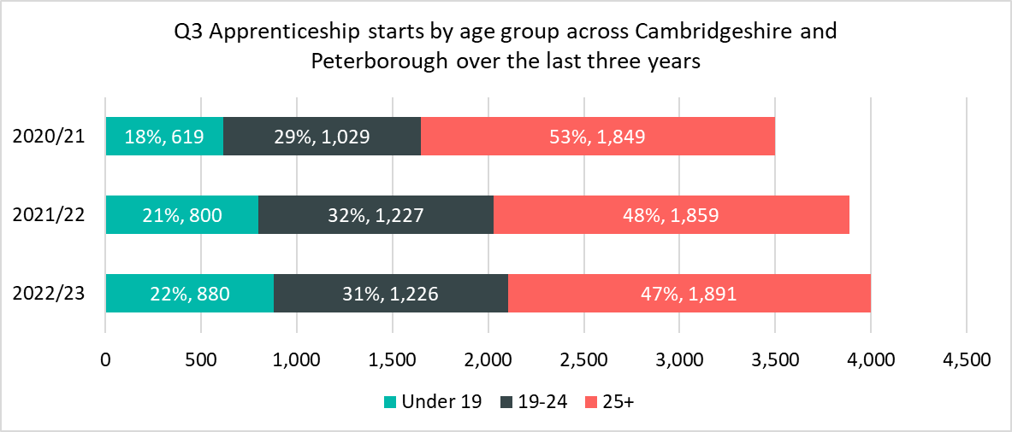
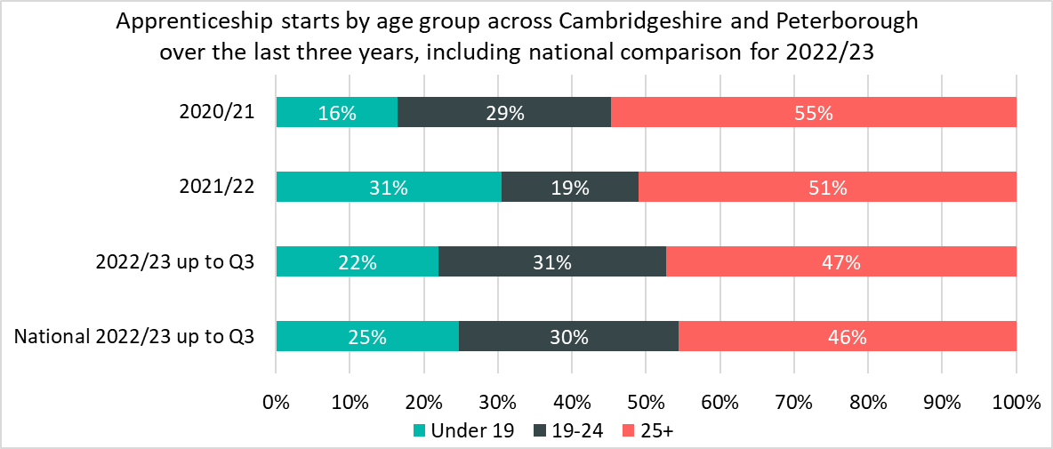
Starts by age groups
Of the 3,997 apprenticeship starts up to Q3 in 2022/23, 1,891 (47%) starts were among 25+ year olds, 1,226 (31%) starts were among 19-24 year olds and those aged 19 and under accounted for 880 (22%) starts.
There has been a higher proportion (+1 percentage points) of apprenticeship starts in 2022/23 up to Q3 among those aged under 19 compared to the same period in 2021/22. Starts increased by +80 (+10%).
There were lower proportions of those aged 19-24 and 25+ undertaking apprenticeships compared to the equivalent period 2021/22. Starts across the 19-24 age group remained very similar to 2021/22 Q3 (-1) however starts across the 25+ age group increased by +32 (+2%).
Nationally, a lower percentage of apprenticeship starts (46%) were across the 25+ age group(47% in Cambridgeshire and Peterborough) and the 19-24 age group (30% compared to 31%)
There were a higher proportion of national starts in the Under 19 age group (25%) compared to in Cambridgeshire and Peterborough (22%)

Slide 6
Who are the main providers delivering starts in the Cambridgeshire and Peterborough area?
Top Five Providers by Q3 Starts 2022/23
Provider | 2022/23 delivery to date (starts) | % of Total 2022/23 starts | 2021/22 delivery (starts) | % Change between 2021/22 and 2022/23
ANGLIA RUSKIN UNIVERSITY HIGHER EDUCATION CORPORATION | 392 | 10% | 349 | +12%
INSPIRE EDUCATION GROUP | 293 | 7% | 197 | +49%
CAMBRIDGE REGIONAL COLLEGE | 257 | 6% | 320 | -20%
LIFETIME TRAINING GROUP LIMITED | 225 | 6% | 184 | +22%
THE COLLEGE OF ANIMAL WELFAE | 155 | 4% | 164 | -5%
The largest provider in the area to date in 2022/23 was Anglia Ruskin University, which accounted for 10% (392) of apprenticeship starts. This provider saw a +12% increase in the number of Q3 starts between 2021/22 and 2022/23.
Inspire Education Group are the second largest apprenticeship provider in the Cambridgeshire and Peterborough area up to Q3 2022/23, accounting for 7% (293) of all starts. Inspire Education Group have increased their provision by 49% since the same point in 2021/22. This is as a result of an increase in the Business, administration and Law subject sector from 11 starts in 2021/22 up to Q3 to 94 starts in the same period in 2022/23

Slide 7
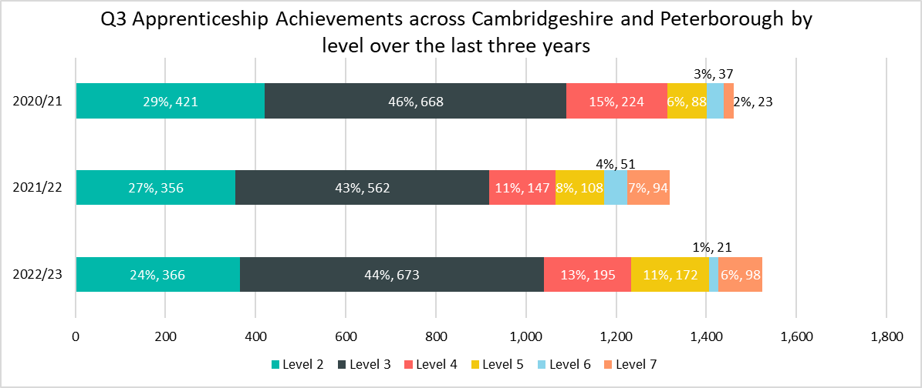
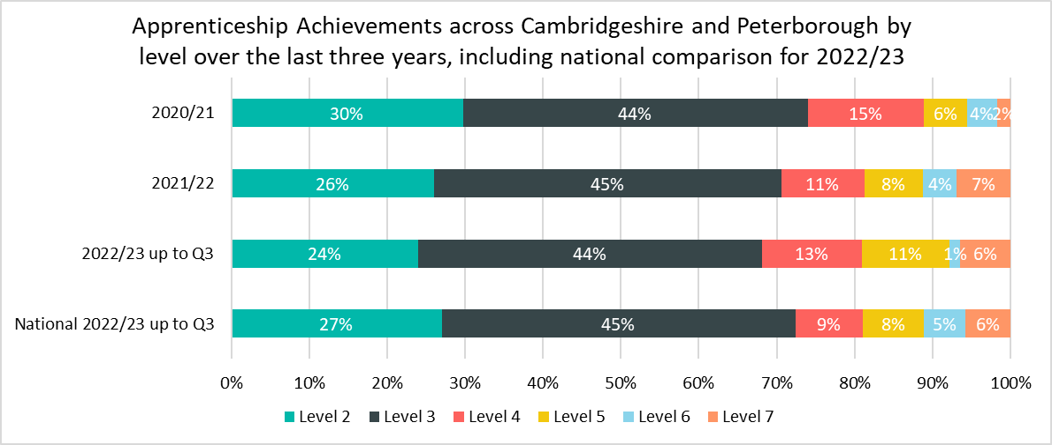
Achievements by Level
Up to Q3 of 2022/23 (August 2022 - April 2023) there have been 1,525 apprenticeship achievements* across Cambridgeshire and Peterborough
Up to Q3 of 2022/23, the largest proportion of achievements were in Level 3 apprenticeships (44%), this is lower than the national proportion (45%).
Across Cambridgeshire and Peterborough, there were higher proportions of apprenticeship achievements in Level 5 (11% in C&P compared to 8% nationally) and Level 4 apprenticeships (13% in C&P and 9% nationally) compared to what was observed nationally. And a lower proportion of Level 2 (24% compared to 27% nationally) and Level 6 apprenticeships (1% compared to 5% nationally).
While the total number of achievements across the Cambridgeshire and Peterborough area in all apprenticeship Levels increased across Q3 in 2022/23, there is some variation between each level:
Level 3 apprenticeships saw the largest increase in this period with +111 (+20%) more achievements compared to the same period in 2021/22. Nationally, Level 3 apprenticeships saw an increase of +6,121 (+15%)
Level 6 apprenticeships were the only level to see a decrease of -30 achievements (-59%) in this period. Nationally, Level 6 apprenticeship achievements increased by +3,065 (+119%).
*Apprenticeship achievements are calculated based on the course delivery location.

Slide 8
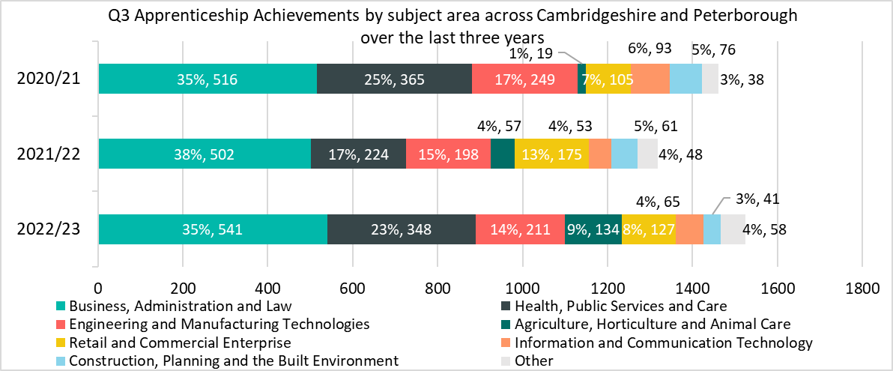
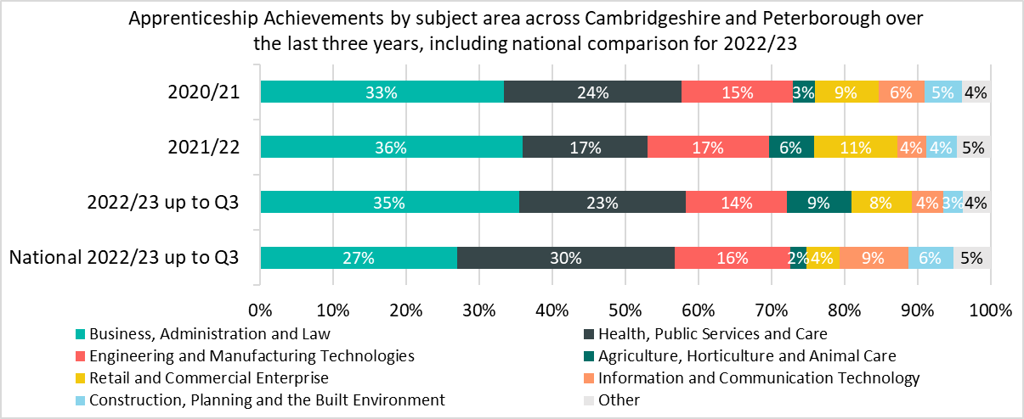
Achievements by subject area
While apprenticeships have seen an increase in the number of achievements, the impact on individual subject areas has varied when considering achievements across Q3 in 2022/23 compared with equivalent periods in 2021/22 and 2020/21.
Comparing Q3 2022/23 with the same point in the previous year, the single biggest raw number decrease in achievements was in the Retail and Commercial Enterprise subject area, with -48 (-27%) achievements. Construction, Planning and the Built Environment saw the largest percentage decrease (-33%, -20 achievements).
The Agriculture, Horticulture and Animal Care sector accounted for a higher percentage of apprenticeship achievements across the Cambridgeshire and Peterborough area across Q3 in 2022/23 at 9%, compared with 4% for the same period in 2021/22. This sector saw achievements increase by +77 (+135%), the largest percentage increase across all sectors. This sector makes up 2% of National achievements.
Health, Public Services and Care accounts for a higher proportion of national achievements up to Q3 (27%) than in Cambridgeshire and Peterborough (23%) but saw the largest raw number increase in achievements (+124, +55%) across the region. A higher proportion of national achievements are also in the Engineering and Manufacturing Technologies subject area (16% nationally compared to 14% in Cambridgeshire and Peterborough).
*Sectors which account for less than 3% of achievements in the Greater Cambridge area and nationally in Q3 of 2022/23 have been included within the Other category. This includes Education and Training; Leisure, Travel and Tourism; Arts, Media and Publishing, Science and Mathematics, History, Philosophy and Theology and Social Sciences

Slide 9
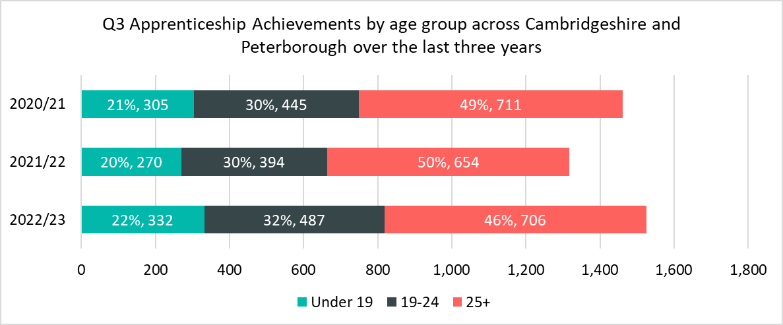
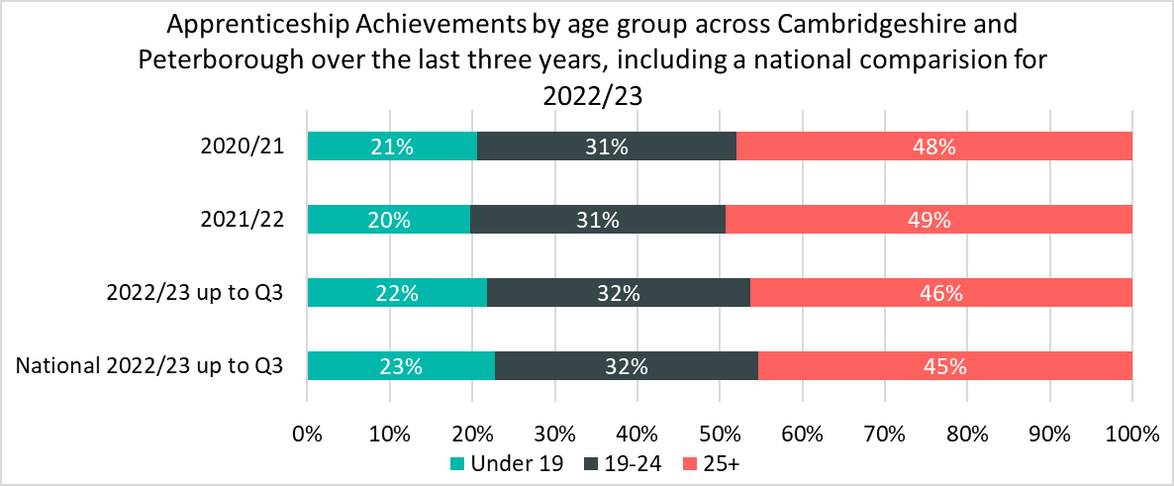
Achievements by age groups
Of the 1,525 apprenticeship achievements up to Q3 in 2022/23, 706 (46%) achievements were 25+ year olds, 487 (32%) achievements were among 19-24 year olds and those aged 19 and under accounted for 322 (22%) achievements.
There has been a higher proportion (+2 percentage points) of apprenticeship achievements in 2022/23 up to Q3 among those aged 19-24 compared to the same period in 2021/22, achievements increased by +93 (+24%).
There were lower proportions of those aged 25+ undertaking apprenticeships compared to the equivalent period 2021/22, however achievements across the 25+ age group still increased by +52 (+8%).
Nationally proportions of achievements for each age group remained the same for Q3 of 2022/23 as Q3 2021/22’ and are closely aligned with Cambridgeshire and Peterborough.

Slide 10
Who are the main providers delivering achievements in the Cambridgeshire and Peterborough area?
Top Five Providers by Q3 achievements 2022/23
Provider | 2022/23 delivery to date (achievements) | % of Total 2022/23 achievements | 2021/22 delivery (achievements) | % Change between 2021/22 and 2022/23
CAMBRIDGE REGIONAL COLLEGE | 183 | 12% | 172 | 6%
THE COLLEGE OF ANIMAL WELFARE LIMITED | 72 | 5% | 24 | 200%
MEDIPRO LIMITED | 54 | 4%
WEST SUFFOLK COLLEGE | 53 | 4% | 25 | 112%
CORNDEL LIMITED | 46 | 3% | 49 | -6%
The largest provider in the area to date in 2022/23 was Cambridge Regional College, which accounted for 12% (183) of apprenticeship achievements. The college accounted for 13% (172) of all achievements up to Q3 2021/22. This provider saw a +6% increase in the number of Q3 achievements between 2021/22 and 2022/23.
The College of Animal Welfare are the second largest apprenticeship provider in the Cambridgeshire and Peterborough area up to Q3 2022/23, accounting for 5% (72) of all achievements. The College of Animal Welfare have increased their provision by 200% from the same period last year
Medipro Limited has the 3rd highest number of achievements (54). It had no achievements last year as it was a new provider for 2022/23.
Corndel Limited was 2nd in apprenticeship achievements up to Q3 2021/22, accounting for 4% (49) of achievements . Up to Q3 2022/23 it is the 5th largest provider accounting for 3% (46) of achievements. This is a decrease of -3 (-6%) from the same point last year

