Slide 1

Transport update: Cambridge and South Cambs Cambridgeshire
COVID-19 transport impacts and recovery
January 2023
Research Team, Cambridgeshire County Council

Slide 2
Data and monitoring report aims
This report is intended to:
Summarise the on-going impacts of COVID-19 on trends in transport and mobility up to 31st December 2023.
Highlight changes in key indicators by comparing December 2022 data with both a pre-pandemic baseline (December 2019) and to the mid-COVID (December 2020). Quarterly metrics are also provided.
Provide a basis for discussion for the Greater Cambridge Partnership’s (GCP) Transport Working Group to understand and identify existing challenges and future data needs.
Notes:
Comparison periods may vary across the different datasets based on the availability of historic data – comparison periods are clearly noted for each dataset.
In additional to monthly metrics, this report also includes quarterly metrics. The quarters used in this report are defined as follows:
  Q1 = January – March
  Q2 = April – June
  Q3 = July – September
  Q4 = October – December (this report)
  Where reference is made to ‘weekdays’ this includes Monday to Thursday (as per DfT guidance).

Slide 3
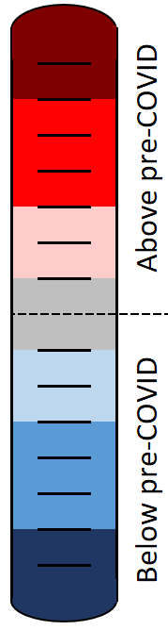
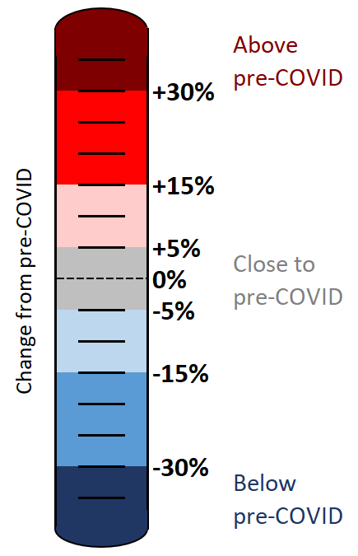
Colour scale
The statistics in this pack have been colour-coded using a heat scale to reflect the level of recovery being experienced (pre-COVID compared to now).
A positive (red) value indicates that levels have increased above those experienced pre-COVID.
A negative (blue) value indicates that levels remain below pre-COVID.
Top tip:
Lookout for the colour scale bar in the top right-hand corner of each page for a reminder of the heat scale used to indicate the level of recovery throughout the pack.

Slide 4
Overview

Slide 5








Headlines: December 2022
Local Roads
Volumes at
compared to pre-COVID
(see analysis on slide 22)
Strategic Roads
Volumes at
-
compared to pre-COVID
(see analysis on slide 12)
Car Parking
Patronage at
compared to pre-COVID
(see analysis on slide 36)
Bus
Patronage at
-
compared to pre-COVID
(see analysis on slide 43)
Park and Ride
Patronage at
compared to pre-COVID
(see analysis on slide 45)
P
P
+
-13%
-4%
-21%
-27%
-12%
Station Square Footfall
Volumes at
-50%
compared to pre-COVID
(see analysis on slide 41)
Retail Footfall
Volumes at
-14%
compared to pre-COVID
(see analysis on slide 33)
Walking
Volumes at
-22%
compared to pre-COVID
(see analysis on slide 31)
Cycling
Volumes at
-25%
compared to pre-COVID
(see analysis on slide 30)
Air Pollution
Concentrations at
-22%
compared to pre-COVID
(see analysis on slide 50)
-50%
-14%
-22%
-25%
-21%

Slide 6
Recovery Tracker
Notes:
Notes:
The method of calculating the strategic road network (SRN) recovery percentages changed in Dec 2022 to include data from a larger number of sites (originally 6 sites, now 28 sites). The SRN percentages have therefore been updated and may not reflect the values presented in previous slide packs for this reason.
The air pollution percentages historically used data from 5 sensors but one of these sensors was removed in April 2022 so the methodology for calculating the air pollution percentages has been adjusted. The air pollution percentages presented here may differ slightly from those in previous slide packs for this reason.

Slide 7
Travel Demand

Slide 8
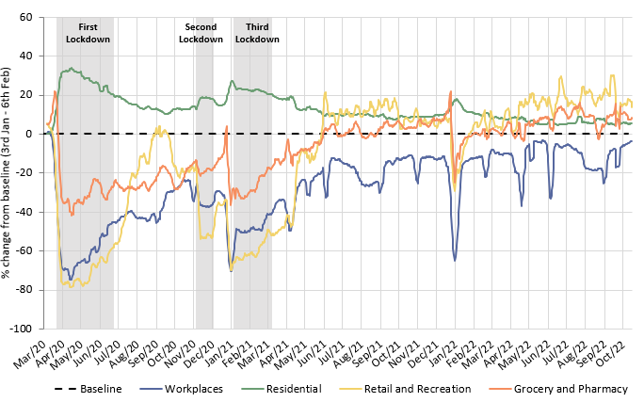
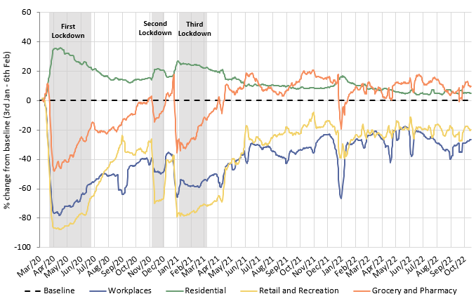
Has COVID-19 changed where we spend our time?
The pandemic caused us to spend more time at home and less time at a designated workplace. Whilst the extent of this impact has steadily reduced since Spring 2021, an impact can still be seen in October 2022, particularly in Cambridge.
Cambridge
South Cambridgeshire
 | Pre-Covid to Now: Baseline (Jan/Feb 2020) to Oct* 2022
Pre-Covid vs Now: | Workplaces | Residential | Retail and Recreation | Grocery and Pharmacy
Cambridge | -26 | +5 | -19 | +11
South Cambridgeshire | -3 | +5 | +16 | +9
*Sourced from Google Mobility data which was discontinued on 16th October 2022. Numbers represent the % change from the baseline period. The baseline period is defined by Google as 3rd Jan – 6th Feb 2020.
Notes:
Please note the charts show a 7-day rolling average. Google Mobility data stopped on October 16th (final day of available data is October 15th).
Commentary:
Cambridge: Cambridge grocery and pharmacy visits continue to be above pre-pandemic levels, while retail and recreation visits continue to be below pre-pandemic levels (-19% in October 2022), suggesting that people continue to undertake their essential shopping habits but are not doing as much discretionary travel for retail and leisure purposes. The proportion of people making workplace visits is still distinctly below the pre-Covid baseline at -26%, although this is an improvement on what we saw across the summer months. Residential visits remain higher than the baseline, in part likely due to the persistence of remote working.
South Cambridgeshire: Workplace visits continue to be lower than pre-pandemic (-3% in October 2022), however this metric has recovered more strongly in South Cambs than it has in Cambridge. Similarly to Cambridge data, residential numbers have been continually above the pre-pandemic baseline since the dataset began (+5% in October 2022). Retail and recreation (+16%), and grocery and pharmacy (+9%) visits remain ahead of the pre-pandemic baseline in South Cambridgeshire, suggesting that people’s shopping and leisure habits have stabilised after the heavy disruption caused by the pandemic and associated lockdowns.
Source: Google LLC "Google COVID-19 Community Mobility Reports". https://www.google.com/covid19/mobility/
Data is gathered from Google account holders location history. This helps to demonstrate where people are spending their time.
The data is based on the most recent month (October 2022) compared to the median of the corresponding day in the baseline period (3rd Jan-6th Feb 2020) as calculated by Google. Tabulated percentages represent the change from the baseline (3rd Jan – 6th Feb) to the most recent month.
Given the discontinuance, we have worked with the first two weeks of October 2022 alone, and assessed whether the resultant output is sensible. On request, we may be able to examine additional historic trends based on the Google dataset – which is still available via the links above (but is not being updated).
“Community Mobility Reports aim to provide insights into what has changed in response to policies aimed at combating COVID-19. The reports chart movement trends over time by geography, across different categories of places such as retail and recreation, groceries and pharmacies, parks, transit stations, workplaces, and residential.”

Slide 9
Strategic Road Network

Slide 10
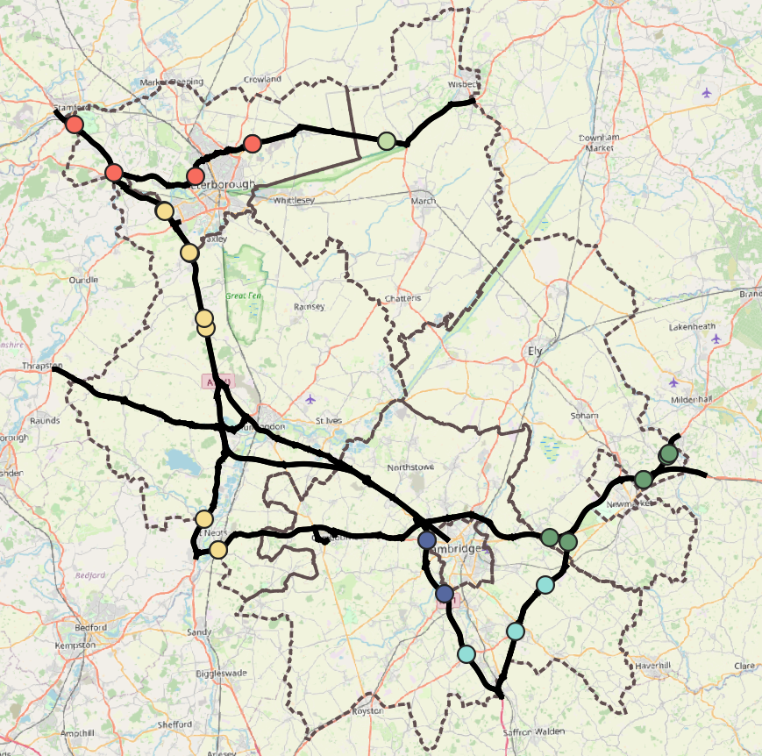

Strategic Road Network Monitoring Sites
Strategic Road Network traffic monitoring sites with continuous data
A1
National Highways have approximately 1,400 permanent traffic monitoring sites on the strategic road network within Cambridgeshire and Peterborough.
Each monitoring site varies in its ability to reliably provide data over time, and periods of inactivity are common. It is therefore not appropriate to conduct a long-term analysis for all-sites.
For this reason, only the 28 sensors with uninterrupted data from January 2019 onwards are included in this analysis. These 28 sites are shown on the map to the left.
A47
N
A14
A1
A11
Cambridge sites
A14
East Cambridgeshire sites
A14
Fenland sites
A428
Huntingdonshire sites
A1
Peterborough sites
South Cambridgeshire sites
Strategic Road Network in Cambridgeshire and Peterborough
M11
© OpenStreetMap Contributors
Notes:
National Highways WebTRIS data
Locations:
Cambridge
Peterborough
East Cambridgeshire
Fenland
Huntingdonshire
South Cambridgeshire

Slide 11
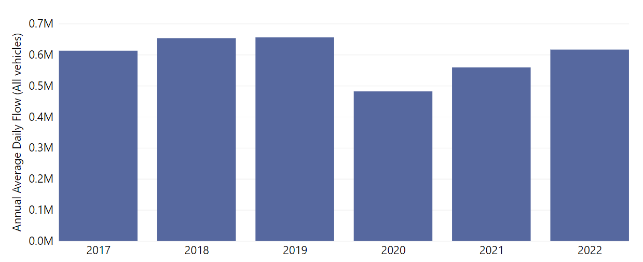
Strategic Road Network: Annual Average Daily Flow by Year
In Cambridgeshire and Peterborough, traffic volumes on the Strategic Road Network in 2022 are just below 2019 volumes, but have exceeded 2017 volumes.
Total Annual Average Daily Flow across all 28 sensors
change from 2019
change from 2017
-6%
change from 2019
change from 2017
-15%
change from 2019
change from 2017
-27%
+1%
-9%
-21%
Analysis using 3 sensors in Cambridge (M11), 6 in East Cambridgeshire (A11 and A14), 2 in Fenland (A47), 9 in Huntingdonshire (A1 and A1(M)), 5 in Peterborough (A47 and A1) and 3 in South Cambridgeshire (M11 and A11).
Notes:
Source: National Highways WebTRIS data. Average Daily Flow by year for main carriageway monitors in each district, all with data 2019 – 2022.

Slide 12
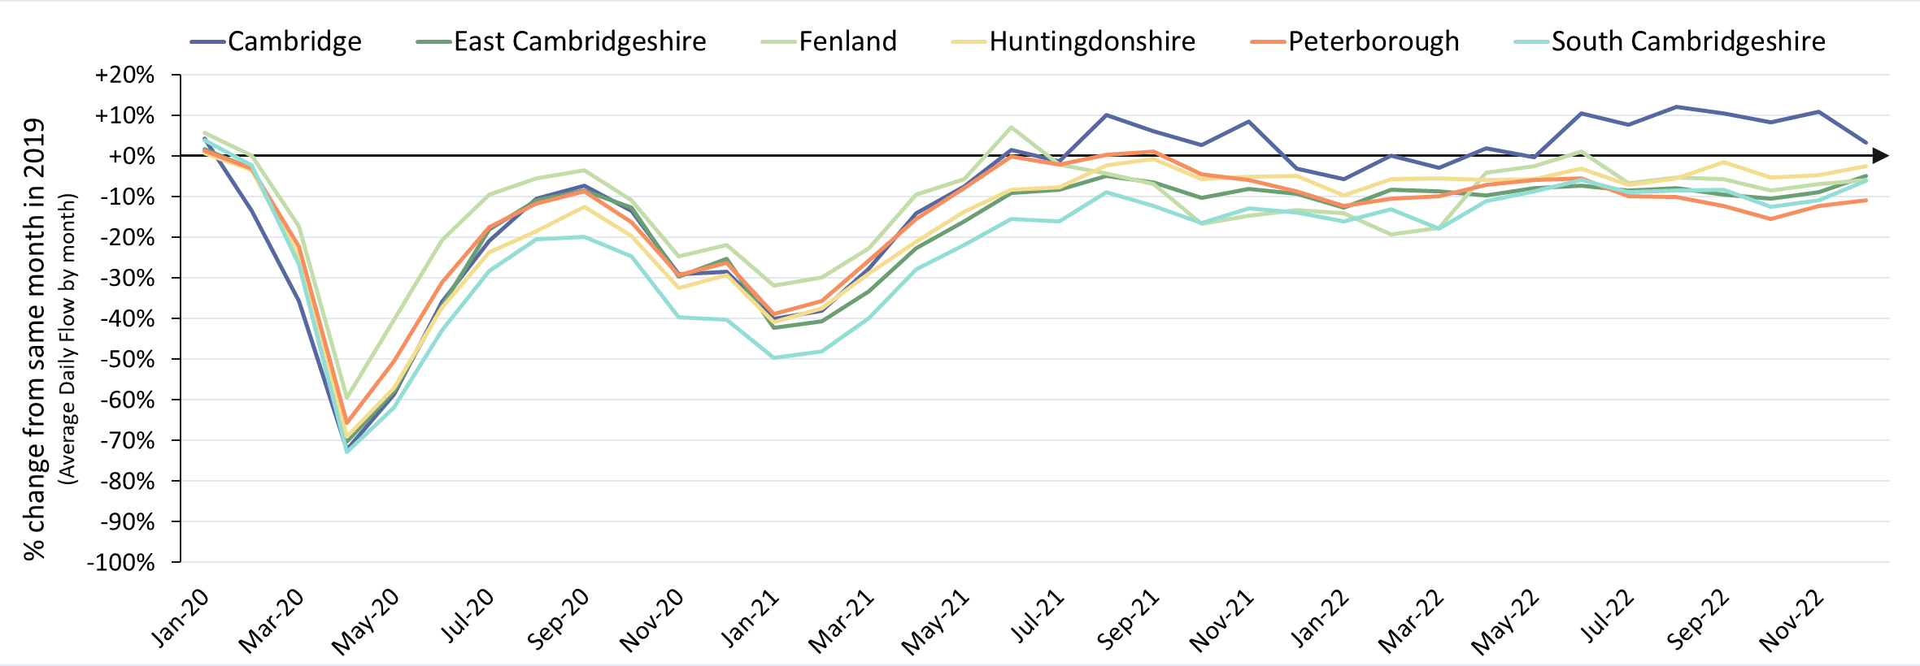
Strategic Road Network: Average Daily Flow by Month
The level of recovery varies by district. Cambridge (M11) has been at/near 2019 volumes since summer 2021. Strategic routes in the other districts remain just below 2019 levels, most notably Peterborough.
 | Pre-COVID to Now Dec 2019 to Dec 2022
Average Daily Flow % change | Cambridge | East Cambridgeshire | Fenland | Huntingdonshire | Peterborough | South Cambridgeshire | ALL DISTRICTS
 | +3% | -5% | -6% | -3% | -11% | -6% | -4%
Analysis based on 28 sensors - 3 in Cambridge (M11), 6 in East Cambridgeshire (A11 and A14), 2 in Fenland (A47), 9 in Huntingdonshire (A1), 5 in Peterborough (A47 and A1) and 3 in South Cambridgeshire (M11 and A11).
Notes:
Source: National Highways WebTRIS data. Average Daily Flow by month for main carriageway monitors in each district, all with data 2019 – 2022.

Slide 13
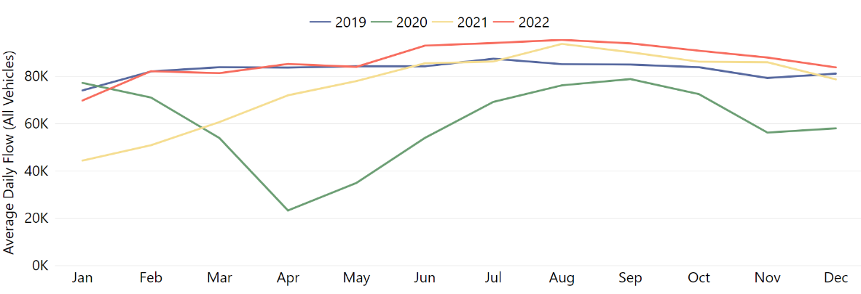
Strategic Road Network: Average Daily Flow by Month
Cambridge strategic road volumes are slightly above pre-COVID levels (+3%) despite decreasing slightly since Sept 2022 (-11%).
District: Cambridge
Pre-COVID to Now: Dec 2019 to Dec 2022 | Mid-COVID to Now: Dec 2020 to Dec 2022 | Previous update to Now: Sept 2022 to Dec 2022
+3% | +44% | -11%
Analysis based on 3 sensors - all on the main carriageway of the M11 (2 near Madingley Road and 1 near Trumpington).
Notes:
Source: National Highways WebTRIS data. Average Daily Flow by month for main carriageway monitors in each district, all with data 2019 – 2022.

Slide 14
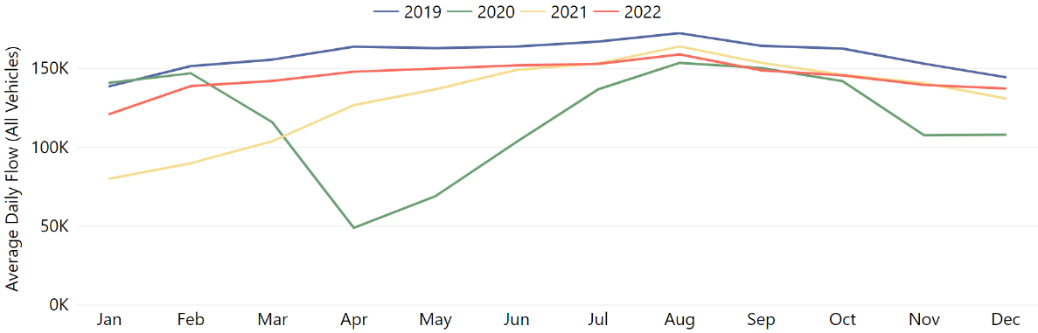
Strategic Road Network: Average Daily Flow by Month
East Cambridgeshire strategic road volumes have almost returned to pre-COVID levels despite seasonal decreases towards the end of the year (-8%).
District: East Cambridgeshire
Pre-COVID to Now: Dec 2019 to Dec 2022 | Mid-COVID to Now: Dec 2020 to Dec 2022 | Previous update to Now: Sept 2022 to Dec 2022
-5% | +27% | -8%
Analysis based on 6 sensors - 3 on the main carriageway of the A11 (2 close to Red Lodge and 1 north of Three Mile Bottom) and 3 on the main carriageway of the A14 (2 north of Newmarket and 1 south of Bottisham).
Notes:
Source: National Highways WebTRIS data. Average Daily Flow by month for main carriageway monitors in each district, all with data 2019 – 2022.

Slide 15
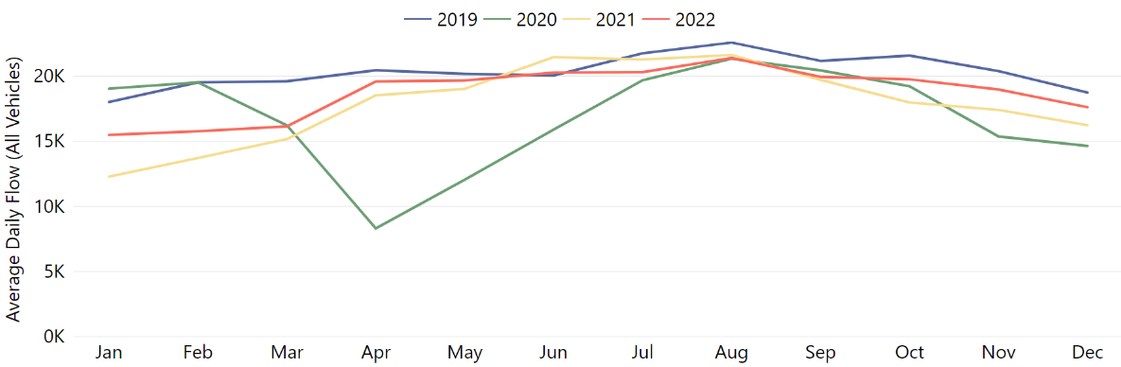
Strategic Road Network: Average Daily Flow by Month
Fenland strategic road volumes remain slightly below pre-COVID levels and also saw a slight decrease towards the end of the year (-12%).
District: Fenland
Pre-COVID to Now: Dec 2019 to Dec 2022 | Mid-COVID to Now: Dec 2020 to Dec 2022 | Previous update to Now: Sept 2022 to Dec 2022
-6% | +20% | -12%
Analysis based on 2 sensors on the main carriageway of the A47 (both close to Guyhirn).
Notes:
Source: National Highways WebTRIS data. Average Daily Flow by month for main carriageway monitors in each district, all with data 2019 – 2022.

Slide 16
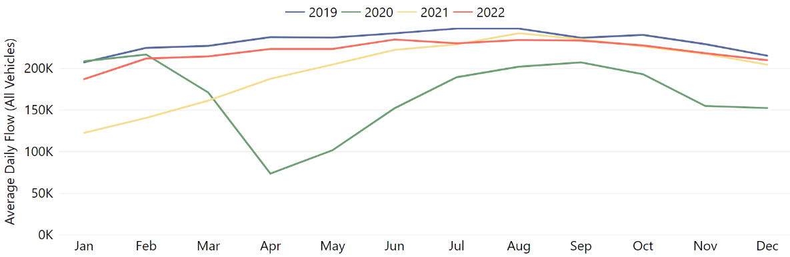
Strategic Road Network: Average Daily Flow by Month
Huntingdonshire strategic road volumes have almost returned to pre-COVID levels and also saw a slight decrease towards the end of the year (-10%).
District: Huntingdonshire
Pre-COVID to Now: Dec 2019 to Dec 2022 | Mid-COVID to Now: Dec 2020 to Dec 2022 | Previous update to Now: Sept 2022 to Dec 2022
-3% | +38% | -10%
Analysis based on 7 sensors - 1 on the A1 (north of St Neots), 6 on the A1(M) (2 east of Sawtry, 2 west of Yaxley, 2 near Alwalton).
Notes:
Source: National Highways WebTRIS data. Average Daily Flow by month for main carriageway monitors in each district, all with data 2019 – 2022.

Slide 17
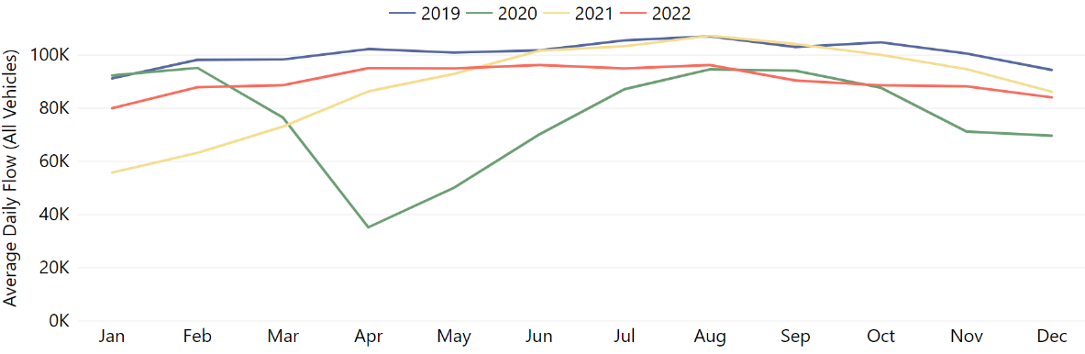
Strategic Road Network: Average Daily Flow by Month
Peterborough strategic road volumes remain slightly below pre-COVID levels (-11%) and also saw a slight decrease towards the end of the year (-7%).
District: Peterborough
Pre-COVID to Now: Dec 2019 to Dec 2022 | Mid-COVID to Now: Dec 2020 to Dec 2022 | Previous update to Now: Sept 2022 to Dec 2022
-11% | +21% | -7%
Analysis based on 5 sensors - 3 on the A47 (2 east of Dogsthrope, 1 south of Bretton) and 2 on the A1 (1 north of Wansford and 1 south of Stamford).
Notes:
Source: National Highways WebTRIS data. Average Daily Flow by month for main carriageway monitors in each district, all with data 2019 – 2022.

Slide 18
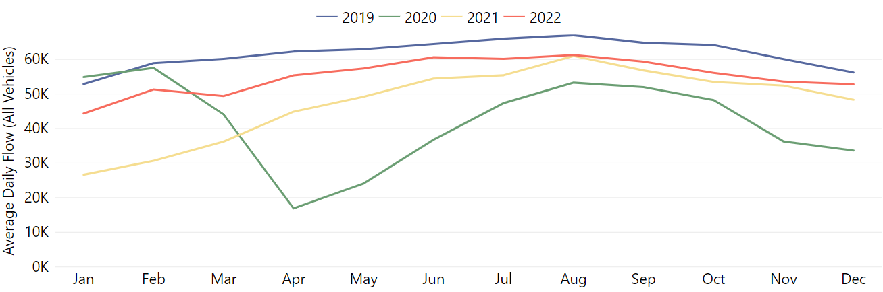
Strategic Road Network: Average Daily Flow by Month
South Cambridgeshire strategic road volumes remain slightly below pre-COVID levels and also saw a slight decrease towards the end of the year (-11%).
District: South Cambridgeshire
Pre-COVID to Now: Dec 2019 to Dec 2022 | Mid-COVID to Now: Dec 2020 to Dec 2022 | Previous update to Now: Sept 2022 to Dec 2022
-6% | +57% | -11%
Analysis based on 3 sensors - 1 on the M11 (near Duxford) and 2 on the A11 (1 south of Great Wilbraham and 1 west of Abington). A428 sensors excluded to avoid data bias due to the A14 roadworks.
Notes:
Source: National Highways WebTRIS data. Average Daily Flow by month for main carriageway monitors in each district, all with data 2019 – 2022.

Slide 19
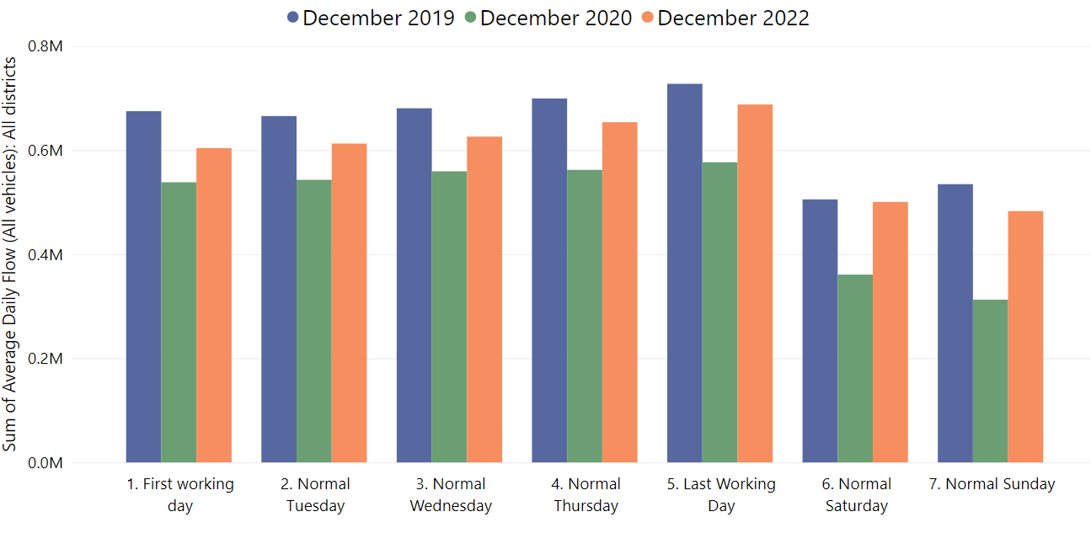
Strategic Road Network: Daily Flow by Day of Week
Fridays and Saturdays are closest to Pre-COVID levels. Mondays and Sundays remain most below pre-COVID volumes.
Dec -19
Dec -19
Dec -19
Dec -19
Dec -19
Dec -22
Dec -22
Dec -22
Dec -22
Dec -22
Dec -20
Dec -20
Dec -20
Dec -20
Dec -20
Dec -19
Dec -19
Dec -22
Dec -22
Dec -20
Dec -20
 | Pre-COVID to Now: Dec 2019 to Dec 2022
Average Daily Flow % change | Frist Working Day | Normal Tuesday | Normal Wednesday | Normal Thursday | Last Working Day | Normal Saturday | Normal Sunday
 | -10% | -8% | -8% | -7% | -5% | -1% | -10%
Analysis based on 28 sensors - 3 sensors in Cambridge, 6, in East Cambridgeshire, 2 in Fenland, 9 in Huntingdonshire, 5 in Peterborough and 3 in South Cambridgeshire.
Notes:
Average daily flow, sites with data for 2019-2022 chosen for each district.
Note the use of ‘normal’ days which allow for a ‘like-for-like’ comparison between comparable days. For example, bank holidays and school holidays are excluded from average flow calculations for ‘normal’ days. As such, this dataset does not account for the Christmas period, Christmas or New Year bank holidays, school summer holidays etc.
Commentary:
Flow rates still below Dec 2019 for weekdays and weekends (-7% Mon-Sun)
In December 2022, the ‘First Working Day’ (-10%) was the weekday furthest behind the 2019 volumes whilst Sunday (-10%) was further behind Saturday (-1%).
The proportion of people travelling on weekdays (M-Th) vs. at the weekend (S-S) has recovered to be similar to pre-pandemic, despite overall volumes being lower.
Both weekdays and weekends are higher than Dec 2020, likely as during Dec 2020 there were tiered lockdowns in place
Activity decreases slightly from September 2022, perhaps as a result of the darker evenings and poorer weather in the winter.
The proportion of people travelling on weekdays (M-Th) vs. at the weekend (S-S) has recovered to be similar to pre-pandemic, despite overall volumes being lower.
Source: National Highways WebTRIS data. Average Daily Flow in the week for main carriageway monitors in each district, all with data 2019 – 2022.

Slide 20
Local Road Network

Slide 21
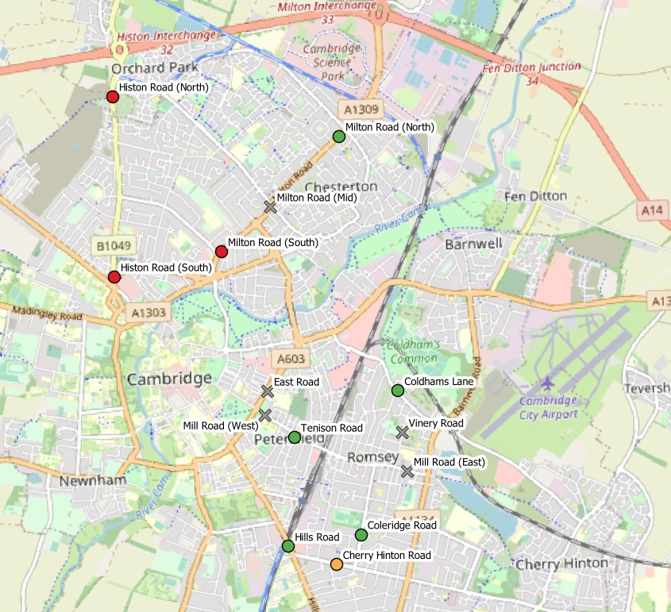
Local Road Network Monitoring Sites
Long Term Vivacity Monitoring Sites
The Mill Road and East Road sensors were upgraded in Sept 2022 and are now detecting significantly more cycles and pedestrians. As a result the active travel flows at these locations are no longer comparable pre/post Sept 2022.
The Vinery Road and Milton Road (Mid) sensors are currently inactive.
Sensor Location​​ | Location description​​ | Installed​
Cherry Hinton Road ​​ | Near Rock Road​​ | May 2019​
Coldham’s Lane​​ | Near Coldham’s Common​​ | May 2019​
Coleridge Road ​​ | Near Coleridge recreation ground​​ | May 2019​
East Road​​ | Close to ARU site​​ | May 2019​
Hills Road Bridge​​ | Near Cherry Hinton Road​​ | May 2019​
Histon Road (North)​​ | Just south of A14​ | Sept 2019​
Histon Road (South) ​​ | Near Victoria Road​ | Sept 2019​
Mill Road (East)​​ | Close to Brookfield’s hospital​​ | May 2019​
Mill Road (West)​​ | Close to Parker’s Piece​​ | May 2019​
Milton Road (Mid)​​ | Near Union Lane​​ | May 2019​
Milton Road (North)​​ | Near King’s Hedges Road​ | Sept 2019​
Milton Road (South)​ | Near Gilbert Road​ | Sept 2019​
Tenison Road​​ | Near Mill Road​​ | May 2019​
Vinery Road ​​ | Near Romsey recreation ground​​ | May 2019​
Legend
Data available for most months and years
Data available for all Decembers (2019, 2020, 2021 & 2022)
Data available for December 2019 and 2022.
Comparable data not available for December 2019 and / or 2022.
© OpenStreetMap Contributors

Slide 22
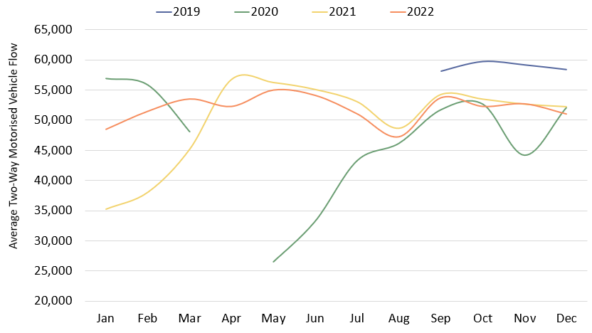
Local Road Motorised Vehicles: Cambridge
Local road vehicle flows are 13% below pre-COVID levels in Cambridge. Daily flows in December 2022 are similar to those seen in December 2020 and 2021.
2019
2021
2022
2020
 | Pre-COVID to Now: Dec 2019 to Dec 2022 |  |  | Mid-COVID to Now: Dec 2020 to Dec 2022 |  |  | Previous update to9 Now: Sept 2022 to Dec 2022
 | Mon-Sun | Weekdays | Weekends | Mon-Sun | Weekdays | Weekends | Mon-Sun | Weekdays | Weekends
Cambridge | -13% | -14% | -7% | -2% | No change | No change | -5% | 1% | -6%
Analysis based on data from the 5 sensors with comparable data for most months and years: Coldham’s Lane, Coleridge Road, Hills Road, Milton Road (North) and Tenison Road.
 | Pre-COVID to Now: Q4 2019 to Q4 2022 |  |  | Mid-COVID to Now: Q4 2020 to Q4 2022 |  |  | Previous quarter to Now: Q3 2022 to Q4 2022
 | Week (Mon - Sun) | Weekdays (Mon - Thu) | Weekends (Sat - Sun) | Week (Mon - Sun) | Weekdays (Mon - Thu) | Weekends (Sat - Sun) | Week (Mon - Sun) | Weekdays (Mon - Thu) | Weekends (Sat - Sun)
Cambridge | -12% | -13% | -7% | +6% | +4% | +15% | +4% | +5% | +7%
Notes:
Commentary:
Small decreases in motorised vehicles in Cambridge since September 2022 (-5% Mon-Sun).
Cambridge flows remain below Dec 2019 ‘pre-COVID’ levels, particularly during the week (Mon-Thu).
Bank holiday weeks are not included within the calculations. School holidays are also excluded (except summer holidays in order to obtain figures for August).
This chart shows the average volume of motor vehicles counted per weekday for each month/year at the 5 Vivacity sensors noted at the bottom of the slide. The table presents full week and weekend changes against various historic benchmarks to give an indication of how traffic flows are recovering.
Improved data cleaning processes are being developed to improve the omission of any poor quality / non-comparable data – gaps on the graph may be present for this reason. Care should be taken in interpreting these charts as they are solely based on the five locations stated – which dilutes the geographical coverage and may not provide a city-wide / holistic view.
Source: Cambridge Vivacity sensors

Slide 23
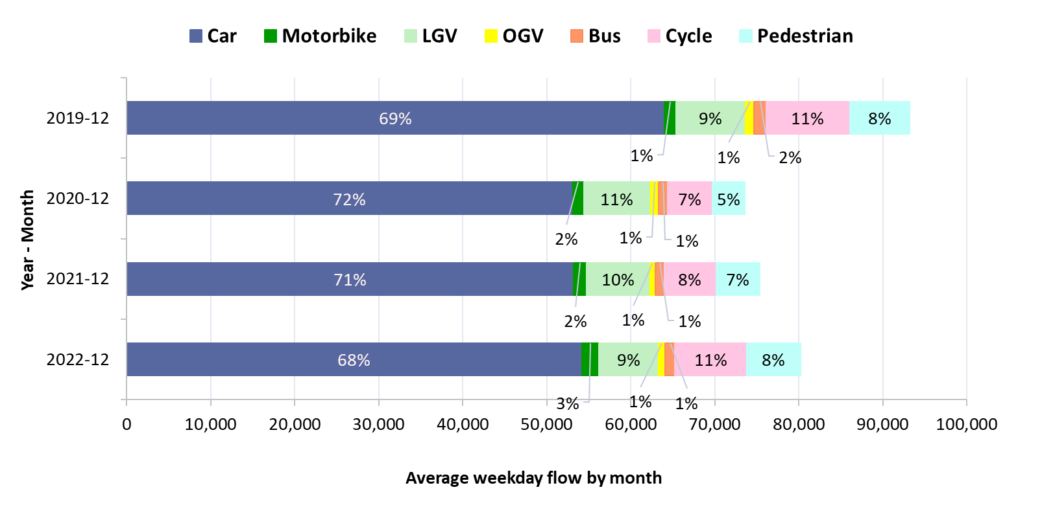
Local Road Mode Split: Cambridge
Total flows remain lower than pre-COVID levels but higher than both 2020 and 2021. The active mode proportion is at the level seen pre-COVID.
Transport mode split – sum of 6 sensors in Cambridge: December comparison
Active: Cyclist + Pedestrian
Year | Active %
Dec 2019 | 18%
Dec 2020 | 13%
Dec 2021 | 15%
Dec 2022 | 19%
December 2022
Location​ | Active %​
Mill Road (West) | 51%
Tenison Road | 37%
Mill Road (East) | 32%
Milton Road (South) | 31%
East Road | 29%
Cherry Hinton Road | 25%
Histon Road (South) | 24%
Hills Road | 22%
Coleridge Road | 15%
Milton Road (North) | 13%
Histon Road (North) | 11%
Coldham's Lane | 7%
ALL SITES | 18%
Analysis based on data from the 6 sensors with comparable data for December 2019, 2020, 2021 and 2022: Cherry Hinton Rd, Coldham’s Ln, Coleridge Rd, Hills Rd, Milton Rd (North) and Tenison Rd
Notes:
Commentary
Motor vehicles dominate in all years. Active travel is now 19% of all traffic in December 2022 – a higher share than December 2019, 2020 and 2021.
Traffic volumes are showing a slight recovery in each year since the pandemic. Modal split is not vastly different year-to-year.
Source: Cambridge Vivacity sensors

Slide 24
Local Road Mode Split: Cambridge by Site
Average two-way weekday flow for December
Notes:
Commentary
Cars are the largest individual category at all sites across all years – but some sites are seeing the dominance of cars recede slightly (Cherry Hinton Road, Histon Road North + South).
Whilst absolute volumes have begun to rebound from the low volumes mid-pandemic (December 2020), there has not been a significant impact on modal split at most locations. Exceptions: Mill Road (West) & East Road, both of which are counting more pedestrians and cyclists as a result of sensor upgrades (as noted on the slide).
Source: Cambridge Vivacity sensors

Slide 25
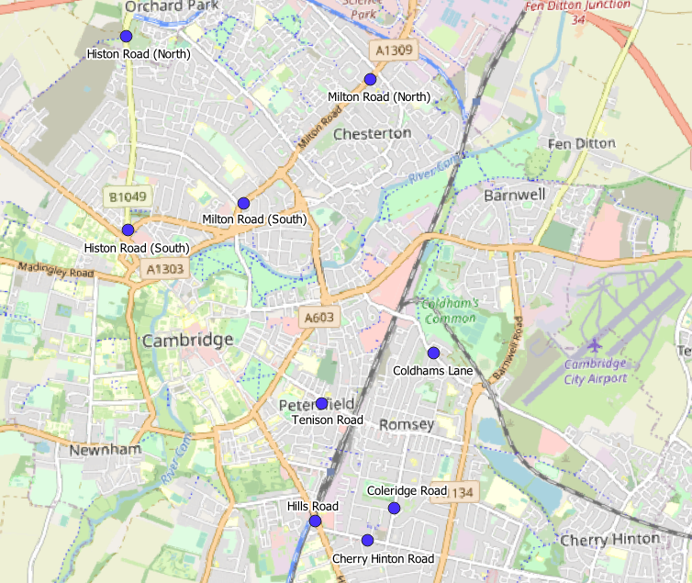
Local Road Recovery: Cambridge
Active travel is 1% below pre-COVID levels across these sites, while motorised travel is 17% below pre-Covid. The level of recovery varies by location.
All 9 Sites Combined
Active Travel: +1%
Motorised Travel: -17%
Motorised & Active % change in weekday volumes: December 2019 to December 2022
Milton Road (North)
Active Travel: +49%
Motorised Travel: -26%
-1%
+46%
-17%
-26%
Histon Road (North)
Active Travel: +73%
Motorised Travel: -14%
Milton Road (South)
Active Travel: +21%
Motorised Travel: -44%
+70%
+18%
-13%
-45%
Histon Road (South)
Active Travel: +36%
Motorised Travel: -17%
Coldham's Lane
Active Travel: +2%
Motorised Travel: -10%
+32%
+1%
-17%
-9%
Hills Road
Active Travel: -36%
Motorised Travel: -7%
Tenison Road
Active Travel: +11%
Motorised Travel: -20%
-37%
+9%
-7%
-20%
Cherry Hinton Road
Active Travel: +43%
Motorised Travel: -17%
Coleridge Road
Active Travel: -31%
Motorised Travel: -19%
+38%
-32%
-17%
-16%
Analysis based on data from the 9 sensors with comparable data for December 2019 and 2022
Notes:
Commentary:
Active travel is 1% below pre-Covid levels across these sites; albeit with several individual sensors showing improved counts against 2019 levels.
Motorised travel is uniformly down on pre-pandemic levels across all these sites; and is 17% below pre-Covid levels overall.
Source: Cambridge Vivacity Sensors

Slide 26
Local Road Recovery by Site and by Mode
Motorcycle volumes continue to be notably higher than pre-COVID levels. Active modes are also notably above pre-COVID levels, but only in some locations.
% change in weekday volumes: December 2019 to December 2022
​ | Car​ | Motorbike​ | LGV​ | OGV​ | Bus​ | Cyclist​ | Pedestrian​ | All modes​ | Motorised Vehicles | Active Modes
Cherry Hinton Road | -19% | +34% | -3% | -54% | -41% | +26% | +51% | -8% | -17% | +38%
Coldham's Lane | -10% | +135% | -11% | -9% | -27% | +26% | -36% | -9% | -9% | +1%
Coleridge Road | -18% | +36% | -13% | -14% | -35% | -16% | -61% | -19% | -16% | -32%
Hills Road | -7% | +50% | -18% | -28% | -13% | -32% | -46% | -16% | -7% | -37%
Histon Road (North) | -15% | +47% | +6% | -33% | -33% | +108% | -19% | -8% | -13% | +70%
Histon Road (South) | -20% | +109% | -10% | -29% | -8% | +93% | -6% | -9% | -17% | +32%
Milton Road (North) | -28% | +13% | -24% | -15% | -20% | +66% | +29% | -21% | -26% | +46%
Milton Road (South) | -48% | +14% | -35% | -48% | -7% | +12% | +27% | -34% | -45% | +18%
Tenison Road | -22% | +24% | +7% | -53% | -74% | -12% | +17% | -11% | -20% | +9%
Analysis based on data from the 9 sensors with comparable data for December 2019 and 2022
Notes:
Commentary:
Motorcycles are ahead of pre-Covid (2019) counts at all sites.
Several sites are showing cycling and walking levels ahead of pre-Covid (2019).
Milton Road (South) is showing the largest fall in car volumes (-48% against 2019).
Source: Cambridge Vivacity Sensors

Slide 27
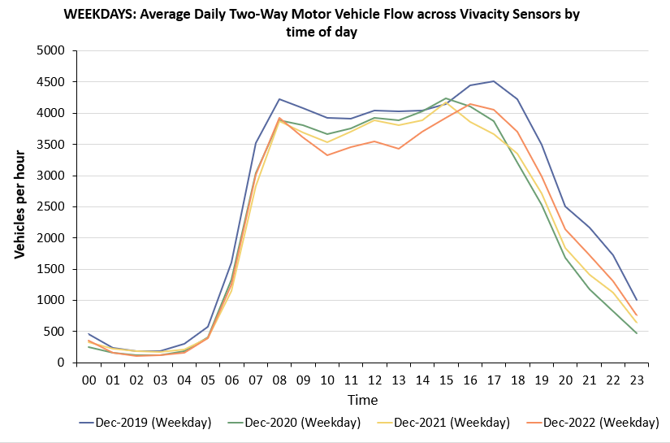
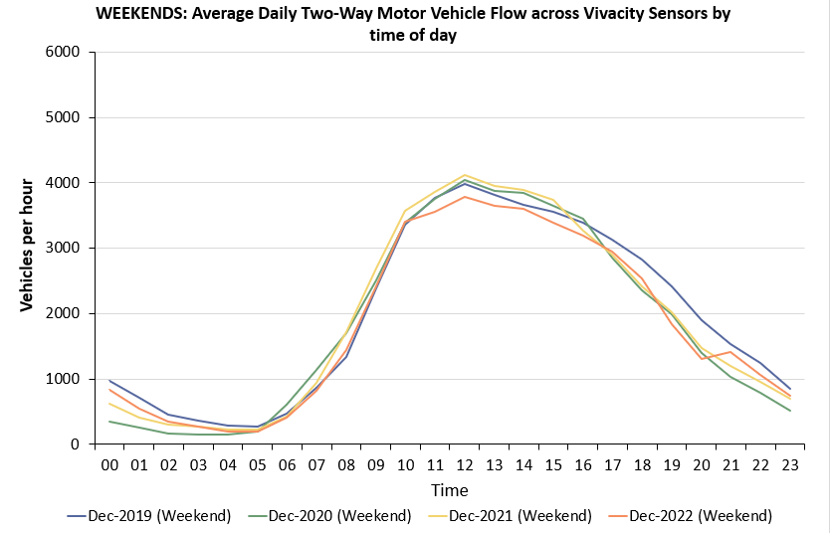
Local Road Hourly Flow Profile: Cambridge
Flows in December 2022 were particularly low in the middle of the day, perhaps due to the snowy conditions resulting in fewer discretionary trips outside of peak times.
Weekdays
Weekends
Analysis based on data from the 5 sensors with comparable hourly data for Dec 2019, 2020, 2021 and 2022: Coldham’s Lane; Coleridge Road; Hills Road; Milton Road (North), and Tenison Road.
Notes:
Commentary:
Weekdays in Dec 2022: Motor traffic sees morning and afternoon peaks which are more akin to those seen in 2019 – but the lunchtime / early afternoon flows are lower than pre-Covid (and 2020 and 2021).
Weekends in Dec 2022: Flows have not fluctuated greatly between the four years – but the late afternoon / evening levels seen in 2019 have not been recovered yet. 2022 flows are showing a little pick-up in the very late evening (21:00 onwards).
Source: Cambridge Vivacity sensors

Slide 28
Active Travel

Slide 29
Local Road Network Monitoring Sites
Long Term Vivacity Monitoring Sites
The Mill Road and East Road sensors were upgraded in Sept 2022 and are now detecting significantly more cycles and pedestrians. As a result the active travel flows at these locations are no longer comparable pre/post Sept 2022.
The Vinery Road and Milton Road (Mid) sensors are currently inactive.
Sensor Location​​ | Location description​​ | Installed​
Cherry Hinton Road ​​ | Near Rock Road​​ | May 2019​
Coldham’s Lane​​ | Near Coldham’s Common​​ | May 2019​
Coleridge Road ​​ | Near Coleridge recreation ground​​ | May 2019​
East Road​​ | Close to ARU site​​ | May 2019​
Hills Road Bridge​​ | Near Cherry Hinton Road​​ | May 2019​
Histon Road (North)​​ | Just south of A14​ | Sept 2019​
Histon Road (South) ​​ | Near Victoria Road​ | Sept 2019​
Mill Road (East)​​ | Close to Brookfield’s hospital​​ | May 2019​
Mill Road (West)​​ | Close to Parker’s Piece​​ | May 2019​
Milton Road (Mid)​​ | Near Union Lane​​ | May 2019​
Milton Road (North)​​ | Near King’s Hedges Road​ | Sept 2019​
Milton Road (South)​ | Near Gilbert Road​ | Sept 2019​
Tenison Road​​ | Near Mill Road​​ | May 2019​
Vinery Road ​​ | Near Romsey recreation ground​​ | May 2019​
Legend
Data available for most months and years
Data available for all Decembers (2019, 2020, 2021 & 2022)
Data available for December 2019 and 2022.
Comparable data not available for December 2019 and / or 2022.
© OpenStreetMap Contributors

Slide 30
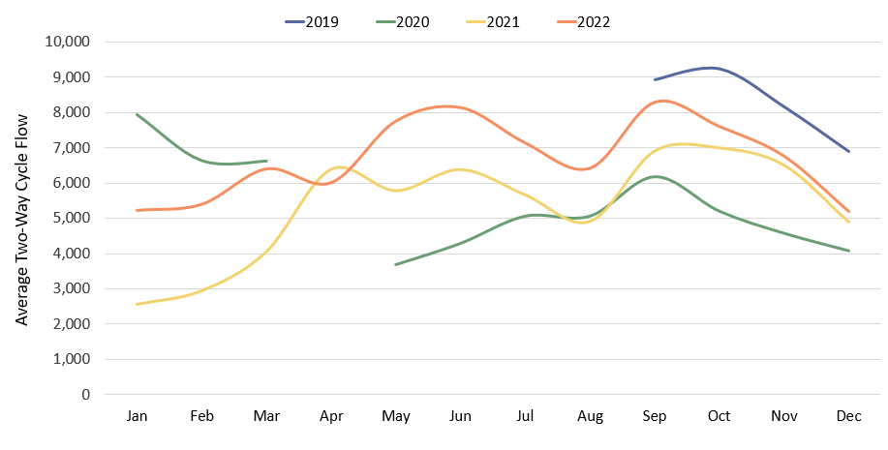
Cyclists: Cambridge Flow by Month:
Cycle volumes had been closer to pre-COVID levels during most of 2022 (within 10%) but have been further away from pre-COVID levels more recently (-25%), perhaps partly due to the snowy conditions in Dec 2022.
2019
2022
2021
2020
 | Pre-COVID to Now: Dec 2019 to Dec 2022 |  |  | Mid-COVID to Now: Dec 2020 to Dec 2022 |  |  | Previous update to Now: Sept 2022 to Dec 2022
 | Mon-Sun | Weekdays | Weekends | Mon-Sun | Weekdays | Weekends | Mon-Sun | Weekdays | Weekends
Cambridge | -25% | -20% | 27% | +27% | +44% | -4% | -37% | -23% | -48%
This analysis is based on data from the 5 sensors with sufficient comparable data for 2019, 2020, 2021 and 2022: Coldham’s Lane, Coleridge Road, Hills Road, Milton Road (North) and Tenison Road.
 | Pre-COVID to Now: Q4 2019 to Q4 2022 |  |  | Mid-COVID to Now: Q4 2020 to Q4 2022 |  |  | Previous quarter to Now: Q3 2022 to Q4 2022
 | Mon-Sun | Weekdays | Weekends | Mon-Sun | Weekdays | Weekends | Mon-Sun | Weekdays | Weekends
Cambridge | -18% | -18% | -8% | +47% | +50% | +31% | -4% | +2% | -16%
Notes:
Commentary:
December 2022 is around 25% below pre-Covid (Dec 2019) overall. Weekends are further behind than weekdays.
Cycling trends are consistently ahead of 2020 and 2021.
December 2022 volumes are substantially below September 2022 volumes – which is to be expected with seasonal changes in weather.
Bank holiday weeks are not included within the calculations. School holidays are also excluded (except summer holidays in order to obtain figures for August).
Source: Cambridge Vivacity sensors

Slide 31
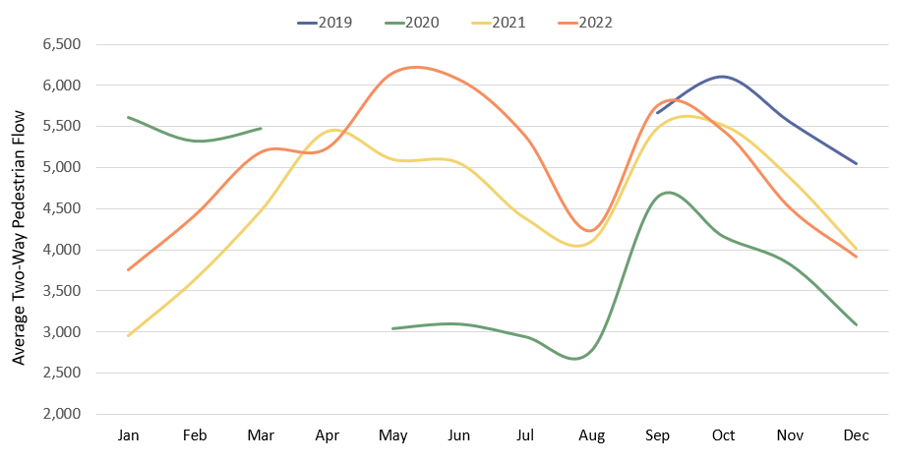
Pedestrians: Cambridge Flow by Month:
Pedestrian volumes had been closer to pre-COVID levels during most of 2022 (within 10%) but have been further away from pre-COVID levels more recently
(-22%), perhaps partly due to the snowy conditions in Dec 2022.
2019
2022
2021
2020
 | Pre-COVID to Now: Dec 2019 to Dec 2022 |  |  | Mid-COVID to Now: Dec 2020 to Dec 2022 |  |  | Previous update to Now: Sept 2022 to Dec 2022
 | Mon-Sun | Weekdays | Weekends | Mon-Sun | Weekdays | Weekends | Mon-Sun | Weekdays | Weekends
Cambridge | -22% | -23% | -20% | +27% | +38% | +1% | -32% | -23% | -40%
This analysis is based on data from the 5 sensors with sufficient comparable data for 2019, 2020, 2021 and 2022: Coldham’s Lane, Coleridge Road, Hills Road, Milton Road (North) and Tenison Road.
 | Pre-COVID to Now: Q4 2019 to Q4 2022 |  |  | Mid-COVID to Now: Q4 2020 to Q4 2022 |  |  | Previous quarter to Now: Q3 2022 to Q4 2022
 | Mon-Sun | Weekdays | Weekends | Mon-Sun | Weekdays | Weekends | Mon-Sun | Weekdays | Weekends
Cambridge | -15% | -18% | -9% | +28% | +31% | +11% | -6% | -1% | -16%
Notes:
Commentary:
Pedestrian volumes are 22% below pre-Covid (Dec 2019) levels, with a relatively even split between weekends and weekdays.
However, they are 27% ahead of mid-Covid (Dec 2020) - with weekday pedestrian traffic (+38%) driving this recovery (weekends are only 1% ahead of 2020).
Seasonality is evident in the latest figures, with December some way below what we saw in September's update.
Bank holiday weeks are not included within the calculations. School holidays are also excluded (except summer holidays in order to obtain figures for August).
Source: Cambridge Vivacity sensors.

Slide 32
Retail Footfall

Slide 33
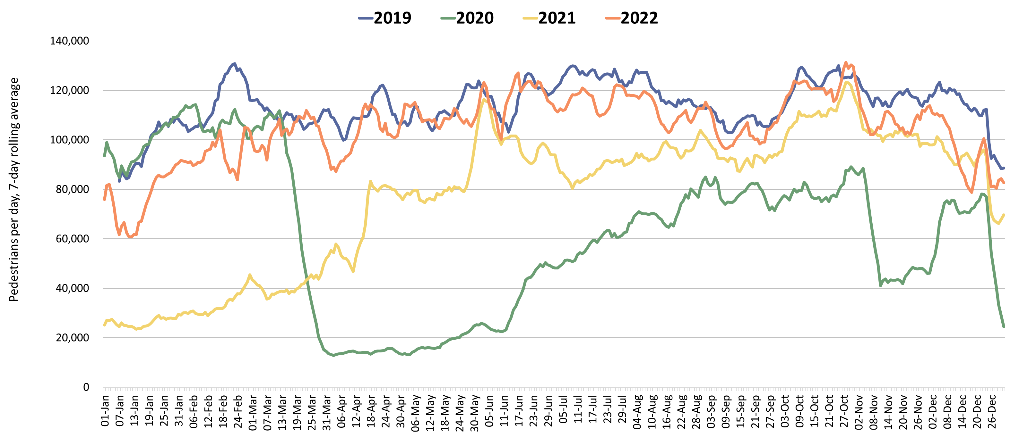
Retail footfall: Central Cambridge
QA’d SL
Central Cambridge retail footfall recovered during 2022 to match pre-COVID (2019) levels at many points. However, more recent months have seen a reduction, with Dec 2022 footfall 14% below Dec 2019. This may be partly due to the extremely cold weather and the FIFA World Cup.
2019
2022
2021
2020
Third lockdown
Second lockdown
First lockdown
 | Pre-COVID to Now: |  |  | Mid-COVID to Now: |  |  | Previous update to Now:
 | Dec 2019 to Dec 2022 |  |  | Dec 2020 to Dec 2022 |  |  | Sept 2022 to Dec 2022
 | Mon-Sun | Weekdays | Weekends | Mon-Sun | Weekdays | Weekends | Mon-Sun | Weekdays | Weekends
Cambridge Retail | -14% | -11% | -21% | +51% | +51% | +41% | -8% | +1% | -25%
This analysis is based on data from 6 locations in central Cambridge – Bridge Street, Fitzroy Street, Market Hill, Regent Street, Rose Crescent and Sidney Street.
 | Pre-COVID to Now: Q4 2019 to Q4 2022 |  |  | Mid-COVID to Now: Q4 2020 to Q4 2022 |  |  | Previous quarter to Now: Q3 2022 to Q4 2022
 | Week (Mon - Sun) | Weekdays (Mon - Thu) | Weekends (Sat - Sun) | Week (Mon - Sun) | Weekdays (Mon - Thu) | Weekends (Sat - Sun) | Week (Mon - Sun) | Weekdays (Mon - Thu) | Weekends (Sat - Sun)
Cambridge Retail | -8% | -10% | -6% | +67% | +59% | +75% | -2% | -2% | -4%
Notes:
Commentary:​
Central Cambridge footfall recovered during 2022 to match pre-Covid (2019) levels at certain points. However, more recent months have seen a drop-off, with Dec 2022 footfall 14% below Dec 2019. This is possibly due to extremely cold weather coupled with the uniquely scheduled winter World Cup. (N.B. Saturday December 10th was a particularly cold day, and was the date of England vs France in the quarter final).
Overall, December 2022 was 51% ahead of December 2020 (Mid-Covid).
Source: Cambridge BID footfall data​
Data from the following locations: Bridge Street, Fitzroy Street at Waitrose, Market Hill, Regent Street, Rose Crescent, Sidney Street. Excludes data for King’s Parade and One Station Square.

Slide 34
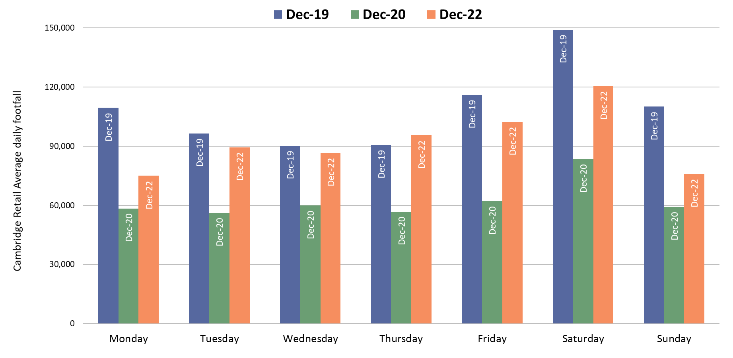
Retail footfall by day of week: Central Cambridge
The middle of the week (Tuesday to Thursday) shows a greater level of recovery to pre-COVID levels, particularly compared to Monday which remains low.
Weekend retail footfall levels had returned to pre-COVID levels during most of 2022 but this pattern did not continue into December.
 | Pre-COVID to Now: Dec 2019 to Dec 2022
 | Monday | Tuesday | Wednesday | Thursday | Friday | Saturday | Sunday
Cambridge Retail | -31% | -7% | -4% | +5% | -12% | -19% | -31%
Notes:
Commentary:​
Thursdays are the only day of the week in which volumes are ahead of pre-Covid levels (+5%).
Monday and Sunday show the weakest recovery against pre-Covid retail footfall levels (-31%).
All days show a recovery from Mid-Covid (Dec 2020).
Source: Cambridge BID footfall data​
Data from the following locations: Bridge Street, Fitzroy Street at Waitrose, Market Hill, Regent Street, Rose Crescent, Sidney Street. Excludes data for King’s Parade and One Station Square.

Slide 35
Car Parking

Slide 36

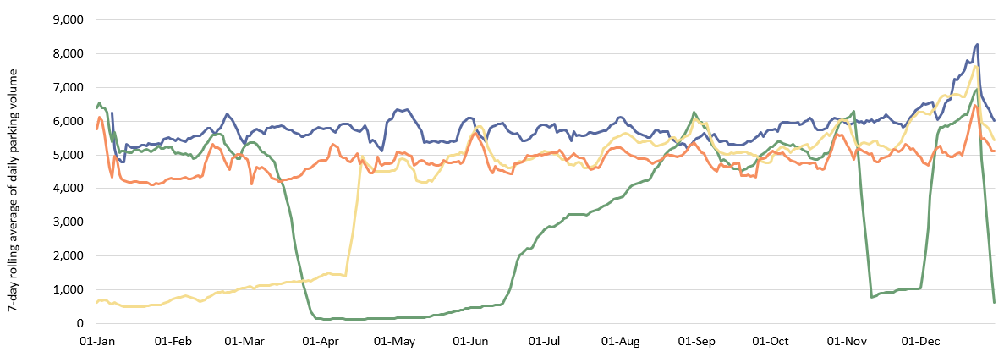
Multi-Storey Car Parks, Cambridge: Daily Usage
Multi-storey car park use in Cambridge is 21% below pre-COVID levels and has been at a similar level of recovery throughout 2022.
2019
2022
2021
2020
Third lockdown
First lockdown
Second lockdown
 | Pre-COVID to Now: |  |  | Mid Covid to Now: |  |  | Previous update to Now:
 | Dec 2019 to Dec 2022** |  |  | Dec 2020 to Dec 2022** |  |  | Sept 2022 to Dec 2022**
 | Mon-Sun | Weekdays | Weekends | Mon-Sun | Weekdays | Weekends | Mon-Sun | Weekdays | Weekends
Cambridge Car Parking | -21% | -17% | -29% | +14% | +19% | -1% | +16% | +40% | -17%
*Park Street car park closed for redevelopment on 4th January 2022; usage figures for this car park are included until its closure. **Grafton West car park was closed due to snow 08/12/22-18/12/22.
 | Pre-COVID to Now: |  |  | Mid Covid to Now: |  |  | Previous quarter to Now:
 | Q4 2019 to Q4 2022 |  |  | Q4 2020 to Q4 2022 |  |  | Q3 2022 to Q4 2022
 | Week (Mon - Sun) | Weekdays (Mon - Thu) | Weekends (Sat - Sun) | Week (Mon - Sun) | Weekdays (Mon - Thu) | Weekends (Sat - Sun) | Week (Mon - Sun) | Weekdays (Mon - Thu) | Weekends (Sat - Sun)
Cambridge | -18% | -20% | -19% | +30% | +23% | +36% | +5% | +7% | No change
Notes:
Commentary:
Car parking is 14% ahead of Mid-Covid (2020) but 21% below pre-Covid (2019) levels.
Weekend parking volumes in December 2022 were likely impacted by cold weather and the uniquely scheduled winter World Cup (similarly to Cambridge Retail footfall). Additionally, Grafton West car park was closed due to snow between December 8th and December 18th 2022.
Source: Cambridge Car Parking data (Cambridge City Council)

Slide 37
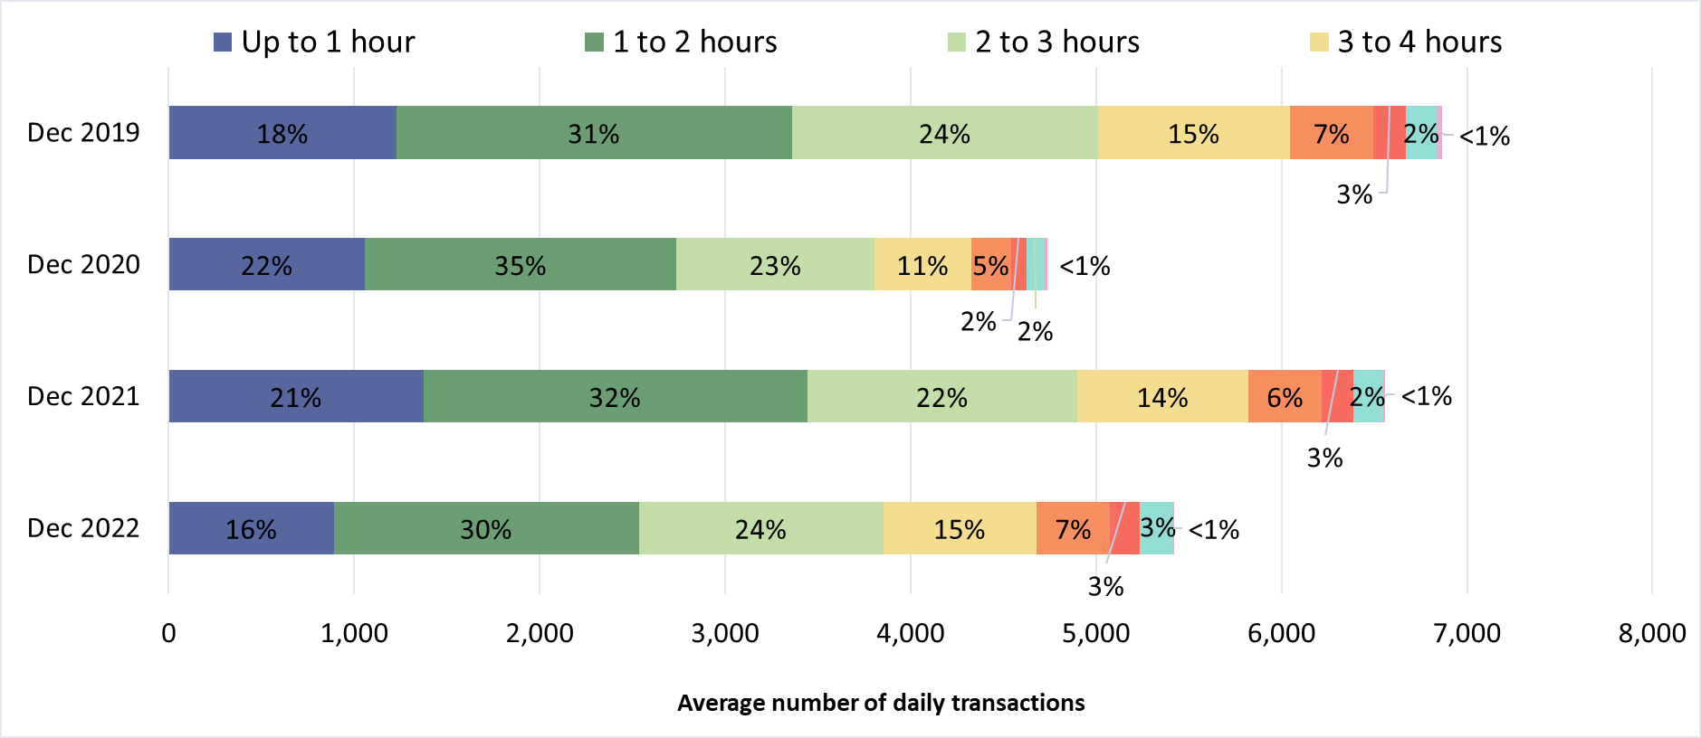
Multi-Storey Car Parks, Cambridge: Length of Stay
Patronage at the multi-storey car parks in Cambridge is 21% below pre-COVID levels. The proportion of short-, medium- and long-term parking closely resembles conditions pre-COVID.
*Park Street car park closed for redevelopment on 4th January 2022; usage figures for this car park are included until its closure. **Grafton West car park was closed due to snow 08/12/22-18/12/22.
Notes:
Commentary:
Daily patronage of multi-storey car parks in Cambridge was 21% below pre-Covid levels (Dec 2019) in December 2022.
The proportionate split in length of stay in December 2022 closely resembles the equivalent split in December 2019.
Source: Cambridge Car Parking data (Cambridge City Council)

Slide 38
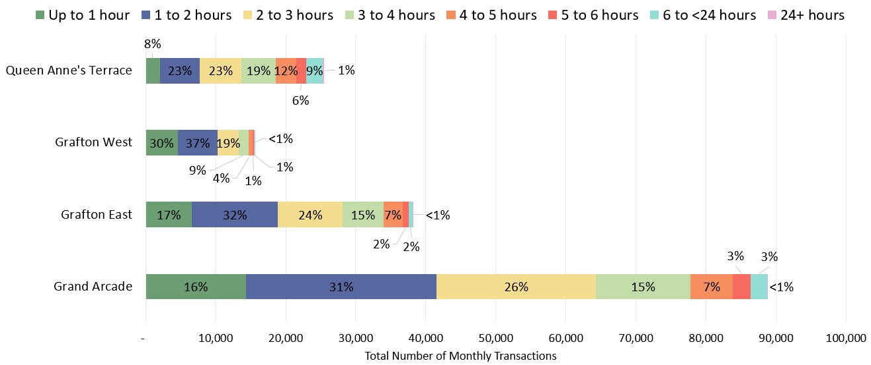
Multi-Storey Car Parks, Cambridge: Length of Stay by Car Park
In December 2022, the Grand Arcade car park was the most heavily used car park. Grafton West had the lowest proportion of long stays in excess of 3 hours (15%) whilst Queen Anne’s Terrace had the highest proportion (46%).
December 2022
Grafton West car park was closed due to snow from 8-18th December 2022.
Notes:
Commentary:
85% of December visits to Grafton West lasted less than three hours – making it the most likely facility to be used for short stays.
Queen Anne's Terrace is the facility most likely to see long stays, with 46% of December visits lasting more than three hours.
Grand Arcade is comfortably the most popular multi storey car park facility in Cambridge – with almost 90,000 patrons in December.
Source: Cambridge Car Parking data (Cambridge City Council)

Slide 39
Rail Passengers

Slide 40
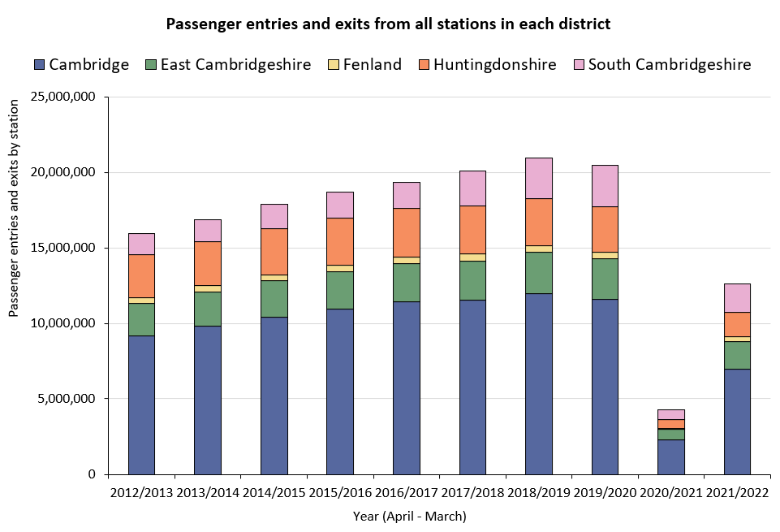
Railway Station Usage: Cambridgeshire
Railway station entries and exits across Cambridgeshire are still significantly below pre-COVID volumes, particularly in Cambridge and Huntingdonshire.
Change in passengers across all stations in each district | Pre-COVID to Now:
 | 2018/19* to 2021/22
Cambridge
East Cambridgeshire
Fenland
Huntingdonshire
South Cambridgeshire
-42%
-32%
-36%
-48%
-30%
*2018/19 used as the pre-COVID baseline as 2019/20 entries and exit data is affected in March 2020 by the first COVID-19 lockdown.
Notes:
Commentary: ​Rail usage overall is down on pre-Covid baselines. Stations in Huntingdonshire have seen the largest decrease in passenger entries and exits, being 48% below 2018/19 figures. Cambridge is also significantly lower than 2018/19 figures (-42%).
Source: Rail statistics, ORR. Table 1415a

Slide 41
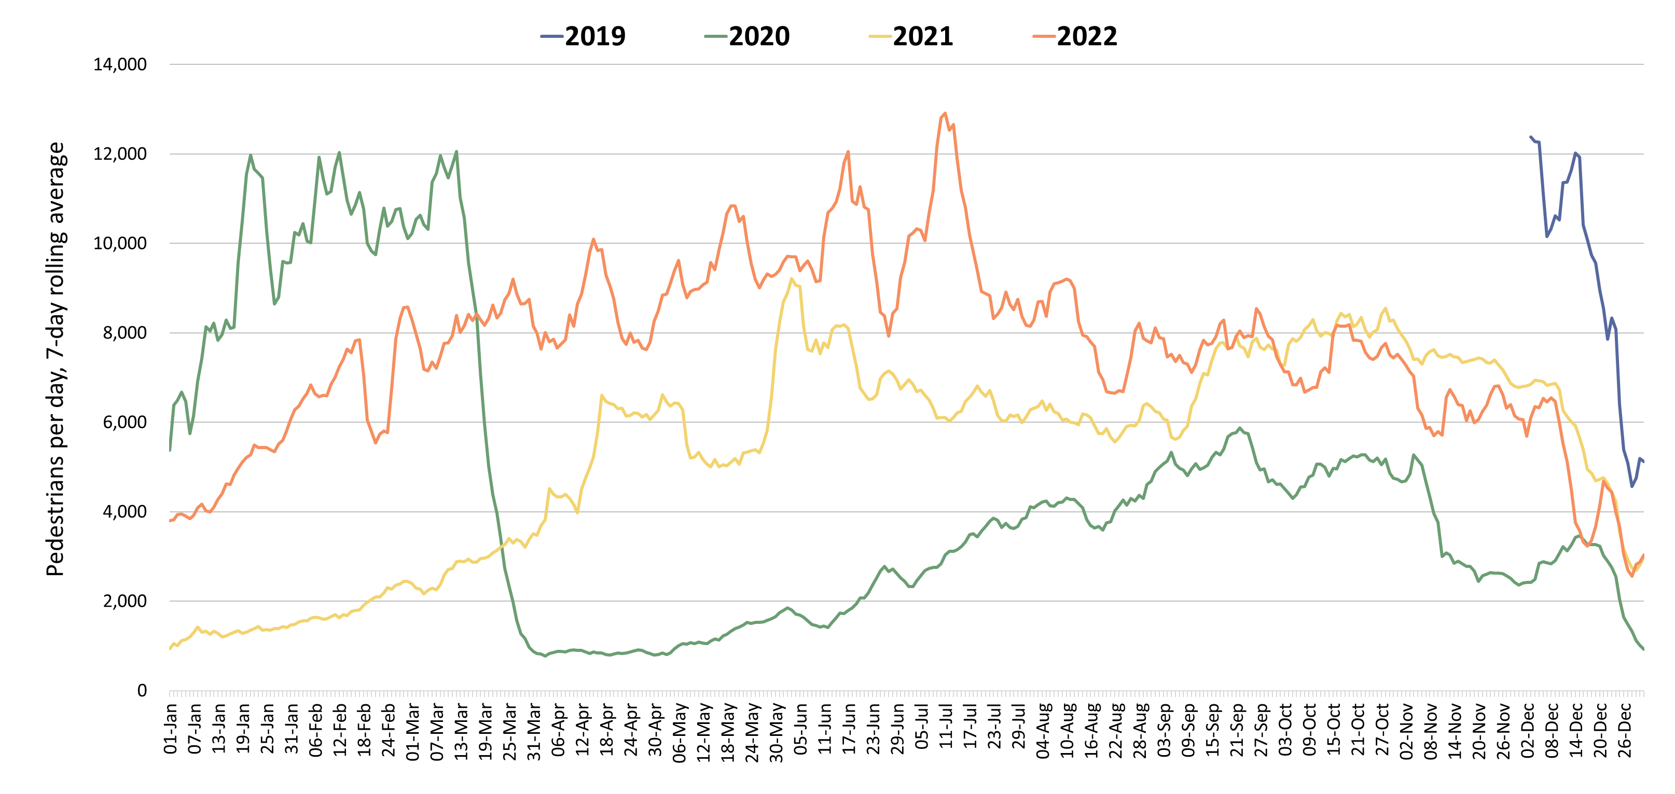
Footfall at One Station Square: Cambridge
Footfall at One Station Square was nearer to pre-COVID levels earlier in 2022 but fell to only 50% of this level in December 2022.
Footfall at One Station Square (directly outside Cambridge train station)
2019
2022
2021
2020
Second lockdown
Third lockdown
First lockdown
 | Pre-COVID to Now: |  |  | Mid-COVID to Now: |  |  | Previous update to Now:
 | Dec 2019 to Dec 2022 |  |  | Dec 2020 to Dec 2022 |  |  | Sept 2022 to Dec 2022
 | Mon-Sun | Weekdays | Weekends | Mon-Sun | Weekdays | Weekends | Mon-Sun | Weekdays | Weekends
One Station Square Footfall | -50% | -51% | -54% | +74% | +85% | +46% | -44% | -43% | -49%
*If using the quarterly comparison stats, Q1 2020 is used as a "Pre-Covid" comparison as the sensor at One Station Square was only installed in December 2019.
 | Pre-COVID to Now: Q1 2020* to Q4 2022 |  |  | Mid-COVID to Now: Q4 2020 to Q4 2022 |  |  | Previous quarter to Now: Q3 2022 to Q4 2022
 | Mon-Sun | Weekdays | Weekends | Mon-Sun | Weekdays | Weekends | Mon-Sun | Weekdays | Weekends
One Station Square Footfall | -41% | -43% | -35% | +71% | +71% | +71% | -30% | -27% | -37%
Notes:
Commentary: ​
December 2022 footfall at One Station Square was 50% of pre-Covid levels.
This still reflects a 74% increase against Mid-Covid (December 2020).
Falls in weekend footfall against pre-Covid and the previous update were more severe than weekdays. This is possibly due to Christmas falling on a Sunday – as well as extremely cold weather earlier in the month impacting foot traffic.
Source: Cambridge BID footfall data​
*The One Station Square sensor was installed in December 2019​
*Data may be impacted by rail strike action

Slide 42
Bus Passengers

Slide 43
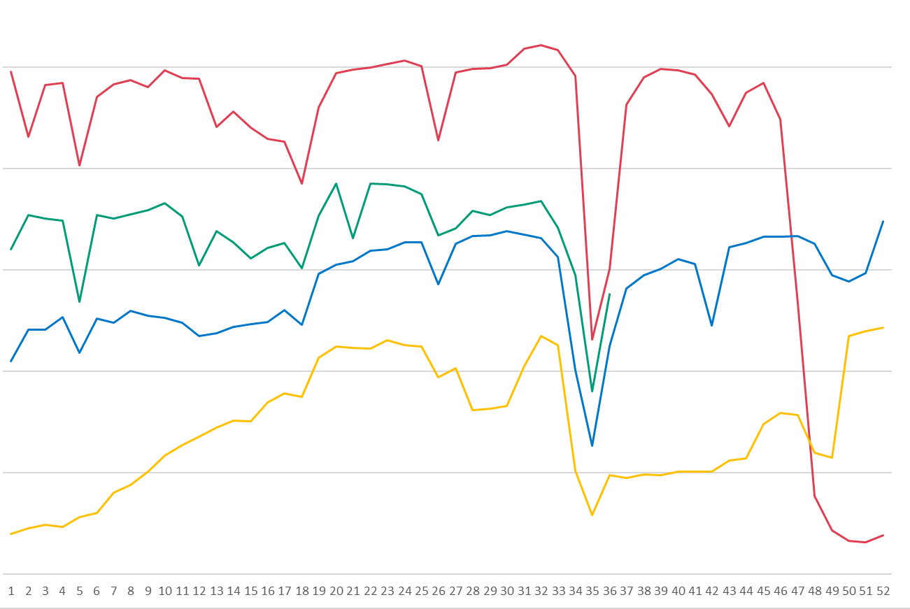
Bus Passengers: CPCA area
Bus passenger volumes remain lower than pre-COVID but are gradually increasing. The number of bus passengers decreases during school holidays.
Stagecoach CPCA Area Bus Passengers
Cambridge
Pre-COVID to Now:
2019-20
Dec 2019 to Dec 2022
-27%
Cambridge
Previous month to Now:
2022-23
Nov 2022 to Dec 2022
-8%
Bus passengers
Second lockdown
Peterborough
Pre-COVID to Now:
2021-22
Dec 2019 to Dec 2022
-33%
Third lockdown
First lockdown continued
First lockdown begins
Peterborough
Previous month to Now:
2020-21
Sep
Nov 2022 to Dec 2022
-16%
May
Jun
Jul
Aug
Sep
Oct
Nov
Dec
Jan
Feb
Mar
Apr
Due to the commercial sensitivity of this data, bus passenger volumes are not marked on the y-axis of this graph.
Notes:
Commentary:
CPCA Area passengers
Passenger numbers in Dec 2022 in Cambridge remain -27% below Dec 2019. This is higher than elsewhere in Cambridgeshire though, in Peterborough, volumes remain -33% below Dec 2019.
Dec 2022 sees a decrease in volumes from Nov 2022, likely the result of the Christmas holidays period and bank holidays in the last week of the year
Bus passenger volumes consistently see decreases during the school holidays.
Source: Stagecoach data

Slide 44
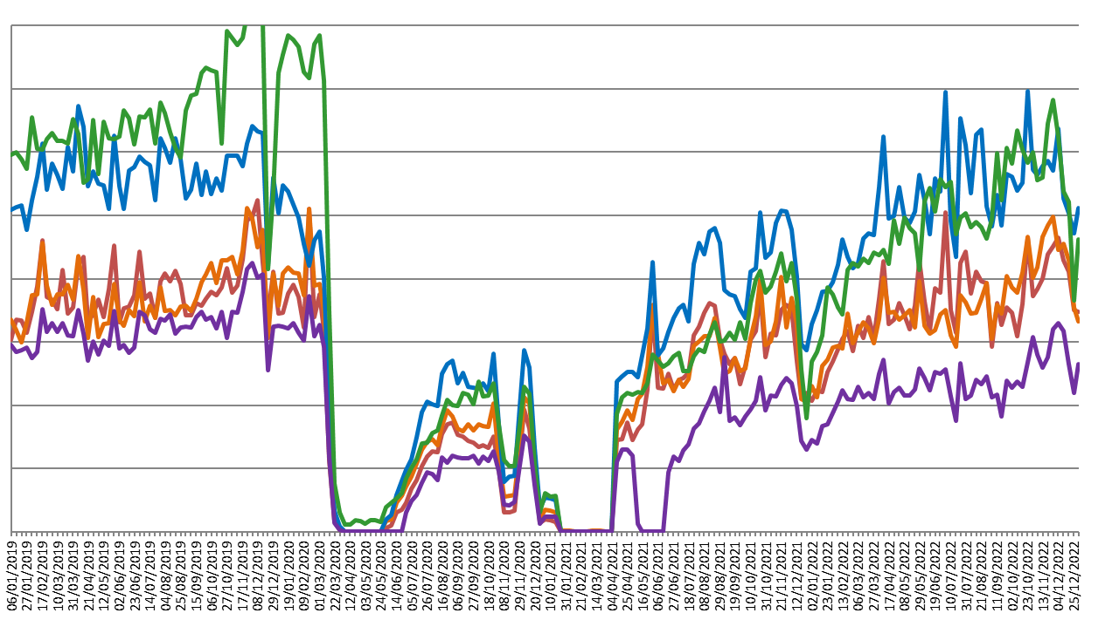
Park & Ride Passengers: Cambridge
Usage of all P&R sites has steadily increased since early 2022. Babraham Road has almost resumed its position as most popular site.
Stagecoach P&R Passengers
2019
2020
2021
2022
Park & Ride passengers
Second lockdown
First lockdown
Third lockdown
Milton Road service temporarily suspended
Due to the commercial sensitivity of this data, bus passenger volumes are not marked on the y-axis of this graph.
Notes:
Commentary:
P&R passengers
Dec 2022 sees the largest decrease in volume from November 2022 to December 2022 at Babraham Road P&R (-8%)
Madingley Road sees the largest increase in volumes from November 2022 to December 2022 (+9%)
Madingley Road, Newmarket Road and Trumpington park and rides show similar volumes at the end of 2022 to pre-covid 2019 volumes
Milton Road and Babraham Road park and ride volumes remain well below their respective 2019 volumes on the graph
Source: Stagecoach data

Slide 45
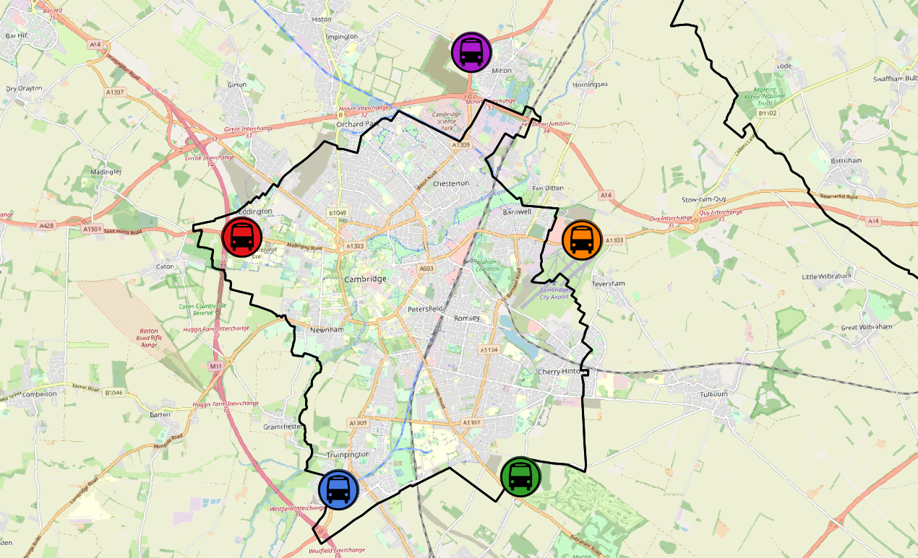
Park and Ride: Average Passenger Volumes by Site
Park and Ride site usage remains below pre-COVID levels at most sites. Babraham Road remains the furthest from 2019 (-24%) whilst Newmarket Road has recovered (+1%) and Trumpington has nearly recovered (-5%).
Park and Ride locations around Cambridge
Milton Road P&R
Dec 2019 to Dec 2022
-21%
-21%
Madingley Road P&R
Dec 2019 to Dec 2022
-6%
-6%
Newmarket Road P&R
Dec 2019 to Dec 2022
+1%
All P&R Sites
Dec 2019 to Dec 2022
-12%
+1%
-12%
Babraham Road P&R
Dec 2019 to Dec 2022
-24%
Trumpington Road P&R
Dec 2019 to Dec 2022
-5%
-24%
-5%
© OpenStreetMap Contributors
Notes:
Source: Stagecoach data

Slide 46
e-Scooters

Slide 47
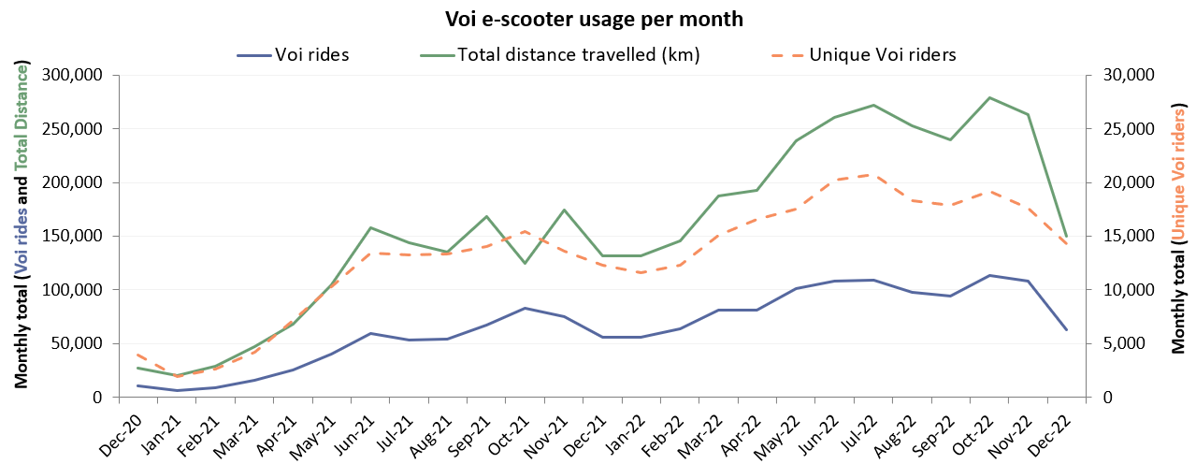



E-scooters: Cambridge Monthly Flows
Voi rides decrease during the winter months in line with other active modes. The sharp decreases in December 2022 could be influenced by the week of snowy weather, added to the fact that the e-scooters were immobilised on Christmas Eve and New Year’s Eve.
Mid-COVID to Now:
Voi rides
Dec 2020 to Dec 2022
+496%
Mid-COVID to Now:
Voi rides
Dec 2021 to Dec 2022
+12%
Previous update to Now:
Voi rides
Sept 2022 to Dec 2022
-34%
Average journey statistics: Dec 2022
Average ride distance: 2.4 km
Average rides per month: 4.4 pp
Average ride duration: 11.3 mins
-2% from Dec 2021
-6% from Sept 2022
-4% from Dec 2021
-17% from Sept 2022
-6% from Dec 2021
-3% from Sept 2022
Notes:
Commentary:
E-scooter usage has seen a decrease since September 2022, likely linked to the expected decrease in active travel during the winter months and the Christmas holidays period
E-scooter usage is still higher than the same time last year, with the total number of rides 12% higher in Dec 2022 than in Dec 2021.
The average journey statistics remain fairly stable each month – suggesting that e-scooters are most popular for short journeys (~2.0-2.5 km, ~10-12 minutes)
Source: Voi e-scooter dashboard

Slide 48
Air Quality

Slide 49
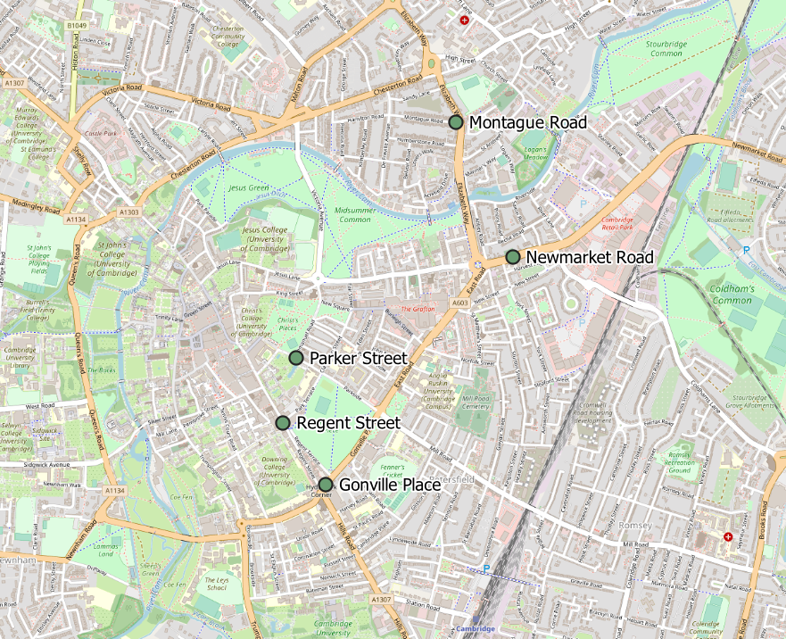
Air Quality: Cambridge Permanent Monitoring Sites
Continuous Air Quality Monitoring Sites, Cambridge
Location | Description
Montague Road | Close to the junction with Elizabeth Way
Newmarket Road | Close to Cambridge Retail park on Newmarket Road
Parker Street | Close to the bus station
Regent Street | To the West of Parker’s Piece
Gonville Place | Near Hill’s Road, South of Parker’s Piece. This sensor was removed in April 2022 so data is no longer available for this site.
Cambridge City Air Quality team provide data from 4 continuous air quality monitors in central Cambridge. The monitors primarily measure Nitrogen Oxides (NOx) and Particulate Matter (PM) which are proxies for overall air quality.
© OpenStreetMap Contributors
Notes:
Commentary:
This data in this pack is from the permanent air quality monitoring sites only. The permanent monitors measure Nitrogen Dioxide on primary routes into the city centre. There are also around 80 non-automatic Nitrogen Dioxide diffusion tubes around the city which provide a supplementary but not continual source of data.
Source: Cambridge City Air Quality Team

Slide 50
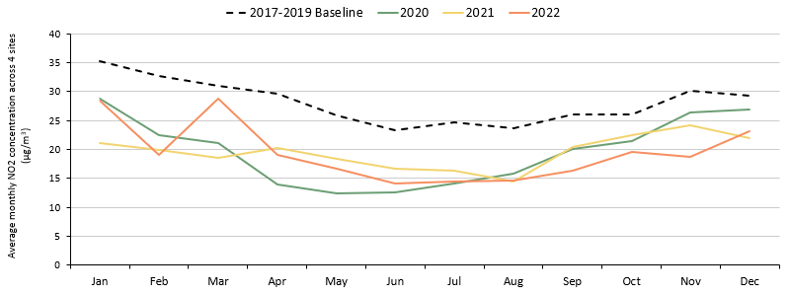
Air Quality: Cambridge Monthly Averages Across All Sites
NO₂ concentrations have increased in recent months, in line with expected seasonal trends, but remain below Dec 2020 and Dec 2017-2019 baseline.
Monthly average NO2 concentration across the continuous monitoring sites
2017 – 2019 baseline
*
2022
2021
2020
 | Pre-COVID to Now: Dec 2017-19 baseline to Dec 2022 | Mid-COVID to Now: Dec 2020 to Dec 2022
NO₂ concentration | -21% | -14%
Analysis based on 5 sensors: Gonville Pl, Montague Rd, Newmarket Rd, Regent St and Parker St. * Data for Gonville Pl is only included in the 2022 line until March 2022 as the sensor was removed in April 2022.
Quarterly analysis | Pre-COVID to Now: Q4 2017-19 baseline to Q4 2022 | Mid-COVID to Now: Q4 2021 to Q4 2022
All sites average | -28% | -10%
Notes:
Commentary:
For all of 2022. average NO2 measurements remained below the 2017 – 2019 baseline.
After a decrease over the summer period, NO2 concentrations have begun to rise from September onwards, in line with expected NO2 seasonal trends.
Despite decreases in COVID-19 lockdowns and restrictions in 2022, NO2 levels have remained similar to 2020 and 2021 concentrations.
Please note that the % change statistics include Gonville Place in the all sites average for the baseline period and for any months up to and including March 2022. For dates April 2022 onwards, Gonville Place is not included in the average.
Source: Cambridge City Air Quality Team. Data for the Cambridge air quality continuous monitors can be found at: Air quality in England (airqualityengland.co.uk). Please note there may be slight differences between the data online and data in this pack as air quality data undergoes a ratification process.

Slide 51
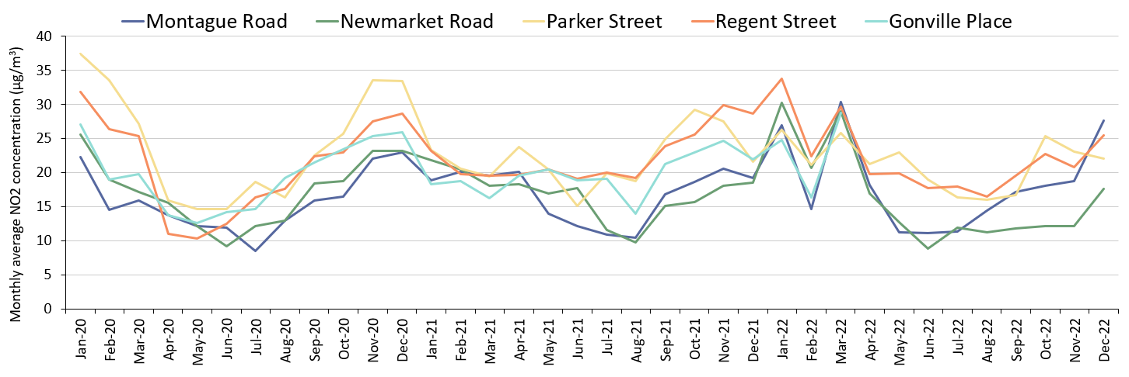
Air Quality: Cambridge Monthly Averages At Individual Sites
NO₂ concentrations have all increased since the last update, as expected due to seasonal trends. Montague Road is the only site above the baseline.
Monthly average NO2 concentration by site
 | Pre-COVID to Now: Dec 2017-19 baseline to Dec 2022 | Mid-COVID to Now: Dec 2020 to Dec 2022
Montague Road | +16% | +20%
Newmarket Road | -44% | -24%
Parker Street | -38% | -34%
Regent Street | -8% | -11%
Gonville Place | No Dec 2022 data | No Dec 2022 data
Quarterly analysis | Pre-COVID to Now: Q4 2017-19 baseline to Q4 2022 | Mid-COVID to Now: Q4 2021 to Q4 2022
Montague Road | -9% | +10%
Newmarket Road | -49% | -20%
Parker Street | -33% | -10%
Regent Street | -15% | -18%
Gonville Place | No Q4 2022 data | No Q4 2022 data
Notes:
Commentary:
The graph shows the absolute monthly average NO2 concentration for each continuous monitoring site.
NO2 concentrations have increased since the Summer which fits in with usual seasonal variation in NO2.
Montague Road is the only location that is above the Dec 2017-2019 baseline reading in December 2022 (at +16%). The other sites remain below their December baselines.
NO2 monitoring is susceptible to seasonal changes and daily weather/general climate patterns and will have been affected by the national COVID-19 lockdowns.
Source: Cambridge City Air Quality Team. Data for the Cambridge air quality continuous monitors can be found at: Air quality in England (airqualityengland.co.uk). Please note there may be slight differences between the data online and data in this pack as air quality data undergoes a ratification process.

Slide 52
research.group@cambridgeshire.gov.uk

