Slide 1
Cambridgeshire and Peterborough
All Age Mental Health and Learning Disabilities Needs Assessment
Chapter 2: Population factors
Population Demographics

Slide 2
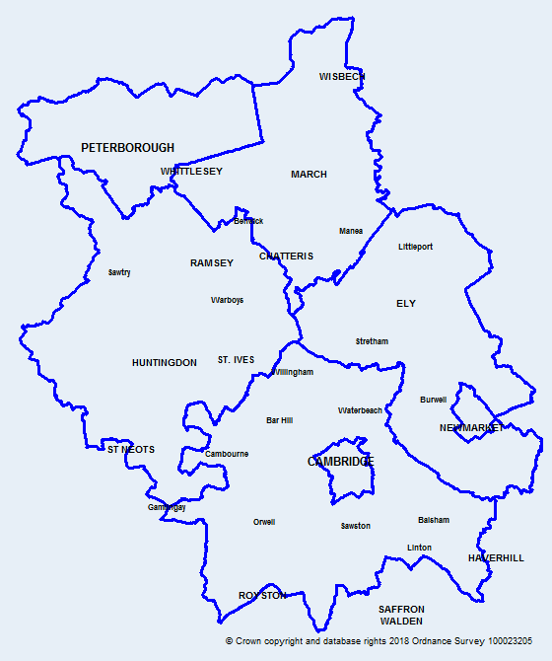
Introduction
Map of Cambridgeshire
and Peterborough
This data pack has been produced on population factors to support the Cambridgeshire and Peterborough all age mental health and learning disabilities needs assessment.
Colour coding and abbreviations used:
Key:
 | Statistically significantly worse than England
 | Statistically similar to England
 | Statistically significantly better than England
CCC | Cambridgeshire County Council
OHID | Office for Health Improvement and Disparities
ONS | Office for National Statistics
APS | Annual Population Survey
DfE | Department for Education
QOF | Quality and Outcomes Framework

Slide 3
Population Demographics

Slide 4
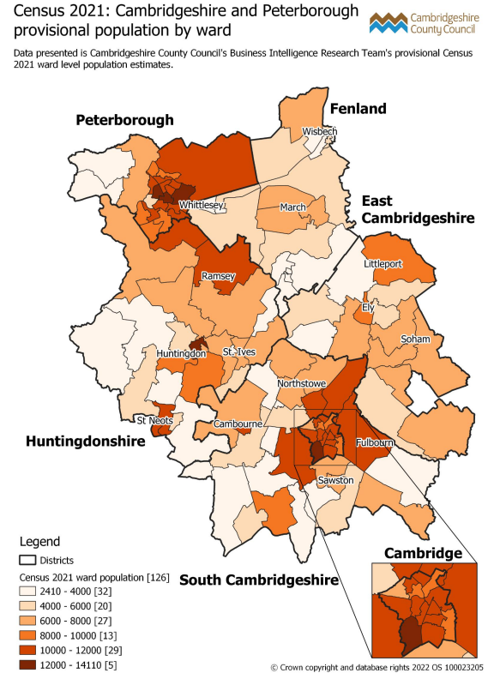
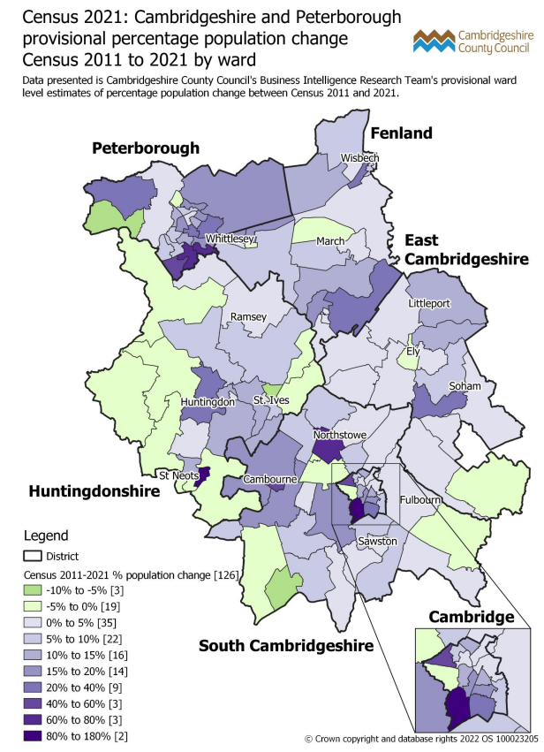
Census 2021 provisional population, by ward
Trumpington in Cambridge, Huntingdon North in Huntingdonshire, and the East, Central, and Ravensthorpe wards in Peterborough have the highest population in the 2021 census.
In Census 2021, the highest percentage increase in population is seen in Trumpington in Cambridge, St Neots East in Huntingdonshire, Longstanton in South Cambridgeshire, and Hargate & Hempsted and Stanground South wards in Peterborough compared to the 2011 Census.
Notes:
Data from: Census 2021: Cambridgeshire and Peterborough ward level population summary (cambridgeshireinsight.org.uk), Produced by CCC Research Team, Business Intelligence
Link: https://cambridgeshireinsight.org.uk/population/census-2021/topic-summaries/demography-and-migration/
Actual data can be found here: https://www.ons.gov.uk/census/aboutcensus/censusproducts/topicsummaries
Definitions:
Usual resident population:
Anyone in the UK and had stayed or intended to stay in the UK for a period of 12 months or more; or
Had a permanent UK address and was outside the UK and intended to be outside the UK for less than 12 months.

Slide 5
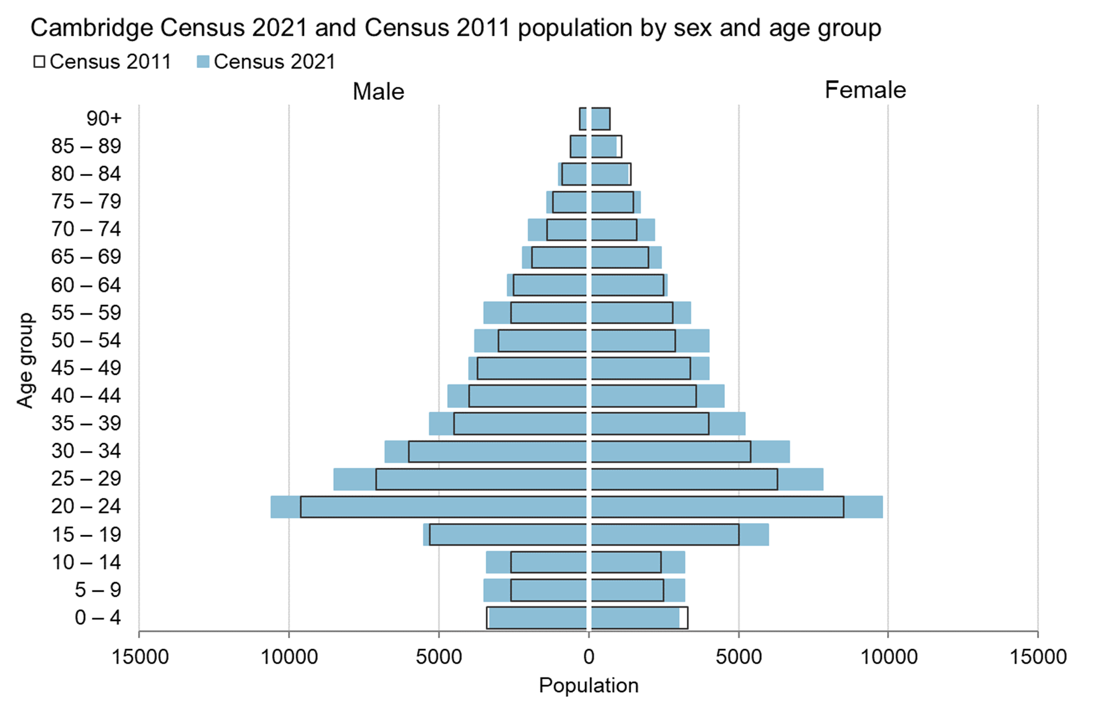
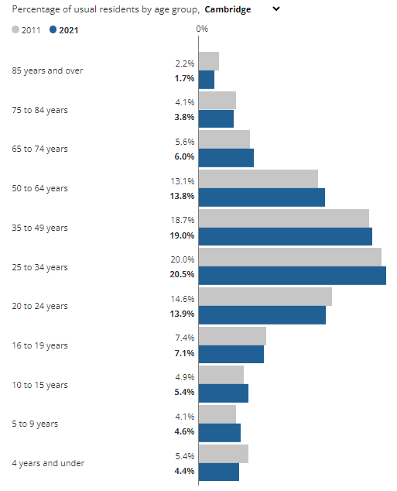
Population by sex and age group, Cambridge
The key trends for Cambridge shown in the population pyramid are that population growth has been more evenly spread across the age groups, with only a notable decrease in population for the 0-4 and 85-89 age groups.
In Census 2021, female population declined in the 80-89 age group, while both male and female population declined in the 0-4 age group compared to the 2011 Census.
The highest percentage of usual residents are among the 25 to 49 year olds.
Notes:
Data from:
Cambridgeshire Insight – Population – Census 2021 – First Results, Produced by CCC Research Team, Business Intelligence
Link: https://cambridgeshireinsight.org.uk/population/census-2021/first-results/
How life has changed in Cambridge: Census 2021 (ons.gov.uk)
Link: https://www.ons.gov.uk/visualisations/censusareachanges/E07000008/
Actual data can be found here: https://www.ons.gov.uk/census/aboutcensus/censusproducts/topicsummaries

Slide 6
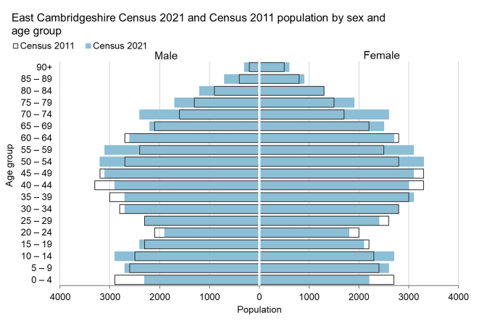
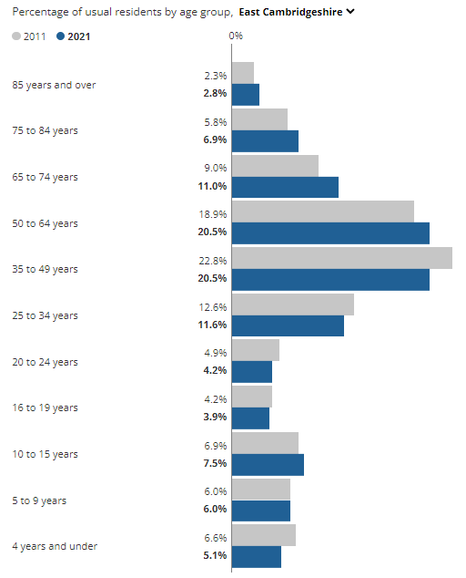
Population by sex and age group, East Cambridgeshire
The key trends for East Cambridgeshire shown in this chart are some very notable population decreases between Census 2011 and 2021, in particular the 0-4 age group and the 20-49 age groups.
In contrast, there has been notable growth for the 5-14, 50-59 and 70-79 age groups.
The highest percentage of usual residents are among the 35 to 64 year olds.
The share of residents aged between 65 and 74 years increased by two percentage points between 2011 and 2021.
Notes:
Data from:
Cambridgeshire Insight – Population – Census 2021 – First Results, Produced by CCC Research Team, Business Intelligence
Link: https://cambridgeshireinsight.org.uk/population/census-2021/first-results/
How life has changed in Cambridge: Census 2021 (ons.gov.uk)
Link: https://www.ons.gov.uk/visualisations/censusareachanges/E07000009/
Actual data can be found here: https://www.ons.gov.uk/census/aboutcensus/censusproducts/topicsummaries

Slide 7
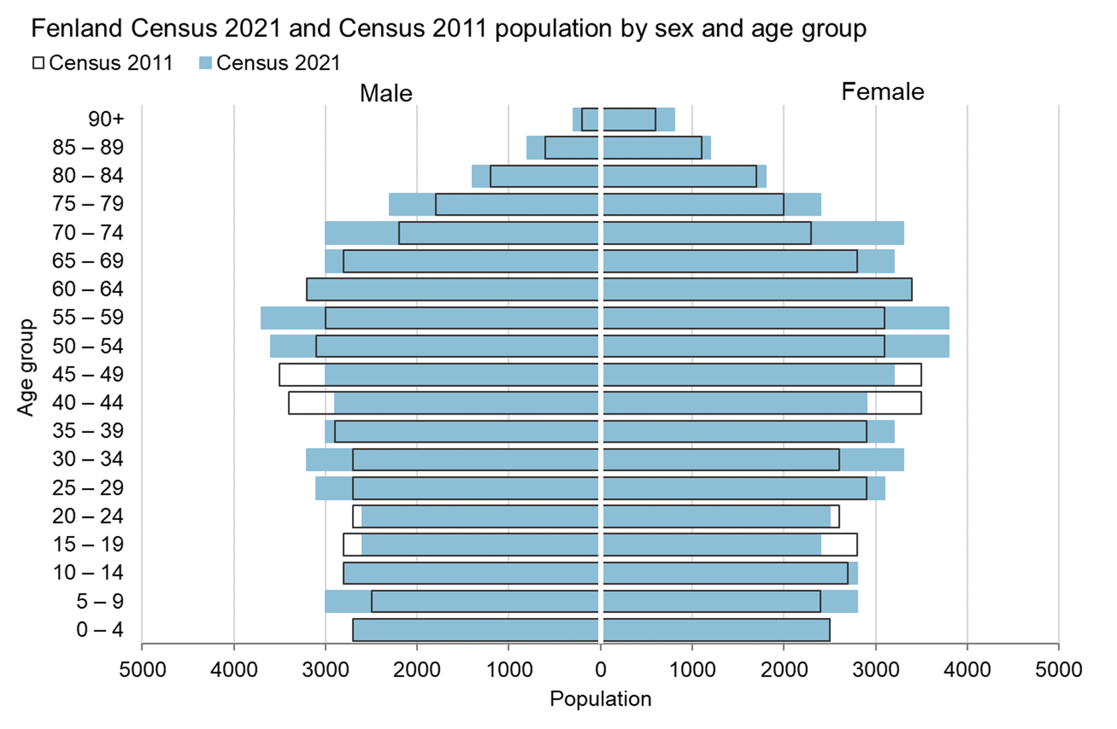
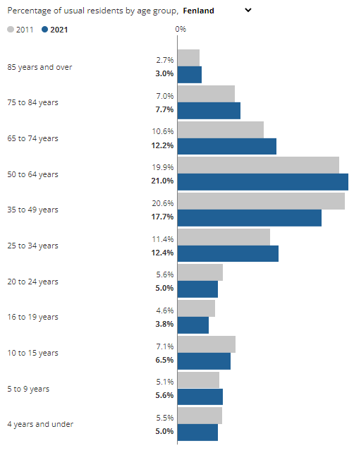
Population by sex and age group, Fenland
The key trends for Fenland shown in this chart are some notable population decreases in the 15-24 and 40-49 age groups.
In contrast, there has been notable growth for the 5-9, 25-34, 50-59 and 70-79 age groups.
The highest percentage of usual residents are among the 50 to 64 year olds (21%).
Notes:
Data from:
Cambridgeshire Insight – Population – Census 2021 – First Results, Produced by CCC Research Team, Business Intelligence
Link: https://cambridgeshireinsight.org.uk/population/census-2021/first-results/
How life has changed in Cambridge: Census 2021 (ons.gov.uk)
Link: https://www.ons.gov.uk/visualisations/censusareachanges/E07000010/
Actual data can be found here: https://www.ons.gov.uk/census/aboutcensus/censusproducts/topicsummaries

Slide 8
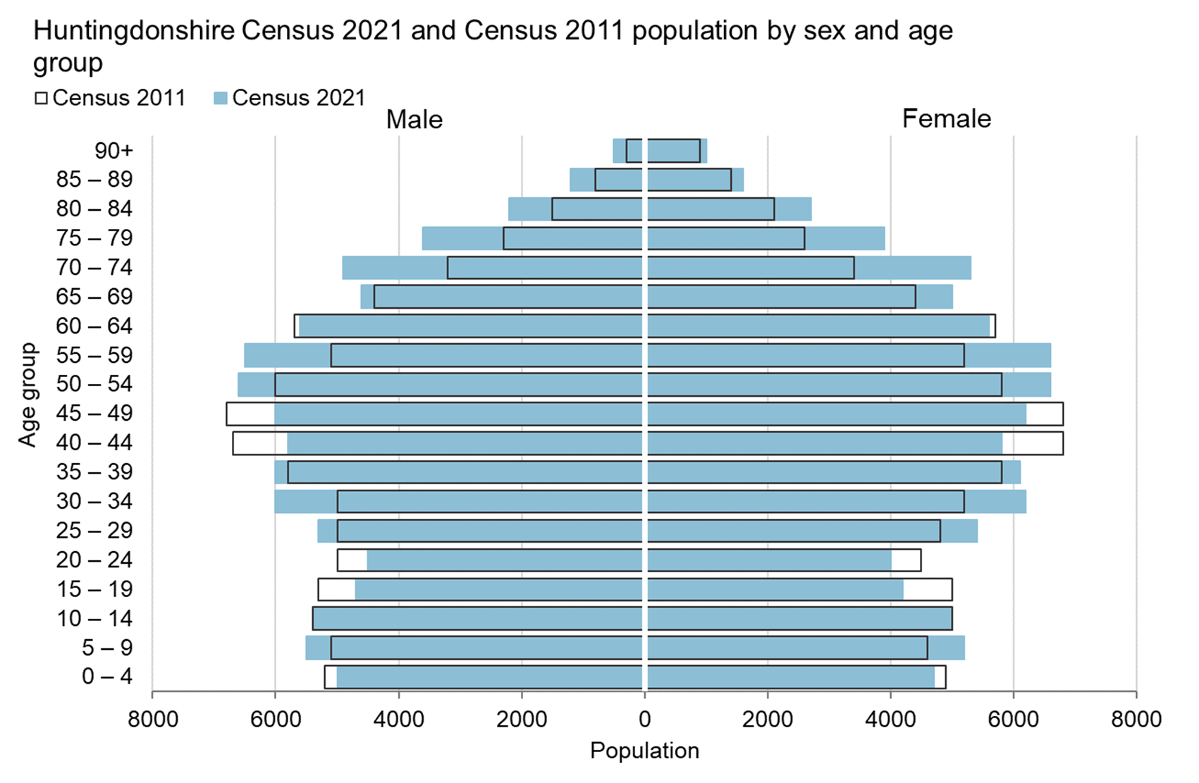
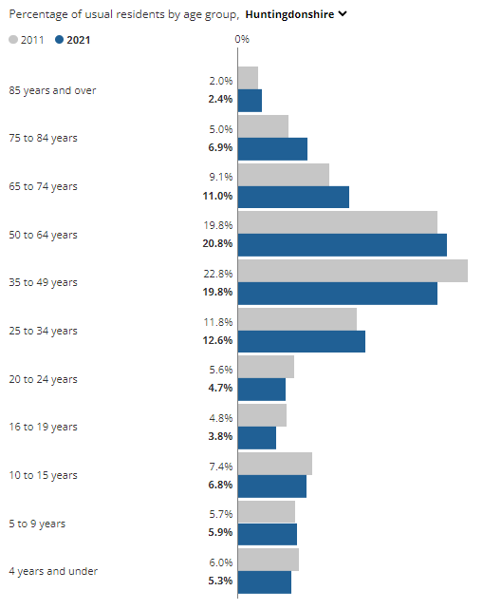
Population by sex and age group, Huntingdonshire
The key trends for Huntingdonshire shown in this chart are some notable population decreases in the 0-4, 15-24 and 40-49 age groups.
In contrast, there has been notable growth for the 25-39, 50-59 and 70-79 age groups.
1.9 percentage points increase is seen for 65-74 and 75-84 age groups each between 2011 and 2021.
Notes:
Data from:
Cambridgeshire Insight – Population – Census 2021 – First Results, Produced by CCC Research Team, Business Intelligence
Link: https://cambridgeshireinsight.org.uk/population/census-2021/first-results/
How life has changed in Cambridge: Census 2021 (ons.gov.uk)
Link: https://www.ons.gov.uk/visualisations/censusareachanges/E07000011/
Actual data can be found here: https://www.ons.gov.uk/census/aboutcensus/censusproducts/topicsummaries

Slide 9
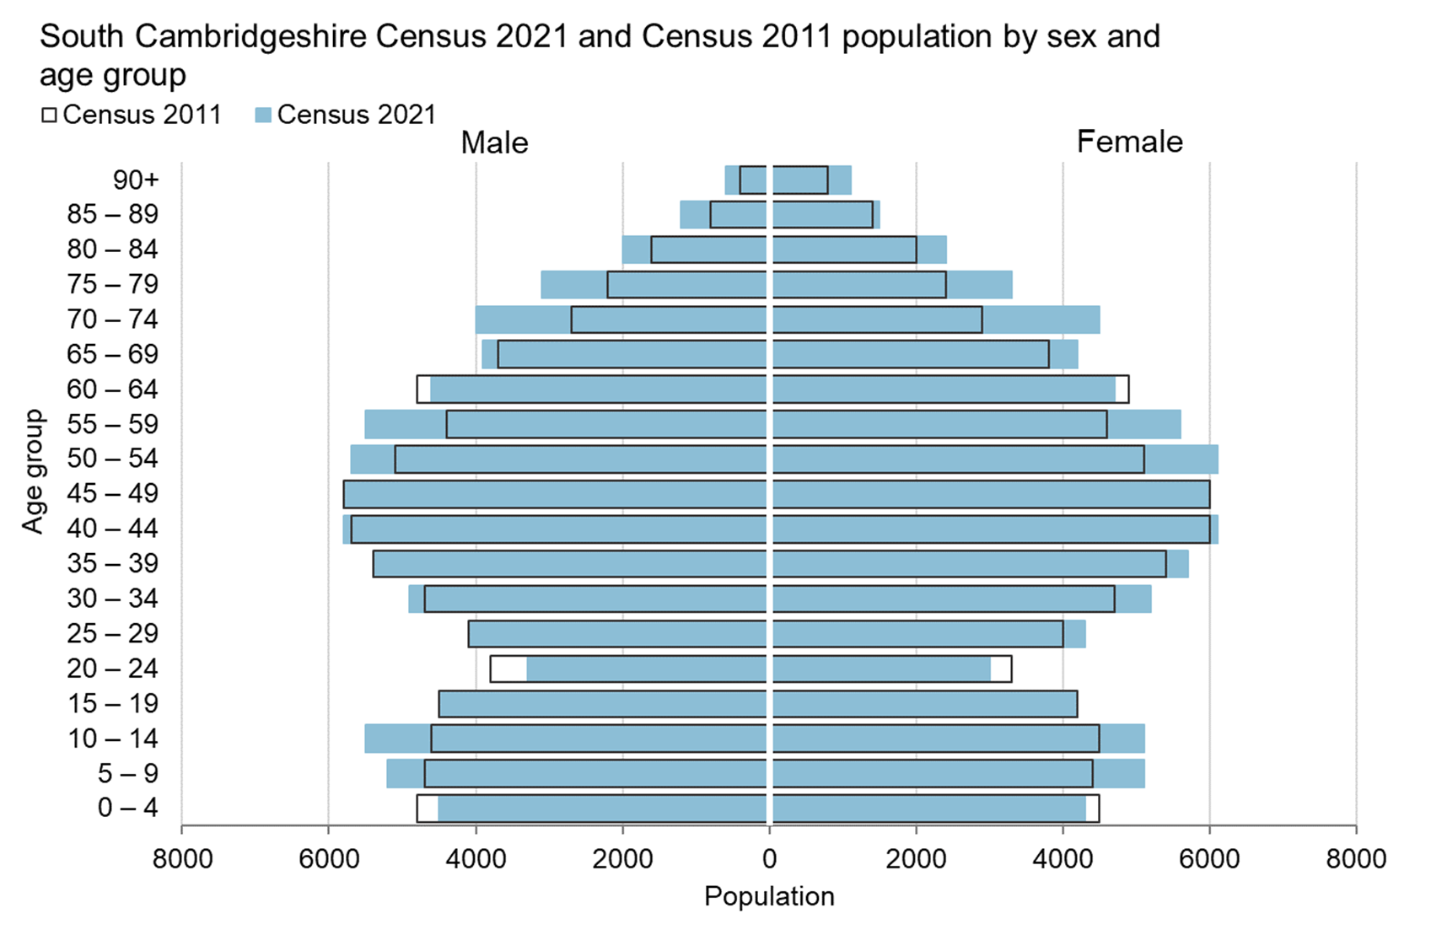
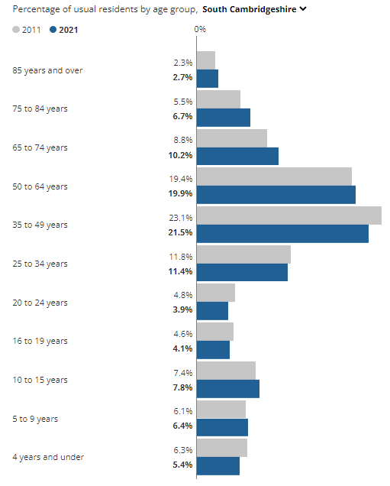
Population by sex and age group, South Cambridgeshire
The key trends for South Cambridgeshire shown in this chart are some notable population decreases in the 0-4, 20-24 and 60-64 age groups.
In contrast, there has been notable growth for the 5-14, 50-59 and 70-79 age groups.
The highest percentage of usual residents are among the 35 – 49 (21.5%) and 50 – 64 (19.9%) year olds.
The share of residents aged between 65 and 74 years increased by 1.4 percentage points between 2011 and 2021.
Notes:
Data from:
Cambridgeshire Insight – Population – Census 2021 – First Results, Produced by CCC Research Team, Business Intelligence
Link: https://cambridgeshireinsight.org.uk/population/census-2021/first-results/
How life has changed in Cambridge: Census 2021 (ons.gov.uk)
Link: https://www.ons.gov.uk/visualisations/censusareachanges/E07000012/
Actual data can be found here: https://www.ons.gov.uk/census/aboutcensus/censusproducts/topicsummaries

Slide 10
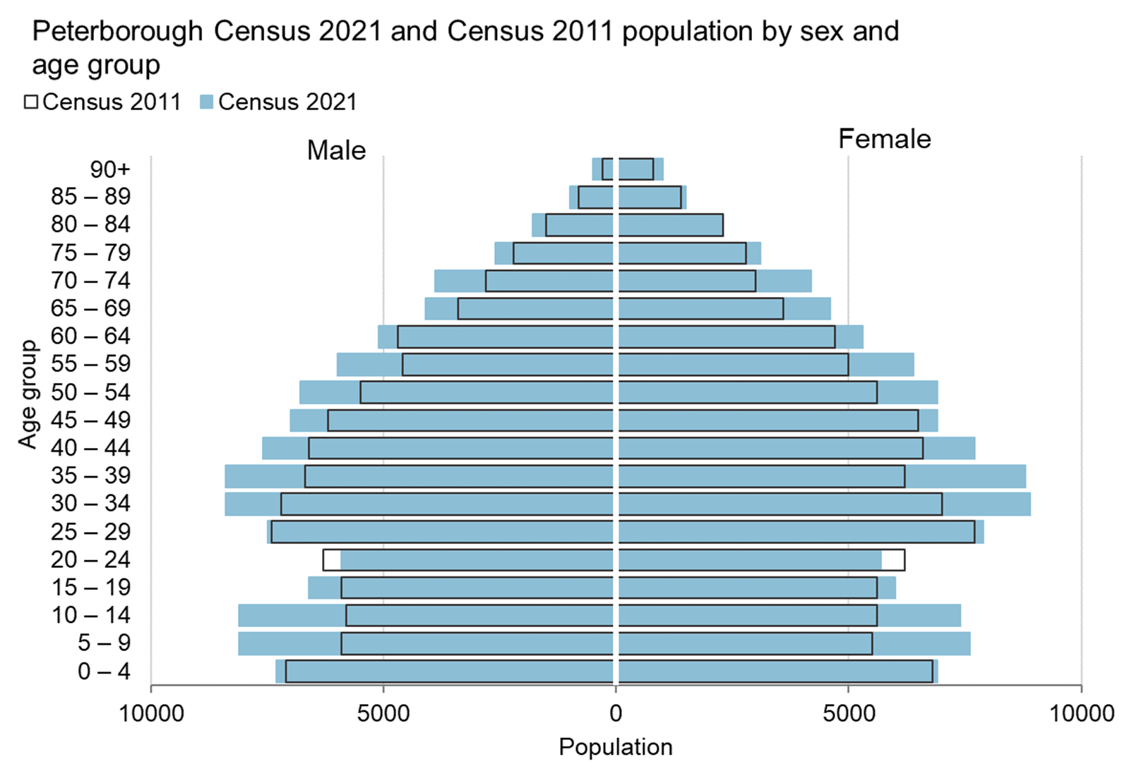
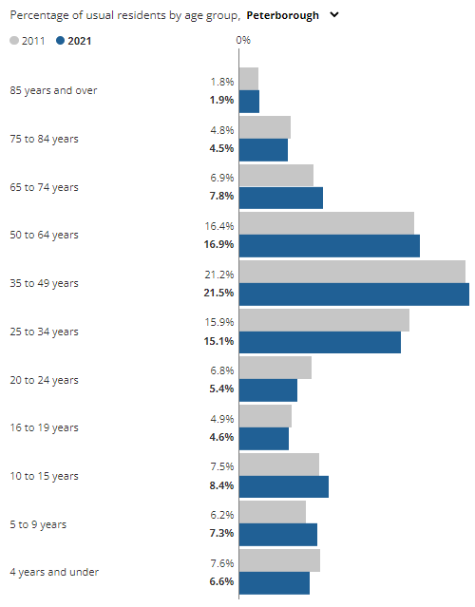
Population by sex and age group, Peterborough
The key trends shown in this chart are that Peterborough has seen population increases for all age groups except for the 20-24 age group, which has decreased.
As with Cambridge, growth is more evenly spread between age groups, with notable population increases for the 5-14 and 30-39 age groups.
The highest percentage of usual residents are among the 35 to 49 year olds (21.5%).
An increase of 0.9 percentage points is seen in 65 – 74 year olds since 2011.
Notes:
Data from:
Cambridgeshire Insight – Population – Census 2021 – First Results, Produced by CCC Research Team, Business Intelligence
Link: https://cambridgeshireinsight.org.uk/population/census-2021/first-results/
How life has changed in Cambridge: Census 2021 (ons.gov.uk)
Link: https://www.ons.gov.uk/visualisations/censusareachanges/E06000031/
Actual data can be found here: https://www.ons.gov.uk/census/aboutcensus/censusproducts/topicsummaries

Slide 11
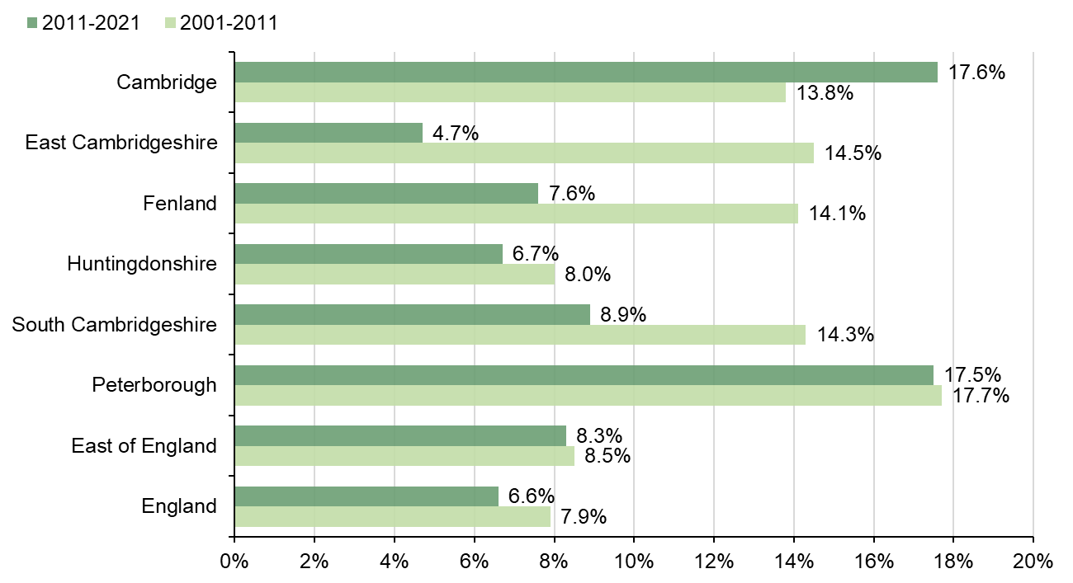
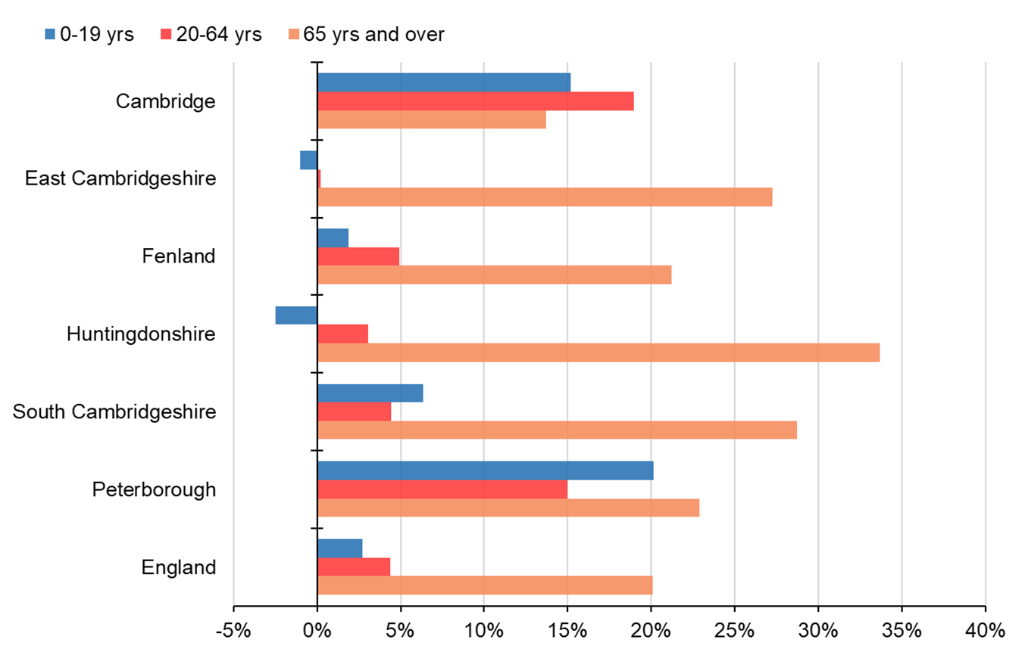
Usual resident population
% change in usual resident population, Census 2001 to 2021
% change in by age group, Census 2011 to 2021
From Census 2011 to 2021, Cambridge (17.6%) and Peterborough (17.5%) had the highest proportion of increase in the usual resident population. However, East Cambridgeshire (4.7%) showed the least increase in its usual resident population from Census 2011 to 2021.
The percentage change in usual resident population from Census 2011 to 2021 is higher than the national average in all areas across Cambridgeshire and Peterborough, except East Cambridgeshire (which is lower) and Huntingdonshire (which is similar).
In Census 2021, the highest increase in the resident population is seen in Peterborough for 0–19 years, in Cambridge for 20–64 years, and in Huntingdonshire for 65 years and over compared to the previous Census.
Since 2011, the population among those 65 and older has had the highest increase among all age groups in all areas except Cambridge.
Notes:
Data from: Cambridgeshire Insight – Population – Census 2021 – First Results, Produced by CCC Research Team, Business Intelligence
Link: https://cambridgeshireinsight.org.uk/population/census-2021/first-results/
Actual data can be found here: https://www.ons.gov.uk/census/aboutcensus/censusproducts/topicsummaries
Definitions:
Usual resident population:
Anyone in the UK and had stayed or intended to stay in the UK for a period of 12 months or more; or
Had a permanent UK address and was outside the UK and intended to be outside the UK for less than 12 months.
High level ethnic groups:
This slide pack uses the Census 2021 definitions of the high level ethnic groups for which respondents are asked to identify with “Asian, Asian British, Asian Welsh”, “Black, Black British, Black Welsh, Caribbean or African”, “Mixed or Multiple”, “White”, “Other ethnic group”.
White UK - refers to those residents who identified themselves as in the “White: English, Welsh, Scottish, Northern Irish or British” ethnic group. All other White ethnic groups are grouped into “White: Other ethnic group”

Slide 12
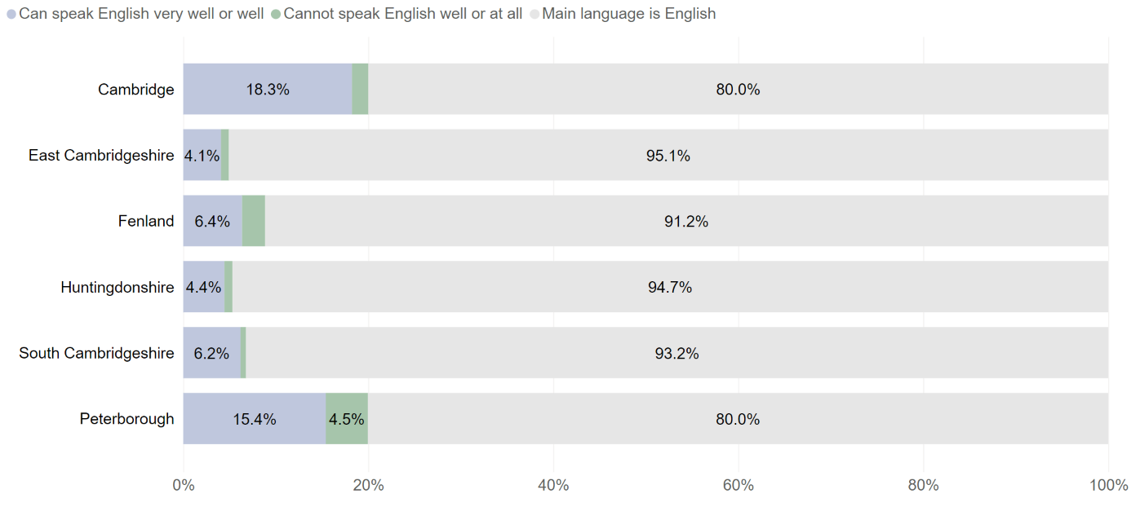
Percent of population aged 3 years and above by proficiency in English, Census 2021
The proportion of residents (aged 3 years and over) whose main language is English varies widely across Cambridgeshire and Peterborough, ranging from 80.0% in Cambridge to 95.1% in East Cambridgeshire, while in Peterborough it is also 80%.
The proportion of residents who cannot speak English well or at all in Peterborough (4.5%) is higher compared to all the districts in Cambridgeshire.
Notes:
Data from: Cambridgeshire Insight – Population – Census 2021 – Topic Summaries – Ethnic Group, National Identity, Language and Religion, Produced by CCC Research Team, Business Intelligence
Link: https://cambridgeshireinsight.org.uk/population/census-2021/topic-summaries/ethnic-group-national-identity-language-and-religion/
Actual data can be found here: https://www.ons.gov.uk/census/aboutcensus/censusproducts/topicsummaries
Definitions:
Usual resident population:
Anyone in the UK and had stayed or intended to stay in the UK for a period of 12 months or more; or
Had a permanent UK address and was outside the UK and intended to be outside the UK for less than 12 months.

Slide 13
Percent of population by ethnic group, Census 2021
Ethnic Group | England | East of England | Peterborough | Cambridge | East Cambridgeshire | Fenland | Huntingdonshire | South Cambridgeshire
Asian, Asian British or Asian Welsh | 9.6% | 6.4% | 14.3% | 14.8% | 1.9% | 1.2% | 3.2% | 5.8%
Black, Black British, Black Welsh, Caribbean or African | 4.2% | 2.9% | 4.1% | 2.4% | 0.8% | 0.8% | 1.5% | 1.2%
Mixed or Multiple ethnic groups | 3.0% | 2.8% | 3.5% | 5.1% | 2.1% | 1.4% | 2.2% | 2.8%
Other ethnic group | 2.2% | 1.4% | 2.7% | 3.1% | 0.7% | 0.7% | 0.7% | 1.1%
White | 81.0% | 86.5% | 75.4% | 74.5% | 94.5% | 95.9% | 92.4% | 89.0%
White of which White: UK | 73.5% | 78.5% | 59.5% | 53.0% | 86.5% | 85.9% | 85.2% | 79.6%
White of which White: Other ethnic group | 7.5% | 8.0% | 15.9% | 21.5% | 8.0% | 10.0% | 7.2% | 9.4%
In Peterborough and Cambridge, the proportion of the population who identify as "Asian, Asian British, or Asian Welsh" is substantially higher than the national and East of England averages; for all other ethnic groups except "White," Peterborough and Cambridge are similar to the national averages.
The proportion of "White" ethnic group in East Cambridgeshire, Fenland, and Huntingdonshire is substantially higher than the national average, whereas the proportions of "Asian, Asian British, or Asian Welsh" and "Black, Black British, Black Welsh, Caribbean, or African" ethnic groups are notable lower than the national averages in these areas.
Notes:
Data from: Cambridgeshire Insight – Population – Census 2021 – Topic Summaries – Ethnic Group, National Identity, Language and Religion, Produced by CCC Research Team, Business Intelligence
Link: https://cambridgeshireinsight.org.uk/population/census-2021/topic-summaries/ethnic-group-national-identity-language-and-religion/
Actual data can be found here: https://www.ons.gov.uk/census/aboutcensus/censusproducts/topicsummaries
Definitions:
Usual resident population:
Anyone in the UK and had stayed or intended to stay in the UK for a period of 12 months or more; or
Had a permanent UK address and was outside the UK and intended to be outside the UK for less than 12 months.
High level ethnic groups:
This slide pack uses the Census 2021 definitions of the high level ethnic groups for which respondents are asked to identify with “Asian, Asian British, Asian Welsh”, “Black, Black British, Black Welsh, Caribbean or African”, “Mixed or Multiple”, “White”, “Other ethnic group”.
White UK - refers to those residents who identified themselves as in the “White: English, Welsh, Scottish, Northern Irish or British” ethnic group. All other White ethnic groups are grouped into “White: Other ethnic group”

Slide 14
Gypsy, Roma and Traveller population, Census 2021
Area Name | All usual resident population | Gypsy, Roma or Traveller (GRT) population | Proportion of GRT population (%)
Cambridge | 145,674 | 998 | 0.7
East Cambridgeshire | 87,762 | 383 | 0.4
Fenland | 102,462 | 775 | 0.8
Huntingdonshire | 180,832 | 401 | 0.2
South Cambridgeshire | 162,118 | 656 | 0.4
Cambridgeshire | 678,849 | 3,214 | 0.5
Peterborough | 215,671 | 1,565 | 0.7
East of England | 6,335,074 | 18,905 | 0.3
England | 56,490,048 | 167,015 | 0.3
The proportion of Gypsy, Roma and Traveller population in all Cambridgeshire districts and Peterborough is higher than the regional and national averages, except Huntingdonshire which is lower.
Notes:
Source: Office for National Statistics, Census 2021
Link: https://www.nomisweb.co.uk/

Slide 15
Percent of population by country of birth, Census 2011 and 2021
International migration has continued to shape the populations of Cambridgeshire and Peterborough.
The proportion of Cambridge and Peterborough residents born outside the UK has increased from 7.6% to 8.6%.
In Cambridge, the population born outside the UK represents 38.0% of the total population, compared to 29.4% at the 2011 Census.
In Peterborough, the population born outside the UK represents 28.2% of the total population, compared to 20.6% at the 2011 Census.
In other Cambridgeshire districts, the numbers of usual residents born outside the UK have increased by 2.0% to 5.1%.
Notes:
Data from: https://cambridgeshireinsight.org.uk/population/census-2021/topic-summaries/demography-and-migration/, Produced by CCC Research Team, Business Intelligence
Link: https://cambridgeshireinsight.org.uk/population/census-2021/topic-summaries/demography-and-migration/
Actual data can be found here: https://www.ons.gov.uk/census/aboutcensus/censusproducts/topicsummaries

Slide 16
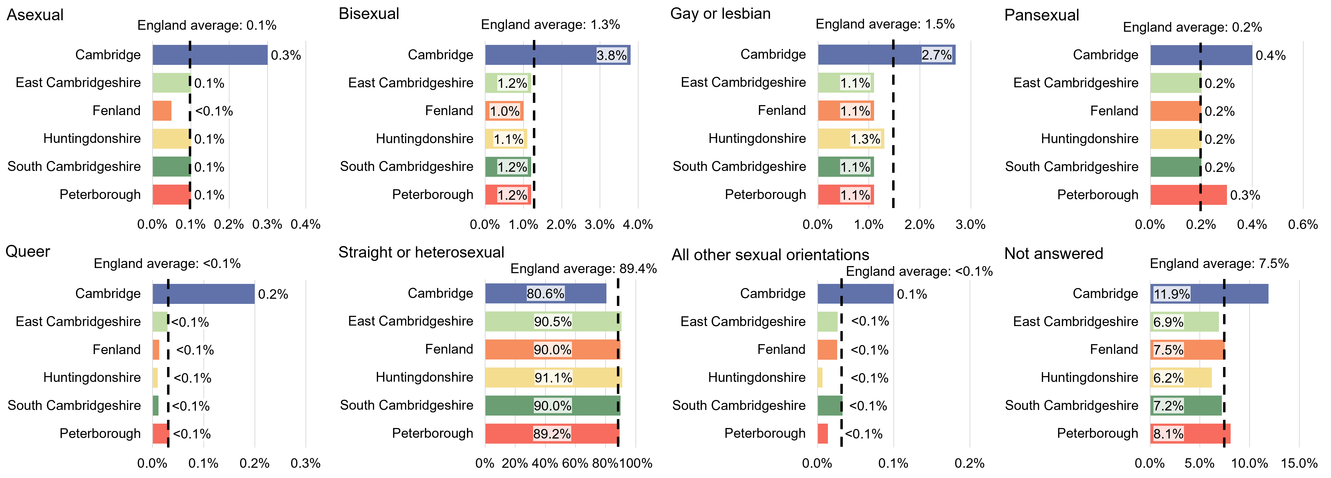
Percent of population ages 16 years and over by sexual orientation, Census 2021
In most districts the proportions of the population aged 16 years and over responding that they are asexual, bisexual, gay or lesbian, pansexual, queer, or other sexual orientation apart from straight or heterosexual, were generally very similar to national averages.
In Cambridge a greater proportion of the population aged 16 years and over responded that they are bisexual, 3.8% compared to the England average of 1.3%, and gay or lesbian, 2.7% compared to the England average of 1.5%
The proportion of the population aged 16 years and over responding that they are straight or heterosexual in most Cambridgeshire districts and Peterborough, was just slightly below the England (89.4%) average. In Cambridge the proportion was much lower at 80.6% compared to a range of 90.0% (Fenland, South Cambridgeshire) to 91.1% (Huntingdonshire) in the other districts of Cambridgeshire.
Notes:
Data from: Cambridgeshire Insight – Population – Census 2021 – Topic Summaries – Sexual Orientation and Gender Identity, Produced by CCC Research Team, Business Intelligence
Link: https://cambridgeshireinsight.org.uk/population/census-2021/topic-summaries/sexual-orientation-and-gender-identity/
Actual data can be found here: https://www.ons.gov.uk/census/aboutcensus/censusproducts/topicsummaries
Definitions:
Usual resident population:
Anyone in the UK and had stayed or intended to stay in the UK for a period of 12 months or more; or
Had a permanent UK address and was outside the UK and intended to be outside the UK for less than 12 months.

Slide 17
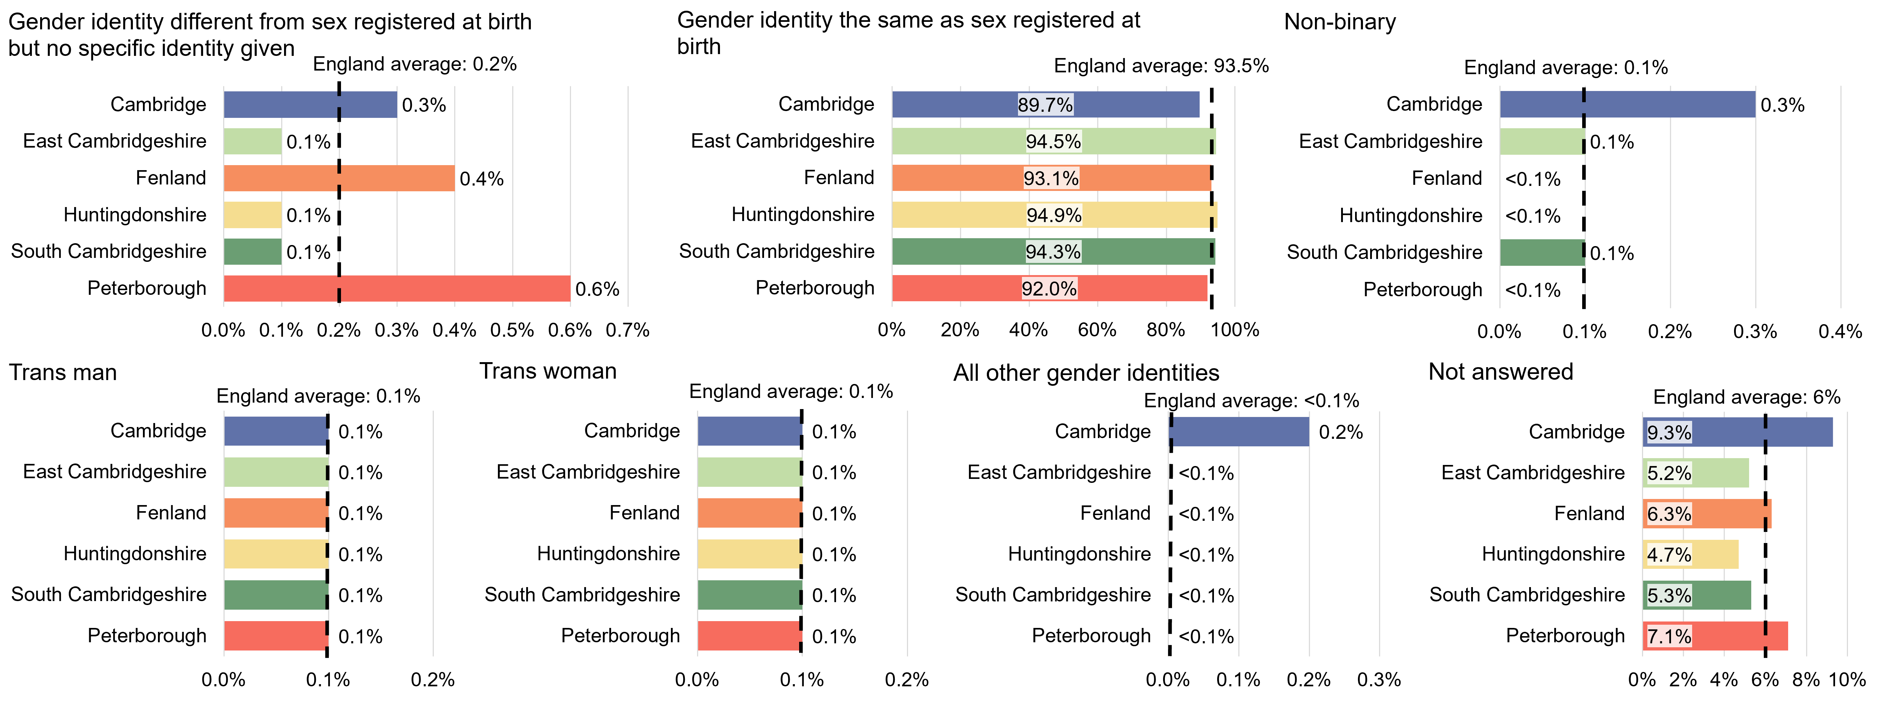
Percent of population ages 16 years and over by gender identity, Census 2021
In Cambridge, 89.7% identified their gender as the same as their sex registered at birth compared to a range of 93.1%, Fenland, to 94.9%, Huntingdonshire, in the other districts of Cambridgeshire and compared to the England (93.5%) averages.
In Fenland, 0.4% identified their gender as different to their sex registered at birth without giving their specific identity compared to the Cambridgeshire average, 0.1%, and the East of England and England averages of 0.2%.
In Peterborough a slightly lower proportion, 92.0%, identified their gender as the same as their sex registered at birth, compared to the England average. A slightly higher proportion, 0.6%, identified their gender as different from their sex registered at birth without giving their specific identity compared to the England average.
Notes:
Data from: Cambridgeshire Insight – Population – Census 2021 – Topic Summaries – Sexual Orientation and Gender Identity, Produced by CCC Research Team, Business Intelligence
Link: https://cambridgeshireinsight.org.uk/population/census-2021/topic-summaries/sexual-orientation-and-gender-identity/
Actual data can be found here: https://www.ons.gov.uk/census/aboutcensus/censusproducts/topicsummaries
Definitions:
Usual resident population:
Anyone in the UK and had stayed or intended to stay in the UK for a period of 12 months or more; or
Had a permanent UK address and was outside the UK and intended to be outside the UK for less than 12 months.

Slide 18
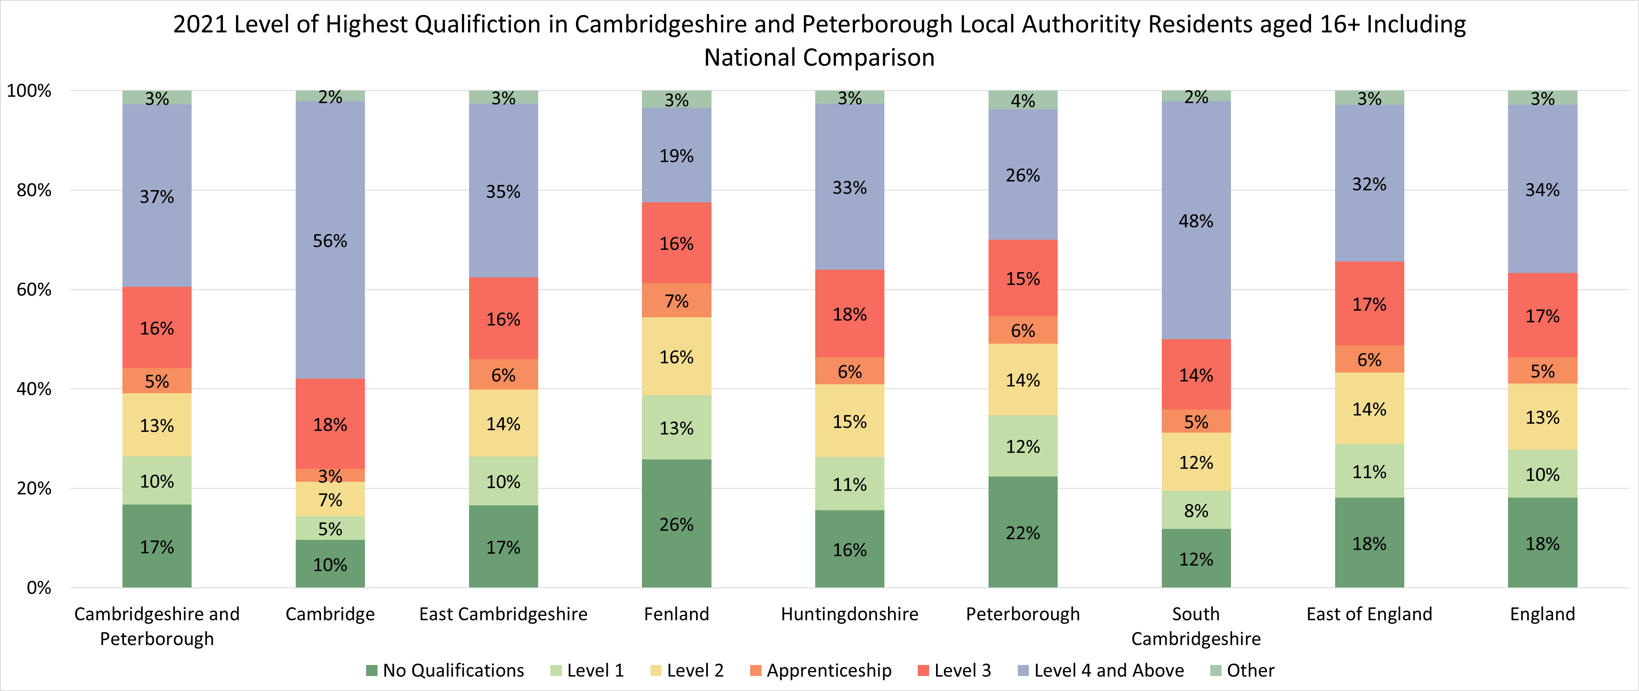
Highest level of qualification, Census 2021
In Cambridgeshire and Peterborough 17% of normal residents aged 16 and over had no formal qualifications. This was a lower proportion than both the East of England (18%) and England (18%) as a whole.
Looking at individual local authorities these proportions were higher than England in Fenland (26%) and Peterborough (22%).
In all other Cambridgeshire and Peterborough local authorities that proportions were lower than England as a whole and were lowest in Cambridge City (10%) and South Cambridgeshire (12%)
Notes:
Data from: Cambridgeshire Insight – Population – Census 2021 – Topic Summaries – Education, Produced by CCC Research Team, Business Intelligence
Link: https://cambridgeshireinsight.org.uk/population/census-2021/topic-summaries/education/
Actual data can be found here: https://www.ons.gov.uk/census/aboutcensus/censusproducts/topicsummaries
Definitions:
Usual resident population:
Anyone in the UK and had stayed or intended to stay in the UK for a period of 12 months or more; or
Had a permanent UK address and was outside the UK and intended to be outside the UK for less than 12 months.

Slide 19
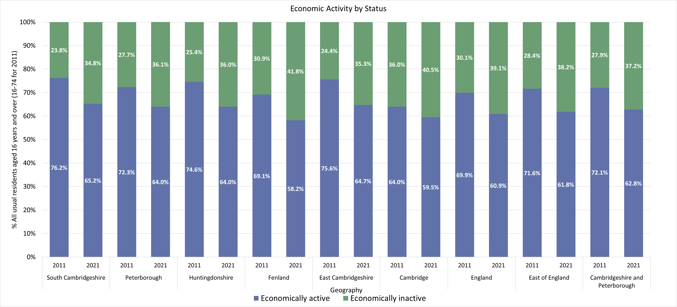
Economic activity status, Census 2011 and 2021
In 2021, all local authorities in Cambridgeshire and Peterborough have seen increases in economic inactivity compared to the 2011 Census.
Notes:
Data from: Cambridgeshire Insight – Population – Census 2021 – Topic Summaries – Labour Market, Produced by CCC Research Team, Business Intelligence
Link: https://cambridgeshireinsight.org.uk/population/census-2021/topic-summaries/labour-market/
Actual data can be found here: https://www.ons.gov.uk/census/aboutcensus/censusproducts/topicsummaries
Economically Active: Economically active is defined as those in employment plus those who are unemployed
Economically Inactive: People not in employment who have not been seeking work within the last 4 weeks and/or are unable to start work within the next 2 weeks

Slide 20
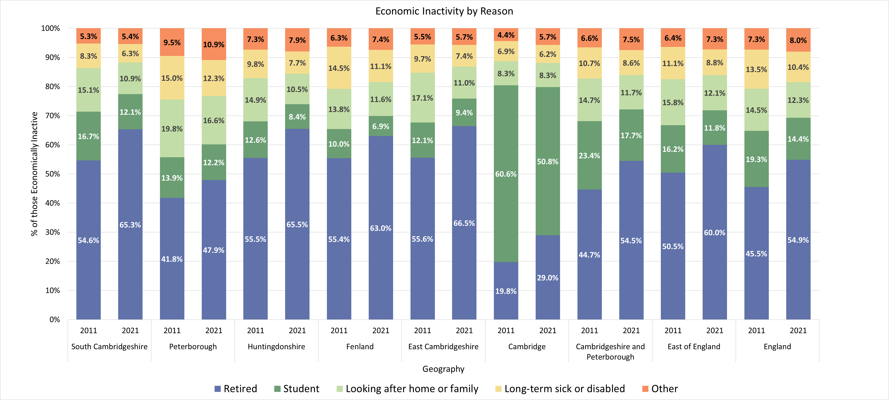
Economic inactivity by reason, Census 2011 and 2021
Being retired is the reason given by the majority of economically inactive residents across Cambridgeshire and Peterborough (54.5%) with the exception of Cambridge where most economically inactive residents are students (50.8%).
In 2021 census, a decline is seen in the proportion of people who are economically inactive due to long-term sickness or disability in all areas across Cambridgeshire and Peterborough.
Notes:
Data from: Cambridgeshire Insight – Population – Census 2021 – Topic Summaries – Labour Market, Produced by CCC Research Team, Business Intelligence
Link: https://cambridgeshireinsight.org.uk/population/census-2021/topic-summaries/labour-market/
Actual data can be found here: https://www.ons.gov.uk/census/aboutcensus/censusproducts/topicsummaries
Economically Inactive: People not in employment who have not been seeking work within the last 4 weeks and/or are unable to start work within the next 2 weeks

Slide 21
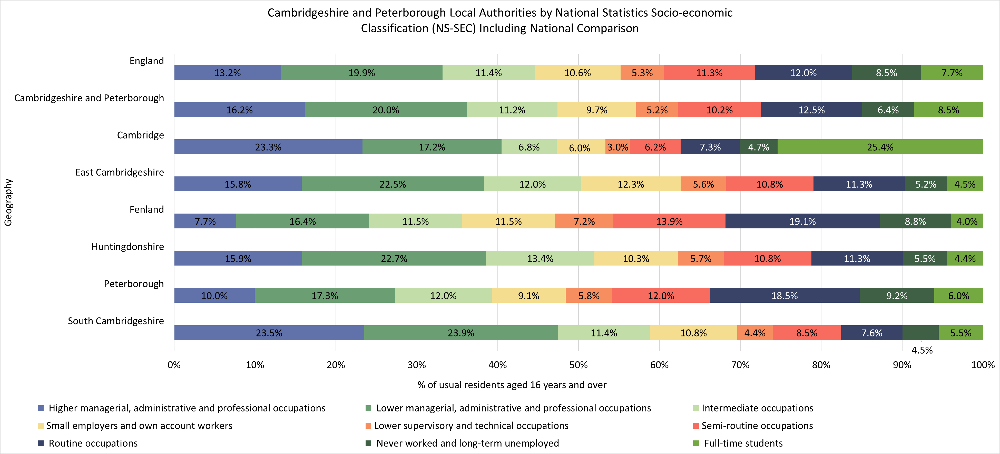
Socio-economic classification, Census 2021
In Cambridgeshire and Peterborough, the top three socio-economic classifications are Lower managerial, administrative and professional occupations (20.0%), Higher managerial, administrative and professional occupations (16.2%) and Routine occupations (12.5%).
Routine occupations was the top socio-economic classification in Fenland (19.1%) and Peterborough (18.5%), whereas in other Cambridgeshire districts it’s either lower or higher managerial, administrative and professional occupations.
Notes:
Data from: Cambridgeshire Insight – Population – Census 2021 – Topic Summaries – Labour Market, Produced by CCC Research Team, Business Intelligence
Link: https://cambridgeshireinsight.org.uk/population/census-2021/topic-summaries/labour-market/
Actual data can be found here: https://www.ons.gov.uk/census/aboutcensus/censusproducts/topicsummaries
NS-Sec: The National Statistics Socio-economic Classification (NS-SeC) provides an indication of socio-economic position based on occupation. It is an Office for National Statistics standard classification
Occupation: A person's occupation relates to their main job and is derived from either their job title or details of the activities involved in their job

Slide 22
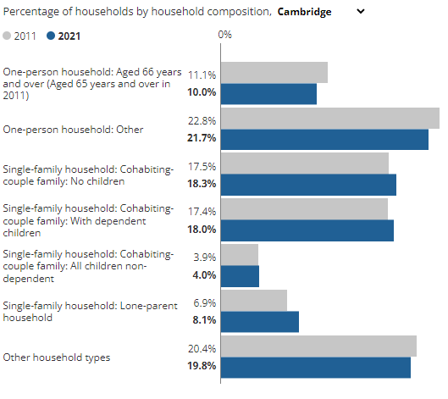
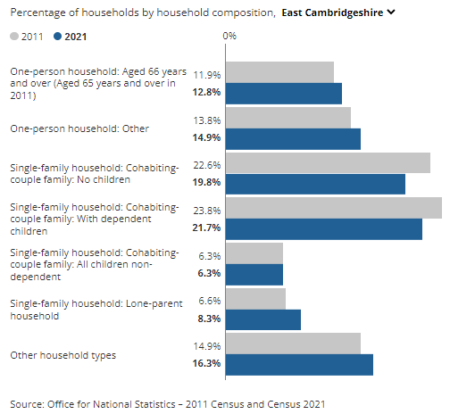
Household composition, Census 2011 and 2021
In 2021, the percentage of households including a couple “with dependent children” and “no children” decreased by 2.8 and 2.1 percentage points since the 2011 Census.
The percentage of households including a lone parent in East Cambridgeshire increased by 1.7 percentage points from Census 2011.
The proportion of one person households of “Aged 66 years and over” and “Other” categories increased by 0.9 to 1.1 percentage points respectively than the 2011 Census.
The percentage of households including a lone parent in Cambridges increased by 1.2 percentage points since the 2011 Census.
The proportion of one person households of “Aged 66 years and over” and “Other” categories decreased in 2021 compared to the 2011 Census.
Notes:
Data from: How life has changed in Cambridge: Census 2021 (ons.gov.uk)
Link: https://www.ons.gov.uk/visualisations/censusareachanges/
Note: Census 2021 took place during the coronavirus (COVID-19) pandemic, a period of rapid and unparalleled change; the national lockdown, associated guidance and furlough measures will have affected the labour market and our ability to measure it.

Slide 23
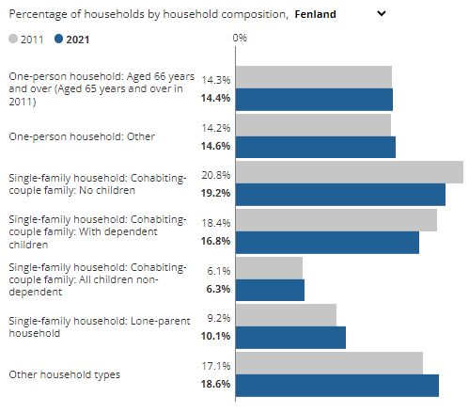
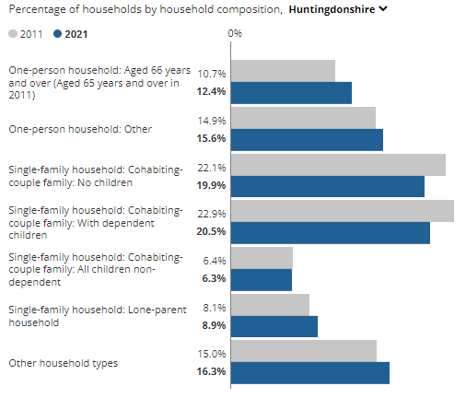
Household composition, Census 2011 and 2021
In 2021, the percentage of households including a couple “with dependent children” and “no children” decreased by 1.6 percentage points since the 2011 Census.
The percentage of households including a lone-parent in Fenland increased by 0.9% percentage points from Census 2011.
In Census 2021, the proportion of one person households of “Aged 66 years and over” was similar to the 2011 Census and “one-person household: Other” had an increase from 14.2% in 2011 to 14.6% in 2021.
Of Huntingdonshire households, 19.9% included a couple but no children in 2021, down from 22.1% in 2011.
The proportion of one person households of “Aged 66 years and over” and “Other” categories increased by 1.7 and 0.7 percentage points since 2011.
The percentage of households including a lone-parent increased by 0.8% percentage points from 2011.
Notes:
Data from: How life has changed in Cambridge: Census 2021 (ons.gov.uk)
Link: https://www.ons.gov.uk/visualisations/censusareachanges/
Note: Census 2021 took place during the coronavirus (COVID-19) pandemic, a period of rapid and unparalleled change; the national lockdown, associated guidance and furlough measures will have affected the labour market and our ability to measure it.

Slide 24
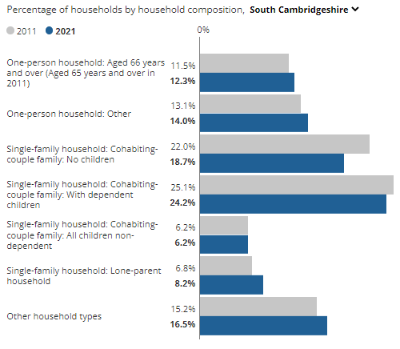
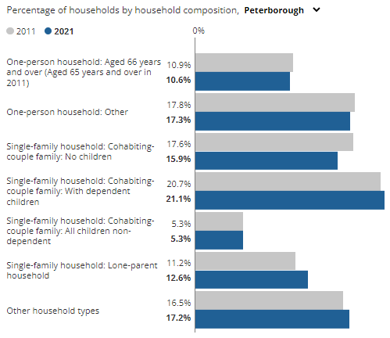
Household composition, Census 2011 and 2021
The proportion of one person households of “Aged 66 years and over” and “Other” categories increased by 0.8 and 0.9 percentage points since 2011.
The percentage of households including a couple without children in South Cambridgeshire decreased by 3.3 percentage points.
The percentage of households including a lone-parent increased to 8.2% from 6.8% in 2011.
The percentage of households including a couple without children in Peterborough fell from 17.6% to 15.9%.
The percentage of households including a lone-parent increased to 12.6% from 11.2% in 2011, an increase of 1.4 percentage points.
Notes:
Data from: How life has changed in Cambridge: Census 2021 (ons.gov.uk)
Link: https://www.ons.gov.uk/visualisations/censusareachanges/
Note: Census 2021 took place during the coronavirus (COVID-19) pandemic, a period of rapid and unparalleled change; the national lockdown, associated guidance and furlough measures will have affected the labour market and our ability to measure it.

Slide 25
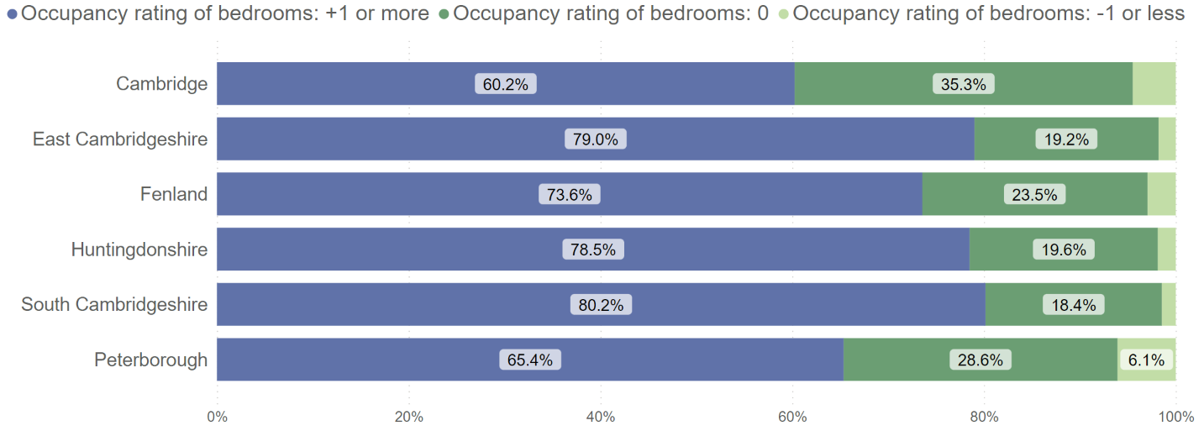
Proportion of households by occupancy rating for bedrooms, Census 2021
The proportion of households classed as having the right number of bedrooms for its occupants is 22.8% of total households in Cambridgeshire, ranging from 18.4% in South Cambridgeshire to 35.3% in Cambridge, and being 28.6% in Peterborough, compared to the East of England average of 25.2% and national average of 26.8%.
In Cambridgeshire 6,714 households (2.4% of total) had fewer bedrooms than required and so are classed as overcrowded, compared to 7,531 households (3.0% of total) in 2011, this is lower than the national figure of 4.3%.
Cambridge has the highest proportion of overcrowded households at 4.5% in Cambridgeshire.
In Peterborough 5,128 households (6.1%) had fewer bedrooms than required, compared to 3,807 (5.1%) in 2011.
Notes:
Data from: Cambridgeshire Insight – Population – Census 2021 – Topic Summaries – Housing, Produced by CCC Research Team, Business Intelligence
Link: https://cambridgeshireinsight.org.uk/population/census-2021/topic-summaries/housing/
Actual data can be found here: https://www.ons.gov.uk/census/aboutcensus/censusproducts/topicsummaries
An occupancy rating of:
-1 or less implies that a household's accommodation has fewer bedrooms than required (overcrowded),
+1 or more implies that a household's accommodation has more bedrooms than required (under-occupied), and
0 suggests that a household's accommodation has an ideal number of bedrooms

Slide 26
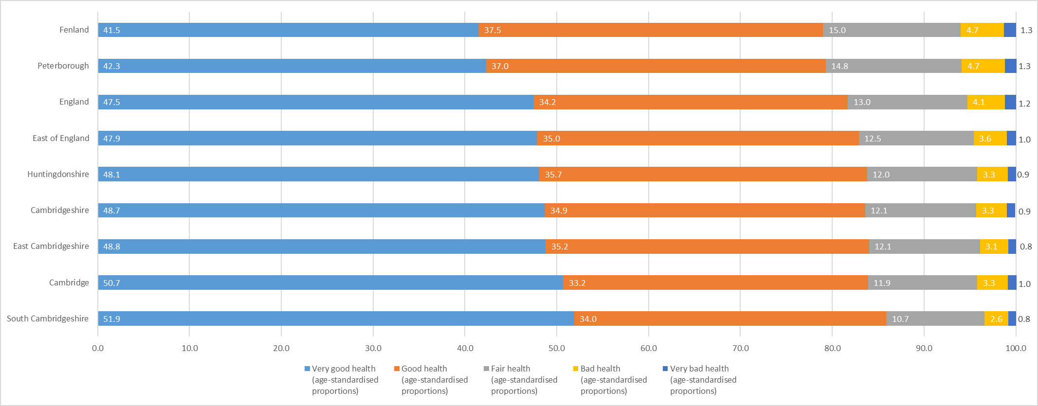
General Health, Census 2021
General Health (Age standardised): % of population
‘Good or very good’ health is reported most highly in South Cambridgeshire (85.9%) and East Cambridgeshire (84%), this is higher than England (81.7%) and the East of England (82.9%).
The lowest level of ‘good or very good’ health is reported in Fenland (79%) and Peterborough (79.3%).
‘Bad or very bad’ health is highest at 6% in both Fenland and Peterborough. This is higher than England 5.3% and the East of England 4.6%.
‘Bad or very bad’ health is lowest in South Cambridgeshire (3.4%) and East Cambridgeshire (3.9%).
Notes:
Data from: Cambridgeshire Insight – Population – Census 2021 – Topic Summaries – Health, Disability and Unpaid Care, Produced by CCC Research Team, Business Intelligence
Link: https://cambridgeshireinsight.org.uk/population/census-2021/topic-summaries/population-census-2021-topic-summaries-health/
Actual data can be found here: https://www.ons.gov.uk/census/aboutcensus/censusproducts/topicsummaries
General health
A person's assessment of the general state of their health from very good to very bad (see categories below). This assessment is not based on a person's health over any specified period of time.
Very good health
Good health
Fair health
Bad health
Very bad health
Age-standardised proportions (ASPs) take into consideration both population size and age-structure, to compare like with like.

Slide 27
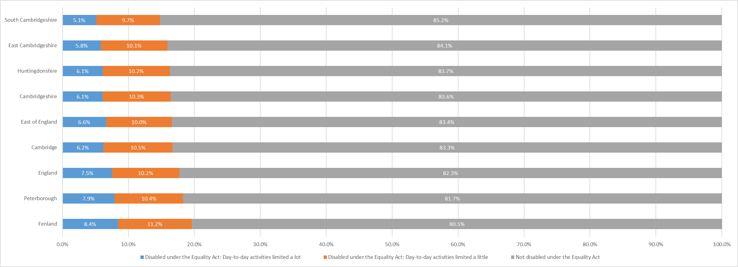
Disability, Census 2021
Disability (Age standardised): % of population
In Cambridgeshire, 16.4% of residents report as being disabled, this is lower than East of England (16.6%) and England (17.7%).
South Cambridgeshire has the lowest proportion of residents reporting as disabled with 14.8%. East Cambridgeshire (15.9%) also has a lower proportion than the East of England and England.
Huntingdonshire (16.7%), Peterborough (18.3%) and Fenland (19.6%) have a higher proportion than the East of England and England.
Notes:
Data from: Cambridgeshire Insight – Population – Census 2021 – Topic Summaries – Health, Disability and Unpaid Care, Produced by CCC Research Team, Business Intelligence
Link: https://cambridgeshireinsight.org.uk/population/census-2021/topic-summaries/population-census-2021-topic-summaries-health/
Actual data can be found here: https://www.ons.gov.uk/census/aboutcensus/censusproducts/topicsummaries
Disability
People who assessed their day-to-day activities as limited by long-term physical or mental health conditions or illnesses are considered disabled (see categories below). This definition of a disabled person meets the harmonised standard for measuring disability and is in line with the Equality Act (2010).
Disabled under the Equality Act: Day-to-day activities limited a lot
Disabled under the Equality Act: Day-to-day activities limited a little
Not disabled under the Equality Act: Has long term physical or mental health condition but day-to-day activities are not limited
Not disabled under the Equality Act: No long term physical or mental health conditions
Age-standardised proportions (ASPs) take into consideration both population size and age-structure, to compare like with like.

Slide 28
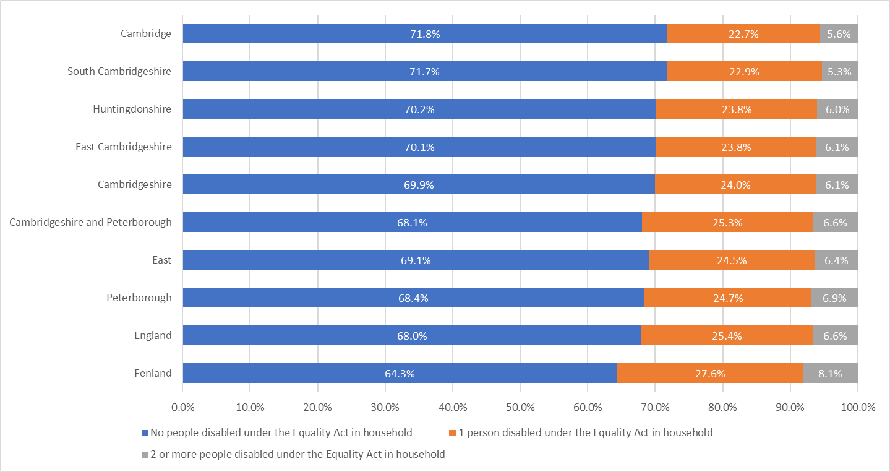
Disability, Census 2021
Number of disabled people in households
Fenland has the highest proportion of homes with at least 1 disabled person resident (35.7%).
Fenland is the only area with a higher proportion than England.
Notes:
Data from: Cambridgeshire Insight – Population – Census 2021 – Topic Summaries – Health, Disability and Unpaid Care, Produced by CCC Research Team, Business Intelligence
Link: https://cambridgeshireinsight.org.uk/population/census-2021/topic-summaries/population-census-2021-topic-summaries-health/
Actual data can be found here: https://www.ons.gov.uk/census/aboutcensus/censusproducts/topicsummaries
Number of disabled people in household
The number of people in a household who assessed their day-to-day activities as limited by long-term physical or mental health conditions or illnesses and are considered disabled. This definition of a disabled person meets the harmonised standard for measuring disability and is in line with the Equality Act (2010).
No people disabled under the Equality Act in household.
1 person disabled under the Equality Act in household.
2 or more people disabled under the Equality Act in household.
Does not apply.

Slide 29
Unpaid care, Census 2021
Unpaid care (non age standardised)
Unpaid Care | Cambridge 2011 | Cambridge 2021 | East Cambridgeshire 2011 | East Cambridgeshire 2021 | Fenland 2011 | Fenland 2021 | Huntingdonshire 2011 | Huntingdonshire 2021 | Peterborough 2011 | Peterborough 2021 | South Cambridgeshire 2011 | South Cambridgeshire 2021 | Cambridgeshire 2011 | Cambridgeshire 2021
Provides No unpaid care | 92.1% | 93.7% | 90.1% | 91.4% | 88.9% | 90.4% | 90.3% | 91.7% | 90.4% | 91.9% | 89.9% | 91.6% | 90.3% | 91.9%
Provides 1 to 19 hours unpaid care a week | 5.8% | 3.7% | 6.8% | 4.9% | 6.5% | 4.2% | 6.6% | 4.5% | 5.8% | 3.6% | 7.5% | 5.1% | 6.7% | 4.5%
Provides 20 to 49 hours unpaid care a week | 0.8% | 1.1% | 1.1% | 1.4% | 1.6% | 2.1% | 1.1% | 1.4% | 1.4% | 1.9% | 0.9% | 1.3% | 1.1% | 1.4%
Provides 50 or more hours unpaid care a week | 1.3% | 1.5% | 2.0% | 2.3% | 3.1% | 3.4% | 2.0% | 2.4% | 2.4% | 2.5% | 1.6% | 2.0% | 1.9% | 2.2%
The proportion of residents providing no unpaid care has risen from 2011 to 2021 across all areas of Cambridgeshire and Peterborough.
Breakdown of those providing unpaid care shows an unexpected increase in number of residents providing more hours of care in 2021 than in 2011.
These trends are seen in the East of England and nationally.
Notes:
Data from: Cambridgeshire Insight – Population – Census 2021 – Topic Summaries – Health, Disability and Unpaid Care, Produced by CCC Research Team, Business Intelligence
Link: https://cambridgeshireinsight.org.uk/population/census-2021/topic-summaries/population-census-2021-topic-summaries-health/
Actual data can be found here: https://www.ons.gov.uk/census/aboutcensus/censusproducts/topicsummaries
Unpaid care
An unpaid carer may look after, give help or support to anyone who has long-term physical or mental ill-health conditions, illness or problems related to old age. This does not include any activities as part of paid employment. This help can be within or outside of the carer's household.
Provides no unpaid care
Provides 9 hours or less unpaid care a week
Provides 10 to 19 hours unpaid care a week
Provides 20 to 34 hours unpaid care a week
Provides 35 to 49 hours unpaid care a week
Provides 50 or more hours unpaid care a week
Note: Census 2021 asked "Do you look after, or give any help or support to, anyone because they have long-term physical or mental health conditions or illnesses, or problems related to old age?". People were asked to exclude anything they did as part of their paid employment. The wording of the question differs from the 2011 Census question, which began "Do you look after, or give any help or support to family members, friends, neighbours or others".

Slide 30
School pupil characteristics, Academic year 2021/22
In Peterborough, the proportion of the school pupils who identify as "Asian” (17.5%) and “Black” (4.8%) ethnic groups was substantially higher than Cambridgeshire (5.4% and 1.5% respectively) during the academic year 2021/22.
The proportion of “Mixed” ethnic group in Peterborough was 1.5% higher than in Cambridgeshire.
The proportion of school pupils whose first language is “known or believed to be other than English” in Peterborough (34%) is substantially higher than Cambridgeshire (14%).
Notes:
Source: Schools, pupils and their characteristics, 2021/22 Academic Year
Link: https://explore-education-statistics.service.gov.uk/find-statistics/school-pupils-and-their-characteristics
Notes:
2. Totals include state-funded nursery, primary, secondary and special schools, non-maintained special schools and pupil referral units. Does not include independent schools

