Slide 1


CPCA Economy & Employment Update
Quarter 1 2023 (January – March 2023) Research Group, Cambridgeshire County Council
Research.Group@Cambridgeshire.gov.uk

Slide 2
Labour Market Overview
(January – December 2022)

Slide 3
Labour Market Headline Findings – January to December 2022
The headline labour market statistics for the full 2022 year in Cambridgeshire and Peterborough appear healthier than the UK as a whole, especially when looking at employment and economic inactivity.
As in previous years, a higher proportion of Cambridgeshire and Peterborough’s working age population is economically active when compared to the UK. Looking at the 16–64-year-old population, the region has consistently had a higher employment rate, a lower unemployment rate and a lower economic inactivity rate than the UK.
Looking at how these rates have changed since the last quarter, and when compared to the same point in 2021, a greater proportion of Cambridgeshire and Peterborough’s economically inactive population are moving towards being economically active and employed than the UK. Especially when comparing 2022 to 2021, the employment rate has increased at a faster pace in the region than nationally, and the economic inactivity rate has decreased whereas nationally it has remained static.
Looking at Census 2021 and the reason for the economic inactivity long term sickness or disability is more prominent amongst the economically inactive populations of Fenland and Peterborough, potentially linked to their higher levels of relative deprivation compared to the region as a whole.

Slide 4
Labour Market Headlines - Definitions
Employment Rate
(Employed Population/Total Population)
Unemployment Rate
(Unemployed Population/Economically Active Population)
Economic Inactivity Rate
(Economically Inactive Population/Total Population)
The percentage of the total population who are employed
The proportion of the Economically Active Population without a job, have been actively seeking work in the past four weeks and are available to start work in the next two weeks or are out of work, have found a job and are waiting to start it in the next two weeks
The proportion of the population without a job and have not sought work in the last four weeks and/or are not available to start work in the next two weeks
Example reasons for being economically inactive could include being a student, having caring responsibilities, being sick and disabled and retirement
Note – All of these measures are calculated on the basis of the working age (16-64) population

Slide 5

Unemployment Rate Overall (aged 16-64) – 2.9%
Quarterly change
Previous Quarterly change
Change since previous year
The unemployment rate between January and December 2022 was 2.9% (lower than the 3.6% nationally), this has decreased by -0.6 percentage points since the last quarter and is also 0.6pp lower than the level 12 months previously
Rolling Quarterly change
(Jan – Mar 2022):
-0.6pp
+0.2pp
-0.6pp
+1.9%
Comparing Jan 2022- Dec 2022 with Oct 2021 - Sept 2022
Comparing Oct 2021– Sept 2022 with Jul 2021 – Jun 2022
Comparing Jan 2022- Dec 2022 with Jan 2021 - Dec 2021
Employment Rate Overall (aged 16-64) – 80.1%
Quarterly change
Previous change
Change since previous year
The employment rate between January and December 2022 was 80.1% (higher than the 75.5% nationally), this has increased by +2.2 percentage points since the last quarter and is +1.8 percentage points higher than the level 12 months previously
+2.2pp
-1.2pp
+1.9%
+1.8pp
Comparing Jan 2022- Dec 2022 with Oct 2021 - Sept 2022
Comparing Oct 2021– Sept 2022 with Jul 2021 – Jun 2022
Comparing Jan 2022- Dec 2022 with Jan 2021 - Dec 2021
Economically Inactive (aged 16-64) – 17.5%
Previous change
17.5% of residents (aged 16-64) were economically inactive between January and December 2022 (lower than the 21.7% nationally), this has decreased by -1.8 percentage points since the last quarter and is -1.3pp lower than the level 12 months previously
Quarterly change
Change since previous year
-1.8pp
+1.1pp
-1.3pp
+1.9%
Comparing Jan 2022- Dec 2022 with Oct 2021 - Sept 2022
Comparing Oct 2021– Sept 2022 with Jul 2021 – Jun 2022
Comparing Jan 2022- Dec 2022 with Jan 2021 - Dec 2021
* Please note: estimates and confidence intervals are unreliable due to small sample sizes and so should be treated as indicative.
Notes:
Source – Annual Population Survey, Office for National Statistics
Technical Notes
A residence based labour market survey encompassing population, economic activity (employment and unemployment), economic inactivity and qualifications. These are broken down where possible by gender, age, ethnicity, industry and occupation. Available at Local Authority level and above. Updated quarterly.
Commentary
Between 2021 and 2022 Cambridgeshire and Peterborough experienced a growth in the proportion of the working age population moving out of economic inactivity into being economically active, and then potentially employed, a greater proportion when compared to the UK as a whole
In January to December 2022 Cambridgeshire and Peterborough has, as it has done in previous years, maintained a higher employment rate, lower unemployment rate and a lower economic inactivity rate than the UK as a whole
In comparison with the same period last year and with the UK as a whole Cambridgeshire and Peterborough had seen a higher increase in the employment rate (+1.8 percentage points in C&P compared to +0.8pp in the UK) and a greater fall in the economic inactivity rate (-1.3pp in C&P compared to no change in the UK as a whole).

Slide 6
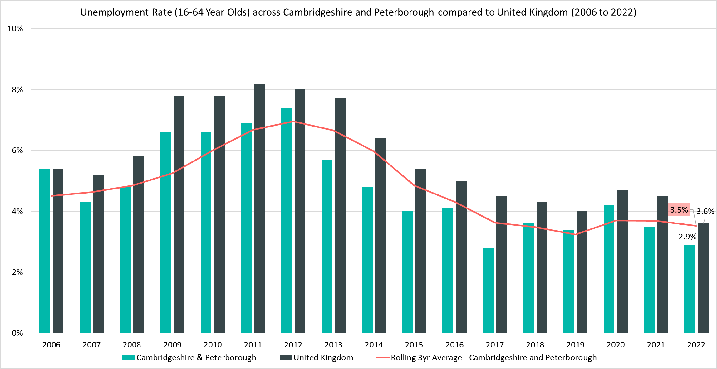
Unemployment Rate (16-64 year olds) - 2.9%, (January 2022 - December 2022)
Rolling Quarterly change
(Sept – Dec 22):
Previous change
(Jun – Sept 22):
Change since December 2021:
-0.6pp
+0.2pp
-0.6pp
Comparing Jan 2022- Dec 2022 with Oct 2021 - Sept 2022
Comparing Oct 2021– Sept 2022 with Jul 2021 – Jun 2022
Comparing Jan 2022- Dec 2022 with Jan 2021 - Dec 2021
Notes:
Source – Annual Population Survey (2006-2022), Office for National Statistics
Technical Notes
A residence based labour market survey encompassing population, economic activity (employment and unemployment), economic inactivity and qualifications. These are broken down where possible by gender, age, ethnicity, industry and occupation. Available at Local Authority level and above. Updated quarterly.
Commentary
The above chart shows the unemployment rate across Cambridgeshire & Peterborough and the United Kingdom from 2006 to 2021 alongside a rolling three year average for the region.
The unemployment rate has been consistently below the national level and has broadly followed the same pattern as seen nationally: a rise during the first year of the pandemic in 2020 and then a gradual decrease over the last two years.
Cambridgeshire and Peterborough’s unemployed population is decreasing at a lower rate than nationally, compared to January – December 2021 the unemployment rate in 2022 decreased by –0.6 percentage points, slower than the UK as a whole where it decreased by -0.9pp.

Slide 7
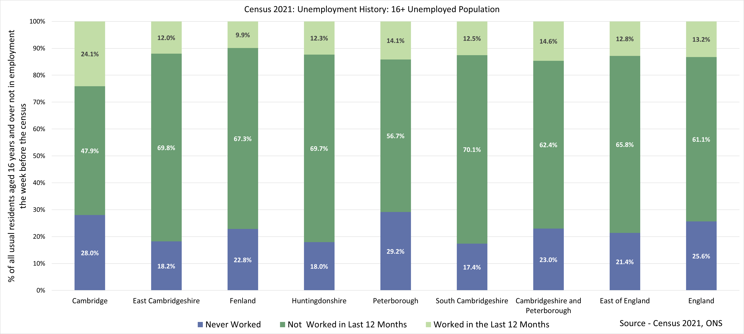
Census 2021 – Unemployment History
Note – As Census 2021 took place during the coronavirus (COVID-19) pandemic, a period of unparalleled and rapid change; the national lockdown, associated guidance and furlough measures will have affected data associated with the labour market. This should be considered when using this data for planning or policy purposes. The chart above depicts unemployed 16+ population regardless of economic activity status, whilst other analysis within this slide pack focuses on the 16-64 age group
Notes:
Source - Census 2021, Office for National Statistics
Technical Notes
All usual residents aged 16 years and over who were either economically active and unemployed, or economically inactive were asked whether they had ever done any paid work. This meant that people in England and Wales who were not in employment during Census 2021 could be divided into three categories:
Last did paid work within the last 12 months
Last did paid work more than 12 months ago
Have never worked
Commentary
The chart above looks at the unemployed population (aged 16+) as they were reported in the 2021 census by their length of unemployment:
The majority of residents who were unemployed in Cambridgeshire and Peterborough had not worked in the last year (62.4%) but had worked at some point prior to this.
There were higher proportions of residents in Cambridge City (28.0%) and Peterborough (29.2%) who have never worked compared to the other local authorities.
Cambridge City had a higher proportion of those not in employment who had worked in the last year (24.1%) compared to the other local authorities.

Slide 8
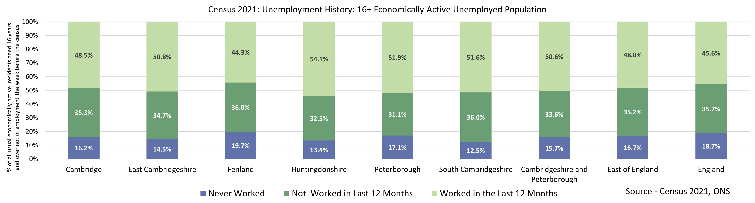
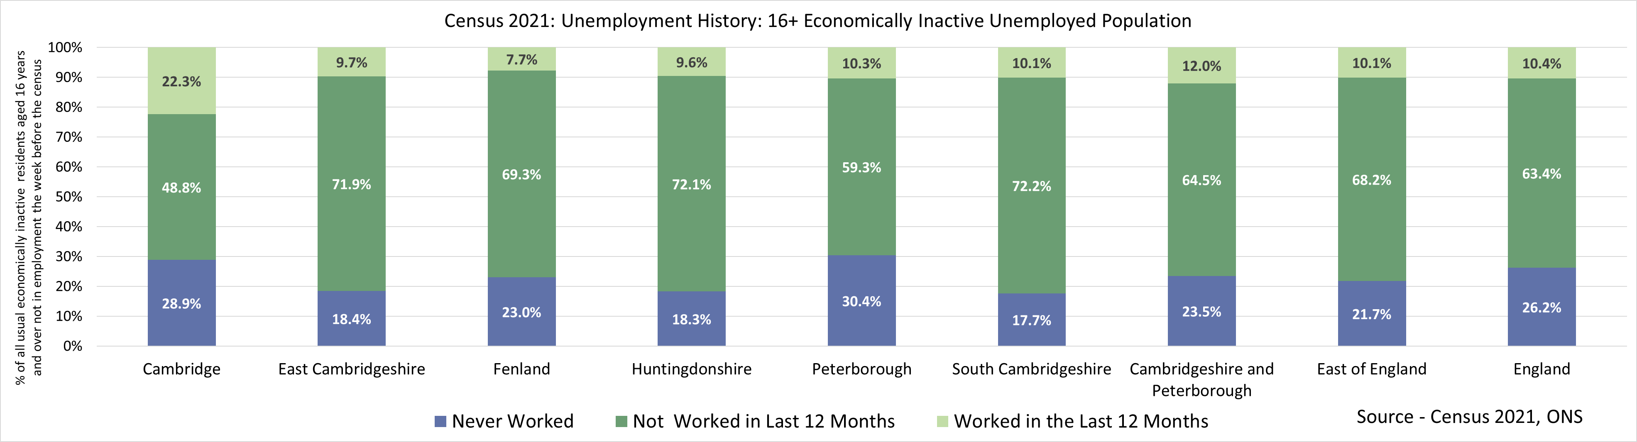
Census 2021 – Long-Term Unemployment by Economic Activity Status
Note – As Census 2021 took place during the coronavirus (COVID-19) pandemic, a period of unparalleled and rapid change; the national lockdown, associated guidance and furlough measures will have affected data associated with the labour market. This should be considered when using this data for planning or policy purposes. The charts above depicts unemployed 16+ population by their economic activity status, whilst other analysis within this slide pack focuses on the 16-64 age group
Notes:
Source - Census 2021, Office for National Statistics
Technical Notes
All usual residents aged 16 years and over who were either economically active and unemployed, or economically inactive were asked whether they had ever done any paid work. This meant that people in England and Wales who were not in employment during Census 2021 could be divided into three categories:
Last did paid work within the last 12 months
Last did paid work more than 12 months ago
Have never worked
Commentary
The chart above looks at the unemployed population by economic activity status as they were reported in the 2021 census by their length of unemployment:
The majority of the economically inactive population in Cambridgeshire and Peterborough have been in employment at some point but have not worked in the last year, as opposed to those who have worked in the last 12 months and those who have never worked at all. This is also the case in the individual local authorities
This compares to the majority of economically active but unemployed population having had worked in the in the last year in Cambridgeshire and Peterborough (50.6%). This is generally the case across most of the local authorities as well apart from Fenland and Cambridge where the majority of unemployed economically active residents have not worked in the last 12 months.

Slide 9
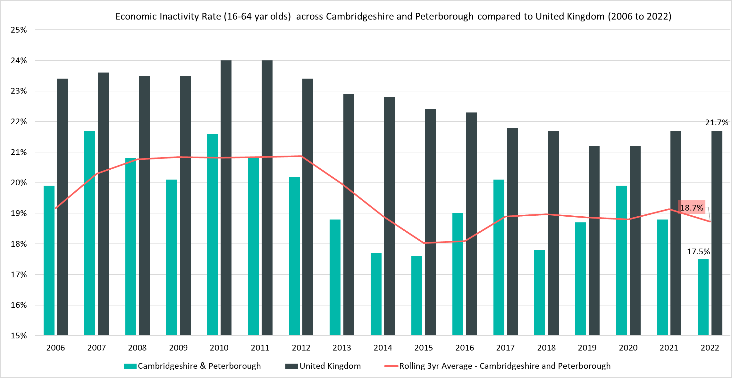
Economically Inactive (16-64 Year Olds) - 17.5%, (January 2022 – December 2022)
Rolling Quarterly change
(Sept – Dec 22):
Previous change
(Jun – Sept 22):
Change since December 2021:
-1.8pp
+1.1pp
-1.3pp
Comparing Jan 2022- Dec 2022 with Oct 2021 - Sept 2022
Comparing Oct 2021– Sept 2022 with Jul 2021 – Jun 2022
Comparing Jan 2022- Dec 2022 with Jan 2021 - Dec 2021
Notes:
Source – Annual Population Survey (2006-2022), Office for National Statistics
Technical Notes
A residence based labour market survey encompassing population, economic activity (employment and unemployment), economic inactivity and qualifications. These are broken down where possible by gender, age, ethnicity, industry and occupation. Available at Local Authority level and above. Updated quarterly.
Commentary
The above chart shows the percentage of those aged 16-64 who are economically inactive across Cambridgeshire & Peterborough and the United Kingdom from 2004 to 2021.
The percentage of those who were economically inactive in Cambridgeshire and Peterborough has been consistently below the national level.
Whilst the gap in economic inactivity between Cambridgeshire and Peterborough and the UK as a whole closed during the pandemic, with the Cambridgeshire and Peterborough rate rising more quickly than the national one, the region appears to have quickly recovered to the extent the economic inactivity is now lower than pre-pandemic levels. This contrasts with the UK where it has only slightly decreased.
This will mean that a higher proportion of Cambridgeshire and Peterborough residents are entering the labour market. The fall in the unemployment rate and rise in the employment rate implies that these residents are not just looking for work but that they are finding it.

Slide 10
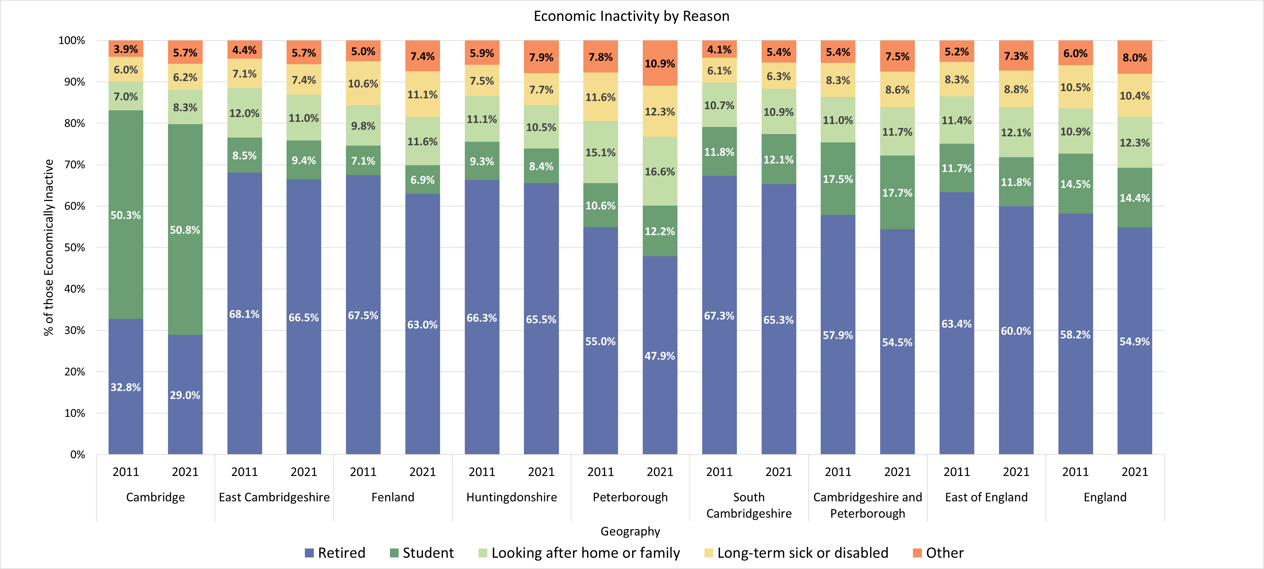
Census 2021 – Economic Inactivity by Reason (16+)
Note – As Census 2021 took place during the coronavirus (COVID-19) pandemic, a period of unparalleled and rapid change; the national lockdown, associated guidance and furlough measures will have affected data associated with the labour market. This should be considered when using this data for planning or policy purposes. The chart above depicts the economically inactive 16+ population, whilst other analysis within this slide pack focuses on the 16-64 age group
Notes:
Source – Census 2021, Office for National Statistics
Technical Notes
People aged 16 years and over were economically inactive if, in the week before Census 2021, they were not in employment, and they were:
not looking for work
looking for work, but were not able to start work in the next two weeks
The reason why they were inactive was recorded as being one of the following:
retired (whether receiving a pension or not)
studying
looking after home or family
long-term sick or disabled
another reason
Commentary
The chart above looks at the reason for economic inactivity recorded for Census 2021 of all usual residents who were economically inactive and aged 16 or over:
The majority of local authorities were comparable when looking at reasons for economic inactivity. Key differences include Cambridge where over half (50.8%) of the economically inactive population was a student, a much higher proportion compared to other local authorities and the 17.7% recorded for Cambridgeshire and Peterborough overall. This is due to the presence of the University of Cambridge and Anglia Ruskin University.
Peterborough had a higher proportion of residents giving Looking after home or family (16.6%) as the reason for economic inactivity compared to other local authorities.
Between 2011 and 2021, there was a decrease in the proportion of the economically inactive population who were retired compared to other reasons across all local authorities in Cambridgeshire and Peterborough as well as nationally.

Slide 11
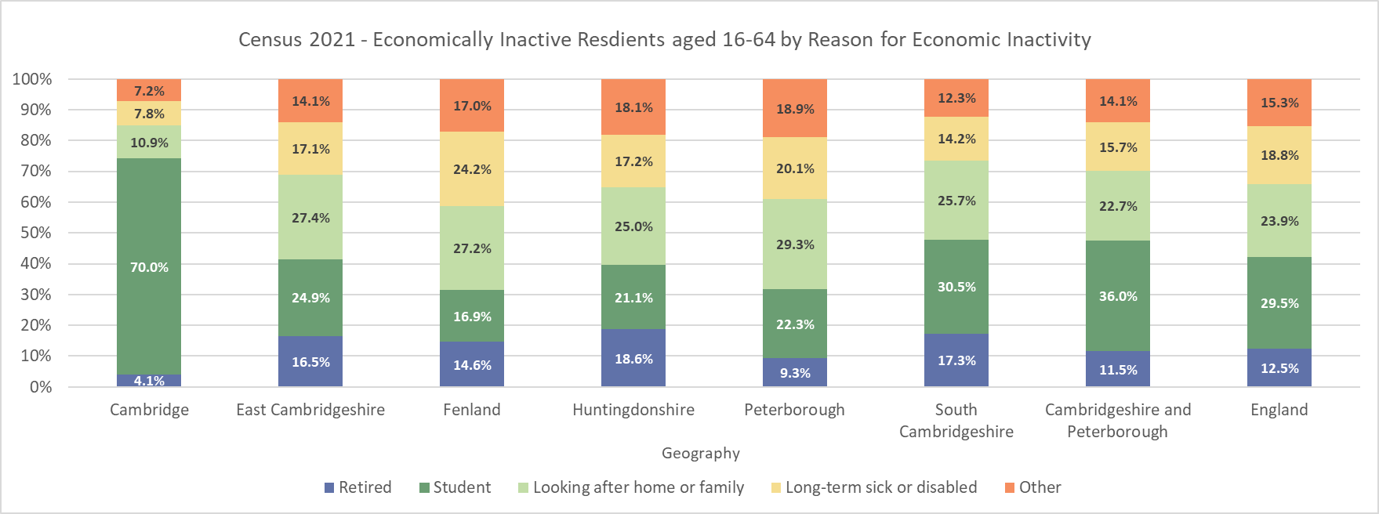
Census 2021 – Economic Inactivity by Reason (16-64 Only)
Note – As Census 2021 took place during the coronavirus (COVID-19) pandemic, a period of unparalleled and rapid change; the national lockdown, associated guidance and furlough measures will have affected data associated with the labour market. This should be considered when using this data for planning or policy purposes.
Notes:
Source – Census 2021, Office for National Statistics
Technical Notes
People aged 16 years and over were economically inactive if, in the week before Census 2021, they were not in employment, and they were:
not looking for work
looking for work, but were not able to start work in the next two weeks
The reason why they were inactive was recorded as being one of the following:
retired (whether receiving a pension or not)
studying
looking after home or family
long-term sick or disabled
another reason
Commentary
The chart above looks at the reason for economic inactivity recorded for Census 2021 for the ‘Working Age’ 16-64 year old population only.
Overall a lower proportion of Cambridgeshire and Peterborough residents were economically inactive due to retirement than England as a whole.
In all local authorities apart from Cambridge City a higher proportion of residents were economically inactive because they were looking after their home or family or because they were long term sick or disabled than nationally.
The more relatively deprived local authorities of Fenland and Peterborough saw an especially high proportion of their economically inactive residents as noting themselves as long-term sick or disabled (24.2% in Fenland and 20.1% in Peterborough).
70% of Cambridge City’s economically inactive 16-64 residents were full time students, again highlighting the presence of the two universities there.

Slide 12
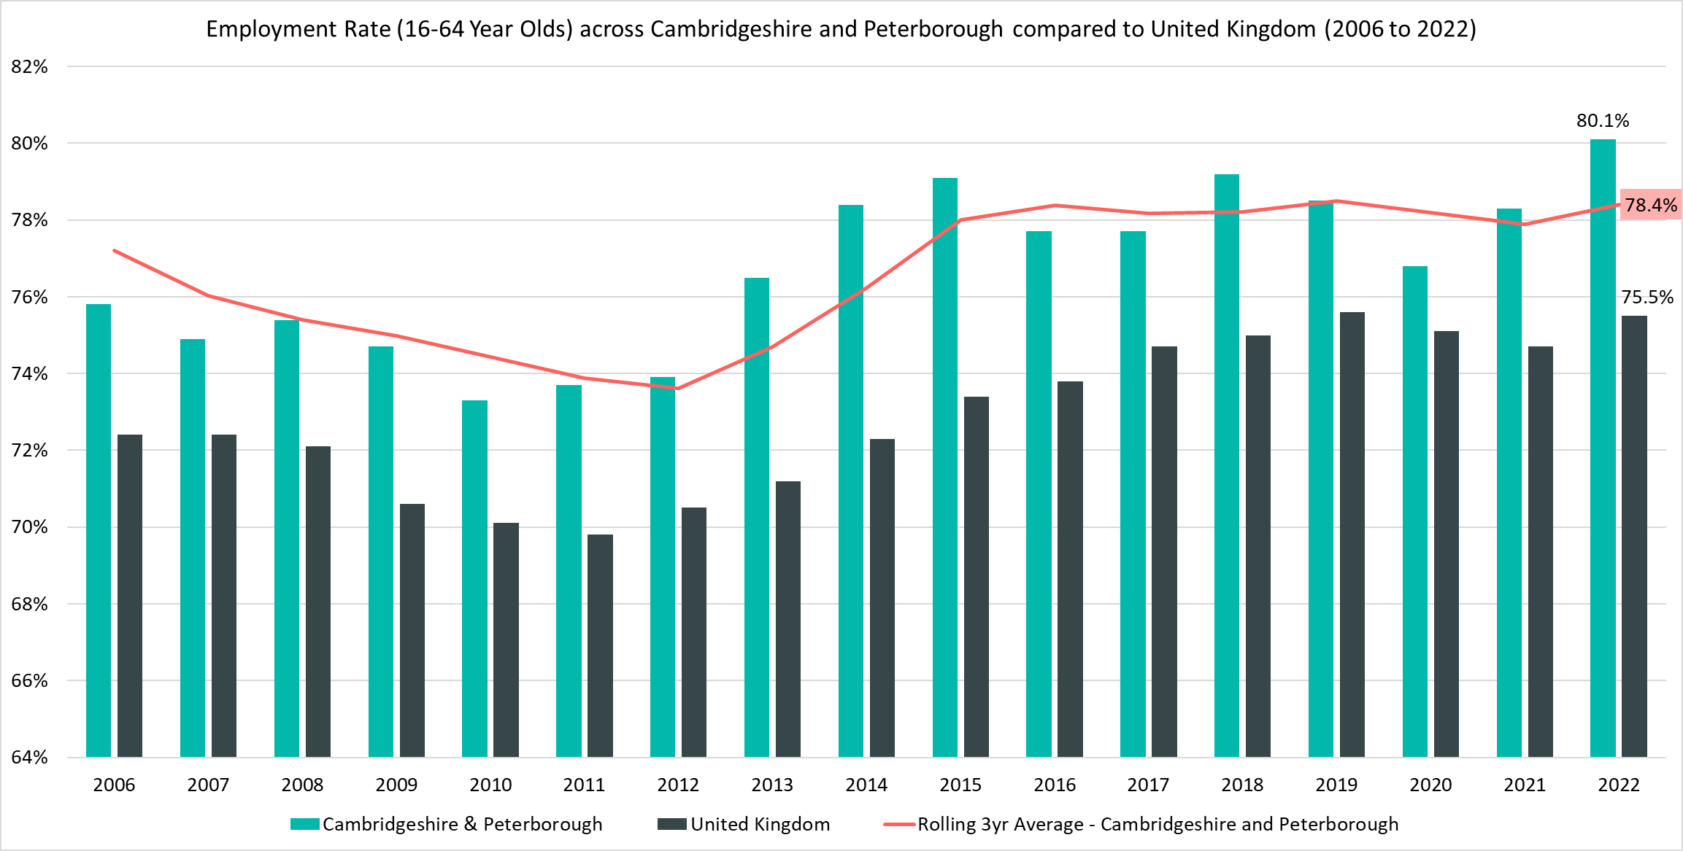
Employment Rate (16-64) – 80.1%, (January 2022 – December 2022)
Rolling Quarterly change
(Sept – Dec 22):
Previous change
(Jun – Sept 22):
Change since December 2021:
+2.2pp
-2.2pp
-1.8pp
Comparing Jan 2022- Dec 2022 with Oct 2021 - Sept 2022
Comparing Oct 2021– Sept 2022 with Jul 2021 – Jun 2022
Comparing Jan 2022- Dec 2022 with Jan 2021 - Dec 2021
Notes:
Source – Annual Population Survey (2006-2022), Office for National Statistics
Technical Notes
A residence based labour market survey encompassing population, economic activity (employment and unemployment), economic inactivity and qualifications. These are broken down where possible by gender, age, ethnicity, industry and occupation. Available at Local Authority level and above. Updated quarterly.
Commentary
The above chart shows the employment rate across Cambridgeshire & Peterborough and United Kingdom from 2006 to 2021.
The employment rate across Cambridgeshire & Peterborough has been consistently higher than the rate seen nationally and has increased at a faster rate than the UK as a whole. This, coupled with the decreasing amount of economic inactivity, indicates that residents of Cambridgeshire and Peterborough are re-entering the workforce.

Slide 13
Claimant Counts
Claimant Count of Benefits Related to Unemployment – March 2023
Universal Credit Claimant Counts – February 2023

Slide 14
Claimants of Benefits related to Unemployment – March 2023
Claimant counts have increased over the last quarter (December 2022 to March 2023). Both short term and longer term trends show that younger claimants (16-24) and those who live in more relatively deprived areas such as Fenland and Peterborough are particular areas of focus.
As with the Unemployment rate a lower proportion of Cambridgeshire and Peterborough residents claim benefits related to unemployment when compared to the UK. However there is a high degree of disparity within the region itself as both Fenland and Peterborough have higher claimant rates than nationally. 56% of claimants live in these local authorities with 42% in Peterborough itself.
Higher claimant rates seem appear to especially affect urban areas in the north of the region such as the city of Peterborough and towns in Fenland such as Wisbech. Outside of Fenland and Peterborough areas such as the north of Huntingdon and the North and West of Cambridge City also have higher claimant rates. All of these also stand out as more relatively deprived areas within the region.
Across all the region’s local authorities apart from Cambridge City (potentially due to its large full time student population who are mostly ineligible for unemployment benefits) young adults (18-24) have a higher claimant rate than other age groups and the working age population as a whole. This difference was especially apparent within the more relatively deprived local authorities like Fenland and Peterborough where the claimant rate of 18-24 year olds was 2.8 percentage points and 2.4 percentage points higher respectively than the claimant rate for 16-64 year olds overall. It is interesting to note that a less relatively deprived local authority like South Cambridgeshire had the lowest percentage point difference between young adults and the working age population.
Over the last quarter the number of claimants in Cambridgeshire and Peterborough has been rising at a faster rate than the UK as a whole and this seems to be driven by existing geographical trends. Particularly large increases have been in areas which already have a high number of claimants such as Peterborough (+12.1% more claimants compared to December 2022, the first highest rise) and Fenland (+8.6% more claimants, the third highest rise), it is worth noting that East Cambridgeshire saw the second highest rise of +9.2% claimants.
Compared to March 2022, the 12 month rolling decreases in the number of claimants have also been slowing down and again there are concerns for younger claimants and those who live in more relatively deprived areas. Although this seems to follow a national trend it is more apparent in Cambridgeshire and Peterborough compared to the UK. Peterborough saw a particularly low decrease in the number of claimants across the year (-0.8% compared to -2.6% in Cambridgeshire and Peterborough and -8.2% in the UK). Whilst claimant counts are still decreasing on a year by year basis overall the number of younger claimants (aged 16-24) has actually increased by +4.2% since March 2022.

Slide 15
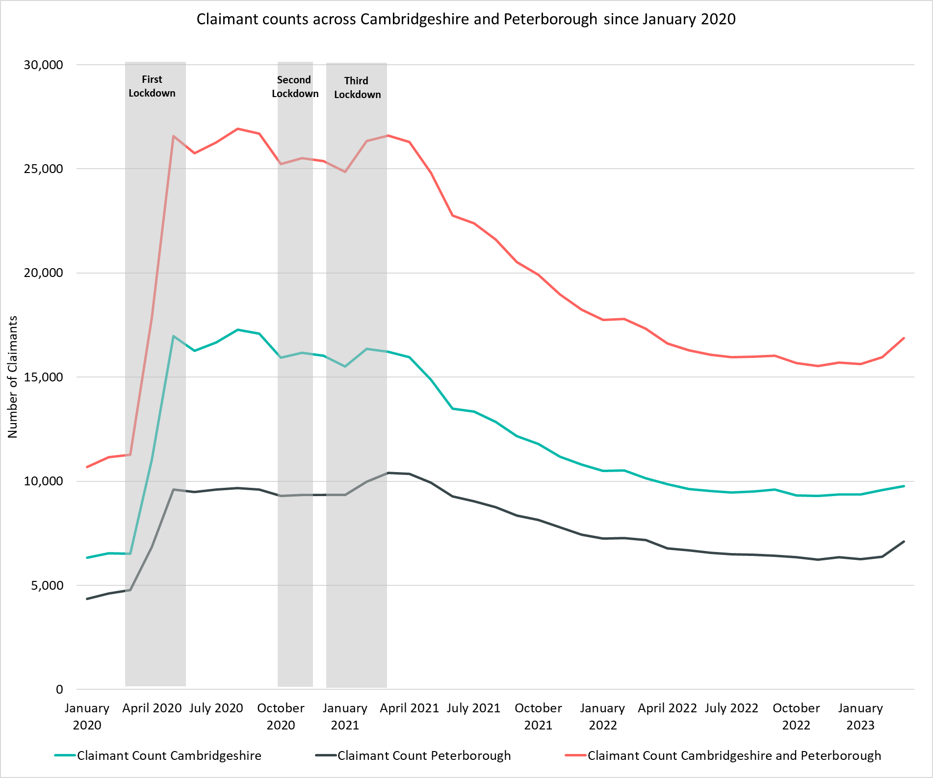
Labour Market – Claimant Count
The Claimant Count measures the number of people (age 16+) claiming benefit principally for the reason of being unemployed. We use data on claimants rather than unemployed numbers because – although the numbers are lower – they are more up to date. It is however a narrower measure of unemployment, and as such does not cover all those out of work, since not all can claim assistance.
Claimant Counts | Number of claimants March 2023 | % 16-64 population March 2023 | % Change 12 Months ago vs Now: March 2022 to March 2023 | % Change Previous update vs Now: December 2022 to March 2023
Cambridgeshire | 9,760 | 2.3% | -3.8% | +4.3%
Cambridge City | 2,100 | 2.0% | -2.1% | +2.2%
East Cambridgeshire | 1,070 | 2.0% | -9.3% | +9.2%
Fenland | 2,400 | 3.9% | -3.0% | +8.6%
Huntingdonshire | 2,425 | 2.2% | -3.6% | +3.9%
South Cambridgeshire | 1,765 | 1.8% | -3.8% | -0.3%
Peterborough | 7,110 | 5.2% | -0.8% | +12.1%
Cambridgeshire & Peterborough | 16,865 | 3.0% | -2.6% | +7.4%
United Kingdom | 1,576,390 | 3.7% | -8.2% | +4.0%
Notes:
Source – Claimant Count, Office for National Statistics
Technical Notes
The Claimant Count measures the number of people (age 16+) claiming benefit principally for the reason of being unemployed. We use data on claimants rather than unemployed numbers because although the numbers are lower they are more up to date. It is however a narrower measure of unemployment, and as such does not cover all those out of work, since not all can claim assistance. The latest claimant count data is a snapshot of the number of claimants on the 9th March 2023.
Commentary
The above chart presents claimant counts across Cambridgeshire & Peterborough from January 2020 to March 2023.
Whilst across Cambridgeshire and Peterborough the proportion of residents who are claiming benefits for reason of unemployment is lower than the UK there is a wide amount of disparity across the region with Fenland and Peterborough both having a higher number of claimants compared to other local authorities. Claimants are especially concentrated within the Peterborough area.
March 2023 data showed an increase in claimant count, there was a +7.4% increase from December 2022 across Cambridgeshire & Peterborough, with a +4.3% increase in Cambridgeshire, and a +12.1% increase in Peterborough compared to a +4.0% increase across the United Kingdom overall.
Claimant counts are lower in every district in March 2023 compared to March 2022, East Cambridgeshire (-9.3%) has seen the largest percentage decrease and Peterborough (-0.8%) the smallest percentage decrease.
Since December 2022, the claimant count across Cambridgeshire and Peterborough has risen by +7.4%. Out of Cambridgeshire and Peterborough’s constituent local authorities Peterborough saw the largest increase in the number of claimants (+765, +12%).
South Cambridgeshire (-0.3%) is the only district to see a decrease in the number of claimants from December 2022.

Slide 16
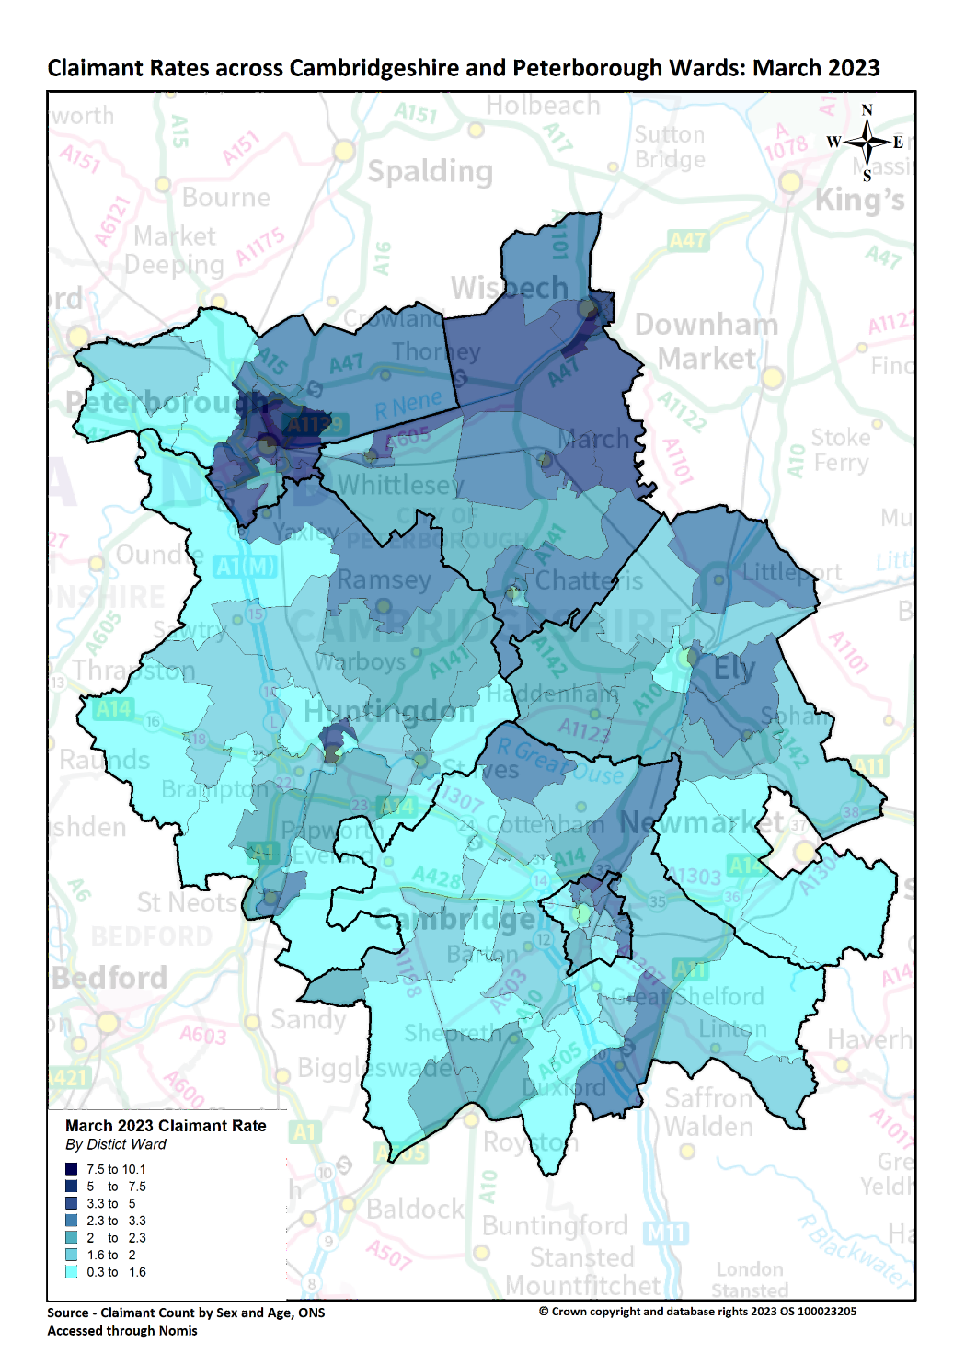
Labour Market – Claimant counts by location
Claimant Rates | Number of claimants March 2023 | % 16-64 population March 2023 | PP Change 12 Months ago vs Now: March 2022 to March 2023 | PP Change Previous update vs Now: December 2022 to March 2023
Cambridgeshire | 9,760 | 2.3% | -0.1pp | +0.1pp
Cambridge City | 2,100 | 2.0% | No Change | +0.1pp
East Cambridgeshire | 1,070 | 2.0% | -0.2pp | +0.2pp
Fenland | 2,400 | 3.9% | -0.1pp | +0.3pp
Huntingdonshire | 2,425 | 2.2% | -0.1pp | +0.1pp
South Cambridgeshire | 1,765 | 1.8% | -0.1pp | No Change
Peterborough | 7,110 | 5.2% | No Change | +0.6pp
Cambridgeshire & Peterborough | 16,865 | 3.0% | -0.1pp | +0.2pp
United Kingdom | 1,576,390 | 3.7% | -0.3pp | +0.1pp
Notes:
Source – Claimant Count, Office for National Statistics
Technical Notes
The Claimant Count measures the number of people (age 16+) claiming benefit principally for the reason of being unemployed. We use data on claimants rather than unemployed numbers because although the numbers are lower they are more up to date. It is however a narrower measure of unemployment, and as such does not cover all those out of work, since not all can claim assistance. The latest claimant count data is a snapshot of the number of claimants on the 9th March 2023.
Commentary
The above map illustrates claimant rate by ward across the Cambridgeshire & Peterborough area. We use this to highlight the wards with the highest claimant rate (represented in dark blue), rather than looking at absolute figures allows us to see the areas with the highest number of claimants for the population.
Claimant rates are generally higher in the north of the region and in urban areas. Whilst the city of Peterborough and Fenland as a whole stand out as areas with particularly high claimant rates, the north of Huntingdon and the North East and East of Cambridge City also stand out as areas with higher claimant rates.
The lowest claimant rates across Cambridgeshire & Peterborough are in the Cambridge City wards of Newnham (0.3%), Castle (0.8%), and the Huntingdonshire ward of The Stukeleys (0.8%).
Top 5 wards with highest claimant rates are: North (10.1%), Medworth (9.4%), Central (8.5%), East (8.0%) and Ravensthorpe (7.1%) 4 out of five of these wards are in the city of Peterborough whilst Medworth covers the south west of Wisbech.
All local authorities have seen decreases in claimant rates when comparing to the previous 12 months (March 2022) apart from Peterborough which saw no change. However, all local authorities have seen increases in claimant rates when compared to the previous update (December 2022) except for South Cambridgeshire which saw no change.

Slide 17
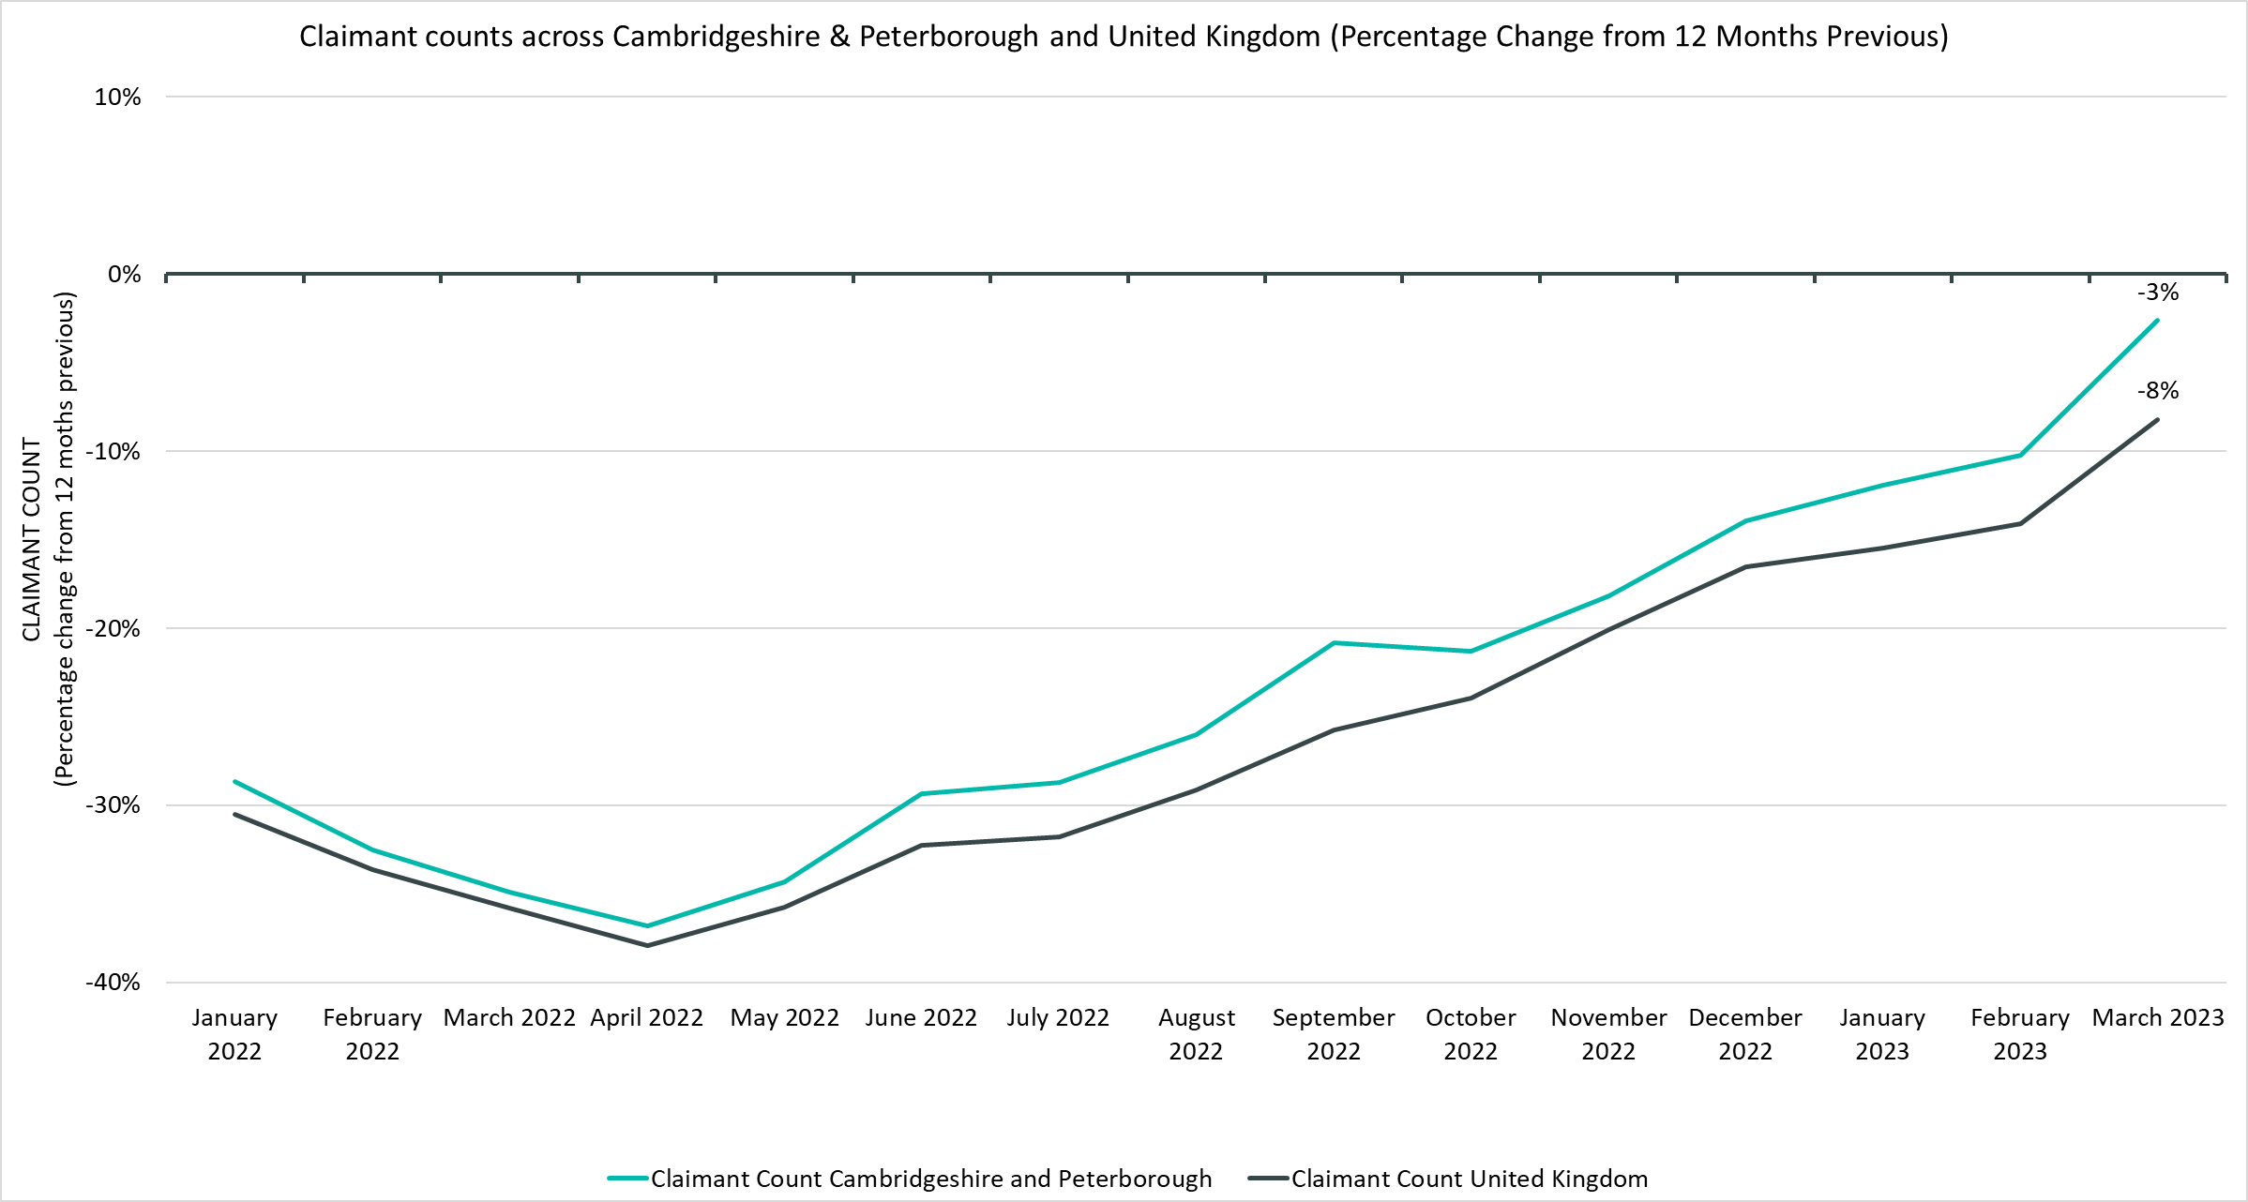
Labour Market – Claimant Count
Notes:
Source – Claimant Count, Office for National Statistics
Technical Notes
The Claimant Count measures the number of people (age 16+) claiming benefit principally for the reason of being unemployed. We use data on claimants rather than unemployed numbers because although the numbers are lower they are more up to date. It is however a narrower measure of unemployment, and as such does not cover all those out of work, since not all can claim assistance. The latest claimant count data is a snapshot of the number of claimants on the 9th March 2023.
Commentary
The above chart presents claimant counts across Cambridgeshire & Peterborough and as a percentage change from 12 months previous.
Throughout 2022 and the first quarter of 2023 the number of claimants compared to the same point in the previous year has been lower in Cambridgeshire and Peterborough as well as the UK as a whole.
The rate at which these counts has decreased in Cambridgeshire and Peterborough compared to the UK has consistently been lower.
As we have moved away from the peak claimant counts of the Covid period in 2021, the rate of the 12-month decrease has slowed but has not turned into an increase for either Cambridgeshire and Peterborough or the UK as a whole.

Slide 18
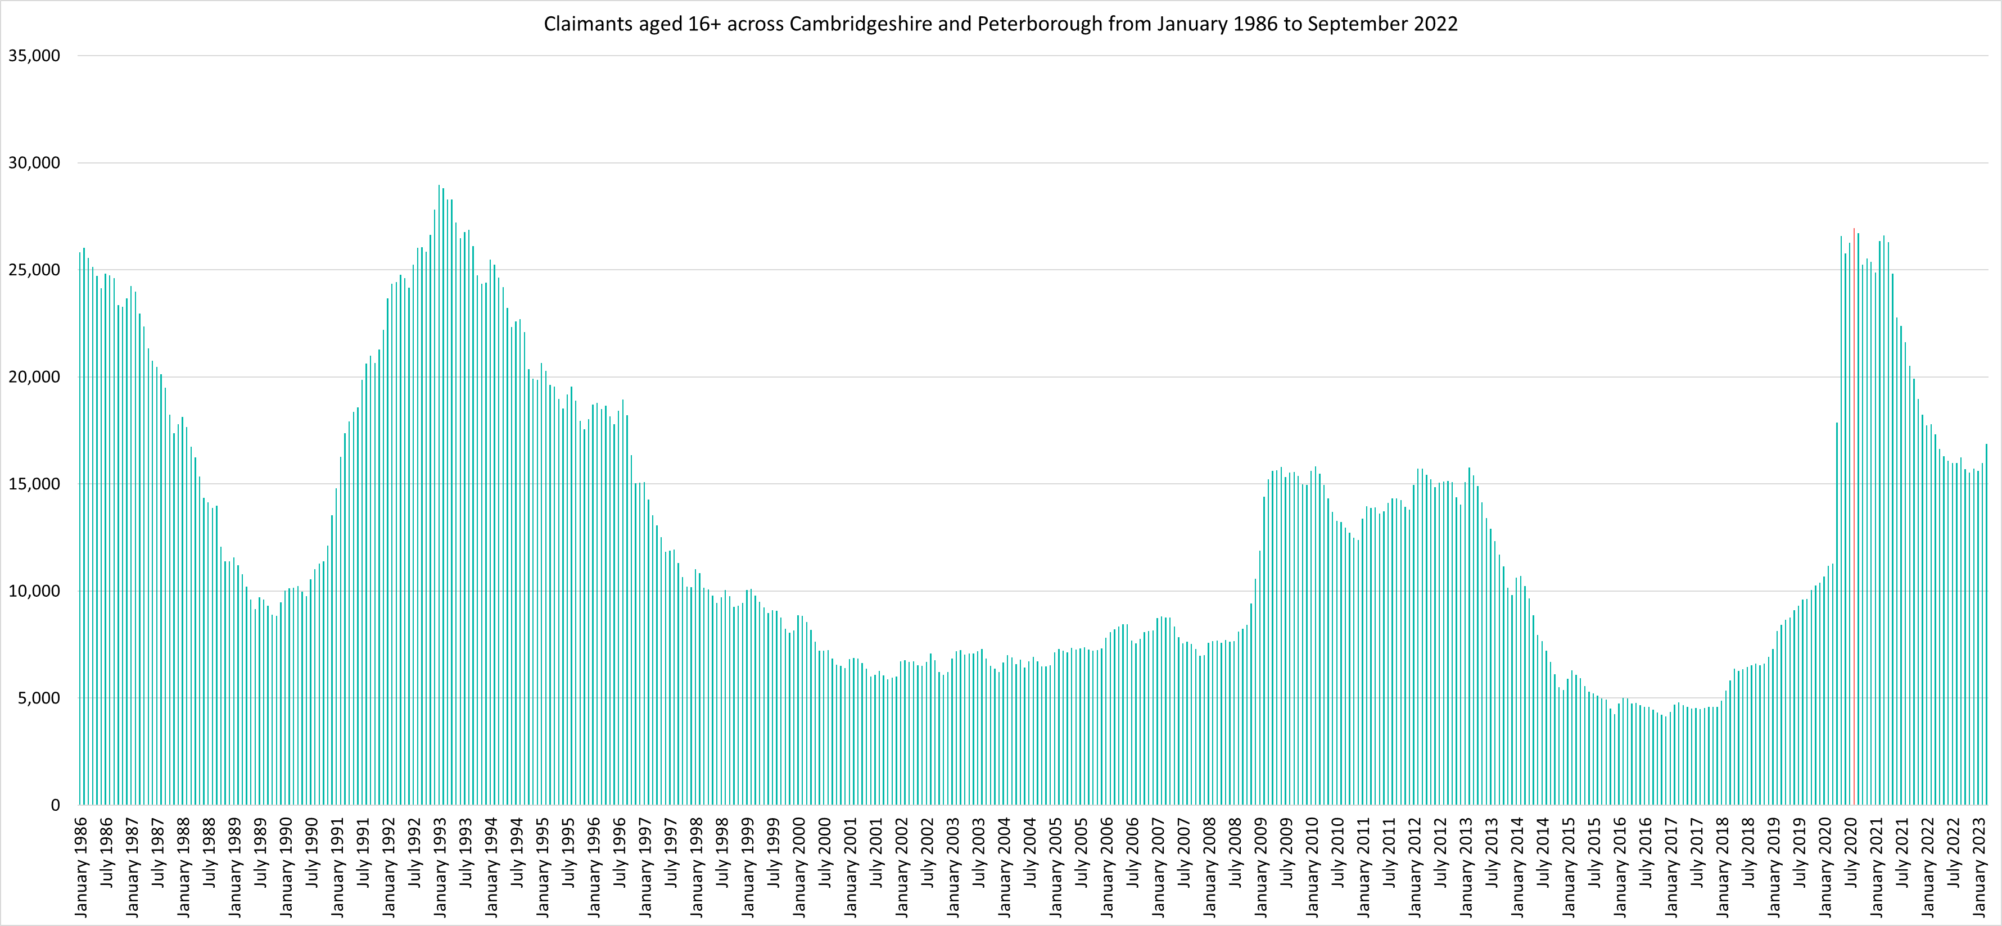
Labour Market – Claimant counts across time
Notes:
Source – Claimant Count, Office for National Statistics
Technical Notes
The Claimant Count measures the number of people (age 16+) claiming benefit principally for the reason of being unemployed. We use data on claimants rather than unemployed numbers because although the numbers are lower they are more up to date. It is however a narrower measure of unemployment, and as such does not cover all those out of work, since not all can claim assistance. The latest claimant count data is a snapshot of the number of claimants on the 9th March 2023.
Commentary
The above chart presents claimant counts across Cambridgeshire & Peterborough from January 1986 to March 2022.
September 2020 (26,700) and August 2020 (26,935) saw the highest number of claimants since 1992.
Claimant counts have decreased at a faster rate than seen from 1992, but this decline appears to have settled, at a much higher level than pre pandemic.

Slide 19
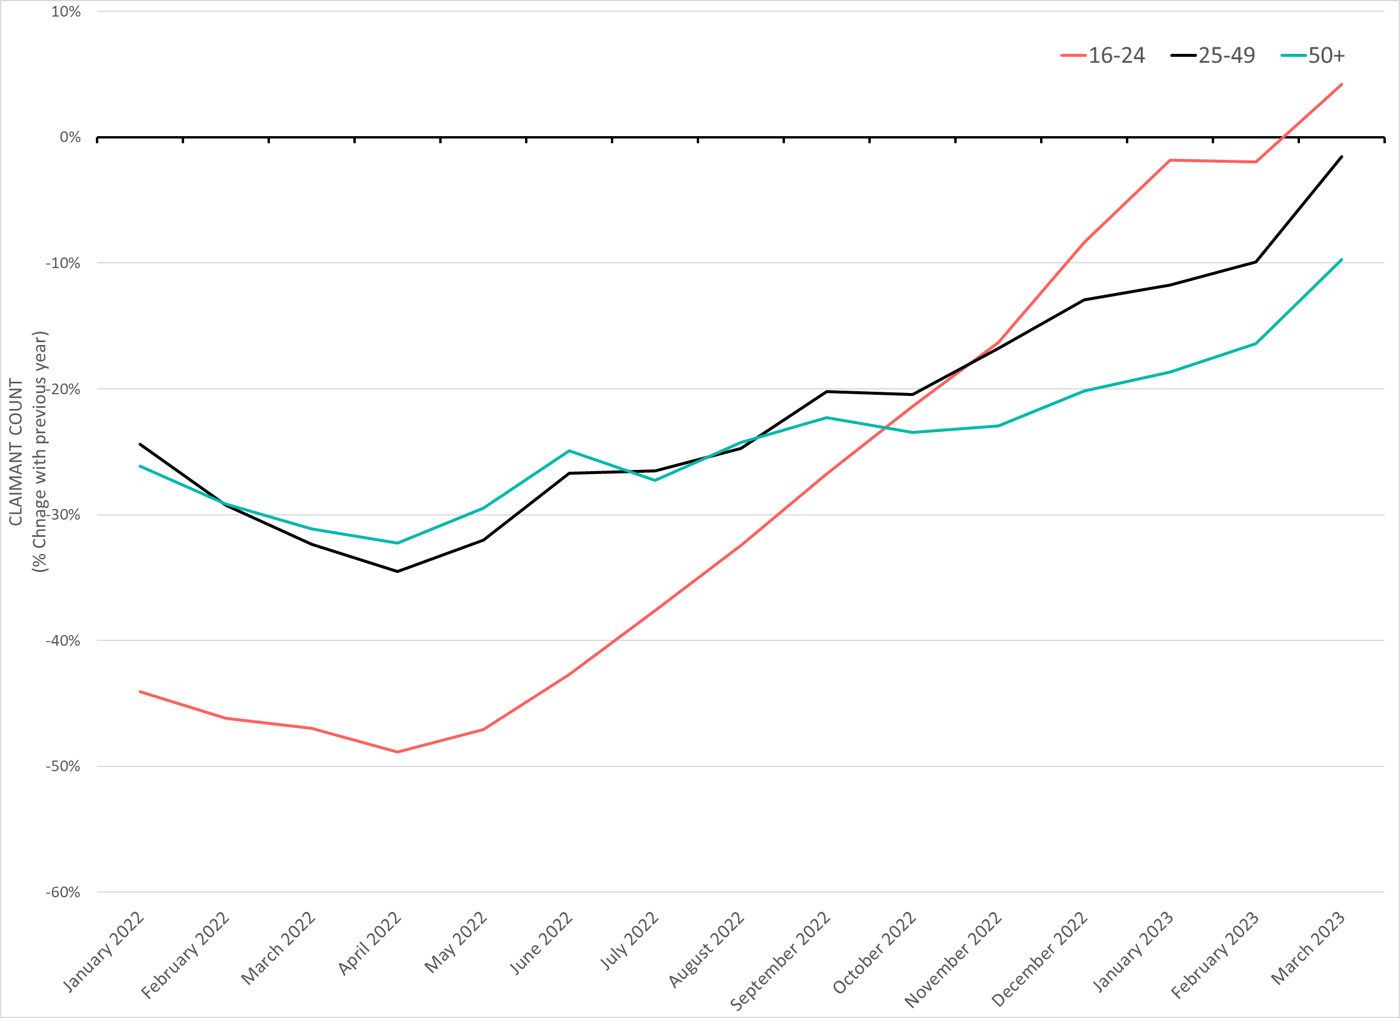
Labour Market – Claimant counts by age
March 2023 Claimant Counts by Age Group (Previous 12 month % Change)
Claimant Rates | 16-64 March 2023 | 16-17 March 2023 | 18-24 March 2023 | 25-49 March 2023 | 50+ March 2023
Cambridgeshire | 2.3% | 0.2% | 2.6% | 2.5% | 1.8%
Cambridge City | 2.0% | 0.2% | 1.2% | 2.2% | 2.6%
East Cambridgeshire | 2.0% | 0.3% | 3.0% | 2.2% | 1.6%
Fenland | 3.9% | 0.2% | 6.7% | 4.5% | 2.5%
Huntingdonshire | 2.2% | 0.3% | 3.5% | 2.5% | 1.5%
South Cambridgeshire | 1.8% | 0.1% | 2.6% | 2.0% | 1.4%
Peterborough | 5.2% | 0.2% | 7.6% | 5.6% | 3.9%
Cambridgeshire & Peterborough | 3.0% | 0.2% | 3.7% | 3.3% | 2.3%
% Change in Claimant Counts | 16-24 | 25-49 | 50+
Cambridgeshire & Peterborough (March 2022 to March 2023) | +4.2% | -1.5% | -9.7%
Cambridgeshire & Peterborough (December 2022 to March 2023) | +6.7% | +7.9% | +6.8%
Notes:
Source – Claimant Count, Office for National Statistics
Technical Notes
The Claimant Count measures the number of people (age 16+) claiming benefit principally for the reason of being unemployed. We use data on claimants rather than unemployed numbers because although the numbers are lower they are more up to date. It is however a narrower measure of unemployment, and as such does not cover all those out of work, since not all can claim assistance. The latest claimant count data is a snapshot of the number of claimants on the 9th March 2023.
Commentary
The above chart presents the percentage change in claimant counts by age for the 12 months previous,
National statistics on claimant count since the pandemic have indicated that younger age groups have been disproportionately impacted. The above chart highlights the levels of change each age group has seen in claimant counts across the Cambridgeshire & Peterborough area.
Like the overall claimant figure, the 12 month trend has shown a consistent slowing in the rate at which the number of claimants has decreased, with 16-24 year olds seeing an actual increase.
The 18-24 claimant rate also remains higher than the other age groups across Cambridgeshire and Peterborough, as is particularly high in the more relatively deprived local authorities of Peterborough and Fenland. Cambridge City is the only local authority which bucks this trend, this may be because a large proportion of 18-24 year olds there will be full time students who are, for the most part, ineligible for claiming unemployment benefits.
In March 2023, there was an +6.7% increase in claimants aged 16-24 from December 2022, a +7.9% increase in claimants aged 25-49 and a +6.8% increase in claimants aged 50+.
In Cambridgeshire, residents in the 18-24 age range have the highest claimant rate (2.6%). In Peterborough, the 18-24 age group also account for the highest claimant rate (7.6%), substantially higher than the 2.6% of this age group claiming across Cambridgeshire. This suggests that youth unemployment is more prevalent in Peterborough than Cambridgeshire. Fenland also has a high proportion of those aged 18-24 claiming relative to the other local authorities (6.7%).
Until April 2022 claimant counts across all age groups showed decreases when compared to the previous 12 months with the magnitude of decreases increasing. However, from April 2022 the magnitude of decreases became smaller and started trending towards increases.
As of March 2023 the 16-24 age group has seen a +4.2% increase when compared to March 2022. All other age groups are still seeing decreases in claimants compared to the previous year but with the magnitude of decreases getting smaller.

Slide 20
Universal Credit Claimants – March 2023
Policy changes to provide economic support during the Covid-19 pandemic allowed those on higher incomes than previously to claim Universal Credit, resulting in a permanent rise in claimants since the Spring lockdowns of 2020.
Both on a quarterly and annual basis Cambridgeshire and Peterborough has seen a higher increase in the number of claimants than Great Britain as a whole. This has mostly been driven by a rise in unemployed claimants.
As with the other benefit claimant measure, Cambridgeshire and Peterborough as a whole has a lower claimant rate than Great Britain as a whole. Again, this varies at the local authority level with Peterborough and Fenland being the only ones where the claimant rates are higher than Great Britain as a whole.
Unemployed claimants have consistently made up the majority of claimants at both a regional and local authority level. Unemployed claimants have driven both the annual and quarterly increases in the number of claimants. The number of employed claimants has remained steady, or in the case of last quarter have decreased slightly.

Slide 21
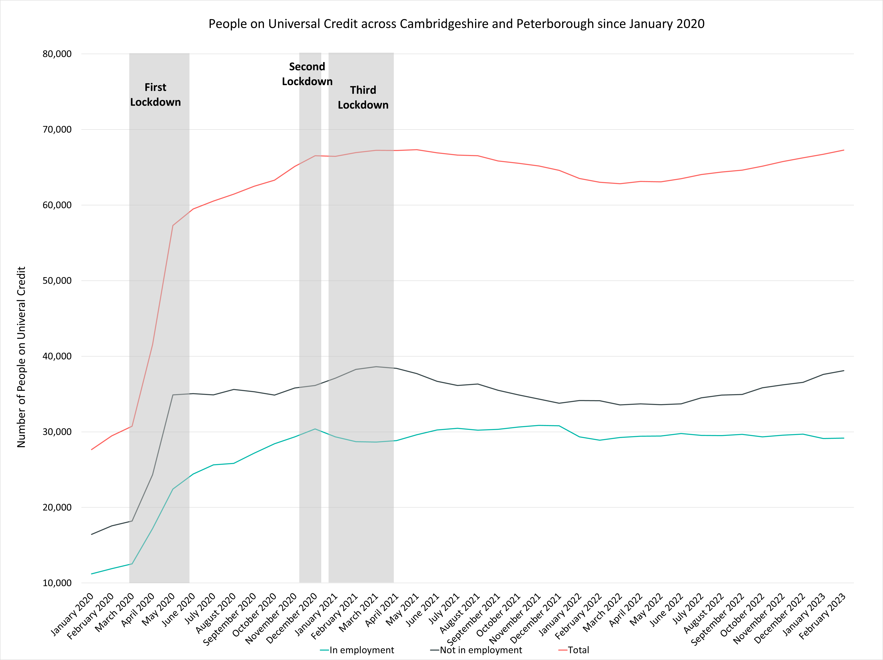
Labour Market – People on Universal Credit
People on Universal Credit | Number of total people on Universal Credit February 2023 | % 16-64 population February 2023 | % Change 12 Months ago vs Now: February 2022 to February 2023 | % Change Previous update vs Now: December 2022 to February 2023
Cambridgeshire | 40,403 | 9.3% | +8.4% | +1.5%
Cambridge City | 7,836 | 7.3% | +5.9% | +1.8%
East Cambridgeshire | 4,808 | 9.0% | +10.0% | +2.1%
Fenland | 9,524 | 15.5% | +7.1% | +2.0%
Huntingdonshire | 10,508 | 9.4% | +8.2% | +0.5%
South Cambridgeshire | 7,727 | 7.8% | +11.8% | +1.4%
Peterborough | 26,876 | 19.6% | +4.4% | +1.7%
Cambridgeshire & Peterborough | 67,279 | 11.8% | +6.7% | +1.6%
Great Britain | 5,832,812 | 13.8% | +5.0% | +1.0%
Universal Credit Status | Number of Claimants February 2023 | Share of Total February 2023 | % Change with December 2022 | % Change with February 2022
Employed | 29,179 | 43% | -1.7% | +1.0%
Unemployed | 38,104 | 57% | +4.2% | +11.6%
Notes:
Source – Universal Credit Claimants, Department for Work and Pensions
Technical Notes
Universal Credit is available in every jobcentre across Great Britain. Roll out was completed in December 2018.
Universal Credit is a single payment for each household to help with living costs for those on a low income or out of work. It is replacing six benefits, commonly referred to as the legacy benefits:
Income-based Jobseeker's Allowance
Income-related Employment and Support Allowance
Income Support
Working Tax Credit
Child Tax Credit
Housing Benefit
Support for housing costs, children and childcare costs are integrated into Universal Credit. It also provides additions for people with a disability, health condition or caring responsibilities which may prevent them from working.
Commentary
The chart above highlights changes in the number of people on universal credit across Cambridgeshire and Peterborough by Employment Status from January 2020.
The number of Universal Credit claimants includes those who have started Universal Credit (completed the Universal Credit claim process and accepted their Claimant Commitment) and have not had a closure of their claim recorded for this spell, up to the 'count date' (second Thursday in each month). A closure of their claim would be recorded either at the request of the individual or if their entitlement to Universal Credit ends, for example, if they no longer satisfy the financial conditions to receive Universal Credit as they have capital over £16,000.
It is important to note that the initial rise in claimants during the first lockdown period was due to policy changes brought in as part of the pandemic response that allowed people on higher incomes than before to claim the benefit, the peak of this increase came during the second lockdown in the Winter of 2020.
Unemployed claimants have consistently made up the majority of claimants. The increases across the last quarter, and the last 12 months, have mostly been driven by these unemployed claimants with the number of employed claimants remaining stable over the last 12 months and even decreasing in the last quarter.
Despite decreases from Q1 of 2021, the numbers of those on universal credit remains much higher than Pre-Covid with numbers trending upwards from May 2022.
Peterborough has the highest proportion of the 16-64 population claiming at 19.6%. Cambridge City has the lowest at 7.3%.
All local authorities have seen increases in the number of those on universal credit from the previous 12 months (February 2022) with the largest increase seen in South Cambridgeshire (+11.8%). Cambridge City has seen the smallest increase (+5.9%) whilst the overall region saw a +6.7% increase and Great Britain a +5.0% increase.
All local authorities have seen an increase in the number of those on universal credit from the previous update (December 2022).
Unemployed claimants make up the majority of people on universal credit (57%) and saw a +4.2% increase from December 2022 and a +11.6% increase from February 2022. In comparison employed claimants saw a -1.7% decrease from December 2022 and a +1.0% increase from February 2022.

Slide 22
Wages and Inflation
Annual Survey of Hours and Earnings 2022 – Survey carried out in April 2022, data released in October 2022

Slide 23
Wages and Inflation– April 2022
Whilst workers who are resident in Cambridgeshire and Peterborough overall have higher median weekly wages than the UK there is not an even distribution across the region. Residents of Cambridge and South Cambridgeshire have higher average wages and Fenland and Peterborough residents have lower.
Annual wage growth in the region has fallen below national levels since 2021 and has fallen well below inflation in 2022.
When comparing the median weekly wages of Cambridgeshire and Peterborough’s residents by district/unitary local authorities to the rest of the country both South Cambridgeshire and Cambridge fall into the top 20% most highly paid in the country, with South Cambridgeshire being in the top 10%. Conversely the local authorities with the lowest pay, Fenland and Peterborough, both fall into the bottom 30% out of the UK’s unitary and district local authorities.
Looking at annual wage growth by local authority, only Huntingdonshire and Fenland saw annual wage growth that was higher than inflation at the point the survey was taken (April 2022 where inflation was at 8%) and were also the only local authorities to see wage growth exceed the overall national figure. It is interesting to note that South Cambridgeshire, whose residents still maintain the highest overall median wages in Cambridgeshire and Peterborough, was the only local authority to see a fall in median weekly wage (-1.2%)

Slide 24
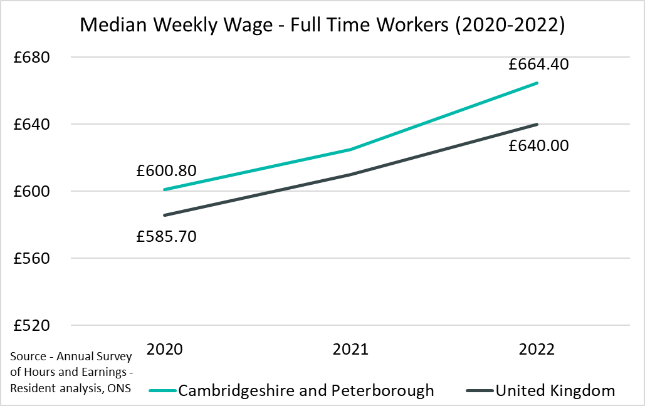
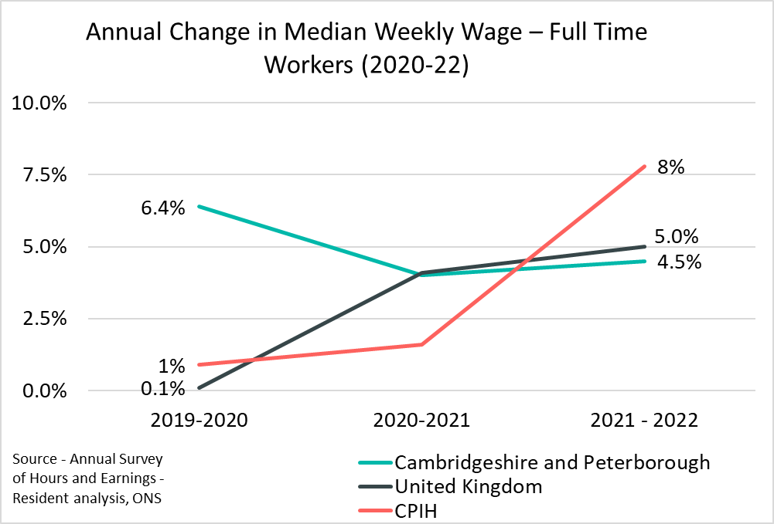
Employment Trends – Median Weekly Wage (Residents)
CPIH – Consumer Prices Index including owner occupiers’ housing costs, the national headline measure of inflation
Local Authority | Cambridge | East Cambridgeshire | Fenland | Huntingdonshire | Peterborough | South Cambridgeshire
Median Weekly Wage (2022) | £748.60 | £637.80 | £593.80 | £642.00 | £586.20 | £767.70
% Change from 2021 | +2.7% | +2.0% | +8.2% | +9.0% | +3.8% | -1.2%
Rolling Quarterly change
(Sept – Dec 22):
Previous change
(Jun – Sept 22):
Change since December 2021:
+2.2pp
-2.2pp
-1.8pp
Comparing Jan 2022- Dec 2022 with Oct 2021 - Sept 2022
Comparing Oct 2021– Sept 2022 with Jul 2021 – Jun 2022
Comparing Jan 2022- Dec 2022 with Jan 2021 - Dec 2021
Notes:
Source –Annual Survey of Hours and Earnings
Technical Notes
The Annual Survey of Hours and Earnings (ASHE) is conducted in April each year to obtain information about the levels, distribution and make-up of earnings and hours worked for employees.
ASHE is based on a sample of employee jobs taken from HM Revenue & Customs PAYE records. Information on earnings and hours is obtained in confidence from employers. ASHE does not cover the self-employed nor does it cover employees not paid during the reference period.
The data on this slide is based on the wages of those who are resident in Cambridgeshire and Peterborough and its constituent local authorities.
Commentary
The above charts show the median weekly wage of full time workers across Cambridgeshire and Peterborough and the United Kingdom over the last three years, and the percentage increase in median weekly wage of full time workers compared to the CPIH, the ONS’ headline inflation measure over the same geography and time.
The median weekly wage in Cambridgeshire and Peterborough in 2022 was £664.40, this is above the United Kingdom value of £640.00 as it has been for each of the last three years .
Between 2021 and 2022 the annual increase in median weekly wage was slightly lower in Cambridgeshire and Peterborough than the United Kingdom as a whole (4.5% compared to 5% in the UK), Both values had fallen well below inflation at the point the survey was taken (8%).
South Cambridgeshire is the only local authority to see a percentage decrease in the median weekly wage (-1.2%) from 2021. However, it still saw the highest median weekly wage out of all of Cambridgeshire and Peterborough’s local authorities (£767.70).
Huntingdonshire (+9%) saw the largest percentage increase in the median weekly wage from 2021.
Fenland (£593.80) and Peterborough (£586.20) are the only local authorities to have a median weekly wage lower than the United Kingdom average.

Slide 25
Vacancies
Lightcast Vacancies Data – March 2023

Slide 26
Vacancies – March 2023
After record numbers of vacancies across Quarter 4 of 2021 and Quarter 1 of the 2022, vacancies decreased in the first half of 2022 and have stabilised at a new baseline.
Looking at how vacancies have changed since the previous update, and when compared to the same point in 2022, vacancies have increased from December 2022 but are substantially down compared to March 2022.It should be noted that this large annual drop is due to March 2022 having the second highest number of monthly vacancies in the last 10 years.
The annual decrease from March 2022 can be observed across all sectors. When compared to December 2022 Construction, Financial and Insurance Activities, Real estate activities and professional, scientific and technical activities all saw increases of more than 10% from December 2022.

Slide 27
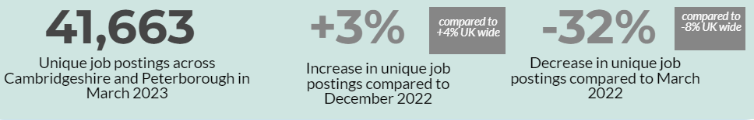
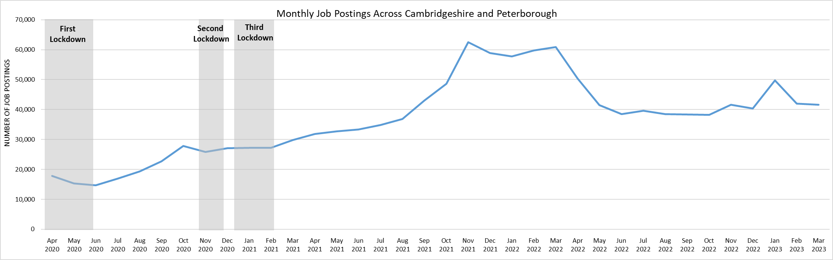
Employment Trends – Vacancies
Notes:
Source – Lightcast
Technical Information
Vacancy data is sourced from Lightcast, a service that has been procured by Cambridgeshire and Peterborough Combined Authority which gives labour market information on Job postings, occupations, and industries. Lightcast has a job posting aggregator which scans jobs websites for posting and presents them together.
Lightcast only scans online jobs postings and therefore does not include any jobs which are advertised solely offline. There is also no guarantee that all online job postings are aggregated. For example, a specific job site may not be scanned.
A unique job posting is a deduplicated count of an online job vacancy advertisement. If the same vacancy is posted twice across a sixty-day period, it is only counted once. If the same vacancy is posted twice more than sixty days apart it is counted as two unique job postings.
Commentary
The above chart illustrates online vacancy data across the Cambridgeshire & Peterborough area since April 2020. A unique job posting is a deduplicated count of an online job vacancy advertisement. If the same vacancy is posted twice across a sixty-day period, it is only counted once. If the same vacancy is posted twice more than sixty days apart it is counted as two unique job postings.
There were 41,633 job postings across Cambridgeshire & Peterborough in September 2022, down by -32% from March 2022. Nationally, job postings decreased by -8% in the same period. It should be noted that this large annual drop is due to March 2022 having the second highest number of monthly vacancies in the last 10 years
November 2021 saw the highest number of vacancies across Cambridgeshire & Peterborough for the past ten years.
January 2023 saw a large increase in job postings: +23% from the previous month in Cambridgeshire and Peterborough and +21% nationally.
The number of vacancies increased rapidly in the final quarter of 2021 but appear to have peaked in late 2021/early 2022 before rapidly decreasing and appearing to stabilise across the 2nd half of 2022 and into 2023
*Lightcast data is available from 2012 onwards.

Slide 28
Employment Trends – Vacancies by Industry
Notes:
Source – Lightcast
Technical Information
Vacancy data is sourced from Lightcast, a service that has been procured by Cambridgeshire and Peterborough Combined Authority which gives labour market information on Job postings, occupations, and industries. Lightcast has a job posting aggregator which scans jobs websites for posting and presents them together.
Lightcast only scans online jobs postings and therefore does not include any jobs which are advertised solely offline. There is also no guarantee that all online job postings are aggregated. For example, a specific job site may not be scanned.
A unique job posting is a deduplicated count of an online job vacancy advertisement. If the same vacancy is posted twice across a sixty-day period, it is only counted once. If the same vacancy is posted twice more than sixty days apart it is counted as two unique job postings.
Commentary
The above table shows the number of Vacancies in Cambridgeshire and Peterborough in March 2023 by employment sector, and includes percentage changes from the previous quarter and previous year, including a national comparison.
Construction (+18%), Financial and Insurance Activities (+19%), Real estate activities (17%) and professional, scientific and technical activities (+14%) all saw increases of more than 10% from December 2022.
Transportation and Storage (-23%), Accommodation and food services (-17%) saw the largest percentage decreases from December 2022 in Cambridgeshire and Peterborough.
Each Sector in Cambridgeshire and Peterborough has decreased from March 2022. However, it should be stated that March 2022 was the month with the second highest number of vacancies over the last ten years.

Slide 29
Employment Trends –by Industry
Median Posting Duration (Cambridgeshire and Peterborough) | Posting Intensity (Cambridgeshire and Peterborough)
33 Days | 3:1
The chart above shows two metrics to measure the potential difficulty in filling roles in certain sectors:
Median Posting Duration measures how long the average job posting is live online for. A longer time up could suggest that the company anticipates the role being harder to fill
Posting Intensity is a ratio of how many times the same job role is posted. A higher ratio could suggest difficulty filling the role
Notes:
Source – Lightcast
Technical Information
Vacancy data is sourced from Lightcast, a service that has been procured by Cambridgeshire and Peterborough Combined Authority which gives labour market information on Job postings, occupations, and industries. Lightcast has a job posting aggregator which scans jobs websites for posting and presents them together.
Lightcast only scans online jobs postings and therefore does not include any jobs which are advertised solely offline. There is also no guarantee that all online job postings are aggregated. For example, a specific job site may not be scanned.
Median Posting Duration measures how long the average job posting is live online for. A longer time up could suggest that the company anticipates the role being harder to fill.
Posting Intensity is a ratio of how many times the same job role is posted. A higher ratio could suggest difficulty filling the role.
Commentary
The table above shows the median posting duration and the posting intensity for employment sectors from January to March 2023. Both measures can be used as an indication of difficult to fill roles.
Across Cambridgeshire and Peterborough, the median posting duration was 33 days. Human Health and Social work, Manufacturing, other service activities and transportation and storage (all 34) were above this. Construction (35 days) had the longest median posting duration.
Professional and Scientific activities (31), Information and Communication (31), are the 2 sectors most below the median posting duration. Arts, Entertainment and recreation, Financial and Insurance activities, Public administration and Defence; compulsory social security and real estate activities (All 32) were also below the Median posting duration for Cambridgeshire and Peterborough.
The posting intensity across Cambridgeshire and Peterborough was 3:1. Human health and social work activities is the only sector above the regional average (4:1).

