Slide 1

GCP Economy & Employment Update
Quarter 1 2023 (Jan-March 2023)
Research Group, Cambridgeshire County Council
Research.Group@Cambridgeshire.gov.uk

Slide 2
Labour Market Overview

Slide 3
Labour Market Headline Findings – January to December 2022
The headline labour market statistics for the full 2022 year across Greater Cambridge as a whole appear healthier than the UK as a whole, especially when looking at the employment and economic inactivity rates
As in previous years, a higher proportion of the Greater Cambridge working age population is economically active and in employment when compared to the UK. Looking at the 16–64-year-old population, the region has consistently had a higher employment rate, a lower unemployment rate and a lower economic inactivity rate than the UK.
Looking at how these rates have changed since the last quarter, and when compared to the same point in 2021, the employment rate is showing decreases whilst the economically inactive population is increasing. This may indicate residents leaving the labour market. This change in economic inactivity has not been seen on a national level but may also be a result of sporadic data due to the small geographical area of the region. The unemployment rate shows decreases in parity with the UK.
Looking at Census 2021 and the reason for the economic inactivity being a student is more prominent amongst the Greater Cambridge population than the United Kingdom as a whole. This is due to the presence of the University of Cambridge and Anglia Ruskin University.

Slide 4
Labour Market Headlines - Definitions
Employment Rate
(Employed Population/Total Population)
Unemployment Rate
(Unemployed Population/Economically Active Population)
Economic Inactivity Rate
(Economically Inactive Population/Total Population)
The percentage of the total population who are employed
The proportion of the Economically Active Population without a job, have been actively seeking work in the past four weeks and are available to start work in the next two weeks or are out of work, have found a job and are waiting to start it in the next two weeks
The proportion of the population without a job and have not sought work in the last four weeks and/or are not available to start work in the next two weeks
Example reasons for being economically inactive could include being a student, having caring responsibilities, being sick and disabled and retirement
Note – All of these measures are calculated on the basis of the working age (16-64) population

Slide 5

Unemployment Rate Overall (aged 16-64) – 2.4%
Quarterly change
Previous change
Change since previous year
The unemployment rate in Dec 2022 was 2.4% (lower than the 3.6% nationally), this has decreased by -1.1 percentage points since the last quarter and is -1.2pp lower than the level 12 months previously
Rolling Quarterly change
(Jan – Mar 2022):
-1.1pp
No Change
-1.2pp
+1.9%
Comparing Jan 2022- Dec 2022 with Oct 2021 - Sept 2022
Comparing Oct 2021– Sept 2022 with Jul 2021 – Jun 2022
Comparing Jan 2022- Dec 2022 with Jan 2021 - Dec 2021
Employment Rate Overall (aged 16-64) – 78.9%
The employment rate to Dec 2022 was 78.9% (higher than the 75.5% nationally), this has decreased by -0.2 percentage points since the last quarter and is -2.0 percentage points lower than the level 12 months previously
Quarterly change
Previous change
Change since previous year
-0.2pp
-3.3pp
+1.9%
-2.0pp
Comparing Jan 2022- Dec 2022 with Oct 2021 - Sept 2022
Comparing Oct 2021– Sept 2022 with Jul 2021 – Jun 2022
Comparing Jan 2022- Dec 2022 with Jan 2021 - Dec 2021
Economically Inactive (aged 16-64) – 19.2%
Previous change
Change since previous year
19.2% were economically inactive in the Year to Dec 2022 (lower than the 21.7% nationally), this has increased by +1.2pp since the last quarter and is +3.1pp higher than then 12 months previously
Quarterly change
+1.2pp
+3.4pp
+3.1pp
+1.9%
Comparing Jan 2022- Dec 2022 with Oct 2021 - Sept 2022
Comparing Oct 2021– Sept 2022 with Jul 2021 – Jun 2022
Comparing Jan 2022- Dec 2022 with Jan 2021 - Dec 2021
* Please note: estimates and confidence intervals are unreliable due to small sample sizes and so should be treated as indicative.
Notes:
Source – Annual Population Survey, Office for National Statistics
Technical Notes
A residence based labour market survey encompassing population, economic activity (employment and unemployment), economic inactivity and qualifications. These are broken down where possible by gender, age, ethnicity, industry and occupation. Available at Local Authority level and above. Updated quarterly.
Commentary
Between 2021 and 2022 Greater Cambridge experienced a growth in the proportion of the working age population moving into economic inactivity with decreases in the unemployment rate and employment rate. Levels of economic inactivity remain below the national average and the employment rate is higher than nationally with the unemployment rate lower.
In January to December 2022 Greater Cambridge, as it has done in previous years, maintained a higher employment rate, lower unemployment rate and a lower economic inactivity rate than the UK as a whole
In comparison with the same period last year and with the UK Greater Cambridge has seen decrease in the employment rate compared to an increase the UK (-2.0pp percentage points in Greater Cambridge compared to +0.8pp in the UK) and a greater increase in the economic inactivity rate (+3.1pp in Greater Cambridge compared to no change in the UK as a whole). It is important to note that these figures may be influenced by student dynamics and the small geography of the region.

Slide 6
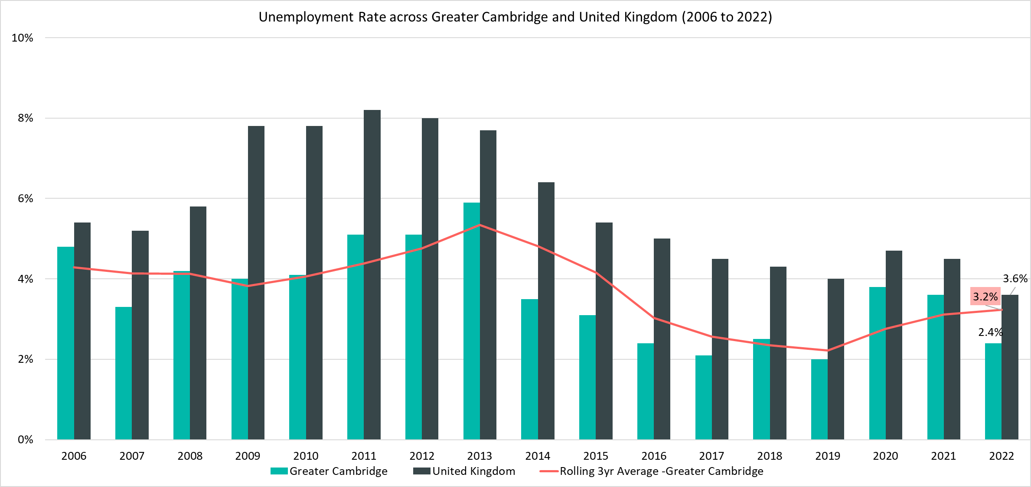
Unemployment Rate (16-64 year olds) - 2.4%, (January 2022 - December 2022)
Rolling Quarterly change
(Sept – Dec 22):
Previous change
(Jun – Sept 22):
Change since December 2021:
Rolling Quarterly change
(Sept – Dec 22):
-1.1pp
Previous change
(Jun – Sept 21):
No Change
Change since December 2021:
-1.2pp
-1.1pp
No Change
-1.2pp
Comparing Jan 2022- Dec 2022 with Oct 2021 - Sept 2022
Comparing Oct 2021– Sept 2022 with Jul 2021 – Jun 2022
Comparing Jan 2022- Dec 2022 with Jan 2021 - Dec 2021
Please note: estimates and confidence intervals are unreliable due to small sample sizes for 2016-2020 and 2022 and so should be treated as indicative.
Notes:
Source – Annual Population Survey (2006-2022), Office for National Statistics
Technical Notes
A residence based labour market survey encompassing population, economic activity (employment and unemployment), economic inactivity and qualifications. These are broken down where possible by gender, age, ethnicity, industry and occupation. Available at Local Authority level and above. Updated quarterly.
Commentary
The above chart shows the unemployment rate across Greater Cambridge and the United Kingdom from 2006 to 2022 alongside a rolling three year average for Greater Cambridge
The unemployment rate has been consistently been lower than the UK but has broadly followed the same pattern seen nationally.
The gap between the United Kingdom and Greater Cambridge unemployment rates are smaller than they were in 2019 before the Covid-19 pandemic.

Slide 7
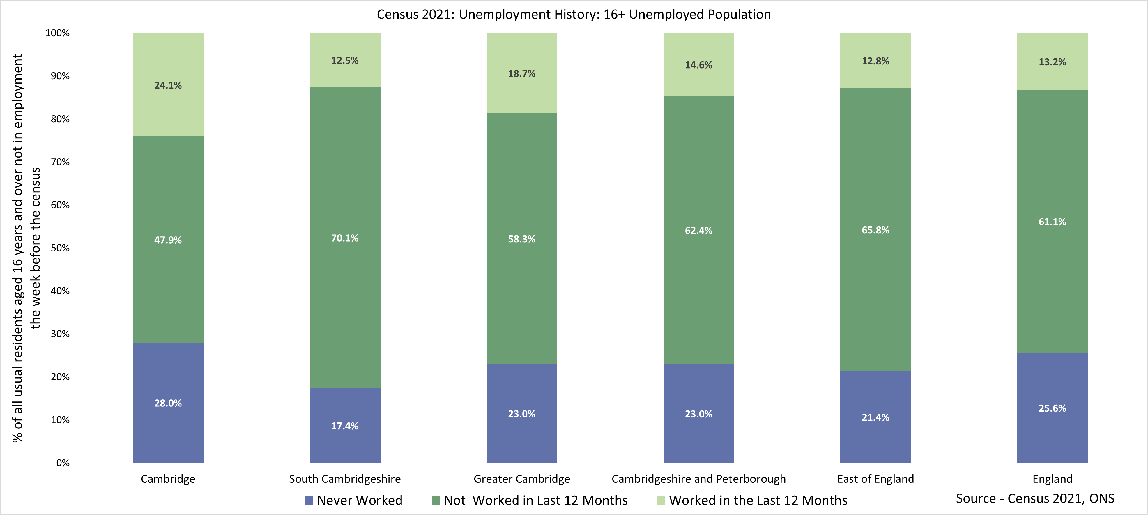
Census 2021 – Unemployment History
Note – As Census 2021 took place during the coronavirus (COVID-19) pandemic, a period of unparalleled and rapid change; the national lockdown, associated guidance and furlough measures will have affected data associated with the labour market. This should be considered when using this data for planning or policy purposes. The charts above depicts unemployed 16+ population by their economic activity status, whilst other analysis within this slide pack focuses on the 16-64 age group
Notes:
Source - Census 2021, Office for National Statistics
Technical Notes
All usual residents aged 16 years and over who were either economically active and unemployed, or economically inactive were asked whether they had ever done any paid work. This meant that people in England and Wales who were not in employment during Census 2021 could be divided into three categories:
Last did paid work within the last 12 months
Last did paid work more than 12 months ago
Have never worked
Commentary
The chart above looks at the unemployed population as they were reported in the 2021 census by their length of unemployment. Please note that this analysis uses the 16+ population as a base rather than the 16-64 used in the other analysis within this pack. Therefore, all analysis should be treated as indicative and not directly compared to the other slides.
The majority of residents who were unemployed in Greater Cambridge had not worked in the last year (58.3%) but have worked prior to this.
There were higher proportions of residents in Cambridge City (28.0%) who have never worked compared to South Cambridgeshire (23.0%).
Cambridge City had a higher proportion of those not in employment who have worked in the last year (24.1%) compared to South Cambridgeshire (12.5%).

Slide 8
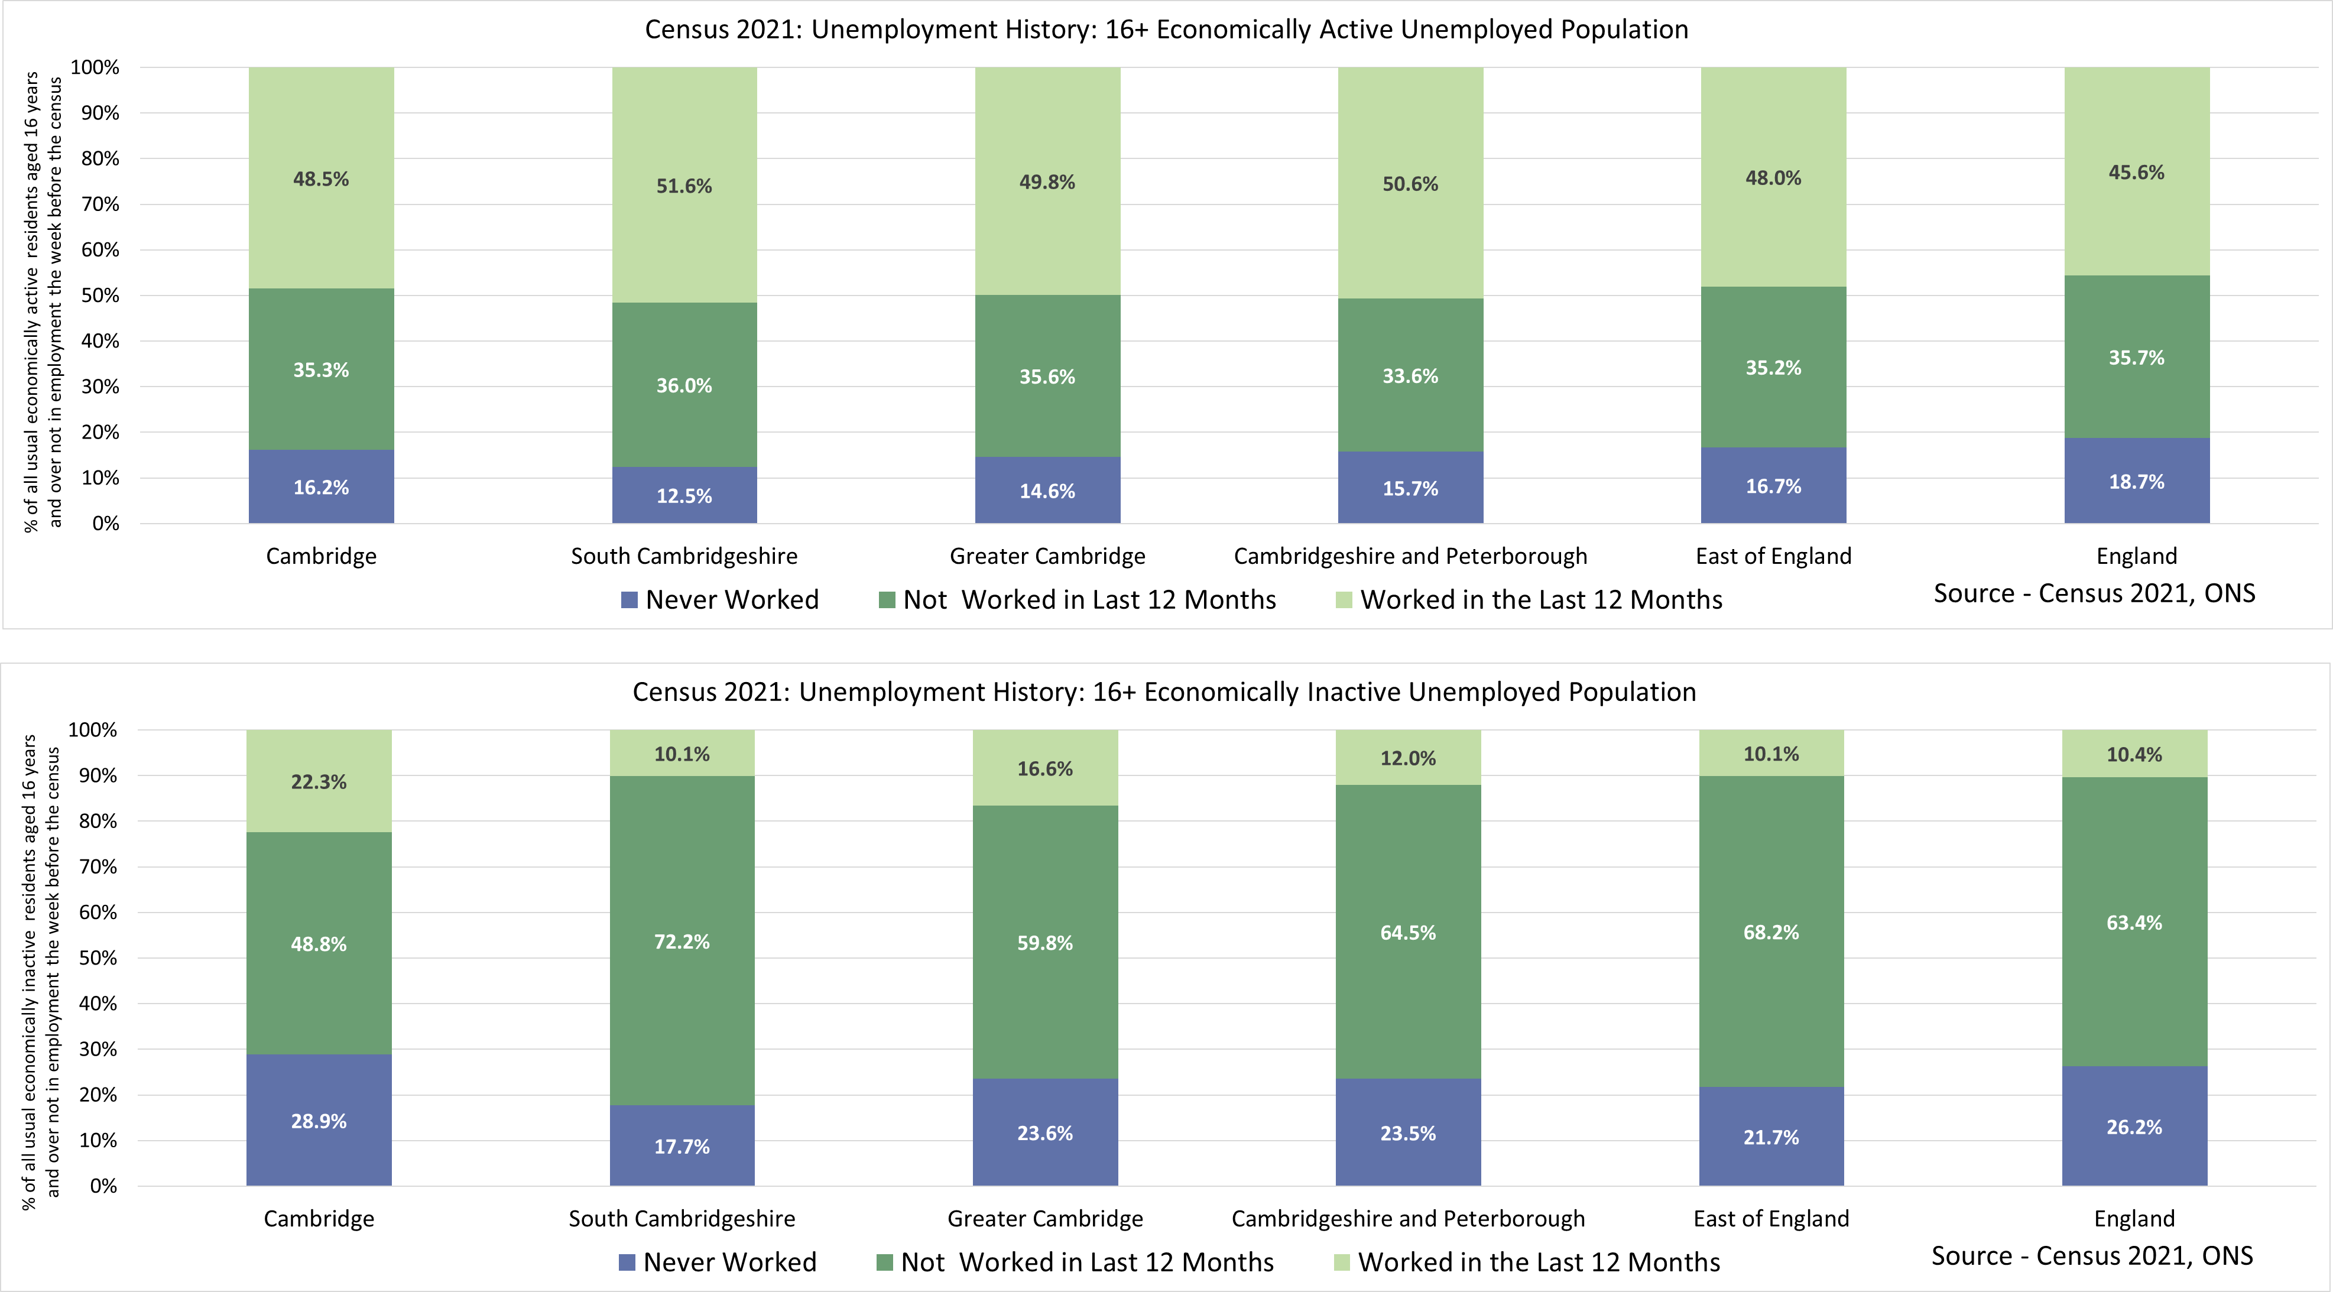
Census 2021 – Unemployment History by Economic Activity Status
Note – As Census 2021 took place during the coronavirus (COVID-19) pandemic, a period of unparalleled and rapid change; the national lockdown, associated guidance and furlough measures will have affected data associated with the labour market. This should be considered when using this data for planning or policy purposes. The charts above depicts unemployed 16+ population by their economic activity status, whilst other analysis within this slide pack focuses on the 16-64 age group
Notes:
Source - Census 2021, Office for National Statistics
Technical Notes
All usual residents aged 16 years and over who were either economically active and unemployed, or economically inactive were asked whether they had ever done any paid work. This meant that people in England and Wales who were not in employment during Census 2021 could be divided into three categories:
Last did paid work within the last 12 months
Last did paid work more than 12 months ago
Have never worked
Commentary
The chart above looks at the unemployed population by economic activity status as they were reported in the 2021 census by their length of unemployment. Please note that this analysis uses the 16+ population as a base rather than the 16-64 used in the other analysis within this pack. Therefore, all analysis should be treated as indicative and not directly compared to the other slides.
The main difference in unemployment history between the economically inactive and economically active population was that more than 80% the economically inactive population in Greater Cambridge had not worked in the last year or had never worked, this compared to 50.2% of the economically active employed population.
When comparing between Cambridge and South Cambridgeshire Cambridge has a higher proportion of those which have ‘Never Worked’. In the economically inactive unemployed population this may be driven by the large student population in Cambridge.

Slide 9
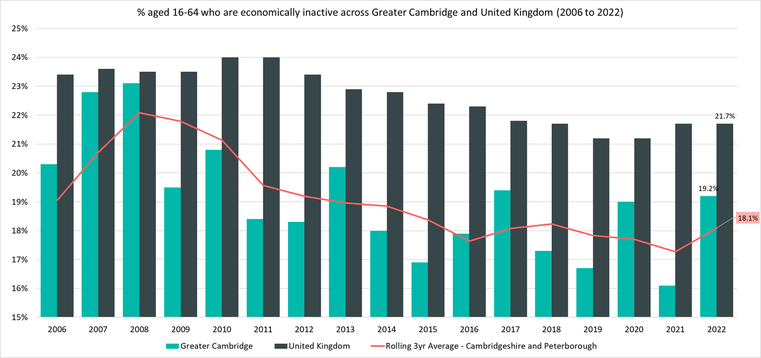
Economically Inactive (16-64 Year Olds) – 19.2%, (January 2022 – December 2022)
Rolling Quarterly change
(Sept – Dec 22):
Previous change
(Jun – Sept 22):
Change since December 2021:
Rolling Quarterly change
(Sept – Dec 22):
+1.1pp
Previous change
(Jun – Sept 21):
+3.4pp
Change since December 2021:
+3.1pp
Rolling Quarterly change
(Sept – Dec 22):
-1.1pp
No Change
-1.2pp
Previous change
(Jun – Sept 22):
Change since December 2021:
-0.2pp
-3.3pp
-2.0pp
Comparing Jan 2022- Dec 2022 with Oct 2021 - Sept 2022
Comparing Oct 2021– Sept 2022 with Jul 2021 – Jun 2022
Comparing Jan 2022- Dec 2022 with Jan 2021 - Dec 2021
Notes:
Source – Annual Population Survey (2006-2022), Office for National Statistics
Technical Notes
A residence based labour market survey encompassing population, economic activity (employment and unemployment), economic inactivity and qualifications. These are broken down where possible by gender, age, ethnicity, industry and occupation. Available at Local Authority level and above. Updated quarterly.
Commentary
The above chart shows the percentage of those aged 16-64 who are economically inactive across Greater Cambridge and United Kingdom from 2004 to 2022.
The percentage of those aged 16-64 who are economically inactive has been consistently below the national level. Note that the pattern is likely to be more sporadic given the smaller geography.

Slide 10
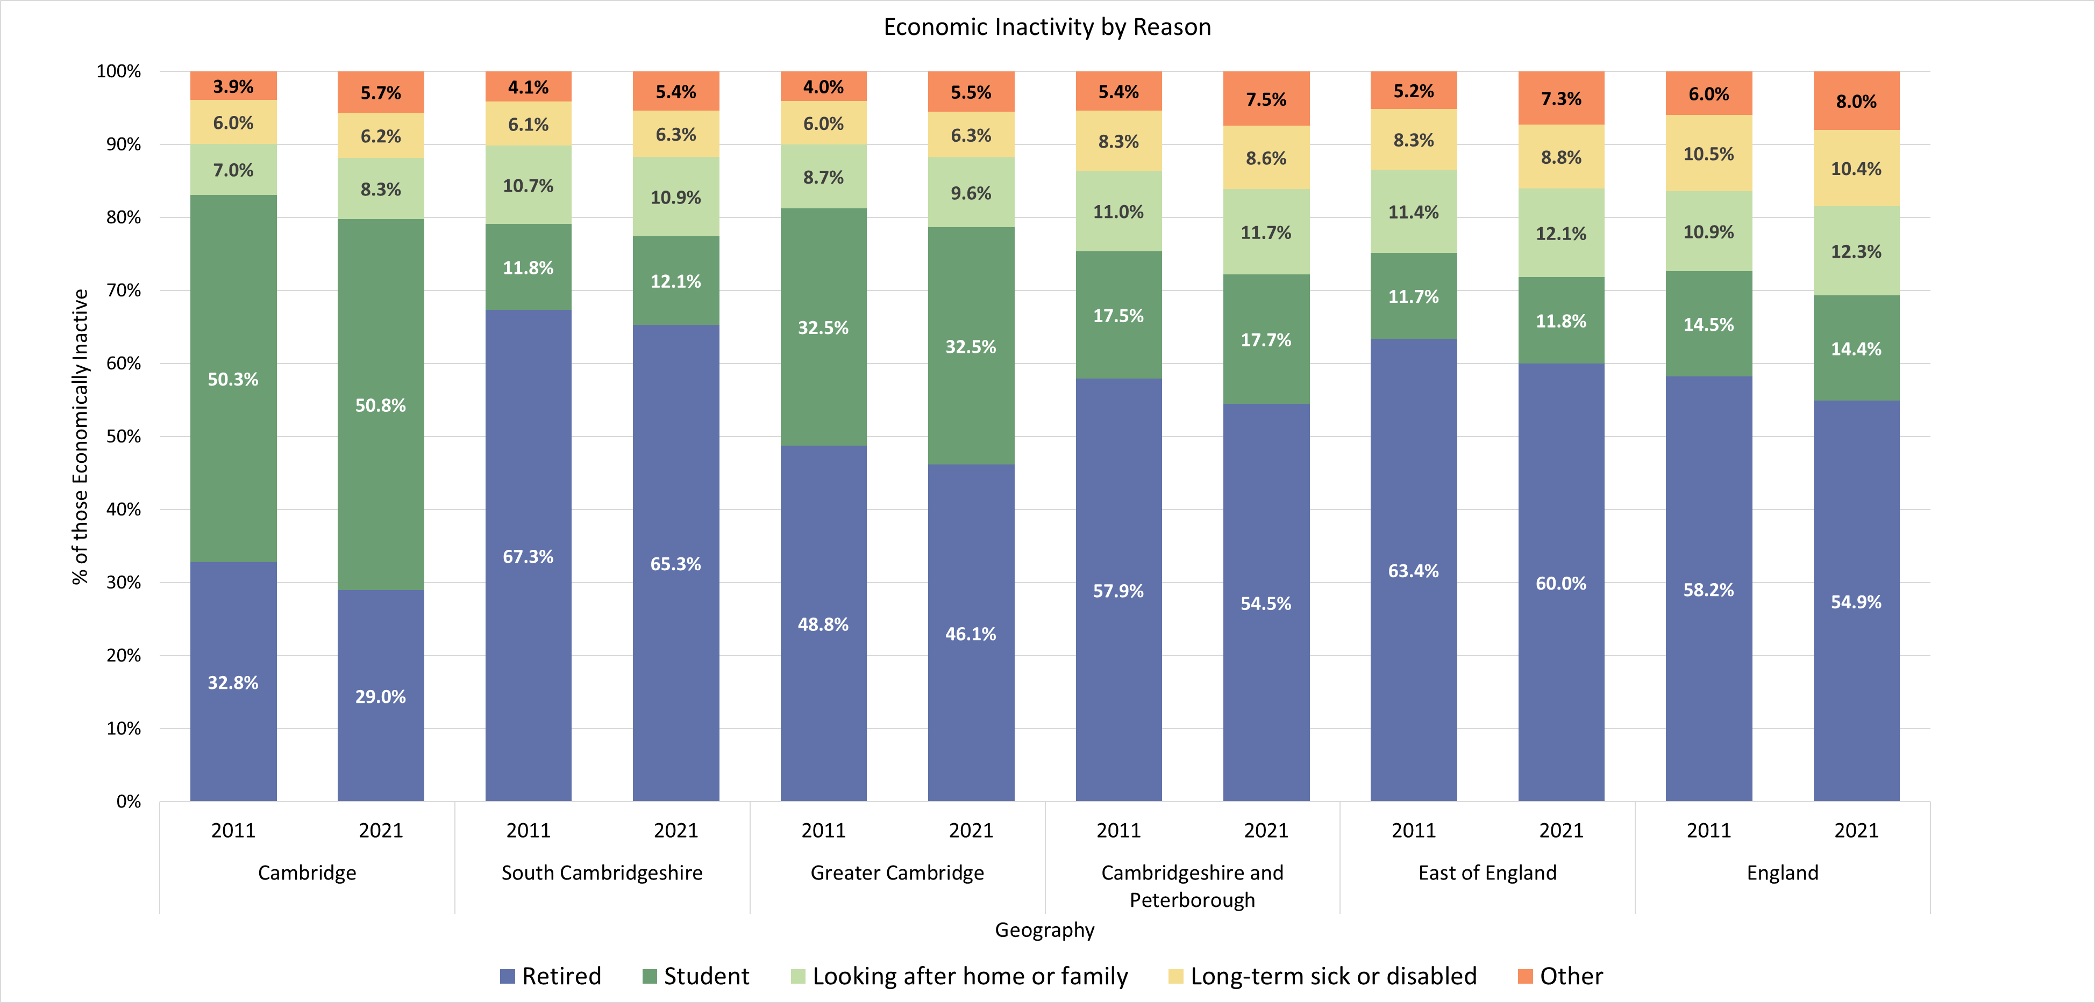
Census 2021 – Economic Inactivity by Reason (16+)
Note – As Census 2021 took place during the coronavirus (COVID-19) pandemic, a period of unparalleled and rapid change; the national lockdown, associated guidance and furlough measures will have affected data associated with the labour market. This should be considered when using this data for planning or policy purposes. The chart above depicts the economically inactive 16+ population regardless of economic activity status, whilst other analysis within this slide pack focuses on the 16-64 age group
Notes:
Source – Census 2021, Office for National Statistics
Technical Notes
People aged 16 years and over were economically inactive if, in the week before Census 2021, they were not in employment, and they were:
not looking for work
looking for work, but were not able to start work in the next two weeks
The reason why they were inactive was recorded as being one of the following:
retired (whether receiving a pension or not)
studying
looking after home or family
long-term sick or disabled
another reason
Commentary
The chart above looks at the reason for economic inactivity recorded for Census 2021:
Greater Cambridge overall saw a lower proportion of the economically inactive population being retired (46.1%) compared to the wider Cambridgeshire and Peterborough region and the UK. The region also saw a substantially higher proportion of the economically inactive population being students. This is driven by Cambridge where the majority (50.8%) of the economically inactive population are students. This is due to the presence of the University of Cambridge and Anglia Ruskin University.
South Cambridgeshire has seen a substantially higher proportion of those citing being retired as a reason for economic inactivity.

Slide 11
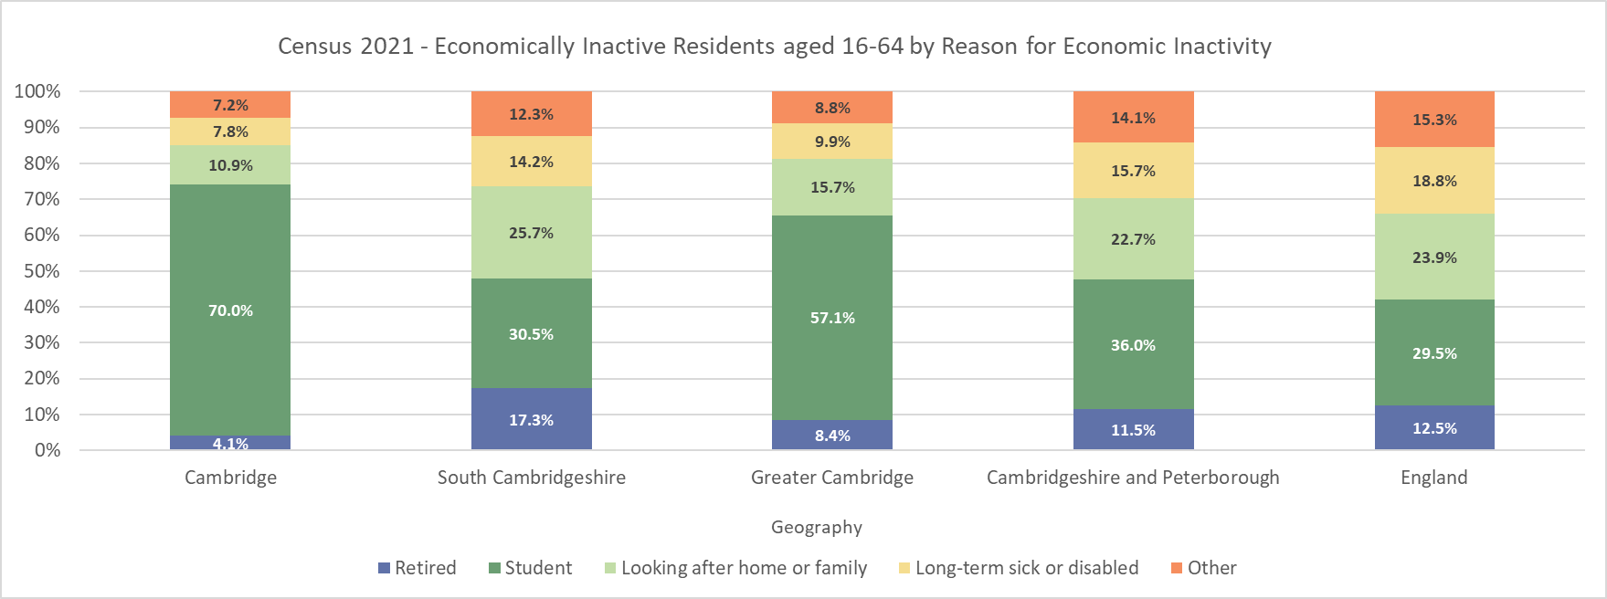
Census 2021 – Economic Inactivity by Reason (16-64 Only)
Note – As Census 2021 took place during the coronavirus (COVID-19) pandemic, a period of unparalleled and rapid change; the national lockdown, associated guidance and furlough measures will have affected data associated with the labour market. This should be considered when using this data for planning or policy purposes.
Notes:
Source – Census 2021, Office for National Statistics
Technical Notes
People aged 16 years and over were economically inactive if, in the week before Census 2021, they were not in employment, and they were:
not looking for work
looking for work, but were not able to start work in the next two weeks
The reason why they were inactive was recorded as being one of the following:
retired (whether receiving a pension or not)
studying
looking after home or family
long-term sick or disabled
another reason
Commentary
The chart above looks at the reason for economic inactivity recorded for Census 2021 for the working age (16-64 year old) population only. This excludes much of the retired population in each of the geographies
57.1% of Greater Cambridge’s working age economically inactive population were students, compared to 29.5% in England as a whole. This was mostly driven by Cambridge where 70% of the working age but economically inactive population were students. This is due to the presence of both the University of Cambridge and Anglia Ruskin University.
Cambridge had a lower proportion of the population who were working age but economically inactive who were looking after home or family (10.9%) or were Long-term sick or disabled (7.8%) compared to South Cambridgeshire (25.7%) and (14.2%) respectively.
The proportion of those retired in South Cambridgeshire is also smaller when compared to the 16+ population but still substantially higher than Cambridge and England as a whole.

Slide 12
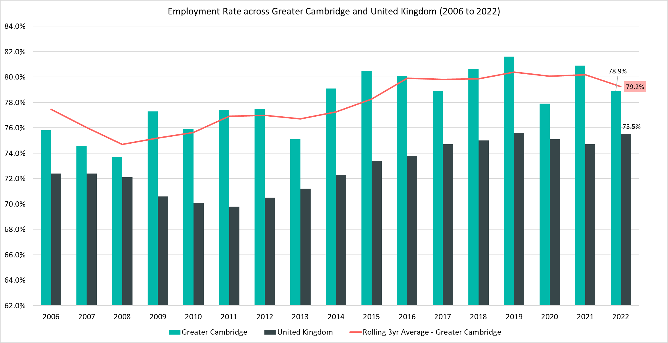
Employment Rate (16-64 year olds) – 78.9%, (January 2022 - December 2022)
Rolling Quarterly change
(Sept – Dec 22):
Previous change
(Jun – Sept 22):
Change since December 2021:
Rolling Quarterly change
(Sept – Dec 22):
-0.2pp
Previous change
(Jun – Sept 21):
-3.3pp
Change since December 2021:
-2.0pp
Rolling Quarterly change
(Sept – Dec 22):
-1.1pp
No Change
-1.2pp
Previous change
(Jun – Sept 22):
Change since December 2021:
-0.2pp
-3.3pp
-2.0pp
Comparing Jan 2022- Dec 2022 with Oct 2021 - Sept 2022
Comparing Oct 2021– Sept 2022 with Jul 2021 – Jun 2022
Comparing Jan 2022- Dec 2022 with Jan 2021 - Dec 2021
Notes:
Source – Annual Population Survey (2006-2022), Office for National Statistics
Technical Notes
A residence based labour market survey encompassing population, economic activity (employment and unemployment), economic inactivity and qualifications. These are broken down where possible by gender, age, ethnicity, industry and occupation. Available at Local Authority level and above. Updated quarterly.
Commentary
The above chart shows the employment rate across Greater Cambridge & and United Kingdom from 2004 to 2022.
The employment rate across Greater Cambridge has been consistently higher than the rate seen nationally. Note that the pattern is likely to be more sporadic given the smaller geography.
When comparing to December 2022 the employment rate decreased by -0.2pp. This contrasts with the UK where it rose by 0.8pp

Slide 13
Claimant Counts
Claimant Count of Benefits Related to Unemployment – March 2023
Universal Credit Claimant Counts – February 2023

Slide 14
Claimants of Benefits related to Unemployment – March 2023
Claimant counts have increased over the last quarter (December 2022 to March 2023) in Cambridge and slightly decreased in South Cambridgeshire. Both short term and longer term trends show that younger claimants (16-24) and those who live in more relatively deprived areas such as north Cambridge City are particular areas of focus.
As with the Unemployment rate a lower proportion of Greater Cambridge residents claim benefits related to unemployment when compared to the UK. However there is a high degree of disparity within the area itself with claimant rates ranging from 3.4% in King’s Hedges (North Cambridge) to 0.3% in Newnham (North West Cambridge)
Higher claimant rates seem appear to especially affect wards in the north of the region such as the King’s Hedges, Arbury, East Chesterton, Abbey and Milton & Waterbeach.
In Cambridge, residents in the 25-49 age range have the highest claimant rate whilst in South Cambridgeshire, the 18-24 age group account for the highest claimant rate (2.6%). This suggests that youth unemployment is more prevalent in South Cambridgeshire than Cambridge City, likely because of Cambridge’s large full time student population who are mostly ineligible for unemployment benefits.
Compared to March 2022, the 12 month rolling decreases in the number of claimants have also been slowing down and again there are concerns for younger claimants and those who live in more relatively deprived areas. Whilst claimant counts are still decreasing on a year by year basis overall the number of younger claimants (aged 16-24) has increased by +8.7% since March 2022.

Slide 15
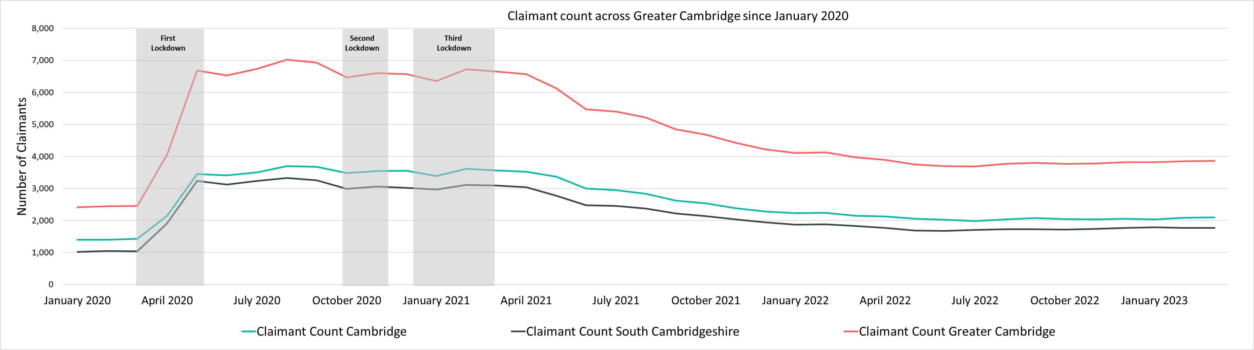
Labour Market – Claimant Count
The Claimant Count measures the number of people (age 16+) claiming benefit principally for the reason of being unemployed. We use data on claimants rather than unemployed numbers because – although the numbers are lower – they are more up to date. It is however a narrower measure of unemployment, and as such does not cover all those out of work, since not all can claim assistance.
Claimant Counts | Number of claimants March 2023 | % of claimants aged 16-64 March 2023 | Previous Year vs Now: March 2022 to March 2023 | Previous update vs Now: December 2022 to March 2023
Cambridge | 2,100 | 1.9% | -2.1% | +2.2%
South Cambridgeshire | 1,765 | 1.8% | -3.8% | -0.3%
Greater Cambridge | 3,865 | 1.9% | -2.9% | +1.0%
United Kingdom | 1,576,390 | 3.7% | -8.2% | +4.0%
Notes:
Source – Claimant Count, Office for National Statistics
Technical Notes
The Claimant Count measures the number of people (age 16+) claiming benefit principally for the reason of being unemployed. We use data on claimants rather than unemployed numbers because, although the numbers are lower, they are more up to date,. It is however a narrower measure of unemployment, and as such does not cover all those out of work, since not all can claim assistance. The latest claimant count data is a snapshot of the number of claimants on the 9th March 2023.
Commentary
March 2023 data showed an increase in claimant counts, there was a +2.2% increase from December 2022 across Greater Cambridge, compared to a +4.0% increase across the United Kingdom overall. The increase in Greater Cambridge was entirely within Cambridge City, whilst South Cambridgeshire saw a slight decrease (-0.3%) in the number of claimants.
Compared to March 2022, Greater Cambridge saw a -2.9% decrease in claimants, a lower decrease than the UK as a whole (-8.2%)

Slide 16
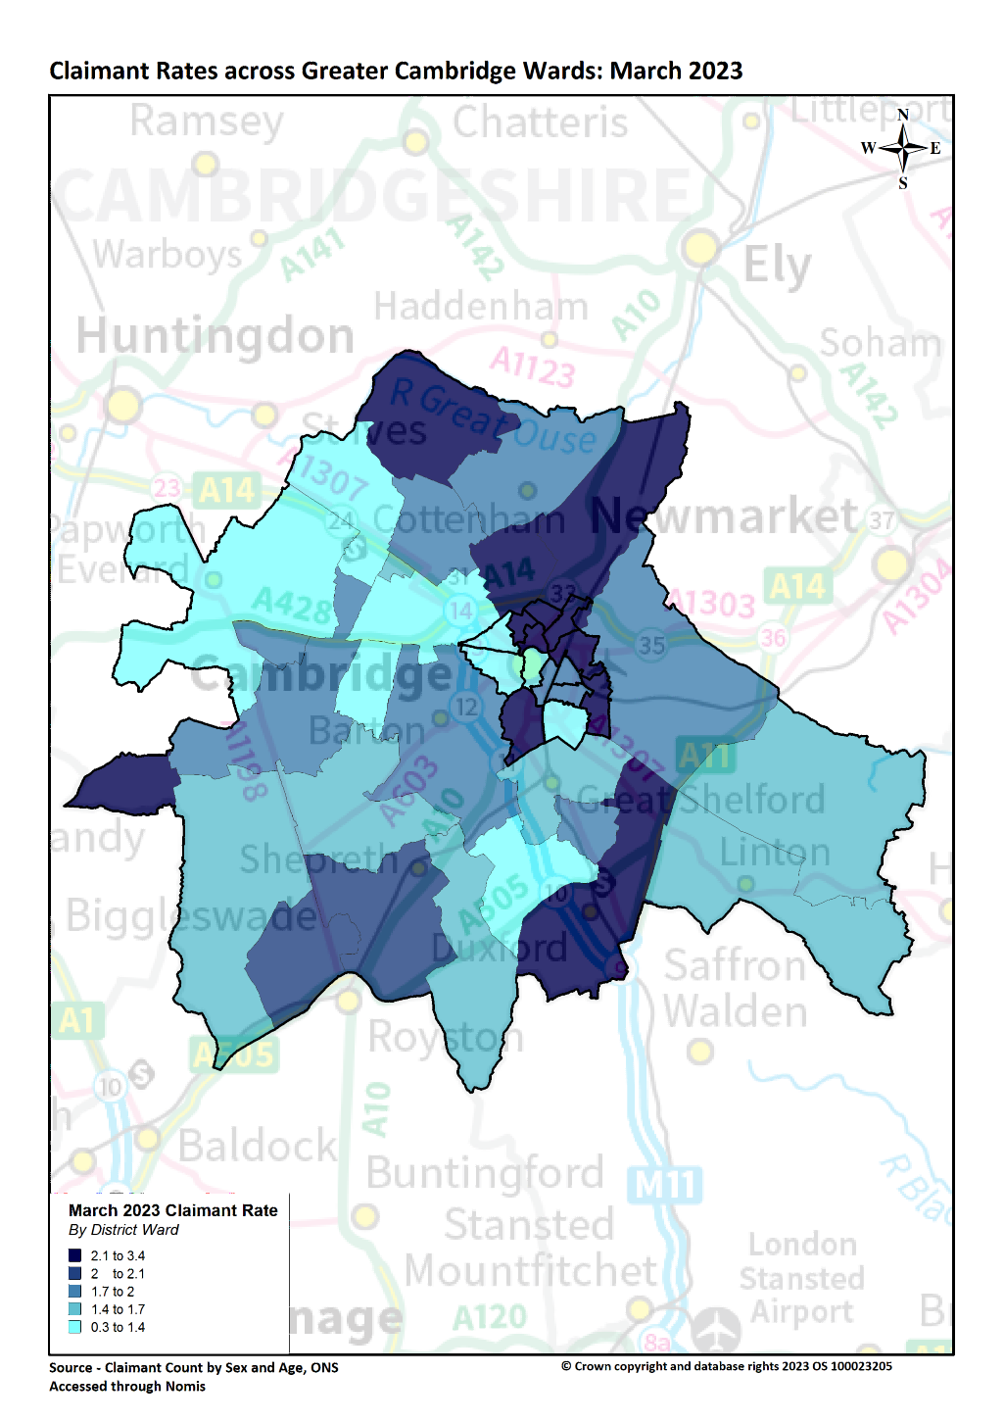
Labour Market – Claimant counts by location
Claimant Rates | Number of claimants March 2023 | % 16-64 population March 2023 | PP Change 12 Months ago vs Now: March 2022 to March 2023 | PP Change Previous update vs Now: December 2022 to March 2023
Greater Cambridge | 3,685 | 1.9% | No Change | No Change
Cambridge City | 2,100 | 2.0% | No Change | +0.1pp
South Cambridgeshire | 1,765 | 1.8% | -0.1pp | No Change
United Kingdom | 1,576,390 | 3.7% | -0.3pp | +0.1pp
Notes:
Source – Claimant Count, Office for National Statistics
Technical Notes
The Claimant Count measures the number of people (age 16+) claiming benefit principally for the reason of being unemployed. We use data on claimants rather than unemployed numbers because, although the numbers are lower, they are more up to date,. It is however a narrower measure of unemployment, and as such does not cover all those out of work, since not all can claim assistance. The latest claimant count data is a snapshot of the number of claimants on the 9th March 2023.
Commentary
The above map illustrates claimant rate by ward across the Greater Cambridge area. We use this to highlight the wards with the highest claimant rate (represented in dark blue).
Claimant rates are generally higher in the north of the region and in urban areas. North East and East of Cambridge City stand out as areas with higher claimant rates.
The lowest claimant rates across the Greater Cambridge area are in the Cambridge City wards of Newnham (0.3%), Castle (0.8%), and the South Cambridgeshire ward of Hardwick (1.0%).
Top 5 wards with highest claimant rates are (March 2023): King’s Hedges (3.4%), Arbury (3.2%), East Chesterton (3.2%), Abbey (2.8%) and Milton & Waterbeach (2.5%). All these wards are in Cambridge City with the exception of Milton & Waterbeach.
On a local authority level South Cambridgeshire saw a small decease in claimant rate (-0.1pp) from March 2022 to March 2023 whilst Cambridge City saw no change. Cambridge City did see a +0.1pp increase in claimant rate between December 2022 and March 2023 whilst South Cambridgeshire saw no change.

Slide 17
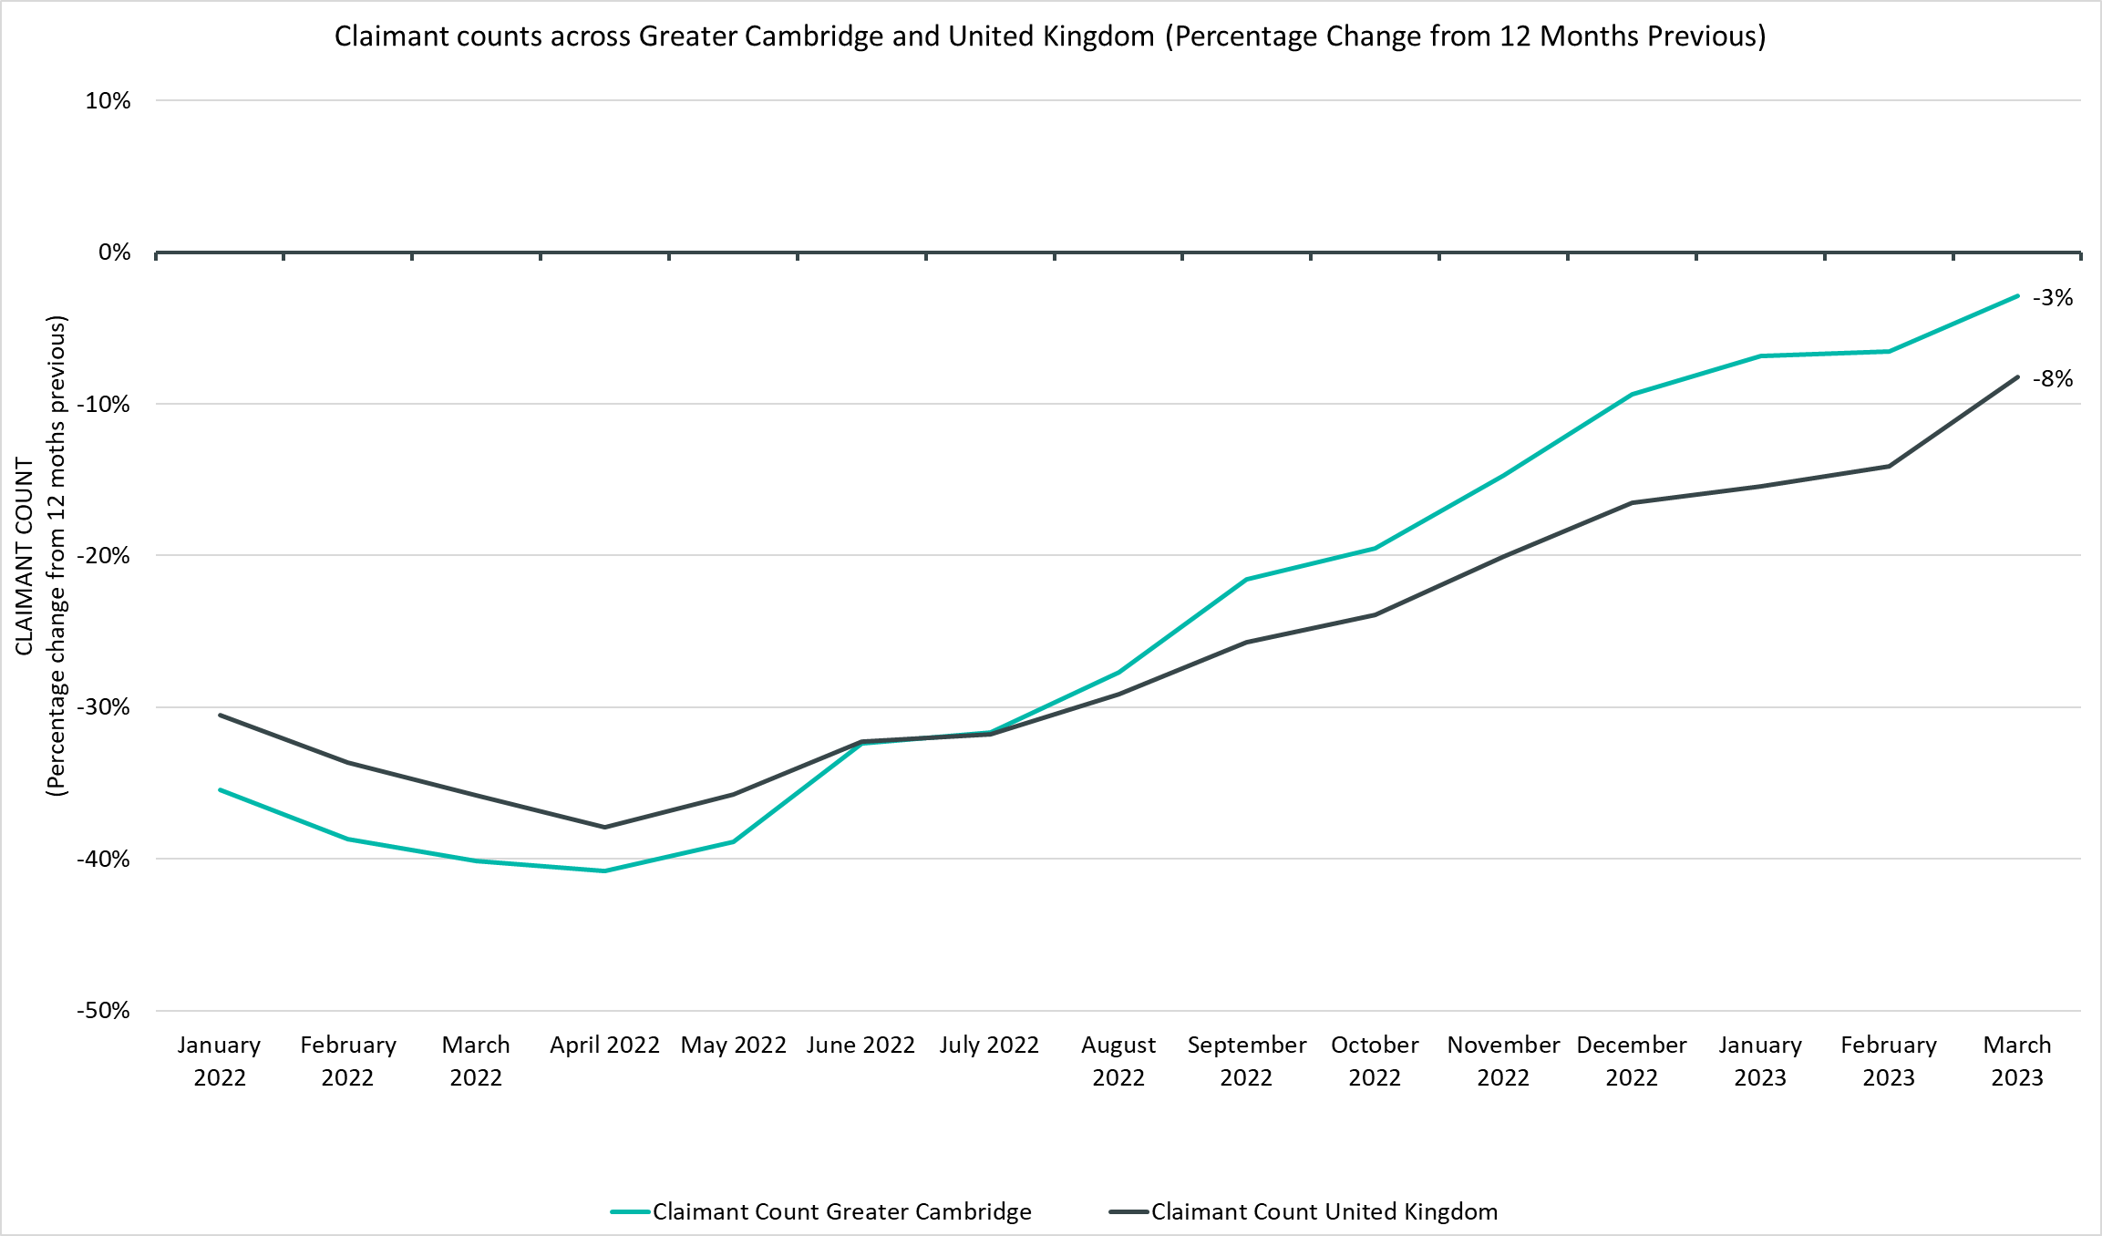
Labour Market – Claimant Count
*this figure includes all residents over the age of 16 (not just working age)
Notes:
Source – Claimant Count, Office for National Statistics
Technical Notes
The Claimant Count measures the number of people (age 16+) claiming benefit principally for the reason of being unemployed. We use data on claimants rather than unemployed numbers because, although the numbers are lower, they are more up to date,. It is however a narrower measure of unemployment, and as such does not cover all those out of work, since not all can claim assistance. The latest claimant count data is a snapshot of the number of claimants on the 9th March 2023.
Commentary
The above chart presents claimant counts across Greater Cambridge as a percentage change from 12 months previous. Whilst the number of claimants is continuing to decrease on a 12-month rolling basis Greater Cambridge seems to be trending towards an increase in claimants at a faster rate than the UK.
Throughout 2022 and the first quarter of 2023 the number of claimants compared to the same point in the previous year has been lower in Greater Cambridge as well as the UK.
The rate at which these counts have decreased across a 12 month period in Greater Cambridge compared to the UK has been lower since July 2022.
As we have moved away from the peak claimant counts of the Covid period, the rate of the 12-month decrease has slowed but has not turned into an increase for Greater Cambridge or the UK.

Slide 18
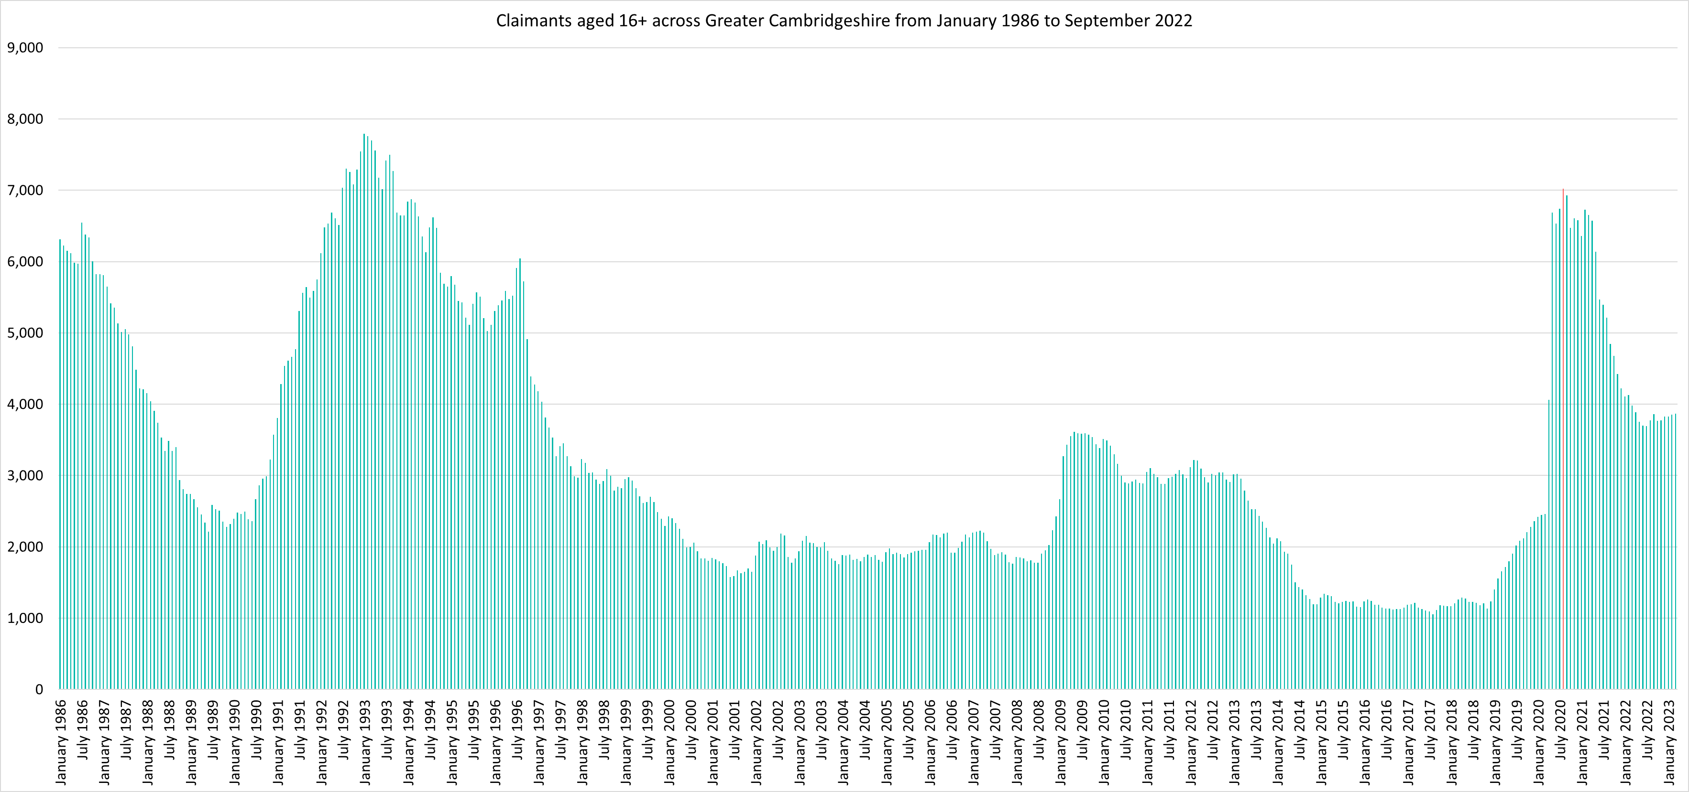
Labour Market – Claimant counts across time
Notes:
Source – Claimant Count, Office for National Statistics
Technical Notes
The Claimant Count measures the number of people (age 16+) claiming benefit principally for the reason of being unemployed. We use data on claimants rather than unemployed numbers because, although the numbers are lower, they are more up to date,. It is however a narrower measure of unemployment, and as such does not cover all those out of work, since not all can claim assistance. The latest claimant count data is a snapshot of the number of claimants on the 9th March 2023.
Commentary
The above chart presents claimant counts across Greater Cambridge from January 1986 to March 2022.
September 2020 saw the highest number of claimants (6,930) since 1992.
Claimant counts have decreased at a faster rate than seen from 1992, but this decline appears to have settled, at a much higher level than pre pandemic.
*this figure includes all residents over the age of 16 (not just working age).

Slide 19
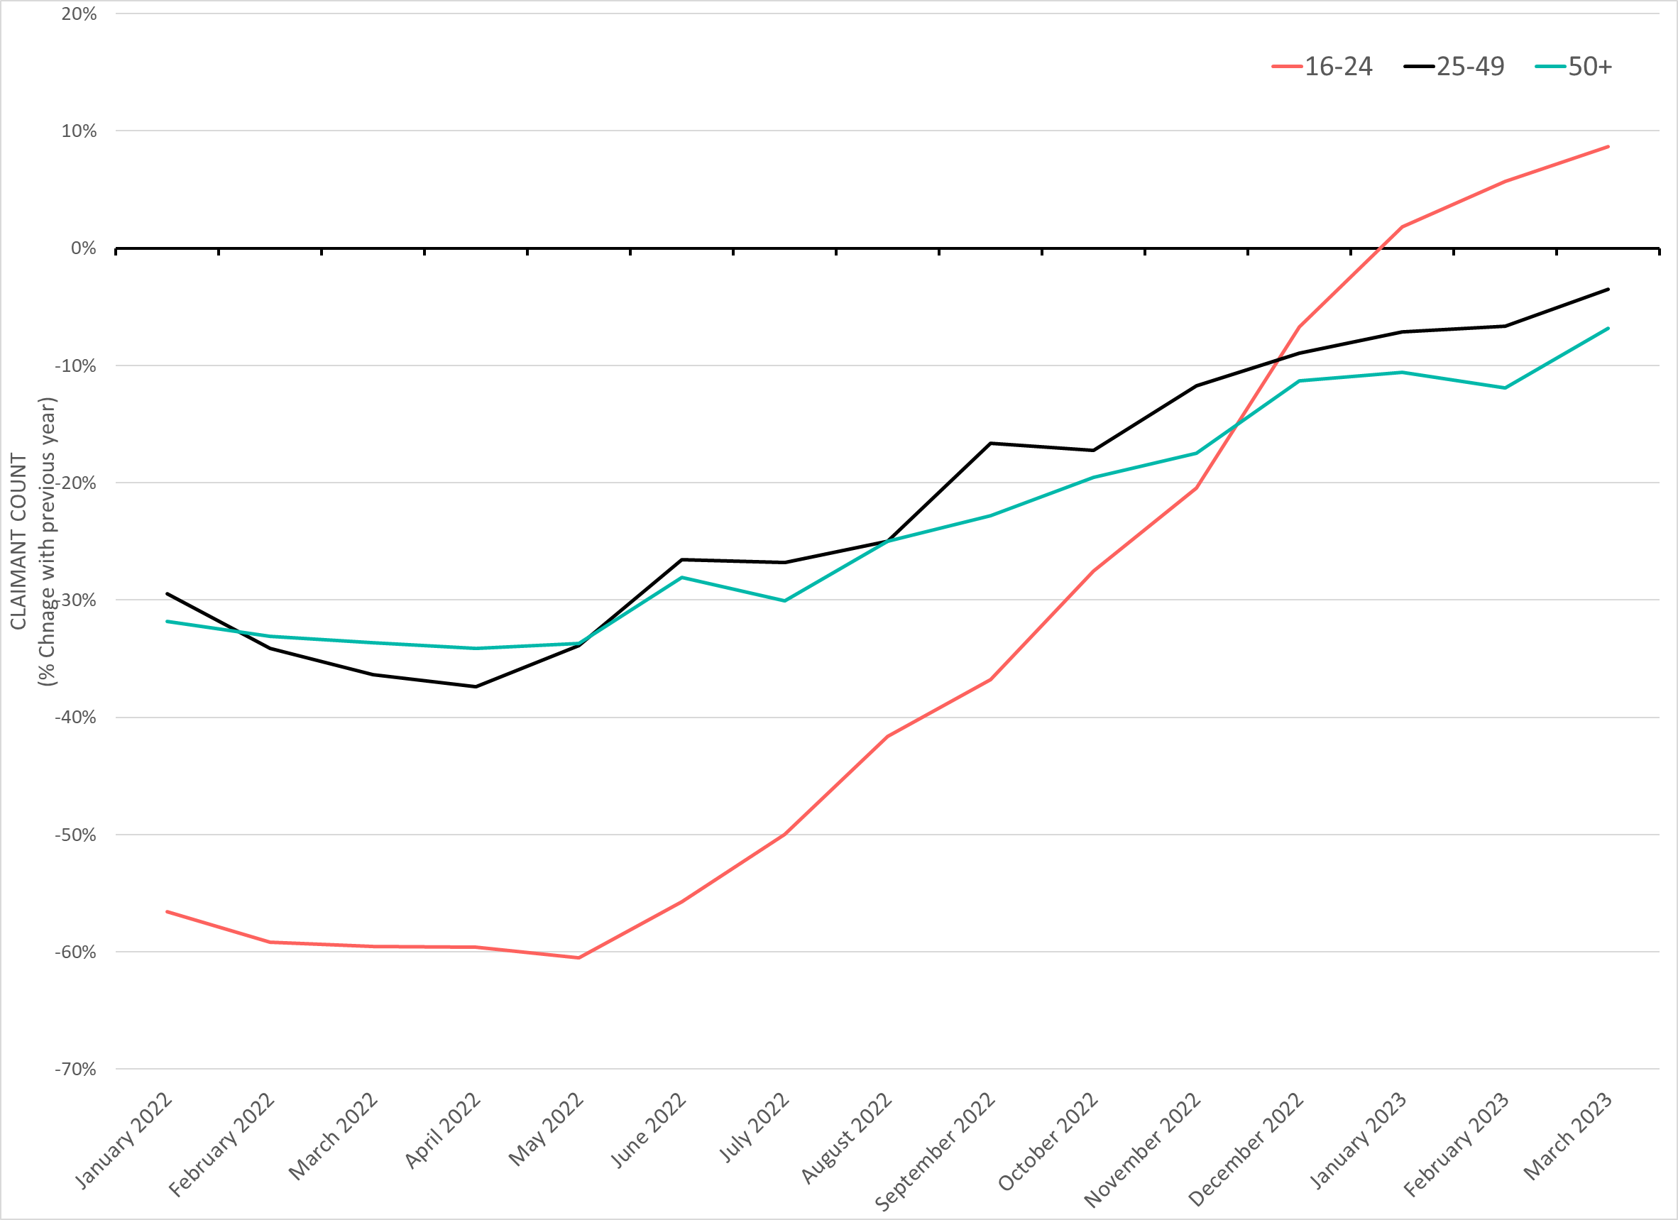
Labour Market – Claimant counts by age
March 2023 Claimant Counts by Age Group (Previous 12 month % Change)
Claimant Rates | 16+ March 2023 | 16-17 March 2023 | 18-24 March 2023 | 25-49 March 2023 | 50+ March 2023
Cambridge City | 2.0% | 0.2% | 1.2% | 2.2% | 2.6%
South Cambridgeshire | 1.8% | 0.1% | 2.6% | 2.0% | 1.4%
Greater Cambridge | 1.9% | 0.2% | 1.5% | 2.1% | 1.8%
% Change in Claimant Counts from March 2022 to March 2023 | 16-24 March 2022 to March 2023 | 25-49 March 2022 to March 2023 | 50+ March 2022 to March 2023
Greater Cambridge | +8.7% | -3.5% | -6.8%
% Change in Claimant Counts from December 2022 to March 2023 | 16-24 December 2022 to March 2023 | 25-49 December 2022 to March 2023 | 50+ December 2022 to March 2023
Greater Cambridge | +1.8% | +0.4% | +1.6%
Notes:
Technical Notes
The Claimant Count measures the number of people (age 16+) claiming benefit principally for the reason of being unemployed. We use data on claimants rather than unemployed numbers because, although the numbers are lower, they are more up to date,. It is however a narrower measure of unemployment, and as such does not cover all those out of work, since not all can claim assistance. The latest claimant count data is a snapshot of the number of claimants on the 9th March 2023.
Commentary
National statistics on claimant count since the pandemic have indicated that younger age groups have been disproportionately impacted. The above chart highlights the levels of change each age group has seen in claimant counts across the Greater Cambridge area.
The above chart presents the percentage change in claimant counts by age for the 12 months previous.
In March 2023, there was an +1.8% increase in claimants aged 16-24 from December 2022, a +0.4% increase in claimants aged 25-49 and a +1.6% increase in claimants aged 50+.
In Cambridge, residents in the 25-49 age range have the highest claimant rate (2.2%). In South Cambridgeshire, the 18-24 age group account for the highest claimant rate (2.6%). This suggests that youth unemployment is more prevalent in South Cambridgeshire than Cambridge City.
When compared to other age groups, 16-24 year olds saw the greatest percentage decreases compared to the previous 12 months across most of 2022. However, percentage decreases began to trend smaller from May 2022, and overtook those aged 25-49 and 50+ from December 2022. From January 2022 the claimant count across the 16-24 year old age group has started to increase when compared to the previous 12 months with an +8.7% increase compared to March 2022.

Slide 20
Universal Credit Claimants – March 2023
Policy changes to provide economic support during the Covid-19 pandemic allowed those on higher incomes than previously to claim Universal Credit, resulting in a permanent rise in claimants since the Spring lockdowns of 2020.
Both on a quarterly and annual basis Greater Cambridge has seen a higher increase in the number of claimants than the United Kingdom as a whole. This has mostly been driven by a rise in unemployed claimants.
As with the other benefit claimant measure, Greater Cambridge has a whole has a lower claimant rate than the United Kingdom as a whole.
Unemployed claimants have consistently made up the majority of claimants at both a regional and local authority level. Unemployed claimants have driven both the annual and quarterly increases in the number of claimants. The number of employed claimants has remained more steady and saw a smaller increase across the last quarter when compared with unemployed claimants

Slide 21
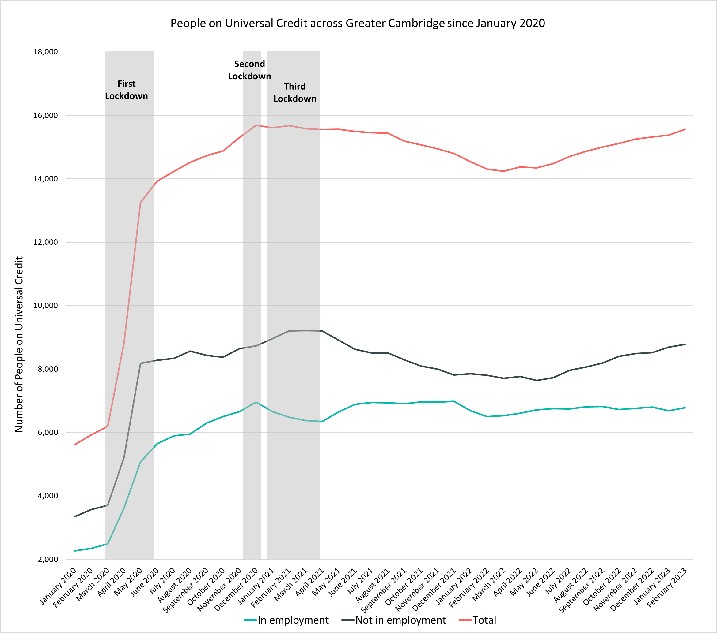
Labour Market – People on Universal Credit
People on Universal Credit | Number of total people on Universal Credit February 2023 | % 16-64 population February 2023 | % Change 12 Months ago vs Now: February 2022 to February 2023 | % Change Previous update vs Now: December 2022 to February 2023
Greater Cambridge | 15,563 | 7.5% | +8.8% | +1.6%
Cambridge City | 7,836 | 7.3% | +5.9% | +1.8%
South Cambridgeshire | 7,727 | 7.8% | +11.8% | +1.4%
United Kingdom | 5,832,812 | 13.8% | +5.0% | +1.0%
Universal Credit Status | Number of People on Universal Credit February 2023 | Share of Total February 2023 | % Change with December 2022 | % Change with February 2022
Employed | 6,785 | 44% | -0.2.% | +4.3%
Unemployed | 8,782 | 56% | +3.1% | +15.1%
Notes:
Source – Universal Credit Claimants, Department for Work and Pensions
Technical Notes
Universal Credit is available in every jobcentre across Great Britain. Roll out was completed in December 2018.
Universal Credit is a single payment for each household to help with living costs for those on a low income or out of work. It is replacing six benefits, commonly referred to as the legacy benefits:
Income-based Jobseeker's Allowance
Income-related Employment and Support Allowance
Income Support
Working Tax Credit
Child Tax Credit
Housing Benefit
Support for housing costs, children and childcare costs are integrated into Universal Credit. It also provides additions for people with a disability, health condition or caring responsibilities which may prevent them from working.
Commentary
The chart above highlights changes in the number of people on universal credit across Greater Cambridge by Employment Status from January 2020.
The number of Universal Credit claimants includes those who have started Universal Credit (completed the Universal Credit claim process and accepted their Claimant Commitment) and have not had a closure of their claim recorded for this spell, up to the 'count date' (second Thursday in each month). A closure of their claim would be recorded either at the request of the individual or if their entitlement to Universal Credit ends, for example, if they no longer satisfy the financial conditions to receive Universal Credit as they have capital over £16,000.
It is important to note that the initial rise in claimants during the first lockdown period was due to policy changes brought in as part of the pandemic response that allowed people on higher incomes than before to claim the benefit, the peak of this increase came during the second lockdown in the Winter of 2020.
The number of people on universal credit increased rapidly during the first lockdown, peaking around the time of the second lockdown.
Despite decreases from Q1 of 2021, the numbers of those on universal credit remain much higher than Pre-Covid with numbers trending upwards from May 2022.
Rates of the 16-64 population on universal credit are comparable between Cambridge and South Cambridgeshire. The largest increase in numbers when comparing to the previous 12 months is seen in South Cambridgeshire (+11.8%). Cambridge City has smaller increase (+5.9%) whilst the overall region saw a +8.8% increase.
The number of those on universal credit has increased by +1.6% from December 2022 across the Greater Cambridge region.
Unemployed claimants make up the majority of people on universal credit (56%) and saw a +3.1% increase from December 2022 and a +15.1% increase from February 2022. In comparison employed claimants saw a -0.2% decrease from December 2022 and a +4.3% increase from February 2022.

Slide 22
Wages and Inflation
Annual Survey of Hours and Earnings 2022 – Survey carried out in April 2022, data released in October 2022

Slide 23
Wages and Inflation– April 2022
Workers who are resident in Greater Cambridge have higher median weekly wages than the UK.
Annual wage growth in the region has fallen below national levels since 2021 and has fallen well below inflation in 2022.
When comparing the median weekly wages of Greater Cambridge residents by district/unitary local authorities to the rest of the country both South Cambridgeshire and Cambridge fall into the top 20% most highly paid in the United Kingdom, with South Cambridgeshire being in the top 10%..
Looking at annual wage growth by local authority, it is interesting to note that South Cambridgeshire, whose residents still maintain the highest overall median wages in Cambridgeshire and Peterborough, was the only local authority to see a fall in median weekly wage (-1.2%)

Slide 24
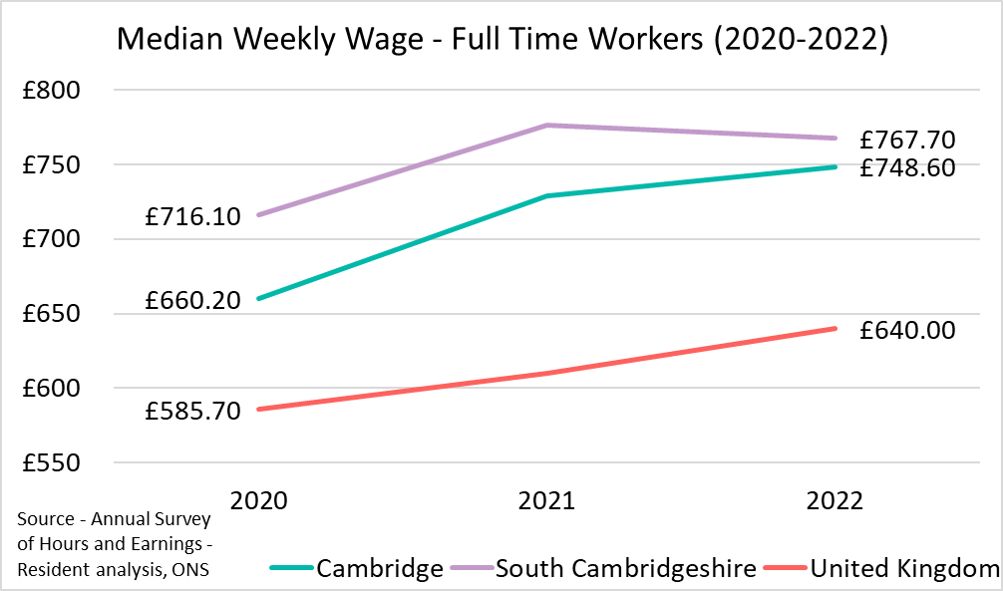
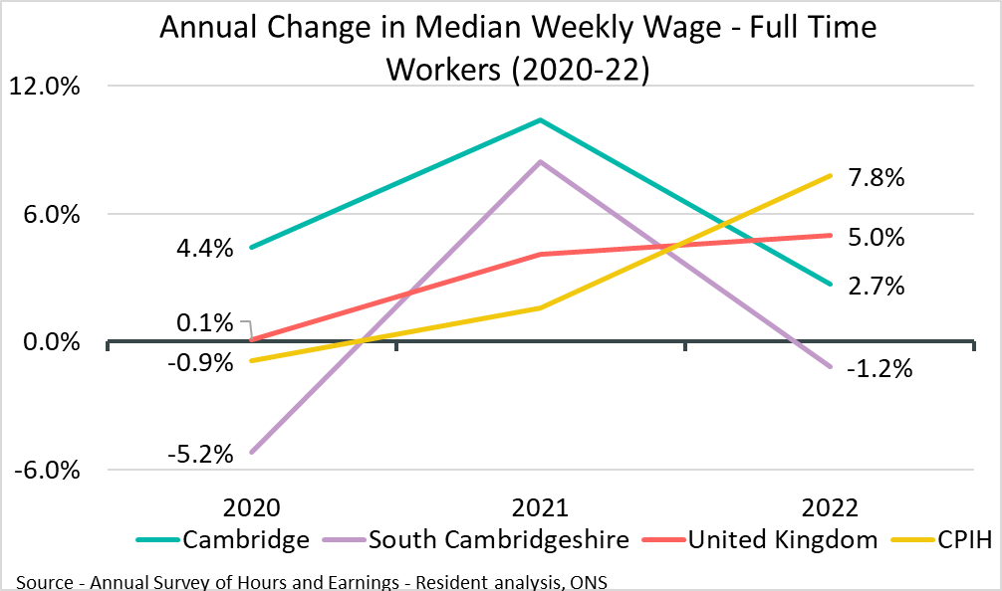
Employment Trends – Median Weekly Wage (Residents)
Local Authority | Cambridge | South Cambridgeshire
Median Weekly Wage | £748.60 | £767.7
% Change from 2021 | +2.7% | -1.2%
Rolling Quarterly change
(Sept – Dec 22):
Previous change
(Jun – Sept 22):
Change since December 2021:
+2.2pp
-2.2pp
-1.8pp
Comparing Jan 2022- Dec 2022 with Oct 2021 - Sept 2022
Comparing Oct 2021– Sept 2022 with Jul 2021 – Jun 2022
Comparing Jan 2022- Dec 2022 with Jan 2021 - Dec 2021
Notes:
Source –Annual Survey of Hours and Earnings
Technical Notes
The Annual Survey of Hours and Earnings (ASHE) is conducted in April each year to obtain information about the levels, distribution and make-up of earnings and hours worked for employees.
ASHE is based on a sample of employee jobs taken from HM Revenue & Customs PAYE records. Information on earnings and hours is obtained in confidence from employers. ASHE does not cover the self-employed nor does it cover employees not paid during the reference period
The data on this slide is based on the wages of those who are resident in Greater Cambridge and its constituent local authorities.
Commentary
The above charts show the median weekly wage of full time workers across Greater Cambridge and the United Kingdom over the last three years, and the percentage increase in median weekly wage of full time workers over the same geography and time.
The median weekly wage in South Cambridgeshire in 2022 was £767.70, this is above the Cambridge value of £748.60 as it has been for each of the last three years. However, the gap in wages has been closing between Cambridge and South Cambridgeshire.
In the United Kingdom the median weekly wage has been consistently far below each of the Greater Cambridge areas.
South Cambridgeshire saw a decrease in median weekly wage of -1.2% from the previous year in 2022. The united kingdom saw an increase of +5% in 202.2

Slide 25
Vacancies
Lightcast Vacancies Data – March 2023

Slide 26
Vacancies – Headline Findings
After record numbers of vacancies across Quarter 4 of 2021 and Quarter 1 of the 2022, vacancies decreased in the 2nd half of 2022 and have stabilised at a new baseline.
Looking at how vacancies have changed since the previous update, and when compared to the same point in 2022, vacancies have increased from December 2022 but are substantially down compared to March 2022. It should be noted that this large annual drop is due to March 2022 having the one of the highest number of monthly vacancies in the last 10 years.
The annual decrease from March 2022 can be observed across all sectors. When compared to December 2022 Real Estate, Construction and Financial and Insurance Activities and Other Service Activities all saw increases of more than 15% from December 2022.

Slide 27
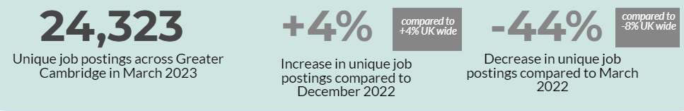
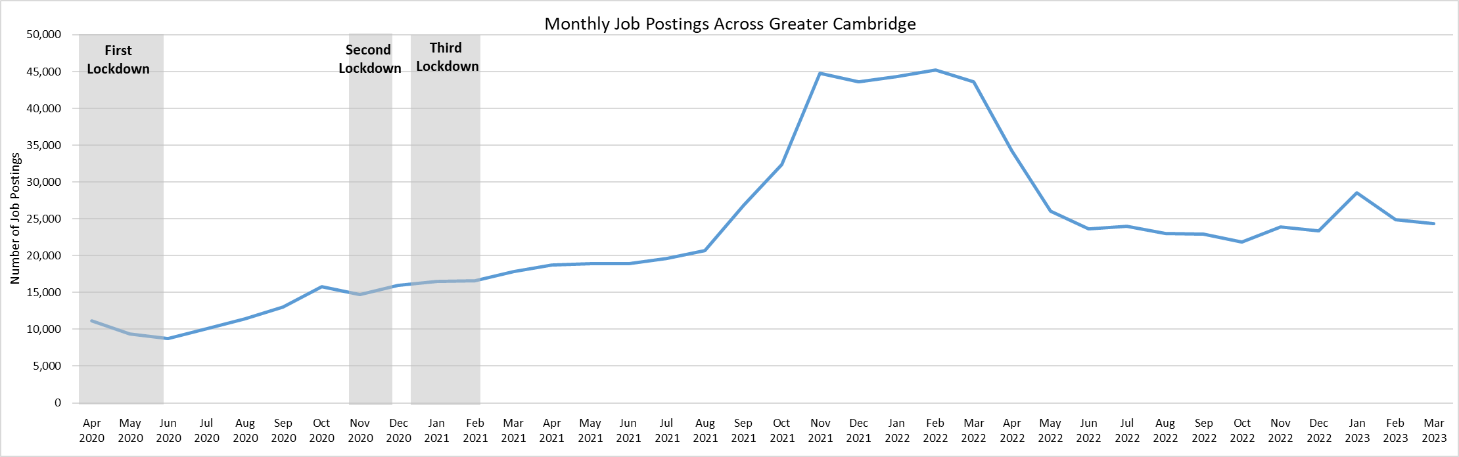
Employment Trends – Vacancies
Notes:
Source – Lightcast
Technical Information
Vacancy data is sourced from Lightcast, a service that has been procured by Cambridgeshire and Peterborough Combined Authority which gives labour market information on Job postings, occupations, and industries. Lightcast has a job posting aggregator which scans jobs websites for posting and presents them together.
Lightcast only scans online jobs postings and therefore does not include any jobs which are advertised solely offline. There is also no guarantee that all online job postings are aggregated. For example, a specific job site may not be scanned.
A unique job posting is a deduplicated count of an online job vacancy advertisement. If the same vacancy is posted twice across a sixty-day period, it is only counted once. If the same vacancy is posted twice more than sixty days apart it is counted as two unique job postings.
Commentary
The above chart illustrates online vacancy data across the Greater Cambridge area since April 2020.
There were 24,323 job postings across Greater Cambridge in September 2022, down by -44% from March 2022. Nationally, job postings decreased by -8% in the same period.
October 2021 saw the highest number of vacancies across Greater Cambridge for the past ten years.
January 2023 saw a large increase in job postings: +22% from the previous month across Greater Cambridge and +21% nationally.
The number of vacancies increased rapidly in the final quarter of 2021 but appear to have peaked in late 2021/early 2022 before rapidly decreasing and appearing to stabilise across the 2nd half of 2022 and into 2023
*Lightcast data is available from 2012 onwards.

Slide 28
Employment Trends – Vacancies by Industry
Notes:
Source – Lightcast
Technical Information
Vacancy data is sourced from Lightcast, a service that has been procured by Cambridgeshire and Peterborough Combined Authority which gives labour market information on Job postings, occupations, and industries. Lightcast has a job posting aggregator which scans jobs websites for posting and presents them together.
Lightcast only scans online jobs postings and therefore does not include any jobs which are advertised solely offline. There is also no guarantee that all online job postings are aggregated. For example, a specific job site may not be scanned.
A unique job posting is a deduplicated count of an online job vacancy advertisement. If the same vacancy is posted twice across a sixty-day period, it is only counted once. If the same vacancy is posted twice more than sixty days apart it is counted as two unique job postings.
Commentary
The above table shows the number of Vacancies in Greater Cambridge in March 2023 by employment sector and includes percentage changes from the previous quarter and previous year, including a national comparison.
Real estate activities (21%), Construction (+20%), Financial and Insurance Activities (+16%) , and Other service activities (+16%) all saw increases of more than 15% from December 2022.
Transportation and Storage (-19%), Accommodation and food services (-16%) saw the largest percentage decreases from December 2022 in Greater Cambridge.
Each Sector in Greater Cambridge has decreased from March 2022. March 2022 is the month with the second highest number of vacancies over the last ten years.

Slide 29
Employment Trends –by Industry
Median Posting Duration (Greater Cambridge) | Posting Intensity (Greater Cambridge)
37 Days | 3:1
The chart above shows two metrics to measure the potential difficulty in filling roles in certain sectors:
Median Posting Duration measures how long the average job posting is live online for. A longer time up could suggest that the company anticipates the role being harder to fill
Posting Intensity is a ratio of how many times the same job role is posted. A higher ratio could suggest difficulty filling the role
*this data covers January 2023- March 2023
Notes:
Source – Lightcast
Technical Information
Vacancy data is sourced from Lightcast, a service that has been procured by Cambridgeshire and Peterborough Combined Authority which gives labour market information on Job postings, occupations, and industries. Lightcast has a job posting aggregator which scans jobs websites for posting and presents them together.
Lightcast only scans online jobs postings and therefore does not include any jobs which are advertised solely offline. There is also no guarantee that all online job postings are aggregated. For example, a specific job site may not be scanned.
A unique job posting is a deduplicated count of an online job vacancy advertisement. If the same vacancy is posted twice across a sixty-day period, it is only counted once. If the same vacancy is posted twice more than sixty days apart it is counted as two unique job postings.
Commentary
The table above shows the median posting duration and the posting intensity for employment sectors from January to March 2023. These measures both can be an indication of difficult to fill roles.
Across Greater Cambridge, the median posting duration was 37 days Financial and insurance activities (39 days), Information and Communication and Public Administration and defence; compulsory social security (both 38) are above this.
Transportation and Storage and Accommodation and food services (both 34) were the lowest below the average.
The posting intensity across Greater Cambridge was 3:1. Human health and social work activities (4:1) is the only sector above the region average.

