Slide 1
Cambridgeshire and Peterborough
All Age Mental Health and Learning Disabilities Needs Assessment
Chapter 3: Perinatal Mental Health

Slide 2
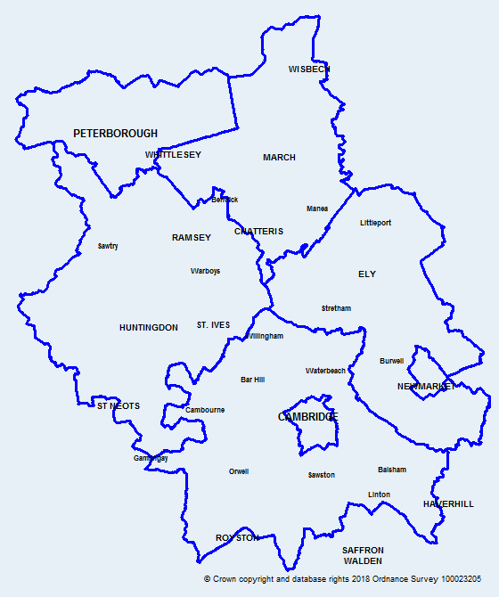
Introduction
Map of Cambridgeshire
and Peterborough
This data pack has been produced on perinatal mental health to support the Cambridgeshire and Peterborough all age mental health and learning disabilities needs assessment.
Colour coding and abbreviations used:
Key:
 | Statistically significantly worse than England
 | Statistically similar to England
 | Statistically significantly better than England
 | Higher than England
 | Lower than England
Indicators that are shaded blue rather than Red or Amber or Green are presented in this way because it is not straightforward to determine for these indicators whether a high value is good or bad.
OHID | Office for Health Improvement and Disparities
ONS | Office for National Statistics
APS | Annual Population Survey
DfE | Department for Education
QOF | Quality and Outcomes Framework
HES | Hospital Episode Statistics

Slide 3
Risk factors

Slide 4
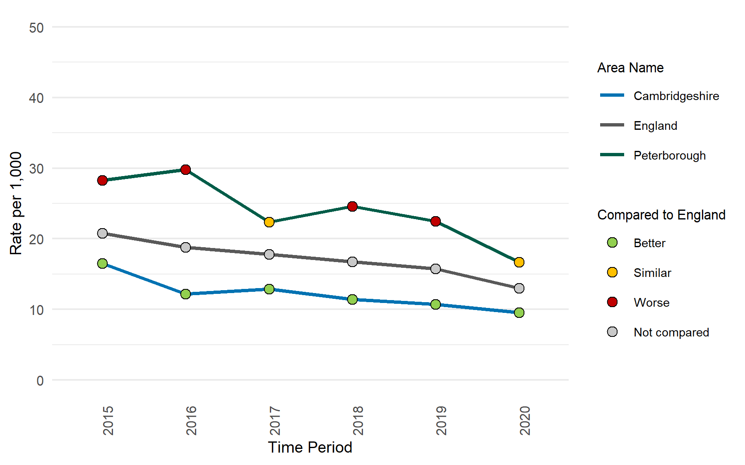
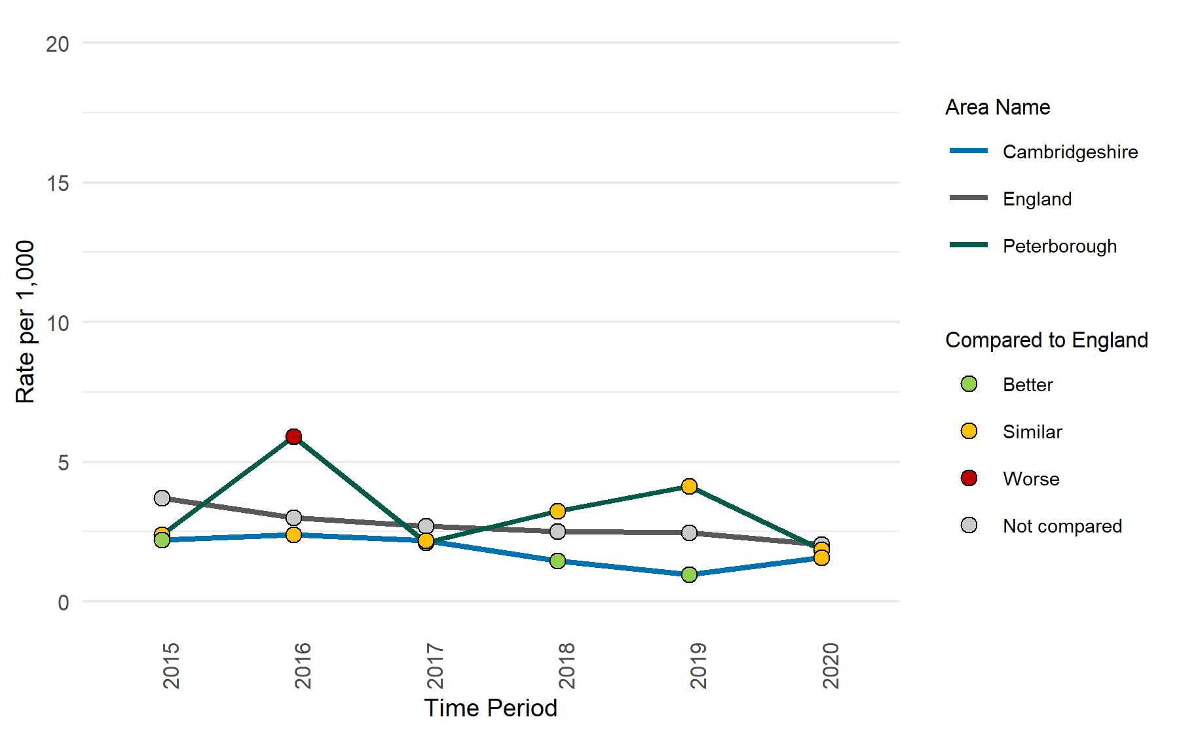
Risk factors
Under 18 conception rate per 1,000
Under 16 conception rate per 1,000
 | Cambridgeshire | Peterborough
Number of under 18s conception, 2020 | 100 | 57
 | Cambridgeshire | Peterborough
Number of under 16s conception, 2020 | 17 | 7
Under 18 conception rates in Cambridgeshire and Peterborough shows an overall decline since 2015. This is also true for England.
In 2020, the rate in Peterborough is statistically similar to the national rate, whereas it is significantly lower in Cambridgeshire.
In 2020, the rate of under 16 conceptions in Cambridgeshire have increased since the previous year whilst a decrease is seen in Peterborough.
The rate in Cambridgeshire and Peterborough was statistically similar to the national rate in 2020.
Notes:
Under 18s conception rate / 1,000: Conceptions in women aged under 18 per 1,000 females aged 15-17
Data from https://fingertips.phe.org.uk/profile/child-health-profiles/data#page/1
Source: Office for National Statistics (ONS)
Under 16s conception rate / 1,000: Conceptions in women aged under 16 per 1,000 females aged 13-15
Data from https://fingertips.phe.org.uk/profile/child-health-profiles/data#page/1
Source: Office for National Statistics (ONS)

Slide 5
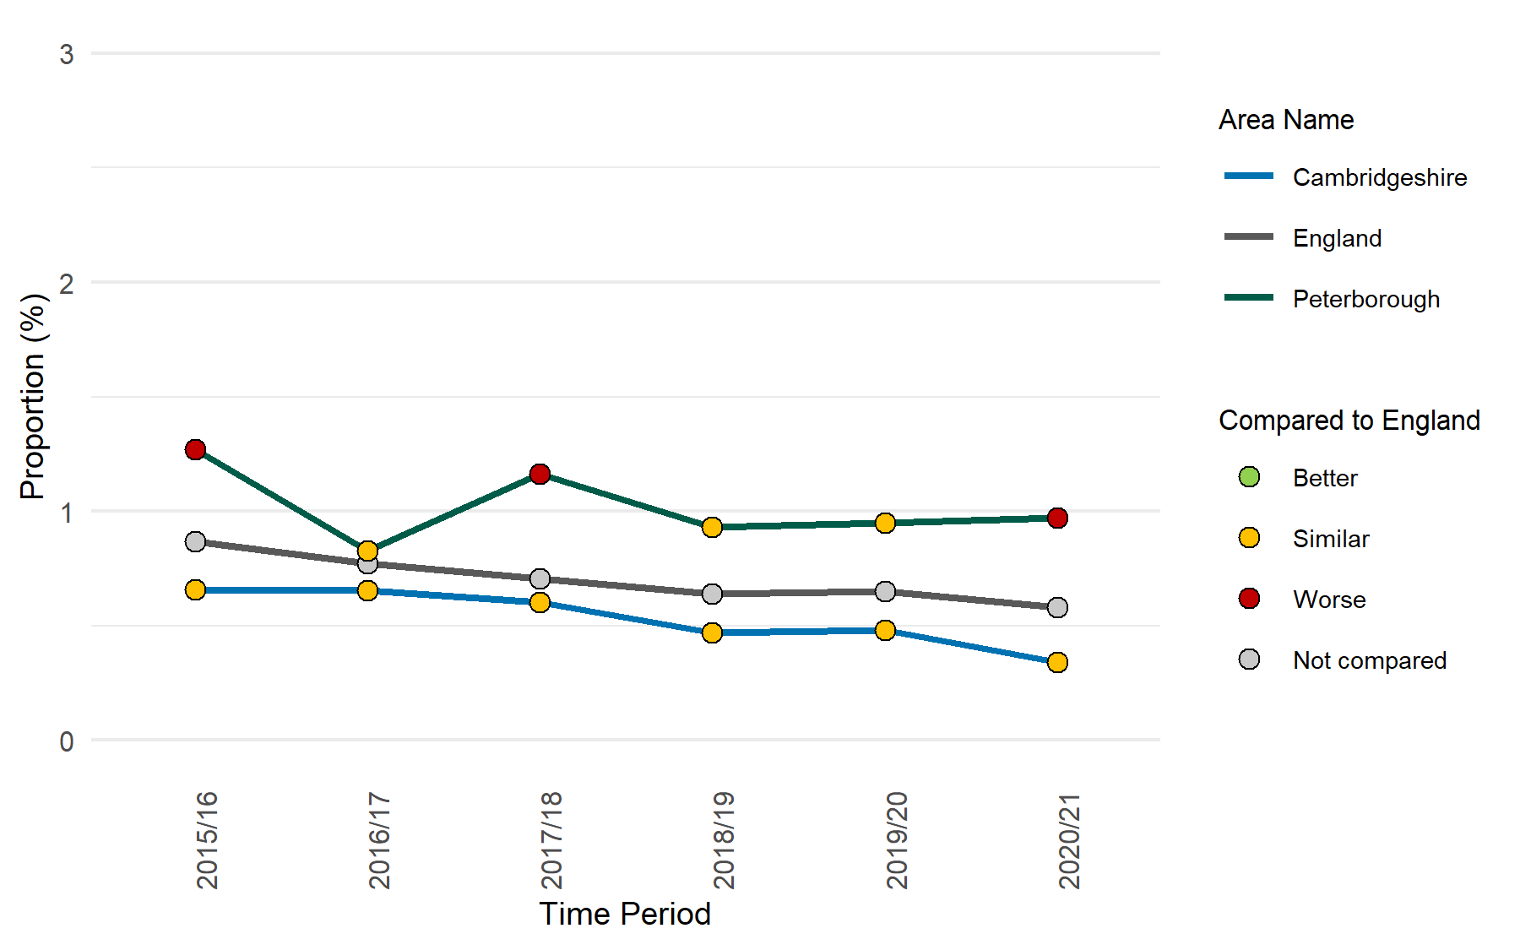
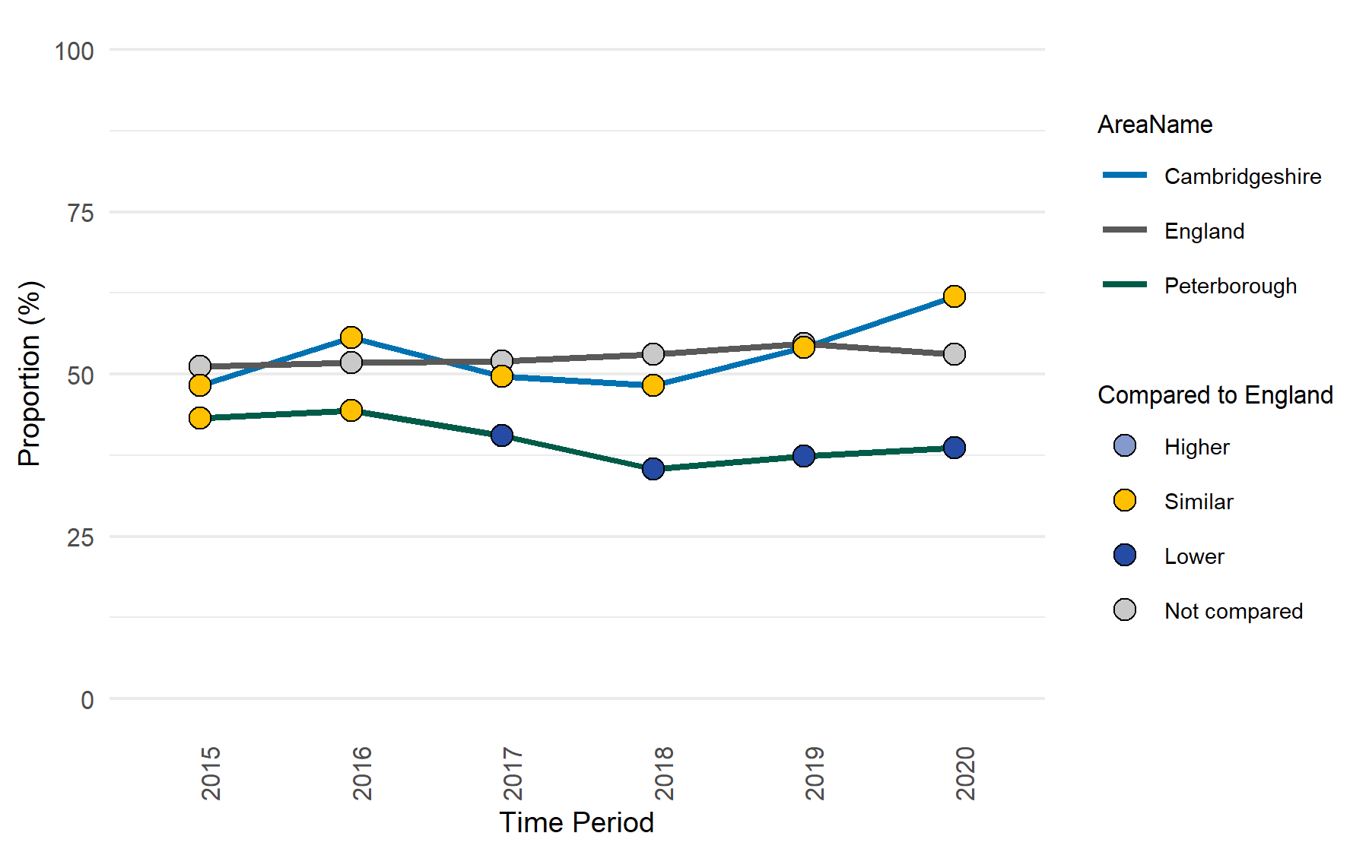
Risk factors
Teenage mothers
Under 18s conception leading to abortions
% of deliveries where mother is aged under 18 yrs
 | Cambridgeshire | Peterborough
Number of teenage mothers, 2020/21 | 15 | 30
 | Cambridgeshire | Peterborough
Number of under 18s conceptions leading to abortion, 2020 | 62 | 22
The percentage of delivery episodes where the mother is aged under 18 years in Cambridgeshire, Peterborough, and England shows an overall decline compared to 2015/16.
In 2020/21, the proportion is significantly higher than the national rate in Peterborough while it is statistically similar in Cambridgeshire.
Under 18 conceptions leading to abortion show an increasing trend since 2018 in Cambridgeshire while it is relatively stable in Peterborough.
In 2020, 62% of the under 18s conception led to abortions in Cambridgeshire and 38.6% in Peterborough.
Notes:
Teenage mothers: Percentage of delivery episodes, where the mother is aged under 18 years.
Data from https://fingertips.phe.org.uk/profile/child-health-profiles/data#page/1
Source: Hospital Episode Statistics (HES)
Under 18s conceptions leading to abortion (%): The percentage of conceptions to those aged under 18 years that led to an abortion
Data from :https://fingertips.phe.org.uk/child-health-profiles#gid/1938133222/ati/6
Source: Office for National Statistics (ONS)

Slide 6
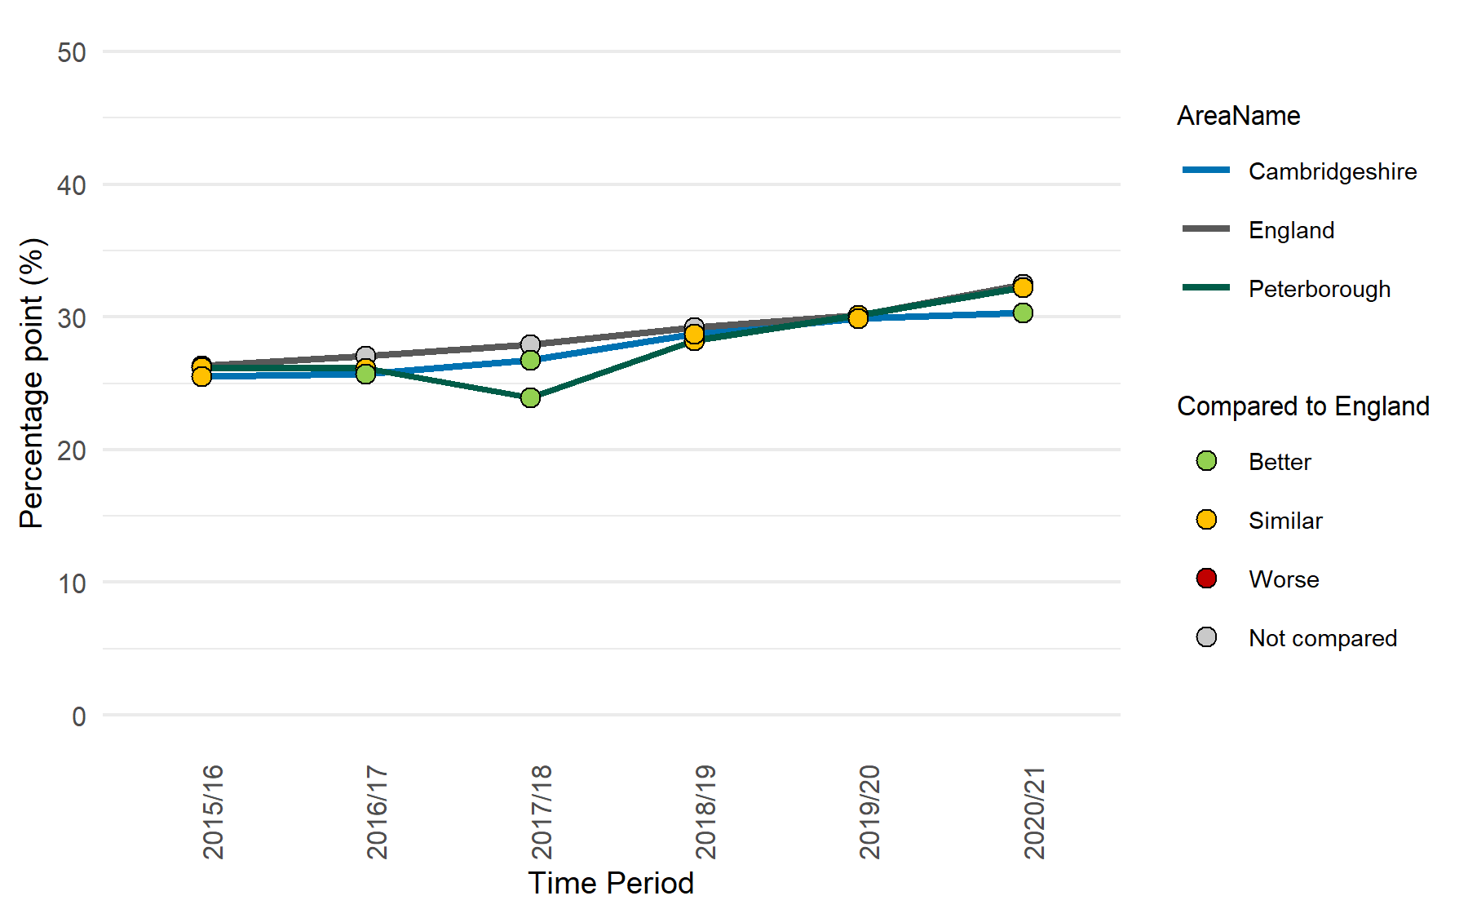
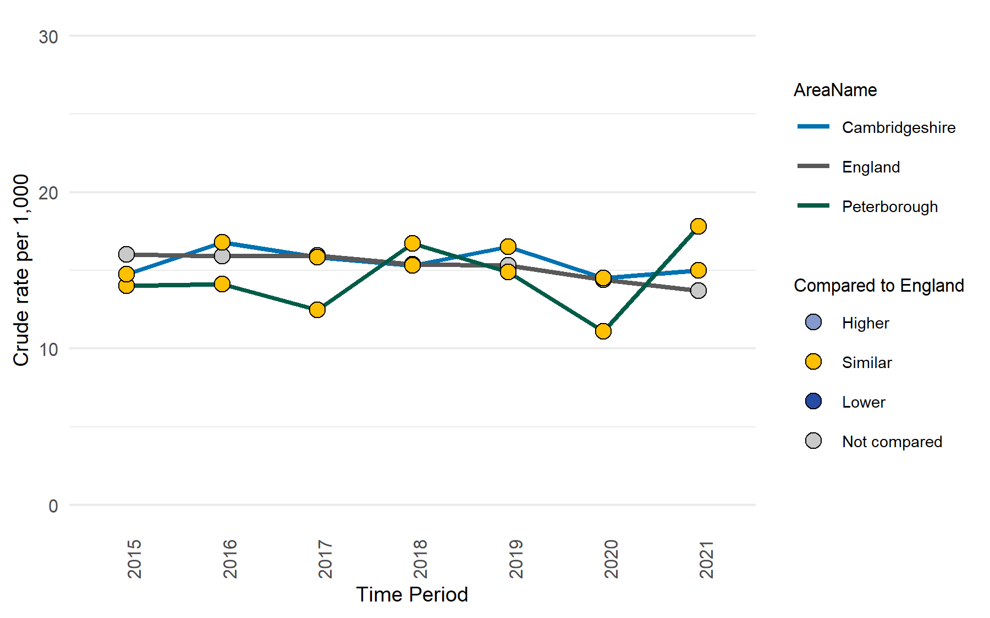
Risk factors
Caesarean section
Multiple births
 | Cambridgeshire | Peterborough
Number of Caesarean section, 2020/21 | 1,775 | 830
 | Cambridgeshire | Peterborough
Number of multiple births, 2021 | 99 | 47
The percentage of delivery by caesarean section shows an overall increase since 2015/16 in Cambridgeshire, Peterborough and England.
The rate is significantly lower than England in Cambridgeshire, while it is similar in Peterborough.
The rate of multiple births in Cambridgeshire and Peterborough has been statistically similar to the national rate since 2015.
Notes:
Caesarean section (%): Percentage of deliveries by caesarean section
Data from https://fingertips.phe.org.uk/profile/child-health-profiles/data#page/1
Source: Hospital Episode Statistics (HES)
Caveats: New data added from March 2020 onwards is subject to new HES disclosure rules - all sub-national counts are rounded to the nearest 5, and counts of 1-7 are suppressed. Rates are calculated using rounded counts, and confidence intervals are calculated using unrounded counts.
Multiple births: Number of maternities where the outcome is a multiple birth expressed as a rate per 1,000 total maternities.
Data from https://fingertips.phe.org.uk/profile/child-health-profiles/data#page/1
Source: Office for National Statistics

Slide 7
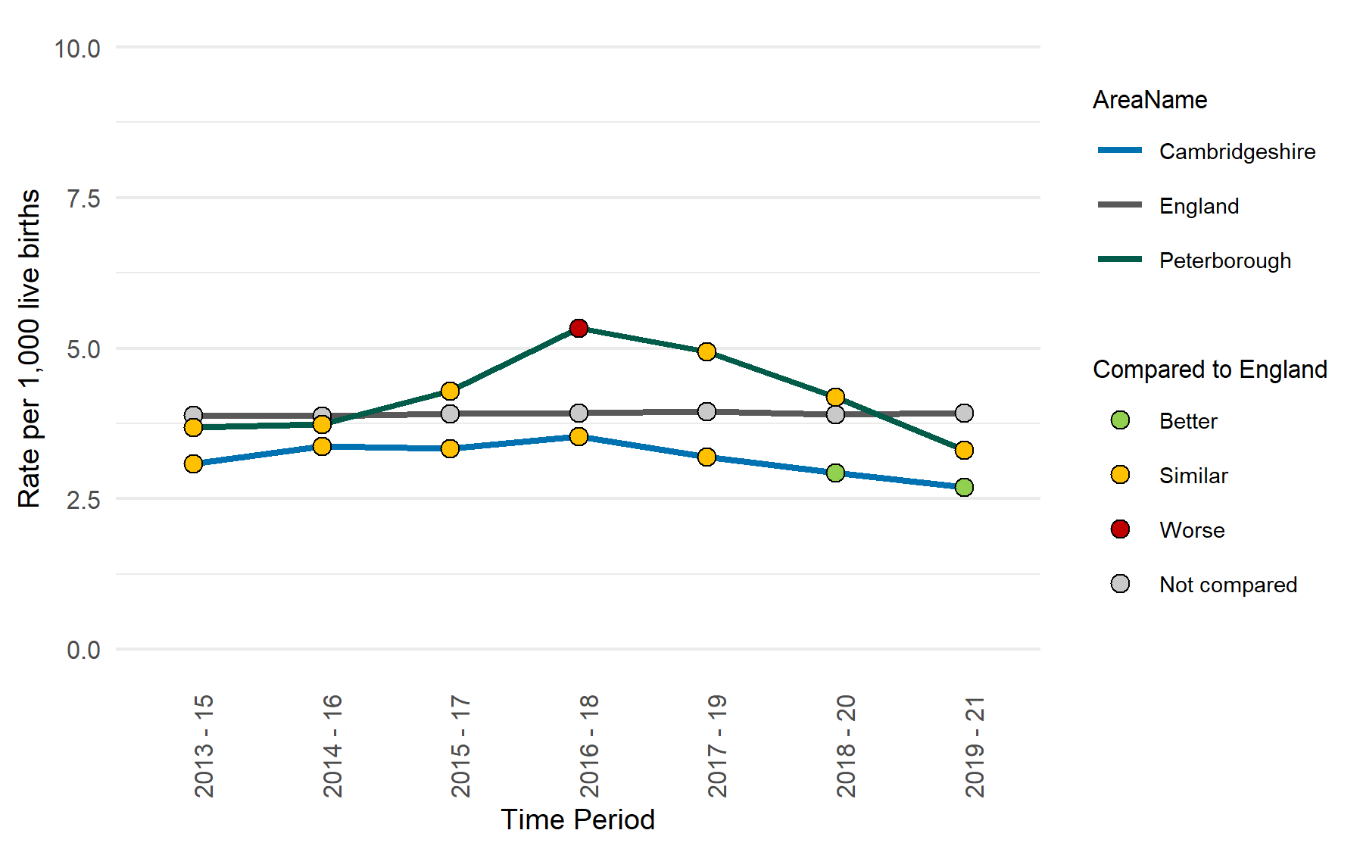
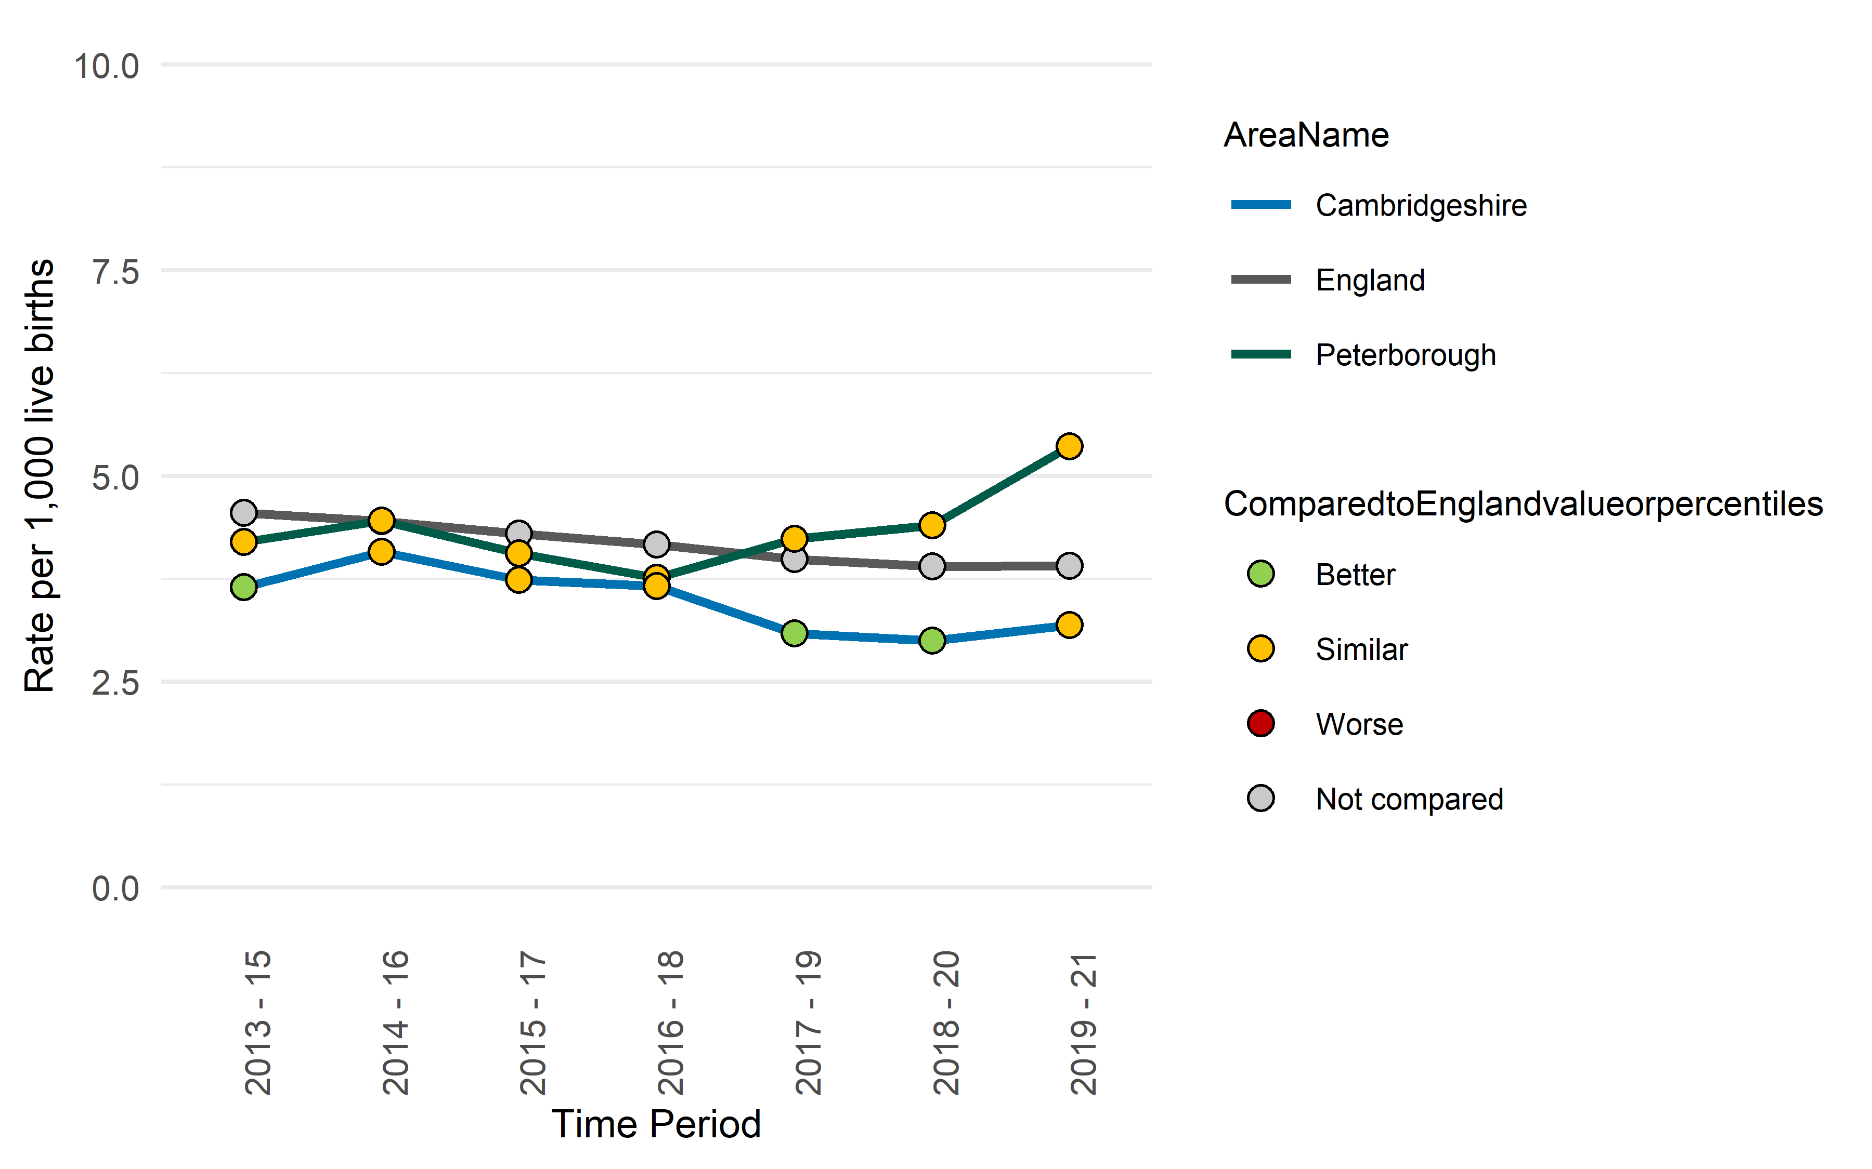
Risk factors
Infant mortality rate
Stillbirth rate
 | Cambridgeshire | Peterborough
Number of infant mortality, 2019 – 21 | 53 | 27
 | Cambridgeshire | Peterborough
Number of stillbirths, 2019 – 21 | 63 | 44
The rate of infant deaths under 1 year of age per 1,000 live births shows a declining trend for Cambridgeshire and Peterborough.
The rate was significantly lower than England in Cambridgeshire, while it was similar to the national rate in Peterborough during the recent period.
The rate of stillbirths (foetal deaths occurring after 24 weeks of gestation) show an increasing trend for Peterborough since 2016-18, where a decline is seen in Cambridgeshire.
During the period 2019-21, the rate was statistically similar to England in Cambridgeshire and Peterborough.
Notes:
Infant mortality rate: Infant deaths under 1 year of age per 1000 live births
Data from https://fingertips.phe.org.uk/profile/child-health-profiles/data#page/1
Source: Office for National Statistics (ONS)
Stillbirth rate: Rate of stillbirths (foetal deaths occurring after 24 weeks of gestation) for all maternal ages occurring in the respective calendar years per 1,000 births.
Data from https://fingertips.phe.org.uk/profile/child-health-profiles/data#page/1
Source: Office for Health Improvement and Disparities (OHID) based on Office for National Statistics births and deaths data

Slide 8
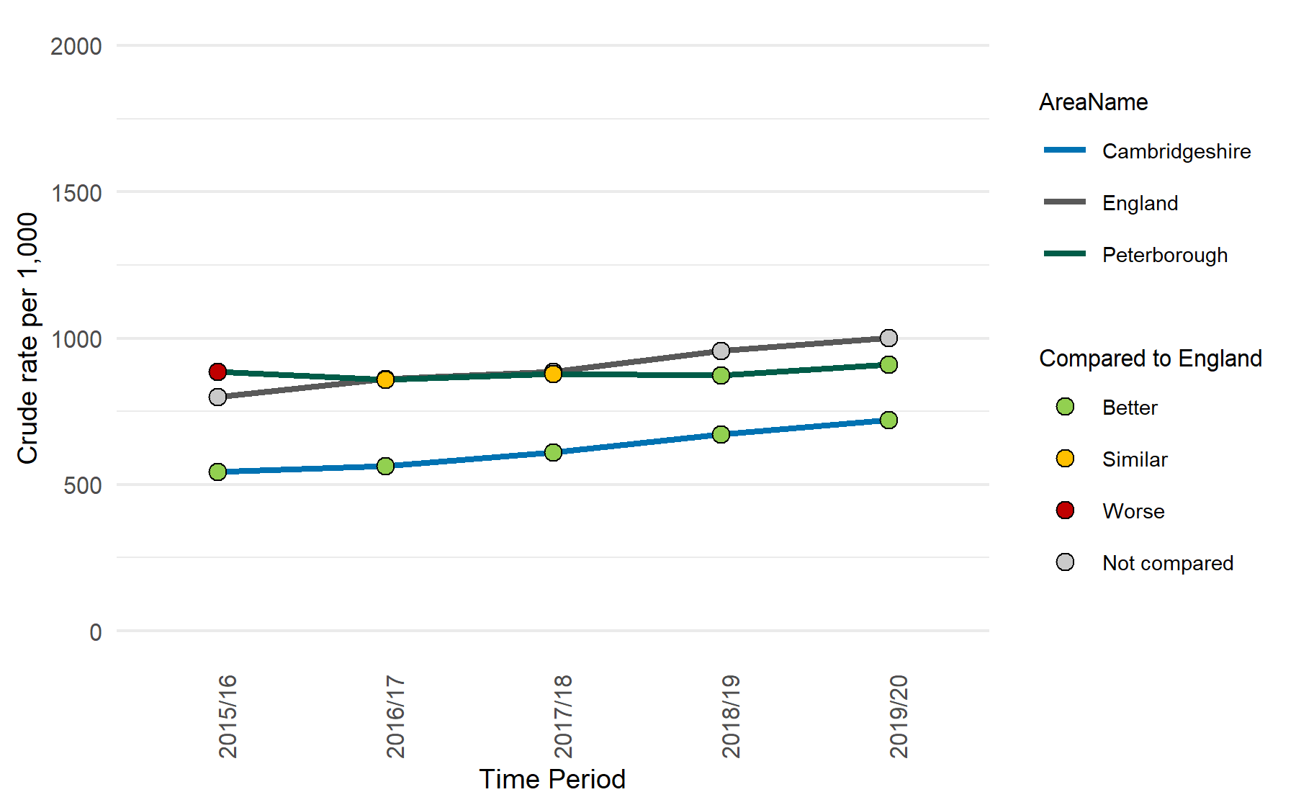
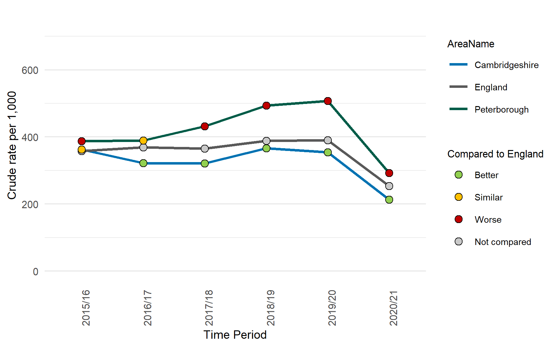
Risk factors
A&E attendances (under 1 year)
Emergency admissions (rate per 1000 population), under 1 year
 | Cambridgeshire | Peterborough
Number of A&E attendance for all children aged under 1 year, 2019/20 | 4,770 | 2,550
 | Cambridgeshire | Peterborough
The number of finished emergency admissions in children aged 0 years, 2020/21 | 1,405 | 810
The rate of accidents and emergency attendance per 1,000 population aged under 1 year show an increasing trend for Cambridgeshire, while a relatively stable trend is seen for Peterborough.
In 2019/20, the rate in Cambridgeshire and Peterborough was significantly lower than the national rate.
The rate of emergency admissions per 1,000 population aged under 1 year has been significantly higher than the national rate in Peterborough in all years except 2016/17. However, the rate in Cambridgeshire has been significantly lower than the national rate since 2016/17.
The Covid-19 pandemic had a large impact on hospital activity with a reduction in admissions in 2020 to 2021.
Notes:
A&E attendances (under 1 year): A&E attendance rate per 1,000 population aged under 1 year.
Data from https://fingertips.phe.org.uk/profile/child-health-profiles/data#page/1
Source: OHID based on NHS Digital, Hospital Episode Statistics (HES), and Office for National Statistics, mid-year Population estimates
Note: A&E HES data was discontinued after 2019/20 so further updates are not available
Emergency admissions (rate per 1000 population) <1: Emergency admissions (rate per 1000 population) <1
Data from https://fingertips.phe.org.uk/profile/child-health-profiles/data#page/1
Source: OHID based on NHS Digital, Hospital Episode Statistics (HES), and Office for National Statistics, mid-year Population estimates

Slide 9
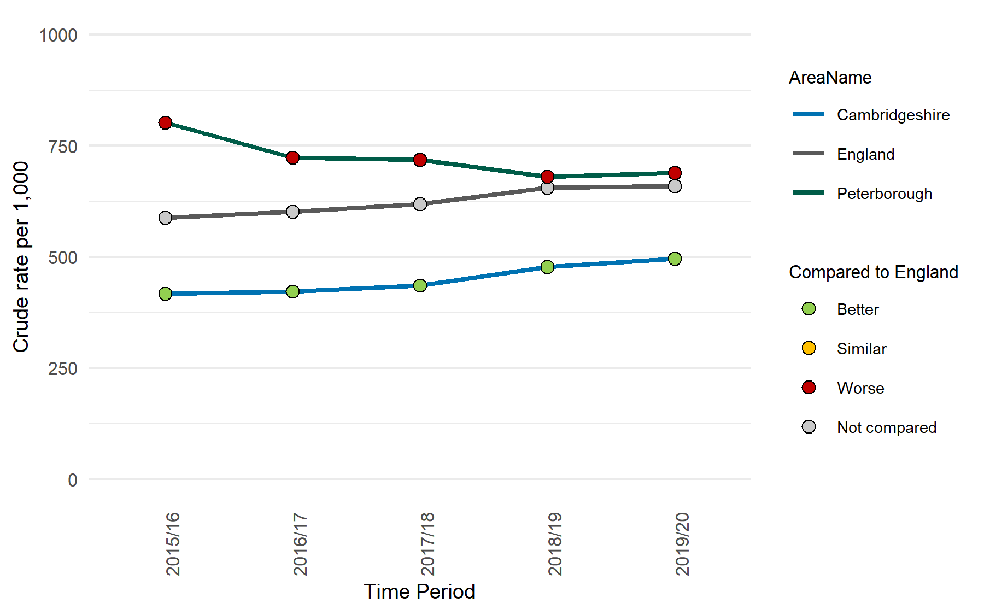
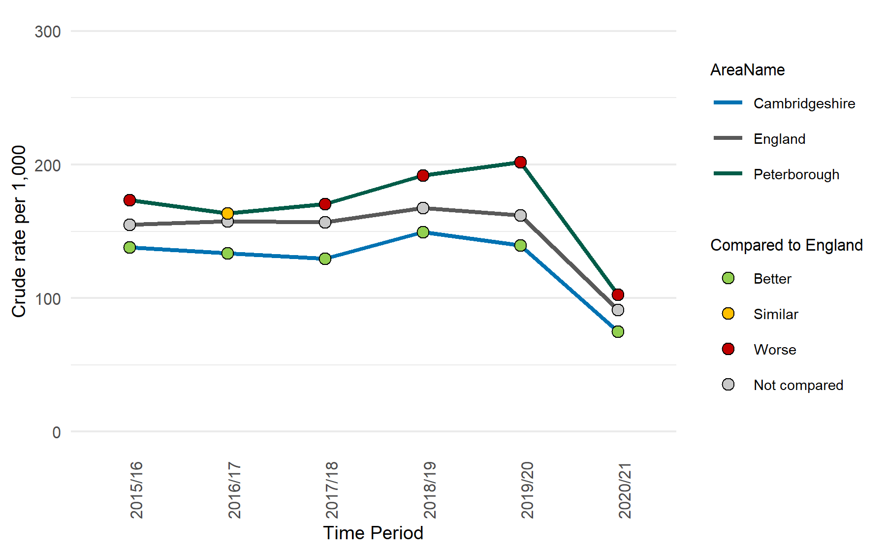
Risk factors
A&E attendances (0-4 years)
Emergency admissions (aged 0-4)
 | Cambridgeshire | Peterborough
Number of A&E attendance for all children aged 0 – 4 years, 2019/20 | 18,105 | 10,650
 | Cambridgeshire | Peterborough
The number of finished emergency admissions in children aged 0 – 4 years, 2020/21 | 2,700 | 1,535
The rate of accidents and emergency attendance per 1,000 population aged 0 - 4 years shows an increasing trend for Cambridgeshire and a declining trend for Peterborough since 2015/16.
The rates have been significantly higher than the national rate in Peterborough and lower than England in Cambridgeshire.
The rate of emergency admissions per 1,000 population aged 0-4 years has been significantly higher than the national rate in Peterborough in all years except 2016/17. However, the rate in Cambridgeshire has been significantly lower than the national rate since 2016/17.
The Covid-19 pandemic had a large impact on hospital activity with a reduction in admissions in 2020 to 2021.
Notes:
A&E attendances (0-4 years): A&E attendance rate per 1,000 population aged 0-4 years.
Data from https://fingertips.phe.org.uk/profile/child-health-profiles/data#page/1
Source: Office for Health Improvement and Disparities, based on ECDS and ONS mid-year population estimates
Emergency admissions (aged 0-4): Emergency admissions (rate per 1,000 population) aged 0-4
Data from https://fingertips.phe.org.uk/profile/child-health-profiles/data#page/1
Source: OHID based on NHS Digital, Hospital Episode Statistics (HES), and Office for National Statistics, mid-year Population estimates

Slide 10
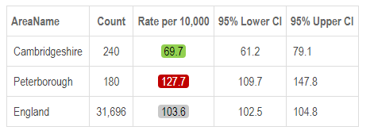
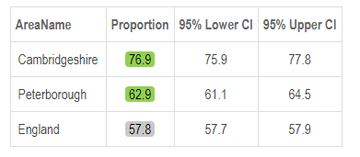
Risk factors
Hospital admissions caused by unintentional and deliberate injuries in children (aged 0 to 4 years), 2021/22
Early access to maternity care, 2018/19
In 2021/22, the rate of hospital admissions caused by injury, poisoning and certain other consequences of external causes in children under 5 years was significantly worse than England in Peterborough. However, the rate in Cambridgeshire was significantly better than England.
For Cambridgeshire and Peterborough, the percentage of pregnant women who have their booking appointment with a midwife within 10 completed weeks of their pregnancy was significantly better than the national rate in 2018/19.
A pregnant woman’s booking appointment allows scheduling of her ultrasound scan, identification of women who might need more than usual care, either because of medical history or social circumstances, for discussion of antenatal screening, identification of risk factors such as smoking and offering support, and discussion of mood and mental health.
Notes:
Hospital admissions caused by unintentional and deliberate injuries in children (aged 0 to 4 years): Crude rate of hospital admissions caused by unintentional and deliberate injuries in children aged under 5 years per 10,000 resident population aged under 5 years.
Numerator: The number of finished emergency admissions (episode number equals 1, admission method starts with 2), with one or more codes for injuries and other adverse effects of external causes (ICD 10: S00 to T79 and or V01 to Y36) in any diagnostic field position, in children (aged 0 to 4 years). Admissions are only included if they have a valid Local Authority code. Regions are the sum of the Local Authorities. England is the sum of all Local Authorities and admissions coded as U (England NOS). Admissions that only include T80 to T98 or Y40 to T98, quality of care issues, in any field are excluded.
Data from https://fingertips.phe.org.uk/profile/child-health-profiles/data#page/1
Source: Office for Health Improvement and Disparities, using data from Hospital Episode Statistics (HES), NHS Digital for the respective financial year, England. Hospital Episode Statistics (HES)
Early access to maternity care: Percentage of pregnant women who have their booking appointment with a midwife within 10 completed weeks of their pregnancy (experimental)
Data from https://fingertips.phe.org.uk/profile/child-health-profiles/data#page/1
Source: Maternity Services Dataset (MSDS) v1.5
Note: 2018/19 was the last data collection for MSDS (Maternity Services Dataset) version 1.5, with data for 2019/20 onwards collected using version 2.0 of the dataset. The release of version 2.0 of the dataset represents a substantial change from the structure of MSDS version 1.5. For this reason, the publication of these indicators in the future, based on more recent data, will require a change of methods.

Slide 11
Risk factors
Live births by mothers aged under 20, 2021
Live births by mothers aged under 18, 2021
Area Name | Number | Proportion of total live births
Cambridge | 17 | 1.3%
East Cambridgeshire | 13 | 1.6%
Fenland | 34 | 3.3%
Huntingdonshire | 30 | 1.6%
South Cambridgeshire | 16 | 1.0%
Cambridgeshire | 110 | 1.6%
Peterborough | 83 | 3.1%
East of England | 1,265 | 1.9%
England | 12,928 | 2.2%
Area Name | Number | Proportion of total live births
Cambridgeshire | 18 | 0.3%
Peterborough | 27 | 1.0%
East of England | 277 | 0.4%
England | 3,035 | 0.5%
The proportion of live births where the age of the mother is under 18 years in Peterborough is substantially higher than Cambridgeshire, East of England and England rates.
The proportion is almost three times as high as in Peterborough than in Cambridgeshire.
The proportion of live births where the age of the mother is less than 20 years is higher than the regional and national average in Fenland and Peterborough.
The rate in Fenland and Peterborough is almost twice as high as that in other Cambridgeshire districts.
Notes:
Source: Office for National Statistics

Slide 12
Risk factors
Live births outside marriage or civil partnership, 2021
Live births by sole registration, 2021
Area Name | Number | Proportion of total live births
Cambridge | 473 | 36.6%
East Cambridgeshire | 383 | 45.8%
Fenland | 686 | 67.1%
Huntingdonshire | 922 | 48.8%
South Cambridgeshire | 611 | 37.4%
Cambridgeshire | 3,075 | 46.1%
Peterborough | 1,407 | 52.7%
East of England | 33,878 | 50.5%
England | 302,677 | 50.8%
Area Name | Live birth sole registrations
 | Number | Proportion of total live births
Cambridge | 58 | 4.5%
East Cambridgeshire | 28 | 3.3%
Fenland | 61 | 6.0%
Huntingdonshire | 56 | 3.0%
South Cambridgeshire | 39 | 2.4%
Cambridgeshire | 242 | 3.6%
Peterborough | 156 | 5.8%
East of England | 2,627 | 3.9%
England | 27,539 | 4.6%
The number of live births registered outside of a marriage or civil partnership is higher than the number of births registered within a marriage or civil partnership in Fenland, Peterborough, East of England and England.
The proportion of live births registered outside marriage or civil partnership in Fenland (67.1%) is substantially higher than the regional (50.5%) and national rates (50.8%). The proportion in Peterborough (52.7%) is also higher than the regional and national rates.
The proportion of live births with sole registrations out of the total live births in Fenland (6.0%) and Peterborough (5.8%) is higher than the national average (4.6%).
The proportion in Cambridge is higher than East of England, but lower than the national rate.
Notes:
Source: Office for National Statistics

Slide 13
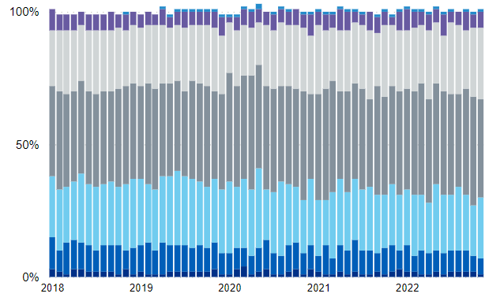
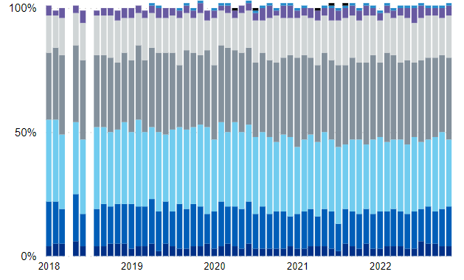
Risk factors
Age of mother at the first antenatal booking (Jan 2018 – Nov 2022)
Cambridge University Hospital NHS Foundation Trust (CUHFT)
North West Anglia NHS Foundation Trust (NWAFT)
The proportion of mothers aged 25 – 29 and 30- 34 years at the time of booking is higher than that of other age groups in Cambridge University Hospital and North West Anglia NHS Foundation Trust.
In CUHFT, the proportion of mothers aged 19 or under at the time of booking has been 3% or less since January 2018, whereas it has been 6% or less in NWAFT.
Notes:
Source: National Maternity Dashboard, NHS Digital
Link: https://app.powerbi.com/view?r=eyJrIjoiMzQ3YWY4MWQtZjEwNS00OGZhLWE3NzEtNzZmM2ViN2ViNWI0IiwidCI6IjUwZjYwNzFmLWJiZmUtNDAxYS04ODAzLTY3Mzc0OGU2MjllMiIsImMiOjh9&pageName=ReportSection3ed77151186ecd679338

Slide 14
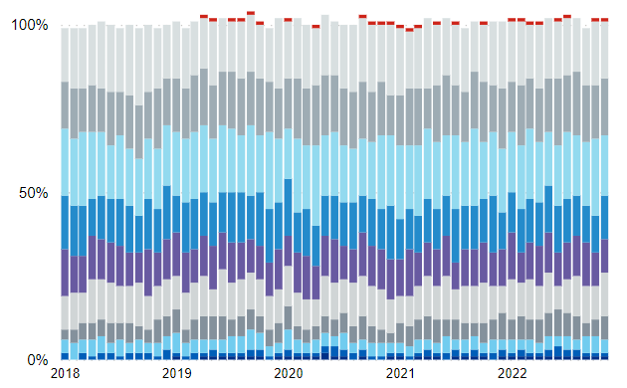
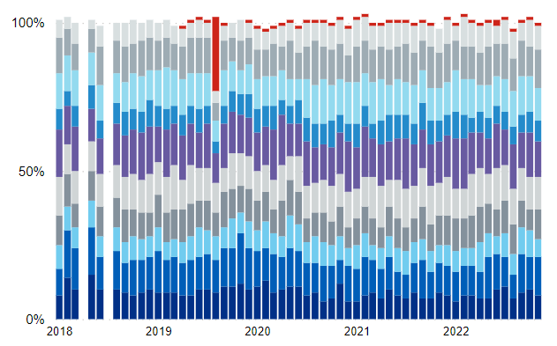
Risk factors
Index of deprivation of mother at booking (Jan 2018 – Nov 2022)
Cambridge University Hospital NHS Foundation Trust (CUHFT)
North West Anglia NHS Foundation Trust (NWAFT)
In CUHFT, lower proportions of mothers were from the top 4 most deprived deciles.
The index of deprivation of mothers at booking shows that the proportions are split across all the deprivation deciles in NWAFT.
Notes:
Source: National Maternity Dashboard, NHS Digital
Link: https://app.powerbi.com/view?r=eyJrIjoiMzQ3YWY4MWQtZjEwNS00OGZhLWE3NzEtNzZmM2ViN2ViNWI0IiwidCI6IjUwZjYwNzFmLWJiZmUtNDAxYS04ODAzLTY3Mzc0OGU2MjllMiIsImMiOjh9&pageName=ReportSection3ed77151186ecd679338

Slide 15
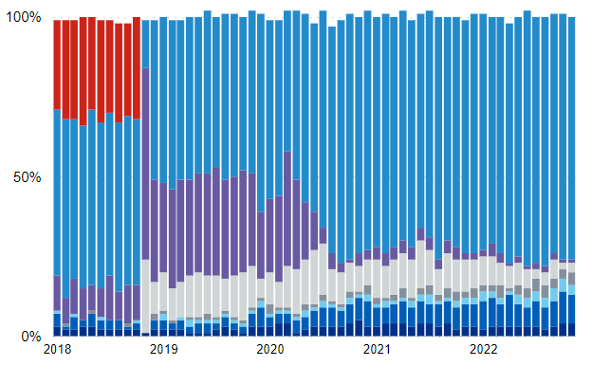
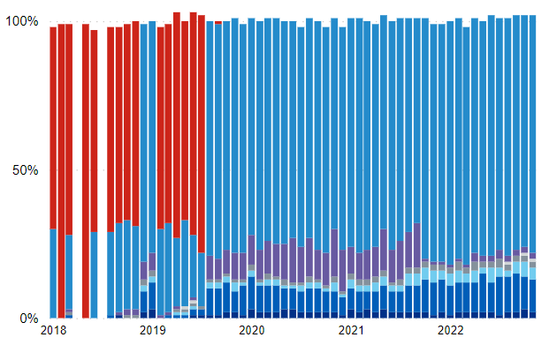
Risk factors
Ethnic category of mother (Jan 2018 – Nov 2022)
Cambridge University Hospital NHS Foundation Trust (CUHFT)
North West Anglia NHS Foundation Trust (NWAFT)
An increasing trend is seen in the proportion of "Asian or Asian British" mothers in the CUHFT and NWAFT. The proportion of "Black or Black British" mothers has also shown a slight increase in recent months.
The proportion of "Not known" and "Not stated" categories show a declining trend in both CUHFT and NWAFT.
Notes:
Source: National Maternity Dashboard, NHS Digital
Link: https://app.powerbi.com/view?r=eyJrIjoiMzQ3YWY4MWQtZjEwNS00OGZhLWE3NzEtNzZmM2ViN2ViNWI0IiwidCI6IjUwZjYwNzFmLWJiZmUtNDAxYS04ODAzLTY3Mzc0OGU2MjllMiIsImMiOjh9&pageName=ReportSection3ed77151186ecd679338

Slide 16
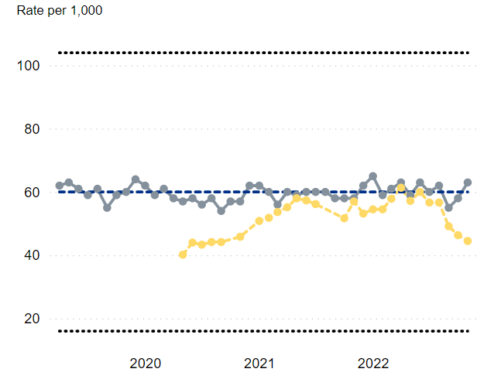
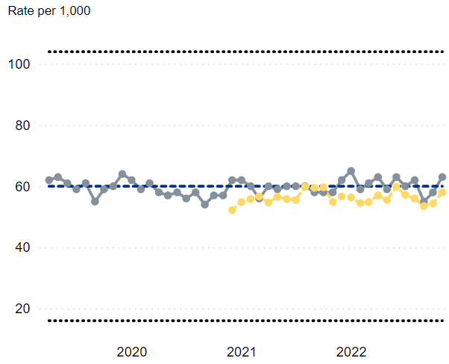
Risk factors
Babies who were born preterm, rate per 1,000
Cambridge University Hospital NHS Foundation Trust (CUHFT)
North West Anglia NHS Foundation Trust (NWAFT)
In CUHFT, the 6-month rolling average rate of babies who were born preterm (babies born whose gestational length was between 154 and 258 days) shows a declining trend in recent months.
In NWAFT, the 6-month rolling average rate of babies who were born preterm shows a relatively stable trend and lower than the national rate.
Notes:
Source: National Maternity Dashboard, NHS Digital
Link: https://app.powerbi.com/view?r=eyJrIjoiMzQ3YWY4MWQtZjEwNS00OGZhLWE3NzEtNzZmM2ViN2ViNWI0IiwidCI6IjUwZjYwNzFmLWJiZmUtNDAxYS04ODAzLTY3Mzc0OGU2MjllMiIsImMiOjh9&pageName=ReportSection3ed77151186ecd679338

Slide 17
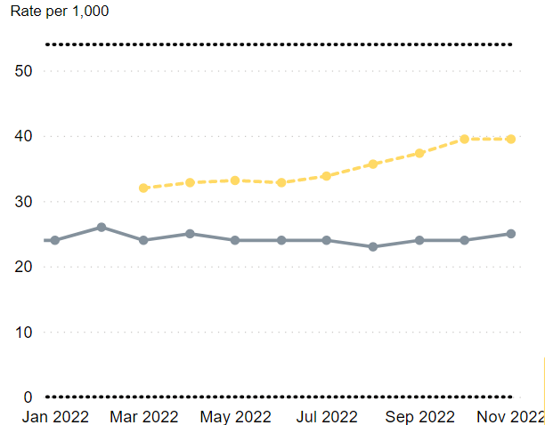
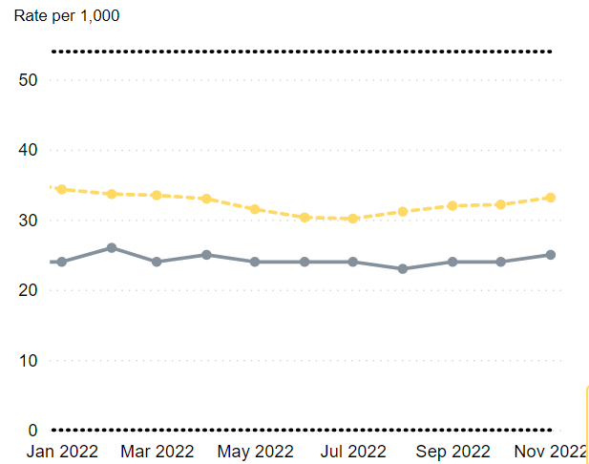
Risk factors
Women delivering vaginally who had a 3rd or 4th degree tear, rate per 1,000
Cambridge University Hospital NHS Foundation Trust (CUHFT)
North West Anglia NHS Foundation Trust (NWAFT)
The 6-month rolling average rate of women delivering vaginally with a 3rd or 4th degree tear in CUHFT has increased substantially in recent months compared to March 2022.
The rate in NWAFT also shows an increasing trend since July 2022.
Notes:
Source: National Maternity Dashboard, NHS Digital
Link: https://app.powerbi.com/view?r=eyJrIjoiMzQ3YWY4MWQtZjEwNS00OGZhLWE3NzEtNzZmM2ViN2ViNWI0IiwidCI6IjUwZjYwNzFmLWJiZmUtNDAxYS04ODAzLTY3Mzc0OGU2MjllMiIsImMiOjh9&pageName=ReportSection3ed77151186ecd679338
a third degree tear – involves the vaginal wall, perineum and the anal sphincter (the muscle that controls the back passage)
a fourth degree tear – also involves the lining of the back passage

Slide 18
Prevalence

Slide 19
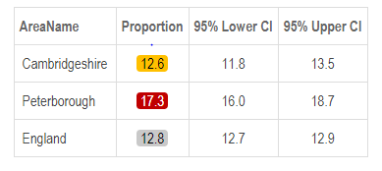
Prevalence
Smoking in early pregnancy, 2018/19
Smoking status at time of delivery by, England, East of England and Cambridgeshire and Peterborough Integrated Care Board April-June 2022
In 2018/19, the percentage of pregnant women who were smoking at the time of booking appointment with midwife was significantly worse than England in Peterborough, while similar to the national rate in Cambridgeshire.
Note: Caution should be taken when interpreting this data. Due to the small number of woman setting a quit date confidence intervals at a local authority level are large. ​
For quarter 1 2022-23 data, the percentage of pregnant woman smoking at time of delivery was statistically significantly lower for the East of England (7.6%) compared to the national average (8.6%), while Cambridgeshire and Peterborough ICB was statistically similar (8.1%). ​
Similarly the percentage of pregnant women who were non-smoking at time of delivery was statistically significantly lower for the East of England (86.5%) compared to the national average (88.4%), while Cambridgeshire and Peterborough ICB was statistically similar (86.9%). ​
The percentage of women whose smoking status was unknown at the time of delivery, for East of England region and Cambridgeshire and Peterborough ICB was statistically significantly higher, 5.9% and 5.0% respectively compared to the 3.0% nationally.
Notes:
Smoking in early pregnancy: Percentage of pregnant women who smoke at the time of booking appointment with midwife (experimental).
Data from https://fingertips.phe.org.uk/profile/child-health-profiles/data#page/1
Source: Maternity Services Dataset (MSDS) v1.5
Caveats: This indicator is based on self-reporting of smoking status therefore bias may remain as women may under-report smoking in early pregnancy.
Women known to be smokers at the time of delivery - defined as pregnant women who self-reported that they were smokers. This includes any cigarettes or tobacco at all, but excludes non-combustible nicotine products, such as e-cigarettes or other nicotine containing products. If a woman intends to give up smoking after the delivery, but was a smoker up until the delivery date they are included in this count.
Women known to be non-smokers at the time of delivery - defined as pregnant women who self-reported that they were non-smokers (no cigarettes or tobacco at all). This count does not include women whose smoking status is not known (which is collected separately), or those who intend to give up smoking after delivery.
Women whose smoking status was not known at the time of delivery - defined as those whose smoking status was not determined for whatever reason.
Source: NHS Digital, Smoking status at time of delivery by Sub Integrated Care Board Location (Sub-ICB), Q1 (April-June 2022). ​
Link: https://digital.nhs.uk/data-and-information/publications/statistical/statistics-on-women-s-smoking-status-at-time-of-delivery-england ​

Slide 20
Prevalence
Maternal mood review at 6-8 weeks development check, (Q1-Q3 2022/23)
Maternal mood review at the 12 month development check, (Q1-Q3 2022/23)
The above chart shows the proportion of mothers who likely had depression and severe anxiety out of those who had a maternal mood review at a 6-8 week development check after birth.
The proportion of mothers who were likely to have depression was around 13% in Peterborough. The proportion varied between 14.3% and 15.6% in North Cambridgeshire and 5.5% and 11.4% in South Cambridgeshire.
An increasing trend is seen in South Cambridgeshire from the first quarter to the third quarter in the rates of mothers who were likely to have depression.
The proportion of mothers who were likely to have severe anxiety was 1.8% in Peterborough, while this varied between 0.9% and 2.1% in North Cambridgeshire and 0.4% to 1.1% in South Cambridgeshire.
The above chart shows the proportion of mothers who likely had depression and severe anxiety out of those who had a maternal mood review at a 12 month development check after birth.
The proportion of mothers who were likely to have depression was substantially higher in the Peterborough Hub (3.7%–4.7%) compared to the North and South Cambridgeshire areas.
The proportion of mothers who were likely to have severe anxiety showed a substantial increase in the third quarter in Peterborough.
The proportion of mothers who were at higher risk of depression or anxiety is substantially higher in Peterborough than in North and South Cambridgeshire.
Notes:
At 6 - 8 weeks and 12 months after birth, health visitors carry out maternal mood reviews during development checks. These checks cover a high proportion of families in Cambridgeshire and Peterborough.
Source: Healthy Child Programme, Health visitors’ key performance indicators
GAD7 - The Generalised Anxiety Disorder Assessment (GAD-7) is a seven-item instrument that is used to measure or assess the severity of generalised anxiety disorder (GAD). Each item asks the individual to rate the severity of his or her symptoms over the past two weeks. Response options include “not at all”, “several days”, “more than half the days” and “nearly every day”.
The GAD-7 score is calculated by assigning scores of 0, 1, 2, and 3, to the response categories of “not at all,” “several days,” “more than half the days,” and “nearly every day,” respectively, and then adding together the scores for the seven questions.
The PHQ2 assessment is a rapid screening test to identify whether a person may be at risk for depression.

Slide 21
Use of Perinatal Mental Health Services

Slide 22
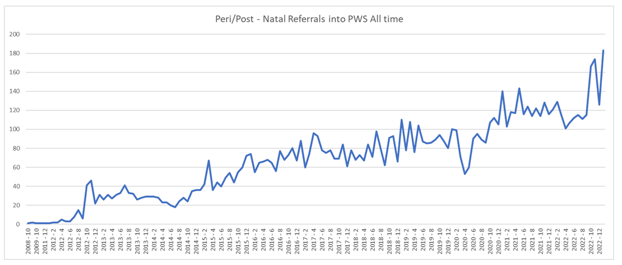
All time Referrals into Cambridgeshire and Peterborough Talking Therapies
Talking Therapies
Referrals per month
A steady increase is seen in the number of referrals to Talking Therapies services for the perinatal patients (both mums and partners) with mild-to-moderate anxiety and depression.
A further increase in perinatal patients has been seen since the introduction of the wider criteria (up to 2 years post-birth) in summer 2022.
Notes:
Source: Cambridgeshire and Peterborough Talking Therapies

Slide 23
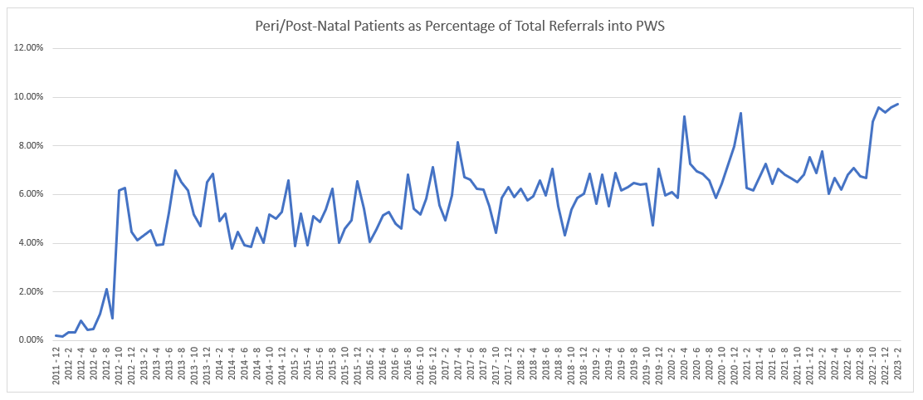
Perinatal patients as a percentage of total referrals into Talking Therapies
Talking Therapies
A steady increase is seen in the percentage of total patients showing as perinatal (both mums and partners), increasing to nearly 10% recently with the widening of the criteria (up to 2 years post birth) for inclusion.
Notes:
Source: Cambridgeshire and Peterborough Talking Therapies

Slide 24
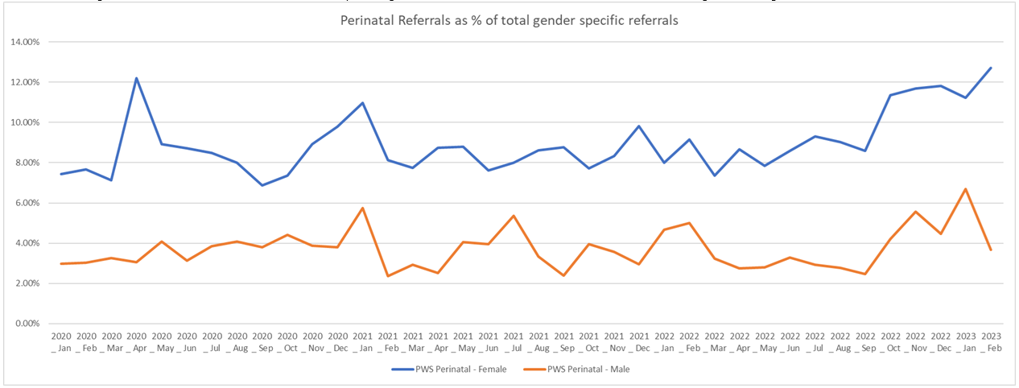
Perinatal referrals as a percentage of total gender specific referrals into Talking Therapies
Talking Therapies
In the above chart, the orange line shows the total Perinatal Male referrals as a percentage of the total Male referrals into Talking Therapies and the blue line showing female referrals.
The proportion of perinatal female referrals show an increasing trend in the recent months.
Notes:
Source: Cambridgeshire and Peterborough Talking Therapies

Slide 25
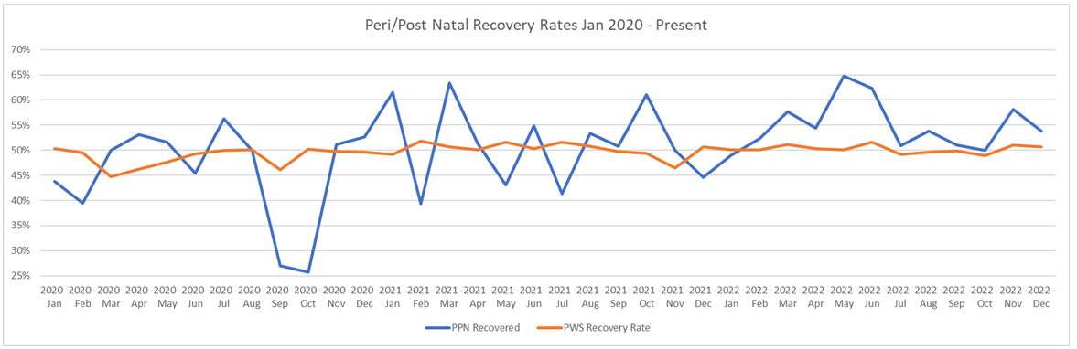
Perinatal recovery rates compared to the whole of Talking Therapies
Talking Therapies
The recovery rates of perinatal patients (both mums and partners) is similar to that of the whole of Talking Therapies patients.
Notes:
Source: Cambridgeshire and Peterborough Talking Therapies
Recovery rate: Proportion of referrals with a discharge date in the period that finished a course of treatment where the service user moved to recovery expressed as a percentage.
Recovery in IAPT is measured in terms of ‘caseness’ – a term which means a referral has severe enough symptoms of anxiety or depression to be regarded as a clinical case. A referral has moved to recovery if they were defined as a clinical case at the start of their treatment (‘at caseness’) and not as a clinical case at the end of their treatment, measured by scores from questionnaires tailored to their specific condition. - https://digital.nhs.uk/data-and-information/publications/statistical/psychological-therapies-report-on-the-use-of-iapt-services/september-2020-final-including-a-report-on-the-iapt-employment-advisors-pilot/outcomes

Slide 26
Number of referrals per month for Cambridgeshire and Peterborough
Specialist Perinatal Mental Health Services
Number of assessment done per month for Cambridgeshire and Peterborough
The number of referrals to a perinatal mental health service has shown an overall increase since July 2021.
The number of assessments refers to the number of women who have their first assessment via face-to-face, videoconferencing, or telephone contact within the reporting month. A large increase has been seen in the number of assessments done from July 2021 (39%) to March 2023 (60%).
Notes:
Source: Specialist perinatal mental health service, CPFT
Number of referrals: The number of referrals to a perinatal mental health service that had a Referral Request Received Date recorded during the reporting period
Number of assessments: The number of women who have had their first assessment (via face to face, videoconferencing or telephone contact) within the reporting month

Slide 27
Proportion of referrals that are assessed per month Cambridgeshire and Peterborough
Specialist Perinatal Mental Health Services
Proportion of slots that were not attended per month for Cambridgeshire and Peterborough
The proportion of referrals that were assessed shows an overall increase from 39% in July 2021 to 52% in March 2023.
A declining trend is seen in the proportion of appointments that were missed in the reporting period. In March 2023, 26% of the appointments were missed, compared to 41% in July 2021.
Notes:
Source: Specialist perinatal mental health service, CPFT

Slide 28
First face to face contact as a percentage of ONS 2016 births, Cambridgeshire and Peterborough
Specialist Perinatal Mental Health Services
Average wait time for first contact, Cambridgeshire and Peterborough
Trend line
The percentage of the 2016 births receiving first face-to-face contact (including video conferencing) shows a rapidly increasing trend in the last year.
Waiting time refers to the time between the referral date and first contact (carried out with the patient or patient proxy delivered face-to-face (including video conferencing) or by telephone, where the duration of the contact is >= 30 minutes). A relatively stable trend has been seen for the average waiting time since May 2022.
Notes:
Source: Specialist perinatal mental health service, CPFT

Slide 29
Access to perinatal mental health services, Cambridgeshire and Peterborough ICB
Specialist Perinatal Mental Health Services
‘Access’ is defined as at least one face-to-face or video-conferencing ‘contact’ with a specialist perinatal mental health service at any point in the financial year.
The above chart for the Cambridgeshire and Peterborough Integrated Care Board (ICB) shows an increasing trend in the 12-month rolling access in recent time periods.
Notes:
Source: Perinatal Mental Health Dashboard, FutureNHS
Link: https://future.nhs.uk/MHRH/view?objectID=27644304

Slide 30
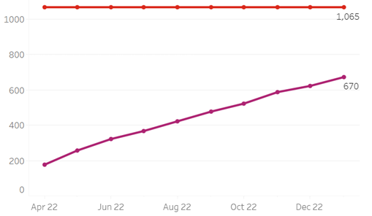
Cumulative year to date access from April 2022 and 22/23 target, Cambridgeshire and Peterborough ICB
Specialist Perinatal Mental Health Services
Target for 2022/23
Cumulative year to date access from April 2022
Number of women
Data upto Jan 23
The above chart shows the cumulative number of women who had at least one attended Face to Face or Videoconferencing contact with specialist Perinatal Mental Health Services from the start of the financial year (2022/23) to Jan 2023
In 2016, the initial target for perinatal mental health access was set at 1,065 to offer assessment to 10% of the births. However, the expected increase in funding didn’t come through to the services, so the target was adjusted to 728 for 2022/23 rather than 1,065. This adjusted target is not reflected on the above chart from the perinatal mental health dashboard.
Note: Telephone appointments do not count in the numbers for access rates and how that has affected the access target too.
Notes:
Source: Perinatal Mental Health Dashboard, FutureNHS
Link: https://future.nhs.uk/MHRH/view?objectID=27644304

Slide 31
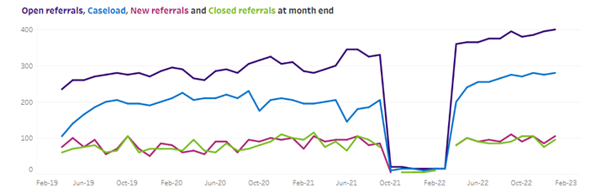
Open referrals, Caseload, New referrals and Closed referrals at month end for Cambridgeshire and Peterborough ICB
Specialist Perinatal Mental Health Services
Note: Submissions for the Cambridgeshire and Peterborough ICB were not made for the period from October 2021 to March 2022.
For Cambridgeshire and Peterborough ICB, the number of open referrals and caseloads at month-end shows an increasing trend, while new referrals and closed referrals show a relatively stable trend.
Notes:
Source: Perinatal Mental Health Dashboard, FutureNHS
Link: https://future.nhs.uk/MHRH/view?objectID=27644304

Slide 32
Perinatal rolling 12 month access up to Jan 2023, by Integrated Care Board (ICB)
Specialist Perinatal Mental Health Services
Access rate is the number of women accessing services in the last 12 month period as a percentage of ONS 2016 births.
The access rate for Cambridgeshire and Peterborough ICB is 6.3%, which is lower than the access rates seen in several other ICBs nationally. This is because the local target has been set to lower level than the national target.
Notes:
Source: Perinatal Mental Health Dashboard, FutureNHS
Link: https://future.nhs.uk/MHRH/view?objectID=27644304

