Slide 1

Transport update: Cambridge and South Cambridgeshire
COVID-19 transport impacts and recovery
April 2023
Research Team, Cambridgeshire County Council

Slide 2
Transport Update Aims
This report is intended to:
Summarise the on-going impacts of COVID-19 on trends in transport and mobility up to 31st March 2023.
Highlight changes in key indicators by comparing March 2023 data with to a pre-pandemic baseline (March 2019 or Feb 2020), to mid-COVID (March 2021) and to last year (March 2022).
Provide a basis for discussion for the Greater Cambridge Partnership (GCP) to understand and identify existing challenges and future data needs.
Notes:
Comparison periods may vary across the different datasets based on the availability of historic data – comparison periods are clearly noted for each dataset.
  Where reference is made to ‘Weekdays’ this only includes Monday, Tuesday, Wednesday and Thursday, as per DfT guidance.

Slide 3
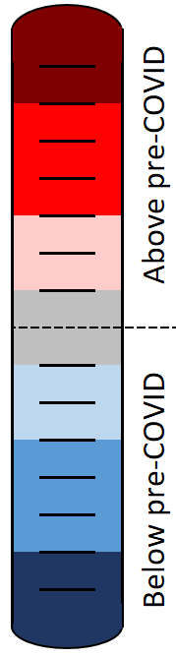
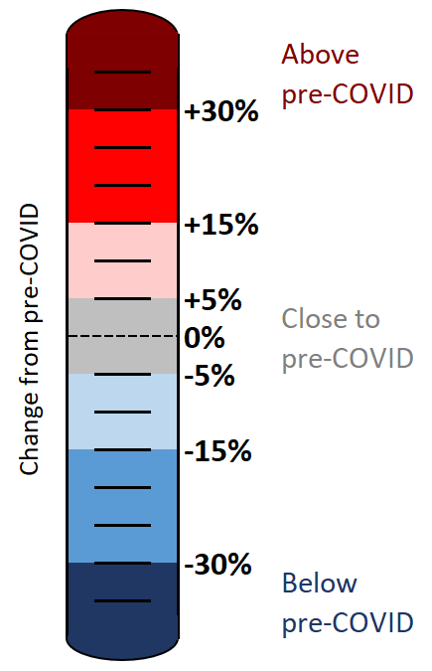
Colour scale
The statistics in this pack have been colour-coded using a heat scale to reflect the level of recovery being experienced (pre-COVID compared to now).
A positive (red) value indicates that levels have increased above those experienced pre-COVID.
A negative (blue) value indicates that levels remain below pre-COVID.
Top tip:
Lookout for the colour scale bar in the top right-hand corner of each page for a reminder of the heat scale used to indicate the level of recovery throughout the pack.

Slide 4





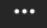
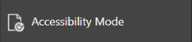
Accessibility
To access the full functionality of PowerPoint, we recommend opening the slides in full screen mode. To do this, click the “Open in New Window” button in the bottom right-hand corner.
1) Navigate through the slide pack using the left and right arrows in the middle-bottom of the screen. Clicking on the sentence “Slide x of x” brings up a pop-up listing all the slides so you can navigate directly to a slide of interest.
2) Open the Notes for each slide to see the data source, technical notes and any additional commentary. See the “Notes” button in the bottom right-hand corner.
3) Use the “Download” button to the right of the centre at the top of the screen to download the slides as a .pptx file.
4) Use the “Print to PDF” option to save the PowerPoint as a PDF document (but please be aware you will lose access to the Notes section which contains additional information for the slide).
5) Use the “More options” icon in the top right-hand corner and choose “Accessibility mode” from the pop-up menu to access the slides in a different format which will display any Alt Text that has been set for charts and images.
We are continually working to improve the accessibility of our content. If you find you are unable to access any part of this update, please contact research.group@cambridgeshire.gov.uk and we will be happy to investigate providing information in a different format.

Slide 5
Overview

Slide 6








Headlines: March 2023
Local Roads
Volumes at
compared to pre-COVID
(see analysis on slide 21 onwards)
Strategic Roads
Volumes at
-
compared to pre-COVID
(see analysis on slide 10 onwards)
Car Parking
Patronage at
compared to pre-COVID
(see analysis on slide 36 onwards)
Bus
Patronage at
-
compared to pre-COVID
(see analysis on slide 44)
Park and Ride
Patronage at
compared to pre-COVID
(see analysis on slide 45 onwards)
P
P
+
-7%
-7%
-22%
-13%
0%
Station Square Footfall
Volumes at
-50%
compared to pre-COVID
(see analysis on slide 42)
Retail Footfall
Volumes at
-14%
compared to pre-COVID
(see analysis on slide 33 onwards)
Walking
Volumes at
-22%
compared to pre-COVID
(see analysis on slide 32)
Cycling
Volumes at
-25%
compared to pre-COVID
(see analysis on slide 31)
Air Pollution
Concentrations at
-22%
compared to pre-COVID
(see analysis on slide 49 onwards)
-24%
-12%
-10%
-29%
-41%

Slide 7
Recovery Tracker
Notes:
Source: Various, listed in the Data Source column
Technical Notes: Our methodology for analysing the data continues to be refined to react to differing levels of data quality and data gaps. Therefore, you may observe small adjustments to the stats in the latest slide pack compared to previously published versions.
For example:
The method of calculating the strategic road network (SRN) recovery percentages changed in Dec 2022 to include data from a larger number of sites (originally 6 sites, now 28 sites). The SRN percentages have therefore been updated and may not reflect the values presented in previous slide packs for this reason.
The air pollution percentages historically used data from 5 sensors but one of these sensors was removed in April 2022 so the methodology for calculating the air pollution percentages has been adjusted. The air pollution percentages presented here may differ slightly from those in previous slide packs for this reason.
Commentary:
This slide indicates the extent to which each of the transport metrics has recovered over time in comparison to pre-Covid (2019 or early 2020) levels.
Google mobility workplace, Cambridge: Plateaued recovery 31% below pre-Covid in Sept 2022. Data source discontinued in October 2022.
Google mobility workplace, South Cambridgeshire: fluctuating recovery, 11% below pre-Covid in Sept 2022. Data source discontinued in October 2022.
Retail footfall, central Cambridge: stabilising recovery levels. Currently just below pre-Covid.
One Station Square footfall: Erratic pattern of recovery over time. Currently some way below pre-Covid levels.
Walking, central Cambridge: Improving recovery trend. Currently just below pre-Covid.
Cycling, central Cambridge: Gradually improving recovery trend - currently below pre-Covid.
Multi Storey Car Parking, central Cambridge: stabilising recovery trend, currently some way below pre-Covid.
Vehicle flows on local roads, central Cambridge: gradually improving recovery trend - currently just below pre-Covid.
Vehicle flow on strategic roads, county-wide: stable recovery trend, currently just below pre-Covid.
Bus passengers, Cambridge: improving recovery trend since March 2022. Currently below pre-Covid.
Park and Ride passengers: gradually improving recovery trend, now back at pre-Covid levels in terms of overall passenger numbers but recovery varies by P&R site.
Air pollution: Fluctuating trend in part linked to expected seasonal variations. Notably below pre-Covid levels.

Slide 8
Travel Demand

Slide 9
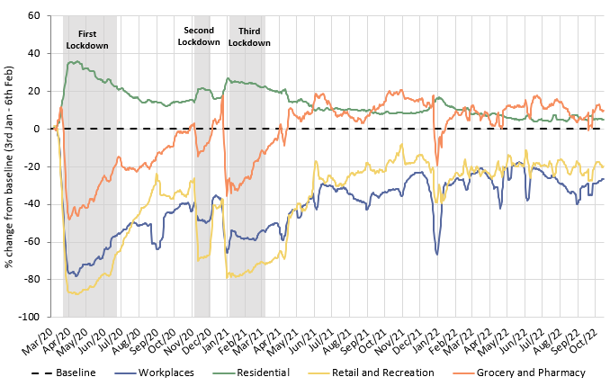
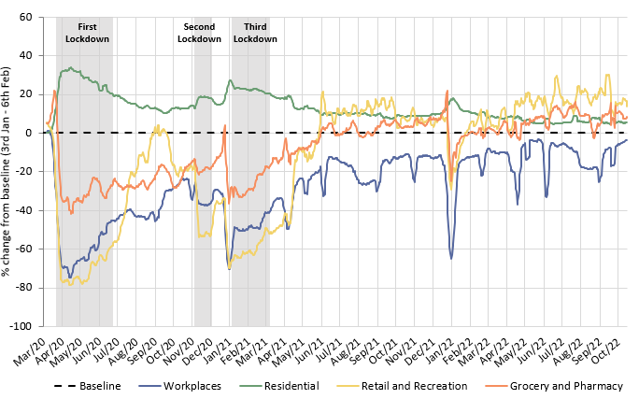
Has COVID-19 changed where we spend our time?
The pandemic caused us to spend more time at home and less time at a designated workplace. Whilst the extent of this impact has steadily reduced since Spring 2021, an impact was still being seen when Google discontinued this dataset in October 2022, particularly in Cambridge.
Cambridge
South Cambridgeshire
 | Pre-Covid to Now: Baseline (Jan/Feb 2020) to Oct* 2022
Pre-Covid vs Now: | Workplaces | Residential | Retail and Recreation | Grocery and Pharmacy
Cambridge | -26 | +5 | -19 | +11
South Cambridgeshire | -3 | +5 | +16 | +9
*Sourced from Google Mobility data which was discontinued on 16th October 2022. Numbers represent the % change from the baseline period. The baseline period is defined by Google as 3rd Jan – 6th Feb 2020.
Notes:
Source: Google LLC "Google COVID-19 Community Mobility Reports". https://www.google.com/covid19/mobility/
Technical notes: Data is gathered from Google account holders location history. This helps to demonstrate where people are spending their time. The data is based on the most recent month (October 2022) compared to the median of the corresponding day in the baseline period (3rd Jan-6th Feb 2020) as calculated by Google. Tabulated percentages represent the change from the baseline (3rd Jan – 6th Feb) to the most recent month.
Commentary: Cambridge: Cambridge grocery and pharmacy visits finished at 11% above pre-pandemic levels in October 2022. Meanwhile, retail and recreation visits finished 19% below pre-pandemic levels, which suggested that essential shopping recovered to a much stronger extent than leisure shopping. The proportion of people making workplace visits stayed steadfastly below the pre-Covid baseline, ending at -26% in October 2022. Conversely, residential visits finished 5% higher than the baseline, in part likely due to the persistence of remote working.
South Cambridgeshire: Data on workplace visits finished at 3% below pre-pandemic baseline levels. Similarly to Cambridge data, residential numbers were continually above the pre-pandemic baseline since the dataset began, finishing at 5% above the baseline in October 2022. Retail and recreation (+16%), and grocery and pharmacy (+9%) visits remain ahead of the pre-pandemic baseline in South Cambridgeshire, suggesting that people’s shopping and leisure habits recovered and then stabilised after the heavy disruption caused by the pandemic and associated lockdowns.

Slide 10
Strategic Road Network

Slide 11
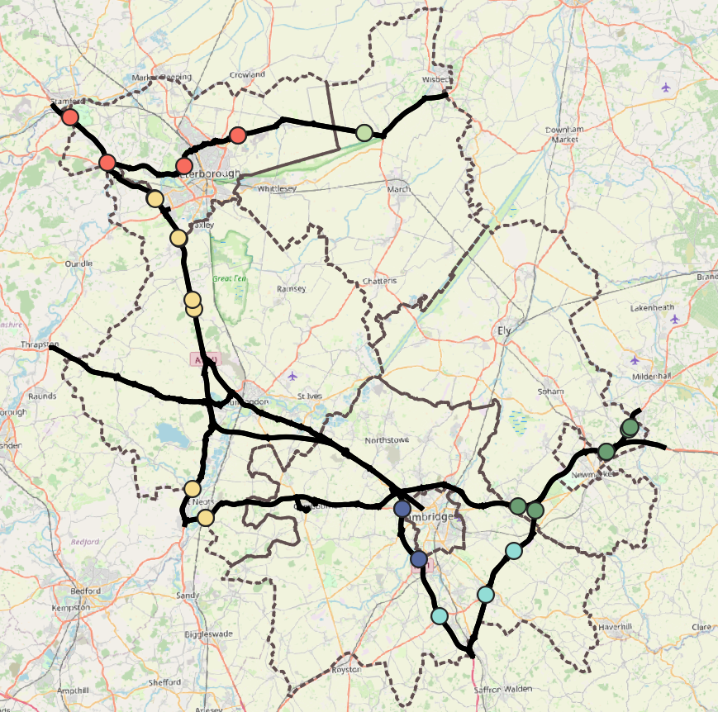
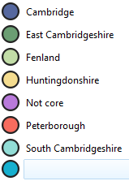
Strategic Road Network Monitoring Sites
Strategic Road Network traffic monitoring sites with continuous data
National Highways have approximately 1,400 permanent traffic monitoring sites on the strategic road network within Cambridgeshire and Peterborough.
Each monitoring site varies in its ability to reliably provide data over time, and periods of inactivity are common. It is therefore not appropriate to conduct a long-term analysis for all-sites.
For this reason, only the 28 sensors with uninterrupted data from January 2019 onwards are included in this analysis. These 28 sites are shown on the map to the left.
A1
A47
N
A14
A1
A11
Cambridge sites
A14
East Cambridgeshire sites
A14
Fenland sites
A428
Huntingdonshire sites
A1
Peterborough sites
South Cambridgeshire sites
Strategic Road Network in Cambridgeshire and Peterborough
M11
© OpenStreetMap Contributors
Notes:
Source: National Highways WebTRIS data. (https://webtris.highwaysengland.co.uk/)
Technical notes:
Count site locations and IDs:
Cambridge: MIDAS site at M11/6886B, MIDAS site at M11/6820A, MIDAS site at M11/6886A
Peterborough: TMU Site 6505/1, TMU Site 6502/2, TMU Site 6351/1, TMU Site 6353/1, TMU Site 6351/2
East Cambridgeshire: MIDAS site at A11/0047B, TMU Site 6317/1, MIDAS site at A11/0883A, MIDAS site at A14/1107A, MIDAS site at A14/1241A, MIDAS site at A14/1241B
Fenland: TMU Site 6350/2, TMU Site 6350/1
Huntingdonshire: TMU Site 6816/1, TMU Site 6782/2, TMU Site 6781/2, MIDAS site at A1M/2134A, MIDAS site at A1M/2220A, MIDAS site at A1M/2145B, MIDAS site at A1M/2219B, TMU Site 6999/1, TMU Site 6999/2
South Cambridgeshire: TMU Site 6312/2, TMU Site 6310/1, MIDAS site at M11/6747A

Slide 12
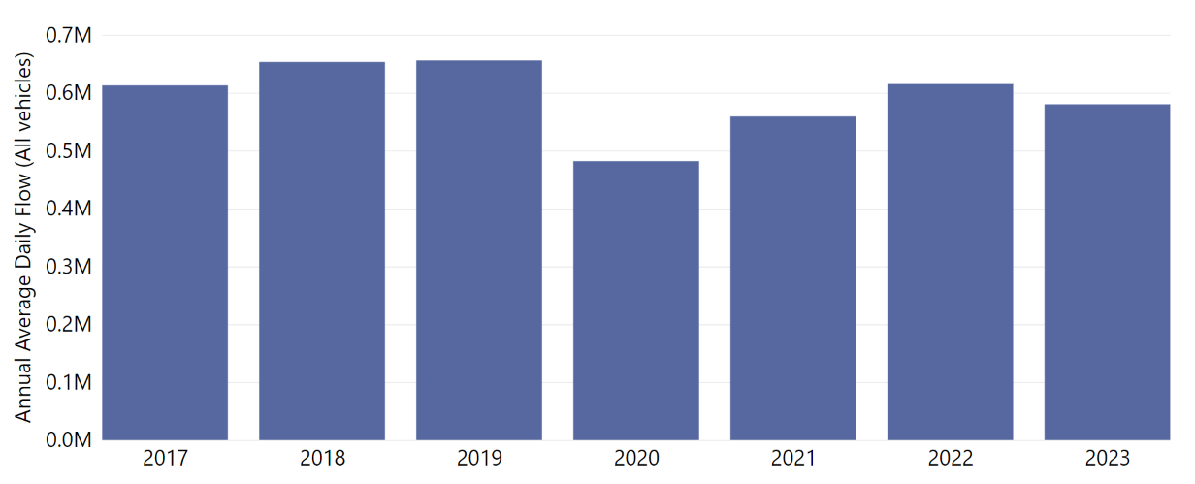
Strategic Road Network: Annual Average Daily Flow by Year
In Cambridgeshire and Peterborough, traffic volumes on the Strategic Road Network in 2023 (Jan-Mar only) are currently 12% below 2019 and 5% below 2017, though the early months of the year typically see lower flows than the middle of the year so this trend may not sustain as the year progresses.
Total Annual Average Daily Flow across all 28 sensors
Jan - Mar only
change from 2019
-6%
change from 2019
change from 2019
-12%
-15%
change from 2019
-27%
Analysis using 3 sensors in Cambridge (M11), 6 in East Cambridgeshire (A11 and A14), 2 in Fenland (A47), 9 in Huntingdonshire (A1 and A1(M)), 5 in Peterborough (A47 and A1) and 3 in South Cambridgeshire (M11 and A11).
Notes:
Source: National Highways WebTRIS data.
Technical note: Average Daily Flow by year for main carriageway monitors in each district, all with data 2019 – 2023. This dataset averages across ALL days (Mon-Sun). The 2023 average is calculated using only Jan – Mar in 2023.
Commentary: Average daily flows are higher than 2020 and 2021 which were affected most by the COVID-19 pandemic but average flows in 2023 so far still remain below pre-pandemic 2019 averages.

Slide 13
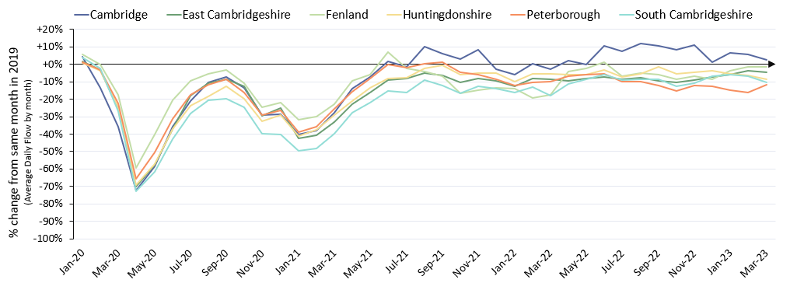
Strategic Road Network: Average Daily Flow by Month
The level of recovery varies by district. Cambridge (M11) has been at/near 2019 volumes since summer 2021. Strategic routes in the other districts remain just below 2019 levels, most notably Peterborough.
Percentage change from the same month in 2019
Pre-COVID to Now Mar 2019 to Mar 2023
Cambridge | East Cambridgeshire | Fenland | Huntingdonshire | Peterborough | South Cambridgeshire | ALL DISTRICTS
+3% | -5% | -2% | -9% | -12% | -10% | -7%
Analysis based on 28 sensors - 3 in Cambridge (M11), 6 in East Cambridgeshire (A11 and A14), 2 in Fenland (A47), 9 in Huntingdonshire (A1), 5 in Peterborough (A47 and A1) and 3 in South Cambridgeshire (M11 and A11).
Notes:
Source: National Highways WebTRIS data.
Technical note: The graph shows the percentage difference from the corresponding month in 2019 (e.g. March 2023 compared to March 2019). Created using Average Daily Flow by month data for main carriageway monitors in each district, all with data 2019 – 2023. This dataset averages across ALL days (Mon-Sun).

Slide 14
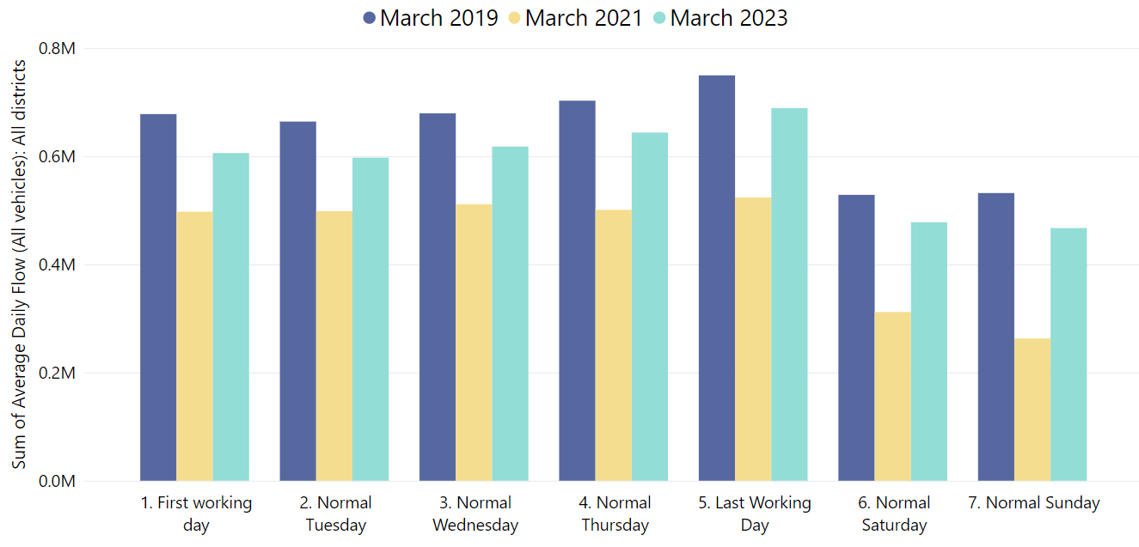
Strategic Road Network: Daily Flow by Day of the Week
On the strategic road network, all days of the week remain approx. 10% below 2019. Thursday and Friday are closest to 2019 (-8%) whilst Sunday is furthest from 2019 (-12%).
Mar-2019
Mar-2019
Mar-2019
Mar-2019
Mar-2023
Mar-2019
Mar-2023
Mar-2023
Mar-2023
Mar-2023
Mar-2021
Mar-2021
Mar-2021
Mar-2021
Mar-2019
Mar-2019
Mar-2021
Mar-2023
Mar-2023
Mar-2021
Mar-2021
Pre-COVID to Now: Mar 2019 to Mar 2023
First Working Day | Normal Tuesday | Normal Wednesday | Normal Thursday | Last Working Day | Normal Saturday | Normal Sunday
-11% | -10% | -9% | -8% | -8% | -10% | -12%
Analysis based on 28 sensors - 3 sensors in Cambridge, 6, in East Cambridgeshire, 2 in Fenland, 9 in Huntingdonshire, 5 in Peterborough and 3 in South Cambridgeshire.
Notes:
Source: National Highways WebTRIS data.
Technical note: Average Daily Flow in the week for main carriageway monitors in each district, all with data 2019 – 2023. Note the use of ‘normal’ days which allow for a ‘like-for-like’ comparison between comparable days. For example, bank holidays and school holidays are excluded from average flow calculations for ‘normal’ days. As such, this dataset does not account for the Christmas period, Christmas or New Year bank holidays, school summer holidays etc.

Slide 15
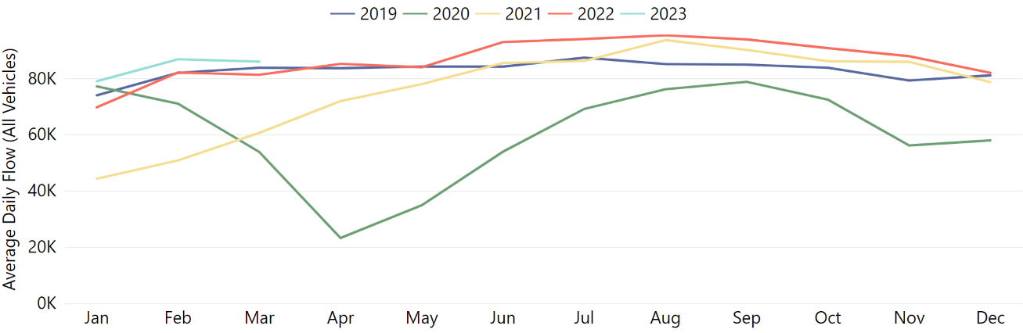
Strategic Road Network: Cambridge
Cambridge strategic road volumes are back to around pre-COVID levels (+3%) and continue to show slight increases (+6% from March 2022).
Pre-COVID to Now: Mar 2019 to Mar 2023 | Mid-COVID to Now: Mar 2021 to Mar 2023 | Previous year to Now: Mar 2022 to Mar 2023
+3% | +42% | +6%
Analysis based on 3 sensors - all on the main carriageway of the M11 (2 near Madingley Road and 1 near Trumpington).
Notes:
Source: National Highways WebTRIS data.
Technical note: This dataset averages across ALL days (Mon-Sun). Analysis is based on 3 sensors - all on the main carriageway of the M11 (2 near Madingley Road and 1 near Trumpington).

Slide 16
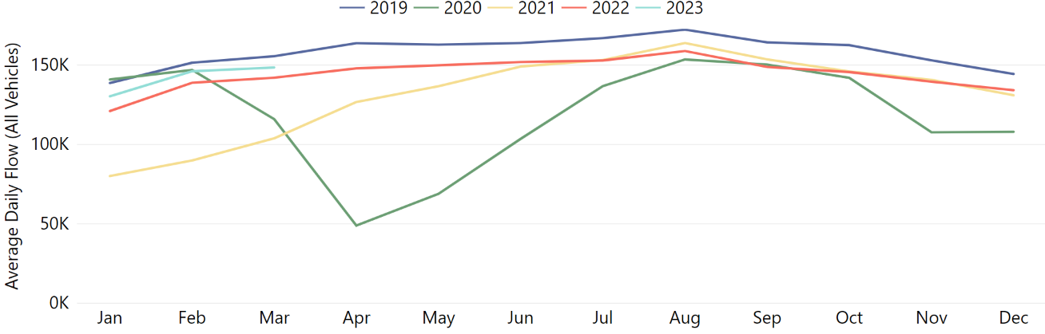
Strategic Road Network: East Cambridgeshire
East Cambridgeshire strategic road volumes remain just below pre-COVID levels (-5%), and volumes are higher in March 2023 than in March 2022 (+5%).
Pre-COVID to Now: Mar 2019 to Mar 2023 | Mid-COVID to Now: Mar 2021 to Mar 2023 | Previous year to Now: Mar 2022 to Mar 2023
-5% | +43% | +5%
Analysis based on 6 sensors - 3 on the main carriageway of the A11 (2 close to Red Lodge and 1 north of Three Mile Bottom) and 3 on the main carriageway of the A14 (2 north of Newmarket and 1 south of Bottisham).
Notes:
Source: National Highways WebTRIS data.
Technical note: This dataset averages across ALL days (Mon-Sun). Analysis based on 6 sensors - 3 on the main carriageway of the A11 (2 close to Red Lodge and 1 north of Three Mile Bottom) and 3 on the main carriageway of the A14 (2 north of Newmarket and 1 south of Bottisham).

Slide 17
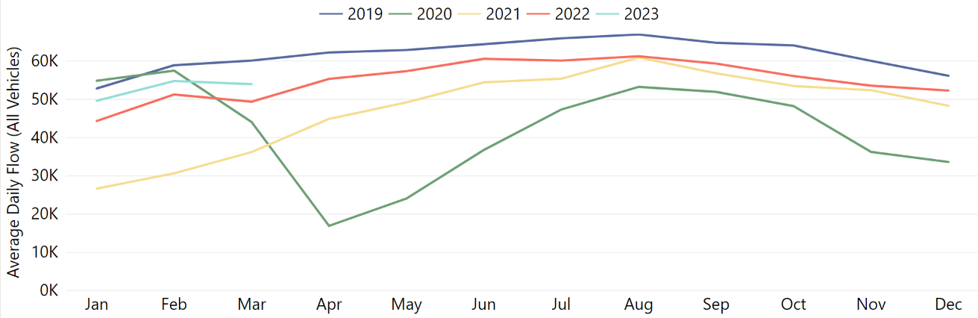
Strategic Road Network: South Cambridgeshire
South Cambridgeshire strategic road volumes remain below pre-COVID levels (-10%) but have increased since March 2022 (+9%).
Pre-COVID to Now: Mar 2019 to Mar 2023 | Mid-COVID to Now: Mar 2021 to Mar 2023 | Previous year to Now: Mar 2022 to Mar 2023
-10% | +49% | +9%
Analysis based on 3 sensors - 1 on the M11 (near Duxford) and 2 on the A11 (1 south of Great Wilbraham and 1 west of Abington). A428 sensors excluded to avoid data bias due to the A14 roadworks.
Notes:
Source: National Highways WebTRIS data.
Technical note: This dataset averages across ALL days (Mon-Sun).

Slide 18
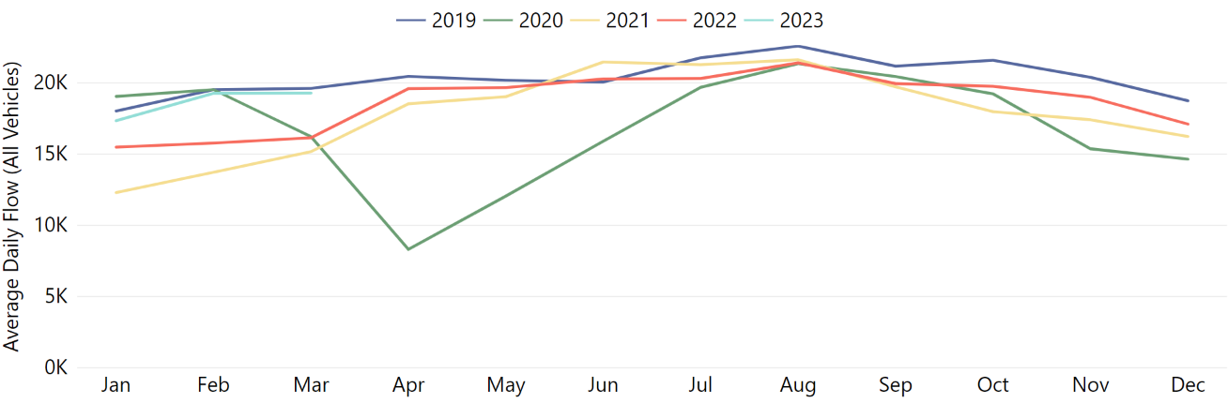
Strategic Road Network: Fenland
Fenland strategic road volumes are just below pre-COVID levels (-2%) and have seen a large increase since March 2022 (+19%), possibly as a result of the A47 Guyhirn improvements completing in May 2022.
Pre-COVID to Now: Mar 2019 to Mar 2023 | Mid-COVID to Now: Mar 2021 to Mar 2023 | Previous year to Now: Mar 2022 to Mar 2023
-2% | +27% | +19%
Analysis based on 2 sensors on the main carriageway of the A47 (both close to Guyhirn).
Notes:
Source: National Highways WebTRIS data.
Technical note: This dataset averages across ALL days (Mon-Sun). Analysis based on 2 sensors on the main carriageway of the A47 (both close to Guyhirn).

Slide 19
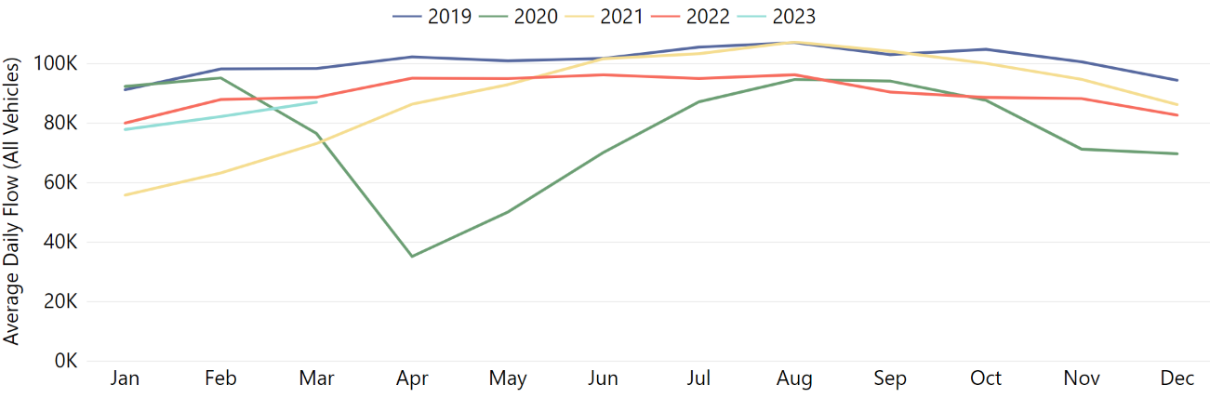
Strategic Road Network: Peterborough
Peterborough strategic road volumes remain below pre-COVID levels (-12%) and have remained stable since March 2022 (-2%).
Pre-COVID to Now: Mar 2019 to Mar 2023 | Mid-COVID to Now: Mar 2021 to Mar 2023 | Previous year to Now: Mar 2022 to Mar 2023
-12% | +19% | -2%
Analysis based on 5 sensors - 3 on the A47 (2 east of Dogsthrope, 1 south of Bretton) and 2 on the A1 (1 north of Wansford and 1 south of Stamford).
Notes:
Source: National Highways WebTRIS data.
Technical note: This dataset averages across ALL days (Mon-Sun). Analysis based on 5 sensors - 3 on the A47 (2 east of Dogsthrope, 1 south of Bretton) and 2 on the A1 (1 north of Wansford and 1 south of Stamford).

Slide 20
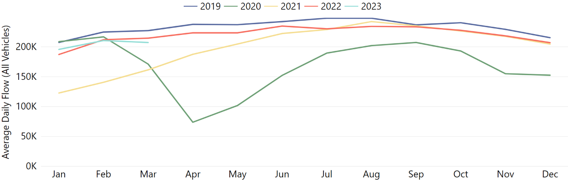
Strategic Road Network: Huntingdonshire
Huntingdonshire strategic road volumes remain below 2019 volumes (-9%) and have remained relatively stable since March 2022 (-3% change).
Pre-COVID to Now: Mar 2019 to Mar 2023 | Mid-COVID to Now: Mar 2021 to Mar 2023 | Previous year to Now: Mar 2022 to Mar 2023
-9% | +28% | -3%
Analysis based on 7 sensors - 1 on the A1 (north of St Neots), 6 on the A1(M) (2 east of Sawtry, 2 west of Yaxley, 2 near Alwalton).
Notes:
Source: National Highways WebTRIS data.
Technical note: This dataset averages across ALL days (Mon-Sun). Analysis based on 7 sensors - 1 on the A1 (north of St Neots), 6 on the A1(M) (2 east of Sawtry, 2 west of Yaxley, 2 near Alwalton).

Slide 21
Local Road Network

Slide 22
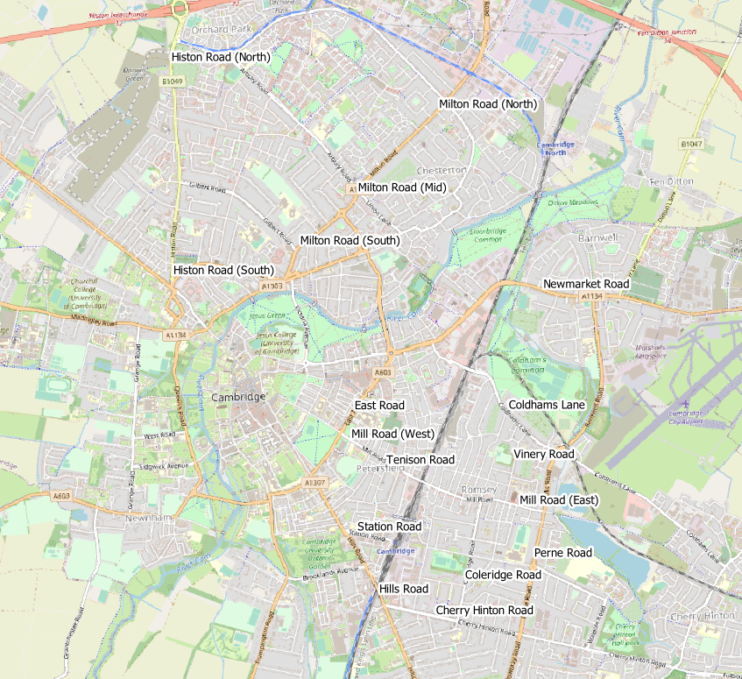
Local Road Network Monitoring Sites: Motorised Transport
Long Term Vivacity Monitoring Sites – Motorised Vehicles
The Mill Road and East Road sensors were upgraded in Sept 2022 and are now detecting significantly more cycles and pedestrians. As a result, the active travel flows at these locations are no longer comparable pre/post Sept 2022.
The Vinery Road and Milton Road (Mid) sensors are currently inactive.
Sensor Location​​ | Location description​​ | Installed​
Cherry Hinton Road ​​ | Near Rock Road​​ | May 2019​
Coldham’s Lane​​ | Near Coldham’s Common​​ | May 2019​
Coleridge Road ​​ | Near Coleridge recreation ground​​ | May 2019​
East Road​​ | Close to ARU site​​ | May 2019​
Hills Road Bridge​​ | Near Cherry Hinton Road​​ | May 2019​
Histon Road (North)​​ | Just south of A14​ | Sep 2019​
Histon Road (South) ​​ | Near Victoria Road​ | Sep 2019​
Mill Road (East)​​ | Close to Brookfield’s hospital​​ | May 2019​
Mill Road (West)​​ | Close to Parker’s Piece​​ | May 2019​
Milton Road (Mid)​​ | Near Union Lane​​ | May 2019​
Milton Road (North)​​ | Near King’s Hedges Road​ | Sep 2019​
Milton Road (South)​ | Near Gilbert Road​ | Sep 2019​
Newmarket Road | Near Ditton Fields | May 2019
Perne Road | Near Birdwood Road roundabout | May 2019
Station Road | Near Kett House | May 2019
Tenison Road​​ | Near Mill Road​​ | May 2019​
Vinery Road ​​ | Near Romsey recreation ground​​ | May 2019​
Legend
Comparable motorised vehicle data available for most months and years.
Comparable motorised vehicle data available for Feb 2020*, Mar 2021, Mar 2022 & Mar 2023.
Comparable motorised vehicle data available for Feb 2020* and Mar 2023.
© OpenStreetMap Contributors
Comparable data not available for February 2020* and / or March 2023.
*The Vivacity sensor network was installed from May 2019 onwards. Therefore, the best 'pre-Covid' estimate for traffic flows which can be compared with subsequent March data is February 2020.
Notes:
Source: Cambridge Vivacity sensors
Technical note: This analysis has excluded sensors which may compromise the validity of historic comparisons when figures for all sites are combined. For example, some sites may have data gaps, road closures or events impacting data within the comparison period.

Slide 23
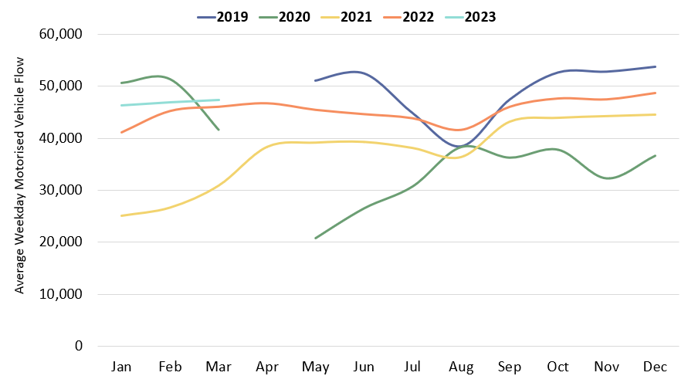
Local Road Network: Motorised Vehicles
In March 2023, local road vehicle flows were slightly above March 2022 (+2%). However, flows are still slightly below pre-Covid (February 2020) volumes (-4%).
Pre-COVID to Now:
Feb 2020 to Mar 2023
Mon-Sun | Weekdays (Mon-Thu) | Weekends (Sat-Sun)
-7% | -8% | -9%
Mid-COVID to Now:
Mar 2021 to Mar 2023
Mon-Sun | Weekdays (Mon-Thu) | Weekends (Sat-Sun)
+59% | +53% | +75%
Previous year to Now:
Mar 2022 to Mar 2023
Mon-Sun | Weekdays (Mon-Thu) | Weekends (Sat-Sun)
+2% | +3% | -5%
Sensors used for the analysis on this slide: Coleridge Road, Hills Road, Mill Road (West), Mill Road (East), and Tenison Road.
Notes:
Source: Cambridge Vivacity sensors
Technical Notes: 'Non-neutral days' are not included within the calculations.
This chart shows the average volume of motor vehicles counted per weekday for each month/year .
The table presents full week and weekend changes against various historic benchmarks to give an indication of how traffic flows are recovering.
Improved data cleaning processes are being developed to improve the omission of any poor quality / non-comparable data – gaps on the graph may be present for this reason. Care should be taken in interpreting these charts as they are solely based on the 5 locations stated – which dilutes the geographical coverage and may not provide a city-wide / holistic view.
Commentary:
Traffic flows have stayed relatively stable from the end of 2022 through the first quarter of 2023 so far. Average flows in March are 2% ahead of this point last year, with weekdays presenting as +3% against March 2022, but weekend motorised trips down by 5%.
Cambridge flows remain below February 2020 ‘pre-COVID’ levels in March 2023 (-4%).

Slide 24
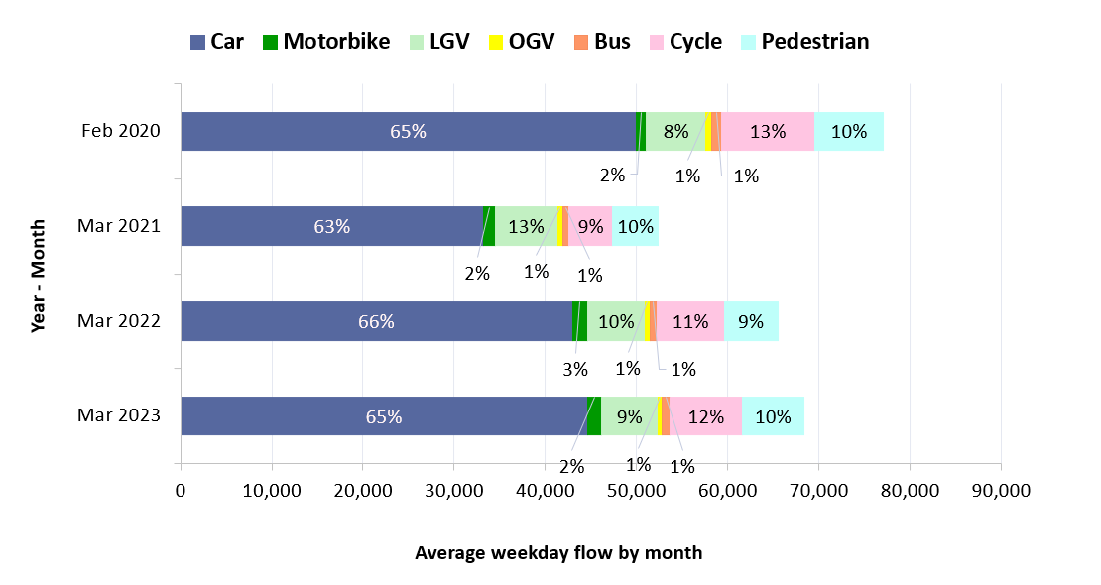
Local Road Modal Split: Overall
March 2023 has seen a slight increase in traffic volumes compared to March 2022 – with no large differences in modal split year-on-year. Active modes of transport accounted for 21% of traffic flows – which is a higher share than March 2022 (20%) but a lower share than pre-Covid (23% - Feb 2020).
Transport mode split – sum of 5 sensors in Cambridge: Four-year comparison.
Active Travel* Share by Year
Year | Active %
Feb 2020 | 23%
Mar 2021 | 19%
Mar 2022 | 20%
Mar 2023 | 21%
March 2023 Active Travel* Share by Location
Location​ | Active %​
Mill Road (West) | 50%
Station Road | 49%
Tenison Road | 41%
Milton Road (South) | 33%
Mill Road (East) | 33%
East Road | 28%
Cherry Hinton Road | 25%
Hills Road | 24%
Histon Road (South) | 24%
Coleridge Road | 17%
Milton Road (North) | 16%
Histon Road (North) | 10%
Perne Road | 10%
Newmarket Road | 8%
Coldham's Lane | 8%
Sensors used for the analysis on this slide: Cherry Hinton Road, Coldham's Lane, Coleridge Road, Hills Road, and Tenison Road.
*Active Travel is cyclists and pedestrians
Notes:
Source: Cambridge Vivacity sensors
Technical Notes: Sensors included within the four-year chart are: Cherry Hinton Road, Coldham's Lane, Coleridge Road, Hills Road, Newmarket Road and Tenison Road. 'Non-neutral' days are not included within average weekday flow calculations. Fridays are not counted as a weekday. Traffic flows on all other days are counted and used to calculate a typical 'average' traffic flow within central Cambridge on a weekday.
We have selected the most recent month of data (March 2023) and compared it to three historic time periods to show how traffic flows have evolved since these sensors were installed.
Please note that rounding may lead to active travel % share (walking + cycling) on the bar chart appearing different from the share on the table.
Commentary
Motor vehicles dominate in all years. Active travel is now 19% of all traffic in March 2023 – which is the same as the active travel share pre-Covid (Feb 2020).
Traffic volumes are showing a slight recovery in each year since the onset of the pandemic. Modal split is not vastly different year-to-year.

Slide 25
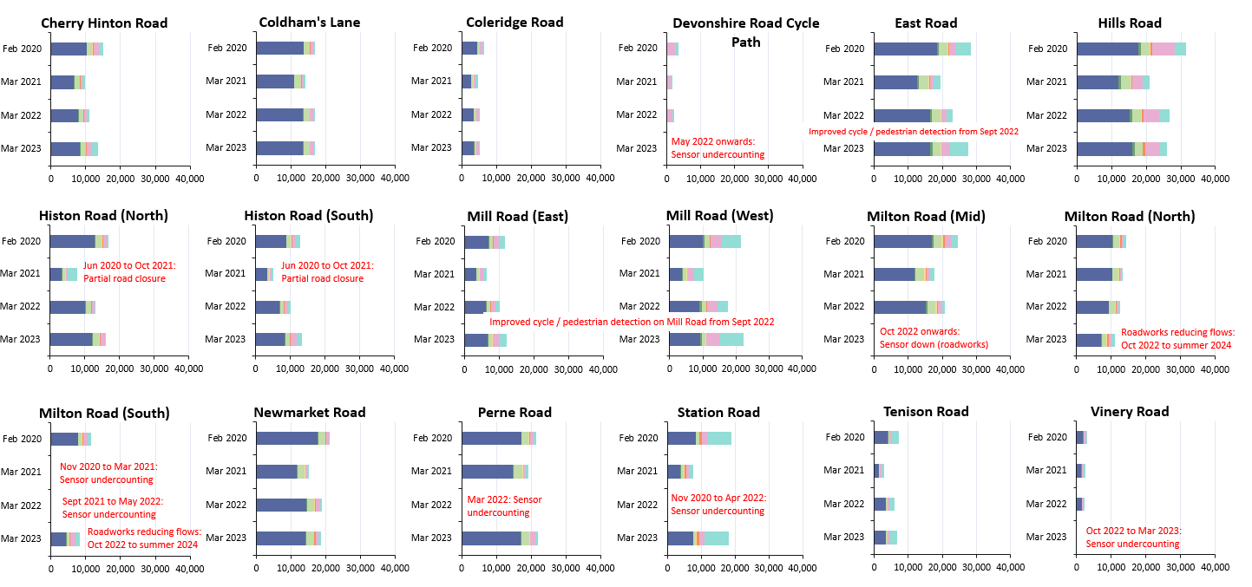
Local Road Modal Split: By Location
Average two-way weekday flow for February 2020, March 2021, March 2022, March 2023.
Notes:
Source: Cambridge Vivacity sensors
Technical Note:
Non-neutral days are not included within the average weekday flow calculations. Weekdays are defined as Monday to Thursday, as per DfT guidance. We have selected the most recent month of data (March 2023) and compared it to three historic months to show how traffic flows have evolved since these sensors were installed.
Please see the comments on the slide which highlight events which are considered likely to have impacted the data. For example, there may be a data gap or a change that is likely to affect the counts either upwards or downwards – and so require caution to be taken when assessing the outputs.
Commentary:
Cars are the largest individual category in all locations across all years – but some sites are seeing the dominance of cars recede very slightly.
Whilst absolute volumes have begun to rebound from the low volumes mid-pandemic (March 2021), there has not been a significant impact on modal split at most locations. Exceptions: Mill Road (West) & East Road, both of which are counting more pedestrians and cyclists as a result of sensor upgrades (as noted on the slide).

Slide 26
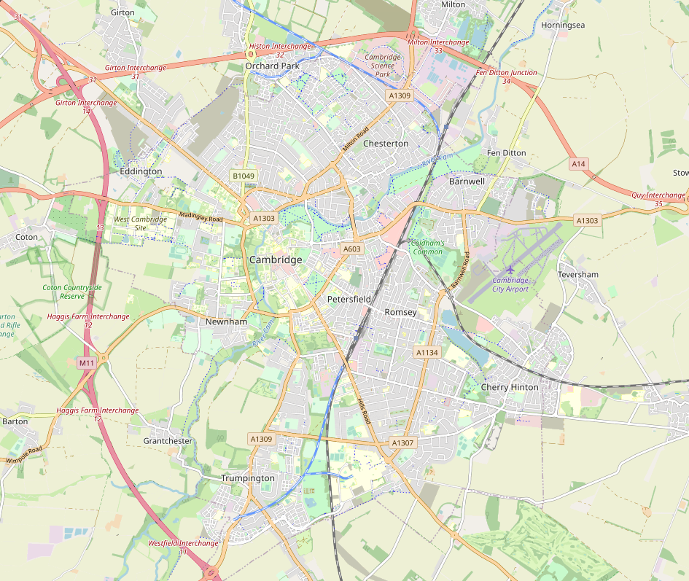
Local Road Network: Recovery Map
Cambridge motorised flows in March 2023 are 7% below pre-Covid (Feb 2020) levels. Active travel is also 7% below pre-Covid, albeit with some sites showing an increase in active travel volumes.
All 8 Sites Combined
Active Travel: +1%
Motorised Travel: -17%
Coldham's Lane
Active Travel: +21%
Motorised Travel: -44%
-7%
+5%
-7%
-1%
Histon Road (North)
Active Travel: +73%
Motorised Travel: -14%
+28%
Station Road
Active Travel: +2%
Motorised Travel: -10%
-6%
+3%
Tenison Road
Active Travel: +36%
Motorised Travel: -17%
-9%
+1%
-12%
Perne Road
Active Travel: +11%
Motorised Travel: -20%
Hills Road
Active Travel: -36%
Motorised Travel: -7%
+28%
-35%
0%
-10%
Cherry Hinton Road
Active Travel: +43%
Motorised Travel: -17%
Coleridge Road
Active Travel: -31%
Motorised Travel: -19%
+19%
-30%
-16%
-17%
Notes:
Source: Cambridge Vivacity sensors
Technical Note: Calculations are made on an average weekday. Low and zero flows are removed from any average calculations. Any ‘non neutral’ days - such as bank holidays or school holidays – are also excluded.
Data is shown only for the nine sensors with comparable data for February 2020 and for March 2023 for both active and motorised traffic flows.
Commentary:
Active travel is 4% below pre-Covid levels across these sites; albeit with several individual sensors showing improved counts against 2020 levels.
Motorised travel is 8% below pre-pandemic levels overall across these sites; with Perne Road the only individual site which does not show a drop against February 2020 volumes (+0%).
Coleridge Road has seen the largest individual drop in motorised vehicle flows against February 2020 (-17%).

Slide 27
Local Road Network: Recovery by Location and Mode
Motorcycle volumes are higher than pre-Covid (Feb 2020) at all sites. Some sites show a large increase in active travel volumes. Most sites are showing a decrease in motorised volumes in comparison to pre-Covid (Feb 2020).
% change in weekday volumes
Pre-COVID to Now:
Feb 2020 to Mar 2023
​ | Car​ | Motorbike​ | LGV​ | OGV​ | Bus​ | Cyclist​ | Pedestrian​ | All modes​ | Motorised Vehicles | Active Modes
Cherry Hinton Road | -18% | +28% | -1% | -43% | -38% | +2% | +37% | -10% | -16% | +38%
Coldham's Lane | -1% | +153% | -4% | -17% | -33% | +26% | -23% | +0% | -1% | +5%
Coleridge Road | -18% | +20% | -13% | -33% | -16% | -15% | -57% | -20% | -17% | -30%
Hills Road | -10% | +26% | -14% | -25% | -4% | -35% | -35% | -17% | -10% | -35%
Histon Road (North) | -6% | +23% | +2% | -25% | -30% | +49% | -28% | -3% | -6% | +28%
Perne Road | -1% | +30% | +10% | -18% | -17% | +56% | -1% | +2% | +0% | +28%
Station Road | -10% | +13% | -9% | -19% | -4% | -8% | +5% | -4% | -9% | +3%
Tenison Road | -15% | +2% | +28% | -19% | -72% | -17% | +8% | -7% | -12% | +1%
Data shown only for the eight sensors with comparable data for February 2020 and March 2023.
Notes:
Source: Cambridge Vivacity sensors
Technical Note: Weekday volumes do not include Fridays. Low and zero flows are removed from any average calculations, and any ‘non neutral’ days - such as bank holidays or school holidays – are also excluded.
Commentary: Motorcycles are ahead of pre-Covid (Feb 2020) counts at all sites.
Several sites are showing cycling and walking levels ahead of pre-Covid (Feb 2020).
Newmarket Road is showing the largest fall in car volumes (-20% against Feb 2020).
There is a large disparity in comparative pedestrian volumes in March 2023 compared to pre-Covid. Newmarket Road is 367% ahead of February 2020 levels, whereas Coleridge Road is 57% below.

Slide 28
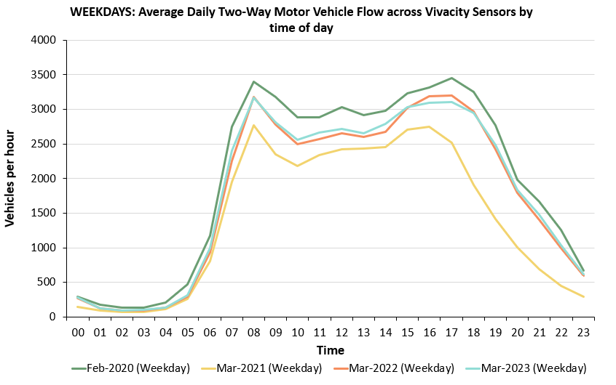
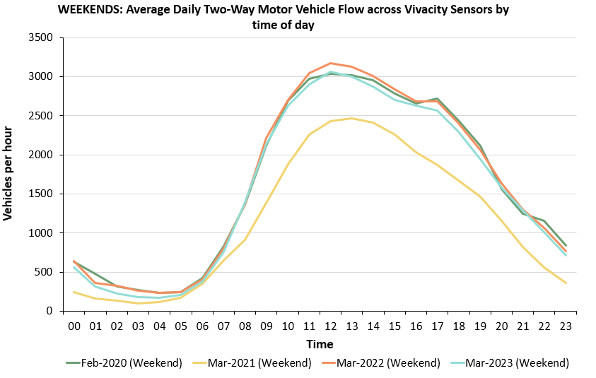
Local Road Network: Hourly Flow Profile
Weekday motorised flows in March 2023 closely resemble the pattern seen in March 2022. Morning and afternoon peaks are clearly visible – but not as wide or pronounced as pre-Covid (Feb 2020).
Weekdays
Weekends
Sensors used for the analysis on this slide: Coldham’s Lane, Coleridge Road, Hills Road, and Tenison Road.
Notes:
Source: Cambridge Vivacity sensors
Technical Note: Sensors used within the calculations: Coldham’s Lane, Coleridge Road, Hills Road, and Tenison Road. All efforts have been made to signify a ‘typical’ traffic volume by hour of day. Low and zero flows are removed from any average calculations, and any ‘non neutral’ days - such as bank holidays or school holidays – are also excluded. Fridays are not included in ‘weekdays’ as per the guidance note at the start of this slide pack.
Commentary:
Weekdays in March 2023: Motor traffic sees morning and afternoon peaks which are similar to those in Feb 2020. Lunchtime / early afternoon flows are lower than pre-Covid – but ahead of 2021.
Weekends in March 2023: Flows are extremely similar in all the analysed periods, with the notable exception of March 2021 (mid-Covid). Lunchtime and early evening traffic peaks are visible.

Slide 29
Active Travel

Slide 30
Local Road Network Monitoring Sites: Active Travel
Long Term Vivacity Monitoring Sites – Active Travel
The Mill Road and East Road sensors were upgraded in Sept 2022 and are now detecting significantly more cycles and pedestrians. As a result, the active travel flows at these locations are no longer comparable pre/post Sept 2022.
The Vinery Road and Milton Road (Mid) sensors are currently inactive.
Sensor Location​​ | Location description​​ | Installed​
Cherry Hinton Road ​​ | Near Rock Road​​ | May 2019​
Coldham’s Lane​​ | Near Coldham’s Common​​ | May 2019​
Coleridge Road ​​ | Near Coleridge recreation ground​​ | May 2019​
East Road​​ | Close to ARU site​​ | May 2019​
Hills Road Bridge​​ | Near Cherry Hinton Road​​ | May 2019​
Histon Road (North)​​ | Just south of A14​ | Sept 2019​
Histon Road (South) ​​ | Near Victoria Road​ | Sept 2019​
Mill Road (East)​​ | Close to Brookfield’s hospital​​ | May 2019​
Mill Road (West)​​ | Close to Parker’s Piece​​ | May 2019​
Milton Road (Mid)​​ | Near Union Lane​​ | May 2019​
Milton Road (North)​​ | Near King’s Hedges Road​ | Sept 2019​
Milton Road (South)​ | Near Gilbert Road​ | Sept 2019​
Newmarket Road | Near Ditton Fields | May 2019
Perne Road | Near Birdwood Road roundabout | May 2019
Station Road | Near Kett House | May 2019
Tenison Road​​ | Near Mill Road​​ | May 2019​
Vinery Road ​​ | Near Romsey recreation ground​​ | May 2019​
Legend
Comparable active travel data available for most months and years.
Comparable active travel data available for Feb 2020*, Mar 2021, Mar 2022 & Mar 2023.
Comparable active travel data available for Feb 2020* and Mar 2023.
© OpenStreetMap Contributors
Comparable data not available for Feb 2020* and/or Mar 2023.
*The Vivacity sensor network was installed from May 2019 onwards. Therefore, the best 'pre-Covid' estimate for traffic flows which can be compared with subsequent March data is February 2020.
Notes:
Source: Cambridge Vivacity sensors
Technical note: This analysis has excluded sensors which may compromise the validity of historic comparisons when figures for all sites are combined. For example, some sites may have data gaps, road closures or events impacting data within the comparison period.

Slide 31
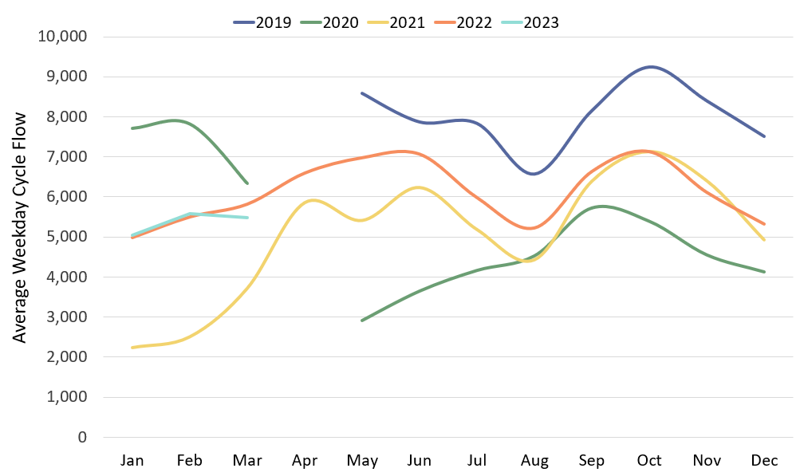
Local Road Network: Cyclists
March 2023 cycle volumes are 7% below last year (March 2022) and are 14% below pre-Covid (February 2020). It is possible that cycle volumes were impacted by wet weather in March 2023.
Pre-COVID to Now:
Feb 2020 to Mar 2023
Mon-Sun | Weekdays (Mon-Thu) | Weekends (Sat-Sun)
-29% | -30% | -25%
Mid-COVID to Now:
Mar 2021 to Mar 2023
Mon-Sun | Weekdays (Mon-Thu) | Weekends (Sat-Sun)
+46% | +47% | +21%
Previous year to Now:
Mar 2022 to Mar 2023
Mon-Sun | Weekdays (Mon-Thu) | Weekends (Sat-Sun)
-7% | -6% | -13%
Sensors used for this analysis: Coleridge Road, Hills Road, and Tenison Road.
Notes:
Source: Cambridge Vivacity sensors
Technical note: Bank holiday weeks are not included within the calculations. School holidays are also excluded (except summer holidays in order to obtain figures for August). Sensors used within the calculations: Coleridge Road, Hills Road, and Tenison Road.
Commentary: March 2023 is around 14% below pre-Covid (Feb 2020) overall, and is 7% below this time last year – with the weather in March 2023 likely to have had an impact on cycling trips.
Cycling trends in early 2023 were tracking alongside 2022 levels until March, when volumes dipped. Cycling flows are ahead of 2021, which was impacted by lockdown restrictions.

Slide 32
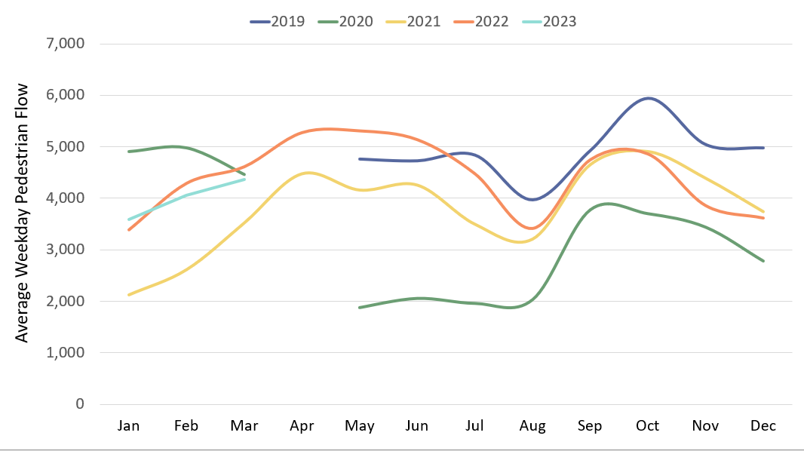
Local Road Network: Pedestrians
Pedestrian volumes in March 2023 were only 2% below pre-Covid (Feb 2020). However, there has been a slight drop in pedestrian numbers since March 2022 (-4%). This is potentially linked to the wet weather in March 2023.
Pre-COVID to Now:
Feb 2020 to Mar 2023
Mon-Sun | Weekdays (Mon-Thu) | Weekends (Sat-Sun)
-10% | -12% | -20%
Mid-COVID to Now:
Mar 2021 to Mar 2023
Mon-Sun | Weekdays (Mon-Thu) | Weekends (Sat-Sun)
+20% | +24% | +5%
Previous year to Now:
Mar 2022 to Mar 2023
Mon-Sun | Weekdays (Mon-Thu) | Weekends (Sat-Sun)
-4% | -5% | -9%
Sensors used for this analysis: Coleridge Road, Hills Road, and Tenison Road.
Notes:
Source: Cambridge Vivacity sensors
Technical Note: Bank holidays and school holidays do not get included in these monthly averages. Fridays are not counted as a 'weekday’ - but Fridays are included in the 'Mon-Sun' calculations.
Sensors used within the calculations: Coleridge Road, Hills Road, and Tenison Road.
Commentary: Pedestrian volumes in March 2023 are 2% below pre-Covid (Feb 2020) levels – albeit that weekdays are slightly further below pre-Covid (-8%) than weekends (-5%). However, the volumes are 20% ahead of mid-Covid (Mar 2021) - with weekends once again appearing to have recovered (+21%) slightly better than weekdays (+17%). March 2023 is 4% below March 2022 for pedestrian volumes in Cambridge – perhaps linked to the wet weather during March this year in comparison to a relatively dry March 2022.

Slide 33
Retail Footfall

Slide 34
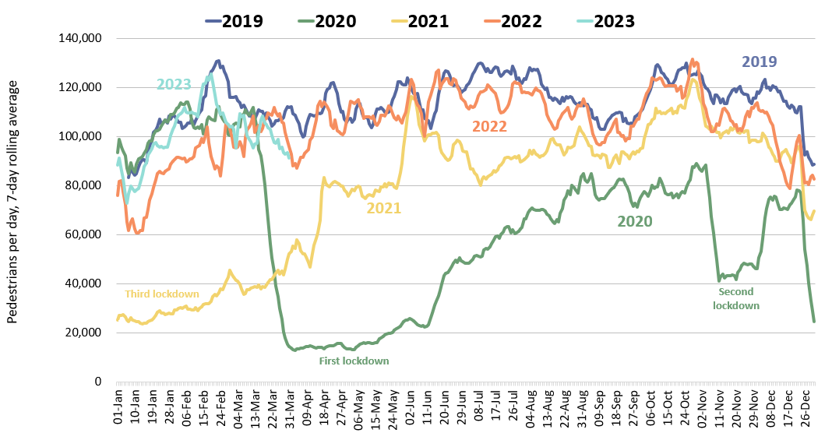
Retail Footfall: Central Cambridge
Retail footfall in Cambridge is 12% below pre-Covid levels on weekdays but only 4% below pre-Covid levels at the weekend.
Pre-COVID to Now:
Mar 2019 to Mar 2023
Mon-Sun | Weekdays (Mon-Thu) | Weekends (Sat-Sun)
-12% | -12% | -4%
Mid-COVID to Now:
Mar 2021 to Mar 2023
Mon-Sun | Weekdays (Mon-Thu) | Weekends (Sat-Sun)
+146% | +142% | +171%
Previous year to Now:
Mar 2022 to Mar 2023
Mon-Sun | Weekdays (Mon-Thu) | Weekends (Sat-Sun)
-1% | No change | -2%
Notes:
Source: Cambridge BID footfall data.
Technical note: Data from the following locations: Bridge Street, Fitzroy Street at Waitrose, Market Hill, Regent Street, Rose Crescent, Sidney Street. Excludes data for King’s Parade and One Station Square. As outlined at the start of this slide pack, 'weekdays' do not include Fridays. Table calculations do not include bank holidays, school holidays or any other "non neutral" days. The percentage changes are designed to reflect change on a "typical" day.
Commentary:
March foot traffic in central Cambridge is 12% below the pre-Covid level of March 2019 – and sits slightly below what we saw in March last year (-1%). This may be due to poorer weather conditions in March 2023 impacting walking trips in the city centre.
Weekend footfall is closer to pre-pandemic levels (-4% in comparison to March 2019) than weekday footfall (-12% in comparison to March 2019). This is likely impacted by the persistence in remote working, which will have a dampening effect on daytime weekday population in Cambridge city centre.
Overall, March 2023 was 146% ahead of March 2021 (Mid-Covid), with weekend footfall 171% ahead of Mid-Covid volumes.

Slide 35
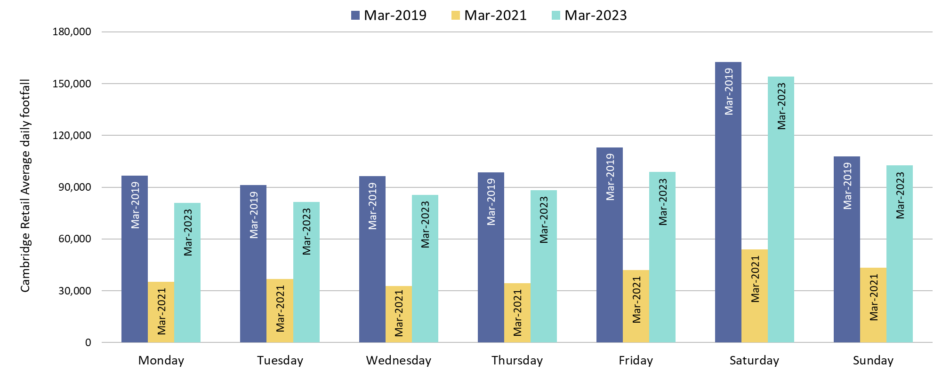
Retail Footfall: Central Cambridge by Day of the Week
All days remain below pre-Covid (March 2019), but weekends are closer to pre-Covid levels. Monday volumes are the furthest below pre-Covid (-16%).
Pre-COVID to Now: Mar 2019 to Mar 2023
Monday | Tuesday | Wednesday | Thursday | Friday | Saturday | Sunday
-16% | -11% | -11% | -11% | -13% | -5% | -5%
Notes:
Source: Cambridge BID footfall data.
Technical note: Data from the following locations: Bridge Street, Fitzroy Street at Waitrose, Market Hill, Regent Street, Rose Crescent, Sidney Street. Excludes data for King’s Parade and One Station Square. Table calculations do not include bank holidays, school holidays or any other "non neutral" days. The percentage changes are designed to reflect change on a "typical" day.
Commentary: Monday shows the weakest recovery against pre-Covid retail footfall levels (-16%). Sundays are closest to pre-Covid levels (-4.9%). All days show a recovery from Mid-Covid (Mar 2021), with Saturday (+186%) showing the strongest growth.

Slide 36
Car Parking

Slide 37
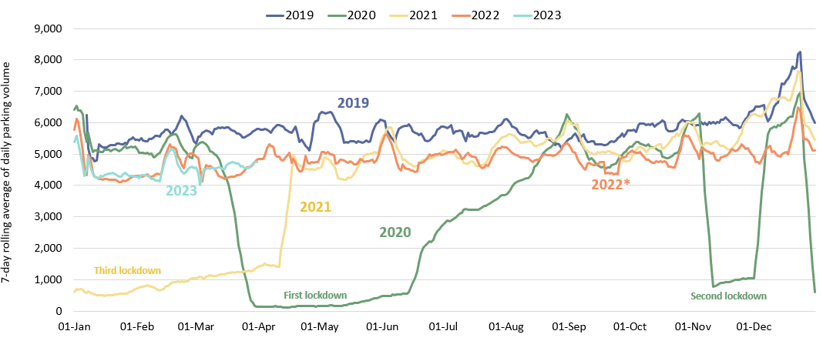
Car Parking: Daily Use
Multi-storey car park use in March 2023 was 22% below pre-Covid (March 2019) levels. The slower recovery of Grafton East (-23%) and Grafton West (-17%) against pre-Covid levels, combined with the closure of Park Street car park, has contributed to this overall drop-off in daily usage.
Pre-COVID to Now:
Mar 2019 to Mar 2023
Mon-Sun | Weekdays (Mon-Thu) | Weekends (Sat-Sun)
-22% | -21% | -17%
Mid Covid to Now:
Mar 2021 to Mar 2023
Mon-Sun | Weekdays (Mon-Thu) | Weekends (Sat-Sun)
+283% | +235% | +410%
Previous year to Now:
Mar 2022 to Mar 2023
Mon-Sun | Weekdays (Mon-Thu) | Weekends (Sat-Sun)
+4% | +4% | +2%
*Park Street car park closed for redevelopment on 4th January 2022; usage figures for this car park are included up to its closure.
Notes:
Source: Cambridge City Council Car Parking data
Technical notes: Table calculations do not include bank holidays, school holidays, or any other "non neutral" days. The percentage changes are designed to reflect change on a "typical" day. As outlined at the start of this slide pack, 'weekdays' do not include Fridays.
Commentary:
Multi-storey car park usage in central Cambridge is 22% below the pre-Covid level of March 2019 – but is slightly higher than what we saw in March last year (+4%). This year-on-year increase may be partially due to poorer weather conditions in March 2023 impacting walking and cycling trips in the city centre – which is backed up by the comparable drop in foot traffic in central Cambridge across the same time-span.
Weekend car park usage is closer to pre-pandemic levels (-17% in comparison to March 2019) than weekday usage (-21% in comparison to March 2019). This weekend/weekday pattern is similar to what we have seen in the footfall data – with weekend figures presenting as closer to pre-pandemic volumes than weekdays.
Overall, March 2023 was 283% ahead of March 2021 (Mid-Covid), with weekend car park usage more than five times higher than Mid-Covid volumes.

Slide 38
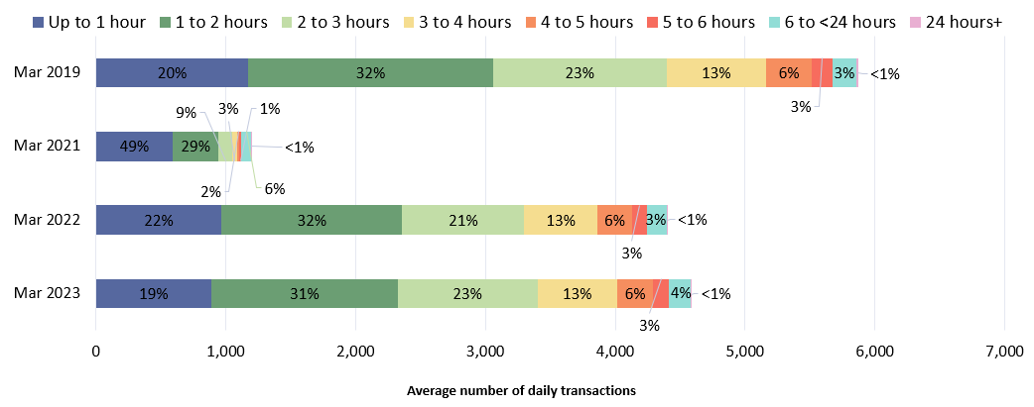
Car Parking: Length of Stay by Month
The proportion of short-, medium- and long-term parking seen in March 2023 within multi-storey car parks closely resembles the pattern which was seen pre-COVID (March 2019).
Park Street car park closed for redevelopment on 4th January 2022; usage figures for this car park are included up to its closure.
Notes:
Source: Cambridge City Council Car Parking data
Technical notes: School holidays, bank holidays and any other "non neutral" days are not included in calculations for this chart.
Commentary:
The proportionate split in length of stay in Cambridge's multi-storey car parks changed dramatically from 2019 to 2021 – with almost half the visits lasting less than one hour in March 2021 as lockdown rules prohibited extensive outdoor activities.
The proportionate split in March 2023 resembles the pre-Covid pattern much more closely; with roughly one-fifth of visits lasting less than one hour, and around three-quarters of visits lasting less than three hours.

Slide 39
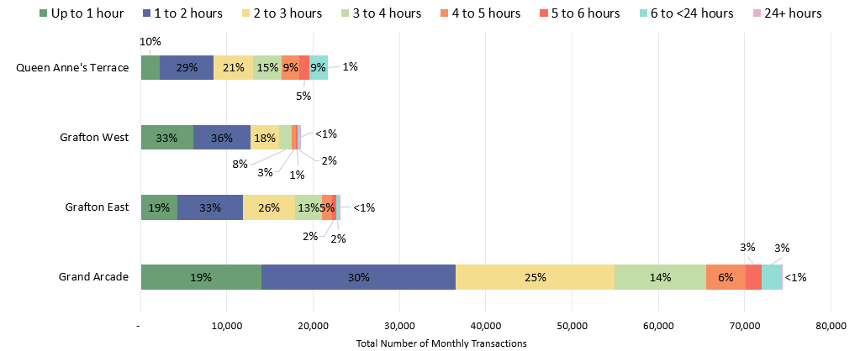
Car Parking: Length of Stay by Car Park
In March 2023, Grafton West had the lowest proportion of long stays in excess of 3 hours (14%) whilst Queen Anne’s Terrace had the highest proportion (40%). In terms of overall car park usage, Grand Arcade (-5%) and Queen Anne's Terrace (-9%) are closest to pre-Covid levels.
March 2023
Notes:
Source: Cambridge City Council Car Parking data
Technical notes: School holidays, bank holidays and any other "non neutral" days are not included in calculations for this chart.
Commentary:
86% of March visits to Grafton West lasted less than three hours – making it the most likely facility to be used for short stays.
Queen Anne's Terrace is the facility most likely to see long stays, with 40% of March visits lasting more than three hours.
Grand Arcade is comfortably the most popular multi storey car park facility in Cambridge – with more than 74,000 patrons in March (neutral days only).

Slide 40
Rail Passengers

Slide 41
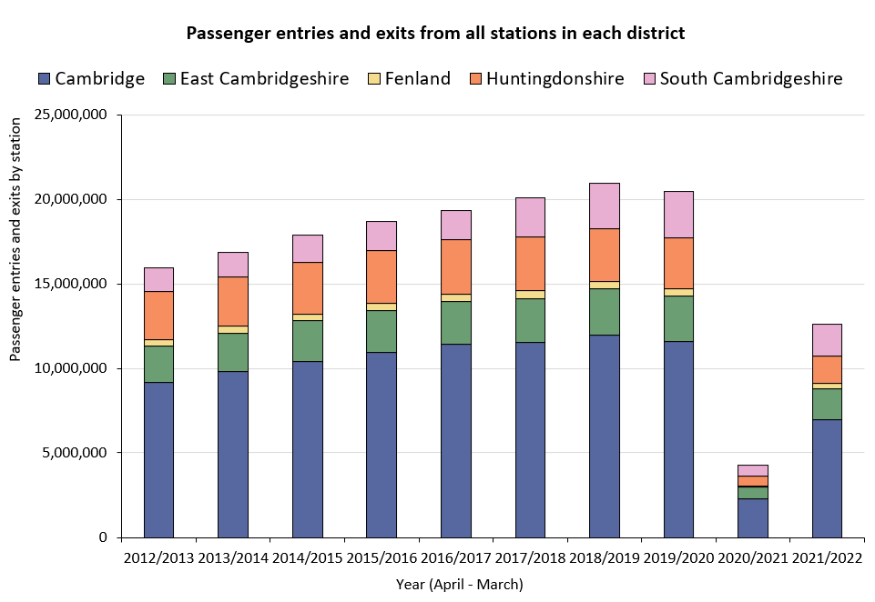
Rail Passengers: Usage
Railway station entries and exits across Cambridgeshire are still significantly below pre-COVID volumes, particularly in Cambridge and Huntingdonshire.
Change in passengers across all stations in each district | Pre-COVID to Mid-COVID: 2018/19* to 2021/22
Cambridge | -42%
East Cambridgeshire | -32%
Fenland | -36%
Huntingdonshire | -48%
South Cambridgeshire | -30%
-42%
-32%
-36%
-48%
-30%
*2018/19 used as the pre-COVID baseline as 2019/20 entries and exit data is affected in March 2020 by the first COVID-19 lockdown.
Notes:
Source: Rail statistics, ORR. Table 1415a
Technical note: Rail Passenger annual data runs April – March and is released in April each year. As such, 2018/19 is used as the pre-COVID baseline as 2019/20 entries and exit data is affected in March 2020 by the first COVID-19 lockdown.
Commentary: Rail usage overall is down on pre-Covid baselines. Stations in Huntingdonshire have seen the largest decrease in passenger entries and exits, being 48% below 2018/19 figures. Cambridge is also significantly lower than 2018/19 figures (-42%).

Slide 42
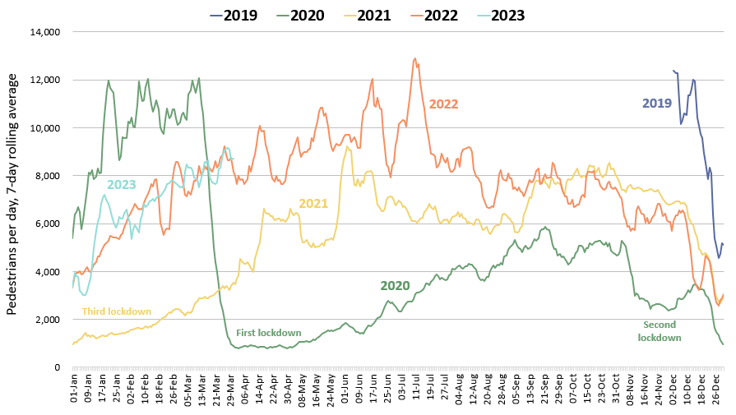
One Station Square Footfall
One Station Square footfall remains notably below pre-Covid (March 2020*) levels (-24%) but is marginally ahead of 2022 levels.
Footfall at One Station Square (directly outside Cambridge train station)
Pre-COVID to Now:
Mar 2020* to Mar 2023
Mon-Sun | Weekdays (Mon-Thu) | Weekends (Sat-Sun)
-24% | -23% | -11%
Mid-COVID to Now:
Mar 2021 to Mar 2023
Mon-Sun | Weekdays (Mon-Thu) | Weekends (Sat-Sun)
+189% | +177% | +253%
Previous year to Now:
Mar 2022 to Mar 2023
Mon-Sun | Weekdays (Mon-Thu) | Weekends (Sat-Sun)
+3% | +5% | -3%
*This sensor was installed in December 2019 so pre-Covid data is not available for all months. We have used data from March 1st-14th 2020 as the baseline for this calculation (pre-lockdown).
Notes:
Source: Cambridge BID footfall data​
Technical note: The One Station Square sensor was fitted in December 2019 so pre-COVID data is not available. March 2020 only uses 1st-14th to ensure impacts of the first lockdown are not included. Data may be impacted by strike action. As outlined at the start of this slide pack, 'weekdays' do not include Fridays.
Commentary:
Footfall at One Station Square during March 2023 was 24% down on pre-Covid levels.
Compared to March 2022, footfall levels have increase by 3% overall – with weekdays 5% higher than this time last year. Weekends, however, are 3% down on March 2022. This pattern might be due to an increase in commuter traffic in comparison to March 2022 – but poor weather impacting weekend trips in and out of central Cambridge via the train link.
March 2023 footfall levels at One Station Square were still almost three times as high as mid-Covid (March 2021) - this is likely due to lockdown restrictions impeding foot traffic at the station in March 2021.

Slide 43
Bus Passengers

Slide 44
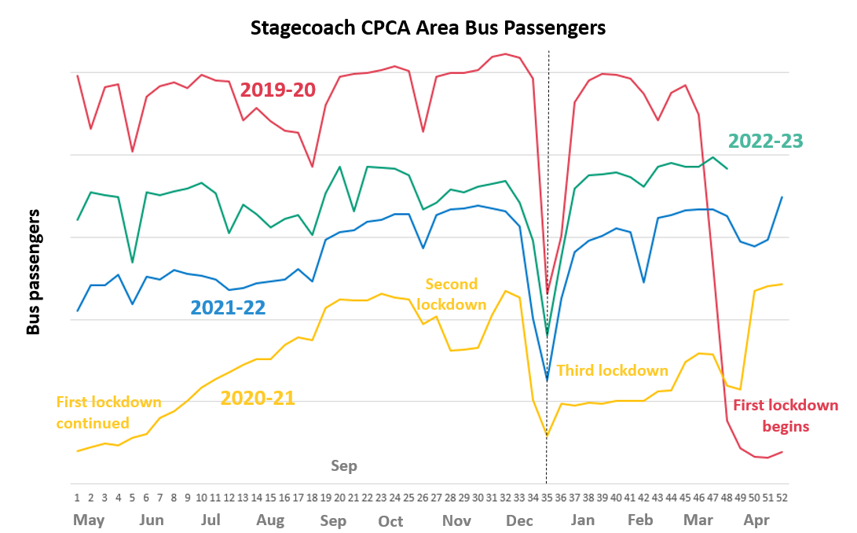
Bus Passengers in Cambridgeshire and Peterborough
Bus passenger volumes remain below pre-COVID but are gradually increasing. The number of bus passengers decreases during school holidays.
£2 bus fare cap introduced by the government (1st Jan 2023)
Cambridge
Pre-COVID to Now:
Mar 2019 to Mar 2023
-13%
Peterborough
Pre-COVID to Now:
Mar 2019 to Mar 2023
-30%
Due to the commercial sensitivity of this data, bus passenger volumes are not marked on the y-axis of this graph.
Notes:
Source: Stagecoach
Technical note: Due to the commercial sensitivity of this data, bus passenger volumes are not marked on the y-axis of this graph.
Commentary: Bus passenger numbers have continued to rise in early 2023. In January 2023, the government announced a £2 cap on single tickets (£2 bus fare cap - GOV.UK (www.gov.uk)).

Slide 45
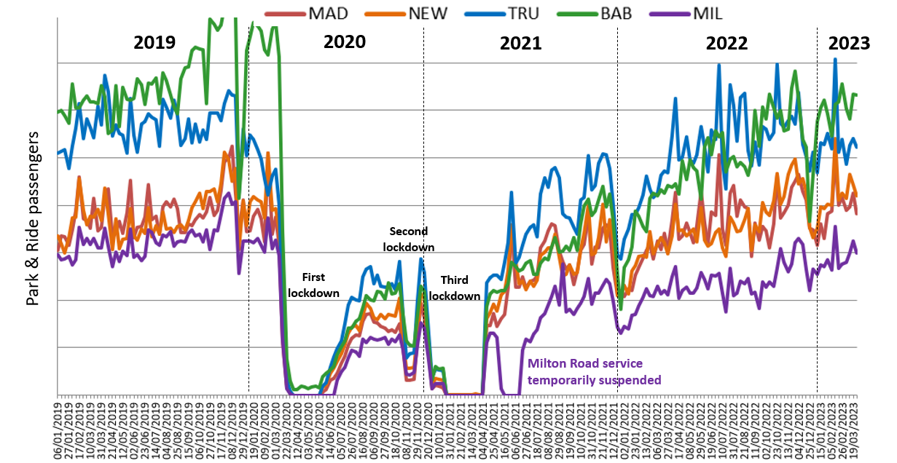
Bus Passengers: Park and Ride
Usage of all P&R sites has increased month-on-month in 2023.
Babraham Road has now resumed its position as the most popular site, although usage volumes remain below pre-COVID.
Stagecoach Park and Ride Passengers
£2 bus fare cap introduced by the government (1st Jan 2023)
Due to the commercial sensitivity of this data, bus passenger volumes are not marked on the y-axis of this graph.
Notes:
Source: Stagecoach
Technical note: Due to the commercial sensitivity of this data, bus passenger volumes are not marked on the y-axis of this graph.
Commentary: P&R passengers see a sharp increase in the February half term holiday. In January 2023, the government announced a £2 cap on single tickets (£2 bus fare cap - GOV.UK (www.gov.uk)).

Slide 46
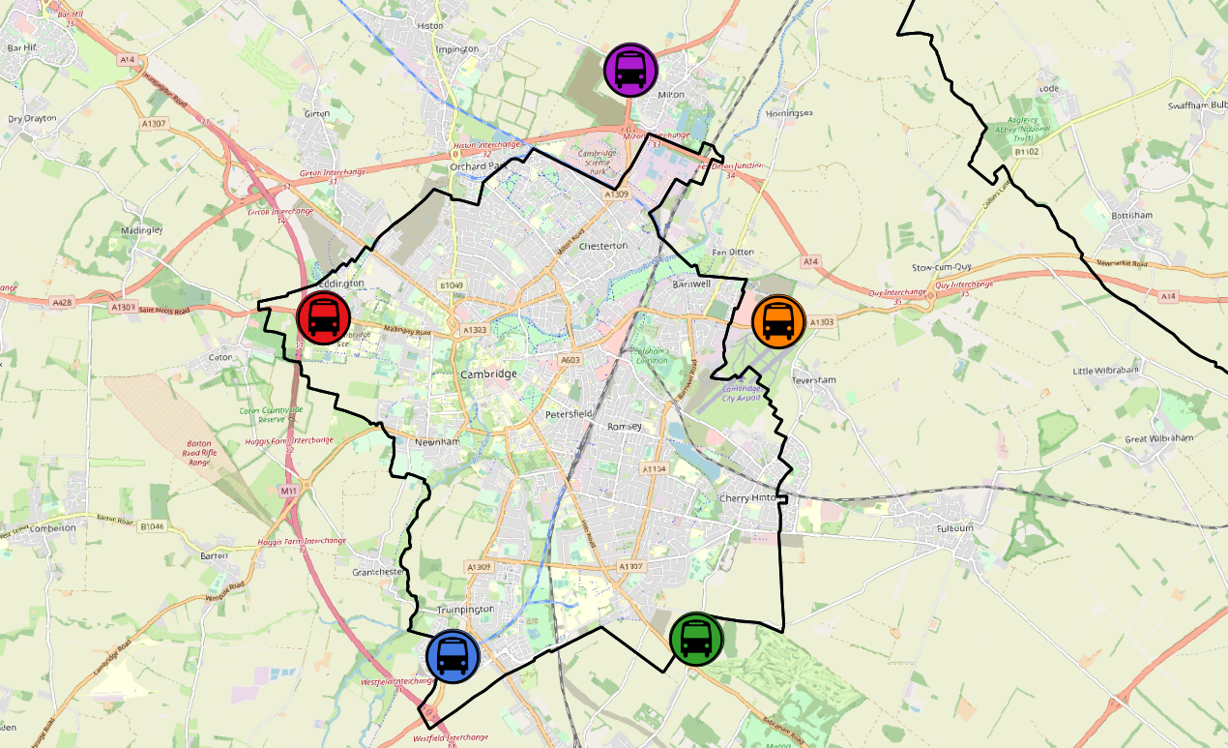
Bus Passengers: Park and Ride by Site
Park and Ride site usage has returned to pre-COVID levels on average across all sites, although some sites have recovered more than others. Newmarket Road has recovered to above March 2019 (+16%). Babraham Road and Milton Road remain furthest below pre-COVID at approx. -10%.
All P&R Sites
Mar 2019 to Mar 2023
0%
Milton Road P&R
Mar 2019 to Mar 2023
-9%
Madingley Road P&R
Mar 2019 to Mar 2023
+14%
Newmarket Road P&R
Mar 2019 to Mar 2023
+16%
Babraham Road P&R
Mar 2019 to Mar 2023
Trumpington Road P&R
Mar 2019 to Mar 2023
-11%
-4%
© OpenStreetMap Contributors
Notes:
Source: Stagecoach

Slide 47
Micro-mobility

Slide 48
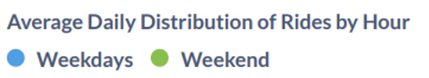
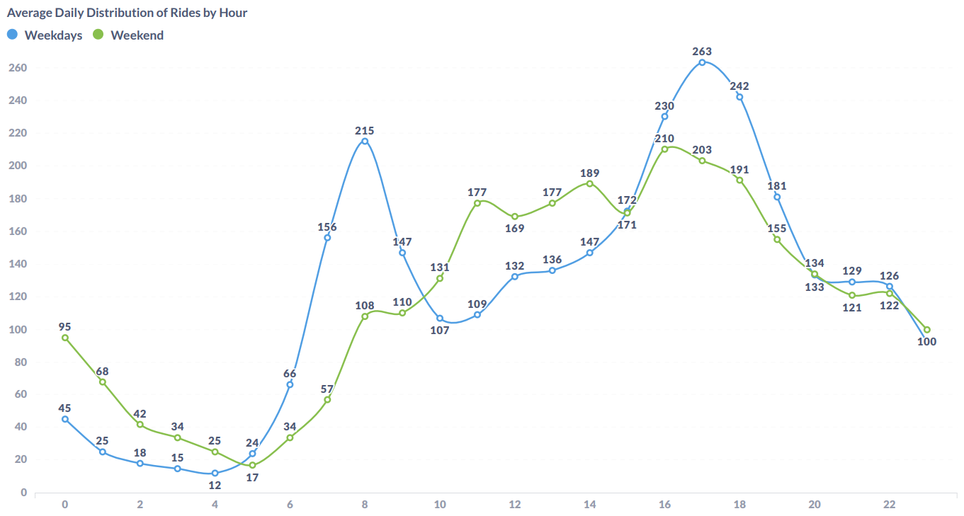
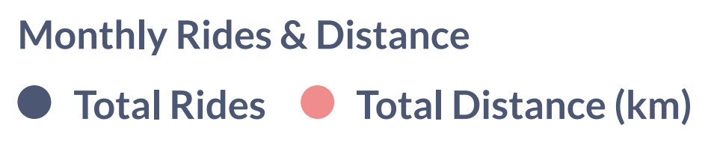
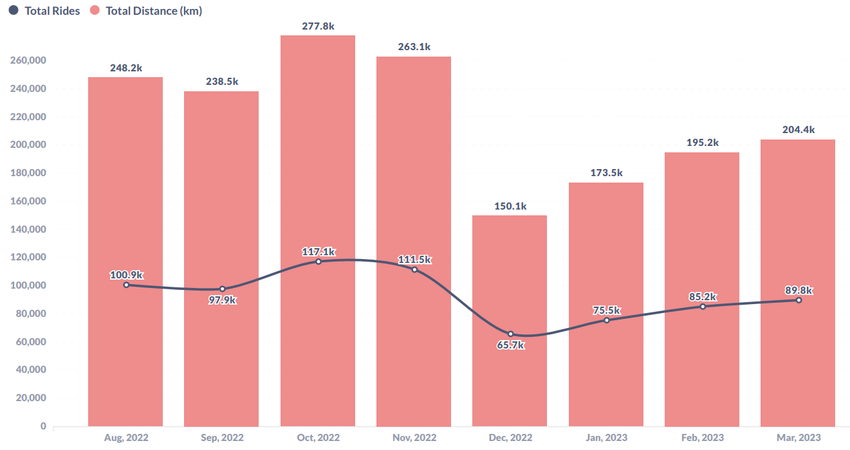
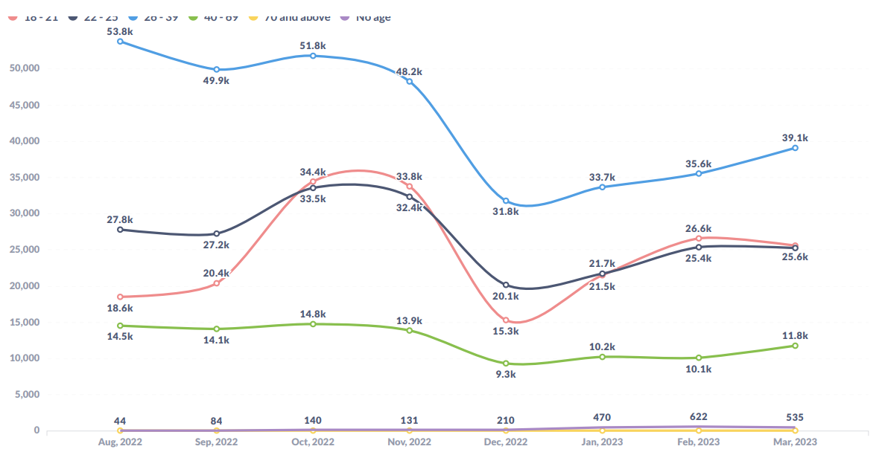
E-scooters and E-bikes in Cambridge
The number of Voi journeys has increased month-on-month during 2023. Usage in March 2023 was 6% higher than March 2022. Weekdays see peaks in travel from 8-9am and 5-6pm which could suggest use for travel to/from work. The 26-39 age group sees the highest number of riders.
Voi have operated an electric bike (e-bike) and electric scooter (e-scooter) trial scheme in Cambridge City since October 2020.
March 2023 key statistics
Total
journeys:
89,751
+442%
from Mar 2021
Total distance:
204,410 km
Returning users:
15,419
New
users:
2,580
+6%
from Mar 2022
Notes:
Source: Voi monthly updates and Voi dashboard

Slide 49
Air Quality

Slide 50
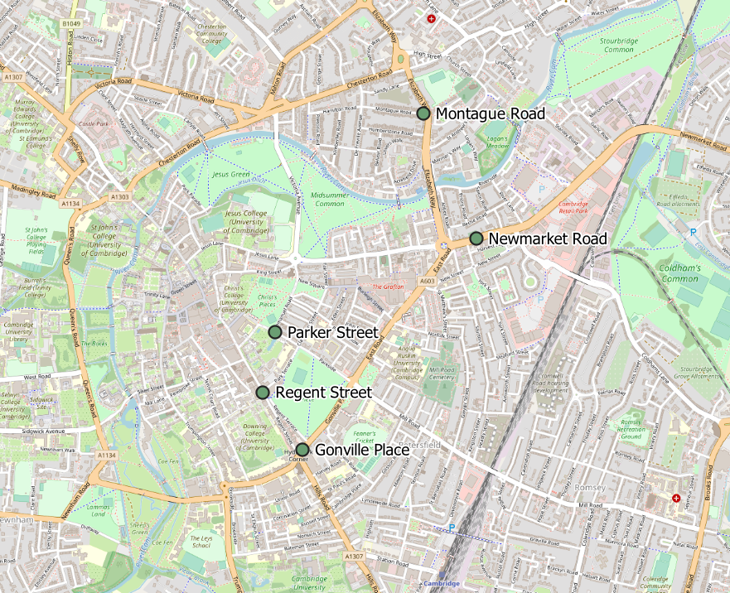
Air Quality Monitoring Locations
Continuous Air Quality Monitoring Sites, Cambridge
Location | Description
Montague Road | Close to the junction with Elizabeth Way
Newmarket Road | Close to Cambridge Retail park on Newmarket Road
Parker Street | Close to the bus station
Regent Street | To the West of Parker’s Piece
Gonville Place | Near Hill’s Road, South of Parker’s Piece. This sensor was removed in April 2022 so data is no longer available for this site.
Cambridge City Air Quality team provide data from 4 continuous air quality monitors in central Cambridge. The monitors primarily measure Nitrogen Oxides (NOx) and Particulate Matter (PM) which are proxies for overall air quality.
© OpenStreetMap Contributors
Notes:
Source: Cambridge City Air Quality team. Data for the Cambridge air quality continuous monitors can also be found at: Air quality in England (airqualityengland.co.uk).
Technical note: Please note there may be slight differences between the data on Air Quality in England and data in this pack as air quality data undergoes a ratification process.

Slide 51
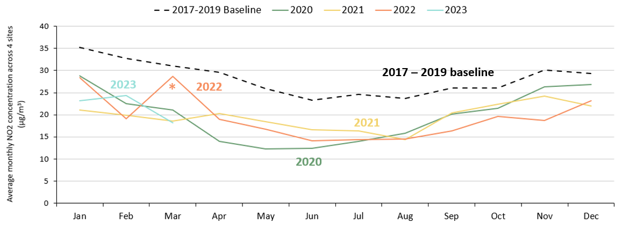
Air Quality: All Sites
So far in 2023, NO₂ concentrations are below the 2017 – 2019 baseline. March 2023 levels are very similar to March 2021.
Monthly average NO2 concentration across the continuous monitoring sites
Pre-COVID to Now: Mar 2017-19 baseline to Mar 2023 | Mid-COVID to Now: Mar 2021 to Mar 2023 | Previous year to Now: Mar 2022 to Mar 2023
-41% | -2% | -36%
*Data for Gonville Place is only included in the 2022 line until March 2022 as the sensor was removed in April 2022.
Notes:
Source: Cambridge City Air Quality team. Data for the Cambridge air quality continuous monitors can also be found at: Air quality in England (airqualityengland.co.uk).
Technical note: Analysis based on 5 sensors: Gonville Pl, Montague Rd, Newmarket Rd, Regent St and Parker St. Data for Gonville Place is included in the averages for all values before it was removed in April 2022. Please note there may be slight differences between the data on Air Quality in England and data in this pack as air quality data undergoes a ratification process.

Slide 52
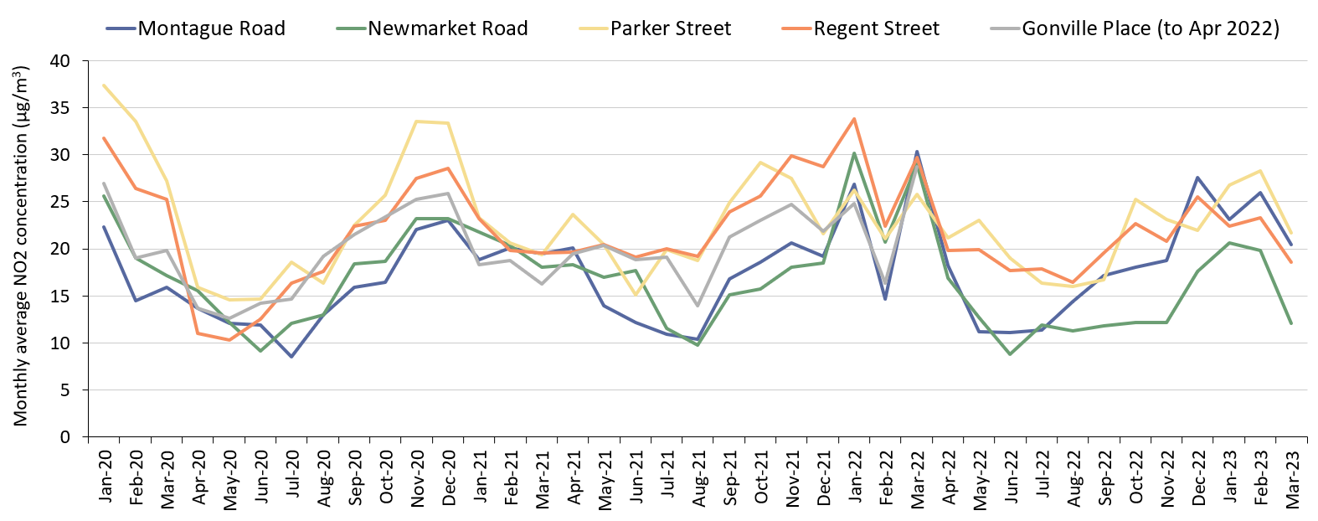
Air Quality: Individual Sites
NO₂ concentrations have increased at all sites between February and March 2023, possibly indicating the start of the expected seasonal decrease during the summer months. No sites are above the baseline. Newmarket Road and Regent Street remain below 2021.
Monthly average NO₂ concentration by site
 | Pre-COVID to Now: Mar 2017-19 baseline to Mar 2023 | Mid-COVID to Now: Mar 2021 to Mar 2023 | Previous year to Now: Mar 2022 to Mar 2023
Montague Road | -29% | +5% | -32%
Newmarket Road | -58% | -33% | -58%
Parker Street | -40% | +12% | -16%
Regent Street | -37% | -5% | -37%
Notes:
Source: Cambridge City Air Quality team. Data for the Cambridge air quality continuous monitors can be found at: Air quality in England (airqualityengland.co.uk).
Technical note: The Gonville Place sensor was removed in April 2022 so there is no data for this site from May 2022 onwards. Please note there may be slight differences between the data on Air Quality in England and data in this pack as air quality data undergoes a ratification process.

Slide 53
research.group@cambridgeshire.gov.uk

