Slide 1
Cambridgeshire and Peterborough
All Age Mental Health and Learning Disabilities Needs Assessment
Chapter 2: Population factors

Slide 2
Table of Contents
  Vulnerable groups
  Alcohol and drug use
  Smoking and health behaviours
  Premature mortality in adults with severe mental illness

Slide 3
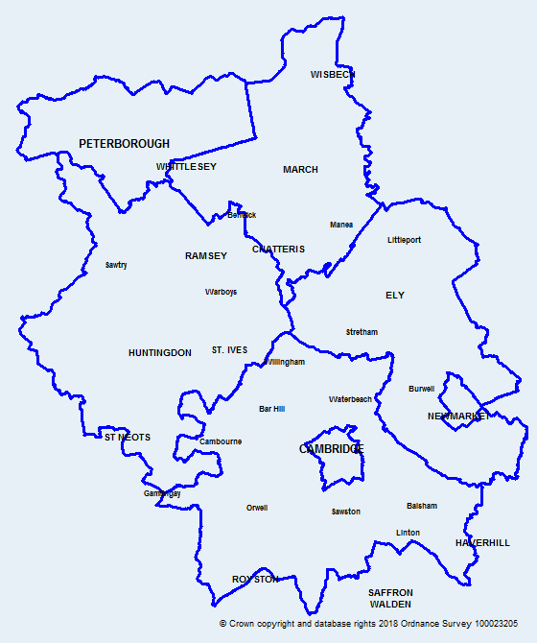
Introduction
Map of Cambridgeshire
and Peterborough
This data pack has been produced on population factors to support the Cambridgeshire and Peterborough all age mental health and learning disabilities needs assessment.
Colour coding and abbreviations used:
Key:
 | Statistically significantly worse than England
 | Statistically similar to England
 | Statistically significantly better than England
CCC | Cambridgeshire County Council
OHID | Office for Health Improvement and Disparities
ONS | Office for National Statistics
APS | Annual Population Survey
DfE | Department for Education
QOF | Quality and Outcomes Framework

Slide 4
Vulnerable Groups

Slide 5
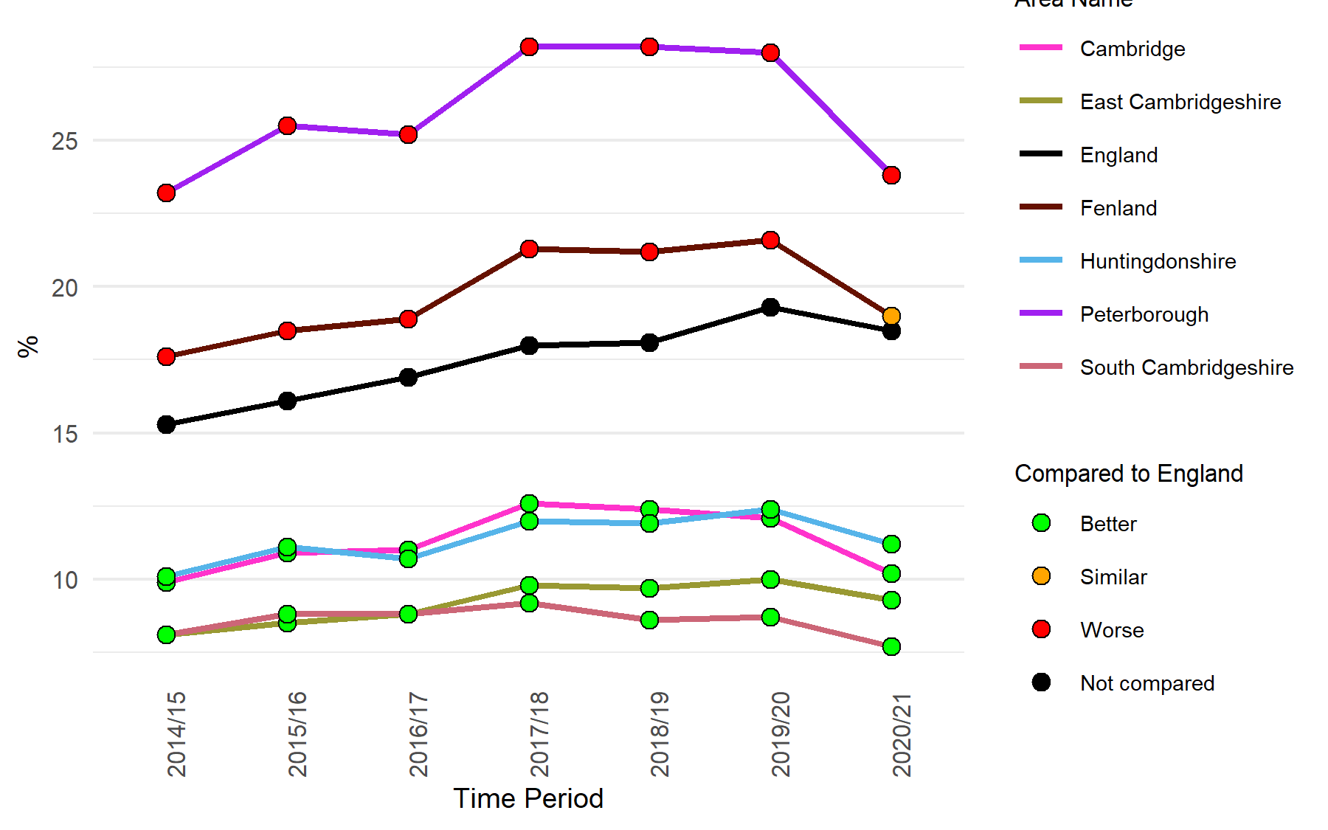
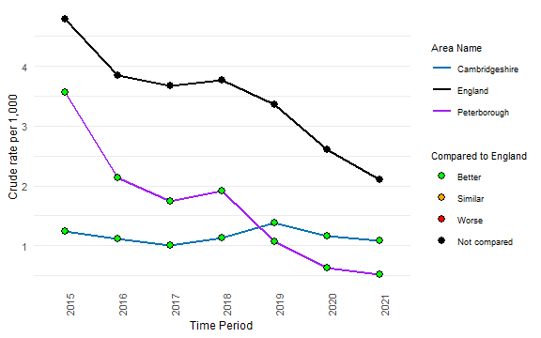
Vulnerable groups
Children in relative low income families (under 16s)
Long term claimants of Jobseeker’s Allowance
 | Cambridgeshire | Peterborough
Number of children in relative low income families, 2020/21 | 13,542 | 11,403
 | Cambridgeshire | Peterborough
Number of long term claimants of jobseeker’s allowance, 2021 | 439 | 65
The proportion of children in relative low-income families in Peterborough and Fenland has been significantly higher than the national average since 2014/15, except in Fenland for 2020/21 (which is similar).
The rate of long term claimants of jobseeker’s allowance in Peterborough shows a rapidly declining trend.
The rates in Cambridgeshire and Peterborough have been significantly lower than the national rate since 2015.
Notes:
Children in relative low income families (under 16s):Percentage of children (<16) in a local area, living in relative low income families. A family is defined as a single adult; or a married or cohabitating couple; or a Civil Partnership; and any dependent children.
Data from: https://fingertips.phe.org.uk/profile/wider-determinants/data#page/1
Source: The Office for Health Improvement and Disparities
Long term claimants of Jobseeker’s Allowance: Count for jobseekers allowance claimants, 16-64 year olds claiming for more than 12 months, crude rate per 1,000 resident population, 16-64 year olds.
Data from: https://fingertips.phe.org.uk/profile/wider-determinants/data#page/1
Source: www.nomisweb.co.uk

Slide 6
Vulnerable groups
Homelessness – Households in temporary accommodation, 2020/21
Homelessness – Households owed a duty under Homelessness Reduction Act (HRA), 2020/21
*Aggregated from all known lower geography values
The rate of households living in temporary accommodation is significantly lower than the national rate in all areas across Cambridgeshire and Peterborough.
Cambridge and Peterborough have significantly higher rates of households owed a prevention or relief duty under the HRA during the financial year, where the main applicant is between the ages of 16 and 24.
When compared to England, Huntingdonshire has a significantly higher rate where the main applicant is 55 or older.
Notes:
Households in temporary accommodation: Households living in temporary accommodation secured by a local housing authority under their statutory homelessness functions.
Data from https://fingertips.phe.org.uk/profile/wider-determinants/data#page/1
Source: Ministry of Housing, Communities & Local Government
Homelessness - households owed a duty under the Homelessness Reduction Act (main applicant 16-24 yrs): Households owed a prevention or relief duty under the Homelessness Reduction Act, where the main applicant is aged 16-24 years, crude rate per 1,000 estimated households
Homelessness - households owed a duty under the Homelessness Reduction Act (main applicant 55+ yrs): Households owed a prevention or relief duty under the Homelessness Reduction Act, where the main applicant is aged 55 years and over, crude rate per 1,000 estimated households where the household reference person is aged 55 years and over
Data from https://fingertips.phe.org.uk/profile/wider-determinants/data#page/1
Source: Ministry of Housing, Communities & Local Government
The Homelessness Reduction Act (HRA) introduced new homelessness duties which meant significantly more households are being provided with a statutory service by local housing authorities than before the Act came into force in April 2018. The HRA introduced new prevention and relief duties, that are owed to all eligible households who are homeless or threatened with becoming homeless, including those single adult households who do not have ‘priority need’ under the legislation (https://www.legislation.gov.uk/ukpga/2017/13/contents/enacted).
As a result of the HRA, local authorities must provide temporary accommodation for households in a number of circumstances, which might include pending the completion of inquiries into an application, or they might spend time waiting in temporary accommodation after an application is accepted until suitable secure accommodation becomes available.

Slide 7
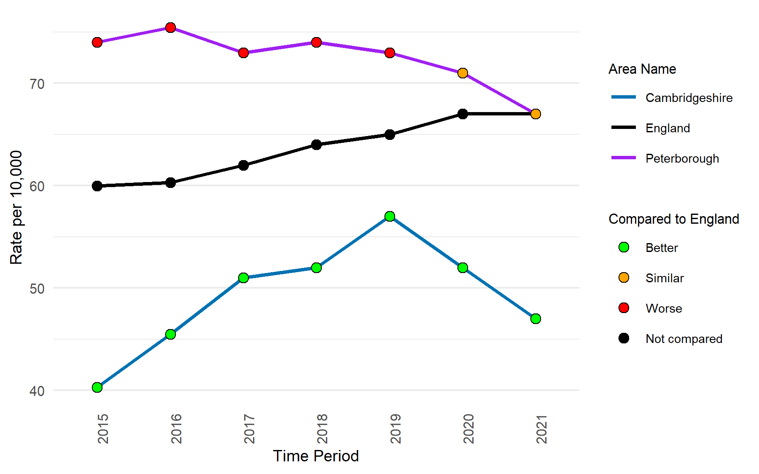
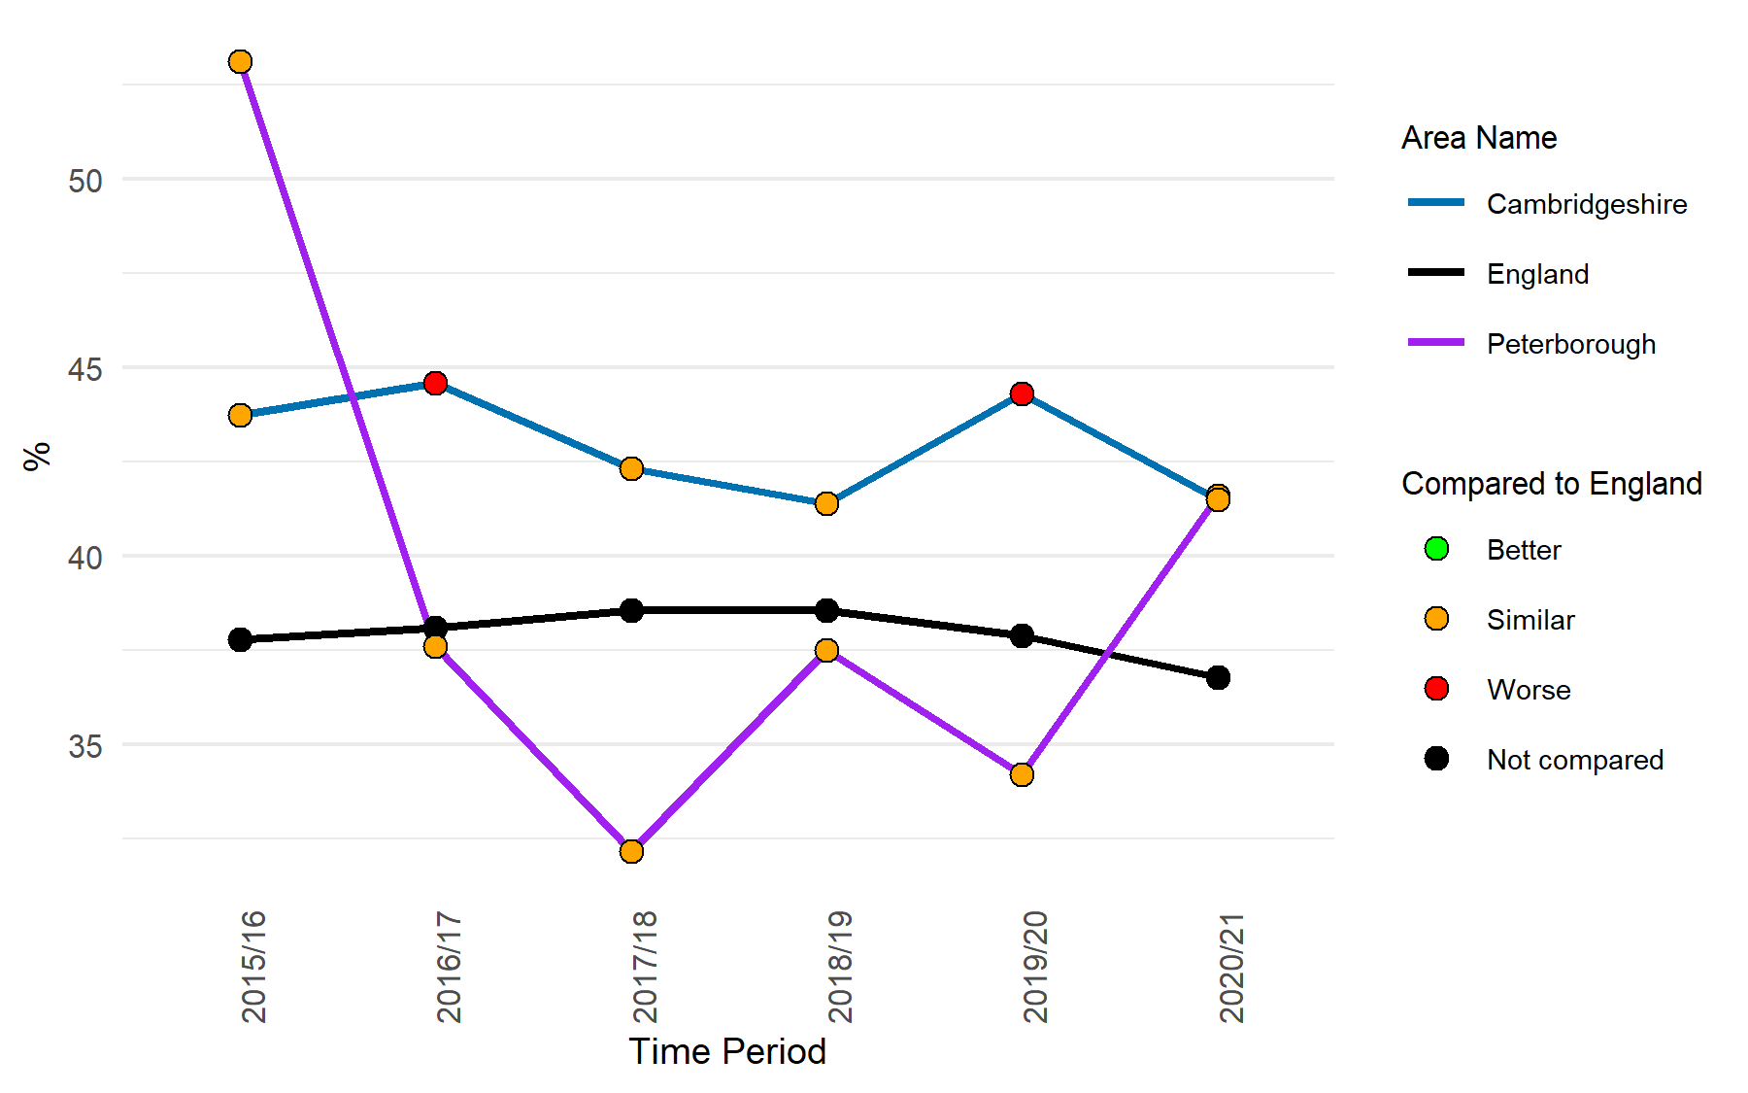
Vulnerable groups
Children in care
Percentage of looked after children whose emotional wellbeing is a cause for concern
 | Cambridgeshire | Peterborough
Number of children in care, 2021 | 649 | 352
 | Cambridgeshire | Peterborough
Number of looked after children whose emotional wellbeing is a cause for concern, 2020/21 | 76 | 47
The rate of children in care in Cambridgeshire was the highest in 2019 and shows a declining trend in the last couple of years; however, the rates remain significantly lower than the national average.
The rate in Peterborough shows a declining trend since 2018 and was statistically similar to the national rate in the last two years.
The proportion of looked after children (who have been in care for at least 12 months) whose emotional wellbeing is a cause for concern shows a varied trend for Cambridgeshire and Peterborough.
The proportion was statistically similar to the national average in 2020/21 for Cambridgeshire and Peterborough.
Notes:
Children in care: Children looked after at 31 March (including adoption and care leavers), (rate per 10,000 population aged under 18 years).
Data from https://fingertips.phe.org.uk/profile/wider-determinants/data#page/1
Source: Department for Education, Children looked after in England.
Percentage of looked after children whose emotional wellbeing is a cause for concern: Proportion of all looked after children aged between 5 and 16 (inclusive) at the date of their latest assessment, who have been in care for at least 12 months on 31 March whose SDQ score was 17 or over.
Data from https://fingertips.phe.org.uk/profile-group/mental-health/profile/cypmh/data#page/1
Source: Department for Education.

Slide 8
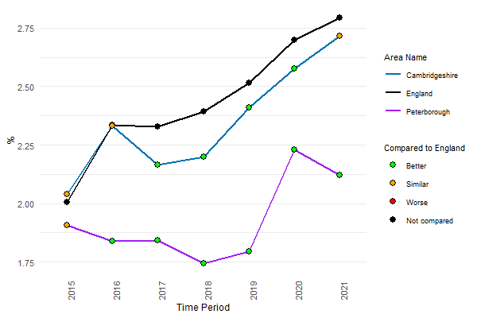
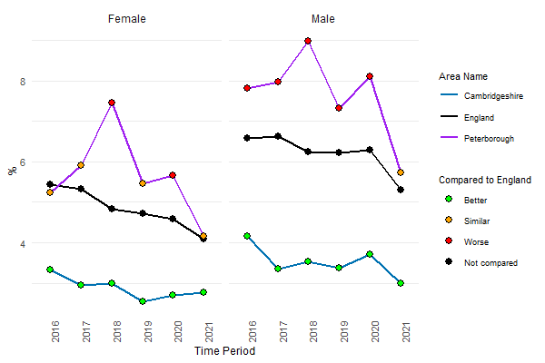
Vulnerable groups
School pupils with social, emotional and mental health needs
16 to 17 year olds not in education, employment or training (NEET) or whose activity is not known
 | Cambridgeshire | Peterborough
Number of School pupils with social, emotional and mental health needs (2021) | 2,397 | 828
 | Cambridgeshire | Peterborough
Number of 16 to 17 year olds not in education, employment or training (NEET) or whose activity is not known (2021) | 381 | 254
The proportion of school pupils with social, emotional and mental health needs show an overall increasing trend for Cambridgeshire, Peterborough and England.
Compared to England, the rate was statistically similar in Cambridgeshire and significantly lower in Peterborough
The proportion of 16 to 17 year olds not in education, employment or training (NEET) or whose activity is not known in Peterborough show a declining trend since 2018 for both males and females and the rates were statistically similar to England in 2021.
The rates in Cambridgeshire were significantly lower than England.
Notes:
School pupils with social, emotional and mental health needs:% of school pupils with social, emotional and mental health needs (School age) - The number of school children with Special Education Needs (SEN) who are identified as having social, emotional and mental health as the primary type of need, expressed as a percentage of all school pupils.
Data from https://fingertips.phe.org.uk/
Source: Department for Education special educational needs statistics: https://explore-education-statistics.service.gov.uk/find-statistics/special-educational-needs-in-england
16 to 17 year olds not in education, employment or training (NEET) or whose activity is not known: Proportion of 16 to 17 year olds not in education, employment or training (NEET) or whose activity is not known.
Data from https://fingertips.phe.org.uk/
Source: Department for Education

Slide 9
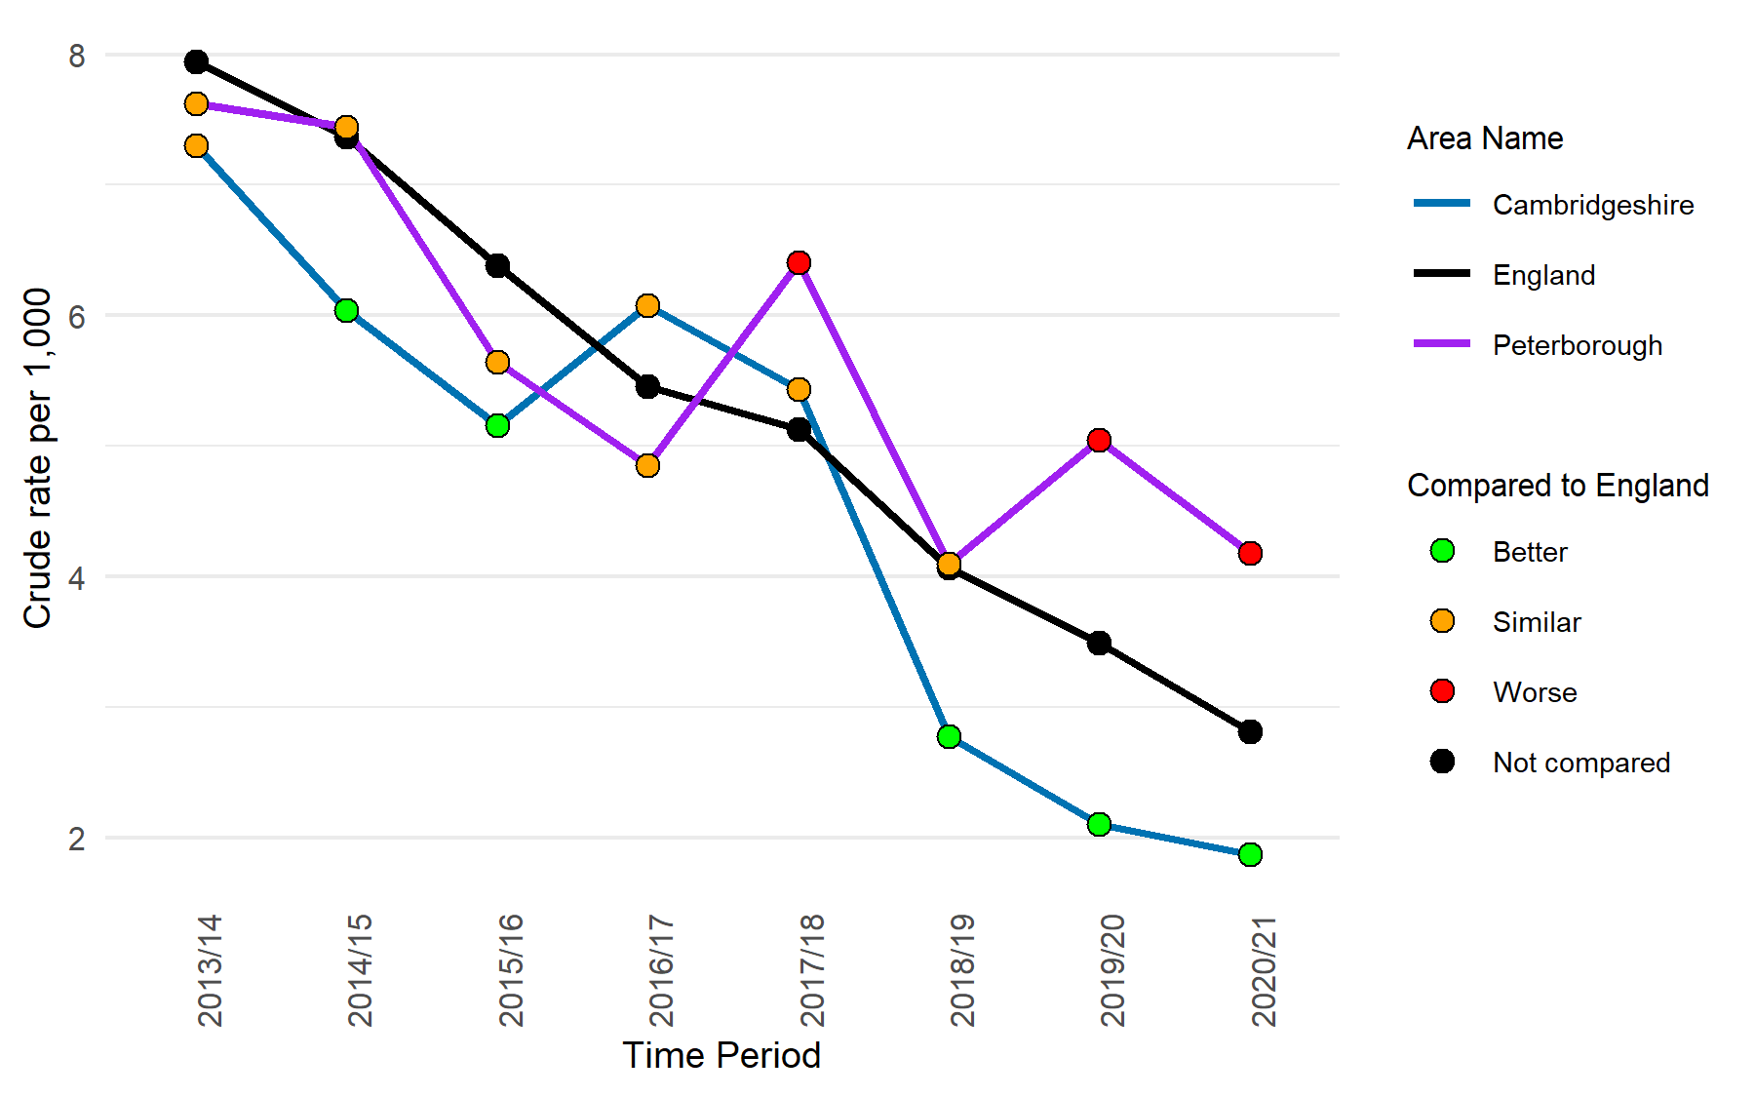
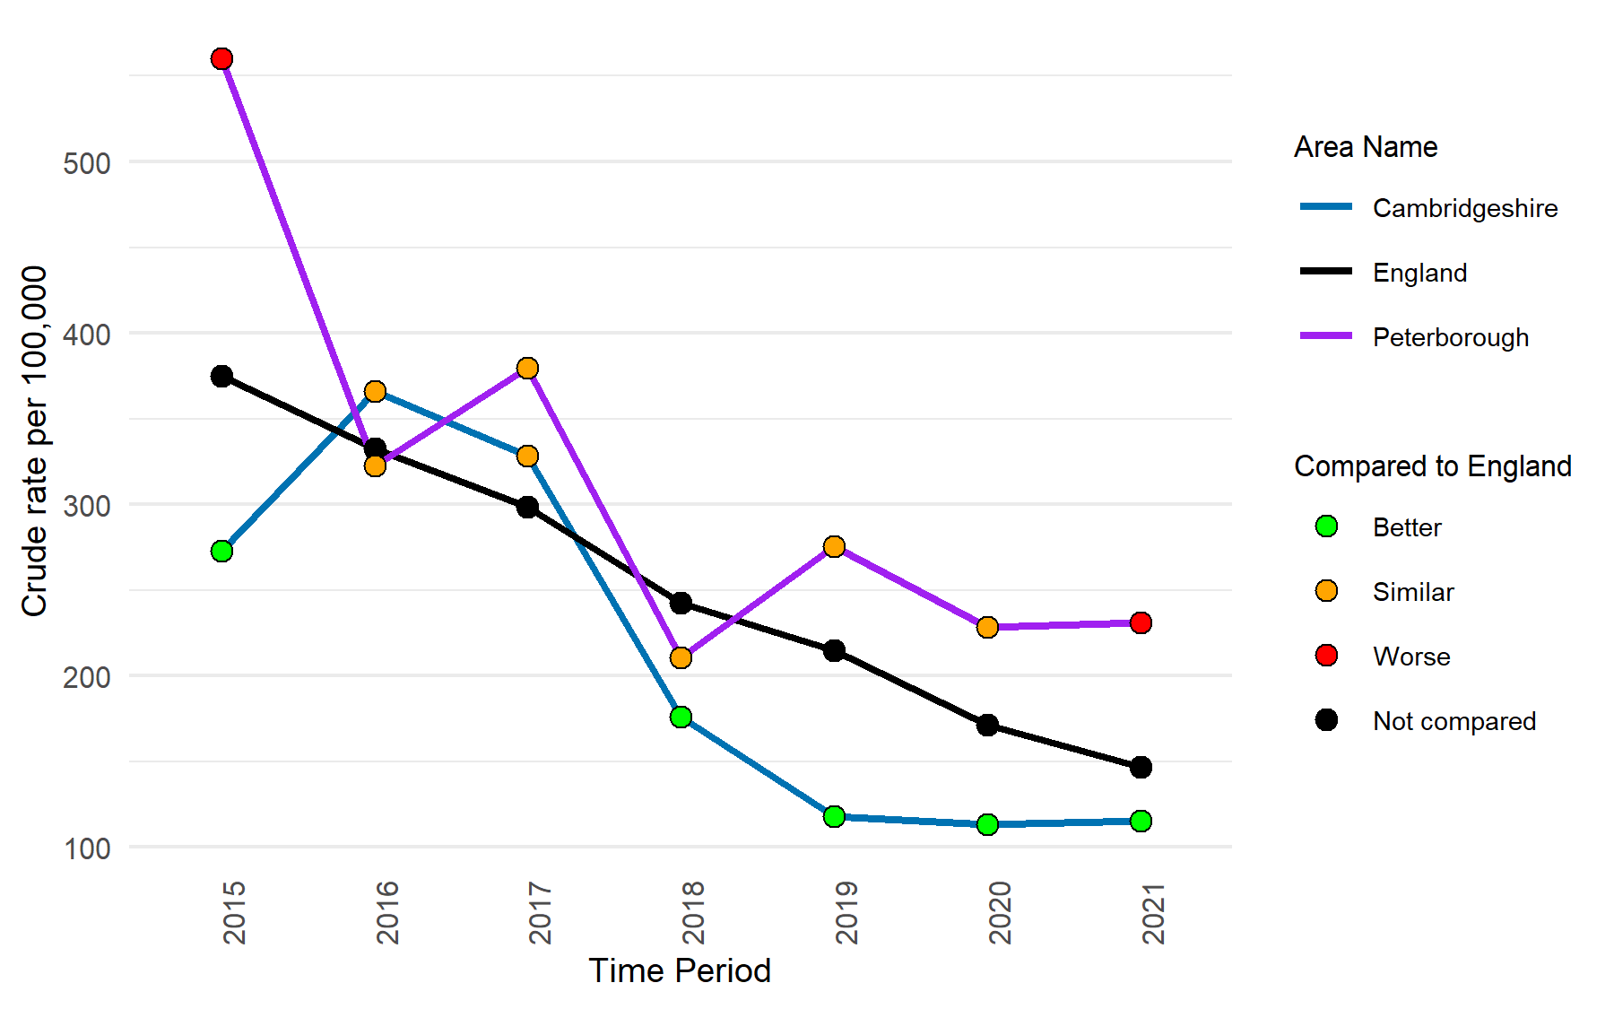
Vulnerable groups
Children entering the youth justice system (10-17 yrs)
First time entrants to the youth justice system
 | Cambridgeshire | Peterborough
Number of children entering the youth justice system (10 – 17 yrs), 2020/21 | 114 | 88
 | Cambridgeshire | Peterborough
Number of first time entrants to the youth justice system, 2021 | 70 | 49
The rate of children entering the youth justice system shows an overall decline for Cambridgeshire, Peterborough, and England compared to 2013/14.
In the last two years, the rate was significantly higher than England for Peterborough, while in Cambridgeshire it was significantly lower than the national rate.
The rate of children entering the youth justice system for the first time shows a varied trend across Cambridgeshire and Peterborough.
In 2021, the rate of 10-17 year-olds receiving their first reprimand, warning, or conviction per 100,000 was significantly higher than the national rate in Peterborough and significantly lower in Cambridgeshire.
Notes:
Children entering the youth justice system (10-17 yrs): Children and Young people aged 10 to 17 years cautioned or sentenced, rate per 1,000 population.
Data from https://fingertips.phe.org.uk/profile/wider-determinants/data#page/1
Source: Youth justice statistics - Annual statistics
First time entrants to the youth justice system: Rate of 10 to 17 year olds receiving their first reprimand, warning or conviction per 100,000 population.
Data from https://fingertips.phe.org.uk/profile/wider-determinants/data#page/1
Source: Figures calculated by OHID’s Population Health Analysis team using crime data supplied by the Ministry of Justice and population data supplied by Office for National Statistics (ONS).

Slide 10
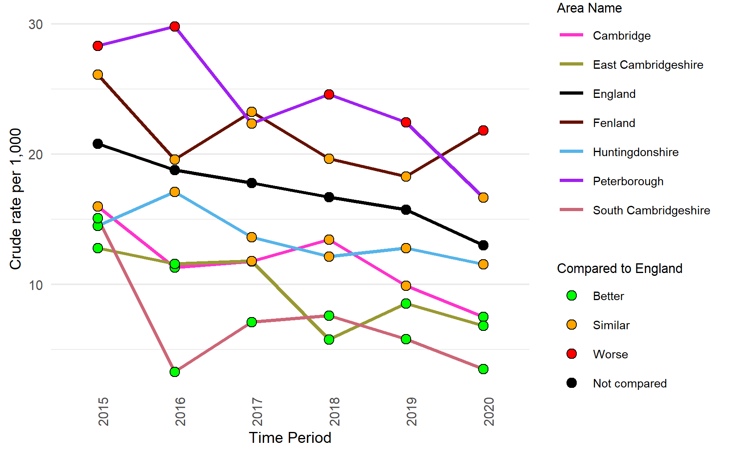
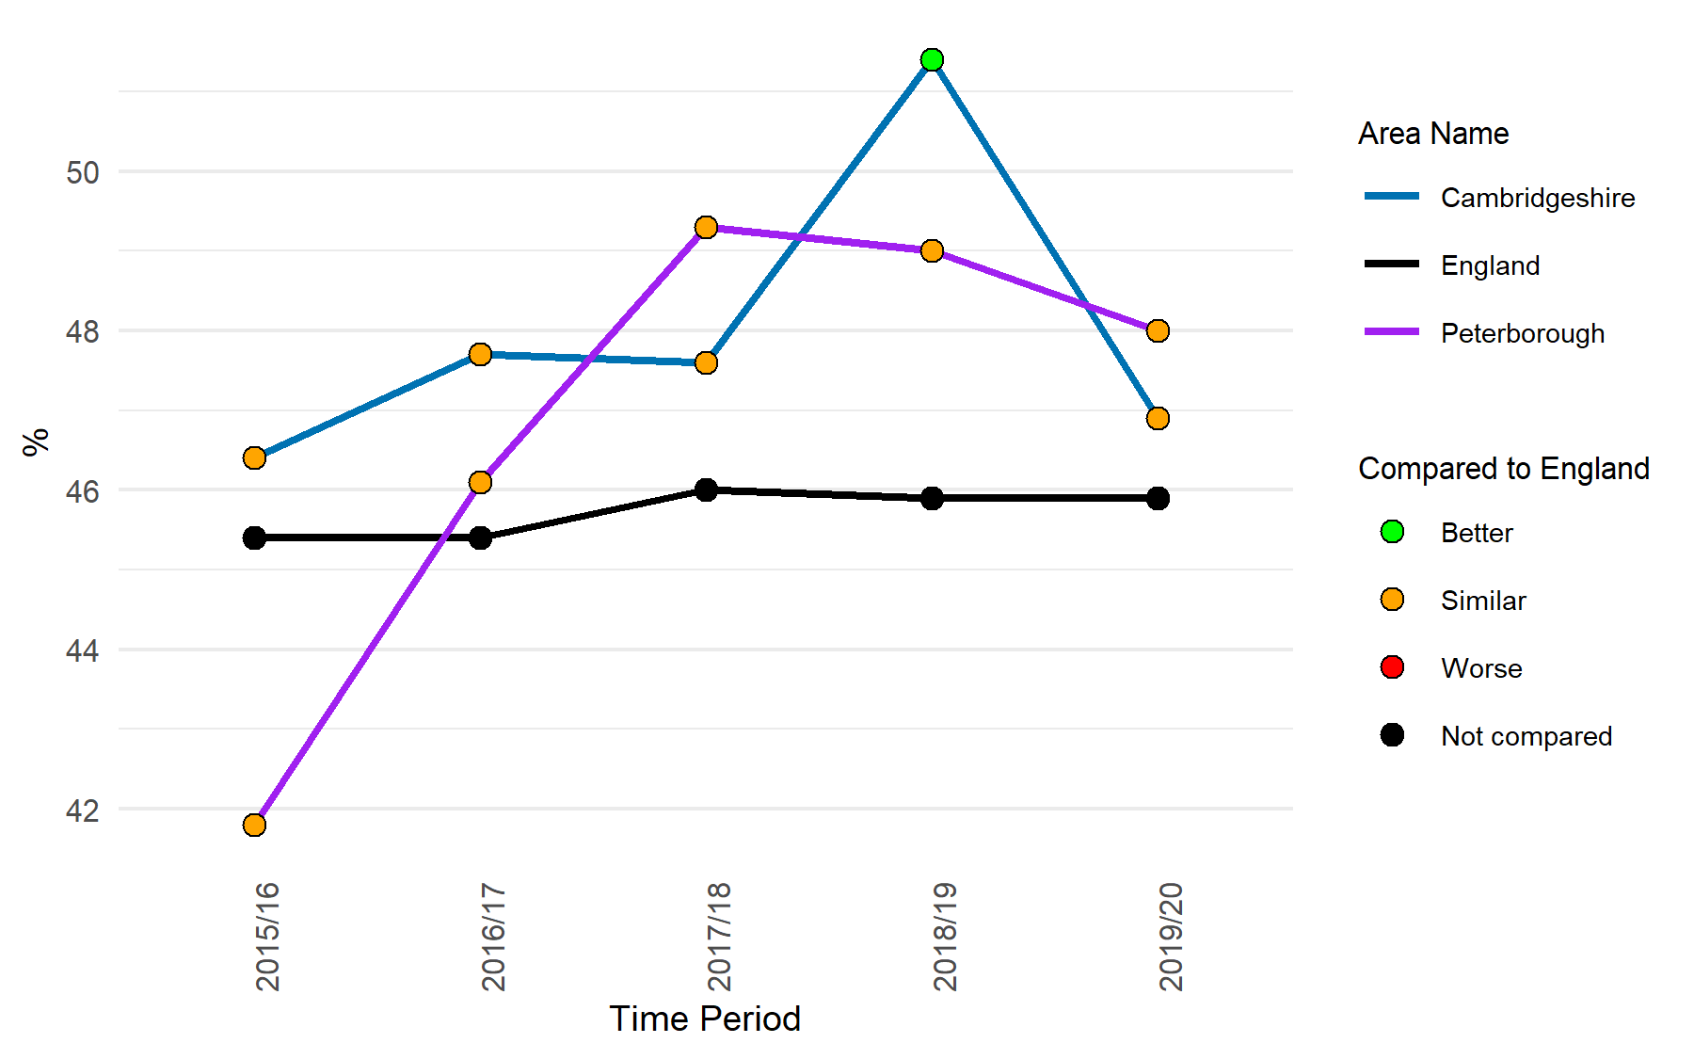
Vulnerable groups
Under 18s conception rate / 1,000
Social Isolation: percentage of adult social care users who have as much social contact as they would like (18+ yrs)
 | Cambridgeshire | Peterborough
Number of under 18 conceptions, 2020 | 100 | 57
From 2015 to 2019, the under-18 conception rate in Peterborough was significantly higher than the England average, but it has recently declined and was statistically similar to the national rate in 2020.
The under-18 conception rate in Fenland showed a recent increase and was significantly higher than England average in 2020.
In 2019/20, the proportion of adult social care users who have as much social contact as they would like shows a decline from the previous year for Cambridgeshire and Peterborough. The proportion was statistically similar to England in both areas.
Notes:
Under 18s conception rate / 1,000: Conceptions in women aged under 18 per 1,000 females aged 15-17.
Data from https://fingertips.phe.org.uk/profile/public-health-outcomes-framework
Source: Office for National Statistics (ONS)
Social Isolation: percentage of adult social care users who have as much social contact as they would like (18+ yrs): The percentage of respondents to the Adult Social Care Survey (service users) who responded to the question “Thinking about how much contact you’ve had with people you like, which of the following statements best describes your social situation?” with the answer “I have as much social contact as I want with people I like”.
This measure applies to those people in receipt, at the point that data are extracted, of long-term support services funded or managed by social services following a full assessment of need.
Data from https://fingertips.phe.org.uk/profile/wider-determinants/data#page/1
Source: Adult Social Care Outcomes Framework (ASCOF) based on the Personal Social Services Adult Social Care Survey, NHS Digital

Slide 11
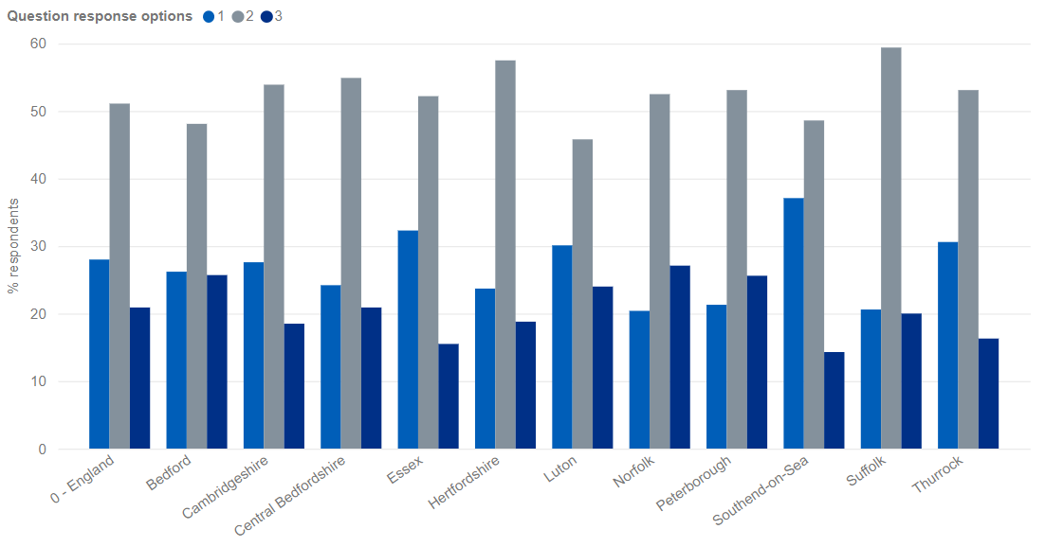
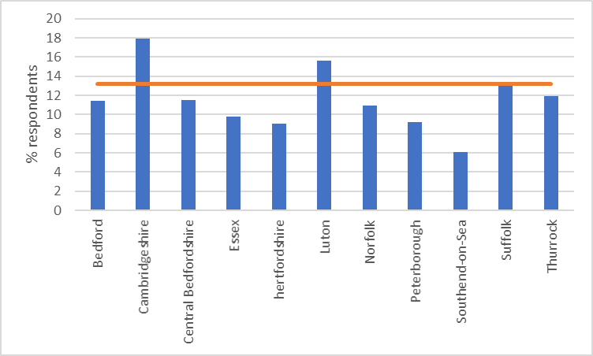
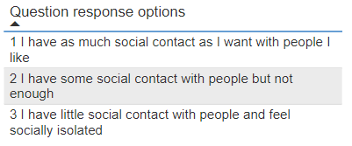
Vulnerable groups
Percentage of adult social carers who have had as much social contact as they would like (18+ years), 2021-22
Percentage of adult social carers who have a mental health problem or illness, 2021-22
The proportion of respondents to the Adult Social Carers Survey who said they have a mental health problem or illness in Cambridgeshire (17.9%) is substantially higher than the national rate (13.2%) and lower than England in Peterborough (9.2%).
Cambridgeshire has the highest proportion of adult social carers with a mental health problem or illness across the East of England region who has responded to the survey.
The proportion of respondents to the Adult Social Carers Survey who have as much social contact as they would like is similar to England (28%) in Cambridgeshire (27.6%); in Peterborough (21.3%), lower than England and several areas in the East of England.
The proportion of respondents who said they have little social contact with people and feel socially isolated in Cambridgeshire (18.5%) is lower than England (20.9%); in Peterborough it is 25.6%, higher than England and most areas in the East of England.
Notes:
Link: https://app.powerbi.com/view?r=eyJrIjoiMGM5OGRlOTAtY2QxYy00YzAxLWEyZWEtNjI3ZWRmOTE2OWI4IiwidCI6IjUwZjYwNzFmLWJiZmUtNDAxYS04ODAzLTY3Mzc0OGU2MjllMiIsImMiOjh9
This national survey takes place every other year and is conducted by Councils with Adult Social Services Responsibilities (CASSRs). The survey seeks the opinions of carers aged 18 or over, caring for a person aged 18 or over, on a number of topics that are considered to be indicative of a balanced life alongside their unpaid caring role.
Carers are included regardless of whether they have received an assessment or review in the previous year.

Slide 12
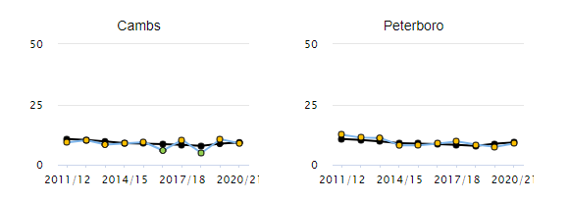
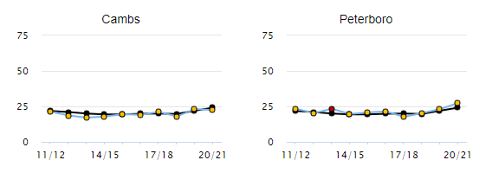
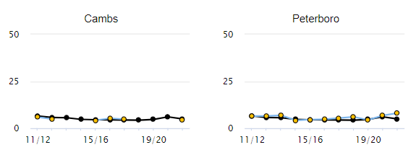
Vulnerable groups
Self-reported wellbeing: people with a low happiness score
Self-reported wellbeing: people with a high anxiety score
Self-reported wellbeing: people with a low satisfaction score
Based on a self-reported wellbeing survey, the proportion of people who responded with low happiness, high anxiety and low satisfaction in Cambridgeshire and Peterborough is statistically similar to the national value
Notes:
Self-reported wellbeing: The percentage of respondents who answered 0-4 to the question "Overall, how happy did you feel yesterday?"
ONS are currently measuring individual/subjective well-being based on four questions included on the Integrated Household Survey:
Overall, how satisfied are you with your life nowadays?
Overall, how happy did you feel yesterday?
Overall, how anxious did you feel yesterday?
Overall, to what extent do you feel the things you do in your life are worthwhile?
Responses are given on a scale of 0-10 (where 0 is “not at all satisfied/happy/anxious/worthwhile” and 10 is “completely satisfied/happy/anxious/worthwhile”)
In the ONS report, the percentage of people scoring 0-4, 5-6, 7-8 and 9-10 have been calculated for this indicator. The percentage of those scoring 0-4 (respondents in that area that scored themselves the lowest marks) in the question: 'Overall, how happy did you feel yesterday?' will be presented in this indicator.
Link: https://fingertips.phe.org.uk/profile/wider-determinants/data#page/1
Source: Annual Population Survey (APS), Office for National Statistics (ONS).

Slide 13
Vulnerable groups
Violent crime - violence offences per 1,000 population, 2020/21
Violent crime – sexual offences per 1,000 population, 2020/21
* Aggregated from all known lower geography values
* Aggregated from all known lower geography values
Peterborough has the highest level of violent offences per 1,000 for the year 2020/21, followed by Cambridge and Fenland. Recent trend shows an increase in violence offence rate across all areas.
The rates are higher than the national average in Peterborough and Cambridge.
The sexual offence rate in Peterborough is higher than all Cambridgeshire districts and England. An increasing trend is seen in Peterborough and all Cambridgeshire districts except Cambridge and South Cambridgeshire.
Notes:
Violence offences - Violence against the person offences, based on police recorded crime data, crude rate per 1,000 population.
Sexual offences - Rate of sexual offences based on police recorded crime data per 1,000 population
Data from https://fingertips.phe.org.uk/profile/wider-determinants
Source: OHID's Population Health Analysis Team using Home Office crime data and ONS population data

Slide 14
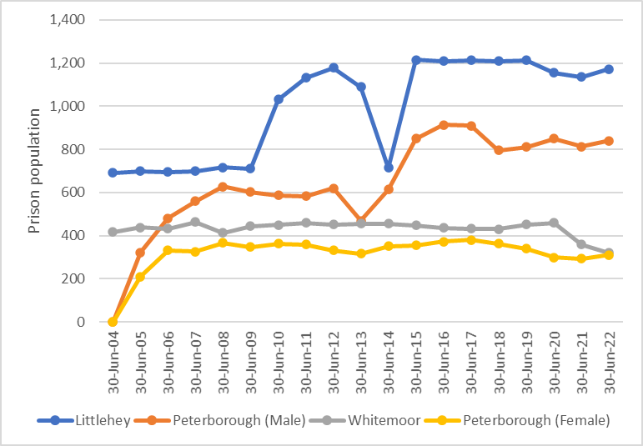
Vulnerable groups
Total number of prisoners at a specific point in time each year, Cambridgeshire and Peterborough prisons
The total number of prisoners shows a stable trend from 2015 to 2019 in Littlehey prison, with a decline seen during the first 2 years of the pandemic (2020 and 21). However, an increase has been seen in the recent year.
The total number of prisoners shows a relatively stable trend in Whitemoor prison from 2004 to 2020. However, a decline is noted in the last 2 year’s snapshot.
The male prison population in Peterborough prison shows fluctuations in recent years.
The female prison population in HMP Peterborough has had a declining trend since 2017. However, a slight increase has been seen in the recent year.
Notes:
Prison population: Total number of prisoners at a specific point in time each year.
Link: https://www.gov.uk/government/collections/prison-population-statistics

Slide 15
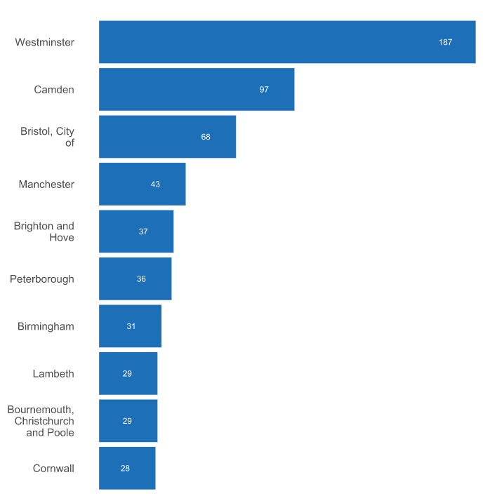
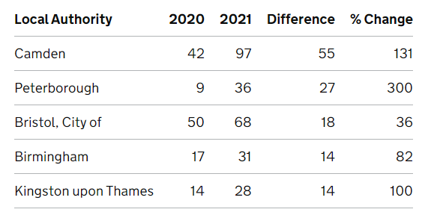
Rough sleeping snapshot in England
Local authorities with the highest estimated number of people sleeping rough on a single night in autumn 2021
Local authorities with the largest increase in the estimated number of people sleeping rough on a single night in autumn 2021 compared to previous year.
Peterborough was in the top 10 local authorities (ranked 6th) with the highest number of people sleeping rough on a single night between 1st Oct and 30th Nov 2021.
Peterborough had the 2nd largest increase (+27) in the estimated number of people sleeping rough on a single night in autumn 2021 compared to previous year.
Estimated number of people sleeping rough on a single night in autumn 2021, by local authority
Peterborough (36) had the highest estimated number of people sleeping rough on a single night in autumn 2021, followed by Cambridge (14).
Notes:
Source: Department for Levelling Up, Housing & Communities, Rough sleeping snapshot in England: autumn 2021
Rough sleeping snapshot England - provides information about the estimated number of people sleeping rough on a single night between 1 October and 30 November 2021. These statistics provide a way of estimating the number of people sleeping rough across England on a single night in autumn and to assess change over time.
In response to the pandemic, particularly in 2020, the government launched a range of extra support for people sleeping rough, in addition to the support already being provided as part of the Rough Sleeping Initiative (RSI).
As well as the pandemic, there are other factors that can affect the number of people who sleep rough on any given night. For example, the availability of night shelters, the weather, where people choose to sleep and the date and time chosen for the snapshot estimate. Whilst local authorities are asked to provide possible reasons for any significant changes in the numbers of people who sleep rough compared to previous years, the figures in this release are subject to some uncertainty and should be treated as estimates of the number of people sleeping rough on a single night in autumn.
Definitions
People sleeping rough are defined as follows: People sleeping, about to bed down (sitting on/in or standing next to their bedding) or bedded down in the open air (such as on the streets, in tents, doorways, parks, bus shelters or encampments). People in buildings or other places not designed for habitation (such as stairwells, barns, sheds, car parks, cars, derelict boats, stations, or ‘bashes’ which are makeshift shelters, often comprised of cardboard boxes). The definition does not include people in hostels or shelters, people in campsites or other sites used for recreational purposes or organised protest, squatters or travellers.
Bedded down is taken to mean either lying down or sleeping.
About to bed down includes those who are sitting in/on or near a sleeping bag or other bedding.
Link: https://www.gov.uk/government/statistics/rough-sleeping-snapshot-in-england-autumn-2021/rough-sleeping-snapshot-in-england-autumn-2021

Slide 16
Vulnerable groups
Households owed a homelessness duty by support needs of household, 2021 - 22
The proportion of households owed a homelessness duty that had a history of mental health problems is higher than the national average in all Cambridgeshire districts, whereas it is lower in Peterborough.
In Fenland, the proportion of households owed a homelessness duty with other support needs are substantially higher than the national rates for most of the categories.
The proportion of households owed a homelessness duty with support needs for access to education, employment, or training is substantially higher than the national rate in East Cambridgeshire.
Notes:
Note: Multiple support needs can be reported per household, but each support need only once. Households can therefore be represented across multiple support needs columns. Support needs are not the same as 'priority need' and it is possible that a household with support needs is not of priority need.
Source: Statutory homelessness April 2021 – March 2022, Development for Levelling Up, Housing and Communities
Data from: https://www.gov.uk/government/statistical-data-sets/live-tables-on-homelessness

Slide 17
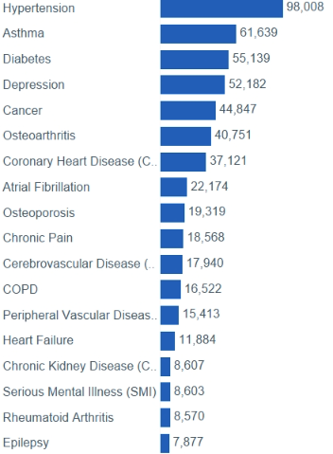
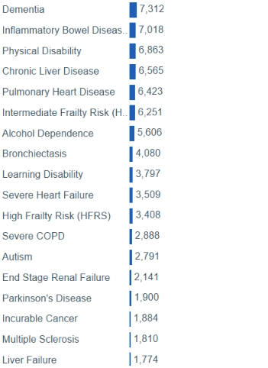

Health conditions, ICS Population
ICS Population: Conditions
Hypertension is the most common disease in the Cambridgeshire and Peterborough ICS population.
Depression is one of the top five health problems, with a higher prevalence (52,182 people) in the Cambridgeshire and Peterborough ICS population.
3,797 people have been identified with learning disabilities, and 2,791 with autism.
Notes:
Source: Population and Person Insight dashboard

Slide 18
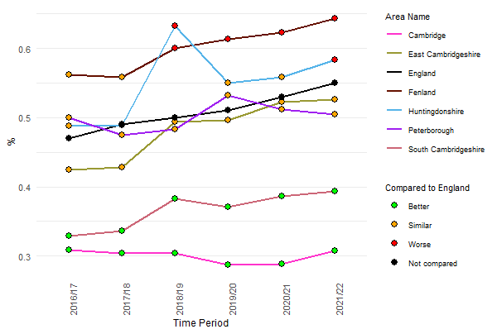
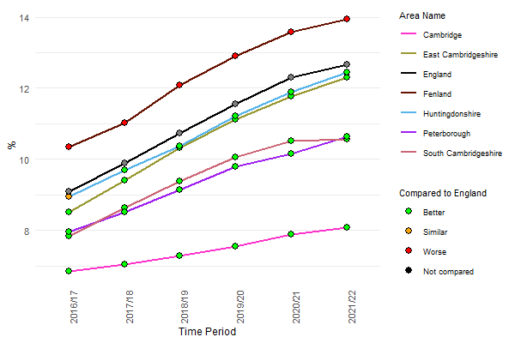
Vulnerable groups
Prevalence of learning disabilities (all ages), QOF
Prevalence of depression (18+ years), QOF
An overall increase is seen in the prevalence of learning disabilities since 2016/17 in all areas, except Cambridge.
From 2018/19 to 2021/22, the prevalence of learning disabilities in Fenland is significantly higher than the national rate.
Prevalence in Huntingdonshire is significantly higher than the national rate in the latest year.
An overall increase is seen in the prevalence of depression since 2016/17 in all areas across Cambridgeshire and Peterborough.
The prevalence of depression in Fenland is significantly higher than the national rate since 2016/17.
Notes:
Learning disability: QOF prevalence (all ages): The percentage of patients with learning disabilities, as recorded on practice disease registers
Source: Quality and Outcomes Framework (QOF), NHS Digital
Depression: QOF prevalence (18+ yrs): The percentage of patients aged 18 and over with depression, as recorded on practice disease registers.
ForLocal authorities: The recorded depression prevalence is the estimated number of people with depression recorded on the practice register as a proportion of the practice list size, aged 18 years or over, allocated to a local authority boundary using the postcode of the practice.
Data from https://fingertips.phe.org.uk/
Source: Quality and Outcomes Framework (QOF), NHS Digital

Slide 19
Alcohol and Drug Use

Slide 20
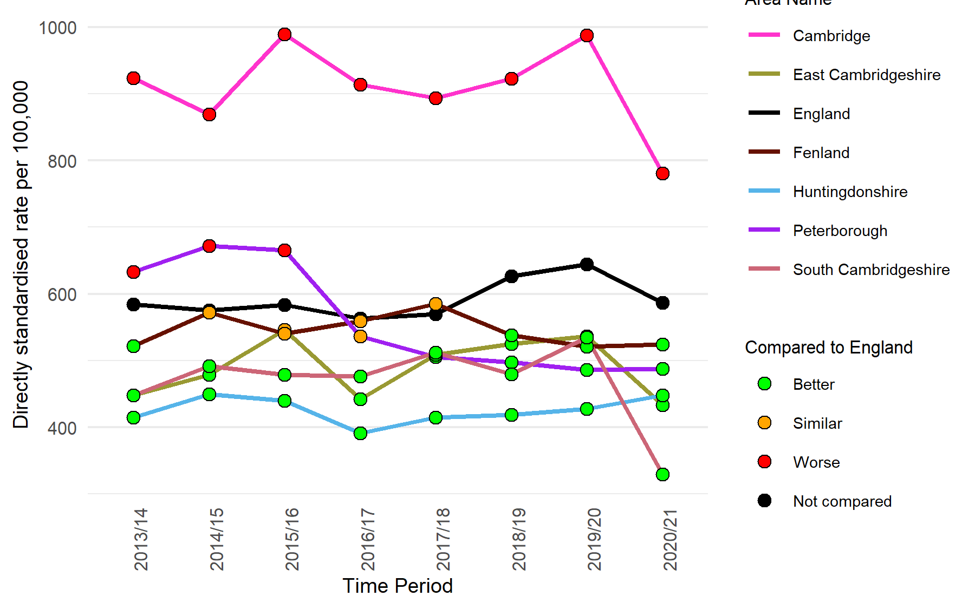
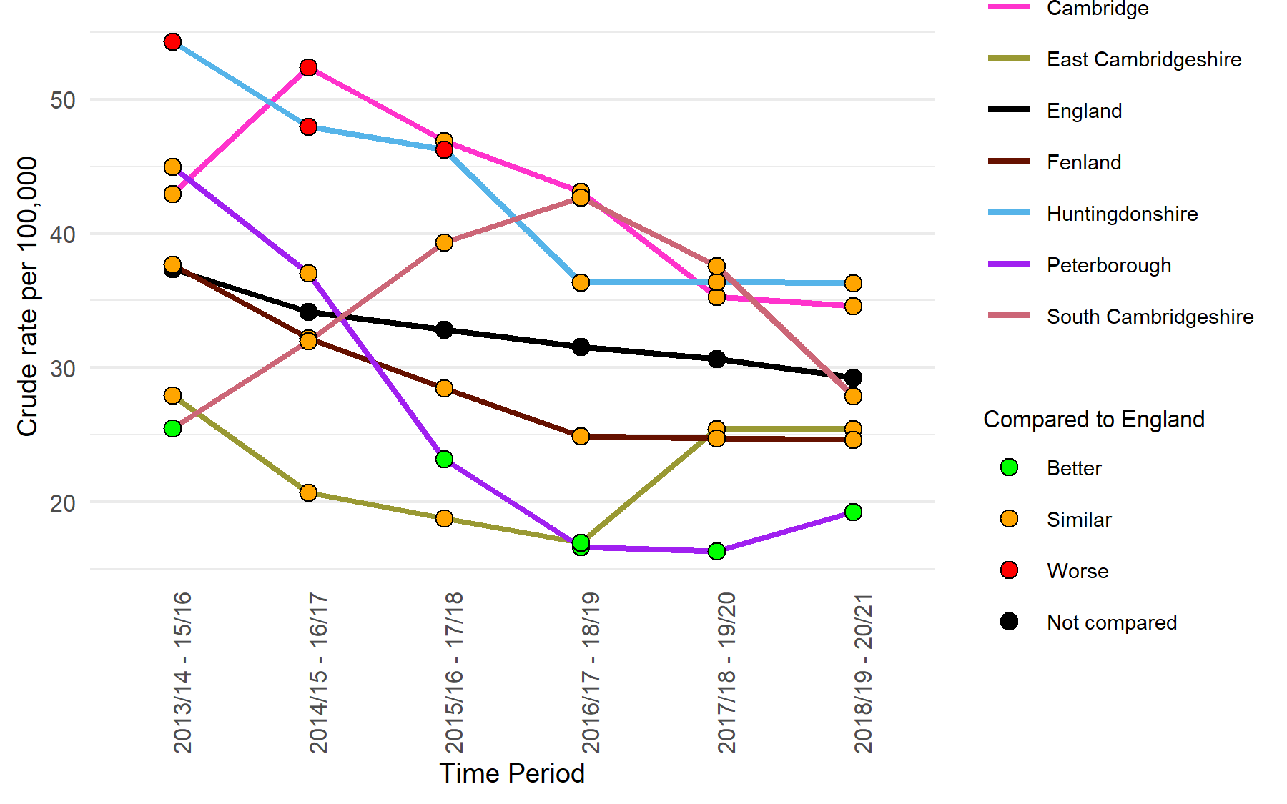
Hospital admissions for alcohol-specific conditions
Admission episodes for alcohol-specific conditions - All ages
Admission episodes for alcohol-specific conditions - Under 18s
 | Cambridgeshire | Peterborough
Number of admission episodes for alcohol-specific conditions – All ages, 2020/21 | 3,005 | 915
 | Cambridgeshire | Peterborough
Number of admission episodes for alcohol-specific conditions – under 18s, 2018/19 – 20/21 | 125 | 30
The rates of admissions to hospitals in Cambridge where the primary diagnosis or any of the secondary diagnoses are an alcohol-specific (wholly attributable) condition have been significantly higher than the England rates since 2013/14; the rates in all other areas in Cambridgeshire and Peterborough have been significantly lower than the national rates in recent years.
The trends in Cambridgeshire districts vary, but the rates have remained statistically similar to the national rates in recent years.
During the period 2018/19 – 20/21, the rate of hospital admissions for alcohol-specific conditions in under-18s showed a slight increase in Peterborough over the previous year but remained significantly lower than the national rate.
Notes:
Admission episodes for alcohol-specific conditions - All ages: Admissions to hospital where the primary diagnosis or any of the secondary diagnoses are an alcohol-specific (wholly attributable) condition. Directly age standardised rate per 100,000 population (standardised to the European standard population).
Data from https://fingertips.phe.org.uk/profile/local-alcohol-profiles
Source: Calculated by OHID: Population Health Analysis (PHA) team using data from NHS Digital - Hospital Episode Statistics (HES) and Office for National Statistics (ONS) - Mid Year Population Estimates.*
Admission episodes for alcohol-specific conditions - Under 18s: Admissions to hospital for under 18s where the primary diagnosis or any of the secondary diagnoses are an alcohol-specific (wholly attributable) condition. Crude rate per 100,000 population.
Data from https://fingertips.phe.org.uk/profile/local-alcohol-profiles
Source: Calculated by OHID: Population Health Analysis (PHA) team using data from NHS Digital - Hospital Episode Statistics (HES) and Office for National Statistics (ONS) - Mid Year Population Estimates.

Slide 21
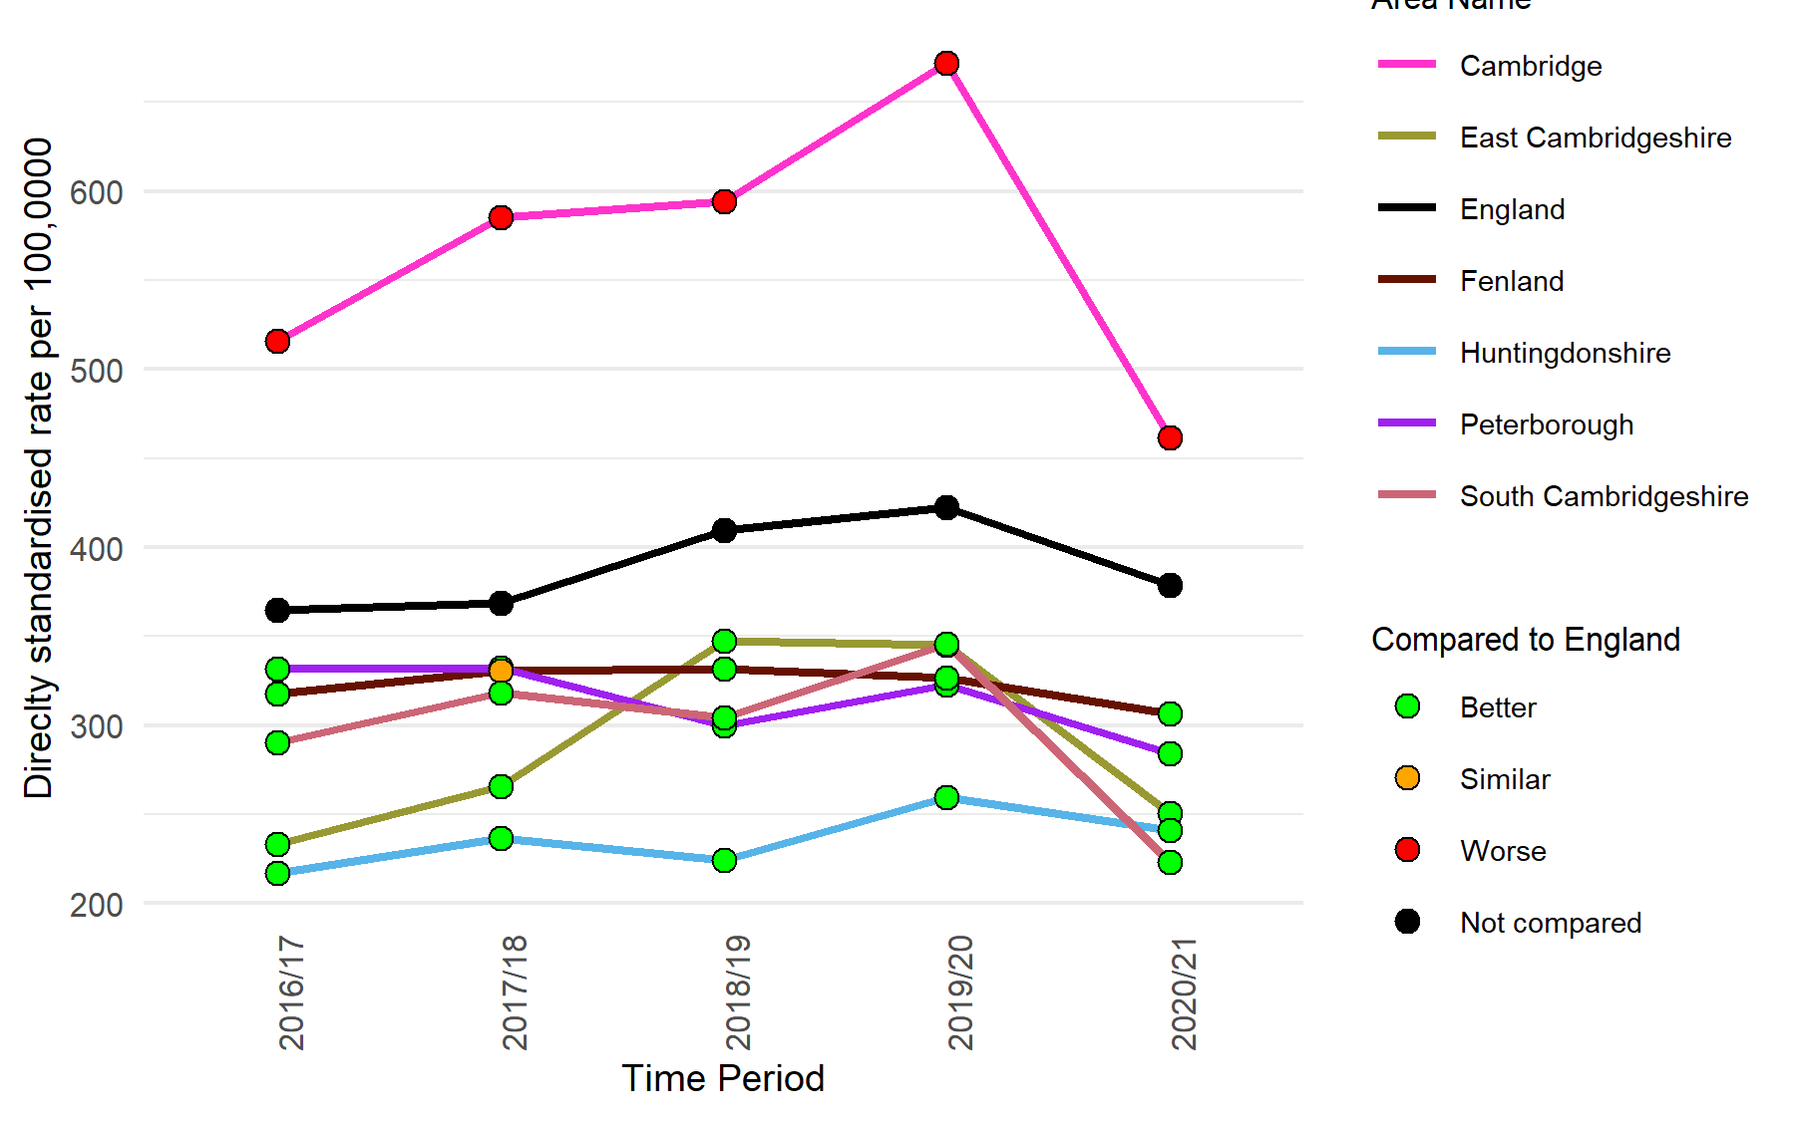
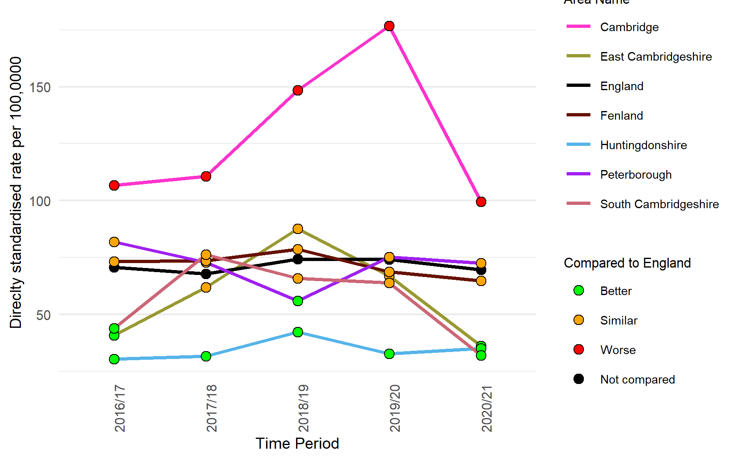
Alcohol-related hospital admissions for mental and behavioural disorders
Admission episodes for mental and behavioural disorders due to use of alcohol (Broad)
Admission episodes for mental and behavioural disorders due to use of alcohol (Narrow)
 | Cambridgeshire | Peterborough
Number of admission episodes for mental and behavioural disorders due to use of alcohol (broad), 2020/21 | 1,762 | 531
 | Cambridgeshire | Peterborough
Number of admission episodes for mental and behavioural disorders due to use of alcohol (narrow), 2020/21 | 305 | 142
The rates of admissions to hospitals in Cambridge where the primary diagnosis or any of the secondary diagnoses are alcohol-attributable mental and behavioural disorders have been significantly higher than the England rates since 2016/17.
The rates in all other areas in Cambridgeshire and Peterborough have been significantly lower than the national rates in recent years.
The rates of admissions to hospitals where the primary diagnosis is alcohol-attributable mental and behavioural disorders due to alcohol use have been significantly higher than the England rate in Cambridge since 2016/17 and peaked in 2019/20.
The rates in all other areas across Cambridgeshire and Peterborough have been significantly lower or similar to the national rates.
Notes:
Admission episodes for mental and behavioural disorders due to use of alcohol (Broad): Admissions to hospital where the primary diagnosis or any of the secondary diagnoses are an alcohol-attributable mental and behavioural disorders due to use of alcohol code.
Data from https://fingertips.phe.org.uk/local-alcohol-profiles
Source: Calculated by OHID: Population Health Analysis (PHA) team using data from NHS Digital - Hospital Episode Statistics (HES) and Office for National Statistics (ONS) - Mid Year Population Estimates.
Admission episodes for mental and behavioural disorders due to use of alcohol (Narrow): Admissions to hospital where the primary diagnosis is an alcohol-attributable mental and behavioural disorders due to use of alcohol code.
Data from https://fingertips.phe.org.uk/local-alcohol-profiles
Source: Calculated by OHID: Population Health Analysis (PHA) team using data from NHS Digital - Hospital Episode Statistics (HES) and Office for National Statistics (ONS) - Mid Year Population Estimates.

Slide 22
Drug-related hospital admissions for mental and behavioural disorders
Directly age standardised rate of admissions where drug-related mental and behavioural disorder were a factor, per 100,000
Directly age standardised rate of admissions for drug-related mental and behavioural disorders, per 100,000
 | Cambridgeshire | Peterborough
Number of admissions where drug-related mental and behavioural disorder were a factor, 2021/22 | 996 | 249
 | Cambridgeshire | Peterborough
Number of admissions for drug-related mental and behavioural disorders, 2021/22 | 23 | 6
The rates of admissions to hospitals in Cambridge where the primary diagnosis or any of the secondary diagnoses are drug-related mental and behavioural disorders have been significantly higher than the Cambridgeshire and Peterborough total since 2016/17.
The rates in East Cambridgeshire show recent increases and have been significantly higher than the C&P rate in the last two years.
The rates of admissions to hospitals where the primary diagnosis is drug-related mental and behavioural disorders in most areas across Cambridgeshire and Peterborough have been statistically similar to the C&P rates.
A varied trend is noted in the rate of admission across Cambridgeshire and Peterborough.

Slide 23
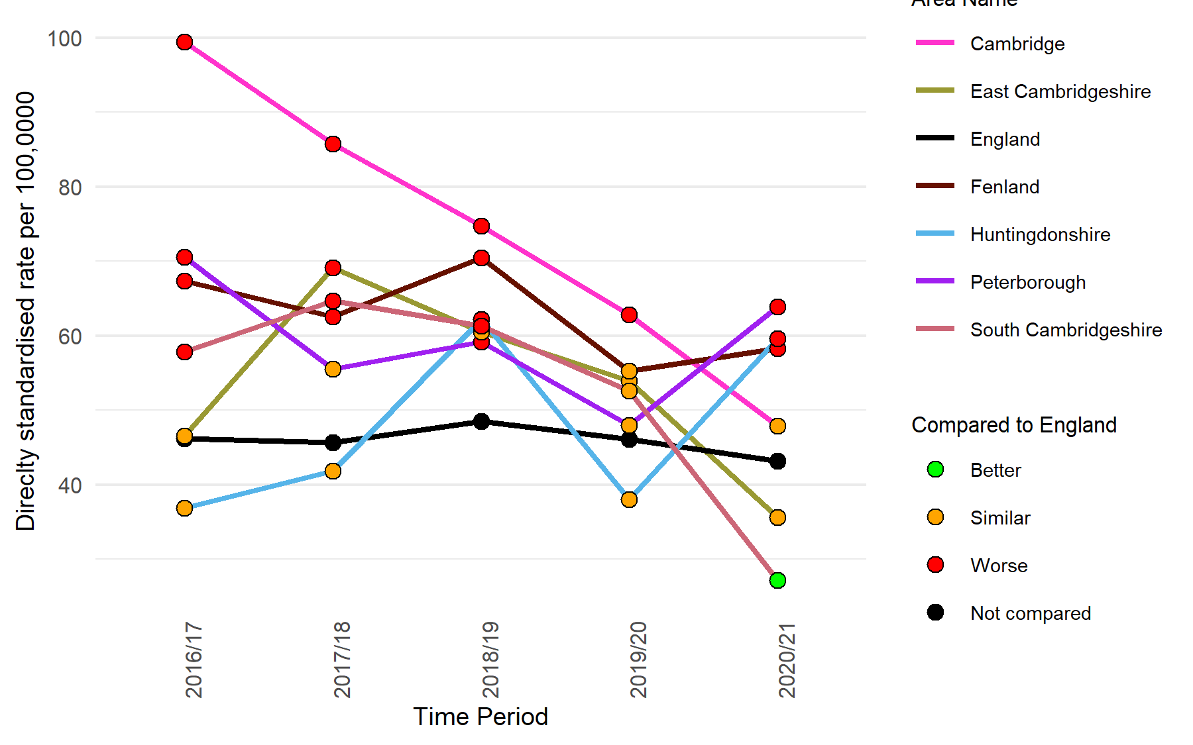
Admission episodes for self-poisoning
Admission episodes for intentional self-poisoning by and exposure to alcohol (Narrow)
Directly age standardised rate of admissions for poisoning by drug misuse, per 100,000
 | Cambridgeshire | Peterborough
Number of admissions for intentional self-poisoning by and exposure to alcohol (Narrow), 2020/21 | 288 | 127
 | Cambridgeshire | Peterborough
Number of admissions for poisoning by drug misuse, 2021/22 | 87 | 32
In 2020/21, the rate of hospital admissions for intentional self-poisoning where the primary diagnosis is an alcohol-related condition show an increase compared to the previous year in Peterborough, Fenland and Huntingdonshire; the rates were significantly higher than the national rate.
The rate of admissions in Cambridge has shown a steep decline since 2016/17; a decline is also seen in East and South Cambridgeshire since 2017/18.
The rates are statistically similar to the Cambridgeshire and Peterborough total in all areas.
Notes:
Admission episodes for intentional self-poisoning by and exposure to alcohol (Narrow): A measure of hospital admissions where the primary diagnosis (main reason for admission) is an alcohol-related condition.
Data from https://fingertips.phe.org.uk/local-alcohol-profiles
Source: Calculated by OHID: Population Health Analysis (PHA) team using data from NHS Digital - Hospital Episode Statistics (HES) and Office for National Statistics (ONS) - Mid Year Population Estimates.

Slide 24
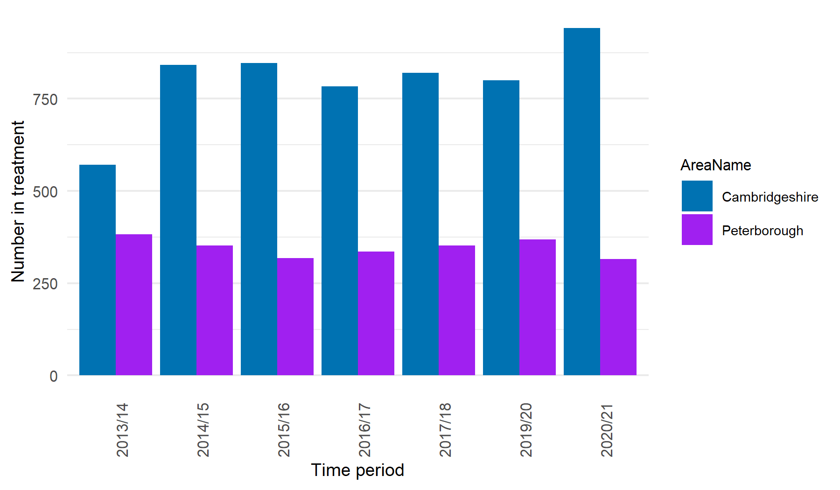
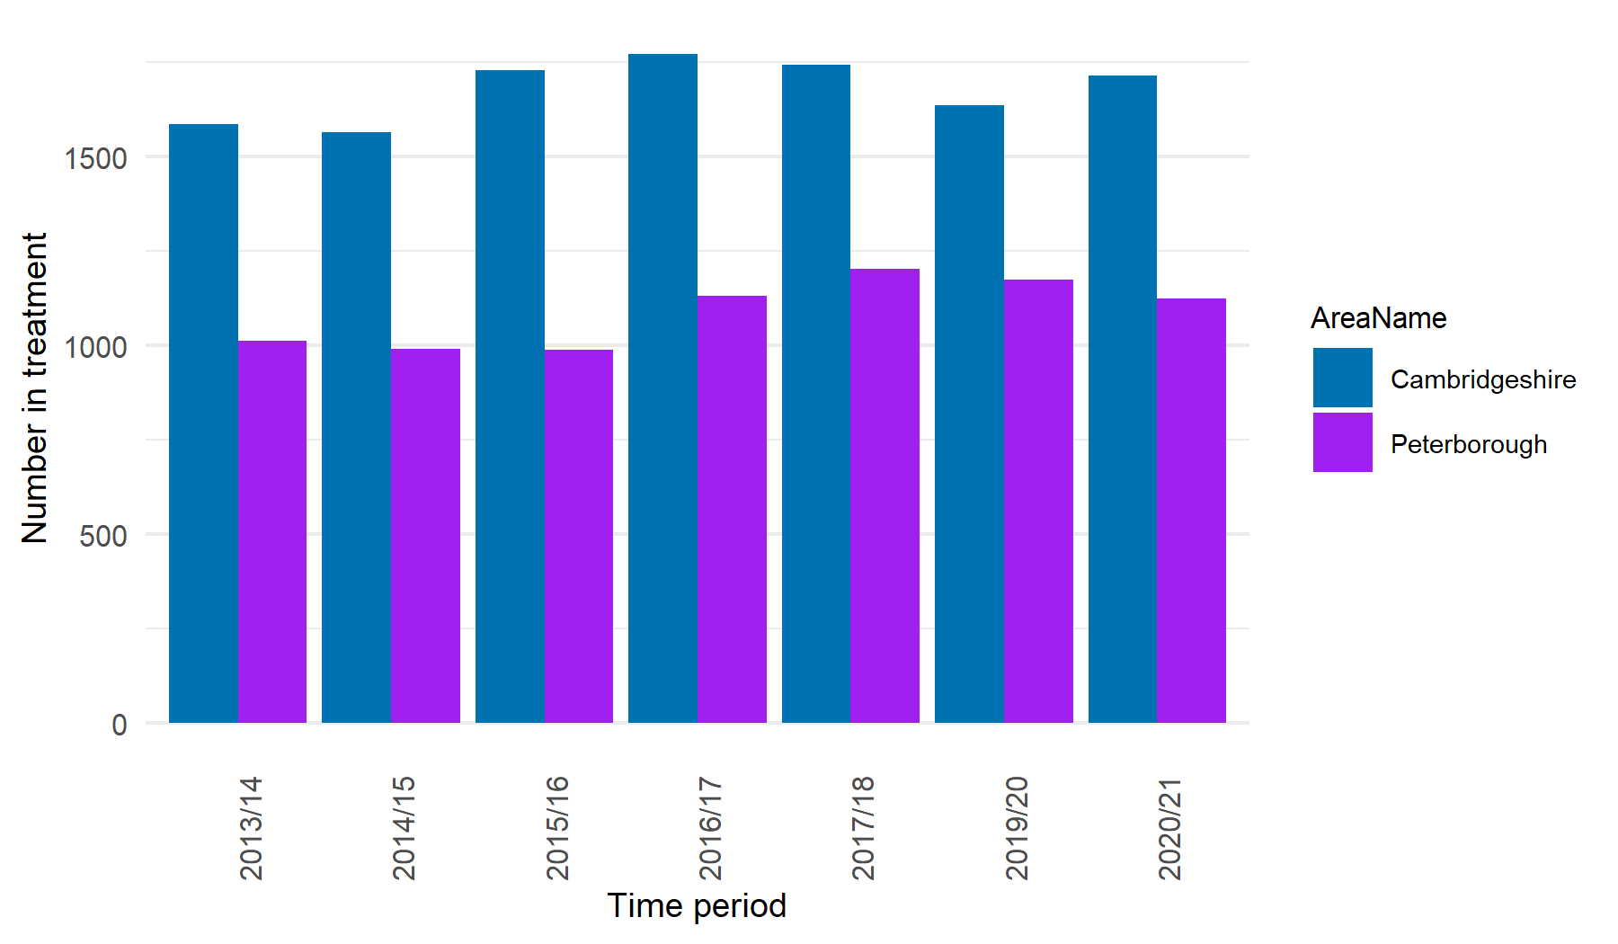
Specialist alcohol and drug misuse service
Number in treatment at specialist alcohol misuse service
Number in treatment at specialist drug misuse service
In 2020/21, 942 people received treatment at a specialist alcohol misuse service in Cambridgeshire, a substantial increase compared to 800 in the previous year.
315 people received treatment in Peterborough in 2020/21, compared to 368 in 2019/20.
In Cambridgeshire, 1,714 people were in specialist drug misuse services in 2020/21 compared to 1,636 in 2019/20.
There were 1,125 people who received treatment at a specialist drug misuse service in 2020/21 compared to 1,174 in the previous year.
Notes:
Number in treatment at specialist alcohol misuse services Total number of individuals who received treatment at a specialist alcohol misuse service.
Data from https://fingertips.phe.org.uk/local-alcohol-profiles
Source: National Drug Treatment Monitoring System
Number in treatment at specialist drug misuse services Total number of individuals who received treatment at a specialist drug misuse service.
Data from https://fingertips.phe.org.uk/profile/tobacco-control
Source: National Drug Treatment Monitoring System

Slide 25
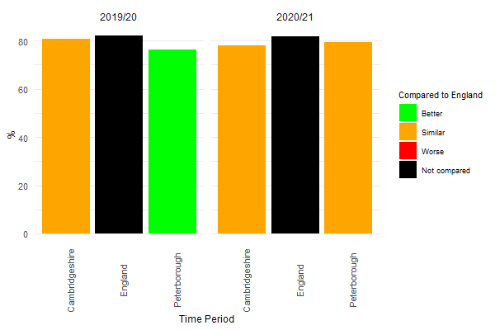
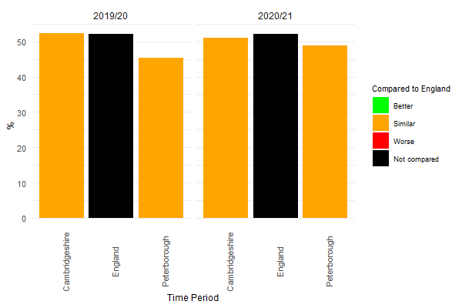
Substance use treatment
Proportion of dependent drinkers not in treatment
Proportion of opiates and/or crack cocaine users (i.e. OCU) not in treatment
 | Cambridgeshire | Peterborough
Number of dependent drinkers not in treatment, 2020/21 | 4,438 | 1,868
 | Cambridgeshire | Peterborough
Number of opiate and/or crack cocaine users not in treatment, 2020/21 | 1,220 | 787
An increase in the proportion of dependent drinkers who are not in treatment in Peterborough increased to 79% in 2020/21 from 76% in the previous year. In contrast, there was a decline in Cambridgeshire than the previous year.
In 2020/21, the proportion of dependent drinkers who are not in treatment was statistically similar to the national average for both Cambridgeshire and Peterborough.
An increase in the proportion of opiates and/or crack cocaine users who are not in treatment in Peterborough increased to 49% in 2020/21 from 45% in the previous year.
The proportion of dependent drinkers who are not in treatment was statistically similar to the national average for both Cambridgeshire and Peterborough in 2019/20 and 2020/21.
Notes:
Proportion of dependent drinkers not in treatment: The estimated proportion of alcohol dependent adults in the given year who were not in contact with alcohol treatment services in that year.
Data from: https://fingertips.phe.org.uk/public-health-dashboard-ft
Source: National Drug Treatment Monitoring System and Estimates of Alcohol Dependence in England
Proportion of opiates and/or crack cocaine users (i.e. OCU) not in treatment: The estimated proportion of the local OCU users in the given year who were not in contact with drug treatment services for an OCU problem in that year.
Data from: https://fingertips.phe.org.uk/public-health-dashboard-ft
Source: National Drug Treatment Monitoring System and Estimates of OCU Use in England

Slide 26
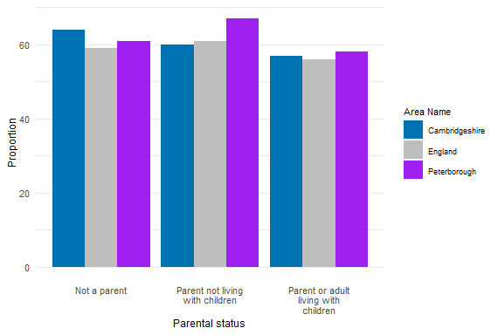
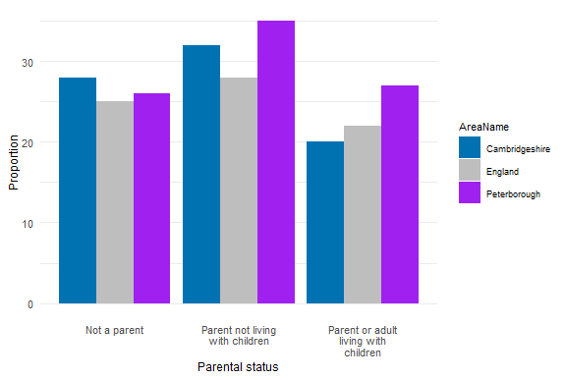
Mental health treatment need among new presentations to substance misuse treatment, 2019-20
Proportion of new presentations to treatment with a mental health treatment need
Proportion of clients with a mental health treatment need that did not receive mental health treatment
The proportion of new clients who are "parents or adults living with children" with a mental health need in Cambridgeshire (57%) and Peterborough (58%) is similar to the England average (56%).
The proportion of new clients who are "parents not living with children" with a mental health need in Peterborough (67%) is higher than the England average (61%), whilst the proportion in Cambridgeshire is similar to the national average.
The proportion of unmet need among the new clients with a mental health treatment need in Cambridgeshire who were either "parents not living with children" or "not parents" was higher than the national rate.
The proportion of unmet need in Peterborough is substantially higher than the national rate for "parents not living with children" and "parents or adults living with children."
Notes:
The data refers to drug and/or alcohol clients (aged between 18 and 99) starting a new treatment journey during 2019-20 (1st April 2019 to 31st March 2020)
Mental health treatment need: Adults who entered treatment in the year and were identified as having a mental health treatment need. The percentage is shown as a proportion of the number of new presentations to treatment during the year.
Unmet mental health treatment need: The proportion of clients who entered treatment in the year who were identified as having a mental health treatment need and were not receiving treatment for their mental health need.
Source: Parents with problem alcohol and drug use: Data for England, Cambridgeshire and Peterborough, 2019 to 2020, NDTMS.
Link: https://www.ndtms.net/ParentalSubstanceMisuse

Slide 27
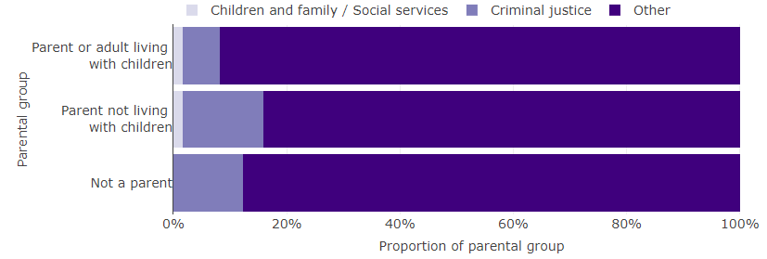
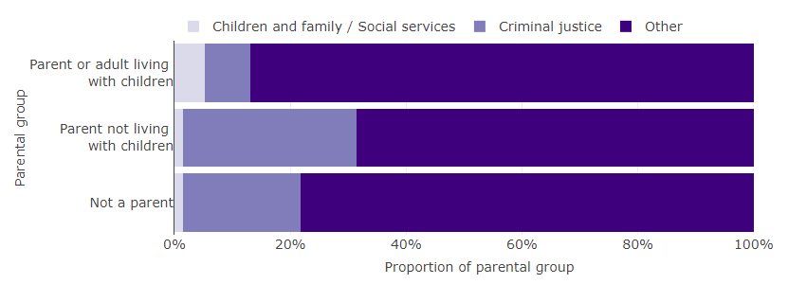
Substance misuse treatment, 2019 – 20
Sources of referrals into treatment for new presentations to treatment
Prevalence of parental substance misuse, mental ill health and domestic abuse
Cambridgeshire
Peterborough
The rate of children in households with all 3 issues (parental alcohol and drug problems, mental ill health and domestic abuse) was higher than the national rate in Cambridgeshire and Peterborough.
The prevalence of parental mental ill health was substantially higher than the prevalence of parental substance misuse and domestic abuse in Cambridgeshire, Peterborough and England in 2019–20.
In Cambridgeshire, the proportion of referrals for “parents or adults living with children” by children and family/social services was 2%, and 7% were referred by criminal justice. However, 14% of the “parents not living with children” were referred by criminal justice for treatment.
In Peterborough, the proportion of referrals by criminal justice for parents or adults living with children was 8%; for parents not living with children, it was 30%; and for adults who are not parents, it was 20%.
Notes:
The data refers to drug and/or alcohol clients (aged between 18 and 99) starting a new treatment journey during 2019-20 (1st April 2019 to 31st March 2020)
Source: Parents with problem alcohol and drug use: Data for England, Cambridgeshire and Peterborough, 2019 to 2020, NDTMS.
Link: https://www.ndtms.net/ParentalSubstanceMisuse

Slide 28
Smoking and Health Behaviours

Slide 29
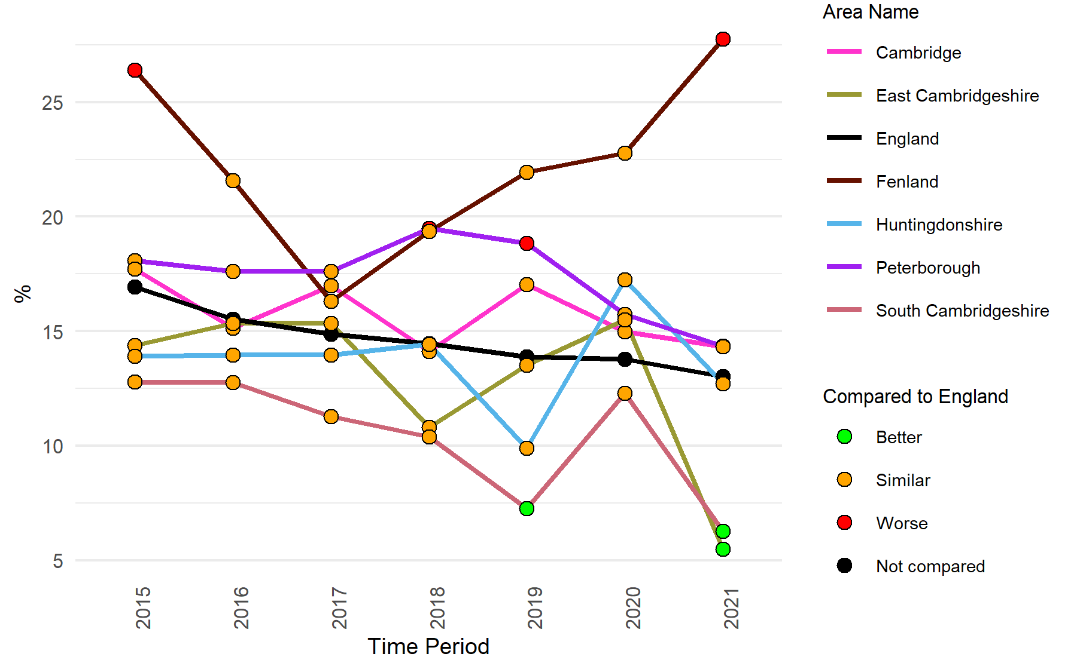
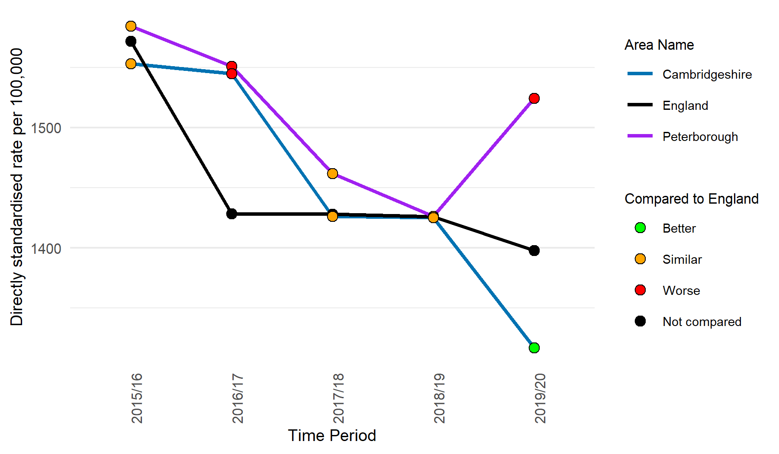
Smoking prevalence and hospital admissions
Smoking Prevalence in adults (18+) - current smokers (APS)
Smoking attributable hospital admissions
A declining trend is seen for England since 2015, whereas varied trends are noted across all areas in Cambridgeshire and Peterborough.
The proportion of smoking prevalence in adults shows a rapid increase in Fenland since 2017 and significantly higher than the national rate in 2021.
The smoking prevalence rate in Fenland is the highest of all local authorities in the UK in 2021.
In 2019/20, Peterborough saw a substantial increase over the previous year, while Cambridgeshire saw a decrease during the same period.
In 2019/20, the rate of hospital admissions for diseases that are wholly or partially attributed to smoking in persons aged 35 and over was significantly higher in Peterborough (1,524 per 100,000) compared to England (1,398 per 100,000); although the rate in Cambridgeshire (1,317 per 100,000) was significantly lower than the national rate.
Notes:
Smoking Prevalence in adults (18+) - current smokers (APS): Prevalence of smoking among persons 18 years and over.
Data from https://fingertips.phe.org.uk/profile/tobacco-control
Source: Annual Population Survey (APS)
Smoking attributable hospital admissions: Total number of hospital admissions for diseases that are wholly or partially attributed to smoking in persons aged 35 and over.
Data from https://fingertips.phe.org.uk/profile/tobacco-control
Source: Admissions data from Hospital Episode Statistics (HES); Office for National Statistics (ONS) - mid-year population estimates; Smoking prevalence data from Annual Population Survey; and . and relative risks from the Royal College of Physician’s Report ‘Hiding in Plain Sight’

Slide 30
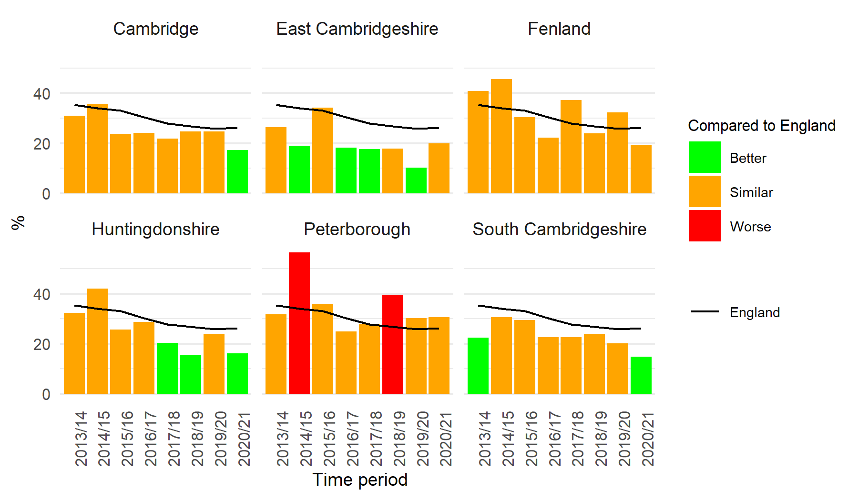
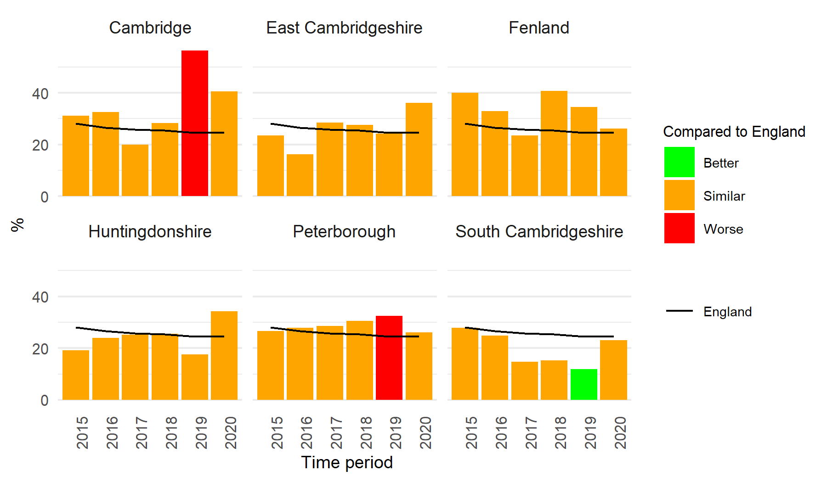
Smoking prevalence in priority populations
Smoking prevalence in adults with a long-term mental health condition (18+) - current smokers (GPPS)
Smoking prevalence in adults in routine and manual occupations (18-64) - current smokers (APS)
In East Cambridgeshire, the prevalence increased substantially (20.0%) in 2020/21 compared to the previous year (10.3%); however, the prevalence has declined or remained similar to the previous year in all other Cambridgeshire districts and Peterborough.
The proportion of smoking prevalence in adults with long-term mental health conditions was significantly lower or similar to the national rate in 2020/21 across all areas.
In 2020, the proportion of adults smoking in routine and manual occupations showed an increase in East Cambridgeshire, Huntingdonshire, and South Cambridgeshire compared to the previous year, whilst the other areas had a decline during the same period.
In 2020, the prevalence was statistically similar to the national rate in all the Cambridgeshire districts and Peterborough
Notes:
Smoking prevalence in adults with a long term mental health condition (18+) - current smokers (GPPS): Smoking prevalence in adults with a diagnosed long term mental health condition - current smokers (GPPS).
Data from https://fingertips.phe.org.uk/profile/tobacco-control
Source: GP Patient Survey (GPPS)
Smoking prevalence in adults in routine and manual occupations (18-64) - current smokers (APS): Prevalence of smoking among persons aged 18-64 years in the routine and manual group
Data from https://fingertips.phe.org.uk/profile/tobacco-control
Source: Annual Population Survey (APS)

Slide 31
Smoking prevalence in priority populations
Smoking status at time of delivery by, England, East of England and Cambridgeshire and Peterborough Integrated Care Board April-June 2022
For quarter 1 2022-23 data the percentage of pregnant woman smoking at time of delivery was statistically significantly lower for the East of England (7.6%) compared to the national average (8.6%), while Cambridgeshire and Peterborough ICB was statistically similar (8.1%). ​
Similarly the percentage of pregnant women who were non-smoking at time of delivery was statistically significantly lower for the East of England (86.5%) compared to the national average (88.4%), while Cambridgeshire and Peterborough ICB was statistically similar (86.9%). ​
The percentage of women whose smoking status was unknown at the time of delivery, for East of England region and Cambridgeshire and Peterborough ICB was statistically significantly higher, 5.9% and 5.0% respectively compared to the 3.0% nationally.
Note: Caution should be taken when interpreting this data. Due to the small number of woman setting a quit date confidence intervals at a local authority level are large. ​
Notes:
Women known to be smokers at the time of delivery - defined as pregnant women who self-reported that they were smokers. This includes any cigarettes or tobacco at all, but excludes non-combustible nicotine products, such as e-cigarettes or other nicotine containing products. If a woman intends to give up smoking after the delivery, but was a smoker up until the delivery date they are included in this count.
Women known to be non-smokers at the time of delivery - defined as pregnant women who self-reported that they were non-smokers (no cigarettes or tobacco at all). This count does not include women whose smoking status is not known (which is collected separately), or those who intend to give up smoking after delivery.
Women whose smoking status was not known at the time of delivery - defined as those whose smoking status was not determined for whatever reason.
Source: NHS Digital, Smoking status at time of delivery by Sub Integrated Care Board Location (Sub-ICB), Q1 (April-June 2022). ​
Link: https://digital.nhs.uk/data-and-information/publications/statistical/statistics-on-women-s-smoking-status-at-time-of-delivery-england ​

Slide 32
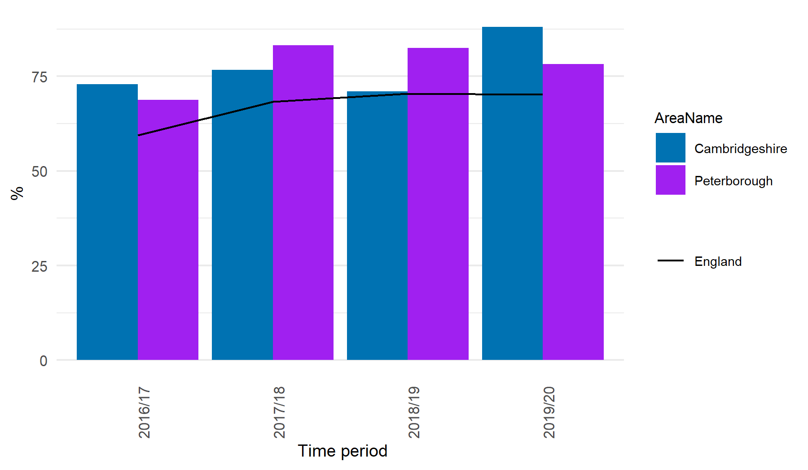
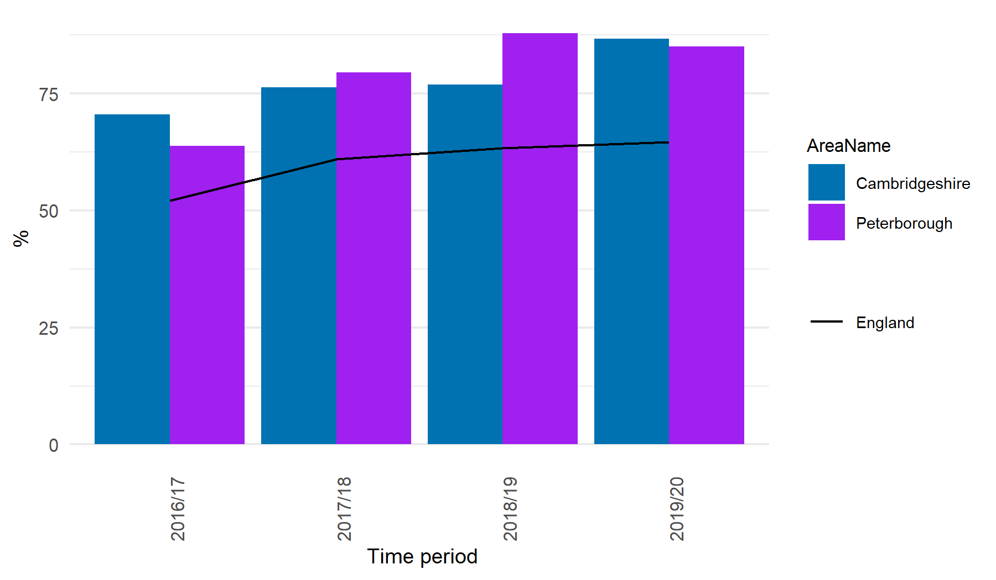
Smoking prevalence in priority populations
Smoking prevalence in adults (18+) admitted to treatment for substance misuse (NDTMS) - all opiates
Smoking prevalence in adults (18+) admitted to treatment for substance misuse (NDTMS) - alcohol & non-opiates
In 2019/20, the smoking prevalence in adults admitted to treatment for substance misuse of all-opiates in Cambridgeshire (88.1%) and Peterborough (78.3%) was higher than the national rate (70.2%).
In 2019/20, the proportion in Cambridgeshire showed a substantial increase from the previous year (71.0%), whereas there was a decline in Peterborough from the previous year.
The smoking prevalence in adults admitted to treatment for substance misuse (alcohol and non-opiates) in Cambridgeshire and Peterborough was substantially higher than the national rates since 2016/17.
In 2019/20, the proportion in Cambridgeshire showed a significant increase from the previous year, whereas there was a decline from the previous in Peterborough.
Notes:
Smoking prevalence in adults (18+) admitted to treatment for substance misuse (NDTMS) - all opiates: Prevalence of smoking in adults age 18+ admitted to treatment for substance misuse (all opiates).
Data from https://fingertips.phe.org.uk/profile/tobacco-control
Source: The National Drug Treatment Monitoring System (NDTMS), Public Health England
Smoking prevalence in adults (18+) admitted to treatment for substance misuse (NDTMS) - alcohol & non-opiates: Prevalence of smoking in adults age 18+ admitted to treatment for substance misuse (alcohol & non- opiates).
Data from https://fingertips.phe.org.uk/profile/tobacco-control
Source: The National Drug Treatment Monitoring System (NDTMS), Public Health England

Slide 33
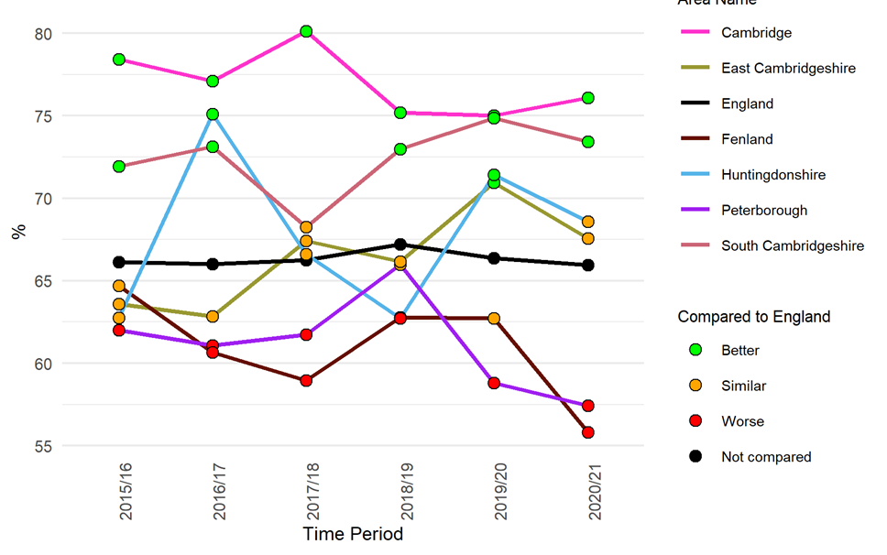
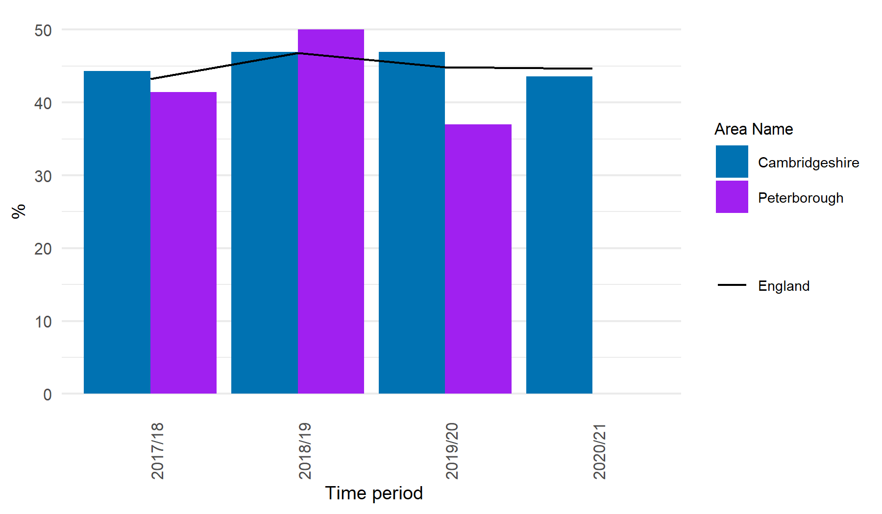
Physical activity
Percentage of physically active adults (19+ yrs)
Percentage of physically active children and young people (5 - 16 yrs)
Except for Cambridge, the proportion of physically active adults decreased in 2020/21 compared to the previous year in all areas.
Since 2018/19, the proportion of physically active adults in Peterborough has rapidly decreased.
In 2020/21, the proportion of physically active adults in Fenland (55.8%) and Peterborough (57.4%) was significantly lower than the national average (65.9%).
In 2020/21, the proportion of physically active children and young people has declined compared to the previous year in Cambridgeshire, and the data for Peterborough is not available for this time period.
A steep decline in the proportion is seen in Peterborough (37.0%) in 2019/20, compared to the previous year (50.1%).
Notes:
Percentage of physically active adults: The number of respondents aged 19 and over, with valid responses to questions on physical activity, doing at least 150 moderate intensity equivalent (MIE) minutes physical activity per week in bouts of 10 minutes or more in the previous 28 days expressed as a percentage of the total number of respondents aged 19 and over.
Data from https://fingertips.phe.org.uk/profile/physical-activity
Source: Office for Health Improvement and Disparities (based on the Active Lives Adult Survey, Sport England)
Percentage of physically active children and young people: Percentage of children aged 5-16 that meet the UK Chief Medical Officers’ (CMOs’) recommendations for physical activity (an average of at least 60 minutes moderate-vigorous intensity activity per day across the week).
Data from https://fingertips.phe.org.uk/profile/physical-activity
Source: Active Lives Children and Young People Survey, Sport England

Slide 34
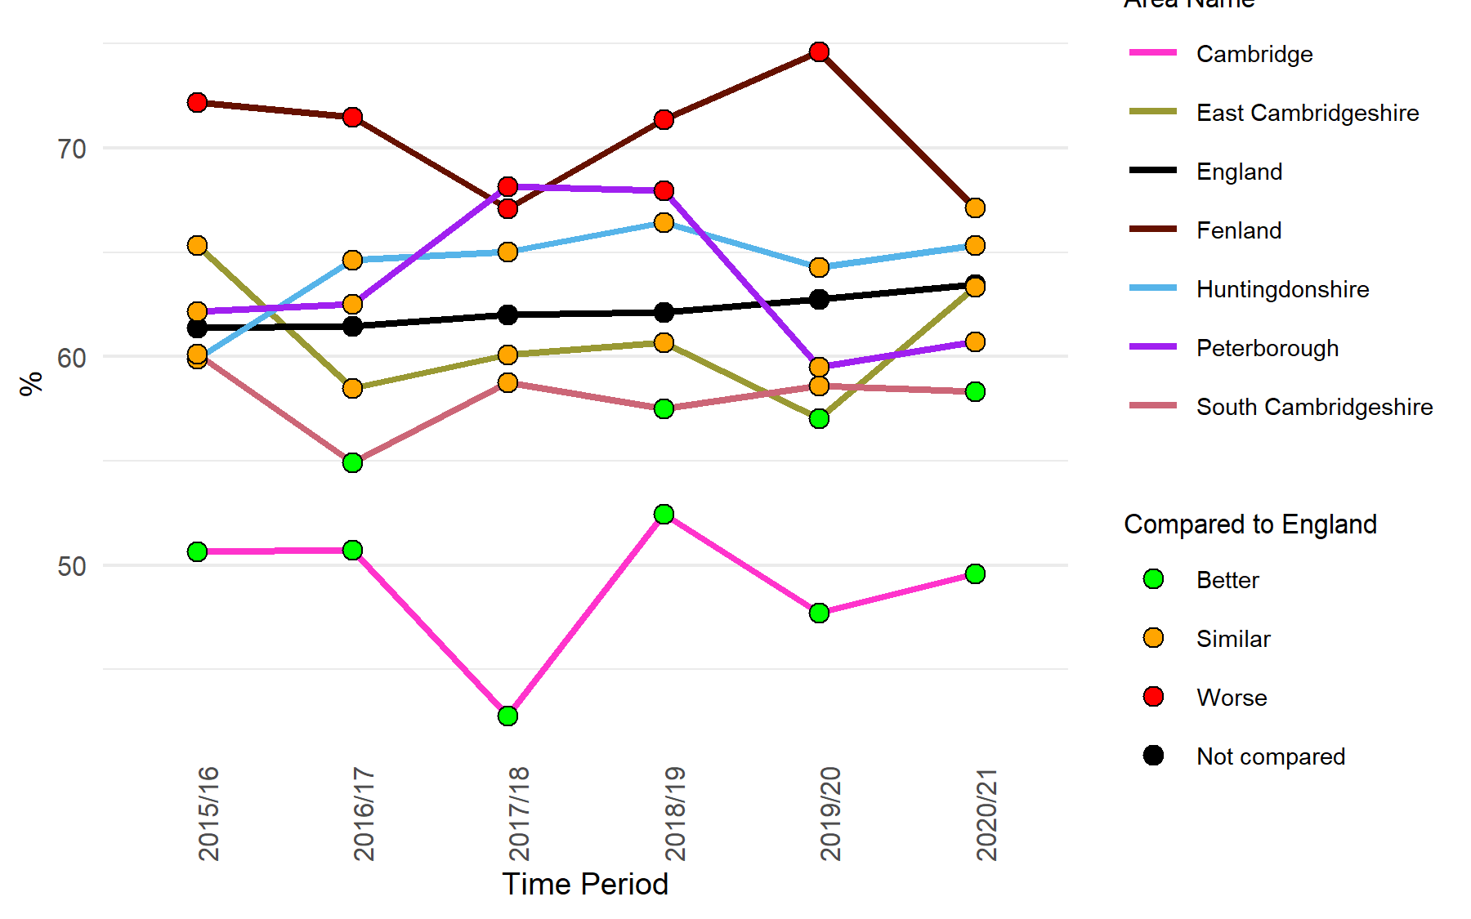
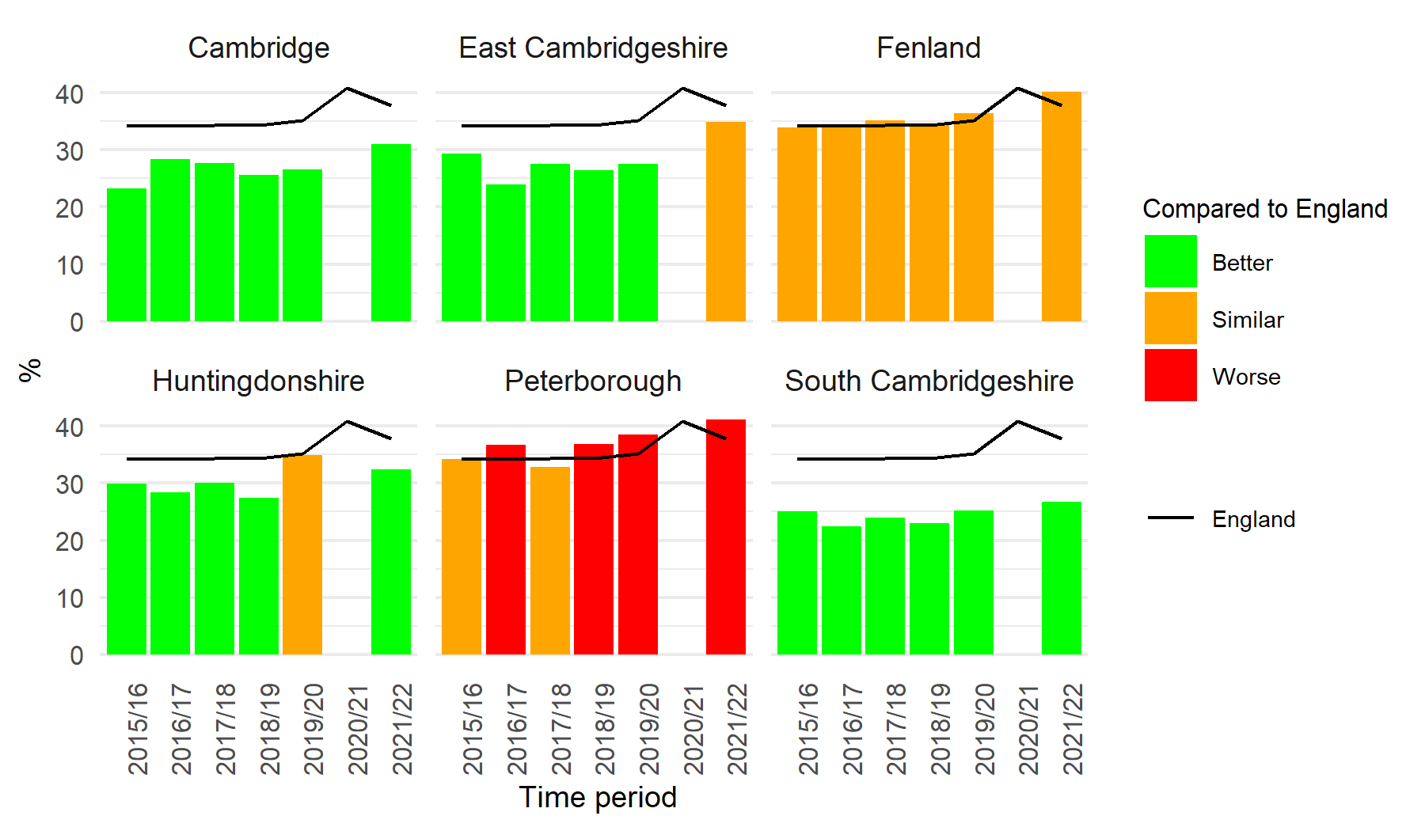
Overweight (including obesity)
Percentage of adults (aged 18+) classified as overweight or obese
Year 6: Prevalence of overweight (including obesity)
In 2020/21, the proportion of adults classified as overweight or obese shows an increase from the previous year in most areas across Cambridgeshire and Peterborough, while a substantial decline is seen in Fenland.
The proportion of overweight or obese adults in Fenland has been significantly higher than England since 2015/16, except for 2020/21 (which is similar).
Except for Huntingdonshire, the proportion of year 6 children classified as overweight or obese increased more than the pre-pandemic levels in 2021/22.
In 2021/22, the proportion of 10–11 year olds who are classified as overweight or obese in Peterborough (41.2%) is significantly higher than the national average (37.8%).
Notes:
Percentage of adults (aged 18+) classified as overweight or obese: Percentage of adults aged 18 and over classified as overweight or obese.
Data from https://fingertips.phe.org.uk/profile/physical-activity
Source: Annual Population Survey (APS)
Year 6: Prevalence of overweight (including obesity): Proportion of children aged 10-11 years classified as overweight or living with obesity. For population monitoring purposes children are classified as overweight (including obesity) if their body mass index (BMI) is on or above the 85th centile of the British 1990 growth reference (UK90) according to age and sex. The population monitoring cut points for overweight, and obesity are slightly lower than the clinical cut points used to assess individual children, this is to capture those children with an unhealthy BMI for their age and those at risk of moving to an unhealthy BMI. This helps ensure that adequate services are planned and delivered for the whole population. Data from https://fingertips.phe.org.uk/profile/physical-activity
Source: Office for Health Improvement and Disparities (based on the Active Lives Adult Survey, Sport England)
Impact of Covid-19: The 2019/20 NCMP data collection stopped in March 2020 when schools were closed due to the coronavirus COVID-19 pandemic. In a usual NCMP collection year, national participation rates are around 95% (over a million) of all eligible children, however in 2019/20 the number of children measured was around 75% of previous years. Despite the lower than usual number of measurements, analysis by NHS Digital indicates that figures at national and regional level are directly comparable to previous years, for all breakdowns.
The start of the 2020/21 NCMP data collection was delayed due to the COVID-19 pandemic response. In March 2021 local authorities were asked to collect a representative 10% sample of data because it was not feasible to expect a full NCMP collection so late into the academic year.
The 2021/22 NCMP was the first data collection since the COVID-19 pandemic that was unaffected by school closures and other public health measures.

Slide 35
Premature mortality in adults with severe mental illness

Slide 36
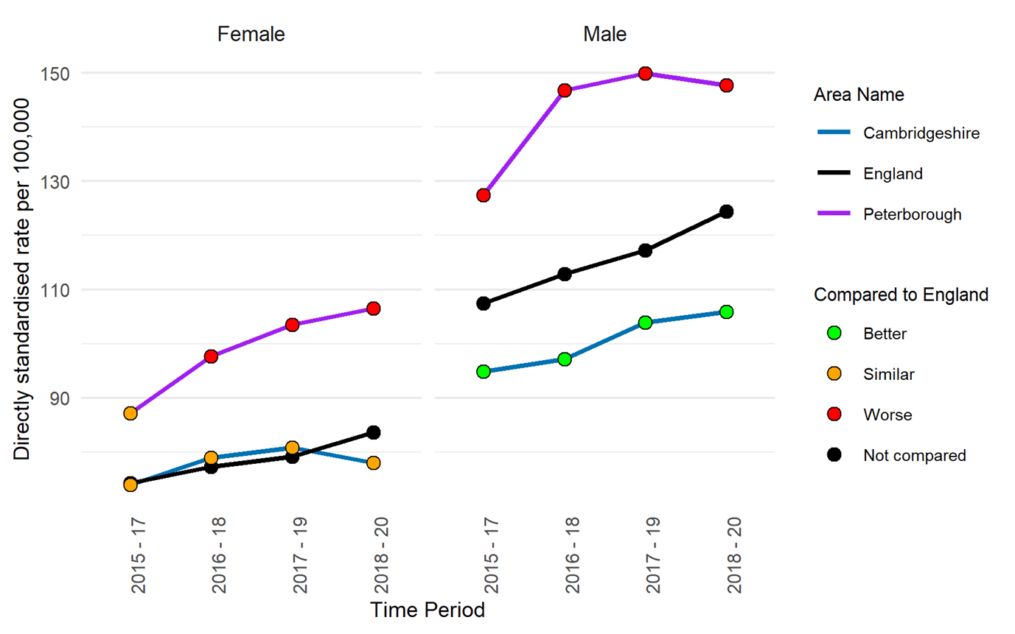
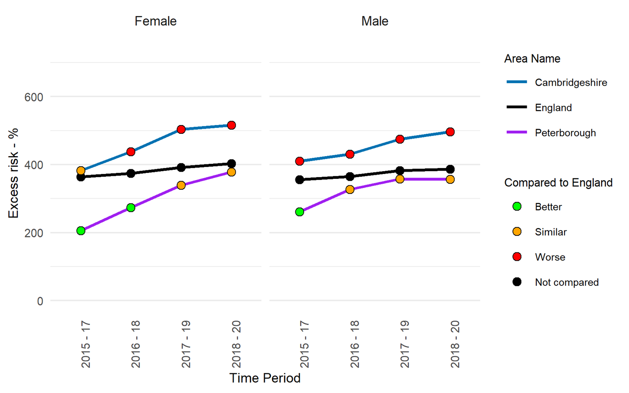
Mortality in adults with severe mental illness (SMI)
Premature mortality in adults with severe mental illness (SMI)
Excess under 75 mortality rate in adults with SMI
 | Cambridgeshire | Peterborough
Number of premature deaths in adults with severe mental illness, 2018–20 | 1,270 | 465
The premature mortality rate in adults with severe mental illness is higher among men compared to women in Cambridgeshire, Peterborough and England.
An increasing trend is seen among Peterborough females and Cambridgeshire males since 2015-17.
Rates for both men and women in Peterborough are significantly higher than England rates.
The premature mortality rates are significantly lower for males in Cambridgeshire compared to the national average.
Excess premature mortality rates show an overall increasing trend for both males and females in Cambridgeshire and Peterborough since 2015-17.
In Cambridgeshire, the risk of dying prematurely for those with SMI was 515.7% higher for females and 496.3% higher for males than for those who do not have SMI in 2018-20. These are significantly higher than the national averages.
In Peterborough, the risk of dying prematurely for those with SMI was 378.7% higher for females and 357.3% higher for males than for those who do not have SMI in 2018-20, which is statistically similar to the England averages.
Notes:
Note: Adults with referrals to secondary mental health services is used as a proxy for adults with a diagnosis of SMI. This omits patients with SMI being cared for in primary care alone, and includes patients with referrals to secondary mental health services for common mental health disorders.
Premature mortality in adults with severe mental illness (SMI): Directly age standardised rate of deaths of adults, aged 18 - 74, with SMI, per 100,000 population. SMI is defined as having a referral to mental health services in the five years preceding death.
Data from https://fingertips.phe.org.uk/severe-mental-illness
Source: NHS Digital Mental Health Services Data Set and its predecessors Office for National Statistics: Civil Registration of Deaths (via NHS Digital asset) Office for National Statistics mid-year population estimates
Caveats: Variations in access to secondary mental health services and referral practice in different local authorities will affect the indicator. Areas where few adults access services will have lower premature mortality in adults with SMI because only a few deaths in adults will be in people defined as having SMI. Conversely, areas where many adults access services, premature mortality in adults with SMI will be higher because more deaths in adults will be in the group defined as having SMI. Analysis of this indicator should be combined with local knowledge and consideration of other indicators in the Severe Mental Illness profile.
Additional information on definitions and caveats can be found here https://fingertips.phe.org.uk/search/premature#page/6/gid/8000039/pat/30000/par/al-BHxpCTj8Ee/ati/402/are/E10000003/iid/93581/age/181/sex/4/cat/-1/ctp/-1/yrr/3/cid/4/tbm/1/page-options/tre-ao-1
Excess under 75 mortality rate in adults with severe mental illness (SMI): Measure of excess premature mortality experienced by adults with SMI over adults without SMI. SMI is defined as having a referral to secondary mental health services in the five years preceding death. Indicator is expressed as a percentage where adults with SMI can be considered to have x% higher/lower risk of premature mortality than adults without SMI.
Data from https://fingertips.phe.org.uk/severe-mental-illness
Source: NHS Digital Mental Health Services Data Set and its predecessors Office for National Statistics: Civil Registration of Deaths (via NHS Digital asset) Office for National Statistics mid-year population estimates
Caveats: This indicator presents the SMI death rates relative to the non-SMI rates. High values of this indicator are the result of lower mortality in the non-SMI population and higher mortality in the SMI population. However, it is also affected by variations in access to secondary mental health services and referral practice in different local authorities. Areas with good access to services will have more of their population in the SMI cohort and that may have an impact on the mortality rate. Analysis of this indicator should be combined with local knowledge and consideration of other indicators in the Severe Mental Illness profile.
Additional information on definitions and caveats can be found here https://fingertips.phe.org.uk/search/premature#page/6/gid/8000039/pat/30000/par/al-BHxpCTj8Ee/ati/402/are/E10000003/iid/93582/age/181/sex/4/cat/-1/ctp/-1/yrr/3/cid/4/tbm/1/page-options/tre-ao-1

Slide 37
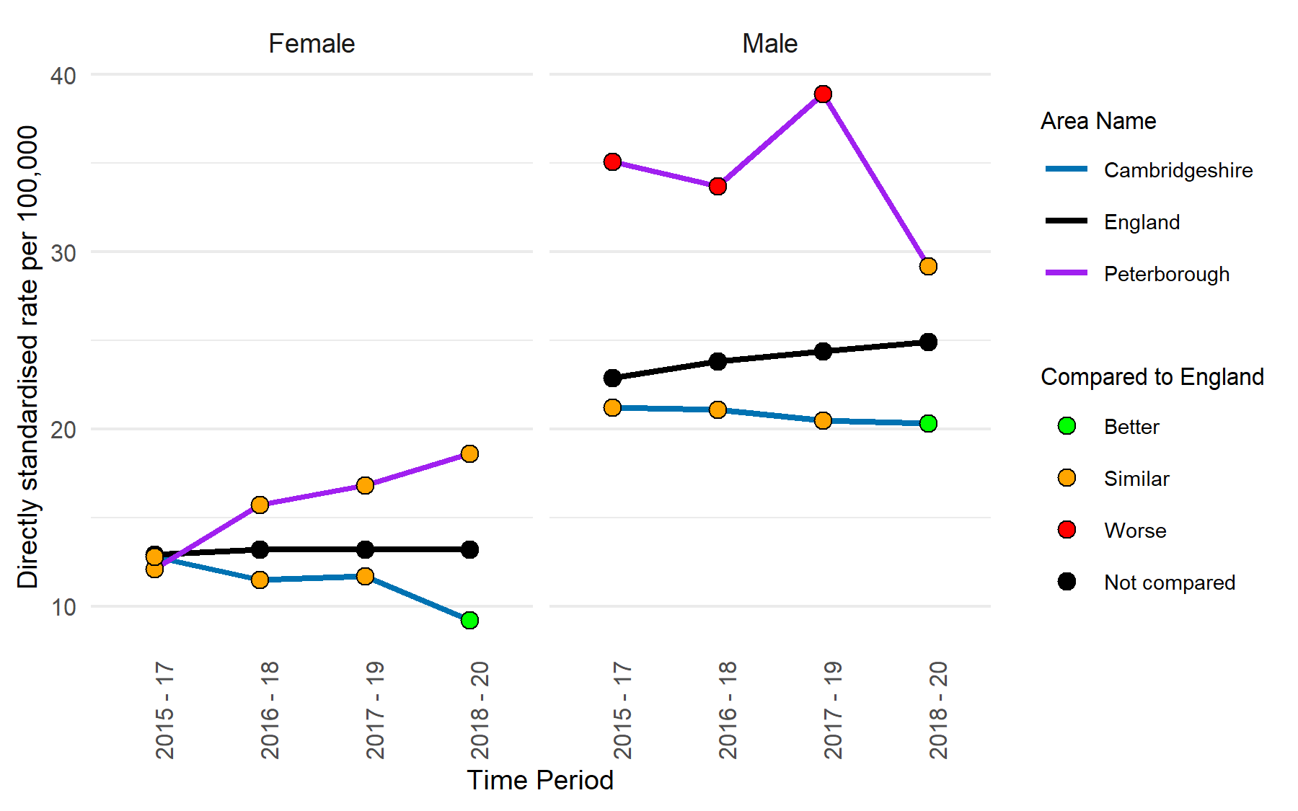

Mortality in adults with severe mental illness (SMI)
Premature mortality due to cardiovascular disease in adults with severe mental illness (SMI)
Excess under 75 mortality rate due to cardiovascular disease in adults with SMI
 | Cambridgeshire | Peterborough
Number of adults aged 18–74 with severe mental illness who died due to cardiovascular disease, 2018–20 | 205 | 85
Excess premature mortality rates due to cardiovascular disease show a rapidly increasing trend for females in Peterborough since 2015-17.
In 2018 – 20 , the risk of dying prematurely due to cardiovascular disease for those with SMI was 405.0% higher for females and 457.1% higher for males than for those who do not have SMI in Cambridgeshire. It was 303.9% higher for females and 242.9% higher for males than for those who do not have SMI in Peterborough.
The rates for both men and women in Cambridgeshire and Peterborough are statistically similar to the national averages for 2018 – 20.
The premature mortality rate due to cardiovascular disease in adults with severe mental illness is substantially higher among men compared to women in Cambridgeshire, Peterborough and England.
Since 2015 – 17, rates for females in Peterborough have shown an increasing trend.
In 2018 – 20, the rates in Peterborough for both men and women are statistically similar to the England rates.
The premature mortality rates are significantly lower for men and women in Cambridgeshire compared to the national average in 2018 - 20.
Notes:
Note: Adults with referrals to secondary mental health services is used as a proxy for adults with a diagnosis of SMI. This omits patients with SMI being cared for in primary care alone, and includes patients with referrals to secondary mental health services for common mental health disorders.
Premature mortality due to cardiovascular diseases in adults with severe mental illness (SMI): Directly age standardised rate of deaths due to all cardiovascular diseases (including heart disease and stroke) in adults with SMI, aged 18 - 74, per 100,000 population. SMI is defined as having a referral to mental health services in the five years preceding death
Data from https://fingertips.phe.org.uk/severe-mental-illness
Source: NHS Digital Mental Health Services Data Set and its predecessors; Office for National Statistics: Civil Registration of Deaths (via NHS Digital asset); Office for National Statistics mid-year population estimates
Caveats: Variations in access to secondary mental health services and referral practice in different local authorities will affect the indicator. Areas where few adults access services will have lower premature mortality in adults with SMI because only a few deaths in adults will be in people defined as having SMI. Conversely, areas where many adults access services, premature mortality in adults with SMI will be higher because more deaths in adults will be in the group defined as having SMI. Analysis of this indicator should be combined with local knowledge and consideration of other indicators in the Severe Mental Illness profile.
Additional information on definitions and caveats can be found here https://fingertips.phe.org.uk/search/premature#page/6/gid/8000039/pat/30000/par/al-BHxpCTj8Ee/ati/402/are/E10000003/iid/93727/age/181/sex/4/cat/-1/ctp/-1/yrr/3/cid/4/tbm/1/page-options/tre-ao-1
Excess under 75 mortality rate due to cardiovascular disease in adults with severe mental illness (SMI): Measure of excess premature mortality due to all cardiovascular diseases (including heart disease and stroke) experienced by adults with SMI over adults without SMI. SMI is defined as having a referral to secondary mental health services in the five years preceding death.
Indicator is expressed as a percentage where adults with SMI can be considered to have x% higher/lower risk of premature mortality due to all cardiovascular diseases than adults without SMI.
Data from https://fingertips.phe.org.uk/severe-mental-illness
Source: NHS Digital Mental Health Services Data Set and its predecessors; Office for National Statistics: Civil Registration of Deaths (via NHS Digital asset); Office for National Statistics mid-year population estimates
Caveats: This indicator presents the SMI death rates relative to the non-SMI rates. High values of this indicator are the result of lower mortality in the non-SMI population and higher mortality in the SMI population. However, it is also affected by variations in access to secondary mental health services and referral practice in different local authorities. Areas with good access to services will have more of their population in the SMI cohort and that may have an impact on the mortality rate. Analysis of this indicator should be combined with local knowledge and consideration of other indicators in the Severe Mental Illness profile.
Additional information on definitions and caveats can be found here https://fingertips.phe.org.uk/search/premature#page/6/gid/8000039/pat/30000/par/al-BHxpCTj8Ee/ati/402/are/E10000003/iid/93731/age/181/sex/4/cat/-1/ctp/-1/yrr/3/cid/4/tbm/1/page-options/tre-ao-1

Slide 38


Mortality in adults with severe mental illness (SMI)
Premature mortality due to cancer in adults with severe mental illness (SMI)
Excess under 75 mortality rate due to cancer in adults with SMI
 | Cambridgeshire | Peterborough
Number of adults aged 18–74 with severe mental illness who died due to cancer, 2018–20 | 255 | 115
Excess premature mortality rates due to cancer show a rapidly increasing trend for males and females in Peterborough since 2015-17.
In 2018 – 20 , the risk of dying prematurely due to cancer for those with SMI was 161.8% higher for females and 160.4% higher for males than for those who do not have SMI in Cambridgeshire. It was 174.2% higher for females and 182.6% higher for males than for those who do not have SMI in Peterborough.
The rates for both men and women in Cambridgeshire and Peterborough are statistically similar to the national averages for 2018 – 20.
The premature mortality rate due to cancer in adults with severe mental illness in Peterborough show a rapid increase since 2015 – 17 for both men and women.
In 2018 – 20, the rates for both men and women in Peterborough are significantly higher than the national rates.
The premature mortality rates are statistically similar to the national averages for men and women in Cambridgeshire in 2018 - 20.
Notes:
Note: Adults with referrals to secondary mental health services is used as a proxy for adults with a diagnosis of SMI. This omits patients with SMI being cared for in primary care alone, and includes patients with referrals to secondary mental health services for common mental health disorders.
Premature mortality due to cancer in adults with severe mental illness (SMI): Directly age standardised rate of deaths from all cancers in adults with SMI, aged 18 - 74, per 100,000 population. SMI is defined as having a referral to mental health services in the five years preceding death.
Data from https://fingertips.phe.org.uk/severe-mental-illness
Source: NHS Digital Mental Health Services Data Set and its predecessors; Office for National Statistics: Civil Registration of Deaths (via NHS Digital asset); Office for National Statistics mid-year population estimates
Caveats: Variations in access to secondary mental health services and referral practice in different local authorities will affect the indicator. Areas where few adults access services will have lower premature mortality in adults with SMI because only a few deaths in adults will be in people defined as having SMI. Conversely, areas where many adults access services, premature mortality in adults with SMI will be higher because more deaths in adults will be in the group defined as having SMI. Analysis of this indicator should be combined with local knowledge and consideration of other indicators in the Severe Mental Illness profile.
Additional information on definitions and caveats can be found here: https://fingertips.phe.org.uk/search/premature#page/6/gid/8000039/pat/30000/par/al-BHxpCTj8Ee/ati/402/are/E10000003/iid/93728/age/181/sex/4/cat/-1/ctp/-1/yrr/3/cid/4/tbm/1/page-options/tre-ao-1
Excess under 75 mortality rate due to cancer in adults with severe mental illness (SMI): Measure of excess premature mortality due to cancer experienced by adults with SMI over adults without SMI. SMI is defined as having a referral to secondary mental health services in the five years preceding death.
Indicator is expressed as a percentage where adults with SMI can be considered to have x% higher/lower risk of premature mortality due to cancer than adults without SMI.
Data from https://fingertips.phe.org.uk/severe-mental-illness
Source: NHS Digital Mental Health Services Data Set and its predecessors; Office for National Statistics: Civil Registration of Deaths (via NHS Digital asset); Office for National Statistics mid-year population estimates
Caveats: This indicator presents the SMI death rates relative to the non-SMI rates. High values of this indicator are the result of lower mortality in the non-SMI population and higher mortality in the SMI population. However, it is also affected by variations in access to secondary mental health services and referral practice in different local authorities. Areas with good access to services will have more of their population in the SMI cohort and that may have an impact on the mortality rate. Analysis of this indicator should be combined with local knowledge and consideration of other indicators in the Severe Mental Illness profile.
Additional information on definitions and caveats can be found here https://fingertips.phe.org.uk/search/premature#page/6/gid/8000039/pat/30000/par/al-BHxpCTj8Ee/ati/402/are/E10000003/iid/93732/age/181/sex/4/cat/-1/ctp/-1/yrr/3/cid/4/tbm/1/page-options/tre-ao-1

Slide 39


Mortality in adults with severe mental illness (SMI)
Premature mortality due to respiratory disease in adults with severe mental illness (SMI)
Excess under 75 mortality rate due to respiratory disease in adults with SMI
 | Cambridgeshire | Peterborough
Number of adults aged 18–74 with severe mental illness who died due to respiratory disease, 2018–20 | 155 | 45
In Cambridgeshire, excess premature mortality rates due to respiratory disease show an overall increase among men and a decrease among women.
In Cambridgeshire, the risk of dying prematurely due to respiratory disease for those with SMI was 732.0% higher for females and 906.5% higher for males than for those who do not have SMI in 2018-20. The rate for men is significantly higher than the national rate, whereas it is similar for women.
In Peterborough, the risk of dying prematurely due to respiratory disease for those with SMI was 576.5% higher for females and 437.5% higher for males than for those who do not have SMI in 2018-20, which is statistically similar to the England averages.
The premature mortality rate due to respiratory disease in adults with severe mental illness show a varied trend for men and women across Cambridgeshire and Peterborough.
The premature mortality rates due to respiratory disease in adults with SMI are statistically similar to the national rates in Cambridgeshire and Peterborough.
Notes:
Note: Adults with referrals to secondary mental health services is used as a proxy for adults with a diagnosis of SMI. This omits patients with SMI being cared for in primary care alone, and includes patients with referrals to secondary mental health services for common mental health disorders.
Premature mortality due to respiratory disease in adults with severe mental illness (SMI): Directly age standardised rate of deaths from respiratory disease in adults with SMI, aged 18 - 74, per 100,000 population. SMI is defined as having a referral to mental health services in the five years preceding death
Data from https://fingertips.phe.org.uk/severe-mental-illness
Source: NHS Digital Mental Health Services Data Set and its predecessors; Office for National Statistics: Civil Registration of Deaths (via NHS Digital asset); Office for National Statistics mid-year population estimates
Caveats: Variations in access to secondary mental health services and referral practice in different local authorities will affect the indicator. Areas where few adults access services will have lower premature mortality in adults with SMI because only a few deaths in adults will be in people defined as having SMI. Conversely, areas where many adults access services, premature mortality in adults with SMI will be higher because more deaths in adults will be in the group defined as having SMI. Analysis of this indicator should be combined with local knowledge and consideration of other indicators in the Severe Mental Illness profile.
Additional information on definitions and caveats can be found here https://fingertips.phe.org.uk/search/premature#page/6/gid/8000039/pat/30000/par/al-BHxpCTj8Ee/ati/402/are/E10000003/iid/93730/age/181/sex/4/cat/-1/ctp/-1/yrr/3/cid/4/tbm/1/page-options/tre-ao-1
Excess under 75 mortality rate due to respiratory disease in adults with severe mental illness (SMI): Measure of excess premature mortality due to respiratory disease experienced by adults with SMI over adults without SMI. SMI is defined as having a referral to secondary mental health services in the five years preceding death.
Indicator is expressed as a percentage where adults with SMI can be considered to have x% higher/lower risk of premature mortality due to respiratory disease than adults without SMI.
Data from https://fingertips.phe.org.uk/severe-mental-illness
Source: NHS Digital Mental Health Services Data Set and its predecessors; Office for National Statistics: Civil Registration of Deaths (via NHS Digital asset); Office for National Statistics mid-year population estimates
Caveats: This indicator presents the SMI death rates relative to the non-SMI rates. High values of this indicator are the result of lower mortality in the non-SMI population and higher mortality in the SMI population. However, it is also affected by variations in access to secondary mental health services and referral practice in different local authorities. Areas with good access to services will have more of their population in the SMI cohort and that may have an impact on the mortality rate. Analysis of this indicator should be combined with local knowledge and consideration of other indicators in the Severe Mental Illness profile.
Additional information on definitions and caveats can be found here https://fingertips.phe.org.uk/search/premature#page/6/gid/8000039/pat/30000/par/al-BHxpCTj8Ee/ati/402/are/E10000003/iid/93734/age/181/sex/4/cat/-1/ctp/-1/yrr/3/cid/4/tbm/1/page-options/tre-ao-1

Slide 40


Mortality in adults with severe mental illness (SMI)
Premature mortality due to liver disease in adults with severe mental illness (SMI)
Excess under 75 mortality rate due to liver disease in adults with SMI
 | Cambridgeshire | Peterborough
Number of adults aged 18–74 with severe mental illness who died due to liver disease, 2018–20 | 85 | 25
Excess premature mortality rates due to liver disease show an overall increasing trend for Cambridgeshire and Peterborough since 2015-17.
In 2018 – 20 , the risk of adults dying prematurely due to liver disease for those with SMI was 940.3% higher than for those who do not have SMI in Cambridgeshire, which is significantly higher than the national rate.
In Peterborough , it was 394.2% higher than for those who do not have SMI, which is statistically similar to the national average for 2018 – 20.
Since 2015-17, the premature mortality rate due to liver disease in adults with severe mental illness in Peterborough has been decreasing, while it has been increasing in Cambridgeshire.
The premature mortality rates due to liver disease in adults with SMI are statistically similar to the national rates in Cambridgeshire and Peterborough.
Notes:
Note: Adults with referrals to secondary mental health services is used as a proxy for adults with a diagnosis of SMI. This omits patients with SMI being cared for in primary care alone, and includes patients with referrals to secondary mental health services for common mental health disorders.
Premature mortality due to liver disease in adults with severe mental illness (SMI): Directly age standardised rate of deaths from liver disease in adults with SMI, aged 18 - 74, per 100,000 population. SMI is defined as having a referral to mental health services in the five years preceding death
Data from https://fingertips.phe.org.uk/severe-mental-illness
Source: NHS Digital Mental Health Services Data Set and its predecessors; Office for National Statistics: Civil Registration of Deaths (via NHS Digital asset); Office for National Statistics mid-year population estimates
Caveats: Variations in access to secondary mental health services and referral practice in different local authorities will affect the indicator. Areas where few adults access services will have lower premature mortality in adults with SMI because only a few deaths in adults will be in people defined as having SMI. Conversely, areas where many adults access services, premature mortality in adults with SMI will be higher because more deaths in adults will be in the group defined as having SMI. Analysis of this indicator should be combined with local knowledge and consideration of other indicators in the Severe Mental Illness profile.
Additional information on definitions and caveats can be found here https://fingertips.phe.org.uk/search/premature#page/6/gid/8000039/pat/30000/par/al-BHxpCTj8Ee/ati/402/are/E10000003/iid/93729/age/181/sex/4/cat/-1/ctp/-1/yrr/3/cid/4/tbm/1/page-options/tre-ao-1
Excess under 75 mortality rate due to liver disease in adults with severe mental illness (SMI): Measure of excess premature mortality due to liver disease experienced by adults with SMI over adults without SMI. SMI is defined as having a referral to secondary mental health services in the five years preceding death.
Indicator is expressed as a percentage where adults with SMI can be considered to have x% higher/lower risk of premature mortality due to liver disease than adults without SMI.
Data from https://fingertips.phe.org.uk/severe-mental-illness
Source: NHS Digital Mental Health Services Data Set and its predecessors; Office for National Statistics: Civil Registration of Deaths (via NHS Digital asset); Office for National Statistics mid-year population estimates
Caveats: This indicator presents the SMI death rates relative to the non-SMI rates. High values of this indicator are the result of lower mortality in the non-SMI population and higher mortality in the SMI population. However, it is also affected by variations in access to secondary mental health services and referral practice in different local authorities. Areas with good access to services will have more of their population in the SMI cohort and that may have an impact on the mortality rate. Analysis of this indicator should be combined with local knowledge and consideration of other indicators in the Severe Mental Illness profile.
Additional information on definitions and caveats can be found here https://fingertips.phe.org.uk/search/premature#page/6/gid/8000039/pat/30000/par/al-BHxpCTj8Ee/ati/402/are/E10000003/iid/93733/age/181/sex/4/cat/-1/ctp/-1/yrr/3/cid/4/tbm/1/page-options/tre-ao-1

