Slide 1
Drugs and Alcohol
Needs Assessment
Data pack
March 2023
Public Health Intelligence - Cambridgeshire and Peterborough

Slide 2
Alcohol

Slide 3
Alcohol summary for 2021/22
Alcohol
Cambridgeshire
Prevalence ⁷: estimated 11.2 adults per 1,000 population need specialist alcohol treatment – lower than national 13.7 per 1,000 population 5,800 adults need specialist alcohol treatment ► 1,160 in treatment = 80% unmet need Hospital admissions ⁸⁻¹¹: alcohol-related admissions are low across Cambridgeshire, with the exception of 40-64 year olds in Fenland and 65+ year olds in Cambridge, which are higher than national rates. Rates for all districts are low in under 40 year olds. Rates are double in males than females. Rates increase with age, with highest rates in 65+ year olds. Conditions associated with alcohol-use are high in mental and behavioural disorders in Cambridge and cardiovascular disease in Fenland. Admissions specifically relating to alcohol are high in males in Cambridge. Frequency and prior admissions are low. Treatment ¹² : 889 people were in specialist alcohol treatment, a 5.6% decrease from 2020/21, but a general increase from 2013/14. Decreasing numbers of people in detox and overall increase in rehab. 520 people entered alcohol treatment in the year, with no one waiting more than 3 weeks to access treatment. ¹¹ Demography of new presentations to treatment ¹³: more males than female with slightly higher proportion of females than nationally. Similar age, sexuality and religious profiles to England. Higher proportion of ‘Other White’ adults. Wider determinants ¹⁴⁻¹⁷: higher regular employment, similar unemployment and low long term sick or disabled. Similar housing needs. Higher proportion of statutory homelessness with a duty owed with alcohol dependency support needs, especially in Fenland and Cambridge. Slightly higher proportion of parents in treatment living with children, with a high proportion with no early help. Co-occurring mental health ¹⁸: similar proportion identified as having a mental health need, with a higher proportion already receiving treatment for their mental health, predominantly through GPs. Routes into treatment ¹⁹ : Majority self-referrals (higher than England), one in 10 through hospital/A&E, low from GPs. Higher males than females through Criminal Justice System. | High level interventions ²⁰ : Almost all adults seen within the community, with 20 residential placements. Lower proportion of adults with a pharmacological intervention for withdrawal and relapse intervention. Length of time in treatment ²¹: High length of stay in treatment (252 days). Almost a fifth of adults had been in treatment for longer than a year. Successful completions ²²⁻²³: Almost 6 in10 adults who exited treatment were successful (free of dependence), similar proportion to England. Just over a third did not re-present within 6 months, similar to England. Successful completions who did not return within 6 months increased over the last three years. Alcohol-related cancer ²⁵: rates are similar in all districts, with a low male incidence in Cambridgeshire overall. Rates are slightly higher in females than males and more notable in Cambridge and South Cambridgeshire. Alcohol-related mortality ²⁶: 202 alcohol-related deaths in 2021, with three-quarters in males. Rates are lower than national for males and females, with all districts lower (Huntingdonshire and South Cambridgeshire) or similar to England.
Note: superscript numbers relates to slide number. (sn) – small numbers Comparisons are made to England.

Slide 4
Alcohol summary for 2021/22
Alcohol
Peterborough
Prevalence ⁷: estimated 15.2 adults per 1,000 population need specialist alcohol treatment – higher than national 13.7 per 1,000 population 2,300 adults need specialist alcohol treatment ► 1,160 in treatment = 76% unmet need Hospital admissions ⁸⁻¹¹: alcohol-related admissions are low. Rates are over double in males than females. Rates increase with age and are highest in 65+ year olds. Alcohol related conditions, such as unintentional injuries, mental and behavioural disorders, intentional self-poisoning, cardiovascular and alcoholic liver disease are similar or lower than seen nationally. Frequency and prior admissions are low. Treatment ¹²: 375 people in specialist alcohol treatment, a 19% increase from 2020/21, but return to levels seen before this year. 280 people entered alcohol treatment in the year, with no one waiting more than 3 weeks to access treatment. ¹¹ Demography of new presentations to treatment ¹³ : Two-thirds were male, higher than the national average. Younger profile, higher proportion of ‘Other White’, ‘White Irish’ (sn) and ‘Other Asian’ (sn), higher proportion of Christians and Muslims (sn). Wider determinants ¹⁴⁻¹⁷: higher regular employment, high unemployment and low long term sick or disabled. High housing needs. Low proportion of statutory homelessness with a duty owed with alcohol dependency support needs. Higher proportion of parents in treatment living with children, with a higher proportion receiving early help, especially child protection plans and child in need. Co-occurring mental health ¹⁸: lower proportion of adults identified with a mental health need. Of those identified similar proportion to England receiving treatment, predominantly through GPs. Routes into treatment ¹⁹ : Majority self-referrals (higher than England), one in 10 through Criminal Justice System, low from GPs. Higher males than females through Criminal Justice System and higher females than males through social services. High level interventions ²⁰ : Almost all adults seen within community setting. Higher proportion of adults with an intended pharmacological intervention for relapse prevention. | Length of time in treatment ²¹: Low length of stay (171 days). Successful completions ²²⁻²³: Slightly lower proportion of adults who exited treatment successfully (free of dependence). Just over a third did not re-present within 6 months, similar to England. Alcohol-related cancer ²⁵: rates are similar to England for males and female, with slightly higher incidence in females than males. Alcohol-related mortality ²⁶: 71 alcohol-related deaths in 2021, with similar rates for males and females but with a slightly higher proportion of deaths in females (sn) compared to England .
Note: superscript numbers relates to slide number. (sn) – small numbers Comparisons are made to England.

Slide 5
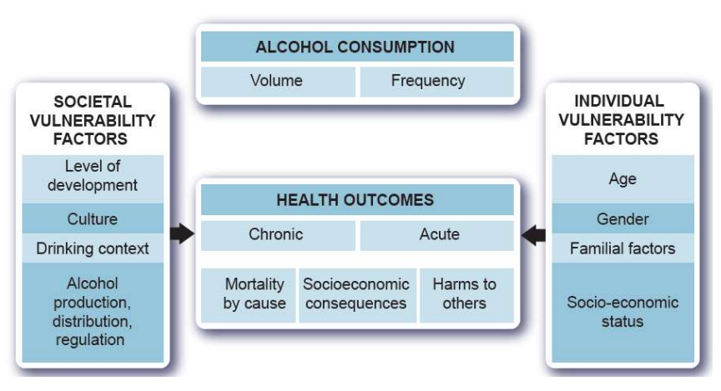
Alcohol related harm
Risk factors
Alcohol
In addition to the volume and pattern of drinking, a number of individual and societal risk factors moderate alcohol-related harm, such as:
age: children and young people are more vulnerable to alcohol-related harm
gender: women are more vulnerable to alcohol-related harm from higher levels of alcohol use or particular patterns of drinking
familial risk factors: exposure to abuse and neglect as a child and a family history of alcohol use disorders (AUD) is a major vulnerability
socioeconomic status: people with lower socioeconomic status experience considerably higher levels of alcohol-related harm
culture and context: the risk of harm varies with the culture and context within which the drinking takes place
alcohol control and regulation: a critical factor in determining levels of alcohol-related harm in a country is the level and effectiveness of alcohol control and regulations
Conceptual framework of the harm caused by alcohol
Overall, the harmful use of alcohol results in a significant health, social and economic cost to society and ranks among the five top risk factors for disease, disability and injury throughout the world.
There are three major categories of alcohol-related health, social and economic costs:
the direct economic costs of alcohol consumption, for example, costs to health and social care, the police and criminal justice system and the unemployment and welfare systems
the indirect costs of alcohol consumption, for example, lost productivity due to absenteeism, unemployment, decreased output, reduced earnings potential and lost working years due to premature pension or death
the intangible costs of alcohol consumption, for example, costs assigned to pain and suffering, poor quality of life, or costs from money spent on alcohol in families where the money should be spent on other things
Source: The Public Health Burden of Alcohol and the Effectiveness and Cost-Effectiveness of Alcohol Control Policies An evidence review, Public Health England, December 2016
https://assets.publishing.service.gov.uk/government/uploads/system/uploads/attachment_data/file/733108/alcohol_public_health_burden_evidence_review_update_2018.pdf

Slide 6
Covid
Impacts of Covid
Alcohol
Impact of Covid-19 on Alcohol Consumption
Nationally the increase in substance-related deaths was the largest among ‘alcohol only’ clients, with a 44% increase in deaths during 2020-2021. It is evident that in addition to the direct effects of COVID-19, the pandemic had numerous other indirect effects on health and wellbeing, including affecting people’s alcohol consumption. Interventions to control coronavirus involved restrictions on social contact as well as the closure of support services and non-essential businesses. This resulted in the purchasing and consumption of alcohol being displaced towards off-trade settings such as supermarkets and off-licences making it more readily available in large quantities. As a result, there was a rise.
Impact of Covid-19 on substance treatment and support services
COVID-19 meant that treatment services had to restrict face-to-face contact, which limited the interventions that service users could access. There were numerous impacts that resulted from this, such as fewer service users being able to access inpatient detoxification for drugs or alcohol due to increased pressure on the NHS at the time of the pandemic. In addition, there was a reduced supply and interrupted access to medicines due to pharmacies being closed. In response to this, more clients were given take-home doses of opioid substitution treatment (OST), which increased the risk of the illegal selling of prescriptions such as methadone. In response to lockdown restrictions and to mitigate the difficulties in providing face-to-face support, services began to increasingly use remote technology via mobile phones or online platforms. Despite its positive contributions, this raised numerous challenges such as excluding clients who do not have access to the internet or a mobile phone, further marginalising specific groups from the service. During COVID-19, many harm reduction interventions including needle exchanges were reduced or suspended. Over 25% of drug users reported greater difficulties accessing equipment for the safer consumption of drugs in 2020 compared to 2019. Testing for blood-borne viruses (BBV) was also significantly reduced as a result of COVID-19, with a 60% decrease in antibody and ribonucleic acid testing. In response to these challenges, services formulated innovative approaches to the provision of harm reduction interventions including home delivery of needles and self-testing kits for BBV. Overall, while the COVID-19 pandemic may be driving innovative models of service provision, it is important that face-to-face services are adequately reinstated to mitigate increased adverse health outcomes and disparities.
Source: TONIC

Slide 7
Prevalence and unmet need in adults aged 18+ years
Prevalence
Alcohol
Alcohol-related harm is largely determined by the volume of alcohol consumed and the frequency of drinking occasions. The risk of harm is directly related to levels and patterns of consumption. There can be a considerable lag between alcohol consumption and alcohol-related harms, particularly for chronic conditions where the delay can be many years.
In England, it is estimated that just under a quarter of the population (23%*) are drinking above the 14 units per week level and so may benefit from some level of intervention. However, harm can be short-term and instantaneous, due to intoxication, or long-term, from continued exposure to the toxic effect of alcohol or from developing dependence. The official alcohol commissioning support guidance recommends a range of different interventions:
Effective population-level actions to control supply and marketing
Large scale delivery of targeted brief advice
Specialist alcohol care services for people in hospital
Quick access to effective, evidence-based alcohol treatment
Estimated prevalence and unmet need
Highlights
It is estimated that there are 5,775 people in need of specialist alcohol treatment in Cambridgeshire and 2,284 in Peterborough, with a higher rate in Peterborough than the national average and a lower rate in Cambridgeshire.
In 2021/22, 1,163 people were known to be in alcohol or alcohol/non-opiate treatment in Cambridgeshire, leaving an estimated 80% of people in need of services but not accessing them, matching the national average.
In Peterborough, the proportion of unmet need was lower at 76%, with 547 in treatment compared to an estimated 2,284 that were in need of treatment.
The Health Survey for England for 2015-2018 * estimated that 29% of adults in Cambridgeshire drink over 14 units a week, higher than England (23%), with Peterborough similar to England at 25%.
Note: prevalence estimates relate to 2018/19 and alcohol only and alcohol/non-opiate treatment numbers for 2021/22 have been used to calculate rates of unmet need
Source: National Drug Treatment Monitoring System (NDTMS), Office for Health Improvement & Disparities *Health Survey for England, Fingertips, Office for Health & Disparities

Slide 8
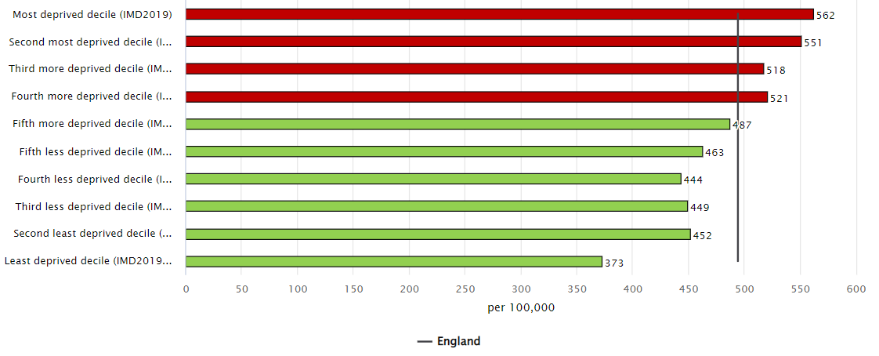
Hospital admissions
Admission episodes for alcohol-related conditions (Narrow *)
Alcohol
Persons Males Female
Highlights
Rates for males and females are similar or better than the England rates for districts, Cambridgeshire and Peterborough.
Admission rates in males are approximately twice that of females.
All areas have low admission rates in people aged under 40 years, however, Fenland had high rates in 40 to 64 year olds and Cambridge in 65+ year olds.
In general, admission rates appear to increase with age.
At a national level, alcohol-related hospital admissions are linked to deprivation, with higher rates in more relatively deprived areas.
Age band
Alcohol-related hospital admission rates, England, 2012/22 – deprivation
(based on districts)
Directly age standardised rates per 100,000 population, all ages
* Narrow definition: A measure of hospital admissions where the primary diagnosis (main reason for admission) is an alcohol-related condition
Source: Local Alcohol Profiles for England, Fingertips, Office for Health Improvement & Disparities Comments relate to statistically significant differences to England

Slide 9
Hospital admissions
Admission episodes for alcohol-related conditions by condition
Alcohol
Unintentional injuries ¹
Mental and behavioural disorders ¹
Intentional self-poisoning ¹
Highlights
Cambridge had a high rate of alcohol-attributable mental and behavioural disorder hospital admission rates compared to England.
Fenland had a high alcohol-related cardiovascular hospital admission rate.
Nationally, rates for all these conditions are highest in areas of greater relative deprivation.
Cardiovascular disease ²
Alcoholic liver disease ²
Directly age standardised rates per 100,000 population, all ages
¹ Narrow definition: A measure of hospital admissions where the primary diagnosis (main reason for admission) is an alcohol-related condition
² Broad definition: A measure of hospital admissions where either the primary diagnosis (main reason for admission) or one of the secondary (contributory) diagnoses is an alcohol-related condition
Source: Local Alcohol Profiles for England, Fingertips, Office for Health Improvement & Disparities Comments relate to statistically significant differences to England

Slide 10
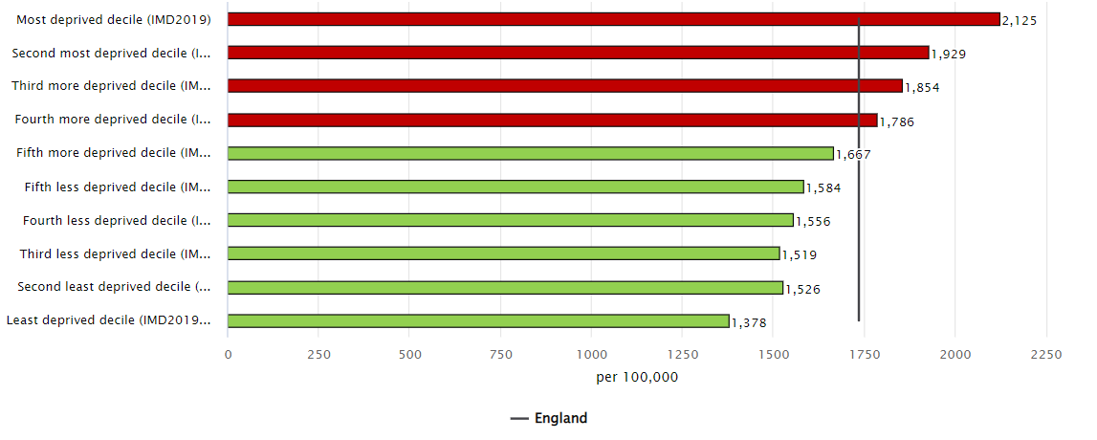
Hospital admissions
Alcohol
Admission episodes for alcohol-related conditions (Broad) *
Persons Males Females
Highlights
All districts, Cambridgeshire and Peterborough have similar or better alcohol-related hospital admissions, based on the broad definition, compared to England.
Overall rates are highest in Fenland and Cambridge, as well as for males. The rate of admissions in females in East Cambridgeshire are similar to those seen in Fenland, the highest local rates.
Admission rates in males are approximately treble that of females.
Nationally, alcohol-related hospital admissions are higher in more relatively deprived areas.
Alcohol-related hospital admission rates, England, 2012/22 – deprivation
(based on districts)
Directly age standardised rates per 100,000 population, all ages
* Broad definition: A measure of hospital admissions where either the primary diagnosis (main reason for admission) or one of the secondary (contributory) diagnoses is an alcohol-related condition
Source: Local Alcohol Profiles for England, Fingertips, Office for Health Improvement & Disparities Comments relate to statistically significant differences to England

Slide 11
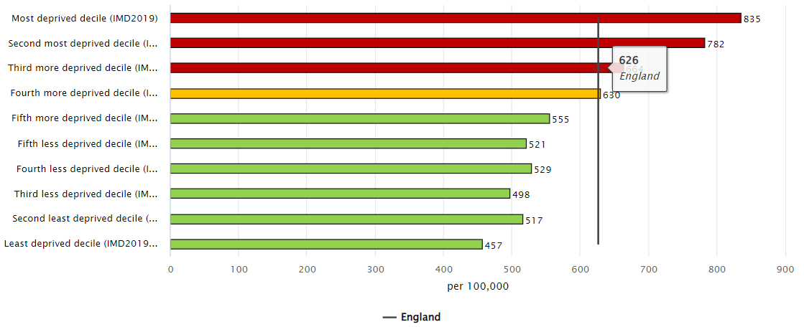
Hospital admissions
Admission episodes for alcohol-specific * conditions
Alcohol
Persons Males Females
Highlights
Alcohol-specific hospital episode rates are high in Cambridge males at over one and a half times higher than the Cambridgeshire rate.
Female rates in all districts, Cambridgeshire and Peterborough are lower than experienced nationally.
Frequency of admissions are lower in Cambridgeshire and Peterborough than nationally. Cambridgeshire had a higher rate of three or more admissions than Peterborough.
Frequent hospital admissions, adults (18+ years) with alcohol-specific hospital admissions and number of admissions in the preceding 24 months
Admission episodes for alcohol-specific conditions, 2012/22 – England, deprivation (based on districts)
Type | Cambridgeshire |  | Peterborough |  | England
 | Number | Rate per 100,000 | Number | Rate per 100,000 | Number | Rate per 100,000
No prior admission | 970 | 177 | 305 | 188 | 110,951 | 248
1 prior admission | 340 | 62 | 115 | 71 | 32,572 | 73
2 prior admissions | 160 | 29 | 45 | 28 | 17,106 | 38
3 prior admissions | 355 | 65 | 90 | 55 | 41,533 | 93
Directly age standardised rates per 100,000 population, all ages
* Primary diagnosis or any of the secondary diagnoses are wholly attributable to an alcohol-specific condition
Source: Local Alcohol Profiles for England, Fingertips, Office for Health Improvement & Disparities Comments relate to statistically significant differences to England

Slide 12
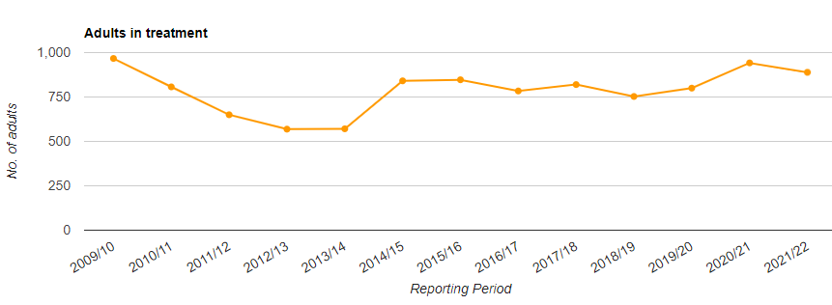
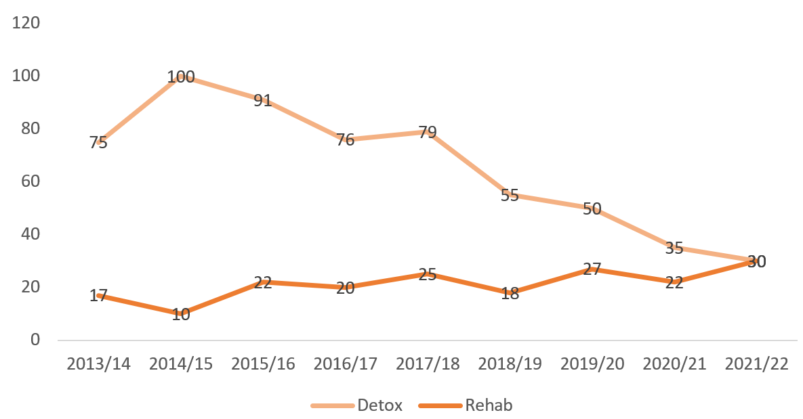
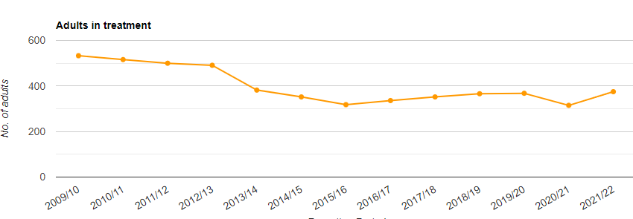
Alcohol Treatment – summary
Treatment
Alcohol
Highlights
In 2020/21, there were 889 people in treatment at specialist alcohol services in Cambridgeshire, a decrease of 52 (-5.6%) from the previous year. In Peterborough, there were 375 in treatment, an increase of 60 (19.4%) from the previous year.
Both Cambridgeshire and Peterborough were better than the national average for the proportion of clients waiting more than 3 weeks for alcohol treatment, with all clients seen within 3 weeks.
Just over a third of clients successfully completed alcohol treatment in 2021 in Cambridgeshire and Peterborough, similar to the national average.
For the three year time period 2018/19 to 2020/21, there were 40 deaths of people in alcohol treatment across Cambridgeshire and Peterborough.
In Cambridgeshire the number of detox’s have been decreasing, whilst numbers in rehab have increased.
Cambridgeshire
Adults in treatment
Adults accessing inpatient detox & rehab
Peterborough
Adults in treatment
Source: Local Alcohol Profiles for England, Fingertips, Office for Health Improvement & Disparities Comments relate to statistically significant differences to England

Slide 13
Alcohol Treatment – New Presentations, 2021/22
Treatment
Alcohol
Demographics |  | Cambridgeshire | Peterborough | England
Number Rate per 100,000 population |  | 520 | 280 | 56,995
Gender * | Male Female | 55% 45% | 63% 37% | 58% 42%
Age * | 18-29 years 30-39 years 40-49 years 50-59 years 60+ years | 9% 22% 27% 27% 16% | 9% 28% 30% 25% 9% | 9% 23% 28% 26% 13%
Ethnicity | White Other White White Irish Other Asian | 84% 10% 1% - | 71% 16% 3% 3% | 82% 5% 1% 1%
Sexuality (where stated) | Heterosexual Gay/Lesbian Bi-sexual | 95% 3% 1% | 95% 3% 2% | 95% 3% 2%
Religion (where stated) | None Christian Muslim Other | 65% 31% - 4% | 49% 43% 3% 2% | 63% 27% 1% 3%
Highlights
In general, Cambridgeshire had an older population profile of adults in treatment compared to England, and Peterborough a younger, especially 30 to 39 year olds.
There were more males than females in treatment. In Peterborough almost two-thirds of adults in treatment were male compared to 55% in Cambridgeshire and 58% in England.
Peterborough had a lower proportion of White clients compared to Cambridgeshire and England. Both Cambridgeshire and Peterborough had higher proportions of ‘Other White’ adults in treatment compared to England.
Almost all clients are heterosexual.
A higher proportion of clients in Cambridgeshire reported not having a religion compared to Peterborough, with Peterborough having a higher proportion of Christian clients and Muslim (small numbers) clients.
* Relates to alcohol only adults in treatment i.e. not new presentations
Source numbers are rounded to the nearest 5 so percentages are approximate
Source: National Drug Treatment Monitoring System (NDTMS), Office for Health Improvement & Disparities

Slide 14
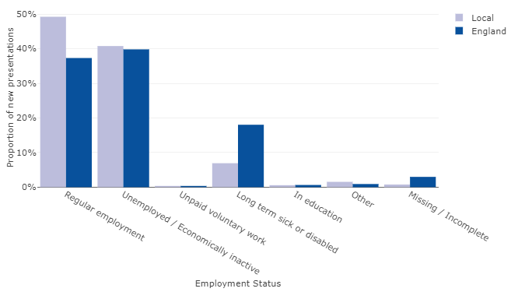
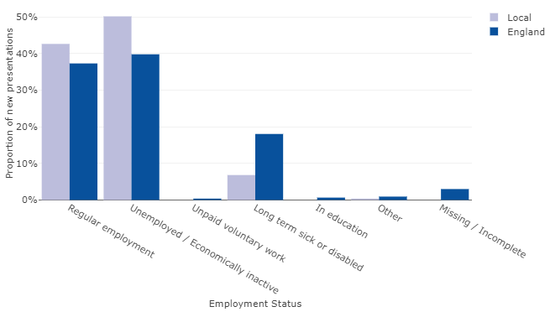
Employment
Treatment
Alcohol
Highlights
In 2021/22, 41% of adults who started alcohol treatment in Cambridgeshire and 50% in Peterborough were unemployed/economically inactive, with the latter being higher than the national average of 40%.
Cambridgeshire (49%) and Peterborough (43%) had higher proportions of regularly employed adults starting treatment compared to England (37%).
Both Cambridgeshire and Peterborough reported having lower proportions of long term sick or disabled adults starting treatment (7%) compared to the national average of 18%. This may indicate a coding issue with those in this category being classed as unemployed locally.
Adults in alcohol treatment at the start of treatment by employment status
Cambridgeshire
Peterborough
Source: National Drug Treatment Monitoring System (NDTMS), Office for Health Improvement & Disparities

Slide 15
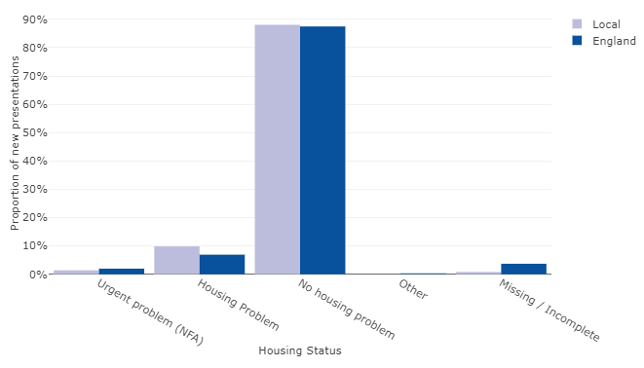
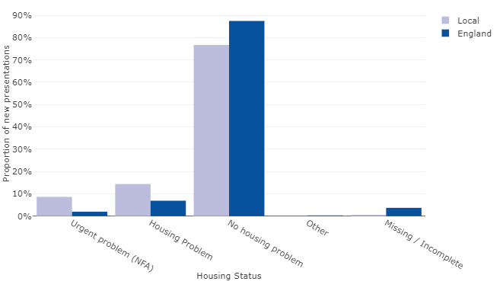
Housing - accommodation status
Treatment
Alcohol
Highlights
In 2021/22, 11% of adults in Cambridgeshire reported having a housing problem at the start of their treatment, similar to the national average (9%). However, 23% of Peterborough’s adults reported having housing problems at the start of their alcohol treatment, with 9% reporting an urgent problem (no fixed abode) and 14% reporting general housing problems (England 2% and 7% respectively).
Adults in alcohol treatment at the start of treatment by accommodation status
Cambridgeshire
Peterborough
Source: National Drug Treatment Monitoring System (NDTMS), Office for Health Improvement & Disparities

Slide 16
Statutory homelessness duties owed – alcohol dependency
Homelessness
Alcohol
Initial assessments of statutory homelessness duties owed
Support needs of households owed a prevention or relief duty, 2021/22
Highlights
 | Total households assessed as owed a duty | Alcohol dependency support needs
 |  | Number | %
Cambridge | 618 | 41 | 6.6%
East Cambridgeshire | 376 | 14 | 3.7%
Fenland | 517 | 39 | 7.5%
Huntingdonshire | 927 | 39 | 4.2%
South Cambridgeshire | 435 | 15 | 3.4%
Cambridgeshire | 2,873 | 148 | 5.2%
Peterborough | 1,363 | 51 | 3.7%
England | 278,110 | 12,900 | 4.6%
In 2021/22, Fenland had a notably high proportion of households reporting an alcohol dependency support need compared to the national average, followed by Cambridge. In comparison, Peterborough had a relatively low rate.
Source: Statutory homelessness in England, April 2021 to March 22, Department for Levelling Up, Housing & Communities

Slide 17
Adults who are parents/carers and their children
Treatment
Alcohol
Adults who are parents/carers and their children, 2021/22 |  | Cambridgeshire | Peterborough | England
Number |  | 520 | 280 | 56,995
Parental status (where known) | Parent living with children Parents not with children Other contact, living with children Not parent/no contact with children | 25% 7% 1% 67% | 30% 13% - 56% | 21% 13% 2% 67%
Living with children | Number of children living with alcohol users | 262 | 167 | 24,346
Early help and children’s social care (where known) | No early help Child protection plan in place Child in need Looked after child Early help | 82% 9% 7% 2% 5% | 67% 17% 19% 4% 4% | 72% 10% 8% 4% 7%
Highlights
In 2021/22, a quarter of adults presenting to alcohol treatment were parents living with children in Cambridgeshire, a lower proportion than Peterborough (30%) and England (21%).
In Peterborough, 13% of parents were not living with children, higher than the Cambridgeshire average (7%) and the same as nationally (13%).
In Cambridgeshire, there was a higher proportion of client’s children not receiving early help compared to nationally, with the proportion in Peterborough being lower.
Peterborough had a higher proportion of children with a child protection plan in place and also children in need.
Source: National Drug Treatment Monitoring System (NDTMS), Office for Health Improvement & Disparities

Slide 18
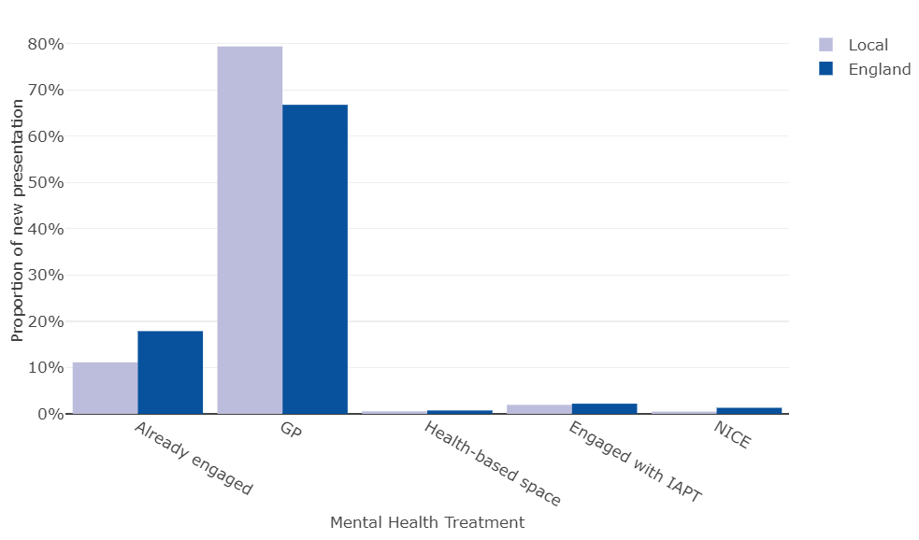
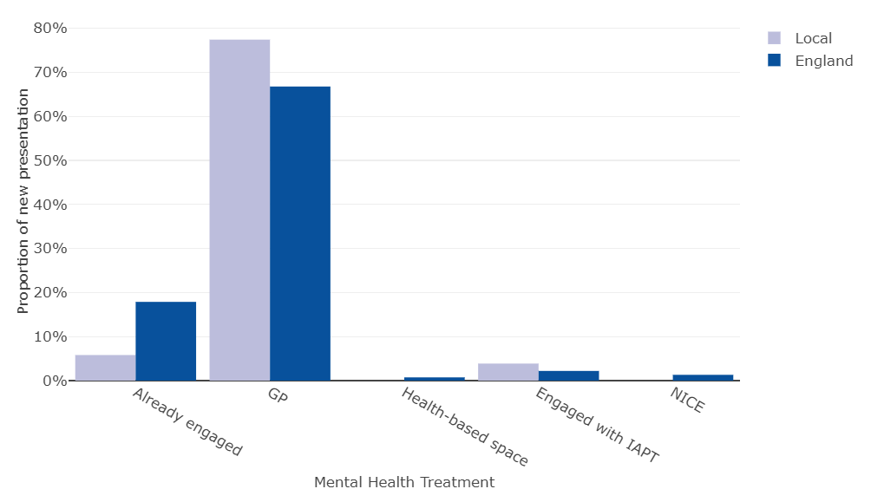
Treatment
Co-occurring mental health conditions
Alcohol
Adults who entered alcohol only treatment and were identified as having a mental health treatment need, 2021/22 | Number | % of new presentations | % receiving treatment for their mental health
Cambridgeshire Peterborough England | 359 155 39,707 | 69% 56% 70% | 87% 81% 83%
Highlights
Around 7 in 10 adults in Cambridgeshire who entered alcohol treatment in 2021/22 were identified as having a mental health treatment need, the same as the national average, but Peterborough was lower at 56%.
Of those identified as having a need in Cambridgeshire, 87% were already receiving treatment, mainly through their GP (79%). The proportion was lower in Peterborough at 81%, with 77% being seen by their GP.
Cambridgeshire
Peterborough
Source: National Drug Treatment Monitoring System (NDTMS), Office for Health Improvement & Disparities

Slide 19
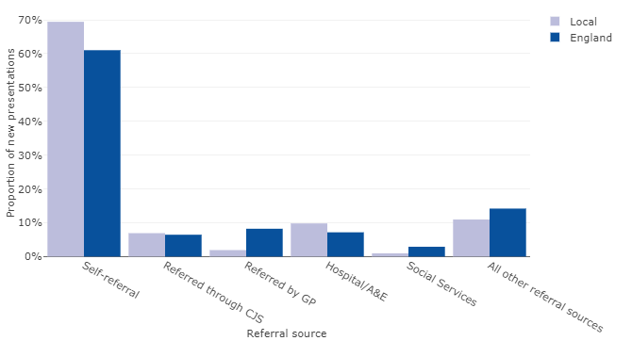
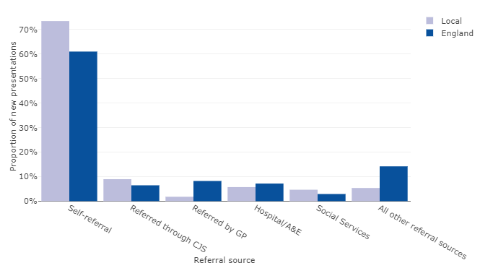
Access - routes into treatment
Treatment
Alcohol
Cambridgeshire
Peterborough
69% of referrals were self-referrals; higher than the national average of 61%
10% of referrals were through hospitals/A&E departments (national average 7%)
Low proportion of referrals from GP’s (2% compared to 8% nationally)
A higher proportion of males (11%) were referred through the Criminal Justice System than females (2%)
A higher proportion of females (15%) were referred through ‘all other referral sources’ than males (8%)
Almost three-quarters (73%) of referrals were self-referrals; higher than the national average of 61%
9% of referrals were through the Criminal Justice System (national average 6%)
Low proportion of referrals from GP’s (2% compared to 8% nationally)
A higher proportion of males (11%) were referred through the Criminal Justice System than females (4%)
A higher proportion of females (9%) were referred through social services than males (3%)
New presentations by referral source, 2021/22
Cambridgeshire
Peterborough
Hospital Alcohol Care Team Liaison 75%
Hospital 25%
Hospital Alcohol Care Team Liaison 25%
Hospital 75%
Source: National Drug Treatment Monitoring System (NDTMS), Office for Health Improvement & Disparities

Slide 20
High level interventions
Treatment
Alcohol
Adults in treatment in high level interventions and settings, 2021/22 |  | Pharmacological |  | Psychosocial |  | Recovery support |  | Total
 |  | Number | % | Number | % | Number | % | Number | %
Cambridgeshire | Community Inpatient Unit Primary Care Residential | 101 14 5 12 | 81% 11% 4% 10% | 864 13 13 17 | 98% 1% - - | 626 10 - - | 98% 2% - - | 872 14 16 20 | 98% 2% 2% 2%
Peterborough | Community Inpatient Unit Primary Care Residential | 39 9 - - | 85% 20% - - | 373 9 - - | 99% 2% - - | 370 8 - - | 99% 2% - - | 373 9 - - | 99% 2% - -
Highlights
Almost all adults in treatment in 2021/22 were seen within the community in both Cambridgeshire and Peterborough.
There were 20 residential interventions in Cambridgeshire, with numbers in Peterborough too small to report.
Cambridgeshire had lower proportions of adults with a pharmacological intervention for withdrawal and relapse intervention compared to England. Peterborough had a higher proportion of pharmacological intervention for relapse intervention.
Adults with a pharmacological intervention type, 2021/22 | Cambridgeshire |  | Peterborough |  | England
 | Number | Proportion | Number | Proportion | Number | Proportion
Withdrawal Relapse intervention | 22 37 | 18% 30% | 12 30 | 26% 65% | 3,810 6,117 | 28% 45%
Source: National Drug Treatment Monitoring System (NDTMS), Office for Health Improvement & Disparities

Slide 21
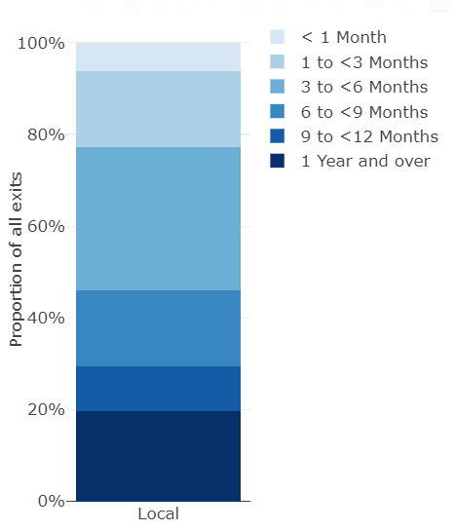
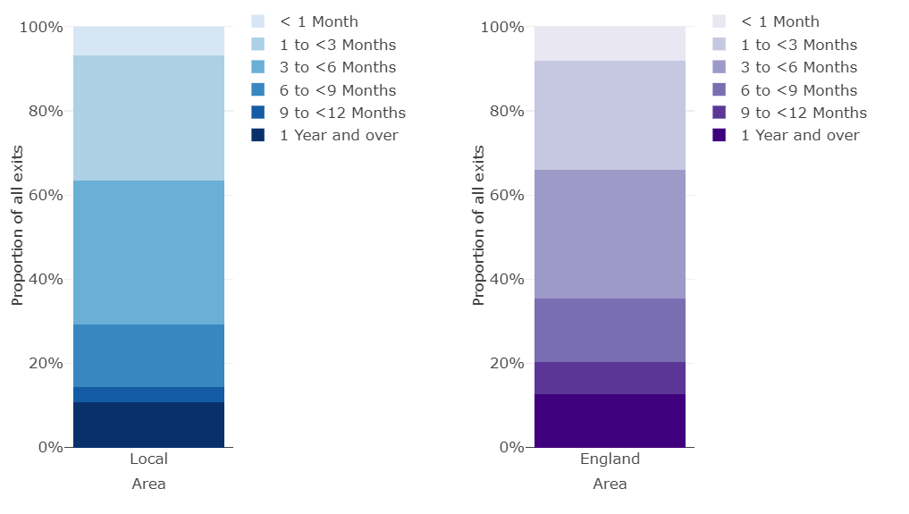
Length of time in treatment
Treatment
Alcohol
Length of time in treatment for adults in alcohol only treatment for exits, 2021/22 | Average days
Cambridgeshire Peterborough England | 252 171 194
Highlights
Cambridgeshire had a higher average length of treatment (252 days) for adults who exited alcohol treatment in 2021/22 compared to England (194 days), and Peterborough had a lower average length (171 days).
Almost a fifth of Cambridgeshire adults had been in treatment for longer than a year, compared to one in ten in Peterborough and England.
Cambridgeshire
Peterborough
England
Source: National Drug Treatment Monitoring System (NDTMS), Office for Health Improvement & Disparities

Slide 22
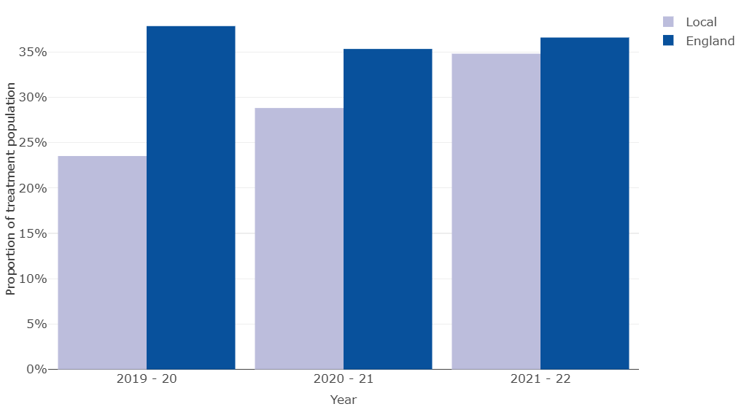
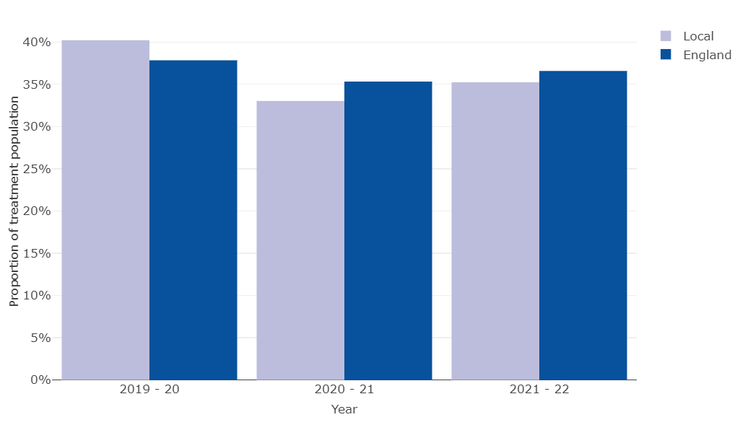
Treatment
Successful completions
Alcohol
Adults successfully completing alcohol treatment, 2021/22 | Cambridgeshire | Peterborough | England
Total leaving treatment - % of treatment population | 541 61% | 222 59% | 53,180 63%
Leaving treatment successfully - % of all in treatment - % of those exiting treatment | 308 35% 57% | 121 32% 55% | 31,611 37% 59%
Not representing within 6 months - % non-representing | 331 35% | 117 35% | 30,785 37%
Highlights
57% of adults who left treatment in 2021/22 were successful (dependent free) in Cambridgeshire and 55% in Peterborough, compared to 59% nationally.
Just over a third of adults who successfully completed treatment in Cambridgeshire and Peterborough did not re-present to treatment within 6 months, similar to the national average.
There has been a notable increase in non-representation within 6 months in Cambridgeshire over the last three years.
Successfully completed and did not return within 6 months
Cambridgeshire
Peterborough
Deaths in treatment are lower in Cambridgeshire (0.9%) compared to Peterborough (1.1%) and England (1.2%). Numbers are small.
Source: National Drug Treatment Monitoring System (NDTMS), Office for Health Improvement & Disparities

Slide 23
Treatment
Abstinence and days drinking
Alcohol
Adults who became abstinent at planned exit and average days drinking, 2021/22 | Abstinence rates |  | Days of drinking
 | Number | % of new presentations | Average days at start | Average days at end
Cambridgeshire Peterborough England | 295 126 27,172 | 55% 57% 50% | 20.3 18.3 20.5 | 12.3 5.2 11.5
Highlights
Over half of adults became abstinent in Cambridgeshire and Peterborough in 2021/22, with a higher proportion than England in both areas.
The average number of days that clients were drinking alcohol at the start of their treatment (within the previous 28 days) and within the 4 weeks before their planned exit notably decreased, especially in Peterborough where there was an average of 13 day reduction.
Abstinence rates at planned exit: The number of clients who reported drinking alcohol at treatment start and then reported no drinking in the 28 days before planned exit.
Days of drinking: The number of clients and their average days of drinking alcohol at treatment start and in the 28 days before planned exit.
Source: National Drug Treatment Monitoring System (NDTMS), Office for Health Improvement & Disparities

Slide 24
Service usage
Other
Alcohol
Probation caseloads | Health Trainer Service
Cambridgeshire probation provided a snapshot of the drug and alcohol needs of people supervised by the sentence management teams on 8th July 2022. A total of 298 men on probation (28% of the overall caseload) and 52 women (48% caseload) were recorded as having alcohol needs. Overall, 33 men and 10 women were required to abide by Alcohol Treatment Requirements as a condition of their community sentence. Additionally, 30 men and 4 women were wearing an alcohol monitoring tag as part of an Alcohol Abstinence Monitoring Requirement. | The Healthy You Health Trainer service, with 2 specialist health trainers, provided data for a 2 year period from 1st October 2020 to 30th September 2022. The service administers the AUDIT-C alcohol screening tool to all referrals irrespective of the area of health-related need with which they require help. Healthy You triaged 9,954 individuals over this 2 year period (with an estimated 5,972 resident in Cambridgeshire) with 19% of 1,140 Cambridgeshire residents assessed as requiring support with their alcohol use via the AUDIT-C tool. An estimated 191 Cambridgeshire residents were provided ongoing support with their alcohol use over this 2 year period.
Source: TONIC

Slide 25
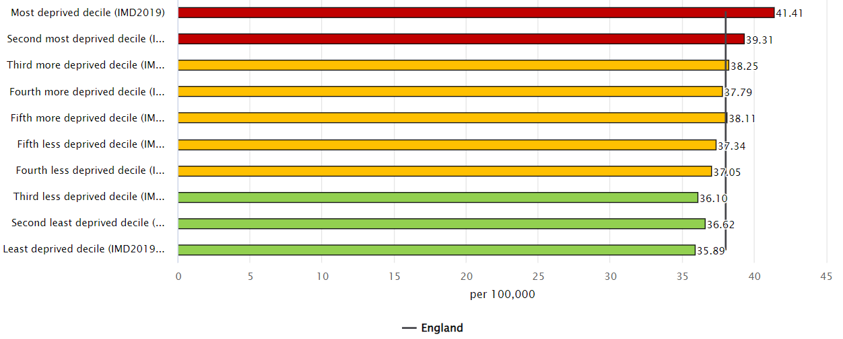
Cancer
Incidence of alcohol-related cancer
Alcohol
Persons Males Females
Highlights
Between 2017 and 2019, there were on average 230 cancers a year in Cambridgeshire that could be related to alcohol use, with 62 in Peterborough. Incidence rates are slightly higher in females than males.
All local authorities have alcohol-related cancer incidence rates that are similar to that of England.
Cambridgeshire had a low male incidence rate of alcohol-related cancer.
Alcohol-related cancer incidence rates are highest in the most deprived districts in England.
Deprivation – England (based on districts)
Directly age standardised rates per 100,000 population, aged 16+ years
Source: Local Alcohol Profiles for England, Fingertips, Office for Health Improvement & Disparities Comments relate to statistically significant differences to England

Slide 26
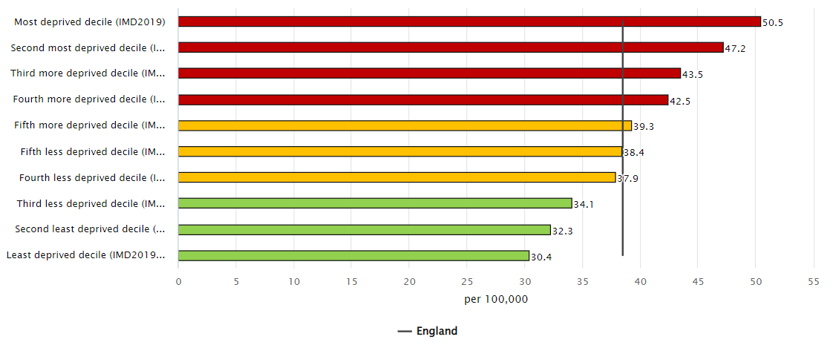
Mortality
Alcohol-related mortality *
Alcohol
Persons Males Females
Highlights
In 2021, there were 202 alcohol-related deaths in Cambridgeshire and 71 in Peterborough, with the majority in males; 73% in Cambridgeshire and 65% in Peterborough.
Peterborough had a higher proportion of deaths in females (35%) compared to Cambridgeshire and England, though numbers are relatively small.
Huntingdonshire, South Cambridgeshire and Cambridgeshire have significantly low alcohol-related mortality rates compared to England, with all other districts having similar rates to nationally.
Potential Years of Life Lost (PYLL) is a measure of the potential number of years lost when a person dies prematurely (based on national life expectancy). Fenland had the highest rate of PYLL due to alcohol-related conditions in males, and Peterborough the highest rate in females.
Nationally, increasing alcohol-related mortality rates are linked to increasing levels of relative deprivation.
Alcohol-related mortality, 2021 Deprivation rates – England
(based on districts)
Potential years of life lost (PYLL)
Males Females
Directly age standardised rates per 100,000 population, all ages
Note: ‘-’ denotes numbers are too small to be able to calculate value. Totals do not agree due to rounding
Source: Local Alcohol Profiles for England, Fingertips, Office for Health Improvement & Disparities * based on alcohol-attributable applied to underlying cause of death

Slide 27
Drugs

Slide 28
Drug summary for 2021/22
Drugs
Cambridgeshire (1)
Prevalence ³⁴: Estimated: 6.3 per 1,000 adults opiate and/or crack users – similar to England ►56% unmet need 3.4 per 1,000 adults opiate users – similar to England ►49% unmet need 3.4 per 1,000 adults crack users – lower than England ►59% unmet need (note these are relatively old estimates. Unmet need compares to current adults in treatment) Hospital admissions ³⁵ : 210 drug poisoning admissions, with lower rates. There has been a decrease in rates over the last 4 years, as also seen nationally but more marked locally. Drug Crimes ³⁶: high rates in Cambridge and remain relatively stable. Rates are low and stable in East Cambridgeshire and South Cambridgeshire, increasing in Fenland and Huntingdonshire, with the latter almost reaching national rates in the latest time period. Treatment ³⁷⁻⁴¹: 1,672 in treatment, 585 new presentations. Decreasing number of adults in treatment for opiates, and significant decrease in new presentations in 2021/22, but remains the highest drug for treatment need, especially for those in treatment. Two thirds of those in treatment were due to opiates. Increasing trend for non-opiate treatment, but a 4% decrease from 2020/21. A third of all new presentations to treatment were due to non-opiates, but overall non-opiates only accounted for 18% of all those in treatment, as a result of a higher successful completion rate compared to opiates. 28% (165) of new presentations to treatment were due to non-opiates and alcohol combined, with a 16% decrease from the previous year. The trend for those in treatment for non-opiate and alcohol treatment population has remained fairly stable over the last 6 years. Opiates, cannabis, alcohol, cocaine and crack cocaine are the most commonly cited substances for new presentations, with a higher proportion of cocaine compared to England. Demography of new presentations to treatment ⁴² : similar age and sex profile, 70% male 60% aged 30-49 years. Higher proportion of females than males in younger age bands. Of those who started treatment in the year there was a higher proportion of White British and ‘Other White, aa higher proportion of people reporting no religion and similar sexuality profile. There was a higher proportion reporting no disability, and of those reporting a disability, the majority were for behaviour and emotions issues and mobility and gross motor. | Wider determinants ⁴³⁻⁴⁶: Higher proportion of employed and unemployed and lower proportion of long term sick or disabled. Similar housing needs pattern, with a slightly higher proportion of ‘no housing problems’. Cambridge has a high statutory homelessness duty owed where there are drug dependency support need, as almost double the national average. Higher proportion of parents living with children. Higher proportion of no early help, but where help is provided a higher proportion of children protection plans in place and child in need. Co-occurring mental health ⁴⁷: similar proportion of adults with a mental health treatment need identified, with a similar level receiving treatment, predominantly through GPs. Opiate users had the lowest proportion of co-occurring mental health, with non-opiate and alcohol the highest. Routes into treatment ⁴⁸⁻⁵⁰ : all referrals seen within 3 weeks. Higher proportion of self-referrals. Differences in gender, with self-referral and referred through Criminal Justice System as the main source of referral for both sexes, but 7% of females were referred through social services compared to 1% of males. Higher proportion of adults in contact with the criminal justice pathway, most notably for opiate and non-opiates and alcohol. High level interventions ⁵¹: almost all adults were seen within community settings. Higher proportion of methadone interventions and unsupervised interventions. Higher proportion of clients, who had a prescribing intention, on maintenance methadone, a lower proportion with buprenorphine maintenance and a higher proportion with an unspecified opioid substance therapy. Vaccination ⁵²: higher Hepatitis B uptake and Hepatitis C testing. Overdose prevention ⁵²: higher proportion of naloxone issued, with similar levels as administration. Injecting use ⁵² : higher portions of currently injection and having previously injected. Engagement ⁵³: similar levels of early unplanned exits, across all drug groups.
Note: superscript numbers relates to slide number. (sn) – small numbers. Comparisons are made to England. Opiates includes opiates only, opiates and alcohol and/or opiate and non-opiates

Slide 29
Drug summary for 2021/22
Drugs
Cambridgeshire (2)
Length of time in treatment ⁵⁴: similar proportion of lengths of stay for opiates and non-opiates, but slightly higher proportion for those in treatment for longer than 2 years for non-opiates and alcohol (sn). Successful completions ^{55:} similar successful completion rates across all drug groups, with a decreasing trend in opiate users. Half of adults transferred to the community from prison successfully engaged with treatment, with high engagement with opiate users. Mortality ⁵⁶: 20 deaths a year are related to drug misuse, with low associated rates and decreasing trend in recent years.
Note: superscript numbers relates to slide number. (sn) – small numbers. Comparisons are made to England. Opiates includes opiates only, opiates and alcohol and/or opiate and non-opiates

Slide 30
Drug summary for 2021/22
Drugs
Peterborough (1)
Prevalence ³⁴: Estimated: 13.8 per 1,000 adults opiate and/or crack users – higher than England ►52% unmet need 9.4 per 1,000 adults opiate users – higher than England ►46% unmet need 6.9 per 1,000 adults crack users – similar to England ►46% unmet need (note these are relatively old estimates. Unmet need compares to current adults in treatment) Hospital admissions ³⁵: similar admission rates for drug poisoning. Notable decrease in rates form 2020/21, as seen nationally, but more marked in Peterborough. Drug Crimes ³⁶: rates are high, but decreasing with the gap between England narrowing. Treatment ³⁷⁻⁴¹: 1,147 in treatment, 240 new presentations. Almost 70% of adults in treatment due to opiates, similar to national. Decreases seen in new presentations for opiate and non-opiates but increase in alcohol and non-opiates from 2020/21. However, the total treatment population has increased within the year, implying longer treatment times. Over the last 6 years, decreasing trend in opiates, and relatively stable trend for non-opiates and non-opiate with alcohol. Opiates, cannabis, alcohol, cocaine and crack cocaine are the most commonly cited substances for new presentations, with a higher proportion of crack cocaine and opiates compared to England. Demography of new presentations to treatment ⁴² : higher proportion of younger adults aged 30 to 29 years, and a similar gender profile with almost three-quarters of those in treatment being male. Notably lower proportion of White British and higher ‘Other White’ and Pakistani. Similar sexuality profile. Higher proportion of Christians and Muslims. Higher proportion reporting a disability and of those a higher proportion of behaviour and emotions issues and learning disabilities. Wider determinants ⁴³⁻⁴⁶: higher proportion of unemployed and lower proportion of long term sick or disabled. Higher proportion reporting housing problems, including no fixed abode’. Peterborough had a low statutory homelessness duty owed where there is a drug dependency support need. Slightly higher proportion of adults who are not parents and have no contact with children. Higher proportion of no early help, but where help is provided a higher proportion of children protection plans in place and child in need. | Co-occurring mental health ⁴⁷: similar proportion of adults with a mental health need identified, with a similar level receiving treatment, predominantly through GPs. Non-opiate users had the lowest proportion of co-occurring mental health, with non-opiate and alcohol the highest. Routes into treatment ⁴⁸⁻⁵⁰ : almost all referrals seen within 3 weeks. Slightly higher proportion of self-referrals and higher referrals through the Criminal Justice System (CJS), with a higher proportion of males than females referred through this route. Higher proportion of females referred through social services. Of those referred from CJS, two-thirds were from prisons. Higher proportion of criminal justice pathway adults in treatment across all drug groups and high proportion of voluntary referrals. High level interventions ⁵¹ : almost all adults were seen within community settings. Similar proportion of those with methadone maintenance, a notably higher proportion of clients with buprenorphine maintenance and higher unspecified opioid substance therapy. Vaccination ⁵²: slightly lower uptake of Hepatitis B and slightly higher Hepatitis C. Overdose prevention ⁵²: lower proportion of naloxone issued, with slightly higher levels as administration. Injecting use ⁵² : similar injecting pattern to England, with three-quarters never injecting and one in 10 currently injecting. Engagement ⁵³: high proportion of early unplanned exit across all drug groups. Length of time in treatment ⁵⁴: low level of long treatment and higher proportion of opiate users treated within 2 years. Successful completions ^{55:} similar successful completion rates across all drug groups, with a decreasing trend in opiate users. Half proportion of adults transferred to the community from prison successfully engaged with treatment, with high engagement with opiate and alcohol and non-opiate users. Mortality ⁵⁶: 8 deaths a year are related to drug misuse, with similar rates to England with decreasing trend in recent years.
Note: superscript numbers relates to slide number. (sn) – small numbers. Comparisons are made to England. Opiates includes opiates only, opiates and alcohol and/or opiate and non-opiates

Slide 31
Drug misuse risk factors
Risk factors
Drugs
Who is at risk
People from every part of society use, misuse, and become dependent on drugs. Groups that are likely to have higher levels of problematic drug use include:
People with coexisting physical and mental health problems
People with Blood Borne Viruses
People who experience homelessness
People Not in Employment, Education and Training
People in contact with the Criminal Justice System
People who are victims/survivors and perpetrators of domestic abuse
People living in more deprived areas
Young people – especially in contact with Youth Offending Services, Looked After Children, excluded from school and not in formal education, employment or training, those involved with County Lines drug dealing
Families – family member’s use of drugs and/or alcohol often has a range of different impacts on a family including on their emotional wellbeing and finances
Steroid users
Sex workers
Chemsex
What works
Harm reduction including Naloxone, long lasting Buprenorphine and outreach work, health promotion and education
Drug treatment and recovery for adults including peer-led recovery communities, online support
Drug treatment and recovery for young people – including a co-ordinated approach across Children’s social services, youth offending services, Child and Adolescent Mental Health services and specialist substance youth services. As a minimum, should integrate support for emotional wellbeing, unhealthy relationships and sexual health.
Drug prevention including preventions on risk factors, contexts and behaviours that make individuals vulnerable.
Source: TONIC

Slide 32
Covid
Impacts of Covid
Drugs
Impact of Covid-19 on drug use
The COVID-19 pandemic impacted the drug market, causing local fluctuations in the availability and price of drugs in England between 2020-2021. Despite this, the overall supply of drugs was maintained. However, patterns of drug use shifted during the COVID-19 pandemic. For example in the UK generally, drug users reported an increase in their substance use compared to 2019, with 17% injecting drugs more frequently and 27% reporting a change in their normal daily drug use.
Impact of Covid-19 on substance treatment and support services
COVID-19 meant that treatment services had to restrict face-to-face contact, which limited the interventions that service users could access. There were numerous impacts that resulted from this, such as fewer service users being able to access inpatient detoxification for drugs or alcohol due to increased pressure on the NHS at the time of the pandemic. In addition, there was a reduced supply and interrupted access to medicines due to pharmacies being closed. As a result more clients were given take-home doses of opioid substitution treatment (OST), which increased the risk of the illegal selling of prescriptions such as methadone.
In response to lockdown restrictions and to mitigate the difficulties in providing face-to-face support, services began to increasingly use remote technology via mobile phones or online platforms. Despite its positive contributions, this raised numerous challenges such as excluding clients who do not have access to the internet or a mobile phone, further marginalising specific groups from the service. During COVID-19, many harm reduction interventions including needle exchanges were reduced or suspended. Over 25% of drug users reported greater difficulties accessing equipment for the safer consumption of drugs in 2020 compared to 2019. Testing for blood-borne viruses (BBV) was also significantly reduced as a result of COVID-19, with a 60% decrease in antibody and ribonucleic acid testing. In response to these challenges, services formulated innovative approaches to the provision of harm reduction interventions including home delivery of needles and self-testing kits for BBV. Overall, while the COVID-19 pandemic may be driving innovative models of service provision, it is important that face-to-face services are adequately reinstated to mitigate increased adverse health outcomes and disparities.
Source: TONIC

Slide 33
Prevalence
Drugs
Drug misuse in England and Wales
Drug misuse in England and Wales – year ending June 2022
Drug use | Approximately 1 in 11 adults aged 16 to 59 years (9.2%) | no change compared with the year ending March 2020
 | Approximately 1 in 5 adults aged 16 to 24 years (18.6%) | no change compared with the year ending March 2020
Class A drug use | 2.7% of adults aged 16 to 59 years | a significant decrease from the year ending March 2020 when this was 3.4%
 | 4.7% of adults aged 16 to 24 years | a significant decrease from the year ending March 2020 when this was 7.4%,
Frequent users (any drug, more than once a month in the past year) | 2.6% of adults aged 16 to 59 years | similar to the year ending March 2020 when this was 2.1%
Year ending June 2022 compared to year ending March 2022:
There were no changes in last year drug use for the majority of individual drugs except:
prevalence of ecstasy use decreased (from 1.4% to 0.7% in adults aged 16 to 59 years and from 4.0% to 1.1% in adults aged 16 to 24 years)
prevalence of nitrous oxide decreased (from 2.4% to 1.3% for adults aged 16 to 59 years and from 8.7% to 3.9% for adults aged 16 to 24 years)
Note: decreases in the use of Class A drugs, ecstasy and nitrous oxide may have been a result of the coronavirus (COVID-19) pandemic and restrictions on social contact
Source: Drug misuse in England and Wales: year ending June 2022, Office for National Statistics - https://www.ons.gov.uk/peoplepopulationandcommunity/crimeandjustice/articles/drugmisuseinenglandandwales/yearendingjune2022

Slide 34
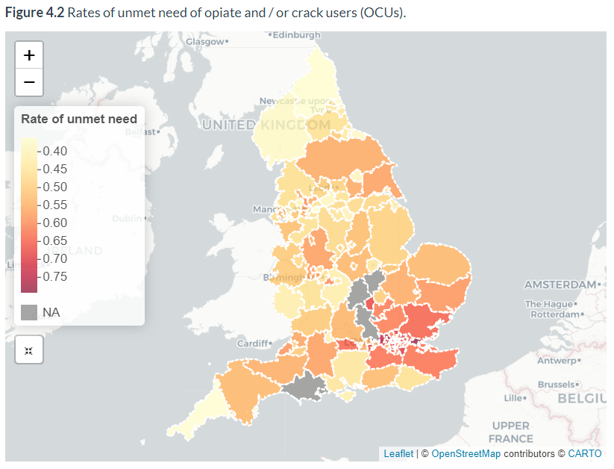
Prevalence and unmet need in adults aged 18+ years
Prevalence
Drugs
Highlights
Prevalence estimates, which are fairly out of date (2016/17), suggest that Peterborough has a high prevalence of Opiate and/or crack users and opiates users, with around half having their needs unmet.
It is estimated that Cambridgeshire has a higher proportion of unmet need in drug dependent users than Peterborough.
Peterborough
Cambridgeshire
Note: prevalence estimates relate to 2016/17 and drug treatment numbers for 2021/22 have been used to calculate rates of unmet need
Source: National Drug Treatment Monitoring System (NDTMS), Office for Health Improvement & Disparities Comments relate to statistically significant differences to England

Slide 35
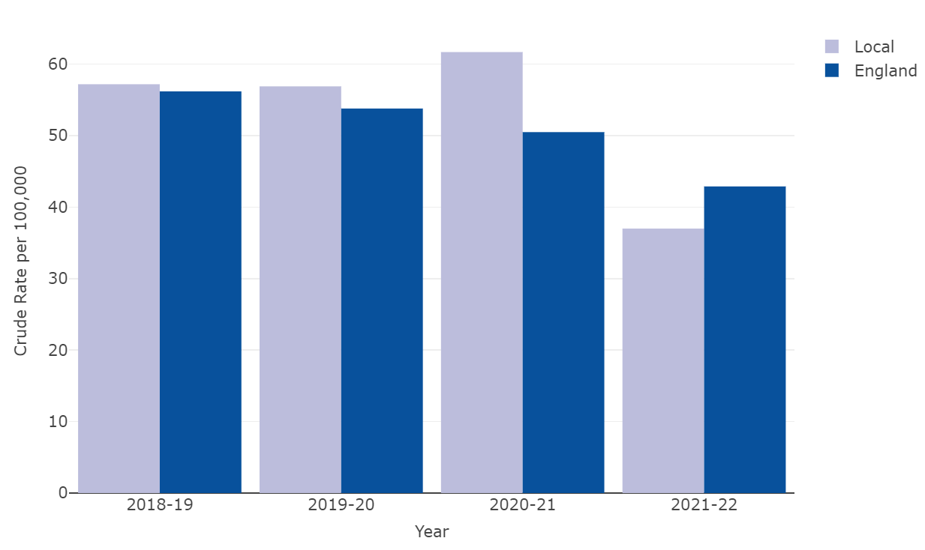
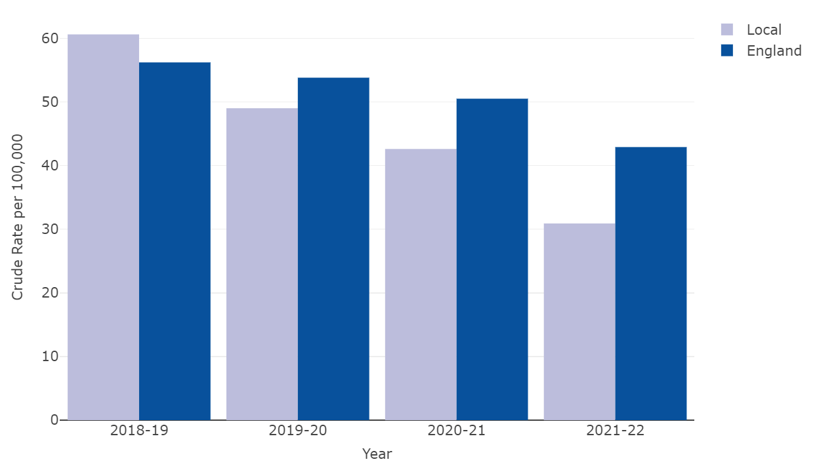
Hospital admissions
Hospital admissions due to drug poisoning
Drugs
Drug specific hospital admissions
Highlights
In 2021/22, there were 210 admissions to hospital specifically relating to drugs in Cambridgeshire and 80 in Peterborough, with Cambridgeshire having a lower drug poisoning hospital admission rate and Peterborough having a similar rate to England.
As also experienced nationally, drug poisoning hospital admission rates have been decreasing annually in Cambridgeshire.
Both Cambridgeshire and Peterborough experienced notable decreases between 2020/21 and 2021/22, with the rate in Peterborough being relatively stable before this.
Hospital admissions due to drug poisoning
Cambridgeshire
Peterborough
Source: National Drug Treatment Monitoring System (NDTMS), Office for Health Improvement & Disparities Comments relate to statistically significant differences to England

Slide 36
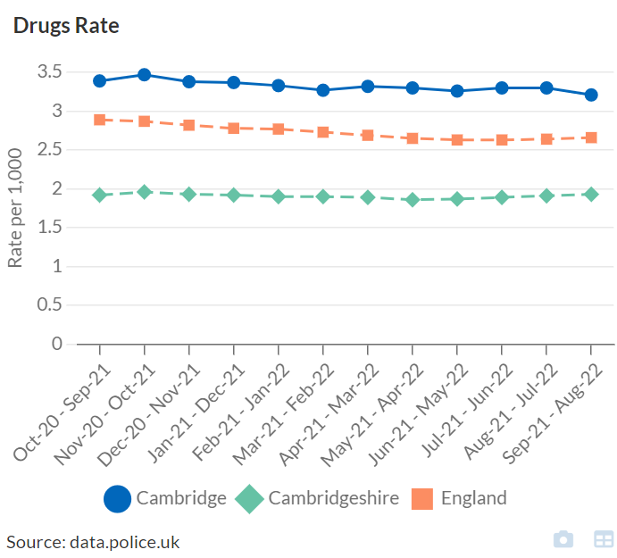
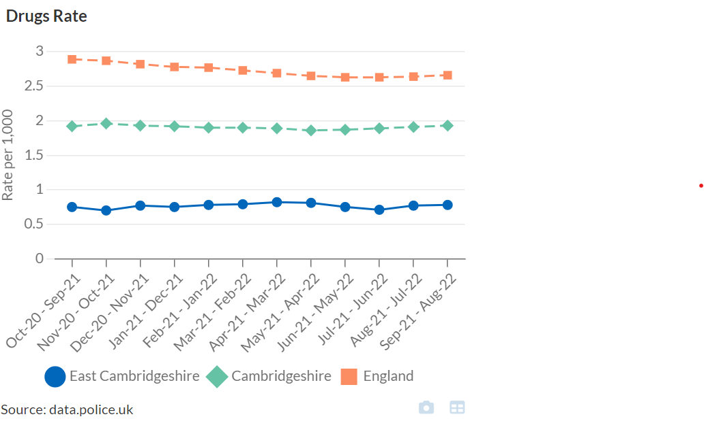
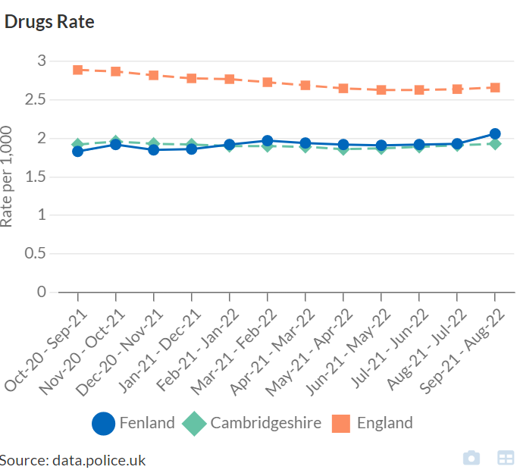
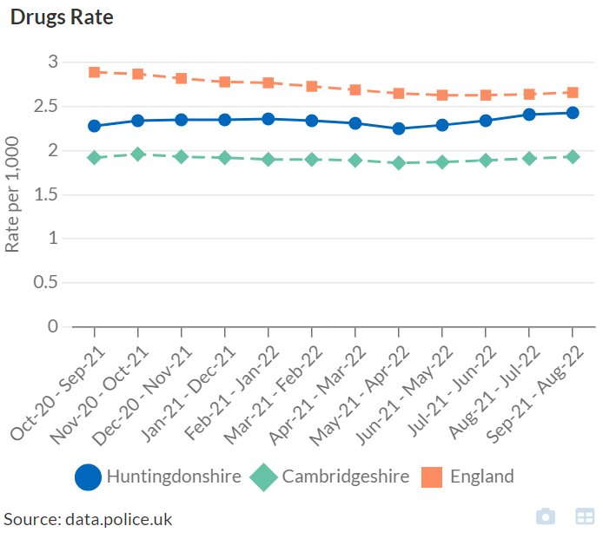
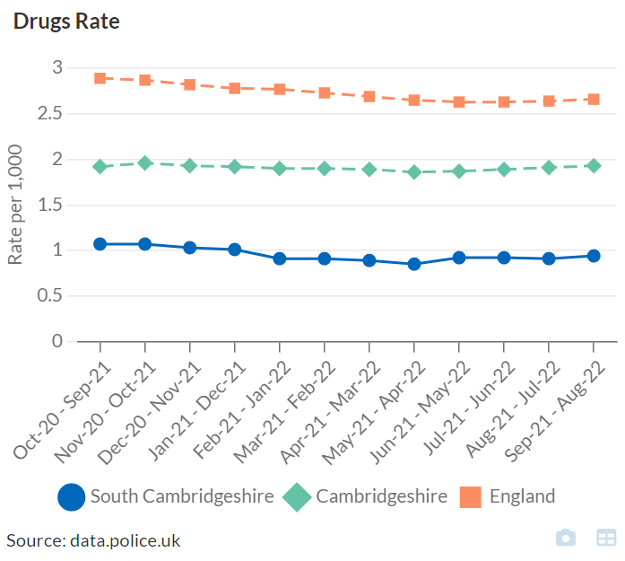
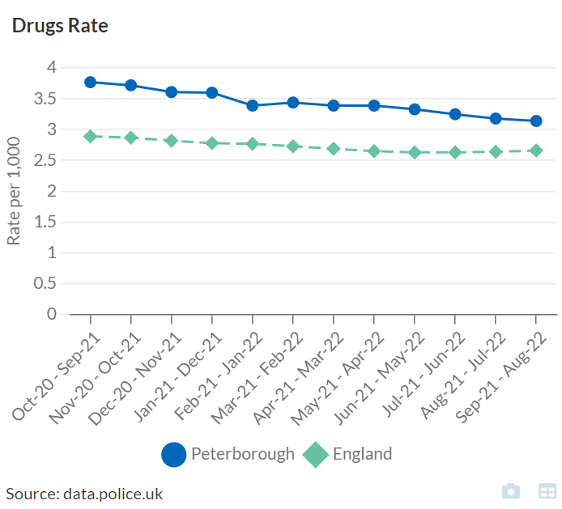
Crime
Drug crime rates
Drugs
Cambridge East Cambridgeshire Fenland
Highlights
Drug-related crimes include offences relating to possession, supply and production.
Drug-related crime rates are highest, and above the national average, in Peterborough and Cambridge. Rates are notably lower in East Cambridgeshire and South Cambridgeshire.
Huntingdonshire South Cambridgeshire Peterborough
Source: Community Safety Interactive report, Cambridgeshire Insight https://cambridgeshireinsight.org.uk/communitysafety/reports/ Note: scale differ

Slide 37
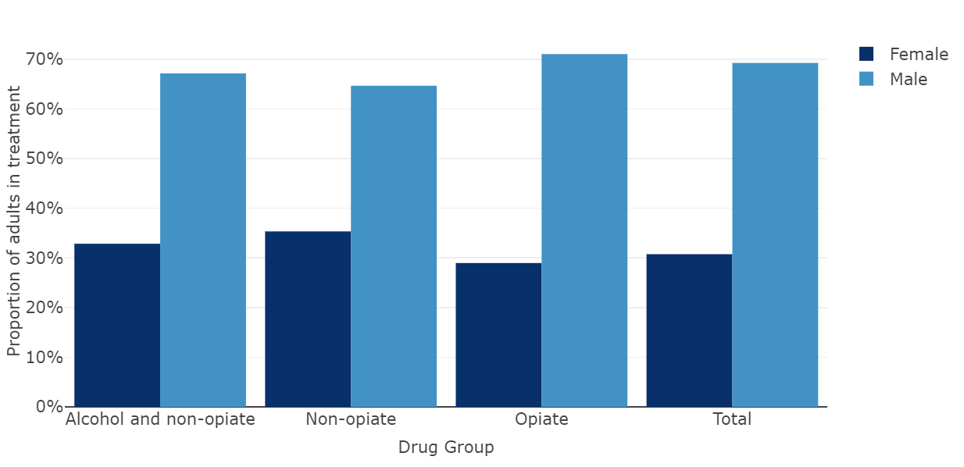
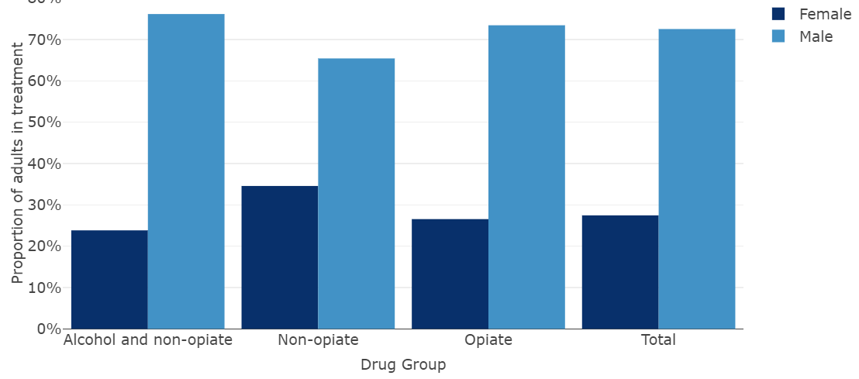
Treatment
Drugs
Adults in drug treatment
Proportion of adults in drug treatment, 2021/22
Highlights
Adults in drug treatment | Cambridgeshire |  |  | Peterborough |  |  | England
 | Number | % | Change from 2020/21 | Number | % | Change from 2020/21 | %
Opiate | 1,098 | 66% | -2.0% | 787 | 69% | 0.9% | 69%
Non opiate | 300 | 18% | 4.2% | 188 | 16% | 9.3% | 14%
Alcohol and non-opiate | 274 | 16% | -10.5% | 787 | 15% | -0.6% | 17%
Total | 1,672 | 100% | -2.5% | 1,147 | 100% | 2.0% | 100%
In 2021/22, there were 1,672 adults in drug treatment in Cambridgeshire and 1,147 in Peterborough.
Around two-thirds of adults in drug treatment in 2021/22 were due to opiates, the same as seen nationally. Both Cambridgeshire and Peterborough had slightly higher proportions of adults in treatment for non-opiates and slightly lower proportions of adults in treatment for alcohol and non-opiates than England.
Around 70% of adults in drug treatment in Cambridgeshire and 73% in Peterborough were males. The highest proportion of females in treatment were for ‘non-opiates’.
Peterborough experienced increases in adults in drug treatment between 2020/21 and 2021/22, in all drug groups except ‘alcohol and non-opiate’ which saw a slight decrease. Cambridgeshire experienced decreases in all drug groups, except in non-opiates where there was a 4.2% increase.
Cambridgeshire
Peterborough
Source: National Drug Treatment Monitoring System (NDTMS), Office for Health Improvement & Disparities. Opiates includes opiates only, opiates and alcohol and/or opiate and non-opiates

Slide 38
Treatment
Drugs
Adults in drug treatment
Highlights
Opiates are by far the highest drug group for adults in treatment in Cambridgeshire and Peterborough. Overall numbers in treatment have decreased over the last 10 years, as also experienced nationally.
Adults in treatment in Cambridgeshire for non-opiates have remained relatively stable, whilst those who also were in treatment for alcohol as well i.e. non-opiate and alcohol has seen an increase to levels the same as non-opiates.
Numbers in treatment for opiates have decreased over 10 years in Peterborough, whilst non-opiates, with and without alcohol have increased.
People in drug treatment
Cambridgeshire
Peterborough
Peterborough
Source: National Drug Treatment Monitoring System (NDTMS), Office for Health Improvement & Disparities. Opiates includes opiates only, opiates and alcohol and/or opiate and non-opiates

Slide 39
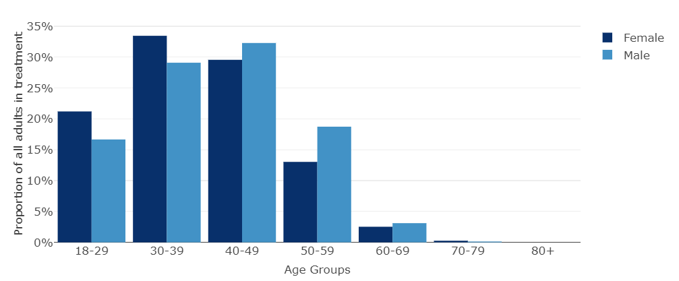
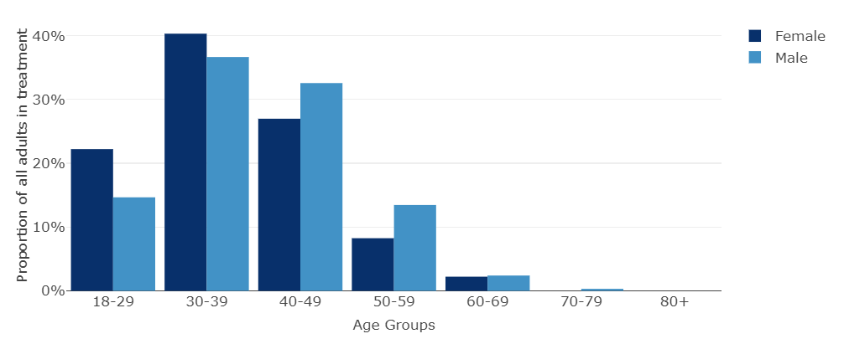
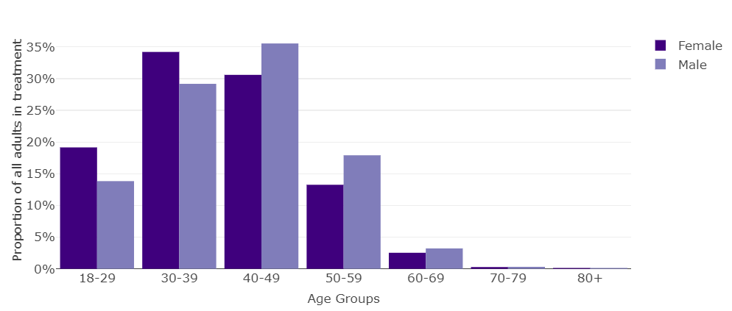
Demographics
Treatment
Drugs
Adults in drug treatment, 2021/22 |  | In treatment
 |  | Cambridgeshire | Peterborough | England
Number |  | 1,672 | 1,147 | 204,518
Sex | Male Female | 69% 31% | 73% 27% | 71% 29%
Age | 18-29 years 30-39 years 40-49 years 50-59 years 60+ years | 18% 30% 31% 17% 3% | 17% 38% 31% 12% 2% | 15% 31% 34% 17% 3%
Highlights
In 2021/22, Peterborough had a higher proportion of males in drug treatment than Cambridgeshire, and a notably higher proportion of 30-39 year olds than both Cambridgeshire and England. Cambridgeshire had a higher proportion of under 30 year olds compared to England.
In line with the national pattern, there were a higher proportion of females in younger age groups and a higher proportion of males in the older ages groups in both local areas.
Cambridgeshire
Peterborough
England
Source: National Drug Treatment Monitoring System (NDTMS), Office for Health Improvement & Disparities

Slide 40
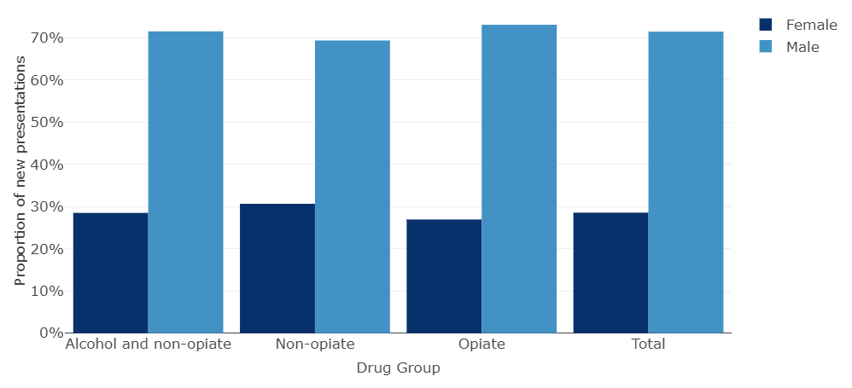
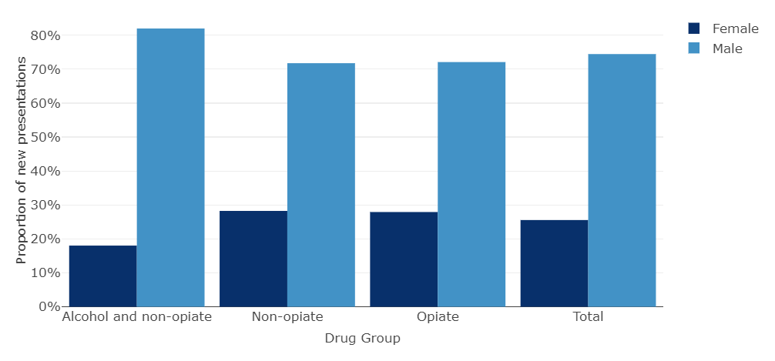
Treatment
Drugs
New presentations to drug treatment
New presentations to drug treatment, 2021/22
Highlights
New presentations | Cambridgeshire |  |  | Peterborough |  |  | England
 | Number | % | Change from 2020/21 | Number | % | Change from 2020/21 | % | Change from 2020/21
Opiate | 234 | 40% | -26.6% | 240 | 49% | -7.0% | 43%
Non opiate | 186 | 32% | -4.1% | 131 | 27% | -3.0% | 26%
Alcohol and non-opiate | 165 | 28% | -15.8% | 122 | 25% | 3.4% | 30%
Total | 585 | 100% | -17.5% | 493 | 100% | -3.5% | 100%
In 2021/22, there were 585 new presentations to drug treatment in Cambridgeshire and 493 in Peterborough, with Peterborough having a higher proportion of opiate new presentations compared to Cambridgeshire and England. Cambridgeshire had a higher increase in non-opiate new presentations.
All drug groups experienced decreases in new presentations between 2020/21 and 2021/22, with the exception of ‘alcohol and non-opiates’ in Peterborough which saw a 3.4% increase.
Around three-quarters of new presentations in Peterborough were male and 71% in Cambridgeshire. There was a higher new presentation proportion in males for ‘alcohol and non-opiate' in Peterborough at 82%.
Cambridgeshire
Peterborough
Source: National Drug Treatment Monitoring System (NDTMS), Office for Health Improvement & Disparities

Slide 41
Most commonly cited problem substances
Treatment
Drugs
Highlights
Opiates, cannabis, alcohol, cocaine and crack cocaine are the most commonly cited substances for new presentations in Cambridgeshire, Peterborough and England.
Peterborough had a higher proportion of crack cocaine and opiates than Cambridgeshire and nationally, with Cambridgeshire having a higher proportion of cocaine.
Source: National Drug Treatment Monitoring System (NDTMS), Office for Health Improvement & Disparities

Slide 42
Protected characteristics
Treatment
Drugs
Protected characteristics of adults presenting to treatment, 2021/22 |  | New presentations
 |  | Cambridgeshire | Peterborough | England
Number % of all in treatment |  | 585 35% | 493 43% | 76,709 38%
Sex | Male Female | 71% 29% | 73% 27% | 71% 29%
Age * | 18-29 years 30-39 years 40-49 years 50-59 years 60+ years | 18% 30% 31% 17% 3% | 17% 38% 31% 12% 2% | 15% 31% 34% 17% 3%
Ethnicity (where known) | White British Other White Pakistani Other Asian African White Irish White and Black Caribbean | 84% 8% 0% 0% 0% 1% 2% | 72% 12% 4% 2% 2% 2% - | 80% 4% 1% 1% 1% 1% 2%
Sexuality (where known) | Heterosexual Gay/Lesbian Bi-sexual | 92% 3% 4% | 95% 2% 2% | 94% 3% 3%
Disability (where known) | No disability Any disability Declared disability - Behaviour and emotional - Mobility and gross motor - Learning | 71% 29% 42% 21% 14% | 59% 41% 64% 19% 17% | 69% 31% 57% 18% 13%
Religion (where known) | None Christian Muslim | 75% 20% 1% | 57% 31% 8% | 69% 22% 4%
Highlights
In 2021/22, there were 585 new presentations to treatment in Cambridgeshire, 35% of all in treatment. In Peterborough there were 493 presentations, 43% of all in treatment. The majority of new presentations were male.
Peterborough had a higher proportion of adults aged 30 to 39 years compared to England and an overall younger treatment population in comparison. The age profile of Cambridgeshire adults in treatment is similar to the national picture
In both Cambridgeshire and Peterborough, the majority of people were White British, with both areas having a notable proportion of ‘Other White’, as well as Peterborough having a higher proportion of Pakistani clients compared to the national average (small numbers).
Most people reported that they were heterosexual, which is in line with the national average.
Peterborough had a higher proportion of clients who reported having a disability compared to Cambridgeshire and England. Of those who declared a disability, the highest were reported as ‘behaviour and emotional’.
Peterborough reported higher levels of Christian and Muslim adults presenting to drug treatment than Cambridgeshire, where a higher proportion of adults reported they had no religion than England.
* Adults in treatment
Source: National Drug Treatment Monitoring System (NDTMS), Office for Health Improvement & Disparities

Slide 43
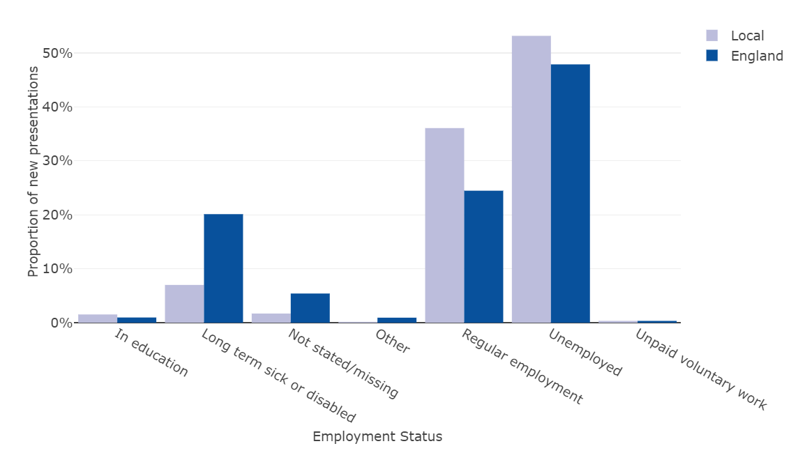
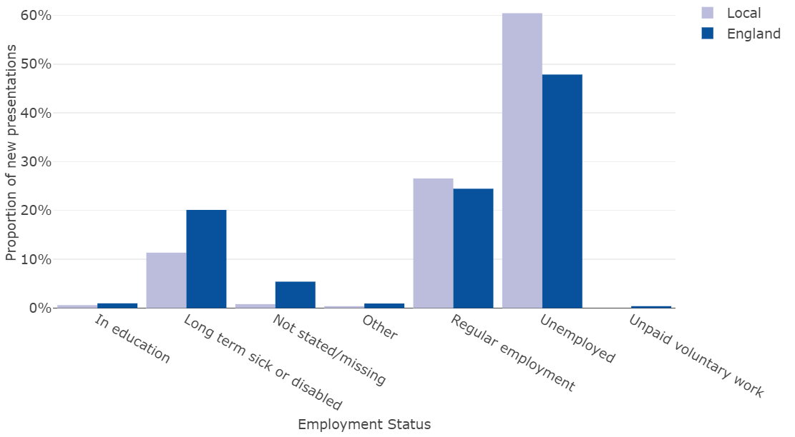
Employment
Treatment
Drugs
Highlights
In 2021/22, over half of adults who started drug treatment in Cambridgeshire (53%) and Peterborough (60%) were unemployed, higher than the national average of 48%.
Cambridgeshire (36%) had a notably high proportion of regularly employed adults starting treatment compared to both Peterborough and England (24%).
Both Cambridgeshire and Peterborough reported having lower proportions of long-term sick or disabled adults starting treatment. This may indicate a coding issue with unemployed.
Adults in drug treatment at the start of treatment by employment status
Cambridgeshire
Peterborough
Source: National Drug Treatment Monitoring System (NDTMS), Office for Health Improvement & Disparities

Slide 44
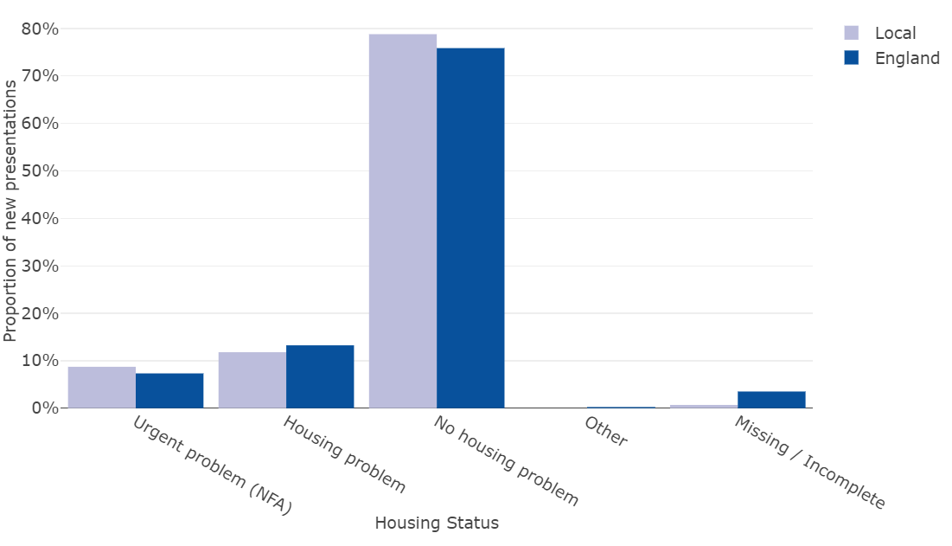
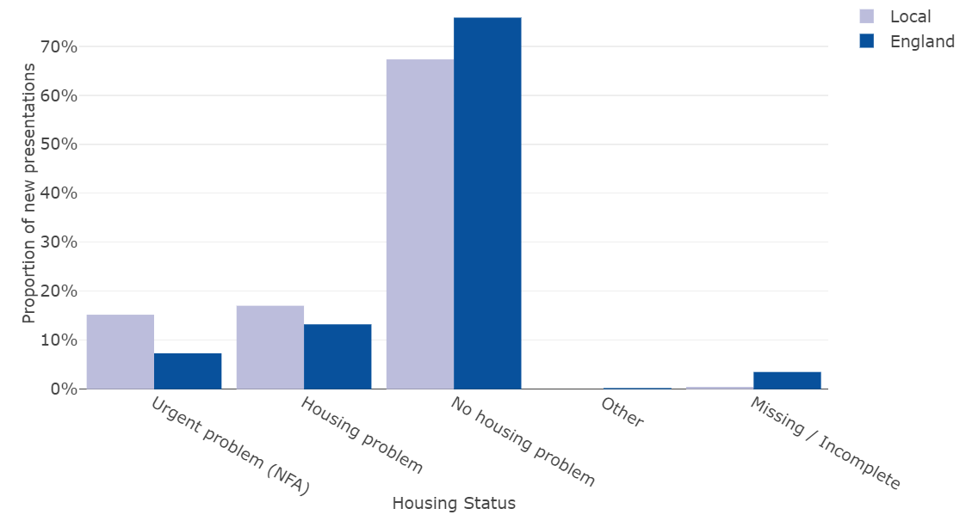
Housing - accommodation status
Treatment
Drugs
Highlights
In 2021/22, overall housing status was similar in Cambridgeshire than experienced nationally. However, at the start of treatment 17% of Peterborough’s clients reported
having a housing problems, higher than the national average of 13%. A further 15% reported having an urgent housing problem, just over double the national proportion (7%).
Drug treatment at the start of treatment by accommodation status
Cambridgeshire
Peterborough
Source: National Drug Treatment Monitoring System (NDTMS), Office for Health Improvement & Disparities

Slide 45
Statutory homelessness duties owed – drug dependency
Homelessness
Drugs
Initial assessments of statutory homelessness duties owed
Support needs of households owed a prevention or relief duty, 2021/22
 | Total households assessed as owed a duty | Drug dependency support needs
 |  | Number | %
Cambridge | 618 | 76 | 12.3%
East Cambridgeshire | 376 | 23 | 6.1%
Fenland | 517 | 35 | 6.8%
Huntingdonshire | 927 | 53 | 5.7%
South Cambridgeshire | 435 | 12 | 2.8%
Cambridgeshire | 2,873 | 199 | 6.9%
Peterborough | 1,363 | 70 | 5.1%
England | 278,110 | 17,630 | 6.3%
Highlights
In 2021/22, 6.9% of households who had an initial assessment of statutory homelessness owed a prevention or relief duty had a drug dependency need in Cambridgeshire, with this need being notably high in Cambridge at 12.3%. All other districts within Cambridgeshire had similar levels to Cambridgeshire, except for South Cambridgeshire where 2.8% were identified as having drug dependency needs.
Peterborough had a lower proportion of drug dependency needs than England at 5.1% compared to 6.3.% nationally.
Source: Statutory homelessness in England: financial year 2021/22, Department for Levelling Up, Housing and Communities

Slide 46
Adults who are parents/carers and their children
Treatment
Drugs
Adults who are parents/carers and their children, 2021/22 |  | Cambridgeshire | Peterborough | England
Number |  | 585 | 493 | 75,929
Parental status (where known) | Living with children Not with children Other contact, living with children Not parent/no contact with children | 21% 11% 2% 66% | 14% 17% - 67% | 16% 18% 2% 64%
Living with children | Number of children living with drug users | 291 | 144 | 25,402
Early help and children’s social care (where known) | No early help Child protection plan in place Child in need Looked after child Early help | 73% 17% 14% 5% 8% | 71% 16% 12% 7% 3% | 64% 14% 8% 9% 6%
Highlights
In 2021/22, a fifth of adults presenting to drug treatment in Cambridgeshire were parents living with children, a higher proportion than Peterborough (14%) and England (16%).
In Peterborough, 17% of parents were not living with children, higher than the Cambridgeshire average (11%) and around the same as nationally (18%).
In both Cambridgeshire and Peterborough, there was a higher proportion of client’s children receiving no early help compared to nationally. Both areas had higher proportions of child protection plan in place and children in need.
Source: National Drug Treatment Monitoring System (NDTMS), Office for Health Improvement & Disparities

Slide 47
Co-occurring mental health and substance misuse
Treatment
Drugs
Adults who entered drug treatment and were identified as having mental health treatment need, 2021/22 |  | Cambridgeshire |  | Peterborough |  | England
 |  | Number | Proportion of eligible adults | Number | Proportion of eligible adults | Proportion of eligible adults
Drug group | Total | 418 | 71% | 335 | 68% | 70%
 | Opiates | 156 | 67% | 162 | 68% | 66%
 | Non opiates | 138 | 74% | 84 | 64% | 70%
 | Alcohol and non-opiates | 124 | 75% | 89 | 73% | 76%
Mental health treatment received | Total | 313 | 75% | 253 | 76% | 75%
 | GP | 274 | 66% | 216 | 64% | 55%
 | Already engaged | 43 | 10% | 42 | 13% | 22%
 | Engaged with IAPT | 7 | 2% | - | - | 2%
 | NICE | - | - | - | - | 2%
 | Health-based place | - | - | - | - | 1%
Highlights
Around 7 in 10 people who entered drug treatment in 2021/22 were identified as having a mental health treatment need in Cambridgeshire and Peterborough.
Three-quarters of those were receiving mental health treatment, primarily from their GPs.
Source: National Drug Treatment Monitoring System (NDTMS), Office for Health Improvement & Disparities. Opiates includes opiates only, opiates and alcohol and/or opiate and non-opiates

Slide 48
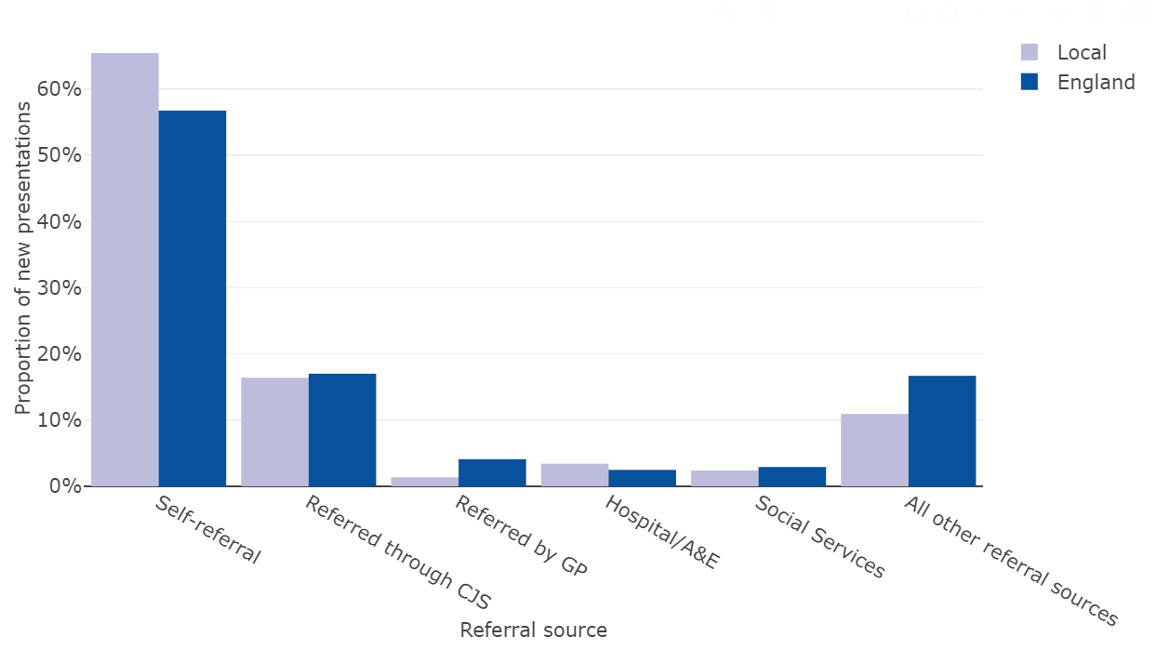
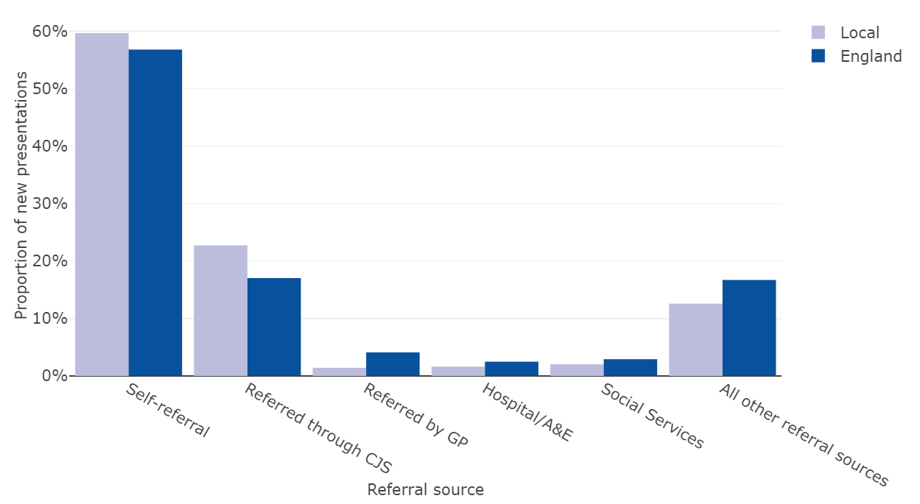
Access - routes into treatment
Treatment
Drugs
Cambridgeshire
Peterborough
100% of Cambridgeshire clients were seen within 3 weeks from referral for their first intervention in 2021/22
A higher proportion of clients self-referred compared to England, at 65% compared to 57%
There were differences in gender, with self-referral and referred through the Criminal Justice System (CJS) as the main source of referral for both sexes but 7% of females were referred through social services compared to 1% of males (small numbers)
99% of Peterborough clients were seen within 3 weeks from referral for their first intervention in 2021/22
Slightly higher proportion of clients self-referred compared to England, at 60% compared to 57%, with a higher proportion referred from the Criminal Justice System (23% compared to 17%).
Double the proportion of males (26%) to females (13%) were referred through CJS
Female referrals were higher from social services (5% compared to 1% in males)
New presentations by referral source, 2021/22
Cambridgeshire
Peterborough
Prison 47%
Probation 45%
Liaison and diversion 4%
Drug Rehabilitation Requirement (DRR) 4%
Prison 64%
Arrest referral 21%
Liaison and diversion 6%
Drug Rehabilitation Requirement (DRR) 4%
Probation 4%
Source: National Drug Treatment Monitoring System (NDTMS), Office for Health Improvement & Disparities

Slide 49
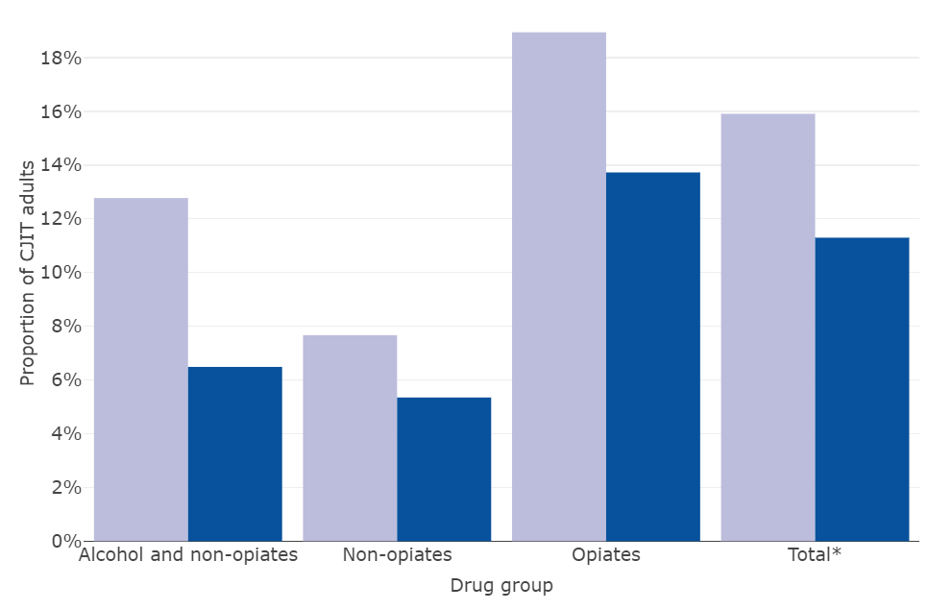
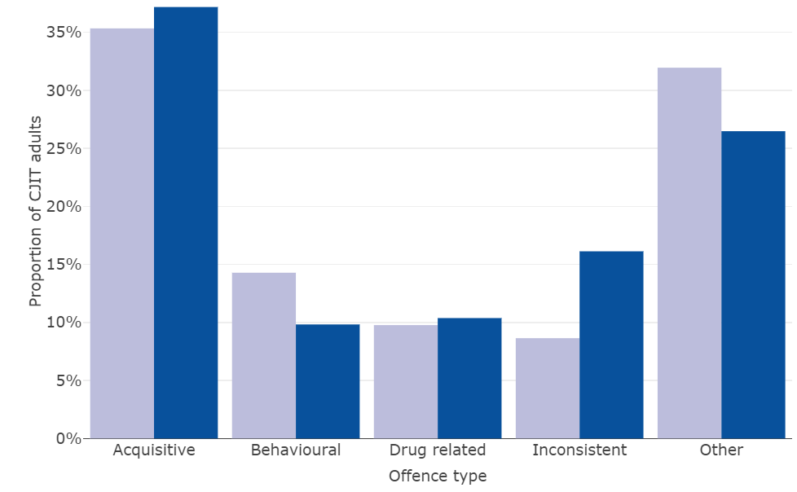
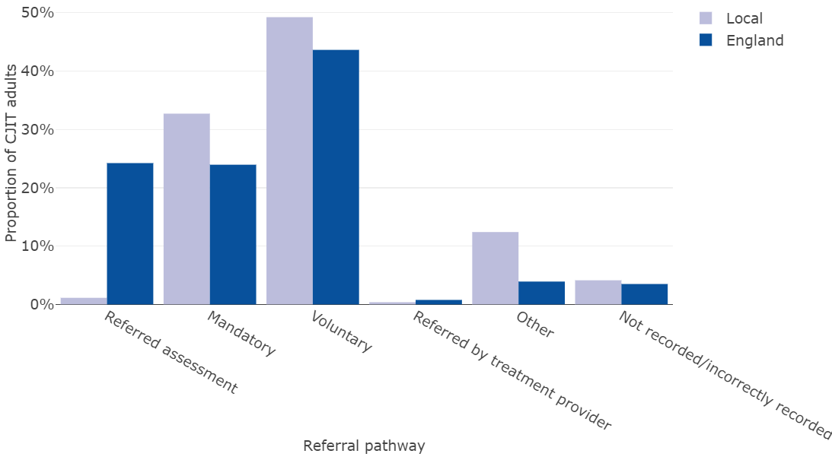
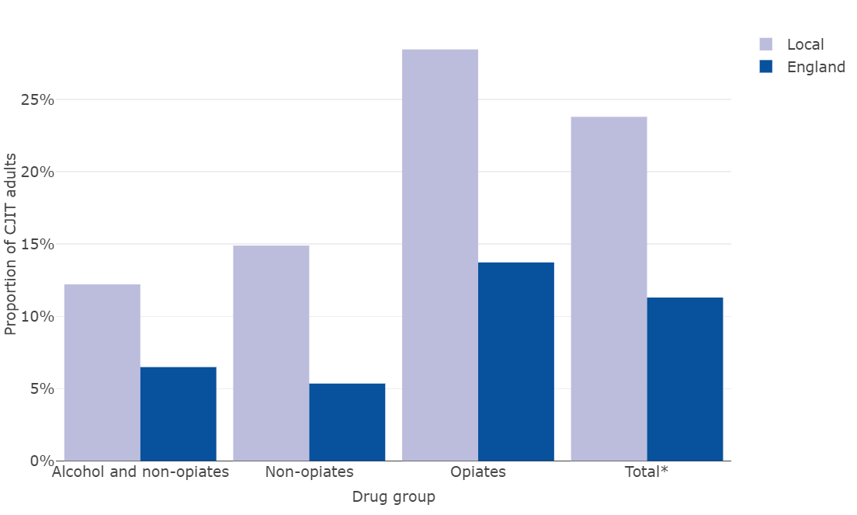
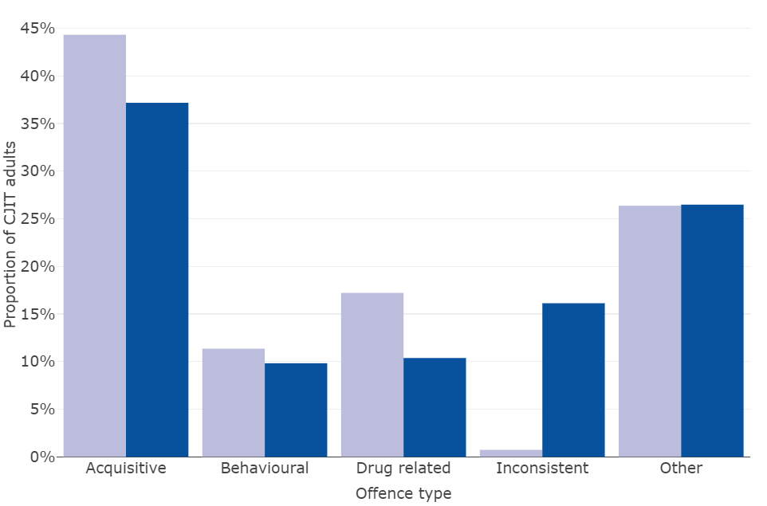
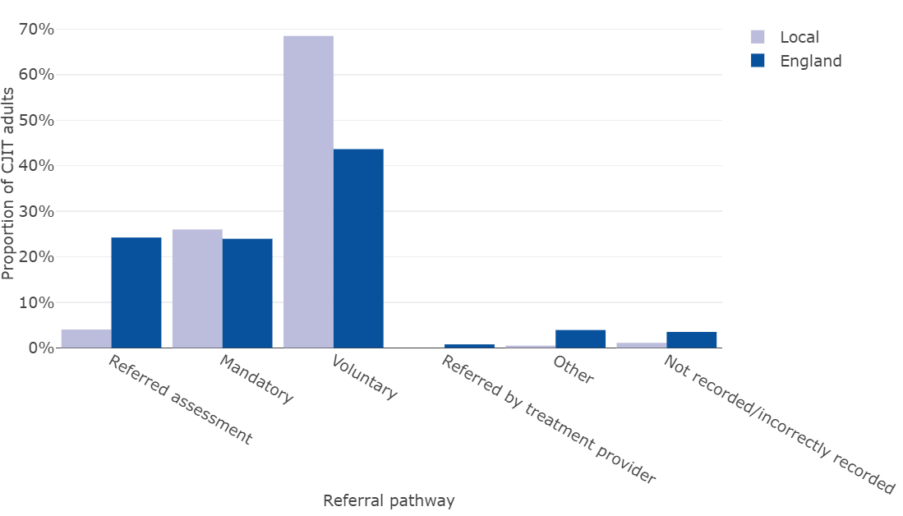
Criminal Justice Integrated Teams(CJIT) – in contact with services
Treatment
Drugs
Clients who were in contact with Criminal Justice Integrated Teams (CJIT) and community-based treatment
Highlights
Cambridgeshire
A higher proportion of CJIT adults were in contact with the treatment system in Cambridgeshire and, notably, Peterborough compared to the national average.
A higher proportion of adults were due to behavioural offences in Cambridgeshire and ‘Other’ compared to England; whilst all types of offences were higher in Peterborough.
There was a notably high proportion of voluntary referrals in Peterborough compared to England, and also a higher proportion in Cambridgeshire, where there was also a higher proportion of mandatory referrals.
CJIT adults in contact with treatment
system
CJIT adults by offence type
CJIT adults by referral pathway
Peterborough
CJIT adults in contact with treatment
system
CJIT adults by offence type
CJIT adults by referral pathway
Criminal Justice Integrated Teams (CJIT) were established in 2003 as part of the Drug Interventions Programme (DIP) as a dedicated resource refer, assess and case manage substance misusing offenders into treatment. When DIP was discontinued as a centrally funded national programme in 2012, some local authorities continued to maintain dedicated teams while others integrated CJIT posts into mainstream community-based treatment services
Source: National Drug Treatment Monitoring System (NDTMS), Office for Health Improvement & Disparities Note: CJIT – Criminal Justice Intervention Teams

Slide 50
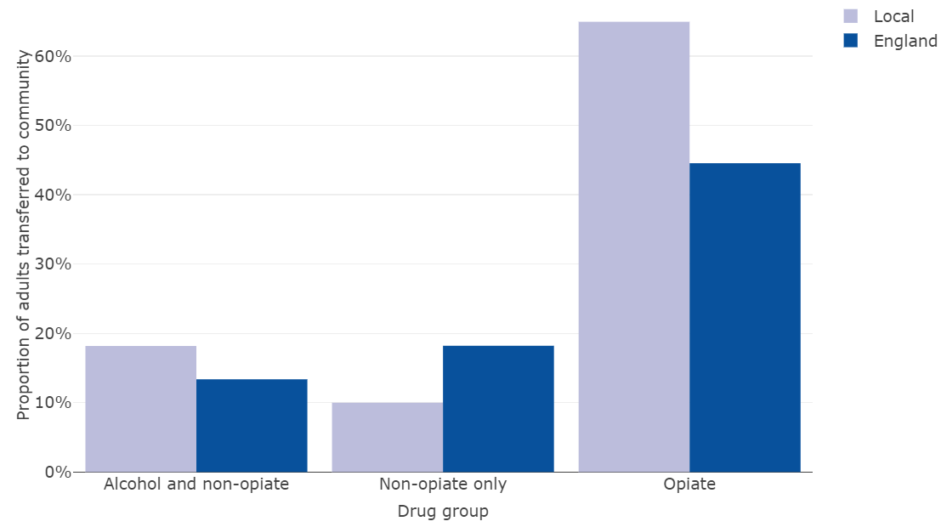

Drugs
Criminal Justice Pathway – release from prison
Treatment
Highlights
In 2021/22 113 adults were released from prison and transferred to a community treatment provider for structured treatment in Cambridgeshire, with half being successfully engaged; higher than the national average of 37%. Engagement was notably high in opiate users, at almost two-thirds of those transferred. In Peterborough 56% of the 158 adults released from prison successfully engaged in community structured treatment, and was almost at two-thirds for opiate users.
Adults transferred to community who successfully engaged, 2021/22
Peterborough
Cambridgeshire
Drug and alcohol use among the prison population is considerably higher in comparison to drug and alcohol use in the general population. National prison estimates suggest 81% of prisoners reported using illicit drugs at some point prior to entering prison, including 64% within the month before entering prison. Specifically, in HMP Peterborough, the overall mandatory drug test (MDT) positive rate for the male cohort was higher in comparison to the average of all prisons, at 32% (nationally across all prisons in England the MDT positive rate was 14%). *
Source: National Drug Treatment Monitoring System (NDTMS), Office for Health Improvement & Disparities. * TONIC report Opiates: opiates only, opiates & alcohol and/or opiate and non-opiates

Slide 51
High level interventions
Treatment
Drugs
Adults in treatment in high level interventions and settings, 2021/22 |  | Pharmacological |  | Psychosocial |  | Recovery support |  | Total
 |  | Number | % | Number | % | Number | % | Number | %
Cambridgeshire | Community Inpatient Unit Primary Care Residential | 1,058 28 51 5 | 98% 3% 5% 0% | 1,650 10 33 17 | 99% 1% 2% 1% | 1,333 6 18 11 | 99% 0% 1% 1% | 1,666 28 57 17 | 100% 2% 3% 1%
Peterborough | Community Inpatient Unit Primary Care Residential | 715 12 - - | 99% 2% - - | 1,147 6 - - | 100% 1% - - | 1,108 - - - | 100% - - - | 1,147 12 - - | 100% 1% - -
Highlights
Almost all adults in treatment are seen within a community setting, and for all types of intervention.
Cambridgeshire had a higher proportion of methadone interventions than seen nationally, and a higher proportion of unsupervised interventions. Peterborough was more similar to the national pattern.
Cambridgeshire had a higher proportion of clients, who had a prescribing intention, on maintenance methadone than nationally, a lower proportion with buprenorphine maintenance and a higher proportion with an unspecified opioid substance therapy.
Peterborough had similar proportion of those with methadone maintenance to England , a notably higher proportion of clients with buprenorphine maintenance, especially compared to Cambridgeshire and higher unspecified OST compared to England.
Adults who were in treatment for opiates and had pharmacological sub-interventions, 2021/22 |  |  | Cambridgeshire | Peterborough | England
Opioid substance therapy (OST) interventions | All prescribing interventions |  | 1,012 | 697 | 131,005
 | Any OST interventions Methadone intervention Buprenorphine intervention Buprenorphine with naloxone intervention |  | 94% 77% 24% 1% | 95% 70% 35% 2% | 89% 71% 28% 6%
OST Supervision status | All clients with an OST supervised status |  | 938 | 658 | 131,005
 | Any supervised OST Any unsupervised OST Supervised methadone Unsupervised methadone |  | 52% 86% 45% 70% | 66% 74% 51% 54% | 59% 78% 49% 62%
OST Prescribing intention | All clients with an OST prescribing intention |  | 956 | 662 | 116,859
 | Methadone | Maintenance Assessment & stabilisation Withdrawal | 76% 32% 14% | 68% 29% 11% | 68% 26% 14%
 | Buprenorphine | Maintenance Assessment & stabilisation Withdrawal | 21% 10% 3% | 32% 15% 2% | 24% 10% 5%
 | Unspecified OST | Maintenance Assessment & stabilisation Withdrawal | 66% 35% 13% | 60% 40% 21% | 54% 30% 15%
Source: National Drug Treatment Monitoring System (NDTMS), Office for Health Improvement & Disparities

Slide 52
Blood-borne virus and overdose death prevention
Treatment
Drugs
It is estimated that over one quarter (29%) of people aged 15 to 64 who use opioids and/or crack cocaine in England inject drugs. People who inject drugs are vulnerable to a wide range of health harms which can result in high levels of morbidity and mortality, including blood borne viral infections, bacterial infections, and overdose ¹
Prevention |  |  | Cambridgeshire |  | Peterborough |  | England
 |  |  | Number | Proportion of eligible adults | Number | Proportion of eligible adults | Proportion of eligible adults
Hepatitis B | Adults eligible for a HBV vaccination and accepted one |  | 166 | 40% | 80 | 24% | 28%
 | Accepted and completed course |  | 12 | 7% | 8 | 10% | 12%
 | Accepted and started |  | 5 | 3% | 5 | 6% | 8%
Hepatitis C | Adults eligible for a HCV test who accepted one |  | 269 | 49% | 225 | 47% | 45%
 | Adults who have a positive HCV antibody test |  | 52 | 22% | 46 | 20% | 21%
Naloxone issued | All opiate adults in treatment issued |  | 563 | 51% | 266 | 34% | 40%
 | Issued | Injectable Nasal Both | 102 - - | 44% - - | 91 5 - | 38% 2% - | 36% 5% -
 | Not issued | Client already has Assessed as not appropriate | 66 17 | 28% 7% | 61 12 | 25% 5% | 20% 24%
Naloxone administered |  |  | 80 | 7% | 67 | 9% | 6%
Injecting use | Never injected Previously injected Currently injecting |  | 100 58 76 | 43% 25% 32% | 365 78 49 | 74% 16% 10% | 72% 17% 10%
Highlights
Vaccination uptake for Hepatitis B and C was higher in Cambridgeshire than seen nationally. Peterborough had slightly lower uptake to England.
Over half of opiate adults in treatment in Cambridgeshire were issues with naloxone, higher than the national average of 40%, Peterborough was lower at 34%. However, Peterborough had a slightly higher proportion of administration of naloxone.
Cambridgeshire had a lower proportion of clients who had never injected, at 43% compared to almost over 70% in England and Peterborough. However, Cambridgeshire had a notably high proportion of adults who are currently injecting, at three times the national average.
Source: National Drug Treatment Monitoring System (NDTMS), Office for Health Improvement & Disparities

Slide 53


Engagement - early unplanned exits
Treatment
Drugs
Early unplanned exits | Cambridgeshire | Peterborough | England
Number | 95 | 132 | 13,647
Opiate | 17% | 26% | 17%
Non-opiate | 17% | 28% | 20%
Alcohol and non-opiate | 14% | 27% | 18%
Total | 16% | 27% | 18%
Highlights
There is a higher proportion of early unplanned exits in Peterborough, at over a quarter of all new presentations, compared to England and Cambridgeshire, and in all drug groups.
In Cambridgeshire the proportions are slightly lower than seen nationally.
When engaged in treatment, people use less illegal drugs, commit less crime, improve their health, and manage their lives better - which also benefits the community. Preventing early drop out and keeping people in treatment long enough to benefit contributes to these improved outcomes. As people progress through treatment, the benefits to them, their families and their community start to accrue
Early unplanned exits as a proportion of new presentations, 2021/22
Cambridgeshire
Peterborough
Source: National Drug Treatment Monitoring System (NDTMS), Office for Health Improvement & Disparities. Opiates includes opiates only, opiates and alcohol and/or opiate and non-opiates

Slide 54
Treatment
Drugs
Length of time in treatment
Drug group | Length of time | Cambridgeshire |  | Peterborough |  | England
 |  | Number | % of all in treatment | Number | % of all in treatment | Number | % of all in treatment
Opiates | < 2 years | 448 | 41% | 385 | 49% | 58,986 | 42%
 | 6+ years | 324 | 30% | 184 | 23% | 39,671 | 28%
Non-opiates | 2+ years | 13 | 4% | - | - | 892 | 3%
Non-opiates and alcohol | 2+ years | 19 | 7% | - | - | 1,396 | 4%
Highlights
Cambridgeshire had a similar proportion of lengths of stay for opiates and non-opiates to England, but slightly higher proportion for those in treatment for longer than 2 years for non-opiates and alcohol.
Peterborough had a higher proportion of adults in treatment for under 2 years compared to England.
Source: National Drug Treatment Monitoring System (NDTMS), Office for Health Improvement & Disparities. Opiates includes opiates only, opiates and alcohol and/or opiate and non-opiates

Slide 55
Successful * completion of drug treatment
Treatment
Drugs
Successful completion of drug treatment
Opiate users Non opiate users
Highlights
In 2021 there were 41 successful (dependent free) treatment completions for opiate users and 204 for non-opiate users in Cambridgeshire, with a further 33 successful opiate treatments and 113 non-opiate treatments in Peterborough. Both areas had similar treatment completion rates to England. All areas, including England, are experiencing decreasing trends in successful completion of opiate treatment.
There were higher proportions of adults with substance misuse treatment need who successfully engage in community-based structured treatment following release from prison in both Cambridgeshire and Peterborough, at 50% in Cambridgeshire and 56% in Peterborough.
Adults with substance misuse treatment need who successfully engage in community-based structured treatment following release from prison
* Free of dependence
Source: Public Health Outcomes Framework, Fingertips, Office for Health Improvement & Disparities Comments relate to statistically significant differences to England

Slide 56


Drugs misuse mortality
Mortality
Drugs
Deaths from drug misuse, directly age standardised rate per 100,000 population
Highlights
There are on average 20 deaths from drug misuse a year in Cambridgeshire and 8 a year in Peterborough, with just over 70% in males in Cambridgeshire and 64% in males in Peterborough (not presented due to small numbers).
The drug misuse mortality rate in Cambridgeshire is lower than seen nationally, and decreasing, with the rate in Peterborough being statistically similar to England, and remains relatively stable at just below the national rate. Nationally there is an increasing rate of drug misuse mortality.
Drug misuse mortality is highest in the most deprived districts of England.
Deaths in drug treatment are significantly lower than expected (given national rates) in Peterborough.
Deaths in drug treatment
(mortality ratio)
England is solid black line
Deaths from drug misuse - deprivation rates – England
(based on districts)
Note: ‘-’ denotes numbers are too small to be able to calculate value. Totals due not agree due to rounding
Source: Public Health Outcomes Framework, Fingertips, Office for Health Improvement & Disparities

Slide 57
Children and Young People

Slide 58
Children and young people summary for 2021/22
Drugs
Cambridgeshire | Peterborough
Alcohol In a school survey there was higher alcohol consumption in the last 7 days in females than male, and within the older age group. Consumption was higher than in Peterborough. ⁵⁹ Hospital admissions due to alcohol similar to England, with a decreasing trend, as also seen nationally. ⁶⁰ Drugs In a school survey around 11% of Year 10 pupils reported taking drugs to get high, and was higher in females than males and notably higher than Year 8. Around a quarter of Year 10 pupils had been offered cannabis resin leaf or oil. ⁶¹⁻⁶² Hospital admissions for substance misuse are low ⁶³ Risk factors Low rate of first time entrants to youth justice system and decreasing trend ⁶⁴ Low suspensions from school for drug and alcohol issues ⁶⁵ Treatment 111 children and young people in treatment and 80 new presentations, higher in males than females and higher proportion of 16-17 year olds ⁶⁶ High proportion of White British ⁶⁷ Higher proportion of cannabis and alcohol ⁶⁸ High proportion not parent but living with children ⁶⁹ High proportion of early help ⁶⁹ Higher proportion of referrals from youth criminal justice and health services. Highest from social care. ⁷⁰ Higher proportion ‘not in education, employment or training’ ⁷³ Higher proportion living with parents ⁷⁴ High proportion identified as having a mental health need and high proportion receiving treatment ⁷⁵ Longer lengths of treatment ⁷⁶ Low harm reduction interventions ⁷⁶ High early onset (started before 15 years) and using two or more substances (including alcohol) ⁷⁷ High involvement in self-harm, anti-social behaviour, affected by domestic abuse and child in need ⁷⁸l Almost all successful completions did not re-present in 6 months ⁷⁹ | Alcohol In a school survey there was higher alcohol consumption in the last 7 days in females than male, and within the older age group. Consumption was lower than in Cambridgeshire. ⁵⁹ Hospital admissions due to alcohol lower than England, with a recent upward trend but remains notably lower than England. ⁶⁰ Drugs In a school survey around 11% of Year 10 pupils reported taking drugs to get high, and was higher in females than males and notably higher than Year 8. Around a quarter of Year 10 pupils had been offered cannabis resin leaf or oil. ⁶¹⁻⁶² Hospital admissions for substance misuse are low ⁶³ Risk factors High rate of first time entrants to youth justice system, highest in East of England ⁶⁴ Similar suspensions from school for drug and alcohol issues ⁶⁵ Treatment 139 children and young people in treatment and 110 new presentations (higher than Cambridgeshire), higher in males than females and notably high proportion in under 16 year olds and 16-17 year olds ⁶⁶ Low proportion of White British and higher ‘Other White’ and Pakistani (sn) ⁶⁷ Cannabis was the only drug that was higher than England ⁶⁸ High proportion not parent but living with children ⁶⁹ Low proportion of early help ⁶⁹ Notably high proportion of referrals from education and young criminal justice ⁷⁰ Higher proportion of alternative education and apprentices ⁷³ Higher proportion living with parents ⁷⁴ Low proportion identified as having a mental health need but of those known high proportion receiving treatment ⁷⁵ Shorter lengths of treatment ⁷⁶ High harm reduction interventions ⁷⁶ High early onset (started before 15 yrs) & using two or more substances (including alcohol) ⁷⁷ High involvement in self-harm, affected by others substance misuse, affected by domestics abuse and affected by sexual exploitation ⁷⁸ Almost all successful completions did not re-present in 6 months ⁷⁹
Note: superscript numbers relates to slide number. (sn) – small numbers. Comparisons are made to England.

Slide 59
A larger proportion of female pupils had recently drunk alcohol. Consumption rates were higher in Cambridgeshire than Peterborough.
Health Related Behavioural Survey
Alcohol
Alcohol
Question: Have you had any alcohol in the last 7 days?
Key findings:
Cambridgeshire
22% of Cambridgeshire pupils and 13% of Peterborough pupils responded they had an alcoholic drink in the 7 days before the survey
In some categories, rates for Cambridgeshire pupils are almost double the rates for Peterborough pupils
A larger proportion of females had drunk alcohol in the 7 days prior in both year groups compared to males. This was true for both Cambridgeshire and Peterborough
In Cambridgeshire, 1 in 3 females in Year 10 had drunk alcohol in the 7 days prior (33% in 2022, 31% in 2021)
There is a considerable increase between responses to having drunk alcohol in the 7 days prior among Year 10 pupils compared to Year 8 pupils.
Peterborough
Other findings:
22% of Cambridgeshire pupils responded they had an alcoholic drink in the 7 days before the survey, this compares to 22% in 2021 and 25% in 2018 (comparator data not available for Peterborough).
When asked how they obtained the alcohol, 78% of Cambridgeshire pupils who stated they had drunk in the last 7 days said ‘someone gave it to me’ (17% of all respondents). For Peterborough this figure was 71% (9% of all respondents)
The proportion of Year 10 males in Cambridgeshire who had drunk alcohol decreased from 31% in 2021 to 27% in 2022.
Source: Health Related Behaviour Survey, The Schools Health Education Unit
Notes:
Health Related Behaviour Survey (HRBS) Cambridgeshire and Peterborough 2022 – questions 29 and 30
HRBS Cambridgeshire 2021 and 2018
Total respondents – 6,142 in Cambridgeshire and 2,580 in Peterborough

Slide 60

Alcohol
Alcohol-specific conditions, under 18 year olds
Hospital admissions
Hospital admission episodes for alcohol-specific conditions,
Under 18 years olds, 2018/19 – 2020/21
Highlights
Peterborough had a low rate of alcohol specific hospital admissions in under 18 year olds compared to England, and has experienced decreases in rates since 2014/17.
The rate in Cambridgeshire is similar to nationally, with a general decrease in rates since 2014/17.
Area | Number | Rate per 100,000
Cambridgeshire | 125 | 30.5
Peterborough | 30 | 19.3
England | 10,569 | 29.3
Cambridgeshire
Peterborough
Source: National Drug Treatment Monitoring System (NDTMS), Office for Health Improvement & Disparities Comments relate to statistically significant differences to England

Slide 61
By Year 10, 1 in 4 pupils across Cambridgeshire & Peterborough reported having been offered cannabis
Drugs
Health Related Behavioural Survey
Drugs
Question: Have you ever been offered drugs to get high? - Cannabis resin, leaf or oil
Cambridgeshire
Key findings:
17% (17% in 2021) of Cambridgeshire pupils and 16% of Peterborough pupils said they had been offered cannabis resin, leaf or oil to get high
There is a considerable increase between responses of being offered drugs among Year 10 pupils compared to Year 8 pupils
By year 10, 1 in 4 pupils had been offered cannabis. A higher proportion of females had been offered cannabis
5% (4% in 2021) of Cambridgeshire pupils and 4% of Peterborough pupils said they had been offered other drugs to get high
Rates of other drugs offered, compared to cannabis, are much lower.
Peterborough
Question: Have you ever been offered drugs to get high? - Other drugs to get high
Cambridgeshire
Peterborough
Source: Health Related Behaviour Survey, The Schools Health Education Unit
Notes:
Health Related Behaviour Survey (HRBS) Cambridgeshire and Peterborough 2022 – question 33
Total respondents – 6,111 in Cambridgeshire and 2,562 in Peterborough

Slide 62
Drugs: More than 1 in 10 Year 10 C&P pupils reported having taken drugs to get high. Rates are higher among females.
Drugs
Health Related Behavioural Survey
Drugs
Question: Have you ever taken any drugs to get high? e.g. cannabis, amphetamine, ecstasy (not your own prescription)?
Key findings:
Cambridgeshire
6% of Cambridgeshire pupils and 7% of Peterborough pupils responded they had ever taken any drugs to get high
In Cambridgeshire, 3% of Year 8 pupils said they had taken drugs to get high compared to 11% of Year 10 pupils
In Peterborough, 2% of Year 8 pupils said they had taken drugs to get high compared to 11% of Year 10 pupils
In both Cambridgeshire and Peterborough a larger proportion of females in Year 10 had taken any drugs to get high
Peterborough
Other findings:
Of those pupils responding that they have taken at least one of the drugs listed, 53%* in Cambridgeshire and 59%* in Peterborough had taken them ‘within the last month’ (most recent drug use recorded).
*3% of all Cambridgeshire respondents, 4% of all Peterborough respondents
Source: Health Related Behaviour Survey, The Schools Health Education Unit
Notes:
Health Related Behaviour Survey (HRBS) Cambridgeshire and Peterborough 2022 – question 34
Total respondents – 6,111 in Cambridgeshire and 2,566 in Peterborough

Slide 63

Hospital admissions
Drugs
Substance misuse (15-24 years)
Hospital admissions due to substance misuse (15-24 years), 2018/19 to 2020/21
Highlights
Both Cambridgeshire and Peterborough had low substance misuse hospital admission in young people compared to England. There have been notable decreases in rates in Peterborough, with rates in 2013/14 to 2017/18 being significantly higher than England to rates in 2018/21 being significantly lower than England, and lower than Cambridgeshire.
Area | Number | Rate per 100,000
Cambridgeshire | 160 | 65.8
Peterborough | 35 | 54.8
England | 16,053 | 81.2
Cambridgeshire
Peterborough
England is solid black line
Source: National Drug Treatment Monitoring System (NDTMS), Office for Health Improvement & Disparities Comments relate to statistically significant differences to England

Slide 64


First time entrants to the youth justice system
Offending
Drugs
First time entrants to the youth justice system, under 18’s, 2021
Highlights
Area | Number | Rate per 100,000
Cambridgeshire | 70 | 115.1
Peterborough | 49 | 231.1
England | 7,805 | 146.9
Peterborough had high rate of first time entrants to the youth justice system in children and young people aged under 18 years compared to England and was the only local authority in the East of England to have a high rate. Until the lates time period Peterborough had rates that were similar to England.
Cambridgeshire had low rates in 2021 compared to England.
First time entrants to the youth justice system, under 18’s, 2021
Cambridgeshire
Peterborough
Youth justice, particularly Youth Offending Teams, are a major source of referrals into substance misuse treatment for young people. To improve co-ordination between Youth Offending Teams (YOTs) and substance misuse services a new substance misuse key performance indicator will be introduced for YOTs in England from April 2023 covering treatment engagement of YOT service users with substance misuse needs.
England is solid black line
Source: Fingertips, Office for Health Improvement & Disparities Comments relate to statistically significant differences to England

Slide 65
Drugs & Alcohol
Suspensions from school
Education
Suspensions from school related to drugs and alcohol, 2020/21
Highlights
In 2020/21 92 suspensions from school in Cambridgeshire and 69 in Peterborough were related to drugs and alcohol, with the rate in Cambridgeshire rate being lower than England and similar in Peterborough.
In total 15% of Peterborough’s permanent exclusions related to drugs and alcohol, but numbers are very small (too small to report here). There were no drug and alcohol related permanent exclusions in Cambridgeshire.
Area | Number | % of all suspensions
Cambridgeshire | 92 | 2.2%
Peterborough | 69 | 2.9%
England | 11,343 | 2.8%
Source: National Drug Treatment Monitoring System (NDTMS), Office for Health Improvement & Disparities Comments relate to statistically significant differences to England

Slide 66



Children and young people in treatment
Treatment
Drugs
Young people in treatment, 2021/22 |  | In treatment
 |  | Cambridgeshire | Peterborough | England
Number |  | 111 | 139 | 14,884
Sex | Male Female | 59% 41% | 59% 41% | 62% 38%
Age | Under 16 years 16-17 years 18-24 years | 39% 51% 10% | 57% 42% - | 40% 37% 24%
Highlights
In 2021/22 there were 111 young people aged under 25 years in specialist substance misuse services in Cambridgeshire, with 59% being male and over half aged 16 to 17 years (higher than the national proportion of 37%). Cambridgeshire had a lower proportion of young adults in treatment compared to England.
Peterborough had a higher number of young people in treatment than Cambridgeshire and a different age profile to England, with only 1% of those in treatment aged 18 to 24 years, compared to almost a quarter nationally.
Cambridgeshire
Peterborough
England
Source: National Drug Treatment Monitoring System (NDTMS), Office for Health Improvement & Disparities

Slide 67


Children and young people – ethnicity
Treatment
Drugs
Young people in treatment by ethnicity, 2021/22
Cambridgeshire
Cambridgeshire had a higher proportion of White British children and young people in treatment compared to England (84% compared to 73%)
Peterborough
Peterborough had a lower proportion of White British children and young people in treatment compared to England (57% compared to 73%) and a higher proportion of ‘Other White’.
Over a fifth of children and young people in treatment were in the ‘Other White’ ethnic group compared to 4% nationally.
Peterborough had a higher proportion of Pakistani children and young people in treatment compared to England (5% compared to 1%) but numbers are small.
Cambridgeshire
Peterborough
Source: National Drug Treatment Monitoring System (NDTMS), Office for Health Improvement & Disparities

Slide 68


Children and young people – substance
Treatment
Drugs
Young people (including 18-24 year in young people’s services) in treatment by reported primary problem substance, 2021/22
Cambridgeshire
Three quarters of children and young people in treatment in Cambridgeshire were due to their cannabis use, higher than the national average of 69%
Almost a quarter (23%) were in treatment for alcohol use, slightly higher than a fifth nationally
Peterborough
Peterborough had a notably high proportion of children and young people in treatment for cannabis use compared to England (86% compared to 69%)
One in ten were in treatment for alcohol use, half than national average of one in five
Cambridgeshire
Peterborough
Source: National Drug Treatment Monitoring System (NDTMS), Office for Health Improvement & Disparities

Slide 69
Young people who are parents/carers and their children
Treatment
Drugs
Young people who are parents/carers and their children, 2021/22 |  | Cambridgeshire | Peterborough | England
Number |  | 100 | 138 | 11,326
Parental status (where known) | Not a parent, not living with children Not a parent, living with children Parent, not living with children Parent, living with children | 41% 57% - - | 49% 49% - - | 55% 35% 3% 2%
Living with children | Number of children living young people in treatment | 101 | 138 | 6,472
Early help and children’s social care (where known) | No early help Early help Child in Need Looked after child Child protection plan in place | 63% 9% 11% 7% 9% | 88% 2% 6% - - | 70% 11% 9% 5% 4%
Highlights
In 2021/22 the majority of young people in treatment were not parents, however 57% of young people in Cambridgeshire and 49% in Peterborough were living with children; higher than the national average of 35%.
Source: National Drug Treatment Monitoring System (NDTMS), Office for Health Improvement & Disparities

Slide 70


Children and young people – drinking levels
Treatment
Alcohol
Young people (aged under 18 years) in treatment by drinking level units (28 days prior to starting treatment)
Cambridgeshire
Cambridgeshire had a higher proportion of young people aged under 18 years who consumed between 1 and 199 drinking units compared to England, and generally higher consumption than nationally, but numbers are small.
Peterborough
Peterborough had a higher proportion of young people aged under 18 years who consumed between 1 and 199 drinking units compared to England
Cambridgeshire
Peterborough
Source: National Drug Treatment Monitoring System (NDTMS), Office for Health Improvement & Disparities

Slide 71
Children and young people new to treatment
Treatment
Alcohol
Young people new to treatment, 2021/22 |  | New to treatment
 |  | Cambridgeshire | Peterborough | England
Number |  | 80 | 110 | 10,347
Sex | Male Female | 59% 41% | 60% 40% | 62% 38%
Age | Under 16 years 16-17 years 18-24 years | 39% 55% 6% | 56% 43% - | 44% 35% 21%
Highlights
In 2021/22 there were 80 new presentations to treatment in Cambridgeshire of children and young people and a higher number of 110 in Peterborough.
Around four in ten were female.
Cambridgeshire had a higher proportion of 16 to 17 year olds than seen nationally and all children and young people in Peterborough being aged under 18 years (a fifth of England’s children and young people were aged 18 to 24 years old). This is likely to be due to treatment pathways.
Source: National Drug Treatment Monitoring System (NDTMS), Office for Health Improvement & Disparities

Slide 72


Children and young people – routes into treatment
Treatment
Drugs
Source of referral for those aged under 18 years who are in treatment, 2021/22
Cambridgeshire
A fifth of referrals were from education, a quarter from young criminal justice, a quarter from social care and a fifth from health services (mainly child and adolescent mental health services).
Referral rates were lower than national from education services and higher or similar in all other categories, especially youth criminal justice and health services.
Peterborough
Almost half of referrals were from education settings (62% mainstream education and 38% alternative education), with a further 30% from youth criminal justice (mainly youth offending team)
Peterborough had a notably low proportion of referrals from social care and health services compared to England.
Cambridgeshire
Peterborough
Note: scales differ
Source: National Drug Treatment Monitoring System (NDTMS), Office for Health Improvement & Disparities

Slide 73


Education
Treatment
Drugs
Highlights
Cambridgeshire had a lower proportion of children and young people in mainstream education than England (53% compared to 60%), and a higher proportion of ‘Not in education, employment or training’ (19% compared to 12%)
Peterborough had a lower proportion of children and young people in mainstream education compared to England (44% compared to 60%), a higher proportion in alternative education (30% compared to 18%) and a higher proportion of apprentices (12% compared to 3%)
Young people (aged under 18 years) in treatment by employment status at the start of their treatment, 2021/22
Cambridgeshire
Peterborough
Source: National Drug Treatment Monitoring System (NDTMS), Office for Health Improvement & Disparities

Slide 74


Housing - accommodation status
Treatment
Drugs
Highlights
In 2021/22 88% of children and young people in treatment in Cambridgeshire lived with their parents; higher than the England average of 82%. In Peterborough this proportion was 86%. Peterborough had a higher proportion of children and young people living in secure care (6% compared to 1%) but numbers are relatively small.
Young people (aged under 18 years) in treatment by accommodation status at the start of their treatment, 2021/22
Cambridgeshire
Peterborough
Source: National Drug Treatment Monitoring System (NDTMS), Office for Health Improvement & Disparities

Slide 75
Children and young people - co-occurring mental health and substance misuse
Treatment
Drugs
Young people (under 18 years) who entered drug treatment and were identified as having mental health treatment need, 2021/22 |  | Cambridgeshire |  | Peterborough |  | England
 |  | Number | Proportion of in treatment | Number | Proportion of in treatment | Proportion of in treatment
Drug group | Total | 66 | 66% | 48 | 36% | 48%
Mental health treatment received | Total | 55 | 83% | 40 | 83% | 71%
 | Already engaged with Community Health Team | 27 | 41% | 23 | 48% | 59%
 | GP | 7 | 11% | 15 | 31% | 9%
 | NICE | 33 | 50% | 0 | 0% | 4%
 | Engaged with IAPT | 0 | 0% | 0 | 0% | 2%
 | Place of safety | 0 | 0% | 7 | 15% | 2%
Highlights
A higher proportion of children and young people in treatment in Cambridgeshire had an identified mental health need, with half receiving any NICE recommended psychosocial or pharmacological interventions and over 40% being already engaged with Community Mental Health Teams.
A lower proportion of children and young people in Peterborough were in treatment and identified as having a mental health need compared to England (36% compared to 48%). Of those identified almost half were already engaged with a community mental health team and a third with their GPs. There was a higher proportion of children and young people with an identified space in a health-based place of safety for mental health crises compared to England (15% compared to 2%).
Both Cambridgeshire and Peterborough had a higher proportion of children and young people with a mental health need and in treatment than nationally.
It is important to note that numbers are small.
Already engaged with CMHT - Already engaged with the Community Mental Health Team/Other mental health services GP - Receiving mental health treatment from GP NICE - Receiving any NICE-recommended psychosocial or pharmacological intervention provided for the treatment of a mental health problem in drug or alcohol services IAPT - Improved Access to Psychological Therapies Place of safety - An identified space in a health-based place of safety for mental health crises
Source: National Drug Treatment Monitoring System (NDTMS), Office for Health Improvement & Disparities

Slide 76
Children and young people – length of time in treatment and interventions
Treatment
Drugs
Length of time in treatment for young people (aged under 18 years) exiting treatment, 2021/22 | Cambridgeshire | Peterborough | England
Number | 76 | 132 | 9,121
Under 13 weeks | 33% | 48% | 40%
13 to 26 weeks | 33% | 44% | 33%
27 to 52 weeks | 26% | 6% | 19%
53 weeks and over | 8% | - | 8%
Highlights
Cambridgeshire had a relatively low number of children and young people who exited treatment in 2021/22 compared to Peterborough.
Peterborough had shorter length of stay in treatment compared to England and Cambridgeshire longer.
Young people (aged under 18 years) in treatment by high level intervention across the treatment journey, 2021/22 | Cambridgeshire | Peterborough | England
Psychosocial | 100% | 100% | 100%
Harm reduction | 35% | 99% | 68%
Prescribing | 0% | 0% | 0%
Highlights
Almost all of young people in treatment in Peterborough received harm reduction interventions, compared to a third in Cambridgeshire and two-thirds in England.
All children and young people in Cambridgeshire and Peterborough were seen within community settings.
Source: National Drug Treatment Monitoring System (NDTMS), Office for Health Improvement & Disparities

Slide 77


Children and young people – substance specific vulnerabilities
Treatment
Drugs
Young people (aged under 18 years) in treatment by substance specific vulnerabilities
Cambridgeshire
Almost two-thirds (64%) of children and young people in treatment started substance use before age 15 (early onset) and over half (54%) were using two or more substances (including alcohol). These proportions are higher than the national averages of 58% and 39% respectively.
Peterborough
7 in10 children and young people in treatment had started substance use before age 15 years (early onset); higher than the national proportion of almost 6 in 10 children and young people.
Peterborough had a slightly higher proportion of children and young people using two or more substances (including alcohol) compared to England (43% compared to 39%)
Cambridgeshire
Peterborough
*Early onset means substance use starting before age 15, either by the age of first use of their reported primary substance, a substance they are currently using
**There are no safe drinking levels for under 15s and young people aged 16-17 should drink infrequently on no more than one day a week. This measure captures young people drinking on an almost daily basis (27+ days out of 28) and those drinking above eight units per day (males) or six units per day (females), on 13 or more days a month.
Source: National Drug Treatment Monitoring System (NDTMS), Office for Health Improvement & Disparities

Slide 78


Children and young people – wider vulnerabilities
Treatment
Drugs
Young people (aged under 18 years) in treatment by substance specific vulnerabilities
Cambridgeshire
Over a third of children and young people in treatment reported being involved with self-harm; notably higher than the national average of a fifth
31% reported anti-social behaviour, compared to 20% nationally
A fifth reported being affected by domestic abuse
Almost a fifth reported being affected by others’ substance abuse
Peterborough
A third of children and young people in treatment reported being involved in self-harm; notably higher than the national average of a fifth
A fifth reported anti-social behaviour; a fifth being affected by others’ substance misuse and a fifth by domestic abuse
A tenth reported being affected by sexual exploitation compare to 3% in England.
Cambridgeshire
Peterborough
Source: National Drug Treatment Monitoring System (NDTMS), Office for Health Improvement & Disparities

Slide 79
Children and young people – successful completions
Treatment
Drugs
Young people aged under 18 years successfully completing treatment, 2021/22 | Cambridgeshire | Peterborough | England
Total leaving treatment - % of treatment population | 76 76% | 132 96% | 9,121 81%
Leaving treatment successfully - % of treatment population - % of exiting treatment | 64 64% 84% | 124 90% 94% | 7,782 69% 85%
Not representing within 6 months - % non-representing | 59 97% | 96 98% | 5,908 96%
Highlights
In 2021/22 Peterborough had a high proportion of children and young people leaving treatment (96%) and having successful completion (94%) compared to England (81% and 85% respectively). Proportions were lower in Cambridgeshire at 76% and 84% respectively.
Cambridgeshire had a lower proportion of females leaving treatment than males. With 85% of males leaving treatment in 2021/22 compared to 62% of females. Of those leaving treatment 88% of males had a successful exit compared to 76% of females. In Peterborough the proportions were higher in females than males.
Source: National Drug Treatment Monitoring System (NDTMS), Office for Health Improvement & Disparities

Slide 80
Services

Slide 81




Mapping of services across Cambridgeshire and Peterborough
Services
Service | Description | Area covered
 | Change Grow Live (CGL) is a nationwide charity that helps people with substance misuse issues. When people enter their services, CGL aims to make them feel welcome and supported, and try to always treat people as an individual. CGL respects and supports the individual’s choices, so they will work with them to find the right treatment and care options, rather than telling them what to do. CGL’s mission is to help people change the direction of their lives, grow as individuals, and live life to its full potential. | Cambridgeshire & Peterborough
 | CGL Cambridgeshire is the current commissioned adult substance misuse service provider, with three main hubs: CGL Cambridge City, CGL Huntingdon, and CGL Wisbech/Fenland. Additionally, CGL Cambridgeshire runs satellite clinics in Ely, March, Chatteris, and Whittlesey. CGL Cambridgeshire’s core service is predominantly delivered via group programmes, but also includes harm reduction, opiate replacement prescribing, referrals to residential rehabs and community detoxes, and emotional support. Needle exchange and naloxone are available from their hubs. Alongside their core service, CGL Cambridgeshire have the following unique elements: Small in-house Psychology Team Hospital Liaison Workers OHID grant funded Homelessness Team (for Cambridge City only) Local Authority funded Family Safeguarding Team Criminal Justice Team | Cambridgeshire
 | CGL Aspire Peterborough is the current commissioned substance misuse service provider for both children and young people and adults. CGL Aspire Peterborough’s main base is on Bridge Street in the City Centre, but there is also a hub in Bretton, which is open 3 days per week. CGL Aspire Peterborough’s core service is similar to CGL Cambridgeshire in terms of predominantly being delivered via group programmes, and includes harm reduction, opiate replacement prescribing, referrals to residential rehabs and community detoxes, and emotional support as well as offering needle exchange and naloxone kits. However, the set up of the service differs as it is divided into the following teams: Opiate Team Alcohol / Non-Opiate / Family Team High Needs Team Hospital Liaison Team Rough Sleeper Outreach Team Criminal Justice Team Young People and Hidden Harms Team | Peterborough
Source: National Drug Treatment Monitoring System (NDTMS), Office for Health Improvement & Disparities

Slide 82


Mapping of services across Cambridgeshire and Peterborough
Services
Service | Description | Area covered
Cambridgeshire Child and Adolescent Substance Use Service | The Cambridgeshire Child and Adolescent Substance Use Service (CASUS) is delivered by Cambridgeshire and Peterborough NHS Foundation Trust (CPFT – provides community, mental health and learning disability services). CASUS provides information, support, and specialist treatment in Cambridgeshire to young people under 18 years old experiencing drug and alcohol problems. In some instances, CASUS will work with an individual up until the age of 21. CASUS is also able to offer support to the families/carers of those accessing the service. CASUS consists of a multidisciplinary team and offers direct specialist support and harm minimisation advice on a one-to-one basis, using a mix of CBT tools, Motivational Interviewing techniques and other evidence-based models of care. Additionally, CASUS provides information, training, and advice to children’s services, including schools. | Cambridgeshire
 | Healthy You is a service for Cambridgeshire and Peterborough residents who are looking to make changes to their lifestyle – this ranges from support to stop smoking, lead a more active lifestyle, lose some weight, or simply take advantage of the NHS Health Checks. Healthy You also deliver training and conduct outreach work. Healthy You services are usually delivered face-to-face in community venues (i.e., at a GP surgery); however, due to COVID-19, they introduced and are continuing to operate a flexible service that offers virtual or telephone-based appointments to provide support. Healthy You has two dedicated Alcohol Health Trainers who work with people using and misusing alcohol (not those who are physically dependent, who are considered to be an ‘emerging risk’ cohort), to help them to achieve their goals - whether that is to reduce their intake and prevent this escalating to physical dependence or abstain completely. Additionally, Healthy You Trainers can support an individual after they have been discharged from a structured treatment service like CGL to help maintain behaviour change. Typically, the Alcohol Health Trainers offer up to 8 person-centred sessions over a 12-month period. | Cambridgeshire & Peterborough
 | The Cambridgeshire Recovery Service (CRS) is a service user and volunteer-led community-based service within CGL Cambridgeshire, aiming to help individuals build a sustained, holistic, and purposeful lifelong recovery from addiction. Those accessing CRS are supported by peers, volunteers, and professional staff, with access to partner agencies to assist with mental health and employment. CRS runs Recovery Cafes, which are drop-in sessions; SMART Recovery meetings; Creative Groups; and Holistic Groups such as auricular acupuncture, Tai Chi, and yoga. Groups are a mixture of online, face-to-face, or hybrid helping people to gain confidence and move forward. There is also access to a volunteer training programme and volunteer positions at CRS. | Cambridgeshire
Source: National Drug Treatment Monitoring System (NDTMS), Office for Health Improvement & Disparities

Slide 83

Mapping of services across Cambridgeshire and Peterborough
Services
Service | Description | Area covered
 | The EDGE Café is described as ‘Cambridge’s Café with a Cause – Compassion through Community’. The EDGE Café promotes community-led recovery to support people to turn their lives around. The EDGE Café, predominantly run by volunteers in recovery, is a place where community groups can meet, and individuals can come to find social interaction. The EDGE Café was independently set up to tackle high relapse rates in Cambridge following the completion of structured treatment and has been designed as a place people can attend and feel safe doing so. The EDGE Cafe has three parts: The Recovery Hub - delivering therapeutic groups and activities like Recovery Writing The Community Cafe - serving homemade food and drinks The Food Hub - tackling food poverty and food waste. | Cambridgeshire
Cambridge Access Surgery | The Cambridge Access Surgery (CAS) was set up in the mid 1990s to deliver healthcare to people experiencing exclusion, for example people sleeping rough. The team is growing and evolving but currently includes doctors, practice and community nurses, health visitors, midwives, receptionists, administrative staff, and management. The team describe themselves as committed to helping individuals by providing the best service possible, aiming to nurture a culture which is innovative, forward looking, and adaptable. | Cambridgeshire
Addenbrookes Hospital – Alcohol Care Team | Addenbrookes will shortly be introducing an Alcohol Care Team (ACT), which should primarily provide specialist expertise and interventions for alcohol dependent patients and those presenting with acute intoxication or other alcohol-related complications, attending A&E, or admitted as inpatients across most departments of the acute hospital. In order to optimise scope to deliver improvements in patient care and reductions in demand on services, ACTs should provide services 7 days per week, to facilitate identification of alcohol misusers in hospitals and contribute to packages of care provided by multi-disciplinary teams. The consensus of a clinical expert group convened by Public Health England (PHE) was that ACTs should: be led by a senior clinician with dedicated time for the team facilitate widespread case identification/identification and brief advice (IBA) provide comprehensive alcohol assessment contribute to nursing and medical care planning provide psychosocial interventions manage medically assisted alcohol withdrawal plan safe discharge, including referral to community services. | Cambridgeshire
Source: National Drug Treatment Monitoring System (NDTMS), Office for Health Improvement & Disparities

Slide 84



Mapping of services across Cambridgeshire and Peterborough
Services
Service | Description | Area covered
Liaison and Diversion Services | Liaison and Diversion services identify people who have mental health, learning disability, substance misuse, or other vulnerabilities when they first come into contact with the criminal justice system as suspects, defendants, or offenders. Across Cambridgeshire and Peterborough, the Liaison and Diversion services team are based in police custody suites as well as the courts. | Cambridgeshire & Peterborough
 | The Terrence Higgins Trust is a charity that campaigns about and provides services relating to HIV and sexual health. In Cambridgeshire and Peterborough, they currently operate by appointment only, offering HIV and STI testing, along with support for people living with HIV and general sexual health advice. They also run group work aimed at young people, gay and bisexual men, sex workers and migrants. Additionally, the Terrence Higgins Trust offers advice and guidance on Chemsex. The Terrence Higgins Trust in Cambridgeshire and Peterborough offers a variety of free training sessions for professionals in regard to sexual health, contraception, and how to use the C-Card scheme. | Cambridgeshire & Peterborough
 | The SUN Network is a non-profit organisation designed to empower service users and individuals with lived experience to take their seat at the table and use their voice equally alongside professionals; so that they can share their experiences, ideas, and challenges to help develop, change, and influence support services so they can be the best they can be. The SUN Network’s vision is that everyone in Cambridgeshire and Peterborough will have equal access to high quality mental health, drug, and alcohol interventions services at the time when it is needed. The SUN Network believes that all services should be co-produced with service users having a say from strategic level right through to ongoing evaluation, and that this involvement should be purposeful and meaningful. The local authority funds the Addiction Recovery Co-Production Facilitator post within the SUN Network, whose role it is to connect people who struggle with addiction, while encouraging improvements amongst relevant support services. | Cambridgeshire & Peterborough
 | Jimmy’s Cambridge offers choices for more independent living, ranging from emergency accommodation, shared housing to innovative modular homes. On arrival at Jimmy's, each person is welcomed by a team of Support Workers and Volunteers who are on hand every step of the way through their journey out of homelessness. Some of those who attend Jimmy’s are contending with issues around drug or alcohol use, often as a result of mental ill health or trauma. Regardless of the reason, Jimmy’s offer vital support to people whose addictions can be a barrier to them living independently. Jimmy’s enables people to access specialist services and can spend time helping people reduce their use of alcohol or substances and keep them safe from harm. Jimmy’s is currently running a Controlled Drinkers’ Project, which has been designed to support single people with alcohol issues between the ages of 18-65. This project has 9 spaces at any one time and the length of stay can range from 3 months to 2 years. Full time staff on-site 7am-11pm, with sleep-in cover. The project operates via a keywork system with keywork meetings at least every 2 weeks. Staff provide support to minimise harm caused by drinking and provide help with controlling drinking towards recovery, signposting to treatment providers, money management, and life skills. | Cambridgeshire
Source: National Drug Treatment Monitoring System (NDTMS), Office for Health Improvement & Disparities

Slide 85


Mapping of services across Cambridgeshire and Peterborough
Services
Service | Description | Area covered
 | The Light Project, Peterborough (hosted in the Garden House day centre) offers information, advice, and support to rough sleepers in Peterborough 5 days a week. People attending can receive much-needed support from housing officers, GPs, drug and alcohol specialists (CGL), mental health teams, chiropodists, hairdressers, and other professionals that run sessions at the Garden House. This project aims to provide wrap around support and professionals report that people often find having the services within the Garden House encourages engagement amongst a cohort who typically don’t engage as it is a ‘neutral space’. | Peterborough
 | Gladca has been a Community Hub located in a prime area for providing advice, signposting and referring, and delivering educational services to the City of Peterborough for over 50 years. Gladca aims to improve the personal development and social wellbeing of local residents. Gladca is a multi-cultural centre and very diverse, fostering ‘community cohesion’ and supporting integration within communities. Gladca delivers services based on the community’s demand, and often this centres around providing people with English lessons. Recently, Gladca partnered with CGL Aspire Peterborough to deliver an information session on understanding substance misuse, how to help people in addiction, and raise awareness of what services they deliver, This was reported to have excellent uptake with over 100 people attending. | Peterborough
Prison substance misuse services | Local prisons to Cambridgeshire and Peterborough are as follows: HMP Peterborough is a Category B private male prison, and a closed prison for women and female young offenders. HMP Peterborough is located in Peterborough and is operated by Sodexo Justice Services. The prison is the only dual purpose-built prison holding males and females in the United Kingdom, and the most commonly releasing prison to Cambridgeshire and Peterborough. HMP Littlehey is a Category C male prison near Huntingdon in Cambridgeshire. HMP Littlehey is operated by HMPPS but is unique in the fact it only holds those that have been convicted of sexual offences. It is believed that the proportion of drug and alcohol users amongst this cohort is relatively low compared to the general prison population. HMP Whitemoor is a Category A male prison near March in Cambridgeshire. The prison is operated by HMPPS, but as a Category A prison, it houses those convicted of the most serious offences and considered to be of highest risk to the public; as such, it is extremely rare for anybody to be directly released from HMP Whitemoor to the community. HMP Highpoint is a Category C male prison, located in the village of Stradishall in Suffolk. HMP Highpoint is operated by HMPPS and while not located in Cambridgeshire and Peterborough, it commonly releases prisoners to these areas. The prison is operated by His Majesty's Prison Service. The commissioning of Substance Misuse Services in HMPPS operated prisons is the responsibility of NHS England. Within HMP Littlehey, HMP Whitemoor, and HMP Highpoint, the currently commissioned Substance Misuse Service provider is Phoenix Futures. Whilst in HMP Peterborough, Substance Misuse Service (clinical and psychosocial) provision is delivered by the Northamptonshire Healthcare NHS Foundation Trust (NHFT), which is available 7 days per week.
Source: National Drug Treatment Monitoring System (NDTMS), Office for Health Improvement & Disparities

Slide 86
Appendices

Slide 87
Definitions
Alcohol
Alcohol-specific conditions are those where alcohol is causally implicated in all cases, including alcohol poisoning or alcoholic liver disease.
Alcohol-related conditions include all alcohol-specific conditions, plus those where alcohol is causally implicated in some but not all cases, for example high blood pressure, various cancers, and falls.
Alcohol-related conditions are further sub-divided into ‘narrow’ where the main reason for admission to hospital is an alcohol-related condition and ‘broad’ where either the primary reason for hospital admission or a secondary diagnosis was linked to alcohol. The two measures provide information for different reasons: the broad measure gives an indication of the full impact of alcohol on hospital admissions and the burden placed on the NHS. The narrow measure estimates the number of hospital admissions which are primarily due to alcohol consumption and provides the best indication of trends in alcohol-related hospital admissions
Drugs
Opiates includes opiates only, opiates and alcohol and/or opiate and non-opiates
Source: National Drug Treatment Monitoring System (NDTMS), Office for Health Improvement & Disparities

